Slide 1
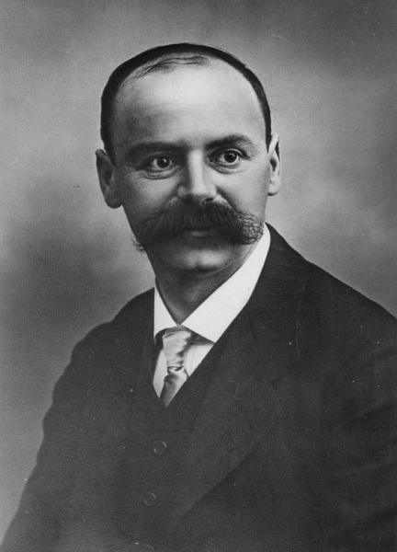



Schwarzschild
Metric
Derivation
$+\left(1−\frac{2GM}{rc^{2}}\right)dct^{2}$
$−{\left(1−\frac{2GM}{rc^{2}}\right)}^{−1}dr^{2}$
$$−r^{2}dθ^{2}−r^{2}{\left(\sin{θ}\right)}^{2}dφ^{2}$$

Slide 2



$G_{μν}−Λg_{μν}=\frac{8πG}{c^{4}}T_{μν}$
Einstein Field Equations
$R_{μν}−\frac{1}{2}Rg_{μν}−Λg_{μν}=\frac{8πG}{c^{4}}T_{μν}$
Complete in any order
Relativity 108
Relativity 109
Relativity 110
Black Holes
Gravitational Waves
Cosmology

Slide 3
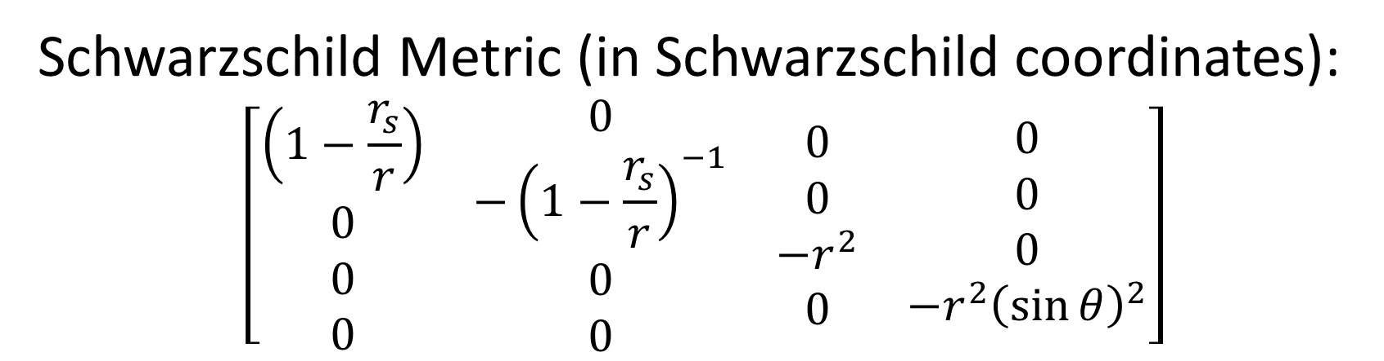
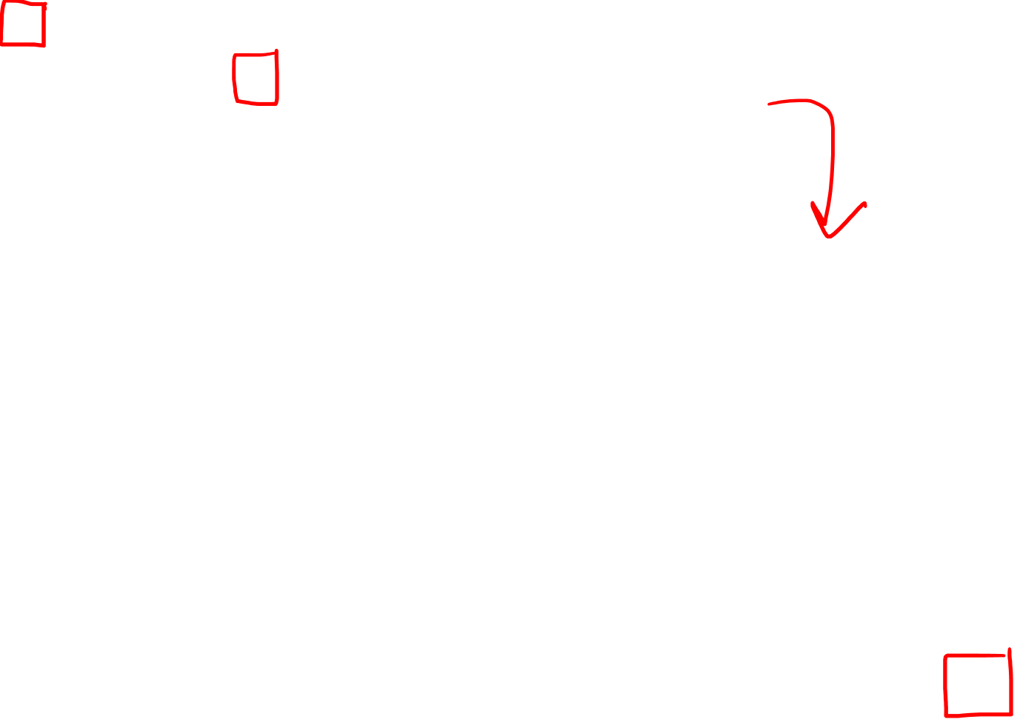
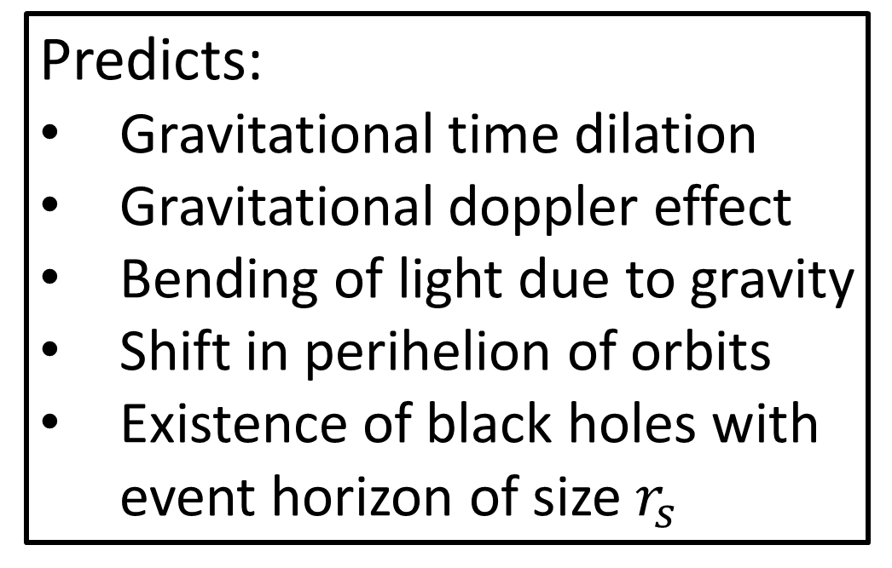
Schwarzschild Metric (in Schwarzschild coordinates):
$$\left[\begin{matrix}\begin{matrix}\begin{aligned}\left(1−\frac{r_{s}}{r}\right) \\ 0 \\ 0 \\ 0\end{aligned} & \begin{aligned}0 \\ −{\left(1−\frac{r_{s}}{r}\right)}^{−1} \\ 0 \\ 0\end{aligned}\end{matrix} & \begin{matrix}\begin{aligned}0 \\ 0 \\ −r^{2} \\ 0\end{aligned} & \begin{aligned}0 \\ 0 \\ 0 \\ −r^{2}{\left(\sin{θ}\right)}^{2}\end{aligned}\end{matrix}\end{matrix}\right]$$
For a mass that’s:
Spherically symmetric
Non-rotating
(and uncharged)
Predicts:
Gravitational time dilation
Gravitational doppler effect
Bending of light due to gravity
Shift in perihelion of orbits
Existence of black holes with event horizon of size $r_{s}$
Describes:
Slowly rotating planets/stars
Non-rotating Black Holes

Slide 4
Nov 1915: Einstein publishes Field Equations for General Relativity
Jan 13, 1916: Schwarzschild’s Paper “On the Gravitational Field of a Mass Point according to Einstein’s Theory” [link in description]
https://arxiv.org/abs/physics/9905030
May 11, 1916: Schwarzschild’s death
Karl Schwarzschild (1873-1916)

Slide 5
Relativity 108: Schwarzschild Solution
Schwarzschild Metric Derivation
Interpretation of Schwarzschild Metric
Gravitational Time Dilation, Event Horizon
Schwarzschild Geodesics
gravitational lensing, perihelion shift
Alternative coordinates in Schwarzschild geometry
Gravitational Doppler Effect
Later?: Rotating Black Holes? (Kerr Solution)
https://arxiv.org/pdf/0712.3709.pdf

Slide 6
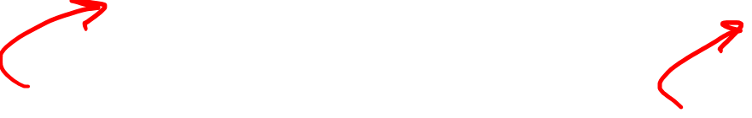
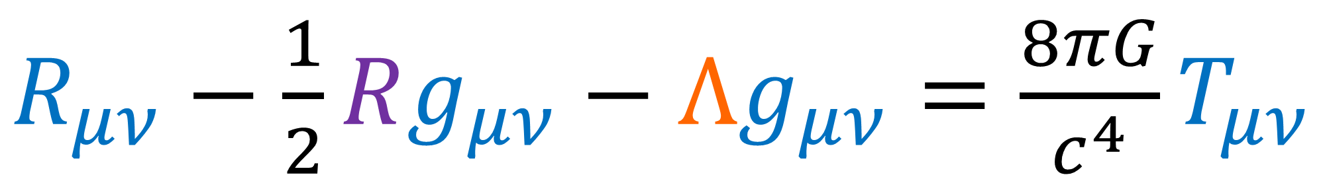
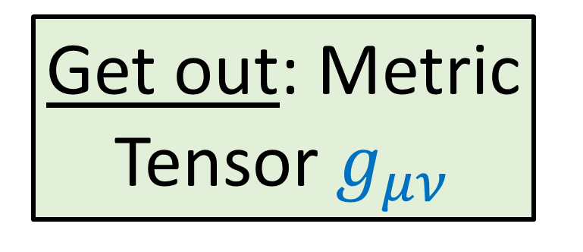
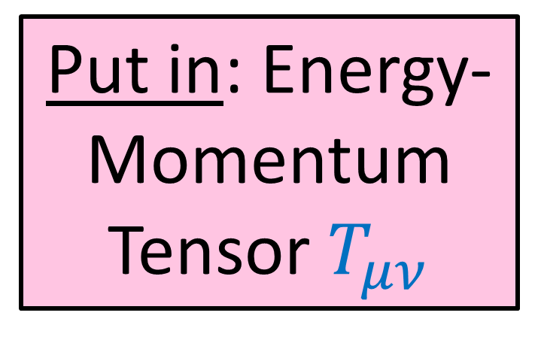
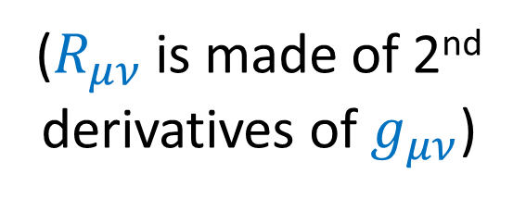
Solve the Einstein Field Equations:
$R_{μν}−\frac{1}{2}Rg_{μν}−Λg_{μν}=\frac{8πG}{c^{4}}T_{μν}$
($R_{μν}$ is made of 2nd derivatives of $g_{μν}$)
Put in: Energy-Momentum Tensor $T_{μν}$
Get out: Metric Tensor $g_{μν}$
(description of geometry of spacetime)
(description of mass-energy and momentum)

Slide 7
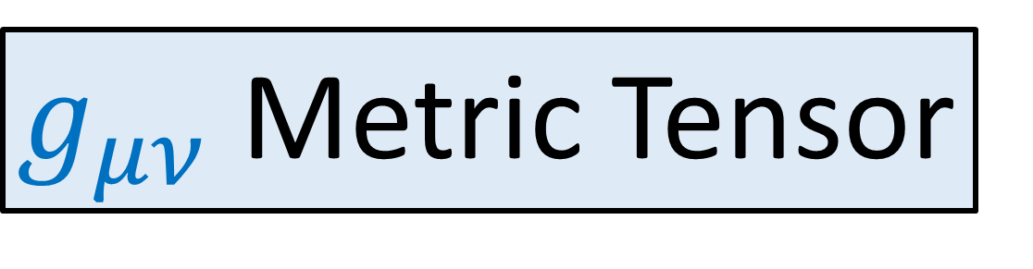
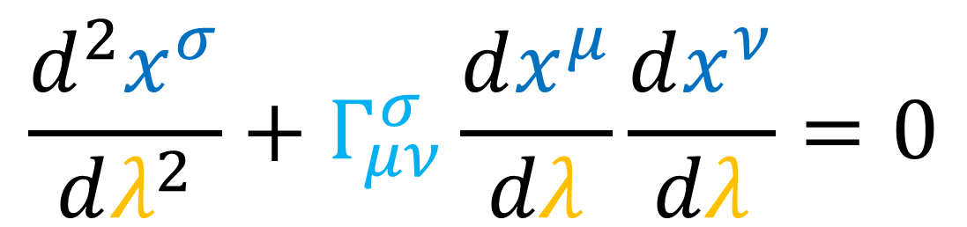

$g_{μν}$ Metric Tensor
Connection Coefficients
$Γ_{μν}^{σ}=\frac{1}{2}g^{σα}\left(∂_{ν}g_{αμ}+∂_{μ}g_{αν}−∂_{α}g_{μν}\right)$
Geodesic Equation
(gives paths of masses and light)
$$\frac{d^{2}x^{σ}}{dλ^{2}}+Γ_{μν}^{σ}\frac{dx^{μ}}{dλ}\frac{dx^{ν}}{dλ}=0$$

Slide 8
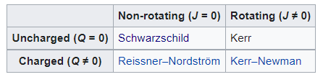

https://en.wikipedia.org/wiki/Kerr_metric
Black Hole spacetime metric solutions:
Non-rotating
Rotating
1.
Schwarzschild Solution
2.
Kerr Solution
Uncharged
3.
4.
Kerr-Newman Solution
Charged
Reissner-Nordström Solution

Slide 9
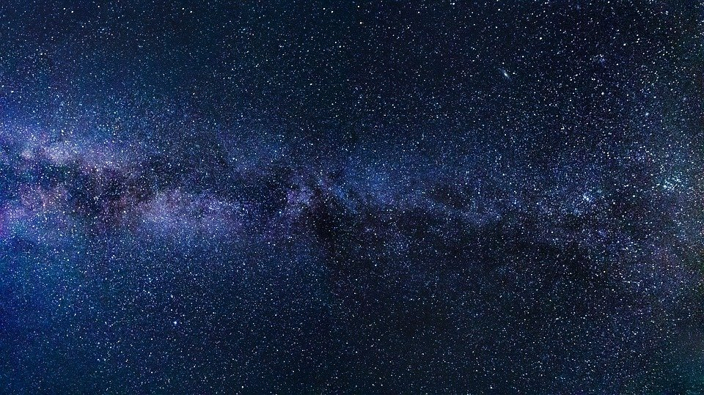
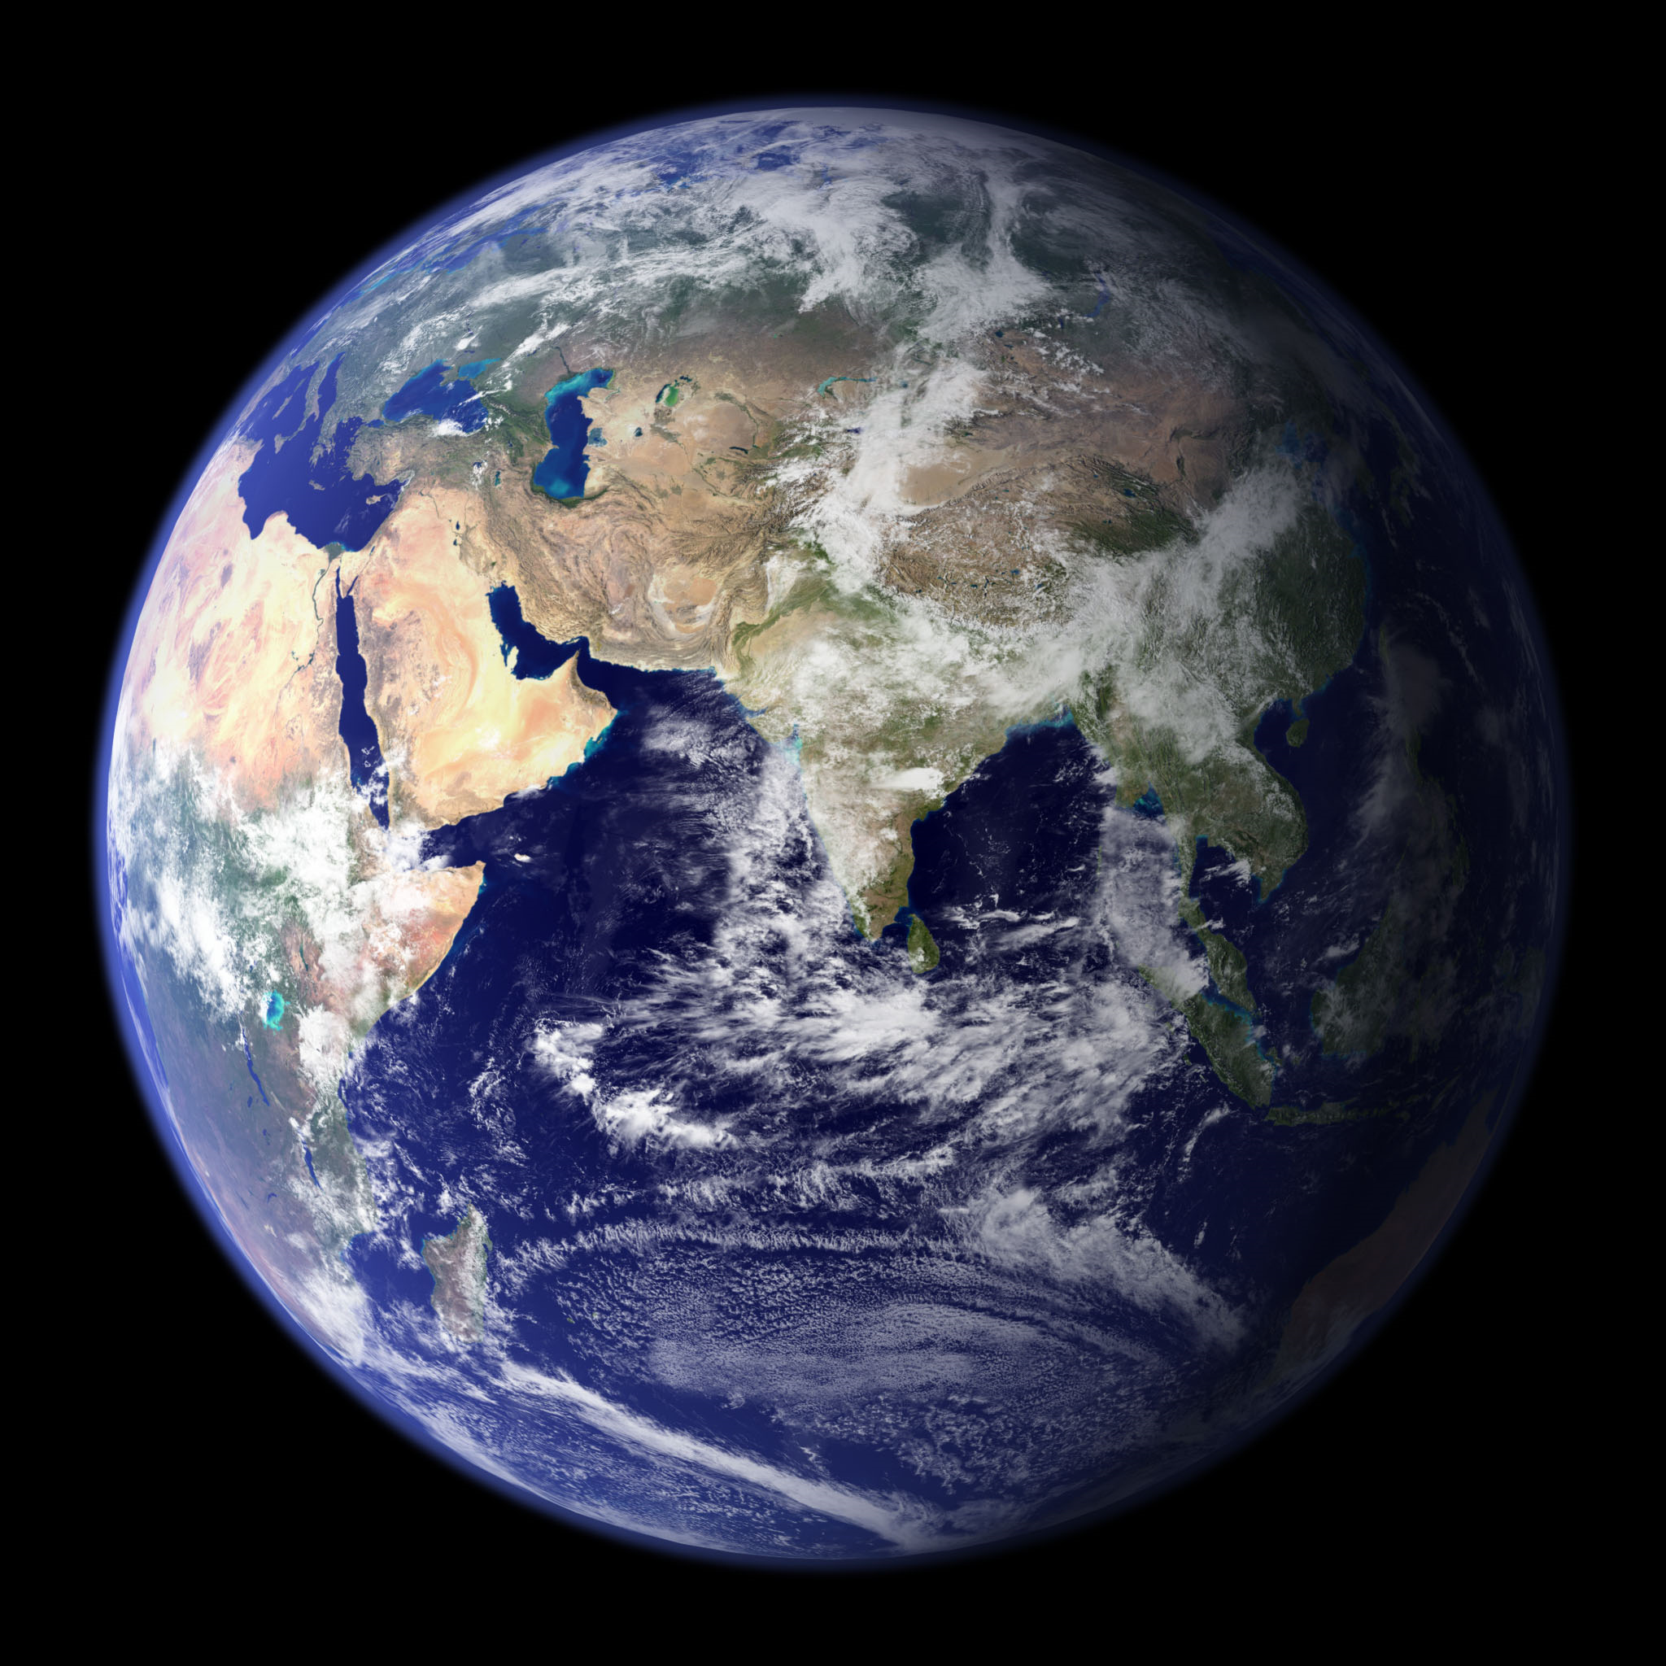
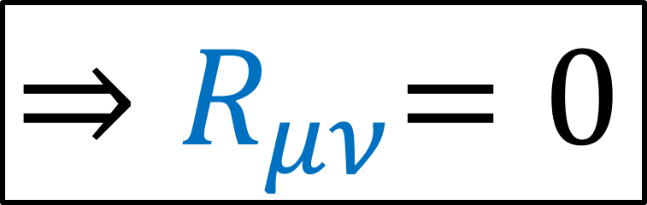
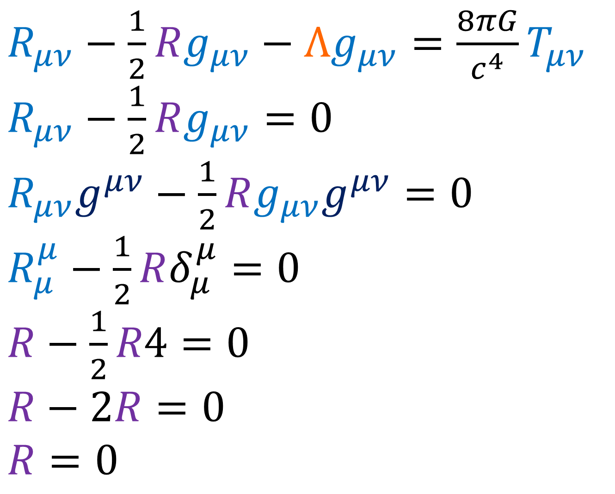

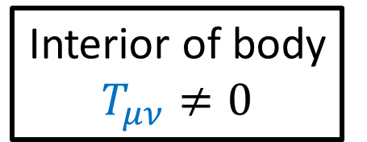
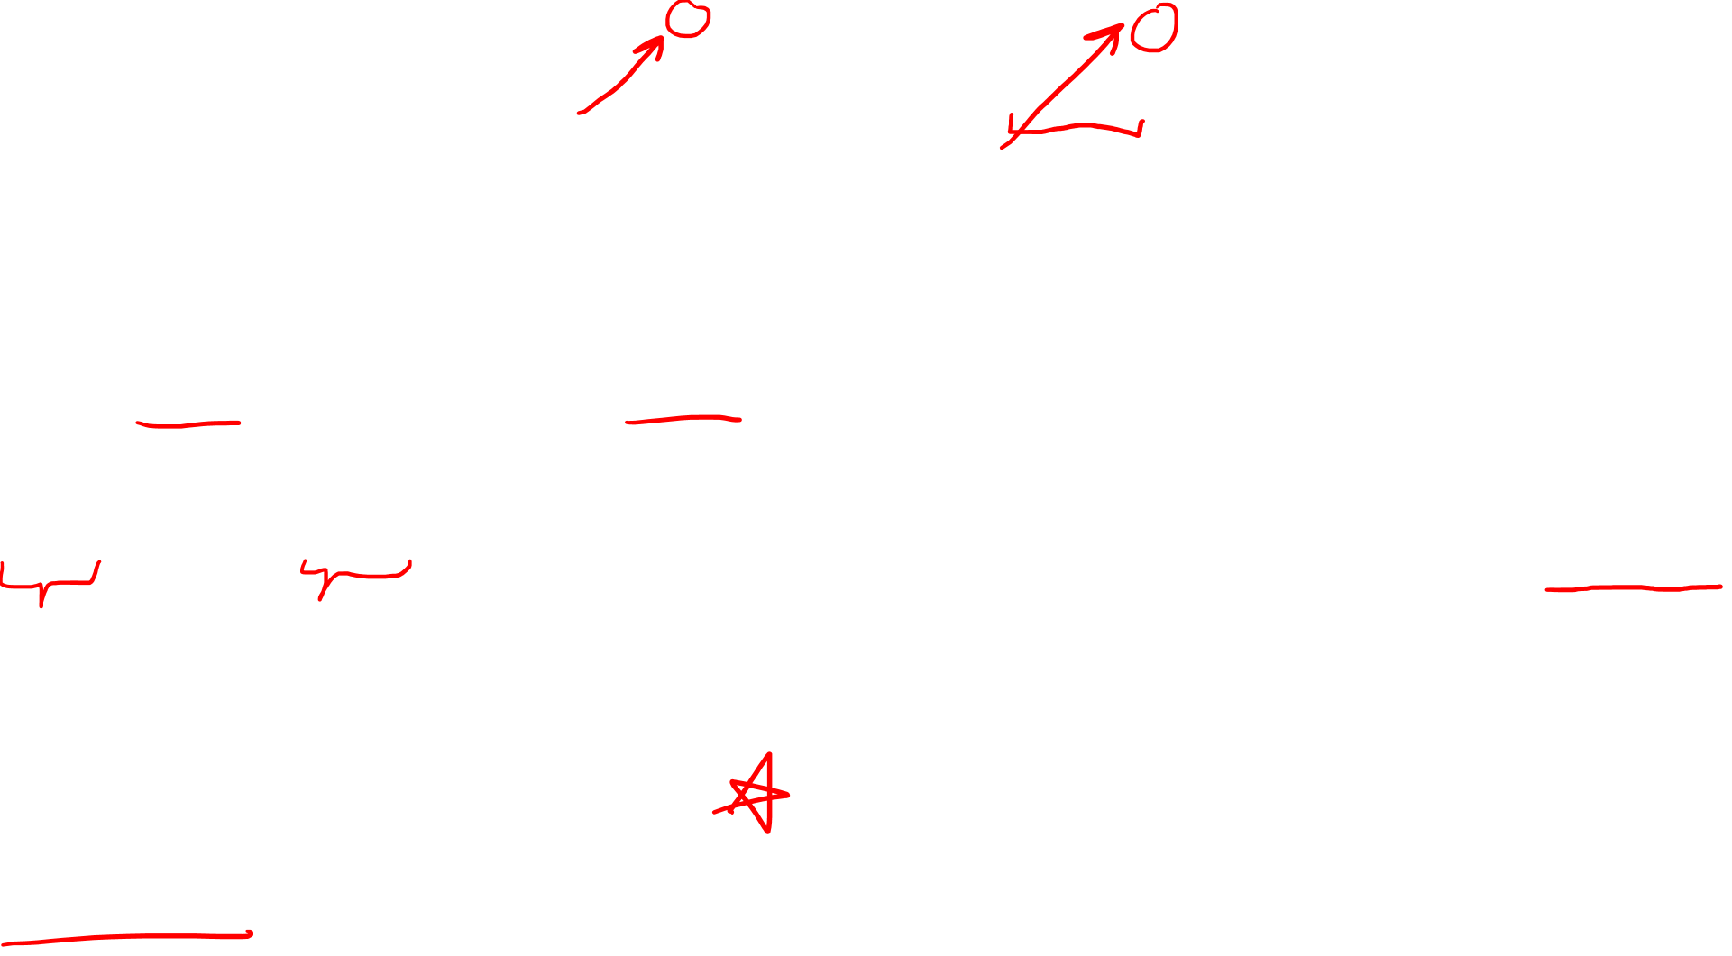
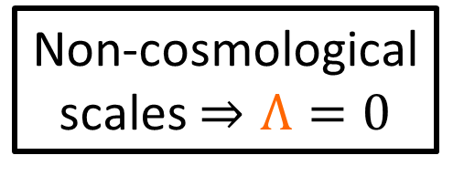
$R_{μν}−\frac{1}{2}Rg_{μν}−Λg_{μν}=\frac{8πG}{c^{4}}T_{μν}$
$R_{μν}−\frac{1}{2}Rg_{μν}=0$
$R_{μν}g^{μν}−\frac{1}{2}Rg_{μν}g^{μν}=0$
$R_{μ}^{μ}−\frac{1}{2}Rδ_{μ}^{μ}=0$
$R−\frac{1}{2}R4=0$
$$R−2R=0$$
$R=0$
Interior of body $T_{μν}≠0$
Non-cosmological scales $⇒Λ=0$
(consider exterior/vacuum solution only!)
Vacuum outside body has $T_{μν}=0$
EFE for Vacuum solution
${⇒R}_{μν}=0$
“Ricci Flat”

Slide 10
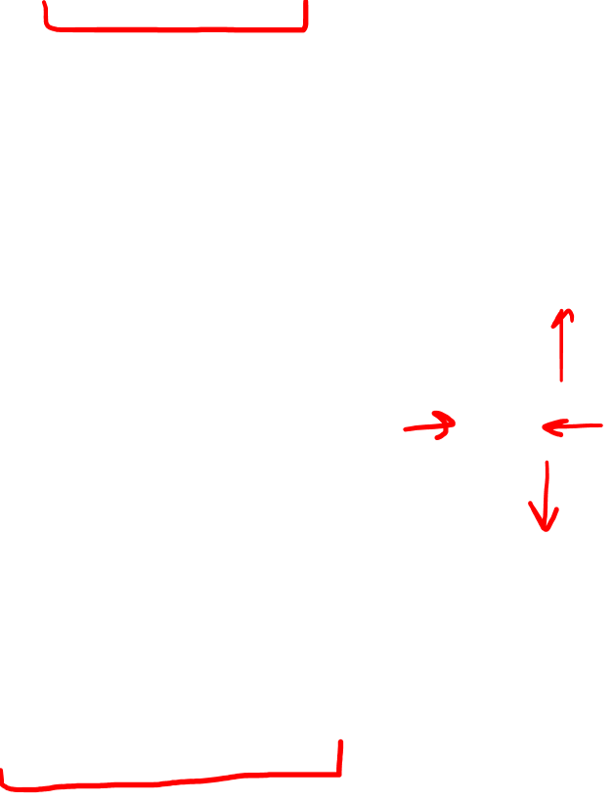
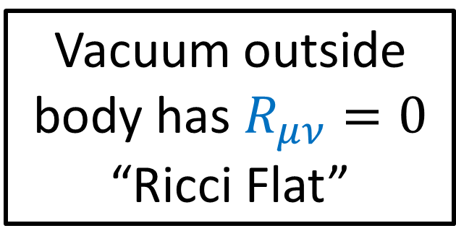
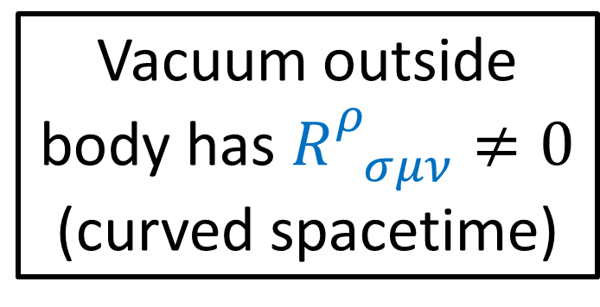
Vacuum outside body has $R_{μν}=0$
“Ricci Flat”
(no immediate volume changes due to curvature of spacetime)
tidal forces
Vacuum outside body has $R_{ σμν}^{ρ}≠0$
(curved spacetime)

Slide 11

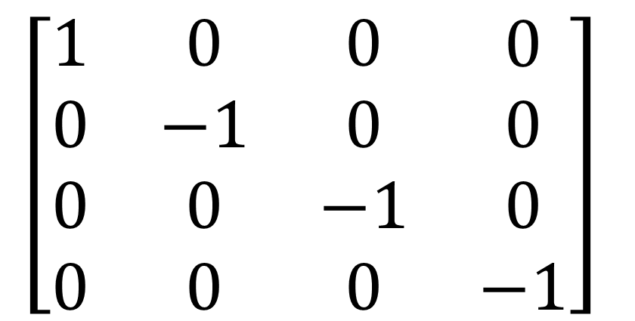
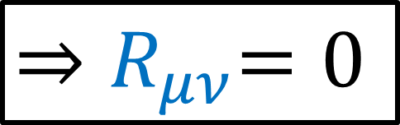

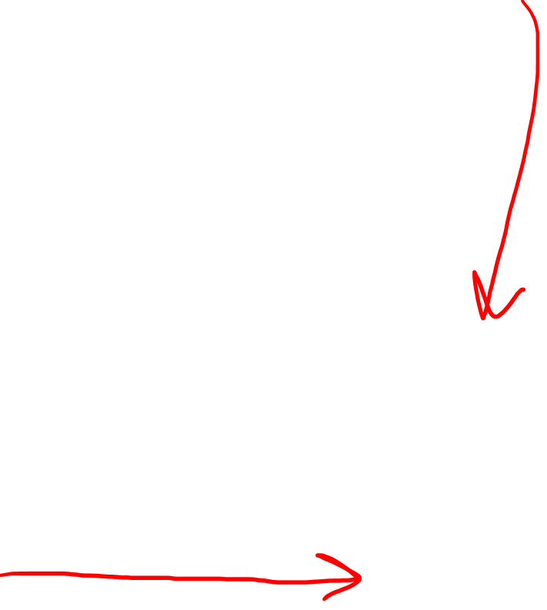
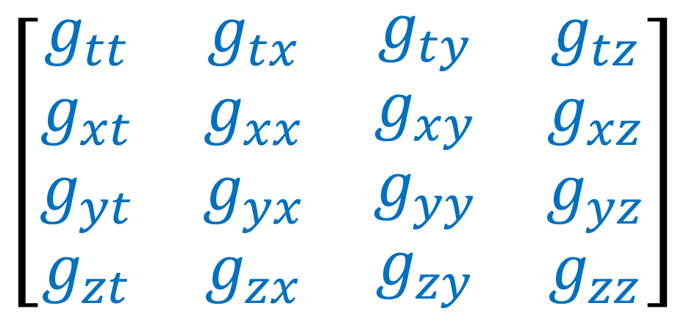
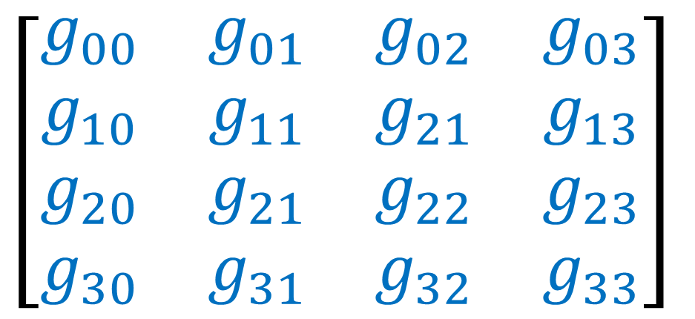

$$\left[\begin{matrix}\begin{matrix}\begin{aligned}g_{00} \\ g_{10} \\ g_{20} \\ g_{30}\end{aligned} & \begin{aligned}g_{01} \\ g_{11} \\ g_{21} \\ g_{31}\end{aligned}\end{matrix} & \begin{matrix}\begin{aligned}g_{02} \\ g_{21} \\ g_{22} \\ g_{32}\end{aligned} & \begin{aligned}g_{03} \\ g_{13} \\ g_{23} \\ g_{33}\end{aligned}\end{matrix}\end{matrix}\right]$$
${⇒R}_{μν}=0$
$$\left[\begin{matrix}\begin{matrix}\begin{aligned}g_{tt} \\ g_{xt} \\ g_{yt} \\ g_{zt}\end{aligned} & \begin{aligned}g_{tx} \\ g_{xx} \\ g_{yx} \\ g_{zx}\end{aligned}\end{matrix} & \begin{matrix}\begin{aligned}g_{ty} \\ g_{xy} \\ g_{yy} \\ g_{zy}\end{aligned} & \begin{aligned}g_{tz} \\ g_{xz} \\ g_{yz} \\ g_{zz}\end{aligned}\end{matrix}\end{matrix}\right]$$
$$\left[\begin{matrix}\begin{matrix}\begin{aligned}1 \\ 0 \\ 0 \\ 0\end{aligned} & \begin{aligned}0 \\ −1 \\ 0 \\ 0\end{aligned}\end{matrix} & \begin{matrix}\begin{aligned}0 \\ 0 \\ −1 \\ 0\end{aligned} & \begin{aligned}0 \\ 0 \\ 0 \\ −1\end{aligned}\end{matrix}\end{matrix}\right]$$
$$g_{μν}=g_{νμ}$$
Minkowski Metric
$$M$$
Curved Spacetime
(Almost) Flat Spacetime
$$M$$

Slide 12
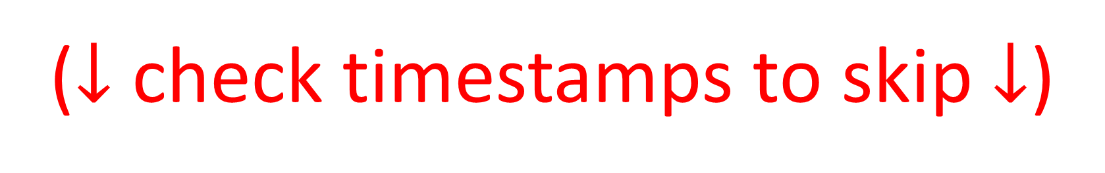
Quick Review of Spherical Coordinates
($↓$ check timestamps to skip $↓$)

Slide 13
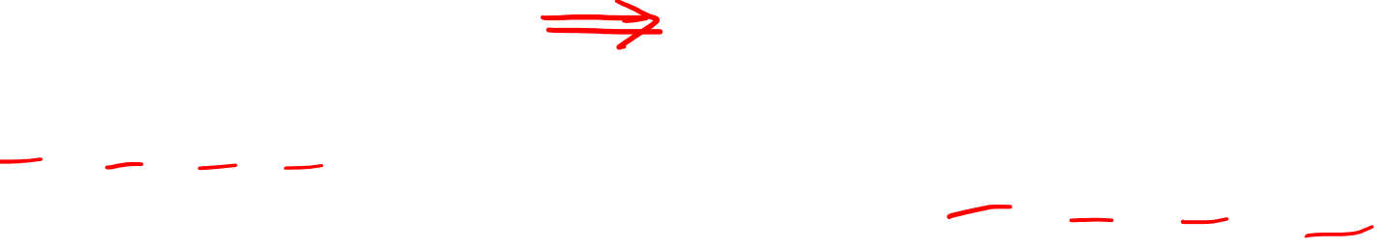
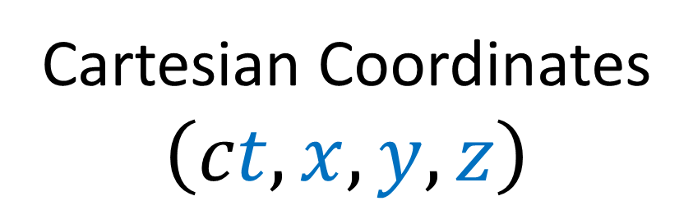
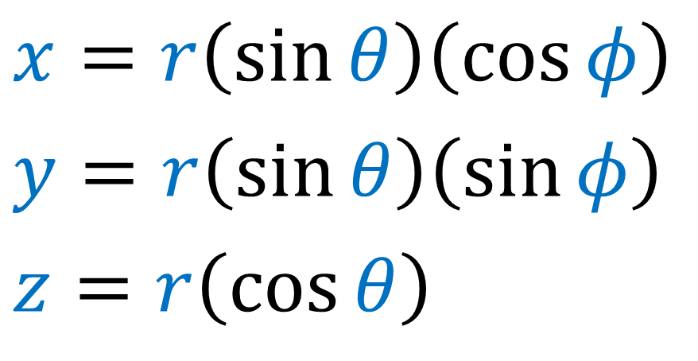
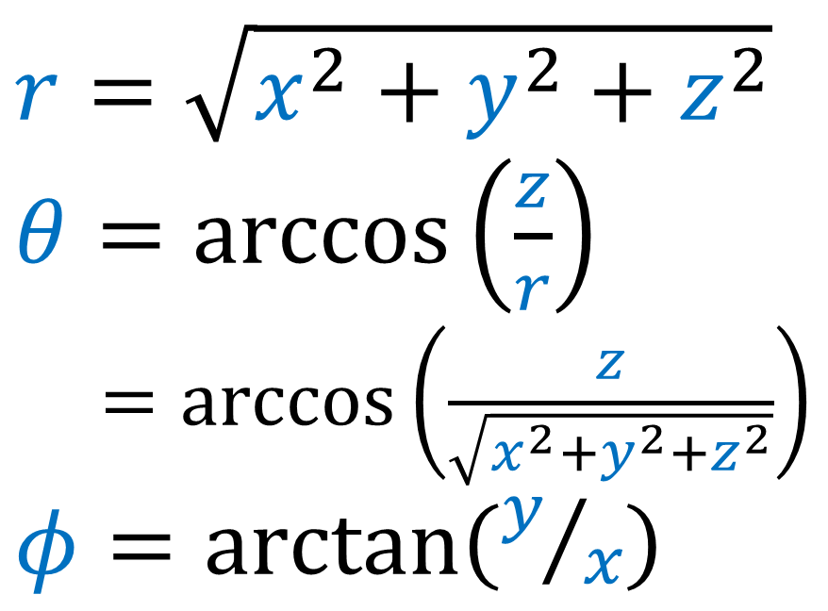
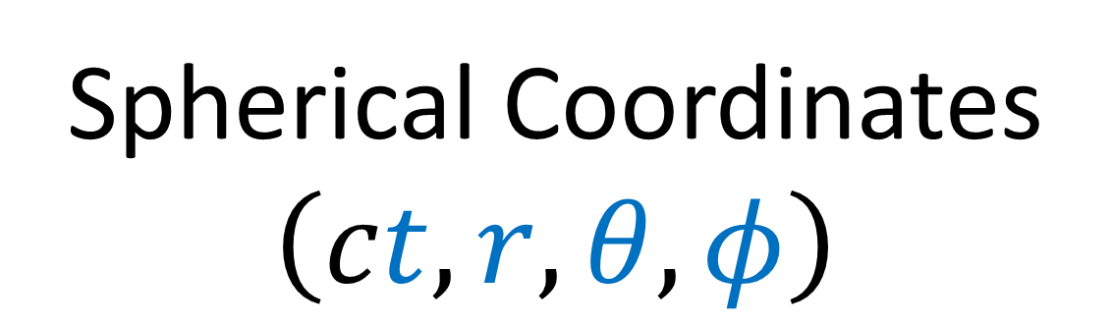
Cartesian Coordinates
$$\left(ct,x,y,z\right)$$
Spherical Coordinates
$$\left(ct,r,θ,φ\right)$$
$$x=r\left(\sin{θ}\right)\left(\cos{φ}\right)$$
$$y=r\left(\sin{θ}\right)\left(\sin{φ}\right)$$
$$z=r\left(\cos{θ}\right)$$
$$r=\sqrt{x^{2}+y^{2}+z^{2}}$$
$θ=\arccos\left(\frac{z}{r}\right)$
$=\arccos\left(\frac{z}{\sqrt{x^{2}+y^{2}+z^{2}}}\right)$
$φ=\arctan\left(y/x\right)$

Slide 14



Spherical Coordinates
$$\left(ct,r,θ,φ\right)$$
$$θ$$
$$r=\sqrt{x^{2}+y^{2}+z^{2}}$$
$θ=\arccos\left(\frac{z}{r}\right)$
$=\arccos\left(\frac{z}{\sqrt{x^{2}+y^{2}+z^{2}}}\right)$
$φ=\arctan\left(y/x\right)$
$$r$$
$$φ$$

Slide 15

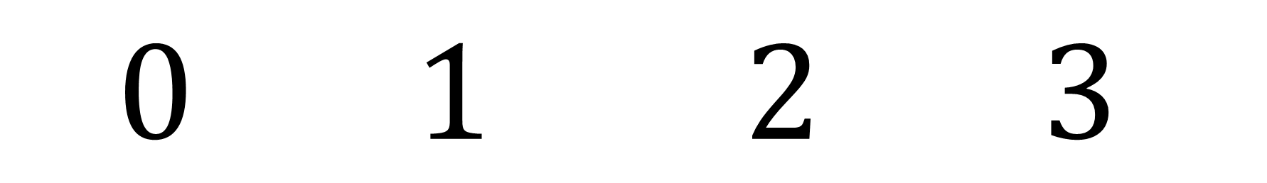
$$ct r θ φ$$
$$0 1 2 3$$

Slide 16
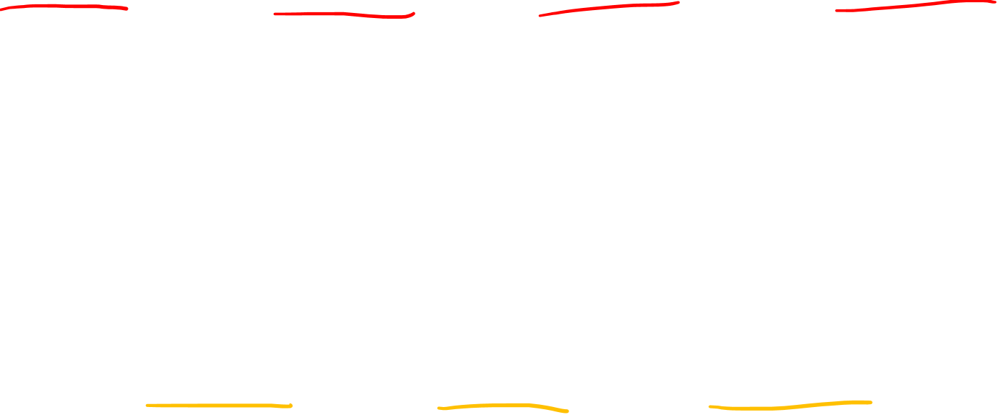
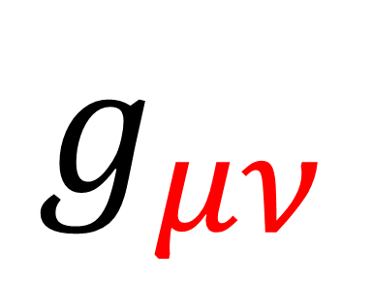


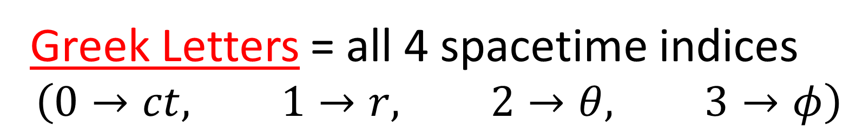
$$g_{μν}$$
Greek Letters = all 4 spacetime indices
$$\left(0→ct, 1→r, 2→θ, 3→φ\right)$$
$$M_{ij}$$
Latin/English Letters = 3 space indices
$$\left(1→r, 2→θ, 3→φ\right)$$

Slide 17
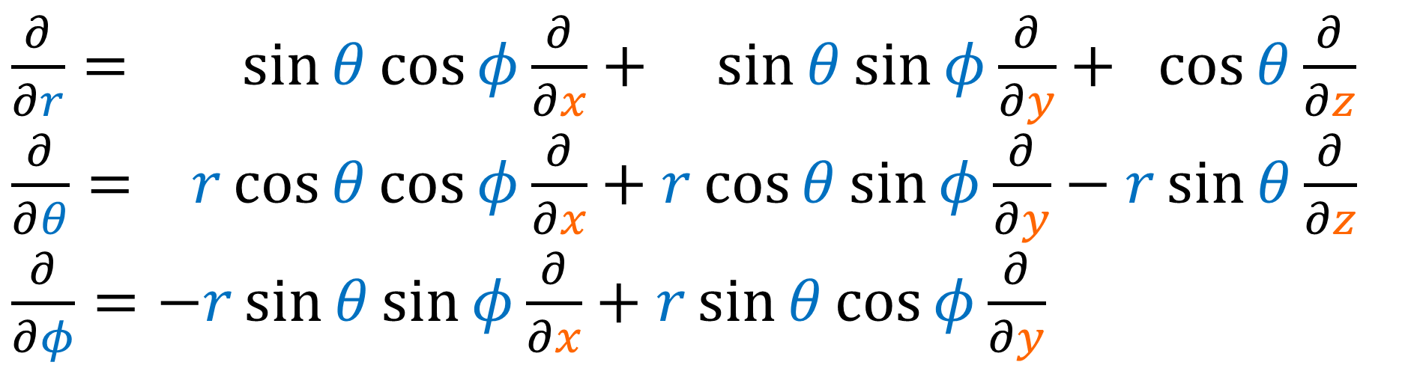
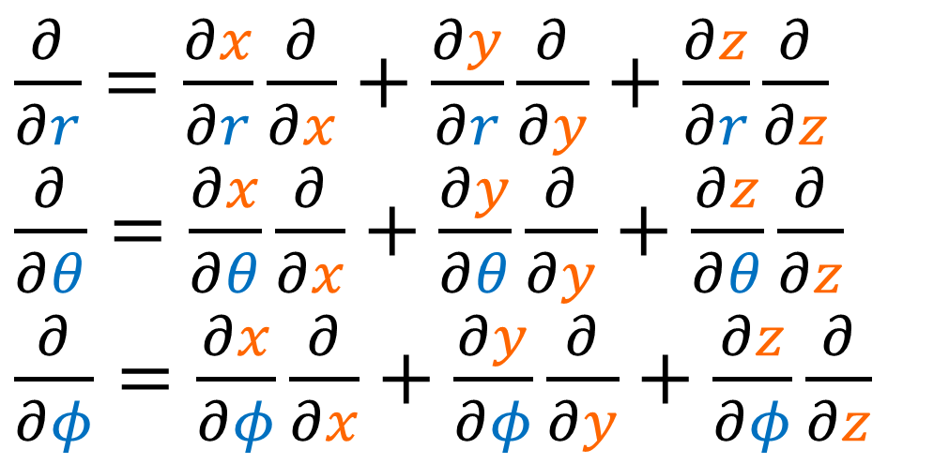
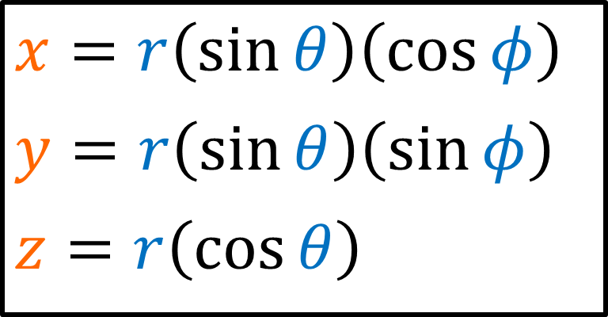
$\frac{∂}{∂r}=\frac{∂x}{∂r}\frac{∂}{∂x}+\frac{∂y}{∂r}\frac{∂}{∂y}+\frac{∂z}{∂r}\frac{∂}{∂z}$
$\frac{∂}{∂θ}=\frac{∂x}{∂θ}\frac{∂}{∂x}+\frac{∂y}{∂θ}\frac{∂}{∂y}+\frac{∂z}{∂θ}\frac{∂}{∂z}$
$\frac{∂}{∂φ}=\frac{∂x}{∂φ}\frac{∂}{∂x}+\frac{∂y}{∂φ}\frac{∂}{∂y}+\frac{∂z}{∂φ}\frac{∂}{∂z}$
$$x=r\left(\sin{θ}\right)\left(\cos{φ}\right)$$
$$y=r\left(\sin{θ}\right)\left(\sin{φ}\right)$$
$$z=r\left(\cos{θ}\right)$$
$\frac{∂}{∂r}= \sin{θ}\cos{φ}\frac{∂}{∂x}+ \sin{θ}\sin{φ}\frac{∂}{∂y}+ \cos{θ}\frac{∂}{∂z}$
$\frac{∂}{∂θ}= r\cos{θ}\cos{φ}\frac{∂}{∂x}+r\cos{θ}\sin{φ}\frac{∂}{∂y}−r\sin{θ}\frac{∂}{∂z}$
$\frac{∂}{∂φ}=−r\sin{θ}\sin{φ}\frac{∂}{∂x}+r\sin{θ}\cos{φ}\frac{∂}{∂y}$

Slide 18
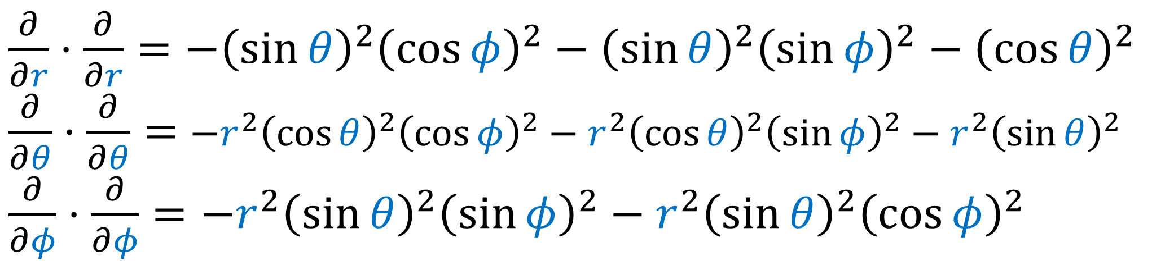
$\frac{∂}{∂r}⋅\frac{∂}{∂r}=−{\left(\sin{θ}\right)}^{2}{\left(\cos{φ}\right)}^{2}−{\left(\sin{θ}\right)}^{2}{\left(\sin{φ}\right)}^{2}−{\left(\cos{θ}\right)}^{2}$
$\frac{∂}{∂θ}⋅\frac{∂}{∂θ}=$ $−r^{2}{\left(\cos{θ}\right)}^{2}{\left(\cos{φ}\right)}^{2}−r^{2}{\left(\cos{θ}\right)}^{2}{\left(\sin{φ}\right)}^{2}−r^{2}{\left(\sin{θ}\right)}^{2}$
$\frac{∂}{∂φ}⋅\frac{∂}{∂φ}=−r^{2}{\left(\sin{θ}\right)}^{2}{\left(\sin{φ}\right)}^{2}−r^{2}{\left(\sin{θ}\right)}^{2}{\left(\cos{φ}\right)}^{2}$
$\frac{∂}{∂r}= \sin{θ}\cos{φ}\frac{∂}{∂x}+ \sin{θ}\sin{φ}\frac{∂}{∂y}+ \cos{θ}\frac{∂}{∂z}$
$\frac{∂}{∂θ}= r\cos{θ}\cos{φ}\frac{∂}{∂x}+r\cos{θ}\sin{φ}\frac{∂}{∂y}−r\sin{θ}\frac{∂}{∂z}$
$\frac{∂}{∂φ}=−r\sin{θ}\sin{φ}\frac{∂}{∂x}+r\sin{θ}\cos{φ}\frac{∂}{∂y}$

Slide 19
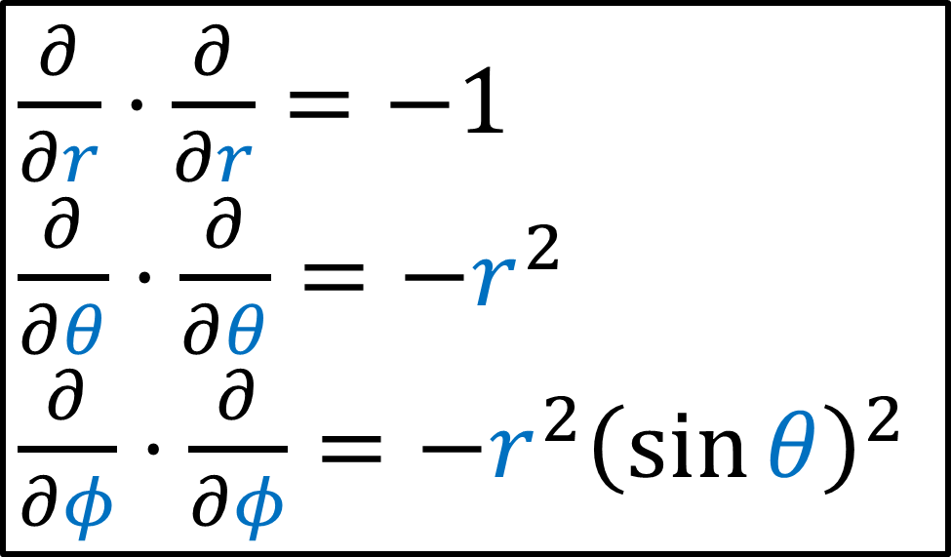
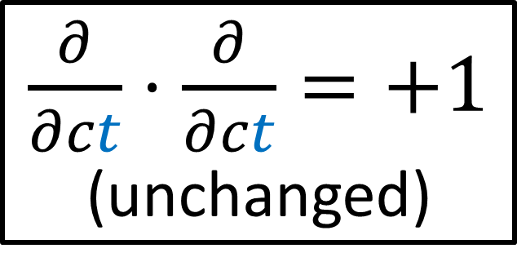
$\frac{∂}{∂r}⋅\frac{∂}{∂r}=−{\left(\sin{θ}\right)}^{2}{\left(\cos{φ}\right)}^{2}−{\left(\sin{θ}\right)}^{2}{\left(\sin{φ}\right)}^{2}−{\left(\cos{θ}\right)}^{2}$
$\frac{∂}{∂θ}⋅\frac{∂}{∂θ}=$ $−r^{2}{\left(\cos{θ}\right)}^{2}{\left(\cos{φ}\right)}^{2}−r^{2}{\left(\cos{θ}\right)}^{2}{\left(\sin{φ}\right)}^{2}−r^{2}{\left(\sin{θ}\right)}^{2}$
$\frac{∂}{∂φ}⋅\frac{∂}{∂φ}=−r^{2}{\left(\sin{θ}\right)}^{2}{\left(\sin{φ}\right)}^{2}−r^{2}{\left(\sin{θ}\right)}^{2}{\left(\cos{φ}\right)}^{2}$
$\frac{∂}{∂r}⋅\frac{∂}{∂r}=−1$
$\frac{∂}{∂θ}⋅\frac{∂}{∂θ}=−r^{2}$
$\frac{∂}{∂φ}⋅\frac{∂}{∂φ}=−r^{2}{\left(\sin{θ}\right)}^{2}$
$\frac{∂}{∂ct}⋅\frac{∂}{∂ct}=+1$
(unchanged)

Slide 20
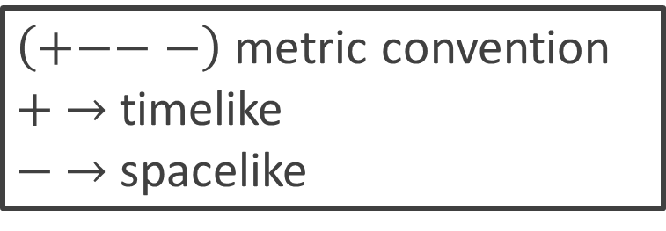
$\frac{∂}{∂r}⋅\frac{∂}{∂r}=−{\left(\sin{θ}\right)}^{2}{\left(\cos{φ}\right)}^{2}−{\left(\sin{θ}\right)}^{2}{\left(\sin{φ}\right)}^{2}−{\left(\cos{θ}\right)}^{2}$
$\frac{∂}{∂θ}⋅\frac{∂}{∂θ}=$ $−r^{2}{\left(\cos{θ}\right)}^{2}{\left(\cos{φ}\right)}^{2}−r^{2}{\left(\cos{θ}\right)}^{2}{\left(\sin{φ}\right)}^{2}−r^{2}{\left(\sin{θ}\right)}^{2}$
$\frac{∂}{∂φ}⋅\frac{∂}{∂φ}=−r^{2}{\left(\sin{θ}\right)}^{2}{\left(\sin{φ}\right)}^{2}−r^{2}{\left(\sin{θ}\right)}^{2}{\left(\cos{φ}\right)}^{2}$
$\frac{∂}{∂r}⋅\frac{∂}{∂r}=−1$
$\frac{∂}{∂θ}⋅\frac{∂}{∂θ}=−r^{2}$
$\frac{∂}{∂φ}⋅\frac{∂}{∂φ}=−r^{2}{\left(\sin{θ}\right)}^{2}$
$\left(+−−−\right)$ metric convention
$+ →$ timelike
$− →$ spacelike
$\frac{∂}{∂ct}⋅\frac{∂}{∂ct}=+1$
(unchanged)

Slide 21

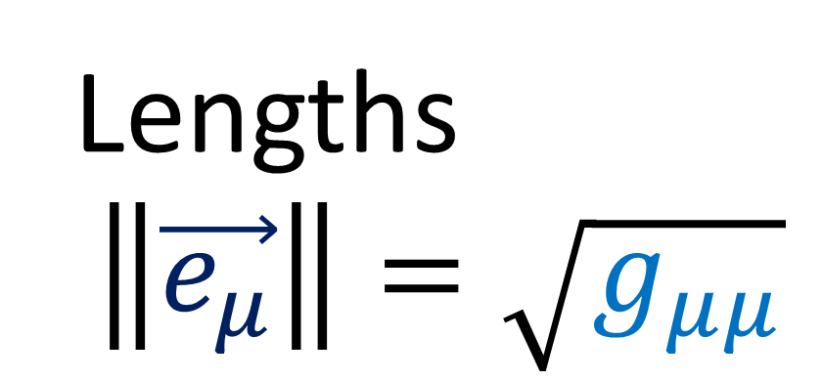


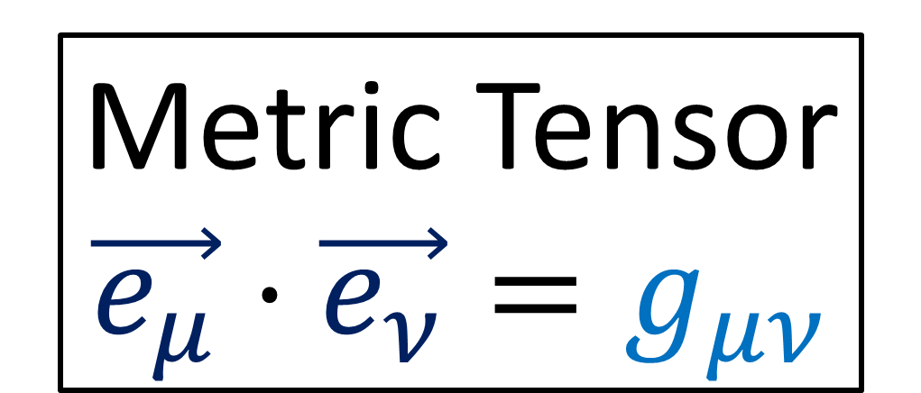
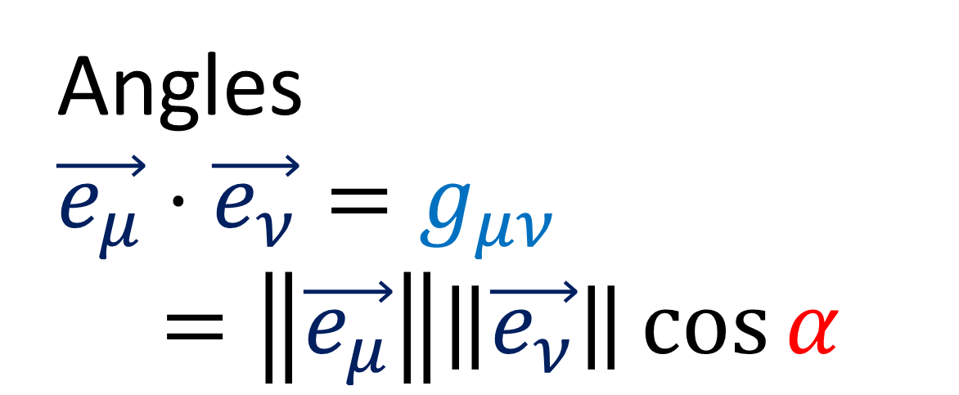

Metric Tensor
$$\vec{e_{μ}}⋅\vec{e_{ν}}=g_{μν}$$
$$\vec{e_{μ}}$$
$$α$$
Angles
$\vec{e_{μ}}⋅\vec{e_{ν}}=g_{μν}$
$$=\left\|\vec{e_{μ}}\right\|\left\|\vec{e_{ν}}\right\|\cos{α}$$
$$\vec{e_{ν}}$$
Lengths
$$\left\|\vec{e_{μ}}\right\|=\sqrt{g_{μμ}}$$
(OR) $\left\|\vec{e_{μ}}\right\|\left\|\vec{e_{ν}}\right\|\cosh{α}$

Slide 22





$$\left[\begin{matrix}\begin{matrix}\begin{aligned}1 \\ 0 \\ 0 \\ 0\end{aligned} & \begin{aligned}0 \\ −1 \\ 0 \\ 0\end{aligned}\end{matrix} & \begin{matrix}\begin{aligned}0 \\ 0 \\ −1 \\ 0\end{aligned} & \begin{aligned}0 \\ 0 \\ 0 \\ −1\end{aligned}\end{matrix}\end{matrix}\right]$$
$$\left[\begin{matrix}\begin{matrix}\begin{aligned}1 \\ 0 \\ 0 \\ 0\end{aligned} & \begin{aligned}0 \\ −1 \\ 0 \\ 0\end{aligned}\end{matrix} & \begin{matrix}\begin{aligned}0 \\ 0 \\ −r^{2} \\ 0\end{aligned} & \begin{aligned}0 \\ 0 \\ 0 \\ −r^{2}{\left(\sin{θ}\right)}^{2}\end{aligned}\end{matrix}\end{matrix}\right]$$
Minkowski Metric
(cartesian coordinates)
$$\left(ct,x,y,z\right)$$
Minkowski Metric
(spherical coordinates)
$$\left(ct,r,θ,φ\right)$$

Slide 23










$\frac{∂}{∂φ}⋅\frac{∂}{∂φ}=−r^{2}{\left(\sin{θ}\right)}^{2}$
$\frac{∂}{∂θ}⋅\frac{∂}{∂θ}=−r^{2}$
$\frac{∂}{∂φ}$
$$θ$$
$$φ$$
$\frac{∂}{∂φ}$
$\frac{∂}{∂φ}$
$\frac{∂}{∂φ}$
$\frac{∂}{∂θ}$
$\frac{∂}{∂θ}$

Slide 24





$$\left[\begin{matrix}\begin{matrix}\begin{aligned}g_{00} \\ g_{10} \\ g_{20} \\ g_{30}\end{aligned} & \begin{aligned}g_{01} \\ g_{11} \\ g_{21} \\ g_{31}\end{aligned}\end{matrix} & \begin{matrix}\begin{aligned}g_{02} \\ g_{21} \\ g_{22} \\ g_{32}\end{aligned} & \begin{aligned}g_{03} \\ g_{13} \\ g_{23} \\ g_{33}\end{aligned}\end{matrix}\end{matrix}\right]$$
$$\left[\begin{matrix}\begin{matrix}\begin{aligned}g_{tt} \\ g_{rt} \\ g_{θt} \\ g_{φt}\end{aligned} & \begin{aligned}g_{tr} \\ g_{rr} \\ g_{θr} \\ g_{φr}\end{aligned}\end{matrix} & \begin{matrix}\begin{aligned}g_{tθ} \\ g_{rθ} \\ g_{θθ} \\ g_{φθ}\end{aligned} & \begin{aligned}g_{tφ} \\ g_{rφ} \\ g_{θφ} \\ g_{φφ}\end{aligned}\end{matrix}\end{matrix}\right]$$
$$\left[\begin{matrix}\begin{matrix}\begin{aligned}1 \\ 0 \\ 0 \\ 0\end{aligned} & \begin{aligned}0 \\ −1 \\ 0 \\ 0\end{aligned}\end{matrix} & \begin{matrix}\begin{aligned}0 \\ 0 \\ −r^{2} \\ 0\end{aligned} & \begin{aligned}0 \\ 0 \\ 0 \\ −r^{2}{\left(\sin{θ}\right)}^{2}\end{aligned}\end{matrix}\end{matrix}\right]$$
$$g_{μν}=g_{νμ}$$
Minkowski Metric
$$M$$
Curved Spacetime
(Almost) Flat Spacetime
$$M$$

Slide 25





Static (in time):
$∂_{t}g_{μν}=0$
$t→−t$ doesn’t change $g_{μν}$
$$\left[\begin{matrix}\begin{matrix}\begin{aligned}g_{tt} \\ g_{rt} \\ g_{θt} \\ g_{φt}\end{aligned} & \begin{aligned}g_{tr} \\ g_{rr} \\ g_{θr} \\ g_{φr}\end{aligned}\end{matrix} & \begin{matrix}\begin{aligned}g_{tθ} \\ g_{rθ} \\ g_{θθ} \\ g_{φθ}\end{aligned} & \begin{aligned}g_{tφ} \\ g_{rφ} \\ g_{θφ} \\ g_{φφ}\end{aligned}\end{matrix}\end{matrix}\right]$$
$\vec{e_{t}}=\frac{∂}{∂ ct}→\frac{∂}{∂ c\left(−t\right)}=−\frac{∂}{∂ ct}=−\vec{e_{t}}$
$$⇒ \\ g_{ti}=0$$
$$g_{ti}=\vec{e_{t}}⋅\vec{e_{i}}→\left(−\vec{e_{t}}\right)⋅\vec{e_{i}}=−g_{ti}$$
$$g_{tt}=\vec{e_{t}}⋅\vec{e_{t}}→\left(−\vec{e_{t}}\right)⋅\left(−\vec{e_{t}}\right)=+g_{tt}$$

Slide 26
Static (in time):
$$\left[\begin{matrix}\begin{matrix}\begin{aligned}g_{tt} \\ g_{rt} \\ g_{θt} \\ g_{φt}\end{aligned} & \begin{aligned}g_{tr} \\ g_{rr} \\ g_{θr} \\ g_{φr}\end{aligned}\end{matrix} & \begin{matrix}\begin{aligned}g_{tθ} \\ g_{rθ} \\ g_{θθ} \\ g_{φθ}\end{aligned} & \begin{aligned}g_{tφ} \\ g_{rφ} \\ g_{θφ} \\ g_{φφ}\end{aligned}\end{matrix}\end{matrix}\right]$$
Formal Definition:
Static spacetime = has a timelike killing vector + is irrotational
(we’ll use simplified definition for now)

Slide 27




Spherical Symmetry
$$\left[\begin{matrix}\begin{matrix}\begin{aligned}g_{tt} \\ 0 \\ 0 \\ 0\end{aligned} & \begin{aligned}0 \\ g_{rr} \\ g_{θr} \\ g_{φr}\end{aligned}\end{matrix} & \begin{matrix}\begin{aligned}0 \\ g_{rθ} \\ g_{θθ} \\ g_{φθ}\end{aligned} & \begin{aligned}0 \\ g_{rφ} \\ g_{θφ} \\ g_{φφ}\end{aligned}\end{matrix}\end{matrix}\right]$$
$θ,φ$ components should use metric for sphere of radius $r$
Allow for radial scaling function $C(r)$
$$\left[\begin{matrix}r^{2} & 0 \\ 0 & r^{2}{\left(\sin{θ}\right)}^{2}\end{matrix}\right]$$

Slide 28



Spherical Symmetry
$$\left[\begin{matrix}\begin{matrix}\begin{aligned}g_{tt} \\ 0 \\ 0 \\ 0\end{aligned} & \begin{aligned}0 \\ g_{rr} \\ g_{θr} \\ g_{φr}\end{aligned}\end{matrix} & \begin{matrix}\begin{aligned}0 \\ g_{rθ} \\ g_{θθ} \\ g_{φθ}\end{aligned} & \begin{aligned}0 \\ g_{rφ} \\ g_{θφ} \\ g_{φφ}\end{aligned}\end{matrix}\end{matrix}\right]$$
$θ,φ$ components should use metric for sphere of radius $r$
Allow for radial scaling function $C(r)$
Use negative signs (spacelike convention)
$$\left[\begin{matrix}C(r) r^{2} & 0 \\ 0 & C(r) r^{2}{\left(\sin{θ}\right)}^{2}\end{matrix}\right]$$

Slide 29


Spherical Symmetry
$$\left[\begin{matrix}\begin{matrix}\begin{aligned}g_{tt} \\ 0 \\ 0 \\ 0\end{aligned} & \begin{aligned}0 \\ g_{rr} \\ g_{θr} \\ g_{φr}\end{aligned}\end{matrix} & \begin{matrix}\begin{aligned}0 \\ g_{rθ} \\ g_{θθ} \\ g_{φθ}\end{aligned} & \begin{aligned}0 \\ g_{rφ} \\ g_{θφ} \\ g_{φφ}\end{aligned}\end{matrix}\end{matrix}\right]$$
$θ,φ$ components should use metric for sphere of radius $r$
Allow for radial scaling function $C(r)$
Use negative signs (spacelike convention)
$$\left[\begin{matrix}−C(r) r^{2} & 0 \\ 0 & −C(r) r^{2}{\left(\sin{θ}\right)}^{2}\end{matrix}\right]$$

Slide 30






$$\left[\begin{matrix}\begin{matrix}\begin{aligned}g_{tt} \\ 0 \\ 0 \\ 0\end{aligned} & \begin{aligned}0 \\ g_{rr} \\ g_{θr} \\ g_{φr}\end{aligned}\end{matrix} & \begin{matrix}\begin{aligned}0 \\ g_{rθ} \\ −C(r) r^{2} \\ 0\end{aligned} & \begin{aligned}0 \\ g_{rφ} \\ 0 \\ −C(r) r^{2}{\left(\sin{θ}\right)}^{2}\end{aligned}\end{matrix}\end{matrix}\right]$$
$$\vec{e_{r}}$$
$$\vec{e_{θ}}⋅\vec{e_{r}}=0=g_{θr}$$
$$\vec{e_{r}}$$
$$\vec{e_{φ}}⋅\vec{e_{r}}=0=g_{φr}$$

Slide 31




Schwarzschild Metric
$$A(r)$$
$$−B(r)$$
$\left[\begin{matrix}\begin{matrix}\begin{aligned}g_{tt}\left(r,θ,φ\right) \\ 0 \\ 0 \\ 0\end{aligned} & \begin{aligned}0 \\ g_{rr}\left(r,θ,φ\right) \\ 0 \\ 0\end{aligned}\end{matrix} & \begin{matrix}\begin{aligned}0 \\ 0 \\ −C\left(r\right)r^{2} \\ 0\end{aligned} & \begin{aligned}0 \\ 0 \\ 0 \\ −C\left(r\right)r^{2}{\left(\sin{θ}\right)}^{2}\end{aligned}\end{matrix}\end{matrix}\right]$

Slide 32



Schwarzschild Metric
$\left[\begin{matrix}\begin{matrix}\begin{aligned}A(r) \\ 0 \\ 0 \\ 0\end{aligned} & \begin{aligned}0 \\ −B(r) \\ 0 \\ 0\end{aligned}\end{matrix} & \begin{matrix}\begin{aligned}0 \\ 0 \\ −C\left(r\right)r^{2} \\ 0\end{aligned} & \begin{aligned}0 \\ 0 \\ 0 \\ −C\left(r\right)r^{2}{\left(\sin{θ}\right)}^{2}\end{aligned}\end{matrix}\end{matrix}\right]$
$\tilde{r}=\sqrt{C\left(r\right)} r$

Slide 33


Schwarzschild Metric
$\left[\begin{matrix}\begin{matrix}\begin{aligned}\tilde{A}(\tilde{r}) \\ 0 \\ 0 \\ 0\end{aligned} & \begin{aligned}0 \\ −\tilde{B}(\tilde{r}) \\ 0 \\ 0\end{aligned}\end{matrix} & \begin{matrix}\begin{aligned}0 \\ 0 \\ −{\tilde{r}}^{2} \\ 0\end{aligned} & \begin{aligned}0 \\ 0 \\ 0 \\ −{\tilde{r}}^{2}{\left(\sin{θ}\right)}^{2}\end{aligned}\end{matrix}\end{matrix}\right]$
(for simplicity, just write $\tilde{r}$ as $r$)
$\tilde{r}=\sqrt{C\left(r\right)} r$

Slide 34





Some textbooks:
MAGICAL FUTURE VISION
$g_{μν}→\left[\begin{matrix}\begin{matrix}\begin{aligned}A(r) \\ 0 \\ 0 \\ 0\end{aligned} & \begin{aligned}0 \\ −B(r) \\ 0 \\ 0\end{aligned}\end{matrix} & \begin{matrix}\begin{aligned}0 \\ 0 \\ −r^{2} \\ 0\end{aligned} & \begin{aligned}0 \\ 0 \\ 0 \\ −r^{2}{\left(\sin{θ}\right)}^{2}\end{aligned}\end{matrix}\end{matrix}\right]$
$g_{μν}→\left[\begin{matrix}\begin{matrix}\begin{aligned}e^{α\left(r\right)} \\ 0 \\ 0 \\ 0\end{aligned} & \begin{aligned}0 \\ −e^{β\left(r\right)} \\ 0 \\ 0\end{aligned}\end{matrix} & \begin{matrix}\begin{aligned}0 \\ 0 \\ −r^{2} \\ 0\end{aligned} & \begin{aligned}0 \\ 0 \\ 0 \\ −r^{2}{\left(\sin{θ}\right)}^{2}\end{aligned}\end{matrix}\end{matrix}\right]$
$$\frac{∂_{r}A}{A}=\frac{∂_{r}e^{α}}{e^{α}}=\frac{e^{α}∂_{r}α}{e^{α}}=∂_{r}α$$

Slide 35





Schwarzschild Metric
$g_{μν}→$ $\left[\begin{matrix}\begin{matrix}\begin{aligned}A(r) \\ 0 \\ 0 \\ 0\end{aligned} & \begin{aligned}0 \\ −B(r) \\ 0 \\ 0\end{aligned}\end{matrix} & \begin{matrix}\begin{aligned}0 \\ 0 \\ −r^{2} \\ 0\end{aligned} & \begin{aligned}0 \\ 0 \\ 0 \\ −r^{2}{\left(\sin{θ}\right)}^{2}\end{aligned}\end{matrix}\end{matrix}\right]$
$$A\left(r\right)$$
$$B\left(r\right)$$
$$g_{μν}$$
$$Γ_{μν}^{σ}$$
$$R_{μν}$$
Match Newtonian Gravity (weak field, low velocity)

Slide 36

Schwarzschild Metric
$g_{μν}→$ $\left[\begin{matrix}\begin{matrix}\begin{aligned}A(r) \\ 0 \\ 0 \\ 0\end{aligned} & \begin{aligned}0 \\ −B(r) \\ 0 \\ 0\end{aligned}\end{matrix} & \begin{matrix}\begin{aligned}0 \\ 0 \\ −r^{2} \\ 0\end{aligned} & \begin{aligned}0 \\ 0 \\ 0 \\ −r^{2}{\left(\sin{θ}\right)}^{2}\end{aligned}\end{matrix}\end{matrix}\right]$
$$A\left(r\right)$$
$$B\left(r\right)$$
$$g_{μν}$$
$$Γ_{μν}^{σ}$$
$$R_{μν}$$
Match Newtonian Gravity (weak field, low velocity)

Slide 37


$R_{μν}−\frac{1}{2}Rg_{μν}−Λg_{μν}=\frac{8πG}{c^{4}}T_{μν}$
$R_{μν}−\frac{1}{2}Rg_{μν}=0$
$R_{μν}g^{μν}−\frac{1}{2}Rg_{μν}g^{μν}=0$
$R_{μ}^{μ}−\frac{1}{2}Rδ_{μ}^{μ}=0$
$$R−\frac{1}{2}R4=0$$
$$R−2R=0$$
$R=0$
Mass density $ρc^{2}=T^{00}>0$
Vacuum outside body has $T_{μν}=0$
EFE for Schwarzschild solution
${⇒R}_{μν}=0$
“Ricci Flat”

Slide 38

Vacuum outside body has $R_{μν}=0$
“Ricci Flat”
(no immediate volume changes due to curvature of spacetime)
tidal forces
Vacuum outside body has $R_{ σμν}^{ρ}≠0$
(Curved spacetime)

Slide 39









Schwarzschild Connection Coefficients
$Γ_{01}^{0}=Γ_{10}^{0}=\frac{1}{2}\frac{1}{A}\left(∂_{r}A\right)$
$Γ_{00}^{1}=\frac{1}{2}\frac{1}{B}\left(∂_{r}A\right)$
$Γ_{11}^{1}=\frac{1}{2}\frac{1}{B}\left(∂_{r}B\right)$
$Γ_{22}^{1}=−\frac{r}{B}$
$Γ_{33}^{1}=−\frac{r{\left(\sin{θ}\right)}^{2}}{B}$
$Γ_{33}^{2}=−\sin{θ}\cos{θ}$
$Γ_{12}^{2}=Γ_{21}^{2}=\frac{1}{r}$
$Γ_{13}^{3}=Γ_{31}^{3}=\frac{1}{r}$
$Γ_{23}^{3}=Γ_{32}^{3}=\cot{θ}$

Slide 40



Schwarzschild Connection Coefficients
Calculate:
$Γ_{μν}^{0}$
$Γ_{μν}^{1}$
$Γ_{μν}^{2}$
$Γ_{μν}^{3}$
$Γ_{μν}^{σ}=\frac{1}{2}g^{σα}\left(∂_{ν}g_{αμ}+∂_{μ}g_{αν}−∂_{α}g_{μν}\right)$

Slide 41




$g_{00}=A\left(r\right), g_{11}=−B\left(r\right), g_{22}=−r^{2}, g_{33}=−r^{2}{\left(\sin{θ}\right)}^{2}$
$g^{00}=\frac{1}{A\left(r\right)}, g^{11}=−\frac{1}{B\left(r\right)}, g^{22}=−\frac{1}{r^{2}}, g^{33}=−\frac{1}{r^{2}{\left(\sin{θ}\right)}^{2}}$
$g_{μν}→\left[\begin{matrix}\begin{matrix}\begin{aligned}A(r) \\ 0 \\ 0 \\ 0\end{aligned} & \begin{aligned}0 \\ −B(r) \\ 0 \\ 0\end{aligned}\end{matrix} & \begin{matrix}\begin{aligned}0 \\ 0 \\ −r^{2} \\ 0\end{aligned} & \begin{aligned}0 \\ 0 \\ 0 \\ −r^{2}{\left(\sin{θ}\right)}^{2}\end{aligned}\end{matrix}\end{matrix}\right]$
$g^{μν}→\left[\begin{matrix}\begin{matrix}\begin{aligned}\frac{1}{A\left(r\right)} \\ 0 \\ 0 \\ 0\end{aligned} & \begin{aligned}0 \\ −\frac{1}{B\left(r\right)} \\ 0 \\ 0\end{aligned}\end{matrix} & \begin{matrix}\begin{aligned}0 \\ 0 \\ −\frac{1}{r^{2}} \\ 0\end{aligned} & \begin{aligned}0 \\ 0 \\ 0 \\ −\frac{1}{r^{2}{\left(\sin{θ}\right)}^{2}}\end{aligned}\end{matrix}\end{matrix}\right]$

Slide 42






$g_{00}=A\left(r\right), g_{11}=−B\left(r\right), g_{22}=−r^{2}, g_{33}=−r^{2}{\left(\sin{θ}\right)}^{2}$
$g^{00}=\frac{1}{A\left(r\right)}, g^{11}=−\frac{1}{B\left(r\right)}, g^{22}=−\frac{1}{r^{2}}, g^{33}=−\frac{1}{r^{2}{\left(\sin{θ}\right)}^{2}}$
$Γ_{μν}^{σ}=\frac{1}{2}g^{σα}\left(∂_{ν}g_{αμ}+∂_{μ}g_{αν}−∂_{α}g_{μν}\right)$
$Γ_{μν}^{σ}=\frac{1}{2}g^{σσ}\left(∂_{ν}g_{σμ}+∂_{μ}g_{σν}−∂_{σ}g_{μν}\right)$
(diagonal metric)
$Γ_{μν}^{0}=\frac{1}{2}g^{00}\left(∂_{ν}g_{0μ}+∂_{μ}g_{0ν}−∂_{0}g_{μν}\right)$
$Γ_{00}^{0}⇒\frac{1}{2}g^{00}\left(∂_{0}g_{00}+∂_{0}g_{00}−∂_{0}g_{00}\right)=0$
$Γ_{00}^{0}=0$

Slide 43








$g_{00}=A\left(r\right), g_{11}=−B\left(r\right), g_{22}=−r^{2}, g_{33}=−r^{2}{\left(\sin{θ}\right)}^{2}$
$g^{00}=\frac{1}{A\left(r\right)}, g^{11}=−\frac{1}{B\left(r\right)}, g^{22}=−\frac{1}{r^{2}}, g^{33}=−\frac{1}{r^{2}{\left(\sin{θ}\right)}^{2}}$
$Γ_{μν}^{σ}=\frac{1}{2}g^{σσ}\left(∂_{ν}g_{σμ}+∂_{μ}g_{σν}−∂_{σ}g_{μν}\right)$
(diagonal metric)
$Γ_{μν}^{0}=\frac{1}{2}g^{00}\left(∂_{ν}g_{0μ}+∂_{μ}g_{0ν}−∂_{0}g_{μν}\right)$
$$Γ_{11}^{0}=0$$
$$Γ_{22}^{0}=0$$
$Γ_{33}^{0}=0$
$Γ_{ii}^{0}=\frac{1}{2}g^{00}\left(∂_{i}g_{0i}+∂_{i}g_{0i}−∂_{0}g_{ii}\right)=0$
$Γ_{ij}^{0}=\frac{1}{2}g^{00}\left(∂_{j}g_{0i}+∂_{i}g_{0j}−∂_{0}g_{ij}\right)=0$
$$\left(i≠j\right)$$
$Γ_{ij}^{0}=0$

Slide 44



$g_{00}=A\left(r\right), g_{11}=−B\left(r\right), g_{22}=−r^{2}, g_{33}=−r^{2}{\left(\sin{θ}\right)}^{2}$
$g^{00}=\frac{1}{A\left(r\right)}, g^{11}=−\frac{1}{B\left(r\right)}, g^{22}=−\frac{1}{r^{2}}, g^{33}=−\frac{1}{r^{2}{\left(\sin{θ}\right)}^{2}}$
$Γ_{μν}^{σ}=\frac{1}{2}g^{σσ}\left(∂_{ν}g_{σμ}+∂_{μ}g_{σν}−∂_{σ}g_{μν}\right)$
(diagonal metric)
$Γ_{μν}^{0}=\frac{1}{2}g^{00}\left(∂_{ν}g_{0μ}+∂_{μ}g_{0ν}−∂_{0}g_{μν}\right)$
$Γ_{0i}^{0}=\frac{1}{2}g^{00}\left(∂_{i}g_{00}+∂_{0}g_{0i}−∂_{0}g_{0i}\right)=\frac{1}{2}g^{00}\left(∂_{i}g_{00}\right)$
$Γ_{01}^{0}=Γ_{10}^{0}=\frac{1}{2}\frac{1}{A}\left(∂_{r}A\right)$
$$Γ_{02}^{0}=Γ_{20}^{0}=Γ_{03}^{0}=Γ_{30}^{0}=0$$

Slide 45

$g_{00}=A\left(r\right), g_{11}=−B\left(r\right), g_{22}=−r^{2}, g_{33}=−r^{2}{\left(\sin{θ}\right)}^{2}$
$g^{00}=\frac{1}{A\left(r\right)}, g^{11}=−\frac{1}{B\left(r\right)}, g^{22}=−\frac{1}{r^{2}}, g^{33}=−\frac{1}{r^{2}{\left(\sin{θ}\right)}^{2}}$
$Γ_{μν}^{σ}=\frac{1}{2}g^{σσ}\left(∂_{ν}g_{σμ}+∂_{μ}g_{σν}−∂_{σ}g_{μν}\right)$
(diagonal metric)
$Γ_{μν}^{0}=\frac{1}{2}g^{00}\left(∂_{ν}g_{0μ}+∂_{μ}g_{0ν}−∂_{0}g_{μν}\right)$
$Γ_{0i}^{0}=\frac{1}{2}g^{00}\left(∂_{i}g_{00}+∂_{0}g_{0i}−∂_{0}g_{0i}\right)=\frac{1}{2}g^{00}\left(∂_{i}g_{00}\right)$
$Γ_{01}^{0}=Γ_{10}^{0}=\frac{1}{2}\frac{1}{A}\left(∂_{r}A\right)$
$$Γ_{02}^{0}=Γ_{20}^{0}=Γ_{03}^{0}=Γ_{30}^{0}=0$$

Slide 46


$g_{00}=A\left(r\right), g_{11}=−B\left(r\right), g_{22}=−r^{2}, g_{33}=−r^{2}{\left(\sin{θ}\right)}^{2}$
$g^{00}=\frac{1}{A\left(r\right)}, g^{11}=−\frac{1}{B\left(r\right)}, g^{22}=−\frac{1}{r^{2}}, g^{33}=−\frac{1}{r^{2}{\left(\sin{θ}\right)}^{2}}$
$Γ_{μν}^{σ}=\frac{1}{2}g^{σσ}\left(∂_{ν}g_{σμ}+∂_{μ}g_{σν}−∂_{σ}g_{μν}\right)$
(diagonal metric)
$Γ_{μν}^{0}=\frac{1}{2}g^{00}\left(∂_{ν}g_{0μ}+∂_{μ}g_{0ν}−∂_{0}g_{μν}\right)$
$Γ_{01}^{0}=Γ_{10}^{0}=\frac{1}{2}\frac{1}{A}\left(∂_{r}A\right)$
All other $Γ_{μν}^{0}=0$

Slide 47



$g_{00}=A\left(r\right), g_{11}=−B\left(r\right), g_{22}=−r^{2}, g_{33}=−r^{2}{\left(\sin{θ}\right)}^{2}$
$g^{00}=\frac{1}{A\left(r\right)}, g^{11}=−\frac{1}{B\left(r\right)}, g^{22}=−\frac{1}{r^{2}}, g^{33}=−\frac{1}{r^{2}{\left(\sin{θ}\right)}^{2}}$
$Γ_{μν}^{σ}=\frac{1}{2}g^{σσ}\left(∂_{ν}g_{σμ}+∂_{μ}g_{σν}−∂_{σ}g_{μν}\right)$
(diagonal metric)
$Γ_{μν}^{1}=\frac{1}{2}g^{11}\left(∂_{ν}g_{1μ}+∂_{μ}g_{1ν}−∂_{1}g_{μν}\right)$
$Γ_{00}^{1}=\frac{1}{2}g^{11}\left(∂_{0}g_{10}+∂_{0}g_{10}−∂_{1}g_{00}\right)=\frac{1}{2}(−\frac{1}{B})\left(−∂_{r}A\right)$
$Γ_{00}^{1}=\frac{1}{2}\frac{1}{B}\left(∂_{r}A\right)$

Slide 48



$g_{00}=A\left(r\right), g_{11}=−B\left(r\right), g_{22}=−r^{2}, g_{33}=−r^{2}{\left(\sin{θ}\right)}^{2}$
$g^{00}=\frac{1}{A\left(r\right)}, g^{11}=−\frac{1}{B\left(r\right)}, g^{22}=−\frac{1}{r^{2}}, g^{33}=−\frac{1}{r^{2}{\left(\sin{θ}\right)}^{2}}$
$Γ_{μν}^{σ}=\frac{1}{2}g^{σσ}\left(∂_{ν}g_{σμ}+∂_{μ}g_{σν}−∂_{σ}g_{μν}\right)$
(diagonal metric)
$Γ_{μν}^{1}=\frac{1}{2}g^{11}\left(∂_{ν}g_{1μ}+∂_{μ}g_{1ν}−∂_{1}g_{μν}\right)$
$Γ_{11}^{1}=\frac{1}{2}g^{11}\left(∂_{1}g_{11}+∂_{1}g_{11}−∂_{1}g_{11}\right)=\frac{1}{2}g^{11}\left(∂_{1}g_{11}\right)$
$=\frac{1}{2}(−\frac{1}{B})\left(∂_{r}(−B)\right)$
$Γ_{11}^{1}=\frac{1}{2}\frac{1}{B}\left(∂_{r}B\right)$

Slide 49





$g_{00}=A\left(r\right), g_{11}=−B\left(r\right), g_{22}=−r^{2}, g_{33}=−r^{2}{\left(\sin{θ}\right)}^{2}$
$g^{00}=\frac{1}{A\left(r\right)}, g^{11}=−\frac{1}{B\left(r\right)}, g^{22}=−\frac{1}{r^{2}}, g^{33}=−\frac{1}{r^{2}{\left(\sin{θ}\right)}^{2}}$
$Γ_{μν}^{σ}=\frac{1}{2}g^{σσ}\left(∂_{ν}g_{σμ}+∂_{μ}g_{σν}−∂_{σ}g_{μν}\right)$
(diagonal metric)
$Γ_{μν}^{1}=\frac{1}{2}g^{11}\left(∂_{ν}g_{1μ}+∂_{μ}g_{1ν}−∂_{1}g_{μν}\right)$
$Γ_{22}^{1}=\frac{1}{2}g^{11}\left(∂_{2}g_{12}+∂_{2}g_{12}−∂_{1}g_{22}\right)=\frac{1}{2}g^{11}\left(−∂_{1}g_{22}\right)$
$Γ_{33}^{1}=\frac{1}{2}g^{11}\left(−∂_{1}g_{33}\right)$
$=\frac{1}{2}\left(−\frac{1}{B}\right)\left(−∂_{r}\left(−r^{2}\right)\right)$
$Γ_{33}^{1}=−\frac{r{\left(\sin{θ}\right)}^{2}}{B}$
$Γ_{22}^{1}=−\frac{1}{2}\frac{1}{B}\left(2r\right)=−\frac{r}{B}$

Slide 50




$g_{00}=A\left(r\right), g_{11}=−B\left(r\right), g_{22}=−r^{2}, g_{33}=−r^{2}{\left(\sin{θ}\right)}^{2}$
$g^{00}=\frac{1}{A\left(r\right)}, g^{11}=−\frac{1}{B\left(r\right)}, g^{22}=−\frac{1}{r^{2}}, g^{33}=−\frac{1}{r^{2}{\left(\sin{θ}\right)}^{2}}$
$Γ_{μν}^{σ}=\frac{1}{2}g^{σσ}\left(∂_{ν}g_{σμ}+∂_{μ}g_{σν}−∂_{σ}g_{μν}\right)$
(diagonal metric)
$Γ_{μν}^{1}=\frac{1}{2}g^{11}\left(∂_{ν}g_{1μ}+∂_{μ}g_{1ν}−∂_{1}g_{μν}\right)$
$Γ_{01}^{1}=\frac{1}{2}g^{11}\left(∂_{1}g_{10}+∂_{0}g_{11}−∂_{1}g_{01}\right)=0$
$Γ_{21}^{1}=\frac{1}{2}g^{11}\left(∂_{1}g_{12}+∂_{2}g_{11}−∂_{1}g_{21}\right)=0$
$Γ_{31}^{1}=\frac{1}{2}g^{11}\left(∂_{1}g_{13}+∂_{3}g_{11}−∂_{1}g_{31}\right)=0$

Slide 51



$g_{00}=A\left(r\right), g_{11}=−B\left(r\right), g_{22}=−r^{2}, g_{33}=−r^{2}{\left(\sin{θ}\right)}^{2}$
$g^{00}=\frac{1}{A\left(r\right)}, g^{11}=−\frac{1}{B\left(r\right)}, g^{22}=−\frac{1}{r^{2}}, g^{33}=−\frac{1}{r^{2}{\left(\sin{θ}\right)}^{2}}$
$Γ_{μν}^{σ}=\frac{1}{2}g^{σσ}\left(∂_{ν}g_{σμ}+∂_{μ}g_{σν}−∂_{σ}g_{μν}\right)$
(diagonal metric)
$Γ_{μν}^{1}=\frac{1}{2}g^{11}\left(∂_{ν}g_{1μ}+∂_{μ}g_{1ν}−∂_{1}g_{μν}\right)$
$Γ_{ij}^{1}=\frac{1}{2}g^{11}\left(∂_{j}g_{1i}+∂_{i}g_{1j}−∂_{1}g_{ij}\right)=0$
$$\left(i≠j≠1\right)$$

Slide 52




$g_{00}=A\left(r\right), g_{11}=−B\left(r\right), g_{22}=−r^{2}, g_{33}=−r^{2}{\left(\sin{θ}\right)}^{2}$
$g^{00}=\frac{1}{A\left(r\right)}, g^{11}=−\frac{1}{B\left(r\right)}, g^{22}=−\frac{1}{r^{2}}, g^{33}=−\frac{1}{r^{2}{\left(\sin{θ}\right)}^{2}}$
$Γ_{μν}^{σ}=\frac{1}{2}g^{σσ}\left(∂_{ν}g_{σμ}+∂_{μ}g_{σν}−∂_{σ}g_{μν}\right)$
(diagonal metric)
$Γ_{μν}^{1}=\frac{1}{2}g^{11}\left(∂_{ν}g_{1μ}+∂_{μ}g_{1ν}−∂_{1}g_{μν}\right)$
$Γ_{00}^{1}=\frac{1}{2}\frac{1}{B}\left(∂_{r}A\right)$
$Γ_{22}^{1}=−\frac{r}{B}$
$Γ_{11}^{1}=\frac{1}{2}\frac{1}{B}\left(∂_{r}B\right)$
$Γ_{33}^{1}=−\frac{r{\left(\sin{θ}\right)}^{2}}{B}$

Slide 53






$g_{00}=A\left(r\right), g_{11}=−B\left(r\right), g_{22}=−r^{2}, g_{33}=−r^{2}{\left(\sin{θ}\right)}^{2}$
$g^{00}=\frac{1}{A\left(r\right)}, g^{11}=−\frac{1}{B\left(r\right)}, g^{22}=−\frac{1}{r^{2}}, g^{33}=−\frac{1}{r^{2}{\left(\sin{θ}\right)}^{2}}$
$Γ_{μν}^{σ}=\frac{1}{2}g^{σσ}\left(∂_{ν}g_{σμ}+∂_{μ}g_{σν}−∂_{σ}g_{μν}\right)$
(diagonal metric)
$Γ_{μν}^{2}=\frac{1}{2}g^{22}\left(∂_{ν}g_{2μ}+∂_{μ}g_{2ν}−∂_{2}g_{μν}\right)$
$Γ_{00}^{2}=\frac{1}{2}g^{22}\left(∂_{0}g_{20}+∂_{0}g_{20}−∂_{2}g_{00}\right)=0$
$Γ_{11}^{2}=\frac{1}{2}g^{22}\left(∂_{1}g_{21}+∂_{1}g_{21}−∂_{2}g_{11}\right)=0$
$Γ_{33}^{2}=−\frac{1}{2}\left(2\sin{θ}\cos{θ}\right)$
$Γ_{33}^{2}=−\sin{θ}\cos{θ}$
$Γ_{22}^{2}=\frac{1}{2}g^{22}\left(∂_{2}g_{22}+∂_{2}g_{22}−∂_{2}g_{22}\right)=0$
$Γ_{33}^{2}=\frac{1}{2}g^{22}\left(∂_{3}g_{23}+∂_{3}g_{23}−∂_{2}g_{33}\right)=\frac{1}{2}\left(−\frac{1}{r^{2}}\right)\left(−∂_{θ}\left(−r^{2}{\left(\sin{θ}\right)}^{2}\right)\right)$

Slide 54




$g_{00}=A\left(r\right), g_{11}=−B\left(r\right), g_{22}=−r^{2}, g_{33}=−r^{2}{\left(\sin{θ}\right)}^{2}$
$g^{00}=\frac{1}{A\left(r\right)}, g^{11}=−\frac{1}{B\left(r\right)}, g^{22}=−\frac{1}{r^{2}}, g^{33}=−\frac{1}{r^{2}{\left(\sin{θ}\right)}^{2}}$
$Γ_{μν}^{σ}=\frac{1}{2}g^{σσ}\left(∂_{ν}g_{σμ}+∂_{μ}g_{σν}−∂_{σ}g_{μν}\right)$
(diagonal metric)
$Γ_{μν}^{2}=\frac{1}{2}g^{22}\left(∂_{ν}g_{2μ}+∂_{μ}g_{2ν}−∂_{2}g_{μν}\right)$
$Γ_{12}^{2}=Γ_{21}^{2}$ $=\frac{1}{2}\left(−\frac{1}{r^{2}}\right)\left(∂_{r}\left(−r^{2}\right)\right)$
$=\frac{1}{2}\left(\frac{1}{r^{2}}\right)\left(2r\right)$
$=\frac{1}{r}$
$Γ_{02}^{2}=\frac{1}{2}g^{22}\left(∂_{2}g_{20}+∂_{0}g_{22}−∂_{2}g_{02}\right)=0$
$Γ_{32}^{2}=\frac{1}{2}g^{22}\left(∂_{2}g_{23}+∂_{3}g_{22}−∂_{2}g_{32}\right)=0$
$Γ_{12}^{2}=\frac{1}{2}g^{22}\left(∂_{2}g_{21}+∂_{1}g_{22}−∂_{2}g_{12}\right)=\frac{1}{2}g^{22}\left(∂_{1}g_{22}\right)$

Slide 55


$g_{00}=A\left(r\right), g_{11}=−B\left(r\right), g_{22}=−r^{2}, g_{33}=−r^{2}{\left(\sin{θ}\right)}^{2}$
$g^{00}=\frac{1}{A\left(r\right)}, g^{11}=−\frac{1}{B\left(r\right)}, g^{22}=−\frac{1}{r^{2}}, g^{33}=−\frac{1}{r^{2}{\left(\sin{θ}\right)}^{2}}$
$Γ_{μν}^{σ}=\frac{1}{2}g^{σσ}\left(∂_{ν}g_{σμ}+∂_{μ}g_{σν}−∂_{σ}g_{μν}\right)$
(diagonal metric)
$Γ_{μν}^{2}=\frac{1}{2}g^{22}\left(∂_{ν}g_{2μ}+∂_{μ}g_{2ν}−∂_{2}g_{μν}\right)$
$Γ_{33}^{2}=−\sin{θ}\cos{θ}$
$Γ_{12}^{2}=Γ_{21}^{2}=\frac{1}{r}$

Slide 56




$g_{00}=A\left(r\right), g_{11}=−B\left(r\right), g_{22}=−r^{2}, g_{33}=−r^{2}{\left(\sin{θ}\right)}^{2}$
$g^{00}=\frac{1}{A\left(r\right)}, g^{11}=−\frac{1}{B\left(r\right)}, g^{22}=−\frac{1}{r^{2}}, g^{33}=−\frac{1}{r^{2}{\left(\sin{θ}\right)}^{2}}$
$Γ_{μν}^{σ}=\frac{1}{2}g^{σσ}\left(∂_{ν}g_{σμ}+∂_{μ}g_{σν}−∂_{σ}g_{μν}\right)$
(diagonal metric)
$Γ_{μν}^{3}=\frac{1}{2}g^{33}\left(∂_{ν}g_{3μ}+∂_{μ}g_{3ν}−∂_{3}g_{μν}\right)$
$Γ_{μμ}^{3}=\frac{1}{2}g^{33}\left(∂_{μ}g_{3μ}+∂_{μ}g_{3μ}−∂_{3}g_{μμ}\right)=0$
$$\left(μ≠3\right)$$
$Γ_{33}^{3}=\frac{1}{2}g^{33}\left(∂_{3}g_{33}+∂_{3}g_{33}−∂_{3}g_{33}\right)=\frac{1}{2}g^{33}\left(∂_{φ}g_{33}\right)=0$

Slide 57





$g_{00}=A\left(r\right), g_{11}=−B\left(r\right), g_{22}=−r^{2}, g_{33}=−r^{2}{\left(\sin{θ}\right)}^{2}$
$g^{00}=\frac{1}{A\left(r\right)}, g^{11}=−\frac{1}{B\left(r\right)}, g^{22}=−\frac{1}{r^{2}}, g^{33}=−\frac{1}{r^{2}{\left(\sin{θ}\right)}^{2}}$
$Γ_{μν}^{σ}=\frac{1}{2}g^{σσ}\left(∂_{ν}g_{σμ}+∂_{μ}g_{σν}−∂_{σ}g_{μν}\right)$
(diagonal metric)
$Γ_{μν}^{3}=\frac{1}{2}g^{33}\left(∂_{ν}g_{3μ}+∂_{μ}g_{3ν}−∂_{3}g_{μν}\right)$
$Γ_{13}^{3}=Γ_{31}^{3}=\frac{1}{r}$
$Γ_{03}^{3}=\frac{1}{2}g^{33}\left(∂_{3}g_{30}+∂_{0}g_{33}−∂_{3}g_{03}\right)=0$
$Γ_{13}^{3}=\frac{1}{2}g^{33}\left(∂_{3}g_{31}+∂_{1}g_{33}−∂_{3}g_{13}\right)=\frac{1}{2}g^{33}\left(∂_{1}g_{33}\right)$
$=\frac{1}{2}\left(−\frac{1}{r^{2}{\left(\sin{θ}\right)}^{2}}\right)\left(∂_{r}\left(−r^{2}{\left(\sin{θ}\right)}^{2}\right)\right)$
$=\frac{1}{2}\left(\frac{1}{r^{2}}\right)\left(2r\right)=\frac{1}{r}$

Slide 58






$g_{00}=A\left(r\right), g_{11}=−B\left(r\right), g_{22}=−r^{2}, g_{33}=−r^{2}{\left(\sin{θ}\right)}^{2}$
$g^{00}=\frac{1}{A\left(r\right)}, g^{11}=−\frac{1}{B\left(r\right)}, g^{22}=−\frac{1}{r^{2}}, g^{33}=−\frac{1}{r^{2}{\left(\sin{θ}\right)}^{2}}$
$Γ_{μν}^{σ}=\frac{1}{2}g^{σσ}\left(∂_{ν}g_{σμ}+∂_{μ}g_{σν}−∂_{σ}g_{μν}\right)$
(diagonal metric)
$Γ_{μν}^{3}=\frac{1}{2}g^{33}\left(∂_{ν}g_{3μ}+∂_{μ}g_{3ν}−∂_{3}g_{μν}\right)$
$Γ_{23}^{3}=\frac{1}{2}g^{33}\left(∂_{3}g_{32}+∂_{2}g_{33}−∂_{3}g_{23}\right)=\frac{1}{2}g^{33}\left(∂_{2}g_{33}\right)$
$=\frac{1}{2}\left(−\frac{1}{r^{2}{\left(\sin{θ}\right)}^{2}}\right)\left(∂_{θ}\left(−r^{2}{\left(\sin{θ}\right)}^{2}\right)\right)$
$Γ_{23}^{3}=Γ_{32}^{3}=\cot{θ}$
$=\frac{1}{2}\frac{1}{{\left(\sin{θ}\right)}^{2}}\left(2\sin{θ}\cos{θ}\right)$
$=\frac{\cos{θ}}{\sin{θ}}=\cot{θ}$

Slide 59


$g_{00}=A\left(r\right), g_{11}=−B\left(r\right), g_{22}=−r^{2}, g_{33}=−r^{2}{\left(\sin{θ}\right)}^{2}$
$g^{00}=\frac{1}{A\left(r\right)}, g^{11}=−\frac{1}{B\left(r\right)}, g^{22}=−\frac{1}{r^{2}}, g^{33}=−\frac{1}{r^{2}{\left(\sin{θ}\right)}^{2}}$
$Γ_{μν}^{σ}=\frac{1}{2}g^{σσ}\left(∂_{ν}g_{σμ}+∂_{μ}g_{σν}−∂_{σ}g_{μν}\right)$
(diagonal metric)
$Γ_{μν}^{3}=\frac{1}{2}g^{33}\left(∂_{ν}g_{3μ}+∂_{μ}g_{3ν}−∂_{3}g_{μν}\right)$
$Γ_{13}^{3}=Γ_{31}^{3}=\frac{1}{r}$
$Γ_{23}^{3}=Γ_{32}^{3}=\cot{θ}$

Slide 60










$Γ_{01}^{0}=Γ_{10}^{0}=\frac{1}{2}\frac{1}{A}\left(∂_{r}A\right)$
$Γ_{00}^{1}=\frac{1}{2}\frac{1}{B}\left(∂_{r}A\right)$
$Γ_{11}^{1}=\frac{1}{2}\frac{1}{B}\left(∂_{r}B\right)$
$Γ_{22}^{1}=−\frac{r}{B}$
Same for $(+−−−)$ and $(−+++)$ metric conventions!
$Γ_{33}^{1}=−\frac{r{\left(\sin{θ}\right)}^{2}}{B}$
$Γ_{33}^{2}=−\sin{θ}\cos{θ}$
$Γ_{13}^{3}=Γ_{31}^{3}=\frac{1}{r}$
$Γ_{12}^{2}=Γ_{21}^{2}=\frac{1}{r}$
$Γ_{23}^{3}=Γ_{32}^{3}=\cot{θ}$

Slide 61




$Γ_{μν}^{0}→\left[\begin{matrix}\begin{matrix}\begin{aligned}0 \\ \frac{∂_{r}A}{2A} \\ 0 \\ 0\end{aligned} & \begin{aligned}\frac{∂_{r}A}{2A} \\ 0 \\ 0 \\ 0\end{aligned}\end{matrix} & \begin{matrix}\begin{aligned}0 \\ 0 \\ 0 \\ 0\end{aligned} & \begin{aligned}0 \\ 0 \\ 0 \\ 0\end{aligned}\end{matrix}\end{matrix}\right]$
$Γ_{μν}^{1}→\left[\begin{matrix}\begin{matrix}\begin{aligned}\frac{∂_{r}A}{2B} \\ 0 \\ 0 \\ 0\end{aligned} & \begin{aligned}0 \\ \frac{∂_{r}B}{2B} \\ 0 \\ 0\end{aligned}\end{matrix} & \begin{matrix}\begin{aligned}0 \\ 0 \\ −\frac{r}{B} \\ 0\end{aligned} & \begin{aligned}0 \\ 0 \\ 0 \\ −\frac{r{\left(\sin{θ}\right)}^{2}}{B}\end{aligned}\end{matrix}\end{matrix}\right]$
$Γ_{μν}^{2}→\left[\begin{matrix}\begin{matrix}\begin{aligned}0 \\ 0 \\ 0 \\ 0\end{aligned} & \begin{aligned}0 \\ 0 \\ \frac{1}{r} \\ 0\end{aligned}\end{matrix} & \begin{matrix}\begin{aligned}0 \\ \frac{1}{r} \\ 0 \\ 0\end{aligned} & \begin{aligned}0 \\ 0 \\ 0 \\ −\sin{θ}\cos{θ}\end{aligned}\end{matrix}\end{matrix}\right]$
$Γ_{μν}^{3}→\left[\begin{matrix}\begin{matrix}\begin{aligned}0 \\ 0 \\ 0 \\ 0\end{aligned} & \begin{aligned}0 \\ 0 \\ 0 \\ \frac{1}{r}\end{aligned}\end{matrix} & \begin{matrix}\begin{aligned}0 \\ 0 \\ 0 \\ \cot{θ}\end{aligned} & \begin{aligned}0 \\ \frac{1}{r} \\ \cot{θ} \\ 0\end{aligned}\end{matrix}\end{matrix}\right]$

Slide 62




$Γ_{01}^{0}=Γ_{10}^{0}=\frac{1}{2}\frac{1}{A}\left(∂_{r}A\right)\text{,} Γ_{00}^{1}=\frac{1}{2}\frac{1}{B}\left(∂_{r}A\right)$
$Γ_{11}^{1}=\frac{1}{2}\frac{1}{B}\left(∂_{r}B\right), Γ_{22}^{1}=−\frac{r}{B}\text{, }Γ_{33}^{1}=−\frac{r{\left(\sin{θ}\right)}^{2}}{B}$
$Γ_{12}^{2}=Γ_{21}^{2}=Γ_{13}^{3}=Γ_{31}^{3}=\frac{1}{r}, Γ_{33}^{2}=−\sin{θ}\cos{θ}, Γ_{23}^{3}=Γ_{32}^{3}=\cot{θ}$
Calculate:
$R_{00}$
$R_{11}$
$R_{22}$
$$=0$$
$$=0$$
$$=0$$
$$R_{μν}=0$$

Slide 63


$Γ_{01}^{0}=Γ_{10}^{0}=\frac{1}{2}\frac{1}{A}\left(∂_{r}A\right)\text{,} Γ_{00}^{1}=\frac{1}{2}\frac{1}{B}\left(∂_{r}A\right)$
$Γ_{11}^{1}=\frac{1}{2}\frac{1}{B}\left(∂_{r}B\right), Γ_{22}^{1}=−\frac{r}{B}\text{, }Γ_{33}^{1}=−\frac{r{\left(\sin{θ}\right)}^{2}}{B}$
$Γ_{12}^{2}=Γ_{21}^{2}=Γ_{13}^{3}=Γ_{31}^{3}=\frac{1}{r}, Γ_{33}^{2}=−\sin{θ}\cos{θ}, Γ_{23}^{3}=Γ_{32}^{3}=\cot{θ}$
$$R_{ σμν}^{ρ}=∂_{μ}Γ_{νσ}^{ρ}−∂_{ν}Γ_{μσ}^{ρ}+Γ_{νσ}^{α}Γ_{μα}^{ρ}−Γ_{μσ}^{β}Γ_{νβ}^{ρ}$$
$$R_{γδ}=R_{ γμδ}^{μ}=∂_{μ}Γ_{δγ}^{μ}−∂_{δ}Γ_{μγ}^{μ}+Γ_{δγ}^{α}Γ_{μα}^{μ}−Γ_{μγ}^{β}Γ_{δβ}^{μ}$$

Slide 64


$Γ_{01}^{0}=Γ_{10}^{0}=\frac{1}{2}\frac{1}{A}\left(∂_{r}A\right)\text{,} Γ_{00}^{1}=\frac{1}{2}\frac{1}{B}\left(∂_{r}A\right)$
$Γ_{11}^{1}=\frac{1}{2}\frac{1}{B}\left(∂_{r}B\right), Γ_{22}^{1}=−\frac{r}{B}\text{, }Γ_{33}^{1}=−\frac{r{\left(\sin{θ}\right)}^{2}}{B}$
$Γ_{12}^{2}=Γ_{21}^{2}=Γ_{13}^{3}=Γ_{31}^{3}=\frac{1}{r}, Γ_{33}^{2}=−\sin{θ}\cos{θ}, Γ_{23}^{3}=Γ_{32}^{3}=\cot{θ}$
$$R_{ σμν}^{ρ}=∂_{μ}Γ_{νσ}^{ρ}−∂_{ν}Γ_{μσ}^{ρ}+Γ_{νσ}^{α}Γ_{μα}^{ρ}−Γ_{μσ}^{β}Γ_{νβ}^{ρ}$$
$$R_{00}=R_{ 0μ0}^{μ}=∂_{μ}Γ_{00}^{μ}−∂_{0}Γ_{μ0}^{μ}+Γ_{00}^{α}Γ_{μα}^{μ}−Γ_{μ0}^{β}Γ_{0β}^{μ}$$
$R_{00} =∂_{1}Γ_{00}^{1}−0+Γ_{00}^{1}Γ_{μ1}^{μ}−Γ_{μ0}^{0}Γ_{00}^{μ}−Γ_{μ0}^{1}Γ_{01}^{μ}$
$R_{00} =∂_{1}Γ_{00}^{1}+Γ_{00}^{1}Γ_{01}^{0}+Γ_{00}^{1}Γ_{11}^{1}+Γ_{00}^{1}Γ_{21}^{2}+Γ_{00}^{1}Γ_{31}^{3}$ $−Γ_{10}^{0}Γ_{00}^{1}−Γ_{10}^{1}Γ_{01}^{1}$

Slide 65


$Γ_{01}^{0}=Γ_{10}^{0}=\frac{1}{2}\frac{1}{A}\left(∂_{r}A\right)\text{,} Γ_{00}^{1}=\frac{1}{2}\frac{1}{B}\left(∂_{r}A\right)$
$Γ_{11}^{1}=\frac{1}{2}\frac{1}{B}\left(∂_{r}B\right), Γ_{22}^{1}=−\frac{r}{B}\text{, }Γ_{33}^{1}=−\frac{r{\left(\sin{θ}\right)}^{2}}{B}$
$Γ_{12}^{2}=Γ_{21}^{2}=Γ_{13}^{3}=Γ_{31}^{3}=\frac{1}{r}, Γ_{33}^{2}=−\sin{θ}\cos{θ}, Γ_{23}^{3}=Γ_{32}^{3}=\cot{θ}$
$$R_{ σμν}^{ρ}=∂_{μ}Γ_{νσ}^{ρ}−∂_{ν}Γ_{μσ}^{ρ}+Γ_{νσ}^{α}Γ_{μα}^{ρ}−Γ_{μσ}^{β}Γ_{νβ}^{ρ}$$
$$R_{00}=R_{ 0μ0}^{μ}=∂_{μ}Γ_{00}^{μ}−∂_{0}Γ_{μ0}^{μ}+Γ_{00}^{α}Γ_{μα}^{μ}−Γ_{μ0}^{β}Γ_{0β}^{μ}$$
$R_{00} =∂_{1}Γ_{00}^{1}−0+Γ_{00}^{1}Γ_{μ1}^{μ}−Γ_{μ0}^{0}Γ_{00}^{μ}−Γ_{μ0}^{1}Γ_{01}^{μ}$
$R_{00} =∂_{1}Γ_{00}^{1}+Γ_{00}^{1}Γ_{01}^{0}+Γ_{00}^{1}Γ_{11}^{1}+Γ_{00}^{1}Γ_{21}^{2}+Γ_{00}^{1}Γ_{31}^{3}$ $−Γ_{10}^{0}Γ_{00}^{1}−Γ_{00}^{1}Γ_{01}^{0}$

Slide 66

$Γ_{01}^{0}=Γ_{10}^{0}=\frac{1}{2}\frac{1}{A}\left(∂_{r}A\right)\text{,} Γ_{00}^{1}=\frac{1}{2}\frac{1}{B}\left(∂_{r}A\right)$
$Γ_{11}^{1}=\frac{1}{2}\frac{1}{B}\left(∂_{r}B\right), Γ_{22}^{1}=−\frac{r}{B}\text{, }Γ_{33}^{1}=−\frac{r{\left(\sin{θ}\right)}^{2}}{B}$
$Γ_{12}^{2}=Γ_{21}^{2}=Γ_{13}^{3}=Γ_{31}^{3}=\frac{1}{r}, Γ_{33}^{2}=−\sin{θ}\cos{θ}, Γ_{23}^{3}=Γ_{32}^{3}=\cot{θ}$
$$R_{ σμν}^{ρ}=∂_{μ}Γ_{νσ}^{ρ}−∂_{ν}Γ_{μσ}^{ρ}+Γ_{νσ}^{α}Γ_{μα}^{ρ}−Γ_{μσ}^{β}Γ_{νβ}^{ρ}$$
$$R_{00}=R_{ 0μ0}^{μ}=∂_{μ}Γ_{00}^{μ}−∂_{0}Γ_{μ0}^{μ}+Γ_{00}^{α}Γ_{μα}^{μ}−Γ_{μ0}^{β}Γ_{0β}^{μ}$$
$R_{00} =∂_{1}Γ_{00}^{1}−0+Γ_{00}^{1}Γ_{μ1}^{μ}−Γ_{μ0}^{0}Γ_{00}^{μ}−Γ_{μ0}^{1}Γ_{01}^{μ}$
$R_{00} =∂_{1}Γ_{00}^{1}+Γ_{00}^{1}Γ_{01}^{0}+Γ_{00}^{1}Γ_{11}^{1}+Γ_{00}^{1}Γ_{21}^{2}+Γ_{00}^{1}Γ_{31}^{3}$ $−Γ_{10}^{0}Γ_{00}^{1}−Γ_{00}^{1}Γ_{01}^{0}$

Slide 67


$Γ_{01}^{0}=Γ_{10}^{0}=\frac{1}{2}\frac{1}{A}\left(∂_{r}A\right)\text{,} Γ_{00}^{1}=\frac{1}{2}\frac{1}{B}\left(∂_{r}A\right)$
$Γ_{11}^{1}=\frac{1}{2}\frac{1}{B}\left(∂_{r}B\right), Γ_{22}^{1}=−\frac{r}{B}\text{, }Γ_{33}^{1}=−\frac{r{\left(\sin{θ}\right)}^{2}}{B}$
$Γ_{12}^{2}=Γ_{21}^{2}=Γ_{13}^{3}=Γ_{31}^{3}=\frac{1}{r}, Γ_{33}^{2}=−\sin{θ}\cos{θ}, Γ_{23}^{3}=Γ_{32}^{3}=\cot{θ}$
$$R_{00}=∂_{1}Γ_{00}^{1}+Γ_{00}^{1}Γ_{11}^{1}+2Γ_{00}^{1}Γ_{21}^{2}−Γ_{10}^{0}Γ_{00}^{1}$$
$=∂_{r}\left(\frac{∂_{r}A}{2B}\right)+\left(\frac{∂_{r}A}{2B}\right)\left(\frac{∂_{r}B}{2B}\right)+2\left(\frac{∂_{r}A}{2B}\right)\left(\frac{1}{r}\right)−\left(\frac{∂_{r}A}{2A}\right)\left(\frac{∂_{r}A}{2B}\right)$
$=∂_{r}\left(\frac{∂_{r}A}{2}B^{−1}\right)+\frac{∂_{r}A ∂_{r}B}{4B^{2}}+\frac{∂_{r}A}{Br}−\frac{{\left(∂_{r}A\right)}^{2}}{4AB}$
$=\frac{∂_{r}∂_{r}A}{2B}+\frac{∂_{r}A}{2}B^{−2}\left(−1\right)\left(∂_{r}B\right)+\frac{∂_{r}A ∂_{r}B}{4B^{2}}+\frac{∂_{r}A}{Br}−\frac{{\left(∂_{r}A\right)}^{2}}{4AB}$
$=\frac{∂_{r}∂_{r}A}{2B}−\frac{∂_{r}A ∂_{r}B}{2B^{2}}+\frac{∂_{r}A ∂_{r}B}{4B^{2}}+\frac{∂_{r}A}{Br}−\frac{{\left(∂_{r}A\right)}^{2}}{4AB}$

Slide 68




$Γ_{01}^{0}=Γ_{10}^{0}=\frac{1}{2}\frac{1}{A}\left(∂_{r}A\right)\text{,} Γ_{00}^{1}=\frac{1}{2}\frac{1}{B}\left(∂_{r}A\right)$
$Γ_{11}^{1}=\frac{1}{2}\frac{1}{B}\left(∂_{r}B\right), Γ_{22}^{1}=−\frac{r}{B}\text{, }Γ_{33}^{1}=−\frac{r{\left(\sin{θ}\right)}^{2}}{B}$
$Γ_{12}^{2}=Γ_{21}^{2}=Γ_{13}^{3}=Γ_{31}^{3}=\frac{1}{r}, Γ_{33}^{2}=−\sin{θ}\cos{θ}, Γ_{23}^{3}=Γ_{32}^{3}=\cot{θ}$
$R_{00}=\frac{∂_{r}∂_{r}A}{2B}−\frac{∂_{r}A ∂_{r}B}{4B^{2}}+\frac{∂_{r}A}{Br}−\frac{{\left(∂_{r}A\right)}^{2}}{4AB}=0$
$$∂_{r}A⇒A^{′}, ∂_{r}B⇒B^{′}$$
$$×4AB^{2}r$$
$R_{00}=2rABA^{′′}−rAA^{′}B^{′}+4ABA^{′}−rB{\left(A^{′}\right)}^{2}=0$
(Equation #3 of 3 on Wikipedia)

Slide 69


$Γ_{01}^{0}=Γ_{10}^{0}=\frac{1}{2}\frac{1}{A}\left(∂_{r}A\right)\text{,} Γ_{00}^{1}=\frac{1}{2}\frac{1}{B}\left(∂_{r}A\right)$
$Γ_{11}^{1}=\frac{1}{2}\frac{1}{B}\left(∂_{r}B\right), Γ_{22}^{1}=−\frac{r}{B}\text{, }Γ_{33}^{1}=−\frac{r{\left(\sin{θ}\right)}^{2}}{B}$
$Γ_{12}^{2}=Γ_{21}^{2}=Γ_{13}^{3}=Γ_{31}^{3}=\frac{1}{r}, Γ_{33}^{2}=−\sin{θ}\cos{θ}, Γ_{23}^{3}=Γ_{32}^{3}=\cot{θ}$
$$R_{11}=R_{ 1μ1}^{μ}=∂_{μ}Γ_{11}^{μ}−∂_{1}Γ_{μ1}^{μ}+Γ_{11}^{α}Γ_{μα}^{μ}−Γ_{μ1}^{β}Γ_{1β}^{μ}$$
$$R_{00} =∂_{1}Γ_{11}^{1}−∂_{1}Γ_{01}^{0}−∂_{1}Γ_{11}^{1}−∂_{1}Γ_{21}^{2}−∂_{1}Γ_{31}^{3}$$ $+Γ_{11}^{1}Γ_{μ1}^{μ}−Γ_{μ1}^{0}Γ_{10}^{μ}−Γ_{μ1}^{1}Γ_{11}^{μ}−Γ_{μ1}^{2}Γ_{12}^{μ}−Γ_{μ1}^{3}Γ_{13}^{μ}$
$$=∂_{1}Γ_{11}^{1}−∂_{1}Γ_{01}^{0}−∂_{1}Γ_{11}^{1}−∂_{1}Γ_{21}^{2}−∂_{1}Γ_{31}^{3}$$ $+Γ_{11}^{1}Γ_{01}^{0}+Γ_{11}^{1}Γ_{11}^{1}+Γ_{11}^{1}Γ_{21}^{2}+Γ_{11}^{1}Γ_{31}^{3}$ $$−Γ_{01}^{0}Γ_{10}^{0}−Γ_{11}^{1}Γ_{11}^{1}−Γ_{21}^{2}Γ_{12}^{2}−Γ_{31}^{3}Γ_{13}^{3}$$

Slide 70


$Γ_{01}^{0}=Γ_{10}^{0}=\frac{1}{2}\frac{1}{A}\left(∂_{r}A\right)\text{,} Γ_{00}^{1}=\frac{1}{2}\frac{1}{B}\left(∂_{r}A\right)$
$Γ_{11}^{1}=\frac{1}{2}\frac{1}{B}\left(∂_{r}B\right), Γ_{22}^{1}=−\frac{r}{B}\text{, }Γ_{33}^{1}=−\frac{r{\left(\sin{θ}\right)}^{2}}{B}$
$Γ_{12}^{2}=Γ_{21}^{2}=Γ_{13}^{3}=Γ_{31}^{3}=\frac{1}{r}, Γ_{33}^{2}=−\sin{θ}\cos{θ}, Γ_{23}^{3}=Γ_{32}^{3}=\cot{θ}$
$$R_{11}=−∂_{1}Γ_{01}^{0}−2∂_{1}Γ_{21}^{2}+Γ_{11}^{1}Γ_{01}^{0}$$ $+2Γ_{11}^{1}Γ_{21}^{2}−Γ_{01}^{0}Γ_{10}^{0}−2Γ_{21}^{2}Γ_{12}^{2}$
$=−∂_{r}\left(\frac{∂_{r}A}{2}A^{−1}\right)−2∂_{r}\left(\frac{1}{r}\right)+\left(\frac{∂_{r}B}{2B}\right)\left(\frac{∂_{r}A}{2A}\right)$
$+2\left(\frac{∂_{r}B}{2B}\right)\left(\frac{1}{r}\right)−\left(\frac{∂_{r}A}{2A}\right)\left(\frac{∂_{r}A}{2A}\right)−2\left(\frac{1}{r}\right)\left(\frac{1}{r}\right)$
$=−\left(\frac{{∂_{r}∂}_{r}A}{2A}+\frac{∂_{r}A}{2A^{2}}\left(−1\right)∂_{r}A\right)−2\left(\frac{1}{r^{2}}\right)\left(−1\right)+\left(\frac{∂_{r}A ∂_{r}B}{4AB}\right)$
$+2\frac{∂_{r}B}{2Br}−\frac{{\left(∂_{r}A\right)}^{2}}{4A^{2}}−\frac{2}{r^{2}}$

Slide 71

$Γ_{01}^{0}=Γ_{10}^{0}=\frac{1}{2}\frac{1}{A}\left(∂_{r}A\right)\text{,} Γ_{00}^{1}=\frac{1}{2}\frac{1}{B}\left(∂_{r}A\right)$
$Γ_{11}^{1}=\frac{1}{2}\frac{1}{B}\left(∂_{r}B\right), Γ_{22}^{1}=−\frac{r}{B}\text{, }Γ_{33}^{1}=−\frac{r{\left(\sin{θ}\right)}^{2}}{B}$
$Γ_{12}^{2}=Γ_{21}^{2}=Γ_{13}^{3}=Γ_{31}^{3}=\frac{1}{r}, Γ_{33}^{2}=−\sin{θ}\cos{θ}, Γ_{23}^{3}=Γ_{32}^{3}=\cot{θ}$
$$R_{11}=−∂_{1}Γ_{01}^{0}−2∂_{1}Γ_{21}^{2}+Γ_{11}^{1}Γ_{01}^{0}$$ $+2Γ_{11}^{1}Γ_{21}^{2}−Γ_{01}^{0}Γ_{10}^{0}−2Γ_{21}^{2}Γ_{12}^{2}$
$=−∂_{r}\left(\frac{∂_{r}A}{2}A^{−1}\right)−2∂_{r}\left(\frac{1}{r}\right)+\left(\frac{∂_{r}B}{2B}\right)\left(\frac{∂_{r}A}{2A}\right)$
$+2\left(\frac{∂_{r}B}{2B}\right)\left(\frac{1}{r}\right)−\left(\frac{∂_{r}A}{2A}\right)\left(\frac{∂_{r}A}{2A}\right)−2\left(\frac{1}{r}\right)\left(\frac{1}{r}\right)$
$=−\left(\frac{{∂_{r}∂}_{r}A}{2A}+\frac{∂_{r}A}{2A^{2}}\left(−1\right)∂_{r}A\right)−2\left(\frac{1}{r^{2}}\right)\left(−1\right)+\left(\frac{∂_{r}A ∂_{r}B}{4AB}\right)$
$+2\frac{∂_{r}B}{2Br}−\frac{{\left(∂_{r}A\right)}^{2}}{4A^{2}}−\frac{2}{r^{2}}$

Slide 72



$Γ_{01}^{0}=Γ_{10}^{0}=\frac{1}{2}\frac{1}{A}\left(∂_{r}A\right)\text{,} Γ_{00}^{1}=\frac{1}{2}\frac{1}{B}\left(∂_{r}A\right)$
$Γ_{11}^{1}=\frac{1}{2}\frac{1}{B}\left(∂_{r}B\right), Γ_{22}^{1}=−\frac{r}{B}\text{, }Γ_{33}^{1}=−\frac{r{\left(\sin{θ}\right)}^{2}}{B}$
$Γ_{12}^{2}=Γ_{21}^{2}=Γ_{13}^{3}=Γ_{31}^{3}=\frac{1}{r}, Γ_{33}^{2}=−\sin{θ}\cos{θ}, Γ_{23}^{3}=Γ_{32}^{3}=\cot{θ}$
$R_{11}=$ $−\frac{{∂_{r}∂}_{r}A}{2A}+\frac{{\left(∂_{r}A\right)}^{2}}{2A^{2}}+\frac{2}{r^{2}}+\frac{∂_{r}A ∂_{r}B}{4AB}+\frac{∂_{r}B}{Br}−\frac{{\left(∂_{r}A\right)}^{2}}{4A^{2}}−\frac{2}{r^{2}}$
$=−\frac{{∂_{r}∂}_{r}A}{2A}+\frac{{\left(∂_{r}A\right)}^{2}}{4A^{2}}+\frac{∂_{r}A ∂_{r}B}{4AB}+\frac{∂_{r}B}{Br}$
$$×4A^{2}Br$$
$R_{11}=−2rABA^{′′}+rB{\left(A^{′}\right)}^{2}+rAA^{′}B^{′}+4A^{2}B^{′}=0$

Slide 73


$Γ_{01}^{0}=Γ_{10}^{0}=\frac{1}{2}\frac{1}{A}\left(∂_{r}A\right)\text{,} Γ_{00}^{1}=\frac{1}{2}\frac{1}{B}\left(∂_{r}A\right)$
$Γ_{11}^{1}=\frac{1}{2}\frac{1}{B}\left(∂_{r}B\right), Γ_{22}^{1}=−\frac{r}{B}\text{, }Γ_{33}^{1}=−\frac{r{\left(\sin{θ}\right)}^{2}}{B}$
$Γ_{12}^{2}=Γ_{21}^{2}=Γ_{13}^{3}=Γ_{31}^{3}=\frac{1}{r}, Γ_{33}^{2}=−\sin{θ}\cos{θ}, Γ_{23}^{3}=Γ_{32}^{3}=\cot{θ}$
$$R_{22}=R_{ 2μ2}^{μ}=∂_{μ}Γ_{22}^{μ}−∂_{2}Γ_{μ2}^{μ}+Γ_{22}^{α}Γ_{μα}^{μ}−Γ_{μ2}^{β}Γ_{2β}^{μ}$$
$$=∂_{1}Γ_{22}^{1}−∂_{2}Γ_{32}^{3}+Γ_{22}^{1}Γ_{μ1}^{μ}−Γ_{μ2}^{1}Γ_{21}^{μ}−Γ_{μ2}^{2}Γ_{22}^{μ}−Γ_{μ2}^{3}Γ_{23}^{μ}$$
$$=∂_{1}Γ_{22}^{1}−∂_{2}Γ_{32}^{3}+Γ_{22}^{1}Γ_{01}^{0}+Γ_{22}^{1}Γ_{11}^{1}+Γ_{22}^{1}Γ_{21}^{2}+Γ_{22}^{1}Γ_{31}^{3}$$
$−Γ_{22}^{1}Γ_{21}^{2}−Γ_{12}^{2}Γ_{22}^{1}−Γ_{32}^{3}Γ_{23}^{3}$
$$=∂_{1}Γ_{22}^{1}−∂_{2}Γ_{32}^{3}+Γ_{22}^{1}Γ_{01}^{0}+Γ_{22}^{1}Γ_{11}^{1}−Γ_{32}^{3}Γ_{23}^{3}$$

Slide 74


$Γ_{01}^{0}=Γ_{10}^{0}=\frac{1}{2}\frac{1}{A}\left(∂_{r}A\right)\text{,} Γ_{00}^{1}=\frac{1}{2}\frac{1}{B}\left(∂_{r}A\right)$
$Γ_{11}^{1}=\frac{1}{2}\frac{1}{B}\left(∂_{r}B\right), Γ_{22}^{1}=−\frac{r}{B}\text{, }Γ_{33}^{1}=−\frac{r{\left(\sin{θ}\right)}^{2}}{B}$
$Γ_{12}^{2}=Γ_{21}^{2}=Γ_{13}^{3}=Γ_{31}^{3}=\frac{1}{r}, Γ_{33}^{2}=−\sin{θ}\cos{θ}, Γ_{23}^{3}=Γ_{32}^{3}=\cot{θ}$
$$R_{22}=∂_{1}Γ_{22}^{1}−∂_{2}Γ_{32}^{3}+Γ_{22}^{1}\left(Γ_{01}^{0}+Γ_{11}^{1}\right)−Γ_{32}^{3}Γ_{23}^{3}$$
$=∂_{r}\left(−rB^{−1}\right)−∂_{θ}\left(\cos{θ} {\left(\sin{θ}\right)}^{−1}\right)+\left(−\frac{r}{B}\right)\left(\frac{∂_{r}A}{2A}+\frac{∂_{r}B}{2B}\right)−{\left(\cot{θ}\right)}^{2}$
$$=−B^{−1}−\left(rB^{−2}\right)\left(−1\right)\left(∂_{r}B\right)−\left(−\sin{θ}\right){\left(\sin{θ}\right)}^{−1}$$ $−\left(\cos{θ}\right){\left(\sin{θ}\right)}^{−2}\left(−1\right)\left(\cos{θ}\right)−\frac{r}{B}\left(\frac{∂_{r}A}{2A}+\frac{∂_{r}B}{2B}\right)−{\left(\cot{θ}\right)}^{2}$
$=−\frac{1}{B}+\frac{r∂_{r}B}{B^{2}}+1+{\left(\cot{θ}\right)}^{2}−\frac{r}{B}\left(\frac{∂_{r}A}{2A}+\frac{∂_{r}B}{2B}\right)−{\left(\cot{θ}\right)}^{2}$

Slide 75



$Γ_{01}^{0}=Γ_{10}^{0}=\frac{1}{2}\frac{1}{A}\left(∂_{r}A\right)\text{,} Γ_{00}^{1}=\frac{1}{2}\frac{1}{B}\left(∂_{r}A\right)$
$Γ_{11}^{1}=\frac{1}{2}\frac{1}{B}\left(∂_{r}B\right), Γ_{22}^{1}=−\frac{r}{B}\text{, }Γ_{33}^{1}=−\frac{r{\left(\sin{θ}\right)}^{2}}{B}$
$Γ_{12}^{2}=Γ_{21}^{2}=Γ_{13}^{3}=Γ_{31}^{3}=\frac{1}{r}, Γ_{33}^{2}=−\sin{θ}\cos{θ}, Γ_{23}^{3}=Γ_{32}^{3}=\cot{θ}$
$R_{22}=−\frac{1}{B}+\frac{r∂_{r}B}{B^{2}}+1−\frac{r}{B}\left(\frac{∂_{r}A}{2A}+\frac{∂_{r}B}{2B}\right)$
$=−\frac{1}{B}+\frac{r∂_{r}B}{B^{2}}+1−\frac{r∂_{r}A}{2AB}−\frac{r∂_{r}B}{2B^{2}}$
$=−\frac{1}{B}+1−\frac{r∂_{r}A}{2AB}+\frac{r∂_{r}B}{2B^{2}}$
$$×2AB^{2}$$
$$R_{22}=−2AB+2AB^{2}−rA^{′}B+rAB^{′}=0$$

Slide 76


$R_{00}= 2rABA^{′′}−rAA^{′}B^{′}+4ABA^{′}−rB{\left(A^{′}\right)}^{2}=0$
$R_{11}=−2rABA^{′′}+rB{\left(A^{′}\right)}^{2}+rAA^{′}B^{′}+4A^{2}B^{′}=0$
$$R_{22}=−2AB+2AB^{2}−rA^{′}B+rAB^{′}=0$$
$$R_{00}+R_{11}=0$$

Slide 77


$R_{00}= 2rABA^{′′}−rAA^{′}B^{′}+4ABA^{′}−rB{\left(A^{′}\right)}^{2}=0$
$R_{11}=−2rABA^{′′}+rB{\left(A^{′}\right)}^{2}+rAA^{′}B^{′}+4A^{2}B^{′}=0$
$$R_{22}=−2AB+2AB^{2}−rA^{′}B+rAB^{′}=0$$
$$R_{00}+R_{11}=0$$
$$4ABA^{′}+4A^{2}B^{′}=0$$
$$BA^{′}+AB^{′}=0$$
$$∂_{r}\left(AB\right)=0$$
$$⇒AB=K$$

Slide 78










$g_{μν}→\left[\begin{matrix}\begin{matrix}\begin{aligned}A(r) \\ 0 \\ 0 \\ 0\end{aligned} & \begin{aligned}0 \\ −B(r) \\ 0 \\ 0\end{aligned}\end{matrix} & \begin{matrix}\begin{aligned}0 \\ 0 \\ −r^{2} \\ 0\end{aligned} & \begin{aligned}0 \\ 0 \\ 0 \\ −r^{2}{\left(\sin{θ}\right)}^{2}\end{aligned}\end{matrix}\end{matrix}\right]$
$$A\left(r\right)B\left(r\right)=K$$
$$r→∞$$
$$r→∞$$
$$A\left(r\right)→1$$
$$B\left(r\right)→1$$
$g_{μν}→\left[\begin{matrix}\begin{matrix}\begin{aligned}1 \\ 0 \\ 0 \\ 0\end{aligned} & \begin{aligned}0 \\ −1 \\ 0 \\ 0\end{aligned}\end{matrix} & \begin{matrix}\begin{aligned}0 \\ 0 \\ −r^{2} \\ 0\end{aligned} & \begin{aligned}0 \\ 0 \\ 0 \\ −r^{2}{\left(\sin{θ}\right)}^{2}\end{aligned}\end{matrix}\end{matrix}\right]$
$$\left(1\right)\left(1\right)=K$$
$$1=K$$
Constant for all $r$
$⇒B\left(r\right)=\frac{1}{A\left(r\right)}$ for all $r$

Slide 79





$$R_{22}=−2AB+2AB^{2}−rA^{′}B+rAB^{′}=0$$
$B=\frac{1}{A}=A^{−1}$
$B^{′}=∂_{r}\left(A^{−1}\right)=−\frac{A^{′}}{A^{2}}$
$$R_{22}=−2AB+2AB^{2}−rA^{′}B+rAB^{′}$$
$0=−2A\frac{1}{A}+2A{\left(\frac{1}{A}\right)}^{2}−rA^{′}\frac{1}{A}+rA\left(−\frac{A^{′}}{A^{2}}\right)$
$0=−2+\frac{2}{A}−r\frac{A^{′}}{A}−r\frac{A^{′}}{A}$
$$0=−2A+2−2rA^{′}$$
$$⇒rA^{′}=1−A$$

Slide 80




$$rA^{′}=1−A$$
$A\left(r\right)≡1−\frac{k}{r}$
$\frac{∂}{∂r}A=\frac{∂}{∂r}(1−\frac{k}{r})$
$A^{′}=\frac{∂}{∂r}1−k\frac{∂}{∂r}r^{−1}$
$A^{′}=0−k\left(−1\right)r^{−2}$
$A^{′}=\frac{k}{r^{2}}$
Plug in and check:
$$rA^{′}=1−A$$
$r\left(\frac{k}{r^{2}}\right)=1−\left(1−\frac{k}{r}\right)$
$\frac{k}{r} = \frac{k}{r}$

Slide 81






$g_{μν}→\left[\begin{matrix}\begin{matrix}\begin{aligned}A(r) \\ 0 \\ 0 \\ 0\end{aligned} & \begin{aligned}0 \\ −B(r) \\ 0 \\ 0\end{aligned}\end{matrix} & \begin{matrix}\begin{aligned}0 \\ 0 \\ −r^{2} \\ 0\end{aligned} & \begin{aligned}0 \\ 0 \\ 0 \\ −r^{2}{\left(\sin{θ}\right)}^{2}\end{aligned}\end{matrix}\end{matrix}\right]$
$A\left(r\right)=1−\frac{k}{r}$
$B(r)=\frac{1}{A(r)}$
$g_{μν}→\left[\begin{matrix}\begin{matrix}\begin{aligned}1−\frac{k}{r} \\ 0 \\ 0 \\ 0\end{aligned} & \begin{aligned}0 \\ −{\left(1−\frac{k}{r}\right)}^{−1} \\ 0 \\ 0\end{aligned}\end{matrix} & \begin{matrix}\begin{aligned}0 \\ 0 \\ −r^{2} \\ 0\end{aligned} & \begin{aligned}0 \\ 0 \\ 0 \\ −r^{2}{\left(\sin{θ}\right)}^{2}\end{aligned}\end{matrix}\end{matrix}\right]$
“Schwarzschild Radius” a.k.a. “Event Horizon”
$k=\frac{2GM}{c^{2}}$

Slide 82



Solve for “Schwarzschild Radius”:
$k=r_{s}=\frac{2GM}{c^{2}}$
$g_{μν}→\left[\begin{matrix}\begin{matrix}\begin{aligned}1−\frac{k}{r} \\ 0 \\ 0 \\ 0\end{aligned} & \begin{aligned}0 \\ −{\left(1−\frac{k}{r}\right)}^{−1} \\ 0 \\ 0\end{aligned}\end{matrix} & \begin{matrix}\begin{aligned}0 \\ 0 \\ −r^{2} \\ 0\end{aligned} & \begin{aligned}0 \\ 0 \\ 0 \\ −r^{2}{\left(\sin{θ}\right)}^{2}\end{aligned}\end{matrix}\end{matrix}\right]$
Force Schwarzschild Metric…
$$m\vec{a}={\vec{F}}_{G}=G\frac{mM}{r^{2}}\left(−\vec{e_{r}}\right)$$
…to match Newtonian Gravity
(In limit of low velocity + weak gravity.)

Slide 83



This part of video, use cartesian coordinates:
$\left[\begin{matrix}\begin{matrix}\begin{aligned}+1 \\ 0 \\ 0 \\ 0\end{aligned} & \begin{aligned}0 \\ −1 \\ 0 \\ 0\end{aligned}\end{matrix} & \begin{matrix}\begin{aligned}0 \\ 0 \\ −r^{2} \\ 0\end{aligned} & \begin{aligned}0 \\ 0 \\ 0 \\ −r^{2}{\left(\sin{θ}\right)}^{2}\end{aligned}\end{matrix}\end{matrix}\right]$
$⇒$ $\left[\begin{matrix}\begin{matrix}\begin{aligned}+1 \\ 0 \\ 0 \\ 0\end{aligned} & \begin{aligned}0 \\ −1 \\ 0 \\ 0\end{aligned}\end{matrix} & \begin{matrix}\begin{aligned}0 \\ 0 \\ −1 \\ 0\end{aligned} & \begin{aligned}0 \\ 0 \\ 0 \\ −1\end{aligned}\end{matrix}\end{matrix}\right]$
(Minkowski metric in
spherical coordinates)
(Minkowski metric in
cartesian coordinates)

Slide 84



Looks like the Geodesic Equation…
Find $λ$ and $Γ_{μν}^{σ}$ to make the match!
From Relativity 107f:
$m\vec{a}={\vec{F}}_{G}$
$m\vec{a}=m\vec{g}$
$\vec{a} = \vec{g}$
$\frac{d^{2}\vec{x}}{dt^{2}}=\left(−∇φ\right)$
$\frac{d^{2}x^{i}}{dt^{2}}=−\frac{∂φ}{∂x^{i}}$
$$\frac{d^{2}x^{i}}{dt^{2}}+\frac{∂φ}{∂x^{i}}=0$$
Geodesic Equation
$$\frac{d^{2}x^{σ}}{dλ^{2}}+Γ_{μν}^{σ}\frac{dx^{μ}}{dλ}\frac{dx^{ν}}{dλ}=0$$
⇔

Slide 85






https://physics.stackexchange.com/questions/474234/how-does-one-derive-the-einstein-field-equations
$\frac{d^{2}x^{σ}}{dτ^{2}}+Γ_{μν}^{σ}\frac{dx^{μ}}{dτ}\frac{dx^{ν}}{dτ}=0$
$\frac{d^{2}x^{σ}}{dτ^{2}}+Γ_{μν}^{σ}U^{μ}U^{ν}=0$
$\frac{d^{2}x^{σ}}{dt^{2}}+Γ_{00}^{σ}U^{0}U^{0}=0$
$\frac{d^{2}x^{σ}}{dt^{2}}+Γ_{00}^{σ}c^{2}=0$
$\frac{d^{2}x^{i}}{dt^{2}}+Γ_{00}^{i}c^{2}=0$
Low-velocity limit
$t≈τ$
$U^{0}≈c$
$U^{i}≈0$
$$\vec{U}→\left[\begin{aligned}c \\ 0 \\ 0 \\ 0\end{aligned}\right]$$
$⇒Γ_{00}^{i}=\frac{∂φ}{∂x^{i}}\frac{1}{c^{2}}$
$\frac{d^{2}x^{i}}{dt^{2}} +\frac{∂φ}{∂x^{i}}=0$

Slide 86


Weak gravity limit $⇒g_{μν}≈η_{μν}+h_{μν}$
$$\left\|h_{μν}\right\|≪1$$

Slide 87



Weak gravity limit $⇒g_{μν}≈η_{μν}+h_{μν}$
$$\left\|h_{μν}\right\|≪1$$
When doing
summations
When taking derivatives
$T^{μα}g_{αν}$
$$=T^{μα}\left(η_{αν}+h_{αν}\right)$$
$=$ $T^{μα}η_{αν}+T^{μα}h_{αν}$
$$≈T^{μα}η_{αν}+0$$
$∂_{σ}g_{μν}$
$$=∂_{σ}\left(η_{μν}+h_{μν}\right)$$
$$=∂_{σ}η_{μν}+∂_{σ}h_{μν}$$
$$≈0+∂_{σ}h_{μν}$$

Slide 88


$Γ_{μν}^{σ}=\frac{1}{2}g^{σα}\left(∂_{ν}g_{αμ}+∂_{μ}g_{αν}−∂_{α}g_{μν}\right)$
$Γ_{00}^{i}=\frac{1}{2}g^{iα}\left(∂_{0}g_{α0}+∂_{0}g_{α0}−∂_{α}g_{00}\right)$
$Γ_{00}^{i}=\frac{1}{2}η^{iα}\left(∂_{0}h_{α0}+∂_{0}h_{α0}−∂_{α}h_{00}\right)$
$Γ_{00}^{i}=\frac{1}{2}η^{ii}\left(∂_{0}h_{i0}+∂_{0}h_{i0}−∂_{i}h_{00}\right)$
$Γ_{00}^{i}=\frac{1}{2}\left(−1\right)\left(−∂_{i}h_{00}\right)$
$Γ_{00}^{i}=\frac{1}{2}∂_{i}h_{00}$

Slide 89






$Γ_{00}^{i}=\frac{1}{2}∂_{i}h_{00}$
$=\frac{1}{c^{2}}∂_{i}φ$
$\frac{1}{2}h_{00}=\frac{1}{c^{2}}φ$
$h_{00}=\frac{2φ}{c^{2}}$
$h_{00}=−\frac{2GM}{c^{2}r}$
Newtonian Gravitational Potential for spherical mass $M$:
$φ=−\frac{GM}{r}$
$−m\left(∇φ\right)=G\frac{mM}{r^{2}}(−\vec{e_{r}})$

Slide 90




Cartesian Coordinates
$$\left(ct,x,y,z\right)$$
Spherical Coordinates
$$\left(ct,r,θ,φ\right)$$
$h_{tt}= h_{00}=−\frac{2GM}{c^{2}r}$
$h_{tt}= h_{00}=−\frac{2GM}{c^{2}r}$

Slide 91





$$g_{μν}→$$
$\left[\begin{matrix}\begin{matrix}\begin{aligned}1−\frac{k}{r} \\ 0 \\ 0 \\ 0\end{aligned} & \begin{aligned}0 \\ −{\left(1−\frac{k}{r}\right)}^{−1} \\ 0 \\ 0\end{aligned}\end{matrix} & \begin{matrix}\begin{aligned}0 \\ 0 \\ −r^{2} \\ 0\end{aligned} & \begin{aligned}0 \\ 0 \\ 0 \\ −r^{2}{\left(\sin{θ}\right)}^{2}\end{aligned}\end{matrix}\end{matrix}\right]$
$h_{00}=−\frac{2GM}{c^{2}r}$
$$g_{00}=η_{00}+h_{00}$$
$g_{00}=+1−\frac{2GM}{c^{2}r}$
$g_{00}=1−\frac{k}{r}$
$⇒k=\frac{2GM}{c^{2}}$

Slide 92




$g_{μν}→\left[\begin{matrix}\begin{matrix}\begin{aligned}1−\frac{k}{r} \\ 0 \\ 0 \\ 0\end{aligned} & \begin{aligned}0 \\ −{\left(1−\frac{k}{r}\right)}^{−1} \\ 0 \\ 0\end{aligned}\end{matrix} & \begin{matrix}\begin{aligned}0 \\ 0 \\ −r^{2} \\ 0\end{aligned} & \begin{aligned}0 \\ 0 \\ 0 \\ −r^{2}{\left(\sin{θ}\right)}^{2}\end{aligned}\end{matrix}\end{matrix}\right]$
$g_{μν}→\left[\begin{matrix}\begin{matrix}\begin{aligned}1−\frac{2GM}{c^{2}r} \\ 0 \\ 0 \\ 0\end{aligned} & \begin{aligned}0 \\ −{\left(1−\frac{2GM}{c^{2}r}\right)}^{−1} \\ 0 \\ 0\end{aligned}\end{matrix} & \begin{matrix}\begin{aligned}0 \\ 0 \\ −r^{2} \\ 0\end{aligned} & \begin{aligned}0 \\ 0 \\ 0 \\ −r^{2}{\left(\sin{θ}\right)}^{2}\end{aligned}\end{matrix}\end{matrix}\right]$
“Schwarzschild Radius” a.k.a. “Event Horizon”
$k≡r_{s}=\frac{2GM}{c^{2}}$

Slide 93



$Γ_{00}^{i}=\frac{1}{2}∂_{i}h_{00}$
$=\frac{1}{c^{2}}∂_{i}φ$
Constant of integration
$⇒\frac{1}{2}h_{00}=\frac{1}{c^{2}}φ+\frac{1}{c^{2}}φ_{∞}$
$h_{00}=\frac{2φ}{c^{2}}+\frac{2φ_{∞}}{c^{2}}$
$h_{00}=−\frac{2GM}{c^{2}r}+\frac{2φ_{∞}}{c^{2}}$

Slide 94





$h_{00}=−\frac{2GM}{c^{2}r}+\frac{2φ_{∞}}{c^{2}}$
$$g_{00}=η_{00}+h_{00}$$
$g_{00}=+1−\frac{2GM}{c^{2}r}+\frac{2φ_{∞}}{c^{2}}$
$⇒φ_{∞}=0$
$\lim_{r→∞}{g_{00}}=+1$

Slide 95







$φ=−\frac{GM}{r}$
$$\vec{F_{g}}=−m\left(∇φ\right)$$
Constant
$⇒\tilde{φ}≡φ+φ_{∞}$
$∇\tilde{φ}=∇φ+∇φ_{∞}$
$∇\tilde{φ}=∇φ$
Newtonian Gravitational Potential for spherical mass $M$:
$φ=−\frac{GM}{r}$
$∇\tilde{φ}=G\frac{mM}{r^{2}}(−\vec{e_{r}})$

Slide 96




$φ=−\frac{GM}{r}$
$$\vec{F_{g}}=−m\left(∇φ\right)$$
Constant
$⇒\tilde{φ}≡φ+φ_{∞}$
$⇒\tilde{φ}=−\frac{GM}{r}+φ_{∞}$
$$\lim_{r→∞}{\tilde{φ}}=φ_{∞}$$
$⇒φ_{∞}=0$

Slide 97




Schwarzschild Metric
Non-cosmological scales $⇒Λ=0$
$\left[\begin{matrix}\begin{matrix}\begin{aligned}1−\frac{r_{s}}{r} \\ 0 \\ 0 \\ 0\end{aligned} & \begin{aligned}0 \\ −{\left(1−\frac{r_{s}}{r}\right)}^{−1} \\ 0 \\ 0\end{aligned}\end{matrix} & \begin{matrix}\begin{aligned}0 \\ 0 \\ −r^{2} \\ 0\end{aligned} & \begin{aligned}0 \\ 0 \\ 0 \\ −r^{2}{\left(\sin{θ}\right)}^{2}\end{aligned}\end{matrix}\end{matrix}\right]$
Valid in Vacuum outside mass $T_{μν}=0$
For a mass that’s:
Spherically symmetric
Uncharged
Non-rotating
Static Spacetime:
$∂_{t}g_{μν}=0$
Symmetry $t→−t$

Slide 98



$g_{μν}→\left[\begin{matrix}\begin{matrix}\begin{aligned}1−\frac{r_{s}}{r} \\ 0 \\ 0 \\ 0\end{aligned} & \begin{aligned}0 \\ −{\left(1−\frac{r_{s}}{r}\right)}^{−1} \\ 0 \\ 0\end{aligned}\end{matrix} & \begin{matrix}\begin{aligned}0 \\ 0 \\ −r^{2} \\ 0\end{aligned} & \begin{aligned}0 \\ 0 \\ 0 \\ −r^{2}{\left(\sin{θ}\right)}^{2}\end{aligned}\end{matrix}\end{matrix}\right]$
$$r_{s}=\frac{2GM}{c^{2}}$$
Next video: metric interpretation
Gravitational time dilation
How curved spacetime affects light
Event Horizon $r_{s}$

