Slide 1
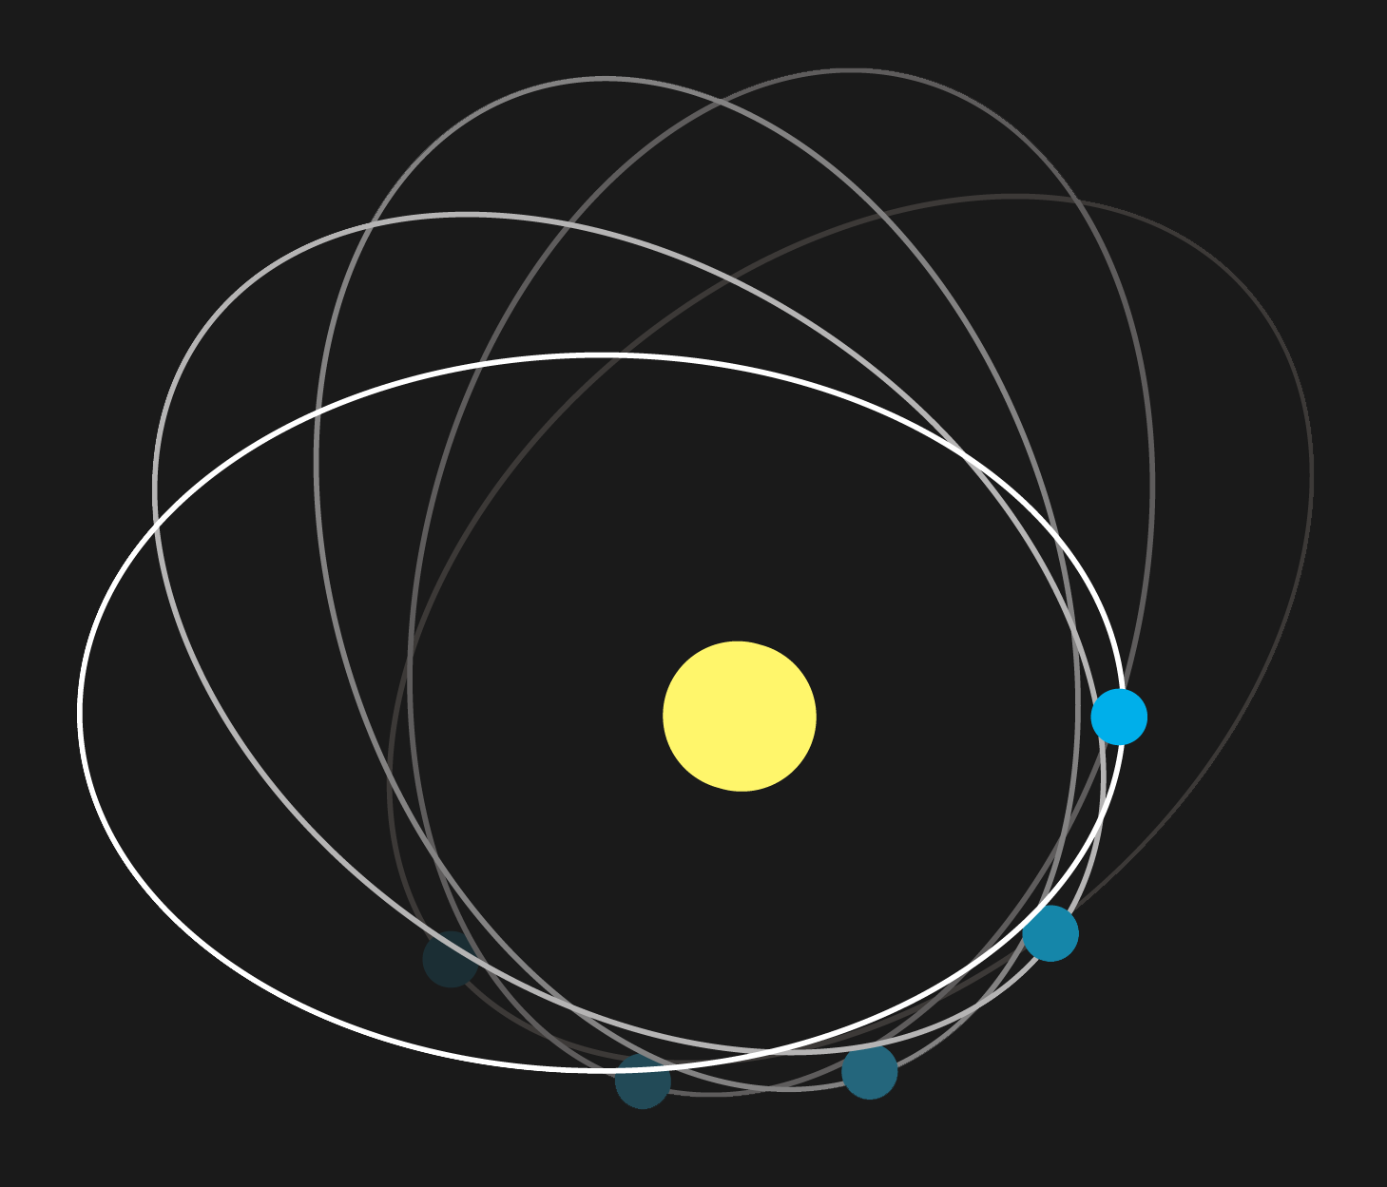
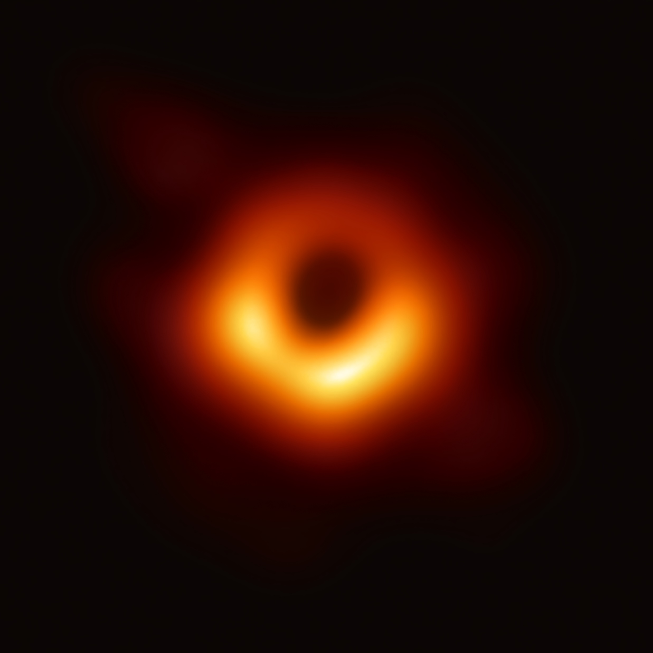
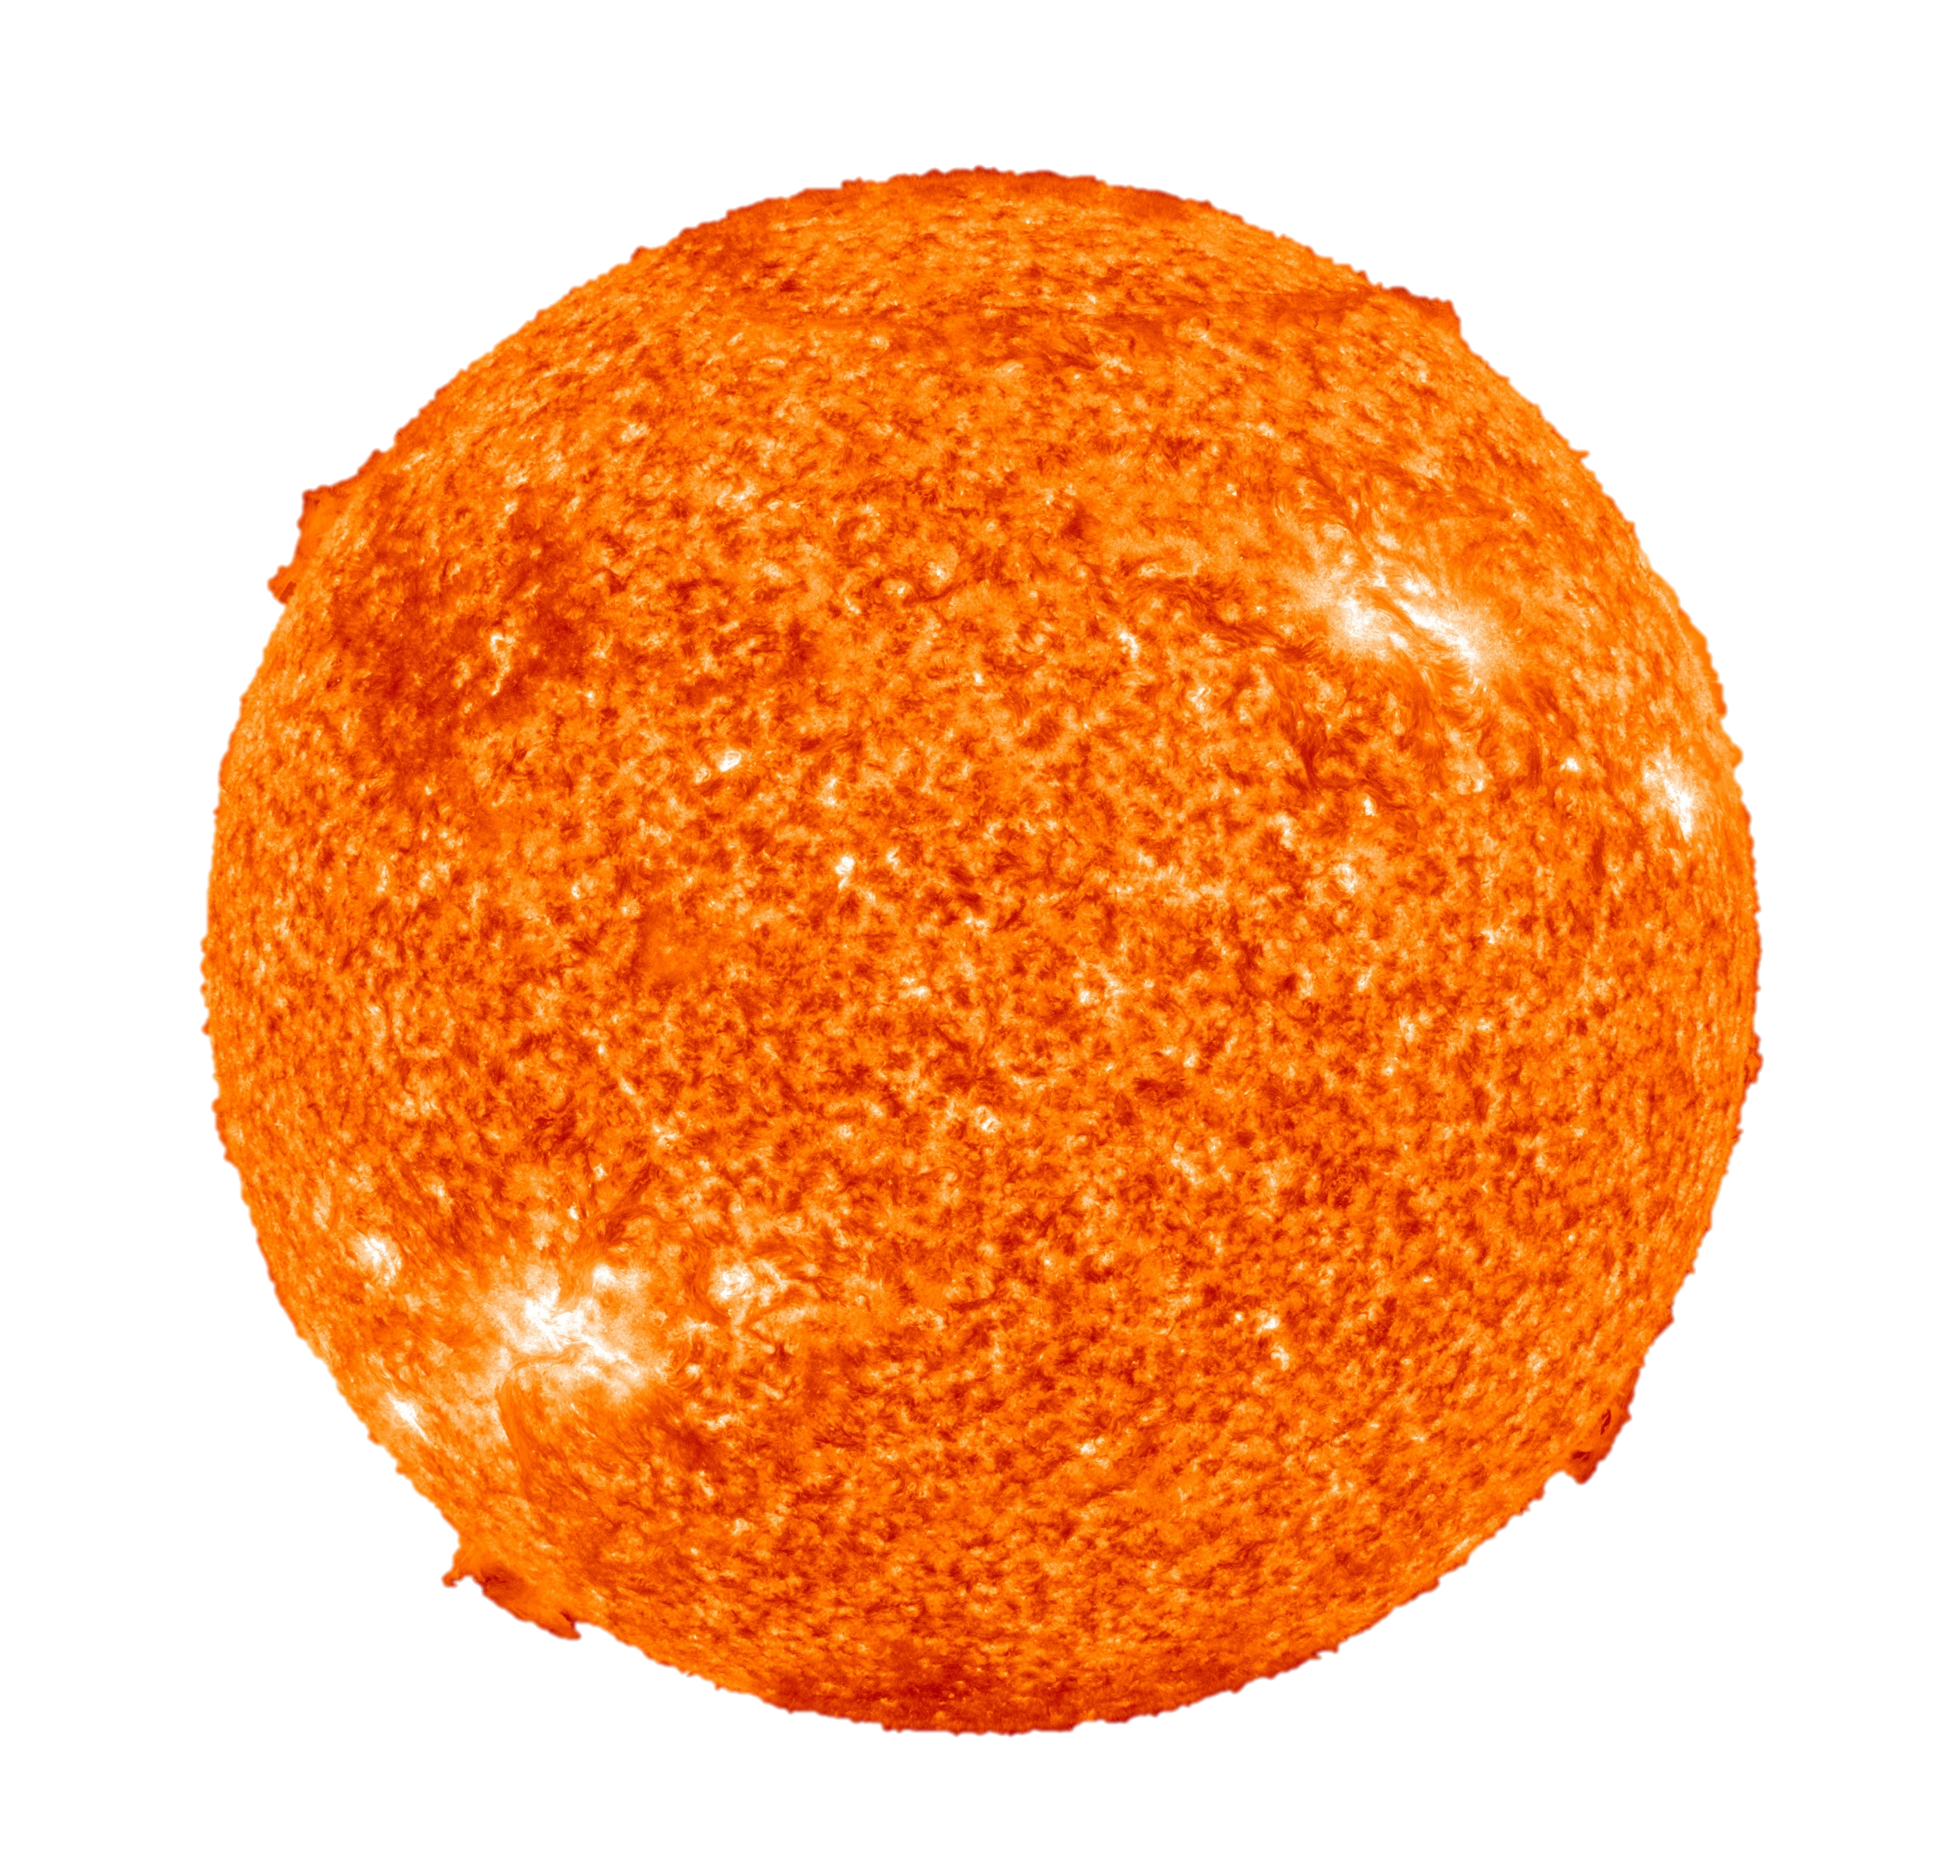
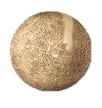
Schwarzschild Geodesics
Photon Sphere
Mercury Perihelion

Slide 2
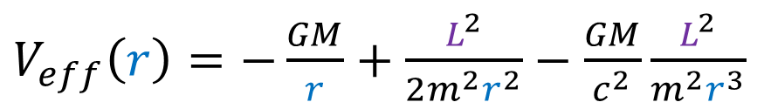
Perihelion Shift (Mercury)
Newtonian gravity: ellipse orbits
General Relativity:
$V_{eff}\left(r\right)=−\frac{GM}{r}+\frac{L^{2}}{2m^{2}r^{2}}−\frac{GM}{c^{2}}\frac{L^{2}}{m^{2}r^{3}}$
perihelion

Slide 3

Relativity 108: Schwarzschild Solution
Schwarzschild Metric Derivation
Interpretation of Schwarzschild Metric
Gravitational Time Dilation, Event Horizon
Schwarzschild Geodesics
gravitational lensing, perihelion shift
Alternative coordinates in Schwarzschild geometry
Gravitational Doppler Effect

Slide 4
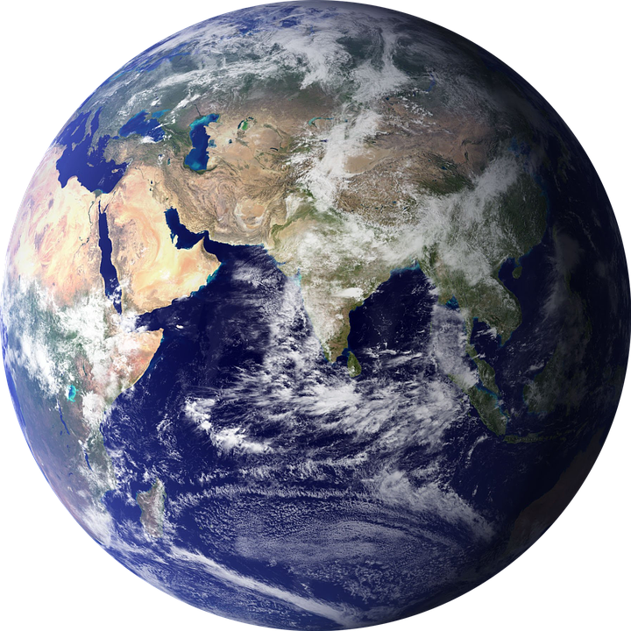
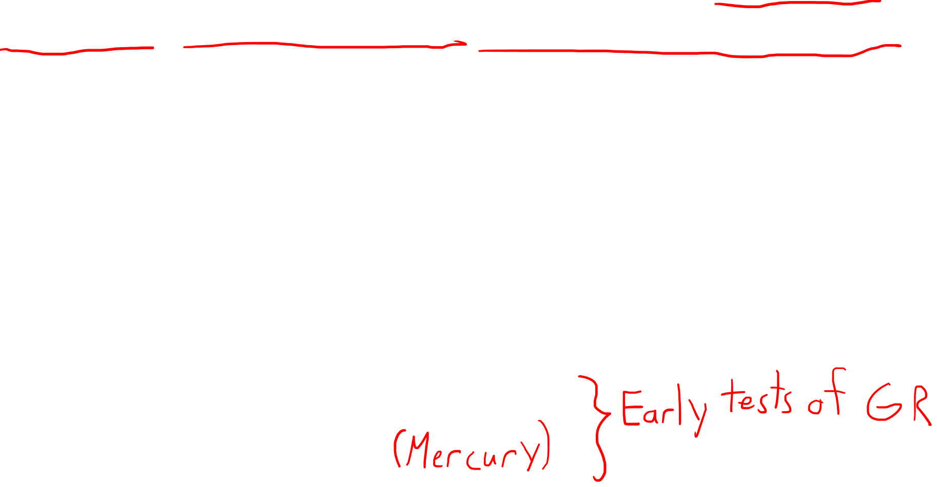
Schwarzschild Geodesics:
Paths massive objects + light means take near spherically-symmetric, electrically neutral, non/slowly-rotating bodies
planets
stars
black holes
Gravitational effects not see in Newtonian Gravity:
Gravitational lensing of light
Perihelion shift of orbits

Slide 5
This Video:
Quick review of geodesics
Review orbits in Newtonian gravity
Derive Schwarzschild geodesics
Compare Newtonian Gravity + General Relativity
Massive bodies
Light
Perihelion Shift

Slide 6

This Video:
Quick review of geodesics
Review orbits in Newtonian gravity
Derive Schwarzschild geodesics
Compare Newtonian Gravity + General Relativity
Massive bodies
Light
Perihelion Shift
Check timestamps if you $↓$ want to skip ahead $↓$

Slide 7
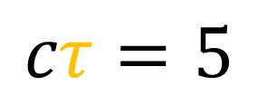
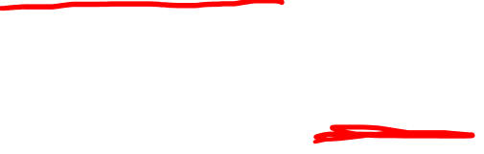
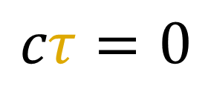
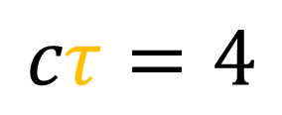
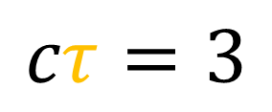
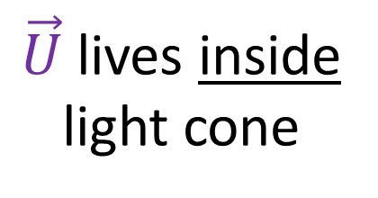
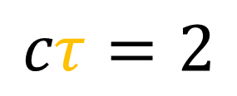
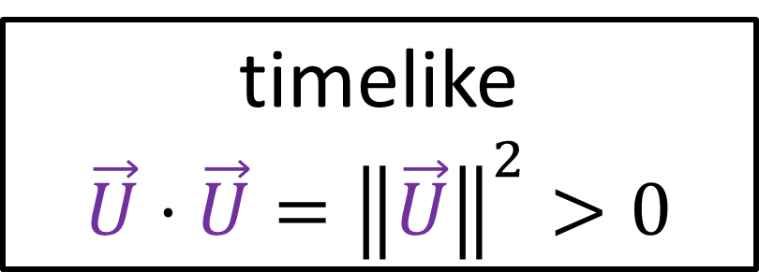
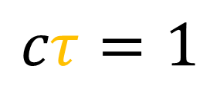
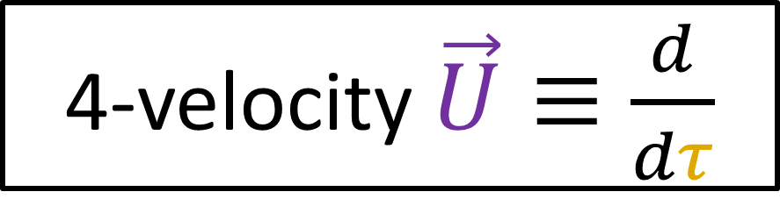
Review of Geodesics (Relativity 105f)
light cone
$$cτ=5$$
4-velocity $\vec{U}≡\frac{d}{dτ}$
$$cτ=4$$
timelike
$\vec{U}⋅\vec{U}={\left\|\vec{U}\right\|}^{2}>0$
light cone
$$cτ=3$$
light cone
$$cτ=2$$
$\vec{U}$ lives inside light cone
$$cτ=1$$
$$cτ=0$$

Slide 8
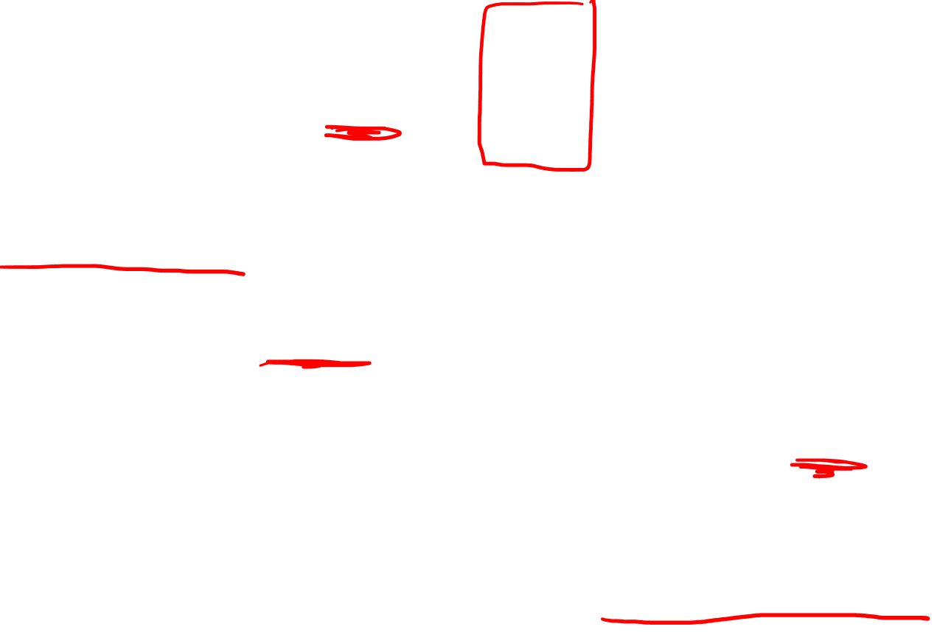
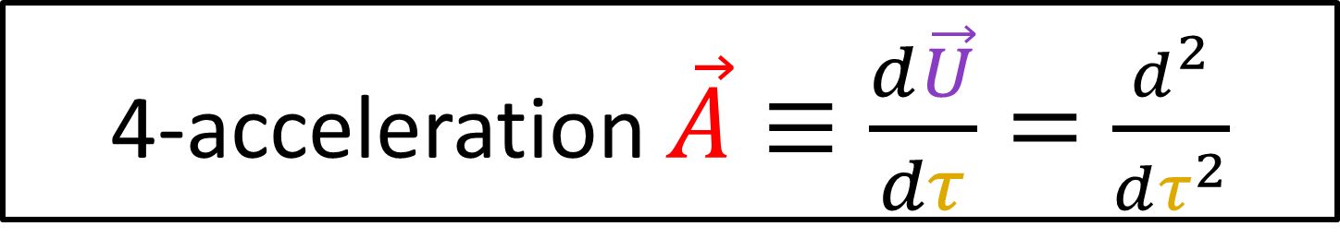
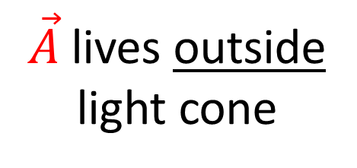
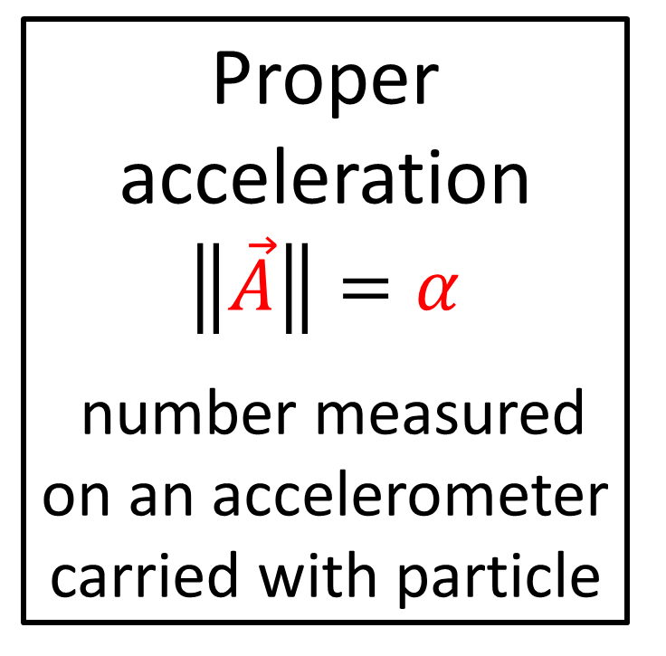
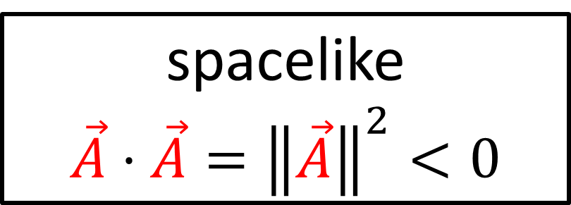
Review of Geodesics (Relativity 105f)
light cone
4-acceleration $\vec{A}≡\frac{d\vec{U}}{dτ}=\frac{d^{2}}{dτ^{2}}$
spacelike
$\vec{A}⋅\vec{A}={\left\|\vec{A}\right\|}^{2}<0$
light cone
Proper acceleration
$$\left\|\vec{A}\right\|=α$$
number measured on an accelerometer carried with particle
light cone
$\vec{A}$lives outside light cone

Slide 9
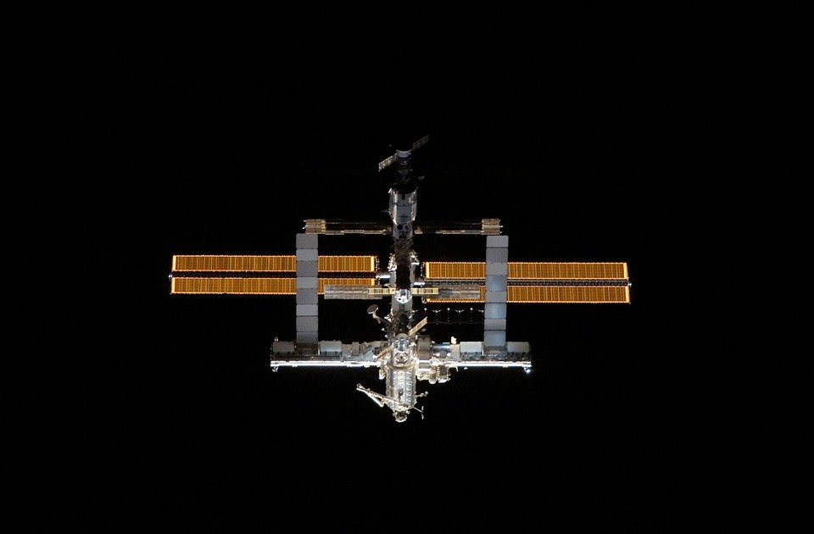
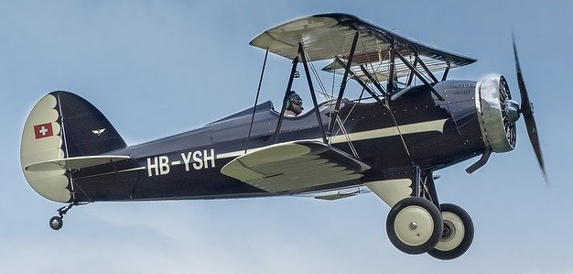
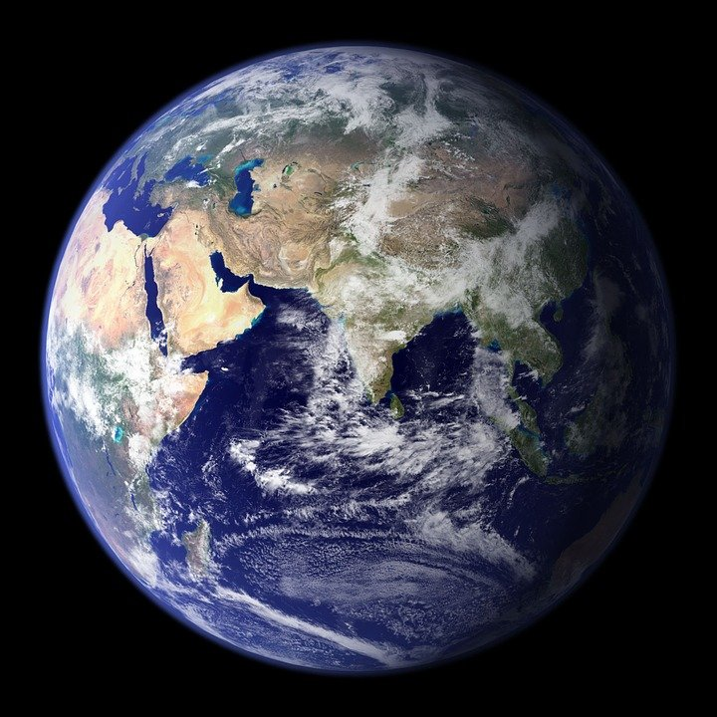
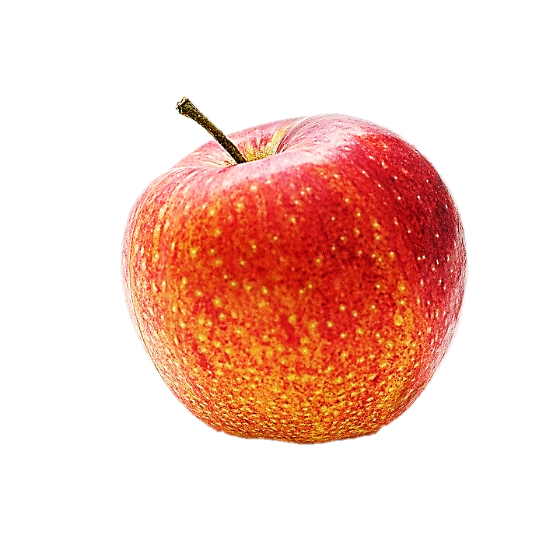
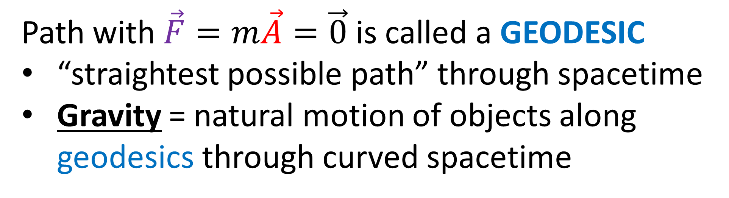
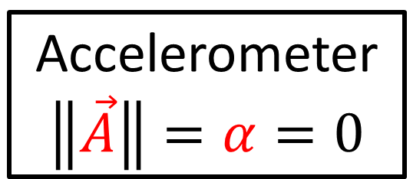

Path with $\vec{F}=m\vec{A}=\vec{0}$ is called a GEODESIC
“straightest possible path” through spacetime
Gravity = natural motion of objects along geodesics through curved spacetime
Accelerometer
$$\left\|\vec{A}\right\|=α=0$$
Accelerometer
$$\left\|\vec{A}\right\|=α=0$$

Slide 10
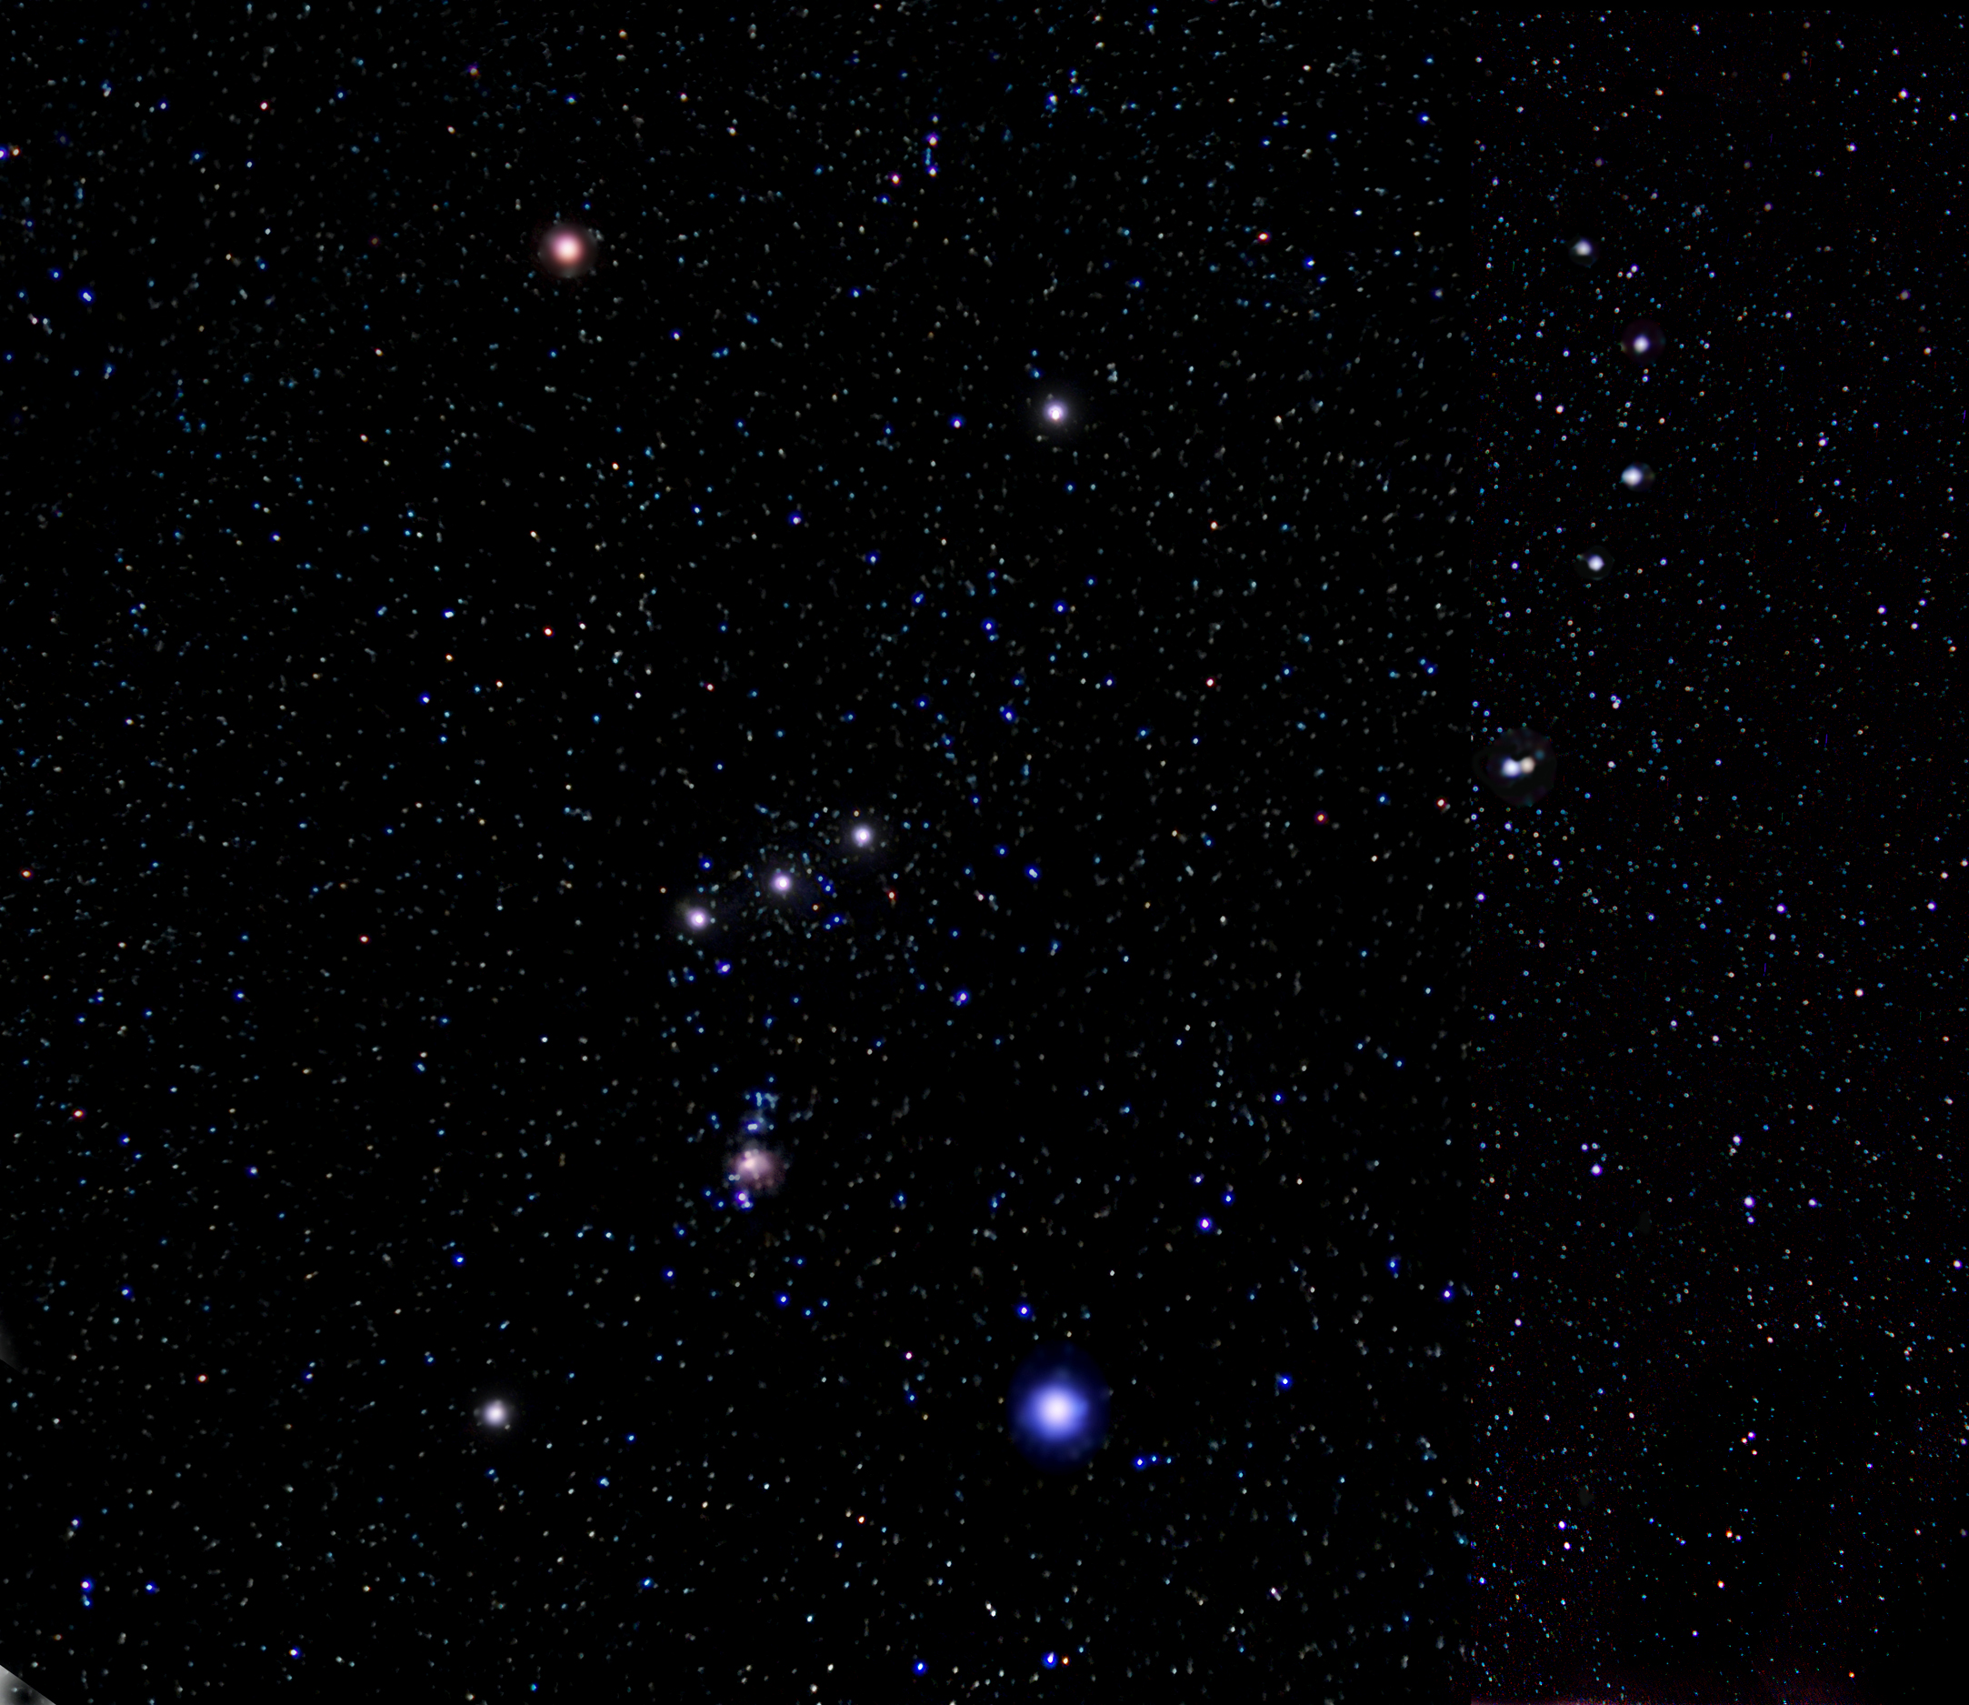
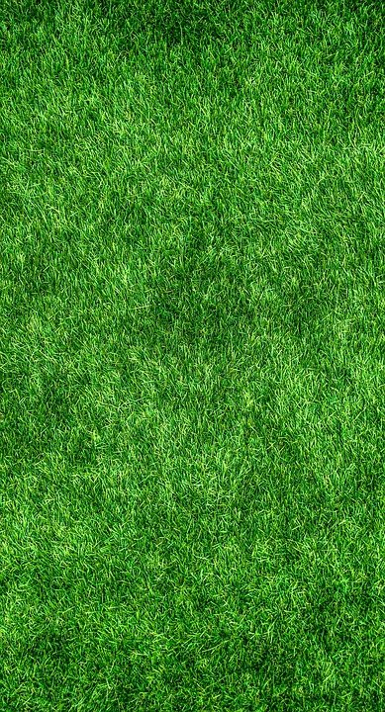

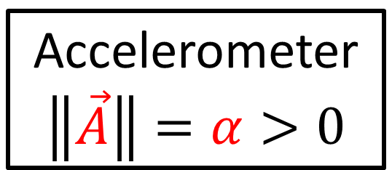

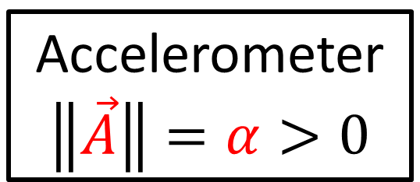
Path with $\vec{F}=m\vec{A}=\vec{0}$ is called a GEODESIC
“straightest possible path” through spacetime
Gravity = natural motion of objects along geodesics through curved spacetime
Accelerometer
$$\left\|\vec{A}\right\|=α>0$$
Accelerometer
$$\left\|\vec{A}\right\|=α>0$$

Slide 11
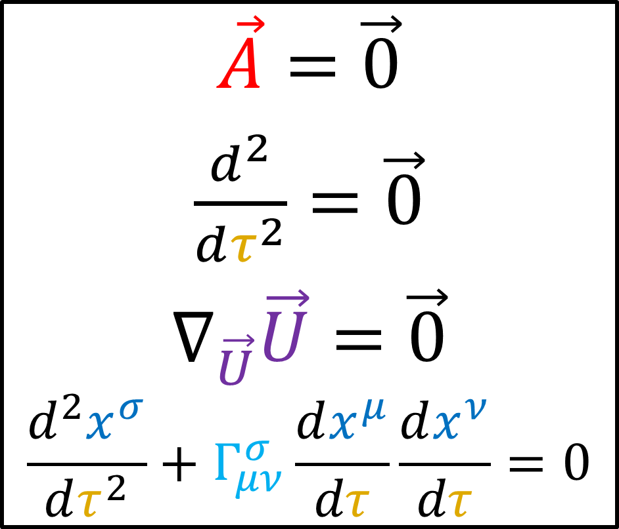
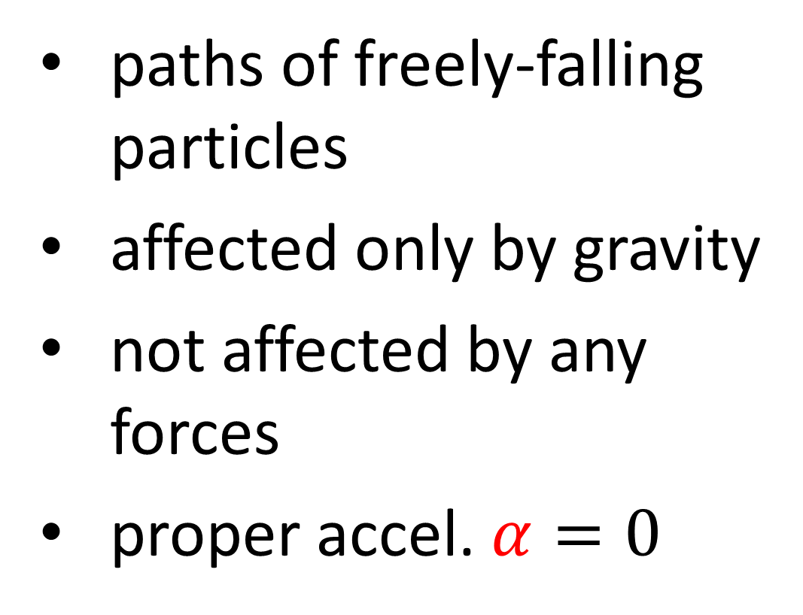
Geodesic Equation
paths of freely-falling particles
affected only by gravity
not affected by any forces
proper accel. $α=0$
$\vec{A}=\vec{0}$
$\frac{d^{2}}{dτ^{2}}=\vec{0}$
$$∇_{\vec{U}}\vec{U}=\vec{0}$$
$$\frac{d^{2}x^{σ}}{dτ^{2}}+Γ_{μν}^{σ}\frac{dx^{μ}}{dτ}\frac{dx^{ν}}{dτ}=0$$

Slide 12
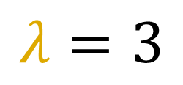
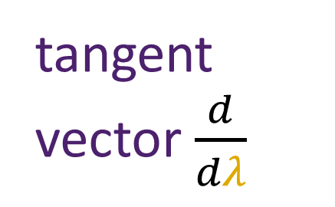
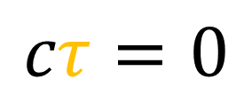
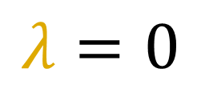
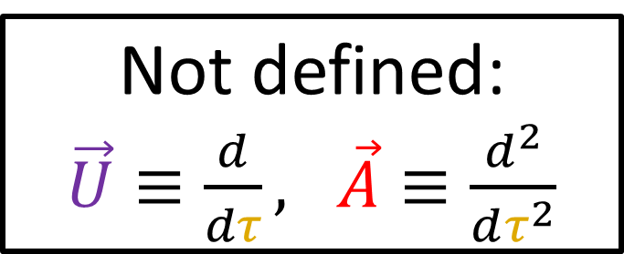
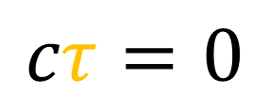
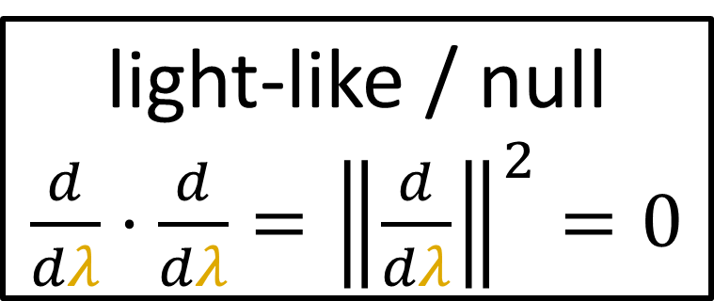



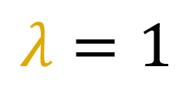
Review of Geodesics (Relativity 105f)
Light beams (massless)
tangent vector $\frac{d}{dλ}$
$$cτ=0$$
$$λ=3$$
$$cτ=0$$
$$λ=2$$
light cone
$$cτ=0$$
$$λ=1$$
$$cτ=0$$
$$λ=0$$
light-like / null
$\frac{d}{dλ}⋅\frac{d}{dλ}={\left\|\frac{d}{dλ}\right\|}^{2}=0$
Not defined:
$\vec{U}≡\frac{d}{dτ}, \vec{A}≡\frac{d^{2}}{dτ^{2}}$

Slide 13
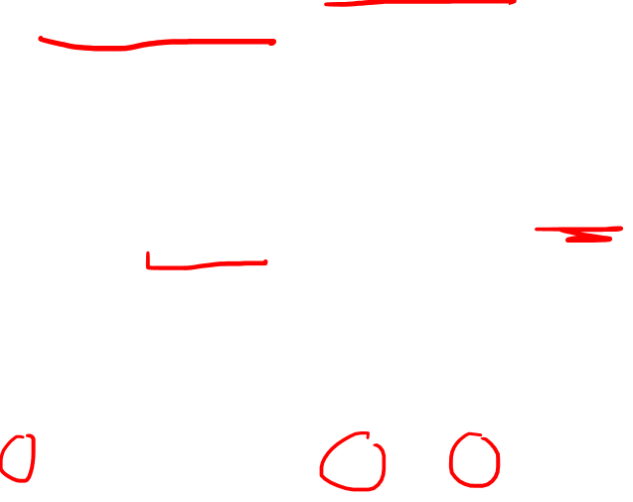
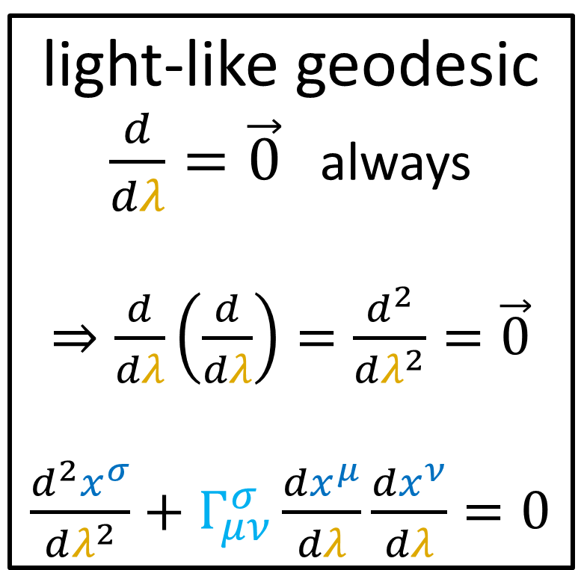
Review of Geodesics (Relativity 105f)
tangent vector $\frac{d}{dλ}$
light-like geodesic
$\frac{d}{dλ}=\vec{0}$ always
$⇒\frac{d}{dλ}\left(\frac{d}{dλ}\right)=\frac{d^{2}}{dλ^{2}}=\vec{0}$
$\frac{d^{2}x^{σ}}{dλ^{2}}+Γ_{μν}^{σ}\frac{dx^{μ}}{dλ}\frac{dx^{ν}}{dλ}=0$
$$λ=3$$
$$λ=2$$
light cone
$$λ=1$$
$$λ=0$$
light-like / null
$\frac{d}{dλ}⋅\frac{d}{dλ}={\left\|\frac{d}{dλ}\right\|}^{2}=0$

Slide 14
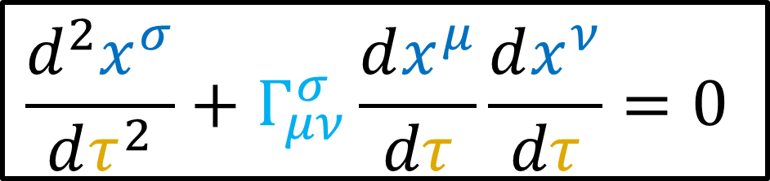

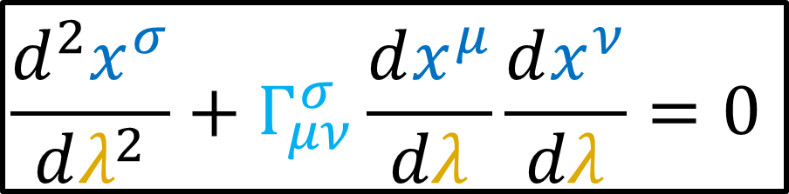
Geodesic Equation
(proper time)
Geodesic Equation
(generic parameter)
$$\frac{d^{2}x^{σ}}{dτ^{2}}+Γ_{μν}^{σ}\frac{dx^{μ}}{dτ}\frac{dx^{ν}}{dτ}=0$$
$$\frac{d^{2}x^{σ}}{dλ^{2}}+Γ_{μν}^{σ}\frac{dx^{μ}}{dλ}\frac{dx^{ν}}{dλ}=0$$
Massive particles
Massless particles

Slide 15
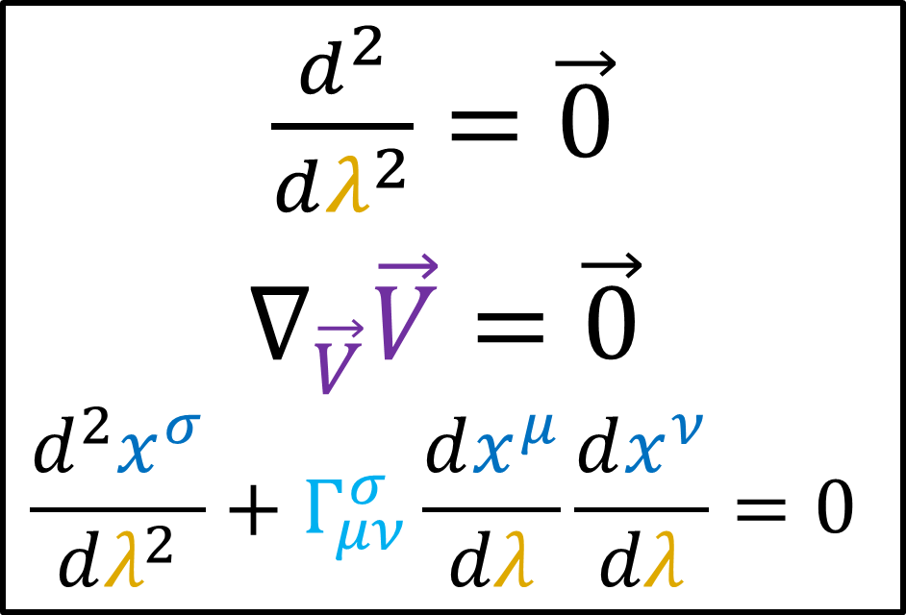
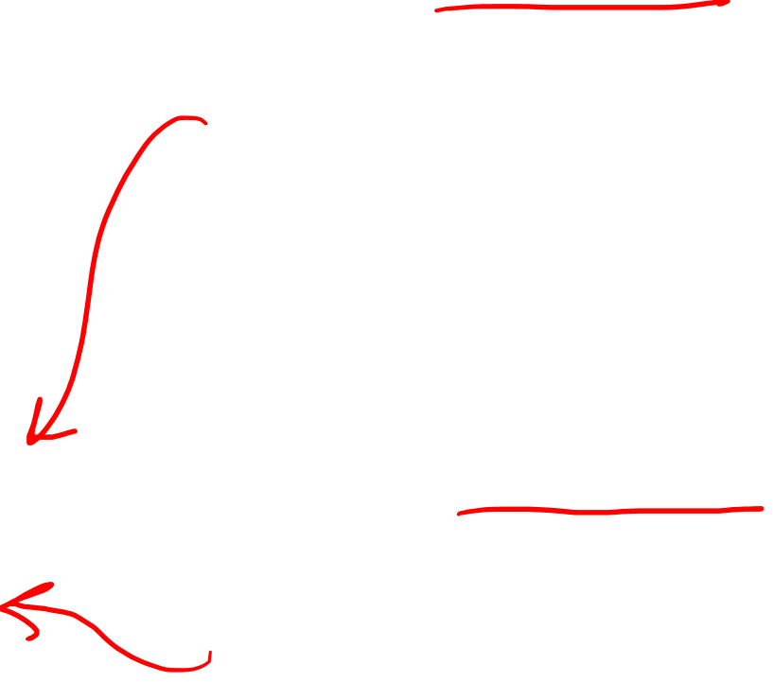
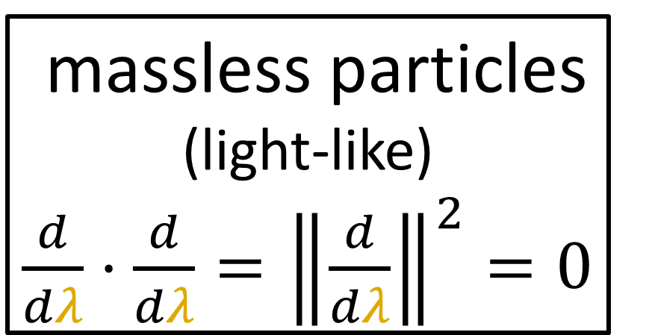
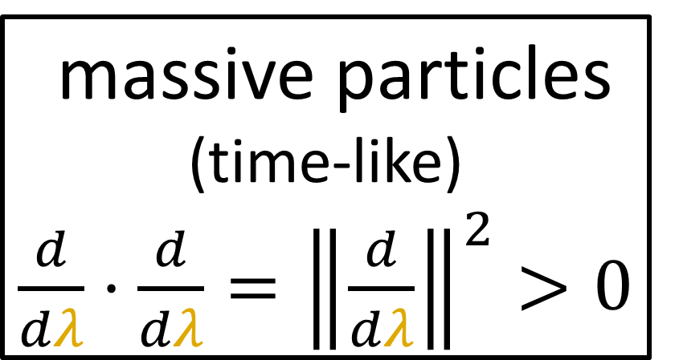
massive particles (time-like)
$\frac{d}{dλ}⋅\frac{d}{dλ}={\left\|\frac{d}{dλ}\right\|}^{2}>0$
Geodesic Equation
$\frac{d^{2}}{dλ^{2}}=\vec{0}$
$$∇_{\vec{V}}\vec{V}=\vec{0}$$
$$\frac{d^{2}x^{σ}}{dλ^{2}}+Γ_{μν}^{σ}\frac{dx^{μ}}{dλ}\frac{dx^{ν}}{dλ}=0$$
massless particles (light-like)
$\frac{d}{dλ}⋅\frac{d}{dλ}={\left\|\frac{d}{dλ}\right\|}^{2}=0$

Slide 16




Schwarzschild Metric
$r_{s}=\frac{2GM}{c^{2}}$
$g_{μν}→\left[\begin{matrix}\begin{matrix}\begin{aligned}1−\frac{r_{s}}{r} \\ 0 \\ 0 \\ 0\end{aligned} & \begin{aligned}0 \\ −\frac{1}{1−\frac{r_{s}}{r}} \\ 0 \\ 0\end{aligned}\end{matrix} & \begin{matrix}\begin{aligned}0 \\ 0 \\ −r^{2} \\ 0\end{aligned} & \begin{aligned}0 \\ 0 \\ 0 \\ −r^{2}{\left(\sin{θ}\right)}^{2}\end{aligned}\end{matrix}\end{matrix}\right]$
Spherically-symmetric
Non-rotating
Uncharnged
Geodesic Equation
$$\frac{d^{2}x^{σ}}{dλ^{2}}+Γ_{μν}^{σ}\frac{dx^{μ}}{dλ}\frac{dx^{ν}}{dλ}=0$$

Slide 17








Review: Newtonian Gravity
$\frac{d\vec{R}}{dr}≡\vec{e_{r}}$ $\frac{d\vec{R}}{dφ}≡\vec{e_{φ}}$
$\frac{d\vec{R}}{dt}$
$$φ$$
$\frac{d\vec{R}}{dt}=\frac{dr}{dt}\frac{d\vec{R}}{dr}+\frac{dφ}{dt}\frac{d\vec{R}}{dφ}$
$\frac{d\vec{R}}{dt}= \dot{r} \vec{e_{r}} + \dot{φ} \vec{e_{φ}}$
$$\vec{R}$$
$$r$$
${\left\|\frac{d\vec{R}}{dt}\right\|}^{2}=\frac{d\vec{R}}{dt}⋅\frac{d\vec{R}}{dt}$
$=\left(\dot{r}\vec{e_{r}}+\dot{φ}\vec{e_{φ}}\right)⋅\left(\dot{r}\vec{e_{r}}+\dot{φ}\vec{e_{φ}}\right)$
$={\dot{r}}^{2}\left(\vec{e_{r}}⋅\vec{e_{r}}\right)+2\dot{r}\dot{φ}\left(\vec{e_{r}}⋅\vec{e_{φ}}\right)+{\dot{φ}}^{2}\left(\vec{e_{φ}}⋅\vec{e_{φ}}\right)$
$={\dot{r}}^{2}+{\dot{φ}}^{2}r^{2}$

Slide 18




Review: Newtonian Gravity
$\frac{d\vec{R}}{dr}≡\vec{e_{r}}$ $\frac{d\vec{R}}{dφ}≡\vec{e_{φ}}$
$\frac{d\vec{R}}{dt}$
$$φ$$
$\frac{d\vec{R}}{dt}=\frac{dr}{dt}\frac{d\vec{R}}{dr}+\frac{dφ}{dt}\frac{d\vec{R}}{dφ}$
$\frac{d\vec{R}}{dt}= \dot{r} \vec{e_{r}} + \dot{φ} \vec{e_{φ}}$
$$\vec{R}$$
$$\vec{e_{φ}}$$
$$\vec{e_{φ}}$$
$$r$$
${\left\|\frac{d\vec{R}}{dt}\right\|}^{2}=\frac{d\vec{R}}{dt}⋅\frac{d\vec{R}}{dt}$
$=\left(\dot{r}\vec{e_{r}}+\dot{φ}\vec{e_{φ}}\right)⋅\left(\dot{r}\vec{e_{r}}+\dot{φ}\vec{e_{φ}}\right)$
$={\dot{r}}^{2}\left(\vec{e_{r}}⋅\vec{e_{r}}\right)+2\dot{r}\dot{φ}\left(\vec{e_{r}}⋅\vec{e_{φ}}\right)+{\dot{φ}}^{2}\left(\vec{e_{φ}}⋅\vec{e_{φ}}\right)$
$={\dot{r}}^{2}+{\dot{φ}}^{2}r^{2}$
$$\vec{e_{r}}$$
$$\vec{e_{r}}$$

Slide 19



$\vec{L}=\vec{R}×\vec{p}=\vec{R}×m\frac{d\vec{R}}{dt}$
$\vec{L}=m\left(\vec{R}×\frac{d\vec{R}}{dt}\right)$
$\vec{L}=m\left(\left(r\vec{e_{r}}\right)×\left(\dot{r}\vec{e_{r}}+\dot{φ}\vec{e_{φ}}\right)\right)$
$\vec{L}=m\left(r\dot{r}\left(\vec{e_{r}}×\vec{e_{r}}\right)+r\dot{φ}\left(\vec{e_{r}}×\vec{e_{φ}}\right)\right)$
$$\vec{L}=mr\dot{φ}\left(r\vec{e_{z}}\right)$$
$$L=mr^{2}\dot{φ}$$
$\frac{L}{mr^{2}}=\dot{φ}$
$\vec{R} =r\vec{e_{r}}$
$\frac{d\vec{R}}{dt} = \dot{r}\vec{e_{r}}+\dot{φ}\vec{e_{φ}}$

Slide 20




Conservation of Energy:
$$E=K.E.+P.E.$$
$E=\frac{1}{2}mv^{2}+mV(r)$
$E=\frac{1}{2}m\left({\dot{r}}^{2}+r^{2}{\dot{φ}}^{2}\right)+mV\left(r\right)$
$E=\frac{1}{2}m{\dot{r}}^{2}+\frac{1}{2}mr^{2}{\dot{φ}}^{2}+mV\left(r\right)$
$E=\frac{1}{2}m{\dot{r}}^{2}+\frac{1}{2}mr^{2}{\left(\frac{L}{mr^{2}}\right)}^{2}+mV\left(r\right)$
$E=\frac{1}{2}m{\dot{r}}^{2}+m\frac{L^{2}}{2m^{2}r^{2}}+mV\left(r\right)$
$E=\frac{1}{2}m{\dot{r}}^{2}+m\frac{L^{2}}{2m^{2}r^{2}}−m\frac{GM}{r}$
$E=\frac{1}{2}m{\dot{r}}^{2}+mV_{eff}\left(r\right)$
${\left\|\frac{d\vec{R}}{dt}\right\|}^{2}$ $=v^{2}={\dot{r}}^{2}+r^{2}{\dot{φ}}^{2}$
$\frac{L}{mr^{2}}=\dot{φ}$

Slide 21




$\vec{L}=\vec{R}×\vec{p}=\vec{R}×m\frac{d\vec{R}}{dt}$
$\vec{L}=m\left(\vec{R}×\frac{d\vec{R}}{dt}\right)$
$\vec{L}=m\left(\left(r\vec{e_{r}}\right)×\left(\dot{r}\vec{e_{r}}+\dot{φ}\vec{e_{φ}}\right)\right)$
$\vec{L}=m\left(r\dot{r}\left(\vec{e_{r}}×\vec{e_{r}}\right)+r\dot{φ}\left(\vec{e_{r}}×\vec{e_{φ}}\right)\right)$
$$\vec{L}=mr\dot{φ}\left(r\vec{e_{z}}\right)$$
$$L=mr^{2}\dot{φ}$$
$\frac{L}{mr^{2}}=\dot{φ}$
$$\vec{e_{φ}}$$
$$\vec{e_{φ}}$$
$$\vec{e_{r}}$$
$$\vec{e_{r}}$$
$$z$$
$\vec{R} =r\vec{e_{r}}$
$\frac{d\vec{R}}{dt} = \dot{r}\vec{e_{r}}+\dot{φ}\vec{e_{φ}}$
$$φ$$
$$r$$

Slide 22

Conservation of Energy:
$$E=K.E.+P.E.$$
$E=\frac{1}{2}mv^{2}+mV(r)$
$E=\frac{1}{2}m\left({\dot{r}}^{2}+r^{2}{\dot{φ}}^{2}\right)+mV\left(r\right)$
$E=\frac{1}{2}m{\dot{r}}^{2}+\frac{1}{2}mr^{2}{\dot{φ}}^{2}+mV\left(r\right)$
$E=\frac{1}{2}m{\dot{r}}^{2}+\frac{1}{2}mr^{2}{\left(\frac{L}{mr^{2}}\right)}^{2}+mV\left(r\right)$
$E=\frac{1}{2}m{\dot{r}}^{2}+m\frac{L^{2}}{2m^{2}r^{2}}+mV\left(r\right)$
$E=\frac{1}{2}m{\dot{r}}^{2}+m\frac{L^{2}}{2m^{2}r^{2}}−m\frac{GM}{r}$
$E=\frac{1}{2}m{\dot{r}}^{2}+mV_{eff}\left(r\right)$
${\left\|\frac{d\vec{R}}{dt}\right\|}^{2}$ $=v^{2}={\dot{r}}^{2}+r^{2}{\dot{φ}}^{2}$
$\frac{L}{mr^{2}}=\dot{φ}$

Slide 23


Newtonian Gravity
$E = \frac{1}{2}m{\left(\frac{dr}{dt}\right)}^{2}+ m\left(−\frac{GM}{r}+\frac{L^{2}}{2m^{2}r^{2}}\right)$

Slide 24

Newtonian Gravity
$E = \frac{1}{2}m{\left(\frac{dr}{dt}\right)}^{2}+ m\left(−\frac{GM}{r}+\frac{L^{2}}{2m^{2}r^{2}}\right)$

Slide 25
Newtonian Gravity
$E = \frac{1}{2}m{\left(\frac{dr}{dt}\right)}^{2}+ m\left(−\frac{GM}{r}+\frac{L^{2}}{2m^{2}r^{2}}\right)$

Slide 26
Newtonian Gravity
$E = \frac{1}{2}m{\left(\frac{dr}{dt}\right)}^{2}+ m\left(−\frac{GM}{r}+\frac{L^{2}}{2m^{2}r^{2}}\right)$
$\frac{1}{2}\left(\frac{E^{2}}{m}−mc^{2}\right)=\frac{1}{2}m{\left(\frac{dr}{dτ}\right)}^{2}+m\left(−\frac{GM}{r}+\frac{L^{2}}{2m^{2}r^{2}}−\frac{GM}{c^{2}}\frac{ℒ^{2}}{r^{3}}\right)$
General Relativity

Slide 27

Newtonian Gravity
$E = \frac{1}{2}m{\left(\frac{dr}{dt}\right)}^{2}+ m\left(−\frac{GM}{r}+\frac{L^{2}}{2m^{2}r^{2}}\right)$
$\frac{1}{2}\left(\frac{E^{2}}{m}−mc^{2}\right)=\frac{1}{2}m{\left(\frac{dr}{dτ}\right)}^{2}+m\left(−\frac{GM}{r}+\frac{L^{2}}{2m^{2}r^{2}}−\frac{GM}{c^{2}}\frac{ℒ^{2}}{r^{3}}\right)$
General Relativity

Slide 28










Geodesic Equation
4 Equations
$0=\frac{d^{2}x^{σ}}{dλ^{2}}+Γ_{μν}^{σ}\frac{dx^{μ}}{dλ}\frac{dx^{ν}}{dλ}$
$θ=\frac{π}{2}$
$\frac{dθ}{dλ}=\frac{d^{2}θ}{dλ^{2}}=0$
$0=\frac{d^{2}\left(ct\right)}{dλ^{2}}+Γ_{μν}^{t}\frac{dx^{μ}}{dλ}\frac{dx^{ν}}{dλ}$
$0= \frac{d^{2}r}{dλ^{2}} +Γ_{μν}^{r}\frac{dx^{μ}}{dλ}\frac{dx^{ν}}{dλ}$
$0= \frac{d^{2}θ}{dλ^{2}} +Γ_{μν}^{θ}\frac{dx^{μ}}{dλ}\frac{dx^{ν}}{dλ}$
$0= \frac{d^{2}φ}{dλ^{2}} +Γ_{μν}^{φ}\frac{dx^{μ}}{dλ}\frac{dx^{ν}}{dλ}$
$$θ$$
$$r$$
$$mass$$
$$mass$$
$$φ$$

Slide 29







Spherical Symmetry Allows:
$$θ$$
$$r$$
$$mass$$
$$mass$$
$$φ$$
$θ=\frac{π}{2}$
$\frac{dθ}{dλ}=\frac{d^{2}θ}{dλ^{2}}=0$

Slide 30



Spherical Symmetry Allows:
$$θ$$
$$r$$
$$φ$$
$$mass$$
$$mass$$
$θ=\frac{π}{2}$
$\frac{dθ}{dλ}=\frac{d^{2}θ}{dλ^{2}}=0$

Slide 31






Relativity 108a: Schwarzschild Metric
$g_{μν}→\left[\begin{matrix}\begin{matrix}\begin{aligned}A\left(r\right) \\ 0 \\ 0 \\ 0\end{aligned} & \begin{aligned}0 \\ −B\left(r\right) \\ 0 \\ 0\end{aligned}\end{matrix} & \begin{matrix}\begin{aligned}0 \\ 0 \\ −r^{2} \\ 0\end{aligned} & \begin{aligned}0 \\ 0 \\ 0 \\ −r^{2}{\left(\sin{θ}\right)}^{2}\end{aligned}\end{matrix}\end{matrix}\right]$
$A\left(r\right)=1−\frac{r_{s}}{r}$
$B\left(r\right)=\frac{1}{A\left(r\right)}$
$B\left(r\right)=\frac{r}{1−\frac{r_{s}}{r}}$
$r_{s}=\frac{2GM}{c^{2}}$
$=\frac{r}{r−r_{s}}$

Slide 32







$Γ_{tr}^{t}=Γ_{rt}^{t}=\frac{1}{2}\frac{r_{s}}{r\left(r−r_{s}\right)}\text{,} Γ_{tt}^{r}=\frac{1}{2}\frac{r_{s}\left(r−r_{s}\right)}{r^{3}}$
$Γ_{rr}^{r}=\frac{1}{2}\frac{r_{s}}{r\left(r_{s}−r\right)}, Γ_{θθ}^{r}=r_{s}−r\text{, }Γ_{φφ}^{r}=\left(r_{s}−r\right){\left(\sin{θ}\right)}^{2}$
$Γ_{rθ}^{θ}=Γ_{θr}^{θ}=Γ_{rφ}^{φ}=Γ_{φr}^{φ}=\frac{1}{r}, Γ_{φφ}^{θ}=−\sin{θ}\cos{θ}, Γ_{θφ}^{φ}=Γ_{φθ}^{φ}=\cot{θ}$
$Γ_{tr}^{t}=Γ_{rt}^{t}=\frac{1}{2}\frac{1}{A}\left(∂_{r}A\right)\text{,} Γ_{tt}^{r}=\frac{1}{2}\frac{1}{B}\left(∂_{r}A\right)$
$Γ_{rr}^{r}=\frac{1}{2}\frac{1}{B}\left(∂_{r}B\right), Γ_{θθ}^{r}=−\frac{r}{B}\text{, }Γ_{φφ}^{r}=−\frac{r{\left(\sin{θ}\right)}^{2}}{B}$
$Γ_{rθ}^{θ}=Γ_{θr}^{θ}=Γ_{rφ}^{φ}=Γ_{φr}^{φ}=\frac{1}{r}, Γ_{φφ}^{θ}=−\sin{θ}\cos{θ}, Γ_{θφ}^{φ}=Γ_{φθ}^{φ}=\cot{θ}$
$B\left(r\right)=\frac{r}{r−r_{s}}$
$A\left(r\right)=1−\frac{r_{s}}{r}$
$∂_{r}B=\frac{r}{r−r_{s}}=r{\left(r−r_{s}\right)}^{−1}$
$$∂_{r}B={\left(r−r_{s}\right)}^{−1}+r\left(−1\right){\left(r−r_{s}\right)}^{−2}$$
$∂_{r}B=\frac{1}{r−r_{s}}−\frac{r}{{\left(r−r_{s}\right)}^{2}}$
$∂_{r}B= −\frac{r_{s}}{{\left(r−r_{s}\right)}^{2}}$
$$∂_{r}A=1−r_{s}r^{−1}$$
$$∂_{r}A=0−r_{s}r^{−2}\left(−1\right)$$
$∂_{r}A=\frac{r_{s}}{r^{2}}$

Slide 33









Check your answers: https://en.wikipedia.org/wiki/Schwarzschild_geodesics#Mathematical_derivations_of_the_orbital_equation
$Γ_{tr}^{t}=Γ_{rt}^{t}=\frac{1}{2}\frac{1}{A}\left(∂_{r}A\right)\text{,} Γ_{tt}^{r}=\frac{1}{2}\frac{1}{B}\left(∂_{r}A\right)$
$Γ_{rr}^{r}=\frac{1}{2}\frac{1}{B}\left(∂_{r}B\right), Γ_{θθ}^{r}=−\frac{r}{B}\text{, }Γ_{φφ}^{r}=−\frac{r{\left(\sin{θ}\right)}^{2}}{B}$
$Γ_{rθ}^{θ}=Γ_{θr}^{θ}=Γ_{rφ}^{φ}=Γ_{φr}^{φ}=\frac{1}{r}, Γ_{φφ}^{θ}=−\sin{θ}\cos{θ}, Γ_{θφ}^{φ}=Γ_{φθ}^{φ}=\cot{θ}$
$A=1−\frac{r_{s}}{r}, sd∂_{r}A=\frac{r_{s}}{r^{2}}$
$B=\frac{r}{r−r_{s}}, ∂_{r}B=−\frac{r_{s}}{{\left(r−r_{s}\right)}^{2}}$
$Γ_{tr}^{t}=Γ_{rt}^{t}=\frac{1}{2}\frac{1}{A}\left(∂_{r}A\right)$
$=\frac{1}{2}\frac{1}{1−\frac{r_{s}}{r}}\frac{r_{s}}{r^{2}}$
$=\frac{1}{2}\frac{r_{s}}{r\left(r−r_{s}\right)}$
$Γ_{tt}^{r}=\frac{1}{2}\frac{1}{B}\left(∂_{r}A\right)$
$Γ_{tt}^{r}=\frac{1}{2}\left(\frac{r−r_{s}}{r}\right)\frac{r_{s}}{r^{2}}$
$Γ_{tt}^{r}=\frac{1}{2}\frac{r_{s}\left(r−r_{s}\right)}{r^{3}}$
$Γ_{rr}^{r}=\frac{1}{2}\frac{1}{B}\left(∂_{r}B\right)$
$Γ_{rr}^{r}=\frac{1}{2}\left(\frac{r−r_{s}}{r}\right)\left(−\frac{r_{s}}{{\left(r−r_{s}\right)}^{2}}\right)$
$Γ_{rr}^{r}=−\frac{1}{2}\frac{r_{s}}{r\left(r−r_{s}\right)}$
$Γ_{rr}^{r}=\frac{1}{2}\frac{r_{s}}{r\left(r_{s}−r\right)}$
$Γ_{22}^{1}=−\frac{1}{B}r$
$Γ_{22}^{1}=−\left(\frac{r}{r−r_{s}}\right)r$
$$Γ_{22}^{1}=r_{s}−r$$
$Γ_{22}^{1}=−\frac{1}{B}r{\left(\sin{θ}\right)}^{2}$
$Γ_{22}^{1}=−\left(\frac{r}{r−r_{s}}\right)r{\left(\sin{θ}\right)}^{2}$
$$Γ_{22}^{1}=\left(r_{s}−r\right){\left(\sin{θ}\right)}^{2}$$

Slide 34



Check your answers: https://en.wikipedia.org/wiki/Schwarzschild_geodesics#Mathematical_derivations_of_the_orbital_equation
$Γ_{tr}^{t}=Γ_{rt}^{t}=\frac{1}{2}\frac{1}{A}\left(∂_{r}A\right)\text{,} Γ_{tt}^{r}=\frac{1}{2}\frac{1}{B}\left(∂_{r}A\right)$
$Γ_{rr}^{r}=\frac{1}{2}\frac{1}{B}\left(∂_{r}B\right), Γ_{θθ}^{r}=−\frac{r}{B}\text{, }Γ_{φφ}^{r}=−\frac{r{\left(\sin{θ}\right)}^{2}}{B}$
$Γ_{rθ}^{θ}=Γ_{θr}^{θ}=Γ_{rφ}^{φ}=Γ_{φr}^{φ}=\frac{1}{r}, Γ_{φφ}^{θ}=−\sin{θ}\cos{θ}, Γ_{θφ}^{φ}=Γ_{φθ}^{φ}=\cot{θ}$
$A=1−\frac{r_{s}}{r}, sd∂_{r}A=\frac{r_{s}}{r^{2}}$
$B=\frac{r}{r−r_{s}}, ∂_{r}B=−\frac{r_{s}}{{\left(r−r_{s}\right)}^{2}}$
$Γ_{θθ}^{r}=−\frac{1}{B}r$
$Γ_{θθ}^{r}=−\left(\frac{r−r_{s}}{r}\right)r$
$$Γ_{θθ}^{r}=r_{s}−r$$
$Γ_{φφ}^{r}=−\frac{1}{B}r{\left(\sin{θ}\right)}^{2}$
$Γ_{φφ}^{r}=−\left(\frac{r−r_{s}}{r}\right)r{\left(\sin{θ}\right)}^{2}$
$$Γ_{φφ}^{r}=\left(r_{s}−r\right){\left(\sin{θ}\right)}^{2}$$

Slide 35


Check your answers: https://en.wikipedia.org/wiki/Schwarzschild_geodesics#Mathematical_derivations_of_the_orbital_equation
$Γ_{tr}^{t}=Γ_{rt}^{t}=\frac{1}{2}\frac{1}{A}\left(∂_{r}A\right)\text{,} Γ_{tt}^{r}=\frac{1}{2}\frac{1}{B}\left(∂_{r}A\right)$
$Γ_{rr}^{r}=\frac{1}{2}\frac{1}{B}\left(∂_{r}B\right), Γ_{θθ}^{r}=−\frac{r}{B}\text{, }Γ_{φφ}^{r}=−\frac{r{\left(\sin{θ}\right)}^{2}}{B}$
$Γ_{rθ}^{θ}=Γ_{θr}^{θ}=Γ_{rφ}^{φ}=Γ_{φr}^{φ}=\frac{1}{r}, Γ_{φφ}^{θ}=−\sin{θ}\cos{θ}, Γ_{θφ}^{φ}=Γ_{φθ}^{φ}=\cot{θ}$
$Γ_{tr}^{t}=Γ_{rt}^{t}=\frac{1}{2}\frac{r_{s}}{r\left(r−r_{s}\right)}\text{,} Γ_{tt}^{r}=\frac{1}{2}\frac{r_{s}\left(r−r_{s}\right)}{r^{3}}$
$Γ_{rr}^{r}=\frac{1}{2}\frac{r_{s}}{r\left(r_{s}−r\right)}, Γ_{θθ}^{r}=r_{s}−r\text{, }Γ_{φφ}^{r}=\left(r_{s}−r\right){\left(\sin{θ}\right)}^{2}$
$Γ_{rθ}^{θ}=Γ_{θr}^{θ}=Γ_{rφ}^{φ}=Γ_{φr}^{φ}=\frac{1}{r}, Γ_{φφ}^{θ}=−\sin{θ}\cos{θ}, Γ_{θφ}^{φ}=Γ_{φθ}^{φ}=\cot{θ}$

Slide 36




Schwarzschild Metric
$r_{s}=\frac{2GM}{c^{2}}$
$g_{μν}→\left[\begin{matrix}\begin{matrix}\begin{aligned}1−\frac{r_{s}}{r} \\ 0 \\ 0 \\ 0\end{aligned} & \begin{aligned}0 \\ −\frac{1}{1−\frac{r_{s}}{r}} \\ 0 \\ 0\end{aligned}\end{matrix} & \begin{matrix}\begin{aligned}0 \\ 0 \\ −r^{2} \\ 0\end{aligned} & \begin{aligned}0 \\ 0 \\ 0 \\ −r^{2}{\left(\sin{θ}\right)}^{2}\end{aligned}\end{matrix}\end{matrix}\right]$
Conserved quantities related to $ct$,$φ$ ?
No $ct$,$φ$ dependence
(Killing vectors…)

Slide 37





Check your answers: https://en.wikipedia.org/wiki/Schwarzschild_geodesics#Mathematical_derivations_of_the_orbital_equation
$Γ_{tr}^{t}=Γ_{rt}^{t}=\frac{1}{2}\frac{r_{s}}{r\left(r−r_{s}\right)}\text{,} Γ_{tt}^{r}=\frac{1}{2}\frac{r_{s}\left(r−r_{s}\right)}{r^{3}}$
$Γ_{rr}^{r}=\frac{1}{2}\frac{r_{s}}{r\left(r_{s}−r\right)}, Γ_{θθ}^{r}=r_{s}−r\text{, }Γ_{φφ}^{r}=\left(r_{s}−r\right){\left(\sin{θ}\right)}^{2}$
$Γ_{rθ}^{θ}=Γ_{θr}^{θ}=Γ_{rφ}^{φ}=Γ_{φr}^{φ}=\frac{1}{r}, Γ_{φφ}^{θ}=−\sin{θ}\cos{θ}, Γ_{θφ}^{φ}=Γ_{φθ}^{φ}=\cot{θ}$
$0=\frac{d^{2}\left(ct\right)}{dλ^{2}}+Γ_{μν}^{t}\frac{dx^{μ}}{dλ}\frac{dx^{ν}}{dλ}$
$0= \frac{d^{2}r}{dλ^{2}} +Γ_{μν}^{r}\frac{dx^{μ}}{dλ}\frac{dx^{ν}}{dλ}$
$0= \frac{d^{2}θ}{dλ^{2}} +Γ_{μν}^{θ}\frac{dx^{μ}}{dλ}\frac{dx^{ν}}{dλ}$
$0= \frac{d^{2}φ}{dλ^{2}} +Γ_{μν}^{φ}\frac{dx^{μ}}{dλ}\frac{dx^{ν}}{dλ}$
Constant of Motion
Radial eqn
$$0=0$$
$θ=\frac{π}{2}, \frac{dθ}{dλ}=\frac{d^{2}θ}{dλ^{2}}=0$
Constant of Motion

Slide 38


Check your answers: https://en.wikipedia.org/wiki/Schwarzschild_geodesics#Mathematical_derivations_of_the_orbital_equation
$Γ_{tr}^{t}=Γ_{rt}^{t}=\frac{1}{2}\frac{r_{s}}{r\left(r−r_{s}\right)}\text{,} Γ_{tt}^{r}=\frac{1}{2}\frac{r_{s}\left(r−r_{s}\right)}{r^{3}}$
$Γ_{rr}^{r}=\frac{1}{2}\frac{r_{s}}{r\left(r_{s}−r\right)}, Γ_{θθ}^{r}=r_{s}−r\text{, }Γ_{φφ}^{r}=\left(r_{s}−r\right){\left(\sin{θ}\right)}^{2}$
$Γ_{rθ}^{θ}=Γ_{θr}^{θ}=Γ_{rφ}^{φ}=Γ_{φr}^{φ}=\frac{1}{r}, Γ_{φφ}^{θ}=−\sin{θ}\cos{θ}, Γ_{θφ}^{φ}=Γ_{φθ}^{φ}=\cot{θ}$
$0= \frac{d^{2}\left(ct\right)}{dλ^{2}}+Γ_{μν}^{t}\frac{dx^{μ}}{dλ}\frac{dx^{ν}}{dλ}$
$0=\frac{d^{2}\left(ct\right)}{dλ^{2}}+2Γ_{tr}^{t}\frac{d\left(ct\right)}{dλ}\frac{dr}{dλ}$
$0=\frac{d^{2}\left(ct\right)}{dλ^{2}}+2\frac{1}{2}\frac{r_{s}}{r\left(r−r_{s}\right)}\frac{d\left(ct\right)}{dλ}\frac{dr}{dλ}$
$0=\frac{d^{2}\left(ct\right)}{dλ^{2}}+\frac{r_{s}}{r\left(r−r_{s}\right)}\frac{d\left(ct\right)}{dλ}\frac{dr}{dλ}$

Slide 39






$0=\frac{d^{2}\left(ct\right)}{dλ^{2}}+\frac{r_{s}}{r\left(r−r_{s}\right)}\frac{d\left(ct\right)}{dλ}\frac{dr}{dλ}$
Leads to Constant of Motion
$\frac{d}{dλ}\left(\frac{d\left(ct\right)}{dλ}\left(1−\frac{r_{s}}{r}\right)\right)$
$=\frac{d^{2}\left(ct\right)}{dλ^{2}}\left(1−\frac{r_{s}}{r}\right)+\frac{d\left(ct\right)}{dλ}\frac{d}{dλ}\left(1−\frac{r_{s}}{r}\right)$
$=\frac{d^{2}\left(ct\right)}{dλ^{2}}\left(1−\frac{r_{s}}{r}\right)−\frac{d\left(ct\right)}{dλ}r_{s}\frac{d}{dλ}\left(r^{−1}\right)$
$=\frac{d^{2}\left(ct\right)}{dλ^{2}}\left(1−\frac{r_{s}}{r}\right)−\frac{d\left(ct\right)}{dλ}r_{s}(−1) \left(r^{−2}\right)\frac{dr}{dλ}$
$=\frac{d^{2}\left(ct\right)}{dλ^{2}}\left(\frac{r−r_{s}}{r}\right)+\frac{d\left(ct\right)}{dλ}\frac{dr}{dλ}\frac{r_{s}}{r^{2}}$
$=\frac{d^{2}\left(ct\right)}{dλ^{2}}+\frac{d\left(ct\right)}{dλ}\frac{dr}{dλ}\frac{r_{s}}{r^{2}}\left(\frac{r}{r−r_{s}}\right)$
$⇒\frac{d\left(ct\right)}{dλ}\left(1−\frac{r_{s}}{r}\right)$ is a constant of motion
(Energy per unit mass)
$\frac{d\left(ct\right)}{dλ}\left(1−\frac{r_{s}}{r}\right)≡\frac{E}{m}≡ℰ$
$$=0$$
$$=0$$

Slide 40



Check your answers: https://en.wikipedia.org/wiki/Schwarzschild_geodesics#Mathematical_derivations_of_the_orbital_equation
$Γ_{tr}^{t}=Γ_{rt}^{t}=\frac{1}{2}\frac{r_{s}}{r\left(r−r_{s}\right)}\text{,} Γ_{tt}^{r}=\frac{1}{2}\frac{r_{s}\left(r−r_{s}\right)}{r^{3}}$
$Γ_{rr}^{r}=\frac{1}{2}\frac{r_{s}}{r\left(r_{s}−r\right)}, Γ_{θθ}^{r}=r_{s}−r\text{, }Γ_{φφ}^{r}=\left(r_{s}−r\right){\left(\sin{θ}\right)}^{2}$
$Γ_{rθ}^{θ}=Γ_{θr}^{θ}=Γ_{rφ}^{φ}=Γ_{φr}^{φ}=\frac{1}{r}, Γ_{φφ}^{θ}=−\sin{θ}\cos{θ}, Γ_{θφ}^{φ}=Γ_{φθ}^{φ}=\cot{θ}$
$0= \frac{d^{2}r}{dλ^{2}} +Γ_{μν}^{r}\frac{dx^{μ}}{dλ}\frac{dx^{ν}}{dλ}$
$0= \frac{d^{2}r}{dλ^{2}}+Γ_{tt}^{r}{\left(\frac{d\left(ct\right)}{dλ}\right)}^{2}+Γ_{rr}^{r}{\left(\frac{dr}{dλ}\right)}^{2}+Γ_{θθ}^{r}{\left(\frac{dθ}{dλ}\right)}^{2}+Γ_{φφ}^{r}{\left(\frac{dφ}{dλ}\right)}^{2}$
$0= \frac{d^{2}r}{dλ^{2}}+\frac{1}{2}\frac{r_{s}\left(r−r_{s}\right)}{r^{3}}{\left(\frac{d\left(ct\right)}{dλ}\right)}^{2}+\frac{1}{2}\frac{r_{s}}{r\left(r_{s}−r\right)}{\left(\frac{dr}{dλ}\right)}^{2}+\left(r_{s}−r\right){\left(\sin{θ}\right)}^{2}{\left(\frac{dφ}{dλ}\right)}^{2}$
$0= \frac{d^{2}r}{dλ^{2}}+\frac{1}{2}\frac{r_{s}\left(r−r_{s}\right)}{r^{3}}{\left(\frac{d\left(ct\right)}{dλ}\right)}^{2}+\frac{1}{2}\frac{r_{s}}{r\left(r_{s}−r\right)}{\left(\frac{dr}{dλ}\right)}^{2}+\left(r_{s}−r\right){\left(\frac{dφ}{dλ}\right)}^{2}$
$θ=\frac{π}{2}, \frac{dθ}{dλ}=0$

Slide 41



Newtonian Energy
$E=\frac{1}{2}mv^{2}+mV\left(r\right)$
Schwarzschild Spacetime “Energy”
“constant of motion for $ct$-translation”
$ℰ≡\frac{E}{m}≡\frac{d\left(ct\right)}{dλ}\left(1−\frac{r_{s}}{r}\right)$

Slide 42






Schwarzschild Spacetime “Energy”
$ℰ≡\frac{E}{m}≡\frac{d\left(ct\right)}{dτ}\left(1−\frac{r_{s}}{r}\right)$
$r→∞$
4-momentum
$\vec{P}→\left[\begin{aligned}P^{t} \\ P^{x} \\ P^{y} \\ P^{z}\end{aligned}\right]=\left[\begin{aligned}mγc \\ mγu^{x} \\ mγu^{y} \\ mγu^{z}\end{aligned}\right]$
$\frac{E}{m}=c\frac{dt}{dτ}$
$E=mcγ$

Slide 43




Check your answers: https://en.wikipedia.org/wiki/Schwarzschild_geodesics#Mathematical_derivations_of_the_orbital_equation
$Γ_{tr}^{t}=Γ_{rt}^{t}=\frac{1}{2}\frac{r_{s}}{r\left(r−r_{s}\right)}\text{,} Γ_{tt}^{r}=\frac{1}{2}\frac{r_{s}\left(r−r_{s}\right)}{r^{3}}$
$Γ_{rr}^{r}=\frac{1}{2}\frac{r_{s}}{r\left(r_{s}−r\right)}, Γ_{θθ}^{r}=r_{s}−r\text{, }Γ_{φφ}^{r}=\left(r_{s}−r\right){\left(\sin{θ}\right)}^{2}$
$Γ_{rθ}^{θ}=Γ_{θr}^{θ}=Γ_{rφ}^{φ}=Γ_{φr}^{φ}=\frac{1}{r}, Γ_{φφ}^{θ}=−\sin{θ}\cos{θ}, Γ_{θφ}^{φ}=Γ_{φθ}^{φ}=\cot{θ}$
$0= \frac{d^{2}θ}{dλ^{2}}+Γ_{μν}^{θ}\frac{dx^{μ}}{dλ}\frac{dx^{ν}}{dλ}$
$0=\frac{d^{2}θ}{dλ^{2}}+2Γ_{rθ}^{θ}\frac{dr}{dλ}\frac{dθ}{dλ}+Γ_{φφ}^{θ}{\left(\frac{dφ}{dλ}\right)}^{2}$
$0=\frac{d^{2}θ}{dλ^{2}}+\frac{2}{r}\frac{dr}{dλ}\frac{dθ}{dλ}−\sin{θ}\cos{θ}{\left(\frac{dφ}{dλ}\right)}^{2}$
$0=0+0−\sin{\frac{π}{2}}\cos{\frac{π}{2}}{\left(\frac{dφ}{dλ}\right)}^{2}$
$θ=\frac{π}{2}, \frac{dθ}{dλ}=\frac{d^{2}θ}{dλ^{2}}=0$
$$0=0$$

Slide 44



Check your answers: https://en.wikipedia.org/wiki/Schwarzschild_geodesics#Mathematical_derivations_of_the_orbital_equation
$Γ_{tr}^{t}=Γ_{rt}^{t}=\frac{1}{2}\frac{r_{s}}{r\left(r−r_{s}\right)}\text{,} Γ_{tt}^{r}=\frac{1}{2}\frac{r_{s}\left(r−r_{s}\right)}{r^{3}}$
$Γ_{rr}^{r}=\frac{1}{2}\frac{r_{s}}{r\left(r_{s}−r\right)}, Γ_{θθ}^{r}=r_{s}−r\text{, }Γ_{φφ}^{r}=\left(r_{s}−r\right){\left(\sin{θ}\right)}^{2}$
$Γ_{rθ}^{θ}=Γ_{θr}^{θ}=Γ_{rφ}^{φ}=Γ_{φr}^{φ}=\frac{1}{r}, Γ_{φφ}^{θ}=−\sin{θ}\cos{θ}, Γ_{θφ}^{φ}=Γ_{φθ}^{φ}=\cot{θ}$
$0= \frac{d^{2}φ}{dλ^{2}}+Γ_{μν}^{φ}\frac{dx^{μ}}{dλ}\frac{dx^{ν}}{dλ}$
$0=\frac{d^{2}φ}{dλ^{2}}+2Γ_{rφ}^{φ}\frac{dr}{dλ}\frac{dφ}{dλ}+2Γ_{θφ}^{φ}\frac{dθ}{dλ}\frac{dφ}{dλ}$
$0=\frac{d^{2}φ}{dλ^{2}}+2\frac{1}{r}\frac{dr}{dλ}\frac{dφ}{dλ}+2\cot{θ}\frac{dθ}{dλ}\frac{dφ}{dλ}$
$0=\frac{d^{2}φ}{dλ^{2}}+2\frac{1}{r}\frac{dr}{dλ}\frac{dφ}{dλ}$
$θ=\frac{π}{2}, \frac{dθ}{dλ}=\frac{d^{2}θ}{dλ^{2}}=0$

Slide 45




Check your answers: https://en.wikipedia.org/wiki/Schwarzschild_geodesics#Mathematical_derivations_of_the_orbital_equation
$0=\frac{d^{2}φ}{dλ^{2}}+2\frac{1}{r}\frac{dr}{dλ}\frac{dφ}{dλ}$
Leads to Constant of Motion
$\frac{d}{dλ}\left(r^{2}\frac{dφ}{dλ}\right)$
$=\frac{d}{dλ}\left(r^{2}\right)\frac{dφ}{dλ}+r^{2}\frac{d^{2}φ}{dλ^{2}}$
$=2r\frac{dr}{dλ}\frac{dφ}{dλ}+r^{2}\frac{d^{2}φ}{dλ^{2}}$
$=2\frac{1}{r}\frac{dr}{dλ}\frac{dφ}{dλ}+\frac{d^{2}φ}{dλ^{2}}$
$=0$
$⇒r^{2}\frac{dφ}{dλ}$ is a constant of motion
(Angular momentum per unit mass)
$r^{2}\frac{dφ}{dλ}≡\frac{L}{m}≡ℒ$

Slide 46




$ℰ≡\frac{d\left(ct\right)}{dλ}\left(1−\frac{r_{s}}{r}\right)$
Constants of Motion
$ℒ≡r^{2}\frac{dφ}{dλ}$
${\left\|\frac{d}{dλ}\right\|}^{2}=\frac{d}{dλ}⋅\frac{d}{dλ}$

Slide 47




Check your answers: https://en.wikipedia.org/wiki/Schwarzschild_geodesics#Mathematical_derivations_of_the_orbital_equation
$g_{μν}→\left[\begin{matrix}\begin{matrix}\begin{aligned}1−\frac{r_{s}}{r} \\ 0 \\ 0 \\ 0\end{aligned} & \begin{aligned}0 \\ −{\left(1−\frac{r_{s}}{r}\right)}^{−1} \\ 0 \\ 0\end{aligned}\end{matrix} & \begin{matrix}\begin{aligned}0 \\ 0 \\ −r^{2} \\ 0\end{aligned} & \begin{aligned}0 \\ 0 \\ 0 \\ −r^{2}{\left(\sin{θ}\right)}^{2}\end{aligned}\end{matrix}\end{matrix}\right]$
$θ=\frac{π}{2}$
$\frac{dθ}{dλ}=0$
${\left\|\frac{d}{dλ}\right\|}^{2}=\frac{d}{dλ}⋅\frac{d}{dλ}$
$=\left(\frac{dx^{μ}}{dλ}\frac{∂}{∂x^{μ}}\right)⋅\left(\frac{dx^{ν}}{dλ}\frac{∂}{∂x^{ν}}\right)=\frac{dx^{μ}}{dλ}$ $\frac{dx^{ν}}{dλ}\left(\frac{∂}{∂x^{μ}}⋅\frac{∂}{∂x^{ν}}\right)=\frac{dx^{μ}}{dλ}\frac{dx^{ν}}{dλ}g_{μν}$
$={\left(\frac{d ct}{dλ}\right)}^{2}g_{tt}+{\left(\frac{dr}{dλ}\right)}^{2}g_{rr}+{\left(\frac{dθ}{dλ}\right)}^{2}g_{θθ}+{\left(\frac{dφ}{dλ}\right)}^{2}g_{φφ}$
$={\left(\frac{d ct}{dλ}\right)}^{2}\left(1−\frac{r_{s}}{r}\right)−{\left(\frac{dr}{dλ}\right)}^{2}{\left(1−\frac{r_{s}}{r}\right)}^{−1}−{\left(\frac{dφ}{dλ}\right)}^{2}r^{2}{\left(\sin{θ}\right)}^{2}$

Slide 48



${\left\|\frac{d}{dλ}\right\|}^{2}={\left(\frac{d ct}{dλ}\right)}^{2}\left(1−\frac{r_{s}}{r}\right)−{\left(\frac{dr}{dλ}\right)}^{2}{\left(1−\frac{r_{s}}{r}\right)}^{−1}−{\left(\frac{dφ}{dλ}\right)}^{2}r^{2}$
$=ℰ^{2}{\left(\frac{r}{r−r_{s}}\right)}^{2}\left(1−\frac{r_{s}}{r}\right)−{\left(\frac{dr}{dλ}\right)}^{2}{\left(1−\frac{r_{s}}{r}\right)}^{−1}−{\left(\frac{ℒ}{r^{2}}\right)}^{2}r^{2}$
$ℰ≡\frac{d\left(ct\right)}{dλ}\left(1−\frac{r_{s}}{r}\right)$
$ℰ=\frac{d\left(ct\right)}{dλ}\left(\frac{r−r_{s}}{r}\right)$
$ℰ\left(\frac{r}{r−r_{s}}\right)=\frac{d\left(ct\right)}{dλ}$
$ℒ≡r^{2}\frac{dφ}{dλ}$
$\frac{ℒ}{r^{2}}=\frac{dφ}{dλ}$

Slide 49



${\left\|\frac{d}{dλ}\right\|}^{2}={\left(\frac{d ct}{dλ}\right)}^{2}\left(1−\frac{r_{s}}{r}\right)−{\left(\frac{dr}{dλ}\right)}^{2}{\left(1−\frac{r_{s}}{r}\right)}^{−1}−{\left(\frac{dφ}{dλ}\right)}^{2}r^{2}$
$ε=ℰ^{2}{\left(\frac{r}{r−r_{s}}\right)}^{2}\left(1−\frac{r_{s}}{r}\right)−{\left(\frac{dr}{dλ}\right)}^{2}{\left(1−\frac{r_{s}}{r}\right)}^{−1}−{\left(\frac{ℒ}{r^{2}}\right)}^{2}r^{2}$
$$ε>0$$
time-like geodesics
(massive bodies)
$$ε=0$$
light-like geodesics

Slide 50


${\left\|\frac{d}{dλ}\right\|}^{2}={\left(\frac{d ct}{dλ}\right)}^{2}\left(1−\frac{r_{s}}{r}\right)−{\left(\frac{dr}{dλ}\right)}^{2}{\left(1−\frac{r_{s}}{r}\right)}^{−1}−{\left(\frac{dφ}{dλ}\right)}^{2}r^{2}$
$ε=ℰ^{2}{\left(\frac{r}{r−r_{s}}\right)}^{2}\left(1−\frac{r_{s}}{r}\right)−{\left(\frac{dr}{dλ}\right)}^{2}{\left(1−\frac{r_{s}}{r}\right)}^{−1}−{\left(\frac{ℒ}{r^{2}}\right)}^{2}r^{2}$
$ε=ℰ^{2}{\left(\frac{r}{r−r_{s}}\right)}^{2}\left(\frac{{r−r}_{s}}{r}\right) −{\left(\frac{dr}{dλ}\right)}^{2}{\left(\frac{{r−r}_{s}}{r}\right)}^{−1} −{\left(\frac{ℒ}{r^{2}}\right)}^{2}r^{2}$
$0= ℰ^{2} \left(\frac{r}{r−r_{s}}\right) −{\left(\frac{dr}{dλ}\right)}^{2}{\left(\frac{{r−r}_{s}}{r}\right)}^{−1} −\frac{ℒ^{2}}{r^{2}}−ε$
$0=ℰ^{2}−{\left(\frac{dr}{dλ}\right)}^{2}−\left(\frac{{r−r}_{s}}{r}\right)\left(\frac{ℒ^{2}}{r^{2}}+ε\right)$
$0=ℰ^{2}−{\left(\frac{dr}{dλ}\right)}^{2}−\left(1−\frac{r_{s}}{r}\right)\left(\frac{ℒ^{2}}{r^{2}}+ε\right)$

Slide 51





$0=ℰ^{2}−{\left(\frac{dr}{dλ}\right)}^{2}−\left(1−\frac{r_{s}}{r}\right)\left(\frac{ℒ^{2}}{r^{2}}+ε\right)$
$ℰ^{2}={\left(\frac{dr}{dλ}\right)}^{2}+\left(1−\frac{r_{s}}{r}\right)\left(\frac{ℒ^{2}}{r^{2}}+ε\right)$
$ℰ^{2}={\left(\frac{dr}{dλ}\right)}^{2}+\frac{ℒ^{2}}{r^{2}}−\frac{r_{s}ℒ^{2}}{r^{3}}+ε−ε\frac{r_{s}}{r}$
$ℰ^{2}={\left(\frac{dr}{dλ}\right)}^{2}+ε−ε\frac{r_{s}}{r}+\frac{ℒ^{2}}{r^{2}}−\frac{r_{s}ℒ^{2}}{r^{3}}$
$$ε=0$$
light-like geodesics
$$ε>0$$
time-like geodesics
(massive bodies)
$$V_{eff}\left(r\right)$$

Slide 52






$ℰ^{2}={\left(\frac{dr}{dλ}\right)}^{2}+ε−ε\frac{r_{s}}{r}+\frac{ℒ^{2}}{r^{2}}−\frac{r_{s}ℒ^{2}}{r^{3}}$
$ℰ^{2}={\left(\frac{dr}{dτ}\right)}^{2}+c^{2}−c^{2}\frac{2GM}{c^{2}}\frac{1}{r}+\frac{ℒ^{2}}{r^{2}}−\frac{2GM}{c^{2}}\frac{ℒ^{2}}{r^{3}}$
$ℰ^{2}={\left(\frac{dr}{dτ}\right)}^{2}+c^{2}−\frac{2GM}{r}+\frac{ℒ^{2}}{r^{2}}−\frac{2GM}{c^{2}}\frac{ℒ^{2}}{r^{3}}$
$\frac{1}{2}ℰ^{2}=\frac{1}{2}{\left(\frac{dr}{dτ}\right)}^{2}+\frac{1}{2}c^{2}−\frac{GM}{r}+\frac{ℒ^{2}}{2r^{2}}−\frac{GM}{c^{2}}\frac{ℒ^{2}}{r^{3}}$
$$ε>0$$
time-like geodesics
(massive bodies)
$$r_{s}=\frac{2GM}{c^{2}}$$
$$λ=τ$$
$ε=\frac{d}{dλ}⋅\frac{d}{dλ}=\frac{d}{dτ}⋅\frac{d}{dτ}=\vec{U}⋅\vec{U}=c^{2}$

Slide 53




$\frac{1}{2}ℰ^{2}=\frac{1}{2}{\left(\frac{dr}{dτ}\right)}^{2}+\frac{1}{2}c^{2}−\frac{GM}{r}+\frac{ℒ^{2}}{2r^{2}}−\frac{GM}{c^{2}}\frac{ℒ^{2}}{r^{3}}$
$\frac{1}{2}ℰ^{2}=\frac{1}{2}{\left(\frac{dr}{dτ}\right)}^{2}+\frac{1}{2}c^{2}−\frac{GM}{r}+\frac{L^{2}}{2m^{2}r^{2}}−\frac{GM}{c^{2}}\frac{L^{2}}{m^{2}r^{3}}$
$\frac{1}{2}{\left(\frac{E}{m}\right)}^{2}=\frac{1}{2}{\left(\frac{dr}{dτ}\right)}^{2}+\frac{1}{2}c^{2}−\frac{GM}{r}+\frac{L^{2}}{2m^{2}r^{2}}−\frac{GM}{c^{2}}\frac{L^{2}}{m^{2}r^{3}}$
$\frac{1}{2}{\left(\frac{E}{m}\right)}^{2}m=\frac{1}{2}m{\left(\frac{dr}{dτ}\right)}^{2}+\frac{1}{2}mc^{2}+m\left(−\frac{GM}{r}+\frac{L^{2}}{2m^{2}r^{2}}−\frac{GM}{c^{2}}\frac{L^{2}}{m^{2}r^{3}}\right)$
$\frac{1}{2}\left(\frac{E^{2}}{m}−mc^{2}\right)=\frac{1}{2}m{\left(\frac{dr}{dτ}\right)}^{2}+m\left(−\frac{GM}{r}+\frac{L^{2}}{2m^{2}r^{2}}−\frac{GM}{c^{2}}\frac{L^{2}}{m^{2}r^{3}}\right)$
$ℒ=\frac{L}{m}$
$ℰ=\frac{E}{m}$

Slide 54




$E=\frac{1}{2}m{\dot{r}}^{2}+m\frac{L^{2}}{2m^{2}r^{2}}−m\frac{GM}{r}$
$E=\frac{1}{2}m{\dot{r}}^{2}+mV_{eff}\left(r\right)$
Newtonian Orbits:
$E = \frac{1}{2}m{\left(\frac{dr}{dt}\right)}^{2}+m\left(−\frac{GM}{r}+\frac{L^{2}}{2m^{2}r^{2}}\right)$
energy term
“kinetic energy”
“effective potential”
(larger effect at small $r$)
$\frac{1}{2}\left(\frac{E^{2}}{m}−mc^{2}\right)=\frac{1}{2}m{\left(\frac{dr}{dτ}\right)}^{2}+m\left(−\frac{GM}{r}+\frac{L^{2}}{2m^{2}r^{2}}−\frac{GM}{c^{2}}\frac{L^{2}}{m^{2}r^{3}}\right)$
General Relativity Orbits:
New Potential Term

Slide 55














$E=\frac{1}{2}m{\dot{r}}^{2}+mV_{eff}\left(r\right)$
$$L=5$$
$$L=4$$
$$L=3$$
$$V_{eff}\left(r\right)$$
$=\frac{L^{2}}{2mr^{2}}−\frac{GM}{r}$
$⇒\frac{L^{2}}{2r^{2}}−\frac{1}{r}$
$$L=2$$
$$r$$
$$L=1$$
$$L=0.75$$
$$L=0.5$$
$$L=0$$

Slide 56








$E=\frac{1}{2}m{\dot{r}}^{2}+mV_{eff}\left(r\right)$
constant
$$V_{eff}\left(r\right)$$
$=\frac{L^{2}}{2r^{2}}−\frac{1}{r}$
$$r$$
$$E=P.E.$$
$$K.E.=0$$
$$L=0.5$$
Elliptical Orbit
$E$
$r$ = min
$r$ = max

Slide 57





$E=\frac{1}{2}m{\dot{r}}^{2}+mV_{eff}\left(r\right)$
constant
$$V_{eff}\left(r\right)$$
$=\frac{L^{2}}{2r^{2}}−\frac{1}{r}$
$$r$$
Circular Orbit
$$L=0.5$$
$r$ = const
$$E=P.E.=const$$
$\dot{r}=0$ always
$E$

Slide 58





$E=\frac{1}{2}m{\dot{r}}^{2}+mV_{eff}\left(r\right)$
$$E=P.E.$$
$$\dot{r}=0$$
$E$
constant
$$r$$
$$L=0.5$$
$r$ = min
$$V_{eff}\left(r\right)$$
$=\frac{L^{2}}{2r^{2}}−\frac{1}{r}$

Slide 59






$E=\frac{1}{2}m{\dot{r}}^{2}+m\left(\frac{L^{2}}{2m^{2}r^{2}}−\frac{GM}{r}\right)$
Circular orbits: $\dot{r}=0$
$$⇒V_{eff}\left(r\right)=const$$
$0=\frac{d}{dr}V_{eff}\left(r\right)$
$0=\frac{d}{dr}\left(m\frac{L^{2}}{2m^{2}r^{2}}−m\frac{GM}{r}\right)$
$0=\left(−2\right)\frac{L^{2}}{2mr^{3}}−\left(−1\right)m\frac{GM}{r^{2}}$
$0=−\frac{L^{2}}{mr^{3}}+m\frac{GM}{r^{2}}$
$0=−\frac{L^{2}}{mr^{3}}r^{3}+m\frac{GM}{r^{2}}r^{3}$
$0=−\frac{L^{2}}{m}+mGMr$
$GMr=\frac{L^{2}}{m^{2}}$
$r_{c}=\frac{L^{2}}{m^{2}GM}$

Slide 60












General Relativity
$$\tilde{ℰ}=P.E.=const$$
$\dot{r}=0$ always
(unstable circular orbit)
$\tilde{ℰ}=\frac{1}{2}m{\left(\frac{dr}{dτ}\right)}^{2}+mV_{eff}\left(r\right)$
$$\tilde{ℰ}$$
$$ℒ=20$$
$$V_{eff}\left(r\right)$$
$=−\frac{GM}{r}+\frac{ℒ^{2}}{2r^{2}}−\frac{GM}{c^{2}}\frac{ℒ^{2}}{r^{3}}$
$⇒−\frac{1}{r}+\frac{ℒ^{2}}{2r^{2}}−\frac{ℒ^{2}}{r^{3}}$
$$r$$
$$ℒ=10$$
$$ℒ=15$$
$$ℒ=5$$
$$ℒ=2$$
$$ℒ =1$$

Slide 61


General Relativity
$\tilde{ℰ}=\frac{1}{2}m{\left(\frac{dr}{dτ}\right)}^{2}+mV_{eff}\left(r\right)$
$\tilde{ℰ}≡\frac{1}{2}\left(\frac{E^{2}}{m}−mc^{2}\right)$
$$V_{eff}\left(r\right)$$
$$r$$

Slide 62




General Relativity
$$\tilde{ℰ}=const; \dot{r}=0$$
(maximum)
(unstable circular orbit)
$\tilde{ℰ}=\frac{1}{2}m{\left(\frac{dr}{dτ}\right)}^{2}+mV_{eff}\left(r\right)$
$$\tilde{ℰ}=const; \dot{r}=0$$
(minimum)
(stable circular orbit)
$$V_{eff}\left(r\right)$$
$=−\frac{GM}{r}+\frac{ℒ^{2}}{2r^{2}}−\frac{GM}{c^{2}}\frac{ℒ^{2}}{r^{3}}$
$⇒−\frac{1}{r}+\frac{ℒ^{2}}{2r^{2}}−\frac{ℒ^{2}}{r^{3}}$
$$r$$
(exaggerated drawing)

Slide 63




$\frac{1}{2}\left(\frac{E^{2}}{m}−mc^{2}\right)=\frac{1}{2}m{\left(\frac{dr}{dτ}\right)}^{2}+m\left(−\frac{GM}{r}+\frac{ℒ^{2}}{2r^{2}}−\frac{GM}{c^{2}}\frac{ℒ^{2}}{r^{3}}\right)$
Circular orbits: $\frac{dr}{dτ}=0$
$$⇒V_{eff}\left(r\right)=const$$
$0=\frac{d}{dr}V_{eff}\left(r\right)$
$0=\frac{d}{dr}\left(−\frac{GM}{r}+\frac{ℒ^{2}}{2r^{2}}−\frac{GM}{c^{2}}\frac{ℒ^{2}}{r^{3}}\right)$
$0=0−(−1)\frac{GM}{r^{2}}+(−2)\frac{ℒ^{2}}{2r^{3}}−(−3)\frac{GM}{c^{2}}\frac{ℒ^{2}}{r^{4}}$
$0=\frac{GM}{r^{2}}−\frac{ℒ^{2}}{r^{3}}+3\frac{GM}{c^{2}}\frac{ℒ^{2}}{r^{4}}$

Slide 64






$0=\frac{GM}{r^{2}}r^{4}−\frac{ℒ^{2}}{r^{3}}r^{4}+3\frac{GM}{c^{2}}\frac{ℒ^{2}}{r^{4}}r^{4}$
$0=GMr^{2}−ℒ^{2}r+3\frac{GM}{c^{2}}ℒ^{2}$
$r=\frac{−𝔟±\sqrt{𝔟^{2}−4𝔞𝔠}}{2𝔞}$
$r_{c}=\frac{−\left(−ℒ^{2}\right)±\sqrt{{\left(−ℒ^{2}\right)}^{2}−4\left(GM\right)\left(3\frac{GM}{c^{2}}ℒ^{2}\right)}}{2\left(GM\right)}$
$r_{c}=\frac{ℒ^{2}±\sqrt{ℒ^{4}−12{\left(\frac{GM}{c}\right)}^{2}ℒ^{2}}}{2GM}$
Two possible circular orbits for a given $ℒ$.

Slide 65




$r_{c}=\frac{ℒ^{2}−\sqrt{ℒ^{4}−12{\left(\frac{GM}{c}\right)}^{2}ℒ^{2}}}{2GM}$
(unstable circular orbit)
$$V_{eff}\left(r\right)$$
$$r$$
$r_{c}=\frac{ℒ^{2}+\sqrt{ℒ^{4}−12{\left(\frac{GM}{c}\right)}^{2}ℒ^{2}}}{2GM}$ (stable circular orbit)

Slide 66





Einstein Circular Orbits
$r_{Ec}=\frac{ℒ^{2}±\sqrt{ℒ^{4}−12{\left(\frac{GM}{c}\right)}^{2}ℒ^{2}}}{2GM}$
$r_{Ec}≈\frac{ℒ^{2}+\sqrt{ℒ^{4}}}{2GM}$
$r_{Ec}≈\frac{ℒ^{2}+ℒ^{2}}{2GM}$
$r_{Ec}≈\frac{{2ℒ}^{2}}{2GM}$
$r_{Ec}≈\frac{L^{2}}{mGM}$
Newton Circular Orbits
$r_{Nc}=\frac{L^{2}}{mGM}$

Slide 67




$r_{c}=\frac{ℒ^{2}±\sqrt{ℒ^{4}−12{\left(\frac{GM}{c}\right)}^{2}ℒ^{2}}}{2GM}$
The two circular orbits “converge” when discriminant = 0.
$0=ℒ^{4}−12{\left(\frac{GM}{c}\right)}^{2}ℒ^{2}$
$ℒ^{4}=12{\left(\frac{GM}{c}\right)}^{2}ℒ^{2}$
$ℒ^{2}=12{\left(\frac{GM}{c}\right)}^{2}$
$r_{isco}=\frac{12{\left(\frac{GM}{c}\right)}^{2}±\sqrt{0}}{2GM}$
$r_{isco}=6M\frac{G}{c^{2}}=3r_{s}$
This is the innermost stable circular orbit (ISCO).

Slide 68









$ℰ^{2}={\left(\frac{dr}{dλ}\right)}^{2}+ε−ε\frac{r_{s}}{r}+\frac{ℒ^{2}}{r^{2}}−\frac{r_{s}ℒ^{2}}{r^{3}}$
$ℰ^{2}={\left(\frac{dr}{dλ}\right)}^{2}+0−0+\frac{ℒ^{2}}{r^{2}}−\frac{r_{s}ℒ^{2}}{r^{3}}$
$$r_{s}=\frac{2GM}{c^{2}}$$
$$ε=0$$
light-like geodesics
Circular orbits: $\frac{dr}{dλ}=0$
$$V_{eff}\left(r\right)$$
$0=\frac{d}{dr}V_{eff}\left(r\right)$
$0=\frac{d}{dr}\left(\frac{ℒ^{2}}{r^{2}}−\frac{r_{s}ℒ^{2}}{r^{3}}\right)$
$0=(−2)\frac{ℒ^{2}}{r^{3}}−\left(−3\right)\frac{r_{s}ℒ^{2}}{r^{4}}$
$0=−2\frac{ℒ^{2}}{r^{3}}+3\frac{r_{s}ℒ^{2}}{r^{4}}$
$0=−2\frac{1}{r^{3}}r^{4}+3\frac{r_{s}}{r^{4}}r^{4}$
$0=−2r+3r_{s}$
$2r=3r_{s}$
$r=\frac{3}{2}r_{s}$
“photon sphere”
$=\frac{3}{2}\frac{2GM}{c^{2}}=3M\frac{G}{c^{2}}$

Slide 69


Check your answers: https://en.wikipedia.org/wiki/Schwarzschild_geodesics#Mathematical_derivations_of_the_orbital_equation
$Γ_{tr}^{t}=Γ_{rt}^{t}=\frac{1}{2}\frac{r_{s}}{r\left(r−r_{s}\right)}\text{,} Γ_{tt}^{r}=\frac{1}{2}\frac{r_{s}\left(r−r_{s}\right)}{r^{3}}$
$Γ_{rr}^{r}=\frac{1}{2}\frac{r_{s}}{r\left(r_{s}−r\right)}, Γ_{θθ}^{r}=r_{s}−r\text{, }Γ_{φφ}^{r}=\left(r_{s}−r\right){\left(\sin{θ}\right)}^{2}$
$Γ_{rθ}^{θ}=Γ_{θr}^{θ}=Γ_{rφ}^{φ}=Γ_{φr}^{φ}=\frac{1}{r}, Γ_{φφ}^{θ}=−\sin{θ}\cos{θ}, Γ_{θφ}^{φ}=Γ_{φθ}^{φ}=\cot{θ}$
$0=\frac{d^{2}\left(ct\right)}{dλ^{2}}+Γ_{μν}^{t}\frac{dx^{μ}}{dλ}\frac{dx^{ν}}{dλ}$
$0= \frac{d^{2}r}{dλ^{2}} +Γ_{μν}^{r}\frac{dx^{μ}}{dλ}\frac{dx^{ν}}{dλ}$
$0= \frac{d^{2}θ}{dλ^{2}} +Γ_{μν}^{θ}\frac{dx^{μ}}{dλ}\frac{dx^{ν}}{dλ}$
$0= \frac{d^{2}φ}{dλ^{2}} +Γ_{μν}^{φ}\frac{dx^{μ}}{dλ}\frac{dx^{ν}}{dλ}$
$θ=\frac{π}{2}, \frac{dθ}{dλ}=\frac{d^{2}θ}{dλ^{2}}=0$

Slide 70




$ℰ≡\frac{d\left(ct\right)}{dλ}\left(1−\frac{r_{s}}{r}\right)$
Constants of Motion
$ℒ≡r^{2}\frac{dφ}{dλ}$
${\left\|\frac{d}{dλ}\right\|}^{2}=\frac{d}{dλ}⋅\frac{d}{dλ}=ε$
$⇒ℰ^{2}={\left(\frac{dr}{dλ}\right)}^{2}+ε−ε\frac{r_{s}}{r}+\frac{ℒ^{2}}{r^{2}}−\frac{r_{s}ℒ^{2}}{r^{3}}$

Slide 71
$E=\frac{1}{2}m{\dot{r}}^{2}+m\frac{L^{2}}{2m^{2}r^{2}}−m\frac{GM}{r}$
$E=\frac{1}{2}m{\dot{r}}^{2}+mV_{eff}\left(r\right)$
Newtonian Orbits:
$E = \frac{1}{2}m{\left(\frac{dr}{dt}\right)}^{2}+m\left(−\frac{GM}{r}+\frac{L^{2}}{2m^{2}r^{2}}\right)$
energy term
“kinetic energy”
“effective potential”
(larger effect at small $r$)
$\frac{1}{2}\left(\frac{E^{2}}{m}−mc^{2}\right)=\frac{1}{2}m{\left(\frac{dr}{dτ}\right)}^{2}+m\left(−\frac{GM}{r}+\frac{L^{2}}{2m^{2}r^{2}}−\frac{GM}{c^{2}}\frac{L^{2}}{m^{2}r^{3}}\right)$
General Relativity Orbits:
New Potential Term

Slide 72





General Relativity Predictions:
Two possible circular orbits for a given $ℒ$:
$r_{c}=\frac{ℒ^{2}±\sqrt{ℒ^{4}−12{\left(\frac{GM}{c}\right)}^{2}ℒ^{2}}}{2GM}$
This is the innermost stable circular orbit (ISCO).
$r_{isco}=6M\frac{G}{c^{2}}=3r_{s}$
Perihelion advance of elliptical orbits:
$α=\frac{3}{4}\frac{c^{2}r_{s}^{2}}{ℒ^{2}}$
$$Δφ=2πα$$

Slide 73


General Relativity Predictions:
Light affected by gravity:
$ℰ^{2}={\left(\frac{dr}{dλ}\right)}^{2}+\frac{ℒ^{2}}{r^{2}}−\frac{r_{s}ℒ^{2}}{r^{3}}$
Circular light orbits (“photon sphere”)
$r_{c}=\frac{3}{2}r_{s}$

Slide 74



singularity
outgoing $→$
Relativity 108d: Alternative coordinates
Event Horizon
$←$ ingoing

Slide 75
$r_{c}=\frac{ℒ^{2}±\sqrt{ℒ^{4}−12{\left(\frac{GM}{c}\right)}^{2}ℒ^{2}}}{2GM}$
The two circular orbits “converge” when discriminant = 0.
$0=ℒ^{4}−12{\left(\frac{GM}{c}\right)}^{2}ℒ^{2}$
$ℒ^{4}=12{\left(\frac{GM}{c}\right)}^{2}ℒ^{2}$
$ℒ^{2}=12{\left(\frac{GM}{c}\right)}^{2}$
$r_{isco}=\frac{12{\left(\frac{GM}{c}\right)}^{2}±\sqrt{0}}{2GM}$
$r_{isco}=6M\frac{G}{c^{2}}=3r_{s}$
This is the innermost stable circular orbit (ISCO).

Slide 76
$0=ℰ^{2}−{\left(\frac{dr}{dλ}\right)}^{2}−\left(1−\frac{r_{s}}{r}\right)\left(\frac{ℒ^{2}}{r^{2}}+ε\right)$
$ℰ^{2}={\left(\frac{dr}{dλ}\right)}^{2}+\left(1−\frac{r_{s}}{r}\right)\left(\frac{ℒ^{2}}{r^{2}}+ε\right)$
$ℰ^{2}={\left(\frac{dr}{dλ}\right)}^{2}+\frac{ℒ^{2}}{r^{2}}−\frac{r_{s}ℒ^{2}}{r^{3}}+ε−ε\frac{r_{s}}{r}$
$ℰ^{2}={\left(\frac{dr}{dλ}\right)}^{2}+ε−ε\frac{r_{s}}{r}+\frac{ℒ^{2}}{r^{2}}−\frac{r_{s}ℒ^{2}}{r^{3}}$
$$ε=0$$
light-like geodesics
$$ε>0$$
time-like geodesics
(massive bodies)
$$V_{eff}\left(r\right)$$

Slide 77
May 29th, 1919: “Eddington Experiment”
observed star
true star

Slide 78


Perihelion Shift (Mercury)
Newtonian gravity: ellipse orbits
General Relativity:
$V_{eff}\left(r\right)=−\frac{GM}{r}+\frac{L^{2}}{2m^{2}r^{2}}−\frac{GM}{c^{2}}\frac{L^{2}}{m^{2}r^{3}}$
(exaggerated)
$$←$$
perihelion
Image by Rainer Zenz (from Wikipedia)

Slide 79


Perihelion Shift (Mercury)
Goal: $r\left(φ\right)$
(pause if you want to see the details)

Slide 80






$ℰ^{2}={\left(\frac{dr}{dλ}\right)}^{2}+ε−ε\frac{r_{s}}{r}+\frac{ℒ^{2}}{r^{2}}−\frac{r_{s}ℒ^{2}}{r^{3}}$
$ℰ^{2}={\left(\frac{dr}{dτ}\right)}^{2}+c^{2}−c^{2}\frac{r_{s}}{r}+\frac{ℒ^{2}}{r^{2}}−\frac{r_{s}ℒ^{2}}{r^{3}}$
$$ε=c^{2}$$
$$λ=τ$$
(massive bodies)
$ℒ≡r^{2}\frac{dφ}{dλ}$
$\frac{ℒ}{r^{2}}=\frac{dφ}{dλ}$
$\frac{dr}{dτ}=\frac{dr}{dφ}\frac{dφ}{dτ}$ $=\frac{dr}{dφ}\frac{ℒ}{r^{2}}$
$ℰ^{2}={\left(\frac{dr}{dφ}\frac{ℒ}{r^{2}}\right)}^{2}+c^{2}−c^{2}\frac{r_{s}}{r}+\frac{ℒ^{2}}{r^{2}}−\frac{r_{s}ℒ^{2}}{r^{3}}$
$ℰ^{2}−c^{2}={\left(\frac{dr}{dφ}\right)}^{2}\frac{ℒ^{2}}{r^{4}}−c^{2}\frac{r_{s}}{r}+\frac{ℒ^{2}}{r^{2}}−\frac{r_{s}ℒ^{2}}{r^{3}}$

Slide 81









$ℰ^{2}−c^{2} ={\left(\frac{dr}{dφ}\right)}^{2}\frac{ℒ^{2}}{r^{4}}−c^{2}\frac{r_{s}}{r}+\frac{ℒ^{2}}{r^{2}}−\frac{r_{s}ℒ^{2}}{r^{3}}$
$×\frac{r^{2}}{ℒ^{2}}$
$\left(ℰ^{2}−c^{2}\right)\frac{r^{2}}{ℒ^{2}}={\left(\frac{dr}{dφ}\right)}^{2}\frac{1}{r^{2}}−c^{2}\frac{r_{s}r}{ℒ^{2}}+1−\frac{r_{s}}{r}$
$r=\frac{1}{u}$
$\left(ℰ^{2}−c^{2}\right)\frac{1}{ℒ^{2}}\frac{1}{u^{2}}={\left(\frac{du}{dφ}\right)}^{2}\frac{1}{u^{2}}−c^{2}\frac{r_{s}}{ℒ^{2}}\frac{1}{u}+1−r_{s}u$
$u≡\frac{1}{r}⇒\frac{du}{dr}=−\frac{1}{r^{2}}$
$\frac{du}{dr}=\frac{du}{dφ}\frac{dφ}{dr}=−\frac{1}{r^{2}}$
$\frac{du}{dφ}=−\frac{dr}{dφ}\frac{1}{r^{2}}$
$\frac{du}{dφ}\frac{1}{u}=−\frac{dr}{dφ}\frac{1}{r}$
$$×u^{2}$$
$\left(ℰ^{2}−c^{2}\right)\frac{1}{ℒ^{2}}={\left(\frac{du}{dφ}\right)}^{2}−\frac{c^{2}r_{s}}{ℒ^{2}}u+u^{2}−r_{s}u^{3}$

Slide 82






$\frac{d}{dφ}$
$\left(ℰ^{2}−c^{2}\right)\frac{1}{ℒ^{2}}={\left(\frac{du}{dφ}\right)}^{2}−\frac{c^{2}r_{s}}{ℒ^{2}}u+u^{2}−r_{s}u^{3}$
$0=2\left(\frac{du}{dφ}\right)\frac{d^{2}u}{dφ^{2}}−\frac{c^{2}r_{s}}{ℒ^{2}}\frac{du}{dφ}+2u\frac{du}{dφ}−3r_{s}u^{2}\frac{du}{dφ}$
$0=2\frac{d^{2}u}{dφ^{2}}−\frac{c^{2}r_{s}}{ℒ^{2}}+2u−3r_{s}u^{2}$
$×\frac{2ℒ^{2}}{c^{2}r_{s}}$
$0=2\frac{d^{2}u}{dφ^{2}}\frac{2ℒ^{2}}{c^{2}r_{s}}−2+2u\frac{2ℒ^{2}}{c^{2}r_{s}}−3u^{2}\frac{2ℒ^{2}}{c^{2}}$
$0=\frac{d^{2}u}{dφ^{2}}\frac{2ℒ^{2}}{c^{2}r_{s}}−1+u\frac{2ℒ^{2}}{c^{2}r_{s}}−3u^{2}\frac{ℒ^{2}}{c^{2}}$

Slide 83






$0=\frac{d^{2}u}{dφ^{2}}\frac{2ℒ^{2}}{c^{2}r_{s}}−1+u\frac{2ℒ^{2}}{c^{2}r_{s}}−3u^{2}\frac{ℒ^{2}}{c^{2}}$
$w=u\frac{2ℒ^{2}}{c^{2}r_{s}}$
$0=\frac{d^{2}w}{dφ^{2}}−1+w−3w^{2}{\left(\frac{c^{2}r_{s}}{2ℒ^{2}}\right)}^{2}\frac{ℒ^{2}}{c^{2}}$
$0=\frac{d^{2}w}{dφ^{2}}−1+w−w^{2}\frac{3}{4}\frac{c^{2}r_{s}^{2}}{ℒ^{2}}$
$0=\frac{d^{2}w}{dφ^{2}}−1+w−αw^{2}$
$\frac{d^{2}w}{dφ^{2}}+w=1+αw^{2}$
$α=\frac{3}{4}\frac{c^{2}r_{s}^{2}}{ℒ^{2}}$

Slide 84








$\frac{d^{2}w}{dφ^{2}}+w=1+αw^{2}$
$α=\frac{3}{4}\frac{c^{2}r_{s}^{2}}{ℒ^{2}}$
$w=\frac{1}{r}\frac{2ℒ^{2}}{c^{2}r_{s}}$
Simple Harmonic
Oscillator
Newtonian Orbits
G.R. correction
$\frac{d^{2}w}{dφ^{2}}+w=0$
$⇒w\left(φ\right)=A\cos{(φ+φ_{0})}$
$\frac{d^{2}w}{dφ^{2}}+w=1$
$$⇒w\left(φ\right)=1+e\cos{(φ+φ_{0})}$$
(equation of ellipse)

Slide 85





$\frac{d^{2}w}{dφ^{2}}+w=1+αw^{2}$
$α=\frac{3}{4}\frac{c^{2}r_{s}^{2}}{ℒ^{2}}$
$w=\frac{1}{r}\frac{2ℒ^{2}}{c^{2}r_{s}}$
$$w=w_{0}+αw_{1}+α^{2}w_{2}+⋯$$
$$α≪1$$
$\frac{d^{2}}{dφ^{2}}\left(w_{0}+αw_{1}+⋯\right)+\left(w_{0}+αw_{1}+⋯\right)=1+α{\left(w_{0}+αw_{1}+⋯\right)}^{2}$
$\left(\frac{d^{2}w_{0}}{dφ^{2}}+w_{0}\right)+α\left(\frac{d^{2}w_{1}}{dφ^{2}}+w_{1}\right)+⋯=1+α{\left(w_{0}+αw_{1}+⋯\right)}^{2}$
$⇒\frac{d^{2}w_{0}}{dφ^{2}}+w_{0}=1$
$⇒\frac{d^{2}w_{1}}{dφ^{2}}+w_{1}={w_{0}}^{2}={\left(1+e\cos{φ}\right)}^{2}$
$$w_{0}\left(φ\right)=1+e\cos{(φ+φ_{0})}$$

Slide 86




$\frac{d^{2}w_{1}}{dφ^{2}}+w_{1}={\left(1+e\cos{φ}\right)}^{2}$
$\frac{d^{2}w_{1}}{dφ^{2}}+w_{1}=1+2e\cos{φ}+e^{2}{\left(\cos{φ}\right)}^{2}$
$${\left(\cos{φ}\right)}^{2}+{\left(\sin{φ}\right)}^{2}=1$$
$$\cos{2φ}={\left(\cos{φ}\right)}^{2}−{\left(\sin{φ}\right)}^{2}$$
$$\cos{2φ}={\left(\cos{φ}\right)}^{2}−\left[1−{\left(\cos{φ}\right)}^{2}\right]$$
${\left(\cos{φ}\right)}^{2}=\frac{1}{2}\left(\cos{2φ}+1\right)$
$\frac{d^{2}w_{1}}{dφ^{2}}+w_{1}=1+2e\cos{φ}+e^{2}\frac{1}{2}\left(\cos{2φ}+1\right)$
$\frac{d^{2}w_{1}}{dφ^{2}}+w_{1}=\left(1+\frac{1}{2}e^{2}\right)+2e\cos{φ}+\frac{1}{2}e^{2}\cos{2φ}$

Slide 87




$\frac{d^{2}w_{1}}{dφ^{2}}+w_{1}=\left(1+\frac{1}{2}e^{2}\right)+2e\cos{φ}+\frac{1}{2}e^{2}\cos{2φ}$
$w_{1}=\left(1+\frac{1}{2}e^{2}\right)+\left(aφ+A\right)\sin{φ}+\left(bφ+B\right)\cos{2φ}$
$\frac{dw_{1}}{dφ}=a\sin{φ}+\left(aφ+A\right)\cos{φ}+b\cos{2φ}−2\left(bφ+B\right)\sin{2φ}$
$\frac{d^{2}w_{1}}{dφ^{2}}=a\cos{φ}+a\cos{φ}−\left(aφ+A\right)\sin{φ}$
$−2b\sin{2φ}−2b\sin{2φ}−4\left(bφ+B\right)\cos{2φ}$
$\frac{d^{2}w_{1}}{dφ^{2}}+w_{1}=\left(1+\frac{1}{2}e^{2}\right)+2a\cos{φ}−2b\sin{2φ}−3\left(bφ+B\right)\cos{2φ}$
$a=e; b=−\frac{1}{6}e^{2}$

Slide 88






$\frac{d^{2}w_{1}}{dφ^{2}}+w_{1}=\left(1+\frac{1}{2}e^{2}\right)+2e\cos{φ}+\frac{1}{2}e^{2}\cos{2φ}$
$\frac{d^{2}w_{1}}{dφ^{2}}+w_{1}=\left(1+\frac{1}{2}e^{2}\right)+2a\cos{φ}−2b\sin{2φ}−3\left(bφ+B\right)\cos{2φ}$
$$a=e$$
$$b=0$$
$B=−\frac{1}{6}e^{2}$
Take $A=0$
$w_{1}=\left(1+\frac{1}{2}e^{2}\right)+\left(aφ+A\right)\sin{φ}+\left(bφ+B\right)\cos{2φ}$
$w_{1}=\left(1+\frac{1}{2}e^{2}\right)+eφ\sin{φ}−\frac{1}{6}e^{2}\cos{2φ}$

Slide 89




$$w_{0}=1+e\cos{φ}$$
$w_{1}=\left(1+\frac{1}{2}e^{2}\right)+eφ\sin{φ}−\frac{1}{6}e^{2}\cos{2φ}$
$$w=w_{0}+αw_{1}+α^{2}w_{2}+⋯$$
$w=\left(1+e\cos{φ}\right)+α\left(\left(1+\frac{1}{2}e^{2}\right)+eφ\sin{φ}−\frac{1}{6}e^{2}\cos{2φ}\right)+⋯$
$w=1+α\left(1+\frac{1}{2}e^{2}\right)+e\left(\cos{φ}+αφ\sin{φ}\right)−α\frac{1}{6}e^{2}\cos{2φ}+⋯$
Advance of Perihelion

Slide 90







$w=1+α\left(1+\frac{1}{2}e^{2}\right)+e\left(\cos{φ}+αφ\sin{φ}\right)−α\frac{1}{6}e^{2}\cos{2φ}+⋯$
$$=\cos{φ}+αφ\sin{φ}$$
$=\left(\cos{φ}\right)\left(\cos{αφ}\right)+\left(\sin{φ}\right)\left(\sin{αφ}\right)$
$$=cos\left(φ−αφ\right)$$
$$=cos\left(\left[1−α\right]φ\right)$$
$$α≪1$$
$\sin{αφ}≈αφ$
$\cos{αφ}≈1$
$$cos\left(φ−θ\right)=\left(\cos{φ}\right)\left(\cos{θ}\right)+\left(\sin{φ}\right)\left(\sin{θ}\right)$$
Complete Period:
$$2π=\left[1−α\right]φ$$
$α=\frac{3}{4}\frac{c^{2}r_{s}^{2}}{ℒ^{2}}$
$φ=\frac{2π}{1−α}$

Slide 91




$φ=\frac{2π}{1−α}$
$φ=\frac{2π}{1−α}\frac{1+α}{1+α}$
$φ=\frac{2π+2πα}{1−α^{2}}$
$φ≈2π+2πα$
$α=\frac{3}{4}\frac{c^{2}r_{s}^{2}}{ℒ^{2}}$
$Δφ$ perihelion advance

Slide 92






$φ=\frac{2π}{1−α}$
$α=\frac{3}{4}\frac{c^{2}r_{s}^{2}}{ℒ^{2}}$
$r_{s}=\frac{2MG}{c^{2}}$
Sun:
$M=1.99×{10}^{30} kg$
$r_{s}=\frac{2MG}{c^{2}}=$ $\frac{2\left(1.99×{10}^{30} kg\right)\left(6.67×{10}^{−11}\frac{Nm^{2}}{kg^{2}}\right)}{{\left(3×{10}^{8} \frac{m}{s}\right)}^{2}}$ $=2.95×{10}^{3}m$

Slide 93








Assume $ℒ$ is same as perfect ellipse:
$$r\left(φ\right)−\frac{\left(1−e^{2}\right)a}{1+e\cos{φ}}$$
$w_{0}\left(φ\right)=\frac{2ℒ^{2}}{c^{2}r_{s}}\frac{1}{r}=1+e\cos{φ}$
$r\left(φ\right)=\frac{2ℒ^{2}}{c^{2}r_{s}}\frac{1}{1+e\cos{φ}}$
semi-major $a$
$w=\frac{1}{r}\frac{2ℒ^{2}}{c^{2}r_{s}}$
$⇒\frac{2ℒ^{2}}{c^{2}r_{s}}=\left(1−e^{2}\right)a$
$⇒ℒ=\sqrt{\frac{c^{2}r_{s}}{2}\left(1−e^{2}\right)a}$

Slide 94



Sun:
$$r_{s}=2.95×{10}^{3}m$$
Mercury:
$$e=0.205$$
$a=5.79×{10}^{10}m$
$$ℒ=\sqrt{\frac{c^{2}r_{s}}{2}\left(1−e^{2}\right)a}$$
$$=\sqrt{\frac{{\left(3×{10}^{8}\frac{m}{s}\right)}^{2}\left(2.95×{10}^{3}m\right)}{2}\left(1−{0.205}^{2}\right)\left(5.79×{10}^{10}m\right)}$$
$$=2.71×{10}^{15}\frac{m^{2}}{s}$$

Slide 95





$$r_{s}=2.95×{10}^{3}m$$
$ℒ=2.71×{10}^{15}\frac{m^{2}}{s}$
$α=\frac{3}{4}\frac{c^{2}r_{s}^{2}}{ℒ^{2}}$
$Δφ≈2πα$
$α=\frac{3}{4}{\left(\frac{\left(3×{10}^{8}\frac{m}{s}\right)\left(2.95×{10}^{3}m \right)}{2.71×{10}^{15}\frac{m^{2}}{s}}\right)}^{2}$
$α=8×{10}^{−8}$
$Δφ≈2πα=2π\left(8×{10}^{−8}\right)$ $\frac{rad}{period}$

Slide 96





$Δφ≈2πα=2π\left(8×{10}^{−8}\right)$ $\frac{rad}{period}$
Mercury’s Period:
$T=88$ Earth Days
$$\frac{2π\left(8×{10}^{−8}\right)}{period}×\frac{period}{88 days}×\frac{365 days}{years}×\frac{100 years}{century}$$
$$=0.0002085 rad/century$$
$$=0.01195 deg/century$$
$$=43 arcsec/century$$
$1 deg =60 arcmin$
$$1\operatorname{arcmin}{=}60 arcsec$$

Slide 97





Perihelion Shift (Mercury)
Observed shift: $5600 arcsec/century$
Other planets: $5557 arcsec/century$
G.R. effects: $43 arcsec/century$
$$5600−5557=43$$

