Slide 1
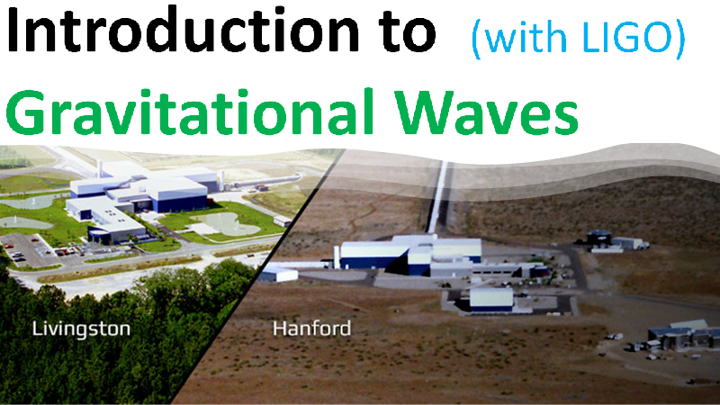
Introduction to
Gravitational Waves
LIGO

Slide 2
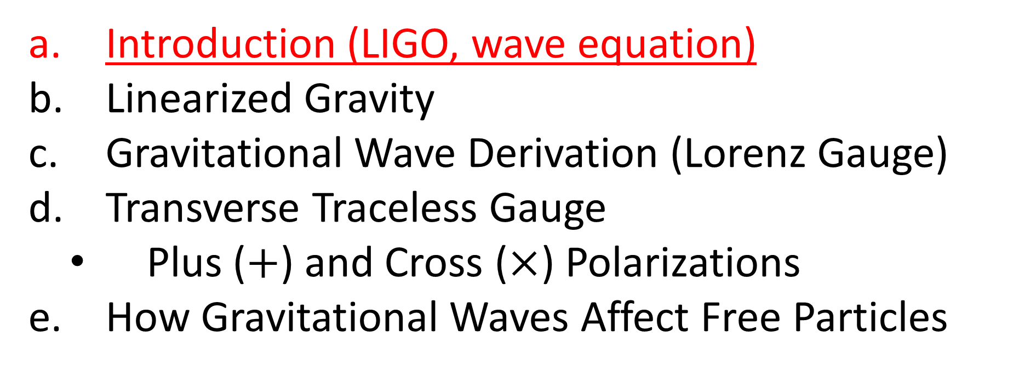
Relativity 109: Gravitational Waves
Introduction (LIGO, wave equation)
Linearized Gravity
Gravitational Wave Derivation (Lorenz Gauge)
Transverse Traceless Gauge
Plus ($+$) and Cross ($×$) Polarizations
How Gravitational Waves Affect Free Particles
Sources:
Good PDF: http://star-www.st-and.ac.uk/~hz4/gr/hendry_GRwaves.pdf
Sean Caroll: https://preposterousuniverse.com/wp-content/uploads/grnotes-six.pdf
Wikipedia: https://en.wikipedia.org/wiki/Linearized_gravity
YouTube: https://www.youtube.com/watch?v=kIBdtbCszB0
Other PDF: https://www.tat.physik.uni-tuebingen.de/~kokkotas/Teaching/NS.BH.GW_files/GW_Physics.pdf

Slide 3
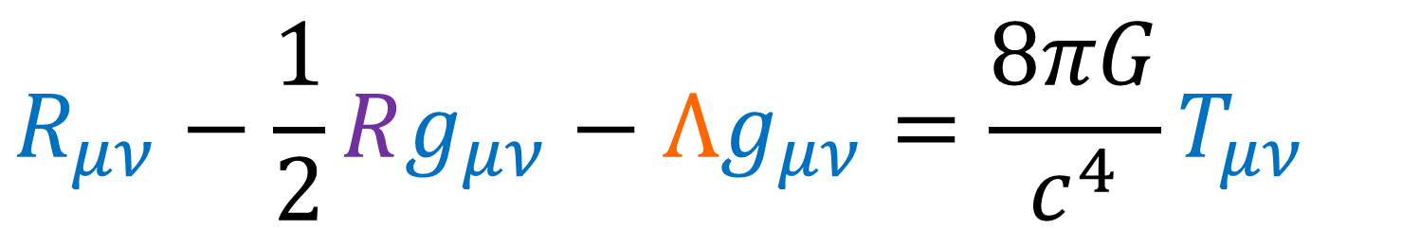
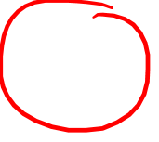
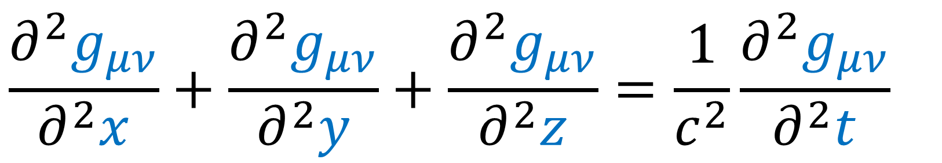
Einstein Field Equations
$$R_{μν}−\frac{1}{2}Rg_{μν}−Λg_{μν}=\frac{8πG}{c^{4}}T_{μν}$$
Gravitational Waves (spacetime metric)
$$\frac{∂^{2}g_{μν}}{∂^{2}x}+\frac{∂^{2}g_{μν}}{∂^{2}y}+\frac{∂^{2}g_{μν}}{∂^{2}z}=\frac{1}{c^{2}}\frac{∂^{2}g_{μν}}{∂^{2}t}$$
speed of light

Slide 4
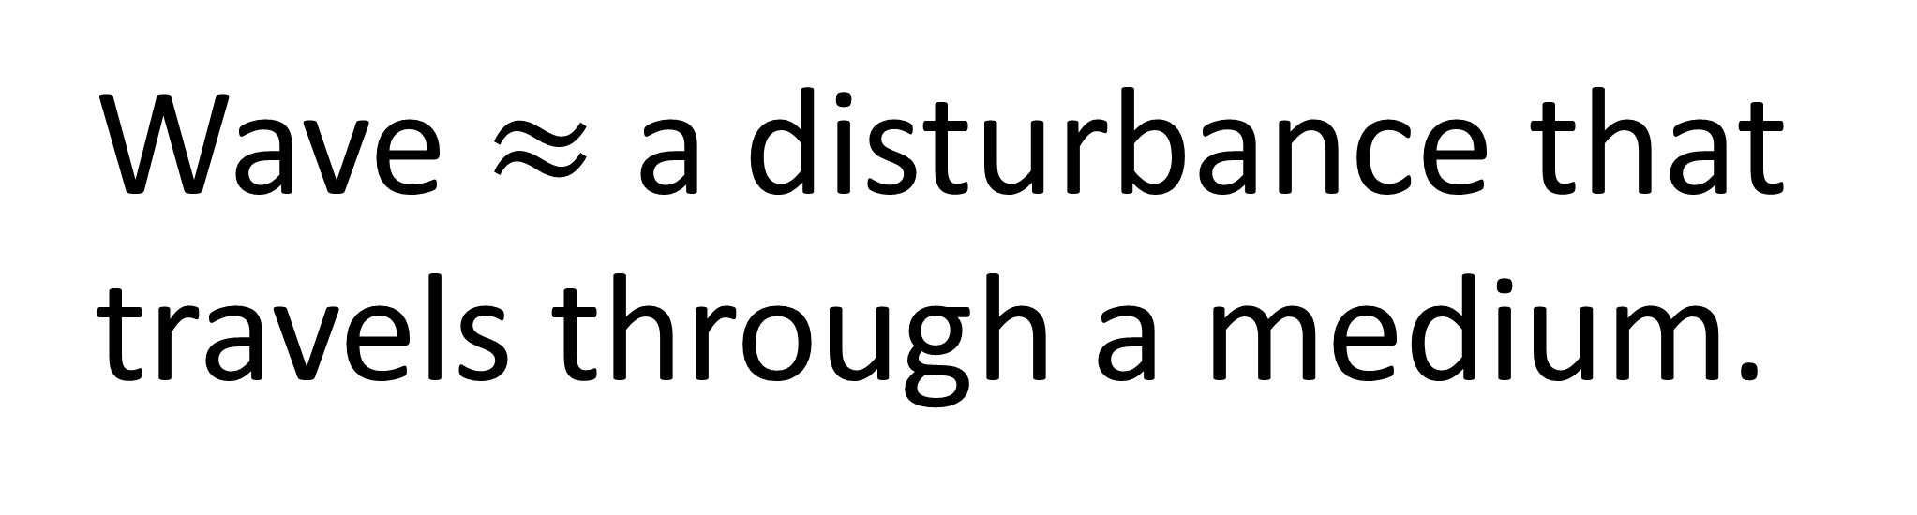
Review of Waves
Wave $≈$ a disturbance that travels through a medium.

Slide 5
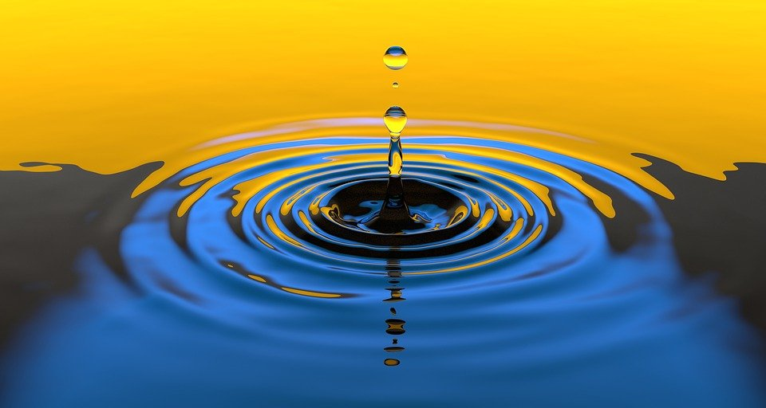
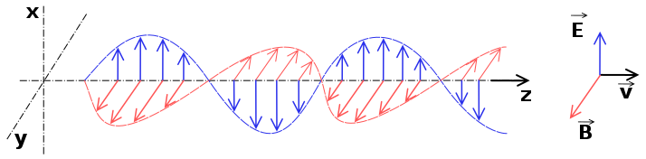
String Wave
Water Wave
Sound Wave
Electromagnetic Wave
Source (by SuperManu): https://en.wikipedia.org/wiki/Electromagnetic_radiation

Slide 6
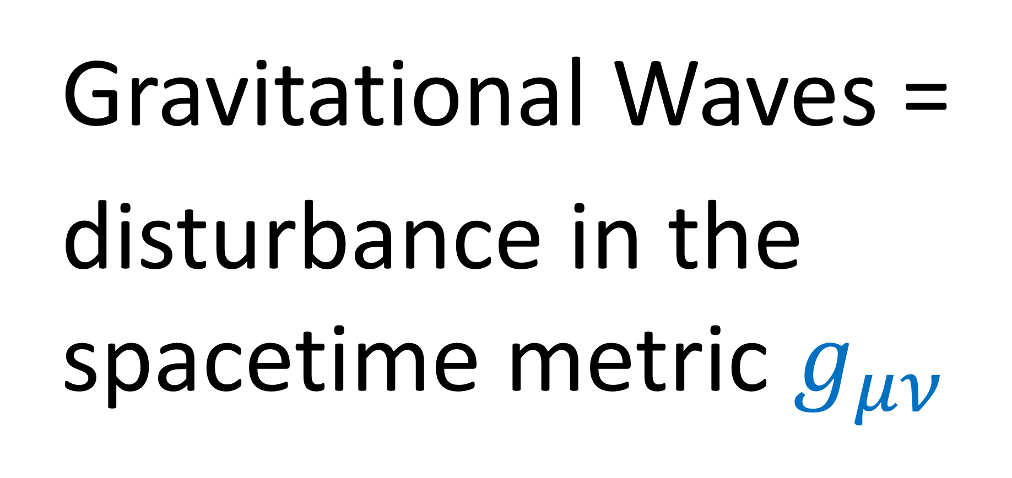
Gravitational Waves =
disturbance in the spacetime metric $g_{μν}$

Slide 7
Gravitational Waves
(cause space itself to stretch/compress)
(Animation credits to Wikipedia User MOBle / Mike Boyle)

Slide 8
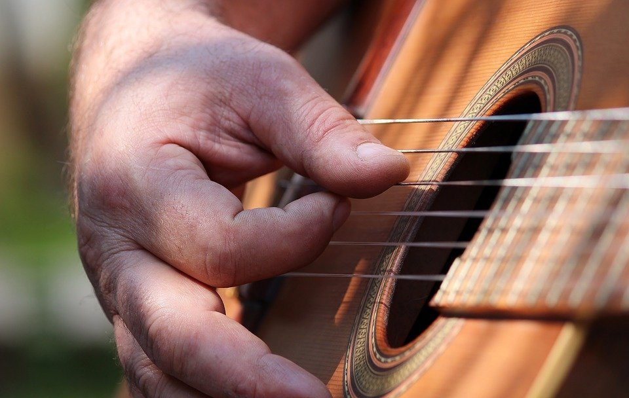
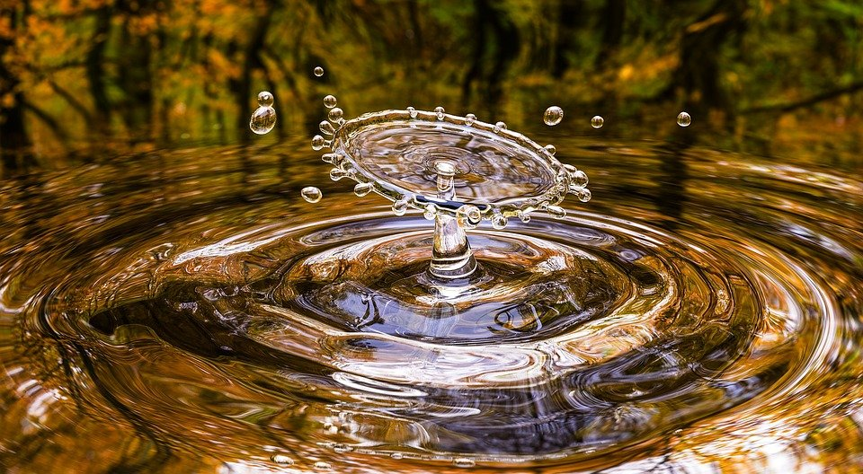
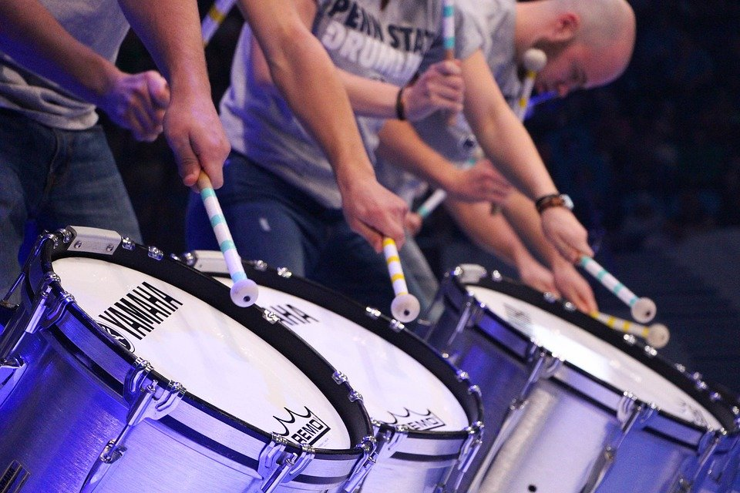
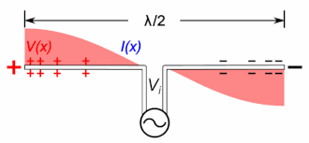
Source: https://en.wikipedia.org/wiki/Antenna_(radio)

Slide 9

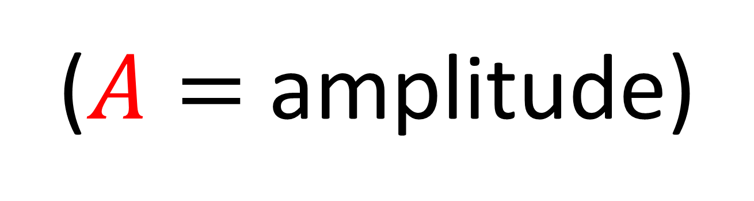
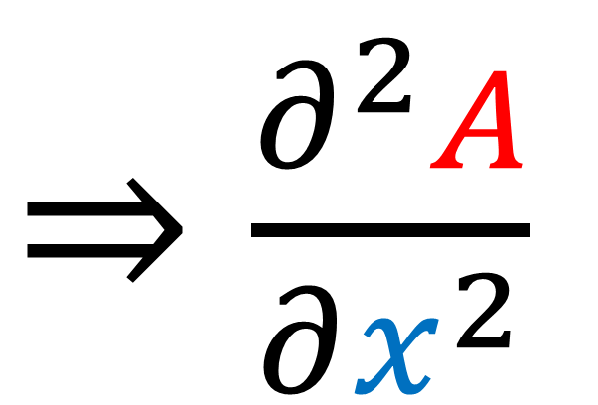
wobble $≈$ acceleration
$⇒\frac{∂^{2}A}{∂x^{2}}$
($A=$ amplitude)

Slide 10
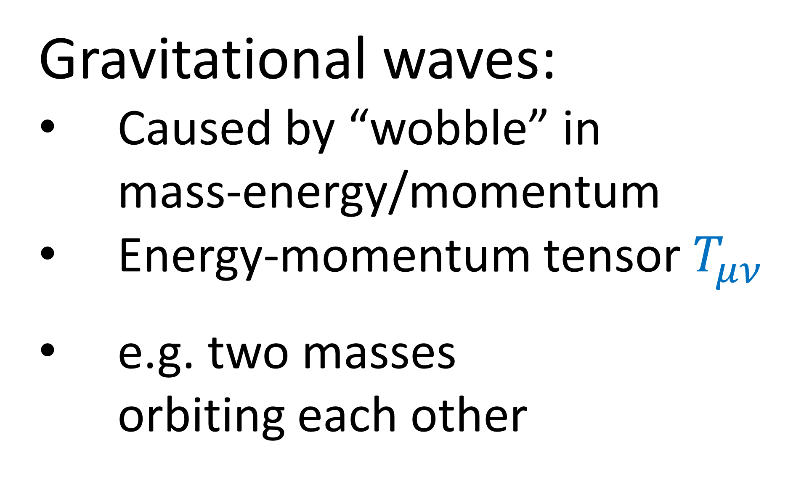


Gravitational waves:
Caused by “wobble” in mass-energy/momentum
Energy-momentum tensor $T_{μν}$
e.g. two masses orbiting each other
$$m_{1}$$
$$m_{2}$$

Slide 11
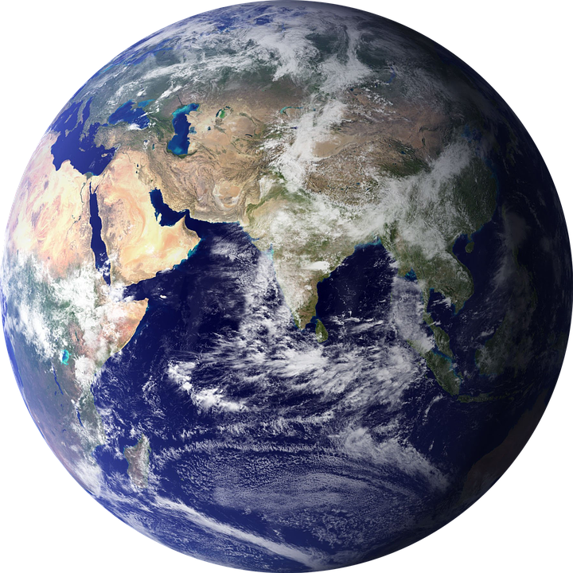
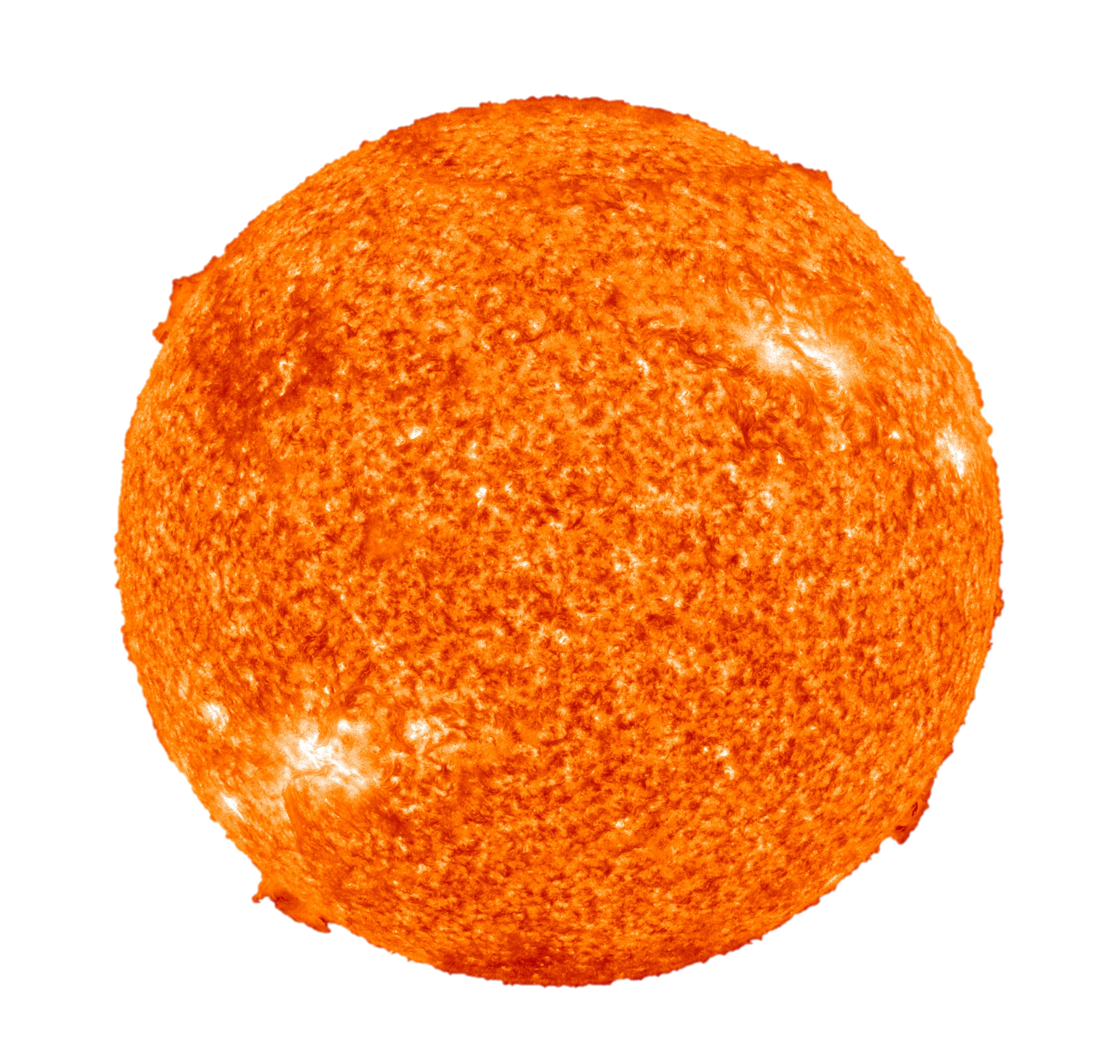
Sun-Earth system:
Produces gravitational waves
Extremely, extremely weak
Basically not detectable
Binary compact system:
White dwarfs
Neutron stars
Black Holes

Slide 12
Example: two black holes orbiting each other
creates gravitational waves/radiation
Image source: NASA https://en.wikipedia.org/wiki/Gravitational_wave
Animation of two massive objects orbiting each other, creating gravitational waves.

Slide 13
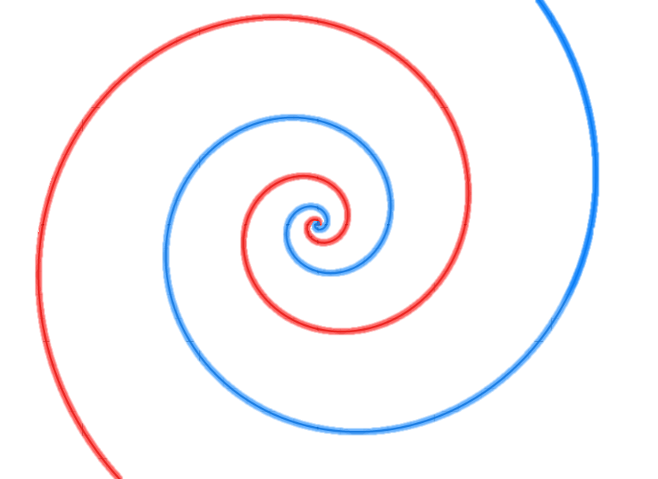
Gravitational Radiation And Orbit Decay
Gravitational radiation (energy loss)

Slide 14
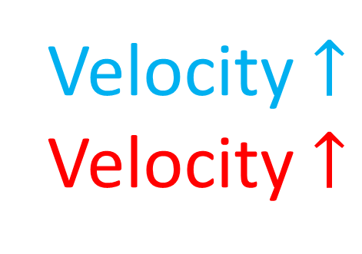
Gravitational Radiation And Orbit Decay
Gravitational radiation (energy loss)
Velocity $↑$
Velocity $↑$

Slide 15
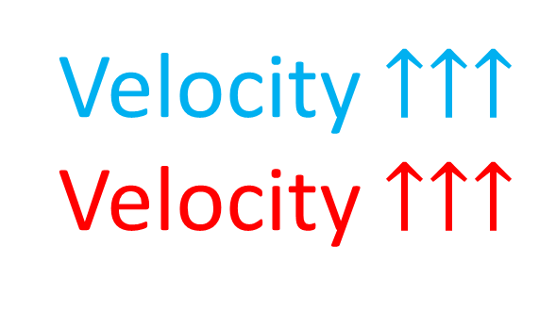
Gravitational Radiation And Orbit Decay
Gravitational radiation (energy loss)
Velocity $↑↑↑$
Velocity $↑↑↑$

Slide 16
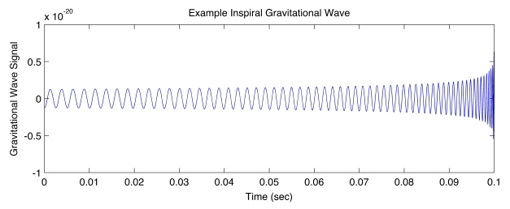
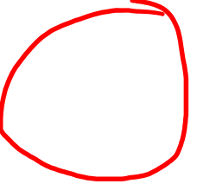
Gravitational Radiation And Orbit Decay
Gravitational Wave Strength
Source: https://www.ligo.org/science/GW-Inspiral.php
time

Slide 17
Gravitational Radiation And Orbit Decay
Gravitational Wave Strength
Source: https://www.ligo.org/science/GW-Inspiral.php
time
(see link in description for the math)

Slide 18
Gravitational Wave Strength
Source: https://www.ligo.org/science/GW-Inspiral.php
time
time
Relatively weak change in the metric,
But CAN be detected by gravitational wave detectors (e.g. LIGO)

Slide 19
1915: Einstein Field Equations Published
1916: Einstein predicts existence of gravitational waves
Paper: “Approximative Integration of the Field Equations of Gravitation” (see description for link)
1970s/1980s: Hulse-Taylor binary star system (neutron star + pulsar) orbit decay gives indirect evidence of gravitational waves
Sept 14, 2015: Direct detection of gravitational waves from LIGO detectors

Slide 20
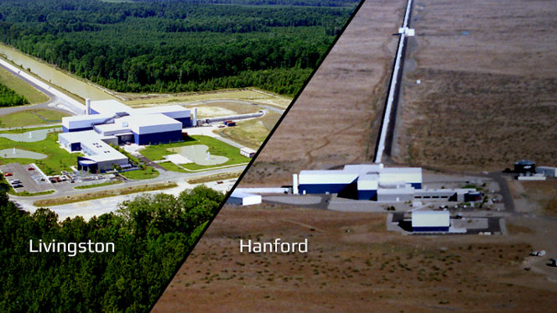

Slide 21
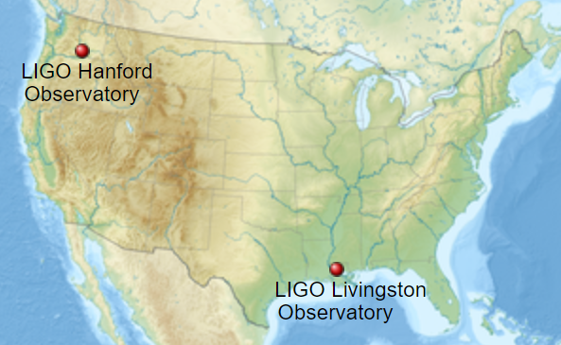
Hanford Site, Washington and Livingston, Louisiana, US
Image Source: https://en.wikipedia.org/wiki/LIGO

Slide 22
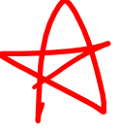
LIGO Detector:
Laser
Interferometer
Gravitational-Wave
Observatory
LIGO Hanford (WA)
LIGO Livingston (IL)
Local noise will only affect one… true G-waves will affect both.
VIRGO (Italy)

Slide 23
Interferometer
= device that measures interference between light beams.
beam splitter
light source

Slide 24
mirror
Interferometer
= device that measures interference between light beams.
beam splitter
light source
mirror

Slide 25
mirror
Interferometer
= device that measures interference between light beams.
beam splitter
light source
mirror

Slide 26
mirror
Interferometer
= device that measures interference between light beams.
beam splitter
light source
mirror
detector

Slide 27
mirror
Interferometer
= device that measures interference between light beams.
beam splitter
light source
mirror
Constructive Interference
detector

Slide 28
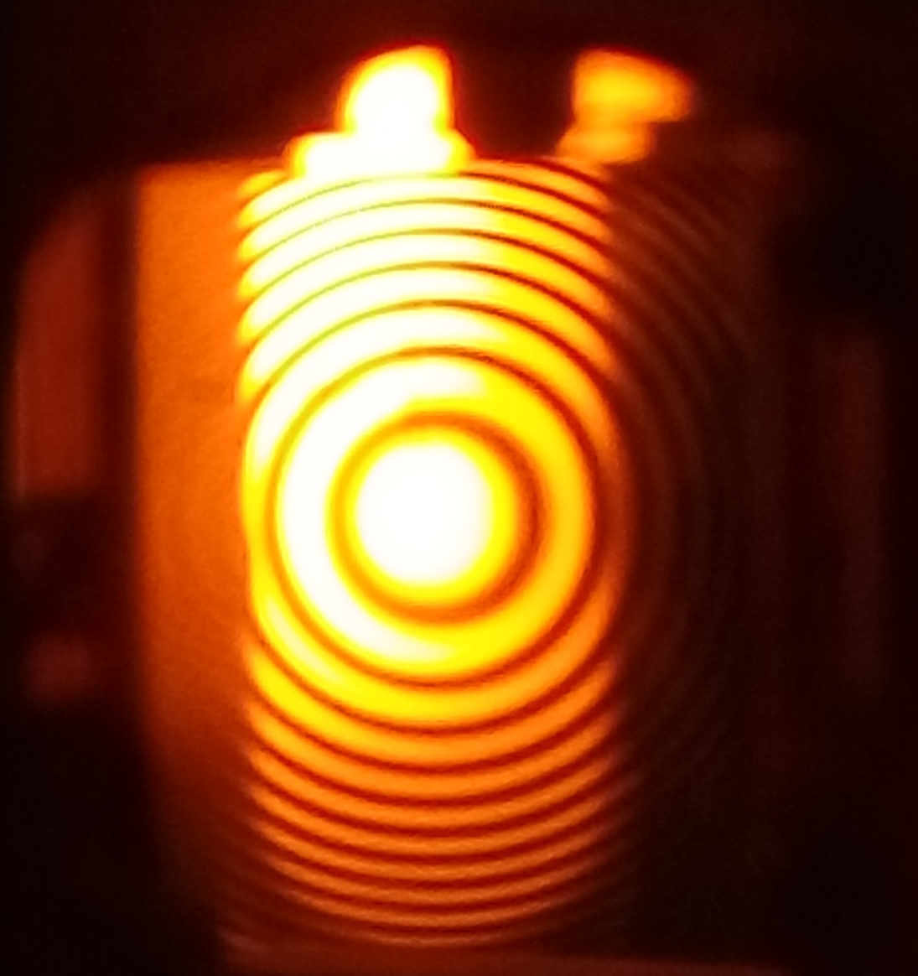
mirror
Interferometer
Path Difference
= device that measures interference between light beams.
beam splitter
light source
mirror
interference pattern
detector

Slide 29
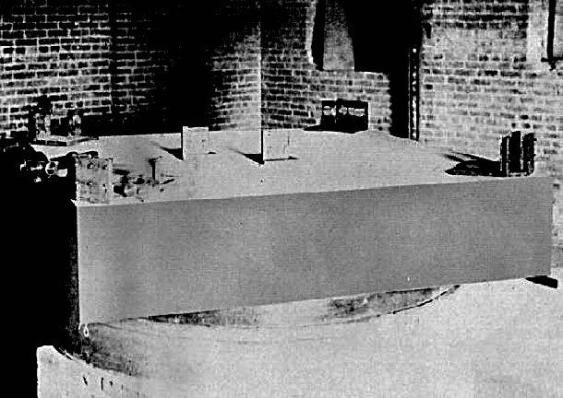
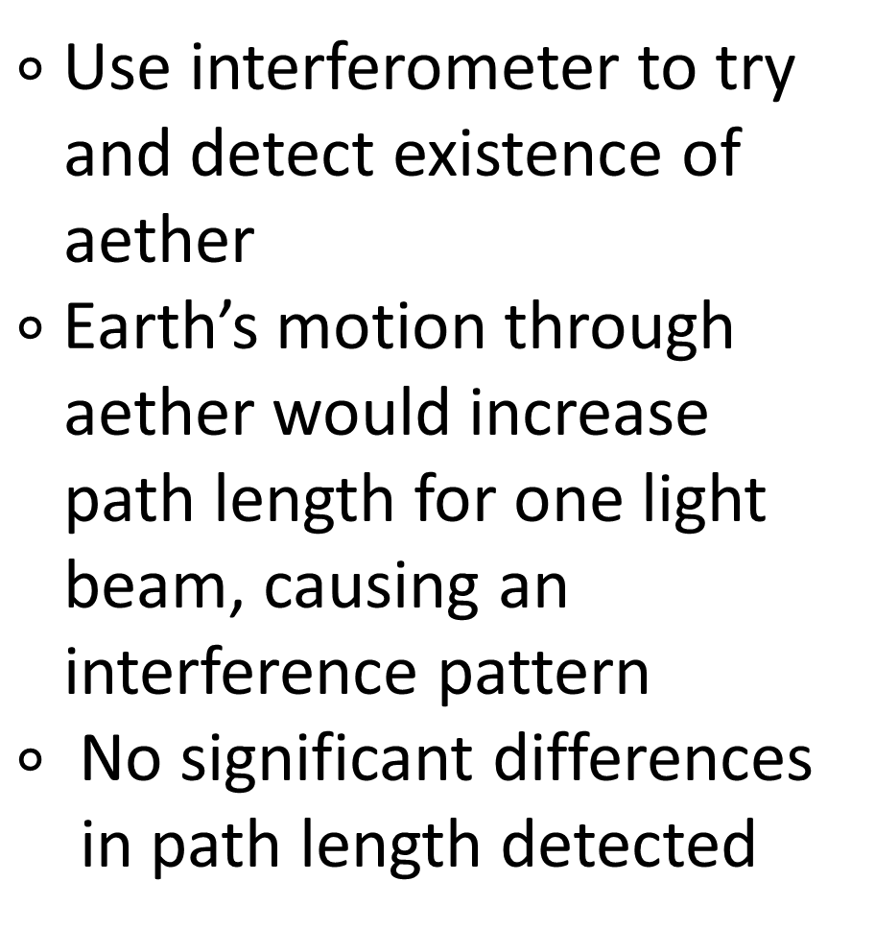
Michelson-Morley Experiment (1887)
$∘$ Use interferometer to try
and detect existence of
aether
$∘$Earth’s motion through
aether would increase
path length for one light
beam, causing an
interference pattern
$∘$ No significant differences
in path length detected

Slide 30
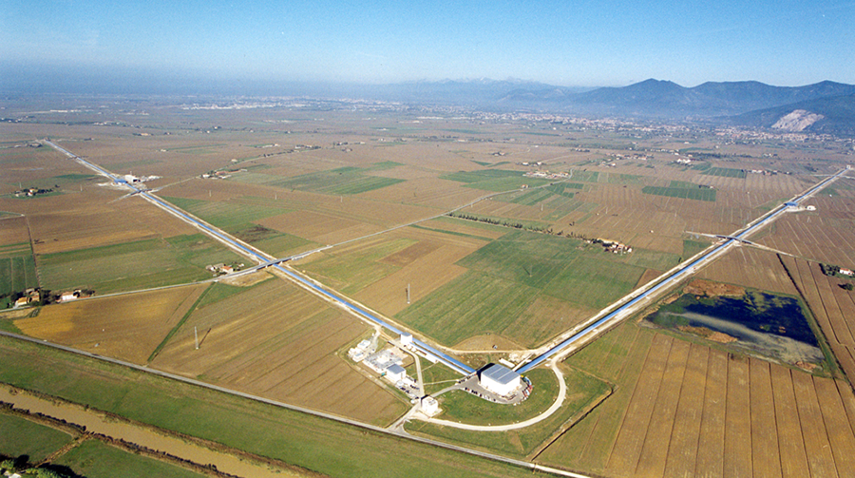


LIGO Detector (Laser Interferometer Gravitational-Wave Observatory)
$$4 km$$
$$4 km$$
LIGO Hanford (WA)
LIGO Livingston (IL)
Local noise will only affect one… true G-waves will affect both.
VIRGO (Italy)

Slide 31
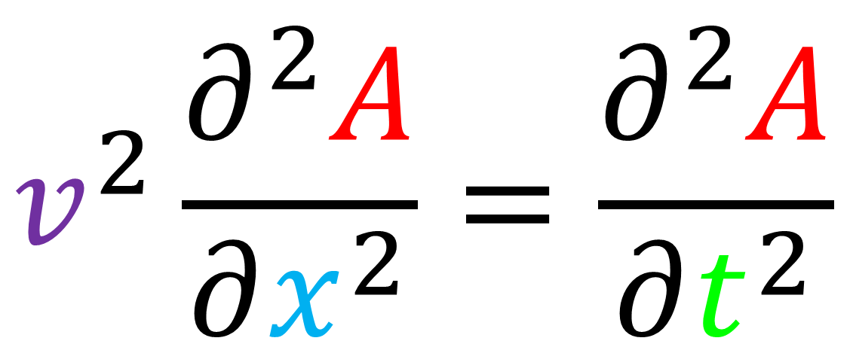
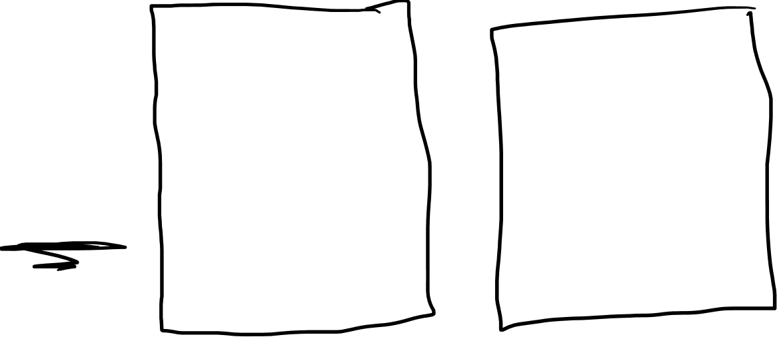
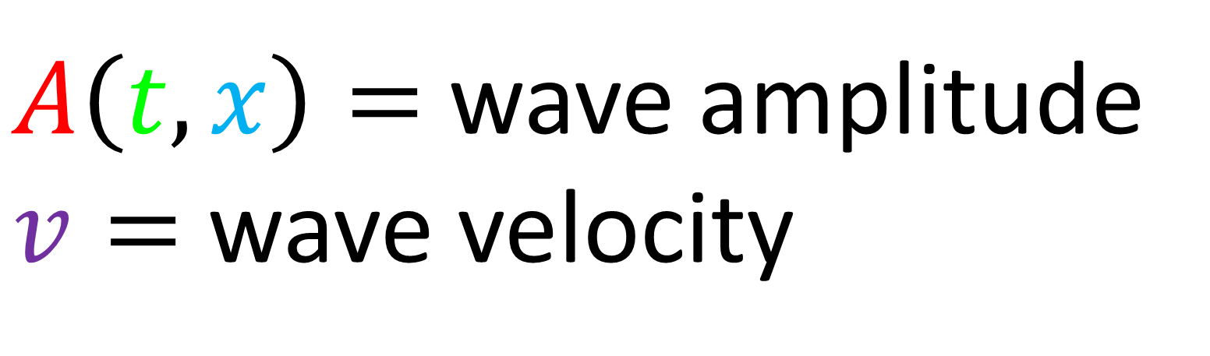
Wave Equation
$$v^{2}\frac{∂^{2}A}{∂x^{2}}=\frac{∂^{2}A}{∂t^{2}}$$
$A\left(t,x\right)=$ wave amplitude
$v=$ wave velocity

Slide 32
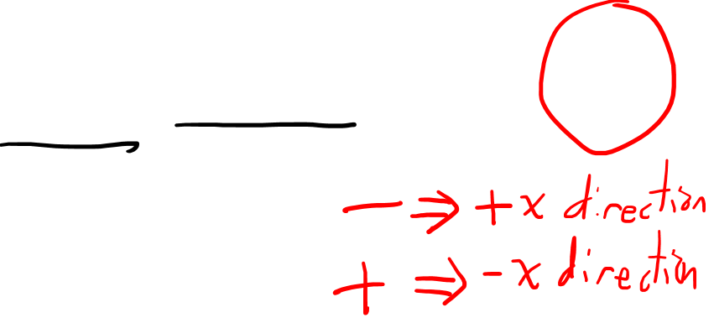
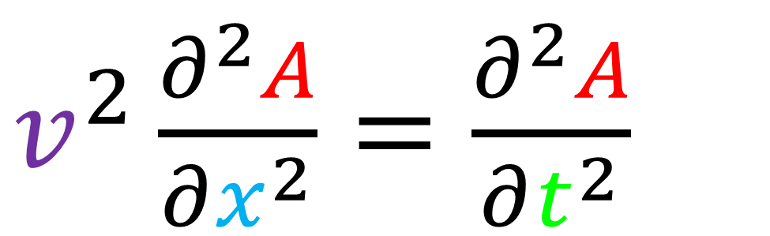
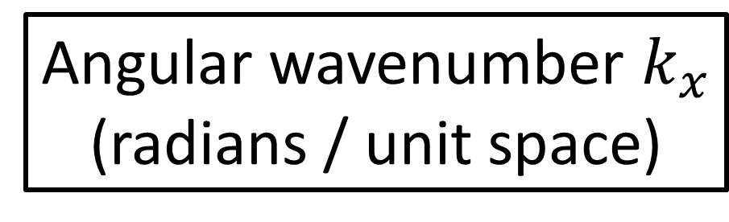
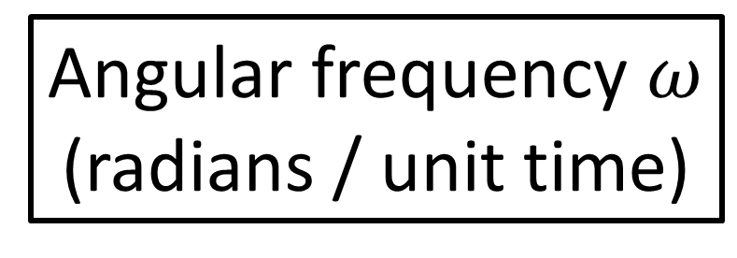
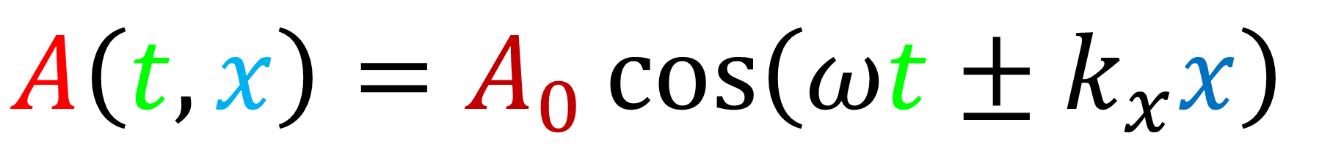
$v^{2}\frac{∂^{2}A}{∂x^{2}}=\frac{∂^{2}A}{∂t^{2}}$
Plane Waves
$A\left(t,x\right)=A_{0}\cos\left(ωt±k_{x}x\right)$
Angular frequency $ω$
(radians / unit time)
Angular wavenumber $k_{x}$
(radians / unit space)

Slide 33
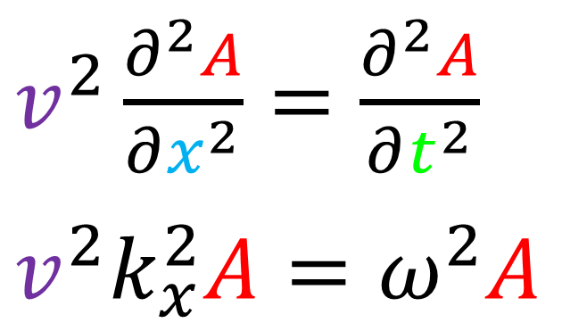
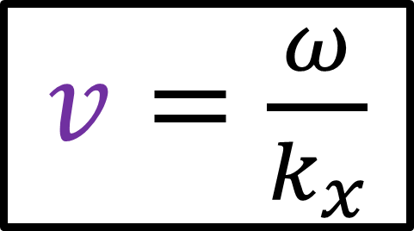
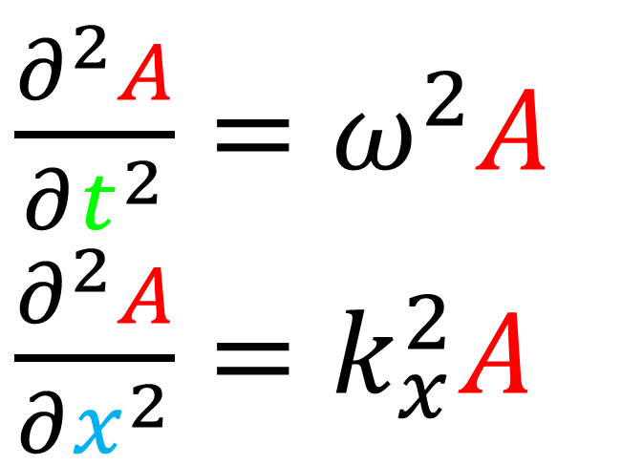
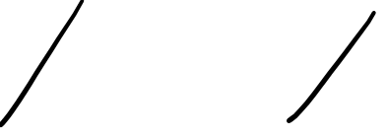
$v^{2}\frac{∂^{2}A}{∂x^{2}}=\frac{∂^{2}A}{∂t^{2}}$
Plane Waves
$A\left(t,x\right)=A_{0}\cos\left(ωt±k_{x}x\right)$
$\frac{∂^{2}A}{∂t^{2}}=ω^{2}A$
$\frac{∂^{2}A}{∂x^{2}}=k_{x}^{2}A$
$v^{2}\frac{∂^{2}A}{∂x^{2}}=\frac{∂^{2}A}{∂t^{2}}$
$$v^{2}k_{x}^{2}A=ω^{2}A$$
$v=\frac{ω}{k_{x}}$

Slide 34
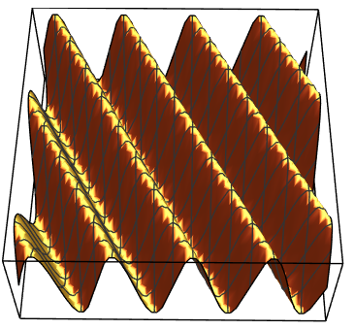


time $t$
Wave is travelling left.
space $x$

Slide 35
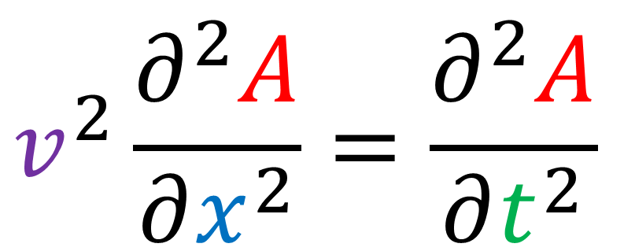
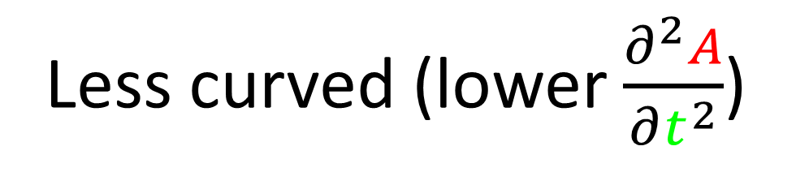
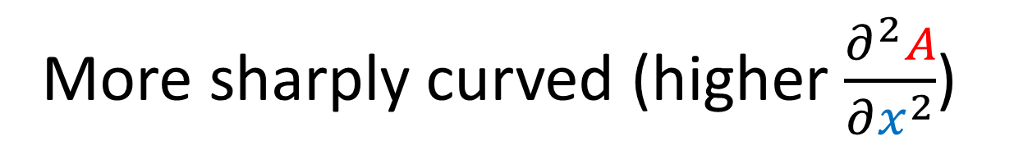
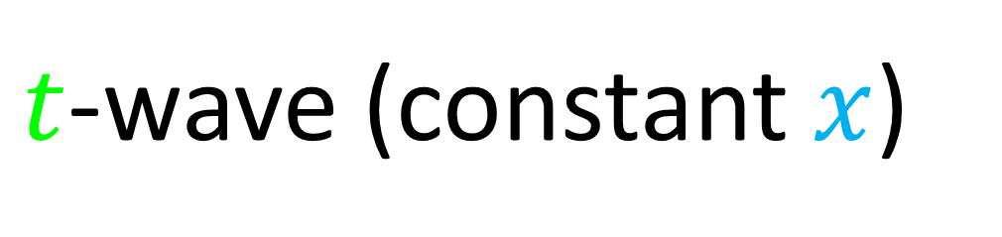
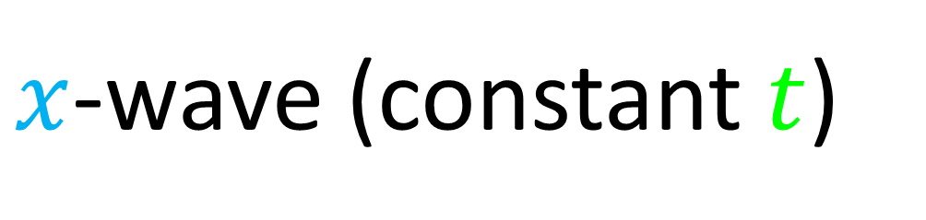
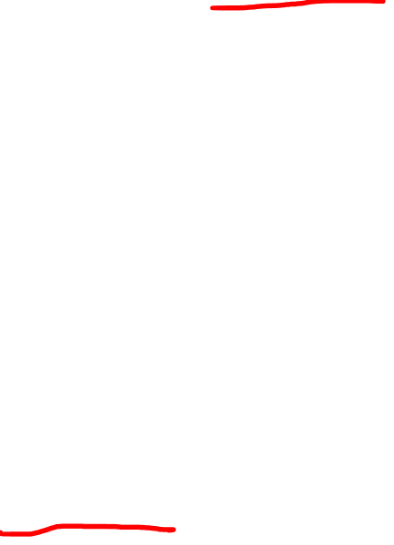
$x$-wave (constant $t$)
$$v^{2}\frac{∂^{2}A}{∂x^{2}}=\frac{∂^{2}A}{∂t^{2}}$$
More sharply curved (higher $\frac{∂^{2}A}{∂x^{2}}$)
big
small
$t$-wave (constant $x$)
pretty small
Less curved (lower $\frac{∂^{2}A}{∂t^{2}}$)

Slide 36




Wave Equations (3D)
$v^{2}\frac{∂^{2}A}{∂x^{2}}=\frac{∂^{2}A}{∂t^{2}}$
$⇒\frac{∂^{2}A}{∂x^{2}}=\frac{1}{v^{2}}\frac{∂^{2}A}{∂t^{2}}$
$\frac{∂^{2}A}{∂x^{2}}+\frac{∂^{2}A}{∂y^{2}}+\frac{∂^{2}A}{∂z^{2}}=\frac{1}{v^{2}}\frac{∂^{2}A}{∂t^{2}}$
$∇^{2}A=∇⋅\left(∇A\right)=\frac{1}{v^{2}}\frac{∂^{2}A}{∂t^{2}}$

Slide 37

$∇^{2}A=\frac{1}{v^{2}}\frac{∂^{2}A}{∂t^{2}}$
Wave Equation
String Wave
Water Wave
Sound Wave
Electromagnetic Wave
Source (by SuperManu): https://en.wikipedia.org/wiki/Electromagnetic_radiation

Slide 38





Maxwell’s Equations
(vacuum)
$∇⋅\vec{E}=\frac{ρ}{ε_{0}}$
$∇×\vec{E}=−\frac{∂\vec{B}}{∂t}$
$$∇⋅\vec{B}=0$$
$∇×\vec{B}=μ_{0}\vec{J}+μ_{0}ε_{0}\frac{∂\vec{E}}{∂t}$

Slide 39






Maxwell’s Equations
(vacuum)
Electro-Magnetic Waves
(Relativity 103e)
$∇⋅\vec{E}=0$
$∇^{2}E=\frac{1}{c^{2}}\frac{∂^{2}E}{∂t^{2}}$
$∇×\vec{E}=−\frac{∂\vec{B}}{∂t}$
$∇^{2}B=\frac{1}{c^{2}}\frac{∂^{2}B}{∂t^{2}}$
$$∇⋅\vec{B}=0$$
$c=\frac{1}{\sqrt{μ_{0}ε_{0}}}$
$∇×\vec{B}=μ_{0}ε_{0}\frac{∂\vec{E}}{∂t}$

Slide 40


Electro-magnetic Wave Equation Notation
$\frac{1}{c^{2}}\frac{∂^{2}E}{∂t^{2}}=\frac{∂^{2}E}{∂x^{2}}+\frac{∂^{2}E}{∂y^{2}}+\frac{∂^{2}E}{∂z^{2}}$
$\frac{∂^{2}E}{∂{\left(ct\right)}^{2}}−\frac{∂^{2}E}{∂x^{2}}−\frac{∂^{2}E}{∂y^{2}}−\frac{∂^{2}E}{∂z^{2}}=0$
$\frac{∂^{2}E}{∂{\left(x^{0}\right)}^{2}}−\frac{∂^{2}E}{∂{\left(x^{1}\right)}^{2}}−\frac{∂^{2}E}{∂{\left(x^{2}\right)}^{2}}−\frac{∂^{2}E}{∂{\left(x^{3}\right)}^{2}}=0$
$∂_{0}^{2}E−∂_{1}^{2}E−∂_{2}^{2}E−∂_{3}^{2}E=0$

Slide 41





Electro-magnetic Wave Equation Notation
$\frac{1}{c^{2}}\frac{∂^{2}E}{∂t^{2}}=\frac{∂^{2}E}{∂x^{2}}+\frac{∂^{2}E}{∂y^{2}}+\frac{∂^{2}E}{∂z^{2}}$
$\frac{∂^{2}E}{∂{\left(ct\right)}^{2}}−\frac{∂^{2}E}{∂x^{2}}−\frac{∂^{2}E}{∂y^{2}}−\frac{∂^{2}E}{∂z^{2}}=0$
$\frac{∂^{2}E}{∂{\left(x^{0}\right)}^{2}}−\frac{∂^{2}E}{∂{\left(x^{1}\right)}^{2}}−\frac{∂^{2}E}{∂{\left(x^{2}\right)}^{2}}−\frac{∂^{2}E}{∂{\left(x^{3}\right)}^{2}}=0$
$+∂_{0}^{2}E−∂_{1}^{2}E−∂_{2}^{2}E−∂_{3}^{2}E=0$
$η^{μν}∂_{μ}∂_{ν}E=0$
$$\left[\begin{matrix}\begin{matrix}\begin{aligned}+1 \\ 0 \\ 0 \\ 0\end{aligned} & \begin{aligned}0 \\ −1 \\ 0 \\ 0\end{aligned}\end{matrix} & \begin{matrix}\begin{aligned}0 \\ 0 \\ −1 \\ 0\end{aligned} & \begin{aligned}0 \\ 0 \\ 0 \\ −1\end{aligned}\end{matrix}\end{matrix}\right]$$
Minkowski
Metric
d’Alembert operator
(d’Alembertian)
$∂_{μ}∂^{μ}E=0$
$□E=0$

Slide 42




d’Alembert operator (d’Alembertian)
$□≡∂_{μ}∂^{μ}≡η^{μν}∂_{μ}∂_{ν}$
$$□≡+∂_{0}^{2}−∂_{1}^{2}−∂_{2}^{2}−∂_{3}^{2}$$
(inverse) Minkowski Metric $η^{μν}$
$$□≡\left[\begin{matrix}\begin{matrix}∂_{0} & ∂_{1}\end{matrix} & \begin{matrix}∂_{2} & ∂_{3}\end{matrix}\end{matrix}\right]\left[\begin{matrix}\begin{matrix}\begin{aligned}+1 \\ 0 \\ 0 \\ 0\end{aligned} & \begin{aligned}0 \\ −1 \\ 0 \\ 0\end{aligned}\end{matrix} & \begin{matrix}\begin{aligned}0 \\ 0 \\ −1 \\ 0\end{aligned} & \begin{aligned}0 \\ 0 \\ 0 \\ −1\end{aligned}\end{matrix}\end{matrix}\right]\left[\begin{aligned}∂_{0} \\ ∂_{1} \\ ∂_{2} \\ ∂_{3}\end{aligned}\right]$$

Slide 43



Laplace operator (Laplacian)
$Δ≡∇^{2}≡\frac{∂^{2}}{∂x^{2}}+\frac{∂^{2}}{∂y^{2}}+\frac{∂^{2}}{∂z^{2}}$
d’Alembert operator (d’Alembertian)
$□≡\frac{∂^{2}}{∂{\left(ct\right)}^{2}}−\frac{∂^{2}}{∂x^{2}}−\frac{∂^{2}}{∂y^{2}}−\frac{∂^{2}}{∂z^{2}}$

Slide 44

Gravitational Wave Equation Notation
$\frac{∂^{2}g_{μν}}{∂{\left(ct\right)}^{2}}−\frac{∂^{2}g_{μν}}{∂x^{2}}−\frac{∂^{2}g_{μν}}{∂y^{2}}−\frac{∂^{2}g_{μν}}{∂z^{2}}=0$
$$∂_{0}^{2}g_{μν}−∂_{1}^{2}g_{μν}−∂_{2}^{2}g_{μν}−∂_{3}^{2}g_{μν}=0$$
$η^{ρσ}∂_{ρ}∂_{σ}g_{μν}=∂^{σ}∂_{σ}g_{μν}=□g_{μν}=0$

Slide 45
Gravitational Waves
(cause space itself to stretch/compress)
(Animation credits to Wikipedia User MOBle / Mike Boyle)

Slide 46



Next videos:
$G_{μν}=\frac{8πG}{c^{4}}T_{μν}$
$$⇒$$
$□g_{μν}=0$

Slide 47
Learn more about LIGO (links in description):
LIGO Website: https://www.ligo.org/index.php
LIGO Frequency Asked Questions: https://www.ligo.org/science/faq.php

