Slide 1
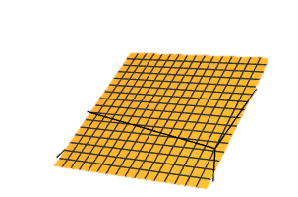
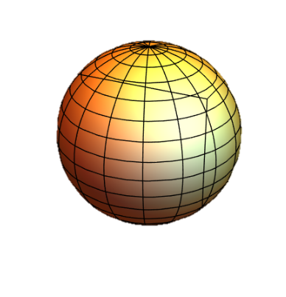
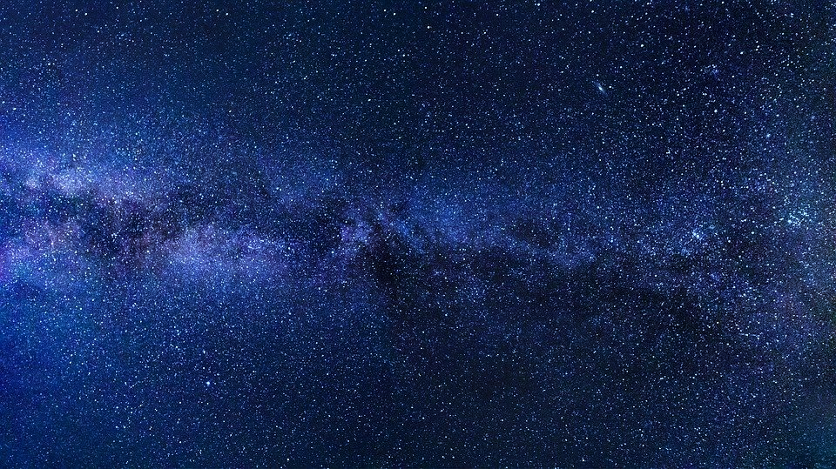
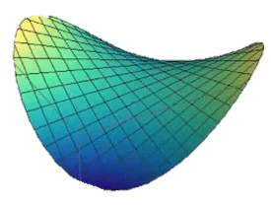
FLRW Metric Derivation
3 universe geometries

Slide 2
Relativity 110: Cosmology
Sources:
Einstein’s Static Universe Model
https://arxiv.org/ftp/arxiv/papers/1701/1701.07261.pdf
1917: “Cosmological Considerations in the General Theory of Relativity” Paper
https://einsteinpapers.press.princeton.edu/vol6-trans/433
History of Cosmology
Big Bang, Expansion of the universe, Cosmological Constant, Dark Energy
Friedmann-Lemaître-Robertson-Walker (FLRW) metric
FLRW Tensors
Comoving Coordinates + FLRW Geodesics
Universe as a perfect fluid + Cosmic Rest Frame
Friedmann Equations Derivation + Interpretation

Slide 3
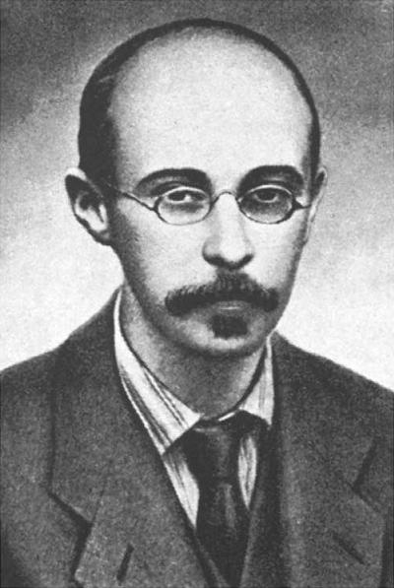
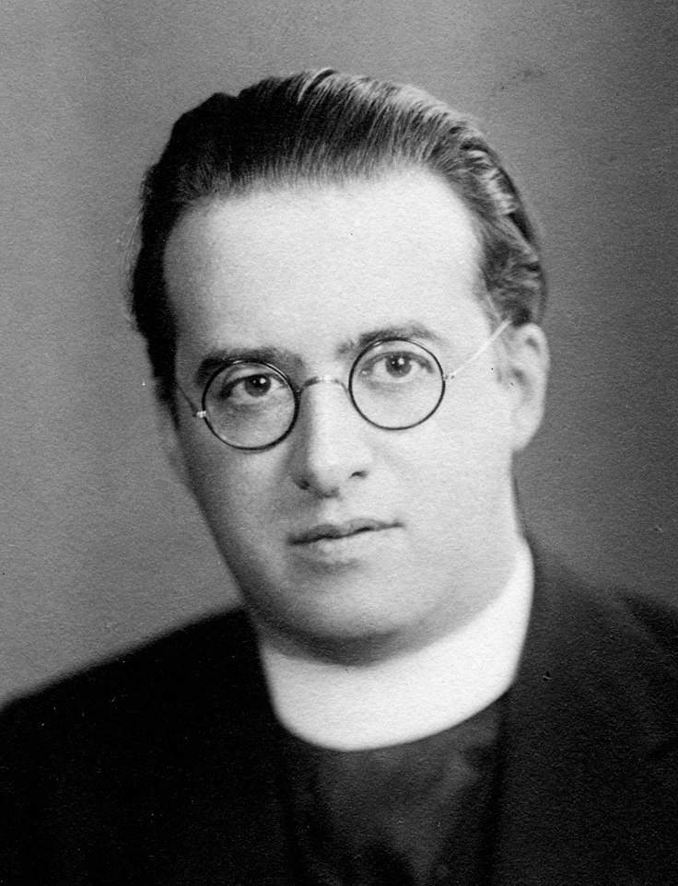
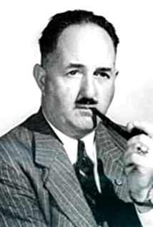
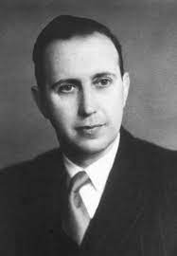
Alexander Friedmann
(1888 – 1925)
Georges Lemaître (1894 – 1966)
Howard Robertson (1903 – 1961)
Arthur Walker (1909 – 2001)
Work was extended by

Slide 4
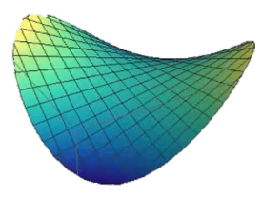

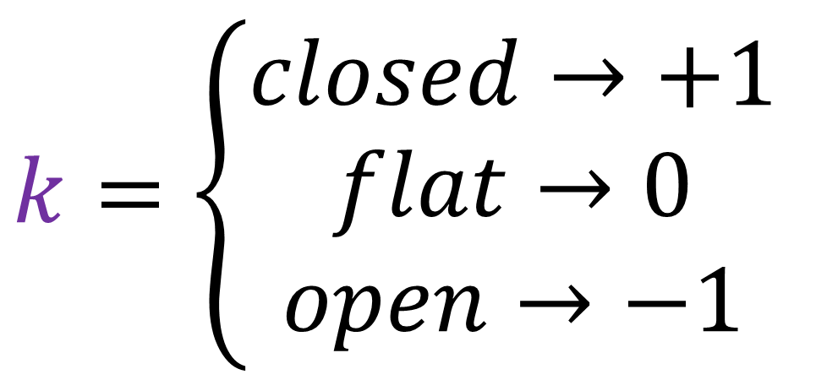
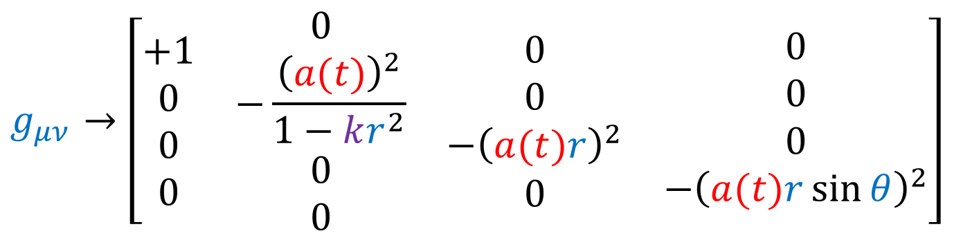
FLRW metric
$$g_{μν}→\left[\begin{matrix}\begin{matrix}\begin{aligned}+1 \\ 0 \\ 0 \\ 0\end{aligned} & \begin{aligned}0 \\ −\frac{{\left(a(t)\right)}^{2}}{1−kr^{2}} \\ 0 \\ 0\end{aligned}\end{matrix} & \begin{matrix}\begin{aligned}0 \\ 0 \\ −{\left(a(t)r\right)}^{2} \\ 0\end{aligned} & \begin{aligned}0 \\ 0 \\ 0 \\ −{\left(a(t)r\sin{θ}\right)}^{2}\end{aligned}\end{matrix}\end{matrix}\right]$$
closed
$$k=\left\{\begin{aligned}closed→+1 \\ flat→0 \\ open→−1\end{aligned}\right.$$
flat
open

Slide 5
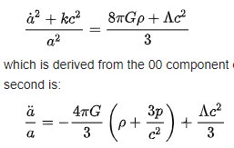
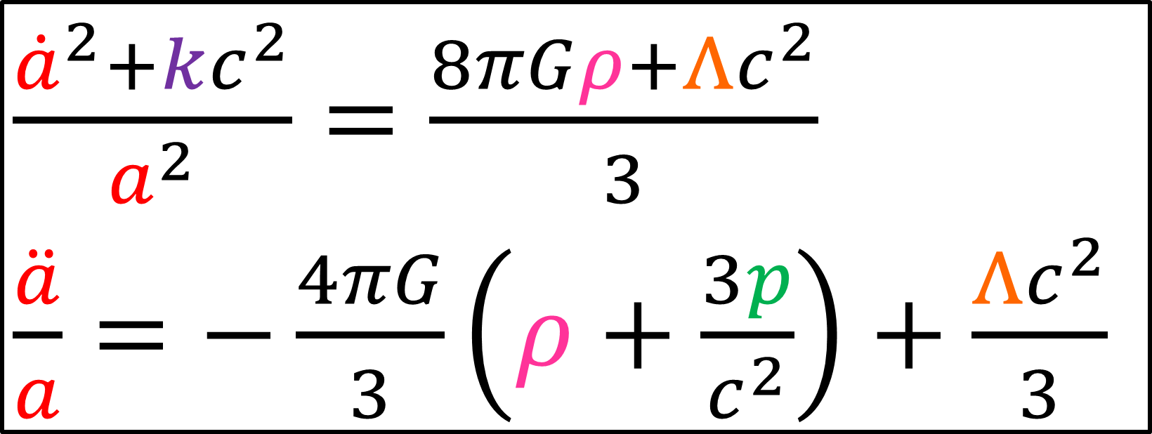
FLRW Metric
Friedmann Equations (universe expansion rate)
$\frac{{\dot{a}}^{2}+kc^{2}}{a^{2}}=\frac{8πGρ+Λc^{2}}{3}$
$\frac{\ddot{a}}{a}=−\frac{4πG}{3}\left(ρ+\frac{3p}{c^{2}}\right)+\frac{Λc^{2}}{3}$

Slide 6
Goal for this video:
Derive a metric that describes the large scale geometry of the entire universe
FLRW metric

Slide 7
Fundamental Assumption:
Cosmological Principle
1. Homogeneous: universe looks the same from all points in space
no change under spatial translations
universe has no spatial center
2. Isotropic: universe looks the same in all directions
no change under spatial rotations

Slide 8
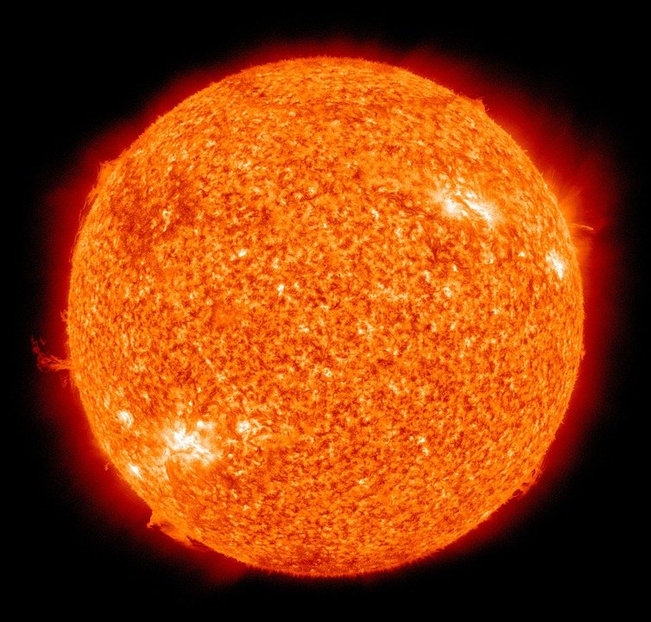
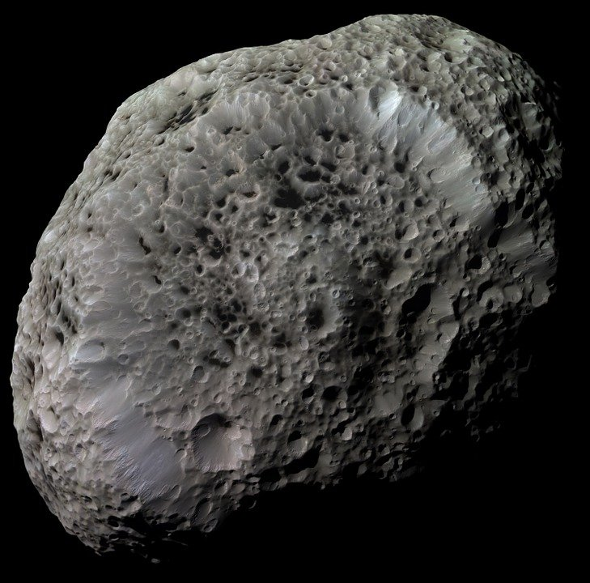
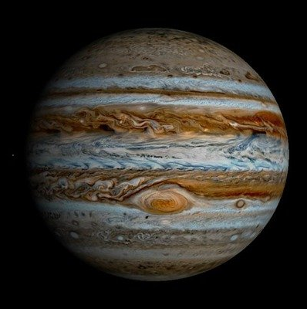
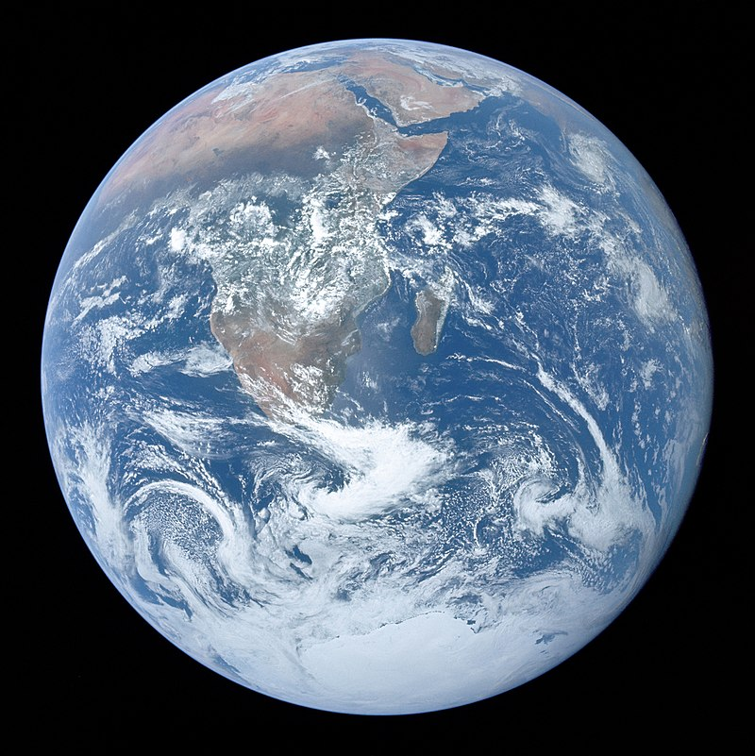
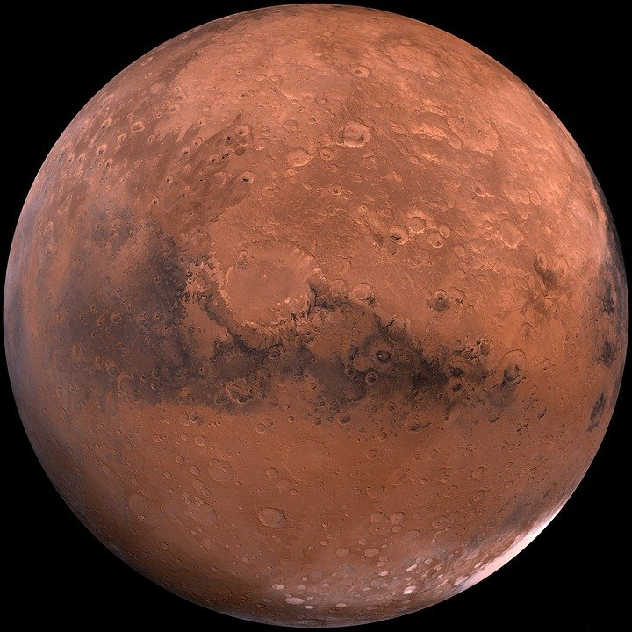
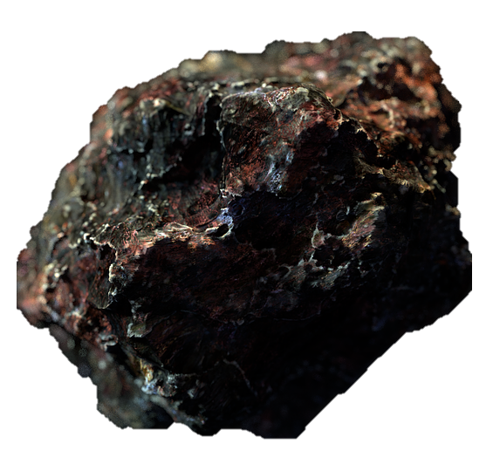
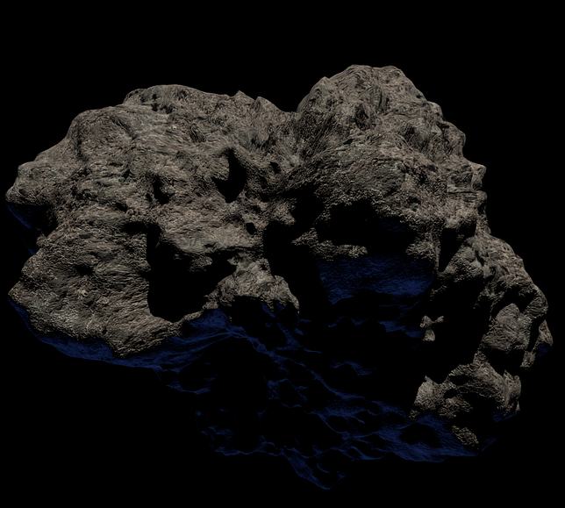
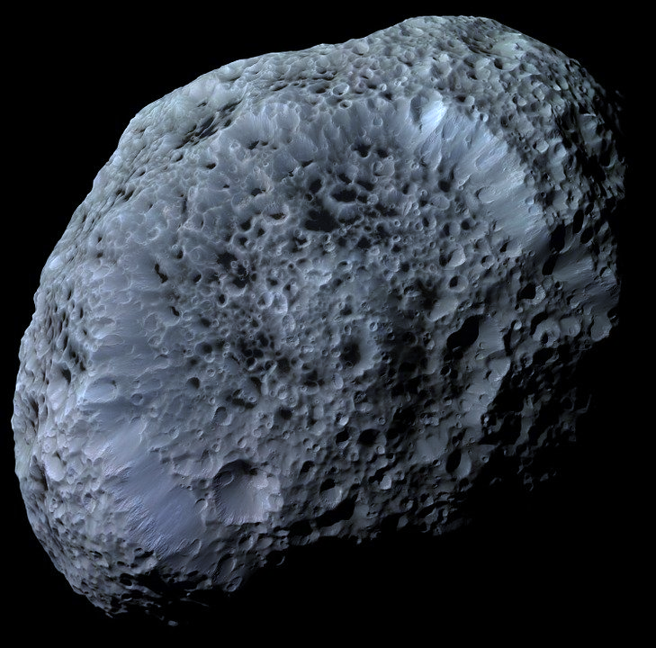
Empty Space

Slide 9
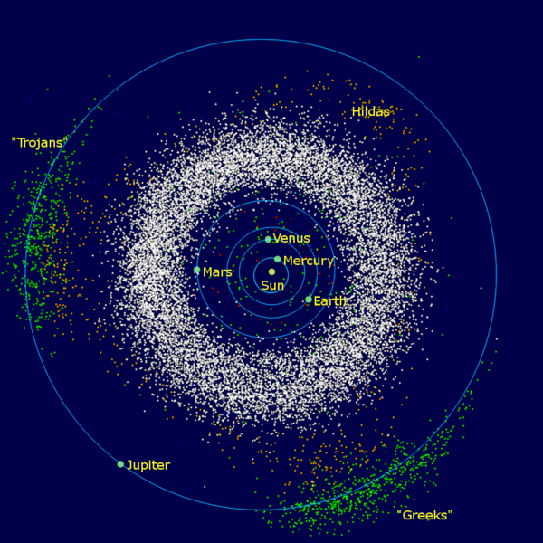
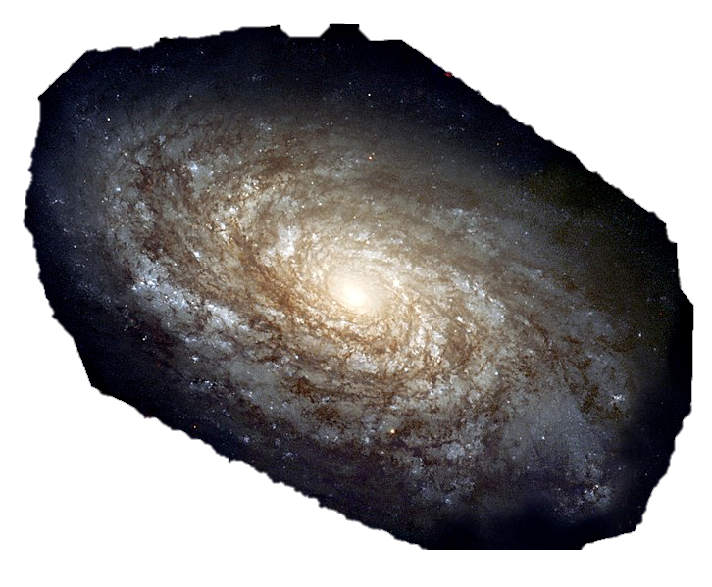
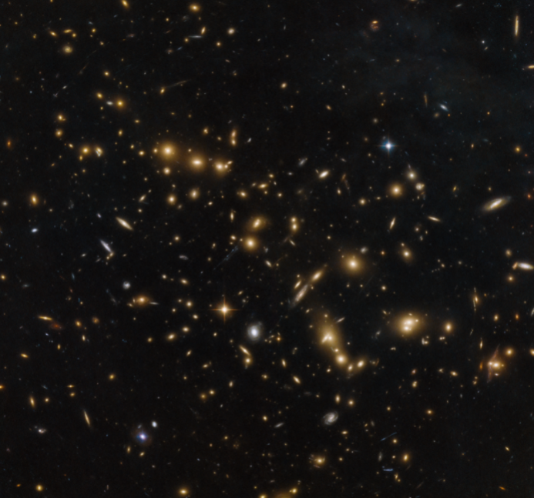
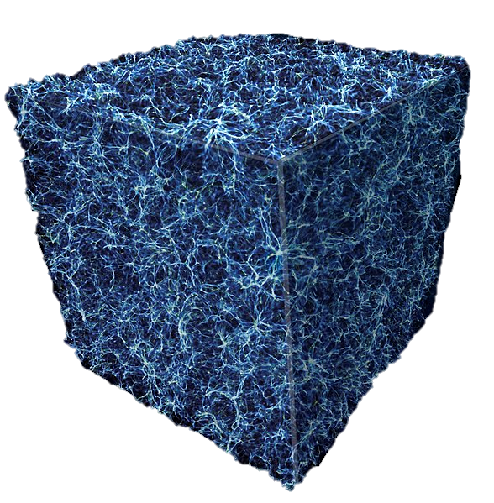
Solar System
Galaxy
Galaxy Clusters/
Superclusters
Galaxy Filaments
Zoom Out

Slide 10
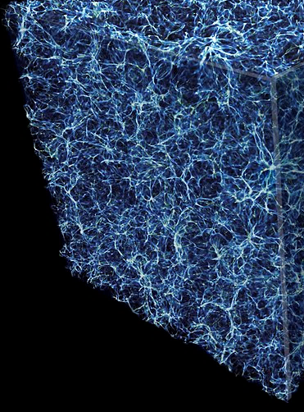

Galaxy Filaments
Boxes $\sim$100 million ly in size are approximately uniform.

Slide 11
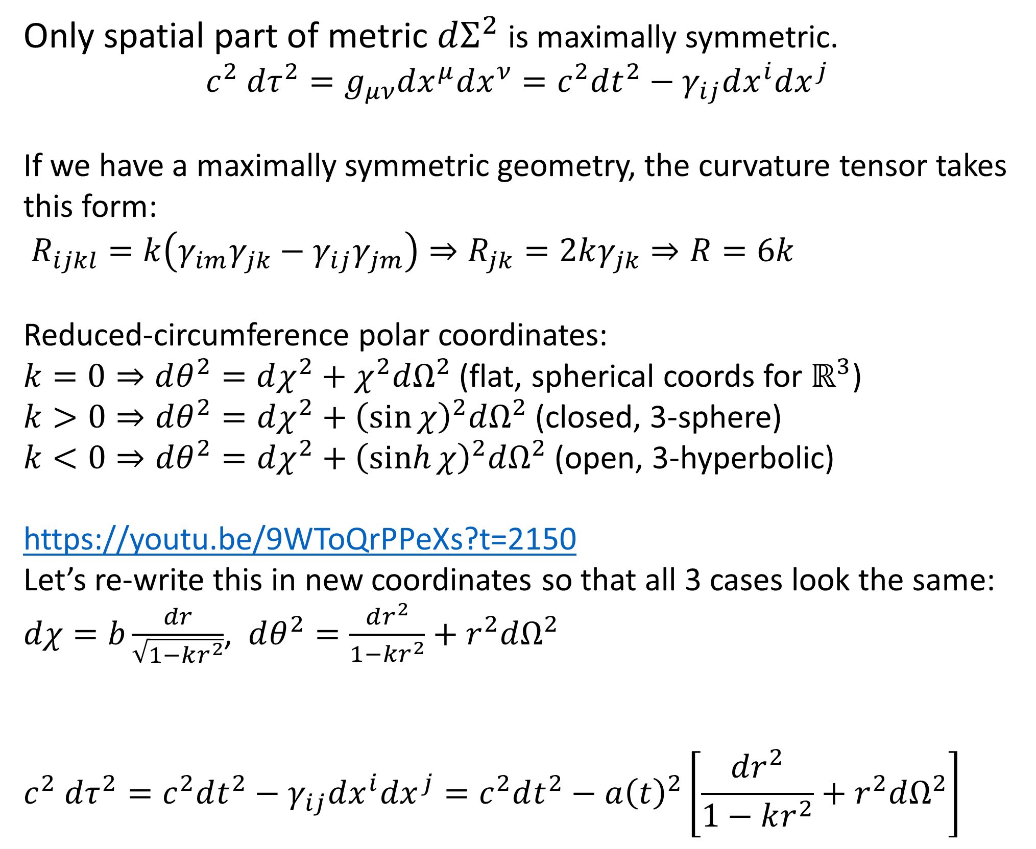
Only spatial part of metric $dΣ^{2}$ is maximally symmetric.
$$c^{2} dτ^{2}=g_{μν}dx^{μ}dx^{ν}=c^{2}dt^{2}−γ_{ij}dx^{i}dx^{j}$$
If we have a maximally symmetric geometry, the curvature tensor takes this form:
$R_{ijkl}=k\left(γ_{im}γ_{jk}−γ_{ij}γ_{jm}\right)⇒R_{jk}=2kγ_{jk}⇒R=6k$
Reduced-circumference polar coordinates:
$k=0⇒dθ^{2}=dχ^{2}+χ^{2}dΩ^{2}$ (flat, spherical coords for $ℝ^{3}$)
$k>0⇒dθ^{2}=dχ^{2}+{\left(\sin{χ}\right)}^{2}dΩ^{2}$ (closed, 3-sphere)
$k<0⇒dθ^{2}=dχ^{2}+{\left(\sinh{χ}\right)}^{2}dΩ^{2}$ (open, 3-hyperbolic)
https://youtu.be/9WToQrPPeXs?t=2150
Let’s re-write this in new coordinates so that all 3 cases look the same: $dχ=b\frac{dr}{\sqrt{1−kr^{2}}}$, $dθ^{2}=\frac{dr^{2}}{1−kr^{2}}+r^{2}dΩ^{2}$
$$c^{2} dτ^{2}=c^{2}dt^{2}−γ_{ij}dx^{i}dx^{j}=c^{2}dt^{2}−a{\left(t\right)}^{2}\left[\frac{dr^{2}}{1−kr^{2}}+r^{2}dΩ^{2}\right]$$

Slide 12

FLRW metric = 3 metrics in one
3 possible spatially homogeneous
and isotropic universes:
closed
flat
open

Slide 13
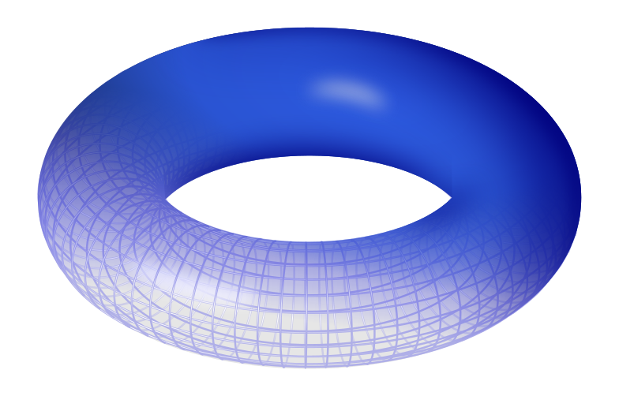
Technically speaking… there are other geometries that are spatially homogeneous and isotropic.
hole
Only consider “simply-connected” geometries (no-holes)

Slide 14
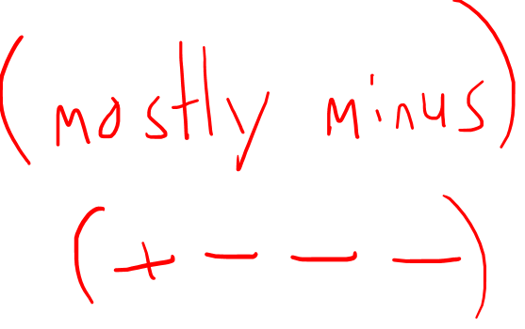
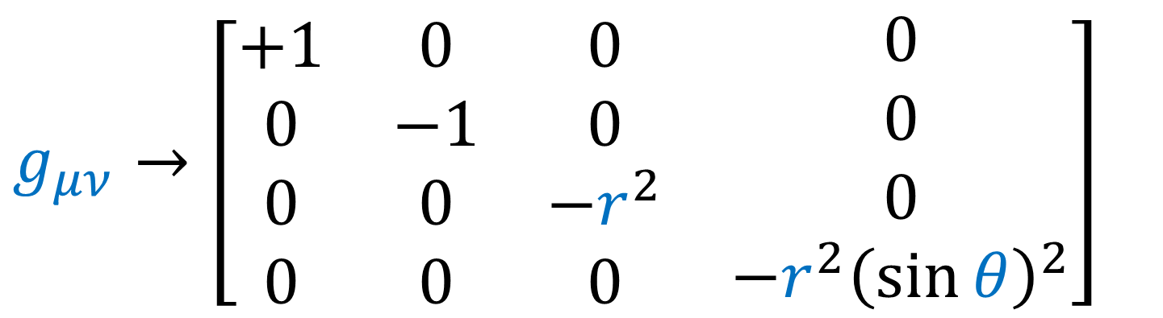
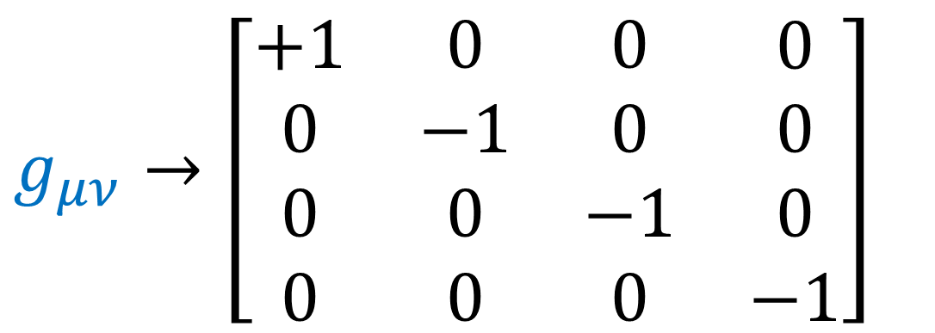
Flat (Minkowski) metric, Cartesian coordinates
$$g_{μν}→\left[\begin{matrix}\begin{matrix}\begin{aligned}+1 \\ 0 \\ 0 \\ 0\end{aligned} & \begin{aligned}0 \\ −1 \\ 0 \\ 0\end{aligned}\end{matrix} & \begin{matrix}\begin{aligned}0 \\ 0 \\ −1 \\ 0\end{aligned} & \begin{aligned}0 \\ 0 \\ 0 \\ −1\end{aligned}\end{matrix}\end{matrix}\right]$$
Flat (Minkowski) metric, Spherical coordinates
$$g_{μν}→\left[\begin{matrix}\begin{matrix}\begin{aligned}+1 \\ 0 \\ 0 \\ 0\end{aligned} & \begin{aligned}0 \\ −1 \\ 0 \\ 0\end{aligned}\end{matrix} & \begin{matrix}\begin{aligned}0 \\ 0 \\ −r^{2} \\ 0\end{aligned} & \begin{aligned}0 \\ 0 \\ 0 \\ −{r^{2}\left(\sin{θ}\right)}^{2}\end{aligned}\end{matrix}\end{matrix}\right]$$

Slide 15
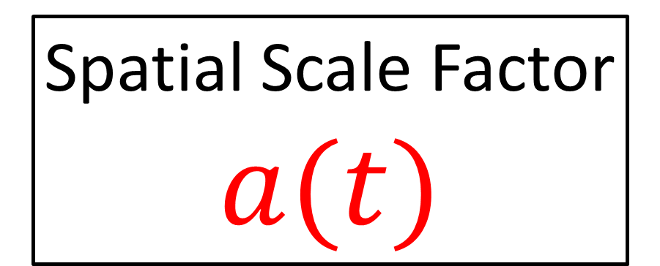
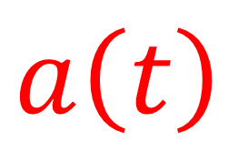
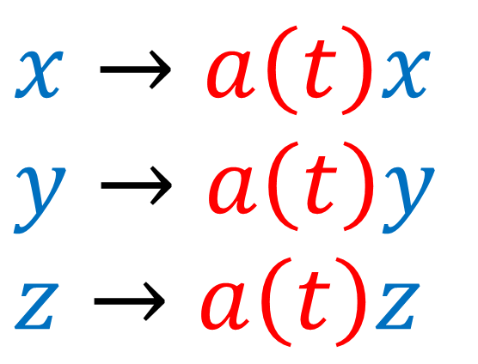
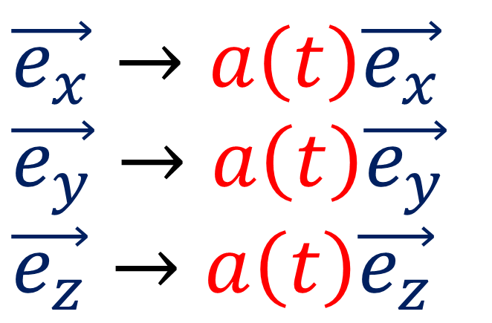
Cosmological Principle
Spatially Homogeneous
Spatially Isotropic
Spatial Scale Factor
$$a(t)$$
Allow scale of space to change overtime.
$$x→a\left(t\right)x$$
$$y→a\left(t\right)y$$
$$z→a\left(t\right)z$$
$$\vec{e_{x}}→a\left(t\right)\vec{e_{x}}$$
$$\vec{e_{y}}→a\left(t\right)\vec{e_{y}}$$
$$\vec{e_{z}}→a\left(t\right)\vec{e_{z}}$$
$$a\left(t\right)$$

Slide 16
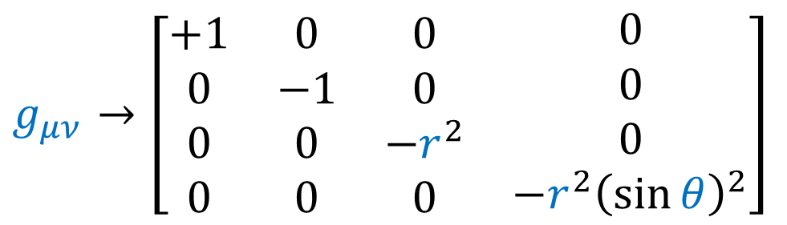
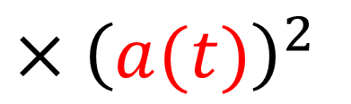
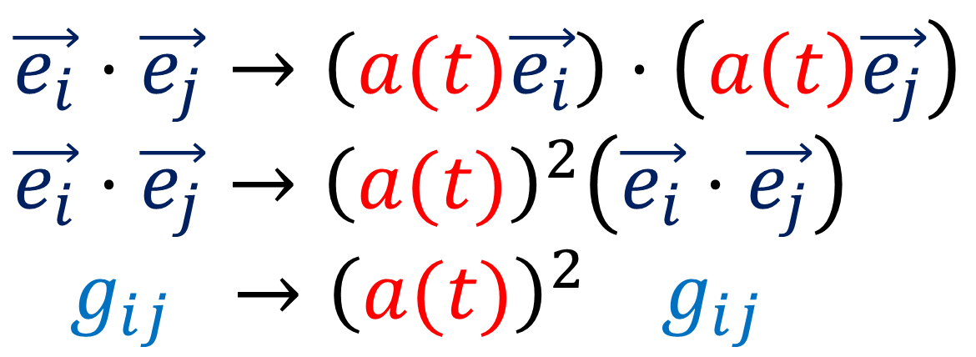
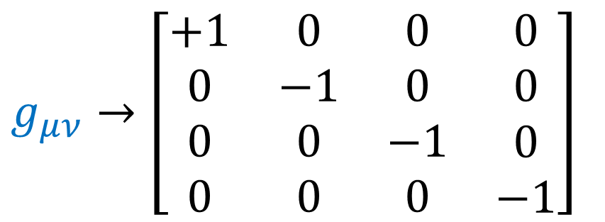
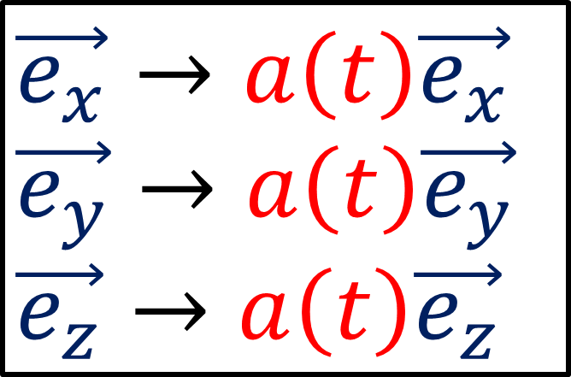
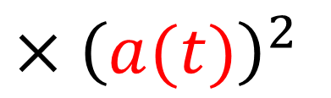
Flat metric, Cartesian coordinates
Flat metric, Spherical coordinates
$$g_{μν}→\left[\begin{matrix}\begin{matrix}\begin{aligned}+1 \\ 0 \\ 0 \\ 0\end{aligned} & \begin{aligned}0 \\ −1 \\ 0 \\ 0\end{aligned}\end{matrix} & \begin{matrix}\begin{aligned}0 \\ 0 \\ −1 \\ 0\end{aligned} & \begin{aligned}0 \\ 0 \\ 0 \\ −1\end{aligned}\end{matrix}\end{matrix}\right]$$
$$g_{μν}→\left[\begin{matrix}\begin{matrix}\begin{aligned}+1 \\ 0 \\ 0 \\ 0\end{aligned} & \begin{aligned}0 \\ −1 \\ 0 \\ 0\end{aligned}\end{matrix} & \begin{matrix}\begin{aligned}0 \\ 0 \\ −r^{2} \\ 0\end{aligned} & \begin{aligned}0 \\ 0 \\ 0 \\ −{r^{2}\left(\sin{θ}\right)}^{2}\end{aligned}\end{matrix}\end{matrix}\right]$$
$×{\left(a(t)\right)}^{2}$
$×{\left(a(t)\right)}^{2}$
$$\vec{e_{x}}→a\left(t\right)\vec{e_{x}}$$
$$\vec{e_{y}}→a\left(t\right)\vec{e_{y}}$$
$$\vec{e_{z}}→a\left(t\right)\vec{e_{z}}$$
$\vec{e_{i}}⋅\vec{e_{j}}→\left(a(t)\vec{e_{i}}\right)⋅\left(a\left(t\right)\vec{e_{j}}\right)$
$$\vec{e_{i}}⋅\vec{e_{j}}→{\left(a(t)\right)}^{2}\left(\vec{e_{i}}⋅\vec{e_{j}}\right)$$
$g_{ij} →{\left(a(t)\right)}^{2} g_{ij}$

Slide 17
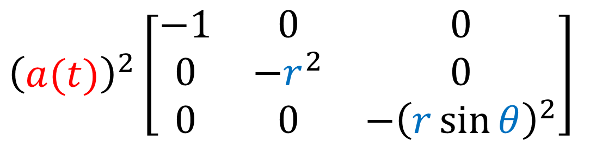
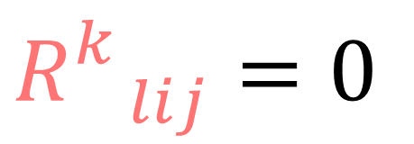
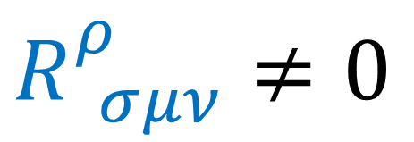
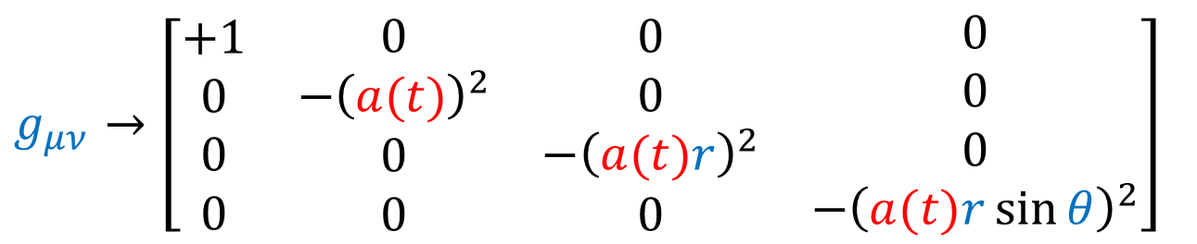

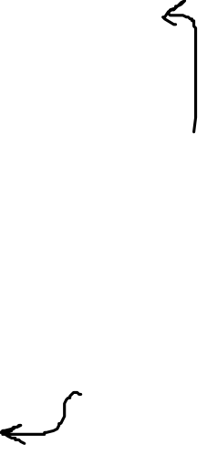
$$R_{ lij}^{k}=0$$
$${\left(a(t)\right)}^{2}\left[\begin{matrix}−1 & 0 & 0 \\ 0 & −r^{2} & 0 \\ 0 & 0 & −{\left(r\sin{θ}\right)}^{2}\end{matrix}\right]$$
$$g_{μν}→\left[\begin{matrix}\begin{matrix}\begin{aligned}+1 \\ 0 \\ 0 \\ 0\end{aligned} & \begin{aligned}0 \\ −{\left(a(t)\right)}^{2} \\ 0 \\ 0\end{aligned}\end{matrix} & \begin{matrix}\begin{aligned}0 \\ 0 \\ −{\left(a(t)r\right)}^{2} \\ 0\end{aligned} & \begin{aligned}0 \\ 0 \\ 0 \\ −{\left(a(t)r\sin{θ}\right)}^{2}\end{aligned}\end{matrix}\end{matrix}\right]$$
$$a\left(t\right)$$
$$R_{ σμν}^{ρ}≠0$$

Slide 18

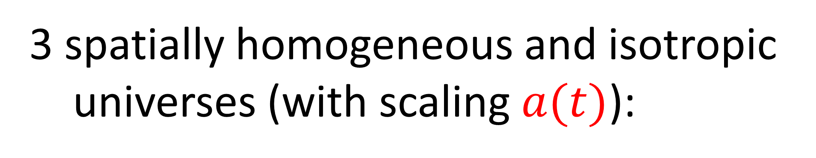
3 spatially homogeneous and isotropic
universes (with scaling $a(t)$):
closed
(spherical)
open
(hyperbolic)
flat

Slide 19
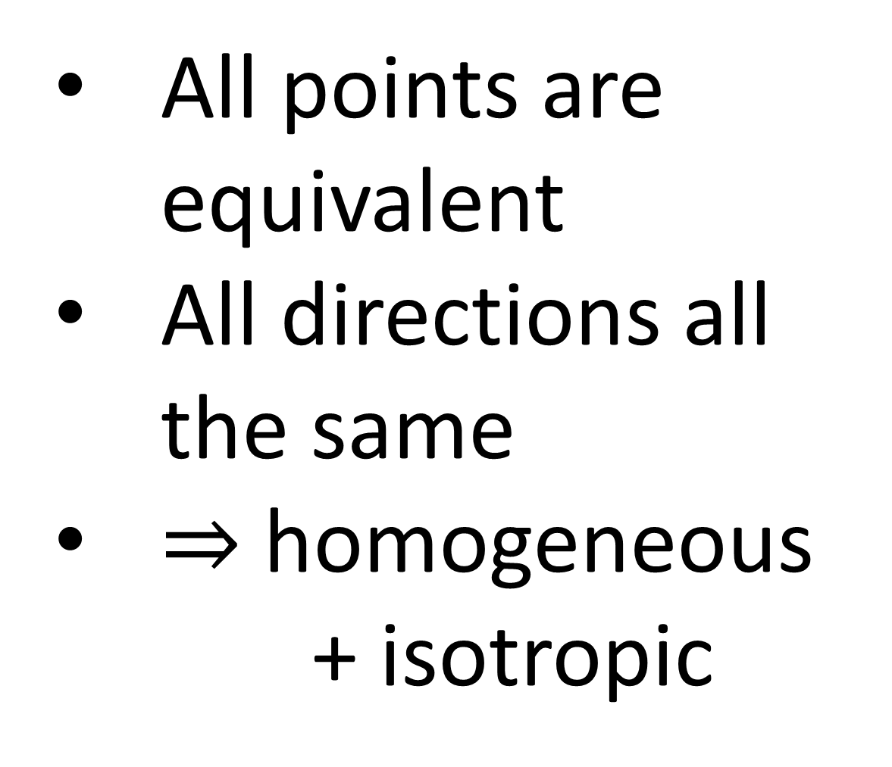
2-dimensional sphere surface
All points are equivalent
All directions all the same
$⇒$ homogeneous + isotropic
But our spatial universe is 3D…

Slide 20
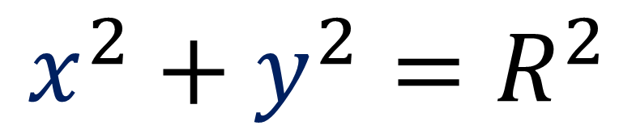







$$y$$
Equation of a circle (1-sphere, $S^{1}$)
$$R$$
$$x^{2}+y^{2}=R^{2}$$
$$θ$$
$$x$$
$$={\left(R\cos{θ}\right)}^{2}+{\left(R\sin{θ}\right)}^{2}$$
$$=R^{2}\left[{\left(\cos{θ}\right)}^{2}+{\left(\sin{θ}\right)}^{2}\right]$$
$$=R^{2}\left[1\right]$$
$=R^{2}$
$$x=R\cos{θ}$$
$$y=R\sin{θ}$$

Slide 21









$$x$$
$$θ$$
Equation of a sphere (2-sphere, $S^{2}$)
$$z$$
$$x^{2}+y^{2}+z^{2}=R^{2}$$
$$φ$$
$$y$$
$$x=R\cos{θ}$$
$$y=R\sin{θ}\cos{φ}$$
$$z=R\sin{θ}\sin{φ}$$

Slide 22




$$x=R\cos{θ}$$
$$y=R\sin{θ}\cos{φ}$$
$$z=R\sin{θ}\sin{φ}$$
$$x^{2}+y^{2}+z^{2}=R^{2}$$
$$={\left(R\cos{θ}\right)}^{2}+{\left(R\sin{θ}\cos{φ}\right)}^{2}+{\left(R\sin{θ}\sin{φ}\right)}^{2}$$
$$=R^{2}\left[{\left(\cos{θ}\right)}^{2}+{\left(\sin{θ}\right)}^{2}{\left(\cos{φ}\right)}^{2}+{\left(\sin{θ}\right)}^{2}{\left(\sin{φ}\right)}^{2}\right]$$
$$=R^{2}\left[{\left(\cos{θ}\right)}^{2}+{\left(\sin{θ}\right)}^{2}\left[{\left(\cos{φ}\right)}^{2}+{\left(\sin{φ}\right)}^{2}\right]\right]$$
$$=R^{2}\left[{\left(\cos{θ}\right)}^{2}+{\left(\sin{θ}\right)}^{2}\right]$$
$$=R^{2}$$

Slide 23











$$z$$
$$θ$$
Equation of a 3-sphere $S^{3}$
$$w$$
$?$
$$x^{2}+y^{2}+z^{2}+w^{2}=R^{2}$$
$$x$$
$$φ$$
$x=x\left(θ,φ,χ\right)$
$y=y\left(θ,φ,χ\right)$
$z=z\left(θ,φ,χ\right)$
$$w=w\left(θ,φ,χ\right)$$
$$y$$
$$χ$$

Slide 24






1-sphere, $S^{1}$
2-sphere, $S^{2}$
3-sphere, $S^{3}$
$$x=R\cos{θ}$$
$$y=R\sin{θ}$$
$$x=R\cos{θ}$$
$$y=R\sin{θ}\cos{φ}$$
$$z=R\sin{θ}\sin{φ}$$
$x=R\cos{θ}$
$y=R\sin{θ}\cos{φ}$
$z=R\sin{θ}\sin{φ}\cos{χ}$
$w=R\sin{θ}\sin{φ}\sin{χ}$

Slide 25




$x=R\cos{θ}$
$y=R\sin{θ}\cos{φ}$
$z=R\sin{θ}\sin{φ}\cos{χ}$
$w=R\sin{θ}\sin{φ}\sin{χ}$
$$x^{2}+y^{2}+z^{2}+w^{2}=R^{2}$$
$$={\left(R\cos{θ}\right)}^{2}+{\left(R\sin{θ}\cos{φ}\right)}^{2}+$$
${\left(R\sin{θ}\sin{φ}\sin{χ}\right)}^{2}+{\left(R\sin{θ}\sin{φ}\cos{χ}\right)}^{2}$
$$=R^{2}\left[\begin{aligned}{\left(\cos{θ}\right)}^{2}+{\left(\sin{θ}\right)}^{2}{\left(\cos{φ}\right)}^{2}+ \\ {\left(\sin{θ}\right)}^{2}{\left(\sin{φ}\right)}^{2}{\left(\cos{χ}\right)}^{2}+{\left(\sin{θ}\right)}^{2}{\left(\sin{φ}\right)}^{2}{\left(\sin{χ}\right)}^{2}\end{aligned}\right]$$
$=R^{2}\left[\begin{aligned}{\left(\cos{θ}\right)}^{2}+{\left(\sin{θ}\right)}^{2}{\left(\cos{φ}\right)}^{2}+ \\ +{\left(\sin{θ}\right)}^{2}{\left(\sin{φ}\right)}^{2}\left[{\left(\cos{χ}\right)}^{2}+{\left(\sin{χ}\right)}^{2}\right]\end{aligned}\right]$

Slide 26

$x=R\cos{θ}$
$y=R\sin{θ}\cos{φ}$
$z=R\sin{θ}\sin{φ}\cos{χ}$
$w=R\sin{θ}\sin{φ}\sin{χ}$
$$x^{2}+y^{2}+z^{2}+w^{2}=R^{2}$$
$=R^{2}\left[\begin{aligned}{\left(\cos{θ}\right)}^{2}+{\left(\sin{θ}\right)}^{2}{\left(\cos{φ}\right)}^{2}+ \\ +{\left(\sin{θ}\right)}^{2}{\left(\sin{φ}\right)}^{2}\left[{\left(\cos{χ}\right)}^{2}+{\left(\sin{χ}\right)}^{2}\right]\end{aligned}\right]$
$=R^{2}\left[{\left(\cos{θ}\right)}^{2}+{\left(\sin{θ}\right)}^{2}{\left(\cos{φ}\right)}^{2}+{\left(\sin{θ}\right)}^{2}{\left(\sin{φ}\right)}^{2}\right]$
$=R^{2}\left[{\left(\cos{θ}\right)}^{2}+{\left(\sin{θ}\right)}^{2}\left[{\left(\cos{φ}\right)}^{2}+{\left(\sin{φ}\right)}^{2}\right]\right]$
$=R^{2}\left[{\left(\cos{θ}\right)}^{2}+{\left(\sin{θ}\right)}^{2}\right]$
$=R^{2}$

Slide 27

1-sphere: $R^{2}=x^{2}+y^{2}$
2-sphere: $R^{2}=x^{2}+y^{2}+z^{2}$
3-sphere: $R^{2}=x^{2}+y^{2}+z^{2}+w^{2}$
4-sphere: $R^{2}=x^{2}+y^{2}+z^{2}+w^{2}+t^{2}$
5-sphere: $R^{2}=x^{2}+y^{2}+z^{2}+w^{2}+t^{2}+u^{2}$
6-sphere: $R^{2}=x^{2}+y^{2}+z^{2}+w^{2}+t^{2}+u^{2}+v^{2}$
N-sphere: $R^{2}=\sum_{i=1}^{N+1}{{\left(x^{i}\right)}^{2}}$

Slide 28












1-sphere, $S^{1}$
2-sphere, $S^{2}$
3-sphere, $S^{3}$
$$x=R\cos{θ}$$
$$y=R\sin{θ}$$
$$x=R\cos{θ}$$
$$y=R\sin{θ}\cos{φ}$$
$$z=R\sin{θ}\sin{φ}$$
$x=R\cos{θ}$
$y=R\sin{θ}\cos{φ}$
$z=R\sin{θ}\sin{φ}\cos{χ}$
$w=R\sin{θ}\sin{φ}\sin{χ}$
4-sphere, $S^{4}$
N-sphere, $S^{N}$
$x=R\cos{θ}$
$y=R\sin{θ}\cos{φ}$
$z=R\sin{θ}\sin{φ}\cos{χ}$
$w=R\sin{θ}\sin{φ}\sin{χ}\cos{ξ}$
$t =R\sin{θ}\sin{φ}\sin{χ}\sin{ξ}$
For $x^{1}$ to $x^{N}$:
$x^{j}=\cos{θ^{j}}\prod_{i=1}^{j−1}{\sin{θ^{i}}}$
$x^{N+1}=\prod_{i=1}^{N}{\sin{θ^{i}}}$

Slide 29



$x=R\cos{θ}$
$y=R\sin{θ}\cos{φ}$
$z=R\sin{θ}\sin{φ}\cos{χ}$
$w=R\sin{θ}\sin{φ}\sin{χ}$
Basis Vectors:
$\frac{∂}{∂θ}= \frac{∂x}{∂θ}\frac{∂}{∂x}+\frac{∂y}{∂θ}\frac{∂}{∂y}+\frac{∂z}{∂θ}\frac{∂}{∂z}+\frac{∂w}{∂θ}\frac{∂}{∂w}$
$\frac{∂}{∂φ}=\frac{∂x}{∂φ}\frac{∂}{∂x}+\frac{∂y}{∂φ}\frac{∂}{∂y}+\frac{∂z}{∂φ}\frac{∂}{∂z}+\frac{∂w}{∂φ}\frac{∂}{∂w}$
$\frac{∂}{∂χ}= \frac{∂x}{∂χ}\frac{∂}{∂x}+\frac{∂y}{∂χ}\frac{∂}{∂y}+\frac{∂z}{∂χ}\frac{∂}{∂z}+\frac{∂w}{∂χ}\frac{∂}{∂w}$
$\frac{∂}{∂θ}=−R\sin{θ}\frac{∂}{∂x}+R\cos{θ}\cos{φ}\frac{∂}{∂y}+R\cos{θ}\sin{φ}\cos{χ}\frac{∂}{∂z}+R\cos{θ}\sin{φ}\sin{χ}\frac{∂}{∂w}$
$\frac{∂}{∂φ}= 0 \frac{∂}{∂x}− R\sin{θ}\sin{φ}\frac{∂}{∂y}+R\sin{θ}\cos{φ}\cos{χ}\frac{∂}{∂z} +R\sin{θ}\cos{φ}\sin{χ}\frac{∂}{∂w}$
$\frac{∂}{∂χ}= 0 \frac{∂}{∂x}+ 0 \frac{∂}{∂y}−R\sin{θ}\sin{φ}\sin{χ}\frac{∂}{∂z} +R\sin{θ}\sin{φ}\cos{χ}\frac{∂}{∂w}$

Slide 30







$\frac{∂}{∂θ}=−R\sin{θ}\frac{∂}{∂x}+R\cos{θ}\cos{φ}\frac{∂}{∂y}+R\cos{θ}\sin{φ}\cos{χ}\frac{∂}{∂z}+R\cos{θ}\sin{φ}\sin{χ}\frac{∂}{∂w}$
$\frac{∂}{∂φ}= 0 \frac{∂}{∂x}− R\sin{θ}\sin{φ}\frac{∂}{∂y}+R\sin{θ}\cos{φ}\cos{χ}\frac{∂}{∂z} +R\sin{θ}\cos{φ}\sin{χ}\frac{∂}{∂w}$
$\frac{∂}{∂χ}= 0 \frac{∂}{∂x}+ 0 \frac{∂}{∂y}−R\sin{θ}\sin{φ}\sin{χ}\frac{∂}{∂z} +R\sin{θ}\sin{φ}\cos{χ}\frac{∂}{∂w}$
$xyzw$ space basis is orthonormal:
$\frac{∂}{∂x^{i}}⋅\frac{∂}{∂x^{j}}=g_{ij}=δ_{ij}$
$θφχ$ basis:
Off-diagonal metric terms are zero:
$g_{θφ}=g_{φχ}=g_{θχ}=0$
$\frac{∂}{∂θ}⋅\frac{∂}{∂θ}=g_{θθ}=R^{2}$
$\frac{∂}{∂φ}⋅\frac{∂}{∂φ}=g_{φφ}=R^{2}{\left(\sin{θ}\right)}^{2}$
$\frac{∂}{∂χ}⋅\frac{∂}{∂χ}=g_{χχ}=R^{2}{\left(\sin{θ}\right)}^{2}{\left(\sin{φ}\right)}^{2}$
$θφχ$ space basis:
$g_{ij}$ = dot products of
$\frac{∂}{∂θ}, \frac{∂}{∂φ},\frac{∂}{∂χ}$
$\frac{d}{dλ}⋅\frac{d}{dλ}=g_{θθ}{\left(\frac{dθ}{dλ}\right)}^{2}+g_{φφ}{\left(\frac{dφ}{dλ}\right)}^{2}+g_{χχ}{\left(\frac{dχ}{dλ}\right)}^{2}$
$\frac{d}{dλ}⋅\frac{d}{dλ}=R^{2}{\left(\frac{dθ}{dλ}\right)}^{2}+R^{2}{\left(\sin{θ}\right)}^{2}{\left(\frac{dφ}{dλ}\right)}^{2}+R^{2}{\left(\sin{θ}\right)}^{2}{\left(\sin{φ}\right)}^{2}{\left(\frac{dχ}{dλ}\right)}^{2}$
$\frac{d}{dλ}⋅\frac{d}{dλ}=R^{2}\left[{\left(\frac{dθ}{dλ}\right)}^{2}+{\left(\sin{θ}\right)}^{2}\left({\left(\frac{dφ}{dλ}\right)}^{2}+{\left(\sin{φ}\right)}^{2}{\left(\frac{dχ}{dλ}\right)}^{2}\right)\right]$

Slide 31







3-sphere metric
$g_{ij}→$ $R^{2}\left[\begin{matrix}1 & 0 & 0 \\ 0 & {\left(\sin{θ}\right)}^{2} & 0 \\ 0 & 0 & {\left(\sin{θ}\right)}^{2}{\left(\sin{φ}\right)}^{2}\end{matrix}\right]$
Metric
Tensor
Connection
coefficients
Riemann Tensor
Ricci Tensor
Ricci Scalar
$$g_{ij}$$
$$Γ_{ij}^{k}$$
$$R_{ kij}^{m}$$
$$R_{ij}$$
$$ℛ$$
$ℛ=+\frac{6}{R^{2}}$
Source in description:
https://www.physics.mcgill.ca/~rhb/ph514/10sol6.pdf
radius

Slide 32



$\frac{∂}{∂θ}⋅\frac{∂}{∂θ}=g_{θθ}=R^{2}$
$\frac{∂}{∂φ}⋅\frac{∂}{∂φ}=g_{φφ}=R^{2}{\left(\sin{θ}\right)}^{2}$
$\frac{∂}{∂χ}⋅\frac{∂}{∂χ}=g_{χχ}=R^{2}{\left(\sin{θ}\right)}^{2}{\left(\sin{φ}\right)}^{2}$
Relabel coordinates: $θ→χ$, $φ→θ$, $χ→φ$
$\frac{∂}{∂χ}⋅\frac{∂}{∂χ}=g_{χχ}=R^{2}$
$\frac{∂}{∂θ}⋅\frac{∂}{∂θ}=g_{θθ}=R^{2}{\left(\sin{χ}\right)}^{2}$
$\frac{∂}{∂φ}⋅\frac{∂}{∂φ}=g_{φφ}=R^{2}{\left(\sin{χ}\right)}^{2}{\left(\sin{θ}\right)}^{2}$

Slide 33




$$\left[\begin{matrix}1 & 0 & 0 \\ 0 & r^{2} & 0 \\ 0 & 0 & r^{2}{\left(\sin{θ}\right)}^{2}\end{matrix}\right]$$
3D flat space metric
(spherical polar coordinates)
3-sphere metric
(hyper-spherical coordinates)
(radius $R=1$)
$$\left[\begin{matrix}1 & 0 & 0 \\ 0 & {\left(\sin{χ}\right)}^{2} & 0 \\ 0 & 0 & {\left(\sin{χ}\right)}^{2}{\left(\sin{θ}\right)}^{2}\end{matrix}\right]$$

Slide 34



Spatially Homogeneous, Isotropic Metrics
3-sphere
(positive curvature)
$$\left[\begin{matrix}1 & 0 & 0 \\ 0 & {\left(\sin{χ}\right)}^{2} & 0 \\ 0 & 0 & {\left(\sin{χ}\right)}^{2}{\left(\sin{θ}\right)}^{2}\end{matrix}\right]$$
$$\left[\begin{matrix}1 & 0 & 0 \\ 0 & r^{2} & 0 \\ 0 & 0 & r^{2}{\left(\sin{θ}\right)}^{2}\end{matrix}\right]$$
3D Flat Space
(zero curvature)
Hyperbolic 3-space
(negative curvature)
$$\left[\begin{matrix}1 & 0 & 0 \\ 0 & {\left(\sinh{χ}\right)}^{2} & 0 \\ 0 & 0 & {\left(\sinh{χ}\right)}^{2}{\left(\sin{θ}\right)}^{2}\end{matrix}\right]$$

Slide 35


2-sphere, $S^{2}$
Hyperbolic Plane, $H^{2}$
2 frowns
(2 smiles)
1 smile and 1 frown

Slide 36





Look at circles of a given circumference $C$…
spherical
flat
hyperbolic
$$A_{flat}$$
$$A>A_{flat}$$
$$A<A_{flat}$$

Slide 37











$$q$$
Hyperbolic Plane, $H^{2}$
Points that satisfy:
$$θ$$
$$χ$$
$$x^{2}+y^{2}−q^{2}=−R^{2}$$
$$x$$
$$q^{2}−x^{2}−y^{2}=+R^{2}$$
$$y$$
$$\left[\begin{matrix}+1 & 0 & 0 \\ 0 & −1 & 0 \\ 0 & 0 & −1\end{matrix}\right]$$
$$q=R\cosh{χ}$$
$$x=R\sinh{χ}\cos{θ }$$
$$y=R\sinh{χ}\sin{θ }$$
NOT the Euclidean metric

Slide 38




Hyperboloid Model: geodesics are “forward-walking” paths constrained on hyperboloid
Klein Disc Model:
“geodesics” are straight lines on a disc.
Poincaré Half-Plane Model:
“geodesics” are vertical lines or semi-circle arcs centered on baseline
Poincaré Disc Model:
“geodesics” are circular arcs or diameter lines on a disc

Slide 39


“Circle Limit III” by Escher
(equal-area fish)
Poincaré Disc Model of Hyperbolic Plane
(equal-area triangles)

Slide 40






($↓$ link in description $↓$)
Klein Disc Model
Poincaré Disc Model
Poincaré Half-Plane Model

Slide 41




$$q=R\cosh{χ}$$
$$x=R\sinh{χ}\cos{θ }$$
$$y=R\sinh{χ}\sin{θ }$$
$$x^{2}+y^{2}−q^{2}=−R^{2}$$
$$={\left(R\sinh{χ}\cos{θ }\right)}^{2}+{\left(R\sinh{χ}\sin{θ }\right)}^{2}−{\left(R\cosh{χ}\right)}^{2}$$
$$=R^{2}\left[{\left(\sinh{χ}\right)}^{2}{\left(\cos{θ }\right)}^{2}+{\left(\sinh{χ}\right)}^{2}{\left(\sin{θ }\right)}^{2}−{\left(\cosh{χ}\right)}^{2}\right]$$
$$=R^{2}\left[{\left(\sinh{χ}\right)}^{2}\left[{\left(\cos{θ }\right)}^{2}+{\left(\sin{θ }\right)}^{2}\right]−{\left(\cosh{χ}\right)}^{2}\right]$$
$$=R^{2}\left[{\left(\sinh{χ}\right)}^{2}−{\left(\cosh{χ}\right)}^{2}\right]$$
$$=−R^{2}$$

Slide 42





Hyperbolic line, $H^{1}$
Hyperbolic plane, $H^{2}$
Hyperbolic 3-space, $H^{3}$
$$q=R\cosh{χ}$$
$$x=R\sinh{χ}\cos{θ}$$
$$y=R\sinh{χ}\sin{θ}$$
$$q=R\cosh{χ}$$
$$x=R\sinh{χ}\cos{θ}$$
$$y=R\sinh{χ}\sin{θ}\cos{φ}$$
$$z=R\sinh{χ}\sin{θ}\sin{φ}$$
(Essentially the same as the Euclidean line)

Slide 43




$$q=R\cosh{χ}$$
$$x=R\sinh{χ}\cos{θ}$$
$$y=R\sinh{χ}\sin{θ}\cos{φ}$$
$$z=R\sinh{χ}\sin{θ}\sin{φ}$$
$$−q^{2}+x^{2}+y^{2}+z^{2}=−R^{2}$$
$$=−{\left(R\cosh{χ}\right)}^{2}+{\left(R\sinh{χ}\cos{θ}\right)}^{2}$$ $+{\left(R\sinh{χ}\sin{θ}\cos{φ}\right)}^{2}+{\left(R\sinh{χ}\sin{θ}\sin{φ}\right)}^{2}$
$$=R^{2}\left[\begin{aligned}−{\left(\cosh{χ}\right)}^{2}+{\left(\sinh{χ}\right)}^{2}{\left(\cos{θ}\right)}^{2}+ \\ {\left(\sinh{χ}\right)}^{2}{\left(\sin{θ}\right)}^{2}{\left(\cos{φ}\right)}^{2}+{\left(\sinh{χ}\right)}^{2}{\left(\sin{θ}\right)}^{2}{\left(\sin{φ}\right)}^{2}\end{aligned}\right]$$
$=R^{2}\left[\begin{aligned}−{\left(\cosh{χ}\right)}^{2}+{\left(\sinh{χ}\right)}^{2}{\left(\cos{θ}\right)}^{2}+ \\ {\left(\sinh{χ}\right)}^{2}{\left(\sin{θ}\right)}^{2}\left[{\left(\cos{φ}\right)}^{2}+{\left(\sin{φ}\right)}^{2}\right]\end{aligned}\right]$

Slide 44


$$q=R\cosh{χ}$$
$$x=R\sinh{χ}\cos{θ}$$
$$y=R\sinh{χ}\sin{θ}\cos{φ}$$
$$z=R\sinh{χ}\sin{θ}\sin{φ}$$
$$−q^{2}+x^{2}+y^{2}+z^{2}=−R^{2}$$
$=R^{2}\left[\begin{aligned}−{\left(\cosh{χ}\right)}^{2}+ \\ {\left(\sinh{χ}\right)}^{2}{\left(\cos{θ}\right)}^{2}+{\left(\sinh{χ}\right)}^{2}{\left(\sin{θ}\right)}^{2}\end{aligned}\right]$
$=R^{2}\left[−{\left(\cosh{χ}\right)}^{2}+{\left(\sinh{χ}\right)}^{2}\left[{\left(\cos{θ}\right)}^{2}+{\left(\sin{θ}\right)}^{2}\right]\right]$
$=R^{2}\left[−{\left(\cosh{χ}\right)}^{2}+{\left(\sinh{χ}\right)}^{2}\right]$
$=−R^{2}$

Slide 45

$H^{2}$: $−R^{2}=−q^{2}+x^{2}+y^{2}$
$H^{3}$: $−R^{2}=−q^{2}+x^{2}+y^{2}+z^{2}$
$H^{4}$: $−R^{2}=−q^{2}+x^{2}+y^{2}+z^{2}+w^{2}$
$H^{5}$: $−R^{2}=−q^{2}+x^{2}+y^{2}+z^{2}+w^{2}+t^{2}$
$H^{6}$: $−R^{2}=−q^{2}+x^{2}+y^{2}+z^{2}+w^{2}+t^{2}+u^{2}$
$H^{N}$: $−R^{2}=−{\left(x^{1}\right)}^{2}+\sum_{i=2}^{N+1}{{\left(x^{i}\right)}^{2}}$

Slide 46












Hyperbolic 2-space, $H^{2}$
Hyperbolic 3-space, $H^{3}$
$$q=R\cosh{χ}$$
$$x=R\sinh{χ}\cos{θ}$$
$$y=R\sinh{χ}\sin{θ}\cos{φ}$$
$$z=R\sinh{χ}\sin{θ}\sin{φ}$$
$$q=R\cosh{χ}$$
$$x=R\sinh{χ}\cos{θ}$$
$$y=R\sinh{χ}\sin{θ}$$
Hyperbolic 4-space, $H^{4}$
Hyperbolic N-space, $H^{N}$
$q=R\cosh{χ}$
$x=R\sinh{χ}\cos{θ}$
$y=R\sinh{χ}\sin{θ}\cos{φ}$
$z=R\sinh{χ}\sin{θ}\sin{φ}\cos{ξ}$
$w=R\sinh{χ}\sin{θ}\sin{φ}\sin{ξ}$
$$x^{1}=\cosh{θ^{1}}$$
For $x^{2}$ to $x^{N}$:
$x^{j}=\sinh{θ^{1}}\cos{θ^{j}}\prod_{i=2}^{j}{\sin{θ^{i}}}$
$x^{N+1}=\sinh{θ^{1}}\prod_{i=2}^{N+1}{\sin{θ^{i}}}$

Slide 47



$$q=R\cosh{χ}$$
$$x=R\sinh{χ}\cos{θ}$$
$$y=R\sinh{χ}\sin{θ}\cos{φ}$$
$$z=R\sinh{χ}\sin{θ}\sin{φ}$$
Basis Vectors:
$\frac{∂}{∂χ}=\frac{∂q}{∂χ}\frac{∂}{∂q}+\frac{∂x}{∂χ}\frac{∂}{∂x}+\frac{∂y}{∂χ}\frac{∂}{∂y}+\frac{∂z}{∂χ}\frac{∂}{∂z}$
$\frac{∂}{∂θ}=\frac{∂q}{∂θ}\frac{∂}{∂q}+\frac{∂x}{∂θ}\frac{∂}{∂x}+\frac{∂y}{∂θ}\frac{∂}{∂y}+\frac{∂z}{∂θ}\frac{∂}{∂z}$
$\frac{∂}{∂φ}=\frac{∂q}{∂φ}\frac{∂}{∂q}+\frac{∂x}{∂φ}\frac{∂}{∂x}+\frac{∂y}{∂φ}\frac{∂}{∂y}+\frac{∂z}{∂φ}\frac{∂}{∂z}$
$\frac{∂}{∂χ}=R \left[\sinh{χ}\frac{∂}{∂q}+\cosh{χ}\cos{θ}\frac{∂}{∂x}+\cosh{χ}\sin{θ}\cos{φ}\frac{∂}{∂y}+\cosh{χ}\sin{θ}\sin{φ}\frac{∂}{∂z}\right]$
$\frac{∂}{∂θ}=R \left[ 0 \frac{∂}{∂q}−\sinh{χ}\sin{θ}\frac{∂}{∂x}+\sinh{χ}\cos{θ}\cos{φ}\frac{∂}{∂y}+\sinh{χ}\cos{θ}\sin{φ}\frac{∂}{∂z}\right]$
$\frac{∂}{∂φ}=R \left[ 0 \frac{∂}{∂q}+ 0 \frac{∂}{∂x}−\sinh{χ}\sin{θ}\sin{φ} \frac{∂}{∂y}+\sinh{χ}\sin{θ}\cos{φ}\frac{∂}{∂z}\right]$

Slide 48







$\frac{∂}{∂χ}=R \left[\sinh{χ}\frac{∂}{∂q}+\cosh{χ}\cos{θ}\frac{∂}{∂x}+\cosh{χ}\sin{θ}\cos{φ}\frac{∂}{∂y}+\cosh{χ}\sin{θ}\sin{φ}\frac{∂}{∂z}\right]$
$\frac{∂}{∂θ}=R \left[ 0 \frac{∂}{∂q}−\sinh{χ}\sin{θ}\frac{∂}{∂x}+\sinh{χ}\cos{θ}\cos{φ}\frac{∂}{∂y}+\sinh{χ}\cos{θ}\sin{φ}\frac{∂}{∂z}\right]$
$\frac{∂}{∂φ}=R \left[ 0 \frac{∂}{∂q}+ 0 \frac{∂}{∂x}−\sinh{χ}\sin{θ}\sin{φ} \frac{∂}{∂y}+\sinh{χ}\sin{θ}\cos{φ}\frac{∂}{∂z}\right]$
$xyzw$ space basis is orthonormal:
$\frac{∂}{∂x^{i}}⋅\frac{∂}{∂x^{j}}=g_{ij}=δ_{ij}$
$qxyz$ space metric:
(using convention $−q^{2}+x^{2}+y^{2}+z^{2}=−R^{2}$)
$\frac{∂}{∂q}⋅\frac{∂}{∂q}=g_{qq}=−1$
$\frac{∂}{∂x}⋅\frac{∂}{∂x}=g_{xx}=+1$
$\frac{∂}{∂y}⋅\frac{∂}{∂y}=g_{yy}=+1$
$\frac{∂}{∂z}⋅\frac{∂}{∂z}=g_{zz}=+1$
$χθφ$ space metric:
Off-diagonal metric terms are zero:
$g_{θφ}=g_{φχ}=g_{θχ}=0$
$\frac{∂}{∂χ}⋅\frac{∂}{∂χ}=g_{χχ}=R^{2}$
$\frac{∂}{∂θ}⋅\frac{∂}{∂θ}=g_{θθ}=R^{2}{\left(\sinh{χ}\right)}^{2}$
$\frac{∂}{∂φ}⋅\frac{∂}{∂φ}=g_{φφ}=R^{2}{\left(\sinh{χ}\right)}^{2}{\left(\sin{θ}\right)}^{2}$
$θφχ$ space basis:
$g_{ij}$ = dot products of
$\frac{∂}{∂θ}, \frac{∂}{∂φ},\frac{∂}{∂χ}$
$\frac{d}{dλ}⋅\frac{d}{dλ}=g_{θθ}{\left(\frac{dθ}{dλ}\right)}^{2}+g_{φφ}{\left(\frac{dφ}{dλ}\right)}^{2}+g_{χχ}{\left(\frac{dχ}{dλ}\right)}^{2}$
$\frac{d}{dλ}⋅\frac{d}{dλ}=R^{2}{\left(\frac{dθ}{dλ}\right)}^{2}+R^{2}{\left(\sin{θ}\right)}^{2}{\left(\frac{dφ}{dλ}\right)}^{2}+R^{2}{\left(\sin{θ}\right)}^{2}{\left(\sin{φ}\right)}^{2}{\left(\frac{dχ}{dλ}\right)}^{2}$
$\frac{d}{dλ}⋅\frac{d}{dλ}=R^{2}\left[{\left(\frac{dθ}{dλ}\right)}^{2}+{\left(\sin{θ}\right)}^{2}\left({\left(\frac{dφ}{dλ}\right)}^{2}+{\left(\sin{φ}\right)}^{2}{\left(\frac{dχ}{dλ}\right)}^{2}\right)\right]$

Slide 49



Hyperbolic 3-space
$g_{ij}→$ $R^{2}\left[\begin{matrix}1 & 0 & 0 \\ 0 & {\left(\sinh{χ}\right)}^{2} & 0 \\ 0 & 0 & {\left(\sinh{χ}\right)}^{2}{\left(\sin{θ}\right)}^{2}\end{matrix}\right]$
Metric
Tensor
Connection
coefficients
Riemann Tensor
Ricci Tensor
Ricci Scalar
$$g_{ij}$$
$$Γ_{ij}^{k}$$
$$R_{ kij}^{m}$$
$$R_{ij}$$
$$ℛ$$
$ℛ=−\frac{6}{R^{2}}$
Source for $H^{2}$ in description:
https://thatsmaths.files.wordpress.com/2013/10/134-half-plane-curvature.pdf
parameter

Slide 50

Spatially Homogeneous, Isotropic Metrics
3-sphere
(positive curvature)
$$\left[\begin{matrix}1 & 0 & 0 \\ 0 & {\left(\sin{χ}\right)}^{2} & 0 \\ 0 & 0 & {\left(\sin{χ}\right)}^{2}{\left(\sin{θ}\right)}^{2}\end{matrix}\right]$$
$$\left[\begin{matrix}1 & 0 & 0 \\ 0 & r^{2} & 0 \\ 0 & 0 & r^{2}{\left(\sin{θ}\right)}^{2}\end{matrix}\right]$$
3D Flat Space
(zero curvature)
Hyperbolic 3-space
(negative curvature)
$$\left[\begin{matrix}1 & 0 & 0 \\ 0 & {\left(\sinh{χ}\right)}^{2} & 0 \\ 0 & 0 & {\left(\sinh{χ}\right)}^{2}{\left(\sin{θ}\right)}^{2}\end{matrix}\right]$$

Slide 51




Spatially Homogeneous, Isotropic Metrics
$$\left[\begin{matrix}1 & 0 & 0 \\ 0 & {\left(\sin{χ}\right)}^{2} & 0 \\ 0 & 0 & {\left(\sin{χ}\right)}^{2}{\left(\sin{θ}\right)}^{2}\end{matrix}\right]$$
spherical
(closed)
$$\left[\begin{matrix}1 & 0 & 0 \\ 0 & r^{2} & 0 \\ 0 & 0 & r^{2}{\left(\sin{θ}\right)}^{2}\end{matrix}\right]$$
flat
$$\left[\begin{matrix}1 & 0 & 0 \\ 0 & {\left(\sinh{χ}\right)}^{2} & 0 \\ 0 & 0 & {\left(\sinh{χ}\right)}^{2}{\left(\sin{θ}\right)}^{2}\end{matrix}\right]$$
hyperbolic
(open)

Slide 52


Spatially Homogeneous, Isotropic Metrics
$$\left[\begin{matrix}1 & 0 & 0 \\ 0 & {\left(\sin{χ}\right)}^{2} & 0 \\ 0 & 0 & {\left(\sin{χ}\right)}^{2}{\left(\sin{θ}\right)}^{2}\end{matrix}\right]$$
spherical
(closed)
$$\left[\begin{matrix}1 & 0 & 0 \\ 0 & χ^{2} & 0 \\ 0 & 0 & χ^{2}{\left(\sin{θ}\right)}^{2}\end{matrix}\right]$$
flat
$$\left[\begin{matrix}1 & 0 & 0 \\ 0 & {\left(\sinh{χ}\right)}^{2} & 0 \\ 0 & 0 & {\left(\sinh{χ}\right)}^{2}{\left(\sin{θ}\right)}^{2}\end{matrix}\right]$$
hyperbolic
(open)

Slide 53




closed
$g_{μν}→$ $\left[\begin{matrix}\begin{matrix}\begin{aligned}+1 \\ 0 \\ 0 \\ 0\end{aligned} & \begin{aligned}0 \\ −{\left(a\left(t\right)\right)}^{2} \\ 0 \\ 0\end{aligned}\end{matrix} & \begin{matrix}\begin{aligned}0 \\ 0 \\ −{\left(a(t)\sin{χ}\right)}^{2} \\ 0\end{aligned} & \begin{aligned}0 \\ 0 \\ 0 \\ −{\left(a(t)\sin{χ}\sin{θ}\right)}^{2}\end{aligned}\end{matrix}\end{matrix}\right]$
flat
$g_{μν}→$ $\left[\begin{matrix}\begin{matrix}\begin{aligned}+1 \\ 0 \\ 0 \\ 0\end{aligned} & \begin{aligned}0 \\ −{\left(a(t)\right)}^{2} \\ 0 \\ 0\end{aligned}\end{matrix} & \begin{matrix}\begin{aligned}0 \\ 0 \\ −{\left(a(t)χ\right)}^{2} \\ 0\end{aligned} & \begin{aligned}0 \\ 0 \\ 0 \\ −{\left(a(t)χ\sin{θ}\right)}^{2}\end{aligned}\end{matrix}\end{matrix}\right]$
open
$g_{μν}→$ $\left[\begin{matrix}\begin{matrix}\begin{aligned}+1 \\ 0 \\ 0 \\ 0\end{aligned} & \begin{aligned}0 \\ −{\left(a(t)\right)}^{2} \\ 0 \\ 0\end{aligned}\end{matrix} & \begin{matrix}\begin{aligned}0 \\ 0 \\ −{\left(a(t)\sinh{χ}\right)}^{2} \\ 0\end{aligned} & \begin{aligned}0 \\ 0 \\ 0 \\ −{\left(a(t)\sinh{χ}\sin{θ}\right)}^{2}\end{aligned}\end{matrix}\end{matrix}\right]$

Slide 54






spherical
flat
hyperbolic
circular angle
$$χ$$
radial
$$χ$$
$$χ$$
hyperbolic angle
$$a(t)$$
$$a(t)$$
$$a(t)$$

Slide 55






$g_{μν}→$ $\left[\begin{matrix}\begin{matrix}\begin{aligned}+1 \\ 0 \\ 0 \\ 0\end{aligned} & \begin{aligned}0 \\ −{\left(a\left(t\right)\right)}^{2} \\ 0 \\ 0\end{aligned}\end{matrix} & \begin{matrix}\begin{aligned}0 \\ 0 \\ −{\left(a(t)\sin{χ}\right)}^{2} \\ 0\end{aligned} & \begin{aligned}0 \\ 0 \\ 0 \\ −{\left(a(t)\sin{χ}\sin{θ}\right)}^{2}\end{aligned}\end{matrix}\end{matrix}\right]$
closed
$g_{μν}→$ $\left[\begin{matrix}\begin{matrix}\begin{aligned}+1 \\ 0 \\ 0 \\ 0\end{aligned} & \begin{aligned}0 \\ −{\left(a(t)\right)}^{2} \\ 0 \\ 0\end{aligned}\end{matrix} & \begin{matrix}\begin{aligned}0 \\ 0 \\ −{\left(a(t)χ\right)}^{2} \\ 0\end{aligned} & \begin{aligned}0 \\ 0 \\ 0 \\ −{\left(a(t)χ\sin{θ}\right)}^{2}\end{aligned}\end{matrix}\end{matrix}\right]$
flat
$g_{μν}→$ $\left[\begin{matrix}\begin{matrix}\begin{aligned}+1 \\ 0 \\ 0 \\ 0\end{aligned} & \begin{aligned}0 \\ −{\left(a(t)\right)}^{2} \\ 0 \\ 0\end{aligned}\end{matrix} & \begin{matrix}\begin{aligned}0 \\ 0 \\ −{\left(a(t)\sinh{χ}\right)}^{2} \\ 0\end{aligned} & \begin{aligned}0 \\ 0 \\ 0 \\ −{\left(a(t)\sinh{χ}\sin{θ}\right)}^{2}\end{aligned}\end{matrix}\end{matrix}\right]$
open
$g_{μν}→$ $\left[\begin{matrix}\begin{matrix}\begin{aligned}+1 \\ 0 \\ 0 \\ 0\end{aligned} & \begin{aligned}0 \\ −\frac{{\left(a(t)\right)}^{2}}{1−kr^{2}} \\ 0 \\ 0\end{aligned}\end{matrix} & \begin{matrix}\begin{aligned}0 \\ 0 \\ −{\left(a(t)r\right)}^{2} \\ 0\end{aligned} & \begin{aligned}0 \\ 0 \\ 0 \\ −{\left(a(t)r\sin{θ}\right)}^{2}\end{aligned}\end{matrix}\end{matrix}\right]$
unified
$$k=\{+1,0,−1\}$$

Slide 56




$g_{μν}→$ $\left[\begin{matrix}\begin{matrix}\begin{aligned}+1 \\ 0 \\ 0 \\ 0\end{aligned} & \begin{aligned}0 \\ −{\left(a\left(t\right)\right)}^{2} \\ 0 \\ 0\end{aligned}\end{matrix} & \begin{matrix}\begin{aligned}0 \\ 0 \\ −{\left(a(t)\sin{χ}\right)}^{2} \\ 0\end{aligned} & \begin{aligned}0 \\ 0 \\ 0 \\ −{\left(a(t)\sin{χ}\sin{θ}\right)}^{2}\end{aligned}\end{matrix}\end{matrix}\right]$
closed
$$r=\sin{χ}$$
$g_{μν}→$ $\left[\begin{matrix}\begin{matrix}\begin{aligned}+1 \\ 0 \\ 0 \\ 0\end{aligned} & \begin{aligned}0 \\ −{\left(a(t)\right)}^{2} \\ 0 \\ 0\end{aligned}\end{matrix} & \begin{matrix}\begin{aligned}0 \\ 0 \\ −{\left(a(t)χ\right)}^{2} \\ 0\end{aligned} & \begin{aligned}0 \\ 0 \\ 0 \\ −{\left(a(t)χ\sin{θ}\right)}^{2}\end{aligned}\end{matrix}\end{matrix}\right]$
flat
$$r=χ$$
$g_{μν}→$ $\left[\begin{matrix}\begin{matrix}\begin{aligned}+1 \\ 0 \\ 0 \\ 0\end{aligned} & \begin{aligned}0 \\ −{\left(a(t)\right)}^{2} \\ 0 \\ 0\end{aligned}\end{matrix} & \begin{matrix}\begin{aligned}0 \\ 0 \\ −{\left(a(t)\sinh{χ}\right)}^{2} \\ 0\end{aligned} & \begin{aligned}0 \\ 0 \\ 0 \\ −{\left(a(t)\sinh{χ}\sin{θ}\right)}^{2}\end{aligned}\end{matrix}\end{matrix}\right]$
open
$$r=\sinh{χ}$$
$g_{μν}→$ $\left[\begin{matrix}\begin{matrix}\begin{aligned}+1 \\ 0 \\ 0 \\ 0\end{aligned} & \begin{aligned}0 \\ −\frac{{\left(a(t)\right)}^{2}}{1−kr^{2}} \\ 0 \\ 0\end{aligned}\end{matrix} & \begin{matrix}\begin{aligned}0 \\ 0 \\ −{\left(a(t)r\right)}^{2} \\ 0\end{aligned} & \begin{aligned}0 \\ 0 \\ 0 \\ −{\left(a(t)r\sin{θ}\right)}^{2}\end{aligned}\end{matrix}\end{matrix}\right]$
unified
$$k=\{+1,0,−1\}$$

Slide 57


Change of coordinates:
$$\left(ct,χ,θ,φ\right)→\left(ct,r,θ,φ\right)$$

Slide 58
$g_{μν}→$ $\left[\begin{matrix}\begin{matrix}\begin{aligned}+1 \\ 0 \\ 0 \\ 0\end{aligned} & \begin{aligned}0 \\ −{\left(a\left(t\right)\right)}^{2} \\ 0 \\ 0\end{aligned}\end{matrix} & \begin{matrix}\begin{aligned}0 \\ 0 \\ −{\left(a(t)\sin{χ}\right)}^{2} \\ 0\end{aligned} & \begin{aligned}0 \\ 0 \\ 0 \\ −{\left(a(t)\sin{χ}\sin{θ}\right)}^{2}\end{aligned}\end{matrix}\end{matrix}\right]$
closed
$$r=\sin{χ}$$
$g_{μν}→$ $\left[\begin{matrix}\begin{matrix}\begin{aligned}+1 \\ 0 \\ 0 \\ 0\end{aligned} & \begin{aligned}0 \\ −{\left(a(t)\right)}^{2} \\ 0 \\ 0\end{aligned}\end{matrix} & \begin{matrix}\begin{aligned}0 \\ 0 \\ −{\left(a(t)χ\right)}^{2} \\ 0\end{aligned} & \begin{aligned}0 \\ 0 \\ 0 \\ −{\left(a(t)χ\sin{θ}\right)}^{2}\end{aligned}\end{matrix}\end{matrix}\right]$
flat
$$r=χ$$
$g_{μν}→$ $\left[\begin{matrix}\begin{matrix}\begin{aligned}+1 \\ 0 \\ 0 \\ 0\end{aligned} & \begin{aligned}0 \\ −{\left(a(t)\right)}^{2} \\ 0 \\ 0\end{aligned}\end{matrix} & \begin{matrix}\begin{aligned}0 \\ 0 \\ −{\left(a(t)\sinh{χ}\right)}^{2} \\ 0\end{aligned} & \begin{aligned}0 \\ 0 \\ 0 \\ −{\left(a(t)\sinh{χ}\sin{θ}\right)}^{2}\end{aligned}\end{matrix}\end{matrix}\right]$
open
$$r=\sinh{χ}$$
$g_{μν}→$ $\left[\begin{matrix}\begin{matrix}\begin{aligned}+1 \\ 0 \\ 0 \\ 0\end{aligned} & \begin{aligned}0 \\ −\frac{{\left(a(t)\right)}^{2}}{1−kr^{2}} \\ 0 \\ 0\end{aligned}\end{matrix} & \begin{matrix}\begin{aligned}0 \\ 0 \\ −{\left(a(t)r\right)}^{2} \\ 0\end{aligned} & \begin{aligned}0 \\ 0 \\ 0 \\ −{\left(a(t)r\sin{θ}\right)}^{2}\end{aligned}\end{matrix}\end{matrix}\right]$
unified
$$k=\{+1,0,−1\}$$

Slide 59






closed
$$g_{μν}→\left[\begin{matrix}\begin{matrix}\begin{aligned}+1 \\ 0 \\ 0 \\ 0\end{aligned} & \begin{aligned}0 \\ −{\left(a\left(t\right)\sin{r}\right)}^{2} \\ 0 \\ 0\end{aligned}\end{matrix} & \begin{matrix}\begin{aligned}0 \\ 0 \\ −{\left(a(t)r\right)}^{2} \\ 0\end{aligned} & \begin{aligned}0 \\ 0 \\ 0 \\ −{\left(a(t)r\sin{θ}\right)}^{2}\end{aligned}\end{matrix}\end{matrix}\right]$$
$$k=+1$$
flat
$$g_{μν}→\left[\begin{matrix}\begin{matrix}\begin{aligned}+1 \\ 0 \\ 0 \\ 0\end{aligned} & \begin{aligned}0 \\ −{\left(a(t)\right)}^{2} \\ 0 \\ 0\end{aligned}\end{matrix} & \begin{matrix}\begin{aligned}0 \\ 0 \\ −{\left(a(t)r\right)}^{2} \\ 0\end{aligned} & \begin{aligned}0 \\ 0 \\ 0 \\ −{\left(a(t)r\sin{θ}\right)}^{2}\end{aligned}\end{matrix}\end{matrix}\right]$$
$$k=0$$
open
$$g_{μν}→\left[\begin{matrix}\begin{matrix}\begin{aligned}+1 \\ 0 \\ 0 \\ 0\end{aligned} & \begin{aligned}0 \\ −{\left(a(t)\sinh{r}\right)}^{2} \\ 0 \\ 0\end{aligned}\end{matrix} & \begin{matrix}\begin{aligned}0 \\ 0 \\ −{\left(a(t)r\right)}^{2} \\ 0\end{aligned} & \begin{aligned}0 \\ 0 \\ 0 \\ −{\left(a(t)r\sin{θ}\right)}^{2}\end{aligned}\end{matrix}\end{matrix}\right]$$
$$k=−1$$

Slide 60



closed
$$g_{μν}→\left[\begin{matrix}\begin{matrix}\begin{aligned}+1 \\ 0 \\ 0 \\ 0\end{aligned} & \begin{aligned}0 \\ −a^{2} \\ 0 \\ 0\end{aligned}\end{matrix} & \begin{matrix}\begin{aligned}0 \\ 0 \\ −{\left(a\sin{r}\right)}^{2} \\ 0\end{aligned} & \begin{aligned}0 \\ 0 \\ 0 \\ −{\left(a\sin{r}\sin{θ}\right)}^{2}\end{aligned}\end{matrix}\end{matrix}\right]$$
$$k=+1$$
flat
$$g_{μν}→\left[\begin{matrix}\begin{matrix}\begin{aligned}+1 \\ 0 \\ 0 \\ 0\end{aligned} & \begin{aligned}0 \\ −a^{2} \\ 0 \\ 0\end{aligned}\end{matrix} & \begin{matrix}\begin{aligned}0 \\ 0 \\ −{\left(ar\right)}^{2} \\ 0\end{aligned} & \begin{aligned}0 \\ 0 \\ 0 \\ −{\left(ar\sin{θ}\right)}^{2}\end{aligned}\end{matrix}\end{matrix}\right]$$
$$k=0$$
open
$$g_{μν}→\left[\begin{matrix}\begin{matrix}\begin{aligned}+1 \\ 0 \\ 0 \\ 0\end{aligned} & \begin{aligned}0 \\ −a^{2} \\ 0 \\ 0\end{aligned}\end{matrix} & \begin{matrix}\begin{aligned}0 \\ 0 \\ −{\left(a\sinh{r}\right)}^{2} \\ 0\end{aligned} & \begin{aligned}0 \\ 0 \\ 0 \\ −{\left(a\sinh{r}\sin{θ}\right)}^{2}\end{aligned}\end{matrix}\end{matrix}\right]$$
$$k=−1$$

Slide 61





$\vec{e_{χ}}≡\frac{∂}{∂χ}$
$\vec{e_{r}}≡\frac{∂}{∂r}$
$$r=Σ\left(χ\right)=\left\{\begin{aligned}closed→\sin{χ} \\ flat→χ \\ open→\sinh{χ}\end{aligned}\right.$$
$\frac{∂}{∂χ}= \frac{dr}{dχ} \frac{∂}{∂r}$
$\vec{e_{χ}}= \frac{dr}{dχ}\vec{e_{r}}$
$$\frac{dr}{dχ}=\left\{\begin{aligned}closed→\cos{χ} \\ flat→1 \\ open→\cosh{χ}\end{aligned}\right.$$

Slide 62


$$g_{rr}=\vec{e_{r}}⋅\vec{e_{r}}$$
$$g_{χχ}=\vec{e_{χ}}⋅\vec{e_{χ}}$$
$g_{χχ}=\left(\frac{dr}{dχ}\vec{e_{r}}\right)⋅\left(\frac{dr}{dχ}\vec{e_{r}}\right)$
$g_{χχ}={\left(\frac{dr}{dχ}\right)}^{2}\left(\vec{e_{r}}⋅\vec{e_{r}}\right)$
$g_{χχ}={\left(\frac{dr}{dχ}\right)}^{2}g_{rr}$
$\vec{e_{χ}}≡\frac{∂}{∂χ}$
$\vec{e_{r}}≡\frac{∂}{∂r}$
$\frac{∂}{∂χ}= \frac{dr}{dχ} \frac{∂}{∂r}$
$\vec{e_{χ}}= \frac{dr}{dχ}\vec{e_{r}}$

Slide 63










closed
flat
open
$$r=\sin{χ}$$
$$r=χ$$
$$r=\sinh{χ}$$
$\frac{dr}{dχ}=\cos{χ}$
$\frac{dr}{dχ}=1$
$\frac{dr}{dχ}=\cosh{χ}$
${\left(\frac{dr}{dχ}\right)}^{2}={\left(\cos{χ}\right)}^{2}$
$=1−{\left(\sin{χ}\right)}^{2}$
$=1−r^{2}$
${\left(\frac{dr}{dχ}\right)}^{2}=1$
${\left(\frac{dr}{dχ}\right)}^{2}={\left(\cosh{χ}\right)}^{2}$
$=1+{\left(\sinh{χ}\right)}^{2}$
$=1+r^{2}$

Slide 64







closed
flat
open
$$r=\sin{χ}$$
$$r=χ$$
$$r=\sinh{χ}$$
$\frac{dr}{dχ}=\cos{χ}$
$\frac{dr}{dχ}=1$
$\frac{dr}{dχ}=\cosh{χ}$
${\left(\frac{dr}{dχ}\right)}^{2}=1−r^{2}$
${\left(\frac{dr}{dχ}\right)}^{2}=1$
${\left(\frac{dr}{dχ}\right)}^{2}=1+r^{2}$
$k=+1$
$k=0$
$k=−1$
${\left(\frac{dr}{dχ}\right)}^{2}=1−kr^{2}$

Slide 65




$$r=\left\{\begin{aligned}closed→\sin{χ} \\ flat→χ \\ open→\sinh{χ}\end{aligned}\right.$$
$$k=\left\{\begin{aligned}closed→+1 \\ flat→0 \\ open→−1\end{aligned}\right.$$
$g_{χχ}= {\left(\frac{dr}{dχ}\right)}^{2} g_{rr}$
$g_{χχ}=\left(1−kr^{2}\right)g_{rr}$
$g_{rr}=\frac{1}{1−kr^{2}}g_{χχ}$
“Reduced Circumference Polar Coordinates”

Slide 66

$g_{μν}→$ $\left[\begin{matrix}\begin{matrix}\begin{aligned}+1 \\ 0 \\ 0 \\ 0\end{aligned} & \begin{aligned}0 \\ −{\left(a\left(t\right)\right)}^{2} \\ 0 \\ 0\end{aligned}\end{matrix} & \begin{matrix}\begin{aligned}0 \\ 0 \\ −{\left(a(t)\sin{χ}\right)}^{2} \\ 0\end{aligned} & \begin{aligned}0 \\ 0 \\ 0 \\ −{\left(a(t)\sin{χ}\sin{θ}\right)}^{2}\end{aligned}\end{matrix}\end{matrix}\right]$
closed
$$r=\sin{χ}$$
$g_{μν}→$ $\left[\begin{matrix}\begin{matrix}\begin{aligned}+1 \\ 0 \\ 0 \\ 0\end{aligned} & \begin{aligned}0 \\ −{\left(a(t)\right)}^{2} \\ 0 \\ 0\end{aligned}\end{matrix} & \begin{matrix}\begin{aligned}0 \\ 0 \\ −{\left(a(t)χ\right)}^{2} \\ 0\end{aligned} & \begin{aligned}0 \\ 0 \\ 0 \\ −{\left(a(t)χ\sin{θ}\right)}^{2}\end{aligned}\end{matrix}\end{matrix}\right]$
flat
$$r=χ$$
$g_{μν}→$ $\left[\begin{matrix}\begin{matrix}\begin{aligned}+1 \\ 0 \\ 0 \\ 0\end{aligned} & \begin{aligned}0 \\ −{\left(a(t)\right)}^{2} \\ 0 \\ 0\end{aligned}\end{matrix} & \begin{matrix}\begin{aligned}0 \\ 0 \\ −{\left(a(t)\sinh{χ}\right)}^{2} \\ 0\end{aligned} & \begin{aligned}0 \\ 0 \\ 0 \\ −{\left(a(t)\sinh{χ}\sin{θ}\right)}^{2}\end{aligned}\end{matrix}\end{matrix}\right]$
open
$$r=\sinh{χ}$$
$g_{μν}→$ $\left[\begin{matrix}\begin{matrix}\begin{aligned}+1 \\ 0 \\ 0 \\ 0\end{aligned} & \begin{aligned}0 \\ −\frac{{\left(a(t)\right)}^{2}}{1−kr^{2}} \\ 0 \\ 0\end{aligned}\end{matrix} & \begin{matrix}\begin{aligned}0 \\ 0 \\ −{\left(a(t)r\right)}^{2} \\ 0\end{aligned} & \begin{aligned}0 \\ 0 \\ 0 \\ −{\left(a(t)r\sin{θ}\right)}^{2}\end{aligned}\end{matrix}\end{matrix}\right]$
unified
$$k=\{+1,0,−1\}$$

Slide 67


$g_{μν}→$ $\left[\begin{matrix}\begin{matrix}\begin{aligned}+1 \\ 0 \\ 0 \\ 0\end{aligned} & \begin{aligned}0 \\ −{\left(a\left(t\right)\right)}^{2} \\ 0 \\ 0\end{aligned}\end{matrix} & \begin{matrix}\begin{aligned}0 \\ 0 \\ −{\left(a(t)\sin{χ}\right)}^{2} \\ 0\end{aligned} & \begin{aligned}0 \\ 0 \\ 0 \\ −{\left(a(t)\sin{χ}\sin{θ}\right)}^{2}\end{aligned}\end{matrix}\end{matrix}\right]$
closed
$$r=\sin{χ}$$
$g_{μν}→$ $\left[\begin{matrix}\begin{matrix}\begin{aligned}+1 \\ 0 \\ 0 \\ 0\end{aligned} & \begin{aligned}0 \\ −{\left(a(t)\right)}^{2} \\ 0 \\ 0\end{aligned}\end{matrix} & \begin{matrix}\begin{aligned}0 \\ 0 \\ −{\left(a(t)χ\right)}^{2} \\ 0\end{aligned} & \begin{aligned}0 \\ 0 \\ 0 \\ −{\left(a(t)χ\sin{θ}\right)}^{2}\end{aligned}\end{matrix}\end{matrix}\right]$
flat
$$r=χ$$
$g_{μν}→$ $\left[\begin{matrix}\begin{matrix}\begin{aligned}+1 \\ 0 \\ 0 \\ 0\end{aligned} & \begin{aligned}0 \\ −{\left(a(t)\right)}^{2} \\ 0 \\ 0\end{aligned}\end{matrix} & \begin{matrix}\begin{aligned}0 \\ 0 \\ −{\left(a(t)\sinh{χ}\right)}^{2} \\ 0\end{aligned} & \begin{aligned}0 \\ 0 \\ 0 \\ −{\left(a(t)\sinh{χ}\sin{θ}\right)}^{2}\end{aligned}\end{matrix}\end{matrix}\right]$
open
$$r=\sinh{χ}$$
$g_{μν}→$ $\left[\begin{matrix}\begin{matrix}\begin{aligned}+1 \\ 0 \\ 0 \\ 0\end{aligned} & \begin{aligned}0 \\ −\frac{{\left(a(t)\right)}^{2}}{1−kr^{2}} \\ 0 \\ 0\end{aligned}\end{matrix} & \begin{matrix}\begin{aligned}0 \\ 0 \\ −{\left(a(t)r\right)}^{2} \\ 0\end{aligned} & \begin{aligned}0 \\ 0 \\ 0 \\ −{\left(a(t)r\sin{θ}\right)}^{2}\end{aligned}\end{matrix}\end{matrix}\right]$
unified
$$k=\{+1,0,−1\}$$

Slide 68


$$k=\left\{\begin{aligned}closed→+1 \\ flat→0 \\ open→−1\end{aligned}\right.$$
FLRW metric
$$g_{μν}→$$
$$\left[\begin{matrix}\begin{matrix}\begin{aligned}+1 \\ 0 \\ 0 \\ 0\end{aligned} & \begin{aligned}0 \\ −\frac{{\left(a(t)\right)}^{2}}{1−kr^{2}} \\ 0 \\ 0\end{aligned}\end{matrix} & \begin{matrix}\begin{aligned}0 \\ 0 \\ −{\left(a(t)r\right)}^{2} \\ 0\end{aligned} & \begin{aligned}0 \\ 0 \\ 0 \\ −{\left(a(t)r\sin{θ}\right)}^{2}\end{aligned}\end{matrix}\end{matrix}\right]$$

Slide 69
Change of coordinates:
$$\left(ct,χ,θ,φ\right)→\left(ct,r,θ,φ\right)$$

Slide 70







$$χ$$
Hyper-spherical Coordinates
3-sphere $S^{3}$
$$φ$$
$χθφ$ are circular angles
$$θ$$
Reduced-Circumference Polar Coordinates
$$rθφ$$
$$r=\sin{χ}$$

Slide 71







$$r=\sin{χ}$$
$$r$$
$$χ$$
$$R=1$$
$$χ$$
$$C=2πr$$
$$R=1$$

Slide 72







Hyperbolic 3-space $H^{3}$
$χ$ is a hyperbolic angle
$θφ$ are circular angles
$$φ$$
$$θ$$
$$χ$$
Reduced-Circumference Polar Coordinates
$$rθφ$$
$$r=\sinh{χ}$$

Slide 73






$$r$$
$$r=\sinh{χ}$$
$$χ$$
$$1$$
$$χ$$
$$C=2πr$$

Slide 74







$$r$$
$$r$$
$$χ$$
$$χ$$
$$r=\sinh{χ}$$
$$r=\sin{χ}$$
Reduced-Circumference Coordinate
$r=\frac{C}{2π}$

Slide 75


$r=\frac{C}{2π}$

Slide 76
Look at circles of a given circumference $C$…
spherical
flat
hyperbolic
$$A_{flat}$$
$$A>A_{flat}$$
$$A<A_{flat}$$

Slide 77


$g_{μν}$ FLRW Metric
$g^{μν}$ Inverse Metric
$Γ_{μν}^{σ}$ Connection Coefficients
$R_{μν}$ Ricci Tensor
$R$ Ricci Scalar
$R_{μν}−\frac{1}{2}Rg_{μν}−Λg_{μν}=\frac{8πG}{c^{4}}T_{μν}$ Einstein Field Equations

