Slide 1
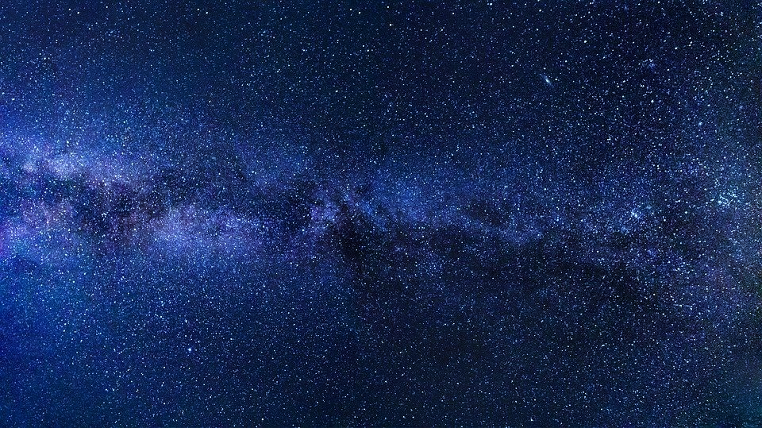




FLRW
Tensors
Derivation
$$g^{μν}$$
$$R_{μν}$$
$$Γ_{μν}^{σ}$$
$$R$$

Slide 2
Other Sources for Derivations:
Dietterich Labs Video: https://www.youtube.com/watch?v=cbRy3sXDJ-U
Helpful PDF: http://supernovae.in2p3.fr/~llg/Enseignements/NPAC/Cosmologie/course-02/course-02-notes.pdf

Slide 3

Relativity 110: Cosmology
Sources:
Einstein’s Static Universe Model
https://arxiv.org/ftp/arxiv/papers/1701/1701.07261.pdf
1917: “Cosmological Considerations in the General Theory of Relativity” Paper
https://einsteinpapers.press.princeton.edu/vol6-trans/433
History of Cosmology
Big Bang, Expansion of the universe, Cosmological Constant, Dark Energy
Friedmann-Lemaître-Robertson-Walker (FLRW) metric
FLRW Tensors
Comoving Coordinates + FLRW Geodesics
Universe as a perfect fluid + Cosmic Rest Frame
Friedmann Equations Derivation + Interpretation

Slide 4
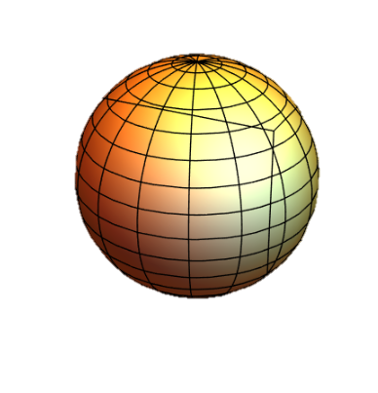
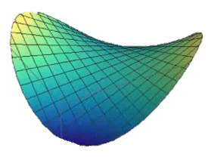
FLRW metric = 3 metrics in one
3 possible spatially homogeneous
and isotropic universes:
closed
flat
open

Slide 5
$$k=\left\{\begin{aligned}closed→+1 \\ flat→0 \\ open→−1\end{aligned}\right.$$
FLRW metric
$$g_{μν}→$$
$$\left[\begin{matrix}\begin{matrix}\begin{aligned}+1 \\ 0 \\ 0 \\ 0\end{aligned} & \begin{aligned}0 \\ −\frac{{\left(a(t)\right)}^{2}}{1−kr^{2}} \\ 0 \\ 0\end{aligned}\end{matrix} & \begin{matrix}\begin{aligned}0 \\ 0 \\ −{\left(a(t)r\right)}^{2} \\ 0\end{aligned} & \begin{aligned}0 \\ 0 \\ 0 \\ −{\left(a(t)r\sin{θ}\right)}^{2}\end{aligned}\end{matrix}\end{matrix}\right]$$

Slide 6
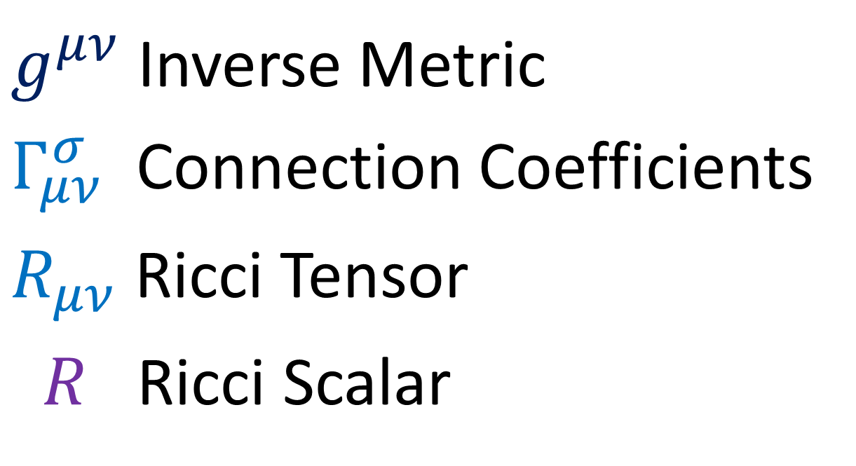

$g_{μν}$ FLRW Metric
$g^{μν}$ Inverse Metric
$Γ_{μν}^{σ}$ Connection Coefficients
$R_{μν}$ Ricci Tensor
$R$ Ricci Scalar
$R_{μν}−\frac{1}{2}Rg_{μν}−Λg_{μν}=\frac{8πG}{c^{4}}T_{μν}$ Einstein Field Equations

Slide 7
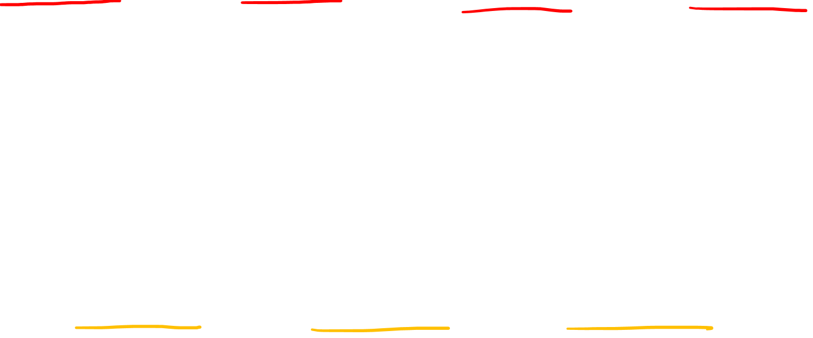
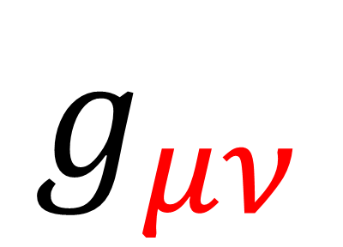
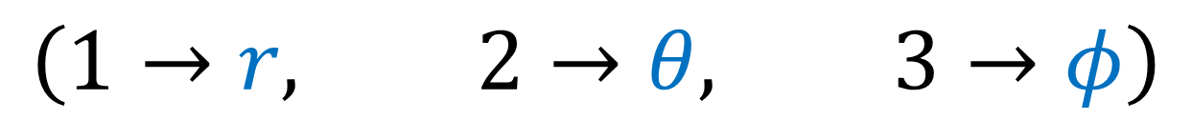

$$g_{μν}$$
Greek Letters = all 4 spacetime indices
$$\left(0→ct, 1→r, 2→θ, 3→φ\right)$$
$$M_{ij}$$
Latin/English Letters = 3 space indices
$$\left(1→r, 2→θ, 3→φ\right)$$

Slide 8
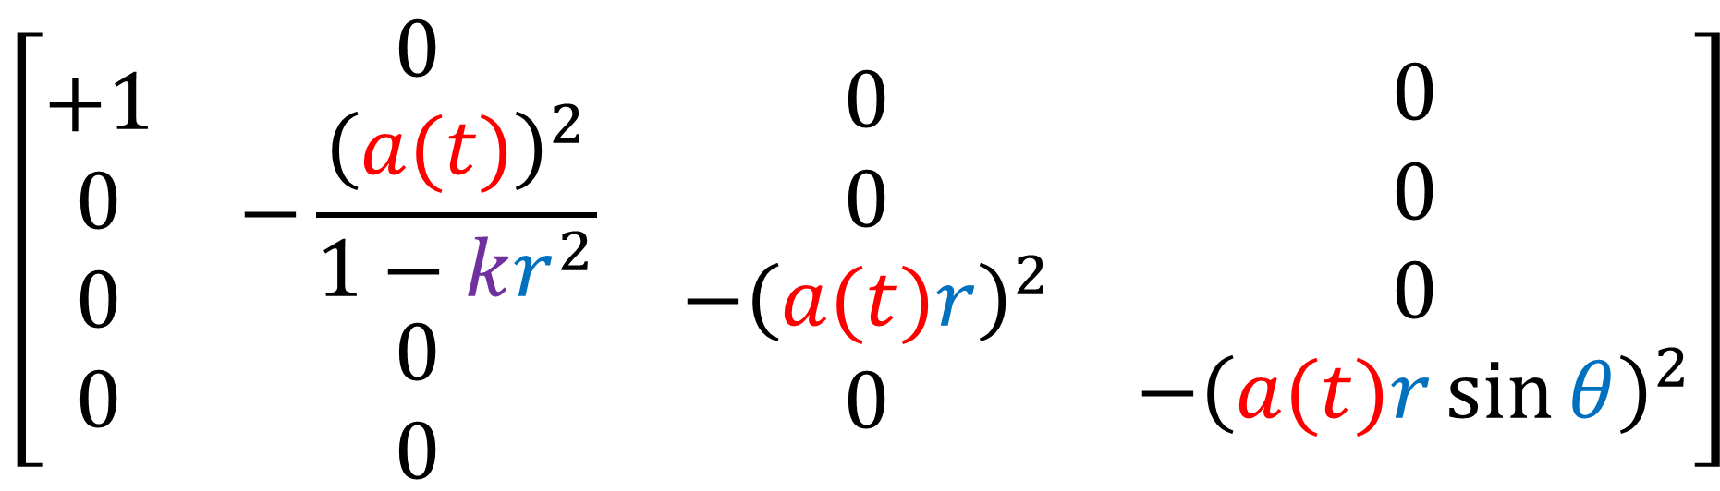
$$\left[\begin{matrix}\begin{matrix}\begin{aligned}+1 \\ 0 \\ 0 \\ 0\end{aligned} & \begin{aligned}0 \\ −\frac{{\left(a(t)\right)}^{2}}{1−kr^{2}} \\ 0 \\ 0\end{aligned}\end{matrix} & \begin{matrix}\begin{aligned}0 \\ 0 \\ −{\left(a(t)r\right)}^{2} \\ 0\end{aligned} & \begin{aligned}0 \\ 0 \\ 0 \\ −{\left(a(t)r\sin{θ}\right)}^{2}\end{aligned}\end{matrix}\end{matrix}\right]$$

Slide 9
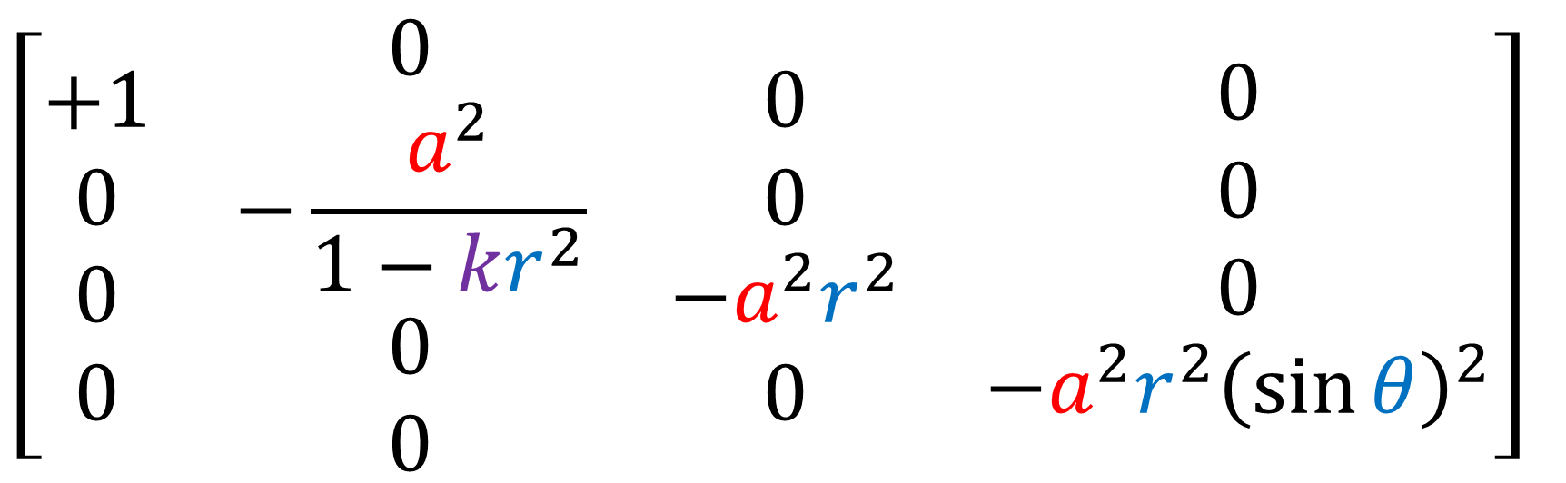
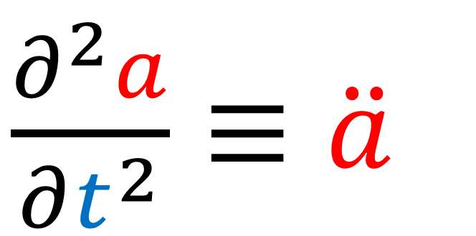
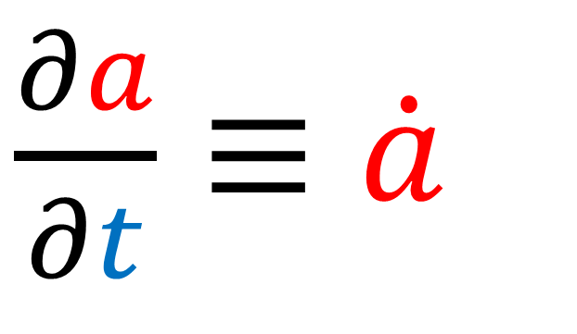
$$\left[\begin{matrix}\begin{matrix}\begin{aligned}+1 \\ 0 \\ 0 \\ 0\end{aligned} & \begin{aligned}0 \\ −\frac{a^{2}}{1−kr^{2}} \\ 0 \\ 0\end{aligned}\end{matrix} & \begin{matrix}\begin{aligned}0 \\ 0 \\ −a^{2}r^{2} \\ 0\end{aligned} & \begin{aligned}0 \\ 0 \\ 0 \\ −a^{2}r^{2}{\left(\sin{θ}\right)}^{2}\end{aligned}\end{matrix}\end{matrix}\right]$$
$\frac{∂a}{∂t}≡\dot{a}$
$\frac{∂^{2}a}{∂t^{2}}≡\ddot{a}$

Slide 10
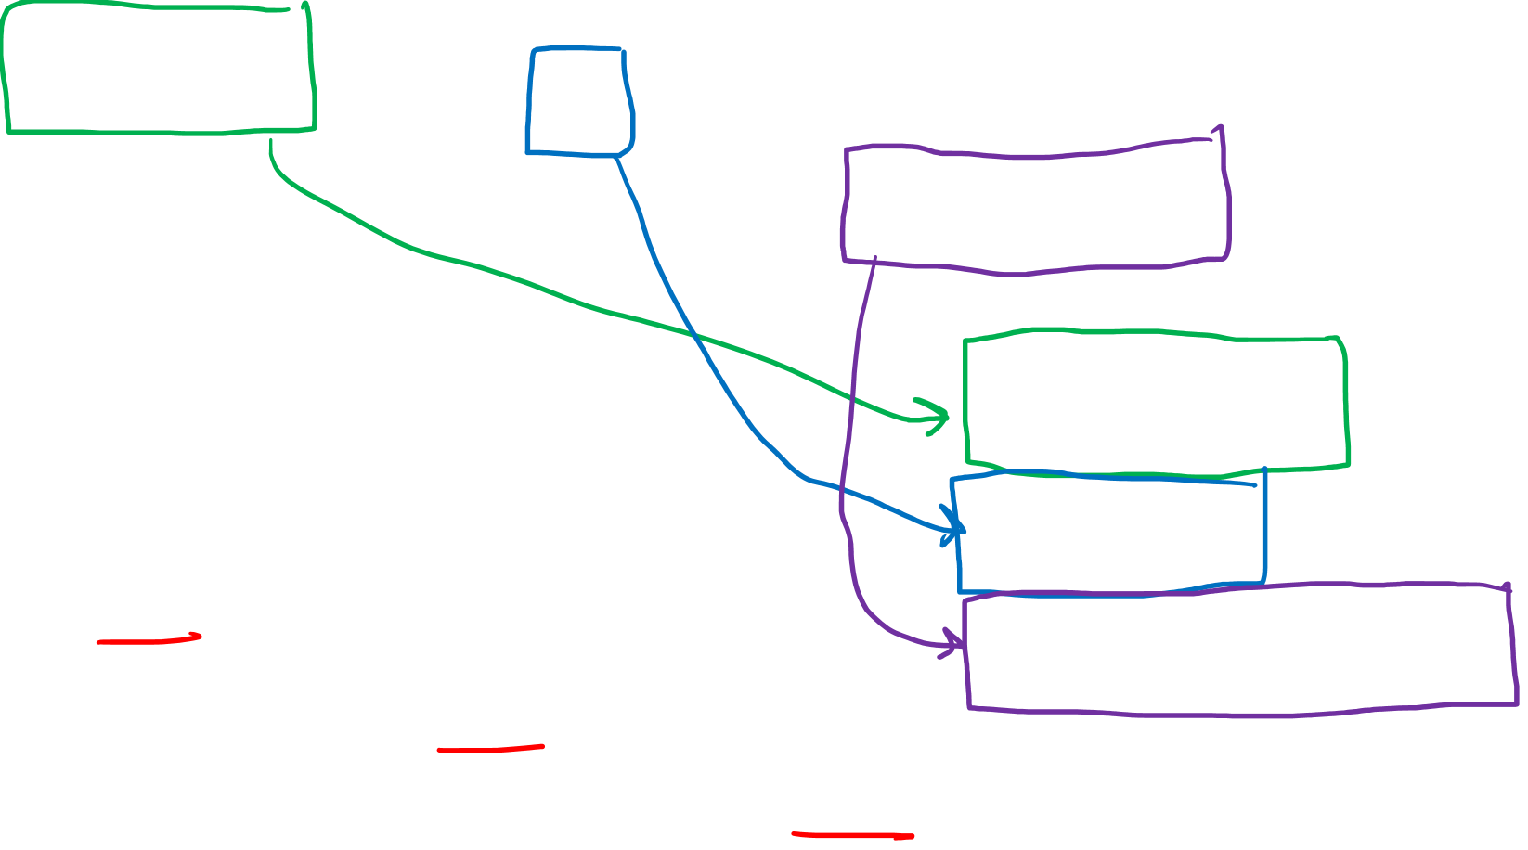
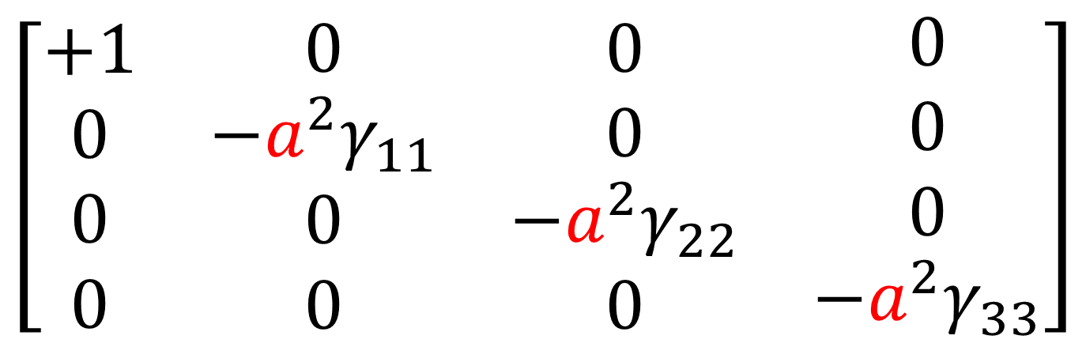
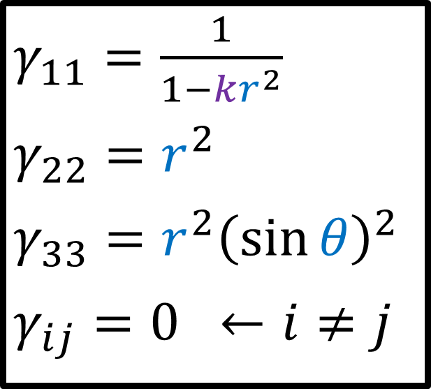
$$\left[\begin{matrix}\begin{matrix}\begin{aligned}+1 \\ 0 \\ 0 \\ 0\end{aligned} & \begin{aligned}0 \\ −\frac{a^{2}}{1−kr^{2}} \\ 0 \\ 0\end{aligned}\end{matrix} & \begin{matrix}\begin{aligned}0 \\ 0 \\ −a^{2}r^{2} \\ 0\end{aligned} & \begin{aligned}0 \\ 0 \\ 0 \\ −a^{2}r^{2}{\left(\sin{θ}\right)}^{2}\end{aligned}\end{matrix}\end{matrix}\right]$$
$γ_{11}=\frac{1}{1−kr^{2}}$
$$γ_{22}=r^{2}$$
$$γ_{33}=r^{2}{\left(\sin{θ}\right)}^{2}$$
$$γ_{ij}=0 ←i≠j$$
$$\left[\begin{matrix}\begin{matrix}\begin{aligned}+1 \\ 0 \\ 0 \\ 0\end{aligned} & \begin{aligned}0 \\ −a^{2}γ_{11} \\ 0 \\ 0\end{aligned}\end{matrix} & \begin{matrix}\begin{aligned}0 \\ 0 \\ −a^{2}γ_{22} \\ 0\end{aligned} & \begin{aligned}0 \\ 0 \\ 0 \\ −a^{2}γ_{33}\end{aligned}\end{matrix}\end{matrix}\right]$$

Slide 11
$g_{μν}$ FLRW Metric
$g^{μν}$ Inverse Metric
$Γ_{μν}^{σ}$ Connection Coefficients
$R_{μν}$ Ricci Tensor
$R$ Ricci Scalar
$R_{μν}−\frac{1}{2}Rg_{μν}−Λg_{μν}=\frac{8πG}{c^{4}}T_{μν}$ Einstein Field Equations

Slide 12
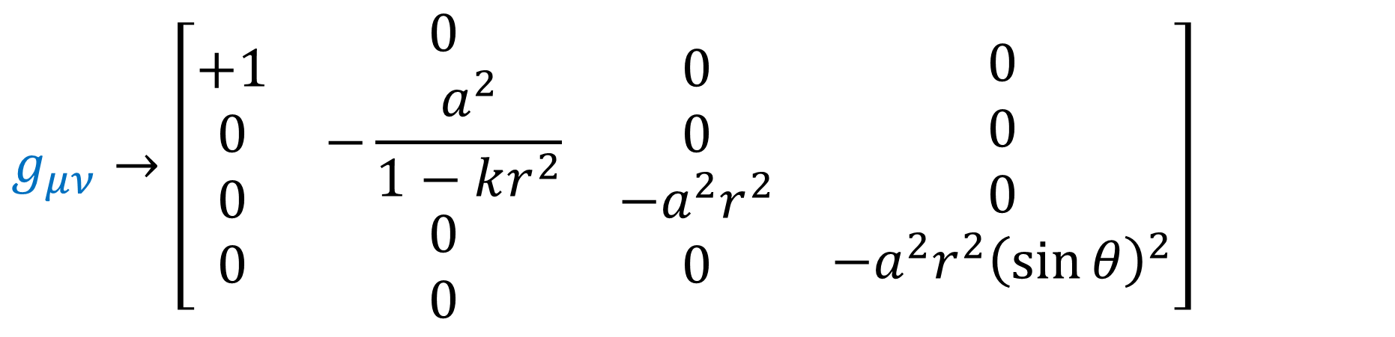
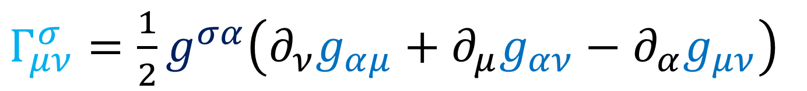
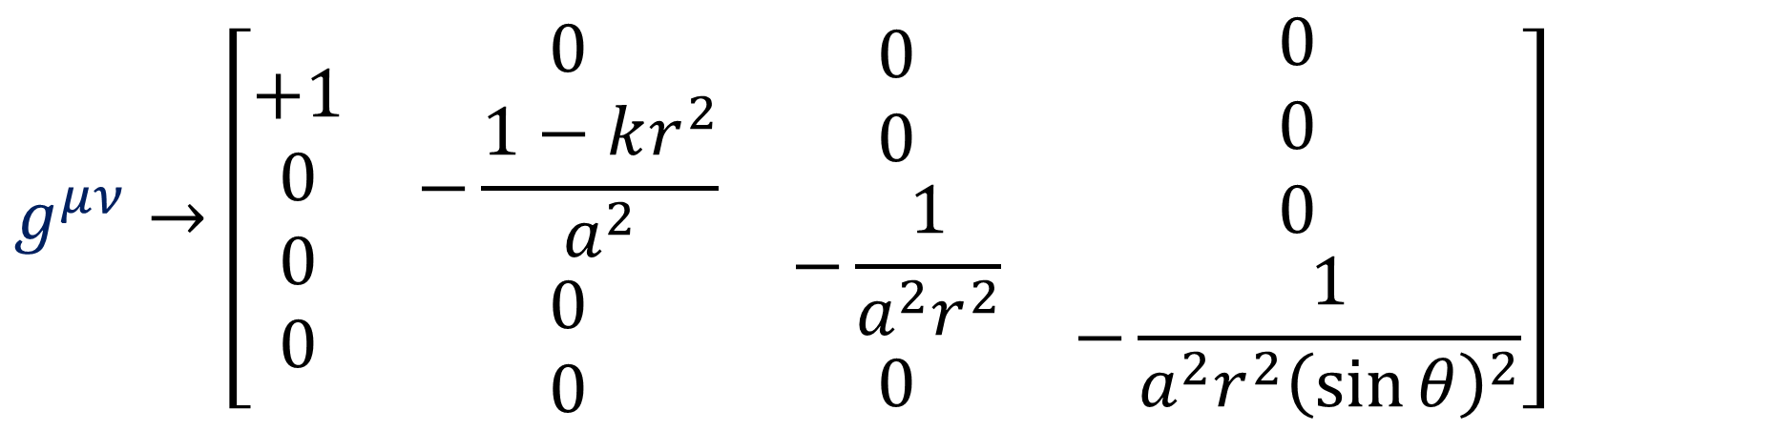
$$g_{μν}→\left[\begin{matrix}\begin{matrix}\begin{aligned}+1 \\ 0 \\ 0 \\ 0\end{aligned} & \begin{aligned}0 \\ −\frac{a^{2}}{1−kr^{2}} \\ 0 \\ 0\end{aligned}\end{matrix} & \begin{matrix}\begin{aligned}0 \\ 0 \\ −a^{2}r^{2} \\ 0\end{aligned} & \begin{aligned}0 \\ 0 \\ 0 \\ −a^{2}r^{2}{\left(\sin{θ}\right)}^{2}\end{aligned}\end{matrix}\end{matrix}\right]$$
$$g^{μν}→\left[\begin{matrix}\begin{matrix}\begin{aligned}+1 \\ 0 \\ 0 \\ 0\end{aligned} & \begin{aligned}0 \\ −\frac{1−kr^{2}}{a^{2}} \\ 0 \\ 0\end{aligned}\end{matrix} & \begin{matrix}\begin{aligned}0 \\ 0 \\ −\frac{1}{a^{2}r^{2}} \\ 0\end{aligned} & \begin{aligned}0 \\ 0 \\ 0 \\ −\frac{1}{a^{2}r^{2}{\left(\sin{θ}\right)}^{2}}\end{aligned}\end{matrix}\end{matrix}\right]$$
$Γ_{μν}^{σ}=\frac{1}{2}g^{σα}\left(∂_{ν}g_{αμ}+∂_{μ}g_{αν}−∂_{α}g_{μν}\right)$

Slide 13

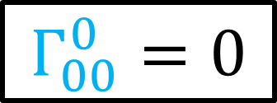
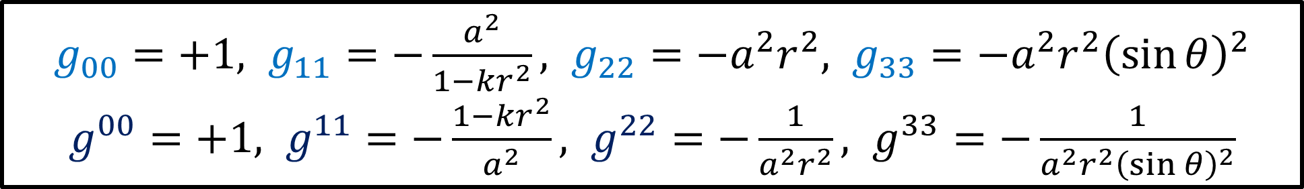
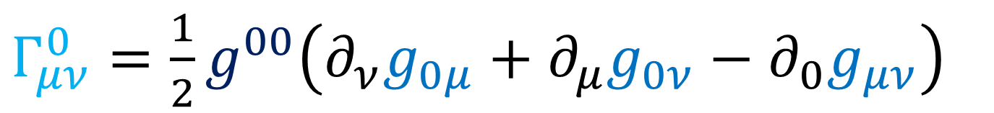
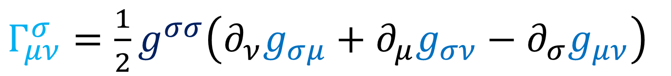
$g_{00}=+1, g_{11}=−\frac{a^{2}}{1−kr^{2}}, g_{22}=−a^{2}r^{2}, g_{33}=−a^{2}r^{2}{\left(\sin{θ}\right)}^{2}$
$g^{00}=+1, g^{11}=−\frac{1−kr^{2}}{a^{2}}, g^{22}=−\frac{1}{a^{2}r^{2}}, g^{33}=−\frac{1}{a^{2}r^{2}{\left(\sin{θ}\right)}^{2}}$
$Γ_{μν}^{σ}=\frac{1}{2}g^{σα}\left(∂_{ν}g_{αμ}+∂_{μ}g_{αν}−∂_{α}g_{μν}\right)$
$Γ_{μν}^{σ}=\frac{1}{2}g^{σσ}\left(∂_{ν}g_{σμ}+∂_{μ}g_{σν}−∂_{σ}g_{μν}\right)$
(diagonal metric)
$Γ_{μν}^{0}=\frac{1}{2}g^{00}\left(∂_{ν}g_{0μ}+∂_{μ}g_{0ν}−∂_{0}g_{μν}\right)$
$Γ_{00}^{0}⇒\frac{1}{2}g^{00}\left(∂_{0}g_{00}+∂_{0}g_{00}−∂_{0}g_{00}\right)=\frac{1}{2}g^{00}\left(∂_{0}g_{00}\right)=0$
$Γ_{00}^{0}=0$

Slide 14
$g_{00}=+1, g_{11}=−\frac{a^{2}}{1−kr^{2}}, g_{22}=−a^{2}r^{2}, g_{33}=−a^{2}r^{2}{\left(\sin{θ}\right)}^{2}$
$g^{00}=+1, g^{11}=−\frac{1−kr^{2}}{a^{2}}, g^{22}=−\frac{1}{a^{2}r^{2}}, g^{33}=−\frac{1}{a^{2}r^{2}{\left(\sin{θ}\right)}^{2}}$
$Γ_{μν}^{σ}=\frac{1}{2}g^{σα}\left(∂_{ν}g_{αμ}+∂_{μ}g_{αν}−∂_{α}g_{μν}\right)$
$Γ_{μν}^{σ}=\frac{1}{2}g^{σσ}\left(∂_{ν}g_{σμ}+∂_{μ}g_{σν}−∂_{σ}g_{μν}\right)$
(diagonal metric)
$Γ_{μν}^{0}=\frac{1}{2}g^{00}\left(∂_{ν}g_{0μ}+∂_{μ}g_{0ν}−∂_{0}g_{μν}\right)$
$Γ_{ii}^{0}⇒\frac{1}{2}g^{00}\left(∂_{i}g_{0i}+∂_{i}g_{0i}−∂_{0}g_{ii}\right)=\frac{1}{2}g^{00}\left(−∂_{0}g_{ii}\right)$
$=\frac{1}{2}\left(+1\right)\frac{1}{c}\frac{∂}{∂t}\left(−a^{2}γ_{ii}\right)=−\frac{1}{2}\left(\frac{2a}{c}\frac{∂}{∂t}\left(a\right)γ_{ii}\right)=−\frac{a\dot{a}}{c}γ_{ii}$

Slide 15
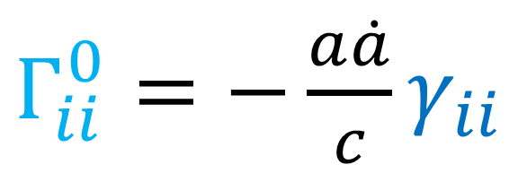
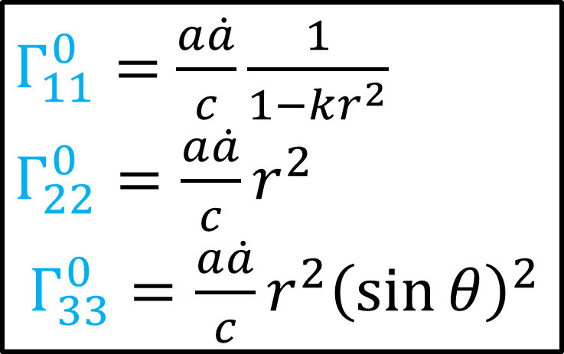
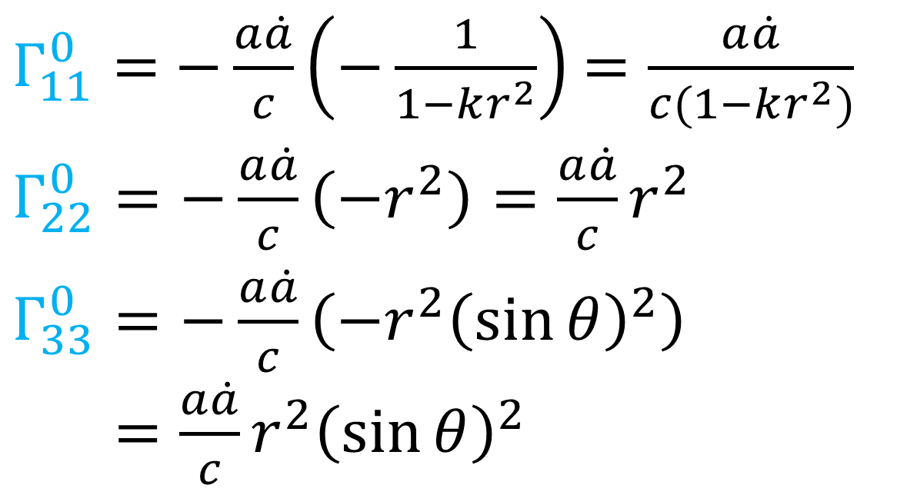
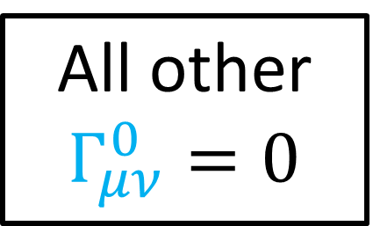
$g_{00}=+1, g_{11}=−\frac{a^{2}}{1−kr^{2}}, g_{22}=−a^{2}r^{2}, g_{33}=−a^{2}r^{2}{\left(\sin{θ}\right)}^{2}$
$g^{00}=+1, g^{11}=−\frac{1−kr^{2}}{a^{2}}, g^{22}=−\frac{1}{a^{2}r^{2}}, g^{33}=−\frac{1}{a^{2}r^{2}{\left(\sin{θ}\right)}^{2}}$
$Γ_{ii}^{0}=−\frac{a\dot{a}}{c}γ_{ii}$
$Γ_{11}^{0}=$ $\frac{a\dot{a}}{c}\frac{1}{1−kr^{2}}$
$Γ_{22}^{0}=\frac{a\dot{a}}{c}r^{2}$
$Γ_{33}^{0}=\frac{a\dot{a}}{c}r^{2}{\left(\sin{θ}\right)}^{2}$
$Γ_{11}^{0}=$ $−\frac{a\dot{a}}{c}\left(−\frac{1}{1−kr^{2}}\right)$ $=\frac{a\dot{a}}{c(1−kr^{2})}$
$Γ_{22}^{0}=−\frac{a\dot{a}}{c}\left(−r^{2}\right)=\frac{a\dot{a}}{c}r^{2}$
$Γ_{33}^{0}=−\frac{a\dot{a}}{c}\left(−r^{2}{\left(\sin{θ}\right)}^{2}\right)$ $Γ_{33}^{0}=\frac{a\dot{a}}{c}r^{2}{\left(\sin{θ}\right)}^{2}$
All other $Γ_{μν}^{0}=0$

Slide 16


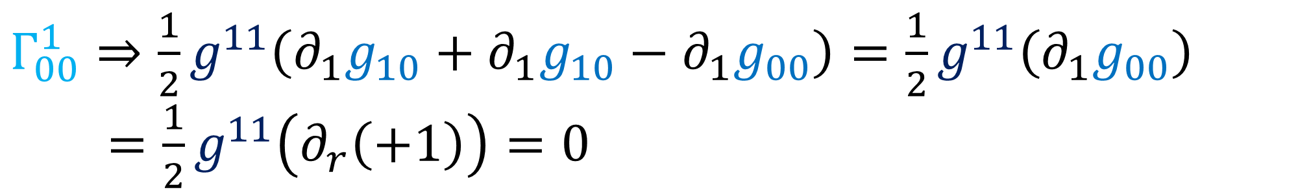
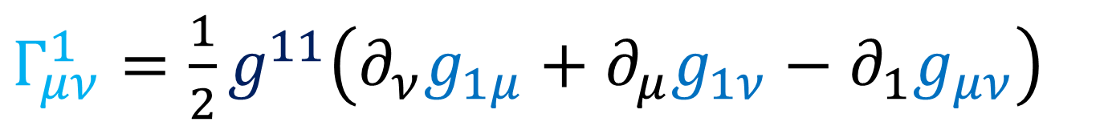
$g_{00}=+1, g_{11}=−\frac{a^{2}}{1−kr^{2}}, g_{22}=−a^{2}r^{2}, g_{33}=−a^{2}r^{2}{\left(\sin{θ}\right)}^{2}$
$g^{00}=+1, g^{11}=−\frac{1−kr^{2}}{a^{2}}, g^{22}=−\frac{1}{a^{2}r^{2}}, g^{33}=−\frac{1}{a^{2}r^{2}{\left(\sin{θ}\right)}^{2}}$
$Γ_{μν}^{σ}=\frac{1}{2}g^{σσ}\left(∂_{ν}g_{σμ}+∂_{μ}g_{σν}−∂_{σ}g_{μν}\right)$
(diagonal metric)
$Γ_{μν}^{1}=\frac{1}{2}g^{11}\left(∂_{ν}g_{1μ}+∂_{μ}g_{1ν}−∂_{1}g_{μν}\right)$
$Γ_{00}^{1}⇒\frac{1}{2}g^{11}\left(∂_{1}g_{10}+∂_{1}g_{10}−∂_{1}g_{00}\right)=\frac{1}{2}g^{11}\left(∂_{1}g_{00}\right)$
$=\frac{1}{2}g^{11}\left(∂_{r}\left(+1\right)\right)=0$
$Γ_{00}^{1}=0$

Slide 17

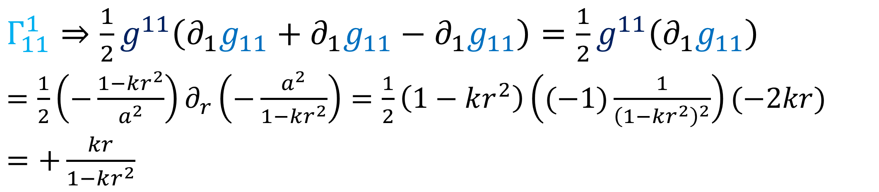
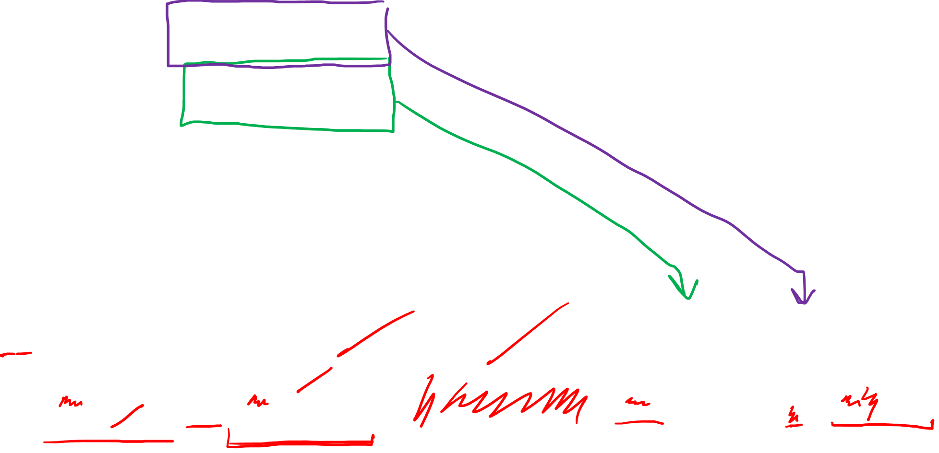
$g_{00}=+1, g_{11}=−\frac{a^{2}}{1−kr^{2}}, g_{22}=−a^{2}r^{2}, g_{33}=−a^{2}r^{2}{\left(\sin{θ}\right)}^{2}$
$g^{00}=+1, g^{11}=−\frac{1−kr^{2}}{a^{2}}, g^{22}=−\frac{1}{a^{2}r^{2}}, g^{33}=−\frac{1}{a^{2}r^{2}{\left(\sin{θ}\right)}^{2}}$
$Γ_{μν}^{σ}=\frac{1}{2}g^{σσ}\left(∂_{ν}g_{σμ}+∂_{μ}g_{σν}−∂_{σ}g_{μν}\right)$
(diagonal metric)
$Γ_{μν}^{1}=\frac{1}{2}g^{11}\left(∂_{ν}g_{1μ}+∂_{μ}g_{1ν}−∂_{1}g_{μν}\right)$
$Γ_{11}^{1}⇒\frac{1}{2}g^{11}\left(∂_{1}g_{11}+∂_{1}g_{11}−∂_{1}g_{11}\right)=\frac{1}{2}g^{11}\left(∂_{1}g_{11}\right)$
$=\frac{1}{2}\left(−\frac{1−kr^{2}}{a^{2}}\right)∂_{r}\left(−\frac{a^{2}}{1−kr^{2}}\right)=\frac{1}{2}\left(1−kr^{2}\right)\left((−1)\frac{1}{{\left(1−kr^{2}\right)}^{2}}\right)(−2kr)$
$=+\frac{kr}{1−kr^{2}}$
$Γ_{11}^{1}=\frac{kr}{1−kr^{2}}$

Slide 18
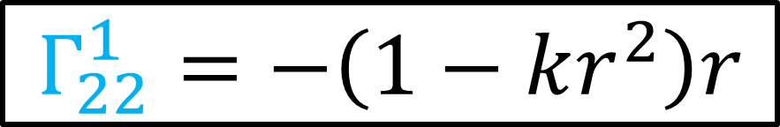
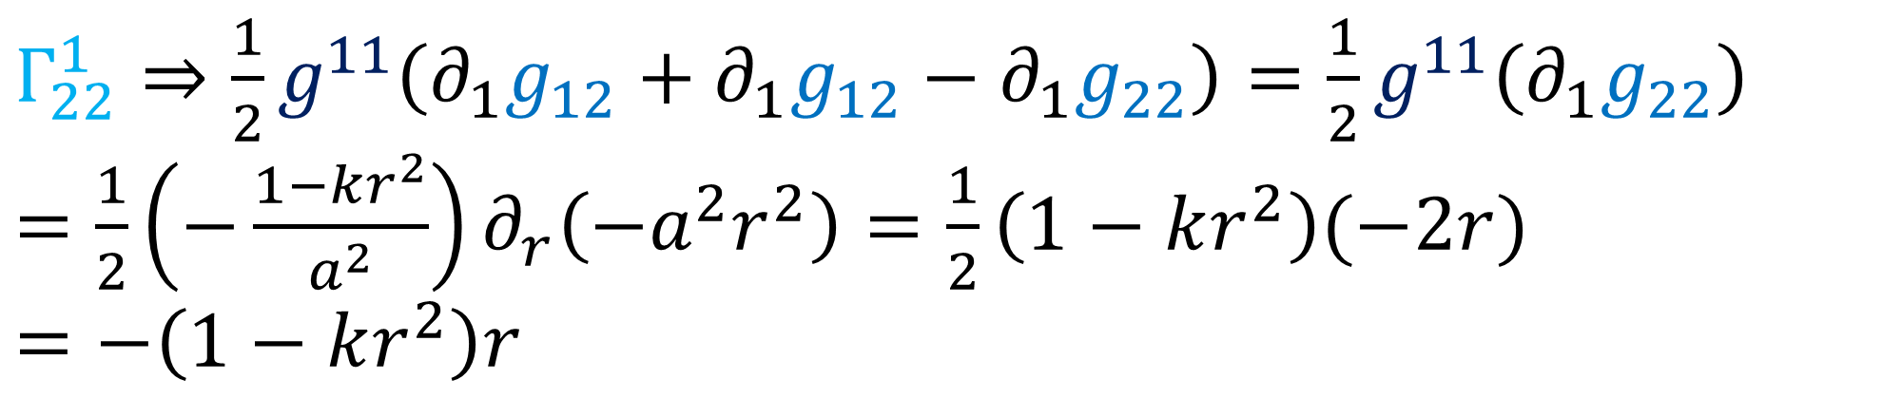
$g_{00}=+1, g_{11}=−\frac{a^{2}}{1−kr^{2}}, g_{22}=−a^{2}r^{2}, g_{33}=−a^{2}r^{2}{\left(\sin{θ}\right)}^{2}$
$g^{00}=+1, g^{11}=−\frac{1−kr^{2}}{a^{2}}, g^{22}=−\frac{1}{a^{2}r^{2}}, g^{33}=−\frac{1}{a^{2}r^{2}{\left(\sin{θ}\right)}^{2}}$
$Γ_{μν}^{σ}=\frac{1}{2}g^{σσ}\left(∂_{ν}g_{σμ}+∂_{μ}g_{σν}−∂_{σ}g_{μν}\right)$
(diagonal metric)
$Γ_{μν}^{1}=\frac{1}{2}g^{11}\left(∂_{ν}g_{1μ}+∂_{μ}g_{1ν}−∂_{1}g_{μν}\right)$
$Γ_{22}^{1}⇒\frac{1}{2}g^{11}\left(∂_{1}g_{12}+∂_{1}g_{12}−∂_{1}g_{22}\right)=\frac{1}{2}g^{11}\left(∂_{1}g_{22}\right)$
$=\frac{1}{2}\left(−\frac{1−kr^{2}}{a^{2}}\right)∂_{r}\left(−a^{2}r^{2}\right)=\frac{1}{2}\left(1−kr^{2}\right)(−2r)$
$=−\left(1−kr^{2}\right)r$
$$Γ_{22}^{1}=−\left(1−kr^{2}\right)r$$

Slide 19
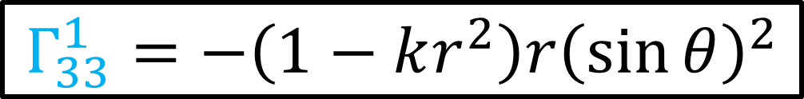
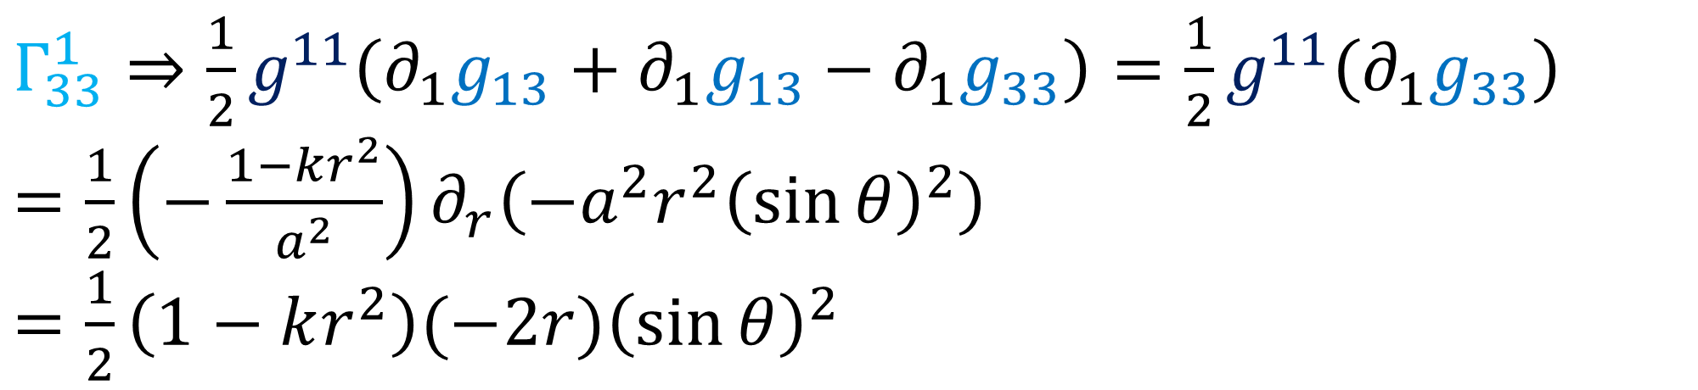
$g_{00}=+1, g_{11}=−\frac{a^{2}}{1−kr^{2}}, g_{22}=−a^{2}r^{2}, g_{33}=−a^{2}r^{2}{\left(\sin{θ}\right)}^{2}$
$g^{00}=+1, g^{11}=−\frac{1−kr^{2}}{a^{2}}, g^{22}=−\frac{1}{a^{2}r^{2}}, g^{33}=−\frac{1}{a^{2}r^{2}{\left(\sin{θ}\right)}^{2}}$
$Γ_{μν}^{σ}=\frac{1}{2}g^{σσ}\left(∂_{ν}g_{σμ}+∂_{μ}g_{σν}−∂_{σ}g_{μν}\right)$
(diagonal metric)
$Γ_{μν}^{1}=\frac{1}{2}g^{11}\left(∂_{ν}g_{1μ}+∂_{μ}g_{1ν}−∂_{1}g_{μν}\right)$
$Γ_{33}^{1}⇒\frac{1}{2}g^{11}\left(∂_{1}g_{13}+∂_{1}g_{13}−∂_{1}g_{33}\right)=\frac{1}{2}g^{11}\left(∂_{1}g_{33}\right)$
$=\frac{1}{2}\left(−\frac{1−kr^{2}}{a^{2}}\right)∂_{r}\left(−a^{2}r^{2}{\left(\sin{θ}\right)}^{2}\right)$
$=\frac{1}{2}\left(1−kr^{2}\right)(−2r){\left(\sin{θ}\right)}^{2}$
$$Γ_{33}^{1}=−\left(1−kr^{2}\right)r{\left(\sin{θ}\right)}^{2}$$

Slide 20
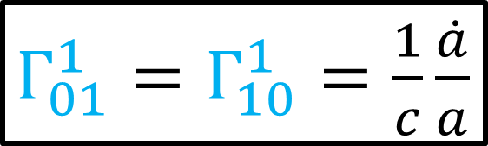
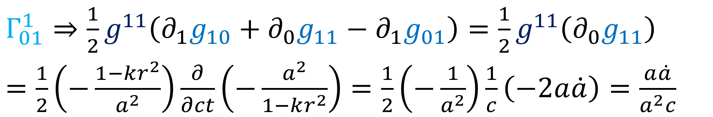
$g_{00}=+1, g_{11}=−\frac{a^{2}}{1−kr^{2}}, g_{22}=−a^{2}r^{2}, g_{33}=−a^{2}r^{2}{\left(\sin{θ}\right)}^{2}$
$g^{00}=+1, g^{11}=−\frac{1−kr^{2}}{a^{2}}, g^{22}=−\frac{1}{a^{2}r^{2}}, g^{33}=−\frac{1}{a^{2}r^{2}{\left(\sin{θ}\right)}^{2}}$
$Γ_{μν}^{σ}=\frac{1}{2}g^{σσ}\left(∂_{ν}g_{σμ}+∂_{μ}g_{σν}−∂_{σ}g_{μν}\right)$
(diagonal metric)
$Γ_{μν}^{1}=\frac{1}{2}g^{11}\left(∂_{ν}g_{1μ}+∂_{μ}g_{1ν}−∂_{1}g_{μν}\right)$
$Γ_{01}^{1}⇒\frac{1}{2}g^{11}\left(∂_{1}g_{10}+∂_{0}g_{11}−∂_{1}g_{01}\right)=\frac{1}{2}g^{11}\left(∂_{0}g_{11}\right)$
$=\frac{1}{2}\left(−\frac{1−kr^{2}}{a^{2}}\right)\frac{∂}{∂ct}\left(−\frac{a^{2}}{1−kr^{2}}\right)=\frac{1}{2}\left(−\frac{1}{a^{2}}\right)\frac{1}{c}\left(−2a\dot{a}\right)=\frac{a\dot{a}}{a^{2}c}$
$Γ_{01}^{1}=Γ_{10}^{1}=\frac{1}{c}\frac{\dot{a}}{a}$

Slide 21
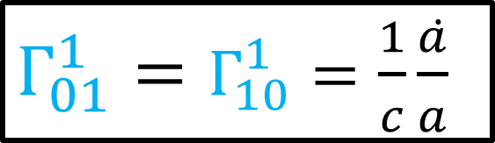
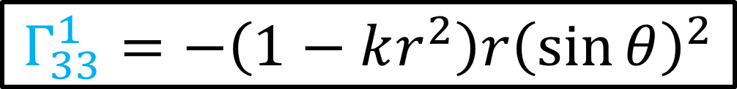
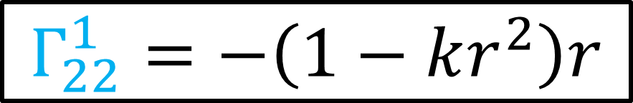
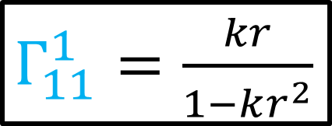
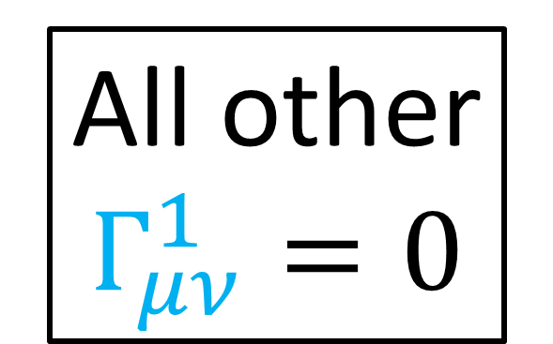
$g_{00}=+1, g_{11}=−\frac{a^{2}}{1−kr^{2}}, g_{22}=−a^{2}r^{2}, g_{33}=−a^{2}r^{2}{\left(\sin{θ}\right)}^{2}$
$g^{00}=+1, g^{11}=−\frac{1−kr^{2}}{a^{2}}, g^{22}=−\frac{1}{a^{2}r^{2}}, g^{33}=−\frac{1}{a^{2}r^{2}{\left(\sin{θ}\right)}^{2}}$
$Γ_{μν}^{σ}=\frac{1}{2}g^{σσ}\left(∂_{ν}g_{σμ}+∂_{μ}g_{σν}−∂_{σ}g_{μν}\right)$
(diagonal metric)
$Γ_{μν}^{1}=\frac{1}{2}g^{11}\left(∂_{ν}g_{1μ}+∂_{μ}g_{1ν}−∂_{1}g_{μν}\right)$
$Γ_{11}^{1}=\frac{kr}{1−kr^{2}}$
$Γ_{01}^{1}=Γ_{10}^{1}=\frac{1}{c}\frac{\dot{a}}{a}$
All other
$Γ_{μν}^{1}=0$
$$Γ_{22}^{1}=−\left(1−kr^{2}\right)r$$
$$Γ_{33}^{1}=−\left(1−kr^{2}\right)r{\left(\sin{θ}\right)}^{2}$$

Slide 22
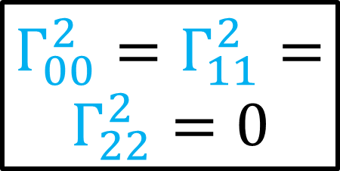
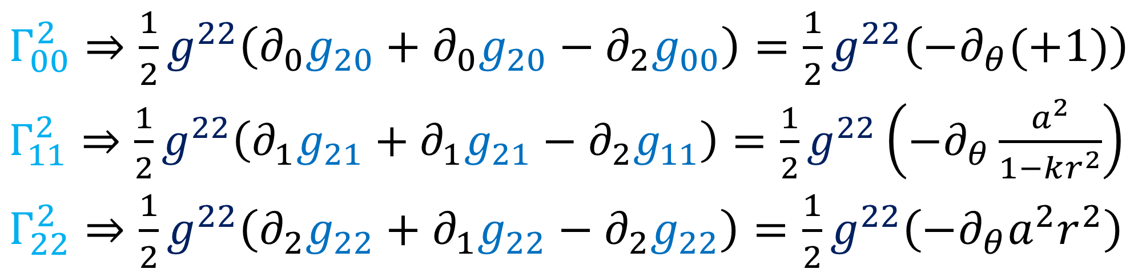
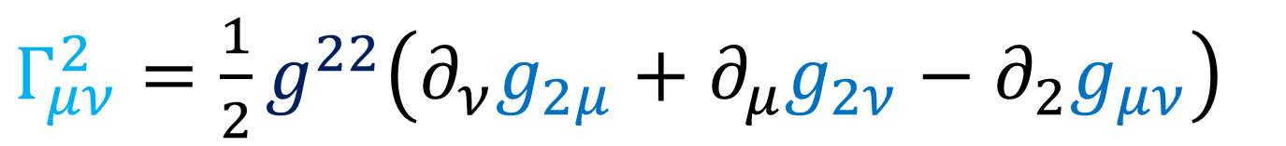
$g_{00}=+1, g_{11}=−\frac{a^{2}}{1−kr^{2}}, g_{22}=−a^{2}r^{2}, g_{33}=−a^{2}r^{2}{\left(\sin{θ}\right)}^{2}$
$g^{00}=+1, g^{11}=−\frac{1−kr^{2}}{a^{2}}, g^{22}=−\frac{1}{a^{2}r^{2}}, g^{33}=−\frac{1}{a^{2}r^{2}{\left(\sin{θ}\right)}^{2}}$
$Γ_{μν}^{σ}=\frac{1}{2}g^{σσ}\left(∂_{ν}g_{σμ}+∂_{μ}g_{σν}−∂_{σ}g_{μν}\right)$
(diagonal metric)
$Γ_{μν}^{2}=\frac{1}{2}g^{22}\left(∂_{ν}g_{2μ}+∂_{μ}g_{2ν}−∂_{2}g_{μν}\right)$
$Γ_{00}^{2}=Γ_{11}^{2}=Γ_{22}^{2}=0$
$Γ_{00}^{2}⇒\frac{1}{2}g^{22}\left(∂_{0}g_{20}+∂_{0}g_{20}−∂_{2}g_{00}\right)=\frac{1}{2}g^{22}\left(−∂_{θ}(+1)\right)$
$Γ_{11}^{2}⇒\frac{1}{2}g^{22}\left(∂_{1}g_{21}+∂_{1}g_{21}−∂_{2}g_{11}\right)=\frac{1}{2}g^{22}\left(−∂_{θ}\frac{a^{2}}{1−kr^{2}}\right)$
$Γ_{22}^{2}⇒\frac{1}{2}g^{22}\left(∂_{2}g_{22}+∂_{1}g_{22}−∂_{2}g_{22}\right)=\frac{1}{2}g^{22}\left(−∂_{θ}a^{2}r^{2}\right)$

Slide 23
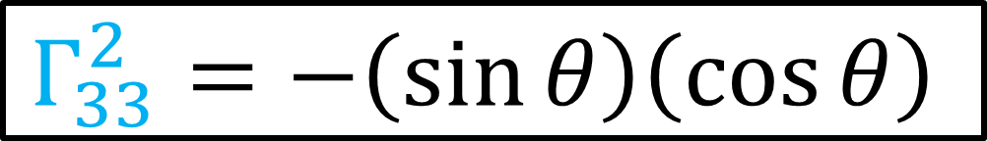
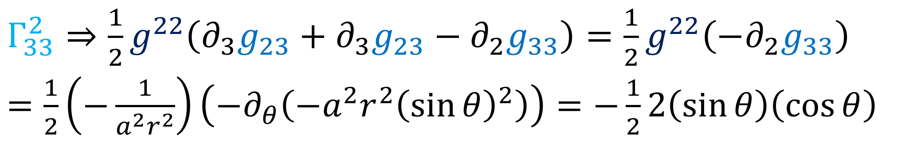
$g_{00}=+1, g_{11}=−\frac{a^{2}}{1−kr^{2}}, g_{22}=−a^{2}r^{2}, g_{33}=−a^{2}r^{2}{\left(\sin{θ}\right)}^{2}$
$g^{00}=+1, g^{11}=−\frac{1−kr^{2}}{a^{2}}, g^{22}=−\frac{1}{a^{2}r^{2}}, g^{33}=−\frac{1}{a^{2}r^{2}{\left(\sin{θ}\right)}^{2}}$
$Γ_{μν}^{σ}=\frac{1}{2}g^{σσ}\left(∂_{ν}g_{σμ}+∂_{μ}g_{σν}−∂_{σ}g_{μν}\right)$
(diagonal metric)
$Γ_{μν}^{2}=\frac{1}{2}g^{22}\left(∂_{ν}g_{2μ}+∂_{μ}g_{2ν}−∂_{2}g_{μν}\right)$
$Γ_{33}^{2}⇒\frac{1}{2}g^{22}\left(∂_{3}g_{23}+∂_{3}g_{23}−∂_{2}g_{33}\right)=\frac{1}{2}g^{22}\left(−∂_{2}g_{33}\right)$
$=\frac{1}{2}\left(−\frac{1}{a^{2}r^{2}}\right)\left(−∂_{θ}\left(−a^{2}r^{2}{\left(\sin{θ}\right)}^{2}\right)\right)=−\frac{1}{2}2\left(\sin{θ}\right)\left(\cos{θ}\right)$
$$Γ_{33}^{2}=−\left(\sin{θ}\right)\left(\cos{θ}\right)$$

Slide 24

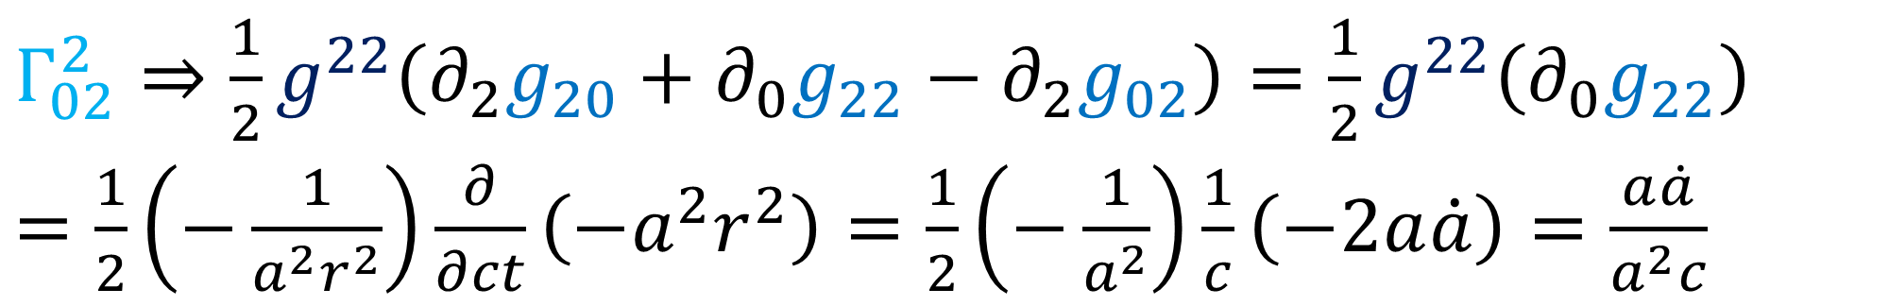
$g_{00}=+1, g_{11}=−\frac{a^{2}}{1−kr^{2}}, g_{22}=−a^{2}r^{2}, g_{33}=−a^{2}r^{2}{\left(\sin{θ}\right)}^{2}$
$g^{00}=+1, g^{11}=−\frac{1−kr^{2}}{a^{2}}, g^{22}=−\frac{1}{a^{2}r^{2}}, g^{33}=−\frac{1}{a^{2}r^{2}{\left(\sin{θ}\right)}^{2}}$
$Γ_{μν}^{σ}=\frac{1}{2}g^{σσ}\left(∂_{ν}g_{σμ}+∂_{μ}g_{σν}−∂_{σ}g_{μν}\right)$
(diagonal metric)
$Γ_{μν}^{2}=\frac{1}{2}g^{22}\left(∂_{ν}g_{2μ}+∂_{μ}g_{2ν}−∂_{2}g_{μν}\right)$
$Γ_{02}^{2}⇒\frac{1}{2}g^{22}\left(∂_{2}g_{20}+∂_{0}g_{22}−∂_{2}g_{02}\right)=\frac{1}{2}g^{22}\left(∂_{0}g_{22}\right)$
$=\frac{1}{2}\left(−\frac{1}{a^{2}r^{2}}\right)\frac{∂}{∂ct}\left(−a^{2}r^{2}\right)=\frac{1}{2}\left(−\frac{1}{a^{2}}\right)\frac{1}{c}\left(−2a\dot{a}\right)=\frac{a\dot{a}}{a^{2}c}$
$Γ_{02}^{2}=Γ_{20}^{2}=\frac{1}{c}\frac{\dot{a}}{a}$

Slide 25


$g_{00}=+1, g_{11}=−\frac{a^{2}}{1−kr^{2}}, g_{22}=−a^{2}r^{2}, g_{33}=−a^{2}r^{2}{\left(\sin{θ}\right)}^{2}$
$g^{00}=+1, g^{11}=−\frac{1−kr^{2}}{a^{2}}, g^{22}=−\frac{1}{a^{2}r^{2}}, g^{33}=−\frac{1}{a^{2}r^{2}{\left(\sin{θ}\right)}^{2}}$
$Γ_{μν}^{σ}=\frac{1}{2}g^{σσ}\left(∂_{ν}g_{σμ}+∂_{μ}g_{σν}−∂_{σ}g_{μν}\right)$
(diagonal metric)
$Γ_{μν}^{2}=\frac{1}{2}g^{22}\left(∂_{ν}g_{2μ}+∂_{μ}g_{2ν}−∂_{2}g_{μν}\right)$
$Γ_{12}^{2}⇒\frac{1}{2}g^{22}\left(∂_{2}g_{21}+∂_{1}g_{22}−∂_{2}g_{12}\right)=\frac{1}{2}g^{22}\left(∂_{1}g_{22}\right)$
$=\frac{1}{2}\left(−\frac{1}{a^{2}r^{2}}\right)∂_{r}\left(−a^{2}r^{2}\right)=\frac{1}{2}\left(\frac{1}{r^{2}}\right)\left(2r\right)=\frac{1}{r}$
$Γ_{12}^{2}=Γ_{21}^{2}=\frac{1}{r}$

Slide 26

$g_{00}=+1, g_{11}=−\frac{a^{2}}{1−kr^{2}}, g_{22}=−a^{2}r^{2}, g_{33}=−a^{2}r^{2}{\left(\sin{θ}\right)}^{2}$
$g^{00}=+1, g^{11}=−\frac{1−kr^{2}}{a^{2}}, g^{22}=−\frac{1}{a^{2}r^{2}}, g^{33}=−\frac{1}{a^{2}r^{2}{\left(\sin{θ}\right)}^{2}}$
$Γ_{μν}^{σ}=\frac{1}{2}g^{σσ}\left(∂_{ν}g_{σμ}+∂_{μ}g_{σν}−∂_{σ}g_{μν}\right)$
(diagonal metric)
$Γ_{μν}^{2}=\frac{1}{2}g^{22}\left(∂_{ν}g_{2μ}+∂_{μ}g_{2ν}−∂_{2}g_{μν}\right)$
$Γ_{32}^{2}⇒\frac{1}{2}g^{22}\left(∂_{2}g_{23}+∂_{3}g_{22}−∂_{2}g_{32}\right)=\frac{1}{2}g^{22}\left(∂_{φ}g_{22}\right)$
$$Γ_{32}^{2}=0$$

Slide 27




$g_{00}=+1, g_{11}=−\frac{a^{2}}{1−kr^{2}}, g_{22}=−a^{2}r^{2}, g_{33}=−a^{2}r^{2}{\left(\sin{θ}\right)}^{2}$
$g^{00}=+1, g^{11}=−\frac{1−kr^{2}}{a^{2}}, g^{22}=−\frac{1}{a^{2}r^{2}}, g^{33}=−\frac{1}{a^{2}r^{2}{\left(\sin{θ}\right)}^{2}}$
$Γ_{μν}^{σ}=\frac{1}{2}g^{σσ}\left(∂_{ν}g_{σμ}+∂_{μ}g_{σν}−∂_{σ}g_{μν}\right)$
(diagonal metric)
$Γ_{μν}^{2}=\frac{1}{2}g^{22}\left(∂_{ν}g_{2μ}+∂_{μ}g_{2ν}−∂_{2}g_{μν}\right)$
$$Γ_{33}^{2}=−\left(\sin{θ}\right)\left(\cos{θ}\right)$$
All other
$Γ_{μν}^{2}=0$
$Γ_{02}^{2}=Γ_{20}^{2}=\frac{1}{c}\frac{\dot{a}}{a}$
$Γ_{12}^{2}=Γ_{21}^{2}=\frac{1}{r}$

Slide 28


$g_{00}=+1, g_{11}=−\frac{a^{2}}{1−kr^{2}}, g_{22}=−a^{2}r^{2}, g_{33}=−a^{2}r^{2}{\left(\sin{θ}\right)}^{2}$
$g^{00}=+1, g^{11}=−\frac{1−kr^{2}}{a^{2}}, g^{22}=−\frac{1}{a^{2}r^{2}}, g^{33}=−\frac{1}{a^{2}r^{2}{\left(\sin{θ}\right)}^{2}}$
$Γ_{μν}^{σ}=\frac{1}{2}g^{σσ}\left(∂_{ν}g_{σμ}+∂_{μ}g_{σν}−∂_{σ}g_{μν}\right)$
(diagonal metric)
$Γ_{μν}^{3}=\frac{1}{2}g^{33}\left(∂_{ν}g_{3μ}+∂_{μ}g_{3ν}−∂_{3}g_{μν}\right)$
$Γ_{μμ}^{3}⇒\frac{1}{2}g^{33}\left(∂_{μ}g_{3μ}+∂_{μ}g_{3μ}−∂_{3}g_{μμ}\right)=\frac{1}{2}g^{33}\left(−∂_{φ}g_{μμ}\right)$
$$Γ_{μμ}^{3}=0$$

Slide 29


$g_{00}=+1, g_{11}=−\frac{a^{2}}{1−kr^{2}}, g_{22}=−a^{2}r^{2}, g_{33}=−a^{2}r^{2}{\left(\sin{θ}\right)}^{2}$
$g^{00}=+1, g^{11}=−\frac{1−kr^{2}}{a^{2}}, g^{22}=−\frac{1}{a^{2}r^{2}}, g^{33}=−\frac{1}{a^{2}r^{2}{\left(\sin{θ}\right)}^{2}}$
$Γ_{μν}^{σ}=\frac{1}{2}g^{σσ}\left(∂_{ν}g_{σμ}+∂_{μ}g_{σν}−∂_{σ}g_{μν}\right)$
(diagonal metric)
$Γ_{μν}^{3}=\frac{1}{2}g^{33}\left(∂_{ν}g_{3μ}+∂_{μ}g_{3ν}−∂_{3}g_{μν}\right)$
$Γ_{03}^{3}⇒\frac{1}{2}g^{33}\left(∂_{3}g_{30}+∂_{0}g_{33}−∂_{3}g_{03}\right)=\frac{1}{2}g^{33}\left(∂_{0}g_{33}\right)$
$=\frac{1}{2}\left(−\frac{1}{a^{2}r^{2}{\left(\sin{θ}\right)}^{2}}\right)\frac{∂}{∂ct}\left(−a^{2}r^{2}{\left(\sin{θ}\right)}^{2}\right)$
$=\frac{1}{2}\left(−\frac{1}{a^{2}}\right)\frac{1}{c}\left(−2a\dot{a}\right)=\frac{a\dot{a}}{a^{2}c}$
$Γ_{03}^{3}=Γ_{30}^{3}=\frac{1}{c}\frac{\dot{a}}{a}$

Slide 30


$g_{00}=+1, g_{11}=−\frac{a^{2}}{1−kr^{2}}, g_{22}=−a^{2}r^{2}, g_{33}=−a^{2}r^{2}{\left(\sin{θ}\right)}^{2}$
$g^{00}=+1, g^{11}=−\frac{1−kr^{2}}{a^{2}}, g^{22}=−\frac{1}{a^{2}r^{2}}, g^{33}=−\frac{1}{a^{2}r^{2}{\left(\sin{θ}\right)}^{2}}$
$Γ_{μν}^{σ}=\frac{1}{2}g^{σσ}\left(∂_{ν}g_{σμ}+∂_{μ}g_{σν}−∂_{σ}g_{μν}\right)$
(diagonal metric)
$Γ_{μν}^{3}=\frac{1}{2}g^{33}\left(∂_{ν}g_{3μ}+∂_{μ}g_{3ν}−∂_{3}g_{μν}\right)$
$Γ_{13}^{3}⇒\frac{1}{2}g^{33}\left(∂_{3}g_{31}+∂_{1}g_{33}−∂_{3}g_{13}\right)=\frac{1}{2}g^{33}\left(∂_{1}g_{33}\right)$
$=\frac{1}{2}\left(−\frac{1}{a^{2}r^{2}{\left(\sin{θ}\right)}^{2}}\right)∂_{r}\left(−a^{2}r^{2}{\left(\sin{θ}\right)}^{2}\right)$
$=\frac{1}{2}\left(\frac{1}{r^{2}}\right)\left(2r\right)=\frac{1}{r}$
$Γ_{13}^{3}=Γ_{31}^{3}=\frac{1}{r}$

Slide 31


$g_{00}=+1, g_{11}=−\frac{a^{2}}{1−kr^{2}}, g_{22}=−a^{2}r^{2}, g_{33}=−a^{2}r^{2}{\left(\sin{θ}\right)}^{2}$
$g^{00}=+1, g^{11}=−\frac{1−kr^{2}}{a^{2}}, g^{22}=−\frac{1}{a^{2}r^{2}}, g^{33}=−\frac{1}{a^{2}r^{2}{\left(\sin{θ}\right)}^{2}}$
$Γ_{μν}^{σ}=\frac{1}{2}g^{σσ}\left(∂_{ν}g_{σμ}+∂_{μ}g_{σν}−∂_{σ}g_{μν}\right)$
(diagonal metric)
$Γ_{μν}^{3}=\frac{1}{2}g^{33}\left(∂_{ν}g_{3μ}+∂_{μ}g_{3ν}−∂_{3}g_{μν}\right)$
$Γ_{23}^{3}⇒\frac{1}{2}g^{33}\left(∂_{3}g_{32}+∂_{2}g_{33}−∂_{3}g_{23}\right)=\frac{1}{2}g^{33}\left(∂_{2}g_{33}\right)$
$=\frac{1}{2}\left(−\frac{1}{a^{2}r^{2}{\left(\sin{θ}\right)}^{2}}\right)∂_{θ}\left(−a^{2}r^{2}{\left(\sin{θ}\right)}^{2}\right)$
$=\frac{1}{2}\left(\frac{1}{{\left(\sin{θ}\right)}^{2}}\right)\left(\sin{θ}\right)\left(\cos{θ}\right)=\frac{\cos{θ}}{\sin{θ}}$
$Γ_{23}^{3}=Γ_{32}^{3}=\cot{θ}$

Slide 32











$Γ_{11}^{0}=$ $\frac{a\dot{a}}{c}\frac{1}{1−kr^{2}}$
$$Γ_{33}^{2}=−\left(\sin{θ}\right)\left(\cos{θ}\right)$$
$Γ_{22}^{0}=\frac{a\dot{a}}{c}r^{2}$
$Γ_{02}^{2}=Γ_{20}^{2}=\frac{1}{c}\frac{\dot{a}}{a}$
$Γ_{33}^{0}=\frac{a\dot{a}}{c}r^{2}{\left(\sin{θ}\right)}^{2}$
$Γ_{12}^{2}=Γ_{21}^{2}=\frac{1}{r}$
$Γ_{11}^{1}=\frac{kr}{1−kr^{2}}$
$Γ_{01}^{1}=Γ_{10}^{1}=\frac{1}{c}\frac{\dot{a}}{a}$
$Γ_{03}^{3}=Γ_{30}^{3}=\frac{1}{c}\frac{\dot{a}}{a}$
$$Γ_{22}^{1}=−\left(1−kr^{2}\right)r$$
$Γ_{13}^{3}=Γ_{31}^{3}=\frac{1}{r}$
$$Γ_{33}^{1}=−\left(1−kr^{2}\right)r{\left(\sin{θ}\right)}^{2}$$
$Γ_{23}^{3}=Γ_{32}^{3}=\cot{θ}$

Slide 33



$Γ_{11}^{0}=$ $\frac{a\dot{a}}{c^{2}}\frac{1}{1−kr^{2}}$
$$Γ_{33}^{2}=−\left(\sin{θ}\right)\left(\cos{θ}\right)$$
$Γ_{22}^{0}=\frac{a\dot{a}}{c^{2}}r^{2}$
$Γ_{02}^{2}=Γ_{20}^{2}=\frac{1}{c}\frac{\dot{a}}{a}$
$Γ_{33}^{0}=\frac{a\dot{a}}{c^{2}}r^{2}{\left(\sin{θ}\right)}^{2}$
$Γ_{12}^{2}=Γ_{21}^{2}=\frac{1}{r}$
$Γ_{11}^{1}=\frac{kr}{1−kr^{2}}$
$Γ_{01}^{1}=Γ_{10}^{1}=\frac{1}{c}\frac{\dot{a}}{a}$
$Γ_{03}^{3}=Γ_{30}^{3}=\frac{1}{c}\frac{\dot{a}}{a}$
$$Γ_{22}^{1}=−\left(1−kr^{2}\right)r$$
$Γ_{13}^{3}=Γ_{31}^{3}=\frac{1}{r}$
$$Γ_{33}^{1}=−\left(1−kr^{2}\right)r{\left(\sin{θ}\right)}^{2}$$
$Γ_{23}^{3}=Γ_{32}^{3}=\cot{θ}$

Slide 34


$$\frac{d^{2}x^{α}}{dλ^{2}}+Γ_{μν}^{α}\frac{dx^{μ}}{dλ}\frac{dx^{ν}}{dλ}=0$$
Schwarzschild Connection Coefficients
$$Γ_{11}^{0}=\frac{a\dot{a}}{c}\frac{1}{\left(1−kr^{2}\right)}, Γ_{22}^{0}=\frac{a\dot{a}}{c}r^{2}, Γ_{33}^{0}=\frac{a\dot{a}}{c}r^{2}{\left(\sin{θ}\right)}^{2}$$
$$Γ_{11}^{1}=\frac{kr}{1−kr^{2}}, \begin{matrix}Γ_{01}^{1} \\ Γ_{10}^{1}\end{matrix}=\begin{matrix}Γ_{02}^{2} \\ Γ_{20}^{2}\end{matrix}=\begin{matrix}Γ_{03}^{3} \\ Γ_{30}^{3}\end{matrix}=\frac{1}{c}\frac{\dot{a}}{a}, Γ_{22}^{1}=−\left(1−kr^{2}\right)r$$
$$Γ_{33}^{1}=−\left(1−kr^{2}\right)r{\left(\sin{θ}\right)}^{2}, Γ_{12}^{2}=Γ_{21}^{2}=Γ_{31}^{3}=Γ_{13}^{3}=\frac{1}{r}$$
$$Γ_{33}^{2}=−\cos{θ}\sin{θ}, Γ_{32}^{3}=Γ_{23}^{3}=\cot{θ}$$

Slide 35



$Γ_{11}^{0}=\frac{a\dot{a}}{c }\frac{1}{\left(1−kr^{2}\right)}, Γ_{22}^{0}=\frac{a\dot{a}}{c}r^{2}, Γ_{33}^{0}=\frac{a\dot{a}}{c}r^{2}{\left(\sin{θ}\right)}^{2}$
$Γ_{11}^{1}=\frac{kr}{1−kr^{2}}, Γ_{10}^{1}=Γ_{01}^{1}=Γ_{02}^{2}=Γ_{20}^{2}=Γ_{03}^{3}=Γ_{30}^{3}=\frac{1}{c}\frac{\dot{a}}{a}, Γ_{22}^{1}=−\left(1−kr^{2}\right)r$
$$Γ_{33}^{1}=−\left(1−kr^{2}\right)r{\left(\sin{θ}\right)}^{2}, Γ_{12}^{2}=Γ_{21}^{2}=Γ_{31}^{3}=Γ_{13}^{3}=\frac{1}{r}$$
$$Γ_{33}^{2}=−\cos{θ}\sin{θ}, Γ_{32}^{3}=Γ_{23}^{3}=\cot{θ}$$
$$R_{ σμν}^{ρ}=∂_{μ}Γ_{νσ}^{ρ}−∂_{ν}Γ_{μσ}^{ρ}+Γ_{νσ}^{α}Γ_{μα}^{ρ}−Γ_{μσ}^{β}Γ_{νβ}^{ρ}$$
$$R_{00}=R_{ 0μ0}^{μ}=∂_{μ}Γ_{00}^{μ}−∂_{0}Γ_{μ0}^{μ}+Γ_{00}^{α}Γ_{μα}^{μ}−Γ_{μ0}^{β}Γ_{0β}^{μ}$$
$$R_{00}=R_{ 0μ0}^{μ}=∂_{μ}\left(0\right)−∂_{0}Γ_{μ0}^{μ}+\left(0\right)Γ_{μα}^{μ}−Γ_{μ0}^{β}Γ_{0β}^{μ}$$
$$R_{00}=R_{ 0μ0}^{μ}=−∂_{0}Γ_{μ0}^{μ}−Γ_{μ0}^{β}Γ_{0β}^{μ}$$

Slide 36


$Γ_{11}^{0}=\frac{a\dot{a}}{c }\frac{1}{\left(1−kr^{2}\right)}, Γ_{22}^{0}=\frac{a\dot{a}}{c}r^{2}, Γ_{33}^{0}=\frac{a\dot{a}}{c}r^{2}{\left(\sin{θ}\right)}^{2}$
$Γ_{11}^{1}=\frac{kr}{1−kr^{2}}, Γ_{10}^{1}=Γ_{01}^{1}=Γ_{02}^{2}=Γ_{20}^{2}=Γ_{03}^{3}=Γ_{30}^{3}=\frac{1}{c}\frac{\dot{a}}{a}, Γ_{22}^{1}=−\left(1−kr^{2}\right)r$
$$Γ_{33}^{1}=−\left(1−kr^{2}\right)r{\left(\sin{θ}\right)}^{2}, Γ_{12}^{2}=Γ_{21}^{2}=Γ_{31}^{3}=Γ_{13}^{3}=\frac{1}{r}$$
$$Γ_{33}^{2}=−\cos{θ}\sin{θ}, Γ_{32}^{3}=Γ_{23}^{3}=\cot{θ}$$
$$R_{00}=−∂_{0}Γ_{μ0}^{μ}−Γ_{μ0}^{β}Γ_{0β}^{μ}=−∂_{0}Γ_{10}^{1}−∂_{0}Γ_{20}^{2}−∂_{0}Γ_{30}^{3}−Γ_{10}^{1}Γ_{01}^{1}−Γ_{20}^{2}Γ_{02}^{2}−Γ_{30}^{3}Γ_{03}^{3}$$
$$=3\left(−∂_{0}Γ_{10}^{1}−Γ_{10}^{1}Γ_{01}^{1}\right)$$
$=3\left(−\frac{∂}{∂ct}\left(\frac{1}{c}\frac{\dot{a}}{a}\right)−\left(\frac{1}{c}\frac{\dot{a}}{a}\right)\left(\frac{1}{c}\frac{\dot{a}}{a}\right)\right)$
$=−\frac{3}{c^{2}}\left(\frac{∂}{∂t}\left(\frac{\dot{a}}{a}\right)+\left(\frac{\dot{a}}{a}\right)\left(\frac{\dot{a}}{a}\right)\right)$

Slide 37


$Γ_{11}^{0}=\frac{a\dot{a}}{c }\frac{1}{\left(1−kr^{2}\right)}, Γ_{22}^{0}=\frac{a\dot{a}}{c}r^{2}, Γ_{33}^{0}=\frac{a\dot{a}}{c}r^{2}{\left(\sin{θ}\right)}^{2}$
$Γ_{11}^{1}=\frac{kr}{1−kr^{2}}, Γ_{10}^{1}=Γ_{01}^{1}=Γ_{02}^{2}=Γ_{20}^{2}=Γ_{03}^{3}=Γ_{30}^{3}=\frac{1}{c}\frac{\dot{a}}{a}, Γ_{22}^{1}=−\left(1−kr^{2}\right)r$
$$Γ_{33}^{1}=−\left(1−kr^{2}\right)r{\left(\sin{θ}\right)}^{2}, Γ_{12}^{2}=Γ_{21}^{2}=Γ_{31}^{3}=Γ_{13}^{3}=\frac{1}{r}$$
$$Γ_{33}^{2}=−\cos{θ}\sin{θ}, Γ_{32}^{3}=Γ_{23}^{3}=\cot{θ}$$
$R_{00}=−\frac{3}{c^{2}}\left(\frac{∂}{∂t}\left(\dot{a}a^{−1}\right)+\left(\frac{\dot{a}}{a}\right)\left(\frac{\dot{a}}{a}\right)\right)$
$=−\frac{3}{c^{2}}\left(\left(∂_{t}\dot{a}\right){\left(a\right)}^{−1}+\dot{a}∂_{t}{\left(a\right)}^{−1}+{\left(\frac{\dot{a}}{a}\right)}^{2}\right)$
$=−\frac{3}{c^{2}}\left(\frac{\ddot{a}}{a}+\left(−1\right)\dot{a}{\left(a\right)}^{−2}\dot{a}+{\left(\frac{\dot{a}}{a}\right)}^{2}\right)=−\frac{3}{c^{2}}\left(\frac{\ddot{a}}{a}−{\left(\frac{\dot{a}}{a}\right)}^{2}+{\left(\frac{\dot{a}}{a}\right)}^{2}\right)$
$R_{00}=−\frac{3}{c^{2}}\frac{\ddot{a}}{a}$

Slide 38


$Γ_{11}^{0}=\frac{a\dot{a}}{c }\frac{1}{\left(1−kr^{2}\right)}, Γ_{22}^{0}=\frac{a\dot{a}}{c}r^{2}, Γ_{33}^{0}=\frac{a\dot{a}}{c}r^{2}{\left(\sin{θ}\right)}^{2}$
$Γ_{11}^{1}=\frac{kr}{1−kr^{2}}, Γ_{10}^{1}=Γ_{01}^{1}=Γ_{02}^{2}=Γ_{20}^{2}=Γ_{03}^{3}=Γ_{30}^{3}=\frac{1}{c}\frac{\dot{a}}{a}, Γ_{22}^{1}=−\left(1−kr^{2}\right)r$
$$Γ_{33}^{1}=−\left(1−kr^{2}\right)r{\left(\sin{θ}\right)}^{2}, Γ_{12}^{2}=Γ_{21}^{2}=Γ_{31}^{3}=Γ_{13}^{3}=\frac{1}{r}$$
$$Γ_{33}^{2}=−\cos{θ}\sin{θ}, Γ_{32}^{3}=Γ_{23}^{3}=\cot{θ}$$
$R_{11}, R_{22},R_{33}$ are all very similar to each other…
Get the basic formulas involving $Γ_{μν}^{σ}$ and then compare them.

Slide 39



$$R_{ σμν}^{ρ}=∂_{μ}Γ_{νσ}^{ρ}−∂_{ν}Γ_{μσ}^{ρ}+Γ_{νσ}^{α}Γ_{μα}^{ρ}−Γ_{μσ}^{β}Γ_{νβ}^{ρ}$$
$Γ_{11}^{0}=\frac{a\dot{a}}{c }\frac{1}{\left(1−kr^{2}\right)}, Γ_{22}^{0}=\frac{a\dot{a}}{c}r^{2}, Γ_{33}^{0}=\frac{a\dot{a}}{c}r^{2}{\left(\sin{θ}\right)}^{2}$
$Γ_{11}^{1}=\frac{kr}{1−kr^{2}}, Γ_{10}^{1}=Γ_{01}^{1}=Γ_{02}^{2}=Γ_{20}^{2}=Γ_{03}^{3}=Γ_{30}^{3}=\frac{1}{c}\frac{\dot{a}}{a}, Γ_{22}^{1}=−\left(1−kr^{2}\right)r$
$$Γ_{33}^{1}=−\left(1−kr^{2}\right)r{\left(\sin{θ}\right)}^{2}, Γ_{12}^{2}=Γ_{21}^{2}=Γ_{31}^{3}=Γ_{13}^{3}=\frac{1}{r}$$
$$Γ_{33}^{2}=−\cos{θ}\sin{θ}, Γ_{32}^{3}=Γ_{23}^{3}=\cot{θ}$$
$$R_{11}=R_{ 1μ1}^{μ}=∂_{μ}Γ_{11}^{μ}−∂_{1}Γ_{μ1}^{μ}+Γ_{11}^{α}Γ_{μα}^{μ}−Γ_{μ1}^{β}Γ_{1β}^{μ}$$
$$=∂_{0}Γ_{11}^{0}+∂_{1}Γ_{11}^{1}−∂_{1}Γ_{11}^{1}−∂_{1}Γ_{21}^{2}−∂_{1}Γ_{31}^{3}$$
$$+Γ_{11}^{0}Γ_{μ0}^{μ}+Γ_{11}^{1}Γ_{μ1}^{μ}−Γ_{μ1}^{0}Γ_{10}^{μ}−Γ_{μ1}^{1}Γ_{11}^{μ}−Γ_{μ1}^{2}Γ_{12}^{μ}−Γ_{μ1}^{3}Γ_{13}^{μ}$$
$=∂_{0}Γ_{11}^{0}−2∂_{1}Γ_{21}^{2}+3Γ_{11}^{0}Γ_{10}^{1}$
$+Γ_{11}^{1}Γ_{11}^{1}+2Γ_{11}^{1}Γ_{21}^{2}−Γ_{11}^{0}Γ_{10}^{1}−Γ_{01}^{1}Γ_{11}^{0}−Γ_{11}^{1}Γ_{11}^{1}−2Γ_{21}^{2}Γ_{12}^{2}$

Slide 40

$$R_{ σμν}^{ρ}=∂_{μ}Γ_{νσ}^{ρ}−∂_{ν}Γ_{μσ}^{ρ}+Γ_{νσ}^{α}Γ_{μα}^{ρ}−Γ_{μσ}^{β}Γ_{νβ}^{ρ}$$
$Γ_{11}^{0}=\frac{a\dot{a}}{c }\frac{1}{\left(1−kr^{2}\right)}, Γ_{22}^{0}=\frac{a\dot{a}}{c}r^{2}, Γ_{33}^{0}=\frac{a\dot{a}}{c}r^{2}{\left(\sin{θ}\right)}^{2}$
$Γ_{11}^{1}=\frac{kr}{1−kr^{2}}, Γ_{10}^{1}=Γ_{01}^{1}=Γ_{02}^{2}=Γ_{20}^{2}=Γ_{03}^{3}=Γ_{30}^{3}=\frac{1}{c}\frac{\dot{a}}{a}, Γ_{22}^{1}=−\left(1−kr^{2}\right)r$
$$Γ_{33}^{1}=−\left(1−kr^{2}\right)r{\left(\sin{θ}\right)}^{2}, Γ_{12}^{2}=Γ_{21}^{2}=Γ_{31}^{3}=Γ_{13}^{3}=\frac{1}{r}$$
$$Γ_{33}^{2}=−\cos{θ}\sin{θ}, Γ_{32}^{3}=Γ_{23}^{3}=\cot{θ}$$
$$R_{11}=R_{ 1μ1}^{μ}=∂_{μ}Γ_{11}^{μ}−∂_{1}Γ_{μ1}^{μ}+Γ_{11}^{α}Γ_{μα}^{μ}−Γ_{μ1}^{β}Γ_{1β}^{μ}$$
$$=∂_{0}Γ_{11}^{0}+∂_{1}Γ_{11}^{1}−∂_{1}Γ_{11}^{1}−∂_{1}Γ_{21}^{2}−∂_{1}Γ_{31}^{3}$$
$$+Γ_{11}^{0}Γ_{μ0}^{μ}+Γ_{11}^{1}Γ_{μ1}^{μ}−Γ_{μ1}^{0}Γ_{10}^{μ}−Γ_{μ1}^{1}Γ_{11}^{μ}−Γ_{μ1}^{2}Γ_{12}^{μ}−Γ_{μ1}^{3}Γ_{13}^{μ}$$
$=∂_{0}Γ_{11}^{0}−2∂_{1}Γ_{21}^{2}+3Γ_{11}^{0}Γ_{10}^{1}$
$+Γ_{11}^{1}Γ_{11}^{1}+2Γ_{11}^{1}Γ_{21}^{2}−Γ_{11}^{0}Γ_{10}^{1}−Γ_{01}^{1}Γ_{11}^{0}−Γ_{11}^{1}Γ_{11}^{1}−2Γ_{21}^{2}Γ_{12}^{2}$

Slide 41



$Γ_{11}^{0}=\frac{a\dot{a}}{c }\frac{1}{\left(1−kr^{2}\right)}, Γ_{22}^{0}=\frac{a\dot{a}}{c}r^{2}, Γ_{33}^{0}=\frac{a\dot{a}}{c}r^{2}{\left(\sin{θ}\right)}^{2}$
$Γ_{11}^{1}=\frac{kr}{1−kr^{2}}, Γ_{10}^{1}=Γ_{01}^{1}=Γ_{02}^{2}=Γ_{20}^{2}=Γ_{03}^{3}=Γ_{30}^{3}=\frac{1}{c}\frac{\dot{a}}{a}, Γ_{22}^{1}=−\left(1−kr^{2}\right)r$
$$Γ_{33}^{1}=−\left(1−kr^{2}\right)r{\left(\sin{θ}\right)}^{2}, Γ_{12}^{2}=Γ_{21}^{2}=Γ_{31}^{3}=Γ_{13}^{3}=\frac{1}{r}$$
$$Γ_{33}^{2}=−\cos{θ}\sin{θ}, Γ_{32}^{3}=Γ_{23}^{3}=\cot{θ}$$
$$R_{11}=∂_{0}Γ_{11}^{0}−2∂_{1}Γ_{21}^{2}+Γ_{11}^{0}Γ_{10}^{1} +2Γ_{11}^{1}Γ_{21}^{2}−2Γ_{21}^{2}Γ_{12}^{2}$$
$$=∂_{1}Γ_{21}^{2}$$
$=∂_{r}\left(\frac{1}{r}\right)$
$=−\frac{1}{r^{2}}$
$$=Γ_{21}^{2}Γ_{12}^{2}$$
$=\left(\frac{1}{r}\right)\left(\frac{1}{r}\right)$
$=+\frac{1}{r^{2}}$

Slide 42

$Γ_{11}^{0}=\frac{a\dot{a}}{c }\frac{1}{\left(1−kr^{2}\right)}, Γ_{22}^{0}=\frac{a\dot{a}}{c}r^{2}, Γ_{33}^{0}=\frac{a\dot{a}}{c}r^{2}{\left(\sin{θ}\right)}^{2}$
$Γ_{11}^{1}=\frac{kr}{1−kr^{2}}, Γ_{10}^{1}=Γ_{01}^{1}=Γ_{02}^{2}=Γ_{20}^{2}=Γ_{03}^{3}=Γ_{30}^{3}=\frac{1}{c}\frac{\dot{a}}{a}, Γ_{22}^{1}=−\left(1−kr^{2}\right)r$
$$Γ_{33}^{1}=−\left(1−kr^{2}\right)r{\left(\sin{θ}\right)}^{2}, Γ_{12}^{2}=Γ_{21}^{2}=Γ_{31}^{3}=Γ_{13}^{3}=\frac{1}{r}$$
$$Γ_{33}^{2}=−\cos{θ}\sin{θ}, Γ_{32}^{3}=Γ_{23}^{3}=\cot{θ}$$
$$R_{11}=∂_{0}Γ_{11}^{0}+Γ_{11}^{0}Γ_{10}^{1} +2Γ_{11}^{1}Γ_{21}^{2}$$

Slide 43


$Γ_{11}^{0}=\frac{a\dot{a}}{c }\frac{1}{\left(1−kr^{2}\right)}, Γ_{22}^{0}=\frac{a\dot{a}}{c}r^{2}, Γ_{33}^{0}=\frac{a\dot{a}}{c}r^{2}{\left(\sin{θ}\right)}^{2}$
$Γ_{11}^{1}=\frac{kr}{1−kr^{2}}, Γ_{10}^{1}=Γ_{01}^{1}=Γ_{02}^{2}=Γ_{20}^{2}=Γ_{03}^{3}=Γ_{30}^{3}=\frac{1}{c}\frac{\dot{a}}{a}, Γ_{22}^{1}=−\left(1−kr^{2}\right)r$
$$Γ_{33}^{1}=−\left(1−kr^{2}\right)r{\left(\sin{θ}\right)}^{2}, Γ_{12}^{2}=Γ_{21}^{2}=Γ_{31}^{3}=Γ_{13}^{3}=\frac{1}{r}$$
$$Γ_{33}^{2}=−\cos{θ}\sin{θ}, Γ_{32}^{3}=Γ_{23}^{3}=\cot{θ}$$
$$R_{22}=R_{ 2μ2}^{μ}=∂_{μ}Γ_{22}^{μ}−∂_{2}Γ_{μ2}^{μ}+Γ_{22}^{α}Γ_{μα}^{μ}−Γ_{μ2}^{β}Γ_{2β}^{μ}$$
$$=∂_{0}Γ_{22}^{0}+∂_{1}Γ_{22}^{1}−∂_{2}Γ_{32}^{3}+Γ_{22}^{0}Γ_{μ0}^{μ}+Γ_{22}^{1}Γ_{μ1}^{μ}$$
$−Γ_{μ2}^{0}Γ_{20}^{μ}−Γ_{μ2}^{1}Γ_{21}^{μ}−Γ_{μ2}^{2}Γ_{22}^{μ}−Γ_{μ2}^{3}Γ_{23}^{μ}$
$$=∂_{0}Γ_{22}^{0}+∂_{1}Γ_{22}^{1}−∂_{2}Γ_{32}^{3}+3Γ_{22}^{0}Γ_{10}^{1}+Γ_{22}^{1}Γ_{11}^{1}+2Γ_{22}^{1}Γ_{21}^{2}$$
$−Γ_{22}^{0}Γ_{20}^{2}−Γ_{22}^{1}Γ_{21}^{2}−Γ_{12}^{2}Γ_{22}^{1}−Γ_{02}^{2}Γ_{22}^{0}−Γ_{32}^{3}Γ_{23}^{3}$

Slide 44

$Γ_{11}^{0}=\frac{a\dot{a}}{c }\frac{1}{\left(1−kr^{2}\right)}, Γ_{22}^{0}=\frac{a\dot{a}}{c}r^{2}, Γ_{33}^{0}=\frac{a\dot{a}}{c}r^{2}{\left(\sin{θ}\right)}^{2}$
$Γ_{11}^{1}=\frac{kr}{1−kr^{2}}, Γ_{10}^{1}=Γ_{01}^{1}=Γ_{02}^{2}=Γ_{20}^{2}=Γ_{03}^{3}=Γ_{30}^{3}=\frac{1}{c}\frac{\dot{a}}{a}, Γ_{22}^{1}=−\left(1−kr^{2}\right)r$
$$Γ_{33}^{1}=−\left(1−kr^{2}\right)r{\left(\sin{θ}\right)}^{2}, Γ_{12}^{2}=Γ_{21}^{2}=Γ_{31}^{3}=Γ_{13}^{3}=\frac{1}{r}$$
$$Γ_{33}^{2}=−\cos{θ}\sin{θ}, Γ_{32}^{3}=Γ_{23}^{3}=\cot{θ}$$
$$R_{22}=R_{ 2μ2}^{μ}=∂_{μ}Γ_{22}^{μ}−∂_{2}Γ_{μ2}^{μ}+Γ_{22}^{α}Γ_{μα}^{μ}−Γ_{μ2}^{β}Γ_{2β}^{μ}$$
$$=∂_{0}Γ_{22}^{0}+∂_{1}Γ_{22}^{1}−∂_{2}Γ_{32}^{3}+Γ_{22}^{0}Γ_{μ0}^{μ}+Γ_{22}^{1}Γ_{μ1}^{μ}$$
$−Γ_{μ2}^{0}Γ_{20}^{μ}−Γ_{μ2}^{1}Γ_{21}^{μ}−Γ_{μ2}^{2}Γ_{22}^{μ}−Γ_{μ2}^{3}Γ_{23}^{μ}$
$$=∂_{0}Γ_{22}^{0}+∂_{1}Γ_{22}^{1}−∂_{2}Γ_{32}^{3}+3Γ_{22}^{0}Γ_{10}^{1}+Γ_{22}^{1}Γ_{11}^{1}+2Γ_{22}^{1}Γ_{21}^{2}$$
$−Γ_{22}^{0}Γ_{20}^{2}−Γ_{22}^{1}Γ_{21}^{2}−Γ_{12}^{2}Γ_{22}^{1}−Γ_{02}^{2}Γ_{22}^{0}−Γ_{32}^{3}Γ_{23}^{3}$

Slide 45


$Γ_{11}^{0}=\frac{a\dot{a}}{c }\frac{1}{\left(1−kr^{2}\right)}, Γ_{22}^{0}=\frac{a\dot{a}}{c}r^{2}, Γ_{33}^{0}=\frac{a\dot{a}}{c}r^{2}{\left(\sin{θ}\right)}^{2}$
$Γ_{11}^{1}=\frac{kr}{1−kr^{2}}, Γ_{10}^{1}=Γ_{01}^{1}=Γ_{02}^{2}=Γ_{20}^{2}=Γ_{03}^{3}=Γ_{30}^{3}=\frac{1}{c}\frac{\dot{a}}{a}, Γ_{22}^{1}=−\left(1−kr^{2}\right)r$
$$Γ_{33}^{1}=−\left(1−kr^{2}\right)r{\left(\sin{θ}\right)}^{2}, Γ_{12}^{2}=Γ_{21}^{2}=Γ_{31}^{3}=Γ_{13}^{3}=\frac{1}{r}$$
$$Γ_{33}^{2}=−\cos{θ}\sin{θ}, Γ_{32}^{3}=Γ_{23}^{3}=\cot{θ}$$
$$R_{22}=R_{ 2μ2}^{μ}=∂_{μ}Γ_{22}^{μ}−∂_{2}Γ_{μ2}^{μ}+Γ_{22}^{α}Γ_{μα}^{μ}−Γ_{μ2}^{β}Γ_{2β}^{μ}$$
$$=∂_{0}Γ_{22}^{0}+∂_{1}Γ_{22}^{1}−∂_{2}Γ_{32}^{3}+Γ_{22}^{0}Γ_{μ0}^{μ}+Γ_{22}^{1}Γ_{μ1}^{μ}$$
$−Γ_{μ2}^{0}Γ_{20}^{μ}−Γ_{μ2}^{1}Γ_{21}^{μ}−Γ_{μ2}^{2}Γ_{22}^{μ}−Γ_{μ2}^{3}Γ_{23}^{μ}$
$$=∂_{0}Γ_{22}^{0}+∂_{1}Γ_{22}^{1}−∂_{2}Γ_{32}^{3}+3Γ_{22}^{0}Γ_{10}^{1}+Γ_{22}^{1}Γ_{11}^{1}+2Γ_{22}^{1}Γ_{21}^{2}$$
$−Γ_{22}^{0}Γ_{20}^{2}−Γ_{22}^{1}Γ_{21}^{2}−Γ_{02}^{2}Γ_{22}^{0}−Γ_{12}^{2}Γ_{22}^{1}−Γ_{32}^{3}Γ_{23}^{3}$

Slide 46

$Γ_{11}^{0}=\frac{a\dot{a}}{c }\frac{1}{\left(1−kr^{2}\right)}, Γ_{22}^{0}=\frac{a\dot{a}}{c}r^{2}, Γ_{33}^{0}=\frac{a\dot{a}}{c}r^{2}{\left(\sin{θ}\right)}^{2}$
$Γ_{11}^{1}=\frac{kr}{1−kr^{2}}, Γ_{10}^{1}=Γ_{01}^{1}=Γ_{02}^{2}=Γ_{20}^{2}=Γ_{03}^{3}=Γ_{30}^{3}=\frac{1}{c}\frac{\dot{a}}{a}, Γ_{22}^{1}=−\left(1−kr^{2}\right)r$
$$Γ_{33}^{1}=−\left(1−kr^{2}\right)r{\left(\sin{θ}\right)}^{2}, Γ_{12}^{2}=Γ_{21}^{2}=Γ_{31}^{3}=Γ_{13}^{3}=\frac{1}{r}$$
$$Γ_{33}^{2}=−\cos{θ}\sin{θ}, Γ_{32}^{3}=Γ_{23}^{3}=\cot{θ}$$
$$R_{22}=R_{ 2μ2}^{μ}=∂_{μ}Γ_{22}^{μ}−∂_{2}Γ_{μ2}^{μ}+Γ_{22}^{α}Γ_{μα}^{μ}−Γ_{μ2}^{β}Γ_{2β}^{μ}$$
$$=∂_{0}Γ_{22}^{0}+∂_{1}Γ_{22}^{1}−∂_{2}Γ_{32}^{3}+Γ_{22}^{0}Γ_{μ0}^{μ}+Γ_{22}^{1}Γ_{μ1}^{μ}$$
$−Γ_{μ2}^{0}Γ_{20}^{μ}−Γ_{μ2}^{1}Γ_{21}^{μ}−Γ_{μ2}^{2}Γ_{22}^{μ}−Γ_{μ2}^{3}Γ_{23}^{μ}$
$$=∂_{0}Γ_{22}^{0}+∂_{1}Γ_{22}^{1}−∂_{2}Γ_{32}^{3}+3Γ_{22}^{0}Γ_{10}^{1}+Γ_{22}^{1}Γ_{11}^{1}+2Γ_{22}^{1}Γ_{21}^{2}$$
$−Γ_{22}^{0}Γ_{20}^{2}−Γ_{22}^{1}Γ_{21}^{2}−Γ_{02}^{2}Γ_{22}^{0}−Γ_{12}^{2}Γ_{22}^{1}−Γ_{32}^{3}Γ_{23}^{3}$

Slide 47



$Γ_{11}^{0}=\frac{a\dot{a}}{c }\frac{1}{\left(1−kr^{2}\right)}, Γ_{22}^{0}=\frac{a\dot{a}}{c}r^{2}, Γ_{33}^{0}=\frac{a\dot{a}}{c}r^{2}{\left(\sin{θ}\right)}^{2}$
$Γ_{11}^{1}=\frac{kr}{1−kr^{2}}, Γ_{10}^{1}=Γ_{01}^{1}=Γ_{02}^{2}=Γ_{20}^{2}=Γ_{03}^{3}=Γ_{30}^{3}=\frac{1}{c}\frac{\dot{a}}{a}, Γ_{22}^{1}=−\left(1−kr^{2}\right)r$
$$Γ_{33}^{1}=−\left(1−kr^{2}\right)r{\left(\sin{θ}\right)}^{2}, Γ_{12}^{2}=Γ_{21}^{2}=Γ_{31}^{3}=Γ_{13}^{3}=\frac{1}{r}$$
$$Γ_{33}^{2}=−\cos{θ}\sin{θ}, Γ_{32}^{3}=Γ_{23}^{3}=\cot{θ}$$
$$R_{22}=∂_{0}Γ_{22}^{0}+∂_{1}Γ_{22}^{1}−∂_{2}Γ_{32}^{3}+Γ_{22}^{0}Γ_{10}^{1}+Γ_{22}^{1}Γ_{11}^{1}−Γ_{32}^{3}Γ_{23}^{3}$$
$$= Γ_{32}^{3} Γ_{23}^{3}$$
$=\left(\cot{θ}\right)\left(\cot{θ}\right)$
$$={\left(\cot{θ}\right)}^{2}$$
$$=∂_{2}Γ_{32}^{3}$$
$=∂_{θ}\left(\cot{θ}\right)$
$$=∂_{θ}\left(\left(\cos{θ}\right){\left(\sin{θ}\right)}^{−1}\right)$$
$$=\left(−\sin{θ}\right){\left(\sin{θ}\right)}^{−1}+\left(\cos{θ}\right)(−1){\left(\sin{θ}\right)}^{−2}\left(\cos{θ}\right)$$
$$=−1−{\left(\cot{θ}\right)}^{2}$$

Slide 48
$Γ_{11}^{0}=\frac{a\dot{a}}{c }\frac{1}{\left(1−kr^{2}\right)}, Γ_{22}^{0}=\frac{a\dot{a}}{c}r^{2}, Γ_{33}^{0}=\frac{a\dot{a}}{c}r^{2}{\left(\sin{θ}\right)}^{2}$
$Γ_{11}^{1}=\frac{kr}{1−kr^{2}}, Γ_{10}^{1}=Γ_{01}^{1}=Γ_{02}^{2}=Γ_{20}^{2}=Γ_{03}^{3}=Γ_{30}^{3}=\frac{1}{c}\frac{\dot{a}}{a}, Γ_{22}^{1}=−\left(1−kr^{2}\right)r$
$$Γ_{33}^{1}=−\left(1−kr^{2}\right)r{\left(\sin{θ}\right)}^{2}, Γ_{12}^{2}=Γ_{21}^{2}=Γ_{31}^{3}=Γ_{13}^{3}=\frac{1}{r}$$
$$Γ_{33}^{2}=−\cos{θ}\sin{θ}, Γ_{32}^{3}=Γ_{23}^{3}=\cot{θ}$$
$$R_{22}=∂_{0}Γ_{22}^{0}+∂_{1}Γ_{22}^{1}+Γ_{22}^{0}Γ_{10}^{1}+Γ_{22}^{1}Γ_{11}^{1}+1$$

Slide 49


$Γ_{11}^{0}=\frac{a\dot{a}}{c }\frac{1}{\left(1−kr^{2}\right)}, Γ_{22}^{0}=\frac{a\dot{a}}{c}r^{2}, Γ_{33}^{0}=\frac{a\dot{a}}{c}r^{2}{\left(\sin{θ}\right)}^{2}$
$Γ_{11}^{1}=\frac{kr}{1−kr^{2}}, Γ_{10}^{1}=Γ_{01}^{1}=Γ_{02}^{2}=Γ_{20}^{2}=Γ_{03}^{3}=Γ_{30}^{3}=\frac{1}{c}\frac{\dot{a}}{a}, Γ_{22}^{1}=−\left(1−kr^{2}\right)r$
$$Γ_{33}^{1}=−\left(1−kr^{2}\right)r{\left(\sin{θ}\right)}^{2}, Γ_{12}^{2}=Γ_{21}^{2}=Γ_{31}^{3}=Γ_{13}^{3}=\frac{1}{r}$$
$$Γ_{33}^{2}=−\cos{θ}\sin{θ}, Γ_{32}^{3}=Γ_{23}^{3}=\cot{θ}$$
$$R_{33}=R_{ 3μ3}^{μ}=∂_{μ}Γ_{33}^{μ}−∂_{3}Γ_{μ3}^{μ}+Γ_{33}^{α}Γ_{μα}^{μ}−Γ_{μ3}^{β}Γ_{3β}^{μ}$$
$$=∂_{0}Γ_{33}^{0}+∂_{1}Γ_{33}^{1}+∂_{2}Γ_{33}^{2}+Γ_{33}^{0}Γ_{μ0}^{μ}+Γ_{33}^{1}Γ_{μ1}^{μ}+Γ_{33}^{2}Γ_{μ2}^{μ}$$
$−Γ_{μ3}^{0}Γ_{30}^{μ}−Γ_{μ3}^{1}Γ_{31}^{μ}−Γ_{μ3}^{2}Γ_{32}^{μ}−Γ_{μ3}^{3}Γ_{33}^{μ}$
$$=∂_{0}Γ_{33}^{0}+∂_{1}Γ_{33}^{1}+∂_{2}Γ_{33}^{2}+3Γ_{33}^{0}Γ_{10}^{1}+Γ_{33}^{1}Γ_{11}^{1}+2Γ_{33}^{1}Γ_{21}^{2}$$
$$+Γ_{33}^{2}Γ_{32}^{3}−Γ_{33}^{0}Γ_{30}^{3}−Γ_{33}^{1}Γ_{31}^{3}−Γ_{33}^{2}Γ_{32}^{3}−Γ_{03}^{3}Γ_{33}^{0}−Γ_{13}^{3}Γ_{33}^{1}−Γ_{23}^{3}Γ_{33}^{2}$$

Slide 50



$Γ_{11}^{0}=\frac{a\dot{a}}{c }\frac{1}{\left(1−kr^{2}\right)}, Γ_{22}^{0}=\frac{a\dot{a}}{c}r^{2}, Γ_{33}^{0}=\frac{a\dot{a}}{c}r^{2}{\left(\sin{θ}\right)}^{2}$
$Γ_{11}^{1}=\frac{kr}{1−kr^{2}}, Γ_{10}^{1}=Γ_{01}^{1}=Γ_{02}^{2}=Γ_{20}^{2}=Γ_{03}^{3}=Γ_{30}^{3}=\frac{1}{c}\frac{\dot{a}}{a}, Γ_{22}^{1}=−\left(1−kr^{2}\right)r$
$$Γ_{33}^{1}=−\left(1−kr^{2}\right)r{\left(\sin{θ}\right)}^{2}, Γ_{12}^{2}=Γ_{21}^{2}=Γ_{31}^{3}=Γ_{13}^{3}=\frac{1}{r}$$
$$Γ_{33}^{2}=−\cos{θ}\sin{θ}, Γ_{32}^{3}=Γ_{23}^{3}=\cot{θ}$$
$$R_{33}=∂_{0}Γ_{33}^{0}+∂_{1}Γ_{33}^{1}+∂_{2}Γ_{33}^{2}+Γ_{33}^{0}Γ_{10}^{1}+Γ_{33}^{1}Γ_{11}^{1}−Γ_{33}^{2}Γ_{32}^{3}$$
$$= Γ_{33}^{2} Γ_{32}^{3}$$
$=\left(−\cos{θ}\sin{θ}\right)\left(\frac{\cos{θ}}{\sin{θ}}\right)$
$$={−\left(\cos{θ}\right)}^{2}$$
$$=∂_{2}Γ_{33}^{2}$$
$=∂_{θ}\left(−\cos{θ}\sin{θ}\right)$
$$=−∂_{θ}\left(\cos{θ}\sin{θ}\right)$$
$$=−\left(−\sin{θ}\sin{θ}\right)−\left(\cos{θ}\cos{θ}\right)$$
$$={\left(\sin{θ}\right)}^{2}−{\left(\cos{θ}\right)}^{2}$$

Slide 51
$Γ_{11}^{0}=\frac{a\dot{a}}{c }\frac{1}{\left(1−kr^{2}\right)}, Γ_{22}^{0}=\frac{a\dot{a}}{c}r^{2}, Γ_{33}^{0}=\frac{a\dot{a}}{c}r^{2}{\left(\sin{θ}\right)}^{2}$
$Γ_{11}^{1}=\frac{kr}{1−kr^{2}}, Γ_{10}^{1}=Γ_{01}^{1}=Γ_{02}^{2}=Γ_{20}^{2}=Γ_{03}^{3}=Γ_{30}^{3}=\frac{1}{c}\frac{\dot{a}}{a}, Γ_{22}^{1}=−\left(1−kr^{2}\right)r$
$$Γ_{33}^{1}=−\left(1−kr^{2}\right)r{\left(\sin{θ}\right)}^{2}, Γ_{12}^{2}=Γ_{21}^{2}=Γ_{31}^{3}=Γ_{13}^{3}=\frac{1}{r}$$
$$Γ_{33}^{2}=−\cos{θ}\sin{θ}, Γ_{32}^{3}=Γ_{23}^{3}=\cot{θ}$$
$$R_{33}=∂_{0}Γ_{33}^{0}+∂_{1}Γ_{33}^{1}+Γ_{33}^{0}Γ_{10}^{1}+Γ_{33}^{1}Γ_{11}^{1}+{\left(\sin{θ}\right)}^{2}$$

Slide 52




$Γ_{11}^{0}=\frac{a\dot{a}}{c }\frac{1}{\left(1−kr^{2}\right)}, Γ_{22}^{0}=\frac{a\dot{a}}{c}r^{2}, Γ_{33}^{0}=\frac{a\dot{a}}{c}r^{2}{\left(\sin{θ}\right)}^{2}$
$Γ_{11}^{1}=\frac{kr}{1−kr^{2}}, Γ_{10}^{1}=Γ_{01}^{1}=Γ_{02}^{2}=Γ_{20}^{2}=Γ_{03}^{3}=Γ_{30}^{3}=\frac{1}{c}\frac{\dot{a}}{a}, Γ_{22}^{1}=−\left(1−kr^{2}\right)r$
$$Γ_{33}^{1}=−\left(1−kr^{2}\right)r{\left(\sin{θ}\right)}^{2}, Γ_{12}^{2}=Γ_{21}^{2}=Γ_{31}^{3}=Γ_{13}^{3}=\frac{1}{r}$$
$$Γ_{33}^{2}=−\cos{θ}\sin{θ}, Γ_{32}^{3}=Γ_{23}^{3}=\cot{θ}$$
$$R_{11}=∂_{0}Γ_{11}^{0}+Γ_{11}^{0}Γ_{10}^{1} +2Γ_{11}^{1}Γ_{21}^{2}$$
$$R_{22}=∂_{0}Γ_{22}^{0}+Γ_{22}^{0}Γ_{10}^{1}+∂_{1}Γ_{22}^{1}+Γ_{22}^{1}Γ_{11}^{1}+1$$
$$R_{33}=∂_{0}Γ_{33}^{0}+Γ_{33}^{0}Γ_{10}^{1}+∂_{1}Γ_{33}^{1}+Γ_{33}^{1}Γ_{11}^{1}+{\left(\sin{θ}\right)}^{2}$$
$∂_{ct}\left(\frac{a\dot{a}}{c}γ_{ii}\right)$
$\left(\frac{a\dot{a}}{c}γ_{ii}\right)\left(\frac{\dot{a}}{a}\frac{1}{c}\right)$

Slide 53



$Γ_{11}^{0}=\frac{a\dot{a}}{c }\frac{1}{\left(1−kr^{2}\right)}, Γ_{22}^{0}=\frac{a\dot{a}}{c}r^{2}, Γ_{33}^{0}=\frac{a\dot{a}}{c}r^{2}{\left(\sin{θ}\right)}^{2}$
$Γ_{11}^{1}=\frac{kr}{1−kr^{2}}, Γ_{10}^{1}=Γ_{01}^{1}=Γ_{02}^{2}=Γ_{20}^{2}=Γ_{03}^{3}=Γ_{30}^{3}=\frac{1}{c}\frac{\dot{a}}{a}, Γ_{22}^{1}=−\left(1−kr^{2}\right)r$
$$Γ_{33}^{1}=−\left(1−kr^{2}\right)r{\left(\sin{θ}\right)}^{2}, Γ_{12}^{2}=Γ_{21}^{2}=Γ_{31}^{3}=Γ_{13}^{3}=\frac{1}{r}$$
$$Γ_{33}^{2}=−\cos{θ}\sin{θ}, Γ_{32}^{3}=Γ_{23}^{3}=\cot{θ}$$
$∂_{ct}\left(\frac{a\dot{a}}{c}γ_{ii}\right)$
$=\frac{1}{c}γ_{ii}\frac{∂}{∂ct}\left(a\dot{a}\right)$
$=\frac{1}{c^{2}}γ_{ii}\left(a\ddot{a}+\dot{a}\dot{a}\right)$
$=\frac{1}{c^{2}}γ_{ii}\left(a\ddot{a}+{\dot{a}}^{2}\right)$
$\left(\frac{a\dot{a}}{c}γ_{ii}\right)\left(\frac{\dot{a}}{a}\frac{1}{c}\right)$
$=\frac{\dot{a}}{c}γ_{ii}\dot{a}\frac{1}{c}$
$=\frac{1}{c^{2}}γ_{ii}\left({\dot{a}}^{2}\right)$

Slide 54






$Γ_{11}^{0}=\frac{a\dot{a}}{c }\frac{1}{\left(1−kr^{2}\right)}, Γ_{22}^{0}=\frac{a\dot{a}}{c}r^{2}, Γ_{33}^{0}=\frac{a\dot{a}}{c}r^{2}{\left(\sin{θ}\right)}^{2}$
$Γ_{11}^{1}=\frac{kr}{1−kr^{2}}, Γ_{10}^{1}=Γ_{01}^{1}=Γ_{02}^{2}=Γ_{20}^{2}=Γ_{03}^{3}=Γ_{30}^{3}=\frac{1}{c}\frac{\dot{a}}{a}, Γ_{22}^{1}=−\left(1−kr^{2}\right)r$
$$Γ_{33}^{1}=−\left(1−kr^{2}\right)r{\left(\sin{θ}\right)}^{2}, Γ_{12}^{2}=Γ_{21}^{2}=Γ_{31}^{3}=Γ_{13}^{3}=\frac{1}{r}$$
$$Γ_{33}^{2}=−\cos{θ}\sin{θ}, Γ_{32}^{3}=Γ_{23}^{3}=\cot{θ}$$
$$R_{11}=∂_{0}Γ_{11}^{0}+Γ_{11}^{0}Γ_{10}^{1} +2Γ_{11}^{1}Γ_{21}^{2}$$
$$R_{22}=∂_{0}Γ_{22}^{0}+Γ_{22}^{0}Γ_{10}^{1}+∂_{1}Γ_{22}^{1}+Γ_{22}^{1}Γ_{11}^{1}+1$$
$$R_{33}=∂_{0}Γ_{33}^{0}+Γ_{33}^{0}Γ_{10}^{1}+∂_{1}Γ_{33}^{1}+Γ_{33}^{1}Γ_{11}^{1}+{\left(\sin{θ}\right)}^{2}$$
$2\left(\frac{kr}{1−kr^{2}}\right)\left(\frac{1}{r}\right)$
$$=2kγ_{11}$$
$\frac{1}{c^{2}}γ_{ii}\left(a\ddot{a}+{\dot{a}}^{2}\right)$
$\frac{1}{c^{2}}γ_{ii}\left({\dot{a}}^{2}\right)$

Slide 55



$Γ_{11}^{0}=\frac{a\dot{a}}{c }\frac{1}{\left(1−kr^{2}\right)}, Γ_{22}^{0}=\frac{a\dot{a}}{c}r^{2}, Γ_{33}^{0}=\frac{a\dot{a}}{c}r^{2}{\left(\sin{θ}\right)}^{2}$
$Γ_{11}^{1}=\frac{kr}{1−kr^{2}}, Γ_{10}^{1}=Γ_{01}^{1}=Γ_{02}^{2}=Γ_{20}^{2}=Γ_{03}^{3}=Γ_{30}^{3}=\frac{1}{c}\frac{\dot{a}}{a}, Γ_{22}^{1}=−\left(1−kr^{2}\right)r$
$$Γ_{33}^{1}=−\left(1−kr^{2}\right)r{\left(\sin{θ}\right)}^{2}, Γ_{12}^{2}=Γ_{21}^{2}=Γ_{31}^{3}=Γ_{13}^{3}=\frac{1}{r}$$
$$Γ_{33}^{2}=−\cos{θ}\sin{θ}, Γ_{32}^{3}=Γ_{23}^{3}=\cot{θ}$$
$$R_{11}=∂_{0}Γ_{11}^{0}+Γ_{11}^{0}Γ_{10}^{1} +2Γ_{11}^{1}Γ_{21}^{2}$$
$$R_{22}=∂_{0}Γ_{22}^{0}+Γ_{22}^{0}Γ_{10}^{1}+∂_{1}Γ_{22}^{1}+Γ_{22}^{1}Γ_{11}^{1}+1$$
$R_{33}=∂_{0}Γ_{33}^{0}+Γ_{33}^{0}Γ_{10}^{1}+∂_{1}Γ_{33}^{1}+Γ_{33}^{1}Γ_{11}^{1}+{\left(\sin{θ}\right)}^{2}$
$$2kγ_{11}$$
$\frac{1}{c^{2}}γ_{ii}\left(a\ddot{a}+{\dot{a}}^{2}\right)$
$\frac{1}{c^{2}}γ_{ii}\left({\dot{a}}^{2}\right)$

Slide 56


$Γ_{11}^{0}=\frac{a\dot{a}}{c }\frac{1}{\left(1−kr^{2}\right)}, Γ_{22}^{0}=\frac{a\dot{a}}{c}r^{2}, Γ_{33}^{0}=\frac{a\dot{a}}{c}r^{2}{\left(\sin{θ}\right)}^{2}$
$Γ_{11}^{1}=\frac{kr}{1−kr^{2}}, Γ_{10}^{1}=Γ_{01}^{1}=Γ_{02}^{2}=Γ_{20}^{2}=Γ_{03}^{3}=Γ_{30}^{3}=\frac{1}{c}\frac{\dot{a}}{a}, Γ_{22}^{1}=−\left(1−kr^{2}\right)r$
$$Γ_{33}^{1}=−\left(1−kr^{2}\right)r{\left(\sin{θ}\right)}^{2}, Γ_{12}^{2}=Γ_{21}^{2}=Γ_{31}^{3}=Γ_{13}^{3}=\frac{1}{r}$$
$$Γ_{33}^{2}=−\cos{θ}\sin{θ}, Γ_{32}^{3}=Γ_{23}^{3}=\cot{θ}$$
$$R_{11}=∂_{0}Γ_{11}^{0}+Γ_{11}^{0}Γ_{10}^{1} +2Γ_{11}^{1}Γ_{21}^{2}$$
$$R_{22}=∂_{0}Γ_{22}^{0}+Γ_{22}^{0}Γ_{10}^{1}+∂_{1}Γ_{22}^{1}+Γ_{22}^{1}Γ_{11}^{1}+1$$
$R_{33}=∂_{0}Γ_{33}^{0}+Γ_{33}^{0}Γ_{10}^{1}+$ $\left(∂_{1}Γ_{22}^{1}+Γ_{22}^{1}Γ_{11}^{1}+1\right){\left(\sin{θ}\right)}^{2}$
$$2kγ_{11}$$
$\frac{1}{c^{2}}γ_{ii}\left(a\ddot{a}+{\dot{a}}^{2}\right)$
$\frac{1}{c^{2}}γ_{ii}\left({\dot{a}}^{2}\right)$

Slide 57




$Γ_{11}^{0}=\frac{a\dot{a}}{c }\frac{1}{\left(1−kr^{2}\right)}, Γ_{22}^{0}=\frac{a\dot{a}}{c}r^{2}, Γ_{33}^{0}=\frac{a\dot{a}}{c}r^{2}{\left(\sin{θ}\right)}^{2}$
$Γ_{11}^{1}=\frac{kr}{1−kr^{2}}, Γ_{10}^{1}=Γ_{01}^{1}=Γ_{02}^{2}=Γ_{20}^{2}=Γ_{03}^{3}=Γ_{30}^{3}=\frac{1}{c}\frac{\dot{a}}{a}, Γ_{22}^{1}=−\left(1−kr^{2}\right)r$
$$Γ_{33}^{1}=−\left(1−kr^{2}\right)r{\left(\sin{θ}\right)}^{2}, Γ_{12}^{2}=Γ_{21}^{2}=Γ_{31}^{3}=Γ_{13}^{3}=\frac{1}{r}$$
$$Γ_{33}^{2}=−\cos{θ}\sin{θ}, Γ_{32}^{3}=Γ_{23}^{3}=\cot{θ}$$
$$∂_{1}Γ_{22}^{1}+Γ_{22}^{1}Γ_{11}^{1}+1$$
$=∂_{r}\left(−\left(1−kr^{2}\right)r\right)+\left(−\left(1−kr^{2}\right)r\right)\left(\frac{kr}{1−kr^{2}}\right)+1$
$=∂_{r}\left(−\left(1−kr^{2}\right)\right)r+\left(−\left(1−kr^{2}\right)∂_{r}r\right)−kr^{2}+1$
$$=\left(2kr\right)r−\left(1−kr^{2}\right)−kr^{2}+1$$
$$=2kr^{2}−1+kr^{2}−kr^{2}+1$$
$$=2kr^{2}=2kγ_{22}$$

Slide 58



$Γ_{11}^{0}=\frac{a\dot{a}}{c }\frac{1}{\left(1−kr^{2}\right)}, Γ_{22}^{0}=\frac{a\dot{a}}{c}r^{2}, Γ_{33}^{0}=\frac{a\dot{a}}{c}r^{2}{\left(\sin{θ}\right)}^{2}$
$Γ_{11}^{1}=\frac{kr}{1−kr^{2}}, Γ_{10}^{1}=Γ_{01}^{1}=Γ_{02}^{2}=Γ_{20}^{2}=Γ_{03}^{3}=Γ_{30}^{3}=\frac{1}{c}\frac{\dot{a}}{a}, Γ_{22}^{1}=−\left(1−kr^{2}\right)r$
$$Γ_{33}^{1}=−\left(1−kr^{2}\right)r{\left(\sin{θ}\right)}^{2}, Γ_{12}^{2}=Γ_{21}^{2}=Γ_{31}^{3}=Γ_{13}^{3}=\frac{1}{r}$$
$$Γ_{33}^{2}=−\cos{θ}\sin{θ}, Γ_{32}^{3}=Γ_{23}^{3}=\cot{θ}$$
$$R_{11}=∂_{0}Γ_{11}^{0}+Γ_{11}^{0}Γ_{10}^{1} +2Γ_{11}^{1}Γ_{21}^{2}$$
$$R_{22}=∂_{0}Γ_{22}^{0}+Γ_{22}^{0}Γ_{10}^{1}+∂_{1}Γ_{22}^{1}+Γ_{22}^{1}Γ_{11}^{1}+1$$
$R_{33}=∂_{0}Γ_{33}^{0}+Γ_{33}^{0}Γ_{10}^{1}+$ $\left(∂_{1}Γ_{22}^{1}+Γ_{22}^{1}Γ_{11}^{1}+1\right){\left(\sin{θ}\right)}^{2}$
$$2kγ_{11}$$
$$2kγ_{22}$$
$$2kγ_{33}$$
$\frac{1}{c^{2}}γ_{ii}\left(a\ddot{a}+{\dot{a}}^{2}\right)$
$\frac{1}{c^{2}}γ_{ii}\left({\dot{a}}^{2}\right)$

Slide 59

$Γ_{11}^{0}=\frac{a\dot{a}}{c }\frac{1}{\left(1−kr^{2}\right)}, Γ_{22}^{0}=\frac{a\dot{a}}{c}r^{2}, Γ_{33}^{0}=\frac{a\dot{a}}{c}r^{2}{\left(\sin{θ}\right)}^{2}$
$Γ_{11}^{1}=\frac{kr}{1−kr^{2}}, Γ_{10}^{1}=Γ_{01}^{1}=Γ_{02}^{2}=Γ_{20}^{2}=Γ_{03}^{3}=Γ_{30}^{3}=\frac{1}{c}\frac{\dot{a}}{a}, Γ_{22}^{1}=−\left(1−kr^{2}\right)r$
$$Γ_{33}^{1}=−\left(1−kr^{2}\right)r{\left(\sin{θ}\right)}^{2}, Γ_{12}^{2}=Γ_{21}^{2}=Γ_{31}^{3}=Γ_{13}^{3}=\frac{1}{r}$$
$$Γ_{33}^{2}=−\cos{θ}\sin{θ}, Γ_{32}^{3}=Γ_{23}^{3}=\cot{θ}$$
$$R_{11}=∂_{0}Γ_{11}^{0}+Γ_{11}^{0}Γ_{10}^{1} +2Γ_{11}^{1}Γ_{21}^{2}$$
$$R_{22}=∂_{0}Γ_{22}^{0}+Γ_{22}^{0}Γ_{10}^{1}+∂_{1}Γ_{22}^{1}+Γ_{22}^{1}Γ_{11}^{1}+1$$
$R_{33}=∂_{0}Γ_{33}^{0}+Γ_{33}^{0}Γ_{10}^{1}+$ $\left(∂_{1}Γ_{22}^{1}+Γ_{22}^{1}Γ_{11}^{1}+1\right){\left(\sin{θ}\right)}^{2}$
$\frac{1}{c^{2}}γ_{ii}\left(a\ddot{a}+{\dot{a}}^{2}\right)$
$\frac{1}{c^{2}}γ_{ii}\left({\dot{a}}^{2}\right)$
$\frac{1}{c^{2}}γ_{ii}\left(2kc^{2}\right)$

Slide 60


$Γ_{11}^{0}=\frac{a\dot{a}}{c }\frac{1}{\left(1−kr^{2}\right)}, Γ_{22}^{0}=\frac{a\dot{a}}{c}r^{2}, Γ_{33}^{0}=\frac{a\dot{a}}{c}r^{2}{\left(\sin{θ}\right)}^{2}$
$Γ_{11}^{1}=\frac{kr}{1−kr^{2}}, Γ_{10}^{1}=Γ_{01}^{1}=Γ_{02}^{2}=Γ_{20}^{2}=Γ_{03}^{3}=Γ_{30}^{3}=\frac{1}{c}\frac{\dot{a}}{a}, Γ_{22}^{1}=−\left(1−kr^{2}\right)r$
$$Γ_{33}^{1}=−\left(1−kr^{2}\right)r{\left(\sin{θ}\right)}^{2}, Γ_{12}^{2}=Γ_{21}^{2}=Γ_{31}^{3}=Γ_{13}^{3}=\frac{1}{r}$$
$$Γ_{33}^{2}=−\cos{θ}\sin{θ}, Γ_{32}^{3}=Γ_{23}^{3}=\cot{θ}$$
$$R_{11}=∂_{0}Γ_{11}^{0}+Γ_{11}^{0}Γ_{10}^{1} +2Γ_{11}^{1}Γ_{21}^{2}$$
$$R_{22}=∂_{0}Γ_{22}^{0}+Γ_{22}^{0}Γ_{10}^{1}+∂_{1}Γ_{22}^{1}+Γ_{22}^{1}Γ_{11}^{1}+1$$
$R_{33}=∂_{0}Γ_{33}^{0}+Γ_{33}^{0}Γ_{10}^{1}+$ $\left(∂_{1}Γ_{22}^{1}+Γ_{22}^{1}Γ_{11}^{1}+1\right){\left(\sin{θ}\right)}^{2}$
$R_{ii}=\frac{1}{c^{2}}\left(a\ddot{a}+2{\dot{a}}^{2}+2kc^{2}\right)γ_{ii}$

Slide 61


$Γ_{11}^{0}=\frac{a\dot{a}}{c }\frac{1}{\left(1−kr^{2}\right)}, Γ_{22}^{0}=\frac{a\dot{a}}{c}r^{2}, Γ_{33}^{0}=\frac{a\dot{a}}{c}r^{2}{\left(\sin{θ}\right)}^{2}$
$Γ_{11}^{1}=\frac{kr}{1−kr^{2}}, Γ_{10}^{1}=Γ_{01}^{1}=Γ_{02}^{2}=Γ_{20}^{2}=Γ_{03}^{3}=Γ_{30}^{3}=\frac{1}{c}\frac{\dot{a}}{a}, Γ_{22}^{1}=−\left(1−kr^{2}\right)r$
$$Γ_{33}^{1}=−\left(1−kr^{2}\right)r{\left(\sin{θ}\right)}^{2}, Γ_{12}^{2}=Γ_{21}^{2}=Γ_{31}^{3}=Γ_{13}^{3}=\frac{1}{r}$$
$$Γ_{33}^{2}=−\cos{θ}\sin{θ}, Γ_{32}^{3}=Γ_{23}^{3}=\cot{θ}$$
$R_{11}=\frac{1}{c^{2}}\left(a\ddot{a}+2{\dot{a}}^{2}+2kc^{2}\right)\frac{1}{\left(1−kr^{2}\right)}$
$R_{22}=\frac{1}{c^{2}}\left(a\ddot{a}+2{\dot{a}}^{2}+2kc^{2}\right)r^{2}$
$R_{33}=\frac{1}{c^{2}}\left(a\ddot{a}+2{\dot{a}}^{2}+2kc^{2}\right)r^{2}{\left(\sin{θ}\right)}^{2}$
$R_{ii}=\frac{1}{c^{2}}\left(a\ddot{a}+2{\dot{a}}^{2}+2kc^{2}\right)γ_{ii}$

Slide 62








$g_{μν}→\left[\begin{matrix}\begin{matrix}\begin{aligned}+1 \\ 0 \\ 0 \\ 0\end{aligned} & \begin{aligned}0 \\ −\frac{a^{2}}{1−kr^{2}} \\ 0 \\ 0\end{aligned}\end{matrix} & \begin{matrix}\begin{aligned}0 \\ 0 \\ −a^{2}r^{2} \\ 0\end{aligned} & \begin{aligned}0 \\ 0 \\ 0 \\ −a^{2}r^{2}{\left(\sin{θ}\right)}^{2}\end{aligned}\end{matrix}\end{matrix}\right]$
$g^{μν}→\left[\begin{matrix}\begin{matrix}\begin{aligned}+1 \\ 0 \\ 0 \\ 0\end{aligned} & \begin{aligned}0 \\ −\frac{1−kr^{2}}{a^{2}} \\ 0 \\ 0\end{aligned}\end{matrix} & \begin{matrix}\begin{aligned}0 \\ 0 \\ −\frac{1}{a^{2}r^{2}} \\ 0\end{aligned} & \begin{aligned}0 \\ 0 \\ 0 \\ −\frac{1}{a^{2}r^{2}{\left(\sin{θ}\right)}^{2}}\end{aligned}\end{matrix}\end{matrix}\right]$
$R_{00}=−\frac{1}{c^{2}}3\frac{\ddot{a}}{a}$
$R_{11}=\frac{1}{c^{2}}\frac{a\ddot{a}+2{\dot{a}}^{2}+2kc^{2}}{1−kr^{2}}$
$R_{22}=\frac{1}{c^{2}}\left(a\ddot{a}+2{\dot{a}}^{2}+2kc^{2}\right)r^{2}$
$R_{33}=\frac{1}{c^{2}}\left(a\ddot{a}+2{\dot{a}}^{2}+2kc^{2}\right)r^{2}{\left(\sin{θ}\right)}^{2}$
$$R=R_{μ}^{ μ}=R_{μν}g^{μν}$$
$$=R_{00}g^{00}+R_{11}g^{11}+R_{22}g^{22}+R_{33}g^{33}$$

Slide 63




$$R=R_{μν}g^{μν}=R_{00}g^{00}+R_{11}g^{11}+R_{22}g^{22}+R_{33}g^{33}$$
$=\left(−\frac{1}{c^{2}}3\frac{\ddot{a}}{a}\right)\left(+1\right)$ $+\left(\frac{1}{c^{2}}\left(a\ddot{a}+2{\dot{a}}^{2}+2kc^{2}\right)\frac{1}{1−kr^{2}}\right)\left(−\frac{1−kr^{2}}{a^{2}}\right)$ $+\left(\frac{1}{c^{2}}\left(a\ddot{a}+2{\dot{a}}^{2}+2kc^{2}\right)r^{2}\right)\left(−\frac{1}{a^{2}r^{2}}\right)$ $+\left(\frac{1}{c^{2}}\left(a\ddot{a}+2{\dot{a}}^{2}+2kc^{2}\right)r^{2}{\left(\sin{θ}\right)}^{2}\right)\left(−\frac{1}{a^{2}r^{2}{\left(\sin{θ}\right)}^{2}}\right)$
$=−\frac{1}{c^{2}}3\frac{a\ddot{a}}{a^{2}}−\frac{1}{c^{2}}3\frac{\left(a\ddot{a}+2{\dot{a}}^{2}+2kc^{2}\right)}{a^{2}}$
$−\frac{1}{c^{2}}3\frac{\left(2a\ddot{a}+2{\dot{a}}^{2}+2kc^{2}\right)}{a^{2}}$
$−$ve for $(+ − − −)$metric
$$R=−6\frac{1}{c^{2}}\frac{\left(a\ddot{a}+{\dot{a}}^{2}+kc^{2}\right)}{a^{2}}$$

Slide 64








$(+ − − −)$ convention
$g_{μν}→\left[\begin{matrix}\begin{matrix}\begin{aligned}+1 \\ 0 \\ 0 \\ 0\end{aligned} & \begin{aligned}0 \\ −\frac{a^{2}}{1−kr^{2}} \\ 0 \\ 0\end{aligned}\end{matrix} & \begin{matrix}\begin{aligned}0 \\ 0 \\ −a^{2}r^{2} \\ 0\end{aligned} & \begin{aligned}0 \\ 0 \\ 0 \\ −a^{2}r^{2}{\left(\sin{θ}\right)}^{2}\end{aligned}\end{matrix}\end{matrix}\right]$
$$R=−6\frac{1}{c^{2}}\frac{\left(a\ddot{a}+{\dot{a}}^{2}+kc^{2}\right)}{a^{2}}$$
$(− +++)$ convention
$g_{μν}→\left[\begin{matrix}\begin{matrix}\begin{aligned}−1 \\ 0 \\ 0 \\ 0\end{aligned} & \begin{aligned}0 \\ +\frac{a^{2}}{1−kr^{2}} \\ 0 \\ 0\end{aligned}\end{matrix} & \begin{matrix}\begin{aligned}0 \\ 0 \\ +a^{2}r^{2} \\ 0\end{aligned} & \begin{aligned}0 \\ 0 \\ 0 \\ +a^{2}r^{2}{\left(\sin{θ}\right)}^{2}\end{aligned}\end{matrix}\end{matrix}\right]$
$$R=+6\frac{1}{c^{2}}\frac{\left(a\ddot{a}+{\dot{a}}^{2}+kc^{2}\right)}{a^{2}}$$
$\frac{1}{2}Rg_{μν}$ same in both cases!
See “Relativity 107f” video for more details on sign conventions.

Slide 65

$g_{μν}$ FLRW Metric
$g^{μν}$ Inverse Metric
$Γ_{μν}^{σ}$ Connection Coefficients
$R_{μν}$ Ricci Tensor
$R$ Ricci Scalar
$R_{μν}−\frac{1}{2}Rg_{μν}−Λg_{μν}=\frac{8πG}{c^{4}}T_{μν}$ Einstein Field Equations

Slide 66





FLRW tensors/coefficients:
$g_{μν}$ $g^{μν}$ Metrics
$Γ_{μν}^{σ}$ Connection Coefficients
$R_{μν}$ Ricci Tensor
$R$ Ricci Scalar
Paths of Free Particles:
$\frac{d^{2}x^{σ}}{dλ^{2}}+Γ_{μν}^{σ}\frac{dx^{μ}}{dλ}\frac{dx^{ν}}{dλ}=0$
$\frac{{\dot{a}}^{2}+kc^{2}}{a^{2}}=\frac{8πGρ+Λc^{2}}{3}$
Friedmann Equations:
$\frac{\ddot{a}}{a}=−\frac{4πG}{3}\left(ρ+\frac{3p}{c^{2}}\right)+\frac{Λc^{2}}{3}$

