Slide 1
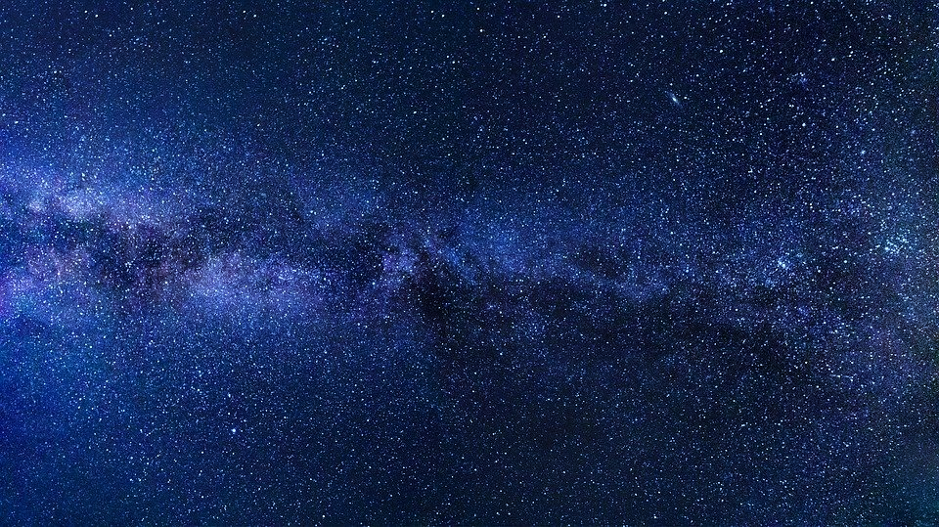
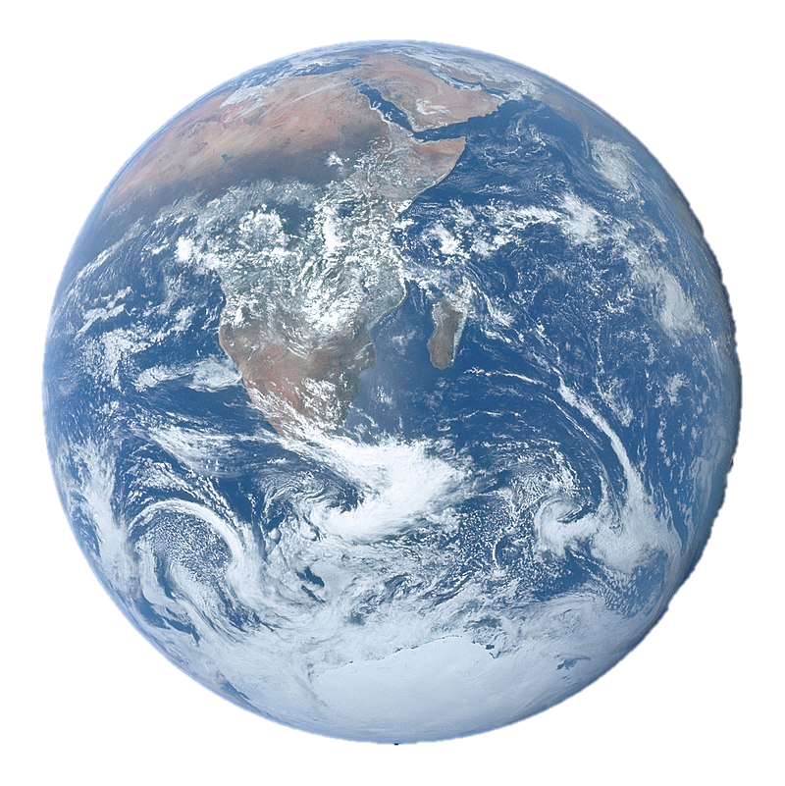
FLRW Geodesics
Cosmological Redshift
Cosmological Horizons

Slide 2
$$k=\left\{\begin{aligned}closed→+1 \\ flat→0 \\ open→−1\end{aligned}\right.$$
FLRW metric
(for an expanding universe)
$$g_{μν}→$$
$$\left[\begin{matrix}\begin{matrix}\begin{aligned}+1 \\ 0 \\ 0 \\ 0\end{aligned} & \begin{aligned}0 \\ −\frac{{\left(a(t)\right)}^{2}}{1−kr^{2}} \\ 0 \\ 0\end{aligned}\end{matrix} & \begin{matrix}\begin{aligned}0 \\ 0 \\ −{\left(a(t)r\right)}^{2} \\ 0\end{aligned} & \begin{aligned}0 \\ 0 \\ 0 \\ −{\left(a(t)r\sin{θ}\right)}^{2}\end{aligned}\end{matrix}\end{matrix}\right]$$

Slide 3
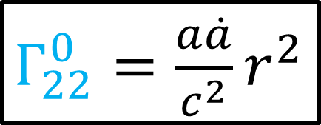
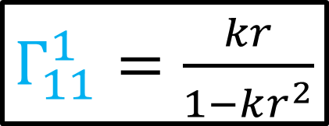
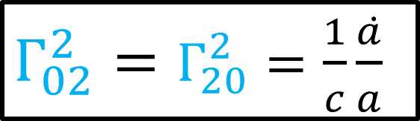
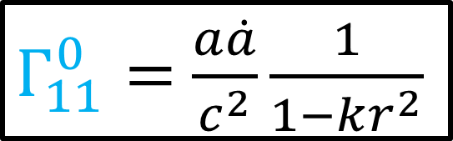
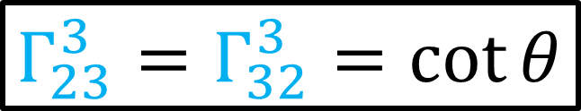
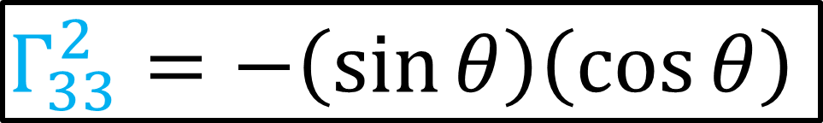
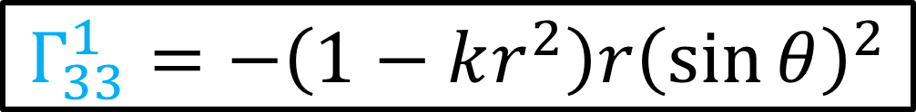
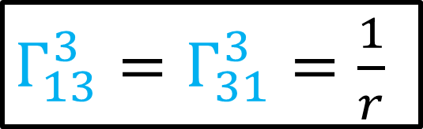
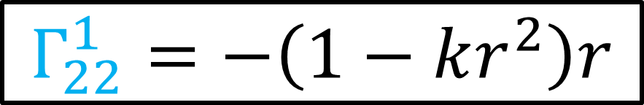
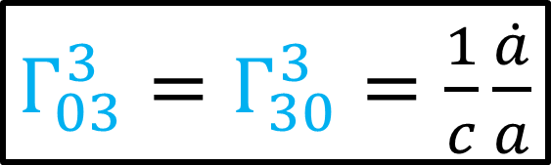
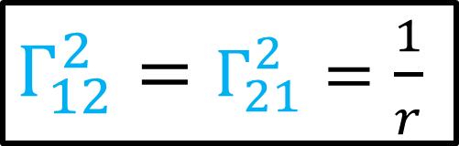
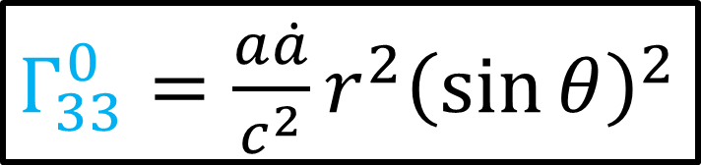
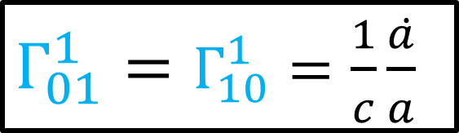
$Γ_{11}^{0}=$ $\frac{a\dot{a}}{c^{2}}\frac{1}{1−kr^{2}}$
$$Γ_{33}^{2}=−\left(\sin{θ}\right)\left(\cos{θ}\right)$$
$Γ_{22}^{0}=\frac{a\dot{a}}{c^{2}}r^{2}$
$Γ_{02}^{2}=Γ_{20}^{2}=\frac{1}{c}\frac{\dot{a}}{a}$
From Relativity 110c
$Γ_{33}^{0}=\frac{a\dot{a}}{c^{2}}r^{2}{\left(\sin{θ}\right)}^{2}$
$Γ_{12}^{2}=Γ_{21}^{2}=\frac{1}{r}$
$Γ_{11}^{1}=\frac{kr}{1−kr^{2}}$
$Γ_{01}^{1}=Γ_{10}^{1}=\frac{1}{c}\frac{\dot{a}}{a}$
$Γ_{03}^{3}=Γ_{30}^{3}=\frac{1}{c}\frac{\dot{a}}{a}$
$$Γ_{22}^{1}=−\left(1−kr^{2}\right)r$$
$Γ_{13}^{3}=Γ_{31}^{3}=\frac{1}{r}$
$$Γ_{33}^{1}=−\left(1−kr^{2}\right)r{\left(\sin{θ}\right)}^{2}$$
$Γ_{23}^{3}=Γ_{32}^{3}=\cot{θ}$

Slide 4
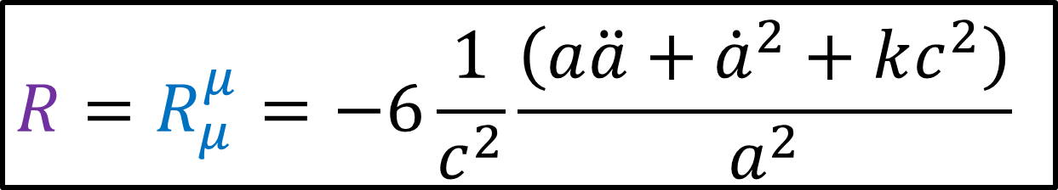
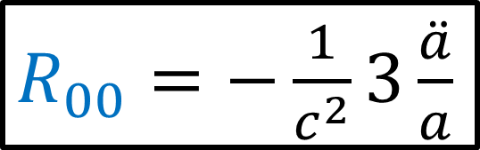
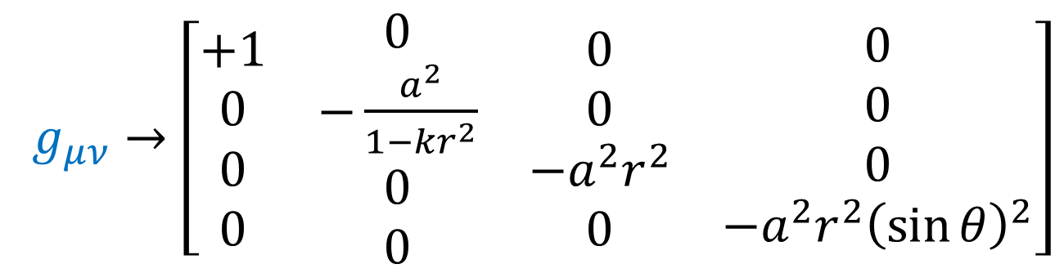
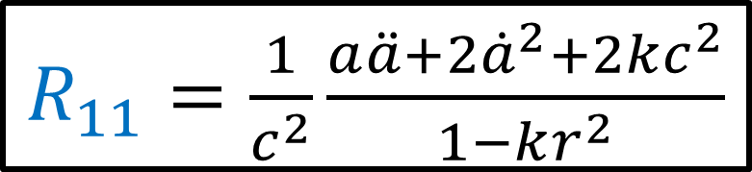
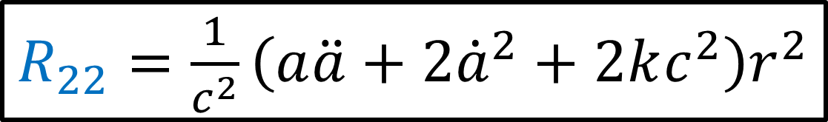
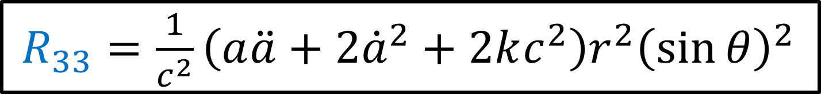
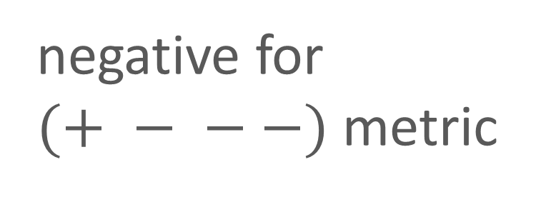
$g_{μν}→\left[\begin{matrix}\begin{matrix}\begin{aligned}+1 \\ 0 \\ 0 \\ 0\end{aligned} & \begin{aligned}0 \\ −\frac{a^{2}}{1−kr^{2}} \\ 0 \\ 0\end{aligned}\end{matrix} & \begin{matrix}\begin{aligned}0 \\ 0 \\ −a^{2}r^{2} \\ 0\end{aligned} & \begin{aligned}0 \\ 0 \\ 0 \\ −a^{2}r^{2}{\left(\sin{θ}\right)}^{2}\end{aligned}\end{matrix}\end{matrix}\right]$
$R_{00}=−\frac{1}{c^{2}}3\frac{\ddot{a}}{a}$
$R_{11}=\frac{1}{c^{2}}\frac{a\ddot{a}+2{\dot{a}}^{2}+2kc^{2}}{1−kr^{2}}$
From Relativity 110c
$R_{22}=\frac{1}{c^{2}}\left(a\ddot{a}+2{\dot{a}}^{2}+2kc^{2}\right)r^{2}$
$R_{33}=\frac{1}{c^{2}}\left(a\ddot{a}+2{\dot{a}}^{2}+2kc^{2}\right)r^{2}{\left(\sin{θ}\right)}^{2}$
$$R=R_{μ}^{μ}=−6\frac{1}{c^{2}}\frac{\left(a\ddot{a}+{\dot{a}}^{2}+kc^{2}\right)}{a^{2}}$$
negative for $(+ − − −)$metric

Slide 5
Relativity 110: Cosmology
Sources:
Einstein’s Static Universe Model
https://arxiv.org/ftp/arxiv/papers/1701/1701.07261.pdf
1917: “Cosmological Considerations in the General Theory of Relativity” Paper
https://einsteinpapers.press.princeton.edu/vol6-trans/433
History of Cosmology
Big Bang, Expansion of the universe, Cosmological Constant, Dark Energy
Friedmann-Lemaître-Robertson-Walker (FLRW) metric
FLRW Tensors
Comoving Coordinates + FLRW Geodesics
Universe as a perfect fluid + Cosmic Rest Frame
Friedmann Equations Derivation + Interpretation
Cosmological redshift
Cosmological horizons

Slide 6
From MTW: §27.3. GEOMETRIC IMPLICATIONS OF HOMOGENEITYAND ISOTROPY
This chapter will idealize the universe to be completely homogeneous and isotropic. This idealization places tight constraints on the geometry of spacetime and on the motion of the cosmological fluid through it. In order to discover these constraints, one must first give precise mathematical meaning to the concepts of homogeneity and isotropy.
Homogeneity means, roughly speaking, that the universe is the same everywhere at a given moment of time. A given moment of what time? Whose time? This isthe crucial question that the investigator asks.
In Newtonian theory there is no ambiguity about the concept “a given of time.” In special relativity there is some ambiguity because of the nonuniversality generalization of simultaneity, but once an inertial reference frame has been specified, the concept time becomes precise. In general relativity there are no global inertial frames (unless spacetime is flat); so the concept of “a given moment of time” is completely ambiguous. However, another, more general concept replaces it: the concept of a three-dimensional spacelike hypersurface. This hypersurface may impose itself on one’s…
Homogeneity of the universe means, then, that through each event in the universe there passes a spacelike “hypersurface of homogeneity” (physical conditions identical at every event on this hypersurface). At each event on such a hypersurface the density, p, and pressure, p, must be the same; and the curvature of spacetime must be the same.
The concept of isotropy must also be made precise. Clearly, the universe cannot look isotropic to all observers. For example, an observer riding on a 107° eV cosmic ray will see the matter of the universe rushing toward him from one direction and receding in the opposite direction. Only an observer who is moving with the cosmological fluid can possibly see things as isotropic. One considers such observers in defining isotropy:
Isotropy of the universe means that, at any event, an observer who is “moving with the cosmological fluid” cannot distinguish one of his space directions from the others by any local physical measurement.

Slide 7
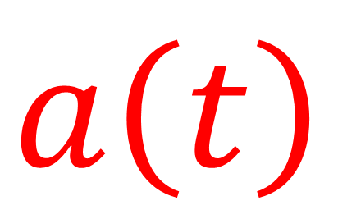
$$a\left(t\right)$$
Look at Geodesics in FLRW metric!
time

Slide 8
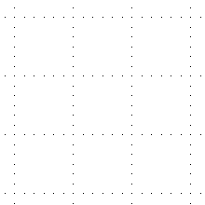
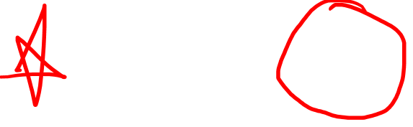
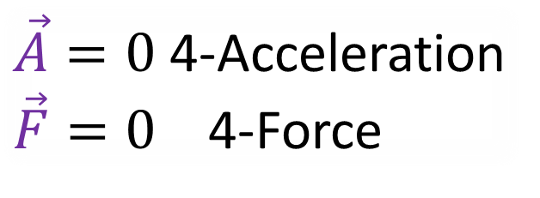
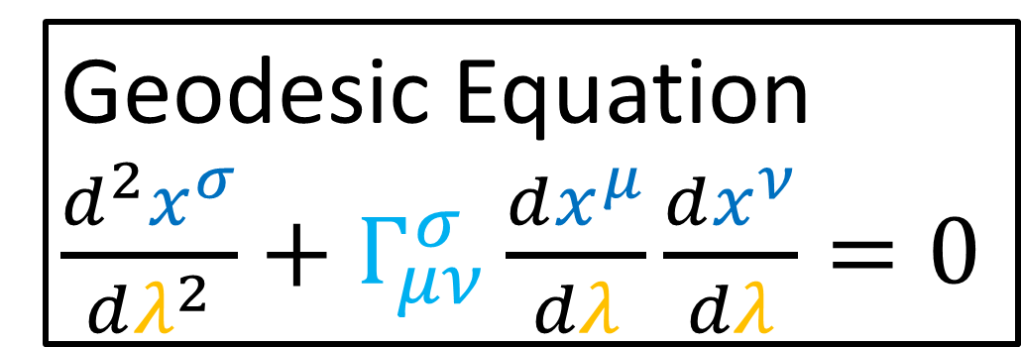
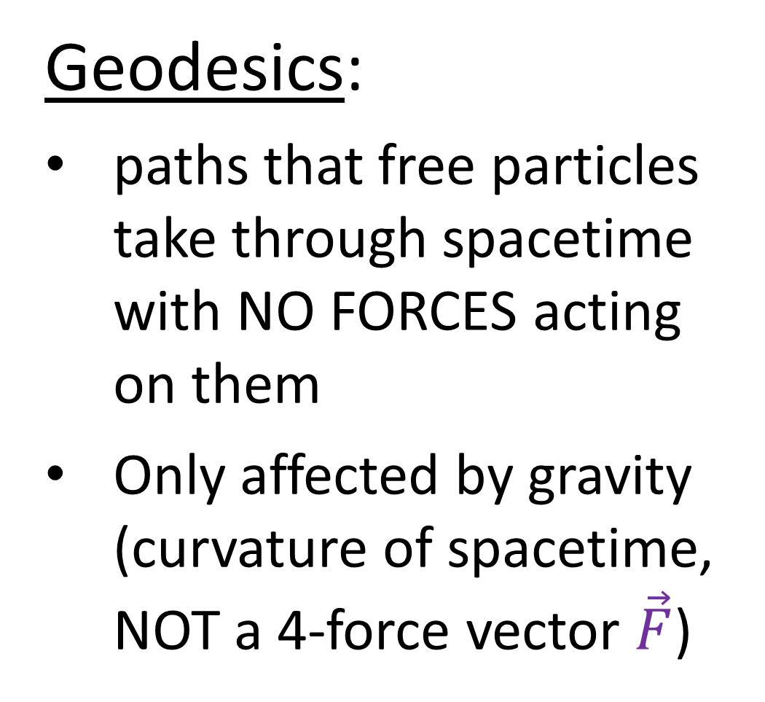
Geodesics:
paths that free particles take through spacetime with NO FORCES acting on them
Only affected by gravity (curvature of spacetime, NOT a 4-force vector $\vec{F}$)
$\vec{A}=0$ 4-Acceleration
$\vec{F}=0$ 4-Force
Geodesic Equation
$\frac{d^{2}x^{σ}}{dλ^{2}}+Γ_{μν}^{σ}\frac{dx^{μ}}{dλ}\frac{dx^{ν}}{dλ}=0$

Slide 9
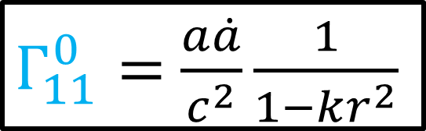
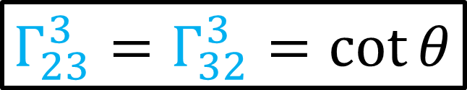
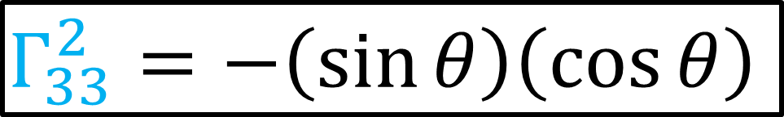


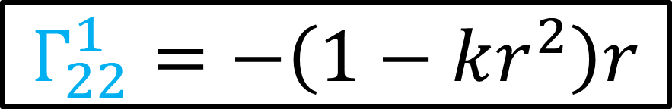
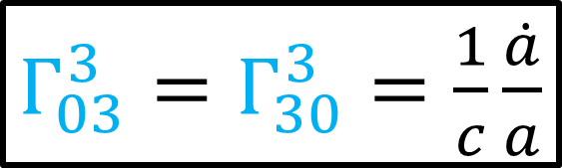
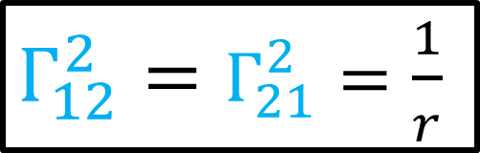
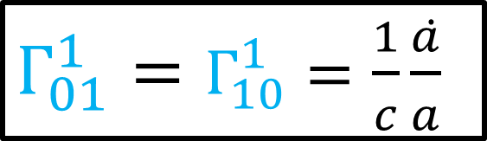

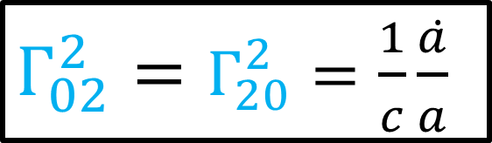

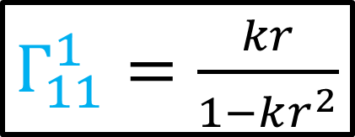
$Γ_{11}^{0}=$ $\frac{a\dot{a}}{c^{2}}\frac{1}{1−kr^{2}}$
$$Γ_{33}^{2}=−\left(\sin{θ}\right)\left(\cos{θ}\right)$$
$Γ_{22}^{0}=\frac{a\dot{a}}{c^{2}}r^{2}$
$Γ_{02}^{2}=Γ_{20}^{2}=\frac{1}{c}\frac{\dot{a}}{a}$
From Relativity 110c
$Γ_{33}^{0}=\frac{a\dot{a}}{c^{2}}r^{2}{\left(\sin{θ}\right)}^{2}$
$Γ_{12}^{2}=Γ_{21}^{2}=\frac{1}{r}$
$Γ_{11}^{1}=\frac{kr}{1−kr^{2}}$
$Γ_{01}^{1}=Γ_{10}^{1}=\frac{1}{c}\frac{\dot{a}}{a}$
$Γ_{03}^{3}=Γ_{30}^{3}=\frac{1}{c}\frac{\dot{a}}{a}$
$$Γ_{22}^{1}=−\left(1−kr^{2}\right)r$$
$Γ_{13}^{3}=Γ_{31}^{3}=\frac{1}{r}$
$$Γ_{33}^{1}=−\left(1−kr^{2}\right)r{\left(\sin{θ}\right)}^{2}$$
$Γ_{23}^{3}=Γ_{32}^{3}=\cot{θ}$

Slide 10
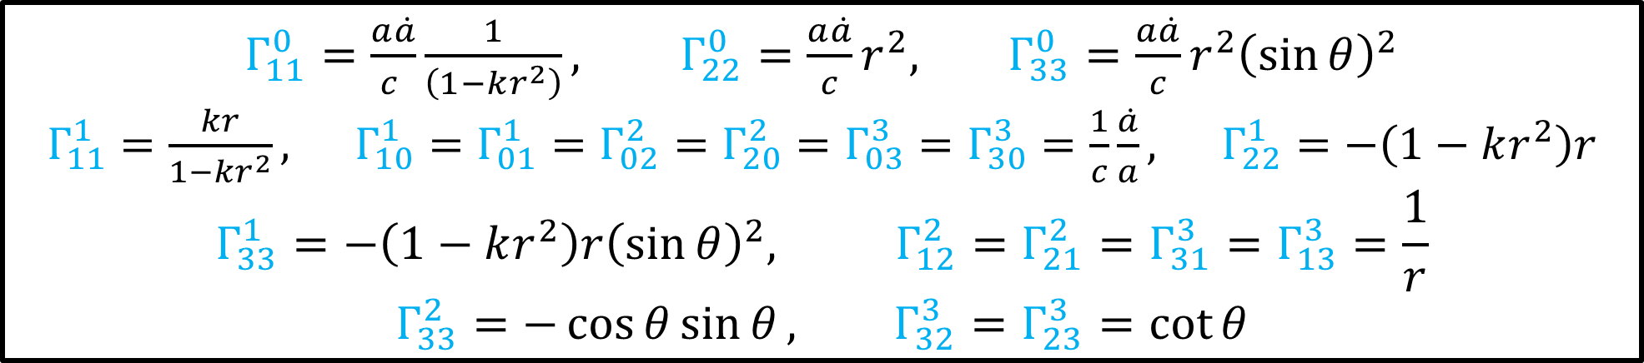

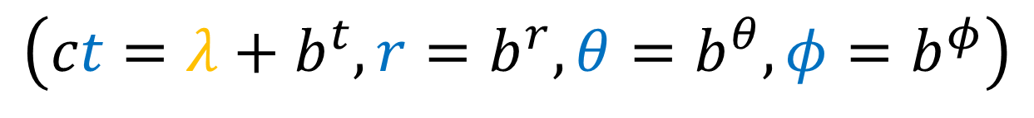
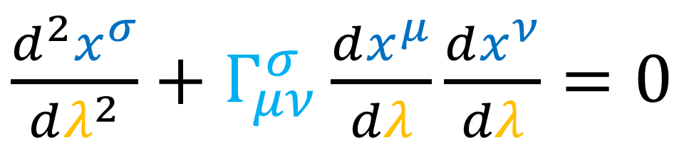
$Γ_{11}^{0}=\frac{a\dot{a}}{c }\frac{1}{\left(1−kr^{2}\right)}, Γ_{22}^{0}=\frac{a\dot{a}}{c}r^{2}, Γ_{33}^{0}=\frac{a\dot{a}}{c}r^{2}{\left(\sin{θ}\right)}^{2}$
$Γ_{11}^{1}=\frac{kr}{1−kr^{2}}, Γ_{10}^{1}=Γ_{01}^{1}=Γ_{02}^{2}=Γ_{20}^{2}=Γ_{03}^{3}=Γ_{30}^{3}=\frac{1}{c}\frac{\dot{a}}{a}, Γ_{22}^{1}=−\left(1−kr^{2}\right)r$
$$Γ_{33}^{1}=−\left(1−kr^{2}\right)r{\left(\sin{θ}\right)}^{2}, Γ_{12}^{2}=Γ_{21}^{2}=Γ_{31}^{3}=Γ_{13}^{3}=\frac{1}{r}$$
$$Γ_{33}^{2}=−\cos{θ}\sin{θ}, Γ_{32}^{3}=Γ_{23}^{3}=\cot{θ}$$
$$0→ct \\ 1→r \\ 2→θ \\ 3→φ$$
$\frac{d^{2}x^{σ}}{dλ^{2}}+Γ_{μν}^{σ}\frac{dx^{μ}}{dλ}\frac{dx^{ν}}{dλ}=0$
Solving for a general geodesic is difficult…
Instead: guess a specific case…
… and check if it works
Guess: constant space coordinates, moves along time coordinate curves.
(path with constant space coordinates that travels along time coordinate)
$$\left(ct=λ+b^{t},r=b^{r},θ=b^{θ},φ=b^{φ}\right)$$

Slide 11
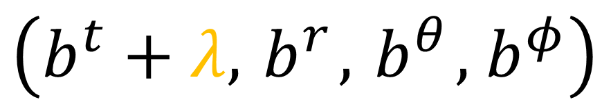

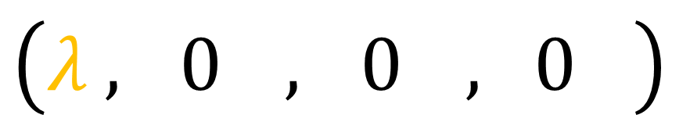

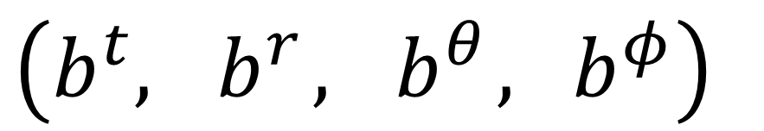
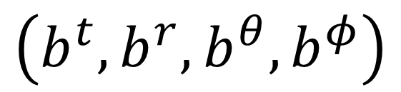





$$\left(b^{t}, { b}^{r}, { b}^{θ}, { b}^{φ}\right)$$
$$λ$$
$$\vec{e_{t}}$$
$$b$$
$$\vec{e_{φ}}$$
$$+$$
$$\left(λ , { 0}^{}, { 0}^{}, { 0}^{}\right)$$
$$\vec{e_{r}}$$
$$\left(b^{t}+λ, { b}^{r}, { b}^{θ}, { b}^{φ}\right)$$
$$\left(b^{t}, b^{r}, b^{θ}, b^{φ}\right)$$

Slide 12








$$\left(ct=λ+b^{t},r=b^{r},θ=b^{θ},φ=b^{φ}\right)$$
$\frac{dct}{dλ}=1$
$\frac{dr}{dλ}=\frac{dθ}{dλ}=\frac{dφ}{dλ}=0$
$\frac{d^{2}ct}{dλ^{2}}=\frac{d^{2}r}{dλ^{2}}=\frac{d^{2}θ}{dλ^{2}}=\frac{d^{2}φ}{dλ^{2}}=0$
$\frac{d^{2}x^{σ}}{dλ^{2}}+Γ_{μν}^{σ}\frac{dx^{μ}}{dλ}\frac{dx^{ν}}{dλ}=0$
$0 + Γ_{tt}^{σ}\frac{dct}{dλ}\frac{dct}{dλ} =0$
$⇒Γ_{tt}^{σ}=0$

Slide 13





$Γ_{11}^{0}=\frac{a\dot{a}}{c }\frac{1}{\left(1−kr^{2}\right)}, Γ_{22}^{0}=\frac{a\dot{a}}{c}r^{2}, Γ_{33}^{0}=\frac{a\dot{a}}{c}r^{2}{\left(\sin{θ}\right)}^{2}$
$Γ_{11}^{1}=\frac{kr}{1−kr^{2}}, Γ_{10}^{1}=Γ_{01}^{1}=Γ_{02}^{2}=Γ_{20}^{2}=Γ_{03}^{3}=Γ_{30}^{3}=\frac{1}{c}\frac{\dot{a}}{a}, Γ_{22}^{1}=−\left(1−kr^{2}\right)r$
$$Γ_{33}^{1}=−\left(1−kr^{2}\right)r{\left(\sin{θ}\right)}^{2}, Γ_{12}^{2}=Γ_{21}^{2}=Γ_{31}^{3}=Γ_{13}^{3}=\frac{1}{r}$$
$$Γ_{33}^{2}=−\cos{θ}\sin{θ}, Γ_{32}^{3}=Γ_{23}^{3}=\cot{θ}$$
$$0→ct \\ 1→r \\ 2→θ \\ 3→φ$$
$Γ_{tt}^{σ} = 0$
Geodesic:
$$\left(ct=λ+b^{t},r=b^{r},θ=b^{θ},φ=b^{φ}\right)$$
$Γ_{00}^{σ} = 0$
$0 = 0$
Satisfied

Slide 14




Constant $r,θ,φ$
for all time
Constant $r,θ,φ$
at start
time $ct$
space $r$

Slide 15



Spatial Slice at time $ct$:
time $ct$
space $r$

Slide 16
Spatial Slice at time $ct$:
time $ct$
space $r$

Slide 17

(arbitrary universe scaling example ) $→$
Spatial Slice at time $ct$:
time $ct$
space $r$

Slide 18



FLRW coordinates $(ct,r,θ,φ)$
= “Co-moving coordinates”
($r,θ,φ$expand along with universe geodesics)
(or $x,y,z$)

Slide 19




Geodesics: $x^{μ}\left(λ\right)→\left(b^{t}+λ,b^{r},b^{θ},b^{φ}\right)$
time $ct$
We can’t trust our eyes (or coordinates)….
The proper length $L_{0}$ could be changing.
space $r$

Slide 20








$$Δr=d$$
$L_{0}=∫\left\|\frac{d}{dλ}\right\|dλ$
$$Δr=d$$
$\vec{e_{t}}$
$$Δr=d$$
$\vec{e_{r}}$
$$\left(r=0,θ=0,φ=0\right)$$
$$\left(r=d,θ=0,φ=0\right)$$

Slide 21







$L_{0}=∫\left\|\frac{d}{dλ}\right\|dλ$
$L_{0}=∫\left\|\frac{d}{dr}\right\|dr$
$=∫\sqrt{−\left(\frac{d}{dr}⋅\frac{d}{dr}\right)}dr$
$=∫\sqrt{−\left(g_{rr}\right)}dr$
$=∫\sqrt{−\left(−\frac{{a\left(t\right)}^{2}}{1−kr^{2}}\right)}dr$
$$λ$$
$$λ=r$$
$$r$$
$$r=0$$
$$r=d$$
$L_{0}=a\left(t\right)∫\sqrt{\frac{1}{1−kr^{2}}}dr$

Slide 22












https://www.int.washington.edu/users/dbkaplan/555/lecture_03
$L_{0}=a\left(t\right)∫\sqrt{\frac{1}{1−kr^{2}}}dr$
closed
flat
open
$k=+1$
$k=0$
$k=−1$
$L_{0}=a\left(t\right)∫\sqrt{\frac{1}{1−r^{2}}}dr$
$L_{0}=a\left(t\right)∫\sqrt{\frac{1}{1}}dr$
$L_{0}=a\left(t\right)∫\sqrt{\frac{1}{1+r^{2}}}dr$
$$L_{0}=a\left(t\right)\arcsin\left(r\right)$$
$$L_{0}=a\left(t\right)r$$
$$L_{0}=a\left(t\right)\operatorname{arsinh}\left(r\right)$$

Slide 23






$$L_{0}$$
$$L_{0}=\left\{\begin{aligned}a\left(t\right)\arcsin\left(r\right) \\ a\left(t\right)r \\ a\left(t\right)\operatorname{arsinh}\left(r\right)\end{aligned}\right.$$
$$k=+1$$
$$k=0$$
$$k=−1$$
time $ct$
space $r$

Slide 24



Geodesics for massive particles in a universe with changing spatial scale $a(t)$:
$$\left(ct=λ+b^{t},_{}r=b^{r},_{}θ=b^{θ},_{}φ=b^{φ}\right)$$
What about geodesics for massless light beams in a universe with changing spatial scale $a(t)$?
Squared length of tangent vectors is zero: ${\left\|\frac{d}{dλ}\right\|}^{2}=0$

Slide 25





$\left[\begin{matrix}\tilde{\vec{e_{t}}} & \tilde{\vec{e_{r}}}\end{matrix}\right]=\left[\begin{matrix}\vec{e_{t}} & \vec{e_{r}}\end{matrix}\right]\left[\begin{matrix}γ & γβ \\ γβ & γ\end{matrix}\right]$
FLRW Metric
Radial light beams: $\frac{dθ}{dλ}=\frac{dφ}{dλ}=0$
$g_{μν}→$ $\left[\begin{matrix}\begin{matrix}\begin{aligned}+1 \\ 0 \\ 0 \\ 0\end{aligned} & \begin{aligned}0 \\ −\frac{{a(t)}^{2}}{1−kr^{2}} \\ 0 \\ 0\end{aligned}\end{matrix} & \begin{matrix}\begin{aligned}0 \\ 0 \\ −{a(t)}^{2}r^{2} \\ 0\end{aligned} & \begin{aligned}0 \\ 0 \\ 0 \\ −{a(t)}^{2}r^{2}{\left(\sin{θ}\right)}^{2}\end{aligned}\end{matrix}\end{matrix}\right]$
${\left\|\frac{d}{dλ}\right\|}^{2}=\frac{d}{dλ}⋅\frac{d}{dλ}$
$0=\left(\frac{dct}{dλ}\frac{∂}{∂ct}+\frac{dr}{dλ}\frac{∂}{∂r}\right)⋅\left(\frac{dct}{dλ}\frac{∂}{∂ct}+\frac{dr}{dλ}\frac{∂}{∂r}\right)$
$0={\left(\frac{dct}{dλ}\right)}^{2}\left(\frac{∂}{∂ct}⋅\frac{∂}{∂ct}\right)+2\left(\frac{dct}{dλ}\right)\left(\frac{dr}{dλ}\right)\left(\frac{∂}{∂ct}⋅\frac{∂}{∂r}\right)+{\left(\frac{dr}{dλ}\right)}^{2}\left(\frac{∂}{∂r}⋅\frac{∂}{∂r}\right)$
$0={\left(\frac{dct}{dλ}\right)}^{2}g_{tt}+2\left(\frac{dct}{dλ}\right)\left(\frac{dr}{dλ}\right)g_{tr}+{\left(\frac{dr}{dλ}\right)}^{2}g_{rr}$
$0={\left(\frac{dct}{dλ}\right)}^{2}\left(+1\right)+0+{\left(\frac{dr}{dλ}\right)}^{2}\left(−\frac{{a(t)}^{2}}{1−kr^{2}}\right)$

Slide 26










$0={\left(\frac{dct}{dλ}\right)}^{2}−\frac{{a(t)}^{2}}{1−kr^{2}}{\left(\frac{dr}{dλ}\right)}^{2}$
${\left(\frac{dct}{dλ}\right)}^{2}=\frac{{a(t)}^{2}}{1−kr^{2}}{\left(\frac{dr}{dλ}\right)}^{2}$
${\left(\frac{dct}{dr}\right)}^{2}=\frac{{a(t)}^{2}}{1−kr^{2}}{\left(\frac{dr}{dr}\right)}^{2}$
$\frac{dct}{dr}=a(t)\frac{1}{\sqrt{1−kr^{2}}}$
closed: $k=+1$
$\frac{dr}{dct}=\frac{1}{a(t) }\sqrt{1−r^{2}}$
$$λ=r$$
flat: $k=0$
$\frac{dr}{dct}=\frac{1}{a(t) }$
open: $k=−1$
$\frac{dr}{dct}=\frac{1}{a(t) }\sqrt{1−kr^{2}}$
$\frac{dr}{dct}=\frac{1}{a(t) }\sqrt{1+r^{2}}$

Slide 27

$0={\left(\frac{dct}{dλ}\right)}^{2}−\frac{{a(t)}^{2}}{1−kr^{2}}{\left(\frac{dr}{dλ}\right)}^{2}$
${\left(\frac{dct}{dλ}\right)}^{2}=\frac{{a(t)}^{2}}{1−kr^{2}}{\left(\frac{dr}{dλ}\right)}^{2}$
${\left(\frac{dct}{dr}\right)}^{2}=\frac{{a(t)}^{2}}{1−kr^{2}}{\left(\frac{dr}{dr}\right)}^{2}$
$\frac{dct}{dr}=a(t)\frac{1}{\sqrt{1−kr^{2}}}$
closed: $k=+1$
$\frac{dr}{dct}=\frac{1}{a(t) }\sqrt{1−r^{2}}$
$$λ=r$$
flat: $k=0$
$\frac{dr}{dct}=\frac{1}{a(t) }$
open: $k=−1$
$\frac{dr}{dct}=\frac{1}{a(t) }\sqrt{1−kr^{2}}$
$\frac{dr}{dct}=\frac{1}{a(t) }\sqrt{1+r^{2}}$

Slide 28

Coordinate speed of light in (flat) FLRW universe:
$\frac{dr}{dct}=\frac{1}{a(t) }$ (for $k=0$)
Most current evidence indicates the universe is very close to being flat:
WMAP study
BOOMERanG study
Planck satellite study
(see links in description, and Relativity 110f video)

Slide 29

























$\frac{dr}{dct}=\frac{1}{a(t) }$
square coordinate boxes
accurate-length coordinate boxes
flat: $k=0$
$\frac{dr}{dct}=\frac{1}{3}$
$$ct$$
$$a\left(t\right)=3$$
$$r$$
$\frac{dr}{dct}=\frac{1}{2}$
$$ct$$
$$ct$$
$$a\left(t\right)=2$$
$$r$$
$$r$$
$\frac{dr}{dct}=1$
$$ct$$
$$ct$$
$$a\left(t\right)=1$$
$$r$$
$$r$$
$a\left(t\right)=\frac{1}{2}$
$\frac{dr}{dct}=2$
$$ct$$
$$ct$$
$$r$$
$$r$$

Slide 30


$\frac{dr}{dct}=\frac{1}{a(t) }$
square coordinate boxes
flat: $k=0$
$\frac{dr}{dct}=\frac{1}{3}$
Local speed of light is ALWAYS:
$$\frac{dL_{0}}{dτ}=c$$
$$\frac{dL_{0}}{dcτ}=1$$
$$a\left(t\right)=3$$
$$ct$$
$$r$$
$\frac{dr}{dct}=\frac{1}{2}$
$$ct$$
$$a\left(t\right)=2$$
$$r$$
$\frac{dr}{dct}=1$
$$ct$$
$$a\left(t\right)=1$$
$$r$$
$a\left(t\right)=\frac{1}{2}$
$\frac{dr}{dct}=2$
$$ct$$
$$r$$

Slide 31






$\frac{dr}{dct}=\frac{1}{a(t) }$
(for $k=0$)
$$a\left(t\right)=3$$
$$ct$$
$$r$$
$$a\left(t\right)=2$$
$$ct$$
$$r$$
$$a\left(t\right)=1$$
$$ct$$
$$r$$
Cannot solve without a specific scaling function $a(t)$.
$a\left(t\right)=\frac{1}{2}$
$$ct$$
$$r$$

Slide 32





$κ=k\left[\frac{1}{a\left(t\right)}ε^{t}−ε^{r}\right]$
Light wave covector field: (from Relativity 108e)
Derivation:
Light-like tangent vector:
$\frac{d}{dλ}=\frac{dct}{dλ}\vec{e_{t}}+\frac{dr}{dλ}\vec{e_{r}}$
$\frac{d}{dr}=\frac{dct}{dr}\vec{e_{t}}+\frac{dr}{dr}\vec{e_{r}}$
$\frac{d}{dr}=a\left(t\right)\vec{e_{t}}+\vec{e_{r}}$
$0=κ\left(\frac{d}{dλ}\right)$ (light covector)
$0=\left(κ_{t}ε^{t}+κ_{r}ε^{r}\right)\left(a\left(t\right)\vec{e_{t}}+\vec{e_{r}}\right)$
$$0=κ_{t}a\left(t\right)+κ_{r}$$
$⇒\frac{κ_{r}}{κ_{t}}=−a\left(t\right)$
number of wave peaks per unit $r$ coordinate is always the same
$⇒κ_{r}=−k$ is constant for all time.
Using $\frac{κ_{r}}{κ_{t}}=−a\left(t\right)$, we get $κ_{t}=\frac{k}{a\left(t\right)}$

Slide 33



$\frac{dr}{dt}=c\frac{\sqrt{1−kr^{2}}}{a(t) }$
Coordinate speed of light in FLRW universe:
$\frac{dr}{dct}=\frac{1}{a(t) }$
(for $k=0$)
$\frac{dr}{dct}$ depends only on time $t$ (through $a(t)$)
No $r$-dependence
At a given time $t$, all (radial) beams of light have the same coordinate speed $\frac{dr}{dct}$

Slide 34


Coordinate speed of light in FLRW universe:
$\frac{dr}{dt}=c\frac{\sqrt{1−kr^{2}}}{a(t) }$
$a(t)=1$

Slide 35


Coordinate speed of light in FLRW universe:
$\frac{dr}{dct}=\frac{1}{a(t) }$

Slide 36




Coordinate speed of light in FLRW universe:
$\frac{dr}{dct}=\frac{1}{1}$
$a(t)=1$

Slide 37



Coordinate speed of light in FLRW universe:
$\frac{dr}{dct}=\frac{1}{15}$
$a(t)=15$

Slide 38



Coordinate speed of light in FLRW universe:
$\frac{dr}{dct}=\frac{1}{1000}$
$a(t)=1000$

Slide 39



Conclusion: The coordinate distance between peaks $Δr$ never changes.
$$Δr$$
(constant)

Slide 40



$$→\left\{\begin{aligned}L_{0} \\ 15L_{0} \\ 1000L_{0}\end{aligned}\right.$$
Proper distance $L_{0}$
changing with $a(t)$
Constant $Δr$

Slide 41





$$→\left\{\begin{aligned}L_{0} \\ 15L_{0} \\ 1000L_{0}\end{aligned}\right.$$
$$a\left(t\right)=1$$
Constant $Δr$
$$a\left(t\right)=15$$
$$a\left(t\right)=1000$$
$$L_{0}=a(t)Δr$$
(for $k=0$)

Slide 42










$$Δr$$
accurate-length coordinate boxes
flat: $k=0$
$$a\left(t\right)=3$$
$$Δr→3L_{0}$$
$$r$$
$$a\left(t\right)=2$$
$$Δr→2L_{0}$$
$$r$$
$$a\left(t\right)=1$$
$$Δr→L_{0}$$
$$r$$
$a\left(t\right)=\frac{1}{2}$
$Δr→\frac{1}{2}L_{0}$
$$r$$

Slide 43





In a universe changing in spatial scale $a(t)$…
A constant co-moving coordinate distance $Δr$
corresponds to a changing proper length $L_{0}$!
$$L_{0}=Δr\left\|\vec{e_{r}}\right\|$$
$$L_{0}=Δr\sqrt{\vec{e_{r}}⋅\vec{e_{r}}}$$
$$L_{0}=Δr\sqrt{g_{rr}}$$
$$L_{0}=Δra(t)$$
1 unit of coordinate $r$ =
$a(t)$ units of proper length $L_{0}$
for $k=0$

Slide 44




In a universe changing in spatial scale $a(t)$… A constant co-moving coordinate distance $Δr$ corresponds to a changing proper length $L_{0}$!
$$L_{0 emit} =Δra(t_{emit})$$
$$L_{0 receive}=Δra(t_{receive})$$
$\frac{L_{0 emit}}{L_{0 receive}}=\frac{a(t_{emit})}{a(t_{receive})}$

Slide 45







$$L_{0}$$
$$=λ$$
$\frac{L_{0 emit}}{L_{0 receive}}=\frac{a(t_{emit})}{a(t_{receive})}$
$\frac{λ_{emit}}{λ_{receive}}=\frac{a(t_{emit})}{a(t_{receive})}$
$λ=\frac{c}{f}$
$\frac{f_{receive}}{f_{emit}}=\frac{a(t_{emit})}{a(t_{receive})}$

Slide 46






$$L_{0}$$
$$=λ$$
$←$ wavelength
$L_{0}=Δr a(t)$
$λ =Δr a(t)$

Slide 47


Time: $t_{receive}$
Scale: $a\left(t_{receive}\right)$
Time: $t_{emit}$
Scale: $a\left(t_{emit}\right)$

Slide 48






constant $Δr$
$$λ_{emit}=Δr a(t_{emit})$$
$λ_{receive}=Δr a(t_{receive})$
$\frac{λ_{emit}}{λ_{receive}}=\frac{a(t_{emit})}{a(t_{receive})}$
$λ=\frac{c}{f}$
$\frac{f_{receive}}{f_{emit}}=\frac{a(t_{emit})}{a(t_{receive})}$

Slide 49


$$t_{emit}≡t_{then}$$
$$t_{receive}≡t_{now}$$

Slide 50



Cosmological Frequency Shift
$\frac{f_{then}}{f_{now}}=\frac{a(t_{now})}{a(t_{then})}$
$$=1+z$$
$>0$ for redshift
$<0$ for blueshift

Slide 51






Cosmological Frequency Shift
$\frac{f_{then}}{f_{now}}=\frac{a(t_{now})}{a(t_{then})}$
$$=1+z$$
$$⇒\left\{\begin{aligned} \\ \end{aligned}\right.$$
$$f_{now}=f_{then}$$
$$z=0$$
$a\left(t_{now}\right)=a(t_{then})$

Slide 52



Cosmological Frequency Shift
$\frac{f_{then}}{f_{now}}=\frac{a(t_{now})}{a(t_{then})}$
$$=1+z$$
redshift
$$⇒\left\{\begin{aligned} \\ \end{aligned}\right.$$
$$f_{now}<f_{then}$$
$$z>0$$
$a\left(t_{now}\right)>a(t_{then})$
expanding

Slide 53



Cosmological Frequency Shift
$\frac{f_{then}}{f_{now}}=\frac{a(t_{now})}{a(t_{then})}$
$$=1+z$$
blueshift
$$⇒\left\{\begin{aligned} \\ \end{aligned}\right.$$
$$f_{now}>f_{then}$$
$$z<0$$
$a\left(t_{now}\right)<a(t_{then})$
contracting

Slide 54







$$\vec{P}$$
$$\vec{P}=5 \vec{e_{t}}+3 \vec{e_{x}}$$
$$\vec{P}=4 \tilde{\vec{e_{t}}}+0 \tilde{\vec{e_{x}}}$$
$$\tilde{\vec{e_{t}}}$$
$x$-momentum
$$\vec{e_{t}}$$
$$\tilde{\vec{e_{x}}}$$
$$\vec{e_{x}}$$

Slide 55






$$\tilde{\vec{e_{t}}}$$
$$κ=3 ε^{t}+3ε^{x}$$
$$κ=6 \tilde{ε^{t}}+6\tilde{ε^{x}}$$
$$\vec{e_{t}}$$
$$\tilde{\vec{e_{x}}}$$
frequency
$$κ$$
$$\vec{e_{x}}$$
(wave convector;
see Relativity 106a)

Slide 56
Cosmological Redshift
Cosmological Blueshift
require measurement in a reference frame
Which reference frame are we measuring in?

Slide 57















$\vec{e_{t}}$
$\vec{e_{t}}$
$\vec{e_{r}}$
$\vec{e_{r}}$
$\frac{f_{then}}{f_{now}}=\frac{a(t_{now})}{a(t_{then})}$
(only works for frames travelling along $ct$-coordinate)
$\vec{e_{t}}$
$\vec{e_{t}}$
$\vec{e_{r}}$
$\vec{e_{r}}$
Requires an additional Doppler effect to be taken into account.
$\vec{e_{t}}$
$\vec{e_{t}}$
time $ct$
$\vec{e_{r}}$
$\vec{e_{r}}$
space $r$

Slide 58


$\vec{e_{t}}$
$\vec{e_{t}}$
$\vec{e_{r}}$
$\vec{e_{r}}$
$\vec{e_{t}}$
$\vec{e_{t}}$
Frame that follows FLRW $ct$-coordinate corresponds to:
“Cosmic Rest Frame”
(will cover in Relativity 110e)
$\vec{e_{r}}$
$\vec{e_{r}}$
$\vec{e_{t}}$
$\vec{e_{t}}$
time $ct$
$\vec{e_{r}}$
$\vec{e_{r}}$
space $r$

Slide 59



Cosmological Horizons
Local Speed of Light:
$c=\frac{dL_{0}}{dτ}$
Proper Length
Proper Time
(universal speed limit on matter/radiation)
Universe scale factor $a(t)$ has no speed limit.

Slide 60
Cosmological Horizons:
Hubble Horizon
Event Horizon (cosmic)
Particle Horizon

Slide 61




Hubble Horizon: boundary beyond which galaxies are travelling away from earth faster than light.
Hubble Constant: $H_{0}≈68\frac{km}{s} per MPsec$
$$⋯$$

Slide 62










Hubble Horizon: boundary beyond which galaxies are travelling away from earth faster than light.
$$1$$
$$MPsec$$
$$2$$
$$MPsec$$
$$4412 \\ MPsec$$
$$4413 \\ MPsec$$
Assume $H_{0}≈68\frac{km}{s}/MPsec$
$$⋯$$
$$68$$
$$km/s$$
$$136$$
$$km/s$$
$$c=3×{10}^{5}$$
$$km/s$$
$$>c$$

Slide 63








$$D$$
Local Speed of Light:
$\frac{dL_{0}}{dτ}=c$
$$D$$
$$D$$
Non-Local separation speed:
$\frac{dD}{dτ}≠c$
$$D$$
$$D$$
$$D$$

Slide 64



$L_{Hubble Horizon}=\frac{c}{H_{0}}$
Hubble Constant
$L_{Hubble Horizon}\left(t\right)=\frac{c}{H\left(t\right)}$
Hubble Parameter

Slide 65

(Cosmic) Event Horizon: the maximum co-moving distance $Δr$ a light beam emitted from earth can travel.

Slide 66
In a static universe, light emitted from Earth can travel infinitely far away to any part of the universe.

Slide 67

Light can reach
Light can’t reach
Cosmic event horizon $r_{EH}$
In an expanding universe, there can be galaxies that light emitted from Earth will never reach.

Slide 68
Cosmic event horizon $r_{EH}$
In an expanding universe, there can be galaxies that light emitted from Earth will never reach.

Slide 69




$dr=\frac{1}{a(t) }dct$
$r=\int{\frac{1}{a(t) }dct}$
Light $(k=0)$
$\frac{dr}{dct}=\frac{1}{a(t) }$
$$r_{event horizon}=$$
$\int_{t_{now}}^{∞}{\frac{1}{a(t) }dct}$
If integral is infinite:
Event Horizon doesn’t exist
Light can reach any point in universe
If integral in finite:
definite boundary on how far a light beam can causally effect something.

Slide 70




Light $(k=0)$
$\frac{dr}{dct}=\frac{1}{a(t) }$
$$r_{event horizon}=$$
$\int_{t_{now}}^{∞}{\frac{1}{a(t) }dct}$
$L_{event horizon}(t)=a\left(t\right)\int_{t_{now}}^{∞}{\frac{1}{a(t′) }dct′}$
$L_{0}=a(t)r$
$$(k=0)$$

Slide 71





If Hubble Parameter $H(t)$ is constant for all time,
Hubble Horizon $=$ Event Horizon
Hubble Horizon (galaxy with speed $c$)
$L_{HH}\left(t\right)=\frac{c}{H\left(t\right)}$
Event Horizon
(light can never reach)
(will never catch up to galaxies with $>c$)
$$>c$$

Slide 72





If Hubble Parameter $H(t)$ is changing,
Hubble Horizon $≠$ Event Horizon
$H(t)$ is decreasing
Hubble Horizon (galaxy with speed $c$)
$L_{HH}\left(t\right)=\frac{c}{H\left(t\right)}$
Event Horizon
(light can never reach)
$$>c$$

Slide 73
If Hubble Parameter $H(t)$ is changing,
Hubble Horizon $≠$ Event Horizon
$H(t)$ is decreasing
Hubble Horizon (galaxy with speed $c$)
$L_{HH}\left(t\right)=\frac{c}{H\left(t\right)}$
Event Horizon
(light can never reach)
$$>c$$

Slide 74


If Hubble Parameter $H(t)$ is changing,
Hubble Horizon $≠$ Event Horizon
$H(t)$ is decreasing
Hubble Horizon (galaxy with speed $c$)
$L_{HH}\left(t\right)=\frac{c}{H\left(t\right)}$
Event Horizon
(light can never reach)
$$<c$$

Slide 75



$H^{2}=\frac{8πG}{3}ρ+\frac{Λc^{2}}{3}$
1st Friedmann Equation ($k=0$):
decreasing
to constant
decreasing
constant
$⇒$Hubble Horizon and Event Horizon will become the same.
Hubble Horizon (galaxy with speed $c$)
Event Horizon
(light can never reach)

Slide 76




In comoving coordinates, $r_{event horizon}$ is shrinking overtime.
$$r_{event horizon}=$$
$\int_{t_{now}}^{∞}{\frac{1}{a(t) }dct}$
$$r$$

Slide 77

Particle Horizon: the distance $Δr$ a light beam has travelled since the beginning of the universe.

Slide 78

Particle Horizon
Unobservable Universe
Observable Universe

Slide 79


$dr=\frac{1}{a(t) }dct$
$r=\int{\frac{1}{a(t) }dct}$
Light $(k=0)$
$\frac{dr}{dct}=\frac{1}{a(t) }$
$$r_{particle horizon}=$$
$\int_{0}^{t_{now}}{\frac{1}{a(t) }dct}$

Slide 80


Light $(k=0)$
$\frac{dr}{dct}=\frac{1}{a(t) }$
$$r_{particle horizon}=$$
$\int_{0}^{t_{now}}{\frac{1}{a(t) }dct}$
$L_{particle horizon}(t)=a\left(t\right)\int_{0}^{t_{now}}{\frac{1}{a(t′) }dct′}$
$L_{0}=a(t)r$
$$(k=0)$$

Slide 81



In comoving coordinates, $r_{particle horizon}$ is growing overtime.
$$r_{particle horizon}=$$
$\int_{0}^{t_{now}}{\frac{1}{a(t) }dct}$
$$r$$

Slide 82





$L_{Hubble horizon}(t) =\frac{c}{H(t)}$
$L_{event horizon}\left(t\right) =a\left(t\right)\int_{t_{now}}^{∞}{\frac{1}{a(t′) }dct′}$
$L_{particle horizon}\left(t\right) =a\left(t\right)\int_{0}^{t_{now}}{\frac{1}{a(t′) }dct′}$
$H\left(t\right)≡\frac{da}{dt}\frac{1}{a\left(t\right)}$
$L_{Hh}≈14 Gly$
$L_{eh}≈16 Gly$
$L_{ph}≈45 Gly$
(calculation links in description)

Slide 83
Do we expand along with the universe?

Slide 84

(expanding) FLRW spacetime
$$a\left(t\right)$$

Slide 85




flat: $k=0$
$$a\left(t\right)=3$$
$$a\left(t\right)=2$$
$$a\left(t\right)=1$$
$a\left(t\right)=\frac{1}{2}$

Slide 86
Do…
atoms
people
star systems
individual galaxies
…expand along with the universe?

Slide 87

















First thing to note:
particles that make up atoms and everyday objects are not free particles!
$−$
$−$
proton
$u$
$$+$$
$$+$$
$$+$$
$−$
$−$
$−$
$u$
$d$
$$+$$
$$+$$
$$+$$
$−$
$$+$$
$−$
Electromagnetic Force
Strong Nuclear Force

Slide 88

First thing to note:
particles that make up atoms and everyday objects are not free particles!
$$≫$$
Strong Nuclear Force
Expansion of the Universe
Electromagnetic Force
(can be neglected for atoms/everyday objects)

Slide 89

Made up of “basically” free particles:
Star/Planetary systems
Individual Galaxies
(only affected by curvature of spacetime and no other forces)
Do not expand with the universe either!

Slide 90

FLRW metric
$$g_{μν}→\left[\begin{matrix}\begin{matrix}\begin{aligned}+1 \\ 0 \\ 0 \\ 0\end{aligned} & \begin{aligned}0 \\ −\frac{{\left(a(t)\right)}^{2}}{1−kr^{2}} \\ 0 \\ 0\end{aligned}\end{matrix} & \begin{matrix}\begin{aligned}0 \\ 0 \\ −{\left(a(t)r\right)}^{2} \\ 0\end{aligned} & \begin{aligned}0 \\ 0 \\ 0 \\ −{\left(a(t)r\sin{θ}\right)}^{2}\end{aligned}\end{matrix}\end{matrix}\right]$$
1. Homogeneous: universe looks the same from all points in space
2. Isotropic: universe looks the same in all directions
Not Homogeneous or Isotropic
FLRW metric does not apply

Slide 91

Schwarzschild metric
$$g_{μν}→\left[\begin{matrix}\begin{matrix}\begin{aligned}1−\frac{r_{s}}{r} \\ 0 \\ 0 \\ 0\end{aligned} & \begin{aligned}0 \\ −\frac{1}{1−\frac{r_{s}}{r}} \\ 0 \\ 0\end{aligned}\end{matrix} & \begin{matrix}\begin{aligned}0 \\ 0 \\ −r^{2} \\ 0\end{aligned} & \begin{aligned}0 \\ 0 \\ 0 \\ −{\left(r\sin{θ}\right)}^{2}\end{aligned}\end{matrix}\end{matrix}\right]$$
Spherically symmetric, uncharged, non-rotating mass.
(No FLRW-style expansion)
Several smaller bodies
Orbiting large central mass
Lots of empty space

Slide 92



$$ds^{2}={\left(1−\frac{r_{s}r}{Σ}\right)\left(dct\right)}^{2}−\frac{Σ}{Δ}dr^{2}−Σdθ^{2}$$
$$−\left(r^{2}+a^{2}+\frac{r_{s}ra^{2}}{Σ}{\left(\sin{θ}\right)}^{2}\right){\left(\sin{θ}\right)}^{2}dφ^{2}$$
$$+\left(\frac{2r_{s}ra{\left(\sin{θ}\right)}^{2}}{Σ}\right)dctdθ$$
Kerr metric
Spherically symmetric, uncharged, rotating mass.
$a=\frac{J}{Mc}$
$$Σ=r^{2}+a^{2}{\left(\cos{θ}\right)}^{2}$$
$$Δ=r^{2}−r_{s}r+a^{2}$$
($J=$ angular momentum)
(No FLRW-style expansion)
Several smaller bodies
Orbiting large central mass
Lots of empty space

Slide 93

In Relativity 110f…
Form of dark energy called the “Cosmological Constant”
Denoted by $Λ$
Causes universe’s expansion to accelerate outward

Slide 94




Schwarzschild metric
$$g_{μν}→\left[\begin{matrix}\begin{matrix}\begin{aligned}1−\frac{r_{s}}{r} \\ 0 \\ 0 \\ 0\end{aligned} & \begin{aligned}0 \\ −\frac{1}{1−\frac{r_{s}}{r}} \\ 0 \\ 0\end{aligned}\end{matrix} & \begin{matrix}\begin{aligned}0 \\ 0 \\ −r^{2} \\ 0\end{aligned} & \begin{aligned}0 \\ 0 \\ 0 \\ −{\left(r\sin{θ}\right)}^{2}\end{aligned}\end{matrix}\end{matrix}\right]$$
(Relativity 108a)
Assumed $Λ=0$
$R_{μν}−\frac{1}{2}Rg_{μν}−Λg_{μν}=\frac{8πG}{c^{4}}T_{μν}$
$R_{μν}−\frac{1}{2}Rg_{μν}=0$
$⇒R=0$
$R_{μν}=0$

Slide 95



Spherically symmetric, uncharged, non-rotating mass.
Assume $Λ>0$
$R_{μν}−\frac{1}{2}Rg_{μν}−Λg_{μν}=\frac{8πG}{c^{4}}T_{μν}$
$R_{μν}−\frac{1}{2}Rg_{μν}−Λg_{μν}=0$
$R_{μν}−\frac{1}{2}Rg_{μν}=Λg_{μν}$

Slide 96


Spherically symmetric, uncharged, non-rotating mass.
Assume $Λ>0$
De Sitter-Schwarzschild metric
https://en.wikipedia.org/wiki/De_Sitter%E2%80%93Schwarzschild_metric
$$g_{μν}→\left[\begin{matrix}\begin{matrix}\begin{aligned}f(r) \\ 0 \\ 0 \\ 0\end{aligned} & \begin{aligned}0 \\ −\frac{1}{f(r)} \\ 0 \\ 0\end{aligned}\end{matrix} & \begin{matrix}\begin{aligned}0 \\ 0 \\ −r^{2} \\ 0\end{aligned} & \begin{aligned}0 \\ 0 \\ 0 \\ −{\left(r\sin{θ}\right)}^{2}\end{aligned}\end{matrix}\end{matrix}\right]$$
$f\left(r\right)=1−\frac{r_{s}}{r}−\frac{Λ}{3}r^{2}$
(won’t derive in this video)

Slide 97






Loose approximation of Newtonian Gravity with a Cosmological Constant:
$R_{μν}−\frac{1}{2}Rg_{μν}−Λg_{μν}=\frac{8πG}{c^{4}}T_{μν}$
Einstein Field Equations (General Relativity)
$$∇^{2}φ =4πGρ$$
$$+ Λc^{2}$$
Poisson’s Equation
(Newtonian Gravity)
$+$ sign needed for “repulsive” gravity
$c^{2}$ needed to get units right.
$G⋅ρ→\left[\frac{m^{3}}{kg⋅s^{2}}\right]⋅\left[\frac{kg}{m^{3}}\right]→\left[\frac{1}{s^{2}}\right]$
$Λ⋅c^{2}→\left[\frac{1}{m^{2}}\right]⋅{\left[\frac{m}{s}\right]}^{2}→\left[\frac{1}{s^{2}}\right]$

Slide 98





$$∇^{2}φ+ Λc^{2}=4πGρ$$
$$∇^{2}φ=4πGρ−Λc^{2}$$
$ρ\left(r\right) \sim$ point-like source
$φ\left(r\right)=−\frac{GM}{r}−\frac{1}{6}Λc^{2}r^{2}$
$F_{G}=−m∂_{r}φ=m\left(−\frac{GM}{r^{2}}+\frac{1}{3}Λc^{2}r\right)$

Slide 99



$F_{G}=−m\frac{GM}{r^{2}}+m\frac{1}{3}Λc^{2}r$
Standard Newtonian Law of Gravity
“Repulsive” Force
$Λ=1.08×{10}^{−52}\frac{1}{m^{2}}$
$Λc^{2}=2.04×{10}^{−35}\frac{1}{s^{2}}$

Slide 100



$F_{G}=−m\frac{GM}{r^{2}}+m\frac{1}{3}Λc^{2}r$
Standard Newtonian Law of Gravity
“Repulsive” Force
$$Λ=0$$
Technically non-zero at small scales.
$$Λ>0$$
(will not tear small gravitational systems apart)

Slide 101


The “Big Rip”:
all galaxies and atoms eventually torn apart by the expansion of the universe
NOT caused by Cosmological Constant $Λ$
constant dark energy density
equation of state has $w=−1$
caused by theoretical “Phantom Energy”
dark energy density increases with time
equation of state has $w<−1$
not much evidence to support it

Slide 102

I’ll talk more about:
Cosmological Constant $Λ$
Dark energy densities
in Relativity 110e/f

Slide 103





FLRW metric
$ct$-curves are time-like geodesics
$$g_{μν}→\left[\begin{matrix}\begin{matrix}\begin{aligned}+1 \\ 0 \\ 0 \\ 0\end{aligned} & \begin{aligned}0 \\ −\frac{{\left(a(t)\right)}^{2}}{1−kr^{2}} \\ 0 \\ 0\end{aligned}\end{matrix} & \begin{matrix}\begin{aligned}0 \\ 0 \\ −{\left(a(t)r\right)}^{2} \\ 0\end{aligned} & \begin{aligned}0 \\ 0 \\ 0 \\ −{\left(a(t)r\sin{θ}\right)}^{2}\end{aligned}\end{matrix}\end{matrix}\right]$$
Spatial coordinates $r,θ,φ$ are “expanding along with the universe”.
time $ct$
space $r$

Slide 104

Spatial coordinates $r,θ,φ$ (or $x,y,z$)
are “expanding along with the universe”.

Slide 105




Spatial coordinates $r,θ,φ$ (or $x,y,z$)
are “expanding along with the universe”.
Proper Lengths
closed ($k=+1$)
$$L_{0}=a\left(t\right)\arcsin\left(r\right)$$
flat ($k=0$)
$$L_{0}=a\left(t\right)r$$
open ($k=−1$)
$$L_{0}=a\left(t\right)\operatorname{arsinh}\left(r\right)$$
“Co-moving coordinates”

Slide 106




Wavelength of light
$\frac{λ_{now}}{λ_{then}}=\frac{a(t_{now})}{a(t_{then})}$
flat: $k=0$
$$a\left(t\right)=3$$
$$a\left(t\right)=2$$
$$a\left(t\right)=1$$
$a\left(t\right)=\frac{1}{2}$

Slide 107
$\vec{e_{t}}$
$\vec{e_{t}}$
$\vec{e_{r}}$
$\vec{e_{r}}$
$\vec{e_{t}}$
$\vec{e_{t}}$
Frame that follows FLRW $ct$-coordinate corresponds to:
“Cosmic Rest Frame”
(will cover in Relativity 110e)
$\vec{e_{r}}$
$\vec{e_{r}}$
$\vec{e_{t}}$
$\vec{e_{t}}$
time $ct$
$\vec{e_{r}}$
$\vec{e_{r}}$
space $r$

Slide 108



Expansion rate $\frac{da\left(t\right)}{dt}$ has no limit.
Distance light has travelled since the big bang:
$L_{particle horizon}\left(t\right) =a\left(t\right)\int_{0}^{t_{now}}{\frac{1}{a(t′) }dct′}$
Maximum distance (today) light release from earth can travel:
$L_{event horizon}\left(t\right) =a\left(t\right)\int_{t_{now}}^{∞}{\frac{1}{a(t′) }dct′}$
Distance to galaxy travelling away at speed $c$:
$L_{Hubble horizon}(t) =\frac{c}{H(t)}$
$H\left(t\right)≡\frac{da}{dt}\frac{1}{a\left(t\right)}$

Slide 109

Next Video:
Cosmic Rest Frame
Model matter/energy as a Perfect Fluid
Equation of State: $p=wρc^{2}$

