Slide 1
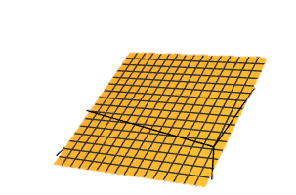
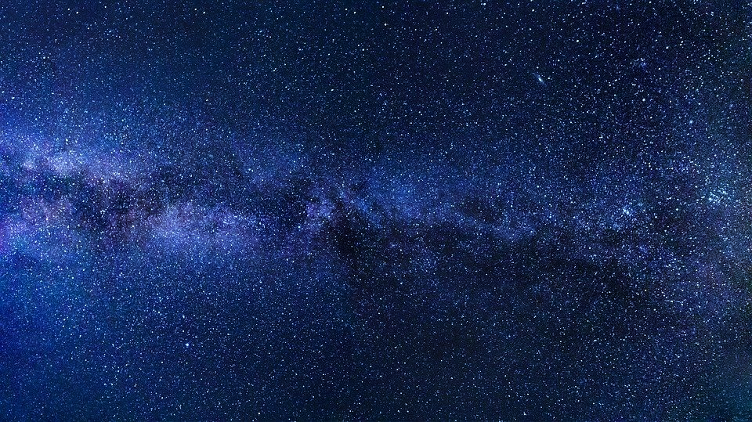
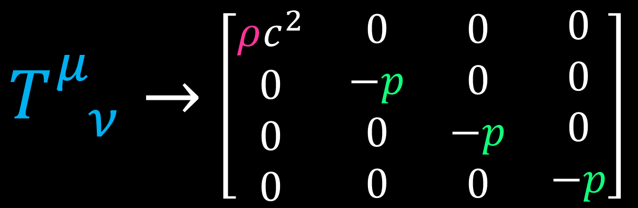
Perfect Fluid & Cosmic Rest Frame
$T_{ ν}^{μ}→$ $\left[\begin{matrix}\begin{matrix}\begin{aligned}ρc^{2} \\ 0 \\ 0 \\ 0\end{aligned} & \begin{aligned}0 \\ −p \\ 0 \\ 0\end{aligned}\end{matrix} & \begin{matrix}\begin{aligned}0 \\ 0 \\ −p \\ 0\end{aligned} & \begin{aligned}0 \\ 0 \\ 0 \\ −p\end{aligned}\end{matrix}\end{matrix}\right]$

Slide 2
Cosmic Rest Frame
https://physics.stackexchange.com/questions/253083/cosmic-rest-frame#:~:text=Cosmic%20Rest%20Frame%20is%20defined,in%20the%20universe%20is%20zero.
It is also written that "It is usually assumed that all forms of energy are at rest on the average with respect to all other forms of energy." How can this be justified?
So what the authors (and others) refer to as the Cosmic Rest Frame is the frame in which these different energy forms have no preferred direction.
A given galaxy, for instance, moves through space with some velocity, typically of the order 100–1000kms−1. But on average, galaxies have a net velocity of zero in comoving coordinates, i.e. the coordinates that expand with space. The same is true for radiation, although in this case we don't consider the photon's velocity (since that is the speed of light in all reference frames), but it average frequency.
https://physics.stackexchange.com/questions/39477/what-is-meant-by-the-term-mean-rest-frame
I found this part in the book of Bernard Schutz on GR. (Sec 12.2: General Relativistic Cosmological Models).
Robertson-Walker metrics: We shall adopt the following assumptions about the universe: (i) spacetime can be sliced into hypersurfaces of constant time which are perfectly homogeneous and isotropic; and (ii) the mean rest frame of the galaxies agrees with the definition of simultaneity.

Slide 3
https://arxiv.org/pdf/astro-ph/0703739.pdf - Section II.B
In cosmology a “rest frame with respect to the universe” or “cosmic rest frame” is frequently cited. Such a rest frame might seem counter-intuitive, because special relativity has no preferred inertial frames. Every place in the universe has a definable rest frame, delineated by the energy in the universe itself. The universe rest frame at any point is the one frame where the average velocity of energy forms in the universe is zero. In this frame, for example, the cosmic microwave background photons will appear the same in all directions.
It is usually assumed that all forms of energy are at rest on the average with respect to all other forms of energy. Note that were any form of energy to dominate the universe, the frame where this energy form is at rest would determine the rest frame for the universe.

Slide 4
Relativity 110: Cosmology
History of Cosmology
Big Bang, Expansion of the universe, Cosmological Constant, Dark Energy
Friedmann-Lemaître-Robertson-Walker (FLRW) metric
FLRW Tensors
Comoving Coordinates + FLRW Geodesics
Universe as a perfect fluid + Cosmic Rest Frame
Friedmann Equations Derivation + Interpretation

Slide 5
Fundamental Assumption:
Cosmological Principle
1. Homogeneous: universe looks the same from all points in space
no change under spatial translations
universe has no spatial center
2. Isotropic: universe looks the same in all directions
no change under spatial rotations

Slide 6
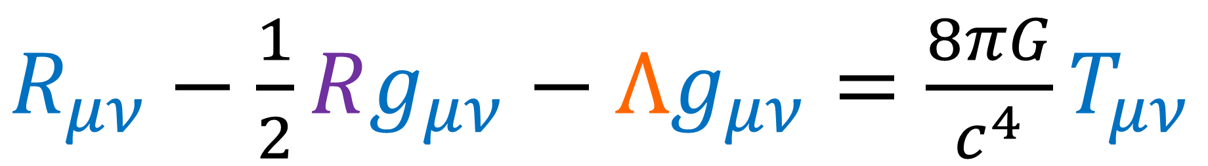
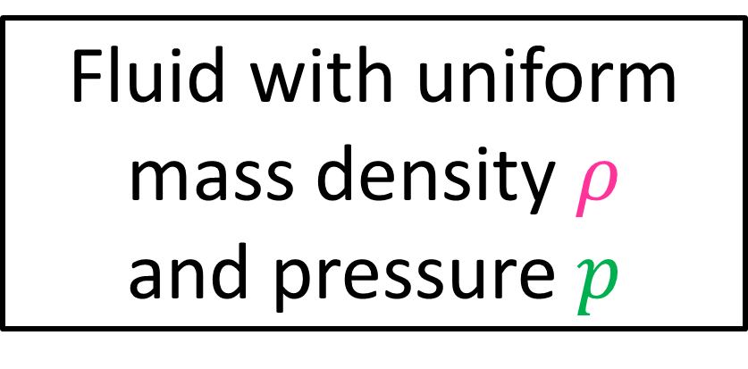
Homogeneous and Isotropic Universe:
$R_{μν}−\frac{1}{2}Rg_{μν}−Λg_{μν}=\frac{8πG}{c^{4}}T_{μν}$
Previous Videos:
Curvature
This Video:
Energy-Momentum
FLRW metric
Fluid with uniform mass density $ρ$ and pressure $p$

Slide 7
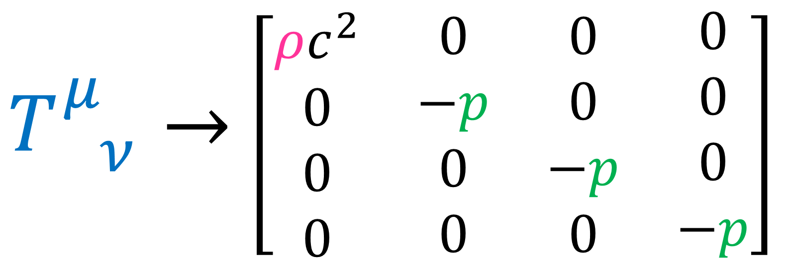

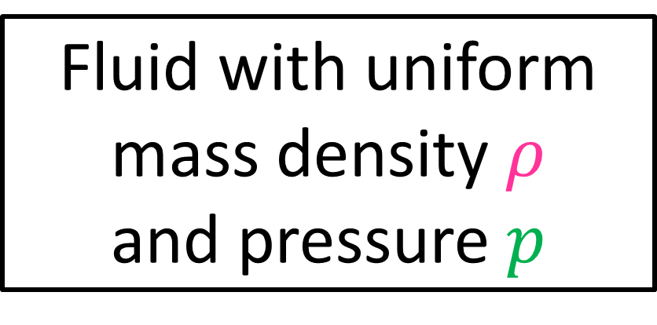
Fluid with uniform mass density $ρ$ and pressure $p$
“Perfect Fluid” energy-momentum tensor:
$T_{ ν}^{μ}→$ $\left[\begin{matrix}\begin{matrix}\begin{aligned}ρc^{2} \\ 0 \\ 0 \\ 0\end{aligned} & \begin{aligned}0 \\ −p \\ 0 \\ 0\end{aligned}\end{matrix} & \begin{matrix}\begin{aligned}0 \\ 0 \\ −p \\ 0\end{aligned} & \begin{aligned}0 \\ 0 \\ 0 \\ −p\end{aligned}\end{matrix}\end{matrix}\right]$
Measured in rest frame:
Cosmic Rest Frame

Slide 8
Video Summary:
Energy Momentum Tensor for Perfect Fluid
Cosmic Rest Frame
Equation of State for Perfect Fluid

Slide 9
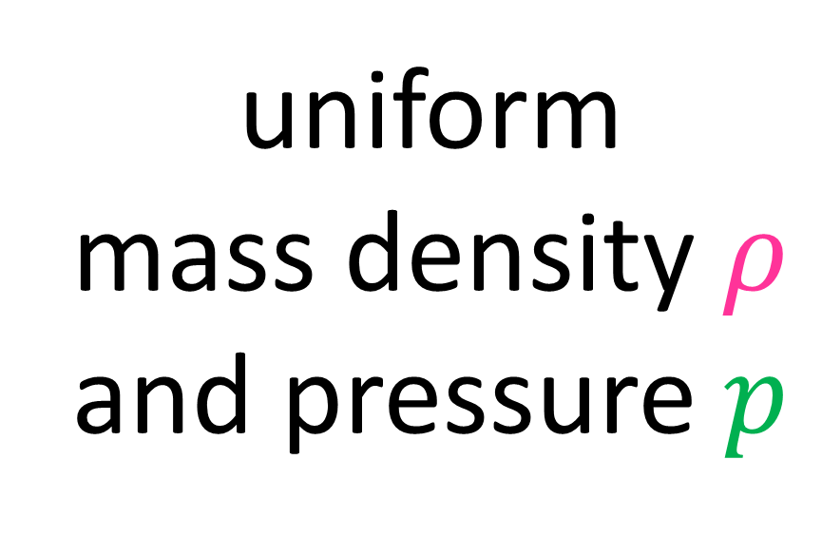
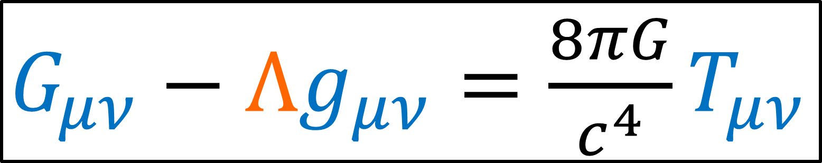
$G_{μν}−Λg_{μν}=\frac{8πG}{c^{4}}T_{μν}$
FLRW metric
uniform mass density $ρ$ and pressure $p$

Slide 10
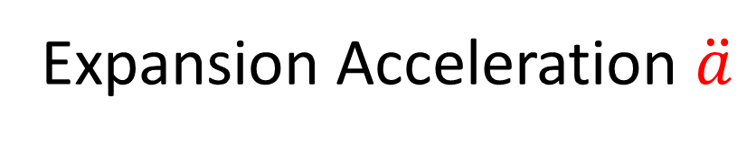
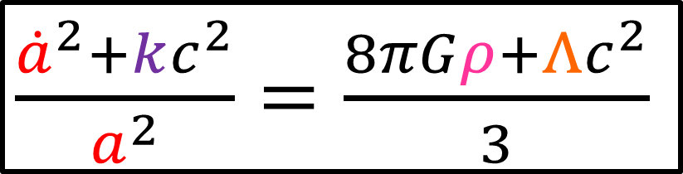
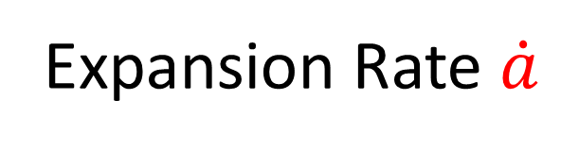
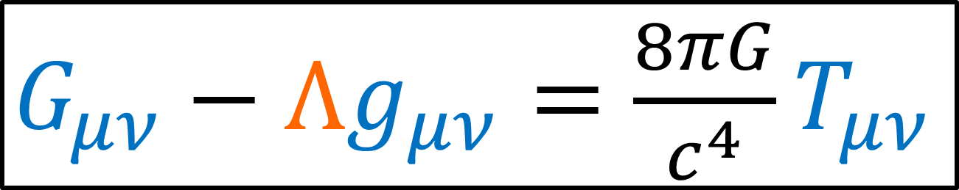

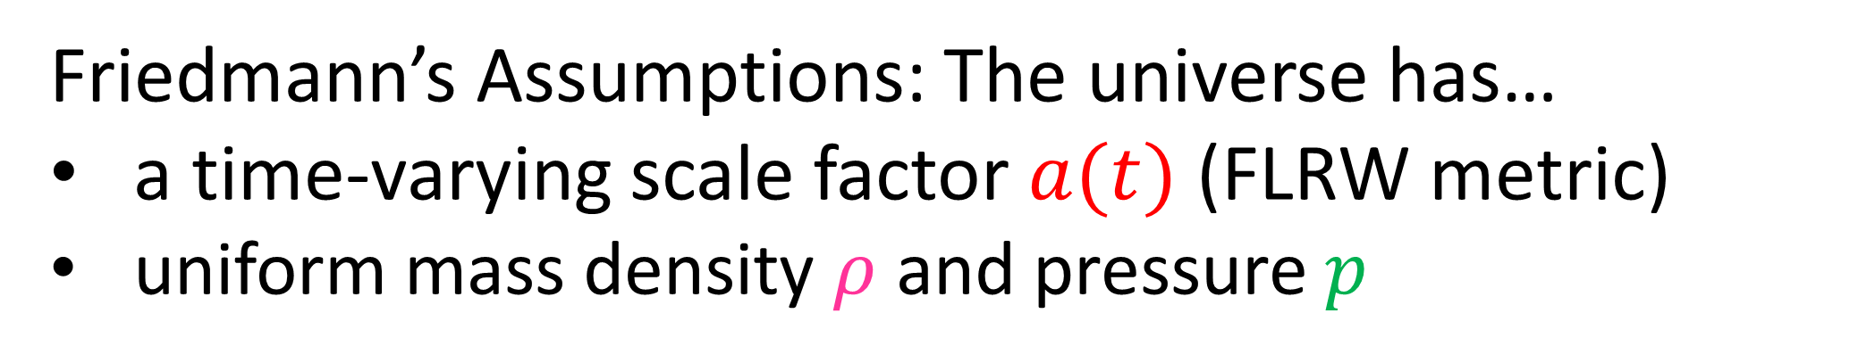
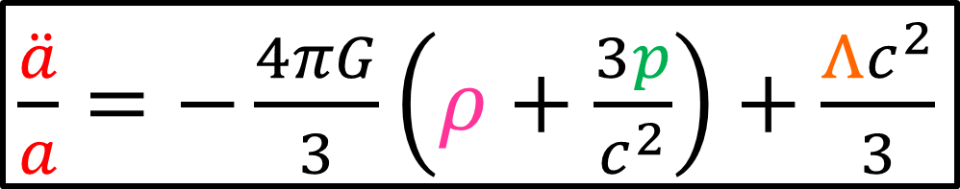

Friedmann’s Assumptions: The universe has…
a time-varying scale factor $a(t)$ (FLRW metric)
uniform mass density $ρ$ and pressure $p$
$G_{μν}−Λg_{μν}=\frac{8πG}{c^{4}}T_{μν}$
curvature $k$
$\frac{{\dot{a}}^{2}+kc^{2}}{a^{2}}=\frac{8πGρ+Λc^{2}}{3}$
$\frac{\ddot{a}}{a}=−\frac{4πG}{3}\left(ρ+\frac{3p}{c^{2}}\right)+\frac{Λc^{2}}{3}$
Expansion Rate $\dot{a}$
Expansion Acceleration $\ddot{a}$

Slide 11
PERFECT FLUID ENERGY-MOMENTUM TENSOR

Slide 12
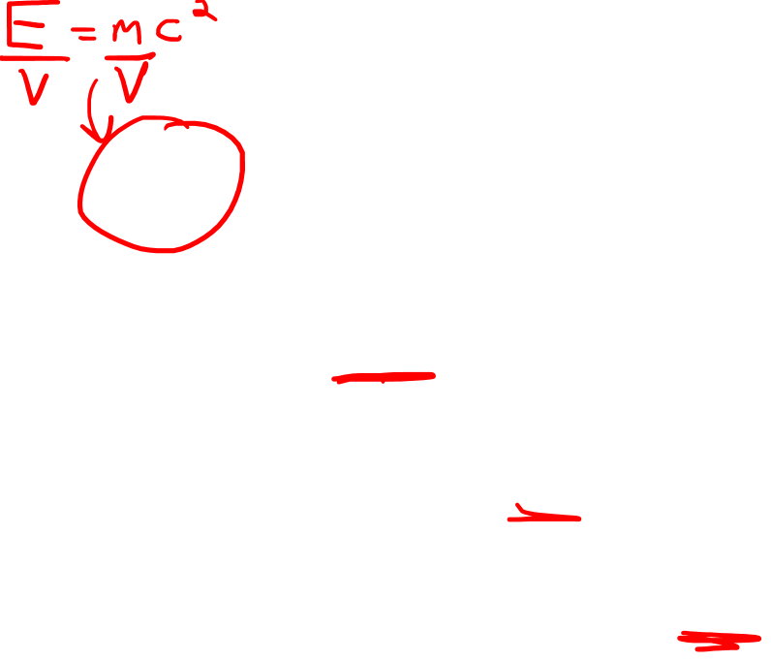
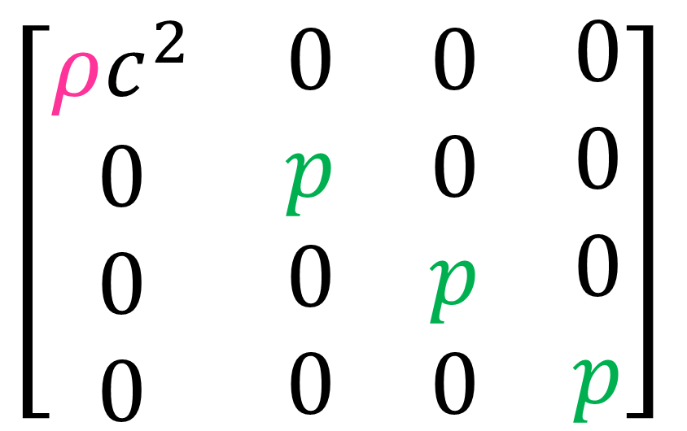
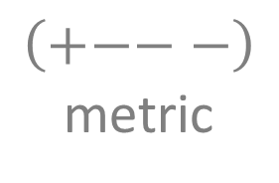
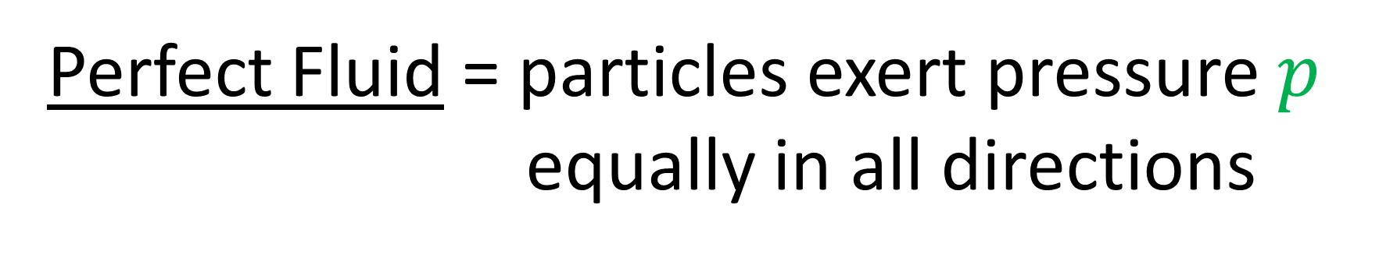
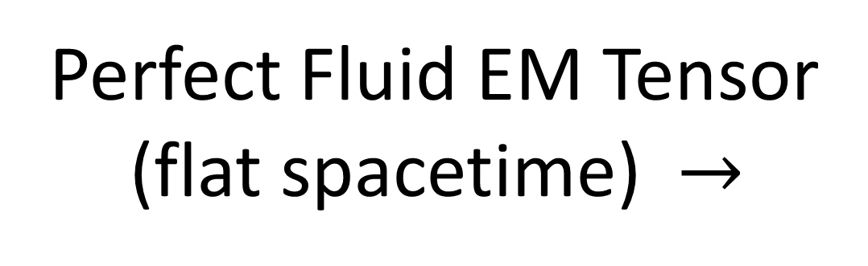
Perfect Fluid = particles exert pressure $p$
equally in all directions
$\left[\begin{matrix}\begin{matrix}\begin{aligned}ρc^{2} \\ 0 \\ 0 \\ 0\end{aligned} & \begin{aligned}0 \\ p \\ 0 \\ 0\end{aligned}\end{matrix} & \begin{matrix}\begin{aligned}0 \\ 0 \\ p \\ 0\end{aligned} & \begin{aligned}0 \\ 0 \\ 0 \\ p\end{aligned}\end{matrix}\end{matrix}\right]$
Perfect Fluid EM Tensor
(flat spacetime) $→$
(rest frame of fluid)
$$\left(+−−−\right)$$
metric

Slide 13
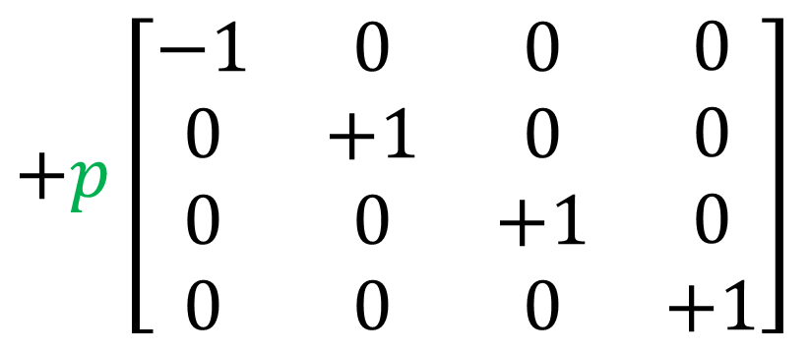
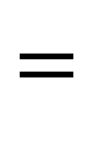
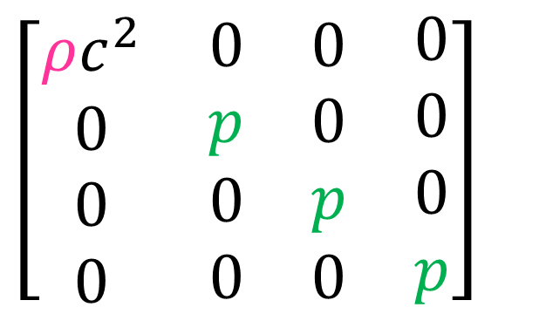
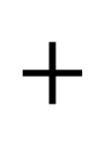
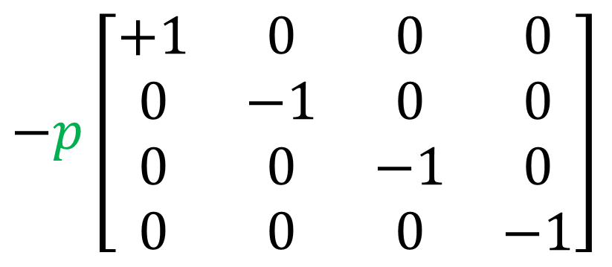
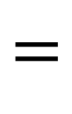
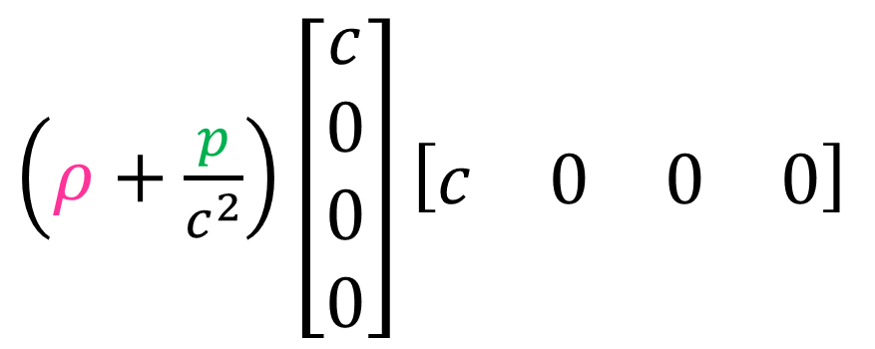
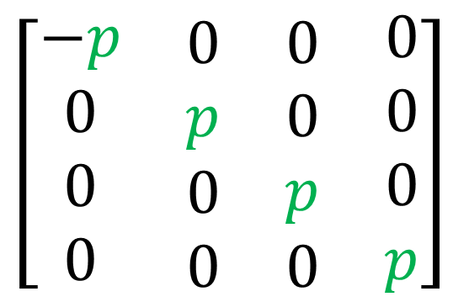
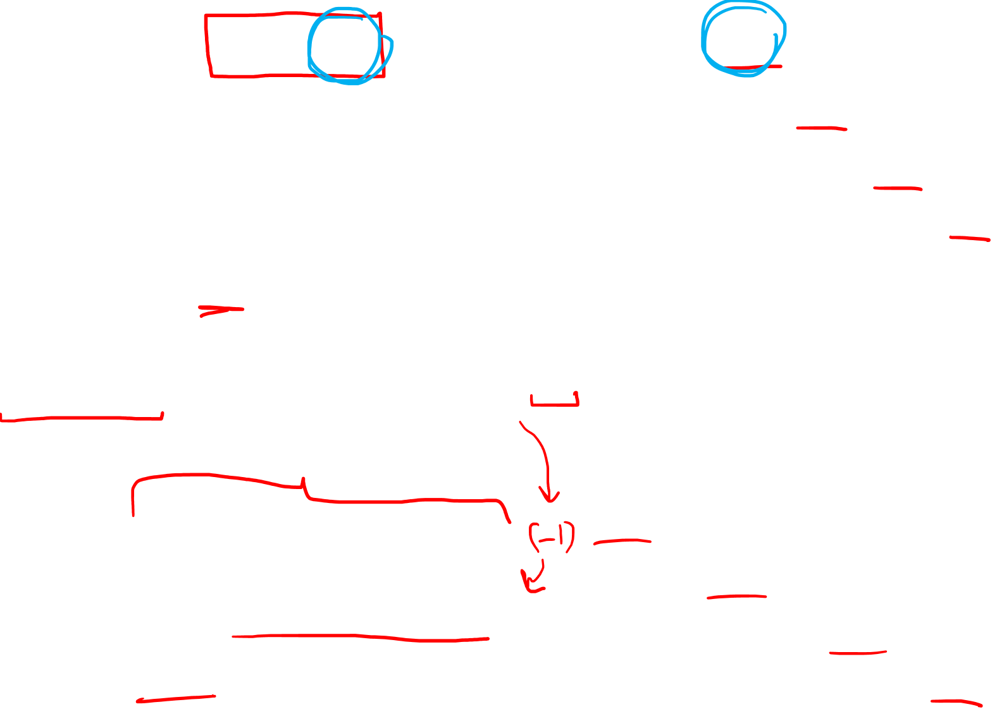
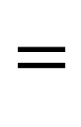
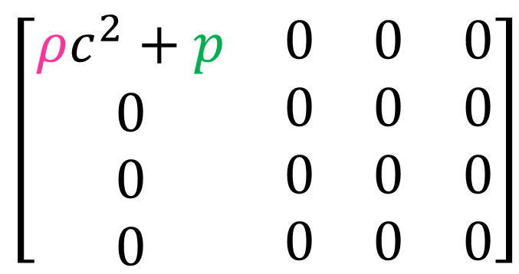
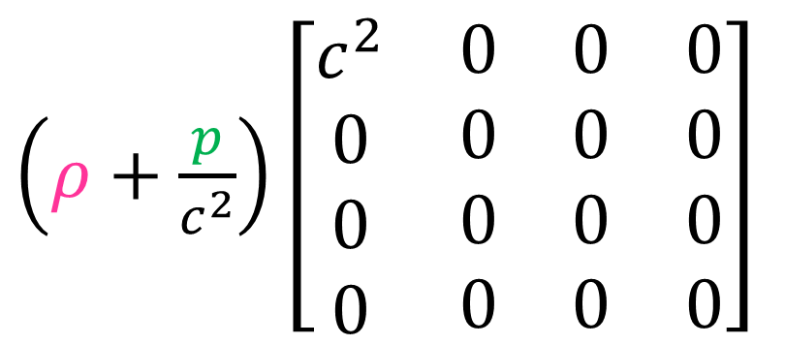
$\left[\begin{matrix}\begin{matrix}\begin{aligned}ρc^{2} \\ 0 \\ 0 \\ 0\end{aligned} & \begin{aligned}0 \\ p \\ 0 \\ 0\end{aligned}\end{matrix} & \begin{matrix}\begin{aligned}0 \\ 0 \\ p \\ 0\end{aligned} & \begin{aligned}0 \\ 0 \\ 0 \\ p\end{aligned}\end{matrix}\end{matrix}\right]$
$\left[\begin{matrix}\begin{matrix}\begin{aligned}ρc^{2}+p \\ 0 \\ 0 \\ 0\end{aligned} & \begin{aligned}0 \\ 0 \\ 0 \\ 0\end{aligned}\end{matrix} & \begin{matrix}\begin{aligned}0 \\ 0 \\ 0 \\ 0\end{aligned} & \begin{aligned}0 \\ 0 \\ 0 \\ 0\end{aligned}\end{matrix}\end{matrix}\right]$
$\left[\begin{matrix}\begin{matrix}\begin{aligned}−p \\ 0 \\ 0 \\ 0\end{aligned} & \begin{aligned}0 \\ p \\ 0 \\ 0\end{aligned}\end{matrix} & \begin{matrix}\begin{aligned}0 \\ 0 \\ p \\ 0\end{aligned} & \begin{aligned}0 \\ 0 \\ 0 \\ p\end{aligned}\end{matrix}\end{matrix}\right]$
$$=$$
$$+$$
(rest frame, flat space)
$\left(ρ+\frac{p}{c^{2}}\right)\left[\begin{matrix}\begin{matrix}\begin{aligned}c^{2} \\ 0 \\ 0 \\ 0\end{aligned} & \begin{aligned}0 \\ 0 \\ 0 \\ 0\end{aligned}\end{matrix} & \begin{matrix}\begin{aligned}0 \\ 0 \\ 0 \\ 0\end{aligned} & \begin{aligned}0 \\ 0 \\ 0 \\ 0\end{aligned}\end{matrix}\end{matrix}\right]$
$+p\left[\begin{matrix}\begin{matrix}\begin{aligned}−1 \\ 0 \\ 0 \\ 0\end{aligned} & \begin{aligned}0 \\ +1 \\ 0 \\ 0\end{aligned}\end{matrix} & \begin{matrix}\begin{aligned}0 \\ 0 \\ +1 \\ 0\end{aligned} & \begin{aligned}0 \\ 0 \\ 0 \\ +1\end{aligned}\end{matrix}\end{matrix}\right]$
$$=$$
$\left(ρ+\frac{p}{c^{2}}\right)\left[\begin{aligned}c \\ 0 \\ 0 \\ 0\end{aligned}\right]\left[\begin{matrix}\begin{matrix}c & 0\end{matrix} & \begin{matrix}0 & 0\end{matrix}\end{matrix}\right]$
$−p\left[\begin{matrix}\begin{matrix}\begin{aligned}+1 \\ 0 \\ 0 \\ 0\end{aligned} & \begin{aligned}0 \\ −1 \\ 0 \\ 0\end{aligned}\end{matrix} & \begin{matrix}\begin{aligned}0 \\ 0 \\ −1 \\ 0\end{aligned} & \begin{aligned}0 \\ 0 \\ 0 \\ −1\end{aligned}\end{matrix}\end{matrix}\right]$
$$=$$

Slide 14
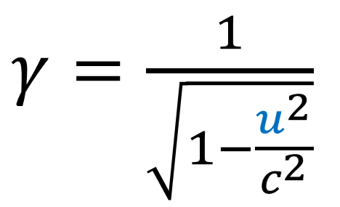

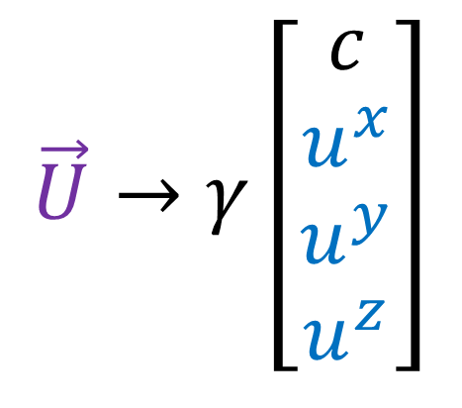
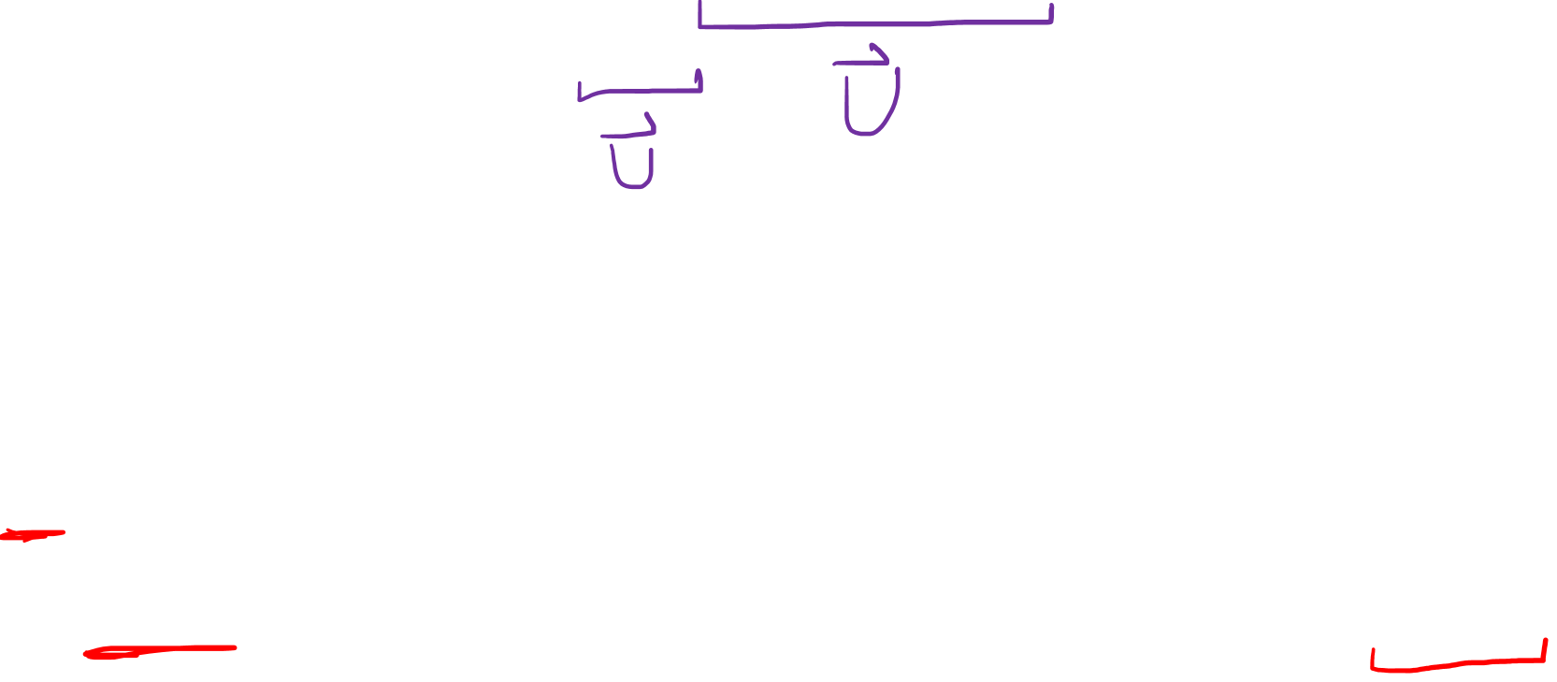
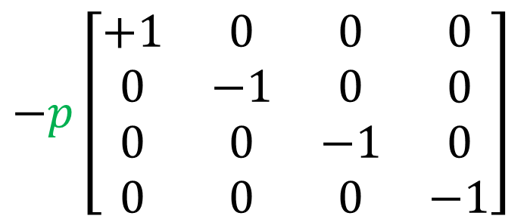


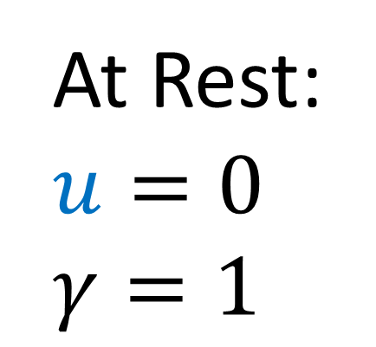
$\left[\begin{matrix}\begin{matrix}\begin{aligned}ρc^{2} \\ 0 \\ 0 \\ 0\end{aligned} & \begin{aligned}0 \\ p \\ 0 \\ 0\end{aligned}\end{matrix} & \begin{matrix}\begin{aligned}0 \\ 0 \\ p \\ 0\end{aligned} & \begin{aligned}0 \\ 0 \\ 0 \\ p\end{aligned}\end{matrix}\end{matrix}\right]$
$\left(ρ+\frac{p}{c^{2}}\right)\left[\begin{aligned}c \\ 0 \\ 0 \\ 0\end{aligned}\right]\left[\begin{matrix}\begin{matrix}c & 0\end{matrix} & \begin{matrix}0 & 0\end{matrix}\end{matrix}\right]$
$−p\left[\begin{matrix}\begin{matrix}\begin{aligned}+1 \\ 0 \\ 0 \\ 0\end{aligned} & \begin{aligned}0 \\ −1 \\ 0 \\ 0\end{aligned}\end{matrix} & \begin{matrix}\begin{aligned}0 \\ 0 \\ −1 \\ 0\end{aligned} & \begin{aligned}0 \\ 0 \\ 0 \\ −1\end{aligned}\end{matrix}\end{matrix}\right]$
$$=$$
(rest frame, flat space)
$$\vec{U}→γ\left[\begin{aligned}c \\ u^{x} \\ u^{y} \\ u^{z}\end{aligned}\right]$$
At Rest:
$u=0$
$γ=1$
$$\vec{U}→\left[\begin{aligned}c \\ 0 \\ 0 \\ 0\end{aligned}\right]$$
$γ=\frac{1}{\sqrt{1−\frac{u^{2}}{c^{2}}}}$

Slide 15
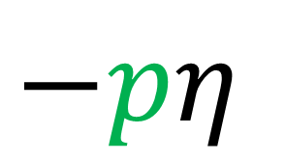


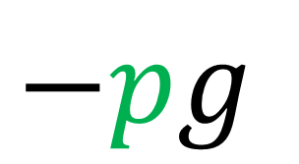

$\left[\begin{matrix}\begin{matrix}\begin{aligned}ρc^{2} \\ 0 \\ 0 \\ 0\end{aligned} & \begin{aligned}0 \\ p \\ 0 \\ 0\end{aligned}\end{matrix} & \begin{matrix}\begin{aligned}0 \\ 0 \\ p \\ 0\end{aligned} & \begin{aligned}0 \\ 0 \\ 0 \\ p\end{aligned}\end{matrix}\end{matrix}\right]$
$\left(ρ+\frac{p}{c^{2}}\right)\left[\begin{aligned}c \\ 0 \\ 0 \\ 0\end{aligned}\right]\left[\begin{matrix}\begin{matrix}c & 0\end{matrix} & \begin{matrix}0 & 0\end{matrix}\end{matrix}\right]$
$−p\left[\begin{matrix}\begin{matrix}\begin{aligned}+1 \\ 0 \\ 0 \\ 0\end{aligned} & \begin{aligned}0 \\ −1 \\ 0 \\ 0\end{aligned}\end{matrix} & \begin{matrix}\begin{aligned}0 \\ 0 \\ −1 \\ 0\end{aligned} & \begin{aligned}0 \\ 0 \\ 0 \\ −1\end{aligned}\end{matrix}\end{matrix}\right]$
$$=$$
(rest frame, flat space)
Flat Spacetime (cartesian cords):
$$𝒯_{perfect fluid}=\left(ρ+\frac{p}{c^{2}}\right)\vec{U}⊗\vec{U}$$
$$−pη$$
Curved Spacetime:
$$𝒯_{perfect fluid}=\left(ρ+\frac{p}{c^{2}}\right)\vec{U}⊗\vec{U}$$
$$−pg$$

Slide 16
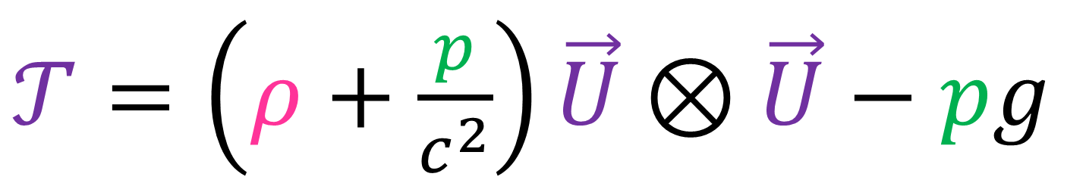
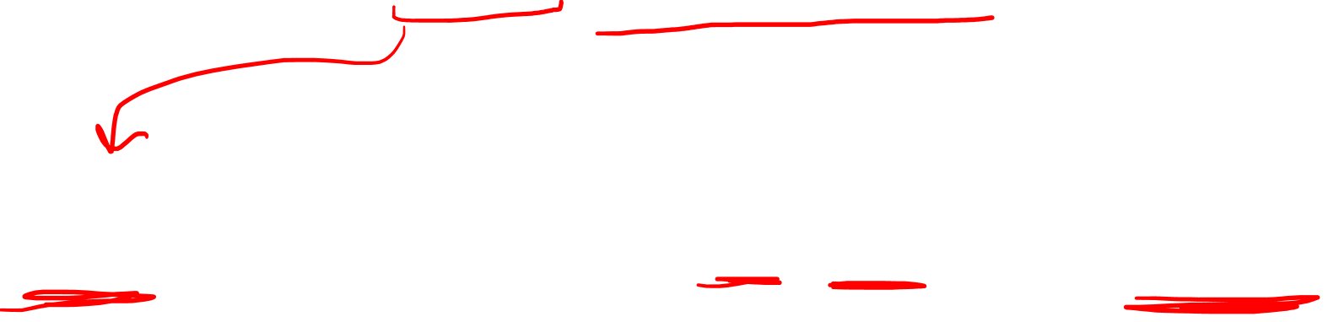
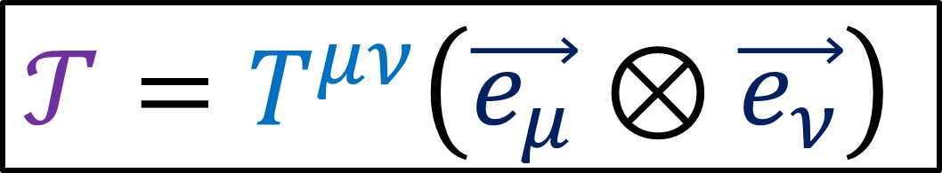

Curved Space:
$𝒯=\left(ρ+\frac{p}{c^{2}}\right)\vec{U}⊗\vec{U}−pg$
$$𝒯=T^{μν}\left(\vec{e_{μ}}⊗\vec{e_{ν}}\right)$$
$T^{μν}=\left(ρ+\frac{p}{c^{2}}\right)U^{μ}U^{ν}−pg^{μν}$

Slide 17
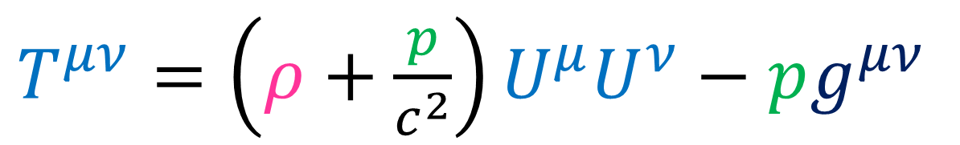
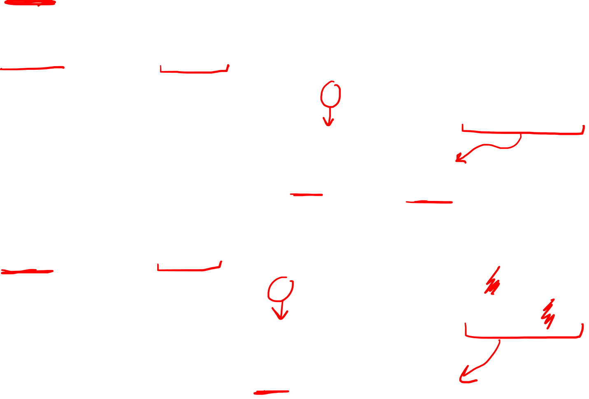
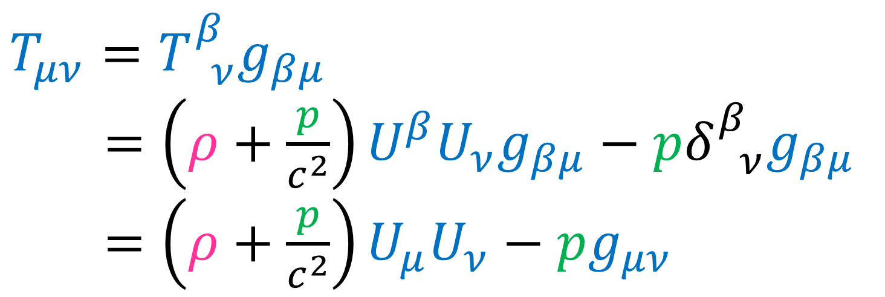
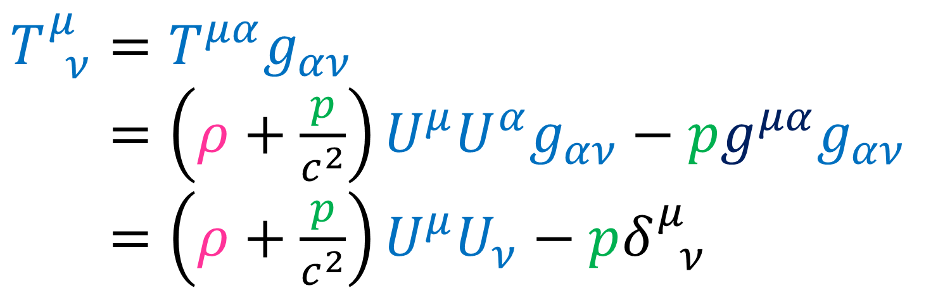
$T^{μν}=\left(ρ+\frac{p}{c^{2}}\right)U^{μ}U^{ν}−pg^{μν}$
$$T_{ ν}^{μ}=T^{μα}g_{αν}$$
$T_{ ν}^{μ}=\left(ρ+\frac{p}{c^{2}}\right)U^{μ}U^{α}g_{αν}−pg^{μα}g_{αν}$
$T_{ ν}^{μ}=\left(ρ+\frac{p}{c^{2}}\right)U^{μ}U_{ν}−pδ_{ ν}^{μ}$
$$T_{μν}=T_{ ν}^{β}g_{βμ}$$
$T_{ ν}^{μ}=\left(ρ+\frac{p}{c^{2}}\right)U^{β}U_{ν}g_{βμ}−pδ_{ ν}^{β}g_{βμ}$
$T_{ ν}^{μ}=\left(ρ+\frac{p}{c^{2}}\right)U_{μ}U_{ν}−pg_{μν}$

Slide 18
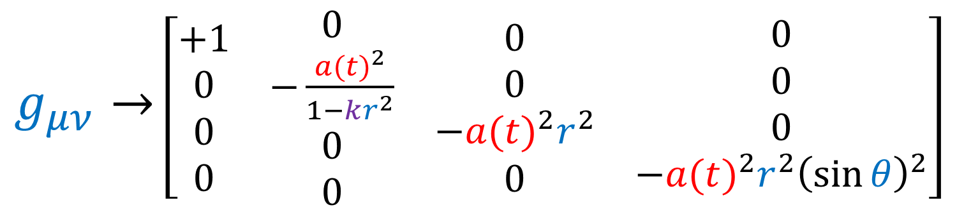
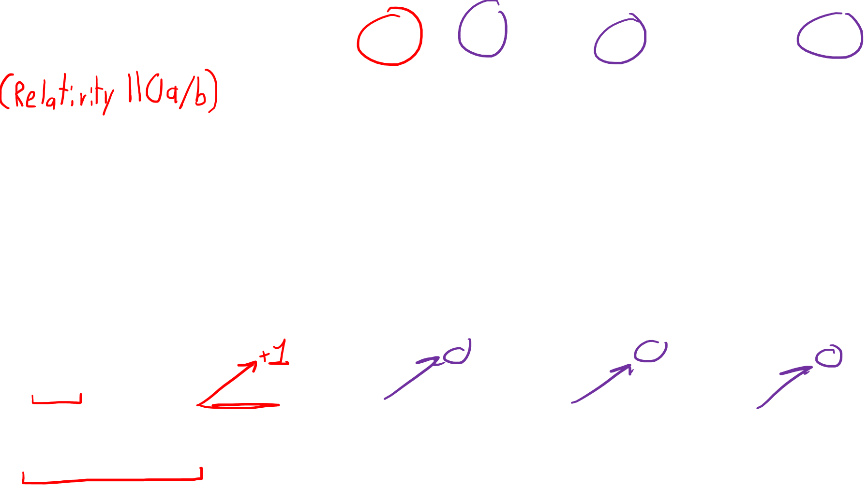

FLRW Metric
$g_{μν}→$ $\left[\begin{matrix}\begin{matrix}\begin{aligned}+1 \\ 0 \\ 0 \\ 0\end{aligned} & \begin{aligned}0 \\ −\frac{{a(t)}^{2}}{1−kr^{2}} \\ 0 \\ 0\end{aligned}\end{matrix} & \begin{matrix}\begin{aligned}0 \\ 0 \\ −{a(t)}^{2}r^{2} \\ 0\end{aligned} & \begin{aligned}0 \\ 0 \\ 0 \\ −{a(t)}^{2}r^{2}{\left(\sin{θ}\right)}^{2}\end{aligned}\end{matrix}\end{matrix}\right]$
(Relativity 110b/c)
$$U_{α}=U^{β}g_{αβ}$$
$$U_{α}=U^{0}g_{α0}+U^{1}g_{α1}+U^{2}g_{α2}+U^{3}g_{α3}$$
$$U_{0}=U^{0}g_{00}+U^{1}g_{01}+U^{2}g_{02}+U^{3}g_{03}$$
$$U_{0}=U^{0}$$

Slide 19






$$T^{μν}=\left(ρ+\frac{p}{c^{2}}\right)U^{μ}U^{ν}−pg^{μν}$$
$T_{ ν}^{μ}=\left(ρ+\frac{p}{c^{2}}\right)U^{μ}U_{ν}−pδ_{ ν}^{μ}$
$T_{μν}=\left(ρ+\frac{p}{c^{2}}\right)U_{μ}U_{ν}−pg_{μν}$
FLRW Metric
$$U_{0}=U^{0}$$
At rest
$$U^{0}=c$$
$$U^{i}=0$$
$\left(ρ+\frac{p}{c^{2}}\right)\left[\begin{aligned}c \\ 0 \\ 0 \\ 0\end{aligned}\right]\left[\begin{matrix}\begin{matrix}c & 0\end{matrix} & \begin{matrix}0 & 0\end{matrix}\end{matrix}\right]−p\left[\begin{matrix}\begin{matrix}\begin{aligned}1 \\ 0 \\ 0 \\ 0\end{aligned} & \begin{aligned}0 \\ 1 \\ 0 \\ 0\end{aligned}\end{matrix} & \begin{matrix}\begin{aligned}0 \\ 0 \\ 1 \\ 0\end{aligned} & \begin{aligned}0 \\ 0 \\ 0 \\ 1\end{aligned}\end{matrix}\end{matrix}\right]$
$$T_{ ν}^{μ}→$$
(rest)

Slide 20


$$T^{μν}=\left(ρ+\frac{p}{c^{2}}\right)U^{μ}U^{ν}−pg^{μν}$$
$T_{ ν}^{μ}=\left(ρ+\frac{p}{c^{2}}\right)U^{μ}U_{ν}−pδ_{ ν}^{μ}$
$T_{μν}=\left(ρ+\frac{p}{c^{2}}\right)U_{μ}U_{ν}−pg_{μν}$
FLRW Metric
$$U_{0}=U^{0}$$
At rest
$$U^{0}=c$$
$$U^{i}=0$$
$\left(ρ+\frac{p}{c^{2}}\right)\left[\begin{matrix}\begin{matrix}\begin{aligned}c^{2} \\ 0 \\ 0 \\ 0\end{aligned} & \begin{aligned}0 \\ 0 \\ 0 \\ 0\end{aligned}\end{matrix} & \begin{matrix}\begin{aligned}0 \\ 0 \\ 0 \\ 0\end{aligned} & \begin{aligned}0 \\ 0 \\ 0 \\ 0\end{aligned}\end{matrix}\end{matrix}\right]−p\left[\begin{matrix}\begin{matrix}\begin{aligned}1 \\ 0 \\ 0 \\ 0\end{aligned} & \begin{aligned}0 \\ 1 \\ 0 \\ 0\end{aligned}\end{matrix} & \begin{matrix}\begin{aligned}0 \\ 0 \\ 1 \\ 0\end{aligned} & \begin{aligned}0 \\ 0 \\ 0 \\ 1\end{aligned}\end{matrix}\end{matrix}\right]$
$$T_{ ν}^{μ}→$$
(rest)

Slide 21


$$T^{μν}=\left(ρ+\frac{p}{c^{2}}\right)U^{μ}U^{ν}−pg^{μν}$$
$T_{ ν}^{μ}=\left(ρ+\frac{p}{c^{2}}\right)U^{μ}U_{ν}−pδ_{ ν}^{μ}$
$T_{μν}=\left(ρ+\frac{p}{c^{2}}\right)U_{μ}U_{ν}−pg_{μν}$
FLRW Metric
$$U_{0}=U^{0}$$
At rest
$$U^{0}=c$$
$$U^{i}=0$$
$\left[\begin{matrix}\begin{matrix}\begin{aligned}ρc^{2}+p \\ 0 \\ 0 \\ 0\end{aligned} & \begin{aligned}0 \\ 0 \\ 0 \\ 0\end{aligned}\end{matrix} & \begin{matrix}\begin{aligned}0 \\ 0 \\ 0 \\ 0\end{aligned} & \begin{aligned}0 \\ 0 \\ 0 \\ 0\end{aligned}\end{matrix}\end{matrix}\right]−\left[\begin{matrix}\begin{matrix}\begin{aligned}p \\ 0 \\ 0 \\ 0\end{aligned} & \begin{aligned}0 \\ p \\ 0 \\ 0\end{aligned}\end{matrix} & \begin{matrix}\begin{aligned}0 \\ 0 \\ p \\ 0\end{aligned} & \begin{aligned}0 \\ 0 \\ 0 \\ p\end{aligned}\end{matrix}\end{matrix}\right]$
$$T_{ ν}^{μ}→$$
(rest)

Slide 22

$$T^{μν}=\left(ρ+\frac{p}{c^{2}}\right)U^{μ}U^{ν}−pg^{μν}$$
$T_{ ν}^{μ}=\left(ρ+\frac{p}{c^{2}}\right)U^{μ}U_{ν}−pδ_{ ν}^{μ}$
$T_{μν}=\left(ρ+\frac{p}{c^{2}}\right)U_{μ}U_{ν}−pg_{μν}$
FLRW Metric
$$U_{0}=U^{0}$$
At rest
$$U^{0}=c$$
$$U^{i}=0$$
$\left[\begin{matrix}\begin{matrix}\begin{aligned}ρc^{2} \\ 0 \\ 0 \\ 0\end{aligned} & \begin{aligned}0 \\ −p \\ 0 \\ 0\end{aligned}\end{matrix} & \begin{matrix}\begin{aligned}0 \\ 0 \\ −p \\ 0\end{aligned} & \begin{aligned}0 \\ 0 \\ 0 \\ −p\end{aligned}\end{matrix}\end{matrix}\right]$
$$T_{ ν}^{μ}→$$
(rest)

Slide 23




$$T^{μν}=\left(ρ+\frac{p}{c^{2}}\right)U^{μ}U^{ν}−pg^{μν}$$
$T_{ ν}^{μ}=\left(ρ+\frac{p}{c^{2}}\right)U^{μ}U_{ν}−pδ_{ ν}^{μ}$
$T_{μν}=\left(ρ+\frac{p}{c^{2}}\right)U_{μ}U_{ν}−pg_{μν}$
FLRW Metric
$$U_{0}=U^{0}$$
At rest
$$U^{0}=c$$
$$U^{i}=0$$
$\left(ρ+\frac{p}{c^{2}}\right)\left[\begin{matrix}\begin{matrix}\begin{aligned}c^{2} \\ 0 \\ 0 \\ 0\end{aligned} & \begin{aligned}0 \\ 0 \\ 0 \\ 0\end{aligned}\end{matrix} & \begin{matrix}\begin{aligned}0 \\ 0 \\ 0 \\ 0\end{aligned} & \begin{aligned}0 \\ 0 \\ 0 \\ 0\end{aligned}\end{matrix}\end{matrix}\right]−p\left[\begin{matrix}\begin{matrix}\begin{aligned}+1 \\ 0 \\ 0 \\ 0\end{aligned} & \begin{aligned}0 \\ \\ \\ \end{aligned}\end{matrix} & \begin{matrix}\begin{aligned}0 \\ \\ \\ \end{aligned} & \begin{aligned}0 \\ \\ \\ \end{aligned}\end{matrix}\end{matrix}\right]$
$$T^{μν}→$$
$$g^{ij}$$
(rest)

Slide 24


$$T^{μν}=\left(ρ+\frac{p}{c^{2}}\right)U^{μ}U^{ν}−pg^{μν}$$
$T_{ ν}^{μ}=\left(ρ+\frac{p}{c^{2}}\right)U^{μ}U_{ν}−pδ_{ ν}^{μ}$
$T_{μν}=\left(ρ+\frac{p}{c^{2}}\right)U_{μ}U_{ν}−pg_{μν}$
FLRW Metric
$$U_{0}=U^{0}$$
At rest
$$U^{0}=c$$
$$U^{i}=0$$
$\left[\begin{matrix}\begin{matrix}\begin{aligned}ρc^{2} \\ 0 \\ 0 \\ 0\end{aligned} & \begin{aligned}0 \\ \\ \\ \end{aligned}\end{matrix} & \begin{matrix}\begin{aligned}0 \\ \\ \\ \end{aligned} & \begin{aligned}0 \\ \\ \\ \end{aligned}\end{matrix}\end{matrix}\right]$
$$T^{μν}→$$
$$−pg^{ij}$$
(rest)

Slide 25



$$T^{μν}=\left(ρ+\frac{p}{c^{2}}\right)U^{μ}U^{ν}−pg^{μν}$$
$T_{ ν}^{μ}=\left(ρ+\frac{p}{c^{2}}\right)U^{μ}U_{ν}−pδ_{ ν}^{μ}$
$T_{μν}=\left(ρ+\frac{p}{c^{2}}\right)U_{μ}U_{ν}−pg_{μν}$
FLRW Metric
$$U_{0}=U^{0}$$
At rest
$$U^{0}=c$$
$$U^{i}=0$$
$\left(ρ+\frac{p}{c^{2}}\right)\left[\begin{matrix}\begin{matrix}\begin{aligned}c^{2} \\ 0 \\ 0 \\ 0\end{aligned} & \begin{aligned}0 \\ 0 \\ 0 \\ 0\end{aligned}\end{matrix} & \begin{matrix}\begin{aligned}0 \\ 0 \\ 0 \\ 0\end{aligned} & \begin{aligned}0 \\ 0 \\ 0 \\ 0\end{aligned}\end{matrix}\end{matrix}\right]−p\left[\begin{matrix}\begin{matrix}\begin{aligned}+1 \\ 0 \\ 0 \\ 0\end{aligned} & \begin{aligned}0 \\ \\ \\ \end{aligned}\end{matrix} & \begin{matrix}\begin{aligned}0 \\ \\ \\ \end{aligned} & \begin{aligned}0 \\ \\ \\ \end{aligned}\end{matrix}\end{matrix}\right]$
$$T_{μν}→$$
$$g_{ij}$$
(rest)

Slide 26


$$T^{μν}=\left(ρ+\frac{p}{c^{2}}\right)U^{μ}U^{ν}−pg^{μν}$$
$T_{ ν}^{μ}=\left(ρ+\frac{p}{c^{2}}\right)U^{μ}U_{ν}−pδ_{ ν}^{μ}$
$T_{μν}=\left(ρ+\frac{p}{c^{2}}\right)U_{μ}U_{ν}−pg_{μν}$
FLRW Metric
$$U_{0}=U^{0}$$
At rest
$$U^{0}=c$$
$$U^{i}=0$$
$\left[\begin{matrix}\begin{matrix}\begin{aligned}ρc^{2} \\ 0 \\ 0 \\ 0\end{aligned} & \begin{aligned}0 \\ \\ \\ \end{aligned}\end{matrix} & \begin{matrix}\begin{aligned}0 \\ \\ \\ \end{aligned} & \begin{aligned}0 \\ \\ \\ \end{aligned}\end{matrix}\end{matrix}\right]$
$$T_{μν}→$$
$$−pg_{ij}$$
(rest)

Slide 27










$\left[\begin{matrix}\begin{matrix}\begin{aligned}ρc^{2} \\ 0 \\ 0 \\ 0\end{aligned} & \begin{aligned}0 \\ \\ \\ \end{aligned}\end{matrix} & \begin{matrix}\begin{aligned}0 \\ \\ \\ \end{aligned} & \begin{aligned}0 \\ \\ \\ \end{aligned}\end{matrix}\end{matrix}\right]$
$$T_{μν}→$$
Perfect Fluid Energy-Momentum Tensor
(Rest Frame)
(FLRW Metric)
$$−pg_{ij}$$
(rest)
$\left[\begin{matrix}\begin{matrix}\begin{aligned}ρc^{2} \\ 0 \\ 0 \\ 0\end{aligned} & \begin{aligned}0 \\ −p \\ 0 \\ 0\end{aligned}\end{matrix} & \begin{matrix}\begin{aligned}0 \\ 0 \\ −p \\ 0\end{aligned} & \begin{aligned}0 \\ 0 \\ 0 \\ −p\end{aligned}\end{matrix}\end{matrix}\right]$
$$T_{ ν}^{μ}→$$
(rest)
$\left[\begin{matrix}\begin{matrix}\begin{aligned}ρc^{2} \\ 0 \\ 0 \\ 0\end{aligned} & \begin{aligned}0 \\ \\ \\ \end{aligned}\end{matrix} & \begin{matrix}\begin{aligned}0 \\ \\ \\ \end{aligned} & \begin{aligned}0 \\ \\ \\ \end{aligned}\end{matrix}\end{matrix}\right]$
$$T^{μν}→$$
$$\left(+−−−\right)$$
signature
$$−pg^{ij}$$
(rest)

Slide 28
COSMIC REST FRAME

Slide 29




$G_{μν}−Λg_{μν}=\frac{8πG}{c^{4}}T_{μν}$
$\left[\begin{matrix}\begin{matrix}\begin{aligned}ρc^{2} \\ 0 \\ 0 \\ 0\end{aligned} & \begin{aligned}0 \\ \\ \\ \end{aligned}\end{matrix} & \begin{matrix}\begin{aligned}0 \\ \\ \\ \end{aligned} & \begin{aligned}0 \\ \\ \\ \end{aligned}\end{matrix}\end{matrix}\right]$
$$T_{μν}→$$
$$−pg_{ij}$$
(rest)
Concern #1:
If the matter/radiation in the universe is a fluid “at rest”,
With respect to which frame is it at rest?
In SR/GR, there should be no “objective” rest frame.

Slide 30



FLRW Metric
$g_{μν}→$ $\left[\begin{matrix}\begin{matrix}\begin{aligned}+1 \\ 0 \\ 0 \\ 0\end{aligned} & \begin{aligned}0 \\ −\frac{{a(t)}^{2}}{1−kr^{2}} \\ 0 \\ 0\end{aligned}\end{matrix} & \begin{matrix}\begin{aligned}0 \\ 0 \\ −{a(t)}^{2}r^{2} \\ 0\end{aligned} & \begin{aligned}0 \\ 0 \\ 0 \\ −{a(t)}^{2}r^{2}{\left(\sin{θ}\right)}^{2}\end{aligned}\end{matrix}\end{matrix}\right]$
Concern #2:
Which reference frame does the $t$ in $a(t)$ belong to?
(In SR/GR, there should be no objective $t$ coordinate.)

Slide 31




It turns out that the matter/radiation in the universe does have a “rest frame”: The Cosmic Rest Frame.
$$T_{μν}$$
$a(t)$
(rest)

Slide 32


It turns out that the matter/radiation in the universe does have a “rest frame”: The Cosmic Rest Frame.
$$T_{μν}$$
$a(t)$
(rest)
redshift
blueshift

Slide 33


It turns out that the matter/radiation in the universe does have a “rest frame”: The Cosmic Rest Frame.
$$T_{μν}$$
$a(t)$
(rest)
redshift
blueshift
Most reference frames:
CMB has doppler shift

Slide 34

It turns out that the matter/radiation in the universe does have a “rest frame”: The Cosmic Rest Frame.
$$T_{μν}$$
$a(t)$
(rest)
redshift
blueshift
Most reference frames:
CMB has doppler shift
One specific frame:
CMB has no doppler shift

Slide 35
It turns out that the matter/radiation in the universe does have a “rest frame”: The Cosmic Rest Frame.
$$T_{μν}$$
$a(t)$
(rest)
Cosmic Rest Frame is the unique frame where:
There is no observed doppler shift in the Cosmic Microwave Background radiation
Frequency looks the same in all directions

Slide 36




Solar System
Galaxy
Galaxy Clusters/
Superclusters
Galaxy Filaments
Zoom Out

Slide 37


Galaxy Filaments
Boxes $\sim$100 million ly
$→$ average velocity of masses is zero

Slide 38



Galaxy Filaments
Boxes $\sim$100 million ly
$→$ average velocity of masses is zero

Slide 39

It turns out that the matter/radiation in the universe does have a “rest frame”: The Cosmic Rest Frame.
$$T_{μν}$$
$a(t)$
(rest)
Cosmic Rest Frame is the unique frame where:
There is no observed doppler shift in the Cosmic Microwave Background radiation
Frequency looks the same in all directions
The average velocity of masses at large scale is zero
$⇒$Aether??

Slide 40


Aether:
Maxwell’s Equations predict light has speed $c=3×{10}^{8}$ m/s
Relative to what frame?
Aether is proposed as a special reference frame that light travels in
Maxwell’s equations work relative to the Aether
Special/General relativity:
Reject the existence of the aether
Claim: all laws of physics, including $c$ and Maxwell’s Eqns, are the same in all frames
(SR ignores gravity)
Equations describing laws of physics are the same in all frames (inertial or non-inertial), provided they are written using invariant 4D tensors

Slide 41


Cosmic Rest Frame:
Has nothing to do with the laws of physics working or not
Really about the distribution of radiation and matter in the universe
If you fly around space in a rocket, in most frames the CMB radiation will have Doppler shift
In one specific frame, you’ll see no CMB Doppler shift. You are “at rest” with respect to the CMB radiation $→T_{μν}^{rest}$
The 3D “spatial slices” of spacetime you observe in this frame define the $r,θ,φ$ coordinates used in FLRW
The direction orthogonal to these “spatial slices” defines the time coordinate $t$ used in the scale factor $a(t)$
As far as the laws of physics are concerned, the Cosmic Rest Frame isn’t any more objective than any other frame…
It’s just a frame based on the distribution of matter and radiation.

Slide 42

In a universe changing in scale…
There is a frame at each point where:
No doppler shift in CMB radiation
Average velocity of matter at large scales is zero
$$a\left(t\right)$$
Frames collectively called: “Cosmic Rest Frame”

Slide 43
BUT!
What if the universe was empty? How would we define the cosmic rest frame then?
You can’t! Spacetime becomes homogeneous/isotropic
Empty Spacetime with Zero curvature | Minkowski Space
Empty Spacetime with Positive curvature | de Sitter Space
Empty Spacetime with Negative curvature | Anti-de Sitter Space
Flat Space
Sphere
Hyperbolic Space
Space Equivalent

Slide 44
EQUATION OF STATE

Slide 45

Equations of State (EOS)
Simplest we can come up with is: $p=wρc^{2}$
Some special cases:
$w=0=p$ is non-relativistic matter
$w=1/3$ is radiation/relativistic matter
$w=−1$ is a constant energy density that doesn’t change, even though the universe expands (cosmological constant)

Slide 46




Van der Waals EOS, Peng Robinson EOS, Virial EOS
Equation of State:
Idea comes from Thermodynamics / Chemistry
Relates state variables together
Pressure, volume, density, temperature, etc.
Example: Ideal Gas Law $pV=nRT$
Simplest Option:
$p=wρc^{2}$
$\left[\begin{matrix}\begin{matrix}\begin{aligned}ρc^{2} \\ 0 \\ 0 \\ 0\end{aligned} & \begin{aligned}0 \\ −p \\ 0 \\ 0\end{aligned}\end{matrix} & \begin{matrix}\begin{aligned}0 \\ 0 \\ −p \\ 0\end{aligned} & \begin{aligned}0 \\ 0 \\ 0 \\ −p\end{aligned}\end{matrix}\end{matrix}\right]$
$$T_{ ν}^{μ}→$$
(rest)
Barotropic Fluid:
Fluid whose density $ρ\left(p\right)$ is a function of pressure only

Slide 47






Perfect Fluid
Equation of State
$$p=wρc^{2}$$
$$T_{ ν}^{μ}→$$
$\left[\begin{matrix}\begin{matrix}\begin{aligned}ρc^{2} \\ 0 \\ 0 \\ 0\end{aligned} & \begin{aligned}0 \\ −p \\ 0 \\ 0\end{aligned}\end{matrix} & \begin{matrix}\begin{aligned}0 \\ 0 \\ −p \\ 0\end{aligned} & \begin{aligned}0 \\ 0 \\ 0 \\ −p\end{aligned}\end{matrix}\end{matrix}\right]$
(rest)
$$w=0$$
$$⇒p=wρc^{2}=0$$
“Dust”-like matter
$$T_{ ν}^{μ}→$$
$\left[\begin{matrix}\begin{matrix}\begin{aligned}ρc^{2} \\ 0 \\ 0 \\ 0\end{aligned} & \begin{aligned}0 \\ 0 \\ 0 \\ 0\end{aligned}\end{matrix} & \begin{matrix}\begin{aligned}0 \\ 0 \\ 0 \\ 0\end{aligned} & \begin{aligned}0 \\ 0 \\ 0 \\ 0\end{aligned}\end{matrix}\end{matrix}\right]$
(rest)

Slide 48



https://physics.stackexchange.com/questions/489197/why-is-the-stress-energy-tensor-for-electromagnetic-radiation-traceless
https://en.wikipedia.org/wiki/Electromagnetic_stress%E2%80%93energy_tensor
Energy-Momentum Tensor for electromagnetic radiation
$T^{μν} =\frac{1}{μ_{0}}\left[F^{μα}F_{ α}^{ν}−\frac{1}{4}g^{μν} F^{αβ}F_{αβ}\right]$
Faraday Tensor (Electromagnetic Tensor)
$$F^{μα}→\left[\begin{matrix}\begin{matrix}\begin{aligned}0 \\ E_{x}/c \\ E_{y}/c \\ E_{z}/c\end{aligned} & \begin{aligned}−E_{x}/c \\ 0 \\ B_{z} \\ −B_{y}\end{aligned}\end{matrix} & \begin{matrix}\begin{aligned}−E_{y}/c \\ −B_{z} \\ 0 \\ B_{x}\end{aligned} & \begin{aligned}−E_{z}/c \\ B_{y} \\ −B_{x} \\ 0\end{aligned}\end{matrix}\end{matrix}\right]$$

Slide 49





https://physics.stackexchange.com/questions/489197/why-is-the-stress-energy-tensor-for-electromagnetic-radiation-traceless
https://en.wikipedia.org/wiki/Electromagnetic_stress%E2%80%93energy_tensor
Energy-Momentum Tensor for electromagnetic radiation
$T^{μν} =\frac{1}{μ_{0}}\left[F^{μα}F_{ α}^{ν}−\frac{1}{4}g^{μν} F^{αβ}F_{αβ}\right]$
https://en.wikipedia.org/wiki/Electromagnetic_tensor
$F_{μν}F^{μν}=2\left(B^{2}−\frac{E^{2}}{c^{2}}\right)$
$T_{ σ}^{μ}=T^{μν}g_{νσ}=\frac{1}{μ_{0}}\left[F^{μα}F_{ α}^{ν}−\frac{1}{4}g^{μν}F^{αβ}F_{αβ}\right]g_{νσ}$
$T_{ σ}^{μ}=T^{μν}g_{νσ}=\frac{1}{μ_{0}}\left[F^{μα}F_{ α}^{ν}g_{νσ}−\frac{1}{4}g^{μν}g_{νσ}F^{αβ}F_{αβ}\right]$
$T_{ σ}^{μ}=T^{μν}g_{νσ}=\frac{1}{μ_{0}}\left[F^{μα}F_{σα}−\frac{1}{4}δ_{ σ}^{μ}F^{αβ}F_{αβ} \right]$
$T=T_{ μ}^{μ}=\frac{1}{μ_{0}}\left[F^{μα}F_{μα}−\frac{1}{4}δ_{ μ}^{μ}F_{αβ} F^{αβ}\right]$
$T=T_{ μ}^{μ}=\frac{1}{μ_{0}}\left[F^{μα}F_{μα}−\frac{1}{4}(4)F_{αβ} F^{αβ}\right]$
$$=0$$

Slide 50




Perfect Fluid
Equation of State
$$p=wρc^{2}$$
$$T_{ ν}^{μ}→$$
$\left[\begin{matrix}\begin{matrix}\begin{aligned}ρc^{2} \\ 0 \\ 0 \\ 0\end{aligned} & \begin{aligned}0 \\ −p \\ 0 \\ 0\end{aligned}\end{matrix} & \begin{matrix}\begin{aligned}0 \\ 0 \\ −p \\ 0\end{aligned} & \begin{aligned}0 \\ 0 \\ 0 \\ −p\end{aligned}\end{matrix}\end{matrix}\right]$
(rest)
Radiation: $T=T_{ μ}^{μ}=0$
$$0=T_{ μ}^{μ}$$
$$0=ρc^{2}−3p$$
$$3p=ρc^{2}$$
$p=\frac{1}{3}ρc^{2}$
$⇒w=\frac{1}{3}$

Slide 51





Perfect Fluid
Equation of State
$$p=wρc^{2}$$
$$T_{ ν}^{μ}→$$
$\left[\begin{matrix}\begin{matrix}\begin{aligned}ρc^{2} \\ 0 \\ 0 \\ 0\end{aligned} & \begin{aligned}0 \\ −p \\ 0 \\ 0\end{aligned}\end{matrix} & \begin{matrix}\begin{aligned}0 \\ 0 \\ −p \\ 0\end{aligned} & \begin{aligned}0 \\ 0 \\ 0 \\ −p\end{aligned}\end{matrix}\end{matrix}\right]$
(rest)
$$T_{ ν}^{μ}→$$
$\left[\begin{matrix}\begin{matrix}\begin{aligned}ρc^{2} \\ 0 \\ 0 \\ 0\end{aligned} & \begin{aligned}0 \\ ρc^{2} \\ 0 \\ 0\end{aligned}\end{matrix} & \begin{matrix}\begin{aligned}0 \\ 0 \\ ρc^{2} \\ 0\end{aligned} & \begin{aligned}0 \\ 0 \\ 0 \\ ρc^{2}\end{aligned}\end{matrix}\end{matrix}\right]$
$$w=−1$$
$$⇒p=−ρc^{2}$$
(rest)

Slide 52

Perfect Fluid
Equation of State
$$p=wρc^{2}$$
$$T_{ ν}^{μ}→$$
$\left[\begin{matrix}\begin{matrix}\begin{aligned}ρc^{2} \\ 0 \\ 0 \\ 0\end{aligned} & \begin{aligned}0 \\ −p \\ 0 \\ 0\end{aligned}\end{matrix} & \begin{matrix}\begin{aligned}0 \\ 0 \\ −p \\ 0\end{aligned} & \begin{aligned}0 \\ 0 \\ 0 \\ −p\end{aligned}\end{matrix}\end{matrix}\right]$
(rest)
$$T_{ ν}^{μ}→$$
$ρc^{2}\left[\begin{matrix}\begin{matrix}\begin{aligned}1 \\ 0 \\ 0 \\ 0\end{aligned} & \begin{aligned}0 \\ 1 \\ 0 \\ 0\end{aligned}\end{matrix} & \begin{matrix}\begin{aligned}0 \\ 0 \\ 1 \\ 0\end{aligned} & \begin{aligned}0 \\ 0 \\ 0 \\ 1\end{aligned}\end{matrix}\end{matrix}\right]$
$$w=−1$$
$$⇒p=−ρc^{2}$$
(rest)

Slide 53




Perfect Fluid
Equation of State
$$p=wρc^{2}$$
$$T_{ ν}^{μ}→$$
$\left[\begin{matrix}\begin{matrix}\begin{aligned}ρc^{2} \\ 0 \\ 0 \\ 0\end{aligned} & \begin{aligned}0 \\ −p \\ 0 \\ 0\end{aligned}\end{matrix} & \begin{matrix}\begin{aligned}0 \\ 0 \\ −p \\ 0\end{aligned} & \begin{aligned}0 \\ 0 \\ 0 \\ −p\end{aligned}\end{matrix}\end{matrix}\right]$
(rest)
$$w=−1$$
$$⇒p=−ρc^{2}$$
$$T_{ ν}^{μ}=ρc^{2}δ_{ ν}^{μ}$$
$$T_{ ν}^{μ}g_{μσ}=ρc^{2}δ_{ ν}^{μ}g_{μσ}$$
$$T_{σν}=ρc^{2}g_{νσ}$$

Slide 54



$$w=−1⇒\tilde{T_{μν}}=ρc^{2}g_{μν}$$
$R_{μν}−\frac{1}{2}Rg_{μν}− Λ g_{μν}=\frac{8πG}{c^{4}}T_{μν}$
$R_{μν}−\frac{1}{2}Rg_{μν}−ρc^{2}g_{μν}=\frac{8πG}{c^{4}}T_{μν}$
$R_{μν}−\frac{1}{2}Rg_{μν}=ρc^{2}g_{μν}+\frac{8πG}{c^{4}}T_{μν}$
$R_{μν}−\frac{1}{2}Rg_{μν}= \tilde{T_{μν}} +\frac{8πG}{c^{4}}T_{μν}$

Slide 55

Summary
$\left[\begin{matrix}\begin{matrix}\begin{aligned}ρc^{2} \\ 0 \\ 0 \\ 0\end{aligned} & \begin{aligned}0 \\ \\ \\ \end{aligned}\end{matrix} & \begin{matrix}\begin{aligned}0 \\ \\ \\ \end{aligned} & \begin{aligned}0 \\ \\ \\ \end{aligned}\end{matrix}\end{matrix}\right]$
$$T_{μν}→$$
$$−pg_{ij}$$
Perfect Fluid
$$𝒯=−pg+$$
$$\left(ρ+\frac{p}{c^{2}}\right)\vec{U}⊗\vec{U}$$
(rest)
$\left[\begin{matrix}\begin{matrix}\begin{aligned}ρc^{2} \\ 0 \\ 0 \\ 0\end{aligned} & \begin{aligned}0 \\ −p \\ 0 \\ 0\end{aligned}\end{matrix} & \begin{matrix}\begin{aligned}0 \\ 0 \\ −p \\ 0\end{aligned} & \begin{aligned}0 \\ 0 \\ 0 \\ −p\end{aligned}\end{matrix}\end{matrix}\right]$
$$T_{ ν}^{μ}→$$
(rest)
$\left[\begin{matrix}\begin{matrix}\begin{aligned}ρc^{2} \\ 0 \\ 0 \\ 0\end{aligned} & \begin{aligned}0 \\ \\ \\ \end{aligned}\end{matrix} & \begin{matrix}\begin{aligned}0 \\ \\ \\ \end{aligned} & \begin{aligned}0 \\ \\ \\ \end{aligned}\end{matrix}\end{matrix}\right]$
$$T^{μν}→$$
$$−pg^{ij}$$
(rest)

Slide 56



Summary
Cosmic Rest Frame is the unique frame where:
There is no observed doppler shift in the Cosmic Microwave Background radiation
Frequency looks the same in all directions
The average velocity of masses at large scale is zero
$$T_{μν}$$
$a(t)$
(rest)

Slide 57



Summary
Equation of State:
$$p=wρc^{2}$$
Dust-like Matter: $w=0$
Radiation: $w=\frac{1}{3}$
C.C. / Dark Energy: $w=−1$

Slide 58


1st Friedmann Equation (universe expansion rate)
$\frac{{\dot{a}}^{2}+kc^{2}}{a^{2}}=\frac{8πGρ+Λc^{2}}{3}$
2st Friedmann Equation (universe acceleration rate)
$\frac{\ddot{a}}{a}=−\frac{4πG}{3}\left(ρ+\frac{3p}{c^{2}}\right)+\frac{Λc^{2}}{3}$

