Slide 1

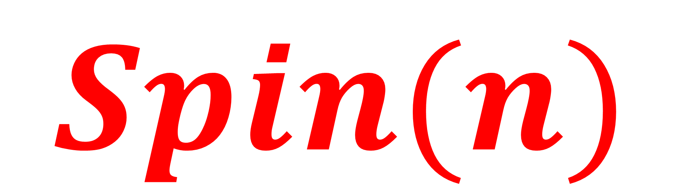
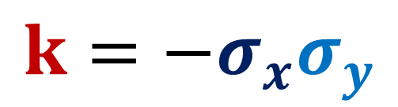
Spinors For Beginners
12
$$Spin(n)$$
generalizes
Quaternions
$$k=−σ_{x}σ_{y}$$

Slide 2
Spinors Learning “Staircase”
Spinors in Particle Physics
Lie Groups & Algebras
Clifford Algebras
Spinors in 3D / (4D)
Examples From Physics (motivation)

Slide 3
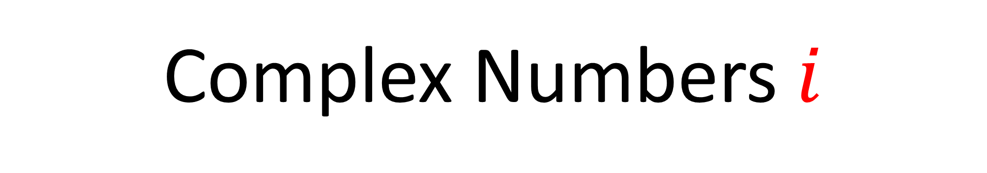


Complex Numbers $i$
Quaternions $i j k$
$Spin(n)$ Groups

Slide 4
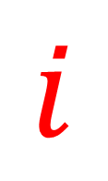
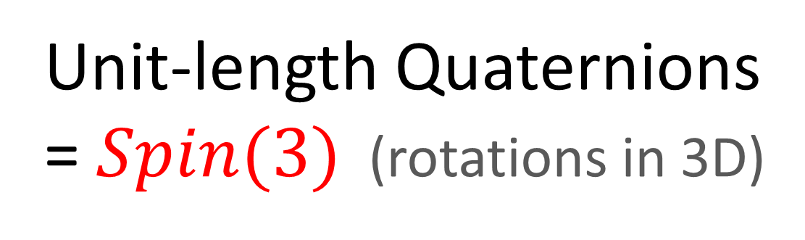

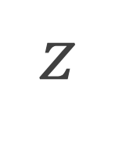

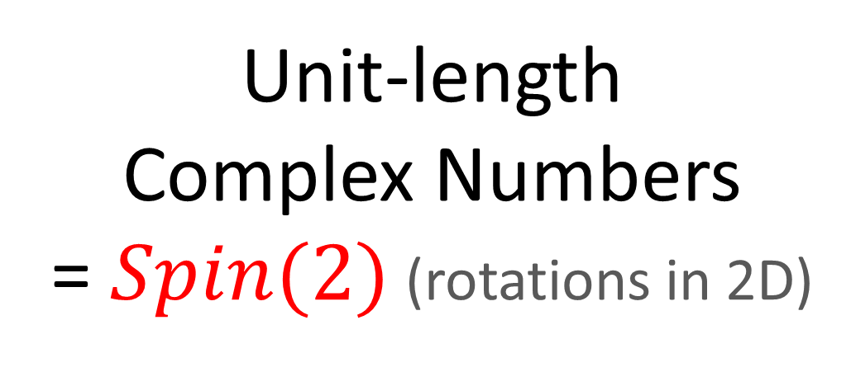




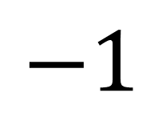
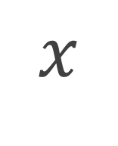



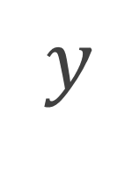
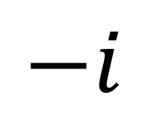
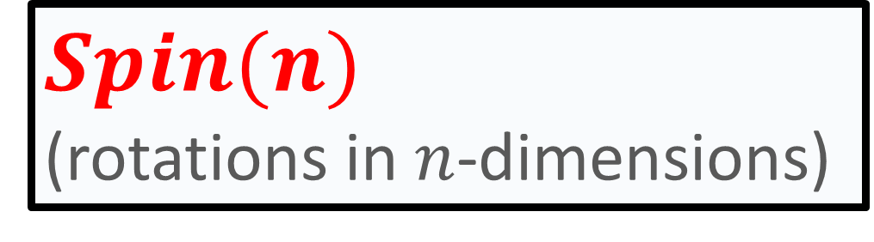
Unit-length Complex Numbers
= $Spin(2)$ (rotations in 2D)
Unit-length Quaternions
= $Spin(3)$ (rotations in 3D)
$$z$$
$$k$$
$$z$$
$$i$$
$$Im$$
$$y$$
$$y$$
$$j$$
$$x$$
$$Re$$
$$i$$
$$−1$$
$$1$$
$$x$$
$$Spin(n)$$
(rotations in $n$-dimensions)
$$−i$$

Slide 5
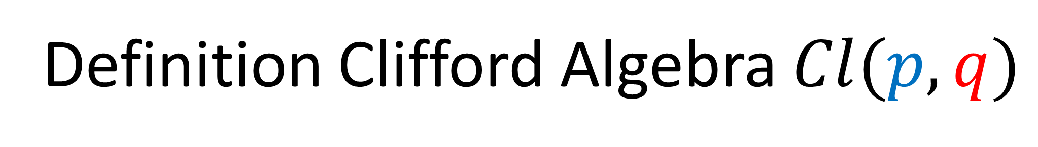
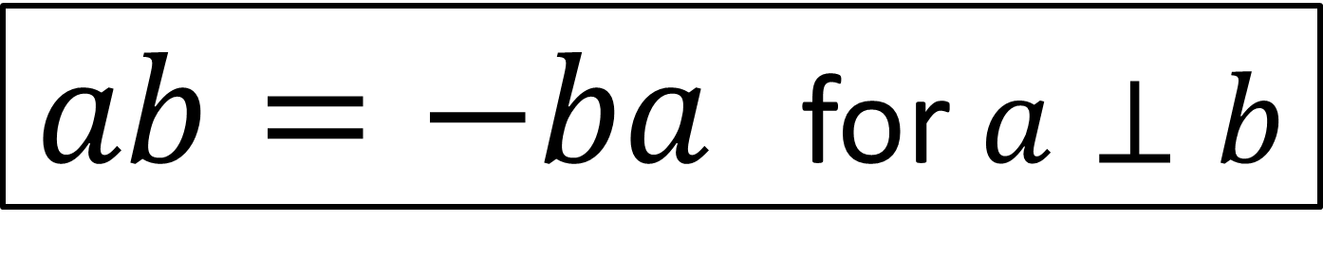
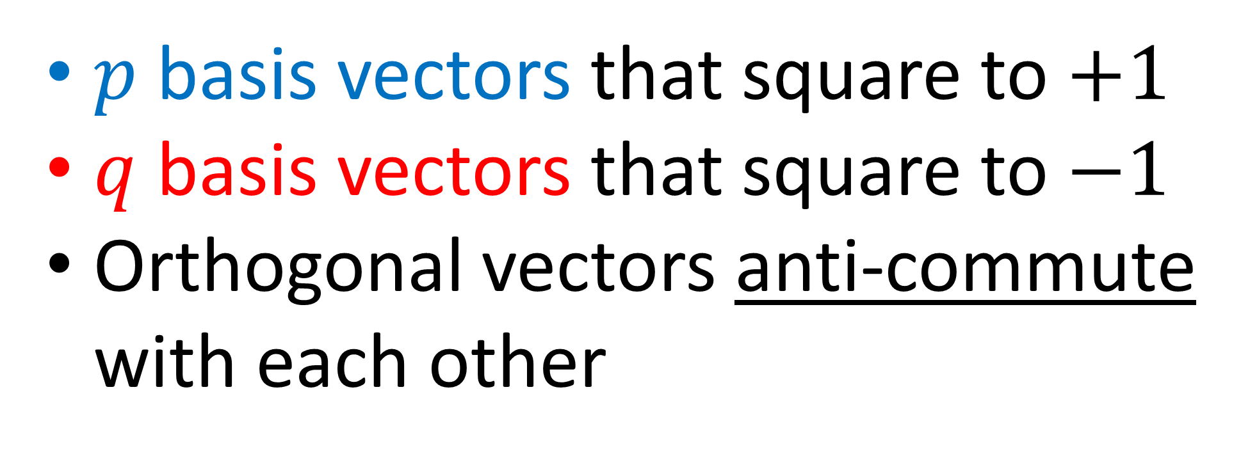
Definition Clifford Algebra $Cl(p,q)$
$p$ basis vectors that square to $+1$
$q$ basis vectors that square to $−1$
Orthogonal vectors anti-commute with each other
$ab=−ba$ for $a⊥b$

Slide 6
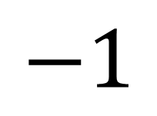
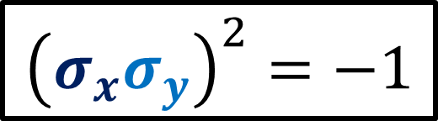


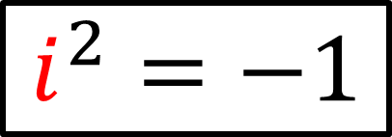
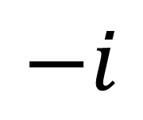
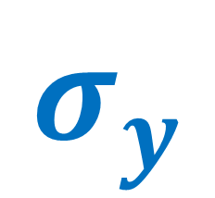

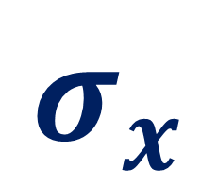


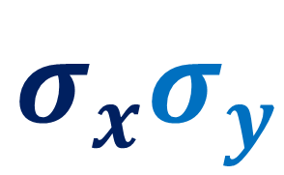
Unit-length Complex Numbers
$$Spin(2)$$
$$σ_{x}σ_{y}$$
$$i$$
$$Im$$
$$σ_{y}$$
$$Re$$
$$−1$$
$$1$$
$$σ_{x}$$
$$−i$$
$$i^{2}=−1$$
$${\left(σ_{x}σ_{y}\right)}^{2}=−1$$

Slide 7
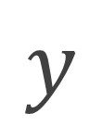

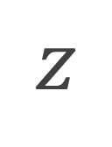
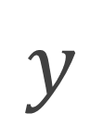
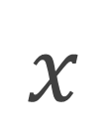
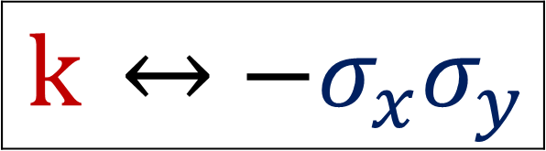
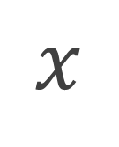
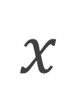
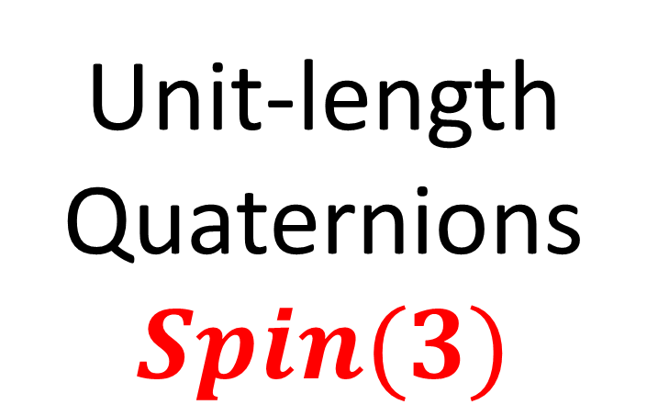
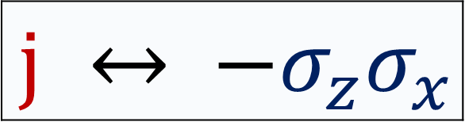

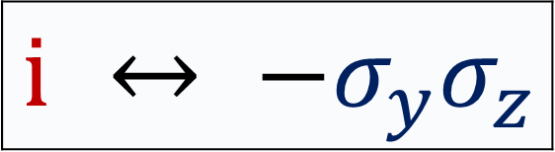




$$z$$
$$k$$
Unit-length Quaternions
$$Spin(3)$$
$$k$$ | $$↔$$ | $$−σ_{x}σ_{y}$$
$$y$$
$$x$$
$$j$$ | $$↔$$ | $$−σ_{z}σ_{x}$$
$$z$$
$$z$$
$$i$$ | $$↔$$ | $$−σ_{y}σ_{z}$$
$$j$$
$$y$$
$$y$$
$$x$$
$$x$$
$$i$$

Slide 8
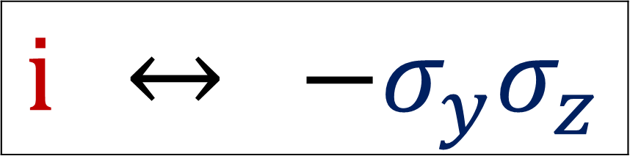


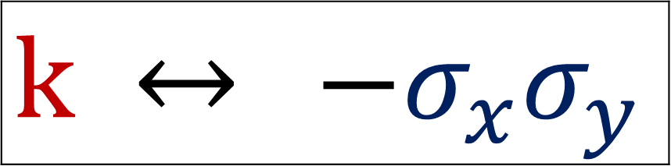
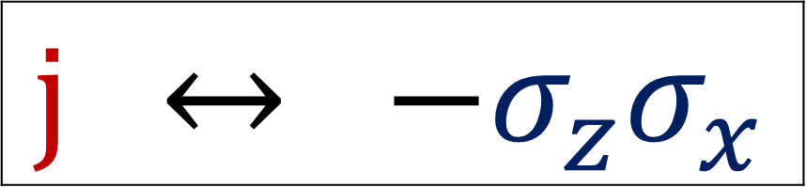
$$i j = k$$
$$i$$ | $$↔$$ | $$−σ_{y}σ_{z}$$
$$\left(−σ_{y}σ_{z} \right)\left(−σ_{z}σ_{x}\right)$$
$$=σ_{y}σ_{z}σ_{z}σ_{x}$$
$$=σ_{y}(1)σ_{x}$$
$$=−σ_{x}σ_{y}$$
$$j$$ | $$↔$$ | $$−σ_{z}σ_{x}$$
$$k$$ | $$↔$$ | $$−σ_{x}σ_{y}$$

Slide 9
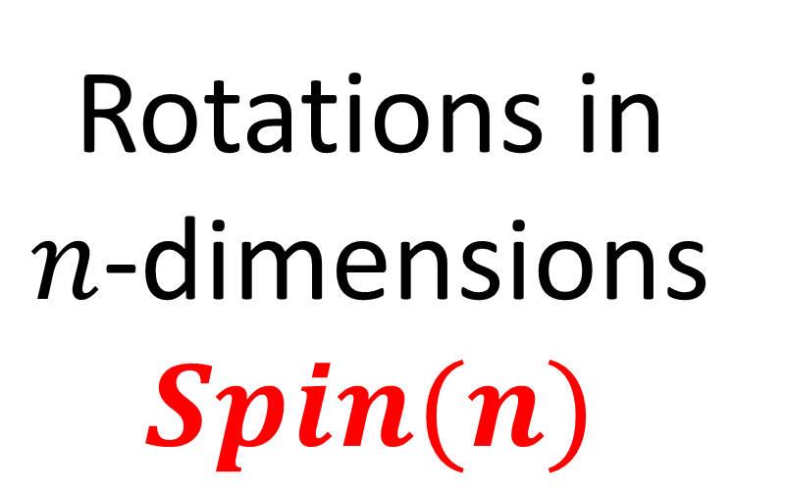
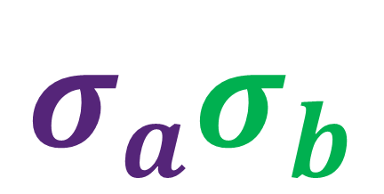


Rotations in $n$-dimensions
$$Spin(n)$$
$$σ_{b}$$
$$σ_{a}σ_{b}$$
$$σ_{a}$$

Slide 10
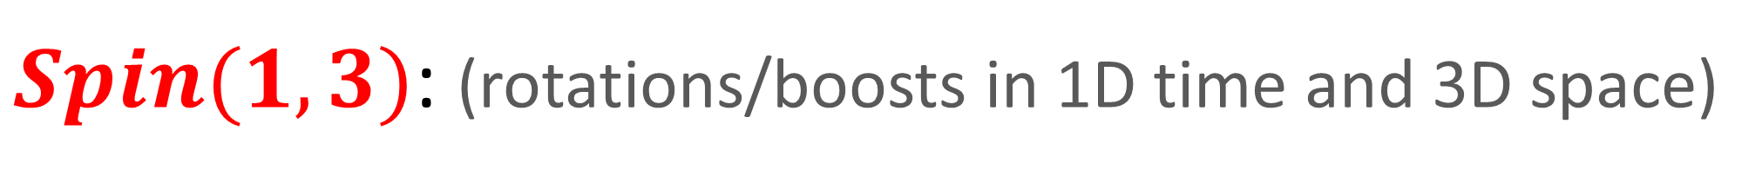
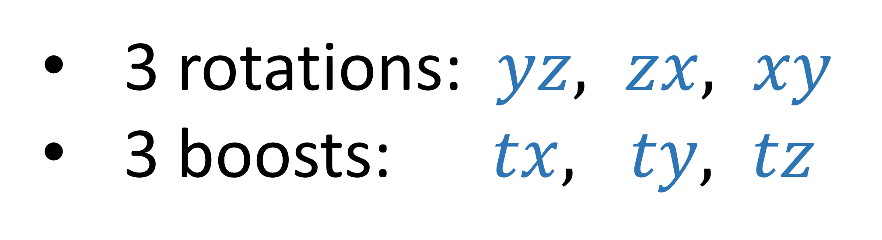
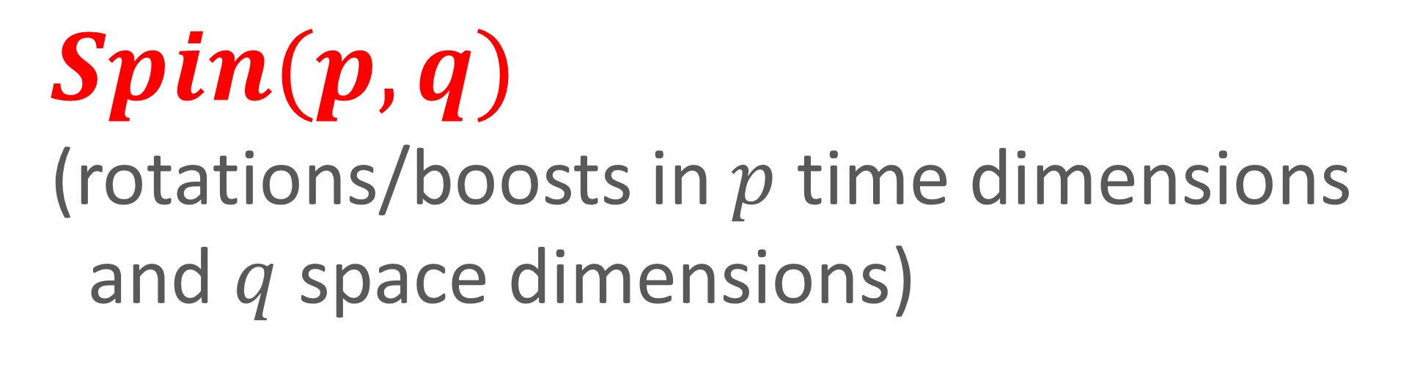
$Spin(1,3)$: (rotations/boosts in 1D time and 3D space)
3 rotations: $yz, zx, xy$
3 boosts: $tx, ty, tz$
$$Spin(p,q)$$
(rotations/boosts in $p$ time dimensions
and $q$ space dimensions)

Slide 11
Clifford Algebras for:
Reflections
Rotations
In any dimension
(This is why they are also called “Geometric Algebras”)

Slide 12





$$σ_{x}=\left[\begin{matrix}0 & 1 \\ 1 & 0\end{matrix}\right]$$
$$σ_{y}=\left[\begin{matrix}0 & −i \\ +i & 0\end{matrix}\right]$$
$$σ_{z}=\left[\begin{matrix}1 & 0 \\ 0 & −1\end{matrix}\right]$$
$$σ_{z}$$
$$σ_{y}$$
$$σ_{x}$$

Slide 13
This video:
$$σ_{x}=\left[\begin{matrix}0 & 1 \\ 1 & 0\end{matrix}\right]$$
$$σ_{y}=\left[\begin{matrix}0 & −i \\ +i & 0\end{matrix}\right]$$
$$σ_{z}=\left[\begin{matrix}1 & 0 \\ 0 & −1\end{matrix}\right]$$
$$σ_{z}$$
$$σ_{y}$$
$$σ_{x}$$

Slide 14
This video:
$$σ_{x}=\left[\begin{matrix}0 & 1 \\ 1 & 0\end{matrix}\right]$$
$$σ_{y}=\left[\begin{matrix}0 & −i \\ +i & 0\end{matrix}\right]$$
$$σ_{z}=\left[\begin{matrix}1 & 0 \\ 0 & −1\end{matrix}\right]$$
$$σ_{z}$$
$$σ_{y}$$
$$σ_{x}$$

Slide 15
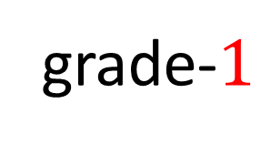


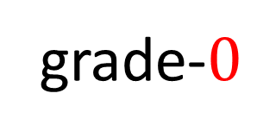
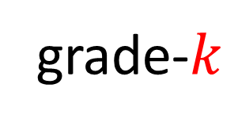
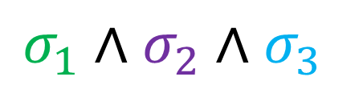

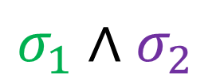





Clifford Algebra Terminology
$$⋯$$
$k$-vectors
/ $k$-blades
Scalars
Vectors
Bi-vectors
Tri-vectors
$$s$$
$$σ_{1}$$
$$σ_{1}∧σ_{2}$$
$$σ_{1}∧σ_{2}∧σ_{3}$$
$$σ_{1}∧σ_{2}∧⋯∧σ_{k}$$
grade-$0$
grade-$1$
grade-$k$
grade-$2$
grade-$3$
Multivector: arbitrary sum of $k$-vectors
$$5+2σ_{1}−3\left(σ_{1}∧σ_{2}\right)+7\left(σ_{1}∧σ_{2}∧σ_{3}\right)+⋯$$

Slide 16



Clifford Algebra Terminology
Versor = Clifford product of vectors
$$V_{1}V_{2}V_{3}⋯V_{n}$$
Clifford
product
Wedge
product
$$UV=U∧V$$
Only if $U$ and $V$ are orthogonal ($U⋅V=0$)
$$UV=U⋅V+U∧V$$
versor
bivector

Slide 17
Reflections

Slide 18








Clifford Algebra $Cl(3,0)$
3 symbols that square to $+1$
0 symbols that squares to $−1$
$$σ_{z}$$
$$σ_{y}σ_{z}=−σ_{z}σ_{y}$$
$$σ_{z}σ_{x}=−σ_{x}σ_{z}$$
$$σ_{x}σ_{y}=−σ_{y}σ_{x}$$
$${\left(σ_{x}\right)}^{2}=+1$$
$${\left(σ_{y}\right)}^{2}=+1$$
$${\left(σ_{z}\right)}^{2}=+1$$
$$σ_{y}$$
$$σ_{x}$$

Slide 19

Reflections done with “negative conjugation”
$$V→−UVU^{−1}$$

Slide 20









Reflect Vector along $z$-axis:
$$+zσ_{z}$$
$$z$$
$$V=xσ_{x}+yσ_{y}+zσ_{z}$$
$$y$$
$$V=xσ_{x}+yσ_{y}−zσ_{z}$$
$$x$$
$$−zσ_{z}$$

Slide 21




Reflect with Negative Conjugation by $σ_{z}$:
$$σ_{x}→−σ_{z}σ_{x}σ_{z}^{−1}$$
$$y=−σ_{z}\left(−σ_{z}σ_{x}\right)$$
$$y=σ_{z}σ_{z}σ_{x}$$
$$y=\left(\text{1}\right)σ_{x}y= σ_{x}$$
$$σ_{z}σ_{z}=1$$
$$σ_{z}^{−1}=σ_{z}$$

Slide 22




Reflect with Negative Conjugation by $σ_{z}$:
$$σ_{x}→−σ_{z}σ_{x}σ_{z}^{−1}$$
$$y=−σ_{z}\left(−σ_{z}σ_{x}\right)$$
$$y=σ_{z}σ_{z}σ_{x}$$
$$y=\left(\text{1}\right)σ_{x}y= σ_{x}$$
$$σ_{z}σ_{z}=1$$
$$σ_{z}^{−1}=σ_{z}$$
$$z$$
$$y$$
$$x$$

Slide 23


Reflect with Negative Conjugation by $σ_{z}$:
$$σ_{y}→−σ_{z}σ_{y}σ_{z}^{−1}$$
$$y=−σ_{z}\left(−σ_{z}σ_{y}\right)$$
$$y=σ_{z}σ_{z}σ_{y}$$
$$y=\left(\text{1}\right)σ_{y}y= σ_{y}$$
$$σ_{z}σ_{z}=1$$
$$σ_{z}^{−1}=σ_{z}$$
$$z$$
$$y$$
$$x$$

Slide 24



Reflect with Negative Conjugation by $σ_{z}$:
$$σ_{z}→−σ_{z}σ_{z}σ_{z}^{−1}$$
$$y=−σ_{z}$$
$$z$$
$$y$$
$$x$$

Slide 25



$$V→−σ_{z}Vσ_{z}^{−1}$$
$$=−σ_{z}\left(xσ_{x}+yσ_{y}+zσ_{z}\right)σ_{z}$$
$$=−\left(xσ_{z}σ_{x}σ_{z}+yσ_{z}σ_{y}σ_{z}+zσ_{z}σ_{z}σ_{z}\right)$$
$$=−\left(−xσ_{z}σ_{z}σ_{x}−yσ_{z}σ_{z}σ_{y}+zσ_{z}σ_{z}σ_{z}\right)$$
$$=−\left(−x(1)σ_{x}−y{\left(1\right)σ}_{y}+z(1)σ_{z}\right)$$
$$=xσ_{x}+yσ_{y}−zσ_{z}$$
(Reflection along $z$-axis)

Slide 26







$$V→−U V U^{−1}$$
$$U^{2}=\text{1}$$
Reflect with Negative Conjugation:
$$σ_{z}σ_{z}=\text{1}$$
$$σ_{z}^{−1}=σ_{z}$$
$$V→−σ_{z}Vσ_{z}^{−1}$$
$$V→−UVU^{−1}$$
$${\left\|U\right\|}^{2}≠1$$

Slide 27


$$V→−U V U^{−1}$$
$$U^{2}=\text{1}$$
Reflect with Negative Conjugation:
$$σ_{z}σ_{z}=\text{1}$$
$$σ_{z}^{−1}=σ_{z}$$
$$V→−σ_{z}Vσ_{z}^{−1}$$
$UU ={\left\|U\right\|}^{2}$
$UUU^{−1}={\left\|U\right\|}^{2}U^{−1}$
$U ={\left\|U\right\|}^{2}U^{−1}$
$\frac{U}{{\left\|U\right\|}^{2}} =U^{−1}$
$$V→−UVU^{−1}$$
$${\left\|U\right\|}^{2}≠1$$

Slide 28


$$V→−U V U^{−1}$$
$$U^{2}=\text{1}$$
Reflect with Negative Conjugation:
$$σ_{z}σ_{z}=\text{1}$$
$$σ_{z}^{−1}=σ_{z}$$
$$V→−σ_{z}Vσ_{z}^{−1}$$
$$V→−\left(5σ_{z}\right)V{\left(5σ_{z}\right)}^{−1}$$
$V→−\left(5σ_{z}\right)V\frac{\left(5σ_{z}\right)}{5^{2}}$
$V→−\frac{\left(5σ_{z}\right)}{5}V\frac{\left(5σ_{z}\right)}{5}$
$$V→ − σ_{z} V σ_{z}$$
$$\left(5σ_{z}\right)\left(5σ_{z}\right)=5^{2}$$
${\left(5σ_{z}\right)}^{−1}=\frac{\left(5σ_{z}\right)}{5^{2}}$

Slide 29




Reflect along vector $U$:
$$V→−UVU^{−1}$$
$$=−U\left(V_{||}+V_{⊥}\right)U^{−1}$$
$=−UV_{||}U^{−1}−UV_{⊥}U^{−1}$
$=−UkUU^{−1}+V_{⊥}UU^{−1}$
$=−Uk\left(1\right)+ V_{⊥}(1)$
$= −V_{||} + V_{⊥}$
$V_{||}$ is parallel to $U$
$⇒V_{||}=kU$
For perpendicular vectors:
$$V_{⊥}U=−UV_{⊥}$$

Slide 30







$$V_{⊥}$$
Reflect along vector $U$:
$$V→−UVU^{−1}$$
$$=−U\left(V_{||}+V_{⊥}\right)U^{−1}$$
$=−UV_{||}U^{−1}−UV_{⊥}U^{−1}$
$=−UkUU^{−1}+V_{⊥}UU^{−1}$
$=−Uk\left(1\right)+ V_{⊥}(1)$
$= −V_{||} + V_{⊥}$
$$V_{||}$$
$$V$$
$$U$$
$$V_{refl}$$
$$−V_{||}$$
$$V_{⊥}$$

Slide 31




Reflections don’t change vector length:
$$V→−UVU^{−1}$$
$${\left\|V\right\|}^{2}=VV→\left(−UVU^{−1}\right)\left(−UVU^{−1}\right)$$
$${\left\|V\right\|}^{2}=VV= UVU^{−1}UVU^{−1}$$
$${\left\|V\right\|}^{2}=VV= UVVU^{−1}$$
$${\left\|V\right\|}^{2}=VV= U{\left\|V\right\|}^{2}U^{−1}$$
$${\left\|V\right\|}^{2}=VV= {\left\|V\right\|}^{2}UU^{−1}$$
$$={\left\|V\right\|}^{2}$$

Slide 32

Spacetime Algebra $Cl(1,3)$ ($+ − − −$ signature)
$${\left(γ_{t}\right)}^{2}=+1$$ | $${\left(γ_{x}\right)}^{2}=−1$$ | $${\left(γ_{y}\right)}^{2}=−1$$ | $${\left(γ_{z}\right)}^{2}=−1$$

Slide 33



Spacetime Algebra $Cl(1,3)$ ($+ − − −$ signature)
$${\left(γ_{t}\right)}^{2}=+1$$ | $${\left(γ_{x}\right)}^{2}=−1$$ | $${\left(γ_{y}\right)}^{2}=−1$$ | $${\left(γ_{z}\right)}^{2}=−1$$
$γ_{μ}γ_{ν}=−γ_{ν}γ_{μ}$ for $μ≠ν$
Alternative: $Cl(3,1)$ ($− + + +$ signature)
$${\left(γ_{t}\right)}^{2}=−1$$ | $${\left(γ_{x}\right)}^{2}=+1$$ | $${\left(γ_{y}\right)}^{2}=+1$$ | $${\left(γ_{z}\right)}^{2}=+1$$

Slide 34



Spacetime Algebra $Cl(1,3)$ ($+ − − −$ signature)
$${\left(γ_{t}\right)}^{2}=+1$$ | $${\left(γ_{x}\right)}^{2}=−1$$ | $${\left(γ_{y}\right)}^{2}=−1$$ | $${\left(γ_{z}\right)}^{2}=−1$$
$γ_{μ}γ_{ν}=−γ_{ν}γ_{μ}$ for $μ≠ν$
Spacetime interval:
$$s^{2}={\left(ct\right)}^{2}−x^{2}−y^{2}−z^{2}$$
Exercise: show that $s^{2}=V^{2}$
$$V =\left(ct\right)γ_{t}+xγ_{x}+yγ_{y}+zγ_{z}$$

Slide 35





Spacetime Algebra $Cl(1,3)$ ($+ − − −$ signature)
$${\left(γ_{t}\right)}^{2}=+1$$ | $${\left(γ_{x}\right)}^{2}=−1$$ | $${\left(γ_{y}\right)}^{2}=−1$$ | $${\left(γ_{z}\right)}^{2}=−1$$
$γ_{μ}γ_{ν}=−γ_{ν}γ_{μ}$ for $μ≠ν$
Spacetime interval:
$$s^{2}={\left(ct\right)}^{2}−x^{2}−y^{2}−z^{2}$$
$$ct$$
timelike
lightlike
lightlike
$$x$$
timelike: $s^{2}>0$
spacelike: $s^{2}<0$
lightlike: $s^{2}=0$
spacelike
spacelike
timelike

Slide 36


3D space orthogonality
4D spacetime orthogonality
$$\vec{V}⋅\vec{W}=0$$
$$=V_{x}W_{x}+V_{y}W_{y}+V_{z}W_{z}$$
$$\vec{V}⋅\vec{W}=0$$
$$=V_{t}W_{t}−V_{x}W_{x}−V_{y}W_{y}−V_{z}W_{z}$$

Slide 37


mirror
$$V→−UVU^{−1}$$
$$U$$

Slide 38





mirror
$$V$$
$$V$$
$$reflected$$
$$θ$$
$$θ$$
circular angles
$$V→−UVU^{−1}$$
$$U$$

Slide 39








$$ct$$
mirror
$$V$$
$$reflected$$
$$V$$
$$φ$$
$$U$$
$$x$$
$$φ$$
$$V→−UVU^{−1}$$
hyperbolic angles

Slide 40


Spacetime Algebra $Cl(1,3)$ ($+ − − −$ signature)
$${\left(γ_{t}\right)}^{2}=+1$$ | $${\left(γ_{x}\right)}^{2}=−1$$ | $${\left(γ_{y}\right)}^{2}=−1$$ | $${\left(γ_{z}\right)}^{2}=−1$$
$γ_{μ}γ_{ν}=−γ_{ν}γ_{μ}$ for $μ≠ν$
Reflect along vector $U$:
$$V→−UVU^{−1}$$

Slide 41



Spacetime Algebra $Cl(1,3)$ ($+ − − −$ signature)
$${\left(γ_{t}\right)}^{2}=+1$$ | $${\left(γ_{x}\right)}^{2}=−1$$ | $${\left(γ_{y}\right)}^{2}=−1$$ | $${\left(γ_{z}\right)}^{2}=−1$$
$γ_{μ}γ_{ν}=−γ_{ν}γ_{μ}$ for $μ≠ν$
Reflect along vector $U$:
$$V→−UVU^{−1}$$
$U^{−1}=\frac{U}{{\left\|U\right\|}^{2}}$

Slide 42



Spacetime Algebra $Cl(1,3)$ ($+ − − −$ signature)
$${\left(γ_{t}\right)}^{2}=+1$$ | $${\left(γ_{x}\right)}^{2}=−1$$ | $${\left(γ_{y}\right)}^{2}=−1$$ | $${\left(γ_{z}\right)}^{2}=−1$$
$γ_{μ}γ_{ν}=−γ_{ν}γ_{μ}$ for $μ≠ν$
Reflect along vector $U$:
$$V→−UVU^{−1}$$
$$γ_{x}γ_{x} =−1$$
$$γ_{x}γ_{x}\left(γ_{x}^{−1}\right)=−1\left(γ_{x}^{−1}\right)$$
$γ_{x} = −γ_{x}^{−1}$
$γ_{x}^{−1}=−γ_{x}$

Slide 43





Reflections in Spacetime Algebra $Cl(1,3)$:
$$γ_{z}→−γ_{x}γ_{z}γ_{x}^{−1}$$
$$γ_{x}^{−1}=−γ_{x}$$
$$y=−γ_{x}γ_{z}\left(−γ_{x}\right)$$
$$y= γ_{x}\left(−γ_{x}γ_{z}\right)$$
$$y=−γ_{x}γ_{x}γ_{z}=−\left(−1\right)γ_{z}=γ_{z}$$

Slide 44



$$U=γ_{t}+γ_{z}$$
$${\left\|U\right\|}^{2}=UU=\left(γ_{t}+γ_{z}\right)\left(γ_{t}+γ_{z}\right)$$
$${\left\|U\right\|}^{2}=\left(γ_{t}γ_{t}+γ_{z}γ_{t}+γ_{t}γ_{z}+γ_{z}γ_{z}\right)$$
$${\left\|U\right\|}^{2}=\left(\left(1\right)−γ_{t}γ_{z}+γ_{t}γ_{z}+\left(−1\right)\right)$$
$${\left\|U\right\|}^{2}=0$$

Slide 45






$$ct$$
$$U=γ_{t}+γ_{z}$$
light-like
$$z$$
$${\left\|U\right\|}^{2}=UU=0$$
Reflect along vector $U$:
$$V→−UVU^{−1}$$
$U^{−1}=\frac{U}{{\left\|U\right\|}^{2}}=\frac{U}{0}$
Inverse/reflection not defined for light-like vectors

Slide 46



$$ct$$
light-like
$$x$$
$$φ=∞$$
hyperbolic angle

Slide 47


Reflect vector $V$ along vector $U$ in any $(p,q)$-dimensional space(time):
$$V→−UVU^{−1}$$

Slide 48

Rotations in $Cl(3,0)$

Slide 49
Rotation = 2 Reflections
mirror #1

Slide 50
Rotation = 2 Reflections
mirror #2
mirror #1

Slide 51


Rotation = 2 Reflections
$θ/2$
$$θ$$
mirror #2
mirror #1

Slide 52




$θ/2$
$θ/2$
$$σ_{x}$$
$τ$ $=\cos{\frac{θ}{2}}σ_{x}+\sin{\frac{θ}{2}}σ_{y}$
mirror #2
mirror #1

Slide 53





$τ$ $=\cos{\frac{θ}{2}}σ_{x}+\sin{\frac{θ}{2}}σ_{y}$
$$V→−τ\left(−σ_{x}Vσ_{x}^{−1}\right)τ^{−1}$$
$$V= τ σ_{x} V {\left( \text{τ} {\text{σ}}_{x} \right)}^{−1}$$
$ABC C^{−1}B^{−1}A^{−1}$
$=AB B^{−1}A^{−1}$
$= A A^{−1}$
$$= 1$$
$${\left(ABC\right)}^{−1}=$$
$$C^{−1}B^{−1}A^{−1}$$

Slide 54



$τ$ $=\cos{\frac{θ}{2}}σ_{x}+\sin{\frac{θ}{2}}σ_{y}$
$$V→−τ\left(−σ_{x}Vσ_{x}^{−1}\right)τ^{−1}$$
$$V= τ σ_{x} V {\left( \text{τ} {\text{σ}}_{x} \right)}^{−1}$$
“versor”
$$τ$$
$θ/2$
$$σ_{x}$$

Slide 55


$τ$ $=\cos{\frac{θ}{2}}σ_{x}+\sin{\frac{θ}{2}}σ_{y}$
$$V→−τ\left(−σ_{x}Vσ_{x}^{−1}\right)τ^{−1}$$
$$V= τ σ_{x} V {\left( \text{τ} {\text{σ}}_{x} \right)}^{−1}$$
$θ/2$
$θ/2$
$$τ$$
$θ/2$
$$σ_{x}$$

Slide 56
$τ$ $=\cos{\frac{θ}{2}}σ_{x}+\sin{\frac{θ}{2}}σ_{y}$
$$V→−τ\left(−σ_{x}Vσ_{x}^{−1}\right)τ^{−1}$$
$$V= τ σ_{x} V {\left( \text{τ} {\text{σ}}_{x} \right)}^{−1}$$

Slide 57


$τ$ $=\cos{\frac{θ}{2}}σ_{x}+\sin{\frac{θ}{2}}σ_{y}$
$$V→−τ\left(−σ_{x}Vσ_{x}^{−1}\right)τ^{−1}$$
$$V= τ σ_{x} V {\left( \text{τ} {\text{σ}}_{x} \right)}^{−1}$$
$=\left(\left[\cos{\frac{θ}{2}}σ_{x}+\sin{\frac{θ}{2}}σ_{y}\right]σ_{x}\right)V{\left(\left[\cos{\frac{θ}{2}}σ_{x}+\sin{\frac{θ}{2}}σ_{y}\right]σ_{x}\right)}^{−1}$
$=\left(\cos{\frac{θ}{2}}σ_{x}σ_{x}+\sin{\frac{θ}{2}}σ_{y}σ_{x}\right)V{\left(\cos{\frac{θ}{2}}σ_{x}σ_{x}+\sin{\frac{θ}{2}}σ_{x}σ_{y}\right)}^{−1}$
$=\left(\cos{\frac{θ}{2}}+\sin{\frac{θ}{2}}σ_{y}σ_{x}\right)V{\left(\cos{\frac{θ}{2}}+\sin{\frac{θ}{2}}σ_{y}σ_{x}\right)}^{−1}$
$=\left(\cos{\frac{θ}{2}}−\sin{\frac{θ}{2}}σ_{x}σ_{y}\right)V{\left(\cos{\frac{θ}{2}}−\sin{\frac{θ}{2}}σ_{x}σ_{y}\right)}^{−1}$

Slide 58

$$V → τ σ_{x} V {\left( \text{τ} {\text{σ}}_{x} \right)}^{−1}$$
$=\left(\cos{\frac{θ}{2}}−\sin{\frac{θ}{2}}σ_{x}σ_{y}\right)V{\left(\cos{\frac{θ}{2}}−\sin{\frac{θ}{2}}σ_{x}σ_{y}\right)}^{−1}$
(unit vector)
$$τ$$
$θ/2$
$$σ_{x}$$
(unit vector)

Slide 59




$$V → τ σ_{x} V {\left( \text{τ} {\text{σ}}_{x} \right)}^{−1}$$
$=\left(\cos{\frac{θ}{2}}−\sin{\frac{θ}{2}}σ_{x}σ_{y}\right)V{\left(\cos{\frac{θ}{2}}−\sin{\frac{θ}{2}}σ_{x}σ_{y}\right)}^{−1}$
versor: $τσ_{x}$
$$≠ τ∧σ_{x}$$
(NOT wedge product)
(NOT bivector)
$=\cos{\frac{θ}{2}}−\sin{\frac{θ}{2}}σ_{x}σ_{y}$

Slide 60



$$V → τ σ_{x} V {\left( \text{τ} {\text{σ}}_{x} \right)}^{−1}$$
$=\left(\cos{\frac{θ}{2}}−\sin{\frac{θ}{2}}σ_{x}σ_{y}\right)V{\left(\cos{\frac{θ}{2}}−\sin{\frac{θ}{2}}σ_{x}σ_{y}\right)}^{−1}$
versor: $τσ_{x}$
$$=τ⋅σ_{x}+ τ∧σ_{x}$$
(Clifford Product)
$=\cos{\frac{θ}{2}}−\sin{\frac{θ}{2}}σ_{x}σ_{y}$
$$σ_{x}σ_{y}=σ_{x}∧σ_{y}$$
(orthogonal)

Slide 61










$${\left( \text{τ} {\text{σ}}_{x} \right)}^{−1}$$
$={\left(\cos{\frac{θ}{2}}−\sin{\frac{θ}{2}}σ_{x}σ_{y}\right)}^{−1}$
Inverse?
$=\cos{\frac{θ}{2}}−\sin{\frac{θ}{2}}σ_{y}σ_{x}$
$$={\text{σ}}_{x}^{−1}τ^{−1}$$
Unit vectors
$${\text{σ}}_{x}^{−1}=σ_{x}$$
$$τ^{−1}=\text{τ}$$
$$= {\text{σ}}_{x} τ$$
$=\cos{\frac{θ}{2}}+\sin{\frac{θ}{2}}σ_{x}σ_{y}$
$$\text{τ} {\text{σ}}_{x}≠− {\text{σ}}_{x} \text{τ}$$
(not orthogonal)
$${\text{σ}}_{x}{\text{σ}}_{y}=−{\text{σ}}_{y}{\text{σ}}_{x}$$
(orthogonal)

Slide 62





$${\left( \text{τ} {\text{σ}}_{x} \right)}^{−1}$$
$={\left(\cos{\frac{θ}{2}}−\sin{\frac{θ}{2}}σ_{x}σ_{y}\right)}^{−1}$
Inverse?
$=\cos{\frac{θ}{2}}−\sin{\frac{θ}{2}}σ_{y}σ_{x}$
$$={\text{σ}}_{x}^{−1}τ^{−1}$$
$$= {\text{σ}}_{x} τ$$
$=\cos{\frac{θ}{2}}+\sin{\frac{θ}{2}}σ_{x}σ_{y}$
$${\left(σ_{x}σ_{y}\right)}^{2}=−1$$
$$i^{2}=−1$$
$={\left(a+bσ_{x}σ_{y}\right)}^{†}$
$= a−bσ_{x}σ_{y}$
$$={\left(a+ib\right)}^{∗}$$
$$= a−ib$$
complex conjugation
reversal

Slide 63





Unit vectors
$${\text{σ}}_{x}^{−1}=σ_{x}$$
$$τ^{−1}=\text{τ}$$
$${\left( \text{τ} {\text{σ}}_{x} \right)}^{−1}={\text{σ}}_{x}^{−1}τ^{−1}$$
$${\left( \text{τ} {\text{σ}}_{x} \right)}^{−1}= {\text{σ}}_{x} \text{τ}$$
$${\left( \text{τ} {\text{σ}}_{x} \right)}^{−1}=\tilde{\left(\text{τ} {\text{σ}}_{x}\right)}$$
$${\left( \text{τ} {\text{σ}}_{x} \right)}^{−1}={\left(\text{τ} {\text{σ}}_{x}\right)}^{†}$$
reversal
Inspired by “Hermitian Conjugate” of Pauli Matrices
$${\left({\text{σ}}_{x}{\text{σ}}_{y}\right)}^{†}={\text{σ}}_{y}{\text{σ}}_{x}$$

Slide 64






$$≠τ 5{\text{σ}}_{x}$$
$${\left(5{\text{σ}}_{x} \text{τ}\right)}^{−1}=τ^{−1}{\left(5{\text{σ}}_{x}\right)}^{−1}$$
${\left(5{\text{σ}}_{x} \text{τ}\right)}^{−1}=\frac{τ5σ_{x}}{5^{2}}$
$${\left(5{\text{σ}}_{x}\right)}^{2}=5^{2}$$
$$V → \left(5{\text{σ}}_{x}\text{τ}\right) V {\left(5{\text{σ}}_{x}\text{τ}\right)}^{−1}$$
$V = \left(5{\text{σ}}_{x}\text{τ}\right) V\left(\frac{τ5σ_{x}}{5^{2}}\right)$
$V = \left(\frac{5σ_{x}τ}{5}\right) V \left(\frac{5τσ_{x}}{5}\right)$
$$=σ_{x}τ V τσ_{x}$$

Slide 65


$$≠τ 5{\text{σ}}_{x}$$
$${\left(5{\text{σ}}_{x} \text{τ}\right)}^{−1}=τ^{−1}{\left(5{\text{σ}}_{x}\right)}^{−1}$$
${\left(5{\text{σ}}_{x} \text{τ}\right)}^{−1}=\frac{τ5σ_{x}}{5^{2}}$
$${\left(5{\text{σ}}_{x}\right)}^{2}=5^{2}$$
$$V → \left(5{\text{σ}}_{x}\text{τ}\right) V {\left(5{\text{σ}}_{x}\text{τ}\right)}^{−1}$$
$V = \left(5{\text{σ}}_{x}\text{τ}\right) V\left(\frac{τ5σ_{x}}{5^{2}}\right)$
$V = \left(\frac{5σ_{x}τ}{5}\right) V \left(\frac{5τσ_{x}}{5}\right)$
$$=σ_{x}τ V{\left({\text{σ}}_{x}\text{τ}\right)}^{−1}$$

Slide 66


$=\left(\cos{\frac{θ}{2}}−\sin{\frac{θ}{2}}σ_{x}σ_{y}\right)V{\left(\cos{\frac{θ}{2}}−\sin{\frac{θ}{2}}σ_{x}σ_{y}\right)}^{−1}$
$=\left(\cos{\frac{θ}{2}}V−\sin{\frac{θ}{2}}σ_{x}σ_{y}V\right){\left(\cos{\frac{θ}{2}}−\sin{\frac{θ}{2}}σ_{x}σ_{y}\right)}^{−1}$
$=\left(V\cos{\frac{θ}{2}}−\sin{\frac{θ}{2}}σ_{x}σ_{y}V\right){\left(\cos{\frac{θ}{2}}−\sin{\frac{θ}{2}}σ_{x}σ_{y}\right)}^{−1}$

Slide 67




$=\left(V\cos{\frac{θ}{2}}−\sin{\frac{θ}{2}}σ_{x}σ_{y}V\right){\left(\cos{\frac{θ}{2}}−\sin{\frac{θ}{2}}σ_{x}σ_{y}\right)}^{−1}$
Take $V$ outside plane of rotation (e.g. $V=σ_{z}$)
$=\left(σ_{z}\cos{\frac{θ}{2}}−\sin{\frac{θ}{2}}σ_{x}σ_{y}σ_{z}\right){\left(\cos{\frac{θ}{2}}−\sin{\frac{θ}{2}}σ_{x}σ_{y}\right)}^{−1}$
$=\left(σ_{z}\cos{\frac{θ}{2}}−σ_{z}\sin{\frac{θ}{2}}σ_{x}σ_{y}\right){\left(\cos{\frac{θ}{2}}−\sin{\frac{θ}{2}}σ_{x}σ_{y}\right)}^{−1}$
$=σ_{z}\left(\cos{\frac{θ}{2}}−\sin{\frac{θ}{2}}σ_{x}σ_{y}\right){\left(\cos{\frac{θ}{2}}−\sin{\frac{θ}{2}}σ_{x}σ_{y}\right)}^{−1}$
$=σ_{z} = V$

Slide 68



$=\left(V\cos{\frac{θ}{2}}−\sin{\frac{θ}{2}}σ_{x}σ_{y}V\right){\left(\cos{\frac{θ}{2}}−\sin{\frac{θ}{2}}σ_{x}σ_{y}\right)}^{−1}$
Take $V$ inside plane of rotation (e.g. $V=σ_{x}$)
$=\left(σ_{x}\cos{\frac{θ}{2}}−\sin{\frac{θ}{2}}σ_{x}σ_{y}σ_{x}\right){\left(\cos{\frac{θ}{2}}−\sin{\frac{θ}{2}}σ_{x}σ_{y}\right)}^{−1}$
$=\left(σ_{x}\cos{\frac{θ}{2}}+σ_{x}\sin{\frac{θ}{2}}σ_{x}σ_{y}\right){\left(\cos{\frac{θ}{2}}−\sin{\frac{θ}{2}}σ_{x}σ_{y}\right)}^{−1}$
$=σ_{x}\left(\cos{\frac{θ}{2}}+\sin{\frac{θ}{2}}σ_{x}σ_{y}\right){\left(\cos{\frac{θ}{2}}−\sin{\frac{θ}{2}}σ_{x}σ_{y}\right)}^{−1}$
$=σ_{x}\left(\cos{\frac{θ}{2}}+\sin{\frac{θ}{2}}σ_{x}σ_{y}\right)$ $\left(\cos{\frac{θ}{2}}+\sin{\frac{θ}{2}}σ_{x}σ_{y}\right)$

Slide 69





$=\left(V\cos{\frac{θ}{2}}−\sin{\frac{θ}{2}}σ_{x}σ_{y}V\right){\left(\cos{\frac{θ}{2}}−\sin{\frac{θ}{2}}σ_{x}σ_{y}\right)}^{−1}$
Take $V$ inside plane of rotation (e.g. $V=σ_{x}$)
$=σ_{x}\left(\cos{\frac{θ}{2}}+\sin{\frac{θ}{2}}σ_{x}σ_{y}\right)$ $\left(\cos{\frac{θ}{2}}+\sin{\frac{θ}{2}}σ_{x}σ_{y}\right)$
$=σ_{x}\left({\left(\cos{\frac{θ}{2}}\right)}^{2}+2\cos{\frac{θ}{2}}\sin{\frac{θ}{2}}σ_{x}σ_{y}+{\left(\sin{\frac{θ}{2}}\right)}^{2}{\left(σ_{x}σ_{y}\right)}^{2}\right)$
$=σ_{x}\left({\left(\cos{\frac{θ}{2}}\right)}^{2}−{\left(\sin{\frac{θ}{2}}\right)}^{2}+2\cos{\frac{θ}{2}}\sin{\frac{θ}{2}}σ_{x}σ_{y}\right)$
$=σ_{x}\left(\cos{θ}+\sin{θ}σ_{x}σ_{y}\right)$ $=\cos{θ}σ_{x}+\sin{θ}σ_{y}$
$$θ$$

Slide 70


$$V → \left(\text{τ} {\text{σ}}_{x}\right) V {\left(\text{τ} {\text{σ}}_{x}\right)}^{−1}$$
$$=\left(\text{τ} {\text{σ}}_{x}\right) \left[V_{outside}+V_{xy plane}\right] {\left(\text{τ} {\text{σ}}_{x}\right)}^{−1}$$
$$= V_{outside} + \left(\text{τ} {\text{σ}}_{x}\right)V_{xy plane}{\left(\text{τ} {\text{σ}}_{x}\right)}^{−1}$$

Slide 71




Rotation in $xy$ plane:
$V→\left(\cos{\frac{θ}{2}}−\sin{\frac{θ}{2}}σ_{x}σ_{y}\right)V\left(\cos{\frac{θ}{2}}+\sin{\frac{θ}{2}}σ_{x}σ_{y}\right)$
Rotation in $yz$ plane:
$V→\left(\cos{\frac{θ}{2}}−\sin{\frac{θ}{2}}σ_{y}σ_{z}\right)V\left(\cos{\frac{θ}{2}}+\sin{\frac{θ}{2}}σ_{y}σ_{z}\right)$
Rotation in $zx$ plane:
$V→\left(\cos{\frac{θ}{2}}−\sin{\frac{θ}{2}}σ_{z}σ_{x}\right)V\left(\cos{\frac{θ}{2}}+\sin{\frac{θ}{2}}σ_{z}σ_{x}\right)$

Slide 72







$$B$$
$$B$$
(Arbitrary Plane)
$θ/2$
$$θ$$
$$A$$
$$A$$
$V→−B\left(−AVA^{−1}\right)B^{−1}$
$V= B A V A^{−1} B^{−1}$
$V= \left(BA\right) V {\left(BA\right)}^{−1}$

Slide 73






Rotate vector by angle $θ$ in the $xy$ plane:
$$i^{2}=−1$$
$$e^{iθ}=\cos{θ}+i\sin{θ}$$
$V→$ $\left(\cos{\frac{θ}{2}}−σ_{x}σ_{y}\sin{\frac{θ}{2}}\right)V\left(\cos{\frac{θ}{2}}+σ_{x}σ_{y}\sin{\frac{θ}{2}}\right)$
$${\left(σ_{x}σ_{y}\right)}^{2}=−1$$
$e^{σ_{x}σ_{y}\frac{θ}{2}}=\cos{\frac{θ}{2}}+σ_{x}σ_{y}\sin{\frac{θ}{2}}$

Slide 74




$e^{x}=1+x+\frac{x^{2}}{2}+\frac{x^{3}}{3!}+\frac{x^{4}}{4!}+\frac{x^{5}}{5!}+⋯$
$$i^{2}=−1$$
$e^{iθ}=1+iθ+\frac{{\left(iθ\right)}^{2}}{2}+\frac{{\left(iθ\right)}^{3}}{3!}+\frac{{\left(iθ\right)}^{4}}{4!}+\frac{{\left(iθ\right)}^{5}}{5!}+⋯$
$e^{iθ}=1+iθ+i^{2}\frac{θ^{2}}{2}+i^{3}\frac{θ^{3}}{3!}+i^{4}\frac{θ^{4}}{4!}+i^{5}\frac{θ^{5}}{5!}+⋯$
$e^{iθ}=1+iθ−\frac{θ^{2}}{2}−i\frac{θ^{3}}{3!}+\frac{θ^{4}}{4!}+i\frac{θ^{5}}{5!}+⋯$
$e^{iθ}=\left(1−\frac{θ^{2}}{2}+\frac{θ^{4}}{4!}−⋯\right)+i\left(θ−\frac{θ^{3}}{3!}+\frac{θ^{5}}{5!}−⋯\right)$
$$e^{iθ} = \cos{θ} + i \sin{θ}$$

Slide 75



$e^{x}=1+x+\frac{x^{2}}{2}+\frac{x^{3}}{3!}+\frac{x^{4}}{4!}+\frac{x^{5}}{5!}+⋯$
$${\left(σ_{x}σ_{y}\right)}^{2}=−1$$
$e^{σ_{x}σ_{y}θ}=1+σ_{x}σ_{y}θ+\frac{{\left(σ_{x}σ_{y}θ\right)}^{2}}{2}+\frac{{\left(σ_{x}σ_{y}θ\right)}^{3}}{3!}+\frac{{\left(σ_{x}σ_{y}θ\right)}^{4}}{4!}+\frac{{\left(σ_{x}σ_{y}θ\right)}^{5}}{5!}+⋯$
$e^{σ_{x}σ_{y}θ}=1+σ_{x}σ_{y}θ+{\left(σ_{x}σ_{y}\right)}^{2}\frac{θ^{2}}{2}+{\left(σ_{x}σ_{y}\right)}^{3}\frac{θ^{3}}{3!}+{\left(σ_{x}σ_{y}\right)}^{4}\frac{θ^{4}}{4!}+{\left(σ_{x}σ_{y}\right)}^{5}\frac{θ^{5}}{5!}+⋯$
$e^{σ_{x}σ_{y}θ}=1+σ_{x}σ_{y}θ−\frac{θ^{2}}{2}−σ_{x}σ_{y}\frac{θ^{3}}{3!}+\frac{θ^{4}}{4!}+σ_{x}σ_{y}\frac{θ^{5}}{5!}+⋯$
$e^{σ_{x}σ_{y}θ}=\left(1−\frac{θ^{2}}{2}+\frac{θ^{4}}{4!}−⋯\right)+σ_{x}σ_{y}\left(θ−\frac{θ^{3}}{3!}+\frac{θ^{5}}{5!}−⋯\right)$
$$e^{σ_{x}σ_{y}θ}=\cos{θ}+σ_{x}σ_{y}\sin{θ}$$

Slide 76




$$e^{σ_{x}σ_{y}θ}=\cos{θ}+σ_{x}σ_{y}\sin{θ}$$
$$e^{σ_{x}σ_{y}\left(−θ\right)}=\cos\left(−θ\right)+σ_{x}σ_{y}\sin\left(−θ\right)$$
$$e^{−σ_{x}σ_{y}θ}=\cos{θ}−σ_{x}σ_{y}\sin{θ}$$

Slide 77




Rotate vector by angle $θ$ in the $xy$ plane:
$V→$ $\left(\cos{\frac{θ}{2}}−\sin{\frac{θ}{2}}σ_{x}σ_{y}\right)V\left(\cos{\frac{θ}{2}}+\sin{\frac{θ}{2}}σ_{x}σ_{y}\right)$
$e^{−σ_{x}σ_{y}\frac{θ}{2}}$
$$e^{+σ_{x}σ_{y}\frac{θ}{2}}$$
$V→e^{−σ_{x}σ_{y}\frac{θ}{2}} V e^{+σ_{x}σ_{y}\frac{θ}{2}}$

Slide 78




Rotate vector by angle $θ$ in the $σ_{i}σ_{j}$-plane:
$V→e^{−σ_{i}σ_{j}\frac{θ}{2}} V e^{+σ_{i}σ_{j}\frac{θ}{2}}$
Rotate vector by angle $θ$ in arbitrary plane given by unit bivector $B$
$$B^{2}=−1$$
$V→e^{−B\frac{θ}{2}} V e^{+B\frac{θ}{2}}$

Slide 79





Rotate vector by angle $θ$ in arbitrary plane given by unit bivector $B$
$V→e^{−B\frac{θ}{2}} V e^{+B\frac{θ}{2}}$
$$B^{2}=−1$$
$$B$$
$$=\vec{v}∧\vec{w}$$

Slide 80


Rotate vector by angle $θ$ in arbitrary plane given by unit bivector $B$
$V→e^{−B\frac{θ}{2}} V e^{+B\frac{θ}{2}}$
$$B^{2}=−1$$
$=B\frac{θ}{2}$
$$B$$
$×\frac{θ}{2}$

Slide 81




Rotate vector by angle $θ$ in arbitrary plane given by unit bivector $B$
$V→e^{−B\frac{θ}{2}} V e^{+B\frac{θ}{2}}$
$$B^{2}=−1$$
rotation axis
$$\vec{u}$$
$$B$$
$$\vec{u}=u_{x}\vec{e_{x}}+u_{y}\vec{e_{y}}+u_{z}\vec{e_{z}}$$
$−B=−u_{x}σ_{y}σ_{z}−u_{y}σ_{z}σ_{x}−u_{z}σ_{x}σ_{y}$

Slide 82


$V→e^{−B\frac{θ}{2}} V e^{+B\frac{θ}{2}}$
$$B^{2}=−1$$
$e^{−B\frac{θ}{2}}=\cos{\frac{θ}{2}}−B\sin{\frac{θ}{2}}$
$aaaa=\cos{\frac{θ}{2}}−αβ\sin{\frac{θ}{2}}$
$aaaa=α\left(α\cos{\frac{θ}{2}}−β\sin{\frac{θ}{2}}\right)$
$$aaaa= α τ$$

Slide 83





$V→e^{−B\frac{θ}{2}} V e^{+B\frac{θ}{2}}$
$$B^{2}=−1$$
$$Im$$
$$θ$$
$$=\left(a+ib\right)e^{iθ}$$
$$=\left(a+ib\right)e^{iθ/2}e^{iθ/2}$$
$$=e^{iθ/2}\left(a+ib\right)e^{iθ/2}$$
$$Re$$

Slide 84



$$= e^{iθ/2} \left( a + ib \right) e^{iθ/2}$$
$$=e^{σ_{x}σ_{y}\frac{θ}{2}}\left(a+σ_{x}σ_{y}b\right)e^{σ_{x}σ_{y}\frac{θ}{2}}$$
$$=e^{σ_{x}σ_{y}\frac{θ}{2}}\left(σ_{x}\left(aσ_{x}+bσ_{y}\right)\right)e^{σ_{x}σ_{y}\frac{θ}{2}}$$
$$=e^{σ_{x}σ_{y}\frac{θ}{2}} \left(σ_{x} V\right)e^{σ_{x}σ_{y}\frac{θ}{2}}$$
$$=σ_{x}e^{−σ_{x}σ_{y}\frac{θ}{2}} \left(V\right)e^{+σ_{x}σ_{y}\frac{θ}{2}}$$
In $xy$-plane:
$$i≡σ_{x}σ_{y}$$
Scalar + Bivector

Slide 85

$$= e^{iθ/2} \left( a + ib \right) e^{iθ/2}$$
$$=e^{σ_{x}σ_{y}\frac{θ}{2}}\left(a+σ_{x}σ_{y}b\right)e^{σ_{x}σ_{y}\frac{θ}{2}}$$
$$=e^{σ_{x}σ_{y}\frac{θ}{2}}\left(σ_{x}\left(aσ_{x}+bσ_{y}\right)\right)e^{σ_{x}σ_{y}\frac{θ}{2}}$$
$$=e^{σ_{x}σ_{y}\frac{θ}{2}} \left(σ_{x} V\right)e^{σ_{x}σ_{y}\frac{θ}{2}}$$
$$=σ_{x}e^{−σ_{x}σ_{y}\frac{θ}{2}} \left(V\right)e^{+σ_{x}σ_{y}\frac{θ}{2}}$$
In $xy$-plane:
$$i≡σ_{x}σ_{y}$$

Slide 86

Spacetime Algebra $Cl(1,3)$ ($+ − − −$ signature)
$${\left(γ_{t}\right)}^{2}=+1$$
$${\left(γ_{x}\right)}^{2}=−1$$
$${\left(γ_{y}\right)}^{2}=−1$$
$${\left(γ_{z}\right)}^{2}=−1$$
$γ_{μ}γ_{ν}=−γ_{ν}γ_{μ}$ for $μ≠ν$
3 Rotations
3 Lorentz Boosts

Slide 87






Algebra of Physical Space $Cl(3,0)$
$V→$ $\left(\cos{\frac{θ}{2}}−σ_{x}σ_{y}\sin{\frac{θ}{2}}\right)V\left(\cos{\frac{θ}{2}}+σ_{x}σ_{y}\sin{\frac{θ}{2}}\right)$
$V→ e^{−σ_{x}σ_{y}\frac{θ}{2}} V e^{+σ_{x}σ_{y}\frac{θ}{2}}$
Spacetime Algebra $Cl(1,3)$
$${\left(γ_{x}γ_{y}\right)}^{2}=−1$$
$V→$ $\left(\cos{\frac{θ}{2}}−γ_{x}γ_{y}\sin{\frac{θ}{2}}\right)V\left(\cos{\frac{θ}{2}}+γ_{x}γ_{y}\sin{\frac{θ}{2}}\right)$
$V→ e^{−γ_{x}γ_{y}\frac{θ}{2}} V e^{+γ_{x}γ_{y}\frac{θ}{2}}$

Slide 88




What about $γ_{t}$?
$V → e^{−γ_{t}γ_{x}\frac{φ}{2}} V e^{+γ_{t}γ_{x}\frac{φ}{2}}$
$$γ_{t}γ_{x}$$ | $x$-boost
$$γ_{t}γ_{y}$$ | $y$-boost
$$γ_{t}γ_{z}$$ | $z$-boost
Lorentz Boosts!

Slide 89


What about $γ_{t}$?
$V → e^{−γ_{t}γ_{x}\frac{φ}{2}} V e^{+γ_{t}γ_{x}\frac{φ}{2}}$
$${\left(γ_{t}γ_{x}\right)}^{2}= γ_{t}γ_{x}γ_{t}γ_{x}$$
$${\left(γ_{t}γ_{x}\right)}^{2}=−γ_{t}γ_{t}γ_{x}γ_{x}$$
$${\left(γ_{t}γ_{x}\right)}^{2}=−\left(+1\right)\left(−1\right)$$
$${\left(γ_{t}γ_{x}\right)}^{2}=+1$$
Lorentz Boosts!

Slide 90


Split-Complex Numbers
$$a+jb$$
$$j^{2}=+1$$

Slide 91



$e^{x}=1+x+\frac{x^{2}}{2}+\frac{x^{3}}{3!}+\frac{x^{4}}{4!}+\frac{x^{5}}{5!}+⋯$
$$j^{2}=+1$$
$e^{jφ}=1+jφ+\frac{{\left(jφ\right)}^{2}}{2}+\frac{{\left(jφ\right)}^{3}}{3!}+\frac{{\left(jφ\right)}^{4}}{4!}+\frac{{\left(jφ\right)}^{5}}{5!}+⋯$
$e^{jφ}=1+jφ+j^{2}\frac{φ^{2}}{2}+j^{3}\frac{φ^{3}}{3!}+j^{4}\frac{φ^{4}}{4!}+j^{5}\frac{φ^{5}}{5!}+⋯$
$e^{jφ}=1+jφ+\frac{φ^{2}}{2}+j\frac{φ^{3}}{3!}+\frac{φ^{4}}{4!}+j\frac{φ^{5}}{5!}+⋯$
$e^{jφ}=\left(1+\frac{φ^{2}}{2}+\frac{φ^{4}}{4!}+⋯\right)+j\left(φ+\frac{φ^{3}}{3!}+\frac{φ^{5}}{5!}+⋯\right)$
$e^{jφ}= \cosh{φ} + j\sinh{φ}$

Slide 92




$e^{x}=1+x+\frac{x^{2}}{2}+\frac{x^{3}}{3!}+\frac{x^{4}}{4!}+\frac{x^{5}}{5!}+⋯$
$${\left(γ_{t}γ_{z}\right)}^{2}=+1$$
$e^{γ_{t}γ_{z}φ}=1+γ_{t}γ_{z}φ+\frac{{\left(γ_{t}γ_{z}φ\right)}^{2}}{2}+\frac{{\left(γ_{t}γ_{z}φ\right)}^{3}}{3!}+\frac{{\left(γ_{t}γ_{z}φ\right)}^{4}}{4!}+\frac{{\left(γ_{t}γ_{z}φ\right)}^{5}}{5!}+⋯$
$e^{γ_{t}γ_{z}φ}=1+γ_{t}γ_{z}φ+{\left(γ_{t}γ_{z}\right)}^{2}\frac{φ^{2}}{2}+{\left(γ_{t}γ_{z}\right)}^{3}\frac{φ^{3}}{3!}+{\left(γ_{t}γ_{z}\right)}^{4}\frac{φ^{4}}{4!}+{\left(γ_{t}γ_{z}\right)}^{5}\frac{φ^{5}}{5!}+⋯$
$e^{γ_{t}γ_{z}φ}=1+γ_{t}γ_{z}φ+\frac{φ^{2}}{2}+γ_{t}γ_{z}\frac{φ^{3}}{3!}+\frac{φ^{4}}{4!}+γ_{t}γ_{z}\frac{φ^{5}}{5!}+⋯$
$e^{γ_{t}γ_{z}φ}=\left(1+\frac{φ^{2}}{2}+\frac{φ^{4}}{4!}+⋯\right)+γ_{t}γ_{z}\left(φ+\frac{φ^{3}}{3!}+\frac{φ^{5}}{5!}+⋯\right)$
$$e^{γ_{t}γ_{z}φ}=\cosh{φ}+γ_{t}γ_{z}\sinh{φ}$$

Slide 93



Boost in $x$-direction:
$e^{γ_{t}γ_{x}\frac{φ}{2}}=\cosh{\frac{φ}{2}}+γ_{t}γ_{x}\sinh{\frac{φ}{2}}$
Boost in $y$-direction:
$e^{γ_{t}γ_{y}\frac{φ}{2}}=\cosh{\frac{φ}{2}}+γ_{t}γ_{y}\sinh{\frac{φ}{2}}$
Boost in $z$-direction:
$e^{γ_{t}γ_{z}\frac{φ}{2}}=\cosh{\frac{φ}{2}}+γ_{t}γ_{z}\sinh{\frac{φ}{2}}$

Slide 94



$$e^{γ_{t}γ_{z}φ}=\cosh{φ}+γ_{t}γ_{z}\sinh{φ}$$
$$e^{γ_{t}γ_{z}\left(−φ\right)}=\cosh\left(−φ\right)+γ_{t}γ_{z}\sinh\left(−φ\right)$$
$$e^{−γ_{t}γ_{z}φ}=\cosh{φ}−γ_{t}γ_{z}\sinh{φ}$$

Slide 95





Boost vector by angle $φ$ in the $tz$ plane:
$V→$ $\left(\cosh{\frac{φ}{2}}−γ_{t}γ_{z}\sin{\frac{φ}{2}}\right)V\left(\cosh{\frac{φ}{2}}+γ_{t}γ_{z}\sinh{\frac{φ}{2}}\right)$
$e^{−γ_{t}γ_{z}\frac{φ}{2}}$
$e^{+γ_{t}γ_{z}\frac{φ}{2}}$
$$V→e^{−γ_{t}γ_{z}\frac{φ}{2}} V e^{+γ_{t}γ_{z}\frac{φ}{2}}$$

Slide 96




Boost vector by angle $φ$ in the axis-aligned plane:
$$V→e^{−γ_{t}γ_{i}\frac{φ}{2}} V e^{+γ_{t}γ_{i}\frac{φ}{2}}$$
Boost vector by angle $φ$ in arbitrary plane given by unit bivector $B$
$$B^{2}=+1$$
$V→e^{−B\frac{φ}{2}} V e^{+B\frac{φ}{2}}$

Slide 97



$V→e^{−B\frac{φ}{2}} V e^{+B\frac{φ}{2}}$
$$B^{2}=+1$$
$$B$$
$$B$$
$$=\vec{v}∧\vec{w}$$
spacelike
timelike

Slide 98


$V→e^{−B\frac{φ}{2}} V e^{+B\frac{φ}{2}}$
$$B^{2}=+1$$
$=B\frac{φ}{2}$
$$B$$
$×\frac{φ}{2}$

Slide 99





$$B=B_{tx}γ_{t}γ_{x}+B_{ty}γ_{t}γ_{y}+B_{tz}γ_{t}γ_{z}+B_{yz}γ_{y}γ_{z}+B_{zx}γ_{z}γ_{x}+B_{xy}γ_{x}γ_{y}$$
Boost or Rotation?
$BB=+1$ (timelike) $→$ Boost
$$e^{Bφ}=\cosh{φ}+B\sinh{φ}$$
$BB=−1$ (spacelike) $→$ Rotation
$$e^{Bθ}=\cos{θ}+B\sin{θ}$$

Slide 100








$$V→e^{−γ_{t}γ_{x}φ/2} V e^{+γ_{t}γ_{x}φ/2}$$
Boosts = 2 Reflections
$$ct$$
$$V$$
$$V→−γ_{t}\left(−γ_{x}Vγ_{x}^{−1}\right)γ_{t}^{−1}$$
$$V= γ_{t} γ_{x} V γ_{x} γ_{t}$$
$$γ_{t}$$
$$γ_{x}$$
$$x$$

Slide 101


$$V→e^{−γ_{t}γ_{x}φ/2} V e^{+γ_{t}γ_{x}φ/2}$$
Boosts = 2 Reflections
$$V→−γ_{t}\left(−γ_{x}Vγ_{x}^{−1}\right)γ_{t}^{−1}$$
$$V= γ_{t} γ_{x} V γ_{x} γ_{t}$$
$e^{γ_{t}γ_{x}φ/2}=\cosh{\frac{φ}{2}}+γ_{t}γ_{z}\sinh{\frac{φ}{2}}$

Slide 102


$$V→e^{−γ_{t}γ_{x}φ/2} V e^{+γ_{t}γ_{x}φ/2}$$
$e^{−γ_{t}γ_{x}φ/2}=\cosh{\frac{φ}{2}}−γ_{t}γ_{z}\sinh{\frac{φ}{2}}$
$e^{ssd}=γ_{t}γ_{t}\cosh{\frac{φ}{2}}+γ_{z}γ_{t}\sinh{\frac{φ}{2}}$
$e^{ssd}=\left(γ_{t}\cosh{\frac{φ}{2}}+γ_{z}\sinh{\frac{φ}{2}}\right)γ_{t}$
$$e^{ssd}= δ γ_{t}$$
$δ^{2}=+1$ (timelike)

Slide 103











$$V→e^{−γ_{t}γ_{x}\frac{φ}{2}}Ve^{+γ_{t}γ_{x}\frac{φ}{2}}$$
$$ct$$
$$δ$$
$$γ_{t}$$
$\frac{φ}{2}$
$\frac{φ}{2}$
$$V=\left(δγ_{t}\right) V {\left(δγ_{t}\right)}^{−1}$$
$$V$$
$$x$$
$δ=\left(γ_{t}\cosh{\frac{φ}{2}}+γ_{z}\sinh{\frac{φ}{2}}\right)$

Slide 104





Take a symbol that squares to zero: $ε^{2}=0$
We invent the Clifford Algebra $Cl\left(0,0,1\right)$
0 symbols that square to +1
0 symbols that squares to -1
1 symbol that squares to 0
aka
dual
numbers
$$ε≡\left[\begin{matrix}0 & 0 \\ 1 & 0\end{matrix}\right]$$
$$⇒ε^{2}=\left[\begin{matrix}0 & 0 \\ 0 & 0\end{matrix}\right]≡0$$
$$a+εb≡\left[\begin{matrix}a & 0 \\ b & a\end{matrix}\right]$$

Slide 105
Take a symbol that squares to zero: $ε^{2}=0$
We invent the Clifford Algebra $Cl\left(0,0,1\right)$
0 symbols that square to +1
0 symbols that squares to -1
1 symbol that squares to 0
aka
dual
numbers
Galilean Boosts!

Slide 106








$$a+εb≡\left[\begin{matrix}a & 0 \\ b & a\end{matrix}\right]$$
$$ε≡\left[\begin{matrix}0 & 0 \\ 1 & 0\end{matrix}\right]$$
$$⇒ε^{2}=\left[\begin{matrix}0 & 0 \\ 0 & 0\end{matrix}\right]≡0$$
$$1+εv≡\left[\begin{matrix}1 & 0 \\ v & 1\end{matrix}\right]$$
$$\left[\begin{aligned}\tilde{t} \\ \tilde{x} \end{aligned}\right]=\left[\begin{matrix}1 & 0 \\ v & 1\end{matrix}\right]\left[\begin{aligned}t \\ x\end{aligned}\right]$$
Galilean Boost formulas
$$=\left(1+vε\right)\left(t+xε\right)$$
$$=t+xε+tvε+xvε^{2}$$
$$=t+\left(vt+x\right)ε$$
$$=\tilde{t}+ \tilde{x} ε$$
$\tilde{t}= t$
$$\tilde{x}=vt+x$$
$$⇒$$

Slide 107




$$e^{\left(vε\right)}=1+vε$$
$$e^{\left(vσε\right)}=$$
$$1+vσε$$
$$=\left(1+vσε\right)\left(t+xσε\right)$$
$$=e^{\left(vσε\right)}\left(t+xσε\right)$$
$$=e^{σε v/2}e^{σε v/2}\left(t+xσε\right)$$
$=e^{σε v/2}\left(t+xσε\right)$ $e^{σε v/2}$
$$=e^{σε v/2}\left(tσσ+xσε\right)e^{σε v/2}$$
$$=e^{σε v/2}σ\left(tσ+xε\right)e^{σε v/2}$$
$$=σe^{−σε v/2}\left(tσ+xε\right)e^{+σε v/2}$$
$$ε^{2}=0$$
$$σ^{2}=+1$$
$${\left(σε\right)}^{2}=0$$
$$σε=−εσ$$

Slide 108






$$\left[\begin{aligned}\tilde{t} \\ \tilde{x} \end{aligned}\right]=\left[\begin{matrix}1 & 0 \\ v & 1\end{matrix}\right]\left[\begin{aligned}t \\ x\end{aligned}\right]$$
$\tilde{t}= t$
$$\tilde{x}=vt+x$$
$$=\left(1+vε\right)\left(t+xε\right)$$
$$=t+xε+tvε+xvε^{2}$$
$$=t+\left(vt+x\right)ε$$
$$=\tilde{t}$$
$$+ \tilde{x} ε$$

Slide 109





$e^{x}=1+x+\frac{x^{2}}{2}+\frac{x^{3}}{3!}+\frac{x^{4}}{4!}+⋯$
$$ε^{2}=0$$
$e^{\left(vε\right)}=1+\left(vε\right)+\frac{{\left(vε\right)}^{2}}{2}+\frac{{\left(vε\right)}^{3}}{3!}+⋯$
$$e^{\left(vε\right)}=1+vε$$

Slide 110

$$=\left(1+vε\right)\left(t+xε\right)$$
$=\left(1+vε+{\left(\frac{v}{2}ε\right)}^{2}\right)\left(t+xε\right)$
$=\left(1+\frac{v}{2}ε\right)\left(1+\frac{v}{2}ε\right)\left(t+xε\right)$
$=\left(1+\frac{v}{2}ε\right)\left(t+xε\right)\left(1+\frac{v}{2}ε\right)$
$$= e^{\frac{v}{2}ε} \left(t+xε\right) e^{\frac{v}{2}ε}$$

Slide 111


$$=e^{−\frac{v}{2}σε}\left(tσ+xε\right)e^{+\frac{v}{2}σε}$$
$=\left(1−\frac{v}{2}σε\right)\left(tσ+xε\right)\left(1+\frac{v}{2}σε\right)$
$=\left(1−\frac{v}{2}σε\right)\left(tσ+xε+tσ\frac{v}{2}σε+xε\frac{v}{2}σε\right)$
$=\left(1−\frac{v}{2}σε\right)\left(tσ+xε+t\frac{v}{2}ε\right)$
$=tσ+xε+t\frac{v}{2}ε−\frac{v}{2}σεtσ−\frac{v}{2}σεxε−\frac{v}{2}σεt\frac{v}{2}ε$
$=tσ+xε+t\frac{v}{2}ε+t\frac{v}{2}εσσ$
$=tσ+xε+t\frac{v}{2}ε+t\frac{v}{2}ε$
$=tσ+xε+tvε$
$=tσ+\left(x+vt\right)ε$
$$ε^{2}=0$$
$$σ^{2}=+1$$
$${\left(σε\right)}^{2}=0$$
$$σε=−εσ$$

Slide 112

$$=e^{−\frac{v}{2}σε}\left(tσ+xε\right)e^{+\frac{v}{2}σε}$$
$=\left(1−\frac{v}{2}σε\right)\left(tσ+xε\right)\left(1+\frac{v}{2}σε\right)$
$1−\frac{v}{2}σε=\left[\begin{matrix}1 & 0 \\ 0 & 1\end{matrix}\right]−\frac{v}{2}\left[\begin{matrix}0 & 1 \\ 1 & 0\end{matrix}\right]\left[\begin{matrix}0 & 0 \\ 1 & 0\end{matrix}\right]$
$1−\frac{v}{2}σε=\left[\begin{matrix}1 & 0 \\ 0 & 1\end{matrix}\right]−\frac{v}{2}\left[\begin{matrix}1 & 0 \\ 0 & 0\end{matrix}\right]$
$1−\frac{v}{2}σε=\left[\begin{matrix}1−\frac{v}{2} & 0 \\ 0 & 0\end{matrix}\right]$
$$ε^{2}=0$$
$$σ^{2}=+1$$
$${\left(σε\right)}^{2}=0$$
$$σε=−εσ$$

Slide 113


$=\left(1−\frac{v}{2}σε\right)\left(tε+xσ\right)\left(1+\frac{v}{2}σε\right)$
$=\left(1−\frac{v}{2}σε\right)\left(tε+xσ+tε\frac{v}{2}σε+xσ\frac{v}{2}σε\right)$
$=\left(1−\frac{v}{2}σε\right)\left(tε+xσ+x\frac{v}{2}ε\right)$
$=tε+xσ+x\frac{v}{2}ε−\frac{v}{2}σεtε−\frac{v}{2}σεxσ−\frac{v}{2}σεx\frac{v}{2}ε$
$=tε+xσ+x\frac{v}{2}ε−x\frac{v}{2}σεσ$
$=tε+xσ+x\frac{v}{2}ε+x\frac{v}{2}εσσ$
$=tε+xσ+x\frac{v}{2}ε+x\frac{v}{2}ε$
$=tε+xσ+xvε$
$=\left(t+xv\right)ε+xσ$
$$ε^{2}=0$$
$$σ^{2}=+1$$
$${\left(σε\right)}^{2}=0$$
$$σε=−εσ$$

Slide 114

Definition of $Spin$ Group

Slide 115






$V→e^{−σ_{x}σ_{y}\frac{θ}{2}}Ve^{+σ_{x}σ_{y}\frac{θ}{2}}$
$V→e^{−σ_{y}σ_{z}\frac{θ}{2}}Ve^{+σ_{y}σ_{z}\frac{θ}{2}}$
$$V→e^{−σ_{z}σ_{x}\frac{θ}{2}}Ve^{+σ_{z}σ_{x}\frac{θ}{2}}$$
3D Space $Cl\left(3,0\right)$
4D Spacetime $Cl\left(1,3\right)$
Rotations in $ij$-plane:
$$V→e^{−σ_{i}σ_{j}\frac{θ}{2}} V e^{+σ_{i}σ_{j}\frac{θ}{2}}$$
Rotations in $ij$-plane:
$$V→e^{−γ_{i}γ_{j}\frac{θ}{2}} V e^{+γ_{i}γ_{j}\frac{θ}{2}}$$
Boost in $k$-direction:
$$V→e^{−γ_{t}γ_{k}\frac{φ}{2}} V e^{+γ_{t}γ_{k}\frac{φ}{2}}$$

Slide 116




$n$-dimensional space $Cl\left(n,0\right)=Cl\left(n\right)$
Rotations by $θ$ in plane given by unit bivector $B$:
$$B^{2}=−1$$
$V → e^{−B\frac{θ}{2}} V e^{+B\frac{θ}{2}}$
$Spin\left(n\right)$ group

Slide 117


$V→e^{−σ_{x}σ_{y}\frac{θ}{2}}Ve^{+σ_{x}σ_{y}\frac{θ}{2}}$
$V→e^{−σ_{y}σ_{z}\frac{θ}{2}}Ve^{+σ_{y}σ_{z}\frac{θ}{2}}$
$$V→e^{−σ_{z}σ_{x}\frac{θ}{2}}Ve^{+σ_{z}σ_{x}\frac{θ}{2}}$$
3D Space $Cl\left(3,0\right)$
4D Spacetime $Cl\left(1,3\right)$
Rotations in $ij$-plane:
$$V→e^{−σ_{i}σ_{j}\frac{θ}{2}} V e^{+σ_{i}σ_{j}\frac{θ}{2}}$$
Rotations in $ij$-plane:
$$V→e^{−γ_{i}γ_{j}\frac{θ}{2}} V e^{+γ_{i}γ_{j}\frac{θ}{2}}$$
$Spin\left(3\right)$ group
Boost in $k$-direction:
$$V→e^{−γ_{t}γ_{k}\frac{φ}{2}} V e^{+γ_{t}γ_{k}\frac{φ}{2}}$$
$Spin\left(1,3\right)$ group

Slide 118



Clifford Algebra $Cl\left(p,q\right)$
$V → e^{−B\frac{θ}{2}} V e^{+B\frac{θ}{2}}$
$Spin\left(p,q\right)$ group

Slide 119







$Spin\left(n\right)$ group
(or $Spin\left(n,0\right)$)
lives in $Cl\left(n\right)$
(or $Cl\left(n,0\right)$)
$${\left(σ_{1}\right)}^{2}={\left(σ_{2}\right)}^{2}=⋯={\left(σ_{n}\right)}^{2}=+1$$
$σ_{i}σ_{j}=−σ_{j}σ_{i}$ for $i≠j$
Start with $Cl\left(n,0\right)=Cl(n)$

Slide 120


How can we use Clifford Algebras to do rotations with a double-sided operation?
Start with $Cl\left(n,0\right)=Cl(n)$
$${\left(σ_{1}\right)}^{2}={\left(σ_{2}\right)}^{2}=⋯={\left(σ_{n}\right)}^{2}=+1$$
$σ_{i}σ_{j}=−σ_{j}σ_{i}$ for $i≠j$

Slide 121






Reflection: $V→−UVU^{−1}$
$$UU=+1$$
$$U^{−1}=U$$
$$UU={\left\|U\right\|}^{2}$$
$U^{−1}=\frac{U}{{\left\|U\right\|}^{2}}$
$$V→−UVU^{−1}$$
$$V=−UVU$$
$$V→−UVU^{−1}$$
$V=−UV\frac{U}{{\left\|U\right\|}^{2}}$
$V=−\frac{U}{\left\|U\right\|}V\frac{U}{\left\|U\right\|}$

Slide 122

Reflection: $V→−UVU^{−1}$
“versor” of length 1

Slide 123


Reflection: $V→−UVU^{−1}$
Rotation = 2 Reflections
$$V→−U_{1}\left(−U_{2}VU_{2}^{−1}\right)U_{1}^{−1}$$
$$V= \left(U_{1}U_{2}\right) V \left(U_{2}^{−1}U_{1}^{−1}\right)$$
$$V= \left(U_{1}U_{2}\right) V {\left(U_{1}U_{2}\right)}^{−1}$$

Slide 124

Rotation: $V→\left(U_{1}U_{2}\right)V{\left(U_{1}U_{2}\right)}^{−1}$
“versor” of length 2

Slide 125





Rotation: $V→\left(U_{1}U_{2}\right)V{\left(U_{1}U_{2}\right)}^{−1}$
$$U_{1}U_{1}=+1$$
$${U_{1}}^{−1}=U_{1}$$
$$U_{2}U_{2}=+1$$
$${U_{2}}^{−1}=U_{2}$$
$${\left(U_{1}U_{2}\right)}^{−1}=U_{2}U_{1}$$
$$={\left(U_{1}U_{2}\right)}^{†}=\tilde{\left(U_{1}U_{2}\right)}$$
$$V→\left(U_{1}U_{2}\right) V {\left(U_{1}U_{2}\right)}^{−1}$$
$$V=\left(U_{1}U_{2}\right) V \left(U_{2}U_{1}\right)$$

Slide 126





Rotation: $V→\left(U_{1}U_{2}\right)V{\left(U_{1}U_{2}\right)}^{−1}$
$$U_{1}U_{1}={\left\|U_{1}\right\|}^{2}$$
${U_{1}}^{−1}=\frac{U_{1}}{{\left\|U_{1}\right\|}^{2}}$
$$U_{2}U_{2}={\left\|U_{2}\right\|}^{2}$$
${U_{2}}^{−1}=\frac{U_{2}}{{\left\|U_{2}\right\|}^{2}}$
$${\left(U_{1}U_{2}\right)}^{−1}={U_{2}}^{−1}{U_{1}}^{−1}$$
${\left(U_{1}U_{2}\right)}^{−1}=\frac{U_{2}}{{\left\|U_{2}\right\|}^{2}}\frac{U_{1}}{{\left\|U_{1}\right\|}^{2}}$
$$V→\left(U_{1} U_{2}\right) V {\left(U_{1} U_{2}\right)}^{−1}$$
$V = \left(U_{1} U_{2}\right) V \left(\frac{U_{2}}{{\left\|U_{2}\right\|}^{2}}\frac{U_{1}}{{\left\|U_{1}\right\|}^{2}}\right)$
$V =\left(\frac{U_{1}}{\left\|U_{1}\right\|}\frac{U_{2}}{\left\|U_{2}\right\|}\right) V \left(\frac{U_{2}}{\left\|U_{2}\right\|}\frac{U_{1}}{\left\|U_{1}\right\|}\right)$

Slide 127


Rotation: $V→\left(U_{1}U_{2}\right)V{\left(U_{1}U_{2}\right)}^{−1}$
$$U_{1}U_{1}={\left\|U_{1}\right\|}^{2}$$
${U_{1}}^{−1}=\frac{U_{1}}{{\left\|U_{1}\right\|}^{2}}$
$$U_{2}U_{2}={\left\|U_{2}\right\|}^{2}$$
${U_{2}}^{−1}=\frac{U_{2}}{{\left\|U_{2}\right\|}^{2}}$
$$\left(U_{1}U_{2}\right)\left(U_{2}U_{1}\right)={\left\|U_{1}\right\|}^{2}{\left\|U_{2}\right\|}^{2}$$

Slide 128


3 Reflections = Rotation + Reflection
$$V→−U_{1}\left(−U_{2}\left(−U_{3}VU_{3}^{−1}\right)U_{2}^{−1}\right)U_{1}^{−1}$$
$$V=−\left(U_{1}U_{2}U_{3}\right) V \left(U_{3}^{−1}U_{2}^{−1}U_{1}^{−1}\right)$$
$$V=−\left(U_{1}U_{2}U_{3}\right) V {\left(U_{1}U_{2}U_{3}\right)}^{−1}$$

Slide 129

3 Reflections: $V→−\left(U_{1}U_{2}U_{3}\right) V {\left(U_{1}U_{2}U_{3}\right)}^{−1}$
“versor” of length 3

Slide 130





3 Reflections: $V→−\left(U_{1}U_{2}U_{3}\right) V {\left(U_{1}U_{2}U_{3}\right)}^{−1}$
for $i=1,2,3$
$${\left(U_{1}U_{2}U_{3}\right)}^{−1}=U_{3}U_{2}U_{1}$$
$$={\left(U_{1}U_{2}U_{3}\right)}^{†}=\tilde{\left(U_{1}U_{2}U_{3}\right)}$$
$$U_{i}U_{i}=+1$$
$${U_{i}}^{−1}=U_{i}$$
$$V→−\left(U_{1}U_{2}U_{3}\right) V {\left(U_{1}U_{2}U_{3}\right)}^{−1}$$
$V=−\left(U_{1}U_{2}U_{3}\right) V \left(U_{3}U_{2}U_{1}\right)$

Slide 131




3 Reflections: $V→−\left(U_{1}U_{2}U_{3}\right) V {\left(U_{1}U_{2}U_{3}\right)}^{−1}$
for $i=1,2,3$
$${\left(U_{1}U_{2}U_{3}\right)}^{−1}={U_{3}}^{−1}{U_{2}}^{−1}{U_{1}}^{−1}$$
${\left(U_{1}U_{2}U_{3}\right)}^{−1}=\frac{U_{3}}{{\left\|U_{3}\right\|}^{2}}\frac{U_{2}}{{\left\|U_{2}\right\|}^{2}}\frac{U_{1}}{{\left\|U_{1}\right\|}^{2}}$
$$U_{i}U_{i}={\left\|U_{i}\right\|}^{2}$$
${U_{i}}^{−1}=\frac{U_{i}}{{\left\|U_{i}\right\|}^{2}}$
$$V→− \left(U_{1}U_{2}U_{3}\right) V {\left(U_{1}U_{2}U_{3}\right)}^{−1}$$
$V = − \left(U_{1}U_{2}U_{3}\right) V \left(\frac{U_{3}}{{\left\|U_{3}\right\|}^{2}}\frac{U_{2}}{{\left\|U_{2}\right\|}^{2}}\frac{U_{1}}{{\left\|U_{1}\right\|}^{2}}\right)$
$V =−\left(\frac{U_{1}}{\left\|U_{1}\right\|}\frac{U_{2}}{\left\|U_{2}\right\|}\frac{U_{3}}{\left\|U_{3}\right\|}\right) V \left(\frac{U_{3}}{\left\|U_{3}\right\|}\frac{U_{2}}{\left\|U_{2}\right\|}\frac{U_{1}}{\left\|U_{1}\right\|}\right)$

Slide 132

4 Reflections = 2 Rotation
$$V→−U_{1}\left(−U_{2}\left(−U_{3}\left(−U_{4}VU_{4}^{−1}\right)U_{3}^{−1}\right)U_{2}^{−1}\right)U_{1}^{−1}$$
$V= \left(U_{1}U_{2}U_{3}U_{4}\right) V \left(U_{4}^{−1}U_{3}^{−1}U_{2}^{−1}U_{1}^{−1}\right)$
$$V= \left(U_{1}U_{2}U_{3}U_{4}\right) V {\left(U_{1}U_{2}U_{3}U_{4}\right)}^{−1}$$

Slide 133
4 Reflections = 2 Rotation
$$V→−U_{1}\left(−U_{2}\left(−U_{3}\left(−U_{4}VU_{4}^{−1}\right)U_{3}^{−1}\right)U_{2}^{−1}\right)U_{1}^{−1}$$
$V= \left(U_{1}U_{2}U_{3}U_{4}\right) V \left(U_{4}^{−1}U_{3}^{−1}U_{2}^{−1}U_{1}^{−1}\right)$
$$V= \left(U_{1}U_{2}U_{3}U_{4}\right) V {\left(U_{1}U_{2}U_{3}U_{4}\right)}^{−1}$$
“versor” of length 4

Slide 134
4 Reflections: $V→\left(U_{1}U_{2}U_{3}U_{4}\right) V {\left(U_{1}U_{2}U_{3}U_{4}\right)}^{−1}$
“versor” of length 4

Slide 135



4 Reflections: $V→\left(U_{1}U_{2}U_{3}U_{4}\right) V {\left(U_{1}U_{2}U_{3}U_{4}\right)}^{−1}$
for $i=1,2,3,4$
$${\left(U_{1}U_{2}U_{3}U_{4}\right)}^{−1}=U_{4}U_{3}U_{2}U_{1}$$
$$={\left(U_{1}U_{2}U_{3}U_{4}\right)}^{†}=\tilde{\left(U_{1}U_{2}U_{3}U_{4}\right)}$$
$$U_{i}U_{i}=+1$$
$${U_{i}}^{−1}=U_{i}$$
$$V→\left(U_{1}U_{2}U_{3}U_{4}\right) V {\left(U_{1}U_{2}U_{3}U_{4}\right)}^{−1}$$
$V=\left(U_{1}U_{2}U_{3}U_{4}\right) V \left(U_{4}U_{3}U_{2}U_{1}\right)$

Slide 136
4 Reflections: $V→\left(U_{1}U_{2}U_{3}U_{4}\right) V {\left(U_{1}U_{2}U_{3}U_{4}\right)}^{−1}$
for $i=1,2,3,4$
$${\left(U_{1}U_{2}U_{3}U_{4}\right)}^{−1}=U_{4}U_{3}U_{2}U_{1}$$
$$={\left(U_{1}U_{2}U_{3}U_{4}\right)}^{†}=\tilde{\left(U_{1}U_{2}U_{3}U_{4}\right)}$$
$$U_{i}U_{i}=+1$$
$${U_{i}}^{−1}=U_{i}$$
$$V→\left(U_{1}U_{2}U_{3}U_{4}\right) V {\left(U_{1}U_{2}U_{3}U_{4}\right)}^{−1}$$
$V=\left(U_{1}U_{2}U_{3}U_{4}\right) V \left(U_{4}U_{3}U_{2}U_{1}\right)$

Slide 137


4 Reflections: $V→\left(U_{1}U_{2}U_{3}U_{4}\right) V {\left(U_{1}U_{2}U_{3}U_{4}\right)}^{−1}$
for $i=1,2,3,4$
$${\left(U_{1}U_{2}U_{3}U_{4}\right)}^{−1}=U_{4}^{−1}U_{3}^{−1}U_{2}^{−1}U_{1}^{−1}$$
${\left(U_{1}U_{2}U_{3}\right)}^{−1}=\frac{U_{4}}{{\left\|U_{4}\right\|}^{2}}\frac{U_{3}}{{\left\|U_{3}\right\|}^{2}}\frac{U_{2}}{{\left\|U_{2}\right\|}^{2}}\frac{U_{1}}{{\left\|U_{1}\right\|}^{2}}$
$$U_{i}U_{i}={\left\|U_{i}\right\|}^{2}$$
${U_{i}}^{−1}=\frac{U_{i}}{{\left\|U_{i}\right\|}^{2}}$
$$V→− \left(U_{1}U_{2}U_{3}U_{4}\right) V {\left(U_{1}U_{2}U_{3}U_{4}\right)}^{−1}$$
$V = − \left(U_{1}U_{2}U_{3}U_{4}\right) V \left(\frac{U_{4}}{{\left\|U_{4}\right\|}^{2}}\frac{U_{3}}{{\left\|U_{3}\right\|}^{2}}\frac{U_{2}}{{\left\|U_{2}\right\|}^{2}}\frac{U_{1}}{{\left\|U_{1}\right\|}^{2}}\right)$
$V =−\left(\frac{U_{1}}{\left\|U_{1}\right\|}\frac{U_{2}}{\left\|U_{2}\right\|}\frac{U_{3}}{\left\|U_{3}\right\|}\frac{U_{4}}{\left\|U_{4}\right\|}\right) V \left(\frac{U_{4}}{\left\|U_{4}\right\|}\frac{U_{3}}{\left\|U_{3}\right\|}\frac{U_{2}}{\left\|U_{2}\right\|}\frac{U_{1}}{\left\|U_{1}\right\|}\right)$

Slide 138



Odd-length Versor = Reflected Rotation
$V→−\left(U_{1}U_{2}⋯U_{2k+1}\right) V {\left(U_{1}U_{2}⋯U_{2k+1}\right)}^{−1}$
Even-length Versor = Pure Rotation
$V→−\left(U_{1}U_{2}⋯U_{2k}\right) V {\left(U_{1}U_{2}⋯U_{2k}\right)}^{−1}$

Slide 139




Infinite number of formulas that do same reflection:
Enforce
$UU={\left\|U\right\|}^{2}=+1$
$$V→−\left( U \right)V{\left( U \right)}^{−1}$$
$$V=−\left(2U\right)V{\left(2U\right)}^{−1}$$
$$V=−\left(5U\right)V{\left(5U\right)}^{−1}$$
$$V=−\left(100U\right)V{\left(100U\right)}^{−1}$$
Only 2 formulas do same reflection:
$$V→−\left(+U\right)V{\left(+U\right)}^{−1}$$
$$V=−\left(−U\right)V{\left(−U\right)}^{−1}$$

Slide 140




Infinite number of formulas that do same rotation:
Enforce
$$U_{1}U_{1}={\left\|U_{1}\right\|}^{2}=+1$$
$U_{2}U_{2}={\left\|U_{2}\right\|}^{2}=+1$
$$V→\left(U_{1}U_{2}\right)V{\left(U_{1}U_{2}\right)}^{−1}$$
$$V=\left(2U_{1}U_{2}\right)V{\left(2U_{1}U_{2}\right)}^{−1}$$
$$V=\left(5U_{1}U_{2}\right)V{\left(5U_{1}U_{2}\right)}^{−1}$$
$$V=\left(100U_{1}U_{2}\right)V{\left(100U_{1}U_{2}\right)}^{−1}$$
Only 2 formulas do same rotation:
$$V→\left(+U_{1}U_{2}\right)V{\left(+U_{1}U_{2}\right)}^{−1}$$
$$V=\left(−U_{1}U_{2}\right)V{\left(−U_{1}U_{2}\right)}^{−1}$$

Slide 141




For $i=1,⋯,k$ enforce
$$U_{i}U_{i}={\left\|U_{i}\right\|}^{2}=+1$$
inverse = reverse
$$U_{k}⋯U_{2}U_{1}$$
Only 2 formulas do same transformation:
$$V→±\left(+U_{1}U_{2}⋯U_{k}\right)V{\left(+U_{1}U_{2}⋯U_{k}\right)}^{−1}$$
$$V=±\left(−U_{1}U_{2}⋯U_{k}\right)V{\left(−U_{1}U_{2}⋯U_{k}\right)}^{−1}$$

Slide 142



Members of $Cl(n)$ that are…
versors of even length: $U_{1}U_{2}⋯U_{2k}$
made of unit vectors: ${\left(U_{i}\right)}^{2}=+1$
… are members of the $Spin\left(n\right)$ group
all rotations in $n$-dimensional space
double-cover of$SO(n)$ group

Slide 143







$Spin(n)=$ double cover of rotation group $SO(n)$
$$+S$$
$$∈Spin(n)$$
$$R$$
$$∈SO(n)$$
$$−S$$
$$∈Spin(n)$$
$$\vec{v}→R\vec{v}$$
$$V→SVS^{−1}$$

Slide 144
Members of $Cl(n)$ that are…
versors of even length: $U_{1}U_{2}⋯U_{2k}$
made of unit vectors: ${\left(U_{i}\right)}^{2}=+1$

Slide 145



Members of $Cl(n)$ that are…
versors of any length: $U_{1}U_{2}⋯U_{k}$
made of unit vectors: ${\left(U_{i}\right)}^{2}=+1$
… are members of the $Pin\left(n\right)$ group
all rotations/reflected rotations in $n$-dimensional space
double-cover of$O(n)$ group

Slide 146







$Pin(n)=$ double cover of orthogonal group $O(n)$
$$+P$$
$$∈Pin(n)$$
$$R$$
$$∈O(n)$$
$$−P$$
$$∈Pin(n)$$
$$\vec{v}→R\vec{v}$$
$$V→±PVP^{−1}$$

Slide 147





Rotations +
reflected rotations
Rotations Only
Include
Reflections
$$SO(n)$$
$$SO(n)$$
Double Cover
Double Cover
Include
Reflections
$$Spin(n)$$
$$SPin(n)$$

Slide 148





Reflected Rotations
Pure Rotations
$$V→+EVE^{−1}$$
$$V→−OVO^{−1}$$
$+$
even versor
$−$
odd versor
grade involution
$$V→α\left(U\right)VU^{−1}$$

Slide 149



Grade Involution $α\left(U\right)≡\hat{U}$
for vector $U$ | $$α\left(U\right)=−U$$
for vectors $U_{1},U_{2}$ | $$α\left(U_{1}U_{2}\right)=α\left(U_{1}\right)α\left(U_{2}\right)$$ $$α\left(U_{1}U_{2}\right)=\left(−U_{1}\right)\left(−U_{2}\right) = U_{1} U_{2}$$
for vectors $U_{1},U_{2},U_{3}$ | $$α\left(U_{1}U_{2}U_{3}\right)=α\left(U_{1}\right)α\left(U_{2}\right)α\left(U_{3}\right)$$ $$α\left(U_{1}U_{2}U_{3}\right)=\left(−U_{1}\right)\left(−U_{2}\right)\left(−U_{3}\right)$$ $$α\left(U_{1}U_{2}U_{3}\right)=− U_{1} U_{2} U_{3}$$
for vectors $U_{1},U_{2},U_{3},U_{4}$ | $$α\left(U_{1}U_{2}U_{3}U_{4}\right)=α\left(U_{1}\right)α\left(U_{2}\right)α\left(U_{3}\right)α\left(U_{4}\right)$$ $$α\left(U_{1}U_{2}U_{3}U_{4}\right)=\left(−U_{1}\right)\left(−U_{2}\right)\left(−U_{3}\right)\left(−U_{4}\right)$$ $$α\left(U_{1}U_{2}U_{3}U_{4}\right)= U_{1} U_{2} U_{3} U_{4}$$

Slide 150





$$V→α\left(U\right)VU^{−1}$$
$U$ is even versor
$U$ is odd versor
$$V→+EVE^{−1}$$
$$V→−OVO^{−1}$$
Reflected Rotations
Pure Rotations

Slide 151
$$V→α\left(U\right)VU^{−1}$$
grade involution
“Twisted” Conjugation

Slide 152


$Spin\left(n\right)$ group
lives in $Cl\left(n\right)$

Slide 153





$Spin\left(p,q\right)$ group
lives in $Cl\left(p,q\right)$
$${\left(γ_{1}\right)}^{2}={\left(γ_{2}\right)}^{2}=⋯={\left(γ_{p}\right)}^{2}=+1$$
$${\left(γ_{p+1}\right)}^{2}={\left(γ_{p+2}\right)}^{2}=⋯={\left(γ_{p+q}\right)}^{2}=−1$$
$γ_{i}γ_{j}=−γ_{j}γ_{i}$ for $i≠j$

Slide 154


$Spin\left(p,q\right)$ group
lives in $Cl\left(p,q\right)$
Reflection:
$$V→ α\left(U\right) V U^{−1}$$
Rotation:
$$V→α\left(U_{1}U_{2}\right)V{\left(U_{1}U_{2}\right)}^{−1}$$

Slide 155








$Spin\left(p,q\right)$ = members of $Cl(p,q)$ that are…
versors of even length: $U_{1}U_{2}⋯U_{2k}$
made of unit vectors: ${\left(U_{i}\right)}^{2}=±1$
Timelike ${\left(U_{i}\right)}^{2}=+1$
Spacelike ${\left(U_{i}\right)}^{2}=−1$
(reverse)
$$\left(U_{1}U_{2}⋯U_{2k}\right)\left(U_{2k}⋯U_{2}U_{1}\right)$$
$$=+1$$
OR
(reverse)
$$\left(U_{1}U_{2}⋯U_{2k}\right)\left(U_{2k}⋯U_{2}U_{1}\right)$$
$$=−1$$

Slide 156


(reverse)
$Spin\left(p,q\right)$ = members of $Cl(p,q)$ that are…
versors of even length: $U_{1}U_{2}⋯U_{2k}$
made of unit vectors: ${\left(U_{i}\right)}^{2}=±1$
$Spin^{+}\left(p,q\right)$ = members of $Cl(p,q)$ that are…
versors of even length: $U_{1}U_{2}⋯U_{2k}$
made of unit vectors: ${\left(U_{i}\right)}^{2}=±1$
inverse = reverse: $\left(U_{1}⋯U_{2k}\right)\left(U_{2k}⋯U_{1}\right)=+1$

Slide 157

(reverse)
$Spin\left(p,q\right)$ = members of $Cl(p,q)$ that are…
versors of even length: $U_{1}U_{2}⋯U_{2k}$
made of unit vectors: ${\left(U_{i}\right)}^{2}=±1$
$Pin\left(p,q\right)$ = members of $Cl(p,q)$ that are…
versors of any length: $U_{1}U_{2}⋯U_{k}$
made of unit vectors: ${\left(U_{i}\right)}^{2}=±1$

Slide 158




Rotations/Boosts Only
Rotations/Boosts +
time/space reflection
Include
Reflections
$$SO^{+}(p,q)$$
$$SO(p,q)$$
Double Cover
Double Cover
Include
Reflections
$$Spin(p,q)$$
$$SPin(p,q)$$

Slide 159





Spacelike vector $U$
$$UU =−1$$
$$UUU^{−1}=−U^{−1}$$
$U =−U^{−1}$
$U^{−1} =−U$
$U^{−1}=\frac{U}{{\left\|U\right\|}^{2}}$
$$V→α\left(U\right)VU^{−1}$$

Slide 160



vector $V$
$$V→α\left(R\right)VR^{−1}$$
versor $R$

Slide 161




$$M$$
multi-vector
$$M→±RMR^{−1}$$
versor $R$
$$M=V W X Y$$

Slide 162

$$M$$
multi-vector
$$M→±RMR^{−1}$$
versor $R$
Assume even-length versor:
$α\left(R\right)=+R$

Slide 163





$$M$$
multi-vector
$$M→RMR^{−1}$$
versor $R$
$$M=V W X Y$$
$$\left(RVR^{−1}\right)\left(RWR^{−1}\right)\left(RXR^{−1}\right)\left(RYR^{−1}\right)$$
$$R\left(V W X Y\right)R^{−1}$$
$$=RMR^{−1}$$

Slide 164



$$M$$
multi-vector
$$M→RMR^{−1}$$
versor $R$
Rotation formula for quaternions:
$$Q \left( ai + bj + ck\right){ Q}^{−1}$$
$$Q\left(−aσ_{y}σ_{z}−bσ_{z}σ_{x}−cσ_{x}σ_{y}\right)Q^{−1}$$

Slide 165

$$M$$
multi-vector
$$M→±RMR^{−1}$$
versor $R$
Any-length versor:
$α\left(R\right)=±R$

Slide 166




$$M$$
multi-vector
$$M→±RMR^{−1}$$
versor $R$
$$M=V W X Y$$
$$\left(α\left(R\right)VR^{−1}\right)\left(α\left(R\right)WR^{−1}\right)\left(α\left(R\right)XR^{−1}\right)\left(α\left(R\right)YR^{−1}\right)$$
$$α\left(R\right)=R{\left(−1\right)}^{length\left(R\right)}$$
$$α\left(R\right)α\left(R\right)α\left(R\right)α\left(R\right)=R^{4}{\left[{\left(−1\right)}^{length\left(R\right)}\right]}^{4}$$

Slide 167

$$M$$
multi-vector
$$M→±RMR^{−1}$$
versor $R$
$$M=V W X Y$$
$$\left(α\left(R\right)VR^{−1}\right)\left(α\left(R\right)WR^{−1}\right)\left(α\left(R\right)XR^{−1}\right)\left(α\left(R\right)YR^{−1}\right)$$
$$α\left(R\right)=R{\left(−1\right)}^{length\left(R\right)}$$
$$α\left(R\right)α\left(R\right)α\left(R\right)α\left(R\right)=R^{4}{\left(−1\right)}^{4⋅length\left(R\right)}$$

Slide 168


$$M$$
multi-vector
$$M→±RMR^{−1}$$
versor $R$
$$M=V W X Y$$
$$\left(α\left(R\right)VR^{−1}\right)\left(α\left(R\right)WR^{−1}\right)\left(α\left(R\right)XR^{−1}\right)\left(α\left(R\right)YR^{−1}\right)$$
overall sign $={\left(−1\right)}^{length\left(V WXY\right)⋅length\left(R\right)}$
overall sign $={\left(−1\right)}^{length\left(M\right)⋅length\left(R\right)}$

Slide 169




Reflections and rotations of a general multivector $M$:
$$M→s RMR^{−1}$$
$$s={\left(−1\right)}^{length\left(M\right)⋅length\left(R\right)}$$

Slide 170





https://arxiv.org/abs/math-ph/0403040
David Hestenes

Slide 171
Hesetenes Definition of Spinor:
(Any sum of) even-grade elements in a Clifford Algebra
Physics Definition of Spinor:
member of minimal left ideal in a Clifford Algebra

Slide 172


https://en.wikipedia.org/wiki/Spinor
These definitions are DIFFERENT!
… but they are related!
Will discuss relationship in future videos.

