Slide 1

Spinors For Beginners
14
Minimal
Left Ideals

Slide 2
Spinors Learning “Staircase”
Spinors in Particle Physics
Lie Groups & Algebras
Clifford Algebras
Spinors in 3D / (4D)
Examples From Physics (motivation)

Slide 3
“Spinors are members of minimal left ideals in Clifford Algebras.”

Slide 4







Pauli Spinor
Clifford Algebra $Cl(3,0)$
Ideal
$$\left[\begin{matrix}0 & 1 \\ 1 & 0\end{matrix}\right]$$
$$\left[\begin{aligned}α \\ β\end{aligned}\right]$$
$\left[\begin{matrix}α & 0 \\ β & 0\end{matrix}\right]$
$$\left[\begin{matrix}0 & −i \\ i & 0\end{matrix}\right]$$
$$\left[\begin{matrix}1 & 0 \\ 0 & −1\end{matrix}\right]$$
minimal left ideal
(no sub-ideals inside)

Slide 5

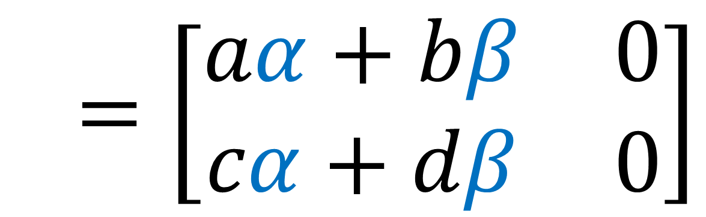
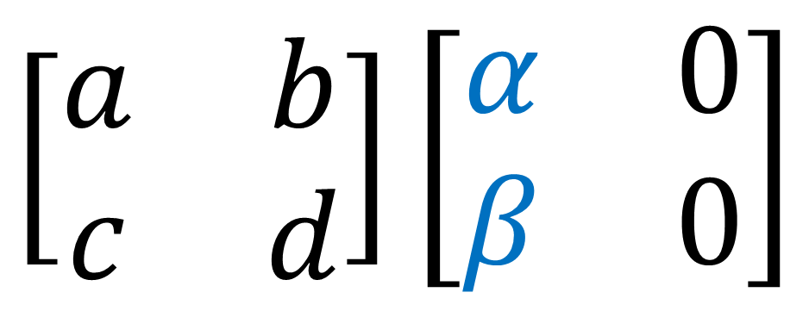
Left Ideal:
$$\left[\begin{matrix}a & b \\ c & d\end{matrix}\right]\left[\begin{matrix}α & 0 \\ β & 0\end{matrix}\right]$$
$$=\left[\begin{matrix}aα+bβ & 0 \\ cα+dβ & 0\end{matrix}\right]$$

Slide 6






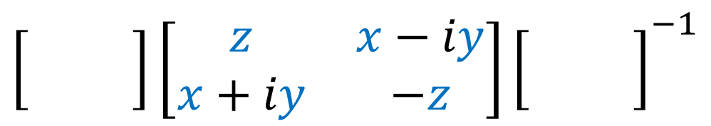
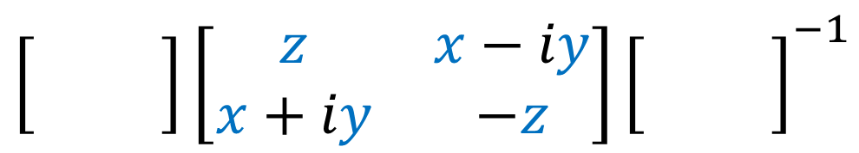



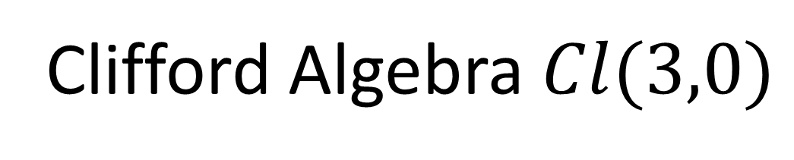








Standard Matrices
$$\left[\begin{matrix}0 & 0 \\ 0 & 0\end{matrix}\right]$$
$$\left[\begin{aligned}α \\ β\end{aligned}\right]$$
$$SU(2)$$
$$\left[\begin{matrix}0 & 0 \\ 0 & 0\end{matrix}\right]\left[\begin{matrix}z & x−iy \\ x+iy & −z\end{matrix}\right]{\left[\begin{matrix}0 & 0 \\ 0 & 0\end{matrix}\right]}^{−1}$$
$$SU(2)$$
$$SU(2)$$
$$θ/2$$
$$θ/2$$
$$θ/2$$
vector
spinor
Clifford Algebra $Cl(3,0)$
$$\left[\begin{matrix}0 & 0 \\ 0 & 0\end{matrix}\right]$$
$$Spin(3)$$
$$\left[\begin{matrix}α & 0 \\ β & 0\end{matrix}\right]$$
$$\left[\begin{matrix}0 & 0 \\ 0 & 0\end{matrix}\right]\left[\begin{matrix}z & x−iy \\ x+iy & −z\end{matrix}\right]{\left[\begin{matrix}0 & 0 \\ 0 & 0\end{matrix}\right]}^{−1}$$
$$Spin(3)$$
$$Spin(3)$$
$$θ/2$$
$$θ/2$$
$$θ/2$$
vector
spinor

Slide 7
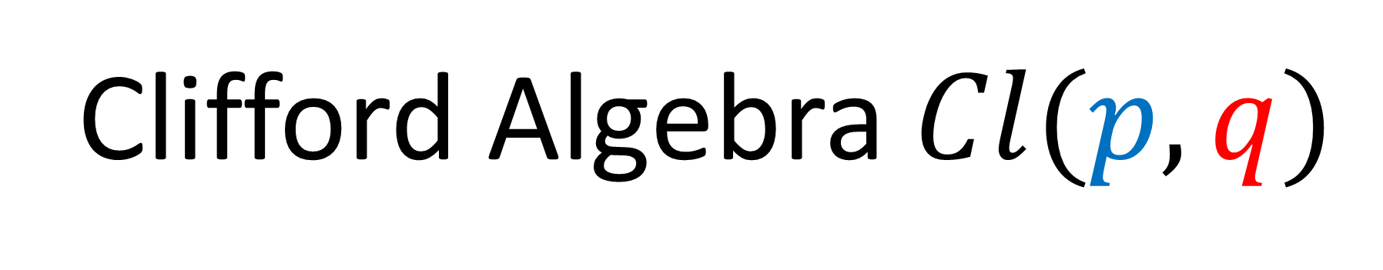
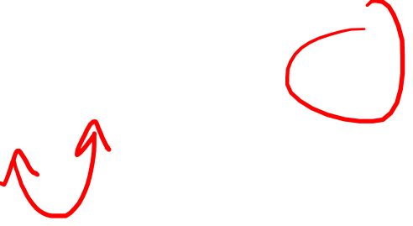
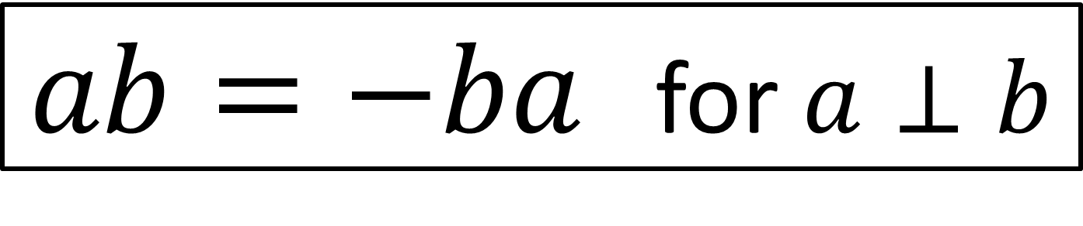
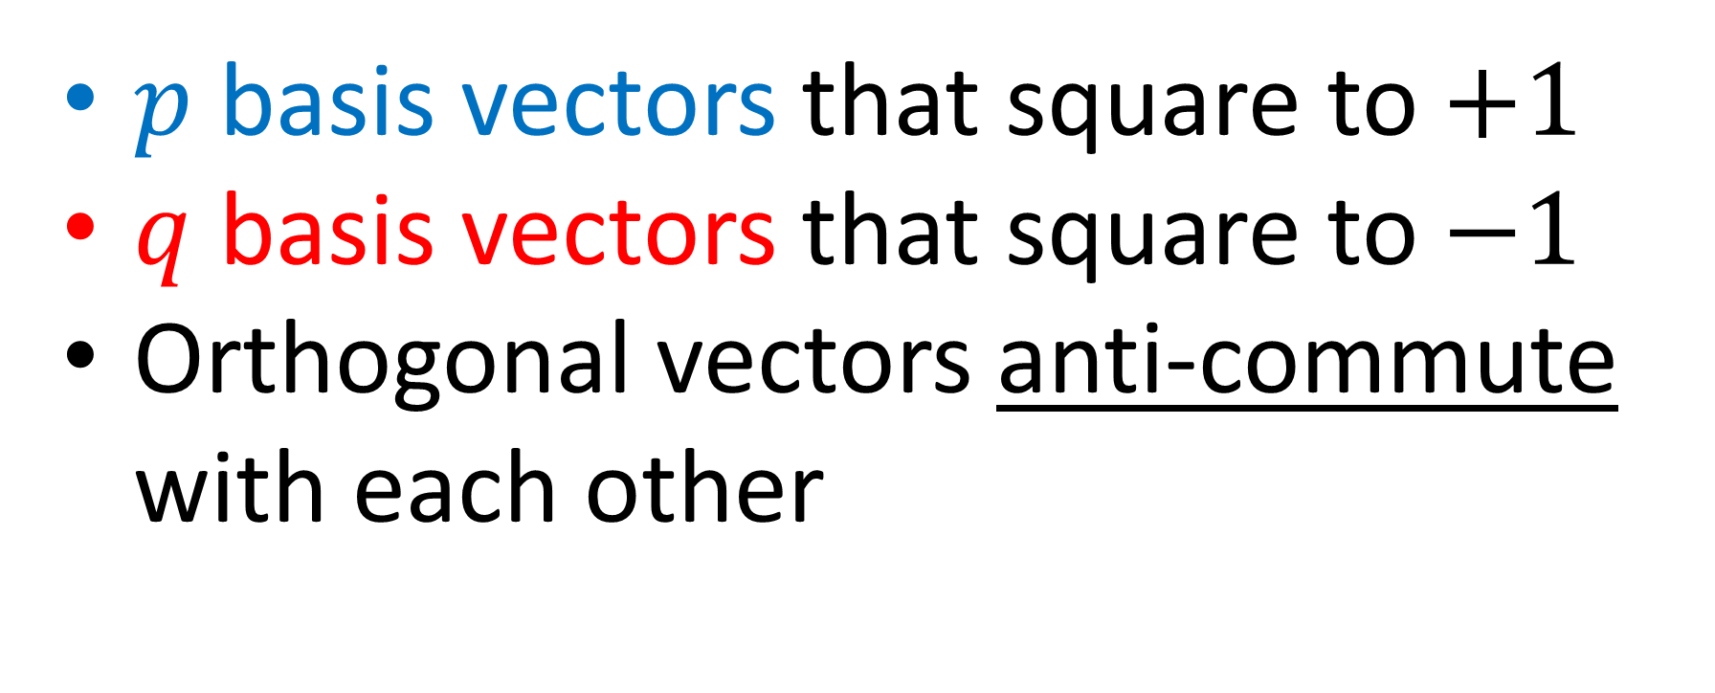
Clifford Algebra $Cl(p,q)$
$p$ basis vectors that square to $+1$
$q$ basis vectors that square to $−1$
Orthogonal vectors anti-commute with each other
$ab=−ba$ for $a⊥b$

Slide 8
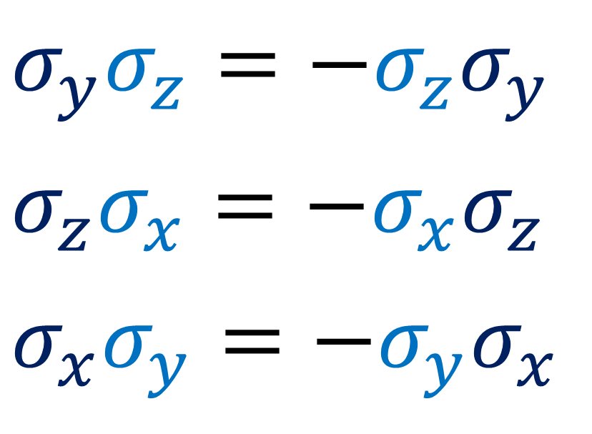

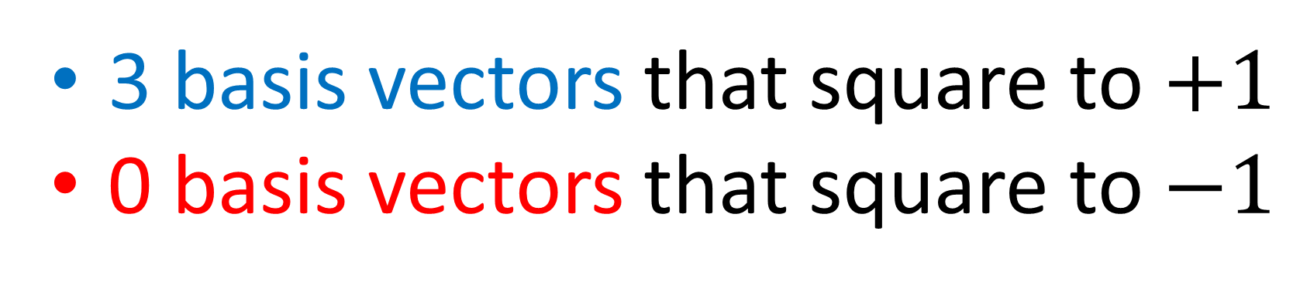
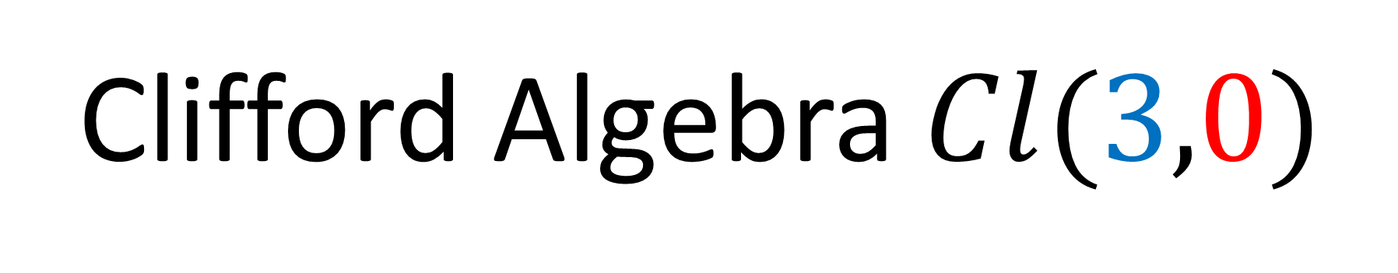



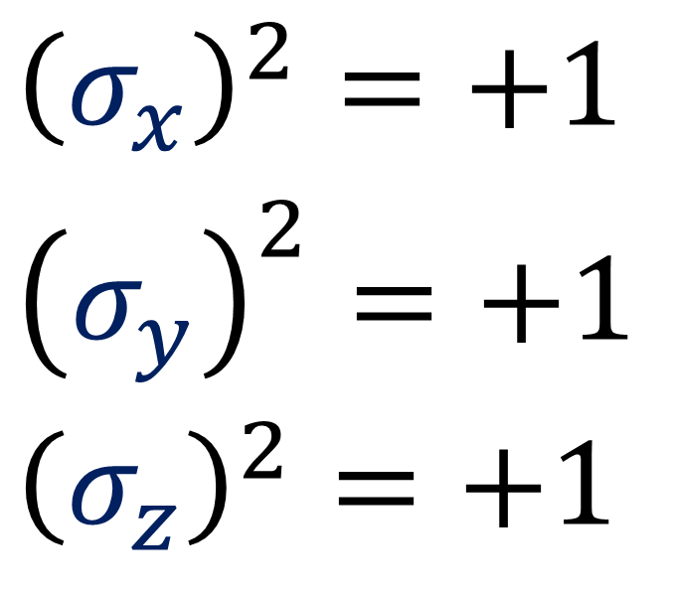
Clifford Algebra $Cl(3,0)$
3 basis vectors that square to $+1$
0 basis vectors that square to $−1$
(unit length)
(anti-commute)
$$σ_{z}$$
$$σ_{y}σ_{z}=−σ_{z}σ_{y}$$
$$σ_{z}σ_{x}=−σ_{x}σ_{z}$$
$$σ_{x}σ_{y}=−σ_{y}σ_{x}$$
$${\left(σ_{x}\right)}^{2}=+1$$
$${\left(σ_{y}\right)}^{2}=+1$$
$${\left(σ_{z}\right)}^{2}=+1$$
$$σ_{y}$$
$$σ_{x}$$

Slide 9
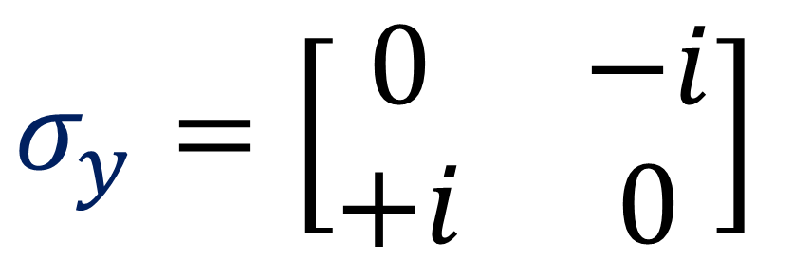
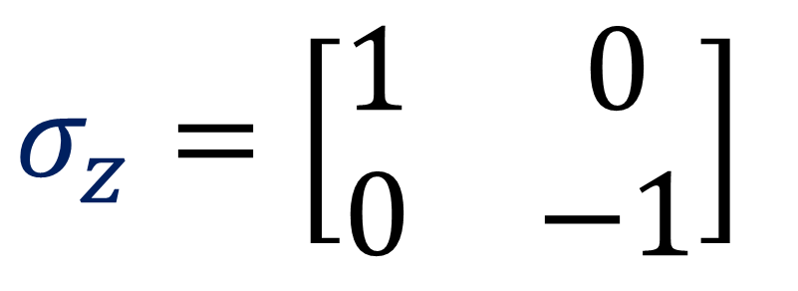
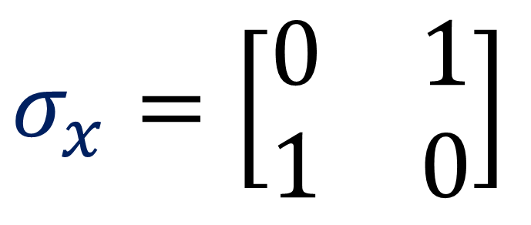

Clifford Algebra $Cl(3,0)$
3 basis vectors that square to $+1$
0 basis vectors that square to $−1$
$$σ_{x}=\left[\begin{matrix}0 & 1 \\ 1 & 0\end{matrix}\right]$$
$$σ_{z}=\left[\begin{matrix}1 & 0 \\ 0 & −1\end{matrix}\right]$$
$$σ_{y}=\left[\begin{matrix}0 & −i \\ +i & 0\end{matrix}\right]$$
(Pauli matrices)

Slide 10
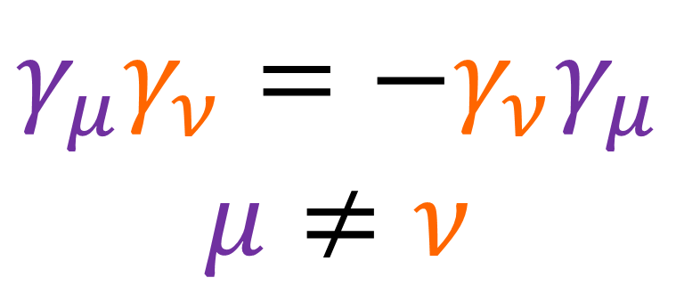

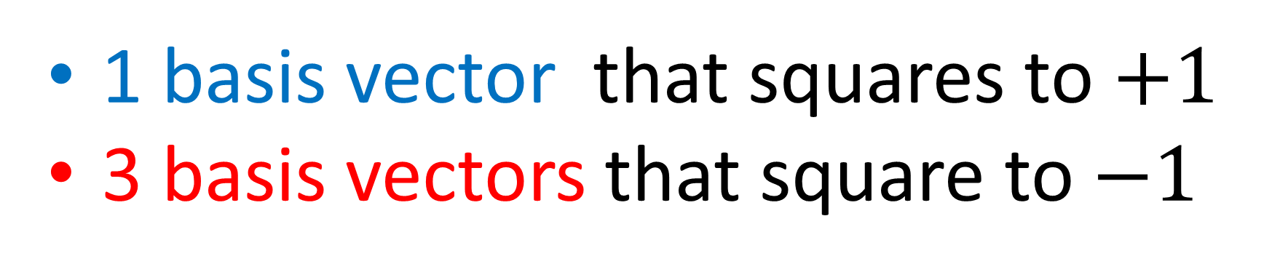

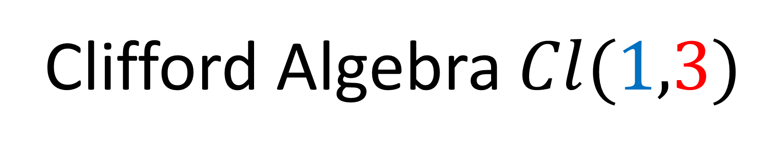



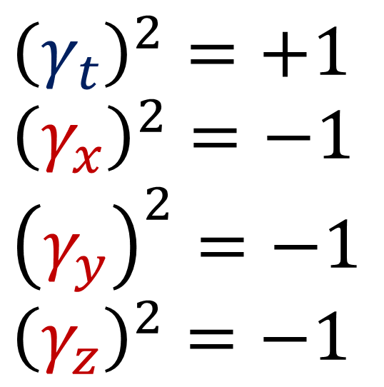
Clifford Algebra $Cl(1,3)$
1 basis vector that squares to $+1$
3 basis vectors that square to $−1$
$$γ_{t}$$
(unit length)
(anti-commute)
$$γ_{z}$$
$${\left(γ_{t}\right)}^{2}=+1$$
$${\left(γ_{x}\right)}^{2}=−1$$
$${\left(γ_{y}\right)}^{2}=−1$$
$${\left(γ_{z}\right)}^{2}=−1$$
$$γ_{μ}γ_{ν}=−γ_{ν}γ_{μ}$$
$$μ≠ν$$
$$γ_{y}$$
$$γ_{x}$$

Slide 11
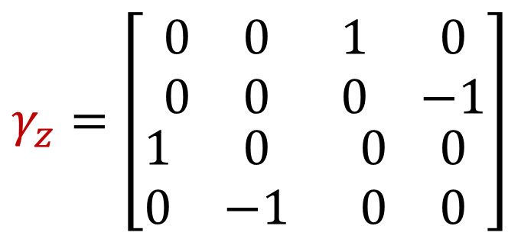
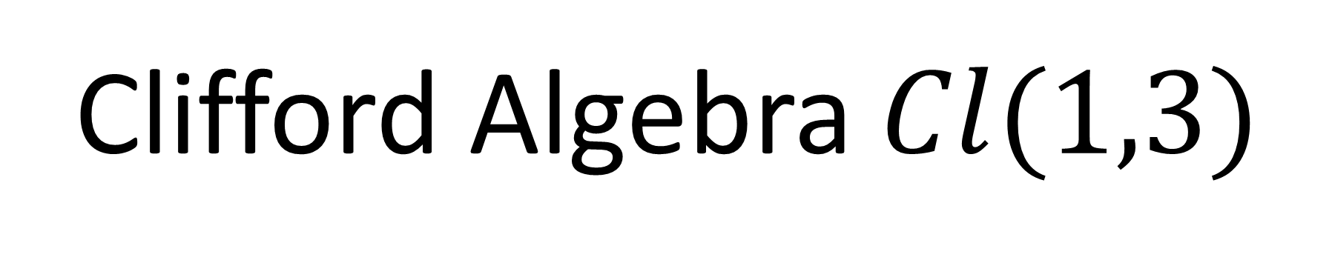
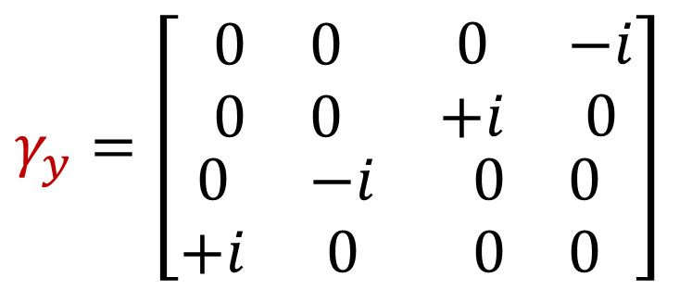
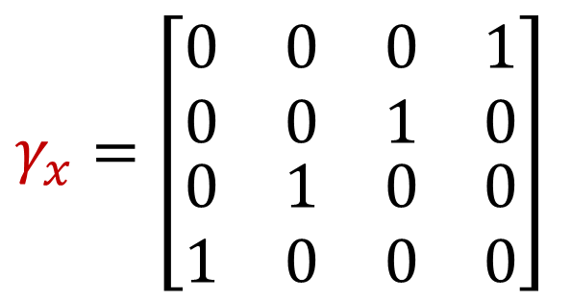
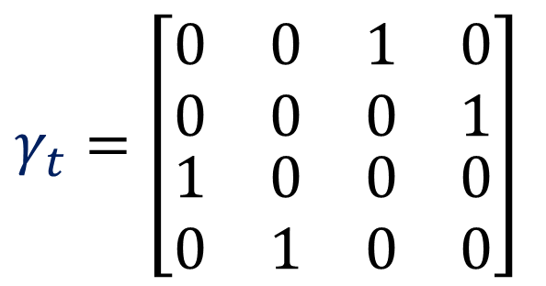

Clifford Algebra $Cl(1,3)$
1 basis vector that squares to $+1$
3 basis vectors that square to $−1$
$$γ_{y}=\left[\begin{matrix}\begin{matrix}0 & 0 \\ 0 & 0\end{matrix} & \begin{matrix}0 & −i \\ +i & 0\end{matrix} \\ \begin{matrix}0 & −i \\ +i & 0\end{matrix} & \begin{matrix}0 & 0 \\ 0 & 0\end{matrix}\end{matrix}\right]$$
$$γ_{t}=\left[\begin{matrix}\begin{matrix}0 & 0 \\ 0 & 0\end{matrix} & \begin{matrix}1 & 0 \\ 0 & 1\end{matrix} \\ \begin{matrix}1 & 0 \\ 0 & 1\end{matrix} & \begin{matrix}0 & 0 \\ 0 & 0\end{matrix}\end{matrix}\right]$$
(Dirac matrices)
$$γ_{x}=\left[\begin{matrix}\begin{matrix}0 & 0 \\ 0 & 0\end{matrix} & \begin{matrix}0 & 1 \\ 1 & 0\end{matrix} \\ \begin{matrix}0 & 1 \\ 1 & 0\end{matrix} & \begin{matrix}0 & 0 \\ 0 & 0\end{matrix}\end{matrix}\right]$$
$$γ_{z}=\left[\begin{matrix}\begin{matrix}0 & 0 \\ 0 & 0\end{matrix} & \begin{matrix}1 & 0 \\ 0 & −1\end{matrix} \\ \begin{matrix}1 & 0 \\ 0 & −1\end{matrix} & \begin{matrix}0 & 0 \\ 0 & 0\end{matrix}\end{matrix}\right]$$

Slide 12
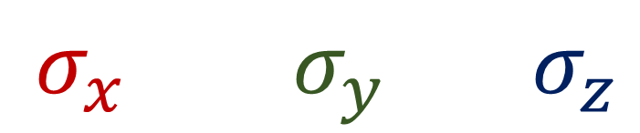

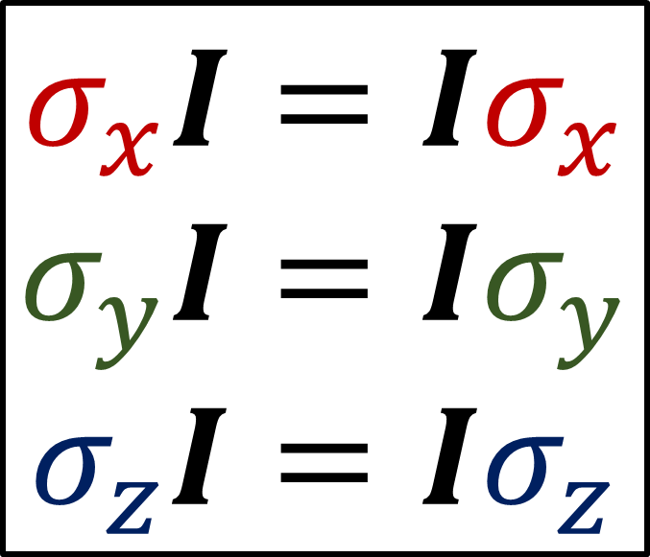



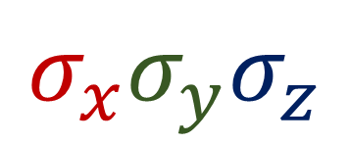
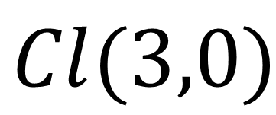

$Cl(3,0)$
trivector
(pseudoscalar)
$$I≡σ_{x}σ_{y}σ_{z}$$
$$σ_{x}σ_{y}σ_{z}$$
$$I^{2}=−1$$
bivectors
(pseudovectors)
$σ_{y}σ_{z}$ $σ_{z}σ_{x}$ $σ_{x}σ_{y}$
$$σ_{x}I=Iσ_{x}$$
$$σ_{y}I=Iσ_{y}$$
$$σ_{z}I=Iσ_{z}$$
$σ_{x}$ $σ_{y}$ $σ_{z}$
vectors
$$1$$
scalar

Slide 13

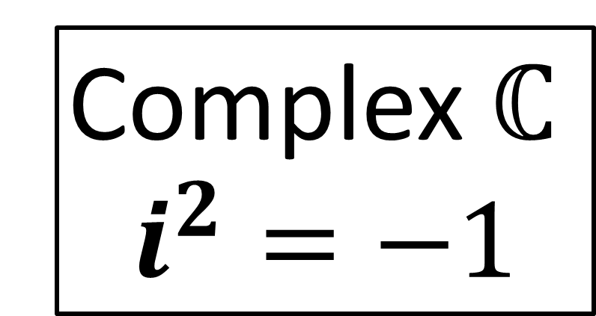
$Cl(3,0)$
trivector
(pseudoscalar)
$$I≡σ_{x}σ_{y}σ_{z}$$
$$σ_{x}σ_{y}σ_{z}$$
$$I^{2}=−1$$
bivectors
(pseudovectors)
$σ_{y}σ_{z}$ $σ_{z}σ_{x}$ $σ_{x}σ_{y}$
Complex $ℂ$
$$i^{2}=−1$$
$σ_{x}$ $σ_{y}$ $σ_{z}$
vectors
$$1$$
scalar

Slide 14
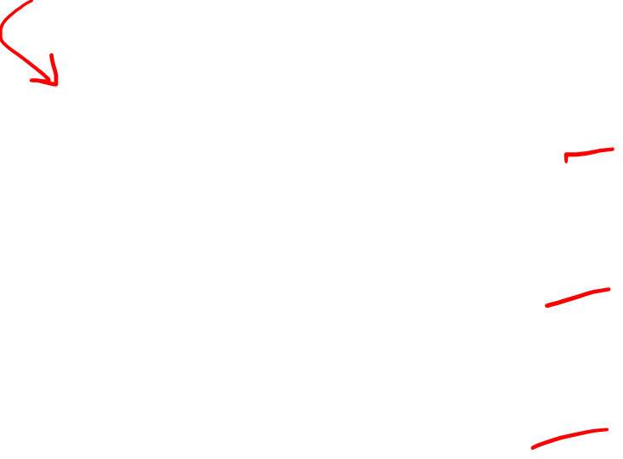
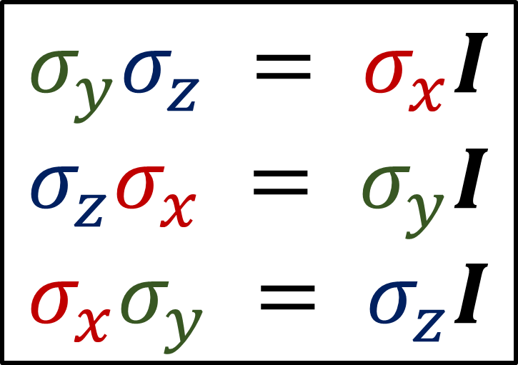
$Cl(3,0)$
trivector
(pseudoscalar)
$$I≡σ_{x}σ_{y}σ_{z}$$
$$σ_{x}σ_{y}σ_{z}$$
bivectors
(pseudovectors)
$σ_{y}σ_{z}$ $σ_{z}σ_{x}$ $σ_{x}σ_{y}$
bivectors
pseudovectors
$$σ_{y}σ_{z} = σ_{x}I$$
$$σ_{z}σ_{x} = σ_{y}I$$
$$σ_{x}σ_{y} = σ_{z}I$$
$σ_{x}$ $σ_{y}$ $σ_{z}$
vectors
$$1$$
scalar

Slide 15
















$Cl(3,0)$
$$\left[\begin{matrix}i & 0 \\ 0 & i\end{matrix}\right]$$
trivector
(pseudoscalar)
$$σ_{x}σ_{y}σ_{z}=I$$
$$\left[\begin{matrix}0 & i \\ i & 0\end{matrix}\right]$$
$$\left[\begin{matrix}0 & 1 \\ −1 & 0\end{matrix}\right]$$
$$\left[\begin{matrix}i & 0 \\ 0 & −i\end{matrix}\right]$$
bivectors
(pseudovectors)
$$σ_{y}σ_{z}=Iσ_{x}$$
$$σ_{z}σ_{x}=Iσ_{y}$$
$$σ_{x}σ_{y}=Iσ_{z}$$
$$\left[\begin{matrix}0 & 1 \\ 1 & 0\end{matrix}\right]$$
$$\left[\begin{matrix}0 & −i \\ i & 0\end{matrix}\right]$$
$$\left[\begin{matrix}1 & 0 \\ 0 & −1\end{matrix}\right]$$
$$σ_{x}$$
$$σ_{y}$$
$$σ_{z}$$
vectors
$$\left[\begin{matrix}1 & 0 \\ 0 & 1\end{matrix}\right]$$
$$1$$
scalar

Slide 16


























$$\left[\begin{matrix}1 & 0 \\ 0 & 1\end{matrix}\right]$$
$$\left[\begin{matrix}0 & 1 \\ 1 & 0\end{matrix}\right]$$
$$\left[\begin{matrix}0 & −i \\ i & 0\end{matrix}\right]$$
$$\left[\begin{matrix}1 & 0 \\ 0 & −1\end{matrix}\right]$$
$$+A$$
$$+B$$
$$+C$$
$$+D$$
$$σ_{x}$$
$$σ_{y}$$
$$σ_{z}$$
$$1$$
$$\left[\begin{matrix}0 & i \\ i & 0\end{matrix}\right]$$
$$\left[\begin{matrix}0 & 1 \\ −1 & 0\end{matrix}\right]$$
$$\left[\begin{matrix}i & 0 \\ 0 & −i\end{matrix}\right]$$
$$\left[\begin{matrix}i & 0 \\ 0 & i\end{matrix}\right]$$
$$+E$$
$$+F$$
$$+G$$
$$+H$$
$$σ_{y}σ_{z}=Iσ_{x}$$
$$σ_{z}σ_{x}=Iσ_{y}$$
$$σ_{x}σ_{y}=Iσ_{z}$$
$$σ_{x}σ_{y}σ_{z}=I$$
$$=\left[\begin{matrix}\left(A+D\right)+i\left(G+H\right) & \left(B+F\right)+i\left(−C+E\right) \\ \left(B−F\right)+i\left(C+E\right) & \left(A−D\right)+i\left(−G+H\right)\end{matrix}\right]$$
$$=\left[\begin{matrix}a+ib & c+id \\ e+if & g+ih\end{matrix}\right]$$

Slide 17



$Cl(3,0)$
$$\left[\begin{matrix}i & 0 \\ 0 & i\end{matrix}\right]$$
trivector
(pseudoscalar)
$$\left[\begin{aligned}ξ^{1} \\ ξ^{2}\end{aligned}\right]$$
Pauli
Spinor
$$σ_{x}σ_{y}σ_{z}=I$$
$$\left[\begin{matrix}0 & i \\ i & 0\end{matrix}\right]$$
$$\left[\begin{matrix}0 & 1 \\ −1 & 0\end{matrix}\right]$$
$$\left[\begin{matrix}i & 0 \\ 0 & −i\end{matrix}\right]$$
bivectors
(pseudovectors)
$$σ_{y}σ_{z}=Iσ_{x}$$
$$σ_{z}σ_{x}=Iσ_{y}$$
$$σ_{x}σ_{y}=Iσ_{z}$$
$$\left[\begin{matrix}0 & 1 \\ 1 & 0\end{matrix}\right]$$
$$\left[\begin{matrix}0 & −i \\ i & 0\end{matrix}\right]$$
$$\left[\begin{matrix}1 & 0 \\ 0 & −1\end{matrix}\right]$$
$$\left[\begin{matrix}ξ^{1} & 0 \\ ξ^{2} & 0\end{matrix}\right]$$
$$σ_{x}$$
$$σ_{y}$$
$$σ_{z}$$
vectors
$$\left[\begin{matrix}1 & 0 \\ 0 & 1\end{matrix}\right]$$
$$1$$
scalar

Slide 18






Stern-Gerlach Experiment
“spin up”
$$→\left[\begin{aligned}1 \\ 0\end{aligned}\right]$$
$$\left|+z\right\rangle$$
S
N
$$→\left[\begin{aligned}0 \\ 1\end{aligned}\right]$$
beam of neutral particles (e.g. silver atoms)
magnetic field
(inhomogeneous)
$$\left|−z\right\rangle$$
“spin down”

Slide 19
$Cl(3,0)$
$$\left[\begin{matrix}i & 0 \\ 0 & i\end{matrix}\right]$$
trivector
(pseudoscalar)
$$\left[\begin{aligned}ξ^{1} \\ ξ^{2}\end{aligned}\right]$$
Pauli
Spinor
$$σ_{x}σ_{y}σ_{z}=I$$
$$\left[\begin{matrix}0 & i \\ i & 0\end{matrix}\right]$$
$$\left[\begin{matrix}0 & 1 \\ −1 & 0\end{matrix}\right]$$
$$\left[\begin{matrix}i & 0 \\ 0 & −i\end{matrix}\right]$$
bivectors
(pseudovectors)
$$σ_{y}σ_{z}=Iσ_{x}$$
$$σ_{z}σ_{x}=Iσ_{y}$$
$$σ_{x}σ_{y}=Iσ_{z}$$
$$\left[\begin{matrix}0 & 1 \\ 1 & 0\end{matrix}\right]$$
$$\left[\begin{matrix}0 & −i \\ i & 0\end{matrix}\right]$$
$$\left[\begin{matrix}1 & 0 \\ 0 & −1\end{matrix}\right]$$
$$σ_{x}$$
$$σ_{y}$$
$$σ_{z}$$
vectors
$$\left[\begin{matrix}1 & 0 \\ 0 & 1\end{matrix}\right]$$
$$1$$
scalar

Slide 20







$$ξ$$
$=ξ^{1}\left|+z\right\rangle +ξ^{2}\left|−z\right\rangle$
$$\left[\begin{aligned}ξ^{1} \\ ξ^{2}\end{aligned}\right]$$
$$= ξ^{1}\left[\begin{aligned}1 \\ 0\end{aligned}\right] +ξ^{2}\left[\begin{aligned}0 \\ 1\end{aligned}\right]$$
$$\left[\begin{matrix}ξ^{1} & 0 \\ ξ^{2} & 0\end{matrix}\right]$$
$$=ξ^{1}\left[\begin{matrix}1 & 0 \\ 0 & 0\end{matrix}\right]+ξ^{2}\left[\begin{matrix}0 & 0 \\ 1 & 0\end{matrix}\right]$$

Slide 21







$Cl(3,0)$
$$\left[\begin{matrix}i & 0 \\ 0 & i\end{matrix}\right]$$
$$\left|+z\right\rangle →\left[\begin{matrix}1 & 0 \\ 0 & 0\end{matrix}\right]$$
$$σ_{x}σ_{y}σ_{z}=I$$
$=\frac{1}{2}\left( 1 + σ_{z} \right)$
$$\left[\begin{matrix}0 & i \\ i & 0\end{matrix}\right]$$
$$\left[\begin{matrix}0 & 1 \\ −1 & 0\end{matrix}\right]$$
$$\left[\begin{matrix}i & 0 \\ 0 & −i\end{matrix}\right]$$
$=\frac{1}{2}\left(\left[\begin{matrix}1 & 0 \\ 0 & 1\end{matrix}\right]+\left[\begin{matrix}1 & 0 \\ 0 & −1\end{matrix}\right]\right)$
$$\left[\begin{matrix}1 & 0 \\ 0 & 1\end{matrix}\right]$$
$$\left[\begin{matrix}1 & 0 \\ 0 & −1\end{matrix}\right]$$
$$σ_{y}σ_{z}=Iσ_{x}$$
$$σ_{z}σ_{x}=Iσ_{y}$$
$$σ_{x}σ_{y}=Iσ_{z}$$
$$\left[\begin{matrix}0 & 1 \\ 1 & 0\end{matrix}\right]$$
$$\left[\begin{matrix}0 & −i \\ i & 0\end{matrix}\right]$$
$$\left[\begin{matrix}1 & 0 \\ 0 & −1\end{matrix}\right]$$
$=\frac{1}{2}\left(\left[\begin{matrix}1+1 & 0 \\ 0 & 1−1\end{matrix}\right]\right)$
$= \frac{1}{2} \left[\begin{matrix}2 & 0 \\ 0 & 0\end{matrix}\right]$
$$= \left[\begin{matrix}1 & 0 \\ 0 & 0\end{matrix}\right]$$
$$σ_{x}$$
$$σ_{y}$$
$$σ_{z}$$
$$\left[\begin{matrix}1 & 0 \\ 0 & 1\end{matrix}\right]$$
$$1$$

Slide 22







$Cl(3,0)$
$$\left[\begin{matrix}i & 0 \\ 0 & i\end{matrix}\right]$$
$$\left|−z\right\rangle →\left[\begin{matrix}0 & 0 \\ 1 & 0\end{matrix}\right]$$
$$σ_{x}σ_{y}σ_{z}=I$$
$=\frac{1}{2}\left( σ_{x} − Iσ_{y} \right)$
$$\left[\begin{matrix}0 & i \\ i & 0\end{matrix}\right]$$
$$\left[\begin{matrix}0 & 1 \\ −1 & 0\end{matrix}\right]$$
$$\left[\begin{matrix}i & 0 \\ 0 & −i\end{matrix}\right]$$
$$\left[\begin{matrix}0 & 1 \\ −1 & 0\end{matrix}\right]$$
$=\frac{1}{2}\left(\left[\begin{matrix}0 & 1 \\ 1 & 0\end{matrix}\right]−\left[\begin{matrix}0 & 1 \\ −1 & 0\end{matrix}\right]\right)$
$$\left[\begin{matrix}0 & 1 \\ 1 & 0\end{matrix}\right]$$
$$σ_{y}σ_{z}=Iσ_{x}$$
$$σ_{z}σ_{x}=Iσ_{y}$$
$$σ_{x}σ_{y}=Iσ_{z}$$
$$\left[\begin{matrix}0 & 1 \\ 1 & 0\end{matrix}\right]$$
$$\left[\begin{matrix}0 & −i \\ i & 0\end{matrix}\right]$$
$$\left[\begin{matrix}1 & 0 \\ 0 & −1\end{matrix}\right]$$
$=\frac{1}{2}\left(\left[\begin{matrix}0 & 1−1 \\ 1+1 & 0\end{matrix}\right]\right)$
$= \frac{1}{2} \left[\begin{matrix}0 & 0 \\ 2 & 0\end{matrix}\right]$
$$= \left[\begin{matrix}0 & 0 \\ 1 & 0\end{matrix}\right]$$
$$σ_{x}$$
$$σ_{y}$$
$$σ_{z}$$
$$\left[\begin{matrix}1 & 0 \\ 0 & 1\end{matrix}\right]$$
$$1$$

Slide 23


$Cl(3,0)$
$$\left[\begin{matrix}i & 0 \\ 0 & i\end{matrix}\right]$$
$$\left|−z\right\rangle →\left[\begin{matrix}0 & 0 \\ 1 & 0\end{matrix}\right]$$
$$σ_{x}σ_{y}σ_{z}=I$$
$=\frac{1}{2}\left( σ_{x} − Iσ_{y} \right)$
$$\left[\begin{matrix}0 & i \\ i & 0\end{matrix}\right]$$
$$\left[\begin{matrix}0 & 1 \\ −1 & 0\end{matrix}\right]$$
$$\left[\begin{matrix}i & 0 \\ 0 & −i\end{matrix}\right]$$
$=\frac{1}{2}\left( σ_{x} − σ_{z}σ_{x} \right)$
$=\frac{1}{2}\left( σ_{x} + σ_{x}σ_{z} \right)$
$=σ_{x}\frac{1}{2}\left( 1 + σ_{z} \right)$
$$=σ_{x}\left|+z\right\rangle$$
$$σ_{y}σ_{z}=Iσ_{x}$$
$$σ_{z}σ_{x}=Iσ_{y}$$
$$σ_{x}σ_{y}=Iσ_{z}$$
$$\left[\begin{matrix}0 & 1 \\ 1 & 0\end{matrix}\right]$$
$$\left[\begin{matrix}0 & −i \\ i & 0\end{matrix}\right]$$
$$\left[\begin{matrix}1 & 0 \\ 0 & −1\end{matrix}\right]$$
$$σ_{x}$$
$$σ_{y}$$
$$σ_{z}$$
$$\left[\begin{matrix}1 & 0 \\ 0 & 1\end{matrix}\right]$$
$$1$$

Slide 24







$$\left|+z\right\rangle →\left[\begin{matrix}1 & 0 \\ 0 & 0\end{matrix}\right]$$
$\frac{1}{2}\left(1+σ_{z}\right)$
$$\left|−z\right\rangle →\left[\begin{matrix}0 & 0 \\ 1 & 0\end{matrix}\right]$$
$σ_{x}\frac{1}{2}\left(1−σ_{z}\right)$
$ξ^{1} \left|+z\right\rangle + ξ^{2} \left|−z\right\rangle$
$ξ^{1}\frac{1}{2}\left(1+σ_{z}\right)+ξ^{2}σ_{x}\frac{1}{2}\left(1−σ_{z}\right)$
$=\left[\begin{matrix}ξ^{1} & 0 \\ ξ^{2} & 0\end{matrix}\right]$
$ξ^{1} \left[\begin{matrix}1 & 0 \\ 0 & 0\end{matrix}\right] + ξ^{2} \left[\begin{matrix}0 & 0 \\ 1 & 0\end{matrix}\right]$

Slide 25













$$\left[\begin{matrix}0 & 0 \\ 0 & 0\end{matrix}\right]$$
$$\left[\begin{aligned}ξ^{1} \\ ξ^{2}\end{aligned}\right]$$
$$\left[\begin{aligned}{\tilde{ξ}}^{1} \\ {\tilde{ξ}}^{2}\end{aligned}\right]$$
$$SU(2)$$
$$=$$
$$θ/2$$
$$\left[\begin{matrix}0 & 0 \\ 0 & 0\end{matrix}\right]$$
$$\left[\begin{matrix}ξ^{1} & 0 \\ ξ^{2} & 0\end{matrix}\right]$$
$$\left[\begin{matrix}{\tilde{ξ}}^{1} & 0 \\ {\tilde{ξ}}^{2} & 0\end{matrix}\right]$$
$$SU(2)$$
$$=$$
$$θ/2$$

Slide 26



$$\left[\begin{matrix}0 & 0 \\ 0 & 0\end{matrix}\right]$$
$$\left[\begin{aligned}ξ^{1} \\ ξ^{2}\end{aligned}\right]$$
$$\left[\begin{aligned}{\tilde{ξ}}^{1} \\ {\tilde{ξ}}^{2}\end{aligned}\right]$$
$$Spin(3,0)$$
$$=$$
$$θ/2$$
$$\left[\begin{matrix}0 & 0 \\ 0 & 0\end{matrix}\right]$$
$$\left[\begin{matrix}ξ^{1} & 0 \\ ξ^{2} & 0\end{matrix}\right]$$
$$\left[\begin{matrix}{\tilde{ξ}}^{1} & 0 \\ {\tilde{ξ}}^{2} & 0\end{matrix}\right]$$
$$Spin(3,0)$$
$$=$$
$$θ/2$$

Slide 27





Hint: $σ_{z}\left|+z\right\rangle =\left|+z\right\rangle$
$ξ^{1}\left|+z\right\rangle +$
$ξ^{2}σ_{x}\left|+z\right\rangle$
$\left(\cos{\frac{θ}{2}}ξ^{1}+\sin{\frac{θ}{2}}ξ^{2}\right)\left|+z\right\rangle +\left(−\sin{\frac{θ}{2}}\left(ξ^{1}\right)+\cos{\frac{θ}{2}}ξ^{2}\right)σ_{x}\left|+z\right\rangle$
$\cos{\frac{θ}{2}}+\sin{\frac{θ}{2}}σ_{z}σ_{x}$
$$\left[\begin{matrix}\cos{\frac{θ}{2}} & \sin{\frac{θ}{2}} \\ −\sin{\frac{θ}{2}} & \cos{\frac{θ}{2}}\end{matrix}\right]$$
$$\left[\begin{matrix}ξ^{1} & 0 \\ ξ^{2} & 0\end{matrix}\right]$$
$$\left[\begin{matrix}{\tilde{ξ}}^{1} & 0 \\ {\tilde{ξ}}^{2} & 0\end{matrix}\right]$$
$$=$$

Slide 28




$Cl(3,0)$
$$\left[\begin{matrix}i & 0 \\ 0 & i\end{matrix}\right]$$
Spinors
$$σ_{x}σ_{y}σ_{z}=I$$
$$\left[\begin{matrix}1 & 0 \\ 0 & 0\end{matrix}\right]=\frac{1}{2}\left(\left[\begin{matrix}1 & 0 \\ 0 & 1\end{matrix}\right]+\left[\begin{matrix}1 & 0 \\ 0 & −1\end{matrix}\right]\right)$$
$$\left[\begin{matrix}0 & i \\ i & 0\end{matrix}\right]$$
$$\left[\begin{matrix}0 & 1 \\ −1 & 0\end{matrix}\right]$$
$$\left[\begin{matrix}i & 0 \\ 0 & −i\end{matrix}\right]$$
$=\frac{1}{2}\left( 1 + σ_{z} \right)$
$$σ_{y}σ_{z}=Iσ_{x}$$
$$σ_{z}σ_{x}=Iσ_{y}$$
$$σ_{x}σ_{y}=Iσ_{z}$$
$$\left[\begin{matrix}0 & 1 \\ 1 & 0\end{matrix}\right]$$
$$\left[\begin{matrix}0 & −i \\ i & 0\end{matrix}\right]$$
$$\left[\begin{matrix}1 & 0 \\ 0 & −1\end{matrix}\right]$$
$$\left[\begin{matrix}0 & 0 \\ 1 & 0\end{matrix}\right]=\frac{1}{2}\left(\left[\begin{matrix}0 & 1 \\ 1 & 0\end{matrix}\right]−\left[\begin{matrix}0 & 1 \\ −1 & 0\end{matrix}\right]\right)$$
$$σ_{x}$$
$$σ_{y}$$
$$σ_{z}$$
$=\frac{1}{2}\left( σ_{x} − Iσ_{y} \right)$
$$\left[\begin{matrix}1 & 0 \\ 0 & 1\end{matrix}\right]$$
$$1$$
Minimal left ideals

Slide 29



Sum of two 1st-column-nonzero matrices gives another:
$$\left[\begin{matrix}m & 0 \\ n & 0\end{matrix}\right]+\left[\begin{matrix}r & 0 \\ s & 0\end{matrix}\right]=\left[\begin{matrix}m+r & 0 \\ n+s & 0\end{matrix}\right]$$
Product of any matrix (from left) with 1st-column-nonzero matrix:
$$\left[\begin{matrix}a & b \\ c & d\end{matrix}\right]\left[\begin{matrix}m & 0 \\ n & 0\end{matrix}\right]=\left[\begin{matrix}am+bn & 0 \\ cm+dn & 0\end{matrix}\right]$$
Left ideal

Slide 30

Doesn’t work for right-multiplication:
$$\left[\begin{matrix}m & 0 \\ n & 0\end{matrix}\right]\left[\begin{matrix}a & b \\ c & d\end{matrix}\right]=\left[\begin{matrix}am & bm \\ an & bn\end{matrix}\right]$$

Slide 31
Ring / Algebra
Ideal
Ideal
minimal ideal
(no sub-ideals inside)
(except trivial ideal)

Slide 32


Ring / Algebra
Ideal
Ideal
minimal ideal
$0$
(no sub-ideals inside)
(except trivial ideal)
The set $\{0\}$ is the “trivial ideal”.

Slide 33

Ring / Algebra
Ideal
minimal ideal
(no sub-ideals inside)
(except trivial ideal)
$$\left[\begin{matrix}a & 0 \\ b & 0\end{matrix}\right]$$

Slide 34




minimal ideal
Ring / Algebra
$$\left[\begin{matrix}\begin{matrix}\begin{aligned}a \\ b \\ c \\ d\end{aligned} & \begin{aligned}0 \\ 0 \\ 0 \\ 0\end{aligned}\end{matrix} & \begin{matrix}\begin{aligned}0 \\ 0 \\ 0 \\ 0\end{aligned} & \begin{aligned}0 \\ 0 \\ 0 \\ 0\end{aligned}\end{matrix}\end{matrix}\right]$$
Ideal
Ideal
Ideal
minimal ideal
NON-minimal ideal
$$\left[\begin{matrix}\begin{matrix}\begin{aligned}a \\ b \\ c \\ d\end{aligned} & \begin{aligned}e \\ f \\ g \\ h\end{aligned}\end{matrix} & \begin{matrix}\begin{aligned}0 \\ 0 \\ 0 \\ 0\end{aligned} & \begin{aligned}0 \\ 0 \\ 0 \\ 0\end{aligned}\end{matrix}\end{matrix}\right]$$
$$\left[\begin{matrix}\begin{matrix}\begin{aligned}0 \\ 0 \\ 0 \\ 0\end{aligned} & \begin{aligned}e \\ f \\ g \\ h\end{aligned}\end{matrix} & \begin{matrix}\begin{aligned}0 \\ 0 \\ 0 \\ 0\end{aligned} & \begin{aligned}0 \\ 0 \\ 0 \\ 0\end{aligned}\end{matrix}\end{matrix}\right]$$

Slide 35







Spinors = members of minimal left ideals
Spinor $≈$ matrices with only one non-zero column
$$\left[\begin{matrix}\begin{matrix}\begin{aligned}a \\ b \\ c \\ d\end{aligned} & \begin{aligned}0 \\ 0 \\ 0 \\ 0\end{aligned}\end{matrix} & \begin{matrix}\begin{aligned}0 \\ 0 \\ 0 \\ 0\end{aligned} & \begin{aligned}0 \\ 0 \\ 0 \\ 0\end{aligned}\end{matrix}\end{matrix}\right]$$
$$\left[\begin{matrix}\begin{matrix}\begin{aligned}0 \\ 0 \\ 0 \\ 0\end{aligned} & \begin{aligned}a \\ b \\ c \\ d\end{aligned}\end{matrix} & \begin{matrix}\begin{aligned}0 \\ 0 \\ 0 \\ 0\end{aligned} & \begin{aligned}0 \\ 0 \\ 0 \\ 0\end{aligned}\end{matrix}\end{matrix}\right]$$
$$\left[\begin{matrix}\begin{matrix}\begin{aligned}0 \\ 0 \\ 0 \\ 0\end{aligned} & \begin{aligned}0 \\ 0 \\ 0 \\ 0\end{aligned}\end{matrix} & \begin{matrix}\begin{aligned}a \\ b \\ c \\ d\end{aligned} & \begin{aligned}0 \\ 0 \\ 0 \\ 0\end{aligned}\end{matrix}\end{matrix}\right]$$
$$\left[\begin{matrix}\begin{matrix}\begin{aligned}0 \\ 0 \\ 0 \\ 0\end{aligned} & \begin{aligned}0 \\ 0 \\ 0 \\ 0\end{aligned}\end{matrix} & \begin{matrix}\begin{aligned}0 \\ 0 \\ 0 \\ 0\end{aligned} & \begin{aligned}a \\ b \\ c \\ d\end{aligned}\end{matrix}\end{matrix}\right]$$
$$\left[\begin{matrix}\begin{matrix}\begin{aligned}a \\ b \\ c \\ d\end{aligned} & \begin{aligned}a \\ b \\ c \\ d\end{aligned}\end{matrix} & \begin{matrix}\begin{aligned}a \\ b \\ c \\ d\end{aligned} & \begin{aligned}a \\ b \\ c \\ d\end{aligned}\end{matrix}\end{matrix}\right]$$
Also minimal left ideal:
$P=\frac{1}{4}\left(1+γ_{tz}\right)\left(1+iγ_{xy}\right)=\left[\begin{matrix}\begin{matrix}\begin{aligned}0.5 \\ 0 \\ 0.5 \\ 0\end{aligned} & \begin{aligned}0 \\ 0 \\ 0 \\ 0\end{aligned}\end{matrix} & \begin{matrix}\begin{aligned}0.5 \\ 0 \\ 0.5 \\ 0\end{aligned} & \begin{aligned}0 \\ 0 \\ 0 \\ 0\end{aligned}\end{matrix}\end{matrix}\right]$
$$γ_{t}P=\left[\begin{matrix}\begin{matrix}\begin{aligned}0.5 \\ 0 \\ −0.5 \\ 0\end{aligned} & \begin{aligned}0 \\ 0 \\ 0 \\ 0\end{aligned}\end{matrix} & \begin{matrix}\begin{aligned}0.5 \\ 0 \\ −0.5 \\ 0\end{aligned} & \begin{aligned}0 \\ 0 \\ 0 \\ 0\end{aligned}\end{matrix}\end{matrix}\right];γ_{x}P=\left[\begin{matrix}\begin{matrix}\begin{aligned}0 \\ 0.5 \\ 0 \\ −0.5\end{aligned} & \begin{aligned}0 \\ 0 \\ 0 \\ 0\end{aligned}\end{matrix} & \begin{matrix}\begin{aligned}0 \\ 0.5 \\ 0 \\ −0.5\end{aligned} & \begin{aligned}0 \\ 0 \\ 0 \\ 0\end{aligned}\end{matrix}\end{matrix}\right];γ_{y}P=\left[\begin{matrix}\begin{matrix}\begin{aligned}0 \\ 0.5i \\ 0 \\ −0.5i\end{aligned} & \begin{aligned}0 \\ 0 \\ 0 \\ 0\end{aligned}\end{matrix} & \begin{matrix}\begin{aligned}0 \\ 0.5i \\ 0 \\ −0.5i\end{aligned} & \begin{aligned}0 \\ 0 \\ 0 \\ 0\end{aligned}\end{matrix}\end{matrix}\right]$$

Slide 36

Spinors = members of minimal left ideals
Spinor $≈$ matrices with only one non-zero column
$$\left[\begin{matrix}\begin{matrix}\begin{aligned}a \\ b \\ c \\ d\end{aligned} & \begin{aligned}0 \\ 0 \\ 0 \\ 0\end{aligned}\end{matrix} & \begin{matrix}\begin{aligned}0 \\ 0 \\ 0 \\ 0\end{aligned} & \begin{aligned}0 \\ 0 \\ 0 \\ 0\end{aligned}\end{matrix}\end{matrix}\right]$$
$$\left[\begin{matrix}\begin{matrix}\begin{aligned}0 \\ 0 \\ 0 \\ 0\end{aligned} & \begin{aligned}a \\ b \\ c \\ d\end{aligned}\end{matrix} & \begin{matrix}\begin{aligned}0 \\ 0 \\ 0 \\ 0\end{aligned} & \begin{aligned}0 \\ 0 \\ 0 \\ 0\end{aligned}\end{matrix}\end{matrix}\right]$$
$$\left[\begin{matrix}\begin{matrix}\begin{aligned}0 \\ 0 \\ 0 \\ 0\end{aligned} & \begin{aligned}0 \\ 0 \\ 0 \\ 0\end{aligned}\end{matrix} & \begin{matrix}\begin{aligned}a \\ b \\ c \\ d\end{aligned} & \begin{aligned}0 \\ 0 \\ 0 \\ 0\end{aligned}\end{matrix}\end{matrix}\right]$$
$$\left[\begin{matrix}\begin{matrix}\begin{aligned}0 \\ 0 \\ 0 \\ 0\end{aligned} & \begin{aligned}0 \\ 0 \\ 0 \\ 0\end{aligned}\end{matrix} & \begin{matrix}\begin{aligned}0 \\ 0 \\ 0 \\ 0\end{aligned} & \begin{aligned}a \\ b \\ c \\ d\end{aligned}\end{matrix}\end{matrix}\right]$$

Slide 37


Spinors = members of minimal left ideals
Spinor $≈$ matrices with only one non-zero column
Dirac Spinor
Pauli Spinor
Left Weyl Spinor
$$\left[\begin{aligned}ψ^{1} \\ ψ^{2} \\ φ_{\dot{1}} \\ φ_{\dot{2}}\end{aligned}\right]→\left[\begin{matrix}\begin{matrix}\begin{aligned}ψ^{1} \\ ψ^{2} \\ φ_{\dot{1}} \\ φ_{\dot{2}}\end{aligned} & \begin{aligned}0 \\ 0 \\ 0 \\ 0\end{aligned}\end{matrix} & \begin{matrix}\begin{aligned}0 \\ 0 \\ 0 \\ 0\end{aligned} & \begin{aligned}0 \\ 0 \\ 0 \\ 0\end{aligned}\end{matrix}\end{matrix}\right]$$
$$\left[\begin{aligned}ξ^{1} \\ ξ^{2}\end{aligned}\right]→\left[\begin{matrix}ξ^{1} & 0 \\ ξ^{2} & 0\end{matrix}\right]$$
Right Weyl Spinor

Slide 38




$$\left[\begin{matrix}1 & 0 \\ 0 & 0\end{matrix}\right]=\frac{1}{2}\left(\left[\begin{matrix}1 & 0 \\ 0 & 1\end{matrix}\right]+\left[\begin{matrix}1 & 0 \\ 0 & −1\end{matrix}\right]\right)$$
$$\left[\begin{matrix}0 & 0 \\ 1 & 0\end{matrix}\right]=\frac{1}{2}\left(\left[\begin{matrix}0 & 1 \\ 1 & 0\end{matrix}\right]−\left[\begin{matrix}0 & 1 \\ −1 & 0\end{matrix}\right]\right)$$
$=\frac{1}{2}\left( 1 + σ_{z} \right)$
$=\frac{1}{2}\left( σ_{x} − Iσ_{y} \right)$

Slide 39


How to build spinors WITHOUT matrix representations?
Key: use Projector/Idempotent $P$
Projector means $P^{2}=P$
$=\frac{1}{2}\left( 1 + σ_{z} \right)$
$=\frac{1}{2}\left( σ_{x} − Iσ_{y} \right)$

Slide 40





$$P_{z+}→\left[\begin{matrix}1 & 0 \\ 0 & 0\end{matrix}\right]$$
$${M P}_{z+}$$
Left Ideal
$$\left[\begin{matrix}α & β \\ γ & δ\end{matrix}\right]\left[\begin{matrix}1 & 0 \\ 0 & 0\end{matrix}\right]$$
$$=\left[\begin{matrix}α & 0 \\ γ & 0\end{matrix}\right]$$

Slide 41
Projector
Ideal
Ring / Algebra
Projector
Ideal

Slide 42

Unit element $U^{2}=1$
$P_{U+}≡\frac{1}{2}\left(1+U\right)$

Slide 43





Unit vector ${\left(σ_{z}\right)}^{2}=1$
$P_{z+}≡\frac{1}{2}\left(1+σ_{z}\right)$
$\left(\begin{aligned}a1 + bσ_{x} + cσ_{y} + dσ_{z} \\ +eσ_{y}σ_{z}+fσ_{z}σ_{x}+gσ_{x}σ_{y}+hσ_{x}σ_{y}σ_{z}\end{aligned}\right)$
$$P_{z+}$$
$$∈Cl(3,0)$$

Slide 44



https://scholar.uwindsor.ca/etd/5652/

Slide 45



Slide 46


Slide 47



Unit vector ${\left(σ_{z}\right)}^{2}=1$
$P_{z+}≡\frac{1}{2}\left(1+σ_{z}\right)$
$P_{z+} σ_{z}$
$=\frac{1}{2}\left(1+σ_{z}\right)σ_{z}$
$=\frac{1}{2}\left(σ_{z}+σ_{z}^{2}\right)$
$=\frac{1}{2}\left(σ_{z}+1\right)$
$=\frac{1}{2}\left(1+σ_{z}\right)$
$$=P_{z+}$$

Slide 48




















$P_{z+}≡\frac{1}{2}\left(1+σ_{z}\right)$
$$P_{z+}σ_{z}=P_{z+}$$
$$P_{z+}$$
$$σ_{z}$$
$$σ_{z}$$
$$σ_{z}$$
$$σ_{z}$$
$$σ_{z}$$
$$=$$
$$P_{z+}$$
$$σ_{z}$$
$$σ_{z}$$
$$σ_{z}$$
$$σ_{z}$$
$$=$$
$$P_{z+}$$
$$σ_{z}$$
$$σ_{z}$$
$$σ_{z}$$

Slide 49



$P_{z+}≡\frac{1}{2}\left(1+σ_{z}\right)$
$$P_{z+}σ_{z}=P_{z+}$$
$$=P_{z+}σ_{z}σ_{z}σ_{z}$$
$$=P_{z+}σ_{z}σ_{z}$$
$$=P_{z+}σ_{z}$$
$$=P_{z+}$$
$$=σ_{z}σ_{z}σ_{z}P_{z+}$$
$$=σ_{z}σ_{z}P_{z+}$$
$$=σ_{z}P_{z+}$$
$$=P_{z+}$$

Slide 50




$\left(\begin{aligned}a1 + bσ_{x} + cσ_{y} + dσ_{z} \\ +eσ_{y}σ_{z}+fσ_{z}σ_{x}+gσ_{x}σ_{y}+hσ_{x}σ_{y}σ_{z}\end{aligned}\right)$
$$P_{z+}$$
$$∈Cl(3,0)$$

Slide 51




$$P_{z+}σ_{x}=P_{z+}$$
$$I=σ_{x}σ_{y}σ_{z}$$
$$1$$ | $$P_{z+}$$ | $$=$$ | $P_{z+}=\frac{1}{2}\left(1+σ_{z}\right)$
$$σ_{x}$$ | $$P_{z+}$$ | $$=$$ | $σ_{x}\frac{1}{2}\left(1+σ_{z}\right)=\frac{1}{2}\left(σ_{x}+σ_{x}σ_{z}\right)=\frac{1}{2}\left(σ_{x}−σ_{y}I\right)$
$$σ_{y}$$ | $$P_{z+}$$ | $$=$$ | $σ_{y}\frac{1}{2}\left(1+σ_{z}\right)=\frac{1}{2}\left(σ_{y}+σ_{y}σ_{z}\right)=\frac{1}{2}\left(σ_{y}+σ_{x}I\right)$
$$σ_{z}$$ | $$P_{z+}$$ | $$=$$ | $σ_{z}P_{z+}=P_{z+}=\frac{1}{2}\left(1+σ_{z}\right)$
$$σ_{y}σ_{z}$$ | $$P_{z+}$$ | $$=$$ | $σ_{y}σ_{z}P_{z+}=σ_{y}P_{z+}=\frac{1}{2}\left(σ_{y}+σ_{x}I\right)$
$$σ_{z}σ_{x}$$ | $$P_{z+}$$ | $$=$$ | $σ_{z}σ_{x}P_{z+}=−σ_{x}σ_{z}P_{z+}=−σ_{x}P_{z+}=−\frac{1}{2}\left(σ_{x}−σ_{y}I\right)$
$$σ_{x}σ_{y}$$ | $$P_{z+}$$ | $$=$$ | $σ_{x}σ_{y}\frac{1}{2}\left(1+σ_{z}\right)=\frac{1}{2}\left(σ_{x}σ_{y}+σ_{x}σ_{y}σ_{z}\right)=\frac{1}{2}\left(σ_{z}I+I\right)$
$$σ_{x}σ_{y}σ_{z}$$ | $$P_{z+}$$ | $$=$$ | $σ_{x}σ_{y}σ_{z}P_{z+}=σ_{x}σ_{y}P_{z+}=\frac{1}{2}\left(σ_{z}I+I\right)$

Slide 52


Applying $P_{z+}$to elements of $Cl(3,0)$
$$1P_{z+}$$ | $$=$$ | $$σ_{z}P_{z+}$$ | $$=$$ | $\frac{1}{2}\left(1+σ_{z}\right)$
$$σ_{x}P_{z+}$$ | $$=$$ | $$−σ_{z}σ_{x}P_{z+}$$ | $$=$$ | $\frac{1}{2}\left(σ_{x}−σ_{y}I\right)$
$$σ_{y}P_{z+}$$ | $$=$$ | $$σ_{y}σ_{z}P_{z+}$$ | $$=$$ | $I\frac{1}{2}\left(σ_{x}−σ_{y}I\right)$
$$σ_{x}σ_{y}P_{z+}$$ | $$=$$ | $$σ_{x}σ_{y}σ_{z}P_{z+}$$ | $$=$$ | $I\frac{1}{2}\left(1+σ_{z}\right)$

Slide 53




Applying $P_{z+}$to elements of $Cl(3,0)$
without $σ_{z}$
with $σ_{z}$
$$1P_{z+}$$ | $$=$$ | $$σ_{z}P_{z+}$$ | $$=$$ | $\frac{1}{2}\left(1+σ_{z}\right)$
$$σ_{x}P_{z+}$$ | $$=$$ | $$−σ_{z}σ_{x}P_{z+}$$ | $$=$$ | $\frac{1}{2}\left(σ_{x}−σ_{y}I\right)$
$$σ_{y}P_{z+}$$ | $$=$$ | $$σ_{y}σ_{z}P_{z+}$$ | $$=$$ | $I\frac{1}{2}\left(σ_{x}−σ_{y}I\right)$
$$σ_{x}σ_{y}P_{z+}$$ | $$=$$ | $$σ_{x}σ_{y}σ_{z}P_{z+}$$ | $$=$$ | $I\frac{1}{2}\left(1+σ_{z}\right)$

Slide 54


Applying $P_{z+}$to elements of $Cl(3,0)$
without $σ_{z}$
with $σ_{z}$
$$1P_{z+}$$ | $$=$$ | $$σ_{z}P_{z+}$$ | $$=$$ | $P_{z+}$
$$σ_{x}P_{z+}$$ | $$=$$ | $$−σ_{z}σ_{x}P_{z+}$$ | $$=$$ | $σ_{x}P_{z+}$
$$σ_{y}P_{z+}$$ | $$=$$ | $$σ_{y}σ_{z}P_{z+}$$ | $$=$$ | $Iσ_{x}P_{z+}$
$$σ_{x}σ_{y}P_{z+}$$ | $$=$$ | $$σ_{x}σ_{y}σ_{z}P_{z+}$$ | $$=$$ | $I{ P}_{z+}$

Slide 55









$P_{z+}=\frac{1}{2}\left(1+σ_{z}\right)$ $→\left[\begin{matrix}1 & 0 \\ 0 & 0\end{matrix}\right]$
$$I=σ_{x}σ_{y}σ_{z}→\left[\begin{matrix}i & 0 \\ 0 & i\end{matrix}\right]$$
$$σ_{x}→\left[\begin{matrix}0 & 1 \\ 1 & 0\end{matrix}\right]$$
$$1P_{z+}$$ | $$=$$ | $$σ_{z}P_{z+}$$ | $$=$$ | $P_{z+}$
$$σ_{x}P_{z+}$$ | $$=$$ | $$−σ_{z}σ_{x}P_{z+}$$ | $$=$$ | $σ_{x}P_{z+}$
$$σ_{y}P_{z+}$$ | $$=$$ | $$σ_{y}σ_{z}P_{z+}$$ | $$=$$ | $Iσ_{x}P_{z+}$
$$σ_{x}σ_{y}P_{z+}$$ | $$=$$ | $$σ_{x}σ_{y}σ_{z}P_{z+}$$ | $$=$$ | $I{ P}_{z+}$
$$\left[\begin{matrix}1 & 0 \\ 0 & 0\end{matrix}\right]$$
$$\left[\begin{matrix}0 & 0 \\ 1 & 0\end{matrix}\right]$$
$$\left[\begin{matrix}0 & 0 \\ i & 0\end{matrix}\right]$$
$$\left[\begin{matrix}i & 0 \\ 0 & 0\end{matrix}\right]$$

Slide 56






$P_{z+}=\frac{1}{2}\left(1+σ_{z}\right)$ $→\left[\begin{matrix}1 & 0 \\ 0 & 0\end{matrix}\right]$
$$I=σ_{x}σ_{y}σ_{z}→\left[\begin{matrix}i & 0 \\ 0 & i\end{matrix}\right]$$
$$σ_{x}→\left[\begin{matrix}0 & 1 \\ 1 & 0\end{matrix}\right]$$
Pauli Spinor
$$1P_{z+}$$ | $$=$$ | $P_{z+}$
$$σ_{x}P_{z+}$$ | $$=$$ | $σ_{x}P_{z+}$
$$σ_{y}P_{z+}$$ | $$=$$ | $Iσ_{x}P_{z+}$
$$σ_{x}σ_{y}P_{z+}$$ | $$=$$ | $I{ P}_{z+}$
$$\left[\begin{matrix}1 & 0 \\ 0 & 0\end{matrix}\right]$$
$$\left[\begin{matrix}0 & 0 \\ 1 & 0\end{matrix}\right]$$
$$\left[\begin{matrix}a+id & 0 \\ c+ib & 0\end{matrix}\right]$$
$$\left[\begin{matrix}0 & 0 \\ i & 0\end{matrix}\right]$$
$$\left[\begin{matrix}i & 0 \\ 0 & 0\end{matrix}\right]$$

Slide 57


$P_{z+}=\frac{1}{2}\left(1+σ_{z}\right)$ $→\left[\begin{matrix}1 & 0 \\ 0 & 0\end{matrix}\right]$
$$I=σ_{x}σ_{y}σ_{z}→\left[\begin{matrix}i & 0 \\ 0 & i\end{matrix}\right]$$
$$σ_{x}→\left[\begin{matrix}0 & 1 \\ 1 & 0\end{matrix}\right]$$
Spinor =
$aP_{z+}+d\left(IP_{z+}\right) +c\left(σ_{x}P_{z+}\right)+b\left(Iσ_{x}P_{z+}\right)$
$$=\left(a+Id\right)P_{z+} +\left(c+Ib\right)\left(σ_{x}P_{z+}\right)$$
$$≈\left(a+id\right)\left|+z\right\rangle +\left(c+ib\right)\left|−z\right\rangle$$

Slide 58




Spinor Space
= minimal left ideal
$$=Cl\left(3,0\right) P_{z+}$$
Generalize this to higher dimensions with $Cl(p,q)$…
$$1P_{z+}$$ | $$=$$ | $P_{z+}$
$$σ_{x}P_{z+}$$ | $$=$$ | $σ_{x}P_{z+}$
$$σ_{y}P_{z+}$$ | $$=$$ | $Iσ_{x}P_{z+}$
$$σ_{x}σ_{y}P_{z+}$$ | $$=$$ | $I{ P}_{z+}$
… but first let’s think more about $Cl(3,0)$.

Slide 59



Stern-Gerlach Experiment
“spin up”
$→+\frac{ℏ}{2}$
$$\left|+z\right\rangle$$
S
N
$→−\frac{ℏ}{2}$
beam of neutral particles (e.g. silver atoms)
magnetic field
(inhomogeneous)
$$\left|−z\right\rangle$$
“spin down”

Slide 60







Spin-z Operator
$\hat{S_{z}}≡\frac{ℏ}{2}σ_{z}$
$\left|+z\right\rangle ≡ P_{z+}=\frac{1}{2}\left(1+σ_{z}\right)$
$\left|−z\right\rangle ≡σ_{x}P_{z+}=\frac{1}{2}\left(σ_{x}−σ_{y}I\right)$
$$σ_{z}\left|+z\right\rangle =σ_{z} P_{z+}$$
$$σ_{z}\left|+z\right\rangle = P_{z+}$$
$$σ_{z}\left|+z\right\rangle =+\left|+z\right\rangle$$
$$σ_{z}\left|−z\right\rangle =σ_{z}σ_{x}P_{z+}$$
$$\left|+z\right\rangle =−σ_{x}σ_{z}P_{z+}$$
$$\left|+z\right\rangle =−σ_{x}P_{z+}=−\left|−z\right\rangle$$
$\hat{S_{z}}\left|+z\right\rangle =+\frac{ℏ}{2}\left|+z\right\rangle$
$\hat{S_{z}}\left|−z\right\rangle =−\frac{ℏ}{2}\left|−z\right\rangle$

Slide 61



$\left|+x\right\rangle =\frac{1}{\sqrt{2}}\left|+z\right\rangle +\frac{1}{\sqrt{2}}\left|−z\right\rangle$
$\left|−x\right\rangle =\frac{1}{\sqrt{2}}\left|+z\right\rangle −\frac{1}{\sqrt{2}}\left|−z\right\rangle$
$\left|+y\right\rangle =\frac{1}{\sqrt{2}}\left|+z\right\rangle +\frac{i}{\sqrt{2}}\left|−z\right\rangle$
$\left|−y\right\rangle =\frac{1}{\sqrt{2}}\left|+z\right\rangle −\frac{i}{\sqrt{2}}\left|−z\right\rangle$
$=\frac{1}{\sqrt{2}}P_{z+}+\frac{1}{\sqrt{2}}σ_{x}P_{z+}=\frac{1}{\sqrt{2}}\left(1+σ_{x}\right)P_{z+}=\sqrt{2}P_{x+}P_{z+}$
$=\frac{1}{\sqrt{2}}P_{z+}−\frac{1}{\sqrt{2}}σ_{x}P_{z+}=\frac{1}{\sqrt{2}}\left(1−σ_{x}\right)P_{z+}=\sqrt{2}P_{x−}P_{z+}$
$=\frac{1}{\sqrt{2}}P_{z+}+\frac{I}{\sqrt{2}}σ_{x}P_{z+}=\frac{1}{\sqrt{2}}\left(1+Iσ_{x}\right)P_{z+}=\frac{1}{\sqrt{2}}\left(1+σ_{y}\right)P_{z+}=\sqrt{2}P_{y+}P_{z+}$
$=\frac{1}{\sqrt{2}}P_{z+}−\frac{I}{\sqrt{2}}σ_{x}P_{z+}=\frac{1}{\sqrt{2}}\left(1−Iσ_{x}\right)P_{z+}=\frac{1}{\sqrt{2}}\left(1−σ_{y}\right)P_{z+}=\sqrt{2}P_{y−}P_{z+}$
$\left|+x\right\rangle =\frac{1}{\sqrt{2}}\left|+z\right\rangle +\frac{1}{\sqrt{2}}\left|−z\right\rangle$ $\left|+x\right\rangle →\frac{1}{\sqrt{2}}P_{z+} +\frac{1}{\sqrt{2}}σ_{x}P_{z+}$ | $=\frac{1}{\sqrt{2}}\left(1+σ_{x}\right)P_{z+}=\sqrt{2}P_{x+}P_{z+}$
$\left|−x\right\rangle =\frac{1}{\sqrt{2}}\left|+z\right\rangle −\frac{1}{\sqrt{2}}\left|−z\right\rangle$ $\left|−x\right\rangle →\frac{1}{\sqrt{2}}P_{z+} −\frac{1}{\sqrt{2}}σ_{x}P_{z+}$ | $=\frac{1}{\sqrt{2}}\left(1−σ_{x}\right)P_{z+}=\sqrt{2}P_{x−}P_{z+}$
$\left|+y\right\rangle =\frac{1}{\sqrt{2}}\left|+z\right\rangle +\frac{i}{\sqrt{2}}\left|−z\right\rangle$ $\left|+y\right\rangle →\frac{1}{\sqrt{2}}P_{z+} +\frac{I}{\sqrt{2}}σ_{x}P_{z+}$ | $=\frac{1}{\sqrt{2}}\left(1+Iσ_{x}\right)P_{z+}$ $=\frac{1}{\sqrt{2}}\left(1+σ_{y}\right)P_{z+}=\sqrt{2}P_{y+}P_{z+}$
$\left|−y\right\rangle =\frac{1}{\sqrt{2}}\left|+z\right\rangle −\frac{i}{\sqrt{2}}\left|−z\right\rangle$ $\left|+y\right\rangle →\frac{1}{\sqrt{2}}P_{z+} −\frac{I}{\sqrt{2}}σ_{x}P_{z+}$ | $=\frac{1}{\sqrt{2}}\left(1−Iσ_{x}\right)P_{z+}$ $=\frac{1}{\sqrt{2}}\left(1−σ_{y}\right)P_{z+}=\sqrt{2}P_{y−}P_{z+}$

Slide 62


$$\left|+x\right\rangle →\sqrt{2}P_{x+}P_{z+}$$ | $$σ_{x}\left|+x\right\rangle =+\left|+x\right\rangle$$
$$\left|−x\right\rangle →\sqrt{2}P_{x−}P_{z+}$$ | $$σ_{x}\left|−x\right\rangle =−\left|−x\right\rangle$$
$$\left|+y\right\rangle →\sqrt{2}P_{y+}P_{z+}$$ | $$σ_{y}\left|+y\right\rangle =+\left|+y\right\rangle$$
$$\left|−y\right\rangle →\sqrt{2}P_{y−}P_{z+}$$ | $$σ_{y}\left|−y\right\rangle =−\left|−y\right\rangle$$
$P_{x+}=\frac{1}{2}\left(1+σ_{x}\right)$ $P_{x−}=\frac{1}{2}\left(1−σ_{x}\right)$ | $P_{y+}=\frac{1}{2}\left(1+σ_{y}\right)$ $P_{y−}=\frac{1}{2}\left(1−σ_{y}\right)$ | $P_{z+}=\frac{1}{2}\left(1+σ_{z}\right)$ $P_{z−}=\frac{1}{2}\left(1−σ_{z}\right)$

Slide 63




(ket) spinor
(bra) dual spinor
$\left|ξ\right\rangle$ $→\left[\begin{aligned}ξ^{1} \\ ξ^{2}\end{aligned}\right]$
$\left\langle ζ\right|$ $→\left[\begin{matrix}{ζ^{1}}^{∗} & {ζ^{2}}^{∗}\end{matrix}\right]$
bra-ket
$$P\left(ζ→ξ\right)$$
$$={\left|\left\langle ζ|ξ\right\rangle \right|}^{2}$$
$$\left\langle ζ|ξ\right\rangle$$

Slide 64









(ket) spinor
(bra) dual spinor
$\left|ξ\right\rangle$ $→\left[\begin{aligned}ξ^{1} \\ ξ^{2}\end{aligned}\right]$
$\left\langle ζ\right|$ $→\left[\begin{matrix}{ζ^{1}}^{∗} & {ζ^{2}}^{∗}\end{matrix}\right]$
Hermitian Conjugate $†$
minimal LEFT ideal
minimal RIGHT ideal
${\left(\left|ξ\right\rangle \right)}^{†}=\left\langle ξ\right|$
${\left[\begin{aligned}ξ^{1} \\ ξ^{2}\end{aligned}\right]}^{†}=\left[\begin{matrix}{ξ^{1}}^{∗} & {ξ^{2}}^{∗}\end{matrix}\right]$
$$†$$
$$\left[\begin{matrix}ξ^{1} & 0 \\ ξ^{2} & 0\end{matrix}\right]$$
$→ \left[\begin{matrix}{ξ^{1}}^{∗} & {ξ^{2}}^{∗} \\ 0 & 0\end{matrix}\right]$
Reversal $†$
$$\left\langle +z\right|={\left|+z\right\rangle }^{†}={\left(P_{z+}\right)}^{†}=P_{z+}$$
$$\left\langle −z\right|={\left|−z\right\rangle }^{†}={\left(σ_{x}P_{z+}\right)}^{†}=P_{z+}σ_{x}$$

Slide 65





LEFT ideal
$$M P_{z+}$$
$$\left[\begin{matrix}α & γ \\ β & δ\end{matrix}\right]\left[\begin{matrix}1 & 0 \\ 0 & 0\end{matrix}\right]=\left[\begin{matrix}α & 0 \\ β & 0\end{matrix}\right]$$
RIGHT ideal
$$P_{z+} M$$
$$\left[\begin{matrix}1 & 0 \\ 0 & 0\end{matrix}\right]\left[\begin{matrix}α & γ \\ β & δ\end{matrix}\right]=\left[\begin{matrix}α & γ \\ 0 & 0\end{matrix}\right]$$

Slide 66





Reversal $†$
$$={\left(P_{z+}\right)}^{†}$$
$=\frac{1}{2}{\left(1+σ_{z}\right)}^{†}$
$=\frac{1}{2}\left(1^{†}+σ_{z}^{†}\right)$
$=\frac{1}{2}\left(1+σ_{z}\right)$
$$=P_{z+}$$
$${\left(MP_{z+}\right)}^{†}$$
$$={\left(P_{z+}\right)}^{†}M^{†}$$
$$= P_{z+} M^{†}$$

Slide 67

Reversal $†$
$$={\left(P_{z+}\right)}^{†}$$
$=\frac{1}{2}{\left(1+σ_{z}\right)}^{†}$
$=\frac{1}{2}\left(1^{†}+σ_{z}^{†}\right)$
$=\frac{1}{2}\left(1+σ_{z}\right)$
$$=P_{z+}$$
$${\left(MP_{z+}\right)}^{†}$$
$$={\left(P_{z+}\right)}^{†}M^{†}$$
$$= P_{z+} M^{†}$$

Slide 68



Reversal $†$
$$\left|ξ\right\rangle =ξ^{1}\left|+z\right\rangle +ξ^{2}\left|−z\right\rangle$$
$${\left|ξ\right\rangle }^{†}={\left( ξ^{1}\left|+z\right\rangle +ξ^{2}\left|−z\right\rangle \right)}^{†}$$
$$\left\langle ξ\right|={\left|+z\right\rangle }^{†}{ξ^{1}}^{†}+{\left|−z\right\rangle }^{†}{ξ^{2}}^{†}$$
$$\left\langle ξ\right|= \left\langle +z\right| {ξ^{1}}^{†}+ \left\langle −z\right| {ξ^{2}}^{†}$$

Slide 69



Reversal $†$
$$= {\left(I\right)}^{†}$$
$= {\left(σ_{x}σ_{y}σ_{z}\right)}^{†}$
$$= σ_{z}σ_{y}σ_{x}$$
$$=−σ_{x}σ_{y}σ_{z}$$
$$=−I$$
$$ξ^{1}=a+Id$$
$${ξ^{1}}^{†}={\left(a1+dI\right)}^{†}$$
$${ξ^{1}}^{†}=a1^{†}+dI^{†}$$
$${ξ^{1}}^{†}=a1 −dI$$

Slide 70




Inner Product
$$\left\langle ζ|ξ\right\rangle →ζ^{†}ξ→$$
$$\left[\begin{matrix}{ζ^{1}}^{∗} & {ζ^{2}}^{∗} \\ 0 & 0\end{matrix}\right]\left[\begin{matrix}ξ^{1} & 0 \\ ξ^{2} & 0\end{matrix}\right]=\left[\begin{matrix}{ζ^{1}}^{∗}ξ^{1}+{ζ^{2}}^{∗}ξ^{2} & 0 \\ 0 & 0\end{matrix}\right]$$
$$≠\left({ζ^{1}}^{∗}ξ^{1}+{ζ^{2}}^{∗}ξ^{2}\right)\left[\begin{matrix}1 & 0 \\ 0 & 1\end{matrix}\right]$$

Slide 71



Grade Projection ${\left\langle M\right\rangle }_{k}$
$$M=a1+bσ_{x}+cσ_{y}+dσ_{z}+eσ_{y}σ_{z}+fσ_{z}σ_{x}+gσ_{x}σ_{y}+hσ_{x}σ_{y}σ_{z}$$
$${\left\langle M\right\rangle }_{0}=a1$$
$${\left\langle M\right\rangle }_{1}=bσ_{x}+cσ_{y}+dσ_{z}$$
$${\left\langle M\right\rangle }_{2}=eσ_{y}σ_{z}+fσ_{z}σ_{x}+gσ_{x}σ_{y}$$
$${\left\langle M\right\rangle }_{3}=hσ_{x}σ_{y}σ_{z}$$

Slide 72


Inner Product
$$ζ^{†}ξ=\left({ζ^{1}}^{∗}ξ^{1}+{ζ^{2}}^{∗}ξ^{2}\right)P_{z+}$$
$ζ^{†}ξ=\left({ζ^{1}}^{∗}ξ^{1}+{ζ^{2}}^{∗}ξ^{2}\right)\frac{1}{2}\left(1+σ_{z}\right)$
$\left\langle ζ|ξ\right\rangle =2{\left\langle ζ^{†}ξ\right\rangle }_{0}=\left({ζ^{1}}^{∗}ξ^{1}+{ζ^{2}}^{∗}ξ^{2}\right)1$
$\left\langle ζ|ξ\right\rangle =2{\left\langle ζ^{†}ξ\right\rangle }_{0}=\left({ζ^{1}}^{∗}ξ^{1}+{ζ^{2}}^{∗}ξ^{2}\right)1$

Slide 73



Inner Product
from minimal RIGHT ideal
$$\left[\begin{matrix}{ζ^{1}}^{∗} & {ζ^{2}}^{∗} \\ 0 & 0\end{matrix}\right]$$
$$\left[\begin{matrix}ξ^{1} & 0 \\ ξ^{2} & 0\end{matrix}\right]$$
from minimal LEFT ideal
$$\left\langle ζ|ξ\right\rangle =2{\left\langle ζ^{†}ξ\right\rangle }_{0}$$
$\left\langle ζ|ξ\right\rangle =\left({ζ^{1}}^{∗}ξ^{1}+{ζ^{2}}^{∗}ξ^{2}\right)1$

Slide 74


scalar
$$2{\left\langle ζ^{†}ξ\right\rangle }_{0}=\left\langle ζ|ξ\right\rangle$$
vector
$$ξ ζ^{†}=V$$

Slide 75












Pauli Vector
$\left[\begin{matrix}0 & 0 \\ 0 & 0\end{matrix}\right]$ $\left[\begin{matrix}z & x−iy \\ x+iy & −z\end{matrix}\right]$ ${\left[\begin{matrix}0 & 0 \\ 0 & 0\end{matrix}\right]}^{−1}$
$$SU(2)$$
$$SU(2)$$
$$θ/2$$
$$θ/2$$
$\left[\begin{matrix}0 & 0 \\ 0 & 0\end{matrix}\right]$ $\left[\begin{aligned}ξ^{1} \\ ξ^{2}\end{aligned}\right] \left[\begin{matrix}−ξ^{2} & ξ^{1}\end{matrix}\right]$ ${\left[\begin{matrix}0 & 0 \\ 0 & 0\end{matrix}\right]}^{−1}$
$$SU(2)$$
$$SU(2)$$
$$θ/2$$
$$θ/2$$
(ket) spinor
$$\left|ξ\right\rangle =ξ^{1}\left|+z\right\rangle +ξ^{2}\left|−z\right\rangle$$
(bra) dual spinor
$$\left\langle ζ\right|=−ξ^{2}\left\langle +z\right|+ξ^{1}\left\langle −z\right|$$

Slide 76






Pauli Vector
$\left[\begin{matrix}0 & 0 \\ 0 & 0\end{matrix}\right]$ $\left[\begin{matrix}z & x−iy \\ x+iy & −z\end{matrix}\right]$ ${\left[\begin{matrix}0 & 0 \\ 0 & 0\end{matrix}\right]}^{−1}$
$$SU(2)$$
$$SU(2)$$
$$θ/2$$
$$θ/2$$
$\left[\begin{matrix}0 & 0 \\ 0 & 0\end{matrix}\right]$ $\left[\begin{matrix}ξ^{1} & 0 \\ ξ^{2} & 0\end{matrix}\right] \left[\begin{matrix}−ξ^{2} & ξ^{1} \\ 0 & 0\end{matrix}\right]$ ${\left[\begin{matrix}0 & 0 \\ 0 & 0\end{matrix}\right]}^{−1}$
$$SU(2)$$
$$SU(2)$$
$$θ/2$$
$$θ/2$$
(ket) spinor
$$\left|ξ\right\rangle =ξ^{1}\left|+z\right\rangle +ξ^{2}\left|−z\right\rangle$$
(bra) dual spinor
$$\left\langle ζ\right|=−ξ^{2}\left\langle +z\right|+ξ^{1}\left\langle −z\right|$$

Slide 77


$$\left|ξ\right\rangle \left\langle ζ\right|=\left(ξ^{1}\left|+z\right\rangle +ξ^{2} \left|−z\right\rangle \right) \left(−ξ^{2}\left\langle +z\right|+ξ^{1} \left\langle −z\right|\right)$$
$$=\left(ξ^{1} P_{z+} +ξ^{2}σ_{x}P_{z+}\right) \left(−ξ^{2} P_{z+}+ξ^{1}P_{z+}σ_{x}\right)$$
$$=\left(ξ^{1} +ξ^{2}σ_{x}\right) P_{z+} P_{z+} \left(−ξ^{2}+ξ^{1}σ_{x}\right)$$
$$=\left(ξ^{1} +ξ^{2}σ_{x}\right)P_{z+}\left(−ξ^{2}+ξ^{1}σ_{x}\right)$$
$=\left(ξ^{1} +ξ^{2}σ_{x}\right)\frac{1}{2}\left(1+σ_{z}\right)\left(−ξ^{2}+ξ^{1}σ_{x}\right)$
$=\frac{1}{2}\left(ξ^{1} +ξ^{1}σ_{z}+ξ^{2}σ_{x}+ξ^{2}σ_{x}σ_{z}\right)\left(−ξ^{2}+ξ^{1}σ_{x}\right)$
$=\frac{1}{2}\left(\begin{aligned}−ξ^{1}ξ^{2}−ξ^{1}ξ^{2}σ_{z}−ξ^{2}ξ^{2}σ_{x}−ξ^{2}ξ^{2}σ_{x}σ_{z} \\ +ξ^{1}ξ^{1}σ_{x}+ξ^{1}ξ^{1}σ_{z}σ_{x}+ξ^{1}ξ^{2}σ_{x}σ_{x}+ξ^{1}ξ^{2}σ_{x}σ_{z}σ_{x}\end{aligned}\right)$

Slide 78




$=\frac{1}{2}\left(\begin{aligned}−ξ^{1}ξ^{2}−ξ^{1}ξ^{2}σ_{z}−ξ^{2}ξ^{2}σ_{x}−ξ^{2}ξ^{2}σ_{x}σ_{z} \\ +ξ^{1}ξ^{1}σ_{x}+ξ^{1}ξ^{1}σ_{z}σ_{x}+ξ^{1}ξ^{2}σ_{x}σ_{x}+ξ^{1}ξ^{2}σ_{x}σ_{z}σ_{x}\end{aligned}\right)$
$=\frac{1}{2}\left(\begin{aligned}−ξ^{1}ξ^{2}−ξ^{1}ξ^{2}σ_{z}−ξ^{2}ξ^{2}σ_{x}+ξ^{2}ξ^{2}σ_{z}σ_{x} \\ ξ^{1}ξ^{1}σ_{x}+ξ^{1}ξ^{1}σ_{z}σ_{x}+ξ^{1}ξ^{2}−ξ^{1}ξ^{2}σ_{z}σ_{x}σ_{x}\end{aligned}\right)$
$=\frac{1}{2}\left[\left(ξ^{1}ξ^{1}−ξ^{2}ξ^{2}\right)σ_{x}+\left(ξ^{1}ξ^{1}+ξ^{2}ξ^{2}\right)σ_{z}σ_{x}+\left(−2ξ^{1}ξ^{2}\right)σ_{z}\right]$
$=\frac{1}{2}\left(ξ^{1}ξ^{1}−ξ^{2}ξ^{2}\right)σ_{x}+\frac{1}{2}\left(ξ^{1}ξ^{1}+ξ^{2}ξ^{2}\right)Iσ_{y}+\left(−ξ^{1}ξ^{2}\right)σ_{z}$
Same formulas from 10:30 of SfB #7
$x=\frac{1}{2}\left(ξ^{1}ξ^{1}−ξ^{2}ξ^{2}\right)$
$y=\frac{i}{2}\left(ξ^{1}ξ^{1}+ξ^{2}ξ^{2}\right)$
$z=−ξ^{1}ξ^{2}$

Slide 79





$$\left|ξ\right\rangle \left\langle ζ\right|=ξ ζ^{†}$$
$=\frac{1}{2}\left(ξ^{1}ξ^{1}−ξ^{2}ξ^{2}\right)σ_{x}$
$+\frac{I}{2}\left(ξ^{1}ξ^{1}+ξ^{2}ξ^{2}\right)σ_{y}$
$+ \left(−ξ^{1}ξ^{2}\right) σ_{z}$
$$ξ^{1}=a1+dI$$
$$ξ^{2}=c1+bI$$
$$I=σ_{x}σ_{y}σ_{z}$$

Slide 80
This video series: spinors are members of minimal left ideals in a Clifford Algebra
Pacwoman
Property
Hestenes Definition: spinors are sums of even-grade members in a Clifford Algebra

Slide 81
















Clifford Algebra $Cl(3,0)$
(8-dimensional)
Minimal Left Ideal $Cl(3,0)P_{z+}$
(4-dimensional)
$$P_{z+}$$
$$1$$
$$1 P_{z+}$$
$$σ_{z}$$
$σ_{x}$
$$σ_{x} P_{z+}$$
$$σ_{x}σ_{z}$$
$$σ_{y}$$
$$σ_{y} P_{z+}$$
$$σ_{y}σ_{z}$$
$$σ_{x}σ_{y}$$
$$σ_{x}σ_{y} P_{z+}$$
$$σ_{x}σ_{y}σ_{z}$$

Slide 82







$\left(\begin{aligned}A1 + Bσ_{x} + Cσ_{y} + Dσ_{z} \\ +Eσ_{y}σ_{z}+Fσ_{z}σ_{x}+Gσ_{x}σ_{y}+Hσ_{x}σ_{y}σ_{z}\end{aligned}\right)$
$$P_{z+}$$
$\left(\begin{aligned}A1 + Bσ_{x}σ_{z} + Cσ_{y}σ_{z}+ D1 \\ +Eσ_{y}σ_{z}+Fσ_{z}σ_{x}+Gσ_{x}σ_{y}+Hσ_{x}σ_{y}\end{aligned}\right)$
$$P_{z+}$$
$\left(\begin{aligned}\left(A+D\right)1+\left(C+E\right)σ_{y}σ_{z} \\ +\left(F−B\right)σ_{z}σ_{x}+\left(G+H\right)σ_{x}σ_{y}\end{aligned}\right)$ $P_{z+}$
$$=$$

Slide 83




$$P_{z+}$$
$\left(a 1+b σ_{y}σ_{z}−c σ_{z}σ_{x}+d σ_{x}σ_{y}\right)$
$$\left(a\left[\begin{matrix}1 & 0 \\ 0 & 1\end{matrix}\right]+b\left[\begin{matrix}0 & i \\ i & 0\end{matrix}\right]−c\left[\begin{matrix}0 & 1 \\ −1 & 0\end{matrix}\right]+d\left[\begin{matrix}i & 0 \\ 0 & −i\end{matrix}\right] \right)\left[\begin{matrix}1 & 0 \\ 0 & 0\end{matrix}\right]$$
$$\left(\left[\begin{matrix}a & 0 \\ 0 & a\end{matrix}\right]+\left[\begin{matrix}0 & bi \\ bi & 0\end{matrix}\right]+\left[\begin{matrix}0 & −c \\ c & 0\end{matrix}\right]+\left[\begin{matrix}di & 0 \\ 0 & −di\end{matrix}\right]\right)\left[\begin{matrix}1 & 0 \\ 0 & 0\end{matrix}\right]$$
$\left[\begin{matrix}a+di & −c+bi \\ c+bi & a−di\end{matrix}\right] \left[\begin{matrix}1 & 0 \\ 0 & 0\end{matrix}\right]$

Slide 84




This video series: spinors are members of minimal left ideals in a Clifford Algebra
$$P_{z+}$$
$\left(a 1+b σ_{y}σ_{z}−c σ_{z}σ_{x}+d σ_{x}σ_{y}\right)$
Hestenes Definition: spinors are sums of even-grade members in a Clifford Algebra
$\left(a 1+b σ_{y}σ_{z}−c σ_{z}σ_{x}+d σ_{x}σ_{y}\right)$

Slide 85



3D space $Cl(3,0)$
4D spacetime $Cl(1,3)$
Generalization $Cl(p,q)$

Slide 86
Clifford Algebra $Cl(1,3)$
1 basis vector that squares to $+1$
3 basis vectors that square to $−1$
$$γ_{t}$$
(unit length)
(anti-commute)
$$γ_{z}$$
$${\left(γ_{t}\right)}^{2}=+1$$
$${\left(γ_{x}\right)}^{2}=−1$$
$${\left(γ_{y}\right)}^{2}=−1$$
$${\left(γ_{z}\right)}^{2}=−1$$
$$γ_{μ}γ_{ν}=−γ_{ν}γ_{μ}$$
$$μ≠ν$$
$$γ_{y}$$
$$γ_{x}$$

Slide 87














$Cl(1,3)$
$$γ_{t}γ_{x}γ_{y}γ_{z}$$
quadvector
$$I≡γ_{t}γ_{x}γ_{y}γ_{z}$$
(pseudoscalar)
$$=I$$
$$I^{2}=−1$$
$$γ_{x}γ_{y}γ_{z} γ_{t}γ_{y}γ_{z} γ_{t}γ_{z}γ_{x} γ_{t}γ_{x}γ_{y}$$
trivectors
$$=γ_{t}I$$
$$=γ_{x}I$$
$$=γ_{y}I$$
$$=γ_{z}I$$
(pseudovectors)
$$γ_{t}I=−Iγ_{t}$$
$$γ_{x}I=−Iγ_{x}$$
$$γ_{y}I=−Iγ_{y}$$
$$γ_{z}I=−Iγ_{z}$$
$$γ_{t}γ_{x} γ_{t}γ_{y} γ_{t}γ_{z} γ_{y}γ_{z} γ_{z}γ_{x} γ_{x}γ_{y}$$
bivectors
$$γ_{t} γ_{x} γ_{y} γ_{z}$$
vectors
$$1$$
scalar

Slide 88








Clifford Algebra $Cl(1,3)$
$$γ_{t}≡\left[\begin{matrix}\begin{matrix}\begin{aligned}0 \\ 0 \\ 1 \\ 0\end{aligned} & \begin{aligned}0 \\ 0 \\ 0 \\ 1\end{aligned}\end{matrix} & \begin{matrix}\begin{aligned}1 \\ 0 \\ 0 \\ 0\end{aligned} & \begin{aligned}0 \\ 1 \\ 0 \\ 0\end{aligned}\end{matrix}\end{matrix}\right]$$
$$γ_{x}≡\left[\begin{matrix}\begin{matrix}\begin{aligned}0 \\ 0 \\ 0 \\ −1\end{aligned} & \begin{aligned}0 \\ 0 \\ −1 \\ 0\end{aligned}\end{matrix} & \begin{matrix}\begin{aligned}0 \\ 1 \\ 0 \\ 0\end{aligned} & \begin{aligned}1 \\ 0 \\ 0 \\ 0\end{aligned}\end{matrix}\end{matrix}\right]$$
$$γ_{y}≡\left[\begin{matrix}\begin{matrix}\begin{aligned}0 \\ 0 \\ 0 \\ −i\end{aligned} & \begin{aligned}0 \\ 0 \\ i \\ 0\end{aligned}\end{matrix} & \begin{matrix}\begin{aligned}0 \\ i \\ 0 \\ 0\end{aligned} & \begin{aligned}−i \\ 0 \\ 0 \\ 0\end{aligned}\end{matrix}\end{matrix}\right]$$
$$γ_{z}≡\left[\begin{matrix}\begin{matrix}\begin{aligned}0 \\ 0 \\ −1 \\ 0\end{aligned} & \begin{aligned}0 \\ 0 \\ 0 \\ 1\end{aligned}\end{matrix} & \begin{matrix}\begin{aligned}1 \\ 0 \\ 0 \\ 0\end{aligned} & \begin{aligned}0 \\ −1 \\ 0 \\ 0\end{aligned}\end{matrix}\end{matrix}\right]$$
Dirac Matrices (Chiral basis / Weyl basis)
Dirac Matrices (Mass basis / Dirac basis)
$$γ_{t}≡\left[\begin{matrix}\begin{matrix}\begin{aligned}1 \\ 0 \\ 0 \\ 0\end{aligned} & \begin{aligned}0 \\ 1 \\ 0 \\ 0\end{aligned}\end{matrix} & \begin{matrix}\begin{aligned}0 \\ 0 \\ −1 \\ 0\end{aligned} & \begin{aligned}0 \\ 0 \\ 0 \\ −1\end{aligned}\end{matrix}\end{matrix}\right]$$
$$γ_{x}≡\left[\begin{matrix}\begin{matrix}\begin{aligned}0 \\ 0 \\ 0 \\ −1\end{aligned} & \begin{aligned}0 \\ 0 \\ −1 \\ 0\end{aligned}\end{matrix} & \begin{matrix}\begin{aligned}0 \\ 1 \\ 0 \\ 0\end{aligned} & \begin{aligned}1 \\ 0 \\ 0 \\ 0\end{aligned}\end{matrix}\end{matrix}\right]$$
$$γ_{y}≡\left[\begin{matrix}\begin{matrix}\begin{aligned}0 \\ 0 \\ 0 \\ −i\end{aligned} & \begin{aligned}0 \\ 0 \\ i \\ 0\end{aligned}\end{matrix} & \begin{matrix}\begin{aligned}0 \\ i \\ 0 \\ 0\end{aligned} & \begin{aligned}−i \\ 0 \\ 0 \\ 0\end{aligned}\end{matrix}\end{matrix}\right]$$
$$γ_{z}≡\left[\begin{matrix}\begin{matrix}\begin{aligned}0 \\ 0 \\ −1 \\ 0\end{aligned} & \begin{aligned}0 \\ 0 \\ 0 \\ 1\end{aligned}\end{matrix} & \begin{matrix}\begin{aligned}1 \\ 0 \\ 0 \\ 0\end{aligned} & \begin{aligned}0 \\ −1 \\ 0 \\ 0\end{aligned}\end{matrix}\end{matrix}\right]$$

Slide 89


minimal left ideal
projector
$P_{U+}≡\frac{1}{2}\left(1+U\right)$
$P_{U−}≡\frac{1}{2}\left(1−U\right)$
Unit element $U^{2}=1$

Slide 90







Applying $P$ to elements of $Cl(1,3)$
?
$P_{t+}=\frac{1}{2}\left(1+γ_{t}\right)$
(Dirac/mass basis)
$P_{t+}→\frac{1}{2}\left(\left[\begin{matrix} & \\ & \end{matrix}\right]+\left[\begin{matrix} & \\ & \end{matrix}\right]\right)$
$$\left[\begin{matrix}\begin{matrix}\begin{aligned}1 \\ 0 \\ 0 \\ 0\end{aligned} & \begin{aligned}0 \\ 1 \\ 0 \\ 0\end{aligned}\end{matrix} & \begin{matrix}\begin{aligned}0 \\ 0 \\ 1 \\ 0\end{aligned} & \begin{aligned}0 \\ 0 \\ 0 \\ 1\end{aligned}\end{matrix}\end{matrix}\right]$$
$$\left[\begin{matrix}\begin{matrix}\begin{aligned}1 \\ 0 \\ 0 \\ 0\end{aligned} & \begin{aligned}0 \\ 1 \\ 0 \\ 0\end{aligned}\end{matrix} & \begin{matrix}\begin{aligned}0 \\ 0 \\ −1 \\ 0\end{aligned} & \begin{aligned}0 \\ 0 \\ 0 \\ −1\end{aligned}\end{matrix}\end{matrix}\right]$$
$$=\left[\begin{matrix}\begin{matrix}\begin{aligned}1 \\ 0 \\ 0 \\ 0\end{aligned} & \begin{aligned}0 \\ 1 \\ 0 \\ 0\end{aligned}\end{matrix} & \begin{matrix}\begin{aligned}0 \\ 0 \\ 0 \\ 0\end{aligned} & \begin{aligned}0 \\ 0 \\ 0 \\ 0\end{aligned}\end{matrix}\end{matrix}\right]$$
$$=\left[\begin{matrix}\begin{matrix}\begin{aligned}1 \\ 0 \\ 0 \\ 0\end{aligned} & \begin{aligned}0 \\ 0 \\ 0 \\ 0\end{aligned}\end{matrix} & \begin{matrix}\begin{aligned}0 \\ 0 \\ 0 \\ 0\end{aligned} & \begin{aligned}0 \\ 0 \\ 0 \\ 0\end{aligned}\end{matrix}\end{matrix}\right]+\left[\begin{matrix}\begin{matrix}\begin{aligned}0 \\ 0 \\ 0 \\ 0\end{aligned} & \begin{aligned}0 \\ 1 \\ 0 \\ 0\end{aligned}\end{matrix} & \begin{matrix}\begin{aligned}0 \\ 0 \\ 0 \\ 0\end{aligned} & \begin{aligned}0 \\ 0 \\ 0 \\ 0\end{aligned}\end{matrix}\end{matrix}\right]$$
(NOT a minimal projector!)

Slide 91




Applying $P$ to elements of $Cl(1,3)$
$$→\left[\begin{matrix}\begin{matrix}\begin{aligned}1 \\ 0 \\ 0 \\ 0\end{aligned} & \begin{aligned}0 \\ 1 \\ 0 \\ 0\end{aligned}\end{matrix} & \begin{matrix}\begin{aligned}0 \\ 0 \\ 0 \\ 0\end{aligned} & \begin{aligned}0 \\ 0 \\ 0 \\ 0\end{aligned}\end{matrix}\end{matrix}\right]$$
$P_{t+}=\frac{1}{2}\left(1+γ_{t}\right)$
$\left[\begin{matrix}\begin{matrix}\begin{aligned}a \\ b \\ c \\ d\end{aligned} & \begin{aligned}e \\ f \\ g \\ h\end{aligned}\end{matrix} & \begin{matrix}\begin{aligned}i \\ j \\ k \\ l\end{aligned} & \begin{aligned}m \\ n \\ o \\ p\end{aligned}\end{matrix}\end{matrix}\right]\left[\begin{matrix}\begin{matrix}\begin{aligned}1 \\ 0 \\ 0 \\ 0\end{aligned} & \begin{aligned}0 \\ 1 \\ 0 \\ 0\end{aligned}\end{matrix} & \begin{matrix}\begin{aligned}0 \\ 0 \\ 0 \\ 0\end{aligned} & \begin{aligned}0 \\ 0 \\ 0 \\ 0\end{aligned}\end{matrix}\end{matrix}\right]=\left[\begin{matrix}\begin{matrix}\begin{aligned}a \\ b \\ c \\ d\end{aligned} & \begin{aligned}e \\ f \\ g \\ h\end{aligned}\end{matrix} & \begin{matrix}\begin{aligned}0 \\ 0 \\ 0 \\ 0\end{aligned} & \begin{aligned}0 \\ 0 \\ 0 \\ 0\end{aligned}\end{matrix}\end{matrix}\right]$
NON-minimal ideal

Slide 92





left
ideal
minimal left ideal
$$P_{t+}$$
$$P$$
$${\left(iγ_{x}γ_{y}\right)}^{2}=+1$$
Projector
$${\left(P_{xy+}\right)}^{2}=P_{xy+}$$
$P_{xy+}=\frac{1}{2}\left(1+iγ_{x}γ_{y}\right)$

Slide 93


$P_{xy+}=\frac{1}{2}\left(1+iγ_{x}γ_{y}\right)$
Complex $i∈ℂ$
NOT pseudoscalar
$I=γ_{t}γ_{x}γ_{y}γ_{z}$

Slide 94



Complexified spacetime algebra
$$Cl\left(1,3,ℂ\right)$$
Real
Clifford algebra
$$Cl\left(3,0,ℝ\right)$$

Slide 95







$$P_{xy+}$$
$$P_{t+}$$
$$≡ P_{++}$$
$$\left[\begin{matrix}\begin{matrix}\begin{aligned}1 \\ 0 \\ 0 \\ 0\end{aligned} & \begin{aligned}0 \\ 0 \\ 0 \\ 0\end{aligned}\end{matrix} & \begin{matrix}\begin{aligned}0 \\ 0 \\ 1 \\ 0\end{aligned} & \begin{aligned}0 \\ 0 \\ 0 \\ 0\end{aligned}\end{matrix}\end{matrix}\right]$$
$$\left[\begin{matrix}\begin{matrix}\begin{aligned}1 \\ 0 \\ 0 \\ 0\end{aligned} & \begin{aligned}0 \\ 1 \\ 0 \\ 0\end{aligned}\end{matrix} & \begin{matrix}\begin{aligned}0 \\ 0 \\ 0 \\ 0\end{aligned} & \begin{aligned}0 \\ 0 \\ 0 \\ 0\end{aligned}\end{matrix}\end{matrix}\right]$$
$$\left[\begin{matrix}\begin{matrix}\begin{aligned}1 \\ 0 \\ 0 \\ 0\end{aligned} & \begin{aligned}0 \\ 0 \\ 0 \\ 0\end{aligned}\end{matrix} & \begin{matrix}\begin{aligned}0 \\ 0 \\ 0 \\ 0\end{aligned} & \begin{aligned}0 \\ 0 \\ 0 \\ 0\end{aligned}\end{matrix}\end{matrix}\right]$$
$$=$$
minimal projector

Slide 96



Applying $P$ to elements of $Cl(1,3)$
$$→\left[\begin{matrix}\begin{matrix}\begin{aligned}1 \\ 0 \\ 0 \\ 0\end{aligned} & \begin{aligned}0 \\ 0 \\ 0 \\ 0\end{aligned}\end{matrix} & \begin{matrix}\begin{aligned}0 \\ 0 \\ 0 \\ 0\end{aligned} & \begin{aligned}0 \\ 0 \\ 0 \\ 0\end{aligned}\end{matrix}\end{matrix}\right]$$
$P_{++}=\frac{1}{2}\left(1+iγ_{x}γ_{y}\right)\frac{1}{2}\left(1+γ_{t}\right)$
$\left[\begin{matrix}\begin{matrix}\begin{aligned}a \\ b \\ c \\ d\end{aligned} & \begin{aligned}e \\ f \\ g \\ h\end{aligned}\end{matrix} & \begin{matrix}\begin{aligned}i \\ j \\ k \\ l\end{aligned} & \begin{aligned}m \\ n \\ o \\ p\end{aligned}\end{matrix}\end{matrix}\right]\left[\begin{matrix}\begin{matrix}\begin{aligned}1 \\ 0 \\ 0 \\ 0\end{aligned} & \begin{aligned}0 \\ 0 \\ 0 \\ 0\end{aligned}\end{matrix} & \begin{matrix}\begin{aligned}0 \\ 0 \\ 0 \\ 0\end{aligned} & \begin{aligned}0 \\ 0 \\ 0 \\ 0\end{aligned}\end{matrix}\end{matrix}\right]=\left[\begin{matrix}\begin{matrix}\begin{aligned}a \\ b \\ c \\ d\end{aligned} & \begin{aligned}0 \\ 0 \\ 0 \\ 0\end{aligned}\end{matrix} & \begin{matrix}\begin{aligned}0 \\ 0 \\ 0 \\ 0\end{aligned} & \begin{aligned}0 \\ 0 \\ 0 \\ 0\end{aligned}\end{matrix}\end{matrix}\right]$
minimal ideal

Slide 97



NOT a minimal projector
$$P_{t+}$$
$P_{xy+}=\frac{1}{2}\left(1+iγ_{x}γ_{y}\right)$
$P_{xy−}=\frac{1}{2}\left(1−iγ_{x}γ_{y}\right)$
$$P_{xy+}+P_{xy−}=1$$
$$=P_{t+}\left(1\right)$$
$$=P_{t+}\left(P_{xy+}+P_{xy−}\right)$$
$$=P_{t+}P_{xy+} + P_{t+}P_{xy−}$$
sum of 2 projectors

Slide 98

















$$P_{xy+}$$
$$P_{t+}$$
$$\left[\begin{matrix}\begin{matrix}\begin{aligned}1 \\ 0 \\ 0 \\ 0\end{aligned} & \begin{aligned}0 \\ 0 \\ 0 \\ 0\end{aligned}\end{matrix} & \begin{matrix}\begin{aligned}0 \\ 0 \\ 1 \\ 0\end{aligned} & \begin{aligned}0 \\ 0 \\ 0 \\ 0\end{aligned}\end{matrix}\end{matrix}\right]\left[\begin{matrix}\begin{matrix}\begin{aligned}1 \\ 0 \\ 0 \\ 0\end{aligned} & \begin{aligned}0 \\ 1 \\ 0 \\ 0\end{aligned}\end{matrix} & \begin{matrix}\begin{aligned}0 \\ 0 \\ 0 \\ 0\end{aligned} & \begin{aligned}0 \\ 0 \\ 0 \\ 0\end{aligned}\end{matrix}\end{matrix}\right]=\left[\begin{matrix}\begin{matrix}\begin{aligned}1 \\ 0 \\ 0 \\ 0\end{aligned} & \begin{aligned}0 \\ 0 \\ 0 \\ 0\end{aligned}\end{matrix} & \begin{matrix}\begin{aligned}0 \\ 0 \\ 0 \\ 0\end{aligned} & \begin{aligned}0 \\ 0 \\ 0 \\ 0\end{aligned}\end{matrix}\end{matrix}\right]$$
$P_{++}≡\frac{1}{2}\left(1+iγ_{x}γ_{y}\right)\frac{1}{2}\left(1+γ_{t}\right)$
$$P_{xy−}$$
$$P_{t+}$$
$$\left[\begin{matrix}\begin{matrix}\begin{aligned}0 \\ 0 \\ 0 \\ 0\end{aligned} & \begin{aligned}0 \\ 1 \\ 0 \\ 0\end{aligned}\end{matrix} & \begin{matrix}\begin{aligned}0 \\ 0 \\ 0 \\ 0\end{aligned} & \begin{aligned}0 \\ 0 \\ 0 \\ 1\end{aligned}\end{matrix}\end{matrix}\right]\left[\begin{matrix}\begin{matrix}\begin{aligned}1 \\ 0 \\ 0 \\ 0\end{aligned} & \begin{aligned}0 \\ 1 \\ 0 \\ 0\end{aligned}\end{matrix} & \begin{matrix}\begin{aligned}0 \\ 0 \\ 0 \\ 0\end{aligned} & \begin{aligned}0 \\ 0 \\ 0 \\ 0\end{aligned}\end{matrix}\end{matrix}\right]=\left[\begin{matrix}\begin{matrix}\begin{aligned}0 \\ 0 \\ 0 \\ 0\end{aligned} & \begin{aligned}0 \\ 1 \\ 0 \\ 0\end{aligned}\end{matrix} & \begin{matrix}\begin{aligned}0 \\ 0 \\ 0 \\ 0\end{aligned} & \begin{aligned}0 \\ 0 \\ 0 \\ 0\end{aligned}\end{matrix}\end{matrix}\right]$$
$P_{+−}≡\frac{1}{2}\left(1−iγ_{x}γ_{y}\right)\frac{1}{2}\left(1+γ_{t}\right)$
$$P_{xy+}$$
$$P_{t−}$$
$$\left[\begin{matrix}\begin{matrix}\begin{aligned}1 \\ 0 \\ 0 \\ 0\end{aligned} & \begin{aligned}0 \\ 0 \\ 0 \\ 0\end{aligned}\end{matrix} & \begin{matrix}\begin{aligned}0 \\ 0 \\ 1 \\ 0\end{aligned} & \begin{aligned}0 \\ 0 \\ 0 \\ 0\end{aligned}\end{matrix}\end{matrix}\right]\left[\begin{matrix}\begin{matrix}\begin{aligned}0 \\ 0 \\ 0 \\ 0\end{aligned} & \begin{aligned}0 \\ 0 \\ 0 \\ 0\end{aligned}\end{matrix} & \begin{matrix}\begin{aligned}0 \\ 0 \\ 1 \\ 0\end{aligned} & \begin{aligned}0 \\ 0 \\ 0 \\ 1\end{aligned}\end{matrix}\end{matrix}\right]=\left[\begin{matrix}\begin{matrix}\begin{aligned}0 \\ 0 \\ 0 \\ 0\end{aligned} & \begin{aligned}0 \\ 0 \\ 0 \\ 0\end{aligned}\end{matrix} & \begin{matrix}\begin{aligned}0 \\ 0 \\ 1 \\ 0\end{aligned} & \begin{aligned}0 \\ 0 \\ 0 \\ 0\end{aligned}\end{matrix}\end{matrix}\right]$$
$P_{−+}≡\frac{1}{2}\left(1+iγ_{x}γ_{y}\right)\frac{1}{2}\left(1−γ_{t}\right)$
$$P_{xy−}$$
$$P_{t−}$$
$$\left[\begin{matrix}\begin{matrix}\begin{aligned}0 \\ 0 \\ 0 \\ 0\end{aligned} & \begin{aligned}0 \\ 1 \\ 0 \\ 0\end{aligned}\end{matrix} & \begin{matrix}\begin{aligned}0 \\ 0 \\ 0 \\ 0\end{aligned} & \begin{aligned}0 \\ 0 \\ 0 \\ 1\end{aligned}\end{matrix}\end{matrix}\right]\left[\begin{matrix}\begin{matrix}\begin{aligned}0 \\ 0 \\ 0 \\ 0\end{aligned} & \begin{aligned}0 \\ 0 \\ 0 \\ 0\end{aligned}\end{matrix} & \begin{matrix}\begin{aligned}0 \\ 0 \\ 1 \\ 0\end{aligned} & \begin{aligned}0 \\ 0 \\ 0 \\ 1\end{aligned}\end{matrix}\end{matrix}\right]=\left[\begin{matrix}\begin{matrix}\begin{aligned}0 \\ 0 \\ 0 \\ 0\end{aligned} & \begin{aligned}0 \\ 0 \\ 0 \\ 0\end{aligned}\end{matrix} & \begin{matrix}\begin{aligned}0 \\ 0 \\ 0 \\ 0\end{aligned} & \begin{aligned}0 \\ 0 \\ 0 \\ 1\end{aligned}\end{matrix}\end{matrix}\right]$$
$P_{−−}≡\frac{1}{2}\left(1−iγ_{x}γ_{y}\right)\frac{1}{2}\left(1−γ_{t}\right)$

Slide 99




$$M$$
$$P_{++}$$
Dirac Spinor
(SfB # 9)
$\left[\begin{matrix}\begin{matrix}\begin{aligned}a \\ b \\ c \\ d\end{aligned} & \begin{aligned}e \\ f \\ g \\ h\end{aligned}\end{matrix} & \begin{matrix}\begin{aligned}i \\ j \\ k \\ l\end{aligned} & \begin{aligned}m \\ n \\ o \\ p\end{aligned}\end{matrix}\end{matrix}\right]\left[\begin{matrix}\begin{matrix}\begin{aligned}1 \\ 0 \\ 0 \\ 0\end{aligned} & \begin{aligned}0 \\ 0 \\ 0 \\ 0\end{aligned}\end{matrix} & \begin{matrix}\begin{aligned}0 \\ 0 \\ 0 \\ 0\end{aligned} & \begin{aligned}0 \\ 0 \\ 0 \\ 0\end{aligned}\end{matrix}\end{matrix}\right]=\left[\begin{matrix}\begin{matrix}\begin{aligned}a \\ b \\ c \\ d\end{aligned} & \begin{aligned}0 \\ 0 \\ 0 \\ 0\end{aligned}\end{matrix} & \begin{matrix}\begin{aligned}0 \\ 0 \\ 0 \\ 0\end{aligned} & \begin{aligned}0 \\ 0 \\ 0 \\ 0\end{aligned}\end{matrix}\end{matrix}\right]$
$=\left[\begin{matrix}\begin{matrix}\begin{aligned}a_{r}+ia_{i} \\ b_{r}+ib_{i} \\ c_{r}+ic_{i} \\ d_{r}+id_{i}\end{aligned} & \begin{aligned}0 \\ 0 \\ 0 \\ 0\end{aligned}\end{matrix} & \begin{matrix}\begin{aligned}0 \\ 0 \\ 0 \\ 0\end{aligned} & \begin{aligned}0 \\ 0 \\ 0 \\ 0\end{aligned}\end{matrix}\end{matrix}\right]$

Slide 100




Pacwoman Properties
$P_{t+}=\frac{1}{2}\left(1+γ_{t}\right)$
$P_{xy+}=\frac{1}{2}\left(1+iγ_{x}γ_{y}\right)$
$$γ_{t}P_{t+}=P_{t+}$$
$$iγ_{x}γ_{y}P_{xy+}=+iP_{xy+}$$
$$γ_{x}γ_{y}P_{xy+}=−iP_{xy+}$$
$$iγ_{y}γ_{x}P_{xy+}=−iP_{xy+}$$
$$γ_{y}γ_{x}P_{xy+}=−iP_{xy+}$$

Slide 101




Pacwoman Properties
$P_{t+}=\frac{1}{2}\left(1+γ_{t}\right)$
$P_{xy+}=\frac{1}{2}\left(1+iγ_{x}γ_{y}\right)$
$$γ_{t}iγ_{x}γ_{y}=iγ_{x}γ_{y}γ_{t}$$
commutes!
$$P_{t+}P_{xy+}=P_{xy+}P_{t+}$$
commutes!

Slide 102




Pacwoman Properties
$P_{t+}=\frac{1}{2}\left(1+γ_{t}\right)$
$P_{xy+}=\frac{1}{2}\left(1+iγ_{x}γ_{y}\right)$
$$γ_{x}γ_{y}γ_{t}P_{t+}P_{xy+}$$
$$γ_{x}γ_{y}P_{t+}P_{xy+}$$
$$γ_{x}γ_{y}P_{xy+}P_{t+}$$
$$−i P_{xy+}P_{t+}$$
$$−i P_{t+}P_{xy+}$$
$γ_{t} P_{t+}=P_{t+}$
$$iγ_{x}γ_{y}P_{xy+}=−iP_{xy+}$$
$$iγ_{x}γ_{y}P_{xy+}=−iP_{xy+}$$
$$P_{t+}P_{xy+}=P_{xy+}P_{t+}$$
$$=$$
$$=$$
$$=$$
$$=$$

Slide 103




Minimal left ideal in $Cl(1,3)$ created by: $P_{++}≡P_{t+}P_{xy+}≡\frac{1}{2}\left(1+γ_{t}\right)\frac{1}{2}\left(1+iγ_{x}γ_{y}\right)$
$γ_{t}P_{++}=P_{++}$
$$iγ_{x}γ_{y}P_{++}=P_{++}$$
$$1P_{++}$$ | $$=γ_{x}γ_{t}P_{++}$$ | $$= iγ_{x}γ_{y}P_{++}$$ | $$= iγ_{x}γ_{y}γ_{t}P_{++}$$
$$γ_{x}P_{++}$$ | $$=γ_{x}γ_{t}P_{++}$$ | $$=γ_{x}iγ_{x}γ_{y}P_{++}$$ $$= −iγ_{y}P_{++}$$ | $$= −iγ_{y}γ_{t}P_{++}$$
$$γ_{z}P_{++}$$ | $$=γ_{z}γ_{t}P_{++}$$ | $$=iγ_{z}γ_{x}γ_{y}P_{++}$$ | $$=iγ_{z}γ_{x}γ_{y}γ_{t}P_{++}$$
$$γ_{x}γ_{z}P_{++}$$ | $$=γ_{x}γ_{z}γ_{t}P_{++}$$ | $$=γ_{x}γ_{z}iγ_{x}γ_{y}P_{++}$$ $$= iγ_{z}γ_{y}P_{++}$$ | $$= iγ_{z}γ_{y}γ_{t}P_{++}$$

Slide 104


Minimal left ideal in $Cl(1,3)$ created by: $P_{++}≡P_{t+}P_{xy+}≡\frac{1}{2}\left(1+γ_{t}\right)\frac{1}{2}\left(1+iγ_{x}γ_{y}\right)$
$γ_{t}P_{++}=P_{++}$
$$iγ_{x}γ_{y}P_{++}=P_{++}$$
$$1P_{++}$$ | $$=\left[\begin{matrix}\begin{matrix}\begin{aligned}1 \\ 0 \\ 0 \\ 0\end{aligned} & \begin{aligned}0 \\ 0 \\ 0 \\ 0\end{aligned}\end{matrix} & \begin{matrix}\begin{aligned}0 \\ 0 \\ 0 \\ 0\end{aligned} & \begin{aligned}0 \\ 0 \\ 0 \\ 0\end{aligned}\end{matrix}\end{matrix}\right]$$ | $$=\left[\begin{matrix}\begin{matrix}\begin{aligned}+1 \\ 0 \\ 0 \\ 0\end{aligned} & \begin{aligned}0 \\ 0 \\ 0 \\ 0\end{aligned}\end{matrix} & \begin{matrix}\begin{aligned}0 \\ 0 \\ 0 \\ 0\end{aligned} & \begin{aligned}0 \\ 0 \\ 0 \\ 0\end{aligned}\end{matrix}\end{matrix}\right]$$
$$γ_{x}P_{++}$$ | $$=\left[\begin{matrix}\begin{matrix}\begin{aligned}0 \\ 0 \\ 0 \\ −1\end{aligned} & \begin{aligned}0 \\ 0 \\ −1 \\ 0\end{aligned}\end{matrix} & \begin{matrix}\begin{aligned}0 \\ 1 \\ 0 \\ 0\end{aligned} & \begin{aligned}1 \\ 0 \\ 0 \\ 0\end{aligned}\end{matrix}\end{matrix}\right]\left[\begin{matrix}\begin{matrix}\begin{aligned}1 \\ 0 \\ 0 \\ 0\end{aligned} & \begin{aligned}0 \\ 0 \\ 0 \\ 0\end{aligned}\end{matrix} & \begin{matrix}\begin{aligned}0 \\ 0 \\ 0 \\ 0\end{aligned} & \begin{aligned}0 \\ 0 \\ 0 \\ 0\end{aligned}\end{matrix}\end{matrix}\right]$$ | $$=\left[\begin{matrix}\begin{matrix}\begin{aligned}0 \\ 0 \\ 0 \\ −1\end{aligned} & \begin{aligned}0 \\ 0 \\ 0 \\ 0\end{aligned}\end{matrix} & \begin{matrix}\begin{aligned}0 \\ 0 \\ 0 \\ 0\end{aligned} & \begin{aligned}0 \\ 0 \\ 0 \\ 0\end{aligned}\end{matrix}\end{matrix}\right]$$
$$γ_{z}P_{++}$$ | $$=\left[\begin{matrix}\begin{matrix}\begin{aligned}0 \\ 0 \\ −1 \\ 0\end{aligned} & \begin{aligned}0 \\ 0 \\ 0 \\ 1\end{aligned}\end{matrix} & \begin{matrix}\begin{aligned}1 \\ 0 \\ 0 \\ 0\end{aligned} & \begin{aligned}0 \\ −1 \\ 0 \\ 0\end{aligned}\end{matrix}\end{matrix}\right]\left[\begin{matrix}\begin{matrix}\begin{aligned}1 \\ 0 \\ 0 \\ 0\end{aligned} & \begin{aligned}0 \\ 0 \\ 0 \\ 0\end{aligned}\end{matrix} & \begin{matrix}\begin{aligned}0 \\ 0 \\ 0 \\ 0\end{aligned} & \begin{aligned}0 \\ 0 \\ 0 \\ 0\end{aligned}\end{matrix}\end{matrix}\right]$$ | $$=\left[\begin{matrix}\begin{matrix}\begin{aligned}0 \\ 0 \\ −1 \\ 0\end{aligned} & \begin{aligned}0 \\ 0 \\ 0 \\ 0\end{aligned}\end{matrix} & \begin{matrix}\begin{aligned}0 \\ 0 \\ 0 \\ 0\end{aligned} & \begin{aligned}0 \\ 0 \\ 0 \\ 0\end{aligned}\end{matrix}\end{matrix}\right]$$
$$γ_{x}γ_{z}P_{++}$$ | $$=\left[\begin{matrix}\begin{matrix}\begin{aligned}0 \\ −1 \\ 0 \\ 0\end{aligned} & \begin{aligned}1 \\ 0 \\ 0 \\ 0\end{aligned}\end{matrix} & \begin{matrix}\begin{aligned}0 \\ 0 \\ 0 \\ −1\end{aligned} & \begin{aligned}0 \\ 0 \\ 1 \\ 0\end{aligned}\end{matrix}\end{matrix}\right]\left[\begin{matrix}\begin{matrix}\begin{aligned}1 \\ 0 \\ 0 \\ 0\end{aligned} & \begin{aligned}0 \\ 0 \\ 0 \\ 0\end{aligned}\end{matrix} & \begin{matrix}\begin{aligned}0 \\ 0 \\ 0 \\ 0\end{aligned} & \begin{aligned}0 \\ 0 \\ 0 \\ 0\end{aligned}\end{matrix}\end{matrix}\right]$$ | $$=\left[\begin{matrix}\begin{matrix}\begin{aligned}0 \\ −1 \\ 0 \\ 0\end{aligned} & \begin{aligned}0 \\ 0 \\ 0 \\ 0\end{aligned}\end{matrix} & \begin{matrix}\begin{aligned}0 \\ 0 \\ 0 \\ 0\end{aligned} & \begin{aligned}0 \\ 0 \\ 0 \\ 0\end{aligned}\end{matrix}\end{matrix}\right]$$

Slide 105


3D space $Cl(3,0)$
4D spacetime $Cl(1,3)$
Generalization $Cl(p,q)$

Slide 106







$$P_{t+}$$
Main Question: How can we find a minimal projector in $Cl(p,q)$?
commuting projectors
$$\left\{P_{1},P_{2},⋯,P_{k}\right\}$$
algebra
$$P_{1}$$
ideal
$$P_{2}$$
ideal
$$P_{3}$$
minimal ideal

Slide 107





Main Question: How can we find a minimal projector in $Cl(p,q)$?
multiply commuting projectors $P_{1}P_{2}⋯P_{k}$
take bivectors that have no elements in common:
$$σ_{1}σ_{2}$$
$$σ_{5}σ_{6}$$
$$σ_{3}σ_{4}$$
$$σ_{7}σ_{8}$$

Slide 108
















Commuting Bivectors
Vector commutes with bivector if they have no elements in common:
$$Cl\left(8,0,ℂ\right)$$
$$=+σ_{2}σ_{3}σ_{4}$$
$$=−σ_{3}σ_{2}σ_{4}$$
$$=−σ_{3}σ_{4}σ_{2}$$
(no vectors in common)
$$σ_{1}$$
$$σ_{2}$$
$$σ_{1}σ_{2}$$
$$σ_{3}$$
$$σ_{4}$$
$$σ_{3}σ_{4}$$
$$σ_{5}$$
$$σ_{6}$$
$$σ_{5}σ_{6}$$
$$=σ_{1}σ_{2}σ_{3}σ_{4}$$
$$=σ_{3}σ_{4}σ_{1}σ_{2}$$
$$σ_{7}$$
$$σ_{8}$$
$$σ_{7}σ_{8}$$

Slide 109





Commuting Bivectors
$$Cl\left(8,0,ℂ\right)$$
(no vectors in common)
$$σ_{1}$$
$$σ_{2}$$
$$σ_{1}σ_{2}$$
$${\left(σ_{1}σ_{2}\right)}^{2}=−1$$
$$σ_{3}$$
$$σ_{4}$$
$$σ_{3}σ_{4}$$
$${\left(σ_{3}σ_{4}\right)}^{2}=−1$$
$$σ_{5}$$
$$σ_{6}$$
$$σ_{5}σ_{6}$$
$${\left(σ_{5}σ_{6}\right)}^{2}=−1$$
$$σ_{7}$$
$$σ_{8}$$
$$σ_{7}σ_{8}$$
$${\left(σ_{7}σ_{8}\right)}^{2}=−1$$

Slide 110









Commuting Bivectors
$$Cl\left(8,0,ℂ\right)$$
(no vectors in common)
$$σ_{1}$$
$$σ_{2}$$
$$iσ_{1}σ_{2}$$
$${\left(iσ_{1}σ_{2}\right)}^{2}=+1$$
$$σ_{3}$$
$$σ_{4}$$
$$iσ_{3}σ_{4}$$
$${\left(iσ_{3}σ_{4}\right)}^{2}=+1$$
$$σ_{5}$$
$$σ_{6}$$
$$iσ_{5}σ_{6}$$
$${\left(iσ_{5}σ_{6}\right)}^{2}=+1$$
$$σ_{7}$$
$$σ_{8}$$
$$iσ_{7}σ_{8}$$
$${\left(iσ_{7}σ_{8}\right)}^{2}=+1$$

Slide 111






Commuting Bivectors
Commuting Projectors
$U^{2}=1⇒P_{U+}=\frac{1}{2}\left(1+U\right)$
$$Cl\left(8,0,ℂ\right)$$
(no vectors in common)
$$σ_{1}$$
$$σ_{2}$$
$$iσ_{1}σ_{2}$$
$P_{12+}=\frac{1}{2}\left(1+iσ_{1}σ_{2}\right)$
$$σ_{3}$$
$$σ_{4}$$
$$iσ_{3}σ_{4}$$
$P_{34+}=\frac{1}{2}\left(1+iσ_{3}σ_{4}\right)$
$$σ_{5}$$
$$σ_{6}$$
$$iσ_{5}σ_{6}$$
$P_{56+}=\frac{1}{2}\left(1+iσ_{5}σ_{6}\right)$
$$σ_{7}$$
$$σ_{8}$$
$$iσ_{7}σ_{8}$$
$P_{78+}=\frac{1}{2}\left(1+iσ_{7}σ_{8}\right)$

Slide 112


Commuting Projectors
$U^{2}=1⇒P_{U+}=\frac{1}{2}\left(1+U\right)$
$$P_{minimal}=$$
$$P_{12+} P_{34+} P_{56+} P_{78+}$$
$P_{12+}=\frac{1}{2}\left(1+iσ_{1}σ_{2}\right)$
$P_{34+}=\frac{1}{2}\left(1+iσ_{3}σ_{4}\right)$
minimal left ideal
$$Cl\left(8,0,ℂ\right) P_{minimal}$$
$P_{56+}=\frac{1}{2}\left(1+iσ_{5}σ_{6}\right)$
$P_{78+}=\frac{1}{2}\left(1+iσ_{7}σ_{8}\right)$

Slide 113




Commuting Bivectors
Vector commutes with bivector if they have no elements in common:
$$Cl\left(7,0,ℂ\right)$$
$$=+σ_{7}σ_{1}σ_{2}$$
$$=−σ_{1}σ_{7}σ_{2}$$
$$=−σ_{1}σ_{2}σ_{7}$$
(no vectors in common)
$$σ_{1}$$
$$σ_{2}$$
$$σ_{1}σ_{2}$$
$$σ_{3}$$
$$σ_{4}$$
$$σ_{3}σ_{4}$$
$$σ_{5}$$
$$σ_{6}$$
$$σ_{5}σ_{6}$$
$$σ_{7}$$
$$σ_{7}$$

Slide 114


Commuting Bivectors
$$Cl\left(7,0,ℂ\right)$$
(no vectors in common)
$$σ_{1}$$
$$σ_{2}$$
$$iσ_{1}σ_{2}$$
$${\left(iσ_{1}σ_{2}\right)}^{2}=+1$$
$$σ_{3}$$
$$σ_{4}$$
$$iσ_{3}σ_{4}$$
$${\left(iσ_{3}σ_{4}\right)}^{2}=+1$$
$$σ_{5}$$
$$σ_{6}$$
$$iσ_{5}σ_{6}$$
$${\left(iσ_{5}σ_{6}\right)}^{2}=+1$$
$$σ_{7}$$
$$σ_{7}$$
$${\left(σ_{7}\right)}^{2}=+1$$
$$σ_{8}$$

Slide 115

Commuting Bivectors
Commuting Projectors
$U^{2}=1⇒P_{U+}=\frac{1}{2}\left(1+U\right)$
$$Cl\left(7,0,ℂ\right)$$
(no vectors in common)
$$σ_{1}$$
$$σ_{2}$$
$$iσ_{1}σ_{2}$$
$P_{12+}=\frac{1}{2}\left(1+iσ_{1}σ_{2}\right)$
$$σ_{3}$$
$$σ_{4}$$
$$iσ_{3}σ_{4}$$
$P_{34+}=\frac{1}{2}\left(1+iσ_{3}σ_{4}\right)$
$$σ_{5}$$
$$σ_{6}$$
$$iσ_{5}σ_{6}$$
$P_{56+}=\frac{1}{2}\left(1+iσ_{5}σ_{6}\right)$
$$σ_{7}$$
$$σ_{7}$$
$P_{7+} =\frac{1}{2}\left(1 + σ_{7} \right)$

Slide 116


Commuting Projectors
$U^{2}=1⇒P_{U+}=\frac{1}{2}\left(1+U\right)$
$$P_{minimal}=$$
$$P_{12+} P_{34+} P_{56+} P_{7+}$$
$P_{12+}=\frac{1}{2}\left(1+iσ_{1}σ_{2}\right)$
$P_{34+}=\frac{1}{2}\left(1+iσ_{3}σ_{4}\right)$
minimal left ideal
$$Cl\left(7,0,ℂ\right) P_{minimal}$$
$P_{56+}=\frac{1}{2}\left(1+iσ_{5}σ_{6}\right)$
$P_{7+} =\frac{1}{2}\left(1 + σ_{7} \right)$

Slide 117


Minimal projectors in Clifford Algebra $Cl(n)$
$${\left(σ_{1}\right)}^{2}=⋯={\left(σ_{n}\right)}^{2}=+1$$
$Cl\left(1\right)→\frac{1}{2}\left(1+σ_{1}\right)$
$Cl\left(2\right)→\frac{1}{2}\left(1+iσ_{1}σ_{2}\right)$
$Cl\left(3\right)→\frac{1}{2}\left(1+iσ_{1}σ_{2}\right)\frac{1}{2}\left(1+σ_{3}\right)$
$Cl\left(4\right)→\frac{1}{2}\left(1+iσ_{1}σ_{2}\right)\frac{1}{2}\left(1+iσ_{3}σ_{4}\right)$
$Cl\left(4\right)→\frac{1}{2}\left(1+iσ_{1}σ_{2}\right)\frac{1}{2}\left(1+iσ_{3}σ_{4}\right)$ $\frac{1}{2}\left(1+σ_{5}\right)$
$Cl\left(6\right)→\frac{1}{2}\left(1+iσ_{1}σ_{2}\right)\frac{1}{2}\left(1+iσ_{3}σ_{4}\right)\frac{1}{2}\left(1+iσ_{5}σ_{6}\right)$

Slide 118

Minimal projectors in Clifford Algebra $Cl(n)$
$${\left(σ_{1}\right)}^{2}=⋯={\left(σ_{n}\right)}^{2}=+1$$
$Cl\left(1\right)→\frac{1}{2}\left(1+σ_{1}\right)$
$Cl\left(2\right)→\frac{1}{2}\left(1+iσ_{1}σ_{2}\right)$
$Cl\left(3\right)→\frac{1}{2}\left(1+iσ_{1}σ_{2}\right)\frac{1}{2}\left(1+σ_{3}\right)$
$Cl\left(4\right)→\frac{1}{2}\left(1+iσ_{1}σ_{2}\right)\frac{1}{2}\left(1+iσ_{3}σ_{4}\right)$
$Cl\left(4\right)→\frac{1}{2}\left(1+iσ_{1}σ_{2}\right)\frac{1}{2}\left(1+iσ_{3}σ_{4}\right)$ $\frac{1}{2}\left(1+σ_{5}\right)$
$Cl\left(6\right)→\frac{1}{2}\left(1+iσ_{1}σ_{2}\right)\frac{1}{2}\left(1+iσ_{3}σ_{4}\right)\frac{1}{2}\left(1+iσ_{5}σ_{6}\right)$

Slide 119














Commuting Bivectors
$$Cl\left(3,3,ℂ\right)$$
(no vectors in common)
$$γ_{1}$$
$$γ_{2}$$
$$γ_{1}γ_{2}$$
$${\left(γ_{1}γ_{2}\right)}^{2}=−1$$
$$γ_{3}$$
$$γ_{4}$$
$$γ_{3}γ_{4}$$
$${\left(γ_{3}γ_{4}\right)}^{2}=+1$$
$$γ_{5}$$
$$γ_{6}$$
$$γ_{5}γ_{6}$$
$${\left(γ_{5}γ_{6}\right)}^{2}=−1$$

Slide 120







Commuting Bivectors
$$Cl\left(3,3,ℂ\right)$$
(no vectors in common)
$$γ_{1}$$
$$γ_{2}$$
$$iγ_{1}γ_{2}$$
$P_{12+}=\frac{1}{2}\left(1+iγ_{1}γ_{2}\right)$
$$γ_{3}$$
$$γ_{4}$$
$$γ_{3}γ_{4}$$
$P_{34+}=\frac{1}{2}\left(1+γ_{3}γ_{4}\right)$
$$γ_{5}$$
$$γ_{6}$$
$$iγ_{5}γ_{6}$$
$P_{56+}=\frac{1}{2}\left(1+iγ_{5}γ_{6}\right)$
$$P_{minimal}=P_{12+} P_{34+} P_{56+}$$

Slide 121
Commuting Bivectors
Commuting Projectors
$U^{2}=1⇒P_{U+}=\frac{1}{2}\left(1+U\right)$
$$Cl\left(7,0,ℂ\right)$$
(no vectors in common)
$$σ_{1}$$
$$σ_{2}$$
$$iσ_{1}σ_{2}$$
$P_{12+}=\frac{1}{2}\left(1+iσ_{1}σ_{2}\right)$
$$σ_{3}$$
$$σ_{4}$$
$$iσ_{3}σ_{4}$$
$P_{34+}=\frac{1}{2}\left(1+iσ_{3}σ_{4}\right)$
$$σ_{5}$$
$$σ_{6}$$
$$iσ_{5}σ_{6}$$
$P_{56+}=\frac{1}{2}\left(1+iσ_{5}σ_{6}\right)$
$$σ_{7}$$
$$σ_{7}$$
$P_{7+} =\frac{1}{2}\left(1 + σ_{7} \right)$
$$σ_{8}$$

Slide 122

Questions:
How can we be sure $P_{minimal}$ is a minimal projector?
What if we don’t have complex coefficients, as in $Cl(3,0,ℝ)$ ?
Will need to delay proofs to an appendix video.

Slide 123

Ensure matrices are “big enough” to hold Clifford Algebra
$$Cl\left(3,0,ℝ\right)$$ (8-real-dimensional) |  | $2×2$ $ℂ$-matrices (8-real-dimensional)
$$1$$ | $$↔$$ | $$\left[\begin{matrix}1 & 0 \\ 0 & 1\end{matrix}\right]$$
$$σ_{x}$$ | $$↔$$ | $$\left[\begin{matrix}0 & 1 \\ 1 & 0\end{matrix}\right]$$
$$σ_{y}$$ | $$↔$$ | $$\left[\begin{matrix}0 & −i \\ i & 0\end{matrix}\right]$$
$$σ_{z}$$ | $$↔$$ | $$\left[\begin{matrix}1 & 0 \\ 0 & −1\end{matrix}\right]$$
$$σ_{y}σ_{z}$$ | $$↔$$ | $$\left[\begin{matrix}0 & i \\ i & 0\end{matrix}\right]$$
$$σ_{z}σ_{x}$$ | $$↔$$ | $$\left[\begin{matrix}0 & 1 \\ −1 & 0\end{matrix}\right]$$
$$σ_{x}σ_{y}$$ | $$↔$$ | $$\left[\begin{matrix}i & 0 \\ 0 & −i\end{matrix}\right]$$
$$σ_{x}σ_{y}σ_{z}$$ | $$↔$$ | $$\left[\begin{matrix}i & 0 \\ 0 & i\end{matrix}\right]$$

Slide 124







Ensure matrices are “big enough” to hold Clifford Algebra
$$Cl\left(3,0,ℂ\right)$$ (16-real-dimensional) |  | $2×2$ $ℂ$-matrices (8-real-dimensional)
$$1 σ_{x}σ_{y}σ_{z}$$
$$\left[\begin{matrix}i & 0 \\ 0 & i\end{matrix}\right]$$
$$i 1$$
“non-faithful representation”
$$1 σ_{z}$$
$$\left[\begin{matrix}1 & 0 \\ 0 & −1\end{matrix}\right]$$
$$−i σ_{x}σ_{y}$$

Slide 125






Ensure matrices are “big enough” to hold Clifford Algebra
$$Cl\left(3,0,ℂ\right)$$ (16-real-dimensional) |  | $4×4$ $ℂ$-matrices (32-real-dimensional)
(trick, $i→\left[\begin{matrix}0 & −1 \\ 1 & 0\end{matrix}\right]$ for Pauli matrices)
$$\left[\begin{matrix}\begin{matrix}\begin{aligned}0 \\ 1 \\ 0 \\ 0\end{aligned} & \begin{aligned}−1 \\ 0 \\ 0 \\ 0\end{aligned}\end{matrix} & \begin{matrix}\begin{aligned}0 \\ 0 \\ 0 \\ 1\end{aligned} & \begin{aligned}0 \\ 0 \\ −1 \\ 0\end{aligned}\end{matrix}\end{matrix}\right]$$
$$1 σ_{x}σ_{y}σ_{z}$$
$$\left[\begin{matrix}\begin{matrix}\begin{aligned}i \\ 0 \\ 0 \\ 0\end{aligned} & \begin{aligned}0 \\ i \\ 0 \\ 0\end{aligned}\end{matrix} & \begin{matrix}\begin{aligned}0 \\ 0 \\ i \\ 0\end{aligned} & \begin{aligned}0 \\ 0 \\ 0 \\ i\end{aligned}\end{matrix}\end{matrix}\right]$$
$$i 1$$
“faithful representation” (1-to-1)
$$\left[\begin{matrix}\begin{matrix}\begin{aligned}1 \\ 0 \\ 0 \\ 0\end{aligned} & \begin{aligned}0 \\ 1 \\ 0 \\ 0\end{aligned}\end{matrix} & \begin{matrix}\begin{aligned}0 \\ 0 \\ −1 \\ 0\end{aligned} & \begin{aligned}0 \\ 0 \\ 0 \\ −1\end{aligned}\end{matrix}\end{matrix}\right]$$
$$1 σ_{z}$$
$$\left[\begin{matrix}\begin{matrix}\begin{aligned}0 \\ −i \\ 0 \\ 0\end{aligned} & \begin{aligned}i \\ 0 \\ 0 \\ 0\end{aligned}\end{matrix} & \begin{matrix}\begin{aligned}0 \\ 0 \\ 0 \\ i\end{aligned} & \begin{aligned}0 \\ 0 \\ −i \\ 0\end{aligned}\end{matrix}\end{matrix}\right]$$
$$−i σ_{x}σ_{y}$$

