Slide 1



Spinors For Beginners
16
Lie Algebras
$$𝖘𝖔\left(3\right)$$
and
Lie Groups
$$SO\left(3\right)$$

Slide 2
Spinors Learning “Staircase”
Spinors in Particle Physics
Lie Groups & Algebras
Clifford Algebras
Spinors in 3D / (4D)
Examples From Physics (motivation)

Slide 3
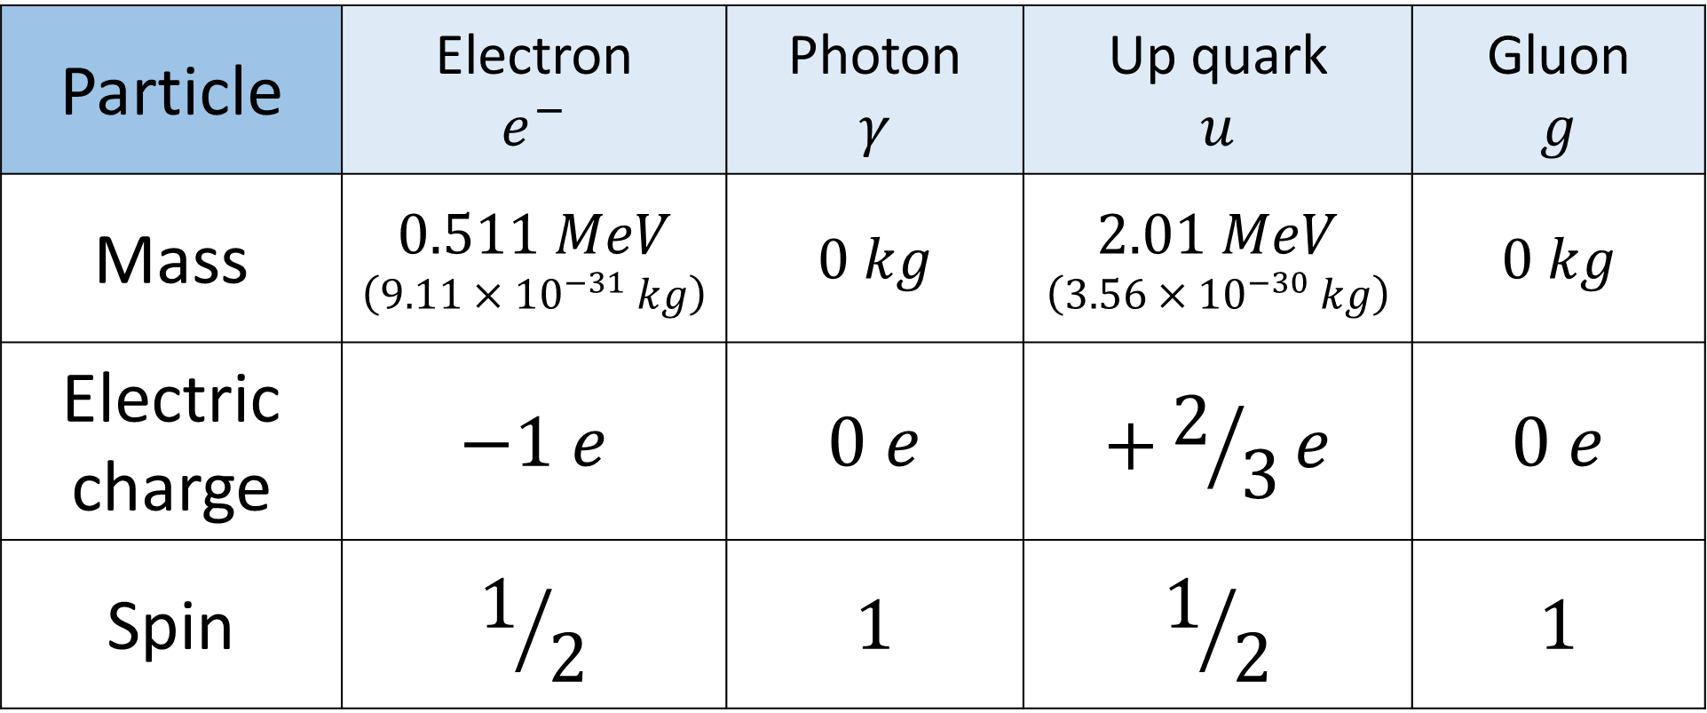
Classifying Particles
Particle | Electron $$e^{−}$$ | Photon $$γ$$ | Up quark $$u$$ | Gluon $$g$$
Mass | $$0.511 MeV$$ $$\left(9.11×{10}^{−31} kg\right)$$ | $$0 kg$$ | $$2.01 MeV$$ $$\left(3.56×{10}^{−30} kg\right)$$ | $$0 kg$$
Electric charge | $$−1 e$$ | $$0 e$$ | $$+2/3e$$ | $$0 e$$
Spin | $$1/2$$ | $$1$$ | $$1/2$$ | $$1$$

Slide 4
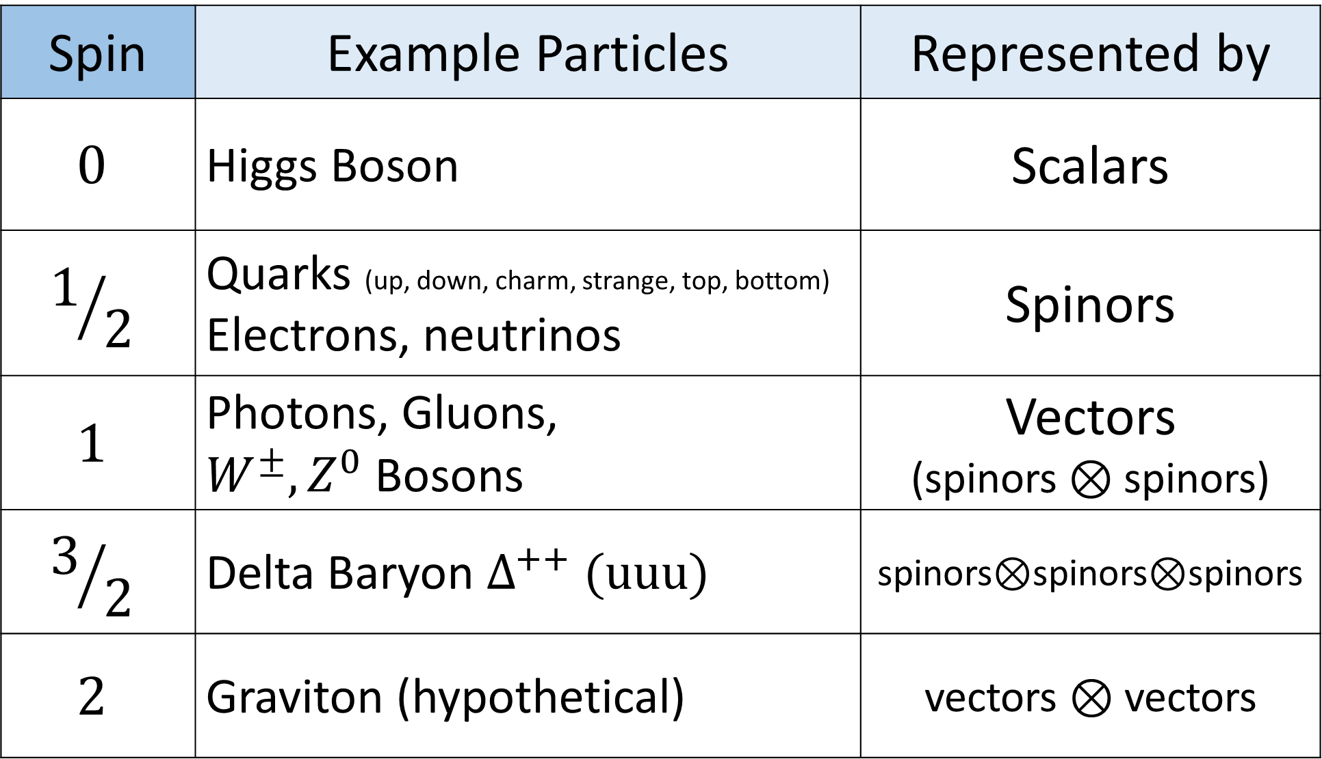
Spin | Example Particles | Represented by
$$0$$ | Higgs Boson | Scalars
$$1/2$$ | Quarks (up, down, charm, strange, top, bottom) Electrons, neutrinos | Spinors
$$1$$ | Photons, Gluons, $W^{±},Z^{0}$ Bosons | Vectors (spinors $⊗$ spinors)
$$3/2$$ | Delta Baryon $Δ^{++} (uuu)$ | spinors$⊗$spinors$⊗$spinors
$$2$$ | Graviton (hypothetical) | vectors $⊗$ vectors

Slide 5
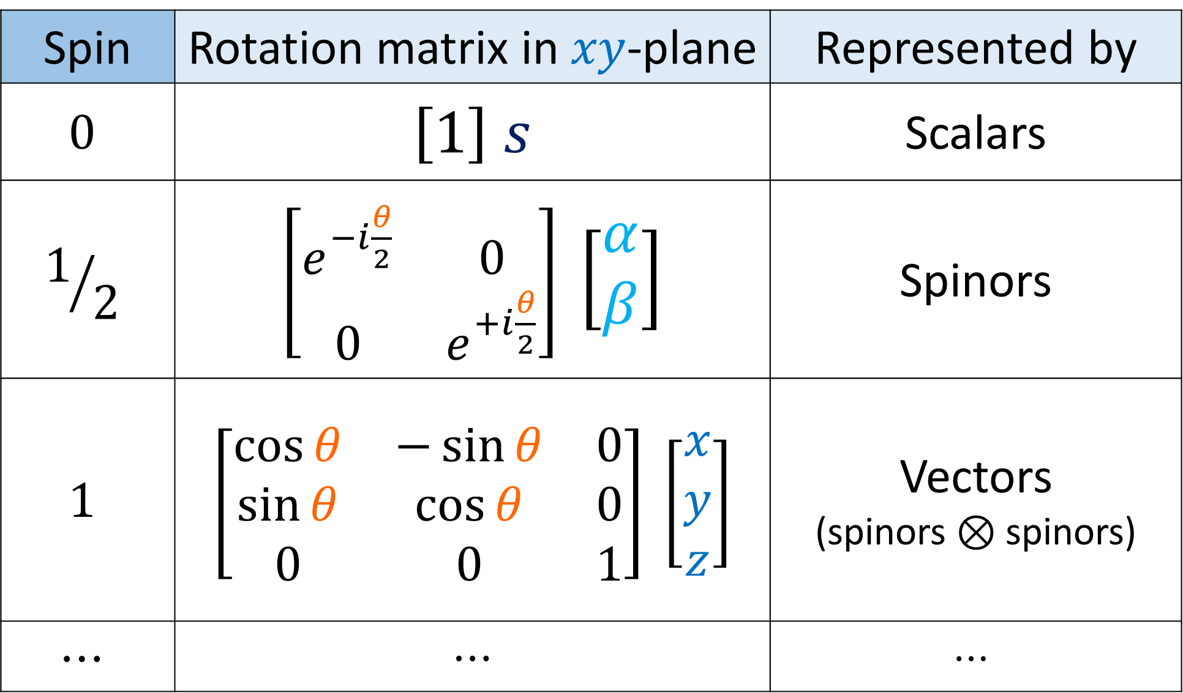
Spin | Rotation matrix in $xy$-plane | Represented by
$$0$$ | $$\left[1\right] s$$ | Scalars
$$1/2$$ | $\left[\begin{matrix}e^{−i\frac{θ}{2}} & 0 \\ 0 & e^{+i\frac{θ}{2}}\end{matrix}\right]$ $\left[\begin{aligned}α \\ β\end{aligned}\right]$ | Spinors
$$1$$ | $$\left[\begin{matrix}\cos{θ} & −\sin{θ} & 0 \\ \sin{θ} & \cos{θ} & 0 \\ 0 & 0 & 1\end{matrix}\right] \left[\begin{aligned}x \\ y \\ z\end{aligned}\right]$$ | Vectors (spinors $⊗$ spinors)
$$⋯$$ | $$⋯$$ | $$⋯$$

Slide 6



Quantum Operators:
$\hat{H}=+iℏ\frac{∂}{∂t}$
$\hat{p_{x}}=−iℏ\frac{∂}{∂x}$
$\hat{p_{y}}=−iℏ\frac{∂}{∂y}$
$\hat{p_{z}}=−iℏ\frac{∂}{∂z}$
$\hat{L_{x}}=−iℏ \left(y\frac{∂}{∂z}−z\frac{∂}{∂y}\right)$
$\hat{L_{y}}=−iℏ\left(z\frac{∂}{∂x}−x\frac{∂}{∂z}\right)$
$\hat{L_{z}}=−iℏ \left(x\frac{∂}{∂y}−y\frac{∂}{∂x}\right)$
$\hat{S_{x}}=\frac{ℏ}{2}$ $\left[\begin{matrix}0 & 1 \\ 1 & 0\end{matrix}\right]$
$\hat{S_{y}}=\frac{ℏ}{2}$ $\left[\begin{matrix}0 & −i \\ i & 0\end{matrix}\right]$
$\hat{S_{z}}=\frac{ℏ}{2}$ $\left[\begin{matrix}1 & 0 \\ 0 & −1\end{matrix}\right]$
Members of Lie Algebras

Slide 7
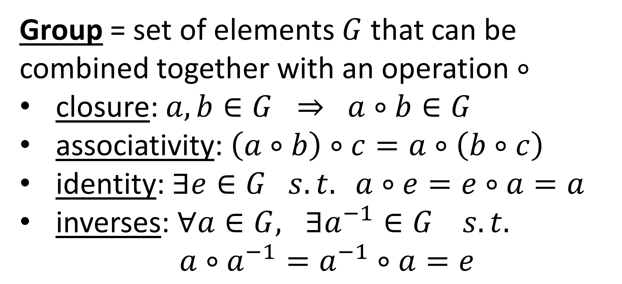
Group = set of elements $G$ that can be combined together with an operation $∘$
closure: $a,b∈G ⇒ a∘b∈G$
associativity: $\left(a∘b\right)∘c=a∘\left(b∘c\right)$
identity: $∃e∈G s.t. a∘e=e∘a=a$
inverses: $∀a∈G, ∃a^{−1}∈G s.t.$
$a∘a^{−1}=a^{−1}∘a=e$

Slide 8

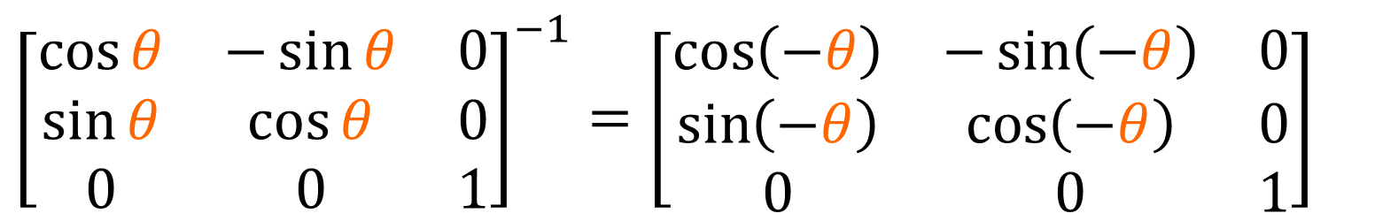
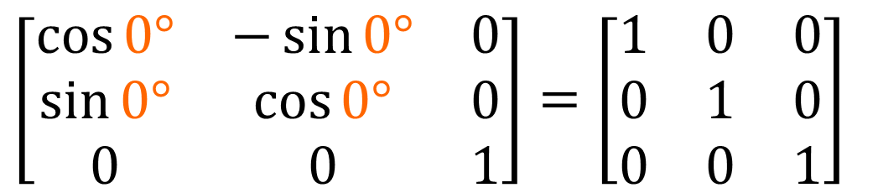
Group = set of elements $G$ that can be combined together with an operation $∘$
Combine:
$$\left[\begin{matrix}\cos{180°} & −\sin{180°} & 0 \\ \sin{180°} & \cos{180°} & 0 \\ 0 & 0 & 1\end{matrix}\right]\left[\begin{matrix}\cos{180°} & 0 & \sin{180°} \\ 0 & 1 & 0 \\ −\sin{180°} & 0 & \cos{180°}\end{matrix}\right]=\left[\begin{matrix}1 & 0 & 0 \\ 0 & \cos{180°} & −\sin{180°} \\ 0 & \sin{180°} & \cos{180°}\end{matrix}\right]$$
$$\left[\begin{matrix}\cos{0°} & −\sin{0°} & 0 \\ \sin{0°} & \cos{0°} & 0 \\ 0 & 0 & 1\end{matrix}\right]=\left[\begin{matrix}1 & 0 & 0 \\ 0 & 1 & 0 \\ 0 & 0 & 1\end{matrix}\right]$$
Identity:
$${\left[\begin{matrix}\cos{θ} & −\sin{θ} & 0 \\ \sin{θ} & \cos{θ} & 0 \\ 0 & 0 & 1\end{matrix}\right]}^{−1}=\left[\begin{matrix}\cos\left(−θ\right) & −\sin\left(−θ\right) & 0 \\ \sin\left(−θ\right) & \cos\left(−θ\right) & 0 \\ 0 & 0 & 1\end{matrix}\right]$$
Inverses:

Slide 9
Group = set of elements $G$ that can be combined together with an operation $∘$
closure: $a,b∈G ⇒ a∘b∈G$
associativity: $\left(a∘b\right)∘c=a∘\left(b∘c\right)$
identity: $∃e∈G s.t. a∘e=e∘a=a$
inverses: $∀a∈G, ∃a^{−1}∈G s.t.$
$a∘a^{−1}=a^{−1}∘a=e$
Lie Group = continuous group

Slide 10
Reflection (discrete)
Rotation (continuous)
mirror

Slide 11









Lie Algebra $𝔤$
Lie Group $G$
$$\left[\begin{matrix}0 & −1 & 0 \\ 1 & 0 & 0 \\ 0 & 0 & 0\end{matrix}\right]$$
exponential
map
$$\left[\begin{matrix}\cos{θ} & −\sin{θ} & 0 \\ \sin{θ} & \cos{θ} & 0 \\ 0 & 0 & 1\end{matrix}\right]$$
$$e^{θM}$$
$$\left[\begin{matrix}1 & 0 & 0 \\ 0 & \cos{θ} & −\sin{θ} \\ 0 & \sin{θ} & \cos{θ}\end{matrix}\right]$$
$$\left[\begin{matrix}0 & 0 & 0 \\ 0 & 0 & −1 \\ 0 & 1 & 0\end{matrix}\right]$$
$$\left[\begin{matrix}\cos{θ} & 0 & \sin{θ} \\ 0 & 1 & 0 \\ −sin{θ} & 0 & \cos{θ}\end{matrix}\right]$$
$$\left[\begin{matrix}0 & 0 & 1 \\ 0 & 0 & 0 \\ −1 & 0 & 0\end{matrix}\right]$$

Slide 12
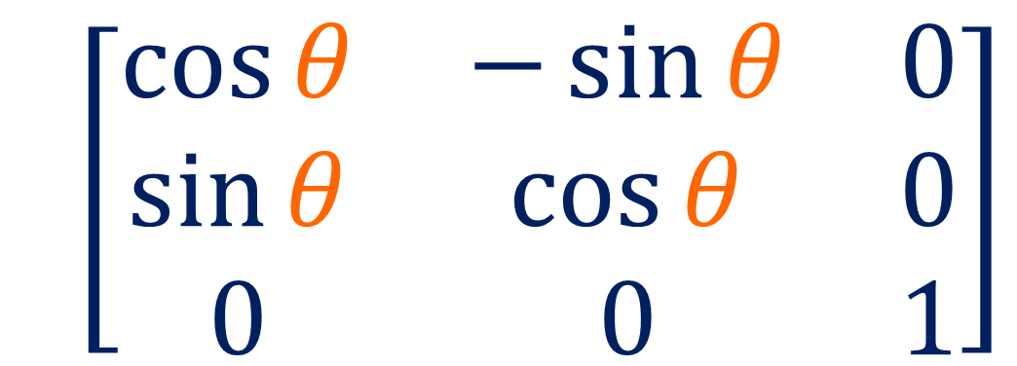
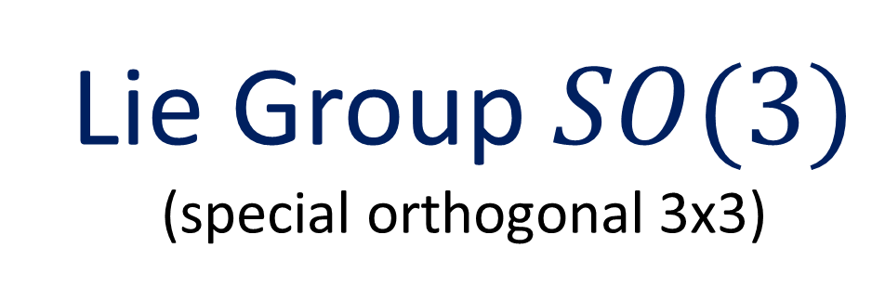
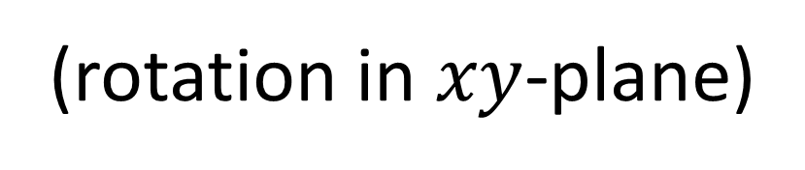
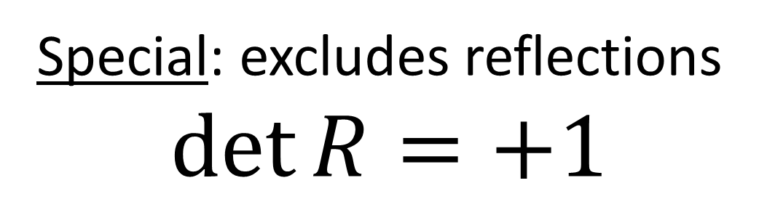
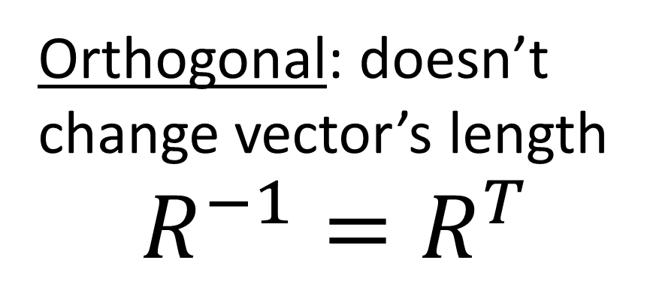
Lie Groups and Lie Algebras:
Orthogonal: doesn’t change vector’s length
$$R^{−1}=R^{T}$$
(rotation in $xy$-plane)
$$\left[\begin{matrix}\cos{θ} & −\sin{θ} & 0 \\ \sin{θ} & \cos{θ} & 0 \\ 0 & 0 & 1\end{matrix}\right]$$
Special: excludes reflections
$$\det{R}=+1$$
Lie Group $SO(3)$ (special orthogonal 3x3)

Slide 13
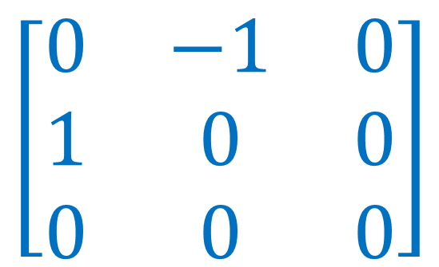


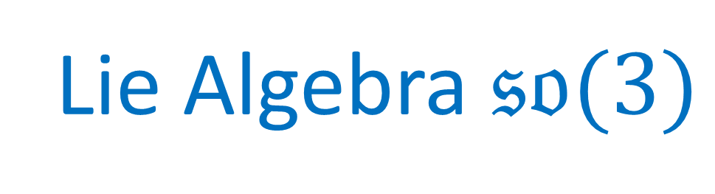
Lie Groups and Lie Algebras:
generator
(rotation in $xy$-plane)
$$\left[\begin{matrix}0 & −1 & 0 \\ 1 & 0 & 0 \\ 0 & 0 & 0\end{matrix}\right]$$
$$\left[\begin{matrix}\cos{θ} & −\sin{θ} & 0 \\ \sin{θ} & \cos{θ} & 0 \\ 0 & 0 & 1\end{matrix}\right]$$
$$e^{θ}$$
$$=$$
Lie Algebra $𝔰𝔬(3)$
Lie Group $SO(3)$ (special orthogonal 3x3)

Slide 14
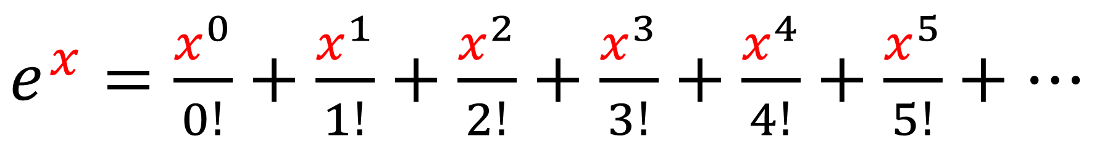
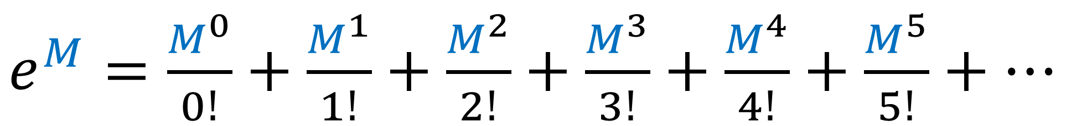
Taylor Series
Taylor Series
number
$e^{x}=\frac{x^{0}}{0!}+\frac{x^{1}}{1!}+\frac{x^{2}}{2!}+\frac{x^{3}}{3!}+\frac{x^{4}}{4!}+\frac{x^{5}}{5!}+⋯$
matrix
$e^{M}=\frac{M^{0}}{0!}+\frac{M^{1}}{1!}+\frac{M^{2}}{2!}+\frac{M^{3}}{3!}+\frac{M^{4}}{4!}+\frac{M^{5}}{5!}+⋯$

Slide 15
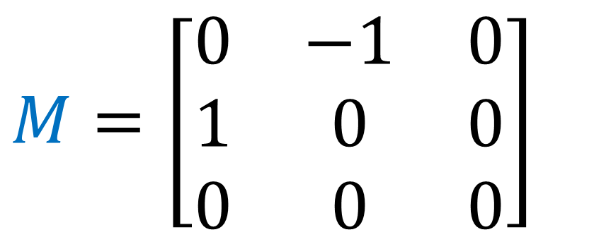
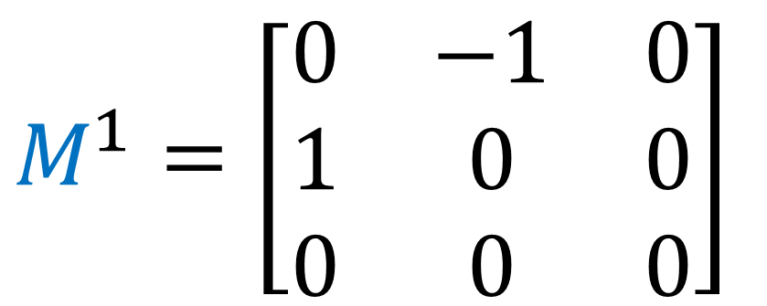
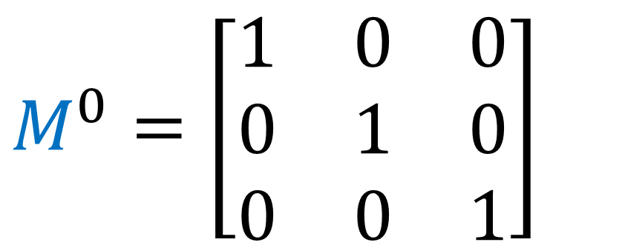
$$M=\left[\begin{matrix}0 & −1 & 0 \\ 1 & 0 & 0 \\ 0 & 0 & 0\end{matrix}\right]$$
$$M^{0}=\left[\begin{matrix}1 & 0 & 0 \\ 0 & 1 & 0 \\ 0 & 0 & 1\end{matrix}\right]$$
$$M^{1}=\left[\begin{matrix}0 & −1 & 0 \\ 1 & 0 & 0 \\ 0 & 0 & 0\end{matrix}\right]$$

Slide 16
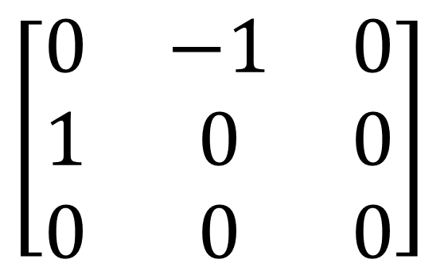

$$M=\left[\begin{matrix}0 & −1 & 0 \\ 1 & 0 & 0 \\ 0 & 0 & 0\end{matrix}\right]$$
$$M^{2}=\left[\begin{matrix}0 & −1 & 0 \\ 1 & 0 & 0 \\ 0 & 0 & 0\end{matrix}\right]$$
$$\left[\begin{matrix}0 & −1 & 0 \\ 1 & 0 & 0 \\ 0 & 0 & 0\end{matrix}\right]$$

Slide 17
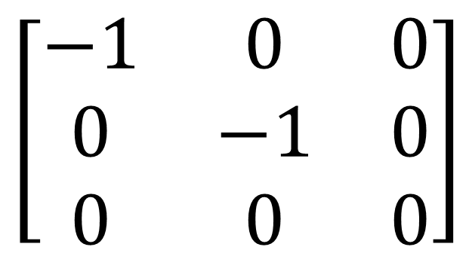
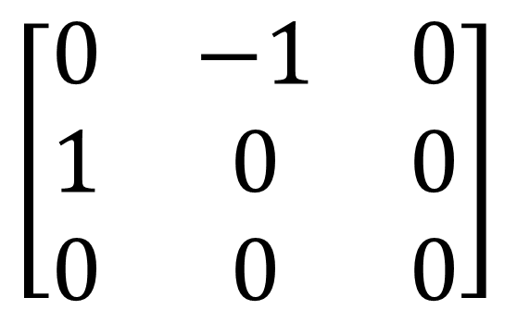
$$M=\left[\begin{matrix}0 & −1 & 0 \\ 1 & 0 & 0 \\ 0 & 0 & 0\end{matrix}\right]$$
$$\left[\begin{matrix}0 & −1 & 0 \\ 1 & 0 & 0 \\ 0 & 0 & 0\end{matrix}\right]$$
$$M^{2}=\left[\begin{matrix}0 & −1 & 0 \\ 1 & 0 & 0 \\ 0 & 0 & 0\end{matrix}\right]$$
$$\left[\begin{matrix}−1 & 0 & 0 \\ 0 & −1 & 0 \\ 0 & 0 & 0\end{matrix}\right]$$

Slide 18
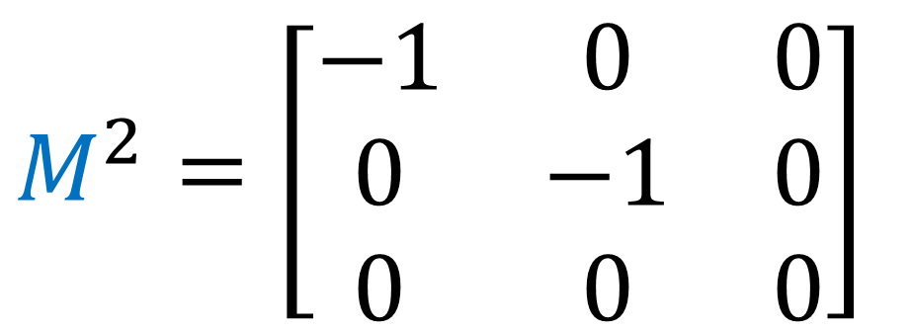
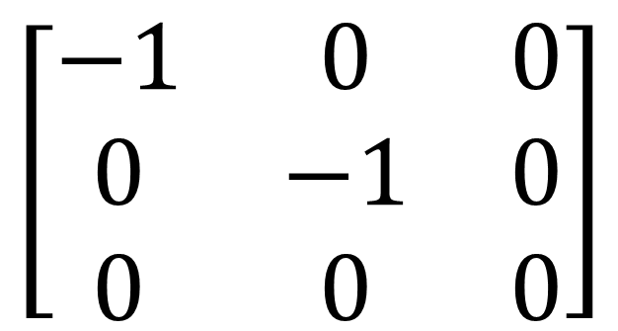
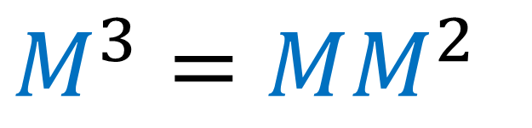
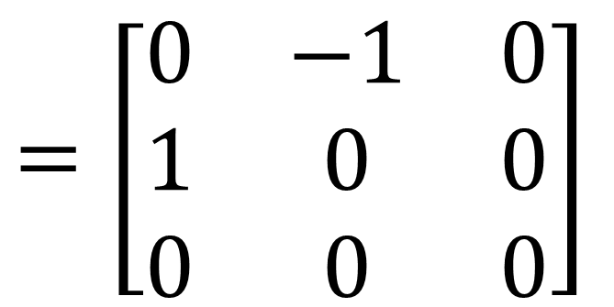
$$M=\left[\begin{matrix}0 & −1 & 0 \\ 1 & 0 & 0 \\ 0 & 0 & 0\end{matrix}\right]$$
$$M^{2}=\left[\begin{matrix}−1 & 0 & 0 \\ 0 & −1 & 0 \\ 0 & 0 & 0\end{matrix}\right]$$
$$=\left[\begin{matrix}0 & −1 & 0 \\ 1 & 0 & 0 \\ 0 & 0 & 0\end{matrix}\right]$$
$$\left[\begin{matrix}−1 & 0 & 0 \\ 0 & −1 & 0 \\ 0 & 0 & 0\end{matrix}\right]$$
$$M^{3}=MM^{2}$$

Slide 19

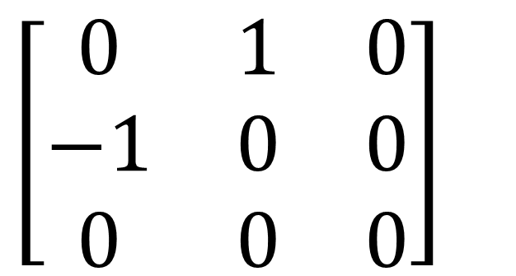
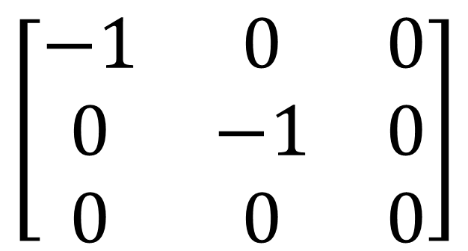
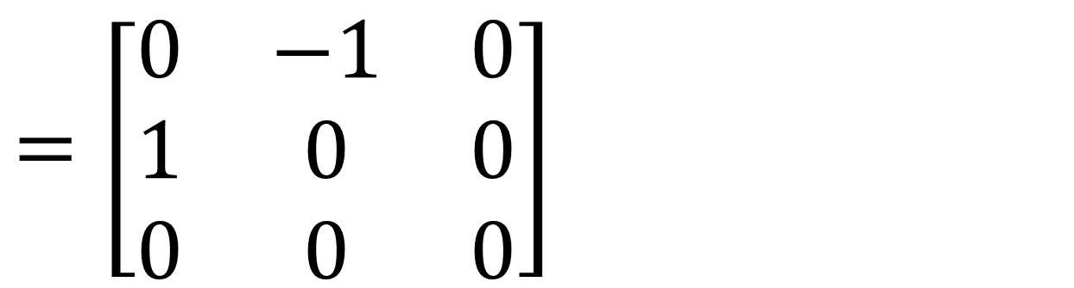
$$M=\left[\begin{matrix}0 & −1 & 0 \\ 1 & 0 & 0 \\ 0 & 0 & 0\end{matrix}\right]$$
$$M^{2}=\left[\begin{matrix}−1 & 0 & 0 \\ 0 & −1 & 0 \\ 0 & 0 & 0\end{matrix}\right]$$
$$\left[\begin{matrix}−1 & 0 & 0 \\ 0 & −1 & 0 \\ 0 & 0 & 0\end{matrix}\right]$$
$$=\left[\begin{matrix}0 & −1 & 0 \\ 1 & 0 & 0 \\ 0 & 0 & 0\end{matrix}\right]$$
$$\left[\begin{matrix}0 & 1 & 0 \\ −1 & 0 & 0 \\ 0 & 0 & 0\end{matrix}\right]$$
$$M^{3}=MM^{2}$$
$$=−M$$

Slide 20
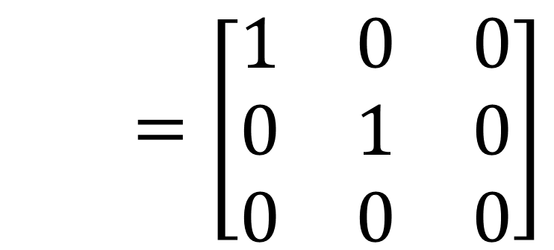
$$M=\left[\begin{matrix}0 & −1 & 0 \\ 1 & 0 & 0 \\ 0 & 0 & 0\end{matrix}\right]$$
$$M^{2}=\left[\begin{matrix}−1 & 0 & 0 \\ 0 & −1 & 0 \\ 0 & 0 & 0\end{matrix}\right]$$
$$M^{4}=M^{3}M=\left(−M\right)M=−M^{2}$$
$$=\left[\begin{matrix}1 & 0 & 0 \\ 0 & 1 & 0 \\ 0 & 0 & 0\end{matrix}\right]$$

Slide 21
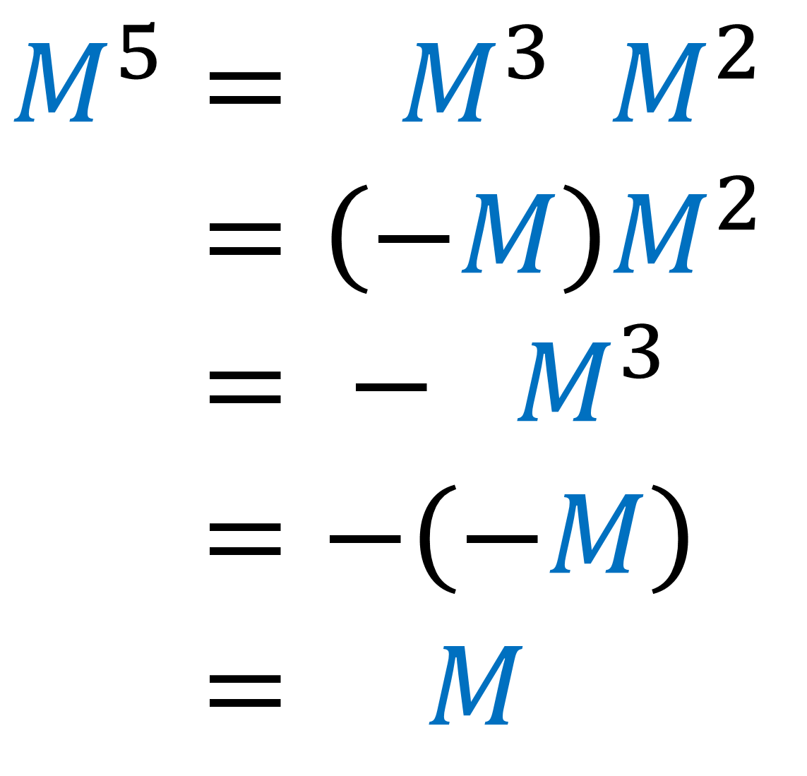
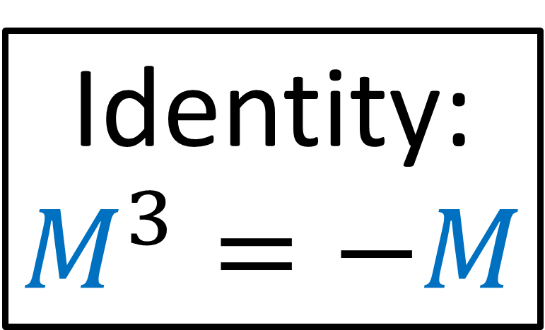
$$M^{5}= M^{3} M^{2}$$
$$M^{5}=\left(−M\right)M^{2}$$
$$M^{5}= − M^{3}$$
$$M^{5}=−\left(−M\right)$$
$$M^{5}= M$$
Identity:
$$M^{3}=−M$$

Slide 22

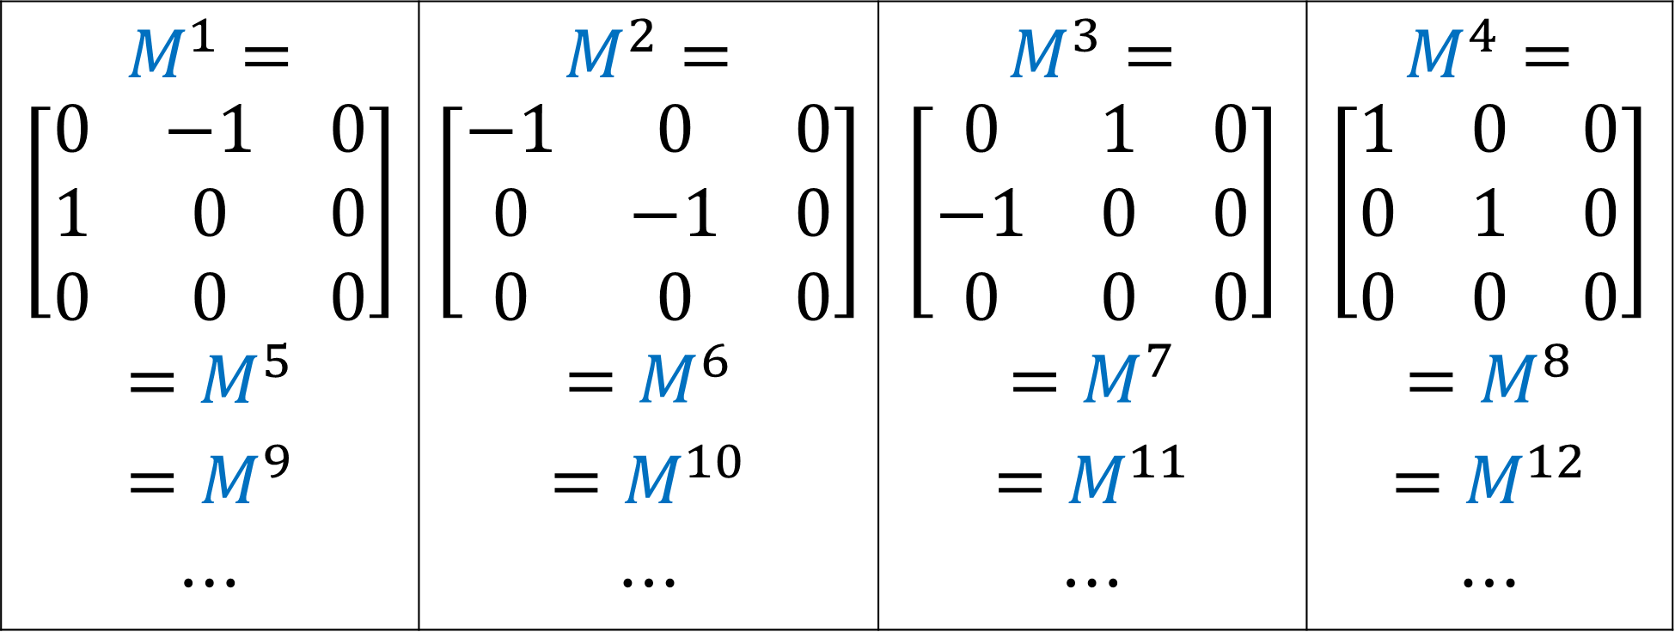
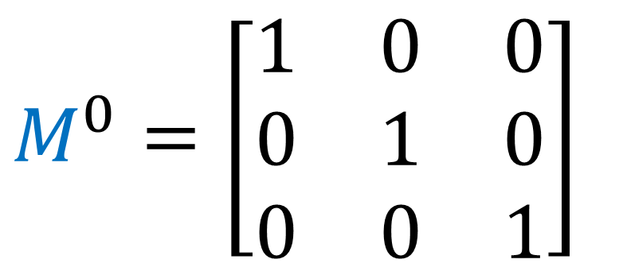
$$M=\left[\begin{matrix}0 & −1 & 0 \\ 1 & 0 & 0 \\ 0 & 0 & 0\end{matrix}\right]$$
$$M^{0}=\left[\begin{matrix}1 & 0 & 0 \\ 0 & 1 & 0 \\ 0 & 0 & 1\end{matrix}\right]$$
$$M^{1}=$$ $$\left[\begin{matrix}0 & −1 & 0 \\ 1 & 0 & 0 \\ 0 & 0 & 0\end{matrix}\right]$$ | $$M^{2}=$$ $$\left[\begin{matrix}−1 & 0 & 0 \\ 0 & −1 & 0 \\ 0 & 0 & 0\end{matrix}\right]$$ | $$M^{3}=$$ $$\left[\begin{matrix}0 & 1 & 0 \\ −1 & 0 & 0 \\ 0 & 0 & 0\end{matrix}\right]$$ | $$M^{4}=$$ $$\left[\begin{matrix}1 & 0 & 0 \\ 0 & 1 & 0 \\ 0 & 0 & 0\end{matrix}\right]$$
$$=M^{5}$$ | $$=M^{6}$$ | $$=M^{7}$$ | $$=M^{8}$$
$$=M^{9}$$ | $$=M^{10}$$ | $$=M^{11}$$ | $$=M^{12}$$
$$⋯$$ | $$⋯$$ | $$⋯$$ | $$⋯$$

Slide 23
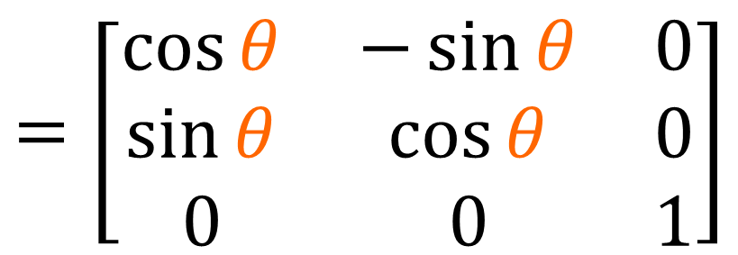
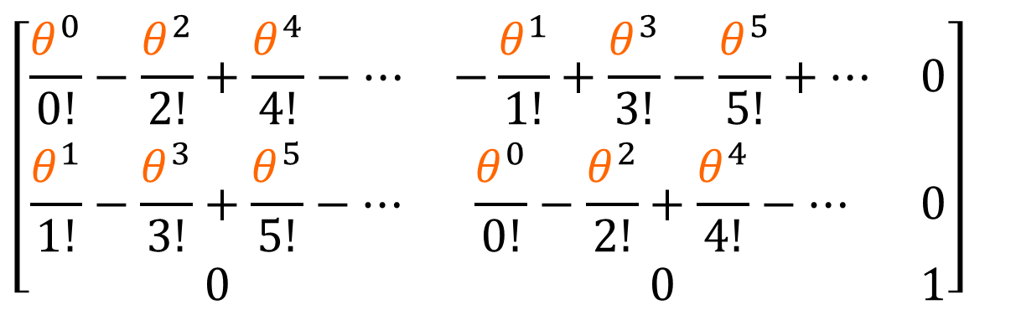
$e^{θM}=\frac{{\left(θM\right)}^{0}}{0!}+\frac{{\left(θM\right)}^{1}}{1!}+\frac{{\left(θM\right)}^{2}}{2!}+\frac{{\left(θM\right)}^{3}}{3!}+\frac{{\left(θM\right)}^{4}}{4!}+⋯$
$e^{θM}=M^{0}\frac{θ^{0}}{0!}+M^{1}\frac{θ^{1}}{1!}+M^{2}\frac{θ^{2}}{2!}+M^{3}\frac{θ^{3}}{3!}+M^{4}\frac{θ^{4}}{4!}+⋯$
$\left[\begin{matrix}1 & 0 & 0 \\ 0 & 1 & 0 \\ 0 & 0 & 1\end{matrix}\right]\frac{θ^{0}}{0!}+\left[\begin{matrix}0 & −1 & 0 \\ 1 & 0 & 0 \\ 0 & 0 & 0\end{matrix}\right]\frac{θ^{1}}{1!}+\left[\begin{matrix}−1 & 0 & 0 \\ 0 & −1 & 0 \\ 0 & 0 & 0\end{matrix}\right]\frac{θ^{2}}{2!}+\left[\begin{matrix}0 & 1 & 0 \\ −1 & 0 & 0 \\ 0 & 0 & 0\end{matrix}\right]\frac{θ^{3}}{3!}+\left[\begin{matrix}1 & 0 & 0 \\ 0 & 1 & 0 \\ 0 & 0 & 0\end{matrix}\right]\frac{θ^{4}}{4!}+⋯$
$$\left[\begin{matrix}\frac{θ^{0}}{0!}−\frac{θ^{2}}{2!}+\frac{θ^{4}}{4!}−⋯ & −\frac{θ^{1}}{1!}+\frac{θ^{3}}{3!}−\frac{θ^{5}}{5!}+⋯ & 0 \\ \frac{θ^{1}}{1!}−\frac{θ^{3}}{3!}+\frac{θ^{5}}{5!}−⋯ & \frac{θ^{0}}{0!}−\frac{θ^{2}}{2!}+\frac{θ^{4}}{4!}−⋯ & 0 \\ 0 & 0 & 1\end{matrix}\right]$$
$$=\left[\begin{matrix}\cos{θ} & −\sin{θ} & 0 \\ \sin{θ} & \cos{θ} & 0 \\ 0 & 0 & 1\end{matrix}\right]$$

Slide 24
Lie Groups and Lie Algebras:
generator
(rotation in $xy$-plane)
$$\left[\begin{matrix}0 & −1 & 0 \\ 1 & 0 & 0 \\ 0 & 0 & 0\end{matrix}\right]$$
$$\left[\begin{matrix}\cos{θ} & −\sin{θ} & 0 \\ \sin{θ} & \cos{θ} & 0 \\ 0 & 0 & 1\end{matrix}\right]$$
$$e^{θ}$$
$$=$$
Lie Algebra $𝔰𝔬(3)$
Lie Group $SO(3)$ (special orthogonal 3x3)

Slide 25


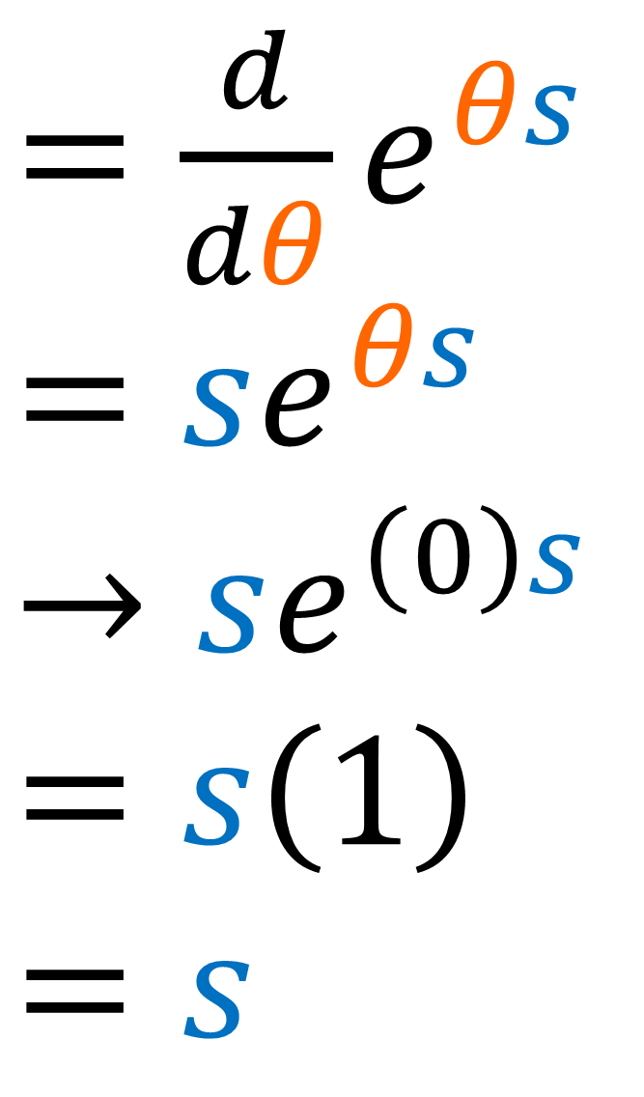
number
$=\frac{d}{dθ}e^{θs}$
$=se^{θs}$
$$→se^{\left(0\right)s}$$
$$=s\left(1\right)$$
$$=s$$
$$e^{θs}$$
$$θ=0$$

Slide 26

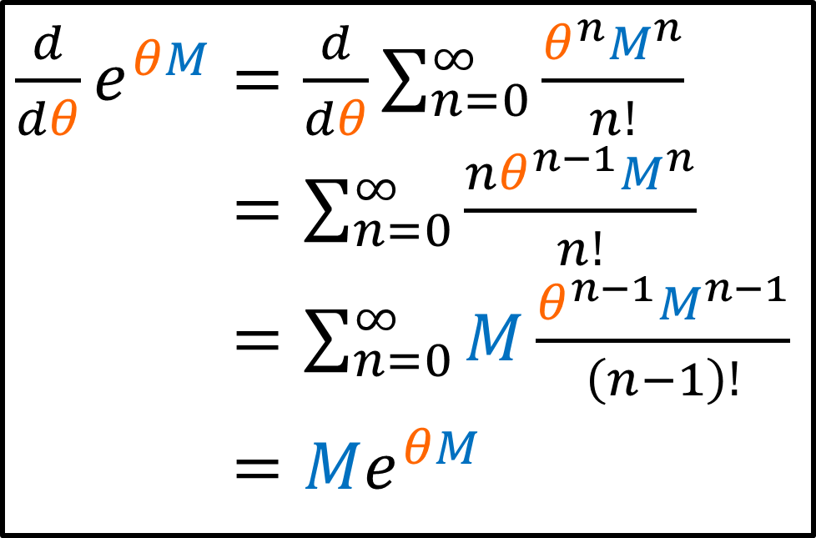
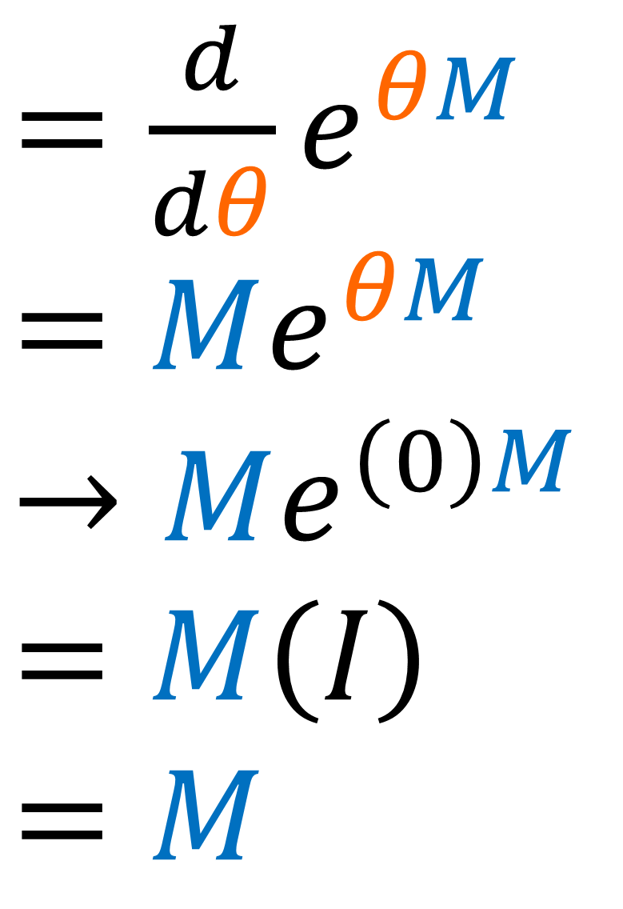
matrix
$=\frac{d}{dθ}e^{θM}$
$=Me^{θM}$
$$→Me^{\left(0\right)M}$$
$$=M\left(I\right)$$
$$=M$$
$$e^{θM}$$
$\frac{d}{dθ}e^{θM}=\frac{d}{dθ}\sum_{n=0}^{∞}{\frac{θ^{n}M^{n}}{n!}}$
$\frac{d}{dθ}e^{θM}=\sum_{n=0}^{∞}{\frac{nθ^{n−1}M^{n}}{n!}}$
$\frac{d}{dθ}e^{θM}=\sum_{n=0}^{∞}{M\frac{θ^{n−1}M^{n−1}}{\left(n−1\right)!}}$
$\frac{d}{dθ}e^{θM}=Me^{θM}$
$$θ=0$$

Slide 27


Recipe for getting Matrix Generator:
$$R=e^{θM}$$
$M={\left[\frac{dR}{dθ}\right]}_{θ=0}$

Slide 28


$${\left(\frac{d}{dθ}\left[\begin{matrix}\cos{θ} & −\sin{θ} & 0 \\ \sin{θ} & \cos{θ} & 0 \\ 0 & 0 & 1\end{matrix}\right]\right)}_{θ=0}$$
$$={\left[\begin{matrix}−sin{θ} & −\cos{θ} & 0 \\ \cos{θ} & −\sin{θ} & 0 \\ 0 & 0 & 0\end{matrix}\right]}_{θ=0}$$
$$=\left[\begin{matrix}−sin\left(0\right) & −\cos\left(0\right) & 0 \\ \cos\left(0\right) & −\sin\left(0\right) & 0 \\ 0 & 0 & 0\end{matrix}\right]=\left[\begin{matrix}0 & −1 & 0 \\ 1 & 0 & 0 \\ 0 & 0 & 0\end{matrix}\right]$$
$M={\left[\frac{dR}{dθ}\right]}_{θ=0}$

Slide 29


Rotation Matrix Generators
$$R_{xy}\left(θ\right)=\left[\begin{matrix}\cos{θ} & −\sin{θ} & 0 \\ \sin{θ} & \cos{θ} & 0 \\ 0 & 0 & 1\end{matrix}\right]$$
$$R_{yz}\left(φ\right)=\left[\begin{matrix}1 & 0 & 0 \\ 0 & \cos{φ} & −\sin{φ} \\ 0 & \sin{φ} & \cos{φ}\end{matrix}\right]$$
$$R_{zx}\left(ψ\right)=\left[\begin{matrix}\cos{ψ} & 0 & \sin{ψ} \\ 0 & 1 & 0 \\ −sin{ψ} & 0 & \cos{ψ}\end{matrix}\right]$$
$${\left[\frac{dR_{xy}\left(θ\right)}{dθ}\right]}_{θ=0}= \left[\begin{matrix}0 & −1 & 0 \\ 1 & 0 & 0 \\ 0 & 0 & 0\end{matrix}\right]$$
$${\left[\frac{dR_{yz}\left(φ\right)}{dφ}\right]}_{φ=0}=\left[\begin{matrix}0 & 0 & 0 \\ 0 & 0 & −1 \\ 0 & 1 & 0\end{matrix}\right]$$
$${\left[\frac{dR_{zx}\left(ψ\right)}{dψ}\right]}_{ψ=0}=\left[\begin{matrix}0 & 0 & 1 \\ 0 & 0 & 0 \\ −1 & 0 & 0\end{matrix}\right]$$

Slide 30


Rotation Matrix Generators
$$R_{xy}\left(θ\right)=\left[\begin{matrix}\cos{θ} & −\sin{θ} & 0 \\ \sin{θ} & \cos{θ} & 0 \\ 0 & 0 & 1\end{matrix}\right]$$
$$R_{yz}\left(φ\right)=\left[\begin{matrix}1 & 0 & 0 \\ 0 & \cos{φ} & −\sin{φ} \\ 0 & \sin{φ} & \cos{φ}\end{matrix}\right]$$
$$R_{zx}\left(ψ\right)=\left[\begin{matrix}\cos{ψ} & 0 & \sin{ψ} \\ 0 & 1 & 0 \\ −sin{ψ} & 0 & \cos{ψ}\end{matrix}\right]$$
$${\left[\frac{dR_{xy}\left(θ\right)}{dθ}\right]}_{θ=0}=g_{xy}= \left[\begin{matrix}0 & −1 & 0 \\ 1 & 0 & 0 \\ 0 & 0 & 0\end{matrix}\right]$$
$${\left[\frac{dR_{yz}\left(φ\right)}{dφ}\right]}_{φ=0}=g_{yz}=\left[\begin{matrix}0 & 0 & 0 \\ 0 & 0 & −1 \\ 0 & 1 & 0\end{matrix}\right]$$
$${\left[\frac{dR_{zx}\left(ψ\right)}{dψ}\right]}_{ψ=0}=g_{zx}=\left[\begin{matrix}0 & 0 & 1 \\ 0 & 0 & 0 \\ −1 & 0 & 0\end{matrix}\right]$$

Slide 31






$$\det\left(e^{A}\right)=e^{tr\left(A\right)}$$
Proof if $A$ is diagonal (non-zero entries are eigenvalues)…
$A=$ $\left[\begin{matrix}λ_{1} & 0 & 0 \\ 0 & λ_{2} & 0 \\ 0 & 0 & λ_{3}\end{matrix}\right]$
$e^{A}=$ $\left[\begin{matrix}e^{λ_{1}} & 0 & 0 \\ 0 & e^{λ_{2}} & 0 \\ 0 & 0 & e^{λ_{3}}\end{matrix}\right]$
$$tr\left(A\right)=λ_{1}+λ_{2}+λ_{3}$$
$$\det\left(e^{A}\right)=e^{λ_{1}}e^{λ_{2}}e^{λ_{3}}$$
$$e^{tr\left(A\right)}=e^{\left(λ_{1}+λ_{2}+λ_{3}\right)}$$

Slide 32







$$g_{xy}=\left[\begin{matrix}0 & −1 & 0 \\ 1 & 0 & 0 \\ 0 & 0 & 0\end{matrix}\right]$$
$$R_{xy}\left(θ\right)=e^{θg_{xy}}=\left[\begin{matrix}\cos{θ} & −\sin{θ} & 0 \\ \sin{θ} & \cos{θ} & 0 \\ 0 & 0 & 1\end{matrix}\right]$$
Diagonalize!
$$C=\left[\begin{matrix}−i & i & 0 \\ 1 & 1 & 0 \\ 0 & 0 & 1\end{matrix}\right]$$
$\tilde{g_{xy}} =C^{−1} g_{xy} C$
$$\tilde{R_{xy}}\left(θ\right)=C^{−1} R_{xy}\left(θ\right) C$$
$$\tilde{R_{xy}}\left(θ\right)=e^{θ\tilde{g_{xy}}}=\left[\begin{matrix}e^{−iθ} & 0 & 0 \\ 0 & e^{+iθ} & 0 \\ 0 & 0 & 1\end{matrix}\right]$$
$$\tilde{g_{xy}}=\left[\begin{matrix}−i & 0 & 0 \\ 0 & i & 0 \\ 0 & 0 & 0\end{matrix}\right]$$

Slide 33





Exercise: explain why rotation matrix $R_{xy}\left(θ\right)$ and its generator $g_{xy}$ transform using the same coordinate-change matrix $C$.
$\tilde{g_{xy}} =C^{−1} g_{xy} C$
$$R_{xy}\left(θ\right)$$
$$=e^{θg_{xy}}$$
$$\tilde{R_{xy}}\left(θ\right)=C^{−1} R_{xy}\left(θ\right) C$$
Hint: recall matrix definition of $e^{M}$

Slide 34




Rotation matrix $R∈SO(3)$
$⇒\det\left(R\right)=+1$
$$\det\left(e^{A}\right)=e^{tr\left(A\right)}$$
$$\det\left(R\left(θ\right)\right)=1$$
$$\det\left(e^{θM}\right)=1$$
$$e^{θtr\left(M\right)}=1$$
$$⇒tr\left(M\right)=0$$

Slide 35




Rotation matrix $R∈SO(3)$
$⇒R^{−1}=R^{T}$
$$R\left(θ\right)≡e^{θM}$$
$$R\left(θ\right){\left[R\left(θ\right)\right]}^{T}=I$$
$$\left(e^{θM}\right){\left(e^{θM}\right)}^{T}=e^{0}$$
$$e^{θM}e^{θ{\left(M\right)}^{T}}=e^{0}$$
$$e^{θ\left(M+M^{T}\right)}=e^{0}$$
$$⇒M+M^{T}=0$$
$$⇒M^{T}=−M$$
${\left(e^{θM}\right)}^{T}={\left(\sum_{n}^{∞}{\frac{{\left(θM\right)}^{n}}{n!}}\right)}^{T}$
$=\sum_{n}^{∞}{\frac{{\left(θM^{T}\right)}^{n}}{n!}}=e^{θ{\left(M\right)}^{T}}$

Slide 36



Rotation matrix $R∈SO(3)$
$⇒R^{−1}=R^{T}$
$$R\left(θ\right)≡e^{θM}$$
$R\left(θ\right){\left[R\left(θ\right)\right]}^{T}= I$
$\frac{d}{dθ}\left(R\left(θ\right){R\left(θ\right)}^{T}\right) =\frac{dI}{dθ}$
$$\frac{dR\left(θ\right)}{dθ}{R\left(θ\right)}^{T}+R\left(θ\right)\frac{d{R\left(θ\right)}^{T}}{dθ}=0$$
$$\frac{d\left(e^{θM}\right)}{dθ}{\left(e^{θM}\right)}^{T}+\left(e^{θM}\right)\frac{d{\left(e^{θM}\right)}^{T}}{dθ}=0$$
$${\left(e^{θM}\right)}^{T}$$
$={\left(\sum_{n}^{∞}{\frac{{\left(θM\right)}^{n}}{n!}}\right)}^{T}$
$=\sum_{n}^{∞}{\frac{{\left(θM^{T}\right)}^{n}}{n!}}$
$=e^{θ{\left(M\right)}^{T}}$

Slide 37

Rotation matrix $R∈SO(3)$
$⇒R^{−1}=R^{T}$
$$R\left(θ\right)≡e^{θM}$$
$R\left(θ\right){\left[R\left(θ\right)\right]}^{T}= I$
$\frac{d}{dθ}\left(R\left(θ\right){R\left(θ\right)}^{T}\right) =\frac{dI}{dθ}$
$$\frac{dR\left(θ\right)}{dθ}{R\left(θ\right)}^{T}+R\left(θ\right)\frac{d{R\left(θ\right)}^{T}}{dθ}=0$$
$$\frac{d\left(e^{θM}\right)}{dθ}\left(e^{θ{\left(M\right)}^{T}}\right)+\left(e^{θM}\right)\frac{d\left(e^{θ{\left(M\right)}^{T}}\right)}{dθ}=0$$
$${\left(e^{θM}\right)}^{T}$$
$={\left(\sum_{n}^{∞}{\frac{{\left(θM\right)}^{n}}{n!}}\right)}^{T}$
$=\sum_{n}^{∞}{\frac{{\left(θM^{T}\right)}^{n}}{n!}}$
$=e^{θ{\left(M\right)}^{T}}$

Slide 38




Rotation matrix $R∈SO(3)$
$⇒R^{−1}=R^{T}$
$$R\left(θ\right)≡e^{θM}$$
$$\frac{d\left(e^{θM}\right)}{dθ}\left(e^{θ{\left(M\right)}^{T}}\right)+\left(e^{θM}\right)\frac{d\left(e^{θ{\left(M\right)}^{T}}\right)}{dθ}=0$$
$$Me^{θM}e^{θ{\left(M\right)}^{T}}+e^{θM} M^{T}e^{θ{\left(M\right)}^{T}}=0$$
$$Me^{0M}e^{0{\left(M\right)}^{T}}+e^{0M} M^{T}e^{0{\left(M\right)}^{T}}=0$$
$$M I I + I M^{T} I=0$$
$M + M^{T} =0$
$\frac{dR\left(θ\right)}{dθ}≡Me^{θM}$
$$⇒θ=0$$
$$⇒M^{T}=−M$$

Slide 39




$$e^{A} e^{B}≠e^{A+B}$$
where $A,B$ are matrices
Matrix multiplication doesn’t commute in general!
$$e^{A} e^{B}≠e^{B} e^{A}$$
$$≠e^{A+B}$$

Slide 40


$e^{A}e^{B}=\left(\frac{A^{0}}{0!}+\frac{A^{1}}{1!}+\frac{A^{2}}{2!}+⋯\right)\left(\frac{B^{0}}{0!}+\frac{B^{1}}{1!}+\frac{B^{2}}{2!}+⋯\right)$
$=\left(I+A+\frac{A^{2}}{2}+⋯\right)\left(I+B+\frac{B^{2}}{2}+⋯\right)$
$=I+A+B+\frac{1}{2}\left(A^{2}+2AB+B^{2}\right)+⋯$
$e^{A+B}=\frac{{\left(A+B\right)}^{0}}{0!}+\frac{{\left(A+B\right)}^{1}}{1!}+\frac{{\left(A+B\right)}^{2}}{2!}+⋯$
$=I+A+B+\frac{1}{2}\left(A^{2}+AB+BA+B^{2}\right)+⋯$

Slide 41

$e^{A}e^{B}=I+A+B+\frac{1}{2}\left(A^{2}+2AB+B^{2}\right)+⋯$
$e^{A+B}=I+A+B+\frac{1}{2}\left(A^{2}+AB+BA+B^{2}\right)+⋯$
Only equal if matrices commute:
$$AB=BA$$
$⇒\left[A,B\right]=AB−BA=0$

Slide 42


Baker–Campbell–Hausdorff formula
$$e^{X}e^{Y}=e^{Z}$$
$Z=X+Y+\frac{1}{2}\left[X,Y\right]$
$+\frac{1}{12}\left(\left[X,\left[X,Y\right]\right]+\left[Y,\left[Y,X\right]\right]\right)+⋯$

Slide 43




Anti-symmetric matrix $M^{T}=−M$
$$e^{A} e^{B}=e^{A+B}$$
only if $AB=BA$
$$= M M^{T}$$
$$= M \left(−M\right)$$
$$=\left(−M\right) M$$
$$= M^{T} M$$
$$e^{M} e^{M^{T}}=e^{M+M^{T}}$$
for anti-symmetric $M$

Slide 44






$\frac{d}{dx}$
$$e^{a}$$
$=\frac{1}{0!}{\left(a\frac{d}{dx}\right)}^{0}+\frac{1}{1!}{\left(a\frac{d}{dx}\right)}^{1}+\frac{1}{2!}{\left(a\frac{d}{dx}\right)}^{2}+⋯$
$$\left(e^{a\frac{d}{dx}}\right)$$
$$f\left(x\right)$$
$$=f\left(x+a\right)$$
Translation Operator

Slide 45




$$\left[\begin{matrix}0 & −1 & 0 \\ 1 & 0 & 0 \\ 0 & 0 & 0\end{matrix}\right]$$
$$\left[\begin{matrix}\cos{θ} & −\sin{θ} & 0 \\ \sin{θ} & \cos{θ} & 0 \\ 0 & 0 & 1\end{matrix}\right]$$
$$e^{θ}$$
$$=$$
Vector rotation
generator
Function Translation
$$\left(e^{a\frac{d}{dx}}\right)$$
$$f\left(x\right)$$
$$=f\left(x+a\right)$$

Slide 46




$f\left(x\right)=\sum_{n=0}^{∞}{\frac{{\left(x−x_{0}\right)}^{n}}{n!}\frac{d^{n}f}{dx^{n}}\left(x_{0}\right)}$
Definition of Taylor Series
$$x=x_{0}+Δx$$
$$x−x_{0}=Δx$$
Define
$f\left(x_{0}+Δx\right)=\sum_{n=0}^{∞}{\frac{{\left(Δx\right)}^{n}}{n!}\frac{d^{n}f}{d{\left(x_{0}+Δx\right)}^{n}}\left(x_{0}\right)}$
$f\left(x_{0}+Δx\right)=\sum_{n=0}^{∞}{\frac{{\left(Δx\right)}^{n}}{n!}\frac{d^{n}f}{d{x_{0}}^{n}}\left(x_{0}\right)}$
$f\left(x_{0}+Δx\right)=\left(\sum_{n=0}^{∞}{\frac{1}{n!}{\left(Δx\frac{d}{dx_{0}}\right)}^{n}}\right)f\left(x_{0}\right)$
$f\left(x_{0}+Δx\right)=e^{Δx\frac{d}{dx_{0}}}f\left(x_{0}\right)$
Substitute
Chain Rule
$\frac{d}{dx_{0}}=\frac{d\left(x_{0}+Δx\right)}{dx_{0}}\frac{d}{d\left(x_{0}+Δx\right)}$
$\frac{d}{dx_{0}}=1\frac{d}{d\left(x_{0}+Δx\right)}$

Slide 47



Momentum Operator
(Lie Algebra)
Translation Operator
(Lie Group)
$$T_{x}\left(a\right)=e^{a \frac{i}{ℏ} \hat{p_{x}}}$$
$T_{x}\left(a\right)=e^{a \frac{d}{dx}}$
$\hat{p_{x}}=−iℏ\frac{d}{dx}$
$$T_{x}\left(a\right)ψ\left(x\right)=ψ\left(x+a\right)$$

Slide 48






Links to more info in description:

Slide 49









Lie Algebra $𝔰𝔬\left(3\right)$
Lie Group $SO\left(3\right)$
$g_{xy}=$ $\left[\begin{matrix}0 & −1 & 0 \\ 1 & 0 & 0 \\ 0 & 0 & 0\end{matrix}\right]$
exponential
map
$$R_{xy}\left(θ\right)=\left[\begin{matrix}\cos{θ} & −\sin{θ} & 0 \\ \sin{θ} & \cos{θ} & 0 \\ 0 & 0 & 1\end{matrix}\right]$$
$$e^{θg}$$
$g_{yz}=$ $\left[\begin{matrix}0 & 0 & 0 \\ 0 & 0 & −1 \\ 0 & 1 & 0\end{matrix}\right]$
$$R_{yz}\left(θ\right)=\left[\begin{matrix}1 & 0 & 0 \\ 0 & \cos{θ} & −\sin{θ} \\ 0 & \sin{θ} & \cos{θ}\end{matrix}\right]$$
$$R_{zx}\left(θ\right)=\left[\begin{matrix}\cos{θ} & 0 & \sin{θ} \\ 0 & 1 & 0 \\ −sin{θ} & 0 & \cos{θ}\end{matrix}\right]$$
$g_{zx}=$ $\left[\begin{matrix}0 & 0 & 1 \\ 0 & 0 & 0 \\ −1 & 0 & 0\end{matrix}\right]$

Slide 50
Rotation Matrix Generators
$$R_{xy}\left(θ\right)=\left[\begin{matrix}\cos{θ} & −\sin{θ} & 0 \\ \sin{θ} & \cos{θ} & 0 \\ 0 & 0 & 1\end{matrix}\right]$$
$$R_{yz}\left(φ\right)=\left[\begin{matrix}1 & 0 & 0 \\ 0 & \cos{φ} & −\sin{φ} \\ 0 & \sin{φ} & \cos{φ}\end{matrix}\right]$$
$$R_{zx}\left(ψ\right)=\left[\begin{matrix}\cos{ψ} & 0 & \sin{ψ} \\ 0 & 1 & 0 \\ −sin{ψ} & 0 & \cos{ψ}\end{matrix}\right]$$
$${\left[\frac{dR_{xy}\left(θ\right)}{dθ}\right]}_{θ=0}= \left[\begin{matrix}0 & −1 & 0 \\ 1 & 0 & 0 \\ 0 & 0 & 0\end{matrix}\right]$$
$${\left[\frac{dR_{yz}\left(φ\right)}{dφ}\right]}_{φ=0}=\left[\begin{matrix}0 & 0 & 0 \\ 0 & 0 & −1 \\ 0 & 1 & 0\end{matrix}\right]$$
$${\left[\frac{dR_{zx}\left(ψ\right)}{dψ}\right]}_{ψ=0}=\left[\begin{matrix}0 & 0 & 1 \\ 0 & 0 & 0 \\ −1 & 0 & 0\end{matrix}\right]$$

Slide 51







Algebra = vector space where $+ − ×$ are defined
don’t need $÷$ to be defined
$$\left[\begin{matrix}0 & −1 & 0 \\ 1 & 0 & 0 \\ 0 & 0 & 0\end{matrix}\right]$$
$$g_{xy}$$
$$g_{yz}$$
$$g_{zx}$$
$$\left[\begin{matrix}0 & 0 & 0 \\ 0 & 0 & −1 \\ 0 & 1 & 0\end{matrix}\right]$$
$$\left[\begin{matrix}0 & 0 & 1 \\ 0 & 0 & 0 \\ −1 & 0 & 0\end{matrix}\right]$$

Slide 52
Lie Algebra =
tangent space
at identity
of Lie Group

Slide 53

Proofs taken from Chapter 5 of John Stillwell’s “Naïve Lie Theory”

Slide 54




$$\left[\begin{matrix}1/\sqrt{2} & 1/\sqrt{2} & 0 \\ −1/\sqrt{2} & 1/\sqrt{2} & 0 \\ 0 & 0 & 1\end{matrix}\right]$$
$$\left[\begin{matrix}1 & 0 & 0 \\ 0 & 0 & −1 \\ 0 & 1 & 0\end{matrix}\right]$$
$$\left[\begin{matrix}1/2 & −\sqrt{3}/2 & 0 \\ \sqrt{3}/2 & 1/2 & 0 \\ 0 & 0 & 1\end{matrix}\right]$$
Lie Group $SO\left(3\right)$

Slide 55



$$R_{xy}\left(θ=0\right)=$$
$$\left[\begin{matrix}1 & 0 & 0 \\ 0 & 1 & 0 \\ 0 & 0 & 1\end{matrix}\right]$$
$$R_{xy}\left(θ\right)=$$
$$\left[\begin{matrix}\cos{θ} & −\sin{θ} & 0 \\ \sin{θ} & \cos{θ} & 0 \\ 0 & 0 & 1\end{matrix}\right]$$
(curve)
Lie Group $SO\left(3\right)$

Slide 56

$\frac{d}{dθ}R_{xy}\left(θ\right)$
(tangent vectors)
Lie Group $SO\left(3\right)$

Slide 57

$\frac{d}{dθ}R_{xy}\left(θ=0\right)$
$$R_{xy}\left(θ=0\right)=$$
$$\left[\begin{matrix}1 & 0 & 0 \\ 0 & 1 & 0 \\ 0 & 0 & 1\end{matrix}\right]$$
(tangent vector at identity)
Lie Group $SO\left(3\right)$

Slide 58




$$g_{zx}=$$
$\frac{d}{dψ}R_{zx}\left(ψ=0\right)$
$$g_{xy}=$$
$\frac{d}{dθ}R_{xy}\left(θ=0\right)$
Lie Algebra $𝖘𝖔\left(3\right)$
(tangent plane at identity)
Lie Group $SO\left(3\right)$

Slide 59














Lie Group $SO(3)$
Lie Group $G$
$$R_{xy}\left(θ\right)$$
$$R_{zx}\left(ψ\right)$$
$$A\left(s\right)$$
$$B\left(t\right)$$
$$R_{yz}\left(φ\right)$$
Lie Algebra $𝖘𝖔(3)$
Lie Algebra $𝖌$
$$a$$
$$g_{xy}$$
$$g_{zx}$$
$$b$$
$$g_{yz}$$

Slide 60
Prove: sum of tangent vectors is a tangent vector

Slide 61






Lie Group $G$
$$A\left(0\right)=B\left(0\right)=I$$
$\frac{dB}{ds}\left(0\right)=b$
$\frac{dA}{ds}\left(0\right)=a$
$$B\left(s\right)$$
$$=e^{sb}$$
$$A\left(s\right)$$
$$=e^{sa}$$

Slide 62





$$C\left(s\right)= A\left(s\right)B\left(s\right)$$
$\frac{d}{ds}C\left(s\right)=\frac{d}{ds}\left[A\left(s\right)B\left(s\right)\right]$
$\frac{d}{ds}C\left(s\right)=\left[\frac{d}{ds}A\left(s\right)\right]B\left(s\right)+A\left(s\right)\left[\frac{d}{ds}B\left(s\right)\right]$
$$s=0$$
$\frac{d}{ds}C\left(0\right)=\left[\frac{dA}{ds}\left(0\right)\right]B\left(0\right)+A\left(0\right)\left[\frac{dB}{ds}\left(0\right)\right]$
$\frac{d}{ds}C\left(0\right)=$ $a I + I b$
$$=a+b$$

Slide 63


$e^{sA}e^{sB}=\left(I+sA+\frac{s^{2}A^{2}}{2}+⋯\right)\left(I+sB+\frac{s^{2}B^{2}}{2}+⋯\right)$
$e^{A} =I+s\left(A+B\right)+\frac{s^{2}}{2}\left(A^{2}+ 2AB +B^{2}\right)+⋯$
$e^{s\left(A+B\right)}=I+s\left(A+B\right)+\frac{s^{2}}{2}\left(A^{2}+AB+BA+B^{2}\right)+⋯$
Same 1st order term
Different 2nd order term

Slide 64



$e^{sA}e^{sB}=\left(I+sA+\frac{s^{2}A^{2}}{2}+⋯\right)\left(I+sB+\frac{s^{2}B^{2}}{2}+⋯\right)$
$e^{A} =I+s\left(A+B\right)+\frac{s^{2}}{2}\left(A^{2}+ 2AB +B^{2}\right)+⋯$
$e^{s\left(A+B\right)}=I+s\left(A+B\right)+\frac{s^{2}}{2}\left(A^{2}+AB+BA+B^{2}\right)+⋯$
$\frac{d}{ds}{\left[e^{sA}e^{sB}\right]}_{s=0}=A+B$
$\frac{d}{ds}{\left[e^{s\left(A+B\right)}\right]}_{s=0}=A+B$

Slide 65



Infinite number of curves through the identity with the same tangent vector.
Tangent vector $a$ generates the unique curve $A\left(s\right)=e^{sa}$
$$a$$
$$A\left(s\right)=e^{sa}$$

Slide 66
Prove: scalar multiple of tangent vector is a tangent vector

Slide 67








$$A\left(s\right) → A\left(rs\right)$$
(constant $r$)
$\frac{d}{ds}A\left(rs\right)=\frac{d\left(rs\right)}{ds}\frac{dA\left(rs\right)}{d\left(rs\right)}$
$\frac{d}{ds}A\left(rs\right)= r \frac{dA\left(s\right)}{ds}$
$←$ chain rule
$←$ variable replacement
$$s=0$$
$\frac{d}{ds}A\left(rs\right)= r \frac{dA}{ds}\left(s=0\right)$
$$=ra$$

Slide 68
Vector space:
Sum of tangent vectors is a tangent vector
Scalar multiple of tangent vectors is a tangent vector

Slide 69
(for Lie Algebra)
Prove: commutator of tangent vectors is a tangent vector

Slide 70




$$D\left(s,t\right)=A\left(s\right)B\left(t\right)A^{−1}\left(s\right)$$
$$A^{−1}\left(s\right)$$
$$A\left(s\right)$$
$$B\left(t\right)$$

Slide 71



$$D\left(s,t\right)=A\left(s\right)B\left(t\right)A^{−1}\left(s\right)$$
$\frac{∂}{∂t}D\left(s,t\right)=\frac{∂}{∂t}\left[A\left(s\right)B\left(t\right)A^{−1}\left(s\right)\right]$
$\frac{∂}{∂t}D\left(s,t\right)=A\left(s\right)\left[\frac{∂}{∂t}B\left(t\right)\right]A^{−1}\left(s\right)$
$$t=0$$
$\frac{∂}{∂t}D\left(s,0\right)=A\left(s\right) \left[ b \right] A^{−1}\left(s\right)$

Slide 72
$$D\left(s,t\right)=A\left(s\right)B\left(t\right)A^{−1}\left(s\right)$$
conjugation

Slide 73



$\frac{∂}{∂t}D\left(s,0\right)=A\left(s\right) b A^{−1}\left(s\right)$
$\frac{∂}{∂s}\frac{∂}{∂t}D\left(s,0\right)=\frac{∂}{∂s}\left[A\left(s\right) b A^{−1}\left(s\right)\right]$
$=\left[\frac{∂}{∂s}A\left(s\right)\right]bA^{−1}\left(s\right)+A\left(s\right)b\left[\frac{∂}{∂s}A^{−1}\left(s\right)\right]$
$$s=0$$
$=\left[\frac{∂A}{∂s}\left(0\right)\right]bA^{−1}\left(0\right)+A\left(0\right)b\left[\frac{∂A^{−1}}{∂s}\left(0\right)\right]$

Slide 74






$\frac{∂^{2}D\left(0,0\right)}{∂s∂t}=\left[\frac{∂A}{∂s}\left(0\right)\right]b I + I b \left[\frac{∂A^{−1}}{∂s}\left(0\right)\right]$
$\frac{∂^{2}D}{∂s∂t} = \left[ a \right] b I + I b \left[ −a \right]$
$\frac{∂^{2}D}{∂s∂t} =ab−ba$
$= [a,b]$
$$A\left(s\right)$$
$$a$$
$$−a$$
$$A^{−1}\left(s\right)$$

Slide 75








$$D\left(s,t\right)$$
$$=A\left(s\right)B\left(t\right)A^{−1}\left(s\right)$$
$\frac{∂}{∂t}$ $D\left(s,t=0\right)$
$$=A\left(s\right) b A^{−1}\left(s\right)$$
(constant $s$)
(constant $s$)
Path in $G$
$$A^{−1}$$
$$A$$
tangent vector
$$B\left(t\right)$$

Slide 76


$\frac{∂}{∂t}$ $D\left(s,t=0\right)$
$$=A\left(s\right) b A^{−1}\left(s\right)$$
(constant $s$)
tangent vector

Slide 77


$\frac{∂}{∂t}$ $D\left(s,t=0\right)$
$$=A\left(s\right) b A^{−1}\left(s\right)$$
(variable $s$)
tangent space
path of tangent vectors
$$s$$

Slide 78


$\frac{∂}{∂s}\frac{∂}{∂t}$ $D\left(s,t=0\right)$
$=\frac{∂}{∂s}A\left(s\right) b A^{−1}\left(s\right)$
tangent space
tangents to path-of-tangent-vectors
$$s$$

Slide 79



$\frac{∂}{∂s}\frac{∂}{∂t}$ $D\left(s=0,t=0\right)$
$$=ab−ba=\left[a,b\right]$$
tangent space
$$s=0$$
$$s$$

Slide 80

$\frac{∂}{∂s}\frac{∂}{∂t}$ $D\left(s=0,t=0\right)$
$$=ab−ba=\left[a,b\right]$$
also member of tangent space
tangent space
$$s=0$$
$$s$$

Slide 81











$$g_{xy} + g_{yz}$$
Lie Algebra $𝔰𝔬\left(3\right)$
traceless
anti-symmetric
$$\left[\begin{matrix}0 & −1 & 0 \\ 1 & 0 & 0 \\ 0 & 0 & 0\end{matrix}\right]+\left[\begin{matrix}0 & 0 & 0 \\ 0 & 0 & −1 \\ 0 & 1 & 0\end{matrix}\right]$$
$=$ $\left[\begin{matrix}0 & −1 & 0 \\ 1 & 0 & −1 \\ 0 & 1 & 0\end{matrix}\right]$
$g_{xy}=$ $\left[\begin{matrix}0 & −1 & 0 \\ 1 & 0 & 0 \\ 0 & 0 & 0\end{matrix}\right]$
$g_{yz}=$ $\left[\begin{matrix}0 & 0 & 0 \\ 0 & 0 & −1 \\ 0 & 1 & 0\end{matrix}\right]$
$g_{zx}=$ $\left[\begin{matrix}0 & 0 & 1 \\ 0 & 0 & 0 \\ −1 & 0 & 0\end{matrix}\right]$
$$g_{xy} − g_{yz}$$
traceless
anti-symmetric
$$\left[\begin{matrix}0 & −1 & 0 \\ 1 & 0 & 0 \\ 0 & 0 & 0\end{matrix}\right]−\left[\begin{matrix}0 & 0 & 0 \\ 0 & 0 & −1 \\ 0 & 1 & 0\end{matrix}\right]$$
$=$ $\left[\begin{matrix}0 & −1 & 0 \\ 1 & 0 & +1 \\ 0 & −1 & 0\end{matrix}\right]$
$$g_{xy} × g_{yz}$$
NOT traceless
NOT anti-symmetric
$$\left[\begin{matrix}0 & −1 & 0 \\ 1 & 0 & 0 \\ 0 & 0 & 0\end{matrix}\right] \left[\begin{matrix}0 & 0 & 0 \\ 0 & 0 & −1 \\ 0 & 1 & 0\end{matrix}\right]$$
$=$ $\left[\begin{matrix}0 & 0 & 1 \\ 0 & 0 & 0 \\ 0 & 0 & 0\end{matrix}\right]$

Slide 82






Lie Algebra $𝔰𝔬\left(3\right)$
$g_{xy} g_{yz}=$ $\left[\begin{matrix}0 & 0 & 1 \\ 0 & 0 & 0 \\ 0 & 0 & 0\end{matrix}\right]$
${\left(g_{xy}g_{yz}\right)}^{2}$
$$=0$$
$g_{xy}=$ $\left[\begin{matrix}0 & −1 & 0 \\ 1 & 0 & 0 \\ 0 & 0 & 0\end{matrix}\right]$
$g_{yz}=$ $\left[\begin{matrix}0 & 0 & 0 \\ 0 & 0 & −1 \\ 0 & 1 & 0\end{matrix}\right]$
$g_{zx}=$ $\left[\begin{matrix}0 & 0 & 1 \\ 0 & 0 & 0 \\ −1 & 0 & 0\end{matrix}\right]$
$e^{θg_{xy}g_{yz}}=$
$1+θg_{xy}g_{yz}+\frac{θ^{2}{\left(g_{xy}g_{yz}\right)}^{2}}{2}+⋯$
$$=\left[\begin{matrix}1 & 0 & 0 \\ 0 & 1 & 0 \\ 0 & 0 & 1\end{matrix}\right]+\left[\begin{matrix}0 & 0 & θ \\ 0 & 0 & 0 \\ 0 & 0 & 0\end{matrix}\right]$$
$=\left[\begin{matrix}1 & 0 & θ \\ 0 & 1 & 0 \\ 0 & 0 & 1\end{matrix}\right]$
Not a rotation matrix!

Slide 83








Lie Algebra $𝔰𝔬\left(3\right)$
$$g_{xy} g_{yz}$$
$$−$$
$$g_{yz} g_{xy}$$
$$\left[\begin{matrix}0 & 0 & 1 \\ 0 & 0 & 0 \\ 0 & 0 & 0\end{matrix}\right]$$
$$\left[\begin{matrix}0 & 0 & 0 \\ 0 & 0 & 0 \\ 1 & 0 & 0\end{matrix}\right]$$
$g_{xy}=$ $\left[\begin{matrix}0 & −1 & 0 \\ 1 & 0 & 0 \\ 0 & 0 & 0\end{matrix}\right]$
$g_{yz}=$ $\left[\begin{matrix}0 & 0 & 0 \\ 0 & 0 & −1 \\ 0 & 1 & 0\end{matrix}\right]$
$g_{zx}=$ $\left[\begin{matrix}0 & 0 & 1 \\ 0 & 0 & 0 \\ −1 & 0 & 0\end{matrix}\right]$
$$−$$
$$=\left[\begin{matrix}0 & 0 & 1 \\ 0 & 0 & 0 \\ −1 & 0 & 0\end{matrix}\right]$$
$$g_{zx}$$

Slide 84




$$g_{xy} g_{yz}−g_{yz} g_{xy}=g_{zx}$$
Lie Algebra $𝔰𝔬\left(3\right)$
$$\left[g_{xy},g_{yz}\right] = g_{zx}$$
$g_{xy}=$ $\left[\begin{matrix}0 & −1 & 0 \\ 1 & 0 & 0 \\ 0 & 0 & 0\end{matrix}\right]$
$g_{yz}=$ $\left[\begin{matrix}0 & 0 & 0 \\ 0 & 0 & −1 \\ 0 & 1 & 0\end{matrix}\right]$
$g_{zx}=$ $\left[\begin{matrix}0 & 0 & 1 \\ 0 & 0 & 0 \\ −1 & 0 & 0\end{matrix}\right]$
commutator
(Lie Bracket)
$$\left[g_{xy},g_{yz}\right]=g_{zx}$$
$$\left[g_{zx},g_{xy}\right]=g_{yz}$$
$$\left[g_{yz}, g_{zx}\right]=g_{xy}$$
$$𝔰𝔬\left(3\right)$$
commutation relations

Slide 85


More Abstract Definition of Lie Bracket
$$\left[x,x\right]=0$$
1. Alternating:
2. Jacobi Identity:
$$\left[x,\left[y,z\right]\right]+\left[z,\left[x,y\right]\right]+\left[y,\left[z,x\right]\right]=0$$
Matrix commutator satisfies these relations
$$\left[A,B\right]=AB−BA$$

Slide 86



$$𝔰𝔬\left(3\right)$$
commutation relations
$$\left[g_{yz}, g_{zx}\right]=g_{xy}$$
$$\left[g_{xy},g_{yz}\right]=g_{zx}$$
$$\left[g_{zx},g_{xy}\right]=g_{yz}$$
$$g_{yz}↔g_{1}$$
$$g_{zx}↔g_{2}$$
$$g_{xy}↔g_{3}$$

Slide 87




$$𝔰𝔬\left(3\right)$$
commutation relations
$$\left[g_{1}, g_{2}\right]=g_{3}$$
$$\left[g_{3},g_{1}\right]=g_{2}$$
$$\left[g_{2},g_{3}\right]=g_{1}$$
$$g_{yz}↔g_{1}$$
$$g_{zx}↔g_{2}$$
$$g_{xy}↔g_{3}$$
General Lie Algebra:
$$\left[g_{i},g_{j}\right]≠g_{k}$$
set of basis generators:
$$\left\{g_{1},g_{2},⋯,g_{n}\right\}$$
$\left[g_{i},g_{j}\right]=\sum_{k}{f_{ij}^{ k} g_{k}}$
structure coefficients

Slide 88
$$𝔰𝔬\left(3\right)$$
commutation relations
$$\left[g_{1}, g_{2}\right]=g_{3}$$
$$\left[g_{3},g_{1}\right]=g_{2}$$
$$\left[g_{2},g_{3}\right]=g_{1}$$
$$g_{yz}↔g_{1}$$
$$g_{zx}↔g_{2}$$
$$g_{xy}↔g_{3}$$
General Lie Algebra:
$$\left[g_{i},g_{j}\right]≠g_{k}$$
set of basis generators:
$$\left\{g_{1},g_{2},⋯,g_{n}\right\}$$
$\left[g_{i},g_{j}\right]=\sum_{k}{f_{ij}^{ k} g_{k}}$
structure coefficients

Slide 89




$$𝔰𝔬\left(3\right)$$
commutation relations
$$\left[g_{1}, g_{2}\right]=g_{3}$$
$$\left[g_{3},g_{1}\right]=g_{2}$$
$$\left[g_{2},g_{3}\right]=g_{1}$$
$$g_{yz}↔g_{1}$$
$$g_{zx}↔g_{2}$$
$$g_{xy}↔g_{3}$$
$\left[g_{i},g_{j}\right]=\sum_{k}{f_{ij}^{ k} g_{k}}$
$$f_{ji}^{ k}=−f_{ij}^{ k}$$
$$f_{12}^{ 3}=1$$ | $$f_{31}^{ 2}=1$$ | $$f_{23}^{ 1}=1$$
$$=−f_{21}^{ 3}$$ | $$=−f_{13}^{ 2}$$ | $$=−f_{32}^{ 1}$$
All other $f_{ij}^{ k}=0$

Slide 90


$$𝔰𝔬\left(3\right)$$
commutation relations
$$\left[g_{1}, g_{2}\right]=g_{3}$$
$$\left[g_{3},g_{1}\right]=g_{2}$$
$$\left[g_{2},g_{3}\right]=g_{1}$$
$$g_{yz}↔g_{1}$$
$$g_{zx}↔g_{2}$$
$$g_{xy}↔g_{3}$$
$\left[g_{i},g_{j}\right]=\sum_{k}{f_{ij}^{ k} g_{k}}$
$$f_{ji}^{ k}=−f_{ij}^{ k}$$
$=\sum_{k}{ε_{ijk} g_{k}}$
$$ε_{ijk}=\left\{\begin{aligned}+1 \\ −1 \\ 0\end{aligned}\right.$$
even permutation
odd permutation
anti-symmetric symbol
(Levi-Civita symbol)
repeated indices

Slide 91



Lie Algebra
$𝔰𝔬\left(3\right)$ (generators)
Lie Group $SO\left(3\right)$
$g_{xy}=$ $\left[\begin{matrix}0 & −1 & 0 \\ 1 & 0 & 0 \\ 0 & 0 & 0\end{matrix}\right]$ | $$⇒e^{θg_{xy}}=$$ | $$R_{xy}\left(θ\right)=\left[\begin{matrix}\cos{θ} & −\sin{θ} & 0 \\ \sin{θ} & \cos{θ} & 0 \\ 0 & 0 & 1\end{matrix}\right]$$
$g_{yz}=$ $\left[\begin{matrix}0 & 0 & 0 \\ 0 & 0 & −1 \\ 0 & 1 & 0\end{matrix}\right]$ | $$⇒e^{φg_{yz}}=$$ | $$R_{yz}\left(φ\right)=\left[\begin{matrix}1 & 0 & 0 \\ 0 & \cos{φ} & −\sin{φ} \\ 0 & \sin{φ} & \cos{φ}\end{matrix}\right]$$
$g_{zx}=$ $\left[\begin{matrix}0 & 0 & 1 \\ 0 & 0 & 0 \\ −1 & 0 & 0\end{matrix}\right]$ | $$⇒e^{ψg_{zx}}=$$ | $R_{zx}\left(ψ\right)=\left[\begin{matrix}\cos{ψ} & 0 & \sin{ψ} \\ 0 & 1 & 0 \\ −sin{ψ} & 0 & \cos{ψ}\end{matrix}\right]$

Slide 92




$$SO\left(3\right)$$
matrix
${\left[\frac{dR}{dθ}\right]}_{θ=0}=g$
$𝔰𝔬\left(3\right)$ generator
${\left[\frac{d}{dθ}R_{xy}\left(θ\right)\right]}_{θ=0}=\frac{d}{dθ}{\left[\begin{matrix}\cos{θ} & −\sin{θ} & 0 \\ \sin{θ} & \cos{θ} & 0 \\ 0 & 0 & 1\end{matrix}\right]}_{θ=0}=\left[\begin{matrix}0 & −1 & 0 \\ 1 & 0 & 0 \\ 0 & 0 & 0\end{matrix}\right]=g_{xy}$
${\left[\frac{d}{dφ}R_{yz}\left(φ\right)\right]}_{φ=0}=\frac{d}{dφ}{\left[\begin{matrix}1 & 0 & 0 \\ 0 & \cos{φ} & −\sin{φ} \\ 0 & \sin{φ} & \cos{φ}\end{matrix}\right]}_{φ=0}=\left[\begin{matrix}0 & 0 & 0 \\ 0 & 0 & −1 \\ 0 & 1 & 0\end{matrix}\right]=g_{yz}$
${\left[\frac{d}{dψ}R_{zx}\left(ψ\right)\right]}_{ψ=0}=\frac{d}{dψ}{\left[\begin{matrix}\cos{ψ} & 0 & \sin{ψ} \\ 0 & 1 & 0 \\ −sin{ψ} & 0 & \cos{ψ}\end{matrix}\right]}_{ψ=0}=\left[\begin{matrix}0 & 0 & 1 \\ 0 & 0 & 0 \\ −1 & 0 & 0\end{matrix}\right]=g_{zx}$

Slide 93




Lie Group
$$SO\left(3\right)=\left\{R∈ℝ^{3×3}:R^{−1}=R^{T},\det{R}=+1\right\}$$
Lie Algebra
$$𝔰𝔬\left(3\right)=\left\{R∈ℝ^{3×3}:R^{T}=−R,\operatorname{tr}{R}=0\right\}$$
$$\left[g_{xy},g_{yz}\right]=g_{zx}$$
$$\left[g_{zx},g_{xy}\right]=g_{yz}$$
$$\left[g_{yz}, g_{zx}\right]=g_{xy}$$
$$𝔰𝔬\left(3\right)$$
commutation relations

Slide 94





Lorentz Group $SO^{+}\left(1,3\right)$
Keep the spacetime interval unchanged:
$s^{2}=+ct^{2}−x^{2}−y^{2}−z^{2}$
Special $S$: $\det{Λ}=+1$
no spatial reflections
Orthochronous $+$: $Λ_{0}^{0}>0$
no time reflections
$$\left[\begin{matrix}\begin{matrix}\begin{aligned}Λ_{0}^{0} \\ Λ_{0}^{1} \\ Λ_{0}^{2} \\ Λ_{0}^{3}\end{aligned} & \begin{aligned}Λ_{1}^{0} \\ Λ_{1}^{1} \\ Λ_{1}^{2} \\ Λ_{1}^{3}\end{aligned}\end{matrix} & \begin{matrix}\begin{aligned}Λ_{2}^{0} \\ Λ_{2}^{1} \\ Λ_{2}^{2} \\ Λ_{2}^{3}\end{aligned} & \begin{aligned}Λ_{3}^{0} \\ Λ_{3}^{1} \\ Λ_{3}^{2} \\ Λ_{3}^{3}\end{aligned}\end{matrix}\end{matrix}\right]$$

Slide 95







Lorentz Transformations $SO^{+}(1,3)$
The set of matrices that preserve $+ct^{2}−x^{2}−y^{2}−z^{2}$.
Rotations:
$$Λ_{yz}\left(θ\right)=$$
$$\left[\begin{matrix}\begin{matrix}\begin{aligned}1 \\ 0 \\ 0 \\ 0\end{aligned} & \begin{aligned}0 \\ 1 \\ 0 \\ 0\end{aligned}\end{matrix} & \begin{matrix}\begin{aligned}0 \\ 0 \\ \cos{θ} \\ \sin{θ}\end{aligned} & \begin{aligned}0 \\ 0 \\ −\sin{θ} \\ \cos{θ}\end{aligned}\end{matrix}\end{matrix}\right]$$
$$Λ_{zx}\left(θ\right)=$$
$$\left[\begin{matrix}\begin{matrix}\begin{aligned}1 \\ 0 \\ 0 \\ 0\end{aligned} & \begin{aligned}0 \\ \cos{θ} \\ 0 \\ −\sin{θ}\end{aligned}\end{matrix} & \begin{matrix}\begin{aligned}0 \\ 0 \\ 1 \\ 0\end{aligned} & \begin{aligned}0 \\ \sin{θ} \\ 0 \\ \cos{θ}\end{aligned}\end{matrix}\end{matrix}\right]$$
$$Λ_{xy}\left(θ\right)=$$
$$\left[\begin{matrix}\begin{matrix}\begin{aligned}1 \\ 0 \\ 0 \\ 0\end{aligned} & \begin{aligned}0 \\ \cos{θ} \\ \sin{θ} \\ 0\end{aligned}\end{matrix} & \begin{matrix}\begin{aligned}0 \\ −\sin{θ} \\ \cos{θ} \\ 0\end{aligned} & \begin{aligned}0 \\ 0 \\ 0 \\ 1\end{aligned}\end{matrix}\end{matrix}\right]$$
Boosts:
$Λ_{tx}\left(φ\right)=\left[\begin{matrix}\begin{matrix}\begin{aligned}\cosh{φ} \\ \sinh{φ} \\ 0 \\ 0\end{aligned} & \begin{aligned}\sinh{φ} \\ \cosh{φ} \\ 0 \\ 0\end{aligned}\end{matrix} & \begin{matrix}\begin{aligned}0 \\ 0 \\ 1 \\ 0\end{aligned} & \begin{aligned}0 \\ 0 \\ 0 \\ 1\end{aligned}\end{matrix}\end{matrix}\right]$
$Λ_{ty}\left(φ\right)=\left[\begin{matrix}\begin{matrix}\begin{aligned}\cosh{φ} \\ 0 \\ \sinh{φ} \\ 0\end{aligned} & \begin{aligned}0 \\ 1 \\ 0 \\ 0\end{aligned}\end{matrix} & \begin{matrix}\begin{aligned}\sinh{φ} \\ 0 \\ \cosh{φ} \\ 0\end{aligned} & \begin{aligned}0 \\ 0 \\ 0 \\ 1\end{aligned}\end{matrix}\end{matrix}\right]$
$$Λ_{tz}\left(φ\right)=$$
$\left[\begin{matrix}\begin{matrix}\begin{aligned}\cosh{φ} \\ 0 \\ 0 \\ \sinh{φ}\end{aligned} & \begin{aligned}0 \\ 1 \\ 0 \\ 0\end{aligned}\end{matrix} & \begin{matrix}\begin{aligned}0 \\ 0 \\ 1 \\ 0\end{aligned} & \begin{aligned}\sinh{φ} \\ 0 \\ 0 \\ \cosh{φ}\end{aligned}\end{matrix}\end{matrix}\right]$

Slide 96








Lorentz Transformations $SO^{+}(1,3)$
The set of matrices that preserve $+ct^{2}−x^{2}−y^{2}−z^{2}$.
Rotation Generators:
(traceless, anti-symmetric)
$J_{yz}=$ ${\left[\frac{dΛ_{yz}\left(θ\right)}{dθ}\right]}_{θ=0}$
$$=\left[\begin{matrix}\begin{matrix}\begin{aligned}0 \\ 0 \\ 0 \\ 0\end{aligned} & \begin{aligned}0 \\ 0 \\ 0 \\ 0\end{aligned}\end{matrix} & \begin{matrix}\begin{aligned}0 \\ 0 \\ 0 \\ 1\end{aligned} & \begin{aligned}0 \\ 0 \\ −1 \\ 0\end{aligned}\end{matrix}\end{matrix}\right]$$
$J_{zx}=$ ${\left[\frac{dΛ_{zx}\left(θ\right)}{dθ}\right]}_{θ=0}$
$$=\left[\begin{matrix}\begin{matrix}\begin{aligned}0 \\ 0 \\ 0 \\ 0\end{aligned} & \begin{aligned}0 \\ 0 \\ 0 \\ −1\end{aligned}\end{matrix} & \begin{matrix}\begin{aligned}0 \\ 0 \\ 0 \\ 0\end{aligned} & \begin{aligned}0 \\ 1 \\ 0 \\ 0\end{aligned}\end{matrix}\end{matrix}\right]$$
$J_{xy}=$ ${\left[\frac{dΛ_{xy}\left(θ\right)}{dθ}\right]}_{θ=0}$
$$=\left[\begin{matrix}\begin{matrix}\begin{aligned}0 \\ 0 \\ 0 \\ 0\end{aligned} & \begin{aligned}0 \\ 0 \\ 1 \\ 0\end{aligned}\end{matrix} & \begin{matrix}\begin{aligned}0 \\ −1 \\ 0 \\ 0\end{aligned} & \begin{aligned}0 \\ 0 \\ 0 \\ 0\end{aligned}\end{matrix}\end{matrix}\right]$$
Boost Generators:
(traceless, symmetric)
$K_{tx}=$ ${\left[\frac{dΛ_{tx}\left(φ\right)}{dφ}\right]}_{φ=0}$
$=\left[\begin{matrix}\begin{matrix}\begin{aligned}0 \\ 1 \\ 0 \\ 0\end{aligned} & \begin{aligned}1 \\ 0 \\ 0 \\ 0\end{aligned}\end{matrix} & \begin{matrix}\begin{aligned}0 \\ 0 \\ 0 \\ 0\end{aligned} & \begin{aligned}0 \\ 0 \\ 0 \\ 0\end{aligned}\end{matrix}\end{matrix}\right]$
$K_{ty}=$ ${\left[\frac{dΛ_{ty}\left(φ\right)}{dφ}\right]}_{φ=0}$
$=\left[\begin{matrix}\begin{matrix}\begin{aligned}0 \\ 0 \\ 1 \\ 0\end{aligned} & \begin{aligned}0 \\ 0 \\ 0 \\ 0\end{aligned}\end{matrix} & \begin{matrix}\begin{aligned}1 \\ 0 \\ 0 \\ 0\end{aligned} & \begin{aligned}0 \\ 0 \\ 0 \\ 0\end{aligned}\end{matrix}\end{matrix}\right]$
$K_{tz}=$ ${\left[\frac{dΛ_{tz}\left(φ\right)}{dφ}\right]}_{φ=0}$
$=\left[\begin{matrix}\begin{matrix}\begin{aligned}0 \\ 0 \\ 0 \\ 1\end{aligned} & \begin{aligned}0 \\ 0 \\ 0 \\ 0\end{aligned}\end{matrix} & \begin{matrix}\begin{aligned}0 \\ 0 \\ 0 \\ 0\end{aligned} & \begin{aligned}1 \\ 0 \\ 0 \\ 0\end{aligned}\end{matrix}\end{matrix}\right]$

Slide 97








Rotation Generators: | $$J_{yz}$$ | $$J_{zx}$$ | $$J_{xy}$$
Boost Generators: | $$K_{tx}$$ | $$K_{ty}$$ | $$K_{tz}$$
Lie Algebra $𝔰𝔬^{+}(1,3)$
$$\left[J_{yz},J_{zx}\right]=J_{xy}$$
$$\left[J_{xy},J_{yz}\right]=J_{zx}$$
$$\left[J_{zx},J_{xy}\right]=J_{yz}$$
$$\left[J_{yz},K_{ty}\right]=+K_{tz}$$
$$\left[J_{yz},K_{tz}\right]=−K_{ty}$$
Sub-Algebra $𝖘𝖔(3)$
$$\left[J_{zx},K_{tz}\right]=+K_{tx}$$
$$\left[J_{zx},K_{tx}\right]=−K_{tz}$$
$$\left[K_{tx},K_{ty}\right]=−J_{xy}$$
$$\left[K_{tz},K_{tx}\right]=−J_{zx}$$
$$\left[K_{ty},K_{tz}\right]=−J_{yz}$$
(all other commutation relations go to zero)
$$\left[J_{xy},K_{tx}\right]=+K_{ty}$$
$$\left[J_{xy},K_{ty}\right]=−K_{tx}$$

Slide 98






Lie Group $SO(3)$
Lie Group $SO^{+}(1,3)$
Lie Algebra $𝔰𝔬(3)$
Lie Algebra $𝔰𝔬^{+}(1,3)$
$$\left[\begin{matrix}\begin{matrix}\begin{aligned}\cosh{φ} \\ \sinh{φ} \\ 0 \\ 0\end{aligned} & \begin{aligned}\sinh{φ} \\ \cosh{φ} \\ 0 \\ 0\end{aligned}\end{matrix} & \begin{matrix}\begin{aligned}0 \\ 0 \\ 1 \\ 0\end{aligned} & \begin{aligned}0 \\ 0 \\ 0 \\ 1\end{aligned}\end{matrix}\end{matrix}\right]\left[\begin{aligned}ct \\ x \\ y \\ z\end{aligned}\right]$$
$$\left[\begin{matrix}\cos{θ} & −\sin{θ} & 0 \\ \sin{θ} & \cos{θ} & 0 \\ 0 & 0 & 1\end{matrix}\right]\left[\begin{aligned}x \\ y \\ z\end{aligned}\right]$$
3D Vector
(rank-1 tensor)
4D Vector
(rank-1 tensor)
Spin-1 Representation

Slide 99






Lie Group $SU(2)$
Lie Group $SL(2,ℂ)$
Lie Algebra $𝔰𝔲(2)$
Lie Algebra $𝔰𝔩(2,ℂ)$
$$\left[\begin{matrix}e^{−iθ/2} & 0 \\ 0 & e^{+iθ/2}\end{matrix}\right]\left[\begin{aligned}ξ^{1} \\ ξ^{2}\end{aligned}\right]$$
$$\left[\begin{matrix}\cosh{φ} & −\sinh{φ} \\ −sinh{φ} & \cosh{φ}\end{matrix}\right]\left[\begin{aligned}ψ^{1} \\ ψ^{2}\end{aligned}\right]$$
Pauli Spinor
(rank-½ tensor)
Weyl Spinor
(rank-½ tensor)
Spin-½ Representation
Notes:
½

Slide 100







Matrix Representation of $ℂ$ with $i^{2}=−1$
$$a+ib→$$
$$\left[\begin{matrix}a & −b \\ b & a\end{matrix}\right]$$
$$1→\left[\begin{matrix}1 & 0 \\ 0 & 1\end{matrix}\right]$$
$$i→\left[\begin{matrix}0 & −1 \\ 1 & 0\end{matrix}\right]$$
$$1→$$
$$\left[\begin{matrix}\begin{matrix}\begin{aligned}1 \\ 0 \\ 0 \\ 0\end{aligned} & \begin{aligned}0 \\ 1 \\ 0 \\ 0\end{aligned}\end{matrix} & \begin{matrix}\begin{aligned}0 \\ 0 \\ 1 \\ 0\end{aligned} & \begin{aligned}0 \\ 0 \\ 0 \\ 1\end{aligned}\end{matrix}\end{matrix}\right]$$
$$i→$$
$\left[\begin{matrix}\begin{matrix}\begin{aligned}0 \\ 0 \\ −1 \\ 0\end{aligned} & \begin{aligned}0 \\ 0 \\ 0 \\ −1\end{aligned}\end{matrix} & \begin{matrix}\begin{aligned}1 \\ 0 \\ 0 \\ 0\end{aligned} & \begin{aligned}0 \\ 1 \\ 0 \\ 0\end{aligned}\end{matrix}\end{matrix}\right]$
$$a+ib→$$
$\left[\begin{matrix}\begin{matrix}\begin{aligned}a \\ 0 \\ −b \\ 0\end{aligned} & \begin{aligned}0 \\ a \\ 0 \\ −b\end{aligned}\end{matrix} & \begin{matrix}\begin{aligned}b \\ 0 \\ a \\ 0\end{aligned} & \begin{aligned}0 \\ b \\ 0 \\ a\end{aligned}\end{matrix}\end{matrix}\right]$

Slide 101




















Spin-1
$g_{yz}=$ $\left[\begin{matrix}0 & 0 & 0 \\ 0 & 0 & −1 \\ 0 & 1 & 0\end{matrix}\right]$
$g_{zx}=$ $\left[\begin{matrix}0 & 0 & 1 \\ 0 & 0 & 0 \\ −1 & 0 & 0\end{matrix}\right]$
$g_{xy}=$ $\left[\begin{matrix}0 & −1 & 0 \\ 1 & 0 & 0 \\ 0 & 0 & 0\end{matrix}\right]$
Lie Algebra $𝔰𝔬(3)$
Spin-½
$g_{yz}=$ $\frac{1}{2}\left[\begin{matrix}0 & −i \\ −i & 0\end{matrix}\right]$
$g_{zx}=$ $\frac{1}{2}\left[\begin{matrix}0 & −1 \\ 1 & 0\end{matrix}\right]$
$g_{xy}=$ $\frac{1}{2}\left[\begin{matrix}−i & 0 \\ 0 & i\end{matrix}\right]$
$J_{yz}=$ $\left[\begin{matrix}\begin{matrix}\begin{aligned}0 \\ 0 \\ 0 \\ 0\end{aligned} & \begin{aligned}0 \\ 0 \\ 0 \\ 0\end{aligned}\end{matrix} & \begin{matrix}\begin{aligned}0 \\ 0 \\ 0 \\ 1\end{aligned} & \begin{aligned}0 \\ 0 \\ −1 \\ 0\end{aligned}\end{matrix}\end{matrix}\right]$
$J_{zx}=$ $\left[\begin{matrix}\begin{matrix}\begin{aligned}0 \\ 0 \\ 0 \\ 0\end{aligned} & \begin{aligned}0 \\ 0 \\ 0 \\ −1\end{aligned}\end{matrix} & \begin{matrix}\begin{aligned}0 \\ 0 \\ 0 \\ 0\end{aligned} & \begin{aligned}0 \\ 1 \\ 0 \\ 0\end{aligned}\end{matrix}\end{matrix}\right]$
$J_{xy}=$ $\left[\begin{matrix}\begin{matrix}\begin{aligned}0 \\ 0 \\ 0 \\ 0\end{aligned} & \begin{aligned}0 \\ 0 \\ 1 \\ 0\end{aligned}\end{matrix} & \begin{matrix}\begin{aligned}0 \\ −1 \\ 0 \\ 0\end{aligned} & \begin{aligned}0 \\ 0 \\ 0 \\ 0\end{aligned}\end{matrix}\end{matrix}\right]$
Spin-1
Lie Algebra $𝔰𝔬^{+}(1,3)$
$K_{tx}=$ $\left[\begin{matrix}\begin{matrix}\begin{aligned}0 \\ 1 \\ 0 \\ 0\end{aligned} & \begin{aligned}1 \\ 0 \\ 0 \\ 0\end{aligned}\end{matrix} & \begin{matrix}\begin{aligned}0 \\ 0 \\ 0 \\ 0\end{aligned} & \begin{aligned}0 \\ 0 \\ 0 \\ 0\end{aligned}\end{matrix}\end{matrix}\right]$
$K_{ty}=$ $\left[\begin{matrix}\begin{matrix}\begin{aligned}0 \\ 0 \\ 1 \\ 0\end{aligned} & \begin{aligned}0 \\ 0 \\ 0 \\ 0\end{aligned}\end{matrix} & \begin{matrix}\begin{aligned}1 \\ 0 \\ 0 \\ 0\end{aligned} & \begin{aligned}0 \\ 0 \\ 0 \\ 0\end{aligned}\end{matrix}\end{matrix}\right]$
$K_{tz}=$ $\left[\begin{matrix}\begin{matrix}\begin{aligned}0 \\ 0 \\ 0 \\ 1\end{aligned} & \begin{aligned}0 \\ 0 \\ 0 \\ 0\end{aligned}\end{matrix} & \begin{matrix}\begin{aligned}0 \\ 0 \\ 0 \\ 0\end{aligned} & \begin{aligned}1 \\ 0 \\ 0 \\ 0\end{aligned}\end{matrix}\end{matrix}\right]$
$J_{yz}=$ $\frac{1}{2}\left[\begin{matrix}0 & −i \\ −i & 0\end{matrix}\right]$
$J_{zx}=$ $\frac{1}{2}\left[\begin{matrix}0 & −1 \\ 1 & 0\end{matrix}\right]$
$J_{xy}=$ $\frac{1}{2}\left[\begin{matrix}−i & 0 \\ 0 & i\end{matrix}\right]$
Spin-½
$K_{tx}=$ $\frac{1}{2}\left[\begin{matrix}0 & 1 \\ 1 & 0\end{matrix}\right]$
$K_{ty}=$ $\frac{1}{2}\left[\begin{matrix}0 & −i \\ i & 0\end{matrix}\right]$
$K_{tz}=$ $\frac{1}{2}\left[\begin{matrix}1 & 0 \\ 0 & −1\end{matrix}\right]$
Notes:
½

Slide 102





Math Convention
Physics Convention
$g_{yz}=$ $\left[\begin{matrix}0 & 0 & 0 \\ 0 & 0 & −1 \\ 0 & 1 & 0\end{matrix}\right]$
$g_{zx}=$ $\left[\begin{matrix}0 & 0 & 1 \\ 0 & 0 & 0 \\ −1 & 0 & 0\end{matrix}\right]$
$g_{xy}=$ $\left[\begin{matrix}0 & −1 & 0 \\ 1 & 0 & 0 \\ 0 & 0 & 0\end{matrix}\right]$
$\tilde{g_{yz}}=−ig_{yz}=$ $\left[\begin{matrix}0 & 0 & 0 \\ 0 & 0 & i \\ 0 & −i & 0\end{matrix}\right]$
$\tilde{g_{zx}}=−ig_{zx}=$ $\left[\begin{matrix}0 & 0 & −i \\ 0 & 0 & 0 \\ i & 0 & 0\end{matrix}\right]$
$\tilde{g_{xy}}=−ig_{xy}=$ $\left[\begin{matrix}0 & i & 0 \\ −i & 0 & 0 \\ 0 & 0 & 0\end{matrix}\right]$
traceless $tr\left(g\right)=0$
antisymmetric $g^{T}=−g$
traceless $tr\left(\tilde{g}\right)=0$
hermitian ${\left({\tilde{g}}^{T}\right)}^{∗}=\tilde{g}$

Slide 103



Math Convention
Physics Convention
$g_{yz}=$ $\left[\begin{matrix}0 & 0 & 0 \\ 0 & 0 & −1 \\ 0 & 1 & 0\end{matrix}\right]$
$g_{zx}=$ $\left[\begin{matrix}0 & 0 & 1 \\ 0 & 0 & 0 \\ −1 & 0 & 0\end{matrix}\right]$
$g_{xy}=$ $\left[\begin{matrix}0 & −1 & 0 \\ 1 & 0 & 0 \\ 0 & 0 & 0\end{matrix}\right]$
$\tilde{g_{yz}}=−ig_{yz}=$ $\left[\begin{matrix}0 & 0 & 0 \\ 0 & 0 & i \\ 0 & −i & 0\end{matrix}\right]$
$\tilde{g_{zx}}=−ig_{zx}=$ $\left[\begin{matrix}0 & 0 & −i \\ 0 & 0 & 0 \\ i & 0 & 0\end{matrix}\right]$
$\tilde{g_{xy}}=−ig_{xy}=$ $\left[\begin{matrix}0 & i & 0 \\ −i & 0 & 0 \\ 0 & 0 & 0\end{matrix}\right]$
$$e^{θg_{xy}}=R_{xy}\left(θ\right)$$
$$e^{θi\tilde{g_{xy}}}=R_{xy}\left(θ\right)$$

Slide 104

Observables in Quantum Mechanics
$≈$ Hermitian Operators
$≈$ Lie Algebra Generators

Slide 105




Hermitian Operators
$\hat{p}≡−iℏ\frac{∂}{∂x}$
$$\hat{S_{y}}≡\left[\begin{matrix}0 & −i \\ i & 0\end{matrix}\right]$$
$\hat{S_{y}}ψ=+\frac{ℏ}{2}ψ$
$\hat{p}ψ=pψ$
Real eigenvalues (observed measurement)

Slide 106

Math Convention
Physics Convention
$g_{yz}=$ $\left[\begin{matrix}0 & 0 & 0 \\ 0 & 0 & −1 \\ 0 & 1 & 0\end{matrix}\right]$
$g_{zx}=$ $\left[\begin{matrix}0 & 0 & 1 \\ 0 & 0 & 0 \\ −1 & 0 & 0\end{matrix}\right]$
$g_{xy}=$ $\left[\begin{matrix}0 & −1 & 0 \\ 1 & 0 & 0 \\ 0 & 0 & 0\end{matrix}\right]$
$\tilde{g_{yz}}=−ig_{yz}=$ $\left[\begin{matrix}0 & 0 & 0 \\ 0 & 0 & i \\ 0 & −i & 0\end{matrix}\right]$
$\tilde{g_{zx}}=−ig_{zx}=$ $\left[\begin{matrix}0 & 0 & −i \\ 0 & 0 & 0 \\ i & 0 & 0\end{matrix}\right]$
$\tilde{g_{xy}}=−ig_{xy}=$ $\left[\begin{matrix}0 & i & 0 \\ −i & 0 & 0 \\ 0 & 0 & 0\end{matrix}\right]$
traceless $tr\left(g\right)=0$
antisymmetric $g^{T}=−g$
traceless $tr\left(\tilde{g}\right)=0$
hermitian ${\left({\tilde{g}}^{T}\right)}^{∗}=\tilde{g}$

