Slide 1






Spinors For Beginners
17
Spin-½
$$R$$
$$+U$$
representations
$$SU\left(2\right)$$
$$SL\left(2,ℂ\right)$$
$$−U$$

Slide 2
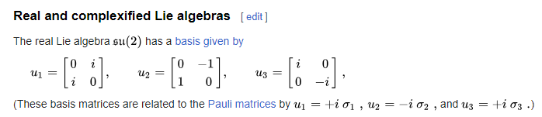
Spinors Learning “Staircase”
Spinors in Particle Physics
Lie Groups & Algebras
Clifford Algebras
Spinors in 3D / (4D)
Examples From Physics (motivation)
https://en.wikipedia.org/wiki/Representation_theory_of_SU(2)

Slide 3
Lie Group =
Continuous Group

Slide 4

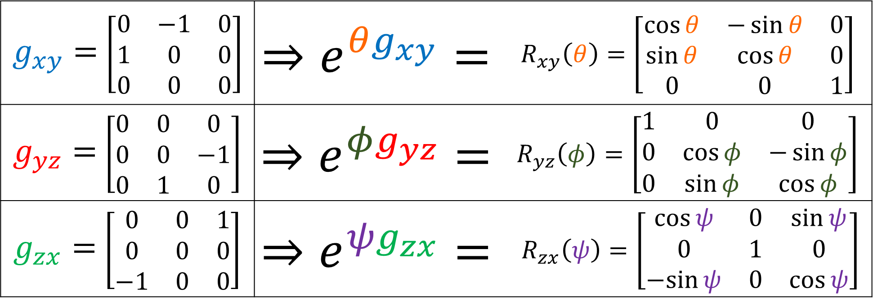
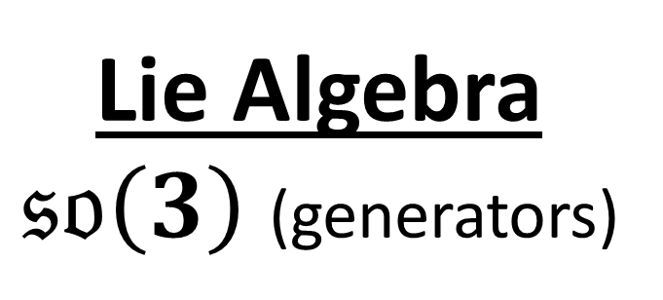
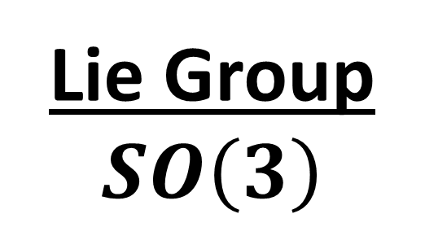
Lie Algebra
$𝔰𝔬\left(3\right)$ (generators)
Lie Group $SO\left(3\right)$
$g_{xy}=$ $\left[\begin{matrix}0 & −1 & 0 \\ 1 & 0 & 0 \\ 0 & 0 & 0\end{matrix}\right]$ | $$⇒e^{θg_{xy}}=$$ | $$R_{xy}\left(θ\right)=\left[\begin{matrix}\cos{θ} & −\sin{θ} & 0 \\ \sin{θ} & \cos{θ} & 0 \\ 0 & 0 & 1\end{matrix}\right]$$
$g_{yz}=$ $\left[\begin{matrix}0 & 0 & 0 \\ 0 & 0 & −1 \\ 0 & 1 & 0\end{matrix}\right]$ | $$⇒e^{φg_{yz}}=$$ | $$R_{yz}\left(φ\right)=\left[\begin{matrix}1 & 0 & 0 \\ 0 & \cos{φ} & −\sin{φ} \\ 0 & \sin{φ} & \cos{φ}\end{matrix}\right]$$
$g_{zx}=$ $\left[\begin{matrix}0 & 0 & 1 \\ 0 & 0 & 0 \\ −1 & 0 & 0\end{matrix}\right]$ | $$⇒e^{ψg_{zx}}=$$ | $R_{zx}\left(ψ\right)=\left[\begin{matrix}\cos{ψ} & 0 & \sin{ψ} \\ 0 & 1 & 0 \\ −sin{ψ} & 0 & \cos{ψ}\end{matrix}\right]$

Slide 5
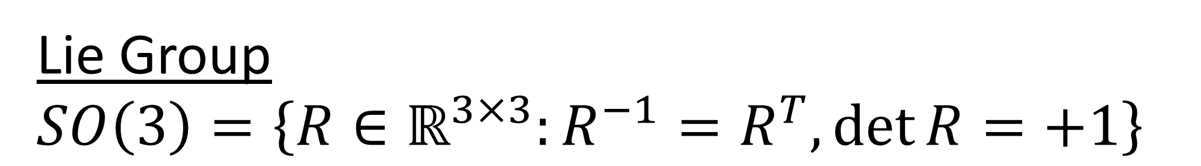

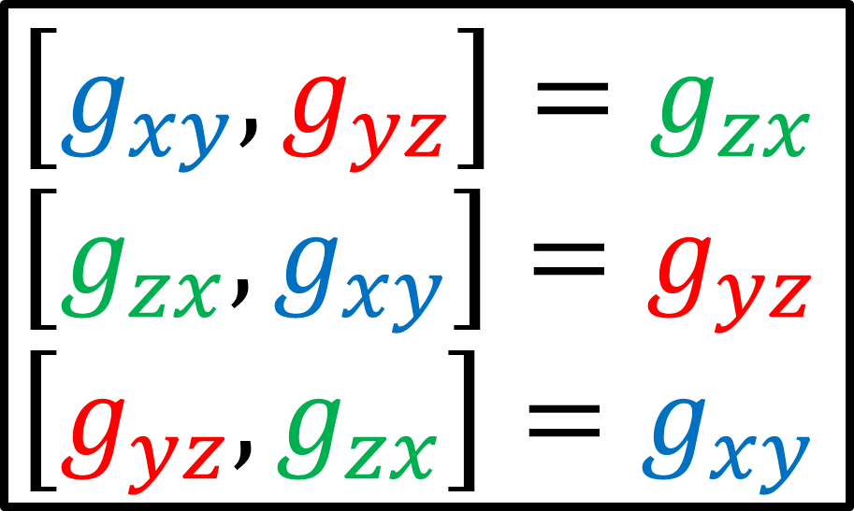
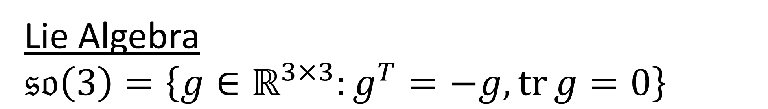
Lie Group
$$SO\left(3\right)=\left\{R∈ℝ^{3×3}:R^{−1}=R^{T},\det{R}=+1\right\}$$
Lie Algebra
$$𝔰𝔬\left(3\right)=\left\{g∈ℝ^{3×3}:g^{T}=−g,\operatorname{tr}{g}=0\right\}$$
$$\left[g_{xy},g_{yz}\right]=g_{zx}$$
$$\left[g_{zx},g_{xy}\right]=g_{yz}$$
$$\left[g_{yz}, g_{zx}\right]=g_{xy}$$
$$𝔰𝔬\left(3\right)$$
commutation relations
(Lie Bracket)

Slide 6
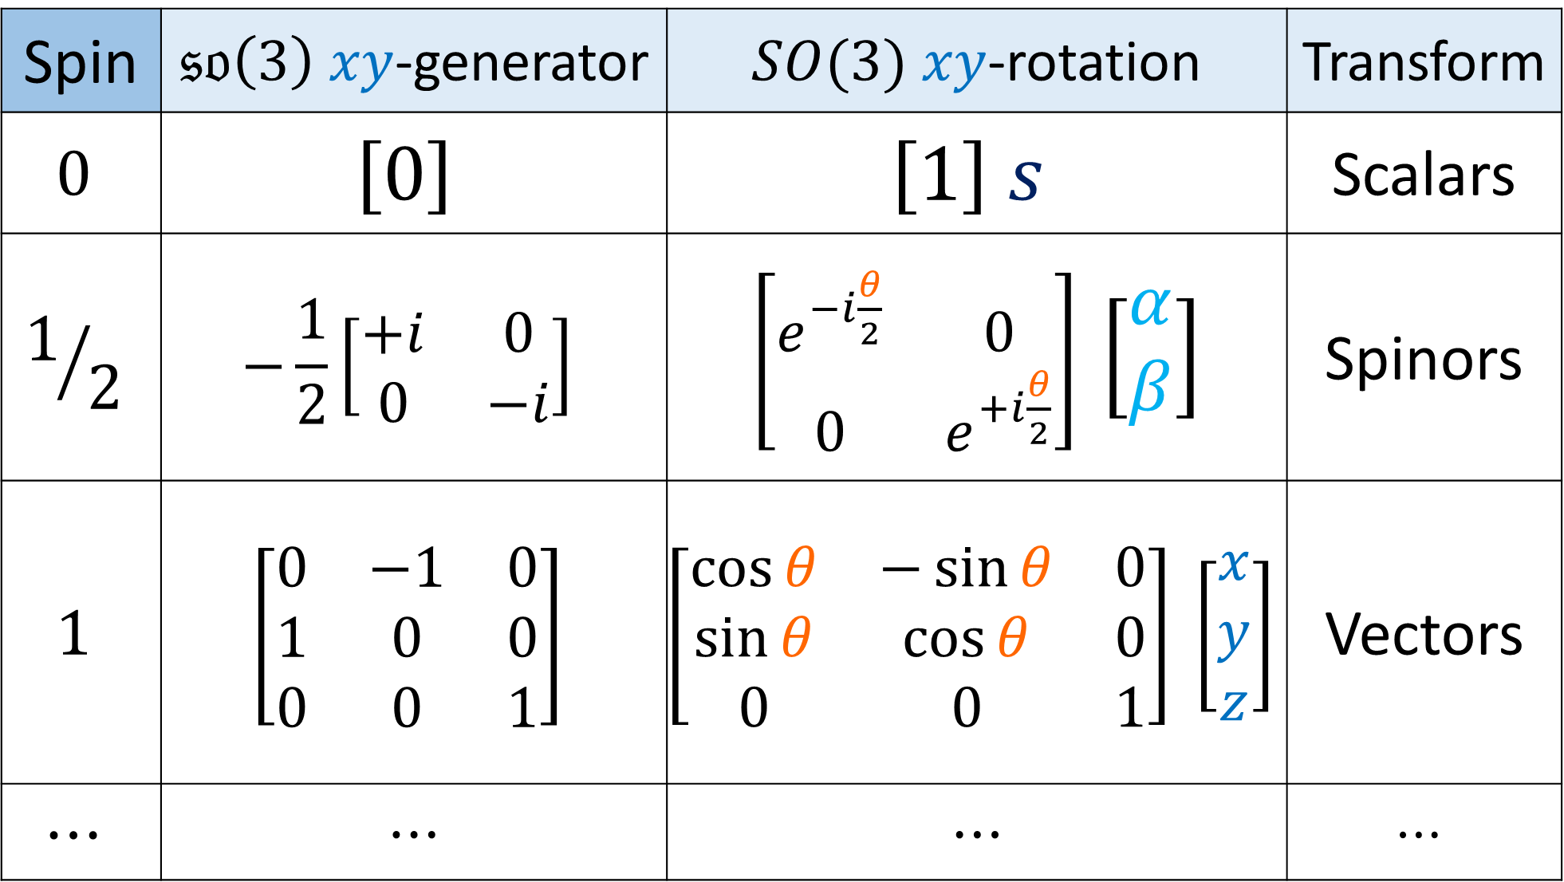
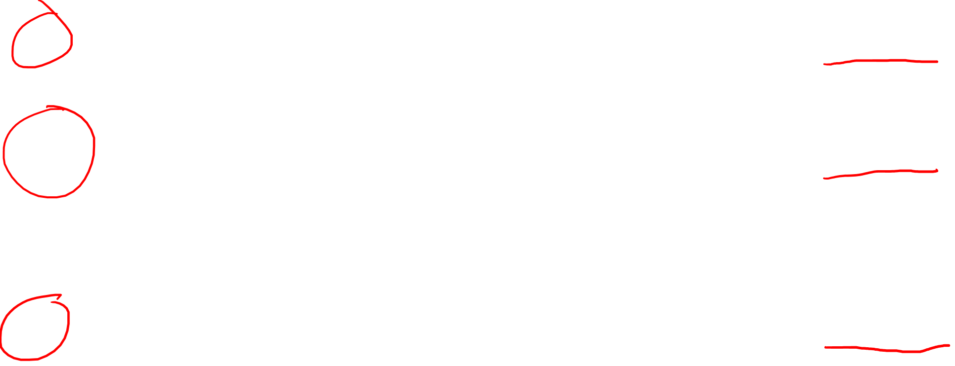
Spin | $𝔰𝔬\left(3\right)$ $xy$-generator | $SO(3)$ $xy$-rotation | Transform
$$0$$ | $$\left[0\right]$$ | $$\left[1\right] s$$ | Scalars
$$1/2$$ | $$−\frac{1}{2}\left[\begin{matrix}+i & 0 \\ 0 & −i\end{matrix}\right]$$ | $\left[\begin{matrix}e^{−i\frac{θ}{2}} & 0 \\ 0 & e^{+i\frac{θ}{2}}\end{matrix}\right]$ $\left[\begin{aligned}α \\ β\end{aligned}\right]$ | Spinors
$$1$$ | $$\left[\begin{matrix}0 & −1 & 0 \\ 1 & 0 & 0 \\ 0 & 0 & 1\end{matrix}\right]$$ | $$\left[\begin{matrix}\cos{θ} & −\sin{θ} & 0 \\ \sin{θ} & \cos{θ} & 0 \\ 0 & 0 & 1\end{matrix}\right] \left[\begin{aligned}x \\ y \\ z\end{aligned}\right]$$ | Vectors
$$⋯$$ | $$⋯$$ | $$⋯$$ | $$⋯$$

Slide 7

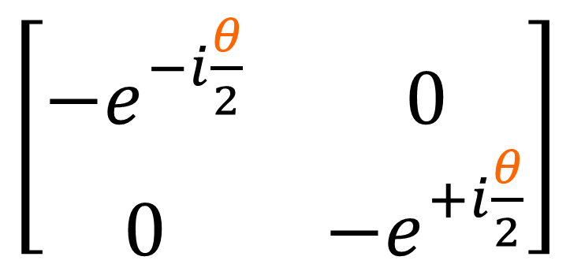
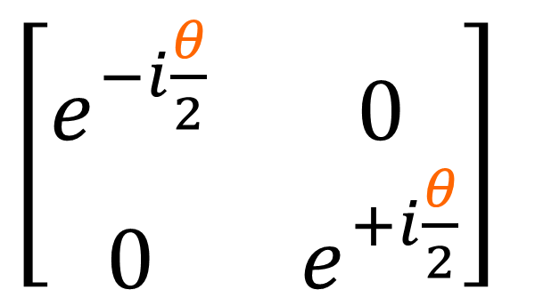
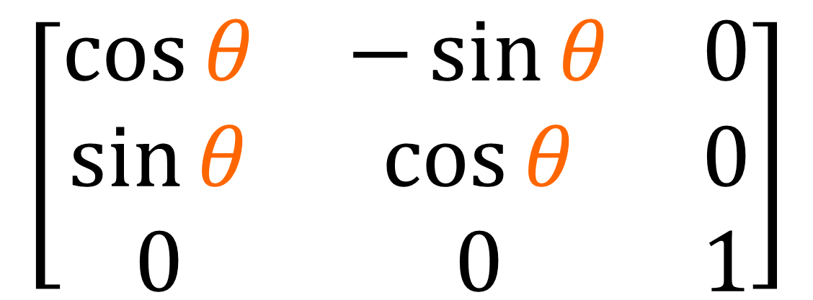
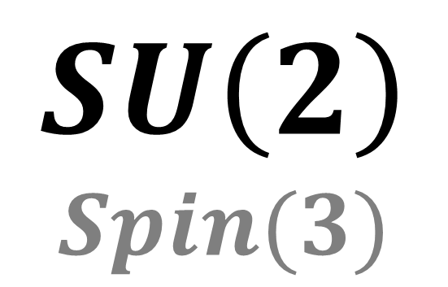
$$SU\left(2\right)$$
$$Spin(3)$$
$\left[\begin{matrix}e^{−i\frac{θ}{2}} & 0 \\ 0 & e^{+i\frac{θ}{2}}\end{matrix}\right]$
$\left[\begin{matrix}−e^{−i\frac{θ}{2}} & 0 \\ 0 & −e^{+i\frac{θ}{2}}\end{matrix}\right]$
double
cover
$$\left[\begin{matrix}\cos{θ} & −\sin{θ} & 0 \\ \sin{θ} & \cos{θ} & 0 \\ 0 & 0 & 1\end{matrix}\right]$$
$$SO\left(3\right)$$

Slide 8
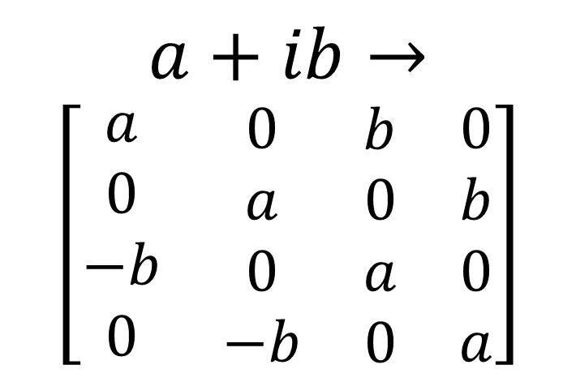
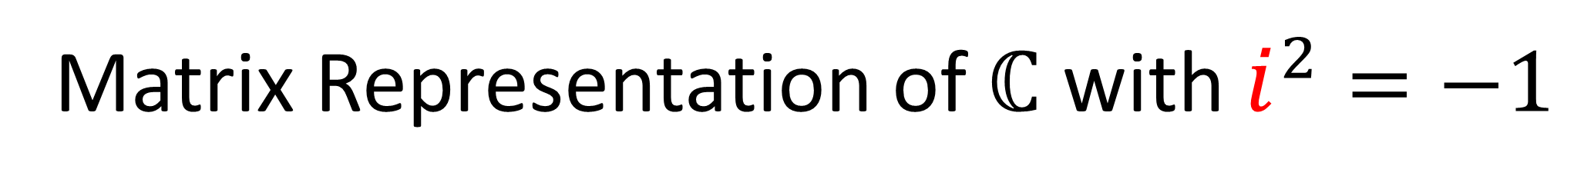
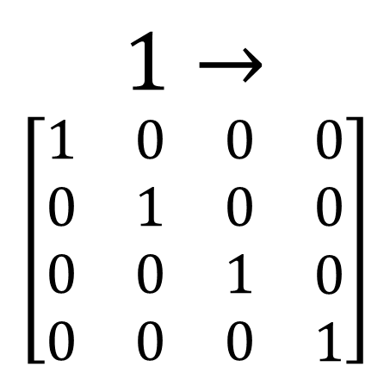
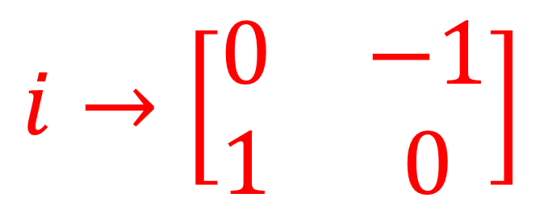

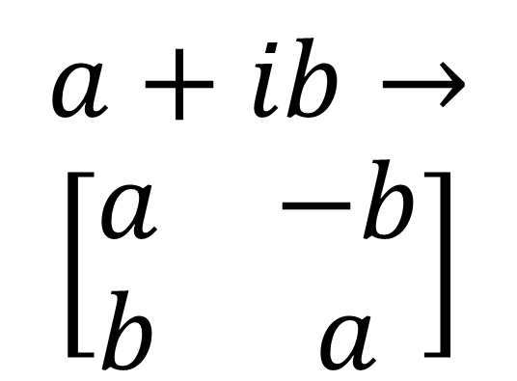
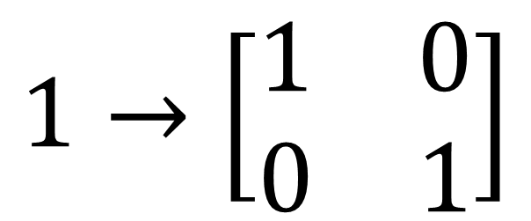
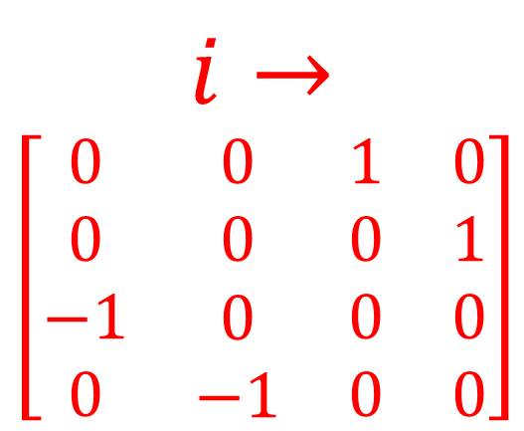
Matrix Representation of $ℂ$ with $i^{2}=−1$
$$a+ib→$$
$$\left[\begin{matrix}a & −b \\ b & a\end{matrix}\right]$$
$$1→\left[\begin{matrix}1 & 0 \\ 0 & 1\end{matrix}\right]$$
$$i→\left[\begin{matrix}0 & −1 \\ 1 & 0\end{matrix}\right]$$
$$1→$$
$$\left[\begin{matrix}\begin{matrix}\begin{aligned}1 \\ 0 \\ 0 \\ 0\end{aligned} & \begin{aligned}0 \\ 1 \\ 0 \\ 0\end{aligned}\end{matrix} & \begin{matrix}\begin{aligned}0 \\ 0 \\ 1 \\ 0\end{aligned} & \begin{aligned}0 \\ 0 \\ 0 \\ 1\end{aligned}\end{matrix}\end{matrix}\right]$$
$$i→$$
$\left[\begin{matrix}\begin{matrix}\begin{aligned}0 \\ 0 \\ −1 \\ 0\end{aligned} & \begin{aligned}0 \\ 0 \\ 0 \\ −1\end{aligned}\end{matrix} & \begin{matrix}\begin{aligned}1 \\ 0 \\ 0 \\ 0\end{aligned} & \begin{aligned}0 \\ 1 \\ 0 \\ 0\end{aligned}\end{matrix}\end{matrix}\right]$
$$a+ib→$$
$\left[\begin{matrix}\begin{matrix}\begin{aligned}a \\ 0 \\ −b \\ 0\end{aligned} & \begin{aligned}0 \\ a \\ 0 \\ −b\end{aligned}\end{matrix} & \begin{matrix}\begin{aligned}b \\ 0 \\ a \\ 0\end{aligned} & \begin{aligned}0 \\ b \\ 0 \\ a\end{aligned}\end{matrix}\end{matrix}\right]$

Slide 9
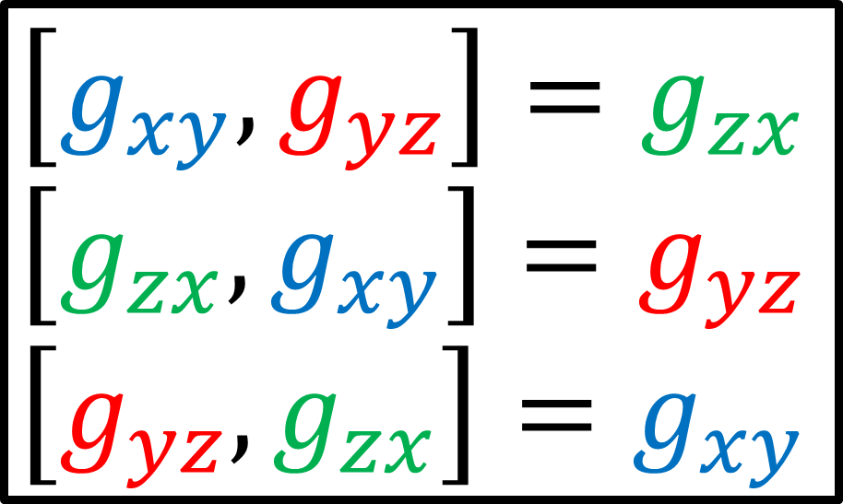
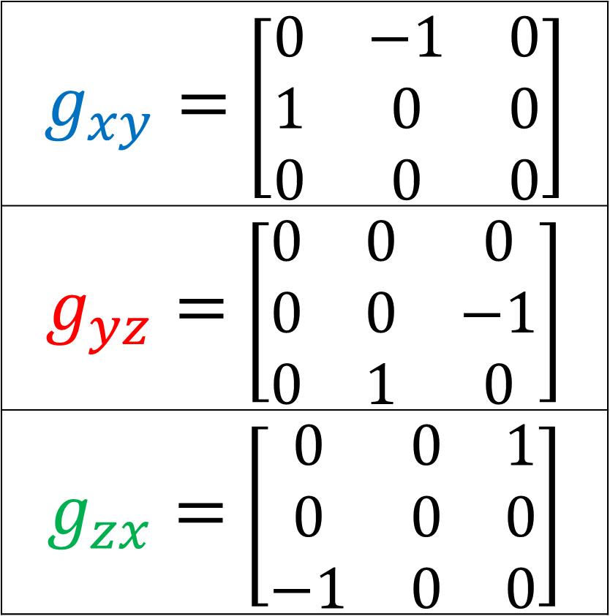
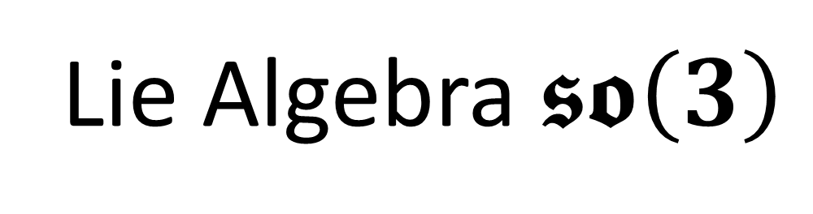
Lie Algebra $𝖘𝖔\left(3\right)$
Spin-1 (3x3) representation
$$\left[g_{xy},g_{yz}\right]=g_{zx}$$
$$\left[g_{zx},g_{xy}\right]=g_{yz}$$
$$\left[g_{yz}, g_{zx}\right]=g_{xy}$$
$g_{xy}=$ $\left[\begin{matrix}0 & −1 & 0 \\ 1 & 0 & 0 \\ 0 & 0 & 0\end{matrix}\right]$
$g_{yz}=$ $\left[\begin{matrix}0 & 0 & 0 \\ 0 & 0 & −1 \\ 0 & 1 & 0\end{matrix}\right]$
$g_{zx}=$ $\left[\begin{matrix}0 & 0 & 1 \\ 0 & 0 & 0 \\ −1 & 0 & 0\end{matrix}\right]$

Slide 10

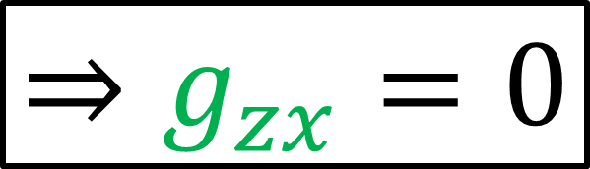
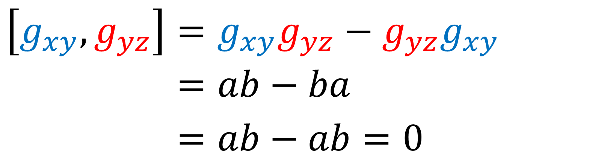
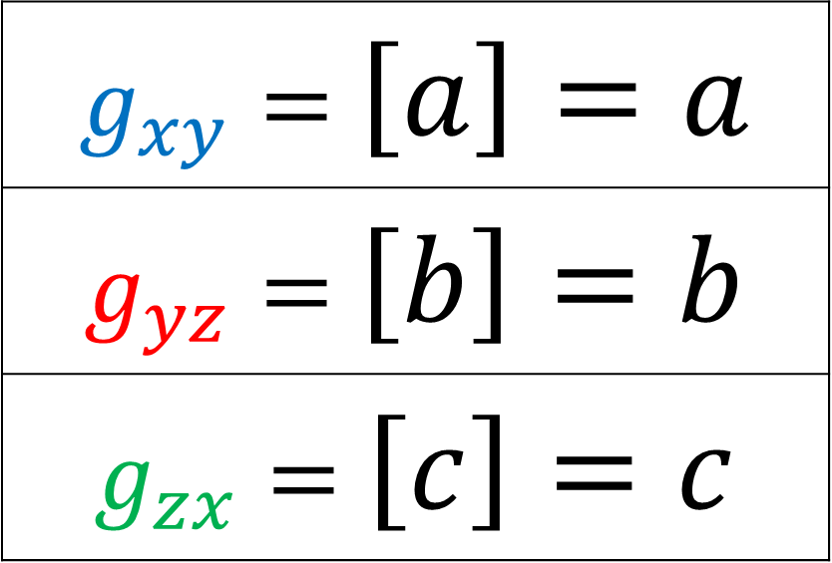
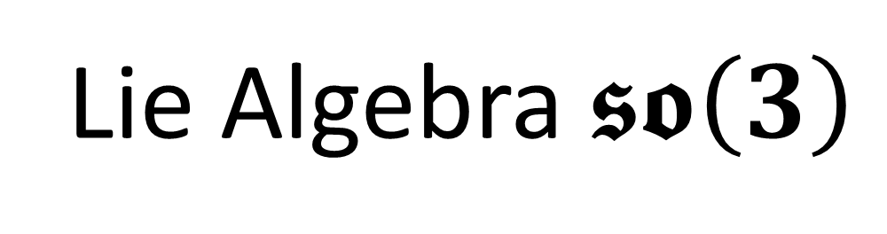

Lie Algebra $𝖘𝖔\left(3\right)$
Spin-0 (1x1) representation
$$\left[g_{xy},g_{yz}\right]=g_{zx}$$
$$\left[g_{zx},g_{xy}\right]=g_{yz}$$
$$\left[g_{yz}, g_{zx}\right]=g_{xy}$$
$g_{xy}=$ $\left[a\right]=a$
$g_{yz}=$ $\left[b\right]=b$
$g_{zx}=$ $\left[c\right]=c$
$$\left[g_{xy},g_{yz}\right]=g_{xy}g_{yz}−g_{yz}g_{xy}$$
$$\left[g_{xy},g_{yz}\right]=ab−ba$$
$$\left[g_{xy},g_{yz}\right]=ab−ab=0$$
$$⇒g_{zx}=0$$

Slide 11

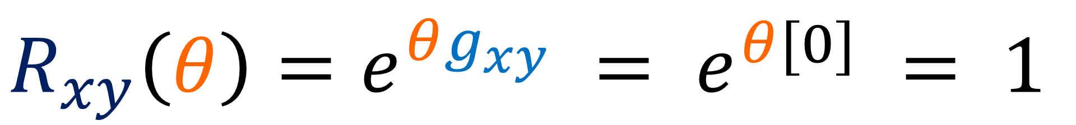
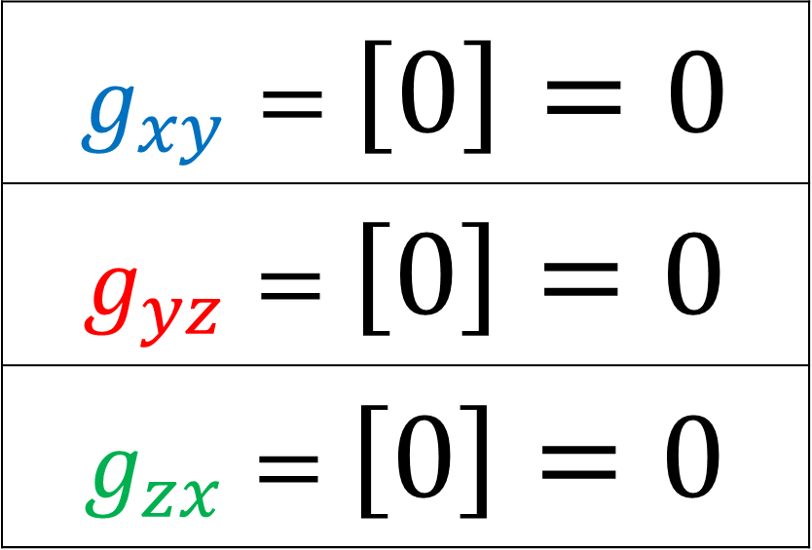
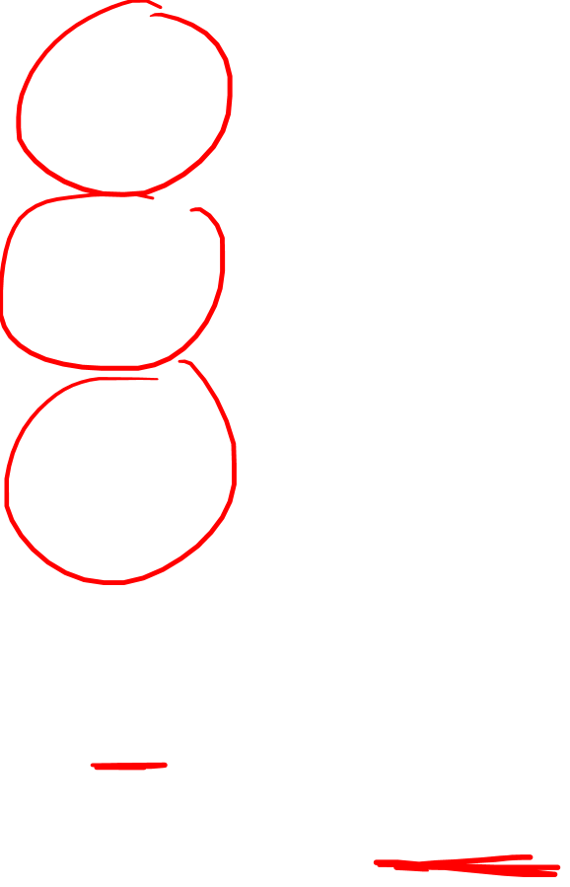
Lie Algebra $𝖘𝖔\left(3\right)$
Spin-0 (1x1) representation
$$\left[g_{xy},g_{yz}\right]=g_{zx}$$
$$\left[g_{zx},g_{xy}\right]=g_{yz}$$
$$\left[g_{yz}, g_{zx}\right]=g_{xy}$$
$g_{xy}=$ $\left[0\right]=0$
$g_{yz}=$ $\left[0\right]=0$
$g_{zx}=$ $\left[0\right]=0$
(Spin-0)
$$R_{xy}^{}\left(θ\right)=e^{θg_{xy}} = e^{θ[0]} = 1$$
$$\left[1 \right]$$

Slide 12

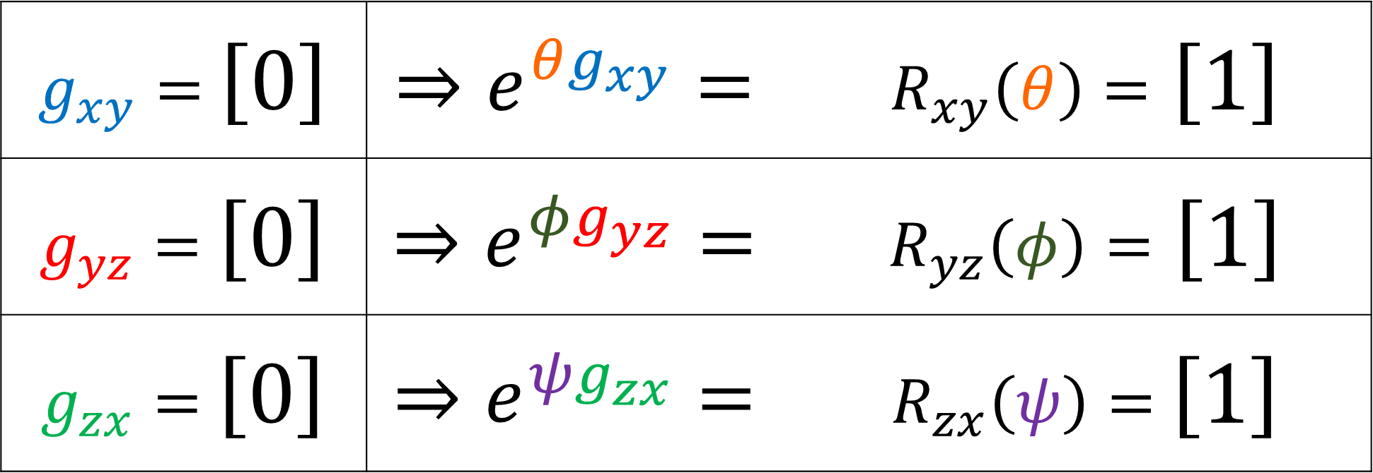
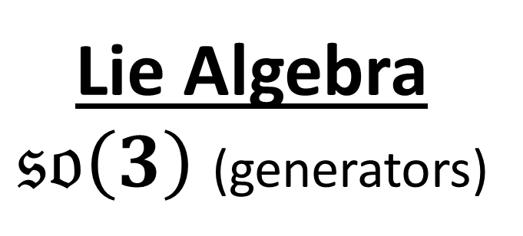
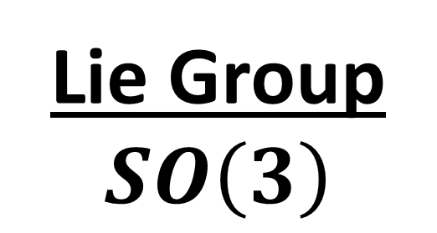
Lie Algebra
$𝔰𝔬\left(3\right)$ (generators)
Spin-0 (1x1)
representation
Lie Group $SO\left(3\right)$
$g_{xy}=$ $\left[0\right]$ | $$⇒e^{θg_{xy}}=$$ | $R_{xy}\left(θ\right)=$ $\left[1\right]$
$g_{yz}=$ $\left[0\right]$ | $$⇒e^{φg_{yz}}=$$ | $R_{yz}\left(φ\right)=$ $\left[1\right]$
$g_{zx}=$ $\left[0\right]$ | $$⇒e^{ψg_{zx}}=$$ | $R_{zx}\left(ψ\right)=$ $\left[1\right]$
Trivial Representation (scalars don’t change under rotations)

Slide 13













Lie Algebra
$𝔰𝔬\left(3\right)$ (generators)
Spin-0 (1x1)
representation
Lie Group $SO\left(3\right)$
Higgs Boson
(spin-0)
Pions (spin-0)
$g_{xy}=$ $\left[0\right]$ | $$⇒e^{θg_{xy}}=$$ | $R_{xy}\left(θ\right)=$ $\left[1\right]$
$g_{yz}=$ $\left[0\right]$ | $$⇒e^{φg_{yz}}=$$ | $R_{yz}\left(φ\right)=$ $\left[1\right]$
$g_{zx}=$ $\left[0\right]$ | $$⇒e^{ψg_{zx}}=$$ | $R_{zx}\left(ψ\right)=$ $\left[1\right]$
$$π^{+}:$$
$$u$$
$$\overline{d}$$
$$H$$
$$π^{0}:$$
$$u$$
$$\overline{u}$$
$$d$$
$$\overline{d}$$
$$π^{−}:$$
$$d$$
$$\overline{u}$$
Trivial Representation (scalars don’t change under rotations)

Slide 14
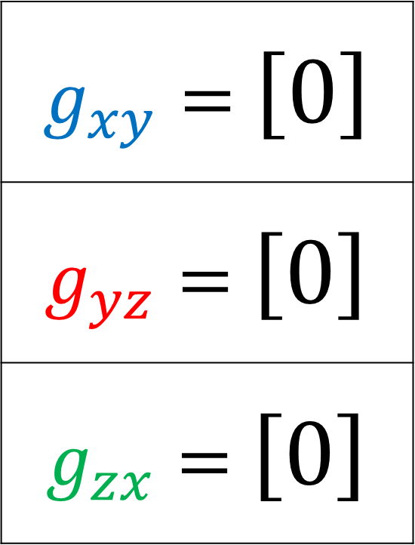
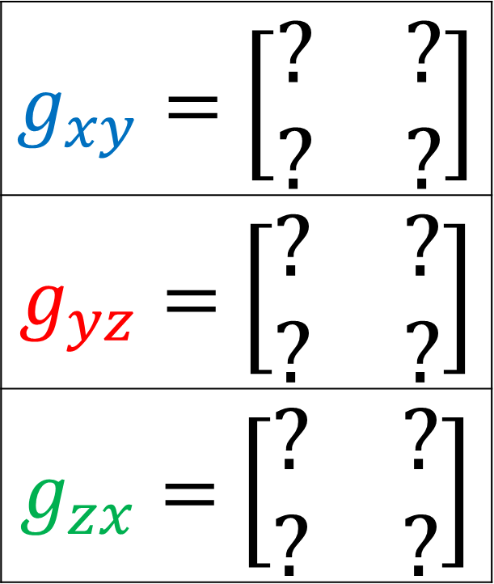
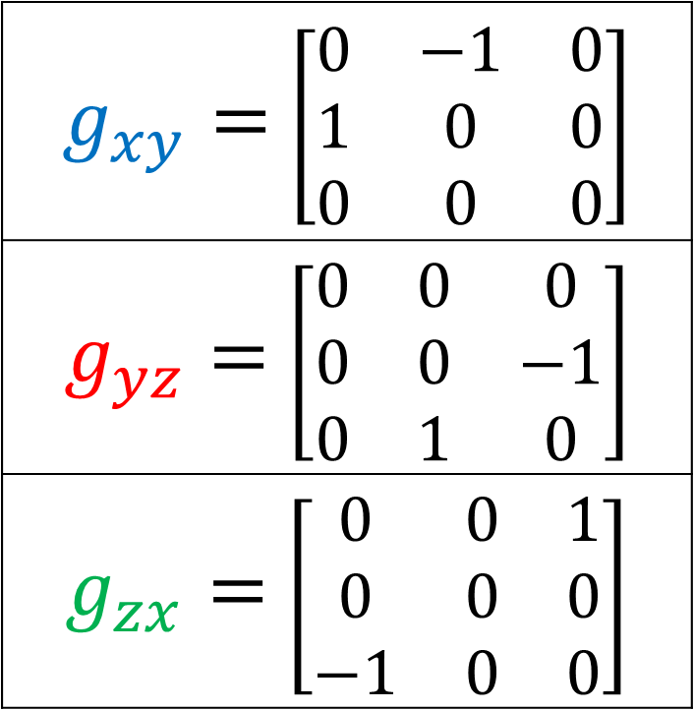
Lie Algebra $𝖘𝖔\left(3\right)$
Spin-0 (1x1) representation
Spin-½ (2x2) representation
Spin-1 (3x3) representation
$g_{xy}=$ $\left[0\right]$
$g_{yz}=$ $\left[0\right]$
$g_{zx}=$ $\left[0\right]$
$g_{xy}=$ $\left[\begin{matrix}? & ? \\ ? & ?\end{matrix}\right]$
$g_{yz}=$ $\left[\begin{matrix}? & ? \\ ? & ?\end{matrix}\right]$
$g_{zx}=$ $\left[\begin{matrix}? & ? \\ ? & ?\end{matrix}\right]$
$g_{xy}=$ $\left[\begin{matrix}0 & −1 & 0 \\ 1 & 0 & 0 \\ 0 & 0 & 0\end{matrix}\right]$
$g_{yz}=$ $\left[\begin{matrix}0 & 0 & 0 \\ 0 & 0 & −1 \\ 0 & 1 & 0\end{matrix}\right]$
$g_{zx}=$ $\left[\begin{matrix}0 & 0 & 1 \\ 0 & 0 & 0 \\ −1 & 0 & 0\end{matrix}\right]$

Slide 15
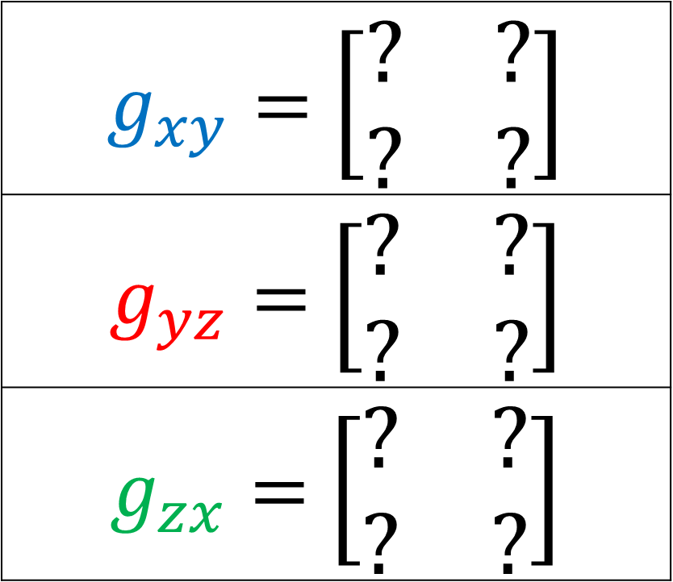
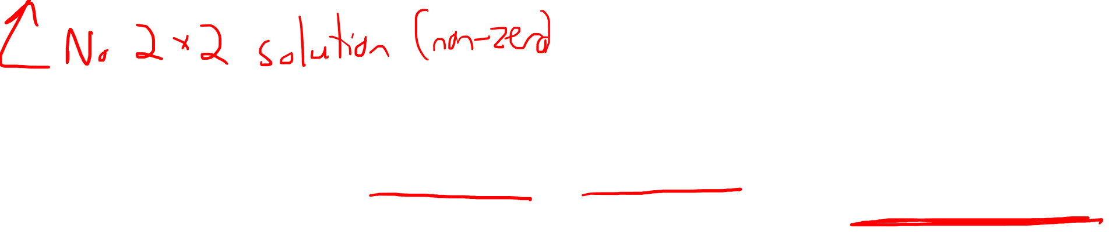
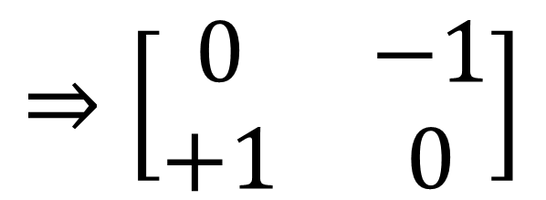
Lie Algebra $𝖘𝖔\left(3\right)$
Spin-½ (2x2) representation
$$\left[g_{xy},g_{yz}\right]=g_{zx}$$
$$\left[g_{zx},g_{xy}\right]=g_{yz}$$
$$\left[g_{yz}, g_{zx}\right]=g_{xy}$$
$g_{xy}=$ $\left[\begin{matrix}? & ? \\ ? & ?\end{matrix}\right]$
$g_{yz}=$ $\left[\begin{matrix}? & ? \\ ? & ?\end{matrix}\right]$
$g_{zx}=$ $\left[\begin{matrix}? & ? \\ ? & ?\end{matrix}\right]$
$$⇒\left[\begin{matrix}0 & −1 \\ +1 & 0\end{matrix}\right]$$
$$𝔰𝔬\left(3\right)=\left\{g∈ℝ^{2×2}:g^{T}=−g,\operatorname{tr}{g}=0\right\}$$
Notes:
½

Slide 16
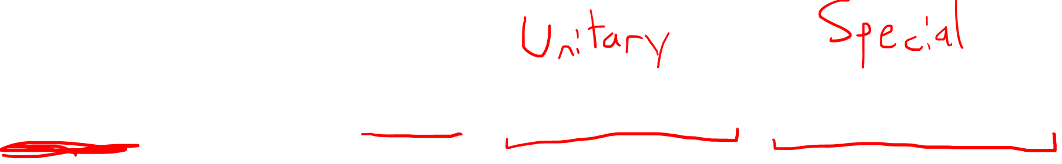

$$SO\left(3\right)=\left\{R∈ℝ^{3×3}:R^{−1}=R^{T},\det{R}=+1\right\}$$
$$SU\left(2\right)=\left\{U∈ℂ^{2×2}:U^{−1}=U^{†},\det{U}=+1\right\}$$
$$U^{†}={\left(U^{∗}\right)}^{T}$$
Hermitian conjugate

Slide 17



$$SU\left(2\right)$$
$$Spin(3)$$
$\left[\begin{matrix}e^{−i\frac{θ}{2}} & 0 \\ 0 & e^{+i\frac{θ}{2}}\end{matrix}\right]$
$\left[\begin{matrix}−e^{−i\frac{θ}{2}} & 0 \\ 0 & −e^{+i\frac{θ}{2}}\end{matrix}\right]$
double
cover
$$\left[\begin{matrix}\cos{θ} & −\sin{θ} & 0 \\ \sin{θ} & \cos{θ} & 0 \\ 0 & 0 & 1\end{matrix}\right]$$
$$SO\left(3\right)$$

Slide 18
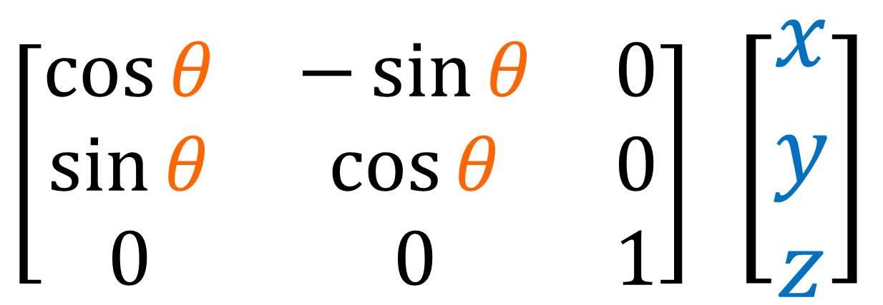



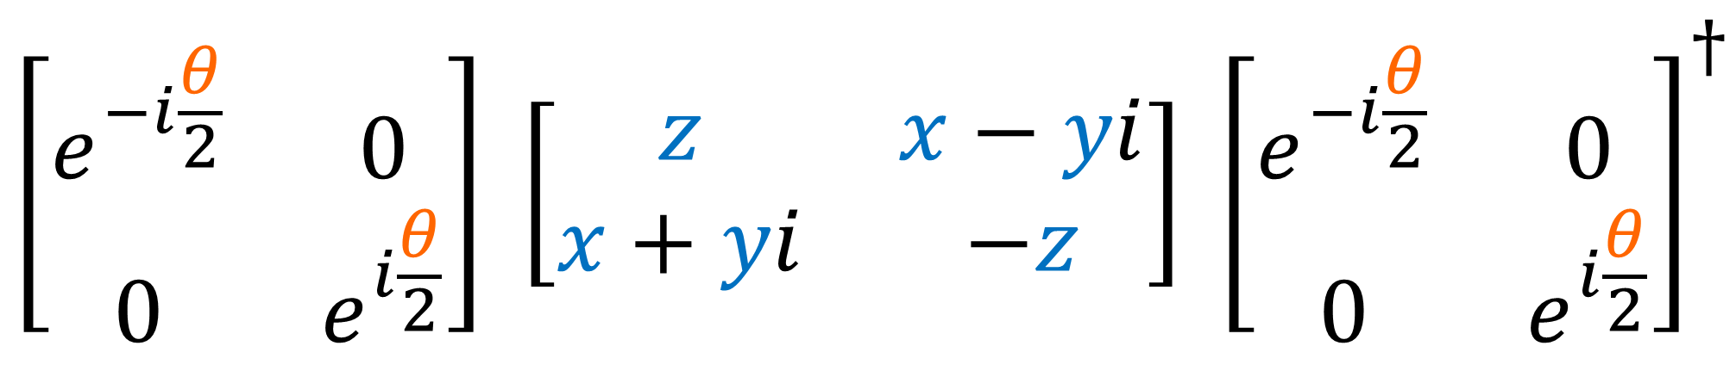
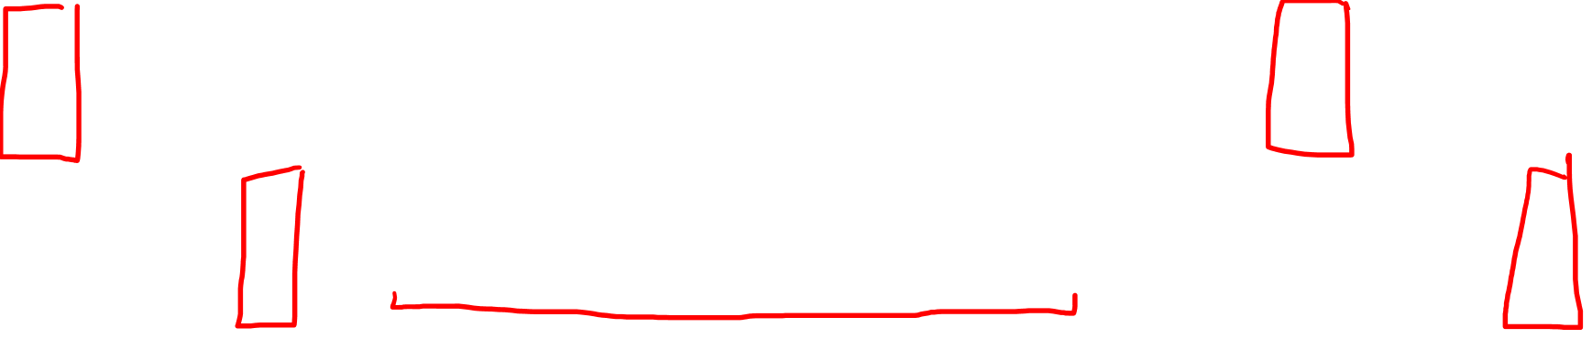
$$SO(3)$$
3D Vector
Rotation
$\left[\begin{matrix}\cos{θ} & −\sin{θ} & 0 \\ \sin{θ} & \cos{θ} & 0 \\ 0 & 0 & 1\end{matrix}\right]$ $\left[\begin{aligned}x \\ y \\ z\end{aligned}\right]$
$$SU(2)$$
$$SU(2)$$
Pauli Vector
$$\left[\begin{matrix}e^{−i\frac{θ}{2}} & 0 \\ 0 & e^{i\frac{θ}{2}}\end{matrix}\right] \left[\begin{matrix}z & x−yi \\ x+yi & −z\end{matrix}\right] {\left[\begin{matrix}e^{−i\frac{θ}{2}} & 0 \\ 0 & e^{i\frac{θ}{2}}\end{matrix}\right]}^{†}$$

Slide 19
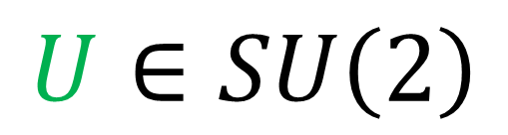


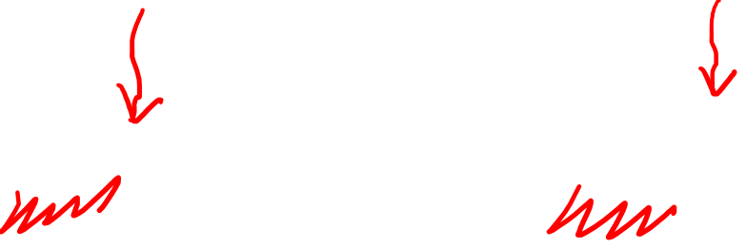
$\left[\begin{matrix} & \\ & \end{matrix}\right]\left[\begin{matrix}z & x−yi \\ x+yi & −z\end{matrix}\right]{\left[\begin{matrix} & \\ & \end{matrix}\right]}^{†}$
$$SU\left(2\right)$$
$$SU\left(2\right)$$
$$U∈SU\left(2\right)$$
$$V → U V U^{†}$$
$$V →\left(−U\right)V{\left(−U\right)}^{†}$$

Slide 20
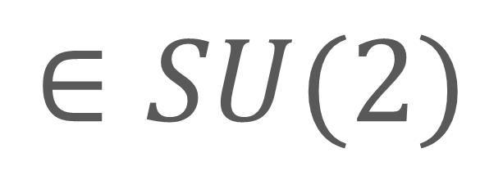








$$\vec{v}→R\vec{v}$$
$$V→UVU^{†}$$
$$+U$$
$$∈SU(2)$$
$$R$$
$$∈SO(3)$$
$$−U$$
$$∈SU(2)$$
$SU(2)=$ double cover of rotation group $SO(3)$

Slide 21





$$SU\left(2\right)$$
$$=$$
$$Spin(3)$$
$Spin(3)$ = members of $Cl(3)$ that are…
versors of even length: $U_{1}U_{2}⋯U_{2k}$
made of unit vectors: ${\left(U_{i}\right)}^{2}=+1$

Slide 22






$$R$$
Half of 3-sphere
(Real Projective Space)
$$ℝP^{3}\sim SO\left(3\right)$$
$$+U$$
3-sphere
$$S^{3}\sim SU\left(2\right)$$
$$U∈SU(2)→\left[\begin{matrix}α & −β^{∗} \\ β & α^{∗}\end{matrix}\right]$$
$$\det{U}={\left|α\right|}^{2}+{\left|β\right|}^{2}=1$$
$$⇒a^{2}+b^{2}+c^{2}+d^{2}=1$$
$$−U$$

Slide 23

Lie Group
$$SU\left(2\right)=\left\{U∈ℂ^{2×2}:U^{−1}=U^{†},\det{U}=+1\right\}$$
Lie Algebra
$$𝔰𝔲\left(2\right)=\left\{M∈ℂ^{2×2}:M=−M^{†},\operatorname{tr}{M}=0\right\}$$

Slide 24




Rotation matrix $U∈SU(2)$
$⇒\det\left(U\right)=+1$
$$\det\left(e^{A}\right)=e^{tr\left(A\right)}$$
$$\det\left(U\left(θ\right)\right)=1$$
$$\det\left(e^{θM}\right)=1$$
$$e^{θtr\left(M\right)}=1$$
$$⇒tr\left(M\right)=0$$

Slide 25




Rotation matrix $U∈SU(2)$
$⇒U^{−1}=U^{†}$
$$U\left(θ\right)≡e^{θM}$$
$U\left(θ\right){\left[U\left(θ\right)\right]}^{†}= I$
$\frac{d}{dθ}\left(U\left(θ\right){U\left(θ\right)}^{†}\right) =\frac{dI}{dθ}$
$$\frac{dU\left(θ\right)}{dθ}{U\left(θ\right)}^{†}+U\left(θ\right)\frac{d{U\left(θ\right)}^{†}}{dθ}=0$$
$$\frac{d\left(e^{θM}\right)}{dθ}{\left(e^{θM}\right)}^{†}+\left(e^{θM}\right)\frac{d{\left(e^{θM}\right)}^{†}}{dθ}=0$$
$${\left(e^{θM}\right)}^{†}$$
$={\left(\sum_{n}^{∞}{\frac{{\left(θM\right)}^{n}}{n!}}\right)}^{†}$
$=\sum_{n}^{∞}{\frac{{\left(θM^{†}\right)}^{n}}{n!}}$
$=e^{θ{\left(M\right)}^{†}}$

Slide 26

Rotation matrix $U∈SU(2)$
$⇒U^{−1}=U^{†}$
$$U\left(θ\right)≡e^{θM}$$
$U\left(θ\right){\left[U\left(θ\right)\right]}^{†}= I$
$\frac{d}{dθ}\left(U\left(θ\right){U\left(θ\right)}^{†}\right) =\frac{dI}{dθ}$
$$\frac{dU\left(θ\right)}{dθ}{U\left(θ\right)}^{†}+U\left(θ\right)\frac{d{U\left(θ\right)}^{†}}{dθ}=0$$
$\frac{d\left(e^{θM}\right)}{dθ}\left(e^{θ{\left(M\right)}^{†}}\right)+\left(e^{θM}\right)\frac{d\left(e^{θ{\left(M\right)}^{†}}\right)}{dθ}=0$
$${\left(e^{θM}\right)}^{†}$$
$={\left(\sum_{n}^{∞}{\frac{{\left(θM\right)}^{n}}{n!}}\right)}^{†}$
$=\sum_{n}^{∞}{\frac{{\left(θM^{†}\right)}^{n}}{n!}}$
$=e^{θ{\left(M\right)}^{†}}$

Slide 27





Rotation matrix $U∈SO(3)$
$⇒U^{−1}=U^{†}$
$$U\left(θ\right)≡e^{θM}$$
$$\frac{d\left(e^{θM}\right)}{dθ}\left(e^{θ{\left(M\right)}^{†}}\right)+\left(e^{θM}\right)\frac{d\left(e^{θ{\left(M\right)}^{†}}\right)}{dθ}=0$$
$$Me^{θM}e^{θ{\left(M\right)}^{†}}+e^{θM} M^{†}e^{θ{\left(M\right)}^{†}}=0$$
$$Me^{0M}e^{0{\left(M\right)}^{†}}+e^{0M} M^{†}e^{0{\left(M\right)}^{†}}=0$$
$$M I I + I M^{†} I=0$$
$M + M^{†} =0$
$\frac{dU\left(θ\right)}{dθ}≡Me^{θM}$
$$⇒θ=0$$
$$⇒M^{†}=−M$$

Slide 28









$$\left[\begin{matrix}α & β \\ γ & δ\end{matrix}\right]$$
General $2×2$ complex $ℂ$ matrix:
Traceless: $Tr\left(M\right)=0$
$$α+δ=0$$
$$⇒δ=−α$$
$$\left[\begin{matrix}α & β \\ γ & −α\end{matrix}\right]$$
Anti-Hermitian:
$$M^{†}=−M$$
$$\left[\begin{matrix}α^{∗} & γ^{∗} \\ β^{∗} & −α^{∗}\end{matrix}\right]=\left[\begin{matrix}−α & −β \\ −γ & α\end{matrix}\right]$$
$$α^{∗}=−α$$
$γ=−β^{∗}$
($α$ is pure imaginary)

Slide 29









$$\left[\begin{matrix}α & β \\ −β^{∗} & −α\end{matrix}\right]$$
($α$ is pure imaginary)
$$M∈ℂ^{2×2}$$
$$Tr\left(M\right)=0$$
$$M^{†}=−M$$
$$\left[\begin{matrix}ic & b+ia \\ −b+ia & −ic\end{matrix}\right]$$
$$a,b,c$$
$$∈ℝ$$
$$a\left[\begin{matrix}0 & i \\ i & 0\end{matrix}\right]+b\left[\begin{matrix}0 & 1 \\ −1 & 0\end{matrix}\right]+c\left[\begin{matrix}i & 0 \\ 0 & −i\end{matrix}\right]$$
$$σ_{y}σ_{z}$$
$$σ_{z}σ_{x}$$
$$σ_{x}σ_{y}$$

Slide 30





















$Cl(3)$
$$\left[\begin{matrix}i & 0 \\ 0 & i\end{matrix}\right]$$
trivector
(pseudoscalar)
$$M∈𝔰𝔲(2)$$
$$Tr\left(M\right)=0$$
$$M^{†}=−M$$
$$σ_{x}σ_{y}σ_{z}=I$$
bivectors
(pseudovectors)
$$\left[\begin{matrix}0 & i \\ i & 0\end{matrix}\right]$$
$$\left[\begin{matrix}0 & 1 \\ −1 & 0\end{matrix}\right]$$
$$\left[\begin{matrix}i & 0 \\ 0 & −i\end{matrix}\right]$$
$$σ_{y}σ_{z}=Iσ_{x}$$
$$σ_{z}σ_{x}=Iσ_{y}$$
$$σ_{x}σ_{y}=Iσ_{z}$$
Squares to identity
$$σ_{i}σ_{i}=\text{𝟙}=\left[\begin{matrix}1 & 0 \\ 0 & 1\end{matrix}\right]$$
$$\left[\begin{matrix}0 & 1 \\ 1 & 0\end{matrix}\right]$$
$$\left[\begin{matrix}0 & −i \\ i & 0\end{matrix}\right]$$
$$\left[\begin{matrix}1 & 0 \\ 0 & −1\end{matrix}\right]$$
$$σ_{x}$$
$$σ_{y}$$
$$σ_{z}$$
vectors
$$\left[\begin{matrix}1 & 0 \\ 0 & 1\end{matrix}\right]$$
Anti-commutivity ($i≠j$)
$$σ_{i}σ_{j}=−σ_{j}σ_{i}$$
$$1$$
scalar

Slide 31


$$g_{yz}=σ_{y}σ_{z}$$ | $$g_{zx}=σ_{z}σ_{x}$$ | $$g_{xy}=σ_{x}σ_{y}$$
$$\left[g_{xy}, g_{yz}\right]=g_{xy}g_{yz}−g_{yz}g_{xy}$$
$$\left[g_{xy}, g_{yz}\right]=\left(σ_{x}σ_{y}\right)\left(σ_{y}σ_{z}\right)−\left(σ_{y}σ_{z}\right)\left(σ_{x}σ_{y}\right)$$
$$\left[g_{xy}, g_{yz}\right]=\left(σ_{x}σ_{y}\right)\left(σ_{y}σ_{z}\right)−\left(−σ_{z}σ_{y}\right)\left(−σ_{y}σ_{x}\right)$$
$$\left[g_{xy}, g_{yz}\right]= σ_{x}σ_{y}σ_{y}σ_{z} − σ_{z}σ_{y}σ_{y}σ_{x}$$
$$\left[g_{xy}, g_{yz}\right]= σ_{x}σ_{z} − σ_{z}σ_{x}$$
$$\left[g_{xy}, g_{yz}\right]=−σ_{z}σ_{x}−σ_{z}σ_{x}=−2σ_{z}σ_{x}=−2g_{zx}$$

Slide 32





Lie Algebra $𝔰𝔲(2)$
$$\left[g_{xy}, g_{yz}\right]=−2g_{zx}$$
$$\left[g_{zx},g_{xy}\right]=−2g_{yz}$$
$$\left[g_{yz},g_{zx}\right]=−2g_{xy}$$
$$g_{yz}=σ_{y}σ_{z}$$
$$g_{zx}=σ_{z}σ_{x}$$
$$g_{xy}=σ_{x}σ_{y}$$
$\tilde{g_{yz}}=−\frac{1}{2}g_{yz}=−\frac{1}{2}σ_{y}σ_{z}$
$\tilde{g_{zx}}=−\frac{1}{2}g_{zx}=−\frac{1}{2}σ_{z}σ_{x}$
$\tilde{g_{xy}}=−\frac{1}{2}g_{xy}=−\frac{1}{2}σ_{x}σ_{y}$
Change of basis

Slide 33






Lie Algebra $𝔰𝔲(2)$
$$\left[g_{xy}, g_{yz}\right]=−2g_{zx}$$
$$\left[g_{zx},g_{xy}\right]=−2g_{yz}$$
$$\left[g_{yz},g_{zx}\right]=−2g_{xy}$$
$$g_{yz}=σ_{y}σ_{z}$$
$$g_{zx}=σ_{z}σ_{x}$$
$$g_{xy}=σ_{x}σ_{y}$$
$$g_{xy}$$
$\tilde{g_{yz}}=−\frac{1}{2}g_{yz}=−\frac{1}{2}σ_{y}σ_{z}$
$\tilde{g_{zx}}=−\frac{1}{2}g_{zx}=−\frac{1}{2}σ_{z}σ_{x}$
$\tilde{g_{xy}}=−\frac{1}{2}g_{xy}=−\frac{1}{2}σ_{x}σ_{y}$
$$\tilde{g_{xy}}$$
$$g_{yz}$$
$$g_{zx}$$
$$\tilde{g_{yz}}$$
$$\tilde{g_{zx}}$$

Slide 34


$\tilde{g_{yz}}=−\frac{1}{2}σ_{y}σ_{z}$ | $\tilde{g_{zx}}=−\frac{1}{2}σ_{z}σ_{x}$ | $\tilde{g_{xy}}=−\frac{1}{2}σ_{x}σ_{y}$
$$\left[\tilde{g_{xy}},\tilde{g_{yz}}\right]=\tilde{g_{xy}}\tilde{g_{yz}}−\tilde{g_{yz}}\tilde{g_{xy}}$$
$\left[g_{xy}, g_{yz}\right]=\left(−\frac{1}{2}σ_{x}σ_{y}\right)\left(−\frac{1}{2}σ_{y}σ_{z}\right)−\left(−\frac{1}{2}σ_{y}σ_{z}\right)\left(−\frac{1}{2}σ_{x}σ_{y}\right)$
$\left[g_{xy}, g_{yz}\right]=\frac{1}{4}\left(σ_{x}σ_{y}\right) \left(σ_{y}σ_{z}\right) −\frac{1}{4}\left(σ_{z}σ_{y}\right) \left(σ_{y}σ_{x}\right)$
$\left[g_{xy}, g_{yz}\right]=\frac{1}{4}σ_{x}σ_{y}σ_{y}σ_{z}−\frac{1}{4}σ_{z}σ_{y}σ_{y}σ_{x}$
$\left[g_{xy}, g_{yz}\right]=\frac{1}{4}σ_{x}σ_{z}−\frac{1}{4}σ_{z}σ_{x}$
$\left[g_{xy}, g_{yz}\right]=−\frac{1}{4}σ_{z}σ_{x}−\frac{1}{4}σ_{z}σ_{x}=−\frac{1}{2}σ_{z}σ_{x}=\tilde{g_{zx}}$

Slide 35





Lie Algebra $𝔰𝔲(2)$
$$\left[g_{xy}, g_{yz}\right]=−2g_{zx}$$
$$\left[g_{zx},g_{xy}\right]=−2g_{yz}$$
$$\left[g_{yz},g_{zx}\right]=−2g_{xy}$$
$$g_{yz}=σ_{y}σ_{z}$$
$$g_{zx}=σ_{z}σ_{x}$$
$$g_{xy}=σ_{x}σ_{y}$$
$\tilde{g_{yz}}=−\frac{1}{2}σ_{y}σ_{z}$
$\tilde{g_{zx}}=−\frac{1}{2}σ_{z}σ_{x}$
$\tilde{g_{xy}}=−\frac{1}{2}σ_{x}σ_{y}$
$$\left[\tilde{g_{xy}},\tilde{g_{yz}}\right]=\tilde{g_{zx}}$$
$$\left[\tilde{g_{zx}},\tilde{g_{xy}}\right]=\tilde{g_{yz}}$$
$$\left[\tilde{g_{yz}},\tilde{g_{zx}}\right]=\tilde{g_{xy}}$$

Slide 36



Lie Algebra $𝔰𝔲(2)$
$g_{yz}=−\frac{1}{2}σ_{y}σ_{z}$
$g_{zx}=−\frac{1}{2}σ_{z}σ_{x}$
$g_{xy}=−\frac{1}{2}σ_{x}σ_{y}$
$$\left[g_{xy}, g_{yz}\right]=g_{zx}$$
$$\left[g_{zx},g_{xy}\right]=g_{yz}$$
$$\left[g_{yz},g_{zx}\right]=g_{xy}$$

Slide 37





Lie Algebra $𝔰𝔲(2)$
=
Lie Algebra $𝔰𝔬(3)$
$$\left[g_{xy}, g_{yz}\right]=g_{zx}$$
$$\left[g_{zx},g_{xy}\right]=g_{yz}$$
$$\left[g_{yz},g_{zx}\right]=g_{xy}$$
$$\left[g_{xy}, g_{yz}\right]=g_{zx}$$
$$\left[g_{zx},g_{xy}\right]=g_{yz}$$
$$\left[g_{yz},g_{zx}\right]=g_{xy}$$
Lie Group $SU(2)$
$$≠$$
Lie Group $SO(3)$
(double cover)

Slide 38



Spin-½ (2x2) representation of $𝔰𝔲\left(2\right)$:
$g_{yz}=−\frac{1}{2}σ_{y}σ_{z}=−\frac{1}{2}\left[\begin{matrix}0 & i \\ i & 0\end{matrix}\right]$
$g_{zx}=−\frac{1}{2}σ_{z}σ_{x}=−\frac{1}{2}\left[\begin{matrix}0 & 1 \\ −1 & 0\end{matrix}\right]$
$g_{xy}=−\frac{1}{2}σ_{x}σ_{y}=−\frac{1}{2}\left[\begin{matrix}i & 0 \\ 0 & −i\end{matrix}\right]$
What about the rotation matrices?
$$R_{xy}\left(θ\right)=e^{θg_{xy}}∈SU(2)$$
Notes:
½

Slide 39





$e^{θg_{xy}}=\frac{{\left(θg_{xy}\right)}^{0}}{0!}+\frac{{\left(θg_{xy}\right)}^{1}}{1!}+\frac{{\left(θg_{xy}\right)}^{2}}{2!}+\frac{{\left(θg_{xy}\right)}^{3}}{3!}+\frac{{\left(θg_{xy}\right)}^{4}}{4!}+⋯$
$=M^{0}\frac{{\left(−θ/2\right)}^{0}}{0!}+M^{1}\frac{{\left(−θ/2\right)}^{1}}{1!}+M^{2}\frac{{\left(−θ/2\right)}^{2}}{2!}+M^{3}\frac{{\left(−θ/2\right)}^{3}}{3!}+M^{4}\frac{\left(−θ/2\right)}{4!}+⋯$
$\left[\begin{matrix}1 & 0 \\ 0 & 1\end{matrix}\right]\frac{{\left(θ/2\right)}^{0}}{0!}−\left[\begin{matrix}i & 0 \\ 0 & −i\end{matrix}\right]\frac{{\left(θ/2\right)}^{1}}{1!}+\left[\begin{matrix}−1 & 0 \\ 0 & −1\end{matrix}\right]\frac{{\left(θ/2\right)}^{2}}{2!}−\left[\begin{matrix}−i & 0 \\ 0 & i\end{matrix}\right]\frac{{\left(θ/2\right)}^{3}}{3!}+\left[\begin{matrix}1 & 0 \\ 0 & 1\end{matrix}\right]\frac{{\left(θ/2\right)}^{4}}{4!}+⋯$
$even={\left(\frac{θ}{2}\right)}^{0}\frac{1}{0!}−{\left(\frac{θ}{2}\right)}^{2}\frac{1}{2!}+{\left(\frac{θ}{2}\right)}^{4}\frac{1}{4!}−⋯$
$even=\cos\left(\frac{θ}{2}\right)$
$odd=−i\left[{\left(\frac{θ}{2}\right)}^{1}\frac{1}{1!}−{\left(\frac{θ}{2}\right)}^{3}\frac{1}{3!}+{\left(\frac{θ}{2}\right)}^{5}\frac{1}{5!}−⋯\right]$
$$odd=−i\sin\left(\frac{θ}{2}\right)$$
$$=\left[\begin{matrix}\cos\left(\frac{θ}{2}\right)−i\sin\left(\frac{θ}{2}\right) & 0 \\ 0 & \cos\left(\frac{θ}{2}\right)+i\sin\left(\frac{θ}{2}\right)\end{matrix}\right]$$
$$=\left[\begin{matrix}e^{−i\frac{θ}{2}} & 0 \\ 0 & e^{+i\frac{θ}{2}}\end{matrix}\right]$$

Slide 40






Because $i^{2}=−1$ …
$$e^{iθ}=\cos{θ}+i\sin{θ}$$
(Euler’s formula)
Because ${\left(σ_{x}σ_{y}\right)}^{2}=−\text{𝟙}=$ $\left[\begin{matrix}−1 & 0 \\ 0 & −1\end{matrix}\right]$
$e^{θg_{xy}}=e^{θ\left(−\frac{1}{2}σ_{x}σ_{y}\right)}=e^{\left(− \frac{θ}{2}\right)σ_{x}σ_{y}}$
$=\text{𝟙}\cos\left(−\frac{θ}{2}\right)+σ_{x}σ_{y}\sin\left(−\frac{θ}{2}\right)$

Slide 41


Because $i^{2}=−1$ …
$$e^{iθ}=\cos{θ}+i\sin{θ}$$
(Euler’s formula)
$e^{iθ}=1+iθ+\frac{{\left(iθ\right)}^{2}}{2}+\frac{{\left(iθ\right)}^{3}}{3!}+\frac{{\left(iθ\right)}^{4}}{4!}+\frac{{\left(iθ\right)}^{5}}{5!}+⋯$
$e^{iθ}=1+iθ−\frac{θ^{2}}{2}−i\frac{θ^{3}}{3!}+\frac{θ^{4}}{4!}+i\frac{θ^{5}}{5!}+⋯$
$e^{iθ}=\left(1−\frac{θ^{2}}{2}+\frac{θ^{4}}{4!}−⋯\right)+i\left(θ−\frac{θ^{3}}{3!}+\frac{θ^{5}}{5!}−⋯\right)$
$$e^{iθ} = \cos{θ} + i \sin{θ}$$

Slide 42

Because $i^{2}=−1$ …
$$e^{iθ}=\cos{θ}+i\sin{θ}$$
(Euler’s formula)
Because ${\left(σ_{x}σ_{y}\right)}^{2}=−\text{𝟙}=$ $\left[\begin{matrix}−1 & 0 \\ 0 & −1\end{matrix}\right]$
$e^{θg_{xy}}=e^{θ\left(−\frac{1}{2}σ_{x}σ_{y}\right)}=e^{\left(− \frac{θ}{2}\right)σ_{x}σ_{y}}$
$=\text{𝟙}\cos\left(−\frac{θ}{2}\right)+σ_{x}σ_{y}\sin\left(−\frac{θ}{2}\right)$

Slide 43


Because $i^{2}=−1$ …
$$e^{iθ}=\cos{θ}+i\sin{θ}$$
(Euler’s formula)
Because ${\left(σ_{x}σ_{y}\right)}^{2}=−\text{𝟙}=$ $\left[\begin{matrix}−1 & 0 \\ 0 & −1\end{matrix}\right]$
$e^{θg_{xy}}=e^{θ\left(−\frac{1}{2}σ_{x}σ_{y}\right)}=e^{\left(− \frac{θ}{2}\right)σ_{x}σ_{y}}$
$=\text{𝟙}\cos{\frac{θ}{2}}−σ_{x}σ_{y}\sin{\frac{θ}{2}}$

Slide 44



$e^{θg_{xy}}=\text{𝟙}\cos{\frac{θ}{2}}−σ_{x}σ_{y}\sin{\frac{θ}{2}}$
$=\left[\begin{matrix}1 & 0 \\ 0 & 1\end{matrix}\right]\cos{\frac{θ}{2}}−\left[\begin{matrix}i & 0 \\ 0 & −i\end{matrix}\right]\sin{\frac{θ}{2}}$
$=\left[\begin{matrix}\cos{θ/2}−i\sin{θ/2} & 0 \\ 0 & \cos{θ/2}+i\sin{θ/2}\end{matrix}\right]$
$=\left[\begin{matrix}e^{−iθ/2} & 0 \\ 0 & e^{+iθ/2}\end{matrix}\right]$

Slide 45










Exercise: Spin-½ representation of $SU\left(2\right)$
$$\left[\begin{matrix}0 & i \\ i & 0\end{matrix}\right]$$
$=\left[\begin{matrix}\cos{\frac{θ}{2}} & −i\sin{\frac{θ}{2}} \\ −i\sin{\frac{θ}{2}} & \cos{\frac{θ}{2}}\end{matrix}\right]$
$e^{θg_{yz}}=\text{𝟙}\cos{\frac{θ}{2}}−σ_{y}σ_{z}\sin{\frac{θ}{2}}$
$$\left[\begin{matrix}0 & 1 \\ −1 & 0\end{matrix}\right]$$
$=\left[\begin{matrix}\cos{\frac{θ}{2}} & \sin{\frac{θ}{2}} \\ −\sin{\frac{θ}{2}} & \cos{\frac{θ}{2}}\end{matrix}\right]$
$e^{θg_{zx}}=\text{𝟙}\cos{\frac{θ}{2}}−σ_{z}σ_{x}\sin{\frac{θ}{2}}$
$$\left[\begin{matrix}i & 0 \\ 0 & −i\end{matrix}\right]$$
$=\left[\begin{matrix}e^{−iθ/2} & 0 \\ 0 & e^{+iθ/2}\end{matrix}\right]$
$e^{θg_{xy}}=\text{𝟙}\cos{\frac{θ}{2}}−σ_{x}σ_{y}\sin{\frac{θ}{2}}$
Notes:
½

Slide 46




Exercise: Prove that
$U\left(θ\right)=\text{𝟙}\cos{\frac{θ}{2}}−σ_{i}σ_{j}\sin{\frac{θ}{2}}$
$$\left(i≠j\right)$$
is unitary: $U^{−1}=U^{†}$.
Hint: ${\left(σ_{i}σ_{j}\right)}^{†}=σ_{j}σ_{i}$
Notes:
½

Slide 47






Spin-½ representation of $𝔰𝔲\left(2\right)$:
bivectors
(see video 11)
$=−\frac{1}{2} \left[\begin{matrix}0 & i \\ i & 0\end{matrix}\right]$
$=−\frac{1}{2} \left[\begin{matrix}0 & 1 \\ −1 & 0\end{matrix}\right]$
$=−\frac{1}{2} \left[\begin{matrix}i & 0 \\ 0 & −i\end{matrix}\right]$
$=−\frac{1}{2} σ_{y}σ_{z}$
$=−\frac{1}{2} σ_{z}σ_{x}$
$=−\frac{1}{2} σ_{x}σ_{y}$
$= \frac{1}{2} i$
$= \frac{1}{2} j$
$= \frac{1}{2} k$
$g_{yz}=−\frac{1}{2} σ_{y}σ_{z} = \frac{1}{2} i$
$g_{zx}=−\frac{1}{2} σ_{z}σ_{x} = \frac{1}{2} j$
$g_{xy}=−\frac{1}{2} σ_{x}σ_{y} = \frac{1}{2} k$
$$M∈ℂ^{2×2}$$
$$Tr\left(M\right)=0$$
$$M^{†}=−M$$
unit quaternions
(this video)
(see video 6.1)

Slide 48





Spin-½ representation of $SU\left(2\right)$:
$e^{θg_{yz}}=$ $\left[\begin{matrix}\cos{\frac{θ}{2}} & −i\sin{\frac{θ}{2}} \\ −i\sin{\frac{θ}{2}} & \cos{\frac{θ}{2}}\end{matrix}\right]$
$e^{θg_{zx}}=$ $\left[\begin{matrix}\cos{\frac{θ}{2}} & \sin{\frac{θ}{2}} \\ −\sin{\frac{θ}{2}} & \cos{\frac{θ}{2}}\end{matrix}\right]$
$e^{θg_{xy}}=$ $\left[\begin{matrix}e^{−iθ/2} & 0 \\ 0 & e^{+iθ/2}\end{matrix}\right]$
$=\text{𝟙}\cos{\frac{θ}{2}}−σ_{y}σ_{z}\sin{\frac{θ}{2}}$
$= \cos{\frac{θ}{2}}+ i \sin{\frac{θ}{2}}$
$=\text{𝟙}\cos{\frac{θ}{2}}−σ_{z}σ_{x}\sin{\frac{θ}{2}}$
$= \cos{\frac{θ}{2}}+ j \sin{\frac{θ}{2}}$
$=\text{𝟙}\cos{\frac{θ}{2}}−σ_{x}σ_{y}\sin{\frac{θ}{2}}$
$= \cos{\frac{θ}{2}}+ k \sin{\frac{θ}{2}}$

Slide 49










Spin-1 representation of $SO\left(3\right)$:
Spin-½ representation of $SU\left(2\right)$:
$$\left[\begin{matrix}\cos{θ} & −\sin{θ} & 0 \\ \sin{θ} & \cos{θ} & 0 \\ 0 & 0 & 1\end{matrix}\right]$$
$\left[\begin{matrix}e^{−iθ/2} & 0 \\ 0 & e^{+iθ/2}\end{matrix}\right]$
$$e^{θg_{xy}}=$$
$$e^{θg_{xy}}=$$
$𝔰𝔬\left(3\right)$ / $𝔰𝔲\left(2\right)$ Lie Algebras
$g_{yz}=−\frac{1}{2}σ_{y}σ_{z}$
$g_{zx}=−\frac{1}{2}σ_{z}σ_{x}$
$g_{xy}=−\frac{1}{2}σ_{x}σ_{y}$
$$\left[g_{xy}, g_{yz}\right]=g_{zx}$$
$$\left[g_{zx},g_{xy}\right]=g_{yz}$$
$$\left[g_{yz},g_{zx}\right]=g_{xy}$$

Slide 50













Spin-1 (3x3) representation of $SO(3)$
$$\left[\begin{matrix}1 & 0 & 0 \\ 0 & \cos{θ} & −\sin{θ} \\ 0 & \sin{θ} & \cos{θ}\end{matrix}\right]$$
$\left[\begin{matrix}1 & 0 & 0 \\ 0 & 1 & 0 \\ 0 & 0 & 1\end{matrix}\right]$
$$θ=2π=360°$$
$$e^{θg_{yz}}=$$
$$\left[\begin{matrix}\cos{θ} & 0 & \sin{θ} \\ 0 & 1 & 0 \\ −\sin{θ} & 0 & \cos{θ}\end{matrix}\right]$$
$\left[\begin{matrix}1 & 0 & 0 \\ 0 & 1 & 0 \\ 0 & 0 & 1\end{matrix}\right]$
$$θ=2π=360°$$
$$e^{θg_{zx}}=$$
$\left[\begin{matrix}1 & 0 & 0 \\ 0 & 1 & 0 \\ 0 & 0 & 1\end{matrix}\right]$
$$\left[\begin{matrix}\cos{θ} & −\sin{θ} & 0 \\ \sin{θ} & \cos{θ} & 0 \\ 0 & 0 & 1\end{matrix}\right]$$
$$θ=2π=360°$$
$$e^{θg_{xy}}=$$

Slide 51








Spin-½ (2x2) representation of $SU(2)$
$\left[\begin{matrix}\cos{\frac{θ}{2}} & −i\sin{\frac{θ}{2}} \\ −i\sin{\frac{θ}{2}} & \cos{\frac{θ}{2}}\end{matrix}\right]$
$\left[\begin{matrix}−1 & 0 \\ 0 & −1\end{matrix}\right]$
$$θ=2π=360°$$
$$e^{θg_{yz}}=$$
$\left[\begin{matrix}\cos{\frac{θ}{2}} & \sin{\frac{θ}{2}} \\ −\sin{\frac{θ}{2}} & \cos{\frac{θ}{2}}\end{matrix}\right]$
$\left[\begin{matrix}−1 & 0 \\ 0 & −1\end{matrix}\right]$
$$θ=2π=360°$$
$$e^{θg_{zx}}=$$
$\left[\begin{matrix}e^{−iθ/2} & 0 \\ 0 & e^{+iθ/2}\end{matrix}\right]$
$$θ=2π=360°$$
$\left[\begin{matrix}−1 & 0 \\ 0 & −1\end{matrix}\right]$
$$e^{θg_{xy}}=$$
Notes:
½

Slide 52







Spin-½ (2x2) representation of $SU(2)$
$\left[\begin{matrix}\cos{\frac{θ}{2}} & −i\sin{\frac{θ}{2}} \\ −i\sin{\frac{θ}{2}} & \cos{\frac{θ}{2}}\end{matrix}\right]$
$\left[\begin{matrix}1 & 0 \\ 0 & 1\end{matrix}\right]$
$$θ=4π=720°$$
$$e^{θg_{yz}}=$$
$\left[\begin{matrix}\cos{\frac{θ}{2}} & \sin{\frac{θ}{2}} \\ −\sin{\frac{θ}{2}} & \cos{\frac{θ}{2}}\end{matrix}\right]$
$\left[\begin{matrix}1 & 0 \\ 0 & 1\end{matrix}\right]$
$$θ=4π=720°$$
$$e^{θg_{zx}}=$$
$\left[\begin{matrix}e^{−iθ/2} & 0 \\ 0 & e^{+iθ/2}\end{matrix}\right]$
$$θ=4π=720°$$
$\left[\begin{matrix}1 & 0 \\ 0 & 1\end{matrix}\right]$
$$e^{θg_{xy}}=$$
Notes:
½

Slide 53









$SU(2)=$ double cover of rotation group $SO(3)$
3-sphere $S^{3}\sim SU\left(2\right)$
half 3-sphere $ℝP^{3}\sim SO\left(3\right)$
$$+U$$
$$R$$
$$+U$$
$$−U$$
$$−U$$

Slide 54
$$\vec{v}→R\vec{v}$$
$$V→UVU^{†}$$
$$+U$$
$$∈SU(2)$$
$$R$$
$$∈SO(3)$$
$$−U$$
$$∈SU(2)$$
$SU(2)=$ double cover of rotation group $SO(3)$

Slide 55
$$R$$
Half of 3-sphere
(Real Projective Space)
$$ℝP^{3}\sim SO\left(3\right)$$
$$+U$$
3-sphere
$$S^{3}\sim SU\left(2\right)$$
$$U∈SU(2)→\left[\begin{matrix}α & −β^{∗} \\ β & α^{∗}\end{matrix}\right]$$
$$\det{U}={\left|α\right|}^{2}+{\left|β\right|}^{2}=1$$
$$⇒a^{2}+b^{2}+c^{2}+d^{2}=1$$
$$−U$$

Slide 56





Lorentz Group $SO^{+}\left(1,3\right)$
Keep the spacetime interval unchanged:
$s^{2}=+ct^{2}−x^{2}−y^{2}−z^{2}$
Special $S$: $\det{Λ}=+1$
no spatial reflections
Orthochronous $+$: $Λ_{0}^{0}>0$
no time reflections
$$\left[\begin{matrix}\begin{matrix}\begin{aligned}Λ_{0}^{0} \\ Λ_{0}^{1} \\ Λ_{0}^{2} \\ Λ_{0}^{3}\end{aligned} & \begin{aligned}Λ_{1}^{0} \\ Λ_{1}^{1} \\ Λ_{1}^{2} \\ Λ_{1}^{3}\end{aligned}\end{matrix} & \begin{matrix}\begin{aligned}Λ_{2}^{0} \\ Λ_{2}^{1} \\ Λ_{2}^{2} \\ Λ_{2}^{3}\end{aligned} & \begin{aligned}Λ_{3}^{0} \\ Λ_{3}^{1} \\ Λ_{3}^{2} \\ Λ_{3}^{3}\end{aligned}\end{matrix}\end{matrix}\right]$$

Slide 57







Spin-1 representation of $SO\left(3\right)$
Spin-½ representation of $SU\left(2\right)$
$R_{yz}\left(θ\right)=e^{θg_{yz}}=$ $\left[\begin{matrix}1 & 0 & 0 \\ 0 & \cos{θ} & −\sin{θ} \\ 0 & \sin{θ} & \cos{θ}\end{matrix}\right]$
$R_{zx}\left(θ\right)=e^{θg_{zx}}=$ $\left[\begin{matrix}\cos{θ} & 0 & \sin{θ} \\ 0 & 1 & 0 \\ −\sin{θ} & 0 & \cos{θ}\end{matrix}\right]$
$R_{xy}\left(θ\right)=e^{θg_{xy}}=$ $\left[\begin{matrix}\cos{θ} & −\sin{θ} & 0 \\ \sin{θ} & \cos{θ} & 0 \\ 0 & 0 & 1\end{matrix}\right]$
$R_{yz}\left(θ\right)=e^{θg_{yz}}=$ $\left[\begin{matrix}\cos{θ/2} & −i\sin{θ/2} \\ −i\sin{θ/2} & \cos{θ/2}\end{matrix}\right]$
$R_{zx}\left(θ\right)=e^{θg_{zx}}=$ $\left[\begin{matrix}\cos{θ/2} & \sin{θ/2} \\ −\sin{θ/2} & \cos{θ/2}\end{matrix}\right]$
$R_{xy}\left(θ\right)=e^{θg_{xy}}=$ $\left[\begin{matrix}e^{−iθ/2} & 0 \\ 0 & e^{+iθ/2}\end{matrix}\right]$
$$\left[g_{xy}, g_{yz}\right]=g_{zx}$$
$$\left[g_{zx},g_{xy}\right]=g_{yz}$$
$$\left[g_{yz},g_{zx}\right]=g_{xy}$$
Lie Algebra $𝔰𝔬(3)$
Lie Algebra $𝔰𝔲(2)$

Slide 58


Lorentz Group $SO^{+}\left(1,3\right)$
Keep the spacetime interval unchanged:
$s^{2}=+{\left(ct\right)}^{2}−x^{2}−y^{2}−z^{2}$
Special $S$: $\det{Λ}=+1$
no spatial reflections
Orthochronous $+$: $Λ_{0}^{0}>0$
no time reflections
$$\left[\begin{matrix}\begin{matrix}\begin{aligned}Λ_{0}^{0} \\ Λ_{0}^{1} \\ Λ_{0}^{2} \\ Λ_{0}^{3}\end{aligned} & \begin{aligned}Λ_{1}^{0} \\ Λ_{1}^{1} \\ Λ_{1}^{2} \\ Λ_{1}^{3}\end{aligned}\end{matrix} & \begin{matrix}\begin{aligned}Λ_{2}^{0} \\ Λ_{2}^{1} \\ Λ_{2}^{2} \\ Λ_{2}^{3}\end{aligned} & \begin{aligned}Λ_{3}^{0} \\ Λ_{3}^{1} \\ Λ_{3}^{2} \\ Λ_{3}^{3}\end{aligned}\end{matrix}\end{matrix}\right]$$

Slide 59




$$s^{2}=+{\left(ct\right)}^{2}−x^{2}−y^{2}−z^{2}$$
$$=\left[ct x y z\right]\left[\begin{matrix}\begin{matrix}\begin{aligned}+1 \\ 0 \\ 0 \\ 0\end{aligned} & \begin{aligned}0 \\ −1 \\ 0 \\ 0\end{aligned}\end{matrix} & \begin{matrix}\begin{aligned}0 \\ 0 \\ −1 \\ 0\end{aligned} & \begin{aligned}0 \\ 0 \\ 0 \\ −1\end{aligned}\end{matrix}\end{matrix}\right]\left[\begin{aligned}ct \\ x \\ y \\ z\end{aligned}\right]$$
Minkowski Metric $η$

Slide 60


Lorentz Group (Spin-1 representation)
$SO^{+}\left(1,3\right)∈$ $\left\{\begin{aligned}Λ∈ℝ^{4×4}: \\ \begin{aligned}ΛηΛ=η, \\ \begin{aligned}\det{Λ}=+1, \\ Λ_{0}^{0}>0\end{aligned}\end{aligned}\end{aligned}\right\}$

Slide 61








$s^{2}=$ $\left[ct x y z\right]\left[\begin{matrix}\begin{matrix}\begin{aligned}+1 \\ 0 \\ 0 \\ 0\end{aligned} & \begin{aligned}0 \\ −1 \\ 0 \\ 0\end{aligned}\end{matrix} & \begin{matrix}\begin{aligned}0 \\ 0 \\ −1 \\ 0\end{aligned} & \begin{aligned}0 \\ 0 \\ 0 \\ −1\end{aligned}\end{matrix}\end{matrix}\right]\left[\begin{aligned}ct \\ x \\ y \\ z\end{aligned}\right]$
Lorentz Transform $Λ$
$$s^{2}= {\vec{w}}^{T} η \vec{w}$$
$$\vec{w}→Λ^{−1}\vec{w}$$
$$\vec{w}→Λ^{−1}\vec{w}$$
$$={\vec{w}}^{T} {\left(Λ^{T}\right)}^{−1} Λ^{T} η Λ Λ^{−1}\vec{w}$$
$$= {\tilde{\vec{w}}}^{T} η \tilde{\vec{w}}$$

Slide 62



$\frac{d}{dθ}\left[Λ^{T}\left(θ\right)ηΛ\left(θ\right)\right]=\frac{d}{dθ}η$
$\frac{d}{dθ}\left(Λ^{T}\left(θ\right)\right)ηΛ\left(θ\right)+Λ^{T}\left(θ\right)η\frac{d}{dθ}\left(Λ\left(θ\right)\right)=0$
$\frac{d}{dθ}\left(e^{θM^{T}}\right)ηe^{θM}+e^{θM^{T}}η\frac{d}{dθ}\left(e^{θM}\right)=0$
$M^{T}e^{θM^{T}}ηe^{θM}+e^{θM^{T}}ηMe^{θM}=0$
$\left(θ=0\right)⇒M^{T}η+ηM=0$
$$M^{T}=−ηMη$$
$$M→\left[\begin{matrix}\begin{matrix}\begin{aligned}0 \\ a \\ b \\ c\end{aligned} & \begin{aligned}a \\ 0 \\ d \\ −e\end{aligned}\end{matrix} & \begin{matrix}\begin{aligned}b \\ −d \\ 0 \\ f\end{aligned} & \begin{aligned}c \\ e \\ −f \\ 0\end{aligned}\end{matrix}\end{matrix}\right]$$
boosts (symmetric)
rotation (anti-symmetric)

Slide 63

$$\left[\begin{matrix}\begin{matrix}\begin{aligned}M_{ t}^{t} \\ M_{ x}^{t} \\ M_{ y}^{t} \\ M_{ z}^{t}\end{aligned} & \begin{aligned}M_{ t}^{x} \\ M_{ x}^{x} \\ M_{ y}^{x} \\ M_{ z}^{x}\end{aligned}\end{matrix} & \begin{matrix}\begin{aligned}M_{ t}^{y} \\ M_{ x}^{y} \\ M_{ y}^{y} \\ M_{ z}^{y}\end{aligned} & \begin{aligned}M_{ t}^{z} \\ M_{ x}^{z} \\ M_{ y}^{z} \\ M_{ z}^{z}\end{aligned}\end{matrix}\end{matrix}\right]=−\left[\begin{matrix}\begin{matrix}\begin{aligned}+1 \\ 0 \\ 0 \\ 0\end{aligned} & \begin{aligned}0 \\ −1 \\ 0 \\ 0\end{aligned}\end{matrix} & \begin{matrix}\begin{aligned}0 \\ 0 \\ −1 \\ 0\end{aligned} & \begin{aligned}0 \\ 0 \\ 0 \\ −1\end{aligned}\end{matrix}\end{matrix}\right]\left[\begin{matrix}\begin{matrix}\begin{aligned}M_{ t}^{t} \\ M_{ t}^{x} \\ M_{ t}^{y} \\ M_{ t}^{z}\end{aligned} & \begin{aligned}M_{ x}^{t} \\ M_{ x}^{x} \\ M_{ x}^{y} \\ M_{ x}^{z}\end{aligned}\end{matrix} & \begin{matrix}\begin{aligned}M_{ y}^{t} \\ M_{ y}^{x} \\ M_{ y}^{y} \\ M_{ y}^{z}\end{aligned} & \begin{aligned}M_{ z}^{t} \\ M_{ z}^{x} \\ M_{ z}^{y} \\ M_{ z}^{z}\end{aligned}\end{matrix}\end{matrix}\right]\left[\begin{matrix}\begin{matrix}\begin{aligned}+1 \\ 0 \\ 0 \\ 0\end{aligned} & \begin{aligned}0 \\ −1 \\ 0 \\ 0\end{aligned}\end{matrix} & \begin{matrix}\begin{aligned}0 \\ 0 \\ −1 \\ 0\end{aligned} & \begin{aligned}0 \\ 0 \\ 0 \\ −1\end{aligned}\end{matrix}\end{matrix}\right]$$
$$\left[\begin{matrix}\begin{matrix}\begin{aligned}M_{ t}^{t} \\ M_{ x}^{t} \\ M_{ y}^{t} \\ M_{ z}^{t}\end{aligned} & \begin{aligned}M_{ t}^{x} \\ M_{ x}^{x} \\ M_{ y}^{x} \\ M_{ z}^{x}\end{aligned}\end{matrix} & \begin{matrix}\begin{aligned}M_{ t}^{y} \\ M_{ x}^{y} \\ M_{ y}^{y} \\ M_{ z}^{y}\end{aligned} & \begin{aligned}M_{ t}^{z} \\ M_{ x}^{z} \\ M_{ y}^{z} \\ M_{ z}^{z}\end{aligned}\end{matrix}\end{matrix}\right]=−\left[\begin{matrix}\begin{matrix}\begin{aligned}+1 \\ 0 \\ 0 \\ 0\end{aligned} & \begin{aligned}0 \\ −1 \\ 0 \\ 0\end{aligned}\end{matrix} & \begin{matrix}\begin{aligned}0 \\ 0 \\ −1 \\ 0\end{aligned} & \begin{aligned}0 \\ 0 \\ 0 \\ −1\end{aligned}\end{matrix}\end{matrix}\right]\left[\begin{matrix}\begin{matrix}\begin{aligned}M_{ t}^{t} \\ M_{ t}^{x} \\ M_{ t}^{y} \\ M_{ t}^{z}\end{aligned} & \begin{aligned}−M_{ x}^{t} \\ −M_{ x}^{x} \\ −M_{ x}^{y} \\ −M_{ x}^{z}\end{aligned}\end{matrix} & \begin{matrix}\begin{aligned}−M_{ y}^{t} \\ −M_{ y}^{x} \\ −M_{ y}^{y} \\ −M_{ y}^{z}\end{aligned} & \begin{aligned}−M_{ z}^{t} \\ −M_{ z}^{x} \\ −M_{ z}^{y} \\ −M_{ z}^{z}\end{aligned}\end{matrix}\end{matrix}\right]$$
$$\left[\begin{matrix}\begin{matrix}\begin{aligned}M_{ t}^{t} \\ M_{ x}^{t} \\ M_{ y}^{t} \\ M_{ z}^{t}\end{aligned} & \begin{aligned}M_{ t}^{x} \\ M_{ x}^{x} \\ M_{ y}^{x} \\ M_{ z}^{x}\end{aligned}\end{matrix} & \begin{matrix}\begin{aligned}M_{ t}^{y} \\ M_{ x}^{y} \\ M_{ y}^{y} \\ M_{ z}^{y}\end{aligned} & \begin{aligned}M_{ t}^{z} \\ M_{ x}^{z} \\ M_{ y}^{z} \\ M_{ z}^{z}\end{aligned}\end{matrix}\end{matrix}\right]=−\left[\begin{matrix}\begin{matrix}\begin{aligned}M_{ t}^{t} \\ −M_{ t}^{x} \\ −M_{ t}^{y} \\ −M_{ t}^{z}\end{aligned} & \begin{aligned}−M_{ x}^{t} \\ M_{ x}^{x} \\ M_{ x}^{y} \\ M_{ x}^{z}\end{aligned}\end{matrix} & \begin{matrix}\begin{aligned}−M_{ y}^{t} \\ M_{ y}^{x} \\ M_{ y}^{y} \\ M_{ y}^{z}\end{aligned} & \begin{aligned}−M_{ z}^{t} \\ M_{ z}^{x} \\ M_{ z}^{y} \\ M_{ z}^{z}\end{aligned}\end{matrix}\end{matrix}\right]=\left[\begin{matrix}\begin{matrix}\begin{aligned}−M_{ t}^{t} \\ M_{ t}^{x} \\ M_{ t}^{y} \\ M_{ t}^{z}\end{aligned} & \begin{aligned}M_{ x}^{t} \\ −M_{ x}^{x} \\ −M_{ x}^{y} \\ −M_{ x}^{z}\end{aligned}\end{matrix} & \begin{matrix}\begin{aligned}M_{ y}^{t} \\ −M_{ y}^{x} \\ −M_{ y}^{y} \\ −M_{ y}^{z}\end{aligned} & \begin{aligned}M_{ z}^{t} \\ −M_{ z}^{x} \\ −M_{ z}^{y} \\ −M_{ z}^{z}\end{aligned}\end{matrix}\end{matrix}\right]$$
$$M→\left[\begin{matrix}\begin{matrix}\begin{aligned}0 \\ a \\ b \\ c\end{aligned} & \begin{aligned}a \\ 0 \\ d \\ e\end{aligned}\end{matrix} & \begin{matrix}\begin{aligned}b \\ −d \\ 0 \\ f\end{aligned} & \begin{aligned}c \\ e \\ −f \\ 0\end{aligned}\end{matrix}\end{matrix}\right]$$

Slide 64







Good Source: https://physics.stackexchange.com/questions/321292/proof-that-1-2-1-2-lorentz-group-representation-is-a-4-vector
Lorentz Transformations $SO^{+}(1,3)$
The set of matrices that preserve $+{\left(ct\right)}^{2}−x^{2}−y^{2}−z^{2}$.
Rotations:
$$Λ_{yz}\left(θ\right)=$$
$$\left[\begin{matrix}\begin{matrix}\begin{aligned}1 \\ 0 \\ 0 \\ 0\end{aligned} & \begin{aligned}0 \\ 1 \\ 0 \\ 0\end{aligned}\end{matrix} & \begin{matrix}\begin{aligned}0 \\ 0 \\ \cos{θ} \\ \sin{θ}\end{aligned} & \begin{aligned}0 \\ 0 \\ −\sin{θ} \\ \cos{θ}\end{aligned}\end{matrix}\end{matrix}\right]$$
$$Λ_{zx}\left(θ\right)=$$
$$\left[\begin{matrix}\begin{matrix}\begin{aligned}1 \\ 0 \\ 0 \\ 0\end{aligned} & \begin{aligned}0 \\ \cos{θ} \\ 0 \\ −\sin{θ}\end{aligned}\end{matrix} & \begin{matrix}\begin{aligned}0 \\ 0 \\ 1 \\ 0\end{aligned} & \begin{aligned}0 \\ \sin{θ} \\ 0 \\ \cos{θ}\end{aligned}\end{matrix}\end{matrix}\right]$$
$$Λ_{xy}\left(θ\right)=$$
$$\left[\begin{matrix}\begin{matrix}\begin{aligned}1 \\ 0 \\ 0 \\ 0\end{aligned} & \begin{aligned}0 \\ \cos{θ} \\ \sin{θ} \\ 0\end{aligned}\end{matrix} & \begin{matrix}\begin{aligned}0 \\ −\sin{θ} \\ \cos{θ} \\ 0\end{aligned} & \begin{aligned}0 \\ 0 \\ 0 \\ 1\end{aligned}\end{matrix}\end{matrix}\right]$$
Boosts:
$Λ_{tx}\left(φ\right)=\left[\begin{matrix}\begin{matrix}\begin{aligned}\cosh{φ} \\ −\sinh{φ} \\ 0 \\ 0\end{aligned} & \begin{aligned}−\sinh{φ} \\ \cosh{φ} \\ 0 \\ 0\end{aligned}\end{matrix} & \begin{matrix}\begin{aligned}0 \\ 0 \\ 1 \\ 0\end{aligned} & \begin{aligned}0 \\ 0 \\ 0 \\ 1\end{aligned}\end{matrix}\end{matrix}\right]$
$Λ_{ty}\left(φ\right)=\left[\begin{matrix}\begin{matrix}\begin{aligned}\cosh{φ} \\ 0 \\ −\sinh{φ} \\ 0\end{aligned} & \begin{aligned}0 \\ 1 \\ 0 \\ 0\end{aligned}\end{matrix} & \begin{matrix}\begin{aligned}−\sinh{φ} \\ 0 \\ \cosh{φ} \\ 0\end{aligned} & \begin{aligned}0 \\ 0 \\ 0 \\ 1\end{aligned}\end{matrix}\end{matrix}\right]$
$$Λ_{tz}\left(φ\right)=$$
$\left[\begin{matrix}\begin{matrix}\begin{aligned}\cosh{φ} \\ 0 \\ 0 \\ −\sinh{φ}\end{aligned} & \begin{aligned}0 \\ 1 \\ 0 \\ 0\end{aligned}\end{matrix} & \begin{matrix}\begin{aligned}0 \\ 0 \\ 1 \\ 0\end{aligned} & \begin{aligned}−\sinh{φ} \\ 0 \\ 0 \\ \cosh{φ}\end{aligned}\end{matrix}\end{matrix}\right]$

Slide 65


Good Source: https://physics.stackexchange.com/questions/321292/proof-that-1-2-1-2-lorentz-group-representation-is-a-4-vector
Lorentz Transformations $SO^{+}(1,3)$
The set of matrices that preserve $+{\left(ct\right)}^{2}−x^{2}−y^{2}−z^{2}$.
Rotations:
$$Λ_{yz}\left(θ\right)=$$
$$\left[\begin{matrix}\begin{matrix}\begin{aligned}1 \\ 0 \\ 0 \\ 0\end{aligned} & \begin{aligned}0 \\ 1 \\ 0 \\ 0\end{aligned}\end{matrix} & \begin{matrix}\begin{aligned}0 \\ 0 \\ \cos{θ} \\ \sin{θ}\end{aligned} & \begin{aligned}0 \\ 0 \\ −\sin{θ} \\ \cos{θ}\end{aligned}\end{matrix}\end{matrix}\right]$$
$$Λ_{zx}\left(θ\right)=$$
$$\left[\begin{matrix}\begin{matrix}\begin{aligned}1 \\ 0 \\ 0 \\ 0\end{aligned} & \begin{aligned}0 \\ \cos{θ} \\ 0 \\ −\sin{θ}\end{aligned}\end{matrix} & \begin{matrix}\begin{aligned}0 \\ 0 \\ 1 \\ 0\end{aligned} & \begin{aligned}0 \\ \sin{θ} \\ 0 \\ \cos{θ}\end{aligned}\end{matrix}\end{matrix}\right]$$
$$Λ_{xy}\left(θ\right)=$$
$$\left[\begin{matrix}\begin{matrix}\begin{aligned}1 \\ 0 \\ 0 \\ 0\end{aligned} & \begin{aligned}0 \\ \cos{θ} \\ \sin{θ} \\ 0\end{aligned}\end{matrix} & \begin{matrix}\begin{aligned}0 \\ −\sin{θ} \\ \cos{θ} \\ 0\end{aligned} & \begin{aligned}0 \\ 0 \\ 0 \\ 1\end{aligned}\end{matrix}\end{matrix}\right]$$
Boosts:
$Λ_{tx}\left(φ\right)=\left[\begin{matrix}\begin{matrix}\begin{aligned}\cosh{φ} \\ −\sinh{φ} \\ 0 \\ 0\end{aligned} & \begin{aligned}−\sinh{φ} \\ \cosh{φ} \\ 0 \\ 0\end{aligned}\end{matrix} & \begin{matrix}\begin{aligned}0 \\ 0 \\ 1 \\ 0\end{aligned} & \begin{aligned}0 \\ 0 \\ 0 \\ 1\end{aligned}\end{matrix}\end{matrix}\right]$
$Λ_{ty}\left(φ\right)=\left[\begin{matrix}\begin{matrix}\begin{aligned}\cosh{φ} \\ 0 \\ −\sinh{φ} \\ 0\end{aligned} & \begin{aligned}0 \\ 1 \\ 0 \\ 0\end{aligned}\end{matrix} & \begin{matrix}\begin{aligned}−\sinh{φ} \\ 0 \\ \cosh{φ} \\ 0\end{aligned} & \begin{aligned}0 \\ 0 \\ 0 \\ 1\end{aligned}\end{matrix}\end{matrix}\right]$
$$Λ_{tz}\left(φ\right)=$$
$\left[\begin{matrix}\begin{matrix}\begin{aligned}\cosh{φ} \\ 0 \\ 0 \\ −\sinh{φ}\end{aligned} & \begin{aligned}0 \\ 1 \\ 0 \\ 0\end{aligned}\end{matrix} & \begin{matrix}\begin{aligned}0 \\ 0 \\ 1 \\ 0\end{aligned} & \begin{aligned}−\sinh{φ} \\ 0 \\ 0 \\ \cosh{φ}\end{aligned}\end{matrix}\end{matrix}\right]$

Slide 66







Lorentz Transformations $SO^{+}(1,3)$
The set of matrices that preserve $+ct^{2}−x^{2}−y^{2}−z^{2}$.
Rotation Generators:
(traceless, anti-symmetric)
$J_{yz}=$ ${\left[\frac{dΛ_{yz}\left(θ\right)}{dθ}\right]}_{θ=0}$
$$=\left[\begin{matrix}\begin{matrix}\begin{aligned}0 \\ 0 \\ 0 \\ 0\end{aligned} & \begin{aligned}0 \\ 0 \\ 0 \\ 0\end{aligned}\end{matrix} & \begin{matrix}\begin{aligned}0 \\ 0 \\ 0 \\ 1\end{aligned} & \begin{aligned}0 \\ 0 \\ −1 \\ 0\end{aligned}\end{matrix}\end{matrix}\right]$$
$J_{zx}=$ ${\left[\frac{dΛ_{zx}\left(θ\right)}{dθ}\right]}_{θ=0}$
$$=\left[\begin{matrix}\begin{matrix}\begin{aligned}0 \\ 0 \\ 0 \\ 0\end{aligned} & \begin{aligned}0 \\ 0 \\ 0 \\ −1\end{aligned}\end{matrix} & \begin{matrix}\begin{aligned}0 \\ 0 \\ 0 \\ 0\end{aligned} & \begin{aligned}0 \\ 1 \\ 0 \\ 0\end{aligned}\end{matrix}\end{matrix}\right]$$
$J_{xy}=$ ${\left[\frac{dΛ_{xy}\left(θ\right)}{dθ}\right]}_{θ=0}$
$$=\left[\begin{matrix}\begin{matrix}\begin{aligned}0 \\ 0 \\ 0 \\ 0\end{aligned} & \begin{aligned}0 \\ 0 \\ 1 \\ 0\end{aligned}\end{matrix} & \begin{matrix}\begin{aligned}0 \\ −1 \\ 0 \\ 0\end{aligned} & \begin{aligned}0 \\ 0 \\ 0 \\ 0\end{aligned}\end{matrix}\end{matrix}\right]$$
Boost Generators:
(traceless, symmetric)
$K_{tx}=$ ${\left[\frac{dΛ_{tx}\left(φ\right)}{dφ}\right]}_{φ=0}$
$=\left[\begin{matrix}\begin{matrix}\begin{aligned}0 \\ −1 \\ 0 \\ 0\end{aligned} & \begin{aligned}−1 \\ 0 \\ 0 \\ 0\end{aligned}\end{matrix} & \begin{matrix}\begin{aligned}0 \\ 0 \\ 0 \\ 0\end{aligned} & \begin{aligned}0 \\ 0 \\ 0 \\ 0\end{aligned}\end{matrix}\end{matrix}\right]$
$K_{ty}=$ ${\left[\frac{dΛ_{ty}\left(φ\right)}{dφ}\right]}_{φ=0}$
$=\left[\begin{matrix}\begin{matrix}\begin{aligned}0 \\ 0 \\ −1 \\ 0\end{aligned} & \begin{aligned}0 \\ 0 \\ 0 \\ 0\end{aligned}\end{matrix} & \begin{matrix}\begin{aligned}−1 \\ 0 \\ 0 \\ 0\end{aligned} & \begin{aligned}0 \\ 0 \\ 0 \\ 0\end{aligned}\end{matrix}\end{matrix}\right]$
$K_{tz}=$ ${\left[\frac{dΛ_{tz}\left(φ\right)}{dφ}\right]}_{φ=0}$
$=\left[\begin{matrix}\begin{matrix}\begin{aligned}0 \\ 0 \\ 0 \\ −1\end{aligned} & \begin{aligned}0 \\ 0 \\ 0 \\ 0\end{aligned}\end{matrix} & \begin{matrix}\begin{aligned}0 \\ 0 \\ 0 \\ 0\end{aligned} & \begin{aligned}−1 \\ 0 \\ 0 \\ 0\end{aligned}\end{matrix}\end{matrix}\right]$

Slide 67


Slide 68





$$SO^{+}(1,3)$$
4D Vector
Lorentz Transformation
$$\left[\begin{matrix}\begin{matrix}\begin{aligned}\cosh{φ} \\ 0 \\ 0 \\ −\sinh{φ}\end{aligned} & \begin{aligned}0 \\ 1 \\ 0 \\ 0\end{aligned}\end{matrix} & \begin{matrix}\begin{aligned}0 \\ 0 \\ 1 \\ 0\end{aligned} & \begin{aligned}−\sinh{φ} \\ 0 \\ 0 \\ \cosh{φ}\end{aligned}\end{matrix}\end{matrix}\right]\left[\begin{aligned}ct \\ x \\ y \\ z\end{aligned}\right]$$
$$SL(2,ℂ)$$
$$SL(2,ℂ)$$
Weyl Vector
$$\left[\begin{matrix}e^{−\frac{φ}{2}} & 0 \\ 0 & e^{+\frac{φ}{2}}\end{matrix}\right] \left[\begin{matrix}ct+z & x−yi \\ x+yi & ct−z\end{matrix}\right] {\left[\begin{matrix}e^{−\frac{φ}{2}} & 0 \\ 0 & e^{+\frac{φ}{2}}\end{matrix}\right]}^{†}$$

Slide 69









$$\vec{w}→Λ\vec{w}$$
$$W→LWL^{†}$$
$$+L$$
$$∈SL(2,ℂ)$$
$$Λ$$
$$∈SO^{+}(1,3)$$
$$−L$$
$$∈SL(2,ℂ)$$
$SL(2,ℂ)=$ double cover of Lorentz group $SO^{+}(1,3)$

Slide 70


Lorentz Transformation matrix $L∈SL(2,ℂ)$
$⇒\det\left(L\right)=+1$
$$\det\left(e^{A}\right)=e^{tr\left(A\right)}$$
$$\det\left(L\left(θ\right)\right)=1$$
$$\det\left(e^{θM}\right)=1$$
$$e^{θtr\left(M\right)}=1$$
$$⇒tr\left(M\right)=0$$

Slide 71

Lie Group
$$SU\left(2\right)=\left\{U∈ℂ^{2×2}:U^{−1}=U^{†},\det{U}=+1\right\}$$
Lie Algebra
$$𝔰𝔲\left(2\right)=\left\{M∈ℂ^{2×2}:M=−M^{†},\operatorname{tr}{M}=0\right\}$$
Lie Group
$$SL\left(2,ℂ\right)=\left\{L∈ℂ^{2×2}:\det{L}=+1\right\}$$
Lie Algebra
$$𝔰𝔩\left(2,ℂ\right)=\left\{M∈ℂ^{2×2}:\operatorname{tr}{M}=0\right\}$$

Slide 72
$$\left[\begin{matrix}α & β \\ γ & δ\end{matrix}\right]$$
General $2×2$ complex $ℂ$ matrix:
Traceless: $Tr\left(M\right)=0$
$$α+δ=0$$
$$⇒δ=−α$$
$$\left[\begin{matrix}α & β \\ γ & −α\end{matrix}\right]$$

Slide 73










$$\left[\begin{matrix}α & β \\ γ & −α\end{matrix}\right]$$
$$α,β,γ$$
$$∈ℂ$$
$$M∈ℂ^{2×2}$$
$$Tr\left(M\right)=0$$
$$M^{†}=−M$$
$a\left[\begin{matrix}0 & i \\ i & 0\end{matrix}\right]+b\left[\begin{matrix}0 & 1 \\ −1 & 0\end{matrix}\right]+c\left[\begin{matrix}i & 0 \\ 0 & −i\end{matrix}\right]$
$$+d\left[\begin{matrix}0 & 1 \\ 1 & 0\end{matrix}\right]+e\left[\begin{matrix}0 & −i \\ i & 0\end{matrix}\right]+f\left[\begin{matrix}1 & 0 \\ 0 & −1\end{matrix}\right]$$
$$a,b,c,$$
$$d,e,f$$
$$∈ℝ$$
$$σ_{y}σ_{z}$$
$$σ_{z}σ_{x}$$
$$σ_{x}σ_{y}$$
$$σ_{x}$$
$$σ_{y}$$
$$σ_{z}$$

Slide 74



$Cl(3)$
$$\left[\begin{matrix}i & 0 \\ 0 & i\end{matrix}\right]$$
trivector
(pseudoscalar)
$$SL(2,ℂ)$$
$$M∈ℂ^{2×2}$$
$$Tr\left(M\right)=0$$
$$σ_{x}σ_{y}σ_{z}=I$$
bivectors
(pseudovectors)
$$\left[\begin{matrix}0 & i \\ i & 0\end{matrix}\right]$$
$$\left[\begin{matrix}0 & 1 \\ −1 & 0\end{matrix}\right]$$
$$\left[\begin{matrix}i & 0 \\ 0 & −i\end{matrix}\right]$$
$$σ_{y}σ_{z}=Iσ_{x}$$
$$σ_{z}σ_{x}=Iσ_{y}$$
$$σ_{x}σ_{y}=Iσ_{z}$$
Squares to identity
$$σ_{i}σ_{i}=\text{𝟙}=\left[\begin{matrix}1 & 0 \\ 0 & 1\end{matrix}\right]$$
$$\left[\begin{matrix}0 & 1 \\ 1 & 0\end{matrix}\right]$$
$$\left[\begin{matrix}0 & −i \\ i & 0\end{matrix}\right]$$
$$\left[\begin{matrix}1 & 0 \\ 0 & −1\end{matrix}\right]$$
$$σ_{x}$$
$$σ_{y}$$
$$σ_{z}$$
vectors
$$\left[\begin{matrix}1 & 0 \\ 0 & 1\end{matrix}\right]$$
Anti-commutivity ($i≠j$)
$$σ_{i}σ_{j}=−σ_{j}σ_{i}$$
$$1$$
scalar

Slide 75










Spin-½ representation of $𝔰𝔩\left(2,ℂ\right)$
Rotation Generators: | $$J_{yz}$$ | $$J_{zx}$$ | $$J_{xy}$$
Boost Generators: | $$K_{tx}$$ | $$K_{ty}$$ | $$K_{tz}$$
$J_{yz}=−\frac{1}{2}σ_{y}σ_{z}$
$J_{zx}=−\frac{1}{2}σ_{z}σ_{x}$
$J_{xy}=−\frac{1}{2}σ_{x}σ_{y}$
$K_{tx}=−\frac{1}{2}σ_{x}$
$K_{ty}=−\frac{1}{2}σ_{y}$
$K_{tz}=−\frac{1}{2}σ_{z}$
Generators of $𝔰𝔬^{+}\left(1,3\right)$ / $𝔰𝔩\left(2,ℂ\right)$
$$\left[J_{yz},J_{zx}\right]=J_{xy}$$
$$\left[J_{xy},J_{yz}\right]=J_{zx}$$
$$\left[J_{zx},J_{xy}\right]=J_{yz}$$
$$\left[J_{yz},K_{ty}\right]=+K_{tz}$$
$$\left[J_{yz},K_{tz}\right]=−K_{ty}$$
$$\left[J_{zx},K_{tz}\right]=+K_{tx}$$
$$\left[J_{zx},K_{tx}\right]=−K_{tz}$$
$$\left[K_{tx},K_{ty}\right]=−J_{xy}$$
$$\left[K_{tz},K_{tx}\right]=−J_{zx}$$
$$\left[K_{ty},K_{tz}\right]=−J_{yz}$$
$$\left[J_{xy},K_{tx}\right]=+K_{ty}$$
$$\left[J_{xy},K_{ty}\right]=−K_{tx}$$

Slide 76



Spin-½ representation of $𝔰𝔩\left(2,ℂ\right)$
Rotation Generators: | $$J_{yz}$$ | $$J_{zx}$$ | $$J_{xy}$$
Boost Generators: | $$K_{tx}$$ | $$K_{ty}$$ | $$K_{tz}$$
$J_{yz}=−\frac{1}{2}σ_{y}σ_{z}$
$J_{zx}=−\frac{1}{2}σ_{z}σ_{x}$
$J_{xy}=−\frac{1}{2}σ_{x}σ_{y}$
$K_{tx}=−\frac{1}{2}σ_{x}$
$K_{ty}=−\frac{1}{2}σ_{y}$
$K_{tz}=−\frac{1}{2}σ_{z}$
$$\left[J_{yz},J_{zx}\right]=J_{xy}$$
$$\left[J_{xy},J_{yz}\right]=J_{zx}$$
$$\left[J_{zx},J_{xy}\right]=J_{yz}$$
$$\left[J_{ij},J_{jk}\right]=J_{ki}$$
$$\left[J_{ij},J_{jk}\right]=J_{ij}J_{jk}−J_{jk}J_{ij}$$
$\left[g_{xy}, g_{yz}\right]=\left(−\frac{1}{2}σ_{i}σ_{j}\right)\left(−\frac{1}{2}σ_{j}σ_{k}\right)−\left(−\frac{1}{2}σ_{j}σ_{k}\right)\left(−\frac{1}{2}σ_{i}σ_{j}\right)$
$\left[g_{xy}, g_{yz}\right]=\frac{1}{4}\left(σ_{i}σ_{j}\right)\left(σ_{j}σ_{k}\right)−\frac{1}{4}\left(σ_{k}σ_{j}\right)\left(σ_{j}σ_{i}\right)$
$\left[g_{xy}, g_{yz}\right]=\frac{1}{4}σ_{i}σ_{j}σ_{j}σ_{k}−\frac{1}{4}σ_{k}σ_{j}σ_{j}σ_{i}$
$\left[g_{xy}, g_{yz}\right]=−\frac{1}{4}σ_{k}σ_{i}−\frac{1}{4}σ_{k}σ_{i}=−\frac{1}{2}σ_{k}σ_{i}=J_{ki}$

Slide 77



Spin-½ representation of $𝔰𝔩\left(2,ℂ\right)$
Rotation Generators: | $$J_{yz}$$ | $$J_{zx}$$ | $$J_{xy}$$
Boost Generators: | $$K_{tx}$$ | $$K_{ty}$$ | $$K_{tz}$$
$J_{yz}=−\frac{1}{2}σ_{y}σ_{z}$
$J_{zx}=−\frac{1}{2}σ_{z}σ_{x}$
$J_{xy}=−\frac{1}{2}σ_{x}σ_{y}$
$K_{tx}=−\frac{1}{2}σ_{x}$
$K_{ty}=−\frac{1}{2}σ_{y}$
$K_{tz}=−\frac{1}{2}σ_{z}$
$$\left[K_{tx},K_{ty}\right]=−J_{xy}$$
$$\left[K_{tz},K_{tx}\right]=−J_{zx}$$
$$\left[K_{ty},K_{tz}\right]=−J_{yz}$$
$$\left[K_{ti},K_{tj}\right]=−J_{ij}$$
$$\left[K_{ti},K_{tj}\right]=K_{ti}K_{tj}−K_{tj}K_{ti}$$
$\left[g_{xy}, g_{yz}\right]=\left(−\frac{1}{2}σ_{i}\right)\left(−\frac{1}{2}σ_{j}\right)−\left(−\frac{1}{2}σ_{j}\right)\left(−\frac{1}{2}σ_{i}\right)$
$\left[g_{xy}, g_{yz}\right]=\frac{1}{4}σ_{i}σ_{j}−\frac{1}{4}σ_{j}σ_{i}$
$\left[g_{xy}, g_{yz}\right]=\frac{1}{4}σ_{i}σ_{j}+\frac{1}{4}σ_{i}σ_{j}=+\frac{1}{2}σ_{k}σ_{i}=−J_{ki}$

Slide 78



Spin-½ representation of $𝔰𝔩\left(2,ℂ\right)$
Rotation Generators: | $$J_{yz}$$ | $$J_{zx}$$ | $$J_{xy}$$
Boost Generators: | $$K_{tx}$$ | $$K_{ty}$$ | $$K_{tz}$$
$J_{yz}=−\frac{1}{2}σ_{y}σ_{z}$
$J_{zx}=−\frac{1}{2}σ_{z}σ_{x}$
$J_{xy}=−\frac{1}{2}σ_{x}σ_{y}$
$K_{tx}=−\frac{1}{2}σ_{x}$
$K_{ty}=−\frac{1}{2}σ_{y}$
$K_{tz}=−\frac{1}{2}σ_{z}$
$$\left[J_{yz},K_{ty}\right]=K_{tz}$$
$$\left[J_{zx},K_{tz}\right]=K_{tx}$$
$$\left[J_{xy},K_{tx}\right]=K_{ty}$$
$$\left[J_{ij},K_{ti}\right]=K_{tj}$$
$$\left[J_{ij},K_{ti}\right]=J_{ij}K_{ti}−K_{ti}J_{ij}$$
$\left[g_{xy}, g_{yz}\right]=\left(−\frac{1}{2}σ_{i}σ_{j}\right)\left(−\frac{1}{2}σ_{i}\right)−\left(−\frac{1}{2}σ_{i}\right)\left(−\frac{1}{2}σ_{i}σ_{j}\right)$
$\left[g_{xy}, g_{yz}\right]=\frac{1}{4}σ_{i}σ_{j}σ_{i}−\frac{1}{4}σ_{i}σ_{i}σ_{j}$
$\left[g_{xy}, g_{yz}\right]=−\frac{1}{4}σ_{j}−\frac{1}{4}σ_{j}=−\frac{1}{2}σ_{j}=K_{tj}$

Slide 79



Spin-½ representation of $𝔰𝔩\left(2,ℂ\right)$
Rotation Generators: | $$J_{yz}$$ | $$J_{zx}$$ | $$J_{xy}$$
Boost Generators: | $$K_{tx}$$ | $$K_{ty}$$ | $$K_{tz}$$
$J_{yz}=−\frac{1}{2}σ_{y}σ_{z}$
$J_{zx}=−\frac{1}{2}σ_{z}σ_{x}$
$J_{xy}=−\frac{1}{2}σ_{x}σ_{y}$
$K_{tx}=−\frac{1}{2}σ_{x}$
$K_{ty}=−\frac{1}{2}σ_{y}$
$K_{tz}=−\frac{1}{2}σ_{z}$
$$\left[J_{yz},K_{tz}\right]=−K_{ty}$$
$$\left[J_{zx},K_{tx}\right]=−K_{tz}$$
$$\left[J_{xy},K_{ty}\right]=−K_{tx}$$
$$\left[J_{ij},K_{tj}\right]=−K_{ti}$$
$$\left[J_{ij},K_{tj}\right]=J_{ij}K_{tj}−K_{tj}J_{ij}$$
$\left[g_{xy}, g_{yz}\right]=\left(−\frac{1}{2}σ_{i}σ_{j}\right)\left(−\frac{1}{2}σ_{j}\right)−\left(−\frac{1}{2}σ_{j}\right)\left(−\frac{1}{2}σ_{i}σ_{j}\right)$
$\left[g_{xy}, g_{yz}\right]=\frac{1}{4}σ_{i}σ_{j}σ_{j}−\frac{1}{4}σ_{j}σ_{i}σ_{j}$
$\left[g_{xy}, g_{yz}\right]=\frac{1}{4}σ_{i}+\frac{1}{4}σ_{i}=+\frac{1}{2}σ_{i}=−K_{ti}$

Slide 80

Spin-½ representation of $𝔰𝔩\left(2,ℂ\right)$
Rotation Generators: | $$J_{yz}$$ | $$J_{zx}$$ | $$J_{xy}$$
Boost Generators: | $$K_{tx}$$ | $$K_{ty}$$ | $$K_{tz}$$
$J_{yz}=−\frac{1}{2}σ_{y}σ_{z}$
$J_{zx}=−\frac{1}{2}σ_{z}σ_{x}$
$J_{xy}=−\frac{1}{2}σ_{x}σ_{y}$
$K_{tx}=−\frac{1}{2}σ_{x}$
$K_{ty}=−\frac{1}{2}σ_{y}$
$K_{tz}=−\frac{1}{2}σ_{z}$
$e^{θJ_{yz}}=\cos{\frac{θ}{2}}−σ_{y}σ_{z}\sin{\frac{θ}{2}} →$ $\left[\begin{matrix}\cos{θ/2} & −i\sin{θ/2} \\ −i\sin{θ/2} & \cos{θ/2}\end{matrix}\right]$
$e^{θJ_{zx}}=\cos{\frac{θ}{2}}−σ_{z}σ_{x}\sin{\frac{θ}{2}} →$ $\left[\begin{matrix}\cos{θ/2} & −\sin{θ/2} \\ \sin{θ/2} & \cos{θ/2}\end{matrix}\right]$
$e^{θJ_{xy}}=\cos{\frac{θ}{2}}−σ_{x}σ_{y}\sin{\frac{θ}{2}} →$ $\left[\begin{matrix}e^{−iθ/2} & 0 \\ 0 & e^{+iθ/2}\end{matrix}\right]$
$e^{φK_{tx}}=\cosh{\frac{φ}{2}}−σ_{x}\sinh{\frac{φ}{2}}→$ $\left[\begin{matrix}\cosh{φ/2} & −\sinh{φ/2} \\ −sinh{φ/2} & \cosh{φ/2}\end{matrix}\right]$
$e^{φK_{ty}}=\cosh{\frac{φ}{2}}−σ_{y}\sinh{\frac{φ}{2}}→$ $\left[\begin{matrix}\cosh{φ/2} & i\sinh{φ/2} \\ −i sinh{φ/2} & \cosh{φ/2}\end{matrix}\right]$
$e^{φK_{tz}}=\cosh{\frac{φ}{2}}−σ_{z}\sinh{\frac{φ}{2}}→$ $\left[\begin{matrix}e^{−φ/2} & 0 \\ 0 & e^{+φ/2}\end{matrix}\right]$

Slide 81





$L=\text{𝟙}\cos{\frac{θ}{2}}−σ_{i}σ_{j}\sin{\frac{θ}{2}}$ Rotation
$L^{†}={\left(\text{𝟙}\cos{\frac{θ}{2}}−σ_{i}σ_{j}\sin{\frac{θ}{2}}\right)}^{†}$
$L^{†}=\text{𝟙}\cos{\frac{θ}{2}}−{\left(σ_{i}σ_{j}\right)}^{†}\sin{\frac{θ}{2}}$
$L^{†}=\text{𝟙}\cos{\frac{θ}{2}}−\left(−σ_{i}σ_{j}\right)\sin{\frac{θ}{2}}$
$L^{†}=\text{𝟙}\cos\left(\frac{−θ}{2}\right)−σ_{i}σ_{j}\sin\left(\frac{−θ}{2}\right)$
Unitary
$L^{†}=L^{−1}$
$$=L^{−1}$$

Slide 82





$L=\text{𝟙}\cosh{\frac{φ}{2}}−σ_{i}\sin{\frac{φ}{2}}$ Boost
$L^{†}={\left(\text{𝟙}\cosh{\frac{φ}{2}}−σ_{i}\sin{\frac{φ}{2}}\right)}^{†}$
$$L^{†}=\text{𝟙}\cosh{\frac{φ}{2}}−{\left(σ_{i}\right)}^{†}\sin{\frac{φ}{2}}$$
$L^{†}=\text{𝟙}\cosh{\frac{φ}{2}}−σ_{i}\sin{\frac{φ}{2}}$
Hermitian
$$L^{†}=L$$
$$=L$$

Slide 83
Spin-½ representation of $𝔰𝔩\left(2,ℂ\right)$
Rotation Generators: | $$J_{yz}$$ | $$J_{zx}$$ | $$J_{xy}$$
Boost Generators: | $$K_{tx}$$ | $$K_{ty}$$ | $$K_{tz}$$
$J_{yz}=−\frac{1}{2}σ_{y}σ_{z}$
$J_{zx}=−\frac{1}{2}σ_{z}σ_{x}$
$J_{xy}=−\frac{1}{2}σ_{x}σ_{y}$
$K_{tx}=−\frac{1}{2}σ_{x}$
$K_{ty}=−\frac{1}{2}σ_{y}$
$K_{tz}=−\frac{1}{2}σ_{z}$
$e^{θJ_{yz}}=\cos{\frac{θ}{2}}−σ_{y}σ_{z}\sin{\frac{θ}{2}} →$ $\left[\begin{matrix}\cos{θ/2} & −i\sin{θ/2} \\ −i\sin{θ/2} & \cos{θ/2}\end{matrix}\right]$
$e^{θJ_{zx}}=\cos{\frac{θ}{2}}−σ_{z}σ_{x}\sin{\frac{θ}{2}} →$ $\left[\begin{matrix}\cos{θ/2} & −\sin{θ/2} \\ \sin{θ/2} & \cos{θ/2}\end{matrix}\right]$
$e^{θJ_{xy}}=\cos{\frac{θ}{2}}−σ_{x}σ_{y}\sin{\frac{θ}{2}} →$ $\left[\begin{matrix}e^{−iθ/2} & 0 \\ 0 & e^{+iθ/2}\end{matrix}\right]$
$e^{φK_{tx}}=\cosh{\frac{φ}{2}}−σ_{x}\sinh{\frac{φ}{2}}→$ $\left[\begin{matrix}\cosh{φ/2} & −\sinh{φ/2} \\ −sinh{φ/2} & \cosh{φ/2}\end{matrix}\right]$
$e^{φK_{ty}}=\cosh{\frac{φ}{2}}−σ_{y}\sinh{\frac{φ}{2}}→$ $\left[\begin{matrix}\cosh{φ/2} & i\sinh{φ/2} \\ −i sinh{φ/2} & \cosh{φ/2}\end{matrix}\right]$
$e^{φK_{tz}}=\cosh{\frac{φ}{2}}−σ_{z}\sinh{\frac{φ}{2}}→$ $\left[\begin{matrix}e^{−φ/2} & 0 \\ 0 & e^{+φ/2}\end{matrix}\right]$

Slide 84








Spin-½ representation of $𝔰𝔩\left(2,ℂ\right)$:
$$σ_{i}→γ_{i}γ_{t}$$
$−\frac{1}{2} \left[\begin{matrix}0 & i \\ i & 0\end{matrix}\right]$
$−\frac{1}{2} \left[\begin{matrix}0 & 1 \\ −1 & 0\end{matrix}\right]$
$−\frac{1}{2} \left[\begin{matrix}i & 0 \\ 0 & −i\end{matrix}\right]$
$−\frac{1}{2} \left[\begin{matrix}0 & i \\ i & 0\end{matrix}\right]$
$−\frac{1}{2} \left[\begin{matrix}0 & 1 \\ −1 & 0\end{matrix}\right]$
$−\frac{1}{2} \left[\begin{matrix}i & 0 \\ 0 & −i\end{matrix}\right]$
$=\frac{1}{2}γ_{y}γ_{z}$
$=\frac{1}{2}γ_{z}γ_{x}$
$=\frac{1}{2}γ_{x}γ_{y}$
$=\frac{1}{2}γ_{t}γ_{x}$
$=\frac{1}{2}γ_{t}γ_{y}$
$=\frac{1}{2}γ_{t}γ_{z}$
$J_{yz}=−\frac{1}{2}σ_{y}σ_{z}$
$J_{zx}=−\frac{1}{2}σ_{z}σ_{x}$
$J_{xy}=−\frac{1}{2}σ_{x}σ_{y}$
$K_{tx}=−\frac{1}{2}σ_{x}$
$K_{ty}=−\frac{1}{2}σ_{y}$
$K_{tz}=−\frac{1}{2}σ_{z}$
$=−\frac{1}{2}σ_{y}σ_{z}$
$=−\frac{1}{2}σ_{z}σ_{x}$
$=−\frac{1}{2}σ_{x}σ_{y}$
$=−\frac{1}{2}σ_{x}$
$=−\frac{1}{2}σ_{y}$
$=−\frac{1}{2}σ_{z}$
$$Cl\left(3\right)$$
$$Cl\left(1,3\right)$$

Slide 85




$e^{θJ_{yz}}=\left[\begin{matrix}\cos{θ/2} & −i\sin{θ/2} \\ −i\sin{θ/2} & \cos{θ/2}\end{matrix}\right]$
$e^{θJ_{zx}}=$ $\left[\begin{matrix}\cos{θ/2} & −\sin{θ/2} \\ \sin{θ/2} & \cos{θ/2}\end{matrix}\right]$
$e^{θJ_{xy}}=\left[\begin{matrix}e^{−iθ/2} & 0 \\ 0 & e^{+iθ/2}\end{matrix}\right]$
$e^{φK_{tx}}=$ $\left[\begin{matrix}\cosh{φ/2} & −\sinh{φ/2} \\ −sinh{φ/2} & \cosh{φ/2}\end{matrix}\right]$
$e^{φK_{ty}}=$ $\left[\begin{matrix}\cosh{φ/2} & i\sinh{φ/2} \\ −i sinh{φ/2} & \cosh{φ/2}\end{matrix}\right]$
$e^{φK_{tz}}=$ $\left[\begin{matrix}e^{−φ/2} & 0 \\ 0 & e^{+φ/2}\end{matrix}\right]$
$=\cos{\frac{θ}{2}}−σ_{y}σ_{z}\sin{\frac{θ}{2}}$
$=\cos{\frac{θ}{2}}+γ_{y}γ_{z}\sin{\frac{θ}{2}}$
$=\cos{\frac{θ}{2}}−σ_{z}σ_{x}\sin{\frac{θ}{2}}$
$=\cos{\frac{θ}{2}}+γ_{z}γ_{x}\sin{\frac{θ}{2}}$
$=\cos{\frac{θ}{2}}−σ_{x}σ_{y}\sin{\frac{θ}{2}}$
$=\cos{\frac{θ}{2}}+γ_{x}γ_{y}\sin{\frac{θ}{2}}$
Spin-½ representation of $SL\left(2,ℂ\right)$:
$=\cosh{\frac{φ}{2}}− σ_{x} \sinh{\frac{φ}{2}}$
$=\cosh{\frac{φ}{2}}+γ_{t}γ_{x}\sinh{\frac{φ}{2}}$
$=\cosh{\frac{φ}{2}}− σ_{y} \sinh{\frac{φ}{2}}$
$=\cosh{\frac{φ}{2}}+γ_{t}γ_{y}\sinh{\frac{φ}{2}}$
$=\cosh{\frac{φ}{2}}− σ_{z} \sinh{\frac{φ}{2}}$
$=\cosh{\frac{φ}{2}}+γ_{t}γ_{z}\sinh{\frac{φ}{2}}$

Slide 86




Spin-½ representation of
3D rotations
Spin-½ representation of 4D Lorentz Transformations
$$SU(2)$$
$$SL(2,ℂ)$$
$2×2$ matrices
$2×2$ matrices
(left/right)
only one 2x2 representation (non-trivial)
two inequivalent 2x2 representations (non-trivial)
Notes:
½

Slide 87










Parity Transformation
$$σ_{z}$$
$$σ_{x}$$
$$σ_{y}$$
$$σ_{z}$$
$$−σ_{x}$$
$$−σ_{y}$$
$$−σ_{z}$$
$$σ_{y}$$
$$−σ_{x}$$
$$−σ_{y}$$
$$σ_{x}$$
$$−σ_{z}$$

Slide 88








$SL(2,ℂ)$Rotation Matrices:
$xy$-rotation
$\left(\cos{\frac{θ}{2}}\text{𝟙}−\sin{\frac{θ}{2}}σ_{x}σ_{y}\right)→\left[\begin{matrix}e^{−iθ/2} & 0 \\ 0 & e^{iθ/2}\end{matrix}\right]$
$$σ_{x}→−σ_{x}$$
$$σ_{y}→−σ_{y}$$
$$σ_{z}→−σ_{z}$$
$\cos{\frac{θ}{2}}\text{𝟙}−\sin{\frac{θ}{2}}\left(−σ_{x}\right)\left(−σ_{y}\right)$
$\left(\cos{\frac{θ}{2}}\text{𝟙}−\sin{\frac{θ}{2}}σ_{x}σ_{y}\right)→\left[\begin{matrix}e^{−iθ/2} & 0 \\ 0 & e^{iθ/2}\end{matrix}\right]$
$xy$-rotation

Slide 89





$𝔰𝔩(2,ℂ)$ Rotation Generator Matrices:
$J_{yz}=−\frac{1}{2} σ_{y}σ_{z}$ | $J_{zx}=−\frac{1}{2} σ_{z}σ_{x}$ | $J_{xy}=−\frac{1}{2} σ_{x}σ_{y}$
$$σ_{x}→−σ_{x}$$
$$σ_{y}→−σ_{y}$$
$$σ_{z}→−σ_{z}$$
$−\frac{1}{2}\left(−σ_{y}\right)\left(−σ_{z}\right)$ | $−\frac{1}{2}\left(−σ_{z}\right)\left(−σ_{x}\right)$ | $−\frac{1}{2}\left(−σ_{x}\right)\left(−σ_{y}\right)$
$=−\frac{1}{2} σ_{y}σ_{z}=J_{yz}$ | $=−\frac{1}{2} σ_{z}σ_{x}=J_{zx}$ | $=−\frac{1}{2} σ_{x}σ_{y}=J_{xy}$

Slide 90





Rotation in $xy$-plane:
$$σ_{y}$$
$$−σ_{x}$$
$$σ_{x}$$
$$−σ_{y}$$

Slide 91







$SL(2,ℂ)$Boost Matrices:
$tz$-boost
$\left(\cosh{\frac{φ}{2}}\text{𝟙}−\sinh{\frac{φ}{2}}σ_{z}\right)→$ $\left[\begin{matrix}e^{− \frac{φ}{2}} & 0 \\ 0 & e^{+ \frac{φ}{2}}\end{matrix}\right]$
$$σ_{x}→−σ_{x}$$
$$σ_{y}→−σ_{y}$$
$$σ_{z}→−σ_{z}$$
Recall:
$$\cosh\left(−φ\right)=\cosh\left(φ\right)$$
$$\sinh\left(−φ\right)=−\sinh\left(φ\right)$$
$\cosh{\frac{φ}{2}}\text{𝟙}−\sinh{\frac{φ}{2}}\left(−σ_{z}\right)$
$\left(\cosh{\frac{−φ}{2}}\text{𝟙}−\sinh{\frac{−φ}{2}}σ_{z}\right)→$ $\left[\begin{matrix}e^{+ \frac{φ}{2}} & 0 \\ 0 & e^{− \frac{φ}{2}}\end{matrix}\right]$
$tz$-boost

Slide 92



$𝔰𝔩(2,ℂ)$ Rotation Generator Matrices:
$K_{tx}=−\frac{1}{2}σ_{x}$ | $K_{ty}=−\frac{1}{2}σ_{y}$ | $K_{tz}=−\frac{1}{2}σ_{z}$
$$σ_{x}→−σ_{x}$$
$$σ_{y}→−σ_{y}$$
$$σ_{z}→−σ_{z}$$
$−\frac{1}{2}\left(−σ_{x}\right)$ | $−\frac{1}{2}\left(−σ_{y}\right)$ | $−\frac{1}{2}\left(−σ_{z}\right)$
$=+\frac{1}{2}σ_{x}=−K_{tx}$ | $=+\frac{1}{2}σ_{y}=−K_{ty}$ | $=+\frac{1}{2}σ_{z}=−K_{tz}$

Slide 93










Boost in $x$-direction:
$$σ_{y}$$
$$−σ_{z}$$
$$−σ_{x}$$
$$σ_{x}$$
$$−σ_{y}$$
$$σ_{z}$$
$$σ_{x}$$
$$−σ_{x}$$

Slide 94






Spin-½ representations of $𝖘𝖑\left(2,ℂ\right)$
LEFT-chiral rep. $\left(\text{½},0\right)$
RIGHT-chiral rep. $\left(0,\text{½}\right)$
$J_{yz}=−\frac{1}{2}σ_{y}σ_{z}$
$J_{zx}=−\frac{1}{2}σ_{z}σ_{x}$
$J_{xy}=−\frac{1}{2}σ_{x}σ_{y}$
$K_{tx}=−\frac{1}{2}σ_{x}$
$K_{ty}=−\frac{1}{2}σ_{y}$
$K_{tz}=−\frac{1}{2}σ_{z}$
$J_{yz}=−\frac{1}{2}σ_{y}σ_{z}$
$J_{zx}=−\frac{1}{2}σ_{z}σ_{x}$
$J_{xy}=−\frac{1}{2}σ_{x}σ_{y}$
$K_{tx}=+\frac{1}{2}σ_{x}$
$K_{ty}=+\frac{1}{2}σ_{y}$
$K_{tz}=+\frac{1}{2}σ_{z}$
$$σ_{x}→−σ_{x}$$
$$σ_{y}→−σ_{y}$$
$$σ_{z}→−σ_{z}$$
(some sources use opposite naming convention)
Notes:
½

Slide 95



Spin-½ representations of $SL\left(2,ℂ\right)$
LEFT-chiral rep. $\left(\text{½},0\right)$
RIGHT-chiral rep. $\left(0,\text{½}\right)$
$e^{θJ_{yz}}=\left[\begin{matrix}\cos{θ/2} & −i\sin{θ/2} \\ −i\sin{θ/2} & \cos{θ/2}\end{matrix}\right]$
$e^{θJ_{zx}}=$ $\left[\begin{matrix}\cos{θ/2} & −\sin{θ/2} \\ \sin{θ/2} & \cos{θ/2}\end{matrix}\right]$
$e^{θJ_{xy}}=\left[\begin{matrix}e^{−iθ/2} & 0 \\ 0 & e^{+iθ/2}\end{matrix}\right]$
$e^{φK_{tx}}=$ $\left[\begin{matrix}\cosh{φ/2} & −\sinh{φ/2} \\ −sinh{φ/2} & \cosh{φ/2}\end{matrix}\right]$
$e^{φK_{ty}}=$ $\left[\begin{matrix}\cosh{φ/2} & +i\sinh{φ/2} \\ −i sinh{φ/2} & \cosh{φ/2}\end{matrix}\right]$
$e^{φK_{tz}}=$ $\left[\begin{matrix}e^{−φ/2} & 0 \\ 0 & e^{+φ/2}\end{matrix}\right]$
$e^{θJ_{yz}}=\left[\begin{matrix}\cos{θ/2} & −i\sin{θ/2} \\ −i\sin{θ/2} & \cos{θ/2}\end{matrix}\right]$
$e^{θJ_{zx}}=$ $\left[\begin{matrix}\cos{θ/2} & −\sin{θ/2} \\ \sin{θ/2} & \cos{θ/2}\end{matrix}\right]$
$e^{θJ_{xy}}=\left[\begin{matrix}e^{−iθ/2} & 0 \\ 0 & e^{+iθ/2}\end{matrix}\right]$
$e^{φK_{tx}}=$ $\left[\begin{matrix}\cosh{φ/2} & +\sinh{φ/2} \\ +sinh{φ/2} & \cosh{φ/2}\end{matrix}\right]$
$e^{φK_{ty}}=$ $\left[\begin{matrix}\cosh{φ/2} & −i\sinh{φ/2} \\ +i sinh{φ/2} & \cosh{φ/2}\end{matrix}\right]$
$e^{φK_{tz}}=$ $\left[\begin{matrix}e^{+φ/2} & 0 \\ 0 & e^{−φ/2}\end{matrix}\right]$
$$σ_{x}→−σ_{x}$$
$$σ_{y}→−σ_{y}$$
$$σ_{z}→−σ_{z}$$
Notes:
½

Slide 96









Left Chiral
$$ψ_{Left} → L ψ_{Left}$$
$$ψ_{Right}→{\left(L^{†}\right)}^{−1}ψ_{Right}$$
Right Chiral
Rotation (Unitary)
$$ψ_{Left} →L ψ_{Left}$$
$$L^{†}=L^{−1}$$
$$ψ_{Right}→L ψ_{Right}$$
Boost (Hermitian)
$$ψ_{Left} →L ψ_{Left}$$
$$L^{†}=L$$
$$ψ_{Right}→L^{−1} ψ_{Right}$$

Slide 97




Right-chiral
$$SL\left(2,ℂ\right)$$
Left-chiral
$$SL\left(2,ℂ\right)$$
$${\left(L^{†}\right)}^{−1}≠C^{−1} L C$$
No solution for change-of-coordinate matrix $C$!

Slide 98







LEFT-chiral Weyl Spinor $\left(\text{½},0\right)$
RIGHT-chiral Weyl Spinor $\left(0,\text{½}\right)$
$$\left[\begin{aligned}ψ^{1} \\ ψ^{2}\end{aligned}\right]$$
$$\left[\begin{aligned}ψ^{1} \\ ψ^{2}\end{aligned}\right]$$
$$\left[\begin{aligned}φ_{\dot{1}} \\ φ_{\dot{2}}\end{aligned}\right]$$
$$⊕$$
$$\left[\begin{aligned}φ_{\dot{1}} \\ φ_{\dot{2}}\end{aligned}\right]$$
Direct Sum

Slide 99

LEFT-chiral Weyl Spinor $\left(\text{½},0\right)$
RIGHT-chiral Weyl Spinor $\left(0,\text{½}\right)$
$$\left[\begin{aligned}ψ^{1} \\ ψ^{2} \\ φ_{\dot{1}} \\ φ_{\dot{2}}\end{aligned}\right]$$
$$\left[\begin{aligned}ψ^{1} \\ ψ^{2}\end{aligned}\right]$$
$$\left[\begin{aligned}φ_{\dot{1}} \\ φ_{\dot{2}}\end{aligned}\right]$$
$$⊕$$
Direct Sum

Slide 100










LEFT-chiral Lorentz tfrm. $\left(\text{½},0\right)$
RIGHT-chiral Lorentz tfrm. $\left(0,\text{½}\right)$
$$\left[\begin{aligned}ψ^{1} \\ ψ^{2} \\ φ_{\dot{1}} \\ φ_{\dot{2}}\end{aligned}\right]$$
$$L$$
$$⊕$$
$$L$$
${\left(L^{−1}\right)}^{†}$
${\left(L^{−1}\right)}^{†}$
Direct Sum

Slide 101








$$\left[\begin{aligned}ψ^{1} \\ ψ^{2} \\ φ_{\dot{1}} \\ φ_{\dot{2}}\end{aligned}\right]$$
$$L$$
$$0$$
$$0$$
${\left(L^{−1}\right)}^{†}$

Slide 102

$$\left[\begin{matrix}\begin{matrix}\begin{aligned} \\ \\ 0 \\ 0\end{aligned} & \begin{aligned} \\ \\ 0 \\ 0\end{aligned}\end{matrix} & \begin{matrix}\begin{aligned}0 \\ 0 \\ \\ \end{aligned} & \begin{aligned}0 \\ 0 \\ \\ \end{aligned}\end{matrix}\end{matrix}\right]$$
$$\left[\begin{aligned}ψ^{1} \\ ψ^{2} \\ φ_{\dot{1}} \\ φ_{\dot{2}}\end{aligned}\right]$$
$$L$$
${\left(L^{−1}\right)}^{†}$

Slide 103





Representation
$\left(\text{½},0\right)⊕\left(0,\text{½}\right)$
$$\left[\begin{matrix}\begin{matrix}\begin{aligned} \\ \\ 0 \\ 0\end{aligned} & \begin{aligned} \\ \\ 0 \\ 0\end{aligned}\end{matrix} & \begin{matrix}\begin{aligned}0 \\ 0 \\ \\ \end{aligned} & \begin{aligned}0 \\ 0 \\ \\ \end{aligned}\end{matrix}\end{matrix}\right]$$
$$\left[\begin{aligned}ψ^{1} \\ ψ^{2} \\ φ_{\dot{1}} \\ φ_{\dot{2}}\end{aligned}\right]$$
$$L$$
Dirac Spinor
(Left + Right Chiral Weyl Spinors)
${\left(L^{−1}\right)}^{†}$
(This is the chiral basis/Weyl basis,
NOT the mass basis/Dirac basis)

Slide 104





Left-projector
Right-projector
$$\left[\begin{matrix}\begin{matrix}\begin{aligned}1 \\ 0 \\ 0 \\ 0\end{aligned} & \begin{aligned}0 \\ 1 \\ 0 \\ 0\end{aligned}\end{matrix} & \begin{matrix}\begin{aligned}0 \\ 0 \\ 0 \\ 0\end{aligned} & \begin{aligned}0 \\ 0 \\ 0 \\ 0\end{aligned}\end{matrix}\end{matrix}\right]$$
$$\left[\begin{matrix}\begin{matrix}\begin{aligned}0 \\ 0 \\ 0 \\ 0\end{aligned} & \begin{aligned}0 \\ 0 \\ 0 \\ 0\end{aligned}\end{matrix} & \begin{matrix}\begin{aligned}0 \\ 0 \\ 1 \\ 0\end{aligned} & \begin{aligned}0 \\ 0 \\ 0 \\ 1\end{aligned}\end{matrix}\end{matrix}\right]$$
$P_{L}=\frac{1}{2}\left(1+iγ_{5}\right)$
$P_{R}=\frac{1}{2}\left(1−iγ_{5}\right)$
(This is the chiral basis/Weyl basis,
NOT the mass basis/Dirac basis)
$$γ_{5}≡iγ_{t}γ_{x}γ_{y}γ_{z}$$

Slide 105



Left-projector
Right-projector
$$\left[\begin{matrix}\begin{matrix}\begin{aligned}1 \\ 0 \\ 0 \\ 0\end{aligned} & \begin{aligned}0 \\ 1 \\ 0 \\ 0\end{aligned}\end{matrix} & \begin{matrix}\begin{aligned}0 \\ 0 \\ 0 \\ 0\end{aligned} & \begin{aligned}0 \\ 0 \\ 0 \\ 0\end{aligned}\end{matrix}\end{matrix}\right]$$
$$\left[\begin{matrix}\begin{matrix}\begin{aligned}0 \\ 0 \\ 0 \\ 0\end{aligned} & \begin{aligned}0 \\ 0 \\ 0 \\ 0\end{aligned}\end{matrix} & \begin{matrix}\begin{aligned}0 \\ 0 \\ 1 \\ 0\end{aligned} & \begin{aligned}0 \\ 0 \\ 0 \\ 1\end{aligned}\end{matrix}\end{matrix}\right]$$
$P_{L}=\frac{1}{2}\left(1+iγ_{5}\right)$
$P_{R}=\frac{1}{2}\left(1−iγ_{5}\right)$
(This is the chiral basis/Weyl basis,
NOT the mass basis/Dirac basis)
$$γ_{5}≡iγ_{t}γ_{x}γ_{y}γ_{z}$$

Slide 106










Pauli Spinors
Pauli Vector
$$\left[\begin{aligned}ξ^{1} \\ ξ^{2}\end{aligned}\right]\left[−ξ^{2} ξ^{1}\right]$$
$$=\left[\begin{matrix}z & x−yi \\ x+yi & −z\end{matrix}\right]$$
$$ξ^{1}=\sqrt{−x−yi}$$
$ξ^{2}=\sqrt{−x−yi}$
can also be written as:
$$x,y,z∈ℂ$$
$$\left[\begin{aligned}ξ^{1} \\ ξ^{2}\end{aligned}\right]⊗\left[−ξ^{2} ξ^{1}\right]$$
Weyl Spinors
Weyl Vector
$$\left|ψ^{1}\right|=\sqrt{ct+z}$$
$$\left|ψ^{2}\right|=\sqrt{ct−z}$$
$\arg\left(\frac{ψ^{2}}{ψ^{1}}\right)=\arctan\left(\frac{y}{x}\right)$
$$\left[\begin{aligned}ψ^{1} \\ ψ^{2}\end{aligned}\right]\left[{ψ^{1}}^{∗} {ψ^{2}}^{∗}\right]$$
$$=\left[\begin{matrix}ct+z & x−yi \\ x+yi & ct−z\end{matrix}\right]$$
can also be written as:
$$ct,x,y,z∈ℝ$$
$$\left[\begin{aligned}ψ^{1} \\ ψ^{2}\end{aligned}\right]⊗\left[{ψ^{1}}^{∗} {ψ^{2}}^{∗}\right]$$

Slide 107




$$W→\left[\begin{matrix}ct+z & x−yi \\ x+yi & ct−z\end{matrix}\right]$$
$$=ct\left[\begin{matrix}1 & 0 \\ 0 & 1\end{matrix}\right] + \left[\begin{matrix}+z & x−yi \\ x+yi & ct−z\end{matrix}\right]$$
$$= ct \text{𝟙} + \left(xσ_{x}+yσ_{y}+zσ_{z}\right)$$
$$= ct \text{𝟙} + V$$

Slide 108



Weyl Vector $→W$
Rotation $→U∈SU\left(2\right)$
$W→UWU^{†}=U\left(ct\text{𝟙}+V\right)U^{†}$
$$W=ct\text{𝟙}UU^{†}+UVU^{†}$$
$$W= ct\text{𝟙} +UVU^{†}$$
scalar (spin-0)
3D vector (spin-1)

Slide 109





Weyl Vector $→W$
Lorentz tfm. $→L∈SL\left(2,ℂ\right)$
$W→LWL^{†}=L\left(ct\text{𝟙}+V\right)L^{†}$
$$W=ct\text{𝟙}LL^{†}+LVL^{†}$$
($L$ is not unitary)
$ct$ does not neatly separate from the space components
Lorentz boosts can mix time and space

Slide 110







left Weyl spinor
(dual) right
Weyl spinor
$$\left[\begin{aligned}ψ^{1} \\ ψ^{2}\end{aligned}\right]⊗\left[{ψ^{1}}^{∗} {ψ^{2}}^{∗}\right]$$
$$L$$
${L }^{†}$
$$^{T}$$
$$L$$
$$\left[\begin{matrix}ct+z & x−yi \\ x+yi & ct−z\end{matrix}\right]$$
$$L^{∗}$$
Left $SL\left(2,ℂ\right)$
(dual) Right $SL\left(2,ℂ\right)$
Weyl Vector

Slide 111



$$\left[\begin{matrix}c\tilde{t}+\tilde{z} & \tilde{x}−\tilde{y}i \\ \tilde{x}+\tilde{y}i & c\tilde{t}−\tilde{z}\end{matrix}\right]=\left[\begin{matrix}α & β \\ γ & δ\end{matrix}\right]\left[\begin{matrix}ct+z & x−yi \\ x+yi & ct−z\end{matrix}\right]\left[\begin{matrix}α^{∗} & γ^{∗} \\ β^{∗} & δ^{∗}\end{matrix}\right]$$
$$=\left[\begin{matrix}α & β \\ γ & δ\end{matrix}\right]\left[\begin{matrix}α^{∗}\left(ct+z\right)+β^{∗}\left(x−yi\right) & γ^{∗}\left(ct+z\right)+δ^{∗}\left(x−yi\right) \\ α^{∗}\left(x+yi\right)+β^{∗}\left(ct−z\right) & γ^{∗}\left(x+yi\right)+δ^{∗}\left(ct−z\right)\end{matrix}\right]$$
$$=\left[\begin{matrix}αα^{∗}\left(ct+z\right)+αβ^{∗}\left(x−yi\right)+βα^{∗}\left(x+yi\right)+ββ^{∗}\left(ct−z\right) & αγ^{∗}\left(ct+z\right)+αδ^{∗}\left(x−yi\right)+βγ^{∗}\left(x+yi\right)+βδ^{∗}\left(ct−z\right) \\ γα^{∗}\left(ct+z\right)+γβ^{∗}\left(x−yi\right)+δα^{∗}\left(x+yi\right)+δβ^{∗}\left(ct−z\right) & γγ^{∗}\left(ct+z\right)+γδ^{∗}\left(x−yi\right)+δγ^{∗}\left(x+yi\right)+δδ^{∗}\left(ct−z\right)\end{matrix}\right]$$
$$c\tilde{t}+\tilde{z}=αα^{∗}\left(ct+z\right)+αβ^{∗}\left(x−yi\right)+βα^{∗}\left(x+yi\right)+ββ^{∗}\left(ct−z\right)$$
$$\tilde{x}−\tilde{y}i=αγ^{∗}\left(ct+z\right)+αδ^{∗}\left(x−yi\right)+βγ^{∗}\left(x+yi\right)+βδ^{∗}\left(ct−z\right)$$
$$\tilde{x}+\tilde{y}i=γα^{∗}\left(ct+z\right)+γβ^{∗}\left(x−yi\right)+δα^{∗}\left(x+yi\right)+δβ^{∗}\left(ct−z\right)$$
$$c\tilde{t}−\tilde{z}=γγ^{∗}\left(ct+z\right)+γδ^{∗}\left(x−yi\right)+δγ^{∗}\left(x+yi\right)+δδ^{∗}\left(ct−z\right)$$

Slide 112

$$\left[\begin{aligned}c\tilde{t}+\tilde{z} \\ \tilde{x}−\tilde{y}i \\ \tilde{x}+\tilde{y}i \\ c\tilde{t}−\tilde{z}\end{aligned}\right]=\left[\begin{matrix}\begin{matrix}\begin{aligned}αα^{∗} \\ αγ^{∗} \\ γα^{∗} \\ γγ^{∗}\end{aligned} & \begin{aligned}αβ^{∗} \\ αδ^{∗} \\ γβ^{∗} \\ γδ^{∗}\end{aligned}\end{matrix} & \begin{matrix}\begin{aligned}βα^{∗} \\ βγ^{∗} \\ δα^{∗} \\ δγ^{∗}\end{aligned} & \begin{aligned}ββ^{∗} \\ βδ^{∗} \\ δβ^{∗} \\ δδ^{∗}\end{aligned}\end{matrix}\end{matrix}\right]\left[\begin{aligned}ct+z \\ x−yi \\ x+yi \\ ct−z\end{aligned}\right]$$
$$c\tilde{t}+\tilde{z}=αα^{∗}\left(ct+z\right)+αβ^{∗}\left(x−yi\right)+βα^{∗}\left(x+yi\right)+ββ^{∗}\left(ct−z\right)$$
$$\tilde{x}−\tilde{y}i=αγ^{∗}\left(ct+z\right)+αδ^{∗}\left(x−yi\right)+βγ^{∗}\left(x+yi\right)+βδ^{∗}\left(ct−z\right)$$
$$\tilde{x}+\tilde{y}i=γα^{∗}\left(ct+z\right)+γβ^{∗}\left(x−yi\right)+δα^{∗}\left(x+yi\right)+δβ^{∗}\left(ct−z\right)$$
$$c\tilde{t}−\tilde{z}=γγ^{∗}\left(ct+z\right)+γδ^{∗}\left(x−yi\right)+δγ^{∗}\left(x+yi\right)+δδ^{∗}\left(ct−z\right)$$

Slide 113











$$\left[\begin{aligned}c\tilde{t}+\tilde{z} \\ \tilde{x}−\tilde{y}i \\ \tilde{x}+\tilde{y}i \\ c\tilde{t}−\tilde{z}\end{aligned}\right]=\left[\begin{matrix}\begin{matrix}\begin{aligned}αα^{∗} \\ αγ^{∗} \\ γα^{∗} \\ γγ^{∗}\end{aligned} & \begin{aligned}αβ^{∗} \\ αδ^{∗} \\ γβ^{∗} \\ γδ^{∗}\end{aligned}\end{matrix} & \begin{matrix}\begin{aligned}βα^{∗} \\ βγ^{∗} \\ δα^{∗} \\ δγ^{∗}\end{aligned} & \begin{aligned}ββ^{∗} \\ βδ^{∗} \\ δβ^{∗} \\ δδ^{∗}\end{aligned}\end{matrix}\end{matrix}\right]\left[\begin{aligned}ct+z \\ x−yi \\ x+yi \\ ct−z\end{aligned}\right]$$
$$\left[\begin{matrix}α\left[\begin{matrix}α^{∗} & β^{∗} \\ γ^{∗} & δ^{∗}\end{matrix}\right] & β\left[\begin{matrix}α^{∗} & β^{∗} \\ γ^{∗} & δ^{∗}\end{matrix}\right] \\ γ\left[\begin{matrix}α^{∗} & β^{∗} \\ γ^{∗} & δ^{∗}\end{matrix}\right] & δ\left[\begin{matrix}α^{∗} & β^{∗} \\ γ^{∗} & δ^{∗}\end{matrix}\right]\end{matrix}\right]$$
$$^{T}$$
$$L$$
$$L^{∗}$$
$$\left[\begin{matrix}α & β \\ γ & δ\end{matrix}\right]⊗\left[\begin{matrix}α^{∗} & β^{∗} \\ γ^{∗} & δ^{∗}\end{matrix}\right]$$
Left $SL\left(2,ℂ\right)$
(dual) Right $SL\left(2,ℂ\right)$

Slide 114


$$\left[\begin{aligned}c\tilde{t}+\tilde{z} \\ \tilde{x}−\tilde{y}i \\ \tilde{x}+\tilde{y}i \\ c\tilde{t}−\tilde{z}\end{aligned}\right]=\left[\begin{matrix}\begin{matrix}\begin{aligned}αα^{∗} \\ αγ^{∗} \\ γα^{∗} \\ γγ^{∗}\end{aligned} & \begin{aligned}αβ^{∗} \\ αδ^{∗} \\ γβ^{∗} \\ γδ^{∗}\end{aligned}\end{matrix} & \begin{matrix}\begin{aligned}βα^{∗} \\ βγ^{∗} \\ δα^{∗} \\ δγ^{∗}\end{aligned} & \begin{aligned}ββ^{∗} \\ βδ^{∗} \\ δβ^{∗} \\ δδ^{∗}\end{aligned}\end{matrix}\end{matrix}\right]\left[\begin{aligned}ct+z \\ x−yi \\ x+yi \\ ct−z\end{aligned}\right]$$
$ct=\frac{1}{2}\left[\left(ct+z\right)+\left(ct−z\right)\right]$
$x=\frac{1}{2}\left[\left(x−yi\right)+\left(x+yi\right)\right]$
$y=\frac{i}{2}\left[\left(x−yi\right)−\left(x+yi\right)\right]$
$z=\frac{1}{2}\left[\left(ct+z\right)−\left(ct−z\right)\right]$
Source in Description (Physics of the Lorentz Group, by Sibel Ba¸skal, Young S Kim, and Marilyn E Noz)
https://iopscience.iop.org/book/mono/978-1-6817-4254-0/chapter/bk978-1-6817-4254-0ch1.pdf

Slide 115


$$\left[\begin{aligned}c\tilde{t}+\tilde{z} \\ \tilde{x}−\tilde{y}i \\ \tilde{x}+\tilde{y}i \\ c\tilde{t}−\tilde{z}\end{aligned}\right]=\left[\begin{matrix}\begin{matrix}\begin{aligned}αα^{∗} \\ αγ^{∗} \\ γα^{∗} \\ γγ^{∗}\end{aligned} & \begin{aligned}αβ^{∗} \\ αδ^{∗} \\ γβ^{∗} \\ γδ^{∗}\end{aligned}\end{matrix} & \begin{matrix}\begin{aligned}βα^{∗} \\ βγ^{∗} \\ δα^{∗} \\ δγ^{∗}\end{aligned} & \begin{aligned}ββ^{∗} \\ βδ^{∗} \\ δβ^{∗} \\ δδ^{∗}\end{aligned}\end{matrix}\end{matrix}\right]\left[\begin{aligned}ct+z \\ x−yi \\ x+yi \\ ct−z\end{aligned}\right]$$
$$\left[\begin{aligned}ct \\ x \\ y \\ z\end{aligned}\right]=\frac{1}{2}\left[\begin{matrix}\begin{matrix}\begin{aligned}1 \\ 0 \\ 0 \\ 1\end{aligned} & \begin{aligned}0 \\ 1 \\ i \\ 0\end{aligned}\end{matrix} & \begin{matrix}\begin{aligned}0 \\ 1 \\ −i \\ 0\end{aligned} & \begin{aligned}1 \\ 0 \\ 0 \\ −1\end{aligned}\end{matrix}\end{matrix}\right]\left[\begin{aligned}ct+z \\ x−yi \\ x+yi \\ ct−z\end{aligned}\right]$$
$$\left[\begin{aligned}ct+z \\ x−yi \\ x+yi \\ ct−z\end{aligned}\right]=\left[\begin{matrix}\begin{matrix}\begin{aligned}1 \\ 0 \\ 0 \\ 1\end{aligned} & \begin{aligned}0 \\ 1 \\ 1 \\ 0\end{aligned}\end{matrix} & \begin{matrix}\begin{aligned}0 \\ −i \\ i \\ 0\end{aligned} & \begin{aligned}1 \\ 0 \\ 0 \\ −1\end{aligned}\end{matrix}\end{matrix}\right]\left[\begin{aligned}ct \\ x \\ y \\ z\end{aligned}\right]$$
Source in Description (Physics of the Lorentz Group, by Sibel Ba¸skal, Young S Kim, and Marilyn E Noz)
https://iopscience.iop.org/book/mono/978-1-6817-4254-0/chapter/bk978-1-6817-4254-0ch1.pdf

Slide 116



$$\left[\begin{aligned}c\tilde{t}+\tilde{z} \\ \tilde{x}−\tilde{y}i \\ \tilde{x}+\tilde{y}i \\ c\tilde{t}−\tilde{z}\end{aligned}\right]=\left[\begin{matrix}\begin{matrix}\begin{aligned}αα^{∗} \\ αγ^{∗} \\ γα^{∗} \\ γγ^{∗}\end{aligned} & \begin{aligned}αβ^{∗} \\ αδ^{∗} \\ γβ^{∗} \\ γδ^{∗}\end{aligned}\end{matrix} & \begin{matrix}\begin{aligned}βα^{∗} \\ βγ^{∗} \\ δα^{∗} \\ δγ^{∗}\end{aligned} & \begin{aligned}ββ^{∗} \\ βδ^{∗} \\ δβ^{∗} \\ δδ^{∗}\end{aligned}\end{matrix}\end{matrix}\right]\left[\begin{aligned}ct+z \\ x−yi \\ x+yi \\ ct−z\end{aligned}\right]$$
$\left[\begin{aligned}c\tilde{t} \\ \tilde{x} \\ \tilde{y} \\ \tilde{z}\end{aligned}\right]=\frac{1}{2}\left[\begin{matrix}\begin{matrix}\begin{aligned}1 \\ 0 \\ 0 \\ 1\end{aligned} & \begin{aligned}0 \\ 1 \\ i \\ 0\end{aligned}\end{matrix} & \begin{matrix}\begin{aligned}0 \\ 1 \\ −i \\ 0\end{aligned} & \begin{aligned}1 \\ 0 \\ 0 \\ −1\end{aligned}\end{matrix}\end{matrix}\right]\left[\begin{matrix}\begin{matrix}\begin{aligned}αα^{∗} \\ αγ^{∗} \\ γγ^{∗} \\ γα^{∗}\end{aligned} & \begin{aligned}αβ^{∗} \\ αδ^{∗} \\ γδ^{∗} \\ γβ^{∗}\end{aligned}\end{matrix} & \begin{matrix}\begin{aligned}ββ^{∗} \\ βδ^{∗} \\ δδ^{∗} \\ δβ^{∗}\end{aligned} & \begin{aligned}βα^{∗} \\ βγ^{∗} \\ δγ^{∗} \\ δα^{∗}\end{aligned}\end{matrix}\end{matrix}\right]\left[\begin{matrix}\begin{matrix}\begin{aligned}1 \\ 0 \\ 0 \\ 1\end{aligned} & \begin{aligned}0 \\ 1 \\ 1 \\ 0\end{aligned}\end{matrix} & \begin{matrix}\begin{aligned}0 \\ −i \\ i \\ 0\end{aligned} & \begin{aligned}1 \\ 0 \\ 0 \\ −1\end{aligned}\end{matrix}\end{matrix}\right]\left[\begin{aligned}ct \\ x \\ y \\ z\end{aligned}\right]$
$$SO^{+}(1,3)$$

Slide 117



$$\left[\begin{aligned}c\tilde{t}+\tilde{z} \\ \tilde{x}−\tilde{y}i \\ \tilde{x}+\tilde{y}i \\ c\tilde{t}−\tilde{z}\end{aligned}\right]=\left[\begin{matrix}\begin{matrix}\begin{aligned}αα^{∗} \\ αγ^{∗} \\ γα^{∗} \\ γγ^{∗}\end{aligned} & \begin{aligned}αβ^{∗} \\ αδ^{∗} \\ γβ^{∗} \\ γδ^{∗}\end{aligned}\end{matrix} & \begin{matrix}\begin{aligned}βα^{∗} \\ βγ^{∗} \\ δα^{∗} \\ δγ^{∗}\end{aligned} & \begin{aligned}ββ^{∗} \\ βδ^{∗} \\ δβ^{∗} \\ δδ^{∗}\end{aligned}\end{matrix}\end{matrix}\right]\left[\begin{aligned}ct+z \\ x−yi \\ x+yi \\ ct−z\end{aligned}\right]$$
$$SL\left(2,ℂ\right)$$
$$SL\left(2,ℂ\right)$$
Left
(dual) Right
$\left[\begin{aligned}c\tilde{t} \\ \tilde{x} \\ \tilde{y} \\ \tilde{z}\end{aligned}\right]=\frac{1}{2}\left[\begin{matrix}\begin{matrix}\begin{aligned}1 \\ 0 \\ 0 \\ 1\end{aligned} & \begin{aligned}0 \\ 1 \\ i \\ 0\end{aligned}\end{matrix} & \begin{matrix}\begin{aligned}0 \\ 1 \\ −i \\ 0\end{aligned} & \begin{aligned}1 \\ 0 \\ 0 \\ −1\end{aligned}\end{matrix}\end{matrix}\right]$ $\left[\begin{matrix}α & β \\ γ & δ\end{matrix}\right]⊗\left[\begin{matrix}α^{∗} & β^{∗} \\ γ^{∗} & δ^{∗}\end{matrix}\right]$ $\left[\begin{matrix}\begin{matrix}\begin{aligned}1 \\ 0 \\ 0 \\ 1\end{aligned} & \begin{aligned}0 \\ 1 \\ 1 \\ 0\end{aligned}\end{matrix} & \begin{matrix}\begin{aligned}0 \\ −i \\ i \\ 0\end{aligned} & \begin{aligned}1 \\ 0 \\ 0 \\ −1\end{aligned}\end{matrix}\end{matrix}\right]\left[\begin{aligned}ct \\ x \\ y \\ z\end{aligned}\right]$
$$SO^{+}(1,3)$$

Slide 118




Representation $\left(\text{½},0\right)⊗\left(0,\text{½}\right)$
$$≡\left(\text{½},\text{½}\right)$$
$$SL\left(2,ℂ\right)$$
$$SL\left(2,ℂ\right)$$
Left
(inverse) Right
$\left[\begin{aligned}c\tilde{t} \\ \tilde{x} \\ \tilde{y} \\ \tilde{z}\end{aligned}\right]=\frac{1}{2}\left[\begin{matrix}\begin{matrix}\begin{aligned}1 \\ 0 \\ 0 \\ 1\end{aligned} & \begin{aligned}0 \\ 1 \\ i \\ 0\end{aligned}\end{matrix} & \begin{matrix}\begin{aligned}0 \\ 1 \\ −i \\ 0\end{aligned} & \begin{aligned}1 \\ 0 \\ 0 \\ −1\end{aligned}\end{matrix}\end{matrix}\right]$ $\left[\begin{matrix}α & β \\ γ & δ\end{matrix}\right]⊗\left[\begin{matrix}α^{∗} & γ^{∗} \\ β^{∗} & δ^{∗}\end{matrix}\right]$ $\left[\begin{matrix}\begin{matrix}\begin{aligned}1 \\ 0 \\ 0 \\ 1\end{aligned} & \begin{aligned}0 \\ 1 \\ 1 \\ 0\end{aligned}\end{matrix} & \begin{matrix}\begin{aligned}0 \\ −i \\ i \\ 0\end{aligned} & \begin{aligned}1 \\ 0 \\ 0 \\ −1\end{aligned}\end{matrix}\end{matrix}\right]\left[\begin{aligned}ct \\ x \\ y \\ z\end{aligned}\right]$
$$SO^{+}(1,3)$$

Slide 119








Representation $\left(\text{½},0\right)⊕\left(0,\text{½}\right)$
$$\left[\begin{matrix}\begin{matrix}\begin{aligned} \\ \\ 0 \\ 0\end{aligned} & \begin{aligned} \\ \\ 0 \\ 0\end{aligned}\end{matrix} & \begin{matrix}\begin{aligned}0 \\ 0 \\ \\ \end{aligned} & \begin{aligned}0 \\ 0 \\ \\ \end{aligned}\end{matrix}\end{matrix}\right]\left[\begin{aligned}ψ^{1} \\ ψ^{2} \\ φ_{\dot{1}} \\ φ_{\dot{2}}\end{aligned}\right]$$
$$SL(2,ℂ)$$
left
$$SL(2,ℂ)$$
right
Dirac Spinor
Representation $\left(\text{½},0\right)⊗\left(0,\text{½}\right)$
$$≡\left(\text{½},\text{½}\right)$$
$$\left[\begin{matrix}\begin{matrix}\begin{aligned} \\ \\ \\ \end{aligned} & \begin{aligned} \\ \\ \\ \end{aligned}\end{matrix} & \begin{matrix}\begin{aligned} \\ \\ \\ \end{aligned} & \begin{aligned} \\ \\ \\ \end{aligned}\end{matrix}\end{matrix}\right]\left[\begin{aligned}ct \\ x \\ y \\ z\end{aligned}\right]$$
$$SO^{+}(1,3)$$
Vector (Spin-1)

Slide 120







Representation $\left(\text{½},0\right)⊕\left(0,\text{½}\right)$
$$\left[\begin{matrix}\begin{matrix}\begin{aligned} \\ \\ 0 \\ 0\end{aligned} & \begin{aligned} \\ \\ 0 \\ 0\end{aligned}\end{matrix} & \begin{matrix}\begin{aligned}0 \\ 0 \\ \\ \end{aligned} & \begin{aligned}0 \\ 0 \\ \\ \end{aligned}\end{matrix}\end{matrix}\right]\left[\begin{aligned}ψ^{1} \\ ψ^{2} \\ φ_{\dot{1}} \\ φ_{\dot{2}}\end{aligned}\right]$$
$$SL(2,ℂ)$$
left
$$SL(2,ℂ)$$
right
Dirac Spinor
Representation $\left(\text{½},0\right)⊗\left(0,\text{½}\right)≡\left(\text{½},\text{½}\right)$
Vector (Spin-1)
$$5^{−1}$$
$$\left[\begin{matrix} & \\ & \end{matrix}\right]\left[\begin{matrix}ct+z & x−yi \\ x+yi & ct−z\end{matrix}\right]\left[\begin{matrix} & \\ & \end{matrix}\right]$$
$$SL(2,ℂ)$$
left
$$SL(2,ℂ)$$
right

Slide 121


Representation $\left(\text{½},0\right)⊕\left(0,\text{½}\right)$
$$\left[\begin{matrix}\begin{matrix}\begin{aligned} \\ \\ 0 \\ 0\end{aligned} & \begin{aligned} \\ \\ 0 \\ 0\end{aligned}\end{matrix} & \begin{matrix}\begin{aligned}0 \\ 0 \\ \\ \end{aligned} & \begin{aligned}0 \\ 0 \\ \\ \end{aligned}\end{matrix}\end{matrix}\right]\left[\begin{aligned}ψ^{1} \\ ψ^{2} \\ φ_{\dot{1}} \\ φ_{\dot{2}}\end{aligned}\right]$$
$$SL(2,ℂ)$$
left
$$SL(2,ℂ)$$
right
Dirac Spinor
Representation $\left(\text{½},0\right)⊗\left(0,\text{½}\right)≡\left(\text{½},\text{½}\right)$
Vector (Spin-1)
$$5^{−1}$$
$$\left[\begin{matrix} & \\ & \end{matrix}\right]\left[\begin{matrix}ct+z & x−yi \\ x+yi & ct−z\end{matrix}\right]\left[\begin{matrix} & \\ & \end{matrix}\right]$$
$$SL(2,ℂ)$$
left
$$\left[\begin{aligned}ψ^{1} \\ ψ^{2}\end{aligned}\right] ⊗ \left[{ψ^{1}}^{∗} {ψ^{2}}^{∗}\right]$$
$$SL(2,ℂ)$$
right

Slide 122

$$𝔰𝔩{\left(2,ℂ\right)}_{ℂ}$$
$$=$$
$$𝔰𝔲{\left(2\right)}_{ℂ}⊕𝔰𝔲{\left(2\right)}_{ℂ}$$

Slide 123









Rotation Generators: | $$J_{yz}$$ | $$J_{zx}$$ | $$J_{xy}$$
Boost Generators: | $$K_{tx}$$ | $$K_{ty}$$ | $$K_{tz}$$
Change of Basis
Generators of $𝔰𝔩\left(2,ℂ\right)$
$$\left[J_{yz},J_{zx}\right]=J_{xy}$$
$$\left[J_{xy},J_{yz}\right]=J_{zx}$$
$$\left[J_{zx},J_{xy}\right]=J_{yz}$$
$$\left[J_{yz},K_{ty}\right]=+K_{tz}$$
$$\left[J_{yz},K_{tz}\right]=−K_{ty}$$
$$J_{yz}$$ | $$J_{zx}$$ | $$J_{xy}$$
$$K_{tx}$$ | $$K_{ty}$$ | $$K_{tz}$$
$$\left[J_{zx},K_{tz}\right]=+K_{tx}$$
$$\left[J_{zx},K_{tx}\right]=−K_{tz}$$
$$\left[K_{tx},K_{ty}\right]=−J_{xy}$$
$$\left[K_{tz},K_{tx}\right]=−J_{zx}$$
$$\left[K_{ty},K_{tz}\right]=−J_{yz}$$
$$A_{x}$$ | $$A_{y}$$ | $$A_{z}$$
$$B_{x}$$ | $$B_{y}$$ | $$B_{z}$$
$$\left[J_{xy},K_{tx}\right]=+K_{ty}$$
$$\left[J_{xy},K_{ty}\right]=−K_{tx}$$

Slide 124


Rotation Generators: | $$J_{yz}$$ | $$J_{zx}$$ | $$J_{xy}$$
Boost Generators: | $$K_{tx}$$ | $$K_{ty}$$ | $$K_{tz}$$
$$J_{yz}→J_{x}$$
$$J_{zx}→J_{y}$$
$$J_{xy}→J_{z}$$
$$K_{tx}→K_{x}$$
$$K_{ty}→K_{y}$$
$$K_{tz}→K_{z}$$
Generators of $𝔰𝔩\left(2,ℂ\right)$
$$\left[J_{yz},J_{zx}\right]=J_{xy}$$
$$\left[J_{xy},J_{yz}\right]=J_{zx}$$
$$\left[J_{zx},J_{xy}\right]=J_{yz}$$
$$\left[J_{yz},K_{ty}\right]=+K_{tz}$$
$$\left[J_{yz},K_{tz}\right]=−K_{ty}$$
$$\left[J_{zx},K_{tz}\right]=+K_{tx}$$
$$\left[J_{zx},K_{tx}\right]=−K_{tz}$$
$$\left[K_{tx},K_{ty}\right]=−J_{xy}$$
$$\left[K_{tz},K_{tx}\right]=−J_{zx}$$
$$\left[K_{ty},K_{tz}\right]=−J_{yz}$$
$$\left[J_{xy},K_{tx}\right]=+K_{ty}$$
$$\left[J_{xy},K_{ty}\right]=−K_{tx}$$

Slide 125









Rotation Generators: | $$J_{x}$$ | $$J_{y}$$ | $$J_{z}$$
Boost Generators: | $$K_{x}$$ | $$K_{y}$$ | $$K_{z}$$
$A_{x}≡\frac{1}{2}\left(J_{x}+iK_{x}\right)$
$A_{y}≡\frac{1}{2}\left(J_{y}+iK_{y}\right)$
$A_{z}≡\frac{1}{2}\left(J_{z}+iK_{z}\right)$
$B_{x}≡\frac{1}{2}\left(J_{x}−iK_{x}\right)$
$B_{y}≡\frac{1}{2}\left(J_{y}−iK_{y}\right)$
$B_{z}≡\frac{1}{2}\left(J_{z}−iK_{z}\right)$
Generators of $𝔰𝔩\left(2,ℂ\right)$
$$\left[J_{x},J_{y}\right]=J_{z}$$
$$\left[J_{z},J_{x}\right]=J_{y}$$
$$\left[J_{y},J_{z}\right]=J_{x}$$
$$\left[J_{x},K_{y}\right]=+K_{z}$$
$$\left[J_{x},K_{z}\right]=−K_{y}$$
$$\left[J_{y},K_{z}\right]=+K_{x}$$
$$\left[J_{y},K_{x}\right]=−K_{z}$$
$$\left[K_{x},K_{y}\right]=−J_{z}$$
$$\left[K_{z},K_{x}\right]=−J_{y}$$
$$\left[K_{y},K_{z}\right]=−J_{x}$$
$$\left[J_{z},K_{x}\right]=+K_{y}$$
$$\left[J_{z},K_{y}\right]=−K_{x}$$

Slide 126




Rotation Generators: | $$J_{x}$$ | $$J_{y}$$ | $$J_{z}$$
Boost Generators: | $$K_{x}$$ | $$K_{y}$$ | $$K_{z}$$
$A_{x}≡\frac{1}{2}\left(J_{x}+iK_{x}\right)$
$A_{y}≡\frac{1}{2}\left(J_{y}+iK_{y}\right)$
$A_{z}≡\frac{1}{2}\left(J_{z}+iK_{z}\right)$
$B_{x}≡\frac{1}{2}\left(J_{x}−iK_{x}\right)$
$B_{y}≡\frac{1}{2}\left(J_{y}−iK_{y}\right)$
$B_{z}≡\frac{1}{2}\left(J_{z}−iK_{z}\right)$
Generators of $𝔰𝔩\left(2,ℂ\right)$
$$\left[A_{x},A_{y}\right]=A_{z}$$
$$\left[A_{z},A_{x}\right]=A_{y}$$
$\left[A_{y},A_{z}\right]=A_{x}$
$$\left[A_{i},B_{j}\right]=0$$
$$\left[B_{x},B_{y}\right]=B_{z}$$
$$\left[B_{z},B_{x}\right]=B_{y}$$
$\left[B_{y},B_{z}\right]=B_{x}$

Slide 127



Rotation Generators: | $$J_{x}$$ | $$J_{y}$$ | $$J_{z}$$
Boost Generators: | $$K_{x}$$ | $$K_{y}$$ | $$K_{z}$$
$A_{i}=\frac{1}{2}\left(J_{i}+iK_{i}\right)$
$B_{i}=\frac{1}{2}\left(J_{i}−iK_{i}\right)$
Generators of $𝔰𝔩\left(2,ℂ\right)$
$$\left[A_{x},A_{y}\right]=A_{z}$$
$$\left[A_{z},A_{x}\right]=A_{y}$$
$\left[A_{y},A_{z}\right]=A_{x}$
$$𝔰𝔲{\left(2\right)}_{ℂ}$$
$$\left[A_{i},B_{j}\right]=0$$
$$\left[B_{x},B_{y}\right]=B_{z}$$
$$\left[B_{z},B_{x}\right]=B_{y}$$
$\left[B_{y},B_{z}\right]=B_{x}$
$$𝔰𝔲{\left(2\right)}_{ℂ}$$

Slide 128



$A_{i}=\frac{1}{2}\left(J_{i}+iK_{i}\right)$
$B_{i}=\frac{1}{2}\left(J_{i}−iK_{i}\right)$
$$∈𝔰𝔲{\left(2\right)}_{ℂ}$$
$$∈𝔰𝔲{\left(2\right)}_{ℂ}$$

Slide 129







$$𝔰𝔲\left(2\right)→$$
$$aJ_{yz}+bJ_{zx}+cJ_{xy}$$
Real $ℝ$ coefficients
$$𝔰𝔲{\left(2\right)}_{ℂ}→$$
$$αJ_{yz}+βJ_{zx}+γJ_{xy}$$
Complex $ℂ$ coefficients

Slide 130

$$𝔰𝔩{\left(2,ℂ\right)}_{ℂ}$$
$$=$$
$$𝔰𝔲{\left(2\right)}_{ℂ}⊕𝔰𝔲{\left(2\right)}_{ℂ}$$

