Slide 1


Spinors For Beginners
19
Tensor Product
Representations
$$2⊗2=3⊕1$$

Slide 2
Spinors Learning “Staircase”
Spinors in Particle Physics
Lie Groups & Algebras
Clifford Algebras
Spinors in 3D / (4D)
Examples From Physics (motivation)

Slide 3
Tensor Product Representations
$$\left|↑↓↓↑\right\rangle =\left|↑\right\rangle ⊗\left|↓\right\rangle ⊗\left|↓\right\rangle ⊗\left|↑\right\rangle$$
“addition of angular momentum”

Slide 4
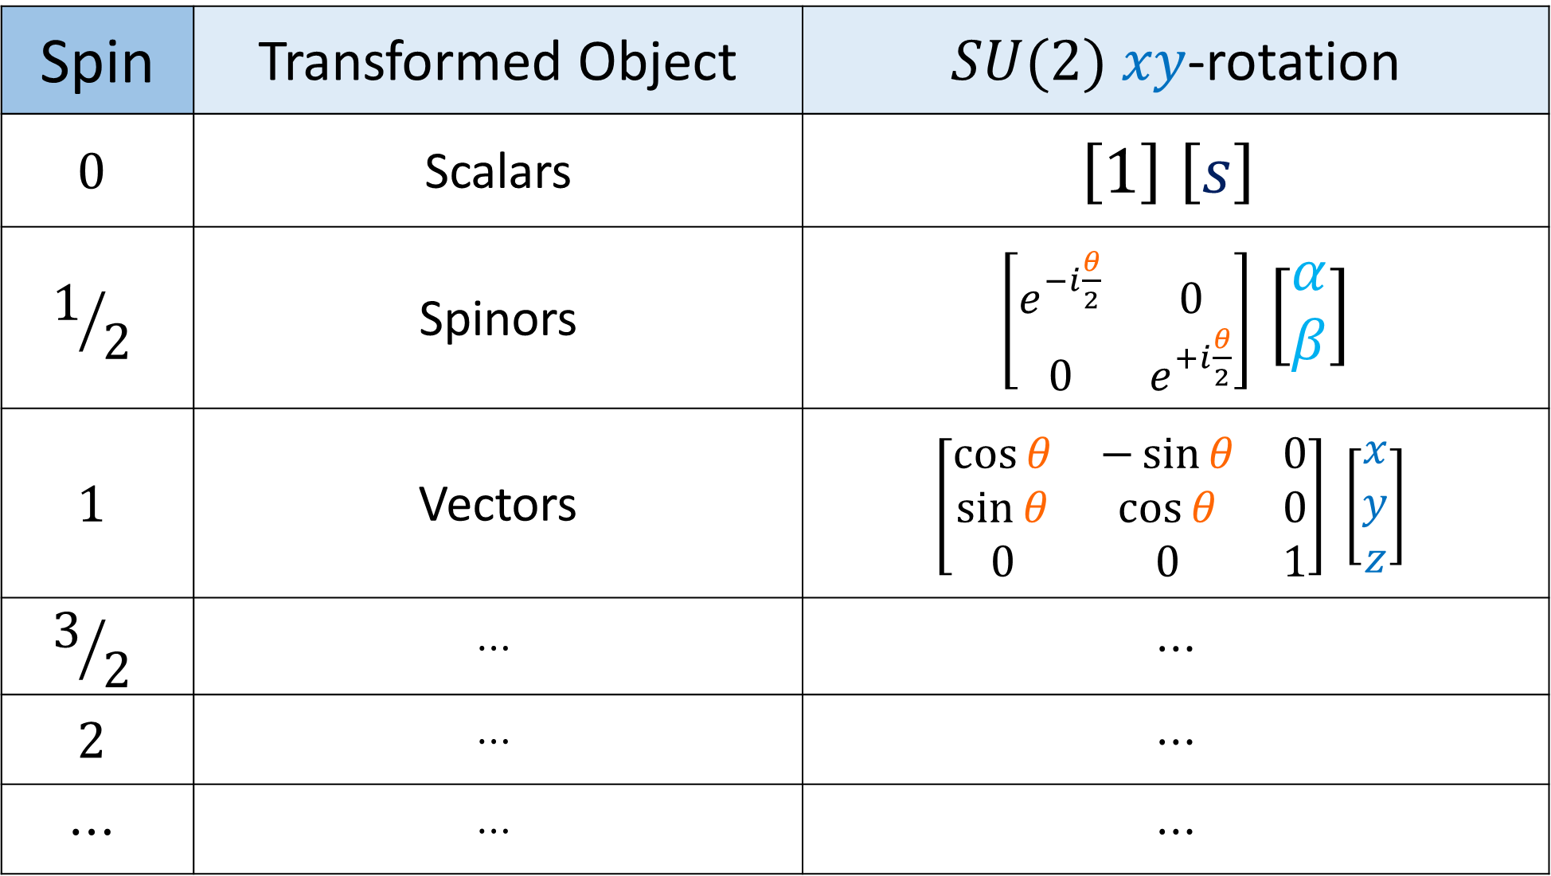
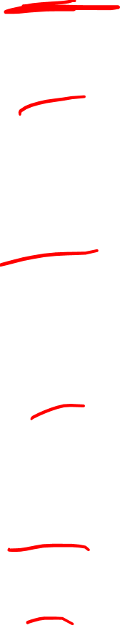
Spin | Transformed Object | $SU(2)$ $xy$-rotation
$$0$$ | Scalars | $$\left[1\right] \left[s\right]$$
$$1/2$$ | Spinors | $\left[\begin{matrix}e^{−i\frac{θ}{2}} & 0 \\ 0 & e^{+i\frac{θ}{2}}\end{matrix}\right]$ $\left[\begin{aligned}α \\ β\end{aligned}\right]$
$$1$$ | Vectors | $$\left[\begin{matrix}\cos{θ} & −\sin{θ} & 0 \\ \sin{θ} & \cos{θ} & 0 \\ 0 & 0 & 1\end{matrix}\right] \left[\begin{aligned}x \\ y \\ z\end{aligned}\right]$$
$$3/2$$ | $$⋯$$ | $$⋯$$
$$2$$ | $$⋯$$ | $$⋯$$
$$⋯$$ | $$⋯$$ | $$⋯$$

Slide 5
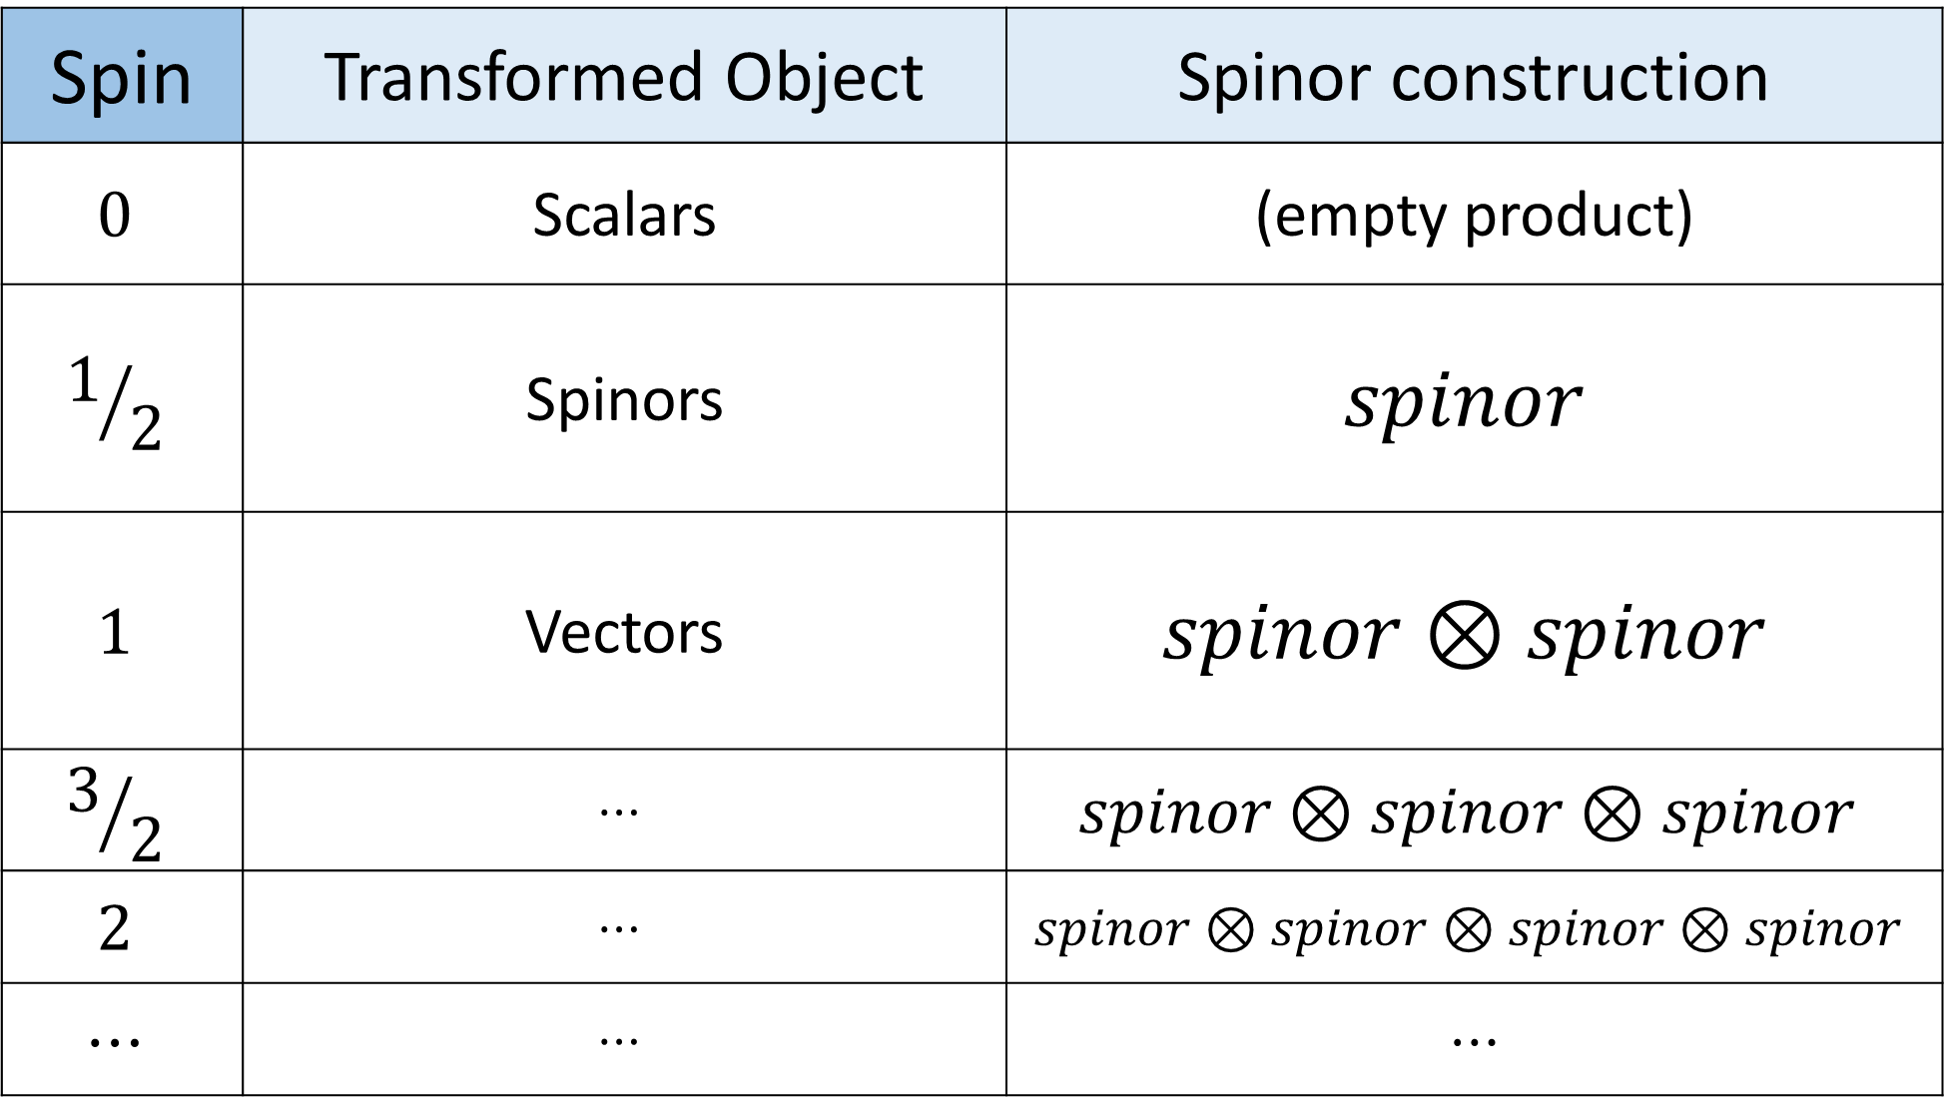
Spin | Transformed Object | Spinor construction
$$0$$ | Scalars | (empty product)
$$1/2$$ | Spinors | $$spinor$$
$$1$$ | Vectors | $$spinor⊗spinor$$
$$3/2$$ | $$⋯$$ | $$spinor⊗spinor⊗spinor$$
$$2$$ | $$⋯$$ | $$spinor⊗spinor⊗spinor⊗spinor$$
$$⋯$$ | $$⋯$$ | $$⋯$$

Slide 6











Multi-spinor systems:
$$e^{−}$$
$$⊗$$
$$e^{−}$$
solid
Cooper Pairs
/ BCS Pairs
$$e^{−}$$
$$e^{−}$$
spin-$1$
$$⊕$$
spin-$0$
(super-conductivity)
Bosons
spin-$\text{½}$
$$⊗$$
spin-$\text{½}$
Fermions
(Pauli exclusion principle)
Notes:
½

Slide 7

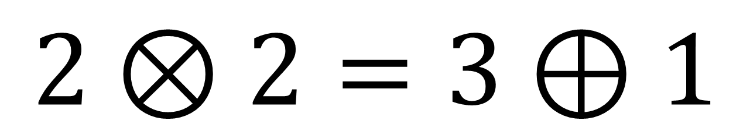
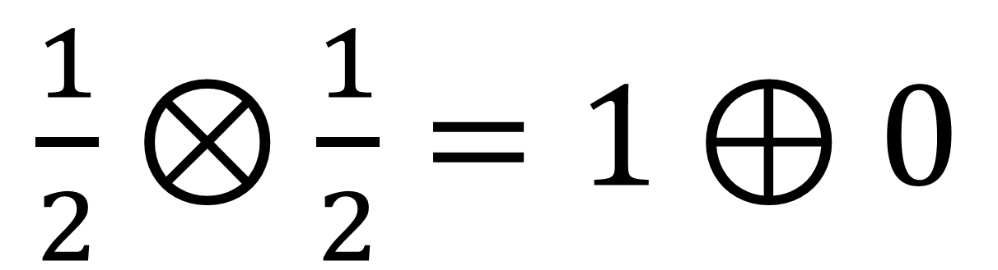
Tensor Product Representations:
$\frac{1}{2}⊗\frac{1}{2}=1⊕0$
Spins:
$$2⊗2=3⊕1$$
Dimension:
Notes:
½

Slide 8
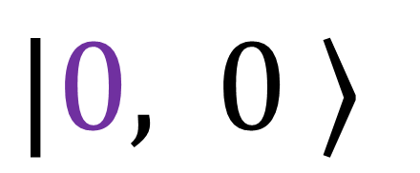
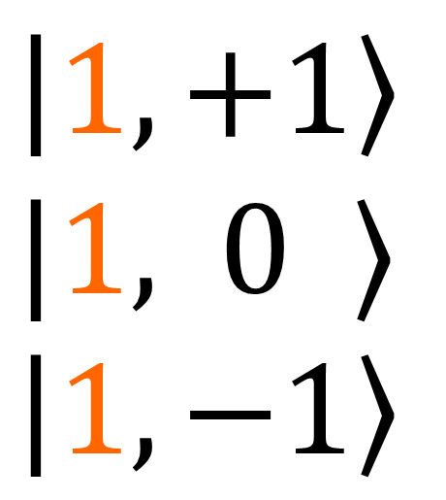
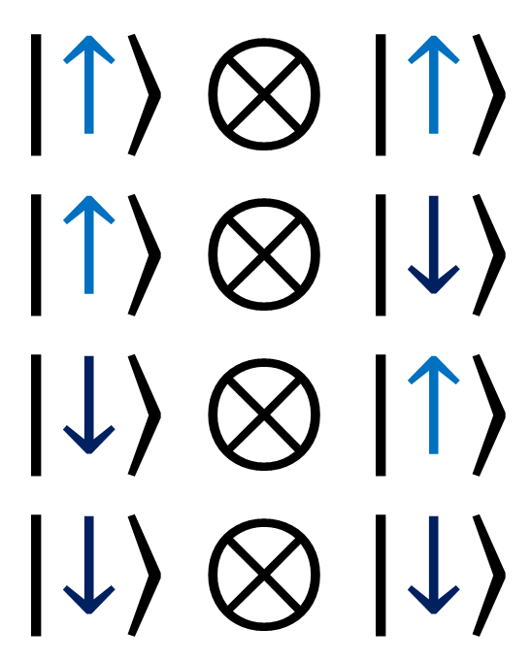
Total Angular Momentum Basis
Coupled Basis
$$\left|↑\right\rangle ⊗\left|↑\right\rangle$$
$$\left|↑\right\rangle ⊗\left|↓\right\rangle$$
$$\left|↓\right\rangle ⊗\left|↑\right\rangle$$
$$\left|↓\right\rangle ⊗\left|↓\right\rangle$$
$$\left|1,+1\right\rangle$$
$|1,$ $0 ⟩$
$$\left|1,−1\right\rangle$$
Clebsch-Gordon
Coefficients
$|0,$ $0 ⟩$
Notes:
½

Slide 9
3D Space
vs.
4D Spacetime

Slide 10
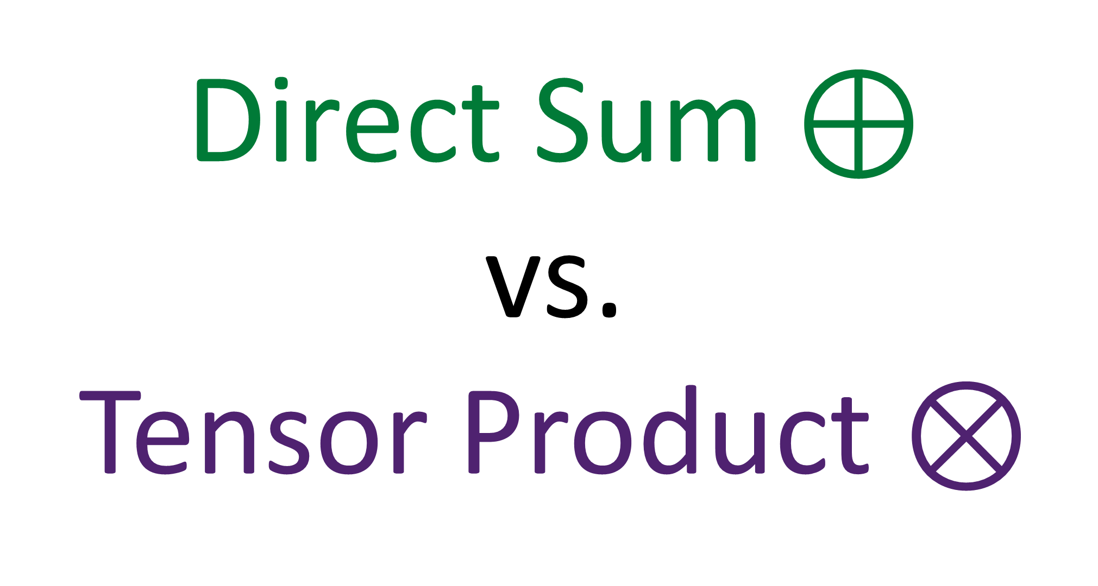
Direct Sum $⊕$
vs.
Tensor Product $⊗$

Slide 11


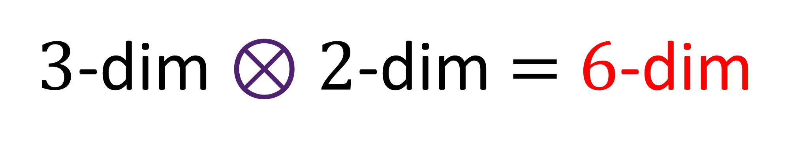
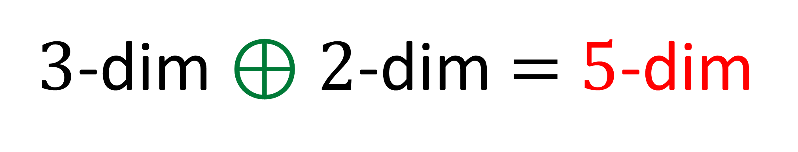
Direct Sum $⊕$
$3$-dim $⊕$ $2$-dim $=$ $5$-dim
Tensor Product $⊗$
$3$-dim $⊗$ $2$-dim $=$ $6$-dim

Slide 12
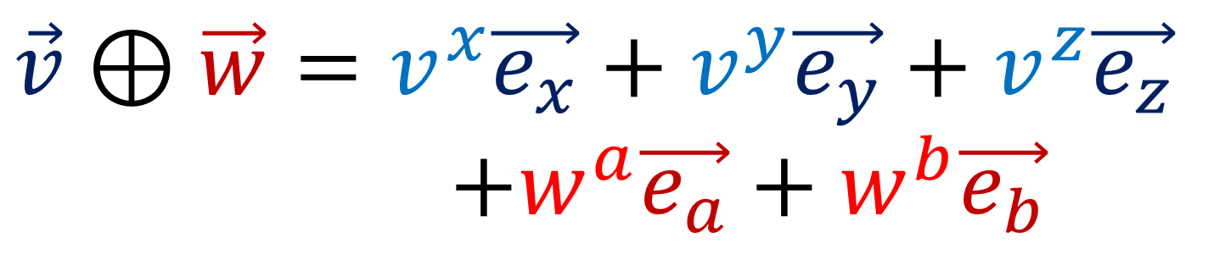
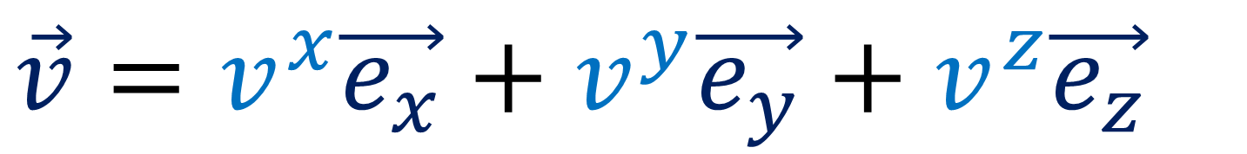
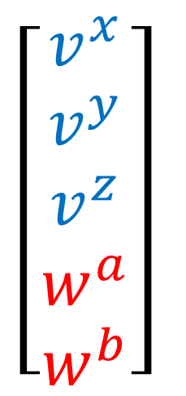
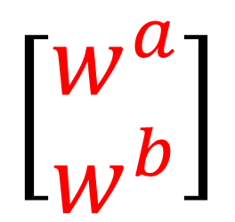
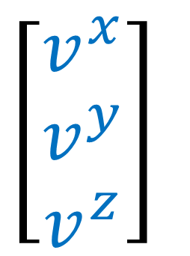
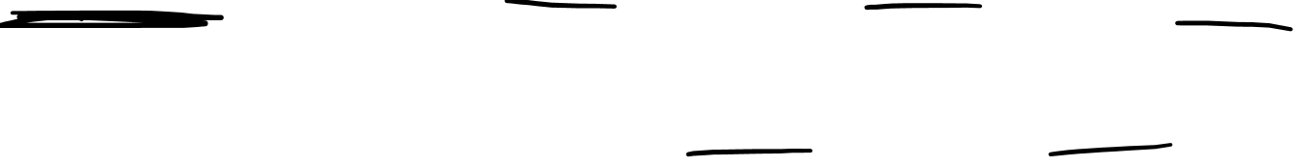
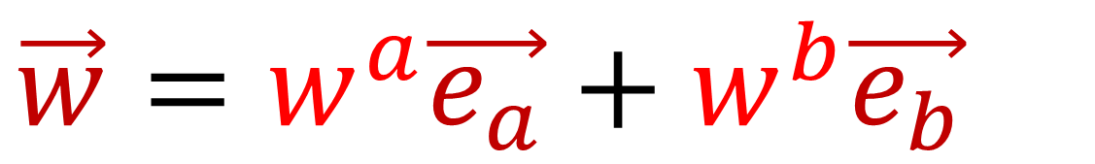
$$\left[\begin{aligned}v^{x} \\ v^{y} \\ v^{z}\end{aligned}\right]$$
$$\vec{v}=v^{x}\vec{e_{x}}+v^{y}\vec{e_{y}}+v^{z}\vec{e_{z}}$$
$$\left[\begin{aligned}w^{a} \\ w^{b}\end{aligned}\right]$$
$$\vec{w}=w^{a}\vec{e_{a}}+w^{b}\vec{e_{b}}$$
$$\left[\begin{aligned}v^{x} \\ v^{y} \\ v^{z} \\ w^{a} \\ w^{b}\end{aligned}\right]$$
$$\vec{v}⊕\vec{w}=v^{x}\vec{e_{x}}+v^{y}\vec{e_{y}}+v^{z}\vec{e_{z}}$$
$+w^{a}\vec{e_{a}}+w^{b}\vec{e_{b}}$

Slide 13

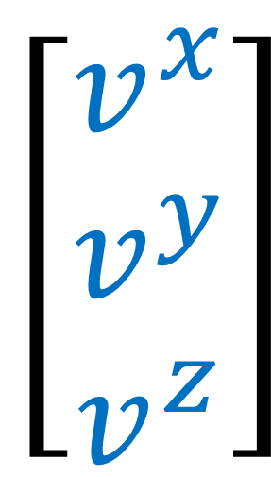

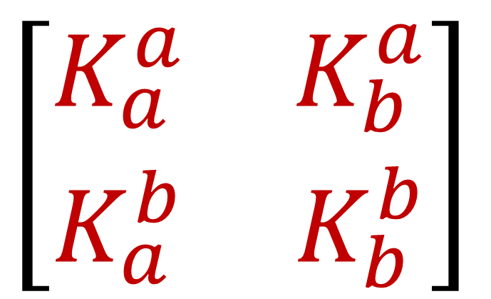
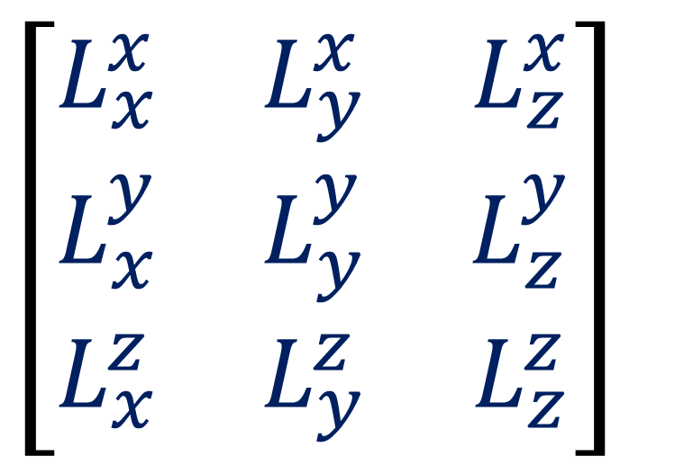
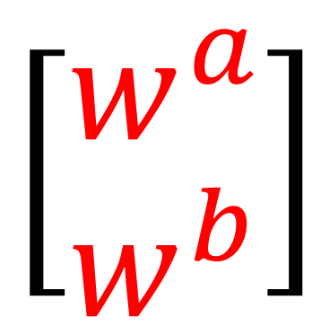
$$\left[\begin{matrix}L_{x}^{x} & L_{y}^{x} & L_{z}^{x} \\ L_{x}^{y} & L_{y}^{y} & L_{z}^{y} \\ L_{x}^{z} & L_{y}^{z} & L_{z}^{z}\end{matrix}\right]$$
$$\left[\begin{aligned}v^{x} \\ v^{y} \\ v^{z}\end{aligned}\right]$$
$$L\vec{v}$$
$$\left[\begin{matrix}K_{a}^{a} & K_{b}^{a} \\ K_{a}^{b} & K_{b}^{b}\end{matrix}\right]$$
$$\left[\begin{aligned}w^{a} \\ w^{b}\end{aligned}\right]$$
$$K\vec{w}$$

Slide 14
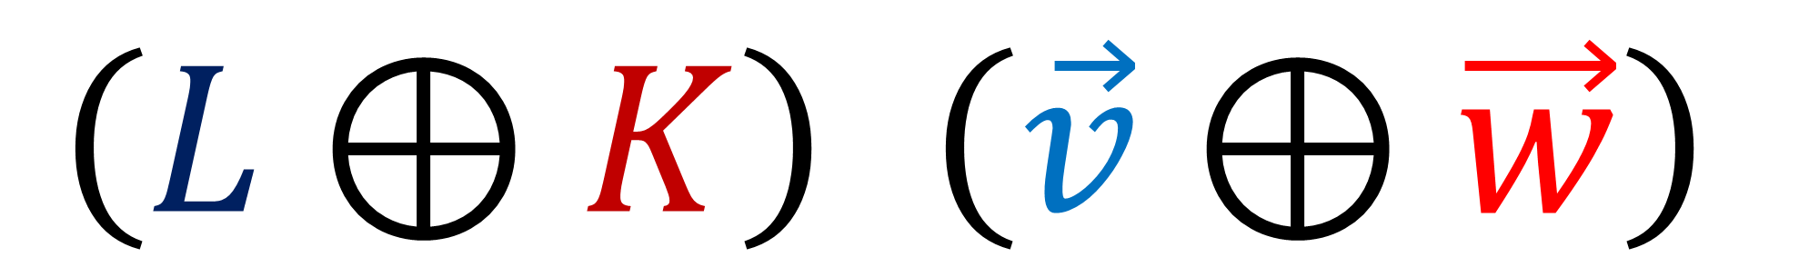



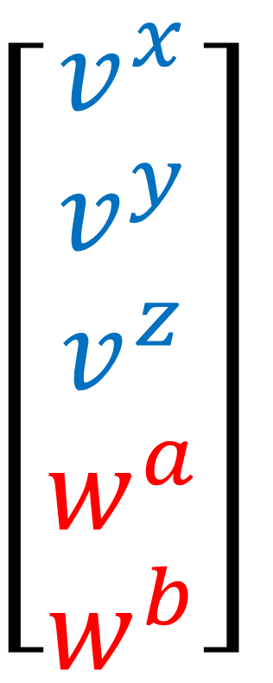

$$\left(L⊕K\right) \left(\vec{v}⊕\vec{w}\right)$$
$$\left[\begin{matrix}\begin{matrix}L_{x}^{x} & L_{y}^{x} & L_{z}^{x} \\ L_{x}^{y} & L_{y}^{y} & L_{z}^{y} \\ L_{x}^{z} & L_{y}^{z} & L_{z}^{z}\end{matrix} & \\ & \begin{matrix}K_{a}^{a} & K_{b}^{a} \\ K_{a}^{b} & K_{b}^{b}\end{matrix}\end{matrix}\right]$$
$$\left[\begin{aligned}v^{x} \\ v^{y} \\ v^{z} \\ w^{a} \\ w^{b}\end{aligned}\right]$$
$$\begin{matrix}\begin{aligned}0 \\ 0 \\ 0\end{aligned} & \begin{aligned}0 \\ 0 \\ 0\end{aligned}\end{matrix}$$
$$\begin{matrix}0 & 0 & 0 \\ 0 & 0 & 0\end{matrix}$$

Slide 15
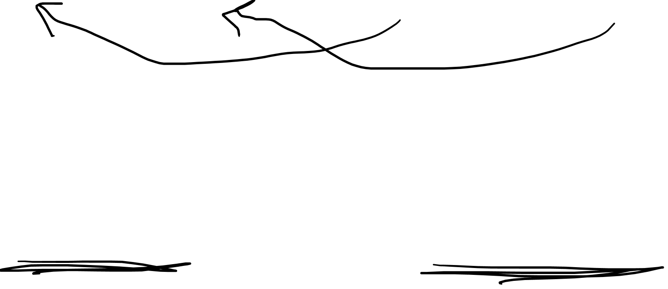
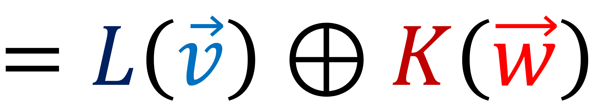
$$\left(L⊕K\right) \left(\vec{v}⊕\vec{w}\right)$$
$$=L\left(\vec{v}\right)⊕K\left(\vec{w}\right)$$

Slide 16
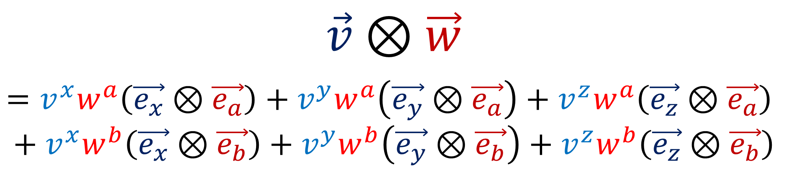
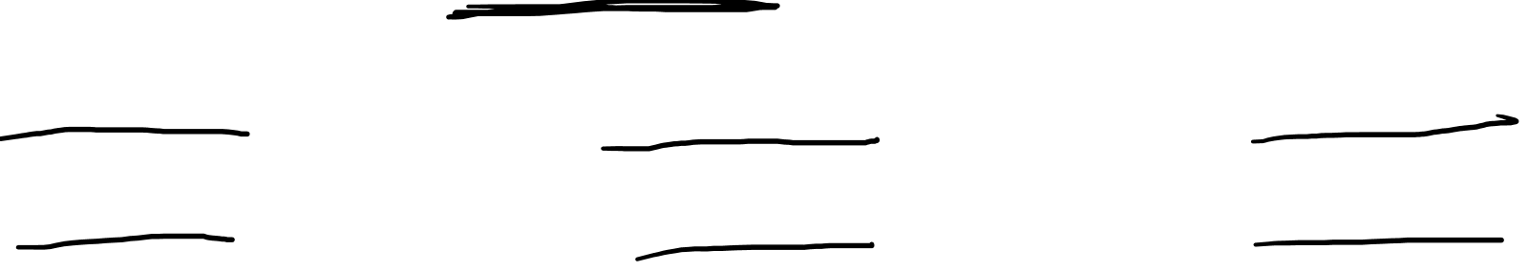
$$\left[\begin{aligned}v^{x} \\ v^{y} \\ v^{z}\end{aligned}\right]$$
$$\vec{v}=v^{x}\vec{e_{x}}+v^{y}\vec{e_{y}}+v^{z}\vec{e_{z}}$$
$$\left[\begin{aligned}w^{a} \\ w^{b}\end{aligned}\right]$$
$$\vec{w}=w^{a}\vec{e_{a}}+w^{b}\vec{e_{b}}$$
$$\vec{v}⊗\vec{w}$$
$$=v^{x}w^{a}\left(\vec{e_{x}}⊗\vec{e_{a}}\right)+v^{y}w^{a}\left(\vec{e_{y}}⊗\vec{e_{a}}\right)+v^{z}w^{a}\left(\vec{e_{z}}⊗\vec{e_{a}}\right)$$
$$+ v^{x}w^{b}\left(\vec{e_{x}}⊗\vec{e_{b}}\right)+v^{y}w^{b}\left(\vec{e_{y}}⊗\vec{e_{b}}\right)+v^{z}w^{b}\left(\vec{e_{z}}⊗\vec{e_{b}}\right)$$

Slide 17
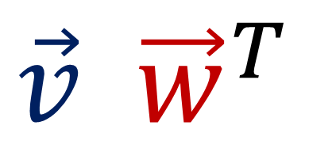
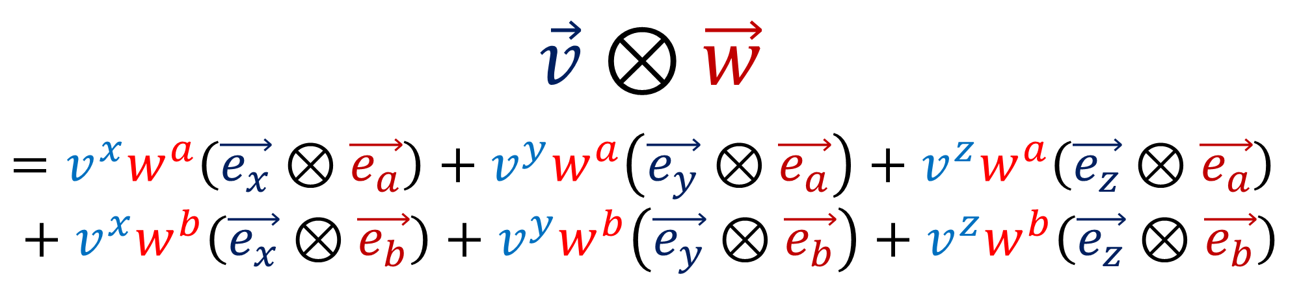
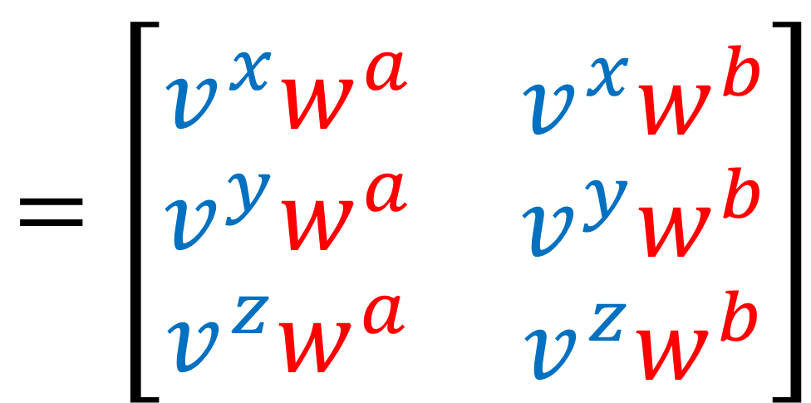
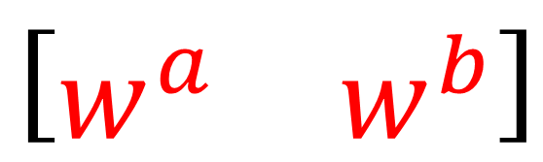
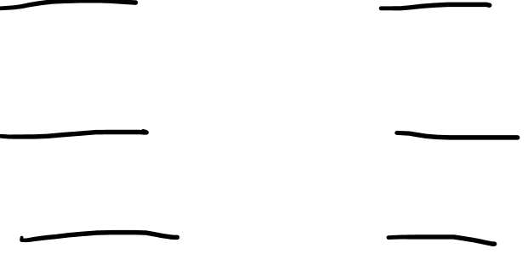
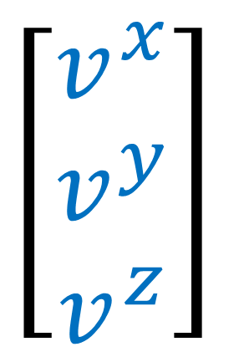
$$\vec{v}⊗\vec{w}$$
$$=v^{x}w^{a}\left(\vec{e_{x}}⊗\vec{e_{a}}\right)+v^{y}w^{a}\left(\vec{e_{y}}⊗\vec{e_{a}}\right)+v^{z}w^{a}\left(\vec{e_{z}}⊗\vec{e_{a}}\right)$$
$$+ v^{x}w^{b}\left(\vec{e_{x}}⊗\vec{e_{b}}\right)+v^{y}w^{b}\left(\vec{e_{y}}⊗\vec{e_{b}}\right)+v^{z}w^{b}\left(\vec{e_{z}}⊗\vec{e_{b}}\right)$$
$$\vec{v} {\vec{w}}^{T}$$
$$=\left[\begin{matrix}\begin{aligned}v^{x}w^{a} \\ v^{y}w^{a} \\ v^{z}w^{a}\end{aligned} & \begin{aligned}v^{x}w^{b} \\ v^{y}w^{b} \\ v^{z}w^{b}\end{aligned}\end{matrix}\right]$$
$$\left[\begin{aligned}v^{x} \\ v^{y} \\ v^{z}\end{aligned}\right]$$
$$\left[\begin{matrix}w^{a} & w^{b}\end{matrix}\right]$$

Slide 18





$$\vec{v}$$
$$⊗$$
$${\vec{w}}^{T}$$
$$\left[\begin{aligned}v^{x} \\ v^{y} \\ v^{z}\end{aligned}\right]$$
$$\left[\begin{matrix}w^{a} & w^{b}\end{matrix}\right]$$
dual vector
vector

Slide 19
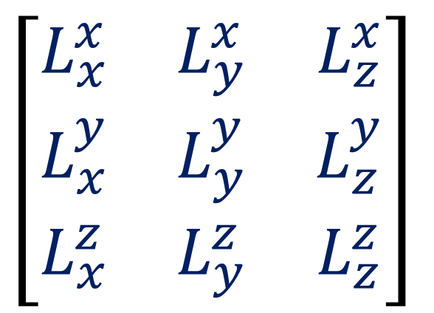

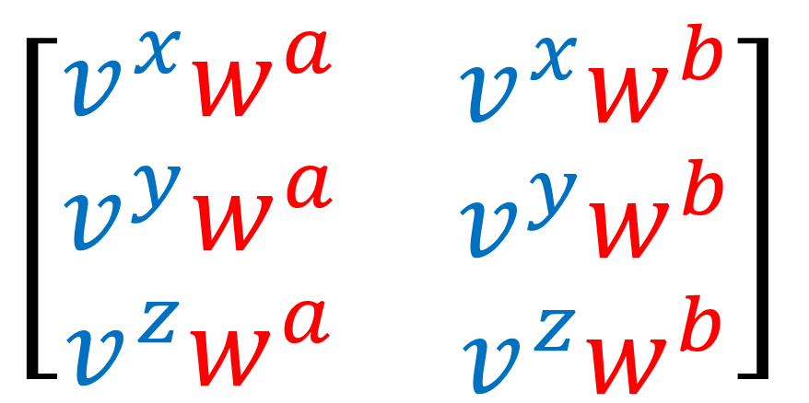
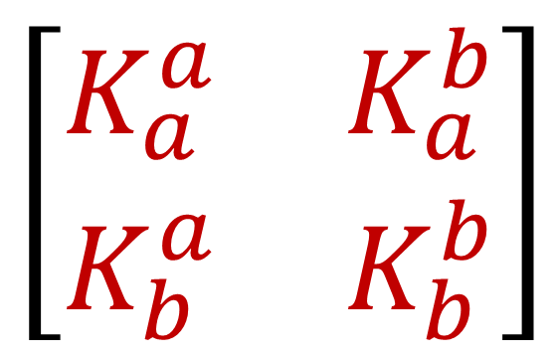
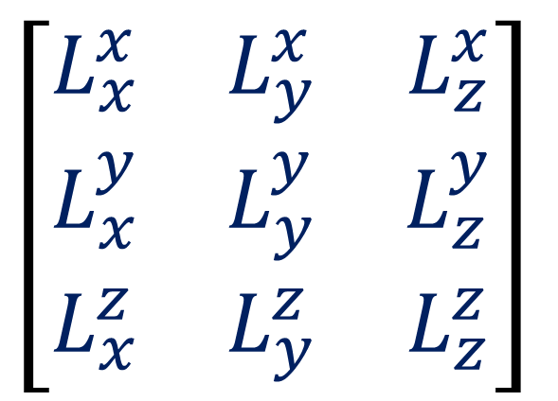


$$L$$
$$\vec{v}$$
$$⊗$$
$${\vec{w}}^{T}$$
$$K^{T}$$
$$\left[\begin{matrix}L_{x}^{x} & L_{y}^{x} & L_{z}^{x} \\ L_{x}^{y} & L_{y}^{y} & L_{z}^{y} \\ L_{x}^{z} & L_{y}^{z} & L_{z}^{z}\end{matrix}\right]$$
$$\left[\begin{aligned}v^{x} \\ v^{y} \\ v^{z}\end{aligned}\right]$$
$$\left[\begin{matrix}K_{a}^{a} & K_{a}^{b} \\ K_{b}^{a} & K_{b}^{b}\end{matrix}\right]$$
$$\left[\begin{matrix}w^{a} & w^{b}\end{matrix}\right]$$
$$\left[\begin{matrix}L_{x}^{x} & L_{y}^{x} & L_{z}^{x} \\ L_{x}^{y} & L_{y}^{y} & L_{z}^{y} \\ L_{x}^{z} & L_{y}^{z} & L_{z}^{z}\end{matrix}\right]$$
$$\left[\begin{matrix}\begin{aligned}v^{x}w^{a} \\ v^{y}w^{a} \\ v^{z}w^{a}\end{aligned} & \begin{aligned}v^{x}w^{b} \\ v^{y}w^{b} \\ v^{z}w^{b}\end{aligned}\end{matrix}\right]$$
$$\left[\begin{matrix}K_{a}^{a} & K_{a}^{b} \\ K_{b}^{a} & K_{b}^{b}\end{matrix}\right]$$

Slide 20


$$L$$
$$\vec{v}$$
$$⊗$$
$${\vec{w}}^{†}$$
$$K^{†}$$
$$\left[\begin{matrix}L_{x}^{x} & L_{y}^{x} & L_{z}^{x} \\ L_{x}^{y} & L_{y}^{y} & L_{z}^{y} \\ L_{x}^{z} & L_{y}^{z} & L_{z}^{z}\end{matrix}\right]$$
$$\left[\begin{aligned}v^{x} \\ v^{y} \\ v^{z}\end{aligned}\right]$$
$$\left[\begin{matrix}K_{a}^{a} & K_{a}^{b} \\ K_{b}^{a} & K_{b}^{b}\end{matrix}\right]$$
$$\left[\begin{matrix}w^{a} & w^{b}\end{matrix}\right]$$
$$\left[\begin{matrix}L_{x}^{x} & L_{y}^{x} & L_{z}^{x} \\ L_{x}^{y} & L_{y}^{y} & L_{z}^{y} \\ L_{x}^{z} & L_{y}^{z} & L_{z}^{z}\end{matrix}\right]$$
$$\left[\begin{matrix}\begin{aligned}v^{x}w^{a} \\ v^{y}w^{a} \\ v^{z}w^{a}\end{aligned} & \begin{aligned}v^{x}w^{b} \\ v^{y}w^{b} \\ v^{z}w^{b}\end{aligned}\end{matrix}\right]$$
$$\left[\begin{matrix}K_{a}^{a} & K_{a}^{b} \\ K_{b}^{a} & K_{b}^{b}\end{matrix}\right]$$

Slide 21
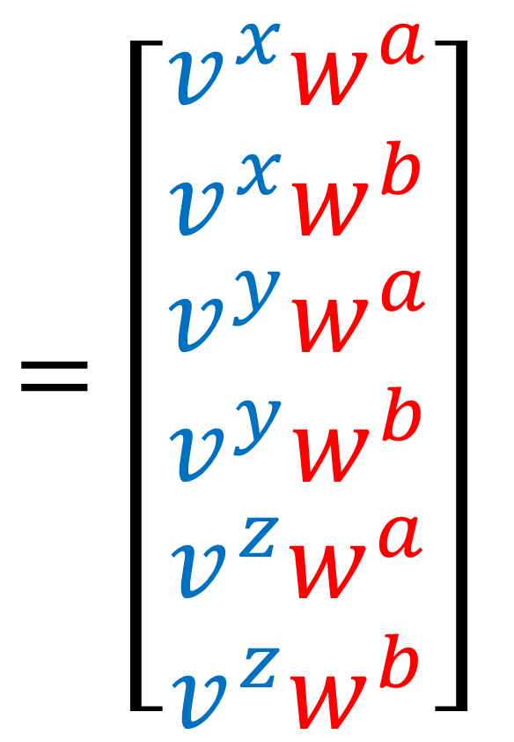
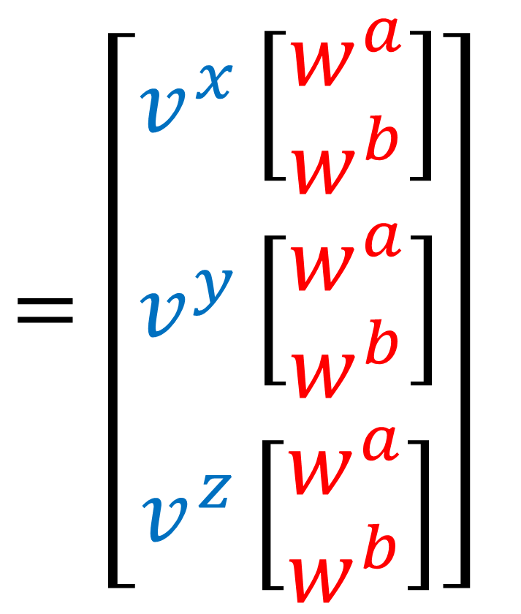


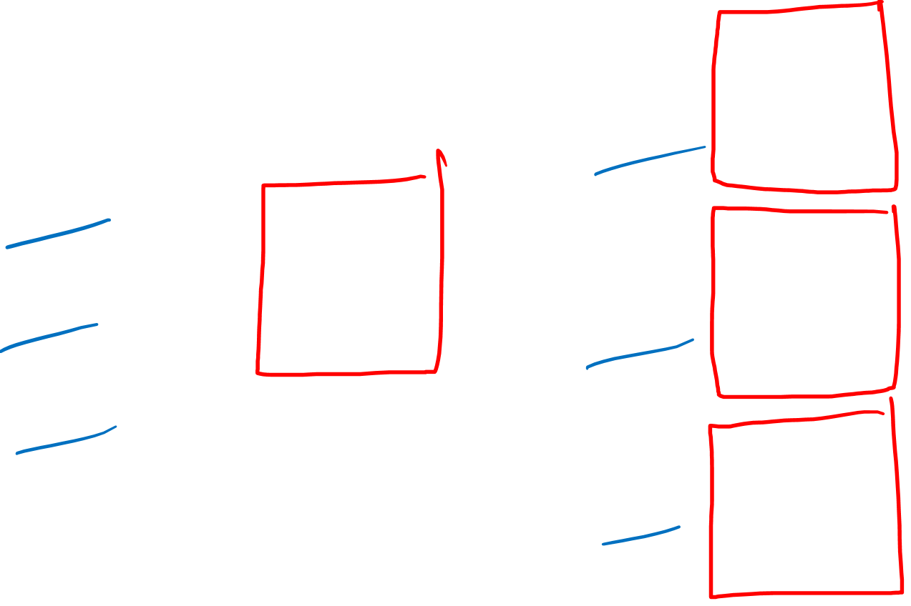

Kronecker Product of arrays
$$=\left[\begin{aligned}v^{x}\left[\begin{aligned}w^{a} \\ w^{b}\end{aligned}\right] \\ v^{y}\left[\begin{aligned}w^{a} \\ w^{b}\end{aligned}\right] \\ v^{z}\left[\begin{aligned}w^{a} \\ w^{b}\end{aligned}\right]\end{aligned}\right]$$
$$=\left[\begin{aligned}\begin{aligned}v^{x}w^{a} \\ v^{x}w^{b}\end{aligned} \\ \begin{aligned}v^{y}w^{a} \\ v^{y}w^{b}\end{aligned} \\ \begin{aligned}v^{z}w^{a} \\ v^{z}w^{b}\end{aligned}\end{aligned}\right]$$
$$\left[\begin{aligned}v^{x} \\ v^{y} \\ v^{z}\end{aligned}\right]$$
$$\left[\begin{aligned}w^{a} \\ w^{b}\end{aligned}\right]$$
$$⊗$$

Slide 22
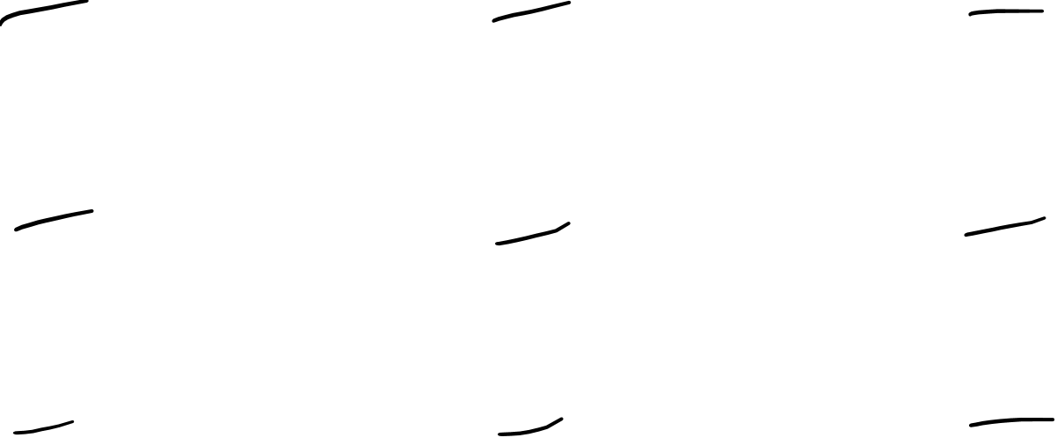




$$\left[\begin{matrix}L_{x}^{x} & L_{y}^{x} & L_{z}^{x} \\ L_{x}^{y} & L_{y}^{y} & L_{z}^{y} \\ L_{x}^{z} & L_{y}^{z} & L_{z}^{z}\end{matrix}\right]$$
$$\left[\begin{matrix}K_{a}^{a} & K_{b}^{a} \\ K_{a}^{b} & K_{b}^{b}\end{matrix}\right]$$
$$⊗$$
$$=\left[\begin{matrix}L_{x}^{x}\left[\begin{matrix}K_{a}^{a} & K_{b}^{a} \\ K_{a}^{b} & K_{b}^{b}\end{matrix}\right] & L_{y}^{x}\left[\begin{matrix}K_{a}^{a} & K_{b}^{a} \\ K_{a}^{b} & K_{b}^{b}\end{matrix}\right] & L_{z}^{x}\left[\begin{matrix}K_{a}^{a} & K_{b}^{a} \\ K_{a}^{b} & K_{b}^{b}\end{matrix}\right] \\ L_{x}^{y}\left[\begin{matrix}K_{a}^{a} & K_{b}^{a} \\ K_{a}^{b} & K_{b}^{b}\end{matrix}\right] & L_{y}^{y}\left[\begin{matrix}K_{a}^{a} & K_{b}^{a} \\ K_{a}^{b} & K_{b}^{b}\end{matrix}\right] & L_{z}^{y}\left[\begin{matrix}K_{a}^{a} & K_{b}^{a} \\ K_{a}^{b} & K_{b}^{b}\end{matrix}\right] \\ L_{x}^{z}\left[\begin{matrix}K_{a}^{a} & K_{b}^{a} \\ K_{a}^{b} & K_{b}^{b}\end{matrix}\right] & L_{y}^{z}\left[\begin{matrix}K_{a}^{a} & K_{b}^{a} \\ K_{a}^{b} & K_{b}^{b}\end{matrix}\right] & L_{z}^{z}\left[\begin{matrix}K_{a}^{a} & K_{b}^{a} \\ K_{a}^{b} & K_{b}^{b}\end{matrix}\right]\end{matrix}\right]$$

Slide 23

$$\left[\begin{matrix}L_{x}^{x} & L_{y}^{x} & L_{z}^{x} \\ L_{x}^{y} & L_{y}^{y} & L_{z}^{y} \\ L_{x}^{z} & L_{y}^{z} & L_{z}^{z}\end{matrix}\right]$$
$$\left[\begin{matrix}K_{a}^{a} & K_{b}^{a} \\ K_{a}^{b} & K_{b}^{b}\end{matrix}\right]$$
$$⊗$$
$$=\left[\begin{matrix}\begin{matrix}L_{x}^{x}K_{a}^{a} & L_{x}^{x}K_{b}^{a} \\ L_{x}^{x}K_{a}^{b} & L_{x}^{x}K_{b}^{b}\end{matrix} & \begin{matrix}L_{y}^{x}K_{a}^{a} & L_{y}^{x}K_{b}^{a} \\ L_{y}^{x}K_{a}^{b} & L_{y}^{x}K_{b}^{b}\end{matrix} & \begin{matrix}L_{z}^{x}K_{a}^{a} & L_{z}^{x}K_{b}^{a} \\ L_{z}^{x}K_{a}^{b} & L_{z}^{x}K_{b}^{b}\end{matrix} \\ \begin{matrix}L_{x}^{y}K_{a}^{a} & L_{x}^{y}K_{b}^{a} \\ L_{x}^{y}K_{a}^{b} & L_{x}^{y}K_{b}^{b}\end{matrix} & \begin{matrix}L_{y}^{y}K_{a}^{a} & L_{y}^{y}K_{b}^{a} \\ L_{y}^{y}K_{a}^{b} & L_{y}^{y}K_{b}^{b}\end{matrix} & \begin{matrix}L_{z}^{y}K_{a}^{a} & L_{z}^{y}K_{b}^{a} \\ L_{z}^{y}K_{a}^{b} & L_{z}^{y}K_{b}^{b}\end{matrix} \\ \begin{matrix}L_{x}^{z}K_{a}^{a} & L_{x}^{z}K_{b}^{a} \\ L_{x}^{z}K_{a}^{b} & L_{x}^{z}K_{b}^{b}\end{matrix} & \begin{matrix}L_{y}^{z}K_{a}^{a} & L_{y}^{z}K_{b}^{a} \\ L_{y}^{z}K_{a}^{b} & L_{y}^{z}K_{b}^{b}\end{matrix} & \begin{matrix}L_{z}^{z}K_{a}^{a} & L_{z}^{z}K_{b}^{a} \\ L_{z}^{z}K_{a}^{b} & L_{z}^{z}K_{b}^{b}\end{matrix}\end{matrix}\right]$$

Slide 24




$$\left(L⊗K\right) \left(\vec{v}⊗\vec{w}\right)$$
$$\left[\begin{matrix}L_{x}^{x}\left[\begin{matrix}K_{a}^{a} & K_{b}^{a} \\ K_{a}^{b} & K_{b}^{b}\end{matrix}\right] & L_{y}^{x}\left[\begin{matrix}K_{a}^{a} & K_{b}^{a} \\ K_{a}^{b} & K_{b}^{b}\end{matrix}\right] & L_{z}^{x}\left[\begin{matrix}K_{a}^{a} & K_{b}^{a} \\ K_{a}^{b} & K_{b}^{b}\end{matrix}\right] \\ L_{x}^{y}\left[\begin{matrix}K_{a}^{a} & K_{b}^{a} \\ K_{a}^{b} & K_{b}^{b}\end{matrix}\right] & L_{y}^{y}\left[\begin{matrix}K_{a}^{a} & K_{b}^{a} \\ K_{a}^{b} & K_{b}^{b}\end{matrix}\right] & L_{z}^{y}\left[\begin{matrix}K_{a}^{a} & K_{b}^{a} \\ K_{a}^{b} & K_{b}^{b}\end{matrix}\right] \\ L_{x}^{z}\left[\begin{matrix}K_{a}^{a} & K_{b}^{a} \\ K_{a}^{b} & K_{b}^{b}\end{matrix}\right] & L_{y}^{z}\left[\begin{matrix}K_{a}^{a} & K_{b}^{a} \\ K_{a}^{b} & K_{b}^{b}\end{matrix}\right] & L_{z}^{z}\left[\begin{matrix}K_{a}^{a} & K_{b}^{a} \\ K_{a}^{b} & K_{b}^{b}\end{matrix}\right]\end{matrix}\right]$$
$$\left[\begin{aligned}v^{x}\left[\begin{aligned}w^{a} \\ w^{b}\end{aligned}\right] \\ v^{y}\left[\begin{aligned}w^{a} \\ w^{b}\end{aligned}\right] \\ v^{z}\left[\begin{aligned}w^{a} \\ w^{b}\end{aligned}\right]\end{aligned}\right]$$

Slide 25


$$\left(L⊗K\right) \left(\vec{v}⊗\vec{w}\right)$$
$$\left[\begin{matrix}\begin{matrix}L_{x}^{x}K_{a}^{a} & L_{x}^{x}K_{b}^{a} \\ L_{x}^{x}K_{a}^{b} & L_{x}^{x}K_{b}^{b}\end{matrix} & \begin{matrix}L_{y}^{x}K_{a}^{a} & L_{y}^{x}K_{b}^{a} \\ L_{y}^{x}K_{a}^{b} & L_{y}^{x}K_{b}^{b}\end{matrix} & \begin{matrix}L_{z}^{x}K_{a}^{a} & L_{z}^{x}K_{b}^{a} \\ L_{z}^{x}K_{a}^{b} & L_{z}^{x}K_{b}^{b}\end{matrix} \\ \begin{matrix}L_{x}^{y}K_{a}^{a} & L_{x}^{y}K_{b}^{a} \\ L_{x}^{y}K_{a}^{b} & L_{x}^{y}K_{b}^{b}\end{matrix} & \begin{matrix}L_{y}^{y}K_{a}^{a} & L_{y}^{y}K_{b}^{a} \\ L_{y}^{y}K_{a}^{b} & L_{y}^{y}K_{b}^{b}\end{matrix} & \begin{matrix}L_{z}^{y}K_{a}^{a} & L_{z}^{y}K_{b}^{a} \\ L_{z}^{y}K_{a}^{b} & L_{z}^{y}K_{b}^{b}\end{matrix} \\ \begin{matrix}L_{x}^{z}K_{a}^{a} & L_{x}^{z}K_{b}^{a} \\ L_{x}^{z}K_{a}^{b} & L_{x}^{z}K_{b}^{b}\end{matrix} & \begin{matrix}L_{y}^{z}K_{a}^{a} & L_{y}^{z}K_{b}^{a} \\ L_{y}^{z}K_{a}^{b} & L_{y}^{z}K_{b}^{b}\end{matrix} & \begin{matrix}L_{z}^{z}K_{a}^{a} & L_{z}^{z}K_{b}^{a} \\ L_{z}^{z}K_{a}^{b} & L_{z}^{z}K_{b}^{b}\end{matrix}\end{matrix}\right]$$
$$\left[\begin{aligned}\begin{aligned}v^{x}w^{a} \\ v^{x}w^{b}\end{aligned} \\ \begin{aligned}v^{y}w^{a} \\ v^{y}w^{b}\end{aligned} \\ \begin{aligned}v^{z}w^{a} \\ v^{z}w^{b}\end{aligned}\end{aligned}\right]$$

Slide 26


$$\left(L⊗K\right) \left(\vec{v}⊗\vec{w}\right)$$
$$=L\left(\vec{v}\right)⊗K\left(\vec{w}\right)$$

Slide 27


Scaling
$$n\left(\vec{v}⊕\vec{w}\right)$$
$$n\left(\vec{v}⊗\vec{w}\right)$$

Slide 28




$$n\left(\vec{v}⊕\vec{w}\right)$$
$$=\left(n\vec{v}\right)⊕\left(n\vec{w}\right)$$
$$n\left[\begin{aligned}v^{x} \\ v^{y} \\ v^{z} \\ w^{a} \\ w^{b}\end{aligned}\right]$$
$$=\left[\begin{aligned}nv^{x} \\ nv^{y} \\ nv^{z} \\ nw^{a} \\ nw^{b}\end{aligned}\right]$$

Slide 29






$$n\left(\vec{v}⊗\vec{w}\right)$$
$$=\left(n\vec{v}\right)⊗\vec{w}$$
$$=\vec{v}⊗\left(n\vec{w}\right)$$
$$=\left[\begin{aligned}\begin{aligned}v^{x}\left(nw^{a}\right) \\ v^{x}\left(nw^{b}\right)\end{aligned} \\ \begin{aligned}v^{y}\left(nw^{a}\right) \\ v^{y}\left(nw^{b}\right)\end{aligned} \\ \begin{aligned}v^{z}\left(nw^{a}\right) \\ v^{z}\left(nw^{b}\right)\end{aligned}\end{aligned}\right]$$
$n\left[\begin{aligned}\begin{aligned}v^{x}w^{a} \\ v^{x}w^{b}\end{aligned} \\ \begin{aligned}v^{y}w^{a} \\ v^{y}w^{b}\end{aligned} \\ \begin{aligned}v^{z}w^{a} \\ v^{z}w^{b}\end{aligned}\end{aligned}\right]$
$$=\left[\begin{aligned}\begin{aligned}\left(nv^{x}\right)w^{a} \\ \left(nv^{x}\right)w^{b}\end{aligned} \\ \begin{aligned}\left(nv^{y}\right)w^{a} \\ \left(nv^{y}\right)w^{b}\end{aligned} \\ \begin{aligned}\left(nv^{z}\right)w^{a} \\ \left(nv^{z}\right)w^{b}\end{aligned}\end{aligned}\right]$$

Slide 30








$$\vec{v}⊗\left(\vec{w}+\vec{u}\right)$$
$$=\vec{v}⊗\vec{w}+\vec{v}⊗\vec{u}$$
$$\left[\begin{aligned}v^{x}\left[\begin{aligned}w^{a}+u^{a} \\ w^{b}+u^{b}\end{aligned}\right] \\ v^{y}\left[\begin{aligned}w^{a}+u^{a} \\ w^{b}+u^{b}\end{aligned}\right] \\ v^{z}\left[\begin{aligned}w^{a}+u^{a} \\ w^{b}+u^{b}\end{aligned}\right]\end{aligned}\right]$$
$$= \left[\begin{aligned}v^{x}\left[\begin{aligned}w^{a} \\ w^{b}\end{aligned}\right] \\ v^{y}\left[\begin{aligned}w^{a} \\ w^{b}\end{aligned}\right] \\ v^{z}\left[\begin{aligned}w^{a} \\ w^{b}\end{aligned}\right]\end{aligned}\right] + \left[\begin{aligned}v^{x}\left[\begin{aligned}u^{a} \\ u^{b}\end{aligned}\right] \\ v^{y}\left[\begin{aligned}u^{a} \\ u^{b}\end{aligned}\right] \\ v^{z}\left[\begin{aligned}u^{a} \\ u^{b}\end{aligned}\right]\end{aligned}\right]$$
$$\left(\vec{v}+\vec{s}\right)⊗\vec{w}$$
$$=\vec{v}⊗\vec{w}+\vec{s}⊗\vec{w}$$
$$\left[\begin{aligned}\left(v^{x}+s^{x}\right)\left[\begin{aligned}w^{a} \\ w^{b}\end{aligned}\right] \\ \left(v^{y}+s^{y}\right)\left[\begin{aligned}w^{a} \\ w^{b}\end{aligned}\right] \\ \left(v^{z}+s^{z}\right)\left[\begin{aligned}w^{a} \\ w^{b}\end{aligned}\right]\end{aligned}\right]$$
$$= \left[\begin{aligned}v^{x}\left[\begin{aligned}w^{a} \\ w^{b}\end{aligned}\right] \\ v^{y}\left[\begin{aligned}w^{a} \\ w^{b}\end{aligned}\right] \\ v^{z}\left[\begin{aligned}w^{a} \\ w^{b}\end{aligned}\right]\end{aligned}\right] + \left[\begin{aligned}s^{x}\left[\begin{aligned}w^{a} \\ w^{b}\end{aligned}\right] \\ s^{y}\left[\begin{aligned}w^{a} \\ w^{b}\end{aligned}\right] \\ s^{z}\left[\begin{aligned}w^{a} \\ w^{b}\end{aligned}\right]\end{aligned}\right]$$

Slide 31






Tensor Product $⊗$
$6×6$ map
$6D$ vector
$$\left(L⊗K\right)\left(\vec{v}⊗\vec{w}\right)$$
$=L\left(\vec{v}\right)⊗K\left(\vec{w}\right)$
$6D$ vector

Slide 32

Multi-Particle Systems:
$$\left|ψ_{AB}\right\rangle =\left|ψ_{A}\right\rangle ⊗\left|ψ_{B}\right\rangle$$

Slide 33






Particle #1
Combined System
$$\left|↑\right\rangle$$
$$\left|↑\right\rangle ⊗\left|↑\right\rangle$$
$$\left|↑\right\rangle ⊗\left|↓\right\rangle$$
$$\left|↓\right\rangle ⊗\left|↑\right\rangle$$
$$\left|↓\right\rangle ⊗\left|↓\right\rangle$$
$$\left|↓\right\rangle$$
$$⊗$$
Particle #2
$$\left|↑\right\rangle$$
$$\left|↓\right\rangle$$

Slide 34




$$U∈SU\left(2\right)$$
$$\left(U⊗U\right)\left(\left|↑\right\rangle ⊗\left|↓\right\rangle \right)$$
$$=U\left|↑\right\rangle ⊗U\left|↓\right\rangle$$

Slide 35







Particle #1
Combined System
$$\left|↑\right\rangle$$
$$\left|↑\right\rangle ⊗\left|↑\right\rangle ⊗\left|↑\right\rangle$$
$$\left|↑\right\rangle ⊗\left|↑\right\rangle ⊗\left|↓\right\rangle$$
$$\left|↑\right\rangle ⊗\left|↓\right\rangle ⊗\left|↑\right\rangle$$
$$\left|↑\right\rangle ⊗\left|↓\right\rangle ⊗\left|↓\right\rangle$$
$$\left|↓\right\rangle ⊗\left|↑\right\rangle ⊗\left|↑\right\rangle$$
$$\left|↓\right\rangle ⊗\left|↑\right\rangle ⊗\left|↓\right\rangle$$
$$\left|↓\right\rangle ⊗\left|↓\right\rangle ⊗\left|↑\right\rangle$$
$$\left|↓\right\rangle ⊗\left|↓\right\rangle ⊗\left|↓\right\rangle$$
$$\left|↓\right\rangle$$
Particle #2
$$⊗$$
$$\left|↑\right\rangle$$
$$\left|↓\right\rangle$$
Particle #3
$$\left|↑\right\rangle$$
$$\left|↓\right\rangle$$

Slide 36


$$U∈SU\left(2\right)$$
$$\left(U⊗U⊗U\right)\left(\left|↑\right\rangle ⊗\left|↓\right\rangle ⊗\left|↑\right\rangle \right)$$
$$=U\left|↑\right\rangle ⊗U\left|↓\right\rangle ⊗U\left|↑\right\rangle$$

Slide 37



$$\left|↑\right\rangle ⊗\left|↓\right\rangle ⊗\left|↑\right\rangle$$
$$≡\left|↑↓↑\right\rangle$$

Slide 38

$$U∈SU\left(2\right)$$
Lie
Group
$$\left(U⊗U\right)\left(\left|↑\right\rangle ⊗\left|↓\right\rangle \right)$$
$$=U\left|↑\right\rangle ⊗U\left|↓\right\rangle$$

Slide 39


$$g_{z}∈𝔰𝔲\left(2\right)$$
Lie
Algebra
$$g_{z}?=\left(\left|↑\right\rangle ⊗\left|↓\right\rangle \right)$$
$$g_{+}?=\left(\left|↑\right\rangle ⊗\left|↓\right\rangle \right)$$
$$g_{−}?=\left(\left|↑\right\rangle ⊗\left|↓\right\rangle \right)$$

Slide 40





Lie Algebra $𝖘𝔲\left(2\right)$
Identity $\text{𝟙}$
$$g_{xy}$$
(tangent plane at identity)
$$R_{xy}\left(θ\right)$$
$=e^{g_{xy}θ}$
Lie Group $SU\left(2\right)$

Slide 41



Lie Algebra $𝖘𝔲\left(2\right)$
Identity $\text{𝟙}$
$$=R_{xy}\left(θ=0\right)$$
(tangent plane at identity)
$$R_{xy}\left(θ\right)$$
$=e^{g_{xy}θ}$
Lie Group $SU\left(2\right)$

Slide 42




$R_{xy}\left(θ\right)=e^{g_{xy}θ}$
${\left[\frac{dR_{xy}\left(θ\right)}{dθ}\right]}_{θ=0}={\left[\frac{d}{dθ}e^{g_{xy}θ}\right]}_{θ=0}$
${\left[\frac{dR_{xy}\left(θ\right)}{dθ}\right]}_{θ=0}={\left[g_{xy}e^{g_{xy}θ}\right]}_{θ=0}$
$=\left[g_{xy}e^{g_{xy}\left(0\right)}\right]$
$=g_{xy}$

Slide 43




$$A\left(t\right)=e^{at}$$
$$B\left(t\right)=e^{bt}$$
$a={\left[\frac{d}{dt}A\left(t\right)\right]}_{t=0}$
$b={\left[\frac{d}{dt}B\left(t\right)\right]}_{t=0}$

Slide 44


$$A\left(t\right)=e^{at}$$
$$B\left(t\right)=e^{bt}$$
$={\left[\frac{d}{dt}\left(A\left(t\right)⊗B\left(t\right)\right)\right]}_{t=0}$
$={\left[\frac{dA\left(t\right)}{dt}⊗B\left(t\right)+A\left(t\right)⊗\frac{dB\left(t\right)}{dt}\right]}_{t=0}$
$=\frac{dA\left(t=0\right)}{dt}⊗B\left(0\right)+A\left(0\right)⊗\frac{dB\left(t=0\right)}{dt}$
$$= a ⊗ \text{𝟙} + \text{𝟙} ⊗ b$$

Slide 45



$$A\left(t\right)=e^{at}$$
$$B\left(t\right)=e^{bt}$$
is generated by:
$$A\left(t\right)⊗B\left(t\right)$$
$$a⊗\text{𝟙}+\text{𝟙}⊗b$$
$$A\left(t\right)⊗B\left(t\right)$$
$$=\exp\left(\left[a⊗\text{𝟙}+\text{𝟙}⊗b\right]t\right)$$

Slide 46





$$ρ_{1}=G→GL(m)$$
$$ρ_{2}=G→GL(n)$$
$$A∈G$$
$$\left(ρ_{1}⊗ρ_{2}\right)\left(A\right)$$
$$=ρ_{1}\left(A\right)⊗ρ_{2}\left(A\right)$$

Slide 47







$$L$$
$$⊗$$
$$K$$
$$\left[\begin{matrix}L_{x}^{x} & L_{y}^{x} & L_{z}^{x} \\ L_{x}^{y} & L_{y}^{y} & L_{z}^{y} \\ L_{x}^{z} & L_{y}^{z} & L_{z}^{z}\end{matrix}\right]$$
$$\left[\begin{matrix}K_{a}^{a} & K_{b}^{a} \\ K_{a}^{b} & K_{b}^{b}\end{matrix}\right]$$
$$⊗$$
$$=\left[\begin{matrix}L_{x}^{x}\left[\begin{matrix}K_{a}^{a} & K_{b}^{a} \\ K_{a}^{b} & K_{b}^{b}\end{matrix}\right] & L_{y}^{x}\left[\begin{matrix}K_{a}^{a} & K_{b}^{a} \\ K_{a}^{b} & K_{b}^{b}\end{matrix}\right] & L_{z}^{x}\left[\begin{matrix}K_{a}^{a} & K_{b}^{a} \\ K_{a}^{b} & K_{b}^{b}\end{matrix}\right] \\ L_{x}^{y}\left[\begin{matrix}K_{a}^{a} & K_{b}^{a} \\ K_{a}^{b} & K_{b}^{b}\end{matrix}\right] & L_{y}^{y}\left[\begin{matrix}K_{a}^{a} & K_{b}^{a} \\ K_{a}^{b} & K_{b}^{b}\end{matrix}\right] & L_{z}^{y}\left[\begin{matrix}K_{a}^{a} & K_{b}^{a} \\ K_{a}^{b} & K_{b}^{b}\end{matrix}\right] \\ L_{x}^{z}\left[\begin{matrix}K_{a}^{a} & K_{b}^{a} \\ K_{a}^{b} & K_{b}^{b}\end{matrix}\right] & L_{y}^{z}\left[\begin{matrix}K_{a}^{a} & K_{b}^{a} \\ K_{a}^{b} & K_{b}^{b}\end{matrix}\right] & L_{z}^{z}\left[\begin{matrix}K_{a}^{a} & K_{b}^{a} \\ K_{a}^{b} & K_{b}^{b}\end{matrix}\right]\end{matrix}\right]$$

Slide 48





$$π_{1}=𝔤→Mat(m)$$
$$π_{2}=𝔤→Mat(n)$$
$$a∈𝔤$$
$$\left(π_{1}⊗π_{2}\right)\left(a\right)$$
$$=π_{1}\left(a\right)⊗\text{𝟙}+\text{𝟙}⊗π_{2}\left(a\right)$$

Slide 49





$$L\left(t\right)=e^{lt}$$
$$K\left(t\right)=e^{kt}$$
$$\left[\begin{matrix}l_{x}^{x} & l_{y}^{x} & l_{z}^{x} \\ l_{x}^{y} & l_{y}^{y} & l_{z}^{y} \\ l_{x}^{z} & l_{y}^{z} & l_{z}^{z}\end{matrix}\right]$$
$\left[\begin{matrix}k_{a}^{a} & k_{b}^{a} \\ k_{a}^{b} & k_{b}^{b}\end{matrix}\right]$
$$L\left(t\right)⊗K\left(t\right)=\exp\left(\left[l⊗{\text{𝟙}}_{2×2}+{\text{𝟙}}_{3×3}⊗k \right]t\right)$$
$\left[\begin{matrix}l_{x}^{x} & l_{y}^{x} & l_{z}^{x} \\ l_{x}^{y} & l_{y}^{y} & l_{z}^{y} \\ l_{x}^{z} & l_{y}^{z} & l_{z}^{z}\end{matrix}\right]⊗\left[\begin{matrix}1 & 0 \\ 0 & 1\end{matrix}\right]+\left[\begin{matrix}1 & 0 & 0 \\ 0 & 1 & 0 \\ 0 & 0 & 1\end{matrix}\right]⊗\left[\begin{matrix}k_{a}^{a} & k_{b}^{a} \\ k_{a}^{b} & k_{b}^{b}\end{matrix}\right]$

Slide 50

$$L\left(t\right)=e^{lt}$$
$$K\left(t\right)=e^{kt}$$
$$\left[\begin{matrix}l_{x}^{x} & l_{y}^{x} & l_{z}^{x} \\ l_{x}^{y} & l_{y}^{y} & l_{z}^{y} \\ l_{x}^{z} & l_{y}^{z} & l_{z}^{z}\end{matrix}\right]$$
$\left[\begin{matrix}k_{a}^{a} & k_{b}^{a} \\ k_{a}^{b} & k_{b}^{b}\end{matrix}\right]$
$$L\left(t\right)⊗K\left(t\right)=$$
$\exp\left(\left[l⊗{\text{𝟙}}_{2×2}+{\text{𝟙}}_{3×3}⊗k \right]t\right)$

Slide 51




$$l⊗{\text{𝟙}}_{2×2}+{\text{𝟙}}_{3×3}⊗k$$
$\left[\begin{matrix}l_{x}^{x} & l_{y}^{x} & l_{z}^{x} \\ l_{x}^{y} & l_{y}^{y} & l_{z}^{y} \\ l_{x}^{z} & l_{y}^{z} & l_{z}^{z}\end{matrix}\right]⊗\left[\begin{matrix}1 & 0 \\ 0 & 1\end{matrix}\right]+\left[\begin{matrix}1 & 0 & 0 \\ 0 & 1 & 0 \\ 0 & 0 & 1\end{matrix}\right]⊗\left[\begin{matrix}k_{a}^{a} & k_{b}^{a} \\ k_{a}^{b} & k_{b}^{b}\end{matrix}\right]$
$\left[\begin{matrix}l_{x}^{x}\left[\begin{matrix}1 & 0 \\ 0 & 1\end{matrix}\right] & l_{y}^{x}\left[\begin{matrix}1 & 0 \\ 0 & 1\end{matrix}\right] & l_{z}^{x}\left[\begin{matrix}1 & 0 \\ 0 & 1\end{matrix}\right] \\ l_{x}^{y}\left[\begin{matrix}1 & 0 \\ 0 & 1\end{matrix}\right] & l_{y}^{y}\left[\begin{matrix}1 & 0 \\ 0 & 1\end{matrix}\right] & l_{z}^{y}\left[\begin{matrix}1 & 0 \\ 0 & 1\end{matrix}\right] \\ l_{x}^{z}\left[\begin{matrix}1 & 0 \\ 0 & 1\end{matrix}\right] & l_{y}^{z}\left[\begin{matrix}1 & 0 \\ 0 & 1\end{matrix}\right] & l_{z}^{z}\left[\begin{matrix}1 & 0 \\ 0 & 1\end{matrix}\right]\end{matrix}\right]+$ $\left[\begin{matrix}1\left[\begin{matrix}k_{a}^{a} & k_{b}^{a} \\ k_{a}^{b} & k_{b}^{b}\end{matrix}\right] & 0\left[\begin{matrix}k_{a}^{a} & k_{b}^{a} \\ k_{a}^{b} & k_{b}^{b}\end{matrix}\right] & 0\left[\begin{matrix}k_{a}^{a} & k_{b}^{a} \\ k_{a}^{b} & k_{b}^{b}\end{matrix}\right] \\ 0\left[\begin{matrix}k_{a}^{a} & k_{b}^{a} \\ k_{a}^{b} & k_{b}^{b}\end{matrix}\right] & 1\left[\begin{matrix}k_{a}^{a} & k_{b}^{a} \\ k_{a}^{b} & k_{b}^{b}\end{matrix}\right] & 0\left[\begin{matrix}k_{a}^{a} & k_{b}^{a} \\ k_{a}^{b} & k_{b}^{b}\end{matrix}\right] \\ 0\left[\begin{matrix}k_{a}^{a} & k_{b}^{a} \\ k_{a}^{b} & k_{b}^{b}\end{matrix}\right] & 0\left[\begin{matrix}k_{a}^{a} & k_{b}^{a} \\ k_{a}^{b} & k_{b}^{b}\end{matrix}\right] & 1\left[\begin{matrix}k_{a}^{a} & k_{b}^{a} \\ k_{a}^{b} & k_{b}^{b}\end{matrix}\right]\end{matrix}\right]$

Slide 52


$$l⊗{\text{𝟙}}_{2×2}+{\text{𝟙}}_{3×3}⊗k$$
$\left[\begin{matrix}l_{x}^{x} & l_{y}^{x} & l_{z}^{x} \\ l_{x}^{y} & l_{y}^{y} & l_{z}^{y} \\ l_{x}^{z} & l_{y}^{z} & l_{z}^{z}\end{matrix}\right]⊗\left[\begin{matrix}1 & 0 \\ 0 & 1\end{matrix}\right]+\left[\begin{matrix}1 & 0 & 0 \\ 0 & 1 & 0 \\ 0 & 0 & 1\end{matrix}\right]⊗\left[\begin{matrix}k_{a}^{a} & k_{b}^{a} \\ k_{a}^{b} & k_{b}^{b}\end{matrix}\right]$
$$\left[\begin{matrix}\begin{matrix}l_{x}^{x} & 0 \\ 0 & l_{x}^{x}\end{matrix} & \begin{matrix}l_{y}^{x} & 0 \\ 0 & l_{y}^{x}\end{matrix} & \begin{matrix}l_{z}^{x} & 0 \\ 0 & l_{z}^{x}\end{matrix} \\ \begin{matrix}l_{x}^{y} & 0 \\ 0 & l_{x}^{y}\end{matrix} & \begin{matrix}l_{y}^{y} & 0 \\ 0 & l_{y}^{y}\end{matrix} & \begin{matrix}l_{z}^{y} & 0 \\ 0 & l_{z}^{y}\end{matrix} \\ \begin{matrix}l_{x}^{z} & 0 \\ 0 & l_{x}^{z}\end{matrix} & \begin{matrix}l_{y}^{z} & 0 \\ 0 & l_{y}^{z}\end{matrix} & \begin{matrix}l_{z}^{z} & 0 \\ 0 & l_{z}^{z}\end{matrix}\end{matrix}\right] + \left[\begin{matrix}\begin{matrix}k_{a}^{a} & k_{b}^{a} \\ k_{a}^{b} & k_{b}^{b}\end{matrix} & \begin{matrix}0 & 0 \\ 0 & 0\end{matrix} & \begin{matrix}0 & 0 \\ 0 & 0\end{matrix} \\ \begin{matrix}0 & 0 \\ 0 & 0\end{matrix} & \begin{matrix}k_{a}^{a} & k_{b}^{a} \\ k_{a}^{b} & k_{b}^{b}\end{matrix} & \begin{matrix}0 & 0 \\ 0 & 0\end{matrix} \\ \begin{matrix}0 & 0 \\ 0 & 0\end{matrix} & \begin{matrix}0 & 0 \\ 0 & 0\end{matrix} & \begin{matrix}k_{a}^{a} & k_{b}^{a} \\ k_{a}^{b} & k_{b}^{b}\end{matrix}\end{matrix}\right]$$

Slide 53


Lie Group Tensor Product Reps.:
$$\left(ρ_{1}⊗ρ_{2}\right)\left(A\right)=ρ_{1}\left(A\right)⊗ρ_{2}\left(A\right)$$
Lie Algebra Tensor Product Reps.:
$$\left(π_{1}⊗π_{2}\right)\left(a\right)=π_{1}\left(a\right)⊗\text{𝟙}+\text{𝟙}⊗π_{2}\left(a\right)$$

Slide 54







$𝔰𝔲(2)$ Lie Algebra
Spin-½ (2x2) representation:
$g_{yz}=−\frac{1}{2}σ_{y}σ_{z}=−\frac{1}{2}\left[\begin{matrix}0 & i \\ i & 0\end{matrix}\right]$
$g_{zx}=−\frac{1}{2}σ_{z}σ_{x}=−\frac{1}{2}\left[\begin{matrix}0 & 1 \\ −1 & 0\end{matrix}\right]$
$g_{xy}=−\frac{1}{2}σ_{x}σ_{y}=−\frac{1}{2}\left[\begin{matrix}i & 0 \\ 0 & −i\end{matrix}\right]$
$$\left[g_{xy},g_{yz}\right]=g_{zx}$$
$$\left[g_{zx},g_{xy}\right]=g_{yz}$$
$$\left[g_{yz}, g_{zx}\right]=g_{xy}$$
Basis: $\left\{\left|+\text{½}\right\rangle ,\left|−\text{½}\right\rangle \right\}$
$$g_{+}≡i g_{yz}−g_{zx}$$
$$g_{−}≡i g_{yz}+g_{zx}$$
$$g_{z} ≡i g_{xy}$$
$$g_{z}\left|+\text{½}\right\rangle =+\text{½}\left|+\text{½}\right\rangle$$
$$g_{z}\left|−\text{½}\right\rangle =−\text{½}\left|−\text{½}\right\rangle$$

Slide 55




$𝔰𝔲(2)$ Lie Algebra
Spin-½ (2x2) representation:
$g_{yz}=−\frac{1}{2}σ_{y}σ_{z}=−\frac{1}{2}\left[\begin{matrix}0 & i \\ i & 0\end{matrix}\right]$
$g_{zx}=−\frac{1}{2}σ_{z}σ_{x}=−\frac{1}{2}\left[\begin{matrix}0 & 1 \\ −1 & 0\end{matrix}\right]$
$g_{xy}=−\frac{1}{2}σ_{x}σ_{y}=−\frac{1}{2}\left[\begin{matrix}i & 0 \\ 0 & −i\end{matrix}\right]$
$$\left[g_{xy},g_{yz}\right]=g_{zx}$$
$$\left[g_{zx},g_{xy}\right]=g_{yz}$$
$$\left[g_{yz}, g_{zx}\right]=g_{xy}$$
Basis: $\left\{\left|↑\right\rangle ,\left|↓\right\rangle \right\}$
$$g_{+}≡i g_{yz}−g_{zx}$$
$$g_{−}≡i g_{yz}+g_{zx}$$
$$g_{z} ≡i g_{xy}$$
$$g_{z}\left|↑\right\rangle =+\text{½}\left|↑\right\rangle$$
$$g_{z}\left|↓\right\rangle =−\text{½}\left|↓\right\rangle$$

Slide 56


2-dim
(spin-½)
2-dim
(spin-½)
Basis:
$$\left|↑\right\rangle ⊗\left|↑\right\rangle ≡\left|↑↑\right\rangle$$
$$\left|↑\right\rangle ⊗\left|↓\right\rangle ≡\left|↑↓\right\rangle$$
$$\left|↓\right\rangle ⊗\left|↑\right\rangle ≡\left|↓↑\right\rangle$$
$$\left|↓\right\rangle ⊗\left|↓\right\rangle ≡\left|↓↓\right\rangle$$
$$𝔰𝔲\left(2\right)⊗𝔰𝔲\left(2\right)$$
4-dim

Slide 57




$$𝔰𝔲\left(2\right)$$
$$𝔰𝔲\left(2\right)⊗𝔰𝔲\left(2\right)$$
$$g_{yz} → g_{yz}⊗\text{𝟙}+\text{𝟙}⊗g_{yz}$$
$$g_{zx} → g_{zx}⊗\text{𝟙}+\text{𝟙}⊗g_{zx}$$
$$g_{xy} → g_{xy}⊗\text{𝟙}+\text{𝟙}⊗g_{xy}$$
$$g_{yz}$$
$$g_{zx}$$
$$g_{xy}$$

Slide 58




$$𝔰𝔲{\left(2\right)}_{ℂ}$$
$$𝔰𝔲{\left(2\right)}_{ℂ}⊗𝔰𝔲{\left(2\right)}_{ℂ}$$
$$g_{z} → g_{z}⊗\text{𝟙}+\text{𝟙}⊗g_{z}$$
$$g_{+} → g_{+}⊗\text{𝟙}+\text{𝟙}⊗g_{+}$$
$$g_{−} → g_{−}⊗\text{𝟙}+\text{𝟙}⊗g_{−}$$
$$g_{z}$$
$$g_{+}$$
$$g_{−}$$

Slide 59









$$𝔰𝔲{\left(2\right)}_{ℂ}⊗𝔰𝔲{\left(2\right)}_{ℂ}$$
$$𝔰𝔲{\left(2\right)}_{ℂ}$$
$$𝔰𝔲{\left(2\right)}_{ℂ}$$
$$g_{z} → g_{z}⊗\text{𝟙}+\text{𝟙}⊗g_{z}$$
$$g_{z}$$
$$𝔰𝔲{\left(2\right)}_{ℂ}⊗𝔰𝔲{\left(2\right)}_{ℂ}$$
$$𝔰𝔲{\left(2\right)}_{ℂ}$$
$$g_{z}\left|↑↑\right\rangle$$
$$g_{z}\left|↑\right\rangle$$

Slide 60
$$𝔰𝔲{\left(2\right)}_{ℂ}$$
$$𝔰𝔲{\left(2\right)}_{ℂ}⊗𝔰𝔲{\left(2\right)}_{ℂ}$$
$$g_{z} → g_{z}⊗\text{𝟙}+\text{𝟙}⊗g_{z}$$
$$g_{+} → g_{+}⊗\text{𝟙}+\text{𝟙}⊗g_{+}$$
$$g_{−} → g_{−}⊗\text{𝟙}+\text{𝟙}⊗g_{−}$$
$$g_{z}$$
$$g_{+}$$
$$g_{−}$$

Slide 61




$𝔰𝔲\left(2\right)⊗𝔰𝔲\left(2\right)$ basis:
$$g_{z}$$
$$\left|↑↑\right\rangle ≡\left|↑\right\rangle ⊗\left|↑\right\rangle$$
$$\left|↑↓\right\rangle ≡\left|↑\right\rangle ⊗\left|↓\right\rangle$$
$$\left|↓↑\right\rangle ≡\left|↓\right\rangle ⊗\left|↑\right\rangle$$
$$\left|↓↓\right\rangle ≡\left|↓\right\rangle ⊗\left|↓\right\rangle$$
eigenvalue operator

Slide 62



$$g_{z}\left|↑↑\right\rangle$$
$$=\left(g_{z}⊗\text{𝟙}+\text{𝟙}⊗g_{z}\right)\left(\left|↑\right\rangle ⊗\left|↑\right\rangle \right)$$
$$=\left(g_{z}⊗\text{𝟙}\right)\left(\left|↑\right\rangle ⊗\left|↑\right\rangle \right)+\left(\text{𝟙}⊗g_{z}\right)\left(\left|↑\right\rangle ⊗\left|↑\right\rangle \right)$$
$$=\left(g_{z}\left|↑\right\rangle ⊗\text{𝟙}\left|↑\right\rangle \right)+\left(\text{𝟙}\left|↑\right\rangle ⊗g_{z}\left|↑\right\rangle \right)$$
$=\left(\text{½}\left|↑\right\rangle ⊗\left|↑\right\rangle \right)+\left(\left|↑\right\rangle ⊗\text{½}\left|↑\right\rangle \right)$
$$=\text{½}\left(\left|↑\right\rangle ⊗\left|↑\right\rangle \right)+\text{½}\left(\left|↑\right\rangle ⊗\left|↑\right\rangle \right)$$
$=1\left(\left|↑\right\rangle ⊗\left|↑\right\rangle \right)$ $=1\left|↑↑\right\rangle$
$g_{z}\left|↑\right\rangle =+\text{½}\left|↑\right\rangle$ | $g_{z}\left|↓\right\rangle =−\text{½}\left|↓\right\rangle$
Notes:
½

Slide 63

$$g_{z}\left|↑↑\right\rangle$$
$$=\left(g_{z}⊗\text{𝟙}+\text{𝟙}⊗g_{z}\right)\left(\left|↑\right\rangle ⊗\left|↑\right\rangle \right)$$
$$=\left(g_{z}⊗\text{𝟙}\right)\left(\left|↑\right\rangle ⊗\left|↑\right\rangle \right)+\left(\text{𝟙}⊗g_{z}\right)\left(\left|↑\right\rangle ⊗\left|↑\right\rangle \right)$$
$$=\left(g_{z}\left|↑\right\rangle ⊗\text{𝟙}\left|↑\right\rangle \right)+\left(\text{𝟙}\left|↑\right\rangle ⊗g_{z}\left|↑\right\rangle \right)$$
$=\left(\text{½}\left|↑\right\rangle ⊗\left|↑\right\rangle \right)+\left(\left|↑\right\rangle ⊗\text{½}\left|↑\right\rangle \right)$
$$=\text{½}\left(\left|↑\right\rangle ⊗\left|↑\right\rangle \right)+\text{½}\left(\left|↑\right\rangle ⊗\left|↑\right\rangle \right)$$
$=1\left(\left|↑\right\rangle ⊗\left|↑\right\rangle \right)$ $=1\left|↑↑\right\rangle$
$g_{z}\left|↑\right\rangle =+\text{½}\left|↑\right\rangle$ | $g_{z}\left|↓\right\rangle =−\text{½}\left|↓\right\rangle$
Notes:
½

Slide 64



$$g_{z}\left|m_{1}m_{2}\right\rangle$$
$$=\left(g_{z}⊗\text{𝟙}+\text{𝟙}⊗g_{z}\right)\left(\left|m_{1}\right\rangle ⊗\left|m_{2}\right\rangle \right)$$
$$=\left(g_{z}⊗\text{𝟙}\right)\left(\left|m_{1}\right\rangle ⊗\left|m_{2}\right\rangle \right)+\left(\text{𝟙}⊗g_{z}\right)\left(\left|m_{1}\right\rangle ⊗\left|m_{2}\right\rangle \right)$$
$$=\left(g_{z}\left|m_{1}\right\rangle ⊗\text{𝟙}\left|m_{2}\right\rangle \right)+\left(\text{𝟙}\left|m_{1}\right\rangle ⊗g_{z}\left|m_{2}\right\rangle \right)$$
$$=\left(m_{1}\left|m_{1}\right\rangle ⊗\left|m_{2}\right\rangle \right)+\left(\left|m_{1}\right\rangle ⊗m_{2}\left|m_{2}\right\rangle \right)$$
$$=m_{1}\left(\left|m_{1}\right\rangle ⊗\left|m_{2}\right\rangle \right)+m_{2}\left(\left|m_{1}\right\rangle ⊗\left|m_{2}\right\rangle \right)$$
$=\left(m_{1}+m_{2}\right)\left(\left|m_{1}\right\rangle ⊗\left|m_{2}\right\rangle \right)$ $=\left(m_{1}+m_{2}\right)\left|m_{1}m_{2}\right\rangle$
$$g_{z}\left|m\right\rangle =m\left|m\right\rangle$$
Notes:
½

Slide 65



$$g_{z}\left|m_{1}m_{2}\right\rangle =\left(m_{1}+m_{2}\right)\left|m_{1}m_{2}\right\rangle$$
$$g_{z}\left|↑↑\right\rangle =\left(+\text{½}+\text{½}\right)\left|↑↑\right\rangle =+1\left|↑↑\right\rangle$$
$$g_{z}\left|↑↓\right\rangle =\left(+\text{½}−\text{½}\right)\left|↑↓\right\rangle = 0 \left|↑↓\right\rangle$$
$$g_{z}\left|↓↑\right\rangle =\left(−\text{½}+\text{½}\right)\left|↓↑\right\rangle = 0 \left|↓↑\right\rangle$$
$$g_{z}\left|↓↓\right\rangle =\left(−\text{½}−\text{½}\right)\left|↓↓\right\rangle =−1\left|↓↓\right\rangle$$
Notes:
½

Slide 66




Raising Operator $g_{+}$
Lowering Operator $g_{−}$
$$g_{+}\left|↓\right\rangle =\left|↑\right\rangle$$
$$g_{+}\left|↑\right\rangle = 0$$
$$g_{−}\left|↑\right\rangle =\left|↓\right\rangle$$
$$g_{−}\left|↓\right\rangle = 0$$

Slide 67



highest eigenvalue
(highest weight)
$$g_{+}\left|↑\right\rangle =g_{+}\left|+\text{½}\right\rangle =0$$
$$g_{−}\left|↓\right\rangle =g_{−}\left|−\text{½}\right\rangle =0$$
lowest eigenvalue
(lowest weight)
Notes:
½

Slide 68



highest eigenvalue
(highest weight)
$$g_{z}\left|↑↑\right\rangle =+1\left|↑↑\right\rangle$$
$$g_{z}\left|↑↓\right\rangle = 0 \left|↑↓\right\rangle$$
$$g_{z}\left|↓↑\right\rangle = 0 \left|↓↑\right\rangle$$
$$g_{z}\left|↓↓\right\rangle =−1\left|↓↓\right\rangle$$
Expectation:
$$g_{+}\left|↑↑\right\rangle =0$$
Notes:
½

Slide 69



$$g_{+}\left|↑↑\right\rangle$$
$$=\left(g_{+}⊗\text{𝟙}+\text{𝟙}⊗g_{+}\right)\left(\left|↑\right\rangle ⊗\left|↑\right\rangle \right)$$
$$=\left(g_{+}⊗\text{𝟙}\right)\left(\left|↑\right\rangle ⊗\left|↑\right\rangle \right)+\left(\text{𝟙}⊗g_{+}\right)\left(\left|↑\right\rangle ⊗\left|↑\right\rangle \right)$$
$$=\left(g_{+}\left|↑\right\rangle ⊗\text{𝟙}\left|↑\right\rangle \right)+\left(\text{𝟙}\left|↑\right\rangle ⊗g_{+}\left|↑\right\rangle \right)$$
$=\left(0⊗\left|↑\right\rangle \right)+\left(\left|↑\right\rangle ⊗0\right)$
$$=0+0=0$$
$g_{+}\left|↑\right\rangle =0$ | $$g_{+}\left|↓\right\rangle =\left|↑\right\rangle$$
Notes:
½

Slide 70





$$g_{−}\left|↑↑\right\rangle$$
$$=\left(g_{−}⊗\text{𝟙}+\text{𝟙}⊗g_{−}\right)\left(\left|↑\right\rangle ⊗\left|↑\right\rangle \right)$$
$$=\left(g_{−}⊗\text{𝟙}\right)\left(\left|↑\right\rangle ⊗\left|↑\right\rangle \right)+\left(\text{𝟙}⊗g_{−}\right)\left(\left|↑\right\rangle ⊗\left|↑\right\rangle \right)$$
$$=\left(g_{−}\left|↑\right\rangle ⊗\text{𝟙}\left|↑\right\rangle \right)+\left(\text{𝟙}\left|↑\right\rangle ⊗g_{−}\left|↑\right\rangle \right)$$
$=\left(\left|↓\right\rangle ⊗\left|↑\right\rangle \right)+\left(\left|↑\right\rangle ⊗\left|↓\right\rangle \right)$
$$=\left|↓↑\right\rangle +\left|↑↓\right\rangle$$
$$g_{−}\left|↑\right\rangle =\left|↓\right\rangle$$ | $$g_{−}\left|↓\right\rangle =0$$
$g_{z}\left(\left|↓↑\right\rangle +\left|↑↓\right\rangle \right)=g_{z}\left|↓↑\right\rangle +g_{z}\left|↑↓\right\rangle$
$$=0\left|↓↑\right\rangle +0\left|↑↓\right\rangle =0\left(\left|↓↑\right\rangle +\left|↑↓\right\rangle \right)$$
Notes:
½

Slide 71




$$g_{−}\left(\left|↓↑\right\rangle +\left|↑↓\right\rangle \right)$$
$$=\left(g_{−}⊗\text{𝟙}+\text{𝟙}⊗g_{−}\right)\left(\left|↓↑\right\rangle +\left|↑↓\right\rangle \right)$$
$$=\left(g_{−}⊗\text{𝟙}\right)\left(\left|↓\right\rangle ⊗\left|↑\right\rangle \right)+\left(\text{𝟙}⊗g_{−}\right)\left(\left|↓\right\rangle ⊗\left|↑\right\rangle \right)$$
$$+\left(g_{−}⊗\text{𝟙}\right)\left(\left|↑\right\rangle ⊗\left|↓\right\rangle \right)+\left(\text{𝟙}⊗g_{−}\right)\left(\left|↑\right\rangle ⊗\left|↓\right\rangle \right)$$
$$=\left(g_{−}\left|↓\right\rangle ⊗\text{𝟙}\left|↑\right\rangle \right)+\left(\text{𝟙}\left|↓\right\rangle ⊗g_{−}\left|↑\right\rangle \right)$$
$$+\left(g_{−}\left|↑\right\rangle ⊗\text{𝟙}\left|↓\right\rangle \right)+\left(\text{𝟙}\left|↑\right\rangle ⊗g_{−}\left|↓\right\rangle \right)$$
$$=0⊗\left|↑\right\rangle +\left|↓\right\rangle ⊗\left|↓\right\rangle +\left|↓\right\rangle ⊗\left|↓\right\rangle +\left|↑\right\rangle ⊗0$$
$$g_{−}\left|↑\right\rangle =\left|↓\right\rangle$$ | $$g_{−}\left|↓\right\rangle =0$$
$$=2\left|↓↓\right\rangle$$
Notes:
½

Slide 72



$$g_{−}\left(\left|↓↑\right\rangle +\left|↑↓\right\rangle \right)$$
$$=\left(g_{−}⊗\text{𝟙}+\text{𝟙}⊗g_{−}\right)\left(\left|↓↑\right\rangle +\left|↑↓\right\rangle \right)$$
$$=\left(g_{−}⊗\text{𝟙}\right)\left(\left|↓\right\rangle ⊗\left|↑\right\rangle \right)+\left(\text{𝟙}⊗g_{−}\right)\left(\left|↓\right\rangle ⊗\left|↑\right\rangle \right)$$
$$+\left(g_{−}⊗\text{𝟙}\right)\left(\left|↑\right\rangle ⊗\left|↓\right\rangle \right)+\left(\text{𝟙}⊗g_{−}\right)\left(\left|↑\right\rangle ⊗\left|↓\right\rangle \right)$$
$$=\left(g_{−}\left|↓\right\rangle ⊗\text{𝟙}\left|↑\right\rangle \right)+\left(\text{𝟙}\left|↓\right\rangle ⊗g_{−}\left|↑\right\rangle \right)$$
$$+\left(g_{−}\left|↑\right\rangle ⊗\text{𝟙}\left|↓\right\rangle \right)+\left(\text{𝟙}\left|↑\right\rangle ⊗g_{−}\left|↓\right\rangle \right)$$
$$g_{−}\left|↑\right\rangle =\left|↓\right\rangle$$ | $$g_{−}\left|↓\right\rangle =0$$
$$=2\left|↓↓\right\rangle$$
$$g_{z}\left|↓↓\right\rangle =−1\left|↓↓\right\rangle$$
Notes:
½

Slide 73







$$g_{+}\left|m\right\rangle =α\left|m+1\right\rangle$$
$$g_{−}\left|m\right\rangle =β\left|m−1\right\rangle$$
$$α=\sqrt{j\left(j+1\right)−m\left(m+1\right)}$$
$$β=\sqrt{j\left(j+1\right)−m\left(m−1\right)}$$
$$β=\sqrt{2}$$
spin-$1$
$$g_{z}$$ | $$\left|↑↑\right\rangle$$ | $$=$$ | $$+1$$ | $$\left|↑↑\right\rangle$$
$$g_{z}$$ | $$\left(\left|↓↑\right\rangle +\left|↑↓\right\rangle \right)$$ | $$=$$ | $$0$$ | $$\left(\left|↓↑\right\rangle +\left|↑↓\right\rangle \right)$$
$$g_{z}$$ | $$\left(2\left|↓↓\right\rangle \right)$$ | $$=$$ | $$−1$$ | $$\left(2\left|↓↓\right\rangle \right)$$

Slide 74












$$g_{−}\left|m\right\rangle =β\left|m−1\right\rangle$$
$$j=1 ⇒ β=\sqrt{2}$$
$$\left|↑↑\right\rangle$$
$$\left|+1\right\rangle$$
$$g_{−}$$
$$g_{−}$$
$$\left|↓↑\right\rangle +\left|↑↓\right\rangle$$
$$\sqrt{2}\left| 0 \right\rangle$$
$$g_{−}$$
$$g_{−}$$
$$2\left|↓↓\right\rangle$$
$$2\left|−1\right\rangle$$

Slide 75

$$g_{−}\left|m\right\rangle =β\left|m−1\right\rangle$$
$$j=1 ⇒ β=\sqrt{2}$$
$$\left|+1\right\rangle$$ | $$=$$ | $$\left|↑↑\right\rangle$$
$$\left| 0 \right\rangle$$ | $$=$$ | $\frac{1}{\sqrt{2}}\left(\left|↓↑\right\rangle +\left|↑↓\right\rangle \right)$
$$\left|−1\right\rangle$$ | $$=$$ | $$\left|↓↓\right\rangle$$

Slide 76
$$g_{z}\left|↑↑\right\rangle =+1\left|↑↑\right\rangle$$
$$g_{z}\left|↑↓\right\rangle = 0 \left|↑↓\right\rangle$$
$$g_{z}\left|↓↑\right\rangle = 0 \left|↓↑\right\rangle$$
$$g_{z}\left|↓↓\right\rangle =−1\left|↓↓\right\rangle$$
Notes:
½

Slide 77


$$g_{−}\left|↓↓\right\rangle$$
$$=\left(g_{−}⊗\text{𝟙}+\text{𝟙}⊗g_{−}\right)\left(\left|↓\right\rangle ⊗\left|↓\right\rangle \right)$$
$$=\left(g_{−}⊗\text{𝟙}\right)\left(\left|↓\right\rangle ⊗\left|↓\right\rangle \right)+\left(\text{𝟙}⊗g_{−}\right)\left(\left|↓\right\rangle ⊗\left|↓\right\rangle \right)$$
$$=\left(g_{−}\left|↓\right\rangle ⊗\text{𝟙}\left|↓\right\rangle \right)+\left(\text{𝟙}\left|↓\right\rangle ⊗g_{−}\left|↓\right\rangle \right)$$
$=\left(0⊗\left|↓\right\rangle \right)+\left(\left|↓\right\rangle ⊗0\right)$
$$=0+0=0$$
$$g_{−}\left|↑\right\rangle =\left|↓\right\rangle$$ | $$g_{−}\left|↓\right\rangle =0$$
Lowest-eigenvalue state:
$$g_{−}\left|↓↓\right\rangle =0$$
Notes:
½

Slide 78



Original Basis
(coupled)
New Basis
(ladder)
$$\left|↑↑\right\rangle$$
$\frac{1}{\sqrt{2}}\left(\left|↓↑\right\rangle +\left|↑↓\right\rangle \right)$
$$\left|↓↓\right\rangle$$
$$\left|↑↑\right\rangle$$
$$\left|↑↓\right\rangle$$
$$\left|↓↑\right\rangle$$
$$\left|↓↓\right\rangle$$
3D
4D
$\frac{1}{\sqrt{2}}\left(\left|↓↑\right\rangle −\left|↑↓\right\rangle \right)$
?

Slide 79



$$g_{+}\left(\left|↓↑\right\rangle −\left|↑↓\right\rangle \right)$$
$$=\left(g_{+}⊗\text{𝟙}+\text{𝟙}⊗g_{+}\right)\left(\left|↓↑\right\rangle −\left|↑↓\right\rangle \right)$$
$$=\left(g_{+}⊗\text{𝟙}\right)\left(\left|↓\right\rangle ⊗\left|↑\right\rangle \right)+\left(\text{𝟙}⊗g_{+}\right)\left(\left|↓\right\rangle ⊗\left|↑\right\rangle \right)$$
$$−\left(g_{+}⊗\text{𝟙}\right)\left(\left|↑\right\rangle ⊗\left|↓\right\rangle \right)−\left(\text{𝟙}⊗g_{+}\right)\left(\left|↑\right\rangle ⊗\left|↓\right\rangle \right)$$
$$=\left(g_{+}\left|↓\right\rangle ⊗\text{𝟙}\left|↑\right\rangle \right)+\left(\text{𝟙}\left|↓\right\rangle ⊗g_{+}\left|↑\right\rangle \right)$$
$$−\left(g_{+}\left|↑\right\rangle ⊗\text{𝟙}\left|↓\right\rangle \right)−\left(\text{𝟙}\left|↑\right\rangle ⊗g_{+}\left|↓\right\rangle \right)$$
$$=\left|↑\right\rangle ⊗\left|↑\right\rangle +\left|↓\right\rangle ⊗0−0⊗\left|↓\right\rangle −\left|↑\right\rangle ⊗\left|↑\right\rangle$$
$$g_{+}\left|↑\right\rangle =0$$ | $$g_{+}\left|↓\right\rangle =\left|↑\right\rangle$$
$$=0$$
Notes:
½

Slide 80


$$g_{−}\left(\left|↓↑\right\rangle −\left|↑↓\right\rangle \right)$$
$$=\left(g_{−}⊗\text{𝟙}+\text{𝟙}⊗g_{−}\right)\left(\left|↓↑\right\rangle −\left|↑↓\right\rangle \right)$$
$$=\left(g_{−}⊗\text{𝟙}\right)\left(\left|↓\right\rangle ⊗\left|↑\right\rangle \right)+\left(\text{𝟙}⊗g_{−}\right)\left(\left|↓\right\rangle ⊗\left|↑\right\rangle \right)$$
$$−\left(g_{−}⊗\text{𝟙}\right)\left(\left|↑\right\rangle ⊗\left|↓\right\rangle \right)−\left(\text{𝟙}⊗g_{−}\right)\left(\left|↑\right\rangle ⊗\left|↓\right\rangle \right)$$
$$=\left(g_{−}\left|↓\right\rangle ⊗\text{𝟙}\left|↑\right\rangle \right)+\left(\text{𝟙}\left|↓\right\rangle ⊗g_{−}\left|↑\right\rangle \right)$$
$$−\left(g_{−}\left|↑\right\rangle ⊗\text{𝟙}\left|↓\right\rangle \right)−\left(\text{𝟙}\left|↑\right\rangle ⊗g_{−}\left|↓\right\rangle \right)$$
$$=0⊗\left|↑\right\rangle +\left|↓\right\rangle ⊗\left|↓\right\rangle −\left|↓\right\rangle ⊗\left|↓\right\rangle −\left|↑\right\rangle ⊗0$$
$$g_{−}\left|↑\right\rangle =\left|↓\right\rangle$$ | $$g_{−}\left|↓\right\rangle =0$$
$$=0$$
Notes:
½

Slide 81


Original Basis
(coupled)
New Basis
(ladder)
$$\left|↑↑\right\rangle$$
$\frac{1}{\sqrt{2}}\left(\left|↓↑\right\rangle +\left|↑↓\right\rangle \right)$
$$\left|↓↓\right\rangle$$
$$\left|↑↑\right\rangle$$
$$\left|↑↓\right\rangle$$
$$\left|↓↑\right\rangle$$
$$\left|↓↓\right\rangle$$
3D
4D
$\frac{1}{\sqrt{2}}\left(\left|↓↑\right\rangle +\left|↑↓\right\rangle \right)$
1D

Slide 82





Dimension: $2⊗2=3⊕1$
$$\left|↑↑\right\rangle$$
$\frac{1}{\sqrt{2}}\left(\left|↓↑\right\rangle +\left|↑↓\right\rangle \right)$
$$\left|↓↓\right\rangle$$
$$\left|↑↑\right\rangle$$
$$\left|↑↓\right\rangle$$
$$\left|↓↑\right\rangle$$
$$\left|↓↓\right\rangle$$
2D
$$⊗$$
2D
3D
$$⊕$$
$\frac{1}{\sqrt{2}}\left(\left|↓↑\right\rangle −\left|↑↓\right\rangle \right)$
1D

Slide 83

Dimension: $2⊗2=3⊕1$
dimension
spin $j=\frac{n−1}{2}$

Slide 84
Dimension: $2⊗2=3⊕1$
$$\left|↑↑\right\rangle$$
$\frac{1}{\sqrt{2}}\left(\left|↓↑\right\rangle +\left|↑↓\right\rangle \right)$
$$\left|↓↓\right\rangle$$
$$\left|↑↑\right\rangle$$
$$\left|↑↓\right\rangle$$
$$\left|↓↑\right\rangle$$
$$\left|↓↓\right\rangle$$
2D
$$⊗$$
2D
3D
$$⊕$$
$\frac{1}{\sqrt{2}}\left(\left|↓↑\right\rangle −\left|↑↓\right\rangle \right)$
1D

Slide 85







Dimension: $2⊗2=3⊕1$
Spin : $1/2 ⊗1/2=1⊕0$
$$\left|↑↑\right\rangle$$
$\frac{1}{\sqrt{2}}\left(\left|↓↑\right\rangle +\left|↑↓\right\rangle \right)$
$$\left|↓↓\right\rangle$$
$$\left|↑↑\right\rangle$$
$$\left|↑↓\right\rangle$$
$$\left|↓↑\right\rangle$$
$$\left|↓↓\right\rangle$$
spin-$\text{½}$
spin-$1$
$$⊗$$
$$⊕$$
spin-$\text{½}$
$\frac{1}{\sqrt{2}}\left(\left|↓↑\right\rangle −\left|↑↓\right\rangle \right)$
spin-$0$

Slide 86




Addition of Angular momentum:
$$\left|j, m\right\rangle =\left|↑\right\rangle ⊗\left|↑\right\rangle$$
$j ℏ=$ total angular momentum
$mℏ=$ $z$-angular momentum
$$J^{2}\left|j, m\right\rangle =j\left(j+1\right)\left|j, m\right\rangle$$
Casimir operator

Slide 87

Addition of Angular momentum:
$$\left|j, m\right\rangle =\left|↑\right\rangle ⊗\left|↑\right\rangle$$
$j ℏ=$ total angular momentum
$mℏ=$ $z$-angular momentum
$$g^{2}\left|j, m\right\rangle =j\left(j+1\right)\left|j, m\right\rangle$$
Casimir operator

Slide 88








$$\left|↑\right\rangle$$
$$=$$
$$\left|j_{1}=\text{½},m_{1}=+\text{½}\right\rangle$$
$$⊗$$
$$⊗$$
$$\left|↑\right\rangle$$
$$=$$
$$\left|j_{2}=\text{½},m_{2}=+\text{½}\right\rangle$$
Notes:
½

Slide 89




Casimir Operator
$$g^{2}≡−{\left(g_{yz}\right)}^{2}−{\left(g_{zx}\right)}^{2}−{\left(g_{xy}\right)}^{2}$$
$$\left[g^{2},g_{yz}\right]=0$$
$$\left[g^{2}, g_{zx}\right]=0$$
$$\left[g^{2},g_{xy}\right]=0$$
$$g^{2} \left|j,m\right\rangle =$$
$$j\left(j+1\right)\left|j,m\right\rangle$$
for spin-$j$ rep.

Slide 90



Casimir Operator
$$g^{2}≡−{\left(g_{yz}\right)}^{2}−{\left(g_{zx}\right)}^{2}−{\left(g_{xy}\right)}^{2}$$
$$?$$
$$g^{2}=g^{2}⊗\text{𝟙}+\text{𝟙}⊗g^{2}$$
NOT a member of the Lie Algebra $𝔰𝔲\left(2\right)$
Part of “Universal Enveloping Algebra”

Slide 91





$g^{2}≡−{\left(g_{yz}\right)}^{2}−{\left(g_{zx}\right)}^{2}−{\left(g_{xy}\right)}^{2}$
$g^{2}=$ $g_{+}^{†}g_{+} +{\left(g_{z}\right)}^{2} + g_{z}$
$$g_{+}≡i g_{yz}−g_{zx}$$
$$g_{−}≡i g_{yz}+g_{zx}$$
$$g_{z} ≡i g_{xy}$$
Tensor Product Representation:
$$g^{2}$$
$$={\left(g_{+}⊗\text{𝟙}+\text{𝟙}⊗g_{+}\right)}^{†}\left(g_{+}⊗\text{𝟙}+\text{𝟙}⊗g_{+}\right)$$
$$+ \left(g_{z}⊗\text{𝟙}+\text{𝟙}⊗g_{z}\right) \left(g_{z}⊗\text{𝟙}+\text{𝟙}⊗g_{z}\right)$$
$$+ \left(g_{z}⊗\text{𝟙}+\text{𝟙}⊗g_{z}\right)$$
$$=\left(g^{2}⊗\text{𝟙}+\text{𝟙}⊗g^{2}\right)+2\left(g_{z}⊗\text{𝟙}\right)\left(\text{𝟙}⊗g_{z}\right)$$
$$+ \left(g_{−}⊗\text{𝟙}\right)\left(\text{𝟙}⊗g_{+}\right)+ \left(\text{𝟙}⊗g_{−}\right)\left(g_{+}⊗\text{𝟙}\right)$$

Slide 92

$g^{2}≡−{\left(g_{yz}\right)}^{2}−{\left(g_{zx}\right)}^{2}−{\left(g_{xy}\right)}^{2}$
$g^{2}=$ $g_{+}^{†}g_{+} +{\left(g_{z}\right)}^{2} + g_{z}$
$$g_{+}≡i g_{yz}−g_{zx}$$
$$g_{−}≡i g_{yz}+g_{zx}$$
$$g_{z} ≡i g_{xy}$$
Tensor Product Representation:
$$g^{2}$$
$$={\left(g_{+}⊗\text{𝟙}+\text{𝟙}⊗g_{+}\right)}^{†}\left(g_{+}⊗\text{𝟙}+\text{𝟙}⊗g_{+}\right)$$
$$+ \left(g_{z}⊗\text{𝟙}+\text{𝟙}⊗g_{z}\right) \left(g_{z}⊗\text{𝟙}+\text{𝟙}⊗g_{z}\right)$$
$$+ \left(g_{z}⊗\text{𝟙}+\text{𝟙}⊗g_{z}\right)$$
$$=\left(g^{2}⊗\text{𝟙}+\text{𝟙}⊗g^{2}\right)+2\left(g_{z}⊗g_{z}\right)$$
$$+ \left(g_{−}⊗g_{+}\right)+\left(g_{+}⊗g_{−}\right)$$

Slide 93
$$\left|↑\right\rangle$$
$$=$$
$$\left|j_{1}=\text{½},m_{1}=+\text{½}\right\rangle$$
$$⊗$$
$$⊗$$
$$\left|↑\right\rangle$$
$$=$$
$$\left|j_{2}=\text{½},m_{2}=+\text{½}\right\rangle$$
Notes:
½

Slide 94






$$g^{2}\left|↑↑\right\rangle =$$
$$= \left(g^{2}⊗\text{𝟙}\right) \left|↑↑\right\rangle$$
$$+ \left(\text{𝟙}⊗g^{2}\right) \left|↑↑\right\rangle$$
$+2\left(g_{z}⊗g_{z}\right)\left|↑↑\right\rangle$
$$+\left(g_{−}⊗g_{+}\right) \left|↑↑\right\rangle$$
$$+\left(g_{+}⊗g_{−}\right) \left|↑↑\right\rangle$$
$$=j_{1}\left(j_{1}+1\right) \left|↑↑\right\rangle$$
$$+ j_{2}\left(j_{2}+1\right) \left|↑↑\right\rangle$$
$+ 2\left(m_{1}m_{2}\right) \left|↑↑\right\rangle$
$$+ 0 \left|↑↑\right\rangle$$
$$+ 0 \left|↑↑\right\rangle$$
$$→j_{1}\left(j_{1}+1\right)+j_{2}\left(j_{2}+1\right)+2\left(m_{1}m_{2}\right)$$
$$=\text{½}\left(\text{½}+1\right)+\text{½}\left(\text{½}+1\right)+2\left(\text{½} \text{½}\right)$$
$=\frac{3}{4}+\frac{3}{4}+\frac{1}{2}=2$
$=J\left(J+1\right)$ for $J=1$
Notes:
½

Slide 95



$J(J+1)$ for $J=1$
$$g^{2}$$ | $\left|↑↑\right\rangle$ | $$=$$ | $$2$$ | $\left|↑↑\right\rangle$
$$g^{2}$$ | $\frac{1}{\sqrt{2}}\left(\left|↓↑\right\rangle +\left|↑↓\right\rangle \right)$ | $$=$$ | $$2$$ | $\frac{1}{\sqrt{2}}\left(\left|↓↑\right\rangle +\left|↑↓\right\rangle \right)$
$$g^{2}$$ | $\left|↓↓\right\rangle$ | $$=$$ | $$2$$ | $\left|↓↓\right\rangle$
$$g^{2}$$ | $\frac{1}{\sqrt{2}}\left(\left|↓↑\right\rangle −\left|↑↓\right\rangle \right)$ | $$=$$ | $$0$$ | $\frac{1}{\sqrt{2}}\left(\left|↓↑\right\rangle −\left|↑↓\right\rangle \right)$
$J(J+1)$ for $J=0$

Slide 96

Tensor Product Basis
(coupled basis)
$$\left|↑↑\right\rangle ≡\left|↑\right\rangle ⊗\left|↑\right\rangle$$
$$\left|↑↓\right\rangle ≡\left|↑\right\rangle ⊗\left|↓\right\rangle$$
$$\left|↓↑\right\rangle ≡\left|↓\right\rangle ⊗\left|↑\right\rangle$$
$$\left|↓↓\right\rangle ≡\left|↓\right\rangle ⊗\left|↓\right\rangle$$
spin-$\text{½}$
$$⊗$$
spin-$\text{½}$

Slide 97





Irrep. Basis
(total angular momentum)
$$\left|1,+1\right\rangle =\left|↑↑\right\rangle$$
$\left|1, 0 \right\rangle =\frac{1}{\sqrt{2}}\left(\left|↓↑\right\rangle +\left|↑↓\right\rangle \right)$
$$\left|1,−1\right\rangle =\left|↓↓\right\rangle$$
spin-$1$
$$⊕$$
$\left|0, 0 \right\rangle =\frac{1}{\sqrt{2}}\left(\left|↓↑\right\rangle −\left|↑↓\right\rangle \right)$
spin-$0$

Slide 98


Spin- $J$ Representation
$$g_{z}\left|J,M\right\rangle =M\left|J,M\right\rangle$$
$$\left|J,M\right\rangle$$
$$\left|1,+1\right\rangle =\left|↑↑\right\rangle$$
$\left|1, 0 \right\rangle =\frac{1}{\sqrt{2}}\left(\left|↓↑\right\rangle +\left|↑↓\right\rangle \right)$
$$\left|1,−1\right\rangle =\left|↓↓\right\rangle$$
spin-$1$
$$⊕$$
$\left|0, 0 \right\rangle =\frac{1}{\sqrt{2}}\left(\left|↓↑\right\rangle −\left|↑↓\right\rangle \right)$
spin-$0$

Slide 99


$$\left|J,M\right\rangle$$
$$\left|1,+1\right\rangle =\left|↑↑\right\rangle$$
$\left|1, 0 \right\rangle =\frac{1}{\sqrt{2}}\left(\left|↓↑\right\rangle +\left|↑↓\right\rangle \right)$
$\left|0, 0 \right\rangle =\frac{1}{\sqrt{2}}\left(\left|↓↑\right\rangle −\left|↑↓\right\rangle \right)$
$$\left|1,−1\right\rangle =\left|↓↓\right\rangle$$

Slide 100

$$\left|J,M\right\rangle$$
$\left|1,+1\right\rangle =1\left|↑↑\right\rangle + 0 \left|↓↑\right\rangle + 0 \left|↑↓\right\rangle +0\left|↓↓\right\rangle$
$\left|1, 0 \right\rangle =0\left|↑↑\right\rangle +\frac{1}{\sqrt{2}}\left|↓↑\right\rangle +\frac{1}{\sqrt{2}}\left|↑↓\right\rangle +0\left|↓↓\right\rangle$
$\left|0, 0 \right\rangle =0\left|↑↑\right\rangle +\frac{1}{\sqrt{2}}\left|↓↑\right\rangle −\frac{1}{\sqrt{2}}\left|↑↓\right\rangle +0\left|↓↓\right\rangle$
$$\left|1,−1\right\rangle =0\left|↑↑\right\rangle + 0 \left|↓↑\right\rangle + 0 \left|↑↓\right\rangle +1\left|↓↓\right\rangle$$

Slide 101







$$\left|J,M\right\rangle$$
$$\left|1,+1\right\rangle$$
$$\left|1, 0 \right\rangle$$
$$\left|0, 0 \right\rangle$$
$$\left|1,−1\right\rangle$$
$$\begin{aligned}\left|+\text{½},+\text{½}\right\rangle \\ \left|+\text{½},−\text{½}\right\rangle \\ \left|−\text{½},+\text{½}\right\rangle \\ \left|−\text{½},−\text{½}\right\rangle \end{aligned} \left[\begin{matrix}\begin{matrix}1 & 0 \\ 0 & 1/\sqrt{2}\end{matrix} & \begin{matrix}0 & 0 \\ −1/\sqrt{2} & 0\end{matrix} \\ \begin{matrix}0 & 1/\sqrt{2} \\ 0 & 0\end{matrix} & \begin{matrix}−1/\sqrt{2} & 0 \\ 0 & 1\end{matrix}\end{matrix}\right]$$
$$\begin{aligned}\left|↑↑\right\rangle \\ \left|↑↓\right\rangle \\ \left|↓↑\right\rangle \\ \left|↓↓\right\rangle \end{aligned}$$
Notes:
½

Slide 102

$$\left|J,M\right\rangle$$
$$\left|1,+1\right\rangle$$
$$\left|1, 0 \right\rangle$$
$$\left|0, 0 \right\rangle$$
$$\left|1,−1\right\rangle$$
$$\begin{aligned}\left|+\text{½},+\text{½}\right\rangle \\ \left|+\text{½},−\text{½}\right\rangle \\ \left|−\text{½},+\text{½}\right\rangle \\ \left|−\text{½},−\text{½}\right\rangle \end{aligned} \left[\begin{matrix}\begin{matrix}1 & 0 \\ 0 & 1/\sqrt{2}\end{matrix} & \begin{matrix}0 & 0 \\ −1/\sqrt{2} & 0\end{matrix} \\ \begin{matrix}0 & 1/\sqrt{2} \\ 0 & 0\end{matrix} & \begin{matrix}−1/\sqrt{2} & 0 \\ 0 & 1\end{matrix}\end{matrix}\right]$$
Notes:
½

Slide 103








$$\left|J,M\right\rangle$$
$$\begin{aligned}+1 \\ +1\end{aligned}$$
$$\begin{aligned}1 \\ 0\end{aligned}$$
$$\begin{aligned}0 \\ 0\end{aligned}$$
$$\begin{aligned}+1 \\ −1\end{aligned}$$
$$+\text{½}, +\text{½}$$
$$\begin{aligned}\left|+\text{½},+\text{½}\right\rangle \\ \left|+\text{½},−\text{½}\right\rangle \\ \left|−\text{½},+\text{½}\right\rangle \\ \left|−\text{½},−\text{½}\right\rangle \end{aligned} \left[\begin{matrix}\begin{matrix}1 & 0 \\ 0 & 1/\sqrt{2}\end{matrix} & \begin{matrix}0 & 0 \\ −1/\sqrt{2} & 0\end{matrix} \\ \begin{matrix}0 & 1/\sqrt{2} \\ 0 & 0\end{matrix} & \begin{matrix}−1/\sqrt{2} & 0 \\ 0 & 1\end{matrix}\end{matrix}\right]$$
$$+\text{½},−\text{½}$$
$$−\text{½}, +\text{½}$$
$$−\text{½},−\text{½}$$
Notes:
½

Slide 104

$$\left|J,M\right\rangle$$
$$\begin{aligned}+1 \\ +1\end{aligned}$$
$$\begin{aligned}1 \\ 0\end{aligned}$$
$$\begin{aligned}0 \\ 0\end{aligned}$$
$$\begin{aligned}+1 \\ −1\end{aligned}$$
$$+\text{½}, +\text{½}$$
$$\begin{aligned}\left|+\text{½},+\text{½}\right\rangle \\ \left|+\text{½},−\text{½}\right\rangle \\ \left|−\text{½},+\text{½}\right\rangle \\ \left|−\text{½},−\text{½}\right\rangle \end{aligned} \left[\begin{matrix}\begin{matrix}1 & 0 \\ 0 & 1/\sqrt{2}\end{matrix} & \begin{matrix}0 & 0 \\ −1/\sqrt{2} & 0\end{matrix} \\ \begin{matrix}0 & 1/\sqrt{2} \\ 0 & 0\end{matrix} & \begin{matrix}−1/\sqrt{2} & 0 \\ 0 & 1\end{matrix}\end{matrix}\right]$$
$$+\text{½},−\text{½}$$
$$−\text{½}, +\text{½}$$
$$−\text{½},−\text{½}$$
Notes:
½

Slide 105









Clebsch-Gordan table
$$\left|J,M\right\rangle$$
spin-$\text{½}$
$$⊗$$
$$\begin{aligned}+1 \\ +1\end{aligned}$$
spin-$\text{½}$
$$\begin{aligned}1 \\ 0\end{aligned}$$
$$\begin{aligned}0 \\ 0\end{aligned}$$
$$+\text{½}, +\text{½}$$
$$\begin{aligned}\left|+\text{½},+\text{½}\right\rangle \\ \left|+\text{½},−\text{½}\right\rangle \\ \left|−\text{½},+\text{½}\right\rangle \\ \left|−\text{½},−\text{½}\right\rangle \end{aligned} \left[\begin{matrix}\begin{matrix}1 & 0 \\ 0 & 1/\sqrt{2}\end{matrix} & \begin{matrix}0 & 0 \\ −1/\sqrt{2} & 0\end{matrix} \\ \begin{matrix}0 & 1/\sqrt{2} \\ 0 & 0\end{matrix} & \begin{matrix}−1/\sqrt{2} & 0 \\ 0 & 1\end{matrix}\end{matrix}\right]$$
$$+\text{½},−\text{½}$$
$$\begin{aligned}+1 \\ −1\end{aligned}$$
$$−\text{½}, +\text{½}$$
$$−\text{½},−\text{½}$$
Notes:
½

Slide 106


Clebsch-Gordan table
$$\left|J,M\right\rangle$$
spin-$\text{½}$
$$⊗$$
$$\begin{aligned}+1 \\ +1\end{aligned}$$
spin-$\text{½}$
$$\begin{aligned}1 \\ 0\end{aligned}$$
$$\begin{aligned}0 \\ 0\end{aligned}$$
$$+\text{½}, +\text{½}$$
$$\begin{aligned}\left|+\text{½},+\text{½}\right\rangle \\ \left|+\text{½},−\text{½}\right\rangle \\ \left|−\text{½},+\text{½}\right\rangle \\ \left|−\text{½},−\text{½}\right\rangle \end{aligned} \left[\begin{matrix}\begin{matrix}1 & 0 \\ 0 & 1/\sqrt{2}\end{matrix} & \begin{matrix}0 & 0 \\ −1/\sqrt{2} & 0\end{matrix} \\ \begin{matrix}0 & 1/\sqrt{2} \\ 0 & 0\end{matrix} & \begin{matrix}−1/\sqrt{2} & 0 \\ 0 & 1\end{matrix}\end{matrix}\right]$$
$$+\text{½},−\text{½}$$
$$\begin{matrix}1/2 & −1/2 \\ 1/2 & −1/2\end{matrix}$$
$$\begin{aligned}+1 \\ −1\end{aligned}$$
$$−\text{½}, +\text{½}$$
*square roots around coefficients have been removed
$$−\text{½},−\text{½}$$
Notes:
½

Slide 107










Clebsch-Gordan table for spin-$\text{½}⊗$ spin-$\text{½}$
$$m_{1}$$
$$m_{2}$$
$$J$$
$$M$$
$\left\langle m_{1} m_{2}|J,M\right\rangle$
$\left|J,M\right\rangle =$
$\left|m_{1} m_{2}\right\rangle$
$$m_{1} m_{2}$$

Slide 108
Clebsch-Gordan table for spin-$\text{½}⊗$ spin-$\text{½}$
(more tables linked in description) https://pdg.lbl.gov/2002/clebrpp.pdf

Slide 109










spin-$\text{½}$
$$\left\{\left|↑↑\right\rangle ,\left|↓↑\right\rangle ,\left|↑↓\right\rangle ,\left|↓↓\right\rangle \right\}$$
$$⊗$$
spin-$\text{½}$
$$=$$
$$\left|1,+1\right\rangle =\left|↑↑\right\rangle$$
$\left|1, 0 \right\rangle =\frac{1}{\sqrt{2}}\left(\left|↓↑\right\rangle +\left|↑↓\right\rangle \right)$
$$\left|1,−1\right\rangle =\left|↓↓\right\rangle$$
spin-$1$
$$⊕$$
$\left|0, 0 \right\rangle =\frac{1}{\sqrt{2}}\left(\left|↓↑\right\rangle −\left|↑↓\right\rangle \right)$
spin-$0$

Slide 110


$$SU\left(2\right)⊗SU\left(2\right)⊗SU\left(2\right)$$
$$\left|↑↑↑\right\rangle = \left|↑\right\rangle ⊗\left|↑\right\rangle ⊗\left|↑\right\rangle$$
$$\left|↑↑↓\right\rangle = \left|↑\right\rangle ⊗\left|↑\right\rangle ⊗\left|↓\right\rangle$$
$$\left|↑↓↑\right\rangle = \left|↑\right\rangle ⊗\left|↓\right\rangle ⊗\left|↑\right\rangle$$
$$\left|↑↓↓\right\rangle = \left|↑\right\rangle ⊗\left|↓\right\rangle ⊗\left|↓\right\rangle$$
$$\left|↓↑↑\right\rangle = \left|↓\right\rangle ⊗\left|↑\right\rangle ⊗\left|↑\right\rangle$$
$$\left|↓↑↓\right\rangle = \left|↓\right\rangle ⊗\left|↑\right\rangle ⊗\left|↓\right\rangle$$
$$\left|↓↓↑\right\rangle = \left|↓\right\rangle ⊗\left|↓\right\rangle ⊗\left|↑\right\rangle$$
$$\left|↓↓↓\right\rangle = \left|↓\right\rangle ⊗\left|↓\right\rangle ⊗\left|↓\right\rangle$$

Slide 111







$$A\left(t\right)=e^{at}$$
$$B\left(t\right)=e^{bt}$$
$$C\left(t\right)=e^{ct}$$
$={\left[\frac{d}{dt}\left(A\left(t\right)⊗B\left(t\right)⊗C\left(t\right)\right)\right]}_{t=0}$
$={\left[\begin{aligned}\frac{dA\left(t\right)}{dt}⊗B\left(t\right)⊗C\left(t\right) \\ +A\left(t\right)⊗\frac{dB\left(t\right)}{dt}⊗C\left(t\right) \\ +A\left(t\right)⊗B\left(t\right)⊗\frac{dC\left(t\right)}{dt}\end{aligned}\right]}_{t=0}$
$=\left[\begin{aligned}\frac{dA\left(t=0\right)}{dt}⊗B\left(0\right)⊗C\left(0\right) \\ +A\left(0\right)⊗\frac{dB\left(t=0\right)}{dt}⊗C\left(0\right) \\ +A\left(0\right)⊗B\left(0\right)⊗\frac{dC\left(t=0\right)}{dt}\end{aligned}\right]$
$$=\left(a⊗\text{𝟙}⊗\text{𝟙}\right)+\left(\text{𝟙}⊗b⊗\text{𝟙}\right)+\left(\text{𝟙}⊗\text{𝟙}⊗c\right)$$

Slide 112



$$g_{z}→g_{z}⊗\text{𝟙}⊗\text{𝟙}+\text{𝟙}⊗g_{z}⊗\text{𝟙}+\text{𝟙}⊗\text{𝟙}⊗g_{z}$$
$$g_{+}→g_{+}⊗\text{𝟙}⊗\text{𝟙}+\text{𝟙}⊗g_{+}⊗\text{𝟙}+\text{𝟙}⊗\text{𝟙}⊗g_{+}$$
$$g_{−}→g_{−}⊗\text{𝟙}⊗\text{𝟙}+\text{𝟙}⊗g_{−}⊗\text{𝟙}+\text{𝟙}⊗\text{𝟙}⊗g_{−}$$
$$===g_{z}=\left|m_{1}m_{2}m_{3}\right\rangle$$
$$=\left(m_{1}+m_{2}+m_{3}\right)\left|m_{1}m_{2}m_{3}\right\rangle$$
$$g_{z}\left|↑↑↑\right\rangle =\left(\text{½}+\text{½}+\text{½}\right)\left|↑↑↑\right\rangle =3/2\left|↑↑↑\right\rangle$$

Slide 113








$$g_{z}→g_{z}⊗\text{𝟙}⊗\text{𝟙}+\text{𝟙}⊗g_{z}⊗\text{𝟙}+\text{𝟙}⊗\text{𝟙}⊗g_{z}$$
$$g_{+}→g_{+}⊗\text{𝟙}⊗\text{𝟙}+\text{𝟙}⊗g_{+}⊗\text{𝟙}+\text{𝟙}⊗\text{𝟙}⊗g_{+}$$
$$g_{−}→g_{−}⊗\text{𝟙}⊗\text{𝟙}+\text{𝟙}⊗g_{−}⊗\text{𝟙}+\text{𝟙}⊗\text{𝟙}⊗g_{−}$$
$$\left|↑↑↑\right\rangle$$
$$g_{+}\left|↑↑↑\right\rangle =0$$
$$g_{−}$$
$$\left|↓↑↑\right\rangle +\left|↑↓↑\right\rangle +\left|↑↑↓\right\rangle$$
$$g_{−}$$
Highest weight/
eigenvalue
$$2\left(\left|↓↓↑\right\rangle +\left|↓↑↓\right\rangle +\left|↑↓↓\right\rangle \right)$$
$$g_{−}$$
$$6\left|↓↓↓\right\rangle$$

Slide 114








$$g_{z}→g_{z}⊗\text{𝟙}⊗\text{𝟙}+\text{𝟙}⊗g_{z}⊗\text{𝟙}+\text{𝟙}⊗\text{𝟙}⊗g_{z}$$
$$g_{+}→g_{+}⊗\text{𝟙}⊗\text{𝟙}+\text{𝟙}⊗g_{+}⊗\text{𝟙}+\text{𝟙}⊗\text{𝟙}⊗g_{+}$$
$$g_{−}→g_{−}⊗\text{𝟙}⊗\text{𝟙}+\text{𝟙}⊗g_{−}⊗\text{𝟙}+\text{𝟙}⊗\text{𝟙}⊗g_{−}$$
$$\left|↑↑↓\right\rangle −\left|↑↓↑\right\rangle$$
$$g_{+}(\left|↑↑↓\right\rangle −\left|↑↓↑\right\rangle ) =0$$
$$g_{−}$$
$$\left|↓↑↓\right\rangle −\left|↓↓↑\right\rangle$$
Highest weight state
$$g_{+}(\left|↑↓↑\right\rangle −\left|↓↑↑\right\rangle ) =0$$
$$\left|↑↓↑\right\rangle −\left|↓↑↑\right\rangle$$
$$g_{−}$$
Highest weight state
$$\left|↑↓↓\right\rangle −\left|↓↑↓\right\rangle$$

Slide 115













$$g_{−}\left|m\right\rangle =β\left|m−1\right\rangle$$
$g_{−}\left|+3/2\right\rangle =\sqrt{3}\left|+1/2\right\rangle$
$g_{−}\left|+1/2\right\rangle = 2 \left|−1/2\right\rangle$
$g_{−}\left|−1/2\right\rangle =\sqrt{3}\left|−3/2\right\rangle$
$$j=3/2$$
$$\left|↑↑↑\right\rangle$$
$$g_{−}$$
$\left|+3/2\right\rangle$
$$\left|↓↑↑\right\rangle +\left|↑↓↑\right\rangle +\left|↑↑↓\right\rangle$$
$\sqrt{3}\left|+1/2\right\rangle$
$$g_{−}$$
$$2\left(\left|↓↓↑\right\rangle +\left|↓↑↓\right\rangle +\left|↑↓↓\right\rangle \right)$$
$2\sqrt{3}\left|−1/2\right\rangle$
$$g_{−}$$
$$6\left|↓↓↓\right\rangle$$
$6\left|−3/2\right\rangle$

Slide 116


$$g_{−}\left|m\right\rangle =β\left|m−1\right\rangle$$
$$j=3/2$$
$\left|+3/2\right\rangle$ | $$=$$ | $$\left|↑↑↑\right\rangle$$
$\left|+1/2\right\rangle$ | $$=$$ | $\frac{1}{\sqrt{3}}\left(\left|↓↑↑\right\rangle +\left|↑↓↑\right\rangle +\left|↑↑↓\right\rangle \right)$
$\left|−1/2\right\rangle$ | $$=$$ | $\frac{1}{\sqrt{3}}\left(\left|↓↓↑\right\rangle +\left|↓↑↓\right\rangle +\left|↑↓↓\right\rangle \right)$
$\left|−3/2\right\rangle$ | $$=$$ | $\left|↓↓↓\right\rangle$

Slide 117



Dimension: $2⊗2⊗2 = 4⊕2⊕2$
Spin: $\frac{1}{2}⊗\frac{1}{2}⊗\frac{1}{2} = \frac{3}{2}⊕\frac{1}{2}⊕\frac{1}{2}$
$$\left|↑↑↑\right\rangle$$ $\frac{1}{\sqrt{3}}\left(\left|↓↑↑\right\rangle +\left|↑↓↑\right\rangle +\left|↑↑↓\right\rangle \right)$ $\frac{1}{\sqrt{3}}\left(\left|↓↓↑\right\rangle +\left|↓↑↓\right\rangle +\left|↑↓↓\right\rangle \right)$ $$\left|↓↓↓\right\rangle$$ | $\left|j=3/2,m=+3/2\right\rangle$ $\left|j=3/2,m=+1/2\right\rangle$ $\left|j=3/2,m=−1/2\right\rangle$ $\left|j=3/2,m=−3/2\right\rangle$
$\frac{1}{\sqrt{2}}\left(\left|↑↑↓\right\rangle −\left|↑↓↑\right\rangle \right)$ $\frac{1}{\sqrt{2}}\left(\left|↓↑↓\right\rangle −\left|↓↓↑\right\rangle \right)$ | $\left|j=1/2,m=+1/2\right\rangle$ $\left|j=1/2,m=−1/2\right\rangle$
$\frac{1}{\sqrt{2}}\left(\left|↑↓↑\right\rangle −\left|↓↑↑\right\rangle \right)$ $\frac{1}{\sqrt{2}}\left(\left|↑↓↓\right\rangle −\left|↓↑↓\right\rangle \right)$ | $\left|j=1/2,m=+1/2\right\rangle$ $\left|j=1/2,m=−1/2\right\rangle$

Slide 118


$$SU\left(2\right)⊗SU\left(2\right)⊗SU\left(2\right)⊗SU\left(2\right)$$
$$\left|↑↑↑↑\right\rangle =\left|↑\right\rangle ⊗\left|↑\right\rangle ⊗\left|↑\right\rangle ⊗\left|↑\right\rangle$$
$$\left|↑↑↑↓\right\rangle =\left|↑\right\rangle ⊗\left|↑\right\rangle ⊗\left|↑\right\rangle ⊗\left|↓\right\rangle$$
$$\left|↑↑↓↑\right\rangle =\left|↑\right\rangle ⊗\left|↑\right\rangle ⊗\left|↓\right\rangle ⊗\left|↑\right\rangle$$
$$\left|↑↑↓↓\right\rangle =\left|↑\right\rangle ⊗\left|↑\right\rangle ⊗\left|↓\right\rangle ⊗\left|↓\right\rangle$$
$$\left|↑↓↑↑\right\rangle =\left|↑\right\rangle ⊗\left|↓\right\rangle ⊗\left|↑\right\rangle ⊗\left|↑\right\rangle$$
$$\left|↑↓↑↓\right\rangle =\left|↑\right\rangle ⊗\left|↓\right\rangle ⊗\left|↑\right\rangle ⊗\left|↓\right\rangle$$
$$\left|↑↓↓↑\right\rangle =\left|↑\right\rangle ⊗\left|↓\right\rangle ⊗\left|↓\right\rangle ⊗\left|↑\right\rangle$$
$$\left|↑↓↓↓\right\rangle =\left|↑\right\rangle ⊗\left|↓\right\rangle ⊗\left|↓\right\rangle ⊗\left|↓\right\rangle$$
$$\left|↓↑↑↑\right\rangle =\left|↓\right\rangle ⊗\left|↑\right\rangle ⊗\left|↑\right\rangle ⊗\left|↑\right\rangle$$
$$\left|↓↑↑↓\right\rangle =\left|↓\right\rangle ⊗\left|↑\right\rangle ⊗\left|↑\right\rangle ⊗\left|↓\right\rangle$$
$$\left|↓↑↓↑\right\rangle =\left|↓\right\rangle ⊗\left|↑\right\rangle ⊗\left|↓\right\rangle ⊗\left|↑\right\rangle$$
$$\left|↓↑↓↓\right\rangle =\left|↓\right\rangle ⊗\left|↑\right\rangle ⊗\left|↓\right\rangle ⊗\left|↓\right\rangle$$
$$\left|↓↓↑↑\right\rangle =\left|↓\right\rangle ⊗\left|↓\right\rangle ⊗\left|↑\right\rangle ⊗\left|↑\right\rangle$$
$$\left|↓↓↑↓\right\rangle =\left|↓\right\rangle ⊗\left|↓\right\rangle ⊗\left|↑\right\rangle ⊗\left|↓\right\rangle$$
$$\left|↓↓↓↑\right\rangle =\left|↓\right\rangle ⊗\left|↓\right\rangle ⊗\left|↓\right\rangle ⊗\left|↑\right\rangle$$
$$\left|↓↓↓↓\right\rangle =\left|↓\right\rangle ⊗\left|↓\right\rangle ⊗\left|↓\right\rangle ⊗\left|↓\right\rangle$$

Slide 119




$$g_{z}→g_{z}⊗\text{𝟙}⊗\text{𝟙}⊗\text{𝟙}$$
$$g_{z} +\text{𝟙}⊗g_{z}⊗\text{𝟙}⊗\text{𝟙}$$
$$g_{z} +\text{𝟙}⊗\text{𝟙}⊗g_{z}⊗\text{𝟙}$$
$$g_{z} +\text{𝟙}⊗\text{𝟙}⊗\text{𝟙}⊗g_{z}$$
$$g_{z}\left|m_{1}m_{2}m_{3}m_{3}\right\rangle$$
$$=$$
$$\left(m_{1}+m_{2}+m_{3}+m_{4}\right)$$
$$\left|m_{1}m_{2}m_{3}m_{4}\right\rangle$$
$$g_{+}→g_{+}⊗\text{𝟙}⊗\text{𝟙}⊗\text{𝟙}$$
$$g_{z} +\text{𝟙}⊗g_{+}⊗\text{𝟙}⊗\text{𝟙}$$
$$g_{z} +\text{𝟙}⊗\text{𝟙}⊗g_{+}⊗\text{𝟙}$$
$$g_{z} +\text{𝟙}⊗\text{𝟙}⊗\text{𝟙}⊗g_{+}$$
$$g_{−}→g_{−}⊗\text{𝟙}⊗\text{𝟙}⊗\text{𝟙}$$
$$g_{z} +\text{𝟙}⊗g_{−}⊗\text{𝟙}⊗\text{𝟙}$$
$$g_{z} +\text{𝟙}⊗\text{𝟙}⊗g_{−}⊗\text{𝟙}$$
$$g_{z} +\text{𝟙}⊗\text{𝟙}⊗\text{𝟙}⊗g_{−}$$

Slide 120


Dimension: $2⊗2⊗2⊗2= 5⊕3⊕1⊕3⊕3⊕1$
Spin: $\frac{1}{2}⊗ \frac{1}{2}⊗\frac{1}{2} ⊗\frac{1}{2}= 2⊕1⊕0⊕1⊕1⊕0$
$$\left|↑↑↑↑\right\rangle$$ $\frac{1}{\sqrt{4}}\left(\left|↓↑↑↑\right\rangle +\left|↑↓↑↑\right\rangle +\left|↑↑↓↑\right\rangle +\left|↑↑↑↓\right\rangle \right)$ $\frac{1}{\sqrt{6}}\left(\left|↓↓↑↑\right\rangle +\left|↑↑↓↓\right\rangle +\left|↓↑↓↑\right\rangle +\left|↑↓↑↓\right\rangle +\left|↓↑↑↓\right\rangle +\left|↑↓↓↑\right\rangle \right)$ $\frac{1}{\sqrt{4}}\left(\left|↑↓↓↓\right\rangle +\left|↓↑↓↓\right\rangle +\left|↓↓↑↓\right\rangle +\left|↓↓↓↑\right\rangle \right)$ $$\left|↓↓↓↓\right\rangle$$ | $\left|j=2,m=+2\right\rangle$ $\left|j=2,m=+1\right\rangle$ $\left|j=2,m= 0 \right\rangle$ $\left|j=2,m=−1\right\rangle$ $\left|j=2,m=−2\right\rangle$
$\frac{1}{\sqrt{2}}\left(\left|↑↑↑↓\right\rangle −\left|↓↑↑↑\right\rangle \right)$ $\frac{1}{\sqrt{4}}\left(\left|↑↑↓↓\right\rangle +\left|↑↓↑↓\right\rangle −\left|↓↑↓↑\right\rangle −\left|↓↓↑↑\right\rangle \right)$ $\frac{1}{\sqrt{2}}\left(\left|↑↓↓↓\right\rangle −\left|↓↓↓↑\right\rangle \right)$ | $\left|j=1,m=+1\right\rangle$ $\left|j=1,m= 0 \right\rangle$ $$\left|j=1,m=−1\right\rangle$$
$\frac{1}{\sqrt{6}}\left(\left|↑↑↓↓\right\rangle −\left|↑↓↑↓\right\rangle −\left|↑↓↓↑\right\rangle −\left|↓↑↑↓\right\rangle −\left|↓↑↓↑\right\rangle +\left|↓↓↑↑\right\rangle \right)$ | $\left|j=0,m= 0 \right\rangle$

Slide 121

Dimension: $2⊗2⊗2⊗2= 5⊕3⊕1⊕3⊕3⊕1$
Spin: $\frac{1}{2}⊗ \frac{1}{2}⊗\frac{1}{2} ⊗\frac{1}{2}= 2⊕1⊕0⊕1⊕1⊕0$
$\frac{1}{\sqrt{2}}\left(\left|↑↑↑↓\right\rangle −\left|↑↑↓↑\right\rangle \right)$ $\frac{1}{\sqrt{4}}\left(\left|↑↓↑↓\right\rangle −\left|↓↑↑↓\right\rangle +\left|↑↓↓↑\right\rangle −\left|↓↑↓↑\right\rangle \right)$ $\frac{1}{\sqrt{2}}\left(\left|↓↓↑↓\right\rangle −\left|↓↓↓↑\right\rangle \right)$ | $\left|j=1,m=+1\right\rangle$ $\left|j=1,m= 0 \right\rangle$ $\left|j=1,m=−1\right\rangle$
$\frac{1}{\sqrt{2}}\left(\left|↑↓↑↑\right\rangle −\left|↓↑↑↑\right\rangle \right)$ $\frac{1}{\sqrt{4}}\left(\left|↑↓↑↓\right\rangle −\left|↓↑↑↓\right\rangle +\left|↑↓↓↑\right\rangle −\left|↓↑↓↑\right\rangle \right)$ $\frac{1}{\sqrt{2}}\left(\left|↑↓↓↓\right\rangle −\left|↓↑↓↓\right\rangle \right)$ | $\left|j=1,m=+1\right\rangle$ $\left|j=1,m= 0 \right\rangle$ $$\left|j=1,m=−1\right\rangle$$
$\frac{1}{\sqrt{4}}\left(\left|↑↓↑↓\right\rangle −\left|↑↓↓↑\right\rangle −\left|↓↑↑↓\right\rangle +\left|↓↑↓↑\right\rangle \right)$ | $\left|j=0,m= 0 \right\rangle$

Slide 122

Dimension: $2⊗2⊗2⊗2= 5⊕3⊕1⊕3⊕3⊕1$
Spin: $\frac{1}{2}⊗ \frac{1}{2}⊗\frac{1}{2} ⊗\frac{1}{2}= 2⊕1⊕0⊕1⊕1⊕0$
$$\left|↑↑↑↑\right\rangle$$ $\frac{1}{\sqrt{4}}\left(\left|↓↑↑↑\right\rangle +\left|↑↓↑↑\right\rangle +\left|↑↑↓↑\right\rangle +\left|↑↑↑↓\right\rangle \right)$ $\frac{1}{\sqrt{6}}\left(\left|↓↓↑↑\right\rangle +\left|↑↑↓↓\right\rangle +\left|↓↑↓↑\right\rangle +\left|↑↓↑↓\right\rangle +\left|↓↑↑↓\right\rangle +\left|↑↓↓↑\right\rangle \right)$ $\frac{1}{\sqrt{4}}\left(\left|↑↓↓↓\right\rangle +\left|↓↑↓↓\right\rangle +\left|↓↓↑↓\right\rangle +\left|↓↓↓↑\right\rangle \right)$ $$\left|↓↓↓↓\right\rangle$$ | $\left|j=2,m=+2\right\rangle$ $\left|j=2,m=+1\right\rangle$ $\left|j=2,m= 0 \right\rangle$ $\left|j=2,m=−1\right\rangle$ $\left|j=2,m=−2\right\rangle$
$\frac{1}{\sqrt{2}}\left(\left|↑↑↑↓\right\rangle −\left|↓↑↑↑\right\rangle \right)$ $\frac{1}{\sqrt{4}}\left(\left|↑↑↓↓\right\rangle +\left|↑↓↑↓\right\rangle −\left|↓↑↓↑\right\rangle −\left|↓↓↑↑\right\rangle \right)$ $\frac{1}{\sqrt{2}}\left(\left|↑↓↓↓\right\rangle −\left|↓↓↓↑\right\rangle \right)$ | $\left|j=1,m=+1\right\rangle$ $\left|j=1,m= 0 \right\rangle$ $$\left|j=1,m=−1\right\rangle$$
$\frac{1}{\sqrt{6}}\left(\left|↑↑↓↓\right\rangle −\left|↑↓↑↓\right\rangle −\left|↑↓↓↑\right\rangle −\left|↓↑↑↓\right\rangle −\left|↓↑↓↑\right\rangle +\left|↓↓↑↑\right\rangle \right)$ | $\left|j=0,m= 0 \right\rangle$

Slide 123
Dimension: $2⊗2⊗2⊗2= 5⊕3⊕1⊕3⊕3⊕1$
Spin: $\frac{1}{2}⊗ \frac{1}{2}⊗\frac{1}{2} ⊗\frac{1}{2}= 2⊕1⊕0⊕1⊕1⊕0$
$\frac{1}{\sqrt{2}}\left(\left|↑↑↑↓\right\rangle −\left|↑↑↓↑\right\rangle \right)$ $\frac{1}{\sqrt{4}}\left(\left|↑↓↑↓\right\rangle −\left|↓↑↑↓\right\rangle +\left|↑↓↓↑\right\rangle −\left|↓↑↓↑\right\rangle \right)$ $\frac{1}{\sqrt{2}}\left(\left|↓↓↑↓\right\rangle −\left|↓↓↓↑\right\rangle \right)$ | $\left|j=1,m=+1\right\rangle$ $\left|j=1,m= 0 \right\rangle$ $\left|j=1,m=−1\right\rangle$
$\frac{1}{\sqrt{2}}\left(\left|↑↓↑↑\right\rangle −\left|↓↑↑↑\right\rangle \right)$ $\frac{1}{\sqrt{4}}\left(\left|↑↓↑↓\right\rangle −\left|↓↑↑↓\right\rangle +\left|↑↓↓↑\right\rangle −\left|↓↑↓↑\right\rangle \right)$ $\frac{1}{\sqrt{2}}\left(\left|↑↓↓↓\right\rangle −\left|↓↑↓↓\right\rangle \right)$ | $\left|j=1,m=+1\right\rangle$ $\left|j=1,m= 0 \right\rangle$ $$\left|j=1,m=−1\right\rangle$$
$\frac{1}{\sqrt{4}}\left(\left|↑↓↑↓\right\rangle −\left|↑↓↓↑\right\rangle −\left|↓↑↑↓\right\rangle +\left|↓↑↓↑\right\rangle \right)$ | $\left|j=0,m= 0 \right\rangle$

Slide 124

Tensor Product Space (spin) |  | Irrep. Decomposition (spin)
(empty product) | $$=$$ | $$0$$
$\frac{1}{2}$ | $$=$$ | $\frac{1}{2}$
$\frac{1}{2}⊗\frac{1}{2}$ | $$=$$ | $$1 ⊕0$$
$\frac{1}{2}⊗\frac{1}{2}⊗\frac{1}{2}$ | $$=$$ | $\frac{3}{2} ⊕\frac{1}{2}⊕\frac{1}{2}$
$\frac{1}{2}⊗\frac{1}{2}⊗\frac{1}{2}⊗\frac{1}{2}$ | $$=$$ | $$2 ⊕1⊕0⊕1⊕1⊕0$$

Slide 125

Tensor Product Space (dim.) |  | Irrep. Decomposition (dim.)
(empty product) | $$=$$ | $$1$$
$$2$$ | $$=$$ | $$2$$
$$2⊗2$$ | $$=$$ | $$3 ⊕1$$
$$2⊗2⊗2$$ | $$=$$ | $$4 ⊕2⊕2$$
$$2⊗2⊗2⊗2$$ | $$=$$ | $$5 ⊕3⊕1⊕3⊕3⊕1$$

Slide 126
Tensor Product Space (spin) |  | Irrep. Decomposition (spin)
(empty product) | $$=$$ | $$0$$
$\frac{1}{2}$ | $$=$$ | $\frac{1}{2}$
$\frac{1}{2}⊗\frac{1}{2}$ | $$=$$ | $$1 ⊕0$$
$\frac{1}{2}⊗\frac{1}{2}⊗\frac{1}{2}$ | $$=$$ | $\frac{3}{2} ⊕\frac{1}{2}⊕\frac{1}{2}$
$\frac{1}{2}⊗\frac{1}{2}⊗\frac{1}{2}⊗\frac{1}{2}$ | $$=$$ | $$2 ⊕1⊕0⊕1⊕1⊕0$$

Slide 127



Tensor Product Space (spin) | Largest Irrep. (spin) | Object
$\frac{1}{2}⊗\frac{1}{2}$ | $$⇒1$$ | $$\left|↑↑\right\rangle$$ $\frac{1}{\sqrt{2}}\left(\left|↓↑\right\rangle +\left|↑↓\right\rangle \right)$ $$\left|↓↓\right\rangle$$
$\frac{1}{2}⊗\frac{1}{2}⊗\frac{1}{2}$ | $⇒\frac{3}{2}$ | $$\left|↑↑↑\right\rangle$$ $\frac{1}{\sqrt{3}}\left(\left|↓↑↑\right\rangle +\left|↑↓↑\right\rangle +\left|↑↑↓\right\rangle \right)$ $\frac{1}{\sqrt{3}}\left(\left|↓↓↑\right\rangle +\left|↓↑↓\right\rangle +\left|↑↓↓\right\rangle \right)$ $$\left|↓↓↓\right\rangle$$
$\frac{1}{2}⊗\frac{1}{2}⊗\frac{1}{2}⊗\frac{1}{2}$ | $$⇒2$$ | $$\left|↑↑↑↑\right\rangle$$ $\frac{1}{\sqrt{4}}\left(\left|↓↑↑↑\right\rangle +\left|↑↓↑↑\right\rangle +\left|↑↑↓↑\right\rangle +\left|↑↑↑↓\right\rangle \right)$ $\frac{1}{\sqrt{6}}\left(\left|↓↓↑↑\right\rangle +\left|↑↑↓↓\right\rangle +\left|↓↑↓↑\right\rangle +\left|↑↓↑↓\right\rangle +\left|↓↑↑↓\right\rangle +\left|↑↓↓↑\right\rangle \right)$ $\frac{1}{\sqrt{4}}\left(\left|↑↓↓↓\right\rangle +\left|↓↑↓↓\right\rangle +\left|↓↓↑↓\right\rangle +\left|↓↓↓↑\right\rangle \right)$ $$\left|↓↓↓↓\right\rangle$$
Vector (rank-1 tensor)
Spin-$3/2$ spin-tensor
Rank-2 tensor

Slide 128

Tensor Product Space (spin) | Largest Irrep. (spin) | Totally Symmetric States
$\frac{1}{2}⊗\frac{1}{2}$ | $$⇒1$$ | $$\left|↑↑\right\rangle$$ $\frac{1}{\sqrt{2}}\left(\left|↓↑\right\rangle +\left|↑↓\right\rangle \right)$ $$\left|↓↓\right\rangle$$
$\frac{1}{2}⊗\frac{1}{2}⊗\frac{1}{2}$ | $⇒\frac{3}{2}$ | $$\left|↑↑↑\right\rangle$$ $\frac{1}{\sqrt{3}}\left(\left|↓↑↑\right\rangle +\left|↑↓↑\right\rangle +\left|↑↑↓\right\rangle \right)$ $\frac{1}{\sqrt{3}}\left(\left|↓↓↑\right\rangle +\left|↓↑↓\right\rangle +\left|↑↓↓\right\rangle \right)$ $$\left|↓↓↓\right\rangle$$
$\frac{1}{2}⊗\frac{1}{2}⊗\frac{1}{2}⊗\frac{1}{2}$ | $$⇒2$$ | $$\left|↑↑↑↑\right\rangle$$ $\frac{1}{\sqrt{4}}\left(\left|↓↑↑↑\right\rangle +\left|↑↓↑↑\right\rangle +\left|↑↑↓↑\right\rangle +\left|↑↑↑↓\right\rangle \right)$ $\frac{1}{\sqrt{6}}\left(\left|↓↓↑↑\right\rangle +\left|↑↑↓↓\right\rangle +\left|↓↑↓↑\right\rangle +\left|↑↓↑↓\right\rangle +\left|↓↑↑↓\right\rangle +\left|↑↓↓↑\right\rangle \right)$ $\frac{1}{\sqrt{4}}\left(\left|↑↓↓↓\right\rangle +\left|↓↑↓↓\right\rangle +\left|↓↓↑↓\right\rangle +\left|↓↓↓↑\right\rangle \right)$ $$\left|↓↓↓↓\right\rangle$$

Slide 129








$\left|s\right\rangle ⊗\left|s\right\rangle ⊗⋯⊗\left|s\right\rangle$
Rank-$n$
Tensor
$$⇒$$
Even product of
$2n$ spinors
$\left|s\right\rangle ⊗\left|s\right\rangle ⊗⋯⊗\left|s\right\rangle$
“Rank-$n/2$”
Spinor-Tensor
$$⇒$$
Odd product of
$n$ spinors

Slide 130





Swap 1st and 2nd positions
Spin-$3/2$ irrep.
(totally symmetric states)
$\left|ABC\right\rangle →\left|BAC\right\rangle$
$$\left|↑↑↑\right\rangle$$
$\frac{1}{\sqrt{3}}\left(\left|↓↑↑\right\rangle +\left|↑↓↑\right\rangle +\left|↑↑↓\right\rangle \right)$
$\frac{1}{\sqrt{3}}\left(\left|↓↓↑\right\rangle +\left|↓↑↓\right\rangle +\left|↑↓↓\right\rangle \right)$
$$\left|↓↓↓\right\rangle$$
$$\left|↑↑↑\right\rangle$$
$\frac{1}{\sqrt{3}}\left(\left|↑↓↑\right\rangle +\left|↓↑↑\right\rangle +\left|↑↑↓\right\rangle \right)$
$\frac{1}{\sqrt{3}}\left(\left|↓↓↑\right\rangle +\left|↑↓↓\right\rangle +\left|↓↑↓\right\rangle \right)$
$$\left|↓↓↓\right\rangle$$

Slide 131

Spin | Transformed Object (3D) | Spinor construction (totally symmetric)
$$0$$ | Scalars | (empty product)
$$1/2$$ | Spinors | $$spinor$$
$$1$$ | Vectors | $$spinor⊗spinor$$
$$3/2$$ | $$⋯$$ | $$spinor⊗spinor⊗spinor$$
$$2$$ | $$⋯$$ | $$spinor⊗spinor⊗spinor⊗spinor$$
$$⋯$$ | $$⋯$$ | $$⋯$$

Slide 132









spin-$\text{½}$
This video:
$$⊗$$
spin-$\text{½}$
spin-$3/2$
spin-$\text{1}$
$$⊗$$
$$⊗$$
spin-$1/2$
spin-$\text{1}$
Notes:
3/2

Slide 133




$\text{spin}\text{−}3/2⊗\text{spin}\text{−}1/2$
$$\text{spin}\text{−}1⊗\text{spin}\text{−}1$$
$$\left|2,+2\right\rangle =\left|+1,+1\right\rangle$$
$\left|2,+1\right\rangle =\sqrt{1/4}\left|+\frac{3}{2},−\frac{1}{2}\right\rangle +\sqrt{3/4}\left|+\frac{1}{2},+\frac{1}{2}\right\rangle$
$|2,$ $0$ $⟩=\frac{1}{\sqrt{2}}\left|+\frac{1}{2},−\frac{1}{2}\right\rangle +\frac{1}{\sqrt{2}}\left|−\frac{1}{2},+\frac{1}{2}\right\rangle$
$\left|2,−1\right\rangle =\sqrt{3/4}\left|−\frac{1}{2},−\frac{1}{2}\right\rangle +\sqrt{1/4}\left|−\frac{3}{2},+\frac{1}{2}\right\rangle$
$$\left|2,−2\right\rangle =\left|−1,−1\right\rangle$$
$\left|1,+1\right\rangle =\sqrt{3/4}\left|+\frac{3}{2},−\frac{1}{2}\right\rangle −\sqrt{1/4}\left|+\frac{1}{2},+\frac{1}{2}\right\rangle$
$|1,$ $0$ $⟩=\frac{1}{\sqrt{2}}\left|+\frac{1}{2},−\frac{1}{2}\right\rangle −\frac{1}{\sqrt{2}}\left|−\frac{1}{2},+\frac{1}{2}\right\rangle$
$\left|1,−1\right\rangle =\sqrt{1/4}\left|−\frac{1}{2},−\frac{1}{2}\right\rangle −\sqrt{3/4}\left|−\frac{3}{2},+\frac{1}{2}\right\rangle$
$$\left|2,+2\right\rangle =\left|+1,+1\right\rangle$$
$\left|2,+1\right\rangle =\frac{1}{\sqrt{2}}\left|+1,0\right\rangle +\frac{1}{\sqrt{2}}\left|0,+1\right\rangle$
$|2,$ $0$ $⟩=\frac{1}{\sqrt{6}}\left|+1,−1\right\rangle +\sqrt{2/3}\left|0,0\right\rangle +\frac{1}{\sqrt{6}}\left|−1,+1\right\rangle$
$\left|2,−1\right\rangle =\frac{1}{\sqrt{2}}\left|0,−1\right\rangle +\frac{1}{\sqrt{2}}\left|−1,0\right\rangle$
$$\left|2,−2\right\rangle =\left|−1,−1\right\rangle$$
$\left|1,+1\right\rangle =\frac{1}{\sqrt{2}}\left|+1,0\right\rangle −\frac{1}{\sqrt{2}}\left|0,+1\right\rangle$
$|1,$ $0$ $⟩=\frac{1}{\sqrt{2}}\left|+1,−1\right\rangle −\frac{1}{\sqrt{2}}\left|−1,+1\right\rangle$
$\left|1,−1\right\rangle =\frac{1}{\sqrt{2}}\left|0,−1\right\rangle −\frac{1}{\sqrt{2}}\left|−1,0\right\rangle$
$|0,$ $0$ $⟩=\frac{1}{\sqrt{3}}\left|+1,−1\right\rangle −\frac{1}{\sqrt{3}}\left|0,0\right\rangle +\frac{1}{\sqrt{3}}\left|−1,+1\right\rangle$

Slide 134



Slide 135














$$2$$
$$\left|J,M\right\rangle →$$
$$J$$
$$M$$
$$2$$
$$1$$
$$\left|m_{1},m_{2}\right\rangle$$
$↓$
$$2$$
$$1$$
$$0$$
$$m_{1}$$ | $$m_{2}$$
$$2$$
$$1$$
$$2$$

Slide 136


$$2$$
$$\left|J,M\right\rangle →$$
$$J$$
$$M$$
$$2$$
$$1$$
$$\left|m_{1},m_{2}\right\rangle$$
$↓$
$$2$$
$$1$$
$$0$$
$$m_{1}$$ | $$m_{2}$$
*square roots around coefficients have been removed
$$2$$
$$1$$
$$2$$
(more videos with examples in description)
$$\left|2,+1\right\rangle =$$
$\frac{1}{\sqrt{2}}\left|+1,0\right\rangle +\frac{1}{\sqrt{2}}\left|0,+1\right\rangle$

Slide 137







“Vector Representation”
$$\left|↑\right\rangle$$
$$\left|↓↑\right\rangle$$
Spin-1 Representation of $𝔰𝔲\left(2\right)$
$g_{yz}=$ $\frac{1}{\sqrt{2}}\left[\begin{matrix}0 & −i & 0 \\ −i & 0 & −i \\ 0 & −i & 0\end{matrix}\right]$
$$\left|↓↑↓\right\rangle$$
$g_{zx}=$ $\frac{1}{\sqrt{2}}\left[\begin{matrix}0 & −1 & 0 \\ +1 & 0 & −1 \\ 0 & +1 & 0\end{matrix}\right]$
“Vectors”
“States”
$g_{xy}=$ $\left[\begin{matrix}−i & 0 & 0 \\ 0 & 0 & 0 \\ 0 & 0 & +i\end{matrix}\right]$

Slide 138




Tensor Product representations of $𝔰𝔲\left(2\right)$
$$\left|1,+1\right\rangle =\left|↑↑\right\rangle$$
$\left|1, 0 \right\rangle =\frac{1}{\sqrt{2}}\left(\left|↓↑\right\rangle +\left|↑↓\right\rangle \right)$
$$\left|1,−1\right\rangle =\left|↓↓\right\rangle$$
$\left|0, 0 \right\rangle =\frac{1}{\sqrt{2}}\left(\left|↓↑\right\rangle −\left|↑↓\right\rangle \right)$
Next video: representations of $𝔰𝔩\left(2,ℂ\right)$

