Slide 1

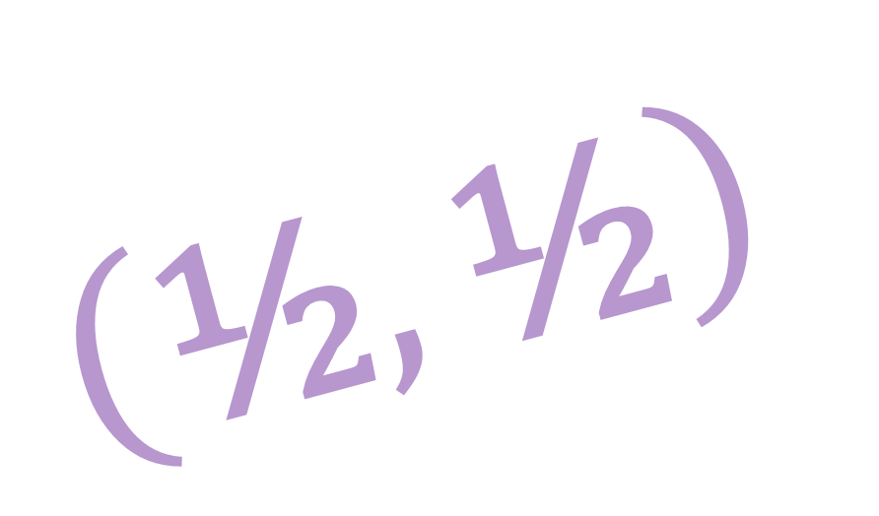
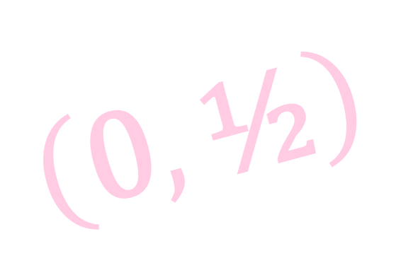

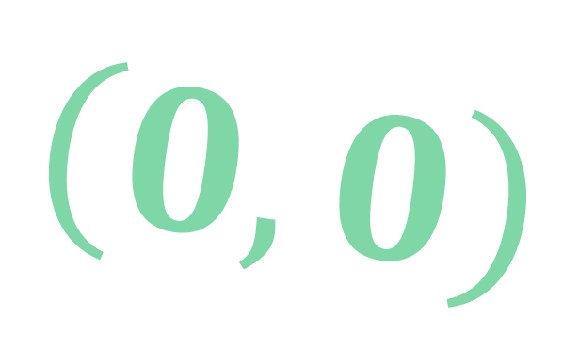
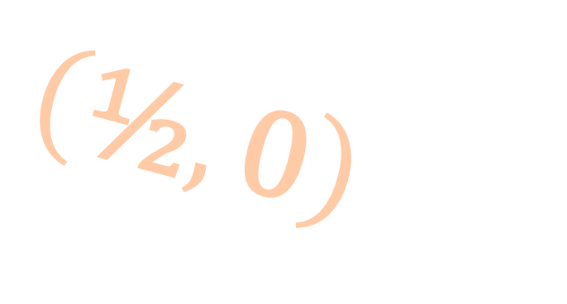
Spinors For Beginners
20
Lorentz
Representations
$$\left(\text{½},\text{0}\right)$$
$$\left(0,0\right)$$
$$\left(\text{0},\text{½}\right)$$
$$\left(\text{½},\text{½}\right)$$
$$\left(1,0\right)⊕\left(0,1\right)$$
Notes:
½

Slide 2
Spinors Learning “Staircase”
Spinors in Particle Physics
Lie Groups & Algebras
Clifford Algebras
Spinors in 3D / (4D)
Examples From Physics (motivation)

Slide 3
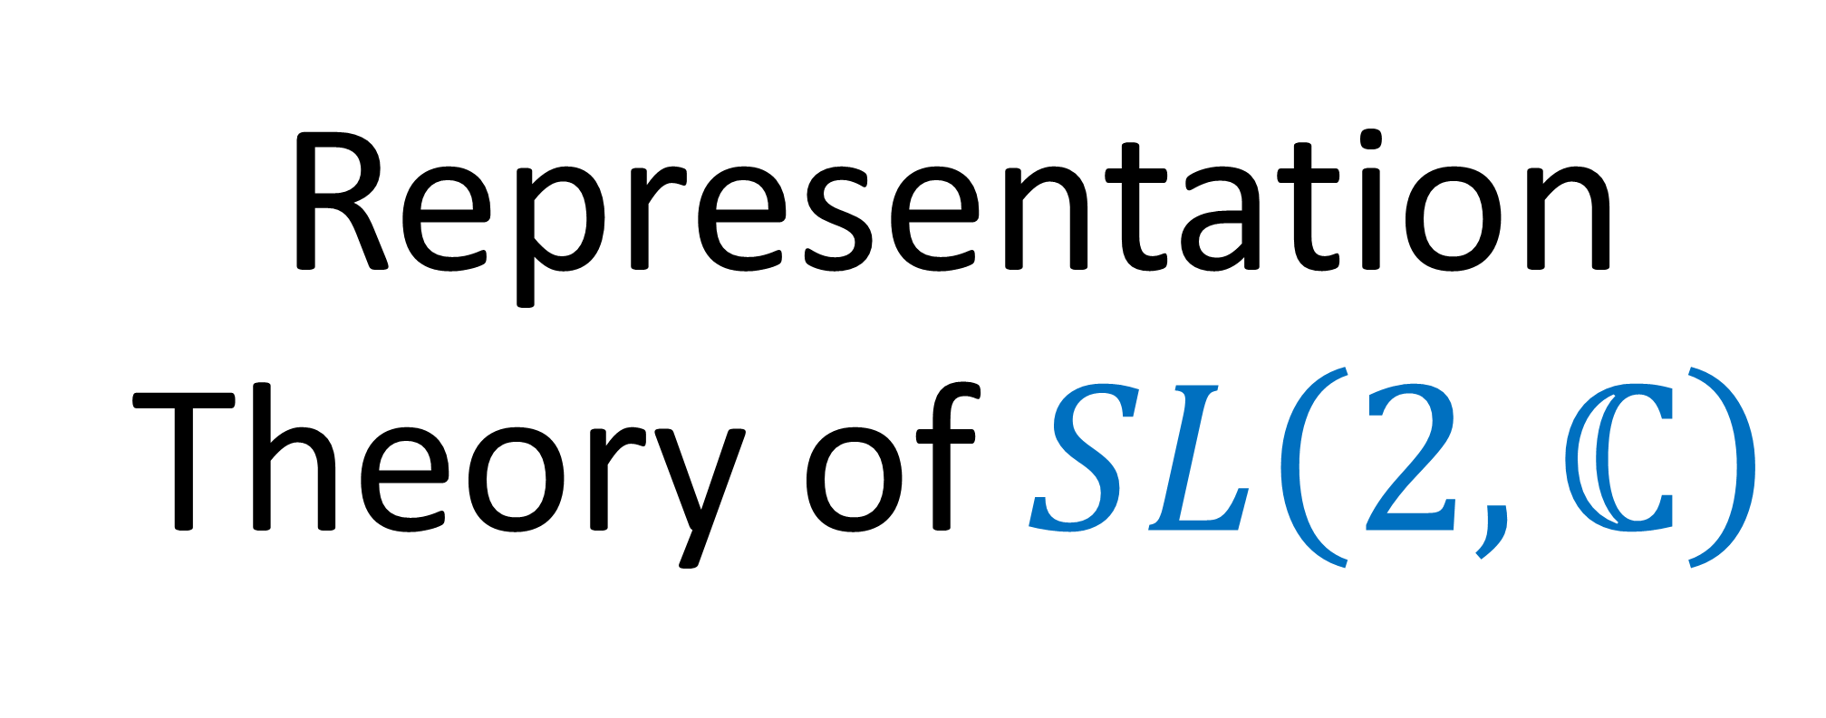

Representation Theory of $SL\left(2,ℂ\right)$
double-cover of Lorentz Group $SO^{+}(1,3)$

Slide 4
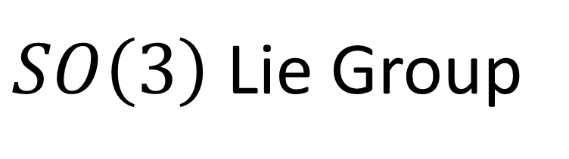

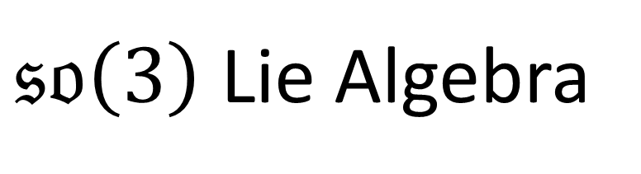
$SO\left(3\right)$ Lie Group
$𝔰𝔬\left(3\right)$ Lie Algebra
$$R_{xy}\left(θ\right)=\left[\begin{matrix}\cos{θ} & −\sin{θ} & 0 \\ \sin{θ} & \cos{θ} & 0 \\ 0 & 0 & 1\end{matrix}\right]= e^{\left( \left[\begin{matrix}0 & −1 & 0 \\ 1 & 0 & 0 \\ 0 & 0 & 0\end{matrix}\right] θ \right)}$$
$R_{yz}\left(θ\right)=\left[\begin{matrix}1 & 0 & 0 \\ 0 & \cos{θ} & −\sin{θ} \\ 0 & \sin{θ} & \cos{θ}\end{matrix}\right]= e^{\left( \left[\begin{matrix}0 & 0 & 0 \\ 0 & 0 & −1 \\ 0 & 1 & 0\end{matrix}\right] θ \right)}$
$R_{zx}\left(θ\right)=\left[\begin{matrix}\cos{θ} & 0 & \sin{θ} \\ 0 & 1 & 0 \\ −sin{θ} & 0 & \cos{θ}\end{matrix}\right] = e^{\left( \left[\begin{matrix}0 & 0 & 1 \\ 0 & 0 & 0 \\ −1 & 0 & 0\end{matrix}\right] θ \right)}$

Slide 5
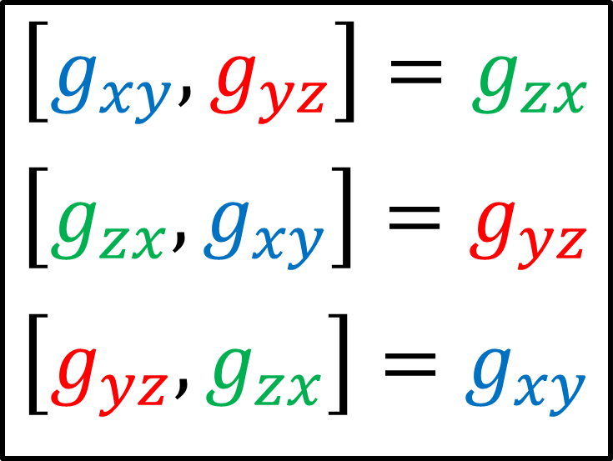
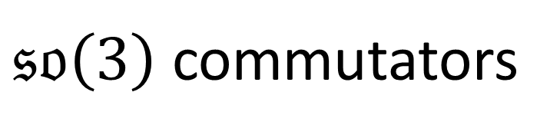
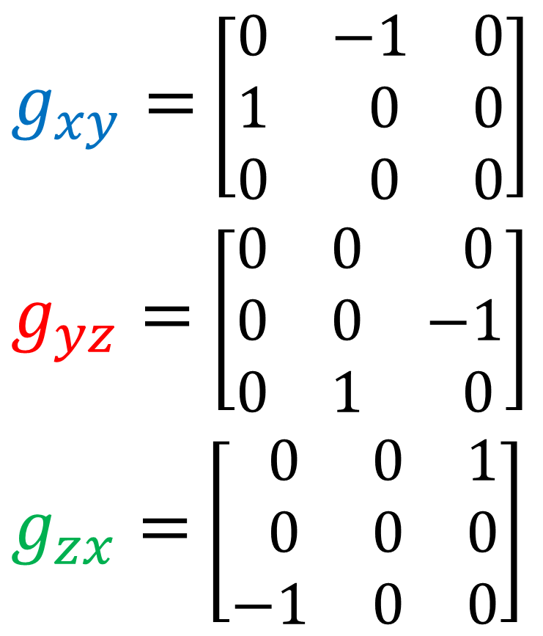
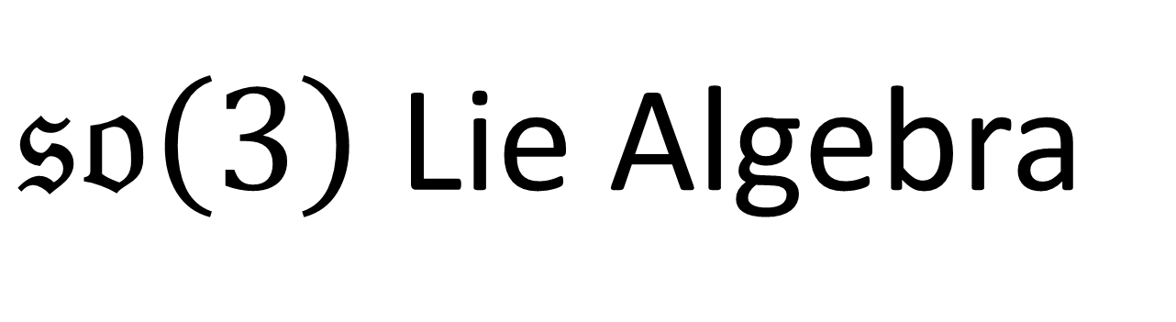
$𝔰𝔬\left(3\right)$ Lie Algebra
$g_{xy}=$ $\left[\begin{matrix}0 & −1 & 0 \\ 1 & 0 & 0 \\ 0 & 0 & 0\end{matrix}\right]$
$g_{yz}=$ $\left[\begin{matrix}0 & 0 & 0 \\ 0 & 0 & −1 \\ 0 & 1 & 0\end{matrix}\right]$
$g_{zx}=$ $\left[\begin{matrix} 0 & 0 & 1 \\ 0 & 0 & 0 \\ −1 & 0 & 0\end{matrix}\right]$
$𝔰𝔬\left(3\right)$ commutators
$$\left[g_{xy}, g_{yz}\right]=g_{zx}$$
$$\left[g_{zx},g_{xy}\right]=g_{yz}$$
$$\left[g_{yz},g_{zx}\right]=g_{xy}$$

Slide 6


Pauli vectors
$R_{yz} → \left[\begin{matrix}\cos{\frac{θ}{2}} & −i\sin{\frac{θ}{2}} \\ −i\sin{\frac{θ}{2}} & \cos{\frac{θ}{2}}\end{matrix}\right] \left[\begin{matrix}z & x−iy \\ x+iy & −z\end{matrix}\right] {\left[\begin{matrix}\cos{\frac{θ}{2}} & −i\sin{\frac{θ}{2}} \\ −i\sin{\frac{θ}{2}} & \cos{\frac{θ}{2}}\end{matrix}\right]}^{†}$
$R_{zx} → \left[\begin{matrix}\cos{\frac{θ}{2}} & −\sin{\frac{θ}{2}} \\ \sin{\frac{θ}{2}} & \cos{\frac{θ}{2}}\end{matrix}\right] \left[\begin{matrix}z & x−iy \\ x+iy & −z\end{matrix}\right] {\left[\begin{matrix}\cos{\frac{θ}{2}} & −\sin{\frac{θ}{2}} \\ \sin{\frac{θ}{2}} & \cos{\frac{θ}{2}}\end{matrix}\right]}^{†}$
$R_{xy} → \left[\begin{matrix}e^{−iθ/2} & 0 \\ 0 & e^{+iθ/2}\end{matrix}\right] \left[\begin{matrix}z & x−iy \\ x+iy & −z\end{matrix}\right] {\left[\begin{matrix}e^{−iθ/2} & 0 \\ 0 & e^{+iθ/2}\end{matrix}\right]}^{†}$
$$\left[\begin{aligned}x \\ y \\ z\end{aligned}\right] →$$

Slide 7


$SU\left(2\right)$ Lie Group
Pauli vectors
$R_{yz} → \left[\begin{matrix}\cos{\frac{θ}{2}} & −i\sin{\frac{θ}{2}} \\ −i\sin{\frac{θ}{2}} & \cos{\frac{θ}{2}}\end{matrix}\right] \left[\begin{matrix}z & x−iy \\ x+iy & −z\end{matrix}\right] {\left[\begin{matrix}\cos{\frac{θ}{2}} & −i\sin{\frac{θ}{2}} \\ −i\sin{\frac{θ}{2}} & \cos{\frac{θ}{2}}\end{matrix}\right]}^{†}$
$R_{zx} → \left[\begin{matrix}\cos{\frac{θ}{2}} & −\sin{\frac{θ}{2}} \\ \sin{\frac{θ}{2}} & \cos{\frac{θ}{2}}\end{matrix}\right] \left[\begin{matrix}z & x−iy \\ x+iy & −z\end{matrix}\right] {\left[\begin{matrix}\cos{\frac{θ}{2}} & −\sin{\frac{θ}{2}} \\ \sin{\frac{θ}{2}} & \cos{\frac{θ}{2}}\end{matrix}\right]}^{†}$
$R_{xy} → \left[\begin{matrix}e^{−iθ/2} & 0 \\ 0 & e^{+iθ/2}\end{matrix}\right] \left[\begin{matrix}z & x−iy \\ x+iy & −z\end{matrix}\right] {\left[\begin{matrix}e^{−iθ/2} & 0 \\ 0 & e^{+iθ/2}\end{matrix}\right]}^{†}$

Slide 8


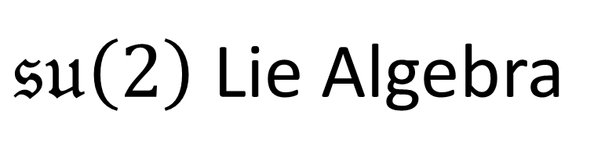

(Pauli)
spinors
$SU\left(2\right)$ Lie Group
$𝔰𝔲\left(2\right)$ Lie Algebra
$R_{yz} → \left[\begin{matrix}\cos{\frac{θ}{2}} & −i\sin{\frac{θ}{2}} \\ −i\sin{\frac{θ}{2}} & \cos{\frac{θ}{2}}\end{matrix}\right]\left[\begin{aligned}ξ^{1} \\ ξ^{2}\end{aligned}\right]$
$R_{zx} → \left[\begin{matrix}\cos{\frac{θ}{2}} & −\sin{\frac{θ}{2}} \\ \sin{\frac{θ}{2}} & \cos{\frac{θ}{2}}\end{matrix}\right] \left[\begin{aligned}ξ^{1} \\ ξ^{2}\end{aligned}\right]$
$R_{xy} → \left[\begin{matrix}e^{−iθ/2} & 0 \\ 0 & e^{+iθ/2}\end{matrix}\right] \left[\begin{aligned}ξ^{1} \\ ξ^{2}\end{aligned}\right]$
$$e^{\left( −\frac{1}{2} \left[\begin{matrix}0 & i \\ i & 0\end{matrix}\right] θ \right)}$$
$e^{\left( −\frac{1}{2} \left[\begin{matrix}0 & 1 \\ −1 & 0\end{matrix}\right] θ \right)}$
$e^{\left( −\frac{1}{2} \left[\begin{matrix}i & 0 \\ 0 & −i\end{matrix}\right] θ \right)}$

Slide 9
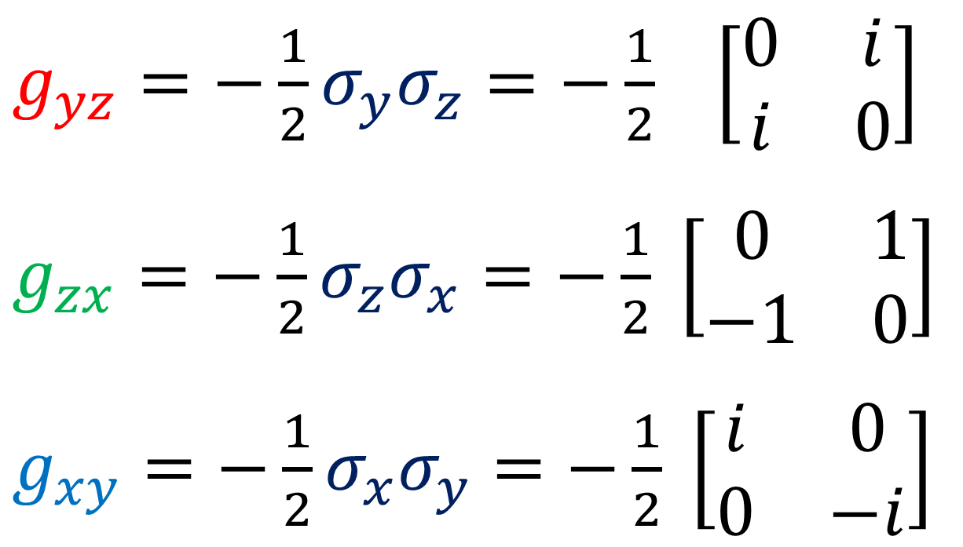

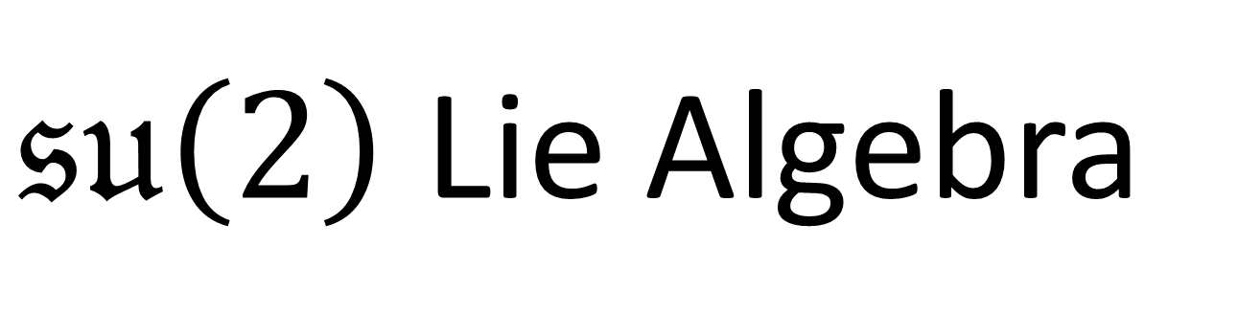
$𝔰𝔲\left(2\right)$ Lie Algebra
$𝔰𝔲\left(2\right)$ commutators
$g_{yz}=−\frac{1}{2}σ_{y}σ_{z}=−\frac{1}{2} \left[\begin{matrix}0 & i \\ i & 0\end{matrix}\right]$
$g_{zx}=−\frac{1}{2}σ_{z}σ_{x}=−\frac{1}{2} \left[\begin{matrix}0 & 1 \\ −1 & 0\end{matrix}\right]$
$g_{xy}=−\frac{1}{2}σ_{x}σ_{y}=−\frac{1}{2} \left[\begin{matrix}i & 0 \\ 0 & −i\end{matrix}\right]$
$$\left[g_{xy}, g_{yz}\right]=g_{zx}$$
$$\left[g_{zx},g_{xy}\right]=g_{yz}$$
$$\left[g_{yz},g_{zx}\right]=g_{xy}$$

Slide 10
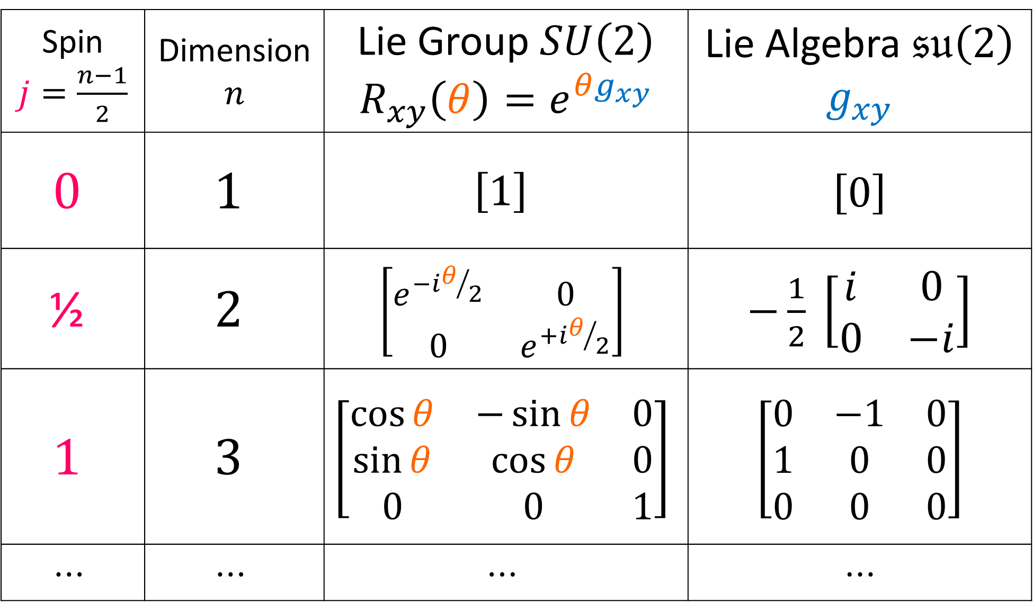
Spin $j=\frac{n−1}{2}$ | Dimension $$n$$ | Lie Group $SU\left(2\right)$ $$R_{xy}\left(θ\right)=e^{θg_{xy}}$$ | Lie Algebra $𝔰𝔲\left(2\right)$ $$g_{xy}$$
$$0$$ | $$1$$ | $$\left[1\right]$$ | $$\left[0\right]$$
$$\text{½}$$ | $$2$$ | $$\left[\begin{matrix}e^{−iθ/2} & 0 \\ 0 & e^{+iθ/2}\end{matrix}\right]$$ | $−\frac{1}{2} \left[\begin{matrix}i & 0 \\ 0 & −i\end{matrix}\right]$
$$1$$ | $$3$$ | $$\left[\begin{matrix}\cos{θ} & −\sin{θ} & 0 \\ \sin{θ} & \cos{θ} & 0 \\ 0 & 0 & 1\end{matrix}\right]$$ | $$\left[\begin{matrix}0 & −1 & 0 \\ 1 & 0 & 0 \\ 0 & 0 & 0\end{matrix}\right]$$
$$⋯$$ | $$⋯$$ | $$⋯$$ | $$⋯$$

Slide 11
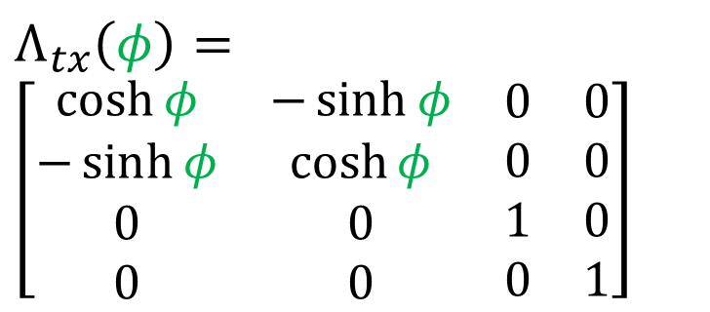
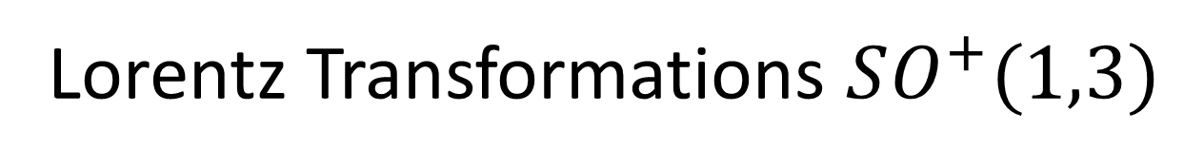
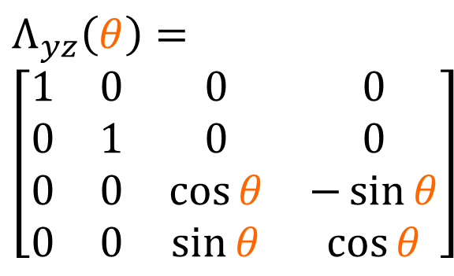
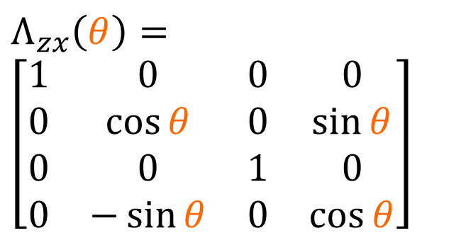
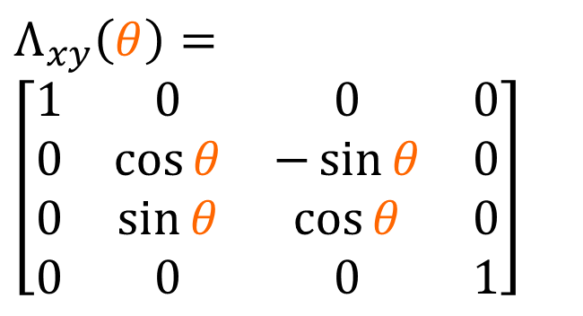
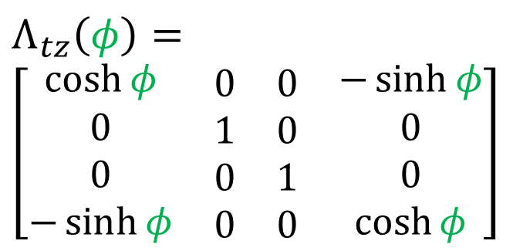
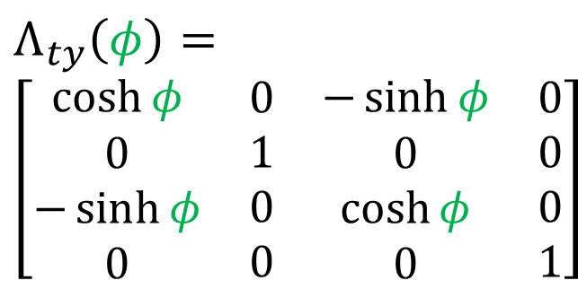
Lorentz Transformations $SO^{+}(1,3)$
The set of matrices that preserve $+ct^{2}−x^{2}−y^{2}−z^{2}$.
Rotations:
$$Λ_{yz}\left(θ\right)=$$
$$\left[\begin{matrix}\begin{matrix}\begin{aligned}1 \\ 0 \\ 0 \\ 0\end{aligned} & \begin{aligned}0 \\ 1 \\ 0 \\ 0\end{aligned}\end{matrix} & \begin{matrix}\begin{aligned}0 \\ 0 \\ \cos{θ} \\ \sin{θ}\end{aligned} & \begin{aligned}0 \\ 0 \\ −\sin{θ} \\ \cos{θ}\end{aligned}\end{matrix}\end{matrix}\right]$$
$$Λ_{zx}\left(θ\right)=$$
$$\left[\begin{matrix}\begin{matrix}\begin{aligned}1 \\ 0 \\ 0 \\ 0\end{aligned} & \begin{aligned}0 \\ \cos{θ} \\ 0 \\ −\sin{θ}\end{aligned}\end{matrix} & \begin{matrix}\begin{aligned}0 \\ 0 \\ 1 \\ 0\end{aligned} & \begin{aligned}0 \\ \sin{θ} \\ 0 \\ \cos{θ}\end{aligned}\end{matrix}\end{matrix}\right]$$
$$Λ_{xy}\left(θ\right)=$$
$$\left[\begin{matrix}\begin{matrix}\begin{aligned}1 \\ 0 \\ 0 \\ 0\end{aligned} & \begin{aligned}0 \\ \cos{θ} \\ \sin{θ} \\ 0\end{aligned}\end{matrix} & \begin{matrix}\begin{aligned}0 \\ −\sin{θ} \\ \cos{θ} \\ 0\end{aligned} & \begin{aligned}0 \\ 0 \\ 0 \\ 1\end{aligned}\end{matrix}\end{matrix}\right]$$
Boosts:
$$Λ_{tx}\left(φ\right)=$$
$\left[\begin{matrix}\begin{matrix}\begin{aligned}\cosh{φ} \\ −\sinh{φ} \\ 0 \\ 0\end{aligned} & \begin{aligned}−\sinh{φ} \\ \cosh{φ} \\ 0 \\ 0\end{aligned}\end{matrix} & \begin{matrix}\begin{aligned}0 \\ 0 \\ 1 \\ 0\end{aligned} & \begin{aligned}0 \\ 0 \\ 0 \\ 1\end{aligned}\end{matrix}\end{matrix}\right]$
$$Λ_{ty}\left(φ\right)=$$
$\left[\begin{matrix}\begin{matrix}\begin{aligned}\cosh{φ} \\ 0 \\ −\sinh{φ} \\ 0\end{aligned} & \begin{aligned}0 \\ 1 \\ 0 \\ 0\end{aligned}\end{matrix} & \begin{matrix}\begin{aligned}−\sinh{φ} \\ 0 \\ \cosh{φ} \\ 0\end{aligned} & \begin{aligned}0 \\ 0 \\ 0 \\ 1\end{aligned}\end{matrix}\end{matrix}\right]$
$$Λ_{tz}\left(φ\right)=$$
$\left[\begin{matrix}\begin{matrix}\begin{aligned}\cosh{φ} \\ 0 \\ 0 \\ −\sinh{φ}\end{aligned} & \begin{aligned}0 \\ 1 \\ 0 \\ 0\end{aligned}\end{matrix} & \begin{matrix}\begin{aligned}0 \\ 0 \\ 1 \\ 0\end{aligned} & \begin{aligned}−\sinh{φ} \\ 0 \\ 0 \\ \cosh{φ}\end{aligned}\end{matrix}\end{matrix}\right]$

Slide 12
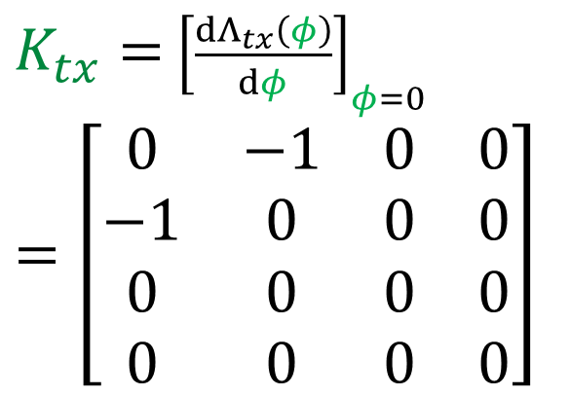
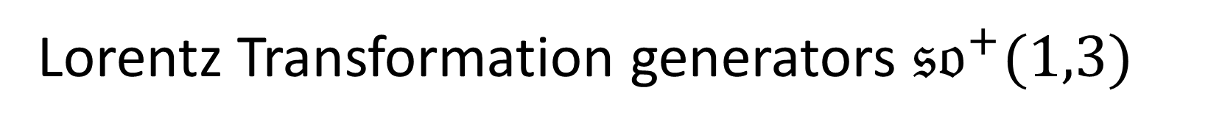
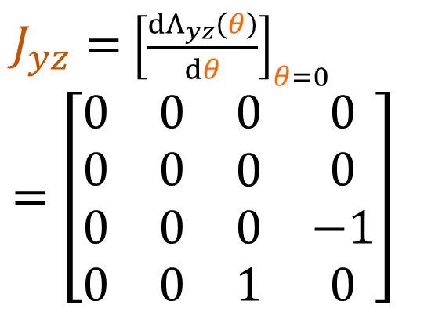

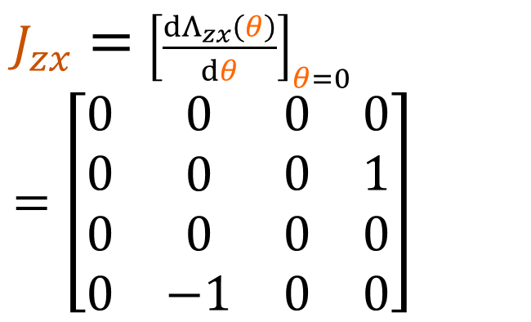
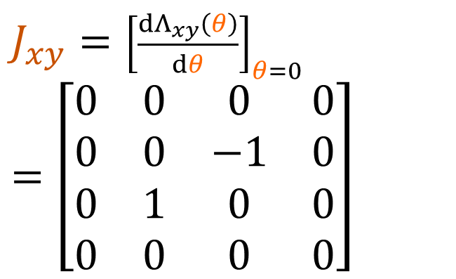
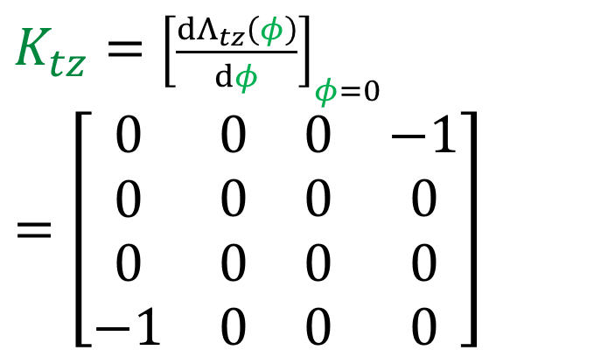
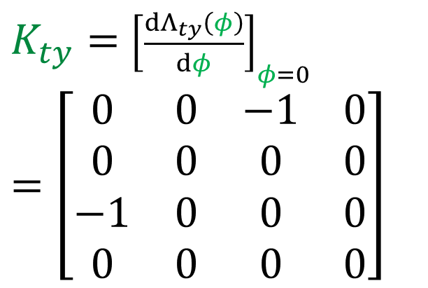
Lorentz Transformation generators ${𝔰𝔬}^{+}(1,3)$
Rotation Generators:
(traceless, anti-hermitian)
$J_{yz}=$ ${\left[\frac{dΛ_{yz}\left(θ\right)}{dθ}\right]}_{θ=0}$
$$=\left[\begin{matrix}\begin{matrix}\begin{aligned}0 \\ 0 \\ 0 \\ 0\end{aligned} & \begin{aligned}0 \\ 0 \\ 0 \\ 0\end{aligned}\end{matrix} & \begin{matrix}\begin{aligned}0 \\ 0 \\ 0 \\ 1\end{aligned} & \begin{aligned}0 \\ 0 \\ −1 \\ 0\end{aligned}\end{matrix}\end{matrix}\right]$$
$J_{zx}=$ ${\left[\frac{dΛ_{zx}\left(θ\right)}{dθ}\right]}_{θ=0}$
$$=\left[\begin{matrix}\begin{matrix}\begin{aligned}0 \\ 0 \\ 0 \\ 0\end{aligned} & \begin{aligned}0 \\ 0 \\ 0 \\ −1\end{aligned}\end{matrix} & \begin{matrix}\begin{aligned}0 \\ 0 \\ 0 \\ 0\end{aligned} & \begin{aligned}0 \\ 1 \\ 0 \\ 0\end{aligned}\end{matrix}\end{matrix}\right]$$
$J_{xy}=$ ${\left[\frac{dΛ_{xy}\left(θ\right)}{dθ}\right]}_{θ=0}$
$$=\left[\begin{matrix}\begin{matrix}\begin{aligned}0 \\ 0 \\ 0 \\ 0\end{aligned} & \begin{aligned}0 \\ 0 \\ 1 \\ 0\end{aligned}\end{matrix} & \begin{matrix}\begin{aligned}0 \\ −1 \\ 0 \\ 0\end{aligned} & \begin{aligned}0 \\ 0 \\ 0 \\ 0\end{aligned}\end{matrix}\end{matrix}\right]$$
Boost Generators:
(traceless, hermitian)
$K_{tx}=$ ${\left[\frac{dΛ_{tx}\left(φ\right)}{dφ}\right]}_{φ=0}$
$=\left[\begin{matrix}\begin{matrix}\begin{aligned}0 \\ −1 \\ 0 \\ 0\end{aligned} & \begin{aligned}−1 \\ 0 \\ 0 \\ 0\end{aligned}\end{matrix} & \begin{matrix}\begin{aligned}0 \\ 0 \\ 0 \\ 0\end{aligned} & \begin{aligned}0 \\ 0 \\ 0 \\ 0\end{aligned}\end{matrix}\end{matrix}\right]$
$K_{ty}=$ ${\left[\frac{dΛ_{ty}\left(φ\right)}{dφ}\right]}_{φ=0}$
$=\left[\begin{matrix}\begin{matrix}\begin{aligned}0 \\ 0 \\ −1 \\ 0\end{aligned} & \begin{aligned}0 \\ 0 \\ 0 \\ 0\end{aligned}\end{matrix} & \begin{matrix}\begin{aligned}−1 \\ 0 \\ 0 \\ 0\end{aligned} & \begin{aligned}0 \\ 0 \\ 0 \\ 0\end{aligned}\end{matrix}\end{matrix}\right]$
$K_{tz}=$ ${\left[\frac{dΛ_{tz}\left(φ\right)}{dφ}\right]}_{φ=0}$
$=\left[\begin{matrix}\begin{matrix}\begin{aligned}0 \\ 0 \\ 0 \\ −1\end{aligned} & \begin{aligned}0 \\ 0 \\ 0 \\ 0\end{aligned}\end{matrix} & \begin{matrix}\begin{aligned}0 \\ 0 \\ 0 \\ 0\end{aligned} & \begin{aligned}−1 \\ 0 \\ 0 \\ 0\end{aligned}\end{matrix}\end{matrix}\right]$

Slide 13
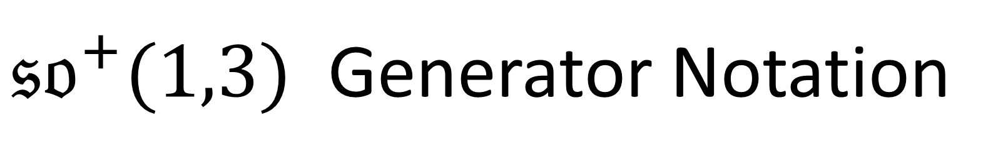
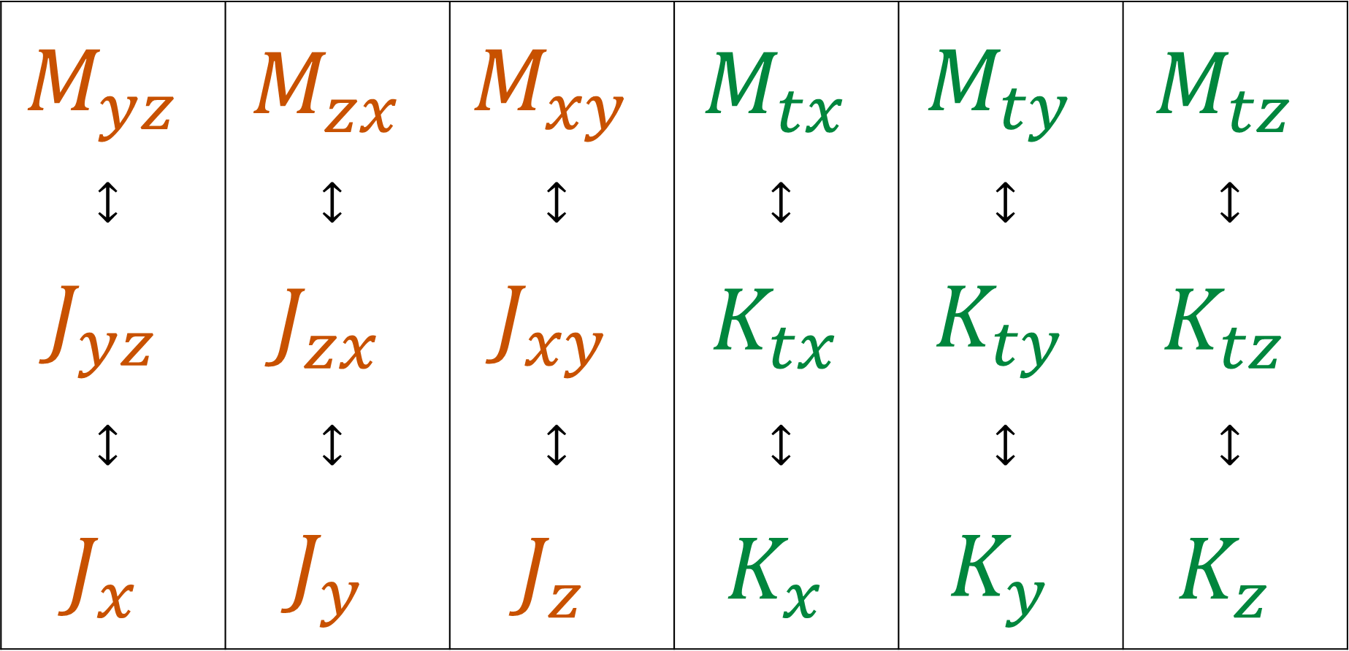
${𝔰𝔬}^{+}(1,3)$ Generator Notation
$$M_{yz}$$ | $$M_{zx}$$ | $$M_{xy}$$ | $$M_{tx}$$ | $$M_{ty}$$ | $$M_{tz}$$
$$↕$$ | $$↕$$ | $$↕$$ | $$↕$$ | $$↕$$ | $$↕$$
$$J_{yz}$$ | $$J_{zx}$$ | $$J_{xy}$$ | $$K_{tx}$$ | $$K_{ty}$$ | $$K_{tz}$$
$$↕$$ | $$↕$$ | $$↕$$ | $$↕$$ | $$↕$$ | $$↕$$
$$J_{x}$$ | $$J_{y}$$ | $$J_{z}$$ | $$K_{x}$$ | $$K_{y}$$ | $$K_{z}$$

Slide 14
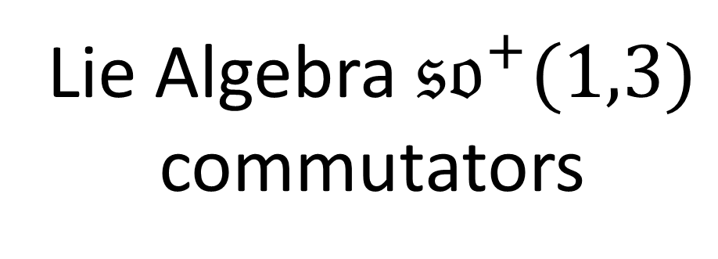
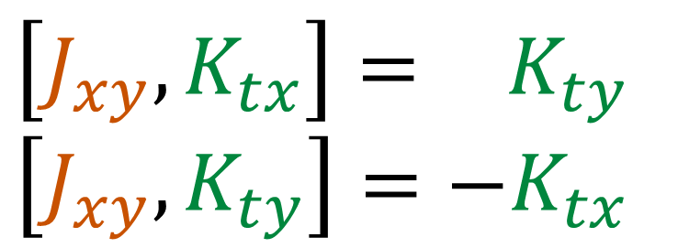
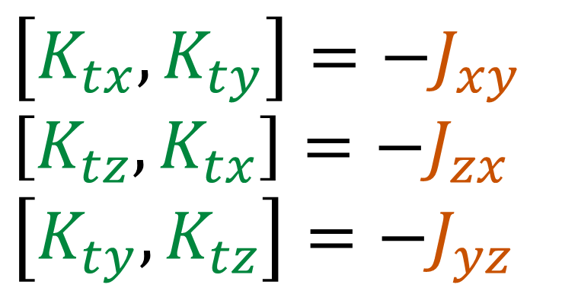
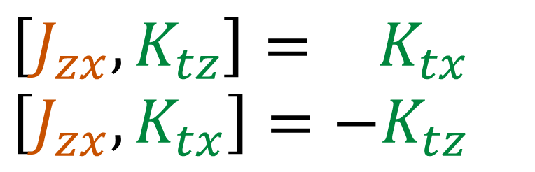
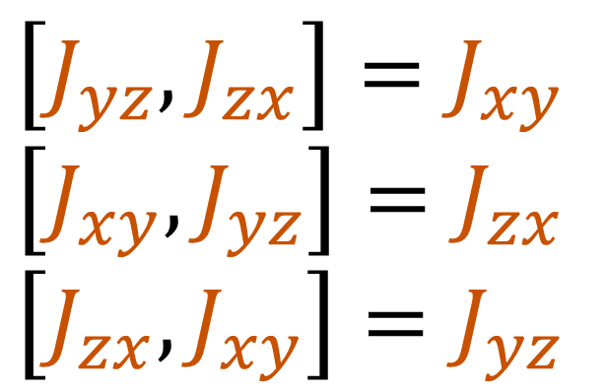
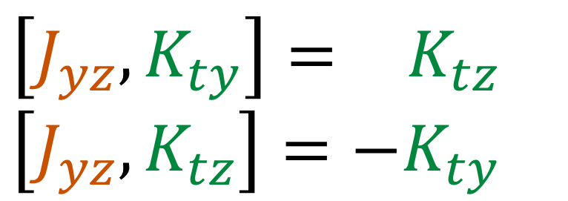
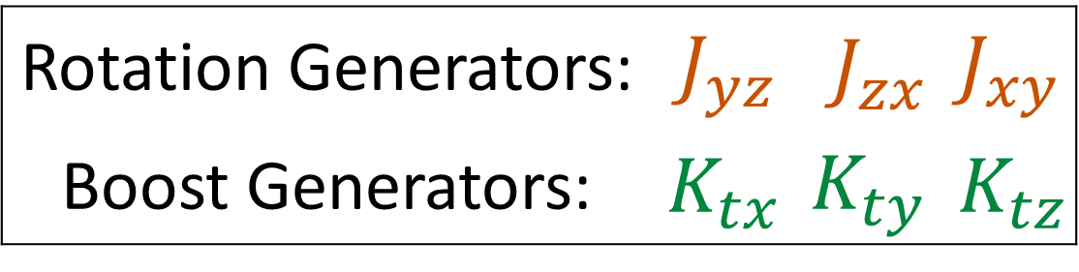
Lie Algebra $𝔰𝔬^{+}(1,3)$
commutators
Rotation Generators: | $$J_{yz}$$ | $$J_{zx}$$ | $$J_{xy}$$
Boost Generators: | $$K_{tx}$$ | $$K_{ty}$$ | $$K_{tz}$$
$$\left[J_{yz},J_{zx}\right]=J_{xy}$$
$$\left[J_{xy},J_{yz}\right]=J_{zx}$$
$$\left[J_{zx},J_{xy}\right]=J_{yz}$$
$$\left[J_{yz},K_{ty}\right]=+K_{tz}$$
$$\left[J_{yz},K_{tz}\right]=−K_{ty}$$
(all other commutation relations go to zero)
$$\left[J_{zx},K_{tz}\right]=+K_{tx}$$
$$\left[J_{zx},K_{tx}\right]=−K_{tz}$$
$$\left[K_{tx},K_{ty}\right]=−J_{xy}$$
$$\left[K_{tz},K_{tx}\right]=−J_{zx}$$
$$\left[K_{ty},K_{tz}\right]=−J_{yz}$$
$$\left[J_{xy},K_{tx}\right]=+K_{ty}$$
$$\left[J_{xy},K_{ty}\right]=−K_{tx}$$

Slide 15
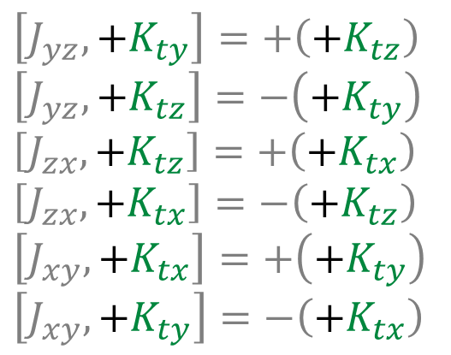
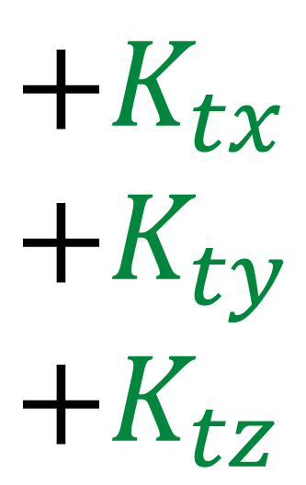
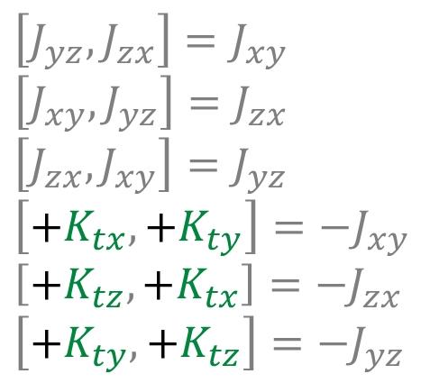
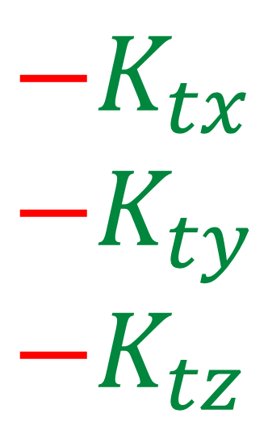
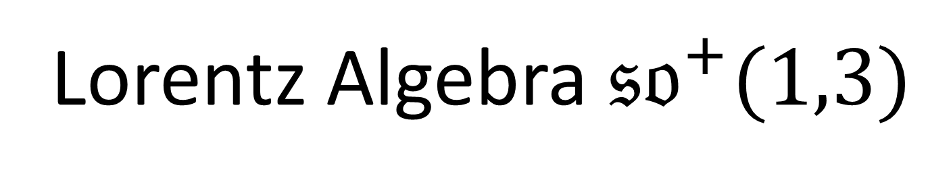
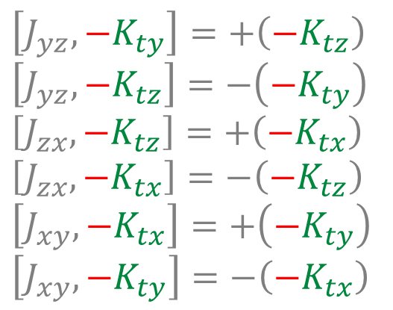

Lorentz Algebra $𝔰𝔬^{+}(1,3)$
$$+K_{tx}$$
$$+K_{ty}$$
$$+K_{tz}$$
$$−K_{tx}$$
$$−K_{ty}$$
$$−K_{tz}$$
$$\left[J_{yz},J_{zx}\right]=J_{xy}$$
$$\left[J_{xy},J_{yz}\right]=J_{zx}$$
$$\left[J_{zx},J_{xy}\right]=J_{yz}$$
$$\left[+K_{tx},+K_{ty}\right]=−J_{xy}$$
$$\left[+K_{tz},+K_{tx}\right]=−J_{zx}$$
$$\left[+K_{ty},+K_{tz}\right]=−J_{yz}$$
$$\left[J_{yz},+K_{ty}\right]=+\left(+K_{tz}\right)$$
$$\left[J_{yz},+K_{tz}\right]=−\left(+K_{ty}\right)$$
$$\left[J_{zx},+K_{tz}\right]=+\left(+K_{tx}\right)$$
$$\left[J_{zx},+K_{tx}\right]=−\left(+K_{tz}\right)$$
$$\left[J_{xy},+K_{tx}\right]=+\left(+K_{ty}\right)$$
$$\left[J_{xy},+K_{ty}\right]=−\left(+K_{tx}\right)$$
$$\left[J_{yz},J_{zx}\right]=J_{xy}$$
$$\left[J_{xy},J_{yz}\right]=J_{zx}$$
$$\left[J_{zx},J_{xy}\right]=J_{yz}$$
$$\left[−K_{tx},−K_{ty}\right]=−J_{xy}$$
$$\left[−K_{tz},−K_{tx}\right]=−J_{zx}$$
$$\left[−K_{ty},−K_{tz}\right]=−J_{yz}$$
$$\left[J_{yz},−K_{ty}\right]=+\left(−K_{tz}\right)$$
$$\left[J_{yz},−K_{tz}\right]=−\left(−K_{ty}\right)$$
$$\left[J_{zx},−K_{tz}\right]=+\left(−K_{tx}\right)$$
$$\left[J_{zx},−K_{tx}\right]=−\left(−K_{tz}\right)$$
$$\left[J_{xy},−K_{tx}\right]=+\left(−K_{ty}\right)$$
$$\left[J_{xy},−K_{ty}\right]=−\left(−K_{tx}\right)$$

Slide 16



Lorentz Algebra $𝔰𝔬^{+}(1,3)$
$K_{tx}=$ $\left[\begin{matrix}\begin{matrix}\begin{aligned}0 \\ 1 \\ 0 \\ 0\end{aligned} & \begin{aligned}1 \\ 0 \\ 0 \\ 0\end{aligned}\end{matrix} & \begin{matrix}\begin{aligned}0 \\ 0 \\ 0 \\ 0\end{aligned} & \begin{aligned}0 \\ 0 \\ 0 \\ 0\end{aligned}\end{matrix}\end{matrix}\right]$
$K_{ty}=$ $\left[\begin{matrix}\begin{matrix}\begin{aligned}0 \\ 0 \\ 1 \\ 0\end{aligned} & \begin{aligned}0 \\ 0 \\ 0 \\ 0\end{aligned}\end{matrix} & \begin{matrix}\begin{aligned}1 \\ 0 \\ 0 \\ 0\end{aligned} & \begin{aligned}0 \\ 0 \\ 0 \\ 0\end{aligned}\end{matrix}\end{matrix}\right]$
$K_{tz}=$ $\left[\begin{matrix}\begin{matrix}\begin{aligned}0 \\ 0 \\ 0 \\ 1\end{aligned} & \begin{aligned}0 \\ 0 \\ 0 \\ 0\end{aligned}\end{matrix} & \begin{matrix}\begin{aligned}0 \\ 0 \\ 0 \\ 0\end{aligned} & \begin{aligned}1 \\ 0 \\ 0 \\ 0\end{aligned}\end{matrix}\end{matrix}\right]$
$−K_{tx}=$ $\left[\begin{matrix}\begin{matrix}\begin{aligned}0 \\ −1 \\ 0 \\ 0\end{aligned} & \begin{aligned}−1 \\ 0 \\ 0 \\ 0\end{aligned}\end{matrix} & \begin{matrix}\begin{aligned}0 \\ 0 \\ 0 \\ 0\end{aligned} & \begin{aligned}0 \\ 0 \\ 0 \\ 0\end{aligned}\end{matrix}\end{matrix}\right]$
$−K_{ty}=$ $\left[\begin{matrix}\begin{matrix}\begin{aligned}0 \\ 0 \\ −1 \\ 0\end{aligned} & \begin{aligned}0 \\ 0 \\ 0 \\ 0\end{aligned}\end{matrix} & \begin{matrix}\begin{aligned}−1 \\ 0 \\ 0 \\ 0\end{aligned} & \begin{aligned}0 \\ 0 \\ 0 \\ 0\end{aligned}\end{matrix}\end{matrix}\right]$
$−K_{tz}=$ $\left[\begin{matrix}\begin{matrix}\begin{aligned}0 \\ 0 \\ 0 \\ −1\end{aligned} & \begin{aligned}0 \\ 0 \\ 0 \\ 0\end{aligned}\end{matrix} & \begin{matrix}\begin{aligned}0 \\ 0 \\ 0 \\ 0\end{aligned} & \begin{aligned}−1 \\ 0 \\ 0 \\ 0\end{aligned}\end{matrix}\end{matrix}\right]$
$\left[\begin{aligned}ct \\ x \\ y \\ z\end{aligned}\right]↔$ $\left[\begin{aligned}ct \\ −x \\ −y \\ −z\end{aligned}\right]$

Slide 17





Rotation in $xy$-plane:
$$y$$
$$−x$$
$$x$$
$$−y$$

Slide 18












Boost in $x$-direction:
$$y$$
$$−z$$
$$−x$$
$$x$$
$$−y$$
$$z$$
$$x$$
$$−x$$

Slide 19




Lorentz Algebra $𝔰𝔬^{+}(1,3)$
$K_{tx}=$ $\left[\begin{matrix}\begin{matrix}\begin{aligned}0 \\ +1 \\ 0 \\ 0\end{aligned} & \begin{aligned}+1 \\ 0 \\ 0 \\ 0\end{aligned}\end{matrix} & \begin{matrix}\begin{aligned}0 \\ 0 \\ 0 \\ 0\end{aligned} & \begin{aligned}0 \\ 0 \\ 0 \\ 0\end{aligned}\end{matrix}\end{matrix}\right]$
$K_{ty}=$ $\left[\begin{matrix}\begin{matrix}\begin{aligned}0 \\ 0 \\ +1 \\ 0\end{aligned} & \begin{aligned}0 \\ 0 \\ 0 \\ 0\end{aligned}\end{matrix} & \begin{matrix}\begin{aligned}+1 \\ 0 \\ 0 \\ 0\end{aligned} & \begin{aligned}0 \\ 0 \\ 0 \\ 0\end{aligned}\end{matrix}\end{matrix}\right]$
$K_{tz}=$ $\left[\begin{matrix}\begin{matrix}\begin{aligned}0 \\ 0 \\ 0 \\ +1\end{aligned} & \begin{aligned}0 \\ 0 \\ 0 \\ 0\end{aligned}\end{matrix} & \begin{matrix}\begin{aligned}0 \\ 0 \\ 0 \\ 0\end{aligned} & \begin{aligned}+1 \\ 0 \\ 0 \\ 0\end{aligned}\end{matrix}\end{matrix}\right]$
$−K_{tx}=$ $\left[\begin{matrix}\begin{matrix}\begin{aligned}0 \\ −1 \\ 0 \\ 0\end{aligned} & \begin{aligned}−1 \\ 0 \\ 0 \\ 0\end{aligned}\end{matrix} & \begin{matrix}\begin{aligned}0 \\ 0 \\ 0 \\ 0\end{aligned} & \begin{aligned}0 \\ 0 \\ 0 \\ 0\end{aligned}\end{matrix}\end{matrix}\right]$
$−K_{ty}=$ $\left[\begin{matrix}\begin{matrix}\begin{aligned}0 \\ 0 \\ −1 \\ 0\end{aligned} & \begin{aligned}0 \\ 0 \\ 0 \\ 0\end{aligned}\end{matrix} & \begin{matrix}\begin{aligned}−1 \\ 0 \\ 0 \\ 0\end{aligned} & \begin{aligned}0 \\ 0 \\ 0 \\ 0\end{aligned}\end{matrix}\end{matrix}\right]$
$−K_{tz}=$ $\left[\begin{matrix}\begin{matrix}\begin{aligned}0 \\ 0 \\ 0 \\ −1\end{aligned} & \begin{aligned}0 \\ 0 \\ 0 \\ 0\end{aligned}\end{matrix} & \begin{matrix}\begin{aligned}0 \\ 0 \\ 0 \\ 0\end{aligned} & \begin{aligned}−1 \\ 0 \\ 0 \\ 0\end{aligned}\end{matrix}\end{matrix}\right]$
$\left[\begin{aligned}ct \\ x \\ y \\ z\end{aligned}\right]↔$ $\left[\begin{aligned}ct \\ −x \\ −y \\ −z\end{aligned}\right]$

Slide 20




Lorentz Group $SO^{+}(1,3)$
$e^{K_{tx}φ}=$ $\left[\begin{matrix}\begin{matrix}\begin{aligned}\cosh{φ} \\ +\sinh{φ} \\ 0 \\ 0\end{aligned} & \begin{aligned}+\sinh{φ} \\ \cosh{φ} \\ 0 \\ 0\end{aligned}\end{matrix} & \begin{matrix}\begin{aligned}0 \\ 0 \\ 1 \\ 0\end{aligned} & \begin{aligned}0 \\ 0 \\ 0 \\ 1\end{aligned}\end{matrix}\end{matrix}\right]$
$e^{K_{ty}φ}=$ $\left[\begin{matrix}\begin{matrix}\begin{aligned}\cosh{φ} \\ 0 \\ +\sinh{φ} \\ 0\end{aligned} & \begin{aligned}0 \\ 1 \\ 0 \\ 0\end{aligned}\end{matrix} & \begin{matrix}\begin{aligned}+\sinh{φ} \\ 0 \\ \cosh{φ} \\ 0\end{aligned} & \begin{aligned}0 \\ 0 \\ 0 \\ 1\end{aligned}\end{matrix}\end{matrix}\right]$
$e^{K_{tz}φ}=$ $\left[\begin{matrix}\begin{matrix}\begin{aligned}\cosh{φ} \\ 0 \\ 0 \\ +\sinh{φ}\end{aligned} & \begin{aligned}0 \\ 1 \\ 0 \\ 0\end{aligned}\end{matrix} & \begin{matrix}\begin{aligned}0 \\ 0 \\ 1 \\ 0\end{aligned} & \begin{aligned}+\sinh{φ} \\ 0 \\ 0 \\ \cosh{φ}\end{aligned}\end{matrix}\end{matrix}\right]$
$e^{−K_{tx}φ}=$ $\left[\begin{matrix}\begin{matrix}\begin{aligned}\cosh{φ} \\ −\sinh{φ} \\ 0 \\ 0\end{aligned} & \begin{aligned}−\sinh{φ} \\ \cosh{φ} \\ 0 \\ 0\end{aligned}\end{matrix} & \begin{matrix}\begin{aligned}0 \\ 0 \\ 1 \\ 0\end{aligned} & \begin{aligned}0 \\ 0 \\ 0 \\ 1\end{aligned}\end{matrix}\end{matrix}\right]$
$e^{−K_{ty}φ}=$ $\left[\begin{matrix}\begin{matrix}\begin{aligned}\cosh{φ} \\ 0 \\ −\sinh{φ} \\ 0\end{aligned} & \begin{aligned}0 \\ 1 \\ 0 \\ 0\end{aligned}\end{matrix} & \begin{matrix}\begin{aligned}−\sinh{φ} \\ 0 \\ \cosh{φ} \\ 0\end{aligned} & \begin{aligned}0 \\ 0 \\ 0 \\ 1\end{aligned}\end{matrix}\end{matrix}\right]$
$e^{−K_{tz}φ}=$ $\left[\begin{matrix}\begin{matrix}\begin{aligned}\cosh{φ} \\ 0 \\ 0 \\ −\sinh{φ}\end{aligned} & \begin{aligned}0 \\ 1 \\ 0 \\ 0\end{aligned}\end{matrix} & \begin{matrix}\begin{aligned}0 \\ 0 \\ 1 \\ 0\end{aligned} & \begin{aligned}−\sinh{φ} \\ 0 \\ 0 \\ \cosh{φ}\end{aligned}\end{matrix}\end{matrix}\right]$
$\left[\begin{aligned}ct \\ x \\ y \\ z\end{aligned}\right]↔$ $\left[\begin{aligned}ct \\ −x \\ −y \\ −z\end{aligned}\right]$

Slide 21





$$SO^{+}(1,3)$$
4D
Spacetime Vector
$$\left[\begin{matrix}\begin{matrix}\begin{aligned}\cosh{φ} \\ 0 \\ 0 \\ −\sinh{φ}\end{aligned} & \begin{aligned}0 \\ 1 \\ 0 \\ 0\end{aligned}\end{matrix} & \begin{matrix}\begin{aligned}0 \\ 0 \\ 1 \\ 0\end{aligned} & \begin{aligned}−\sinh{φ} \\ 0 \\ 0 \\ \cosh{φ}\end{aligned}\end{matrix}\end{matrix}\right]\left[\begin{aligned}ct \\ x \\ y \\ z\end{aligned}\right]$$
$\left[\begin{matrix}e^{−\frac{φ}{2}} & 0 \\ 0 & e^{+\frac{φ}{2}}\end{matrix}\right]\left[\begin{matrix}ct+z & x−yi \\ x+yi & ct−z\end{matrix}\right]{\left[\begin{matrix}e^{−\frac{φ}{2}} & 0 \\ 0 & e^{+\frac{φ}{2}}\end{matrix}\right]}^{†}$
Weyl Vector
$$SL(2,ℂ)$$
$$SL(2,ℂ)$$

Slide 22


$R_{yz} → \left[\begin{matrix}\cos{\frac{θ}{2}} & −i\sin{\frac{θ}{2}} \\ −i\sin{\frac{θ}{2}} & \cos{\frac{θ}{2}}\end{matrix}\right] \left[\begin{matrix}ct+z & x−yi \\ x+yi & ct−z\end{matrix}\right] {\left[\begin{matrix}\cos{\frac{θ}{2}} & −i\sin{\frac{θ}{2}} \\ −i\sin{\frac{θ}{2}} & \cos{\frac{θ}{2}}\end{matrix}\right]}^{†}$
$R_{zx} → \left[\begin{matrix}\cos{\frac{θ}{2}} & −\sin{\frac{θ}{2}} \\ \sin{\frac{θ}{2}} & \cos{\frac{θ}{2}}\end{matrix}\right] \left[\begin{matrix}ct+z & x−yi \\ x+yi & ct−z\end{matrix}\right] {\left[\begin{matrix}\cos{\frac{θ}{2}} & −\sin{\frac{θ}{2}} \\ \sin{\frac{θ}{2}} & \cos{\frac{θ}{2}}\end{matrix}\right]}^{†}$
$R_{xy} → \left[\begin{matrix}e^{−iθ/2} & 0 \\ 0 & e^{+iθ/2}\end{matrix}\right] \left[\begin{matrix}ct+z & x−yi \\ x+yi & ct−z\end{matrix}\right] {\left[\begin{matrix}e^{−iθ/2} & 0 \\ 0 & e^{+iθ/2}\end{matrix}\right]}^{†}$
$B_{tx} → \left[\begin{matrix}\cos{\frac{φ}{2}} & −\sin{\frac{φ}{2}} \\ −\sin{\frac{φ}{2}} & \cos{\frac{φ}{2}}\end{matrix}\right] \left[\begin{matrix}ct+z & x−yi \\ x+yi & ct−z\end{matrix}\right] {\left[\begin{matrix}\cos{\frac{φ}{2}} & −\sin{\frac{φ}{2}} \\ −\sin{\frac{φ}{2}} & \cos{\frac{φ}{2}}\end{matrix}\right]}^{†}$
$B_{ty} → \left[\begin{matrix}\cos{\frac{φ}{2}} & i\sin{\frac{φ}{2}} \\ −i\sin{\frac{φ}{2}} & \cos{\frac{φ}{2}}\end{matrix}\right] \left[\begin{matrix}ct+z & x−yi \\ x+yi & ct−z\end{matrix}\right] {\left[\begin{matrix}\cos{\frac{φ}{2}} & i\sin{\frac{φ}{2}} \\ −i\sin{\frac{φ}{2}} & \cos{\frac{φ}{2}}\end{matrix}\right]}^{†}$
$B_{tz} → \left[\begin{matrix}e^{−φ/2} & 0 \\ 0 & e^{+φ/2}\end{matrix}\right] \left[\begin{matrix}ct+z & x−yi \\ x+yi & ct−z\end{matrix}\right] {\left[\begin{matrix}e^{−φ/2} & 0 \\ 0 & e^{+φ/2}\end{matrix}\right]}^{†}$
$$SL\left(2,ℂ\right)$$
Lie Group
(left rep.)
Notes:
½

Slide 23


(Weyl)
spinors
$R_{yz} → \left[\begin{matrix}\cos{\frac{θ}{2}} & −i\sin{\frac{θ}{2}} \\ −i\sin{\frac{θ}{2}} & \cos{\frac{θ}{2}}\end{matrix}\right]$ $\left[\begin{matrix}ct+z & x−yi \\ x+yi & ct−z\end{matrix}\right] {\left[\begin{matrix}\cos{\frac{θ}{2}} & −\sin{\frac{θ}{2}} \\ \sin{\frac{θ}{2}} & \cos{\frac{θ}{2}}\end{matrix}\right]}^{†}$
$R_{zx} → \left[\begin{matrix}\cos{\frac{θ}{2}} & −\sin{\frac{θ}{2}} \\ \sin{\frac{θ}{2}} & \cos{\frac{θ}{2}}\end{matrix}\right] \left[\begin{matrix}ct+z & x−yi \\ x+yi & ct−z\end{matrix}\right] {\left[\begin{matrix}\cos{\frac{θ}{2}} & −\sin{\frac{θ}{2}} \\ \sin{\frac{θ}{2}} & \cos{\frac{θ}{2}}\end{matrix}\right]}^{†}$
$R_{xy} → \left[\begin{matrix}e^{−iθ/2} & 0 \\ 0 & e^{+iθ/2}\end{matrix}\right] \left[\begin{matrix}ct+z & x−yi \\ x+yi & ct−z\end{matrix}\right] {\left[\begin{matrix}e^{−iθ/2} & 0 \\ 0 & e^{+iθ/2}\end{matrix}\right]}^{†}$
$B_{tx} → \left[\begin{matrix}\cos{\frac{φ}{2}} & −\sin{\frac{φ}{2}} \\ −\sin{\frac{φ}{2}} & \cos{\frac{φ}{2}}\end{matrix}\right] \left[\begin{matrix}ct+z & x−yi \\ x+yi & ct−z\end{matrix}\right] {\left[\begin{matrix}\cos{\frac{φ}{2}} & −\sin{\frac{φ}{2}} \\ −\sin{\frac{φ}{2}} & \cos{\frac{φ}{2}}\end{matrix}\right]}^{†}$
$B_{ty} → \left[\begin{matrix}\cos{\frac{φ}{2}} & i\sin{\frac{φ}{2}} \\ −i\sin{\frac{φ}{2}} & \cos{\frac{φ}{2}}\end{matrix}\right] \left[\begin{matrix}ct+z & x−yi \\ x+yi & ct−z\end{matrix}\right] {\left[\begin{matrix}\cos{\frac{φ}{2}} & i\sin{\frac{φ}{2}} \\ −i\sin{\frac{φ}{2}} & \cos{\frac{φ}{2}}\end{matrix}\right]}^{†}$
$B_{tz} → \left[\begin{matrix}e^{−φ/2} & 0 \\ 0 & e^{+φ/2}\end{matrix}\right] \left[\begin{matrix}ct+z & x−yi \\ x+yi & ct−z\end{matrix}\right] {\left[\begin{matrix}e^{−φ/2} & 0 \\ 0 & e^{+φ/2}\end{matrix}\right]}^{†}$
$\left[\begin{aligned}ψ^{1} \\ ψ^{2}\end{aligned}\right]$
$\left[\begin{aligned}ψ^{1} \\ ψ^{2}\end{aligned}\right]$
$\left[\begin{aligned}ψ^{1} \\ ψ^{2}\end{aligned}\right]$
$\left[\begin{aligned}ψ^{1} \\ ψ^{2}\end{aligned}\right]$
$\left[\begin{aligned}ψ^{1} \\ ψ^{2}\end{aligned}\right]$
$\left[\begin{aligned}ψ^{1} \\ ψ^{2}\end{aligned}\right]$
$$SL\left(2,ℂ\right)$$
Lie Group
(left rep.)
Notes:
½

Slide 24


$R_{yz} → \left[\begin{matrix}\cos{\frac{θ}{2}} & −i\sin{\frac{θ}{2}} \\ −i\sin{\frac{θ}{2}} & \cos{\frac{θ}{2}}\end{matrix}\right]$ $\left[\begin{matrix}ct+z & x−yi \\ x+yi & ct−z\end{matrix}\right] {\left[\begin{matrix}\cos{\frac{θ}{2}} & −\sin{\frac{θ}{2}} \\ \sin{\frac{θ}{2}} & \cos{\frac{θ}{2}}\end{matrix}\right]}^{†}$
$R_{zx} → \left[\begin{matrix}\cos{\frac{θ}{2}} & −\sin{\frac{θ}{2}} \\ \sin{\frac{θ}{2}} & \cos{\frac{θ}{2}}\end{matrix}\right] \left[\begin{matrix}ct+z & x−yi \\ x+yi & ct−z\end{matrix}\right] {\left[\begin{matrix}\cos{\frac{θ}{2}} & −\sin{\frac{θ}{2}} \\ \sin{\frac{θ}{2}} & \cos{\frac{θ}{2}}\end{matrix}\right]}^{†}$
$R_{xy} → \left[\begin{matrix}e^{−iθ/2} & 0 \\ 0 & e^{+iθ/2}\end{matrix}\right] \left[\begin{matrix}ct+z & x−yi \\ x+yi & ct−z\end{matrix}\right] {\left[\begin{matrix}e^{−iθ/2} & 0 \\ 0 & e^{+iθ/2}\end{matrix}\right]}^{†}$
$B_{tx} → \left[\begin{matrix}\cos{\frac{φ}{2}} & −\sin{\frac{φ}{2}} \\ −\sin{\frac{φ}{2}} & \cos{\frac{φ}{2}}\end{matrix}\right] \left[\begin{matrix}ct+z & x−yi \\ x+yi & ct−z\end{matrix}\right] {\left[\begin{matrix}\cos{\frac{φ}{2}} & −\sin{\frac{φ}{2}} \\ −\sin{\frac{φ}{2}} & \cos{\frac{φ}{2}}\end{matrix}\right]}^{†}$
$B_{ty} → \left[\begin{matrix}\cos{\frac{φ}{2}} & i\sin{\frac{φ}{2}} \\ −i\sin{\frac{φ}{2}} & \cos{\frac{φ}{2}}\end{matrix}\right] \left[\begin{matrix}ct+z & x−yi \\ x+yi & ct−z\end{matrix}\right] {\left[\begin{matrix}\cos{\frac{φ}{2}} & i\sin{\frac{φ}{2}} \\ −i\sin{\frac{φ}{2}} & \cos{\frac{φ}{2}}\end{matrix}\right]}^{†}$
$B_{tz} → \left[\begin{matrix}e^{−φ/2} & 0 \\ 0 & e^{+φ/2}\end{matrix}\right] \left[\begin{matrix}ct+z & x−yi \\ x+yi & ct−z\end{matrix}\right] {\left[\begin{matrix}e^{−φ/2} & 0 \\ 0 & e^{+φ/2}\end{matrix}\right]}^{†}$
$\left[\begin{aligned}ψ^{1} \\ ψ^{2}\end{aligned}\right]$
$\left[\begin{aligned}ψ^{1} \\ ψ^{2}\end{aligned}\right]$
$\left[\begin{aligned}ψ^{1} \\ ψ^{2}\end{aligned}\right]$
$\left[\begin{aligned}ψ^{1} \\ ψ^{2}\end{aligned}\right]$
$\left[\begin{aligned}ψ^{1} \\ ψ^{2}\end{aligned}\right]$
$\left[\begin{aligned}ψ^{1} \\ ψ^{2}\end{aligned}\right]$
$$𝔰𝔩\left(2,ℂ\right)$$
Lie Algebra
(left rep.)
$J_{yz}=−\frac{1}{2}σ_{y}σ_{z}=−\frac{1}{2}\left[\begin{matrix}0 & i \\ i & 0\end{matrix}\right]$
$J_{zx}=−\frac{1}{2}σ_{z}σ_{x}=−\frac{1}{2}\left[\begin{matrix}0 & 1 \\ −1 & 0\end{matrix}\right]$
$J_{xy}=−\frac{1}{2}σ_{x}σ_{y}=−\frac{1}{2}\left[\begin{matrix}i & 0 \\ 0 & −i\end{matrix}\right]$
$K_{tx}=−\frac{1}{2}σ_{x} =−\frac{1}{2}\left[\begin{matrix}0 & 1 \\ 1 & 0\end{matrix}\right]$
$K_{ty}=−\frac{1}{2}σ_{y} =−\frac{1}{2}\left[\begin{matrix}0 & −i \\ i & 0\end{matrix}\right]$
$K_{tz}=−\frac{1}{2}σ_{z} =−\frac{1}{2}\left[\begin{matrix}1 & 0 \\ 0 & −1\end{matrix}\right]$
Notes:
½

Slide 25




Lorentz Algebra $𝔰𝔬^{+}(1,3)$
$K_{tx}=$ $\left[\begin{matrix}\begin{matrix}\begin{aligned}0 \\ 1 \\ 0 \\ 0\end{aligned} & \begin{aligned}1 \\ 0 \\ 0 \\ 0\end{aligned}\end{matrix} & \begin{matrix}\begin{aligned}0 \\ 0 \\ 0 \\ 0\end{aligned} & \begin{aligned}0 \\ 0 \\ 0 \\ 0\end{aligned}\end{matrix}\end{matrix}\right]$
$K_{ty}=$ $\left[\begin{matrix}\begin{matrix}\begin{aligned}0 \\ 0 \\ 1 \\ 0\end{aligned} & \begin{aligned}0 \\ 0 \\ 0 \\ 0\end{aligned}\end{matrix} & \begin{matrix}\begin{aligned}1 \\ 0 \\ 0 \\ 0\end{aligned} & \begin{aligned}0 \\ 0 \\ 0 \\ 0\end{aligned}\end{matrix}\end{matrix}\right]$
$K_{tz}=$ $\left[\begin{matrix}\begin{matrix}\begin{aligned}0 \\ 0 \\ 0 \\ 1\end{aligned} & \begin{aligned}0 \\ 0 \\ 0 \\ 0\end{aligned}\end{matrix} & \begin{matrix}\begin{aligned}0 \\ 0 \\ 0 \\ 0\end{aligned} & \begin{aligned}1 \\ 0 \\ 0 \\ 0\end{aligned}\end{matrix}\end{matrix}\right]$
$−K_{tx}=$ $\left[\begin{matrix}\begin{matrix}\begin{aligned}0 \\ −1 \\ 0 \\ 0\end{aligned} & \begin{aligned}−1 \\ 0 \\ 0 \\ 0\end{aligned}\end{matrix} & \begin{matrix}\begin{aligned}0 \\ 0 \\ 0 \\ 0\end{aligned} & \begin{aligned}0 \\ 0 \\ 0 \\ 0\end{aligned}\end{matrix}\end{matrix}\right]$
$−K_{ty}=$ $\left[\begin{matrix}\begin{matrix}\begin{aligned}0 \\ 0 \\ −1 \\ 0\end{aligned} & \begin{aligned}0 \\ 0 \\ 0 \\ 0\end{aligned}\end{matrix} & \begin{matrix}\begin{aligned}−1 \\ 0 \\ 0 \\ 0\end{aligned} & \begin{aligned}0 \\ 0 \\ 0 \\ 0\end{aligned}\end{matrix}\end{matrix}\right]$
$−K_{tz}=$ $\left[\begin{matrix}\begin{matrix}\begin{aligned}0 \\ 0 \\ 0 \\ −1\end{aligned} & \begin{aligned}0 \\ 0 \\ 0 \\ 0\end{aligned}\end{matrix} & \begin{matrix}\begin{aligned}0 \\ 0 \\ 0 \\ 0\end{aligned} & \begin{aligned}−1 \\ 0 \\ 0 \\ 0\end{aligned}\end{matrix}\end{matrix}\right]$
$\left[\begin{aligned}ct \\ x \\ y \\ z\end{aligned}\right]↔$ $\left[\begin{aligned}ct \\ −x \\ −y \\ −z\end{aligned}\right]$
Equivalent Representations
$$−K= K$$
$$\left[\begin{matrix}\begin{matrix}\begin{aligned}1 \\ 0 \\ 0 \\ 0\end{aligned} & \begin{aligned}0 \\ −1 \\ 0 \\ 0\end{aligned}\end{matrix} & \begin{matrix}\begin{aligned}0 \\ 0 \\ −1 \\ 0\end{aligned} & \begin{aligned}0 \\ 0 \\ 0 \\ −1\end{aligned}\end{matrix}\end{matrix} \right]$$
$$\left[\begin{matrix}\begin{matrix}\begin{aligned}1 \\ 0 \\ 0 \\ 0\end{aligned} & \begin{aligned}0 \\ −1 \\ 0 \\ 0\end{aligned}\end{matrix} & \begin{matrix}\begin{aligned}0 \\ 0 \\ −1 \\ 0\end{aligned} & \begin{aligned}0 \\ 0 \\ 0 \\ −1\end{aligned}\end{matrix}\end{matrix} \right]$$

Slide 26





Lorentz Algebra $𝔰𝔩(2,ℂ)$
$K_{tx}=+\frac{1}{2}σ_{x}$ $=\frac{1}{2}\left[\begin{matrix}0 & 1 \\ 1 & 0\end{matrix}\right]$
$K_{ty}=+\frac{1}{2}σ_{y}$ $=\frac{1}{2}\left[\begin{matrix}0 & −i \\ i & 0\end{matrix}\right]$
$K_{tz}=+\frac{1}{2}σ_{z}$ $=\frac{1}{2}\left[\begin{matrix}1 & 0 \\ 0 & −1\end{matrix}\right]$
$K_{tx}=−\frac{1}{2}σ_{x}$ $=\frac{1}{2}\left[\begin{matrix}0 & −1 \\ −1 & 0\end{matrix}\right]$
$K_{ty}=−\frac{1}{2}σ_{y}$ $=\frac{1}{2}\left[\begin{matrix}0 & i \\ −i & 0\end{matrix}\right]$
$K_{tz}=−\frac{1}{2}σ_{z}$ $=\frac{1}{2}\left[\begin{matrix}−1 & 0 \\ 0 & 1\end{matrix}\right]$
$$σ_{x}→−σ_{x}$$
$$σ_{y}→−σ_{y}$$
$$σ_{z}→−σ_{z}$$
NOT Equivalent Representations
(not a change of spinor basis: $−K≠AKA^{−1}$)

Slide 27






Spin-½ representations of $𝖘𝖑\left(2,ℂ\right)$
LEFT-chiral rep. $\left(\text{½},0\right)$
RIGHT-chiral rep. $\left(0,\text{½}\right)$
$J_{yz}=−\frac{1}{2}σ_{y}σ_{z}$
$J_{zx}=−\frac{1}{2}σ_{z}σ_{x}$
$J_{xy}=−\frac{1}{2}σ_{x}σ_{y}$
$K_{tx}=−\frac{1}{2}σ_{x}$
$K_{ty}=−\frac{1}{2}σ_{y}$
$K_{tz}=−\frac{1}{2}σ_{z}$
$J_{yz}=−\frac{1}{2}σ_{y}σ_{z}$
$J_{zx}=−\frac{1}{2}σ_{z}σ_{x}$
$J_{xy}=−\frac{1}{2}σ_{x}σ_{y}$
$K_{tx}=+\frac{1}{2}σ_{x}$
$K_{ty}=+\frac{1}{2}σ_{y}$
$K_{tz}=+\frac{1}{2}σ_{z}$
$$σ_{x}→−σ_{x}$$
$$σ_{y}→−σ_{y}$$
$$σ_{z}→−σ_{z}$$
(some sources use opposite naming convention)
Notes:
½

Slide 28



Spin-½ representations of $SL\left(2,ℂ\right)$
LEFT-chiral rep. $\left(\text{½},0\right)$
RIGHT-chiral rep. $\left(0,\text{½}\right)$
$e^{θJ_{yz}}=\left[\begin{matrix}\cos{θ/2} & −i\sin{θ/2} \\ −i\sin{θ/2} & \cos{θ/2}\end{matrix}\right]$
$e^{θJ_{zx}}=$ $\left[\begin{matrix}\cos{θ/2} & −\sin{θ/2} \\ \sin{θ/2} & \cos{θ/2}\end{matrix}\right]$
$e^{θJ_{xy}}=\left[\begin{matrix}e^{−iθ/2} & 0 \\ 0 & e^{+iθ/2}\end{matrix}\right]$
$e^{φK_{tx}}=$ $\left[\begin{matrix}\cosh{φ/2} & −\sinh{φ/2} \\ −sinh{φ/2} & \cosh{φ/2}\end{matrix}\right]$
$e^{φK_{ty}}=$ $\left[\begin{matrix}\cosh{φ/2} & +i\sinh{φ/2} \\ −i sinh{φ/2} & \cosh{φ/2}\end{matrix}\right]$
$e^{φK_{tz}}=$ $\left[\begin{matrix}e^{−φ/2} & 0 \\ 0 & e^{+φ/2}\end{matrix}\right]$
$e^{θJ_{yz}}=\left[\begin{matrix}\cos{θ/2} & −i\sin{θ/2} \\ −i\sin{θ/2} & \cos{θ/2}\end{matrix}\right]$
$e^{θJ_{zx}}=$ $\left[\begin{matrix}\cos{θ/2} & −\sin{θ/2} \\ \sin{θ/2} & \cos{θ/2}\end{matrix}\right]$
$e^{θJ_{xy}}=\left[\begin{matrix}e^{−iθ/2} & 0 \\ 0 & e^{+iθ/2}\end{matrix}\right]$
$e^{φK_{tx}}=$ $\left[\begin{matrix}\cosh{φ/2} & +\sinh{φ/2} \\ +sinh{φ/2} & \cosh{φ/2}\end{matrix}\right]$
$e^{φK_{ty}}=$ $\left[\begin{matrix}\cosh{φ/2} & −i\sinh{φ/2} \\ +i sinh{φ/2} & \cosh{φ/2}\end{matrix}\right]$
$e^{φK_{tz}}=$ $\left[\begin{matrix}e^{+φ/2} & 0 \\ 0 & e^{−φ/2}\end{matrix}\right]$
$$σ_{x}→−σ_{x}$$
$$σ_{y}→−σ_{y}$$
$$σ_{z}→−σ_{z}$$
Notes:
½

Slide 29





Irreducible Representations for $SL\left(2,ℂ\right)$
Spin values: $\left( j_{L} , j_{R} \right)$
Dimension $n=\left(2j_{L}+1\right)\left(2j_{R}+1\right)$ in parenthesis
$$j_{R}$$
 | $$0$$ | $1/2$ | $$1$$ | $3/2$
$$0$$ | Scalar (1) | Right-chiral Weyl Spinor (2) | Right-helicity Photon (3) | (4)
$1/2$ | Left-chiral Weyl Spinor (2) | 4-Vector (4) | (6) | (8)
$$1$$ | Left-helicity Photon (3) | (6) | Traceless, symmetric rank-2 tensor (9) | (12)
$3/2$ | (4) | (8) | (12) | (16)
$$j_{L}$$
Table from: https://en.wikipedia.org/wiki/Representation_theory_of_the_Lorentz_group

Slide 30
Rotation Generators: | $$J_{x}$$ | $$J_{y}$$ | $$J_{z}$$
Boost Generators: | $$K_{x}$$ | $$K_{y}$$ | $$K_{z}$$
$A_{x}≡\frac{1}{2}\left(J_{x}+iK_{x}\right)$
$A_{y}≡\frac{1}{2}\left(J_{y}+iK_{y}\right)$
$A_{z}≡\frac{1}{2}\left(J_{z}+iK_{z}\right)$
$B_{x}≡\frac{1}{2}\left(J_{x}−iK_{x}\right)$
$B_{y}≡\frac{1}{2}\left(J_{y}−iK_{y}\right)$
$B_{z}≡\frac{1}{2}\left(J_{z}−iK_{z}\right)$
Generators of $𝔰𝔩\left(2,ℂ\right)$
$$\left[J_{x},J_{y}\right]=J_{z}$$
$$\left[J_{z},J_{x}\right]=J_{y}$$
$$\left[J_{y},J_{z}\right]=J_{x}$$
$$\left[J_{x},K_{y}\right]=+K_{z}$$
$$\left[J_{x},K_{z}\right]=−K_{y}$$
$$\left[J_{y},K_{z}\right]=+K_{x}$$
$$\left[J_{y},K_{x}\right]=−K_{z}$$
$$\left[K_{x},K_{y}\right]=−J_{z}$$
$$\left[K_{z},K_{x}\right]=−J_{y}$$
$$\left[K_{y},K_{z}\right]=−J_{x}$$
$$\left[J_{z},K_{x}\right]=+K_{y}$$
$$\left[J_{z},K_{y}\right]=−K_{x}$$

Slide 31










Rotation Generators: | $$J_{x}$$ | $$J_{y}$$ | $$J_{z}$$
Boost Generators: | $$K_{x}$$ | $$K_{y}$$ | $$K_{z}$$
$$𝔰𝔩{\left(2,ℂ\right)}_{ℂ}$$
$A_{x}≡\frac{1}{2}\left(J_{x}+iK_{x}\right)$
$A_{y}≡\frac{1}{2}\left(J_{y}+iK_{y}\right)$
$A_{z}≡\frac{1}{2}\left(J_{z}+iK_{z}\right)$
$B_{x}≡\frac{1}{2}\left(J_{x}−iK_{x}\right)$
$B_{y}≡\frac{1}{2}\left(J_{y}−iK_{y}\right)$
$B_{z}≡\frac{1}{2}\left(J_{z}−iK_{z}\right)$
Generators of $𝔰𝔩\left(2,ℂ\right)$
$$\left[J_{x},J_{y}\right]=J_{z}$$
$$\left[J_{z},J_{x}\right]=J_{y}$$
$$\left[J_{y},J_{z}\right]=J_{x}$$
$$\left[J_{x},K_{y}\right]=+K_{z}$$
$$\left[J_{x},K_{z}\right]=−K_{y}$$
$$\left[J_{y},K_{z}\right]=+K_{x}$$
$$\left[J_{y},K_{x}\right]=−K_{z}$$
$$\left[K_{x},K_{y}\right]=−J_{z}$$
$$\left[K_{z},K_{x}\right]=−J_{y}$$
$$\left[K_{y},K_{z}\right]=−J_{x}$$
$$\left[J_{z},K_{x}\right]=+K_{y}$$
$$\left[J_{z},K_{y}\right]=−K_{x}$$

Slide 32


Rotation Generators: | $$J_{x}$$ | $$J_{y}$$ | $$J_{z}$$
Boost Generators: | $$K_{x}$$ | $$K_{y}$$ | $$K_{z}$$
$$𝔰𝔩{\left(2,ℂ\right)}_{ℂ}$$
$A_{x}≡\frac{1}{2}\left(J_{x}+iK_{x}\right)$
$A_{y}≡\frac{1}{2}\left(J_{y}+iK_{y}\right)$
$A_{z}≡\frac{1}{2}\left(J_{z}+iK_{z}\right)$
$B_{x}≡\frac{1}{2}\left(J_{x}−iK_{x}\right)$
$B_{y}≡\frac{1}{2}\left(J_{y}−iK_{y}\right)$
$B_{z}≡\frac{1}{2}\left(J_{z}−iK_{z}\right)$
Generators of $𝔰𝔩\left(2,ℂ\right)$
$$\left[A_{x},A_{y}\right]=A_{z}$$
$$\left[A_{z},A_{x}\right]=A_{y}$$
$\left[A_{y},A_{z}\right]=A_{x}$
$$\left[A_{i},B_{j}\right]=0$$
$$\left[B_{x},B_{y}\right]=B_{z}$$
$$\left[B_{z},B_{x}\right]=B_{y}$$
$\left[B_{y},B_{z}\right]=B_{x}$

Slide 33



Rotation Generators: | $$J_{x}$$ | $$J_{y}$$ | $$J_{z}$$
Boost Generators: | $$K_{x}$$ | $$K_{y}$$ | $$K_{z}$$
Generators of $𝔰𝔩\left(2,ℂ\right)$
$$\left[A_{x},A_{y}\right]=A_{z}$$
$$\left[A_{z},A_{x}\right]=A_{y}$$
$\left[A_{y},A_{z}\right]=A_{x}$
$𝔰𝔲\left(2\right)$
$$\left[A_{i},B_{j}\right]=0$$
$$\left[B_{x},B_{y}\right]=B_{z}$$
$$\left[B_{z},B_{x}\right]=B_{y}$$
$\left[B_{y},B_{z}\right]=B_{x}$
$𝔰𝔲\left(2\right)$

Slide 34






Video 18:
$𝔰𝔲{\left(2\right)}_{ℂ}⊕𝔰𝔲{\left(2\right)}_{ℂ}$
$A_{x}≡\frac{1}{2}\left(J_{x}+iK_{x}\right)$
$A_{y}≡\frac{1}{2}\left(J_{y}+iK_{y}\right)$
$A_{z}≡\frac{1}{2}\left(J_{z}+iK_{z}\right)$
$$\left[A_{x},A_{y}\right]=A_{z}$$
$$\left[A_{z},A_{x}\right]=A_{y}$$
$\left[A_{y},A_{z}\right]=A_{x}$
$B_{x}≡\frac{1}{2}\left(J_{x}−iK_{x}\right)$
$B_{y}≡\frac{1}{2}\left(J_{y}−iK_{y}\right)$
$B_{z}≡\frac{1}{2}\left(J_{z}−iK_{z}\right)$
$$\left[B_{x},B_{y}\right]=B_{z}$$
$$\left[B_{z},B_{x}\right]=B_{y}$$
$\left[B_{y},B_{z}\right]=B_{x}$
$$A_{+}=iA_{x}−A_{y}$$
$$A_{−}=iA_{x}+A_{y}$$
$$A_{eigen}=iA_{z}$$
spin
$$B_{+}=iB_{x}−B_{y}$$
$$B_{−}=iB_{x}+B_{y}$$
$$B_{eigen}=iB_{z}$$
spin
$j_{L}$
$$j_{R}$$

Slide 35


Video 18:
$𝔰𝔲{\left(2\right)}_{ℂ}⊕𝔰𝔲{\left(2\right)}_{ℂ}$
$A_{x}≡\frac{1}{2}\left(J_{x}+iK_{x}\right)$
$A_{y}≡\frac{1}{2}\left(J_{y}+iK_{y}\right)$
$A_{z}≡\frac{1}{2}\left(J_{z}+iK_{z}\right)$
$$\left[A_{x},A_{y}\right]=A_{z}$$
$$\left[A_{z},A_{x}\right]=A_{y}$$
$\left[A_{y},A_{z}\right]=A_{x}$
$B_{x}≡\frac{1}{2}\left(J_{x}−iK_{x}\right)$
$B_{y}≡\frac{1}{2}\left(J_{y}−iK_{y}\right)$
$B_{z}≡\frac{1}{2}\left(J_{z}−iK_{z}\right)$
$$\left[B_{x},B_{y}\right]=B_{z}$$
$$\left[B_{z},B_{x}\right]=B_{y}$$
$\left[B_{y},B_{z}\right]=B_{x}$
$$=𝔰𝔩{\left(2,ℂ\right)}_{ℂ}$$

Slide 36










$$SL\left(2,ℂ\right)$$
$$𝔰𝔩\left(2,ℂ\right)$$
$$L$$
$$L = \exp\left\{θ_{yz}J_{yz} +θ_{zx}J_{Zx} +θ_{xy}J_{xy}+ φ_{tx}K_{tx} + φ_{ty}K_{ty} + φ_{tz}K_{tz}\right\}$$
$$=\exp\left\{θ_{x}J_{x} +θ_{y}J_{y} +θ_{z}J_{z}+φ_{x}K_{x}+φ_{y}K_{y}+φ_{z}K_{z}\right\}$$
$A_{i}=\frac{1}{2}\left(J_{i}+iK_{i}\right)$
$B_{i}=\frac{1}{2}\left(J_{i}−iK_{i}\right)$
$$A_{+}=iA_{x}−A_{y}$$
$$A_{−}=iA_{x}+A_{y}$$
$$A_{eigen}=iA_{z}$$
$$B_{+}=iB_{x}−B_{y}$$
$$B_{−}=iB_{x}+B_{y}$$
$$B_{eigen}=iB_{z}$$
$$𝔰𝔩{\left(2,ℂ\right)}_{ℂ}$$
$$=\exp\left\{α_{x}A_{x}+α_{y}A_{y} +α_{z}A_{z}+β_{x}B_{x}+β_{y}B_{y}+β_{z}B_{z} \right\}$$
$$=\exp\left\{α_{+}A_{+}+α_{−}A_{−}+α_{e}A_{e}+{β_{+}B}_{+}+β_{−}B_{−}+β_{e}B_{e}\right\}$$
$$𝔰𝔲{\left(2\right)}_{ℂ}$$
$$𝔰𝔲{\left(2\right)}_{ℂ}$$

Slide 37









$𝔰𝔲{\left(2\right)}_{ℂ}$ as a vector space is 3$ℂ$-dimensional
$$𝔰𝔲{\left(2\right)}_{ℂ}$$
$$𝔰𝔲{\left(2\right)}_{ℂ}$$
$$α_{x}A_{x}+α_{y}A_{y} +α_{z}A_{z}$$
$$β_{x}B_{x}+β_{y}B_{y}+β_{z}B_{z}$$
$α_{x}\left[\begin{aligned}1 \\ 0 \\ 0\end{aligned}\right]+α_{y}\left[\begin{aligned}0 \\ 1 \\ 0\end{aligned}\right]+α_{z}\left[\begin{aligned}0 \\ 0 \\ 1\end{aligned}\right]$
$β_{x}\left[\begin{aligned}1 \\ 0 \\ 0\end{aligned}\right]+β_{y}\left[\begin{aligned}0 \\ 1 \\ 0\end{aligned}\right]+β_{z}\left[\begin{aligned}0 \\ 0 \\ 1\end{aligned}\right]$
$$\left[\begin{aligned}β_{x} \\ β_{y} \\ β_{z}\end{aligned}\right]$$
$$\left[\begin{aligned}α_{x} \\ α_{y} \\ α_{z}\end{aligned}\right]$$

Slide 38





$𝔰𝔩{\left(2,ℂ\right)}_{ℂ}$ as a vector space is 6$ℂ$-dimensional
$$𝔰𝔩{\left(2,ℂ\right)}_{ℂ}=𝔰𝔲{\left(2\right)}_{ℂ}⊕𝔰𝔲{\left(2\right)}_{ℂ}$$
$$α_{x}A_{x}+α_{y}A_{y} +α_{z}A_{z}$$
$$β_{x}B_{x}+β_{y}B_{y}+β_{z}B_{z}$$
$$+$$
$$\left[\begin{aligned}α_{x} \\ α_{y} \\ α_{z} \\ β_{x} \\ β_{y} \\ β_{z}\end{aligned}\right]$$
$$\left[\begin{aligned}α_{x} \\ α_{y} \\ α_{z}\end{aligned}\right]⊕\left[\begin{aligned}β_{x} \\ β_{y} \\ β_{z}\end{aligned}\right] =$$

Slide 39

$𝔰𝔩{\left(2,ℂ\right)}_{ℂ}$ as a vector space is 6$ℂ$-dimensional
$$𝔰𝔩{\left(2,ℂ\right)}_{ℂ}=𝔰𝔲{\left(2\right)}_{ℂ}⊕𝔰𝔲{\left(2\right)}_{ℂ}$$
$$α_{x}A_{x}+α_{y}A_{y} +α_{z}A_{z}$$
$$β_{x}B_{x}+β_{y}B_{y}+β_{z}B_{z}$$
$$+$$
$α_{x}\left[\begin{aligned}1 \\ 0 \\ 0 \\ 0 \\ 0 \\ 0\end{aligned}\right]+α_{y}\left[\begin{aligned}0 \\ 1 \\ 0 \\ 0 \\ 0 \\ 0\end{aligned}\right]+α_{z}\left[\begin{aligned}0 \\ 0 \\ 1 \\ 0 \\ 0 \\ 0\end{aligned}\right]+β_{x}\left[\begin{aligned}0 \\ 0 \\ 0 \\ 1 \\ 0 \\ 0\end{aligned}\right]+β_{y}\left[\begin{aligned}0 \\ 0 \\ 0 \\ 0 \\ 1 \\ 0\end{aligned}\right]+β_{z}\left[\begin{aligned}0 \\ 0 \\ 0 \\ 0 \\ 0 \\ 1\end{aligned}\right]$

Slide 40


















$$\left[X,Y\right]=0$$
$$⇒ e^{X+Y}=e^{X}e^{Y}$$
$$SL{\left(2,ℂ\right)}_{ℂ}$$
$$𝔰𝔩{\left(2,ℂ\right)}_{ℂ}$$
$$L$$
$$=\exp\left\{α_{+}A_{+}+α_{−}A_{−}+α_{e}A_{e}+{β_{+}B}_{+}+β_{−}B_{−}+β_{e}B_{e}\right\}$$
$$\left[A_{i},B_{j}\right]=0$$
$$𝔰𝔲{\left(2\right)}_{ℂ}$$
$$𝔰𝔲{\left(2\right)}_{ℂ}$$
$$L$$
$$=\exp\left\{α_{+}A_{+}+α_{−}A_{−}+α_{e}A_{e}\right\}\exp\left\{{β_{+}B}_{+}+β_{−}B_{−}+β_{e}B_{e}\right\}$$
$$L =$$
$$U_{A}$$
$$U_{B}$$
commute:
$$=e^{X}e^{Y}=e^{X+Y}$$
$$=e^{Y+X}=e^{Y}e^{X}$$
$$SL{\left(2,ℂ\right)}_{ℂ}$$
$$=$$
$$SU{\left(2\right)}_{ℂ}$$
$$×$$
$$SU{\left(2\right)}_{ℂ}$$

Slide 41





$$\left[A_{i},B_{j}\right]=0$$
$$→ U_{A} U_{B}$$
$$⇒e^{\left(∑A_{i}α_{i}\right)} e^{\left(∑B_{j}β_{j}\right)}$$
$$=e^{\left(∑A_{i}α_{i}+∑B_{j}β_{j}\right)}$$
$$=e^{\left(∑B_{j}β_{j}+∑A_{i}α_{i}\right)}$$
$$=e^{\left(∑B_{j}β_{j}\right)} e^{\left(∑A_{i}α_{i}\right)}$$
$$=$$
$$→ U_{B} U_{A}$$

Slide 42





$$L_{1}=\left(U_{A_{1}}U_{B_{1}}\right)$$
The two copies of $SU{\left(2\right)}_{ℂ}$ commute
$$U_{A}U_{B}=U_{B}U_{A}$$
$$L_{2}=\left(U_{A_{2}}U_{B_{2}}\right)$$
$L_{1}L_{2}=\left(U_{A_{1}}U_{B_{1}}\right)\left(U_{A_{2}}U_{B_{2}}\right)$
$L_{1}L_{2}=\left(U_{A_{1}}U_{A_{2}}\right)\left(U_{B_{1}}U_{B_{2}}\right)$

Slide 43






$$SL{\left(2,ℂ\right)}_{ℂ}$$
$$SU{\left(2\right)}_{ℂ}$$
$$SU{\left(2\right)}_{ℂ}$$
$$L=\left(U_{A},U_{B}\right)$$
$L_{1}L_{2}=\left(U_{A_{1}},U_{B_{1}}\right)\left(U_{A_{2}},U_{B_{2}}\right)$
$$L_{1}L_{2}=\left(U_{A_{1}}U_{A_{2}},U_{B_{1}}U_{B_{2}}\right)$$
$SL{\left(2,ℂ\right)}_{ℂ}=SU{\left(2\right)}_{ℂ}×SU{\left(2\right)}_{ℂ}$
Direct Product

Slide 44








Group Composition Rule for $SL{\left(2,ℂ\right)}_{ℂ}$
$$=$$
$$×$$
$$SU{\left(2\right)}_{ℂ}$$
$$SU{\left(2\right)}_{ℂ}$$
$L_{1}∘L_{2}=\left(U_{A_{1}}U_{B_{1}}\right)∘\left(U_{A_{2}}U_{B_{2}}\right)$
$L_{1}L_{2}=\left(U_{A_{1}}∘U_{A_{2}}\right)\left(U_{B_{1}}∘U_{B_{2}}\right)$
Tensor Product of Linear Maps
$$\left(R_{1}⊗S_{1}\right) \left(R_{2}⊗S_{2}\right)$$
$$=\left(R_{1}R_{2}\right)⊗\left(S_{1}S_{2}\right)$$

Slide 45



Lie Group Rep. $ρ : SL{\left(2,ℂ\right)}_{ℂ} → GL\left(n\right)$
$$L = U_{A} U_{B}$$
$$ρ\left(L\right)=ρ_{L}\left(U_{A}\right)⊗ρ_{R}\left(U_{B}\right)$$
${\left[\frac{d}{dt}e^{lt}\right]}_{t=0}= {\left[\frac{d}{dt}\left(e^{u_{A}t}⊗e^{u_{B}t}\right)\right]}_{t=0}$
${\left[le^{lt}\right]}_{t=0}={\left[u_{A}e^{u_{A}t}⊗e^{u_{B}t}+e^{u_{A}t}⊗u_{B}e^{u_{B}t}\right]}_{t=0}$
$$l = u_{A} ⊗ I + I ⊗ u_{B}$$

Slide 46





Lie Group Rep. $ρ : SL{\left(2,ℂ\right)}_{ℂ} → GL\left(n\right)$
$$L = U_{A} U_{B}$$
$$ρ\left(L\right)=ρ_{L}\left(U_{A}\right)⊗ρ_{R}\left(U_{B}\right)$$
Lie Algebra Rep. $π :𝔰𝔩{\left(2,ℂ\right)}_{ℂ}→Mat\left(n\right)$
$L=e^{lt}$
$U_{A}=e^{u_{A}α}$
$U_{B}=e^{u_{B}β}$
$$π\left(l\right)=π_{L}\left(u_{A}\right)⊗{\text{𝟙}}_{R}+{\text{𝟙}}_{L}⊗π_{R}\left(u_{B}\right)$$

Slide 47















$SL{\left(2,ℂ\right)}_{ℂ}=SU{\left(2\right)}_{ℂ}×SU{\left(2\right)}_{ℂ}$
$$ρ : SL{\left(2,ℂ\right)}_{ℂ}→GL\left(n\right)$$
$$L=\left(U_{A},U_{B}\right)$$
$$ρ\left(L\right)=ρ_{L}\left(U_{A}\right)⊗ρ_{R}\left(U_{B}\right)$$
$L_{1}L_{2}=\left(U_{A_{1}},U_{B_{1}}\right)\left(U_{A_{2}},U_{B_{2}}\right)$
$$L_{1}L_{2}=\left(U_{A_{1}}U_{A_{2}},U_{B_{1}}U_{B_{2}}\right)$$
$$ρ_{L}: SU{\left(2\right)}_{ℂ}→GL\left(n\right)$$
$$ρ_{R}: SU{\left(2\right)}_{ℂ}→GL\left(n\right)$$
$𝔰𝔩{\left(2,ℂ\right)}_{ℂ}=𝔰𝔲{\left(2\right)}_{ℂ}⊕𝔰𝔲{\left(2\right)}_{ℂ}$
$$π :𝔰𝔩{\left(2,ℂ\right)}_{ℂ}→Mat\left(n\right)$$
$$θ_{x}J_{x} +θ_{y}J_{y} +θ_{z}J_{z}+φ_{x}K_{x}+φ_{y}K_{y}+φ_{z}K_{z}$$
$L=e^{lt}$
$U_{A}=e^{u_{A}α}$
$U_{B}=e^{u_{B}β}$
$=α_{+}A_{+}+α_{−}A_{−}+α_{e}A_{e}+{β_{+}B}_{+}+β_{−}B_{−}+β_{e}B_{e}$
$$π\left(l\right)=π_{L}\left(u_{A}\right)⊗{\text{𝟙}}_{R}+{\text{𝟙}}_{L}⊗π_{R}\left(u_{B}\right)$$
$$𝔰𝔲{\left(2\right)}_{ℂ}$$
$𝔰𝔲{\left(2\right)}_{ℂ}$
$$π_{L}:𝔰𝔲{\left(2\right)}_{ℂ}→Mat\left(n\right)$$
$$π_{R}:𝔰𝔲{\left(2\right)}_{ℂ}→Mat\left(n\right)$$
$$\left[A_{i},B_{j}\right]=0$$

Slide 48








$\left(M\text{−}\text{dim},N\text{−}\text{dim}\right)$ irrep.
$\left(\text{spin}\text{−}j_{L},\text{spin}\text{−}j_{R}\right)$irrep.
$$π :𝔰𝔩{\left(2,ℂ\right)}_{ℂ}→Mat\left(n\right)$$
$$π\left(l\right)=π_{L}\left(u_{A}\right)⊗{\text{𝟙}}_{R}+{\text{𝟙}}_{L}⊗π_{R}\left(u_{B}\right)$$
$$π_{L}:𝔰𝔲{\left(2\right)}_{ℂ}→Mat\left(n\right)$$
$$π_{R}:𝔰𝔲{\left(2\right)}_{ℂ}→Mat\left(n\right)$$
$M$-dim irrep.
spin-$j_{L}$ irrep.
$N$-dim irrep.
spin-$j_{R}$ irrep.
$j_{L}=\frac{M−1}{2}$
$j_{R}=\frac{N−1}{2}$
Notes:
½

Slide 49










Lie Algebra Dimension
$=$ # of linearly independent generators
$𝔰𝔩\left(2,ℂ\right)=$ 6-dimensional
$$J_{x} J_{y} J_{z} K_{x} K_{y} K_{z}$$
$𝔰𝔲\left(2\right)=$ 3-dimensional
$$g_{yz} g_{zx} g_{xy}$$
Representation Dimension
$=$ size $n$ of $n×n$ matrix representation
$J_{z}→$ $\left[\begin{matrix}0 & −1 & 0 \\ 1 & 0 & 0 \\ 0 & 0 & 0\end{matrix}\right]$
$$J_{z}→\left[0\right]$$
$J_{z}→$ $\frac{1}{2} \left[\begin{matrix}−i & 0 \\ 0 & i\end{matrix}\right]$
$$n=1$$
$$j=0$$
$$n=2$$
$$j=\text{½}$$
$$n=3$$
$$j=\text{1}$$
Notes:
½

Slide 50













$𝔰𝔩{\left(2,ℂ\right)}_{ℂ}=𝔰𝔲{\left(2\right)}_{ℂ}⊕𝔰𝔲{\left(2\right)}_{ℂ}$
$3$-dim
$3$-dim
$α_{+}A_{+}+α_{−}A_{−}+α_{e}A_{e}+{β_{+}B}_{+}+β_{−}B_{−}+β_{e}B_{e}$
$6$-dim
$$ρ_{L}\left(U_{A}\right)⊗ρ_{R}\left(U_{B}\right)$$
$$π_{L}\left(u_{A}\right)⊗{\text{𝟙}}_{R}+{\text{𝟙}}_{L}⊗π_{R}\left(u_{B}\right)$$
$M$-dim
$N$-dim
$M$-dim
$N$-dim
$M$-dim
$N$-dim
$M×N$-dim
$M×N$-dim

Slide 51





$A_{i}=\frac{1}{2}\left(J_{i}+iK_{i}\right)$
$B_{i}=\frac{1}{2}\left(J_{i}−iK_{i}\right)$
$$J_{i}= A_{i}+B_{i}$$
$$K_{i}=−i\left(A_{i}−B_{i}\right)$$
$$ρ\left(e^{J_{i}θ}\right)=ρ\left(e^{\left(A_{i}+B_{i}\right)θ}\right)=ρ\left(e^{A_{i}θ}e^{B_{i}θ}\right)$$
$=ρ\left(\left(e^{A_{i}θ},e^{B_{i}θ}\right)\right)=ρ_{L}\left(e^{A_{i}θ}\right)⊗ρ_{R}\left(e^{B_{i}θ}\right)$
${\left[\frac{d}{dθ}ρ\left(e^{J_{i}θ}\right)\right]}_{θ=0}={\left[\frac{d}{dθ}\left(ρ_{L}\left(e^{A_{i}θ}\right)⊗ρ_{R}\left(e^{B_{i}θ}\right)\right)\right]}_{θ=0}$

Slide 52


$A_{i}=\frac{1}{2}\left(J_{i}+iK_{i}\right)$
$B_{i}=\frac{1}{2}\left(J_{i}−iK_{i}\right)$
$$J_{i}= A_{i}+B_{i}$$
$$K_{i}=−i\left(A_{i}−B_{i}\right)$$
${\left[\frac{d}{dθ}ρ\left(e^{J_{i}θ}\right)\right]}_{θ=0}={\left[\frac{d}{dθ}\left(ρ_{L}\left(e^{A_{i}θ}\right)⊗ρ_{R}\left(e^{B_{i}θ}\right)\right)\right]}_{θ=0}$
$={\left[\frac{d}{dθ}\left(ρ_{L}\left(e^{A_{i}θ}\right)\right)⊗ρ_{R}\left(e^{B_{i}θ}\right)+ρ_{L}\left(e^{A_{i}θ}\right)⊗\frac{d}{dθ}\left(ρ_{R}\left(e^{B_{i}θ}\right)\right)\right]}_{θ=0}$
$$π\left(J_{i}\right)=π_{L}\left(A_{i}\right)⊗{\text{𝟙}}_{R}+{\text{𝟙}}_{L}⊗π_{R}\left(B_{i}\right)$$

Slide 53

$A_{i}=\frac{1}{2}\left(J_{i}+iK_{i}\right)$
$B_{i}=\frac{1}{2}\left(J_{i}−iK_{i}\right)$
$$J_{i}= A_{i}+B_{i}$$
$$K_{i}=−i\left(A_{i}−B_{i}\right)$$
${\left[\frac{d}{dθ}ρ\left(e^{J_{i}θ}\right)\right]}_{θ=0}={\left[\frac{d}{dθ}\left(ρ_{L}\left(e^{A_{i}θ}\right)⊗ρ_{R}\left(e^{B_{i}θ}\right)\right)\right]}_{θ=0}$
$={\left[\frac{d}{dθ}\left(ρ_{L}\left(e^{A_{i}θ}\right)\right)⊗ρ_{R}\left(e^{B_{i}θ}\right)+ρ_{L}\left(e^{A_{i}θ}\right)⊗\frac{d}{dθ}\left(ρ_{R}\left(e^{B_{i}θ}\right)\right)\right]}_{θ=0}$
$$π\left(J_{i}\right)=π_{L}\left(A_{i}\right)⊗{\text{𝟙}}_{R}+{\text{𝟙}}_{L}⊗π_{R}\left(B_{i}\right)$$

Slide 54


$A_{i}=\frac{1}{2}\left(J_{i}+iK_{i}\right)$
$B_{i}=\frac{1}{2}\left(J_{i}−iK_{i}\right)$
$$J_{i}= A_{i}+B_{i}$$
$$K_{i}=−i\left(A_{i}−B_{i}\right)$$
${\left[\frac{d}{dθ}ρ\left(e^{K_{i}θ}\right)\right]}_{θ=0}={\left[\frac{d}{dθ}\left(ρ_{L}\left(e^{−iA_{i}θ}\right)⊗ρ_{R}\left(e^{+iB_{i}θ}\right)\right)\right]}_{θ=0}$
$={\left[\frac{d}{dθ}\left(ρ_{L}\left(e^{−iA_{i}θ}\right)\right)⊗ρ_{R}\left(e^{+iB_{i}θ}\right)+ρ_{L}\left(e^{−iA_{i}θ}\right)⊗\frac{d}{dθ}\left(ρ_{R}\left(e^{+iB_{i}θ}\right)\right)\right]}_{θ=0}$
$$π\left(K_{i}\right)=−i\left[ π_{L}\left(A_{i}\right)⊗{\text{𝟙}}_{R} − {\text{𝟙}}_{L}⊗π_{R}\left(B_{i}\right) \right]$$

Slide 55





$$𝔰𝔩{\left(2,ℂ\right)}_{ℂ}$$
Taking $α_{i},β_{i}∈ℂ$
(assuming any arbitrary complex number)
$$α_{x}A_{x}+α_{y}A_{y} +α_{z}A_{z}+β_{x}B_{x}+β_{y}B_{y}+β_{z}B_{z}$$
$$α_{+}A_{+}+α_{−}A_{−}+α_{e}A_{e}+{β_{+}B}_{+}+β_{−}B_{−}+β_{e}B_{e}$$
$A_{i}=\frac{1}{2}\left(J_{i}+iK_{i}\right)$
$B_{i}=\frac{1}{2}\left(J_{i}−iK_{i}\right)$
$$J_{i}= A_{i}+B_{i}$$
$$K_{i}=−i\left(A_{i}−B_{i}\right)$$
$$𝔰𝔩\left(2,ℂ\right)$$
Taking$θ_{i},φ_{i}∈ℝ$
$$θ_{x}J_{x} +θ_{y}J_{y} +θ_{z}J_{z}+φ_{x}K_{x}+φ_{y}K_{y}+φ_{z}K_{z}$$

Slide 56




$$J_{i}=A_{i}+B_{i}$$ | $$K_{i}=−i\left(A_{i}−B_{i}\right)$$
$$π\left(J_{i}\right)= π_{L}\left(A_{i}\right)⊗{\text{𝟙}}_{R} + {\text{𝟙}}_{L}⊗π_{R}\left(B_{i}\right)$$
$$π\left(K_{i}\right)=−i\left[ π_{L}\left(A_{i}\right)⊗{\text{𝟙}}_{R} − {\text{𝟙}}_{L}⊗π_{R}\left(B_{i}\right) \right]$$
LEFT irrep: dimension $M$ (spin $j_{L}=\frac{M−1}{2}$) | RIGHT irrep: dimension $N$ (spin $j_{R}=\frac{N−1}{2}$)
$$π_{M,N}\left(J_{i}\right) =−i\left[π_{M}\left(A_{i}\right)⊗{\text{𝟙}}_{N}+{\text{𝟙}}_{M}⊗π_{N}\left(B_{i}\right)\right]$$
$$π_{M,N}\left(K_{i}\right)=−i\left[π_{M}\left(A_{i}\right)⊗{\text{𝟙}}_{N}−{\text{𝟙}}_{M}⊗π_{N}\left(B_{i}\right)\right]$$

Slide 57





$\left(M=\text{1},N=1\right)$ irrep.
$\left(j_{L}=\text{0},j_{R}=\text{0}\right)$ irrep.
$$π_{1}\left(A_{x}\right)=\left[0\right]$$ | $π_{1}\left(B_{x}\right)=\left[0\right]$
$$π_{1}\left(A_{y}\right)=\left[0\right]$$ | $π_{1}\left(B_{y}\right)=\left[0\right]$
$$π_{1}\left(A_{z}\right)=\left[0\right]$$ | $π_{1}\left(B_{z}\right)=\left[0\right]$
$$π_{M,N} \left(J_{i}\right)= π_{M}\left(A_{i}\right)⊗{\text{𝟙}}_{N}+{\text{𝟙}}_{M}⊗π_{N}\left(B_{i}\right)$$
$$π_{1,1} \left(J_{i}\right)= π_{1}\left(A_{i}\right) ⊗ {\text{𝟙}}_{1}+ {\text{𝟙}}_{1}⊗π_{1}\left(B_{i}\right)$$
$$π_{1,1} \left(J_{i}\right)= \left[0\right] ⊗\left[1\right]+\left[1\right]⊗ [0]$$
$$π_{1,1} \left(J_{i}\right)= \left[0\right]$$
Notes:
½

Slide 58


$\left(M=\text{1},N=1\right)$ irrep.
$\left(j_{L}=\text{0},j_{R}=\text{0}\right)$ irrep.
$$π_{1}\left(A_{x}\right)=\left[0\right]$$ | $π_{1}\left(B_{x}\right)=\left[0\right]$
$$π_{1}\left(A_{y}\right)=\left[0\right]$$ | $π_{1}\left(B_{y}\right)=\left[0\right]$
$$π_{1}\left(A_{z}\right)=\left[0\right]$$ | $π_{1}\left(B_{z}\right)=\left[0\right]$
$π_{M,N} \left(K_{i}\right)=−i\left[π_{M}\left(A_{i}\right)⊗{\text{𝟙}}_{N}−{\text{𝟙}}_{M}⊗π_{N}\left(B_{i}\right)\right]$
$$π_{1,1} \left(K_{i}\right)=−i\left[ π_{1}\left(A_{i}\right)⊗ {\text{𝟙}}_{1}− {\text{𝟙}}_{1}⊗ π_{1}\left(B_{i}\right)\right]$$
$$π_{1,1} \left(K_{i}\right)=−i\left[ \left[0\right] ⊗\left[1\right]−\left[1\right]⊗ \left[0\right] \right]$$
$$π_{1,1} \left(K_{i}\right)= \left[0\right]$$
Notes:
½

Slide 59

$\left(M=\text{1},N=1\right)$ irrep.
$\left(j_{L}=\text{0},j_{R}=\text{0}\right)$ irrep.
$$π_{1}\left(A_{x}\right)=\left[0\right]$$ | $π_{1}\left(B_{x}\right)=\left[0\right]$
$$π_{1}\left(A_{y}\right)=\left[0\right]$$ | $π_{1}\left(B_{y}\right)=\left[0\right]$
$$π_{1}\left(A_{z}\right)=\left[0\right]$$ | $π_{1}\left(B_{z}\right)=\left[0\right]$
$$π_{1,1}\left(J_{i}\right) =\left[0\right]$$
$$π_{1,1}\left(K_{i}\right)=\left[0\right]$$
Notes:
½

Slide 60








$$π_{1,1}\left(J_{i}\right) =\left[0\right]$$
$$π_{1,1}\left(K_{i}\right)=\left[0\right]$$
Rotations:
$$R_{i}=e^{π_{1,1}\left(J_{i}\right)θ} =e^{\left[0\right]}=\left[1\right]$$
Boost:
$$B_{i}=e^{π_{1,1}\left(K_{i}\right)φ}=e^{\left[0\right]}=\left[1\right]$$
$\left(M=\text{1},N=1\right)$ irrep.
$⇒$ scalars
$\left(j_{L}=\text{0},j_{R}=\text{0}\right)$ irrep.
Notes:
½

Slide 61


2x2 (spin-½) representation of $𝔰𝔲\left(2\right)$:
$π_{2}\left(A_{x}\right)=π_{2}\left(B_{x}\right) =−\frac{1}{2}σ_{y}σ_{z}=\frac{1}{2}\left[\begin{matrix}0 & −i \\ −i & 0\end{matrix}\right]$
$π_{2}\left(A_{y}\right)=π_{2}\left(B_{y}\right)=−\frac{1}{2}σ_{z}σ_{x}=\frac{1}{2}\left[\begin{matrix}0 & −1 \\ +1 & 0\end{matrix}\right]$
$π_{2}\left(A_{z}\right)=π_{2}\left(B_{z}\right) =−\frac{1}{2}σ_{x}σ_{y}=\frac{1}{2}\left[\begin{matrix}−i & 0 \\ 0 & +i\end{matrix}\right]$

Slide 62





$\left(M=\text{2},N=1\right)$ irrep.
$\left(j_{L}=\text{½},j_{R}=\text{0}\right)$ irrep.
$π_{2}\left(A_{x}\right)=$ $\frac{1}{2}\left[\begin{matrix}0 & −i \\ −i & 0\end{matrix}\right]$ | $π_{1}\left(B_{x}\right)=\left[0\right]$
$π_{2}\left(A_{y}\right)=$ $\frac{1}{2}\left[\begin{matrix}0 & −1 \\ +1 & 0\end{matrix}\right]$ | $π_{1}\left(B_{y}\right)=\left[0\right]$
$π_{2}\left(A_{z}\right)=$ $\frac{1}{2}\left[\begin{matrix}−i & 0 \\ 0 & +i\end{matrix}\right]$ | $π_{1}\left(B_{z}\right)=\left[0\right]$
$$π_{M,N} \left(J_{i}\right)= π_{M}\left(A_{i}\right)⊗{\text{𝟙}}_{N}+{\text{𝟙}}_{M}⊗π_{N}\left(B_{i}\right)$$
$$π_{2,1} \left(J_{i}\right)= π_{2}\left(A_{i}\right) ⊗ {\text{𝟙}}_{1}+ {\text{𝟙}}_{2}⊗π_{1}\left(B_{i}\right)$$
$$π_{2,1} \left(J_{i}\right)= π_{2}\left(A_{i}\right)⊗\left[1\right]+ {\text{𝟙}}_{2}⊗ [0]$$
$$π_{2,1} \left(J_{i}\right)= π_{2}\left(A_{i}\right)$$
Notes:
½

Slide 63


$\left(M=\text{2},N=1\right)$ irrep.
$\left(j_{L}=\text{½},j_{R}=\text{0}\right)$ irrep.
$π_{2}\left(A_{x}\right)=$ $\frac{1}{2}\left[\begin{matrix}0 & −i \\ −i & 0\end{matrix}\right]$ | $π_{1}\left(B_{x}\right)=\left[0\right]$
$π_{2}\left(A_{y}\right)=$ $\frac{1}{2}\left[\begin{matrix}0 & −1 \\ +1 & 0\end{matrix}\right]$ | $π_{1}\left(B_{y}\right)=\left[0\right]$
$π_{2}\left(A_{z}\right)=$ $\frac{1}{2}\left[\begin{matrix}−i & 0 \\ 0 & +i\end{matrix}\right]$ | $π_{1}\left(B_{z}\right)=\left[0\right]$
$π_{M,N} \left(K_{i}\right)=−i\left[π_{M}\left(A_{i}\right)⊗{\text{𝟙}}_{N}−{\text{𝟙}}_{M}⊗π_{N}\left(B_{i}\right)\right]$
$$π_{2,1} \left(K_{i}\right)=−i\left[π_{2}\left(A_{i}\right)⊗ {\text{𝟙}}_{1}− {\text{𝟙}}_{2}⊗ π_{1}\left(B_{i}\right)\right]$$
$$π_{2,1} \left(K_{i}\right)=−i\left[π_{2}\left(A_{i}\right)⊗\left[1\right]− {\text{𝟙}}_{2}⊗ \left[0\right] \right]$$
$$π_{2,1} \left(K_{i}\right)= −i π_{2}\left(A_{i}\right)$$
Notes:
½

Slide 64

$\left(M=\text{2},N=1\right)$ irrep.
$\left(j_{L}=\text{½},j_{R}=\text{0}\right)$ irrep.
$π_{2}\left(A_{x}\right)=$ $\frac{1}{2}\left[\begin{matrix}0 & −i \\ −i & 0\end{matrix}\right]$ | $π_{1}\left(B_{x}\right)=\left[0\right]$
$π_{2}\left(A_{y}\right)=$ $\frac{1}{2}\left[\begin{matrix}0 & −1 \\ +1 & 0\end{matrix}\right]$ | $π_{1}\left(B_{y}\right)=\left[0\right]$
$π_{2}\left(A_{z}\right)=$ $\frac{1}{2}\left[\begin{matrix}−i & 0 \\ 0 & +i\end{matrix}\right]$ | $π_{1}\left(B_{z}\right)=\left[0\right]$
$$π_{2,1}\left(J_{i}\right) = π_{2}\left(A_{i}\right)$$
$$π_{2,1}\left(K_{i}\right)=−iπ_{2}\left(A_{i}\right)$$
Notes:
½

Slide 65




$π_{2,1}\left(J_{x}\right)=π_{2}\left(A_{x}\right) =−\frac{1}{2}σ_{y}σ_{z}$
$π_{2,1}\left(J_{y}\right)=π_{2}\left(A_{y}\right)=−\frac{1}{2}σ_{z}σ_{x}$
$π_{2,1}\left(J_{z}\right)=π_{2}\left(A_{z}\right) =−\frac{1}{2}σ_{x}σ_{y}$
$$−iσ_{y}σ_{z}=σ_{x}$$
$$−iσ_{z}σ_{x}=σ_{y}$$
$$−iσ_{x}σ_{y}=σ_{z}$$
$π_{2,1}\left(K_{x}\right)=−iπ_{2}\left(A_{x}\right) =−\frac{1}{2}σ_{x}$
$π_{2,1}\left(K_{y}\right)=−iπ_{2}\left(A_{y}\right)=−\frac{1}{2}σ_{y}$
$π_{2,1}\left(K_{z}\right)=−iπ_{2}\left(A_{z}\right) =−\frac{1}{2}σ_{z}$
Notes:
½

Slide 66










$𝔰𝔩\left(2,ℂ\right)$ Lie Algebra
$\left(M=2,N=1\right)$ irrep.
$SL\left(2,ℂ\right)$ Lie Group
$\left(M=2,N=1\right)$ irrep.
$J_{x}=−\frac{1}{2}σ_{y}σ_{z}=−\frac{1}{2}\left[\begin{matrix}0 & i \\ i & 0\end{matrix}\right]$
$J_{y}=−\frac{1}{2}σ_{z}σ_{x}=−\frac{1}{2}\left[\begin{matrix}0 & 1 \\ −1 & 0\end{matrix}\right]$
$J_{z}=−\frac{1}{2}σ_{x}σ_{y}=−\frac{1}{2}\left[\begin{matrix}i & 0 \\ 0 & −i\end{matrix}\right]$
$K_{x}=−\frac{1}{2}σ_{x} =−\frac{1}{2}\left[\begin{matrix}0 & 1 \\ 1 & 0\end{matrix}\right]$
$K_{y}=−\frac{1}{2}σ_{y} =−\frac{1}{2}\left[\begin{matrix}0 & −i \\ i & 0\end{matrix}\right]$
$K_{z}=−\frac{1}{2}σ_{z} =−\frac{1}{2}\left[\begin{matrix}1 & 0 \\ 0 & −1\end{matrix}\right]$
$e^{J_{x}θ} =$ $\left[\begin{matrix}\cos{\frac{θ}{2}} & −i\sin{\frac{θ}{2}} \\ −i\sin{\frac{θ}{2}} & \cos{\frac{θ}{2}}\end{matrix}\right]$
$e^{J_{y}θ} =$ $\left[\begin{matrix}\cos{\frac{θ}{2}} & −\sin{\frac{θ}{2}} \\ \sin{\frac{θ}{2}} & \cos{\frac{θ}{2}}\end{matrix}\right]$
$e^{J_{z}θ} =$ $\left[\begin{matrix}e^{−iθ/2} & 0 \\ 0 & e^{+iθ/2}\end{matrix}\right]$
$e^{K_{x}φ}=$ $\left[\begin{matrix}\cos{\frac{φ}{2}} & −\sin{\frac{φ}{2}} \\ −\sin{\frac{φ}{2}} & \cos{\frac{φ}{2}}\end{matrix}\right]$
$e^{K_{y}φ}=$ $\left[\begin{matrix}\cos{\frac{φ}{2}} & i\sin{\frac{φ}{2}} \\ −i\sin{\frac{φ}{2}} & \cos{\frac{φ}{2}}\end{matrix}\right]$
$e^{K_{z}φ}=$ $\left[\begin{matrix}e^{−φ/2} & 0 \\ 0 & e^{+φ/2}\end{matrix}\right]$
$\left[\begin{aligned}ψ^{1} \\ ψ^{2}\end{aligned}\right]$
$\left[\begin{aligned}ψ^{1} \\ ψ^{2}\end{aligned}\right]$
Left-Chiral
Weyl Spinors
$\left[\begin{aligned}ψ^{1} \\ ψ^{2}\end{aligned}\right]$
$\left[\begin{aligned}ψ^{1} \\ ψ^{2}\end{aligned}\right]$
$\left[\begin{aligned}ψ^{1} \\ ψ^{2}\end{aligned}\right]$
$\left[\begin{aligned}ψ^{1} \\ ψ^{2}\end{aligned}\right]$

Slide 67

$R_{yz} → \left[\begin{matrix}\cos{\frac{θ}{2}} & −i\sin{\frac{θ}{2}} \\ −i\sin{\frac{θ}{2}} & \cos{\frac{θ}{2}}\end{matrix}\right]$ $\left[\begin{matrix}ct+z & x−yi \\ x+yi & ct−z\end{matrix}\right] {\left[\begin{matrix}\cos{\frac{θ}{2}} & −\sin{\frac{θ}{2}} \\ \sin{\frac{θ}{2}} & \cos{\frac{θ}{2}}\end{matrix}\right]}^{†}$
$R_{zx} → \left[\begin{matrix}\cos{\frac{θ}{2}} & −\sin{\frac{θ}{2}} \\ \sin{\frac{θ}{2}} & \cos{\frac{θ}{2}}\end{matrix}\right] \left[\begin{matrix}ct+z & x−yi \\ x+yi & ct−z\end{matrix}\right] {\left[\begin{matrix}\cos{\frac{θ}{2}} & −\sin{\frac{θ}{2}} \\ \sin{\frac{θ}{2}} & \cos{\frac{θ}{2}}\end{matrix}\right]}^{†}$
$R_{xy} → \left[\begin{matrix}e^{−iθ/2} & 0 \\ 0 & e^{+iθ/2}\end{matrix}\right] \left[\begin{matrix}ct+z & x−yi \\ x+yi & ct−z\end{matrix}\right] {\left[\begin{matrix}e^{−iθ/2} & 0 \\ 0 & e^{+iθ/2}\end{matrix}\right]}^{†}$
$B_{tx} → \left[\begin{matrix}\cos{\frac{φ}{2}} & −\sin{\frac{φ}{2}} \\ −\sin{\frac{φ}{2}} & \cos{\frac{φ}{2}}\end{matrix}\right] \left[\begin{matrix}ct+z & x−yi \\ x+yi & ct−z\end{matrix}\right] {\left[\begin{matrix}\cos{\frac{φ}{2}} & −\sin{\frac{φ}{2}} \\ −\sin{\frac{φ}{2}} & \cos{\frac{φ}{2}}\end{matrix}\right]}^{†}$
$B_{ty} → \left[\begin{matrix}\cos{\frac{φ}{2}} & i\sin{\frac{φ}{2}} \\ −i\sin{\frac{φ}{2}} & \cos{\frac{φ}{2}}\end{matrix}\right] \left[\begin{matrix}ct+z & x−yi \\ x+yi & ct−z\end{matrix}\right] {\left[\begin{matrix}\cos{\frac{φ}{2}} & i\sin{\frac{φ}{2}} \\ −i\sin{\frac{φ}{2}} & \cos{\frac{φ}{2}}\end{matrix}\right]}^{†}$
$B_{tz} → \left[\begin{matrix}e^{−φ/2} & 0 \\ 0 & e^{+φ/2}\end{matrix}\right] \left[\begin{matrix}ct+z & x−yi \\ x+yi & ct−z\end{matrix}\right] {\left[\begin{matrix}e^{−φ/2} & 0 \\ 0 & e^{+φ/2}\end{matrix}\right]}^{†}$
$\left[\begin{aligned}ψ^{1} \\ ψ^{2}\end{aligned}\right]$
$\left[\begin{aligned}ψ^{1} \\ ψ^{2}\end{aligned}\right]$
$\left[\begin{aligned}ψ^{1} \\ ψ^{2}\end{aligned}\right]$
$\left[\begin{aligned}ψ^{1} \\ ψ^{2}\end{aligned}\right]$
$\left[\begin{aligned}ψ^{1} \\ ψ^{2}\end{aligned}\right]$
$\left[\begin{aligned}ψ^{1} \\ ψ^{2}\end{aligned}\right]$
$$𝔰𝔩\left(2,ℂ\right)$$
Lie Algebra
(left rep.)
$J_{yz}=−\frac{1}{2}σ_{y}σ_{z}=−\frac{1}{2}\left[\begin{matrix}0 & i \\ i & 0\end{matrix}\right]$
$J_{zx}=−\frac{1}{2}σ_{z}σ_{x}=−\frac{1}{2}\left[\begin{matrix}0 & 1 \\ −1 & 0\end{matrix}\right]$
$J_{xy}=−\frac{1}{2}σ_{x}σ_{y}=−\frac{1}{2}\left[\begin{matrix}i & 0 \\ 0 & −i\end{matrix}\right]$
$K_{tx}=−\frac{1}{2}σ_{x} =−\frac{1}{2}\left[\begin{matrix}0 & 1 \\ 1 & 0\end{matrix}\right]$
$K_{ty}=−\frac{1}{2}σ_{y} =−\frac{1}{2}\left[\begin{matrix}0 & −1 \\ 1 & 0\end{matrix}\right]$
$K_{tz}=−\frac{1}{2}σ_{z} =−\frac{1}{2}\left[\begin{matrix}1 & 0 \\ 0 & −1\end{matrix}\right]$
Notes:
½

Slide 68





$\left(M=\text{1},N=2\right)$ irrep.
$\left(j_{L}=0,j_{R}=\text{½}\right)$ irrep.
$$π_{1}\left(A_{x}\right)=\left[0\right]$$ | $π_{2}\left(B_{x}\right)=$ $\frac{1}{2}\left[\begin{matrix}0 & −i \\ −i & 0\end{matrix}\right]$
$$π_{1}\left(A_{y}\right)=\left[0\right]$$ | $π_{2}\left(B_{y}\right)=$ $\frac{1}{2}\left[\begin{matrix}0 & −1 \\ +1 & 0\end{matrix}\right]$
$$π_{1}\left(A_{z}\right)=\left[0\right]$$ | $π_{2}\left(B_{z}\right)=$ $\frac{1}{2}\left[\begin{matrix}−i & 0 \\ 0 & +i\end{matrix}\right]$
$$π_{M,N} \left(J_{i}\right)= π_{M}\left(A_{i}\right)⊗{\text{𝟙}}_{N}+{\text{𝟙}}_{M}⊗π_{N}\left(B_{i}\right)$$
$$π_{1,2} \left(J_{i}\right)= π_{1}\left(A_{i}\right) ⊗ {\text{𝟙}}_{2}+ {\text{𝟙}}_{1}⊗π_{2}\left(B_{i}\right)$$
$$π_{1,2} \left(J_{i}\right)= \left[0\right] ⊗ {\text{𝟙}}_{2}+\left[1\right]⊗π_{2}\left(B_{i}\right)$$
$$π_{1,2} \left(J_{i}\right)= π_{2}\left(B_{i}\right)$$
Notes:
½

Slide 69


$\left(M=\text{1},N=2\right)$ irrep.
$\left(j_{L}=0,j_{R}=\text{½}\right)$ irrep.
$$π_{1}\left(A_{x}\right)=\left[0\right]$$ | $π_{2}\left(B_{x}\right)=$ $\frac{1}{2}\left[\begin{matrix}0 & −i \\ −i & 0\end{matrix}\right]$
$$π_{1}\left(A_{y}\right)=\left[0\right]$$ | $π_{2}\left(B_{y}\right)=$ $\frac{1}{2}\left[\begin{matrix}0 & −1 \\ +1 & 0\end{matrix}\right]$
$$π_{1}\left(A_{z}\right)=\left[0\right]$$ | $π_{2}\left(B_{z}\right)=$ $\frac{1}{2}\left[\begin{matrix}−i & 0 \\ 0 & +i\end{matrix}\right]$
$π_{M,N} \left(K_{i}\right)=−i\left[π_{M}\left(A_{i}\right)⊗{\text{𝟙}}_{N}−{\text{𝟙}}_{M}⊗π_{N}\left(B_{i}\right)\right]$
$$π_{1,2} \left(K_{i}\right)=−i\left[π_{1}\left(A_{i}\right) ⊗ {\text{𝟙}}_{2}− {\text{𝟙}}_{1}⊗π_{2}\left(B_{i}\right)\right]$$
$$π_{1,2} \left(K_{i}\right)=−i\left[ \left[0\right] ⊗ {\text{𝟙}}_{2}−\left[1\right]⊗π_{2}\left(B_{i}\right)\right]$$
$$π_{1,2} \left(K_{i}\right)= +i π_{2}\left(B_{i}\right)$$
Notes:
½

Slide 70


$\left(M=\text{1},N=2\right)$ irrep.
$\left(j_{L}=0,j_{R}=\text{½}\right)$ irrep.
$$π_{1}\left(A_{x}\right)=\left[0\right]$$ | $π_{2}\left(B_{x}\right)=$ $\frac{1}{2}\left[\begin{matrix}0 & −i \\ −i & 0\end{matrix}\right]$
$$π_{1}\left(A_{y}\right)=\left[0\right]$$ | $π_{2}\left(B_{y}\right)=$ $\frac{1}{2}\left[\begin{matrix}0 & −1 \\ +1 & 0\end{matrix}\right]$
$$π_{1}\left(A_{z}\right)=\left[0\right]$$ | $π_{2}\left(B_{z}\right)=$ $\frac{1}{2}\left[\begin{matrix}−i & 0 \\ 0 & +i\end{matrix}\right]$
$$π_{1,2}\left(J_{i}\right) = π_{2}\left(B_{i}\right)$$
$$π_{1,2}\left(K_{i}\right)=+iπ_{2}\left(B_{i}\right)$$
Notes:
½

Slide 71




$𝔰𝔩\left(2,ℂ\right)$ Lie Algebra
$\left(M=1,N=2\right)$ irrep.
$SL\left(2,ℂ\right)$ Lie Group
$\left(M=1,N=2\right)$ irrep.
$J_{x}=−\frac{1}{2}σ_{y}σ_{z}=−\frac{1}{2}\left[\begin{matrix}0 & i \\ i & 0\end{matrix}\right]$
$J_{y}=−\frac{1}{2}σ_{z}σ_{x}=−\frac{1}{2}\left[\begin{matrix}0 & 1 \\ −1 & 0\end{matrix}\right]$
$J_{z}=−\frac{1}{2}σ_{x}σ_{y}=−\frac{1}{2}\left[\begin{matrix}i & 0 \\ 0 & −i\end{matrix}\right]$
$K_{x}=+\frac{1}{2}σ_{x} =+\frac{1}{2}\left[\begin{matrix}0 & 1 \\ 1 & 0\end{matrix}\right]$
$K_{y}=+\frac{1}{2}σ_{y} =+\frac{1}{2}\left[\begin{matrix}0 & −i \\ i & 0\end{matrix}\right]$
$K_{z}=+\frac{1}{2}σ_{z} =+\frac{1}{2}\left[\begin{matrix}1 & 0 \\ 0 & −1\end{matrix}\right]$
$e^{J_{x}θ} =$ $\left[\begin{matrix}\cos{\frac{θ}{2}} & −i\sin{\frac{θ}{2}} \\ −i\sin{\frac{θ}{2}} & \cos{\frac{θ}{2}}\end{matrix}\right]$
$e^{J_{y}θ} =$ $\left[\begin{matrix}\cos{\frac{θ}{2}} & −\sin{\frac{θ}{2}} \\ \sin{\frac{θ}{2}} & \cos{\frac{θ}{2}}\end{matrix}\right]$
$e^{J_{z}θ} =$ $\left[\begin{matrix}e^{−iθ/2} & 0 \\ 0 & e^{+iθ/2}\end{matrix}\right]$
$e^{K_{x}φ}=$ $\left[\begin{matrix}\cos{\frac{φ}{2}} & \sin{\frac{φ}{2}} \\ \sin{\frac{φ}{2}} & \cos{\frac{φ}{2}}\end{matrix}\right]$
$e^{K_{y}φ}=$ $\left[\begin{matrix}\cos{\frac{φ}{2}} & −i\sin{\frac{φ}{2}} \\ i\sin{\frac{φ}{2}} & \cos{\frac{φ}{2}}\end{matrix}\right]$
$e^{K_{z}φ}=$ $\left[\begin{matrix}e^{+φ/2} & 0 \\ 0 & e^{−φ/2}\end{matrix}\right]$
$\left[\begin{aligned}ψ^{1} \\ ψ^{2}\end{aligned}\right]$
$\left[\begin{aligned}ψ^{1} \\ ψ^{2}\end{aligned}\right]$
Right-Chiral
Weyl Spinors
$\left[\begin{aligned}ψ^{1} \\ ψ^{2}\end{aligned}\right]$
$\left[\begin{aligned}ψ^{1} \\ ψ^{2}\end{aligned}\right]$
$\left[\begin{aligned}ψ^{1} \\ ψ^{2}\end{aligned}\right]$
$\left[\begin{aligned}ψ^{1} \\ ψ^{2}\end{aligned}\right]$

Slide 72










dim.: $\left(M=2,N=1\right)$
spin: $\left(j_{L}=\text{½},j_{R}=0\right)$
dim.: $\left(M=1,N=2\right)$
spin: $\left(j_{L}=\text{0},j_{R}=\text{½}\right)$
$$π_{2,1} \left(J_{i}\right)= π_{2}\left(A_{i}\right)$$
$$π_{2,1} \left(K_{i}\right)=−iπ_{2}\left(A_{i}\right)$$
$$π_{1,2} \left(J_{i}\right)= π_{2}\left(B_{i}\right)$$
$$π_{1,2} \left(K_{i}\right)=+iπ_{2}\left(B_{i}\right)$$
$J_{x}=−\frac{1}{2}σ_{y}σ_{z}$
$J_{y}=−\frac{1}{2}σ_{z}σ_{x}$
$J_{z}=−\frac{1}{2}σ_{x}σ_{y}$
$K_{x}=−\frac{1}{2}σ_{x}$
$K_{y}=−\frac{1}{2}σ_{y}$
$K_{z}=−\frac{1}{2}σ_{z}$
$J_{x}=−\frac{1}{2}σ_{y}σ_{z}$
$J_{y}=−\frac{1}{2}σ_{z}σ_{x}$
$J_{z}=−\frac{1}{2}σ_{x}σ_{y}$
$K_{x}=+\frac{1}{2}σ_{x}$
$K_{y}=+\frac{1}{2}σ_{y}$
$K_{z}=+\frac{1}{2}σ_{z}$
$⇒$ left-chiral spinor rep
$⇒$ right-chiral spinor rep

Slide 73
Spin-½ representations of $𝖘𝖑\left(2,ℂ\right)$
LEFT-chiral rep. $\left(\text{½},0\right)$
RIGHT-chiral rep. $\left(0,\text{½}\right)$
$J_{yz}=−\frac{1}{2}σ_{y}σ_{z}$
$J_{zx}=−\frac{1}{2}σ_{z}σ_{x}$
$J_{xy}=−\frac{1}{2}σ_{x}σ_{y}$
$K_{tx}=−\frac{1}{2}σ_{x}$
$K_{ty}=−\frac{1}{2}σ_{y}$
$K_{tz}=−\frac{1}{2}σ_{z}$
$J_{yz}=−\frac{1}{2}σ_{y}σ_{z}$
$J_{zx}=−\frac{1}{2}σ_{z}σ_{x}$
$J_{xy}=−\frac{1}{2}σ_{x}σ_{y}$
$K_{tx}=+\frac{1}{2}σ_{x}$
$K_{ty}=+\frac{1}{2}σ_{y}$
$K_{tz}=+\frac{1}{2}σ_{z}$
$$σ_{x}→−σ_{x}$$
$$σ_{y}→−σ_{y}$$
$$σ_{z}→−σ_{z}$$
(some sources use opposite naming convention)
Notes:
½

Slide 74

Spin-½ representations of $𝖘𝖑\left(2,ℂ\right)$
LEFT-chiral rep. $\left(\text{½},0\right)$
RIGHT-chiral rep. $\left(0,\text{½}\right)$
$J_{yz}=−\frac{1}{2}σ_{y}σ_{z}$
$J_{zx}=−\frac{1}{2}σ_{z}σ_{x}$
$J_{xy}=−\frac{1}{2}σ_{x}σ_{y}$
$K_{tx}=−\frac{1}{2}σ_{x}$
$K_{ty}=−\frac{1}{2}σ_{y}$
$K_{tz}=−\frac{1}{2}σ_{z}$
$J_{yz}=−\frac{1}{2}σ_{y}σ_{z}$
$J_{zx}=−\frac{1}{2}σ_{z}σ_{x}$
$J_{xy}=−\frac{1}{2}σ_{x}σ_{y}$
$K_{tx}=+\frac{1}{2}σ_{x}$
$K_{ty}=+\frac{1}{2}σ_{y}$
$K_{tz}=+\frac{1}{2}σ_{z}$
$$M_{L}≠CM_{R}C^{−1}$$
Can’t swap representations using change of spinor basis (see video 9).
NOT equivalent representations!!!
Notes:
½

Slide 75

Spin-½ representations of $𝖘𝖑\left(2,ℂ\right)$
LEFT-chiral rep. $\left(\text{½},0\right)$
RIGHT-chiral rep. $\left(0,\text{½}\right)$
$J_{yz}=−\frac{1}{2}σ_{y}σ_{z}$
$J_{zx}=−\frac{1}{2}σ_{z}σ_{x}$
$J_{xy}=−\frac{1}{2}σ_{x}σ_{y}$
$K_{tx}=−\frac{1}{2}σ_{x}$
$K_{ty}=−\frac{1}{2}σ_{y}$
$K_{tz}=−\frac{1}{2}σ_{z}$
$J_{yz}=−\frac{1}{2}σ_{y}σ_{z}$
$J_{zx}=−\frac{1}{2}σ_{z}σ_{x}$
$J_{xy}=−\frac{1}{2}σ_{x}σ_{y}$
$K_{tx}=+\frac{1}{2}σ_{x}$
$K_{ty}=+\frac{1}{2}σ_{y}$
$K_{tz}=+\frac{1}{2}σ_{z}$
$$σ_{x}→−σ_{x}$$
$$σ_{y}→−σ_{y}$$
$$σ_{z}→−σ_{z}$$
Notes:
½

Slide 76

Spin-½ representations of $SL\left(2,ℂ\right)$
LEFT-chiral rep. $\left(\text{½},0\right)$
RIGHT-chiral rep. $\left(0,\text{½}\right)$
$e^{θJ_{yz}}=\left[\begin{matrix}\cos{θ/2} & −i\sin{θ/2} \\ −i\sin{θ/2} & \cos{θ/2}\end{matrix}\right]$
$e^{θJ_{zx}}=$ $\left[\begin{matrix}\cos{θ/2} & −\sin{θ/2} \\ \sin{θ/2} & \cos{θ/2}\end{matrix}\right]$
$e^{θJ_{xy}}=\left[\begin{matrix}e^{−iθ/2} & 0 \\ 0 & e^{+iθ/2}\end{matrix}\right]$
$e^{φK_{tx}}=$ $\left[\begin{matrix}\cosh{φ/2} & −\sinh{φ/2} \\ −sinh{φ/2} & \cosh{φ/2}\end{matrix}\right]$
$e^{φK_{ty}}=$ $\left[\begin{matrix}\cosh{φ/2} & +i\sinh{φ/2} \\ −i sinh{φ/2} & \cosh{φ/2}\end{matrix}\right]$
$e^{φK_{tz}}=$ $\left[\begin{matrix}e^{−φ/2} & 0 \\ 0 & e^{+φ/2}\end{matrix}\right]$
$e^{θJ_{yz}}=\left[\begin{matrix}\cos{θ/2} & −i\sin{θ/2} \\ −i\sin{θ/2} & \cos{θ/2}\end{matrix}\right]$
$e^{θJ_{zx}}=$ $\left[\begin{matrix}\cos{θ/2} & −\sin{θ/2} \\ \sin{θ/2} & \cos{θ/2}\end{matrix}\right]$
$e^{θJ_{xy}}=\left[\begin{matrix}e^{−iθ/2} & 0 \\ 0 & e^{+iθ/2}\end{matrix}\right]$
$e^{φK_{tx}}=$ $\left[\begin{matrix}\cosh{φ/2} & +\sinh{φ/2} \\ +sinh{φ/2} & \cosh{φ/2}\end{matrix}\right]$
$e^{φK_{ty}}=$ $\left[\begin{matrix}\cosh{φ/2} & −i\sinh{φ/2} \\ +i sinh{φ/2} & \cosh{φ/2}\end{matrix}\right]$
$e^{φK_{tz}}=$ $\left[\begin{matrix}e^{+φ/2} & 0 \\ 0 & e^{−φ/2}\end{matrix}\right]$
$$σ_{x}→−σ_{x}$$
$$σ_{y}→−σ_{y}$$
$$σ_{z}→−σ_{z}$$
Notes:
½

Slide 77



LEFT
RIGHT
(Reducible Representation)
$$\left(\text{½},0\right)⊕\left(0, \text{½}\right)$$
$$\left[\begin{aligned}ψ^{1} \\ ψ^{2}\end{aligned}\right]$$
Left Chiral
Weyl Spinor
$$\left[\begin{aligned}φ_{\dot{1}} \\ φ_{\dot{2}}\end{aligned}\right]$$
Right Chiral
Weyl Spinor

Slide 78




LEFT
RIGHT
(Reducible Representation)
$$\left(\text{½},0\right)⊕\left(0, \text{½}\right)$$
$$\left[\begin{matrix}\begin{matrix}\begin{aligned} \\ \\ 0 \\ 0\end{aligned} & \begin{aligned} \\ \\ 0 \\ 0\end{aligned}\end{matrix} & \begin{matrix}\begin{aligned}0 \\ 0 \\ \\ \end{aligned} & \begin{aligned}0 \\ 0 \\ \\ \end{aligned}\end{matrix}\end{matrix}\right]$$
$$\left[\begin{aligned}ψ^{1} \\ ψ^{2} \\ φ_{\dot{1}} \\ φ_{\dot{2}}\end{aligned}\right]$$
$$SL\left(2,ℂ\right)$$
Dirac Spinor
LEFT
$$SL\left(2,ℂ\right)$$
RIGHT

Slide 79











Dirac Matrices (Chiral basis / Weyl basis)
$$γ_{0}→\left[\begin{matrix}\begin{matrix}\begin{aligned}0 \\ 0 \\ 1 \\ 0\end{aligned} & \begin{aligned}0 \\ 0 \\ 0 \\ 1\end{aligned}\end{matrix} & \begin{matrix}\begin{aligned}1 \\ 0 \\ 0 \\ 0\end{aligned} & \begin{aligned}0 \\ 1 \\ 0 \\ 0\end{aligned}\end{matrix}\end{matrix}\right]$$
$$γ_{1}→\left[\begin{matrix}\begin{matrix}\begin{aligned}0 \\ 0 \\ 0 \\ −1\end{aligned} & \begin{aligned}0 \\ 0 \\ −1 \\ 0\end{aligned}\end{matrix} & \begin{matrix}\begin{aligned}0 \\ 1 \\ 0 \\ 0\end{aligned} & \begin{aligned}1 \\ 0 \\ 0 \\ 0\end{aligned}\end{matrix}\end{matrix}\right]$$
$$γ_{2}→\left[\begin{matrix}\begin{matrix}\begin{aligned}0 \\ 0 \\ 0 \\ −i\end{aligned} & \begin{aligned}0 \\ 0 \\ i \\ 0\end{aligned}\end{matrix} & \begin{matrix}\begin{aligned}0 \\ i \\ 0 \\ 0\end{aligned} & \begin{aligned}−i \\ 0 \\ 0 \\ 0\end{aligned}\end{matrix}\end{matrix}\right]$$
$$γ_{3}→\left[\begin{matrix}\begin{matrix}\begin{aligned}0 \\ 0 \\ −1 \\ 0\end{aligned} & \begin{aligned}0 \\ 0 \\ 0 \\ 1\end{aligned}\end{matrix} & \begin{matrix}\begin{aligned}1 \\ 0 \\ 0 \\ 0\end{aligned} & \begin{aligned}0 \\ −1 \\ 0 \\ 0\end{aligned}\end{matrix}\end{matrix}\right]$$
$$\left[\begin{matrix}\begin{matrix}\begin{aligned}−1 \\ 0 \\ 0 \\ 0\end{aligned} & \begin{aligned}0 \\ −1 \\ 0 \\ 0\end{aligned}\end{matrix} & \begin{matrix}\begin{aligned}0 \\ 0 \\ +1 \\ 0\end{aligned} & \begin{aligned}0 \\ 0 \\ 0 \\ +1\end{aligned}\end{matrix}\end{matrix}\right]\left[\begin{aligned}ψ^{1} \\ ψ^{2} \\ 0 \\ 0\end{aligned}\right] = − \left[\begin{aligned}ψ^{1} \\ ψ^{2} \\ 0 \\ 0\end{aligned}\right]$$
$$γ_{5}≡iγ_{0}γ_{1}γ_{2}γ_{3}$$
$$γ_{5} ψ_{L} = − ψ_{L}$$
$γ_{5}→$ $\left[\begin{matrix}\begin{matrix}\begin{aligned}−1 \\ 0 \\ 0 \\ 0\end{aligned} & \begin{aligned}0 \\ −1 \\ 0 \\ 0\end{aligned}\end{matrix} & \begin{matrix}\begin{aligned}0 \\ 0 \\ +1 \\ 0\end{aligned} & \begin{aligned}0 \\ 0 \\ 0 \\ +1\end{aligned}\end{matrix}\end{matrix}\right]$
$$\left[\begin{matrix}\begin{matrix}\begin{aligned}−1 \\ 0 \\ 0 \\ 0\end{aligned} & \begin{aligned}0 \\ −1 \\ 0 \\ 0\end{aligned}\end{matrix} & \begin{matrix}\begin{aligned}0 \\ 0 \\ +1 \\ 0\end{aligned} & \begin{aligned}0 \\ 0 \\ 0 \\ +1\end{aligned}\end{matrix}\end{matrix}\right]\left[\begin{aligned}0 \\ 0 \\ φ_{\dot{1}} \\ φ_{\dot{2}}\end{aligned}\right] = + \left[\begin{aligned}0 \\ 0 \\ φ_{\dot{1}} \\ φ_{\dot{2}}\end{aligned}\right]$$
$$γ_{5} ψ_{R} = + ψ_{R}$$

Slide 80



Dirac Matrices (Chiral basis / Weyl basis)
$$γ_{0}→\left[\begin{matrix}\begin{matrix}\begin{aligned}0 \\ 0 \\ 1 \\ 0\end{aligned} & \begin{aligned}0 \\ 0 \\ 0 \\ 1\end{aligned}\end{matrix} & \begin{matrix}\begin{aligned}1 \\ 0 \\ 0 \\ 0\end{aligned} & \begin{aligned}0 \\ 1 \\ 0 \\ 0\end{aligned}\end{matrix}\end{matrix}\right]$$
$$γ_{1}→\left[\begin{matrix}\begin{matrix}\begin{aligned}0 \\ 0 \\ 0 \\ −1\end{aligned} & \begin{aligned}0 \\ 0 \\ −1 \\ 0\end{aligned}\end{matrix} & \begin{matrix}\begin{aligned}0 \\ 1 \\ 0 \\ 0\end{aligned} & \begin{aligned}1 \\ 0 \\ 0 \\ 0\end{aligned}\end{matrix}\end{matrix}\right]$$
$$γ_{2}→\left[\begin{matrix}\begin{matrix}\begin{aligned}0 \\ 0 \\ 0 \\ −i\end{aligned} & \begin{aligned}0 \\ 0 \\ i \\ 0\end{aligned}\end{matrix} & \begin{matrix}\begin{aligned}0 \\ i \\ 0 \\ 0\end{aligned} & \begin{aligned}−i \\ 0 \\ 0 \\ 0\end{aligned}\end{matrix}\end{matrix}\right]$$
$$γ_{3}→\left[\begin{matrix}\begin{matrix}\begin{aligned}0 \\ 0 \\ −1 \\ 0\end{aligned} & \begin{aligned}0 \\ 0 \\ 0 \\ 1\end{aligned}\end{matrix} & \begin{matrix}\begin{aligned}1 \\ 0 \\ 0 \\ 0\end{aligned} & \begin{aligned}0 \\ −1 \\ 0 \\ 0\end{aligned}\end{matrix}\end{matrix}\right]$$
$$\left[\begin{matrix}\begin{matrix}\begin{aligned}−1 \\ 0 \\ 0 \\ 0\end{aligned} & \begin{aligned}0 \\ −1 \\ 0 \\ 0\end{aligned}\end{matrix} & \begin{matrix}\begin{aligned}0 \\ 0 \\ +1 \\ 0\end{aligned} & \begin{aligned}0 \\ 0 \\ 0 \\ +1\end{aligned}\end{matrix}\end{matrix}\right]\left[\begin{aligned}ψ^{1} \\ ψ^{2} \\ 0 \\ 0\end{aligned}\right] = − \left[\begin{aligned}ψ^{1} \\ ψ^{2} \\ 0 \\ 0\end{aligned}\right]$$
Left Weyl Spinor =
$−1$ eigenspace of $γ_{5}$
$$γ_{5} ψ_{L} = − ψ_{L}$$
$$\left[\begin{matrix}\begin{matrix}\begin{aligned}−1 \\ 0 \\ 0 \\ 0\end{aligned} & \begin{aligned}0 \\ −1 \\ 0 \\ 0\end{aligned}\end{matrix} & \begin{matrix}\begin{aligned}0 \\ 0 \\ +1 \\ 0\end{aligned} & \begin{aligned}0 \\ 0 \\ 0 \\ +1\end{aligned}\end{matrix}\end{matrix}\right]\left[\begin{aligned}0 \\ 0 \\ φ_{\dot{1}} \\ φ_{\dot{2}}\end{aligned}\right] = + \left[\begin{aligned}0 \\ 0 \\ φ_{\dot{1}} \\ φ_{\dot{2}}\end{aligned}\right]$$
Right Weyl Spinor =
$+1$ eigenspace of $γ_{5}$
$$γ_{5} ψ_{R} = + ψ_{R}$$

Slide 81







$P_{L}≡\frac{1}{2}\left(1−γ_{5}\right)$
$P_{R}≡\frac{1}{2}\left(1+γ_{5}\right)$
$${\left(P_{L}\right)}^{2}=P_{L}$$
$${\left(P_{R}\right)}^{2}=P_{R}$$
$$P_{L}+P_{R}=1$$
$P_{L}→$ $\left[\begin{matrix}\begin{matrix}\begin{aligned}1 \\ 0 \\ 0 \\ 0\end{aligned} & \begin{aligned}0 \\ 1 \\ 0 \\ 0\end{aligned}\end{matrix} & \begin{matrix}\begin{aligned}0 \\ 0 \\ 0 \\ 0\end{aligned} & \begin{aligned}0 \\ 0 \\ 0 \\ 0\end{aligned}\end{matrix}\end{matrix}\right]$
$P_{R}→$ $\left[\begin{matrix}\begin{matrix}\begin{aligned}0 \\ 0 \\ 0 \\ 0\end{aligned} & \begin{aligned}0 \\ 0 \\ 0 \\ 0\end{aligned}\end{matrix} & \begin{matrix}\begin{aligned}0 \\ 0 \\ 1 \\ 0\end{aligned} & \begin{aligned}0 \\ 0 \\ 0 \\ 1\end{aligned}\end{matrix}\end{matrix}\right]$
$P_{L}$ $\left[\begin{aligned}ψ^{1} \\ ψ^{2} \\ φ_{\dot{1}} \\ φ_{\dot{2}}\end{aligned}\right]=\left[\begin{aligned}ψ^{1} \\ ψ^{2} \\ 0 \\ 0\end{aligned}\right]$
$P_{R}$ $\left[\begin{aligned}ψ^{1} \\ ψ^{2} \\ φ_{\dot{1}} \\ φ_{\dot{2}}\end{aligned}\right]=\left[\begin{aligned}0 \\ 0 \\ φ_{\dot{1}} \\ φ_{\dot{2}}\end{aligned}\right]$

Slide 82




$\left(M=\text{2},N=2\right)$ irrep.
$\left(j_{L}=\text{½},j_{R}=\text{½}\right)$ irrep.
$π_{2}\left(A_{x}\right)=$ $\frac{1}{2}\left[\begin{matrix}0 & −i \\ −i & 0\end{matrix}\right]$ | $π_{2}\left(B_{x}\right)=$ $\frac{1}{2}\left[\begin{matrix}0 & −i \\ −i & 0\end{matrix}\right]$
$π_{2}\left(A_{y}\right)=$ $\frac{1}{2}\left[\begin{matrix}0 & −1 \\ +1 & 0\end{matrix}\right]$ | $π_{2}\left(B_{y}\right)=$ $\frac{1}{2}\left[\begin{matrix}0 & −1 \\ +1 & 0\end{matrix}\right]$
$π_{2}\left(A_{z}\right)=$ $\frac{1}{2}\left[\begin{matrix}−i & 0 \\ 0 & +i\end{matrix}\right]$ | $π_{2}\left(B_{z}\right)=$ $\frac{1}{2}\left[\begin{matrix}−i & 0 \\ 0 & +i\end{matrix}\right]$
$$π_{M,N} \left(J_{i}\right)= π_{M}\left(A_{i}\right)⊗{\text{𝟙}}_{N}+{\text{𝟙}}_{M}⊗π_{N}\left(B_{i}\right)$$
$$π_{2,2} \left(J_{i}\right)= π_{2}\left(A_{i}\right) ⊗ {\text{𝟙}}_{2}+ {\text{𝟙}}_{2}⊗π_{2}\left(B_{i}\right)$$
$π_{2,2} \left(J_{i}\right)=π_{2}\left(A_{i}\right)⊗$ $\left[\begin{matrix}1 & 0 \\ 0 & 1\end{matrix}\right]$ $+$ $\left[\begin{matrix}1 & 0 \\ 0 & 1\end{matrix}\right]$ $⊗π_{2}\left(B_{i}\right)$
Notes:
½

Slide 83





$\left(M=\text{2},N=2\right)$ irrep.
$\left(j_{L}=\text{½},j_{R}=\text{½}\right)$ irrep.
$π_{2}\left(A_{x}\right)=$ $\frac{1}{2}\left[\begin{matrix}0 & −i \\ −i & 0\end{matrix}\right]$ | $π_{2}\left(B_{x}\right)=$ $\frac{1}{2}\left[\begin{matrix}0 & −i \\ −i & 0\end{matrix}\right]$
$π_{2}\left(A_{y}\right)=$ $\frac{1}{2}\left[\begin{matrix}0 & −1 \\ +1 & 0\end{matrix}\right]$ | $π_{2}\left(B_{y}\right)=$ $\frac{1}{2}\left[\begin{matrix}0 & −1 \\ +1 & 0\end{matrix}\right]$
$π_{2}\left(A_{z}\right)=$ $\frac{1}{2}\left[\begin{matrix}−i & 0 \\ 0 & +i\end{matrix}\right]$ | $π_{2}\left(B_{z}\right)=$ $\frac{1}{2}\left[\begin{matrix}−i & 0 \\ 0 & +i\end{matrix}\right]$
$$π_{M,N} \left(J_{i}\right)= π_{M}\left(A_{i}\right)⊗{\text{𝟙}}_{N}+{\text{𝟙}}_{M}⊗π_{N}\left(B_{i}\right)$$
$$π_{2,2} \left(J_{i}\right)= π_{2}\left(A_{i}\right) ⊗ {\text{𝟙}}_{2}+ {\text{𝟙}}_{2}⊗π_{2}\left(B_{i}\right)$$
$π_{2,2} \left(J_{i}\right)=π_{2}\left(A_{i}\right)⊗$ $\left[\begin{matrix}1 & 0 \\ 0 & 1\end{matrix}\right]$ $+$ $\left[\begin{matrix}1 & 0 \\ 0 & 1\end{matrix}\right]$ $⊗π_{2}\left(B_{i}\right)$
$$4×4$$
$$2×2$$
$$2×2$$
$$2×2$$
$$2×2$$
Notes:
½

Slide 84




$\left(M=\text{2},N=2\right)$ irrep.
$\left(j_{L}=\text{½},j_{R}=\text{½}\right)$ irrep.
$π_{2}\left(A_{x}\right)=$ $\frac{1}{2}\left[\begin{matrix}0 & −i \\ −i & 0\end{matrix}\right]$ | $π_{2}\left(B_{x}\right)=$ $\frac{1}{2}\left[\begin{matrix}0 & −i \\ −i & 0\end{matrix}\right]$
$π_{2}\left(A_{y}\right)=$ $\frac{1}{2}\left[\begin{matrix}0 & −1 \\ +1 & 0\end{matrix}\right]$ | $π_{2}\left(B_{y}\right)=$ $\frac{1}{2}\left[\begin{matrix}0 & −1 \\ +1 & 0\end{matrix}\right]$
$π_{2}\left(A_{z}\right)=$ $\frac{1}{2}\left[\begin{matrix}−i & 0 \\ 0 & +i\end{matrix}\right]$ | $π_{2}\left(B_{z}\right)=$ $\frac{1}{2}\left[\begin{matrix}−i & 0 \\ 0 & +i\end{matrix}\right]$
$$π_{M,N} \left(K_{i}\right)=−i\left[π_{M}\left(A_{i}\right)⊗{\text{𝟙}}_{N}−{\text{𝟙}}_{M}⊗π_{N}\left(B_{i}\right)\right]$$
$$π_{2,2} \left(K_{i}\right)=−i\left[ π_{2} \left(A_{i}\right)⊗{\text{𝟙}}_{2} −{\text{𝟙}}_{2}⊗ π_{2}\left(B_{i}\right)\right]$$
$π_{2,2} \left(K_{i}\right)=−i\left[ π_{2} \left(A_{i}\right)⊗\left[\begin{matrix}1 & 0 \\ 0 & 1\end{matrix}\right]−\left[\begin{matrix}1 & 0 \\ 0 & 1\end{matrix}\right]⊗ π_{2}\left(B_{i}\right)\right]$
$$4×4$$
$$2×2$$
$$2×2$$
$$2×2$$
$$2×2$$
Notes:
½

Slide 85



$$=\left(a⊗\text{𝟙}\right)\left(\text{𝟙}⊗b\right)$$
$$= \left(a⊗b\right)$$
$$=\left(\text{𝟙}⊗b\right)\left(a⊗\text{𝟙}\right)$$
$$\left[\left(a⊗\text{𝟙}\right),\left(\text{𝟙}⊗b\right)\right]=0$$

Slide 86



$e^{\left(a⊗\text{𝟙}\right)}=\sum_{n}^{∞}{\frac{1}{n!}{\left(a⊗\text{𝟙}\right)}^{n}}$
$${\left(a⊗\text{𝟙}\right)}^{2}=\left(a⊗\text{𝟙}\right)\left(a⊗\text{𝟙}\right)$$
$${\left(a⊗\text{𝟙}\right)}^{2}=\left(aa⊗\text{𝟙𝟙}\right)$$
$${\left(a⊗\text{𝟙}\right)}^{2}=\left(a^{2}⊗\text{𝟙}\right)$$

Slide 87



$e^{\left(a⊗\text{𝟙}\right)}=\sum_{n}^{∞}{\frac{1}{n!}{\left(a⊗\text{𝟙}\right)}^{n}}$
$${\left(a⊗\text{𝟙}\right)}^{n}=\left(a^{n}⊗\text{𝟙}\right)$$
$=\sum_{n}^{∞}{\frac{1}{n!}{\left(a⊗\text{𝟙}\right)}^{n}}=\sum_{n}^{∞}{\frac{1}{n!}\left(a^{n}⊗\text{𝟙}\right)}$

Slide 88
$e^{\left(a⊗\text{𝟙}\right)}=\sum_{n}^{∞}{\frac{1}{n!}{\left(a⊗\text{𝟙}\right)}^{n}}$
$${\left(a⊗\text{𝟙}\right)}^{n}=\left(a^{n}⊗\text{𝟙}\right)$$
$=\sum_{n}^{∞}{\frac{1}{n!}{\left(a⊗\text{𝟙}\right)}^{n}}=\sum_{n}^{∞}{\frac{1}{n!}\left(a^{n}⊗\text{𝟙}\right)}$
$\frac{1}{0!}\left(a^{0}⊗\text{𝟙}\right)+\frac{1}{1!}\left(a^{1}⊗\text{𝟙}\right)+\frac{1}{2!}\left(a^{2}⊗\text{𝟙}\right)+\frac{1}{3!}\left(a^{3}⊗\text{𝟙}\right)+⋯$

Slide 89
$e^{\left(a⊗\text{𝟙}\right)}=\sum_{n}^{∞}{\frac{1}{n!}{\left(a⊗\text{𝟙}\right)}^{n}}$
$${\left(a⊗\text{𝟙}\right)}^{n}=\left(a^{n}⊗\text{𝟙}\right)$$
$=\sum_{n}^{∞}{\frac{1}{n!}{\left(a⊗\text{𝟙}\right)}^{n}}=\sum_{n}^{∞}{\frac{1}{n!}\left(a^{n}⊗\text{𝟙}\right)}$
$\left(\frac{1}{0!}a^{0}⊗\text{𝟙}\right)+\left(\frac{1}{1!}a^{1}⊗\text{𝟙}\right)+\left(\frac{1}{2!}a^{2}⊗\text{𝟙}\right)+\left(\frac{1}{3!}a^{3}⊗\text{𝟙}\right)+⋯$

Slide 90


$e^{\left(a⊗\text{𝟙}\right)}=\sum_{n}^{∞}{\frac{1}{n!}{\left(a⊗\text{𝟙}\right)}^{n}}$
$${\left(a⊗\text{𝟙}\right)}^{n}=\left(a^{n}⊗\text{𝟙}\right)$$
$=\sum_{n}^{∞}{\frac{1}{n!}{\left(a⊗\text{𝟙}\right)}^{n}}=\sum_{n}^{∞}{\frac{1}{n!}\left(a^{n}⊗\text{𝟙}\right)}$
$=\left(\frac{1}{0!}a^{0}+\frac{1}{1!}a^{1}+\frac{1}{2!}a^{2}+\frac{1}{3!}a^{3}+⋯⊗\text{𝟙}\right)$

Slide 91


$e^{\left(a⊗\text{𝟙}\right)}=\sum_{n}^{∞}{\frac{1}{n!}{\left(a⊗\text{𝟙}\right)}^{n}}$
$${\left(a⊗\text{𝟙}\right)}^{n}=\left(a^{n}⊗\text{𝟙}\right)$$
$=\sum_{n}^{∞}{\frac{1}{n!}{\left(a⊗\text{𝟙}\right)}^{n}}=\sum_{n}^{∞}{\frac{1}{n!}\left(a^{n}⊗\text{𝟙}\right)}$
$=\left(\sum_{n}^{∞}{\frac{1}{n!}a^{n}}\right)⊗\text{𝟙}=e^{a}⊗\text{𝟙}$

Slide 92


$e^{\left(a⊗\text{𝟙}\right)}=e^{a}⊗\text{𝟙}$
$$e^{\left(\text{𝟙}⊗b\right)}=\text{𝟙}⊗e^{b}$$

Slide 93





$e^{\left(a⊗\text{𝟙}\right)}=e^{a}⊗\text{𝟙}$
$$e^{\left(\text{𝟙}⊗b\right)}=\text{𝟙}⊗e^{b}$$
$$\left[\left(a⊗\text{𝟙}\right),\left(\text{𝟙}⊗b\right)\right]=0$$
$$π_{M,N} \left(J_{i}\right)= π_{M}\left(A_{i}\right)⊗{\text{𝟙}}_{N}+{\text{𝟙}}_{M}⊗π_{N}\left(B_{i}\right)$$
$$e^{π_{M,N}\left(J_{i}\right)θ}=e^{\left(π_{M}\left(A_{i}\right)⊗{\text{𝟙}}_{N}+{\text{𝟙}}_{M}⊗π_{N}\left(B_{i}\right)\right)θ}$$
$$e^{π_{M,N}\left(J_{i}\right)θ}=e^{\left(π_{M}\left(A_{i}\right)θ⊗{\text{𝟙}}_{N}\right)}e^{\left({\text{𝟙}}_{M}⊗π_{N}\left(B_{i}\right)θ\right)}$$
$$e^{π_{M,N}\left(J_{i}\right)θ}=\left(e^{π_{M}\left(A_{i}\right)θ}⊗{\text{𝟙}}_{N}\right)\left({\text{𝟙}}_{M}⊗e^{π_{N}\left(B_{i}\right)θ}\right)$$
$$e^{π_{M,N}\left(J_{i}\right)θ}=\left(e^{π_{M}\left(A_{i}\right)θ}{\text{𝟙}}_{M}\right)⊗\left({\text{𝟙}}_{N}e^{π_{N}\left(B_{i}\right)θ}\right)$$
$$e^{π_{M,N}\left(J_{i}\right)θ}=\left(e^{π_{M}\left(A_{i}\right)θ}\right)⊗\left(e^{π_{N}\left(B_{i}\right)θ}\right)$$

Slide 94


$e^{\left(a⊗\text{𝟙}\right)}=e^{a}⊗\text{𝟙}$
$$e^{\left(\text{𝟙}⊗b\right)}=\text{𝟙}⊗e^{b}$$
$$\left[\left(a⊗\text{𝟙}\right),\left(\text{𝟙}⊗b\right)\right]=0$$
$$π_{M,N} \left(K_{i}\right)=−i\left[π_{M}\left(A_{i}\right)⊗{\text{𝟙}}_{N}−{\text{𝟙}}_{M}⊗π_{N}\left(B_{i}\right)\right]$$
$$e^{π_{M,N}\left(K_{i}\right)φ}=e^{−i\left(π_{M}\left(A_{i}\right)⊗{\text{𝟙}}_{N}−{\text{𝟙}}_{M}⊗π_{N}\left(B_{i}\right)\right)φ}$$
$$e^{π_{M,N}\left(K_{i}\right)φ}=e^{\left(−iπ_{M}\left(A_{i}\right)φ⊗{\text{𝟙}}_{N}\right)}e^{\left({\text{𝟙}}_{M}⊗iπ_{N}\left(B_{i}\right)φ\right)}$$
$$e^{π_{M,N}\left(K_{i}\right)φ}=\left(e^{{−iπ}_{M}\left(A_{i}\right)φ}⊗{\text{𝟙}}_{N}\right)\left({\text{𝟙}}_{M}⊗e^{iπ_{N}\left(B_{i}\right)φ}\right)$$
$$e^{π_{M,N}\left(K_{i}\right)φ}=\left(e^{{−iπ}_{M}\left(A_{i}\right)φ}{\text{𝟙}}_{M}\right)⊗\left({\text{𝟙}}_{N}e^{iπ_{N}\left(B_{i}\right)φ}\right)$$
$$e^{π_{M,N}\left(K_{i}\right)φ}=\left(e^{−iπ_{M}\left(A_{i}\right)φ}\right)⊗\left(e^{+iπ_{N}\left(B_{i}\right)φ}\right)$$

Slide 95





$𝖘𝖑\left(2,ℂ\right)$ algebra irreducible representations:
$$π_{M,N} \left(J_{i}\right)= π_{M}\left(A_{i}\right)⊗{\text{𝟙}}_{N}+{\text{𝟙}}_{M}⊗π_{N}\left(B_{i}\right)$$
$$π_{M,N} \left(K_{i}\right)=−i\left[π_{M}\left(A_{i}\right)⊗{\text{𝟙}}_{N}−{\text{𝟙}}_{M}⊗π_{N}\left(B_{i}\right)\right]$$
$SL\left(2,ℂ\right)$ group irreducible representations:
$e^{π_{M,N}\left(J_{i}\right)θ} = \left(e^{π_{M}\left(A_{i}\right)θ}\right)⊗\left(e^{π_{N}\left(B_{i}\right)θ}\right)$
$$ρ_{M,N}\left(R_{i}\left(θ\right)\right)=ρ_{M}\left(R_{i}\left(θ\right)\right)⊗ρ_{N}\left(R_{i}\left(θ\right)\right)$$
$e^{π_{M,N}\left(K_{i}\right)φ} =\left(e^{−iπ_{M}\left(A_{i}\right)φ}\right)⊗\left(e^{+iπ_{N}\left(B_{i}\right)φ}\right)$
$$ρ_{M,N}\left(B_{i}\left(φ\right)\right)=ρ_{M}\left(B_{i}\left(+φ\right)\right)⊗ρ_{N}\left(B_{i}\left(−φ\right)\right)$$

Slide 96


$𝖘𝖑\left(2,ℂ\right)$ algebra irreducible representations:
$$π_{M,N} \left(J_{i}\right)= π_{M}\left(A_{i}\right)⊗{\text{𝟙}}_{N}+{\text{𝟙}}_{M}⊗π_{N}\left(B_{i}\right)$$
$$π_{M,N} \left(K_{i}\right)=−i\left[π_{M}\left(A_{i}\right)⊗{\text{𝟙}}_{N}−{\text{𝟙}}_{M}⊗π_{N}\left(B_{i}\right)\right]$$
$SL\left(2,ℂ\right)$ group irreducible representations:
$e^{π_{M,N}\left(J_{i}\right)θ} = \left(e^{π_{M}\left(A_{i}\right)θ}\right) ⊗ \left(e^{π_{N}\left(B_{i}\right)θ}\right)$
$e^{π_{M,N}\left(K_{i}\right)φ} =\left(e^{−iπ_{M}\left(A_{i}\right)φ}\right)⊗\left(e^{+iπ_{N}\left(B_{i}\right)φ}\right)$
$$ρ_{M,N}\left(R_{i}\left(θ\right)\right)= ρ_{M}\left(R_{i}\left(θ\right)\right) ⊗ ρ_{N}\left(R_{i}\left(θ\right)\right)$$
$$ρ_{M,N}\left(B_{i}\left(φ\right)\right)=ρ_{M}\left(B_{i}\left(+φ\right)\right)⊗ρ_{N}\left(B_{i}\left(−φ\right)\right)$$

Slide 97









$2×2$ irreducible representations $SL\left(2,ℂ\right)$:
$$\left[\begin{matrix}α^{∗} & β^{∗} \\ γ^{∗} & δ^{∗}\end{matrix}\right]⊗\left[\begin{matrix}α^{∗} & β^{∗} \\ γ^{∗} & δ^{∗}\end{matrix}\right]$$
$$SU{\left(2\right)}_{ℂ}$$
$$SU{\left(2\right)}_{ℂ}$$
$$ρ_{2,2}\left(L\right)=$$
LEFT
RIGHT
$$\left[\begin{matrix}α^{∗} & β^{∗} \\ γ^{∗} & δ^{∗}\end{matrix}\right]⊗\left[\begin{matrix}α^{∗} & β^{∗} \\ γ^{∗} & δ^{∗}\end{matrix}\right]$$
$$SL\left(2,ℂ\right)$$
$$SL\left(2,ℂ\right)$$
$$ρ_{2,2}\left(L\right)=$$
LEFT
RIGHT
$$U\left(θ\right)∈SU\left(2\right)$$
$⇒ U\left(iθ\right)∈$ boost

Slide 98








LEFT $\left(\text{½},0\right)$ rep. of $𝖘𝖑\left(2,ℂ\right)$
LEFT $\left(\text{½},0\right)$ rep. of $SL\left(2,ℂ\right)$
$J_{x}=\frac{1}{2}\left[\begin{matrix}0 & −i \\ −i & 0\end{matrix}\right]$
$J_{y}=\frac{1}{2}\left[\begin{matrix}0 & −1 \\ 1 & 0\end{matrix}\right]$
$J_{z}=\frac{1}{2}\left[\begin{matrix}−i & 0 \\ 0 & i\end{matrix}\right]$
$K_{x}=\frac{1}{2}\left[\begin{matrix}0 & −1 \\ −1 & 0\end{matrix}\right]$
$K_{y}=\frac{1}{2}\left[\begin{matrix}0 & +i \\ −i & 0\end{matrix}\right]$
$K_{z}=\frac{1}{2}\left[\begin{matrix}−1 & 0 \\ 0 & +1\end{matrix}\right]$
$R_{x}\left(θ\right)=e^{θJ_{x}}=\left[\begin{matrix}\cos{\frac{θ}{2}} & −i\sin{\frac{θ}{2}} \\ −i\sin{\frac{θ}{2}} & \cos{\frac{θ}{2}}\end{matrix}\right]$
$R_{y}\left(θ\right)=e^{θJ_{y}}=$ $\left[\begin{matrix}\cos{\frac{θ}{2}} & −\sin{\frac{θ}{2}} \\ \sin{\frac{θ}{2}} & \cos{\frac{θ}{2}}\end{matrix}\right]$
$R_{z}\left(θ\right)=e^{θJ_{z}}=\left[\begin{matrix}e^{−i\frac{θ}{2}} & 0 \\ 0 & e^{+i\frac{θ}{2}}\end{matrix}\right]$
$B_{x}\left(φ\right)=e^{φK_{x}}=$ $\left[\begin{matrix}\cosh{\frac{φ}{2}} & −\sinh{\frac{φ}{2}} \\ −sinh{\frac{φ}{2}} & \cosh{\frac{φ}{2}}\end{matrix}\right]$
$B_{y}\left(φ\right)=e^{φK_{y}}=$ $\left[\begin{matrix}\cosh{\frac{φ}{2}} & +i\sinh{\frac{φ}{2}} \\ −i sinh{\frac{φ}{2}} & \cosh{\frac{φ}{2}}\end{matrix}\right]$
$B_{z}\left(φ\right)=e^{φK_{z}}=$ $\left[\begin{matrix}e^{−\frac{φ}{2}} & 0 \\ 0 & e^{+\frac{φ}{2}}\end{matrix}\right]$
Traceless,
Anti-Hermitian
$$J^{†}=−J$$
Unitary
$$R^{†}=R^{−1}$$
Traceless,
Hermitian
$$K^{†}=K$$
Hermitian
$$B^{†}=B$$

Slide 99






RIGHT $\left(0,\text{½}\right)$ rep. of $𝖘𝖑\left(2,ℂ\right)$
RIGHT $\left(0,\text{½}\right)$ rep. of $SL\left(2,ℂ\right)$
$J_{x}=\frac{1}{2}\left[\begin{matrix}0 & −i \\ −i & 0\end{matrix}\right]$
$J_{y}=\frac{1}{2}\left[\begin{matrix}0 & −1 \\ 1 & 0\end{matrix}\right]$
$J_{z}=\frac{1}{2}\left[\begin{matrix}−i & 0 \\ 0 & i\end{matrix}\right]$
$K_{x}=\frac{1}{2}\left[\begin{matrix}0 & +1 \\ +1 & 0\end{matrix}\right]$
$K_{y}=\frac{1}{2}\left[\begin{matrix}0 & −i \\ +i & 0\end{matrix}\right]$
$K_{z}=\frac{1}{2}\left[\begin{matrix}+1 & 0 \\ 0 & −1\end{matrix}\right]$
$R_{x}\left(θ\right)=e^{θJ_{x}}=\left[\begin{matrix}\cos{\frac{θ}{2}} & −i\sin{\frac{θ}{2}} \\ −i\sin{\frac{θ}{2}} & \cos{\frac{θ}{2}}\end{matrix}\right]$
$R_{y}\left(θ\right)=e^{θJ_{y}}=$ $\left[\begin{matrix}\cos{\frac{θ}{2}} & −\sin{\frac{θ}{2}} \\ \sin{\frac{θ}{2}} & \cos{\frac{θ}{2}}\end{matrix}\right]$
$R_{z}\left(θ\right)=e^{θJ_{z}}=\left[\begin{matrix}e^{−i\frac{θ}{2}} & 0 \\ 0 & e^{+i\frac{θ}{2}}\end{matrix}\right]$
$B_{x}\left(φ\right)=e^{φK_{x}}=$ $\left[\begin{matrix}\cosh{\frac{φ}{2}} & +\sinh{\frac{φ}{2}} \\ +sinh{\frac{φ}{2}} & \cosh{\frac{φ}{2}}\end{matrix}\right]$
$B_{y}\left(φ\right)=e^{φK_{y}}=$ $\left[\begin{matrix}\cosh{\frac{φ}{2}} & −i\sinh{\frac{φ}{2}} \\ +i sinh{\frac{φ}{2}} & \cosh{\frac{φ}{2}}\end{matrix}\right]$
$B_{z}\left(φ\right)=e^{φK_{z}}=$ $\left[\begin{matrix}e^{+\frac{φ}{2}} & 0 \\ 0 & e^{−\frac{φ}{2}}\end{matrix}\right]$
Traceless,
Anti-Hermitian
$$J^{†}=−J$$
Unitary
$$R^{†}=R^{−1}$$
Traceless,
Hermitian
$$K^{†}=K$$
Hermitian
$$B^{†}=B$$
(inverse of LEFT boost matrices)

Slide 100







Lorentz Trfm.: $L∈SL\left(2,ℂ\right)$
$L→{\left(L^{†}\right)}^{−1}$
Rotations (Unitary)
$$L^{†}=L^{−1}$$
Boosts (Hermitian)
$$L^{†}=L$$
$$⇒{\left(L^{†}\right)}^{−1}={\left(L^{−1}\right)}^{−1}$$
$$⇒{\left(L^{†}\right)}^{−1}=L$$
$$⇒{\left(L^{†}\right)}^{−1}={\left(L\right)}^{−1}$$
$$⇒{\left(L^{†}\right)}^{−1}=L^{−1}$$

Slide 101



Lorentz Trfm.: $L∈SL\left(2,ℂ\right)$
$L→{\left(L^{†}\right)}^{−1}$
LEFT $\left(\text{½},0\right)$ rep. of $SL\left(2,ℂ\right)$
RIGHT $\left(0,\text{½}\right)$ rep. of $SL\left(2,ℂ\right)$
Rotations unchanged
Boosts reversed

Slide 102






“Scalar product” for Weyl Spinors
$$ε=\left[\begin{matrix}0 & 1 \\ −1 & 0\end{matrix}\right]$$
$$ε^{−1}=−ε=ε^{T}$$
$$\left(ξ,ψ\right)=ξ^{T} ε ψ$$
$$\left(φ,ψ\right)→{\left(Lξ\right)}^{T} ε \left(Lψ\right)$$
$$\left(φ,ψ\right)= ξ^{T} L^{T} ε L ψ$$
$$L∈SL\left(2,ℂ\right)$$
$$ψ→Lψ$$
$$ξ→Lξ$$
$$εLε^{−1}={\left(L^{−1}\right)}^{T}$$
$$L^{T}ε=εL^{−1}$$
$ε$ $=L^{T}εL$

Slide 103




LEFT
RIGHT DUAL
$$ε^{∗}=ε$$
$$ψ^{T}ε ψ$$
$${\left(ψ^{T}\right)}^{∗}ε ψ^{∗}$$
$∗$
LEFT DUAL
RIGHT

Slide 104






LEFT
RIGHT DUAL
$$ε^{∗}=ε$$
$$ψ^{T}ε ψ$$
$${\left(ψ^{T}\right)}^{∗}ε ψ^{∗}$$
$∗$
LEFT DUAL
RIGHT
LEFT spinor rep. $\left(\text{½},0\right)$
RIGHT spinor rep. $\left(0,\text{½}\right)$
$$ψ$$
$$−εψ$$
$$ψ^{∗}$$
$$−εψ^{∗}$$
LEFT DUAL
RIGHT
LEFT
RIGHT DUAL
(transpose)
(transpose)

Slide 105







$$ψ→−εψ$$
$$ψ^{∗} ← −εψ^{∗}$$
LEFT
RIGHT
LEFT
RIGHT
DUAL
DUAL
$$L→εLε^{−1}$$
$$ε^{−1}{\left(L^{†}\right)}^{−1}ε←{\left(L^{†}\right)}^{−1}$$
$L={\left(L^{−1}\right)}^{T}$
$$={\left(L^{†}\right)}^{T}=L^{∗}$$

Slide 106


4D spacetime
vector
Weyl Vector
$$\left[\begin{aligned}ct \\ x \\ y \\ z\end{aligned}\right]$$
$$\left[\begin{matrix}ct+z & x−yi \\ x+yi & ct−z\end{matrix}\right]$$

Slide 107







Lorentz Transformations
$$\left[\begin{matrix}\begin{matrix} & \\ & \end{matrix} & \begin{matrix} & \\ & \end{matrix} \\ \begin{matrix} & \\ & \end{matrix} & \begin{matrix} & \\ & \end{matrix}\end{matrix}\right]\left[\begin{aligned}ct \\ x \\ y \\ z\end{aligned}\right]$$
$$Λ$$
$$Λ∈SO^{+}\left(1,3\right)$$
$$L∈SL\left(2,ℂ\right)$$
$\left[\begin{matrix} & \\ & \end{matrix}\right]\left[\begin{matrix}ct+z & x−yi \\ x+yi & ct−z\end{matrix}\right]\left[\begin{matrix} & \\ & \end{matrix}\right]$
$$L$$
$$L^{†}$$

Slide 108


$$\left[\begin{matrix}c\tilde{t}+\tilde{z} & \tilde{x}−\tilde{y}i \\ \tilde{x}+\tilde{y}i & c\tilde{t}−\tilde{z}\end{matrix}\right]=\left[\begin{matrix}α & β \\ γ & δ\end{matrix}\right]\left[\begin{matrix}ct+z & x−yi \\ x+yi & ct−z\end{matrix}\right]\left[\begin{matrix}α^{∗} & γ^{∗} \\ β^{∗} & δ^{∗}\end{matrix}\right]$$
$$=\left[\begin{matrix}α & β \\ γ & δ\end{matrix}\right]\left[\begin{matrix}α^{∗}\left(ct+z\right)+β^{∗}\left(x−yi\right) & γ^{∗}\left(ct+z\right)+δ^{∗}\left(x−yi\right) \\ α^{∗}\left(x+yi\right)+β^{∗}\left(ct−z\right) & γ^{∗}\left(x+yi\right)+δ^{∗}\left(ct−z\right)\end{matrix}\right]$$
$$=\left[\begin{matrix}αα^{∗}\left(ct+z\right)+αβ^{∗}\left(x−yi\right)+βα^{∗}\left(x+yi\right)+ββ^{∗}\left(ct−z\right) & αγ^{∗}\left(ct+z\right)+αδ^{∗}\left(x−yi\right)+βγ^{∗}\left(x+yi\right)+βδ^{∗}\left(ct−z\right) \\ γα^{∗}\left(ct+z\right)+γβ^{∗}\left(x−yi\right)+δα^{∗}\left(x+yi\right)+δβ^{∗}\left(ct−z\right) & γγ^{∗}\left(ct+z\right)+γδ^{∗}\left(x−yi\right)+δγ^{∗}\left(x+yi\right)+δδ^{∗}\left(ct−z\right)\end{matrix}\right]$$
$$c\tilde{t}+\tilde{z}=αα^{∗}\left(ct+z\right)+αβ^{∗}\left(x−yi\right)+βα^{∗}\left(x+yi\right)+ββ^{∗}\left(ct−z\right)$$
$$\tilde{x}−\tilde{y}i=αγ^{∗}\left(ct+z\right)+αδ^{∗}\left(x−yi\right)+βγ^{∗}\left(x+yi\right)+βδ^{∗}\left(ct−z\right)$$
$$\tilde{x}+\tilde{y}i=γα^{∗}\left(ct+z\right)+γβ^{∗}\left(x−yi\right)+δα^{∗}\left(x+yi\right)+δβ^{∗}\left(ct−z\right)$$
$$c\tilde{t}−\tilde{z}=γγ^{∗}\left(ct+z\right)+γδ^{∗}\left(x−yi\right)+δγ^{∗}\left(x+yi\right)+δδ^{∗}\left(ct−z\right)$$

Slide 109

$$\left[\begin{aligned}c\tilde{t}+\tilde{z} \\ \tilde{x}−\tilde{y}i \\ \tilde{x}+\tilde{y}i \\ c\tilde{t}−\tilde{z}\end{aligned}\right]=\left[\begin{matrix}\begin{matrix}\begin{aligned}αα^{∗} \\ αγ^{∗} \\ γα^{∗} \\ γγ^{∗}\end{aligned} & \begin{aligned}αβ^{∗} \\ αδ^{∗} \\ γβ^{∗} \\ γδ^{∗}\end{aligned}\end{matrix} & \begin{matrix}\begin{aligned}βα^{∗} \\ βγ^{∗} \\ δα^{∗} \\ δγ^{∗}\end{aligned} & \begin{aligned}ββ^{∗} \\ βδ^{∗} \\ δβ^{∗} \\ δδ^{∗}\end{aligned}\end{matrix}\end{matrix}\right]\left[\begin{aligned}ct+z \\ x−yi \\ x+yi \\ ct−z\end{aligned}\right]$$
$$c\tilde{t}+\tilde{z}=αα^{∗}\left(ct+z\right)+αβ^{∗}\left(x−yi\right)+βα^{∗}\left(x+yi\right)+ββ^{∗}\left(ct−z\right)$$
$$\tilde{x}−\tilde{y}i=αγ^{∗}\left(ct+z\right)+αδ^{∗}\left(x−yi\right)+βγ^{∗}\left(x+yi\right)+βδ^{∗}\left(ct−z\right)$$
$$\tilde{x}+\tilde{y}i=γα^{∗}\left(ct+z\right)+γβ^{∗}\left(x−yi\right)+δα^{∗}\left(x+yi\right)+δβ^{∗}\left(ct−z\right)$$
$$c\tilde{t}−\tilde{z}=γγ^{∗}\left(ct+z\right)+γδ^{∗}\left(x−yi\right)+δγ^{∗}\left(x+yi\right)+δδ^{∗}\left(ct−z\right)$$

Slide 110











$$\left[\begin{aligned}c\tilde{t}+\tilde{z} \\ \tilde{x}−\tilde{y}i \\ \tilde{x}+\tilde{y}i \\ c\tilde{t}−\tilde{z}\end{aligned}\right]=\left[\begin{matrix}\begin{matrix}\begin{aligned}αα^{∗} \\ αγ^{∗} \\ γα^{∗} \\ γγ^{∗}\end{aligned} & \begin{aligned}αβ^{∗} \\ αδ^{∗} \\ γβ^{∗} \\ γδ^{∗}\end{aligned}\end{matrix} & \begin{matrix}\begin{aligned}βα^{∗} \\ βγ^{∗} \\ δα^{∗} \\ δγ^{∗}\end{aligned} & \begin{aligned}ββ^{∗} \\ βδ^{∗} \\ δβ^{∗} \\ δδ^{∗}\end{aligned}\end{matrix}\end{matrix}\right]\left[\begin{aligned}ct+z \\ x−yi \\ x+yi \\ ct−z\end{aligned}\right]$$
Right
(dual) Right
$$\left[\begin{matrix}α\left[\begin{matrix}α^{∗} & β^{∗} \\ γ^{∗} & δ^{∗}\end{matrix}\right] & β\left[\begin{matrix}α^{∗} & β^{∗} \\ γ^{∗} & δ^{∗}\end{matrix}\right] \\ γ\left[\begin{matrix}α^{∗} & β^{∗} \\ γ^{∗} & δ^{∗}\end{matrix}\right] & δ\left[\begin{matrix}α^{∗} & β^{∗} \\ γ^{∗} & δ^{∗}\end{matrix}\right]\end{matrix}\right]$$
$${\left(L^{†}\right)}^{−1}→ε^{−1}L^{∗}ε$$
$$L$$
$$L^{∗}$$
$$\left[\begin{matrix}α & β \\ γ & δ\end{matrix}\right]⊗\left[\begin{matrix}α^{∗} & β^{∗} \\ γ^{∗} & δ^{∗}\end{matrix}\right]$$
Left $SL\left(2,ℂ\right)$
(dual) Right $SL\left(2,ℂ\right)$

Slide 111



$$\left[\begin{aligned}c\tilde{t}+\tilde{z} \\ \tilde{x}−\tilde{y}i \\ \tilde{x}+\tilde{y}i \\ c\tilde{t}−\tilde{z}\end{aligned}\right]=\left[\begin{matrix}\begin{matrix}\begin{aligned}αα^{∗} \\ αγ^{∗} \\ γα^{∗} \\ γγ^{∗}\end{aligned} & \begin{aligned}αβ^{∗} \\ αδ^{∗} \\ γβ^{∗} \\ γδ^{∗}\end{aligned}\end{matrix} & \begin{matrix}\begin{aligned}βα^{∗} \\ βγ^{∗} \\ δα^{∗} \\ δγ^{∗}\end{aligned} & \begin{aligned}ββ^{∗} \\ βδ^{∗} \\ δβ^{∗} \\ δδ^{∗}\end{aligned}\end{matrix}\end{matrix}\right]\left[\begin{aligned}ct+z \\ x−yi \\ x+yi \\ ct−z\end{aligned}\right]$$
$ct=\frac{1}{2}\left[\left(ct+z\right)+\left(ct−z\right)\right]$
$x=\frac{1}{2}\left[\left(x−yi\right)+\left(x+yi\right)\right]$
$y=\frac{i}{2}\left[\left(x−yi\right)−\left(x+yi\right)\right]$
$z=\frac{1}{2}\left[\left(ct+z\right)−\left(ct−z\right)\right]$
Source in Description (Physics of the Lorentz Group, by Sibel Ba¸skal, Young S Kim, and Marilyn E Noz)
https://iopscience.iop.org/book/mono/978-1-6817-4254-0/chapter/bk978-1-6817-4254-0ch1.pdf

Slide 112




$$\left[\begin{aligned}c\tilde{t}+\tilde{z} \\ \tilde{x}−\tilde{y}i \\ \tilde{x}+\tilde{y}i \\ c\tilde{t}−\tilde{z}\end{aligned}\right]=\left[\begin{matrix}\begin{matrix}\begin{aligned}αα^{∗} \\ αγ^{∗} \\ γα^{∗} \\ γγ^{∗}\end{aligned} & \begin{aligned}αβ^{∗} \\ αδ^{∗} \\ γβ^{∗} \\ γδ^{∗}\end{aligned}\end{matrix} & \begin{matrix}\begin{aligned}βα^{∗} \\ βγ^{∗} \\ δα^{∗} \\ δγ^{∗}\end{aligned} & \begin{aligned}ββ^{∗} \\ βδ^{∗} \\ δβ^{∗} \\ δδ^{∗}\end{aligned}\end{matrix}\end{matrix}\right]\left[\begin{aligned}ct+z \\ x−yi \\ x+yi \\ ct−z\end{aligned}\right]$$
$$C$$
$$C^{−1}$$
$$\left[\begin{aligned}ct \\ x \\ y \\ z\end{aligned}\right]=\frac{1}{2}\left[\begin{matrix}\begin{matrix}\begin{aligned}1 \\ 0 \\ 0 \\ 1\end{aligned} & \begin{aligned}0 \\ 1 \\ i \\ 0\end{aligned}\end{matrix} & \begin{matrix}\begin{aligned}0 \\ 1 \\ −i \\ 0\end{aligned} & \begin{aligned}1 \\ 0 \\ 0 \\ −1\end{aligned}\end{matrix}\end{matrix}\right]\left[\begin{aligned}ct+z \\ x−yi \\ x+yi \\ ct−z\end{aligned}\right]$$
$$\left[\begin{aligned}ct+z \\ x−yi \\ x+yi \\ ct−z\end{aligned}\right]=\left[\begin{matrix}\begin{matrix}\begin{aligned}1 \\ 0 \\ 0 \\ 1\end{aligned} & \begin{aligned}0 \\ 1 \\ 1 \\ 0\end{aligned}\end{matrix} & \begin{matrix}\begin{aligned}0 \\ −i \\ i \\ 0\end{aligned} & \begin{aligned}1 \\ 0 \\ 0 \\ −1\end{aligned}\end{matrix}\end{matrix}\right]\left[\begin{aligned}ct \\ x \\ y \\ z\end{aligned}\right]$$
Source in Description (Physics of the Lorentz Group, by Sibel Ba¸skal, Young S Kim, and Marilyn E Noz)
https://iopscience.iop.org/book/mono/978-1-6817-4254-0/chapter/bk978-1-6817-4254-0ch1.pdf

Slide 113





$$\left[\begin{aligned}c\tilde{t}+\tilde{z} \\ \tilde{x}−\tilde{y}i \\ \tilde{x}+\tilde{y}i \\ c\tilde{t}−\tilde{z}\end{aligned}\right]=\left[\begin{matrix}\begin{matrix}\begin{aligned}αα^{∗} \\ αγ^{∗} \\ γα^{∗} \\ γγ^{∗}\end{aligned} & \begin{aligned}αβ^{∗} \\ αδ^{∗} \\ γβ^{∗} \\ γδ^{∗}\end{aligned}\end{matrix} & \begin{matrix}\begin{aligned}βα^{∗} \\ βγ^{∗} \\ δα^{∗} \\ δγ^{∗}\end{aligned} & \begin{aligned}ββ^{∗} \\ βδ^{∗} \\ δβ^{∗} \\ δδ^{∗}\end{aligned}\end{matrix}\end{matrix}\right]\left[\begin{aligned}ct+z \\ x−yi \\ x+yi \\ ct−z\end{aligned}\right]$$
$$C$$
$$C^{−1}$$
$\left[\begin{aligned}c\tilde{t} \\ \tilde{x} \\ \tilde{y} \\ \tilde{z}\end{aligned}\right]=\frac{1}{2}\left[\begin{matrix}\begin{matrix}\begin{aligned}1 \\ 0 \\ 0 \\ 1\end{aligned} & \begin{aligned}0 \\ 1 \\ i \\ 0\end{aligned}\end{matrix} & \begin{matrix}\begin{aligned}0 \\ 1 \\ −i \\ 0\end{aligned} & \begin{aligned}1 \\ 0 \\ 0 \\ −1\end{aligned}\end{matrix}\end{matrix}\right]\left[\begin{matrix}\begin{matrix}\begin{aligned}αα^{∗} \\ αγ^{∗} \\ γα^{∗} \\ γγ^{∗}\end{aligned} & \begin{aligned}αβ^{∗} \\ αδ^{∗} \\ γβ^{∗} \\ γδ^{∗}\end{aligned}\end{matrix} & \begin{matrix}\begin{aligned}βα^{∗} \\ βγ^{∗} \\ δα^{∗} \\ δγ^{∗}\end{aligned} & \begin{aligned}ββ^{∗} \\ βδ^{∗} \\ δβ^{∗} \\ δδ^{∗}\end{aligned}\end{matrix}\end{matrix}\right]\left[\begin{matrix}\begin{matrix}\begin{aligned}1 \\ 0 \\ 0 \\ 1\end{aligned} & \begin{aligned}0 \\ 1 \\ 1 \\ 0\end{aligned}\end{matrix} & \begin{matrix}\begin{aligned}0 \\ −i \\ i \\ 0\end{aligned} & \begin{aligned}1 \\ 0 \\ 0 \\ −1\end{aligned}\end{matrix}\end{matrix}\right]\left[\begin{aligned}ct \\ x \\ y \\ z\end{aligned}\right]$
$$SO^{+}(1,3)$$

Slide 114



$$\left[\begin{aligned}c\tilde{t}+\tilde{z} \\ \tilde{x}−\tilde{y}i \\ \tilde{x}+\tilde{y}i \\ c\tilde{t}−\tilde{z}\end{aligned}\right]=\left[\begin{matrix}\begin{matrix}\begin{aligned}αα^{∗} \\ αγ^{∗} \\ γα^{∗} \\ γγ^{∗}\end{aligned} & \begin{aligned}αβ^{∗} \\ αδ^{∗} \\ γβ^{∗} \\ γδ^{∗}\end{aligned}\end{matrix} & \begin{matrix}\begin{aligned}βα^{∗} \\ βγ^{∗} \\ δα^{∗} \\ δγ^{∗}\end{aligned} & \begin{aligned}ββ^{∗} \\ βδ^{∗} \\ δβ^{∗} \\ δδ^{∗}\end{aligned}\end{matrix}\end{matrix}\right]\left[\begin{aligned}ct+z \\ x−yi \\ x+yi \\ ct−z\end{aligned}\right]$$
$$SL\left(2,ℂ\right)$$
$$SL\left(2,ℂ\right)$$
Left
(dual) Right
$\left[\begin{aligned}c\tilde{t} \\ \tilde{x} \\ \tilde{y} \\ \tilde{z}\end{aligned}\right]=\frac{1}{2}\left[\begin{matrix}\begin{matrix}\begin{aligned}1 \\ 0 \\ 0 \\ 1\end{aligned} & \begin{aligned}0 \\ 1 \\ i \\ 0\end{aligned}\end{matrix} & \begin{matrix}\begin{aligned}0 \\ 1 \\ −i \\ 0\end{aligned} & \begin{aligned}1 \\ 0 \\ 0 \\ −1\end{aligned}\end{matrix}\end{matrix}\right]$ $\left[\begin{matrix}α & β \\ γ & δ\end{matrix}\right]⊗\left[\begin{matrix}α^{∗} & β^{∗} \\ γ^{∗} & δ^{∗}\end{matrix}\right]$ $\left[\begin{matrix}\begin{matrix}\begin{aligned}1 \\ 0 \\ 0 \\ 1\end{aligned} & \begin{aligned}0 \\ 1 \\ 1 \\ 0\end{aligned}\end{matrix} & \begin{matrix}\begin{aligned}0 \\ −i \\ i \\ 0\end{aligned} & \begin{aligned}1 \\ 0 \\ 0 \\ −1\end{aligned}\end{matrix}\end{matrix}\right]\left[\begin{aligned}ct \\ x \\ y \\ z\end{aligned}\right]$
$$SO^{+}(1,3)$$

Slide 115




Representation $\left(\text{½},0\right)⊗\left(0,\text{½}\right)$
$$≡\left(\text{½},\text{½}\right)$$
$$SL\left(2,ℂ\right)$$
$$SL\left(2,ℂ\right)$$
Left
(dual) Right
$\left[\begin{aligned}c\tilde{t} \\ \tilde{x} \\ \tilde{y} \\ \tilde{z}\end{aligned}\right]=\frac{1}{2}\left[\begin{matrix}\begin{matrix}\begin{aligned}1 \\ 0 \\ 0 \\ 1\end{aligned} & \begin{aligned}0 \\ 1 \\ i \\ 0\end{aligned}\end{matrix} & \begin{matrix}\begin{aligned}0 \\ 1 \\ −i \\ 0\end{aligned} & \begin{aligned}1 \\ 0 \\ 0 \\ −1\end{aligned}\end{matrix}\end{matrix}\right]$ $\left[\begin{matrix}α & β \\ γ & δ\end{matrix}\right]⊗\left[\begin{matrix}α^{∗} & β^{∗} \\ γ^{∗} & δ^{∗}\end{matrix}\right]$ $\left[\begin{matrix}\begin{matrix}\begin{aligned}1 \\ 0 \\ 0 \\ 1\end{aligned} & \begin{aligned}0 \\ 1 \\ 1 \\ 0\end{aligned}\end{matrix} & \begin{matrix}\begin{aligned}0 \\ −i \\ i \\ 0\end{aligned} & \begin{aligned}1 \\ 0 \\ 0 \\ −1\end{aligned}\end{matrix}\end{matrix}\right]\left[\begin{aligned}ct \\ x \\ y \\ z\end{aligned}\right]$
$$SO^{+}(1,3)$$

Slide 116
Irreducible Representations for $SU\left(2\right)$
Spin-$j$ | Dimension $$n=2j+1$$
$$0$$ | $$1$$
$1/2$ | $$2$$
$$1$$ | $$3$$
$3/2$ | $$4$$
$$2$$ | $$5$$
$$⋮$$ | $$⋮$$

Slide 117
Irreducible Representations for $𝔰𝔩\left(2,ℂ\right)$
$$\left(j_{L},j_{R}\right)$$
Dimension $n=\left(2j_{L}+1\right)\left(2j_{R}+1\right)$ in parenthesis
$$j_{R}$$
 | $$0$$ | $1/2$ | $$1$$ | $3/2$
$$0$$ | (1) | (2) | (3) | (4)
$1/2$ | (2) | (4) | (6) | (8)
$$1$$ | (3) | (6) | (9) | (12)
$3/2$ | (4) | (8) | (12) | (16)
$$j_{L}$$

Slide 118
irreps
Lie Algebra $𝔰𝔩\left(2,ℂ\right)$:
$$\left(j_{L},j_{R}\right)$$
irreps
$$\left(j_{L},j_{R}\right)$$
Lie Group $SL\left(2,ℂ\right)$:
irreps: $SL{\left(2,ℂ\right)}_{L}⊗SL{\left(2,ℂ\right)}_{R}$
(will talk about tensor product reps in next video)

Slide 119
Irreducible Representations for $SL\left(2,ℂ\right)$
$$\left(j_{L},j_{R}\right)=\left(j_{L},0\right)⊗\left(0,j_{R}\right)$$
Dimension $n=\left(2j_{L}+1\right)\left(2j_{R}+1\right)$ in parenthesis
$$j_{R}$$
 | $$0$$ | $1/2$ | $$1$$ | $3/2$
$$0$$ | Scalar (1) | Right-chiral Weyl Spinor (2) | (3) | (4)
$1/2$ | Left-chiral Weyl Spinor (2) | 4-Vector (4) | (6) | (8)
$$1$$ | (3) | (6) | (9) | (12)
$3/2$ | (4) | (8) | (12) | (16)
$$j_{L}$$
Table from: https://en.wikipedia.org/wiki/Representation_theory_of_the_Lorentz_group

Slide 120
Representation
$\left(\text{½},0\right)⊕\left(0,\text{½}\right)$
Reducible!
$$\left[\begin{matrix}\begin{matrix}\begin{aligned} \\ \\ 0 \\ 0\end{aligned} & \begin{aligned} \\ \\ 0 \\ 0\end{aligned}\end{matrix} & \begin{matrix}\begin{aligned}0 \\ 0 \\ \\ \end{aligned} & \begin{aligned}0 \\ 0 \\ \\ \end{aligned}\end{matrix}\end{matrix}\right]$$
$$\left[\begin{aligned}ψ^{1} \\ ψ^{2} \\ φ_{\dot{1}} \\ φ_{\dot{2}}\end{aligned}\right]$$
$$L$$
Dirac Spinor
(Left + Right Chiral Weyl Spinors)
${\left(L^{−1}\right)}^{†}$
(This is the chiral basis/Weyl basis,
NOT the mass basis/Dirac basis)

Slide 121






$\left(M=\text{3},N=1\right)$ irrep.
$\left(j_{L}=\text{1},j_{R}=\text{0}\right)$ irrep.
$π_{3}\left(A_{x}\right)=$ $\left[\begin{matrix}0 & 0 & 0 \\ 0 & 0 & −1 \\ 0 & 1 & 0\end{matrix}\right]$ | $π_{1}\left(B_{x}\right)=\left[0\right]$
$π_{3}\left(A_{y}\right)=$ $\left[\begin{matrix}0 & 0 & 1 \\ 0 & 0 & 0 \\ −1 & 0 & 0\end{matrix}\right]$ | $π_{1}\left(B_{y}\right)=\left[0\right]$
$π_{3}\left(A_{z}\right)=$ $\left[\begin{matrix}0 & −1 & 0 \\ 1 & 0 & 0 \\ 0 & 0 & 0\end{matrix}\right]$ | $π_{1}\left(B_{z}\right)=\left[0\right]$
$$π_{M,N} \left(J_{i}\right)= π_{M}\left(A_{i}\right)⊗{\text{𝟙}}_{N}+{\text{𝟙}}_{M}⊗π_{N}\left(B_{i}\right)$$
$$π_{3,1} \left(J_{i}\right)= π_{3}\left(A_{i}\right) ⊗ {\text{𝟙}}_{1}+ {\text{𝟙}}_{3}⊗π_{1}\left(B_{i}\right)$$
$$π_{3,1} \left(J_{i}\right)= π_{3}\left(A_{i}\right)⊗\left[1\right]+ {\text{𝟙}}_{3}⊗ [0]$$
$$π_{3,1} \left(J_{i}\right)= π_{3}\left(A_{i}\right)$$
Notes:
½

Slide 122


$\left(M=\text{3},N=1\right)$ irrep.
$\left(j_{L}=\text{1},j_{R}=\text{0}\right)$ irrep.
$π_{3}\left(A_{x}\right)=$ $\left[\begin{matrix}0 & 0 & 0 \\ 0 & 0 & −1 \\ 0 & 1 & 0\end{matrix}\right]$ | $π_{1}\left(B_{x}\right)=\left[0\right]$
$π_{3}\left(A_{y}\right)=$ $\left[\begin{matrix}0 & 0 & 1 \\ 0 & 0 & 0 \\ −1 & 0 & 0\end{matrix}\right]$ | $π_{1}\left(B_{y}\right)=\left[0\right]$
$π_{3}\left(A_{z}\right)=$ $\left[\begin{matrix}0 & −1 & 0 \\ 1 & 0 & 0 \\ 0 & 0 & 0\end{matrix}\right]$ | $π_{1}\left(B_{z}\right)=\left[0\right]$
$π_{M,N} \left(K_{i}\right)=−i\left[π_{M}\left(A_{i}\right)⊗{\text{𝟙}}_{N}−{\text{𝟙}}_{M}⊗π_{N}\left(B_{i}\right)\right]$
$$π_{3,1} \left(K_{i}\right)=−i\left[π_{3}\left(A_{i}\right)⊗ {\text{𝟙}}_{1}− {\text{𝟙}}_{3}⊗ π_{1}\left(B_{i}\right)\right]$$
$$π_{3,1} \left(K_{i}\right)=−i\left[π_{3}\left(A_{i}\right)⊗\left[1\right]− {\text{𝟙}}_{3}⊗ \left[0\right] \right]$$
$$π_{3,1} \left(K_{i}\right)= −i π_{3}\left(A_{i}\right)$$
Notes:
½

Slide 123





$\left(M=\text{1},N=3\right)$ irrep.
$\left(j_{L}=\text{0},j_{R}=\text{1}\right)$ irrep.
$π_{1}\left(A_{x}\right)=\left[0\right]$ | $π_{3}\left(B_{x}\right)=$ $\left[\begin{matrix}0 & 0 & 0 \\ 0 & 0 & −1 \\ 0 & 1 & 0\end{matrix}\right]$
$π_{1}\left(A_{y}\right)=\left[0\right]$ | $π_{3}\left(B_{y}\right)=$ $\left[\begin{matrix}0 & 0 & 1 \\ 0 & 0 & 0 \\ −1 & 0 & 0\end{matrix}\right]$
$π_{1}\left(A_{z}\right)=\left[0\right]$ | $π_{3}\left(B_{z}\right)=$ $\left[\begin{matrix}0 & −1 & 0 \\ 1 & 0 & 0 \\ 0 & 0 & 0\end{matrix}\right]$
$$π_{M,N} \left(J_{i}\right)= π_{M}\left(A_{i}\right)⊗{\text{𝟙}}_{N}+{\text{𝟙}}_{M}⊗π_{N}\left(B_{i}\right)$$
$$π_{1,3} \left(J_{i}\right)= π_{1}\left(A_{i}\right) ⊗ {\text{𝟙}}_{3}+ {\text{𝟙}}_{1}⊗π_{3}\left(B_{i}\right)$$
$π_{1,3} \left(J_{i}\right)= \left[0\right] ⊗{\text{𝟙}}_{3}+ \left[1\right]⊗π_{3}\left(B_{i}\right)$
$$π_{1,3} \left(J_{i}\right)= π_{3}\left(B_{i}\right)$$
Notes:
½

Slide 124


$\left(M=\text{1},N=3\right)$ irrep.
$\left(j_{L}=\text{0},j_{R}=\text{1}\right)$ irrep.
$π_{1}\left(A_{x}\right)=\left[0\right]$ | $π_{3}\left(B_{x}\right)=$ $\left[\begin{matrix}0 & 0 & 0 \\ 0 & 0 & −1 \\ 0 & 1 & 0\end{matrix}\right]$
$π_{1}\left(A_{y}\right)=\left[0\right]$ | $π_{3}\left(B_{y}\right)=$ $\left[\begin{matrix}0 & 0 & 1 \\ 0 & 0 & 0 \\ −1 & 0 & 0\end{matrix}\right]$
$π_{1}\left(A_{z}\right)=\left[0\right]$ | $π_{3}\left(B_{z}\right)=$ $\left[\begin{matrix}0 & −1 & 0 \\ 1 & 0 & 0 \\ 0 & 0 & 0\end{matrix}\right]$
$π_{M,N} \left(K_{i}\right)=−i\left[π_{M}\left(A_{i}\right)⊗{\text{𝟙}}_{N}−{\text{𝟙}}_{M}⊗π_{N}\left(B_{i}\right)\right]$
$$π_{1,3} \left(K_{i}\right)=−i\left[π_{1}\left(A_{i}\right) ⊗ {\text{𝟙}}_{3}− {\text{𝟙}}_{1}⊗π_{3}\left(B_{i}\right)\right]$$
$$π_{1,3} \left(K_{i}\right)=−i\left[ \left[0\right] ⊗ {\text{𝟙}}_{3}− \left[1\right]⊗π_{3}\left(B_{i}\right)\right]$$
$$π_{1,3} \left(K_{i}\right)= +i π_{3}\left(B_{i}\right)$$
Notes:
½

Slide 125







$\left(j_{L}=\text{1},j_{R}=\text{0}\right)$ irrep.
$\left(j_{L}=\text{0},j_{R}=\text{1}\right)$ irrep.
$\left(M=\text{3},N=1\right)$ irrep.
$\left(M=\text{1},N=3\right)$ irrep.
Left Spin-1
Right Spin-1
$$π_{3,1}\left(J_{i}\right) =−iπ_{3}\left(A_{i}\right)$$
$$π_{3,1}\left(K_{i}\right)=−i π_{3}\left(A_{i}\right)$$
$$π_{1,3}\left(J_{i}\right) =−iπ_{3}\left(B_{i}\right)$$
$$π_{1,3}\left(K_{i}\right)=+i π_{3}\left(B_{i}\right)$$
Notes:
½

Slide 126



$\left(j_{L}=\text{1},j_{R}=\text{0}\right)$ irrep.
$\left(j_{L}=\text{0},j_{R}=\text{1}\right)$ irrep.
$\left(M=\text{3},N=1\right)$ irrep.
$\left(M=\text{1},N=3\right)$ irrep.
$$π_{3,1}\left(J_{i}\right) =−iπ_{3}\left(A_{i}\right)$$
$$π_{3,1}\left(K_{i}\right)=−i π_{3}\left(A_{i}\right)$$
$$π_{1,3}\left(J_{i}\right) =−iπ_{3}\left(B_{i}\right)$$
$$π_{1,3}\left(K_{i}\right)=+i π_{3}\left(B_{i}\right)$$
Left Spin-1
Right Spin-1
Notes:
½

Slide 127




$\left(j_{L}=\text{1},j_{R}=\text{0}\right)$ irrep.
$\left(j_{L}=\text{0},j_{R}=\text{1}\right)$ irrep.
$J_{x}→$ $\left[\begin{matrix}0 & 0 & 0 \\ 0 & 0 & −1 \\ 0 & 1 & 0\end{matrix}\right]$
$J_{y}→$ $\left[\begin{matrix}0 & 0 & 1 \\ 0 & 0 & 0 \\ −1 & 0 & 0\end{matrix}\right]$
$J_{z}→$ $\left[\begin{matrix}0 & −1 & 0 \\ 1 & 0 & 0 \\ 0 & 0 & 0\end{matrix}\right]$
$J_{x}→$ $\left[\begin{matrix}0 & 0 & 0 \\ 0 & 0 & −1 \\ 0 & 1 & 0\end{matrix}\right]$
$J_{y}→$ $\left[\begin{matrix}0 & 0 & 1 \\ 0 & 0 & 0 \\ −1 & 0 & 0\end{matrix}\right]$
$J_{z}→$ $\left[\begin{matrix}0 & −1 & 0 \\ 1 & 0 & 0 \\ 0 & 0 & 0\end{matrix}\right]$
$K_{x}→$ $\left[\begin{matrix}0 & 0 & 0 \\ 0 & 0 & +i \\ 0 & −i & 0\end{matrix}\right]$
$K_{y}→$ $\left[\begin{matrix}0 & 0 & −i \\ 0 & 0 & 0 \\ +i & 0 & 0\end{matrix}\right]$
$K_{Z}→$ $\left[\begin{matrix}0 & +i & 0 \\ −i & 0 & 0 \\ 0 & 0 & 0\end{matrix}\right]$
$K_{x}→$ $\left[\begin{matrix}0 & 0 & 0 \\ 0 & 0 & −i \\ 0 & +i & 0\end{matrix}\right]$
$K_{y}→$ $\left[\begin{matrix}0 & 0 & +i \\ 0 & 0 & 0 \\ −i & 0 & 0\end{matrix}\right]$
$K_{Z}→$ $\left[\begin{matrix}0 & −i & 0 \\ +i & 0 & 0 \\ 0 & 0 & 0\end{matrix}\right]$
Notes:
½

Slide 128




$\left(j_{L}=\text{1},j_{R}=\text{0}\right)$ irrep.
$\left(j_{L}=\text{0},j_{R}=\text{1}\right)$ irrep.
$e^{J_{x}θ}→$ $\left[\begin{matrix}1 & 0 & 0 \\ 0 & \cos{θ} & −\sin{θ} \\ 0 & \sin{θ} & \cos{θ}\end{matrix}\right]$
$e^{J_{y}θ}→$ $\left[\begin{matrix}\cos{θ} & 0 & \sin{θ} \\ 0 & 1 & 0 \\ −\sin{θ} & 0 & \cos{θ}\end{matrix}\right]$
$e^{J_{z}θ}→$ $\left[\begin{matrix}\cos{θ} & −\sin{θ} & 0 \\ \sin{θ} & \cos{θ} & 0 \\ 0 & 0 & 1\end{matrix}\right]$
$e^{J_{x}θ}→$ $\left[\begin{matrix}1 & 0 & 0 \\ 0 & \cos{θ} & −\sin{θ} \\ 0 & \sin{θ} & \cos{θ}\end{matrix}\right]$
$e^{J_{y}θ}→$ $\left[\begin{matrix}\cos{θ} & 0 & \sin{θ} \\ 0 & 1 & 0 \\ −\sin{θ} & 0 & \cos{θ}\end{matrix}\right]$
$e^{J_{z}θ}→$ $\left[\begin{matrix}\cos{θ} & −\sin{θ} & 0 \\ \sin{θ} & \cos{θ} & 0 \\ 0 & 0 & 1\end{matrix}\right]$
$e^{K_{x}φ}→$ $\left[\begin{matrix}1 & 0 & 0 \\ 0 & \cosh{φ} & +i\sinh{φ} \\ 0 & −i\sinh{φ} & \cosh{φ}\end{matrix}\right]$
$e^{K_{y}φ}→$ $\left[\begin{matrix}\cosh{φ} & 0 & −i\sinh{φ} \\ 0 & 1 & 0 \\ +i\sinh{φ} & 0 & \cosh{φ}\end{matrix}\right]$
$e^{K_{z}φ}→$ $\left[\begin{matrix}\cosh{φ} & +i\sinh{φ} & 0 \\ −i\sinh{φ} & \cosh{φ} & 0 \\ 0 & 0 & 1\end{matrix}\right]$
$e^{K_{x}φ}→$ $\left[\begin{matrix}1 & 0 & 0 \\ 0 & \cosh{φ} & −i\sinh{φ} \\ 0 & +i\sinh{φ} & \cosh{φ}\end{matrix}\right]$
$e^{K_{y}φ}→$ $\left[\begin{matrix}\cosh{φ} & 0 & +i\sinh{φ} \\ 0 & 1 & 0 \\ −i\sinh{φ} & 0 & \cosh{φ}\end{matrix}\right]$
$e^{K_{z}φ}→$ $\left[+\begin{matrix}\cosh{φ} & −i\sinh{φ} & 0 \\ i\sinh{φ} & \cosh{φ} & 0 \\ 0 & 0 & 1\end{matrix}\right]$
Notes:
½

Slide 129



$$\left(1,0\right) ⊕ \left(0,1\right)$$
$$E_{x}$$ | $$B_{x}$$
$$E_{y}$$ | $$B_{y}$$
$$E_{z}$$ | $$B_{z}$$
Electromagnetic Field
(Faraday Tensor)

Slide 130





4D Spacetime Vector
$$\left(c=1\right)$$
$$\vec{V}=ct \vec{e_{t}}+x\vec{e_{x}}+y\vec{e_{y}}+z\vec{e_{z}}$$
Electromagnetic Field (Bivector)
$$ℱ$$
$$= E_{x} \vec{e_{t}}∧\vec{e_{x}}+E_{y} \vec{e_{t}}∧\vec{e_{y}}+E_{z} \vec{e_{t}}∧\vec{e_{z}}$$
$$+ B_{x} \vec{e_{y}}∧\vec{e_{z}}+B_{y} \vec{e_{z}}∧\vec{e_{x}}+B_{z} \vec{e_{x}}∧\vec{e_{y}}$$

Slide 131



4D Spacetime Vector
$$\left(c=1\right)$$
$$\vec{V}=ct γ_{t}+x γ_{x}+y{ γ}_{y}+z γ_{z}$$
Electromagnetic Field (Bivector)
$$ℱ$$
$$=E_{x} γ_{t}γ_{x}+E_{y} γ_{t}γ_{y}+E_{z} γ_{t}γ_{z}$$
$$+ B_{x} γ_{y}γ_{z}+B_{y} γ_{z}γ_{x}+B_{z} γ_{x}γ_{y}$$

Slide 132







$$ℱ$$
$$=E_{x} γ_{t}γ_{x}+E_{y} γ_{t}γ_{y}+E_{z} γ_{t}γ_{z}$$
$$+ B_{x} γ_{y}γ_{z}+B_{y} γ_{z}γ_{x}+B_{z} γ_{x}γ_{y}$$
$$E_{z}$$
$$B_{z}$$
$$\left[\begin{aligned} E \\ P^{x} \\ P^{y} \\ P^{z}\end{aligned}\right]$$
$$\left[\begin{aligned} E \\ P^{x} \\ P^{y} \\ P^{z}\end{aligned}\right]$$

Slide 133

$$ℱ$$
$$=E_{x} γ_{t}γ_{x}+E_{y} γ_{t}γ_{y}+E_{z} γ_{t}γ_{z}$$
$$+ B_{x} γ_{y}γ_{z}+B_{y} γ_{z}γ_{x}+B_{z} γ_{x}γ_{y}$$
$$\left(1,0\right) ⊕ \left(0,1\right)$$

Slide 134








$$γ_{5}β=−β$$
(3D)
Faraday Tensor
$ℱ$ (6D)
$$γ_{5}α=+α$$
(3D)
$$\left(γ_{t}γ_{x}−iγ_{y}γ_{z}\right)$$
$$\left(γ_{t}γ_{y}−iγ_{z}γ_{x}\right)$$
$$\left(γ_{t}γ_{z}−iγ_{x}γ_{y}\right)$$
$$\left(−γ_{t}γ_{x}−iγ_{y}γ_{z}\right)$$
$$\left(−γ_{t}γ_{y}−iγ_{z}γ_{x}\right)$$
$$\left(−γ_{t}γ_{z}−iγ_{x}γ_{y}\right)$$
$$γ_{x}→−γ_{x}$$
$$γ_{y}→−γ_{y}$$
$$γ_{z}→−γ_{z}$$
$P_{L}ℱ ≡ \frac{1}{2}\left(1−γ_{5}\right)ℱ$
$P_{R}ℱ ≡ \frac{1}{2}\left(1+γ_{5}\right)ℱ$

Slide 135
LEFT
RIGHT
(Reducible Representation)
$$\left(\text{½},0\right)⊕\left(0, \text{½}\right)$$
$$\left[\begin{matrix}\begin{matrix}\begin{aligned} \\ \\ 0 \\ 0\end{aligned} & \begin{aligned} \\ \\ 0 \\ 0\end{aligned}\end{matrix} & \begin{matrix}\begin{aligned}0 \\ 0 \\ \\ \end{aligned} & \begin{aligned}0 \\ 0 \\ \\ \end{aligned}\end{matrix}\end{matrix}\right]$$
$$\left[\begin{aligned}ψ^{1} \\ ψ^{2} \\ φ_{\dot{1}} \\ φ_{\dot{2}}\end{aligned}\right]$$
$$SL\left(2,ℂ\right)$$
Dirac Spinor
LEFT
$$SL\left(2,ℂ\right)$$
RIGHT

Slide 136
Dirac Matrices (Chiral basis / Weyl basis)
$$γ_{0}→\left[\begin{matrix}\begin{matrix}\begin{aligned}0 \\ 0 \\ 1 \\ 0\end{aligned} & \begin{aligned}0 \\ 0 \\ 0 \\ 1\end{aligned}\end{matrix} & \begin{matrix}\begin{aligned}1 \\ 0 \\ 0 \\ 0\end{aligned} & \begin{aligned}0 \\ 1 \\ 0 \\ 0\end{aligned}\end{matrix}\end{matrix}\right]$$
$$γ_{1}→\left[\begin{matrix}\begin{matrix}\begin{aligned}0 \\ 0 \\ 0 \\ −1\end{aligned} & \begin{aligned}0 \\ 0 \\ −1 \\ 0\end{aligned}\end{matrix} & \begin{matrix}\begin{aligned}0 \\ 1 \\ 0 \\ 0\end{aligned} & \begin{aligned}1 \\ 0 \\ 0 \\ 0\end{aligned}\end{matrix}\end{matrix}\right]$$
$$γ_{2}→\left[\begin{matrix}\begin{matrix}\begin{aligned}0 \\ 0 \\ 0 \\ −i\end{aligned} & \begin{aligned}0 \\ 0 \\ i \\ 0\end{aligned}\end{matrix} & \begin{matrix}\begin{aligned}0 \\ i \\ 0 \\ 0\end{aligned} & \begin{aligned}−i \\ 0 \\ 0 \\ 0\end{aligned}\end{matrix}\end{matrix}\right]$$
$$γ_{3}→\left[\begin{matrix}\begin{matrix}\begin{aligned}0 \\ 0 \\ −1 \\ 0\end{aligned} & \begin{aligned}0 \\ 0 \\ 0 \\ 1\end{aligned}\end{matrix} & \begin{matrix}\begin{aligned}1 \\ 0 \\ 0 \\ 0\end{aligned} & \begin{aligned}0 \\ −1 \\ 0 \\ 0\end{aligned}\end{matrix}\end{matrix}\right]$$
$$\left[\begin{matrix}\begin{matrix}\begin{aligned}−1 \\ 0 \\ 0 \\ 0\end{aligned} & \begin{aligned}0 \\ −1 \\ 0 \\ 0\end{aligned}\end{matrix} & \begin{matrix}\begin{aligned}0 \\ 0 \\ +1 \\ 0\end{aligned} & \begin{aligned}0 \\ 0 \\ 0 \\ +1\end{aligned}\end{matrix}\end{matrix}\right]\left[\begin{aligned}ψ^{1} \\ ψ^{2} \\ 0 \\ 0\end{aligned}\right] = − \left[\begin{aligned}ψ^{1} \\ ψ^{2} \\ 0 \\ 0\end{aligned}\right]$$
$$γ_{5}≡iγ_{0}γ_{1}γ_{2}γ_{3}$$
$$γ_{5} ψ_{L} = − ψ_{L}$$
$γ_{5}→$ $\left[\begin{matrix}\begin{matrix}\begin{aligned}−1 \\ 0 \\ 0 \\ 0\end{aligned} & \begin{aligned}0 \\ −1 \\ 0 \\ 0\end{aligned}\end{matrix} & \begin{matrix}\begin{aligned}0 \\ 0 \\ +1 \\ 0\end{aligned} & \begin{aligned}0 \\ 0 \\ 0 \\ +1\end{aligned}\end{matrix}\end{matrix}\right]$
$$\left[\begin{matrix}\begin{matrix}\begin{aligned}−1 \\ 0 \\ 0 \\ 0\end{aligned} & \begin{aligned}0 \\ −1 \\ 0 \\ 0\end{aligned}\end{matrix} & \begin{matrix}\begin{aligned}0 \\ 0 \\ +1 \\ 0\end{aligned} & \begin{aligned}0 \\ 0 \\ 0 \\ +1\end{aligned}\end{matrix}\end{matrix}\right]\left[\begin{aligned}0 \\ 0 \\ φ_{\dot{1}} \\ φ_{\dot{2}}\end{aligned}\right] = + \left[\begin{aligned}0 \\ 0 \\ φ_{\dot{1}} \\ φ_{\dot{2}}\end{aligned}\right]$$
$$γ_{5} ψ_{R} = + ψ_{R}$$

Slide 137
Dirac Matrices (Chiral basis / Weyl basis)
$$γ_{0}→\left[\begin{matrix}\begin{matrix}\begin{aligned}0 \\ 0 \\ 1 \\ 0\end{aligned} & \begin{aligned}0 \\ 0 \\ 0 \\ 1\end{aligned}\end{matrix} & \begin{matrix}\begin{aligned}1 \\ 0 \\ 0 \\ 0\end{aligned} & \begin{aligned}0 \\ 1 \\ 0 \\ 0\end{aligned}\end{matrix}\end{matrix}\right]$$
$$γ_{1}→\left[\begin{matrix}\begin{matrix}\begin{aligned}0 \\ 0 \\ 0 \\ −1\end{aligned} & \begin{aligned}0 \\ 0 \\ −1 \\ 0\end{aligned}\end{matrix} & \begin{matrix}\begin{aligned}0 \\ 1 \\ 0 \\ 0\end{aligned} & \begin{aligned}1 \\ 0 \\ 0 \\ 0\end{aligned}\end{matrix}\end{matrix}\right]$$
$$γ_{2}→\left[\begin{matrix}\begin{matrix}\begin{aligned}0 \\ 0 \\ 0 \\ −i\end{aligned} & \begin{aligned}0 \\ 0 \\ i \\ 0\end{aligned}\end{matrix} & \begin{matrix}\begin{aligned}0 \\ i \\ 0 \\ 0\end{aligned} & \begin{aligned}−i \\ 0 \\ 0 \\ 0\end{aligned}\end{matrix}\end{matrix}\right]$$
$$γ_{3}→\left[\begin{matrix}\begin{matrix}\begin{aligned}0 \\ 0 \\ −1 \\ 0\end{aligned} & \begin{aligned}0 \\ 0 \\ 0 \\ 1\end{aligned}\end{matrix} & \begin{matrix}\begin{aligned}1 \\ 0 \\ 0 \\ 0\end{aligned} & \begin{aligned}0 \\ −1 \\ 0 \\ 0\end{aligned}\end{matrix}\end{matrix}\right]$$
$$\left[\begin{matrix}\begin{matrix}\begin{aligned}−1 \\ 0 \\ 0 \\ 0\end{aligned} & \begin{aligned}0 \\ −1 \\ 0 \\ 0\end{aligned}\end{matrix} & \begin{matrix}\begin{aligned}0 \\ 0 \\ +1 \\ 0\end{aligned} & \begin{aligned}0 \\ 0 \\ 0 \\ +1\end{aligned}\end{matrix}\end{matrix}\right]\left[\begin{aligned}ψ^{1} \\ ψ^{2} \\ 0 \\ 0\end{aligned}\right] = − \left[\begin{aligned}ψ^{1} \\ ψ^{2} \\ 0 \\ 0\end{aligned}\right]$$
Left Weyl Spinor =
$−1$ eigenspace of $γ_{5}$
$$γ_{5} ψ_{L} = − ψ_{L}$$
$$\left[\begin{matrix}\begin{matrix}\begin{aligned}−1 \\ 0 \\ 0 \\ 0\end{aligned} & \begin{aligned}0 \\ −1 \\ 0 \\ 0\end{aligned}\end{matrix} & \begin{matrix}\begin{aligned}0 \\ 0 \\ +1 \\ 0\end{aligned} & \begin{aligned}0 \\ 0 \\ 0 \\ +1\end{aligned}\end{matrix}\end{matrix}\right]\left[\begin{aligned}0 \\ 0 \\ φ_{\dot{1}} \\ φ_{\dot{2}}\end{aligned}\right] = + \left[\begin{aligned}0 \\ 0 \\ φ_{\dot{1}} \\ φ_{\dot{2}}\end{aligned}\right]$$
Right Weyl Spinor =
$+1$ eigenspace of $γ_{5}$
$$γ_{5} ψ_{R} = + ψ_{R}$$

Slide 138









$$γ_{5}=iγ_{t}γ_{x}γ_{y}γ_{z}$$
Dirac Spinor
$\left(\text{½},0\right)$ irrep.
$\left(0,\text{½}\right)$ irrep.
$$γ_{5}ψ_{L}=−ψ_{L}$$
$$γ_{5}ψ_{R}=+ψ_{R}$$
$\left(\text{1},0\right)$ irrep.
$\left(0,1\right)$ irrep.
Faraday Tensor
$$γ_{5}ℱ_{L}=−ℱ_{L}$$
$$γ_{5}ℱ_{R}=+ℱ_{R}$$

Slide 139





$$γ_{5}=iγ_{t}γ_{x}γ_{y}γ_{z}$$
Clifford Algebra $Cl(1,3)$
$${\left(γ_{t}\right)}^{2}=+1$$
$${\left(γ_{x}\right)}^{2}=−1$$
$${\left(γ_{y}\right)}^{2}=−1$$
$${\left(γ_{z}\right)}^{2}=−1$$
$$= γ_{5} \left(γ_{t}γ_{z}\right)$$
$$=−iγ_{t}γ_{x}γ_{y}γ_{z}\left(γ_{t}γ_{z}\right)$$
$$=−iγ_{t}γ_{t}γ_{x}γ_{y}γ_{z}γ_{z}$$
$$=−i\left(+1\right)γ_{x}γ_{y}\left(−1\right)$$
$$=−iγ_{x}γ_{y}$$
$$γ_{μ}γ_{ν}=−γ_{ν}γ_{μ}$$
$$μ≠ν$$

Slide 140



$$γ_{5}\left(γ_{t}γ_{x}\right)=−iγ_{y}γ_{z}$$ $$γ_{5}\left(γ_{t}γ_{y}\right)=−iγ_{z}γ_{x}$$ $$γ_{5}\left(γ_{t}γ_{z}\right)=−iγ_{x}γ_{y}$$ | $$γ_{5}\left(γ_{y}γ_{z}\right)=−iγ_{t}γ_{x}$$ $$γ_{5}\left(γ_{z}γ_{x}\right)=−iγ_{t}γ_{y}$$ $$γ_{5}\left(γ_{x}γ_{y}\right)=−iγ_{t}γ_{z}$$
$$γ_{5}\left(γ_{t}γ_{x}−iγ_{y}γ_{z}\right)=− \left(γ_{t}γ_{x}−iγ_{y}γ_{z}\right)$$
$$γ_{5}\left(γ_{t}γ_{y}−iγ_{z}γ_{x}\right)=− \left(γ_{t}γ_{y}−iγ_{z}γ_{x}\right)$$
$$γ_{5}\left(γ_{t}γ_{z}−iγ_{x}γ_{y}\right)=− \left(γ_{t}γ_{z}−iγ_{x}γ_{y}\right)$$

Slide 141
$$γ_{5}\left(γ_{t}γ_{x}\right)=−iγ_{y}γ_{z}$$ $$γ_{5}\left(γ_{t}γ_{y}\right)=−iγ_{z}γ_{x}$$ $$γ_{5}\left(γ_{t}γ_{z}\right)=−iγ_{x}γ_{y}$$ | $$γ_{5}\left(γ_{y}γ_{z}\right)=−iγ_{t}γ_{x}$$ $$γ_{5}\left(γ_{z}γ_{x}\right)=−iγ_{t}γ_{y}$$ $$γ_{5}\left(γ_{x}γ_{y}\right)=−iγ_{t}γ_{z}$$
eigenvalue
eigen-bivector
$$γ_{5}\left(γ_{t}γ_{x}−iγ_{y}γ_{z}\right)=− \left(γ_{t}γ_{x}−iγ_{y}γ_{z}\right)$$
$$γ_{5}\left(γ_{t}γ_{y}−iγ_{z}γ_{x}\right)=− \left(γ_{t}γ_{y}−iγ_{z}γ_{x}\right)$$
$$γ_{5}\left(γ_{t}γ_{z}−iγ_{x}γ_{y}\right)=− \left(γ_{t}γ_{z}−iγ_{x}γ_{y}\right)$$

Slide 142



$$γ_{5}\left(γ_{t}γ_{x}\right)=−iγ_{y}γ_{z}$$ $$γ_{5}\left(γ_{t}γ_{y}\right)=−iγ_{z}γ_{x}$$ $$γ_{5}\left(γ_{t}γ_{z}\right)=−iγ_{x}γ_{y}$$ | $$γ_{5}\left(γ_{y}γ_{z}\right)=−iγ_{t}γ_{x}$$ $$γ_{5}\left(γ_{z}γ_{x}\right)=−iγ_{t}γ_{y}$$ $$γ_{5}\left(γ_{x}γ_{y}\right)=−iγ_{t}γ_{z}$$
$$γ_{5}\left(γ_{t}γ_{x}−iγ_{y}γ_{z}\right)$$
$$γ_{5}\left(γ_{t}γ_{y}−iγ_{z}γ_{x}\right)$$
$$γ_{5}\left(γ_{t}γ_{z}−iγ_{x}γ_{y}\right)$$
$$\left(−γ_{t}γ_{x}−iγ_{y}γ_{z}\right)$$
$$\left(−γ_{t}γ_{y}−iγ_{z}γ_{x}\right)$$
$$\left(−γ_{t}γ_{z}−iγ_{x}γ_{y}\right)$$
$$γ_{x}→−γ_{x}$$
$$γ_{y}→−γ_{y}$$
$$γ_{z}→−γ_{z}$$

Slide 143


$$γ_{5}\left(γ_{t}γ_{x}\right)=−iγ_{y}γ_{z}$$ $$γ_{5}\left(γ_{t}γ_{y}\right)=−iγ_{z}γ_{x}$$ $$γ_{5}\left(γ_{t}γ_{z}\right)=−iγ_{x}γ_{y}$$ | $$γ_{5}\left(γ_{y}γ_{z}\right)=−iγ_{t}γ_{x}$$ $$γ_{5}\left(γ_{z}γ_{x}\right)=−iγ_{t}γ_{y}$$ $$γ_{5}\left(γ_{x}γ_{y}\right)=−iγ_{t}γ_{z}$$
$$γ_{5}\left(−γ_{t}γ_{x}−iγ_{y}γ_{z}\right)=+ \left(−γ_{t}γ_{x}−iγ_{y}γ_{z}\right)$$
$$γ_{5}\left(−γ_{t}γ_{y}−iγ_{z}γ_{x}\right)=+ \left(−γ_{t}γ_{y}−iγ_{z}γ_{x}\right)$$
$$γ_{5}\left(−γ_{t}γ_{z}−iγ_{x}γ_{y}\right)=+ \left(−γ_{t}γ_{z}−iγ_{x}γ_{y}\right)$$

Slide 144



$$γ_{5}\left(γ_{t}γ_{x}\right)=−iγ_{y}γ_{z}$$ $$γ_{5}\left(γ_{t}γ_{y}\right)=−iγ_{z}γ_{x}$$ $$γ_{5}\left(γ_{t}γ_{z}\right)=−iγ_{x}γ_{y}$$ | $$γ_{5}\left(γ_{y}γ_{z}\right)=−iγ_{t}γ_{x}$$ $$γ_{5}\left(γ_{z}γ_{x}\right)=−iγ_{t}γ_{y}$$ $$γ_{5}\left(γ_{x}γ_{y}\right)=−iγ_{t}γ_{z}$$
$$γ_{5}\left(−γ_{t}γ_{x}−iγ_{y}γ_{z}\right)$$
$$γ_{5}\left(−γ_{t}γ_{y}−iγ_{z}γ_{x}\right)$$
$$γ_{5}\left(−γ_{t}γ_{z}−iγ_{x}γ_{y}\right)$$
$$\left(γ_{t}γ_{x}+iγ_{y}γ_{z}\right)$$
$$\left(γ_{t}γ_{y}+iγ_{z}γ_{x}\right)$$
$$\left(γ_{t}γ_{z}+iγ_{x}γ_{y}\right)$$
$$×\left(−1\right)$$

Slide 145





$$γ_{5}\left(γ_{t}γ_{x}−iγ_{y}γ_{z}\right)=− \left(γ_{t}γ_{x}−iγ_{y}γ_{z}\right)$$
$$γ_{5}\left(γ_{t}γ_{y}−iγ_{z}γ_{x}\right)=− \left(γ_{t}γ_{y}−iγ_{z}γ_{x}\right)$$
$$γ_{5}\left(γ_{t}γ_{z}−iγ_{x}γ_{y}\right)=− \left(γ_{t}γ_{z}−iγ_{x}γ_{y}\right)$$
anti-self
-dual
transforms with $\left(1,0\right)$ rep.
LEFT-circular polarization
$$γ_{5}\left(γ_{t}γ_{x}+iγ_{y}γ_{z}\right)=+ \left(γ_{t}γ_{x}+iγ_{y}γ_{z}\right)$$
$$γ_{5}\left(γ_{t}γ_{y}+iγ_{z}γ_{x}\right)=+ \left(γ_{t}γ_{y}+iγ_{z}γ_{x}\right)$$
$$γ_{5}\left(γ_{t}γ_{z}+iγ_{x}γ_{y}\right)=+ \left(γ_{t}γ_{z}+iγ_{x}γ_{y}\right)$$
self-dual
transforms with $\left(0,1\right)$ rep.
RIGHT-circular polarization

Slide 146






Lorentz tfm. using $Spin(1,3)$
(see Spinors for Beginners video 12)
$$γ_{5}α=+α$$
$$γ_{5}\left(e^{+γ_{μ}γ_{ν}\frac{φ}{2}} α e^{−γ_{μ}γ_{ν}\frac{φ}{2}}\right)$$
$$=e^{+γ_{μ}γ_{ν}\frac{φ}{2}}\left( γ_{5}α \right)e^{−γ_{μ}γ_{ν}\frac{φ}{2}}$$
$$=e^{+γ_{μ}γ_{ν}\frac{φ}{2}}\left(+1α\right)e^{−γ_{μ}γ_{ν}\frac{φ}{2}}$$
$$=+1\left(e^{+γ_{μ}γ_{ν}\frac{φ}{2}}αe^{−γ_{μ}γ_{ν}\frac{φ}{2}}\right)$$
$e^{+γ_{μ}γ_{ν}\frac{θ}{2}}$ (rotation)
$=\cos{\frac{θ}{2}}+γ_{μ}γ_{ν}\sin{\frac{θ}{2}}$
$e^{+γ_{μ}γ_{ν}\frac{φ}{2}}$ (boost)
$=\cosh{\frac{φ}{2}}+γ_{μ}γ_{ν}\sinh{\frac{φ}{2}}$
$$γ_{5}\left(γ_{μ}γ_{ν}\right)=\left(γ_{μ}γ_{ν}\right)γ_{5}$$

Slide 147



Lorentz tfm. using $Spin(1,3)$
(see Spinors for Beginners video 12)
$$γ_{5}β=−β$$
$γ_{5}\left(e^{+γ_{μ}γ_{ν}\frac{φ}{2}} β e^{−γ_{μ}γ_{ν}\frac{φ}{2}}\right)$
$$=e^{+γ_{μ}γ_{ν}\frac{φ}{2}}\left( γ_{5}β \right)e^{−γ_{μ}γ_{ν}\frac{φ}{2}}$$
$$=e^{+γ_{μ}γ_{ν}\frac{φ}{2}}\left(−1β\right)e^{−γ_{μ}γ_{ν}\frac{φ}{2}}$$
$$=−1\left(e^{+γ_{μ}γ_{ν}\frac{φ}{2}}βe^{−γ_{μ}γ_{ν}\frac{φ}{2}}\right)$$
$e^{+γ_{μ}γ_{ν}\frac{θ}{2}}$ (rotation)
$=\cos{\frac{θ}{2}}+γ_{μ}γ_{ν}\sin{\frac{θ}{2}}$
$e^{+γ_{μ}γ_{ν}\frac{φ}{2}}$ (boost)
$=\cosh{\frac{φ}{2}}+γ_{μ}γ_{ν}\sinh{\frac{φ}{2}}$
$$γ_{5}\left(γ_{μ}γ_{ν}\right)=\left(γ_{μ}γ_{ν}\right)γ_{5}$$

Slide 148






$$ℱ$$
$$=E_{x}γ_{t}γ_{x}+E_{y} γ_{t}γ_{y}+E_{z} γ_{t}γ_{z}$$
$$+ B_{x} γ_{y}γ_{z}+B_{y} γ_{z}γ_{x}+B_{z} γ_{x}γ_{y}$$
$$=\left(E_{x}+iB_{x}\right)e_{x−}+\left(E_{y}+iB_{y}\right)e_{y−}+\left(E_{z}+iB_{z}\right)e_{z−}$$
$$+\left(E_{x}−iB_{x}\right)e_{x+}+\left(E_{y}−iB_{y}\right)e_{y+}+\left(E_{z}−iB_{z}\right)e_{z+}$$
$e_{x−}≡\frac{1}{2}\left(γ_{t}γ_{x}−iγ_{y}γ_{z}\right)$
$e_{y−}≡\frac{1}{2}\left(γ_{t}γ_{y}−iγ_{z}γ_{x}\right)$
$e_{z−}≡\frac{1}{2}\left(γ_{t}γ_{z}−iγ_{x}γ_{y}\right)$
$e_{x+}≡\frac{1}{2}\left(γ_{t}γ_{x}+iγ_{y}γ_{z}\right)$
$e_{y+}≡\frac{1}{2}\left(γ_{t}γ_{y}+iγ_{z}γ_{x}\right)$
$e_{z+}≡\frac{1}{2}\left(γ_{t}γ_{z}+iγ_{x}γ_{y}\right)$

Slide 149






$$ℱ$$
$$=\left(E_{x}+iB_{x}\right)e_{x−}+\left(E_{y}+iB_{y}\right)e_{y−}+\left(E_{z}+iB_{z}\right)e_{z−}$$
$$+\left(E_{x}−iB_{x}\right)e_{x+}+\left(E_{y}−iB_{y}\right)e_{y+}+\left(E_{z}−iB_{z}\right)e_{z+}$$
$$\left[\begin{matrix}\begin{matrix} & & \\ & & \\ & & \end{matrix} & \begin{matrix}0 & 0 & 0 \\ 0 & 0 & 0 \\ 0 & 0 & 0\end{matrix} \\ \begin{matrix}0 & 0 & 0 \\ 0 & 0 & 0 \\ 0 & 0 & 0\end{matrix} & \begin{matrix} & & \\ & & \\ & & \end{matrix}\end{matrix}\right]\left[\begin{aligned}E_{x}+iB_{x} \\ E_{y}+iB_{y} \\ E_{z}+iB_{z} \\ E_{x}−iB_{x} \\ E_{y}−iB_{y} \\ E_{z}−iB_{z}\end{aligned}\right]$$
$$SL\left(2,C\right)$$
$\left(1,0\right)$ rep
$$γ_{5}α=−α$$
$$SL\left(2,C\right)$$
$\left(0,1\right)$ rep
$$γ_{5}α=+α$$

Slide 150
$$ℱ$$
$$=\left(E_{x}+iB_{x}\right)e_{x−}+\left(E_{y}+iB_{y}\right)e_{y−}+\left(E_{z}+iB_{z}\right)e_{z−}$$
$$+\left(E_{x}−iB_{x}\right)e_{x+}+\left(E_{y}−iB_{y}\right)e_{y+}+\left(E_{z}−iB_{z}\right)e_{z+}$$
$$\left[\begin{matrix}\begin{matrix} & & \\ & & \\ & & \end{matrix} & \begin{matrix}0 & 0 & 0 \\ 0 & 0 & 0 \\ 0 & 0 & 0\end{matrix} \\ \begin{matrix}0 & 0 & 0 \\ 0 & 0 & 0 \\ 0 & 0 & 0\end{matrix} & \begin{matrix} & & \\ & & \\ & & \end{matrix}\end{matrix}\right]\left[\begin{aligned}E_{x}+iB_{x} \\ E_{y}+iB_{y} \\ E_{z}+iB_{z} \\ E_{x}−iB_{x} \\ E_{y}−iB_{y} \\ E_{z}−iB_{z}\end{aligned}\right]$$
Riemann-Silberstein Vector
$$SL\left(2,C\right)$$
$\left(1,0\right)$ rep
$$SL\left(2,C\right)$$
$\left(0,1\right)$ rep

Slide 151



$$e^{+γ_{x}γ_{y}\frac{θ}{2}}\left(γ_{x}\right)e^{−γ_{x}γ_{y}\frac{θ}{2}}=\left(γ_{x}\right)e^{−γ_{x}γ_{y}θ}=\left(γ_{x}\right)\left(\cos{θ}−γ_{x}γ_{y}\sin{θ}\right)= γ_{x}\cos{θ}+γ_{y}\sin{θ}$$
$$e^{+γ_{x}γ_{y}\frac{θ}{2}}\left(γ_{y}\right)e^{−γ_{x}γ_{y}\frac{θ}{2}}=\left(γ_{y}\right)e^{−γ_{x}γ_{y}θ}=\left(γ_{y}\right)\left(\cos{θ}−γ_{x}γ_{y}\sin{θ}\right)=−γ_{x}\sin{θ}+γ_{y}\cos{θ}$$
$$=e^{+γ_{x}γ_{y}\frac{θ}{2}}\left(±γ_{t}γ_{x}−iγ_{y}γ_{z}\right)e^{−γ_{x}γ_{y}\frac{θ}{2}}$$
$$=±γ_{t}e^{+γ_{x}γ_{y}\frac{θ}{2}}\left(γ_{x}\right)e^{−γ_{x}γ_{y}\frac{θ}{2}}−ie^{+γ_{x}γ_{y}\frac{θ}{2}}\left(γ_{y}\right)e^{−γ_{x}γ_{y}\frac{θ}{2}}γ_{z}$$
$$=±γ_{t}\left(γ_{x}\cos{θ}+γ_{y}\sin{θ}\right)−i\left(−γ_{x}\sin{θ}+γ_{y}\cos{θ}\right)γ_{z}$$
$$=±\cos{θ}γ_{t}γ_{x}±\sin{θ}γ_{t}γ_{y}−i\left(−\sin{θ}γ_{x}γ_{z}+\cos{θ}γ_{y}γ_{z}\right)$$
$$=±\cos{θ}γ_{t}γ_{x}±\sin{θ}γ_{t}γ_{y}−i\left(\sin{θ}γ_{z}γ_{x}+\cos{θ}γ_{y}γ_{z}\right)$$
$$=\cos{θ}\left(±γ_{t}γ_{x}−iγ_{y}γ_{z}\right)+\sin{θ}\left(±γ_{t}γ_{y}−iγ_{z}γ_{x}\right)$$
$$=\cos{θ}e_{x∓}+\sin{θ}e_{y∓}$$
$+$ 1st case = anti-self-dual
$−$ 2nd case = self-dual

Slide 152



$$e^{+γ_{t}γ_{z}\frac{φ}{2}}\left(γ_{t}\right)e^{−γ_{t}γ_{z}\frac{φ}{2}}=\left(γ_{t}\right)e^{−γ_{t}γ_{z}φ}=\left(γ_{t}\right)\left(\cosh{φ}−γ_{t}γ_{z}\sinh{φ}\right)= γ_{t}\cosh{φ}−γ_{z}\sinh{φ}$$
$$e^{+γ_{t}γ_{z}\frac{φ}{2}}\left(γ_{z}\right)e^{−γ_{t}γ_{z}\frac{φ}{2}}=\left(γ_{z}\right)e^{−γ_{t}γ_{z}φ}=\left(γ_{z}\right)\left(\cosh{φ}−γ_{t}γ_{z}\sinh{φ}\right)=−γ_{t}\sinh{φ}+γ_{z}\cosh{φ}$$
$$=e^{+γ_{t}γ_{z}\frac{φ}{2}}\left(±γ_{t}γ_{x}−iγ_{y}γ_{z}\right)e^{−γ_{t}γ_{z}\frac{φ}{2}}$$
$$=±e^{+γ_{t}γ_{z}\frac{φ}{2}}\left(γ_{t}\right)e^{−γ_{t}γ_{z}\frac{φ}{2}}γ_{x}−iγ_{y}e^{+γ_{t}γ_{z}\frac{φ}{2}}\left(γ_{z}\right)e^{−γ_{t}γ_{z}\frac{φ}{2}}$$
$$=±\left(γ_{t}\cosh{φ}−γ_{z}\sinh{φ}\right)γ_{x}−iγ_{y}\left(−γ_{t}\sinh{φ}+γ_{z}\cosh{φ}\right)$$
$$=\left(±\cosh{φ}γ_{t}γ_{x}∓\sinh{φ}γ_{z}γ_{x}\right)−i\left(\sinh{φ}γ_{t}γ_{y}+\cosh{φ}γ_{y}γ_{z}\right)$$
$$=\cosh{φ}\left(±γ_{t}γ_{x}−iγ_{y}γ_{z}\right)+\sinh{φ}\left(∓γ_{z}γ_{x}−iγ_{t}γ_{y}\right)$$
$$=\cosh{φ}\left(±γ_{t}γ_{x}−iγ_{y}γ_{z}\right)−\sinh{φ}\left(±γ_{z}γ_{x}+iγ_{t}γ_{y}\right)$$
$$=\cosh{φ}\left(±γ_{t}γ_{x}−iγ_{y}γ_{z}\right)−i\sinh{φ}\left(γ_{t}γ_{y}±iγ_{z}γ_{x}\right)$$
$$=\cosh{φ}\left(±γ_{t}γ_{x}−iγ_{y}γ_{z}\right)∓i\sinh{φ}\left(±γ_{t}γ_{y}−iγ_{z}γ_{x}\right)$$
$$=\cosh{φ}e_{x∓}∓i\sinh{φ}e_{y∓}$$
$+$ 1st case = anti-self-dual
$−$ 2nd case = self-dual

Slide 153







$$\left(γ_{t}γ_{x}−iγ_{y}γ_{z}\right)→\cos{θ}\left(γ_{t}γ_{x}−iγ_{y}γ_{z}\right)−\sin{θ}\left(γ_{t}γ_{y}−iγ_{z}γ_{x}\right)$$
$$\left(γ_{t}γ_{y}−iγ_{z}γ_{x}\right)→\sin{θ}\left(γ_{t}γ_{x}−iγ_{y}γ_{z}\right)+\cos{θ}\left(γ_{t}γ_{y}−iγ_{z}γ_{x}\right)$$
$$\left(γ_{t}γ_{z}−iγ_{x}γ_{y}\right)→\left(γ_{t}γ_{z}−iγ_{x}γ_{y}\right)$$
$$e_{x−}→ \cos{θ}e_{x−}+\sin{θ}e_{y−}$$
$$e_{y−}→−\sin{θ}e_{x−}+\cos{θ}e_{y−}$$
$$e_{z−}→e_{z−}$$
$$\left[e_{x−} e_{y−} e_{z−}\right]$$
$π_{3,1}\left(J_{z}\right)=π_{3}\left(A_{z}\right)=$ $\left[\begin{matrix}0 & −1 & 0 \\ 1 & 0 & 0 \\ 0 & 0 & 0\end{matrix}\right]$ | $e^{π_{3,1}\left(J_{z}\right)θ}=$ $\left[\begin{matrix}\cos{θ} & −\sin{θ} & 0 \\ \sin{θ} & \cos{θ} & 0 \\ 0 & 0 & 1\end{matrix}\right]$
$$\left(γ_{t}γ_{x}−iγ_{y}γ_{z}\right)→ \cosh{φ}\left(γ_{t}γ_{x}−iγ_{y}γ_{z}\right)−i\sinh{φ}\left(γ_{t}γ_{y}−iγ_{z}γ_{x}\right)$$
$$\left(γ_{t}γ_{y}−iγ_{z}γ_{x}\right)→i\sinh{φ}\left(γ_{t}γ_{x}−iγ_{y}γ_{z}\right)+ \cosh{φ}\left(γ_{t}γ_{y}−iγ_{z}γ_{x}\right)$$
$$\left(γ_{t}γ_{z}−iγ_{x}γ_{y}\right)→\left(γ_{t}γ_{z}−iγ_{x}γ_{y}\right)$$
$$e_{x−}→ \cosh{φ}e_{x−}−i\sinh{φ}e_{y−}$$
$$e_{y−}→i\sinh{φ}e_{x−}+\cosh{φ}e_{y−}$$
$$e_{z−}→e_{z−}$$
$$\left[e_{x−} e_{y−} e_{z−}\right]$$
$π_{3,1}\left(K_{z}\right)=−iπ_{3}\left(A_{z}\right)=$ $−i\left[\begin{matrix}0 & −1 & 0 \\ 1 & 0 & 0 \\ 0 & 0 & 0\end{matrix}\right]$ | $e^{π_{3,1}\left(K_{z}\right)φ}=$ $\left[\begin{matrix}\cosh{φ} & i\sinh{φ} & 0 \\ −i\sinh{φ} & \cosh{φ} & 0 \\ 0 & 0 & 1\end{matrix}\right]$

Slide 154






Electromagnetic Wave
$$\vec{E}$$
$E$-field
$$\vec{B}$$
$$\vec{V}$$
$B$-field
$$\vec{E}×\vec{B}=\vec{V}$$

Slide 155






LEFT-circular polarized
RIGHT-circular polarized
$$\vec{B}$$
$$\vec{B}=−i \vec{E}$$
$$\vec{B}$$
$$\vec{B}=+i \vec{E}$$
$$\vec{E}$$
lag
$$\vec{E}$$
lead

Slide 156







LEFT-circular polarized
RIGHT-circular polarized
$$\vec{B}=−i\vec{E}$$
$$\vec{B}=+i\vec{E}$$
$$\left(\vec{E}=+i\vec{B}\right)$$
$$\left(\vec{E}=−i\vec{B}\right)$$
$$\left[\begin{aligned}2E_{x}=2iB_{x} \\ 2E_{y}=2iB_{y} \\ 2E_{z}=2iB_{z} \\ 0 \\ 0 \\ 0\end{aligned}\right]$$
$$\left[\begin{aligned}E_{x}+iB_{x} \\ E_{y}+iB_{y} \\ E_{z}+iB_{z} \\ E_{x}−iB_{x} \\ E_{y}−iB_{y} \\ E_{z}−iB_{z}\end{aligned}\right]$$
$$\left[\begin{aligned}0 \\ 0 \\ 0 \\ 2E_{x}=−2iB_{x} \\ 2E_{y}=−2iB_{y} \\ 2E_{z}=−2iB_{z}\end{aligned}\right]$$

Slide 157






$A_{x}≡\frac{1}{2}\left(J_{x}+iK_{x}\right)$
$A_{y}≡\frac{1}{2}\left(J_{y}+iK_{y}\right)$
$A_{z}≡\frac{1}{2}\left(J_{z}+iK_{z}\right)$
$$E_{x}+iB_{x}$$
$$E_{y}+iB_{y}$$
$$E_{z}+iB_{z}$$
$$(1,0)$$
irrep.
$B_{x}≡\frac{1}{2}\left(J_{x}−iK_{x}\right)$
$B_{y}≡\frac{1}{2}\left(J_{y}−iK_{y}\right)$
$B_{z}≡\frac{1}{2}\left(J_{z}−iK_{z}\right)$
$$E_{x}−iB_{x}$$
$$E_{y}−iB_{y}$$
$$E_{z}−iB_{z}$$
$$(0,1)$$
irrep.

Slide 158


$A_{x}≡\frac{1}{2}\left(J_{x}+iK_{x}\right)$
$A_{y}≡\frac{1}{2}\left(J_{y}+iK_{y}\right)$
$A_{z}≡\frac{1}{2}\left(J_{z}+iK_{z}\right)$
$e_{x−}≡\frac{1}{2}\left(γ_{t}γ_{x}−iγ_{y}γ_{z}\right)$
$e_{y−}≡\frac{1}{2}\left(γ_{t}γ_{y}−iγ_{z}γ_{x}\right)$
$e_{z−}≡\frac{1}{2}\left(γ_{t}γ_{z}−iγ_{x}γ_{y}\right)$
$$(1,0)$$
irrep.
$B_{x}≡\frac{1}{2}\left(J_{x}−iK_{x}\right)$
$B_{y}≡\frac{1}{2}\left(J_{y}−iK_{y}\right)$
$B_{z}≡\frac{1}{2}\left(J_{z}−iK_{z}\right)$
$e_{x+}≡\frac{1}{2}\left(γ_{t}γ_{x}+iγ_{y}γ_{z}\right)$
$e_{y+}≡\frac{1}{2}\left(γ_{t}γ_{y}+iγ_{z}γ_{x}\right)$
$e_{z+}≡\frac{1}{2}\left(γ_{t}γ_{z}+iγ_{x}γ_{y}\right)$
$$(0,1)$$
irrep.

Slide 159





$J_{x}\sim \frac{1}{2}γ_{y}γ_{z}$
$J_{y}\sim \frac{1}{2}γ_{z}γ_{x}$
$J_{z}\sim \frac{1}{2}γ_{x}γ_{y}$
$K_{x}\sim \frac{1}{2}γ_{t}γ_{x}$
$K_{y}\sim \frac{1}{2}γ_{t}γ_{y}$
$K_{z}\sim \frac{1}{2}γ_{t}γ_{z}$
$−iA_{x}≡\frac{1}{2}\left(K_{x}−iJ_{x}\right)$
$−iA_{y}≡\frac{1}{2}\left(K_{y}−iJ_{y}\right)$
$−iA_{z}≡\frac{1}{2}\left(K_{z}−iJ_{z}\right)$
$\sim e_{x−}≡\frac{1}{2}\left(γ_{t}γ_{x}−iγ_{y}γ_{z}\right)$
$\sim e_{y−}≡\frac{1}{2}\left(γ_{t}γ_{y}−iγ_{z}γ_{x}\right)$
$\sim e_{z−}≡\frac{1}{2}\left(γ_{t}γ_{z}−iγ_{x}γ_{y}\right)$
$−iB_{x}≡\frac{1}{2}\left(−K_{x}−iJ_{x}\right)$
$−iB_{y}≡\frac{1}{2}\left(−K_{y}−iJ_{y}\right)$
$−iB_{z}≡\frac{1}{2}\left(−K_{z}−iJ_{z}\right)$
$\sim e_{x+}≡\frac{1}{2}\left(−γ_{t}γ_{x}−iγ_{y}γ_{z}\right)$
$\sim e_{y+}≡\frac{1}{2}\left(−γ_{t}γ_{y}−iγ_{z}γ_{x}\right)$
$\sim e_{z+}≡\frac{1}{2}\left(−γ_{t}γ_{z}−iγ_{x}γ_{y}\right)$

Slide 160






Hodge-Star Operator (Differential Geometry)
$$⋆α=±α$$
$+ →$ self-dual
$− →$ anti-self-dual
Spacetime $Cl(1,3)$
$$⋆α=±i α$$
$$γ_{5}α=±α$$

Slide 161




$\left(M=\text{3},N=3\right)$ irrep.
$\left(j_{L}=\text{1},j_{R}=1\right)$ irrep.
$π_{2}\left(A_{x}\right)=$ $\left[\begin{matrix}0 & 0 & 0 \\ 0 & 0 & −1 \\ 0 & 1 & 0\end{matrix}\right]$ | $π_{2}\left(B_{x}\right)=$ $\left[\begin{matrix}0 & 0 & 0 \\ 0 & 0 & −1 \\ 0 & 1 & 0\end{matrix}\right]$
$π_{2}\left(A_{y}\right)=$ $\left[\begin{matrix}0 & 0 & 1 \\ 0 & 0 & 0 \\ −1 & 0 & 0\end{matrix}\right]$ | $π_{2}\left(B_{y}\right)=$ $\left[\begin{matrix}0 & 0 & 1 \\ 0 & 0 & 0 \\ −1 & 0 & 0\end{matrix}\right]$
$π_{2}\left(A_{z}\right)=$ $\left[\begin{matrix}0 & −1 & 0 \\ 1 & 0 & 0 \\ 0 & 0 & 0\end{matrix}\right]$ | $π_{2}\left(B_{z}\right)=$ $\left[\begin{matrix}0 & −1 & 0 \\ 1 & 0 & 0 \\ 0 & 0 & 0\end{matrix}\right]$
$$π_{3,3} \left(J_{i}\right)= π_{3}\left(A_{i}\right) ⊗ {\text{𝟙}}_{3}+ {\text{𝟙}}_{3}⊗π_{3}\left(B_{i}\right)$$
$$π_{3,3} \left(K_{i}\right)=−i\left[π_{3}\left(A_{i}\right) ⊗ {\text{𝟙}}_{3}− {\text{𝟙}}_{3}⊗π_{3}\left(B_{i}\right)\right]$$
Notes:
½

Slide 162




$\left(M=\text{3},N=3\right)$ irrep.
$\left(j_{L}=\text{1},j_{R}=1\right)$ irrep.
$π_{2}\left(A_{x}\right)=$ $\left[\begin{matrix}0 & 0 & 0 \\ 0 & 0 & −1 \\ 0 & 1 & 0\end{matrix}\right]$ | $π_{2}\left(B_{x}\right)=$ $\left[\begin{matrix}0 & 0 & 0 \\ 0 & 0 & −1 \\ 0 & 1 & 0\end{matrix}\right]$
$π_{2}\left(A_{y}\right)=$ $\left[\begin{matrix}0 & 0 & 1 \\ 0 & 0 & 0 \\ −1 & 0 & 0\end{matrix}\right]$ | $π_{2}\left(B_{y}\right)=$ $\left[\begin{matrix}0 & 0 & 1 \\ 0 & 0 & 0 \\ −1 & 0 & 0\end{matrix}\right]$
$π_{2}\left(A_{z}\right)=$ $\left[\begin{matrix}0 & −1 & 0 \\ 1 & 0 & 0 \\ 0 & 0 & 0\end{matrix}\right]$ | $π_{2}\left(B_{z}\right)=$ $\left[\begin{matrix}0 & −1 & 0 \\ 1 & 0 & 0 \\ 0 & 0 & 0\end{matrix}\right]$
$$π_{3,3} \left(J_{i}\right)= π_{3}\left(A_{i}\right) ⊗ {\text{𝟙}}_{3}+ {\text{𝟙}}_{3}⊗π_{3}\left(B_{i}\right)$$
$$π_{3,3} \left(K_{i}\right)=−i\left[π_{3}\left(A_{i}\right) ⊗ {\text{𝟙}}_{3}− {\text{𝟙}}_{3}⊗π_{3}\left(B_{i}\right)\right]$$
(9-dimensional representation)
Notes:
½

Slide 163






Rank-2 spacetime tensor $M_{μν}$
$$\sum_{μ,ν=1}^{4}{M_{μν}v^{μ}w^{ν}}=s$$
$$\left[\begin{matrix}\begin{matrix}\begin{aligned}M_{00} \\ M_{10} \\ M_{20} \\ M_{30}\end{aligned} & \begin{aligned}M_{01} \\ M_{11} \\ M_{21} \\ M_{31}\end{aligned}\end{matrix} & \begin{matrix}\begin{aligned}M_{02} \\ M_{12} \\ M_{22} \\ M_{32}\end{aligned} & \begin{aligned}M_{03} \\ M_{13} \\ M_{23} \\ M_{33}\end{aligned}\end{matrix}\end{matrix}\right]$$
scalar
${\vec{v}}^{T}M\vec{w}=s$
$$\left[v^{0} v^{1} v^{2} v^{3}\right]\left[\begin{matrix}\begin{matrix}\begin{aligned}M_{00} \\ M_{10} \\ M_{20} \\ M_{30}\end{aligned} & \begin{aligned}M_{01} \\ M_{11} \\ M_{21} \\ M_{31}\end{aligned}\end{matrix} & \begin{matrix}\begin{aligned}M_{02} \\ M_{12} \\ M_{22} \\ M_{32}\end{aligned} & \begin{aligned}M_{03} \\ M_{13} \\ M_{23} \\ M_{33}\end{aligned}\end{matrix}\end{matrix}\right]\left[\begin{aligned}w^{0} \\ w^{1} \\ w^{2} \\ w^{3}\end{aligned}\right]$$
$$=s$$

Slide 164








$$\vec{w}→\left(Λ^{−1}\right)\vec{w}$$
$\vec{v} → \left(Λ^{−1}\right)\vec{v}$
${\vec{v}}^{T}→{\vec{v}}^{T}{\left(Λ^{−1}\right)}^{T}$
$={\vec{v}}^{T}{\left(Λ^{T}\right)}^{−1}$
$Λ∈SO^{+}(1,3)$
$s= {\vec{v}}^{T} M \vec{w}$
$s = {\vec{v}}^{T}{\left(Λ^{T}\right)}^{−1}\left(Λ^{T}MΛ\right)\left(Λ^{−1}\vec{w}\right)$
$${\tilde{\vec{v}}}^{T}$$
$$\tilde{M}$$
$$\tilde{\vec{w}}$$

Slide 165







$$M→ Λ^{T} M Λ$$
$$T$$
${\left[\begin{matrix}\begin{matrix}\begin{aligned}Λ_{ 0}^{0} \\ Λ_{ 0}^{1} \\ Λ_{ 0}^{2} \\ Λ_{ 0}^{3}\end{aligned} & \begin{aligned}Λ_{ 1}^{0} \\ Λ_{ 1}^{1} \\ Λ_{ 1}^{2} \\ Λ_{ 1}^{3}\end{aligned}\end{matrix} & \begin{matrix}\begin{aligned}Λ_{ 2}^{0} \\ Λ_{ 2}^{1} \\ Λ_{ 2}^{2} \\ Λ_{ 2}^{3}\end{aligned} & \begin{aligned}Λ_{ 3}^{0} \\ Λ_{ 3}^{1} \\ Λ_{ 3}^{2} \\ Λ_{ 3}^{3}\end{aligned}\end{matrix}\end{matrix}\right]}^{T} \left[\begin{matrix}\begin{matrix}\begin{aligned}M_{00} \\ M_{10} \\ M_{20} \\ M_{30}\end{aligned} & \begin{aligned}M_{01} \\ M_{11} \\ M_{21} \\ M_{31}\end{aligned}\end{matrix} & \begin{matrix}\begin{aligned}M_{02} \\ M_{12} \\ M_{22} \\ M_{32}\end{aligned} & \begin{aligned}M_{03} \\ M_{13} \\ M_{23} \\ M_{33}\end{aligned}\end{matrix}\end{matrix}\right] \left[\begin{matrix}\begin{matrix}\begin{aligned}Λ_{ 0}^{0} \\ Λ_{ 0}^{1} \\ Λ_{ 0}^{2} \\ Λ_{ 0}^{3}\end{aligned} & \begin{aligned}Λ_{ 1}^{0} \\ Λ_{ 1}^{1} \\ Λ_{ 1}^{2} \\ Λ_{ 1}^{3}\end{aligned}\end{matrix} & \begin{matrix}\begin{aligned}Λ_{ 2}^{0} \\ Λ_{ 2}^{1} \\ Λ_{ 2}^{2} \\ Λ_{ 2}^{3}\end{aligned} & \begin{aligned}Λ_{ 3}^{0} \\ Λ_{ 3}^{1} \\ Λ_{ 3}^{2} \\ Λ_{ 3}^{3}\end{aligned}\end{matrix}\end{matrix}\right]$
$${\left[\begin{matrix}\begin{matrix}\begin{aligned}Λ_{ 0}^{0} \\ Λ_{ 0}^{1} \\ Λ_{ 0}^{2} \\ Λ_{ 0}^{3}\end{aligned} & \begin{aligned}Λ_{ 1}^{0} \\ Λ_{ 1}^{1} \\ Λ_{ 1}^{2} \\ Λ_{ 1}^{3}\end{aligned}\end{matrix} & \begin{matrix}\begin{aligned}Λ_{ 2}^{0} \\ Λ_{ 2}^{1} \\ Λ_{ 2}^{2} \\ Λ_{ 2}^{3}\end{aligned} & \begin{aligned}Λ_{ 3}^{0} \\ Λ_{ 3}^{1} \\ Λ_{ 3}^{2} \\ Λ_{ 3}^{3}\end{aligned}\end{matrix}\end{matrix}\right]}^{T}$$
$${\left[\begin{aligned}AA \\ A \\ A \\ A\end{aligned}\right]}^{T}$$
$$16×16$$
$$16×1$$

Slide 166










Symmetric
Anti-Symmetric
$S≡\frac{1}{2}\left(M+M^{T}\right)$
$A≡\frac{1}{2}\left(M−M^{T}\right)$
$$S^{T}=S$$
$$M=S+A$$
$$A^{T}=−A$$
$S→Λ^{T} S Λ$
$A→Λ^{T}A Λ$
${\left(Λ^{T}AΛ\right)}^{T}=Λ^{T}A^{T}{\left(Λ^{T}\right)}^{T}$
$${\left(Λ^{T}SΛ\right)}^{T}=Λ^{T}\left(−A\right)Λ$$
$${\left(Λ^{T}SΛ\right)}^{T}=−\left(Λ^{T}AΛ\right)$$
${\left(Λ^{T}SΛ\right)}^{T}=Λ^{T}S^{T}{\left(Λ^{T}\right)}^{T}$
$${\left(Λ^{T}SΛ\right)}^{T}=Λ^{T}SΛ$$

Slide 167














Symmetric
$$S =\frac{1}{2}\left(M+M^{T}\right)$$
$$S^{T}=S$$
$$\left[\begin{matrix}\begin{matrix}\begin{aligned}M_{00} \\ M_{10} \\ M_{20} \\ M_{30}\end{aligned} & \begin{aligned}M_{01} \\ M_{11} \\ M_{21} \\ M_{31}\end{aligned}\end{matrix} & \begin{matrix}\begin{aligned}M_{02} \\ M_{12} \\ M_{22} \\ M_{32}\end{aligned} & \begin{aligned}M_{03} \\ M_{13} \\ M_{23} \\ M_{33}\end{aligned}\end{matrix}\end{matrix}\right]$$
Anti-symmetric
$A =\frac{1}{2}\left(M−M^{T}\right)$
$$A^{T}=−A$$
$$\left[\begin{matrix}\begin{matrix}\begin{aligned}a \\ b \\ c \\ d\end{aligned} & \begin{aligned}b \\ e \\ f \\ g\end{aligned}\end{matrix} & \begin{matrix}\begin{aligned}c \\ f \\ h \\ i\end{aligned} & \begin{aligned}d \\ g \\ i \\ j\end{aligned}\end{matrix}\end{matrix}\right]$$
$$\left[\begin{matrix}\begin{matrix}\begin{aligned}0 \\ α \\ β \\ γ\end{aligned} & \begin{aligned}−α \\ 0 \\ δ \\ ε\end{aligned}\end{matrix} & \begin{matrix}\begin{aligned}−β \\ −δ \\ 0 \\ η\end{aligned} & \begin{aligned}−γ \\ −ε \\ −η \\ 0\end{aligned}\end{matrix}\end{matrix}\right]$$
$$+$$
$${\left[\begin{matrix}\begin{matrix}\begin{aligned}Λ_{ 0}^{0} \\ Λ_{ 0}^{1} \\ Λ_{ 0}^{2} \\ Λ_{ 0}^{3}\end{aligned} & \begin{aligned}Λ_{ 1}^{0} \\ Λ_{ 1}^{1} \\ Λ_{ 1}^{2} \\ Λ_{ 1}^{3}\end{aligned}\end{matrix} & \begin{matrix}\begin{aligned}Λ_{ 2}^{0} \\ Λ_{ 2}^{1} \\ Λ_{ 2}^{2} \\ Λ_{ 2}^{3}\end{aligned} & \begin{aligned}Λ_{ 3}^{0} \\ Λ_{ 3}^{1} \\ Λ_{ 3}^{2} \\ Λ_{ 3}^{3}\end{aligned}\end{matrix}\end{matrix}\right]}^{T}$$
$${\left[\begin{aligned}AA \\ A \\ A \\ A\end{aligned}\right]}^{T}$$
$$10×10$$
$$0$$
$10$ components
$$0$$
$$6×6$$
$6 \text{components}$

Slide 168


Symmetric
$$S =\frac{1}{2}\left(M+M^{T}\right)$$
$$S^{T}=S$$
$$\left[\begin{matrix}\begin{matrix}\begin{aligned}M_{00} \\ M_{10} \\ M_{20} \\ M_{30}\end{aligned} & \begin{aligned}M_{01} \\ M_{11} \\ M_{21} \\ M_{31}\end{aligned}\end{matrix} & \begin{matrix}\begin{aligned}M_{02} \\ M_{12} \\ M_{22} \\ M_{32}\end{aligned} & \begin{aligned}M_{03} \\ M_{13} \\ M_{23} \\ M_{33}\end{aligned}\end{matrix}\end{matrix}\right]$$
Anti-symmetric
$A =\frac{1}{2}\left(M−M^{T}\right)$
$$A^{T}=−A$$
$$\left[\begin{matrix}\begin{matrix}\begin{aligned}a \\ b \\ c \\ d\end{aligned} & \begin{aligned}b \\ e \\ f \\ g\end{aligned}\end{matrix} & \begin{matrix}\begin{aligned}c \\ f \\ h \\ i\end{aligned} & \begin{aligned}d \\ g \\ i \\ j\end{aligned}\end{matrix}\end{matrix}\right]$$
$$\left[\begin{matrix}\begin{matrix}\begin{aligned}0 \\ α \\ β \\ γ\end{aligned} & \begin{aligned}−α \\ 0 \\ δ \\ ε\end{aligned}\end{matrix} & \begin{matrix}\begin{aligned}−β \\ −δ \\ 0 \\ η\end{aligned} & \begin{aligned}−γ \\ −ε \\ −η \\ 0\end{aligned}\end{matrix}\end{matrix}\right]$$
$$+$$
$$\left(j_{L},j_{R}\right)$$
Lorentz irrep:
Symmetric
Traceless
(9 components)
Trace
(1 component)
$\left(1,1\right)$

Slide 169











$$⇒$$
$$g=Λ^{T}gΛ$$
$$g^{−1}Λ^{T}=Λ^{−1}g^{−1}$$
$$\left[\begin{matrix}\begin{matrix}\begin{aligned}M_{00} \\ M_{10} \\ M_{20} \\ M_{30}\end{aligned} & \begin{aligned}M_{01} \\ M_{11} \\ M_{21} \\ M_{31}\end{aligned}\end{matrix} & \begin{matrix}\begin{aligned}M_{02} \\ M_{12} \\ M_{22} \\ M_{32}\end{aligned} & \begin{aligned}M_{03} \\ M_{13} \\ M_{23} \\ M_{33}\end{aligned}\end{matrix}\end{matrix}\right]$$
$$g^{−1}M$$
$$\left[\begin{matrix}\begin{matrix}\begin{aligned}M_{ 0}^{0} \\ M_{ 0}^{1} \\ M_{ 0}^{2} \\ M_{ 0}^{3}\end{aligned} & \begin{aligned}M_{ 1}^{0} \\ M_{ 1}^{1} \\ M_{ 1}^{2} \\ M_{ 1}^{3}\end{aligned}\end{matrix} & \begin{matrix}\begin{aligned}M_{ 2}^{0} \\ M_{ 2}^{1} \\ M_{ 2}^{2} \\ M_{ 2}^{3}\end{aligned} & \begin{aligned}M_{ 3}^{0} \\ M_{ 3}^{1} \\ M_{ 3}^{2} \\ M_{ 3}^{3}\end{aligned}\end{matrix}\end{matrix}\right]$$
$$g^{αμ}M_{μν}=M_{ ν}^{α}$$
$\sum_{μ}{M_{μμ}≠}$ trace
$\sum_{μ}{M_{ μ}^{μ}=}$ trace
$$M→Λ^{T}MΛ$$
$$g^{−1}M→g^{−1}\left(Λ^{T}MΛ \right)$$
$$g^{−1}M=Λ^{−1}\left(g^{−1}M\right)Λ$$
$$tr\left(Λ^{−1}AΛ\right)=tr\left({ΛΛ}^{−1}A\right)=tr\left(A\right)$$

Slide 170









$T=\text{𝟙}\frac{tr\left(M\right)}{4}$
$\left[\begin{matrix}\begin{matrix}\begin{aligned}\frac{tr\left(M\right)}{4} \\ 0 \\ 0 \\ 0\end{aligned} & \begin{aligned}0 \\ \frac{tr\left(M\right)}{4} \\ 0 \\ 0\end{aligned}\end{matrix} & \begin{matrix}\begin{aligned}0 \\ 0 \\ \frac{tr\left(M\right)}{4} \\ 0\end{aligned} & \begin{aligned}0 \\ 0 \\ 0 \\ \frac{tr\left(M\right)}{4}\end{aligned}\end{matrix}\end{matrix}\right]$
$$→$$
$$T=Λ^{−1}TΛ$$
$\sum_{μ}{T_{ μ}^{μ}}=\sum_{μ}{M_{ μ}^{μ}}$
$$tr\left(T\right)=tr\left(M\right)$$
(scalar)
$$T_{μν}=g_{αμ}T_{ ν}^{α}$$
$$gT=g\left(Λ^{−1}TΛ\right)$$
$$gT=Λ^{T}\left(gT\right)Λ$$
$$g=Λ^{T}gΛ$$
$$Λ^{T}g=gΛ^{−1}$$
(scalar)

Slide 171


Symmetric
$$S =\frac{1}{2}\left(M+M^{T}\right)$$
$$S^{T}=S$$
$$\left[\begin{matrix}\begin{matrix}\begin{aligned}M_{00} \\ M_{10} \\ M_{20} \\ M_{30}\end{aligned} & \begin{aligned}M_{01} \\ M_{11} \\ M_{21} \\ M_{31}\end{aligned}\end{matrix} & \begin{matrix}\begin{aligned}M_{02} \\ M_{12} \\ M_{22} \\ M_{32}\end{aligned} & \begin{aligned}M_{03} \\ M_{13} \\ M_{23} \\ M_{33}\end{aligned}\end{matrix}\end{matrix}\right]$$
Anti-symmetric
$A =\frac{1}{2}\left(M−M^{T}\right)$
$$A^{T}=−A$$
$$\left[\begin{matrix}\begin{matrix}\begin{aligned}a \\ b \\ c \\ d\end{aligned} & \begin{aligned}b \\ e \\ f \\ g\end{aligned}\end{matrix} & \begin{matrix}\begin{aligned}c \\ f \\ h \\ i\end{aligned} & \begin{aligned}d \\ g \\ i \\ j\end{aligned}\end{matrix}\end{matrix}\right]$$
$$\left[\begin{matrix}\begin{matrix}\begin{aligned}0 \\ α \\ β \\ γ\end{aligned} & \begin{aligned}−α \\ 0 \\ δ \\ ε\end{aligned}\end{matrix} & \begin{matrix}\begin{aligned}−β \\ −δ \\ 0 \\ η\end{aligned} & \begin{aligned}−γ \\ −ε \\ −η \\ 0\end{aligned}\end{matrix}\end{matrix}\right]$$
$$+$$
$$\left(j_{L},j_{R}\right)$$
Lorentz irrep:
Symmetric
Traceless $S−gT$
(9 components)
Trace $gT$
(1 component)
$\left(1,1\right)$

Slide 172












Rank-2
Tensor
Symmetric
Traceless
Anti-
Symmetric
Trace
$$M = 𝒮 + 𝒜 + 𝒯$$
Rep. dimensions:
$$16 = 9 ⊕ 6 ⊕ 1$$
$\left(j_{L},j_{R}\right)$ irreps:
$$\left(½,½\right)$$
vector
$$=$$
$\left(1,1\right)$
$\left(0,0\right)$
$$⊗$$
$$⊕$$
$$\left(1,0\right)⊕\left(0,1\right)$$
$$⊕$$
$$\left(½,½\right)$$
vector

Slide 173


Rank-2
Tensor
Symmetric
Traceless
Anti-
Symmetric
Trace
$$M = 𝒮 + 𝒜 + 𝒯$$
Rep. dimensions:
$$16 = 9 ⊕ 6 ⊕ 1$$
$\left(j_{L},j_{R}\right)$ irreps:
$$ℱ=\left[\begin{matrix}\begin{matrix}\begin{aligned}0 \\ −E_{x} \\ −E_{y} \\ −E_{z}\end{aligned} & \begin{aligned}E_{x} \\ 0 \\ B_{z} \\ −B_{y}\end{aligned}\end{matrix} & \begin{matrix}\begin{aligned}E_{y} \\ −B_{z} \\ 0 \\ B_{x}\end{aligned} & \begin{aligned}E_{z} \\ B_{y} \\ −B_{x} \\ 0\end{aligned}\end{matrix}\end{matrix}\right]$$
$$\left(c=1\right)$$
$$\left(½,½\right)$$
vector
$$=$$
$\left(1,1\right)$
$\left(0,0\right)$
$$⊗$$
$$⊕$$
$$\left(1,0\right)⊕\left(0,1\right)$$
$$⊕$$
$$\left(½,½\right)$$
vector

Slide 174
$SL{\left(2,ℂ\right)}_{ℂ}=SU{\left(2\right)}_{ℂ}×SU{\left(2\right)}_{ℂ}$
$$ρ : SL{\left(2,ℂ\right)}_{ℂ}→GL\left(n\right)$$
$$L=\left(U_{A},U_{B}\right)$$
$$ρ\left(L\right)=ρ_{L}\left(U_{A}\right)⊗ρ_{R}\left(U_{B}\right)$$
$L_{1}L_{2}=\left(U_{A_{1}},U_{B_{1}}\right)\left(U_{A_{2}},U_{B_{2}}\right)$
$$L_{1}L_{2}=\left(U_{A_{1}}U_{A_{2}},U_{B_{1}}U_{B_{2}}\right)$$
$$ρ_{L}: SU{\left(2\right)}_{ℂ}→GL\left(n\right)$$
$$ρ_{R}: SU{\left(2\right)}_{ℂ}→GL\left(n\right)$$
$𝔰𝔩{\left(2,ℂ\right)}_{ℂ}=𝔰𝔲{\left(2\right)}_{ℂ}⊕𝔰𝔲{\left(2\right)}_{ℂ}$
$$π :𝔰𝔩{\left(2,ℂ\right)}_{ℂ}→Mat\left(n\right)$$
$$θ_{x}J_{x} +θ_{y}J_{y} +θ_{z}J_{z}+φ_{x}K_{x}+φ_{y}K_{y}+φ_{z}K_{z}$$
$L=e^{lt}$
$U_{A}=e^{u_{A}α}$
$U_{B}=e^{u_{B}β}$
$=α_{+}A_{+}+α_{−}A_{−}+α_{e}A_{e}+{β_{+}B}_{+}+β_{−}B_{−}+β_{e}B_{e}$
$$π\left(l\right)=π_{L}\left(u_{A}\right)⊗{\text{𝟙}}_{R}+{\text{𝟙}}_{L}⊗π_{R}\left(u_{B}\right)$$
$$𝔰𝔲{\left(2\right)}_{ℂ}$$
$𝔰𝔲{\left(2\right)}_{ℂ}$
$$π_{L}:𝔰𝔲{\left(2\right)}_{ℂ}→Mat\left(n\right)$$
$$π_{R}:𝔰𝔲{\left(2\right)}_{ℂ}→Mat\left(n\right)$$
$$\left[A_{i},B_{j}\right]=0$$

Slide 175




$$ρ_{M,N}\left(R_{i}\left(θ\right)\right)= ρ_{M}\left(R_{i}\left(θ\right)\right) ⊗ ρ_{N}\left(R_{i}\left(θ\right)\right)$$
$$ρ_{M,N}\left(B_{i}\left(φ\right)\right)=ρ_{M}\left(B_{i}\left(+φ\right)\right)⊗ρ_{N}\left(B_{i}\left(−φ\right)\right)$$
$$π_{M,N} \left(J_{i}\right)= π_{M}\left(A_{i}\right)⊗{\text{𝟙}}_{N}+{\text{𝟙}}_{M}⊗π_{N}\left(B_{i}\right)$$
$$π_{M,N} \left(K_{i}\right)=−i\left[π_{M}\left(A_{i}\right)⊗{\text{𝟙}}_{N}−{\text{𝟙}}_{M}⊗π_{N}\left(B_{i}\right)\right]$$
Labels for $𝔰𝔲\left(2\right)$ irreps:
Dimensions: $\left(M,N\right)$
Spins: $\left(j_{L}=\frac{M−1}{2},j_{R}=\frac{N−1}{2}\right)$

Slide 176

Irreducible Representations for $SL\left(2,ℂ\right)$
Spin values: $\left( j_{L} , j_{R} \right)$
Dimension $n=\left(2j_{L}+1\right)\left(2j_{R}+1\right)$ in parenthesis
$$j_{R}$$
 | $$0$$ | $1/2$ | $$1$$ | $3/2$
$$0$$ | Scalar (1) | Right-chiral Weyl Spinor (2) | Right-helicity Photon (3) | (4)
$1/2$ | Left-chiral Weyl Spinor (2) | 4-Vector (4) | (6) | (8)
$$1$$ | Left-helicity Photon (3) | (6) | Traceless, symmetric rank-2 tensor (9) | (12)
$3/2$ | (4) | (8) | (12) | (16)
$$j_{L}$$
Table from: https://en.wikipedia.org/wiki/Representation_theory_of_the_Lorentz_group

Slide 177







Left irreps.
$$\left(j_{L},0\right)$$
Right irreps.
$$\left(0,j_{R}\right)$$
$$γ_{x}→−γ_{x}$$
$$γ_{y}→−γ_{y}$$
$$γ_{z}→−γ_{z}$$
$$γ_{5}β=−β$$
$$γ_{5}α=+α$$
$$P_{L} ≡ \frac{1}{2}\left(1−γ_{5}\right)$$
$$P_{R}≡ \frac{1}{2}\left(1+γ_{5}\right)$$

