Slide 1


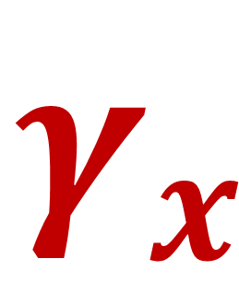



22
Spinors For Beginners
Dirac
$$\left(i∂−m\right)ψ$$
Equation
&
Gamma
$$γ_{y}$$
$$γ_{t}$$
$$γ_{x}$$
$$γ_{z}$$
Matrices

Slide 2
Spinors Learning “Staircase”
Spinors in Particle Physics
Lie Groups & Algebras
Clifford Algebras
Spinors in 3D / (4D)
Examples From Physics (motivation)

Slide 3
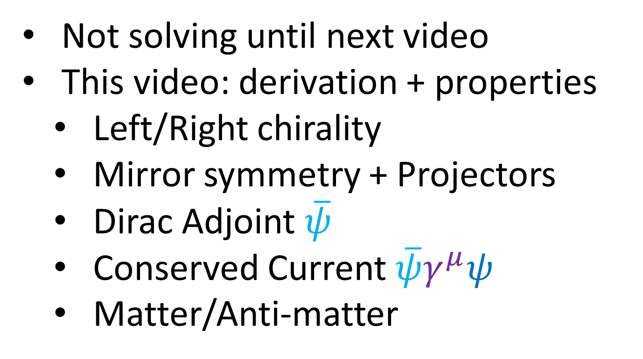
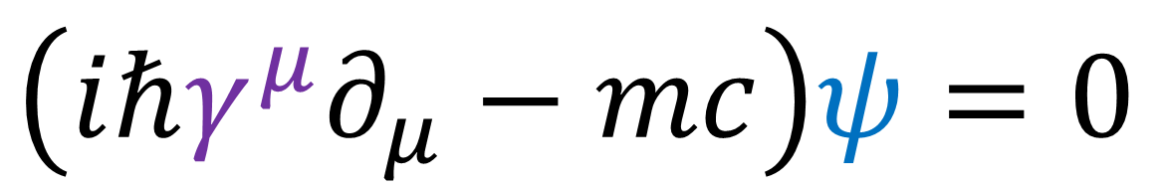
Dirac Equation
$$\left(iℏγ^{μ}∂_{μ}−mc\right)ψ=0$$
$⇒$ spin-½ particles in relativistic quantum mechanics
Not solving until next video
This video: derivation + properties
Left/Right chirality
Mirror symmetry + Projectors
Dirac Adjoint $\overline{ψ}$
Conserved Current $\overline{ψ}γ^{μ}ψ$
Matter/Anti-matter

Slide 4
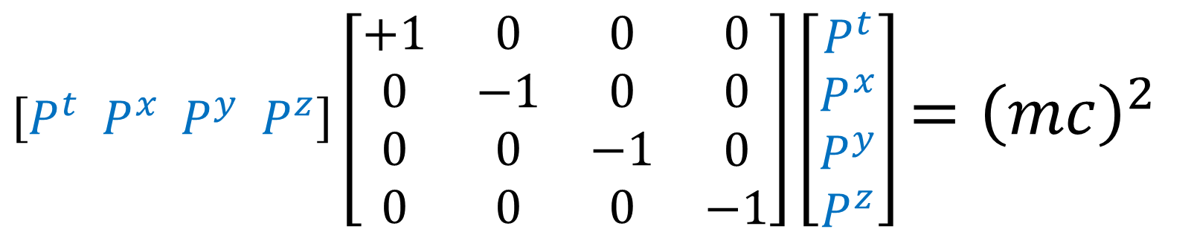
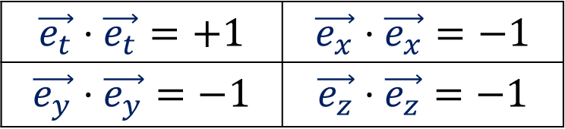
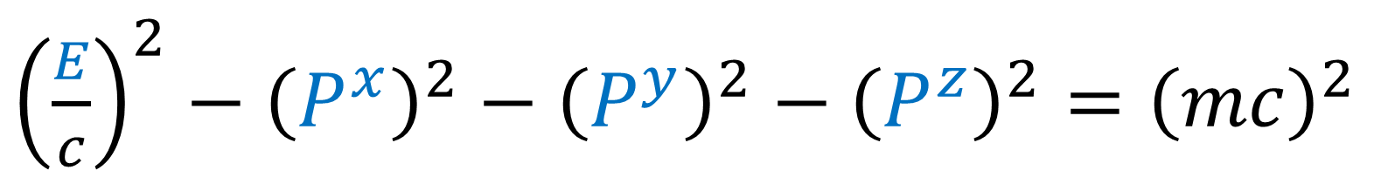
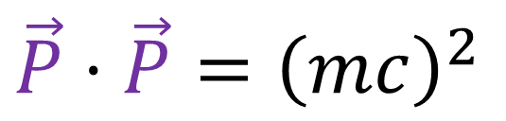


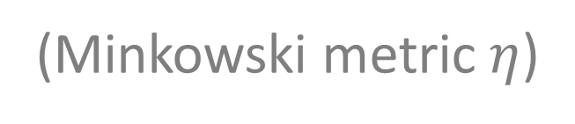
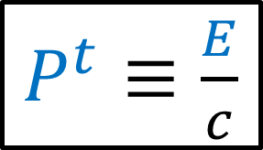
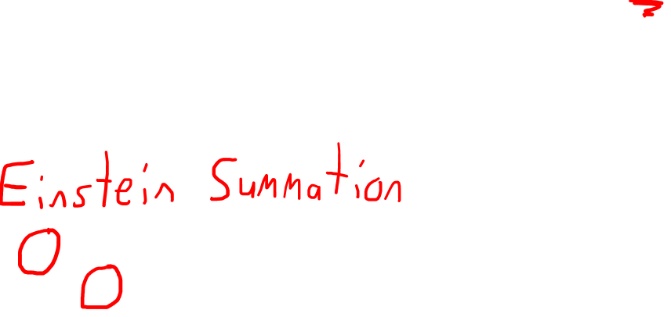
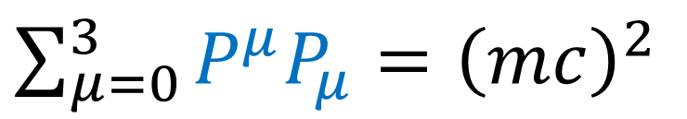
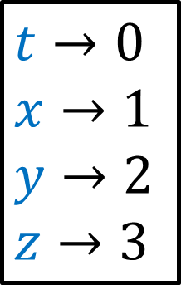
Mass-energy-momentum relation
${\left(\frac{E}{c}\right)}^{2}−{\left(P^{x}\right)}^{2}−{\left(P^{y}\right)}^{2}−{\left(P^{z}\right)}^{2}={\left(mc\right)}^{2}$
${\left(P^{t}\right)}^{2}−{\left(P^{x}\right)}^{2}−{\left(P^{y}\right)}^{2}−{\left(P^{z}\right)}^{2}={\left(mc\right)}^{2}$
$P^{t}≡\frac{E}{c}$
$\left[P^{t} P^{x} P^{y} P^{z}\right]\left[\begin{matrix}\begin{matrix}\begin{aligned}+1 \\ 0 \\ 0 \\ 0\end{aligned} & \begin{aligned}0 \\ −1 \\ 0 \\ 0\end{aligned}\end{matrix} & \begin{matrix}\begin{aligned}0 \\ 0 \\ −1 \\ 0\end{aligned} & \begin{aligned}0 \\ 0 \\ 0 \\ −1\end{aligned}\end{matrix}\end{matrix}\right]\left[\begin{aligned}P^{t} \\ P^{x} \\ P^{y} \\ P^{z}\end{aligned}\right]$ $={\left(mc\right)}^{2}$
(Minkowski metric $η$)
$$t→0$$
$$x→1$$
$$y→2$$
$$z→3$$
$$\sum_{μ,ν=0}^{3}{P^{μ}η_{μν}P^{ν}}={\left(mc\right)}^{2}$$
$$\vec{P}=P^{t}\vec{e_{t}}+P^{x}\vec{e_{x}}+P^{y}\vec{e_{y}}+P^{z}\vec{e_{z}}$$
$\vec{P}⋅\vec{P}={\left(mc\right)}^{2}$
$$\vec{e_{t}}⋅\vec{e_{t}}=+1$$ | $$\vec{e_{x}}⋅\vec{e_{x}}=−1$$
$$\vec{e_{y}}⋅\vec{e_{y}}=−1$$ | $$\vec{e_{z}}⋅\vec{e_{z}}=−1$$
$\sum_{μ=0}^{3}{P^{μ}P_{μ}}={\left(mc\right)}^{2}$

Slide 5

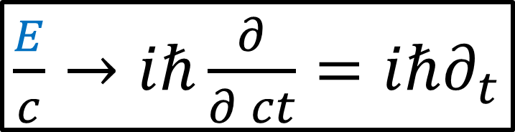
Mass-energy-momentum relation
${\left(\frac{E}{c}\right)}^{2}−{\left(P^{x}\right)}^{2}−{\left(P^{y}\right)}^{2}−{\left(P^{z}\right)}^{2}={\left(mc\right)}^{2}$
$\frac{E}{c}→iℏ\frac{∂}{∂ ct}=iℏ∂_{t}$
$P^{i}→iℏ∂^{i}=−iℏ∂_{i}$
$$−ℏ^{2}\left[{\left(∂_{t}\right)}^{2}−{\left(∂_{x}\right)}^{2}−{\left(∂_{y}\right)}^{2}−{\left(∂_{z}\right)}^{2}\right]ψ={\left(mc\right)}^{2}ψ$$
Klein-Gordon Equation
(relativistic wave equation)

Slide 6
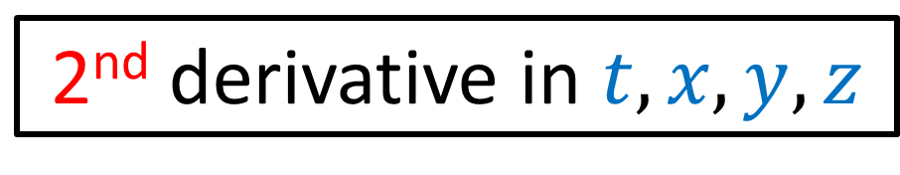

Mass-energy-momentum relation
${\left(\frac{E}{c}\right)}^{2}−{\left(P^{x}\right)}^{2}−{\left(P^{y}\right)}^{2}−{\left(P^{z}\right)}^{2}={\left(mc\right)}^{2}$
$\frac{E}{c}→iℏ\frac{∂}{∂ ct}=iℏ∂_{t}$
$P^{i}→iℏ∂^{i}=−iℏ∂_{i}$
$$−ℏ^{2}\left[{\left(∂_{t}\right)}^{2}−{\left(∂_{x}\right)}^{2}−{\left(∂_{y}\right)}^{2}−{\left(∂_{z}\right)}^{2}\right]ψ={\left(mc\right)}^{2}ψ$$
2nd derivative in $t,x,y,z$
$→$ does NOT change form under Lorentz transformations
Klein-Gordon Equation
(relativistic wave equation)

Slide 7
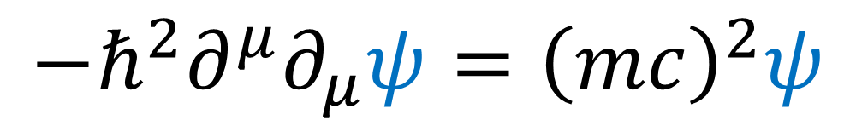
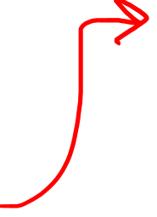
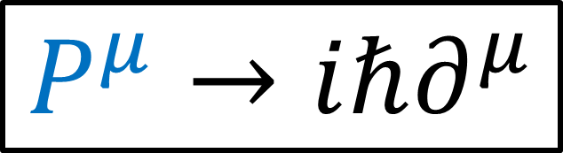
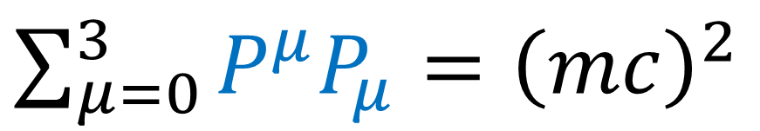
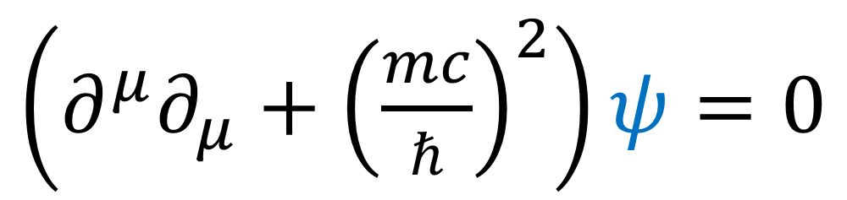
Mass-energy-momentum relation
${\left(\frac{E}{c}\right)}^{2}−{\left(P^{x}\right)}^{2}−{\left(P^{y}\right)}^{2}−{\left(P^{z}\right)}^{2}={\left(mc\right)}^{2}$
$\frac{E}{c}→iℏ\frac{∂}{∂ ct}=iℏ∂_{t}$
$P^{i}→iℏ∂^{i}=−iℏ∂_{i}$
$$−ℏ^{2}\left[{\left(∂_{t}\right)}^{2}−{\left(∂_{x}\right)}^{2}−{\left(∂_{y}\right)}^{2}−{\left(∂_{z}\right)}^{2}\right]ψ={\left(mc\right)}^{2}ψ$$
$\sum_{μ=0}^{3}{P^{μ}P_{μ}}={\left(mc\right)}^{2}$
$$−ℏ^{2}∂^{μ}∂_{μ}ψ={\left(mc\right)}^{2}ψ$$
$\left(∂^{μ}∂_{μ}+{\left(\frac{mc}{ℏ}\right)}^{2}\right)ψ=0$
$$P^{μ}→iℏ∂^{μ}$$
Klein-Gordon Equation

Slide 8
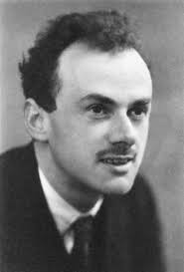
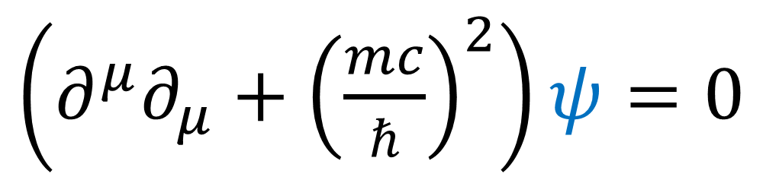
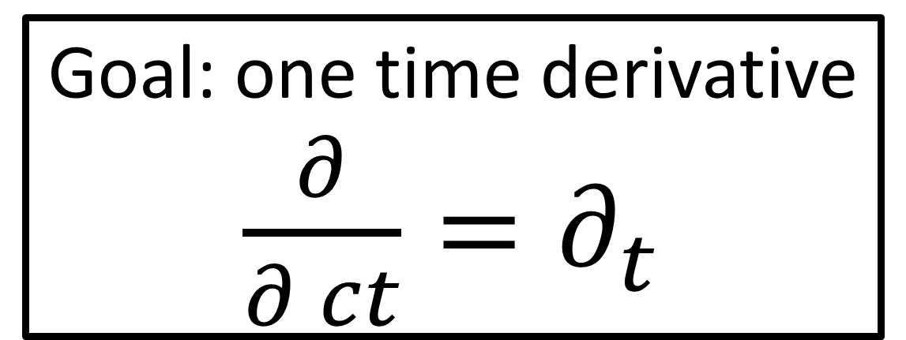
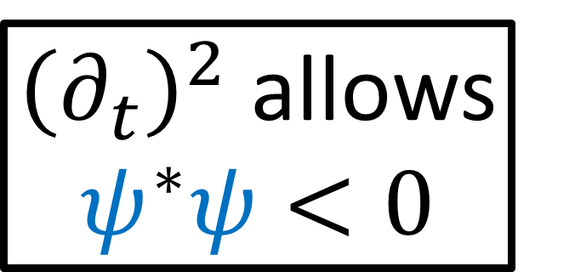
$\left(∂^{μ}∂_{μ}+{\left(\frac{mc}{ℏ}\right)}^{2}\right)ψ=0$
(video #21)
${\left(∂_{t}\right)}^{2}$ allows $ψ^{∗}ψ<0$
No Probabilistic Interpretation
Goal: one time derivative
$\frac{∂}{∂ ct}=∂_{t}$
Paul
Dirac

Slide 9
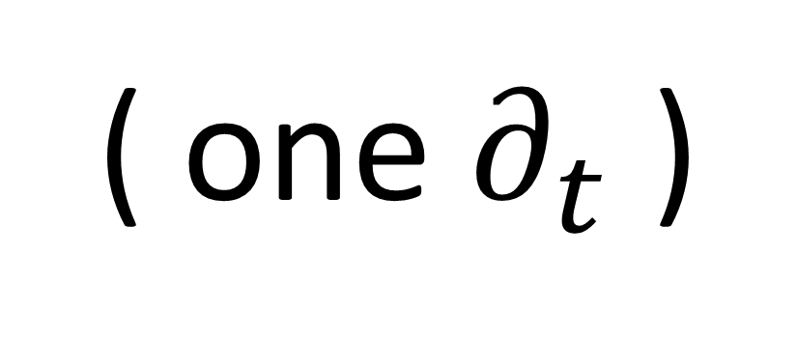
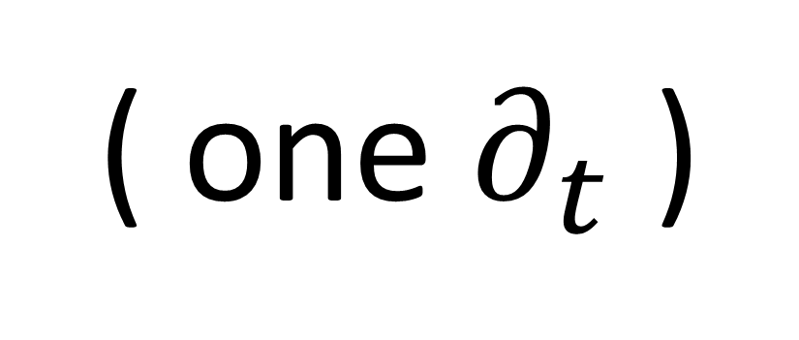
$\left(∂^{μ}∂_{μ}+{\left(\frac{mc}{ℏ}\right)}^{2}\right)ψ=0$
( one $∂_{t}$ )
( one $∂_{t}$ )

Slide 10
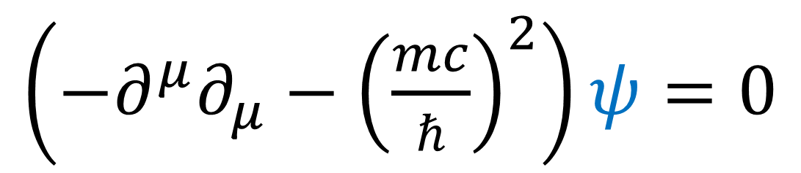
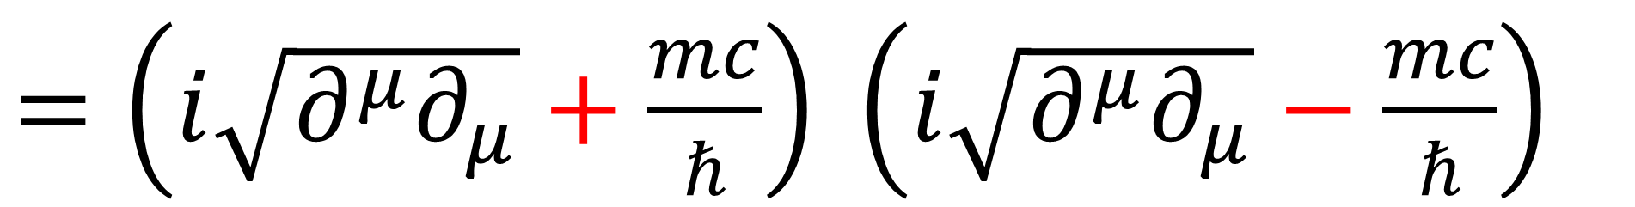
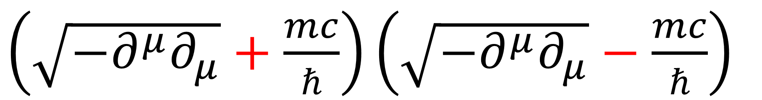
$\left(−∂^{μ}∂_{μ}−{\left(\frac{mc}{ℏ}\right)}^{2}\right)ψ=0$
$\left(\sqrt{−∂^{μ}∂_{μ}}+\frac{mc}{ℏ}\right)\left(\sqrt{−∂^{μ}∂_{μ}}−\frac{mc}{ℏ}\right)$
$=\left(i\sqrt{∂^{μ}∂_{μ}}+\frac{mc}{ℏ}\right) \left(i\sqrt{∂^{μ}∂_{μ}}−\frac{mc}{ℏ}\right)$
$\sqrt{∂^{μ}∂_{μ}}=γ_{t}∂^{t}+γ_{x}∂^{x}+γ_{y}∂^{y}+γ_{z}∂^{z}$

Slide 11
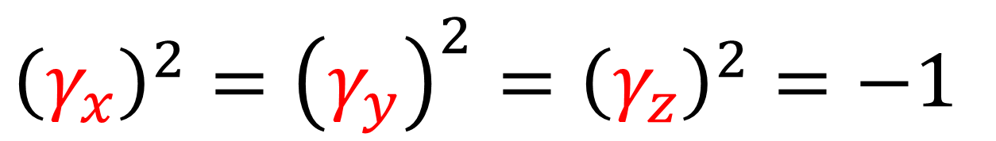
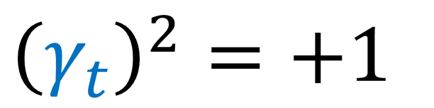
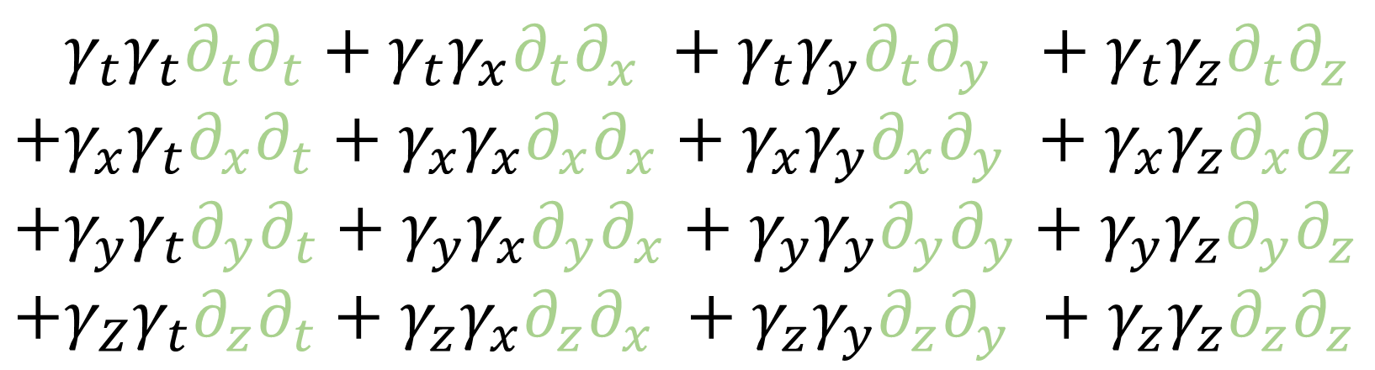
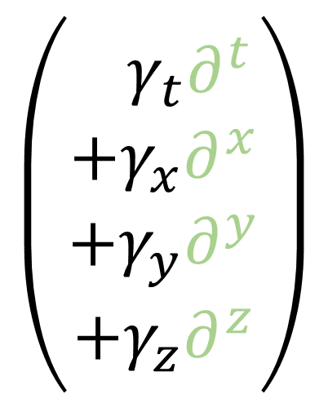
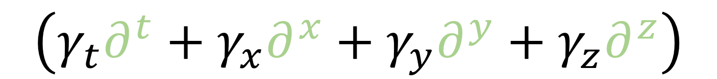

$∂^{μ}∂_{μ}=+{\left(∂^{t}\right)}^{2}−{\left(∂^{x}\right)}^{2}−{\left(∂^{y}\right)}^{2}−{\left(∂^{z}\right)}^{2}$
$$\left(γ_{t}∂^{t}+γ_{x}∂^{x}+γ_{y}∂^{y}+γ_{z}∂^{z}\right)$$
$$\left(\begin{aligned}+γ_{t}∂^{t} \\ +γ_{x}∂^{x} \\ +γ_{y}∂^{y} \\ +γ_{z}∂^{z}\end{aligned}\right)$$
$$+γ_{t}γ_{t}∂_{t}∂_{t}+γ_{t}γ_{x}∂_{t}∂_{x} +γ_{t}γ_{y}∂_{t}∂_{y} +γ_{t}γ_{z}∂_{t}∂_{z}$$
$$+γ_{x}γ_{t}∂_{x}∂_{t}+γ_{x}γ_{x}∂_{x}∂_{x}+γ_{x}γ_{y}∂_{x}∂_{y} +γ_{x}γ_{z}∂_{x}∂_{z}$$
$$+γ_{y}γ_{t}∂_{y}∂_{t}+γ_{y}γ_{x}∂_{y}∂_{x}+γ_{y}γ_{y}∂_{y}∂_{y}+γ_{y}γ_{z}∂_{y}∂_{z}$$
$$+γ_{Z}γ_{t}∂_{z}∂_{t}+γ_{z}γ_{x}∂_{z}∂_{x} +γ_{z}γ_{y}∂_{z}∂_{y} +γ_{z}γ_{z}∂_{z}∂_{z}$$
$${\left(γ_{t}\right)}^{2}=+1$$
$$γ_{μ}γ_{ν}=−γ_{ν}γ_{μ}$$
$${\left(γ_{x}\right)}^{2}={\left(γ_{y}\right)}^{2}={\left(γ_{z}\right)}^{2}=−1$$

Slide 12

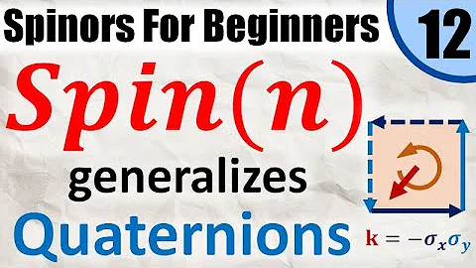
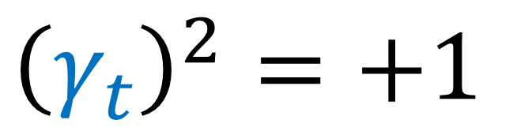
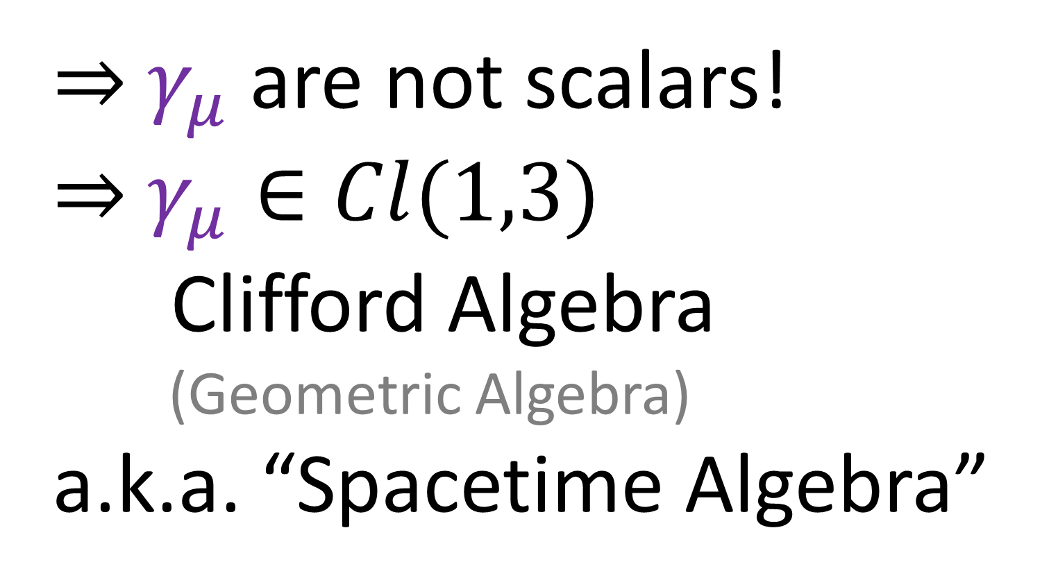


$${\left(γ_{t}\right)}^{2}=+1$$
$${\left(γ_{x}\right)}^{2}={\left(γ_{y}\right)}^{2}={\left(γ_{z}\right)}^{2}=−1$$
$$γ_{μ}γ_{ν}=−γ_{ν}γ_{μ}$$
$⇒$ $γ_{μ}$are not scalars!
$⇒$ $γ_{μ}∈Cl(1,3)$
Clifford Algebra
(Geometric Algebra)
a.k.a. “Spacetime Algebra”

Slide 13
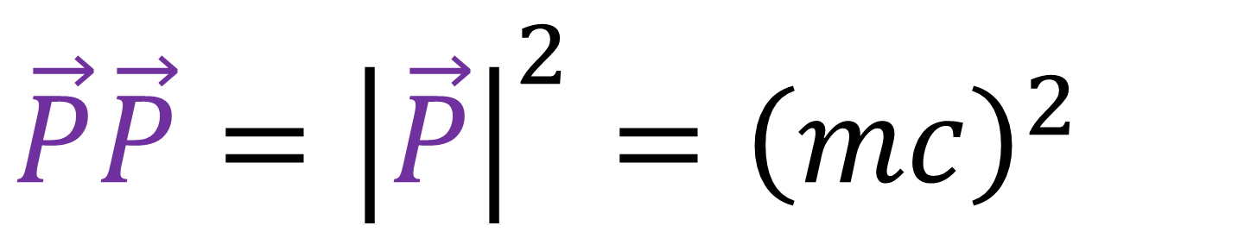
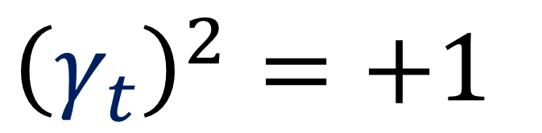
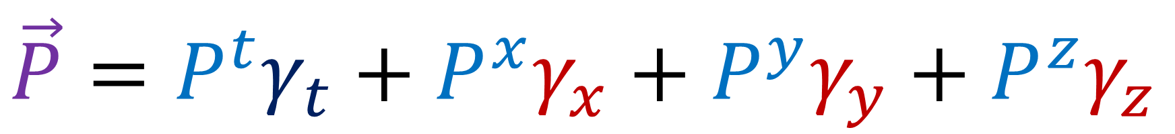





$${\left(γ_{t}\right)}^{2}=+1$$
$${\left(γ_{x}\right)}^{2}={\left(γ_{y}\right)}^{2}={\left(γ_{z}\right)}^{2}=−1$$
$$γ_{μ}γ_{ν}=−γ_{ν}γ_{μ}$$
$$γ_{y}$$
$$γ_{t}$$
$$\vec{P}=P^{t}γ_{t}+P^{x}γ_{x}+P^{y}γ_{y}+P^{z}γ_{z}$$
$$γ_{x}$$
$$γ_{z}$$
${\left(P^{t}\right)}^{2}−{\left(P^{x}\right)}^{2}−{\left(P^{y}\right)}^{2}−{\left(P^{z}\right)}^{2}={\left(mc\right)}^{2}$
$\vec{P}\vec{P}={\left|\vec{P}\right|}^{2}={\left(mc\right)}^{2}$

Slide 14
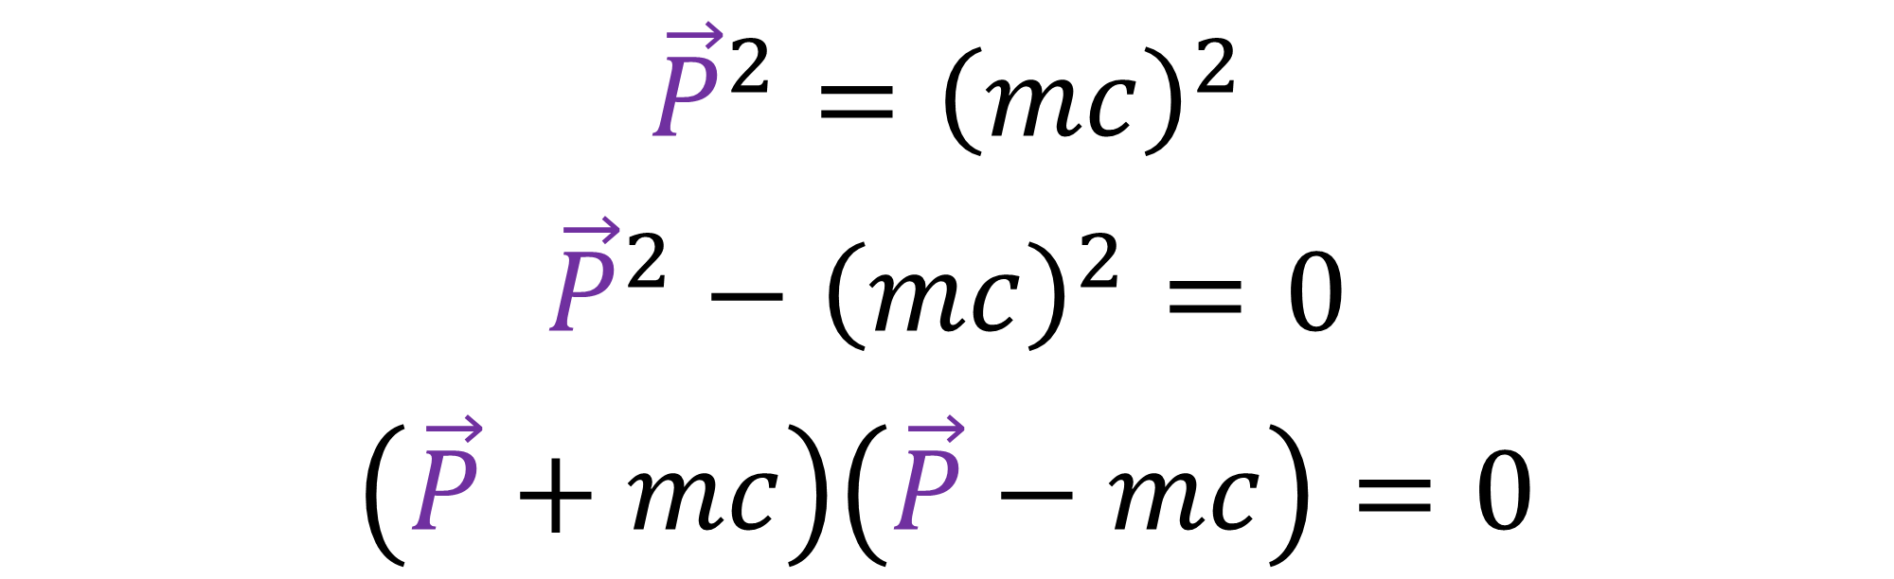
$${\left(γ_{t}\right)}^{2}=+1$$
$${\left(γ_{x}\right)}^{2}={\left(γ_{y}\right)}^{2}={\left(γ_{z}\right)}^{2}=−1$$
$$γ_{μ}γ_{ν}=−γ_{ν}γ_{μ}$$
${\vec{P}}^{2}={\left(mc\right)}^{2}$
${\vec{P}}^{2}−{\left(mc\right)}^{2}=0$
$\left(\vec{P}+mc\right)\left(\vec{P}−mc\right)=0$

Slide 15
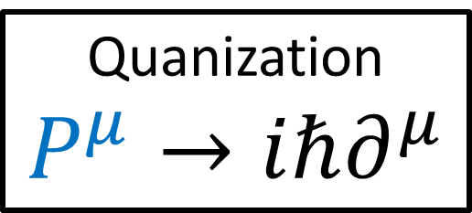
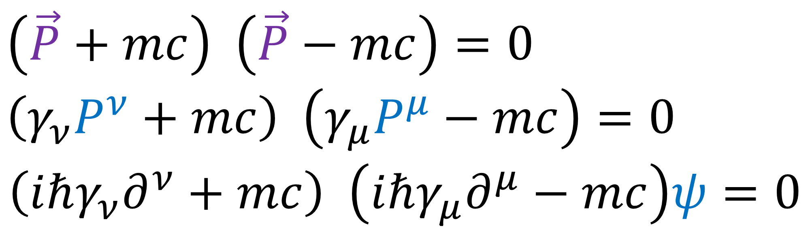
$${\left(γ_{t}\right)}^{2}=+1$$
$${\left(γ_{x}\right)}^{2}={\left(γ_{y}\right)}^{2}={\left(γ_{z}\right)}^{2}=−1$$
$$γ_{μ}γ_{ν}=−γ_{ν}γ_{μ}$$
$\left(\vec{P}+mc\right) \left(\vec{P}−mc\right)=0$
$$\left(γ_{ν}P^{ν}+mc\right) \left(γ_{μ}P^{μ}−mc\right)=0$$
$$\left(iℏγ_{ν}∂^{ν}+mc\right) \left(iℏγ_{μ}∂^{μ}−mc\right)ψ=0$$
Quanization
$$P^{μ}→iℏ∂^{μ}$$
Dirac Equation

Slide 16
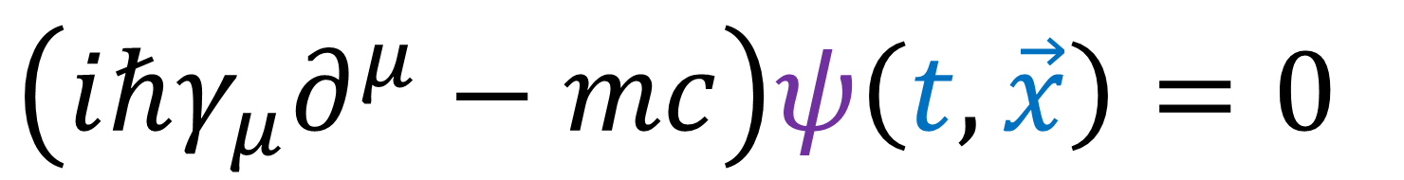

Klein-Gordon Equation:
$$\left(∂^{μ}∂_{μ}+m^{2}\right)φ\left(t,\vec{x}\right)=0$$
$μ≡\frac{mc}{ℏ}$
scalar field
Dirac Equation:
$\left(iℏγ_{μ}∂^{μ}−mc\right)ψ\left(t,\vec{x}\right)=0$
spinor field

Slide 17
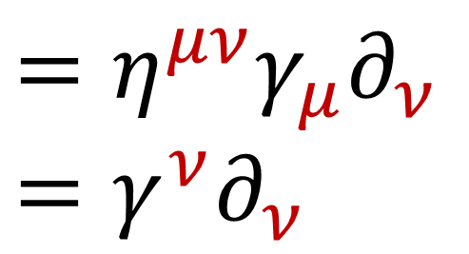
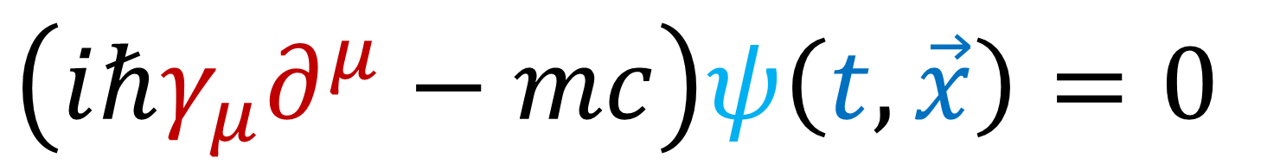
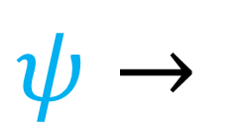
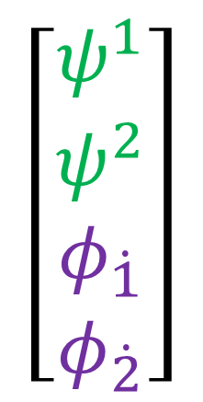

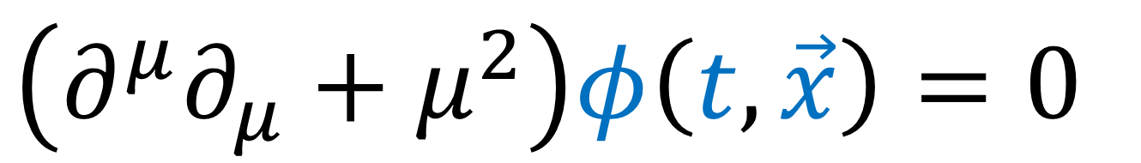
Klein-Gordon Equation:
$$\left(∂^{μ}∂_{μ}+μ^{2}\right)φ\left(t,\vec{x}\right)=0$$
$μ≡\frac{mc}{ℏ}$
scalar field
Dirac Equation:
Dirac Spinor
$\left(iℏγ_{μ}∂^{μ}−mc\right)ψ\left(t,\vec{x}\right)=0$
$$\left[\begin{aligned}ψ^{1} \\ ψ^{2} \\ φ_{\dot{1}} \\ φ_{\dot{2}}\end{aligned}\right]$$
spinor field
$$ψ→$$
$$=η^{μν}γ_{μ}∂_{ν}$$
$$=γ^{ν}∂_{ν}$$

Slide 18

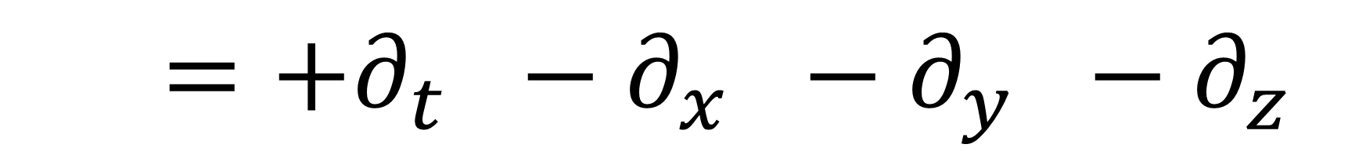



$\left(iℏγ_{μ}∂^{μ}−mc\right)ψ\left(t,\vec{x}\right)=0$
$η_{μν}→$ $\left[\begin{matrix}\begin{matrix}\begin{aligned}+1 \\ 0 \\ 0 \\ 0\end{aligned} & \begin{aligned}0 \\ −1 \\ 0 \\ 0\end{aligned}\end{matrix} & \begin{matrix}\begin{aligned}0 \\ 0 \\ −1 \\ 0\end{aligned} & \begin{aligned}0 \\ 0 \\ 0 \\ −1\end{aligned}\end{matrix}\end{matrix}\right]$ $←η^{μν}={\left(η^{−1}\right)}_{μν}$
$$∂^{μ}=η^{μν}∂_{ν}$$
$$∂^{μ}=+∂_{t} −∂_{x} −∂_{y} −∂_{z}$$

Slide 19










Clifford Algebra
$$Cl\left(1,3\right)$$
$${\left(γ_{t}\right)}^{2}=+1$$ | $${\left(γ_{x}\right)}^{2}={\left(γ_{y}\right)}^{2}={\left(γ_{z}\right)}^{2}=−1$$
 | $$γ_{μ}γ_{ν}=−γ_{ν}γ_{μ}$$
$$γ_{t}≡\left[\begin{matrix}\begin{matrix}\begin{aligned}1 \\ 0 \\ 0 \\ 0\end{aligned} & \begin{aligned}0 \\ 1 \\ 0 \\ 0\end{aligned}\end{matrix} & \begin{matrix}\begin{aligned}0 \\ 0 \\ −1 \\ 0\end{aligned} & \begin{aligned}0 \\ 0 \\ 0 \\ −1\end{aligned}\end{matrix}\end{matrix}\right]$$
$$γ_{x}≡\left[\begin{matrix}\begin{matrix}\begin{aligned}0 \\ 0 \\ 0 \\ −1\end{aligned} & \begin{aligned}0 \\ 0 \\ −1 \\ 0\end{aligned}\end{matrix} & \begin{matrix}\begin{aligned}0 \\ 1 \\ 0 \\ 0\end{aligned} & \begin{aligned}1 \\ 0 \\ 0 \\ 0\end{aligned}\end{matrix}\end{matrix}\right]$$
$$γ_{y}≡\left[\begin{matrix}\begin{matrix}\begin{aligned}0 \\ 0 \\ 0 \\ −i\end{aligned} & \begin{aligned}0 \\ 0 \\ i \\ 0\end{aligned}\end{matrix} & \begin{matrix}\begin{aligned}0 \\ i \\ 0 \\ 0\end{aligned} & \begin{aligned}−i \\ 0 \\ 0 \\ 0\end{aligned}\end{matrix}\end{matrix}\right]$$
$$γ_{z}≡\left[\begin{matrix}\begin{matrix}\begin{aligned}0 \\ 0 \\ −1 \\ 0\end{aligned} & \begin{aligned}0 \\ 0 \\ 0 \\ 1\end{aligned}\end{matrix} & \begin{matrix}\begin{aligned}1 \\ 0 \\ 0 \\ 0\end{aligned} & \begin{aligned}0 \\ −1 \\ 0 \\ 0\end{aligned}\end{matrix}\end{matrix}\right]$$
Dirac Matrices (Mass basis / Dirac basis)
Dirac Matrices (Chiral basis / Weyl basis)
$$γ_{t}≡\left[\begin{matrix}\begin{matrix}\begin{aligned}0 \\ 0 \\ 1 \\ 0\end{aligned} & \begin{aligned}0 \\ 0 \\ 0 \\ 1\end{aligned}\end{matrix} & \begin{matrix}\begin{aligned}1 \\ 0 \\ 0 \\ 0\end{aligned} & \begin{aligned}0 \\ 1 \\ 0 \\ 0\end{aligned}\end{matrix}\end{matrix}\right]$$
$$γ_{x}≡\left[\begin{matrix}\begin{matrix}\begin{aligned}0 \\ 0 \\ 0 \\ −1\end{aligned} & \begin{aligned}0 \\ 0 \\ −1 \\ 0\end{aligned}\end{matrix} & \begin{matrix}\begin{aligned}0 \\ 1 \\ 0 \\ 0\end{aligned} & \begin{aligned}1 \\ 0 \\ 0 \\ 0\end{aligned}\end{matrix}\end{matrix}\right]$$
$$γ_{y}≡\left[\begin{matrix}\begin{matrix}\begin{aligned}0 \\ 0 \\ 0 \\ −i\end{aligned} & \begin{aligned}0 \\ 0 \\ i \\ 0\end{aligned}\end{matrix} & \begin{matrix}\begin{aligned}0 \\ i \\ 0 \\ 0\end{aligned} & \begin{aligned}−i \\ 0 \\ 0 \\ 0\end{aligned}\end{matrix}\end{matrix}\right]$$
$$γ_{z}≡\left[\begin{matrix}\begin{matrix}\begin{aligned}0 \\ 0 \\ −1 \\ 0\end{aligned} & \begin{aligned}0 \\ 0 \\ 0 \\ 1\end{aligned}\end{matrix} & \begin{matrix}\begin{aligned}1 \\ 0 \\ 0 \\ 0\end{aligned} & \begin{aligned}0 \\ −1 \\ 0 \\ 0\end{aligned}\end{matrix}\end{matrix}\right]$$

Slide 20





Dirac Matrices (Chiral basis / Weyl basis)
$$γ_{t}≡\left[\begin{matrix}\begin{matrix}\begin{aligned}0 \\ 0 \\ 1 \\ 0\end{aligned} & \begin{aligned}0 \\ 0 \\ 0 \\ 1\end{aligned}\end{matrix} & \begin{matrix}\begin{aligned}1 \\ 0 \\ 0 \\ 0\end{aligned} & \begin{aligned}0 \\ 1 \\ 0 \\ 0\end{aligned}\end{matrix}\end{matrix}\right]$$
$$γ_{x}≡\left[\begin{matrix}\begin{matrix}\begin{aligned}0 \\ 0 \\ 0 \\ −1\end{aligned} & \begin{aligned}0 \\ 0 \\ −1 \\ 0\end{aligned}\end{matrix} & \begin{matrix}\begin{aligned}0 \\ 1 \\ 0 \\ 0\end{aligned} & \begin{aligned}1 \\ 0 \\ 0 \\ 0\end{aligned}\end{matrix}\end{matrix}\right]$$
$$γ_{y}≡\left[\begin{matrix}\begin{matrix}\begin{aligned}0 \\ 0 \\ 0 \\ −i\end{aligned} & \begin{aligned}0 \\ 0 \\ i \\ 0\end{aligned}\end{matrix} & \begin{matrix}\begin{aligned}0 \\ i \\ 0 \\ 0\end{aligned} & \begin{aligned}−i \\ 0 \\ 0 \\ 0\end{aligned}\end{matrix}\end{matrix}\right]$$
$$γ_{z}≡\left[\begin{matrix}\begin{matrix}\begin{aligned}0 \\ 0 \\ −1 \\ 0\end{aligned} & \begin{aligned}0 \\ 0 \\ 0 \\ 1\end{aligned}\end{matrix} & \begin{matrix}\begin{aligned}1 \\ 0 \\ 0 \\ 0\end{aligned} & \begin{aligned}0 \\ −1 \\ 0 \\ 0\end{aligned}\end{matrix}\end{matrix}\right]$$
Dirac Equation:
$\left(iℏ γ_{μ}∂^{μ} − mc\right) ψ =0$
$\left(iℏ\left[\begin{matrix}\begin{matrix}\begin{aligned}0 \\ 0 \\ ∂^{t}−∂^{z} \\ −∂^{x}−i∂^{y}\end{aligned} & \begin{aligned}0 \\ 0 \\ −∂^{x}+i∂^{y} \\ ∂^{t}+∂^{z}\end{aligned}\end{matrix} & \begin{matrix}\begin{aligned}∂^{t}+∂^{z} \\ ∂^{x}+i∂^{y} \\ 0 \\ 0\end{aligned} & \begin{aligned}∂^{x}−i∂^{y} \\ ∂^{t}−∂^{z} \\ 0 \\ 0\end{aligned}\end{matrix}\end{matrix}\right]−mc\left[\begin{matrix}\begin{matrix}\begin{aligned}1 \\ 0 \\ 0 \\ 0\end{aligned} & \begin{aligned}0 \\ 1 \\ 0 \\ 0\end{aligned}\end{matrix} & \begin{matrix}\begin{aligned}0 \\ 0 \\ 1 \\ 0\end{aligned} & \begin{aligned}0 \\ 0 \\ 0 \\ 1\end{aligned}\end{matrix}\end{matrix}\right]\right)\left[\begin{aligned}ψ^{1} \\ ψ^{2} \\ ψ^{3} \\ ψ^{4}\end{aligned}\right]=\left[\begin{aligned}0 \\ 0 \\ 0 \\ 0\end{aligned}\right]$
(Chiral basis / Weyl basis)

Slide 21





Dirac Equation (Chiral Basis):
$\left(iℏ\left[\begin{matrix}\begin{matrix}\begin{aligned}0 \\ 0 \\ ∂^{t}−∂^{z} \\ −∂^{x}−i∂^{y}\end{aligned} & \begin{aligned}0 \\ 0 \\ −∂^{x}+i∂^{y} \\ ∂^{t}+∂^{z}\end{aligned}\end{matrix} & \begin{matrix}\begin{aligned}∂^{t}+∂^{z} \\ ∂^{x}+i∂^{y} \\ 0 \\ 0\end{aligned} & \begin{aligned}∂^{x}−i∂^{y} \\ ∂^{t}−∂^{z} \\ 0 \\ 0\end{aligned}\end{matrix}\end{matrix}\right]−mc\left[\begin{matrix}\begin{matrix}\begin{aligned}1 \\ 0 \\ 0 \\ 0\end{aligned} & \begin{aligned}0 \\ 1 \\ 0 \\ 0\end{aligned}\end{matrix} & \begin{matrix}\begin{aligned}0 \\ 0 \\ 1 \\ 0\end{aligned} & \begin{aligned}0 \\ 0 \\ 0 \\ 1\end{aligned}\end{matrix}\end{matrix}\right]\right)\left[\begin{aligned}ψ^{1} \\ ψ^{2} \\ ψ^{3} \\ ψ^{4}\end{aligned}\right]=\left[\begin{aligned}0 \\ 0 \\ 0 \\ 0\end{aligned}\right]$
$\left(iℏ γ_{μ}∂^{μ} − mc\right) ψ =0$
$μ∈\left\{ct,x,y,z\right\}$
$a∈\left\{1,2,3,4\right\}$
Spacetime indices
Spinor indices
$$ψ^{a}$$

Slide 22


Dirac Equation (Chiral Basis):
$\left(iℏ\left[\begin{matrix}\begin{matrix}\begin{aligned}0 \\ 0 \\ ∂^{t}−∂^{z} \\ −∂^{x}−i∂^{y}\end{aligned} & \begin{aligned}0 \\ 0 \\ −∂^{x}+i∂^{y} \\ ∂^{t}+∂^{z}\end{aligned}\end{matrix} & \begin{matrix}\begin{aligned}∂^{t}+∂^{z} \\ ∂^{x}+i∂^{y} \\ 0 \\ 0\end{aligned} & \begin{aligned}∂^{x}−i∂^{y} \\ ∂^{t}−∂^{z} \\ 0 \\ 0\end{aligned}\end{matrix}\end{matrix}\right]−mc\left[\begin{matrix}\begin{matrix}\begin{aligned}1 \\ 0 \\ 0 \\ 0\end{aligned} & \begin{aligned}0 \\ 1 \\ 0 \\ 0\end{aligned}\end{matrix} & \begin{matrix}\begin{aligned}0 \\ 0 \\ 1 \\ 0\end{aligned} & \begin{aligned}0 \\ 0 \\ 0 \\ 1\end{aligned}\end{matrix}\end{matrix}\right]\right)\left[\begin{aligned}ψ^{1} \\ ψ^{2} \\ ψ^{3} \\ ψ^{4}\end{aligned}\right]=\left[\begin{aligned}0 \\ 0 \\ 0 \\ 0\end{aligned}\right]$
$\left(iℏ γ_{μ}∂^{μ} − mc\right) ψ =0$
$μ∈\left\{ct,x,y,z\right\}$
$\left[\begin{aligned}ψ^{1} \\ ψ^{2} \\ ψ^{3} \\ ψ^{4}\end{aligned}\right]=\left[\begin{aligned}ψ^{1} \\ ψ^{2} \\ φ_{\dot{1}} \\ φ_{\dot{2}}\end{aligned}\right]$
Spacetime indices
(see video #9)

Slide 23




$iℏ∂^{μ} γ_{μ a}^{ b} ψ^{a}− mcψ^{b}=0$
$$\left[\begin{matrix}\begin{matrix}\begin{aligned}γ_{μ 1}^{ 1} \\ γ_{μ 1}^{ 2} \\ γ_{μ 1}^{ 3} \\ γ_{μ 1}^{ 4}\end{aligned} & \begin{aligned}γ_{μ 2}^{ 1} \\ γ_{μ 2}^{ 2} \\ γ_{μ 2}^{ 3} \\ γ_{μ 2}^{ 4}\end{aligned}\end{matrix} & \begin{matrix}\begin{aligned}γ_{μ 3}^{ 1} \\ γ_{μ 3}^{ 2} \\ γ_{μ 3}^{ 3} \\ γ_{μ 3}^{ 4}\end{aligned} & \begin{aligned}γ_{μ 4}^{ 1} \\ γ_{μ 4}^{ 2} \\ γ_{μ 4}^{ 3} \\ γ_{μ 4}^{ 4}\end{aligned}\end{matrix}\end{matrix}\right]$$
$\left[\begin{aligned}ψ^{1} \\ ψ^{2} \\ ψ^{3} \\ ψ^{4}\end{aligned}\right]$
$\sum_{a }{γ_{μ a}^{ b} ψ^{a}}$

Slide 24



$iℏ∂^{μ} γ_{μ a}^{ b} ψ^{a}− mcψ^{b}=0$
$iℏ∂^{μ} γ_{μ} ψ − mcψ=0$

Slide 25















Dirac Matrices (Mass basis / Dirac basis)
$$γ_{t}^{M}≡\left[\begin{matrix}\begin{matrix}\begin{aligned}1 \\ 0 \\ 0 \\ 0\end{aligned} & \begin{aligned}0 \\ 1 \\ 0 \\ 0\end{aligned}\end{matrix} & \begin{matrix}\begin{aligned}0 \\ 0 \\ −1 \\ 0\end{aligned} & \begin{aligned}0 \\ 0 \\ 0 \\ −1\end{aligned}\end{matrix}\end{matrix}\right]$$
$$γ_{x}^{M}≡\left[\begin{matrix}\begin{matrix}\begin{aligned}0 \\ 0 \\ 0 \\ −1\end{aligned} & \begin{aligned}0 \\ 0 \\ −1 \\ 0\end{aligned}\end{matrix} & \begin{matrix}\begin{aligned}0 \\ 1 \\ 0 \\ 0\end{aligned} & \begin{aligned}1 \\ 0 \\ 0 \\ 0\end{aligned}\end{matrix}\end{matrix}\right]$$
$$γ_{y}^{M}≡\left[\begin{matrix}\begin{matrix}\begin{aligned}0 \\ 0 \\ 0 \\ −i\end{aligned} & \begin{aligned}0 \\ 0 \\ i \\ 0\end{aligned}\end{matrix} & \begin{matrix}\begin{aligned}0 \\ i \\ 0 \\ 0\end{aligned} & \begin{aligned}−i \\ 0 \\ 0 \\ 0\end{aligned}\end{matrix}\end{matrix}\right]$$
$$γ_{z}^{M}≡\left[\begin{matrix}\begin{matrix}\begin{aligned}0 \\ 0 \\ −1 \\ 0\end{aligned} & \begin{aligned}0 \\ 0 \\ 0 \\ 1\end{aligned}\end{matrix} & \begin{matrix}\begin{aligned}1 \\ 0 \\ 0 \\ 0\end{aligned} & \begin{aligned}0 \\ −1 \\ 0 \\ 0\end{aligned}\end{matrix}\end{matrix}\right]$$
$\left[\begin{aligned}ψ^{C 1} \\ ψ^{C 2} \\ ψ^{C 3} \\ ψ^{C 4}\end{aligned}\right]$
$=\frac{1}{\sqrt{2}}$ $\left[\begin{matrix}\begin{matrix}\begin{aligned}1 \\ 0 \\ 1 \\ 0\end{aligned} & \begin{aligned}0 \\ 1 \\ 0 \\ 1\end{aligned}\end{matrix} & \begin{matrix}\begin{aligned}−1 \\ 0 \\ 1 \\ 0\end{aligned} & \begin{aligned}0 \\ −1 \\ 0 \\ 1\end{aligned}\end{matrix}\end{matrix}\right]\left[\begin{aligned}ψ^{M 1} \\ ψ^{M 2} \\ ψ^{M 3} \\ ψ^{M 4}\end{aligned}\right]$
$\left[\begin{matrix}\begin{matrix}\begin{aligned}1 \\ 0 \\ 1 \\ 0\end{aligned} & \begin{aligned}0 \\ 1 \\ 0 \\ 1\end{aligned}\end{matrix} & \begin{matrix}\begin{aligned}1 \\ 0 \\ 1 \\ 0\end{aligned} & \begin{aligned}0 \\ 1 \\ 0 \\ 1\end{aligned}\end{matrix}\end{matrix}\right]=\left[\begin{matrix}\begin{matrix}\begin{aligned}1 \\ 0 \\ 1 \\ 0\end{aligned} & \begin{aligned}0 \\ 1 \\ 0 \\ 1\end{aligned}\end{matrix} & \begin{matrix}\begin{aligned}−1 \\ 0 \\ 1 \\ 0\end{aligned} & \begin{aligned}0 \\ −1 \\ 0 \\ 1\end{aligned}\end{matrix}\end{matrix}\right]\left[\begin{matrix}\begin{matrix}\begin{aligned}1 \\ 0 \\ 1 \\ 0\end{aligned} & \begin{aligned}0 \\ 1 \\ 0 \\ 1\end{aligned}\end{matrix} & \begin{matrix}\begin{aligned}1 \\ 0 \\ 1 \\ 0\end{aligned} & \begin{aligned}0 \\ 1 \\ 0 \\ 1\end{aligned}\end{matrix}\end{matrix}\right]{\left[\begin{matrix}\begin{matrix}\begin{aligned}1 \\ 0 \\ 1 \\ 0\end{aligned} & \begin{aligned}0 \\ 1 \\ 0 \\ 1\end{aligned}\end{matrix} & \begin{matrix}\begin{aligned}−1 \\ 0 \\ 1 \\ 0\end{aligned} & \begin{aligned}0 \\ −1 \\ 0 \\ 1\end{aligned}\end{matrix}\end{matrix}\right]}^{−1}$
$$ψ^{C}$$
$$ψ^{M}$$
$$γ_{μ}^{C}$$
$$γ_{μ}^{M}$$
Change of spinor basis
$$γ_{t}^{C}≡\left[\begin{matrix}\begin{matrix}\begin{aligned}0 \\ 0 \\ 1 \\ 0\end{aligned} & \begin{aligned}0 \\ 0 \\ 0 \\ 1\end{aligned}\end{matrix} & \begin{matrix}\begin{aligned}1 \\ 0 \\ 0 \\ 0\end{aligned} & \begin{aligned}0 \\ 1 \\ 0 \\ 0\end{aligned}\end{matrix}\end{matrix}\right]$$
$$γ_{x}^{C}≡\left[\begin{matrix}\begin{matrix}\begin{aligned}0 \\ 0 \\ 0 \\ −1\end{aligned} & \begin{aligned}0 \\ 0 \\ −1 \\ 0\end{aligned}\end{matrix} & \begin{matrix}\begin{aligned}0 \\ 1 \\ 0 \\ 0\end{aligned} & \begin{aligned}1 \\ 0 \\ 0 \\ 0\end{aligned}\end{matrix}\end{matrix}\right]$$
$$γ_{y}^{C}≡\left[\begin{matrix}\begin{matrix}\begin{aligned}0 \\ 0 \\ 0 \\ −i\end{aligned} & \begin{aligned}0 \\ 0 \\ i \\ 0\end{aligned}\end{matrix} & \begin{matrix}\begin{aligned}0 \\ i \\ 0 \\ 0\end{aligned} & \begin{aligned}−i \\ 0 \\ 0 \\ 0\end{aligned}\end{matrix}\end{matrix}\right]$$
$$γ_{z}^{C}≡\left[\begin{matrix}\begin{matrix}\begin{aligned}0 \\ 0 \\ −1 \\ 0\end{aligned} & \begin{aligned}0 \\ 0 \\ 0 \\ 1\end{aligned}\end{matrix} & \begin{matrix}\begin{aligned}1 \\ 0 \\ 0 \\ 0\end{aligned} & \begin{aligned}0 \\ −1 \\ 0 \\ 0\end{aligned}\end{matrix}\end{matrix}\right]$$
Dirac Matrices (Chiral basis / Weyl basis)

Slide 26









Dirac Matrices (Chiral basis / Weyl basis)
$$γ_{t}≡\left[\begin{matrix}\begin{matrix}\begin{aligned}0 \\ 0 \\ 1 \\ 0\end{aligned} & \begin{aligned}0 \\ 0 \\ 0 \\ 1\end{aligned}\end{matrix} & \begin{matrix}\begin{aligned}1 \\ 0 \\ 0 \\ 0\end{aligned} & \begin{aligned}0 \\ 1 \\ 0 \\ 0\end{aligned}\end{matrix}\end{matrix}\right]$$
$$γ_{x}≡\left[\begin{matrix}\begin{matrix}\begin{aligned}0 \\ 0 \\ 0 \\ −1\end{aligned} & \begin{aligned}0 \\ 0 \\ −1 \\ 0\end{aligned}\end{matrix} & \begin{matrix}\begin{aligned}0 \\ 1 \\ 0 \\ 0\end{aligned} & \begin{aligned}1 \\ 0 \\ 0 \\ 0\end{aligned}\end{matrix}\end{matrix}\right]$$
$$γ_{y}≡\left[\begin{matrix}\begin{matrix}\begin{aligned}0 \\ 0 \\ 0 \\ −i\end{aligned} & \begin{aligned}0 \\ 0 \\ i \\ 0\end{aligned}\end{matrix} & \begin{matrix}\begin{aligned}0 \\ i \\ 0 \\ 0\end{aligned} & \begin{aligned}−i \\ 0 \\ 0 \\ 0\end{aligned}\end{matrix}\end{matrix}\right]$$
$$γ_{z}≡\left[\begin{matrix}\begin{matrix}\begin{aligned}0 \\ 0 \\ −1 \\ 0\end{aligned} & \begin{aligned}0 \\ 0 \\ 0 \\ 1\end{aligned}\end{matrix} & \begin{matrix}\begin{aligned}1 \\ 0 \\ 0 \\ 0\end{aligned} & \begin{aligned}0 \\ −1 \\ 0 \\ 0\end{aligned}\end{matrix}\end{matrix}\right]$$
$$γ_{t}$$
$$γ_{y}$$
$$γ_{z}$$
$$γ_{x}$$
Clifford Algebra
$$Cl\left(1,3\right)$$
$${\left(γ_{t}\right)}^{2}=+1$$ | $${\left(γ_{x}\right)}^{2}={\left(γ_{y}\right)}^{2}={\left(γ_{z}\right)}^{2}=−1$$
 | $$γ_{μ}γ_{ν}=−γ_{ν}γ_{μ}$$

Slide 27







$$\left[\begin{aligned}ct \\ x \\ y \\ z\end{aligned}\right]$$
$$= ct\left[\begin{aligned}1 \\ 0 \\ 0 \\ 0\end{aligned}\right] + x\left[\begin{aligned}0 \\ 1 \\ 0 \\ 0\end{aligned}\right] + y\left[\begin{aligned}0 \\ 0 \\ 1 \\ 0\end{aligned}\right] + z\left[\begin{aligned}0 \\ 0 \\ 0 \\ 1\end{aligned}\right]$$
$$\vec{w} = ct \vec{e_{t}} + x \vec{e_{x}} + y \vec{e_{y}} + z \vec{e_{z}}$$
$$SO^{+}(1,3)$$
Lorentz Transformation
$$\left[\begin{aligned}ct \\ x \\ y \\ z\end{aligned}\right]$$
$$\vec{w}→Λ\vec{w}$$
$$Λ∈SO^{+}(1,3)$$

Slide 28





$$\left[\begin{aligned}ct \\ x \\ y \\ z\end{aligned}\right]$$
$$→ \left[\begin{matrix}ct+z & x−yi \\ x+yi & ct−z\end{matrix}\right]$$
$$=ct\left[\begin{matrix}1 & 0 \\ 0 & 1\end{matrix}\right] +x\left[\begin{matrix}0 & 1 \\ 1 & 0\end{matrix}\right] +y\left[\begin{matrix}0 & −i \\ +i & 0\end{matrix}\right] +z\left[\begin{matrix}1 & 0 \\ 0 & −1\end{matrix}\right]$$
$$=ct σ_{t} + x σ_{x} + y σ_{y} + z σ_{z}$$
$${\text{𝟙}}_{2×2}$$
$$=x^{μ}σ_{μ}$$

Slide 29






$\left[\begin{matrix} & \\ & \end{matrix}\right]\left[\begin{matrix}ct+z & x−yi \\ x+yi & ct−z\end{matrix}\right]{\left[\begin{matrix} & \\ & \end{matrix}\right]}^{†}$
$SL\left(2,ℂ\right)$
$$θ/2$$
$SL\left(2,ℂ\right)$
$$θ/2$$
$$\vec{W}=x^{μ}σ_{μ}$$
$$L∈SL\left(2,ℂ\right)$$
$$\vec{W}→L\vec{W}L^{†}$$
(double cover of $SO^{+}\left(1,3\right)$)
$$∈Spin\left(1,3\right)$$

Slide 30



$SL\left(2,ℂ\right)=Spin\left(1,3\right)$ matrices
$R_{yz}\left(θ\right)=\left[\begin{matrix}\cos{\frac{θ}{2}} & −i\sin{\frac{θ}{2}} \\ −i\sin{\frac{θ}{2}} & \cos{\frac{θ}{2}}\end{matrix}\right]$ | $=\left[\begin{matrix}1 & 0 \\ 0 & 1\end{matrix}\right]\cos\left(\frac{θ}{2}\right)−\left[\begin{matrix}0 & i \\ i & 0\end{matrix}\right]\sin\left(\frac{θ}{2}\right)$ | $=\text{𝟙}\cos\left(\frac{θ}{2}\right)−σ_{y}σ_{z}\sin\left(\frac{θ}{2}\right)$ | $$=e^{−σ_{y}σ_{z}\frac{θ}{2}}$$
$R_{zx}\left(θ\right)=\left[\begin{matrix}\cos{\frac{θ}{2}} & −\sin{\frac{θ}{2}} \\ +\sin{\frac{θ}{2}} & \cos{\frac{θ}{2}}\end{matrix}\right]$ | $=\left[\begin{matrix}1 & 0 \\ 0 & 1\end{matrix}\right]\cos\left(\frac{θ}{2}\right)−\left[\begin{matrix}0 & +1 \\ −1 & 0\end{matrix}\right]\sin\left(\frac{θ}{2}\right)$ | $=\text{𝟙}\cos\left(\frac{θ}{2}\right)−σ_{z}σ_{x}\sin\left(\frac{θ}{2}\right)$ | $$=e^{−σ_{z}σ_{x}\frac{θ}{2}}$$
$R_{xy}\left(θ\right)=\left[\begin{matrix}e^{−i\frac{θ}{2}} & 0 \\ 0 & e^{+i\frac{θ}{2}}\end{matrix}\right]$ | $=\left[\begin{matrix}1 & 0 \\ 0 & 1\end{matrix}\right]\cos\left(\frac{θ}{2}\right)−\left[\begin{matrix}+i & 0 \\ 0 & −i\end{matrix}\right]\sin\left(\frac{θ}{2}\right)$ | $=\text{𝟙}\cos\left(\frac{θ}{2}\right)−σ_{x}σ_{y}\sin\left(\frac{θ}{2}\right)$ | $$=e^{−σ_{x}σ_{y}\frac{θ}{2}}$$
$B_{x}\left(φ\right)=\left[\begin{matrix}\cosh{\frac{φ}{2}} & −\sinh{\frac{φ}{2}} \\ −sinh{\frac{φ}{2}} & \cosh{\frac{φ}{2}}\end{matrix}\right]$ | $=\left[\begin{matrix}1 & 0 \\ 0 & 1\end{matrix}\right]\cosh\left(\frac{φ}{2}\right)−\left[\begin{matrix}0 & 1 \\ 1 & 0\end{matrix}\right]\sinh\left(\frac{φ}{2}\right)$ | $=\text{𝟙}\cosh\left(\frac{φ}{2}\right)−σ_{x}\sinh\left(\frac{φ}{2}\right)$ | $$=e^{−σ_{x}\frac{φ}{2}}$$
$B_{y}\left(φ\right)=\left[\begin{matrix}\cosh{\frac{φ}{2}} & i\sinh{\frac{φ}{2}} \\ −i sinh{\frac{φ}{2}} & \cosh{\frac{φ}{2}}\end{matrix}\right]$ | $=\left[\begin{matrix}1 & 0 \\ 0 & 1\end{matrix}\right]\cosh\left(\frac{φ}{2}\right)−\left[\begin{matrix}0 & −i \\ i & 0\end{matrix}\right]\sinh\left(\frac{φ}{2}\right)$ | $=\text{𝟙}\cosh\left(\frac{φ}{2}\right)−σ_{y}\sinh\left(\frac{φ}{2}\right)$ | $$=e^{−σ_{y}\frac{φ}{2}}$$
$B_{z}\left(φ\right)=\left[\begin{matrix}e^{−\frac{φ}{2}} & 0 \\ 0 & e^{+\frac{φ}{2}}\end{matrix}\right]$ | $=\left[\begin{matrix}1 & 0 \\ 0 & 1\end{matrix}\right]\cosh\left(\frac{φ}{2}\right)−\left[\begin{matrix}1 & 0 \\ 0 & −1\end{matrix}\right]\sinh\left(\frac{φ}{2}\right)$ | $=\text{𝟙}\cosh\left(\frac{φ}{2}\right)−σ_{z}\sinh\left(\frac{φ}{2}\right)$ | $$=e^{−σ_{z}\frac{φ}{2}}$$

Slide 31









$$\left[\begin{matrix}ct+z & x−yi \\ x+yi & ct−z\end{matrix}\right]$$
$$\left[\begin{matrix}ct−z & −x+yi \\ −x−yi & ct+z\end{matrix}\right]$$
Parity
transformation
$$\vec{W}=x^{μ}σ_{μ}$$
$$\vec{W}=ct\text{𝟙}+x^{i}σ_{i}$$
$$\vec{W}=x^{μ}{\overline{σ}}_{μ}$$
$$\vec{W}=ct\text{𝟙}−x^{i}σ_{i}$$
$${\left(L^{†}\right)}^{−1}∈SL\left(2,ℂ\right)$$
$$L∈SL\left(2,ℂ\right)$$
$R_{jk}\left(θ\right)=e^{−σ_{j}σ_{k}\frac{θ}{2}}$
$B_{i}\left(φ\right)=e^{−σ_{i}\frac{φ}{2}}$
$R_{jk}\left(θ\right)=e^{−σ_{j}σ_{k}\frac{θ}{2}}$
$B_{i}\left(φ\right)=e^{+σ_{i}\frac{φ}{2}}$

Slide 32





Rotation in $xy$-plane:
$$y$$
$$−x$$
$$x$$
$$−y$$

Slide 33












Boost in $x$-direction:
$$y$$
$$−z$$
$$−x$$
$$x$$
$$−y$$
$$z$$
$$x$$
$$−x$$

Slide 34













Lorentz Trfm. on Weyl Spinor: $L∈Spin\left(1,3\right)$
$L→{\left(L^{†}\right)}^{−1}$
$$=e^{−σ_{i}σ_{j}\frac{θ}{2}}$$
$$=e^{−σ_{i}\frac{φ}{2}}$$
Rotations $L$
Boosts $L$
(Unitary) $L^{†}=L^{−1}$
(Hermitian) $L^{†}=L$
$${\left(σ_{i}σ_{j}\right)}^{†}={\left(σ_{i}σ_{j}\right)}^{−1}=−σ_{i}σ_{j}$$
$${\left(σ_{i}\right)}^{†} = σ_{i}$$
$$⇒{\left(L^{†}\right)}^{−1}={\left(L^{−1}\right)}^{−1}$$
$$⇒{\left(L^{†}\right)}^{−1}=L$$
$$⇒{\left(L^{†}\right)}^{−1}={\left(L\right)}^{−1}$$
$$⇒{\left(L^{†}\right)}^{−1}=L^{−1}$$

Slide 35





$$\left[\begin{matrix}ct+z & x−yi \\ x+yi & ct−z\end{matrix}\right]$$
$$\left[\begin{matrix}ct−z & −x+yi \\ −x−yi & ct+z\end{matrix}\right]$$
Parity
transformation
Dirac Matrices (Chiral basis / Weyl basis)
$$γ_{t}→\left[\begin{matrix}\begin{matrix}\begin{aligned}0 \\ 0 \\ 1 \\ 0\end{aligned} & \begin{aligned}0 \\ 0 \\ 0 \\ 1\end{aligned}\end{matrix} & \begin{matrix}\begin{aligned}1 \\ 0 \\ 0 \\ 0\end{aligned} & \begin{aligned}0 \\ 1 \\ 0 \\ 0\end{aligned}\end{matrix}\end{matrix}\right]$$
$$γ_{x}→\left[\begin{matrix}\begin{matrix}\begin{aligned}0 \\ 0 \\ 0 \\ −1\end{aligned} & \begin{aligned}0 \\ 0 \\ −1 \\ 0\end{aligned}\end{matrix} & \begin{matrix}\begin{aligned}0 \\ 1 \\ 0 \\ 0\end{aligned} & \begin{aligned}1 \\ 0 \\ 0 \\ 0\end{aligned}\end{matrix}\end{matrix}\right]$$
$$γ_{y}→\left[\begin{matrix}\begin{matrix}\begin{aligned}0 \\ 0 \\ 0 \\ −i\end{aligned} & \begin{aligned}0 \\ 0 \\ i \\ 0\end{aligned}\end{matrix} & \begin{matrix}\begin{aligned}0 \\ i \\ 0 \\ 0\end{aligned} & \begin{aligned}−i \\ 0 \\ 0 \\ 0\end{aligned}\end{matrix}\end{matrix}\right]$$
$$γ_{z}→\left[\begin{matrix}\begin{matrix}\begin{aligned}0 \\ 0 \\ −1 \\ 0\end{aligned} & \begin{aligned}0 \\ 0 \\ 0 \\ 1\end{aligned}\end{matrix} & \begin{matrix}\begin{aligned}1 \\ 0 \\ 0 \\ 0\end{aligned} & \begin{aligned}0 \\ −1 \\ 0 \\ 0\end{aligned}\end{matrix}\end{matrix}\right]$$
$$=ct\left[\begin{matrix}\begin{matrix}\begin{aligned}0 \\ 0 \\ 1 \\ 0\end{aligned} & \begin{aligned}0 \\ 0 \\ 0 \\ 1\end{aligned}\end{matrix} & \begin{matrix}\begin{aligned}1 \\ 0 \\ 0 \\ 0\end{aligned} & \begin{aligned}0 \\ 1 \\ 0 \\ 0\end{aligned}\end{matrix}\end{matrix}\right]+x\left[\begin{matrix}\begin{matrix}\begin{aligned}0 \\ 0 \\ 0 \\ −1\end{aligned} & \begin{aligned}0 \\ 0 \\ −1 \\ 0\end{aligned}\end{matrix} & \begin{matrix}\begin{aligned}0 \\ 1 \\ 0 \\ 0\end{aligned} & \begin{aligned}1 \\ 0 \\ 0 \\ 0\end{aligned}\end{matrix}\end{matrix}\right]+y\left[\begin{matrix}\begin{matrix}\begin{aligned}0 \\ 0 \\ 0 \\ −i\end{aligned} & \begin{aligned}0 \\ 0 \\ i \\ 0\end{aligned}\end{matrix} & \begin{matrix}\begin{aligned}0 \\ i \\ 0 \\ 0\end{aligned} & \begin{aligned}−i \\ 0 \\ 0 \\ 0\end{aligned}\end{matrix}\end{matrix}\right]+z\left[\begin{matrix}\begin{matrix}\begin{aligned}0 \\ 0 \\ −1 \\ 0\end{aligned} & \begin{aligned}0 \\ 0 \\ 0 \\ 1\end{aligned}\end{matrix} & \begin{matrix}\begin{aligned}1 \\ 0 \\ 0 \\ 0\end{aligned} & \begin{aligned}0 \\ −1 \\ 0 \\ 0\end{aligned}\end{matrix}\end{matrix}\right]$$
$$= ct γ_{t} + x γ_{x} + y γ_{y} + z γ_{z}$$

Slide 36





$$\left[\begin{matrix}ct+z & x−yi \\ x+yi & ct−z\end{matrix}\right]$$
$$\left[\begin{matrix}ct−z & −x+yi \\ −x−yi & ct+z\end{matrix}\right]$$
Parity
transformation
$$\left[\begin{matrix}\begin{matrix}\begin{aligned}0 \\ 0 \\ ct−z \\ −x−yi\end{aligned} & \begin{aligned}0 \\ 0 \\ −x+yi \\ ct+z\end{aligned}\end{matrix} & \begin{matrix}\begin{aligned}ct+z \\ x+yi \\ 0 \\ 0\end{aligned} & \begin{aligned}x−yi \\ ct−z \\ 0 \\ 0\end{aligned}\end{matrix}\end{matrix}\right]$$
$$γ_{t}→\left[\begin{matrix}\begin{matrix}\begin{aligned}0 \\ 0 \\ 1 \\ 0\end{aligned} & \begin{aligned}0 \\ 0 \\ 0 \\ 1\end{aligned}\end{matrix} & \begin{matrix}\begin{aligned}1 \\ 0 \\ 0 \\ 0\end{aligned} & \begin{aligned}0 \\ 1 \\ 0 \\ 0\end{aligned}\end{matrix}\end{matrix}\right]$$
$$γ_{x}→\left[\begin{matrix}\begin{matrix}\begin{aligned}0 \\ 0 \\ 0 \\ −1\end{aligned} & \begin{aligned}0 \\ 0 \\ −1 \\ 0\end{aligned}\end{matrix} & \begin{matrix}\begin{aligned}0 \\ 1 \\ 0 \\ 0\end{aligned} & \begin{aligned}1 \\ 0 \\ 0 \\ 0\end{aligned}\end{matrix}\end{matrix}\right]$$
$$γ_{y}→\left[\begin{matrix}\begin{matrix}\begin{aligned}0 \\ 0 \\ 0 \\ −i\end{aligned} & \begin{aligned}0 \\ 0 \\ i \\ 0\end{aligned}\end{matrix} & \begin{matrix}\begin{aligned}0 \\ i \\ 0 \\ 0\end{aligned} & \begin{aligned}−i \\ 0 \\ 0 \\ 0\end{aligned}\end{matrix}\end{matrix}\right]$$
$$γ_{z}→\left[\begin{matrix}\begin{matrix}\begin{aligned}0 \\ 0 \\ −1 \\ 0\end{aligned} & \begin{aligned}0 \\ 0 \\ 0 \\ 1\end{aligned}\end{matrix} & \begin{matrix}\begin{aligned}1 \\ 0 \\ 0 \\ 0\end{aligned} & \begin{aligned}0 \\ −1 \\ 0 \\ 0\end{aligned}\end{matrix}\end{matrix}\right]$$
Dirac Matrices (Chiral basis / Weyl basis)

Slide 37
$$\left[\begin{matrix}ct+z & x−yi \\ x+yi & ct−z\end{matrix}\right]$$
$$\left[\begin{matrix}ct−z & −x+yi \\ −x−yi & ct+z\end{matrix}\right]$$
Parity
transformation
$$\left[\begin{matrix}\begin{matrix}\begin{aligned}0 \\ 0 \\ ct−z \\ −x−yi\end{aligned} & \begin{aligned}0 \\ 0 \\ −x+yi \\ ct+z\end{aligned}\end{matrix} & \begin{matrix}\begin{aligned}ct+z \\ x+yi \\ 0 \\ 0\end{aligned} & \begin{aligned}x−yi \\ ct−z \\ 0 \\ 0\end{aligned}\end{matrix}\end{matrix}\right]$$
$$=ct\left[\begin{matrix}\begin{matrix}\begin{aligned}0 \\ 0 \\ 1 \\ 0\end{aligned} & \begin{aligned}0 \\ 0 \\ 0 \\ 1\end{aligned}\end{matrix} & \begin{matrix}\begin{aligned}1 \\ 0 \\ 0 \\ 0\end{aligned} & \begin{aligned}0 \\ 1 \\ 0 \\ 0\end{aligned}\end{matrix}\end{matrix}\right]+x\left[\begin{matrix}\begin{matrix}\begin{aligned}0 \\ 0 \\ 0 \\ −1\end{aligned} & \begin{aligned}0 \\ 0 \\ −1 \\ 0\end{aligned}\end{matrix} & \begin{matrix}\begin{aligned}0 \\ 1 \\ 0 \\ 0\end{aligned} & \begin{aligned}1 \\ 0 \\ 0 \\ 0\end{aligned}\end{matrix}\end{matrix}\right]+y\left[\begin{matrix}\begin{matrix}\begin{aligned}0 \\ 0 \\ 0 \\ −i\end{aligned} & \begin{aligned}0 \\ 0 \\ i \\ 0\end{aligned}\end{matrix} & \begin{matrix}\begin{aligned}0 \\ i \\ 0 \\ 0\end{aligned} & \begin{aligned}−i \\ 0 \\ 0 \\ 0\end{aligned}\end{matrix}\end{matrix}\right]+z\left[\begin{matrix}\begin{matrix}\begin{aligned}0 \\ 0 \\ −1 \\ 0\end{aligned} & \begin{aligned}0 \\ 0 \\ 0 \\ 1\end{aligned}\end{matrix} & \begin{matrix}\begin{aligned}1 \\ 0 \\ 0 \\ 0\end{aligned} & \begin{aligned}0 \\ −1 \\ 0 \\ 0\end{aligned}\end{matrix}\end{matrix}\right]$$
$$= ct γ_{t} + x γ_{x} + y γ_{y} + z γ_{z}$$

Slide 38

Dirac Matrices (Chiral basis / Weyl basis)
$$γ_{t}→\left[\begin{matrix}\begin{matrix}\begin{aligned}0 \\ 0 \\ 1 \\ 0\end{aligned} & \begin{aligned}0 \\ 0 \\ 0 \\ 1\end{aligned}\end{matrix} & \begin{matrix}\begin{aligned}1 \\ 0 \\ 0 \\ 0\end{aligned} & \begin{aligned}0 \\ 1 \\ 0 \\ 0\end{aligned}\end{matrix}\end{matrix}\right]$$
$$γ_{x}→\left[\begin{matrix}\begin{matrix}\begin{aligned}0 \\ 0 \\ 0 \\ −1\end{aligned} & \begin{aligned}0 \\ 0 \\ −1 \\ 0\end{aligned}\end{matrix} & \begin{matrix}\begin{aligned}0 \\ 1 \\ 0 \\ 0\end{aligned} & \begin{aligned}1 \\ 0 \\ 0 \\ 0\end{aligned}\end{matrix}\end{matrix}\right]$$
$$γ_{y}→\left[\begin{matrix}\begin{matrix}\begin{aligned}0 \\ 0 \\ 0 \\ −i\end{aligned} & \begin{aligned}0 \\ 0 \\ i \\ 0\end{aligned}\end{matrix} & \begin{matrix}\begin{aligned}0 \\ i \\ 0 \\ 0\end{aligned} & \begin{aligned}−i \\ 0 \\ 0 \\ 0\end{aligned}\end{matrix}\end{matrix}\right]$$
$$γ_{z}→\left[\begin{matrix}\begin{matrix}\begin{aligned}0 \\ 0 \\ −1 \\ 0\end{aligned} & \begin{aligned}0 \\ 0 \\ 0 \\ 1\end{aligned}\end{matrix} & \begin{matrix}\begin{aligned}1 \\ 0 \\ 0 \\ 0\end{aligned} & \begin{aligned}0 \\ −1 \\ 0 \\ 0\end{aligned}\end{matrix}\end{matrix}\right]$$
$$\text{𝟙}→\left[\begin{matrix}1 & \text{0} \\ 0 & 1\end{matrix}\right]$$ | $$σ_{x}→\left[\begin{matrix}0 & 1 \\ 1 & 0\end{matrix}\right]$$ | $$σ_{y}→\left[\begin{matrix}0 & −i \\ i & 0\end{matrix}\right]$$ | $$σ_{z}→\left[\begin{matrix}1 & 0 \\ 0 & −1\end{matrix}\right]$$
$$γ_{t}→\left[\begin{matrix}0 & \text{𝟙} \\ \text{𝟙} & 0\end{matrix}\right]$$ | $$γ_{x}→\left[\begin{matrix}0 & σ_{x} \\ {−σ}_{x} & 0\end{matrix}\right]$$ | $$γ_{y}→\left[\begin{matrix}0 & σ_{y} \\ {−σ}_{y} & 0\end{matrix}\right]$$ | $$γ_{z}→\left[\begin{matrix}0 & σ_{z} \\ {−σ}_{Z} & 0\end{matrix}\right]$$

Slide 39



Dirac Matrices (Chiral basis / Weyl basis)
$$γ_{t}→\left[\begin{matrix}0 & \text{𝟙} \\ \text{𝟙} & 0\end{matrix}\right]$$ | $$γ_{x}→\left[\begin{matrix}0 & σ_{x} \\ {−σ}_{x} & 0\end{matrix}\right]$$ | $$γ_{y}→\left[\begin{matrix}0 & σ_{y} \\ {−σ}_{y} & 0\end{matrix}\right]$$ | $$γ_{z}→\left[\begin{matrix}0 & σ_{z} \\ {−σ}_{Z} & 0\end{matrix}\right]$$
$$ct γ_{t} + x γ_{x} + y γ_{y} + z γ_{z}$$
$=ct\left[\begin{matrix}0 & \text{𝟙} \\ \text{𝟙} & 0\end{matrix}\right]+x\left[\begin{matrix}0 & σ_{x} \\ {−σ}_{x} & 0\end{matrix}\right]+y\left[\begin{matrix}0 & σ_{y} \\ {−σ}_{y} & 0\end{matrix}\right]+z\left[\begin{matrix}0 & σ_{z} \\ {−σ}_{Z} & 0\end{matrix}\right]$
$$=\left[\begin{matrix}0 & ct\text{𝟙}+xσ_{x}+yσ_{y}+zσ_{z} \\ ct\text{𝟙}−xσ_{x}−yσ_{y}−zσ_{z} & 0\end{matrix}\right]$$

Slide 40







$$\vec{W}=x^{μ}σ_{μ}$$
$$L∈Spin\left(1,3\right)$$
$$\left[\begin{matrix}\begin{matrix}\begin{aligned}0 \\ 0 \\ ct−z \\ −x−yi\end{aligned} & \begin{aligned}0 \\ 0 \\ −x+yi \\ ct+z\end{aligned}\end{matrix} & \begin{matrix}\begin{aligned}ct+z \\ x+yi \\ 0 \\ 0\end{aligned} & \begin{aligned}x−yi \\ ct−z \\ 0 \\ 0\end{aligned}\end{matrix}\end{matrix}\right]$$
$$\vec{W}→L\vec{W}L^{†}$$
$$𝒱=x^{μ}γ_{μ}$$
Rotations:
$$L=e^{−σ_{i}σ_{j}\frac{θ}{2}}$$
$$𝒱→e^{+γ_{μ}γ_{ν}\frac{θ}{2}} 𝒱 e^{−γ_{μ}γ_{ν}\frac{θ}{2}}$$
Boosts:
$L=e^{−σ_{i}\frac{φ}{2}}$
bivector

Slide 41



Dirac Matrices (Chiral basis / Weyl basis)
$$γ_{t}→\left[\begin{matrix}0 & \text{𝟙} \\ \text{𝟙} & 0\end{matrix}\right]$$ | $$γ_{x}→\left[\begin{matrix}0 & σ_{x} \\ {−σ}_{x} & 0\end{matrix}\right]$$ | $$γ_{y}→\left[\begin{matrix}0 & σ_{y} \\ {−σ}_{y} & 0\end{matrix}\right]$$ | $$γ_{z}→\left[\begin{matrix}0 & σ_{z} \\ {−σ}_{Z} & 0\end{matrix}\right]$$
$$γ_{y}γ_{z}→\left[\begin{matrix}−σ_{y}σ_{z} & 0 \\ 0 & −σ_{y}σ_{z}\end{matrix}\right]$$
$$γ_{z}γ_{x}→\left[\begin{matrix}−σ_{z}σ_{x} & 0 \\ 0 & −σ_{z}σ_{x}\end{matrix}\right]$$
$$γ_{x}γ_{y}→\left[\begin{matrix}−σ_{x}σ_{y} & 0 \\ 0 & −σ_{x}σ_{y}\end{matrix}\right]$$
$$γ_{t}γ_{x}→\left[\begin{matrix}−σ_{x} & 0 \\ 0 & +σ_{x}\end{matrix}\right]$$
$$γ_{t}γ_{y}→\left[\begin{matrix}−σ_{y} & 0 \\ 0 & +σ_{y}\end{matrix}\right]$$
$$γ_{t}γ_{z}→\left[\begin{matrix}−σ_{z} & 0 \\ 0 & +σ_{z}\end{matrix}\right]$$
Rotation Generators
Boost Generators

Slide 42





$$γ_{y}γ_{z}→\left[\begin{matrix}−σ_{y}σ_{z} & 0 \\ 0 & −σ_{y}σ_{z}\end{matrix}\right]$$
$$γ_{z}γ_{x}→\left[\begin{matrix}−σ_{z}σ_{x} & 0 \\ 0 & −σ_{z}σ_{x}\end{matrix}\right]$$
$$γ_{x}γ_{y}→\left[\begin{matrix}−σ_{x}σ_{y} & 0 \\ 0 & −σ_{x}σ_{y}\end{matrix}\right]$$
$$γ_{t}γ_{x}→\left[\begin{matrix}−σ_{x} & 0 \\ 0 & +σ_{x}\end{matrix}\right]$$
$$γ_{t}γ_{y}→\left[\begin{matrix}−σ_{y} & 0 \\ 0 & +σ_{y}\end{matrix}\right]$$
$$γ_{t}γ_{z}→\left[\begin{matrix}−σ_{z} & 0 \\ 0 & +σ_{z}\end{matrix}\right]$$
$$γ_{y}γ_{z}→\left[\begin{matrix}−σ_{y}σ_{z} & 0 \\ 0 & −σ_{y}σ_{z}\end{matrix}\right]$$
$$γ_{z}γ_{x}→\left[\begin{matrix}−σ_{z}σ_{x} & 0 \\ 0 & −σ_{z}σ_{x}\end{matrix}\right]$$
$$γ_{x}γ_{y}→\left[\begin{matrix}−σ_{x}σ_{y} & 0 \\ 0 & −σ_{x}σ_{y}\end{matrix}\right]$$
$$γ_{x}→−γ_{x}$$
$$γ_{y}→−γ_{y}$$
$$γ_{z}→−γ_{z}$$
Parity
Transformation
$$−γ_{t}γ_{x}→\left[\begin{matrix}+σ_{x} & 0 \\ 0 & −σ_{x}\end{matrix}\right]$$
$$−γ_{t}γ_{y}→\left[\begin{matrix}+σ_{y} & 0 \\ 0 & −σ_{y}\end{matrix}\right]$$
$$−γ_{t}γ_{z}→\left[\begin{matrix}+σ_{z} & 0 \\ 0 & −σ_{z}\end{matrix}\right]$$
$$σ_{x}→−σ_{x}$$
$$σ_{y}→−σ_{y}$$
$$σ_{z}→−σ_{z}$$

Slide 43






Spatial gammas $\left(i≠j\right)$
${\left(γ_{i}\right)}^{2}={\left(γ_{j}\right)}^{2}=−{\text{𝟙}}_{4×4}$ ${\left(γ_{i}γ_{j}\right)}^{2}=−{\text{𝟙}}_{4×4}$
$e^{+γ_{i}γ_{j}\frac{θ}{2}}$
$={\text{𝟙}}_{4×4}\cos\left(\frac{θ}{2}\right)+γ_{i}γ_{j}\sin\left(\frac{θ}{2}\right)$
$=$ $\left[\begin{matrix}\text{𝟙} & 0 \\ 0 & \text{𝟙}\end{matrix}\right]$ $\cos\left(\frac{θ}{2}\right)+$ $\left[\begin{matrix}−σ_{i}σ_{j} & 0 \\ 0 & −σ_{i}σ_{j}\end{matrix}\right]$ $\sin\left(\frac{θ}{2}\right)$
$=\left[\begin{matrix}\text{𝟙}\cos\left(\frac{θ}{2}\right)−σ_{i}σ_{j}\sin\left(\frac{θ}{2}\right) & 0 \\ 0 & \text{𝟙}\cos\left(\frac{θ}{2}\right)−σ_{i}σ_{j}\sin\left(\frac{θ}{2}\right)\end{matrix}\right]$ $=$ $\left[\begin{matrix}e^{−σ_{i}σ_{j}\frac{θ}{2}} & 0 \\ 0 & e^{−σ_{i}σ_{j}\frac{θ}{2}}\end{matrix}\right]$
$=$ $\left[\begin{matrix}e^{−σ_{i}σ_{j}\frac{θ}{2}} & 0 \\ 0 & e^{−σ_{i}σ_{j}\frac{θ}{2}}\end{matrix}\right]$

Slide 44










$=$ $\left[\begin{matrix}e^{−σ_{i}σ_{j}\frac{θ}{2}} & 0 \\ 0 & e^{−σ_{i}σ_{j}\frac{θ}{2}}\end{matrix}\right]$
$$λ=$$
$e^{+γ_{i}γ_{j} \frac{θ}{2}}$
rotations
(chiral basis)
$$𝒱→λ 𝒱 λ^{−1}$$
$\left[\begin{matrix}e^{−σ_{i}σ_{j}\frac{θ}{2}} & 0 \\ 0 & e^{−σ_{i}σ_{j}\frac{θ}{2}}\end{matrix}\right]$
$\left[\begin{matrix}0 & {\vec{W}}_{left} \\ {\vec{W}}_{right} & 0\end{matrix}\right]$
$\left[\begin{matrix}e^{+σ_{i}σ_{j}\frac{θ}{2}} & 0 \\ 0 & e^{+σ_{i}σ_{j}\frac{θ}{2}}\end{matrix}\right]$
$=\left[\begin{matrix}0 & e^{−σ_{i}σ_{j}\frac{θ}{2}} {\vec{W}}_{left} e^{+σ_{i}σ_{j}\frac{θ}{2}} \\ e^{−σ_{i}σ_{j}\frac{θ}{2}} {\vec{W}}_{right} e^{+σ_{i}σ_{j}\frac{θ}{2}} & 0\end{matrix}\right]$
$$L\vec{W}L^{†}$$

Slide 45








$=$ $\left[\begin{matrix}e^{−σ_{i}\frac{φ}{2}} & 0 \\ 0 & e^{+σ_{i}\frac{φ}{2}}\end{matrix}\right]$
$$λ=$$
$e^{+γ_{t}γ_{i} \frac{φ}{2}}$
boosts
(chiral basis)
$$𝒱→λ 𝒱 λ^{−1}$$
$\left[\begin{matrix}e^{−σ_{i}\frac{φ}{2}} & 0 \\ 0 & e^{+σ_{i}\frac{φ}{2}}\end{matrix}\right]$
$\left[\begin{matrix}0 & {\vec{W}}_{left} \\ {\vec{W}}_{right} & 0\end{matrix}\right]$
$\left[\begin{matrix}e^{+σ_{i}\frac{φ}{2}} & 0 \\ 0 & e^{−σ_{i}\frac{φ}{2}}\end{matrix}\right]$
$$L\vec{W}L^{†}$$
$=\left[\begin{matrix}0 & e^{−σ_{i}\frac{φ}{2}} {\vec{W}}_{left} e^{−σ_{i}\frac{φ}{2}} \\ e^{+σ_{i}\frac{φ}{2}} {\vec{W}}_{right} e^{+σ_{i}\frac{φ}{2}} & 0\end{matrix}\right]$

Slide 46






















$$Λ$$
$$\left[\begin{aligned}ct \\ x \\ y \\ z\end{aligned}\right]$$
$$Λ∈SO^{+}(1,3)$$
$$\vec{W}=x^{μ}σ_{μ}$$
$$L∈Spin(1,3)$$
$$L∈SL(2,ℂ)$$
$\left[\begin{matrix} & \\ & \end{matrix}\right]\left[\begin{matrix}ct+z & x−yi \\ x+yi & ct−z\end{matrix}\right]{\left[\begin{matrix} & \\ & \end{matrix}\right]}^{}$
$$L$$
$$L^{†}$$
$$L$$
$$𝒱=x^{μ}γ_{μ}$$
$$L^{−1}$$
$${\left(L^{†}\right)}^{−1}$$
$$L^{†}$$
$$λ∈Spin{\left(1,3\right)}_{left}$$
$$⊕Spin{\left(1,3\right)}_{right}$$
$$λ$$
$$\left[\begin{matrix}\begin{matrix}\begin{aligned}0 \\ 0 \\ ct−z \\ −x−yi\end{aligned} & \begin{aligned}0 \\ 0 \\ −x+yi \\ ct+z\end{aligned}\end{matrix} & \begin{matrix}\begin{aligned}ct+z \\ x+yi \\ 0 \\ 0\end{aligned} & \begin{aligned}x−yi \\ ct−z \\ 0 \\ 0\end{aligned}\end{matrix}\end{matrix}\right]$$
$$λ^{−1}$$

Slide 47


$$\vec{𝒱}→ λ \vec{𝒱} λ^{−1}$$
$$\vec{𝒱}=e^{+B\frac{θ}{2}} \vec{𝒱} e^{−B\frac{θ}{2}}$$

Slide 48
Rotation = 2 Reflections
mirror #2
mirror #1

Slide 49


Rotation = 2 Reflections
$θ/2$
$$θ$$
mirror #2
mirror #1

Slide 50


$$\vec{V}→−\vec{U} \vec{V} {\vec{U}}^{−1}$$
(reflect $\vec{V}$ along $\vec{U}$)

Slide 51




$$\vec{V}→−γ_{z} \vec{V} γ_{z}^{−1}$$
(reflect $\vec{V}$ along $γ_{z}$)
$$γ_{t}→ − γ_{z} γ_{t} γ_{z}^{−1} =+ γ_{t}$$
$$γ_{x}→ − γ_{z} γ_{x} γ_{z}^{−1} =+ γ_{x}$$
$$γ_{y}→ − γ_{z} γ_{y} γ_{z}^{−1} =+ γ_{y}$$
$$γ_{z}→ − γ_{z} γ_{z} γ_{z}^{−1} =− γ_{z}$$

Slide 52






Rotation in $ρτ$-plane:
$V→$ $−τ\left(−ρ Vρ ^{−1}\right)τ^{−1}$
$=\left(τρ\right) V {\left(\text{τ}ρ\right)}^{−1}$
$θ/2$
$θ/2$
$$τ$$
$$ρ$$
mirror #1
mirror #2

Slide 53




Rotation in $ρτ$-plane:
$$V→\left(τρ\right) V {\left(\text{τ}ρ\right)}^{−1}$$
$τρ=\left(τ⋅ρ\right)+\left(τ∧ρ\right)$
$τρ=\cosh{\frac{θ}{2}}+B\sinh{\frac{θ}{2}}$
$$B^{2}=−1⇒cos/sin$$
$$B^{2}=+1⇒cosh/sinh$$
$V→e^{+B\frac{θ}{2}} V e^{−B\frac{θ}{2}}$

Slide 54






Rotation in $ρτ$-plane:
$$V→\left(τρ\right) V {\left(\text{τ}ρ\right)}^{−1}$$
$τρ=\left(τ⋅ρ\right)+\left(τ∧ρ\right)$
$τρ=\cosh{\frac{θ}{2}}+B\sinh{\frac{θ}{2}}$
$B^{2}=−1⇒$ rotation
$\left(cos/sin\right)$
$${\left(γ_{i}γ_{j}\right)}^{2}=−1$$
$B^{2}=+1⇒$ boost
$\left(cosh/sinh\right)$
$${\left(γ_{t}γ_{i}\right)}^{2}=+1$$
$V→e^{+B\frac{θ}{2}} V e^{−B\frac{θ}{2}}$

Slide 55





Abstract Gammas
$$γ_{t} γ_{x} γ_{y} γ_{z}$$
Dirac Matrices (Chiral basis / Weyl basis)
For Chirality
$$γ_{t}≡\left[\begin{matrix}\begin{matrix}\begin{aligned}0 \\ 0 \\ 1 \\ 0\end{aligned} & \begin{aligned}0 \\ 0 \\ 0 \\ 1\end{aligned}\end{matrix} & \begin{matrix}\begin{aligned}1 \\ 0 \\ 0 \\ 0\end{aligned} & \begin{aligned}0 \\ 1 \\ 0 \\ 0\end{aligned}\end{matrix}\end{matrix}\right]$$
$$γ_{x}≡\left[\begin{matrix}\begin{matrix}\begin{aligned}0 \\ 0 \\ 0 \\ −1\end{aligned} & \begin{aligned}0 \\ 0 \\ −1 \\ 0\end{aligned}\end{matrix} & \begin{matrix}\begin{aligned}0 \\ 1 \\ 0 \\ 0\end{aligned} & \begin{aligned}1 \\ 0 \\ 0 \\ 0\end{aligned}\end{matrix}\end{matrix}\right]$$
$$γ_{y}≡\left[\begin{matrix}\begin{matrix}\begin{aligned}0 \\ 0 \\ 0 \\ −i\end{aligned} & \begin{aligned}0 \\ 0 \\ i \\ 0\end{aligned}\end{matrix} & \begin{matrix}\begin{aligned}0 \\ i \\ 0 \\ 0\end{aligned} & \begin{aligned}−i \\ 0 \\ 0 \\ 0\end{aligned}\end{matrix}\end{matrix}\right]$$
$$γ_{z}≡\left[\begin{matrix}\begin{matrix}\begin{aligned}0 \\ 0 \\ −1 \\ 0\end{aligned} & \begin{aligned}0 \\ 0 \\ 0 \\ 1\end{aligned}\end{matrix} & \begin{matrix}\begin{aligned}1 \\ 0 \\ 0 \\ 0\end{aligned} & \begin{aligned}0 \\ −1 \\ 0 \\ 0\end{aligned}\end{matrix}\end{matrix}\right]$$
For matter / anti-matter
Dirac Matrices (Mass basis / Dirac basis)
$$γ_{t}≡\left[\begin{matrix}\begin{matrix}\begin{aligned}1 \\ 0 \\ 0 \\ 0\end{aligned} & \begin{aligned}0 \\ 1 \\ 0 \\ 0\end{aligned}\end{matrix} & \begin{matrix}\begin{aligned}0 \\ 0 \\ −1 \\ 0\end{aligned} & \begin{aligned}0 \\ 0 \\ 0 \\ −1\end{aligned}\end{matrix}\end{matrix}\right]$$
$$γ_{x}≡\left[\begin{matrix}\begin{matrix}\begin{aligned}0 \\ 0 \\ 0 \\ −1\end{aligned} & \begin{aligned}0 \\ 0 \\ −1 \\ 0\end{aligned}\end{matrix} & \begin{matrix}\begin{aligned}0 \\ 1 \\ 0 \\ 0\end{aligned} & \begin{aligned}1 \\ 0 \\ 0 \\ 0\end{aligned}\end{matrix}\end{matrix}\right]$$
$$γ_{y}≡\left[\begin{matrix}\begin{matrix}\begin{aligned}0 \\ 0 \\ 0 \\ −i\end{aligned} & \begin{aligned}0 \\ 0 \\ i \\ 0\end{aligned}\end{matrix} & \begin{matrix}\begin{aligned}0 \\ i \\ 0 \\ 0\end{aligned} & \begin{aligned}−i \\ 0 \\ 0 \\ 0\end{aligned}\end{matrix}\end{matrix}\right]$$
$$γ_{z}≡\left[\begin{matrix}\begin{matrix}\begin{aligned}0 \\ 0 \\ −1 \\ 0\end{aligned} & \begin{aligned}0 \\ 0 \\ 0 \\ 1\end{aligned}\end{matrix} & \begin{matrix}\begin{aligned}1 \\ 0 \\ 0 \\ 0\end{aligned} & \begin{aligned}0 \\ −1 \\ 0 \\ 0\end{aligned}\end{matrix}\end{matrix}\right]$$

Slide 56





Dirac Equation
$$\left(\vec{P}−mc\right)ψ=0$$
$$\left(γ^{μ}P_{μ}−mc\right)ψ=0$$
Quantization: $P_{μ}→iℏ∂_{μ}$
$$\left(γ^{μ}iℏ∂_{μ}−mc\right)ψ=0$$

Slide 57

Dirac Equation
$$\left(\vec{P}−mc\right)ψ=0$$
Vector (rank-1)
Scalar (rank-0)
Spinor (rank-½)

Slide 58

Dirac Equation
$$\left(\vec{P}−mc\right)ψ=0$$
$$⇒ \vec{P}ψ=mcψ$$
Eigenvalue equation?

Slide 59











Vector (rank-1) as column
$$\left[\begin{matrix}\begin{matrix}\begin{aligned}0 \\ 0 \\ 0 \\ 0\end{aligned} & \begin{aligned}0 \\ 0 \\ 0 \\ 0\end{aligned}\end{matrix} & \begin{matrix}\begin{aligned}0 \\ 0 \\ 0 \\ 0\end{aligned} & \begin{aligned}0 \\ 0 \\ 0 \\ 0\end{aligned}\end{matrix}\end{matrix}\right] \left[\begin{aligned}00 \\ 00 \\ 00 \\ 00\end{aligned}\right]$$
$$\left[\begin{aligned}00 \\ 00 \\ 00 \\ 00\end{aligned}\right]$$
Linear Map (rank-2)
as matrix
$$=$$
$$λ$$
Scalar (rank-0)
Spinor (rank-½) as column
$$\left[\begin{matrix}\begin{matrix}\begin{aligned}0 \\ 0 \\ 0 \\ 0\end{aligned} & \begin{aligned}0 \\ 0 \\ 0 \\ 0\end{aligned}\end{matrix} & \begin{matrix}\begin{aligned}0 \\ 0 \\ 0 \\ 0\end{aligned} & \begin{aligned}0 \\ 0 \\ 0 \\ 0\end{aligned}\end{matrix}\end{matrix}\right] \left[\begin{aligned}00 \\ 00 \\ 00 \\ 00\end{aligned}\right]$$
$$\left[\begin{aligned}00 \\ 00 \\ 00 \\ 00\end{aligned}\right]$$
Vector $\vec{P}$ (rank-1)
as matrix
$$ψ$$
$$ψ$$
$$=$$
$$mc$$
Scalar (rank-0)

Slide 60
















$$L∈Spin(1,3)=SL(2,ℂ)$$
$\left[\begin{matrix} & \\ & \end{matrix}\right]\left[\begin{matrix}ct+z & x−yi \\ x+yi & ct−z\end{matrix}\right]{\left[\begin{matrix} & \\ & \end{matrix}\right]}^{}$
$$L$$
$$L^{†}$$
$$L$$
$$\left[\begin{aligned}ψ^{1} \\ ψ^{2}\end{aligned}\right]$$
$$L^{†}$$
$$\left[{ψ^{1}}^{∗} {ψ^{2}}^{∗}\right]$$
Parity
transformation
Weyl Spinor
Weyl Spinor
$$\left[\begin{aligned}φ_{\dot{1}} \\ φ_{\dot{2}}\end{aligned}\right]$$
$${\left(L^{†}\right)}^{−1}$$
$$L^{−1}$$
$$\left[{φ_{\dot{1}}}^{∗} {φ_{\dot{2}}}^{∗}\right]$$

Slide 61









$$\left[\begin{aligned}ψ^{1} \\ ψ^{2} \\ φ_{\dot{1}} \\ φ_{2}\end{aligned}\right]$$
$$L$$
Dirac Spinor
(chiral basis)
$${\left(L^{†}\right)}^{−1}$$
$$\left[\begin{aligned}ψ^{1} \\ ψ^{2} \\ φ_{\dot{2}} \\ φ_{2}\end{aligned}\right]$$
$$λ$$
$ψ$
$$=$$

Slide 62





Lorentz Transformations
Vector (rank-1): $\vec{P} →λ \vec{P} λ^{−1}$
Spinor (rank-½): $ψ→λ ψ$
Scalar (rank-0): $m→m$
$$P^{μ}$$
$$M^{μν}$$
$$T^{μνσ}$$
rank-1
rank-2
rank-3
(not related to “rank” of a matrix; e.g. linearly independent columns)

Slide 63




Lorentz Transformations
Vector (rank-1): $\vec{P} →λ \vec{P} λ^{−1}$
Spinor (rank-½): $ψ→λ ψ$
Scalar (rank-0): $m→m$
$θ/2 + θ/2 =$ $θ$
$θ/2$

Slide 64



Lorentz Transformations
Vector (rank-1): $\vec{P} →λ \vec{P} λ^{−1}$
Spinor (rank-½): $ψ→λ ψ$
Scalar (rank-0): $m→m$
$$ψ^{a}ψ^{b} \sim P^{μ}$$
$$γ_{μ a}^{ b}$$

Slide 65

Lorentz Transformations
Vector (rank-1): $\vec{P} →λ \vec{P} λ^{−1}$
Spinor (rank-½): $ψ→λ ψ$
Scalar (rank-0): $m→m$

Slide 66



Dirac Equation
$$\vec{P}ψ=mc ψ$$
Lorentz Transformation
$$\vec{P} →λ \vec{P} λ^{−1}$$
$$ψ→λ ψ$$
$$m→m$$
$$\left(λ \vec{P} λ^{−1}\right)\left(λ ψ\right)=mc \left(λ ψ\right)$$
$λ \vec{P} λ^{−1} λ ψ =mc λ ψ$
$λ^{−1} λ \vec{P} ψ =λ^{−1} λ mc ψ$
$\vec{P} ψ = mcψ$

Slide 67




mirror
Chirality
Parity
transformation
mirror
Chirality
(Dirac Spinor)
$$\left[\begin{aligned}ψ^{1} \\ ψ^{2} \\ 0 \\ 0\end{aligned}\right]$$
$$\left[\begin{aligned}0 \\ 0 \\ ψ^{1} \\ ψ^{2}\end{aligned}\right]$$
Parity
transformation
(chiral basis)
(chiral basis)

Slide 68












$$λ ψ$$
$$\left[\begin{matrix}\begin{matrix}\begin{aligned} \\ \\ 0 \\ 0\end{aligned} & \begin{aligned} \\ \\ 0 \\ 0\end{aligned}\end{matrix} & \begin{matrix}\begin{aligned}0 \\ 0 \\ \\ \end{aligned} & \begin{aligned}0 \\ 0 \\ \\ \end{aligned}\end{matrix}\end{matrix}\right]$$
$$\left[\begin{aligned}ψ^{1} \\ ψ^{2} \\ φ_{\dot{1}} \\ φ_{\dot{2}}\end{aligned}\right]$$
$$L$$
Left Chiral
(Chiral Basis)
$${\left(L^{†}\right)}^{−1}$$
Right Chiral
$$\left[\begin{matrix}\begin{matrix}\begin{aligned} \\ \\ 0 \\ 0\end{aligned} & \begin{aligned} \\ \\ 0 \\ 0\end{aligned}\end{matrix} & \begin{matrix}\begin{aligned}0 \\ 0 \\ \\ \end{aligned} & \begin{aligned}0 \\ 0 \\ \\ \end{aligned}\end{matrix}\end{matrix}\right]$$
$$\left[\begin{matrix}\begin{matrix}\begin{aligned} \\ \\ 0 \\ 0\end{aligned} & \begin{aligned} \\ \\ 0 \\ 0\end{aligned}\end{matrix} & \begin{matrix}\begin{aligned}0 \\ 0 \\ \\ \end{aligned} & \begin{aligned}0 \\ 0 \\ \\ \end{aligned}\end{matrix}\end{matrix}\right]$$
$$e^{−σ_{i}σ_{j}\frac{θ}{2}}$$
Parity
transformation
$$e^{−σ_{i}\frac{φ}{2}}$$
Parity
transformation
Rotation
Boost
$$e^{−σ_{i}σ_{j}\frac{θ}{2}}$$
$$e^{+σ_{i}\frac{φ}{2}}$$

Slide 69








$$λ ψ$$
$$\left[\begin{matrix}\begin{matrix}\begin{aligned} \\ \\ 0 \\ 0\end{aligned} & \begin{aligned} \\ \\ 0 \\ 0\end{aligned}\end{matrix} & \begin{matrix}\begin{aligned}0 \\ 0 \\ \\ \end{aligned} & \begin{aligned}0 \\ 0 \\ \\ \end{aligned}\end{matrix}\end{matrix}\right]$$
$$\left[\begin{aligned}ψ^{1} \\ ψ^{2} \\ φ_{\dot{1}} \\ φ_{\dot{2}}\end{aligned}\right]$$
$$L$$
Left Chiral
(Chiral Basis)
$${\left(L^{†}\right)}^{−1}$$
Right Chiral
$$\left[\begin{aligned}ψ^{1} \\ ψ^{2} \\ φ_{\dot{1}} \\ φ_{\dot{2}}\end{aligned}\right]$$
Parity
transformation
$$\left[\begin{aligned}φ_{\dot{1}} \\ φ_{\dot{2}} \\ ψ^{1} \\ ψ^{2}\end{aligned}\right]$$
$$ψ$$
$$φ$$
$$φ$$
$$ψ$$

Slide 70







Dirac Matrices (Chiral basis / Weyl basis)
$$γ_{t}→\left[\begin{matrix}0 & \text{𝟙} \\ \text{𝟙} & 0\end{matrix}\right]$$ | $$γ_{x}→\left[\begin{matrix}0 & σ_{x} \\ {−σ}_{x} & 0\end{matrix}\right]$$ | $$γ_{y}→\left[\begin{matrix}0 & σ_{y} \\ {−σ}_{y} & 0\end{matrix}\right]$$ | $$γ_{z}→\left[\begin{matrix}0 & σ_{z} \\ {−σ}_{Z} & 0\end{matrix}\right]$$
$$\left[\begin{matrix}\begin{matrix}\begin{aligned}−1 \\ 0 \\ 0 \\ 0\end{aligned} & \begin{aligned}0 \\ −1 \\ 0 \\ 0\end{aligned}\end{matrix} & \begin{matrix}\begin{aligned}0 \\ 0 \\ +1 \\ 0\end{aligned} & \begin{aligned}0 \\ 0 \\ 0 \\ +1\end{aligned}\end{matrix}\end{matrix}\right]\left[\begin{aligned}ψ^{1} \\ ψ^{2} \\ 0 \\ 0\end{aligned}\right] = − \left[\begin{aligned}ψ^{1} \\ ψ^{2} \\ 0 \\ 0\end{aligned}\right]$$
$$γ_{5}≡iγ_{t}γ_{x}γ_{y}γ_{z}$$
$$γ_{5} ψ_{L} = − ψ_{L}$$
$γ_{5}→$ $\left[\begin{matrix}\begin{matrix}\begin{aligned}−1 \\ 0 \\ 0 \\ 0\end{aligned} & \begin{aligned}0 \\ −1 \\ 0 \\ 0\end{aligned}\end{matrix} & \begin{matrix}\begin{aligned}0 \\ 0 \\ +1 \\ 0\end{aligned} & \begin{aligned}0 \\ 0 \\ 0 \\ +1\end{aligned}\end{matrix}\end{matrix}\right]$
$$\left[\begin{matrix}\begin{matrix}\begin{aligned}−1 \\ 0 \\ 0 \\ 0\end{aligned} & \begin{aligned}0 \\ −1 \\ 0 \\ 0\end{aligned}\end{matrix} & \begin{matrix}\begin{aligned}0 \\ 0 \\ +1 \\ 0\end{aligned} & \begin{aligned}0 \\ 0 \\ 0 \\ +1\end{aligned}\end{matrix}\end{matrix}\right]\left[\begin{aligned}0 \\ 0 \\ φ_{\dot{1}} \\ φ_{\dot{2}}\end{aligned}\right] = + \left[\begin{aligned}0 \\ 0 \\ φ_{\dot{1}} \\ φ_{\dot{2}}\end{aligned}\right]$$
$$γ_{5} ψ_{R} = + ψ_{R}$$

Slide 71


Dirac Matrices (Chiral basis / Weyl basis)
$$γ_{t}→\left[\begin{matrix}0 & \text{𝟙} \\ \text{𝟙} & 0\end{matrix}\right]$$ | $$γ_{x}→\left[\begin{matrix}0 & σ_{x} \\ {−σ}_{x} & 0\end{matrix}\right]$$ | $$γ_{y}→\left[\begin{matrix}0 & σ_{y} \\ {−σ}_{y} & 0\end{matrix}\right]$$ | $$γ_{z}→\left[\begin{matrix}0 & σ_{z} \\ {−σ}_{Z} & 0\end{matrix}\right]$$
$$\left[\begin{matrix}\begin{matrix}\begin{aligned}−1 \\ 0 \\ 0 \\ 0\end{aligned} & \begin{aligned}0 \\ −1 \\ 0 \\ 0\end{aligned}\end{matrix} & \begin{matrix}\begin{aligned}0 \\ 0 \\ +1 \\ 0\end{aligned} & \begin{aligned}0 \\ 0 \\ 0 \\ +1\end{aligned}\end{matrix}\end{matrix}\right]\left[\begin{aligned}ψ^{1} \\ ψ^{2} \\ 0 \\ 0\end{aligned}\right] = − \left[\begin{aligned}ψ^{1} \\ ψ^{2} \\ 0 \\ 0\end{aligned}\right]$$
Left Weyl Spinor =
$−1$ eigenspace of $γ_{5}$
$$γ_{5} ψ_{L} = − ψ_{L}$$
$$\left[\begin{matrix}\begin{matrix}\begin{aligned}−1 \\ 0 \\ 0 \\ 0\end{aligned} & \begin{aligned}0 \\ −1 \\ 0 \\ 0\end{aligned}\end{matrix} & \begin{matrix}\begin{aligned}0 \\ 0 \\ +1 \\ 0\end{aligned} & \begin{aligned}0 \\ 0 \\ 0 \\ +1\end{aligned}\end{matrix}\end{matrix}\right]\left[\begin{aligned}0 \\ 0 \\ φ_{\dot{1}} \\ φ_{\dot{2}}\end{aligned}\right] = + \left[\begin{aligned}0 \\ 0 \\ φ_{\dot{1}} \\ φ_{\dot{2}}\end{aligned}\right]$$
Right Weyl Spinor =
$+1$ eigenspace of $γ_{5}$
$$γ_{5} ψ_{R} = + ψ_{R}$$

Slide 72










Left Weyl Spinor
$$γ_{5} ψ_{L} = − ψ_{L}$$
Right Weyl Spinor
$$γ_{5} ψ_{R} = + ψ_{R}$$
$$γ_{x}→−γ_{x}$$
$$γ_{y}→−γ_{y}$$
$$γ_{z}→−γ_{z}$$
$$γ_{5}≡iγ_{t}γ_{x}γ_{y}γ_{z}$$
$$iγ_{t}\left(−γ_{x}\right)\left(−γ_{y}\right)\left(−γ_{z}\right)=−γ_{5}$$
$P_{L}≡\frac{1}{2}\left(1−γ_{5}\right)$
$P_{R}≡\frac{1}{2}\left(1+γ_{5}\right)$
$P_{L}ψ_{L}=\frac{1}{2}\left(1−γ_{5}\right)ψ_{L}$
$=\frac{1}{2}\left(1−\left(−1\right)\right)ψ_{L}=ψ_{L}$
$P_{R}ψ_{R}=\frac{1}{2}\left(1+γ_{5}\right)ψ_{R}$
$=\frac{1}{2}\left(1+1\right)ψ_{R}=ψ_{R}$
$P_{L}ψ_{R}=\frac{1}{2}\left(1−γ_{5}\right)ψ_{R}$
$=\frac{1}{2}\left(1−1\right)ψ_{R}=0$
$P_{R}ψ_{L}=\frac{1}{2}\left(1+γ_{5}\right)ψ_{L}$
$=\frac{1}{2}\left(1+\left(−1\right)\right)ψ_{L}=0$

Slide 73






$P_{L}+P_{R}=1$
$P_{L}≡\frac{1}{2}\left(1−γ_{5}\right)$
$P_{R}≡\frac{1}{2}\left(1+γ_{5}\right)$
$$P_{L}ψ+P_{R}ψ=1ψ$$
$$ψ_{L} + ψ_{R} = ψ$$
(orthogonal)
Projectors
$${\left(P_{L}\right)}^{2}=P_{L}$$
$${\left(P_{R}\right)}^{2}=P_{R}$$
$P_{L}P_{R}=P_{R}P_{L}=0$
$$P_{R}P_{L}ψ= P_{R}ψ_{L}=0$$
$$P_{L}P_{R}ψ= P_{L}ψ_{R}=0$$

Slide 74









$${\left(P_{L}\right)}^{2}=P_{L}$$
$${\left(P_{R}\right)}^{2}=P_{R}$$
$P_{L}+P_{R}=1$
$P_{L}P_{R}=P_{R}P_{L}=0$
Chiral Basis:
$1→$ $\left[\begin{matrix}\begin{matrix}\begin{aligned}1 \\ 0 \\ 0 \\ 0\end{aligned} & \begin{aligned}0 \\ 1 \\ 0 \\ 0\end{aligned}\end{matrix} & \begin{matrix}\begin{aligned}0 \\ 0 \\ 1 \\ 0\end{aligned} & \begin{aligned}0 \\ 0 \\ 0 \\ 1\end{aligned}\end{matrix}\end{matrix}\right]$
$γ_{5}→$ $\left[\begin{matrix}\begin{matrix}\begin{aligned}−1 \\ 0 \\ 0 \\ 0\end{aligned} & \begin{aligned}0 \\ −1 \\ 0 \\ 0\end{aligned}\end{matrix} & \begin{matrix}\begin{aligned}0 \\ 0 \\ 1 \\ 0\end{aligned} & \begin{aligned}0 \\ 0 \\ 0 \\ 1\end{aligned}\end{matrix}\end{matrix}\right]$
$P_{L}→$ $\left[\begin{matrix}\begin{matrix}\begin{aligned}1 \\ 0 \\ 0 \\ 0\end{aligned} & \begin{aligned}0 \\ 1 \\ 0 \\ 0\end{aligned}\end{matrix} & \begin{matrix}\begin{aligned}0 \\ 0 \\ 0 \\ 0\end{aligned} & \begin{aligned}0 \\ 0 \\ 0 \\ 0\end{aligned}\end{matrix}\end{matrix}\right]$
$P_{R}→$ $\left[\begin{matrix}\begin{matrix}\begin{aligned}0 \\ 0 \\ 0 \\ 0\end{aligned} & \begin{aligned}0 \\ 0 \\ 0 \\ 0\end{aligned}\end{matrix} & \begin{matrix}\begin{aligned}0 \\ 0 \\ 1 \\ 0\end{aligned} & \begin{aligned}0 \\ 0 \\ 0 \\ 1\end{aligned}\end{matrix}\end{matrix}\right]$
$≡\frac{1}{2}\left(1−γ_{5}\right)$
$≡\frac{1}{2}\left(1+γ_{5}\right)$

Slide 75




$${\left(P_{L}\right)}^{2}=P_{L}$$
$${\left(P_{R}\right)}^{2}=P_{R}$$
$P_{L}+P_{R}=1$
$P_{L}P_{R}=P_{R}P_{L}=0$
Mass Basis:
$1→$ $\left[\begin{matrix}\begin{matrix}\begin{aligned}1 \\ 0 \\ 0 \\ 0\end{aligned} & \begin{aligned}0 \\ 1 \\ 0 \\ 0\end{aligned}\end{matrix} & \begin{matrix}\begin{aligned}0 \\ 0 \\ 1 \\ 0\end{aligned} & \begin{aligned}0 \\ 0 \\ 0 \\ 1\end{aligned}\end{matrix}\end{matrix}\right]$
$γ_{5}→$ $\left[\begin{matrix}\begin{matrix}\begin{aligned}0 \\ 0 \\ 1 \\ 0\end{aligned} & \begin{aligned}0 \\ 0 \\ 0 \\ 1\end{aligned}\end{matrix} & \begin{matrix}\begin{aligned}1 \\ 0 \\ 0 \\ 0\end{aligned} & \begin{aligned}0 \\ 1 \\ 0 \\ 0\end{aligned}\end{matrix}\end{matrix}\right]$
$P_{L}→$ $\left[\begin{matrix}\begin{matrix}\begin{aligned}1 \\ 0 \\ −1 \\ 0\end{aligned} & \begin{aligned}0 \\ 1 \\ 0 \\ −1\end{aligned}\end{matrix} & \begin{matrix}\begin{aligned}−1 \\ 0 \\ 1 \\ 0\end{aligned} & \begin{aligned}0 \\ −1 \\ 0 \\ 1\end{aligned}\end{matrix}\end{matrix}\right]$
$P_{R}→$ $\left[\begin{matrix}\begin{matrix}\begin{aligned}1 \\ 0 \\ 1 \\ 0\end{aligned} & \begin{aligned}0 \\ 1 \\ 0 \\ 1\end{aligned}\end{matrix} & \begin{matrix}\begin{aligned}1 \\ 0 \\ 1 \\ 0\end{aligned} & \begin{aligned}0 \\ 1 \\ 0 \\ 1\end{aligned}\end{matrix}\end{matrix}\right]$
$≡\frac{1}{2}\left(1−γ_{5}\right)$
$≡\frac{1}{2}\left(1+γ_{5}\right)$

Slide 76


$$\vec{V}→−γ_{t}\vec{V}γ_{t}^{−1}$$
(reflect along time axis)
$$γ_{t}→ − γ_{t} γ_{t} γ_{t}^{−1} =−γ_{t}$$
$$γ_{x}→ − γ_{t} γ_{x} γ_{t}^{−1} =+γ_{x}$$
$$γ_{y}→ − γ_{t} γ_{y} γ_{t}^{−1} =+γ_{y}$$
$$γ_{z}→ − γ_{t} γ_{z} γ_{t}^{−1} =+γ_{z}$$

Slide 77

$$\vec{V}→−γ_{t}\vec{V}γ_{t}^{−1}$$
(reflection in space)
$$γ_{t}→ − γ_{t} γ_{t} γ_{t}^{−1} =+γ_{t}$$
$$γ_{x}→ − γ_{t} γ_{x} γ_{t}^{−1} =−γ_{x}$$
$$γ_{y}→ − γ_{t} γ_{y} γ_{t}^{−1} =−γ_{y}$$
$$γ_{z}→ − γ_{t} γ_{z} γ_{t}^{−1} =−γ_{z}$$

Slide 78


$$\vec{V}→−γ_{t}\vec{V}γ_{t}^{−1}$$
(reflection in space)
$$\vec{V}\vec{W}→\left(γ_{t} \vec{V} γ_{t}^{−1}\right)\left(γ_{t} \vec{W} γ_{t}^{−1}\right)$$
$$\vec{V}\vec{W}= γ_{t} \vec{V} γ_{t}^{−1} γ_{t} \vec{W} γ_{t}^{−1}$$
$$\vec{V}\vec{W}= γ_{t} \vec{V} \vec{W} γ_{t}^{−1}$$

Slide 79

$$\vec{V}→−γ_{t}\vec{V}γ_{t}^{−1}$$
(reflection in space)
$$e^{Bθ}→ γ_{t} e^{Bθ} γ_{t}^{−1}$$
$$12=γ_{t}\left(\cosh{θ}+B\sinh{θ}\right)γ_{t}^{−1}$$
$12=γ_{t}γ_{t}^{−1}\cosh{θ}+γ_{t}Bγ_{t}^{−1}\sinh{θ}$
$12=\cosh{θ}+γ_{t}Bγ_{t}^{−1}\sinh{θ}$
$$12=e^{\left(γ_{t}Bγ_{t}^{−1}\right)θ}$$

Slide 80





(rotation)
$$=e^{γ_{t}γ_{x}γ_{y}γ_{t}^{−1}θ}$$
$$=e^{+γ_{x}γ_{y}θ}$$
$γ_{t}e^{γ_{x}γ_{y}θ}γ_{t}^{−1}$
(boost)
$$=e^{γ_{t}γ_{t}γ_{z}γ_{t}^{−1}φ}$$
$$=e^{−γ_{t}γ_{z}φ}$$
$γ_{t}e^{γ_{t}γ_{z}φ}γ_{t}^{−1}$

Slide 81






$$Spin{\left(1,3\right)}_{left}⊕Spin{\left(1,3\right)}_{right}$$
$$\left[\begin{matrix}\begin{matrix}\begin{aligned} \\ \\ 0 \\ 0\end{aligned} & \begin{aligned} \\ \\ 0 \\ 0\end{aligned}\end{matrix} & \begin{matrix}\begin{aligned}0 \\ 0 \\ \\ \end{aligned} & \begin{aligned}0 \\ 0 \\ \\ \end{aligned}\end{matrix}\end{matrix}\right]$$
$$\left[\begin{aligned}ψ^{1} \\ ψ^{2} \\ φ_{\dot{1}} \\ φ_{\dot{2}}\end{aligned}\right]$$
$$L$$
$$λ=$$
Dirac Spinor
(Left + Right Weyl Spinors)
(in CHIRAL BASIS)
$${\left(L^{†}\right)}^{−1}$$

Slide 82





$$Spin{\left(1,3\right)}_{left}⊕Spin{\left(1,3\right)}_{right}$$
(*in CHIRAL BASIS)
$$\left[\begin{matrix}\begin{matrix}\begin{aligned} \\ \\ 0 \\ 0\end{aligned} & \begin{aligned} \\ \\ 0 \\ 0\end{aligned}\end{matrix} & \begin{matrix}\begin{aligned}0 \\ 0 \\ \\ \end{aligned} & \begin{aligned}0 \\ 0 \\ \\ \end{aligned}\end{matrix}\end{matrix}\right]$$
$$L$$
$$λ=$$
$${\left(L^{†}\right)}^{−1}$$
$$\left[\begin{matrix}\begin{matrix}\begin{aligned} \\ \\ 0 \\ 0\end{aligned} & \begin{aligned} \\ \\ 0 \\ 0\end{aligned}\end{matrix} & \begin{matrix}\begin{aligned}0 \\ 0 \\ \\ \end{aligned} & \begin{aligned}0 \\ 0 \\ \\ \end{aligned}\end{matrix}\end{matrix}\right]$$
$$L^{†}$$
$$λ^{†}=$$
$${\left(L^{}\right)}^{−1}$$

Slide 83





$$Spin{\left(1,3\right)}_{left}⊕Spin{\left(1,3\right)}_{right}$$
(*in CHIRAL BASIS)
$$\left[\begin{matrix}\begin{matrix}\begin{aligned} \\ \\ 0 \\ 0\end{aligned} & \begin{aligned} \\ \\ 0 \\ 0\end{aligned}\end{matrix} & \begin{matrix}\begin{aligned}0 \\ 0 \\ \\ \end{aligned} & \begin{aligned}0 \\ 0 \\ \\ \end{aligned}\end{matrix}\end{matrix}\right]$$
$$L$$
$$λ=$$
$${\left(L^{†}\right)}^{−1}$$
$$\left[\begin{matrix}\begin{matrix}\begin{aligned} \\ \\ 0 \\ 0\end{aligned} & \begin{aligned} \\ \\ 0 \\ 0\end{aligned}\end{matrix} & \begin{matrix}\begin{aligned}0 \\ 0 \\ \\ \end{aligned} & \begin{aligned}0 \\ 0 \\ \\ \end{aligned}\end{matrix}\end{matrix}\right]$$
$$L^{−1}$$
$$λ^{−1}=$$
$${\left(L^{†}\right)}^{}$$

Slide 84




$$Spin{\left(1,3\right)}_{left}⊕Spin{\left(1,3\right)}_{right}$$
(*in CHIRAL BASIS)
$$\left[\begin{matrix}\begin{matrix}\begin{aligned} \\ \\ 0 \\ 0\end{aligned} & \begin{aligned} \\ \\ 0 \\ 0\end{aligned}\end{matrix} & \begin{matrix}\begin{aligned}0 \\ 0 \\ \\ \end{aligned} & \begin{aligned}0 \\ 0 \\ \\ \end{aligned}\end{matrix}\end{matrix}\right]$$
$$L$$
$$λ=$$
$${\left(L^{†}\right)}^{−1}$$
Parity
transformation
$$\left[\begin{matrix}\begin{matrix}\begin{aligned} \\ \\ 0 \\ 0\end{aligned} & \begin{aligned} \\ \\ 0 \\ 0\end{aligned}\end{matrix} & \begin{matrix}\begin{aligned}0 \\ 0 \\ \\ \end{aligned} & \begin{aligned}0 \\ 0 \\ \\ \end{aligned}\end{matrix}\end{matrix}\right]$$
$${\left(L^{†}\right)}^{−1}$$
$${\left(λ^{†}\right)}^{−1}=$$
$$L$$

Slide 85





$$λ∈Spin\left(1,3\right)⊕Spin\left(1,3\right)$$
$$=e^{B\frac{θ}{2}} ψ$$
$$λψ$$
parity transformation
parity transformation
$$\left(γ_{t} e^{Bθ/2} γ_{t}^{−1}\right)ψ$$
$$\left(γ_{t}λγ_{t}^{−1}\right)ψ$$

Slide 86



$$λ∈Spin\left(1,3\right)⊕Spin\left(1,3\right)$$
parity transformation
parity transformation
$={\left(λ^{†}\right)}^{−1}$
$$λ→γ_{t} λ γ_{t}^{−1}$$
$$⇒ γ_{t}λ^{−1} = λ^{†}γ_{t}$$

Slide 87


Dirac Adjoint Spinor: $\overline{ψ}$
$$\overline{ψ}ψ→\left(\overline{ψ}λ^{−1}\right)\left(λψ\right)$$
$$\overline{ψ}ψ= \overline{ψ} ψ$$

Slide 88






Pauli Spinors: $SU(2)$
Weyl Spinors: $SL\left(2,ℂ\right)$
$U∈SU\left(2\right)$ $=Spin(3)$
$⇒U^{†}=U^{−1}$
$L∈SL\left(2,ℂ\right)$ $=Spin(1,3)$
$⇒L^{†}≠L^{−1}$ for some $L$
$$χ^{†}ξ→{\left(Uχ\right)}^{†}\left(Uξ\right)$$
$$ξ^{†}ξ=χ^{†}U^{†}Uξ$$
$$ξ^{†}ξ=χ^{†}U^{−1}Uξ$$
$$ξ^{†}ξ= χ^{†} ξ$$
$$φ^{†}ψ→{\left(Lφ\right)}^{†}\left(Lψ\right)$$
$$φ^{T}εψ=φ^{†}L^{†}Lψ$$
$φ^{T}εψ⇒$ not invariant!

Slide 89



Pauli Spinors: $SU(2)$
Weyl Spinors: $SL\left(2,ℂ\right)$
$U∈SU\left(2\right)$ $=Spin(3)$
$⇒U^{†}=U^{−1}$
$L∈SL\left(2,ℂ\right)$ $=Spin(1,3)$
$⇒L^{†}≠L^{−1}$ for some $L$
$$χ^{†}ξ→{\left(Uχ\right)}^{†}\left(Uξ\right)$$
$$ξ^{†}ξ=χ^{†}U^{†}Uξ$$
$$ξ^{†}ξ=χ^{†}U^{−1}Uξ$$
$$ξ^{†}ξ= χ^{†} ξ$$
$$φ^{T}εψ→{\left(Lφ\right)}^{T}ε\left(Lψ\right)$$
$$φ^{T}εψ=φ^{T}L^{T}εLψ$$
$$φ^{T}εψ=φ^{T} ε ψ$$
$$⇒L^{T}εL=ε ⇒L^{T}ε=εL^{−1}$$
$$φ^{T}ε→\left(φ^{T}ε\right)L^{−1}$$

Slide 90








Dirac Spinors: $SL{\left(2,ℂ\right)}_{left}⊕SL{\left(2,ℂ\right)}_{right}$
$$λ∈SL{\left(2,ℂ\right)}_{left}⊕SL{\left(2,ℂ\right)}_{right}$$
$$Spin{\left(1,3\right)}_{left}$$
$$⊕$$
$Spin{\left(1,3\right)}_{right}$
$$=$$
$$φ^{†}Mψ→\left(φ^{†}λ^{†}\right) M \left(λψ\right)$$
$$ψ^{†}Mψ=φ^{†} \left(λ^{†}Mλ\right) ψ$$
$$⇒ M = λ^{†}Mλ$$
${\left(λ^{†}\right)}^{−1}MM^{−1}={\left(λ^{†}\right)}^{−1}λ^{†}MλM^{−1}$
${\left(λ^{†}\right)}^{−1} = MλM^{−1}$
$$\text{M}=γ_{t}$$
$${\left(λ^{†}\right)}^{−1}=γ_{t} λ γ_{t}^{−1}$$

Slide 91


Dirac Spinors: $SL{\left(2,ℂ\right)}_{left}⊕SL{\left(2,ℂ\right)}_{right}$
$$λ∈SL{\left(2,ℂ\right)}_{left}⊕SL{\left(2,ℂ\right)}_{right}$$
$$Spin{\left(1,3\right)}_{left}$$
$$⊕$$
$Spin{\left(1,3\right)}_{right}$
$$=$$
$$φ^{†}ψ$$
$$→{\left(λφ\right)}^{†}\left(λψ\right)$$
$$=φ^{†}λ^{†}λψ$$
$⇒$ not invariant!

Slide 92






Dirac Spinors: $SL{\left(2,ℂ\right)}_{left}⊕SL{\left(2,ℂ\right)}_{right}$
$$λ∈SL{\left(2,ℂ\right)}_{left}⊕SL{\left(2,ℂ\right)}_{right}$$
$$Spin{\left(1,3\right)}_{left}$$
$$⊕$$
$Spin{\left(1,3\right)}_{right}$
$$=$$
$$φ^{†}γ_{t}ψ→\left(φ^{†}λ^{†}\right)γ_{t}\left(λψ\right)$$
$$ψ^{†}Mψ=φ^{†} \left(λ^{†}γ_{t}λ\right) ψ$$
$$ψ^{†}Mψ= φ^{†} γ_{t} ψ$$
$${\left(λ^{†}\right)}^{−1}=γ_{t} λ γ_{t}^{−1}$$
$$⇒γ_{t} =λ^{†}γ_{t}λ$$
$$⇒γ_{t}λ^{−1}=λ^{†}γ_{t}$$
$φ^{†}γ_{t}→φ^{†}λ^{†}γ_{t}$
$$φ^{†}γ_{t}=\left(φ^{†}γ_{t}\right)λ^{−1}$$
Dirac Adjoint
of $φ$
$$\overline{φ} ψ$$

Slide 93









Expected Left Behaviour
Expected Right Behaviour
$$γ_{5}ψ_{L}=−ψ_{L}$$
$$γ_{5}ψ_{R}=+ψ_{R}$$
Apply $γ_{t}$, and
Left behaves like Right
Apply $γ_{t}$, and
Right behaves like Left
$$γ_{5}\left(γ_{t}ψ_{L}\right)=−γ_{t}\left(γ_{5}ψ_{L}\right)$$
$$γ_{5}\left(γ_{t}ψ_{L}\right)=−γ_{t}\left(−ψ_{L}\right)$$
$$γ_{5}\left(γ_{t}ψ_{L}\right)=+\left(γ_{t}ψ_{L}\right)$$
$$γ_{5}\left(γ_{t}ψ_{R}\right)=−γ_{t}\left(γ_{5}ψ_{R}\right)$$
$$γ_{5}\left(γ_{t}ψ_{L}\right)=−γ_{t}\left(+ψ_{R}\right)$$
$$γ_{5}\left(γ_{t}ψ_{L}\right)=−\left(γ_{t}ψ_{R}\right)$$
Boosts reversed:
Boosts reversed:
$$e^{+\frac{φ}{2}γ_{t}γ_{i}}\left(γ_{t}ψ_{L}\right)=γ_{t}\left(e^{−\frac{φ}{2}γ_{t}γ_{i}}ψ_{L}\right)$$
$$e^{−\frac{φ}{2}γ_{t}γ_{z}}\left(γ_{t}ψ_{R}\right)=γ_{t}\left(e^{+\frac{φ}{2}γ_{t}γ_{z}}ψ_{R}\right)$$

Slide 94


















Chiral basis / Weyl basis
$\left[\begin{aligned}χ^{1} \\ χ^{2} \\ 0 \\ 0\end{aligned}\right]=$
$\left[\begin{aligned}0 \\ 0 \\ ξ^{1} \\ ξ^{2}\end{aligned}\right]=$
$ψ→$ $\left[\begin{aligned}−0 \\ 0− \\ −0 \\ 0−\end{aligned}\right]$
$ψ→$ $\left[\begin{aligned}−0 \\ 0− \\ −0 \\ 0−\end{aligned}\right]$
$χ$
$$ψ_{L}→$$
$$ψ_{R}→$$
$$ξ$$
$$ψ_{L} + ψ_{R} = ψ$$
$ψ→$ $\left[\begin{aligned}−0 \\ 0− \\ −0 \\ 0−\end{aligned}\right]$
$ψ→$ $\left[\begin{aligned}−0 \\ 0− \\ −0 \\ 0−\end{aligned}\right]$
$ψ→$ $\left[\begin{aligned}−0 \\ 0− \\ −0 \\ 0−\end{aligned}\right]$
$χ$
$χ$
$$+$$
$$=$$
$$ξ$$
$$ξ$$

Slide 95













Chiral basis / Weyl basis
$ψ→$ $\left[\begin{aligned}−0 \\ 0− \\ −0 \\ 0−\end{aligned}\right]$
$γ_{t}→$ $\left[\begin{matrix}\begin{matrix}\begin{aligned}0 \\ 0 \\ 1 \\ 0\end{aligned} & \begin{aligned}0 \\ 0 \\ 0 \\ 1\end{aligned}\end{matrix} & \begin{matrix}\begin{aligned}1 \\ 0 \\ 0 \\ 0\end{aligned} & \begin{aligned}0 \\ 1 \\ 0 \\ 0\end{aligned}\end{matrix}\end{matrix}\right]$
$$χ$$
$$=\left[\begin{matrix}0 & \text{𝟙} \\ \text{𝟙} & 0\end{matrix}\right]$$
$$ξ$$
$ψ→$ $\left[\begin{aligned}−0 \\ 0− \\ −0 \\ 0−\end{aligned}\right]$
$ψ→$ $\left[\begin{aligned}−0 \\ 0− \\ −0 \\ 0−\end{aligned}\right]$
$$\left[\begin{matrix}0 & \text{𝟙} \\ \text{𝟙} & 0\end{matrix}\right]$$
$$χ$$
$$ξ$$
$$=$$
$$ξ$$
$$χ$$

Slide 96




Invariant: $\overline{ψ} ψ$
Invariant:
$$→\overline{ψ} \vec{V} ψ$$
$$→\left(\overline{ψ}λ^{−1}\right)\left(λ\vec{V}λ^{−1}\right)\left(λψ\right)$$
$$=\overline{ψ} \vec{V} ψ$$
Lorentz Transformations
$$\vec{V}→λ\vec{V}λ^{−1}$$
$$ψ→λψ$$
$$\overline{ψ}→\overline{ψ}λ^{−1}$$

Slide 97






Current density 4-vector $\vec{J}$
$$\overline{ψ} γ^{t} ψ$$ | $$≡$$ | $$J^{t}$$
$$\overline{ψ} γ^{x} ψ$$ | $$≡$$ | $$J^{x}$$
$$\overline{ψ} γ^{y} ψ$$ | $$≡$$ | $$J^{y}$$
$$\overline{ψ} γ^{z} ψ$$ | $$≡$$ | $$J^{z}$$
$$\left[\begin{aligned}J^{t} \\ J^{x} \\ J^{y} \\ J^{z}\end{aligned}\right]$$
Continuity Equation:
$$∂_{μ}J^{μ}=0$$
$$⇒∂_{t}J^{t}+∇⋅{\vec{j}}_{xyz}=0$$

Slide 98





$$P^{μ}γ_{μ}ψ = mcψ$$
$${\left(P^{μ}γ_{μ}ψ\right)}^{†}={\left(mcψ\right)}^{†}$$
$$ψ^{†}{γ_{μ}}^{†}{P^{μ}}^{†}= mcψ^{†}$$
$$ψ^{†}{P^{μ}}^{†}{γ_{μ}}^{†}= mcψ^{†}$$
$$ψ^{†}{P^{μ}}^{†}γ_{t}γ_{μ}γ_{t}^{−1} =mcψ^{†}$$
$ψ^{†}γ_{t}{P^{μ}}^{†}γ_{μ}=mcψ^{†}γ_{t}$
$$\overline{ψ}{P^{μ}}^{†}γ_{μ}=mc\overline{ψ}$$
$\vec{V}→{\vec{V}}^{†}$(Parity Transformation)
$$γ_{t}^{†}=+γ_{t}$$
$$γ_{x}^{†}=−γ_{x}$$
$$γ_{y}^{†}=−γ_{y}$$
$$γ_{z}^{†}=−γ_{z}$$
$γ_{t}$
$γ_{t}$
(Adjoint Dirac Equation)

Slide 99




(Adjoint Dirac Equation)
$$\overline{ψ}{P^{μ}}^{†}γ_{μ}=mc\overline{ψ}$$
Quantization
$$P^{μ}→iℏ∂^{μ}$$
$$\overline{ψ}{\left(iℏ∂^{μ}\right)}^{†}γ_{μ}=mc\overline{ψ}$$
$$\overline{ψ}\left(−iℏ\overset{⃖}{∂^{μ}}\right)γ_{μ}=mc\overline{ψ}$$
$\overline{ψ}\overset{⃖}{∂^{μ}}γ_{μ}=−\frac{mc}{iℏ}\overline{ψ}$

Slide 100




$γ_{μ}∂^{μ}ψ=\frac{mc}{iℏ} ψ$
$\overline{ψ}γ_{μ}∂^{μ}ψ=\frac{mc}{iℏ}\overline{ψ}ψ$
$\overline{ψ}γ^{μ}∂_{μ}ψ=\frac{mc}{iℏ}\overline{ψ}ψ$
$\overline{ψ}\overset{⃖}{∂^{μ}}γ_{μ} =−\frac{mc}{iℏ}\overline{ψ}$
$\overline{ψ}\overset{⃖}{∂^{μ}}γ_{μ}ψ=−\frac{mc}{iℏ}\overline{ψ}ψ$
$\overline{ψ}\overset{⃖}{∂_{μ}}γ^{μ}ψ=−\frac{mc}{iℏ}\overline{ψ}ψ$
$$\overline{ψ}\overset{⃖}{∂_{μ}}γ^{μ}ψ+\overline{ψ}γ^{μ}∂_{μ}ψ=0$$
$$\left(∂_{μ}\overline{ψ}\right)γ^{μ}ψ+\overline{ψ}γ^{μ}\left(∂_{μ}ψ\right)=0$$
$$∂_{μ}\left(\overline{ψ}γ^{μ}ψ\right)=0=∂_{μ} J^{μ}$$

Slide 101





$$\vec{P}ψ=mc ψ$$
$$\overline{ψ}\vec{P}ψ=mc\overline{ψ}ψ$$
$$\overline{ψ}\overset{⃖}{P} =mc\overline{ψ}$$
$$\overline{ψ}\overset{⃖}{P}ψ=mc\overline{ψ}ψ$$
Quantization:
$$P_{μ}→iℏ∂_{μ}$$
$$\overset{⃖}{P_{μ}}→−iℏ∂_{μ}$$
$$\overline{ψ}\overset{⃖}{P}ψ−\overline{ψ}\vec{P}ψ=0$$
$$\overline{ψ}\overset{⃖}{P_{μ}}γ^{μ}ψ−\overline{ψ}γ^{μ}P_{μ}ψ=0$$
$$\left(−iℏ\overline{ψ}\overset{⃖}{∂_{μ}}γ^{μ}\right)ψ−\overline{ψ}\left(iℏγ^{μ}∂_{μ}ψ\right)=0$$
$$\left(∂_{μ}\overline{ψ}\right)γ^{μ}ψ+\overline{ψ}γ^{μ}\left(∂_{μ}ψ\right)=0$$
$$∂_{μ}\left(\overline{ψ}γ^{μ}ψ\right)=0=∂_{μ} J^{μ}$$

Slide 102

$$J^{μ}=\overline{ψ}γ^{μ}ψ$$
$$⇒∂_{μ}J^{μ}=0$$
“Probability Density” in single-particle QM
$$J^{t}=\overline{ψ}γ^{t}ψ=ψ^{†}γ_{t}γ^{t}ψ=ψ^{†}ψ≥0$$
“Charge Density” in Quantum Field Theory

Slide 103



Dirac Lagrangian Density:
$$ℒ=\overline{ψ}\left(\vec{P}−mc\right)ψ$$
$=\overline{ψ}\vec{P}ψ−mc\overline{ψ}ψ$
$U(1)$ symmetry:
$$ψ→e^{+iα}ψ$$
$$\overline{ψ}→\overline{ψ}e^{−iα}$$
Conserved Noether current:
$$J^{μ}≡\overline{ψ} γ^{μ} ψ$$
$$∂_{μ}J^{μ}=0$$

Slide 104








$$γ_{5}ψ_{L}=−ψ_{L}$$
$$γ_{5}ψ_{R}=+ψ_{R}$$
$$γ_{t}ψ=\left[\begin{matrix}0 & \text{𝟙} \\ \text{𝟙} & 0\end{matrix}\right]\left[\begin{aligned}χ \\ ξ\end{aligned}\right]=\left[\begin{aligned}ξ \\ χ\end{aligned}\right]$$
Chiral basis / Weyl basis
$$γ_{t}ψ_{+}=+ψ_{+}$$
$$γ_{t}ψ_{−}=−ψ_{−}$$
$=γ_{t}\left(ψ+γ_{t}ψ\right)$
$= \left(γ_{t}ψ+γ_{t}γ_{t}ψ\right)$
$=+\left(γ_{t}ψ+ψ\right)$
$=+\left(ψ+γ_{t}ψ\right)$
$=γ_{t}\left(ψ−γ_{t}ψ\right)$
$= \left(γ_{t}ψ−γ_{t}γ_{t}ψ\right)$
$=+\left(γ_{t}ψ−ψ\right)$
$=−\left(ψ−γ_{t}ψ\right)$
$$≡+ψ_{+}$$
$$≡−ψ_{−}$$

Slide 105





$$ψ_{+}≡ψ+γ_{t}ψ$$
$$ψ_{−}≡ψ−γ_{t}ψ$$
Chiral basis / Weyl basis
$$=\left[\begin{aligned}χ \\ ξ\end{aligned}\right]+\left[\begin{matrix}0 & \text{𝟙} \\ \text{𝟙} & 0\end{matrix}\right]\left[\begin{aligned}χ \\ ξ\end{aligned}\right]$$
$$=\left[\begin{aligned}χ \\ ξ\end{aligned}\right]+\left[\begin{aligned}ξ \\ χ\end{aligned}\right]$$
$=\left[\begin{aligned}χ+ξ \\ χ+ξ\end{aligned}\right]$
$=\left[\begin{aligned}a \\ a\end{aligned}\right]$
$$=\left[\begin{aligned}χ \\ ξ\end{aligned}\right]−\left[\begin{matrix}0 & \text{𝟙} \\ \text{𝟙} & 0\end{matrix}\right]\left[\begin{aligned}χ \\ ξ\end{aligned}\right]$$
$$=\left[\begin{aligned}χ \\ ξ\end{aligned}\right]−\left[\begin{aligned}ξ \\ χ\end{aligned}\right]$$
$=\left[\begin{aligned}−\left(−χ+ξ\right) \\ −χ+ξ\end{aligned}\right]$
$=\left[\begin{aligned}−b \\ −b\end{aligned}\right]$

Slide 106



$$ψ_{+}≡ψ+γ_{t}ψ$$
$$ψ_{−}≡ψ−γ_{t}ψ$$
Chiral basis / Weyl basis
$$=γ_{5}ψ_{+}$$
$=\left[\begin{matrix}−\text{𝟙} & \text{0} \\ 0 & \text{𝟙}\end{matrix}\right]\left[\begin{aligned}a \\ a\end{aligned}\right]$
$=\left[\begin{aligned}−a \\ −a\end{aligned}\right]$
$\sim ψ_{−}$
$$=γ_{5}ψ_{−}$$
$=\left[\begin{matrix}−\text{𝟙} & \text{0} \\ 0 & \text{𝟙}\end{matrix}\right]\left[\begin{aligned}−b \\ −b\end{aligned}\right]$
$=\left[\begin{aligned}b \\ b\end{aligned}\right]$
$$\sim ψ_{+}$$

Slide 107














$$ψ$$
$$= ψ_{L} + ψ_{R}$$
$$=χ s_{L}+ξ s_{R}$$
$$= ψ_{+} + ψ_{−}$$
$$=α s_{+}+β s_{−}$$
$$\left[\begin{aligned}χ \\ ξ\end{aligned}\right]=χ \left[\begin{aligned}1 \\ 0\end{aligned}\right]+ξ \left[\begin{aligned}0 \\ 1\end{aligned}\right]$$
$=α\frac{1}{\sqrt{2}}\left[\begin{aligned}1 \\ 1\end{aligned}\right]+β\frac{1}{\sqrt{2}}\left[\begin{aligned}−1 \\ 1\end{aligned}\right]$
$$\left[\begin{aligned}χ^{↑} \\ χ^{↓} \\ ξ^{↑} \\ ξ^{↓}\end{aligned}\right]$$
$$\left[\begin{aligned}χ^{↑} \\ χ^{↓} \\ 0 \\ 0\end{aligned}\right]$$
$$\left[\begin{aligned}0 \\ 0 \\ ξ^{↑} \\ ξ^{↓}\end{aligned}\right]$$
$α=\frac{1}{\sqrt{2}}\left(χ+ξ\right)$
$β=\frac{1}{\sqrt{2}}\left(−χ+ξ\right)$
$$\left[\begin{aligned}χ^{↑} \\ χ^{↓}\end{aligned}\right]$$
$$\left[\begin{aligned}ξ^{↑} \\ ξ^{↓}\end{aligned}\right]$$
matter
anti-matter
(eigenspinors of $γ_{5}$)
Chiral Spinor Basis
(eigenspinors of $γ_{t}$)
Mass Spinor Basis

Slide 108




$$ψ$$
$$= ψ_{L} + ψ_{R}$$
$$=χ s_{L}+ξ s_{R}$$
$$= ψ_{+} + ψ_{−}$$
$$=α s_{+}+β s_{−}$$
$$\left[\begin{aligned}χ \\ ξ\end{aligned}\right]=χ \left[\begin{aligned}1 \\ 0\end{aligned}\right]+ξ \left[\begin{aligned}0 \\ 1\end{aligned}\right]$$
$=α\frac{1}{\sqrt{2}}\left[\begin{aligned}1 \\ 1\end{aligned}\right]+β\frac{1}{\sqrt{2}}\left[\begin{aligned}−1 \\ 1\end{aligned}\right]$
$α=\frac{1}{\sqrt{2}}\left(χ+ξ\right)$
$β=\frac{1}{\sqrt{2}}\left(−χ+ξ\right)$
$$\left[ψ^{mass}\right] = U \left[ψ^{chiral}\right]$$
$\left[\begin{aligned}α \\ β\end{aligned}\right]=\frac{1}{\sqrt{2}}\left[\begin{matrix}\text{𝟙} & \text{𝟙} \\ −\text{𝟙} & \text{𝟙}\end{matrix}\right]\left[\begin{aligned}χ \\ ξ\end{aligned}\right]$
$U=\frac{1}{\sqrt{2}}\left(1+γ_{t}γ_{5}\right)$

Slide 109











$U=\frac{1}{\sqrt{2}}\left(1+γ_{t}γ_{5}\right)=\frac{1}{\sqrt{2}}\left[\begin{matrix}\text{𝟙} & \text{𝟙} \\ −\text{𝟙} & \text{𝟙}\end{matrix}\right]$
$$\left[\begin{aligned} \\ ψ^{mass} \\ \end{aligned}\right]$$
$=\left[\begin{matrix} & \\ & \end{matrix}\right]$
$$\left[\begin{aligned} \\ ψ^{chiral} \\ \end{aligned}\right]$$
$$U$$
$$\left[\begin{aligned} \\ γ^{mass} \\ \end{aligned}\right]$$
$=\left[\begin{matrix} & \\ & \end{matrix}\right]$
$$\left[\begin{aligned} \\ γ^{chiral} \\ \end{aligned}\right]$$
$$U$$
$$U^{−1}$$

Slide 110














$ψ_{L}→$ $\left[\begin{aligned}−0 \\ 0− \\ −0 \\ 0−\end{aligned}\right]$
$$γ_{x}→\left[\begin{matrix}0 & σ_{x} \\ {−σ}_{x} & 0\end{matrix}\right]$$ | $$γ_{y}→\left[\begin{matrix}0 & σ_{y} \\ {−σ}_{y} & 0\end{matrix}\right]$$ | $$γ_{z}→\left[\begin{matrix}0 & σ_{z} \\ {−σ}_{Z} & 0\end{matrix}\right]$$
$$χ$$
Chiral basis / Weyl basis
$γ_{t}→$ $\left[\begin{matrix}0 & \text{𝟙} \\ \text{𝟙} & 0\end{matrix}\right]$
$γ_{5}→$ $\left[\begin{matrix}−\text{𝟙} & 0 \\ 0 & \text{𝟙}\end{matrix}\right]$
$ψ_{R}→$ $\left[\begin{aligned}−0 \\ 0− \\ −0 \\ 0−\end{aligned}\right]$
$$ξ$$
$ψ_{+}→$ $\left[\begin{aligned}−0 \\ 0− \\ −0 \\ 0−\end{aligned}\right]$
$$α$$
$$γ_{x}→\left[\begin{matrix}0 & σ_{x} \\ {−σ}_{x} & 0\end{matrix}\right]$$ | $$γ_{y}→\left[\begin{matrix}0 & σ_{y} \\ {−σ}_{y} & 0\end{matrix}\right]$$ | $$γ_{z}→\left[\begin{matrix}0 & σ_{z} \\ {−σ}_{Z} & 0\end{matrix}\right]$$
Mass basis / Dirac basis
$γ_{t}→$ $\left[\begin{matrix}\text{𝟙} & 0 \\ 0 & −\text{𝟙}\end{matrix}\right]$
$γ_{5}→$ $\left[\begin{matrix}0 & \text{𝟙} \\ \text{𝟙} & 0\end{matrix}\right]$
$ψ_{−}→$ $\left[\begin{aligned}−0 \\ 0− \\ −0 \\ 0−\end{aligned}\right]$
$$β$$

Slide 111






$P_{+}+P_{−}=1$
$P_{+}≡\frac{1}{2}\left(1+γ_{t}\right)$
$P_{−}≡\frac{1}{2}\left(1−γ_{t}\right)$
$$P_{+}ψ+P_{−}ψ=1ψ$$
$$ψ_{+} + ψ_{−}= ψ$$
(orthogonal)
Projectors
$${\left(P_{+}\right)}^{2}=P_{+}$$
$${\left(P_{−}\right)}^{2}=P_{−}$$
$P_{+}P_{−}=P_{−}P_{+}=0$
$$P_{−}P_{+}ψ= P_{−}ψ_{+}=0$$
$$P_{+}P_{−}ψ=P_{+}ψ_{−}=0$$

Slide 112








Dirac Equation
$=$ relativistic wave equation for spin-½ particles
$$P^{μ}P_{μ}−{\left(mc\right)}^{2}=0$$
Mass-energy-momentum relation
Quantization
$\left[\left(iℏ∂^{μ}\right)\left(iℏ∂_{μ}\right)−{\left(mc\right)}^{2}\right]ψ=0$
$\left(iℏγ^{ν}∂_{ν}+mc\right)\left(iℏγ^{μ}∂_{μ}−mc\right)ψ=0$
Clifford Algebra $Cl(1,3)$
$${\left(γ_{x}\right)}^{2}={\left(γ_{y}\right)}^{2}={\left(γ_{z}\right)}^{2}=−1$$
$${\left(γ_{t}\right)}^{2}=+1$$
$$γ_{μ}γ_{ν}=−γ_{ν}γ_{μ}$$
for $μ≠ν$

Slide 113



Dirac Equation
$\left(iℏγ^{μ}∂_{μ}−mc\right)ψ=0$
Dirac
spinor
Dirac Matrices (Chiral basis / Weyl basis)
$$γ_{t}≡\left[\begin{matrix}\begin{matrix}\begin{aligned}0 \\ 0 \\ 1 \\ 0\end{aligned} & \begin{aligned}0 \\ 0 \\ 0 \\ 1\end{aligned}\end{matrix} & \begin{matrix}\begin{aligned}1 \\ 0 \\ 0 \\ 0\end{aligned} & \begin{aligned}0 \\ 1 \\ 0 \\ 0\end{aligned}\end{matrix}\end{matrix}\right]$$
$$γ_{x}≡\left[\begin{matrix}\begin{matrix}\begin{aligned}0 \\ 0 \\ 0 \\ −1\end{aligned} & \begin{aligned}0 \\ 0 \\ −1 \\ 0\end{aligned}\end{matrix} & \begin{matrix}\begin{aligned}0 \\ 1 \\ 0 \\ 0\end{aligned} & \begin{aligned}1 \\ 0 \\ 0 \\ 0\end{aligned}\end{matrix}\end{matrix}\right]$$
$$γ_{y}≡\left[\begin{matrix}\begin{matrix}\begin{aligned}0 \\ 0 \\ 0 \\ −i\end{aligned} & \begin{aligned}0 \\ 0 \\ i \\ 0\end{aligned}\end{matrix} & \begin{matrix}\begin{aligned}0 \\ i \\ 0 \\ 0\end{aligned} & \begin{aligned}−i \\ 0 \\ 0 \\ 0\end{aligned}\end{matrix}\end{matrix}\right]$$
$$γ_{z}≡\left[\begin{matrix}\begin{matrix}\begin{aligned}0 \\ 0 \\ −1 \\ 0\end{aligned} & \begin{aligned}0 \\ 0 \\ 0 \\ 1\end{aligned}\end{matrix} & \begin{matrix}\begin{aligned}1 \\ 0 \\ 0 \\ 0\end{aligned} & \begin{aligned}0 \\ −1 \\ 0 \\ 0\end{aligned}\end{matrix}\end{matrix}\right]$$
$$γ_{t}$$
$$γ_{y}$$
$$γ_{z}$$
$$γ_{x}$$
Clifford Algebra
$$Cl\left(1,3\right)$$
$${\left(γ_{t}\right)}^{2}=+1$$ | $${\left(γ_{x}\right)}^{2}={\left(γ_{y}\right)}^{2}={\left(γ_{z}\right)}^{2}=−1$$
 | $$γ_{μ}γ_{ν}=−γ_{ν}γ_{μ}$$

Slide 114
$$Λ$$
$$\left[\begin{aligned}ct \\ x \\ y \\ z\end{aligned}\right]$$
$$Λ∈SO^{+}(1,3)$$
$$\vec{W}=x^{μ}σ_{μ}$$
$$L∈Spin(1,3)$$
$$L∈SL(2,ℂ)$$
$\left[\begin{matrix} & \\ & \end{matrix}\right]\left[\begin{matrix}ct+z & x−yi \\ x+yi & ct−z\end{matrix}\right]{\left[\begin{matrix} & \\ & \end{matrix}\right]}^{}$
$$L$$
$$L^{†}$$
$$L$$
$$𝒱=x^{μ}γ_{μ}$$
$$L^{−1}$$
$${\left(L^{†}\right)}^{−1}$$
$$L^{†}$$
$$λ∈Spin{\left(1,3\right)}_{left}$$
$$⊕Spin{\left(1,3\right)}_{right}$$
$$λ$$
$$\left[\begin{matrix}\begin{matrix}\begin{aligned}0 \\ 0 \\ ct−z \\ −x−yi\end{aligned} & \begin{aligned}0 \\ 0 \\ −x+yi \\ ct+z\end{aligned}\end{matrix} & \begin{matrix}\begin{aligned}ct+z \\ x+yi \\ 0 \\ 0\end{aligned} & \begin{aligned}x−yi \\ ct−z \\ 0 \\ 0\end{aligned}\end{matrix}\end{matrix}\right]$$
$$λ^{−1}$$

Slide 115







Dirac Equation
$\left(iℏγ^{μ}∂_{μ}−mc\right)ψ=0$
Dirac
spinor
$$γ_{5}≡iγ_{t}γ_{x}γ_{y}γ_{z}$$
Parity Transformation
$$−γ_{5}≡iγ_{t}\left(−γ_{x}\right)\left(−γ_{y}\right)\left(−γ_{z}\right)$$
$$γ_{x}→−γ_{x}$$
$$γ_{y}→−γ_{y}$$
$$γ_{z}→−γ_{z}$$
$ψ_{L}≡\frac{1}{2}\left(1−γ_{5}\right)ψ$
$γ_{5}ψ_{L}=−ψ_{L}$
$ψ_{R}≡\frac{1}{2}\left(1+γ_{5}\right)ψ$
$$γ_{5}ψ_{R}=+ψ_{R}$$
$γ_{t}ψ_{L}=ψ_{R}$
$γ_{t}ψ_{R}=ψ_{L}$
$$γ_{t}λγ_{t}^{−1}={\left(λ^{†}\right)}^{−1}$$

Slide 116



Dirac Equation
$\left(iℏγ^{μ}∂_{μ}−mc\right)ψ=0$
Dirac
spinor
$$\overline{φ}≡φ^{†}γ_{t}$$
$$\overline{φ}ψ→\left({\overline{φ}λ}^{−1}\right)\left(λψ\right)=\overline{φ}ψ$$
Conserved Current: $J^{μ}=\overline{ψ}γ^{μ}ψ$

Slide 117



Dirac Equation
$\left(iℏγ^{μ}∂_{μ}−mc\right)ψ=0$
Dirac
spinor
Matter
$ψ_{+}≡\frac{1}{\sqrt{2}}\left( ψ_{L}+ψ_{R}\right)$
$ψ_{−}≡\frac{1}{\sqrt{2}}\left(−ψ_{L}+ψ_{R}\right)$
Anti-Matter
$ψ_{+}≡\frac{1}{2}\left(1+γ_{t}\right)ψ$
$$γ_{t}ψ_{+}=+ψ_{+}$$
$ψ_{−}≡\frac{1}{2}\left(1−γ_{t}\right)ψ$
$$γ_{t}ψ_{−}=−ψ_{−}$$

