Slide 1

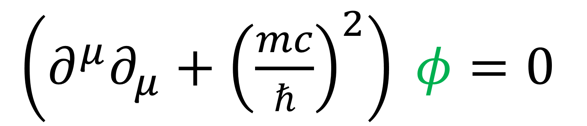
23
Spinors For Beginners
Klein-Gordon
Derivation & Solutions
$\left(∂^{μ}∂_{μ}+{\left(\frac{mc}{ℏ}\right)}^{2}\right) φ=0$

Slide 2
Spinors Learning “Staircase”
Spinors in Particle Physics
Lie Groups & Algebras
Clifford Algebras
Spinors in 3D / (4D)
Examples From Physics (motivation)

Slide 3
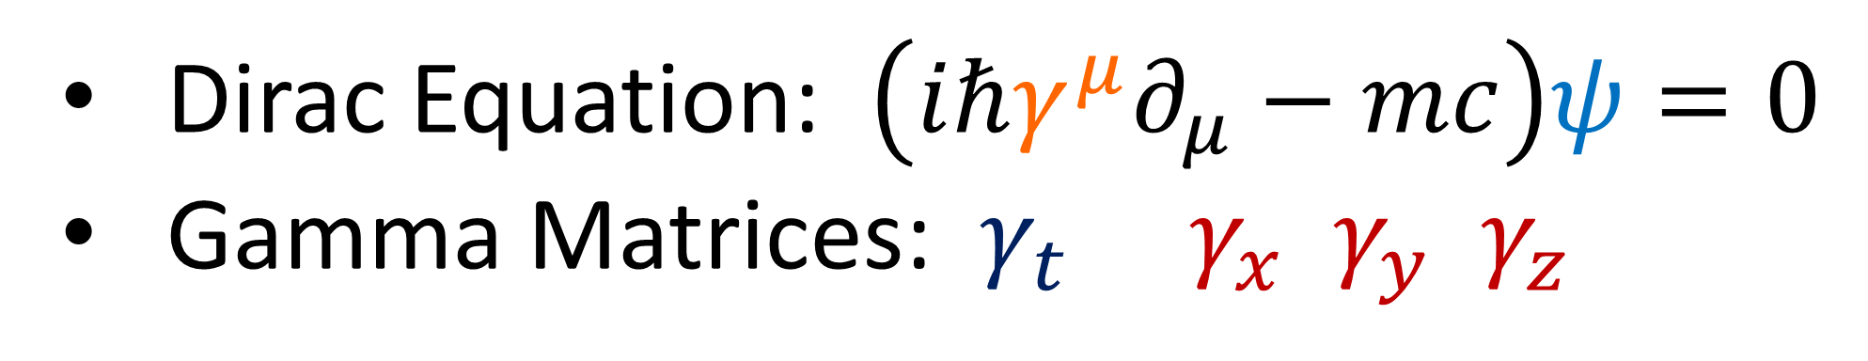
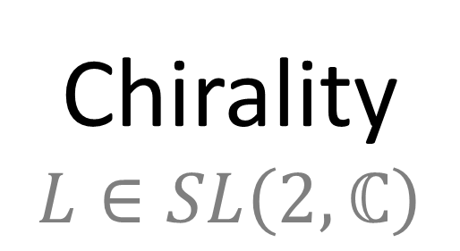
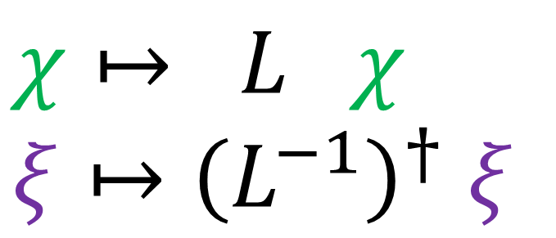
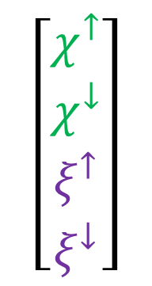
Previous video:
Dirac Equation: $\left(iℏγ^{μ}∂_{μ}−mc\right)ψ=0$
Gamma Matrices: $γ_{t} γ_{x} γ_{y} γ_{z}$
$$\left[\begin{aligned}χ^{↑} \\ χ^{↓} \\ ξ^{↑} \\ ξ^{↓}\end{aligned}\right]$$
Dirac
Spinors
$χ↦ L χ$
$$ξ↦{\left(L^{−1}\right)}^{†} ξ$$
Chirality
$$L∈SL\left(2,ℂ\right)$$
Next few videos:
Work up to Solutions of Dirac Equation

Slide 4
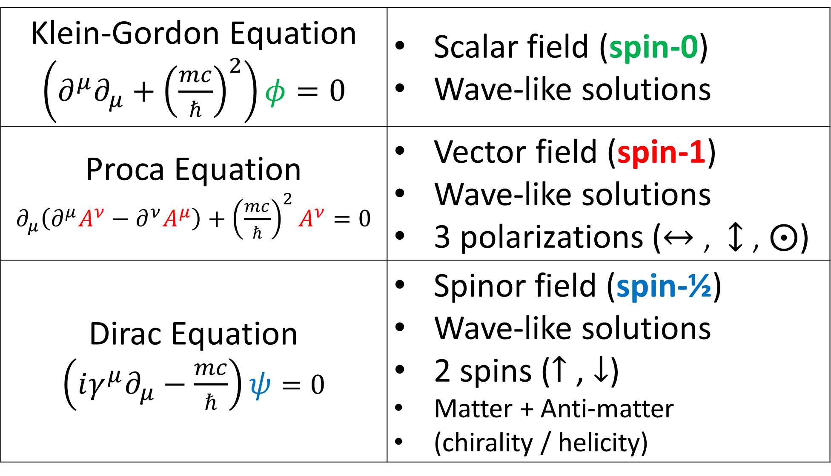
Klein-Gordon Equation $\left(∂^{μ}∂_{μ}+{\left(\frac{mc}{ℏ}\right)}^{2}\right)φ=0$ | Scalar field (spin-0) Wave-like solutions
Proca Equation $∂_{μ}\left(∂^{μ}A^{ν}−∂^{ν}A^{μ}\right)+{\left(\frac{mc}{ℏ}\right)}^{2}A^{ν}=0$ | Vector field (spin-1) Wave-like solutions 3 polarizations ($↔$ , $↕$ , $⨀$)
Dirac Equation $\left(iγ^{μ}∂_{μ}−\frac{mc}{ℏ}\right)ψ=0$ | Spinor field (spin-½) Wave-like solutions 2 spins ($↑$ , $↓$) Matter + Anti-matter (chirality / helicity)

Slide 5

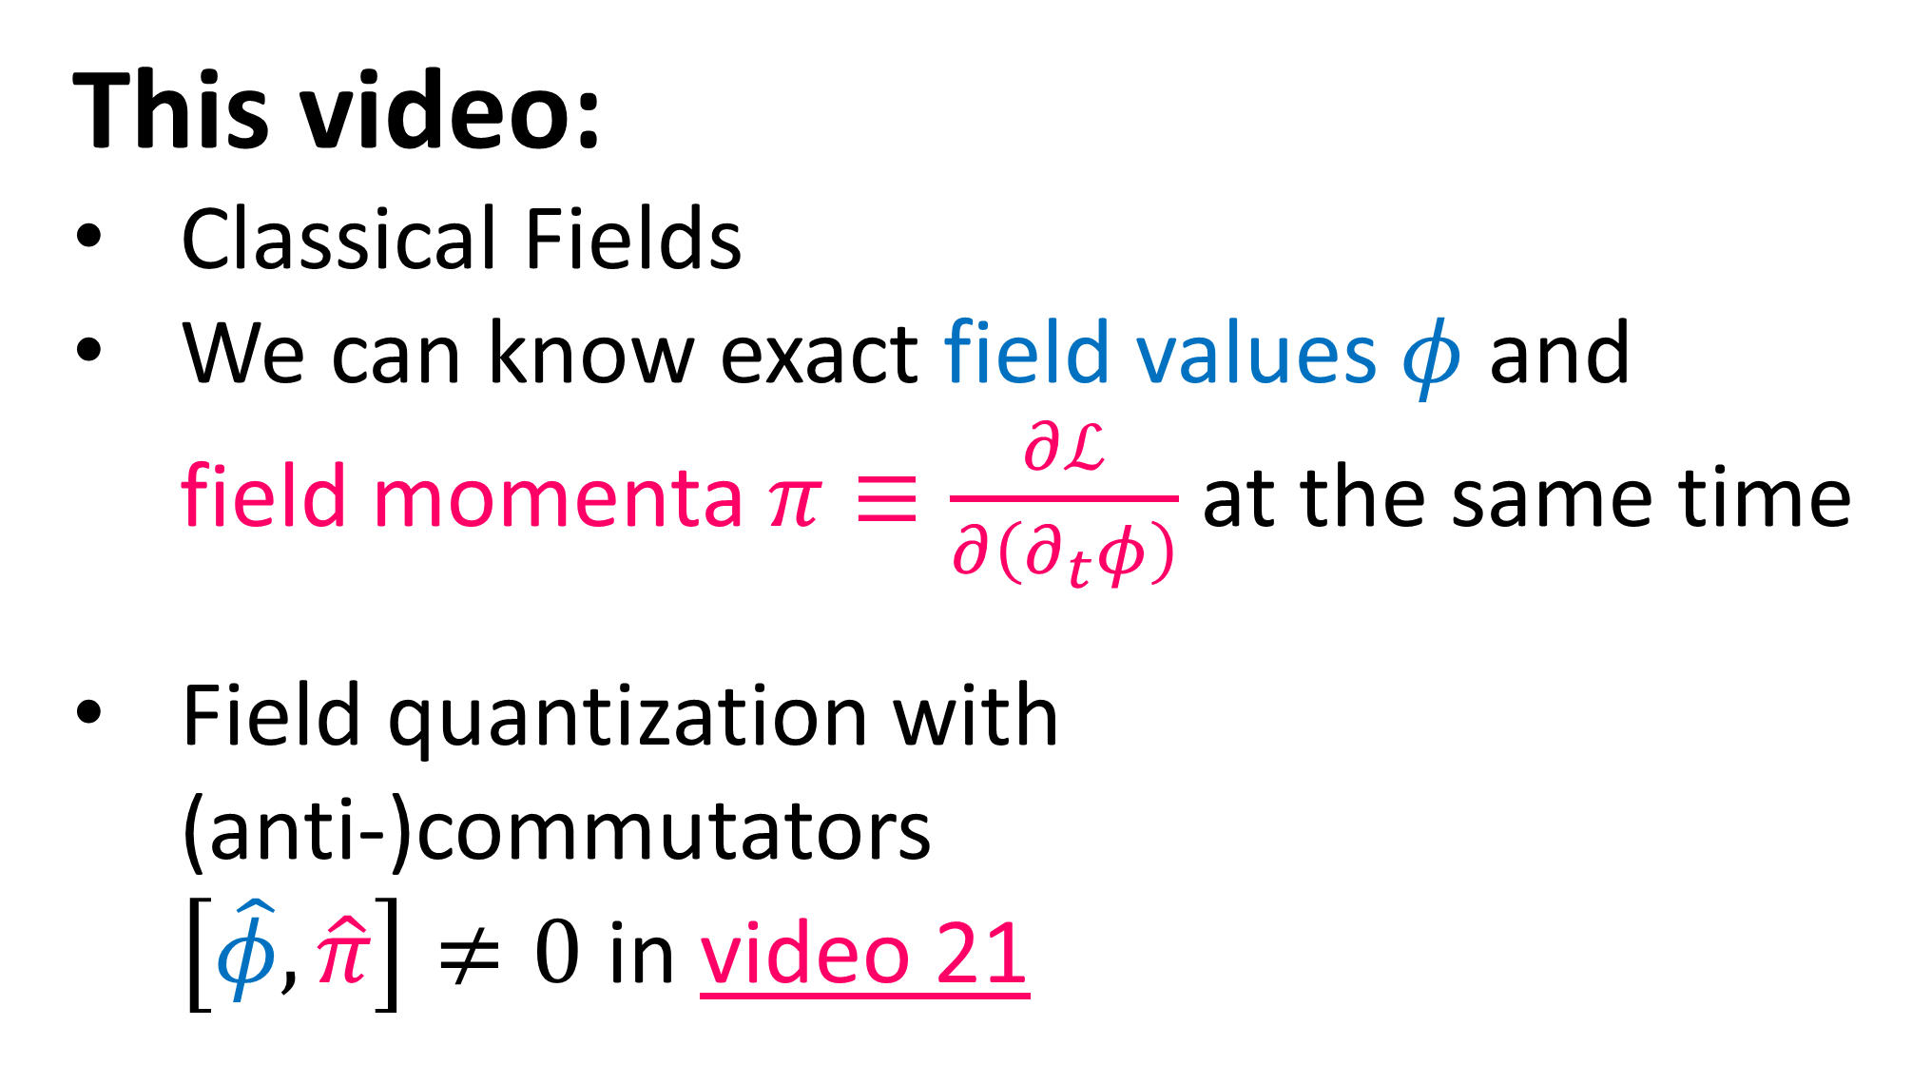
This video:
Classical Fields
We can know exact field values $φ$ and field momenta $π≡\frac{∂ℒ}{∂\left(∂_{t}φ\right)}$ at the same time
Field quantization with (anti-)commutators $\left[\hat{φ},\hat{π}\right]≠0$ in video 21

Slide 6
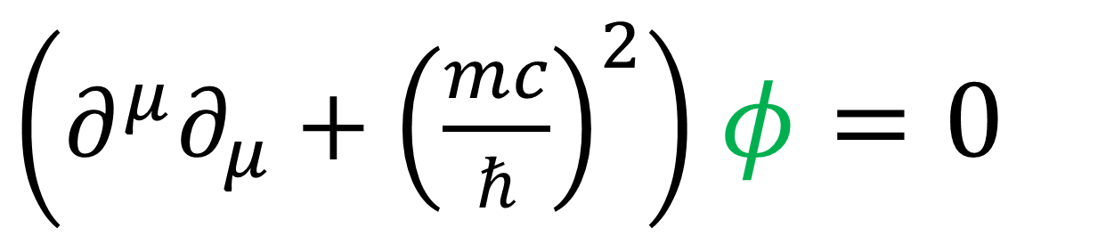
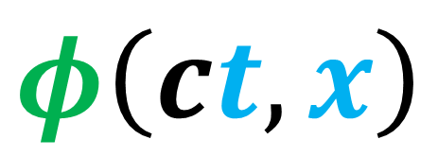

Klein-Gordon Equation
$\left(∂^{μ}∂_{μ}+{\left(\frac{mc}{ℏ}\right)}^{2}\right)$ $φ=0$
1D scalar field:
$$φ\left(ct,x\right)$$
$$x$$

Slide 7
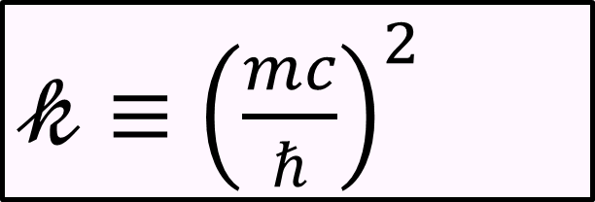
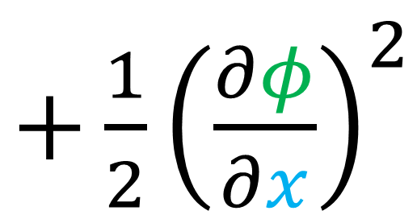
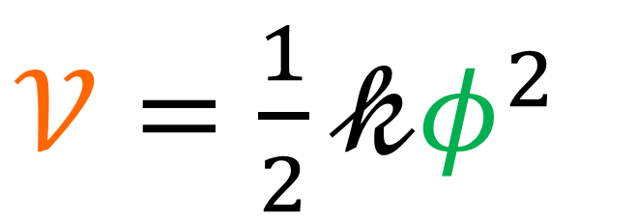
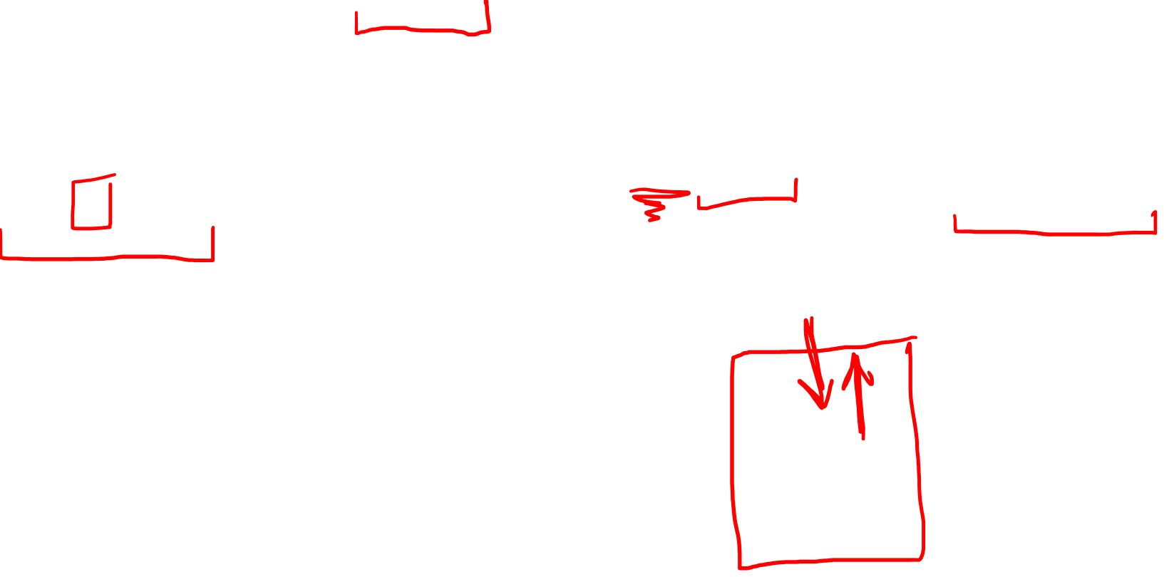
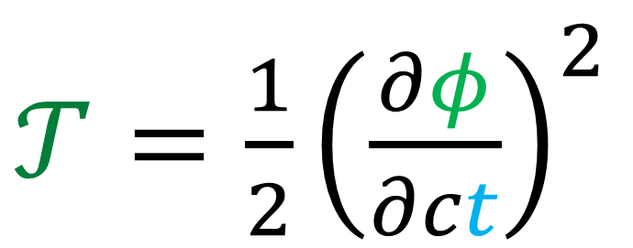

Kinetic Energy
(per mass)
$𝓀≡{\left(\frac{mc}{ℏ}\right)}^{2}$
Potential Energy
(per mass)
$$\left[\frac{1}{m^{2}}\right]$$
$𝒯=\frac{1}{2}{\left(\frac{∂φ}{∂ct}\right)}^{2}$
$+\frac{1}{2}{\left(\frac{∂φ}{∂x}\right)}^{2}$
$𝒱=\frac{1}{2}𝓀φ^{2}$
(springs)
(coupling)
$$φ\left(ct,x\right)$$
$$x$$

Slide 8
Kinetic Energy
Density
$𝓀≡{\left(\frac{mc}{ℏ}\right)}^{2}$
Potential Energy
Density
$$\left[\frac{1}{m^{2}}\right]$$
$𝒯=\frac{1}{2}{\left(\frac{∂φ}{∂ct}\right)}^{2}$
$+\frac{1}{2}{\left(\frac{∂φ}{∂x}\right)}^{2}$
$𝒱=\frac{1}{2}𝓀φ^{2}$
(springs)
(coupling)
$$φ\left(ct,x\right)$$
$$x$$

Slide 9
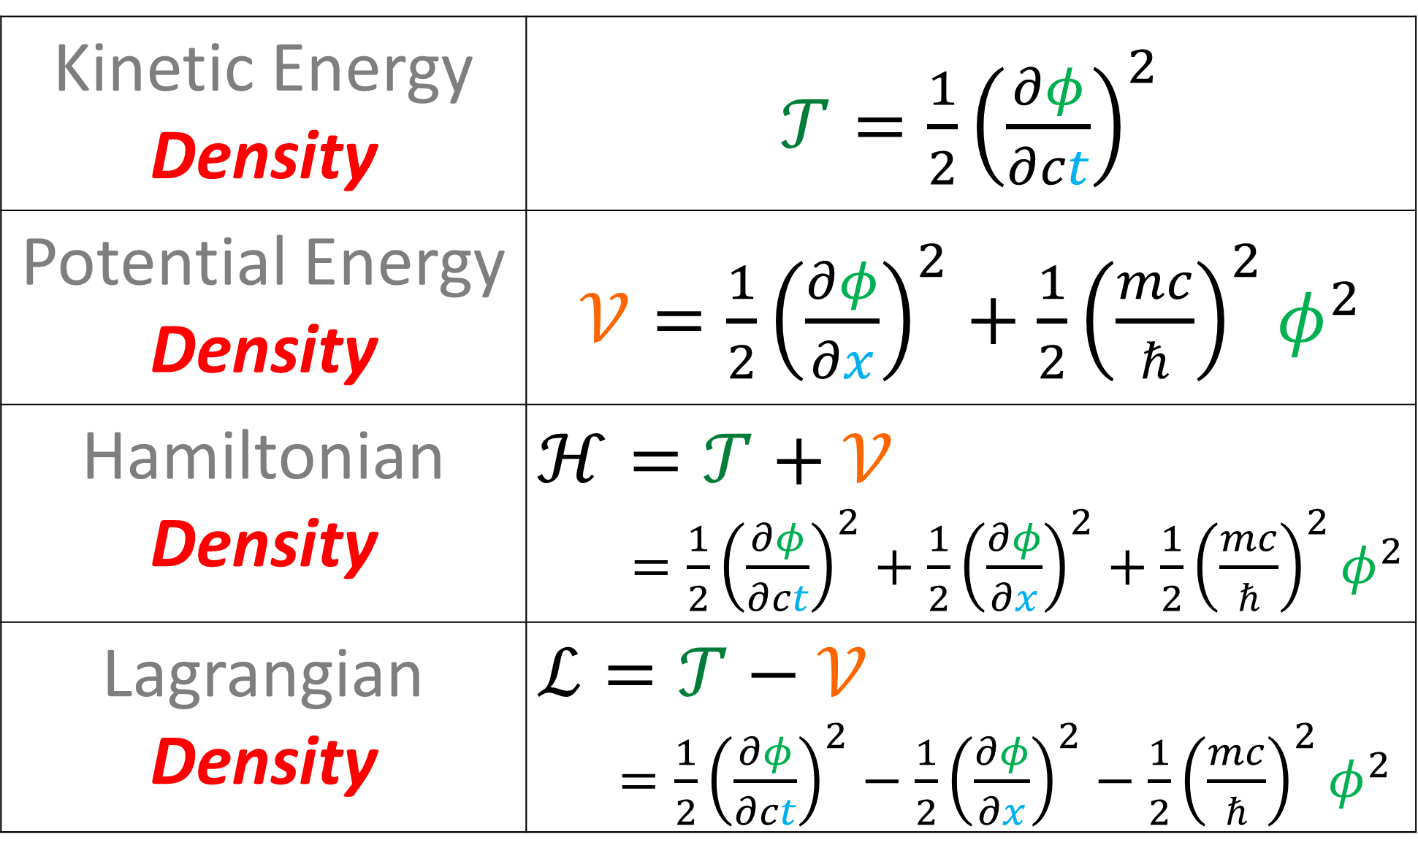
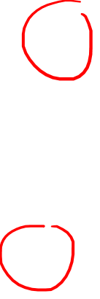
Kinetic Energy Density | $𝒯=\frac{1}{2}{\left(\frac{∂φ}{∂ct}\right)}^{2}$
Potential Energy Density | $𝒱=\frac{1}{2}{\left(\frac{∂φ}{∂x}\right)}^{2}+\frac{1}{2}{\left(\frac{mc}{ℏ}\right)}^{2}φ^{2}$
Hamiltonian Density | $$ℋ=𝒯+𝒱$$ $=\frac{1}{2}{\left(\frac{∂φ}{∂ct}\right)}^{2}+\frac{1}{2}{\left(\frac{∂φ}{∂x}\right)}^{2}+\frac{1}{2}{\left(\frac{mc}{ℏ}\right)}^{2}φ^{2}$
Lagrangian Density | $$ℒ=𝒯−𝒱$$ $=\frac{1}{2}{\left(\frac{∂φ}{∂ct}\right)}^{2}−\frac{1}{2}{\left(\frac{∂φ}{∂x}\right)}^{2}−\frac{1}{2}{\left(\frac{mc}{ℏ}\right)}^{2}φ^{2}$
(*formula with + works in certain special cases)

Slide 10
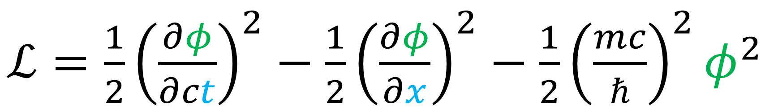
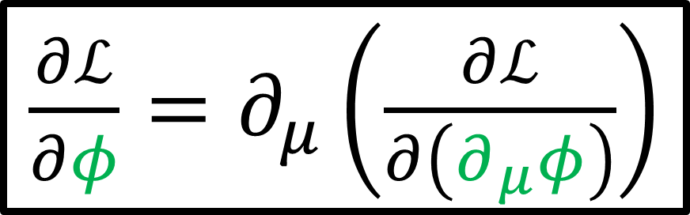
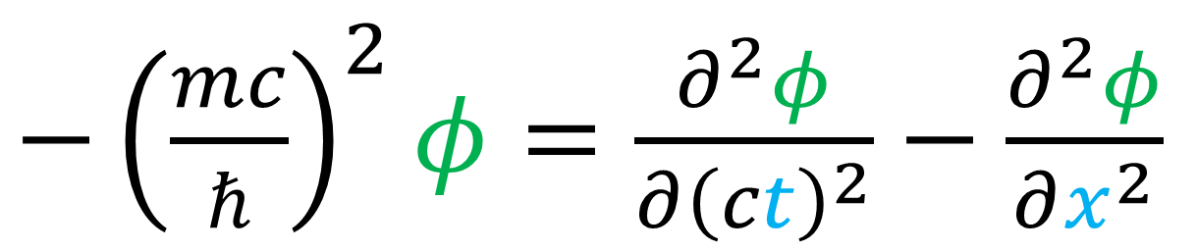
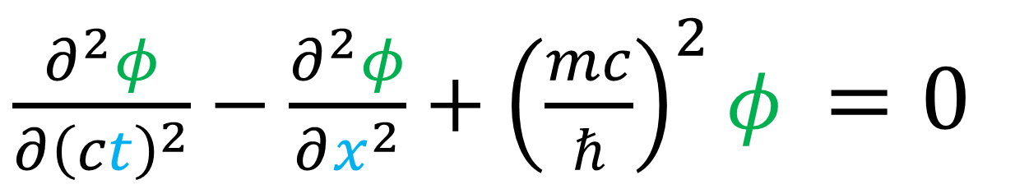

$ℒ=\frac{1}{2}{\left(\frac{∂φ}{∂ct}\right)}^{2}−\frac{1}{2}{\left(\frac{∂φ}{∂x}\right)}^{2}−\frac{1}{2}{\left(\frac{mc}{ℏ}\right)}^{2}φ^{2}$
$\frac{∂ℒ}{∂φ}=∂_{μ}\left(\frac{∂ℒ}{∂\left(∂_{μ}φ\right)}\right)$
Field Euler- Lagrange Equation
$−{\left(\frac{mc}{ℏ}\right)}^{2}φ=\frac{∂^{2}φ}{∂{\left(ct\right)}^{2}}−\frac{∂^{2}φ}{∂x^{2}}$
$\frac{∂^{2}φ}{∂{\left(ct\right)}^{2}}−\frac{∂^{2}φ}{∂x^{2}}+{\left(\frac{mc}{ℏ}\right)}^{2}φ =0$
Klein-Gordon Equation

Slide 11
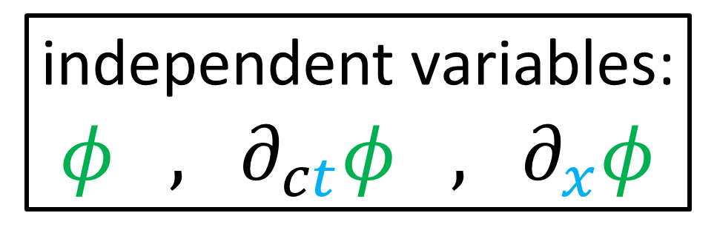
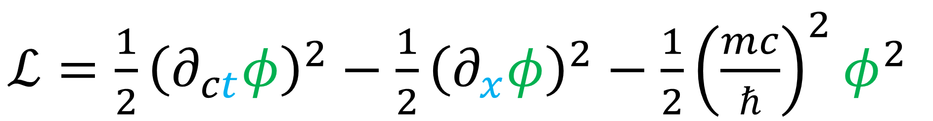
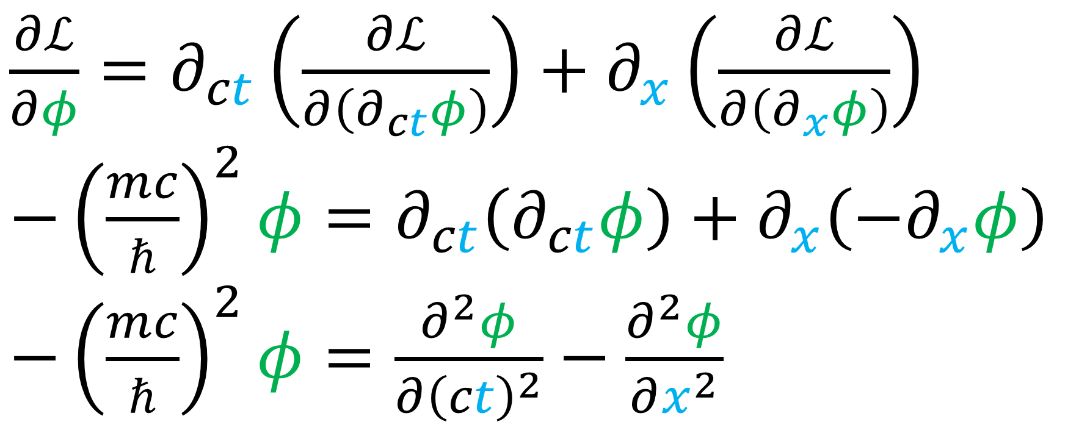
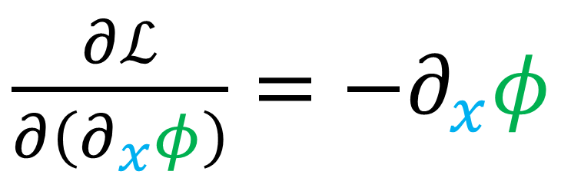
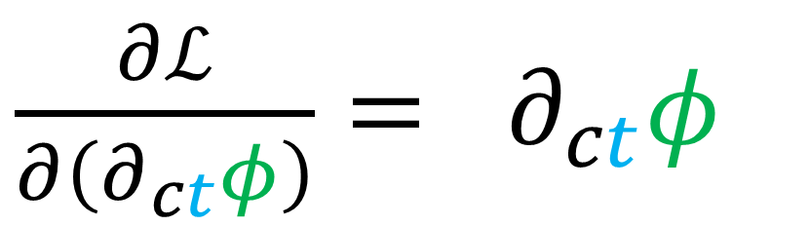

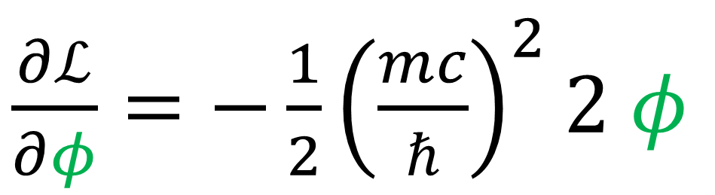
$\frac{∂ℒ}{∂φ}=∂_{ct}\left(\frac{∂ℒ}{∂\left(∂_{ct}φ\right)}\right)+∂_{x}\left(\frac{∂ℒ}{∂\left(∂_{x}φ\right)}\right)$
$−{\left(\frac{mc}{ℏ}\right)}^{2}φ=∂_{ct}\left(∂_{ct}φ\right)+∂_{x}\left(−∂_{x}φ\right)$
$−{\left(\frac{mc}{ℏ}\right)}^{2}φ=\frac{∂^{2}φ}{∂{\left(ct\right)}^{2}}−\frac{∂^{2}φ}{∂x^{2}}$
$ℒ=\frac{1}{2}{\left(∂_{ct}φ\right)}^{2}−\frac{1}{2}{\left(∂_{x}φ\right)}^{2}−\frac{1}{2}{\left(\frac{mc}{ℏ}\right)}^{2}φ^{2}$
$\frac{∂ℒ}{∂φ}=−\frac{1}{2}{\left(\frac{mc}{ℏ}\right)}^{2}2 φ$
independent variables:
$φ$ , $∂_{ct}φ$ , $∂_{x}φ$
$\frac{∂ℒ}{∂\left(∂_{ct}φ\right)}= ∂_{ct}φ$
$\frac{∂ℒ}{∂\left(∂_{x}φ\right)}=−∂_{x}φ$

Slide 12
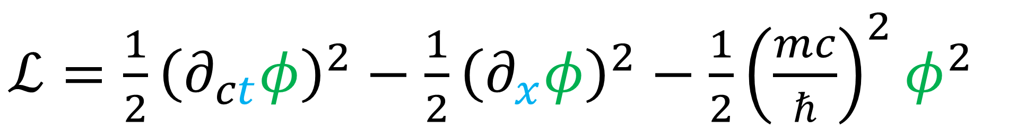
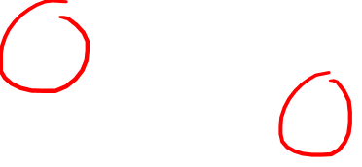
$ℒ=\frac{1}{2}{\left(∂_{ct}φ\right)}^{2}−\frac{1}{2}{\left(∂_{x}φ\right)}^{2}−\frac{1}{2}{\left(\frac{mc}{ℏ}\right)}^{2}φ^{2}$
$\frac{∂ℒ}{∂φ}=∂_{μ}\left(\frac{∂ℒ}{∂\left(∂_{μ}φ\right)}\right)$

Slide 13
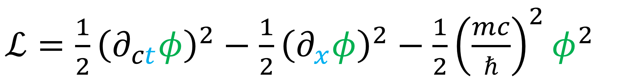
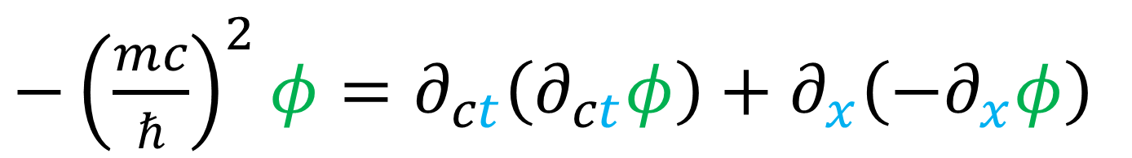
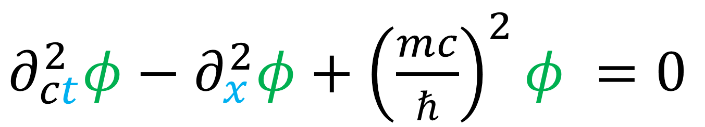
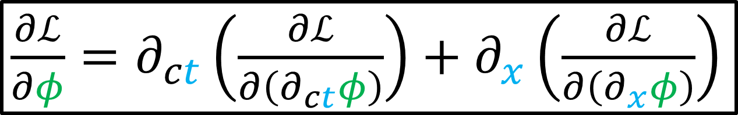
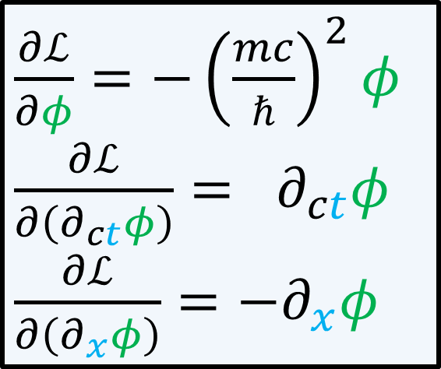
$ℒ=\frac{1}{2}{\left(∂_{ct}φ\right)}^{2}−\frac{1}{2}{\left(∂_{x}φ\right)}^{2}−\frac{1}{2}{\left(\frac{mc}{ℏ}\right)}^{2}φ^{2}$
$\frac{∂ℒ}{∂φ}=−{\left(\frac{mc}{ℏ}\right)}^{2}φ$
$\frac{∂ℒ}{∂\left(∂_{ct}φ\right)}= ∂_{ct}φ$
$\frac{∂ℒ}{∂\left(∂_{x}φ\right)}=−∂_{x}φ$
$\frac{∂ℒ}{∂φ}=∂_{ct}\left(\frac{∂ℒ}{∂\left(∂_{ct}φ\right)}\right)+∂_{x}\left(\frac{∂ℒ}{∂\left(∂_{x}φ\right)}\right)$
$−{\left(\frac{mc}{ℏ}\right)}^{2}φ=∂_{ct}\left(∂_{ct}φ\right)+∂_{x}\left(−∂_{x}φ\right)$
$∂_{ct}^{2}φ−∂_{x}^{2}φ+{\left(\frac{mc}{ℏ}\right)}^{2}φ =0$
Klein-Gordon Equation

Slide 14
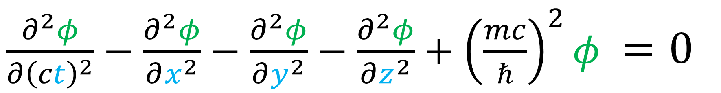
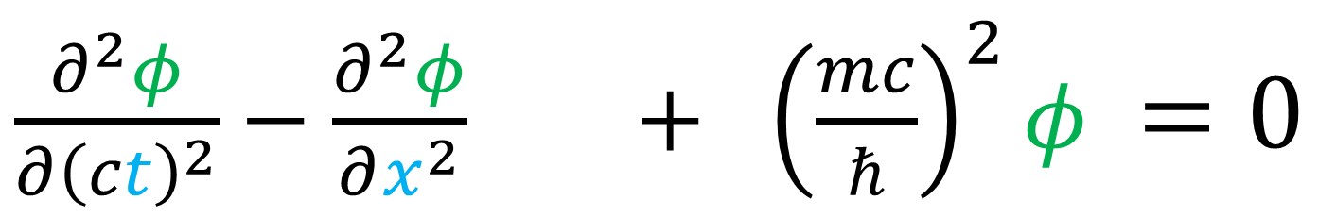

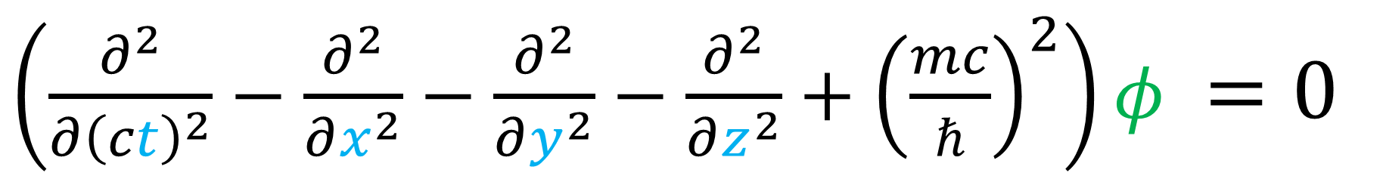
$\frac{∂^{2}φ}{∂{\left(ct\right)}^{2}}−\frac{∂^{2}φ}{∂x^{2}} + {\left(\frac{mc}{ℏ}\right)}^{2}φ =0$
Klein-Gordon Equation
$\frac{∂^{2}φ}{∂{\left(ct\right)}^{2}}−\frac{∂^{2}φ}{∂x^{2}}−\frac{∂^{2}φ}{∂y^{2}}−\frac{∂^{2}φ}{∂z^{2}}+{\left(\frac{mc}{ℏ}\right)}^{2}φ =0$
$\left(\frac{∂^{2}}{∂{\left(ct\right)}^{2}}−\frac{∂^{2}}{∂x^{2}}−\frac{∂^{2}}{∂y^{2}}−\frac{∂^{2}}{∂z^{2}}+{\left(\frac{mc}{ℏ}\right)}^{2}\right)φ =0$
$\left(∂^{μ}∂_{μ}+{\left(\frac{mc}{ℏ}\right)}^{2}\right)$ $φ=0$

Slide 15
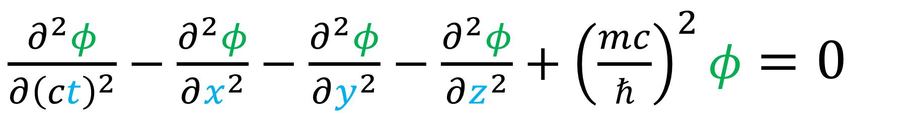
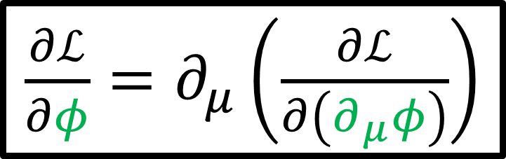
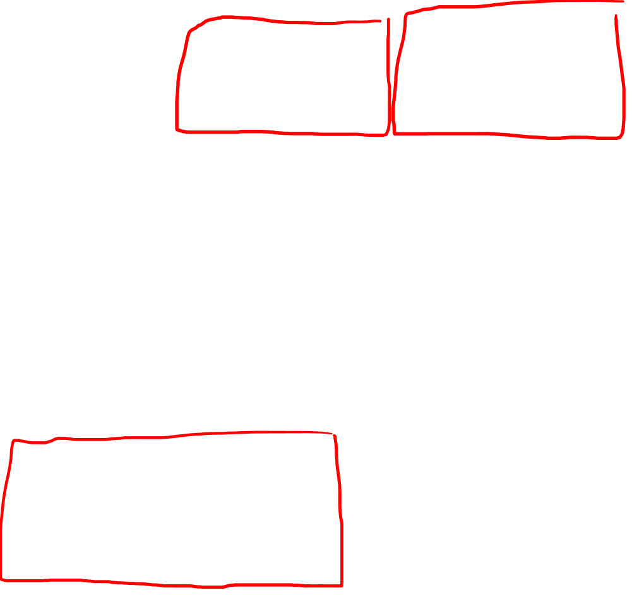
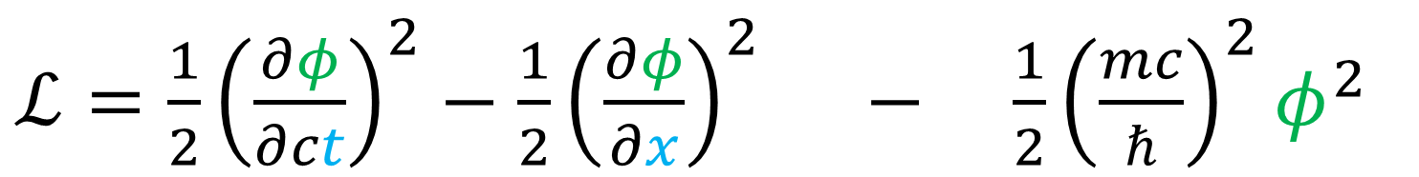
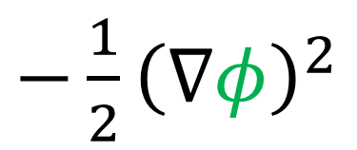
$ℒ=\frac{1}{2}{\left(\frac{∂φ}{∂ct}\right)}^{2}−\frac{1}{2}{\left(\frac{∂φ}{∂x}\right)}^{2} − \frac{1}{2}{\left(\frac{mc}{ℏ}\right)}^{2}φ^{2}$
$ℒ=\frac{1}{2}{\left(\frac{∂φ}{∂ct}\right)}^{2}−\frac{1}{2}{\left(\frac{∂φ}{∂x}\right)}^{2}−\frac{1}{2}{\left(\frac{∂φ}{∂y}\right)}^{2}−\frac{1}{2}{\left(\frac{∂φ}{∂z}\right)}^{2}−\frac{1}{2}{\left(\frac{mc}{ℏ}\right)}^{2}φ^{2}$
$−\frac{1}{2}{\left(∇φ\right)}^{2}$
$\frac{∂ℒ}{∂φ}=∂_{μ}\left(\frac{∂ℒ}{∂\left(∂_{μ}φ\right)}\right)$
Field Euler- Lagrange Equation
$\frac{∂^{2}φ}{∂{\left(ct\right)}^{2}}−\frac{∂^{2}φ}{∂x^{2}}−\frac{∂^{2}φ}{∂y^{2}}−\frac{∂^{2}φ}{∂z^{2}}+{\left(\frac{mc}{ℏ}\right)}^{2}φ=0$

Slide 16

$\frac{∂^{2}φ}{∂{\left(ct\right)}^{2}}−\frac{∂^{2}φ}{∂x^{2}}−\frac{∂^{2}φ}{∂y^{2}}−\frac{∂^{2}φ}{∂z^{2}}+{\left(\frac{mc}{ℏ}\right)}^{2}φ=0$

Slide 17
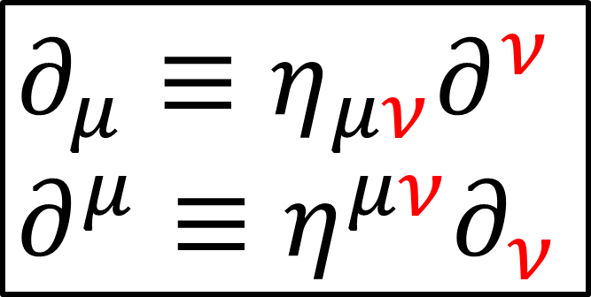
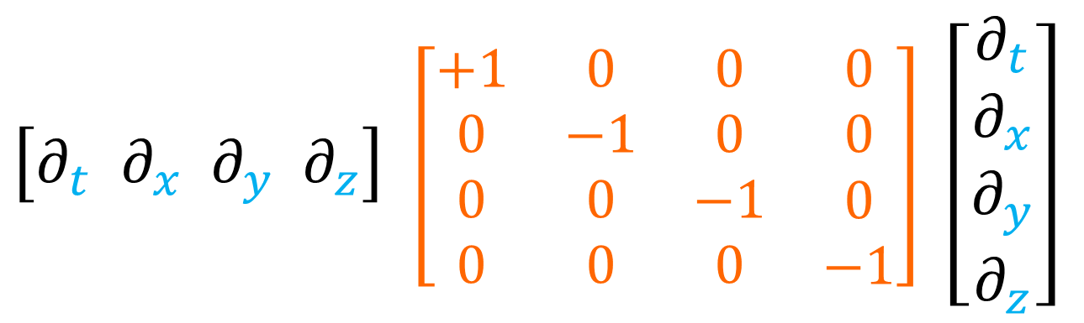
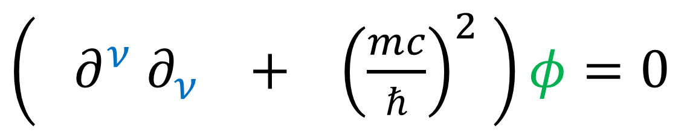
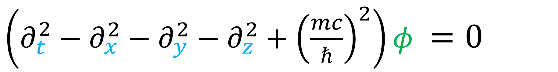
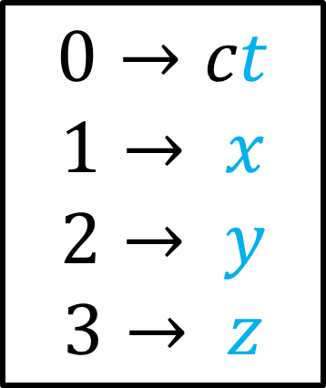
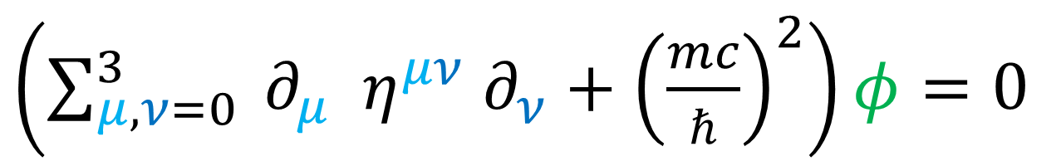


$\left(∂_{t}^{2}−∂_{x}^{2}−∂_{y}^{2}−∂_{z}^{2}+{\left(\frac{mc}{ℏ}\right)}^{2}\right)φ =0$
$\left[∂_{t} ∂_{x} ∂_{y} ∂_{z}\right]$ $\left[\begin{matrix}\begin{matrix}\begin{aligned}+1 \\ 0 \\ 0 \\ 0\end{aligned} & \begin{aligned}0 \\ −1 \\ 0 \\ 0\end{aligned}\end{matrix} & \begin{matrix}\begin{aligned}0 \\ 0 \\ −1 \\ 0\end{aligned} & \begin{aligned}0 \\ 0 \\ 0 \\ −1\end{aligned}\end{matrix}\end{matrix}\right]$ $\left[\begin{aligned}∂_{t} \\ ∂_{x} \\ ∂_{y} \\ ∂_{z}\end{aligned}\right]$
$$0→ct$$
$$1→ x$$
$$2→ y$$
$$3→ z$$
Minkowski Metric $η^{μν}$
$\left(\sum_{μ,ν=0}^{3}{ ∂_{μ} η^{μν} ∂_{ν}}+{\left(\frac{mc}{ℏ}\right)}^{2}\right)φ=0$
$$∂_{μ}≡η_{μν}∂^{ν}$$
$$∂^{μ}≡η^{μν}∂_{ν}$$
$\left( {∂^{ν} ∂}_{ν} + {\left(\frac{mc}{ℏ}\right)}^{2} \right)φ=0$

Slide 18

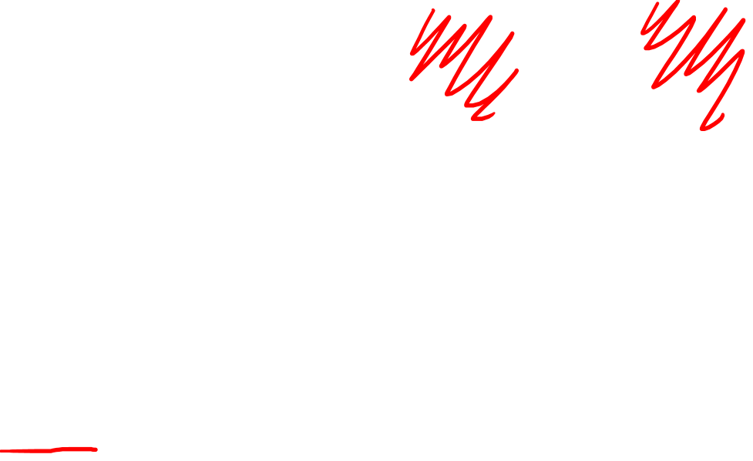


Klein-Gordon Equation
$\left(∂^{μ}∂_{μ}+{\left(\frac{mc}{ℏ}\right)}^{2}\right)$ $φ=0$
$\left(∂_{ct}^{2} −∂_{x}^{2} −∂_{y}^{2} −∂_{z}^{2}+{\left(\frac{mc}{ℏ}\right)}^{2}\right)$ $φ=0$
3+1 spacetime
$\left(∂_{ct}^{2} −∂_{x}^{2} +{\left(\frac{mc}{ℏ}\right)}^{2}\right)$ $φ=0$
1+1 spacetime

Slide 19




Klein-Gordon Equation
$\left(∂^{μ}∂_{μ}+{\left(\frac{mc}{ℏ}\right)}^{2}\right)$ $φ=0$
$$∂_{μ}≡η_{μν}∂^{ν}$$
$$∂^{μ}≡η^{μν}∂_{ν}$$
$$μ∈\left\{0, 1, 2, 3\right\}$$
$$0→ct$$
$$1→ x$$
$$2→ y$$
$$3→ z$$
$η→$ $\left[\begin{matrix}\begin{matrix}\begin{aligned}+1 \\ 0 \\ 0 \\ 0\end{aligned} & \begin{aligned}0 \\ −1 \\ 0 \\ 0\end{aligned}\end{matrix} & \begin{matrix}\begin{aligned}0 \\ 0 \\ −1 \\ 0\end{aligned} & \begin{aligned}0 \\ 0 \\ 0 \\ −1\end{aligned}\end{matrix}\end{matrix}\right]$

Slide 20




Klein-Gordon Equation
$\left(∂^{μ}∂_{μ}+{\left(\frac{mc}{ℏ}\right)}^{2}\right)$ $φ=0$
$η→$ $\left[\begin{matrix}\begin{matrix}\begin{aligned}+1 \\ 0 \\ 0 \\ 0\end{aligned} & \begin{aligned}0 \\ −1 \\ 0 \\ 0\end{aligned}\end{matrix} & \begin{matrix}\begin{aligned}0 \\ 0 \\ −1 \\ 0\end{aligned} & \begin{aligned}0 \\ 0 \\ 0 \\ −1\end{aligned}\end{matrix}\end{matrix}\right]$
$\left(η^{νμ}∂_{ν}∂_{μ}+{\left(\frac{mc}{ℏ}\right)}^{2}\right)$ $φ=0$
$\left(∂_{ct}^{2} −∂_{x}^{2} −∂_{y}^{2} −∂_{z}^{2}+{\left(\frac{mc}{ℏ}\right)}^{2}\right)$ $φ=0$
3+1 spacetime

Slide 21




Klein-Gordon Equation
1+1 spacetime
$\left(∂_{ct}^{2} −∂_{x}^{2} +{\left(\frac{mc}{ℏ}\right)}^{2}\right)$ $φ=0$
$φ\left(ct,x\right)=\cos\left(\frac{ω}{c} ct−k x\right)$
Solution:
$$ct, x \sim [meters]$$
$\frac{ω}{c}, k \sim \left[\frac{1}{meters}\right]$

Slide 22




Klein-Gordon Equation
$\left(∂_{ct}^{2} −∂_{x}^{2} +{\left(\frac{mc}{ℏ}\right)}^{2}\right)$ $φ=0$
Solution:
$φ\left(ct,x\right)=\cos\left(\frac{ω}{c}ct−kx\right)$
$= ∂_{ct}^{2} φ\left(ct,x\right)$
$=\frac{∂}{∂ct} \frac{∂}{∂ct} \left[\cos\left(\frac{ω}{c} ct−k x\right)\right]$
$= \frac{∂}{∂ct} \left[−\sin\left(\frac{ω}{c} ct−k x\right)\frac{ω}{c}\right]$
$= \left[−\cos\left(\frac{ω}{c} ct−k x\right)\frac{ω}{c}\frac{ω}{c}\right]$
$∂_{ct}^{2} φ=−{\left(\frac{ω}{c}\right)}^{2}φ$

Slide 23


Klein-Gordon Equation
$\left(∂_{ct}^{2} −∂_{x}^{2} +{\left(\frac{mc}{ℏ}\right)}^{2}\right)$ $φ=0$
Solution:
$φ\left(ct,x\right)=\cos\left(\frac{ω}{c}ct−kx\right)$
$= ∂_{x}^{2} φ\left(ct,x\right)$
$=\frac{∂}{∂x} \frac{∂}{∂x} \left[\cos\left(\frac{ω}{c} ct−k x\right)\right]$
$= \frac{∂}{∂x} \left[−\sin\left(\frac{ω}{c} ct−k x\right)\left(−k\right)\right]$
$= \left[−\cos\left(\frac{ω}{c} ct−k x\right)\left(−k\right)\left(−k\right)\right]$
$∂_{x}^{2}φ=−k^{2}φ$

Slide 24




$∂_{ct}^{2} φ=−{\left(\frac{ω}{c}\right)}^{2}φ$
Solution:
$φ\left(ct,x\right)=\cos\left(\frac{ω}{c}ct−kx\right)$
$∂_{x}^{2}φ=−k^{2}φ$
$\left(∂_{ct}^{2} −∂_{x}^{2} +{\left(\frac{mc}{ℏ}\right)}^{2}\right)$ $φ=0$
$∂_{ct}^{2}φ−∂_{x}^{2}φ+{\left(\frac{mc}{ℏ}\right)}^{2}φ=0$
$−{\left(\frac{ω}{c}\right)}^{2}φ−\left(−k^{2}\right)φ+{\left(\frac{mc}{ℏ}\right)}^{2}φ=0$
$\left(−{\left(\frac{ω}{c}\right)}^{2}+k^{2}+{\left(\frac{mc}{ℏ}\right)}^{2}\right)$ $φ=0$
Dispersion Relation
${\left(\frac{mc}{ℏ}\right)}^{2}={\left(\frac{ω}{c}\right)}^{2}−k^{2}$

Slide 25




1+1 spacetime
$\left(∂_{ct}^{2} −∂_{x}^{2} +{\left(\frac{mc}{ℏ}\right)}^{2}\right)$ $φ=0$
Dispersion Relation
${\left(\frac{mc}{ℏ}\right)}^{2}={\left(\frac{ω}{c}\right)}^{2}−k^{2}$
Basic Solution:
scale factor
phase factor
$φ\left(ct,x\right)=A \cos\left(\frac{ω}{c}ct−kx+θ\right)$
$φ\left(ct,x\right)=A\cos\left(θ\right)\cos\left(\frac{ω}{c}ct−kx\right)−A\sin\left(θ\right)\sin\left(\frac{ω}{c}ct−kx\right)$
$φ\left(ct,x\right)= A_{c} \cos\left(\frac{ω}{c}ct−kx\right)+ A_{s} \sin\left(\frac{ω}{c}ct−kx\right)$
$\cos\left(α+θ\right)=\cos\left(θ\right)\cos\left(α\right)−\sin\left(θ\right)\sin\left(α\right)$

Slide 26





1+1 spacetime
$\left(∂_{ct}^{2} −∂_{x}^{2} +{\left(\frac{mc}{ℏ}\right)}^{2}\right)$ $φ=0$
Dispersion Relation
${\left(\frac{mc}{ℏ}\right)}^{2}={\left(\frac{ω}{c}\right)}^{2}−k^{2}$
Basic Solution:
scale factor
phase factor
$φ\left(ct,x\right)=A \cos\left(\frac{ω}{c}ct−kx+θ\right)$
(real part only)
$$φ\left(ct,x\right)=A e^{i\left(\frac{ω}{c}ct−kx+θ\right)}$$
$$φ\left(ct,x\right)=A e^{i\left(\frac{ω}{c}ct−kx\right)}e^{iθ}$$
$$φ\left(ct,x\right)= 𝒜 e^{i\left(\frac{ω}{c}ct−kx\right)}$$
$e^{iα}{=\cos\left(α\right)+i\sin\left(α\right)}$

Slide 27


1+1 spacetime
$\left(∂_{ct}^{2} −∂_{x}^{2} +{\left(\frac{mc}{ℏ}\right)}^{2}\right)$ $φ=0$
Dispersion Relation
${\left(\frac{mc}{ℏ}\right)}^{2}={\left(\frac{ω}{c}\right)}^{2}−k^{2}$
LINEAR
$φ_{1}\left(ct,x\right)=A_{1}\cos\left(\frac{ω_{1}}{c}ct−k_{1}x+θ_{1}\right)$
Solution #1:
$φ_{2}\left(ct,x\right)=A_{2}\cos\left(\frac{ω_{2}}{c}ct−k_{2}x+θ_{2}\right)$
Solution #2:
Sum Solution:
$$φ\left(ct,x\right)=φ_{1}\left(ct,x\right)+φ_{2}\left(ct,x\right)$$

Slide 28

1+1 spacetime
$\left(∂_{ct}^{2} −∂_{x}^{2} +{\left(\frac{mc}{ℏ}\right)}^{2}\right)$ $φ=0$
Dispersion Relation
${\left(\frac{mc}{ℏ}\right)}^{2}={\left(\frac{ω}{c}\right)}^{2}−k^{2}$
LINEAR
$\left(∂_{ct}^{2} −∂_{x}^{2} +{\left(\frac{mc}{ℏ}\right)}^{2}\right)\left(φ_{1}+φ_{2}\right)=0$
$\left(∂_{ct}^{2} −∂_{x}^{2} +{\left(\frac{mc}{ℏ}\right)}^{2}\right)φ_{1} + \left(∂_{ct}^{2} −∂_{x}^{2} +{\left(\frac{mc}{ℏ}\right)}^{2}\right)φ_{2} = 0$
$0 + 0 = 0$

Slide 29

1+1 spacetime
$\left(∂_{ct}^{2} −∂_{x}^{2} +{\left(\frac{mc}{ℏ}\right)}^{2}\right)$ $φ=0$
Dispersion Relation
${\left(\frac{mc}{ℏ}\right)}^{2}={\left(\frac{ω}{c}\right)}^{2}−k^{2}$
LINEAR
$φ\left(ct,x\right)=A_{1}\cos\left(\frac{ω_{1}}{c}ct−k_{1}x+θ_{1}\right)$
$φ\left(ct,x\right)+A_{2}\cos\left(\frac{ω_{2}}{c}ct−k_{2}x+θ_{2}\right)$
$φ\left(ct,x\right)+A_{3}\cos\left(\frac{ω_{3}}{c}ct−k_{3}x+θ_{3}\right)$
$φ\left(ct,x\right)+A_{4}\cos\left(\frac{ω_{4}}{c}ct−k_{4}x+θ_{4}\right)$

Slide 30




1+1 spacetime
$\left(∂_{ct}^{2} −∂_{x}^{2} +{\left(\frac{mc}{ℏ}\right)}^{2}\right)$ $φ=0$
Dispersion Relation
${\left(\frac{mc}{ℏ}\right)}^{2}={\left(\frac{ω}{c}\right)}^{2}−k^{2}$
LINEAR
$\frac{ω}{c}=± \sqrt{{\left(\frac{mc}{ℏ}\right)}^{2}+k^{2}}$
$$φ\left(ct,x\right)=\int{dk A\left(k\right)\cos\left(\frac{ω}{c}ct−kx+θ\left(k\right)\right)}$$
$=\int{dk \left[A_{c}\left(k\right)\cos\left(\frac{ω}{c}ct−kx\right)+A_{s}\left(k\right)\sin\left(\frac{ω}{c}ct−kx\right)\right]}$
$=Real\left[\int{dk 𝒜\left(k\right)e^{i\left(\frac{ω}{c}ct−kx\right)}}\right]$

Slide 31




1+1 spacetime
$\left(∂_{ct}^{2} −∂_{x}^{2} +{\left(\frac{mc}{ℏ}\right)}^{2}\right)$ $φ=0$
Dispersion Relation
${\left(\frac{mc}{ℏ}\right)}^{2}={\left(\frac{ω}{c}\right)}^{2}−k^{2}$
$φ_{k}\left(ct,x\right)=A\left(k\right)\cos\left(\frac{ω}{c}ct−kx+θ\left(k\right)\right)$
3+1 spacetime
$\left(∂_{ct}^{2} −∂_{x}^{2} −∂_{y}^{2} −∂_{z}^{2}+{\left(\frac{mc}{ℏ}\right)}^{2}\right)$ $φ=0$
$${\left(\frac{mc}{ℏ}\right)}^{2}={\left(\frac{ω}{c}\right)}^{2}−{\left(k^{x}\right)}^{2}−{\left(k^{y}\right)}^{2}−{\left(k^{z}\right)}^{2}$$
$φ_{\vec{k}}\left(ct,x,y,z\right)=A\left(\vec{k}\right)\cos\left(\frac{ω}{c}ct−k^{x}x−k^{y}y−k^{z}z+θ\left(\vec{k}\right)\right)$

Slide 32





$φ_{\vec{k}}\left(ct,x,y,z\right)=A\left(\vec{k}\right)\cos\left(\frac{ω}{c}ct−k^{x}x−k^{y}x−k^{z}x+θ\left(\vec{k}\right)\right)$
$\frac{ω}{c}≡k^{t}$
$φ_{\vec{k}}\left(ct,x,y,z\right)=A\left(\vec{k}\right)\cos\left(k^{t}x^{t}−k^{x}x^{x}−k^{y}x^{y}−k^{z}x^{z}+θ\left(\vec{k}\right)\right)$
$\vec{K}→\left[\begin{aligned}k^{t}=\frac{ω}{c} \\ k^{x} \\ k^{y} \\ k^{z}\end{aligned}\right]$
Wavenumber 4-vector
$φ_{\vec{k}}\left(x^{ν}\right)=A\left(\vec{k}\right)\cos\left(η_{μν}k^{μ}x^{ν}+θ\left(\vec{k}\right)\right)$

Slide 33







$φ_{\vec{k}}\left(ct,x,y,z\right)=A\left(\vec{k}\right)\cos\left(\frac{ω}{c}ct−k^{x}x−k^{y}x−k^{z}x+θ\left(\vec{k}\right)\right)$
$\frac{ω}{c}≡k^{t}$
$φ_{\vec{k}}\left(ct,x,y,z\right)=A\left(\vec{k}\right)\cos\left(k^{t}x^{t}−k^{x}x^{x}−k^{y}x^{y}−k^{z}x^{z}+θ\left(\vec{k}\right)\right)$
$$y$$
$\vec{K}→\left[\begin{aligned}k^{t}=\frac{ω}{c} \\ k^{x} \\ k^{y} \\ k^{z}\end{aligned}\right]$
Wavenumber 4-vector
Plane wave solution
$φ_{\vec{k}}\left(ct,x,y,z\right)$
$$\vec{k}$$
$$x$$

Slide 34






Klein-Gordon Lagrangian (Real, $φ\left(ct,x\right)∈ℝ$)
$ℒ=\frac{1}{2}{\left(∂_{ct}φ\right)}^{2}−\frac{1}{2}{\left(∂_{x}φ\right)}^{2}− \frac{1}{2}{\left(\frac{mc}{ℏ}\right)}^{2}φ^{2}$
$\frac{∂ℒ}{∂φ}=∂_{μ}\left(\frac{∂ℒ}{∂\left(∂_{μ}φ\right)}\right)$
Field Euler- Lagrange Equation
$\left(∂_{ct}^{2}−∂_{x}^{2}+ {\left(\frac{mc}{ℏ}\right)}^{2}\right)φ=0$
Klein-Gordon Lagrangian (Complex , $φ\left(ct,x\right)∈ℂ$)
$ℒ=\frac{1}{2}{\left|∂_{ct}φ\right|}^{2}−\frac{1}{2}{\left|∂_{x}φ\right|}^{2}− \frac{1}{2}{\left(\frac{mc}{ℏ}\right)}^{2}{\left|φ\right|}^{2}$

Slide 35




Klein-Gordon Lagrangian (Complex , $φ\left(ct,x\right)∈ℂ$)
$ℒ=\frac{1}{2}{\left|∂_{ct}φ\right|}^{2}−\frac{1}{2}{\left|∂_{x}φ\right|}^{2}− \frac{1}{2}{\left(\frac{mc}{ℏ}\right)}^{2}{\left|φ\right|}^{2}$
$ℒ=\frac{1}{2}{\left(∂_{ct}φ\right)}^{∗}\left(∂_{ct}φ\right)−\frac{1}{2}{\left(∂_{x}φ\right)}^{∗}\left(∂_{x}φ\right)− \frac{1}{2}{\left(\frac{mc}{ℏ}\right)}^{2}φ^{∗}φ$
$ℒ=\frac{1}{2}\left(∂_{ct}φ^{∗}\right)\left(∂_{ct}φ\right)−\frac{1}{2}\left(∂_{x}φ^{∗}\right)\left(∂_{x}φ\right)− \frac{1}{2}{\left(\frac{mc}{ℏ}\right)}^{2}φ^{∗}φ$
1 complex field = 2 real fields
$$φ =φ_{r}+iφ_{i}$$
$$φ^{∗}=φ_{r}−iφ_{i}$$

Slide 36





Field Euler- Lagrange Equation
Klein-Gordon Lagrangian (Complex , $φ\left(ct,x\right)∈ℂ$)
$ℒ=\frac{1}{2}\left(∂_{ct}φ^{∗}\right)\left(∂_{ct}φ\right)−\frac{1}{2}\left(∂_{x}φ^{∗}\right)\left(∂_{x}φ\right)− \frac{1}{2}{\left(\frac{mc}{ℏ}\right)}^{2}φ^{∗}φ$
$\frac{∂ℒ}{∂φ}=∂_{μ}\left(\frac{∂ℒ}{∂\left(∂_{μ}φ\right)}\right)$
Field E-L Equations
$\frac{∂ℒ}{∂φ^{∗}}=∂_{μ}\left(\frac{∂ℒ}{∂\left(∂_{μ}φ^{∗}\right)}\right)$
$\frac{1}{2}\left(∂_{ct}^{2}−∂_{x}^{2}+ {\left(\frac{mc}{ℏ}\right)}^{2}\right)φ^{∗}=0$
$\frac{1}{2}\left(∂_{ct}^{2}−∂_{x}^{2}+ {\left(\frac{mc}{ℏ}\right)}^{2}\right)φ=0$

Slide 37





Klein-Gordon Lagrangian (Complex , $φ\left(ct,x\right)∈ℂ$)
$ℒ=\left(∂_{ct}φ^{∗}\right)\left(∂_{ct}φ\right)−\left(∂_{x}φ^{∗}\right)\left(∂_{x}φ\right)− {\left(\frac{mc}{ℏ}\right)}^{2}φ^{∗}φ$
$\frac{∂ℒ}{∂φ}=∂_{μ}\left(\frac{∂ℒ}{∂\left(∂_{μ}φ\right)}\right)$
Field E-L Equations
$\frac{∂ℒ}{∂φ^{∗}}=∂_{μ}\left(\frac{∂ℒ}{∂\left(∂_{μ}φ^{∗}\right)}\right)$
$\left(∂_{ct}^{2}−∂_{x}^{2}+ {\left(\frac{mc}{ℏ}\right)}^{2}\right)φ^{∗}=0$
$\left(∂_{ct}^{2}−∂_{x}^{2}+ {\left(\frac{mc}{ℏ}\right)}^{2}\right)φ=0$
Anti-Matter $φ^{∗}$
Matter $φ$
(opposite charge)

Slide 38







$$φ\left(ct,x\right)=e^{+i\left(\frac{ω}{c} ct−kx\right)}$$
Matter $φ$
$=\cos\left(\frac{ω}{c} ct−kx\right)+i\sin\left(\frac{ω}{c} ct−kx\right)$
$$φ^{∗}\left(ct,x\right)=e^{−i\left(\frac{ω}{c} ct−kx\right)}$$
Anti-Matter $φ^{∗}$
(opposite charge)
$=\cos\left(\frac{ω}{c} ct−kx\right)−i\sin\left(\frac{ω}{c} ct−kx\right)$

Slide 39








$\left(∂_{ct}^{2}−∂_{x}^{2}+ {\left(\frac{mc}{ℏ}\right)}^{2}\right)φ^{∗}=0$
$\left(∂_{ct}^{2}−∂_{x}^{2}+ {\left(\frac{mc}{ℏ}\right)}^{2}\right)φ=0$
Anti-Matter $φ^{∗}$
Matter $φ$
(opposite charge)
$φ^{∗}=e^{−i\left(\frac{ω}{c} ct−kx\right)}$
$φ=e^{i\left(\frac{ω}{c} ct−kx\right)}$
$\left(∂_{ct}^{2}−∂_{x}^{2}− {\left(\frac{mc}{ℏ}\right)}^{2}\right)φ^{∗}=0$
$\left({\left(−i\frac{ω}{c}\right)}^{2}−{\left(ik\right)}^{2}− {\left(\frac{mc}{ℏ}\right)}^{2}\right)φ^{∗}=0$
$\left(∂_{ct}^{2}−∂_{x}^{2}− {\left(\frac{mc}{ℏ}\right)}^{2}\right)φ=0$
$\left({\left(i\frac{ω}{c}\right)}^{2}−{\left(−ik\right)}^{2}− {\left(\frac{mc}{ℏ}\right)}^{2}\right)φ=0$

Slide 40




$U(1)$ Symmetry and Conserved Quantity (Noether)
$$φ →e^{iθ}φ$$
$$φ^{∗}→{\left(e^{iθ}φ\right)}^{∗}=e^{−iθ}φ^{∗}$$
$$U\left(1\right)=\left\{e^{iθ}:θ∈ℝ\right\}$$
$ℒ=\left(∂_{ct}φ^{∗}\right)\left(∂_{ct}φ\right)−\left(∂_{x}φ^{∗}\right)\left(∂_{x}φ\right)− {\left(\frac{mc}{ℏ}\right)}^{2}φ^{∗}φ$
$→\left(∂_{ct}\left(e^{−iθ}φ^{∗}\right)\right)\left(∂_{ct}\left(e^{iθ}φ\right)\right)−\left(∂_{x}\left(e^{−iθ}φ^{∗}\right)\right)\left(∂_{x}\left(e^{iθ}φ\right)\right)− {\left(\frac{mc}{ℏ}\right)}^{2}\left(e^{−iθ}φ^{∗}\right)\left(e^{iθ}φ\right)$
$=\left(∂_{ct}φ^{∗}\right)\left(∂_{ct}φ\right)−\left(∂_{x}φ^{∗}\right)\left(∂_{x}φ\right)− {\left(\frac{mc}{ℏ}\right)}^{2}φ^{∗}φ=ℒ$

Slide 41






$\left(∂_{μ}∂^{μ}− {\left(\frac{mc}{ℏ}\right)}^{2}\right)φ=0$
$\left(∂_{μ}∂^{μ}− {\left(\frac{mc}{ℏ}\right)}^{2}\right)φ^{∗}=0$
$φ^{∗}\left(∂_{μ}∂^{μ}− {\left(\frac{mc}{ℏ}\right)}^{2}\right)φ=0$
$φ\left(∂_{μ}∂^{μ}− {\left(\frac{mc}{ℏ}\right)}^{2}\right)φ^{∗}=0$
subtract
$φ^{∗}\left(∂_{μ}∂^{μ}φ\right) − φ\left(∂_{μ}∂^{μ}φ^{∗}\right)=0$
$$\left(∂_{μ}φ^{∗}\right)\left(∂^{μ}φ\right)+φ^{∗}\left(∂_{μ}∂^{μ}φ\right)−\left(∂^{μ}φ\right)\left(∂_{μ}φ^{∗}\right)−φ\left(∂_{μ}∂^{μ}φ^{∗}\right)=0$$
$∂_{μ}\left[φ^{∗}\left(∂^{μ}φ\right)\right] − ∂_{μ}\left[φ\left(∂^{μ}φ^{∗}\right)\right] =0$
$∂_{μ}\left[φ^{∗}\left(∂^{μ}φ\right)−φ\left(∂^{μ}φ^{∗}\right)\right]=0$

Slide 42







Complex Klein-Gordon Continuity Equation
$$∂_{μ}\left[φ^{∗}\left(∂^{μ}φ\right)−φ\left(∂^{μ}φ^{∗}\right)\right]=0$$
$$j^{μ}≡φ^{∗}\left(∂^{μ}φ\right)−φ\left(∂^{μ}φ^{∗}\right)$$
$$∂_{μ}j^{μ}=0$$
$$≡j^{μ}$$
current 4-vector
$$∂_{t}j^{t} + \vec{∇} ⋅\vec{j} = 0$$
Electric charge current
$+$
$$=$$
$−$

Slide 43






$$j^{μ}=φ^{∗}\left(∂^{μ}φ\right)−φ\left(∂^{μ}φ^{∗}\right)$$
$←$ Pure Imaginary
${\left(j^{μ}\right)}^{∗}= {\left[φ^{∗}\left(∂^{μ}φ\right)−φ\left(∂^{μ}φ^{∗}\right)\right]}^{∗}$
$${\left(j^{μ}\right)}^{∗}= \left[φ\left(∂^{μ}φ^{∗}\right)−φ^{∗}\left(∂^{μ}φ\right)\right]$$
$${\left(j^{μ}\right)}^{∗}=−\left[φ^{∗}\left(∂^{μ}φ\right)−φ\left(∂^{μ}φ^{∗}\right)\right]$$
$${\left(j^{μ}\right)}^{∗}=−j^{μ}$$
Redefinition:
$$j^{μ}=i \left[φ^{∗}\left(∂^{μ}φ\right)−φ\left(∂^{μ}φ^{∗}\right)\right]$$
$←$ Pure Real

Slide 44





Field Quantization (Quantum Field Theory):
$π≡\frac{∂ℒ}{∂\left(∂_{μ}φ\right)}$
$$\left[\hat{φ}\left(x_{1}\right),\hat{π}\left(x_{2}\right)\right]=iℏ δ\left(x_{1}−x_{2}\right)$$
 | Creation/Annihilation Operators | Number Operators
Matter | $$\left[\hat{A}\left(k_{1}\right),{\hat{A}}^{†}\left(k_{2}\right)\right]=δ\left(k_{1}−k_{2}\right)$$ | $${\hat{N}}_{A}\left(k\right)≡{\hat{A}}^{†}\left(k\right)\hat{A}\left(k\right)$$
Anti-Matter | $$\left[\hat{B}\left(k_{1}\right),{\hat{B}}^{†}\left(k_{2}\right)\right]=δ\left(k_{1}−k_{2}\right)$$ | $${\hat{N}}_{B}\left(k\right)≡{\hat{B}}^{†}\left(k\right)\hat{B}\left(k\right)$$
$$\hat{Q}= ∫dk \left( e {\hat{N}}_{A}\left(k\right) − e {\hat{N}}_{B}\left(k\right) \right)$$
$\hat{Q}=e∫dk \left({\hat{A}}^{†}\left(k\right)\hat{A}\left(k\right)−{\hat{B}}^{†}\left(k\right)\hat{B}\left(k\right)\right)$
Electric Charge Operator

Slide 45


Higgs Field
(Complex Scalar Doublet)
$$Φ→\left[\begin{aligned}φ_{1} \\ φ_{2}\end{aligned}\right]$$
$ℒ_{Higgs}=\frac{1}{2}\left(∂_{μ}Φ^{†}\right)\left(∂_{μ}Φ\right)+μ^{2}Φ^{†}Φ$ $−λ{\left(Φ^{†}Φ\right)}^{2}$
Opposite-sign “mass-like” term
Self-interaction term
(the 4 Higgs components only have 1 real physical degree of freedom due to the doublet’s $SU(2)$ symmetry)

Slide 46




$\left(∂_{ct}^{2}−∂_{x}^{2}− {\left(\frac{mc}{ℏ}\right)}^{2}\right)φ=0$
Klein-Gordon Summary
$ℒ=\frac{1}{2}{\left(∂_{ct}φ\right)}^{2}−\frac{1}{2}{\left(∂_{x}φ\right)}^{2}−\frac{1}{2}{\left(\frac{mc}{ℏ}\right)}^{2}φ^{2}$
Kinetic Energy
(density)
Elastic Potential Energy
(density)
Spring Potential Energy
(density)
$$φ\left(ct,x\right)$$
$$x$$

Slide 47


Klein-Gordon Summary
$ℒ=\frac{1}{2}{\left(∂_{ct}φ\right)}^{2}−\frac{1}{2}{\left(∂_{x}φ\right)}^{2}−\frac{1}{2}{\left(\frac{mc}{ℏ}\right)}^{2}φ^{2}$
$\frac{∂ℒ}{∂φ}=∂_{μ}\left(\frac{∂ℒ}{∂\left(∂_{μ}φ\right)}\right)$
Field Euler- Lagrange Equation
$\left(∂_{ct}^{2}−∂_{x}^{2}+ {\left(\frac{mc}{ℏ}\right)}^{2}\right)φ=0$
Klein-Gordon Equation
1+1 spacetime
$\left(∂_{ct}^{2}−∂_{x}^{2}−∂_{y}^{2}−∂_{z}^{2}+ {\left(\frac{mc}{ℏ}\right)}^{2}\right)φ=0$
3+1 spacetime

Slide 48

1+1 spacetime
$\left(∂_{ct}^{2} −∂_{x}^{2} +{\left(\frac{mc}{ℏ}\right)}^{2}\right)$ $φ=0$
Dispersion Relation
${\left(\frac{mc}{ℏ}\right)}^{2}={\left(\frac{ω}{c}\right)}^{2}−k^{2}$
Basic Solution:
scale factor
phase factor
$φ\left(ct,x\right)=A \cos\left(\frac{ω}{c}ct−kx+θ\right)$
(real part only)
$$φ\left(ct,x\right)=A e^{i\left(\frac{ω}{c}ct−kx+θ\right)}$$
$$φ\left(ct,x\right)=A e^{i\left(\frac{ω}{c}ct−kx\right)}e^{iθ}$$
$$φ\left(ct,x\right)= 𝒜 e^{i\left(\frac{ω}{c}ct−kx\right)}$$
$e^{iα}{=\cos\left(α\right)+i\sin\left(α\right)}$

Slide 49


1+1 spacetime
$\left(∂_{ct}^{2} −∂_{x}^{2} +{\left(\frac{mc}{ℏ}\right)}^{2}\right)$ $φ=0$
Dispersion Relation
${\left(\frac{mc}{ℏ}\right)}^{2}={\left(\frac{ω}{c}\right)}^{2}−k^{2}$
LINEAR
Two-wave solution:
$φ\left(ct,x\right)=A_{1}\cos\left(\frac{ω_{1}}{c}ct−k_{1}x+θ_{1}\right)+A_{2}\cos\left(\frac{ω_{2}}{c}ct−k_{2}x+θ_{2}\right)$
General solution:
$\frac{ω}{c}=± \sqrt{{\left(\frac{mc}{ℏ}\right)}^{2}+k^{2}}$
$φ\left(ct,x\right)=\int{dk A\left(k\right)\cos\left(\frac{ω}{c}ct−kx+θ\left(k\right)\right)}$

Slide 50





Phase Velocity vs. Group Velocity
Animation inspired by Kraaiennest on Wikipedia
Group Velocity $v_{g}=\frac{dω}{dk}=c$ $\frac{1}{\sqrt{1+{\left(\frac{mc}{kℏ}\right)}^{2}}}$ $≤ c$
Transmits information (must be $≤c$)
Phase Velocity $v_{g}=\frac{ω}{k}=c$ $\sqrt{1+{\left(\frac{mc}{kℏ}\right)}^{2}}$ $≥ c$
Cannot Transmit information (can be $≥c$)

Slide 51
Klein-Gordon Lagrangian (Complex , $φ\left(ct,x\right)∈ℂ$)
$ℒ=\left(∂_{ct}φ^{∗}\right)\left(∂_{ct}φ\right)−\left(∂_{x}φ^{∗}\right)\left(∂_{x}φ\right)− {\left(\frac{mc}{ℏ}\right)}^{2}φ^{∗}φ$
$\frac{∂ℒ}{∂φ}=∂_{μ}\left(\frac{∂ℒ}{∂\left(∂_{μ}φ\right)}\right)$
Field E-L Equations
$\frac{∂ℒ}{∂φ^{∗}}=∂_{μ}\left(\frac{∂ℒ}{∂\left(∂_{μ}φ^{∗}\right)}\right)$
$\left(∂_{ct}^{2}−∂_{x}^{2}+ {\left(\frac{mc}{ℏ}\right)}^{2}\right)φ^{∗}=0$
$\left(∂_{ct}^{2}−∂_{x}^{2}+ {\left(\frac{mc}{ℏ}\right)}^{2}\right)φ=0$
Anti-Matter $φ^{∗}$
Matter $φ$
(opposite charge)

Slide 52







Klein-Gordon Lagrangian (Complex , $φ\left(ct,x\right)∈ℂ$)
$\left(∂_{ct}^{2}−∂_{x}^{2}− {\left(\frac{mc}{ℏ}\right)}^{2}\right)φ^{∗}=0$
$\left(∂_{ct}^{2}−∂_{x}^{2}− {\left(\frac{mc}{ℏ}\right)}^{2}\right)φ=0$
Anti-Matter $φ^{∗}$
Matter $φ$
$U(1)$ Symmetry
Electric Charge Conservation
$$φ →e^{iθ}φ$$
$$φ^{∗}→e^{−iθ}φ^{∗}$$
$$ℒ → ℒ$$
$j^{μ}≡φ^{∗}\left(∂^{μ}φ\right)−φ\left(∂^{μ}φ^{∗}\right)$
$$∂_{μ}j^{μ}=0$$
$ℒ=\left(∂_{ct}φ^{∗}\right)\left(∂_{ct}φ\right)−\left(∂_{x}φ^{∗}\right)\left(∂_{x}φ\right)− {\left(\frac{mc}{ℏ}\right)}^{2}φ^{∗}φ$
$→\left(∂_{ct}\left(e^{−iθ}φ^{∗}\right)\right)\left(∂_{ct}\left(e^{iθ}φ\right)\right)−\left(∂_{x}\left(e^{−iθ}φ^{∗}\right)\right)\left(∂_{x}\left(e^{iθ}φ\right)\right)− {\left(\frac{mc}{ℏ}\right)}^{2}\left(e^{−iθ}φ^{∗}\right)\left(e^{iθ}φ\right)$
$=\left(∂_{ct}φ^{∗}\right)\left(∂_{ct}φ\right)−\left(∂_{x}φ^{∗}\right)\left(∂_{x}φ\right)− {\left(\frac{mc}{ℏ}\right)}^{2}φ^{∗}φ=ℒ$

Slide 53

Next Video:
Proca Lagrangian (Vector Fields)
$ℒ=−\frac{1}{2}\left(∂_{μ}A_{ν}−∂_{ν}A_{μ}\right)\left(∂^{μ}A^{ν}−∂^{ν}A^{μ}\right)+{\left(\frac{mc}{ℏ}\right)}^{2}A_{ν}A^{ν}$

