Slide 1

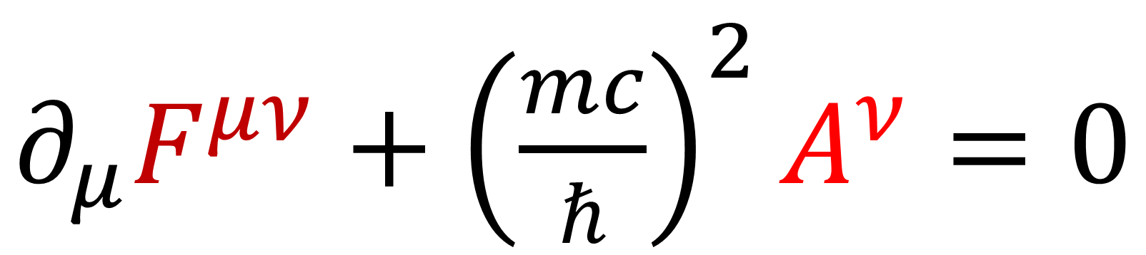
24
Spinors For Beginners
Proca / Maxwell
Derivation & Solutions
$∂_{μ}F^{μν}+{\left(\frac{mc}{ℏ}\right)}^{2}A^{ν}=0$

Slide 2
Spinors Learning “Staircase”
Spinors in Particle Physics
Lie Groups & Algebras
Clifford Algebras
Spinors in 3D / (4D)
Examples From Physics (motivation)

Slide 3
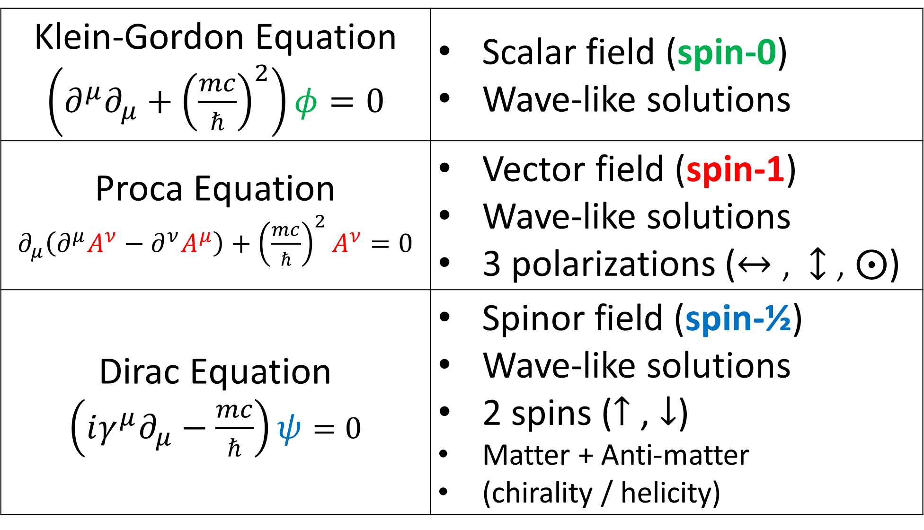
Klein-Gordon Equation $\left(∂^{μ}∂_{μ}+{\left(\frac{mc}{ℏ}\right)}^{2}\right)φ=0$ | Scalar field (spin-0) Wave-like solutions
Proca Equation $∂_{μ}\left(∂^{μ}A^{ν}−∂^{ν}A^{μ}\right)+{\left(\frac{mc}{ℏ}\right)}^{2}A^{ν}=0$ | Vector field (spin-1) Wave-like solutions 3 polarizations ($↔$ , $↕$ , $⨀$)
Dirac Equation $\left(iγ^{μ}∂_{μ}−\frac{mc}{ℏ}\right)ψ=0$ | Spinor field (spin-½) Wave-like solutions 2 spins ($↑$ , $↓$) Matter + Anti-matter (chirality / helicity)

Slide 4
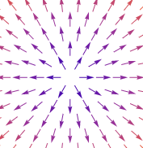
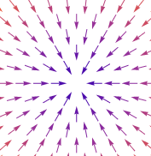
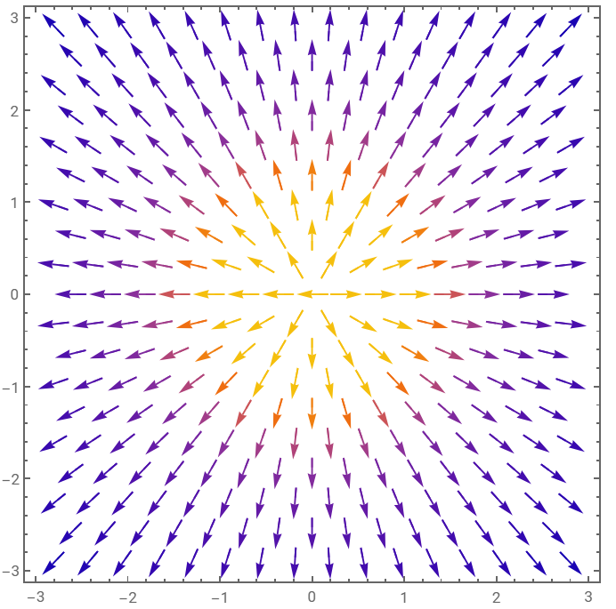
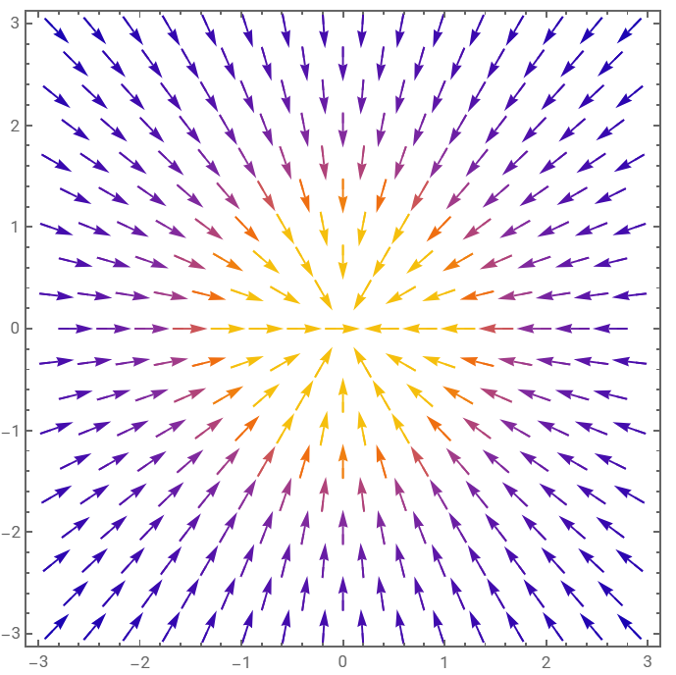

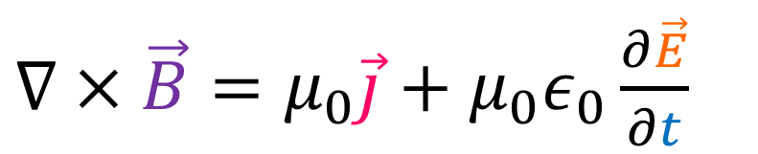

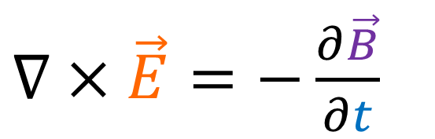
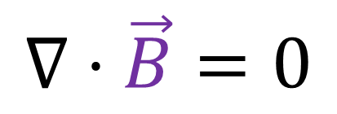

Maxwell’s Equations
$∇⋅\vec{E}=\frac{ρ}{ε_{0}}$
$+$
$−$
$∇×\vec{E}=−\frac{∂\vec{B}}{∂t}$
$$∇⋅\vec{B}=0$$
+
+
+
+
+
+
+
$∇×\vec{B}=μ_{0}\vec{j}+μ_{0}ε_{0}\frac{∂\vec{E}}{∂t}$

Slide 5
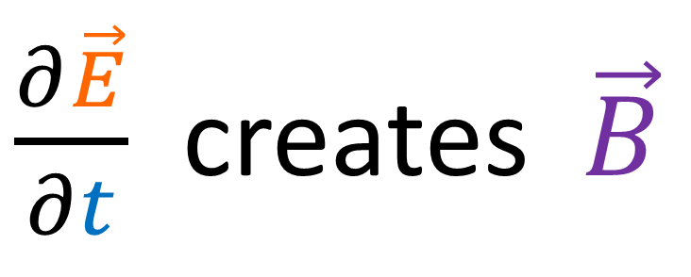
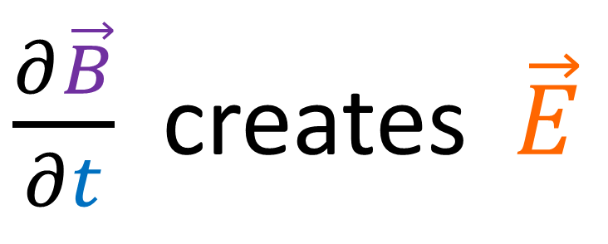
Maxwell’s Equations
$∇⋅\vec{E}=\frac{ρ}{ε_{0}}$
$\frac{∂\vec{B}}{∂t}$ creates $\vec{E}$
$∇×\vec{E}=−\frac{∂\vec{B}}{∂t}$
$$∇⋅\vec{B}=0$$
$\frac{∂\vec{E}}{∂t}$ creates $\vec{B}$
$∇×\vec{B}=μ_{0}\vec{j}+μ_{0}ε_{0}\frac{∂\vec{E}}{∂t}$

Slide 6
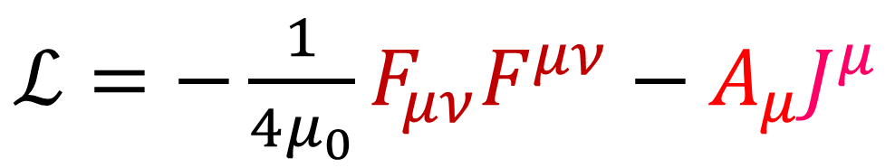
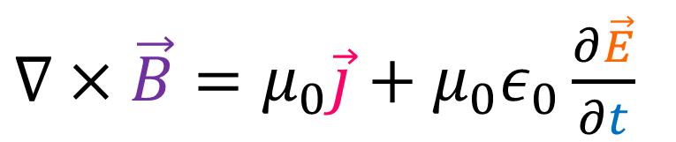
Maxwell’s Equations
Inhomogeneous Maxwell Equations
(with sources)
$∇⋅\vec{E}=\frac{ρ}{ε_{0}}$
$∇×\vec{E}=−\frac{∂\vec{B}}{∂t}$
Maxwell Lagrangian Density:
$$∇⋅\vec{B}=0$$
$ℒ=−\frac{1}{4μ_{0}}F_{μν}F^{μν}−A_{μ}J^{μ}$
$∇×\vec{B}=μ_{0}\vec{j}+μ_{0}ε_{0}\frac{∂\vec{E}}{∂t}$

Slide 7
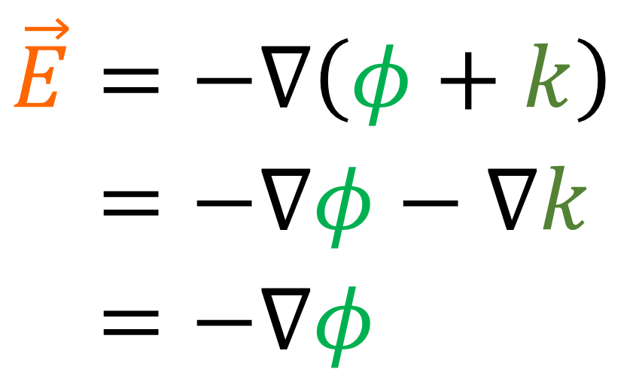
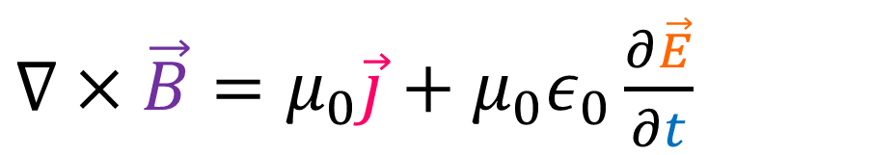
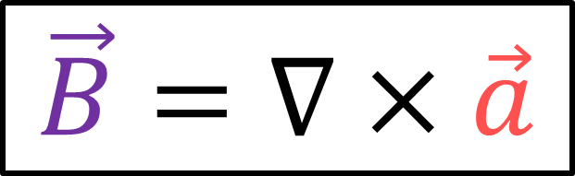
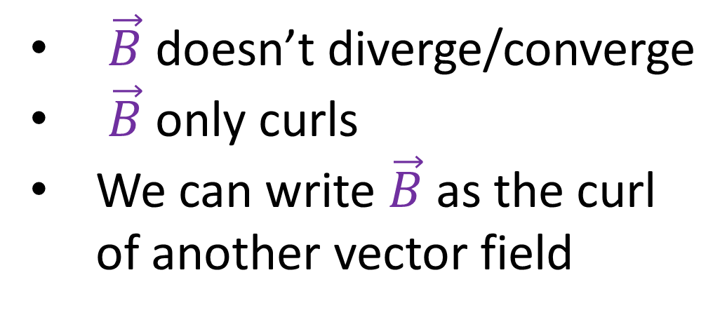

Maxwell’s Equations
(See Griffith’s “Introduction to Electrodynamics”, section 10.1)
$$\vec{E}=−∇\left(φ+k\right)$$
$$\vec{E}=−∇φ−∇k$$
$$\vec{E}=−∇φ$$
$∇⋅\vec{E}=\frac{ρ}{ε_{0}}$
$$∇⋅\vec{B}=0$$
$∇×\vec{E}=−\frac{∂\vec{B}}{∂t}$
$\vec{B}$ doesn’t diverge/converge
$\vec{B}$ only curls
We can write $\vec{B}$ as the curl of another vector field
$$∇⋅\vec{B}=0$$
$∇×\vec{B}=μ_{0}\vec{j}+μ_{0}ε_{0}\frac{∂\vec{E}}{∂t}$
magnetic vector potential
$$\vec{B}=∇×\vec{a}$$

Slide 8


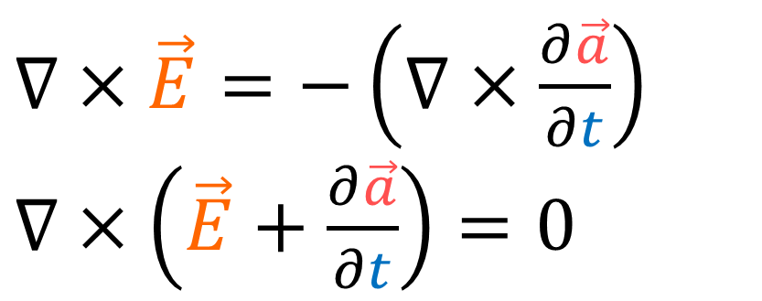
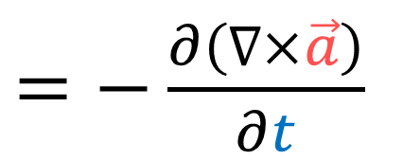
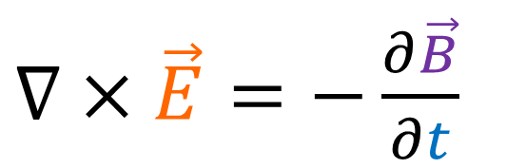
Maxwell’s Equations
(See Griffith’s “Introduction to Electrodynamics”, section 10.1)
$∇⋅\vec{E}=\frac{ρ}{ε_{0}}$
$$\vec{B}=∇×\vec{a}$$
$∇×\vec{E}=−\frac{∂\vec{B}}{∂t}$
$=−\frac{∂\left(∇×\vec{a}\right)}{∂t}$
$∇×\vec{E}=−\frac{∂\vec{B}}{∂t}$
$∇×\vec{E}=−\left(∇×\frac{∂\vec{a}}{∂t}\right)$
$∇×\left(\vec{E}+\frac{∂\vec{a}}{∂t}\right)=0$
$$∇⋅\vec{B}=0$$
$∇×\vec{B}=μ_{0}\vec{j}+μ_{0}ε_{0}\frac{∂\vec{E}}{∂t}$
Curl-less field, so it only diverges.
Can be written as a gradient of a scalar field

Slide 9
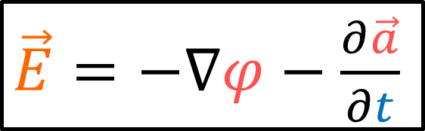
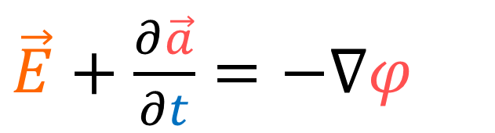
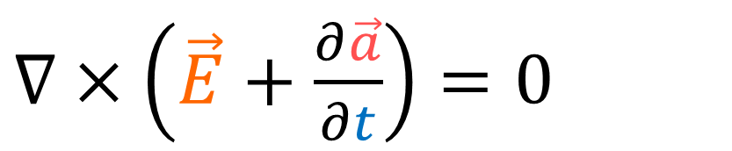
Maxwell’s Equations
(See Griffith’s “Introduction to Electrodynamics”, section 10.1)
$∇⋅\vec{E}=\frac{ρ}{ε_{0}}$
$$\vec{B}=∇×\vec{a}$$
$∇×\left(\vec{E}+\frac{∂\vec{a}}{∂t}\right)=0$
$∇×\vec{E}=−\frac{∂\vec{B}}{∂t}$
electric potential
$\vec{E}+\frac{∂\vec{a}}{∂t}=−∇φ$
$$∇⋅\vec{B}=0$$
$\vec{E}=−∇φ−\frac{∂\vec{a}}{∂t}$
$∇×\vec{B}=μ_{0}\vec{j}+μ_{0}ε_{0}\frac{∂\vec{E}}{∂t}$
Curl-less field, so it only diverges.
Can be written as a gradient of a scalar field

Slide 10
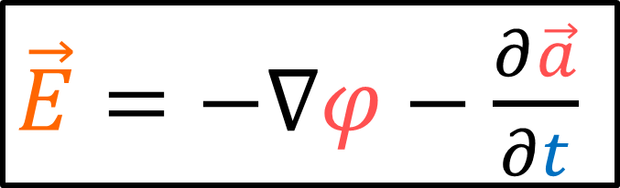
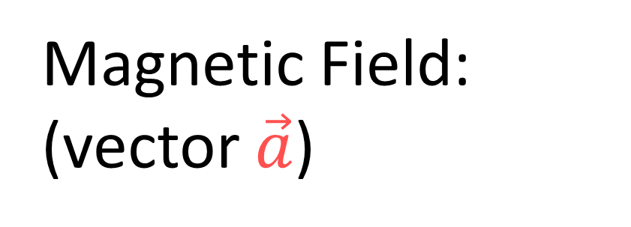
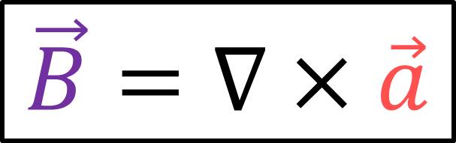
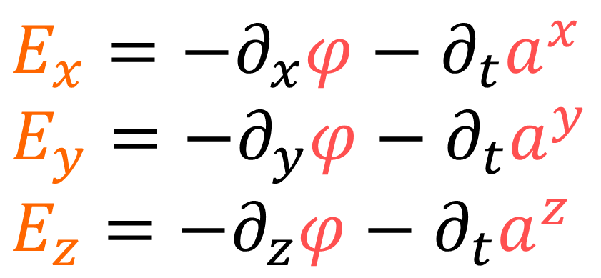
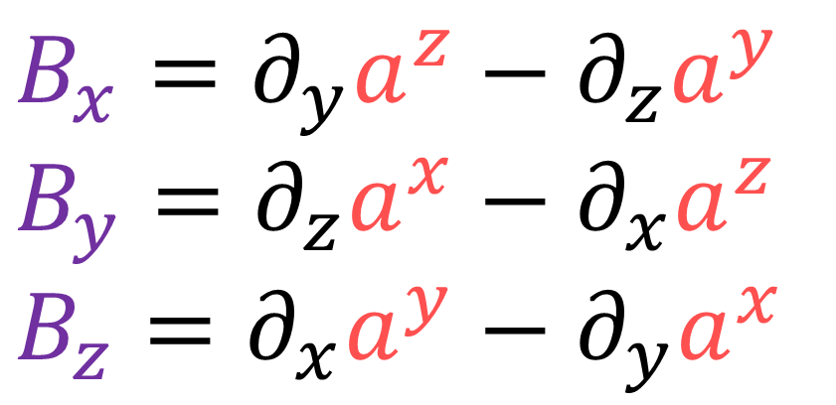
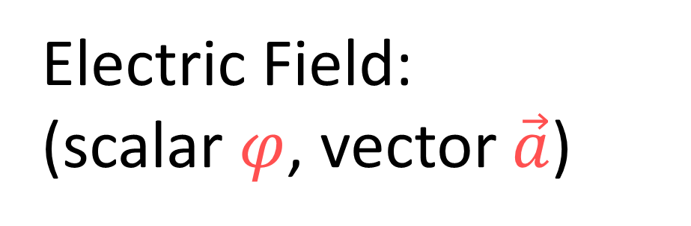
Electric Field:
(scalar $φ$, vector $\vec{a}$)
Magnetic Field: (vector $\vec{a}$)
$\vec{E}=−∇φ−\frac{∂\vec{a}}{∂t}$
$$\vec{B}=∇×\vec{a}$$
$E_{x}=−∂_{x}φ−∂_{t}a^{x}$
$E_{y}=−∂_{y}φ−∂_{t}a^{y}$
$E_{z}=−∂_{z}φ−∂_{t}a^{z}$
$$B_{x}=∂_{y}a^{z}−∂_{z}a^{y}$$
$$B_{y}=∂_{z}a^{x}−∂_{x}a^{z}$$
$$B_{z}=∂_{x}a^{y}−∂_{y}a^{x}$$

Slide 11
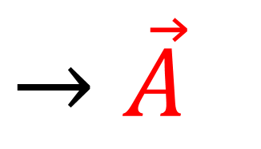
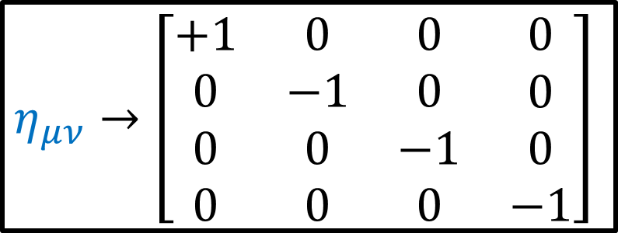
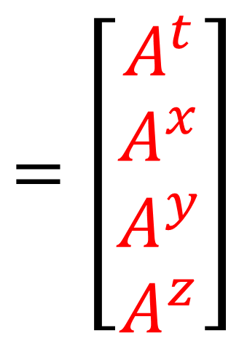
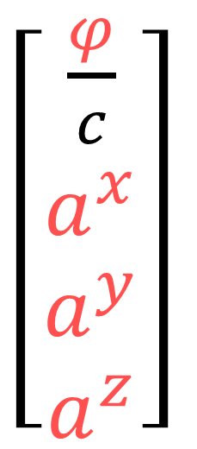
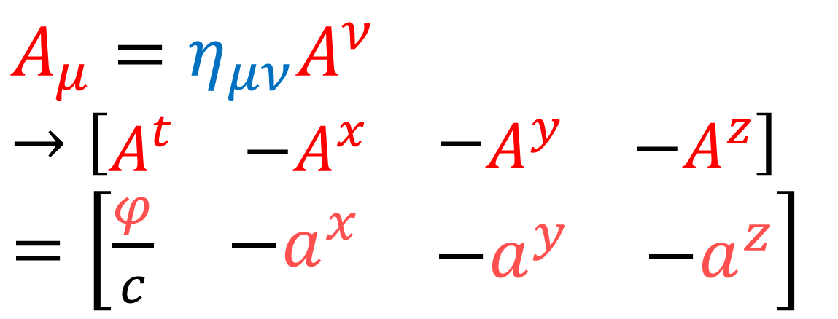

$\left[\begin{aligned}\frac{φ}{c} \\ a^{x} \\ a^{y} \\ a^{z}\end{aligned}\right]$
4-Potential Vector
$$=\left[\begin{aligned}A^{t} \\ A^{x} \\ A^{y} \\ A^{z}\end{aligned}\right]$$
$$→\vec{A}$$
4-Potential Covector
$η_{μν}→\left[\begin{matrix}\begin{matrix}\begin{aligned}+1 \\ 0 \\ 0 \\ 0\end{aligned} & \begin{aligned}0 \\ −1 \\ 0 \\ 0\end{aligned}\end{matrix} & \begin{matrix}\begin{aligned}0 \\ 0 \\ −1 \\ 0\end{aligned} & \begin{aligned}0 \\ 0 \\ 0 \\ −1\end{aligned}\end{matrix}\end{matrix}\right]$
$$A_{μ}=η_{μν}A^{ν}$$
$→\left[\begin{matrix}\begin{matrix}A^{t} & −A^{x}\end{matrix} & −\begin{matrix}A^{y} & −A^{z}\end{matrix}\end{matrix}\right]$
$=\left[\begin{matrix}\begin{matrix}\frac{φ}{c} & −a^{x}\end{matrix} & \begin{matrix}−a^{y} & −a^{z}\end{matrix}\end{matrix}\right]$

Slide 12
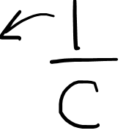
Electric Field:
(scalar $φ$, vector $\vec{a}$)
Magnetic Field: (vector $\vec{a}$)
$\vec{E}=−∇φ−\frac{∂\vec{a}}{∂t}$
$$\vec{B}=∇×\vec{a}$$
$E_{x}=−∂_{x}φ−∂_{t}a^{x}$
$E_{y}=−∂_{y}φ−∂_{t}a^{y}$
$E_{z}=−∂_{z}φ−∂_{t}a^{z}$
$$B_{x}=∂_{y}a^{z}−∂_{z}a^{y}$$
$$B_{y}=∂_{z}a^{x}−∂_{x}a^{z}$$
$$B_{z}=∂_{x}a^{y}−∂_{y}a^{x}$$

Slide 13
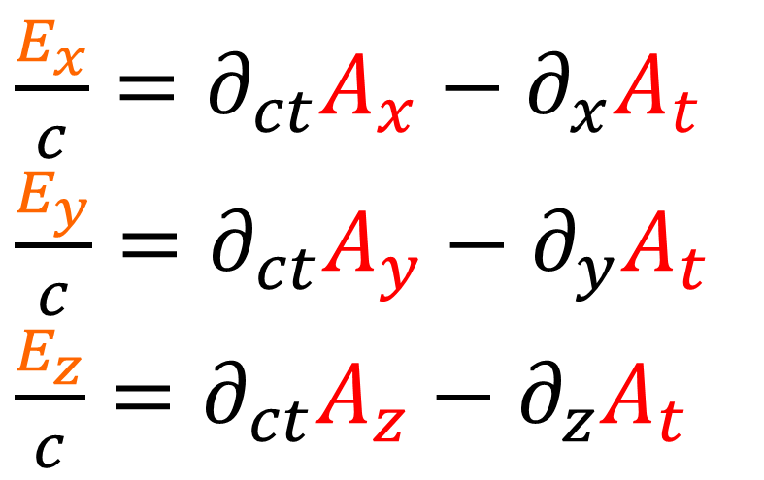
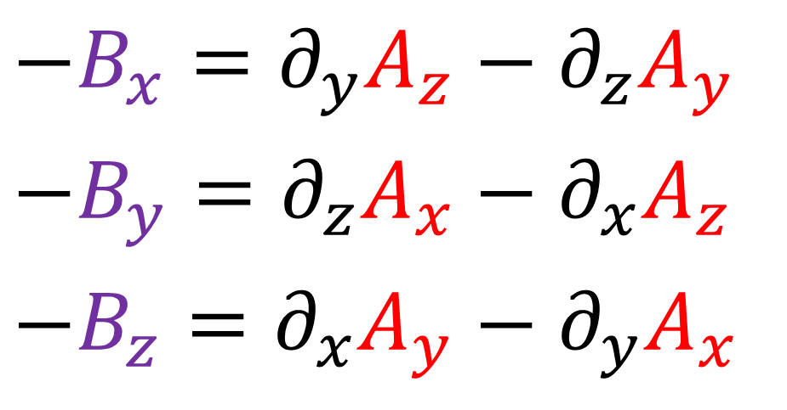


$\frac{E_{x}}{c}=−∂_{x}\frac{φ}{c}−∂_{ct}a^{x}$
$\frac{E_{y}}{c}=−∂_{y}\frac{φ}{c}−∂_{ct}a^{y}$
$\frac{E_{z}}{c}=−∂_{z}\frac{φ}{c}−∂_{ct}a^{z}$
$$B_{x}=∂_{y}a^{z}−∂_{z}a^{y}$$
$$B_{y}=∂_{z}a^{x}−∂_{x}a^{z}$$
$$B_{z}=∂_{x}a^{y}−∂_{y}a^{x}$$
$A_{t}=\frac{φ}{c}=a^{t}$ | $$A_{x}=−a^{x}$$ | $$A_{y}=−a^{y}$$ | $$A_{z}=−a^{z}$$
$\frac{E_{x}}{c}=∂_{ct}A_{x}−∂_{x}A_{t}$
$\frac{E_{y}}{c}=∂_{ct}A_{y}−∂_{y}A_{t}$
$\frac{E_{z}}{c}=∂_{ct}A_{z}−∂_{z}A_{t}$
$$−B_{x}=∂_{y}A_{z}−∂_{z}A_{y}$$
$$−B_{y}=∂_{z}A_{x}−∂_{x}A_{z}$$
$$−B_{z}=∂_{x}A_{y}−∂_{y}A_{x}$$

Slide 14
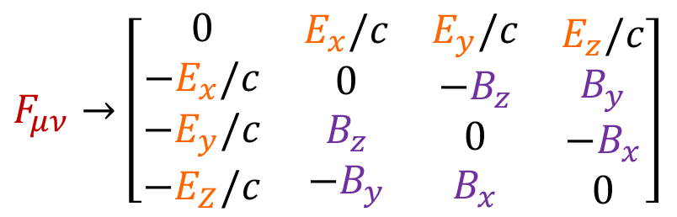
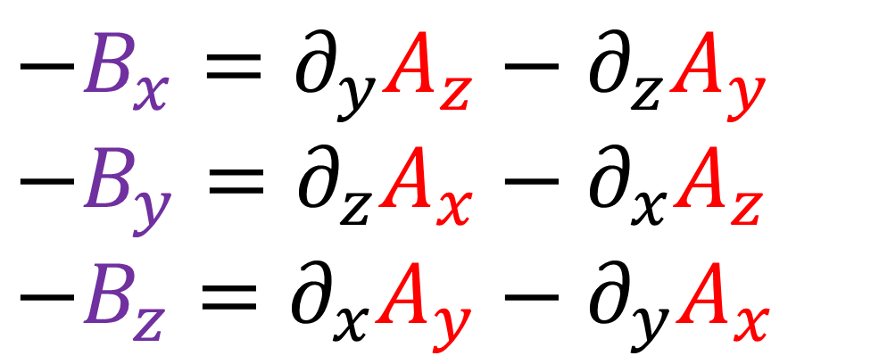



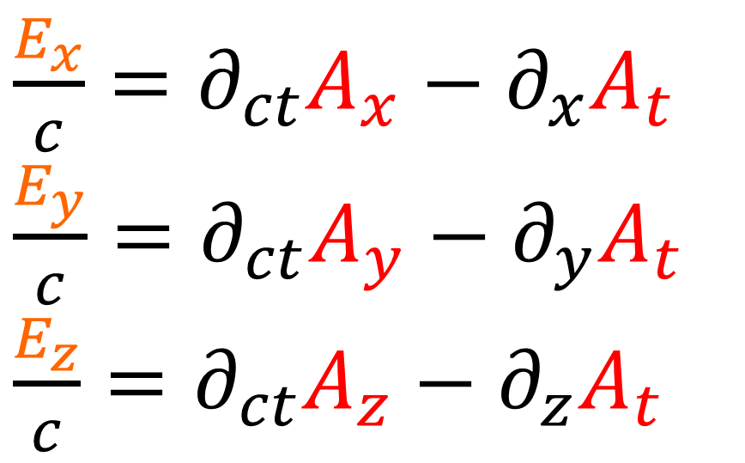
$$−B_{x}=∂_{y}A_{z}−∂_{z}A_{y}$$
$$−B_{y}=∂_{z}A_{x}−∂_{x}A_{z}$$
$$−B_{z}=∂_{x}A_{y}−∂_{y}A_{x}$$
$$=F_{yz}$$
$$=F_{zx}$$
$$=F_{xy}$$
Faraday Tensor
$\frac{E_{x}}{c}=∂_{ct}A_{x}−∂_{x}A_{t}$
$\frac{E_{y}}{c}=∂_{ct}A_{y}−∂_{y}A_{t}$
$\frac{E_{z}}{c}=∂_{ct}A_{z}−∂_{z}A_{t}$
$$=F_{tx}$$
$$=F_{ty}$$
$$=F_{tz}$$
$$F_{μν}=∂_{μ}A_{ν}−∂_{ν}A_{μ}$$
$F_{μν}→\left[\begin{matrix}\begin{matrix}\begin{aligned}0 \\ −E_{x}/c \\ −E_{y}/c \\ −E_{Z}/c\end{aligned} & \begin{aligned}E_{x}/c \\ 0 \\ B_{z} \\ −B_{y}\end{aligned}\end{matrix} & \begin{matrix}\begin{aligned}E_{y}/c \\ −B_{z} \\ 0 \\ B_{x}\end{aligned} & \begin{aligned}E_{z}/c \\ B_{y} \\ −B_{x} \\ 0\end{aligned}\end{matrix}\end{matrix}\right]$

Slide 15
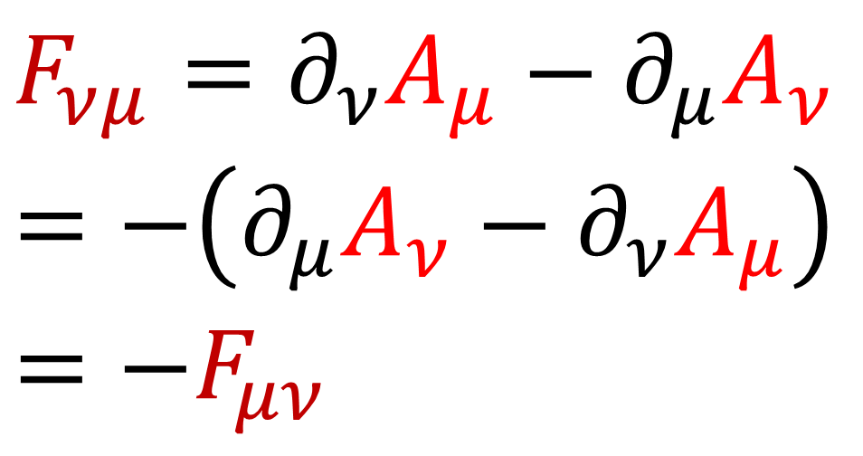

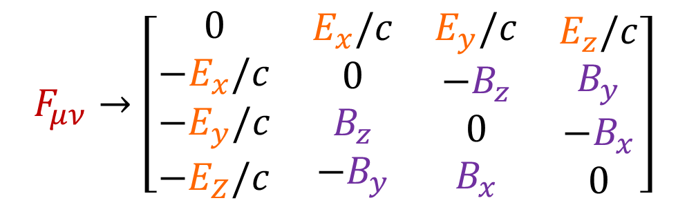
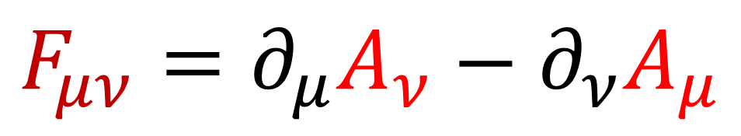
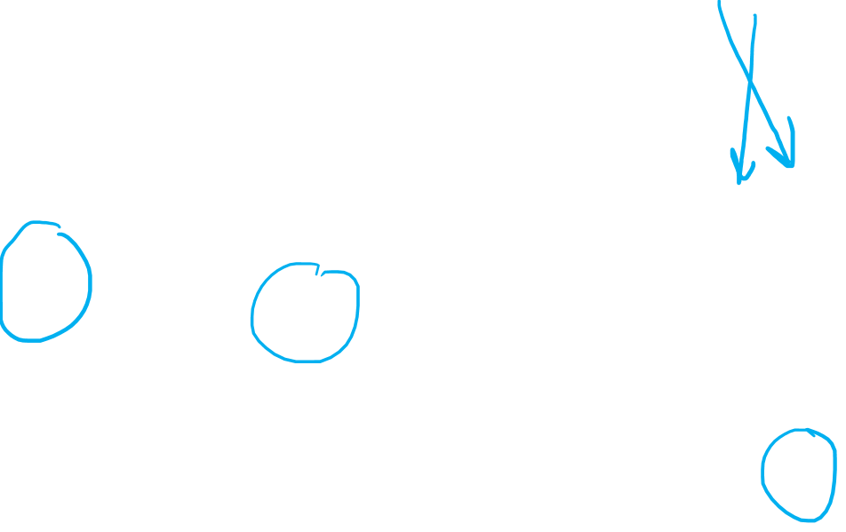
Faraday Tensor is Anti-Symmetric
$F_{μν}→\left[\begin{matrix}\begin{matrix}\begin{aligned}0 \\ −E_{x}/c \\ −E_{y}/c \\ −E_{Z}/c\end{aligned} & \begin{aligned}E_{x}/c \\ 0 \\ B_{z} \\ −B_{y}\end{aligned}\end{matrix} & \begin{matrix}\begin{aligned}E_{y}/c \\ −B_{z} \\ 0 \\ B_{x}\end{aligned} & \begin{aligned}E_{z}/c \\ B_{y} \\ −B_{x} \\ 0\end{aligned}\end{matrix}\end{matrix}\right]$
$$F_{μν}=∂_{μ}A_{ν}−∂_{ν}A_{μ}$$
$$F_{νμ}=∂_{ν}A_{μ}−∂_{μ}A_{ν}$$
$=−\left(∂_{μ}A_{ν}−∂_{ν}A_{μ}\right)$
$$=−F_{μν}$$
$F^{T}=−F$

Slide 16
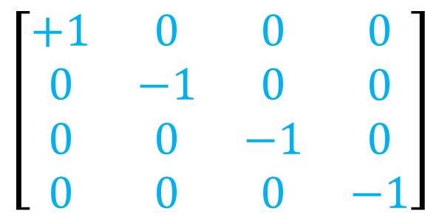






$$F_{μν}=∂_{μ}A_{ν}−∂_{ν}A_{μ}$$
$$F^{αβ}≡η^{αμ}F_{μν}η^{βν}$$
$\left[\begin{matrix}\begin{matrix}\begin{aligned}+1 \\ 0 \\ 0 \\ 0\end{aligned} & \begin{aligned}0 \\ −1 \\ 0 \\ 0\end{aligned}\end{matrix} & \begin{matrix}\begin{aligned}0 \\ 0 \\ −1 \\ 0\end{aligned} & \begin{aligned}0 \\ 0 \\ 0 \\ −1\end{aligned}\end{matrix}\end{matrix}\right]$
$\left[\begin{matrix}\begin{matrix}\begin{aligned}0 \\ −E_{x}/c \\ −E_{y}/c \\ −E_{Z}/c\end{aligned} & \begin{aligned}E_{x}/c \\ 0 \\ B_{z} \\ −B_{y}\end{aligned}\end{matrix} & \begin{matrix}\begin{aligned}E_{y}/c \\ −B_{z} \\ 0 \\ B_{x}\end{aligned} & \begin{aligned}E_{z}/c \\ B_{y} \\ −B_{x} \\ 0\end{aligned}\end{matrix}\end{matrix}\right]$
$\left[\begin{matrix}\begin{matrix}\begin{aligned}+1 \\ 0 \\ 0 \\ 0\end{aligned} & \begin{aligned}0 \\ −1 \\ 0 \\ 0\end{aligned}\end{matrix} & \begin{matrix}\begin{aligned}0 \\ 0 \\ −1 \\ 0\end{aligned} & \begin{aligned}0 \\ 0 \\ 0 \\ −1\end{aligned}\end{matrix}\end{matrix}\right]$
$F^{μν}→\left[\begin{matrix}\begin{matrix}\begin{aligned}0 \\ +E_{x}/c \\ +E_{y}/c \\ +E_{Z}/c\end{aligned} & \begin{aligned}−E_{x}/c \\ 0 \\ B_{z} \\ −B_{y}\end{aligned}\end{matrix} & \begin{matrix}\begin{aligned}{−E}_{y}/c \\ −B_{z} \\ 0 \\ B_{x}\end{aligned} & \begin{aligned}−E_{z}/c \\ B_{y} \\ −B_{x} \\ 0\end{aligned}\end{matrix}\end{matrix}\right]$

Slide 17








$∇⋅\vec{E}=\frac{ρ}{ε_{0}}$
$∇×\vec{B}=μ_{0}\vec{j}+μ_{0}ε_{0}\frac{∂\vec{E}}{∂t}$
$μ_{0}ε_{0}=\frac{1}{c^{2}}$
$∇⋅\frac{\vec{E}}{c}=μ_{0}cρ$
$c^{2}μ_{0}=\frac{1}{ε_{0}}$
$−\frac{∂\left(\vec{E}/c\right)}{∂ct}+∇×\vec{B}=μ_{0}\vec{j}$
$−∂_{ct}\frac{E_{x}}{c}+∂_{y}B_{z}−∂_{z}B_{y}=μ_{0}j^{x}$
$−∂_{ct}\frac{E_{y}}{c}+∂_{z}B_{x}−∂_{x}B_{z}=μ_{0}j^{y}$
$−∂_{ct}\frac{E_{z}}{c}+∂_{x}B_{y}−∂_{y}B_{x}=μ_{0}j^{z}$
$∂_{x}\frac{E_{x}}{c}+∂_{y}\frac{E_{y}}{c}+∂_{z}\frac{E_{z}}{c}=μ_{0} cρ$

Slide 18


$$0$$ | $$+$$ | $∂_{x}\frac{E_{x}}{c}$ | $$+$$ | $∂_{y}\frac{E_{y}}{c}$ | $$+$$ | $∂_{z}\frac{E_{z}}{c}$ | $=μ_{0} cρ$
$−∂_{ct}\frac{E_{x}}{c}$ | $$+$$ | $$0$$ | $$+$$ | $$∂_{y}B_{z}$$ | $$+$$ | $$\left(−∂_{z}B_{y}\right)$$ | $=μ_{0}j^{x}$
$−∂_{ct}\frac{E_{y}}{c}$ | $$+$$ | $$\left(−∂_{x}B_{z}\right)$$ | $$+$$ | $$0$$ | $$+$$ | $$∂_{z}B_{x}$$ | $=μ_{0}j^{y}$
$−∂_{ct}\frac{E_{z}}{c}$ | $$+$$ | $$∂_{x}B_{y}$$ | $$+$$ | $$\left(−∂_{y}B_{x}\right)$$ | $$+$$ | $$0$$ | $$=μ_{0}j^{z}$$
$${\left(\left[∂_{ct} ∂_{x} ∂_{y} ∂_{z}\right]\left[\begin{matrix}\begin{matrix}\begin{aligned}0 \\ E_{x}/c \\ E_{y}/c \\ E_{Z}/c\end{aligned} & \begin{aligned}−E_{x}/c \\ 0 \\ B_{z} \\ −B_{y}\end{aligned}\end{matrix} & \begin{matrix}\begin{aligned}{−E}_{y}/c \\ −B_{z} \\ 0 \\ B_{x}\end{aligned} & \begin{aligned}−E_{z}/c \\ B_{y} \\ −B_{x} \\ 0\end{aligned}\end{matrix}\end{matrix}\right]\right)}^{T}=μ_{0}\left[\begin{aligned}cρ \\ j^{x} \\ j^{y} \\ j^{z}\end{aligned}\right]$$

Slide 19




$${\left(\left[∂_{ct} ∂_{x} ∂_{y} ∂_{z}\right]\left[\begin{matrix}\begin{matrix}\begin{aligned}0 \\ E_{x}/c \\ E_{y}/c \\ E_{Z}/c\end{aligned} & \begin{aligned}−E_{x}/c \\ 0 \\ B_{z} \\ −B_{y}\end{aligned}\end{matrix} & \begin{matrix}\begin{aligned}{−E}_{y}/c \\ −B_{z} \\ 0 \\ B_{x}\end{aligned} & \begin{aligned}−E_{z}/c \\ B_{y} \\ −B_{x} \\ 0\end{aligned}\end{matrix}\end{matrix}\right]\right)}^{T}=μ_{0}\left[\begin{aligned}cρ \\ j^{x} \\ j^{y} \\ j^{z}\end{aligned}\right]$$
$${\left(\left[∂_{ct} ∂_{x} ∂_{y} ∂_{z}\right]\left[\begin{matrix}\begin{matrix}\begin{aligned}F^{tt} \\ F^{xt} \\ F^{yt} \\ F^{zt}\end{aligned} & \begin{aligned}F^{tx} \\ F^{xx} \\ F^{yx} \\ F^{zx}\end{aligned}\end{matrix} & \begin{matrix}\begin{aligned}F^{ty} \\ F^{xy} \\ F^{yy} \\ F^{zy}\end{aligned} & \begin{aligned}F^{tz} \\ F^{xz} \\ F^{yz} \\ F^{zz}\end{aligned}\end{matrix}\end{matrix}\right]\right)}^{T}=μ_{0}\left[\begin{aligned}J^{t} \\ J^{x} \\ J^{y} \\ J^{z}\end{aligned}\right]$$
$$∂_{μ}F^{μν}=μ_{0}J^{ν}$$

Slide 20



(Inhomogeneous) Maxwell Equations:
$$∂_{μ}F^{μν}=μ_{0}J^{ν}$$
$$F_{μν}=∂_{μ}A_{ν}−∂_{ν}A_{μ}$$
Maxwell Lagrangian Density:
$ℒ=−\frac{1}{4μ_{0}}F_{μν}F^{μν}−A_{μ}J^{μ}$
$ℒ=−\frac{1}{4μ_{0}}\left(∂_{μ}A_{ν}−∂_{ν}A_{μ}\right)\left(∂^{μ}A^{ν}−∂^{ν}A^{μ}\right)−A_{ν}J^{ν}$

Slide 21



Field Euler-Lagrange Equation
Scalar Field:
Vector Field:
$\frac{∂ℒ}{∂φ}=∂_{μ}\left(\frac{∂ℒ}{∂\left(∂_{μ}φ\right)}\right)$
$\frac{∂ℒ}{∂A_{ν}}=∂_{μ}\left(\frac{∂ℒ}{∂\left(∂_{μ}A_{ν}\right)}\right)$
$\frac{∂ℒ}{∂A_{t}}=∂_{μ}\left(\frac{∂ℒ}{∂\left(∂_{μ}A_{t}\right)}\right)$ $\frac{∂ℒ}{∂A_{x}}=∂_{μ}\left(\frac{∂ℒ}{∂\left(∂_{μ}A_{x}\right)}\right)$ $\frac{∂ℒ}{∂A_{y}}=∂_{μ}\left(\frac{∂ℒ}{∂\left(∂_{μ}A_{y}\right)}\right)$ $\frac{∂ℒ}{∂A_{z}}=∂_{μ}\left(\frac{∂ℒ}{∂\left(∂_{μ}A_{z}\right)}\right)$

Slide 22

Field Euler-Lagrange Equation
Scalar Field:
Vector Field:
$\frac{∂ℒ}{∂φ}=∂_{μ}\left(\frac{∂ℒ}{∂\left(∂_{μ}φ\right)}\right)$
$\frac{∂ℒ}{∂A_{ν}}=∂_{μ}\left(\frac{∂ℒ}{∂\left(∂_{μ}A_{ν}\right)}\right)$
Independent Variables:
$$A_{t}$$ | $$A_{x}$$ | $$A_{y}$$ | $$A_{z}$$
$$∂_{ct}A_{t}$$ | $$∂_{ct}A_{x}$$ | $$∂_{ct}A_{y}$$ | $$∂_{ct}A_{z}$$
$$∂_{x}A_{t}$$ | $$∂_{x}A_{x}$$ | $$∂_{x}A_{y}$$ | $$∂_{x}A_{z}$$
$$∂_{y}A_{t}$$ | $$∂_{y}A_{x}$$ | $$∂_{y}A_{y}$$ | $$∂_{y}A_{z}$$
$$∂_{z}A_{t}$$ | $$∂_{z}A_{x}$$ | $$∂_{z}A_{y}$$ | $$∂_{z}A_{z}$$

Slide 23



$$F_{μν}=∂_{μ}A_{ν}−∂_{ν}A_{μ}$$
$ℒ=−\frac{1}{4μ_{0}}F_{μν}F^{μν}−A_{μ}J^{μ}$
$ℒ=−\frac{1}{4μ_{0}}\left(∂_{μ}A_{ν}−∂_{ν}A_{μ}\right)\left(∂^{μ}A^{ν}−∂^{ν}A^{μ}\right)−A_{ν}J^{ν}$
$\frac{∂ℒ}{∂A_{ν}}=\frac{∂}{∂A_{ν}}\left(−A_{α}J^{α }\right)=−\frac{∂A_{α}}{∂A_{ν}}J^{α }=−δ_{α}^{ν}J^{α }$
$\frac{∂ℒ}{∂\left(∂_{μ}A_{ν}\right)}=−\frac{1}{4μ_{0}}\left[\frac{∂F_{αβ}}{∂\left(∂_{μ}A_{ν}\right)}F^{αβ}+F_{αβ}\frac{∂F^{αβ}}{∂\left(∂_{μ}A_{ν}\right)}\right]$

Slide 24






$$F_{μν}=∂_{μ}A_{ν}−∂_{ν}A_{μ}$$
$ℒ=−\frac{1}{4μ_{0}}F_{μν}F^{μν}−A_{μ}J^{μ}$
$ℒ=−\frac{1}{4μ_{0}}\left(∂_{μ}A_{ν}−∂_{ν}A_{μ}\right)\left(∂^{μ}A^{ν}−∂^{ν}A^{μ}\right)−A_{ν}J^{ν}$
$\frac{∂ℒ}{∂A_{α}}=\frac{∂}{∂A_{α}}\left(−A_{ν}J^{ν }\right)=−\frac{∂A_{ν}}{∂A_{α}}J^{ν }=−δ_{ν}^{α}J^{ν }$
$=−J^{α}$
$$δ_{ν}^{α}=\left\{\begin{aligned}1 if α=ν \\ 0 if α≠ν\end{aligned}\right.$$
$\frac{∂A_{t}}{∂A_{t}}=1$
$\frac{∂A_{t}}{∂A_{y}}=0$

Slide 25




$$F_{μν}=∂_{μ}A_{ν}−∂_{ν}A_{μ}$$
$ℒ=−\frac{1}{4μ_{0}}F_{μν}F^{μν}−A_{μ}J^{μ}$
$ℒ=−\frac{1}{4μ_{0}}\left(∂_{μ}A_{ν}−∂_{ν}A_{μ}\right)\left(∂^{μ}A^{ν}−∂^{ν}A^{μ}\right)−A_{ν}J^{ν}$
$\frac{∂ℒ}{∂\left(∂_{β}A_{α}\right)}=−\frac{1}{4μ_{0}}\left[\frac{∂F_{μν}}{∂\left(∂_{β}A_{α}\right)}F^{μν}+F_{μν}\frac{∂F^{μν}}{∂\left(∂_{β}A_{α}\right)}\right]$
$\frac{∂F_{μν}}{∂\left(∂_{β}A_{α}\right)}=\frac{∂}{∂\left(∂_{β}A_{α}\right)}\left(∂_{μ}A_{ν}−∂_{ν}A_{μ}\right)=δ_{μ}^{β}δ_{ν}^{α}−δ_{ν}^{β}δ_{μ}^{α}$
$\frac{∂F_{μν}}{∂\left(∂_{β}A_{α}\right)}F^{μν}=\left(δ_{μ}^{β}δ_{ν}^{α}−δ_{ν}^{β}δ_{μ}^{α}\right)F^{μν}=\left(F^{βα}−F^{αβ}\right)$
$$=2F^{βα}$$

Slide 26


$$F_{μν}=∂_{μ}A_{ν}−∂_{ν}A_{μ}$$
$ℒ=−\frac{1}{4μ_{0}}F_{μν}F^{μν}−A_{μ}J^{μ}$
$ℒ=−\frac{1}{4μ_{0}}\left(∂_{μ}A_{ν}−∂_{ν}A_{μ}\right)\left(∂^{μ}A^{ν}−∂^{ν}A^{μ}\right)−A_{ν}J^{ν}$
$\frac{∂ℒ}{∂\left(∂_{β}A_{α}\right)}=−\frac{1}{4μ_{0}}\left[\frac{∂F_{μν}}{∂\left(∂_{β}A_{α}\right)}F^{μν}+F_{μν}\frac{∂F^{μν}}{∂\left(∂_{β}A_{α}\right)}\right]$
$\frac{∂F^{μν}}{∂\left(∂_{β}A_{α}\right)}=η^{μσ}η^{ντ}\frac{∂F_{στ}}{∂\left(∂_{β}A_{α}\right)}=η^{μσ}η^{ντ}\left(δ_{σ}^{β}δ_{τ}^{α}−δ_{τ}^{β}δ_{σ}^{α}\right)$
$F_{μν}\frac{∂F^{μν}}{∂\left(∂_{β}A_{α}\right)}=F_{μν}η^{μσ}η^{ντ}\left(δ_{σ}^{β}δ_{τ}^{α}−δ_{τ}^{β}δ_{σ}^{α}\right)$
$=F^{στ}\left(δ_{σ}^{β}δ_{τ}^{α}−δ_{τ}^{β}δ_{σ}^{α}\right)=\left(F^{βα}−F^{αβ}\right)=2F^{βα}$

Slide 27



$$F_{μν}=∂_{μ}A_{ν}−∂_{ν}A_{μ}$$
$ℒ=−\frac{1}{4μ_{0}}F_{μν}F^{μν}−A_{μ}J^{μ}$
$ℒ=−\frac{1}{4μ_{0}}\left(∂_{μ}A_{ν}−∂_{ν}A_{μ}\right)\left(∂^{μ}A^{ν}−∂^{ν}A^{μ}\right)−A_{ν}J^{ν}$
$\frac{∂ℒ}{∂\left(∂_{β}A_{α}\right)}=−\frac{1}{4μ_{0}}\left[\frac{∂F_{μν}}{∂\left(∂_{β}A_{α}\right)}F^{μν}+F_{μν}\frac{∂F^{μν}}{∂\left(∂_{β}A_{α}\right)}\right]$
$$2F^{βα}$$
$$2F^{βα}$$
$$4F^{βα}$$

Slide 28






$$F_{μν}=∂_{μ}A_{ν}−∂_{ν}A_{μ}$$
$ℒ=−\frac{1}{4μ_{0}}F_{μν}F^{μν}−A_{μ}J^{μ}$
$ℒ=−\frac{1}{4μ_{0}}\left(∂_{μ}A_{ν}−∂_{ν}A_{μ}\right)\left(∂^{μ}A^{ν}−∂^{ν}A^{μ}\right)−A_{ν}J^{ν}$
$\frac{∂ℒ}{∂A_{α}}=∂_{β}\left(\frac{∂ℒ}{∂\left(∂_{β}A_{α}\right)}\right)$
$\frac{∂ℒ}{∂A_{α}}=−J^{α}$
$−J^{α}=∂_{β}\left(−\frac{1}{4μ_{0}}\left[4F^{βα}\right]\right)$
$\frac{∂ℒ}{∂\left(∂_{β}A_{α}\right)}=−\frac{1}{4μ_{0}}\left[4F^{βα}\right]$
$$∂_{β}F^{βα}=μ_{0}J^{α}$$

Slide 29






Maxwell Lagrangian
Maxwell Equation
$ℒ=−\frac{1}{4μ_{0}}F_{μν}F^{μν}−A_{μ}J^{μ}$
$$∂_{μ}F^{μν}=μ_{0}J^{ν}$$
$ℒ_{KG}=\frac{1}{2}\left(∂_{μ}φ\right)\left(∂^{μ}φ\right)−\frac{1}{2}{\left(\frac{mc}{ℏ}\right)}^{2}φ^{2}$
Proca Lagrangian
$ℒ=−\frac{1}{4}F_{μν}F^{μν}−A_{μ}J^{μ}+\frac{1}{2}{\left(\frac{mc}{ℏ}\right)}^{2}A_{μ}A^{μ}$
$∂_{μ}F^{μν}+{\left(\frac{mc}{ℏ}\right)}^{2}A^{ν}=J^{ν}$
Proca Equation

Slide 30



Maxwell Lagrangian
Maxwell Equation
$ℒ=−\frac{1}{4μ_{0}}F_{μν}F^{μν}−A_{μ}J^{μ}$
$$∂_{μ}F^{μν}=μ_{0}J^{ν}$$
$ℒ_{KG}=\frac{1}{2}\left(∂_{μ}φ\right)\left(∂^{μ}φ\right)−\frac{1}{2}{\left(\frac{mc}{ℏ}\right)}^{2}φ^{2}$
Proca Lagrangian
$ℒ=−\frac{1}{4}F_{μν}F^{μν}−A_{μ}J^{μ}+\frac{1}{2}{\left(\frac{mc}{ℏ}\right)}^{2}A_{μ}A^{μ}$
Proca Equation
$∂_{μ}F^{μν}+{\left(\frac{mc}{ℏ}\right)}^{2}A^{ν}=0$
$$J^{ν}=0$$

Slide 31


Proca Equation
$∂_{μ}F^{μν} + {\left(\frac{mc}{ℏ}\right)}^{2}A^{ν} = 0$
$A^{ν}→$ $\left[\begin{aligned}A^{t} \\ A^{x} \\ A^{y} \\ A^{z}\end{aligned}\right]$

Slide 32






Proca Equation
$∂_{ν}\left(∂_{μ}F^{μν}+{\left(\frac{mc}{ℏ}\right)}^{2}A^{ν}\right)=0$
$∂_{ν}∂_{μ}F^{μν}+{\left(\frac{mc}{ℏ}\right)}^{2}∂_{ν}A^{ν}=0$
Symmetric
$$∂_{ν}∂_{μ}=∂_{μ}∂_{ν}$$
Anti-symmetric
$$F^{μν}=−F^{νμ}$$
$F^{μν}≡∂^{μ}A^{ν}−∂^{ν}A^{μ}$

Slide 33






Proca Equation
$∂_{ν}\left(∂_{μ}F^{μν}+{\left(\frac{mc}{ℏ}\right)}^{2}A^{ν}\right)=0$
$∂_{ν}∂_{μ}F^{μν}+{\left(\frac{mc}{ℏ}\right)}^{2}∂_{ν}A^{ν}=0$
$S_{μν}A^{μν}=0$
$$=⋯+S_{12}A^{12}+S_{21}A^{21}+⋯$$
anti-symmetric
$$−S_{12}A^{12}$$
symmetric

Slide 34


Proca Equation
$∂_{ν}\left(∂_{μ}F^{μν}+{\left(\frac{mc}{ℏ}\right)}^{2}A^{ν}\right)=0$
$∂_{ν}∂_{μ}F^{μν}+{\left(\frac{mc}{ℏ}\right)}^{2}∂_{ν}A^{ν}=0$
$$\left[\begin{matrix}a & b \\ b & c\end{matrix}\right]\left[\begin{matrix}0 & d \\ −d & 0\end{matrix}\right]=\left[\begin{matrix}−bd & ad \\ −cd & bd\end{matrix}\right]$$
anti-symmetric
symmetric
trace $=0$

Slide 35

Proca Equation
$∂_{ν}\left(∂_{μ}F^{μν}+{\left(\frac{mc}{ℏ}\right)}^{2}A^{ν}\right)=0$
$∂_{ν}∂_{μ}F^{μν}+{\left(\frac{mc}{ℏ}\right)}^{2}∂_{ν}A^{ν}=0$
Symmetric
$$∂_{ν}∂_{μ}=∂_{μ}∂_{ν}$$
Anti-symmetric
$$F^{μν}=−F^{νμ}$$

Slide 36

Proca Equation
$∂_{ν}\left(∂_{μ}F^{μν}+{\left(\frac{mc}{ℏ}\right)}^{2}A^{ν}\right)=0$
$∂_{ν}∂_{μ}F^{μν}+{\left(\frac{mc}{ℏ}\right)}^{2}∂_{ν}A^{ν}=0$
Lorenz Condition
$∂_{ν}A^{ν}=0$

Slide 37


Lorenz Condition
$∂_{ν}A^{ν}=0$
$∂_{ct}A^{t}+∂_{x}A^{x}+∂_{y}A^{y}+∂_{z}A^{z}=0$
3 degrees of freedom
(not 4)

Slide 38






Proca Equation
$∂_{μ}F^{μν} + {\left(\frac{mc}{ℏ}\right)}^{2}A^{ν} = 0$
$∂_{μ}\left(∂^{μ}A^{ν}−∂^{ν}A^{μ}\right)+{\left(\frac{mc}{ℏ}\right)}^{2}A^{ν}=0$
$∂_{μ}∂^{μ}A^{ν}−∂^{ν}∂_{μ}A^{μ}+{\left(\frac{mc}{ℏ}\right)}^{2}A^{ν}=0$
$∂_{μ}A^{μ}=0$
Lorenz Condition
$\left(∂_{μ}∂^{μ}+{\left(\frac{mc}{ℏ}\right)}^{2}\right)A^{ν}=0$
Klein-Gordon Equation

Slide 39






Proca Equation
$∂_{μ}F^{μν} + {\left(\frac{mc}{ℏ}\right)}^{2}A^{ν} = 0$
Klein-Gordon Equation
$\left(∂_{μ}∂^{μ}+{\left(\frac{mc}{ℏ}\right)}^{2}\right)A^{ν}=0$
$$\left[\begin{aligned}A^{t}\left(ct,x,y,z\right) \\ A^{x}\left(ct,x,y,z\right) \\ A^{y}\left(ct,x,y,z\right) \\ A^{z}\left(ct,x,y,z\right)\end{aligned}\right]$$
$$\left[\begin{aligned}α^{t} \\ α^{x} \\ α^{y} \\ α^{z}\end{aligned}\right]$$
$$=$$
$\cos\left(\frac{ω}{c}ct−k^{x}x−k^{y}y−k^{z}z\right)$

Slide 40






$A^{μ}→$ $\left[\begin{aligned}α^{t} \\ α^{x} \\ α^{y} \\ α^{z}\end{aligned}\right]$ $\cos\left(\frac{ω}{c}ct−k^{x}x−k^{y}y−k^{z}z\right)$
$A^{μ} = α^{μ} e^{i\left(\frac{ω}{c}ct−k^{x}x−k^{y}y−k^{z}z\right)}$
$$A^{μ} = α^{μ} e^{i\left(k^{t}x^{t}−k^{x}x^{x}−k^{y}x^{y}−k^{z}x^{z}\right)}$$
$$A^{μ} = α^{μ} e^{i\left(k^{0}x^{0}−k^{1}x^{1}−k^{2}x^{2}−k^{3}x^{3}\right)}$$
$$A^{μ} = α^{μ} e^{i\left(k_{0}x^{0}+k_{1}x^{1}+k_{2}x^{2}+k_{3}x^{3}\right)}$$
$$A^{μ} =α^{μ} e^{i\left(k_{ν}x^{ν}\right)}$$
$$k_{α}=η_{αβ}k^{β}$$
$η→$ $\left[\begin{matrix}\begin{matrix}\begin{aligned}+1 \\ 0 \\ 0 \\ 0\end{aligned} & \begin{aligned}0 \\ −1 \\ 0 \\ 0\end{aligned}\end{matrix} & \begin{matrix}\begin{aligned}0 \\ 0 \\ −1 \\ 0\end{aligned} & \begin{aligned}0 \\ 0 \\ 0 \\ −1\end{aligned}\end{matrix}\end{matrix}\right]$

Slide 41




$A^{μ} =α^{μ} e^{i\left(k_{ν}x^{ν}\right)} = α^{μ} e^{i\left(\frac{ω}{c}ct−k^{x}x−k^{y}y−k^{z}z\right)}$
$$∂_{μ}A^{μ}=∂_{μ}\left(α^{μ} e^{i\left(k_{ν}x^{ν}\right)}\right)$$
$$∂_{μ}A^{μ}=α^{μ} ∂_{μ}e^{i\left(k_{ν}x^{ν}\right)}$$
$∂_{μ}A^{μ}=0$
Lorenz Condition
$\frac{∂}{∂x^{0}}e^{i\left(k_{0}x^{0}+k_{1}x^{1}+k_{2}x^{2}+k_{3}x^{3}\right)}=ik_{0} e^{i\left(k_{0}x^{0}+k_{1}x^{1}+k_{2}x^{2}+k_{3}x^{3}\right)}$
$$∂_{μ}A^{μ}=α^{μ} \left(ik_{μ}\right) e^{i\left(k_{ν}x^{ν}\right)}$$
$$0 =α^{μ} \left(ik_{μ}\right) e^{i\left(k_{ν}x^{ν}\right)}$$
$$0 =α^{μ}k_{μ}$$

Slide 42





Simplified Case:
Wave travelling in z-direction:
$\cos\left( \frac{ω}{c}ct + k_{z}z \right)$
$=\cos\left(\frac{ω}{c}ct−0 x−0 y−k^{z}z\right)$
Wavevector:
$$\left[k_{t} k_{x} k_{y} k_{z}\right]$$
$=\left[ \frac{ω}{c} 0 0 k_{z} \right]$

Slide 43








Lorenz Condition
z-direction wave
$$k^{t}α^{t}−k^{z}α^{z} = 0$$
Solution #1:
$$α^{x}=1$$
$$\left[k^{t} 0 0 −k^{z}\right] \left[\begin{aligned}0 \\ 1 \\ 0 \\ 0\end{aligned}\right]=0$$
$$= k^{t}0−0\left(1\right)−0\left(0\right)−k^{z}0$$
Solution #2:
$$α^{y}=1$$
$$\left[k^{t} 0 0 −k^{z}\right] \left[\begin{aligned}0 \\ 0 \\ 1 \\ 0\end{aligned}\right]=0$$
$$= k^{t}0−0\left(0\right)−0\left(1\right)−k^{z}0$$

Slide 44










Lorenz Condition
$$k_{μ}α^{μ}=0$$
$$\left[k_{t} k_{x} k_{y} k_{z}\right]\left[\begin{aligned}α^{t} \\ α^{x} \\ α^{y} \\ α^{z}\end{aligned}\right]=0$$
$$=k_{t}α^{t}+k_{x}α^{x}+k_{y}α^{y}+k_{z}α^{z}$$
z-direction wave (special case)
$$k_{μ}η^{μν}=k^{ν}$$
$$\left[k_{t} 0 0 k_{z}\right]\left[\begin{aligned}α^{t} \\ α^{x} \\ α^{y} \\ α^{z}\end{aligned}\right]=0$$
$$= k_{t}α^{t} + k_{z}α^{z}$$
$$k_{t}=k^{t}$$
$$k_{z}=−k^{z}$$
$$= k^{t}α^{t} − k^{z}α^{z}$$

Slide 45





Lorenz Condition
z-direction wave
$$k^{t}α^{t}−k^{z}α^{z} = 0$$
Solution #3:
$$α^{t}=k^{z},α^{z}=k^{t}$$
$$\left[k^{t} 0 0 −k^{z}\right] \left[\begin{aligned}k^{z} \\ 0 \\ 0 \\ k^{t}\end{aligned}\right]=0$$
$$= k^{t}\left(k^{z}\right)+0\left(0\right)+0\left(0\right)−k^{z}\left(k^{t}\right)$$
Dispersion Relation
${\left(\frac{mc}{ℏ}\right)}^{2}={\left(k^{t}\right)}^{2}−{\left(k^{x}\right)}^{2}−{\left(k^{y}\right)}^{2}−{\left(k^{z}\right)}^{2}$
$k^{t}=±\sqrt{{\left(k^{z}\right)}^{2}+{\left(\frac{mc}{ℏ}\right)}^{2}}$

Slide 46





3 basic solutions for Proca field: $A^{μ} =α^{μ} e^{i\left(k_{ν}x^{ν}\right)}$
(special case of z-direction wave)
Solution #1:
Solution #2:
Solution #3:
$$\left[\begin{aligned}0 \\ 1 \\ 0 \\ 0\end{aligned}\right]e^{i\left(k_{t}ct +k_{z}z\right)}$$
$$\left[\begin{aligned}0 \\ 0 \\ 1 \\ 0\end{aligned}\right]e^{i\left(k_{t}ct +k_{z}z\right)}$$
$$\left[\begin{aligned}k^{z} \\ 0 \\ 0 \\ k^{t}\end{aligned}\right]e^{i\left(k_{t}ct +k_{z}z\right)}$$
$k^{t}=±\sqrt{{\left(k^{z}\right)}^{2}+{\left(\frac{mc}{ℏ}\right)}^{2}}$
z-direction is arbitrary
$⇒$ Proca equation always has 3 basic solutions for a given wavevector $\left[k_{t} k_{x} k_{y} k_{z}\right]$

Slide 47



























Klein-Gordon Equation
$\left(∂^{μ}∂_{μ}+{\left(\frac{mc}{ℏ}\right)}^{2}\right)φ=0$
1 solution per wave vector $k_{ν}$
$$φ\left(x^{ν}\right)= 𝒜 e^{i\left(k_{ν}x^{ν}\right)}$$
Proca Equation
$∂_{μ}\left(∂^{μ}A^{ν}−∂^{ν}A^{μ}\right)+{\left(\frac{mc}{ℏ}\right)}^{2}A^{ν}=0$
3 solutions per wave vector $k_{ν}$
$$A^{μ}\left(x^{ν}\right)=𝒜 α^{μ} e^{i\left(k_{ν}x^{ν}\right)}$$
$α^{μ}→$ $\left[\begin{aligned}0 \\ 1 \\ 0 \\ 0\end{aligned}\right]$
$α^{μ}→$ $\left[\begin{aligned}0 \\ 0 \\ 1 \\ 0\end{aligned}\right]$
$α^{μ}→$ $\left[\begin{aligned}k^{z} \\ 0 \\ 0 \\ k^{t}\end{aligned}\right]$
Horizontal Polarization
Vertical Polarization
Longitudinal Polarization
$$y$$
$$y$$
$$y$$
$$x$$
$$y$$
$$x$$
$$y$$
$$x$$
$$y$$
$$x$$
$$x$$
$$x$$
$$z$$
$$z$$
$$z$$
$$z$$

Slide 48
TRANSVERSE
LONGITUDINAL
Perpendicular to direction of wave travel
Parallel to direction of wave travel
Horizontal Polarization
Vertical Polarization
Longitudinal Polarization

Slide 49





$$\vec{H}$$
Horizontal Polarization
$$\vec{V}$$
Vertical Polarization
$\vec{L}=\frac{1}{\sqrt{2}}\vec{H}+\frac{e^{i π/2}}{\sqrt{2}} \vec{V}$
Left-Circular Polarization
$\vec{R}=\frac{1}{\sqrt{2}}\vec{H}−\frac{e^{i π/2}}{\sqrt{2}}\vec{V}$
Right-Circular Polarization

Slide 50
TRANSVERSE
LONGITUDINAL
Perpendicular to direction of wave travel
Parallel to direction of wave travel
Horizontal Polarization
Vertical Polarization
Longitudinal Polarization

Slide 51





TRANSVERSE
LONGITUDINAL
Perpendicular to direction of wave travel
Parallel to direction of wave travel
spin $S_{z}$
$$+1$$
spin $S_{z}$
$$−1$$
spin $S_{z}$
$$0$$
Left-Circular Polarization
Right-Circular Polarization
Longitudinal Polarization

Slide 52








3+1 spacetime
$∂_{μ}F^{μν}+{\left(\frac{mc}{ℏ}\right)}^{2}A^{ν}=0$
Dispersion Relation
$${\left(\frac{mc}{ℏ}\right)}^{2}={\left(k_{t}\right)}^{2}−{\left(k_{x}\right)}^{2}−{\left(k_{y}\right)}^{2}−{\left(k_{z}\right)}^{2}$$
$k_{t}=\frac{ω}{c}= \sqrt{{\left(\frac{mc}{ℏ}\right)}^{2}+{\left(k_{x}\right)}^{2}+{\left(k_{y}\right)}^{2}+{\left(k_{z}\right)}^{2}}$
LINEAR
$$a\left(\vec{k}\right)e^{iθ\left(\vec{k}\right)}$$
$A^{ν}\left(x^{σ}\right)=\sum_{r=1}^{3}{\int{dk_{x}dk_{y}dk_{z} 𝒜^{r}\left(\vec{k}\right) {\vec{\text{ε}}}_{r} e^{i\left(k_{σ}x^{σ}\right)}}}$
$${}^{ν}$$
Horizontal
Vertical
Longitudinal
${\vec{ε}}_{ 1}=$ $\left[\begin{aligned}0 \\ 1 \\ 0 \\ 0\end{aligned}\right]$
${\vec{ε}}_{ 2}=$ $\left[\begin{aligned}0 \\ 0 \\ 1 \\ 0\end{aligned}\right]$
${\vec{ε}}_{ 3}=$ $\left[\begin{aligned}k^{z} \\ 0 \\ 0 \\ k^{t}\end{aligned}\right]$
* These specific polarization vectors are for a z-travelling wave

Slide 53










Proca Equation
Maxwell Equation ($J^{ν}=0$)
$∂_{μ}F^{μν}+\left(\frac{mc}{ℏ}\right)A^{ν}=0$
$$∂_{μ}F^{μν}=0$$
Dispersion Relation
$${\left(\frac{mc}{ℏ}\right)}^{2}={\left(\frac{ω}{c}\right)}^{2}−{\left|{\vec{k}}_{3D}\right|}^{2}$$
Dispersion Relation ($m=0$)
${\left(0\right)}^{2}={\left(\frac{ω}{c}\right)}^{2}−{\left|{\vec{k}}_{3D}\right|}^{2}$
$v_{phase}=\frac{ω}{\left|{\vec{k}}_{3D}\right|}=c$
$v_{phase}=\frac{ω}{\left|{\vec{k}}_{3D}\right|}=c$ $\sqrt{1+{\left(\frac{mc}{ℏ\left|{\vec{k}}_{3D}\right|}\right)}^{2}}$
3 Polarizations:
Horizontal $↔$
Vertical $↕$
Longitudinal $⨀$
2 Polarizations:
Horizontal $↔$
Vertical $↕$
Longitudinal $⨀$

Slide 54









Electrostatics
Full electrodynamics
$\vec{E}=−∇φ−\frac{∂\vec{a}}{∂t}$
$$\vec{B}=∇×\vec{a}$$
$\vec{E}=−∇φ−\frac{∂\vec{a}}{∂t}$
$$F_{μν}=∂_{μ}A_{ν}−∂_{ν}A_{μ}$$
$$φ\left(x^{α}\right)→φ\left(x^{α}\right)+k$$
$$A_{μ}\left(x^{α}\right)→A_{μ}\left(x^{α}\right)+∂_{μ}λ\left(x^{α}\right)$$
$$\vec{E}=−∇φ$$
$$−→−∇\left(φ+k\right)$$
$$−=−∇φ−∇k$$
$$−=−∇φ−=\vec{E}$$
$$F_{μν}=∂_{μ}A_{ν}−∂_{ν}A_{μ}$$
$$→∂_{μ}\left(A_{ν}+∂_{ν}λ\right)−∂_{ν}\left(A_{μ}+∂_{μ}λ\right)$$
$$=∂_{μ}A_{ν}+∂_{μ}∂_{ν}λ−∂_{ν}A_{μ}−∂_{ν}∂_{μ}λ$$
$$=∂_{μ}A_{ν}−∂_{ν}A_{μ}=F_{μν}$$

Slide 55



Full electrodynamics
$$A_{μ}→A_{μ}+∂_{μ}λ$$
$\vec{E}=−∇φ−\frac{∂\vec{a}}{∂t}$
$$\vec{B}=∇×\vec{a}$$
$$F_{μν}→F_{μν}$$
$$F_{μν}=∂_{μ}A_{ν}−∂_{ν}A_{μ}$$
Gauge Transformation
$$A_{μ}\left(x^{α}\right)→A_{μ}\left(x^{α}\right)+∂_{μ}λ\left(x^{α}\right)$$
$$F_{μν}=∂_{μ}A_{ν}−∂_{ν}A_{μ}$$
$$→∂_{μ}\left(A_{ν}+∂_{ν}λ\right)−∂_{ν}\left(A_{μ}+∂_{μ}λ\right)$$
$$=∂_{μ}A_{ν}+∂_{μ}∂_{ν}λ−∂_{ν}A_{μ}−∂_{ν}∂_{μ}λ$$
$$=∂_{μ}A_{ν}−∂_{ν}A_{μ}=F_{μν}$$
Choice of $A_{μ}$
$=$ a “gauge”

Slide 56




Transformations
Experiment
Experiment
N
S
N
S
$+$
$+$
$−$
$−$
Same results
Rotational Symmetry!

Slide 57







Transformations
Rotation:
$$A_{μ}→ A_{μ} R_{α}^{μ}$$
$$F_{μν}→F_{μν}R_{σ}^{μ}R_{τ}^{ν}$$
$F^{αβ}→{\left(R^{−1}\right)}_{α}^{σ}{\left(R^{−1}\right)}_{β}^{τ}F^{αβ}$
Experiment
N
S
$+$
$−$
$ℒ=−\frac{1}{4μ_{0}}F_{μν}F^{μν}$
$→−\frac{1}{4μ_{0}}F_{μν}R_{σ}^{μ}R_{τ}^{ν} {\left(R^{−1}\right)}_{α}^{σ}{\left(R^{−1}\right)}_{β}^{τ}F^{αβ}$
$=−\frac{1}{4μ_{0}}F_{μν}δ_{α}^{μ} δ_{β}^{ν}F^{αβ}=−\frac{1}{4μ_{0}}F_{μν}F^{μν}$
Experiment
N
S
$+$
$−$

Slide 58



Transformations
Rotation:
$$A_{μ}→ A_{μ} R_{α}^{μ}$$
$$F_{μν}→F_{μν}R_{σ}^{μ}R_{τ}^{ν}$$
$F^{αβ}→{\left(R^{−1}\right)}_{α}^{σ}{\left(R^{−1}\right)}_{β}^{τ}F^{αβ}$
Experiment
N
S
$+$
$−$
$ℒ=−\frac{1}{4μ_{0}}F_{μν}F^{μν}→ℒ$
Experiment
N
S
$$S=∫∫∫∫ℒ d^{4}x$$
$+$
$−$
$S→S$

Slide 59







Transformations
Gauge Transformation:
$$A_{μ}→A_{μ}+∂_{μ}λ$$
$F_{μν}→F_{μν}$
Experiment
Experiment
N
S
N
S
$+$
$+$
$−$
$−$
$ℒ → ℒ$ , $S→S$
Rotation:
$$A_{μ}→ A_{μ} R_{α}^{μ}$$
$$F_{μν}→F_{μν}R_{α}^{μ}R_{β}^{ν}$$
$F^{μν}→$ ${\left(R^{−1}\right)}_{μ}^{α}{{\left(R^{−1}\right)}_{μ}^{α}}_{β}^{ν}$ $F^{μν}$
$ℒ → ℒ$ , $S→S$

Slide 60






Not measurable
Transformations
$$A_{μ}→A_{μ}+∂_{μ}λ$$
$F_{μν}→F_{μν}$
$$y$$
Experiment
$$y$$
Experiment
N
S
N
S
$+$
$+$
$−$
$−$
$$x$$
$$x$$
Measurable
Gauge transformation:
Not changing physical state
Only changing mathematical description
Change physical state
Rotation:
$$V_{μ}→ V_{μ} R_{α}^{μ}$$

Slide 61







$$A_{μ}→A_{μ}+∂_{μ}λ$$
Choice of $A_{μ}$
$=$ a “gauge”
$$F_{μν}→F_{μν}$$
Proca Lagrangian ($m≠0$)
$ℒ=−\frac{1}{4μ_{0}}F_{μν}F^{μν}+{\left(\frac{mc}{ℏ}\right)}^{2}A_{μ}A^{μ}$
$ℒ→−\frac{1}{4μ_{0}}F_{μν}F^{μν}+{\left(\frac{mc}{ℏ}\right)}^{2}\left(A_{μ}+∂_{μ}λ\right)\left(A^{μ}+∂^{μ}λ\right)$
$ℒ=−\frac{1}{4μ_{0}}F_{μν}F^{μν}+{\left(\frac{mc}{ℏ}\right)}^{2}A_{μ}A^{μ}$
$+{\left(\frac{mc}{ℏ}\right)}^{2}\left[A_{μ}∂^{μ}λ+A^{μ}∂_{μ}λ+\left(∂_{μ}λ\right)\left(∂^{μ}λ\right)\right]$
$$≠ℒ$$

Slide 62





$$A_{μ}→A_{μ}+∂_{μ}λ$$
Choice of $A_{μ}$
$=$ a “gauge”
$$F_{μν}→F_{μν}$$
Maxwell Lagrangian ($m=0$)
$ℒ=−\frac{1}{4μ_{0}}F_{μν}F^{μν}$
$→ −\frac{1}{4μ_{0}}F_{μν}F^{μν}=ℒ$

Slide 63





$$A_{μ}→A_{μ}+∂_{μ}λ$$
Choice of $A_{μ}$
$=$ a “gauge”
$$F_{μν}→F_{μν}$$
Maxwell Lagrangian ($m=0$)
$$\left(∂_{μ}J^{μ}\right)λ−∂_{μ}\left(J^{μ}λ\right)$$
$ℒ=−\frac{1}{4μ_{0}}F_{μν}F^{μν}−A_{μ}J^{μ}$
$ℒ→−\frac{1}{4μ_{0}}F_{μν}F^{μν}−\left(A_{μ}+∂_{μ}λ\right)J^{μ}$
$ℒ=−\frac{1}{4μ_{0}}F_{μν}F^{μν}−A_{μ}J^{μ}−J^{μ}∂_{μ}λ$
Continuity
equation
$$∂_{μ}J^{μ}=0$$
Divergence doesn’t
affect action
$$S=∫\left(∂_{μ}X^{μ}\right)d^{4}x=0$$

Slide 64





Proca Lagrangian
($m≠0$)
Maxwell Lagrangian
($m=0$)
$$A_{μ}→A_{μ}+∂_{μ}λ$$
$$A_{μ}→A_{μ}+∂_{μ}λ$$
Action Changes
$$S↛S$$
Action NOT Changed
$$S→S$$
Different Physics
Same Physics

Slide 65










Proca Equation
($m≠0$)
Maxwell Equation
($m=0$)
$\left(∂_{μ}F^{μν}+{\left(\frac{mc}{ℏ}\right)}^{2}A^{ν}\right)=0$
$∂_{ν}\left(∂_{μ}F^{μν}+{\left(\frac{mc}{ℏ}\right)}^{2}A^{ν}\right)=0$
$∂_{ν}∂_{μ}F^{μν}+{\left(\frac{mc}{ℏ}\right)}^{2}∂_{ν}A^{ν}=0$
$\left(∂_{μ}F^{μν}\right)= μ_{0}J^{ν}$
$$∂_{ν}\left(∂_{μ}F^{μν}\right)=∂_{ν}\left(μ_{0}J^{ν}\right)$$
$0 = 0$
$⇒∂_{ν}A^{ν}=0$ is not mandatory
If $∂_{ν}A^{ν}=f$,
Lorenz Condition
Choose $λ$ with $∂_{ν}∂^{ν}λ=−f$
$∂_{ν}A^{ν}=0$
$$∂_{ν}{\tilde{A}}^{ν}=∂_{ν}\left(A^{ν}+∂^{ν}λ\right)$$
$$∂_{ν}{\tilde{A}}^{ν}=∂_{ν}A^{ν}+∂_{ν}∂^{ν}λ=f−f=0$$

Slide 66



Proca Lagrangian
($m≠0$)
Maxwell Lagrangian
($m=0$)
$$A_{μ}→A_{μ}+∂_{μ}λ$$
$$A_{μ}→A_{μ}+∂_{μ}λ$$
Action Changes
$$S↛S$$
Action NOT Changed
$$S→S$$
Longitudinal Polarizations EXIST
Longitudinal Polarizations DO NOT EXIST

Slide 67








Massless $⇒$ No Longitudinal Polarization
$$A^{ν}\left(x^{μ}\right)= a^{ν} e^{i\left(k^{t} ct−k^{z}z\right)}$$
$$k→\left[\begin{matrix}\begin{matrix}k_{t} & k_{x}\end{matrix} & \begin{matrix}k_{y} & k_{z}\end{matrix}\end{matrix}\right]$$
$$k=\left[\begin{matrix}\begin{matrix}k_{t} & 0\end{matrix} & \begin{matrix}0 & k_{z}\end{matrix}\end{matrix}\right]$$
$$A^{ν}\left(x^{μ}\right)=\left[\begin{aligned}k^{z} \\ 0 \\ 0 \\ k^{t}\end{aligned}\right]e^{i\left(k^{t} ct−k^{z}z\right)}$$
Dispersion Relation
${\left(\frac{mc}{ℏ}\right)}^{2}={\left(k^{t}\right)}^{2}−{\left(k^{z}\right)}^{2}$
$$m=0 ⇒ k^{t}=± k^{z}$$
Use $k^{t}= k^{z}$
$$A^{ν}\left(x^{μ}\right)= \left[\begin{aligned}k^{t} \\ 0 \\ 0 \\ k^{t}\end{aligned}\right] e^{i\left(k^{t} ct−k^{t}z\right)}$$

Slide 68





Massless $⇒$ No Longitudinal Polarization
$$A^{ν}\left(x^{μ}\right)= \left[\begin{aligned}k^{t} \\ 0 \\ 0 \\ k^{t}\end{aligned}\right] e^{i\left(k^{t} ct−k^{t}z\right)}$$
$$λ=i e^{i\left(k^{t} ct−k^{t}z\right)}$$
$${\tilde{A}}^{ν}=A^{ν}+∂^{ν}λ$$
${\tilde{A}}^{ν}=\left[\begin{aligned}k^{t} \\ 0 \\ 0 \\ k^{t}\end{aligned}\right] e^{i\left(k^{t} ct−k^{t}z\right)}+$ $\left[\begin{aligned}∂^{ct}\left(i e^{i\left(k^{t} ct−k^{t}z\right)}\right) \\ ∂^{x}\left(i e^{i\left(k^{t} ct−k^{t}z\right)}\right) \\ ∂^{y}\left(i e^{i\left(k^{t} ct−k^{t}z\right)}\right) \\ ∂^{z}\left(i e^{i\left(k^{t} ct−k^{t}z\right)}\right)\end{aligned}\right]$

Slide 69



${\tilde{A}}^{ν}= \left[\begin{aligned}k^{t} \\ 0 \\ 0 \\ k^{t}\end{aligned}\right] e^{i\left(k^{t} ct−k^{t}z\right)}+$ $\left[\begin{aligned}∂^{ct}\left(i e^{i\left(k^{t} ct−k^{t}z\right)}\right) \\ ∂^{x}\left(i e^{i\left(k^{t} ct−k^{t}z\right)}\right) \\ ∂^{y}\left(i e^{i\left(k^{t} ct−k^{t}z\right)}\right) \\ ∂^{z}\left(i e^{i\left(k^{t} ct−k^{t}z\right)}\right)\end{aligned}\right]$
$$∂^{ct}=+∂_{ct}$$
$$∂^{x}=−∂_{x}$$
$$∂^{y}=−∂_{y}$$
$$∂^{z}=−∂_{z}$$

Slide 70





${\tilde{A}}^{ν}= \left[\begin{aligned}k^{t} \\ 0 \\ 0 \\ k^{t}\end{aligned}\right] e^{i\left(k^{t} ct−k^{t}z\right)}+$ $\left[\begin{aligned}∂_{ct}\left(i e^{i\left(k^{t} ct−k^{t}z\right)}\right) \\ −∂_{x}\left(i e^{i\left(k^{t} ct−k^{t}z\right)}\right) \\ −∂_{y}\left(i e^{i\left(k^{t} ct−k^{t}z\right)}\right) \\ −∂_{z}\left(i e^{i\left(k^{t} ct−k^{t}z\right)}\right)\end{aligned}\right]$
$$∂^{ct}=+∂_{ct}$$
$$∂^{x}=−∂_{x}$$
$$∂^{y}=−∂_{y}$$
$$∂^{z}=−∂_{z}$$
${\tilde{A}}^{ν}= \left[\begin{aligned}k^{t} \\ 0 \\ 0 \\ k^{t}\end{aligned}\right] e^{i\left(k^{t} ct−k^{t}z\right)}+$ $\left[\begin{aligned}k^{t}i\left(i e^{i\left(k^{t} ct−k^{t}z\right)}\right) \\ 0 \\ 0 \\ −\left(−k^{t}i\right)\left(i e^{i\left(k^{t} ct−k^{t}z\right)}\right)\end{aligned}\right]$
${\tilde{A}}^{ν}= \left[\begin{aligned}k^{t} \\ 0 \\ 0 \\ k^{t}\end{aligned}\right] e^{i\left(k^{t} ct−k^{t}z\right)}+$ $\left[\begin{aligned}−k^{t} \\ 0 \\ 0 \\ −k^{t}\end{aligned}\right]e^{i\left(k^{t} ct−k^{t}z\right)}$
$$=\left[\begin{aligned}0 \\ 0 \\ 0 \\ 0\end{aligned}\right]$$

Slide 71



Massless $⇒$ No Longitudinal Polarization
$$A^{ν}\left(x^{μ}\right)=\left[\begin{aligned}k^{z} \\ 0 \\ 0 \\ k^{t}\end{aligned}\right] e^{i\left(k^{t} ct−k^{z}z\right)}$$
$${\tilde{A}}^{ν}\left(x^{μ}\right)=\left[\begin{aligned}0 \\ 0 \\ 0 \\ 0\end{aligned}\right]$$
Gauge Transformation
$${\tilde{A}}^{ν}=A^{ν}+∂^{ν}λ$$
$$λ=i e^{i\left(k^{t} ct−k^{t}z\right)}$$

Slide 72




Massive Spin-2 particle
Massless Spin-2 particle
(graviton)
$$S_{z}=+2$$
$$S_{z}=+1$$
$$S_{z}=+0$$
$$S_{z}=−1$$
$$S_{z}=−2$$
$$S_{z}=+2$$
$$S_{z}=−2$$
$$≈$$
Polarizations
Gravitational Wave videos (links in description)

Slide 73





Vector
Anti-Particles
$${A^{ν}}^{∗}$$
Vector
Particles
$$A^{ν}$$
Mostly a repeat of:
Scalar
Anti-Particles
$$φ^{∗}$$
Scalar
Particles
$$φ$$

Slide 74











Klein-Gordon Lagrangian (Real, $φ\left(x^{ν}\right)∈ℝ$)
$ℒ=\frac{1}{2}\left(∂_{μ}φ\right)\left(∂^{μ}φ\right)−\frac{1}{2} {\left(\frac{mc}{ℏ}\right)}^{2}φ^{2}$
Klein-Gordon Lagrangian (Complex, $φ\left(x^{ν}\right)∈ℂ$)
$ℒ=\left(∂_{μ}φ^{∗}\right)\left(∂^{μ}φ\right)− {\left(\frac{mc}{ℏ}\right)}^{2}φ^{∗}φ$
$\frac{∂ℒ}{∂φ}=∂_{μ}\left(\frac{∂ℒ}{∂\left(∂_{μ}φ\right)}\right)$
Field E-L Equations
$\frac{∂ℒ}{∂φ^{∗}}=∂_{μ}\left(\frac{∂ℒ}{∂\left(∂_{μ}φ^{∗}\right)}\right)$
$\left(∂_{μ}∂^{μ}+ {\left(\frac{mc}{ℏ}\right)}^{2}\right)φ^{∗}=0$
$\left(∂_{μ}∂^{μ}+ {\left(\frac{mc}{ℏ}\right)}^{2}\right)φ=0$
Anti-Particles $φ^{∗}$
Particles $φ$

Slide 75





Klein-Gordon Lagrangian (Complex, $φ\left(x^{ν}\right)∈ℂ$)
$ℒ=\left(∂_{μ}φ^{∗}\right)\left(∂^{μ}φ\right)− {\left(\frac{mc}{ℏ}\right)}^{2}φ^{∗}φ$
$U(1)$ Symmetry
Electric Charge Conservation
$$φ →e^{iθ}φ$$
$$φ^{∗}→e^{−iθ}φ^{∗}$$
$$ℒ → ℒ$$
$$j^{μ}≡i \left[φ^{∗}\left(∂^{μ}φ\right)−φ\left(∂^{μ}φ^{∗}\right)\right]$$
$$∂_{μ}j^{μ}=0$$

Slide 76











Proca Lagrangian (Real , $A^{μ}\left(x^{ν}\right)∈ℝ^{4}$)
$ℒ=−\frac{1}{4}F_{μν}F^{μν}+\frac{1}{2}{\left(\frac{mc}{ℏ}\right)}^{2}A_{μ}A^{μ}$
$$F_{μν}=∂_{μ}A_{ν}−∂_{ν}A_{μ}$$
Proca Lagrangian (Complex, $A^{μ}\left(x^{ν}\right)∈ℂ^{4}$)
$ℒ=−\frac{1}{2}F_{μν}^{∗}F^{μν}+{\left(\frac{mc}{ℏ}\right)}^{2}A_{μ}^{∗}A^{μ}$
$\frac{∂ℒ}{∂A^{ν}}=∂_{μ}\left(\frac{∂ℒ}{∂\left(∂_{μ}A^{ν}\right)}\right)$
Field E-L Equations
$\frac{∂ℒ}{∂{A^{ν}}^{∗}}=∂_{μ}\left(\frac{∂ℒ}{∂\left(∂_{μ}{A^{ν}}^{∗}\right)}\right)$
$∂_{μ}{F^{μν}}^{∗}+{\left(\frac{mc}{ℏ}\right)}^{2}{A^{ν}}^{∗}=0$
$∂_{μ}F^{μν}+{\left(\frac{mc}{ℏ}\right)}^{2}A^{ν}=0$
Anti-Particles ${A^{ν}}^{∗}$
Particles $A^{ν}$

Slide 77






Proca Lagrangian (Complex, $A^{μ}\left(x^{ν}\right)∈ℂ^{4}$)
$ℒ=−\frac{1}{2}F_{μν}^{∗}F^{μν}+{\left(\frac{mc}{ℏ}\right)}^{2}A_{μ}^{∗}A^{μ}$
$$F_{μν}=∂_{μ}A_{ν}−∂_{ν}A_{μ}$$
$U(1)$ Symmetry
Electric Charge Conservation
$$A^{ν}→ e^{iθ} A^{ν}$$
$$A_{ν}^{∗}→e^{−iθ}A_{ν}^{∗}$$
$$ℒ → ℒ$$
$$j^{μ}≡i \left[A_{ν}^{∗}\left(∂^{μ}A^{ν}\right)−A^{ν}\left(∂^{μ}A_{ν}^{∗}\right)\right]$$
$$∂_{μ}j^{μ}=0$$

Slide 78







Real Proca fields
vector field
particle $=$ anti-particle
zero electric charge
Complex Proca fields
vector field
particle $≠$ anti-particle
has electric charge
Photon (no interactions)
W-Bosons (no interactions)
$ℒ=−\frac{1}{4}F_{μν}F^{μν}+\frac{1}{2}{\left(\frac{mc}{ℏ}\right)}^{2}A_{μ}A^{μ}$
$ℒ=−\frac{1}{2}𝔉_{μν}^{∗}𝔉^{μν}+{\left(\frac{mc}{ℏ}\right)}^{2}{W_{μ}^{∗}W}^{μ}$
$W^{+}$ and $W^{−}$ are
particle/anti-particle pairs.
Z-Boson (no interactions)
$ℒ=−\frac{1}{4}ℱ_{μν}ℱ^{μν}+\frac{1}{2}{\left(\frac{mc}{ℏ}\right)}^{2}Z_{μ}Z^{μ}$

