Slide 1





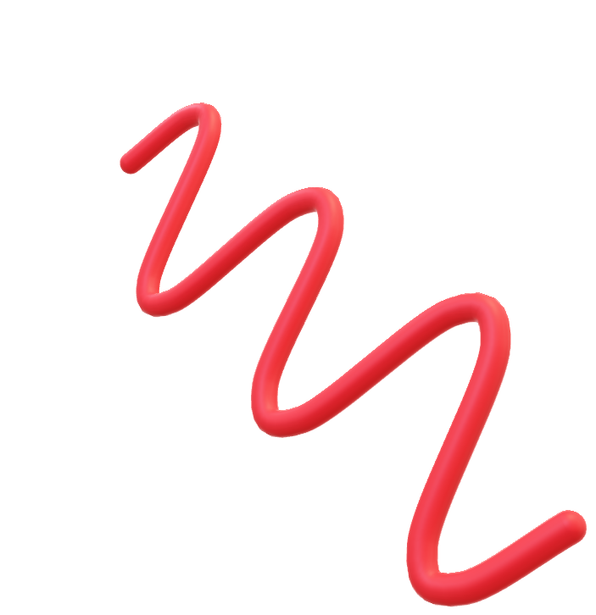
Spinors For Beginners
2
$$y$$
Jones Vectors
$\frac{1}{\sqrt{2}}\left[\begin{aligned}1 \\ 1\end{aligned}\right]$
$$x$$
$$z$$

Slide 2
Spinors Learning “Staircase”
Spinors in Particle Physics
Lie Groups & Algebras
Clifford Algebras
Spinors as square roots of vectors
Examples From Physics (motivation)

Slide 3
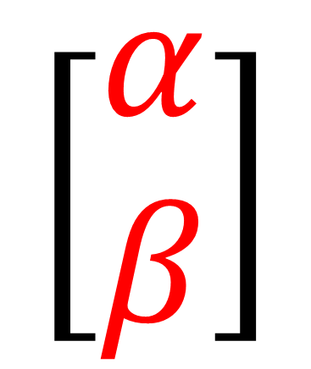
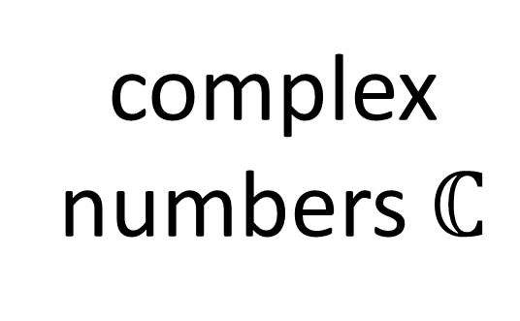
Spinors for Beginners
Next few videos…
Examples of how spinors come up in physics:
polarization of light waves
quantum spin states
$$\left[\begin{aligned}α \\ β\end{aligned}\right]$$
complex numbers $ℂ$
Spinor:

Slide 4


$$\left[\begin{aligned}α \\ β\end{aligned}\right]$$
Spinor

Slide 5

$$\left[\begin{aligned}α \\ β\end{aligned}\right]$$
Spinor
Poincaré Sphere
/Bloch Sphere

Slide 6
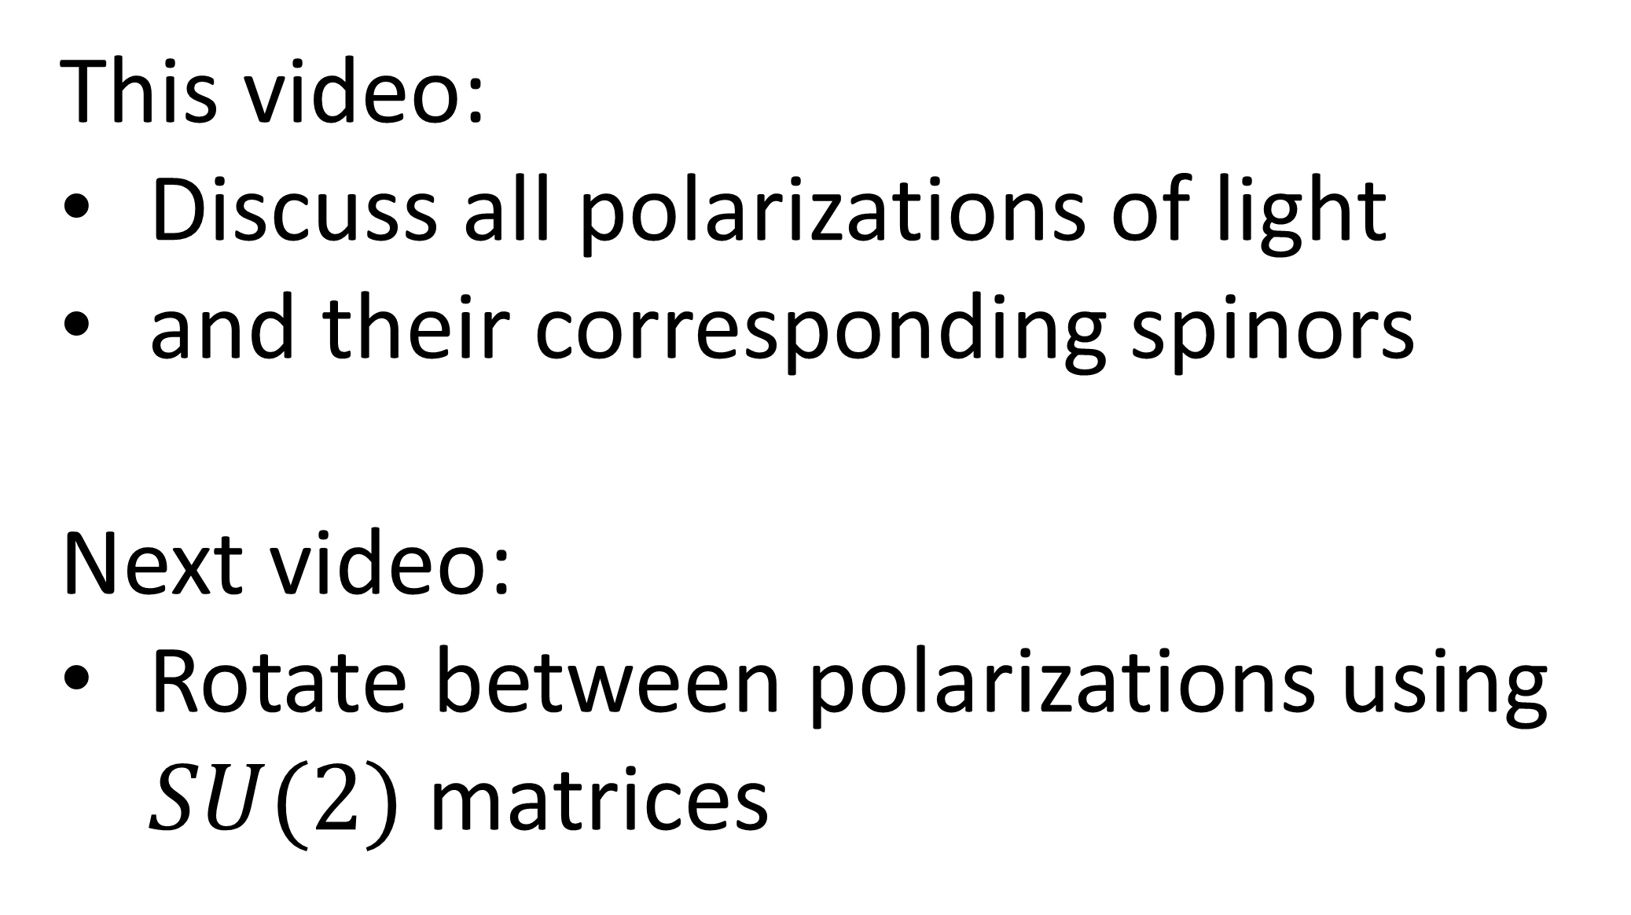
This video:
Discuss all polarizations of light
and their corresponding spinors
Next video:
Rotate between polarizations using $SU(2)$matrices

Slide 7
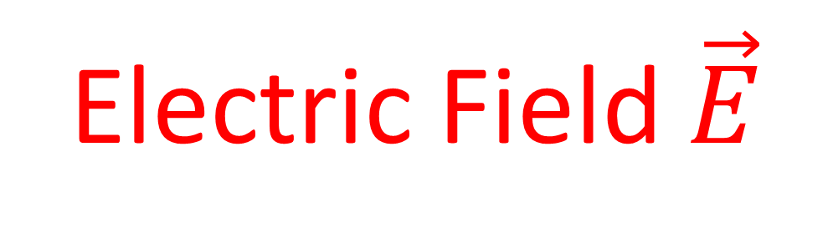

Electric Field $\vec{E}$
Magnetic Field $\vec{B}$
Initial velocity
+

Slide 8

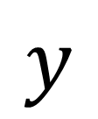
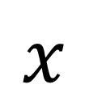
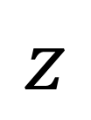

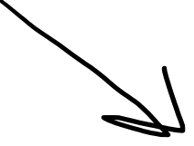
Electromagnetic Wave
(Light)
$$y$$
$E$-field
(transverse)
(transverse)
$$x$$
$B$-field
$$z$$

Slide 9

Electromagnetic Wave
(Light)
$E$-field
Travelling Wave
$B$-field

Slide 10
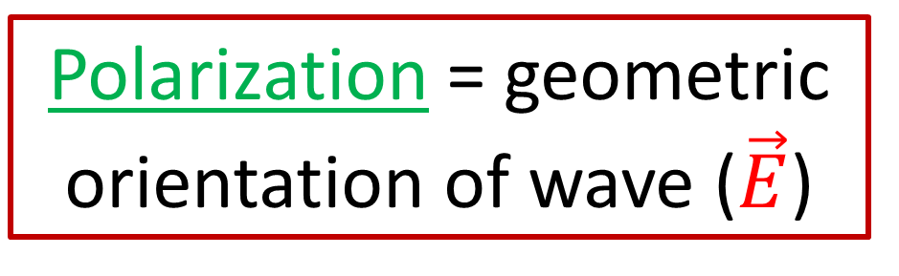
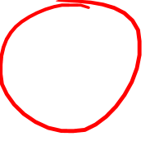
Electromagnetic Wave
(Light)
$$y$$
$E$-field
(transverse)
$$x$$
$B$-field
Polarization = geometric orientation of wave ($\vec{E}$)
$$z$$

Slide 11
Electromagnetic Wave
(Light)
$$y$$
$E$-field
$$x$$
Polarization = geometric orientation of wave ($\vec{E}$)
$$z$$

Slide 12
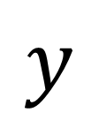
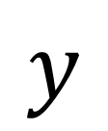
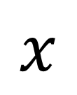
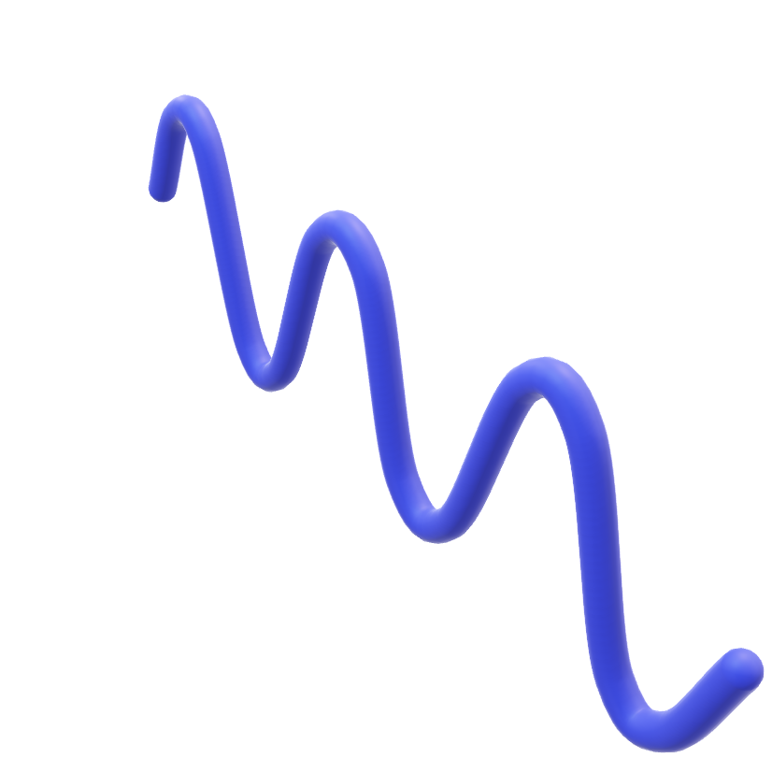
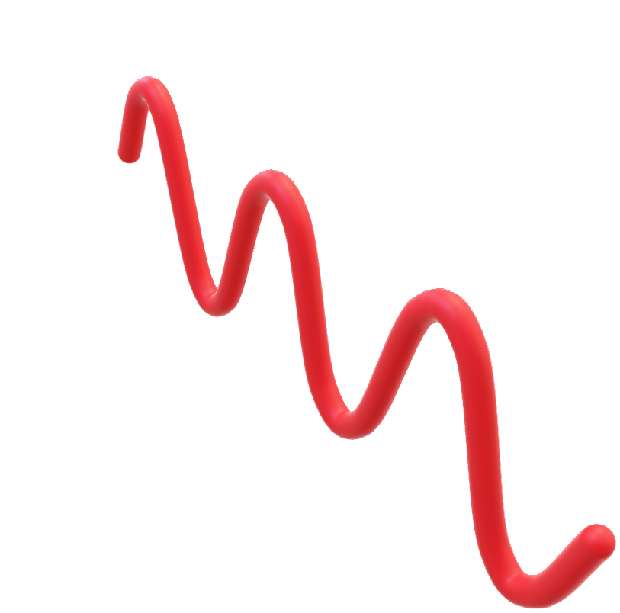
$$y$$
Vertical Polarization
$$y$$
$$x$$
$$x$$
$$z$$

Slide 13
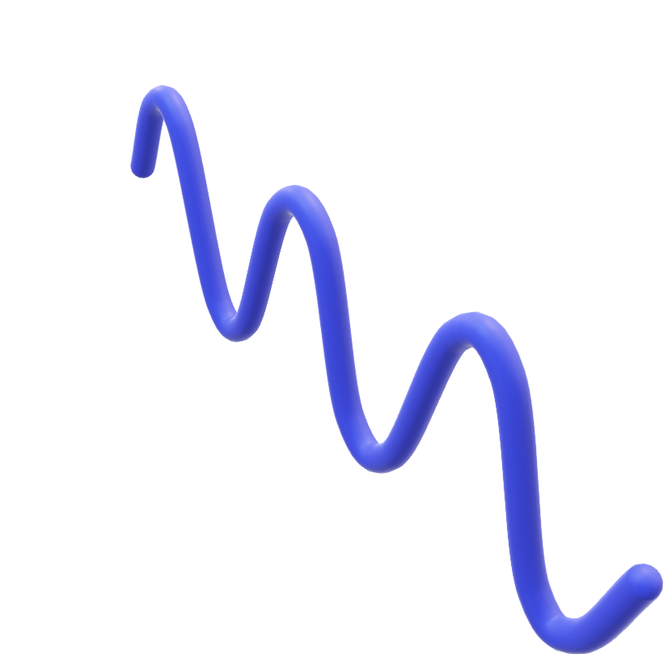
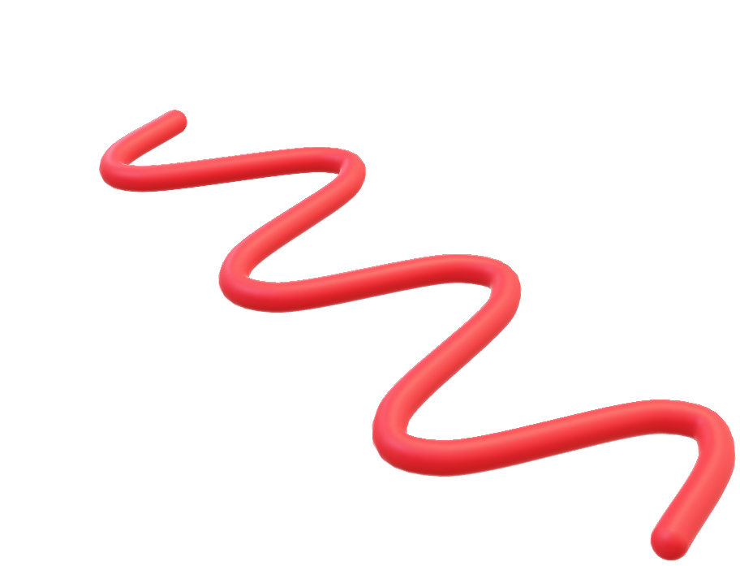
$$y$$
Horizontal Polarization
$$y$$
$$x$$
$$x$$
$$z$$

Slide 14
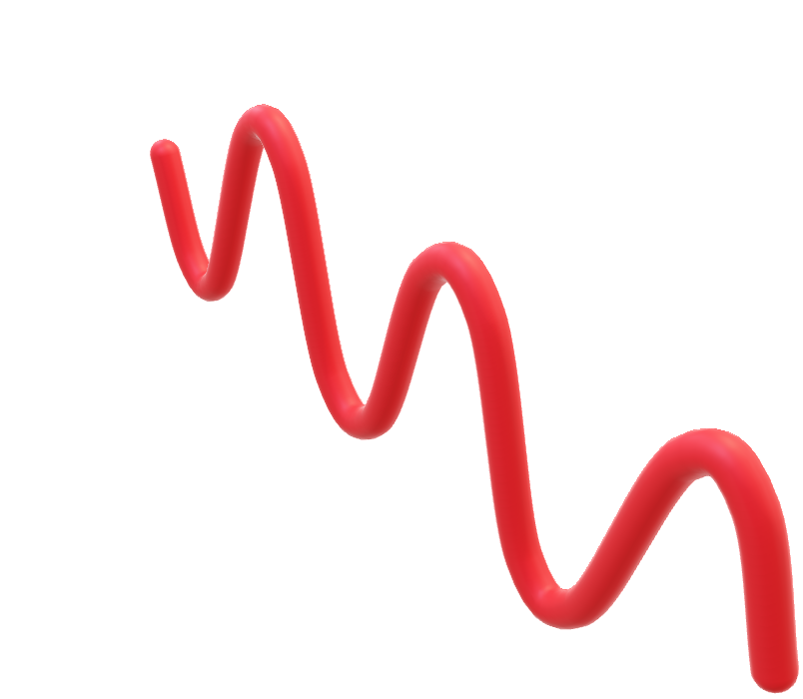
$$y$$
Vertical Polarization
$$y$$
$$x$$
½-cycle shift
$$x$$
$$z$$

Slide 15
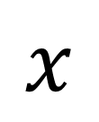



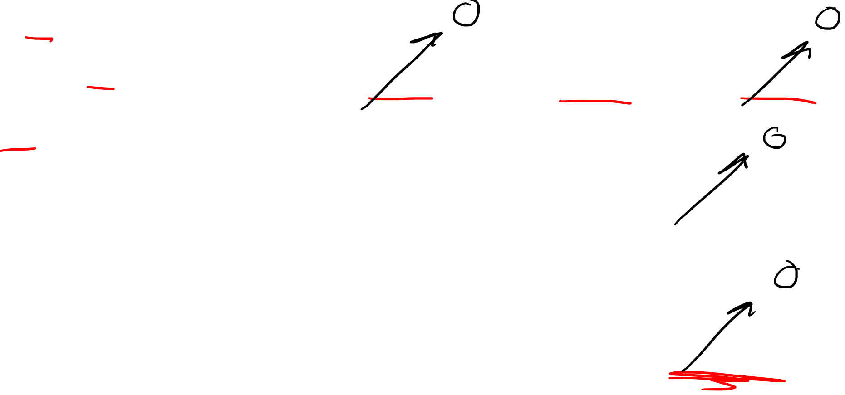
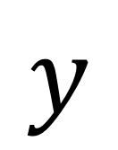

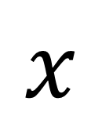
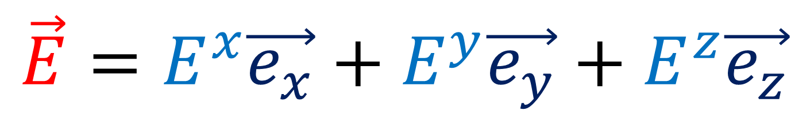
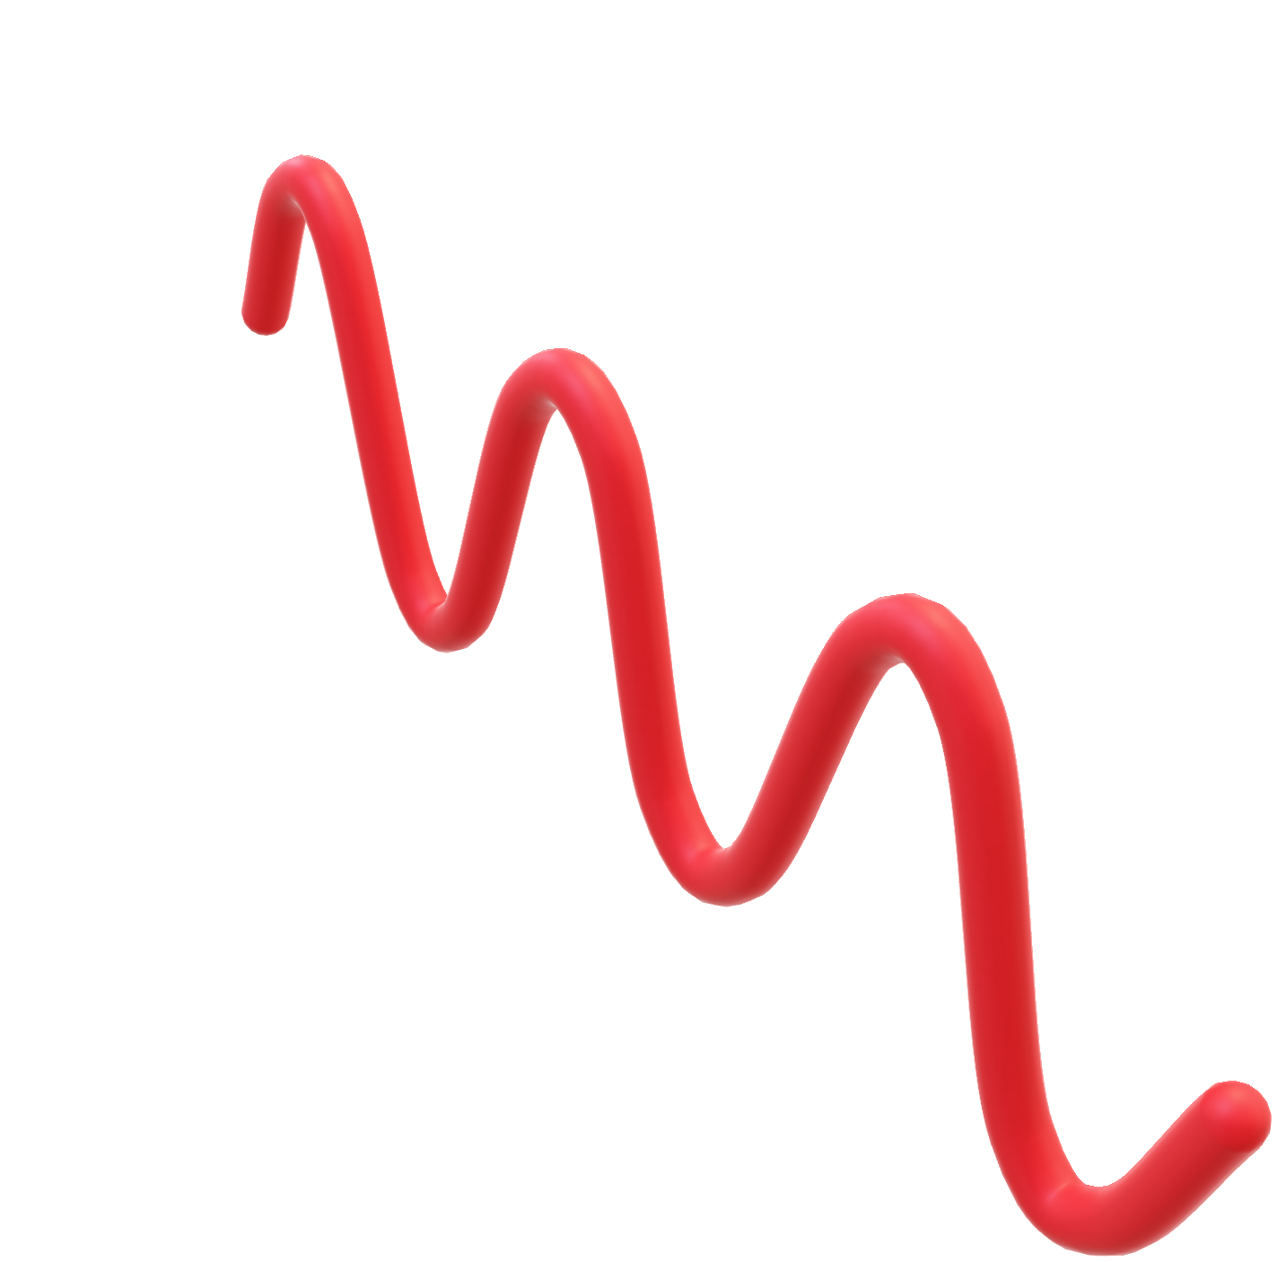
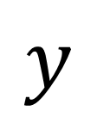

$$y$$
Vertical Polarization
$$x$$
$$y$$
$$\vec{e_{y}}$$
$$\vec{E}=E^{x}\vec{e_{x}}+E^{y}\vec{e_{y}}+E^{z}\vec{e_{z}}$$
$$\vec{e_{x}}$$
$$\vec{e_{z}}$$
$$x$$
$$\vec{E}→\left[\begin{aligned}E^{x} \\ E^{y} \\ E^{z}\end{aligned}\right]$$
Vertical Polarization
$$z$$

Slide 16


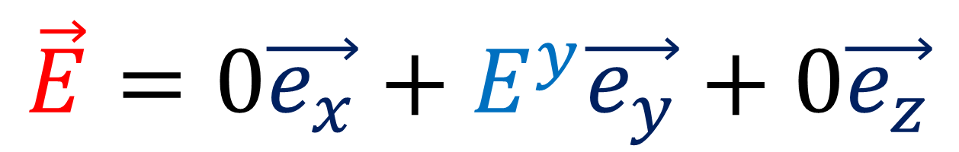
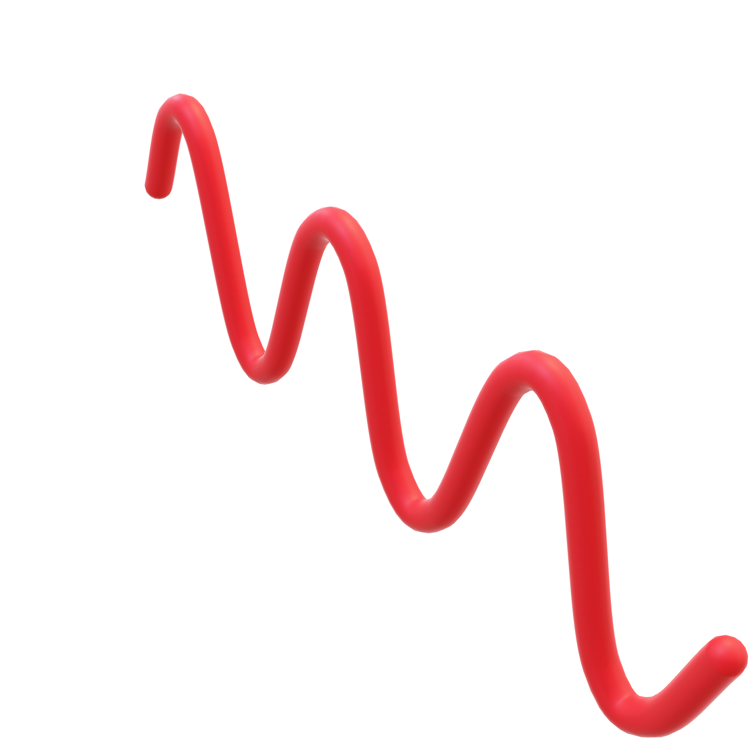
$$y$$
Vertical Polarization
$$x$$
$$y$$
$$\vec{e_{y}}$$
$$\vec{E}=0\vec{e_{x}}+E^{y}\vec{e_{y}}+0\vec{e_{z}}$$
$$\vec{e_{x}}$$
$$\vec{e_{z}}$$
$$x$$
$$\vec{E}→\left[\begin{aligned}0 \\ E^{y} \\ 0\end{aligned}\right]$$
Vertical Polarization
$$z$$

Slide 17

$$y$$
Vertical Polarization
$$x$$
$$y$$
$$E^{y}\left(t,z\right)=A\cos\left(ωt−kz\right)$$
$$x$$
time
location
angular frequency
angular wavenumber
Vertical Polarization
$$z$$

Slide 18

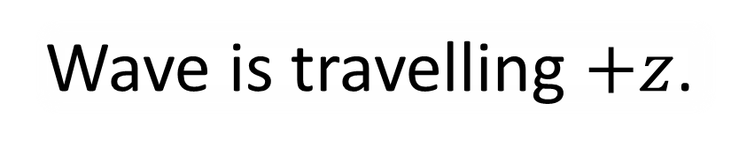
time $t$
Wave is travelling $+z$.
space $z$

Slide 19
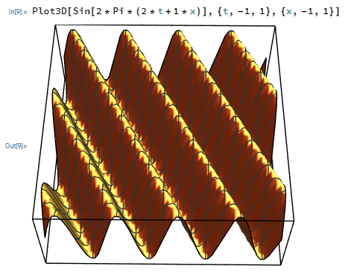
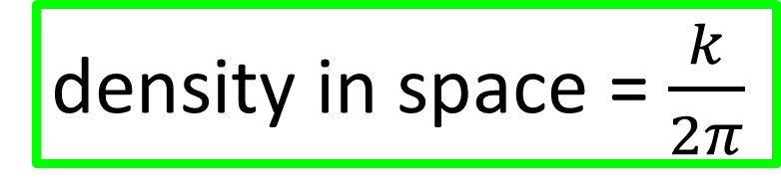
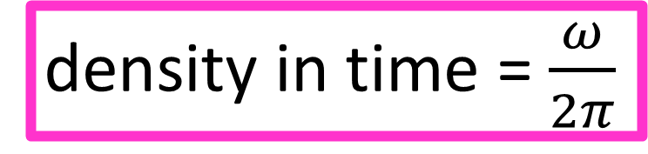

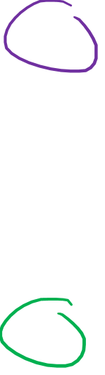
time $t$
Wave is travelling $+z$.
density in time = $\frac{ω}{2π}$
density in space = $\frac{k}{2π}$
space $z$

Slide 20
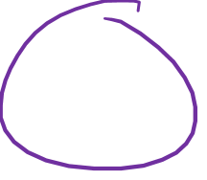

$$y$$
Vertical Polarization
$$x$$
$$y$$
$$E^{y}=A\cos\left(ωt−kz+φ\right)$$
$$x$$
phase
Vertical Polarization
$$z$$

Slide 21
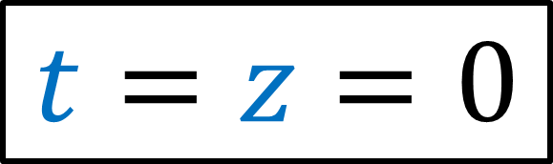

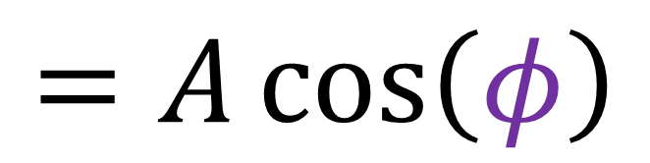
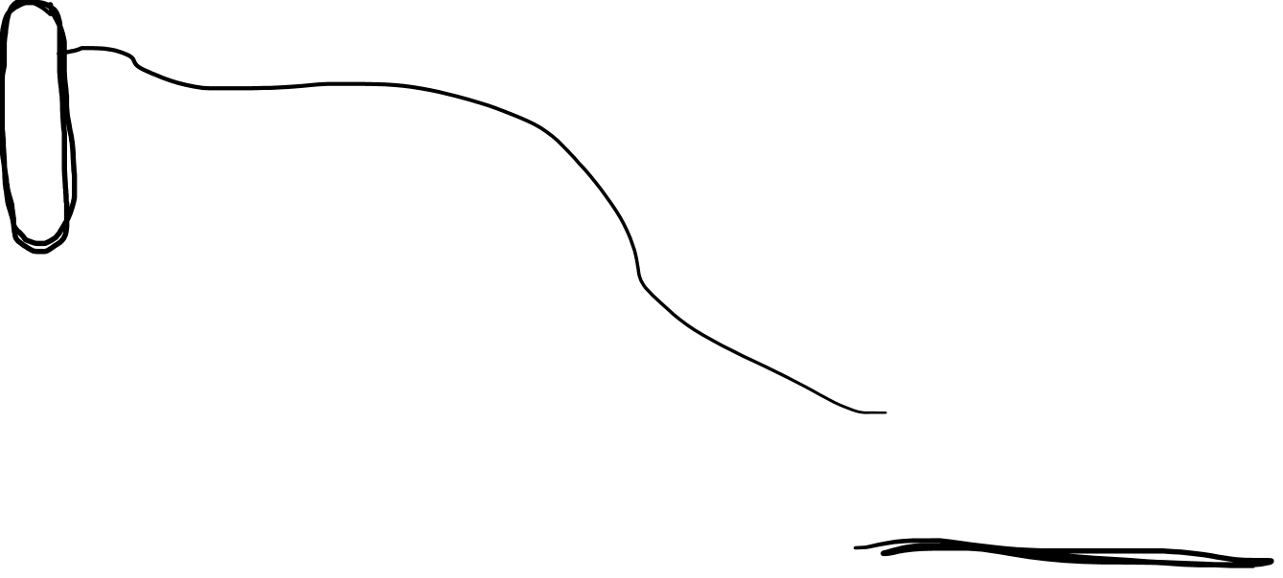
$$y$$
Vertical Polarization
$$x$$
$$y$$
$$E^{y}=A\cos\left(ωt−kz+φ\right)$$
$$x$$
$$t=z=0$$
$$=A\cos\left(φ\right)$$
Vertical Polarization
$$z$$

Slide 22

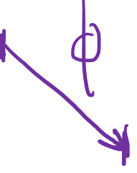
$$y$$
Vertical Polarization
$$x$$
$$y$$
$$φ$$
$$E^{y}=A\cos\left(ωt−kz+φ\right)$$
$$x$$
phase
Vertical Polarization
$$z$$

Slide 23
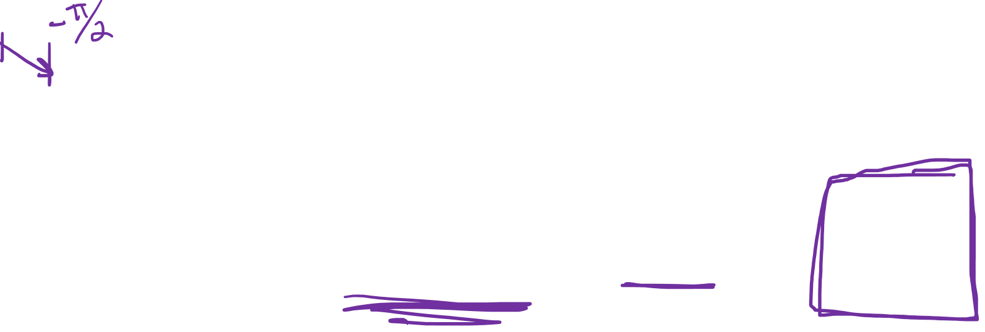
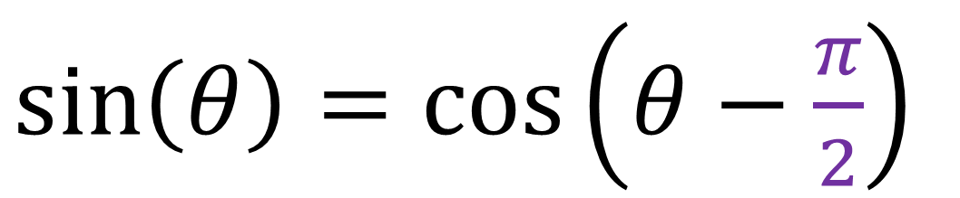
$$y$$
Vertical Polarization
$$x$$
$$y$$
$$E^{y}=A\cos\left(ωt−kz+φ\right)$$
$$x$$
$\sin\left(θ\right)=\cos\left(θ−\frac{π}{2}\right)$
Vertical Polarization
$$z$$

Slide 24
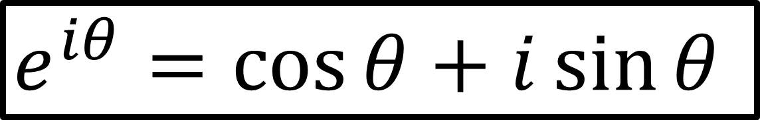


Euler’s Formula:
$e^{iθ}=\cos{θ}+i\sin{θ}$
$$e^{iθ}e^{iφ}=e^{iθ+iφ}=e^{i\left(θ+φ\right)}$$
$$e^{iθ}e^{iφ}=\cos\left(θ+φ\right)+i\sin\left(θ+φ\right)$$

Slide 25



Euler’s Formula:
$e^{iθ}=\cos{θ}+i\sin{θ}$
Electric field $E^{y}$ is real!
For convenience… pretend $E^{y}$ is complex!
$$E^{y}=\left[\begin{aligned}real part \\ (true E field)\end{aligned}\right]+i\left[\begin{aligned}imaginary part \\ (ignored)\end{aligned}\right]$$
$$E^{y}=A\cos\left(ωt−kz+φ\right)+iA\sin\left(ωt−kz+φ\right)$$

Slide 26



Euler’s Formula:
$e^{iθ}=\cos{θ}+i\sin{θ}$
$$E^{y}=A\cos\left(ωt−kz+φ\right)+iA\sin\left(ωt−kz+φ\right)$$
$E^{y}=Ae^{i\left(ωt−kz+φ\right)}$
$$E^{y}=Ae^{i\left(ωt−kz\right)+iφ}$$
$E^{y}=Ae^{i\left(ωt−kz\right)}e^{iφ}$
$$Ae^{iφ} e^{i\left(ωt−kz\right)}$$
amplitude
phase
wave

Slide 27


$$y$$
Vertical Polarization
$$x$$
$$y$$
$$Real\left(E^{y}\right)=A\cos\left(ωt−kz+φ\right)$$
$$E^{y}=Ae^{iφ} e^{i\left(ωt−kz\right)}$$
$$x$$
Vertical Polarization
$$z$$

Slide 28
$$y$$
Vertical Polarization
$$y$$
$$x$$
$$x$$
$$z$$

Slide 29

$$y$$
Horizontal Polarization
$$y$$
$$x$$
$$x$$
$$z$$

Slide 30





$$y$$
Vertical Polarization
$$x$$
$$y$$
$$\vec{e_{y}}$$
$$\vec{E}=E^{x}\vec{e_{x}}+E^{y}\vec{e_{y}}+E^{z}\vec{e_{z}}$$
$$\vec{e_{x}}$$
$$\vec{e_{z}}$$
$$x$$
$$\vec{E}→\left[\begin{aligned}E^{x} \\ E^{y} \\ E^{z}\end{aligned}\right]$$
Horizontal Polarization
$$z$$

Slide 31


$$y$$
Vertical Polarization
$$x$$
$$y$$
$$\vec{e_{y}}$$
$$\vec{E}=E^{x}\vec{e_{x}}+0\vec{e_{y}}+0\vec{e_{z}}$$
$$\vec{e_{x}}$$
$$\vec{e_{z}}$$
$$x$$
$$\vec{E}→\left[\begin{aligned}E^{x} \\ 0 \\ 0\end{aligned}\right]$$
Horizontal Polarization
$$z$$

Slide 32



$$y$$
Vertical Polarization
$$x$$
$$y$$
$$Real\left(E^{x}\right)=A\cos\left(ωt−kz+φ\right)$$
$$E^{x}=Ae^{iφ} e^{i\left(ωt−kz\right)}$$
$$x$$
Horizontal Polarization
$$z$$

Slide 33




Vertical Polarization
Horizontal Polarization
$E^{x}=0=E^{z}$
$E^{y}=A^{y}e^{iφ_{y}}e^{i\left(ωt−kz\right)}$
$E^{x}=A^{x}e^{iφ_{x}}e^{i\left(ωt−kz\right)}$
$E^{y}=0=E^{z}$
$$\vec{E}→\left[\begin{aligned}0 \\ A^{y}e^{iφ_{y}}e^{i\left(ωt−kz\right)} \\ 0\end{aligned}\right]$$
$$\vec{E}→\left[\begin{aligned}A^{x}e^{iφ_{x}}e^{i\left(ωt−kz\right)} \\ 0 \\ 0\end{aligned}\right]$$
Electromagnetic waves can be superimposed!
Mixing Polarization:

Slide 34




Vertical Polarization
Horizontal Polarization
$$\vec{E}→\left[\begin{aligned}0 \\ A^{y}e^{iφ_{y}}e^{i\left(ωt−kz\right)} \\ 0\end{aligned}\right]$$
$$\vec{E}→\left[\begin{aligned}A^{x}e^{iφ_{x}}e^{i\left(ωt−kz\right)} \\ 0 \\ 0\end{aligned}\right]$$
Vertical + Horizontal Polarization:
$$\left[\begin{aligned}A^{x}e^{iφ_{x}}e^{i\left(ωt−kz\right)} \\ A^{y}e^{iφ_{y}}e^{i\left(ωt−kz\right)} \\ 0\end{aligned}\right]$$
$$\left[\begin{aligned}0 \\ A^{y}e^{iφ_{y}}e^{i\left(ωt−kz\right)} \\ 0\end{aligned}\right]+\left[\begin{aligned}A^{x}e^{iφ_{x}}e^{i\left(ωt−kz\right)} \\ 0 \\ 0\end{aligned}\right]=$$

Slide 35



Vertical Polarization
Horizontal Polarization
$$\vec{E}→\left[\begin{aligned}0 \\ A^{y}e^{iφ_{y}}e^{i\left(ωt−kz\right)} \\ 0\end{aligned}\right]$$
$$\vec{E}→\left[\begin{aligned}A^{x}e^{iφ_{x}}e^{i\left(ωt−kz\right)} \\ 0 \\ 0\end{aligned}\right]$$
Vertical + Horizontal Polarization:
$$\vec{E}→\left[\begin{aligned}A^{x}e^{iφ_{x}}e^{i\left(ωt−kz\right)} \\ A^{y}e^{iφ_{y}}e^{i\left(ωt−kz\right)} \\ 0\end{aligned}\right]$$
$$=\left[\begin{aligned}A^{x}e^{iφ_{x}} \\ A^{y}e^{iφ_{y}} \\ 0\end{aligned}\right]e^{i\left(ωt−kz\right)}$$

Slide 36




$$\vec{E}→\left[\begin{aligned}A^{x}e^{iφ_{x}} \\ A^{y}e^{iφ_{y}} \\ 0\end{aligned}\right]e^{i\left(ωt−kz\right)}$$
We can choose coordinates where $z$ is the direction of travel $⇒E^{z}=0$
$$\vec{J}→\left[\begin{aligned}A^{x}e^{iφ_{x}} \\ A^{y}e^{iφ_{y}}\end{aligned}\right]$$
Jones Vector
(all polarization info)

Slide 37




Horizontal Polarization
Vertical Polarization
$$\left[\begin{aligned}1 \\ 0\end{aligned}\right]$$
$$\vec{J}→A^{x}e^{iφ_{x}}\left[\begin{aligned}1 \\ 0\end{aligned}\right]+A^{y}e^{iφ_{y}}\left[\begin{aligned}0 \\ 1\end{aligned}\right]$$
$$\left[\begin{aligned}0 \\ 1\end{aligned}\right]$$
$$\vec{J}→\left[\begin{aligned}A^{x}e^{iφ_{x}} \\ A^{y}e^{iφ_{y}}\end{aligned}\right]$$
Jones Vector
(all polarization info)

Slide 38


Horizontal Polarization
Vertical Polarization
$$\left[\begin{aligned}1 \\ 0\end{aligned}\right]$$
$$\vec{J}→A^{x}e^{iφ_{x}}\left[\begin{aligned}1 \\ 0\end{aligned}\right]+A^{y}e^{iφ_{y}}\left[\begin{aligned}0 \\ 1\end{aligned}\right]$$
$$\left[\begin{aligned}0 \\ 1\end{aligned}\right]$$
$\vec{J}=$ $A^{x}e^{iφ_{x}}$ $\vec{H}+$ $A^{y}e^{iφ_{y}}$ $\vec{V}$

Slide 39








$$\vec{V}$$
$$y$$
$$\vec{D}$$
$$\vec{J}=A^{x}e^{iφ_{x}}\vec{H}+A^{y}e^{iφ_{y}}\vec{V}$$
$$\vec{J}=A^{x}\left(1\right)\vec{H}+A^{y}\left(1\right)\vec{V}$$
$$\vec{J}= 1 \vec{H} + 1 \vec{V}$$
$$\vec{H}$$
$$x$$
$$\vec{J}= \vec{H} + \vec{V}$$

Slide 40


$$y$$
Horizontal Polarization
$$y$$
$$x$$
$$x$$
$$z$$

Slide 41

$$y$$
Diagonal Polarization
$$y$$
$$x$$
$$x$$
$$z$$

Slide 42





$$\vec{V}$$
$$y$$
$$\vec{D}$$
$$\vec{D} = \vec{H}+\vec{V}$$
$$\sqrt{2}$$
$$1$$
$$\vec{H}$$
$$x$$
$$1$$

Slide 43



$$\vec{V}$$
$\vec{D}=\frac{1}{\sqrt{2}}\vec{H}+\frac{1}{\sqrt{2}}\vec{V}$
$$y$$
$$\vec{D}$$
$$\vec{H}$$
$$x$$

Slide 44




$$\vec{V}$$
$$y$$
$$\vec{J}=A^{x}e^{iφ_{x}}\vec{H}+A^{y}e^{iφ_{y}}\vec{V}$$
$$\vec{J}=A^{x}\left(1\right)\vec{H}+A^{y}\left(1\right)\vec{V}$$
$$\vec{J}= 1 \vec{H} + \left(−1\right) \vec{V}$$
$$\vec{H}$$
$$x$$
$$\vec{J}= \vec{H} − \vec{V}$$
$$\vec{A}$$

Slide 45
$$y$$
Horizontal Polarization
$$y$$
$$x$$
$$x$$
$$z$$

Slide 46


$$y$$
Anti-Diagonal Polarization
$$y$$
$$x$$
$$x$$
$\vec{A}=\frac{1}{\sqrt{2}}\vec{H}−\frac{1}{\sqrt{2}}\vec{V}$
$$z$$

Slide 47















$$\vec{V}$$
$$\vec{D}$$
$\vec{D}=\frac{1}{\sqrt{2}}\vec{H}+\frac{1}{\sqrt{2}}\vec{V}$
$$\vec{H}$$
$$\vec{V}$$
$$\vec{J}$$
$\vec{A}=\frac{1}{\sqrt{2}}\vec{H}−\frac{1}{\sqrt{2}}\vec{V}$
$$\vec{V}$$
$$y$$
$$\vec{H}$$
$$\vec{A}$$
$$θ$$
$$x$$
$\vec{J}=\cos{θ}\vec{H}+\sin{θ}\vec{V}$
$$\vec{H}$$

Slide 48



$$\vec{J}=A^{x}e^{iφ_{x}}\vec{H}+A^{y}e^{iφ_{y}}\vec{V}$$
$$\vec{J}=1e^{iφ_{x}}\vec{H}+1e^{iφ_{y}}\vec{V}$$
$$\vec{J}= 1 \vec{H} +e^{i π/2 }\vec{V}$$
$$\vec{J}= \vec{H} +e^{i\frac{π}{2}}\vec{V}$$

Slide 49








$$y$$
$$\vec{J}=\vec{H}+e^{i\frac{π}{2}}\vec{V}$$
$$z=0$$
$\vec{J}→\left[\begin{aligned}1 \\ e^{i\frac{π}{2}}\end{aligned}\right]e^{i\left(ωt−kz\right)}$
$$x$$
Take $z=0$ and $ω=1$
$$\vec{J}→\left[\begin{aligned}1 \\ e^{i\frac{π}{2}}\end{aligned}\right]e^{it}=\left[\begin{aligned}e^{it} \\ e^{i\left(t+π/2\right)}\end{aligned}\right]$$

Slide 50


$$y$$
$$\vec{J}→\left[\begin{aligned}1 \\ e^{i π/2}\end{aligned}\right]e^{it}$$
$$=\left[\begin{aligned}e^{it} \\ e^{i\left(t+π/2\right)}\end{aligned}\right]$$
$=\left[\begin{aligned}\cos\left(t\right)+i\sin\left(t\right) \\ \cos\left(t+π/2\right)+i\sin\left(t+π/2\right)\end{aligned}\right]$
$$→\left[\begin{aligned}\cos\left(t\right) \\ \cos\left(t+π/2\right)\end{aligned}\right]=\left[\begin{aligned} \cos\left(t\right) \\ −\sin\left(t\right)\end{aligned}\right]$$
$$z=0$$
$$x$$

Slide 51













$$y$$
$$\vec{J}→\left[\begin{aligned} \cos\left(t\right) \\ −\sin\left(t\right)\end{aligned}\right]$$
$$z=0$$
$$4$$
$t=0 ⇒\left[\begin{aligned}1 \\ 0\end{aligned}\right]$
$t=\frac{π}{2} ⇒\left[\begin{aligned}0 \\ −1\end{aligned}\right]$
$t=π ⇒\left[\begin{aligned}−1 \\ 0\end{aligned}\right]$
$t=\frac{3π}{2}⇒\left[\begin{aligned}0 \\ 1\end{aligned}\right]$
$⇒\left[\begin{aligned}1 \\ 0\end{aligned}\right]$
$⇒\left[\begin{aligned}0 \\ −1\end{aligned}\right]$
$⇒\left[\begin{aligned}−1 \\ 0\end{aligned}\right]$
$⇒\left[\begin{aligned}0 \\ 1\end{aligned}\right]$
$$⇐t=2π$$
$$1$$
$$x$$
$$3$$
$$1$$
$$2$$
$$3$$
$$2$$
$$4$$

Slide 52
$$y$$
$$\vec{J}→\left[\begin{aligned} \cos\left(t\right) \\ −\sin\left(t\right)\end{aligned}\right]$$
$$z=0$$
$$4$$
$t=0 ⇒\left[\begin{aligned}1 \\ 0\end{aligned}\right]$
$t=\frac{π}{2} ⇒\left[\begin{aligned}0 \\ −1\end{aligned}\right]$
$t=π ⇒\left[\begin{aligned}−1 \\ 0\end{aligned}\right]$
$t=\frac{3π}{2}⇒\left[\begin{aligned}0 \\ 1\end{aligned}\right]$
$⇒\left[\begin{aligned}1 \\ 0\end{aligned}\right]$
$⇒\left[\begin{aligned}0 \\ −1\end{aligned}\right]$
$⇒\left[\begin{aligned}−1 \\ 0\end{aligned}\right]$
$⇒\left[\begin{aligned}0 \\ 1\end{aligned}\right]$
$$⇐t=2π$$
$$1$$
$$x$$
$$3$$
$$1$$
$$2$$
$$3$$
$$2$$
$$4$$

Slide 53






$$y$$
$$4$$
$$x$$
$$3$$
$$1$$
$$2$$
$$z$$

Slide 54


$$y$$
Credit user Dave3457 from Wikipedia (link in description)
$$4$$
$$x$$
$$3$$
$$1$$
$$2$$
Left-Circular Polarization
$$z$$

Slide 55











$$Im$$
$$\vec{L}=\vec{H}+e^{i\frac{π}{2}}\vec{V}$$
$$i$$
$$e^{i\frac{π}{2}}$$
$$−1$$
$$1$$
$$\vec{L}=\vec{H}+ i \vec{V}$$
$$Re$$
Normalize:
$$−i$$
$\vec{L}=\frac{1}{\sqrt{2}}\vec{H}+\frac{i}{\sqrt{2}}\vec{V}$

Slide 56








$$y$$
$$\vec{J}=A^{x}e^{iφ_{x}}\vec{H}+A^{y}e^{iφ_{y}}\vec{V}$$
$$\vec{J}=1e^{iφ_{x}}\vec{H}+1e^{iφ_{y}}\vec{V}$$
$$\vec{J}= 1 \vec{H} +e^{i \left(−π/2\right) }\vec{V}$$
$$2$$
$$x$$
$$3$$
$$1$$
$$4$$
$$z$$
Right-Circular Polarization
$\vec{R}=\frac{1}{\sqrt{2}}\vec{H}−\frac{i}{\sqrt{2}}\vec{V}$
Credit Dave3457

Slide 57





My convention
Other convention
$$e^{i\left(+ωt−kz+φ\right)}$$
$$e^{i\left(−ωt+kz+φ\right)}$$
$$=e^{−i\left(ωt−kz−φ\right)}$$
$$\vec{L}→\left[\begin{aligned}1 \\ +i\end{aligned}\right]$$
$$\vec{R}→\left[\begin{aligned}1 \\ −i\end{aligned}\right]$$
$$\vec{L}→\left[\begin{aligned}1 \\ −i\end{aligned}\right]$$
$$\vec{R}→\left[\begin{aligned}1 \\ +i\end{aligned}\right]$$

Slide 58




$\vec{H}→\left[\begin{aligned}1 \\ 0\end{aligned}\right]$
$\vec{V}→\left[\begin{aligned}0 \\ 1\end{aligned}\right]$
$\vec{D}=\frac{1}{\sqrt{2}}\vec{H}+\frac{1}{\sqrt{2}}\vec{V}$
$\vec{A}=\frac{1}{\sqrt{2}}\vec{H}−\frac{1}{\sqrt{2}}\vec{V}$
$\vec{L}=\frac{1}{\sqrt{2}}\vec{H}+\frac{i}{\sqrt{2}}\vec{V}$
$\vec{R}=\frac{1}{\sqrt{2}}\vec{H}−\frac{i}{\sqrt{2}}\vec{V}$
$→\frac{1}{\sqrt{2}} \left[\begin{aligned}1 \\ 1\end{aligned}\right]$
$→\frac{1}{\sqrt{2}}\left[\begin{aligned} 1 \\ −1\end{aligned}\right]$
$→\frac{1}{\sqrt{2}} \left[\begin{aligned}1 \\ i\end{aligned}\right]$
$→\frac{1}{\sqrt{2}}\left[\begin{aligned} 1 \\ −i\end{aligned}\right]$
(wave travelling out of the screen)

Slide 59







Physical Space
Polarization Space
$$\vec{V}$$
$$\vec{V}$$
$$\vec{H}$$
$$\vec{A}$$
$$SU(2)$$
$$\vec{D}$$
$$\vec{H}$$

Slide 60



$$y$$
Exercise: Draw the wave overtime in the XY plane for these Jones Vectors:
(answers in description)
$$x$$
(a) | (b) | (c) | (d) | (e) | (f)
$$\left[\begin{aligned}1 \\ \text{½}\end{aligned}\right]$$ | $$\left[\begin{aligned}2 \\ 1\end{aligned}\right]$$ | $$\left[\begin{aligned}i \\ 1\end{aligned}\right]$$ | $$\left[\begin{aligned}−1 \\ i\end{aligned}\right]$$ | $$\left[\begin{aligned}1 \\ e^{i\frac{π}{4}}\end{aligned}\right]$$ | $$\left[\begin{aligned}e^{i\frac{π}{4}} \\ e^{i\frac{π}{2}}\end{aligned}\right]$$

Slide 61


$$y$$
$$\left[\begin{aligned}e^{i\left(ωt+kz\right)} \\ e^{i\left(ωt+kz+π/2\right)}\end{aligned}\right]$$
$$ω=1$$
$$z=0$$
$$4$$
$t=0 ⇒\left[\begin{aligned}1 \\ 0\end{aligned}\right]$
$t=\frac{π}{2} ⇒\left[\begin{aligned}0 \\ −1\end{aligned}\right]$
$t=π ⇒\left[\begin{aligned}−1 \\ 0\end{aligned}\right]$
$t=\frac{3π}{2}⇒\left[\begin{aligned}0 \\ 1\end{aligned}\right]$
$⇒\left[\begin{aligned}1 \\ 0\end{aligned}\right]$
$⇒\left[\begin{aligned}0 \\ −1\end{aligned}\right]$
$⇒\left[\begin{aligned}−1 \\ 0\end{aligned}\right]$
$⇒\left[\begin{aligned}0 \\ 1\end{aligned}\right]$
$$⇐t=2π$$
$$1$$
$$x$$
$$3$$
$$1$$
$$2$$
$$3$$
$$2$$
$$4$$

