Slide 1








Spinors For Beginners
3
Waveplates & $SU(2)$ Matrices
$$↔$$
$$↗$$
$$↗$$
$$↘$$
$$↘$$
$$↕$$

Slide 2
Spinors Learning “Staircase”
Spinors in Particle Physics
Lie Groups & Algebras
Clifford Algebras
Spinors as square roots of vectors
Examples From Physics (motivation)

Slide 3



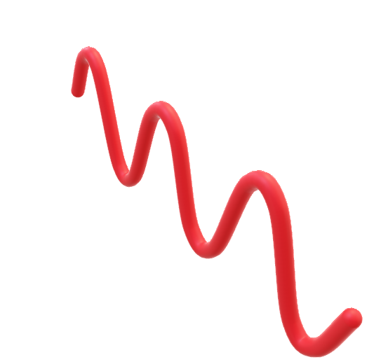

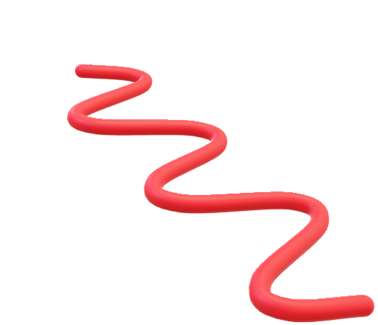




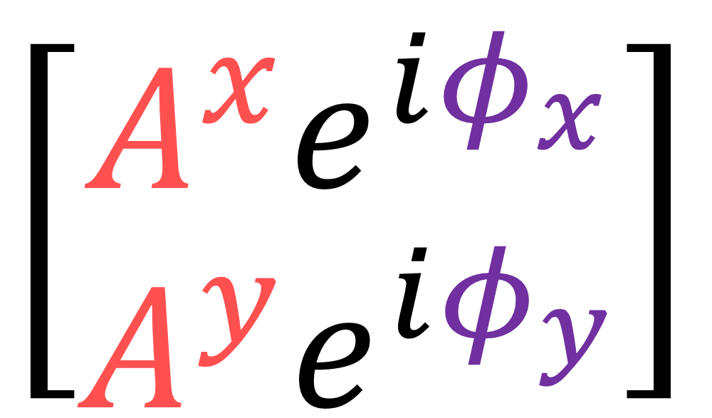

$$y$$
$$y$$
Jones Vector $\vec{J}$
$$x$$
$$x$$
$\left[\begin{aligned}A^{x}e^{iφ_{x}} \\ A^{y}e^{iφ_{y}}\end{aligned}\right]$
Horizontal Polarization
$$z$$
$$y$$
$$y$$
$$x$$
$$x$$
(complex number
components)
Vertical Polarization
$$z$$

Slide 4
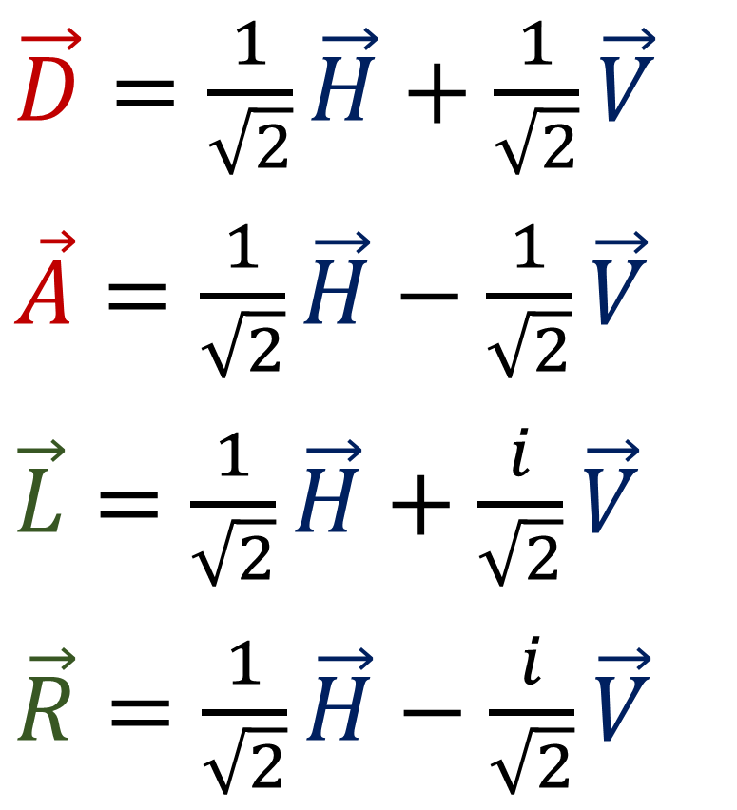
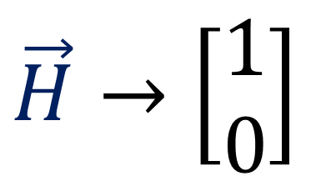
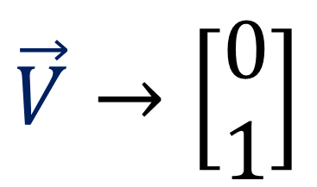
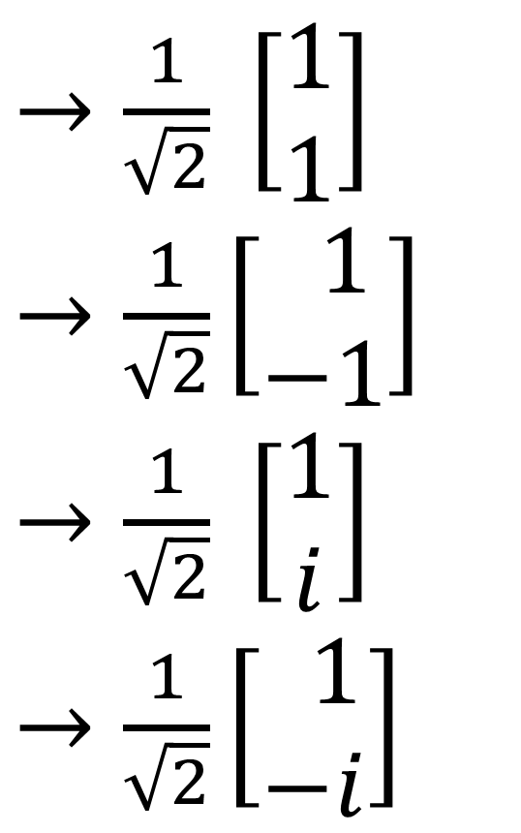
$\vec{H}→\left[\begin{aligned}1 \\ 0\end{aligned}\right]$
$\vec{V}→\left[\begin{aligned}0 \\ 1\end{aligned}\right]$
$\vec{D}=\frac{1}{\sqrt{2}}\vec{H}+\frac{1}{\sqrt{2}}\vec{V}$
$\vec{A}=\frac{1}{\sqrt{2}}\vec{H}−\frac{1}{\sqrt{2}}\vec{V}$
$\vec{L}=\frac{1}{\sqrt{2}}\vec{H}+\frac{i}{\sqrt{2}}\vec{V}$
$\vec{R}=\frac{1}{\sqrt{2}}\vec{H}−\frac{i}{\sqrt{2}}\vec{V}$
$→\frac{1}{\sqrt{2}} \left[\begin{aligned}1 \\ 1\end{aligned}\right]$
$→\frac{1}{\sqrt{2}}\left[\begin{aligned} 1 \\ −1\end{aligned}\right]$
$→\frac{1}{\sqrt{2}} \left[\begin{aligned}1 \\ i\end{aligned}\right]$
$→\frac{1}{\sqrt{2}}\left[\begin{aligned} 1 \\ −i\end{aligned}\right]$
(wave travelling out of the screen)

Slide 5
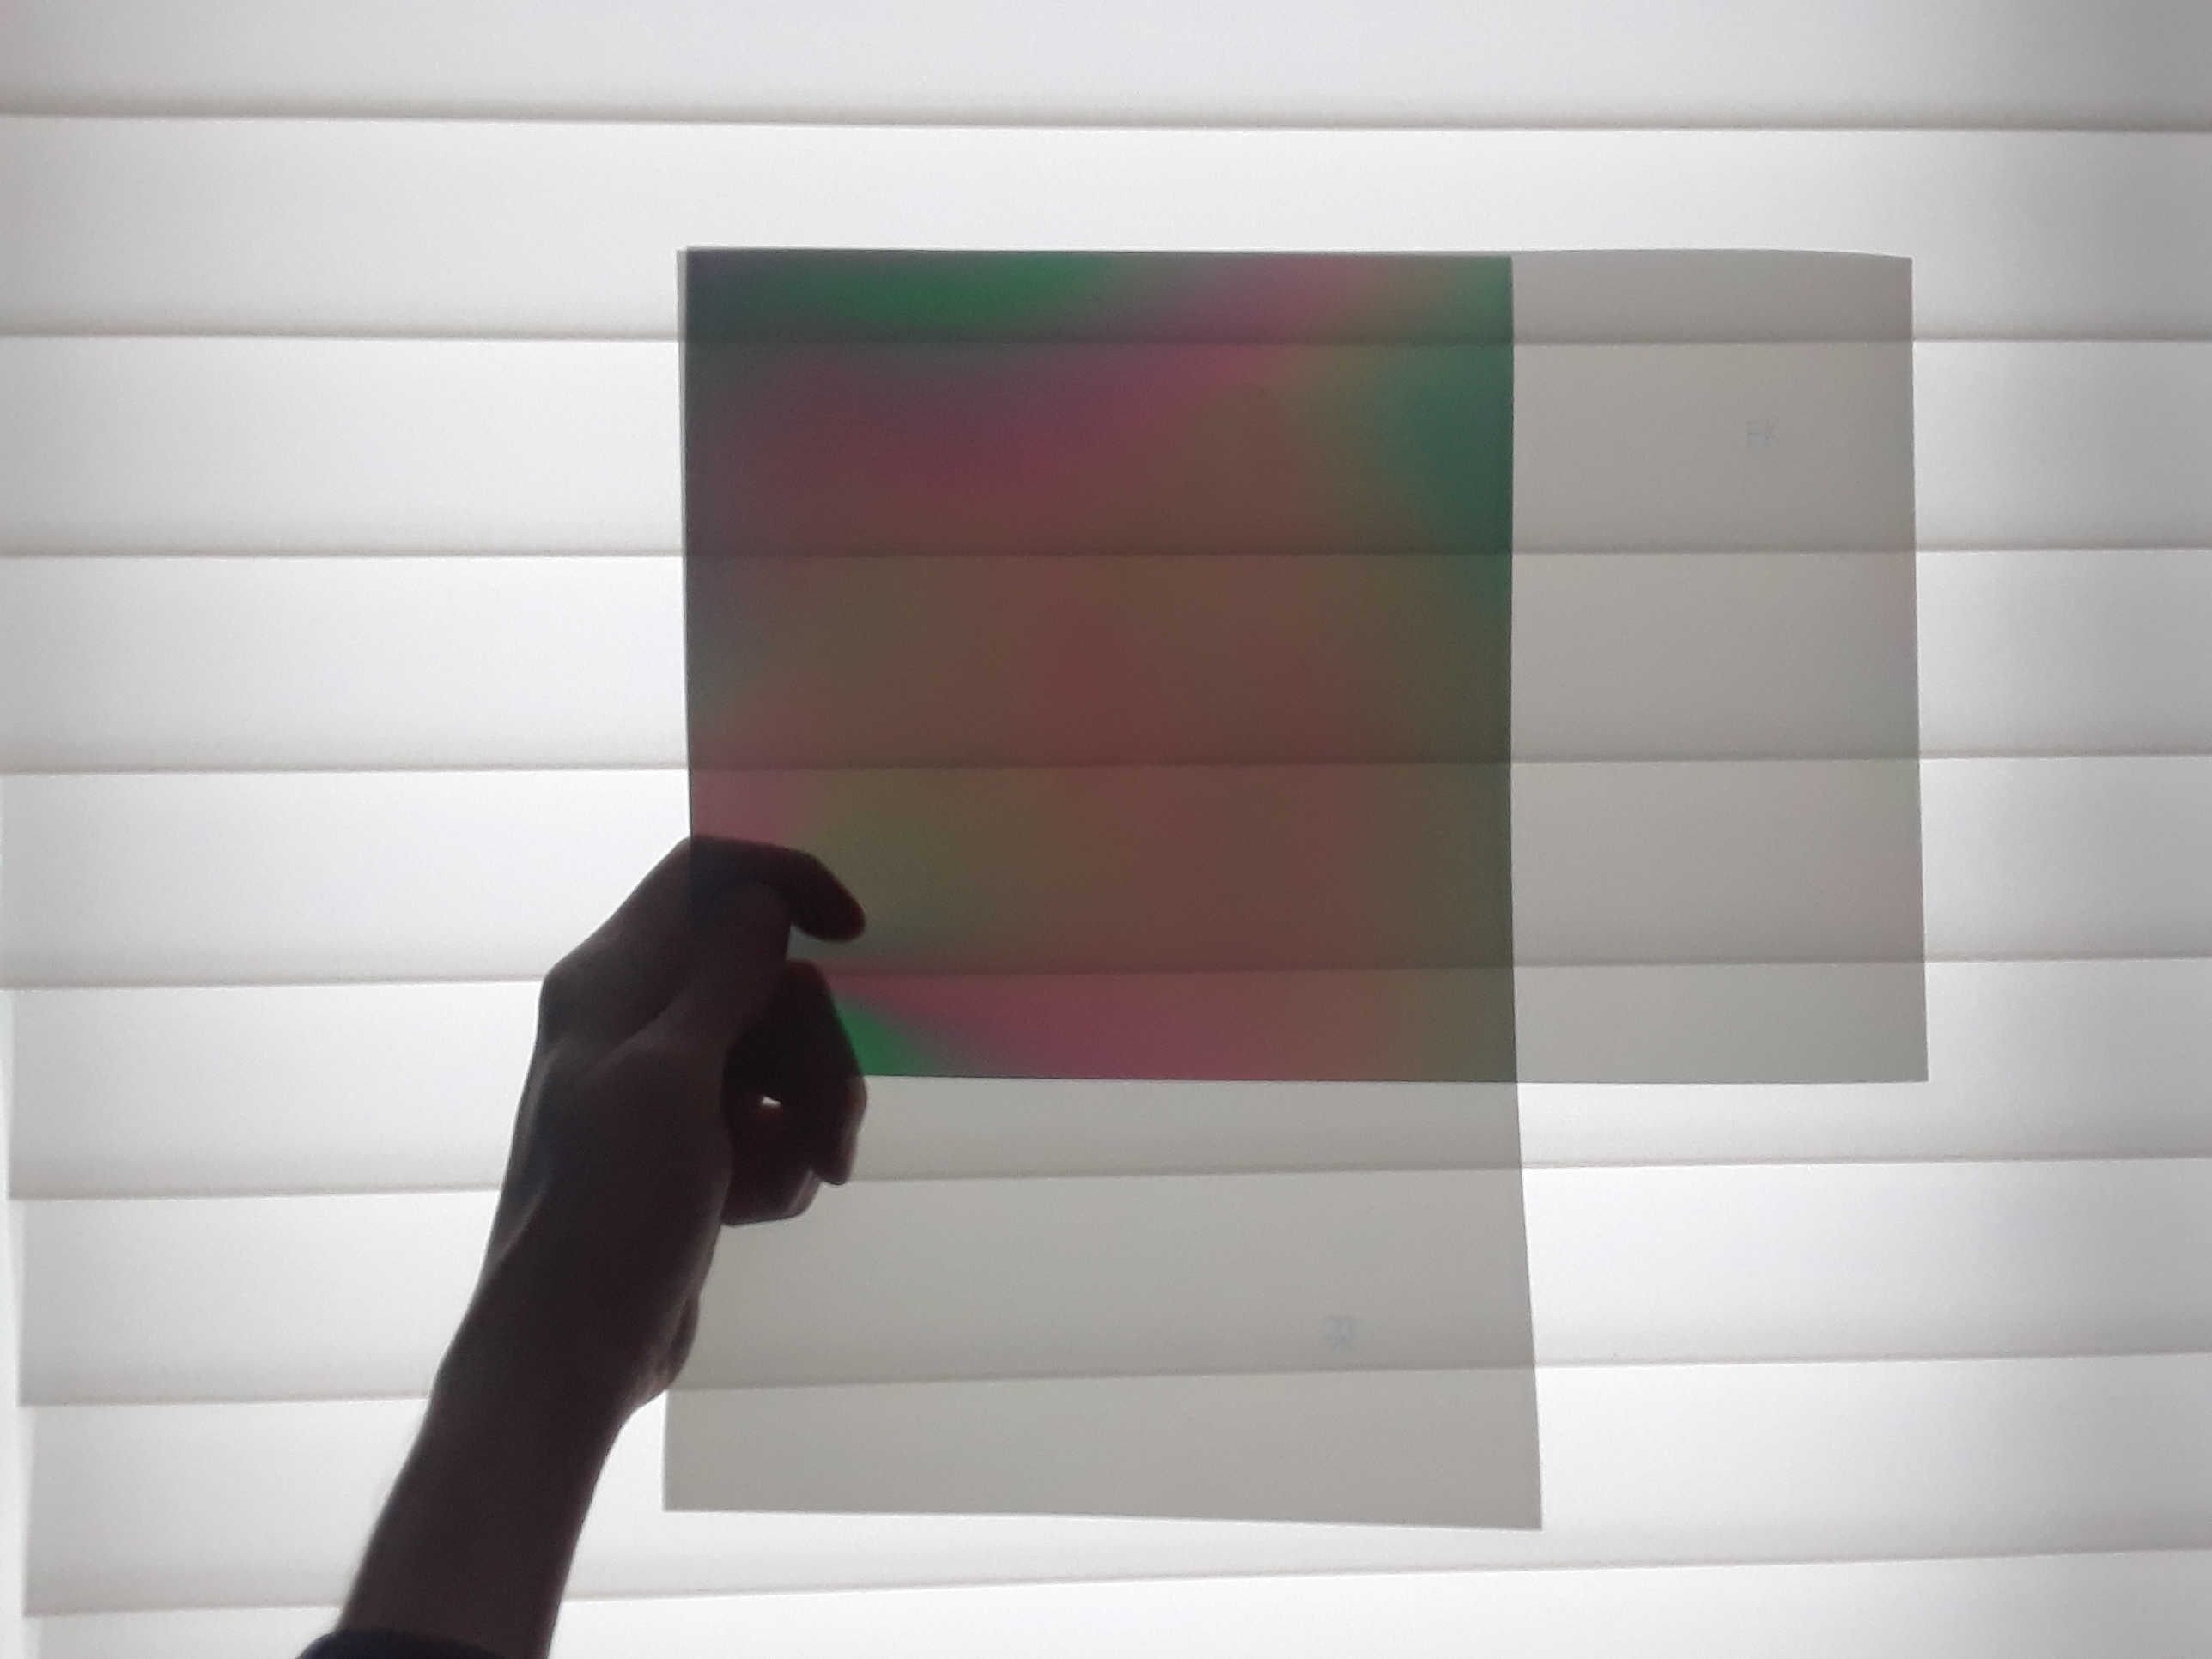
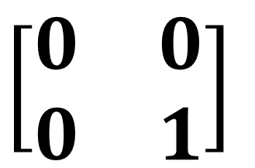
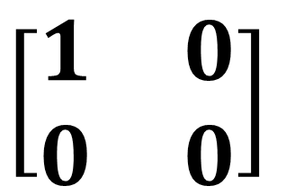
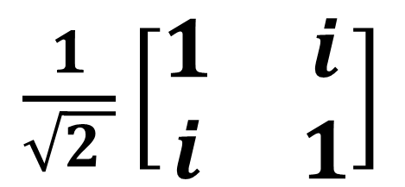
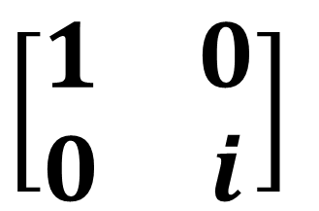
Optical Devices
Polarizers
$$\left[\begin{matrix}1 & 0 \\ 0 & 0\end{matrix}\right]$$
$$\left[\begin{matrix}0 & 0 \\ 0 & 1\end{matrix}\right]$$
Jones Matrices
Waveplates
$$\left[\begin{matrix}1 & 0 \\ 0 & i\end{matrix}\right]$$
$\frac{1}{\sqrt{2 }}\left[\begin{matrix}1 & i \\ i & 1\end{matrix}\right]$

Slide 6
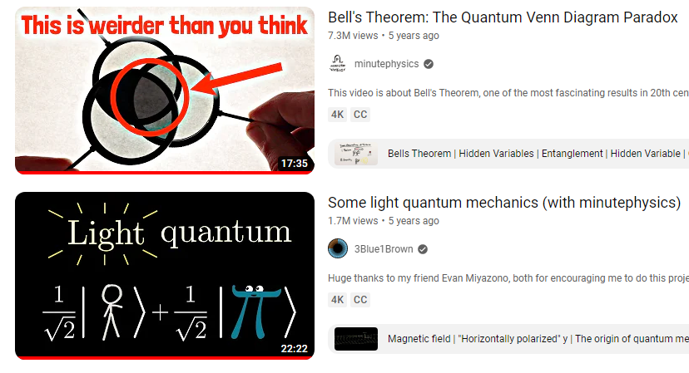
Polarizers
$$\left[\begin{matrix}1 & 0 \\ 0 & 0\end{matrix}\right]$$
$$\left[\begin{matrix}0 & 0 \\ 0 & 1\end{matrix}\right]$$

Slide 7
Waveplates: “rotates” one polarization into another through a phase delay.
Waveplates
$$\left[\begin{matrix}1 & 0 \\ 0 & i\end{matrix}\right]$$
$\frac{1}{\sqrt{2 }}\left[\begin{matrix}1 & i \\ i & 1\end{matrix}\right]$

Slide 8
Light changes speed when it passes from one medium to another.

Slide 9
Light changes speed when it passes from one medium to another.
phase change

Slide 10



Birefringent Crystal: phase change is different in horizontal and vertical directions.
Vertical $↕$
$$↗$$
Horizontal $↙$

Slide 11
Birefringent Crystal: phase change is different in horizontal and vertical directions.
phase change
aligned
Vertical $↕$
$$↗$$
Horizontal $↙$

Slide 12
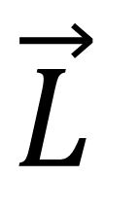
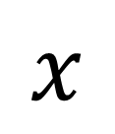
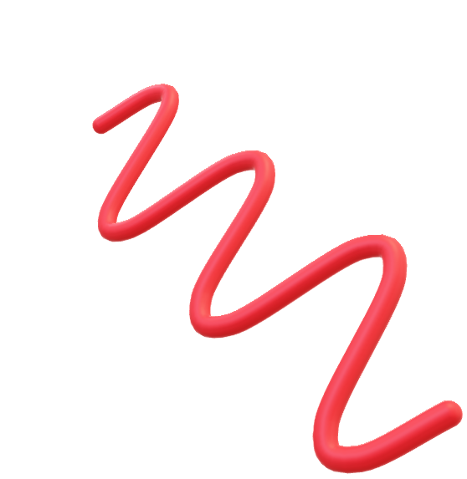
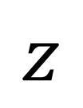

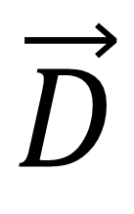
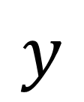


$$y$$
$$y$$
Diagonal Polarization
$\vec{D}$
$$x$$
$$x$$
Bi-refringent
Crystal
Left Circular Polarization
$\vec{L}$
$$y$$
$$x$$
$$z$$

Slide 13


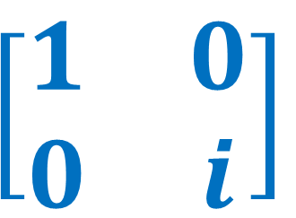
$$y$$
$$y$$
Diagonal Polarization
$\vec{D}$
$$x$$
$$x$$
Quarter Waveplate
$$\left[\begin{matrix}1 & 0 \\ 0 & i\end{matrix}\right]$$
Left Circular Polarization
$\vec{L}$
$$y$$
$$x$$
$$z$$

Slide 14


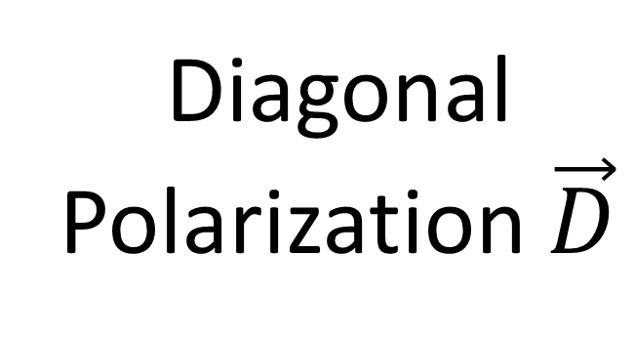


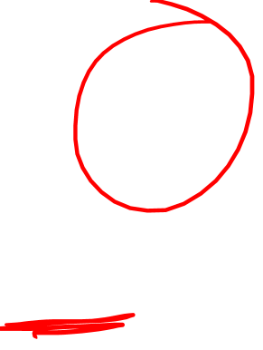
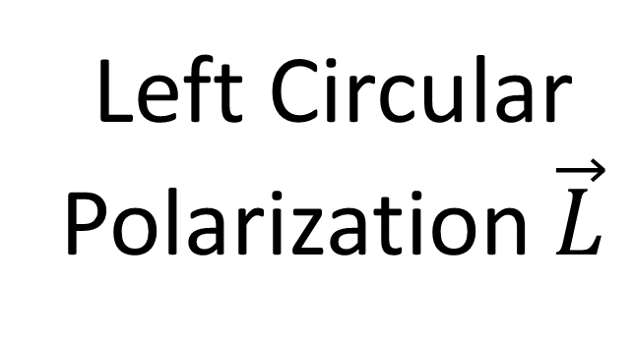

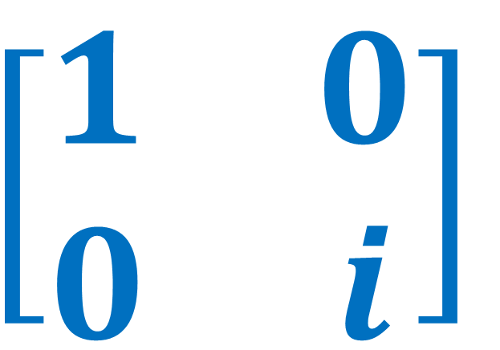
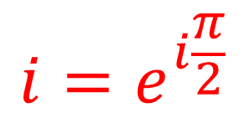

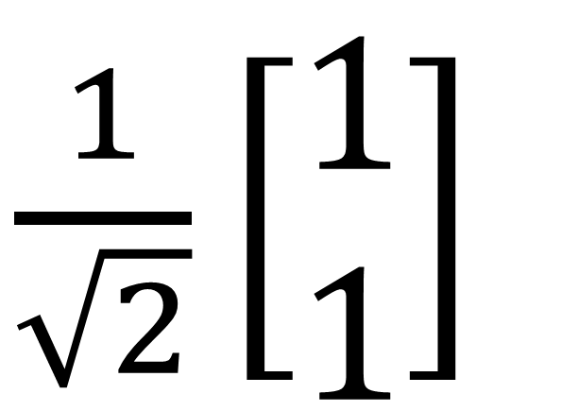

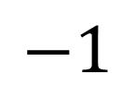
Quarter Waveplate
Diagonal Polarization $\vec{D}$
Left Circular Polarization $\vec{L}$
$$\left[\begin{matrix}1 & 0 \\ 0 & i\end{matrix}\right]$$
$\frac{1}{\sqrt{2}}\left[\begin{aligned}1 \\ 1\end{aligned}\right]$
$\frac{1}{\sqrt{2}}\left[\begin{aligned}1 \\ i\end{aligned}\right]$
$$=$$
$$Im$$
$$i$$
$$i=e^{i\frac{π}{2}}$$
$$Re$$
$$−1$$
$$1$$
$$−i$$

Slide 15
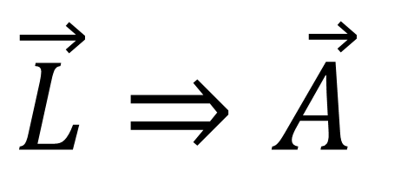
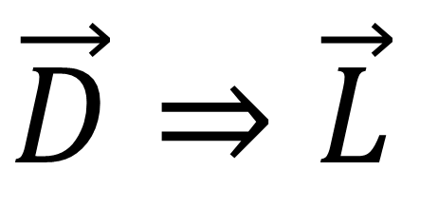
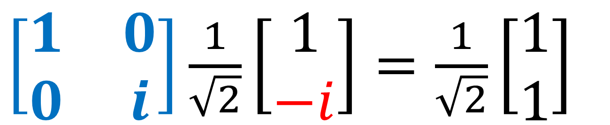
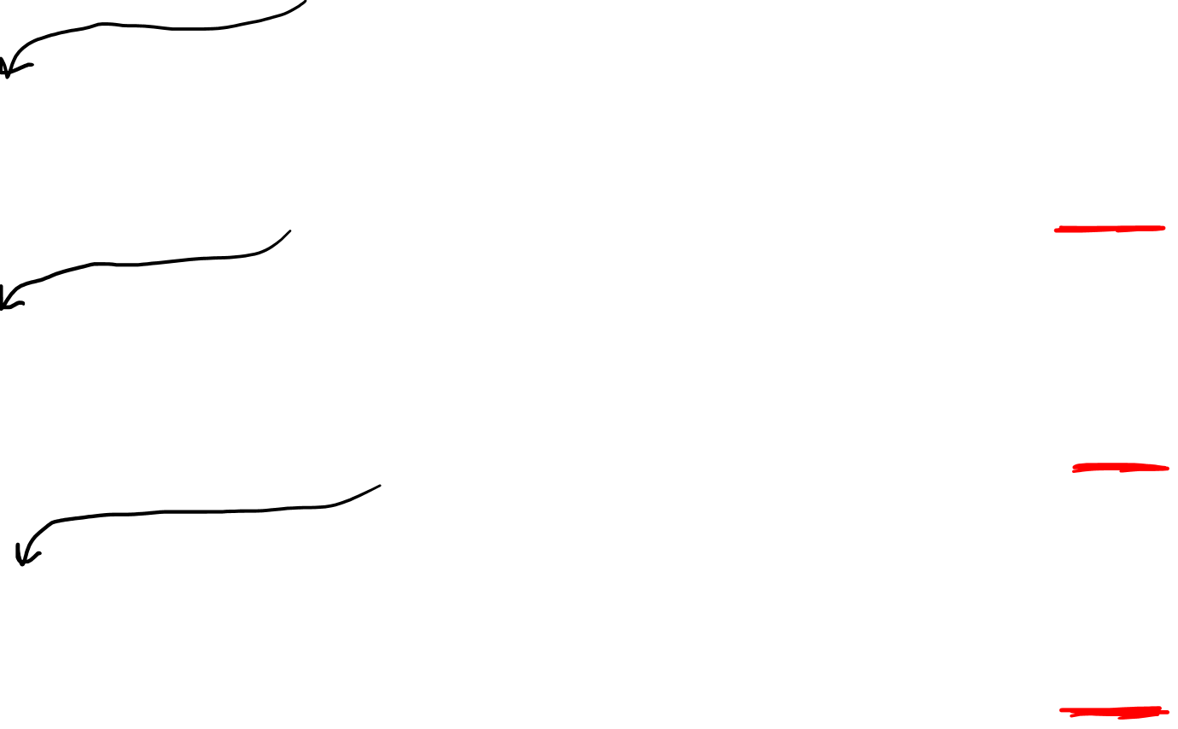
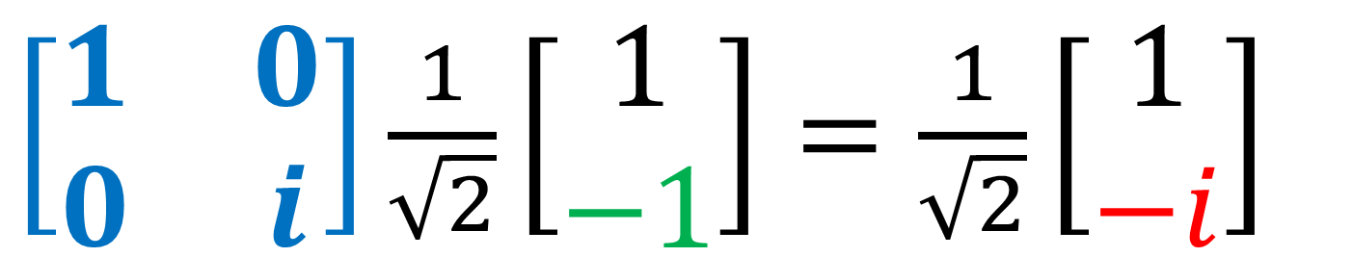
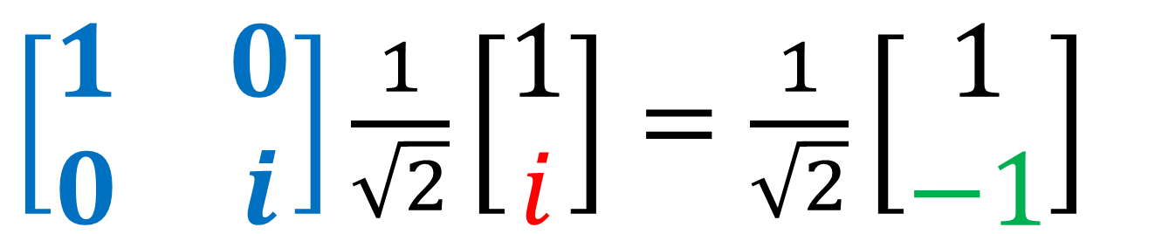
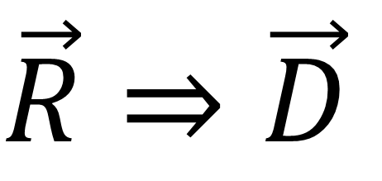
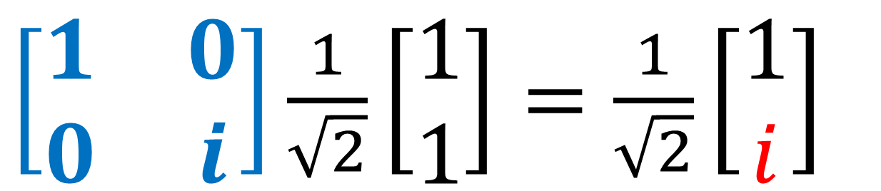
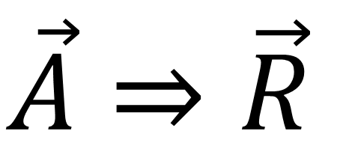
$\left[\begin{matrix}1 & 0 \\ 0 & i\end{matrix}\right]\frac{1}{\sqrt{2}}\left[\begin{aligned}1 \\ 1\end{aligned}\right]=\frac{1}{\sqrt{2}}\left[\begin{aligned}1 \\ i\end{aligned}\right]$
$$\vec{D}⇒\vec{L}$$
$\left[\begin{matrix}1 & 0 \\ 0 & i\end{matrix}\right]\frac{1}{\sqrt{2}}\left[\begin{aligned}1 \\ i\end{aligned}\right]=\frac{1}{\sqrt{2}}\left[\begin{aligned}1 \\ −1\end{aligned}\right]$
$$\vec{L}⇒\vec{A}$$
$\left[\begin{matrix}1 & 0 \\ 0 & i\end{matrix}\right]\frac{1}{\sqrt{2}}\left[\begin{aligned}1 \\ −1\end{aligned}\right]=\frac{1}{\sqrt{2}}\left[\begin{aligned}1 \\ −i\end{aligned}\right]$
$$\vec{A}⇒\vec{R}$$
$\left[\begin{matrix}1 & 0 \\ 0 & i\end{matrix}\right]\frac{1}{\sqrt{2}}\left[\begin{aligned}1 \\ −i\end{aligned}\right]=\frac{1}{\sqrt{2}}\left[\begin{aligned}1 \\ 1\end{aligned}\right]$
$$\vec{R}⇒\vec{D}$$

Slide 16










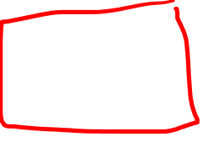
Polarization Space
$$\vec{D}$$
$$\vec{D}$$
$$\left[\begin{matrix}1 & 0 \\ 0 & i\end{matrix}\right]$$
$$\left[\begin{matrix}1 & 0 \\ 0 & e^{iφ}\end{matrix}\right]$$
$$\vec{R}$$
$$\vec{L}$$
$$\vec{R}$$
$$\vec{L}$$
$$\vec{A}$$
$$\vec{A}$$

Slide 17
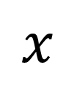
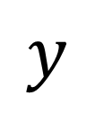
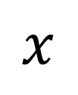
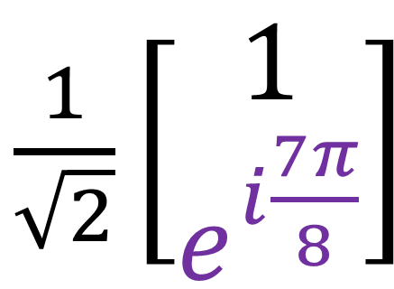
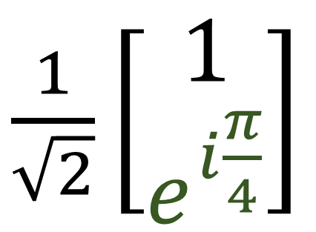
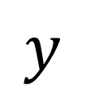
Polarization Space
$$y$$
$$\vec{D}$$
$\frac{1}{\sqrt{2}}\left[\begin{aligned}1 \\ e^{i\frac{π}{4}}\end{aligned}\right]$
$$x$$
$$\left[\begin{matrix}1 & 0 \\ 0 & e^{iφ}\end{matrix}\right]$$
$$\vec{R}$$
$$\vec{L}$$
$$y$$
$\frac{1}{\sqrt{2}}\left[\begin{aligned}1 \\ e^{i\frac{7π}{8}}\end{aligned}\right]$
$$x$$
$$\vec{A}$$

Slide 18
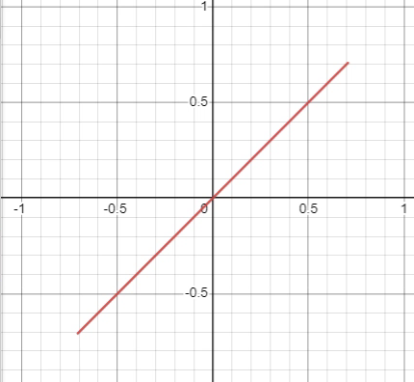
Polarization Space
$$\vec{D}$$
$$\left[\begin{matrix}1 & 0 \\ 0 & e^{iφ}\end{matrix}\right]$$
$$\vec{R}$$
$$\vec{L}$$
$$\vec{A}$$

Slide 19
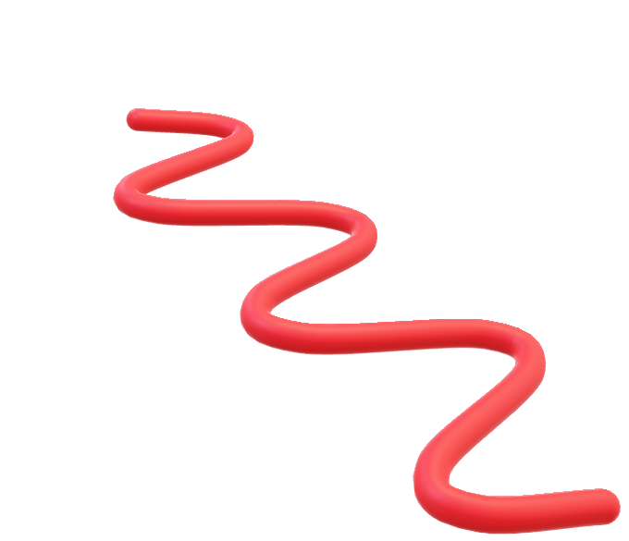
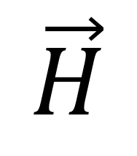





$$y$$
$$y$$
Horizontal Polarization
$$\vec{H}$$
$$x$$
$$x$$
Quarter Waveplate
$$\left[\begin{matrix}1 & 0 \\ 0 & i\end{matrix}\right]$$
Horizontal Polarization
$$\vec{H}$$
$$y$$
$$x$$
$$z$$

Slide 20



$$y$$
$$y$$
Horizontal Polarization
$$\vec{H}$$
$$x$$
$$x$$
Quarter Waveplate
$$z$$

Slide 21


$$y$$
$$y$$
Horizontal Polarization
$$\vec{H}$$
$$x$$
$$x$$
Quarter Waveplate
(turned $45°$)
Left Circular Polarization
$\vec{L}$
$$y$$
$$x$$
$$z$$

Slide 22
$$y$$
$$x$$
$$z$$

Slide 23







$$y$$
$$y$$
(Original Example)
$$x$$
$$x$$
$$\vec{D}$$
$$\vec{L}$$
$$z$$
$$z$$

Slide 24





$$y$$
(Original Example)
$$y$$
$$x$$
$$x$$
$$45°$$
$$z$$
$$z$$

Slide 25
$$y$$
$$y$$
(Original Example)
$$x$$
$$x$$
$$z$$
$$z$$

Slide 26



$$y$$
Quarter Waveplate
($45°$)
$$x$$
$\frac{1}{\sqrt{2}}\left[\begin{matrix}1 & i \\ i & 1\end{matrix}\right]e^{i\frac{π}{4}}$
$$z$$

Slide 27

$$y$$
Quarter Waveplate
($45°$)
$$x$$
$\frac{1}{\sqrt{2}}\left[\begin{matrix}1 & i \\ i & 1\end{matrix}\right]e^{i\frac{π}{4}}$
$$z$$

Slide 28







$$y$$
$$y$$
$$⇒$$
$$x$$
$$x$$
$\frac{1}{\sqrt{2}}\left[\begin{matrix}1 & −1 \\ 1 & 1\end{matrix}\right]$
$$\left[\begin{matrix}\cos{45°} & −\sin{45°} \\ \sin{45°} & \cos{45°}\end{matrix}\right]$$

Slide 29


$$y$$
$$y$$
$$y$$
$$⇒$$
$$x$$
$$x$$
$$x$$
$\frac{1}{\sqrt{2}}\left[\begin{matrix}1 & −1 \\ 1 & 1\end{matrix}\right]$
$$\left[\begin{matrix}\cos{45°} & −\sin{45°} \\ \sin{45°} & \cos{45°}\end{matrix}\right]$$

Slide 30




$$y$$
Quarter waveplate
(aligned $xy$ axes)
$$y$$
$$y$$
$$⇒$$
$$x$$
$$x$$
$$x$$
$\left[\begin{matrix}1 & 0 \\ 0 & i\end{matrix}\right]$
$\frac{1}{\sqrt{2}}\left[\begin{matrix}1 & −1 \\ 1 & 1\end{matrix}\right]$
$$\left[\begin{matrix}\cos{45°} & −\sin{45°} \\ \sin{45°} & \cos{45°}\end{matrix}\right]$$

Slide 31






$$y$$
Quarter waveplate
(aligned $xy$ axes)
$$y$$
$$y$$
$$y$$
$$⇒$$
$$⇒$$
$$x$$
$$x$$
$$x$$
$$x$$
$\frac{1}{\sqrt{2}}\left[\begin{matrix}1 & 1 \\ −1 & 1\end{matrix}\right]$
$\left[\begin{matrix}1 & 0 \\ 0 & i\end{matrix}\right]$
$\frac{1}{\sqrt{2}}\left[\begin{matrix}1 & −1 \\ 1 & 1\end{matrix}\right]$
$$\left[\begin{matrix}\cos{45°} & −\sin{45°} \\ \sin{45°} & \cos{45°}\end{matrix}\right]$$

Slide 32



$$y$$
Quarter waveplate
(aligned $xy$ axes)
$$y$$
$$y$$
$$y$$
$$⇒$$
$$⇒$$
$$x$$
$$x$$
$$x$$
$$x$$
$\frac{1}{\sqrt{2}}\left[\begin{matrix}1 & 1 \\ −1 & 1\end{matrix}\right]$
$\left[\begin{matrix}1 & 0 \\ 0 & i\end{matrix}\right]$
$\frac{1}{\sqrt{2}}\left[\begin{matrix}1 & −1 \\ 1 & 1\end{matrix}\right]$
$=\frac{1}{\sqrt{2}}\left[\begin{matrix}1 & i \\ i & 1\end{matrix}\right]e^{i\frac{π}{4}}$
$=\frac{1}{2}\left[\begin{matrix}1+i & −1+i \\ −1+i & 1+i\end{matrix}\right]$

Slide 33









$e^{i\frac{π}{4}}$ $\frac{1}{\sqrt{2}}\left[\begin{matrix}1 & i \\ i & 1\end{matrix}\right]\left[\begin{aligned}1 \\ 0\end{aligned}\right] =$ $e^{i\frac{π}{4}}$ $\frac{1}{\sqrt{2}}\left[\begin{aligned}1 \\ i\end{aligned}\right]$
$$\vec{H}⇒\vec{L}$$
$e^{i\frac{π}{4}}$ $\frac{1}{\sqrt{2}}\left[\begin{matrix}1 & i \\ i & 1\end{matrix}\right]$ $e^{i\frac{π}{4}}$ $\frac{1}{\sqrt{2}}\left[\begin{aligned}1 \\ i\end{aligned}\right]=$ $e^{iπ}$ $\left[\begin{aligned}0 \\ 1\end{aligned}\right]$
$$\vec{L}⇒\vec{V}$$
$e^{i\frac{π}{4}}$ $\frac{1}{\sqrt{2}}\left[\begin{matrix}1 & i \\ i & 1\end{matrix}\right]$ $e^{iπ}$ $\left[\begin{aligned}0 \\ 1\end{aligned}\right] =$ $e^{−i\frac{π}{4}}$ $\frac{1}{\sqrt{2}}\left[\begin{aligned}1 \\ −i\end{aligned}\right]$
$$\vec{V}⇒\vec{R}$$
$e^{i\frac{π}{4}}$ $\frac{1}{\sqrt{2}}\left[\begin{matrix}1 & i \\ i & 1\end{matrix}\right]$ $e^{−i\frac{π}{4}}$ $\frac{1}{\sqrt{2}}\left[\begin{aligned}1 \\ −i\end{aligned}\right] =$ $\left[\begin{aligned}1 \\ 0\end{aligned}\right]$
$$\vec{R}⇒\vec{H}$$

Slide 34






Polarization Space
$$\vec{H}$$
Quarter Waveplate
($45°$)
$e^{i\frac{π}{4}}$ $\frac{1}{\sqrt{2}}\left[\begin{matrix}1 & i \\ i & 1\end{matrix}\right]$
$$\vec{R}$$
$$\vec{L}$$
$$\vec{V}$$

Slide 35



Polarization Space
$$\left[\begin{matrix}{\left(\cos{θ}\right)}^{2}+i{\left(\sin{θ}\right)}^{2} & \left(i−1\right)\cos{θ}\sin{θ} \\ \left(i−1\right)\cos{θ}\sin{θ} & {\left(\sin{θ}\right)}^{2}+i{\left(\cos{θ}\right)}^{2}\end{matrix}\right]$$
$$\vec{H}$$
$$\vec{H}$$
$e^{i\frac{π}{4}}$ $\frac{1}{\sqrt{2}}\left[\begin{matrix}1 & i \\ i & 1\end{matrix}\right]$
$$\vec{R}$$
$$\vec{L}$$
$$\vec{R}$$
$$\vec{L}$$
$$\vec{V}$$
$$\vec{V}$$

Slide 36

$$y$$
Quarter waveplate
(aligned $xy$ axes)
$$y$$
$$y$$
$$y$$
$$⇒$$
$$⇒$$
$$x$$
$$x$$
$$x$$
$$x$$
$\frac{1}{\sqrt{2}}\left[\begin{matrix}1 & 1 \\ −1 & 1\end{matrix}\right]$
$\left[\begin{matrix}1 & 0 \\ 0 & i\end{matrix}\right]$
$\frac{1}{\sqrt{2}}\left[\begin{matrix}1 & −1 \\ 1 & 1\end{matrix}\right]$

Slide 37








$$\left[\begin{matrix}\cos{θ} & \sin{θ} \\ −\sin{θ} & \cos{θ}\end{matrix}\right]\left[\begin{matrix}\cos{θ} & −\sin{θ} \\ i\sin{θ} & i\cos{θ}\end{matrix}\right]$$
$=\left[\begin{matrix}{\left(\cos{θ}\right)}^{2}+i{\left(\sin{θ}\right)}^{2} & \left(1−i\right)\cos{θ}\sin{θ} \\ \left(1−i\right)\cos{θ}\sin{θ} & {\left(\sin{θ}\right)}^{2}+i{\left(\cos{θ}\right)}^{2}\end{matrix}\right]$
Quarter waveplate
(aligned $xy$ axes)
$$θ$$
$$θ$$
$\left[\begin{matrix}1 & 0 \\ 0 & i\end{matrix}\right]$
$$\left[\begin{matrix}\cos{θ} & \sin{θ} \\ −\sin{θ} & \cos{θ}\end{matrix}\right]$$
$$\left[\begin{matrix}\cos{θ} & −\sin{θ} \\ \sin{θ} & \cos{θ}\end{matrix}\right]$$
$$=\left[\begin{matrix}{\left(\cos{θ}\right)}^{2}+i{\left(\sin{θ}\right)}^{2} & \left(i−1\right)\cos{θ}\sin{θ} \\ \left(i−1\right)\cos{θ}\sin{θ} & {\left(\sin{θ}\right)}^{2}+i{\left(\cos{θ}\right)}^{2}\end{matrix}\right]$$
$$\left[\begin{matrix}\cos{θ} & −\sin{θ} \\ \sin{θ} & \cos{θ}\end{matrix}\right]\left[\begin{matrix}\cos{θ} & \sin{θ} \\ −i\sin{θ} & i\cos{θ}\end{matrix}\right]$$
$=\left[\begin{matrix}{\left(\cos{θ}\right)}^{2}+i{\left(\sin{θ}\right)}^{2} & \left(1−i\right)\cos{θ}\sin{θ} \\ \left(1−i\right)\cos{θ}\sin{θ} & {\left(\sin{θ}\right)}^{2}+i{\left(\cos{θ}\right)}^{2}\end{matrix}\right]$

Slide 38

$e^{i\frac{π}{4}}$ $\frac{1}{\sqrt{2}}\left[\begin{matrix}1 & i \\ i & 1\end{matrix}\right]\left[\begin{aligned}1 \\ 0\end{aligned}\right] =$ $e^{i\frac{π}{4}}$ $\frac{1}{\sqrt{2}}\left[\begin{aligned}1 \\ i\end{aligned}\right]$
$$\vec{H}⇒\vec{L}$$
$e^{i\frac{π}{4}}$ $\frac{1}{\sqrt{2}}\left[\begin{matrix}1 & i \\ i & 1\end{matrix}\right]$ $e^{i\frac{π}{4}}$ $\frac{1}{\sqrt{2}}\left[\begin{aligned}1 \\ i\end{aligned}\right]=$ $e^{iπ}$ $\left[\begin{aligned}0 \\ 1\end{aligned}\right]$
$$\vec{L}⇒\vec{V}$$
$e^{i\frac{π}{4}}$ $\frac{1}{\sqrt{2}}\left[\begin{matrix}1 & i \\ i & 1\end{matrix}\right]$ $e^{iπ}$ $\left[\begin{aligned}0 \\ 1\end{aligned}\right] =$ $e^{−i\frac{π}{4}}$ $\frac{1}{\sqrt{2}}\left[\begin{aligned}1 \\ −i\end{aligned}\right]$
$$\vec{V}⇒\vec{R}$$
$e^{i\frac{π}{4}}$ $\frac{1}{\sqrt{2}}\left[\begin{matrix}1 & i \\ i & 1\end{matrix}\right]$ $e^{−i\frac{π}{4}}$ $\frac{1}{\sqrt{2}}\left[\begin{aligned}1 \\ −i\end{aligned}\right] =$ $\left[\begin{aligned}1 \\ 0\end{aligned}\right]$
$$\vec{R}⇒\vec{H}$$

Slide 39










$\frac{1}{\sqrt{2}}\left[\begin{aligned}1 \\ 1\end{aligned}\right]$
$\frac{1}{\sqrt{2}}\left[\begin{aligned}1 \\ i\end{aligned}\right]$
$$e^{iπ/2}$$
$$y$$
$$y$$
$$x$$
$$x$$
$$z$$
$$z$$

Slide 40




$\frac{1}{\sqrt{2}}\left[\begin{aligned}1 \\ 1\end{aligned}\right]$
$$e^{iπ/2}$$
$\frac{1}{\sqrt{2}}\left[\begin{aligned}i \\ i\end{aligned}\right]$
$$e^{iπ/2}$$
$$y$$
$$y$$
$$x$$
$$x$$
$$z$$
$$z$$

Slide 41


$\frac{1}{\sqrt{2}}\left[\begin{aligned}1 \\ 1\end{aligned}\right]$
$$e^{iπ/2}$$
$e^{iπ/2}$ $\frac{1}{\sqrt{2}}\left[\begin{aligned}1 \\ 1\end{aligned}\right]$
$$e^{iπ/2}$$
$$y$$
$$y$$
$$x$$
$$x$$
$$z$$
$$z$$

Slide 42

















$\frac{1}{\sqrt{2}}\left[\begin{aligned}1 \\ 1\end{aligned}\right]$
$e^{−iπ/2}$ $\frac{1}{\sqrt{2}}\left[\begin{aligned}1 \\ 1\end{aligned}\right]$
$e^{−iπ}$ $\frac{1}{\sqrt{2}}\left[\begin{aligned}1 \\ 1\end{aligned}\right]$
$$−i$$
$$−1$$
$$y$$
$$y$$
$$y$$
$$x$$
$$x$$
$$x$$
Diagonal Polarization
$$z$$
Diagonal Polarization
$$z$$
Diagonal Polarization
$$z$$

Slide 43


$\frac{1}{\sqrt{2}}\left[\begin{aligned}1 \\ 1\end{aligned}\right]$
$e^{−iπ/2}$ $\frac{1}{\sqrt{2}}\left[\begin{aligned}1 \\ 1\end{aligned}\right]$
$e^{−iπ}$ $\frac{1}{\sqrt{2}}\left[\begin{aligned}1 \\ 1\end{aligned}\right]$
$$−i$$
$$−1$$
Diagonal $\vec{D}$ Polarization

Slide 44




Polarization Space
$$\vec{D}$$
$$\vec{H}$$
$$\left[\begin{matrix}1 & 0 \\ 0 & i\end{matrix}\right]$$
$e^{i\frac{π}{4}}$ $\frac{1}{\sqrt{2}}\left[\begin{matrix}1 & i \\ i & 1\end{matrix}\right]$
$$\vec{R}$$
$$\vec{L}$$
$$\vec{R}$$
$$\vec{L}$$
$$\vec{A}$$
$$\vec{V}$$

Slide 45








Polarization Space
$$D$$
$$H$$
$$R$$
$$L$$
$$R$$
$$L$$
$$A$$
$$V$$

Slide 46


Polarization Space
$$H$$
$$D$$
$$R$$
$$L$$
$$R$$
$$L$$
$$A$$
$$V$$

Slide 47




Polarization Space
$$H$$
$$D$$
$$R$$
$$R$$
$$L$$
$$L$$
$$A$$
$$V$$

Slide 48







$$y$$
$$H$$
Polarization Space
$$H$$
$$x$$
$$A$$
$$D$$
$$R$$
$$R$$
$$L$$
$$L$$
$$H⇒A$$
Turn:
$\frac{1}{\sqrt{2}}\left[\begin{matrix}1 & 1 \\ −1 & 1\end{matrix}\right]$
$$A$$
Continuous Turn:
$\left[\begin{matrix}\cos{θ} & \sin{θ} \\ −\sin{θ} & \cos{θ}\end{matrix}\right]$
$$V$$

Slide 49








Poincaré Sphere
$$\left[\begin{matrix}1 & 0 \\ 0 & i\end{matrix}\right]$$
$$\vec{D}⇒\vec{L}$$
$$H$$
$e^{i\frac{π}{4}}$ $\frac{1}{\sqrt{2}}\left[\begin{matrix}1 & i \\ i & 1\end{matrix}\right]$
$$H⇒\vec{L}$$
$$D$$
$$D$$
$\frac{1}{\sqrt{2}}\left[\begin{matrix}1 & 1 \\ −1 & 1\end{matrix}\right]$
$$\vec{H}⇒\vec{A}$$
$$R$$
$$R$$
$$L$$
$$L$$
$$A$$
$U(2)$ matrices
(unitary $2×2$)
$$V$$

Slide 50







Poincaré Sphere
$$H$$
Key idea: not changing lengths of Jones vectors on sphere.
$$D$$
$$R$$
$$L$$
$$A$$
$$V$$

Slide 51

Poincaré Sphere
$$H$$
Key idea: not changing lengths of Jones vectors on sphere.
$$D$$
$$R$$
$$L$$
$$A$$
$$V$$

Slide 52


Poincaré Sphere
$$H$$
Key idea: not changing lengths of Jones vectors on sphere.
$$D$$
$$R$$
$$L$$
$U(2)$ matrices
(unitary $2×2$)
represent rotations on the Poincaré Sphere
$$A$$
$$V$$

Slide 53





Squared length of a vector $\vec{v}$
Write $\vec{v}$ as $\left[\begin{aligned}x \\ y \\ z\end{aligned}\right]$
$${\left\|\vec{v}\right\|}^{2}={\vec{v}}^{T}\vec{v}=\left[x y z\right]\left[\begin{aligned}x \\ y \\ z\end{aligned}\right]$$
$$=x^{2}+y^{2}+z^{2}$$

Slide 54








Rotation Matrix $R$
$$\vec{v}→R\vec{v}$$
Rotations don’t change vector lengths!
$${\left\|\vec{v}\right\|}^{2}={\vec{v}}^{T}\vec{v}→{\left\|R\vec{v}\right\|}^{2}={\left(R\vec{v}\right)}^{T}\left(R\vec{v}\right)$$
$${\left(AB\right)}^{T}=B^{T}A^{T}$$
$${\vec{v}}^{T}\vec{v} = {\left(R\vec{v}\right)}^{T}\left(R\vec{v}\right)$$
$${\vec{v}}^{T}\vec{v} = {\vec{v}}^{T}R^{T}R\vec{v}$$
$$R^{−1}=R^{T}$$
$$=I$$
identity

Slide 55


$$\left[\begin{matrix}a & d & g \\ b & e & h \\ c & f & i\end{matrix}\right]$$
$R$ is

Slide 56




$$R^{T}R=I$$
$$\left[\begin{matrix}a & d & g \\ b & e & h \\ c & f & i\end{matrix}\right]$$
$R$ is
$$\left[\begin{matrix}a & b & c \\ d & e & f \\ g & h & i\end{matrix}\right]$$
$R^{T}$ is

Slide 57






$$R^{T}R=I$$
$$\left[\begin{matrix}a & d & g \\ b & e & h \\ c & f & i\end{matrix}\right]$$
Each column has magnitude 1
Each pair of columns is orthogonal to one another
$$\left[\begin{matrix}a & b & c \\ d & e & f \\ g & h & i\end{matrix}\right]$$
$$\left[\begin{matrix}a & d & g \\ b & e & h \\ c & f & i\end{matrix}\right]$$
$⇒$Orthogonal matrices
$O(3)$ = 3x3 orthogonal matrices

Slide 58



3D Rotations:
$O(3)$ matrices don’t change 3D vector length
Rotations don’t change the length of a vector
Reflections don’t change the length of a vector
$O(3)$ contains both Rotations AND Reflections!

Slide 59






$det\left( R^{T} R \right)=\det\left( I \right)$
$$\det\left(R^{T}\right)\det\left(R\right)=\det\left(I\right)$$
$$\det\left(R\right)\det\left(R\right)=\det\left(I\right)$$
$${\left[\det\left(R\right)\right]}^{2}=1$$
$$\det\left(R\right)=±1$$
$$\det\left(AB\right)= \\ \det\left(A\right)\det\left(B\right)$$
“Volume” change
$$=\det\left(M\right)$$
Rotations $⇒det\left(R\right)=+1$
Reflections $⇒det\left(R\right)=−1$

Slide 60













$O(3)$ matrices ($R^{T}R=I$) don’t change ${\left\|\vec{v}\right\|}^{2}$
Rotations, $\det\left(R\right)=+1$
Reflections, $\det\left(R\right)=−1$
$$\left[\begin{matrix}1 & 0 & 0 \\ 0 & 0 & −1 \\ 0 & 1 & 0\end{matrix}\right]$$
$$\left[\begin{matrix}1 & 0 & 0 \\ 0 & 1 & 0 \\ 0 & 0 & −1\end{matrix}\right]$$
$$\left[\begin{matrix}0 & 0 & −1 \\ 0 & 1 & 0 \\ 1 & 0 & 0\end{matrix}\right]$$
$$\left[\begin{matrix}−1 & 0 & 0 \\ 0 & −1 & 0 \\ 0 & 0 & −1\end{matrix}\right]$$
$$\left[\begin{matrix}0 & −1 & 0 \\ −1 & 0 & 0 \\ 0 & 0 & −1\end{matrix}\right]$$
$$\left[\begin{matrix}1 & 0 & 0 \\ 0 & 1 & 0 \\ 0 & 0 & 1\end{matrix}\right]$$
$$\left[\begin{matrix}−1 & 0 & 0 \\ 0 & 0 & 1 \\ 0 & −1 & 0\end{matrix}\right]$$
$$\left[\begin{matrix}1 & 0 & 0 \\ 0 & 0 & 1 \\ 0 & 1 & 0\end{matrix}\right]$$
Special Orthogonal 3x3 Matrices $SO(3)$
(“special” $⇒\det{(R)}=+1$)

Slide 61

$SO(3)$ matrices
$\left\{3×3 matrices R : R^{T}R=I,\det\left(R\right)=+1\right\}$
Rotate 3D vectors
don’t change ${\left\|\vec{v}\right\|}^{2}$

Slide 62
Poincaré Sphere
$$H$$
$$D$$
$$R$$
$$L$$
$$A$$
$$V$$

Slide 63
Poincaré Sphere
$$H$$
$$D$$
$$R$$
$$L$$
$$A$$
$$V$$

Slide 64


Poincaré Sphere
$$H$$
$$\left[\begin{aligned}A^{x}e^{iφ_{x}} \\ A^{y}e^{iφ_{y}}\end{aligned}\right]$$
Jones Vector
$$D$$
$$R$$
$$L$$
$$A$$
Complex
Numbers $ℂ$
$$V$$

Slide 65





$$c^{2}=\left(c\right)\left(c\right)$$
$$=\left(a+ib\right)\left(a+ib\right)$$
$$=a^{2}+aib+iba+i^{2}b^{2}$$
$$=a^{2}+2iab−b^{2}$$
$$Im$$
$$c=3+4i$$
$$Re$$

Slide 66


$${\left|c\right|}^{2}=c^{∗}c$$
$$={\left(a+ib\right)}^{∗}\left(a+ib\right)$$
$$=\left(a−ib\right)\left(a+ib\right)$$
$$=a^{2}+aib−iba−i^{2}b^{2}$$
$$=a^{2}+b^{2}$$
$=3^{2}+4^{2}=5^{2}$
$$Im$$
$$c=3+4i$$
$$Re$$

Slide 67






With Jones Vector $\vec{J}$:
$$\left[\begin{aligned}A^{x}e^{iφ_{x}} \\ A^{y}e^{iφ_{y}}\end{aligned}\right]$$
$${\left\|\vec{J}\right\|}^{2}={\vec{J}}^{T}\vec{J}$$
Hermitian Conjugate:
$${\vec{J}}^{†}≡{\left({\vec{J}}^{T}\right)}^{∗}={\left({\vec{J}}^{∗}\right)}^{T}$$
$${\left\|\vec{J}\right\|}^{2}={\left({\vec{J}}^{T}\right)}^{∗}\vec{J}$$
$${\left\|\vec{J}\right\|}^{2}= {\vec{J}}^{†} \vec{J}$$

Slide 68







Exercise - check that $J^{†}J=1$ for the following Jones Vectors:
$$\left[\begin{matrix}1 & 0 \\ 0 & i\end{matrix}\right]$$
$\frac{1}{\sqrt{2}}\left[\begin{aligned}1 \\ −1\end{aligned}\right]$
$\frac{1}{\sqrt{2}}\left[\begin{aligned}1 \\ i\end{aligned}\right]$
$$\left[\begin{aligned}i\cos{θ} \\ i\sin{θ}\end{aligned}\right]$$
$\frac{1}{\sqrt{2}}\left[\begin{matrix}1 & −i \\ 1 & i\end{matrix}\right]$
$\frac{1}{\sqrt{2}}\left[\begin{matrix}1 & −i \\ −i & 1\end{matrix}\right]$

Slide 69









$$\vec{J}→U\vec{J}$$
Rotation Matrix $U$
Rotations don’t change vector lengths!
$${\left\|\vec{J}\right\|}^{2}={\vec{J}}^{†}\vec{J}→{\left\|U\vec{J}\right\|}^{2}={\left(U\vec{J}\right)}^{†}\left(U\vec{J}\right)$$
$${\vec{J}}^{†}\vec{J} = {\left(U\vec{J}\right)}^{†}\left(U\vec{J}\right)$$
$${\left(AB\right)}^{†}=B^{†}A^{†}$$
$${\vec{J}}^{†}\vec{J} = {\vec{J}}^{†}U^{†}U\vec{J}$$
$$U^{−1}=U^{†}$$
$$=I$$
identity

Slide 70


$$\vec{J}→U\vec{J}$$
Rotation Matrix $U$
$$U^{−1}=U^{†}$$
2x2 Unitary Matrices: $U(2)$

Slide 71




Exercise - check that $U^{−1}=U^{†}$ for the following matrices:
$$\left[\begin{matrix}1 & 0 \\ 0 & i\end{matrix}\right]$$
$$\left[\begin{matrix}1 & 0 \\ 0 & i\end{matrix}\right]$$
$\frac{1}{\sqrt{2}}\left[\begin{matrix}1 & i \\ i & 1\end{matrix}\right]$
$\frac{1}{\sqrt{2}}\left[\begin{matrix}1 & 1 \\ −1 & 1\end{matrix}\right]$
$\frac{1}{\sqrt{2}}\left[\begin{matrix}1 & −i \\ 1 & i\end{matrix}\right]$
$\frac{1}{\sqrt{2}}\left[\begin{matrix}1 & −i \\ −i & 1\end{matrix}\right]$

Slide 72



$det\left( U^{†} U \right) =\det\left( I \right)$
$$\det\left(U^{†}\right)\det\left(U\right)=\det\left(I\right)$$
$$\det\left({\left(U^{∗}\right)}^{T}\right)\det\left(U\right)=\det\left(I\right)$$
$$\det\left(U^{∗}\right)\det\left(U\right)=\det\left(I\right)$$
$${\left[\det\left(U\right)\right]}^{∗}\det\left(U\right)=\det\left(I\right)$$
$${\left|\det\left(U\right)\right|}^{2}=1$$
$$\det\left(AB\right)= \\ \det\left(A\right)\det\left(B\right)$$
$$⇒\det\left(U\right)=e^{iθ}$$

Slide 73




$det\left( U^{†} U \right) =\det\left( I \right)$
$$\det\left(U^{†}\right)\det\left(U\right)=\det\left(I\right)$$
$$\det\left({\left(U^{∗}\right)}^{T}\right)\det\left(U\right)=\det\left(I\right)$$
$$\det\left(U^{∗}\right)\det\left(U\right)=\det\left(I\right)$$
$${\left[\det\left(U\right)\right]}^{∗}\det\left(U\right)=\det\left(I\right)$$
$${\left|\det\left(U\right)\right|}^{2}=1$$
$$\det\left(AB\right)= \\ \det\left(A\right)\det\left(B\right)$$
$$i$$
$$Im$$
$$Re$$
$$−1$$
$$1$$
$$−i$$
$$⇒\det\left(U\right)=e^{iθ}$$

Slide 74


$det\left( U^{†} U \right) =\det\left( I \right)$
$$\det\left(U^{†}\right)\det\left(U\right)=\det\left(I\right)$$
$$\det\left({\left(U^{∗}\right)}^{T}\right)\det\left(U\right)=\det\left(I\right)$$
$$\det\left(U^{∗}\right)\det\left(U\right)=\det\left(I\right)$$
$${\left[\det\left(U\right)\right]}^{∗}\det\left(U\right)=\det\left(I\right)$$
$${\left|\det\left(U\right)\right|}^{2}=1$$
$$\det\left(AB\right)= \\ \det\left(A\right)\det\left(B\right)$$
$${\left(e^{iθ}\right)}^{∗}\left(e^{iθ}\right)$$
$$=\left(e^{−iθ}\right)\left(e^{iθ}\right)$$
$$=e^{−iθ+iθ}=1$$
$$⇒\det\left(U\right)=e^{iθ}$$

Slide 75






Overall phase of Jones Vector
does not affect polarization.
$$\left[\begin{aligned}1 \\ 1\end{aligned}\right]$$
$$e^{i\frac{π}{4}}\left[\begin{aligned}1 \\ 1\end{aligned}\right]=\left[\begin{aligned}i \\ i\end{aligned}\right]$$
$$≈$$
$$e^{i\frac{π}{2}}\left[\begin{aligned}1 \\ 1\end{aligned}\right]=\left[\begin{aligned}−1 \\ −1\end{aligned}\right]$$
$$≈$$

Slide 76


$\left[\begin{aligned}J^{x} \\ J^{y}\end{aligned}\right] ≈$ $e^{iφ}$ $\left[\begin{aligned}J^{x} \\ J^{y}\end{aligned}\right]$
Represent the same polarization.

Slide 77









Diagonal Polarization
Left Circ. Polarization
$U(2)$ matrices
$$\left[\begin{matrix}1 & 0 \\ 0 & i\end{matrix}\right]$$
$$\left[\begin{aligned}1 \\ i\end{aligned}\right]$$
$$\left[\begin{aligned}1 \\ 1\end{aligned}\right]$$
$$e^{−i\frac{π}{4}}\left[\begin{aligned}1 \\ i\end{aligned}\right]$$
$$e^{−i\frac{π}{4}}\left[\begin{matrix}1 & 0 \\ 0 & i\end{matrix}\right]$$
$$e^{i\frac{π}{2}}\left[\begin{matrix}1 & 0 \\ 0 & i\end{matrix}\right]$$
$$e^{i\frac{π}{2}}\left[\begin{aligned}1 \\ i\end{aligned}\right]$$

Slide 78




Determinant
$U(2)$ matrices
$$\left[\begin{matrix}1 & 0 \\ 0 & i\end{matrix}\right]$$
$$\det{⇒}+i$$
$$e^{−i\frac{π}{4}}\left[\begin{matrix}1 & 0 \\ 0 & i\end{matrix}\right]$$
$$\det{⇒}+1$$
$$e^{i\frac{π}{2}}\left[\begin{matrix}1 & 0 \\ 0 & i\end{matrix}\right]$$
$$\det{⇒}−i$$

Slide 79



If $det\left[\begin{matrix}a & b \\ c & d\end{matrix}\right]=ad−bc=e^{iθ}$
Then $det\left(e^{−i\frac{θ}{2}}\left[\begin{matrix}a & b \\ c & d\end{matrix}\right]\right)$
$$=e^{−iθ/2}ae^{−iθ/2}d−e^{−iθ/2}be^{−iθ/2}c$$
$$=e^{−iθ}\left(ad−bc\right)=e^{−iθ}e^{iθ}=+1$$

Slide 80











$U(2)$ matrices ($U^{†}U=I$) don’t change ${\left\|\vec{J}\right\|}^{2}$
$$\det\left(U\right)=+1$$
$$\det\left(U\right)≠+1$$
$\frac{1}{\sqrt{2}} \left[\begin{matrix}1 & i \\ 1 & −i\end{matrix}\right]$
$$\frac{1}{\sqrt{2}}\left[\begin{matrix}1+i & 0 \\ 0 & 1−i\end{matrix}\right]$$
$$\left[\begin{matrix}1 & 0 \\ 0 & i\end{matrix}\right]$$
$$\left[\begin{matrix}i & 0 \\ 0 & −i\end{matrix}\right]$$
$$\left[\begin{matrix}i & 0 \\ 0 & i\end{matrix}\right]$$
$$\left[\begin{matrix}1 & 0 \\ 0 & −1\end{matrix}\right]$$
Special Unitary 2x2 Matrices $SU(2)$
(“special” $⇒\det{(U)}=+1$)

Slide 81










Physical Space
Polarization Space
(Poincaré Sphere)
$$\left[\begin{aligned}0 \\ 1\end{aligned}\right]$$
$$\vec{V}$$
$$\vec{V}$$
$$\vec{R}$$
$$\vec{H}$$
$$\vec{A}$$
$$\vec{D}$$
$$\vec{L}$$
$$\vec{H}$$

Slide 82

Physical Space
Polarization Space
(Poincaré Sphere)
$$\left[\begin{aligned}0 \\ 1\end{aligned}\right]$$
$$\vec{V}$$
$$\vec{V}$$
$$\vec{D}$$
$$\vec{H}$$
$$\vec{A}$$
$$\vec{D}$$
$$\vec{H}$$

Slide 83




Physical Space
Polarization Space
(Poincaré Sphere)
$$\left[\begin{aligned}0 \\ −1\end{aligned}\right]$$
$$\left[\begin{aligned}0 \\ 1\end{aligned}\right]$$
$$\vec{V}$$
$$\vec{V}$$
$$\vec{D}$$
$$\vec{H}$$
$$\vec{A}$$
$$\vec{D}$$
$$\vec{A}$$
$$−\vec{V}$$
$$\vec{H}$$

Slide 84




Physical Space
Polarization Space
(Poincaré Sphere)
$$\left[\begin{aligned}0 \\ −1\end{aligned}\right]$$
$$\left[\begin{aligned}0 \\ 1\end{aligned}\right]$$
$$\vec{V}$$
$$\vec{V}$$
$$−\vec{A}$$
$$\vec{D}$$
$$−\vec{H}$$
$$\vec{H}$$
$$\vec{A}$$
$$\vec{D}$$
$$−\vec{D}$$
$$\vec{A}$$
$$−\vec{V}$$
$$\vec{H}$$

Slide 85


Physical Space
Polarization Space
(Poincaré Sphere)
$$\vec{V}$$
$$\vec{V}$$
$$\vec{D}$$
$$θ/2$$
$$\vec{H}$$
$$\vec{A}$$
$$θ$$
$$\vec{D}$$
$$\vec{A}$$
$$\vec{H}$$

Slide 86



















$$\vec{V}$$
$\left[\begin{matrix}\cos{\frac{θ}{2}} & \sin{\frac{θ}{2}} \\ −sin{\frac{θ}{2}} & \cos{\frac{θ}{2}}\end{matrix}\right]$
Polarization Space
$$←SU(2)$$
$$\vec{A}$$
$$θ$$
$$\vec{D}$$
$$\vec{H}$$
set
$$θ=π$$
$$\vec{V}$$
$$\vec{V}$$
$$\vec{H}$$
$$\vec{D}$$
Physical Space
$$θ/2$$
$$\vec{H}$$
$$\left[\begin{aligned}0 \\ 1\end{aligned}\right]$$
$\left[\begin{matrix}\cos{\frac{π}{2}} & \sin{\frac{π}{2}} \\ −sin{\frac{π}{2}} & \cos{\frac{π}{2}}\end{matrix}\right]$
$$⇒\left[\begin{aligned}1 \\ 0\end{aligned}\right]$$
$$\vec{A}$$

Slide 87

Next Video:
Quantum Spin States
Spinors that transform with $SU(2)$

Slide 88
$\vec{H}→\left[\begin{aligned}1 \\ 0\end{aligned}\right]$
$\vec{V}→\left[\begin{aligned}0 \\ 1\end{aligned}\right]$
$\vec{D}=\frac{1}{\sqrt{2}}\vec{H}+\frac{1}{\sqrt{2}}\vec{V}$
$\vec{A}=\frac{1}{\sqrt{2}}\vec{H}−\frac{1}{\sqrt{2}}\vec{V}$
$\vec{L}=\frac{1}{\sqrt{2}}\vec{H}+\frac{i}{\sqrt{2}}\vec{V}$
$\vec{R}=\frac{1}{\sqrt{2}}\vec{H}−\frac{i}{\sqrt{2}}\vec{V}$
$→\frac{1}{\sqrt{2}} \left[\begin{aligned}1 \\ 1\end{aligned}\right]$
$→\frac{1}{\sqrt{2}}\left[\begin{aligned} 1 \\ −1\end{aligned}\right]$
$→\frac{1}{\sqrt{2}} \left[\begin{aligned}1 \\ i\end{aligned}\right]$
$→\frac{1}{\sqrt{2}}\left[\begin{aligned} 1 \\ −i\end{aligned}\right]$
(wave travelling out of the screen)

Slide 89




$\left|+z\right\rangle →\left[\begin{aligned}1 \\ 0\end{aligned}\right]$
$\left|−z\right\rangle →\left[\begin{aligned}0 \\ 1\end{aligned}\right]$
$\left|+x\right\rangle =\frac{1}{\sqrt{2}}\left|+z\right\rangle +\frac{1}{\sqrt{2}}\left|−z\right\rangle$
$\left|−x\right\rangle =\frac{1}{\sqrt{2}}\left|+z\right\rangle −\frac{1}{\sqrt{2}}\left|−z\right\rangle$
$\left|+y\right\rangle =\frac{1}{\sqrt{2}}\left|+z\right\rangle +\frac{i}{\sqrt{2}}\left|−z\right\rangle$
$\left|−y\right\rangle =\frac{1}{\sqrt{2}}\left|+z\right\rangle −\frac{i}{\sqrt{2}}\left|−z\right\rangle$
$→\frac{1}{\sqrt{2}} \left[\begin{aligned}1 \\ 1\end{aligned}\right]$
$→\frac{1}{\sqrt{2}}\left[\begin{aligned} 1 \\ −1\end{aligned}\right]$
$→\frac{1}{\sqrt{2}} \left[\begin{aligned}1 \\ i\end{aligned}\right]$
$→\frac{1}{\sqrt{2}}\left[\begin{aligned} 1 \\ −i\end{aligned}\right]$

Slide 90





$$\left[\begin{aligned}1 \\ 0\end{aligned}\right]$$
Exercise
$\frac{1}{\sqrt{2}}\left[\begin{matrix}1 & −i \\ −i & 1\end{matrix}\right]$
$$H$$
$$D$$
$$D$$
$\frac{1}{\sqrt{2}}\left[\begin{matrix}1+i & 0 \\ 0 & 1−i\end{matrix}\right]$
$$R$$
$$R$$
$$L$$
$$L$$
$$A$$
$\frac{1}{\sqrt{2}}\left[\begin{matrix}1 & 1 \\ −1 & 1\end{matrix}\right]$
$$V$$

