Slide 1



Spinors For Beginners
4
Quantum Spin States
S
N
$\left|ψ\right\rangle =α\left|↑\right\rangle +β\left|↓\right\rangle$

Slide 2
Spinors Learning “Staircase”
Stern-Gerlach Experiment
Quantum Spin States
Spinors in Particle Physics
Lie Groups & Algebras
Clifford Algebras
Spinors as square roots of vectors
Examples From Physics (motivation)

Slide 3
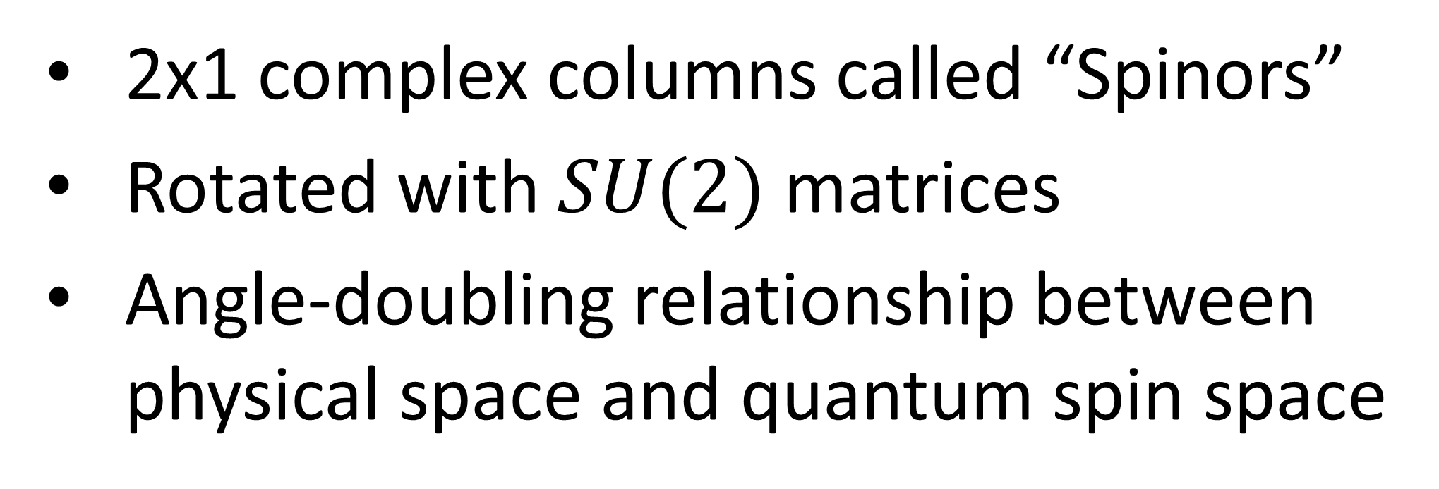


$\left|ψ\right\rangle =α\left|↑\right\rangle +β\left|↓\right\rangle$
Quantum Spin State:
$\vec{J} =α \vec{H}+β \vec{V}$
Light Polarization:
2x1 complex columns called “Spinors”
Rotated with $SU(2)$ matrices
Angle-doubling relationship between physical space and quantum spin space

Slide 4

Stern-Gerlach Experiment (1922):
(S.G. experiment)
homogeneous field
S
N
beam of neutral particles (e.g. silver atoms)
magnetic field
(inhomogeneous)

Slide 5
Stern-Gerlach Experiment (1922):
(S.G. experiment)
inhomogeneous field
S
S
stronger at tip
N
beam of neutral particles (e.g. silver atoms)
magnetic field
(inhomogeneous)
N

Slide 6


Stern-Gerlach Experiment (1922):
(S.G. experiment)
“spin iiup”
$$\left|↑\right\rangle$$
S
N
$$\left|↓\right\rangle$$
beam of neutral particles (e.g. silver atoms)
magnetic field
(inhomogeneous)
“spin down”

Slide 7
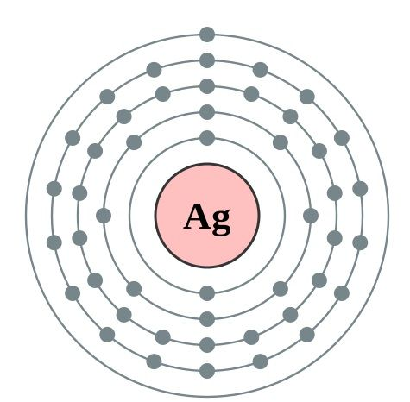
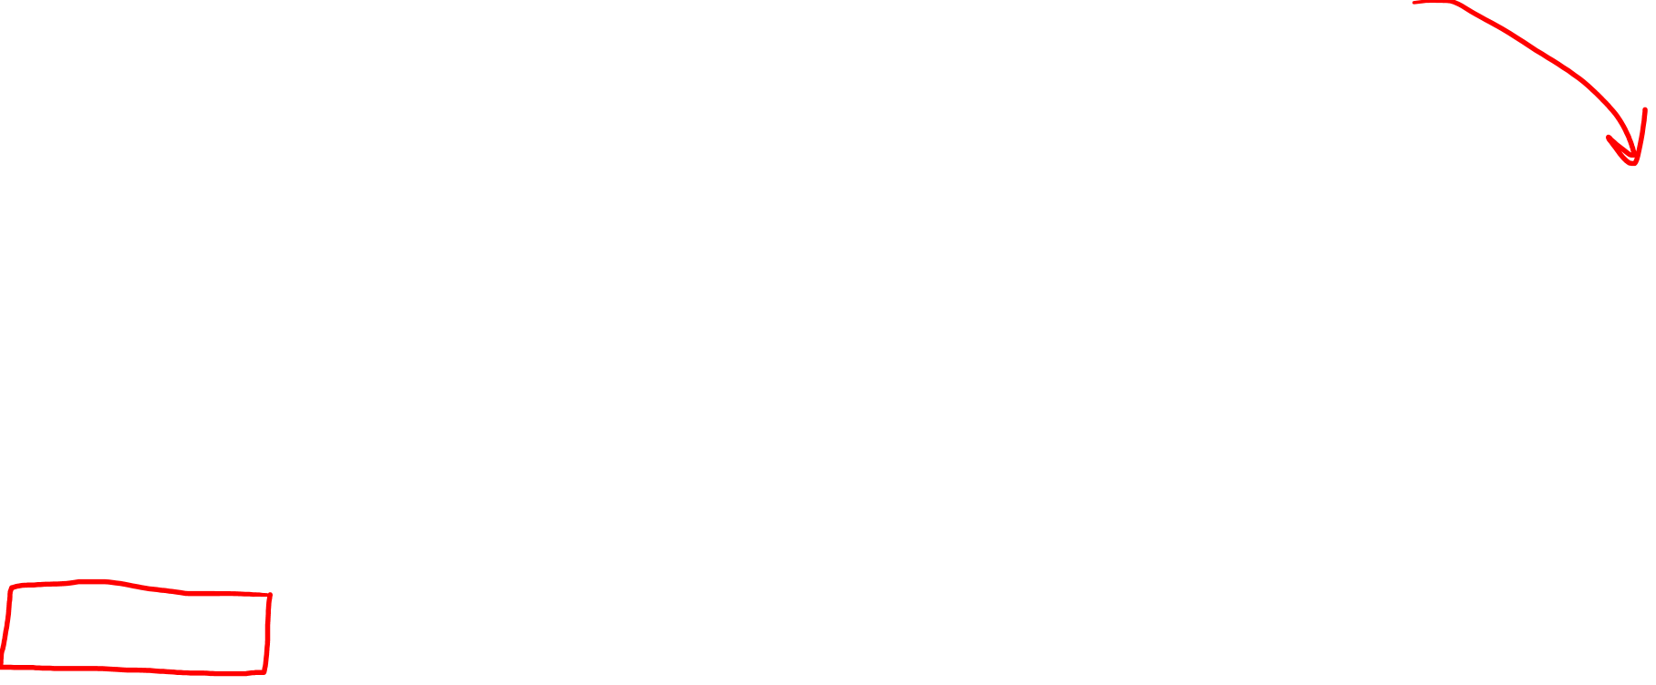

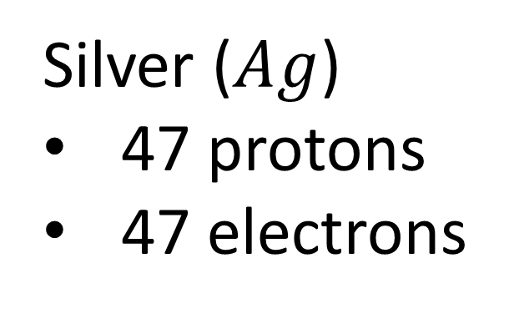
Stern-Gerlach Experiment (1922):
(S.G. experiment)
Silver ($Ag$)
47 protons
47 electrons
Bohr Model of Atom
-
-
-
-
-
-
-
-
-
-
-
-
-
-
-
Shells:
2 electrons
8 electrons
18 electrons
18 electrons
1 electron
-
-
-
-
-
-
-
-
$$Ag$$
-
-
-
-
beam of neutral particles (e.g. silver atoms)
-
-
-
-
-
-
-
-
-
-
-
-
-
-
-
-
-
-
-
-
-
-
-
-
-
-
-
-

Slide 8
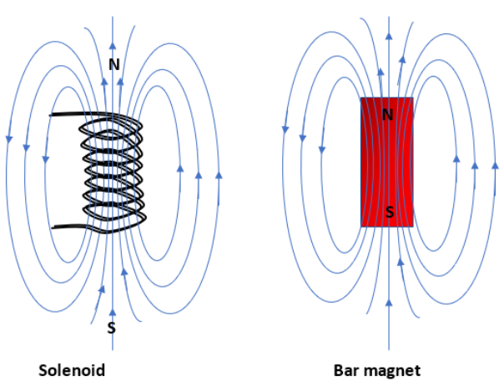
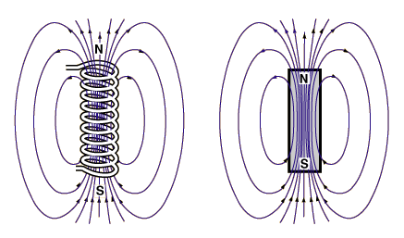
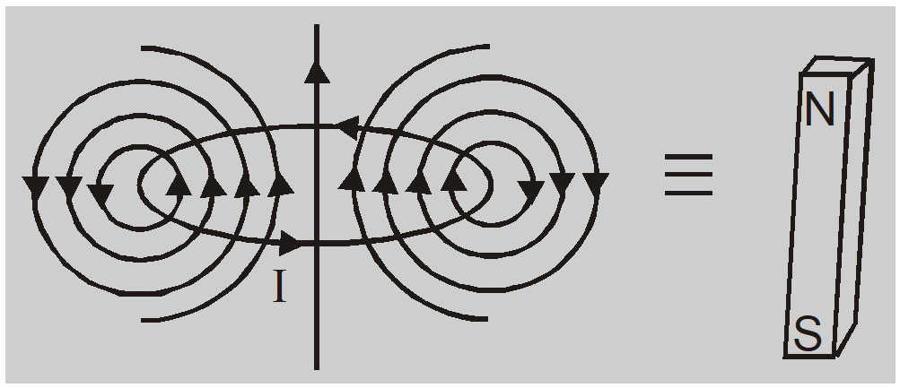
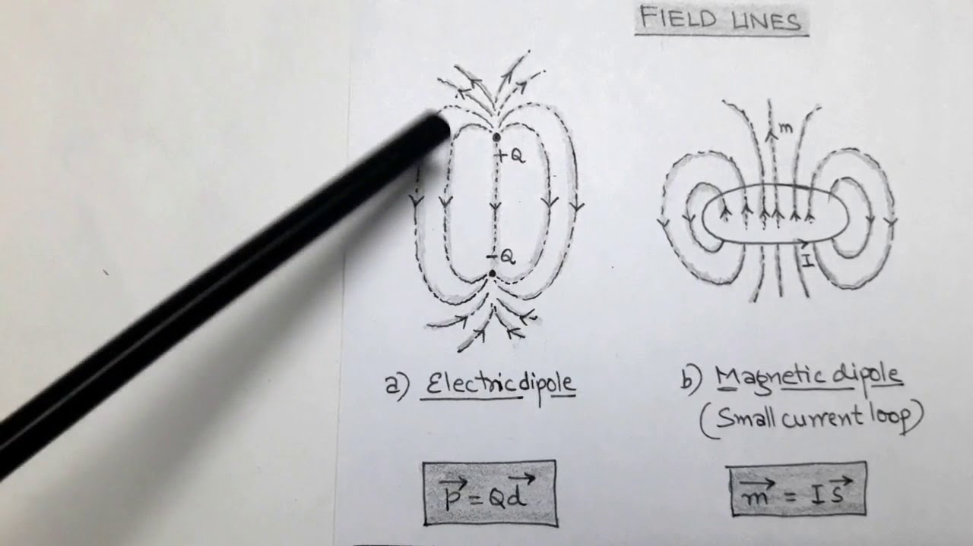
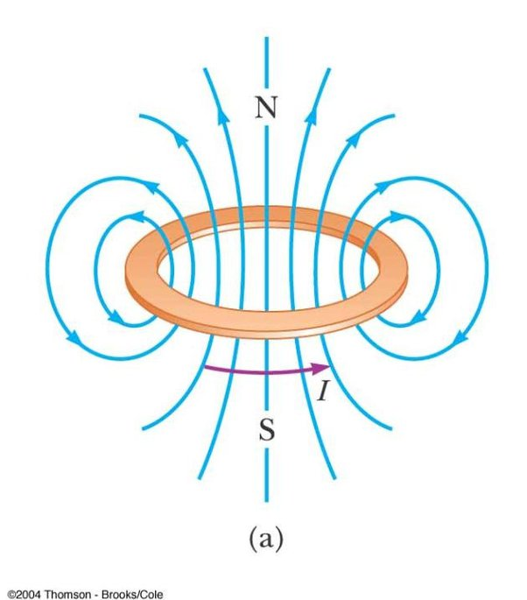
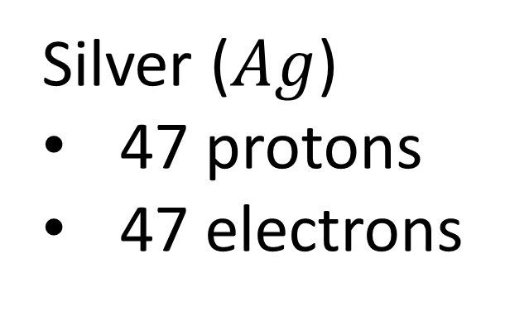

Stern-Gerlach Experiment (1922):
(S.G. experiment)
Silver ($Ag$)
47 protons
47 electrons
Orbital Angular Momentum
= Magnet
N
beam of neutral particles (e.g. silver atoms)
S
-

Slide 9
Stern-Gerlach Experiment (1922):
(S.G. experiment)
S
N
N
N
N
N
S
S
S
S
S
N
beam of neutral particles (e.g. silver atoms)
magnetic field
(inhomogeneous)

Slide 10
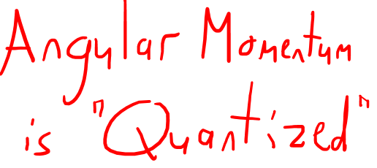


Stern-Gerlach Experiment (1922):
(S.G. experiment)
“spin iiup”
$$\left|↑\right\rangle$$
S
N
$$\left|↓\right\rangle$$
beam of neutral particles (e.g. silver atoms)
magnetic field
(inhomogeneous)
“spin down”

Slide 11
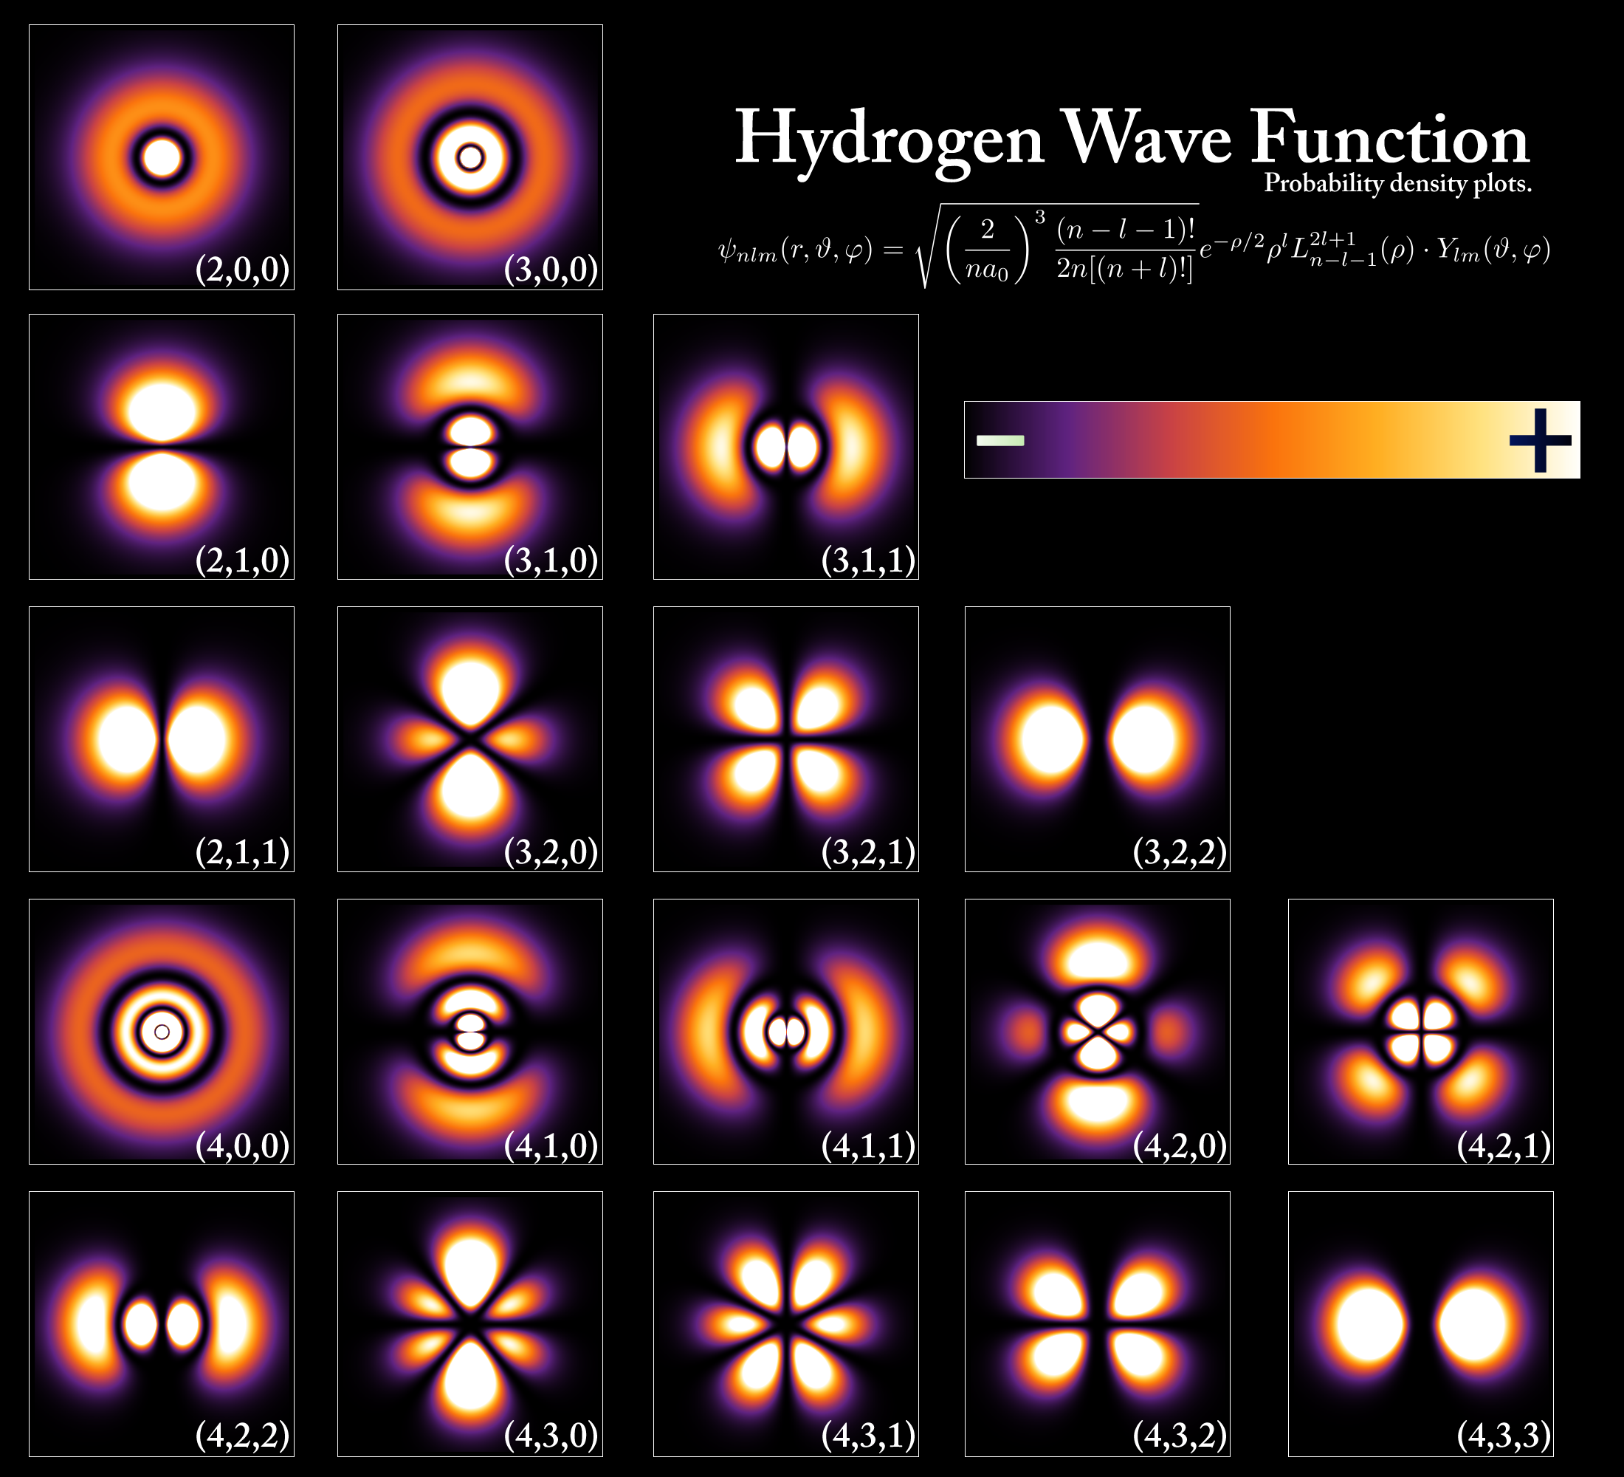
Modern understanding of electron orbitals:
Bohr Model of Atom:
-
-
-
-
-
-
-
-
-
-
-
-
-
-
-
-
-
-
-
-
-
-
-
$$Ag$$
-
-
-
-
-
-
-
-
-
-
-
-
-
-
-
-
-
-
-
-
-
-
-
-
-
-
-
-
-
-
-
-
(Image by PoorLeno on Wikipedia)

Slide 12
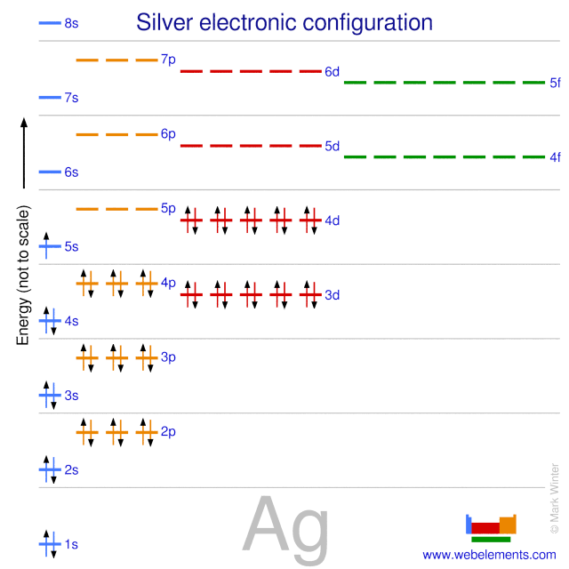
Atoms “prefer” orbitals that are either “full” or “half-full”. This is why the 4d orbital is filled before the 5s orbital in silver atoms.
http://www.dommelen.net/quantum2/style_a/shells.html#:~:text=In%20general%2C%20a%20completely%20filled,momentum%20and%20is%20spherically%20symmetric.
In gen­eral, a com­pletely filled shell has zero an­gu­lar mo­men­tum and is spher­i­cally sym­met­ric.

Slide 13











Spherical Orbital (no net orbital angular momentum)
$$5p$$
$$5s$$
$$4d$$
$$4s$$
$$4p$$
$$3d$$
$$3s$$
$$3p$$
No Net Orbital Angular Momentum
$$2s$$
$$2p$$
$$1s$$

Slide 14

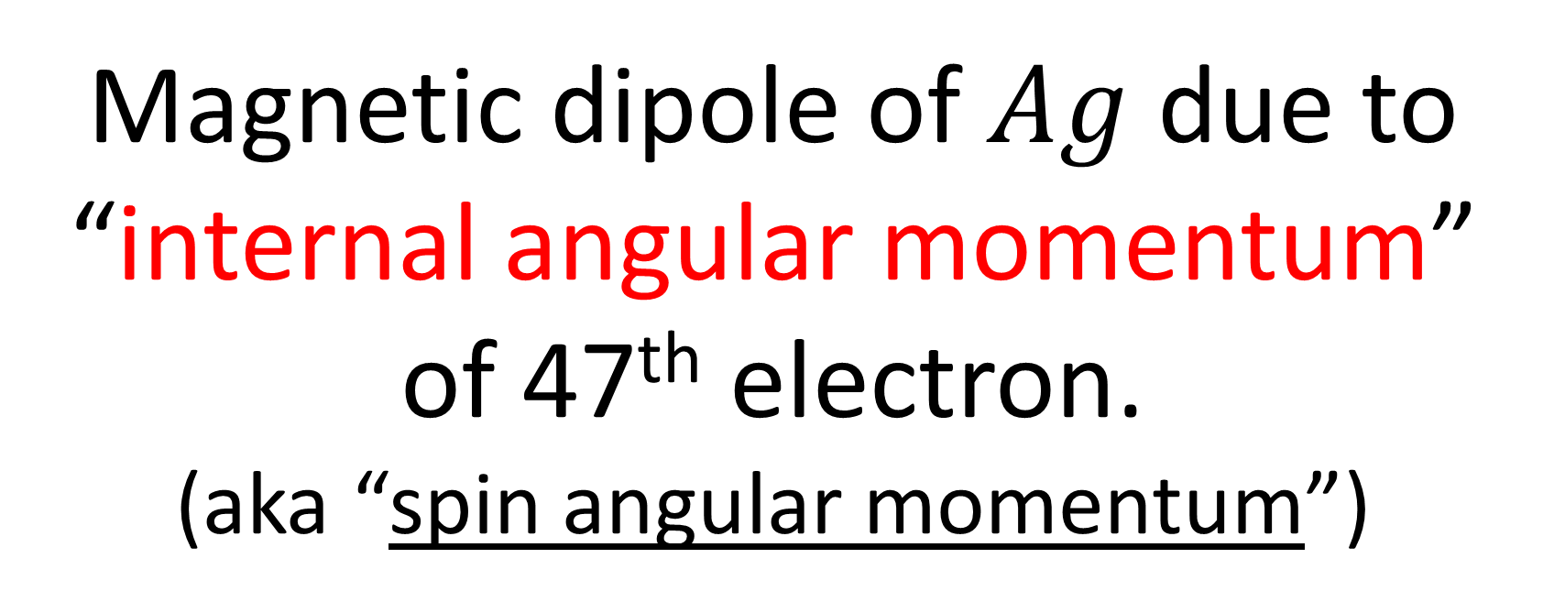
Magnetic dipole of $Ag$ due to “internal angular momentum”
of 47th electron.
(aka “spin angular momentum”)
$$5s$$
wavefunction
-

Slide 15
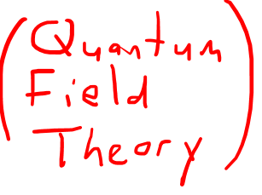
Matter Orbital Angular Momentum
Light Orbital Angular Momentum
(material with index-of-refraction gradient)
+
-
Matter Internal Angular Momentum?
Light Internal Angular Momentum
-
Credit link in description (Dave3457 on Wikipedia)

Slide 16
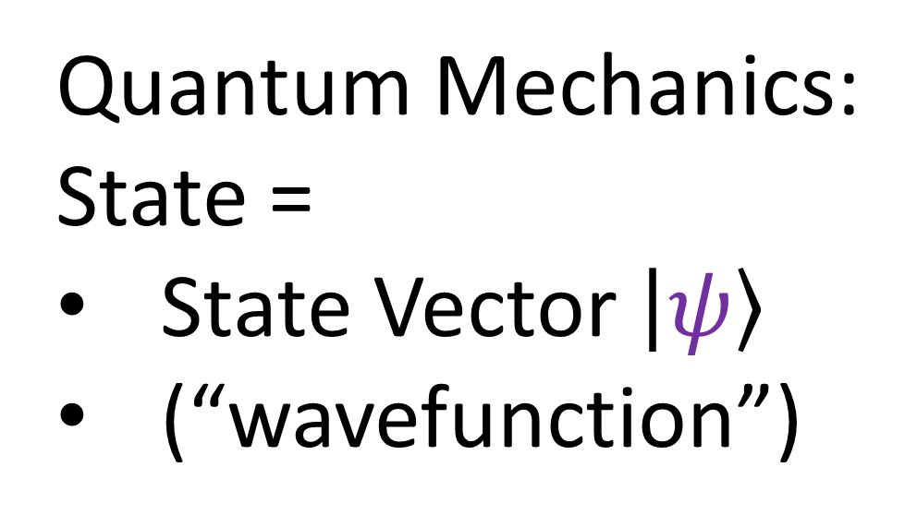

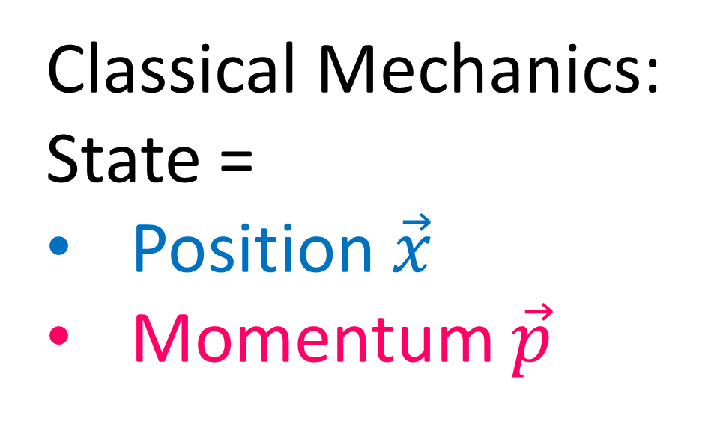
Classical Mechanics:
State =
Position $\vec{x}$
Momentum $\vec{p}$
Quantum Mechanics:
State =
State Vector $\left|ψ\right\rangle$
(“wavefunction”)
$$≈$$

Slide 17

Light Orbital Angular Momentum
Matter Orbital Angular Momentum
(material with index-of-refraction gradient)
+
-
Light Internal Angular Momentum
Matter Internal Angular Momentum?
-
Credit link in description (Dave3457 on Wikipedia)

Slide 18
Stern-Gerlach Experiment:
(S.G. experiment)
“spin iiup”
$$\left|↑\right\rangle$$
S
N
$$\left|↓\right\rangle$$
beam of neutral particles (e.g. silver atoms)
magnetic field
(inhomogeneous)
“spin down”

Slide 19
Stern-Gerlach Experiment:
(S.G. experiment)
S
S
N
N

Slide 20
Stern-Gerlach Experiment:
(S.G. experiment)
“spin iiup”
$$\left|↑\right\rangle$$
N
S
$$\left|↓\right\rangle$$
beam of neutral particles (e.g. silver atoms)
magnetic field
“spin down”

Slide 21
In Classical Mechanics, we represent the classical particle states as position + momentum
In Quantum Mechanics, we represent the quantum states of particles as vectors:

Slide 22
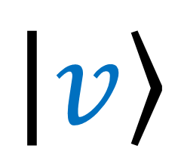


Standard Vector notation:
$$\vec{v}$$
$$\left|v\right\rangle$$
Quantum “ket” Vector notation:
$$\left\langle v\right|$$
Quantum “bra” Vector notation:
dual vector
covector
linear functional
linear form
one-form
Machine that eats a vector, outputs a scalar.

Slide 23

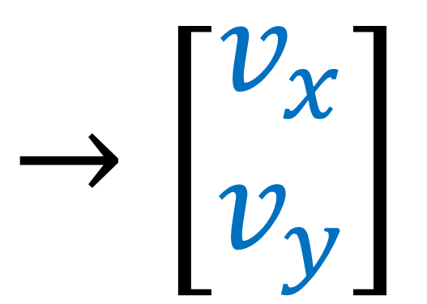

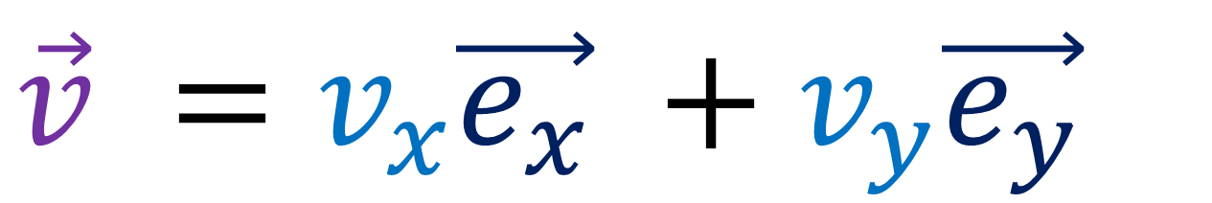
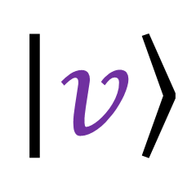
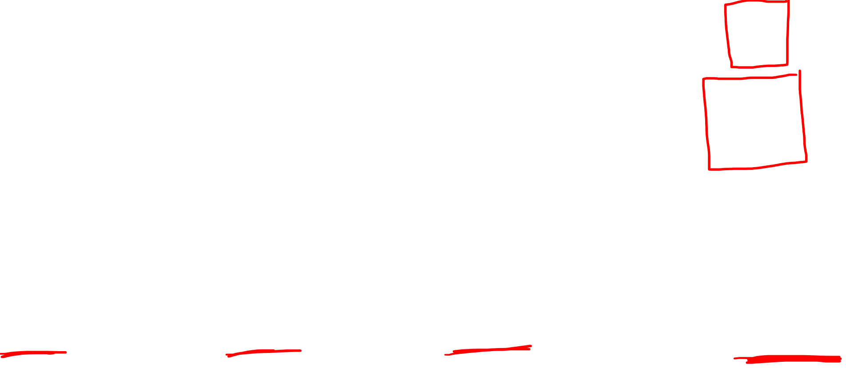
In Quantum Mechanics, we represent the quantum states of particles as vectors:
Standard Vector notation:
$$\vec{v}$$
$$\left|v\right\rangle$$
Quantum “ket” Vector notation:
$$\vec{v} =v_{x}\vec{e_{x}} +v_{y}\vec{e_{y}}$$
$→\left[\begin{aligned}v_{x} \\ v_{y}\end{aligned}\right]$
$$\left|v\right\rangle =v_{x}\left|e_{x}\right\rangle +v_{y}\left|e_{y}\right\rangle$$

Slide 24
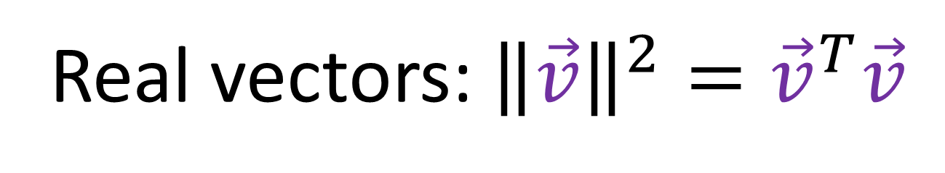
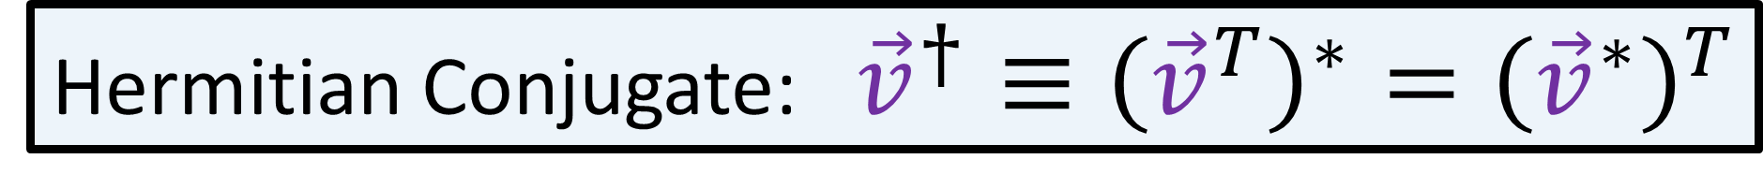
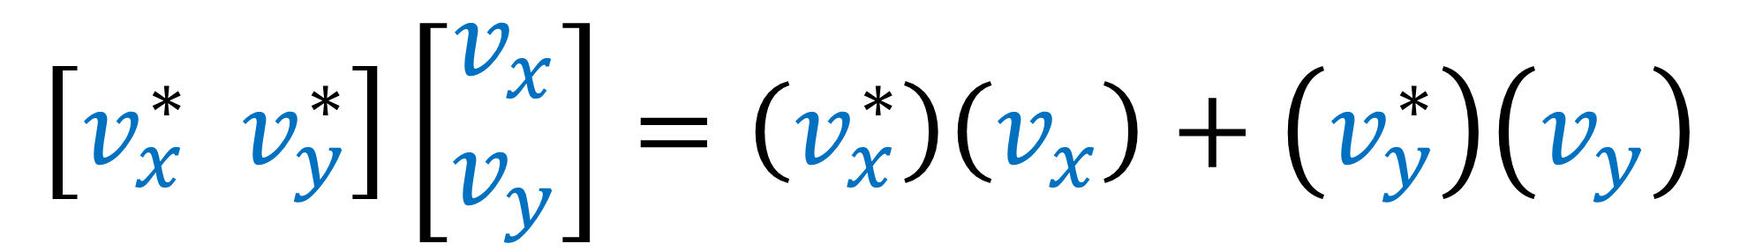
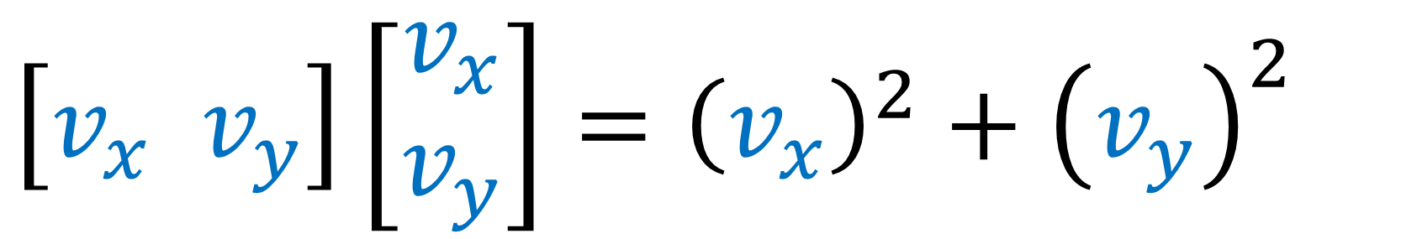
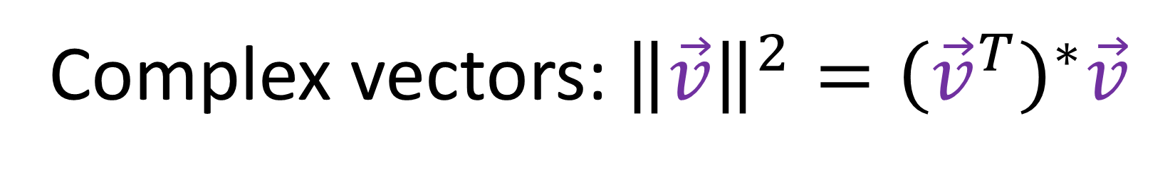
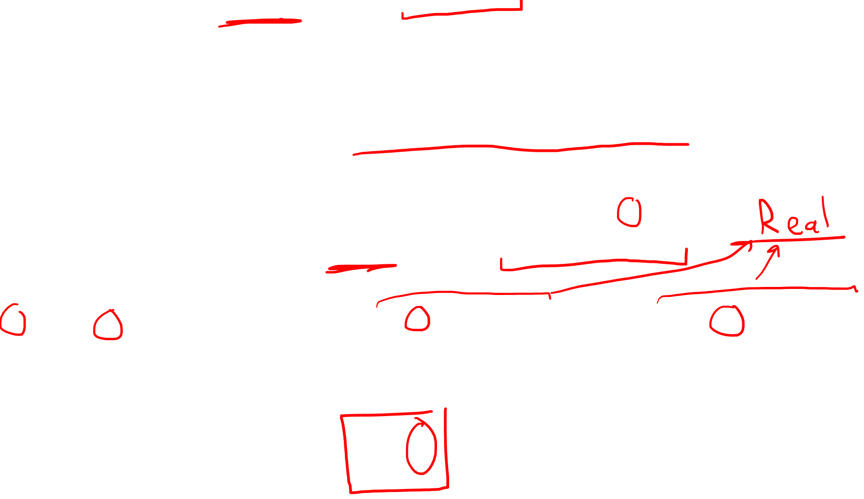
Real vectors: ${\left\|\vec{v}\right\|}^{2}={\vec{v}}^{T}\vec{v}$
$\left[v_{x} v_{y}\right]\left[\begin{aligned}v_{x} \\ v_{y}\end{aligned}\right]={\left(v_{x}\right)}^{2}+{\left(v_{y}\right)}^{2}$
Complex vectors: ${\left\|\vec{v}\right\|}^{2}={\left({\vec{v}}^{T}\right)}^{∗}\vec{v}$
$$\left[v_{x}^{∗} v_{y}^{∗}\right]\left[\begin{aligned}v_{x} \\ v_{y}\end{aligned}\right]=\left(v_{x}^{∗}\right)\left(v_{x}\right)+\left(v_{y}^{∗}\right)\left(v_{y}\right)$$
Hermitian Conjugate: ${\vec{v}}^{†}≡{\left({\vec{v}}^{T}\right)}^{∗}={\left({\vec{v}}^{∗}\right)}^{T}$

Slide 25

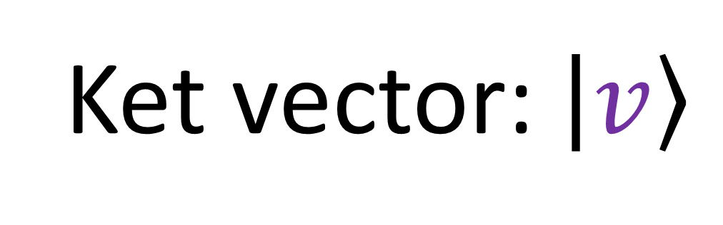

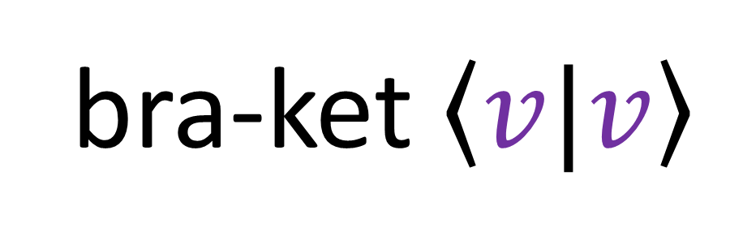
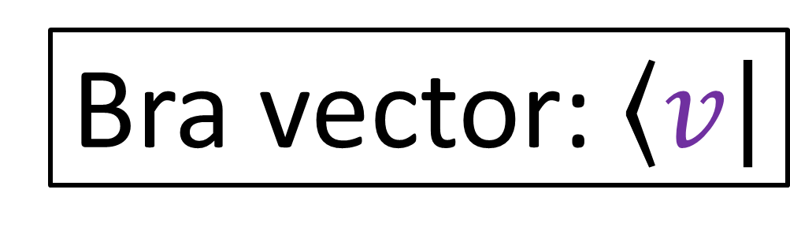


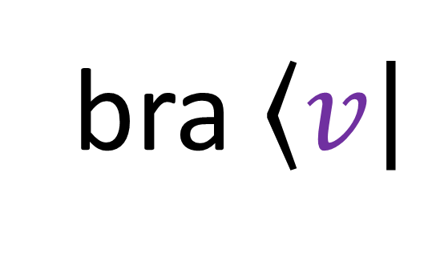
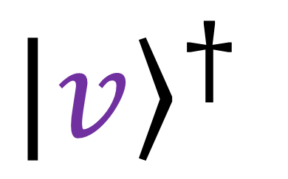

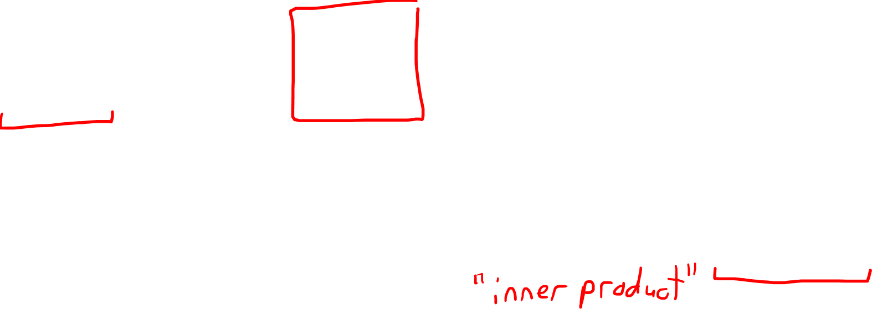
Ket vector: $\left|v\right\rangle$
Bra vector: $\left\langle v\right|$
Also Called:
dual vector
covector
linear functional
linear form
one-form
${\left|v\right\rangle }^{†}$
$$≡\left\langle v\right|$$
ket $\left|v\right\rangle$
bra $\left\langle v\right|$
bra-ket $\left\langle v|v\right\rangle$
$$\left[\begin{aligned}v_{x} \\ v_{y}\end{aligned}\right]$$
$$\left[v_{x}^{∗} v_{y}^{∗}\right]\left[\begin{aligned}v_{x} \\ v_{y}\end{aligned}\right]$$
$$\left[v_{x}^{∗} v_{y}^{∗}\right]$$

Slide 26

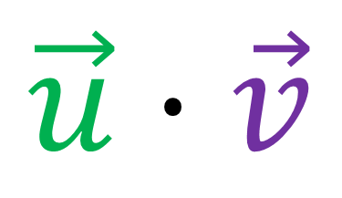
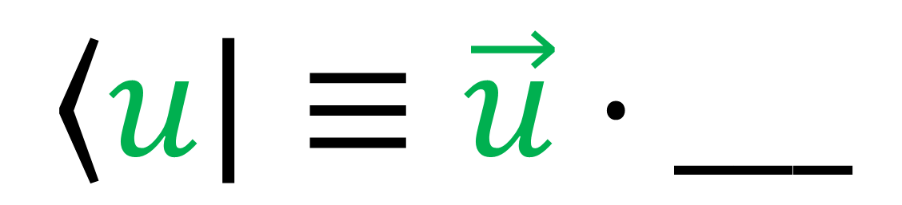
$$\vec{u}⋅\vec{v}$$
Standard inner product notation:
$$\left\langle \vec{u}|\vec{v}\right\rangle$$
“bra-ket” inner product notation:
$$\left\langle u\right|≡\vec{u}⋅___$$

Slide 27
Wavefunction Collapse
Quantum
Superposition
Measurement
Collapse to one state

Slide 28
Wavefunction Collapse
Quantum
Superposition
$$\left|ψ\right\rangle =α_{1}\left|e_{1}\right\rangle +α_{2}\left|e_{2}\right\rangle +α_{3}\left|e_{3}\right\rangle +α_{4}\left|e_{4}\right\rangle$$
Probability amplitudes for each possible state

Slide 29


$$\left|ψ\right\rangle =α_{↑}\left|↑\right\rangle +α_{↓}\left|↓\right\rangle$$
“spin iiup”
$$\left|↑\right\rangle$$
S
N
$$\left|↓\right\rangle$$
beam of neutral particles (e.g. silver atoms)
magnetic field
(inhomogeneous)
“spin down”

Slide 30
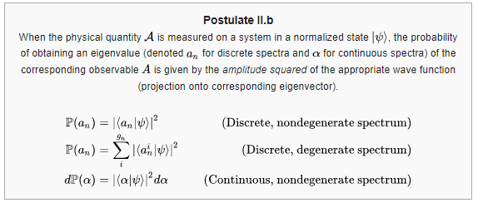


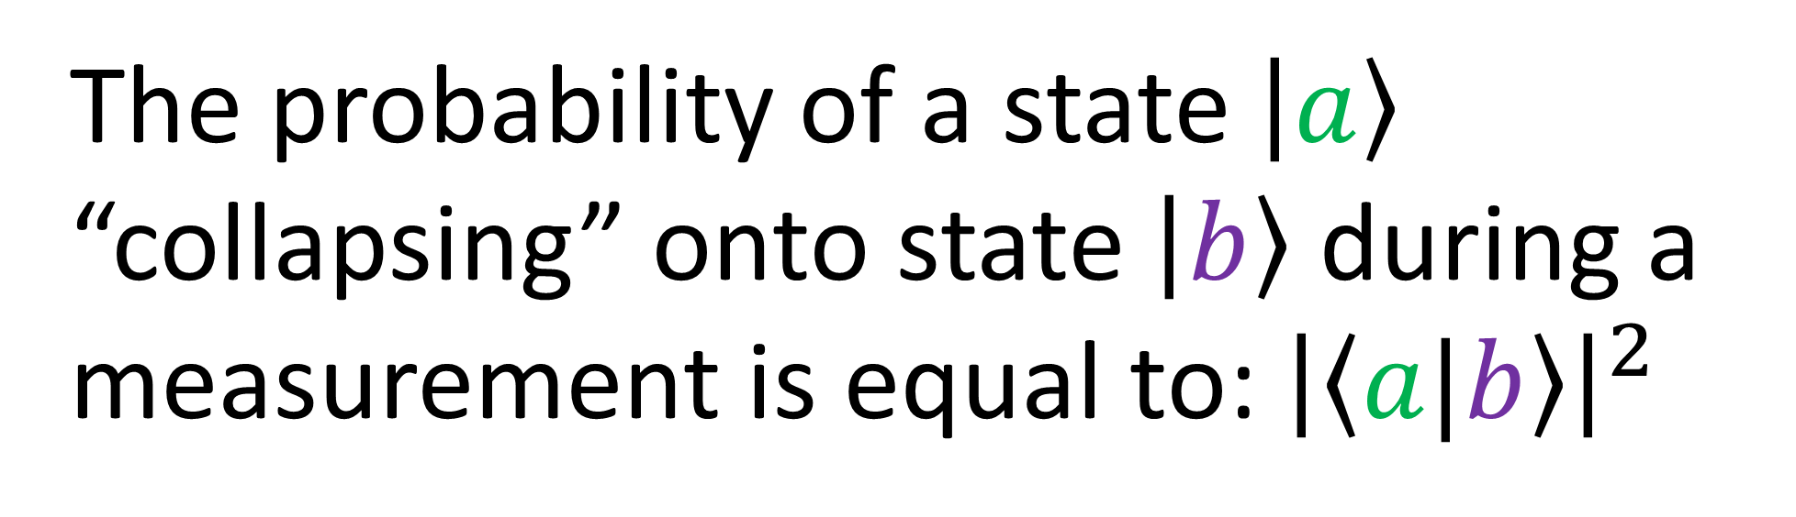
Born’s Rule (simplified):
The probability of a state $\left|a\right\rangle$
“collapsing” onto state $\left|b\right\rangle$ during a
measurement is equal to: ${\left|\left\langle a|b\right\rangle \right|}^{2}$
$$P\left(a⇒b\right)={\left|\left\langle a|b\right\rangle \right|}^{2}$$

Slide 31


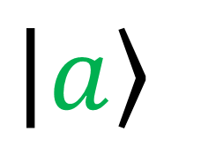




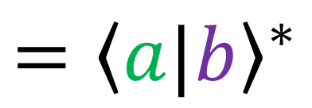
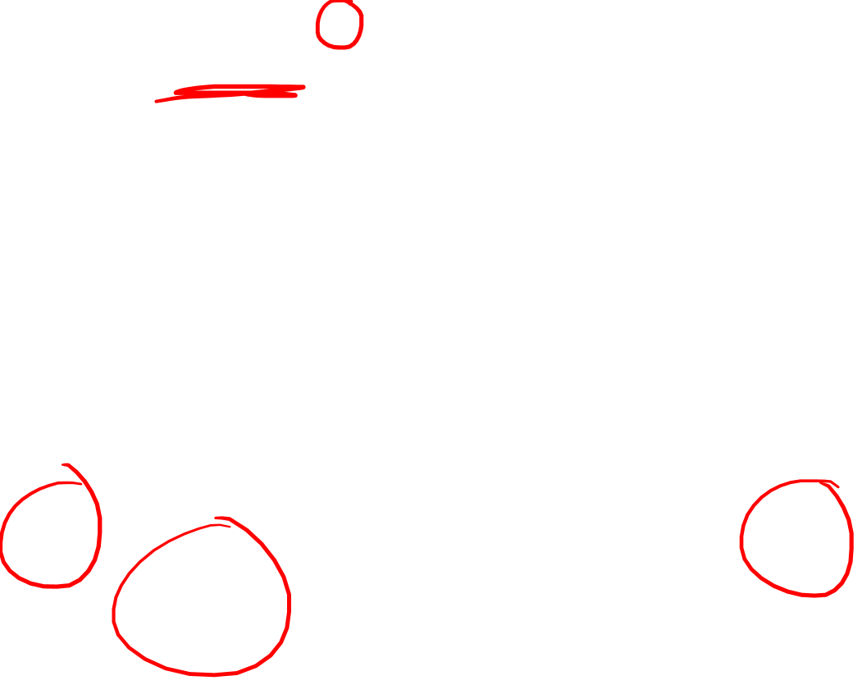
$$\left|a\right\rangle$$
$$\left|a\right\rangle$$
$$\left\langle b|a\right\rangle$$
$={\left\langle a|b\right\rangle }^{∗}$
$$\left|b\right\rangle$$
$$\left|b\right\rangle$$
$\left\langle a|b\right\rangle$
$${\left|\left\langle a|b\right\rangle \right|}^{2}={\left|\left\langle b|a\right\rangle \right|}^{2}$$

Slide 32
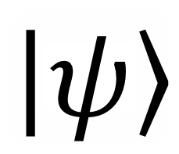



Stern-Gerlach Experiment:
(S.G. experiment)
S
$$\left|↑\right\rangle$$
$$\left|ψ\right\rangle$$
N
S
N
$$\left|↓\right\rangle$$

Slide 33


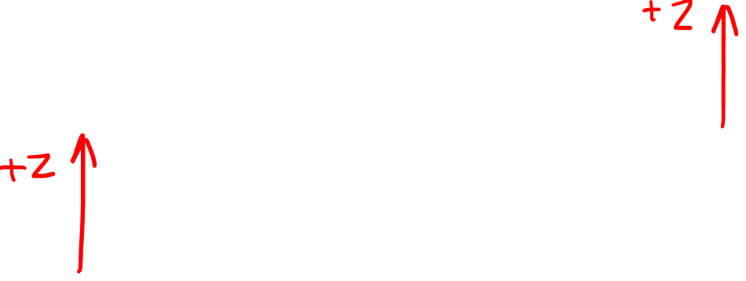
Stern-Gerlach Experiment:
(S.G. experiment)
S.G.
$$\left|↑\right\rangle$$
$Z$
$$\left|ψ\right\rangle$$
S.G.
$Z$
$$\left|↓\right\rangle$$

Slide 34
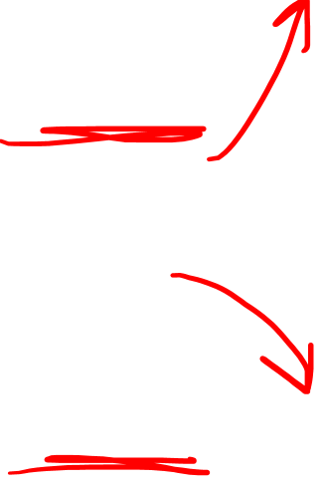

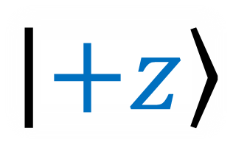
Stern-Gerlach Experiment:
(S.G. experiment)
S.G.
$$\left|+z\right\rangle$$
$Z$
$$\left|ψ\right\rangle$$
S.G.
$Z$
$$\left|−z\right\rangle$$

Slide 35
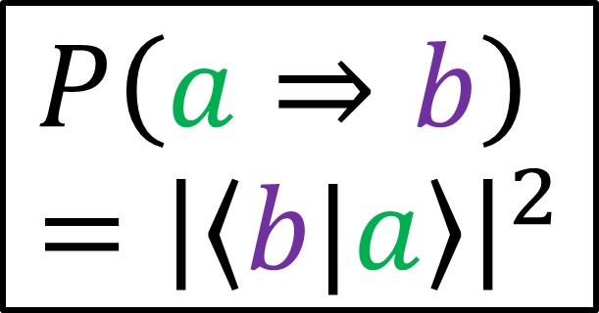
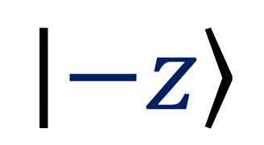




$$P\left(a⇒b\right)={\left|\left\langle b|a\right\rangle \right|}^{2}$$
$$P\left(+z⇒+z\right)$$
$$={\left|\left\langle +z|+z\right\rangle \right|}^{2}=1$$
$$\left|+z\right\rangle$$
S.G.
$$\left|+z\right\rangle$$
$Z$
$$\left|ψ\right\rangle$$
S.G.
$$\left|−z\right\rangle$$
$Z$
$$P\left(+z⇒−z\right)$$
$$={\left|\left\langle −z|+z\right\rangle \right|}^{2}=0$$
$$\left|−z\right\rangle$$

Slide 36








$$P\left(−z⇒+z\right)$$
$$={\left|\left\langle +z|−z\right\rangle \right|}^{2}=0$$
$$\left|ψ\right\rangle$$
S.G.
$Z$
$$\left|+z\right\rangle$$
S.G.
$Z$
$$\left|−z\right\rangle$$
$$\left|−z\right\rangle$$
$$P\left(a⇒b\right)={\left|\left\langle b|a\right\rangle \right|}^{2}$$
$$P\left(−z⇒−z\right)$$
$$={\left|\left\langle −z|−z\right\rangle \right|}^{2}=1$$

Slide 37




$P\left(+z⇒+z\right)={\left|\left\langle +z|+z\right\rangle \right|}^{2}=1$
means that $\left\|\left|+z\right\rangle \right\|=1$
$$P\left(−z⇒−z\right)={\left|\left\langle −z|−z\right\rangle \right|}^{2}=1$$
means that $\left\|\left|−z\right\rangle \right\|=1$
$$P\left(+z⇒−z\right)={\left|\left\langle −z|+z\right\rangle \right|}^{2}=0$$
$$P\left(−z⇒+z\right)={\left|\left\langle +z|−z\right\rangle \right|}^{2}=0$$
ortho-gonal
$\left|+z\right\rangle$ and $\left|−z\right\rangle$ are “orthogonal” vectors

Slide 38





Quantum State Space
Physical Space
$$\left|+z\right\rangle$$
$$+z$$
$$\left|−z\right\rangle$$
$$−z$$

Slide 39
Stern-Gerlach Experiment:
(S.G. experiment)
S
$$\left|ψ\right\rangle$$
N
S
N

Slide 40


Stern-Gerlach Experiment:
(S.G. experiment)
S
N
$$+x$$
$$\left|ψ\right\rangle$$
S
N
$$+x$$

Slide 41









$$P\left(a⇒b\right)={\left|\left\langle b|a\right\rangle \right|}^{2}$$
$$P\left(+x⇒+x\right)$$
$$={\left|\left\langle +x|+x\right\rangle \right|}^{2}=1$$
$$\left|+x\right\rangle$$
S.G.
$$\left|+x\right\rangle$$
$X$
$$\left|ψ\right\rangle$$
S.G.
$$\left|−x\right\rangle$$
$X$
$$P\left(+x⇒−x\right)$$
$$={\left|\left\langle −x|+x\right\rangle \right|}^{2}=0$$
$$\left|−x\right\rangle$$

Slide 42






$$P\left(−x⇒+x\right)$$
$$={\left|\left\langle +x|−x\right\rangle \right|}^{2}=0$$
$$\left|ψ\right\rangle$$
S.G.
$X$
$$\left|+x\right\rangle$$
S.G.
$X$
$$\left|−x\right\rangle$$
$$\left|−x\right\rangle$$
$$P\left(a⇒b\right)={\left|\left\langle b|a\right\rangle \right|}^{2}$$
$$P\left(−x⇒−x\right)$$
$$={\left|\left\langle −x|−x\right\rangle \right|}^{2}=1$$

Slide 43




$P\left(+x⇒+x\right)={\left|\left\langle +x|+x\right\rangle \right|}^{2}=1$
means that $\left\|\left|+x\right\rangle \right\|=1$
$$P\left(−x⇒−x\right)={\left|\left\langle −x|−x\right\rangle \right|}^{2}=1$$
means that $\left\|\left|−x\right\rangle \right\|=1$
$$P\left(+x⇒−x\right)={\left|\left\langle −x|+x\right\rangle \right|}^{2}=0$$
$$P\left(−x⇒+x\right)={\left|\left\langle +x|−x\right\rangle \right|}^{2}=0$$
ortho-gonal
$\left|+x\right\rangle$ and $\left|−x\right\rangle$ are “orthogonal” vectors

Slide 44
Stern-Gerlach Experiment:
(S.G. experiment)
S
$$\left|ψ\right\rangle$$
N
S
N

Slide 45

Stern-Gerlach Experiment:
(S.G. experiment)
S
$$+z$$
$$\left|ψ\right\rangle$$
N
S
N
$$+x$$

Slide 46








$$P\left(a⇒b\right)={\left|\left\langle b|a\right\rangle \right|}^{2}$$
$$P\left(+x⇒+z\right)$$
$$={\left|\left\langle +z|+x\right\rangle \right|}^{2}=\text{½}$$
$$\left|+z\right\rangle$$
$$\left|+x\right\rangle$$
S.G.
$$+z$$
$Z$
$$\left|ψ\right\rangle$$
S.G.
$$\left|−z\right\rangle$$
$X$
$$+x$$
$$P\left(+x⇒−z\right)$$
$$={\left|\left\langle −z|+x\right\rangle \right|}^{2}=\text{½}$$

Slide 47







$$P\left(−x⇒+z\right)$$
$$={\left|\left\langle +z|−x\right\rangle \right|}^{2}=\text{½}$$
$$\left|ψ\right\rangle$$
S.G.
$$\left|+z\right\rangle$$
$X$
$$+x$$
S.G.
$$+z$$
$Z$
$$\left|−x\right\rangle$$
$$\left|−z\right\rangle$$
$$P\left(a⇒b\right)={\left|\left\langle b|a\right\rangle \right|}^{2}$$
$$P\left(−x⇒−z\right)$$
$$={\left|\left\langle −z|−x\right\rangle \right|}^{2}=\text{½}$$

Slide 48







$$\left|+x\right\rangle$$
$$\left|−x\right\rangle$$
collapse
collapse
$$\left|+z\right\rangle$$
$$\left|−z\right\rangle$$
$$\left|+z\right\rangle$$
$$\left|−z\right\rangle$$
$$\left|+x\right\rangle =α\left|+z\right\rangle +β\left|−z\right\rangle$$
Probability amplitudes

Slide 49







Born Rule Results:
$\left|+x\right\rangle =\frac{1}{\sqrt{2}}\left|+z\right\rangle +\frac{1}{\sqrt{2}}\left|−z\right\rangle$
$${\left|\left\langle +z|+x\right\rangle \right|}^{2}=\text{½}$$
$${\left|\left\langle −z|+x\right\rangle \right|}^{2}=\text{½}$$
$${\left|\left\langle +z|−x\right\rangle \right|}^{2}=\text{½}$$
$${\left|\left\langle −z|−x\right\rangle \right|}^{2}=\text{½}$$
$\left\langle +z|+x\right\rangle =\frac{1}{\sqrt{2}}\left\langle +z|+z\right\rangle +\frac{1}{\sqrt{2}}\left\langle +z|−z\right\rangle$
$\left\langle +z|+x\right\rangle =\frac{1}{\sqrt{2}}\left(1\right)+\frac{1}{\sqrt{2}}\left(0\right)$
${\left|\left\langle +z|+x\right\rangle \right|}^{2}={\left|\frac{1}{\sqrt{2}}\right|}^{2}=\frac{1}{2}$
$\left\langle −z|+x\right\rangle =\frac{1}{\sqrt{2}}\left\langle −z|+z\right\rangle +\frac{1}{\sqrt{2}}\left\langle −z|−z\right\rangle$
$\left\langle −z|+x\right\rangle =\frac{1}{\sqrt{2}}\left(0\right)+\frac{1}{\sqrt{2}}\left(1\right)$
${\left|\left\langle −z|+x\right\rangle \right|}^{2}={\left|\frac{1}{\sqrt{2}}\right|}^{2}=\frac{1}{2}$
$${\left|\left\langle +x|+x\right\rangle \right|}^{2}=\text{1}$$
$${\left|\left\langle −x|−x\right\rangle \right|}^{2}=1$$
$${\left|\left\langle +x|−x\right\rangle \right|}^{2}=0$$
$\left|−x\right\rangle =\frac{1}{\sqrt{2}}\left|+z\right\rangle −\frac{1}{\sqrt{2}}\left|−z\right\rangle$

Slide 50




Born Rule Results:
$\left|−x\right\rangle =\frac{1}{\sqrt{2}}\left|+z\right\rangle −\frac{1}{\sqrt{2}}\left|−z\right\rangle$
$${\left|\left\langle +z|+x\right\rangle \right|}^{2}=\text{½}$$
$${\left|\left\langle −z|+x\right\rangle \right|}^{2}=\text{½}$$
$${\left|\left\langle +z|−x\right\rangle \right|}^{2}=\text{½}$$
$${\left|\left\langle −z|−x\right\rangle \right|}^{2}=\text{½}$$
$\left\langle +z|−x\right\rangle =\frac{1}{\sqrt{2}}\left\langle +z|+z\right\rangle −\frac{1}{\sqrt{2}}\left\langle +z|−z\right\rangle$
$\left\langle +z|−x\right\rangle =\frac{1}{\sqrt{2}}\left(1\right)−\frac{1}{\sqrt{2}}\left(0\right)$
${\left|\left\langle +z|−x\right\rangle \right|}^{2}={\left|\frac{1}{\sqrt{2}}\right|}^{2}=\frac{1}{2}$
$\left\langle −z|−x\right\rangle =\frac{1}{\sqrt{2}}\left\langle −z|+z\right\rangle −\frac{1}{\sqrt{2}}\left\langle −z|−z\right\rangle$
$\left\langle −z|−x\right\rangle =\frac{1}{\sqrt{2}}\left(0\right)−\frac{1}{\sqrt{2}}\left(1\right)$
${\left|\left\langle −z|−x\right\rangle \right|}^{2}={\left|−\frac{1}{\sqrt{2}}\right|}^{2}=\frac{1}{2}$
$${\left|\left\langle +x|+x\right\rangle \right|}^{2}=\text{1}$$
$${\left|\left\langle −x|−x\right\rangle \right|}^{2}=1$$
$${\left|\left\langle +x|−x\right\rangle \right|}^{2}=0$$

Slide 51




Born Rule Results:
$\left|+x\right\rangle =\frac{1}{\sqrt{2}}\left|+z\right\rangle +\frac{1}{\sqrt{2}}\left|−z\right\rangle$
$\left|−x\right\rangle =\frac{1}{\sqrt{2}}\left|+z\right\rangle −\frac{1}{\sqrt{2}}\left|−z\right\rangle$
$${\left|\left\langle +z|+x\right\rangle \right|}^{2}=\text{½}$$
$${\left|\left\langle −z|+x\right\rangle \right|}^{2}=\text{½}$$
$${\left|\left\langle +z|−x\right\rangle \right|}^{2}=\text{½}$$
$${\left|\left\langle −z|−x\right\rangle \right|}^{2}=\text{½}$$
$\left\langle +x|−x\right\rangle$
$=\left(\left\langle +z\right|\frac{1}{\sqrt{2}}+\left\langle −z\right|\frac{1}{\sqrt{2}}\right)\left(\frac{1}{\sqrt{2}}\left|+z\right\rangle −\frac{1}{\sqrt{2}}\left|−z\right\rangle \right)$
$=\frac{1}{\sqrt{2}}\frac{1}{\sqrt{2}}\left\langle +z|+z\right\rangle +\frac{1}{\sqrt{2}}\left(−\frac{1}{\sqrt{2}}\right)\left\langle +z|−z\right\rangle$ $+\frac{1}{\sqrt{2}}\frac{1}{\sqrt{2}}\left\langle −z|+z\right\rangle +\frac{1}{\sqrt{2}}\left(−\frac{1}{\sqrt{2}}\right)\left\langle −z|−z\right\rangle$
$=\frac{1}{2}+0+0−\frac{1}{2}$
$=0$
$${\left|\left\langle +x|+x\right\rangle \right|}^{2}=\text{1}$$
$${\left|\left\langle −x|−x\right\rangle \right|}^{2}=1$$
$${\left|\left\langle +x|−x\right\rangle \right|}^{2}=0$$
Left as exercise:
$${\left|\left\langle +x|+x\right\rangle \right|}^{2}=\text{1}$$
$${\left|\left\langle −x|−x\right\rangle \right|}^{2}=1$$

Slide 52







$\left|+x\right\rangle =\frac{1}{\sqrt{2}}\left|+z\right\rangle +\frac{1}{\sqrt{2}}\left|−z\right\rangle$
$\left|−x\right\rangle =\frac{1}{\sqrt{2}}\left|+z\right\rangle −\frac{1}{\sqrt{2}}\left|−z\right\rangle$
$\left|↙\right\rangle =\frac{1}{\sqrt{2}}\left|↑\right\rangle −\frac{1}{\sqrt{2}}\left|↓\right\rangle$
$\left|↗\right\rangle =\frac{1}{\sqrt{2}}\left|↑\right\rangle +\frac{1}{\sqrt{2}}\left|↓\right\rangle$
$$\left|↓\right\rangle$$
$$\left|↙\right\rangle$$
$$\left|↗\right\rangle$$
$$\left|↑\right\rangle$$
Quantum Spin State Space

Slide 53










Quantum State Space
Physical Space
$$\left|+z\right\rangle$$
$$+z$$
$$\left|+x\right\rangle$$
$$\left|−z\right\rangle$$
$$−x$$
$$+x$$
$$\left|−x\right\rangle$$
$\left|+x\right\rangle =\frac{1}{\sqrt{2}}\left|+z\right\rangle +\frac{1}{\sqrt{2}}\left|−z\right\rangle$
$\left|−x\right\rangle =\frac{1}{\sqrt{2}}\left|+z\right\rangle −\frac{1}{\sqrt{2}}\left|−z\right\rangle$
$$−z$$

Slide 54
Quantum State Space
Physical Space
$$\left|+z\right\rangle$$
$$+z$$
$$\left|+x\right\rangle$$
$$\left|−z\right\rangle$$
$$−x$$
$$+x$$
$$\left|−x\right\rangle$$
$\left|+x\right\rangle =\frac{1}{\sqrt{2}}\left|+z\right\rangle +\frac{1}{\sqrt{2}}\left|−z\right\rangle$
$\left|−x\right\rangle =\frac{1}{\sqrt{2}}\left|+z\right\rangle −\frac{1}{\sqrt{2}}\left|−z\right\rangle$
$$−z$$

Slide 55








$$P\left(a⇒b\right)={\left|\left\langle b|a\right\rangle \right|}^{2}$$
$$P\left(+y⇒+y\right)$$
$$={\left|\left\langle +y|+y\right\rangle \right|}^{2}=1$$
$$\left|+y\right\rangle$$
S.G.
$$\left|+y\right\rangle$$
$Y$
$$\left|ψ\right\rangle$$
S.G.
$$\left|−y\right\rangle$$
$Y$
$$P\left(+y⇒−y\right)$$
$$={\left|\left\langle −y|+y\right\rangle \right|}^{2}=0$$
$$\left|−y\right\rangle$$

Slide 56





$$P\left(−y⇒+y\right)$$
$$={\left|\left\langle +y|−y\right\rangle \right|}^{2}=0$$
$$\left|ψ\right\rangle$$
S.G.
$Y$
$$\left|+y\right\rangle$$
S.G.
$Y$
$$\left|−y\right\rangle$$
$$\left|−y\right\rangle$$
$$P\left(a⇒b\right)={\left|\left\langle b|a\right\rangle \right|}^{2}$$
$$P\left(−y⇒−y\right)$$
$$={\left|\left\langle −y|−y\right\rangle \right|}^{2}=1$$

Slide 57




$$P\left(a⇒b\right)={\left|\left\langle b|a\right\rangle \right|}^{2}$$
$$P\left(+y⇒+z\right)$$
$$={\left|\left\langle +z|+y\right\rangle \right|}^{2}=\text{½}$$
$$\left|+z\right\rangle$$
$$\left|+y\right\rangle$$
S.G.
$$+z$$
$Z$
$$\left|ψ\right\rangle$$
S.G.
$$\left|−z\right\rangle$$
$Y$
$$+y$$
$$P\left(+y⇒−z\right)$$
$$={\left|\left\langle −z|+y\right\rangle \right|}^{2}=\text{½}$$

Slide 58





$$P\left(−y⇒+z\right)$$
$$={\left|\left\langle +z|−y\right\rangle \right|}^{2}=\text{½}$$
$$\left|ψ\right\rangle$$
S.G.
$$\left|+z\right\rangle$$
$Y$
$$+y$$
S.G.
$$+z$$
$Z$
$$\left|−y\right\rangle$$
$$\left|−z\right\rangle$$
$$P\left(a⇒b\right)={\left|\left\langle b|a\right\rangle \right|}^{2}$$
$$P\left(−y⇒−z\right)$$
$$={\left|\left\langle −z|−y\right\rangle \right|}^{2}=\text{½}$$

Slide 59




$$\left|+y\right\rangle$$
$$\left|−y\right\rangle$$
collapse
collapse
$$\left|+z\right\rangle$$
$$\left|−z\right\rangle$$
$$\left|+z\right\rangle$$
$$\left|−z\right\rangle$$
$$\left|+y\right\rangle =α\left|+z\right\rangle +β\left|−z\right\rangle$$
$$\left|−y\right\rangle =γ\left|+z\right\rangle +δ\left|−z\right\rangle$$

Slide 60



$$P\left(a⇒b\right)={\left|\left\langle b|a\right\rangle \right|}^{2}$$
$$P\left(+y⇒+z\right)$$
$$={\left|\left\langle +z|+y\right\rangle \right|}^{2}=\text{½}$$
$$\left|+z\right\rangle$$
$$\left|+y\right\rangle$$
S.G.
$$+z$$
$Z$
$$\left|ψ\right\rangle$$
S.G.
$$\left|−z\right\rangle$$
$Y$
$$+y$$
$$P\left(+y⇒−z\right)$$
$$={\left|\left\langle −z|+y\right\rangle \right|}^{2}=\text{½}$$

Slide 61



$$P\left(−y⇒+z\right)$$
$$={\left|\left\langle +z|−y\right\rangle \right|}^{2}=\text{½}$$
$$\left|ψ\right\rangle$$
S.G.
$$\left|+z\right\rangle$$
$Y$
$$+y$$
S.G.
$$+z$$
$Z$
$$\left|−y\right\rangle$$
$$\left|−z\right\rangle$$
$$P\left(a⇒b\right)={\left|\left\langle b|a\right\rangle \right|}^{2}$$
$$P\left(−y⇒−z\right)$$
$$={\left|\left\langle −z|−y\right\rangle \right|}^{2}=\text{½}$$

Slide 62





Born Rule Results:
$${\left|\left\langle +z|+y\right\rangle \right|}^{2}=\text{½}$$
$${\left|\left\langle −z|+y\right\rangle \right|}^{2}=\text{½}$$
$${\left|\left\langle +z|−y\right\rangle \right|}^{2}=\text{½}$$
$${\left|\left\langle −z|−y\right\rangle \right|}^{2}=\text{½}$$
$$\left|+y\right\rangle =α\left|+z\right\rangle +β\left|−z\right\rangle$$
$$\left|−y\right\rangle =γ\left|+z\right\rangle +δ\left|−z\right\rangle$$
$\left|+x\right\rangle =\frac{1}{\sqrt{2}}\left|+z\right\rangle +\frac{1}{\sqrt{2}}\left|−z\right\rangle$
$\left|−x\right\rangle =\frac{1}{\sqrt{2}}\left|+z\right\rangle −\frac{1}{\sqrt{2}}\left|−z\right\rangle$
$${\left|\left\langle +y|+y\right\rangle \right|}^{2}=\text{1}$$
$${\left|\left\langle −y|−y\right\rangle \right|}^{2}=1$$
$${\left|\left\langle +y|−y\right\rangle \right|}^{2}=0$$

Slide 63




Born Rule Results:
$\left|+y\right\rangle =\frac{1}{\sqrt{2}}\left|+z\right\rangle +\frac{i}{\sqrt{2}}\left|−z\right\rangle$
$${\left|\left\langle +z|+y\right\rangle \right|}^{2}=\text{½}$$
$${\left|\left\langle −z|+y\right\rangle \right|}^{2}=\text{½}$$
$${\left|\left\langle +z|−y\right\rangle \right|}^{2}=\text{½}$$
$${\left|\left\langle −z|−y\right\rangle \right|}^{2}=\text{½}$$
$\left\langle +z|+y\right\rangle =\frac{1}{\sqrt{2}}\left\langle +z|+z\right\rangle +\frac{i}{\sqrt{2}}\left\langle +z|−z\right\rangle$
$\left\langle +z|+y\right\rangle =\frac{1}{\sqrt{2}}\left(1\right)+\frac{i}{\sqrt{2}}\left(0\right)$
${\left|\left\langle +z|+y\right\rangle \right|}^{2}={\left|\frac{1}{\sqrt{2}}\right|}^{2}={\left(\frac{1}{\sqrt{2}}\right)}^{∗}\left(\frac{1}{\sqrt{2}}\right)=\frac{1}{2}$
$\left\langle −z|+y\right\rangle =\frac{1}{\sqrt{2}}\left\langle −z|+z\right\rangle +\frac{i}{\sqrt{2}}\left\langle −z|−z\right\rangle$
$\left\langle −z|+y\right\rangle =\frac{1}{\sqrt{2}}\left(0\right)+\frac{i}{\sqrt{2}}\left(1\right)$
${\left|\left\langle −z|+y\right\rangle \right|}^{2}={\left|\frac{i}{\sqrt{2}}\right|}^{2}={\left(\frac{i}{\sqrt{2}}\right)}^{∗}\left(\frac{i}{\sqrt{2}}\right)=\frac{1}{2}$
$${\left|\left\langle +y|+y\right\rangle \right|}^{2}=\text{1}$$
$${\left|\left\langle −y|−y\right\rangle \right|}^{2}=1$$
$${\left|\left\langle +y|−y\right\rangle \right|}^{2}=0$$

Slide 64




Born Rule Results:
$\left|−y\right\rangle =\frac{1}{\sqrt{2}}\left|+z\right\rangle −\frac{i}{\sqrt{2}}\left|−z\right\rangle$
$${\left|\left\langle +z|+y\right\rangle \right|}^{2}=\text{½}$$
$${\left|\left\langle −z|+y\right\rangle \right|}^{2}=\text{½}$$
$${\left|\left\langle +z|−y\right\rangle \right|}^{2}=\text{½}$$
$${\left|\left\langle −z|−y\right\rangle \right|}^{2}=\text{½}$$
$\left\langle +z|−y\right\rangle =\frac{1}{\sqrt{2}}\left\langle +z|+z\right\rangle −\frac{i}{\sqrt{2}}\left\langle +z|−z\right\rangle$
$\left\langle +z|−y\right\rangle =\frac{1}{\sqrt{2}}\left(1\right)−\frac{i}{\sqrt{2}}\left(0\right)$
${\left|\left\langle +z|−y\right\rangle \right|}^{2}={\left|\frac{1}{\sqrt{2}}\right|}^{2}={\left(\frac{1}{\sqrt{2}}\right)}^{∗}\left(\frac{1}{\sqrt{2}}\right)=\frac{1}{2}$
$\left\langle −z|−y\right\rangle =\frac{1}{\sqrt{2}}\left\langle −z|+z\right\rangle −\frac{i}{\sqrt{2}}\left\langle −z|−z\right\rangle$
$\left\langle −z|−y\right\rangle =\frac{1}{\sqrt{2}}\left(0\right)−\frac{i}{\sqrt{2}}\left(1\right)$
${\left|\left\langle −z|−y\right\rangle \right|}^{2}=$ ${\left|−\frac{i}{\sqrt{2}}\right|}^{2}={\left(−\frac{i}{\sqrt{2}}\right)}^{∗}\left(−\frac{i}{\sqrt{2}}\right)$ $=\frac{1}{2}$
$${\left|\left\langle +y|+y\right\rangle \right|}^{2}=\text{1}$$
$${\left|\left\langle −y|−y\right\rangle \right|}^{2}=1$$
$${\left|\left\langle +y|−y\right\rangle \right|}^{2}=0$$

Slide 65




Born Rule Results:
$\left|+y\right\rangle =\frac{1}{\sqrt{2}}\left|+z\right\rangle +\frac{i}{\sqrt{2}}\left|−z\right\rangle$
$\left|−y\right\rangle =\frac{1}{\sqrt{2}}\left|+z\right\rangle −\frac{i}{\sqrt{2}}\left|−z\right\rangle$
$${\left|\left\langle +z|+y\right\rangle \right|}^{2}=\text{½}$$
$${\left|\left\langle −z|+y\right\rangle \right|}^{2}=\text{½}$$
$${\left|\left\langle +z|−y\right\rangle \right|}^{2}=\text{½}$$
$${\left|\left\langle −z|−y\right\rangle \right|}^{2}=\text{½}$$
$\left\langle +y|−y\right\rangle$
$=\left(\left\langle +z\right|\frac{1}{\sqrt{2}}−\left\langle −z\right|\frac{i}{\sqrt{2}}\right)\left(\frac{1}{\sqrt{2}}\left|+z\right\rangle −\frac{i}{\sqrt{2}}\left|−z\right\rangle \right)$
$=\frac{1}{\sqrt{2}}\frac{1}{\sqrt{2}}\left\langle +z|+z\right\rangle +\frac{1}{\sqrt{2}}\left(−\frac{i}{\sqrt{2}}\right)\left\langle +z|−z\right\rangle$ $+\left(−\frac{i}{\sqrt{2}}\right)\frac{1}{\sqrt{2}}\left\langle −z|+z\right\rangle +\left(−\frac{i}{\sqrt{2}}\right)\left(−\frac{i}{\sqrt{2}}\right)\left\langle −z|−z\right\rangle$
$=\frac{1}{2}+0+0+\frac{i^{2}}{2}$
$=0$
$${\left|\left\langle +y|+y\right\rangle \right|}^{2}=\text{1}$$
$${\left|\left\langle −y|−y\right\rangle \right|}^{2}=1$$
$${\left|\left\langle +y|−y\right\rangle \right|}^{2}=0$$
Can also be shown:
$${\left|\left\langle +y|+y\right\rangle \right|}^{2}=\text{1}$$
$${\left|\left\langle −y|−y\right\rangle \right|}^{2}=1$$

Slide 66


Exercise: Show that…
$\left|+x\right\rangle =\frac{1}{\sqrt{2}}\left|+z\right\rangle +\frac{1}{\sqrt{2}}\left|−z\right\rangle$
$\left|−x\right\rangle =\frac{1}{\sqrt{2}}\left|+z\right\rangle −\frac{1}{\sqrt{2}}\left|−z\right\rangle$
$\left|+y\right\rangle =\frac{1}{\sqrt{2}}\left|+z\right\rangle +\frac{i}{\sqrt{2}}\left|−z\right\rangle$
$\left|−y\right\rangle =\frac{1}{\sqrt{2}}\left|+z\right\rangle −\frac{i}{\sqrt{2}}\left|−z\right\rangle$
$${\left|\left\langle +x|+y\right\rangle \right|}^{2}=\text{½}$$
$${\left|\left\langle −x|+y\right\rangle \right|}^{2}=\text{½}$$
$${\left|\left\langle +x|−y\right\rangle \right|}^{2}=\text{½}$$
$${\left|\left\langle −x|−y\right\rangle \right|}^{2}=\text{½}$$
What does this mean in terms of the results of the corresponding Stern Gerlach experiments?

Slide 67






$\vec{H}→\left[\begin{aligned}1 \\ 0\end{aligned}\right]$
$\vec{V}→\left[\begin{aligned}0 \\ 1\end{aligned}\right]$
$\left|+z\right\rangle →\left[\begin{aligned}1 \\ 0\end{aligned}\right]$
$\left|−z\right\rangle →\left[\begin{aligned}0 \\ 1\end{aligned}\right]$
$\vec{D}=\frac{1}{\sqrt{2}}\vec{H}+\frac{1}{\sqrt{2}}\vec{V}$
$\vec{A}=\frac{1}{\sqrt{2}}\vec{H}−\frac{1}{\sqrt{2}}\vec{V}$
$\vec{L}=\frac{1}{\sqrt{2}}\vec{H}+\frac{i}{\sqrt{2}}\vec{V}$
$\vec{R}=\frac{1}{\sqrt{2}}\vec{H}−\frac{i}{\sqrt{2}}\vec{V}$
$\left|+x\right\rangle =\frac{1}{\sqrt{2}}\left|+z\right\rangle +\frac{1}{\sqrt{2}}\left|−z\right\rangle$
$\left|−x\right\rangle =\frac{1}{\sqrt{2}}\left|+z\right\rangle −\frac{1}{\sqrt{2}}\left|−z\right\rangle$
$\left|+y\right\rangle =\frac{1}{\sqrt{2}}\left|+z\right\rangle +\frac{i}{\sqrt{2}}\left|−z\right\rangle$
$\left|−y\right\rangle =\frac{1}{\sqrt{2}}\left|+z\right\rangle −\frac{i}{\sqrt{2}}\left|−z\right\rangle$

Slide 68

“Dictionary” between Jones Vectors
and Quantum Spin States:
$$\vec{H}$$ | $$\vec{V}$$ | $$\vec{D}$$ | $$\vec{A}$$ | $$\vec{L}$$ | $$\vec{R}$$
$$↕$$ | $$↕$$ | $$↕$$ | $$↕$$ | $$↕$$ | $$↕$$
$$\left|+z\right\rangle$$ | $$\left|−z\right\rangle$$ | $$\left|+x\right\rangle$$ | $$\left|−x\right\rangle$$ | $$\left|+y\right\rangle$$ | $$\left|−y\right\rangle$$

Slide 69















Bloch Sphere
Poincaré Sphere
$$z$$
$$\vec{H}$$
$$\left|+z\right\rangle$$
$$y$$
$$\vec{A}$$
$$\left|−x\right\rangle$$
$$x$$
$$\vec{R}$$
$$\vec{L}$$
$$\left|−y\right\rangle$$
$$\left|+y\right\rangle$$
$$\vec{D}$$
$$\left|+x\right\rangle$$
$$\vec{V}$$
$$\left|−z\right\rangle$$

Slide 70






$$y$$
Poincaré Sphere
$$\vec{H}$$
$$x$$
$$\vec{A}$$
$$\vec{R}$$
$$\vec{L}$$
$$\vec{D}$$
$$\vec{J}$$
$\vec{J}=\frac{\sqrt{3}}{2}\vec{H}+\frac{i}{2}\vec{V}$
$$\vec{V}$$

Slide 71



Bloch Sphere
$$z$$
$$z$$
$$\left|+z\right\rangle$$
$$y$$
$$y$$
$$\left|−x\right\rangle$$
N
$$x$$
$$x$$
$$\left|−y\right\rangle$$
$$\left|+y\right\rangle$$
S
$$\left|+x\right\rangle$$
$\left|ψ\right\rangle =\frac{\sqrt{3}}{2}\left|+z\right\rangle +\frac{i}{2}\left|−z\right\rangle$
$$\left|ψ\right\rangle$$
$$\left|−z\right\rangle$$

Slide 72







Poincaré Sphere
$$H$$
Key idea: not changing lengths of Jones vectors on sphere.
$$D$$
$$R$$
$$L$$
$$A$$
$$V$$

Slide 73

Poincaré Sphere
$$H$$
Key idea: not changing lengths of Jones vectors on sphere.
$$D$$
$$R$$
$$L$$
$$A$$
$$V$$

Slide 74


Poincaré Sphere
$$H$$
Key idea: not changing lengths of Jones vectors on sphere.
$$D$$
$$R$$
$$L$$
$U(2)$ matrices
(unitary $2×2$)
represent rotations on the Poincaré Sphere
$$A$$
$$V$$

Slide 75






Bloch Sphere
Key idea: not changing lengths of vectors on sphere.
$$\left|+z\right\rangle$$
$$\left|−x\right\rangle$$
$$\left|−y\right\rangle$$
$$\left|+y\right\rangle$$
$$\left|+x\right\rangle$$
$$\left|−z\right\rangle$$

Slide 76
Bloch Sphere
Key idea: not changing lengths of vectors on sphere.
$$\left|+z\right\rangle$$
$$\left|−x\right\rangle$$
$$\left|−y\right\rangle$$
$$\left|+y\right\rangle$$
$$\left|+x\right\rangle$$
$$\left|−z\right\rangle$$

Slide 77

Bloch Sphere
Key idea: not changing lengths of vectors on sphere.
$$\left|+z\right\rangle$$
$$\left|−x\right\rangle$$
$$\left|−y\right\rangle$$
$$\left|+y\right\rangle$$
$U(2)$ matrices
(unitary $2×2$)
represent rotations on the Bloch Sphere
$$\left|+x\right\rangle$$
$$\left|−z\right\rangle$$

Slide 78

Bloch Sphere
Key idea: not changing lengths of vectors on sphere.
$$\left|+z\right\rangle$$
$$\left|−x\right\rangle$$
$$\left|−y\right\rangle$$
$$\left|+y\right\rangle$$
$U(2)$ matrices
(unitary $2×2$)
represent rotations on the Bloch Sphere
$$\left|+x\right\rangle$$
$$\left|−z\right\rangle$$

Slide 79








$$\left|ψ\right\rangle →U\left|ψ\right\rangle$$
Rotation Matrix $U$
Rotations don’t change vector lengths!
$${\left\|\left|ψ\right\rangle \right\|}^{2}={\left(\left|ψ\right\rangle \right)}^{†}\left|ψ\right\rangle →{\left\|U\left|ψ\right\rangle \right\|}^{2}={\left(U\left|ψ\right\rangle \right)}^{†}U\left|ψ\right\rangle$$
$${\left(\left|ψ\right\rangle \right)}^{†}\left|ψ\right\rangle ={\left(\left|ψ\right\rangle \right)}^{†}U^{†}U\left|ψ\right\rangle$$
$${\left(AB\right)}^{†}=B^{†}A^{†}$$
$$\left\langle ψ|ψ\right\rangle = \left\langle ψ\right|U^{†}U\left|ψ\right\rangle$$
$$U^{−1}=U^{†}$$
$$=I$$
identity

Slide 80



$$\left|ψ\right\rangle →U\left|ψ\right\rangle$$
Rotation Matrix $U$
$$U^{−1}=U^{†}$$
2x2 Unitary Matrices: $U(2)$
$U(2)$ is too general…

Slide 81




Born’s Rule: $P\left(a⇒b\right)={\left|\left\langle a|b\right\rangle \right|}^{2}$
$\left|a\right\rangle =a_{1}\left|+z\right\rangle +a_{2}\left|−z\right\rangle$
$\left|b\right\rangle =b_{1}\left|+z\right\rangle +b_{2}\left|−z\right\rangle$
$${\left|\left\langle a|b\right\rangle \right|}^{2}={\left| \left(\left\langle +z\right|a_{1}^{∗}+\left\langle −z\right|a_{2}^{∗}\right) \left(b_{1}\left|+z\right\rangle +b_{2}\left|−z\right\rangle \right) \right|}^{2}$$
$$={\left|\begin{aligned}a_{1}^{∗}b_{1}\left\langle +z|+z\right\rangle +a_{2}^{∗}b_{1}\left\langle −z|+z\right\rangle \\ +a_{1}^{∗}b_{2}\left\langle −z|+z\right\rangle +a_{2}^{∗}b_{2}\left\langle −z|−z\right\rangle \end{aligned}\right|}^{2}$$
$$={\left|a_{1}^{∗}b_{1}+a_{2}^{∗}b_{2}\right|}^{2}$$

Slide 82





Born’s Rule: $P\left(a⇒b\right)={\left|\left\langle a|b\right\rangle \right|}^{2}$
$\left|a\right\rangle = a_{1}\left|+z\right\rangle +a_{2}\left|−z\right\rangle$
$$e^{iθ}\left|b\right\rangle =e^{iθ}\left(b_{1}\left|+z\right\rangle +b_{2}\left|−z\right\rangle \right)$$
$${\left|\left\langle a\right|e^{iθ}\left|b\right\rangle \right|}^{2}={\left|\left(\left\langle +z\right|a_{1}^{∗}+\left\langle −z\right|a_{2}^{∗}\right)e^{iθ}\left(b_{1}\left|+z\right\rangle +b_{2}\left|−z\right\rangle \right)\right|}^{2}$$
$$={\left|\begin{aligned}a_{1}^{∗}b_{1}e^{iθ}\left\langle +z|+z\right\rangle +a_{2}^{∗}b_{1}e^{iθ}\left\langle −z|+z\right\rangle \\ +a_{1}^{∗}b_{2}e^{iθ}\left\langle −z|+z\right\rangle +a_{2}^{∗}b_{2}e^{iθ}\left\langle −z|−z\right\rangle \end{aligned}\right|}^{2}$$
$={\left|e^{iθ}\left(a_{1}^{∗}b_{1}+a_{2}^{∗}b_{2}\right)\right|}^{2}={{\left|e^{iθ}\right|}^{2}\left|\left(a_{1}^{∗}b_{1}+a_{2}^{∗}b_{2}\right)\right|}^{2}$
$${\left|e^{iθ}\right|}^{2}={\left(e^{iθ}\right)}^{∗} \left(e^{iθ}\right)=e^{−iθ}e^{iθ}=e^{−iθ+iθ}=1$$

Slide 83









Born’s Rule: $P\left(a⇒b\right)={\left|\left\langle a|b\right\rangle \right|}^{2}$
$$\left|b\right\rangle →e^{iθ}\left|b\right\rangle$$
$$i$$
$$Im$$
$P\left(a⇒e^{iθ}b\right)={\left|\left\langle a\right|e^{iθ}\left|b\right\rangle \right|}^{2}$
$P\left(a⇒e^{iθ}b\right)={\left|e^{iθ}\left\langle a|b\right\rangle \right|}^{2}$
$P\left(a⇒e^{iθ}b\right)={\left|e^{iθ}\right|}^{2}{\left|\left\langle a|b\right\rangle \right|}^{2}$
$$P\left(a⇒e^{iθ}b\right)={\left|\left\langle a|b\right\rangle \right|}^{2}=P\left(a⇒b\right)$$
$${\left(e^{iθ}\right)}^{∗}\left(e^{iθ}\right)$$
$$=\left(e^{−iθ}\right)\left(e^{iθ}\right)$$
$$=e^{−iθ+iθ}=1$$
$$Re$$
$$−1$$
$$1$$
$$−i$$

Slide 84
Born’s Rule: $P\left(a⇒b\right)={\left|\left\langle a|b\right\rangle \right|}^{2}$
$\left|a\right\rangle = a_{1}\left|+z\right\rangle +a_{2}\left|−z\right\rangle$
$$e^{iθ}\left|b\right\rangle =e^{iθ}\left(b_{1}\left|+z\right\rangle +b_{2}\left|−z\right\rangle \right)$$
$${\left|\left\langle a\right|e^{iθ}\left|b\right\rangle \right|}^{2}={\left|\left(\left\langle +z\right|a_{1}^{∗}+\left\langle −z\right|a_{2}^{∗}\right)e^{iθ}\left(b_{1}\left|+z\right\rangle +b_{2}\left|−z\right\rangle \right)\right|}^{2}$$
$$={\left|\begin{aligned}a_{1}^{∗}b_{1}e^{iθ}\left\langle +z|+z\right\rangle +a_{2}^{∗}b_{1}e^{iθ}\left\langle −z|+z\right\rangle \\ +a_{1}^{∗}b_{2}e^{iθ}\left\langle −z|+z\right\rangle +a_{2}^{∗}b_{2}e^{iθ}\left\langle −z|−z\right\rangle \end{aligned}\right|}^{2}$$
$={\left|e^{iθ}\left(a_{1}^{∗}b_{1}+a_{2}^{∗}b_{2}\right)\right|}^{2}={{\left|e^{iθ}\right|}^{2}\left|\left(a_{1}^{∗}b_{1}+a_{2}^{∗}b_{2}\right)\right|}^{2}$
$${\left|e^{iθ}\right|}^{2}={\left(e^{iθ}\right)}^{∗} \left(e^{iθ}\right)=e^{−iθ}e^{iθ}=e^{−iθ+iθ}=1$$

Slide 85










Born’s Rule: $P\left(a⇒b\right)={\left|\left\langle a|b\right\rangle \right|}^{2}$
$$\left|b\right\rangle →e^{iθ}\left|b\right\rangle$$
$P\left(a⇒e^{iθ}b\right)={\left|\left\langle a\right|e^{iθ}\left|b\right\rangle \right|}^{2}={\left|e^{iθ}\left\langle a|b\right\rangle \right|}^{2}$
$$={\left|e^{iθ}\left\langle a|b\right\rangle \right|}^{2}={\left|e^{iθ}\right|}^{2}{\left|\left\langle a|b\right\rangle \right|}^{2}={\left|\left\langle a|b\right\rangle \right|}^{2}$$
$$i$$
$$Im$$
$${\left|e^{iθ}\right|}^{2}={\left(e^{iθ}\right)}^{∗} \left(e^{iθ}\right)=e^{−iθ}e^{iθ}=e^{−iθ+iθ}=1$$
$$Re$$
$$−1$$
$$1$$
$$−i$$

Slide 86
Born’s Rule: $P\left(a⇒b\right)={\left|\left\langle a|b\right\rangle \right|}^{2}$
$\left|a\right\rangle = a_{1}\left|+z\right\rangle +a_{2}\left|−z\right\rangle$
$$e^{iθ}\left|b\right\rangle =e^{iθ}\left(b_{1}\left|+z\right\rangle +b_{2}\left|−z\right\rangle \right)$$
$${\left|\left\langle a\right|e^{iθ}\left|b\right\rangle \right|}^{2}={\left|\left(\left\langle +z\right|a_{1}^{∗}+\left\langle −z\right|a_{2}^{∗}\right)e^{iθ}\left(b_{1}\left|+z\right\rangle +b_{2}\left|−z\right\rangle \right)\right|}^{2}$$
$$={\left|\begin{aligned}a_{1}^{∗}b_{1}e^{iθ}\left\langle +z|+z\right\rangle +a_{2}^{∗}b_{1}e^{iθ}\left\langle −z|+z\right\rangle \\ +a_{1}^{∗}b_{2}e^{iθ}\left\langle −z|+z\right\rangle +a_{2}^{∗}b_{2}e^{iθ}\left\langle −z|−z\right\rangle \end{aligned}\right|}^{2}$$
$={\left|e^{iθ}\left(a_{1}^{∗}b_{1}+a_{2}^{∗}b_{2}\right)\right|}^{2}={{\left|e^{iθ}\right|}^{2}\left|\left(a_{1}^{∗}b_{1}+a_{2}^{∗}b_{2}\right)\right|}^{2}$
$${\left|e^{iθ}\right|}^{2}={\left(e^{iθ}\right)}^{∗} \left(e^{iθ}\right)=e^{−iθ}e^{iθ}=e^{−iθ+iθ}=1$$

Slide 87





Born’s Rule: $P\left(a⇒b\right)={\left|\left\langle a|b\right\rangle \right|}^{2}$
$$\left|a\right\rangle →e^{iθ}\left|a\right\rangle$$
$${\left(e^{iθ}\left|a\right\rangle \right)}^{†}=\left\langle a\right|e^{−iθ}$$
$P\left(e^{iθ}a⇒b\right)={\left|\left(\left\langle a\right|e^{−iθ}\right)\left|b\right\rangle \right|}^{2}$ $={\left|e^{−iθ}\left\langle a|b\right\rangle \right|}^{2}$
$$={\left|e^{−iθ}\left\langle a|b\right\rangle \right|}^{2}={\left|e^{−iθ}\right|}^{2}{\left|\left\langle a|b\right\rangle \right|}^{2}={\left|\left\langle a|b\right\rangle \right|}^{2}$$
$$i$$
$$Im$$
$${\left|e^{−iθ}\right|}^{2}={\left(e^{−iθ}\right)}^{∗} \left(e^{−iθ}\right)=e^{iθ}e^{−iθ}=e^{iθ−iθ}=1$$
$$Re$$
$$−1$$
$$1$$
$$−i$$

Slide 88





















collapse
$$\left|b\right\rangle$$
$$P\left(a⇒b\right)={\left|\left\langle a|b\right\rangle \right|}^{2}$$
$$⇒$$
$$\left|a\right\rangle$$
$$⇒$$
$$\left|c\right\rangle$$
$$P\left(a⇒c\right)={\left|\left\langle a|c\right\rangle \right|}^{2}$$
$$⇒$$
$$\left|d\right\rangle$$
$$P\left(a⇒d\right)={\left|\left\langle a|d\right\rangle \right|}^{2}$$
collapse
$$\left|b\right\rangle$$
$$P\left(e^{iθ}a⇒b\right)={\left|\left\langle a|b\right\rangle \right|}^{2}$$
$$⇒$$
$$e^{iθ}\left|a\right\rangle$$
$$⇒$$
$$\left|c\right\rangle$$
$$P\left(e^{iθ}a⇒c\right)={\left|\left\langle a|c\right\rangle \right|}^{2}$$
$$⇒$$
$$\left|d\right\rangle$$
$$P\left(e^{iθ}a⇒d\right)={\left|\left\langle a|d\right\rangle \right|}^{2}$$

Slide 89


$\left|a\right\rangle ≈$ $e^{iθ}$ $\left|a\right\rangle$
No practical difference!

Slide 90












Scientist #1
Scientist #2
$$\left|a\right\rangle$$
$$e^{iθ}\left|a\right\rangle$$
$$⇒$$
$$⇒$$
$$⇒$$
$$⇒$$
$$\left|+z\right\rangle$$
$$\left|−z\right\rangle$$
$$\left|+z\right\rangle$$
$$\left|−z\right\rangle$$

Slide 91
$\left|a\right\rangle ≈$ $e^{iθ}$ $\left|a\right\rangle$
Represent the same physical state.

Slide 92

$\left|a\right\rangle ≈$ $e^{iθ}$ $\left|a\right\rangle$
$\left|a\right\rangle ≈i\left|a\right\rangle ≈−1\left|a\right\rangle ≈$ $e^{i\frac{3π}{8}}$ $\left|a\right\rangle$

Slide 93











$$\left|+y\right\rangle$$
$$\left|+x\right\rangle$$
$U(2)$ matrices
$$\left[\begin{matrix}1 & 0 \\ 0 & i\end{matrix}\right]$$
$$\left[\begin{aligned}1 \\ i\end{aligned}\right]$$
$$\left[\begin{aligned}1 \\ 1\end{aligned}\right]$$
$$e^{−i\frac{π}{4}}\left[\begin{aligned}1 \\ i\end{aligned}\right]$$
$$e^{−i\frac{π}{4}}\left[\begin{matrix}1 & 0 \\ 0 & i\end{matrix}\right]$$
$$e^{i\frac{π}{2}}\left[\begin{matrix}1 & 0 \\ 0 & i\end{matrix}\right]$$
$$e^{i\frac{π}{2}}\left[\begin{aligned}1 \\ i\end{aligned}\right]$$

Slide 94




Determinant
$U(2)$ matrices
$$\left[\begin{matrix}1 & 0 \\ 0 & i\end{matrix}\right]$$
$$\det{⇒}+i$$
$$e^{−i\frac{π}{4}}\left[\begin{matrix}1 & 0 \\ 0 & i\end{matrix}\right]$$
$$\det{⇒}+1$$
$$e^{i\frac{π}{2}}\left[\begin{matrix}1 & 0 \\ 0 & i\end{matrix}\right]$$
$$\det{⇒}−i$$

Slide 95



If $det\left[\begin{matrix}a & b \\ c & d\end{matrix}\right]=ad−bc=e^{iθ}$
Then $det\left(e^{−i\frac{θ}{2}}\left[\begin{matrix}a & b \\ c & d\end{matrix}\right]\right)$
$$=e^{−iθ/2}ae^{−iθ/2}d−e^{−iθ/2}be^{−iθ/2}c$$
$$=e^{−iθ}\left(ad−bc\right)=e^{−iθ}e^{iθ}=+1$$

Slide 96











$U(2)$ matrices ($U^{†}U=I$) don’t change ${\left\|\left|ψ\right\rangle \right\|}^{2}$
$$\det\left(U\right)=+1$$
$$\det\left(U\right)≠+1$$
$\frac{1}{\sqrt{2}} \left[\begin{matrix}1 & i \\ 1 & −i\end{matrix}\right]$
$$\frac{1}{\sqrt{2}}\left[\begin{matrix}1+i & 0 \\ 0 & 1−i\end{matrix}\right]$$
$$\left[\begin{matrix}1 & 0 \\ 0 & i\end{matrix}\right]$$
$$\left[\begin{matrix}i & 0 \\ 0 & −i\end{matrix}\right]$$
$$\left[\begin{matrix}i & 0 \\ 0 & i\end{matrix}\right]$$
$$\left[\begin{matrix}1 & 0 \\ 0 & −1\end{matrix}\right]$$
Special Unitary 2x2 Matrices $SU(2)$
(“special” $⇒\det{(U)}=+1$)

Slide 97








Quantum Spin States $≈$ Jones Vectors
2-component complex columns
Represented on a sphere
Rotate between points using $SU\left(2\right)$ matrices
Spinors ignore overall phases
$$\left|+z\right\rangle$$
$$\left|−x\right\rangle$$
$$\left|−y\right\rangle$$
$$\left|+y\right\rangle$$
$$\left|+x\right\rangle$$
$$\left|−z\right\rangle$$

Slide 98













Physical Space
$$\vec{V}$$
$$\vec{V}$$
Polarization Space
(Poincaré Sphere)
$$−\vec{H}$$
$$\vec{H}$$
$$−\vec{V}$$
$$\vec{H}$$
Quantum State Space
$$\left|↑\right\rangle$$
$$\left|↑\right\rangle$$
Physical Space
(Bloch Sphere)
$$−\left|↓\right\rangle$$
$$\left|↓\right\rangle$$
$$−\left|↑\right\rangle$$
$$\left|↓\right\rangle$$

Slide 99
Physical Space
$$\vec{V}$$
$$\vec{V}$$
Polarization Space
(Poincaré Sphere)
$$−\vec{H}$$
$$\vec{H}$$
$$−\vec{V}$$
$$\vec{H}$$
Quantum State Space
$$\left|↑\right\rangle$$
$$\left|↑\right\rangle$$
Physical Space
(Bloch Sphere)
$$−\left|↓\right\rangle$$
$$\left|↓\right\rangle$$
$$−\left|↑\right\rangle$$
$$\left|↓\right\rangle$$

Slide 100

Physical Space
$$\vec{V}$$
$$\vec{V}$$
Polarization Space
(Poincaré Sphere)
$$−\vec{H}$$
$$\vec{H}$$
$$−\vec{V}$$
$$\vec{H}$$
Quantum State Space
$$\left|↑\right\rangle$$
$$\left|↑\right\rangle$$
Physical Space
(Bloch Sphere)
$$−\left|↓\right\rangle$$
$$\left|↓\right\rangle$$
$$−\left|↑\right\rangle$$
$$\left|↓\right\rangle$$

Slide 101



Spinors $=2×1$ complex columns that transform with $SU\left(2\right)$ ?
$$\left[\begin{matrix} & \\ & \end{matrix}\right]\left[\begin{aligned}α \\ β\end{aligned}\right]$$
$$SU\left(2\right)$$

Slide 102







$$\left|+z\right\rangle$$
$$\left|−x\right\rangle$$
$$\left|−y\right\rangle$$
$$\left|+y\right\rangle$$
$$\left|+x\right\rangle$$
Flagpole Visualization
$$\left|−z\right\rangle$$

Slide 103



$$\left|+z\right\rangle$$
Spinors = elements of Complex Projective Line $ℂP^{1}$
$$\left|−x\right\rangle$$
$$\left|−y\right\rangle$$
$$\left|+y\right\rangle$$
$$\left|+x\right\rangle$$
Flagpole Visualization
$$\left|−z\right\rangle$$

Slide 104






$$H$$
$$D$$
$$R$$
$$L$$
$$A$$
Flagpole Visualization
$$V$$

Slide 105

$$H$$
Spinors = elements of Complex Projective Line $ℂP^{1}$
$$D$$
$$R$$
$$L$$
$$A$$
Flagpole Visualization
$$V$$

Slide 106
Poincaré Sphere
$$H$$
Key idea: not changing lengths of Jones vectors on sphere.
$$D$$
$$R$$
$$L$$
$$A$$
$$V$$

Slide 107
Poincaré Sphere
$$H$$
Key idea: not changing lengths of Jones vectors on sphere.
$$D$$
$$R$$
$$L$$
$U(2)$ matrices
(unitary $2×2$)
represent rotations on the Poincaré Sphere
$$A$$
$$V$$

Slide 108





$$\left|↑\right\rangle$$
$$P\left(ψ⇒φ\right)={\left|\left\langle φ|ψ\right\rangle \right|}^{2}$$
$$\left|ψ\right\rangle$$
N
$$\left|ψ\right\rangle =α\left|↑\right\rangle +β\left|↓\right\rangle$$
S
$$\left|↓\right\rangle$$

Slide 109


$$P\left(ψ⇒↑\right)={\left|\left\langle ↑|ψ\right\rangle \right|}^{2}$$
$$\left\langle ↑|ψ\right\rangle =\left\langle ↑\right|\left(α\left|↑\right\rangle +β\left|↓\right\rangle \right)$$
$$\left\langle ↑|ψ\right\rangle =α\left\langle ↑|↑\right\rangle +β\left\langle ↑|↓\right\rangle$$
$$\left\langle ↑|ψ\right\rangle =α$$
$$P\left(ψ⇒ ↑\right)={\left|\left\langle ↑|ψ\right\rangle \right|}^{2}={\left|α\right|}^{2}=α^{∗}α$$

Slide 110


$$P\left(ψ⇒↑\right)={\left|\left\langle ↓|ψ\right\rangle \right|}^{2}$$
$$\left\langle ↓|ψ\right\rangle =\left\langle ↓\right|\left(α\left|↑\right\rangle +β\left|↓\right\rangle \right)$$
$$\left\langle ↓|ψ\right\rangle =α\left\langle ↓|↑\right\rangle +β\left\langle ↓|↓\right\rangle$$
$$\left\langle ↓|ψ\right\rangle =β$$
$$P\left(ψ⇒ ↑\right)={\left|\left\langle ↑|ψ\right\rangle \right|}^{2}={\left|β\right|}^{2}=β^{∗}β$$

Slide 111

$$1=\left\langle ψ|ψ\right\rangle$$
$1=\left(\left\langle ↑\right|α^{∗}+\left\langle ↓\right|β^{∗}\right)\left(α\left|↑\right\rangle +β\left|↓\right\rangle \right)$
$$1=α^{∗}α\left\langle ↑|↑\right\rangle +α^{∗}β\left\langle ↑|↓\right\rangle +β^{∗}α\left\langle ↓|↑\right\rangle +β^{∗}β\left\langle ↓|↓\right\rangle$$
$$1=α^{∗}α+β^{∗}β$$
$$1={\left|α\right|}^{2}+{\left|β\right|}^{2}$$

Slide 112




$$P\left(+x⇒+x\right)={\left|\left\langle +x|+x\right\rangle \right|}^{2}=1$$
$$P\left(−x⇒−x\right)={\left|\left\langle −x|−x\right\rangle \right|}^{2}=1$$
$\left|+x\right\rangle$ and $\left|−x\right\rangle$ are “normalized” vectors
$$P\left(+x⇒−x\right)={\left|\left\langle −x|+x\right\rangle \right|}^{2}=0$$
$$P\left(−x⇒+x\right)={\left|\left\langle +x|−x\right\rangle \right|}^{2}=0$$
$\left|+x\right\rangle$ and $\left|−x\right\rangle$ are “orthogonal” vectors

Slide 113



$$P\left(+z⇒+x\right)={\left|\left\langle +x|+z\right\rangle \right|}^{2}=\text{½}$$
$$P\left(+z⇒−x\right)={\left|\left\langle −x|+z\right\rangle \right|}^{2}=\text{½}$$
$$P\left(+x⇒+z\right)={\left|\left\langle +z|+x\right\rangle \right|}^{2}=\text{½}$$
$$P\left(+x⇒−z\right)={\left|\left\langle −z|+x\right\rangle \right|}^{2}=\text{½}$$
$\left|+x\right\rangle = α\left|+z\right\rangle +β\left|−z\right\rangle$
$$\left\langle +z|+x\right\rangle =\left\langle +z\right|\left(α\left|+z\right\rangle +β\left|−z\right\rangle \right)$$
$\left\langle +z|+x\right\rangle =α\left\langle +z|+z\right\rangle +β\left\langle +z|−z\right\rangle$
$\left\langle +z|+x\right\rangle =α$
$$P\left(+x⇒+z\right)={\left|\left\langle +z|+x\right\rangle \right|}^{2}={\left|α\right|}^{2}\text{= }\text{½}$$

Slide 114

$$P\left(+z⇒+x\right)={\left|\left\langle +x|+z\right\rangle \right|}^{2}=\text{½}$$
$$P\left(+z⇒−x\right)={\left|\left\langle −x|+z\right\rangle \right|}^{2}=\text{½}$$
$$P\left(+x⇒+z\right)={\left|\left\langle +z|+x\right\rangle \right|}^{2}=\text{½}$$
$$P\left(+x⇒−z\right)={\left|\left\langle −z|+x\right\rangle \right|}^{2}=\text{½}$$
$\left|+x\right\rangle = α\left|+z\right\rangle +β\left|−z\right\rangle$
$$\left\langle −z|+x\right\rangle =\left\langle −z\right|\left(α\left|+z\right\rangle +β\left|−z\right\rangle \right)$$
$\left\langle −z|+x\right\rangle =α\left\langle −z|+z\right\rangle +β\left\langle −z|−z\right\rangle$
$\left\langle −z|+x\right\rangle =β$
$$P\left(+x⇒−z\right)={\left|\left\langle −z|+x\right\rangle \right|}^{2}={\left|β\right|}^{2}\text{= }\text{½}$$

Slide 115




$\left|+x\right\rangle =α\left|+z\right\rangle +β\left|−z\right\rangle$
Choose:
$α=\sqrt{1/2}$
$β=\sqrt{1/2}$
$$P\left(+x⇒+z\right)={\left|α\right|}^{2}\text{= }\text{½}$$
$$P\left(+x⇒−z\right)={\left|β\right|}^{2}\text{= }\text{½}$$
$\left|+x\right\rangle =\sqrt{1/2}\left|+z\right\rangle +\sqrt{1/2}\left|−z\right\rangle$

Slide 116




$\left|−x\right\rangle =γ\left|+z\right\rangle +δ\left|−z\right\rangle$
Choose:
$γ=+\sqrt{1/2}$
$δ=−\sqrt{1/2}$
$$P\left(−x⇒+z\right)={\left|γ\right|}^{2}\text{= }\text{½}$$
$$P\left(−x⇒−z\right)={\left|δ\right|}^{2}\text{= }\text{½}$$
$$P\left(+x⇒−x\right)={\left|\left\langle −x|+x\right\rangle \right|}^{2}\text{= 0}$$
$\left|−x\right\rangle =\sqrt{1/2}\left|+z\right\rangle −\sqrt{1/2}\left|−z\right\rangle$

Slide 117




$$P\left(↗ ⇒ ↗\right)={\left|\left\langle ↗|↗\right\rangle \right|}^{2}=1$$
$$P\left(↙ ⇒ ↙\right)={\left|\left\langle ↙|↙\right\rangle \right|}^{2}=1$$
$\left|↗\right\rangle$ and $\left|↙\right\rangle$ are “normalized” vectors
$$P\left(↗ ⇒ ↙\right)={\left|\left\langle ↙|↗\right\rangle \right|}^{2}=0$$
$$P\left(↙ ⇒ ↗\right)={\left|\left\langle ↗|↙\right\rangle \right|}^{2}=0$$
$\left|↗\right\rangle$ and $\left|↙\right\rangle$ are “orthogonal” vectors

Slide 118


$$P\left(+z⇒+x\right)={\left|\left\langle +x|+z\right\rangle \right|}^{2}=\text{½}$$
$$P\left(+z⇒−x\right)={\left|\left\langle −x|+z\right\rangle \right|}^{2}=\text{½}$$
$$P\left(↗ ⇒ ↑\right)={\left|\left\langle ↑|↗\right\rangle \right|}^{2}=\text{½}$$
$$P\left(↗ ⇒ ↓\right)={\left|\left\langle ↓|↗\right\rangle \right|}^{2}=\text{½}$$
$\left|↗\right\rangle = α\left|↑\right\rangle +β\left|↓\right\rangle$
$$\left\langle ↑|↗\right\rangle =\left\langle ↑\right|\left(α\left|↑\right\rangle +β\left|↓\right\rangle \right)$$
$\left\langle ↑|↗\right\rangle =α\left\langle ↑|↑\right\rangle +β\left\langle ↑|↓\right\rangle$
$\left\langle ↑|↗\right\rangle =α$
$$P\left(↗ ⇒ ↑\right)={\left|\left\langle ↑|↗\right\rangle \right|}^{2}={\left|α\right|}^{2}\text{= }\text{½}$$

Slide 119

$$P\left(+z⇒+x\right)={\left|\left\langle +x|+z\right\rangle \right|}^{2}=\text{½}$$
$$P\left(+z⇒−x\right)={\left|\left\langle −x|+z\right\rangle \right|}^{2}=\text{½}$$
$$P\left(↗ ⇒ ↑\right)={\left|\left\langle ↑|↗\right\rangle \right|}^{2}=\text{½}$$
$$P\left(↗ ⇒ ↓\right)={\left|\left\langle ↓|↗\right\rangle \right|}^{2}=\text{½}$$
$\left|↗\right\rangle = α\left|↑\right\rangle +β\left|↓\right\rangle$
$$\left\langle ↓|↗\right\rangle =\left\langle ↓\right|\left(α\left|↑\right\rangle +β\left|↓\right\rangle \right)$$
$\left\langle ↓|↗\right\rangle =α\left\langle ↓|↑\right\rangle +β\left\langle ↓|↓\right\rangle$
$\left\langle ↓|↗\right\rangle =β$
$$P\left(↗ ⇒ ↓\right)={\left|\left\langle ↓|↗\right\rangle \right|}^{2}={\left|β\right|}^{2}\text{= }\text{½}$$

Slide 120




$\left|↗\right\rangle =α\left|↑\right\rangle +β\left|↓\right\rangle$
Choose:
$α=\sqrt{1/2}$
$β=\sqrt{1/2}$
$$P\left(↗ ⇒ ↑\right)={\left|α\right|}^{2}\text{= }\text{½}$$
$$P\left(↗ ⇒ ↓\right)={\left|β\right|}^{2}\text{= }\text{½}$$
$\left|↗\right\rangle =\sqrt{1/2}\left|↑\right\rangle +\sqrt{1/2}\left|↓\right\rangle$

Slide 121




$\left|↙\right\rangle =γ\left|↑\right\rangle +δ\left|↓\right\rangle$
Result:
$γ=+\sqrt{1/2}$
$δ=−\sqrt{1/2}$
$$P\left(↙ ⇒ ↑\right)={\left|γ\right|}^{2}\text{= }\text{½}$$
$$P\left(↙ ⇒ ↓\right)={\left|δ\right|}^{2}\text{= }\text{½}$$
$$P\left(↗ ⇒ ↙\right)={\left|\left\langle ↙|↗\right\rangle \right|}^{2}\text{= 0}$$
$\left|↙\right\rangle =\sqrt{1/2}\left|↑\right\rangle −\sqrt{1/2}\left|↓\right\rangle$

Slide 122
$\left|+x\right\rangle =\frac{1}{\sqrt{2}}\left|+z\right\rangle +\frac{1}{\sqrt{2}}\left|−z\right\rangle$
$\left|−x\right\rangle =\frac{1}{\sqrt{2}}\left|+z\right\rangle −\frac{1}{\sqrt{2}}\left|−z\right\rangle$
$\left|↙\right\rangle =\frac{1}{\sqrt{2}}\left|↑\right\rangle −\frac{1}{\sqrt{2}}\left|↓\right\rangle$
$\left|↗\right\rangle =\frac{1}{\sqrt{2}}\left|↑\right\rangle +\frac{1}{\sqrt{2}}\left|↓\right\rangle$
$$\left|↓\right\rangle$$
$$\left|↙\right\rangle$$
$$\left|↗\right\rangle$$
$$\left|↑\right\rangle$$
Quantum Spin State Space

Slide 123




$\left|→\right\rangle =ε\left|↑\right\rangle +η\left|↓\right\rangle$
Result:
$ε=i\sqrt{1/2}$
$η=i\sqrt{1/2}$
$$P\left(→ ⇒ ↑\right)={\left|ε\right|}^{2}\text{= }\text{½}$$
$$P\left(→ ⇒ ↓\right)={\left|η\right|}^{2}\text{= }\text{½}$$
$$P\left(→ ⇒ ↗\right)=P\left(→ ⇒ ↙\right)\text{= }\text{½}$$
$\left|→\right\rangle =\frac{i}{\sqrt{2}}\left|↑\right\rangle +\frac{i}{\sqrt{2}}\left|↓\right\rangle$

Slide 124




$\left|←\right\rangle =ζ\left|↑\right\rangle +θ\left|↓\right\rangle$
Result:
$ζ=+i\sqrt{1/2}$
$θ=−i\sqrt{1/2}$
$$P\left(← ⇒ ↑\right)={\left|ζ\right|}^{2}\text{= }\text{½}$$
$$P\left(← ⇒ ↓\right)={\left|θ\right|}^{2}\text{= }\text{½}$$
$$P\left(← ⇒ ↗\right)=P\left(← ⇒ ↙\right)\text{= }\text{½}$$
$$P\left(← ⇒ →\right)={\left|\left\langle ←|→\right\rangle \right|}^{2}\text{= 0}$$
$\left|←\right\rangle =\frac{i}{\sqrt{2}}\left|↑\right\rangle −\frac{i}{\sqrt{2}}\left|↓\right\rangle$

Slide 125




$\left|←\right\rangle =ε\left|↑\right\rangle +η\left|↓\right\rangle$
Result:
$ε=\sqrt{1/2}$
$η=i\sqrt{1/2}$
$$P\left(← ⇒ ↑\right)={\left|ε\right|}^{2}\text{= }\text{½}$$
$$P\left(← ⇒ ↓\right)={\left|η\right|}^{2}\text{= }\text{½}$$
$$P\left(← ⇒ ↗\right)=P\left(← ⇒ ↙\right)\text{= }\text{½}$$
$\left|←\right\rangle =\frac{1}{\sqrt{2}}\left|↑\right\rangle +\frac{i}{\sqrt{2}}\left|↓\right\rangle$

Slide 126




$\left|→\right\rangle =ζ\left|↑\right\rangle +θ\left|↓\right\rangle$
Result:
$ζ=\sqrt{1/2}$
$θ=−i\sqrt{1/2}$
$$P\left(→ ⇒ ↑\right)={\left|ζ\right|}^{2}\text{= }\text{½}$$
$$P\left(→ ⇒ ↓\right)={\left|θ\right|}^{2}\text{= }\text{½}$$
$$P\left(→ ⇒ ↗\right)=P\left(→⇒ ↙\right)\text{= }\text{½}$$
$$P\left(→ ⇒ ←\right)={\left|\left\langle ←|→\right\rangle \right|}^{2}\text{= 0}$$
$\left|→\right\rangle =\frac{1}{\sqrt{2}}\left|↑\right\rangle −\frac{i}{\sqrt{2}}\left|↓\right\rangle$

Slide 127









$\left|+x\right\rangle =\frac{1}{\sqrt{2}}\left|+z\right\rangle +\frac{1}{\sqrt{2}}\left|−z\right\rangle$
$\left|−x\right\rangle =\frac{1}{\sqrt{2}}\left|+z\right\rangle −\frac{1}{\sqrt{2}}\left|−z\right\rangle$
$$\left|↓\right\rangle$$
$$\left|↙\right\rangle$$
$$\left|↗\right\rangle$$
$\left|→\right\rangle =\frac{1}{\sqrt{2}}\left|↑\right\rangle −\frac{i}{\sqrt{2}}\left|↓\right\rangle$
$$\left|→\right\rangle$$
$$\left|↑\right\rangle$$
$$i\left|↓\right\rangle$$
$$\left|←\right\rangle$$
$\left|←\right\rangle =\frac{1}{\sqrt{2}}\left|↑\right\rangle +\frac{i}{\sqrt{2}}\left|↓\right\rangle$
Quantum Spin State Space

Slide 128

$\left|↗\right\rangle =\frac{1}{\sqrt{2}}\left|↑\right\rangle +\frac{1}{\sqrt{2}}\left|↓\right\rangle$
$\left|↙\right\rangle =\frac{1}{\sqrt{2}}\left|↑\right\rangle −\frac{1}{\sqrt{2}}\left|↓\right\rangle$
$\left|←\right\rangle =\frac{1}{\sqrt{2}}\left|↑\right\rangle +\frac{i}{\sqrt{2}}\left|↓\right\rangle$
$\left|→\right\rangle =\frac{1}{\sqrt{2}}\left|↑\right\rangle −\frac{i}{\sqrt{2}}\left|↓\right\rangle$

Slide 129

$\left|+x\right\rangle =\frac{1}{\sqrt{2}}\left|+z\right\rangle +\frac{1}{\sqrt{2}}\left|−z\right\rangle$
$\left|−x\right\rangle =\frac{1}{\sqrt{2}}\left|+z\right\rangle −\frac{1}{\sqrt{2}}\left|−z\right\rangle$
$\left|+y\right\rangle =\frac{1}{\sqrt{2}}\left|+z\right\rangle +\frac{i}{\sqrt{2}}\left|−z\right\rangle$
$\left|−y\right\rangle =\frac{1}{\sqrt{2}}\left|+z\right\rangle −\frac{i}{\sqrt{2}}\left|−z\right\rangle$

Slide 130






$${\vec{v}}^{T}\vec{v}={\left\|\vec{v}\right\|}^{2}$$
Vector Length
$$R→R\vec{v}$$
Rotation $R$ on vector.
$${\vec{v}}^{T}→{\left(R\vec{v}\right)}^{T}={\vec{v}}^{T}R^{T}$$
We must “preserve” length when we rotate:
$${\vec{v}}^{T}\vec{v} → {\vec{v}}^{T}R^{T}R\vec{v}$$
$$={\vec{v}}^{T}\vec{v}$$

Slide 131




Rotation matrix $R$:
$${\vec{v}}^{T}R^{T}R\vec{v}={\vec{v}}^{T}\vec{v}$$
$$I=R^{T}R$$
$$IR^{−1}=R^{T}RR^{−1}$$
$$R^{−1}=R^{T}$$
$$I$$

Slide 132

$$I=R^{T}R$$
$$\det\left(I\right)=\det\left(R^{T}\right)\det\left(R\right)$$
$$\det\left(I\right)=\det\left(R\right)\det\left(R\right)$$
$$1 ={\left[\det\left(R\right)\right]}^{2}$$
$$±1 =\det\left(R\right)$$

Slide 133






$$\left\langle ψ|ψ\right\rangle =1$$
Sum of probabilities of all results must sum to 1.
$$\left|ψ\right\rangle →U\left|ψ\right\rangle$$
Rotation $U$ on quantum spin state vector.
$$\left\langle ψ\right|→\left\langle ψ\right|U^{†}$$
We must “preserve” probabilities when we change frame:
$$\left\langle ψ|ψ\right\rangle →\left\langle ψ\right|U^{†}U\left|ψ\right\rangle$$
$$=\left\langle ψ|ψ\right\rangle$$

Slide 134



Rotation matrix $R$:
$$\left\langle ψ\right|U^{†}U\left|ψ\right\rangle =\left\langle ψ|ψ\right\rangle$$
$$I=U^{†}U$$
$$IU^{−1}=U^{†}UU^{−1}$$
$$U^{−1}=U^{†}$$
$$I$$

Slide 135

$$I=U^{†}U$$
$$\det\left(I\right)=\det\left(U^{†}\right)\det\left(U\right)$$
$$\det\left(I\right)={\det\left(U\right)}^{∗}\det\left(U\right)$$
$$1 ={\left|\det\left(U\right)\right|}^{2}$$
$$e^{iθ} =\det\left(U\right)$$

Slide 136








$$\left|ψ\right\rangle = α\left|↑\right\rangle + β\left|↓\right\rangle$$
$$\left\langle ψ\right|=\left\langle ↑\right|α^{∗}+\left\langle ↓\right|β^{∗}$$
$\left|ψ\right\rangle →\left[\begin{aligned}α \\ β\end{aligned}\right]$
$$\left\langle ψ\right|→\left[α^{∗} β^{∗}\right]$$
$$\vec{v}$$
$$\vec{e_{y}}$$
$\left\langle ψ|ψ\right\rangle =\left[α^{∗} β^{∗}\right]\left[\begin{aligned}α \\ β\end{aligned}\right]$
$=α^{∗}α+β^{∗}$ $β$
$$\vec{e_{x}}$$

