Slide 1

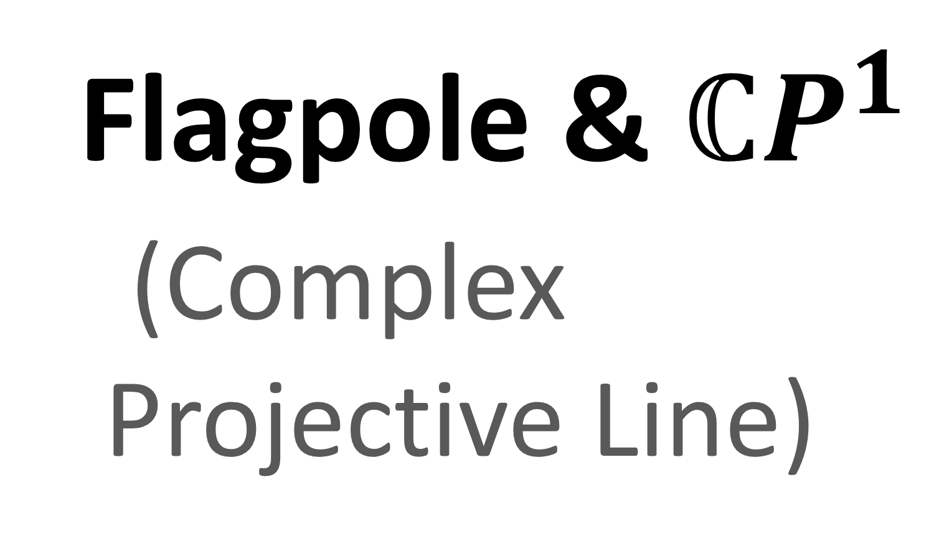

Spinors For Beginners
5
Flagpole & $ℂP^{1}$
(Complex
Projective Line)

Slide 2
Spinors Learning “Staircase”
Spinors in Particle Physics
Lie Groups & Algebras
Clifford Algebras
Spinors in 3D / (4D)
Examples From Physics (motivation)

Slide 3



















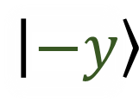
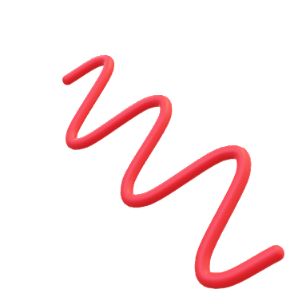


$$y$$
Quantum Spin States
$$x$$
$$\left|↑\right\rangle$$
Light
Wave Polarizations
S
$$z$$
$$y$$
$$z$$
N
$$\left|↓\right\rangle$$
$$\vec{H}$$
$$\left|+z\right\rangle$$
$$x$$
$$\left[\begin{aligned}A_{1}e^{iφ_{1}} \\ A_{2}e^{iφ_{2}}\end{aligned}\right]$$
$$\left[\begin{aligned}A_{1}e^{iφ_{1}} \\ A_{2}e^{iφ_{2}}\end{aligned}\right]$$
$$\vec{A}$$
$$\left|−x\right\rangle$$
$$\vec{R}$$
$$\vec{L}$$
$$\left|−y\right\rangle$$
$$\left|+y\right\rangle$$
$$\vec{D}$$
$$\left|+x\right\rangle$$
$$SU(2)$$
$$SU(2)$$
$$\vec{V}$$
$$\left|−z\right\rangle$$

Slide 4







$$\left|+z\right\rangle$$
$$\left|−x\right\rangle$$
$$\left|−y\right\rangle$$
$$\left|+y\right\rangle$$
$$\left|+x\right\rangle$$
Flagpole Visualization
$$\left|−z\right\rangle$$

Slide 5

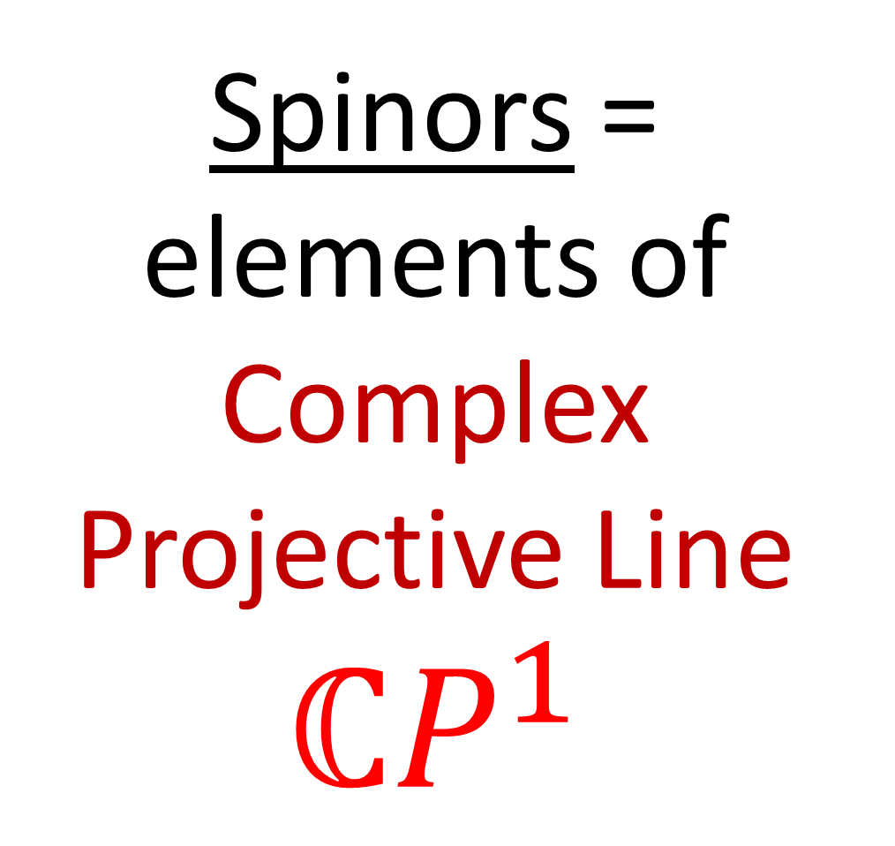

$$\left|+z\right\rangle$$
Spinors = elements of Complex Projective Line $ℂP^{1}$
$$\left|−x\right\rangle$$
$$\left|−y\right\rangle$$
$$\left|+y\right\rangle$$
$$\left|+x\right\rangle$$
Flagpole Visualization
$$\left|−z\right\rangle$$

Slide 6

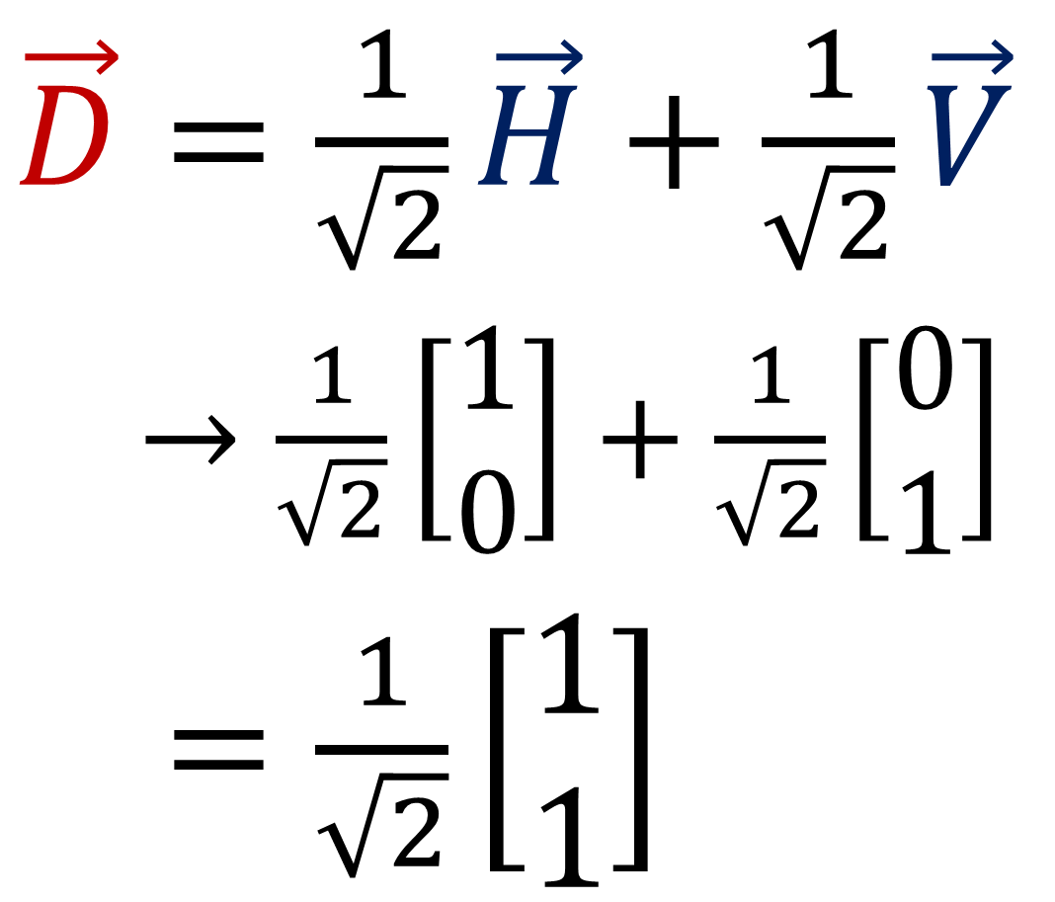
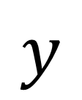

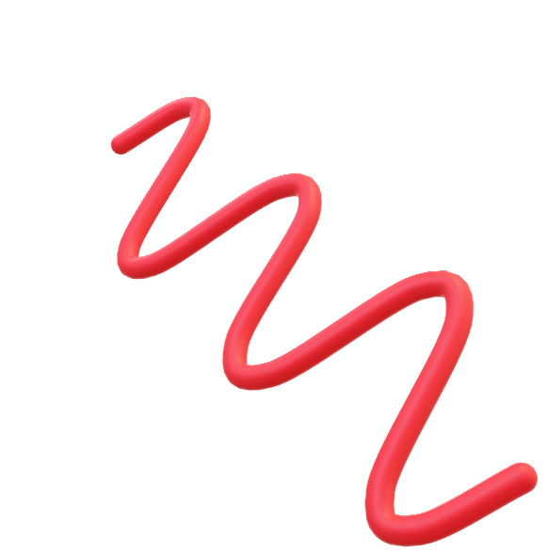
Diagonal Polarization
$\vec{D}=\frac{1}{\sqrt{2}}\vec{H}+\frac{1}{\sqrt{2}}\vec{V}$
$\vec{D}→\frac{1}{\sqrt{2}}\left[\begin{aligned}1 \\ 0\end{aligned}\right]+\frac{1}{\sqrt{2}}\left[\begin{aligned}0 \\ 1\end{aligned}\right]$
$\vec{D}=\frac{1}{\sqrt{2}}\left[\begin{aligned}1 \\ 1\end{aligned}\right]$
$$y$$
$$x$$
$$z$$

Slide 7
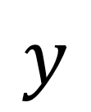


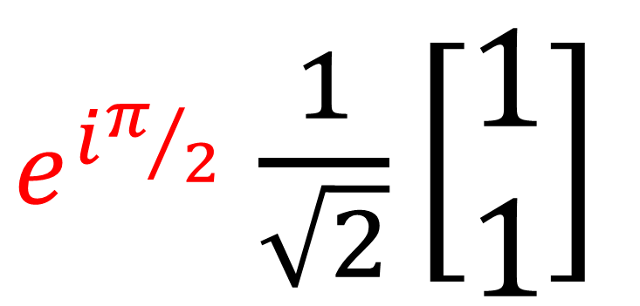


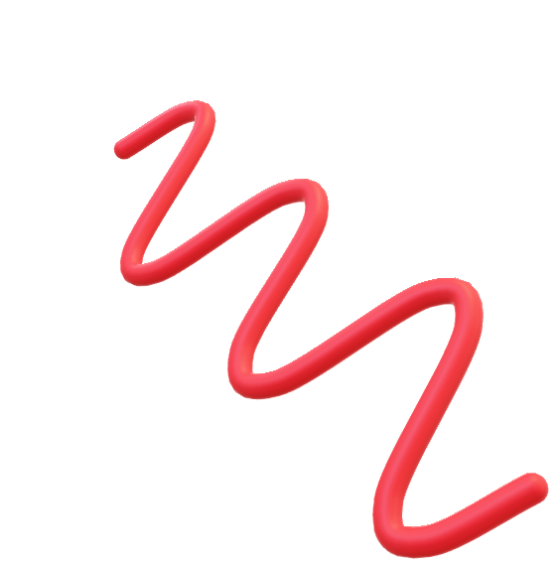
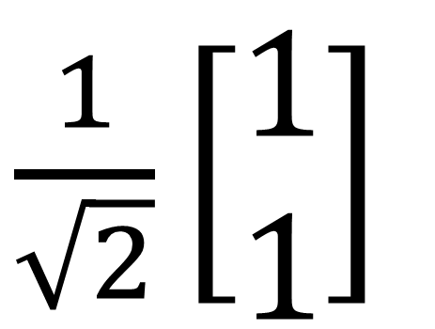

$\frac{1}{\sqrt{2}}\left[\begin{aligned}1 \\ 1\end{aligned}\right]$
$$e^{iπ/2}$$
$e^{iπ/2}$ $\frac{1}{\sqrt{2}}\left[\begin{aligned}1 \\ 1\end{aligned}\right]$
$$e^{iπ/2}$$
$$y$$
$$y$$
$$x$$
$$x$$
$$z$$
$$z$$

Slide 8


$\frac{1}{\sqrt{2}}\left[\begin{aligned}1 \\ 1\end{aligned}\right]$
$$e^{iπ/2}$$
$e^{iπ/2}$ $\frac{1}{\sqrt{2}}\left[\begin{aligned}1 \\ 1\end{aligned}\right]$
$$e^{iπ/2}$$
$$y$$
$$y$$
$$x$$
$$x$$
$$z$$
$$z$$

Slide 9

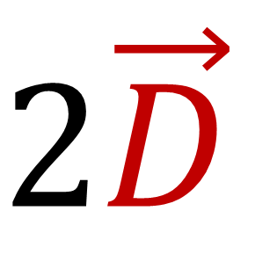

$$\vec{D}$$
$$2\vec{D}$$
Diagonal Polarization
$$y$$
$$y$$
$$x$$
$$x$$
$$z$$
$$z$$

Slide 10
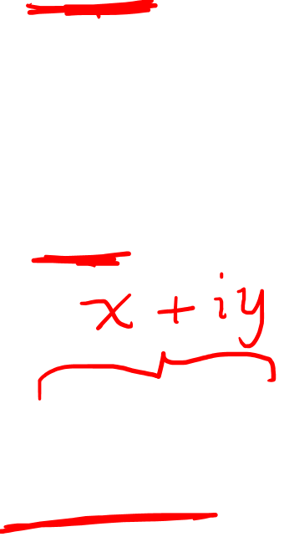

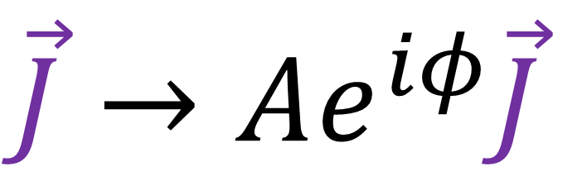
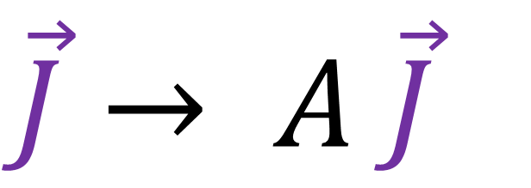
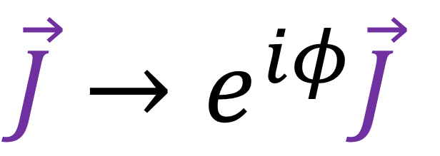
Jones Vector $\vec{J}$
$$\vec{J}→e^{iφ}\vec{J}$$
(polarization unchanged)
$$\vec{J}→ A \vec{J}$$
(polarization unchanged)
$$\vec{J}→Ae^{iφ}\vec{J}$$
(polarization unchanged)

Slide 11



Stern-Gerlach Experiment (1922):
(S.G. experiment)
“spin iiup”
$$\left|↑\right\rangle$$
S
N
$$\left|↓\right\rangle$$
beam of neutral particles (e.g. silver atoms)
magnetic field
(inhomogeneous)
“spin down”

Slide 12
Stern-Gerlach Experiment (1922):
(S.G. experiment)
$$\left|↑\right\rangle$$
S
N
$$\left|↓\right\rangle$$
beam of neutral particles (e.g. silver atoms)
magnetic field
(inhomogeneous)
superposition
collapse happens at detector

Slide 13
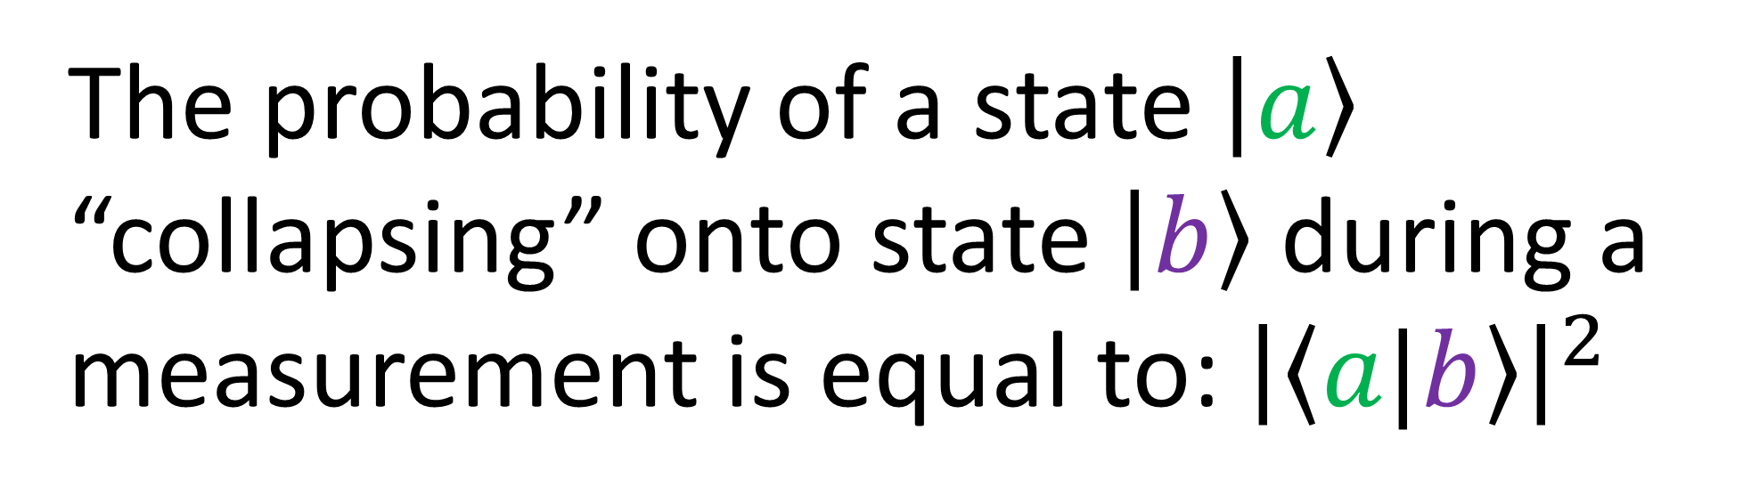

$$P\left(a⇒b\right)={\left|\left\langle a|b\right\rangle \right|}^{2}$$
Born’s Rule (simplified):
The probability of a state $\left|a\right\rangle$
“collapsing” onto state $\left|b\right\rangle$ during a
measurement is equal to: ${\left|\left\langle a|b\right\rangle \right|}^{2}$

Slide 14

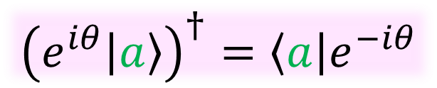
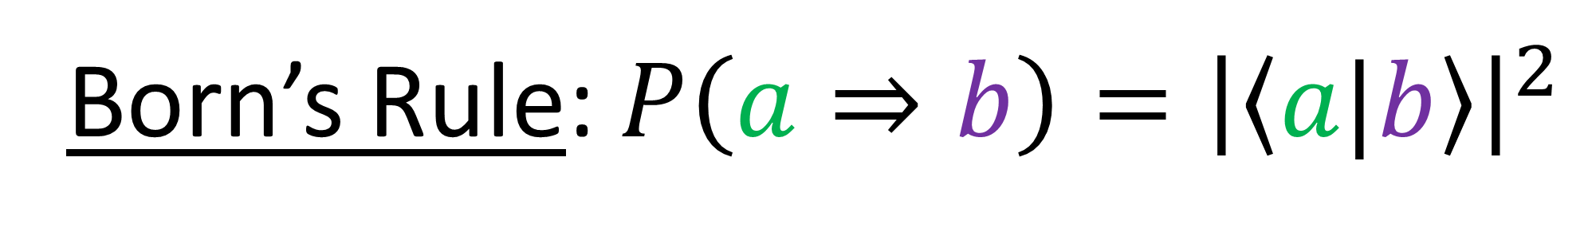


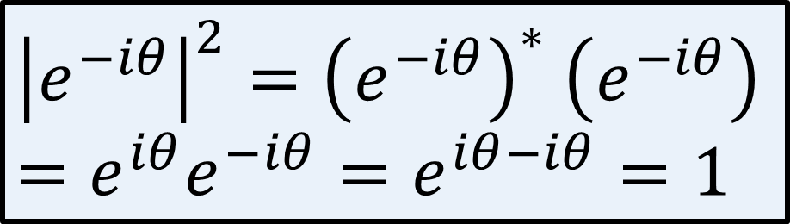

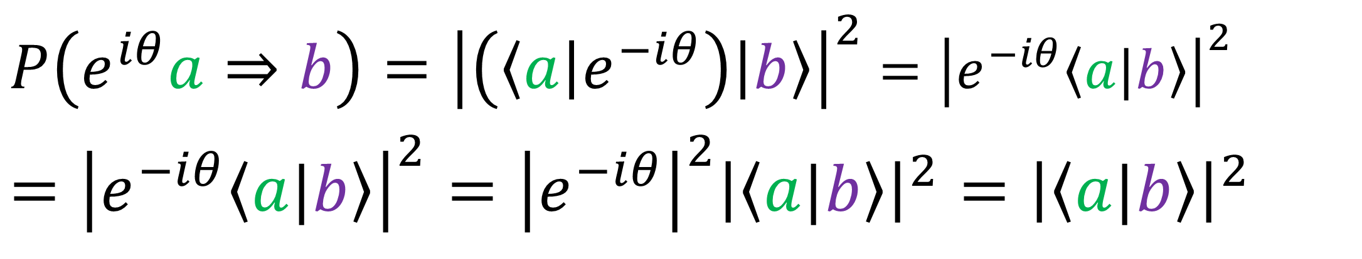
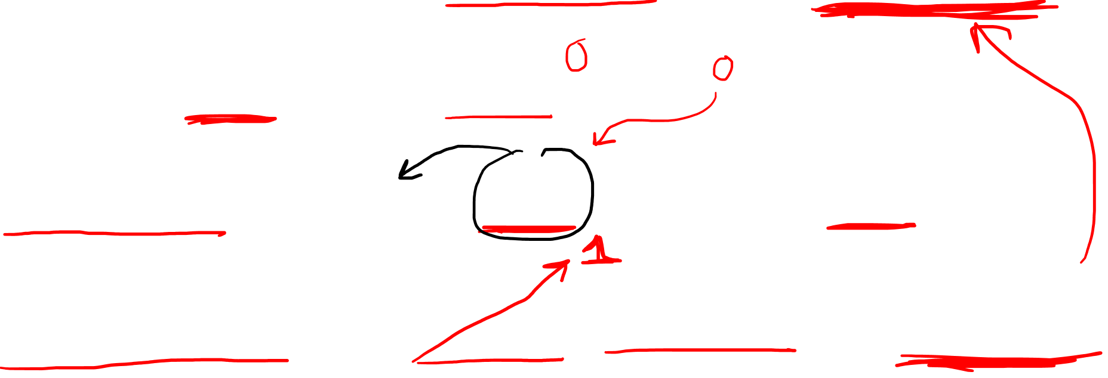



Born’s Rule: $P\left(a⇒b\right)={\left|\left\langle a|b\right\rangle \right|}^{2}$
$$\left|a\right\rangle →e^{iθ}\left|a\right\rangle$$
$${\left(e^{iθ}\left|a\right\rangle \right)}^{†}=\left\langle a\right|e^{−iθ}$$
$P\left(e^{iθ}a⇒b\right)={\left|\left(\left\langle a\right|e^{−iθ}\right)\left|b\right\rangle \right|}^{2}$ $={\left|e^{−iθ}\left\langle a|b\right\rangle \right|}^{2}$
$$={\left|e^{−iθ}\left\langle a|b\right\rangle \right|}^{2}={\left|e^{−iθ}\right|}^{2}{\left|\left\langle a|b\right\rangle \right|}^{2}={\left|\left\langle a|b\right\rangle \right|}^{2}$$
$$i$$
$$Im$$
$${\left|e^{−iθ}\right|}^{2}={\left(e^{−iθ}\right)}^{∗} \left(e^{−iθ}\right)=e^{iθ}e^{−iθ}=e^{iθ−iθ}=1$$
$$Re$$
$$−1$$
$$1$$
$$−i$$

Slide 15
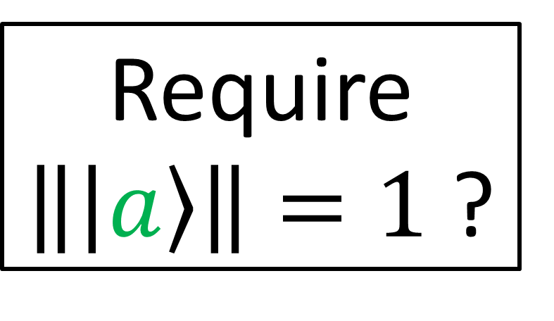
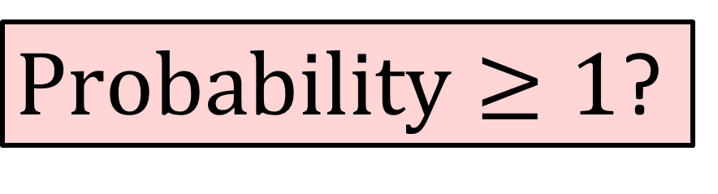
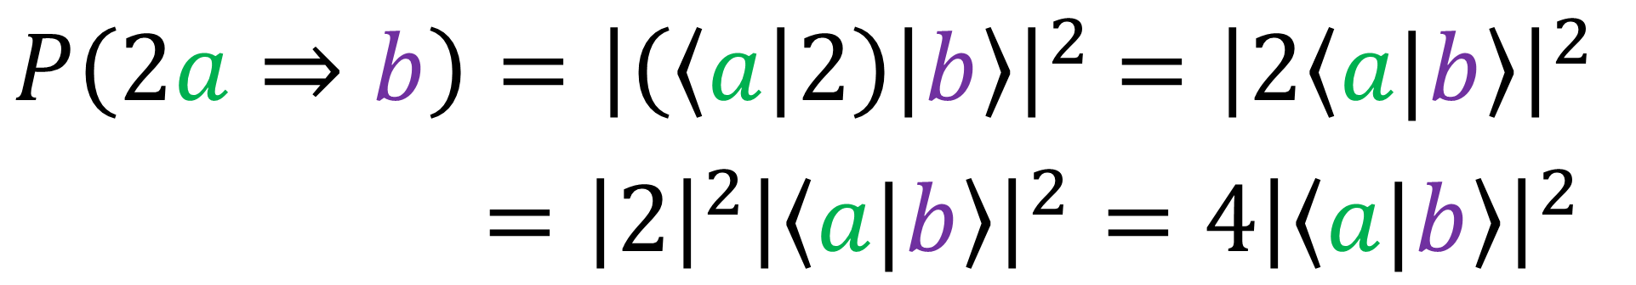

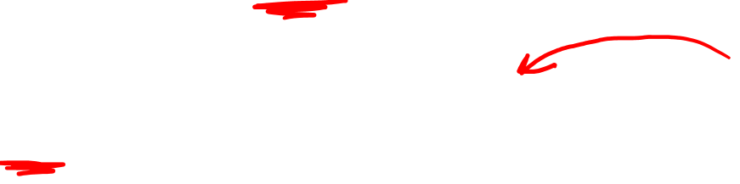
Born’s Rule: $P\left(a⇒b\right)={\left|\left\langle a|b\right\rangle \right|}^{2}$
$$\left|a\right\rangle →2\left|a\right\rangle$$
$P\left(2a⇒b\right)={\left|\left(\left\langle a\right|2\right)\left|b\right\rangle \right|}^{2}$ $={\left|2\left\langle a|b\right\rangle \right|}^{2}$
$={\left|2\right|}^{2}{\left|\left\langle a|b\right\rangle \right|}^{2}=4{\left|\left\langle a|b\right\rangle \right|}^{2}$
Require $\left\|\left|a\right\rangle \right\|=1$ ?
$Probability≥1$?

Slide 16
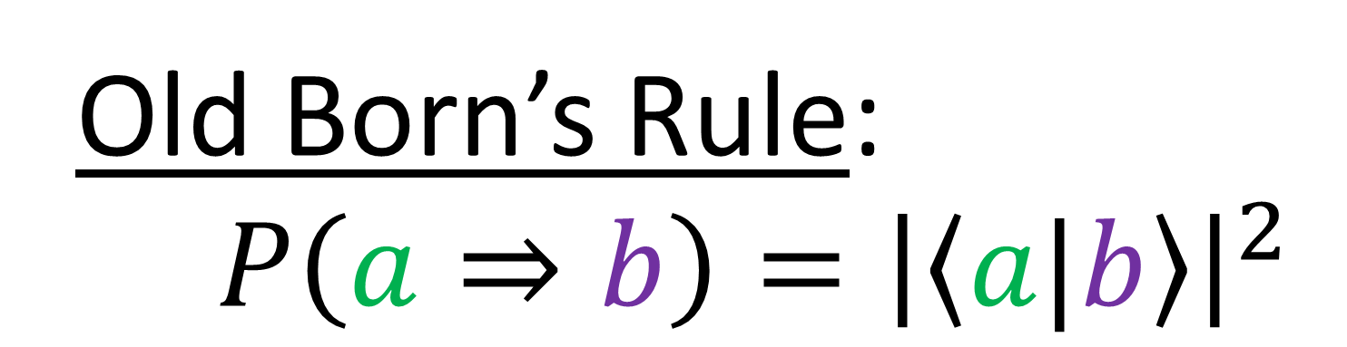

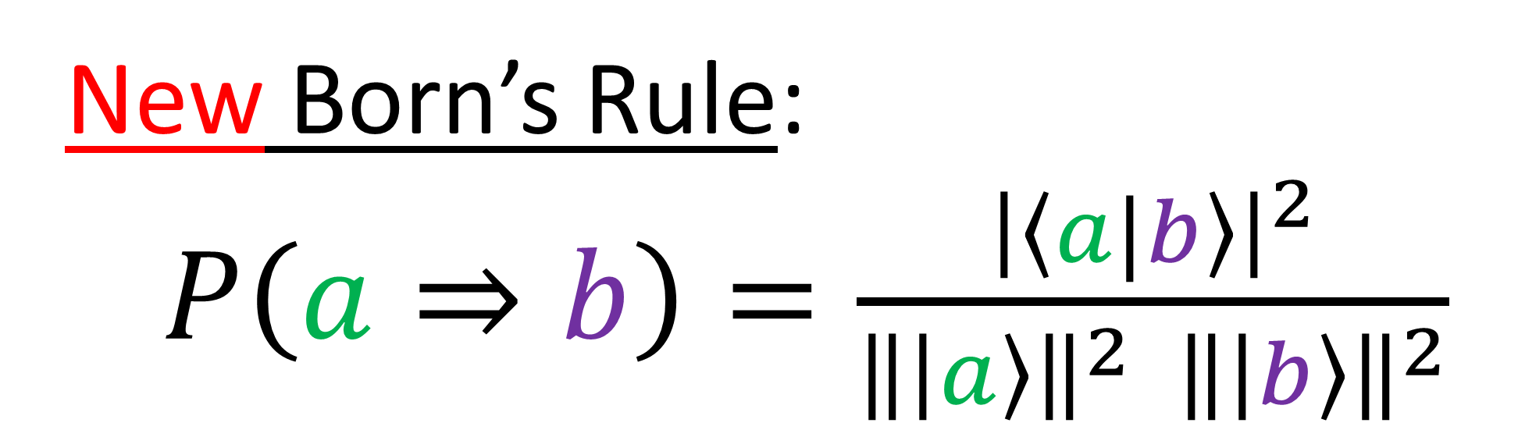
Old Born’s Rule:
$P\left(a⇒b\right)={\left|\left\langle a|b\right\rangle \right|}^{2}$
$${\left\|\left|a\right\rangle \right\|}^{2}=\left\langle a|a\right\rangle$$
$${\left\|\left|b\right\rangle \right\|}^{2}=\left\langle b|b\right\rangle$$
New Born’s Rule:
$P\left(a⇒b\right)=\frac{{\left|\left\langle a|b\right\rangle \right|}^{2}}{{\left\|\left|a\right\rangle \right\|}^{2} {\left\|\left|b\right\rangle \right\|}^{2}}$

Slide 17

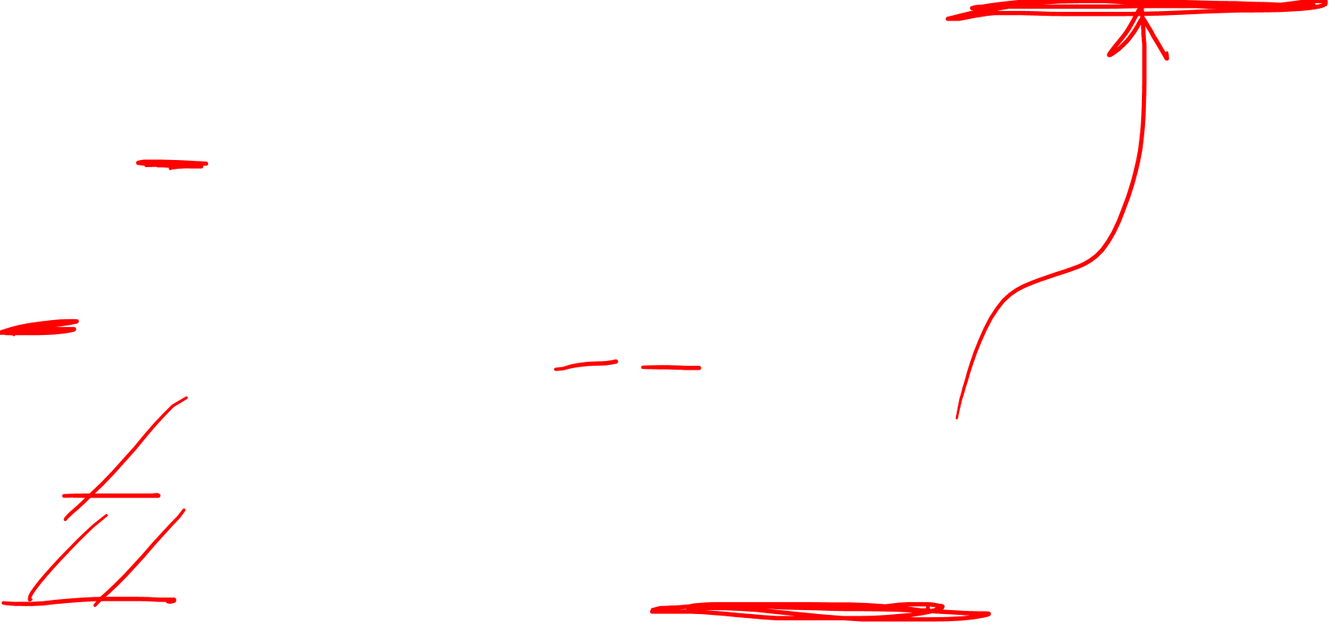


New Born’s Rule:
$P\left(a⇒b\right)=\frac{{\left|\left\langle a|b\right\rangle \right|}^{2}}{\left\langle a|a\right\rangle \left\langle b|b\right\rangle }$
$$\left|a\right\rangle →2\left|a\right\rangle$$
$P\left(2a⇒b\right)=\frac{{\left|\left(\left\langle a\right|2\right)\left|b\right\rangle \right|}^{2}}{\left(\left\langle a\right|2\right)\left(2\left|a\right\rangle \right)\left\langle b|b\right\rangle }$
$=\frac{{\left|2\right|}^{2}{\left|\left\langle a|b\right\rangle \right|}^{2}}{\left(2\right)\left(2\right)\left\langle a|a\right\rangle \left\langle b|b\right\rangle }=\frac{{\left|\left\langle a|b\right\rangle \right|}^{2}}{\left\langle a|a\right\rangle \left\langle b|b\right\rangle }$

Slide 18





Quantum State Vector $\left|a\right\rangle$
$$\left|a\right\rangle →e^{iφ}\left|a\right\rangle$$
(state unchanged)
$$\left|a\right\rangle → A\left|a\right\rangle$$
(state unchanged)
$$\left|a\right\rangle →Ae^{iφ}\left|a\right\rangle$$
(state unchanged)

Slide 19




$$y$$
Quantum Spin States
$$x$$
$$\left|↑\right\rangle$$
Light
Wave Polarizations
S
$$z$$
$$y$$
$$z$$
N
$$\left|↓\right\rangle$$
$$x$$
$$\left[\begin{aligned}A_{1}e^{iφ_{1}} \\ A_{2}e^{iφ_{2}}\end{aligned}\right]$$
$$\left[\begin{aligned}A_{1}e^{iφ_{1}} \\ A_{2}e^{iφ_{2}}\end{aligned}\right]$$
$$Ae^{iφ}$$
$$Ae^{iφ}$$
(ignore)
(ignore)
Spinor
Spinor

Slide 20





$$\left[\begin{aligned}α \\ β\end{aligned}\right]$$
$$\left|ψ\right\rangle =α\left|s_{1}\right\rangle +β\left|s_{2}\right\rangle$$
$\left[\begin{aligned}α \\ β\end{aligned}\right]$ $=\left[\begin{aligned}A_{1}e^{iφ_{1}} \\ A_{2}e^{iφ_{2}}\end{aligned}\right]$
2 complex numbers
4 real parameters?
Multiply by complex number without changing spinor…
$\left[\begin{aligned}α \\ β\end{aligned}\right]\sim 1/α\left[\begin{aligned}α \\ β\end{aligned}\right]=\left[\begin{aligned}1 \\ β/α\end{aligned}\right]=\left[\begin{aligned}1 \\ \tilde{β}\end{aligned}\right]$
1 complex parameter; 2 real parameters

Slide 21

Visualization Sphere
Required Parameters:
Longitude
Latitude
Ignored Parameters:
Overall Phase
Overall Scaling

Slide 22

Visualization Sphere
Required Parameters:
Longitude
Latitude
Ignored Parameters:
Overall Phase
Overall Scaling

Slide 23


Visualization Sphere
Required Parameters:
Longitude
Latitude
Ignored Parameters:
Overall Phase
Overall Scaling

Slide 24

Visualization Sphere
Required Parameters:
Longitude
Latitude
Ignored Parameters:
Overall Phase
Overall Scaling

Slide 25

Visualization Sphere
Required Parameters:
Longitude
Latitude
Ignored Parameters:
Overall Phase
Overall Scaling

Slide 26

Visualization Sphere
Required Parameters:
Longitude
Latitude
Ignored Parameters:
Overall Phase
Overall Scaling

Slide 27

Visualization Sphere
Required Parameters:
Longitude
Latitude
Ignored Parameters:
Overall Phase
Overall Scaling

Slide 28


Visualization Sphere
Spinor defined by
point on sphere:
Required Parameters:
Longitude
Latitude
Ignored Parameters:
Overall Phase
Overall Scaling

Slide 29


Spinor:
$$\left|ψ\right\rangle =A_{1}e^{iφ_{1}}\left|s_{1}\right\rangle +A_{2}e^{iφ_{2}}\left|s_{2}\right\rangle$$
$\left|ψ\right\rangle =A_{1}e^{iφ_{1}}\left|s_{1}\right\rangle +A_{2}\frac{e^{iφ_{1}}}{e^{iφ_{1}}}e^{iφ_{2}}\left|s_{2}\right\rangle$
$\left|ψ\right\rangle =e^{iφ_{1}}\left(A_{1}\left|s_{1}\right\rangle +A_{2}\frac{e^{iφ_{2}}}{e^{iφ_{1}}}\left|s_{2}\right\rangle \right)$

Slide 30



$$\left|ψ\right\rangle =e^{iφ_{1}}\left(A_{1}\left|s_{1}\right\rangle +A_{2}e^{i\left(φ_{2}−φ_{1}\right)}\left|s_{2}\right\rangle \right)$$
Take $\left\|\left|ψ\right\rangle \right\|=M$
$\left|ψ\right\rangle =e^{iφ_{1}}\left(\frac{M}{M}A_{1}\left|s_{1}\right\rangle +\frac{M}{M}A_{2}e^{i\left(φ_{2}−φ_{1}\right)}\left|s_{2}\right\rangle \right)$
$\left|ψ\right\rangle =Me^{iφ_{1}}\left(\frac{A_{1}}{M}\left|s_{1}\right\rangle +\frac{A_{2}}{M}e^{i\left(φ_{2}−φ_{1}\right)}\left|s_{2}\right\rangle \right)$

Slide 31











$\left|ψ\right\rangle =Me^{iφ_{1}}\left(\frac{A_{1}}{M}\left|s_{1}\right\rangle +\frac{A_{2}}{M}e^{i\left(φ_{2}−φ_{1}\right)}\left|s_{2}\right\rangle \right)$
$$\left|s_{1}\right\rangle$$
$\frac{A_{1}}{M}=\cos\left(\frac{θ}{2}\right)$
$$A_{2}$$
$$\left|ψ\right\rangle$$
$$θ/2$$
$\frac{A_{2}}{M}=\sin\left(\frac{θ}{2}\right)$
$$A_{1}$$
$$M$$
$$\left|s_{2}\right\rangle$$

Slide 32





$\left|ψ\right\rangle =Me^{iφ_{1}}\left(\frac{A_{1}}{M}\left|s_{1}\right\rangle +\frac{A_{2}}{M}e^{i\left(φ_{2}−φ_{1}\right)}\left|s_{2}\right\rangle \right)$
$$\left|s_{1}\right\rangle$$
$$\left|s_{1}\right\rangle$$
$$A_{2}$$
$$\left|ψ\right\rangle$$
$$θ$$
$$\left|ψ\right\rangle$$
$$θ/2$$
$$A_{1}$$
$$M$$
$$\left|s_{2}\right\rangle$$
$$\left|s_{2}\right\rangle$$

Slide 33



$\left|ψ\right\rangle =Me^{iφ_{1}}\left(\frac{A_{1}}{M}\left|s_{1}\right\rangle +\frac{A_{2}}{M}e^{i\left(φ_{2}−φ_{1}\right)}\left|s_{2}\right\rangle \right)$
$\left|ψ\right\rangle =Me^{iφ_{1}}\left(\cos\left(\frac{θ}{2}\right)\left|s_{1}\right\rangle +\sin\left(\frac{θ}{2}\right)e^{i\left(φ_{2}−φ_{1}\right)}\left|s_{2}\right\rangle \right)$
$\left|ψ\right\rangle =Me^{iω}\left(\cos\left(\frac{θ}{2}\right)\left|s_{1}\right\rangle +\sin\left(\frac{θ}{2}\right)e^{iφ}\left|s_{2}\right\rangle \right)$
$\left|ψ\right\rangle →Me^{iω}$ $\left[\begin{aligned}\cos\left(\frac{θ}{2}\right) \\ \sin\left(\frac{θ}{2}\right)e^{iφ}\end{aligned}\right]$

Slide 34





Visualization Sphere
$$M$$
$$ω$$
$$φ$$
$$θ$$
$$\left|ψ\right\rangle →$$
$Me^{iω}$ $\left[\begin{aligned}\cos\left(\frac{θ}{2}\right) \\ \sin\left(\frac{θ}{2}\right)e^{iφ}\end{aligned}\right]$

Slide 35
Visualization Sphere
Spinor defined by
point on sphere:
$$φ$$
$$θ$$
$$\left|ψ\right\rangle →$$
$Me^{iω}$ $\left[\begin{aligned}\cos\left(\frac{θ}{2}\right) \\ \sin\left(\frac{θ}{2}\right)e^{iφ}\end{aligned}\right]$

Slide 36











$$\left[\begin{aligned}1 \\ 0\end{aligned}\right]$$
$\frac{1}{\sqrt{2}}\left[\begin{aligned}1+i \\ 0\end{aligned}\right]$
Exercise:
find $θ,φ,ω$
$\frac{1}{2}\left[\begin{aligned}1−i \\ 1+i\end{aligned}\right]$
Recall:
$$ω=φ_{α}$$
$$φ=φ_{β}−φ_{α}$$
$\cos\left(\frac{θ}{2}\right)=\left|α\right|$
$\sin\left(\frac{θ}{2}\right)=\left|β\right|$
$$\left[\begin{aligned}α \\ β\end{aligned}\right]=$$
$e^{iω}$ $\left[\begin{aligned}\cos\left(\frac{θ}{2}\right) \\ \sin\left(\frac{θ}{2}\right)e^{iφ}\end{aligned}\right]$
magnitude $M=1$
$\frac{1}{\sqrt{2}}\left[\begin{aligned}1 \\ 1\end{aligned}\right]$

Slide 37

$$\left[\begin{aligned}α \\ β\end{aligned}\right] \sim Me^{iω}\left[\begin{aligned}α \\ β\end{aligned}\right]$$
Spinors
“Complex Projective Line”

Slide 38





Orthogonal Projection
$y$
$$\left[\begin{aligned}x \\ y\end{aligned}\right]$$
$$\left[\begin{aligned}1 \\ y\end{aligned}\right]$$
$x$
$x=1$

Slide 39

Orthogonal Projection
$y$
$x$
$x=1$

Slide 40

Perspective Projection
$y$
$x$
$x=1$

Slide 41
Perspective Projection
$y$
$x$
$x=1$

Slide 42
Perspective Projection
$y$
$x$
$x=1$

Slide 43







Perspective Projection
$y$
$$y=mx+b$$
$⇒y/x=m$
$x$
$$\left[\begin{aligned}2 \\ 1\end{aligned}\right]$$
$$\left[\begin{aligned}3 \\ 1.5\end{aligned}\right]$$
$$\left[\begin{aligned}4 \\ 2\end{aligned}\right]$$
$y/x=1/2$
$x=1$

Slide 44






Perspective Projection
$y$
$$y=mx+b$$
$⇒y/x=m$
$x$
$$\left[\begin{aligned}2 \\ 1\end{aligned}\right]$$
$$\left[\begin{aligned}3 \\ 1.5\end{aligned}\right]$$
$$\left[\begin{aligned}4 \\ 2\end{aligned}\right]$$
$$\left[\begin{aligned}1 \\ y/x\end{aligned}\right]$$
$$\left[\begin{aligned}1 \\ 1/2\end{aligned}\right]$$
$$\left[\begin{aligned}1 \\ m\end{aligned}\right]$$
$$=$$
$$=$$
$x=1$

Slide 45






Perspective Projection
$y$
$$a$$
$$\left[\begin{aligned}x \\ y\end{aligned}\right]$$
$$→\left[\begin{aligned}ax \\ ay\end{aligned}\right]$$
$$×a$$
$x$
$$m=\frac{y}{x}→\frac{ay}{ax}=\frac{y}{x}$$
$x=1$

Slide 46

Perspective Projection
$y$
Real Projective Line
$$ℝP^{1}$$
$x$
$x=1$

Slide 47



Real Projective Line
$$\left[\begin{aligned}x=0 \\ y=\text{2}\end{aligned}\right]$$
$y$
$$\left[\begin{aligned}x \\ y\end{aligned}\right]→\left[\begin{aligned}1 \\ y/x\end{aligned}\right]$$
$$\left[\begin{aligned}x \\ y\end{aligned}\right] =\left[\begin{aligned}1 \\ y/0\end{aligned}\right]≈\left[\begin{aligned}1 \\ ∞\end{aligned}\right]$$
$x$
“point at
infinity”
$x=1$

Slide 48












Real Projective Line
$y$
screen at $x=1$
“point at
infinity”
$$+10$$
$$+∞$$
$$+2$$
$$+9999$$
$$+1$$
point at infinity
$x$
$$0$$
$$−1$$
$$−∞$$
$$−9999$$
$$−2$$
“point at
infinity”
$$−10$$
$x=1$

Slide 49




Real Projective Line
$y$
All points with the same $y/x$ ratio are projected to the same point in $ℝP^{1}$.
“point at
infinity”
$x$
$$\left[\begin{aligned}0 \\ −2\end{aligned}\right]$$
$$\left[\begin{aligned}0 \\ 1\end{aligned}\right]$$
$$\left[\begin{aligned}0 \\ 5\end{aligned}\right]$$
“point at
infinity”
Point at Infinity
$x=1$

Slide 50

Real Projective Line
$y$
All points with the same $y/x$ ratio are projected to the same point in $ℝP^{1}$.
“point at
infinity”
Origin $\left[\begin{aligned}0 \\ 0\end{aligned}\right]$ is ignored for projection to $ℝP^{1}$
$x$
“point at
infinity”
$x=1$

Slide 51
Real Projective Line
$y$
Left half-plane (behind our eye)
$x$
$x=1$

Slide 52
Real Projective Line
$y$
$x$
$x=1$

Slide 53






Real Projective Line
$y$
$$\left[\begin{aligned}x \\ y\end{aligned}\right]→\left[\begin{aligned}1 \\ y/x\end{aligned}\right]$$
$$+p$$
$$\left[\begin{aligned}−x \\ −y\end{aligned}\right]→\left[−\begin{aligned}1 \\ y/{−x}\end{aligned}\right]$$
$x$
$$=\left[\begin{aligned}1 \\ y/x\end{aligned}\right]$$
$$−p$$
$x=1$

Slide 54

Real Projective Line
$y$
$x$
Point at $∞$
$x=1$

Slide 55


Slide 56
Projection

Slide 57



Real Projective Line $ℝP^{1}$
Real Projective Plane $ℝP^{2}$

Slide 58



Real Projective $n$-space $ℝP^{n}$
$$\left[\begin{aligned}x_{1} \\ x_{2} \\ ⋮ \\ x_{n+1}\end{aligned}\right]\sim \left[\begin{aligned}ax_{1} \\ ax_{2} \\ ⋮ \\ ax_{n+1}\end{aligned}\right]→\left[\begin{aligned}1 \\ x_{2}/x_{1} \\ ⋮ \\ x_{n+1}/x_{1}\end{aligned}\right]$$
(like $n$-sphere with opposite points identified)

Slide 59





Real Projective Line $ℝP^{1}$
$y$
$$\left[\begin{aligned}x \\ y\end{aligned}\right]$$
$$→\left[\begin{aligned}1 \\ y/x\end{aligned}\right]$$
“point at
infinity”
$x$
$$\left[\begin{aligned}ax \\ ay\end{aligned}\right]$$
“point at
infinity”
$x=1$

Slide 60
Real Projective Line $ℝP^{1}$
$y$
$$\left[\begin{aligned}x \\ y\end{aligned}\right]$$
$$→\left[\begin{aligned}1 \\ y/x\end{aligned}\right]$$
$$+p$$
$x$
$$\left[\begin{aligned}ax \\ ay\end{aligned}\right]$$
$$−p$$
$x=1$

Slide 61








Real Projective Plane $ℝP^{2}$
$y$
$$\left[\begin{aligned}x \\ y \\ z\end{aligned}\right]$$
$$\sim \left[\begin{aligned}1 \\ y/x \\ z/x\end{aligned}\right]$$
$x$
$z$
$x=1$

Slide 62







Real Projective Line $ℝP^{1}$
Complex Projective Line $ℂP^{1}$
$$\left[\begin{aligned}α \\ β\end{aligned}\right] \sim Re^{iθ}\left[\begin{aligned}α \\ β\end{aligned}\right]$$
$$\left[\begin{aligned}x \\ y\end{aligned}\right]\sim a\left[\begin{aligned}x \\ y\end{aligned}\right]$$
$$\sim \left[\begin{aligned}1 \\ y/x\end{aligned}\right]$$
$$\sim \left[\begin{aligned}1 \\ β/α\end{aligned}\right]$$

Slide 63






Complex Projective Line $ℂP^{1}$
$β$
$\left[\begin{aligned}α \\ β\end{aligned}\right]\sim \frac{1}{α}\left[\begin{aligned}α \\ β\end{aligned}\right]$
$\sim \left[\begin{aligned}1 \\ β/α\end{aligned}\right]$
$α$
$α=1$

Slide 64




Complex Projective Line $ℂP^{1}$
$β$
$$\left[\begin{aligned}α=0 \\ β=\text{2+1}\text{i}\end{aligned}\right]$$
$$\left[\begin{aligned}α \\ β\end{aligned}\right]→\left[\begin{aligned}1 \\ {β }/α\end{aligned}\right]$$
$$\left[\begin{aligned}x \\ y\end{aligned}\right] =\left[\begin{aligned}1 \\ β/0\end{aligned}\right]=\left[\begin{aligned}1 \\ ∞\end{aligned}\right]$$
$α$
(ignore origin $\left[\begin{aligned}0 \\ 0\end{aligned}\right]$)
$α=1$

Slide 65
Complex Projective Line $ℂP^{1}$
$β$
$$\left[\begin{aligned}α=0 \\ β=\text{2+1}\text{i}\end{aligned}\right]$$
$$\left[\begin{aligned}α \\ β\end{aligned}\right]→\left[\begin{aligned}1 \\ {β }/α\end{aligned}\right]$$
$$\left[\begin{aligned}x \\ y\end{aligned}\right] =\left[\begin{aligned}1 \\ β/0\end{aligned}\right]=\left[\begin{aligned}1 \\ ∞\end{aligned}\right]$$
$α$
$α=1$

Slide 66





Complex Projective Line $ℂP^{1}$
$$β$$
$$\left[\begin{aligned}α \\ β\end{aligned}\right]$$
$$→\left[\begin{aligned}1 \\ β/α\end{aligned}\right]$$
$$+p$$
$$α$$
$$\left[\begin{aligned}−α \\ −β\end{aligned}\right]$$
$$−p$$
$α=1$

Slide 67

Complex Projective Line $ℂP^{1}$
$$β$$
$$\left[\begin{aligned}α \\ β\end{aligned}\right]$$
$$→\left[\begin{aligned}1 \\ β/α\end{aligned}\right]$$
$$+p$$
$$α$$
$\left[\begin{aligned}Me^{iω}α \\ Me^{iω}β\end{aligned}\right]$
$$−p$$
$α=1$

Slide 68


Visualization Sphere
$$M$$
$$ω$$
$$φ$$
$$θ$$
point at infinity
$$\left[\begin{aligned}0 \\ 1\end{aligned}\right]$$

Slide 69



Visualization Sphere
$$M$$
$$ω$$
$$φ$$
$\frac{β}{α}=\tan{\frac{θ}{2}} e^{iφ}$
$$θ$$
$$\left[\begin{aligned}α \\ β\end{aligned}\right]$$
$=\left[\begin{aligned}Me^{iω}\cos{\frac{θ}{2}}e^{iφ} \\ Me^{iω}\sin{\frac{θ}{2}}e^{iφ}\end{aligned}\right]$

Slide 70
Visualization Sphere
$$M$$
$$ω$$
$$φ$$
Polarizations:
Poincare Sphere
Quantum States:
Bloch Sphere
Complex Projective Line:
Riemann Sphere
$$θ$$

Slide 71


$$\vec{V}$$ | $$\vec{H}$$ | $$\vec{D}$$ | $$\vec{A}$$ | $$\vec{L}$$ | $$\vec{R}$$
$$\left|−z\right\rangle$$ | $$\left|+z\right\rangle$$ | $$\left|+x\right\rangle$$ | $$\left|−x\right\rangle$$ | $$\left|+y\right\rangle$$ | $$\left|−y\right\rangle$$
$$\left[\begin{aligned}0 \\ 1\end{aligned}\right]$$ | $\left[\begin{aligned}1 \\ 0\end{aligned}\right]$ | $\left[\begin{aligned}1 \\ 1\end{aligned}\right]$ | $\left[\begin{aligned}1 \\ −1\end{aligned}\right]$ | $\left[\begin{aligned}1 \\ i\end{aligned}\right]$ | $$\left[\begin{aligned}1 \\ −i\end{aligned}\right]$$
$$1/0=∞$$ | $$0/1$$ | $$1/1$$ | $${−1}/1$$ | $$i/1$$ | $${−i}/1$$

Slide 72






$$\left[\begin{aligned}1 \\ 0\end{aligned}\right]$$
$$\left|+z\right\rangle$$
$\frac{1}{\sqrt{2}}\left[\begin{aligned}1 \\ −1\end{aligned}\right]$
$\frac{1}{\sqrt{2}}\left[\begin{aligned}1 \\ −i\end{aligned}\right]$
$$\left|−x\right\rangle$$
$\frac{1}{\sqrt{2}}\left[\begin{aligned}1 \\ i\end{aligned}\right]$
$$\left|−y\right\rangle$$
$$\left|+y\right\rangle$$
$$\left|+x\right\rangle$$
$\frac{1}{\sqrt{2}}\left[\begin{aligned}1 \\ 1\end{aligned}\right]$
$$\left[\begin{aligned}0 \\ 1\end{aligned}\right]$$
$$\left|−z\right\rangle$$

Slide 73







$\left[\begin{aligned}γ \\ δ\end{aligned}\right]=\left[\begin{matrix}a & b \\ c & d\end{matrix}\right]\left[\begin{aligned}α \\ β\end{aligned}\right]$
$=\left[\begin{aligned}aα+bβ \\ cα+dβ\end{aligned}\right]$
$ad−bc≠0$
$=\frac{a\left(α/β\right)+b}{c\left(α/β\right)+d}$
$$\frac{γ}{δ}=\frac{aα+bβ}{cα+dβ}$$
$×\frac{1/β}{1/β}$
Möbius Transformations: $\tilde{γ}=\frac{a\tilde{α}+b}{c\tilde{α}+d}$

Slide 74


Conclusion
Spinor = member of complex projective line $ℂP^{1}$
Pair of complex numbers $\left[\begin{aligned}α \\ β\end{aligned}\right]$
Overall scaling/phase ignored: $Ae^{iφ}\left[\begin{aligned}α \\ β\end{aligned}\right]$
Only the ratio $β/α$ matters

Slide 75







Original Space
Projected Space
$$+p$$
$$p$$
$$−q$$
$$+q$$
$$q$$
$$−p$$

Slide 76

Visualization Sphere
$$M$$
Spinor defined by 2 real numbers: $θ,φ$
$$ω$$
$$φ$$
$$θ$$
$$\left|ψ\right\rangle →$$
$Me^{iω}$ $\left[\begin{aligned}\cos\left(\frac{θ}{2}\right) \\ \sin\left(\frac{θ}{2}\right)e^{iφ}\end{aligned}\right]$

Slide 77

Visualization Sphere
Spinor defined by
point on sphere:
Spinor defined by 2 real numbers: $θ,φ$
$$φ$$
$$θ$$
$$\left|ψ\right\rangle →$$
$Me^{iω}$ $\left[\begin{aligned}\cos\left(\frac{θ}{2}\right) \\ \sin\left(\frac{θ}{2}\right)e^{iφ}\end{aligned}\right]$

Slide 78
Spinors Learning “Staircase”
Applications:
Polarizations of Light
Quantum Spin States
Spinors in Particle Physics
Lie Groups & Algebras
Clifford Algebras
Spinors in 3D / (4D)
Examples From Physics (motivation)

Slide 79
Spinors Learning “Staircase”
Spinors in Particle Physics
Lie Groups & Algebras
Clifford Algebras
Spinors in 3D / (4D)
Examples From Physics (motivation)

Slide 80





3D Vector
Pauli Vector
$$\left[\begin{aligned}x \\ y \\ z\end{aligned}\right]$$
$$\left[\begin{matrix}z & x−yi \\ x+yi & −z\end{matrix}\right]$$
$\left[\begin{matrix} & \\ & \end{matrix}\right]\left[\begin{matrix}z & x−yi \\ x+yi & −z\end{matrix}\right]{\left[\begin{matrix} & \\ & \end{matrix}\right]}^{†}$
$$SU\left(2\right)$$
$$SU\left(2\right)$$

Slide 81


Quaternions rotating vector:
$$q \vec{v} q^{∗}$$
$\left[\begin{matrix} & \\ & \end{matrix}\right]\left[\begin{matrix}z & x−yi \\ x+yi & −z\end{matrix}\right]{\left[\begin{matrix} & \\ & \end{matrix}\right]}^{†}$
$$SU\left(2\right)$$
$$SU\left(2\right)$$

Slide 82


factor
$$\left[\begin{aligned}ξ_{1} \\ ξ_{2}\end{aligned}\right]\left[−ξ_{2} ξ_{1}\right]$$
$$\left[\begin{matrix}z & x−yi \\ x+yi & −z\end{matrix}\right]$$
$\left[\begin{matrix} & \\ & \end{matrix}\right]\left[\begin{matrix}z & x−yi \\ x+yi & −z\end{matrix}\right]{\left[\begin{matrix} & \\ & \end{matrix}\right]}^{†}$
$$SU\left(2\right)$$
$$SU\left(2\right)$$

Slide 83



factor
$$\left[\begin{aligned}ξ_{1} \\ ξ_{2}\end{aligned}\right]\left[−ξ_{2} ξ_{1}\right]$$
$$\left[\begin{matrix}z & x−yi \\ x+yi & −z\end{matrix}\right]$$
$\left[\begin{matrix} & \\ & \end{matrix}\right]\left[\begin{aligned}ξ_{1} \\ ξ_{2}\end{aligned}\right]\left[\begin{matrix} −ξ_{2} & ξ_{1} \end{matrix}\right]{\left[\begin{matrix} & \\ & \end{matrix}\right]}^{†}$
$$SU\left(2\right)$$
$$SU\left(2\right)$$

Slide 84


Quaternions rotating spinors:
$$q ξ$$
$$\tilde{ξ} q^{∗}$$
half rotation
half rotation
$\left[\begin{matrix} & \\ & \end{matrix}\right]\left[\begin{aligned}ξ_{1} \\ ξ_{2}\end{aligned}\right]\left[\begin{matrix} −ξ_{2} & ξ_{1} \end{matrix}\right]{\left[\begin{matrix} & \\ & \end{matrix}\right]}^{†}$
$$SU\left(2\right)$$
$$SU\left(2\right)$$

Slide 85


Rotations in 3D space
$SU(2)$ matrices
Unit quaternions
Rotations in 4D spacetime
$SL(2,ℂ)$ matrices
Clifford Algebra bivectors $γ_{μ}γ_{ν}$

Slide 86



See Links in Description for more info!
Applications of spinors in physics
More on flagpole https://arxiv.org/pdf/1312.3824.pdf

