Slide 1




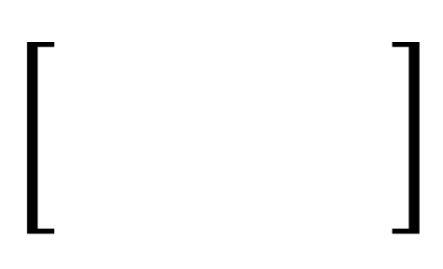
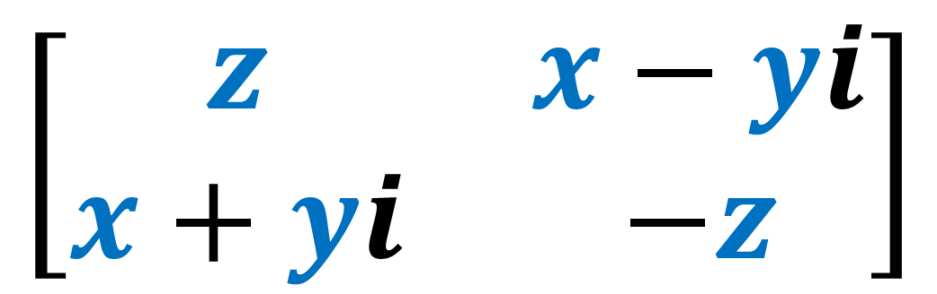
Spinors For Beginners
6
Pauli Vectors
$$\left[\begin{matrix}z & x−yi \\ x+yi & −z\end{matrix}\right]$$
${\left[\begin{matrix} & \\ & \end{matrix}\right]}^{†}$
$$SU\left(2\right)$$
$$SU\left(2\right)$$

Slide 2
Spinors Learning “Staircase”
Spinors in Particle Physics
Lie Groups & Algebras
Clifford Algebras
Spinors in 3D / (4D)
Examples From Physics (motivation)

Slide 3
Spinors Learning “Staircase”
Spinors in Particle Physics
Lie Groups & Algebras
Clifford Algebras
Spinors in 3D / (4D)
Examples From Physics (motivation)

Slide 4
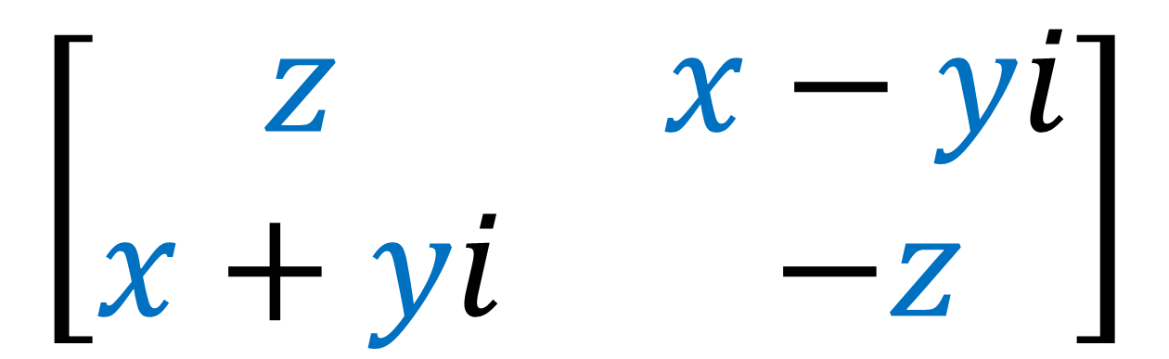
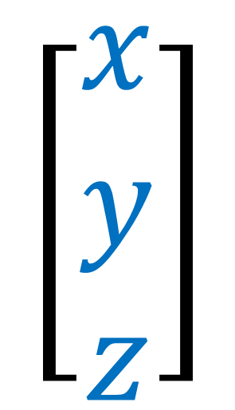
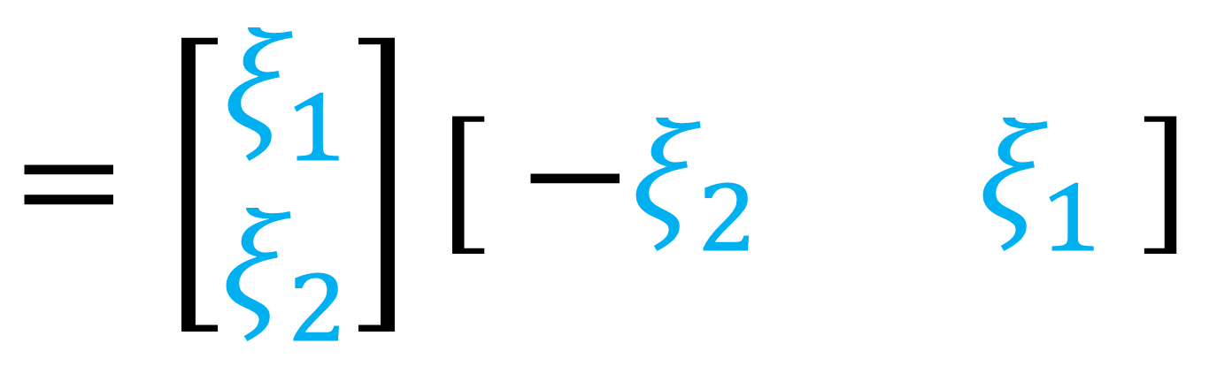
3D Vector
Pauli Vector
$$\left[\begin{aligned}x \\ y \\ z\end{aligned}\right]$$
$$\left[\begin{matrix}z & x−yi \\ x+yi & −z\end{matrix}\right]$$
$$=\left[\begin{aligned}ξ_{1} \\ ξ_{2}\end{aligned}\right]\left[\begin{matrix} −ξ_{2} & ξ_{1} \end{matrix}\right]$$
Pauli Spinors

Slide 5
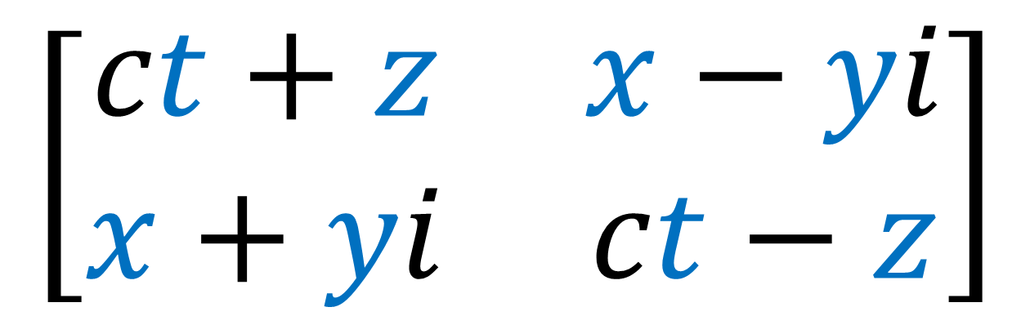

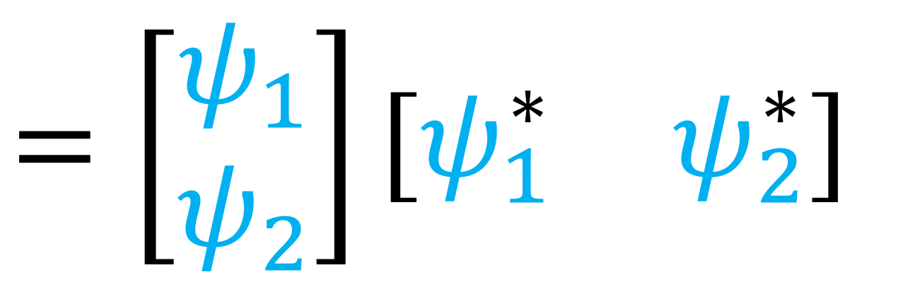
4D Vector
Weyl Representation
$$\left[\begin{aligned}ct \\ x \\ y \\ z\end{aligned}\right]$$
$$\left[\begin{matrix}ct+z & x−yi \\ x+yi & ct−z\end{matrix}\right]$$
$$=\left[\begin{aligned}ψ_{1} \\ ψ_{2}\end{aligned}\right]\left[\begin{matrix}ψ_{1}^{∗} & ψ_{2}^{∗}\end{matrix}\right]$$
Weyl Spinors

Slide 6
For the next few videos:
we’ll be starting over
inventing spinors from scratch
previous videos not necessary
(source links in description)

Slide 7
3D Vector
Pauli Vector
$$\left[\begin{aligned}x \\ y \\ z\end{aligned}\right]$$
$$\left[\begin{matrix}z & x−yi \\ x+yi & −z\end{matrix}\right]$$
✓
Reflections
Rotations
✓

Slide 8
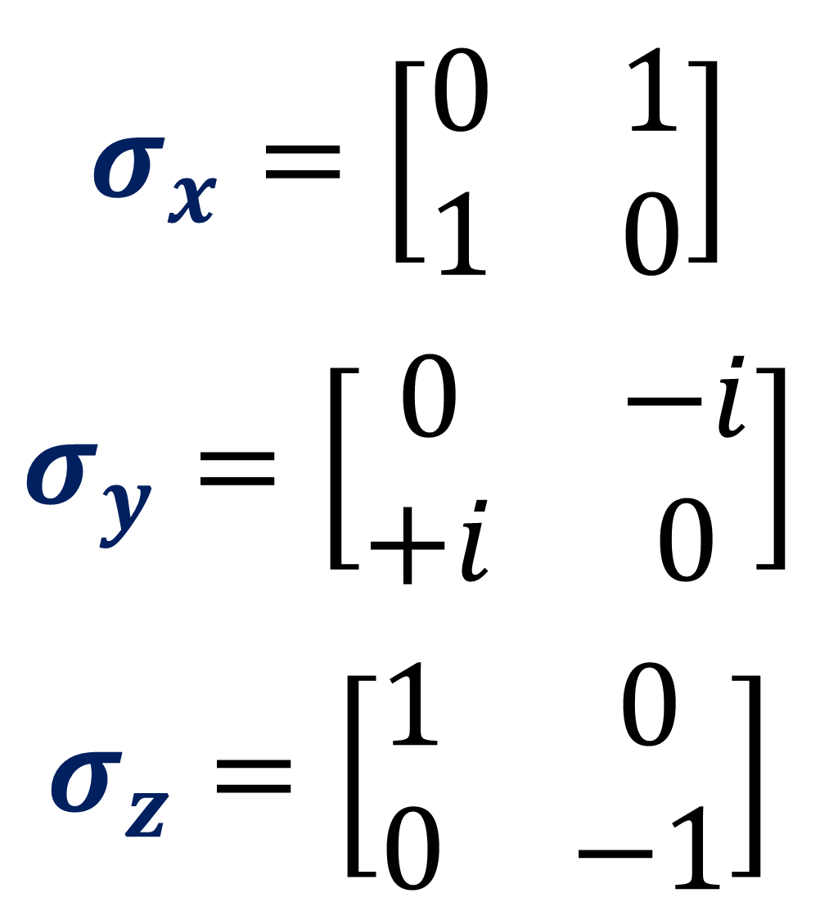
$$σ_{x}=\left[\begin{matrix}0 & 1 \\ 1 & 0\end{matrix}\right]$$
$$σ_{y}=\left[\begin{matrix}0 & −i \\ +i & 0\end{matrix}\right]$$
$$σ_{z}=\left[\begin{matrix}1 & 0 \\ 0 & −1\end{matrix}\right]$$
Pauli Matrices (Sigma Matrices)

Slide 9

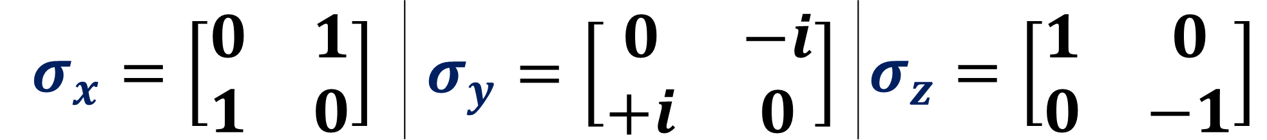
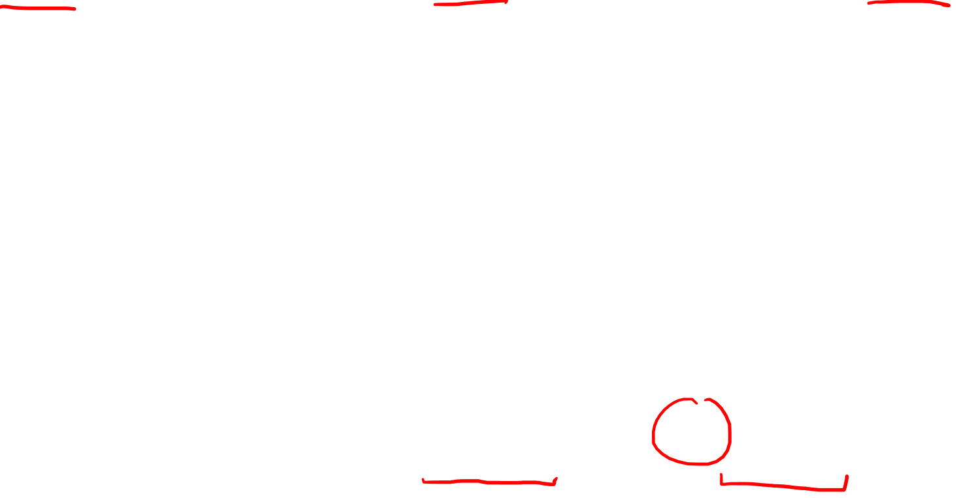
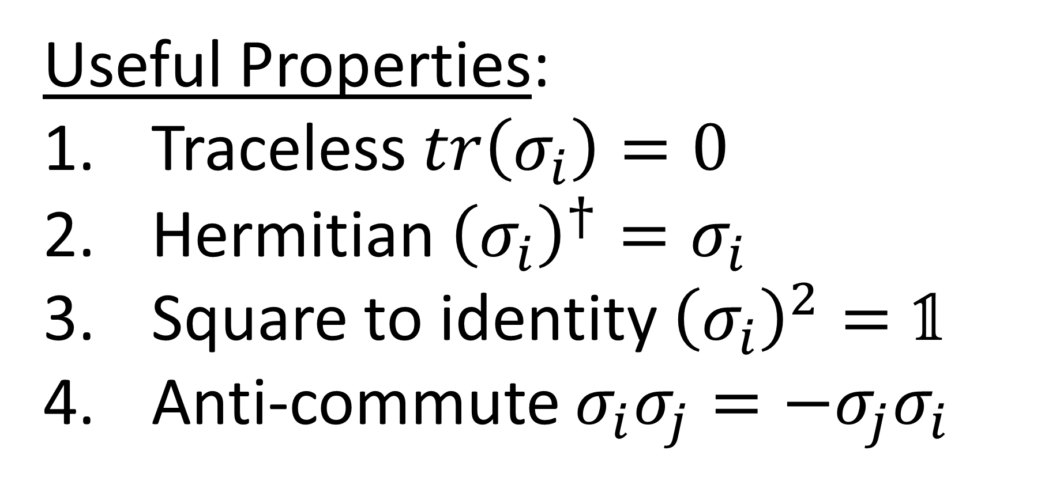
$$σ_{x}=\left[\begin{matrix}0 & 1 \\ 1 & 0\end{matrix}\right]$$ | $$σ_{y}=\left[\begin{matrix}0 & −i \\ +i & 0\end{matrix}\right]$$ | $$σ_{z}=\left[\begin{matrix}1 & 0 \\ 0 & −1\end{matrix}\right]$$
$$=σ_{1}$$ | $$=σ_{2}$$ | $$=σ_{3}$$
Useful Properties:
Traceless $tr\left(σ_{i}\right)=0$
Hermitian ${\left(σ_{i}\right)}^{†}=σ_{i}$
Square to identity ${\left(σ_{i}\right)}^{2}=\text{𝟙}$
Anti-commute $σ_{i}σ_{j}=−σ_{j}σ_{i}$
$\left(i≠j\right)$

Slide 10
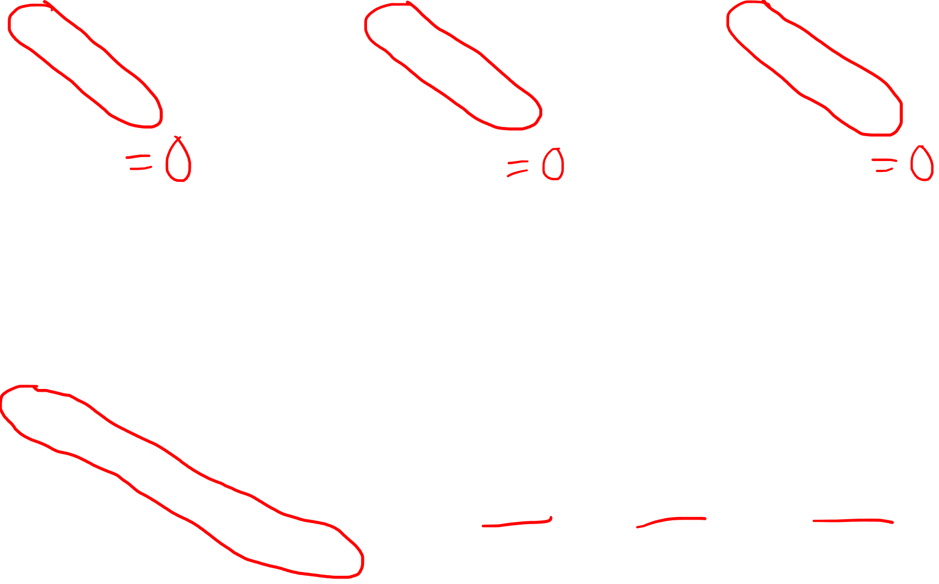
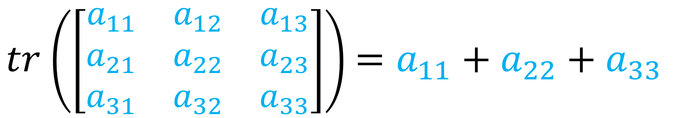
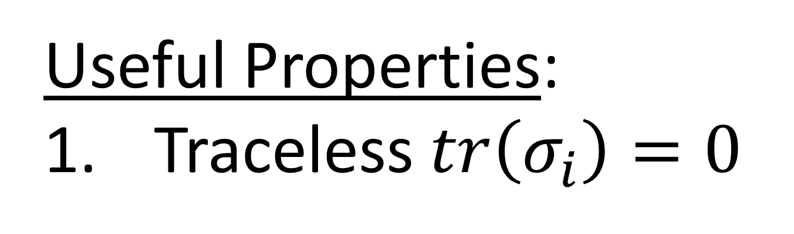
$$σ_{x}=\left[\begin{matrix}0 & 1 \\ 1 & 0\end{matrix}\right]$$ | $$σ_{y}=\left[\begin{matrix}0 & −i \\ +i & 0\end{matrix}\right]$$ | $$σ_{z}=\left[\begin{matrix}1 & 0 \\ 0 & −1\end{matrix}\right]$$
$$=σ_{1}$$ | $$=σ_{2}$$ | $$=σ_{3}$$
Useful Properties:
Traceless $tr\left(σ_{i}\right)=0$
$tr$ $\left(\left[\begin{matrix}a_{11} & a_{12} & a_{13} \\ a_{21} & a_{22} & a_{23} \\ a_{31} & a_{32} & a_{33}\end{matrix}\right]\right)$ $=a_{11}+a_{22}+a_{33}$

Slide 11
$$σ_{x}=\left[\begin{matrix}0 & 1 \\ 1 & 0\end{matrix}\right]$$ | $$σ_{y}=\left[\begin{matrix}0 & −i \\ +i & 0\end{matrix}\right]$$ | $$σ_{z}=\left[\begin{matrix}1 & 0 \\ 0 & −1\end{matrix}\right]$$
$$=σ_{1}$$ | $$=σ_{2}$$ | $$=σ_{3}$$
Useful Properties:
Traceless $tr\left(σ_{i}\right)=0$
Hermitian ${\left(σ_{i}\right)}^{†}=σ_{i}$
Square to identity ${\left(σ_{i}\right)}^{2}=\text{𝟙}$
Anti-commute $σ_{i}σ_{j}=−σ_{j}σ_{i}$
$\left(i≠j\right)$

Slide 12


$$σ_{x}=\left[\begin{matrix}0 & 1 \\ 1 & 0\end{matrix}\right]$$ | $$σ_{y}=\left[\begin{matrix}0 & −i \\ +i & 0\end{matrix}\right]$$ | $$σ_{z}=\left[\begin{matrix}1 & 0 \\ 0 & −1\end{matrix}\right]$$
$$=σ_{1}$$ | $$=σ_{2}$$ | $$=σ_{3}$$
Transpose:
$${\left[\begin{matrix}a & b \\ c & d\end{matrix}\right]}^{T}$$
$$=\left[\begin{matrix}a & c \\ b & d\end{matrix}\right]$$

Slide 13
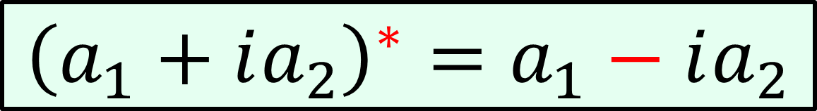

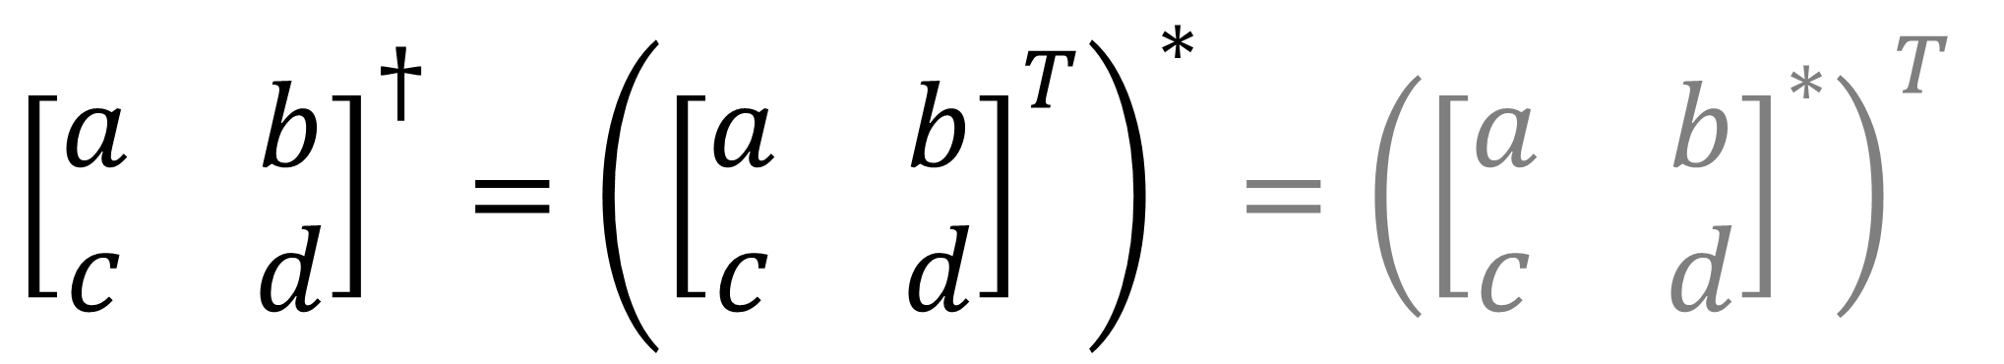
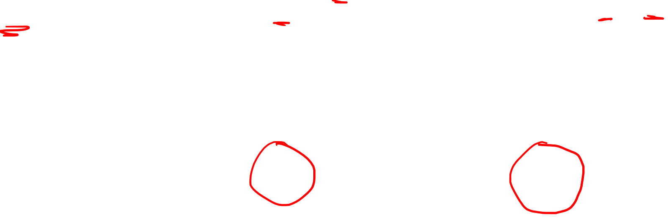
$$σ_{x}=\left[\begin{matrix}0 & 1 \\ 1 & 0\end{matrix}\right]$$ | $$σ_{y}=\left[\begin{matrix}0 & −i \\ +i & 0\end{matrix}\right]$$ | $$σ_{z}=\left[\begin{matrix}1 & 0 \\ 0 & −1\end{matrix}\right]$$
$$=σ_{1}$$ | $$=σ_{2}$$ | $$=σ_{3}$$
Hermitian Conjugate:
${\left[\begin{matrix}a & b \\ c & d\end{matrix}\right]}^{†}={\left({\left[\begin{matrix}a & b \\ c & d\end{matrix}\right]}^{T}\right)}^{∗}={\left({\left[\begin{matrix}a & b \\ c & d\end{matrix}\right]}^{∗}\right)}^{T}$
$$=\left[\begin{matrix}a^{∗} & c^{∗} \\ b^{∗} & d^{∗}\end{matrix}\right]$$
$${\left(a_{1}+ia_{2}\right)}^{∗}=a_{1}−ia_{2}$$

Slide 14

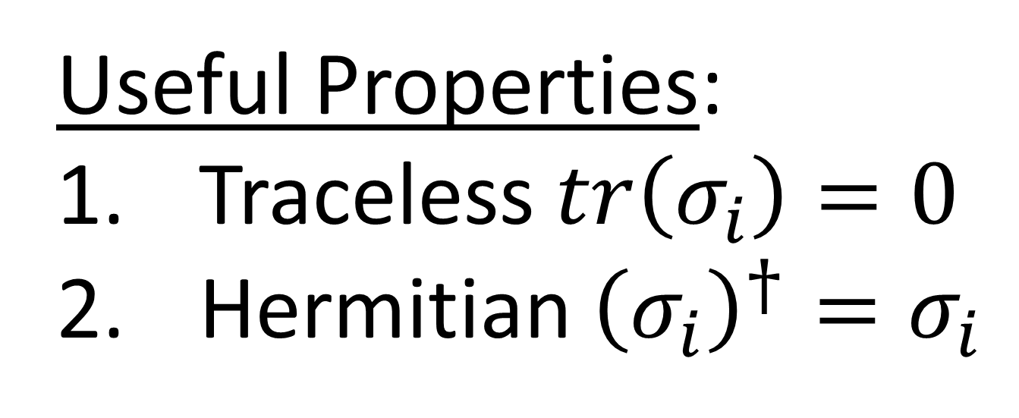
$$σ_{x}=\left[\begin{matrix}0 & 1 \\ 1 & 0\end{matrix}\right]$$ | $$σ_{y}=\left[\begin{matrix}0 & −i \\ +i & 0\end{matrix}\right]$$ | $$σ_{z}=\left[\begin{matrix}1 & 0 \\ 0 & −1\end{matrix}\right]$$
$$=σ_{1}$$ | $$=σ_{2}$$ | $$=σ_{3}$$
Useful Properties:
Traceless $tr\left(σ_{i}\right)=0$
Hermitian ${\left(σ_{i}\right)}^{†}=σ_{i}$

Slide 15
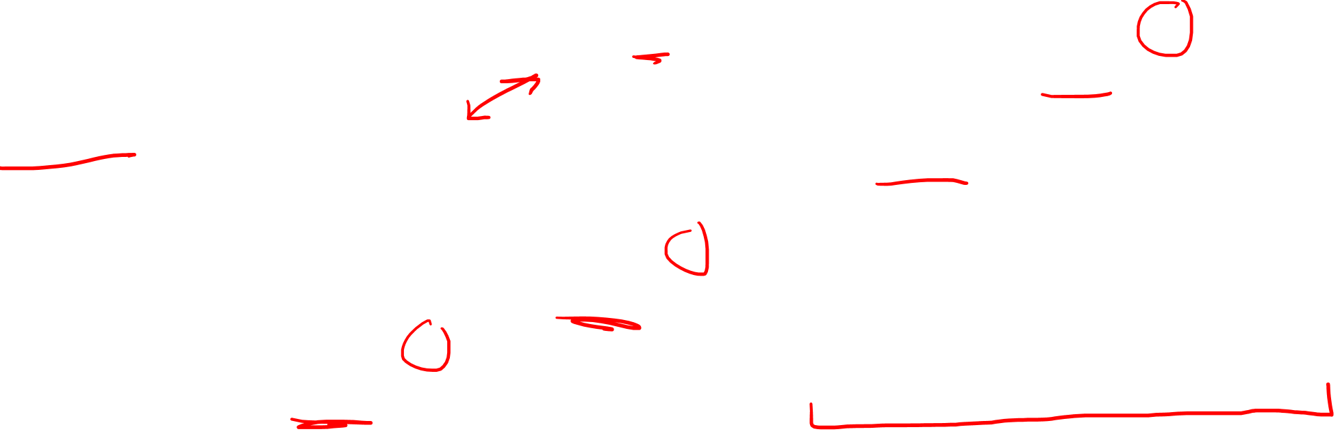
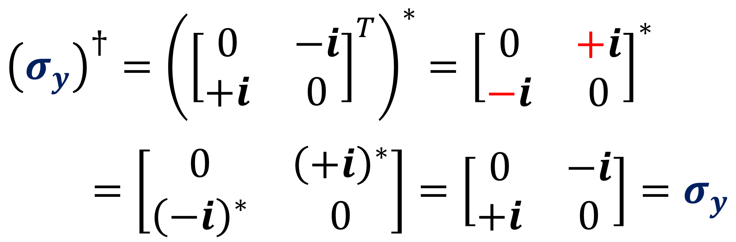
$$σ_{x}=\left[\begin{matrix}0 & 1 \\ 1 & 0\end{matrix}\right]$$ | $$σ_{y}=\left[\begin{matrix}0 & −i \\ +i & 0\end{matrix}\right]$$ | $$σ_{z}=\left[\begin{matrix}1 & 0 \\ 0 & −1\end{matrix}\right]$$
$$=σ_{1}$$ | $$=σ_{2}$$ | $$=σ_{3}$$
${\left(σ_{y}\right)}^{†}={\left({\left[\begin{matrix}0 & −i \\ +i & 0\end{matrix}\right]}^{T}\right)}^{∗}$ $={\left[\begin{matrix}0 & +i \\ −i & 0\end{matrix}\right]}^{∗}$
$=\left[\begin{matrix}0 & {\left(+i\right)}^{∗} \\ {\left(−i\right)}^{∗} & 0\end{matrix}\right]=\left[\begin{matrix}0 & −i \\ +i & 0\end{matrix}\right]=σ_{y}$

Slide 16

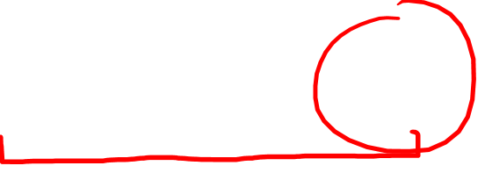
$$σ_{x}=\left[\begin{matrix}0 & 1 \\ 1 & 0\end{matrix}\right]$$ | $$σ_{y}=\left[\begin{matrix}0 & −i \\ +i & 0\end{matrix}\right]$$ | $$σ_{z}=\left[\begin{matrix}1 & 0 \\ 0 & −1\end{matrix}\right]$$
$$=σ_{1}$$ | $$=σ_{2}$$ | $$=σ_{3}$$
Useful Properties:
Traceless $tr\left(σ_{i}\right)=0$
Hermitian ${\left(σ_{i}\right)}^{†}=σ_{i}$
Square to identity ${\left(σ_{i}\right)}^{2}=\text{𝟙}$
Anti-commute $σ_{i}σ_{j}=−σ_{j}σ_{i}$
$$\left[\begin{matrix}1 & 0 \\ 0 & 1\end{matrix}\right]$$
identity
$\left(i≠j\right)$

Slide 17
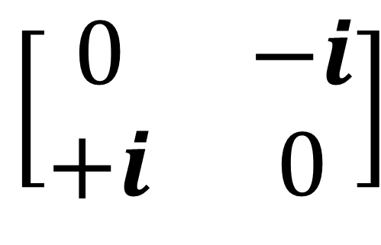
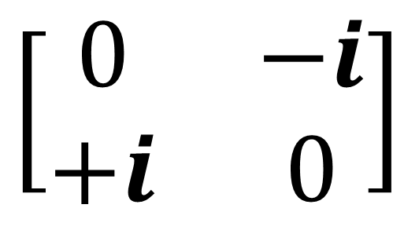
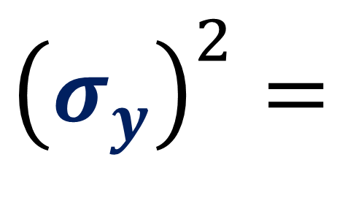
$$σ_{x}=\left[\begin{matrix}0 & 1 \\ 1 & 0\end{matrix}\right]$$ | $$σ_{y}=\left[\begin{matrix}0 & −i \\ +i & 0\end{matrix}\right]$$ | $$σ_{z}=\left[\begin{matrix}1 & 0 \\ 0 & −1\end{matrix}\right]$$
$$=σ_{1}$$ | $$=σ_{2}$$ | $$=σ_{3}$$
$$\left[\begin{matrix}0 & −i \\ +i & 0\end{matrix}\right]$$
$$\left[\begin{matrix}0 & −i \\ +i & 0\end{matrix}\right]$$
$${\left(σ_{y}\right)}^{2}=$$

Slide 18

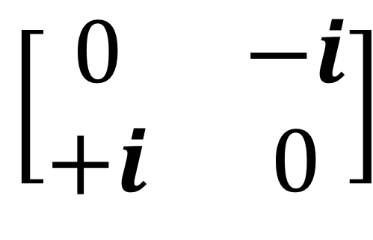
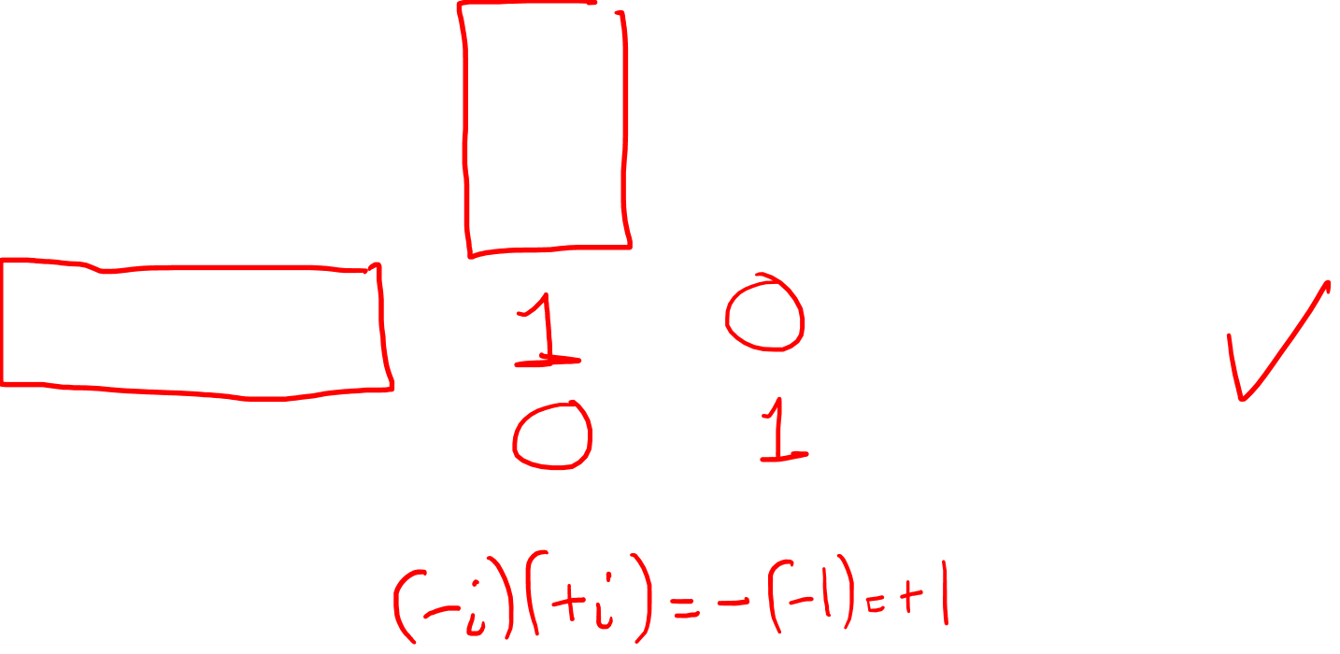
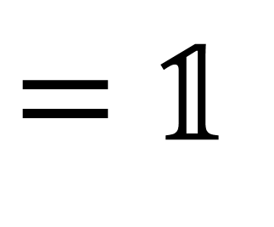
$$σ_{x}=\left[\begin{matrix}0 & 1 \\ 1 & 0\end{matrix}\right]$$ | $$σ_{y}=\left[\begin{matrix}0 & −i \\ +i & 0\end{matrix}\right]$$ | $$σ_{z}=\left[\begin{matrix}1 & 0 \\ 0 & −1\end{matrix}\right]$$
$$=σ_{1}$$ | $$=σ_{2}$$ | $$=σ_{3}$$
$$\left[\begin{matrix}0 & −i \\ +i & 0\end{matrix}\right]$$
$${\left(σ_{y}\right)}^{2}=$$
$$\left[\begin{matrix}0 & −i \\ +i & 0\end{matrix}\right]$$
$$\left[\begin{matrix}0 & −i \\ +i & 0\end{matrix}\right]$$
$$=\text{𝟙}$$
identity matrix

Slide 19
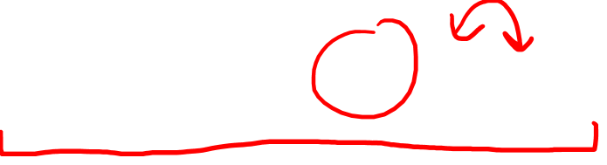
$$σ_{x}=\left[\begin{matrix}0 & 1 \\ 1 & 0\end{matrix}\right]$$ | $$σ_{y}=\left[\begin{matrix}0 & −i \\ +i & 0\end{matrix}\right]$$ | $$σ_{z}=\left[\begin{matrix}1 & 0 \\ 0 & −1\end{matrix}\right]$$
$$=σ_{1}$$ | $$=σ_{2}$$ | $$=σ_{3}$$
Useful Properties:
Traceless $tr\left(σ_{i}\right)=0$
Hermitian ${\left(σ_{i}\right)}^{†}=σ_{i}$
Square to identity ${\left(σ_{i}\right)}^{2}=\text{𝟙}$
Anti-commute $σ_{i}σ_{j}=−σ_{j}σ_{i}$
$\left(i≠j\right)$

Slide 20
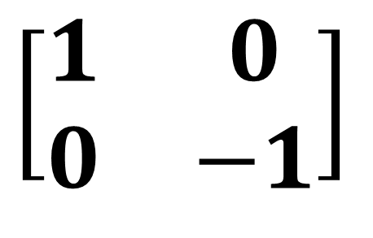
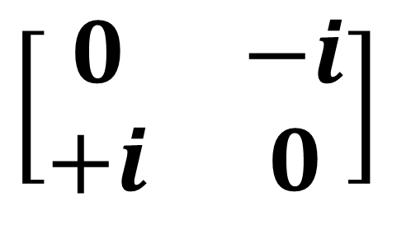
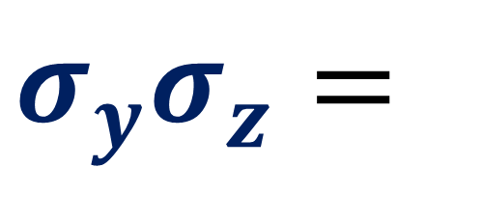
$$σ_{x}=\left[\begin{matrix}0 & 1 \\ 1 & 0\end{matrix}\right]$$ | $$σ_{y}=\left[\begin{matrix}0 & −i \\ +i & 0\end{matrix}\right]$$ | $$σ_{z}=\left[\begin{matrix}1 & 0 \\ 0 & −1\end{matrix}\right]$$
$$=σ_{1}$$ | $$=σ_{2}$$ | $$=σ_{3}$$
$$σ_{y}σ_{z}=$$
$$\left[\begin{matrix}0 & −i \\ +i & 0\end{matrix}\right]$$
$$\left[\begin{matrix}1 & 0 \\ 0 & −1\end{matrix}\right]$$

Slide 21
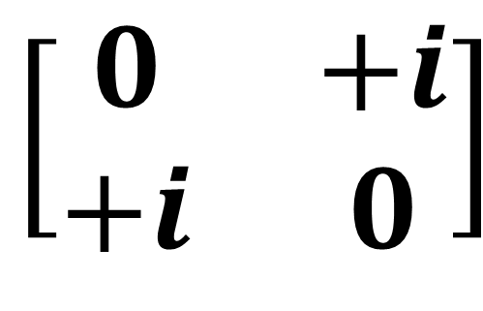
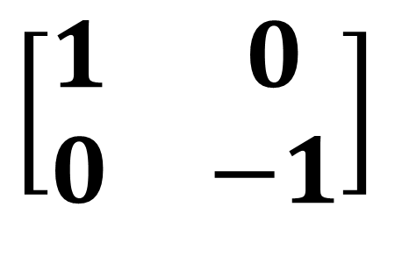
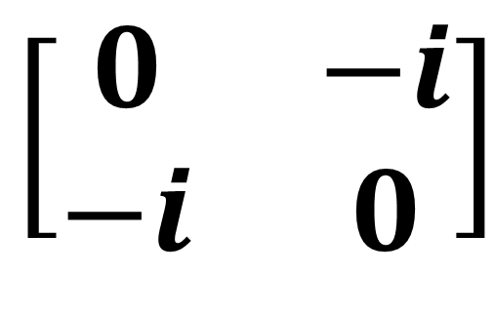
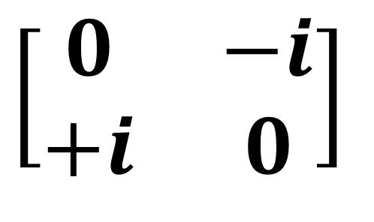
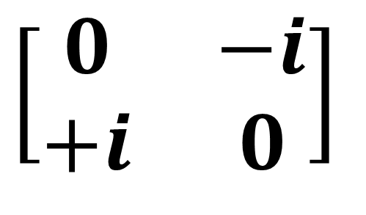
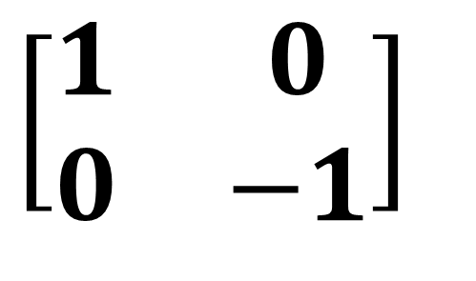
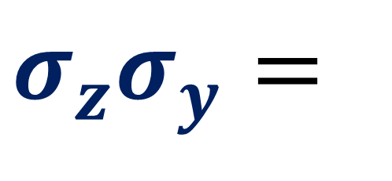
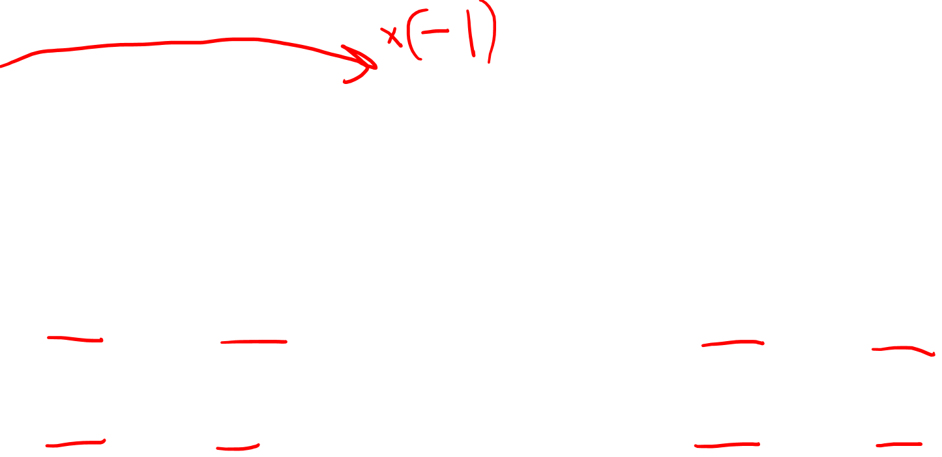
$$σ_{x}=\left[\begin{matrix}0 & 1 \\ 1 & 0\end{matrix}\right]$$ | $$σ_{y}=\left[\begin{matrix}0 & −i \\ +i & 0\end{matrix}\right]$$ | $$σ_{z}=\left[\begin{matrix}1 & 0 \\ 0 & −1\end{matrix}\right]$$
$$=σ_{1}$$ | $$=σ_{2}$$ | $$=σ_{3}$$
$$σ_{y}σ_{z}=$$
$$σ_{z}σ_{y}=$$
$$\left[\begin{matrix}1 & 0 \\ 0 & −1\end{matrix}\right]$$
$$\left[\begin{matrix}0 & −i \\ +i & 0\end{matrix}\right]$$
$$\left[\begin{matrix}0 & −i \\ +i & 0\end{matrix}\right]$$
$$\left[\begin{matrix}0 & +i \\ +i & 0\end{matrix}\right]$$
$$\left[\begin{matrix}0 & −i \\ −i & 0\end{matrix}\right]$$
$$\left[\begin{matrix}1 & 0 \\ 0 & −1\end{matrix}\right]$$

Slide 22
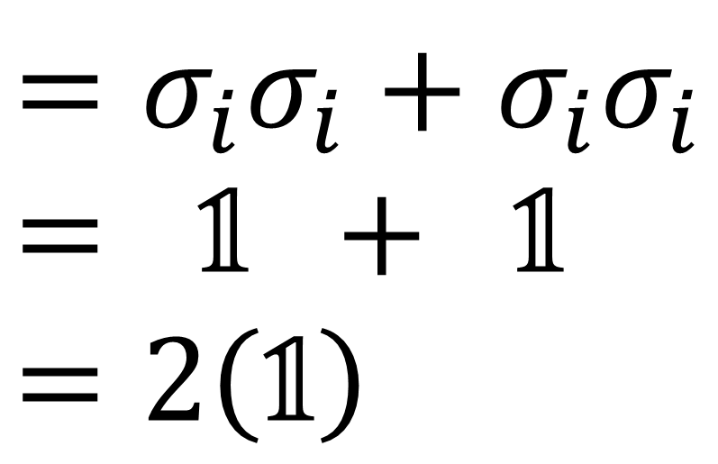
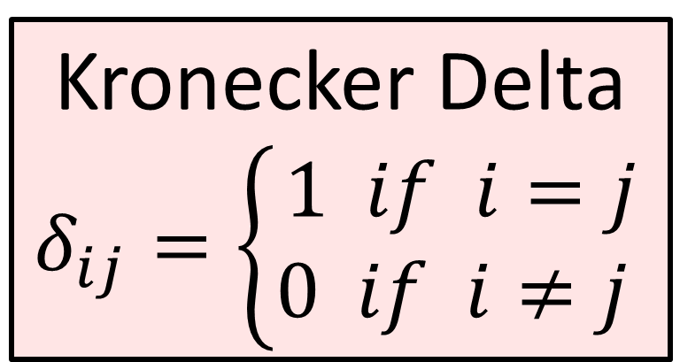
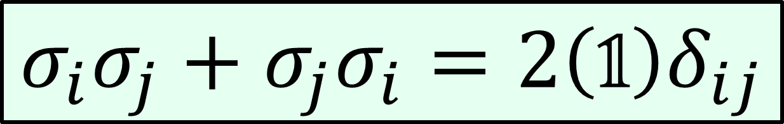
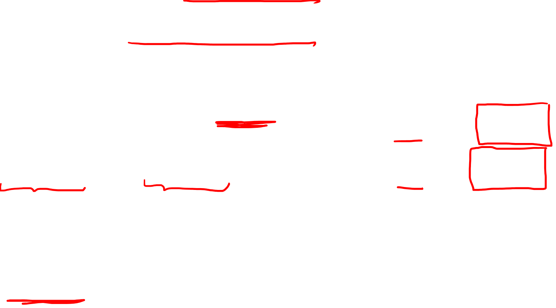



Useful Properties:
3. Square to identity ${\left(σ_{i}\right)}^{2}=\text{𝟙}$
4. Anti-commute $σ_{i}σ_{j}=−σ_{j}σ_{i}$
$\left(i≠j\right)$
$$σ_{i}σ_{j}+σ_{j}σ_{i}=2\left(\text{𝟙}\right)δ_{ij}$$
Kronecker Delta
$$δ_{ij}=\left\{\begin{aligned}1 if i=j \\ 0 if i≠j \end{aligned}\right.$$
$$=σ_{i}σ_{i}+σ_{i}σ_{i}$$
$$= \text{𝟙} + \text{𝟙}$$
$$=2\left(\text{𝟙}\right)$$
$$i=j$$

Slide 23




Useful Properties:
3. Square to identity ${\left(σ_{i}\right)}^{2}=\text{𝟙}$
4. Anti-commute $σ_{i}σ_{j}=−σ_{j}σ_{i}$
$\left(i≠j\right)$
$$σ_{i}σ_{j}+σ_{j}σ_{i}=2\left(\text{𝟙}\right)δ_{ij}$$
Kronecker Delta
$$δ_{ij}=\left\{\begin{aligned}1 if i=j \\ 0 if i≠j \end{aligned}\right.$$
$$=σ_{i}σ_{j}+σ_{j}σ_{i}$$
$$=σ_{i}σ_{j}−σ_{i}σ_{j}$$
$$=0$$
$$i≠j$$

Slide 24

Useful Properties:
3. Square to identity ${\left(σ_{i}\right)}^{2}=\text{𝟙}$
4. Anti-commute $σ_{i}σ_{j}=−σ_{j}σ_{i}$
$\left(i≠j\right)$
$$σ_{i}σ_{j}+σ_{j}σ_{i}=2\left(\text{𝟙}\right)δ_{ij}$$
Kronecker Delta
$$δ_{ij}=\left\{\begin{aligned}1 if i=j \\ 0 if i≠j \end{aligned}\right.$$
$$\left\{σ_{i},σ_{j}\right\}=2\left(\text{𝟙}\right)δ_{ij}$$
Anti-commutator

Slide 25

Pauli Vector
$$\left[\begin{matrix}z & x−yi \\ x+yi & −z\end{matrix}\right]$$

Slide 26







$\vec{v}→$ $\left[\begin{aligned}x \\ y \\ z\end{aligned}\right]$
$$\vec{e_{y}}$$
$$\vec{e_{x}}$$
$$\vec{e_{z}}$$
$$\vec{v} = x\vec{e_{x}} + y\vec{e_{y}} + z\vec{e_{z}}$$
$$V = xσ_{x} + yσ_{y} + zσ_{z}$$

Slide 27

$V = xσ_{x} + yσ_{y} + zσ_{z}$
$V$ $=x\left[\begin{matrix}0 & 1 \\ 1 & 0\end{matrix}\right]+y\left[\begin{matrix}0 & −i \\ +i & 0\end{matrix}\right]+z\left[\begin{matrix}1 & 0 \\ 0 & −1\end{matrix}\right]$
$V$ $=\left[\begin{matrix}0 & x \\ x & 0\end{matrix}\right]+\left[\begin{matrix}0 & −iy \\ +iy & 0\end{matrix}\right]+\left[\begin{matrix}z & 0 \\ 0 & −z\end{matrix}\right]$
$V$ $= \left[\begin{matrix}z & x−iy \\ x+iy & −z\end{matrix}\right]$
Pauli Vector

Slide 28



Pauli Vector is Traceless: $tr\left(V\right)=0$
$tr\left(V\right)=tr\left(xσ_{x} + yσ_{y} + zσ_{z}\right)$
$$=xtr\left(σ_{x}\right)+ytr\left(σ_{y}\right)+ztr\left(σ_{z}\right)$$
$= x\left(0\right)+ y\left(0\right)+ z\left(0\right)$
$= 0$

Slide 29



Pauli Vector is Hermitian: $V^{†}=V$
$$V^{†}={\left(xσ_{x} + yσ_{y} + zσ_{z}\right)}^{†}$$
$$= xσ_{x}^{†} + yσ_{y}^{†} + zσ_{z}^{†}$$
$= xσ_{x} + yσ_{y} + zσ_{z}$ $=V$

Slide 30


$$V= xσ_{x} + yσ_{y} + zσ_{z}$$
Exercise - show that:
$$V^{2}=\left(x^{2}+y^{2}+z^{2}\right)\text{𝟙}$$
$$V^{2}={\left\|\vec{v}\right\|}^{2}\text{𝟙}$$

Slide 31
3D Vector
Pauli Vector
$$\left[\begin{aligned}x \\ y \\ z\end{aligned}\right]$$
$$\left[\begin{matrix}z & x−yi \\ x+yi & −z\end{matrix}\right]$$
✓
Reflections
Rotations
✓

Slide 32









Reflect Vector along $z$-axis:
$$+z\vec{e_{z}}$$
$$z$$
$$\vec{v}=x\vec{e_{x}}+y\vec{e_{y}}+z\vec{e_{z}}$$
$$y$$
$$\vec{v}=x\vec{e_{x}}+y\vec{e_{y}}−z\vec{e_{z}}$$
$$x$$
$$−z\vec{e_{z}}$$

Slide 33




Conjugation by $σ_{z}$:
$$σ_{z}σ_{z}=\text{𝟙}$$
$$σ_{z}=σ_{z}^{−1}$$
$$σ_{x}→σ_{z}σ_{x}σ_{z}^{−1}$$

Slide 34


Conjugation by $σ_{z}$:
$$σ_{x}→σ_{z}σ_{x}σ_{z}$$
$$=−σ_{z}σ_{z}σ_{x}$$
$=−(\text{𝟙})σ_{x}$
$=−σ_{x}$
$$σ_{y}→σ_{z}σ_{y}σ_{z}$$
$$=−σ_{z}σ_{z}σ_{y}$$
$=−(\text{𝟙})σ_{y}$
$=−σ_{y}$

Slide 35




Conjugation by $σ_{z}$:
$$σ_{x}→σ_{z}σ_{x}σ_{z}$$
$=−σ_{x}$
$$σ_{z}→σ_{z}σ_{z}σ_{z}$$
$=(\text{𝟙})σ_{z}$
$=+σ_{z}$
$$σ_{y}→σ_{z}σ_{y}σ_{z}$$
$=−σ_{y}$

Slide 36


Conjugation by $σ_{z}$:
$$σ_{x}→σ_{z}σ_{x}σ_{z}=−σ_{x}$$
$$σ_{y}→σ_{z}σ_{y}σ_{z}=−σ_{y}$$
$$σ_{z}→σ_{z}σ_{z}σ_{z}=+σ_{z}$$

Slide 37



Negative Conjugation by $σ_{z}$:
$$σ_{x}→−σ_{z}σ_{x}σ_{z}=+σ_{x}$$
$$σ_{y}→−σ_{z}σ_{y}σ_{z}=+σ_{y}$$
$$σ_{z}→−σ_{z}σ_{z}σ_{z}=−σ_{z}$$

Slide 38



$$V→−σ_{z}Vσ_{z}$$
$$=−σ_{z}\left(xσ_{x}+yσ_{y}+zσ_{z}\right)σ_{z}$$
$$=−\left(xσ_{z}σ_{x}σ_{z}+yσ_{z}σ_{y}σ_{z}+zσ_{z}σ_{z}σ_{z}\right)$$
$$=−\left(−xσ_{z}σ_{z}σ_{x}−yσ_{z}σ_{z}σ_{y}+zσ_{z}σ_{z}σ_{z}\right)$$
$$=−\left(−x(\text{𝟙})σ_{x}−y(\text{𝟙})σ_{y}+z(\text{𝟙})σ_{z}\right)$$
$$=xσ_{x}+yσ_{y}−zσ_{z}$$
(Reflection along $z$-axis)

Slide 39




Reflect along $z$-axis: $V→−σ_{z}Vσ_{z}$
Reflect along $x$-axis: $V→−σ_{x}Vσ_{x}$
Reflect along $y$-axis: $V→−σ_{y}Vσ_{y}$
Reflect along unit vector $U$: $V→−UVU$
(unit vector $U^{2}=\text{𝟙}$)

Slide 40








Reflect along unit vector $U$:
$$V→−UVU$$
$$=−U\left(V_{||}+V_{⊥}\right)U$$
$=−UV_{||}U−UV_{⊥}U$
$=−UkUU+UUV_{⊥}$
($U^{2}=\text{𝟙}$)
$V_{||}$ is parallel to $U$
$⇒V_{||}=kU$
$$V_{⊥}$$
$$V_{||}$$
$$V$$
$$U$$

Slide 41



Reflect along unit vector $U$:
$$V→−UVU$$
$$=−U\left(V_{||}+V_{⊥}\right)U$$
$=−UV_{||}U−UV_{⊥}U$
$=−UkUU+UUV_{⊥}$
$=−Uk\left(\text{𝟙}\right)+(\text{𝟙}) V_{⊥}$
$= −V_{||} + V_{⊥}$
($U^{2}=\text{𝟙}$)
$V_{||}$ is parallel to $U$
$⇒V_{||}=kU$
For perpendicular vectors:
$$V_{⊥}U=−UV_{⊥}$$

Slide 42







$$V_{⊥}$$
Reflect along unit vector $U$:
$$V→−UVU$$
$$=−U\left(V_{||}+V_{⊥}\right)U$$
$=−UV_{||}U−UV_{⊥}U$
$=−UkUU+UUV_{⊥}$
$=−Uk\left(\text{𝟙}\right)+(\text{𝟙}) V_{⊥}$
$= −V_{||} + V_{⊥}$
$$V_{||}$$
$$V$$
$$U$$
$$V_{refl}$$
$$−V_{||}$$
$$V_{⊥}$$

Slide 43






Take orthogonal vectors $\vec{v}$ and $\vec{w}$:
$$VW=−WV$$
$\vec{v}⋅\vec{w}=0=V_{x}W_{x}+V_{y}W_{y}+V_{z}W_{z}$
$$VW=\left(V_{x}σ_{x}+V_{y}σ_{y}+V_{z}σ_{z}\right)\left(W_{x}σ_{x}+W_{y}σ_{y}+W_{z}σ_{z}\right)$$
$$=+V_{x}W_{x}σ_{x}σ_{x}+V_{y}W_{x}σ_{y}σ_{x}+V_{z}W_{x}σ_{z}σ_{x}$$
$$=+V_{x}W_{y}σ_{x}σ_{y}+V_{y}W_{y}σ_{y}σ_{y}+V_{z}W_{y}σ_{z}σ_{y}$$
$$=+V_{x}W_{z}σ_{x}σ_{z}+V_{y}W_{z}σ_{y}σ_{z}+V_{z}W_{z}σ_{z}σ_{z}$$
$$=−W_{x}V_{x}σ_{x}σ_{x}−W_{x}V_{y}σ_{x}σ_{y}−W_{x}V_{z}σ_{x}σ_{z}$$
$$=−W_{y}V_{x}σ_{y}σ_{x}−W_{y}V_{y}σ_{y}σ_{y}−W_{y}V_{z}σ_{y}σ_{z}$$
$$=−W_{z}V_{x}σ_{z}σ_{x}−W_{z}V_{y}σ_{z}σ_{y}−W_{z}V_{z}σ_{z}σ_{z}$$
$$=−WV$$

Slide 44
Rotation = 2 Reflections
mirror #1

Slide 45
Rotation = 2 Reflections
mirror #2
mirror #1

Slide 46


Rotation = 2 Reflections
$θ/2$
$$θ$$
mirror #2
mirror #1

Slide 47




Reflect along $x$-axis, then along $y$-axis:
$$y$$
$$x$$
$$180°$$

Slide 48


Reflect along $x$-axis, then along $y$-axis:
$$y$$
$$90°$$
mirror #1
$$180°$$
$$x$$
mirror #2

Slide 49




Reflect along $x$-axis, then along $y$-axis:
$$V→−σ_{y}\left(−σ_{x}Vσ_{x}\right)σ_{y}$$
$$=σ_{y}σ_{x}Vσ_{x}σ_{y}$$
$$=σ_{y}σ_{x}Vσ_{x}^{†}σ_{y}^{†}$$
$$=σ_{y}σ_{x}V{\left(σ_{y}σ_{x}\right)}^{†}$$
$$σ_{x}^{†}=σ_{x}$$
$$σ_{y}^{†}=σ_{y}$$
$${\left(AB\right)}^{†}=B^{†}A^{†}$$

Slide 50

Reflect along $x$-axis, then along $y$-axis:
$$V→−σ_{y}\left(−σ_{x}Vσ_{x}\right)σ_{y}$$
$$=σ_{y}σ_{x}Vσ_{x}σ_{y}$$
$$=σ_{y}σ_{x}Vσ_{x}^{†}σ_{y}^{†}$$
$$=σ_{y}σ_{x}V{\left(σ_{y}σ_{x}\right)}^{†}$$
$$σ_{x}^{†}=σ_{x}$$
$$σ_{y}^{†}=σ_{y}$$
$${\left(AB\right)}^{†}=B^{†}A^{†}$$

Slide 51


$$V→σ_{y}σ_{x}V{\left(σ_{y}σ_{x}\right)}^{†}=σ_{y}σ_{x}Vσ_{x}σ_{y}$$
$$=σ_{y}σ_{x}\left(xσ_{x}+yσ_{y}+zσ_{z}\right)σ_{x}σ_{y}$$
$$=xσ_{y}σ_{x}σ_{x}σ_{x}σ_{y}+yσ_{y}σ_{x}σ_{y}σ_{x}σ_{y}+zσ_{y}σ_{x}σ_{z}σ_{x}σ_{y}$$
$$=xσ_{y}σ_{x}σ_{x}σ_{x}σ_{y}−yσ_{y}σ_{x}σ_{x}σ_{y}σ_{y}−zσ_{y}σ_{x}σ_{x}σ_{z}σ_{y}$$
$=xσ_{y}σ_{x}σ_{y}−yσ_{y}σ_{y}σ_{y}−zσ_{y}σ_{z}σ_{y}$
$=−xσ_{x}σ_{y}σ_{y}−yσ_{y}σ_{y}σ_{y}+zσ_{z}σ_{y}σ_{y}$
$$=−xσ_{x}−yσ_{y}+zσ_{z}$$

Slide 52



$$V→σ_{y}σ_{x}V{\left(σ_{y}σ_{x}\right)}^{†}=σ_{y}σ_{x}Vσ_{x}σ_{y}$$
$$=σ_{y}σ_{x}\left(xσ_{x}+yσ_{y}+zσ_{z}\right)σ_{x}σ_{y}$$
$$=xσ_{y}σ_{x}σ_{x}σ_{x}σ_{y}+yσ_{y}σ_{x}σ_{y}σ_{x}σ_{y}+zσ_{y}σ_{x}σ_{z}σ_{x}σ_{y}$$
$$=xσ_{y}σ_{x}σ_{x}σ_{x}σ_{y}−yσ_{y}σ_{x}σ_{x}σ_{y}σ_{y}−zσ_{y}σ_{x}σ_{x}σ_{z}σ_{y}$$
$=xσ_{y}σ_{x}σ_{y}−yσ_{y}σ_{y}σ_{y}−zσ_{y}σ_{z}σ_{y}$
$=−xσ_{x}σ_{y}σ_{y}−yσ_{y}σ_{y}σ_{y}+zσ_{z}σ_{y}σ_{y}$
$$=−xσ_{x}−yσ_{y}+zσ_{z}$$
$$y$$
$$180°$$
$$x$$

Slide 53


$$V→σ_{y}σ_{x}V$$
$$=σ_{y}σ_{x}\left(xσ_{x}+yσ_{y}+zσ_{z}\right)$$
$$=xσ_{y}σ_{x}σ_{x}+yσ_{y}σ_{x}σ_{y}+zσ_{y}σ_{x}σ_{z}$$
$$=xσ_{y}σ_{x}σ_{x}−yσ_{x}σ_{y}σ_{y}+zσ_{y}σ_{x}σ_{z}$$
$$=xσ_{y}−yσ_{x}+zσ_{y}σ_{x}σ_{z}$$
$$=−yσ_{x}+xσ_{y}+zσ_{y}σ_{x}σ_{z}$$

Slide 54



$$V→σ_{y}σ_{x}V$$
$$=σ_{y}σ_{x}\left(xσ_{x}+yσ_{y}+zσ_{z}\right)$$
$$=xσ_{y}σ_{x}σ_{x}+yσ_{y}σ_{x}σ_{y}+zσ_{y}σ_{x}σ_{z}$$
$$=xσ_{y}σ_{x}σ_{x}−yσ_{x}σ_{y}σ_{y}+zσ_{y}σ_{x}σ_{z}$$
$$=xσ_{y}−yσ_{x}+zσ_{y}σ_{x}σ_{z}$$
$$=−yσ_{x}+xσ_{y}+zσ_{y}σ_{x}σ_{z}$$
$$y$$
$$90°$$
$$x$$

Slide 55




$$V→σ_{y}σ_{x}V{\left(σ_{y}σ_{x}\right)}^{†}$$
$$90°$$
$$90°$$
$$180°$$

Slide 56










$$V→\text{𝟙}V{\text{𝟙}}^{†}$$
$$V→σ_{y}σ_{x}V{\left(σ_{y}σ_{x}\right)}^{†}$$
$$0°$$
$$180°$$
$$V$$
${\left(\cos{\frac{θ}{2}}\text{𝟙}+\sin{\frac{θ}{2}}σ_{y}σ_{x}\right)}^{†}$
$\left(\cos{\frac{θ}{2}}\text{𝟙}+\sin{\frac{θ}{2}}σ_{y}σ_{x}\right)$
$$θ/2$$
$$θ/2$$
$$θ$$

Slide 57




$$y$$
$θ/2$
$$θ$$
$$x$$
mirror #2
mirror #1

Slide 58




$θ/2$
$θ/2$
$$σ_{x}$$
$τ$ $=\cos{\frac{θ}{2}}σ_{x}+\sin{\frac{θ}{2}}σ_{y}$
mirror #2
mirror #1

Slide 59



$$V→−τ\left(−σ_{x}Vσ_{x}\right)τ$$
$$V= τ σ_{x} V σ_{x} τ$$
$V=\left(\cos{\frac{θ}{2}}σ_{x}+\sin{\frac{θ}{2}}σ_{y}\right)σ_{x}Vσ_{x}\left(\cos{\frac{θ}{2}}σ_{x}+\sin{\frac{θ}{2}}σ_{y}\right)$
$=\left(\cos{\frac{θ}{2}}σ_{x}σ_{x}+\sin{\frac{θ}{2}}σ_{y}σ_{x}\right)V\left(\cos{\frac{θ}{2}}σ_{x}σ_{x}+\sin{\frac{θ}{2}}σ_{x}σ_{y}\right)$
$=\left(\cos{\frac{θ}{2}}\text{𝟙}+\sin{\frac{θ}{2}}σ_{y}σ_{x}\right)V\left(\cos{\frac{θ}{2}}\text{𝟙}+\sin{\frac{θ}{2}}σ_{x}σ_{y}\right)$
$=\left(\cos{\frac{θ}{2}}\text{𝟙}−\sin{\frac{θ}{2}}σ_{x}σ_{y}\right)V{\left(\cos{\frac{θ}{2}}\text{𝟙}−\sin{\frac{θ}{2}}σ_{x}σ_{y}\right)}^{†}$
$τ$ $=\cos{\frac{θ}{2}}σ_{x}+\sin{\frac{θ}{2}}σ_{y}$

Slide 60





Rotate vector by angle $θ$ in the $xy$ plane:
$V→$ $\left(\cos{\frac{θ}{2}}\text{𝟙}−\sin{\frac{θ}{2}}σ_{x}σ_{y}\right)V{\left(\cos{\frac{θ}{2}}\text{𝟙}−\sin{\frac{θ}{2}}σ_{x}σ_{y}\right)}^{†}$
$$θ/2$$
$$θ/2$$
$$θ$$

Slide 61


$V→$ $\left(\cos{\frac{θ}{2}}\text{𝟙}−\sin{\frac{θ}{2}}σ_{x}σ_{y}\right)V{\left(\cos{\frac{θ}{2}}\text{𝟙}−\sin{\frac{θ}{2}}σ_{x}σ_{y}\right)}^{†}$
$$θ=0$$
mirror #2
mirror #1

Slide 62


$V→$ $\left(\cos{\frac{θ}{2}}\text{𝟙}−\sin{\frac{θ}{2}}σ_{x}σ_{y}\right)V{\left(\cos{\frac{θ}{2}}\text{𝟙}−\sin{\frac{θ}{2}}σ_{x}σ_{y}\right)}^{†}$
$$θ=0$$
$$θ=0$$
$V→\text{𝟙}V{\text{𝟙}}^{†}$
mirror #2
mirror #1

Slide 63
$V→$ $\left(\cos{\frac{θ}{2}}\text{𝟙}−\sin{\frac{θ}{2}}σ_{x}σ_{y}\right)V{\left(\cos{\frac{θ}{2}}\text{𝟙}−\sin{\frac{θ}{2}}σ_{x}σ_{y}\right)}^{†}$
$$θ=0$$
$$θ=0$$
$V→\text{𝟙}V{\text{𝟙}}^{†}$
mirror #2
mirror #1

Slide 64
$V→$ $\left(\cos{\frac{θ}{2}}\text{𝟙}−\sin{\frac{θ}{2}}σ_{x}σ_{y}\right)V{\left(\cos{\frac{θ}{2}}\text{𝟙}−\sin{\frac{θ}{2}}σ_{x}σ_{y}\right)}^{†}$
$$θ=0$$
$$θ=0$$
$V→\text{𝟙}V{\text{𝟙}}^{†}$
mirror #2
mirror #1

Slide 65
$V→$ $\left(\cos{\frac{θ}{2}}\text{𝟙}−\sin{\frac{θ}{2}}σ_{x}σ_{y}\right)V{\left(\cos{\frac{θ}{2}}\text{𝟙}−\sin{\frac{θ}{2}}σ_{x}σ_{y}\right)}^{†}$
$$θ=0$$
$$θ=0$$
$V→\text{𝟙}V{\text{𝟙}}^{†}$
mirror #2
mirror #1

Slide 66



$\left(\cos{\frac{θ}{2}}\text{𝟙}−\sin{\frac{θ}{2}}σ_{x}σ_{y}\right)V{\left(\cos{\frac{θ}{2}}\text{𝟙}−\sin{\frac{θ}{2}}σ_{x}σ_{y}\right)}^{†}$
$\cos{\frac{θ}{2}}\text{𝟙}−\sin{\frac{θ}{2}}σ_{x}σ_{y}$
$=\cos{\frac{θ}{2}}\left[\begin{matrix}1 & 0 \\ 0 & 1\end{matrix}\right]−\sin{\frac{θ}{2}}\left[\begin{matrix}0 & 1 \\ 1 & 0\end{matrix}\right]\left[\begin{matrix}0 & −i \\ +i & 0\end{matrix}\right]$
$$=\cos{\frac{θ}{2}}\left[\begin{matrix}1 & 0 \\ 0 & 1\end{matrix}\right]−\sin{\frac{θ}{2}}\left[\begin{matrix}+i & 0 \\ 0 & −i\end{matrix}\right]$$
$=\left[\begin{matrix}\cos{\frac{θ}{2}−i}\sin{\frac{θ}{2}} & 0 \\ 0 & \cos{\frac{θ}{2}+i\sin{\frac{θ}{2}}}\end{matrix}\right]=\left[\begin{matrix}e^{−i\frac{θ}{2}} & 0 \\ 0 & e^{i\frac{θ}{2}}\end{matrix}\right]$

Slide 67


$\left(\cos{\frac{θ}{2}}\text{𝟙}−\sin{\frac{θ}{2}}σ_{x}σ_{y}\right)V{\left(\cos{\frac{θ}{2}}\text{𝟙}−\sin{\frac{θ}{2}}σ_{x}σ_{y}\right)}^{†}$
$$=\left[\begin{matrix}e^{−iθ/2} & 0 \\ 0 & e^{iθ/2}\end{matrix}\right]\left[\begin{matrix}z & x−iy \\ x+iy & −z\end{matrix}\right]{\left[\begin{matrix}e^{−iθ/2} & 0 \\ 0 & e^{iθ/2}\end{matrix}\right]}^{†}$$
$$=\left[\begin{matrix}e^{−iθ/2}z & e^{−iθ/2}\left(x−iy\right) \\ e^{iθ/2}\left(x+iy\right) & −e^{iθ/2}z\end{matrix}\right]\left[\begin{matrix}e^{iθ/2} & 0 \\ 0 & e^{−iθ/2}\end{matrix}\right]$$
$=\left[\begin{matrix}e^{−iθ/2}ze^{iθ/2} & e^{−iθ/2}\left(x−iy\right)e^{−iθ/2} \\ e^{iθ/2}\left(x+iy\right)e^{iθ/2} & −e^{iθ/2}ze^{−iθ/2}\end{matrix}\right]$
$=\left[\begin{matrix}z & e^{−iθ}\left(x−iy\right) \\ e^{iθ}\left(x+iy\right) & −z\end{matrix}\right]$

Slide 68





$$\left[\begin{matrix}0 & −1 & 0 \\ 1 & 0 & 0 \\ 0 & 0 & 1\end{matrix}\right]:\left[\begin{aligned}1 \\ 0 \\ 0\end{aligned}\right]→\left[\begin{aligned}0 \\ 1 \\ 0\end{aligned}\right]→\left[\begin{aligned}−1 \\ 0 \\ 0\end{aligned}\right]→\left[\begin{aligned}0 \\ −1 \\ 0\end{aligned}\right]$$
$\left(\cos{\frac{θ}{2}}\text{𝟙}−\sin{\frac{θ}{2}}σ_{x}σ_{y}\right)V{\left(\cos{\frac{θ}{2}}\text{𝟙}−\sin{\frac{θ}{2}}σ_{x}σ_{y}\right)}^{†}$
$=\left[\begin{matrix}z & e^{−iθ}\left(x−iy\right) \\ e^{iθ}\left(x+iy\right) & −z\end{matrix}\right]$
$$\left(x+iy\right)→\left(\cos{θ}+i\sin{θ}\right)\left(x+iy\right)$$
$$=\operatorname{xcos}{θ}+ix\sin{θ}+iy\cos{θ}+i^{2}y\sin{θ}$$
$$=\operatorname{xcos}{θ}−y\sin{θ}+i\left(x\sin{θ}+y\cos{θ}\right)$$
$x→\operatorname{xcos}{θ}−y\sin{θ}$ $y→x\sin{θ}+y\cos{θ}$
$$\left[\begin{aligned}x \\ y \\ z\end{aligned}\right]→\left[\begin{matrix}\cos{θ} & −\sin{θ} & 0 \\ \sin{θ} & \cos{θ} & 0 \\ 0 & 0 & 1\end{matrix}\right]\left[\begin{aligned}x \\ y \\ z\end{aligned}\right]$$

Slide 69





$$\left[\begin{matrix}0 & −1 & 0 \\ 1 & 0 & 0 \\ 0 & 0 & 1\end{matrix}\right]:\left[\begin{aligned}1 \\ 0 \\ 0\end{aligned}\right]→\left[\begin{aligned}0 \\ 1 \\ 0\end{aligned}\right]→\left[\begin{aligned}−1 \\ 0 \\ 0\end{aligned}\right]→\left[\begin{aligned}0 \\ −1 \\ 0\end{aligned}\right]$$
$\left(\cos{\frac{θ}{2}}\text{𝟙}−\sin{\frac{θ}{2}}σ_{x}σ_{y}\right)V{\left(\cos{\frac{θ}{2}}\text{𝟙}−\sin{\frac{θ}{2}}σ_{x}σ_{y}\right)}^{†}$
$=\left[\begin{matrix}z & e^{−iθ}\left(x−iy\right) \\ e^{iθ}\left(x+iy\right) & −z\end{matrix}\right]$
$$y$$
$$θ$$
$$\left[\begin{aligned}x \\ y \\ z\end{aligned}\right]→\left[\begin{matrix}\cos{θ} & −\sin{θ} & 0 \\ \sin{θ} & \cos{θ} & 0 \\ 0 & 0 & 1\end{matrix}\right]\left[\begin{aligned}x \\ y \\ z\end{aligned}\right]$$
$$x$$

Slide 70






We can “rotate” a vector using a double-sided action of a 2x2 complex half-angle matrix, which is a member of SU(2).
Each matrix does “half” the work of $θ/2$, so we get a total rotation of $θ$.
Matrices for rotating Pauli Vectors:
$\left(\cos{\frac{θ}{2}}\text{𝟙}−\sin{\frac{θ}{2}}σ_{x}σ_{y}\right)→\left[\begin{matrix}e^{−iθ/2} & 0 \\ 0 & e^{iθ/2}\end{matrix}\right]$
$R_{yz}\left(θ\right)=\cos{\frac{θ}{2}}I−i\sin{\frac{θ}{2}}σ_{x}=\left[\begin{matrix}\cos{\frac{θ}{2}} & −i\sin{\frac{θ}{2}} \\ −i\sin{\frac{θ}{2}} & \cos{\frac{θ}{2}}\end{matrix}\right]$
$R_{zx}\left(θ\right)=\cos{\frac{θ}{2}}I−i\sin{\frac{θ}{2}}σ_{y}=\left[\begin{matrix}\cos{\frac{θ}{2}} & −\sin{\frac{θ}{2}} \\ \sin{\frac{θ}{2}} & \cos{\frac{θ}{2}}\end{matrix}\right]$
$R_{xy}\left(θ\right)=\cos{\frac{θ}{2}}I−i\sin{\frac{θ}{2}}σ_{z}=\left[\begin{matrix}e^{−i\frac{θ}{2}} & 0 \\ 0 & e^{i\frac{θ}{2}}\end{matrix}\right]$
$\left(\cos{\frac{θ}{2}}\text{𝟙}−\sin{\frac{θ}{2}}σ_{z}σ_{x}\right)→\left[\begin{matrix}\cos{θ/2} & −\sin{θ/2} \\ \sin{θ/2} & \cos{θ/2}\end{matrix}\right]$
$\left(\cos{\frac{θ}{2}}\text{𝟙}−\sin{\frac{θ}{2}}σ_{y}σ_{z}\right)→\left[\begin{matrix}\cos{\frac{θ}{2}} & −i\sin{\frac{θ}{2}} \\ −i\sin{\frac{θ}{2}} & \cos{\frac{θ}{2}}\end{matrix}\right]$

Slide 71




Matrices for rotating Pauli Vectors:
$\left(\cos{\frac{θ}{2}}\text{𝟙}+\sin{\frac{θ}{2}}σ_{y}σ_{x}\right)→\left[\begin{matrix}e^{−iθ/2} & 0 \\ 0 & e^{iθ/2}\end{matrix}\right]$
$SU(2)$Matrices:
(Special Unitary 2x2)
Special: $\det\left(M\right)=+1$
Unitary: $U^{−1}=U^{†}$
$\left(\cos{\frac{θ}{2}}\text{𝟙}+\sin{\frac{θ}{2}}σ_{x}σ_{z}\right)→\left[\begin{matrix}\cos{θ/2} & −\sin{θ/2} \\ \sin{θ/2} & \cos{θ/2}\end{matrix}\right]$
$\left(\cos{\frac{θ}{2}}\text{𝟙}+\sin{\frac{θ}{2}}σ_{z}σ_{y}\right)→\left[\begin{matrix}\cos{\frac{θ}{2}} & −i\sin{\frac{θ}{2}} \\ −i\sin{\frac{θ}{2}} & \cos{\frac{θ}{2}}\end{matrix}\right]$

Slide 72

Exercise: prove that $UU^{†}=\text{𝟙}$ for below:
$\left(\cos{\frac{θ}{2}}\text{𝟙}−\sin{\frac{θ}{2}}σ_{x}σ_{y}\right)→\left[\begin{matrix}e^{−iθ/2} & 0 \\ 0 & e^{iθ/2}\end{matrix}\right]$
$\left(\cos{\frac{θ}{2}}\text{𝟙}−\sin{\frac{θ}{2}}σ_{z}σ_{x}\right)→\left[\begin{matrix}\cos{θ/2} & −\sin{θ/2} \\ \sin{θ/2} & \cos{θ/2}\end{matrix}\right]$
$\left(\cos{\frac{θ}{2}}\text{𝟙}−\sin{\frac{θ}{2}}σ_{y}σ_{z}\right)→\left[\begin{matrix}\cos{\frac{θ}{2}} & −i\sin{\frac{θ}{2}} \\ −i\sin{\frac{θ}{2}} & \cos{\frac{θ}{2}}\end{matrix}\right]$

Slide 73
Matrices for rotating Pauli Vectors:
$\left(\cos{\frac{θ}{2}}\text{𝟙}+\sin{\frac{θ}{2}}σ_{y}σ_{x}\right)→\left[\begin{matrix}e^{−iθ/2} & 0 \\ 0 & e^{iθ/2}\end{matrix}\right]$
$SU(2)$Matrices:
(Special Unitary 2x2)
Special: $\det\left(M\right)=+1$
Unitary: $U^{−1}=U^{†}$
$\left(\cos{\frac{θ}{2}}\text{𝟙}+\sin{\frac{θ}{2}}σ_{x}σ_{z}\right)→\left[\begin{matrix}\cos{θ/2} & −\sin{θ/2} \\ \sin{θ/2} & \cos{θ/2}\end{matrix}\right]$
$\left(\cos{\frac{θ}{2}}\text{𝟙}+\sin{\frac{θ}{2}}σ_{z}σ_{y}\right)→\left[\begin{matrix}\cos{\frac{θ}{2}} & −i\sin{\frac{θ}{2}} \\ −i\sin{\frac{θ}{2}} & \cos{\frac{θ}{2}}\end{matrix}\right]$

Slide 74




Rotation of Pauli Vector: $V→AVB$
Properties of Pauli Vector:
Hermitian $V=V^{†}$
Traceless $tr\left(V\right)=0$
Rotations won’t change:
$${\left\|\vec{v}\right\|}^{2}=x^{2}+y^{2}+z^{2}$$

Slide 75






$$\det\left(\left[\begin{matrix}z & x−yi \\ x+yi & −z\end{matrix}\right]\right)$$
$$\det\left(\left[\begin{matrix}a & b \\ c & d\end{matrix}\right]\right)$$
$$=ad−bc$$
$$=\left(z\right)\left(−z\right)−\left(x−yi\right)\left(x+yi\right)$$
$$=−z^{2}−\left(x^{2}−yix+xyi−i^{2}y^{2}\right)$$
$$=−z^{2}−x^{2}−y^{2}$$
$$=−x^{2}−y^{2}−z^{2}$$
$$=−{\left\|\vec{v}\right\|}^{2}$$

Slide 76


Rotation of Pauli Vector: $V→AVB$
Properties of Pauli Vector:
Hermitian $V=V^{†}$
Traceless $tr\left(V\right)=0$
Rotations don’t change determinant
$$\det\left(V\right)=−{\left\|\vec{v}\right\|}^{2}−\left(x^{2}+y^{2}+z^{2}\right)$$

Slide 77








1. Pauli Vector is Hermitian: $V=V^{†}$
$$V→A V B$$
$$={\left(AVB\right)}^{†}$$
$$=B^{†}V^{†}A^{†}$$
$$=B^{†}VA^{†}$$
$$V→A VA^{†}$$
Hint: $B=A^{†}$

Slide 78






2. Determinant / squared length $\det\left(V\right)=−{\left\|\vec{v}\right\|}^{2}$ unchanged after rotation
$$V → A VA^{†}$$
$$\det\left(AB\right)=$$
$$\det\left(A\right)\det\left(B\right)$$
$$\det\left(V\right)=\det\left(AVA^{†}\right)$$
$$\det\left(V\right)=\det\left(A\right)\det\left(V\right)\det\left({\left(A^{T}\right)}^{∗}\right)$$
$$1=\det\left(A\right)\det{{\left(A\right)}^{∗}}$$
$$={\left|\det\left(A\right)\right|}^{2}$$

Slide 79









2. Determinant / squared length $\det\left(V\right)=−{\left\|\vec{v}\right\|}^{2}$ unchanged after rotation
$$i$$
$$Im$$
${\left|\det\left(A\right)\right|}^{2}=1$
$$Re$$
$$−1$$
$$1$$
$$\det\left(A\right)=e^{iθ}$$
$$−i$$
$${\left(e^{iθ}\right)}^{∗}\left(e^{iθ}\right)$$
$$=\left(e^{−iθ}\right)\left(e^{iθ}\right)$$
$$=e^{−iθ+iθ}=1$$

Slide 80




$$V→A VA^{†}$$
replace $A⇒Ae^{iφ}$
$$=\left(Ae^{iφ}\right)V{\left(Ae^{iφ}\right)}^{†}$$
$$=Ae^{iφ}V{\left(e^{iφ}\right)}^{∗}{\left(A\right)}^{†}$$
$$=Ae^{iφ}Ve^{−iφ}A^{†}$$
$$=AVA^{†}$$

Slide 81






$$Ae^{iπ/2}$$
$$Ae^{i{3π}/8}$$
$$Ae^{i0}$$
$$Ae^{iπ/4}$$
$$V→A VA^{†}$$

Slide 82












$$\det\left(Ae^{iπ/2}\right)$$
$$Ae^{iπ/2}$$
$$=+1$$
$$\det\left(Ae^{iπ/2}\right)$$
$$Ae^{i0}$$
$$=−1$$
$$Ae^{i{3π}/8}$$
$$\det\left(Ae^{iπ/2} \right)$$
$$=e^{−iπ/4}$$
$$\det\left(Ae^{iπ/2}\right)$$
$$Ae^{iπ/4}$$
$$=−i$$

Slide 83



If $det\left[\begin{matrix}a & b \\ c & d\end{matrix}\right]=ad−bc=e^{iθ}$
Then $det\left(e^{−i\frac{θ}{2}}\left[\begin{matrix}a & b \\ c & d\end{matrix}\right]\right)$
$$=e^{−iθ/2}ae^{−iθ/2}d−e^{−iθ/2}be^{−iθ/2}c$$
$$=e^{−iθ}\left(ad−bc\right)=e^{−iθ}e^{iθ}=+1$$

Slide 84





$$\det\left(A\right)=e^{iθ}$$
$⇒\det\left(Ae^{−iθ/2}\right)=+1$
$$=\left(Ae^{−iθ/2}\right)V{\left(Ae^{−iθ/2}\right)}^{†}$$
$$=Ae^{−iθ/2}V{\left(e^{−iθ/2}\right)}^{∗}{\left(A\right)}^{†}$$
$$=Ae^{−iθ/2}Ve^{+iθ/2}A^{†}$$
$$=AVA^{†}$$
$$\tilde{A}≡Ae^{−iθ/2}$$
$$\det\left(\tilde{A}\right)=+1$$

Slide 85






3. Pauli Vector zero trace: $tr\left(V\right)=0$
$$V → A VA^{†}$$
$\operatorname{tr}\left(ABC\right)$
$=\operatorname{tr}\left(CAB\right)$
$$\operatorname{tr}\left(V\right)=\operatorname{tr}\left(AVA^{†}\right)=0$$
$$0 =\operatorname{tr}\left(A^{†}AV\right)$$
$$A^{†}A=k\text{𝟙}$$

Slide 86




3. Pauli Vector zero trace: $tr\left(V\right)=0$
Define $A^{†}A≡Q=\left[\begin{matrix}a & b \\ c & d\end{matrix}\right]$
$$0=\operatorname{tr}\left(Qσ_{x}\right)=\operatorname{tr}\left(\left[\begin{matrix}a & b \\ c & d\end{matrix}\right]\left[\begin{matrix}0 & 1 \\ 1 & 0\end{matrix}\right]\right)=\operatorname{tr}\left(\left[\begin{matrix}b & a \\ d & c\end{matrix}\right]\right)=b+c$$
$$0=\operatorname{tr}\left(Qσ_{y}\right)=\operatorname{tr}\left(\left[\begin{matrix}a & b \\ c & d\end{matrix}\right]\left[\begin{matrix}0 & −i \\ i & 0\end{matrix}\right]\right)=\operatorname{tr}\left(\left[\begin{matrix}ib & −ia \\ id & −ic\end{matrix}\right]\right)=i\left(b−c\right)$$
$$0=\operatorname{tr}\left(Qσ_{z}\right)=\operatorname{tr}\left(\left[\begin{matrix}a & b \\ c & d\end{matrix}\right]\left[\begin{matrix}1 & 0 \\ 0 & −1\end{matrix}\right]\right)=\operatorname{tr}\left(\left[\begin{matrix}a & −b \\ c & −d\end{matrix}\right]\right)=a−d$$
$$⇒b=c=0; a=d$$
$$⇒A^{†}A≡k\text{𝟙}$$

Slide 87




3. Pauli Vector zero trace: $tr\left(V\right)=0$
$A^{†}A = k\text{𝟙}$
$\det\left(A^{†}A\right) = \det\left(k\text{𝟙}\right)$
$$\det\left(A^{†}\right)\det\left(A\right)=k^{2}\det\left(\text{𝟙}\right)$$
$$\left(1\right) \left(1\right) =k^{2} \left(1\right)$$
$$⇒k=±1$$

Slide 88





3. Pauli Vector zero trace: $tr\left(V\right)=0$
$$A^{†}A=±\text{𝟙}$$
$$≥0$$
$\left[\begin{matrix}α^{∗} & β^{∗} \\ γ^{∗} & δ^{∗}\end{matrix}\right]\left[\begin{matrix}α & γ \\ β & δ\end{matrix}\right]=\left[\begin{matrix}α^{∗}α+β^{∗}β & − \\ − & −\end{matrix}\right]$
$$⇒A^{†}A=\text{𝟙}$$
$$A^{†}=A^{−1}$$

Slide 89




$$A^{†}=A^{−1}$$
$$A∈U(2)$$
Unitary 2x2
$$\det\left(A\right)=1$$
$$A∈SU(2)$$
Special Unitary 2x2

Slide 90




Rotating a Pauli Vector:
$\left[\begin{matrix} & \\ & \end{matrix}\right]\left[\begin{matrix}z & x−yi \\ x+yi & −z\end{matrix}\right]{\left[\begin{matrix} & \\ & \end{matrix}\right]}^{†}$
$$SU\left(2\right)$$
$$SU\left(2\right)$$
Properties of Pauli Vector:
Traceless $tr\left(V\right)=0$
Hermitian $V=V^{†}$
Determinant: $\det\left(V\right)=−{\left\|\vec{v}\right\|}^{2}$

Slide 91







$$A∈SU\left(2\right)$$
$A^{†}=A^{−1}$
$\det\left(A\right)=1$
What do $SU\left(2\right)$ matrices look like?
$$A=\left[\begin{matrix}α & γ \\ β & δ\end{matrix}\right]$$
$$δ=α^{∗}$$
$$γ=−β^{∗}$$
$A^{†}=\left[\begin{matrix}α^{∗} & β^{∗} \\ γ^{∗} & δ^{∗}\end{matrix}\right]$
$A^{−1}=\frac{1}{\det{A}}\left[\begin{matrix}δ & −γ \\ −β & α\end{matrix}\right]$

Slide 92


$$A=\left[\begin{matrix}α & −β^{∗} \\ β & α^{∗}\end{matrix}\right]$$
$$A∈SU\left(2\right)$$
$A^{†}=A^{−1}$
$\det\left(A\right)=1$
$$\det\left(A\right) =1$$
$$αα^{∗}−\left(−β^{∗}\right)β=1$$
$${\left|α\right|}^{2} + {\left|β\right|}^{2} =1$$

Slide 93


Matrices for rotating Pauli Vectors:
$\left(\cos{\frac{θ}{2}}\text{𝟙}+\sin{\frac{θ}{2}}σ_{y}σ_{x}\right)→\left[\begin{matrix}e^{−iθ/2} & 0 \\ 0 & e^{iθ/2}\end{matrix}\right]$
$SU(2)$Matrices:
(Special Unitary 2x2)
Special: $\det\left(A\right)=+1$
Unitary: $A^{−1}=A^{†}$
$\left(\cos{\frac{θ}{2}}\text{𝟙}+\sin{\frac{θ}{2}}σ_{x}σ_{z}\right)→\left[\begin{matrix}\cos{θ/2} & −\sin{θ/2} \\ \sin{θ/2} & \cos{θ/2}\end{matrix}\right]$
$\left(\cos{\frac{θ}{2}}\text{𝟙}+\sin{\frac{θ}{2}}σ_{z}σ_{y}\right)→\left[\begin{matrix}\cos{\frac{θ}{2}} & −i\sin{\frac{θ}{2}} \\ −i\sin{\frac{θ}{2}} & \cos{\frac{θ}{2}}\end{matrix}\right]$
$$A=\left[\begin{matrix}α & −β^{∗} \\ β & α^{∗}\end{matrix}\right]$$

Slide 94





$SU(2)$ matrix
$$A=\left[\begin{matrix}α & −β^{∗} \\ β & α^{∗}\end{matrix}\right]$$
2 complex parameters
4 real parameters
$$\det\left(A\right)={\left|α\right|}^{2}+{\left|β\right|}^{2}=1$$
General $U(2)$ matrix has determinant $e^{iθ}$
$$e^{iθ}=1 ⇒ θ=0$$
1 real constraint

Slide 95


$SU(2)$ matrix
$${\left|α\right|}^{2}+{\left|β\right|}^{2}=1$$
$$A=\left[\begin{matrix}α & −β^{∗} \\ β & α^{∗}\end{matrix}\right]$$
3 real parameters
rotation $θ$ in $xy$-plane
rotation $φ$ in $yz$-plane
rotation $ψ$ in $zx$-plane

Slide 96






$$V→A VA^{†}$$
replace $A⇒−A$
$$=\left(−A\right)V{\left(−A\right)}^{†}$$
$$=A VA^{†}$$
For every 3x3 rotation matrix $R∈SO(3)$…
There are two corresponding $SU(2)$ matrices $±A$
$SU(2)$ is the double-cover $SO(3)$

Slide 97


$$σ_{x}=\left[\begin{matrix}0 & 1 \\ 1 & 0\end{matrix}\right]$$ | $$σ_{y}=\left[\begin{matrix}0 & −i \\ +i & 0\end{matrix}\right]$$ | $$σ_{z}=\left[\begin{matrix}1 & 0 \\ 0 & −1\end{matrix}\right]$$
$$\left\{σ_{i},σ_{j}\right\}=σ_{i}σ_{j}+σ_{j}σ_{i}=2\left(\text{𝟙}\right)δ_{ij}$$
Anti-commutator
$V = xσ_{x} + yσ_{y} + zσ_{z}$
$V$ $= \left[\begin{matrix}z & x−iy \\ x+iy & −z\end{matrix}\right]$

Slide 98








Reflect $V$ along unit vector $U$:
$$V→−UVU$$
$$U^{2}=\text{𝟙}$$
Rotate $V$ in a plane:
$$V→AVA^{†}$$
$$A∈SU\left(2\right)$$
$$θ/2$$
$$θ/2$$

Slide 99






$\left[\begin{matrix} & \\ & \end{matrix}\right]\left[\begin{matrix}z & x−yi \\ x+yi & −z\end{matrix}\right]{\left[\begin{matrix} & \\ & \end{matrix}\right]}^{†}$
$$SU\left(2\right)$$
$$SU\left(2\right)$$
half rotation
half rotation
$\left[\begin{matrix} & \\ & \end{matrix}\right]\left[\begin{aligned}ξ_{1} \\ ξ_{2}\end{aligned}\right]\left[\begin{matrix} −ξ_{2} & ξ_{1} \end{matrix}\right]{\left[\begin{matrix} & \\ & \end{matrix}\right]}^{†}$
$$SU\left(2\right)$$
$$SU\left(2\right)$$

