Slide 1






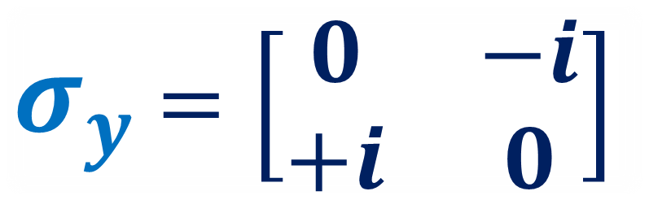
Spinors For Beginners
8
Vectors or Matrices?
$$σ_{z}$$
$σ_{x}$ $=\left[\begin{matrix}0 & 1 \\ 1 & 0\end{matrix}\right]$
$σ_{z}$ $=\left[\begin{matrix}1 & 0 \\ 0 & −1\end{matrix}\right]$
$$σ_{y}$$
$σ_{y}$ $=\left[\begin{matrix}0 & −i \\ +i & 0\end{matrix}\right]$
$$σ_{x}$$

Slide 2
Spinors Learning “Staircase”
Spinors in Particle Physics
Lie Groups & Algebras
Clifford Algebras
Spinors in 3D / (4D)
Examples From Physics (motivation)

Slide 3
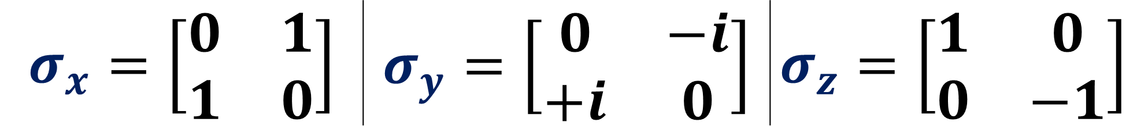
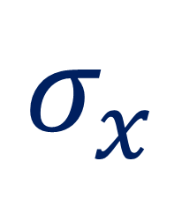


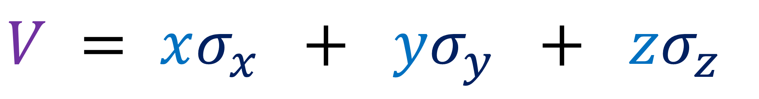
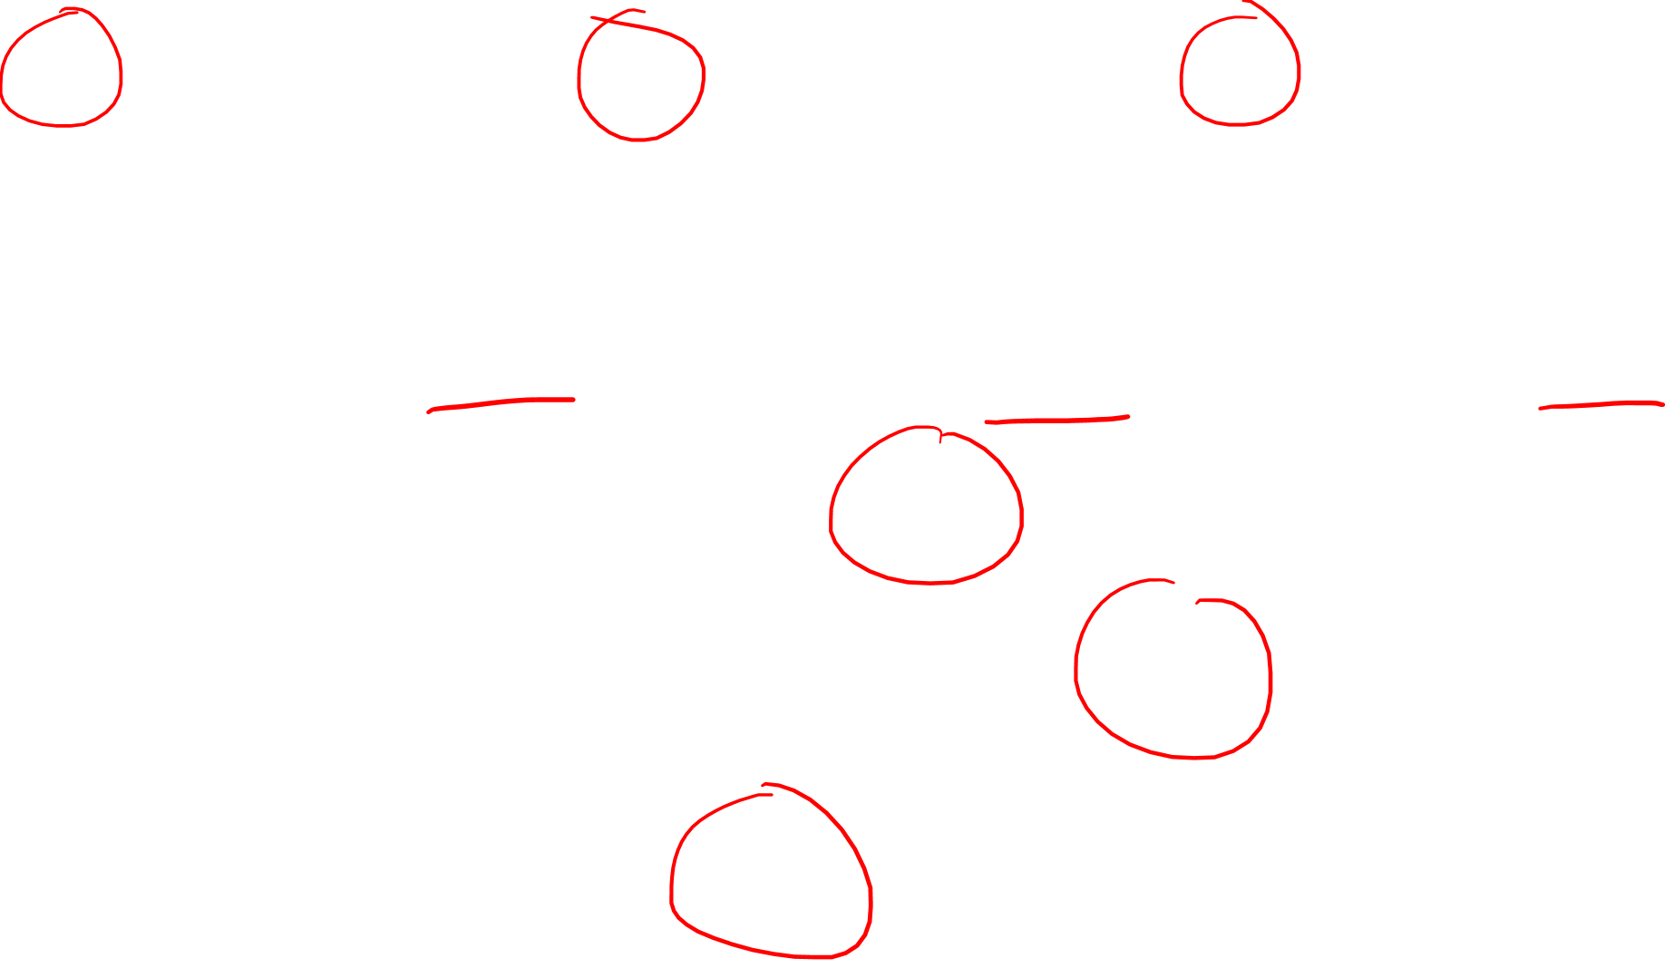
$$σ_{x}=\left[\begin{matrix}0 & 1 \\ 1 & 0\end{matrix}\right]$$ | $$σ_{y}=\left[\begin{matrix}0 & −i \\ +i & 0\end{matrix}\right]$$ | $$σ_{z}=\left[\begin{matrix}1 & 0 \\ 0 & −1\end{matrix}\right]$$
$$V = xσ_{x} + yσ_{y} + zσ_{z}$$
$$σ_{z}$$
$$σ_{y}$$
$$σ_{x}$$

Slide 4
One answer involves Clifford Algebras… (later video)

Slide 5
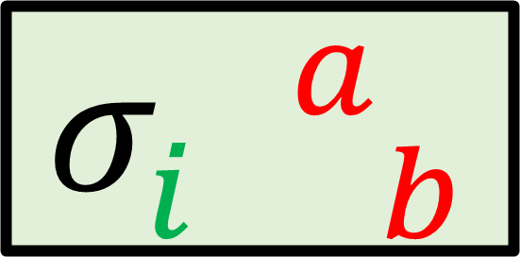



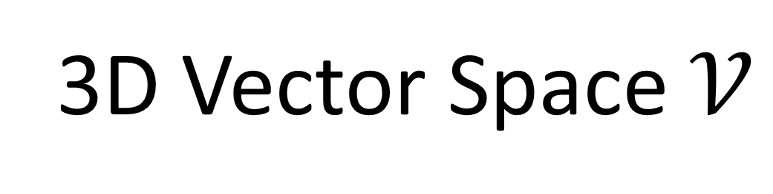





Spinor-Pair Space $𝒮⊗𝒮^{dual}$
3D Vector Space $𝒱$
$$s_{1}⊗𝖘^{1}$$
$$\vec{e_{x}}$$
$$σ_{i b}^{ a}$$
$$s_{1}⊗𝖘^{2}$$
$$\vec{e_{y}}$$
$$s_{2}⊗𝖘^{1}$$
$$\vec{e_{z}}$$
Tensor Index
Spinor Indices
$$s_{2}⊗𝖘^{2}$$

Slide 6




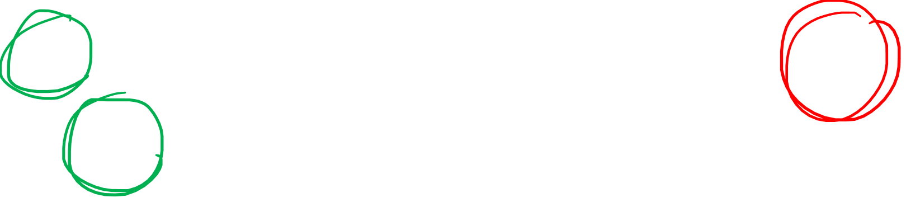

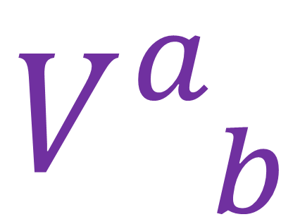

$$V_{ b}^{a}=σ_{i b}^{ a}v^{i}$$
$$V_{ b}^{a}$$
$$σ_{i b}^{ a}$$
$$v^{i}$$
$$=$$
Standard Vector
Pauli Vector
$$\left[\begin{aligned}v^{x} \\ v^{y} \\ v^{z}\end{aligned}\right]$$
$$\left[\begin{matrix}V_{ 1}^{1} & V_{ 2}^{1} \\ V_{ 1}^{2} & V_{ 2}^{2}\end{matrix}\right]$$

Slide 7
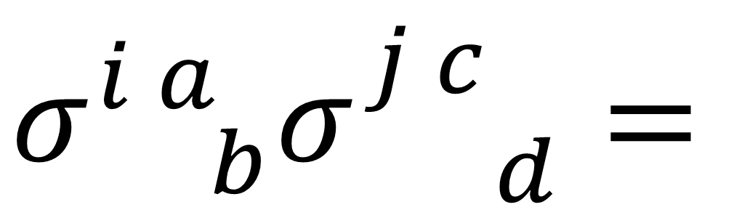
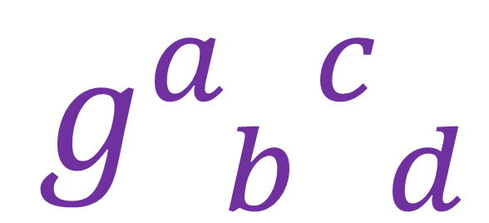

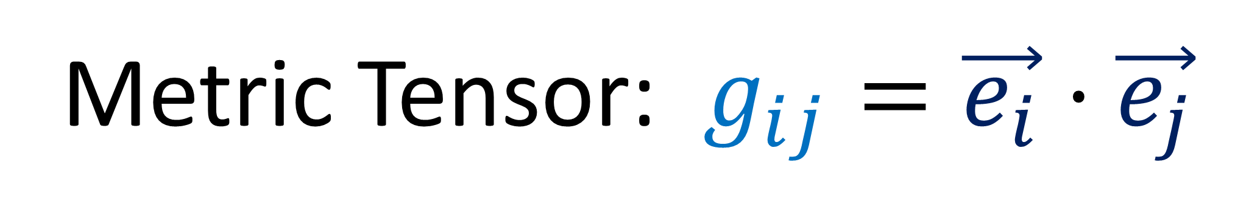
Metric Tensor: $g_{ij}=\vec{e_{i}}⋅\vec{e_{j}}$
$$g_{ij}$$
$$σ_{ b}^{i a}σ_{ d}^{j c}=$$
$$g_{ b d}^{a c}$$
Tensor Indices
Spinor Indices

Slide 8

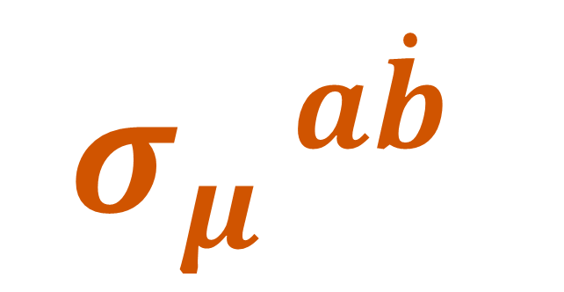
Infeld-Van der Waerden Symbols
$$σ_{μ}^{ a\dot{b}}$$
(used for spacetime)

Slide 9
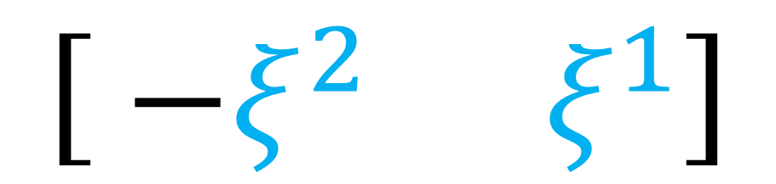
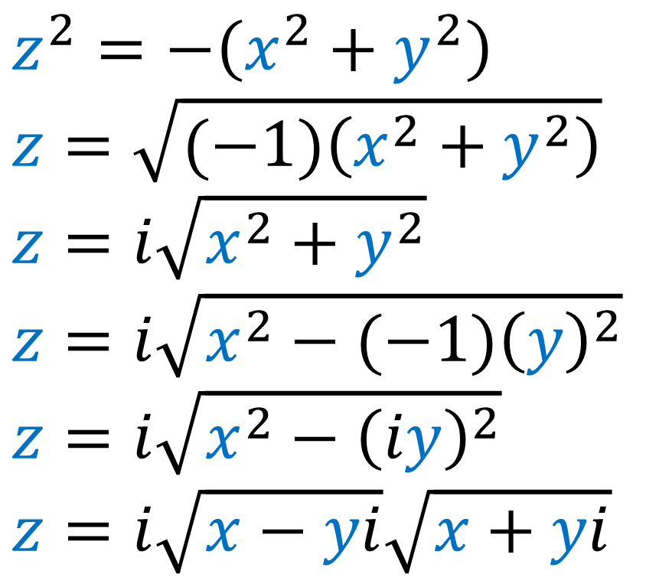
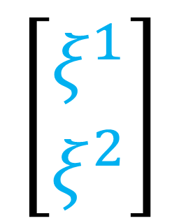
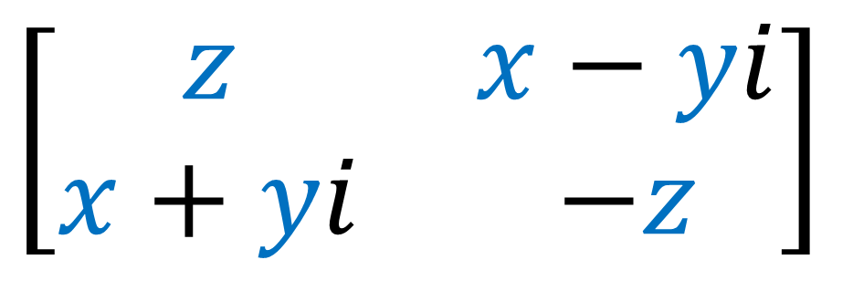
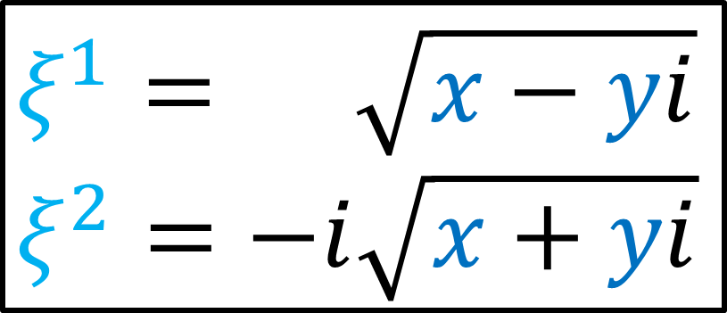
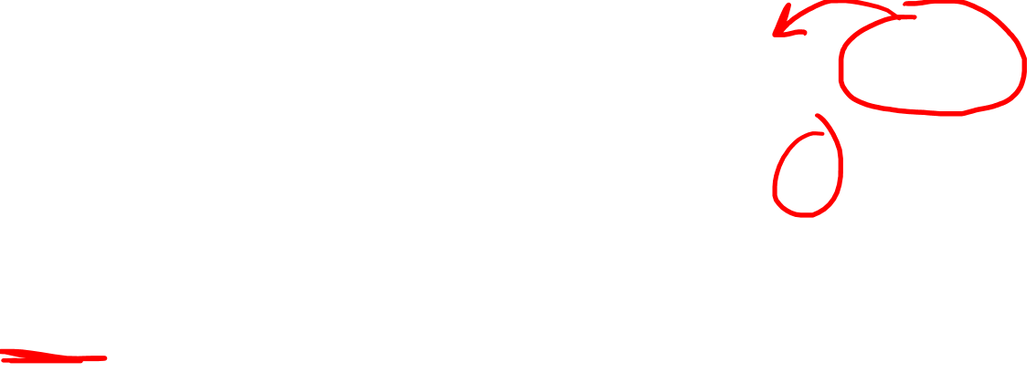
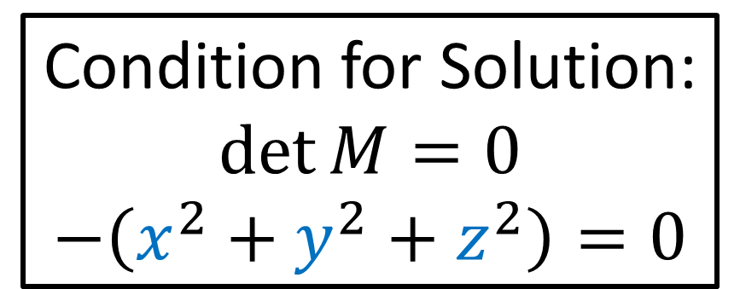
$$\left[\begin{matrix} −ξ^{2} & ξ^{1}\end{matrix}\right]$$
Condition for Solution:
$$\det{M}=0$$
$$−\left(x^{2}+y^{2}+z^{2}\right)=0$$
$$\left[\begin{aligned}ξ^{1} \\ ξ^{2}\end{aligned}\right]$$
$$\left[\begin{matrix}z & x−yi \\ x+yi & −z\end{matrix}\right]$$
$$z^{2}=−\left(x^{2}+y^{2}\right)$$
$$z=\sqrt{(−1)\left(x^{2}+y^{2}\right)}$$
$$z=i\sqrt{x^{2}+y^{2}}$$
$$z=i\sqrt{x^{2}−{(−1)\left(y\right)}^{2}}$$
$$z=i\sqrt{x^{2}−{\left(iy\right)}^{2}}$$
$z=i\sqrt{x−yi}\sqrt{x+yi}$
$$ξ^{1}= \sqrt{x−yi}$$
$$ξ^{2}=−i\sqrt{x+yi}$$

Slide 10
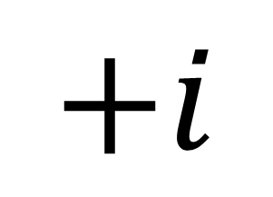
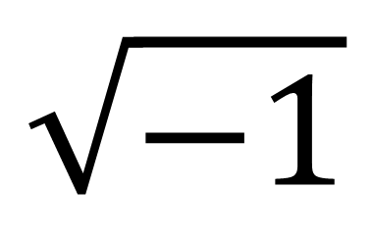
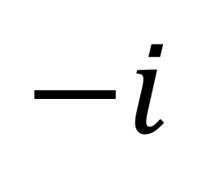
$$\left[\begin{matrix} −ξ^{2} & ξ^{1}\end{matrix}\right]$$
Condition for Solution:
$$\det{M}=0$$
$$−\left(x^{2}+y^{2}+z^{2}\right)=0$$
$$\left[\begin{aligned}ξ^{1} \\ ξ^{2}\end{aligned}\right]$$
$$\left[\begin{matrix}z & x−yi \\ x+yi & −z\end{matrix}\right]$$
$$+i$$
$$\sqrt{−1}$$
$$−i$$

Slide 11
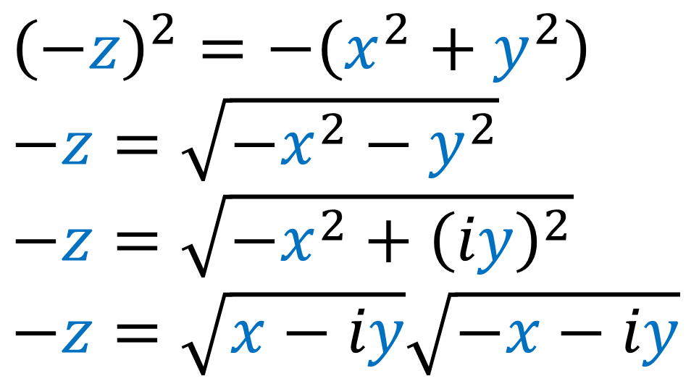
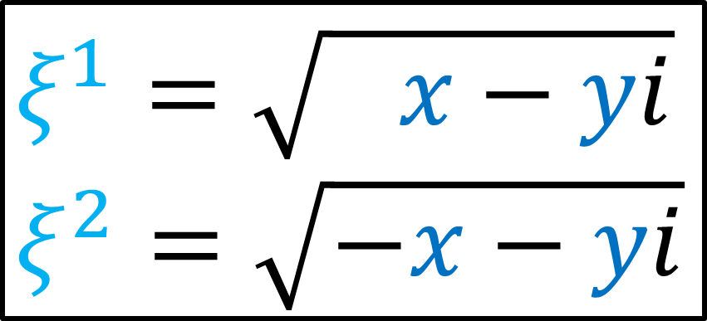
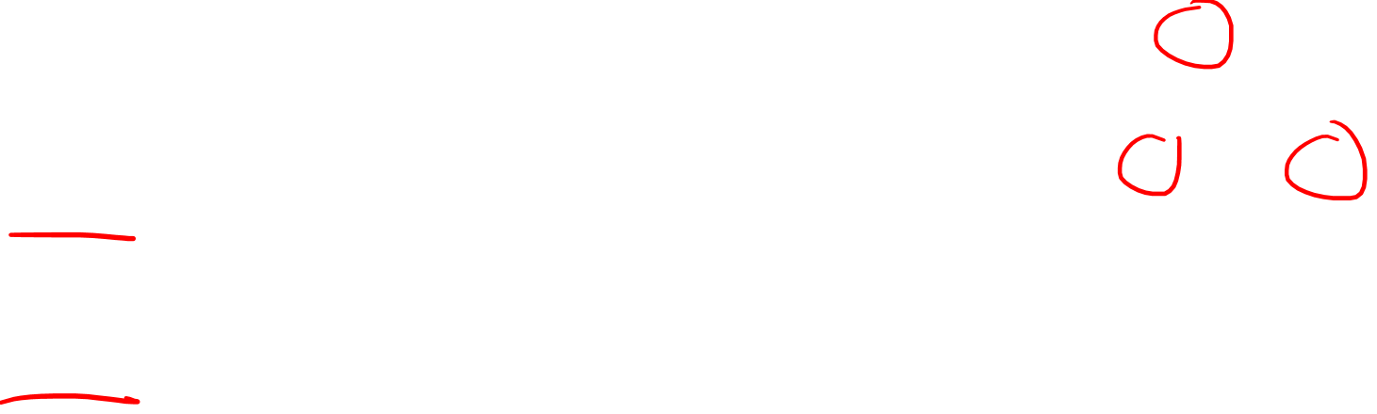
$$\left[\begin{matrix} −ξ^{2} & ξ^{1}\end{matrix}\right]$$
Condition for Solution:
$$\det{M}=0$$
$$−\left(x^{2}+y^{2}+z^{2}\right)=0$$
$$\left[\begin{aligned}ξ^{1} \\ ξ^{2}\end{aligned}\right]$$
$$\left[\begin{matrix}z & x−yi \\ x+yi & −z\end{matrix}\right]$$
$${\left(−z\right)}^{2}=−\left(x^{2}+y^{2}\right)$$
$$−z=\sqrt{−x^{2}−y^{2}}$$
$$−z=\sqrt{−x^{2}+{\left(iy\right)}^{2}}$$
$−z=\sqrt{x−iy}\sqrt{−x−iy}$
$$ξ^{1}=\sqrt{ x−yi}$$
$$ξ^{2}=\sqrt{−x−yi}$$

Slide 12
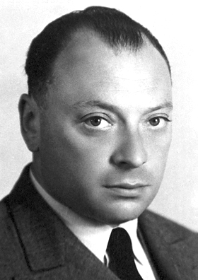
Wolfgang Pauli
(Austrian)

Slide 13

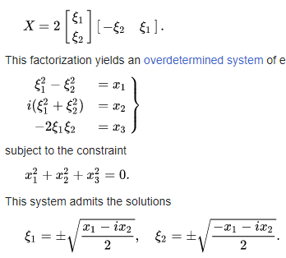

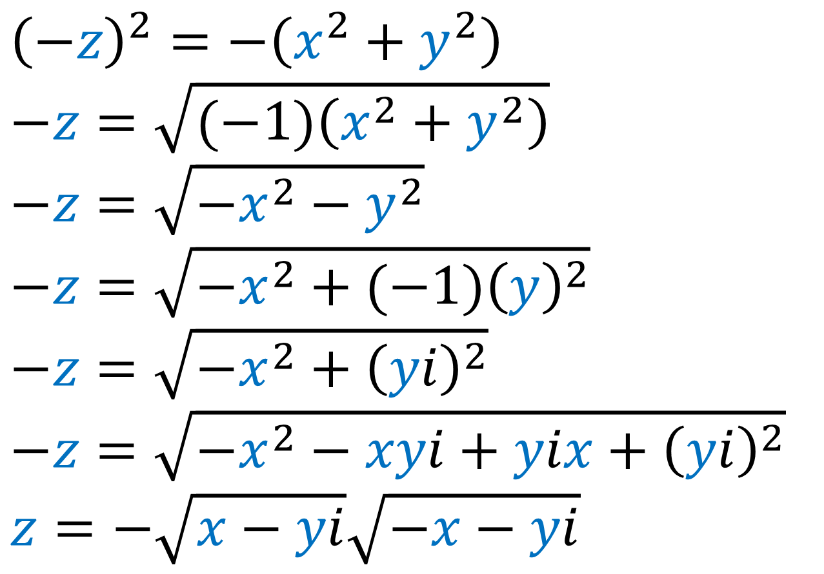
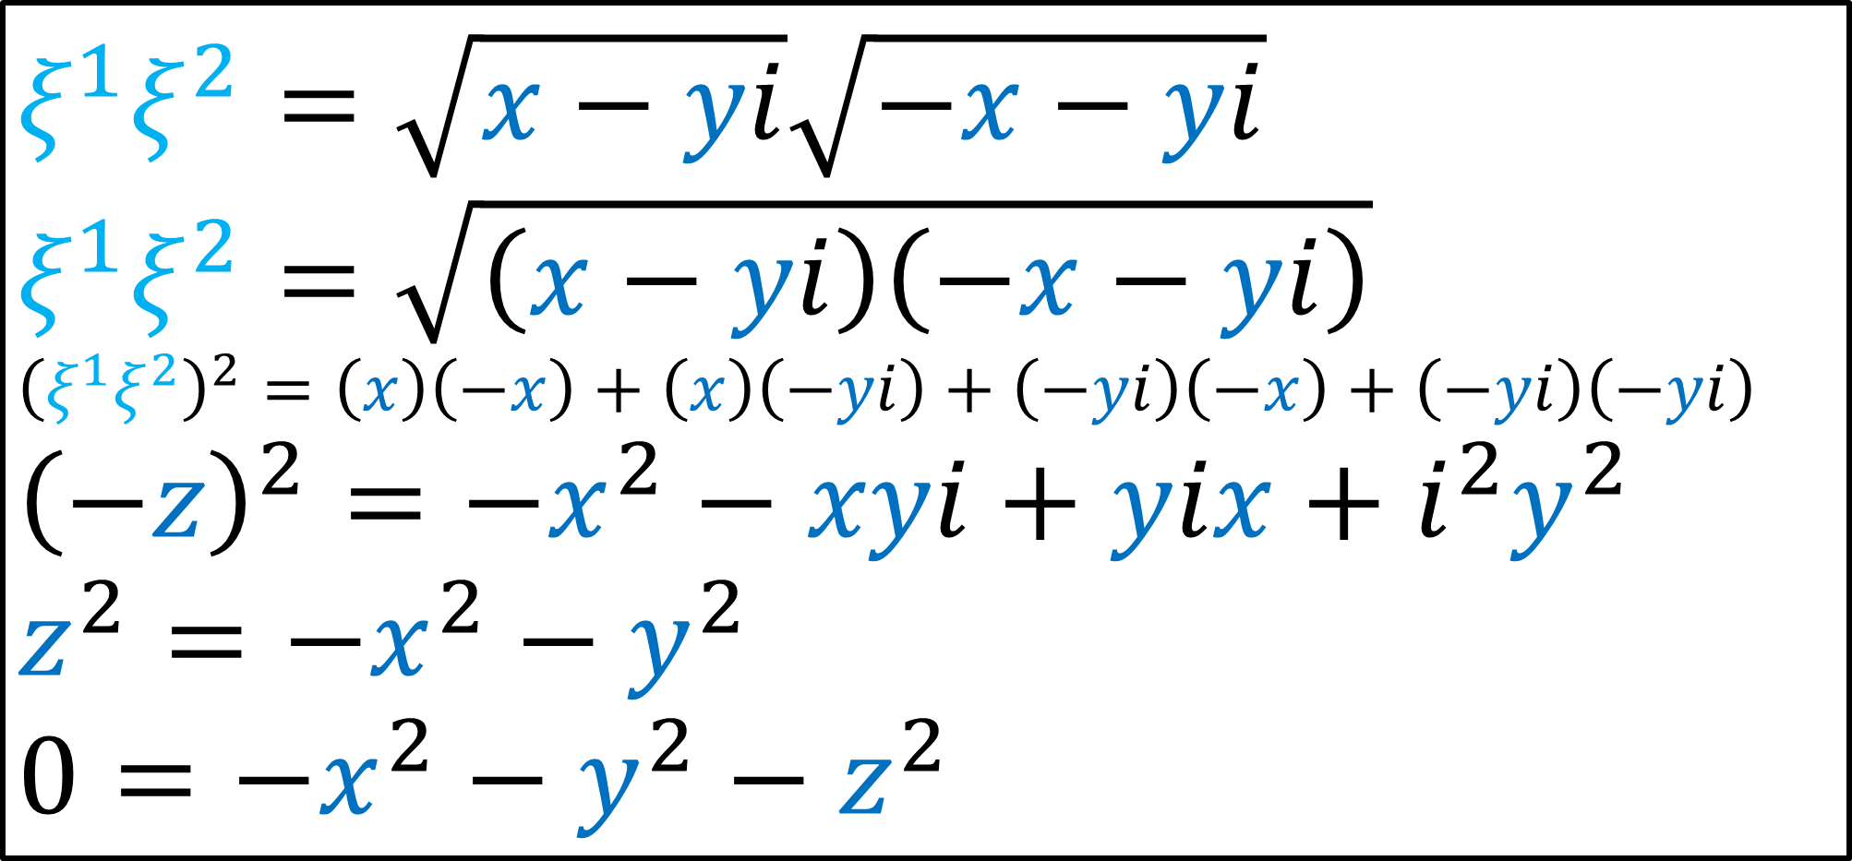
$$ξ^{1}ξ^{2}=\sqrt{x−yi}\sqrt{−x−yi}$$
$$ξ^{1}ξ^{2}=\sqrt{\left(x−yi\right)\left(−x−yi\right)}$$
$${\left(ξ^{1}ξ^{2}\right)}^{2}=\left(x\right)\left(−x\right)+\left(x\right)\left(−yi\right)+\left(−yi\right)\left(−x\right)+\left(−yi\right)\left(−yi\right)$$
$${\left(−z\right)}^{2}=−x^{2}−xyi+yix+i^{2}y^{2}$$
$$z^{2}=−x^{2}−y^{2}$$
$$0=−x^{2}−y^{2}−z^{2}$$
$${\left(−z\right)}^{2}=−\left(x^{2}+y^{2}\right)$$
$$−z=\sqrt{(−1)\left(x^{2}+y^{2}\right)}$$
$$−z=\sqrt{−x^{2}−y^{2}}$$
$$−z=\sqrt{−x^{2}+{(−1)\left(y\right)}^{2}}$$
$$−z=\sqrt{−x^{2}+{\left(yi\right)}^{2}}$$
$$−z=\sqrt{−x^{2}−xyi+yix+{\left(yi\right)}^{2}}$$
$z=−\sqrt{x−yi}\sqrt{−x−yi}$
$$z^{2}=−\left(x^{2}+y^{2}\right)$$
$$z=\sqrt{(−1)\left(x^{2}+y^{2}\right)}$$
$$z=i\sqrt{x^{2}+y^{2}}$$
$$z=i\sqrt{x^{2}−{(−1)\left(y\right)}^{2}}$$
$$z=i\sqrt{x^{2}−{\left(iy\right)}^{2}}$$
$z=i\sqrt{x−yi}\sqrt{x+yi}$

Slide 14

$$V=ξ⊗ξ^{dual}$$
Dual
Pauli Spinor
Pauli Vector
Pauli Spinor

Slide 15
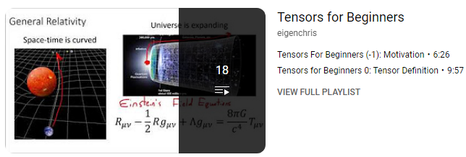
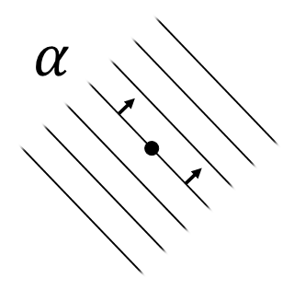

Prerequisites:
Link in description:
Tensor Product
$$\vec{v}⊗\vec{w}$$
Dual Vectors (covectors)

Slide 16
Tensors Review

Slide 17
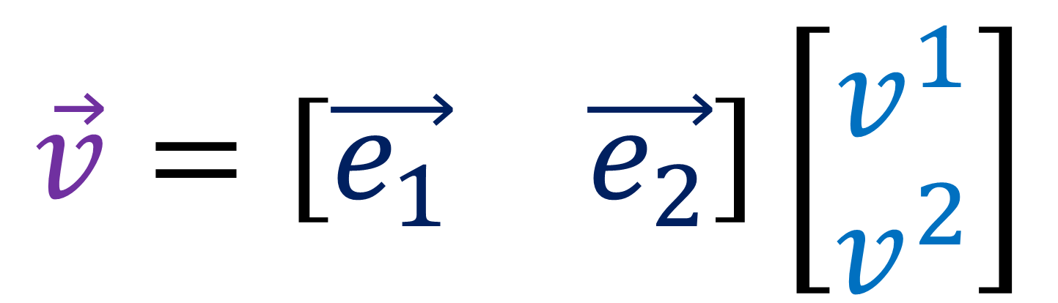

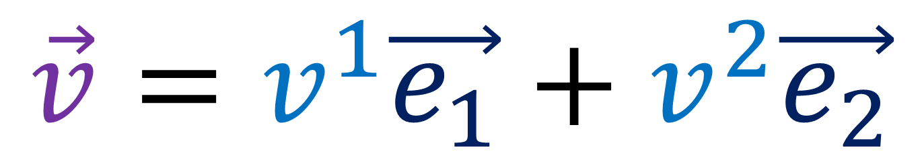
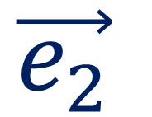
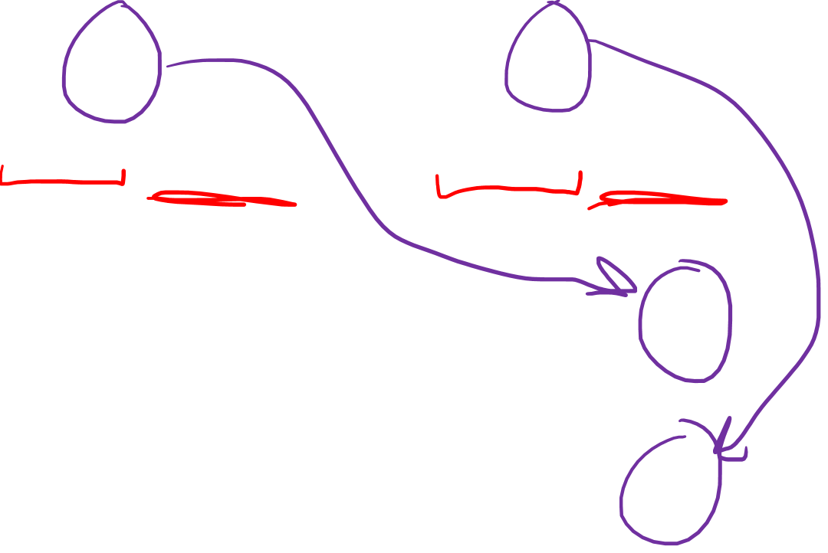

$$\vec{e_{2}}$$
$$\vec{v}$$
$$\vec{v}=v^{1}\vec{e_{1}}+v^{2}\vec{e_{2}}$$
$$\vec{e_{1}}$$
$$\vec{v}=\left[\begin{matrix}\vec{e_{1}} & \vec{e_{2}}\end{matrix}\right]\left[\begin{aligned}v^{1} \\ v^{2}\end{aligned}\right]$$
Notes:
In Relativity 102, I showed that if we took this basis eX and eY and measured this pencil to have components 1,1… If we doubled the length of the basis vectors, the components would become ½, ½.

Slide 18
$$\vec{e_{2}}$$
$$\vec{v}$$
$$\vec{v}=v^{1}\vec{e_{1}}+v^{2}\vec{e_{2}}$$
$$\vec{e_{1}}$$
contra-variant
“opposite” - ”change”
Notes:
In Relativity 102, I showed that if we took this basis eX and eY and measured this pencil to have components 1,1… If we doubled the length of the basis vectors, the components would become ½, ½.

Slide 19

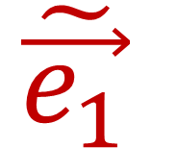
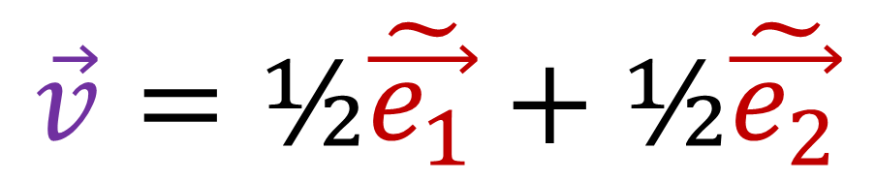

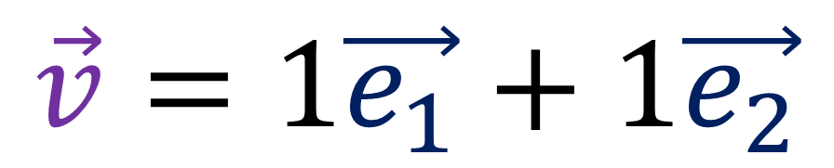
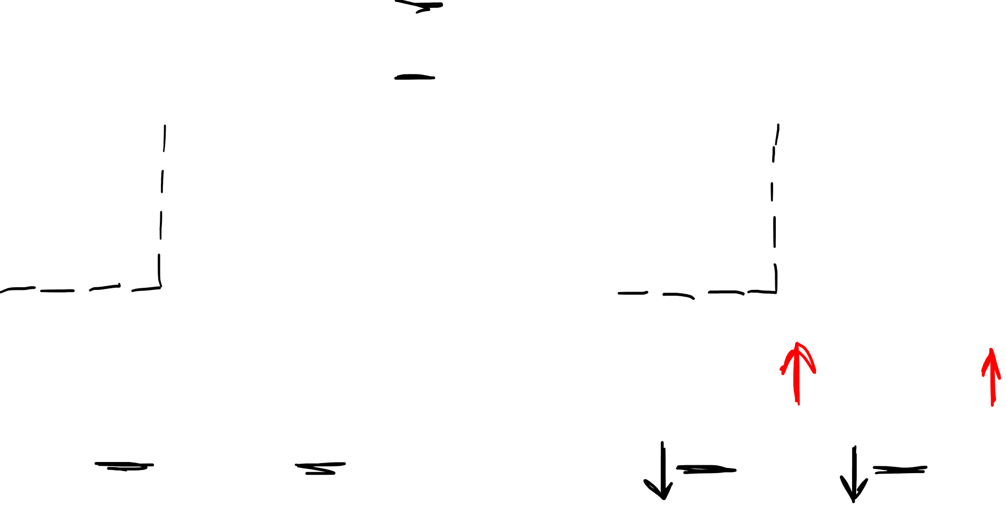





$$\tilde{\vec{e_{1}}}=2\vec{e_{1}}$$
$$\tilde{\vec{e_{2}}}=2\vec{e_{2}}$$
$$\tilde{\vec{e_{2}}}$$
$$\vec{e_{2}}$$
$$\vec{v}$$
$$\vec{v}$$
$$\tilde{\vec{e_{1}}}$$
$$\vec{e_{1}}$$
$$\vec{v}=1\vec{e_{1}}+1\vec{e_{2}}$$
$$\vec{v}=\text{½}\tilde{\vec{e_{1}}}+\text{½}\tilde{\vec{e_{2}}}$$
Notes:
In Relativity 102, I showed that if we took this basis eX and eY and measured this pencil to have components 1,1… If we doubled the length of the basis vectors, the components would become ½, ½.

Slide 20




$$\vec{v}=v^{1}\vec{e_{1}}+v^{2}\vec{e_{2}}$$
$$\vec{v}=\left[\vec{e_{1}} \vec{e_{2}}\right]\left[\begin{aligned}v^{1} \\ v^{2}\end{aligned}\right]$$
$=\left[\vec{e_{1}} \vec{e_{2}}\right]$ $\left[\begin{matrix}a & b \\ c & d\end{matrix}\right]{\left[\begin{matrix}a & b \\ c & d\end{matrix}\right]}^{−1}$ $\left[\begin{aligned}v^{1} \\ v^{2}\end{aligned}\right]$
Notes:
In Relativity 102, I showed that if we took this basis eX and eY and measured this pencil to have components 1,1… If we doubled the length of the basis vectors, the components would become ½, ½.

Slide 21




$$\vec{v}=v^{1}\vec{e_{1}}+v^{2}\vec{e_{2}}$$
$=\left[\vec{e_{1}} \vec{e_{2}}\right]$ $\left[\begin{matrix}M_{1}^{ 1} & M_{2}^{ 1} \\ M_{1}^{ 2} & M_{2}^{ 2}\end{matrix}\right]{\left[\begin{matrix}M_{1}^{ 1} & M_{2}^{ 1} \\ M_{1}^{ 2} & M_{2}^{ 2}\end{matrix}\right]}^{−1}$ $\left[\begin{aligned}v^{1} \\ v^{2}\end{aligned}\right]$
$= \sum_{i}{ v^{i} \vec{e_{i}} }$
$→\sum_{i}{\left(\sum_{j}{{(M^{−1})}_{j}^{ i}v^{j}}\right)\left(\sum_{k}{M_{i}^{ k}\vec{e_{k}}}\right)}$
Notes:
In Relativity 102, I showed that if we took this basis eX and eY and measured this pencil to have components 1,1… If we doubled the length of the basis vectors, the components would become ½, ½.

Slide 22



$$\vec{v}=v^{1}\vec{e_{1}}+v^{2}\vec{e_{2}}$$
$=\left[\vec{e_{1}} \vec{e_{2}}\right]$ $\left[\begin{matrix}M_{1}^{ 1} & M_{2}^{ 1} \\ M_{1}^{ 2} & M_{2}^{ 2}\end{matrix}\right]{\left[\begin{matrix}M_{1}^{ 1} & M_{2}^{ 1} \\ M_{1}^{ 2} & M_{2}^{ 2}\end{matrix}\right]}^{−1}$ $\left[\begin{aligned}v^{1} \\ v^{2}\end{aligned}\right]$
$= \sum_{i}{v^{i} \vec{e_{i}} }$
$→\left({(M^{−1})}_{j}^{ i}v^{j}\right)\left(M_{i}^{ k}\vec{e_{k}}\right)$
Notes:
In Relativity 102, I showed that if we took this basis eX and eY and measured this pencil to have components 1,1… If we doubled the length of the basis vectors, the components would become ½, ½.

Slide 23

$$\vec{v}=v^{1}\vec{e_{1}}+v^{2}\vec{e_{2}}$$
$=\left[\vec{e_{1}} \vec{e_{2}}\right]$ $\left[\begin{matrix}M_{1}^{ 1} & M_{2}^{ 1} \\ M_{1}^{ 2} & M_{2}^{ 2}\end{matrix}\right]{\left[\begin{matrix}M_{1}^{ 1} & M_{2}^{ 1} \\ M_{1}^{ 2} & M_{2}^{ 2}\end{matrix}\right]}^{−1}$ $\left[\begin{aligned}v^{1} \\ v^{2}\end{aligned}\right]$
$= \sum_{i}{ v^{i} \vec{e_{i}} }$
$=\sum_{i}{\left(\sum_{j}{{(M^{−1})}_{j}^{ i}v^{j}}\right)\left(\sum_{k}{M_{i}^{ k}\vec{e_{k}}}\right)}$
Notes:
In Relativity 102, I showed that if we took this basis eX and eY and measured this pencil to have components 1,1… If we doubled the length of the basis vectors, the components would become ½, ½.

Slide 24

$$\vec{v}=v^{1}\vec{e_{1}}+v^{2}\vec{e_{2}}$$
$=\left[\vec{e_{1}} \vec{e_{2}}\right]$ $\left[\begin{matrix}M_{1}^{ 1} & M_{2}^{ 1} \\ M_{1}^{ 2} & M_{2}^{ 2}\end{matrix}\right]{\left[\begin{matrix}M_{1}^{ 1} & M_{2}^{ 1} \\ M_{1}^{ 2} & M_{2}^{ 2}\end{matrix}\right]}^{−1}$ $\left[\begin{aligned}v^{1} \\ v^{2}\end{aligned}\right]$
$= \sum_{i}{v^{i} \vec{e_{i}} }$
$=\left({(M^{−1})}_{j}^{ i}v^{j}\right)\left(M_{i}^{ k}\vec{e_{k}}\right)$
Notes:
In Relativity 102, I showed that if we took this basis eX and eY and measured this pencil to have components 1,1… If we doubled the length of the basis vectors, the components would become ½, ½.

Slide 25

Dual Vectors
Also Called:
dual vector
covector
linear functional
linear form
one-form
bra vector
(bra vector $\left\langle ψ\right|$)

Slide 26
Vector = an arrow
Represents something with length and direction
Dual Vector = a stack
Represents something with density and direction
Give geometrical representation of:
Position
Velocity
Acceleration
Momentum
Force
(3D and 4D versions)
Give geometrical representation of:
Waves
(Doppler effect)
Density in time = frequency
Density in space = wavenumber

Slide 27
larger dual vector
smaller dual vector

Slide 28




$$\vec{v}$$
$$α\left(\vec{v}\right)=$$
$α\left(\vec{v}\right)=$ # stacks pierced by vector
$$α$$

Slide 29



$$α\left(\vec{v}\right)=3$$
$$\vec{v}$$
$$α\left(\vec{v}\right)=$$
$α\left(\vec{v}\right)=$ # stacks pierced by vector
$$α$$

Slide 30









$$α\left(\vec{u}+\vec{w}\right)=$$
$$α\left(\vec{u}\right)+α\left(\vec{w}\right)$$
$$α\left(n\vec{v}\right) =nα\left(\vec{v}\right)$$
$$\vec{u}+\vec{w}$$
$$α$$
$$α$$
$$\vec{w}$$
$$n\vec{v}$$
$$\vec{v}$$
$$\vec{u}$$

Slide 31





$$α$$
$$\left[α_{1} α_{2}\right]$$
$$\vec{e_{2}}$$
$$=\left[ 3 2 \right]$$
$$\vec{e_{1}}$$

Slide 32


Vectors
Dual Vectors
$$\left[\begin{aligned}v^{1} \\ v^{2}\end{aligned}\right]$$
$$\left[α_{1} α_{2}\right]$$
co-variant
contra-variant
“same” - ”change”
“opposite” - ”change”

Slide 33
Vectors
Dual Vectors
$$\left[\begin{aligned}v^{1} \\ v^{2}\end{aligned}\right]$$
$$\left[α_{1} α_{2}\right]$$
co-variant
contra-variant
“same” - ”change”
“opposite” - ”change”

Slide 34













Dual Basis
$$ε^{1}$$
$$ε^{2}$$
Kronecker Delta
$$δ_{ j}^{i}=\left\{\begin{aligned}1 if i=j \\ 0 if i≠j \end{aligned}\right.$$
$$\vec{e_{2}}$$
$$\vec{e_{2}}$$
$$\vec{e_{1}}$$
$$\vec{e_{1}}$$
$$ε^{i}\left(\vec{e_{j}}\right)=δ_{ j}^{i}$$
$$ε^{1}\left(\vec{e_{1}}\right)=1$$
$$ε^{2}\left(\vec{e_{1}}\right)=0$$
$$ε^{1}\left(\vec{e_{2}}\right)=0$$
$$ε^{2}\left(\vec{e_{2}}\right)=1$$

Slide 35





contra-variant
$$ε^{i}\left(\vec{e_{j}}\right)=δ_{ j}^{i}$$
$$\tilde{\vec{e_{1}}}=2\vec{e_{1}}$$
$$\tilde{\vec{e_{2}}}=2\vec{e_{2}}$$
$$\tilde{ε^{i}}\left( \tilde{\vec{e_{j}}} \right)=δ_{ j}^{i}$$
$$\text{½}ε^{i}\left(2\vec{e_{j}}\right)=δ_{ j}^{i}$$

Slide 36





Vector
$$=\left[\vec{e_{1}} \vec{e_{2}}\right]\left[\begin{aligned}v^{1} \\ v^{2}\end{aligned}\right]$$
$$\vec{v}=v^{1}\vec{e_{1}}+v^{2}\vec{e_{2}}$$
Dual Vector
$$=\left[α_{1} α_{2}\right]\left[\begin{aligned}ε^{1} \\ ε^{2}\end{aligned}\right]$$
$$α=α_{1}ε^{1}+α_{2}ε^{2}$$

Slide 37






Vector Space $𝒱$
Dual Space $𝒱^{∗}$
$$\vec{e_{2}}$$
$$ε^{1}$$
$$ε^{2}$$
$$\vec{e_{1}}$$

Slide 38

Vector Space $𝒱$
Dual Space $𝒱^{dual}$
$$\vec{e_{2}}$$
$$ε^{1}$$
$$ε^{2}$$
$$\vec{e_{1}}$$

Slide 39






$$=\left[α_{1} α_{2}\right]\left[\begin{aligned}v^{1} \\ v^{2}\end{aligned}\right]$$
$$α\left(\vec{v}\right)$$
“Inner Product”
$$=α_{1}v^{1}+α_{2}v^{2}$$
$$\left[\begin{aligned}v^{1} \\ v^{2}\end{aligned}\right]\left[α_{1} α_{2}\right]$$
“Outer Product”
$$=\left[\begin{matrix}v^{1}α_{1} & v^{1}α_{2} \\ v^{2}α_{1} & v^{2}α_{2}\end{matrix}\right]$$

Slide 40


$$\left[\begin{aligned}v^{1} \\ v^{2}\end{aligned}\right]\left[α_{1} α_{2}\right]$$
“Outer
Product”
$$\vec{v}⊗α$$
“Tensor
Product”

Slide 41







Outer Product
$$=\left[\begin{aligned}nv^{1} \\ nv^{2}\end{aligned}\right]\left[α_{1} α_{2}\right]$$
$$n\left[\begin{aligned}v^{1} \\ v^{2}\end{aligned}\right]\left[α_{1} α_{2}\right]$$
$$=\left[\begin{aligned}v^{1} \\ v^{2}\end{aligned}\right]\left[nα_{1} nα_{2}\right]$$
Tensor Product
$$=\left(n\vec{v}\right)⊗α$$
$$n\left(\vec{v}⊗α\right)$$
$$=\vec{v}⊗\left(nα\right)$$

Slide 42





$$\left[\begin{aligned}v^{1} \\ v^{2}\end{aligned}\right]\left(\left[α_{1} α_{2}\right]+\left[β_{1} β_{2}\right]\right)$$
$$=\left[\begin{aligned}v^{1} \\ v^{2}\end{aligned}\right]\left[α_{1} α_{2}\right]+\left[\begin{aligned}v^{1} \\ v^{2}\end{aligned}\right]\left[β_{1} β_{2}\right]$$
$$\vec{v}⊗\left(α+β\right)$$
$$=\left(\vec{v}⊗α\right)+\left(\vec{v}⊗β\right)$$

Slide 43





$$\left(\left[\begin{aligned}v^{1} \\ v^{2}\end{aligned}\right]+\left[\begin{aligned}w^{1} \\ w^{2}\end{aligned}\right]\right)\left[α_{1} α_{2}\right]$$
$$=\left[\begin{aligned}v^{1} \\ v^{2}\end{aligned}\right]\left[α_{1} α_{2}\right]+\left[\begin{aligned}w^{1} \\ w^{2}\end{aligned}\right]\left[α_{1} α_{2}\right]$$
$$\left(\vec{v}+\vec{w}\right)⊗α$$
$$=\left(\vec{v}⊗α\right)+\left(\vec{w}⊗α\right)$$

Slide 44





$$\left[\begin{aligned}v^{1} \\ v^{2}\end{aligned}\right]\left(\left[α_{1} α_{2}\right]+\left[β_{1} β_{2}\right]\right)$$
$$=\left[\begin{aligned}v^{1} \\ v^{2}\end{aligned}\right]\left[α_{1} α_{2}\right]+\left[\begin{aligned}v^{1} \\ v^{2}\end{aligned}\right]\left[β_{1} β_{2}\right]$$
$$\left(\left[\begin{aligned}v^{1} \\ v^{2}\end{aligned}\right]+\left[\begin{aligned}w^{1} \\ w^{2}\end{aligned}\right]\right)\left[α_{1} α_{2}\right]$$
$$=\left[\begin{aligned}v^{1} \\ v^{2}\end{aligned}\right]\left[α_{1} α_{2}\right]+\left[\begin{aligned}w^{1} \\ w^{2}\end{aligned}\right]\left[α_{1} α_{2}\right]$$

Slide 45





$$\vec{v}⊗\left(α+β\right)$$
$$=\left(\vec{v}⊗α\right)+\left(\vec{v}⊗β\right)$$
$$\left(\vec{v}+\vec{w}\right)⊗α$$
$$=\left(\vec{v}⊗α\right)+\left(\vec{w}⊗α\right)$$

Slide 46



determinant $=0$
$$\left[\begin{matrix}1 & 100 \\ 4 & 400\end{matrix}\right]$$
$$=\left[\begin{aligned}1 \\ 4\end{aligned}\right]\left[\begin{matrix}1 & 100\end{matrix}\right]$$

Slide 47



determinant $=0$
$$\left[\begin{matrix}L_{1}^{1} & L_{2}^{1} \\ L_{1}^{2} & L_{2}^{2}\end{matrix}\right]$$
$$=\left[\begin{aligned}v^{1} \\ v^{2}\end{aligned}\right]\left[\begin{matrix}α_{1} & α_{2}\end{matrix}\right]$$
$$L = \vec{v} ⊗ α$$

Slide 48



determinant $≠0$
$$\left[\begin{matrix}1 & 100 \\ 4 & 500\end{matrix}\right]$$
$$≠\left[\begin{aligned}a \\ b\end{aligned}\right]\left[\begin{matrix}c & d\end{matrix}\right]$$

Slide 49




$$\left[\begin{matrix}1 & 100 \\ 4 & 500\end{matrix}\right]=$$
$$\left[\begin{matrix}1 & 0 \\ 0 & 0\end{matrix}\right]+\left[\begin{matrix}0 & 0 \\ 4 & 0\end{matrix}\right]+\left[\begin{matrix}0 & 100 \\ 0 & 0\end{matrix}\right]+\left[\begin{matrix}0 & 0 \\ 0 & 500\end{matrix}\right]$$
$$1\left[\begin{matrix}1 & 0 \\ 0 & 0\end{matrix}\right]+4\left[\begin{matrix}0 & 0 \\ 1 & 0\end{matrix}\right]+100\left[\begin{matrix}0 & 1 \\ 0 & 0\end{matrix}\right]+500\left[\begin{matrix}0 & 0 \\ 0 & 1\end{matrix}\right]$$
determinant $=0$

Slide 50

$$\left[\begin{matrix}1 & 100 \\ 4 & 500\end{matrix}\right]=$$
$$1\left[\begin{matrix}1 & 0 \\ 0 & 0\end{matrix}\right]+4\left[\begin{matrix}0 & 0 \\ 1 & 0\end{matrix}\right]+100\left[\begin{matrix}0 & 1 \\ 0 & 0\end{matrix}\right]+500\left[\begin{matrix}0 & 0 \\ 0 & 1\end{matrix}\right]$$
$$1\left[\begin{aligned}1 \\ 0\end{aligned}\right]\left[1 0\right]+4\left[\begin{aligned}0 \\ 1\end{aligned}\right]\left[1 0\right]+100\left[\begin{aligned}1 \\ 0\end{aligned}\right]\left[0 1\right]+500\left[\begin{aligned}0 \\ 1\end{aligned}\right]\left[0 1\right]$$

Slide 51


$$\left[\begin{matrix}L_{1}^{1} & L_{2}^{1} \\ L_{1}^{2} & L_{2}^{2}\end{matrix}\right]=$$
$$L_{1}^{1}\left[\begin{matrix}1 & 0 \\ 0 & 0\end{matrix}\right]+L_{1}^{2}\left[\begin{matrix}0 & 0 \\ 1 & 0\end{matrix}\right]+L_{2}^{1}\left[\begin{matrix}0 & 1 \\ 0 & 0\end{matrix}\right]+L_{2}^{2}\left[\begin{matrix}0 & 0 \\ 0 & 1\end{matrix}\right]$$
$$L_{1}^{1}\left[\begin{aligned}1 \\ 0\end{aligned}\right]\left[1 0\right]+L_{1}^{2}\left[\begin{aligned}0 \\ 1\end{aligned}\right]\left[1 0\right]+L_{2}^{1}\left[\begin{aligned}1 \\ 0\end{aligned}\right]\left[0 1\right]+L_{2}^{2}\left[\begin{aligned}0 \\ 1\end{aligned}\right]\left[0 1\right]$$

Slide 52


$$\left[\begin{matrix}L_{1}^{1} & L_{2}^{1} \\ L_{1}^{2} & L_{2}^{2}\end{matrix}\right]=$$
$$L_{1}^{1}\left[\begin{aligned}1 \\ 0\end{aligned}\right]\left[1 0\right]+L_{1}^{2}\left[\begin{aligned}0 \\ 1\end{aligned}\right]\left[1 0\right]+L_{2}^{1}\left[\begin{aligned}1 \\ 0\end{aligned}\right]\left[0 1\right]+L_{2}^{2}\left[\begin{aligned}0 \\ 1\end{aligned}\right]\left[0 1\right]$$
$$L_{1}^{1}\left(\vec{e_{1}}⊗ε^{1}\right)+L_{1}^{2}\left(\vec{e_{2}}⊗ε^{1}\right)+L_{2}^{1}\left(\vec{e_{1}}⊗ε^{2}\right)+L_{2}^{2}\left(\vec{e_{2}}⊗ε^{2}\right)$$
$L=\sum_{i}{\sum_{j}{L_{j}^{i}\left(\vec{e_{i}}⊗ε^{j}\right)}}$

Slide 53





Vector Space $𝒱$
Dual Space $𝒱^{dual}$
$$\left|e_{2}\right\rangle$$
$$\left\langle ε^{1}\right|$$
$$\left\langle ε^{2}\right|$$
$$\left|e_{1}\right\rangle$$

Slide 54






$$=\left[α_{1} α_{2}\right]\left[\begin{aligned}v^{1} \\ v^{2}\end{aligned}\right]$$
$$\left\langle α|v\right\rangle$$
“Inner Product”
$$=α_{1}v^{1}+α_{2}v^{2}$$
$$\left|v\right\rangle ⊗\left\langle α\right|$$
$$=\left|v\right\rangle \left\langle α\right|$$
“Outer Product”
$$=\left[\begin{matrix}v^{1}α_{1} & v^{1}α_{2} \\ v^{2}α_{1} & v^{2}α_{2}\end{matrix}\right]$$
$$\left[\begin{aligned}v^{1} \\ v^{2}\end{aligned}\right]\left[α_{1} α_{2}\right]$$

Slide 55






Vectors
$$\vec{v}=v^{1}\vec{e_{1}}+v^{2}\vec{e_{2}}$$
Spinors
$$ξ=ξ^{1}s_{1}+ξ^{2}s_{2}$$
Dual Vectors
$$α=α_{1}ε^{1}+α_{2}ε^{2}$$
Dual Spinors
$$ζ=ζ_{1}𝖘^{1}+ζ_{2}𝖘^{2}$$
Tensor Products
$$\vec{v}⊗α$$
Tensor Products
$$ξ⊗ζ$$

Slide 56





Spinor Space
$$𝒮$$
Dual Spinor Space
$$𝒮^{dual}$$
$$ξ∈𝒮$$
$$ζ∈𝒮^{dual}$$
bold
bold

Slide 57







Spinors
$$ξ=ξ^{1}s_{1}+ξ^{2}s_{2}$$
$$\left[s_{1} s_{2}\right]\left[\begin{aligned}ξ^{1} \\ ξ^{2}\end{aligned}\right]$$
$\sum_{a}{ξ^{a}s_{a}}$
$\left[ζ_{1} ζ_{2}\right]\left[\begin{aligned}𝖘^{1} \\ 𝖘^{2}\end{aligned}\right]$
Dual Spinors
$$ζ=ζ_{1}𝖘^{1}+ζ_{2}𝖘^{2}$$
$\sum_{a}{ζ_{a}𝖘^{a}}$

Slide 58





$$→\left[\begin{aligned}ξ^{1} \\ ξ^{2}\end{aligned}\right]$$
Spinors
$$ξ=ξ^{1}s_{1}+ξ^{2}s_{2}$$
Dual Spinors
$$ζ=ζ_{1}𝖘^{1}+ζ_{2}𝖘^{2}$$
$$→\left[ζ_{1} ζ_{2}\right]$$

Slide 59




$$\left[\begin{aligned}ξ^{1} \\ ξ^{2}\end{aligned}\right]$$
Spinor
$$\left[s_{1} s_{2}\right]$$
Dual Spinor
$$\left[\begin{aligned}𝖘^{1} \\ 𝖘^{2}\end{aligned}\right]$$
$$\left[ζ_{1} ζ_{2}\right]$$

Slide 60




covariant
contravariant
$${\left[\begin{matrix}a & b \\ c & d\end{matrix}\right]}^{−1}$$
$$\left[\begin{aligned}ξ^{1} \\ ξ^{2}\end{aligned}\right]$$
$$\left[\begin{matrix}a & b \\ c & d\end{matrix}\right]$$
$$\left[s_{1} s_{2}\right]$$
$$\left[\begin{aligned}𝖘^{1} \\ 𝖘^{2}\end{aligned}\right]$$
$$\left[ζ_{1} ζ_{2}\right]$$

Slide 61




covariant
contravariant
$${\left[\begin{matrix}a & b \\ c & d\end{matrix}\right]}^{−1}$$
$$\left[\begin{aligned}ξ^{1} \\ ξ^{2}\end{aligned}\right]$$
$$\left[\begin{matrix}a & b \\ c & d\end{matrix}\right]$$
$$\left[s_{1} s_{2}\right]$$
$${\left[\begin{matrix}a & b \\ c & d\end{matrix}\right]}^{−1}$$
$$\left[\begin{aligned}𝖘^{1} \\ 𝖘^{2}\end{aligned}\right]$$
$$\left[\begin{matrix}a & b \\ c & d\end{matrix}\right]$$
$$\left[ζ_{1} ζ_{2}\right]$$
covariant
contravariant

Slide 62





$$=\left[ζ_{1} ζ_{2}\right]\left[\begin{aligned}ξ^{1} \\ ξ^{2}\end{aligned}\right]$$
$$ζ\left(ξ\right)$$
“Inner Product”
$$=ζ_{1}ξ^{1}+ζ_{2}ξ^{2}$$
$$\left[\begin{aligned}ξ^{1} \\ ξ^{2}\end{aligned}\right]\left[ζ_{1} ζ_{2}\right]$$
“Outer Product”
$$=\left[\begin{matrix}ξ^{1}ζ_{1} & ξ^{1}ζ_{2} \\ ξ^{2}ζ_{1} & ξ^{2}ζ_{2}\end{matrix}\right]$$

Slide 63



Vector Space Axioms:
$\vec{u}+\left(\vec{v}+\vec{w}\right)=\left(\vec{u}+\vec{v}\right)+\vec{w}$
$\vec{u}+\vec{v}=\vec{v}+\vec{u}$
$∃\vec{0}: \vec{v}+\vec{0}=\vec{v}$
$∃−\vec{v}: \vec{v}+\left(−\vec{v}\right)=\vec{0}$
$a\left(b\vec{v}\right)=\left(ab\right)\vec{v}$
$1\vec{v}=\vec{v}$
$a\left(\vec{u}+\vec{v}\right)=a\vec{u}+a\vec{v}$
$\left(a+b\right)\vec{v}=a\vec{v}+b\vec{v}$

Slide 64



Vector Space $𝒱$
Spinor Space $𝒮$
$$σ$$

Slide 65





Pauli Vector
$$z=\left(ξ^{1}\right)\left(−ξ^{2}\right)$$
$$z=\left(\sqrt{x−yi}\right)\left(\sqrt{−x−yi}\right)$$
$$z=\sqrt{−x^{2}−xyi+yix+i^{2}y^{2}}$$
$$z=\sqrt{−x^{2}−y^{2}}$$
$$z^{2}=−x^{2}−y^{2}$$
$$x^{2}+y^{2}+z^{2}=0$$
determinant $=0$
$$=\left[\begin{aligned}ξ^{1} \\ ξ^{2}\end{aligned}\right]\left[−ξ^{2} ξ^{1}\right]$$
$$\left[\begin{matrix}z & x−yi \\ x+yi & −z\end{matrix}\right]$$
$$ξ^{1}= \sqrt{x−yi}$$
$$ξ^{2}=−\sqrt{−x−yi}$$

Slide 66



Pauli Vector
determinant $=0$
$$=\left[\begin{aligned}ξ^{1} \\ ξ^{2}\end{aligned}\right]\left[\begin{matrix}ζ_{1} & ζ_{2}\end{matrix}\right]$$
$$\left[\begin{matrix}z & x−yi \\ x+yi & −z\end{matrix}\right]$$
$$ξ^{1}= ζ_{2}= \sqrt{x−yi}$$
$$ξ^{2}=−ζ_{1}=−i\sqrt{x+yi}$$

Slide 67


Pauli Vector
determinant $=0$
$$=\left[\begin{aligned}ξ^{1} \\ ξ^{2}\end{aligned}\right]\left[\begin{matrix}ζ_{1} & ζ_{2}\end{matrix}\right]$$
$$\left[\begin{matrix}z & x−yi \\ x+yi & −z\end{matrix}\right]$$
$$V=ξ⊗ζ$$

Slide 68



determinant $≠0$
$$\left[\begin{matrix}z & x−yi \\ x+yi & −z\end{matrix}\right]=$$
$$\left[\begin{matrix}z & 0 \\ 0 & 0\end{matrix}\right]+\left[\begin{matrix}0 & 0 \\ x+yi & 0\end{matrix}\right]+\left[\begin{matrix}0 & x−yi \\ 0 & 0\end{matrix}\right]+\left[\begin{matrix}0 & 0 \\ 0 & −z\end{matrix}\right]$$
$$z\left[\begin{matrix}1 & 0 \\ 0 & 0\end{matrix}\right]+\left(x+yi\right)\left[\begin{matrix}0 & 0 \\ 1 & 0\end{matrix}\right]+\left(x−yi\right)\left[\begin{matrix}0 & 1 \\ 0 & 0\end{matrix}\right]+\left(−z\right)\left[\begin{matrix}0 & 0 \\ 0 & 1\end{matrix}\right]$$
determinant $=0$

Slide 69
determinant $≠0$
$$\left[\begin{matrix}z & x−yi \\ x+yi & −z\end{matrix}\right]=$$
$$z\left[\begin{matrix}1 & 0 \\ 0 & 0\end{matrix}\right]+\left(x+yi\right)\left[\begin{matrix}0 & 0 \\ 1 & 0\end{matrix}\right]+\left(x−yi\right)\left[\begin{matrix}0 & 1 \\ 0 & 0\end{matrix}\right]+\left(−z\right)\left[\begin{matrix}0 & 0 \\ 0 & 1\end{matrix}\right]$$
$$z\left[\begin{aligned}1 \\ 0\end{aligned}\right]\left[1 0\right]+\left(x+yi\right)\left[\begin{aligned}0 \\ 1\end{aligned}\right]\left[1 0\right]+\left(x−yi\right)\left[\begin{aligned}1 \\ 0\end{aligned}\right]\left[0 1\right]+\left(−z\right)\left[\begin{aligned}0 \\ 1\end{aligned}\right]\left[0 1\right]$$

Slide 70

determinant $≠0$
$$\left[\begin{matrix}z & x−yi \\ x+yi & −z\end{matrix}\right]=$$
$$z\left[\begin{aligned}1 \\ 0\end{aligned}\right]\left[1 0\right]+\left(x+yi\right)\left[\begin{aligned}0 \\ 1\end{aligned}\right]\left[1 0\right]+\left(x−yi\right)\left[\begin{aligned}1 \\ 0\end{aligned}\right]\left[0 1\right]+\left(−z\right)\left[\begin{aligned}0 \\ 1\end{aligned}\right]\left[0 1\right]$$
$$V_{1}^{1}\left(s_{1}⊗𝖘^{1}\right)+V_{1}^{2}\left(s_{2}⊗𝖘^{1}\right)+V_{2}^{1}\left(s_{1}⊗𝖘^{2}\right)+V_{2}^{2}\left(s_{2}⊗𝖘^{2}\right)$$
$V=\sum_{a}{\sum_{b}{V_{ b}^{a}\left(s_{a}⊗𝖘^{b}\right)}}$

Slide 71

determinant $≠0$
$$\left[\begin{matrix}z & x−yi \\ x+yi & −z\end{matrix}\right]=$$
$$z\left[\begin{aligned}1 \\ 0\end{aligned}\right]\left[1 0\right]+\left(x+yi\right)\left[\begin{aligned}0 \\ 1\end{aligned}\right]\left[1 0\right]+\left(x−yi\right)\left[\begin{aligned}1 \\ 0\end{aligned}\right]\left[0 1\right]+\left(−z\right)\left[\begin{aligned}0 \\ 1\end{aligned}\right]\left[0 1\right]$$
$$V_{1}^{1}\left|s_{1}\right\rangle \left\langle 𝖘^{1}\right|+V_{1}^{2}\left|s_{2}\right\rangle \left\langle 𝖘^{1}\right|+V_{2}^{1}\left|s_{1}\right\rangle \left\langle 𝖘^{2}\right|+V_{2}^{2}\left|s_{2}\right\rangle \left\langle 𝖘^{2}\right|$$
$V=\sum_{a}{\sum_{b}{V_{ b}^{a}\left|s_{a}\right\rangle \left\langle 𝖘^{b}\right|}}$

Slide 72




$$z\left[\begin{aligned}1 \\ 0\end{aligned}\right]\left[1 0\right]+\left(x+yi\right)\left[\begin{aligned}0 \\ 1\end{aligned}\right]\left[1 0\right]+\left(x−yi\right)\left[\begin{aligned}1 \\ 0\end{aligned}\right]\left[0 1\right]+\left(−z\right)\left[\begin{aligned}0 \\ 1\end{aligned}\right]\left[0 1\right]$$
$$\left[\begin{matrix}ζ_{1} & ζ_{2}\end{matrix}\right]$$
(if zero determinant)
$$\left[\begin{aligned}ξ^{1} \\ ξ^{2}\end{aligned}\right]$$
$$\left[\begin{matrix}V_{ 1}^{1} & V_{ 2}^{1} \\ V_{ 1}^{2} & V_{ 2}^{2}\end{matrix}\right]$$

Slide 73


$$σ_{x}→\left[\begin{matrix}0 & 1 \\ 1 & 0\end{matrix}\right]$$
$$=0\left[\begin{matrix}1 & 0 \\ 0 & 0\end{matrix}\right]+1\left[\begin{matrix}0 & 0 \\ 1 & 0\end{matrix}\right]+1\left[\begin{matrix}0 & 1 \\ 0 & 0\end{matrix}\right]+0\left[\begin{matrix}0 & 0 \\ 0 & 1\end{matrix}\right]$$
$=0\left[\begin{aligned}1 \\ 0\end{aligned}\right]\left[1 0\right]+1\left[\begin{aligned}0 \\ 1\end{aligned}\right]\left[1 0\right]+1\left[\begin{aligned}1 \\ 0\end{aligned}\right]\left[0 1\right]+0\left[\begin{aligned}0 \\ 1\end{aligned}\right]\left[0 1\right]$
$$=0\left(s_{1}⊗𝖘^{1}\right)+1\left(s_{2}⊗𝖘^{1}\right)+1\left(s_{1}⊗𝖘^{2}\right)+0\left(s_{2}⊗𝖘^{2}\right)$$
$$=0\left|s_{1}\right\rangle \left\langle 𝖘^{1}\right|+1\left|s_{2}\right\rangle \left\langle 𝖘^{1}\right|+1\left|s_{1}\right\rangle \left\langle 𝖘^{2}\right|+0\left|s_{2}\right\rangle \left\langle 𝖘^{2}\right|$$

Slide 74


$$σ_{y}→\left[\begin{matrix}0 & −i \\ +i & 0\end{matrix}\right]$$
$$=0\left[\begin{matrix}1 & 0 \\ 0 & 0\end{matrix}\right]+i\left[\begin{matrix}0 & 0 \\ 1 & 0\end{matrix}\right]−i\left[\begin{matrix}0 & 1 \\ 0 & 0\end{matrix}\right]+0\left[\begin{matrix}0 & 0 \\ 0 & 1\end{matrix}\right]$$
$=0\left[\begin{aligned}1 \\ 0\end{aligned}\right]\left[1 0\right]+i\left[\begin{aligned}0 \\ 1\end{aligned}\right]\left[1 0\right]−i\left[\begin{aligned}1 \\ 0\end{aligned}\right]\left[0 1\right]+0\left[\begin{aligned}0 \\ 1\end{aligned}\right]\left[0 1\right]$
$$=0\left(s_{1}⊗𝖘^{1}\right)+i\left(s_{2}⊗𝖘^{1}\right)−i\left(s_{1}⊗𝖘^{2}\right)+0\left(s_{2}⊗𝖘^{2}\right)$$
$$=0\left|s_{1}\right\rangle \left\langle 𝖘^{1}\right|+i\left|s_{2}\right\rangle \left\langle 𝖘^{1}\right|−i\left|s_{1}\right\rangle \left\langle 𝖘^{2}\right|+0\left|s_{2}\right\rangle \left\langle 𝖘^{2}\right|$$

Slide 75


$$σ_{z}→\left[\begin{matrix}+1 & 0 \\ 0 & −1\end{matrix}\right]$$
$$=1\left[\begin{matrix}1 & 0 \\ 0 & 0\end{matrix}\right]+0\left[\begin{matrix}0 & 0 \\ 1 & 0\end{matrix}\right]+0\left[\begin{matrix}0 & 1 \\ 0 & 0\end{matrix}\right]−1\left[\begin{matrix}0 & 0 \\ 0 & 1\end{matrix}\right]$$
$=1\left[\begin{aligned}1 \\ 0\end{aligned}\right]\left[1 0\right]+0\left[\begin{aligned}0 \\ 1\end{aligned}\right]\left[1 0\right]+0\left[\begin{aligned}1 \\ 0\end{aligned}\right]\left[0 1\right]−1\left[\begin{aligned}0 \\ 1\end{aligned}\right]\left[0 1\right]$
$$=1\left(s_{1}⊗𝖘^{1}\right)+0\left(s_{2}⊗𝖘^{1}\right)+0\left(s_{1}⊗𝖘^{2}\right)−1\left(s_{2}⊗𝖘^{2}\right)$$
$$=1\left|s_{1}\right\rangle \left\langle 𝖘^{1}\right|+0\left|s_{2}\right\rangle \left\langle 𝖘^{1}\right|+0\left|s_{1}\right\rangle \left\langle 𝖘^{2}\right|−1\left|s_{2}\right\rangle \left\langle 𝖘^{2}\right|$$

Slide 76




$$σ_{x}=$$
$0\left|s_{1}\right\rangle \left\langle 𝖘^{1}\right|+1\left|s_{2}\right\rangle \left\langle 𝖘^{1}\right|+1\left|s_{1}\right\rangle \left\langle 𝖘^{2}\right|+0\left|s_{2}\right\rangle \left\langle 𝖘^{2}\right|$
$$σ_{y}=$$
$0\left|s_{1}\right\rangle \left\langle 𝖘^{1}\right|+i\left|s_{2}\right\rangle \left\langle 𝖘^{1}\right|−i\left|s_{1}\right\rangle \left\langle 𝖘^{2}\right|+0\left|s_{2}\right\rangle \left\langle 𝖘^{2}\right|$
$$σ_{z}=$$
$1\left|s_{1}\right\rangle \left\langle 𝖘^{1}\right|+0\left|s_{2}\right\rangle \left\langle 𝖘^{1}\right|+0\left|s_{1}\right\rangle \left\langle 𝖘^{2}\right|−1\left|s_{2}\right\rangle \left\langle 𝖘^{2}\right|$

Slide 77

Spinor-Pair Space $𝒮⊗𝒮^{dual}$
3D Vector Space $𝒱$
$$s_{1}⊗𝖘^{1}$$
$$\vec{e_{x}}$$
$$σ_{i b}^{ a}$$
$$s_{1}⊗𝖘^{2}$$
$$\vec{e_{y}}$$
(Linear Map)
$$s_{2}⊗𝖘^{1}$$
$$\vec{e_{z}}$$
$$s_{2}⊗𝖘^{2}$$
Tensor Index
Spinor Indices

Slide 78





$$σ_{x}=\left[\begin{matrix}0 & 1 \\ 1 & 0\end{matrix}\right]$$ | $$σ_{y}=\left[\begin{matrix}0 & −i \\ +i & 0\end{matrix}\right]$$ | $$σ_{z}=\left[\begin{matrix}1 & 0 \\ 0 & −1\end{matrix}\right]$$
$$σ\left(\vec{e_{x}}\right)=$$
$0\left|s_{1}\right\rangle \left\langle 𝖘^{1}\right|+1\left|s_{2}\right\rangle \left\langle 𝖘^{1}\right|+1\left|s_{1}\right\rangle \left\langle 𝖘^{2}\right|+0\left|s_{2}\right\rangle \left\langle 𝖘^{2}\right|$
$$σ\left(\vec{e_{y}}\right)=$$
$0\left|s_{1}\right\rangle \left\langle 𝖘^{1}\right|+i\left|s_{2}\right\rangle \left\langle 𝖘^{1}\right|−i\left|s_{1}\right\rangle \left\langle 𝖘^{2}\right|+0\left|s_{2}\right\rangle \left\langle 𝖘^{2}\right|$
$$σ\left(\vec{e_{z}}\right)=$$
$1\left|s_{1}\right\rangle \left\langle 𝖘^{1}\right|+0\left|s_{2}\right\rangle \left\langle 𝖘^{1}\right|+0\left|s_{1}\right\rangle \left\langle 𝖘^{2}\right|−1\left|s_{2}\right\rangle \left\langle 𝖘^{2}\right|$

Slide 79





$$σ_{i b}^{ a}$$
$$σ\left(\vec{e_{x}}\right)$$
$$=σ_{x 1}^{ 1}\left|s_{1}\right\rangle \left\langle 𝖘^{1}\right|+σ_{x 1}^{ 2}\left|s_{2}\right\rangle \left\langle 𝖘^{1}\right|+σ_{x 2}^{ 1}\left|s_{1}\right\rangle \left\langle 𝖘^{2}\right|+σ_{x 2}^{ 2}\left|s_{2}\right\rangle \left\langle 𝖘^{2}\right|$$
$$σ\left(\vec{e_{y}}\right)=$$
$$σ_{y 1}^{ 1}\left|s_{1}\right\rangle \left\langle 𝖘^{1}\right|+σ_{y 1}^{ 2}\left|s_{2}\right\rangle \left\langle 𝖘^{1}\right|+σ_{y 2}^{ 1}\left|s_{1}\right\rangle \left\langle 𝖘^{2}\right|+σ_{y 2}^{ 2}\left|s_{2}\right\rangle \left\langle 𝖘^{2}\right|$$
$$σ\left(\vec{e_{z}}\right)=$$
$σ_{z 1}^{ 1}\left|s_{1}\right\rangle \left\langle 𝖘^{1}\right|+σ_{z 1}^{ 2}\left|s_{2}\right\rangle \left\langle 𝖘^{1}\right|+σ_{z 2}^{ 1}\left|s_{1}\right\rangle \left\langle 𝖘^{2}\right|+σ_{z 2}^{ 2}\left|s_{2}\right\rangle \left\langle 𝖘^{2}\right|$

Slide 80







3D Vector Space
3D Vector Space
$$\vec{e_{1}}$$
$$\tilde{\vec{e_{1}}}$$
$$L$$
$$\vec{e_{2}}$$
$$\tilde{\vec{e_{2}}}$$
$$\vec{e_{3}}$$
$$\tilde{\vec{e_{3}}}$$

Slide 81





$$L\left(\vec{e_{1}}\right)=L_{1}^{ 1}\tilde{\vec{e_{1}}}+L_{1}^{ 2}\tilde{\vec{e_{2}}}+L_{1}^{ 3}\tilde{\vec{e_{3}}}$$
$$L\left(\vec{e_{2}}\right)=L_{2}^{ 1}\tilde{\vec{e_{1}}}+L_{2}^{ 2}\tilde{\vec{e_{2}}}+L_{2}^{ 3}\tilde{\vec{e_{3}}}$$
$$L\left(\vec{e_{3}}\right)=L_{3}^{ 1}\tilde{\vec{e_{1}}}+L_{3}^{ 2}\tilde{\vec{e_{2}}}+L_{3}^{ 3}\tilde{\vec{e_{3}}}$$
$L\left(\vec{e_{i}}\right)=$ $L_{i}^{ j}\tilde{\vec{e_{j}}}$

Slide 82





$$σ\left(\vec{e_{x}}\right)=σ_{x 1}^{ 1}\left|s_{1}\right\rangle \left\langle 𝖘^{1}\right|+σ_{x 1}^{ 2}\left|s_{2}\right\rangle \left\langle 𝖘^{1}\right|$$
$+σ_{x 2}^{ 1}\left|s_{1}\right\rangle \left\langle 𝖘^{2}\right|+σ_{x 2}^{ 2}\left|s_{2}\right\rangle \left\langle 𝖘^{2}\right|$
$$σ\left(\vec{e_{y}}\right)=σ_{y 1}^{ 1}\left|s_{1}\right\rangle \left\langle 𝖘^{1}\right|+σ_{y 1}^{ 2}\left|s_{2}\right\rangle \left\langle 𝖘^{1}\right|$$
$+σ_{y 2}^{ 1}\left|s_{1}\right\rangle \left\langle 𝖘^{2}\right|+σ_{y 2}^{ 2}\left|s_{2}\right\rangle \left\langle 𝖘^{2}\right|$
$$σ\left(\vec{e_{z}}\right)=σ_{z 1}^{ 1}\left|s_{1}\right\rangle \left\langle 𝖘^{1}\right|+σ_{z 1}^{ 2}\left|s_{2}\right\rangle \left\langle 𝖘^{1}\right|$$
$+σ_{z 2}^{ 1}\left|s_{1}\right\rangle \left\langle 𝖘^{2}\right|+σ_{z 2}^{ 2}\left|s_{2}\right\rangle \left\langle 𝖘^{2}\right|$
$$L\left(\vec{e_{i}}\right)=σ_{i b}^{ a}\left|s_{a}\right\rangle \left\langle 𝖘^{b}\right|$$

Slide 83

$$σ\left(\vec{e_{x}}\right)=σ_{x 1}^{ 1}\left|s_{1}\right\rangle \left\langle 𝖘^{1}\right|+σ_{x 1}^{ 2}\left|s_{2}\right\rangle \left\langle 𝖘^{1}\right|$$
$+σ_{x 2}^{ 1}\left|s_{1}\right\rangle \left\langle 𝖘^{2}\right|+σ_{x 2}^{ 2}\left|s_{2}\right\rangle \left\langle 𝖘^{2}\right|$
$$σ\left(\vec{e_{y}}\right)=σ_{y 1}^{ 1}\left|s_{1}\right\rangle \left\langle 𝖘^{1}\right|+σ_{y 1}^{ 2}\left|s_{2}\right\rangle \left\langle 𝖘^{1}\right|$$
$+σ_{y 2}^{ 1}\left|s_{1}\right\rangle \left\langle 𝖘^{2}\right|+σ_{y 2}^{ 2}\left|s_{2}\right\rangle \left\langle 𝖘^{2}\right|$
$$σ\left(\vec{e_{z}}\right)=σ_{z 1}^{ 1}\left|s_{1}\right\rangle \left\langle 𝖘^{1}\right|+σ_{z 1}^{ 2}\left|s_{2}\right\rangle \left\langle 𝖘^{1}\right|$$
$+σ_{z 2}^{ 1}\left|s_{1}\right\rangle \left\langle 𝖘^{2}\right|+σ_{z 2}^{ 2}\left|s_{2}\right\rangle \left\langle 𝖘^{2}\right|$
$$L\left(\vec{e_{i}}\right)=σ_{i b}^{ a}\left|s_{a}\right\rangle \left\langle 𝖘^{b}\right|$$

Slide 84



$$σ\left(\vec{v}\right)=σ\left(v^{x}\vec{e_{x}}+v^{y}\vec{e_{y}}+v^{z}\vec{e_{z}}\right)$$
$$σ\left(\vec{v}\right)=v^{x}σ\left(\vec{e_{x}}\right)+v^{y}σ\left(\vec{e_{y}}\right)+v^{z}σ\left(\vec{e_{z}}\right)$$
$$=v^{x}\left(σ_{x 1}^{ 1}\left|s_{1}\right\rangle \left\langle 𝖘^{1}\right|+σ_{x 1}^{ 2}\left|s_{2}\right\rangle \left\langle 𝖘^{1}\right|+σ_{x 2}^{ 1}\left|s_{1}\right\rangle \left\langle 𝖘^{2}\right|+σ_{x 2}^{ 2}\left|s_{2}\right\rangle \left\langle 𝖘^{2}\right| \right)$$
$$+v^{y}\left(σ_{y 1}^{ 1}\left|s_{1}\right\rangle \left\langle 𝖘^{1}\right|+σ_{y 1}^{ 2}\left|s_{2}\right\rangle \left\langle 𝖘^{1}\right|+σ_{y 2}^{ 1}\left|s_{1}\right\rangle \left\langle 𝖘^{2}\right|+σ_{y 2}^{ 2}\left|s_{2}\right\rangle \left\langle 𝖘^{2}\right| \right)$$
$$+v^{z}\left(σ_{z 1}^{ 1}\left|s_{1}\right\rangle \left\langle 𝖘^{1}\right|+σ_{z 1}^{ 2}\left|s_{2}\right\rangle \left\langle 𝖘^{1}\right|+σ_{z 2}^{ 1}\left|s_{1}\right\rangle \left\langle 𝖘^{2}\right|+σ_{z 2}^{ 2}\left|s_{2}\right\rangle \left\langle 𝖘^{2}\right|\right)$$

Slide 85

$$σ\left(\vec{v}\right)=σ\left(v^{x}\vec{e_{x}}+v^{y}\vec{e_{y}}+v^{z}\vec{e_{z}}\right)$$
$$σ\left(\vec{v}\right)=v^{x}σ\left(\vec{e_{x}}\right)+v^{y}σ\left(\vec{e_{y}}\right)+v^{z}σ\left(\vec{e_{z}}\right)$$
$$=\left(v^{x}σ_{x 1}^{ 1}+v^{y}σ_{y 1}^{ 1}+v^{z}σ_{z 1}^{ 1}\right)\left|s_{1}\right\rangle \left\langle 𝖘^{1}\right|$$
$$+\left(v^{x}σ_{x 1}^{ 2}+v^{y}σ_{y 1}^{ 2}+v^{z}σ_{z 1}^{ 2}\right)\left|s_{2}\right\rangle \left\langle 𝖘^{1}\right|$$
$$+\left(v^{x}σ_{x 2}^{ 1}+v^{y}σ_{y 2}^{ 1}+v^{z}σ_{z 2}^{ 1}\right)\left|s_{1}\right\rangle \left\langle 𝖘^{2}\right|$$
$$+\left(v^{x}σ_{x 2}^{ 2}+v^{y}σ_{y 2}^{ 2}+v^{z}σ_{z 2}^{ 2}\right)\left|s_{2}\right\rangle \left\langle 𝖘^{2}\right|$$

Slide 86



$$\left[\begin{matrix}V_{ 1}^{1} & V_{ 2}^{1} \\ V_{ 1}^{2} & V_{ 2}^{2}\end{matrix}\right]=$$
$$\left[\begin{matrix}v^{x}σ_{x 1}^{ 1}+v^{y}σ_{y 1}^{ 1}+v^{z}σ_{z 1}^{ 1} & v^{x}σ_{x 2}^{ 1}+v^{y}σ_{y 2}^{ 1}+v^{z}σ_{z 2}^{ 1} \\ v^{x}σ_{x 1}^{ 2}+v^{y}σ_{y 1}^{ 2}+v^{z}σ_{z 1}^{ 2} & v^{x}σ_{x 2}^{ 2}+v^{y}σ_{y 2}^{ 2}+v^{z}σ_{z 2}^{ 2}\end{matrix}\right]$$

Slide 87




$$=\left(v^{x}σ_{x 1}^{ 1}+v^{y}σ_{y 1}^{ 1}+v^{z}σ_{z 1}^{ 1}\right)\left|s_{1}\right\rangle \left\langle 𝖘^{1}\right|$$
$$+\left(v^{x}σ_{x 1}^{ 2}+v^{y}σ_{y 1}^{ 2}+v^{z}σ_{z 1}^{ 2}\right)\left|s_{2}\right\rangle \left\langle 𝖘^{1}\right|$$
$$+\left(v^{x}σ_{x 2}^{ 1}+v^{y}σ_{y 2}^{ 1}+v^{z}σ_{z 2}^{ 1}\right)\left|s_{1}\right\rangle \left\langle 𝖘^{2}\right|$$
$$+\left(v^{x}σ_{x 2}^{ 2}+v^{y}σ_{y 2}^{ 2}+v^{z}σ_{z 2}^{ 2}\right)\left|s_{2}\right\rangle \left\langle 𝖘^{2}\right|$$
$$\left[\begin{aligned}V_{ 1}^{1} \\ V_{ 1}^{2} \\ V_{ 2}^{1} \\ V_{ 2}^{2}\end{aligned}\right]=\left[\begin{aligned}\begin{matrix}σ_{x 1}^{ 1} & σ_{y 1}^{ 1} & σ_{z 1}^{ 1}\end{matrix} \\ \begin{matrix}σ_{x 1}^{ 2} & σ_{y 1}^{ 2} & σ_{z 1}^{ 2}\end{matrix} \\ \begin{matrix}σ_{x 2}^{ 1} & σ_{y 2}^{ 1} & σ_{z 2}^{ 1}\end{matrix} \\ \begin{matrix}σ_{x 2}^{ 2} & σ_{y 2}^{ 2} & σ_{z 2}^{ 2}\end{matrix}\end{aligned}\right]\left[\begin{aligned}v^{x} \\ v^{y} \\ v^{z}\end{aligned}\right]$$
$$V_{ b}^{a}=v^{i}σ_{i b}^{ a}$$

Slide 88




Spinor-Pair Space $𝒮⊗𝒮^{dual}$
3D Vector Space $𝒱$
$$\left|s_{1}\right\rangle \left\langle 𝖘^{1}\right|$$
$$\vec{e_{x}}$$
$$σ_{i b}^{ a}$$
$$\left|s_{1}\right\rangle \left\langle 𝖘^{2}\right|$$
$$\vec{e_{y}}$$
$$\left|s_{2}\right\rangle \left\langle 𝖘^{1}\right|$$
$$\vec{e_{z}}$$
$$\left|s_{2}\right\rangle \left\langle 𝖘^{2}\right|$$
Tensor Index
Spinor Indices

Slide 89






Spinor-Pair Space $𝒮⊗𝒮^{dual}$
3D Vector Space $𝒱$
$$\vec{v}$$
$$σ_{i b}^{ a}$$
$$V$$
$$\left[\begin{aligned}x \\ y \\ z\end{aligned}\right]$$
$$\left[\begin{matrix}z & x−yi \\ x+yi & −z\end{matrix}\right]$$
$$\left[\begin{matrix}V_{ 1}^{1} & V_{ 2}^{1} \\ V_{ 1}^{2} & V_{ 2}^{2}\end{matrix}\right]$$
Tensor Index
Spinor Indices

Slide 90



Spinor-Pair Space $𝒮⊗𝒮^{dual}$
3D Vector Space $𝒱$
$$\vec{v}$$
$$σ_{i b}^{ a}$$
$$V=ξ⊗ζ$$
$$\left[\begin{aligned}x \\ y \\ z\end{aligned}\right]$$
$$\left[\begin{aligned}ξ^{1} \\ ξ^{2}\end{aligned}\right]\left[ζ_{1} ζ_{2}\right]$$
$$=\left[\begin{matrix}ξ^{1}ζ_{1} & ξ^{1}ζ_{2} \\ ξ^{2}ζ_{1} & ξ^{2}ζ_{2}\end{matrix}\right]$$

Slide 91







$$\left[\begin{aligned}x \\ y \\ z\end{aligned}\right]$$
$$\left[\begin{matrix}z & x−yi \\ x+yi & −z\end{matrix}\right]$$
$$σ_{i b}^{ a}$$
Hermitian $V^{\text{†}}=V$
Traceless $tr\left(V\right)=0$
$$\left[\begin{aligned}x \\ y \\ z\end{aligned}\right]$$
$$\left[\begin{matrix}V_{ 1}^{1} & V_{ 2}^{1} \\ V_{ 1}^{2} & V_{ 2}^{2}\end{matrix}\right]$$

Slide 92






$$σ_{i b}^{ a}$$
$$v^{i}$$
$$V_{ b}^{a}$$
$$=$$
Vector Index
Spinor Indices
1 Vector Index $≈$ 2 Spinor Indices

Slide 93



$$σ_{ b}^{i a}σ_{ d}^{j c} =$$
$$T_{ij}$$
$$T_{ b d}^{a c}$$
Tensor Indices
Spinor Indices

Slide 94



$$s$$
$$ξ^{a}$$
$$V_{ b}^{a}$$
Scalar (Rank 0)
Spinor (Rank ½)
Vector (Rank 1)
Notes:
½

Slide 95
(zero-determinant Pauli vector)
$$\left[\begin{matrix}z & x−yi \\ x+yi & −z\end{matrix}\right]$$
$$=\left[\begin{aligned}ξ_{1} \\ ξ_{2}\end{aligned}\right]\left[\begin{matrix} −ξ_{2} & ξ_{1} \end{matrix}\right]$$
Rank ½
Rank 1
Rank ½

Slide 96





1 Vector Index
1 Vector Index $≈$ 2 Spinor Indices
$$v^{i}$$
$$V_{ b}^{a}$$
Standard Vector
Pauli Vector
$$\left[\begin{aligned}v^{x} \\ v^{y} \\ v^{z}\end{aligned}\right]$$
$$\left[\begin{matrix}V_{ 1}^{1} & V_{ 2}^{1} \\ V_{ 1}^{2} & V_{ 2}^{2}\end{matrix}\right]$$

Slide 97




Rotating 3D Vector - $SO(3)$ matrix:
$$\left[\begin{matrix}\cos{θ} & −\sin{θ} & 0 \\ \sin{θ} & \cos{θ} & 0 \\ 0 & 0 & 1\end{matrix}\right]\left[\begin{aligned}x \\ y \\ z\end{aligned}\right]$$
Rotating Pauli Spinors - $SU\left(2\right)$ matrices:
$\left[\begin{matrix}e^{−i\frac{θ}{2}} & 0 \\ 0 & e^{i\frac{θ}{2}}\end{matrix}\right]\left[\begin{aligned}ξ^{1} \\ ξ^{2}\end{aligned}\right] \left[\begin{matrix} ζ_{1} & ζ_{2}\end{matrix}\right]{\left[\begin{matrix}e^{−i\frac{θ}{2}} & 0 \\ 0 & e^{i\frac{θ}{2}}\end{matrix}\right]}^{†}$
half-angle rotation
half-angle rotation

Slide 98













$$\vec{e_{z}}$$
$$\tilde{\vec{e_{z}}}$$
$$𝒱$$
$$\tilde{\vec{e_{y}}}$$
$$\vec{e_{y}}$$
change of vector basis
$$\vec{e_{x}}$$
$$\tilde{\vec{e_{x}}}$$
$$s_{2}$$
change of spinor basis
$$\tilde{s_{2}}=s_{2}$$
$$s_{1}$$
$$\tilde{s_{1}}=2s_{1}$$
$$𝒮$$

Slide 99













$$𝔰^{1}$$
$$s_{2}$$
$$𝔰^{2}$$
$$s_{2}$$
$$s_{1}$$
$$s_{1}$$
$\tilde{𝔰^{1}}=\frac{1}{2}𝔰^{1}$
$$\tilde{s_{2}}$$
$$\tilde{𝔰^{2}}=𝔰^{2}$$
$$\tilde{s_{2}}$$
$$\tilde{s_{1}}$$
$$\tilde{s_{1}}$$

Slide 100

$$\left|\tilde{s_{1}}\right\rangle =2\left|s_{1}\right\rangle$$ | $$\left|\tilde{s_{2}}\right\rangle =\left|s_{2}\right\rangle$$
$\left\langle \tilde{𝖘^{1}}\right|=\frac{1}{2}\left\langle 𝖘^{1}\right|$ | $$\left\langle \tilde{𝖘^{2}}\right|=\left\langle 𝖘^{2}\right|$$

Slide 101





$\left|s_{1}\right\rangle =\frac{1}{2}\left|\tilde{s_{1}}\right\rangle$ | $$\left|s_{2}\right\rangle =\left|\tilde{s_{2}}\right\rangle$$
$$\left\langle 𝖘^{1}\right|=2\left\langle \tilde{𝖘^{1}}\right|$$ | $$\left\langle 𝖘^{2}\right|=\left\langle \tilde{𝖘^{2}}\right|$$
$$V_{1}^{1}\left|s_{1}\right\rangle \left\langle 𝖘^{1}\right|+V_{1}^{2}\left|s_{2}\right\rangle \left\langle 𝖘^{1}\right|+V_{2}^{1}\left|s_{1}\right\rangle \left\langle 𝖘^{2}\right|+V_{2}^{2}\left|s_{2}\right\rangle \left\langle 𝖘^{2}\right|$$
$\left(\frac{1}{2}\left|\tilde{s_{1}}\right\rangle \right)\left(2\left\langle \tilde{𝖘^{1}}\right|\right)$
$\left(\frac{1}{2}\left|\tilde{s_{1}}\right\rangle \right)\left\langle \tilde{𝖘^{2}}\right|$
$\left|\tilde{s_{2}}\right\rangle \left(2\left\langle \tilde{𝖘^{1}}\right|\right)$
$$\left|\tilde{s_{2}}\right\rangle \left\langle \tilde{𝖘^{2}}\right|$$
$V_{1}^{1}\left|\tilde{s_{1}}\right\rangle \left\langle \tilde{𝖘^{1}}\right|+2V_{1}^{2}\left|\tilde{s_{2}}\right\rangle \left\langle \tilde{𝖘^{1}}\right|+\frac{1}{2}V_{2}^{1}\left|\tilde{s_{1}}\right\rangle \left\langle \tilde{𝖘^{2}}\right|+V_{2}^{2}\left|\tilde{s_{2}}\right\rangle \left\langle \tilde{𝖘^{2}}\right|$
$\tilde{V_{1}^{1}}\left|\tilde{s_{1}}\right\rangle \left\langle \tilde{𝖘^{1}}\right|+\tilde{V_{1}^{2}}\left|\tilde{s_{2}}\right\rangle \left\langle \tilde{𝖘^{1}}\right|+\tilde{V_{2}^{1}}\left|\tilde{s_{1}}\right\rangle \left\langle \tilde{𝖘^{2}}\right|+\tilde{V_{2}^{2}}\left|\tilde{s_{2}}\right\rangle \left\langle \tilde{𝖘^{2}}\right|$

Slide 102






$$V_{1}^{1}\left|s_{1}\right\rangle \left\langle 𝖘^{1}\right|+V_{1}^{2}\left|s_{2}\right\rangle \left\langle 𝖘^{1}\right|+V_{2}^{1}\left|s_{1}\right\rangle \left\langle 𝖘^{2}\right|+V_{2}^{2}\left|s_{2}\right\rangle \left\langle 𝖘^{2}\right|$$
$$\left|\tilde{s_{1}}\right\rangle =2\left|s_{1}\right\rangle$$ | $$\left|\tilde{s_{2}}\right\rangle =\left|s_{2}\right\rangle$$
$\left\langle \tilde{𝖘^{1}}\right|=\frac{1}{2}\left\langle 𝖘^{1}\right|$ | $$\left\langle \tilde{𝖘^{2}}\right|=\left\langle 𝖘^{2}\right|$$
$$V_{1}^{1}\left|\tilde{s_{1}}\right\rangle \left\langle \tilde{𝖘^{1}}\right|+V_{1}^{2}\left|\tilde{s_{2}}\right\rangle \left\langle \tilde{𝖘^{1}}\right|+V_{2}^{1}\left|\tilde{s_{1}}\right\rangle \left\langle \tilde{𝖘^{2}}\right|+V_{2}^{2}\left|\tilde{s_{2}}\right\rangle \left\langle \tilde{𝖘^{2}}\right|$$
$\left(2\left|s_{1}\right\rangle \right)\left(\frac{1}{2}\left\langle 𝖘^{1}\right|\right)$
$$\left(2\left|s_{1}\right\rangle \right)\left\langle 𝖘^{2}\right|$$
$\left|s_{2}\right\rangle \left(\frac{1}{2}\left\langle 𝖘^{1}\right|\right)$
$$\left|s_{2}\right\rangle \left\langle 𝖘^{2}\right|$$
$V_{1}^{1}\left|s_{1}\right\rangle \left\langle 𝖘^{1}\right|+\frac{1}{2}V_{1}^{2}\left|s_{2}\right\rangle \left\langle 𝖘^{1}\right|+2V_{2}^{1}\left|s_{1}\right\rangle \left\langle 𝖘^{2}\right|+V_{2}^{2}\left|s_{2}\right\rangle \left\langle 𝖘^{2}\right|$

Slide 103





$$\left[\begin{matrix}V_{ 1}^{1} & V_{ 2}^{1} \\ V_{ 1}^{2} & V_{ 2}^{2}\end{matrix}\right]$$
$$\left[\begin{matrix}V_{ 1}^{1} & \text{½}V_{ 2}^{1} \\ 2V_{ 1}^{2} & V_{ 2}^{2}\end{matrix}\right]$$
$$σ_{x}=\left[\begin{matrix}0 & 1 \\ 1 & 0\end{matrix}\right]$$
$$σ_{y}=\left[\begin{matrix}0 & −i \\ +i & 0\end{matrix}\right]$$
$$σ_{z}=\left[\begin{matrix}1 & 0 \\ 0 & −1\end{matrix}\right]$$
$$σ_{x}=\left[\begin{matrix}0 & \text{½} \\ 2 & 0\end{matrix}\right]$$
$$σ_{y}=\left[\begin{matrix}0 & −\text{½}i \\ +2i & 0\end{matrix}\right]$$
$$σ_{z}=\left[\begin{matrix}1 & 0 \\ 0 & −1\end{matrix}\right]$$

Slide 104








Vector Space
$$𝒱$$
Spinor Space
$$𝒮$$
$$\vec{v}=v^{1}\vec{e_{1}}+v^{2}\vec{e_{2}}+v^{3}\vec{e_{3}}$$
$$ξ=ξ^{1}s_{1}+ξ^{2}s_{2}$$
Dual Vector Space
$$𝒱^{dual}$$
Dual Spinor Space
$$𝒮^{dual}$$
$$ζ=ζ_{1}𝔰^{1}+ζ_{2}𝔰^{2}$$
$$α =α_{1}ε^{1}+α_{2}ε^{2}+α_{3}ε^{3}$$

Slide 105
Vector Space Axioms:
$\vec{u}+\left(\vec{v}+\vec{w}\right)=\left(\vec{u}+\vec{v}\right)+\vec{w}$
$\vec{u}+\vec{v}=\vec{v}+\vec{u}$
$∃\vec{0}: \vec{v}+\vec{0}=\vec{v}$
$∃−\vec{v}: \vec{v}+\left(−\vec{v}\right)=\vec{0}$
$a\left(b\vec{v}\right)=\left(ab\right)\vec{v}$
$1\vec{v}=\vec{v}$
$a\left(\vec{u}+\vec{v}\right)=a\vec{u}+a\vec{v}$
$\left(a+b\right)\vec{v}=a\vec{v}+b\vec{v}$

Slide 106
Spinor-Pair Space $𝒮⊗𝒮^{dual}$
3D Vector Space $𝒱$
$$s_{1}⊗𝖘^{1}$$
$$\vec{e_{x}}$$
$$σ_{i b}^{ a}$$
$$s_{1}⊗𝖘^{2}$$
$$\vec{e_{y}}$$
$$s_{2}⊗𝖘^{1}$$
$$\vec{e_{z}}$$
$$s_{2}⊗𝖘^{2}$$

Slide 107

Spinor-Pair Space $𝒮⊗𝒮^{dual}$
3D Vector Space $𝒱$
$$\vec{v}$$
$$σ_{i b}^{ a}$$
$$V$$
$$\left[\begin{aligned}v^{x} \\ v^{y} \\ v^{z}\end{aligned}\right]$$
$$\left[\begin{matrix}z & x−yi \\ x+yi & −z\end{matrix}\right]$$
(Pauli Vector)

Slide 108
Spinor-Pair Space $𝒮⊗𝒮^{dual}$
3D Vector Space $𝒱$
$$\vec{v}$$
$$σ_{i b}^{ a}$$
$$V=ξ⊗ζ$$
$$\left[\begin{aligned}v^{x} \\ v^{y} \\ v^{z}\end{aligned}\right]$$
$$\left[\begin{aligned}ξ^{1} \\ ξ^{2}\end{aligned}\right]\left[ζ_{1} ζ_{2}\right]$$
$$=\left[\begin{matrix}ξ^{1}ζ_{1} & ξ^{1}ζ_{2} \\ ξ^{2}ζ_{1} & ξ^{2}ζ_{2}\end{matrix}\right]$$

Slide 109


$$\left[\begin{aligned}V_{ 1}^{1} \\ V_{ 1}^{2} \\ V_{ 2}^{1} \\ V_{ 2}^{2}\end{aligned}\right]=\left[\begin{aligned}\begin{matrix}σ_{x 1}^{ 1} & σ_{y 1}^{ 1} & σ_{z 1}^{ 1}\end{matrix} \\ \begin{matrix}σ_{x 1}^{ 2} & σ_{y 1}^{ 2} & σ_{z 1}^{ 2}\end{matrix} \\ \begin{matrix}σ_{x 2}^{ 1} & σ_{y 2}^{ 1} & σ_{z 2}^{ 1}\end{matrix} \\ \begin{matrix}σ_{x 2}^{ 2} & σ_{y 2}^{ 2} & σ_{z 2}^{ 2}\end{matrix}\end{aligned}\right]\left[\begin{aligned}v^{x} \\ v^{y} \\ v^{z}\end{aligned}\right]$$
$$V_{ b}^{a}=v^{i}σ_{i b}^{ a}$$

Slide 110


Next Video: Spacetime
(Infeld-Van der Waerden Symbols)
$$\left[\begin{aligned}V^{1\dot{1}} \\ V^{2\dot{1}} \\ V^{1\dot{2}} \\ V^{2\dot{2}}\end{aligned}\right]=\left[\begin{matrix}\begin{matrix}\begin{aligned}σ_{t}^{1\dot{1}} \\ σ_{t}^{2\dot{1}} \\ σ_{t}^{1\dot{2}} \\ σ_{t}^{2\dot{2}}\end{aligned} & \begin{aligned}σ_{x}^{1\dot{1}} \\ σ_{x}^{2\dot{1}} \\ σ_{x}^{1\dot{2}} \\ σ_{x}^{2\dot{2}}\end{aligned}\end{matrix} & \begin{matrix}\begin{aligned}σ_{y}^{1\dot{1}} \\ σ_{y}^{2\dot{1}} \\ σ_{y}^{1\dot{2}} \\ σ_{y}^{2\dot{2}}\end{aligned} & \begin{aligned}σ_{z}^{1\dot{1}} \\ σ_{z}^{2\dot{1}} \\ σ_{z}^{1\dot{2}} \\ σ_{z}^{2\dot{2}}\end{aligned}\end{matrix}\end{matrix}\right]\left[\begin{aligned}ct \\ x \\ y \\ z\end{aligned}\right]$$
$$V^{a\dot{b}}=x^{μ}σ_{μ}^{ a\dot{b}}$$

