Slide 1




Spinors For Beginners
9
Pauli
$$\left[\begin{aligned}ξ^{1} \\ ξ^{2}\end{aligned}\right]$$
Weyl
$$\left[\begin{aligned}ψ^{1} \\ ψ^{2}\end{aligned}\right]$$
VS
Dirac
$$\left[\begin{aligned}ψ^{1} \\ ψ^{2} \\ ψ^{3} \\ ψ^{4}\end{aligned}\right]$$
VS

Slide 2
Spinors Learning “Staircase”
Spinors in Particle Physics
Lie Groups & Algebras
Clifford Algebras
Spinors in 3D / (4D)
Examples From Physics (motivation)

Slide 3
Differences Between:
Pauli Spinors
Weyl Spinors
Dirac Spinors

Slide 4
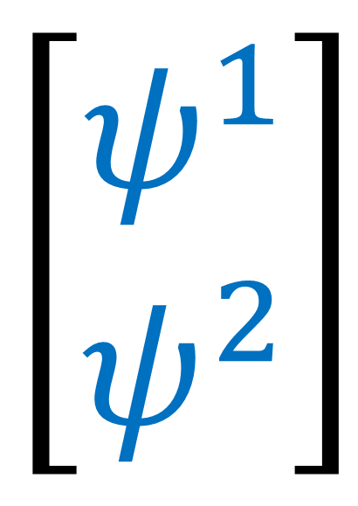
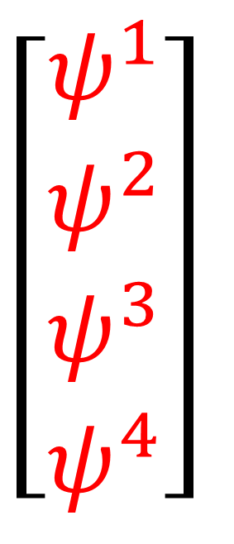
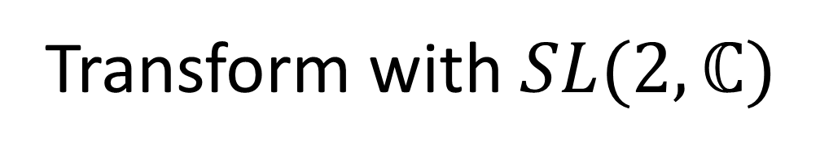
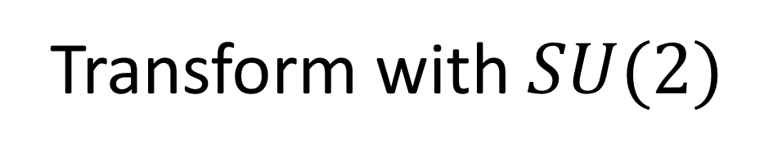
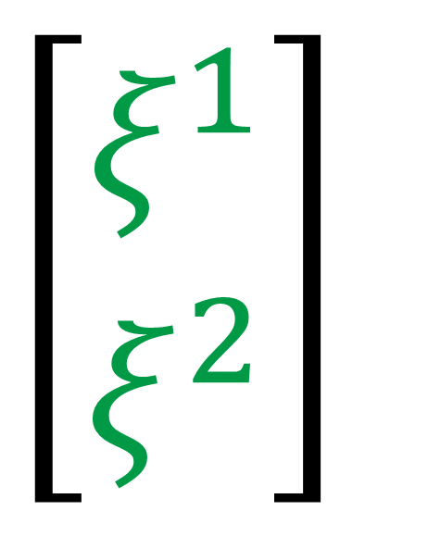
Pauli Spinors
(3D space)
Weyl Spinors
(4D spacetime)
Dirac Spinors
(4D spacetime)
$$\left[\begin{aligned}ψ^{1} \\ ψ^{2} \\ ψ^{3} \\ ψ^{4}\end{aligned}\right]$$
$$\left[\begin{aligned}ξ^{1} \\ ξ^{2}\end{aligned}\right]$$
$$\left[\begin{aligned}ψ^{1} \\ ψ^{2}\end{aligned}\right]$$
Left Weyl
Right Weyl
Transform with $SU(2)$
Transform with $SL(2,ℂ)$

Slide 5
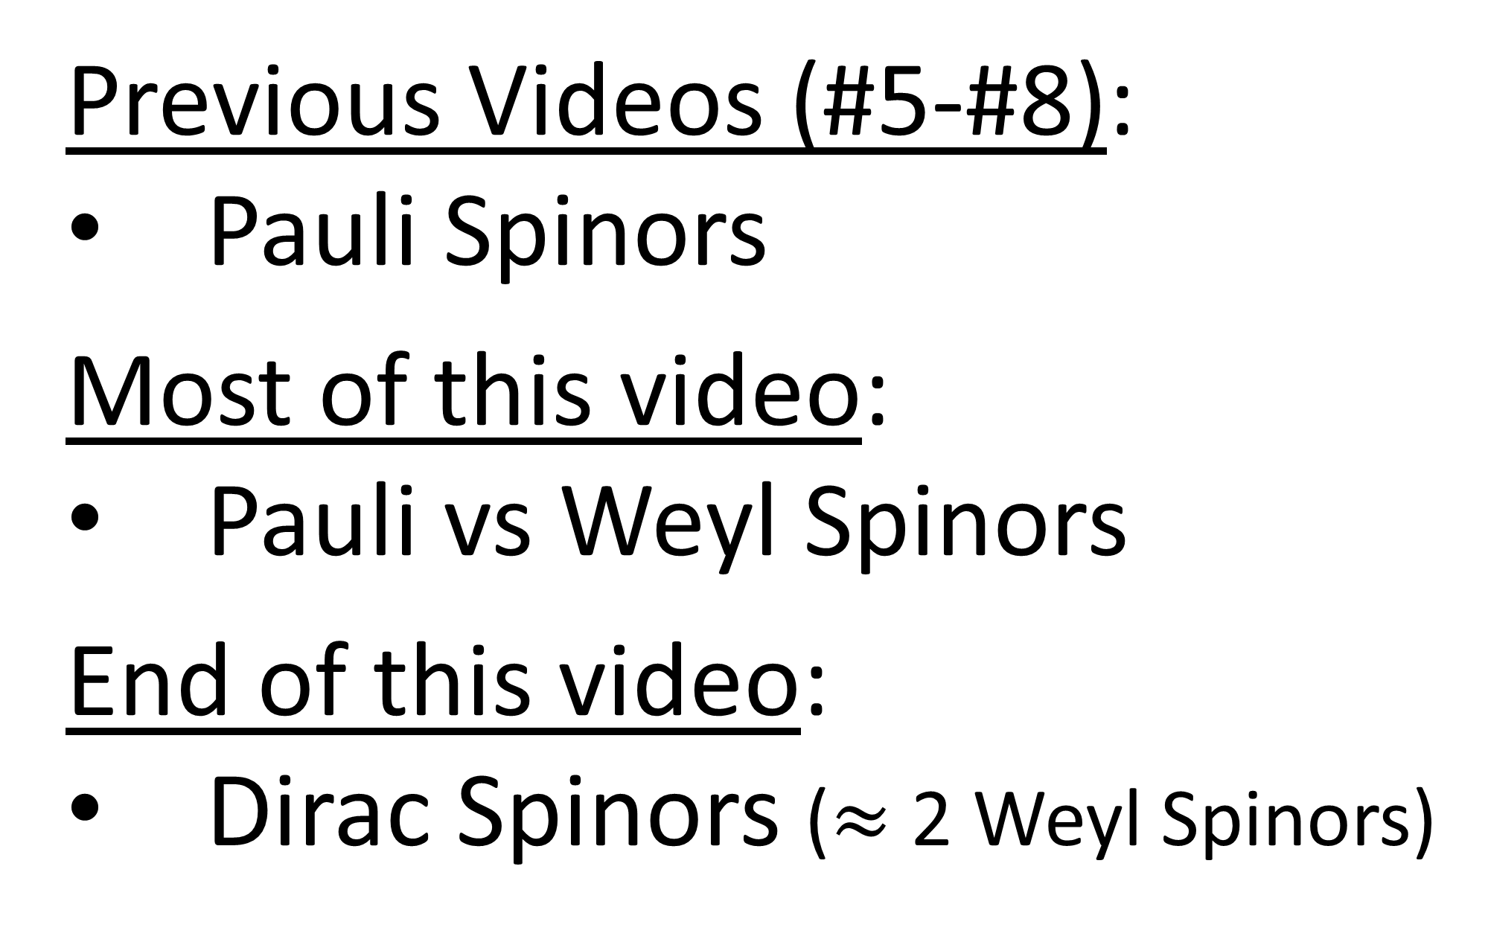
Previous Videos (#5-#8):
Pauli Spinors
Most of this video:
Pauli vs Weyl Spinors
End of this video:
Dirac Spinors ($≈$ 2 Weyl Spinors)

Slide 6






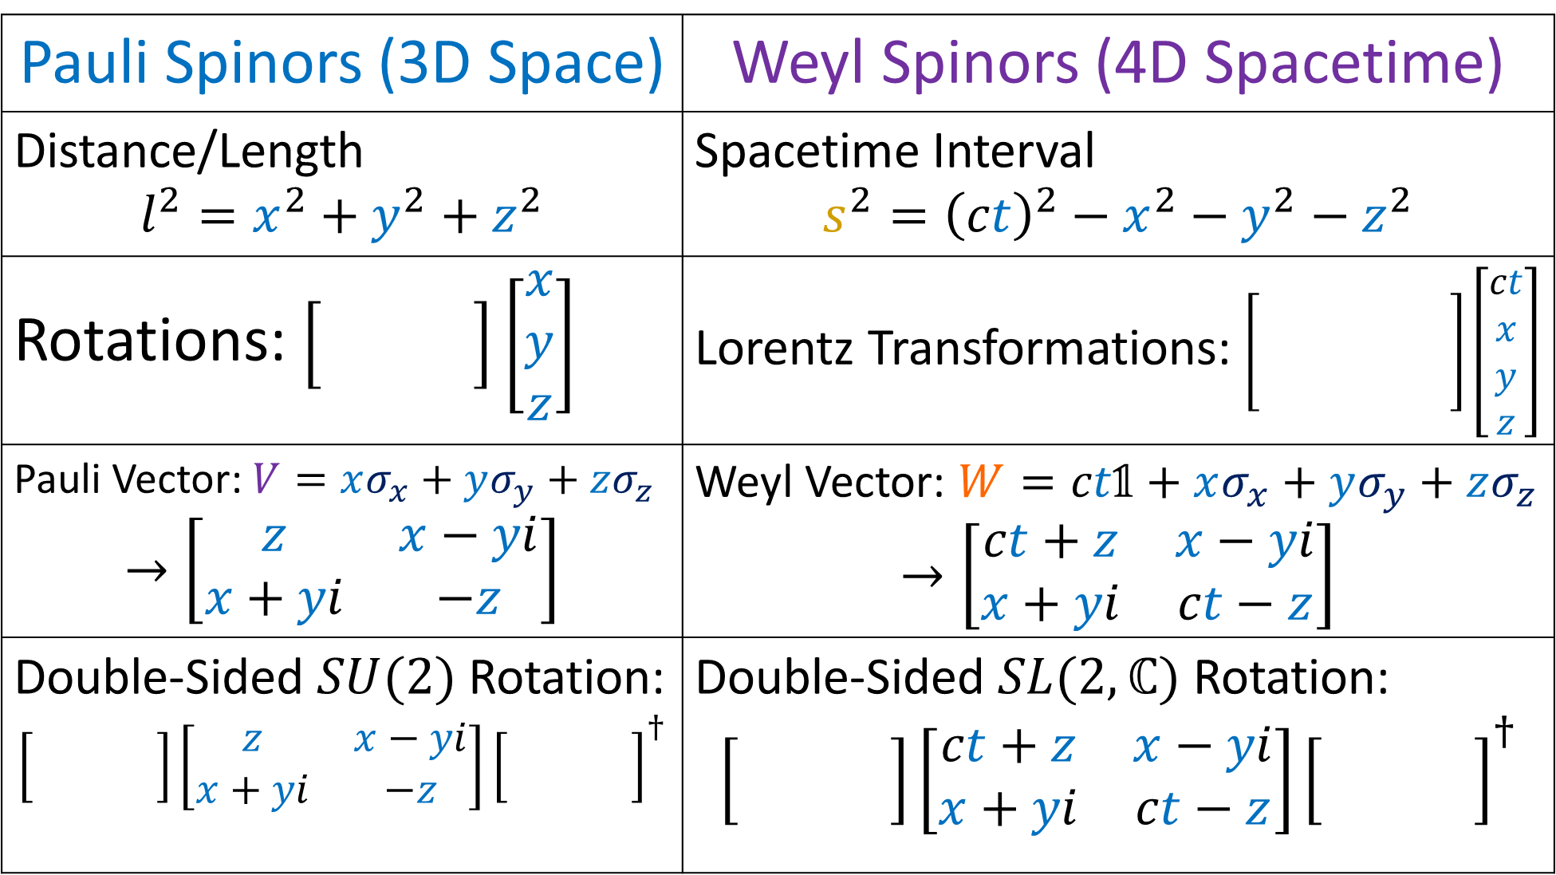

Pauli Spinors (3D Space) | Weyl Spinors (4D Spacetime)
Distance/Length $$l^{2}=x^{2}+y^{2}+z^{2}$$ | Spacetime Interval $$s^{2}={\left(ct\right)}^{2}−x^{2}−y^{2}−z^{2}$$
Rotations: $\left[\begin{aligned}x \\ y \\ z\end{aligned}\right]$ | Lorentz Transformations: $\left[\begin{matrix} & & \\ & & \\ & & \end{matrix}\right]\left[\begin{aligned}ct \\ x \\ y \\ z\end{aligned}\right]$
Pauli Vector: $V=xσ_{x}+yσ_{y}+zσ_{z}$ $$→\left[\begin{matrix}z & x−yi \\ x+yi & −z\end{matrix}\right]$$ | Weyl Vector: $W=ct\text{𝟙}+xσ_{x}+yσ_{y}+zσ_{z}$ $$→\left[\begin{matrix}ct+z & x−yi \\ x+yi & ct−z\end{matrix}\right]$$
Double-Sided $SU(2)$ Rotation: $$\left[\begin{matrix} & \\ & \end{matrix}\right]\left[\begin{matrix}z & x−yi \\ x+yi & −z\end{matrix}\right]{\left[\begin{matrix} & \\ & \end{matrix}\right]}^{†}$$ | Double-Sided $SL(2,ℂ)$ Rotation: $$\left[\begin{matrix} & \\ & \end{matrix}\right]\left[\begin{matrix}ct+z & x−yi \\ x+yi & ct−z\end{matrix}\right]{\left[\begin{matrix} & \\ & \end{matrix}\right]}^{†}$$
$$SO(3)$$
$$SO(1,3)$$
$$SU(2)$$
$$SU(2)$$
$$SL(2,ℂ)$$
$$SL(2,ℂ)$$
Notes:
This video is going all about taking geometry that you’re familiar with in everyday life, which is Euclidean Geometry, and changing it slightly so that we get Minkowski Geometry, which is the geometry of spacetime in special relativity.
Instead of measuring distance or length using the familiar equation x^2 + y^2, we’re going to measure distances in spacetime using the spacetime invariant, ct^2 – x^2.
Instead of using the Euclidean Metric where the dot products of an orthonormal basis are 1,0,1… we’re going to use the Minkowsi metric where the dot products of an orothonormal basis are 1, 0, -1.
Instead of using circular trig functions like sine and cosine, we’re going to use hyperbolic trig functions, like hyperbolic sine and hyperbolic cosine.
And instead of doing circular rotations in space, we’re going to do hyperbolic rotations in spacetime. We’ll see that Lorentz transformations we’ve been studying all along are really just hyperbolic rotations.

Slide 7
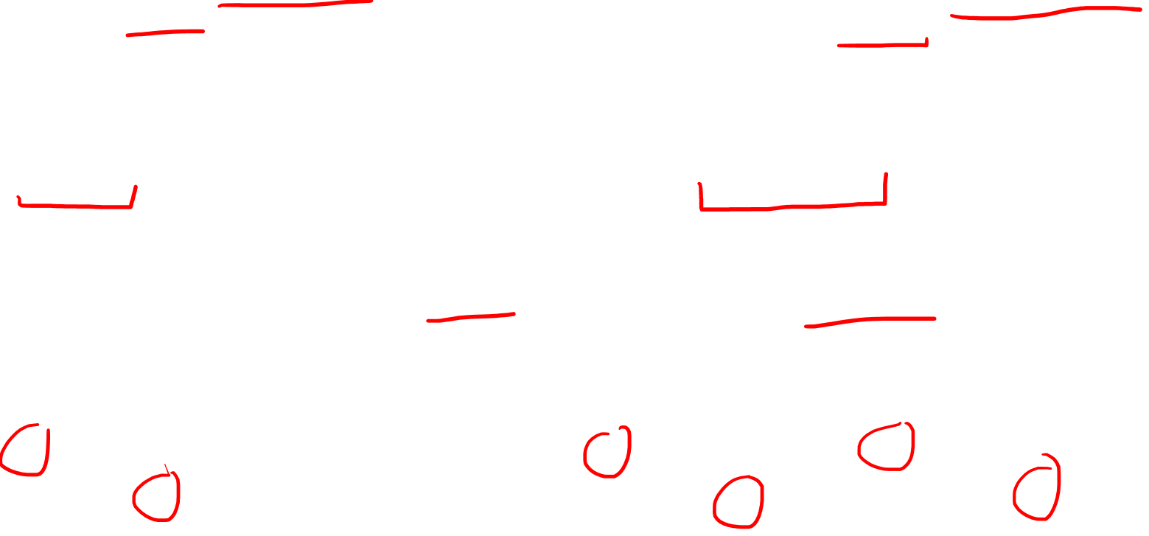
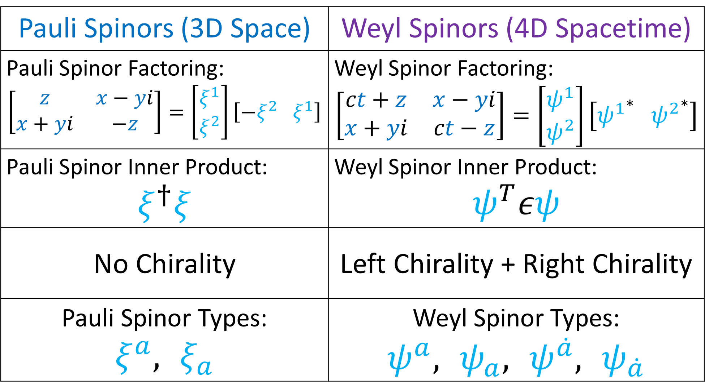
Pauli Spinors (3D Space) | Weyl Spinors (4D Spacetime)
Pauli Spinor Factoring: $$\left[\begin{matrix}z & x−yi \\ x+yi & −z\end{matrix}\right]=\left[\begin{aligned}ξ^{1} \\ ξ^{2}\end{aligned}\right]\left[−ξ^{2} ξ^{1}\right]$$ | Weyl Spinor Factoring: $$\left[\begin{matrix}ct+z & x−yi \\ x+yi & ct−z\end{matrix}\right]=\left[\begin{aligned}ψ^{1} \\ ψ^{2}\end{aligned}\right]\left[{ψ^{1}}^{∗} {ψ^{2}}^{∗}\right]$$
Pauli Spinor Inner Product: $$ξ^{†}ξ$$ | Weyl Spinor Inner Product: $$ψ^{T}εψ$$
No Chirality | Left Chirality + Right Chirality
Pauli Spinor Types: $$ξ^{a},,ξ_{a}$$ | Weyl Spinor Types: $ψ^{a}, ,ψ_{a},,ψ^{\dot{a}},,ψ_{\dot{a}}$
Notes:
This video is going all about taking geometry that you’re familiar with in everyday life, which is Euclidean Geometry, and changing it slightly so that we get Minkowski Geometry, which is the geometry of spacetime in special relativity.
Instead of measuring distance or length using the familiar equation x^2 + y^2, we’re going to measure distances in spacetime using the spacetime invariant, ct^2 – x^2.
Instead of using the Euclidean Metric where the dot products of an orthonormal basis are 1,0,1… we’re going to use the Minkowsi metric where the dot products of an orothonormal basis are 1, 0, -1.
Instead of using circular trig functions like sine and cosine, we’re going to use hyperbolic trig functions, like hyperbolic sine and hyperbolic cosine.
And instead of doing circular rotations in space, we’re going to do hyperbolic rotations in spacetime. We’ll see that Lorentz transformations we’ve been studying all along are really just hyperbolic rotations.

Slide 8
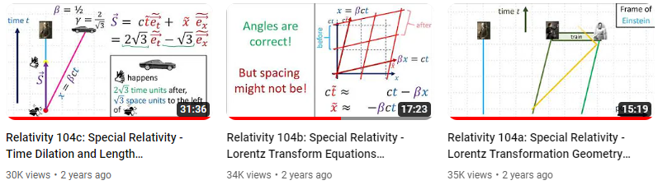
Special Relativity Review
(links in description to videos that cover this more slowly)

Slide 9
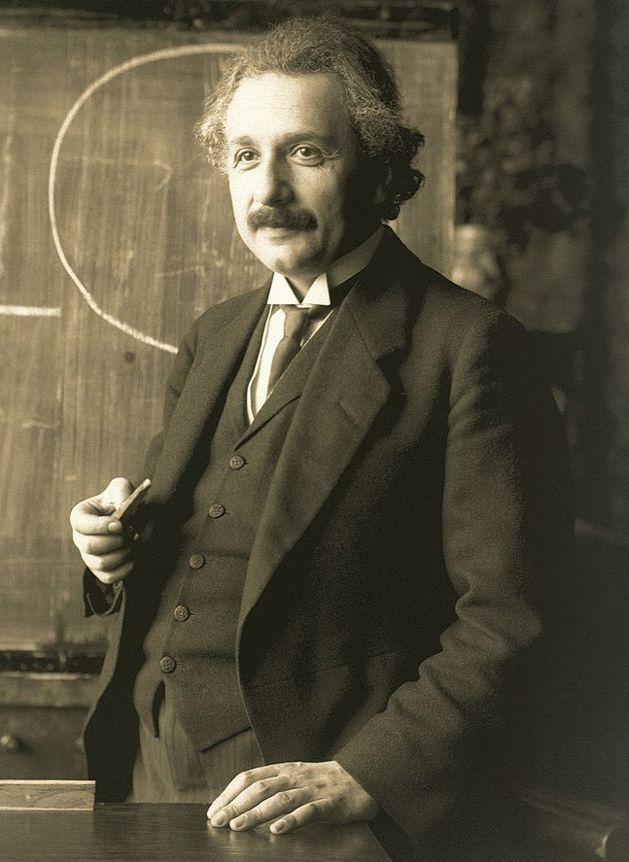
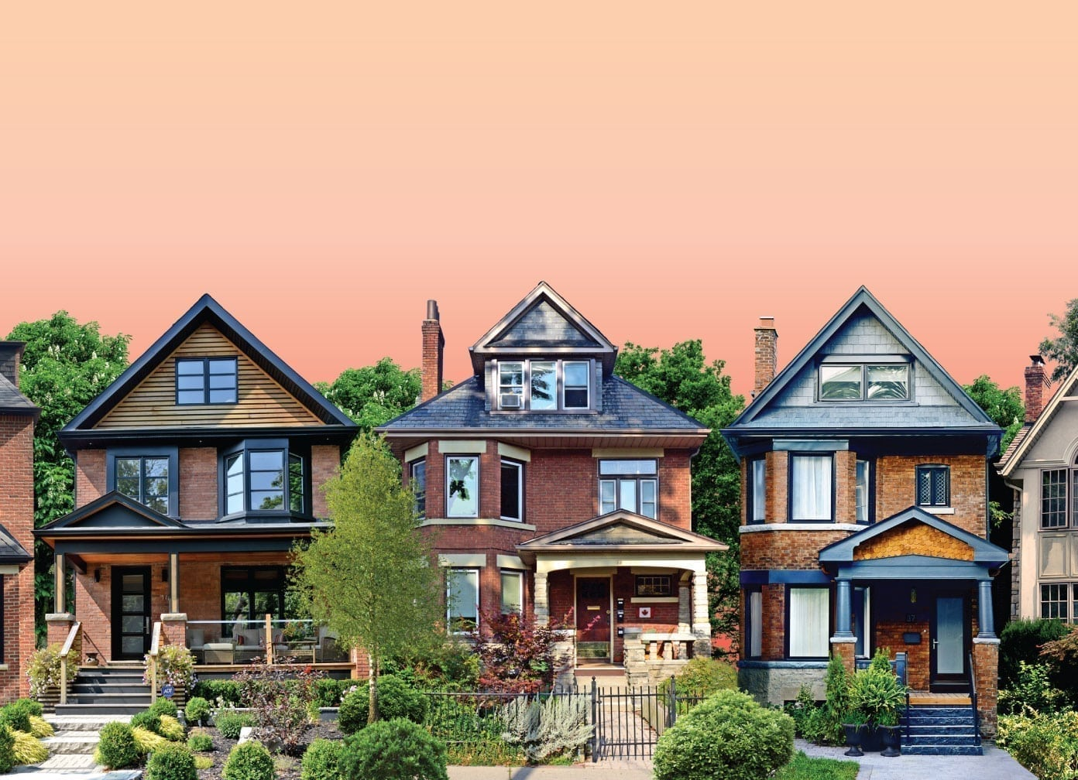
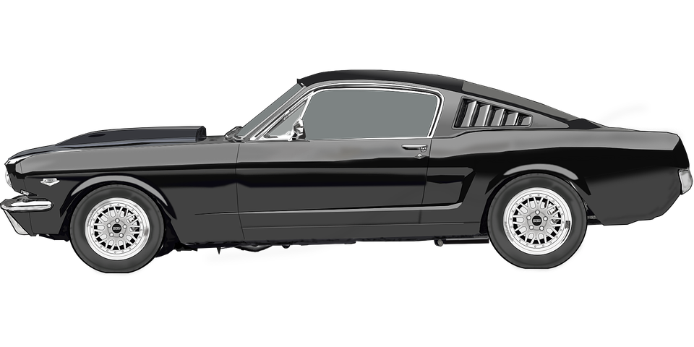



time $t$
Galilean Relativity
position $x$
Notes:
Using the Galilean Transform, we can see that the speed of light is different in different reference frames. In this reference frame, Einstein is standing, The car is travelling to the right, and these suns represent a beam of light also travelling to the right, but much faster. To change to the reference frame of the car, we just rearrange the time slices so that the car’s path in spacetime is vertical. Now Einstein is moving to the left, and the beam of light is still travelling right, but at a slower speed. We can also rearrange the time slices so that the beam of light has a vertical path. This means the beam of light’s position is constant and is standing still. We can even change the frame of reference sot that it is going faster than light, so that the beam of light appears to be travelling left, because it’s not travelling fast enough to keep up with our reference frame.

Slide 10
time $t$
Galilean Relativity
position $x$
Notes:
Using the Galilean Transform, we can see that the speed of light is different in different reference frames. In this reference frame, Einstein is standing, The car is travelling to the right, and these suns represent a beam of light also travelling to the right, but much faster. To change to the reference frame of the car, we just rearrange the time slices so that the car’s path in spacetime is vertical. Now Einstein is moving to the left, and the beam of light is still travelling right, but at a slower speed. We can also rearrange the time slices so that the beam of light has a vertical path. This means the beam of light’s position is constant and is standing still. We can even change the frame of reference sot that it is going faster than light, so that the beam of light appears to be travelling left, because it’s not travelling fast enough to keep up with our reference frame.

Slide 11
time $t$
Galilean Relativity
position $x$
Notes:
Using the Galilean Transform, we can see that the speed of light is different in different reference frames. In this reference frame, Einstein is standing, The car is travelling to the right, and these suns represent a beam of light also travelling to the right, but much faster. To change to the reference frame of the car, we just rearrange the time slices so that the car’s path in spacetime is vertical. Now Einstein is moving to the left, and the beam of light is still travelling right, but at a slower speed. We can also rearrange the time slices so that the beam of light has a vertical path. This means the beam of light’s position is constant and is standing still. We can even change the frame of reference sot that it is going faster than light, so that the beam of light appears to be travelling left, because it’s not travelling fast enough to keep up with our reference frame.

Slide 12
time $t$
Galilean Relativity
position $x$
Notes:
Using the Galilean Transform, we can see that the speed of light is different in different reference frames. In this reference frame, Einstein is standing, The car is travelling to the right, and these suns represent a beam of light also travelling to the right, but much faster. To change to the reference frame of the car, we just rearrange the time slices so that the car’s path in spacetime is vertical. Now Einstein is moving to the left, and the beam of light is still travelling right, but at a slower speed. We can also rearrange the time slices so that the beam of light has a vertical path. This means the beam of light’s position is constant and is standing still. We can even change the frame of reference sot that it is going faster than light, so that the beam of light appears to be travelling left, because it’s not travelling fast enough to keep up with our reference frame.

Slide 13
time $t$
Galilean Relativity
position $x$
Notes:
Using the Galilean Transform, we can see that the speed of light is different in different reference frames. In this reference frame, Einstein is standing, The car is travelling to the right, and these suns represent a beam of light also travelling to the right, but much faster. To change to the reference frame of the car, we just rearrange the time slices so that the car’s path in spacetime is vertical. Now Einstein is moving to the left, and the beam of light is still travelling right, but at a slower speed. We can also rearrange the time slices so that the beam of light has a vertical path. This means the beam of light’s position is constant and is standing still. We can even change the frame of reference sot that it is going faster than light, so that the beam of light appears to be travelling left, because it’s not travelling fast enough to keep up with our reference frame.

Slide 14
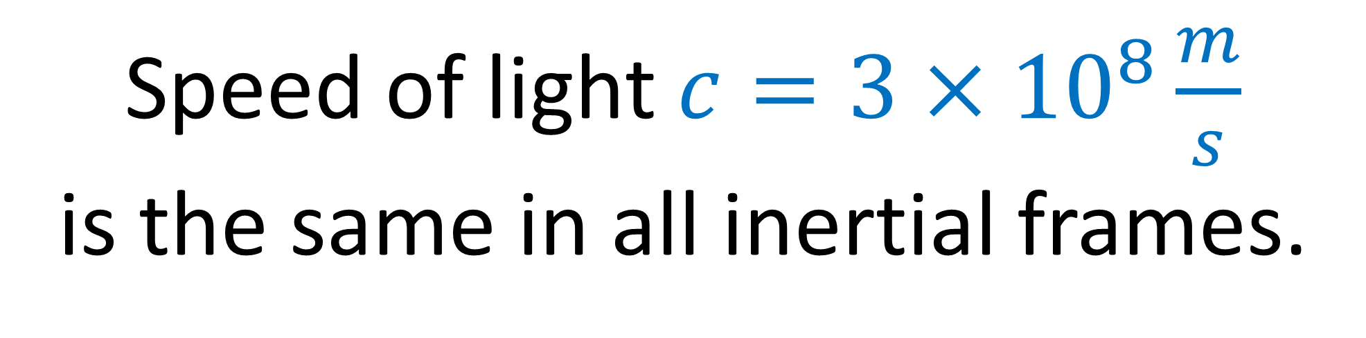
Special Relativity:
Speed of light $c=3×{10}^{8}\frac{m}{s}$ is the same in all inertial frames.

Slide 15


time $ct$
Special Relativity
position $x$
Notes:
Using the Galilean Transform, we can see that the speed of light is different in different reference frames. In this reference frame, Einstein is standing, The car is travelling to the right, and these suns represent a beam of light also travelling to the right, but much faster. To change to the reference frame of the car, we just rearrange the time slices so that the car’s path in spacetime is vertical. Now Einstein is moving to the left, and the beam of light is still travelling right, but at a slower speed. We can also rearrange the time slices so that the beam of light has a vertical path. This means the beam of light’s position is constant and is standing still. We can even change the frame of reference sot that it is going faster than light, so that the beam of light appears to be travelling left, because it’s not travelling fast enough to keep up with our reference frame.

Slide 16
time $ct$
position $x$
Notes:
Using the Galilean Transform, we can see that the speed of light is different in different reference frames. In this reference frame, Einstein is standing, The car is travelling to the right, and these suns represent a beam of light also travelling to the right, but much faster. To change to the reference frame of the car, we just rearrange the time slices so that the car’s path in spacetime is vertical. Now Einstein is moving to the left, and the beam of light is still travelling right, but at a slower speed. We can also rearrange the time slices so that the beam of light has a vertical path. This means the beam of light’s position is constant and is standing still. We can even change the frame of reference sot that it is going faster than light, so that the beam of light appears to be travelling left, because it’s not travelling fast enough to keep up with our reference frame.

Slide 17
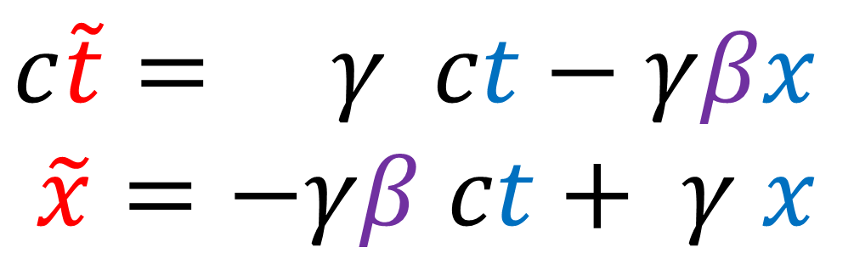
time $ct$
“Lorentz
Boost”
$$c\tilde{t}= γ ct−γβx$$
$\tilde{x}=−γβ ct+ γ x$
position $x$
Notes:
Using the Galilean Transform, we can see that the speed of light is different in different reference frames. In this reference frame, Einstein is standing, The car is travelling to the right, and these suns represent a beam of light also travelling to the right, but much faster. To change to the reference frame of the car, we just rearrange the time slices so that the car’s path in spacetime is vertical. Now Einstein is moving to the left, and the beam of light is still travelling right, but at a slower speed. We can also rearrange the time slices so that the beam of light has a vertical path. This means the beam of light’s position is constant and is standing still. We can even change the frame of reference sot that it is going faster than light, so that the beam of light appears to be travelling left, because it’s not travelling fast enough to keep up with our reference frame.

Slide 18
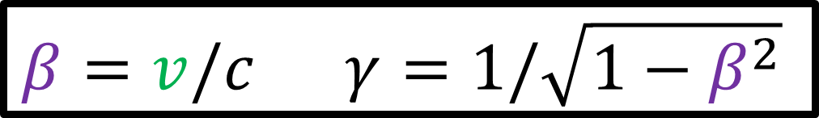
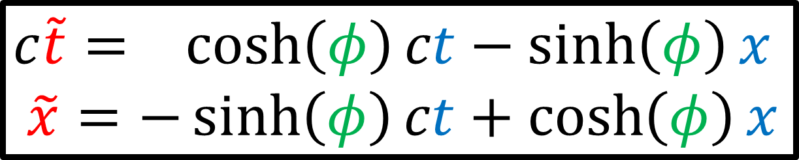
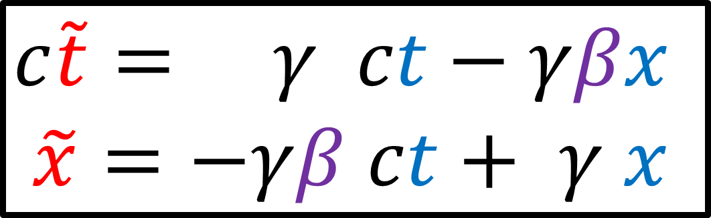
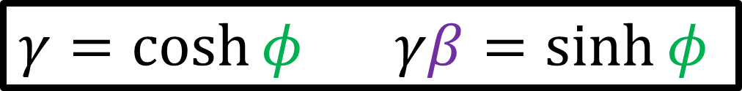
$$β=v/c γ=1/\sqrt{1−β^{2}}$$
time $ct$
$$c\tilde{t}= γ ct−γβx$$
$\tilde{x}=−γβ ct+ γ x$
“Lorentz
Boost”
$$γ=\cosh{φ} γβ=\sinh{φ}$$
$$c\tilde{t}= \cosh\left(φ\right)ct−\sinh\left(φ\right)x$$
$\tilde{x}=−\sinh\left(φ\right)ct+\cosh\left(φ\right)x$
“Hyperbolic Rotation”
position $x$
Notes:
Using the Galilean Transform, we can see that the speed of light is different in different reference frames. In this reference frame, Einstein is standing, The car is travelling to the right, and these suns represent a beam of light also travelling to the right, but much faster. To change to the reference frame of the car, we just rearrange the time slices so that the car’s path in spacetime is vertical. Now Einstein is moving to the left, and the beam of light is still travelling right, but at a slower speed. We can also rearrange the time slices so that the beam of light has a vertical path. This means the beam of light’s position is constant and is standing still. We can even change the frame of reference sot that it is going faster than light, so that the beam of light appears to be travelling left, because it’s not travelling fast enough to keep up with our reference frame.

Slide 19
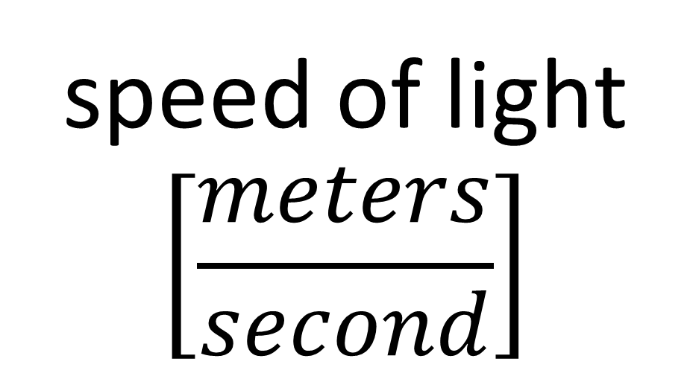

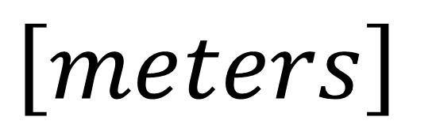

$$c t$$
speed of light
$$\left[\frac{meters}{second}\right]$$
time
$$\left[seconds\right]$$
$$\left[meters\right]$$

Slide 20
Pauli Spinors (3D Space) | Weyl Spinors (4D Spacetime)
Distance/Length $$l^{2}=x^{2}+y^{2}+z^{2}$$ | Spacetime Interval $$s^{2}={\left(ct\right)}^{2}−x^{2}−y^{2}−z^{2}$$
Rotations: $\left[\begin{aligned}x \\ y \\ z\end{aligned}\right]$ | Lorentz Transformations: $\left[\begin{matrix} & & \\ & & \\ & & \end{matrix}\right]\left[\begin{aligned}ct \\ x \\ y \\ z\end{aligned}\right]$
Pauli Vector: $V=xσ_{x}+yσ_{y}+zσ_{z}$ $$→\left[\begin{matrix}z & x−yi \\ x+yi & −z\end{matrix}\right]$$ | Weyl Vector: $W=ct\text{𝟙}+xσ_{x}+yσ_{y}+zσ_{z}$ $$→\left[\begin{matrix}ct+z & x−yi \\ x+yi & ct−z\end{matrix}\right]$$
Double-Sided $SU(2)$ Rotation: $$\left[\begin{matrix} & \\ & \end{matrix}\right]\left[\begin{matrix}z & x−yi \\ x+yi & −z\end{matrix}\right]{\left[\begin{matrix} & \\ & \end{matrix}\right]}^{†}$$ | Double-Sided $SL(2,ℂ)$ Rotation: $$\left[\begin{matrix} & \\ & \end{matrix}\right]\left[\begin{matrix}ct+z & x−yi \\ x+yi & ct−z\end{matrix}\right]{\left[\begin{matrix} & \\ & \end{matrix}\right]}^{†}$$
$$SO(3)$$
$$SO(1,3)$$
$$SU(2)$$
$$SU(2)$$
$$SL(2,ℂ)$$
$$SL(2,ℂ)$$
Notes:
This video is going all about taking geometry that you’re familiar with in everyday life, which is Euclidean Geometry, and changing it slightly so that we get Minkowski Geometry, which is the geometry of spacetime in special relativity.
Instead of measuring distance or length using the familiar equation x^2 + y^2, we’re going to measure distances in spacetime using the spacetime invariant, ct^2 – x^2.
Instead of using the Euclidean Metric where the dot products of an orthonormal basis are 1,0,1… we’re going to use the Minkowsi metric where the dot products of an orothonormal basis are 1, 0, -1.
Instead of using circular trig functions like sine and cosine, we’re going to use hyperbolic trig functions, like hyperbolic sine and hyperbolic cosine.
And instead of doing circular rotations in space, we’re going to do hyperbolic rotations in spacetime. We’ll see that Lorentz transformations we’ve been studying all along are really just hyperbolic rotations.

Slide 21

Equation of a circle:
$$x^{2}+y^{2}=r^{2}$$
“radius”
$$x^{2}+y^{2}=1^{2}$$
$$\vec{e_{y}}$$
$$x^{2}+y^{2}=2^{2}$$
$$\vec{e_{x}}$$
$$x^{2}+y^{2}=3^{2}$$
Notes:
Recall the equation of a circle is x^2 + y^2 = r^2, where r is the radius.
Here we can see circles of radius 1, radius 2, and radius 3. A circle of radius 0 would just be a single point at the origin. And a circle of negative radius doesn’t make much physical sense.

Slide 22
Equation of a circle:
$$x^{2}+y^{2}=r^{2}$$
$$x^{2}+y^{2}=0$$
“radius”
$$x^{2}+y^{2}=1^{2}$$
$$\vec{e_{y}}$$
$$x^{2}+y^{2}=2^{2}$$
$$\vec{e_{x}}$$
$$x^{2}+y^{2}=3^{2}$$
Notes:
Recall the equation of a circle is x^2 + y^2 = r^2, where r is the radius.
Here we can see circles of radius 1, radius 2, and radius 3. A circle of radius 0 would just be a single point at the origin. And a circle of negative radius doesn’t make much physical sense.

Slide 23
$${\left(ct\right)}^{2}−x^{2}=s^{2}$$
Equation of hyperbola:
$${(ct)}^{2}−x^{2}=+\left(1^{2}\right)$$
time-like
“spacetime
interval”
$${(ct)}^{2}−x^{2}=0$$
$$\vec{e_{t}}$$
null
isotropic
light-like
$$\vec{e_{x}}$$
$${(ct)}^{2}−x^{2}=−\left(1^{2}\right)$$
space-like
Notes:
Now if we instead take the equation ct^2 – x^2 = s^2… this is the euation of a curve called a hyperbolic, where s^2 is the hyperbola’s invariant.
A hyperbola with invariant s^2=+1^2 looks like this. Notice that it has an upper portion and a lower portion. This is because a positive value of ct or a negative value of ct can result in the same positive invariant s^2.
This is a hyperbola with invariant s^2 = + 2^2. And this is a hyperbolia with invariant s^2 = + 3^2
We can also have an invariant of s^2=0, which corresponds to these two diagonal lines.
We can also have an invariant of s^2 that’s negative, which are also hyperbolas, but these have a left portion and a right portion.

Slide 24
3D Space - squared length:
$$r^{2}=x^{2}+y^{2}+z^{2}$$
4D Spacetime - squared interval:
$$s^{2}={\left(ct\right)}^{2}−x^{2}−y^{2}−z^{2}$$

Slide 25
Pauli Spinors (3D Space) | Weyl Spinors (4D Spacetime)
Distance/Length $$l^{2}=x^{2}+y^{2}+z^{2}$$ | Spacetime Interval $$s^{2}={\left(ct\right)}^{2}−x^{2}−y^{2}−z^{2}$$
Rotations: $\left[\begin{aligned}x \\ y \\ z\end{aligned}\right]$ | Lorentz Transformations: $\left[\begin{matrix} & & \\ & & \\ & & \end{matrix}\right]\left[\begin{aligned}ct \\ x \\ y \\ z\end{aligned}\right]$
Pauli Vector: $V=xσ_{x}+yσ_{y}+zσ_{z}$ $$→\left[\begin{matrix}z & x−yi \\ x+yi & −z\end{matrix}\right]$$ | Weyl Vector: $W=ct\text{𝟙}+xσ_{x}+yσ_{y}+zσ_{z}$ $$→\left[\begin{matrix}ct+z & x−yi \\ x+yi & ct−z\end{matrix}\right]$$
Double-Sided $SU(2)$ Rotation: $$\left[\begin{matrix} & \\ & \end{matrix}\right]\left[\begin{matrix}z & x−yi \\ x+yi & −z\end{matrix}\right]{\left[\begin{matrix} & \\ & \end{matrix}\right]}^{†}$$ | Double-Sided $SL(2,ℂ)$ Rotation: $$\left[\begin{matrix} & \\ & \end{matrix}\right]\left[\begin{matrix}ct+z & x−yi \\ x+yi & ct−z\end{matrix}\right]{\left[\begin{matrix} & \\ & \end{matrix}\right]}^{†}$$
$$SO(3)$$
$$SO(1,3)$$
$$SU(2)$$
$$SU(2)$$
$$SL(2,ℂ)$$
$$SL(2,ℂ)$$
Notes:
This video is going all about taking geometry that you’re familiar with in everyday life, which is Euclidean Geometry, and changing it slightly so that we get Minkowski Geometry, which is the geometry of spacetime in special relativity.
Instead of measuring distance or length using the familiar equation x^2 + y^2, we’re going to measure distances in spacetime using the spacetime invariant, ct^2 – x^2.
Instead of using the Euclidean Metric where the dot products of an orthonormal basis are 1,0,1… we’re going to use the Minkowsi metric where the dot products of an orothonormal basis are 1, 0, -1.
Instead of using circular trig functions like sine and cosine, we’re going to use hyperbolic trig functions, like hyperbolic sine and hyperbolic cosine.
And instead of doing circular rotations in space, we’re going to do hyperbolic rotations in spacetime. We’ll see that Lorentz transformations we’ve been studying all along are really just hyperbolic rotations.

Slide 26
$$=\left[v^{x} v^{y} v^{z}\right]\left[\begin{aligned}v^{x} \\ v^{y} \\ v^{z}\end{aligned}\right]$$
$${\left\|\vec{v}\right\|}^{2}$$
$$={\vec{v}}^{T}\vec{v}$$
$${\left\|R\vec{v}\right\|}^{2}$$
$$={\left(R\vec{v}\right)}^{T}\left(R\vec{v}\right)$$
$$={\vec{v}}^{T}R^{T}R\vec{v}$$
$$= {\vec{v}}^{ T} \vec{v}$$
$$R∈O\left(3\right)$$
$$R^{T}=R^{−1}$$

Slide 27
$$R∈O\left(3\right)$$
$$R^{−1}=R^{T}$$
Rotations
$$\det{R}=+1$$
Reflected-Rotations
$$\det{R}=−1$$
$$R∈SO\left(3\right)$$
$$R^{−1}=R^{T} \det{R}=+1$$

Slide 28
3D Space: Rotations
Keep vector length constant:
$${\left\|\vec{v}\right\|}^{2}=x^{2}+y^{2}+z^{2}$$
Rotations happen in a plane.
(defined by pair of variables)
$$y$$
$$x$$

Slide 29
3D Space: Rotations
Keep vector length constant:
$${\left\|\vec{v}\right\|}^{2}=x^{2}+y^{2}+z^{2}$$
Rotations happen in a plane.
(defined by pair of variables)
Rotation in $xy$-plane
Rotation in $yz$-plane
Rotation in $zx$-plane

Slide 30
$$\left[\begin{matrix}\cos{θ} & −\sin{θ} & 0 \\ \sin{θ} & \cos{θ} & 0 \\ 0 & 0 & 1\end{matrix}\right]\left[\begin{aligned}x \\ y \\ z\end{aligned}\right]$$
Rotation in $xy$-plane
$$\left[\begin{matrix}1 & 0 & 0 \\ 0 & \cos{θ} & −\sin{θ} \\ 0 & \sin{θ} & \cos{θ}\end{matrix}\right]\left[\begin{aligned}x \\ y \\ z\end{aligned}\right]$$
Rotation in $yz$-plane
$$\left[\begin{matrix}\cos{θ} & 0 & \sin{θ} \\ 0 & 1 & 0 \\ −\sin{θ} & 0 & \cos{θ}\end{matrix}\right]\left[\begin{aligned}x \\ y \\ z\end{aligned}\right]$$
Rotation in $zx$-plane

Slide 31
$${\left\|\vec{w}\right\|}^{2}$$
$$=s^{2}={\vec{w}}^{T} η \vec{w}$$
$$=\left[ct x y z\right]\left[\begin{matrix}\begin{matrix}\begin{aligned}+1 \\ 0 \\ 0 \\ 0\end{aligned} & \begin{aligned}0 \\ −1 \\ 0 \\ 0\end{aligned}\end{matrix} & \begin{matrix}\begin{aligned}0 \\ 0 \\ −1 \\ 0\end{aligned} & \begin{aligned}0 \\ 0 \\ 0 \\ −1\end{aligned}\end{matrix}\end{matrix}\right]\left[\begin{aligned}ct \\ x \\ y \\ z\end{aligned}\right]$$
Minkowski metric
$$s^{2}={\left(ct\right)}^{2}−x^{2}−y^{2}−z^{2}$$

Slide 32
$${\left\|\vec{w}\right\|}^{2}$$
$$={\vec{w}}^{T} η \vec{w}$$
$${\left\|Λ\vec{w}\right\|}^{2}$$
$$={\left(Λ\vec{w}\right)}^{T}η\left(Λ\vec{w}\right)$$
$$={\vec{w}}^{T}Λ^{T}ηΛ\vec{w}$$
$$= {\vec{w}}^{T} η \vec{w}$$
$$Λ∈O\left(1,3\right)$$
$$Λ^{T}ηΛ=η$$

Slide 33
$$Λ∈O\left(1,3\right)$$
$$Λ^{T}ηΛ=η$$
$$Λ∈SO\left(1,3\right)$$
$$Λ^{T}ηΛ=η$$
$$\det{Λ}=+1$$
Forbid spatial reflections

Slide 34
$$\left[\begin{matrix}\begin{matrix}\begin{aligned}Λ_{0}^{ 0} \\ Λ_{0}^{ 1} \\ Λ_{0}^{ 2} \\ Λ_{0}^{ 3}\end{aligned} & \begin{aligned}Λ_{1}^{ 0} \\ Λ_{1}^{ 1} \\ Λ_{1}^{ 2} \\ Λ_{1}^{ 3}\end{aligned}\end{matrix} & \begin{matrix}\begin{aligned}Λ_{2}^{ 0} \\ Λ_{2}^{ 1} \\ Λ_{2}^{ 2} \\ Λ_{2}^{ 3}\end{aligned} & \begin{aligned}Λ_{3}^{ 0} \\ Λ_{3}^{ 1} \\ Λ_{3}^{ 2} \\ Λ_{3}^{ 3}\end{aligned}\end{matrix}\end{matrix}\right]$$
$$Λ∈SO\left(1,3\right)$$
$$Λ^{T}ηΛ=η$$
$$\det{Λ}=+1$$
$$Λ∈SO^{+}\left(1,3\right)$$
$$Λ^{T}ηΛ=η$$
$$\det{Λ}=+1$$
$$Λ_{ 0}^{0}>0$$
Forbid time reflections
“orthochronous”

Slide 35
4D Spacetime: Lorentz Transformations
Keep spacetime interval constant:
$$s^{2}={\left(ct\right)}^{2}−x^{2}−y^{2}−z^{2}$$
(defined by pair of variables)
Lorentz tfms. happen in planes.
$$ct$$
$$x$$

Slide 36
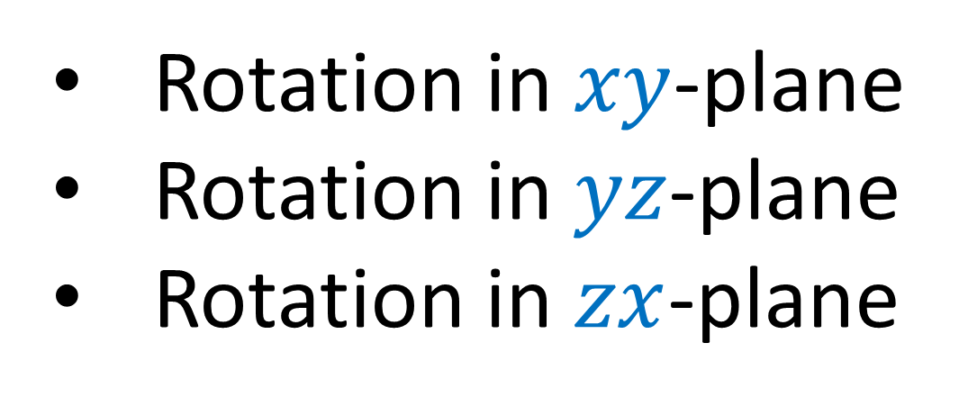

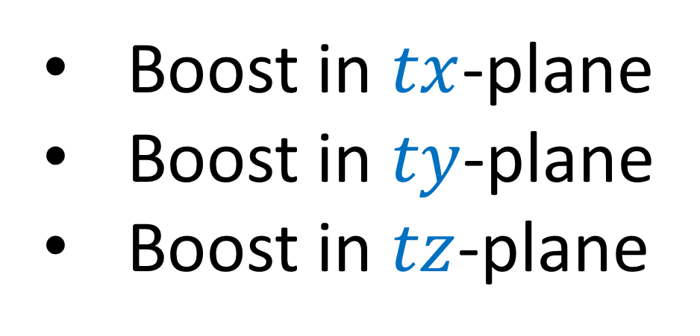
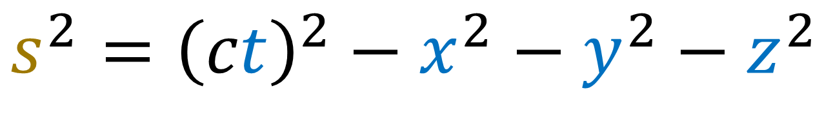
4D Spacetime: Lorentz Transformations
Keep spacetime interval constant:
$$s^{2}={\left(ct\right)}^{2}−x^{2}−y^{2}−z^{2}$$
(defined by pair of variables)
Lorentz tfms. happen in planes.
Rotation in $xy$-plane
Rotation in $yz$-plane
Rotation in $zx$-plane
Boost in $tx$-plane
Boost in $ty$-plane
Boost in $tz$-plane

Slide 37

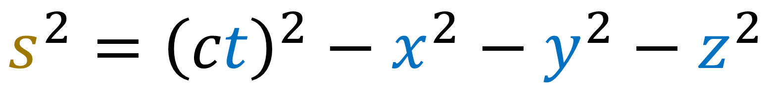

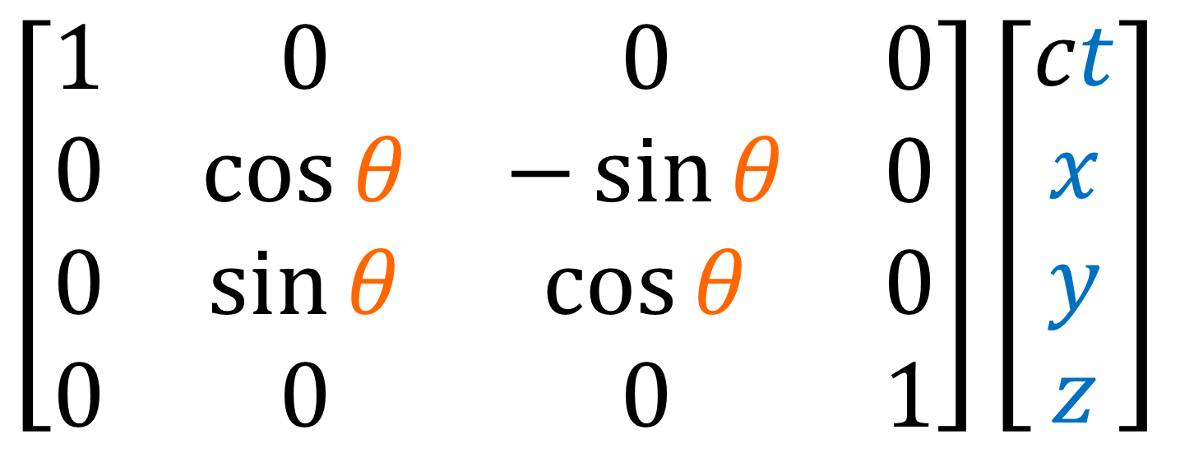

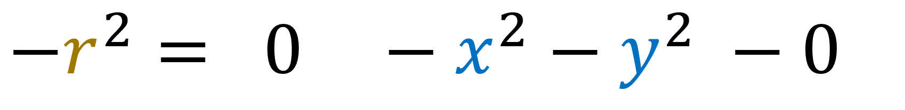
4D Spacetime: Lorentz Transformations
$$s^{2}={\left(ct\right)}^{2}−x^{2}−y^{2}−z^{2}$$
$$−r^{2}= 0 −x^{2}−y^{2} −0$$
$$y$$
$$\left[\begin{matrix}\begin{matrix}\begin{aligned}1 \\ 0 \\ 0 \\ 0\end{aligned} & \begin{aligned}0 \\ \cos{θ} \\ \sin{θ} \\ 0\end{aligned}\end{matrix} & \begin{matrix}\begin{aligned}0 \\ −\sin{θ} \\ \cos{θ} \\ 0\end{aligned} & \begin{aligned}0 \\ 0 \\ 0 \\ 1\end{aligned}\end{matrix}\end{matrix}\right]\left[\begin{aligned}ct \\ x \\ y \\ z\end{aligned}\right]$$
$$x$$

Slide 38

4D Spacetime: Lorentz Transformations
Keep spacetime interval constant:
$$s^{2}={\left(ct\right)}^{2}−x^{2}−y^{2}−z^{2}$$
(defined by pair of variables)
Lorentz tfms. happen in planes.
Rotation in $xy$-plane
Rotation in $yz$-plane
Rotation in $zx$-plane
Boost in $tx$-plane
Boost in $ty$-plane
Boost in $tz$-plane

Slide 39


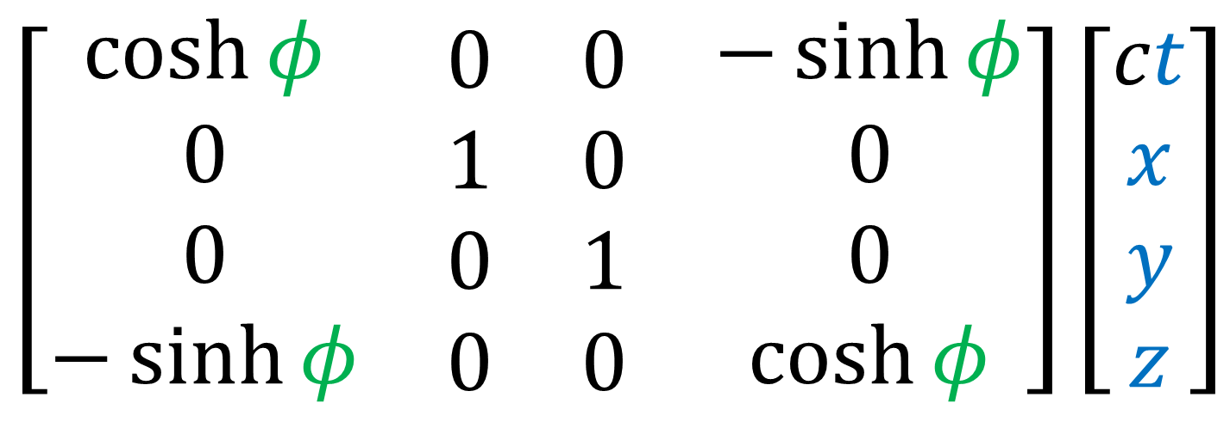
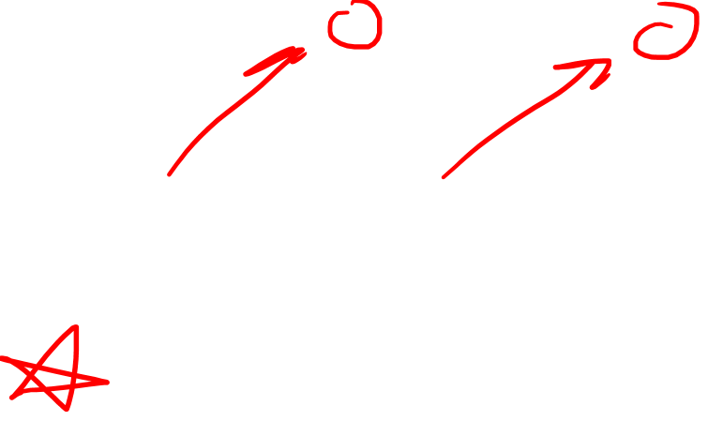
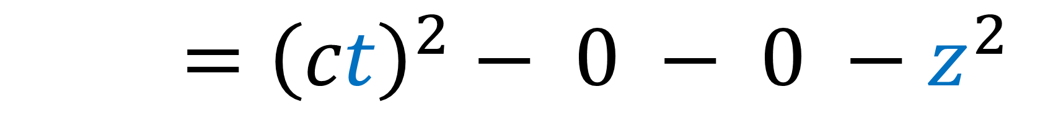
4D Spacetime: Lorentz Transformations
$$s^{2}={\left(ct\right)}^{2}−x^{2}−y^{2}−z^{2}$$
$$−r^{2}={\left(ct\right)}^{2}− 0 − 0 −z^{2}$$
$$ct$$
$$\left[\begin{matrix}\begin{matrix}\begin{aligned}\cosh{φ} \\ 0 \\ 0 \\ −\sinh{φ}\end{aligned} & \begin{aligned}0 \\ 1 \\ 0 \\ 0\end{aligned}\end{matrix} & \begin{matrix}\begin{aligned}0 \\ 0 \\ 1 \\ 0\end{aligned} & \begin{aligned}−\sinh{φ} \\ 0 \\ 0 \\ \cosh{φ}\end{aligned}\end{matrix}\end{matrix}\right]\left[\begin{aligned}ct \\ x \\ y \\ z\end{aligned}\right]$$
$$z$$

Slide 40

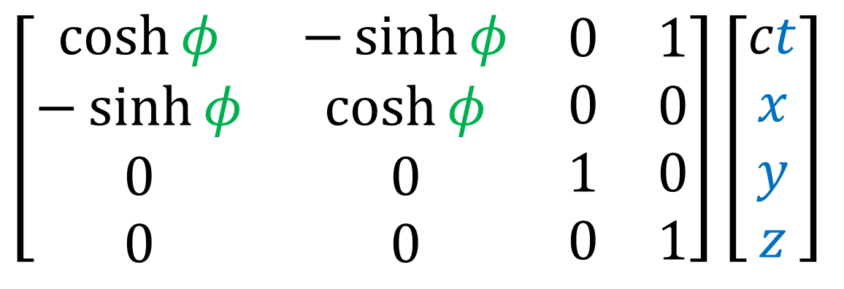
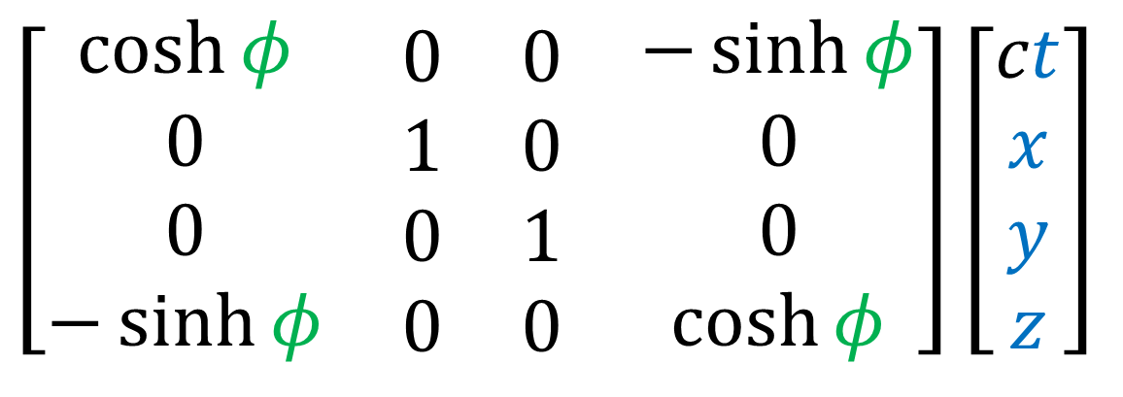

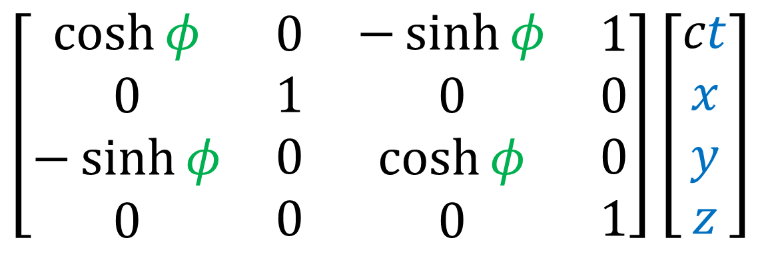

$$\left[\begin{matrix}\begin{matrix}\begin{aligned}\cosh{φ} \\ −\sinh{φ} \\ 0 \\ 0\end{aligned} & \begin{aligned}−\sinh{φ} \\ \cosh{φ} \\ 0 \\ 0\end{aligned}\end{matrix} & \begin{matrix}\begin{aligned}0 \\ 0 \\ 1 \\ 0\end{aligned} & \begin{aligned}1 \\ 0 \\ 0 \\ 1\end{aligned}\end{matrix}\end{matrix}\right]\left[\begin{aligned}ct \\ x \\ y \\ z\end{aligned}\right]$$
Boost in $tx$-plane
$$\left[\begin{matrix}\begin{matrix}\begin{aligned}\cosh{φ} \\ 0 \\ −\sinh{φ} \\ 0\end{aligned} & \begin{aligned}0 \\ 1 \\ 0 \\ 0\end{aligned}\end{matrix} & \begin{matrix}\begin{aligned}−\sinh{φ} \\ 0 \\ \cosh{φ} \\ 0\end{aligned} & \begin{aligned}1 \\ 0 \\ 0 \\ 1\end{aligned}\end{matrix}\end{matrix}\right]\left[\begin{aligned}ct \\ x \\ y \\ z\end{aligned}\right]$$
Boost in $ty$-plane
$$\left[\begin{matrix}\begin{matrix}\begin{aligned}\cosh{φ} \\ 0 \\ 0 \\ −\sinh{φ}\end{aligned} & \begin{aligned}0 \\ 1 \\ 0 \\ 0\end{aligned}\end{matrix} & \begin{matrix}\begin{aligned}0 \\ 0 \\ 1 \\ 0\end{aligned} & \begin{aligned}−\sinh{φ} \\ 0 \\ 0 \\ \cosh{φ}\end{aligned}\end{matrix}\end{matrix}\right]\left[\begin{aligned}ct \\ x \\ y \\ z\end{aligned}\right]$$
Boost in $tz$-plane

Slide 41
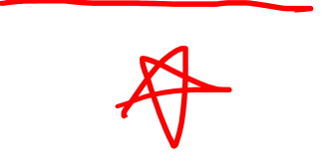

Pauli Spinors (3D Space) | Weyl Spinors (4D Spacetime)
Distance/Length $$l^{2}=x^{2}+y^{2}+z^{2}$$ | Spacetime Interval $$s^{2}={\left(ct\right)}^{2}−x^{2}−y^{2}−z^{2}$$
Rotations: $\left[\begin{aligned}x \\ y \\ z\end{aligned}\right]$ | Lorentz Transformations: $\left[\begin{matrix} & & \\ & & \\ & & \end{matrix}\right]\left[\begin{aligned}ct \\ x \\ y \\ z\end{aligned}\right]$
Pauli Vector: $V=xσ_{x}+yσ_{y}+zσ_{z}$ $$→\left[\begin{matrix}z & x−yi \\ x+yi & −z\end{matrix}\right]$$ | Weyl Vector: $W=ct\text{𝟙}+xσ_{x}+yσ_{y}+zσ_{z}$ $$→\left[\begin{matrix}ct+z & x−yi \\ x+yi & ct−z\end{matrix}\right]$$
Double-Sided $SU(2)$ Rotation: $$\left[\begin{matrix} & \\ & \end{matrix}\right]\left[\begin{matrix}z & x−yi \\ x+yi & −z\end{matrix}\right]{\left[\begin{matrix} & \\ & \end{matrix}\right]}^{†}$$ | Double-Sided $SL(2,ℂ)$ Rotation: $$\left[\begin{matrix} & \\ & \end{matrix}\right]\left[\begin{matrix}ct+z & x−yi \\ x+yi & ct−z\end{matrix}\right]{\left[\begin{matrix} & \\ & \end{matrix}\right]}^{†}$$
$$SO(3)$$
$$SO(1,3)$$
$$SU(2)$$
$$SU(2)$$
$$SL(2,ℂ)$$
$$SL(2,ℂ)$$
Notes:
This video is going all about taking geometry that you’re familiar with in everyday life, which is Euclidean Geometry, and changing it slightly so that we get Minkowski Geometry, which is the geometry of spacetime in special relativity.
Instead of measuring distance or length using the familiar equation x^2 + y^2, we’re going to measure distances in spacetime using the spacetime invariant, ct^2 – x^2.
Instead of using the Euclidean Metric where the dot products of an orthonormal basis are 1,0,1… we’re going to use the Minkowsi metric where the dot products of an orothonormal basis are 1, 0, -1.
Instead of using circular trig functions like sine and cosine, we’re going to use hyperbolic trig functions, like hyperbolic sine and hyperbolic cosine.
And instead of doing circular rotations in space, we’re going to do hyperbolic rotations in spacetime. We’ll see that Lorentz transformations we’ve been studying all along are really just hyperbolic rotations.

Slide 42
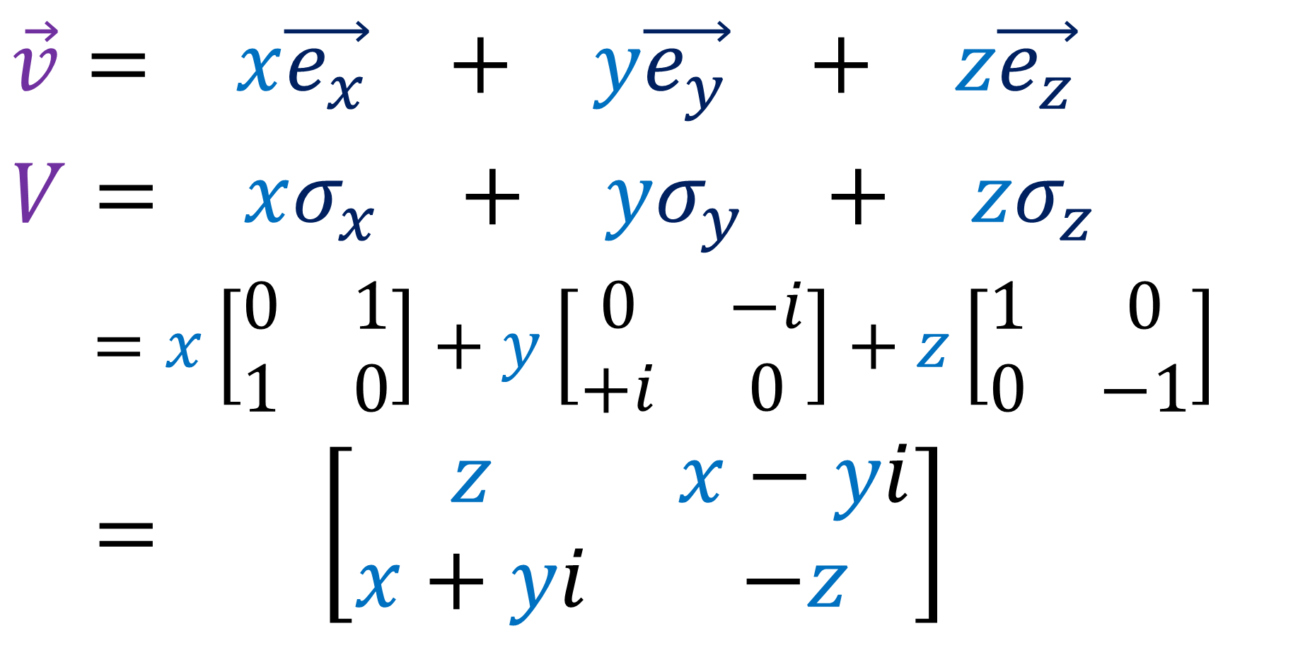
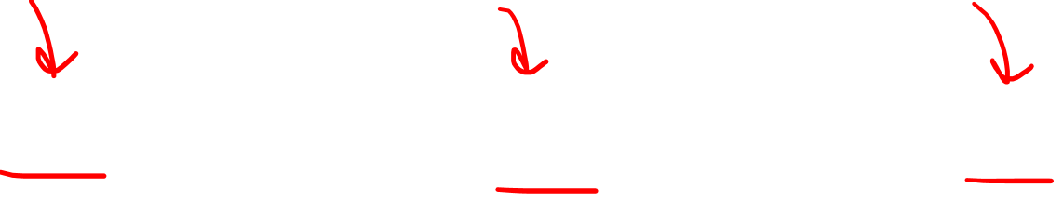
“Pauli Vector” from of a 3D vector:
$$\vec{v}= x\vec{e_{x}} + y\vec{e_{y}} + z\vec{e_{z}}$$
$$V= xσ_{x} + yσ_{y} + zσ_{z}$$
$$V =x\left[\begin{matrix}0 & 1 \\ 1 & 0\end{matrix}\right]+y\left[\begin{matrix}0 & −i \\ +i & 0\end{matrix}\right]+z\left[\begin{matrix}1 & 0 \\ 0 & −1\end{matrix}\right]$$
$$V= \left[\begin{matrix}z & x−yi \\ x+yi & −z\end{matrix}\right]$$
“Pauli
Vector”

Slide 43
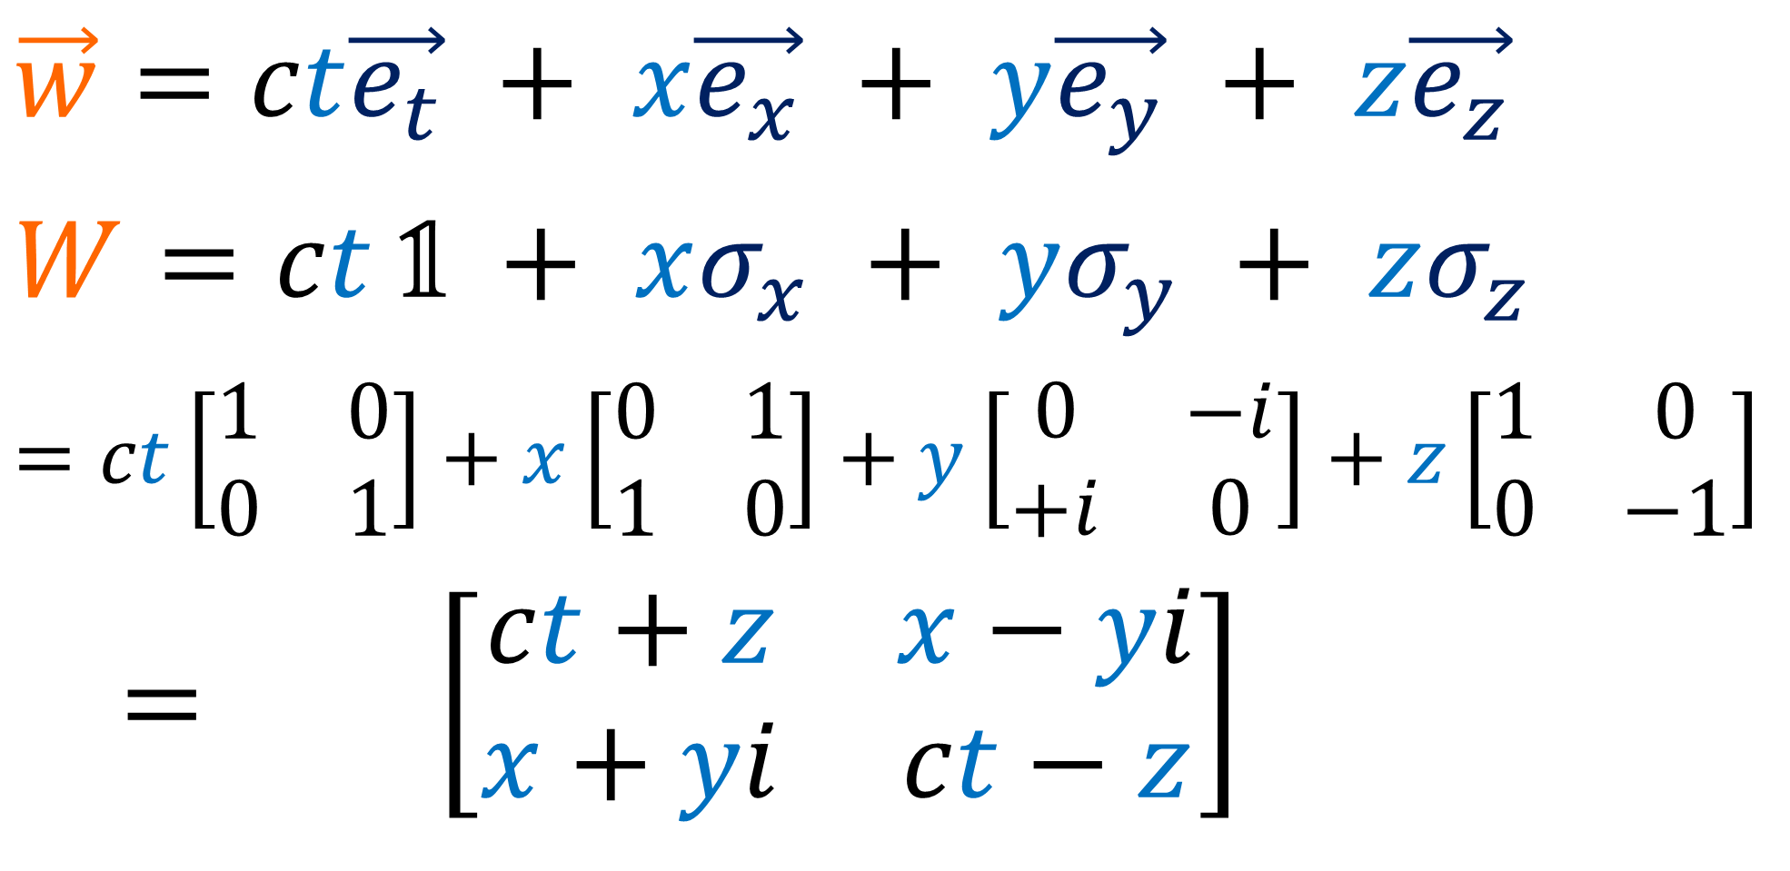
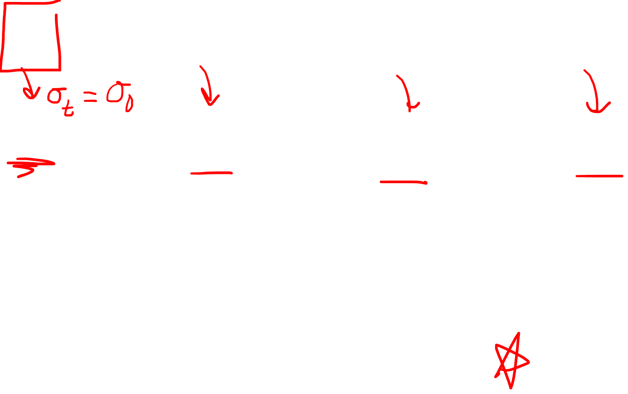
“Weyl Vector” form of a 3+1D spacetime vector
$$\vec{w}=ct\vec{e_{t}} + x\vec{e_{x}} + y\vec{e_{y}} + z\vec{e_{z}}$$
$$W=ct \text{𝟙} + xσ_{x} + yσ_{y} + zσ_{z}$$
$$=ct\left[\begin{matrix}1 & 0 \\ 0 & 1\end{matrix}\right]+x\left[\begin{matrix}0 & 1 \\ 1 & 0\end{matrix}\right]+y\left[\begin{matrix}0 & −i \\ +i & 0\end{matrix}\right]+z\left[\begin{matrix}1 & 0 \\ 0 & −1\end{matrix}\right]$$
$$V= \left[\begin{matrix}ct+z & x−yi \\ x+yi & ct−z\end{matrix}\right]$$
“Weyl
Vector”

Slide 44
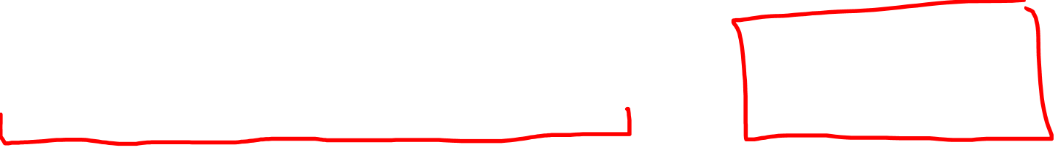
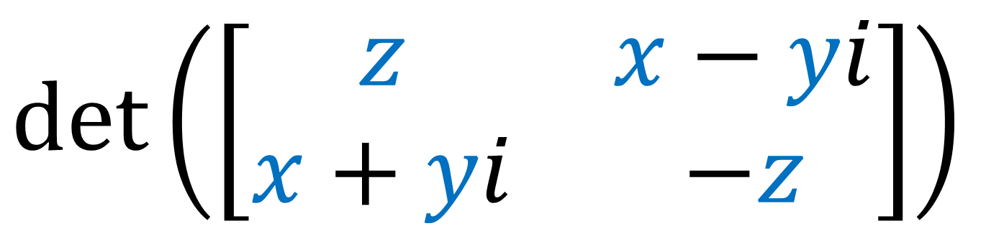
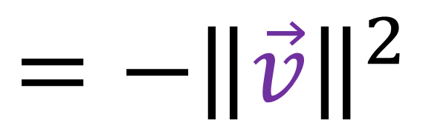
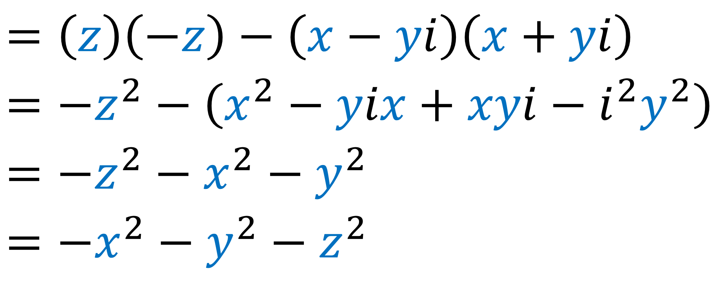
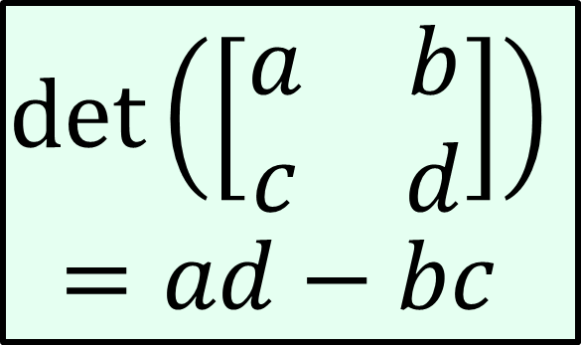
$$\det\left(\left[\begin{matrix}z & x−yi \\ x+yi & −z\end{matrix}\right]\right)$$
$$\det\left(\left[\begin{matrix}a & b \\ c & d\end{matrix}\right]\right)$$
$$=ad−bc$$
$$=\left(z\right)\left(−z\right)−\left(x−yi\right)\left(x+yi\right)$$
$$=−z^{2}−\left(x^{2}−yix+xyi−i^{2}y^{2}\right)$$
$$=−z^{2}−x^{2}−y^{2}$$
$$=−x^{2}−y^{2}−z^{2}$$
$$=−{\left\|\vec{v}\right\|}^{2}$$

Slide 45
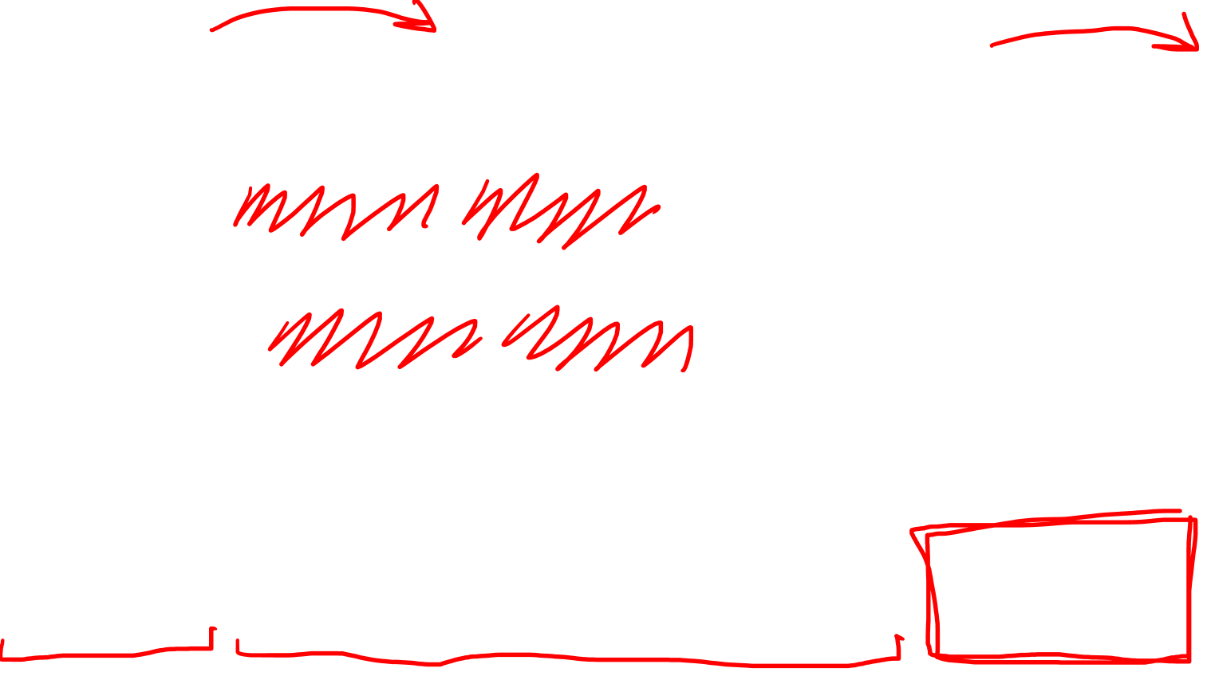




$$\det\left(\left[\begin{matrix}ct+z & x−yi \\ x+yi & ct−z\end{matrix}\right]\right)$$
$$\det\left(\left[\begin{matrix}a & b \\ c & d\end{matrix}\right]\right)$$
$$=ad−bc$$
$$=\left(ct+z\right)\left(ct−z\right)−\left(x−yi\right)\left(x+yi\right)$$
$$=\left({\left(ct\right)}^{2}−ctz+zct−z^{2}\right)$$
$−\left(x^{2}−yix+xyi−i^{2}y^{2}\right)$
$$={\left(ct\right)}^{2}−z^{2}−x^{2}−y^{2}$$
$$={\left(ct\right)}^{2}−x^{2}−y^{2}−z^{2}$$
$$=s^{2}$$

Slide 46
Pauli Spinors (3D Space) | Weyl Spinors (4D Spacetime)
Distance/Length $$l^{2}=x^{2}+y^{2}+z^{2}$$ | Spacetime Interval $$s^{2}={\left(ct\right)}^{2}−x^{2}−y^{2}−z^{2}$$
Rotations: $\left[\begin{aligned}x \\ y \\ z\end{aligned}\right]$ | Lorentz Transformations: $\left[\begin{matrix} & & \\ & & \\ & & \end{matrix}\right]\left[\begin{aligned}ct \\ x \\ y \\ z\end{aligned}\right]$
Pauli Vector: $V=xσ_{x}+yσ_{y}+zσ_{z}$ $$→\left[\begin{matrix}z & x−yi \\ x+yi & −z\end{matrix}\right]$$ | Weyl Vector: $W=ct\text{𝟙}+xσ_{x}+yσ_{y}+zσ_{z}$ $$→\left[\begin{matrix}ct+z & x−yi \\ x+yi & ct−z\end{matrix}\right]$$
Double-Sided $SU(2)$ Rotation: $$\left[\begin{matrix} & \\ & \end{matrix}\right]\left[\begin{matrix}z & x−yi \\ x+yi & −z\end{matrix}\right]{\left[\begin{matrix} & \\ & \end{matrix}\right]}^{†}$$ | Double-Sided $SL(2,ℂ)$ Rotation: $$\left[\begin{matrix} & \\ & \end{matrix}\right]\left[\begin{matrix}ct+z & x−yi \\ x+yi & ct−z\end{matrix}\right]{\left[\begin{matrix} & \\ & \end{matrix}\right]}^{†}$$
$$SO(3)$$
$$SO(1,3)$$
$$SU(2)$$
$$SU(2)$$
$$SL(2,ℂ)$$
$$SL(2,ℂ)$$
Notes:
This video is going all about taking geometry that you’re familiar with in everyday life, which is Euclidean Geometry, and changing it slightly so that we get Minkowski Geometry, which is the geometry of spacetime in special relativity.
Instead of measuring distance or length using the familiar equation x^2 + y^2, we’re going to measure distances in spacetime using the spacetime invariant, ct^2 – x^2.
Instead of using the Euclidean Metric where the dot products of an orthonormal basis are 1,0,1… we’re going to use the Minkowsi metric where the dot products of an orothonormal basis are 1, 0, -1.
Instead of using circular trig functions like sine and cosine, we’re going to use hyperbolic trig functions, like hyperbolic sine and hyperbolic cosine.
And instead of doing circular rotations in space, we’re going to do hyperbolic rotations in spacetime. We’ll see that Lorentz transformations we’ve been studying all along are really just hyperbolic rotations.

Slide 47






$$SO(3)$$
3D Vector
$$\left[\begin{matrix}\cos{θ} & −\sin{θ} & 0 \\ \sin{θ} & \cos{θ} & 0 \\ 0 & 0 & 1\end{matrix}\right]\left[\begin{aligned}x \\ y \\ z\end{aligned}\right]$$
$$SU(2)$$
$$SU(2)$$
Pauli Vector
$$\left[\begin{matrix}e^{−i\frac{θ}{2}} & 0 \\ 0 & e^{i\frac{θ}{2}}\end{matrix}\right]\left[\begin{matrix}z & x−yi \\ x+yi & −z\end{matrix}\right]{\left[\begin{matrix}e^{−i\frac{θ}{2}} & 0 \\ 0 & e^{i\frac{θ}{2}}\end{matrix}\right]}^{†}$$
(video #6)

Slide 48



$$SO(1,3)$$
4D
Spacetime Vector
$$\left[\begin{matrix}\begin{matrix}\begin{aligned}\cosh{φ} \\ \sinh{φ} \\ 0 \\ 0\end{aligned} & \begin{aligned}\sinh{φ} \\ \cosh{φ} \\ 0 \\ 0\end{aligned}\end{matrix} & \begin{matrix}\begin{aligned}0 \\ 0 \\ 1 \\ 0\end{aligned} & \begin{aligned}0 \\ 0 \\ 0 \\ 1\end{aligned}\end{matrix}\end{matrix}\right]\left[\begin{aligned}ct \\ x \\ y \\ z\end{aligned}\right]$$
Weyl Vector
$$\left[\begin{matrix}? & ? \\ ? & ?\end{matrix}\right]\left[\begin{matrix}ct+z & x−yi \\ x+yi & ct−z\end{matrix}\right]{\left[\begin{matrix}? & ? \\ ? & ?\end{matrix}\right]}^{†}$$

Slide 49








Pauli Vector
complex-conjugate transpose
$$V=\left[\begin{matrix}z & x−yi \\ x+yi & −z\end{matrix}\right]$$
$$V=V^{†}$$
$$V→A V B$$
$$={\left(AVB\right)}^{†}$$
$$B=A^{†}$$
$$V→A VA^{†}$$
$$=B^{†}V^{†}A^{†}$$
$$=B^{†}VA^{†}$$

Slide 50








Weyl Vector
complex-conjugate transpose
$$W=\left[\begin{matrix}ct+z & x−yi \\ x+yi & ct−z\end{matrix}\right]$$
$$W=W^{†}$$
$$W→A W B$$
$$={\left(AWB\right)}^{†}$$
$$B=A^{†}$$
$$W→AWA^{†}$$
$$=B^{†}W^{†}A^{†}$$
$$=B^{†}WA^{†}$$

Slide 51







$$V=\left[\begin{matrix}z & x−yi \\ x+yi & −z\end{matrix}\right]$$
$$\det{V}=−{\left\|\vec{v}\right\|}^{2}$$
$$V → A VA^{†}$$
$$\det\left(AB\right)=$$
$$\det\left(A\right)\det\left(B\right)$$
$$\det\left(V\right)=\det\left(AVA^{†}\right)$$
$$\det\left(V\right)=\det\left(A\right)\det\left(V\right)\det\left({\left(A^{T}\right)}^{∗}\right)$$
$$1=\det\left(A\right)\det{{\left(A\right)}^{∗}}$$
$$\left|\det\left(A\right)\right|=1$$

Slide 52





$$V=\left[\begin{matrix}z & x−yi \\ x+yi & −z\end{matrix}\right]$$
$$\det{V}=−{\left\|\vec{v}\right\|}^{2}$$
$\left|\det\left(A\right)\right|=1$
$$⇒\det\left(A\right)=e^{iθ}$$
$$A V A^{†}$$
$$=\left(Ae^{iφ}\right)V{\left(Ae^{iφ}\right)}^{†}$$
$$= Ae^{iφ} V e^{−iφ}A^{†}$$
$$= A V A^{†}$$
Using $A→Ae^{−iθ/2}$
we can force:
$\det\left(A\right)=+1$

Slide 53





$$W=\left[\begin{matrix}ct+z & x−yi \\ x+yi & ct−z\end{matrix}\right]$$
$$\det{W}=s^{2}$$
$$W→ AWA^{†}$$
$$\det\left(AB\right)=$$
$$\det\left(A\right)\det\left(B\right)$$
$$\det\left(W\right)=\det\left(AWA^{†}\right)$$
$$\det\left(W\right)=\det\left(A\right)\det\left(W\right)\det\left({\left(A^{T}\right)}^{∗}\right)$$
$$1=\det\left(A\right)\det{{\left(A\right)}^{∗}}$$
$$\left|\det\left(A\right)\right|=1$$

Slide 54



$$W=\left[\begin{matrix}ct+z & x−yi \\ x+yi & ct−z\end{matrix}\right]$$
$$\det{W}=s^{2}$$
$\left|\det\left(A\right)\right|=1$
$$⇒\det\left(A\right)=e^{iθ}$$
$$A W A^{†}$$
$$=\left(Ae^{iφ}\right)W{\left(Ae^{iφ}\right)}^{†}$$
$$= Ae^{iφ} W e^{−iφ}A^{†}$$
$$= A W A^{†}$$
Using $A→Ae^{−iθ/2}$
we can force:
$\det\left(A\right)=+1$

Slide 55




$$V=\left[\begin{matrix}z & x−yi \\ x+yi & −z\end{matrix}\right]$$
$$\operatorname{tr}{V}=0$$
$$V → A VA^{†}$$
(See video #6 for proof)
Unitary
$$A^{−1}=A^{†}$$

Slide 56




not always equal
$$W=\left[\begin{matrix}ct+z & x−yi \\ x+yi & ct−z\end{matrix}\right]$$
$$\operatorname{tr}{W}≠0$$
$$W → AWA^{†}$$
$A$ is not guaranteed to be Unitary.

Slide 57







Pauli Vector $V$
Transformation:
Special: $\det\left(U\right)=+1$
Unitary: $U^{−1}=U^{†}$
$U∈SU(2)$Matrices
(Special Unitary 2x2)
$$UVU^{†}$$
Weyl Vector $W$
Transformation:
Special: $\det\left(L\right)=+1$
$L∈SL(2,ℂ)$Matrices:
(Special Linear 2x2)
$$LWL^{†}$$

Slide 58



$$SO(1,3)$$
4D
Spacetime Vector
$$\left[\begin{matrix}\begin{matrix}\begin{aligned}\cosh{φ} \\ \sinh{φ} \\ 0 \\ 0\end{aligned} & \begin{aligned}\sinh{φ} \\ \cosh{φ} \\ 0 \\ 0\end{aligned}\end{matrix} & \begin{matrix}\begin{aligned}0 \\ 0 \\ 1 \\ 0\end{aligned} & \begin{aligned}0 \\ 0 \\ 0 \\ 1\end{aligned}\end{matrix}\end{matrix}\right]\left[\begin{aligned}ct \\ x \\ y \\ z\end{aligned}\right]$$
Weyl Vector
$$\left[\begin{matrix} & \\ & \end{matrix}\right]\left[\begin{matrix}ct+z & x−yi \\ x+yi & ct−z\end{matrix}\right]{\left[\begin{matrix} & \\ & \end{matrix}\right]}^{†}$$
$$SL(2,ℂ)$$
$$SL(2,ℂ)$$

Slide 59





$SU(2)$ matrix
(Video #6 Review)
$$U=\left[\begin{matrix}α & −β^{∗} \\ β & α^{∗}\end{matrix}\right]$$
2 complex parameters
4 real parameters
$$\det\left(U\right)={\left|α\right|}^{2}+{\left|β\right|}^{2}=1$$
General $U(2)$ matrix has determinant $e^{iθ}$
$$e^{iθ}=1 ⇒ θ=0$$
1 real constraint

Slide 60







$SU(2)$ matrix
$${\left|α\right|}^{2}+{\left|β\right|}^{2}=1$$
$$U=\left[\begin{matrix}α & −β^{∗} \\ β & α^{∗}\end{matrix}\right]$$
3 real parameters
rotation in $xy$-plane
rotation in $yz$-plane
rotation in $zx$-plane
$\left[\begin{matrix}e^{−i\frac{θ}{2}} & 0 \\ 0 & e^{i\frac{θ}{2}}\end{matrix}\right]$
$\left[\begin{matrix}\cos{\frac{θ}{2}} & −i\sin{\frac{θ}{2}} \\ −i\sin{\frac{θ}{2}} & \cos{\frac{θ}{2}}\end{matrix}\right]$
$\left[\begin{matrix}\cos{\frac{θ}{2}} & −\sin{\frac{θ}{2}} \\ \sin{\frac{θ}{2}} & \cos{\frac{θ}{2}}\end{matrix}\right]$

Slide 61






$SL(2,ℂ)$ matrix
$$L=\left[\begin{matrix}α & γ \\ β & δ\end{matrix}\right]$$
4 complex parameters
8 real parameters
$$\det\left(L\right)=αδ−βγ=1$$
General $2×2$ $ℂ$ matrix has determinant $re^{iθ}$
$$re^{iθ}=1 ⇒ r=1$$
$$⇒ θ=0$$
2 real constraints

Slide 62



$SL(2,ℂ)$ matrix
$$αδ−βγ=1$$
$$L=\left[\begin{matrix}α & γ \\ β & δ\end{matrix}\right]$$
6 real parameters
rotations in:
$xy$-plane
$yz$-plane
$zx$-plane
boosts in:
$tx$-plane
$ty$-plane
$tz$-plane

Slide 63






$SL(2,ℂ)$ matrix
$$αδ−βγ=1$$
$$L=\left[\begin{matrix}α & γ \\ β & δ\end{matrix}\right]$$
6 real parameters
rotation in $xy$-plane
rotation in $yz$-plane
rotation in $zx$-plane
$\left[\begin{matrix}\cos{\frac{θ}{2}} & −i\sin{\frac{θ}{2}} \\ −i\sin{\frac{θ}{2}} & \cos{\frac{θ}{2}}\end{matrix}\right]$
$\left[\begin{matrix}\cos{\frac{θ}{2}} & −\sin{\frac{θ}{2}} \\ \sin{\frac{θ}{2}} & \cos{\frac{θ}{2}}\end{matrix}\right]$
$\left[\begin{matrix}e^{−i\frac{θ}{2}} & 0 \\ 0 & e^{i\frac{θ}{2}}\end{matrix}\right]$

Slide 64






boost in $tz$-plane
boost in $ty$-plane
boost in $tx$-plane
$$\left[\begin{matrix}e^{−\frac{φ}{2}} & 0 \\ 0 & e^{+\frac{φ}{2}}\end{matrix}\right]$$
$$\left[\begin{matrix}\cosh{\frac{φ}{2}} & i\sinh{\frac{φ}{2}} \\ −i\sinh{\frac{φ}{2}} & \cosh{\frac{φ}{2}}\end{matrix}\right]$$
$\left[\begin{matrix}\cosh{\frac{φ}{2}} & −\sinh{\frac{φ}{2}} \\ −\sinh{\frac{φ}{2}} & \cosh{\frac{φ}{2}}\end{matrix}\right]$
rotation in $xy$-plane
rotation in $yz$-plane
rotation in $zx$-plane
$\left[\begin{matrix}\cos{\frac{θ}{2}} & −i\sin{\frac{θ}{2}} \\ −i\sin{\frac{θ}{2}} & \cos{\frac{θ}{2}}\end{matrix}\right]$
$\left[\begin{matrix}\cos{\frac{θ}{2}} & −\sin{\frac{θ}{2}} \\ \sin{\frac{θ}{2}} & \cos{\frac{θ}{2}}\end{matrix}\right]$
$\left[\begin{matrix}e^{−i\frac{θ}{2}} & 0 \\ 0 & e^{i\frac{θ}{2}}\end{matrix}\right]$

Slide 65
Recall from Video #6: getting SU(2) matrices
$\left(\cos{\frac{θ}{2}}\text{𝟙}−\sin{\frac{θ}{2}}σ_{x}σ_{y}\right)→\left[\begin{matrix}e^{−iθ/2} & 0 \\ 0 & e^{iθ/2}\end{matrix}\right]$
$xy$-rotation
$\left(\cos{\frac{θ}{2}}\text{𝟙}−\sin{\frac{θ}{2}}σ_{z}σ_{x}\right)→\left[\begin{matrix}\cos{θ/2} & −\sin{θ/2} \\ \sin{θ/2} & \cos{θ/2}\end{matrix}\right]$
$zx$-rotation
$\left(\cos{\frac{θ}{2}}\text{𝟙}−\sin{\frac{θ}{2}}σ_{y}σ_{z}\right)→\left[\begin{matrix}\cos{\frac{θ}{2}} & −i\sin{\frac{θ}{2}} \\ −i\sin{\frac{θ}{2}} & \cos{\frac{θ}{2}}\end{matrix}\right]$
$yz$-rotation

Slide 66
SL(2,C) matrices:
$$σ_{t}=\text{𝟙}$$
$\left(\cosh{\frac{φ}{2}}\text{𝟙}−\sinh{\frac{φ}{2}}σ_{t}σ_{x}\right)→\left[\begin{matrix}\cosh{\frac{φ}{2}} & −\sinh{\frac{φ}{2}} \\ −\sinh{\frac{φ}{2}} & \cosh{\frac{φ}{2}}\end{matrix}\right]$
$tx$-boost
$\left(\cosh{\frac{φ}{2}}\text{𝟙}−\sinh{\frac{φ}{2}}σ_{t}σ_{y}\right)→\left[\begin{matrix}\cosh{\frac{φ}{2}} & −i\sinh{\frac{φ}{2}} \\ i\sinh{\frac{φ}{2}} & \cosh{\frac{φ}{2}}\end{matrix}\right]$
$ty$-boost
$\left(\cosh{\frac{φ}{2}}\text{𝟙}−\sinh{\frac{φ}{2}}σ_{t}σ_{z}\right)→\left[\begin{matrix}e^{−\frac{φ}{2}} & 0 \\ 0 & e^{+\frac{φ}{2}}\end{matrix}\right]$
$tz$-boost
$\cosh{\frac{φ}{2}}−\sinh{\frac{φ}{2}}$
$\frac{1}{2}\left(e^{\frac{φ}{2}}+e^{−\frac{φ}{2}}\right)−\frac{1}{2}\left(e^{\frac{φ}{2}}−e^{−\frac{φ}{2}}\right)$
$\frac{1}{2}e^{−\frac{φ}{2}}+\frac{1}{2}e^{−\frac{φ}{2}}=e^{−\frac{φ}{2}}$

Slide 67
Pauli Spinors (3D Space) | Weyl Spinors (4D Spacetime)
Pauli Spinor Factoring: $$\left[\begin{matrix}z & x−yi \\ x+yi & −z\end{matrix}\right]=\left[\begin{aligned}ξ^{1} \\ ξ^{2}\end{aligned}\right]\left[−ξ^{2} ξ^{1}\right]$$ | Weyl Spinor Factoring: $$\left[\begin{matrix}ct+z & x−yi \\ x+yi & ct−z\end{matrix}\right]=\left[\begin{aligned}ψ^{1} \\ ψ^{2}\end{aligned}\right]\left[{ψ^{1}}^{∗} {ψ^{2}}^{∗}\right]$$
Pauli Spinor Inner Product: $$ξ^{†}ξ$$ | Weyl Spinor Inner Product: $$ψ^{T}εψ$$
No Chirality | Left Chirality + Right Chirality
Pauli Spinor Types: $$ξ^{a},,ξ_{a}$$ | Weyl Spinor Types: $ψ^{a}, ,ψ_{a},,ψ^{\dot{a}},,ψ_{\dot{a}}$
Notes:
This video is going all about taking geometry that you’re familiar with in everyday life, which is Euclidean Geometry, and changing it slightly so that we get Minkowski Geometry, which is the geometry of spacetime in special relativity.
Instead of measuring distance or length using the familiar equation x^2 + y^2, we’re going to measure distances in spacetime using the spacetime invariant, ct^2 – x^2.
Instead of using the Euclidean Metric where the dot products of an orthonormal basis are 1,0,1… we’re going to use the Minkowsi metric where the dot products of an orothonormal basis are 1, 0, -1.
Instead of using circular trig functions like sine and cosine, we’re going to use hyperbolic trig functions, like hyperbolic sine and hyperbolic cosine.
And instead of doing circular rotations in space, we’re going to do hyperbolic rotations in spacetime. We’ll see that Lorentz transformations we’ve been studying all along are really just hyperbolic rotations.

Slide 68


Pauli Vector
Pauli Spinor
Dual Pauli Spinor
(Video #7)
$$=\left[\begin{aligned}ξ^{1} \\ ξ^{2}\end{aligned}\right]\left[\begin{matrix}ζ_{1} & ζ_{2}\end{matrix}\right]$$
$$\left[\begin{matrix}z & x−yi \\ x+yi & −z\end{matrix}\right]$$

Slide 69




Pauli Vector
(Video #7)
$$=\left[\begin{aligned}ξ^{1} \\ ξ^{2}\end{aligned}\right] \left[\begin{matrix}ζ_{1} & ζ_{2}\end{matrix}\right]$$
$$\left[\begin{matrix}z & x−yi \\ x+yi & −z\end{matrix}\right]$$
$\frac{1}{k}$
$$k$$

Slide 70

Pauli Vector
(Video #7)
$$=\left[\begin{aligned}ξ^{1} \\ ξ^{2}\end{aligned}\right]\left[\begin{matrix}ζ_{1} & ζ_{2}\end{matrix}\right]$$
$$\left[\begin{matrix}z & x−yi \\ x+yi & −z\end{matrix}\right]$$
$$ξ^{1}= ζ_{2}=\sqrt{ x−yi}$$
$ξ^{2}=−ζ_{1}=\sqrt{−x−yi}$

Slide 71




$$=\left[\begin{aligned}ξ^{1} \\ ξ^{2}\end{aligned}\right]\left[\begin{matrix}ζ_{1} & ζ_{2}\end{matrix}\right]$$
$$\left[\begin{matrix}z & x−yi \\ x+yi & −z\end{matrix}\right]$$
$⇒$ All of $x,y,z$ must be zero
OR
some of $x,y,z$ must be complex $∈ℂ$
Condition for Solution:
$$\det{V}=0$$
$$−\left(x^{2}+y^{2}+z^{2}\right)=0$$
“null” vector
“isotropic” vector

Slide 72






$$=\left[\begin{aligned}𝔞 \\ 𝔟\end{aligned}\right]\left[\begin{matrix}𝔠 & 𝔡\end{matrix}\right]$$
$$\left[\begin{matrix}ct+z & x−yi \\ x+yi & ct−z\end{matrix}\right]$$
$$=\left[\begin{aligned}A \\ B\end{aligned}\right]\left[\begin{matrix}C & D\end{matrix}\right]$$
Condition for Solution:
$$\det{W}=0$$
$$+{\left(ct\right)}^{2}−x^{2}−y^{2}−z^{2}=0$$
“null” vector
“isotropic” vector
“light-like” vector
$⇒$ All of $ct,x,y,z$ can be real $∈ℝ$

Slide 73










$$\left[\begin{matrix} C & D \end{matrix}\right]$$
Condition for Solution:
$$\det{W}=0$$
$${\left(ct\right)}^{2}−x^{2}−y^{2}−z^{2}=0$$
All components real ($ℝ$)
$$\left[\begin{aligned}A \\ B\end{aligned}\right]$$
$$\left[\begin{matrix}ct+z & x−yi \\ x+yi & ct−z\end{matrix}\right]$$
$$AC=ct+z$$
$$BD=ct−z$$
$$BC=x+yi$$
$$AD=x−yi$$
$←$ real
$⇒$ $C=k_{1}A^{∗}$ so that $AC∈ℝ$
$←$ real
$⇒$ $D=k_{2}B^{∗}$ so that $BD∈ℝ$

Slide 74









$$AC=ct+z$$
$$BD=ct−z$$
$$BC=x+yi$$
$$AD=x−yi$$
$←$ real $⇒C=k_{1}A^{∗}$
$$k_{1}, k_{2}∈ℝ$$
$←$ real $⇒D=k_{2}B^{∗}$
$${\left(BC\right)}^{∗}=AD$$
$${\left(Bk_{1}A^{∗}\right)}^{∗}=Ak_{2}B^{∗}$$
$$B^{∗}k_{1}^{∗}A=Ak_{2}B^{∗}$$
$$k_{1}^{∗}=k_{1}=k_{2}=k$$
$$\left[\begin{aligned}A \\ B\end{aligned}\right]$$
$$\left[\begin{matrix}kA^{∗} & kB^{∗}\end{matrix}\right]$$

Slide 75











$$ct$$
$$k\vec{w}$$
$$\left[\begin{aligned}A \\ B\end{aligned}\right]$$
$$\left[\begin{matrix}kA^{∗} & kB^{∗}\end{matrix}\right]$$
$$\vec{w}$$
$$x$$
$$=k\left[\begin{aligned}A \\ B\end{aligned}\right]$$
$$\left[\begin{matrix}A^{∗} & B^{∗}\end{matrix}\right]$$
Simplest Choice:
$$k=1$$
$$=k\left[\begin{matrix}ct+z & x−yi \\ x+yi & ct−z\end{matrix}\right]$$

Slide 76






$$AC=ct+z$$
$$BD=ct−z$$
$$BC=x+yi$$
$$AD=x−yi$$
$$=\left[\begin{aligned}A \\ B\end{aligned}\right]\left[A^{∗} B^{∗}\right]$$
$$\left[\begin{matrix}ct+z & x−yi \\ x+yi & ct−z\end{matrix}\right]$$
$$AA^{∗}=ct+z$$
$$BB^{∗}=ct−z$$
$$BA^{∗}=x+yi$$
$$AB^{∗}=x−yi$$
$$AA^{∗}+BB^{∗}=2 ct$$

Slide 77



$$BA^{∗}=x+yi$$
$$AB^{∗}=x−yi$$
$$BA^{∗}−AB^{∗}=\left(x+yi\right)−\left(x−yi\right)$$
$$BA^{∗}−AB^{∗}=2yi$$
$$=\left[\begin{aligned}A \\ B\end{aligned}\right]\left[A^{∗} B^{∗}\right]$$
$$\left[\begin{matrix}ct+z & x−yi \\ x+yi & ct−z\end{matrix}\right]$$
$ct=\frac{1}{2}\left(AA^{∗}+BB^{∗}\right)$
$z =\frac{1}{2}\left(AA^{∗}−BB^{∗}\right)$
$x=\frac{1}{2}\left(BA^{∗}+AB^{∗}\right)$
$y=\frac{1}{2i}\left(BA^{∗}−AB^{∗}\right)$
$$AA^{∗}=ct+z$$
$$BB^{∗}=ct−z$$
$$BA^{∗}=x+yi$$
$$AB^{∗}=x−yi$$

Slide 78





$$AA^{∗}=ct+z$$
$$BB^{∗}=ct−z$$
$$BA^{∗}=x+yi$$
$$AB^{∗}=x−yi$$
$$A=\left|A\right|e^{iθ_{A}}$$
$$B=\left|B\right|e^{iθ_{B}}$$
$$AA^{∗}={\left|A\right|}^{2}=ct+z$$
$$AA^{∗}=\left|A\right|=\sqrt{ct+z}$$
$$BB^{∗}={\left|B\right|}^{2}=ct−z$$
$$BB^{∗}=\left|B\right|=\sqrt{ct−z}$$

Slide 79





$$AA^{∗}=ct+z$$
$$BB^{∗}=ct−z$$
$$BA^{∗}=x+yi$$
$$AB^{∗}=x−yi$$
$BA^{∗} = x+yi$
$$\frac{BA^{∗}}{\left|B\right|\left|A\right|}=\frac{x+yi}{\sqrt{ct−z}\sqrt{ct+z}}$$
$e^{iθ_{B}}e^{−iθ_{A}}=\frac{x+yi}{\sqrt{{\left(ct\right)}^{2}−z^{2}}}$
$e^{i\left(θ_{B}−θ_{A}\right)}=\frac{x+yi}{\sqrt{x^{2}+y^{2}}}$
$$A=\left|A\right|e^{iθ_{A}}$$
$$B=\left|B\right|e^{iθ_{B}}$$
$$\left|A\right|=\sqrt{ct+z}$$
$$\left|B\right|=\sqrt{ct−z}$$
$${\left(ct\right)}^{2}−x^{2}−y^{2}−z^{2}=0$$
$${\left(ct\right)}^{2}−z^{2} = x^{2}+y^{2}$$

Slide 80



$$AA^{∗}=ct+z$$
$$BB^{∗}=ct−z$$
$$BA^{∗}=x+yi$$
$$AB^{∗}=x−yi$$
$$\left|A\right|=\sqrt{ct+z}$$
$$\left|B\right|=\sqrt{ct−z}$$
$e^{i\left(θ_{B}−θ_{A}\right)}=\frac{x+yi}{\sqrt{x^{2}+y^{2}}}$
$⇒θ_{B}−θ_{A}=\arctan\left(\frac{y}{x}\right)$
$$A=\left|A\right|e^{iθ_{A}}$$
$$B=\left|B\right|e^{iθ_{B}}$$
Null vector:
$${\left(ct\right)}^{2}−x^{2}−y^{2}−z^{2}=0$$

Slide 81





$$\left[\begin{aligned}A \\ B\end{aligned}\right] \left[A^{∗} B^{∗}\right]$$
$$=\left[\begin{aligned}\left|A\right|e^{iθ_{A}} \\ \left|B\right|e^{iθ_{B}}\end{aligned}\right] \left[\left|A\right|e^{−iθ_{A}} \left|B\right|e^{−iθ_{B}}\right]$$
$$=\left[\begin{aligned}\left|A\right| \\ \left|B\right|e^{i\left(θ_{B}−θ_{A}\right)}\end{aligned}\right]e^{+iθ_{A}}e^{−iθ_{A}}\left[\left|A\right| \left|B\right|e^{−\left(θ_{B}−θ_{A}\right)}\right]$$
$$=\left[\begin{matrix}{\left|A\right|}^{2} & \left|A\right|\left|B\right|e^{−i\left(θ_{B}−θ_{A}\right)} \\ \left|A\right|\left|B\right|e^{i\left(θ_{B}−θ_{A}\right)} & {\left|B\right|}^{2}\end{matrix}\right]$$

Slide 82




(null) Weyl Vector
Weyl Spinor
Dual Weyl Spinor
$$\left[\begin{matrix}ct+z & x−yi \\ x+yi & ct−z\end{matrix}\right]$$
$$=\left[\begin{aligned}A \\ B\end{aligned}\right]\left[A^{∗} B^{∗}\right]$$
$ct=\frac{1}{2}\left(AA^{∗}+BB^{∗}\right)$
$z =\frac{1}{2}\left(AA^{∗}−BB^{∗}\right)$
$x=\frac{1}{2}\left(BA^{∗}+AB^{∗}\right)$
$y=\frac{1}{2i}\left(BA^{∗}−AB^{∗}\right)$
$$\left|A\right|=\sqrt{ct+z}$$
$$\left|B\right|=\sqrt{ct−z}$$
$θ_{B}−θ_{A}=\arctan\left(\frac{y}{x}\right)$

Slide 83




(null) Weyl Vector
Weyl Spinor
Dual Weyl Spinor
$$\left[\begin{matrix}ct+z & x−yi \\ x+yi & ct−z\end{matrix}\right]$$
$$=\left[\begin{aligned}ψ^{1} \\ ψ^{2}\end{aligned}\right]\left[{ψ^{1}}^{∗} {ψ^{2}}^{∗}\right]$$
$ct=\frac{1}{2}\left(ψ^{1}{ψ^{1}}^{∗}+ψ^{2}{ψ^{2}}^{∗}\right)$
$z =\frac{1}{2}\left(ψ^{1}{ψ^{1}}^{∗}−ψ^{2}{ψ^{2}}^{∗}\right)$
$x=\frac{1}{2}\left(ψ^{2}{ψ^{1}}^{∗}+ψ^{1}{ψ^{2}}^{∗}\right)$
$y=\frac{1}{2i}\left(ψ^{2}{ψ^{1}}^{∗}−ψ^{1}{ψ^{2}}^{∗}\right)$
$$\left|ψ^{1}\right|=\sqrt{ct+z}$$
$$\left|ψ^{2}\right|=\sqrt{ct−z}$$
$θ_{2}−θ_{1}=\arctan\left(\frac{y}{x}\right)$

Slide 84




boost in $tz$-plane
boost in $tx$-plane
boost in $ty$-plane
$$\left[\begin{matrix}e^{−\frac{φ}{2}} & 0 \\ 0 & e^{+\frac{φ}{2}}\end{matrix}\right]$$
$\left[\begin{matrix}\cosh{\frac{φ}{2}} & −\sinh{\frac{φ}{2}} \\ −\sinh{\frac{φ}{2}} & \cosh{\frac{φ}{2}}\end{matrix}\right]$
$$\left[\begin{matrix}\cosh{\frac{φ}{2}} & i\sinh{\frac{φ}{2}} \\ −i\sinh{\frac{φ}{2}} & \cosh{\frac{φ}{2}}\end{matrix}\right]$$
rotation in $xy$-plane
rotation in $yz$-plane
rotation in $zx$-plane
$\left[\begin{matrix}\cos{\frac{θ}{2}} & −i\sin{\frac{θ}{2}} \\ −i\sin{\frac{θ}{2}} & \cos{\frac{θ}{2}}\end{matrix}\right]$
$\left[\begin{matrix}\cos{\frac{θ}{2}} & −\sin{\frac{θ}{2}} \\ \sin{\frac{θ}{2}} & \cos{\frac{θ}{2}}\end{matrix}\right]$
$\left[\begin{matrix}e^{−i\frac{θ}{2}} & 0 \\ 0 & e^{i\frac{θ}{2}}\end{matrix}\right]$

Slide 85




Rotating a Pauli Vector:
$\left[\begin{matrix} & \\ & \end{matrix}\right]\left[\begin{matrix}z & x−yi \\ x+yi & −z\end{matrix}\right]{\left[\begin{matrix} & \\ & \end{matrix}\right]}^{†}$
$$SU\left(2\right)$$
$$SU\left(2\right)$$
Properties of Pauli Vector:
Hermitian $V=V^{†}$
Determinant: $\det\left(V\right)=−{\left\|\vec{v}\right\|}^{2}$
Traceless $tr\left(V\right)=0$

Slide 86



Pauli Vector Rotation: SU(2) matrices
$\left[\begin{matrix}e^{−iθ/2} & 0 \\ 0 & e^{iθ/2}\end{matrix}\right]\left[\begin{matrix}z & x−yi \\ x+yi & −z\end{matrix}\right]{\left[\begin{matrix}e^{−iθ/2} & 0 \\ 0 & e^{iθ/2}\end{matrix}\right]}^{†}$
Pauli Spinors:
half rotation
half rotation
$\left[\begin{matrix}e^{−iθ/2} & 0 \\ 0 & e^{iθ/2}\end{matrix}\right]\left[\begin{aligned}ξ_{1} \\ ξ_{2}\end{aligned}\right]\left[\begin{matrix} −ξ_{2} & ξ_{1} \end{matrix}\right]{\left[\begin{matrix}e^{−iθ/2} & 0 \\ 0 & e^{iθ/2}\end{matrix}\right]}^{†}$

Slide 87



Weyl Vector Lorentz Transformation: SL(2,C) matrices
$\left[\begin{matrix}e^{−φ/2} & 0 \\ 0 & e^{φ/2}\end{matrix}\right]\left[\begin{matrix}ct+z & x−yi \\ x+yi & ct−z\end{matrix}\right]{\left[\begin{matrix}e^{−φ/2} & 0 \\ 0 & e^{φ/2}\end{matrix}\right]}^{†}$
Weyl Spinors:
half rotation
half rotation
$\left[\begin{matrix}e^{−φ/2} & 0 \\ 0 & e^{φ/2}\end{matrix}\right]\left[\begin{aligned}ψ^{1} \\ ψ^{2}\end{aligned}\right]\left[\begin{matrix}{ψ^{1}}^{∗} & {ψ^{2}}^{∗}\end{matrix}\right]{\left[\begin{matrix}e^{−φ/2} & 0 \\ 0 & e^{φ/2}\end{matrix}\right]}^{†}$

Slide 88
Pauli Spinors (3D Space) | Weyl Spinors (4D Spacetime)
Pauli Spinor Factoring: $$\left[\begin{matrix}z & x−yi \\ x+yi & −z\end{matrix}\right]=\left[\begin{aligned}ξ^{1} \\ ξ^{2}\end{aligned}\right]\left[−ξ^{2} ξ^{1}\right]$$ | Weyl Spinor Factoring: $$\left[\begin{matrix}ct+z & x−yi \\ x+yi & ct−z\end{matrix}\right]=\left[\begin{aligned}ψ^{1} \\ ψ^{2}\end{aligned}\right]\left[{ψ^{1}}^{∗} {ψ^{2}}^{∗}\right]$$
Pauli Spinor Inner Product: $$ξ^{†}ξ$$ | Weyl Spinor Inner Product: $$ψ^{T}εψ$$
No Chirality | Left Chirality + Right Chirality
Pauli Spinor Types: $$ξ^{a},,ξ_{a}$$ | Weyl Spinor Types: $ψ^{a}, ,ψ_{a},,ψ^{\dot{a}},,ψ_{\dot{a}}$
Notes:
This video is going all about taking geometry that you’re familiar with in everyday life, which is Euclidean Geometry, and changing it slightly so that we get Minkowski Geometry, which is the geometry of spacetime in special relativity.
Instead of measuring distance or length using the familiar equation x^2 + y^2, we’re going to measure distances in spacetime using the spacetime invariant, ct^2 – x^2.
Instead of using the Euclidean Metric where the dot products of an orthonormal basis are 1,0,1… we’re going to use the Minkowsi metric where the dot products of an orothonormal basis are 1, 0, -1.
Instead of using circular trig functions like sine and cosine, we’re going to use hyperbolic trig functions, like hyperbolic sine and hyperbolic cosine.
And instead of doing circular rotations in space, we’re going to do hyperbolic rotations in spacetime. We’ll see that Lorentz transformations we’ve been studying all along are really just hyperbolic rotations.

Slide 89



Inner Product:
$$\vec{u}⋅\vec{v}=\left\|\vec{u}\right\|\left\|\vec{v}\right\|\cos{θ}$$
$$\vec{v}⋅\vec{v}={\left\|\vec{v}\right\|}^{2}$$
(Inner products do not change under rotation)

Slide 90






$$=\left[u^{x} u^{y} u^{z}\right]\left[\begin{aligned}v^{x} \\ v^{y} \\ v^{z}\end{aligned}\right]$$
$$\vec{u}⋅\vec{v}$$
$$={\vec{u}}^{T}\vec{v}$$
$${\left(R\vec{u}\right)}^{T}\left(R\vec{v}\right)$$
$$={\vec{u}}^{T}R^{T}R\vec{v}$$
$$= {\vec{u}}^{ T} \vec{v}$$
$$R∈SO\left(3\right)$$
$$R^{−1}=R^{T}$$

Slide 91





Pauli Spinors
$$ξ^{†} χ$$
$$=\left[{ξ^{1}}^{∗} {ξ^{2}}^{∗}\right]\left[\begin{aligned}χ^{1} \\ χ^{2}\end{aligned}\right]$$
$${\left(Uξ\right)}^{†}\left(Uχ\right)$$
$$=ξ^{†}U^{†}Uχ$$
$$= ξ^{†} χ$$
$$U∈SU\left(2\right)$$
$$U^{−1}=U^{†}$$

Slide 92





Weyl Spinors
$$ψ^{†} φ$$
$$=\left[{ψ^{1}}^{∗} {ψ^{2}}^{∗}\right]\left[\begin{aligned}φ^{1} \\ φ^{2}\end{aligned}\right]$$
$${\left(Lψ\right)}^{†}\left(Lφ\right)$$
$$=ψ^{†}L^{†}Lφ$$
$$L∈SL\left(2,ℂ\right)$$
$$L^{−1}≠L^{†}$$
(not equal in all cases)

Slide 93


$$\left[a b c\right]\left[\begin{aligned}d \\ e \\ f\end{aligned}\right]$$
$\left[a b c\right]$ $\left[\begin{matrix}m_{11} & m_{12} & m_{13} \\ m_{21} & m_{22} & m_{23} \\ m_{31} & m_{32} & m_{33}\end{matrix}\right]$ $\left[\begin{aligned}d \\ e \\ f\end{aligned}\right]$

Slide 94





$$\vec{s}⋅\vec{s}=s^{2}$$
$$={\left(ct\right)}^{2}−x^{2}−y^{2}−z^{2}$$
$$=\left[ct x y z\right]\left[\begin{matrix}\begin{matrix}\begin{aligned}+1 \\ 0 \\ 0 \\ 0\end{aligned} & \begin{aligned}0 \\ −1 \\ 0 \\ 0\end{aligned}\end{matrix} & \begin{matrix}\begin{aligned}0 \\ 0 \\ −1 \\ 0\end{aligned} & \begin{aligned}0 \\ 0 \\ 0 \\ −1\end{aligned}\end{matrix}\end{matrix}\right]\left[\begin{aligned}ct \\ x \\ y \\ z\end{aligned}\right]$$
$$={\vec{s}}^{T}η\vec{s}$$
Minkowski metric

Slide 95






$$ψ^{†}ε φ$$
$$=\left[{ψ^{1}}^{∗} {ψ^{2}}^{∗}\right]\left[\begin{matrix}ε_{11} & ε_{12} \\ ε_{21} & ε_{22}\end{matrix}\right]\left[\begin{aligned}φ^{1} \\ φ^{2}\end{aligned}\right]$$
$$L∈SL\left(2,ℂ\right)$$
$$L^{−1}≠L^{†}$$
(not equal in all cases)
$${\left(Lψ\right)}^{†}ε\left(Lφ\right)$$
$$=ψ^{†}L^{†}εLφ$$
$$= ψ^{†} ε φ$$
$$⇒L^{†}εL=ε$$

Slide 96
$$ψ^{†}ε φ$$
$$=\left[{ψ^{1}}^{∗} {ψ^{2}}^{∗}\right]\left[\begin{matrix}ε_{11} & ε_{12} \\ ε_{21} & ε_{22}\end{matrix}\right]\left[\begin{aligned}φ^{1} \\ φ^{2}\end{aligned}\right]$$
$$L∈SL\left(2,ℂ\right)$$
$$L^{−1}≠L^{†}$$
(not equal in all cases)
$${\left(Lψ\right)}^{†}ε\left(Lφ\right)$$
$$=ψ^{†}L^{†}εLφ$$
$$= ψ^{†} ε φ$$
$$⇒L^{†}εL=ε$$

Slide 97






$$ψ^{T}ε φ$$
$$=\left[ψ^{1} ψ^{2}\right]\left[\begin{matrix}ε_{11} & ε_{12} \\ ε_{21} & ε_{22}\end{matrix}\right]\left[\begin{aligned}φ^{1} \\ φ^{2}\end{aligned}\right]$$
$$L∈SL\left(2,ℂ\right)$$
$$L^{−1}≠L^{†}$$
(not equal in all cases)
$${\left(Lψ\right)}^{T}ε\left(Lφ\right)$$
$$=ψ^{T}L^{T}εLφ$$
$$= ψ^{T} ε φ$$
$$⇒L^{T}εL=ε$$

Slide 98





$$\det\left(L\right)=αδ−βγ=1$$
$$ε = L^{T} ε L$$
$$L∈SL\left(2,ℂ\right)$$
$$\det{L}=1$$
$$\left[\begin{matrix}ε_{11} & ε_{12} \\ ε_{21} & ε_{22}\end{matrix}\right]={\left[\begin{matrix}α & γ \\ β & δ\end{matrix}\right]}^{T}\left[\begin{matrix}ε_{11} & ε_{12} \\ ε_{21} & ε_{22}\end{matrix}\right]\left[\begin{matrix}α & γ \\ β & δ\end{matrix}\right]$$
$$=\left[\begin{matrix}α & β \\ γ & δ\end{matrix}\right]\left[\begin{matrix}αε_{11}+βε_{12} & γε_{11}+δε_{12} \\ αε_{21}+βε_{22} & γε_{21}+δε_{22}\end{matrix}\right]$$
$$=\left[\begin{matrix}α\left(αε_{11}+βε_{12}\right)+β\left(αε_{21}+βε_{22}\right) & α\left(γε_{11}+δε_{12}\right)+β\left(γε_{21}+δε_{22}\right) \\ γ\left(αε_{11}+βε_{12}\right)+δ\left(αε_{21}+βε_{22}\right) & γ\left(γε_{11}+δε_{12}\right)+δ\left(γε_{21}+δε_{22}\right)\end{matrix}\right]$$
$$=\left[\begin{matrix}α^{2}ε_{11}+αβε_{12}+βαε_{21}+β^{2}ε_{22} & αγε_{11}+αδε_{12}+βγε_{21}+βδε_{22} \\ γαε_{11}+γβε_{12}+δαε_{21}+δβε_{22} & γ^{2}ε_{11}+γδε_{12}+δγε_{21}+δ^{2}ε_{22}\end{matrix}\right]$$

Slide 99





$α^{2}ϵ_{11}+αβ\left(ϵ_{12}+ϵ_{21}\right)+β^{2}ϵ_{22} =ϵ_{11}$
$αγϵ_{11}+αδϵ_{12}+βγϵ_{21}+βδϵ_{22}=ϵ_{12}$
$γαϵ_{11}+γβϵ_{12}+δαϵ_{21}+δβϵ_{22}=ϵ_{21}$
$γ^{2}ϵ_{11}+γδ\left(ϵ_{12}+ϵ_{21}\right)+δ^{2}ϵ_{22} =ϵ_{22}$
Equation #1 must work for any $α,β,γ,δ$ with $αδ−βγ=1$
$$α^{2}ϵ_{11}+αβ\left(ϵ_{12}+ϵ_{21}\right)+β^{2}ϵ_{22} =ϵ_{11}$$
$$ϵ_{12}+ϵ_{21}=0$$
$ϵ_{21}=−ϵ_{12}$
$$ϵ_{11}=0$$
$$ϵ_{22}=0$$

Slide 100






$0 =0$
$\left(αδ−βγ\right)ϵ_{12}=ϵ_{12}$
$\left(γβ−δα\right)ϵ_{12}=−ϵ_{12}$
$0 =0$
Recall: $αδ−βγ=1$
$$ϵ_{11}=ϵ_{22}=0$$
$$ϵ_{21}=−ϵ_{12}$$
$$⇒ϵ_{12}=1$$
$$\left[\begin{matrix}ε_{11} & ε_{12} \\ ε_{21} & ε_{22}\end{matrix}\right]=\left[\begin{matrix}0 & +1 \\ −1 & 0\end{matrix}\right]$$

Slide 101




$$ϵ_{11}=ϵ_{22}=0$$
$$ϵ_{21}=−ϵ_{12}$$
Simplest: $⇒ϵ_{12}=1$
$$\left[\begin{matrix}ε_{11} & ε_{12} \\ ε_{21} & ε_{22}\end{matrix}\right]=\left[\begin{matrix}0 & +1 \\ −1 & 0\end{matrix}\right]$$

Slide 102

$$ψ^{T}ε φ$$
$$=\left[ψ^{1} ψ^{2}\right]\left[\begin{matrix}ε_{11} & ε_{12} \\ ε_{21} & ε_{22}\end{matrix}\right]\left[\begin{aligned}φ^{1} \\ φ^{2}\end{aligned}\right]$$
$$L∈SL\left(2,ℂ\right)$$
$$L^{−1}≠L^{†}$$
(not equal in all cases)
$${\left(Lψ\right)}^{T}ε\left(Lφ\right)$$
$$=ψ^{T}L^{T}εLφ$$
$$= ψ^{T} ε φ$$
$$ε→\left[\begin{matrix}0 & +1 \\ −1 & 0\end{matrix}\right]$$

Slide 103











Pauli Spinors
Weyl Spinors
Inner Product:
$$ξ^{†} χ$$
Inner Product:
$$ψ^{T}ε φ$$
Dual Space
Spinor Space
Dual Space
Spinor Space
$$ξ^{†}→$$
$$ξ→\left[\begin{aligned}ξ^{1} \\ ξ^{2}\end{aligned}\right]$$
$$ψ^{T}ε→$$
$$ψ→\left[\begin{aligned}ψ^{1} \\ ψ^{2}\end{aligned}\right]$$
$$\left[{ξ^{1}}^{∗} {ξ^{2}}^{∗}\right]$$
$$\left[−ψ^{2} ψ^{1}\right]$$
$$=\left[ξ_{1} ξ_{2}\right]$$
$$=\left[ψ_{1} ψ_{2}\right]$$

Slide 104








$$ψ^{T} ε φ$$
$$ε→\left[\begin{matrix}0 & +1 \\ −1 & 0\end{matrix}\right]$$
$$=ψ^{T}L^{T}εLφ$$
$$L^{T}εL =ε$$
$$L^{T}εLL^{−1}=εL^{−1}$$
$$L^{T}ε =εL^{−1}$$
$$=ψ^{T}εL^{−1}Lφ$$
Transforms with $L^{−1}$
Transforms with $L$

Slide 105





Anti-Symmetric:
$$ψ^{T} ε φ$$
$$=− φ^{T}ε ψ$$
$$φ^{T} ε φ=0$$
“Spinor Metric”
$$ε→\left[\begin{matrix}0 & +1 \\ −1 & 0\end{matrix}\right]$$
Symplectic Form

Slide 106
Pauli Spinors (3D Space) | Weyl Spinors (4D Spacetime)
Pauli Spinor Factoring: $$\left[\begin{matrix}z & x−yi \\ x+yi & −z\end{matrix}\right]=\left[\begin{aligned}ξ^{1} \\ ξ^{2}\end{aligned}\right]\left[−ξ^{2} ξ^{1}\right]$$ | Weyl Spinor Factoring: $$\left[\begin{matrix}ct+z & x−yi \\ x+yi & ct−z\end{matrix}\right]=\left[\begin{aligned}ψ^{1} \\ ψ^{2}\end{aligned}\right]\left[{ψ^{1}}^{∗} {ψ^{2}}^{∗}\right]$$
Pauli Spinor Inner Product: $$ξ^{†}ξ$$ | Weyl Spinor Inner Product: $$ψ^{T}εψ$$
No Chirality | Left Chirality + Right Chirality
Pauli Spinor Types: $$ξ^{a},,ξ_{a}$$ | Weyl Spinor Types: $ψ^{a}, ,ψ_{a},,ψ^{\dot{a}},,ψ_{\dot{a}}$
Notes:
This video is going all about taking geometry that you’re familiar with in everyday life, which is Euclidean Geometry, and changing it slightly so that we get Minkowski Geometry, which is the geometry of spacetime in special relativity.
Instead of measuring distance or length using the familiar equation x^2 + y^2, we’re going to measure distances in spacetime using the spacetime invariant, ct^2 – x^2.
Instead of using the Euclidean Metric where the dot products of an orthonormal basis are 1,0,1… we’re going to use the Minkowsi metric where the dot products of an orothonormal basis are 1, 0, -1.
Instead of using circular trig functions like sine and cosine, we’re going to use hyperbolic trig functions, like hyperbolic sine and hyperbolic cosine.
And instead of doing circular rotations in space, we’re going to do hyperbolic rotations in spacetime. We’ll see that Lorentz transformations we’ve been studying all along are really just hyperbolic rotations.

Slide 107




Pauli Spinors
Weyl Spinors
$$SL(2,ℂ)$$
$$SU(2)$$
(left)
$$∗$$
complex conjugation
(only one
“version”/“copy”)
$$SL(2,ℂ)$$
(right)

Slide 108











$$\left[\begin{matrix}\cos{θ} & −\sin{θ} & 0 \\ \sin{θ} & \cos{θ} & 0 \\ 0 & 0 & 1\end{matrix}\right]$$
$$\left[\begin{matrix}1 & 0 & 0 \\ 0 & \cos{θ} & −\sin{θ} \\ 0 & \sin{θ} & \cos{θ}\end{matrix}\right]$$
Rotation in $xy$-plane
Rotation in $yz$-plane
$$z$$
$$z$$
$$y$$
$$y$$
$$x$$
$$x$$

Slide 109





$$\left[\begin{matrix}\cos{θ} & −\sin{θ} & 0 \\ \sin{θ} & \cos{θ} & 0 \\ 0 & 0 & 1\end{matrix}\right]$$
$$\left[\begin{matrix}1 & 0 & 0 \\ 0 & \cos{θ} & −\sin{θ} \\ 0 & \sin{θ} & \cos{θ}\end{matrix}\right]$$
Rotation in $xy$-plane
Rotation in $\tilde{y}\tilde{z}$-plane
$$\tilde{x}$$
$$z$$
$$\tilde{z}$$
$$y$$
$$\tilde{y}$$
$$x$$

Slide 110









$$z$$
$$\tilde{x}$$
$$y$$
$$\tilde{z}$$
$$\tilde{y}$$
$$x$$
$$C^{−1} R C$$

Slide 111




$$z$$
$$z$$
$$\tilde{x}$$
$$y$$
$$\tilde{z}$$
$$y$$
$$\tilde{y}$$
$$x$$
$$x$$
$$C^{−1} R C$$

Slide 112






$$z$$
$$z$$
$$\tilde{x}$$
$$z$$
$$\tilde{x}$$
$$y$$
$$\tilde{z}$$
$$y$$
$$\tilde{z}$$
$$y$$
$$\tilde{y}$$
$$\tilde{y}$$
$$x$$
$$x$$
$$x$$
$$C^{−1} R C$$

Slide 113























$$z$$
$$\tilde{x}$$
$$z$$
$$z$$
$$y$$
$$y$$
$$\tilde{z}$$
$$x$$
$$y$$
$$x$$
$$\tilde{x}$$
$$\tilde{x}$$
$$\tilde{y}$$
$$\tilde{z}$$
$$x$$
$$\tilde{z}$$
$$\tilde{y}$$
$$\tilde{y}$$
$$\left[\begin{matrix}1 & 0 & 0 \\ 0 & \cos{θ} & −\sin{θ} \\ 0 & \sin{θ} & \cos{θ}\end{matrix}\right]=\left[\begin{matrix}0 & 0 & 1 \\ 0 & 1 & 0 \\ −1 & 0 & 0\end{matrix}\right]\left[\begin{matrix}\cos{θ} & −\sin{θ} & 0 \\ \sin{θ} & \cos{θ} & 0 \\ 0 & 0 & 1\end{matrix}\right]\left[\begin{matrix}0 & 0 & −1 \\ 0 & 1 & 0 \\ 1 & 0 & 0\end{matrix}\right]$$
$$\tilde{R} =C^{−1} R C$$

Slide 114



$$U∈SU\left(2\right)$$
$$U^{−1}=U^{†}$$
$$\det{U}=1$$
$$U^{∗} = C U C^{−1}$$
$${\left[\begin{matrix}α & −β^{∗} \\ β & α^{∗}\end{matrix}\right]}^{∗}=\left[\begin{matrix}a & b \\ c & d\end{matrix}\right]\left[\begin{matrix}α & −β^{∗} \\ β & α^{∗}\end{matrix}\right]{\left[\begin{matrix}a & b \\ c & d\end{matrix}\right]}^{−1}$$
$$=\left[\begin{matrix}aα+bβ & −aβ^{∗}+bα^{∗} \\ cα+dβ & −cβ^{∗}+dα^{∗}\end{matrix}\right]\left[\begin{matrix}d & −b \\ −c & a\end{matrix}\right]\frac{1}{ad−bc}$$
$$=\left[\begin{matrix}d\left(aα+bβ\right)−c\left(−aβ^{∗}+bα^{∗}\right) & −b\left(aα+bβ\right)+a\left(−aβ^{∗}+bα^{∗}\right) \\ d\left(cα+dβ\right)−c\left(−cβ^{∗}+dα^{∗}\right) & −b\left(cα+dβ\right)+a\left(−cβ^{∗}+dα^{∗}\right)\end{matrix}\right]\frac{1}{ad−bc}$$

Slide 115






$α^{∗}D= daα+dbβ+caβ^{∗}−cbα^{∗}$
$β^{∗}D= dcα+d^{2}β+c^{2}β^{∗}−cdα^{∗}$
$−βD=−baα−b^{2}β−a^{2}β^{∗}+abα^{∗}$
$αD=−bcα−bdβ−acβ^{∗}+adα^{∗}$
$$D=$$
$$ad−bc$$
Equation #2 must work for any $α,β,$ with ${\left|α\right|}^{2}+{\left|β\right|}^{2}=1$
$$β^{∗}D= dcα+d^{2}β+c^{2}β^{∗}−cdα^{∗}$$
$$dc=0$$
$$cd=0$$
$$d^{2}=0$$
$$c^{2}=D$$

Slide 116




$α^{∗}D= daα+dbβ+caβ^{∗}−cbα^{∗}$
$β^{∗}D= dcα+d^{2}β+c^{2}β^{∗}−cdα^{∗}$
$−βD=−baα−b^{2}β−a^{2}β^{∗}+abα^{∗}$
$αD=−bcα−bdβ−acβ^{∗}+adα^{∗}$
$$D=$$
$$ad−bc$$
Equation #3 must work for any $α,β,$ with ${\left|α\right|}^{2}+{\left|β\right|}^{2}=1$
$$−βD=−baα−b^{2}β−a^{2}β^{∗}+abα^{∗}$$
$$ba=0$$
$$ab=0$$
$$b^{2}=D$$
$$a^{2}=0$$

Slide 117








$\left[\begin{matrix}\cos{\frac{θ}{2}} & −\sin{\frac{θ}{2}} \\ \sin{\frac{θ}{2}} & \cos{\frac{θ}{2}}\end{matrix}\right]$
$\left[\begin{matrix} \cos{\frac{θ}{2}} & \sin{\frac{θ}{2}} \\ −\sin{\frac{θ}{2}} & \cos{\frac{θ}{2}}\end{matrix}\right]$
Rotation in $ξ^{1}ξ^{2}$-plane
Rotation in $\tilde{ξ^{1}}\tilde{ξ^{2}}$-plane
$$s_{2}$$
$$\tilde{s_{2}}$$
$$\tilde{s_{1}}$$
$$s_{1}$$

Slide 118




$\left[\begin{matrix}\cos{\frac{θ}{2}} & i\sin{\frac{θ}{2}} \\ i\sin{\frac{θ}{2}} & \cos{\frac{θ}{2}}\end{matrix}\right]$
$\left[\begin{matrix} \cos{\frac{θ}{2}} & −i\sin{\frac{θ}{2}} \\ −i\sin{\frac{θ}{2}} & \cos{\frac{θ}{2}}\end{matrix}\right]$
$$U$$
$$U^{∗}$$

Slide 119


$$U∈SU\left(2\right)$$
$$U^{−1}=U^{†}$$
$$\det{U}=1$$
$$U^{∗} =C^{−1} U C$$
$${\left[\begin{matrix}α & −β^{∗} \\ β & α^{∗}\end{matrix}\right]}^{∗}={\left[\begin{matrix}a & b \\ c & d\end{matrix}\right]}^{−1}\left[\begin{matrix}α & −β^{∗} \\ β & α^{∗}\end{matrix}\right]\left[\begin{matrix}a & b \\ c & d\end{matrix}\right]$$
$$=\left[\begin{matrix}d & −b \\ −c & a\end{matrix}\right]\frac{1}{ad−bc}\left[\begin{matrix}aα−cβ^{∗} & bα−dβ^{∗} \\ aβ+cα^{∗} & bβ+dα^{∗}\end{matrix}\right]$$
$$=\frac{1}{ad−bc}\left[\begin{matrix}d\left(aα−cβ^{∗}\right)−b\left(aβ+cα^{∗}\right) & d\left(bα−dβ^{∗}\right)−b\left(bβ+dα^{∗}\right) \\ −c\left(aα−cβ^{∗}\right)+a\left(aβ+cα^{∗}\right) & −c\left(bα−dβ^{∗}\right)+a\left(bβ+dα^{∗}\right)\end{matrix}\right]$$

Slide 120







$${\left[\begin{matrix}α & −β^{∗} \\ β & α^{∗}\end{matrix}\right]}^{∗}(ad−bc)$$
$$\left[\begin{matrix}d\left(aα−cβ^{∗}\right)−b\left(aβ+cα^{∗}\right) & d\left(bα−dβ^{∗}\right)−b\left(bβ+dα^{∗}\right) \\ −c\left(aα−cβ^{∗}\right)+a\left(aβ+cα^{∗}\right) & −c\left(bα−dβ^{∗}\right)+a\left(bβ+dα^{∗}\right)\end{matrix}\right]$$
$α^{∗}D= daα−dcβ^{∗}−baβ−bcα^{∗}$
$β^{∗}D=−caα+c^{2}β^{∗}+a^{2}β+acα^{∗}$
$−βD= dbα−d^{2}β^{∗}−b^{2}β−bdα^{∗}$
$αD=−cbα+cdβ^{∗}+abβ+adα^{∗}$
$$D=$$
$$ad−bc$$
Equation #2 must work for any $α,β,$ with ${\left|α\right|}^{2}+{\left|β\right|}^{2}=1$
$$β^{∗}D=−caα+c^{2}β^{∗}+a^{2}β+acα^{∗}$$
$$−ca=0$$
$$ac=0$$
$$c^{2}=D$$
$$a^{2}=0$$

Slide 121





$α^{∗}D= daα−dcβ^{∗}−baβ−bcα^{∗}$
$β^{∗}D=−caα+c^{2}β^{∗}+a^{2}β+acα^{∗}$
$−βD= dbα−d^{2}β^{∗}−b^{2}β−bdα^{∗}$
$αD=−cbα+cdβ^{∗}+abβ+adα^{∗}$
$$D=$$
$$ad−bc$$
Equation #3 must work for any $α,β,$ with ${\left|α\right|}^{2}+{\left|β\right|}^{2}=1$
$$−βD= dbα−d^{2}β^{∗}−b^{2}β−bdα^{∗}$$
$$db=0$$
$$−bd=0$$
$$d^{2}=0$$
$$b^{2}=D$$

Slide 122




$α^{∗}D= daα−dcβ^{∗}−baβ−bcα^{∗}$
$β^{∗}D=−caα+c^{2}β^{∗}+a^{2}β+acα^{∗}$
$−βD= dbα−d^{2}β^{∗}−b^{2}β−bdα^{∗}$
$αD=−cbα+cdβ^{∗}+abβ+adα^{∗}$
$$D=$$
$$ad−bc$$
$$D=ad−bc$$
$$D=−bc$$
$$b^{2}=−bc$$
$$b=−c$$
$$a^{2}=0$$
$$b^{2}=D$$
$$c^{2}=D$$
$$d^{2}=0$$
$$C=\left[\begin{matrix}0 & b \\ −b & 0\end{matrix}\right]$$

Slide 123




$$U^{∗}=C^{−1}UC$$
$$U∈SU\left(2\right)$$
$$U^{−1}=U^{†}$$
$$\det{U}=1$$
$$C=\left[\begin{matrix}0 & b \\ −b & 0\end{matrix}\right]$$
$${\left[\begin{matrix}α & −β^{∗} \\ β & α^{∗}\end{matrix}\right]}^{∗}={\left[\begin{matrix}0 & b \\ −b & 0\end{matrix}\right]}^{−1}\left[\begin{matrix}α & −β^{∗} \\ β & α^{∗}\end{matrix}\right]\left[\begin{matrix}0 & b \\ −b & 0\end{matrix}\right]$$

Slide 124






$$L^{∗}≠C^{−1}LC$$
$$L∈SL\left(2,ℂ\right)$$
$$\det{L}=1$$
No solution for $C$!
$${\left[\begin{matrix}α & γ \\ β & δ\end{matrix}\right]}^{∗} {\left[\begin{matrix}a & b \\ c & d\end{matrix}\right]}^{−1}\left[\begin{matrix}α & γ \\ β & δ\end{matrix}\right]\left[\begin{matrix}a & b \\ c & d\end{matrix}\right]$$
$$≠$$

Slide 125





















Left $SL\left(2,ℂ\right)$
Right $SL\left(2,ℂ\right)$
$\left[\begin{matrix}e^{−iθ/2} & 0 \\ 0 & e^{iθ/2}\end{matrix}\right]$
$\left[\begin{matrix}e^{iθ/2} & 0 \\ 0 & e^{−iθ/2}\end{matrix}\right]$
$∗$
$\left[\begin{matrix}\cos{θ/2} & −\sin{θ/2} \\ \sin{θ/2} & \cos{θ/2}\end{matrix}\right]$
$\left[\begin{matrix}\cos{θ/2} & −\sin{θ/2} \\ \sin{θ/2} & \cos{θ/2}\end{matrix}\right]$
$∗$
$\left[\begin{matrix}\cos{θ/2} & −i\sin{θ/2} \\ −i\sin{θ/2} & \cos{θ/2}\end{matrix}\right]$
$\left[\begin{matrix}\cos{θ/2} & i\sin{θ/2} \\ i\sin{θ/2} & \cos{θ/2}\end{matrix}\right]$
$∗$
$\left[\begin{matrix}\cosh{φ/2} & −\sinh{φ/2} \\ −\sinh{φ/2} & \cosh{φ/2}\end{matrix}\right]$
$\left[\begin{matrix}\cosh{φ/2} & −\sinh{φ/2} \\ −\sinh{φ/2} & \cosh{φ/2}\end{matrix}\right]$
$∗$
$\left[\begin{matrix}\cosh{φ/2} & i\sinh{φ/2} \\ −i\sinh{φ/2} & \cosh{φ/2}\end{matrix}\right]$
$\left[\begin{matrix}\cosh{φ/2} & −i\sinh{φ/2} \\ i\sinh{φ/2} & \cosh{φ/2}\end{matrix}\right]$
$∗$
$\left[\begin{matrix}e^{−φ/2} & 0 \\ 0 & e^{+φ/2}\end{matrix}\right]$
$\left[\begin{matrix}e^{−φ/2} & 0 \\ 0 & e^{+φ/2}\end{matrix}\right]$
$∗$

Slide 126






















Left $SL\left(2,ℂ\right)$
Representation
Right $SL\left(2,ℂ\right)$
Representation
$\left[\begin{matrix}e^{−iθ/2} & 0 \\ 0 & e^{iθ/2}\end{matrix}\right]$
$\left[\begin{matrix}e^{−φ/2} & 0 \\ 0 & e^{+φ/2}\end{matrix}\right]$
$\left[\begin{matrix}e^{iθ/2} & 0 \\ 0 & e^{−iθ/2}\end{matrix}\right]$
$\left[\begin{matrix}e^{−φ/2} & 0 \\ 0 & e^{+φ/2}\end{matrix}\right]$
$\left[\begin{matrix}\cos{θ/2} & −\sin{θ/2} \\ \sin{θ/2} & \cos{θ/2}\end{matrix}\right]$
$\left[\begin{matrix}\cosh{φ/2} & −\sinh{φ/2} \\ −\sinh{φ/2} & \cosh{φ/2}\end{matrix}\right]$
$\left[\begin{matrix}\cos{θ/2} & −\sin{θ/2} \\ \sin{θ/2} & \cos{θ/2}\end{matrix}\right]$
$\left[\begin{matrix}\cosh{φ/2} & −\sinh{φ/2} \\ −\sinh{φ/2} & \cosh{φ/2}\end{matrix}\right]$
$\left[\begin{matrix}\cos{θ/2} & −i\sin{θ/2} \\ −i\sin{θ/2} & \cos{θ/2}\end{matrix}\right]$
$\left[\begin{matrix}\cosh{φ/2} & −i\sinh{φ/2} \\ i\sinh{φ/2} & \cosh{φ/2}\end{matrix}\right]$
$\left[\begin{matrix}\cos{θ/2} & i\sin{θ/2} \\ i\sin{θ/2} & \cos{θ/2}\end{matrix}\right]$
$\left[\begin{matrix}\cosh{φ/2} & i\sinh{φ/2} \\ −i\sinh{φ/2} & \cosh{φ/2}\end{matrix}\right]$
$\left[\begin{matrix}0 & 0 \\ 0 & 0\end{matrix}\right]$
$\left[\begin{aligned} w \\ w\end{aligned}\right]$
$\left[\begin{matrix}0 & 0 \\ 0 & 0\end{matrix}\right]$
$\left[\begin{aligned} w \\ w\end{aligned}\right]$
$$SL\left(2,ℂ\right)$$
Left
$$SL\left(2,ℂ\right)$$
Right
$$ψ_{Left}$$
$$ψ_{Right}$$

Slide 127
Pauli Spinors (3D Space) | Weyl Spinors (4D Spacetime)
Pauli Spinor Factoring: $$\left[\begin{matrix}z & x−yi \\ x+yi & −z\end{matrix}\right]=\left[\begin{aligned}ξ^{1} \\ ξ^{2}\end{aligned}\right]\left[−ξ^{2} ξ^{1}\right]$$ | Weyl Spinor Factoring: $$\left[\begin{matrix}ct+z & x−yi \\ x+yi & ct−z\end{matrix}\right]=\left[\begin{aligned}ψ^{1} \\ ψ^{2}\end{aligned}\right]\left[{ψ^{1}}^{∗} {ψ^{2}}^{∗}\right]$$
Pauli Spinor Inner Product: $$ξ^{†}ξ$$ | Weyl Spinor Inner Product: $$ψ^{T}εψ$$
No Chirality | Left Chirality + Right Chirality
Pauli Spinor Types: $$ξ^{a},,ξ_{a}$$ | Weyl Spinor Types: $ψ^{a}, ,ψ_{a},,ψ^{\dot{a}},,ψ_{\dot{a}}$
Notes:
This video is going all about taking geometry that you’re familiar with in everyday life, which is Euclidean Geometry, and changing it slightly so that we get Minkowski Geometry, which is the geometry of spacetime in special relativity.
Instead of measuring distance or length using the familiar equation x^2 + y^2, we’re going to measure distances in spacetime using the spacetime invariant, ct^2 – x^2.
Instead of using the Euclidean Metric where the dot products of an orthonormal basis are 1,0,1… we’re going to use the Minkowsi metric where the dot products of an orothonormal basis are 1, 0, -1.
Instead of using circular trig functions like sine and cosine, we’re going to use hyperbolic trig functions, like hyperbolic sine and hyperbolic cosine.
And instead of doing circular rotations in space, we’re going to do hyperbolic rotations in spacetime. We’ll see that Lorentz transformations we’ve been studying all along are really just hyperbolic rotations.

Slide 128
 | Left | Left Dual | Right Dual | Right
This Video | $$ψ^{a}$$ | $$ψ_{a}$$ | $$ψ^{\dot{a}}$$ | $$ψ_{\dot{a}}$$
Introduction to 2-Spinors for General Relativity (Peter O’Donnell) | $$ζ^{A}$$ | $$ζ_{A}$$ | $${\overline{ζ}}^{A^{′}}$$ | $${\overline{ζ}}_{A^{′}}$$
General Relativity (Wald) | $$ψ^{A}$$ | $$ψ_{A}$$ | $${\overline{ψ}}^{\dot{X}}$$ | $${\overline{ψ}}_{\dot{X}}$$
Wikipedia, Quantum Field Theory in a Nutshell (A. Zee), Introduction to Supersymmetry (Müller-Kirsten, Wiedemann) | $$ψ_{a}$$ | $$ψ^{a}$$ | $${\overline{χ}}_{\dot{a}}$$ | $${\overline{χ}}^{\dot{a}}$$
No Nonsense Quantum Field Theory (Jakob Schwichtenberg) | $$χ_{a}$$ | $$ξ^{a}$$ | $$χ_{\dot{a}}$$ | $$ξ^{\dot{a}}$$
The Road to Reality (Roger Penrose) | $$α_{A}$$ | $$?$$ | $$?$$ | $$β_{A^{′}}$$
(There were even more conventions than this. I become very sad trying to sort it all out.)

Slide 129
Left Chiral
Right Chiral
Weyl Spinors
Left Spinor
Right Spinor
Spinor
Dual
Spinor
Left Dual Spinor
Right Dual Spinor

Slide 130











Left Spinor $ψ$:
$$\left[\begin{aligned}ψ^{1} \\ ψ^{2}\end{aligned}\right]$$
$$L∈SL\left(2,ℂ\right)$$
$$ψ→Lψ$$
Left Dual Spinor $ψ^{T}ε$:
$$\left[ψ_{1} ψ_{2}\right]$$
$$ψ^{T}ε→\left(ψ^{T}ε\right)L^{−1}$$
$={\left[\begin{aligned}ψ^{1} \\ ψ^{2}\end{aligned}\right]}^{T}\left[\begin{matrix}0 & +1 \\ −1 & 0\end{matrix}\right]$
$$ε=\left[\begin{matrix}0 & +1 \\ −1 & 0\end{matrix}\right]$$
$$\left(ψ^{T}εL^{−1}\right)\left(Lψ\right)$$
$=\left[−ψ^{2} ψ^{1}\right]$

Slide 131




Left Spinor $ψ$:
$$\left[\begin{aligned}ψ^{1} \\ ψ^{2}\end{aligned}\right]$$
$$L∈SL\left(2,ℂ\right)$$
$$ψ→Lψ$$
Right Dual Spinor $ψ^{∗}$:
$$\left[\begin{aligned}ψ^{\dot{1}} \\ ψ^{\dot{2}}\end{aligned}\right]$$
$$=\left[\begin{aligned}{ψ^{1}}^{∗} \\ {ψ^{2}}^{∗}\end{aligned}\right]$$
$$ψ^{∗}→L^{∗}ψ^{∗}$$

Slide 132






Right Dual Spinor $ψ^{∗}$:
$$\left[\begin{aligned}ψ^{\dot{1}} \\ ψ^{\dot{2}}\end{aligned}\right]$$
$$=\left[\begin{aligned}{ψ^{1}}^{∗} \\ {ψ^{2}}^{∗}\end{aligned}\right]$$
$$ψ^{∗}→L^{∗}ψ^{∗}$$
$$\left(ψ^{T}εL^{−1}\right)\left(Lψ\right)$$
$$→^{∗} {\left(ψ^{T}εL^{−1}\right)}^{∗}{\left(Lψ\right)}^{∗}$$
$$=\left({ψ^{T}}^{∗}ε^{∗}{\left(L^{−1}\right)}^{∗}\right)\left(L^{∗}ψ^{∗}\right)$$
$$=\left(ψ^{\text{†}}ε{\left(L^{−1}\right)}^{∗}\right)\left(L^{∗}ψ^{∗}\right)$$
Note: $ε^{∗}=ε$

Slide 133







Right Dual Spinor $ψ^{∗}$:
$$\left[\begin{aligned}ψ^{\dot{1}} \\ ψ^{\dot{2}}\end{aligned}\right]$$
$$=\left[\begin{aligned}{ψ^{1}}^{∗} \\ {ψ^{2}}^{∗}\end{aligned}\right]$$
$$ψ^{∗}→L^{∗}ψ^{∗}$$
Right Spinor $ψ^{\text{†}}ε$:
$$\left[ψ_{\dot{1}} ψ_{\dot{2}}\right]$$
$$ψ^{\text{†}}ε→ψ^{\text{†}}ε{\left(L^{−1}\right)}^{∗}$$
$={\left[\begin{aligned}ψ^{1} \\ ψ^{2}\end{aligned}\right]}^{\text{†}}\left[\begin{matrix}0 & +1 \\ −1 & 0\end{matrix}\right]$
$$ε=\left[\begin{matrix}0 & +1 \\ −1 & 0\end{matrix}\right]$$
$$\left(ψ^{\text{†}}ε{\left(L^{−1}\right)}^{∗}\right)\left(L^{∗}ψ^{∗}\right)$$
$=\left[−{ψ^{2}}^{∗} {ψ^{1}}^{∗}\right]$

Slide 134

Weyl Spinor Type | Lorentz Transformation | Notation | In terms of Left spinor components
Left | $$ψ→Lψ$$ | $$\left[\begin{aligned}ψ^{1} \\ ψ^{2}\end{aligned}\right]$$ | -
Left Dual | $$ψ^{T}ε→ψ^{T}εL^{−1}$$ | $$\left[ψ_{1} ψ_{2}\right]$$ | $=\left[−ψ^{2} ψ^{1}\right]$
Right Dual | $$ψ^{∗}→L^{∗}ψ^{∗}$$ | $$\left[\begin{aligned}ψ^{\dot{1}} \\ ψ^{\dot{2}}\end{aligned}\right]$$ | $$=\left[\begin{aligned}{ψ^{1}}^{∗} \\ {ψ^{2}}^{∗}\end{aligned}\right]$$
Right | $$ψ^{\text{†}}ε→ψ^{\text{†}}ε{\left(L^{−1}\right)}^{∗}$$ | $$\left[ψ_{\dot{1}} ψ_{\dot{2}}\right]$$ | $=\left[−{ψ^{2}}^{∗} {ψ^{1}}^{∗}\right]$

Slide 135





Left | $$→$$
Left Dual | $$→$$
Right Dual | $$→$$
Right | $$→$$
$$ψ^{a}$$ | $$→$$
$$ψ_{a}$$ | $$→$$
$$ψ^{\dot{a}}$$ | $$→$$
$$ψ_{\dot{a}}$$ | $$→$$
$$\left[\begin{aligned}ψ^{1} \\ ψ^{2}\end{aligned}\right]$$
$$\left[\begin{aligned}ψ_{1} \\ ψ_{2}\end{aligned}\right]$$
$$\left[\begin{aligned}ψ^{\dot{1}} \\ ψ^{\dot{2}}\end{aligned}\right]$$
$$\left[\begin{aligned}ψ_{\dot{1}} \\ ψ_{\dot{2}}\end{aligned}\right]$$
“Van der
Warden
notation”
$$T$$
(placement of dots and indices can vary depending on the source)
$$T$$

Slide 136

Left | $$→$$
Left Dual | $$→$$
Right Dual | $$→$$
Right | $$→$$
$$\left[\begin{aligned}ψ^{1} \\ ψ^{2}\end{aligned}\right]$$ | $$→$$
$$\left[ψ_{1} ψ_{2}\right]$$ | $$→$$
$$\left[\begin{aligned}ψ^{\dot{1}} \\ ψ^{\dot{2}}\end{aligned}\right]$$ | $$→$$
$$\left[ψ_{\dot{1}} ψ_{\dot{2}}\right]$$ | $$→$$
$$\left[\begin{aligned}ψ^{1} \\ ψ^{2}\end{aligned}\right]$$
$$\left[\begin{aligned}ψ_{1} \\ ψ_{2}\end{aligned}\right]$$
$$\left[\begin{aligned}ψ^{\dot{1}} \\ ψ^{\dot{2}}\end{aligned}\right]$$
$$\left[\begin{aligned}ψ_{\dot{1}} \\ ψ_{\dot{2}}\end{aligned}\right]$$
$$T$$
$$T$$

Slide 137






$${\left( \right)}^{T}$$
$${\left( \right)}^{T}$$
$$ψ^{T}ε → ψ^{T}εL^{−1}$$
$$ε→\left[\begin{matrix}0 & +1 \\ −1 & 0\end{matrix}\right]$$
$$ε^{T}=−ε$$
$$ε^{T}ψ→ {\left(L^{−1}\right)}^{T}ε^{T}ψ$$
$$−εψ→−{\left(L^{−1}\right)}^{T}εψ$$
$$−εψ→−{\left(L^{−1}\right)}^{T}εψ$$

Slide 138

Weyl Spinor Type | Lorentz Transformation | Notation | In terms of Left spinor components
Left | $$ψ→Lψ$$ | $$\left[\begin{aligned}ψ^{1} \\ ψ^{2}\end{aligned}\right]$$ | -
Left Dual | $$ψ^{T}ε→ψ^{T}εL^{−1}$$ | $$\left[ψ_{1} ψ_{2}\right]$$ | $=\left[−ψ^{2} ψ^{1}\right]$
Right Dual | $$ψ^{∗}→L^{∗}ψ^{∗}$$ | $$\left[\begin{aligned}ψ^{\dot{1}} \\ ψ^{\dot{2}}\end{aligned}\right]$$ | $$=\left[\begin{aligned}{ψ^{1}}^{∗} \\ {ψ^{2}}^{∗}\end{aligned}\right]$$
Right | $$ψ^{\text{†}}ε→ψ^{\text{†}}ε{\left(L^{−1}\right)}^{∗}$$ | $$\left[ψ_{\dot{1}} ψ_{\dot{2}}\right]$$ | $=\left[−{ψ^{2}}^{∗} {ψ^{1}}^{∗}\right]$

Slide 139

Weyl Spinor Type | Lorentz Transformation | Notation | In terms of Left spinor components
Left | $$ψ→Lψ$$ | $$\left[\begin{aligned}ψ^{1} \\ ψ^{2}\end{aligned}\right]$$ | -
Left Dual | $$−εψ→−{\left(L^{−1}\right)}^{T}εψ$$ | $$\left[\begin{aligned}ψ_{1} \\ ψ_{2}\end{aligned}\right]$$ | $=−\left[\begin{aligned}−ψ^{2} \\ −ψ^{1}\end{aligned}\right]$
Right Dual | $$ψ^{∗}→L^{∗}ψ^{∗}$$ | $$\left[\begin{aligned}ψ^{\dot{1}} \\ ψ^{\dot{2}}\end{aligned}\right]$$ | $$=\left[\begin{aligned}{ψ^{1}}^{∗} \\ {ψ^{2}}^{∗}\end{aligned}\right]$$
Right | $$−εψ^{\text{∗}}→−{\left(L^{−1}\right)}^{\text{†}}εψ^{\text{∗}}$$ | $$\left[\begin{aligned}ψ_{\dot{1}} \\ ψ_{\dot{2}}\end{aligned}\right]$$ | $$=−\left[\begin{aligned}−{ψ^{2}}^{∗} \\ −{ψ^{1}}^{∗}\end{aligned}\right]$$

Slide 140




mirror
Left Chiral
Right Chiral
$$ψ→Lψ$$
$$εψ^{\text{∗}}→{\left(L^{−1}\right)}^{\text{†}}εψ^{\text{∗}}$$
mirror

Slide 141









$$σ_{z}$$
$$σ_{x}$$
$$σ_{y}$$
$$σ_{z}$$
$$−σ_{x}$$
$$−σ_{y}$$
$$−σ_{z}$$
$$σ_{y}$$
$$−σ_{x}$$
$$−σ_{y}$$
$$σ_{x}$$
$$−σ_{z}$$

Slide 142






Rotation in $xy$-plane:
$$σ_{y}$$
$$−σ_{x}$$
$$σ_{x}$$
$$−σ_{y}$$

Slide 143






SU(2) Rotation Matrices:
$xy$-rotation
$\left(\cos{\frac{θ}{2}}\text{𝟙}−\sin{\frac{θ}{2}}σ_{x}σ_{y}\right)→\left[\begin{matrix}e^{−iθ/2} & 0 \\ 0 & e^{iθ/2}\end{matrix}\right]$
$zx$-rotation
$\left(\cos{\frac{θ}{2}}\text{𝟙}−\sin{\frac{θ}{2}}σ_{z}σ_{x}\right)→\left[\begin{matrix}\cos{θ/2} & −\sin{θ/2} \\ \sin{θ/2} & \cos{θ/2}\end{matrix}\right]$
$\left(\cos{\frac{θ}{2}}\text{𝟙}−\sin{\frac{θ}{2}}σ_{y}σ_{z}\right)→\left[\begin{matrix}\cos{\frac{θ}{2}} & −i\sin{\frac{θ}{2}} \\ −i\sin{\frac{θ}{2}} & \cos{\frac{θ}{2}}\end{matrix}\right]$
$yz$-rotation

Slide 144




SU(2) Rotation Matrices:
$xy$-rotation
$\left(\cos{\frac{θ}{2}}\text{𝟙}−\sin{\frac{θ}{2}}σ_{x}σ_{y}\right)→\left[\begin{matrix}e^{−iθ/2} & 0 \\ 0 & e^{iθ/2}\end{matrix}\right]$
$$σ_{x}→−σ_{x}$$
$$σ_{y}→−σ_{y}$$
$$σ_{z}→−σ_{z}$$
$\cos{\frac{θ}{2}}\text{𝟙}−\sin{\frac{θ}{2}}\left(−σ_{x}\right)\left(−σ_{y}\right)$
$\left(\cos{\frac{θ}{2}}\text{𝟙}−\sin{\frac{θ}{2}}σ_{x}σ_{y}\right)→\left[\begin{matrix}e^{−iθ/2} & 0 \\ 0 & e^{iθ/2}\end{matrix}\right]$
$xy$-rotation

Slide 145






Left Chiral
Right Chiral
$$ψ→Lψ$$
$$εψ^{\text{∗}}→{\left(L^{−1}\right)}^{\text{†}}εψ^{\text{∗}}$$
SU(2) rotation (unitary)
$$L^{−1}=L^{\text{†}}$$
$$εψ^{\text{∗}}→{\left(L^{\text{†}}\right)}^{\text{†}}εψ^{\text{∗}}$$
$$εψ^{\text{∗}}→ L εψ^{\text{∗}}$$

Slide 146













Boost Matrices (Hermitian):
$$\text{†}$$
$\left[\begin{matrix}e^{−\frac{φ}{2}} & 0 \\ 0 & e^{+\frac{φ}{2}}\end{matrix}\right]$
$=$ $\left[\begin{matrix}e^{−\frac{φ}{2}} & 0 \\ 0 & e^{+\frac{φ}{2}}\end{matrix}\right]$
$tz$-boost
$$\text{†}$$
$\left[\begin{matrix}\cosh{\frac{φ}{2}} & i\sinh{\frac{φ}{2}} \\ −i\sinh{\frac{φ}{2}} & \cosh{\frac{φ}{2}}\end{matrix}\right]$
$=$ $\left[\begin{matrix}\cosh{\frac{φ}{2}} & i\sinh{\frac{φ}{2}} \\ −i\sinh{\frac{φ}{2}} & \cosh{\frac{φ}{2}}\end{matrix}\right]$
$ty$-boost
$$\text{†}$$
$\left[\begin{matrix}\cosh{\frac{φ}{2}} & −\sinh{\frac{φ}{2}} \\ −\sinh{\frac{φ}{2}} & \cosh{\frac{φ}{2}}\end{matrix}\right]$
$=$ $\left[\begin{matrix}\cosh{\frac{φ}{2}} & −\sinh{\frac{φ}{2}} \\ −\sinh{\frac{φ}{2}} & \cosh{\frac{φ}{2}}\end{matrix}\right]$
$tx$-boost

Slide 147








Boost Matrices (Hermitian):
$$σ_{x}^{\text{†} }=σ_{x}$$
$$σ_{y}^{\text{†} }=σ_{y}$$
$$σ_{z}^{\text{†} }=σ_{z}$$
$tz$-boost
$\left(\cosh{\frac{φ}{2}}\text{𝟙}−\sinh{\frac{φ}{2}}σ_{z}\right)→$ $\left[\begin{matrix}e^{−\frac{φ}{2}} & 0 \\ 0 & e^{+\frac{φ}{2}}\end{matrix}\right]$
$\left(\cosh{\frac{φ}{2}}\text{𝟙}−\sinh{\frac{φ}{2}}σ_{y}\right)→$ $\left[\begin{matrix}\cosh{\frac{φ}{2}} & i\sinh{\frac{φ}{2}} \\ −i\sinh{\frac{φ}{2}} & \cosh{\frac{φ}{2}}\end{matrix}\right]$
$ty$-boost
$\left(\cosh{\frac{φ}{2}}\text{𝟙}−\sinh{\frac{φ}{2}}σ_{x}\right)→$ $\left[\begin{matrix}\cosh{\frac{φ}{2}} & −\sinh{\frac{φ}{2}} \\ −\sinh{\frac{φ}{2}} & \cosh{\frac{φ}{2}}\end{matrix}\right]$
$tx$-boost

Slide 148




Boost Matrices (Hermitian):
$tz$-boost
$\left(\cosh{\frac{φ}{2}}\text{𝟙}−\sinh{\frac{φ}{2}}σ_{z}\right)→$ $\left[\begin{matrix}e^{−\frac{φ}{2}} & 0 \\ 0 & e^{+\frac{φ}{2}}\end{matrix}\right]$
$$σ_{x}→−σ_{x}$$
$$σ_{y}→−σ_{y}$$
$$σ_{z}→−σ_{z}$$
Recall:
$$\cosh\left(−φ\right)=\cosh\left(φ\right)$$
$$\sinh\left(−φ\right)=−\sinh\left(φ\right)$$
$\cosh{\frac{φ}{2}}\text{𝟙}−\sinh{\frac{φ}{2}}\left(−σ_{z}\right)$
$\left(\cosh{\frac{−φ}{2}}\text{𝟙}−\sinh{\frac{−φ}{2}}σ_{z}\right)→$ $\left[\begin{matrix}e^{+\frac{φ}{2}} & 0 \\ 0 & e^{−\frac{φ}{2}}\end{matrix}\right]$
$tz$-boost

Slide 149





Left Chiral
Right Chiral
$$ψ→Lψ$$
$$εψ^{\text{∗}}→{\left(L^{−1}\right)}^{\text{†}}εψ^{\text{∗}}$$
Lorentz Boost (Hermitian)
$L=L^{\text{†}}$ and $L^{−1}={\left(L^{−1}\right)}^{\text{†}}$
$L$ boosts in $+x$
$L^{−1}$ boosts in $−x$
$$εψ^{\text{∗}}→{\left(L^{−1}\right)}^{\text{†}}εψ^{\text{∗}}$$
$$εψ^{\text{∗}}→\left(L^{−1}\right)εψ^{\text{∗}}$$

Slide 150







Weyl Vector Lorentz Transformation: SL(2,C) matrices
$$\left[\begin{matrix}e^{−φ/2} & 0 \\ 0 & e^{φ/2}\end{matrix}\right]\left[\begin{matrix}ct+z & x−yi \\ x+yi & ct−z\end{matrix}\right]\left[\begin{matrix}e^{−φ/2} & 0 \\ 0 & e^{φ/2}\end{matrix}\right]$$
$$L$$
$$L^{†}$$
Weyl Spinors:
transpose $T$
Left-chiral Weyl Spinor
$$\left[\begin{matrix}e^{−φ/2} & 0 \\ 0 & e^{φ/2}\end{matrix}\right]\left[\begin{aligned}ψ^{1} \\ ψ^{2}\end{aligned}\right]\left[\begin{matrix}{ψ^{1}}^{∗} & {ψ^{2}}^{∗}\end{matrix}\right]\left[\begin{matrix}e^{−φ/2} & 0 \\ 0 & e^{φ/2}\end{matrix}\right]$$
$$L$$
$$L^{†}$$

Slide 151



Weyl Vector Lorentz Transformation: SL(2,C) matrices
$$\left[\begin{matrix}e^{−φ/2} & 0 \\ 0 & e^{φ/2}\end{matrix}\right]\left[\begin{matrix}ct+z & x−yi \\ x+yi & ct−z\end{matrix}\right]\left[\begin{matrix}e^{−φ/2} & 0 \\ 0 & e^{φ/2}\end{matrix}\right]$$
$$L$$
$$L^{†}$$
Weyl Spinors:
Left-chiral Weyl Spinor
Right-chiral Dual Weyl Spinor
$$\left[\begin{matrix}e^{−φ/2} & 0 \\ 0 & e^{φ/2}\end{matrix}\right]\left[\begin{aligned}ψ^{1} \\ ψ^{2}\end{aligned}\right]\left[\begin{matrix}{ψ^{1}}^{∗} & {ψ^{2}}^{∗}\end{matrix}\right]\left[\begin{matrix}e^{−φ/2} & 0 \\ 0 & e^{φ/2}\end{matrix}\right]$$
$$\left[\begin{matrix}e^{−φ/2} & 0 \\ 0 & e^{φ/2}\end{matrix}\right]\left[\begin{aligned}{ψ^{1}}^{∗} \\ {ψ^{2}}^{∗}\end{aligned}\right]$$
$$L$$
$$L^{∗}$$

Slide 152




$$=\left[\begin{matrix}W^{1\dot{1}} & W^{1\dot{2}} \\ W^{2\dot{1}} & W^{2\dot{2}}\end{matrix}\right]$$
$$\left[\begin{matrix}ct+z & x−yi \\ x+yi & ct−z\end{matrix}\right]$$
Weyl Vector
(determinant = 0)
$$=\left[\begin{aligned}ψ^{1} \\ ψ^{2}\end{aligned}\right]\left[\begin{matrix}ψ^{\dot{1}} & ψ^{\dot{2}}\end{matrix}\right]$$
Left-chiral Weyl Spinor
Right-chiral Dual Weyl Spinor

Slide 153

$$\left[\begin{matrix}W^{1\dot{1}} & W^{1\dot{2}} \\ W^{2\dot{1}} & W^{2\dot{2}}\end{matrix}\right]=$$
(from video #8)
$$W^{1\dot{1}}\left[\begin{matrix}1 & 0 \\ 0 & 0\end{matrix}\right]+W^{2\dot{1}}\left[\begin{matrix}0 & 0 \\ 1 & 0\end{matrix}\right]+W^{1\dot{2}}\left[\begin{matrix}0 & 1 \\ 0 & 0\end{matrix}\right]+W^{2\dot{2}}\left[\begin{matrix}0 & 0 \\ 0 & 1\end{matrix}\right]$$
$$W^{1\dot{1}}\left[\begin{aligned}1 \\ 0\end{aligned}\right]\left[1 0\right]+W^{2\dot{1}}\left[\begin{aligned}0 \\ 1\end{aligned}\right]\left[1 0\right]+W^{1\dot{2}}\left[\begin{aligned}1 \\ 0\end{aligned}\right]\left[0 1\right]+W^{2\dot{2}}\left[\begin{aligned}0 \\ 1\end{aligned}\right]\left[0 1\right]$$

Slide 154


$$\left[\begin{matrix}W^{1\dot{1}} & W^{1\dot{2}} \\ W^{2\dot{1}} & W^{2\dot{2}}\end{matrix}\right]=$$
(from video #8)
$$W^{1\dot{1}}\left[\begin{aligned}1 \\ 0\end{aligned}\right]\left[1 0\right]+W^{2\dot{1}}\left[\begin{aligned}0 \\ 1\end{aligned}\right]\left[1 0\right]+W^{1\dot{2}}\left[\begin{aligned}1 \\ 0\end{aligned}\right]\left[0 1\right]+W^{2\dot{2}}\left[\begin{aligned}0 \\ 1\end{aligned}\right]\left[0 1\right]$$
$$W^{1\dot{1}}\left|s_{1}\right\rangle \left\langle s_{\dot{1}}\right|+W^{2\dot{1}}\left|s_{2}\right\rangle \left\langle s_{\dot{1}}\right|+W^{1\dot{2}}\left|s_{1}\right\rangle \left\langle s_{\dot{2}}\right|+W^{2\dot{2}}\left|s_{2}\right\rangle \left\langle s_{\dot{2}}\right|$$
$W=\sum_{a}{\sum_{b}{W^{a\dot{b}}\left|s_{a}\right\rangle \left\langle s_{\dot{b}}\right|}}$

Slide 155



$$σ\left(\vec{v}\right)=σ\left(v^{x}\vec{e_{x}}+v^{y}\vec{e_{y}}+v^{z}\vec{e_{z}}\right)$$
$$σ\left(\vec{v}\right)=v^{x}σ\left(\vec{e_{x}}\right)+v^{y}σ\left(\vec{e_{y}}\right)+v^{z}σ\left(\vec{e_{z}}\right)$$
$$=v^{x}\left(σ_{x 1}^{ 1}\left|s_{1}\right\rangle \left\langle 𝖘^{1}\right|+σ_{x 1}^{ 2}\left|s_{2}\right\rangle \left\langle 𝖘^{1}\right|+σ_{x 2}^{ 1}\left|s_{1}\right\rangle \left\langle 𝖘^{2}\right|+σ_{x 2}^{ 2}\left|s_{2}\right\rangle \left\langle 𝖘^{2}\right| \right)$$
$$+v^{y}\left(σ_{y 1}^{ 1}\left|s_{1}\right\rangle \left\langle 𝖘^{1}\right|+σ_{y 1}^{ 2}\left|s_{2}\right\rangle \left\langle 𝖘^{1}\right|+σ_{y 2}^{ 1}\left|s_{1}\right\rangle \left\langle 𝖘^{2}\right|+σ_{y 2}^{ 2}\left|s_{2}\right\rangle \left\langle 𝖘^{2}\right| \right)$$
$$+v^{z}\left(σ_{z 1}^{ 1}\left|s_{1}\right\rangle \left\langle 𝖘^{1}\right|+σ_{z 1}^{ 2}\left|s_{2}\right\rangle \left\langle 𝖘^{1}\right|+σ_{z 2}^{ 1}\left|s_{1}\right\rangle \left\langle 𝖘^{2}\right|+σ_{z 2}^{ 2}\left|s_{2}\right\rangle \left\langle 𝖘^{2}\right|\right)$$

Slide 156


$$σ\left(\vec{v}\right)=σ\left(v^{x}\vec{e_{x}}+v^{y}\vec{e_{y}}+v^{z}\vec{e_{z}}\right)$$
$$σ\left(\vec{v}\right)=v^{x}σ\left(\vec{e_{x}}\right)+v^{y}σ\left(\vec{e_{y}}\right)+v^{z}σ\left(\vec{e_{z}}\right)$$
$$=\left(v^{x}σ_{x 1}^{ 1}+v^{y}σ_{y 1}^{ 1}+v^{z}σ_{z 1}^{ 1}\right)\left|s_{1}\right\rangle \left\langle 𝖘^{1}\right|$$
$$+\left(v^{x}σ_{x 1}^{ 2}+v^{y}σ_{y 1}^{ 2}+v^{z}σ_{z 1}^{ 2}\right)\left|s_{2}\right\rangle \left\langle 𝖘^{1}\right|$$
$$+\left(v^{x}σ_{x 2}^{ 1}+v^{y}σ_{y 2}^{ 1}+v^{z}σ_{z 2}^{ 1}\right)\left|s_{1}\right\rangle \left\langle 𝖘^{2}\right|$$
$$+\left(v^{x}σ_{x 2}^{ 2}+v^{y}σ_{y 2}^{ 2}+v^{z}σ_{z 2}^{ 2}\right)\left|s_{2}\right\rangle \left\langle 𝖘^{2}\right|$$
Spinor-Pair Space: $𝒮⊗𝒮^{dual}$

Slide 157




$$=\left(v^{x}σ_{x 1}^{ 1}+v^{y}σ_{y 1}^{ 1}+v^{z}σ_{z 1}^{ 1}\right)\left|s_{1}\right\rangle \left\langle 𝖘^{1}\right|$$
$$+\left(v^{x}σ_{x 1}^{ 2}+v^{y}σ_{y 1}^{ 2}+v^{z}σ_{z 1}^{ 2}\right)\left|s_{2}\right\rangle \left\langle 𝖘^{1}\right|$$
$$+\left(v^{x}σ_{x 2}^{ 1}+v^{y}σ_{y 2}^{ 1}+v^{z}σ_{z 2}^{ 1}\right)\left|s_{1}\right\rangle \left\langle 𝖘^{2}\right|$$
$$+\left(v^{x}σ_{x 2}^{ 2}+v^{y}σ_{y 2}^{ 2}+v^{z}σ_{z 2}^{ 2}\right)\left|s_{2}\right\rangle \left\langle 𝖘^{2}\right|$$
$$\left[\begin{aligned}V_{ 1}^{1} \\ V_{ 1}^{2} \\ V_{ 2}^{1} \\ V_{ 2}^{2}\end{aligned}\right]=\left[\begin{aligned}\begin{matrix}σ_{x 1}^{ 1} & σ_{y 1}^{ 1} & σ_{z 1}^{ 1}\end{matrix} \\ \begin{matrix}σ_{x 1}^{ 2} & σ_{y 1}^{ 2} & σ_{z 1}^{ 2}\end{matrix} \\ \begin{matrix}σ_{x 2}^{ 1} & σ_{y 2}^{ 1} & σ_{z 2}^{ 1}\end{matrix} \\ \begin{matrix}σ_{x 2}^{ 2} & σ_{y 2}^{ 2} & σ_{z 2}^{ 2}\end{matrix}\end{aligned}\right]\left[\begin{aligned}v^{x} \\ v^{y} \\ v^{z}\end{aligned}\right]$$
$$V_{ b}^{a}=v^{i}σ_{i b}^{ a}$$

Slide 158

$$σ\left(\vec{w}\right)=σ\left(w^{t}\vec{e_{t}}+v^{x}\vec{e_{x}}+v^{y}\vec{e_{y}}+v^{z}\vec{e_{z}}\right)$$
$$σ\left(\vec{w}\right)=w^{t}σ\left(\vec{e_{t}}\right)+w^{x}σ\left(\vec{e_{x}}\right)+w^{y}σ\left(\vec{e_{y}}\right)+w^{z}σ\left(\vec{e_{z}}\right)$$
$$=w^{t}\left(σ_{t}^{1\dot{1}}\left|s_{1}\right\rangle \left\langle s_{\dot{1}}\right|+σ_{t}^{2\dot{1}}\left|s_{2}\right\rangle \left\langle s_{\dot{1}}\right|+σ_{t}^{1\dot{2}}\left|s_{1}\right\rangle \left\langle s_{\dot{2}}\right|+σ_{t}^{2\dot{2}}\left|s_{2}\right\rangle \left\langle s_{\dot{2}}\right|\right)$$
$$+w^{x}\left(σ_{x}^{1\dot{1}}\left|s_{1}\right\rangle \left\langle s_{\dot{1}}\right|+σ_{x}^{2\dot{1}}\left|s_{2}\right\rangle \left\langle s_{\dot{1}}\right|+σ_{x}^{1\dot{2}}\left|s_{1}\right\rangle \left\langle s_{\dot{2}}\right|+σ_{x}^{2\dot{2}}\left|s_{2}\right\rangle \left\langle s_{\dot{2}}\right|\right)$$
$$+w^{y}\left(σ_{y}^{1\dot{1}}\left|s_{1}\right\rangle \left\langle s_{\dot{1}}\right|+σ_{y}^{2\dot{1}}\left|s_{2}\right\rangle \left\langle s_{\dot{1}}\right|+σ_{y}^{1\dot{2}}\left|s_{1}\right\rangle \left\langle s_{\dot{2}}\right|+σ_{y}^{2\dot{2}}\left|s_{2}\right\rangle \left\langle s_{\dot{2}}\right|\right)$$
$$+w^{z}\left(σ_{z}^{1\dot{1}}\left|s_{1}\right\rangle \left\langle s_{\dot{1}}\right|+σ_{z}^{2\dot{1}}\left|s_{2}\right\rangle \left\langle s_{\dot{1}}\right|+σ_{z}^{1\dot{2}}\left|s_{1}\right\rangle \left\langle s_{\dot{2}}\right|+σ_{z}^{2\dot{2}}\left|s_{2}\right\rangle \left\langle s_{\dot{2}}\right|\right)$$

Slide 159


$$σ\left(\vec{w}\right)=σ\left(w^{t}\vec{e_{t}}+v^{x}\vec{e_{x}}+v^{y}\vec{e_{y}}+v^{z}\vec{e_{z}}\right)$$
$$σ\left(\vec{w}\right)=w^{t}σ\left(\vec{e_{t}}\right)+w^{x}σ\left(\vec{e_{x}}\right)+w^{y}σ\left(\vec{e_{y}}\right)+w^{z}σ\left(\vec{e_{z}}\right)$$
$$=\left(w^{t}σ_{t}^{1\dot{1}}+w^{x}σ_{x}^{1\dot{1}}+w^{y}σ_{y}^{1\dot{1}}+w^{z}σ_{z}^{1\dot{1}}\right)\left|s_{1}\right\rangle \left\langle s_{\dot{1}}\right|$$
$$+\left(w^{t}σ_{t}^{2\dot{1}}+w^{x}σ_{x}^{2\dot{1}}+w^{y}σ_{y}^{2\dot{1}}+w^{z}σ_{z}^{2\dot{1}}\right)\left|s_{2}\right\rangle \left\langle s_{\dot{1}}\right|$$
$$+\left(w^{t}σ_{t}^{1\dot{2}}+w^{x}σ_{x}^{1\dot{2}}+w^{y}σ_{y}^{1\dot{2}}+w^{z}σ_{z}^{1\dot{2}}\right)\left|s_{1}\right\rangle \left\langle s_{\dot{2}}\right|$$
$$+\left(w^{t}σ_{t}^{2\dot{2}}+w^{x}σ_{x}^{2\dot{2}}+w^{y}σ_{y}^{2\dot{2}}+w^{z}σ_{z}^{2\dot{2}}\right)\left|s_{2}\right\rangle \left\langle s_{\dot{2}}\right|$$
Spinor-Pair Space: $𝒮^{left}⊗𝒮^{right dual}$

Slide 160



$$\left[\begin{aligned}W^{1\dot{1}} \\ W^{2\dot{1}} \\ W^{1\dot{2}} \\ W^{2\dot{2}}\end{aligned}\right]=\left[\begin{matrix}\begin{matrix}\begin{aligned}σ_{t}^{1\dot{1}} \\ σ_{t}^{2\dot{1}} \\ σ_{t}^{1\dot{2}} \\ σ_{t}^{2\dot{2}}\end{aligned} & \begin{aligned}σ_{x}^{1\dot{1}} \\ σ_{x}^{2\dot{1}} \\ σ_{x}^{1\dot{2}} \\ σ_{x}^{2\dot{2}}\end{aligned}\end{matrix} & \begin{matrix}\begin{aligned}σ_{y}^{1\dot{1}} \\ σ_{y}^{2\dot{1}} \\ σ_{y}^{1\dot{2}} \\ σ_{y}^{2\dot{2}}\end{aligned} & \begin{aligned}σ_{z}^{1\dot{1}} \\ σ_{z}^{2\dot{1}} \\ σ_{z}^{1\dot{2}} \\ σ_{z}^{2\dot{2}}\end{aligned}\end{matrix}\end{matrix}\right]\left[\begin{aligned}w^{t} \\ w^{x} \\ w^{y} \\ w^{z}\end{aligned}\right]$$
$$W^{a\dot{b}}=w^{μ} σ_{μ}^{a\dot{b}}$$
Infeld-Van der Waerden symbols

