Slide 1
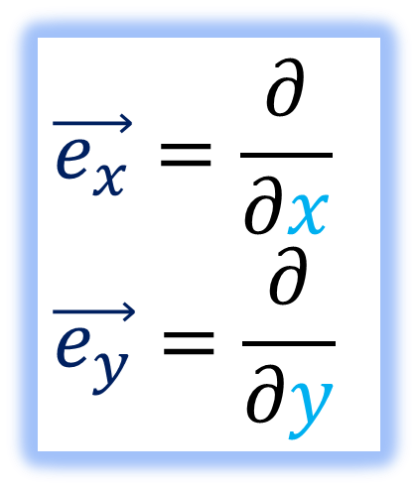

“Why are Derivative Operators Vectors?” Discussion
$$\vec{e_{x}}=\frac{∂}{∂x}$$
$$\vec{e_{y}}=\frac{∂}{∂y}$$

Slide 2
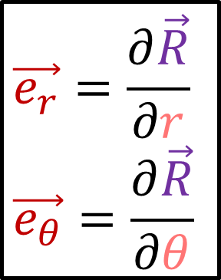

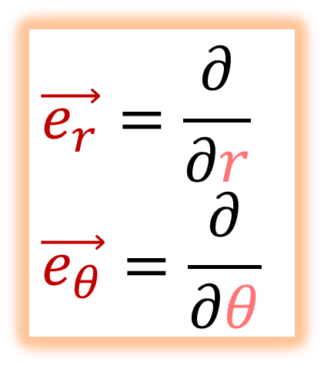
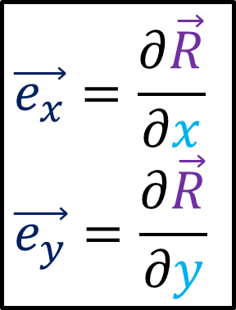
New Notation
Old Notation
$$\vec{e_{x}}=\frac{∂}{∂x}$$
$$\vec{e_{y}}=\frac{∂}{∂y}$$
$$\vec{e_{x}}=\frac{∂\vec{R}}{∂x}$$
$$\vec{e_{y}}=\frac{∂\vec{R}}{∂y}$$
$$\vec{e_{r}}=\frac{∂\vec{R}}{∂r}$$
$$\vec{e_{θ}}=\frac{∂\vec{R}}{∂θ}$$
$$\vec{e_{r}}=\frac{∂}{∂r}$$
$$\vec{e_{θ}}=\frac{∂}{∂θ}$$

Slide 3

Let’s learn General Relativity…
4-dimensions
Curved Spacetime
Tensor Calculus
Covariant derivative
Differentials
Metric Tensor

Slide 4
Let’s learn General Relativity…

Slide 5
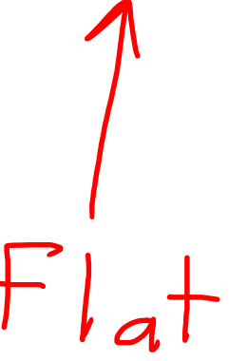
Let’s learn General Relativity…
Tensor
Algebra
Tensor
Calculus
Curved (Differential) Geometry
General
Relativity

Slide 6

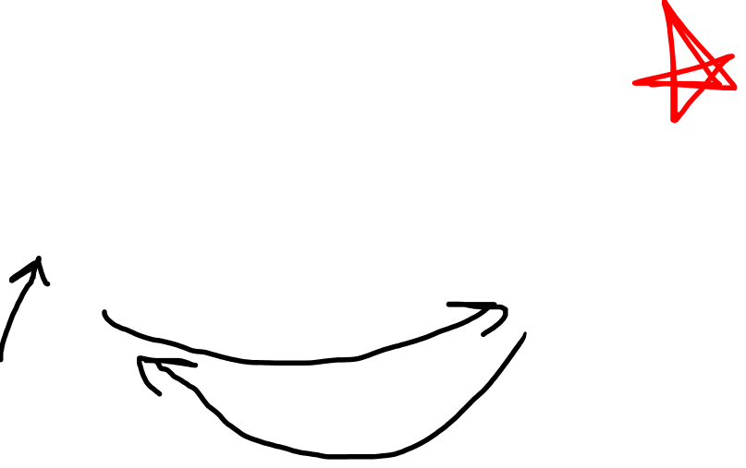
Let’s learn General Relativity…
Tensor
Algebra
Tensor
Calculus
Curved (Differential) Geometry
General
Relativity
$$\vec{e_{x}}=\frac{∂}{∂x}$$
$$\vec{e_{y}}=\frac{∂}{∂y}$$

Slide 7

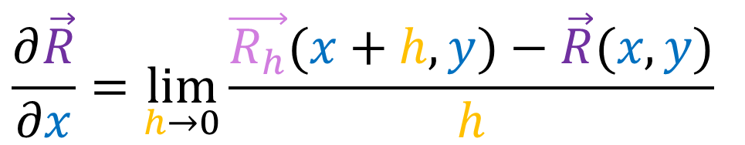



$$y$$
$$\frac{∂\vec{R}}{∂x}=\lim_{h→0}{\frac{\vec{R_{h}}(x+h,y)−\vec{R}(x,y)}{h}}$$
$$\vec{R}$$
$$\vec{R_{h}}$$
$$x$$

Slide 8
$$y$$
$$x$$

Slide 9
$$y$$
$$x$$

Slide 10

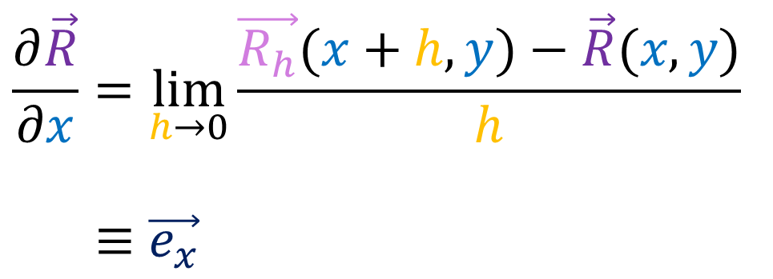
$$y$$
$$\frac{∂\vec{R}}{∂x}=\lim_{h→0}{\frac{\vec{R_{h}}(x+h,y)−\vec{R}(x,y)}{h}}$$
$$≡\vec{e_{x}}$$
$$\vec{R}$$
$$\vec{R_{h}}$$
$$x$$

Slide 11




$$y$$
$$\vec{R}\left(λ+h\right)$$
$$x$$
$$\vec{R}\left(λ\right)$$

Slide 12
$$y$$
$$x$$

Slide 13
$$y$$
$$x$$

Slide 14
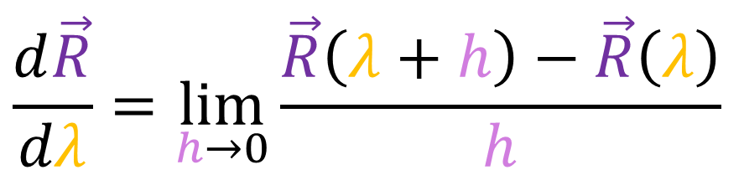
$$y$$
$$\frac{d\vec{R}}{dλ}=\lim_{h→0}\frac{\vec{R}\left(λ+h\right)−\vec{R}\left(λ\right)}{h}$$
$$\vec{R}\left(λ+h\right)$$
$$x$$
$$\vec{R}\left(λ\right)$$

Slide 15
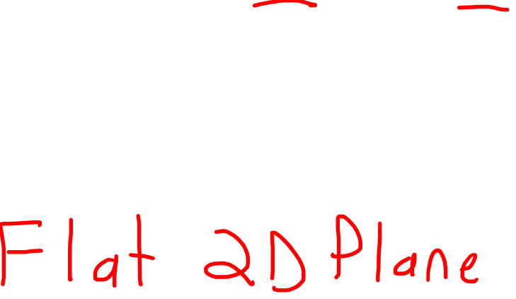
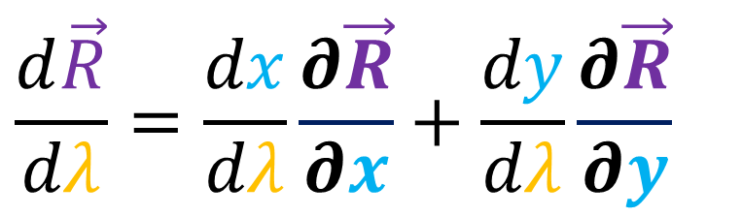
$$y$$
$$\frac{d\vec{R}}{dλ}=\frac{dx}{dλ}\frac{∂\vec{R}}{∂x}+\frac{dy}{dλ}\frac{∂\vec{R}}{∂y}$$
$$x$$

Slide 16

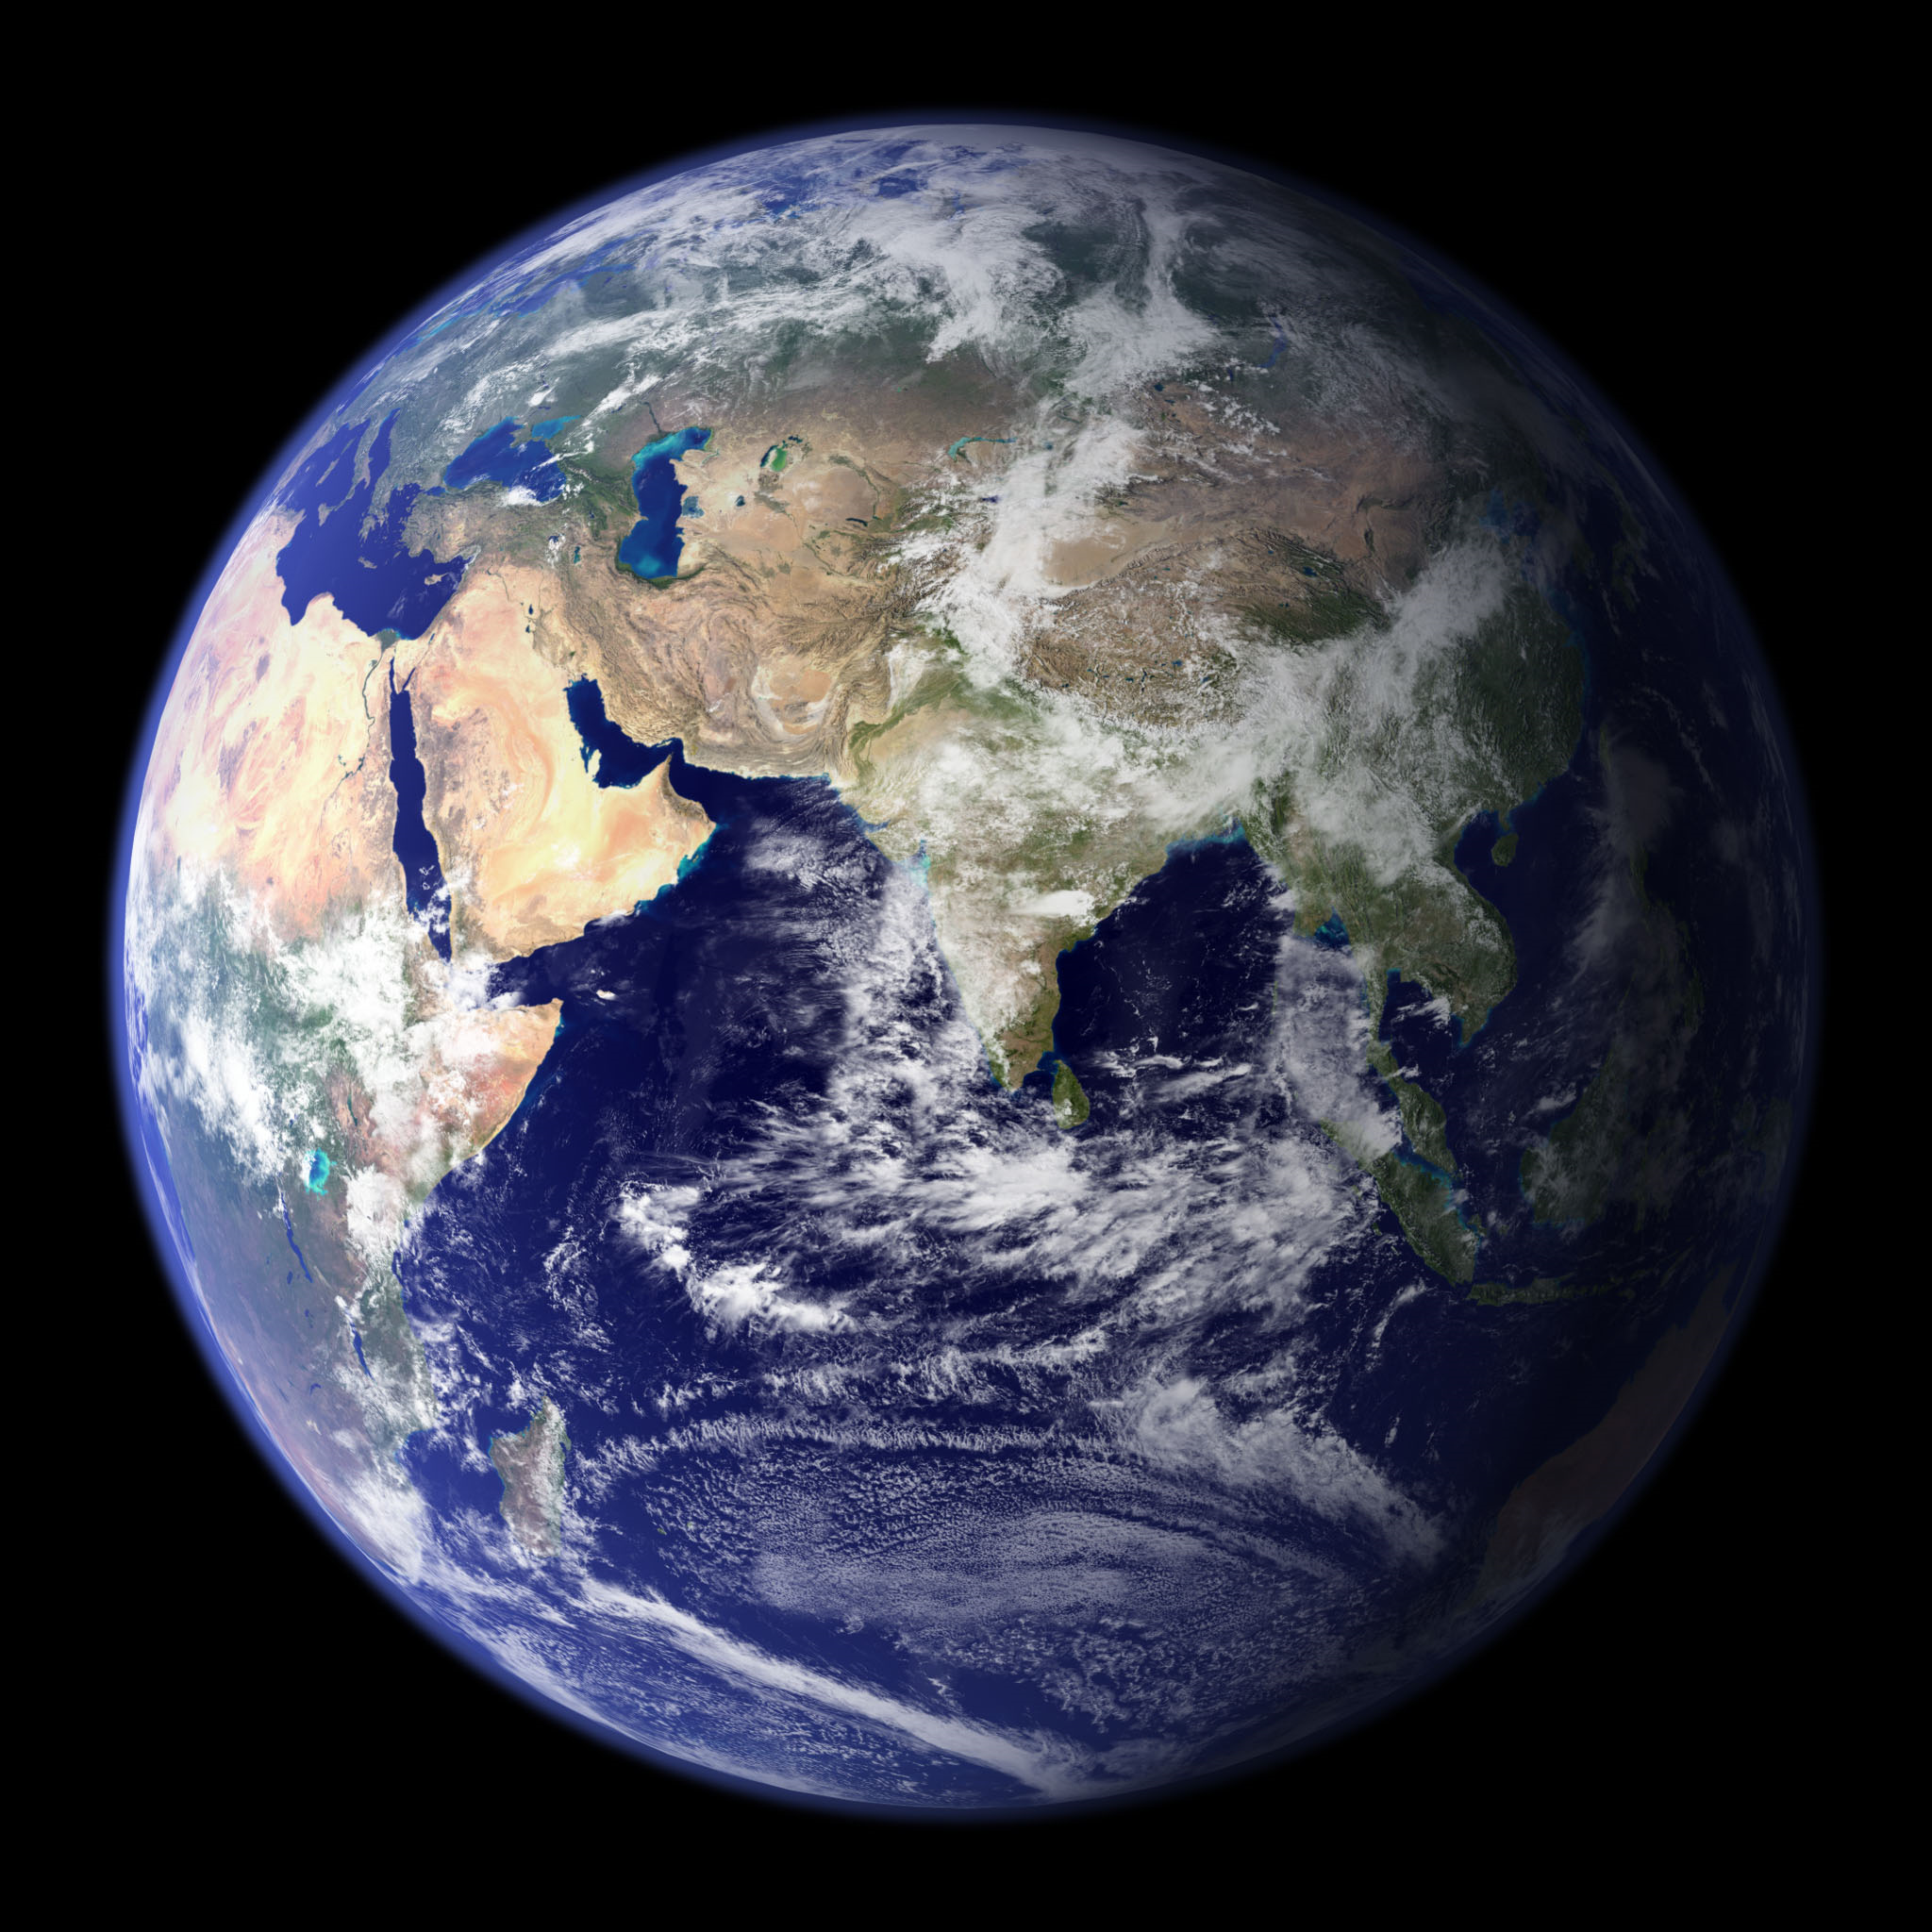


Slide 17


Slide 18
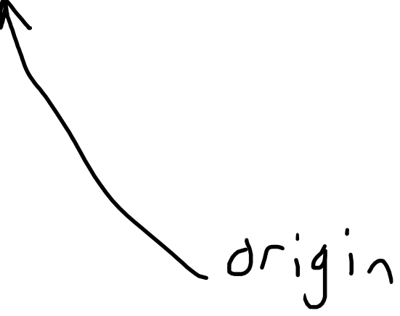

Slide 19
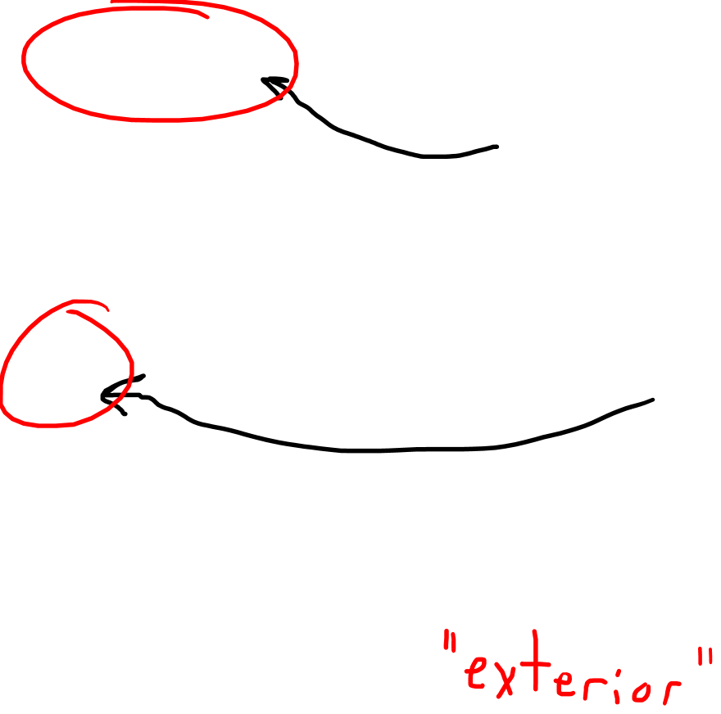
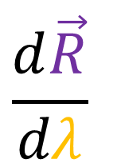
$$\frac{d\vec{R}}{dλ}$$
Velocity vector lives outside surface.
Origin doesn’t live on the Earth’s 2D surface.
EXTRINSIC GEOMETRY

Slide 20
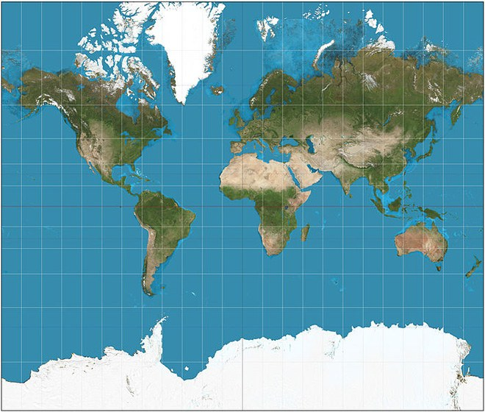

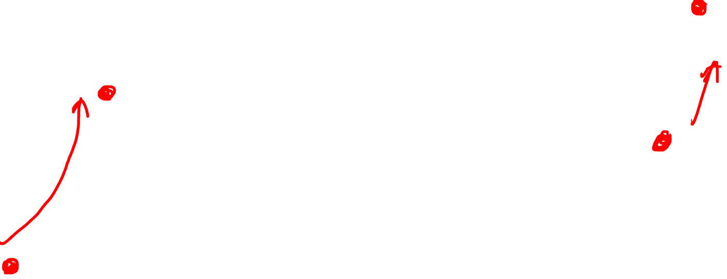


Slide 22

INTRINSIC
GEOMETRY

Slide 23
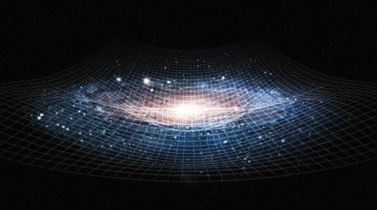

Spacetime is a 4D
curved space.
INTRINSIC
GEOMETRY

Slide 24
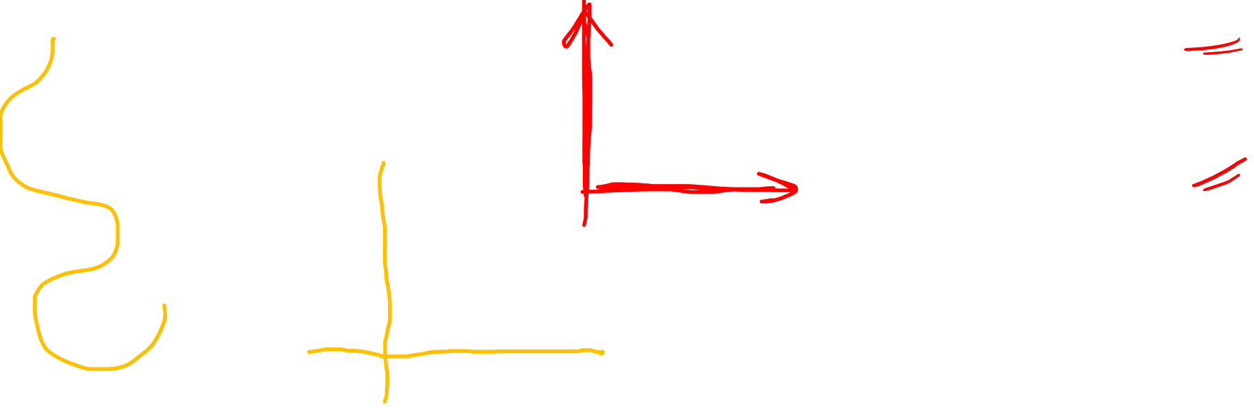

$$\vec{e_{x}}=\frac{∂}{∂x}$$
$$\vec{e_{y}}=\frac{∂}{∂y}$$

Slide 25


$$\frac{∂}{∂y}$$
$$\vec{e_{x}}=\frac{∂}{∂x}$$
$$\vec{e_{y}}=\frac{∂}{∂y}$$
$$\frac{∂}{∂x}$$

Slide 26
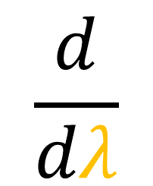
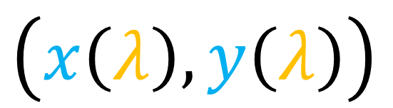
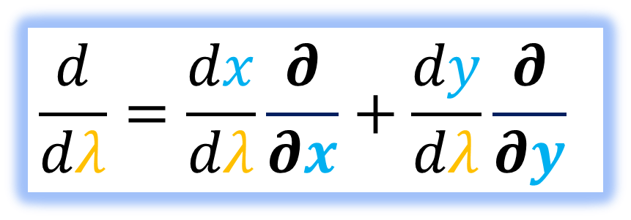
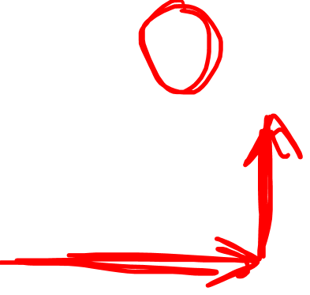
$$\frac{d}{dλ}=\frac{dx}{dλ}\frac{∂}{∂x}+\frac{dy}{dλ}\frac{∂}{∂y}$$
$$\frac{d}{dλ}$$
$$\vec{e_{x}}=\frac{∂}{∂x}$$
$$\vec{e_{y}}=\frac{∂}{∂y}$$
$$\left(x\left(λ\right),y\left(λ\right)\right)$$

Slide 27
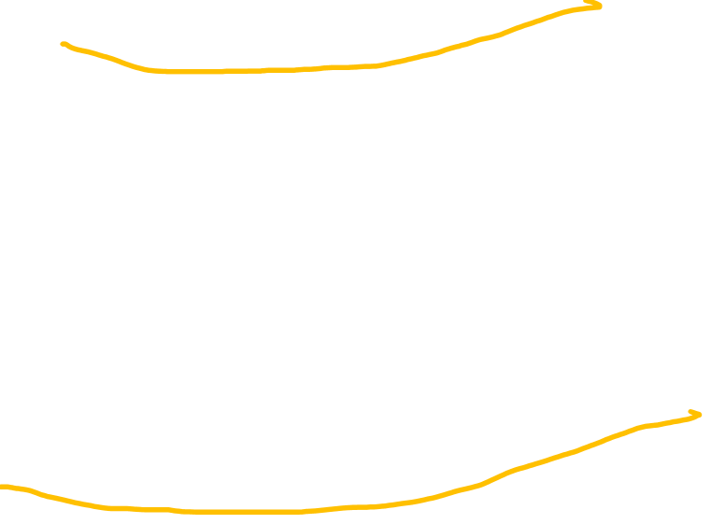
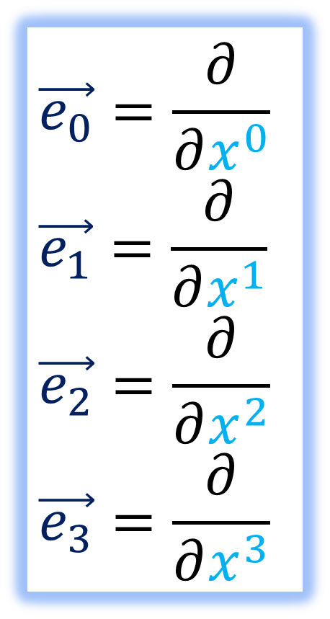
$$\vec{e_{0}}=\frac{∂}{∂x^{0}}$$
$$\vec{e_{1}}=\frac{∂}{∂x^{1}}$$
$$\vec{e_{2}}=\frac{∂}{∂x^{2}}$$
$$\vec{e_{3}}=\frac{∂}{∂x^{3}}$$

Slide 28
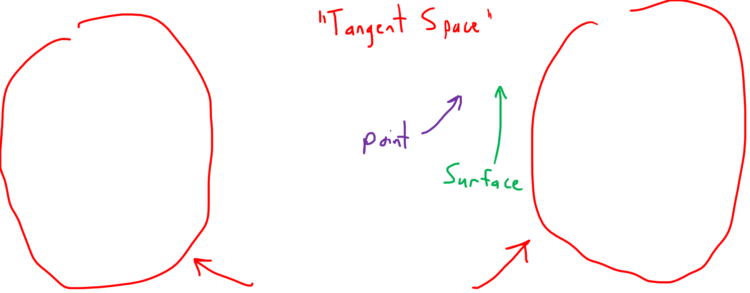
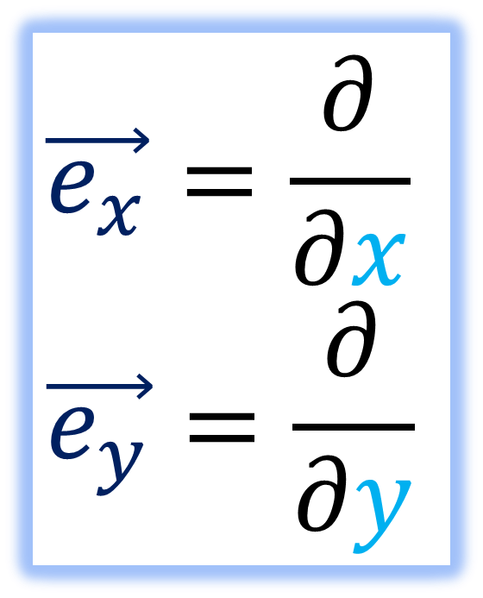
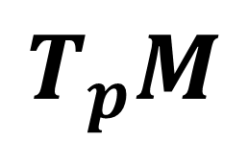
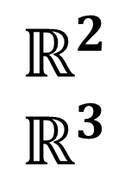
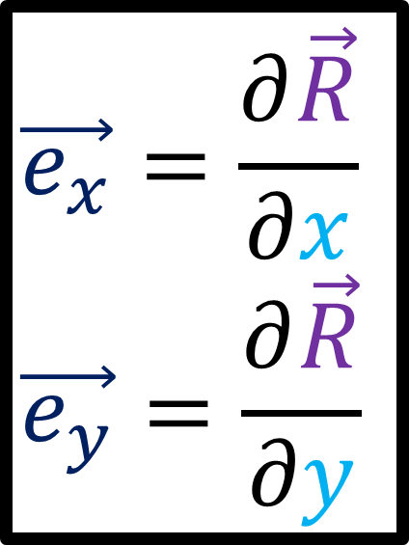
New Notation
Old Notation
$$ℝ^{2}$$
$$ℝ^{3}$$
$$T_{p}M$$
$$\vec{e_{x}}=\frac{∂}{∂x}$$
$$\vec{e_{y}}=\frac{∂}{∂y}$$
$$\vec{e_{x}}=\frac{∂\vec{R}}{∂x}$$
$$\vec{e_{y}}=\frac{∂\vec{R}}{∂y}$$
Different
Vector Spaces

Slide 29
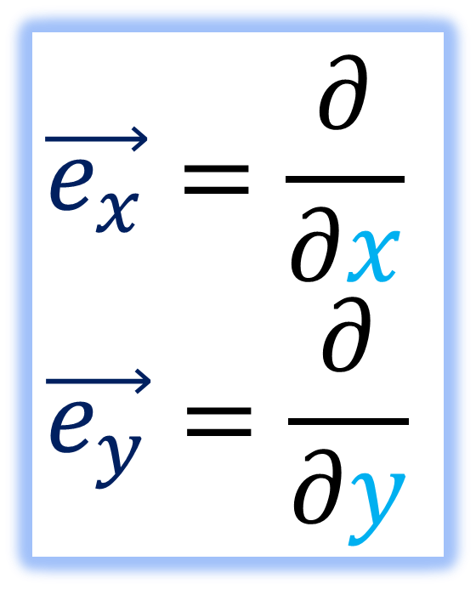
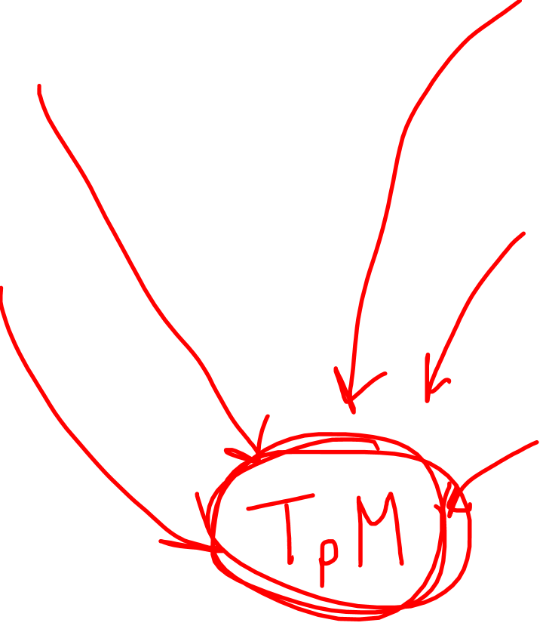
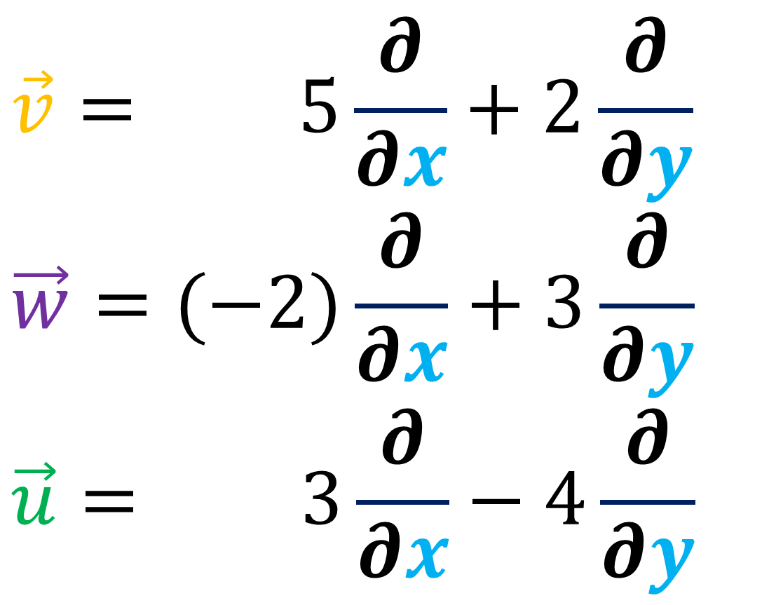
$$\vec{v}= 5\frac{∂}{∂x}+2\frac{∂}{∂y}$$
$$\vec{w}=(−2)\frac{∂}{∂x}+3\frac{∂}{∂y}$$
$$\vec{u}= 3\frac{∂}{∂x}−4\frac{∂}{∂y}$$
$$\vec{e_{x}}=\frac{∂}{∂x}$$
$$\vec{e_{y}}=\frac{∂}{∂y}$$

Slide 30


$$\vec{e_{x}}=\frac{∂}{∂x}$$
$$\vec{e_{y}}=\frac{∂}{∂y}$$
Useful for
curved spaces!

Slide 31
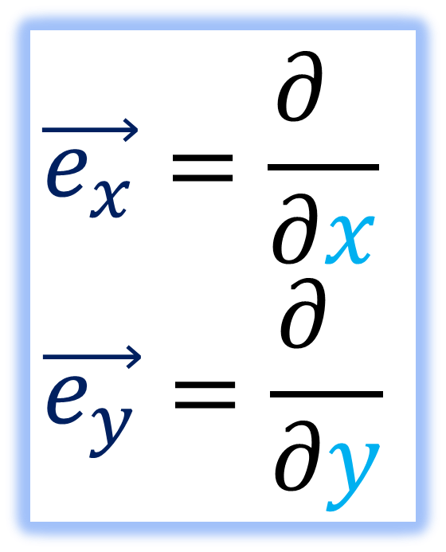
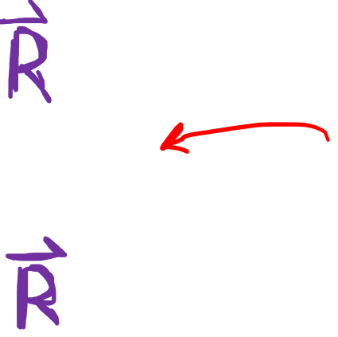
$$\vec{e_{x}}=\frac{∂ }{∂x}$$
$$\vec{e_{y}}=\frac{∂ }{∂y}$$
Fine for flat/extrinsic geometry!

