Slide 1
Integration With Differential Forms
(see links in description to learn about differential forms/covector fields)

Slide 2
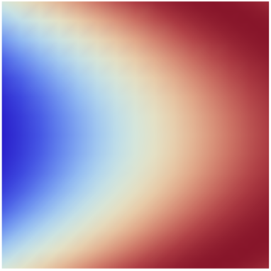
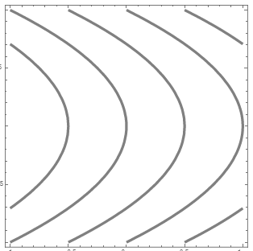
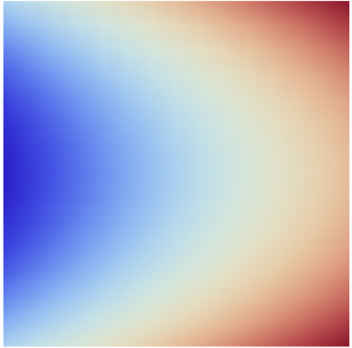
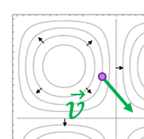
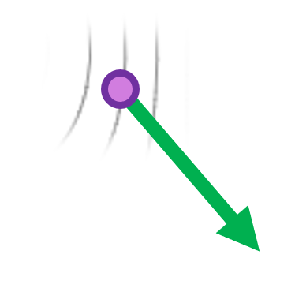

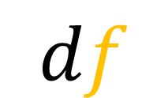

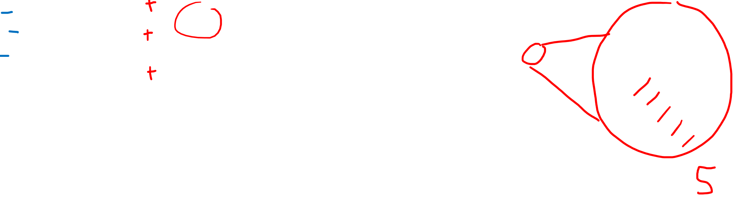

Differential Forms
$$d$$
$$df$$
Scalar Field
Covector Field
$$f$$
$$df$$

Slide 3
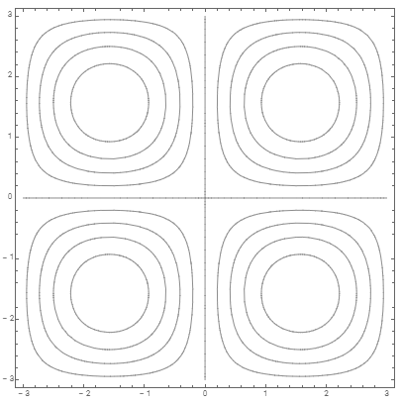
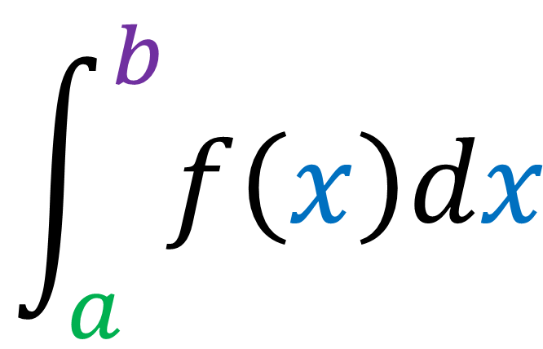
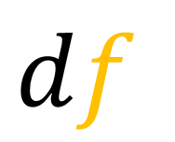
$$df$$
$$\int_{a}^{b}{f\left(x\right)dx}$$
Integration
Covector Field/
Differential Form

Slide 4
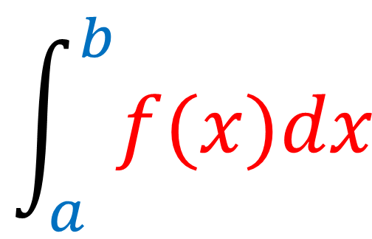
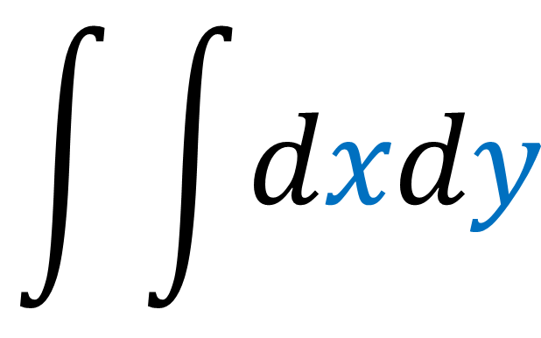
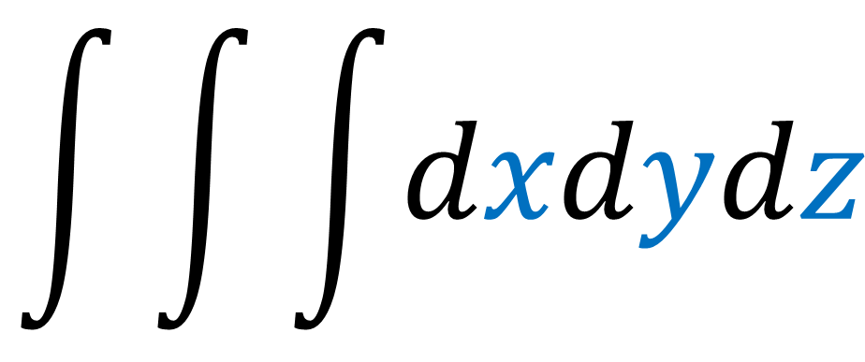
Differential Form interpretation of Integrals
Every (single) integral….
$$\int_{a}^{b}{f(x)dx}$$
$$\int{\int{dxdy}}$$
$$\int{\int{\int{dxdydz}}}$$

Slide 5
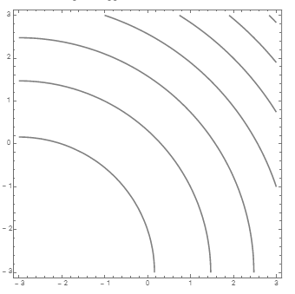
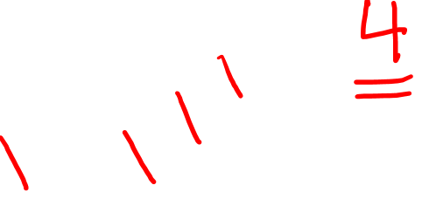
Differential Form interpretation of Integrals
Every (single) integral involves
a differential form (covector field)
a path
$$\int_{a}^{b}{f(x)dx}$$
The result of the integral is just
the number of covector stacks pierced by the path.

Slide 6
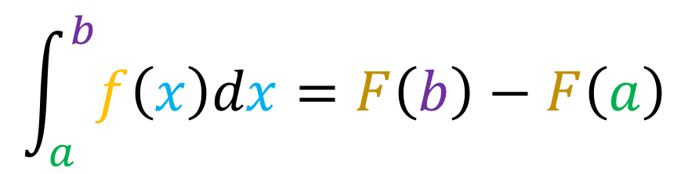
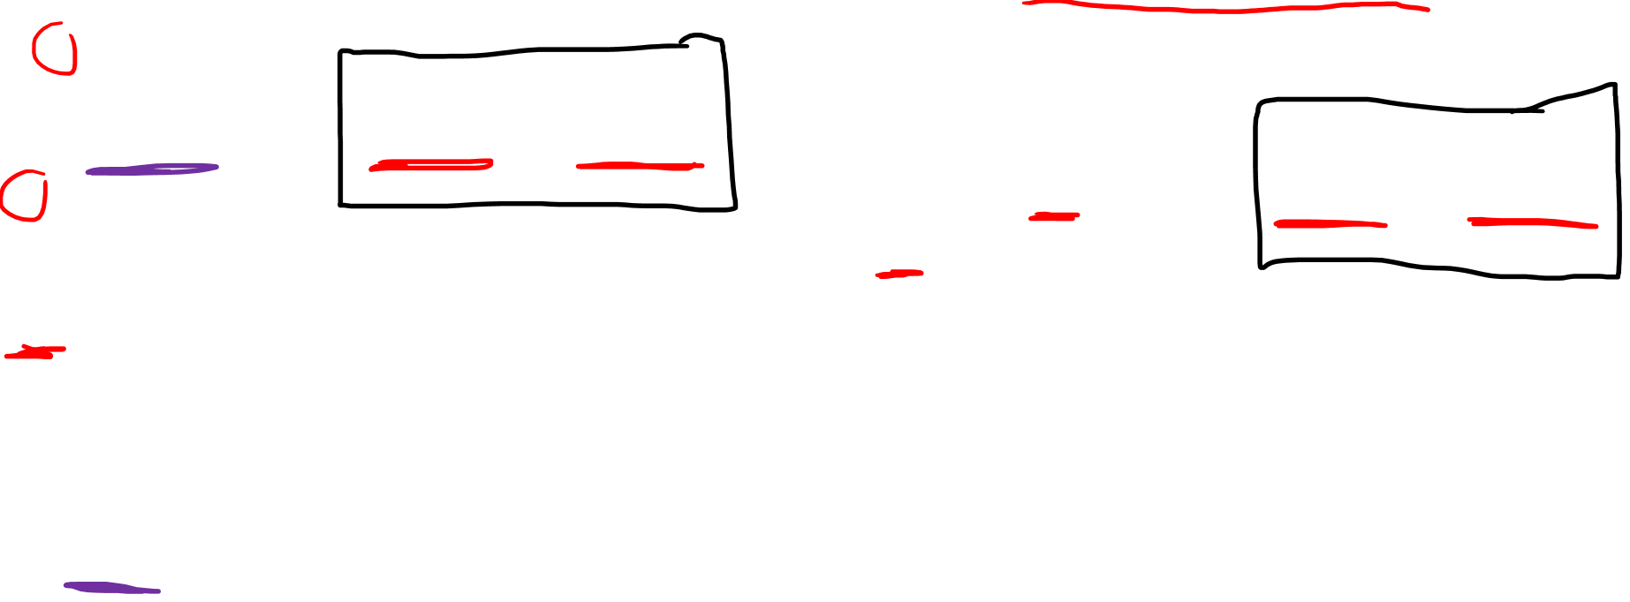
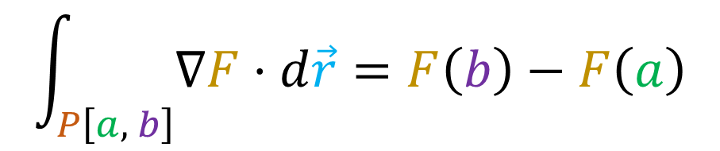

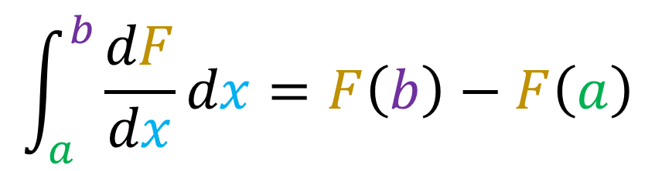
Fundamental Theorem
of Calculus
Fundamental Theorem
of Calculus for Line Integrals
(“Gradient Theorem”)
$$\int_{a}^{b}{f\left(x\right)dx}=F\left(b\right)−F\left(a\right)$$
$$\int_{P\left[a, b\right]}{∇F⋅d\vec{r}}=F\left(b\right)−F\left(a\right)$$
$F$ is the anti-derivative of $f$
$$\int_{a}^{b}{\frac{dF}{dx}dx}=F\left(b\right)−F\left(a\right)$$

Slide 7
Work

Slide 8
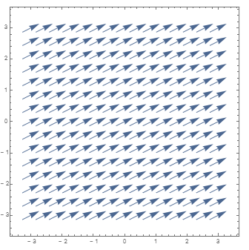
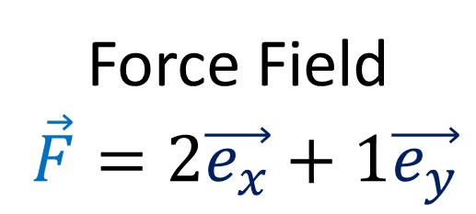

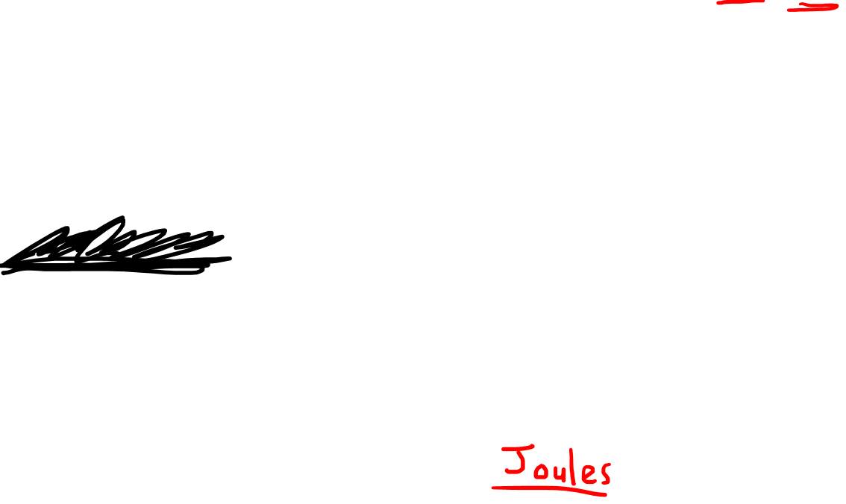
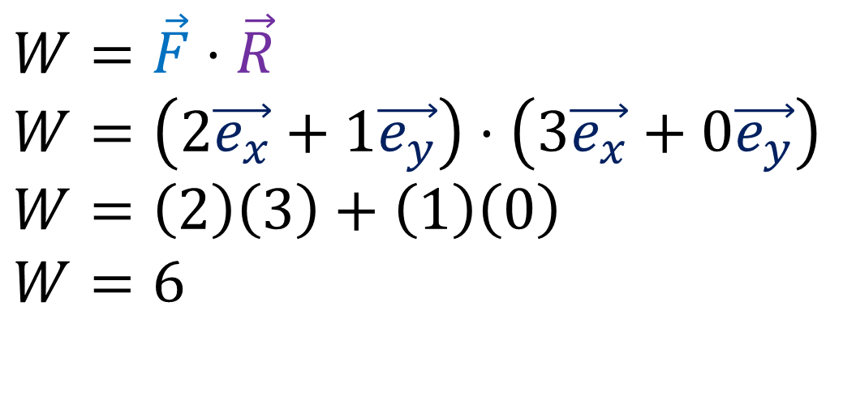
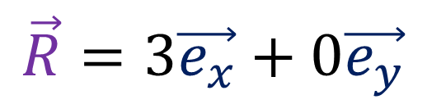
Force Field
$\vec{F}=2\vec{e_{x}}+1\vec{e_{y}}$
Work done by Force Field
$$W=\vec{F}⋅\vec{R}$$
$$\vec{R}=3\vec{e_{x}}+0\vec{e_{y}}$$
$$W=\vec{F}⋅\vec{R}$$
$$W=\left(2\vec{e_{x}}+1\vec{e_{y}}\right)⋅\left(3\vec{e_{x}}+0\vec{e_{y}}\right)$$
$$W=\left(2\right)\left(3\right)+\left(1\right)\left(0\right)$$
$$W=6$$

Slide 9
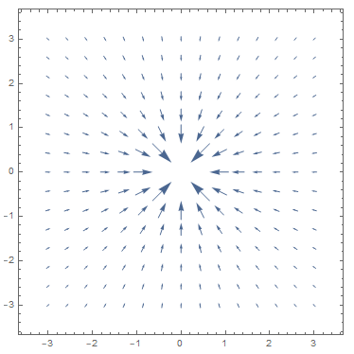
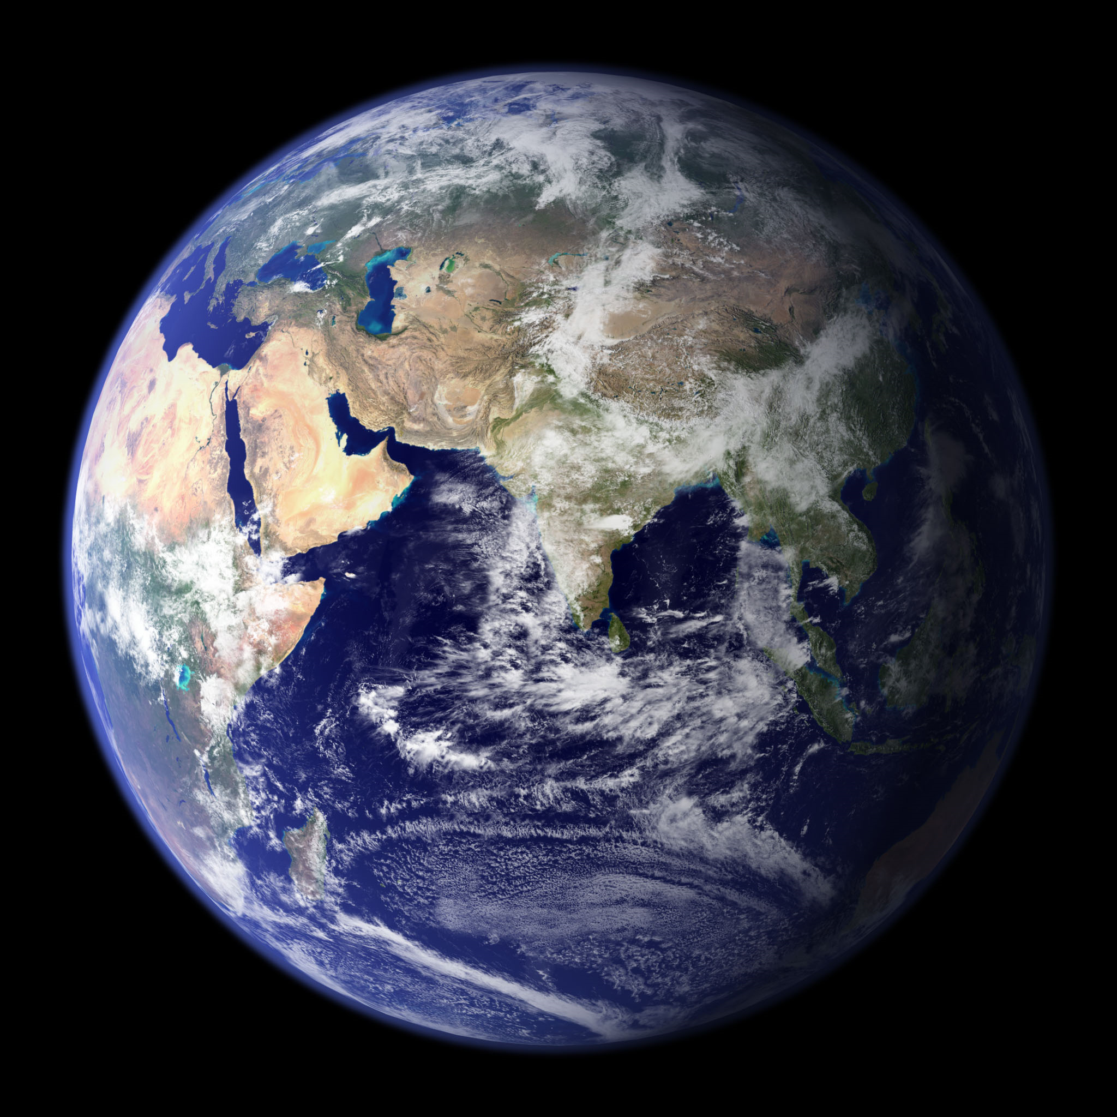
Gravitational Force Field
${\vec{F}}_{G}=\frac{GMm}{{\left\|\vec{R}\right\|}^{2}}(−\vec{e_{r}})$

Slide 10
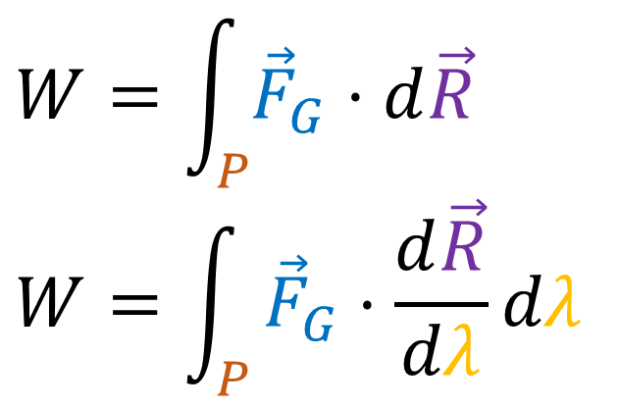

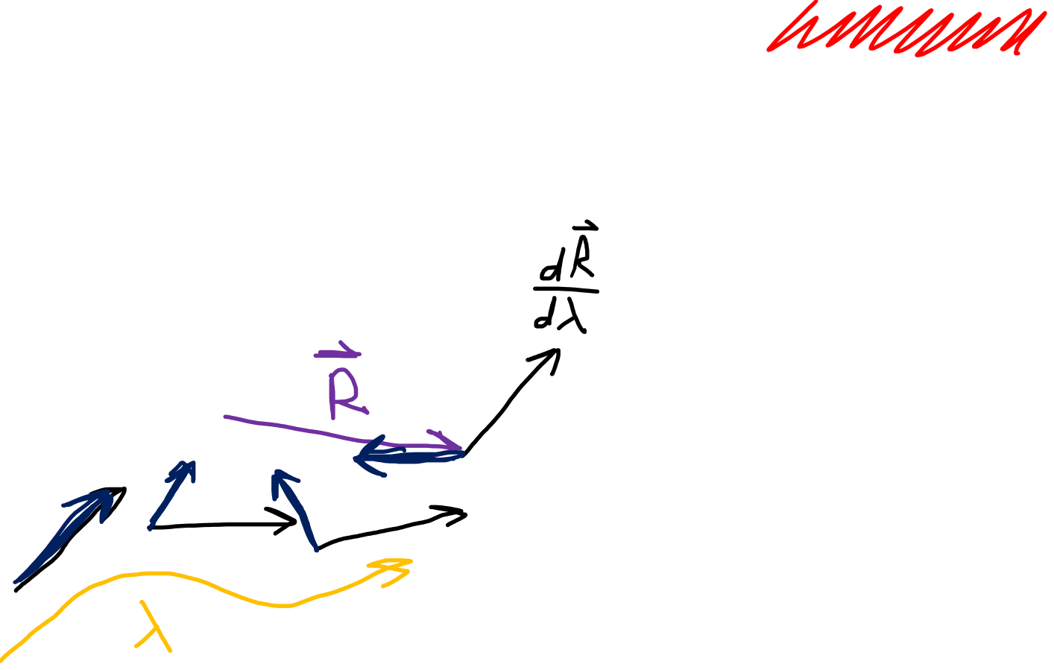
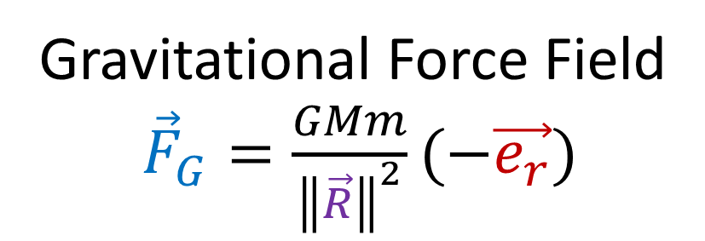
Gravitational Force Field
${\vec{F}}_{G}=\frac{GMm}{{\left\|\vec{R}\right\|}^{2}}(−\vec{e_{r}})$
Work done by Force Field
$$W=\vec{F}⋅\vec{R}$$
$$W=\int_{P}{{\vec{F}}_{G}⋅d\vec{R}}$$
$$W=\int_{P}{{\vec{F}}_{G}⋅\frac{d\vec{R}}{dλ}}dλ$$

Slide 11
Gravitational Force Field
${\vec{F}}_{G}=\frac{GMm}{{\left\|\vec{R}\right\|}^{2}}(−\vec{e_{r}})$
$$\vec{R}\left(λ\right)=\left(r=2,θ=λ\right)$$
$\frac{d\vec{R}}{dλ}=\frac{dr}{dλ}\frac{d\vec{R}}{dr}+\frac{dθ}{dλ}\frac{d\vec{R}}{dθ}$
$\frac{d\vec{R}}{dλ}=0\vec{e_{r}}+1\vec{e_{θ}}$
$W=\int_{P}{{\vec{F}}_{G}⋅\frac{d\vec{R}}{dλ}}dλ$
$$W=\int_{P}{\left(\frac{GMm}{{\left\|\vec{R}\right\|}^{2}}(−\vec{e_{r}})\right)⋅\left(\vec{e_{θ}}\right)}dλ$$
$$W=−\frac{GMm}{4}\int_{C}{\left(\vec{e_{r}}⋅\vec{e_{θ}}\right)}dλ$$

Slide 12
Gravitational Force Field
${\vec{F}}_{G}=\frac{GMm}{{\left\|\vec{R}\right\|}^{2}}(−\vec{e_{r}})$
$$\vec{R}\left(λ\right)=\left(r=λ,θ=0\right)$$
$\frac{d\vec{R}}{dλ}=1\vec{e_{r}}+0\vec{e_{θ}}$
$$W=\int_{P}{{\vec{F}}_{G}⋅\frac{d\vec{R}}{dλ}}dλ$$
$W=\int_{P}{\left(\frac{GMm}{{\left\|\vec{R}\right\|}^{2}}(−\vec{e_{r}})\right)⋅\left(\vec{e_{r}}\right)}dλ$
$W=GMm\int_{P}{\left(−\frac{1}{λ^{2}}\right)\left(\vec{e_{r}}⋅\vec{e_{r}}\right)}dλ$
$$W=GMm{\left[\frac{1}{λ}\right]}_{a}^{b}$$
$=GMm\left(\frac{1}{b}−\frac{1}{a}\right)$

Slide 13
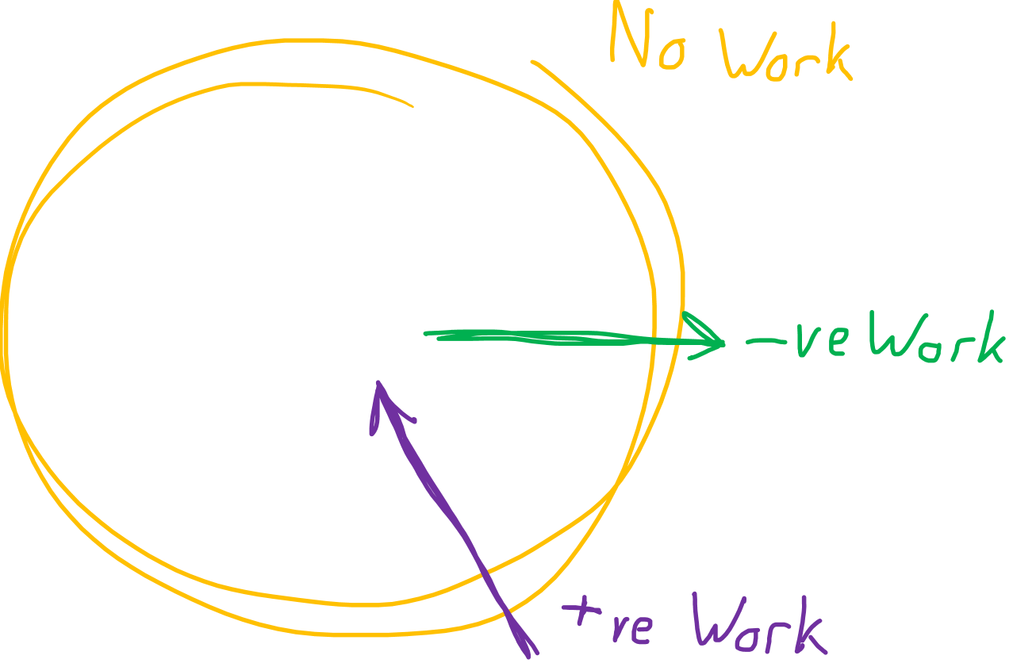

Slide 14
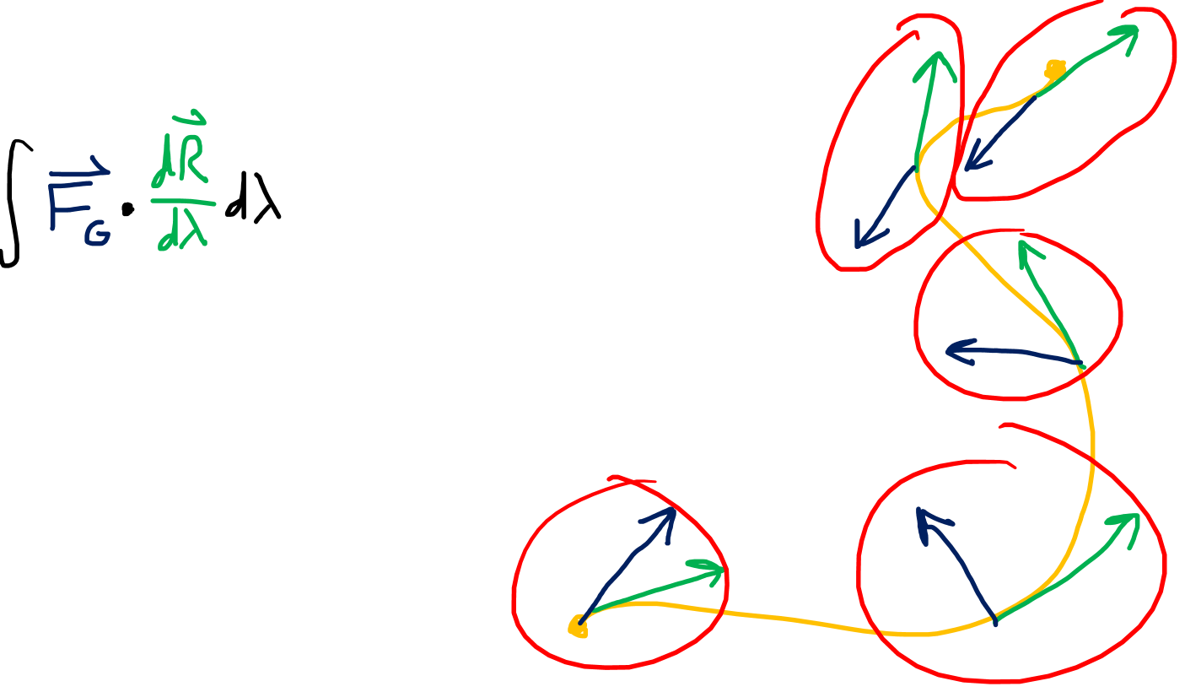

Slide 15
Gravitational Potential

Slide 16
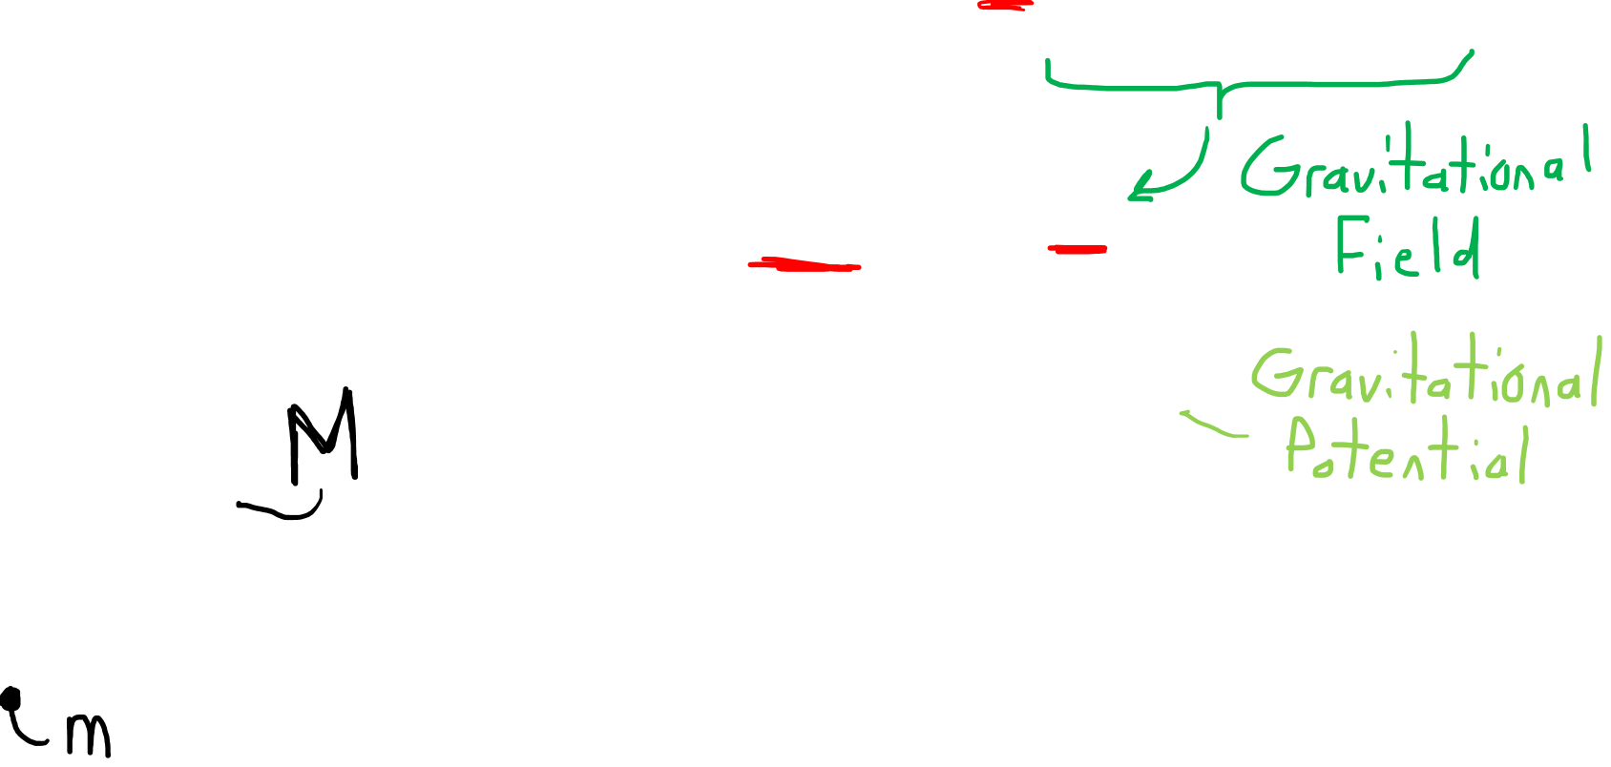
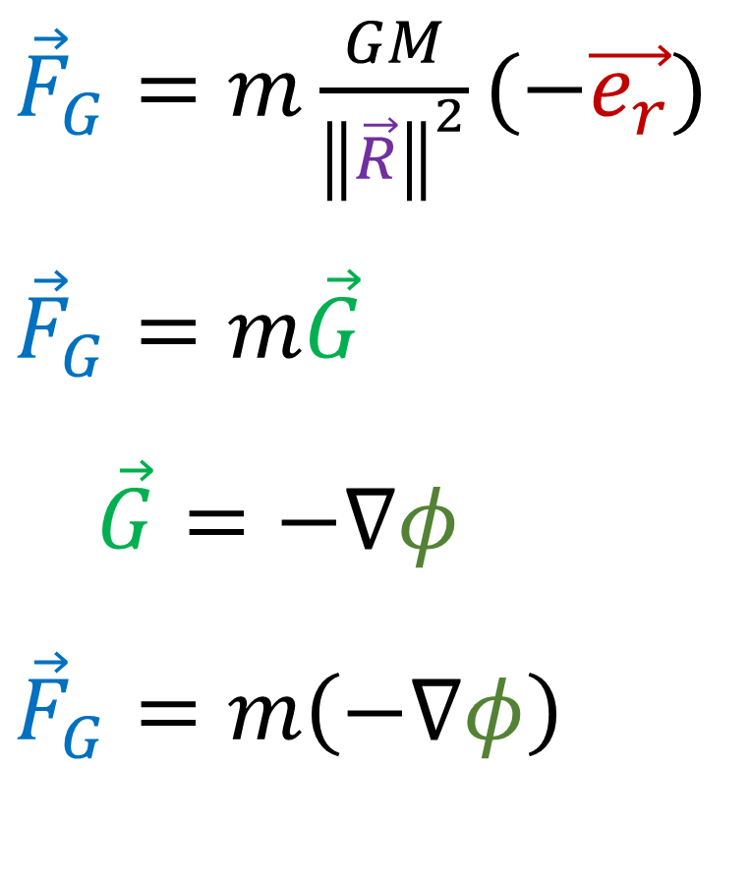
Gravitational Force Field
${\vec{F}}_{G}=\frac{GMm}{{\left\|\vec{R}\right\|}^{2}}(−\vec{e_{r}})$
${\vec{F}}_{G}=m\frac{GM}{{\left\|\vec{R}\right\|}^{2}}(−\vec{e_{r}})$
$${\vec{F}}_{G}=m\vec{G}$$
$\vec{G}=−∇φ$
$${\vec{F}}_{G}=m\left(−∇φ\right)$$

Slide 17
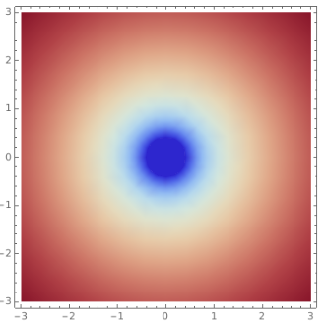
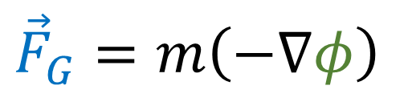
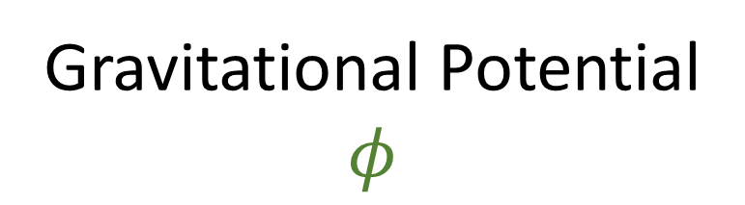
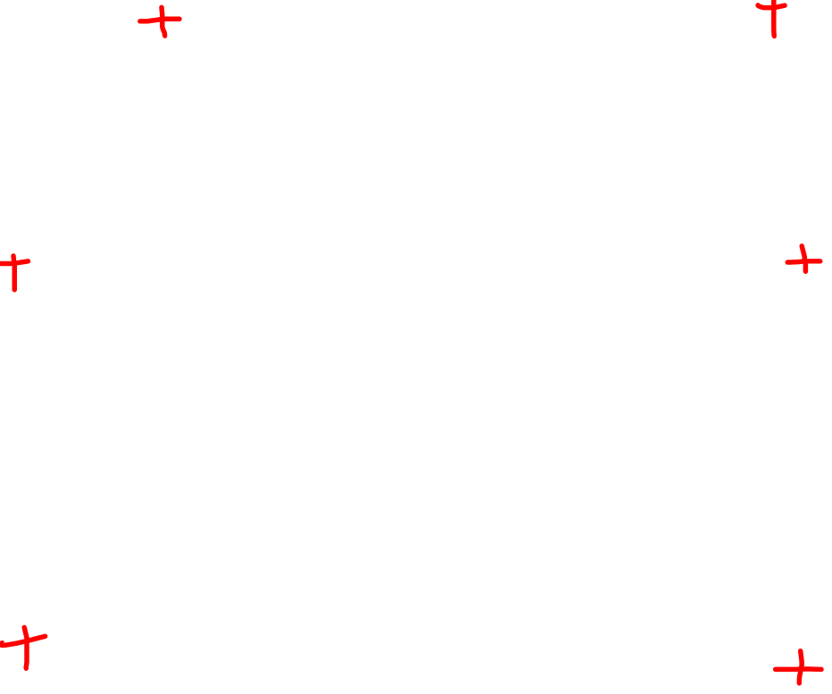
Gravitational Force Field
Gravitational Potential
$$φ$$
$${\vec{F}}_{G}=m\left(−∇φ\right)$$

Slide 18

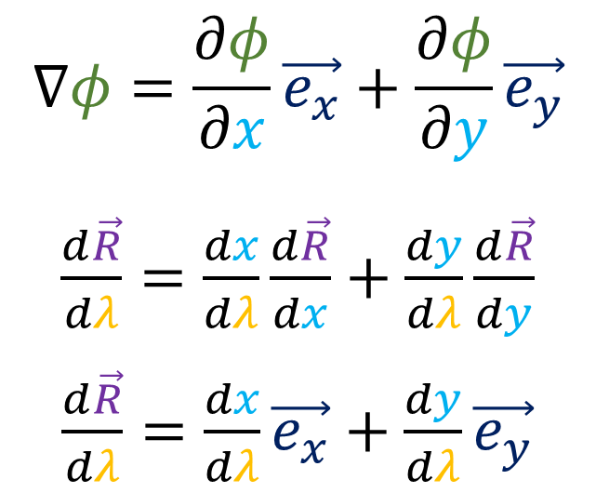

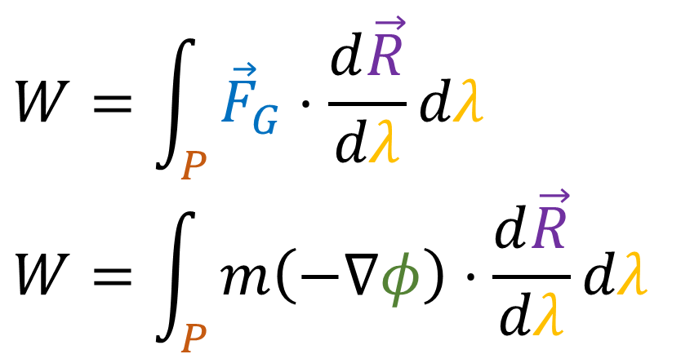

Gravitational Force Field
${\vec{F}}_{G}=m\left(−∇φ\right)$
$$W=\int_{P}{{\vec{F}}_{G}⋅\frac{d\vec{R}}{dλ}}dλ$$
$$W=\int_{P}{m\left(−∇φ\right)⋅\frac{d\vec{R}}{dλ}}dλ$$
$$∇φ=\frac{∂φ}{∂x}\vec{e_{x}}+\frac{∂φ}{∂y}\vec{e_{y}}$$
$\frac{d\vec{R}}{dλ}=\frac{dx}{dλ}\frac{d\vec{R}}{dx}+\frac{dy}{dλ}\frac{d\vec{R}}{dy}$
$\frac{d\vec{R}}{dλ}=\frac{dx}{dλ}\vec{e_{x}}+\frac{dy}{dλ}\vec{e_{y}}$
Path $P$

Slide 19
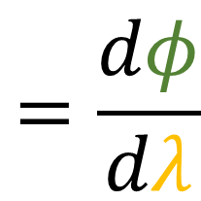

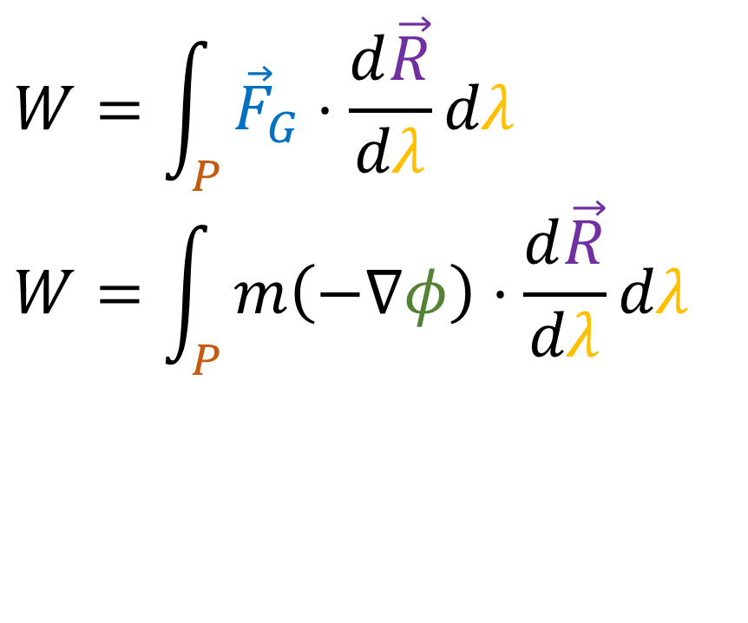
Gravitational Force Field
${\vec{F}}_{G}=m\left(−∇φ\right)$
$$W=\int_{P}{{\vec{F}}_{G}⋅\frac{d\vec{R}}{dλ}}dλ$$
$$W=\int_{P}{m\left(−∇φ\right)⋅\frac{d\vec{R}}{dλ}}dλ$$
$$∇φ⋅\frac{d\vec{R}}{dλ}$$
$$=\left(\frac{∂φ}{∂x}\vec{e_{x}}+\frac{∂φ}{∂y}\vec{e_{y}}\right)⋅\left(\frac{dx}{dλ}\vec{e_{x}}+\frac{dy}{dλ}\vec{e_{y}}\right)$$
$$=\frac{∂φ}{∂x}\frac{dx}{dλ}+\frac{∂φ}{∂y}\frac{dy}{dλ}$$
$$=\frac{dφ}{dλ}$$
Path $P$

Slide 20
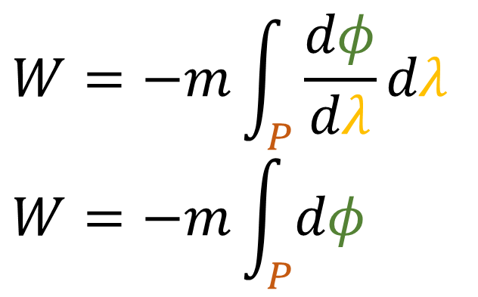
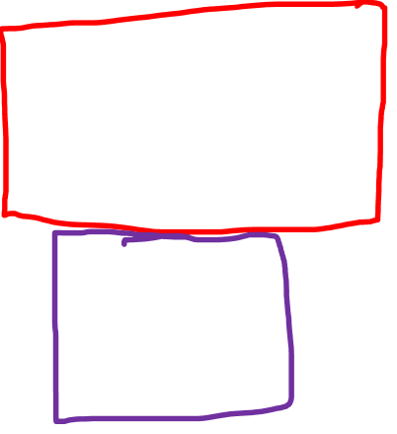
Gravitational Force Field
${\vec{F}}_{G}=m\left(−∇φ\right)$
$$W=\int_{P}{{\vec{F}}_{G}⋅\frac{d\vec{R}}{dλ}}dλ$$
$$W=\int_{P}{m\left(−∇φ\right)⋅\frac{d\vec{R}}{dλ}}dλ$$
$$W=−m\int_{P}{\frac{dφ}{dλ}}dλ$$
$$W=−m\int_{P}{dφ}$$
Path $P$

Slide 21
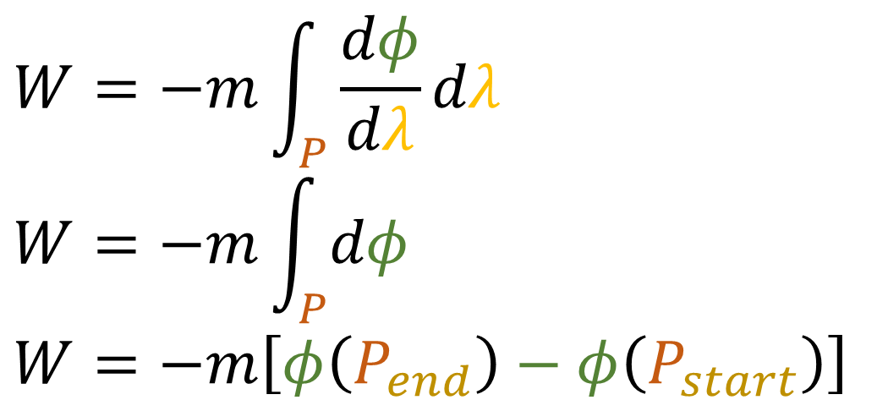
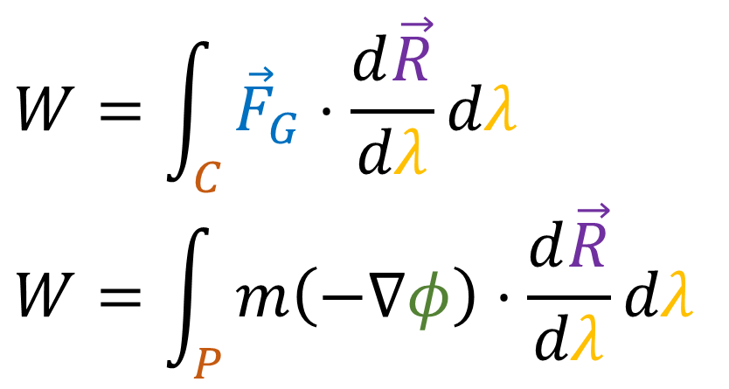
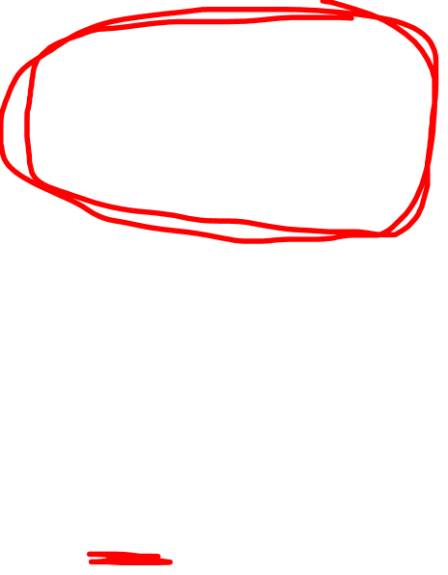
Gravitational Force Field
${\vec{F}}_{G}=m\left(−∇φ\right)$
$$W=\int_{C}{{\vec{F}}_{G}⋅\frac{d\vec{R}}{dλ}}dλ$$
$$W=\int_{P}{m\left(−∇φ\right)⋅\frac{d\vec{R}}{dλ}}dλ$$
$$W=−m\int_{P}{\frac{dφ}{dλ}}dλ$$
$$W=−m\int_{P}{dφ}$$
$$W=−m\left[φ\left(P_{end}\right)−φ\left(P_{start}\right)\right]$$
Path $P$

Slide 22
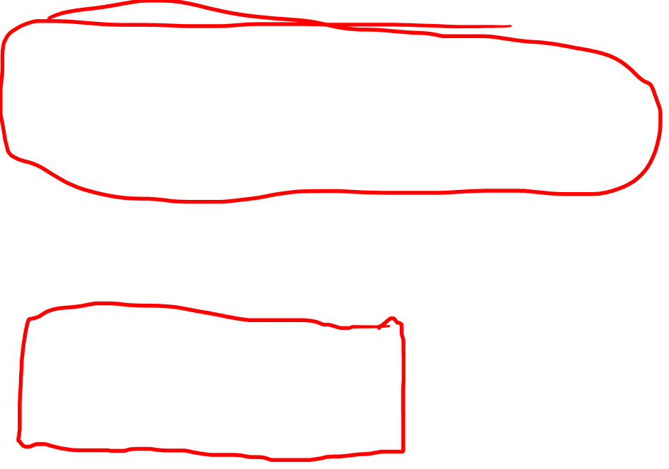
Gravitational Force Field
${\vec{F}}_{G}=m\left(−∇φ\right)$
$$W=\int_{C}{{\vec{F}}_{G}⋅\frac{d\vec{R}}{dλ}}dλ$$
$$W=\int_{P}{m\left(−∇φ\right)⋅\frac{d\vec{R}}{dλ}}dλ$$
$$W=−m\int_{P}{\frac{dφ}{dλ}}dλ$$
$$W=−m\int_{P}{dφ}$$
$$W=−m\left[φ\left(P_{end}\right)−φ\left(P_{start}\right)\right]$$
Path $P$

Slide 23
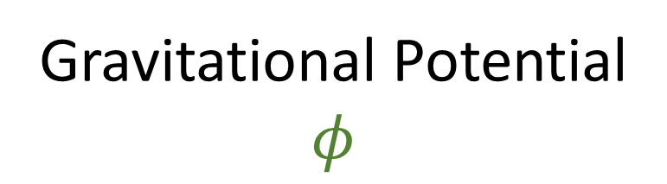

Gravitational Force Field
${\vec{F}}_{G}=m\left(−∇φ\right)$
Gravitational Potential
$$φ$$

Slide 24
Gravitational Force Field
${\vec{F}}_{G}=m\left(−∇φ\right)$
Gravitational Potential
$$φ$$
(if m=1)

Slide 25



Gravitational Force (Covector) Field
$dF_{G}=m\left(−dφ\right)$
Gravitational Potential
$$φ$$

Slide 26






Gravitational
Potential
$$φ$$
Gravitational Force
Vector Field
$\vec{F_{G}}=m\left(−∇φ\right)$
$$−∇φ$$
Gravitational Force
Covector Field
$$dF_{G}=m\left(−dφ\right)$$
$$−dφ$$

Slide 27



Fundamental Theorem of Calculus for Line Integrals
(“Gradient Theorem”)
Old way (hard)
New way (easy)
$$\int_{P\left[a, b\right]}{∇φ⋅d\vec{R}}=φ\left(b\right)−φ\left(a\right)$$
$$\int_{P\left[a, b\right]}{dφ}=φ\left(b\right)−φ\left(a\right)$$

Slide 28


Slide 29


Slide 30


Gravitational
Potential
$$φ$$
$$−∇φ$$
$$\int_{P[a,b]}{∇φ⋅d\vec{R}}$$
$$=φ\left(b\right)−φ\left(a\right)$$
$$\int_{P[a,b]}{dφ}$$
$$=φ\left(b\right)−φ\left(a\right)$$
$$−dφ$$

Slide 31



Differential Form interpretation of Integrals
Every (single) integral involves
a path
a covector field (differential form)
$$\int_{P[a,b]}{ydx+xdy}$$
$$\int_{0}^{2}{(−6x+4)dx}$$

Slide 32


Differential Form interpretation of Integrals
Every (single) integral involves
a path
a covector field (differential form)
$$\int_{P[a,b]}{dφ}$$
The result of the integral is just
the number of covector stacks pierced* by the path.
*(In the aligned direction.)

