Slide 1
Integration With Differential Forms 2 (Examples)
(see link in description for first video)

Slide 2
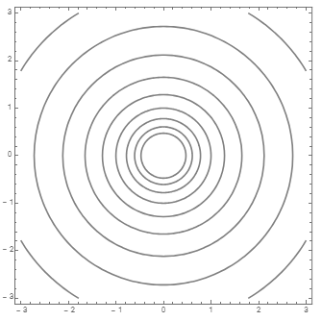
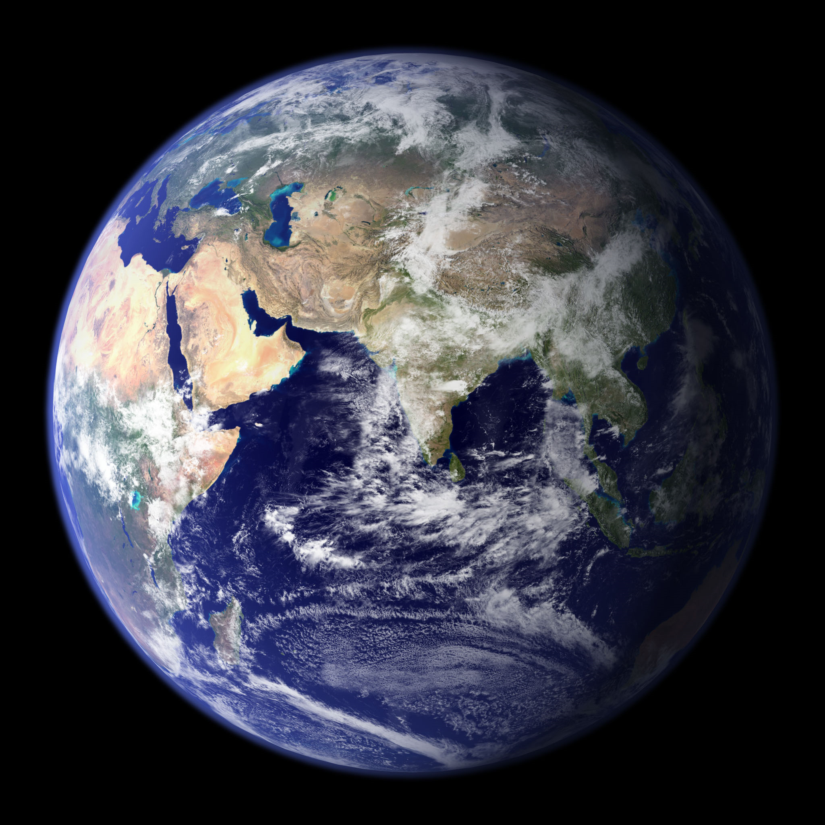
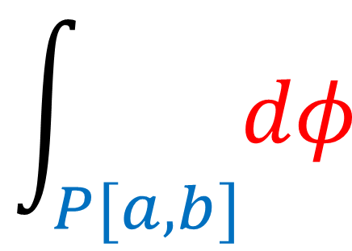
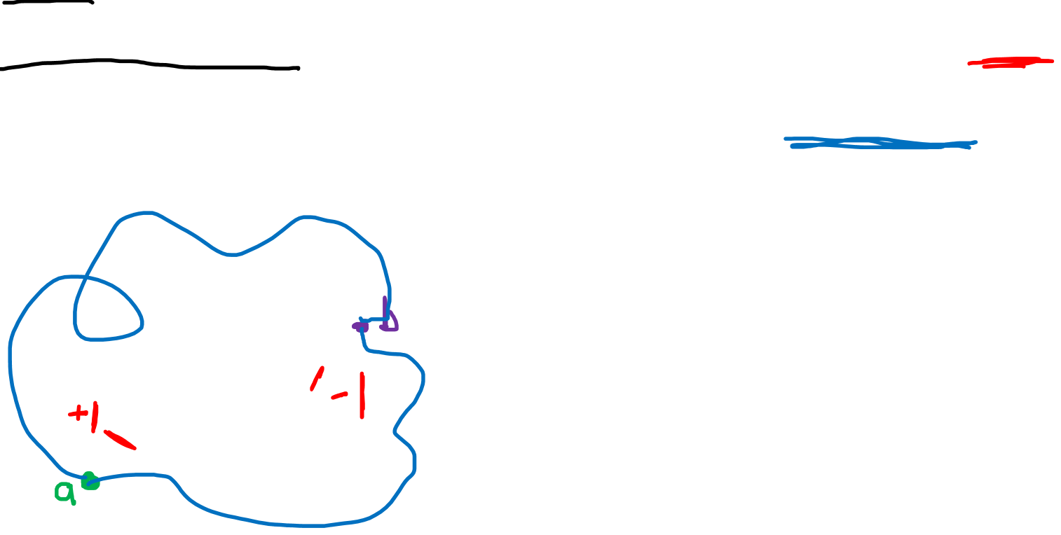
Differential Form interpretation of Integrals
Every (single) integral involves
a path
a covector field (differential form)
$$\int_{P[a,b]}{dφ}$$
The result of the integral is just
the number of covector curves pierced* by the path.
*(In the aligned direction.)

Slide 3
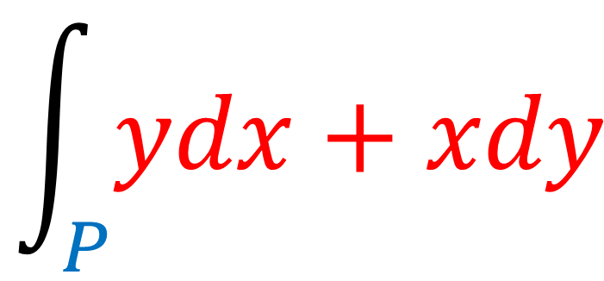
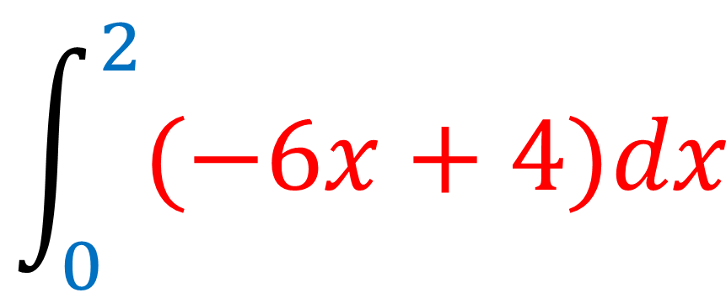
Differential Form interpretation of Integrals
Every (single) integral involves
a path/curve
a covector field (differential form)
$$\int_{P}{ydx+xdy}$$
$$\int_{0}^{2}{(−6x+4)dx}$$

Slide 4
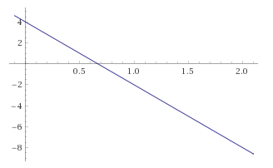

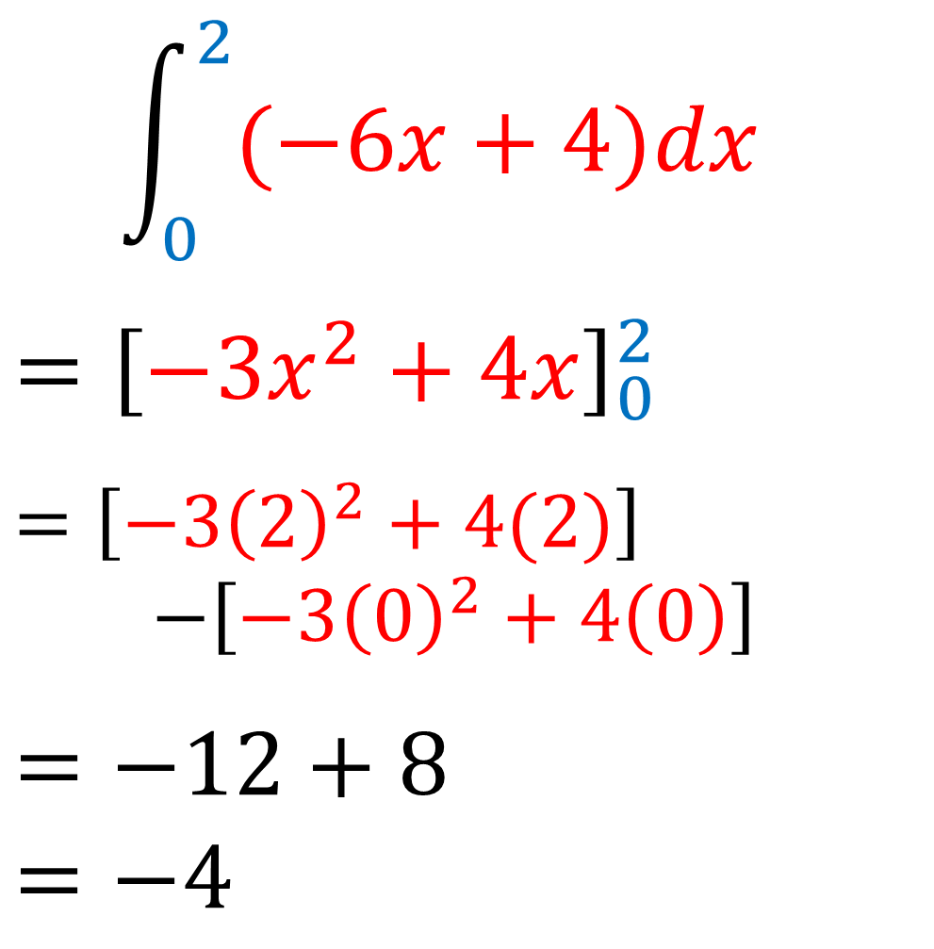


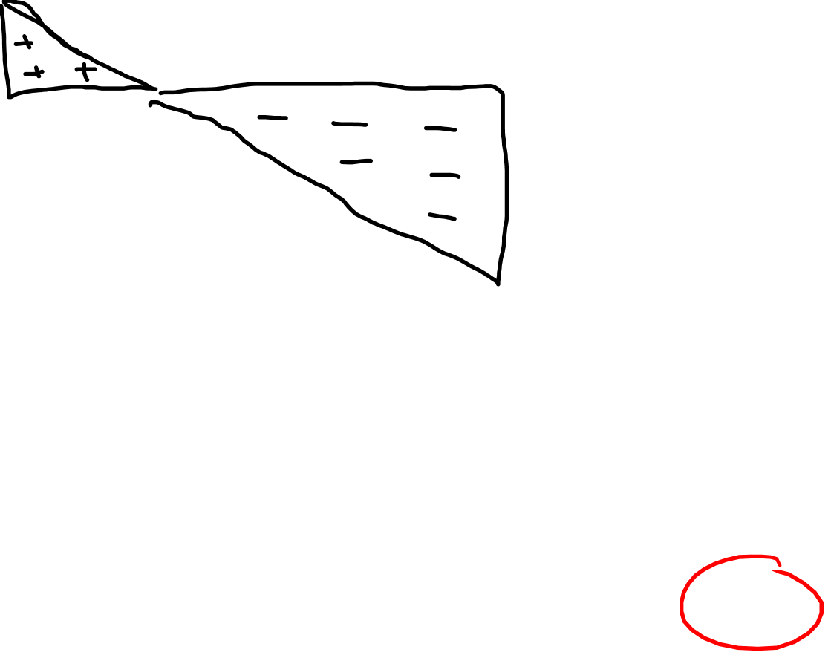
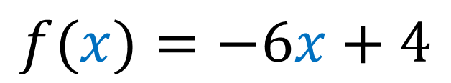

$$f(x)$$
$$\int_{0}^{2}{(−6x+4)dx}$$
$${=\left[−3x^{2}+4x\right]}_{0}^{2}$$
$$=\left[−3{\left(2\right)}^{2}+4(2)\right]$$ $−\left[−3{\left(0\right)}^{2}+4\left(0\right)\right]$
$$=−12+8$$
$$=−4$$
$$x$$
$$a=0$$
$$b=2$$
$$f(x)=−6x+4$$

Slide 5
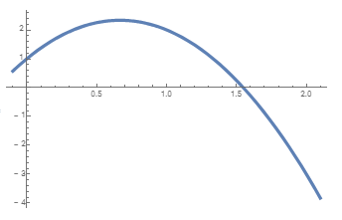
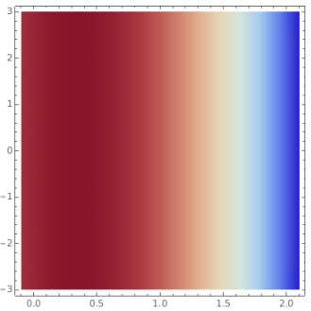


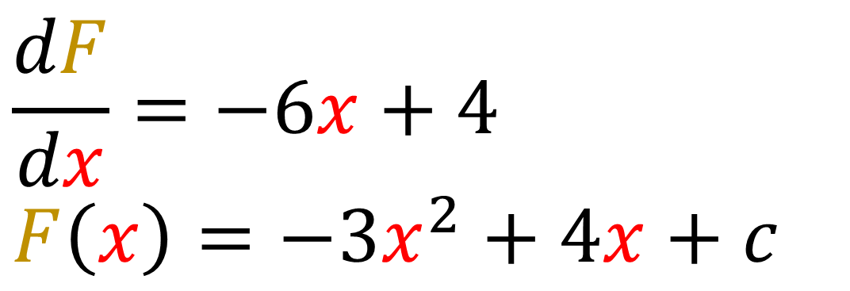
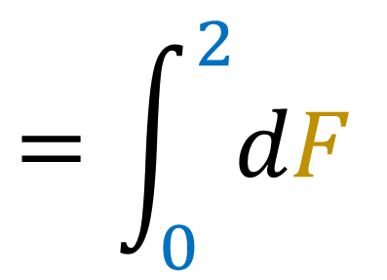
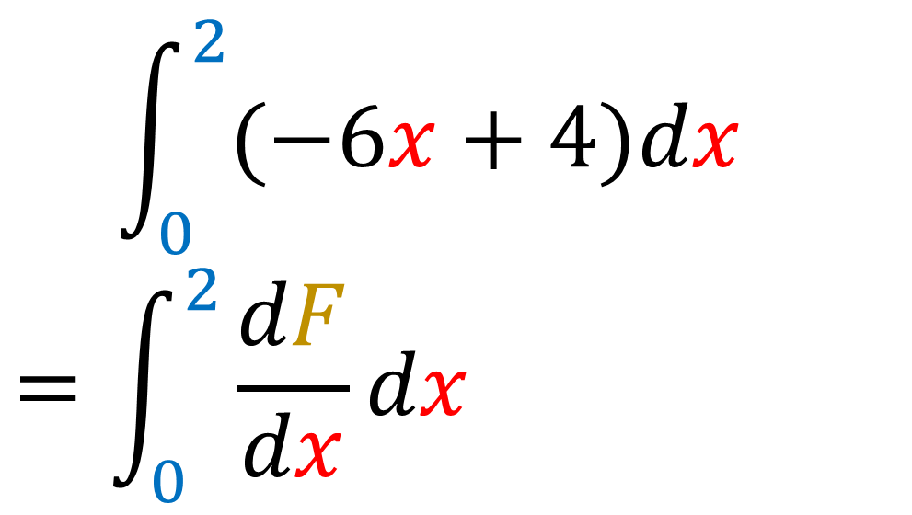

$$F\left(x\right)=−3x^{2}+4x+1$$
$$\int_{0}^{2}{(−6x+4)dx}$$
$$=\int_{0}^{2}{\frac{dF}{dx}dx}$$
$$=\int_{0}^{2}{dF}$$
$$dF$$
$$\frac{dF}{dx}=−6x+4$$
$$F\left(x\right)=−3x^{2}+4x+c$$

Slide 6
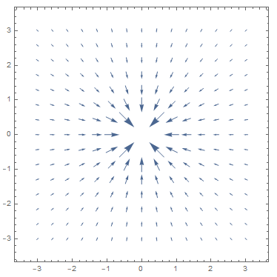
$$y$$
$$\int_{P}{ydx+xdy}$$
$$=\int_{0}^{2}{y\frac{dx}{dt}dt+x\frac{dy}{dt}dt}$$
$=\int_{0}^{2}{\left(\frac{3}{2}t−1\right)\left(\frac{1}{2}\right)dt+\left(\frac{1}{2}t+1\right)\left(\frac{3}{2}\right)dt}$
$$=\int_{0}^{2}{\left(\frac{6}{4}t+1\right)dt}$$
$$={\left[\frac{3}{4}t^{2}+t\right]}_{0}^{2}$$
$$=\left(3/4\right){\left(2\right)}^{2}+2=3+2=5$$
$$x$$
$$P\left(t\right), t∈\left[0,2\right]$$
$\left(x=\frac{1}{2}t+1,y=\frac{3}{2}t−1\right)$

Slide 7
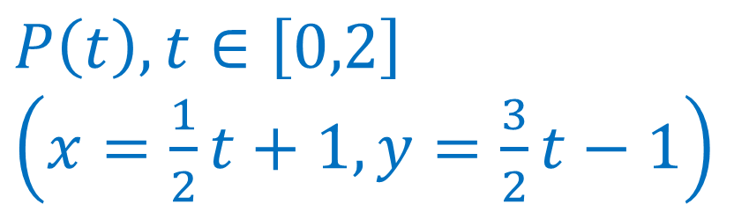
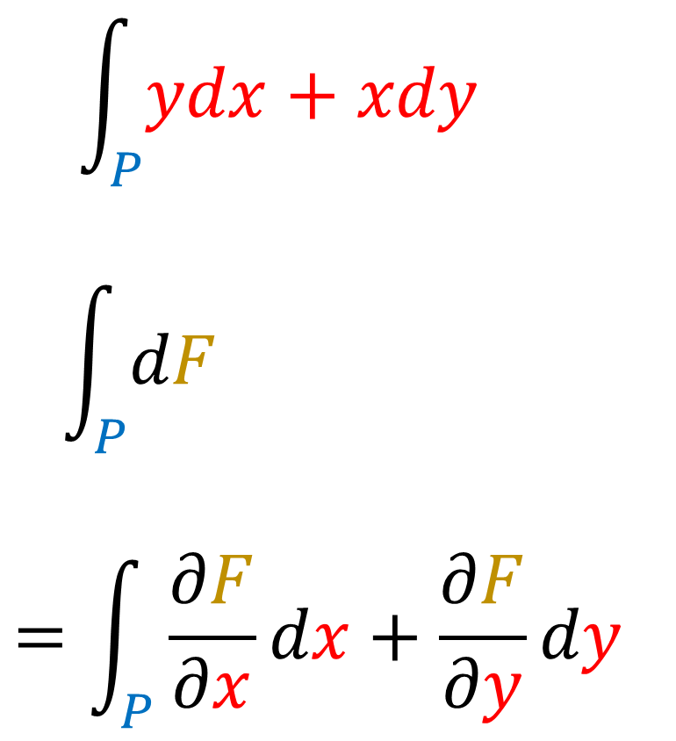



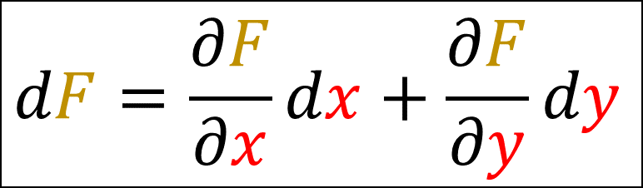
$$y$$
$$\int_{P}{ydx+xdy}$$
$$\int_{P}{dF }$$
$$=\int_{P}{\frac{∂F}{∂x}dx+\frac{∂F}{∂y}dy}$$
$$dF=\frac{∂F}{∂x}dx+\frac{∂F}{∂y}dy$$
$$x$$
$$P\left(t\right), t∈\left[0,2\right]$$
$\left(x=\frac{1}{2}t+1,y=\frac{3}{2}t−1\right)$

Slide 8
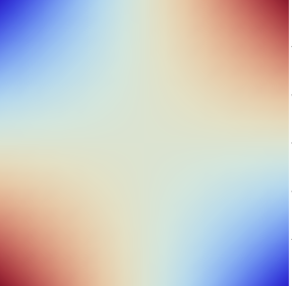
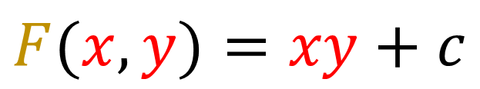
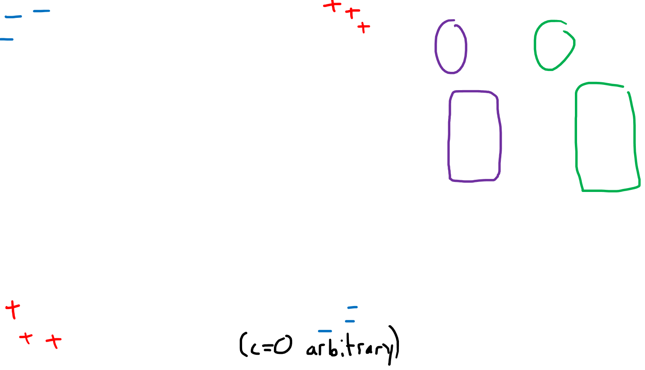
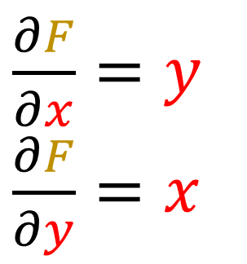
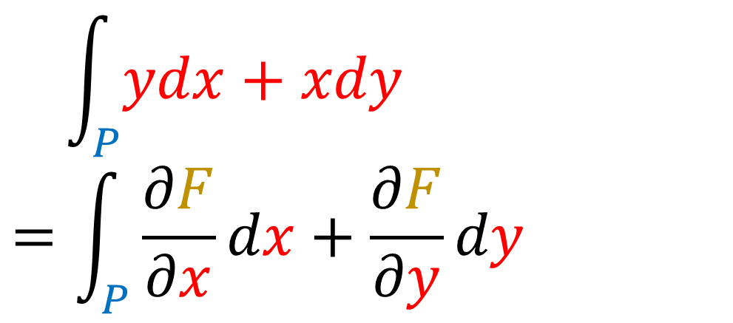
$$y$$
$$\int_{P}{ydx+xdy}$$
$$=\int_{P}{\frac{∂F}{∂x}dx+\frac{∂F}{∂y}dy}$$
$$x$$
$\frac{∂F}{∂x}=y$
$\frac{∂F}{∂y}=x$
$$F(x,y)=xy+c$$
$$P\left(t\right), t∈\left[0,2\right]$$
$\left(x=\frac{1}{2}t+1,y=\frac{3}{2}t−1\right)$

Slide 9
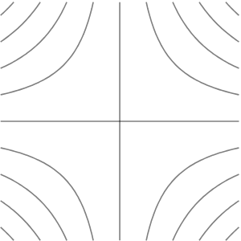
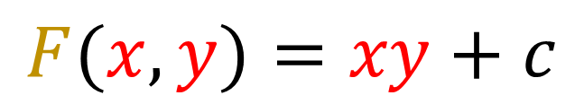
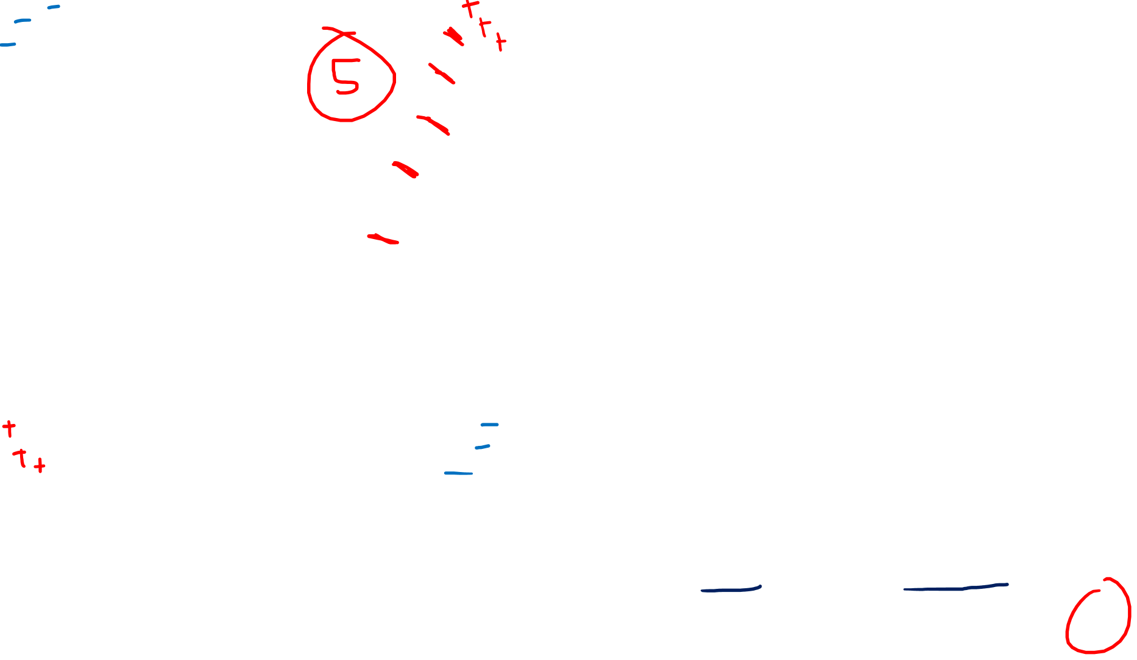
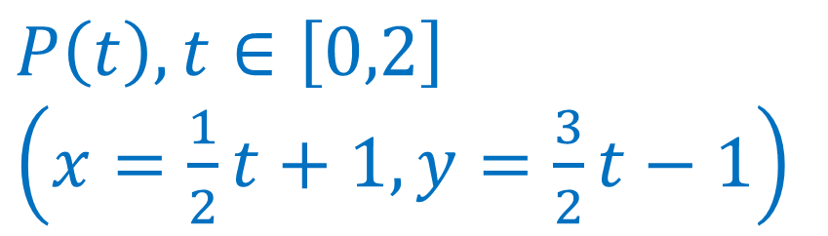

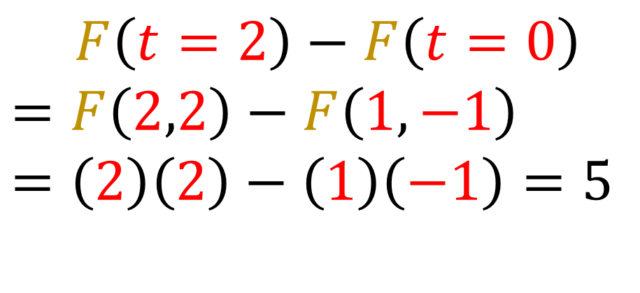

$$\int_{P}{ydx+xdy}$$
$$=\int_{P}{\frac{∂F}{∂x}dx+\frac{∂F}{∂y}dy}$$
$$dF$$
$\frac{∂F}{∂x}=y$
$\frac{∂F}{∂y}=x$
$$F(x,y)=xy+c$$
$\int_{P}{dF }=$
$$F\left(t=2\right)−F\left(t=0\right)$$
$$=F\left(2,2\right)−F\left(1,−1\right)$$
$$=\left(2\right)\left(2\right)−\left(1\right)\left(−1\right)=5$$
$$P\left(t\right), t∈\left[0,2\right]$$
$\left(x=\frac{1}{2}t+1,y=\frac{3}{2}t−1\right)$

Slide 10
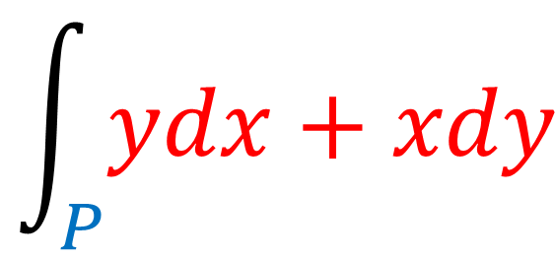

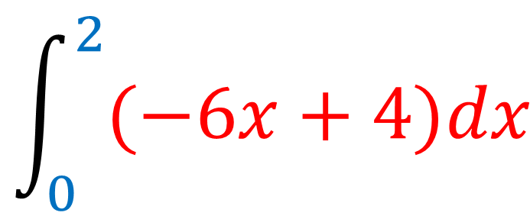

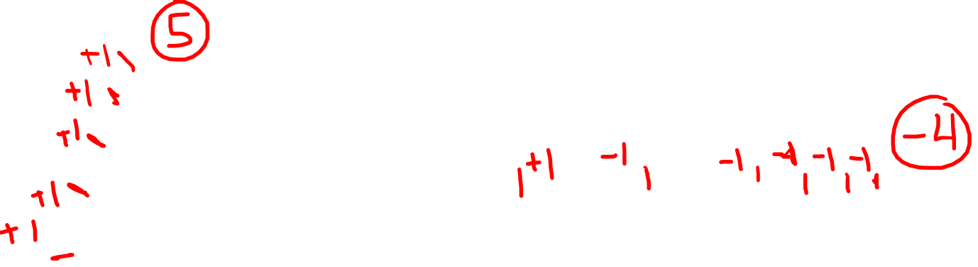
Differential Form interpretation of Integrals
$$\int_{P}{ydx+xdy}$$
$$\int_{0}^{2}{(−6x+4)dx}$$
$$dF$$
$$dF$$

Slide 11
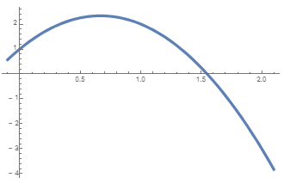

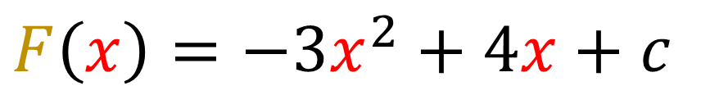
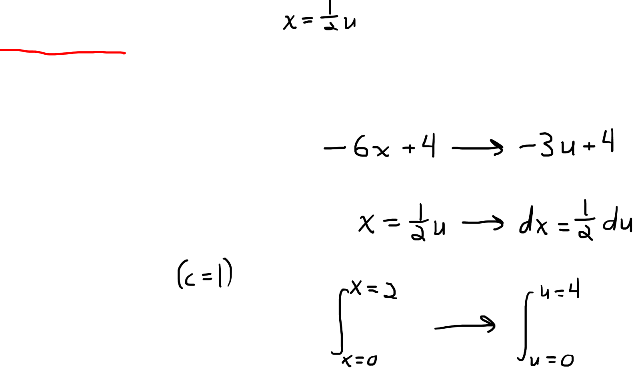
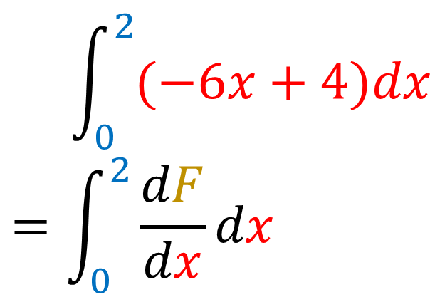
$$\int_{0}^{2}{(−6x+4)dx}$$
$$=\int_{0}^{2}{\frac{dF}{dx}dx}$$
$$u=2x$$
$$F\left(x\right)=−3x^{2}+4x+c$$

Slide 12
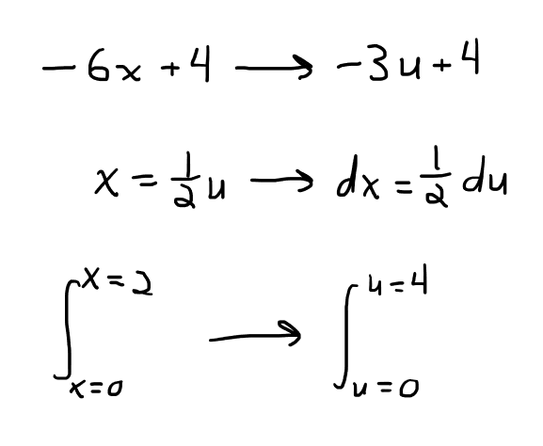
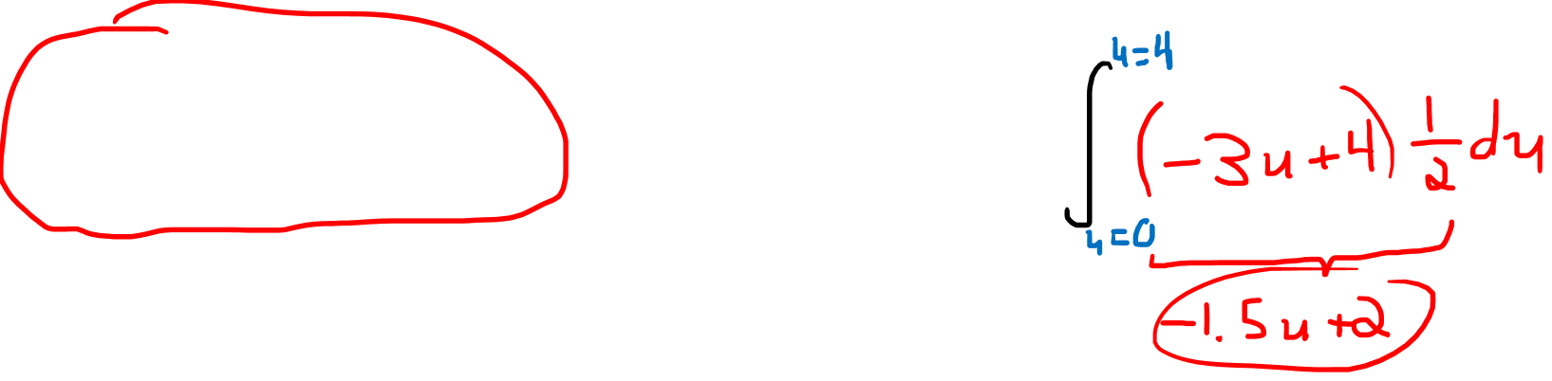
$$\int_{0}^{2}{(−6x+4)dx}$$
$$=\int_{0}^{2}{\frac{dF}{dx}dx}$$
$$u=2x$$
$$F\left(x\right)=−3x^{2}+4x+c$$

Slide 13
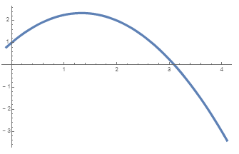
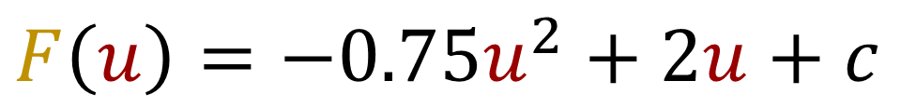
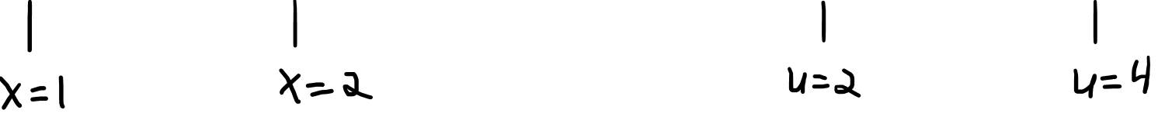
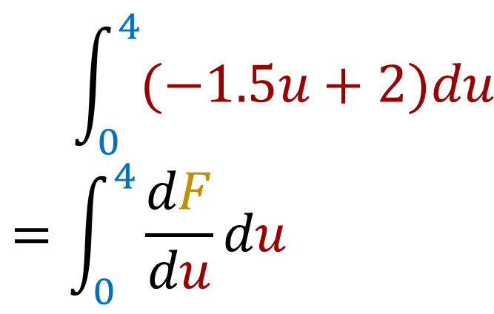
$$\int_{0}^{2}{(−6x+4)dx}$$
$$=\int_{0}^{2}{\frac{dF}{dx}dx}$$
$$\int_{0}^{4}{(−1.5u+2)du}$$
$$=\int_{0}^{4}{\frac{dF}{du}du}$$
$$u=2x$$
$$F\left(x\right)=−3x^{2}+4x+c$$
$$F\left(u\right)=−0.75u^{2}+2u+c$$

Slide 14
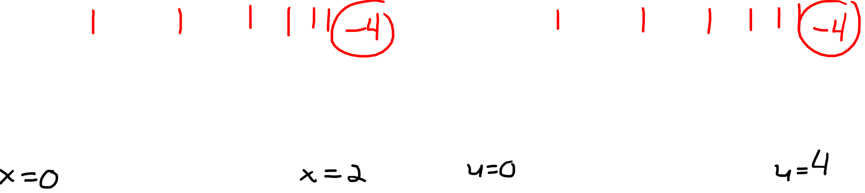


$$\int_{0}^{2}{(−6x+4)dx}$$
$$=\int_{0}^{2}{\frac{dF}{dx}dx}$$
$$\int_{0}^{4}{(−1.5u+2)du}$$
$$=\int_{0}^{4}{\frac{dF}{du}du}$$
$$u=2x$$
$$F\left(x\right)=−3x^{2}+4x+c$$
$$F\left(u\right)=−0.75u^{2}+2u+c$$
$$dF$$
$$dF$$

Slide 15
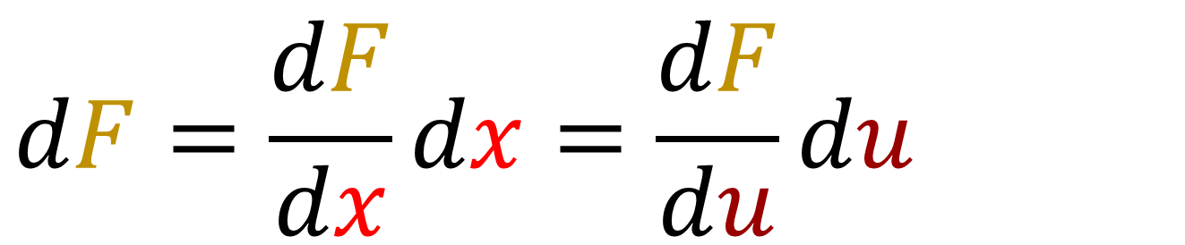
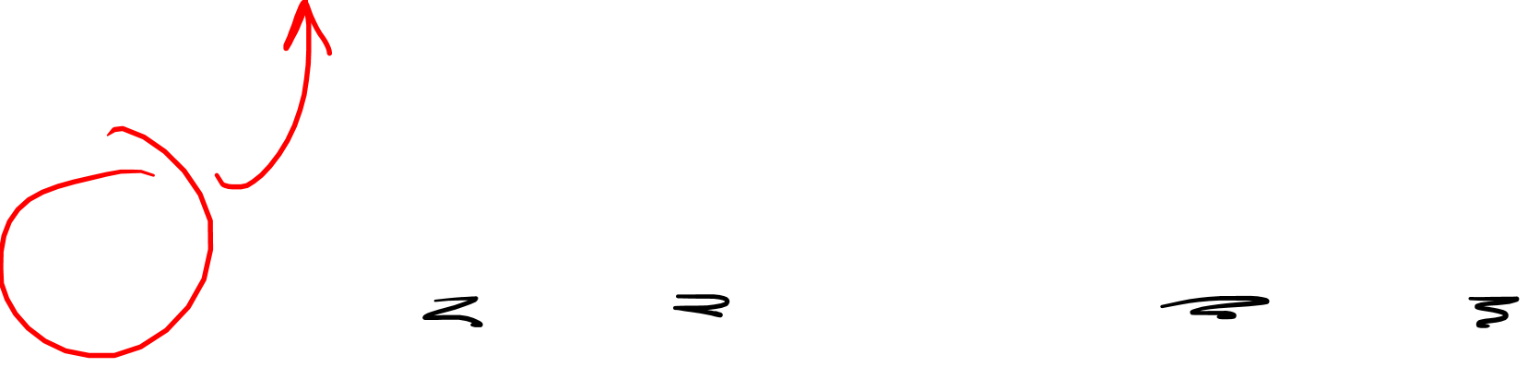
$$dF=\frac{dF}{dx}dx=\frac{dF}{du}du$$
$$dF=(−6x+4)dx=(−1.5u+2)du$$

Slide 16
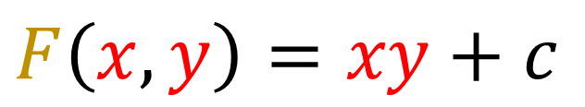
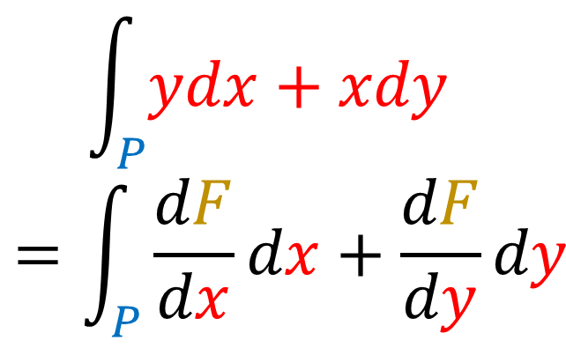





$$\int_{P}{ydx+xdy}$$
$$=\int_{P}{\frac{dF}{dx}dx+\frac{dF}{dy}dy}$$
$$u=2x$$
$$v=2y$$
$$F\left(x,y\right)=xy+c$$
$$y$$
$$x$$
$P\left(t\right)→\left(x=\frac{1}{2}t+1,y=\frac{3}{2}t−1\right)$
$P\left(t\right)→\left(u=t+2,v=3t−2\right)$

Slide 17





$$\int_{P}{ydx+xdy}$$
$$=\int_{P}{\frac{dF}{dx}dx+\frac{dF}{dy}dy}$$
$$\int_{P}{\frac{1}{4}vdu+\frac{1}{4}udv}$$
$$=\int_{P}{\frac{dF}{du}du+\frac{dF}{dv}dv}$$
$$u=2x$$
$$v=2y$$
$$F\left(u,v\right)=\frac{1}{4}uv+k$$
$$F\left(x,y\right)=xy+c$$
$$y$$
$$v$$
$$x$$
$$u$$
$P\left(t\right)→\left(x=\frac{1}{2}t+1,y=\frac{3}{2}t−1\right)$
$P\left(t\right)→\left(u=t+2,v=3t−2\right)$

Slide 18







$$\int_{C}{ydx+xdy}$$
$$=\int_{C}{\frac{dF}{dx}dx+\frac{dF}{dy}dy}$$
$$\int_{C}{\frac{1}{4}vdu+\frac{1}{4}udv}$$
$$=\int_{C}{\frac{dF}{du}du+\frac{dF}{dv}dv}$$
$$u=2x$$
$$v=2y$$
$$F\left(u,v\right)=\frac{1}{4}uv+k$$
$$F\left(x,y\right)=xy+c$$
$$y$$
$$v$$
$$dF$$
$$dF$$
$$x$$
$$u$$
$C\left(t\right)→\left(x=\frac{1}{2}t+1,y=\frac{3}{2}t−1\right)$
$C\left(t\right)→\left(u=t+2,v=3t−2\right)$

Slide 19

$$\int_{P}{ydx+xdy}$$
$$=\int_{P}{\frac{dF}{dx}dx+\frac{dF}{dy}dy}$$
$$\int_{P}{\frac{1}{4}vdu+\frac{1}{4}udv}$$
$$=\int_{P}{\frac{dF}{du}du+\frac{dF}{dv}dv}$$
$$u=2x$$
$$v=2y$$
$$F\left(u,v\right)=\frac{1}{4}uv+k$$
$$F\left(x,y\right)=xy+c$$
$$y$$
$$v$$
$$dF$$
$$dF$$
$$x$$
$$u$$
$P\left(t\right)→\left(x=\frac{1}{2}t+1,y=\frac{3}{2}t−1\right)$
$P\left(t\right)→\left(u=t+2,v=3t−2\right)$

Slide 20




$$dF$$
$$dF=\frac{dF}{dx}dx+\frac{dF}{dy}dy=\frac{dF}{du}du+\frac{dF}{dv}dv$$
$$dF=ydx + xdy=\frac{1}{4}vdu+\frac{1}{4}udv$$

Slide 21

Covector fields are INVARIANT to the choice of coordinates Covector field components DEPEND on the choice of coordinates

Slide 22











Old Basis: $\{\vec{e_{1}},\vec{e_{2}}\}$
New Basis: $\{\tilde{\vec{e_{1}}},\tilde{\vec{e_{2}}}\}$
$$\vec{v}= 1 \vec{e_{1}}+ 1.5 \vec{e_{2}}$$
$$\vec{v}$$
$$\vec{e_{2}}$$
$$\vec{v}= 1 \tilde{\vec{e_{1}}}+ \text{2 }\tilde{\vec{e_{2}}}$$
$$\tilde{\vec{e_{1}}}$$
$$\tilde{\vec{e_{2}}}$$
$$\vec{e_{1}}$$

Slide 23






$$\vec{v}= 1 \vec{e_{1}}+ 1.5 \vec{e_{2}}$$
$$\vec{v}$$
$$\breve{\vec{e_{2}}}$$
$$\vec{v}= 1 \tilde{\vec{e_{1}}}+ \text{2 }\tilde{\vec{e_{2}}}$$
$$\breve{\vec{e_{1}}}$$
$$\vec{v}=1.25\breve{\vec{e_{1}}}+\text{0.25}\breve{\vec{e_{2}}}$$

Slide 24




$$\vec{v}= 1 \vec{e_{1}}+ 1.5 \vec{e_{2}}$$
$$\vec{v}$$
$$\overset{⃛}{\vec{e_{2}}}$$
$$\vec{v}= 1 \tilde{\vec{e_{1}}}+ \text{2 }\tilde{\vec{e_{2}}}$$
$$\vec{v}=1.25\breve{\vec{e_{1}}}+\text{0.25}\breve{\vec{e_{2}}}$$
$$\overset{⃛}{\vec{e_{1}}}$$
$$\vec{v}= 0\overset{⃛}{\vec{e_{1}}}+ \text{1}\overset{⃛}{\vec{e_{2}}}$$

Slide 25







$$\vec{v}= 1 \vec{e_{1}}+ 1.5 \vec{e_{2}}$$
$$\vec{v}= 1 \tilde{\vec{e_{1}}}+ \text{2 }\tilde{\vec{e_{2}}}$$
$$\vec{v}=1.25\breve{\vec{e_{1}}}+\text{0.25}\breve{\vec{e_{2}}}$$
$$\vec{v}= 0\overset{⃛}{\vec{e_{1}}}+ \text{1}\overset{⃛}{\vec{e_{2}}}$$
$$\vec{v}$$
$${\left[\begin{aligned}1 \\ 1.5\end{aligned}\right]}_{\vec{e_{i}}}$$
$${\left[\begin{aligned}1 \\ 2\end{aligned}\right]}_{\tilde{\vec{e_{i}}}}$$
$${\left[\begin{aligned}1.25 \\ \text{0.25}\end{aligned}\right]}_{\breve{\vec{e_{i}}}}$$
$${\left[\begin{aligned}0 \\ \text{1}\end{aligned}\right]}_{\overset{⃛}{\vec{e_{i}}}}$$

Slide 26





$$=\int_{x=0}^{\frac{π}{2}}{{3\left(\sin\left(x\right)\right)}^{2}cos\left(x\right)dx}$$
$$=\int_{u=0}^{1}{3{\left(u\right)}^{2}du}$$
$$=\int_{y=−2}^{−1}{\left(3y^{2}+12y+12\right)dy}$$
$$=\int_{s=0}^{1/2}{12s^{2}ds}$$
$$u=\sin\left(x\right)$$
$$y=u−2$$
$$s=\frac{y+2}{2}$$

Slide 27



$$=\int_{x=0}^{\frac{π}{2}}{{3\left(\sin\left(x\right)\right)}^{2}cos\left(x\right)dx}$$
$$=\int_{u=0}^{1}{3{\left(u\right)}^{2}du}$$
$$=\int_{y=−2}^{−1}{\left(3y^{2}+12y+12\right)dy}$$
$$=\int_{s=0}^{1/2}{12s^{2}ds}$$
$$\vec{v}= 1 \vec{e_{1}}+ 1.5 \vec{e_{2}}$$
$$\vec{v}= 1 \tilde{\vec{e_{1}}}+ \text{2 }\tilde{\vec{e_{2}}}$$
$$\vec{v}=1.25\breve{\vec{e_{1}}}+\text{0.25}\breve{\vec{e_{2}}}$$
$$\vec{v}= 0\overset{⃛}{\vec{e_{1}}}+ \text{1}\overset{⃛}{\vec{e_{2}}}$$
$$=\int_{P}{dF}$$

Slide 28



$$\vec{v}= 1 \vec{e_{1}}+ 1.5 \vec{e_{2}}$$
$$\vec{v}= 1 \tilde{\vec{e_{1}}}+ \text{2 }\tilde{\vec{e_{2}}}$$
$$\vec{v}=1.25\breve{\vec{e_{1}}}+\text{0.25}\breve{\vec{e_{2}}}$$
$$\vec{v}= 0\overset{⃛}{\vec{e_{1}}}+ \text{1}\overset{⃛}{\vec{e_{2}}}$$
$$dF={3\left(\sin\left(x\right)\right)}^{2}cos\left(x\right)dx$$
$$df=3{\left(u\right)}^{2}du$$
$$df=\left(3y^{2}+12y+12\right)dy$$
$$df=12s^{2}ds$$

Slide 29


$$dF$$
$$\vec{v}$$
Vector
Covector Field

Slide 30


Covector fields are INVARIANT to the choice of coordinates Covector field components DEPEND on the choice of coordinates
$$dF_{1}=(−6x+4)dx=(−1.5u+2)du$$
$$dF_{2}=ydx + xdy=\frac{1}{4}vdu+\frac{1}{4}udv$$

