Slide 1
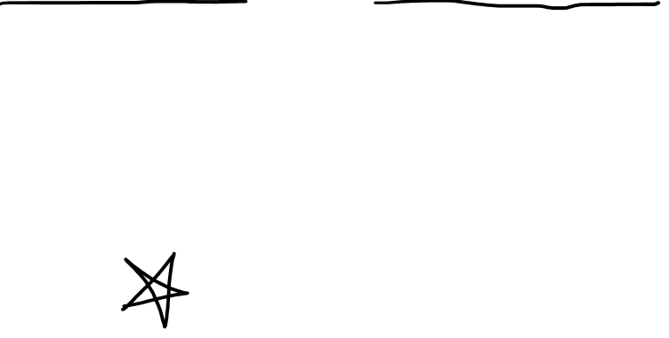
The Metric Tensor In Curved Space (Extrinsic + Intrinsic Geometry)
(See Previous videos First)
(Links in Description)

Slide 2
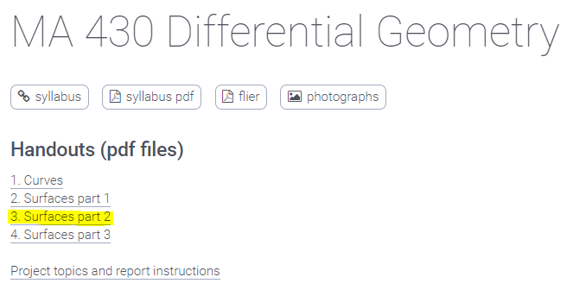
http://liavas.net/courses/math430/
Metric Tensor
(aka “First Fundamental Form”)

Slide 3
The Metric Tensor for…
Vector Length (review)
Arc Length (flat space)
Arc Length (curved space)

Slide 4
The Metric Tensor for… 3. Arc Length (curved space)

Slide 5
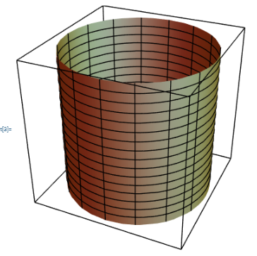
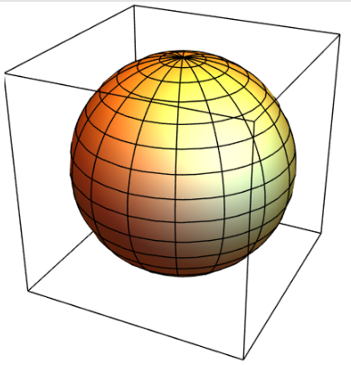
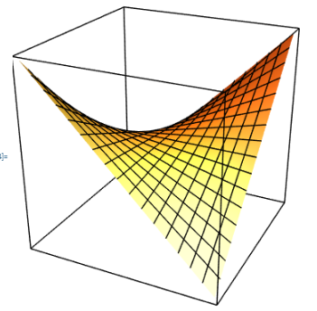

Examples of curved 2D surfaces…
Cylinder
Sphere
Hyperbolic Paraboloid
(“Saddle”)

Slide 6

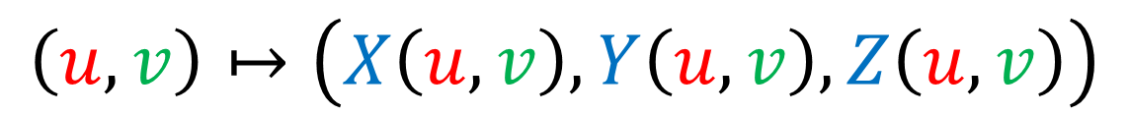



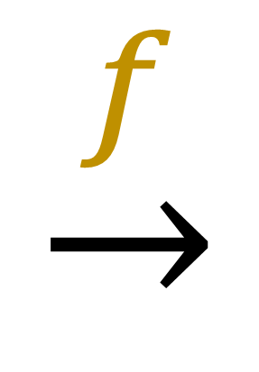

How do you make a 2D surface?
$$\left(u,v\right)↦\left(X\left(u,v\right),Y\left(u,v\right),Z\left(u,v\right)\right)$$
$$u$$
$$\underset{→}{f}$$
$$Z$$
$$Y$$
$$X$$
$$v$$

Slide 7
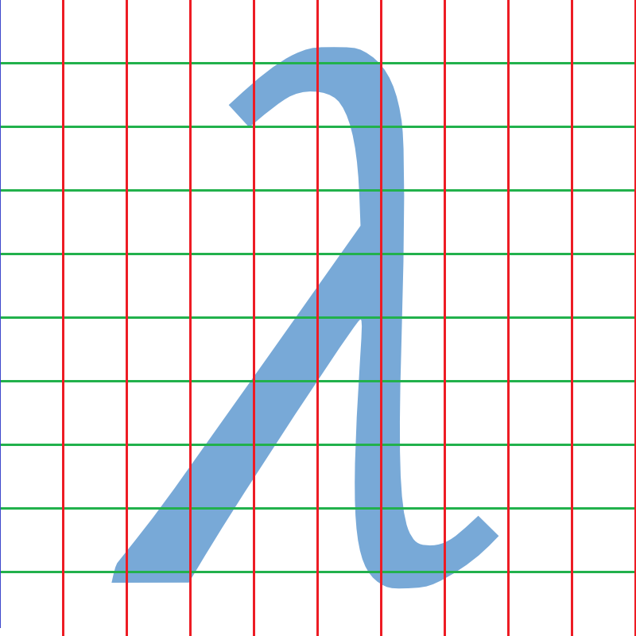
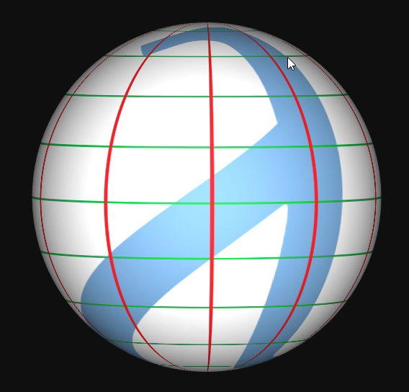
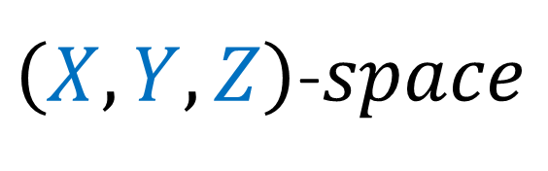
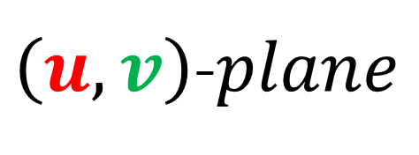
How do you make a 2D surface?
www.maptoglobe.com
$$\underset{→}{f}$$
$\left(u,v\right)$-$plane$
$\left(X,Y,Z\right)$-$space$

Slide 8
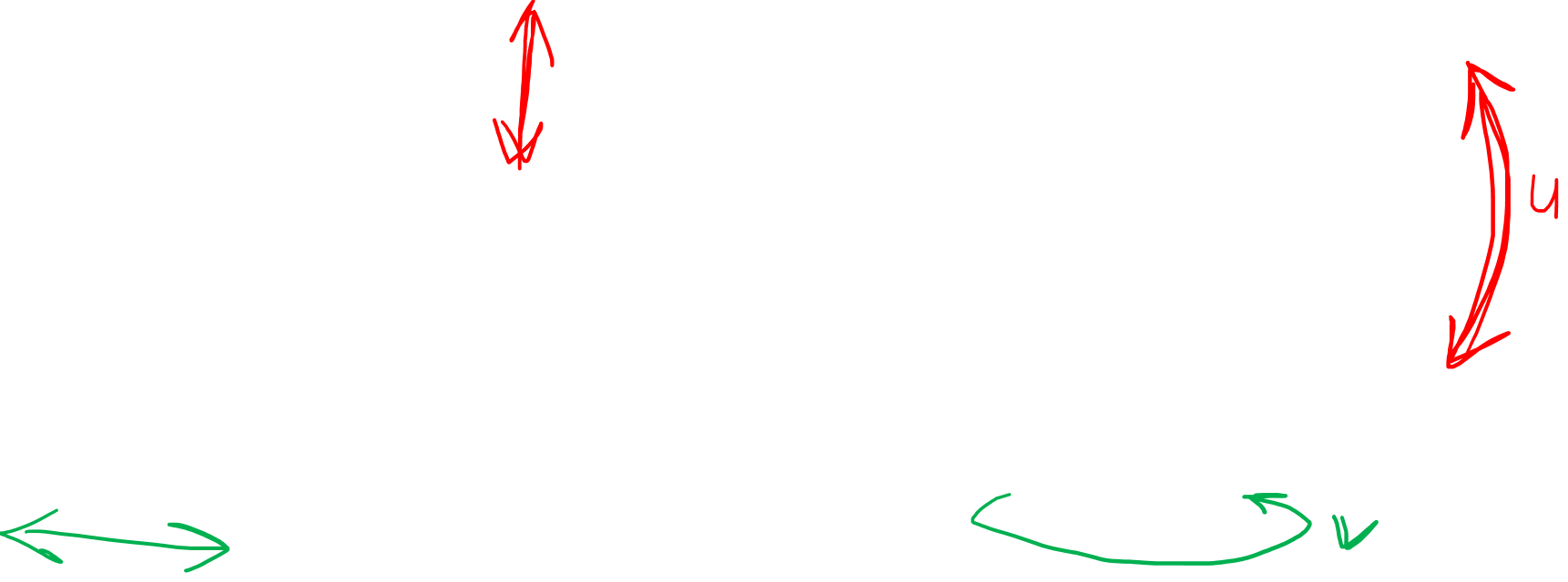
How do you make a 2D surface?
www.maptoglobe.com
$$\underset{→}{f}$$
$\left(u,v\right)$-$plane$
$\left(X,Y,Z\right)$-$space$

Slide 9
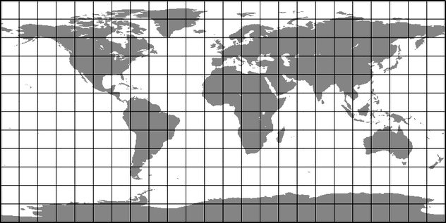
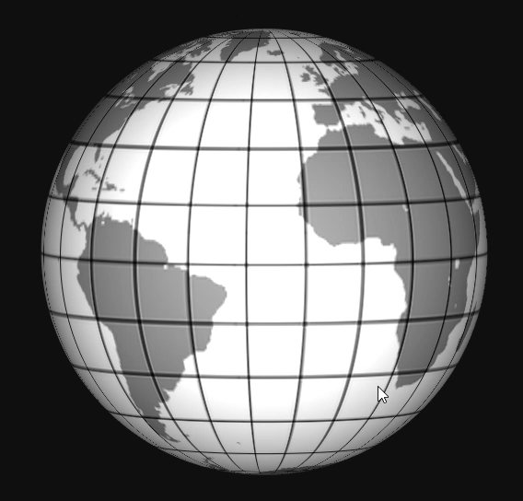
How do you make a 2D surface?
www.maptoglobe.com
$$\underset{→}{f}$$
$\left(u,v\right)$-$plane$
$\left(X,Y,Z\right)$-$space$

Slide 10
How do you make a 2D surface?
www.maptoglobe.com
$$\underset{→}{f}$$
$\left(u,v\right)$-$plane$
$\left(X,Y,Z\right)$-$space$

Slide 11



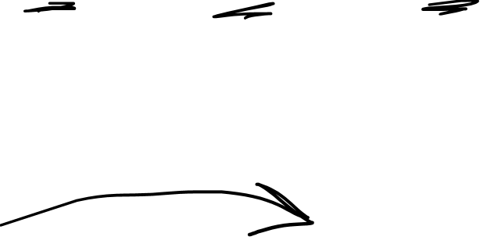
Parametric Equation for a Sphere
$$\left(u,v\right)↦\left(X\left(u,v\right),Y\left(u,v\right),Z\left(u,v\right)\right)$$
$$u$$
$$Z$$
$$Y$$
$$X$$
$$v$$

Slide 12
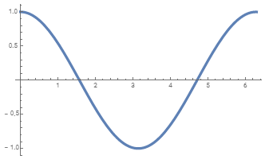
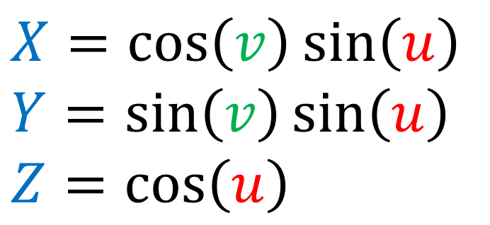
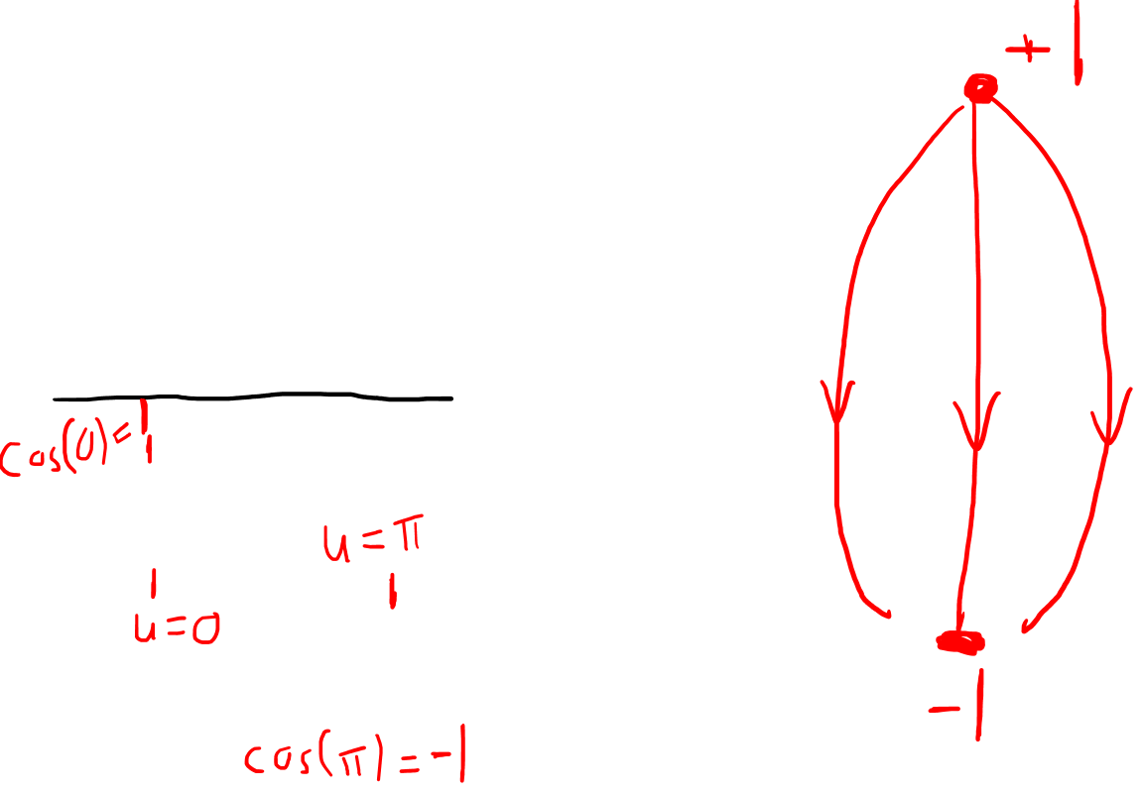
Parametric Equation for a Sphere
$$\left(u,v\right)↦\left(X\left(u,v\right),Y\left(u,v\right),Z\left(u,v\right)\right)$$
$$u$$
$$Z$$
$$X=\cos\left(v\right)\sin\left(u\right)$$
$$Y=\sin\left(v\right)\sin\left(u\right)$$
$$Z=\cos\left(u\right)$$
$$Y$$
$$X$$
$$v$$

Slide 13
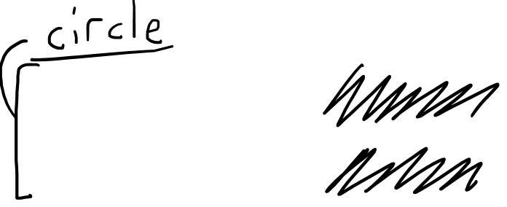
Parametric Equation for a Sphere
$$\left(u,v\right)↦\left(X\left(u,v\right),Y\left(u,v\right),Z\left(u,v\right)\right)$$
$$u$$
$$Z$$
$$X=\cos\left(v\right)\sin\left(u\right)$$
$$Y=\sin\left(v\right)\sin\left(u\right)$$
$$Z=\cos\left(u\right)$$
$$Y$$
$$X$$
$$v$$

Slide 14
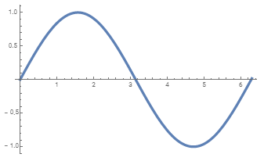
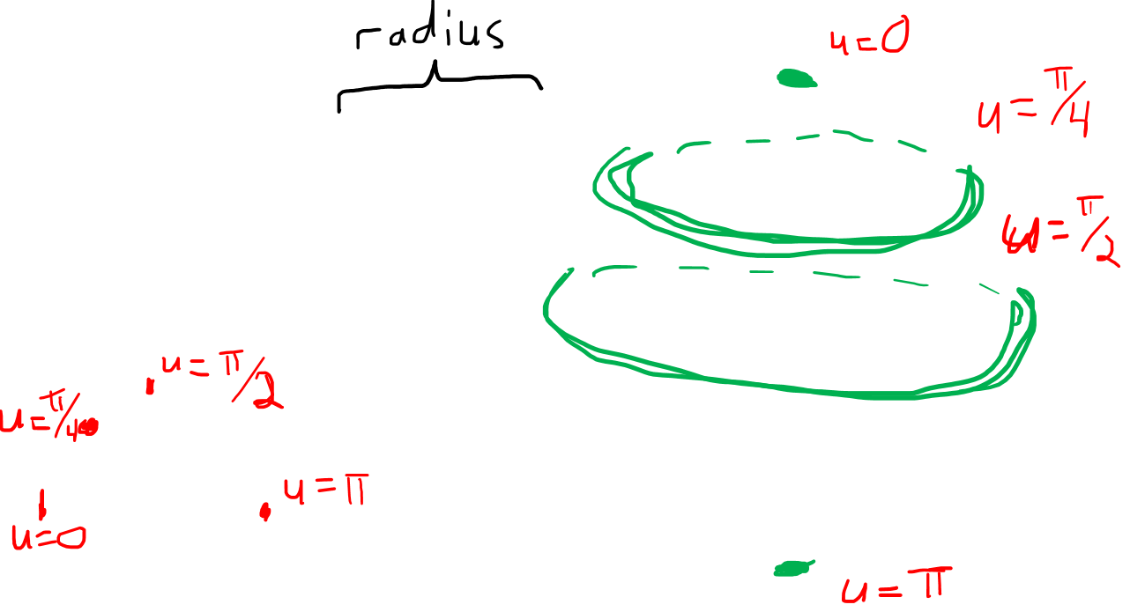
Parametric Equation for a Sphere
$$\left(u,v\right)↦\left(X\left(u,v\right),Y\left(u,v\right),Z\left(u,v\right)\right)$$
$$u$$
$$Z$$
$$X=\cos\left(v\right)\sin\left(u\right)$$
$$Y=\sin\left(v\right)\sin\left(u\right)$$
$$Z=\cos\left(u\right)$$
$$Y$$
$$X$$
$$v$$

Slide 15
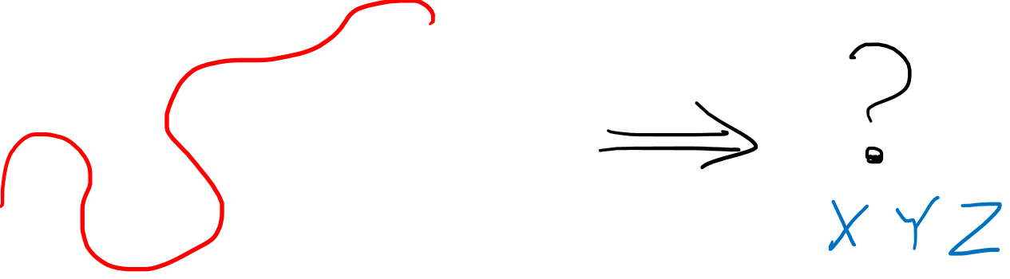
How do you draw curves on 2D surfaces?
$\left(u,v\right)$-$plane$

Slide 16
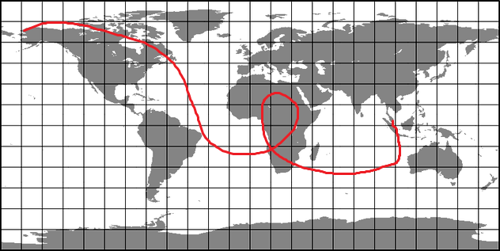
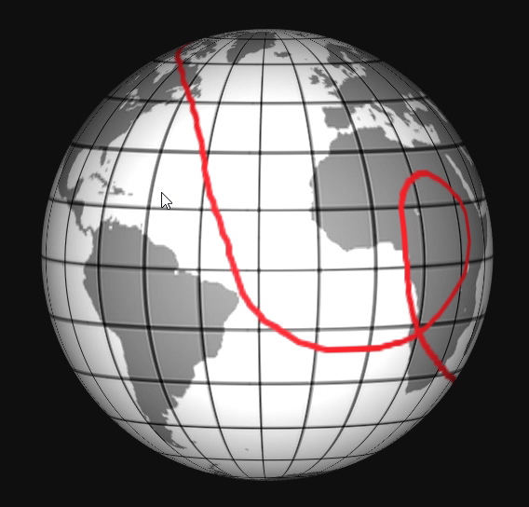
www.maptoglobe.com
How do you draw curves on 2D surfaces?
$$\underset{→}{f}$$
$\left(u,v\right)$-$plane$
$\left(X,Y,Z\right)$-$space$

Slide 17
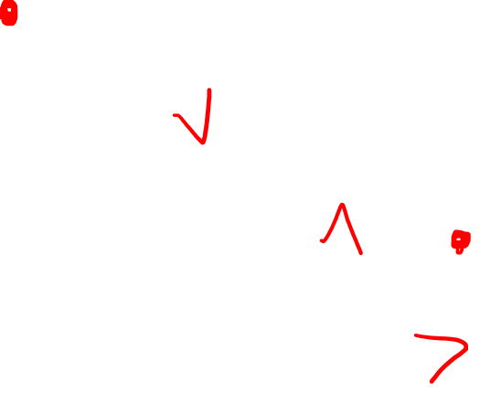
www.maptoglobe.com
How do you draw curves on 2D surfaces?
$$\underset{→}{f}$$
$\left(u,v\right)$-$plane$
$\left(X,Y,Z\right)$-$space$

Slide 18



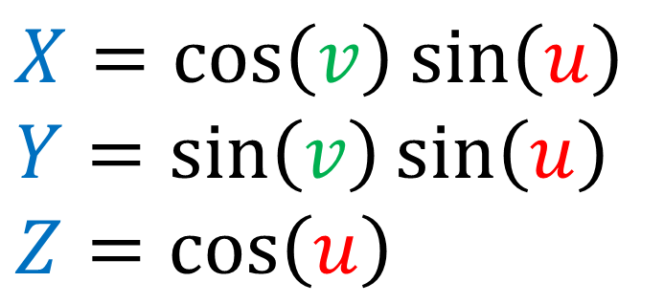
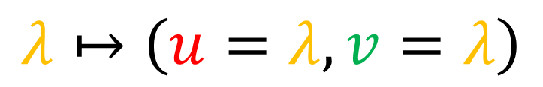

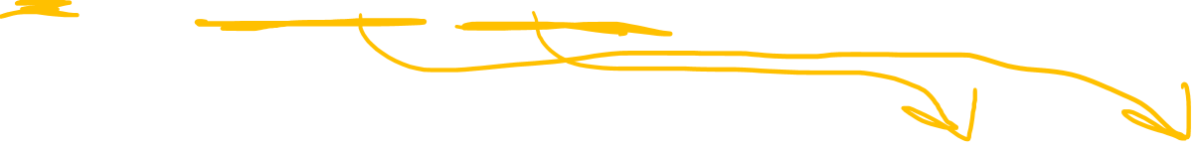
Parametric Equation for a Sphere
$$λ↦\left(u=λ,v=λ\right)$$
$$\left(u,v\right)↦\left(X\left(u,v\right),Y\left(u,v\right),Z\left(u,v\right)\right)$$
$$u$$
$$X=\cos\left(v\right)\sin\left(u\right)$$
$$Y=\sin\left(v\right)\sin\left(u\right)$$
$$Z=\cos\left(u\right)$$
$$v$$

Slide 19
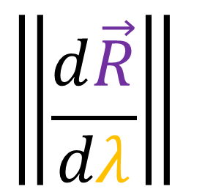
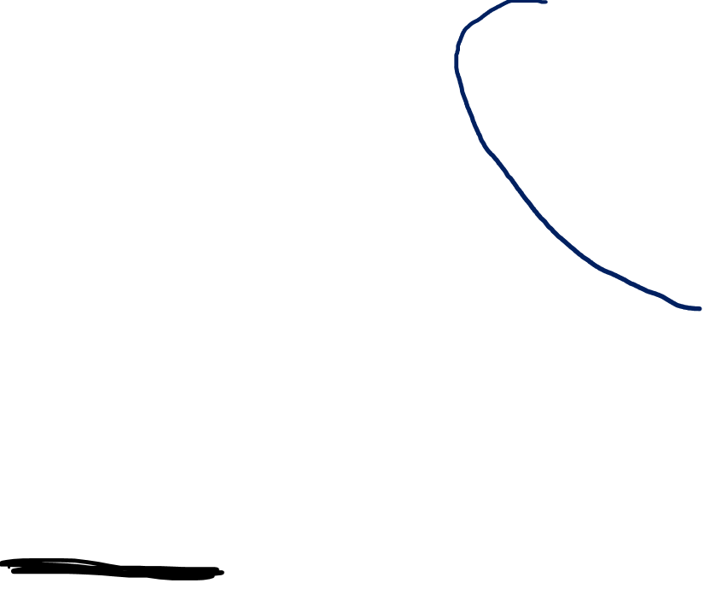
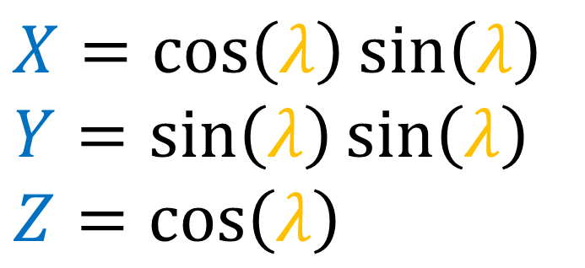
Parametric Equation for a Sphere
$$λ↦\left(u=λ,v=λ\right)$$
$$\left(u,v\right)↦\left(X\left(u,v\right),Y\left(u,v\right),Z\left(u,v\right)\right)$$
$$u$$
$$X=\cos\left(λ\right)\sin\left(λ\right)$$
$$Y=\sin\left(λ\right)\sin\left(λ\right)$$
$$Z=\cos\left(λ\right)$$
$$\left\|\frac{d\vec{R}}{dλ}\right\|$$
$$v$$

Slide 20
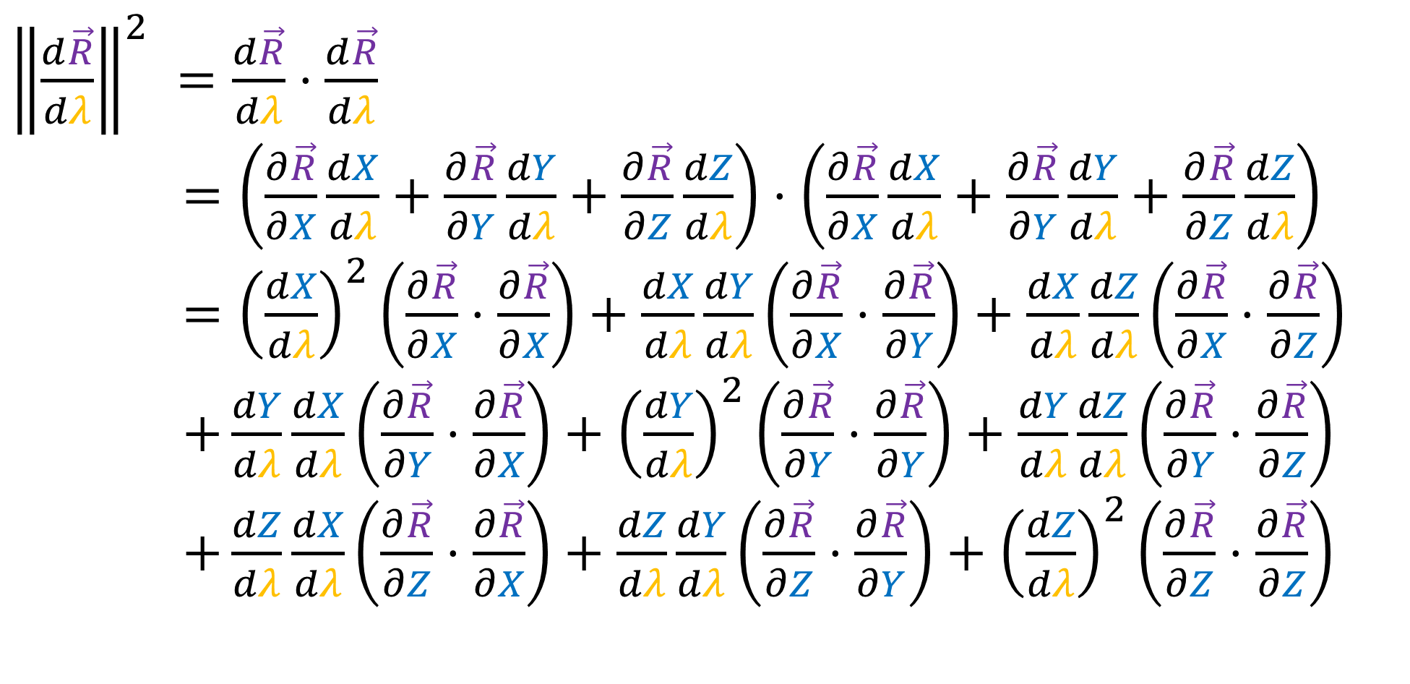
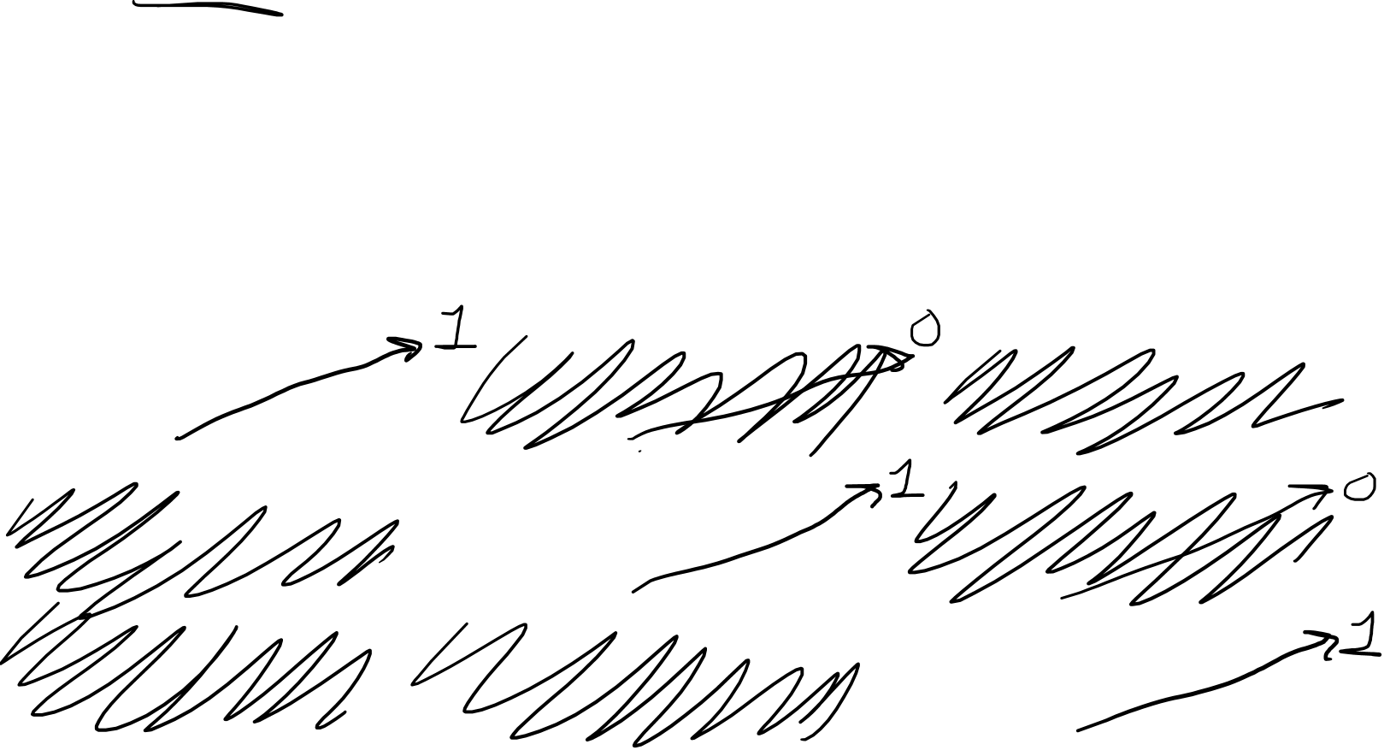
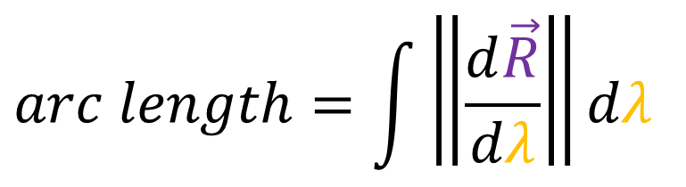
$$arc length=\int{\left\|\frac{d\vec{R}}{dλ}\right\|dλ}$$
${\left\|\frac{d\vec{R}}{dλ}\right\|}^{2} =\frac{d\vec{R}}{dλ}⋅\frac{d\vec{R}}{dλ}$
$=\left(\frac{∂\vec{R}}{∂X}\frac{dX}{dλ}+\frac{∂\vec{R}}{∂Y}\frac{dY}{dλ}+\frac{∂\vec{R}}{∂Z}\frac{dZ}{dλ}\right)⋅\left(\frac{∂\vec{R}}{∂X}\frac{dX}{dλ}+\frac{∂\vec{R}}{∂Y}\frac{dY}{dλ}+\frac{∂\vec{R}}{∂Z}\frac{dZ}{dλ}\right)$
$={\left(\frac{dX}{dλ}\right)}^{2}\left(\frac{∂\vec{R}}{∂X}⋅\frac{∂\vec{R}}{∂X}\right)+\frac{dX}{dλ}\frac{dY}{dλ}\left(\frac{∂\vec{R}}{∂X}⋅\frac{∂\vec{R}}{∂Y}\right)+\frac{dX}{dλ}\frac{dZ}{dλ}\left(\frac{∂\vec{R}}{∂X}⋅\frac{∂\vec{R}}{∂Z}\right)$
$+\frac{dY}{dλ}\frac{dX}{dλ}\left(\frac{∂\vec{R}}{∂Y}⋅\frac{∂\vec{R}}{∂X}\right)+{\left(\frac{dY}{dλ}\right)}^{2}\left(\frac{∂\vec{R}}{∂Y}⋅\frac{∂\vec{R}}{∂Y}\right)+\frac{dY}{dλ}\frac{dZ}{dλ}\left(\frac{∂\vec{R}}{∂Y}⋅\frac{∂\vec{R}}{∂Z}\right)$
$+\frac{dZ}{dλ}\frac{dX}{dλ}\left(\frac{∂\vec{R}}{∂Z}⋅\frac{∂\vec{R}}{∂X}\right)+\frac{dZ}{dλ}\frac{dY}{dλ}\left(\frac{∂\vec{R}}{∂Z}⋅\frac{∂\vec{R}}{∂Y}\right)+{\left(\frac{dZ}{dλ}\right)}^{2}\left(\frac{∂\vec{R}}{∂Z}⋅\frac{∂\vec{R}}{∂Z}\right)$

Slide 21
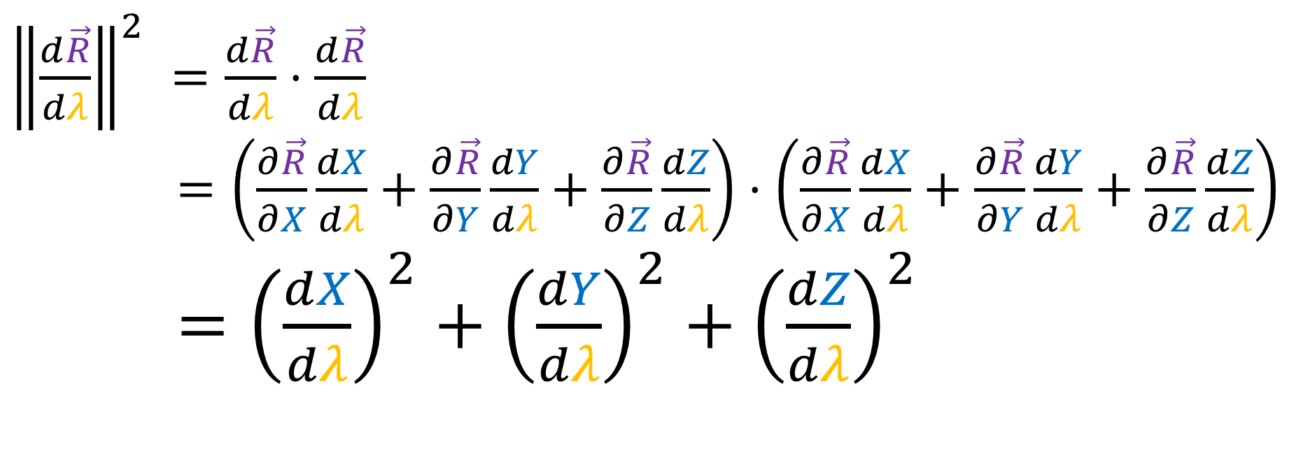
$$arc length=\int{\left\|\frac{d\vec{R}}{dλ}\right\|dλ}$$
${\left\|\frac{d\vec{R}}{dλ}\right\|}^{2} =\frac{d\vec{R}}{dλ}⋅\frac{d\vec{R}}{dλ}$
$=\left(\frac{∂\vec{R}}{∂X}\frac{dX}{dλ}+\frac{∂\vec{R}}{∂Y}\frac{dY}{dλ}+\frac{∂\vec{R}}{∂Z}\frac{dZ}{dλ}\right)⋅\left(\frac{∂\vec{R}}{∂X}\frac{dX}{dλ}+\frac{∂\vec{R}}{∂Y}\frac{dY}{dλ}+\frac{∂\vec{R}}{∂Z}\frac{dZ}{dλ}\right)$
$={\left(\frac{dX}{dλ}\right)}^{2}+{\left(\frac{dY}{dλ}\right)}^{2}+{\left(\frac{dZ}{dλ}\right)}^{2}$

Slide 22
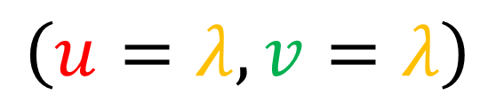
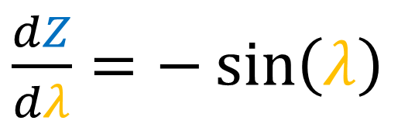
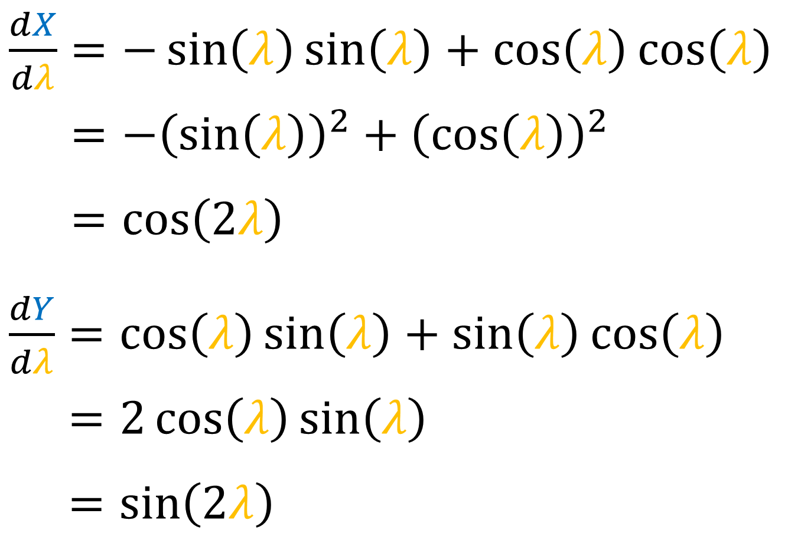
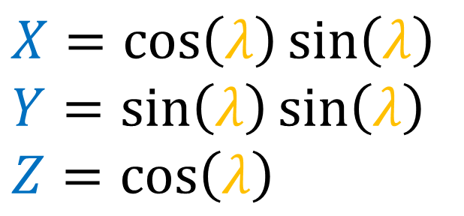
$$arc length=\int{\left\|\frac{d\vec{R}}{dλ}\right\|dλ}$$
Sphere
$$\left(u=λ,v=λ\right)$$
$$X=\cos\left(λ\right)\sin\left(λ\right)$$
$$Y=\sin\left(λ\right)\sin\left(λ\right)$$
$$Z=\cos\left(λ\right)$$
$\frac{dX}{dλ}=−\sin\left(λ\right)\sin\left(λ\right)+\cos\left(λ\right)\cos\left(λ\right)$
$\frac{dX}{dλ}=−{\left(\sin\left(λ\right)\right)}^{2}+{\left(\cos\left(λ\right)\right)}^{2}$
$\frac{dX}{dλ}=\cos\left(2λ\right)$
$\frac{dY}{dλ}=\cos\left(λ\right)\sin\left(λ\right)+\sin\left(λ\right)\cos\left(λ\right)$
$\frac{dY}{dλ}=2\cos\left(λ\right)\sin\left(λ\right)$
$\frac{dY}{dλ}=\sin\left(2λ\right)$
$\frac{dZ}{dλ}=−\sin\left(λ\right)$

Slide 23
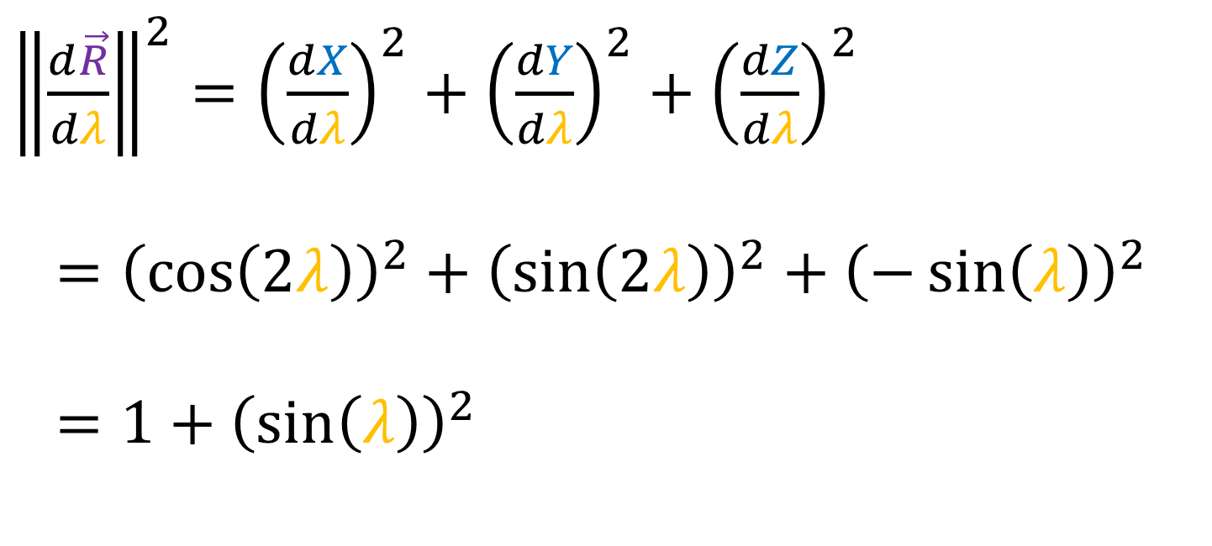
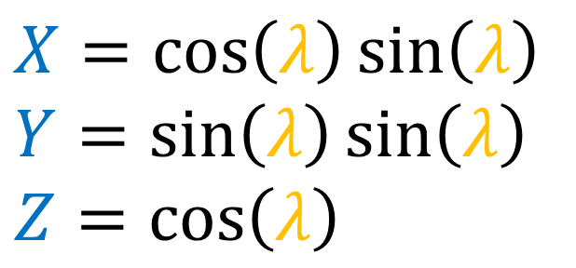
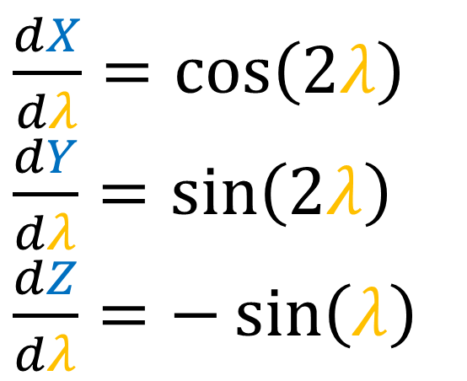
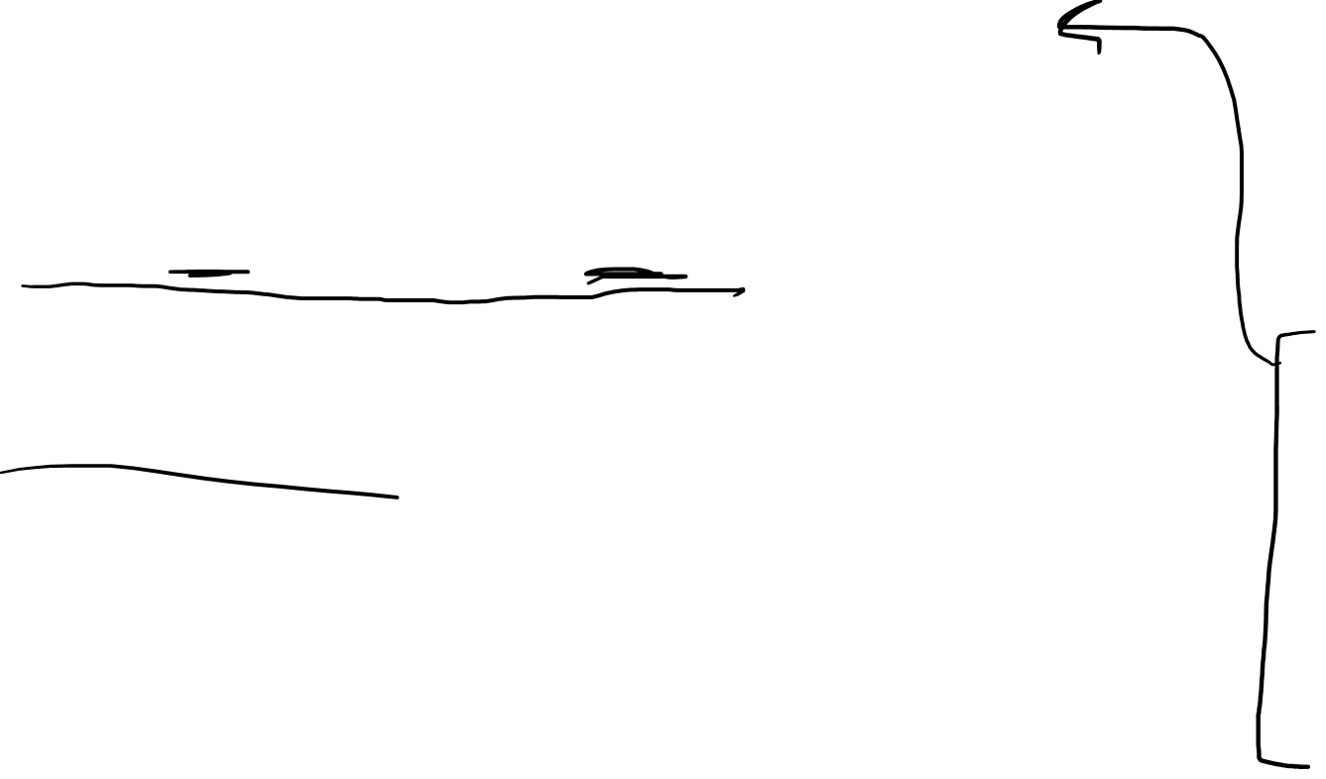
$$arc length=\int{\left\|\frac{d\vec{R}}{dλ}\right\|dλ}$$
Sphere
$$\left(u=λ,v=λ\right)$$
${\left\|\frac{d\vec{R}}{dλ}\right\|}^{2}={\left(\frac{dX}{dλ}\right)}^{2}+{\left(\frac{dY}{dλ}\right)}^{2}+{\left(\frac{dZ}{dλ}\right)}^{2}$
$={\left(\cos\left(2λ\right)\right)}^{2}+{\left(\sin\left(2λ\right)\right)}^{2}+{\left(−\sin\left(λ\right)\right)}^{2}$
$=1+{\left(\sin\left(λ\right)\right)}^{2}$
$$X=\cos\left(λ\right)\sin\left(λ\right)$$
$$Y=\sin\left(λ\right)\sin\left(λ\right)$$
$$Z=\cos\left(λ\right)$$
$\frac{dX}{dλ}=\cos\left(2λ\right)$
$\frac{dY}{dλ}=\sin\left(2λ\right)$
$\frac{dZ}{dλ}=−\sin\left(λ\right)$

Slide 24
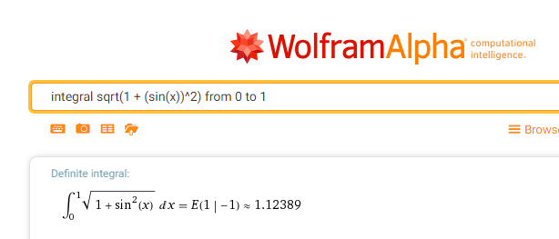
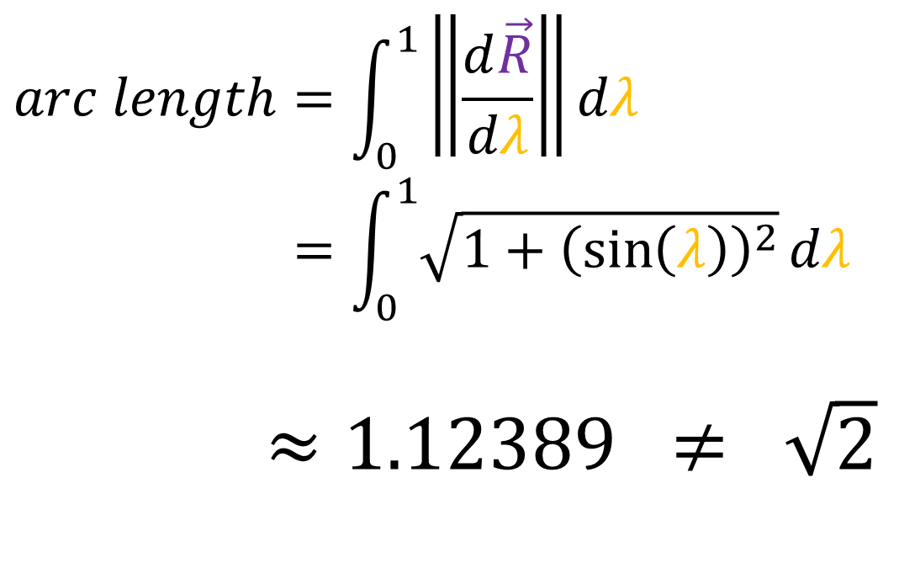

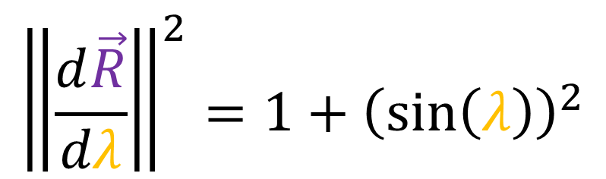
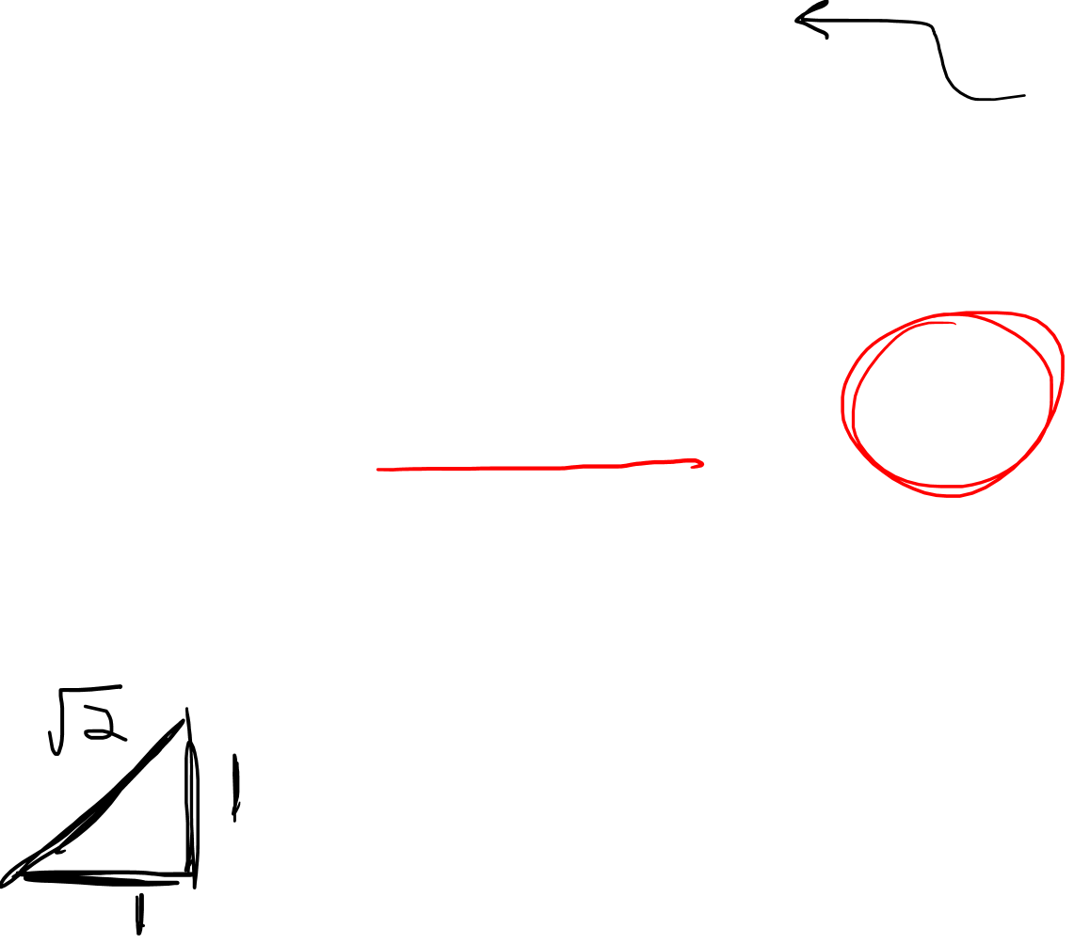
$$arc length=\int_{0}^{1}{\left\|\frac{d\vec{R}}{dλ}\right\|}dλ$$
$$arc length=\int_{0}^{1}{\sqrt{1+{\left(\sin\left(λ\right)\right)}^{2}}}dλ$$
$≈1.12389 ≠ \sqrt{2}$
$${\left\|\frac{d\vec{R}}{dλ}\right\|}^{2}=1+{\left(\sin\left(λ\right)\right)}^{2}$$
$$u$$
$$v$$

Slide 25
$$arc length=\int{\left\|\frac{d\vec{R}}{dλ}\right\|dλ}$$
${\left\|\frac{d\vec{R}}{dλ}\right\|}^{2} =\frac{d\vec{R}}{dλ}⋅\frac{d\vec{R}}{dλ}$
$=\left(\frac{∂\vec{R}}{∂X}\frac{dX}{dλ}+\frac{∂\vec{R}}{∂Y}\frac{dY}{dλ}+\frac{∂\vec{R}}{∂Z}\frac{dZ}{dλ}\right)⋅\left(\frac{∂\vec{R}}{∂X}\frac{dX}{dλ}+\frac{∂\vec{R}}{∂Y}\frac{dY}{dλ}+\frac{∂\vec{R}}{∂Z}\frac{dZ}{dλ}\right)$
$={\left(\frac{dX}{dλ}\right)}^{2}\left(\frac{∂\vec{R}}{∂X}⋅\frac{∂\vec{R}}{∂X}\right)+\frac{dX}{dλ}\frac{dY}{dλ}\left(\frac{∂\vec{R}}{∂X}⋅\frac{∂\vec{R}}{∂Y}\right)+\frac{dX}{dλ}\frac{dZ}{dλ}\left(\frac{∂\vec{R}}{∂X}⋅\frac{∂\vec{R}}{∂Z}\right)$
$+\frac{dY}{dλ}\frac{dX}{dλ}\left(\frac{∂\vec{R}}{∂Y}⋅\frac{∂\vec{R}}{∂X}\right)+{\left(\frac{dY}{dλ}\right)}^{2}\left(\frac{∂\vec{R}}{∂Y}⋅\frac{∂\vec{R}}{∂Y}\right)+\frac{dY}{dλ}\frac{dZ}{dλ}\left(\frac{∂\vec{R}}{∂Y}⋅\frac{∂\vec{R}}{∂Z}\right)$
$+\frac{dZ}{dλ}\frac{dX}{dλ}\left(\frac{∂\vec{R}}{∂Z}⋅\frac{∂\vec{R}}{∂X}\right)+\frac{dZ}{dλ}\frac{dY}{dλ}\left(\frac{∂\vec{R}}{∂Z}⋅\frac{∂\vec{R}}{∂Y}\right)+{\left(\frac{dZ}{dλ}\right)}^{2}\left(\frac{∂\vec{R}}{∂Z}⋅\frac{∂\vec{R}}{∂Z}\right)$

Slide 26
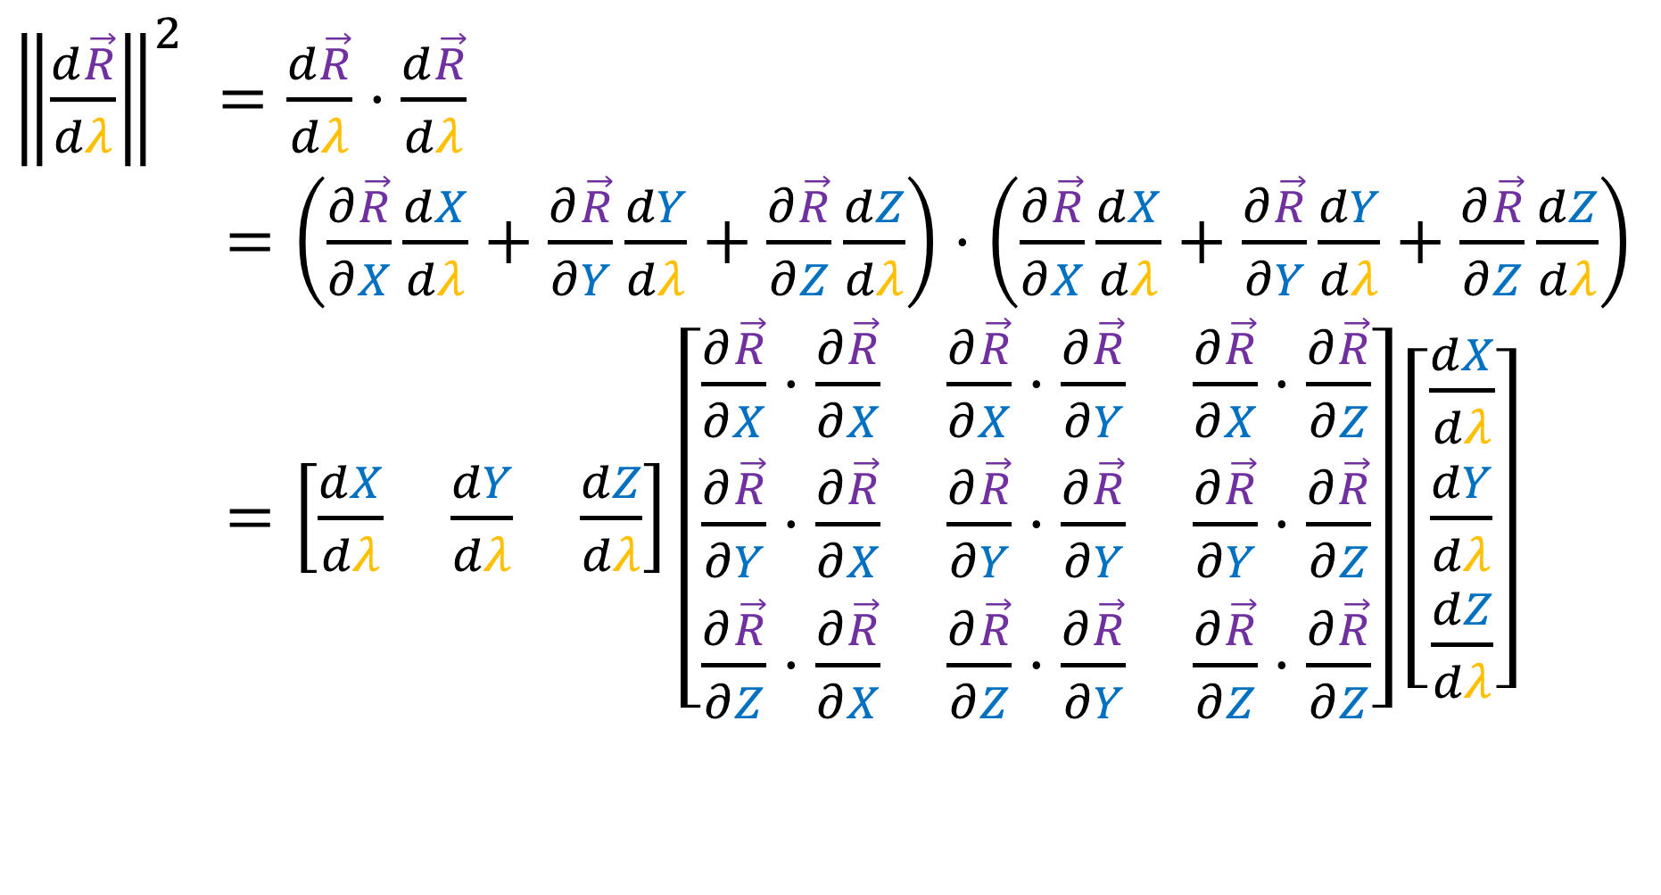
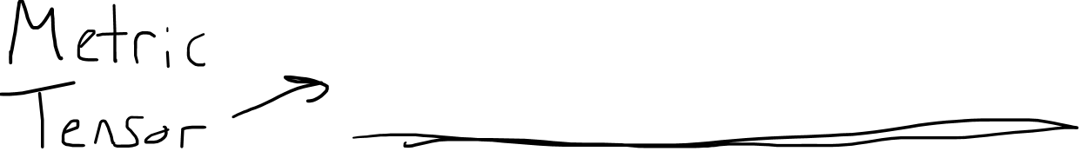
$$arc length=\int{\left\|\frac{d\vec{R}}{dλ}\right\|dλ}$$
${\left\|\frac{d\vec{R}}{dλ}\right\|}^{2} =\frac{d\vec{R}}{dλ}⋅\frac{d\vec{R}}{dλ}$
$=\left(\frac{∂\vec{R}}{∂X}\frac{dX}{dλ}+\frac{∂\vec{R}}{∂Y}\frac{dY}{dλ}+\frac{∂\vec{R}}{∂Z}\frac{dZ}{dλ}\right)⋅\left(\frac{∂\vec{R}}{∂X}\frac{dX}{dλ}+\frac{∂\vec{R}}{∂Y}\frac{dY}{dλ}+\frac{∂\vec{R}}{∂Z}\frac{dZ}{dλ}\right)$
$=\left[\begin{matrix}\frac{dX}{dλ} & \frac{dY}{dλ} & \frac{dZ}{dλ}\end{matrix}\right]\left[\begin{matrix}\frac{∂\vec{R}}{∂X}⋅\frac{∂\vec{R}}{∂X} & \frac{∂\vec{R}}{∂X}⋅\frac{∂\vec{R}}{∂Y} & \frac{∂\vec{R}}{∂X}⋅\frac{∂\vec{R}}{∂Z} \\ \frac{∂\vec{R}}{∂Y}⋅\frac{∂\vec{R}}{∂X} & \frac{∂\vec{R}}{∂Y}⋅\frac{∂\vec{R}}{∂Y} & \frac{∂\vec{R}}{∂Y}⋅\frac{∂\vec{R}}{∂Z} \\ \frac{∂\vec{R}}{∂Z}⋅\frac{∂\vec{R}}{∂X} & \frac{∂\vec{R}}{∂Z}⋅\frac{∂\vec{R}}{∂Y} & \frac{∂\vec{R}}{∂Z}⋅\frac{∂\vec{R}}{∂Z}\end{matrix}\right]\left[\begin{aligned}\frac{dX}{dλ} \\ \frac{dY}{dλ} \\ \frac{dZ}{dλ}\end{aligned}\right]$

Slide 27
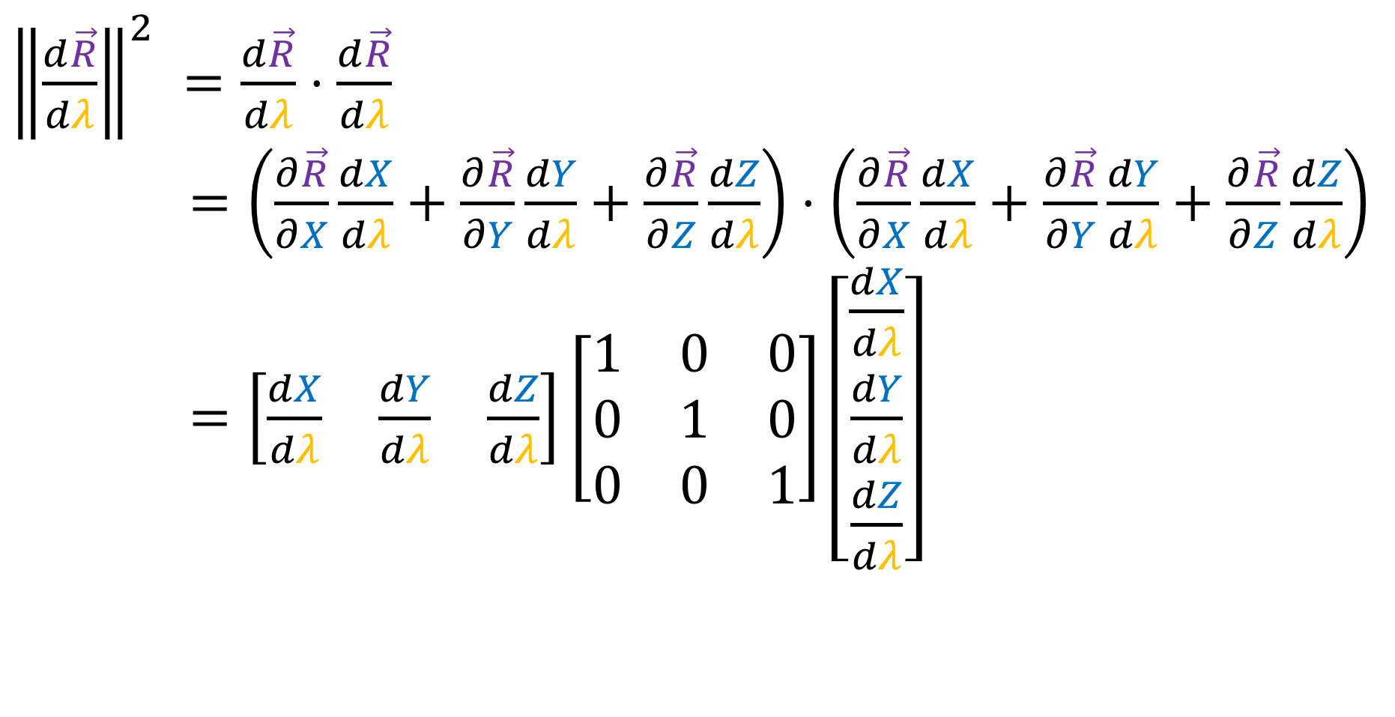
$$arc length=\int{\left\|\frac{d\vec{R}}{dλ}\right\|dλ}$$
${\left\|\frac{d\vec{R}}{dλ}\right\|}^{2} =\frac{d\vec{R}}{dλ}⋅\frac{d\vec{R}}{dλ}$
$=\left(\frac{∂\vec{R}}{∂X}\frac{dX}{dλ}+\frac{∂\vec{R}}{∂Y}\frac{dY}{dλ}+\frac{∂\vec{R}}{∂Z}\frac{dZ}{dλ}\right)⋅\left(\frac{∂\vec{R}}{∂X}\frac{dX}{dλ}+\frac{∂\vec{R}}{∂Y}\frac{dY}{dλ}+\frac{∂\vec{R}}{∂Z}\frac{dZ}{dλ}\right)$
$=\left[\begin{matrix}\frac{dX}{dλ} & \frac{dY}{dλ} & \frac{dZ}{dλ}\end{matrix}\right]\left[\begin{matrix}1 & 0 & 0 \\ 0 & 1 & 0 \\ 0 & 0 & 1\end{matrix}\right]\left[\begin{aligned}\frac{dX}{dλ} \\ \frac{dY}{dλ} \\ \frac{dZ}{dλ}\end{aligned}\right]$

Slide 28

How to measure curves on 2D surfaces?
Intrinsic
Extrinsic
$$\underset{→}{f}$$
$\left(u,v\right)$-$plane$
$\left(X,Y,Z\right)$-$space$

Slide 29


Slide 30


Slide 31





How to measure curves on 2D surfaces?
$$\underset{→}{f}$$
$\left(u,v\right)$-$plane$
$\left(X,Y,Z\right)$-$space$
$$\frac{d\vec{R}}{dλ}=\left(\frac{∂\vec{R}}{∂u}\frac{du}{dλ}+\frac{∂\vec{R}}{∂v}\frac{dv}{dλ}\right)$$
$$\frac{d\vec{R}}{dλ}=\left(\frac{∂\vec{R}}{∂X}\frac{dX}{dλ}+\frac{∂\vec{R}}{∂Y}\frac{dY}{dλ}+\frac{∂\vec{R}}{∂Z}\frac{dZ}{dλ}\right)$$

Slide 32

$$arc length=\int{\left\|\frac{d\vec{R}}{dλ}\right\|dλ}$$
${\left\|\frac{d\vec{R}}{dλ}\right\|}^{2} =\frac{d\vec{R}}{dλ}⋅\frac{d\vec{R}}{dλ}$
$=\left(\frac{∂\vec{R}}{∂u}\frac{du}{dλ}+\frac{∂\vec{R}}{∂v}\frac{dv}{dλ}\right)⋅\left(\frac{∂\vec{R}}{∂u}\frac{du}{dλ}+\frac{∂\vec{R}}{∂v}\frac{dv}{dλ}\right)$
$={\left(\frac{du}{dλ}\right)}^{2}\left(\frac{∂\vec{R}}{∂u}⋅\frac{∂\vec{R}}{∂u}\right)+\frac{du}{dλ}\frac{dv}{dλ}\left(\frac{∂\vec{R}}{∂u}⋅\frac{∂\vec{R}}{∂v}\right)$
$+\frac{dv}{dλ}\frac{du}{dλ}\left(\frac{d\vec{R}}{dv}⋅\frac{∂\vec{R}}{∂u}\right)+{\left(\frac{dv}{dλ}\right)}^{2}\left(\frac{∂\vec{R}}{∂v}⋅\frac{∂\vec{R}}{∂v}\right)$

Slide 33


$$arc length=\int{\left\|\frac{d\vec{R}}{dλ}\right\|dλ}$$
${\left\|\frac{d\vec{R}}{dλ}\right\|}^{2} =\frac{d\vec{R}}{dλ}⋅\frac{d\vec{R}}{dλ}$
$=\left(\frac{∂\vec{R}}{∂u}\frac{du}{dλ}+\frac{∂\vec{R}}{∂v}\frac{dv}{dλ}\right)⋅\left(\frac{∂\vec{R}}{∂u}\frac{du}{dλ}+\frac{∂\vec{R}}{∂v}\frac{dv}{dλ}\right)$
$=\left[\begin{matrix}\frac{du}{dλ} & \frac{dv}{dλ}\end{matrix}\right]\left[\begin{matrix}\frac{∂\vec{R}}{∂u}⋅\frac{∂\vec{R}}{∂u} & \frac{∂\vec{R}}{∂u}⋅\frac{∂\vec{R}}{∂v} \\ \frac{d\vec{R}}{dv}⋅\frac{∂\vec{R}}{∂u} & \frac{∂\vec{R}}{∂v}⋅\frac{∂\vec{R}}{∂v}\end{matrix}\right]\left[\begin{matrix}\frac{du}{dλ} \\ \frac{dv}{dλ}\end{matrix}\right]$

Slide 34



Can we measure curve lengths in $u,v$ space?
Metric Tensor for
Curved Surfaces
$$\vec{e_{u}}=\frac{∂\vec{R}}{∂u}$$
$$\vec{e_{v}}=\frac{∂\vec{R}}{∂v}$$
$$\left[\begin{matrix}\frac{∂\vec{R}}{∂u}⋅\frac{∂\vec{R}}{∂u} & \frac{∂\vec{R}}{∂u}⋅\frac{∂\vec{R}}{∂v} \\ \frac{d\vec{R}}{dv}⋅\frac{∂\vec{R}}{∂u} & \frac{∂\vec{R}}{∂v}⋅\frac{∂\vec{R}}{∂v}\end{matrix}\right]$$
$\left(u,v\right)$-$plane$

Slide 35


Can we measure curve lengths in $u,v$ space?
Metric Tensor for
Curved Surfaces
$$\left[\begin{matrix}\vec{e_{u}}⋅\vec{e_{u}} & \vec{e_{u}}⋅\vec{e_{v}} \\ \vec{e_{v}}⋅\vec{e_{u}} & \vec{e_{v}}⋅\vec{e_{v}}\end{matrix}\right]$$
$\left(u,v\right)$-$plane$

Slide 36







Metric Tensor in $u,v$space
$$u$$
$$\vec{e_{u}}=\frac{∂\vec{R}}{∂u}$$
$$\vec{e_{v}}=\frac{∂\vec{R}}{∂v}$$
$$\vec{e_{v}}$$
$$\vec{e_{v}}$$
$$\vec{e_{u}}$$
$$\vec{e_{u}}$$
$$v$$

Slide 37


Getting the tangent space basis
$$X=\cos\left(v\right)\sin\left(u\right)$$
$$Y=\sin\left(v\right)\sin\left(u\right)$$
$$Z=\cos\left(u\right)$$
$$Z$$
$\frac{∂\vec{R}}{∂u}=\frac{dX}{du}\frac{∂\vec{R}}{∂X}+\frac{dY}{du}\frac{∂\vec{R}}{∂Y}+\frac{dZ}{du}\frac{∂\vec{R}}{∂Z}$
$\frac{∂\vec{R}}{∂v}=\frac{dX}{dv}\frac{∂\vec{R}}{∂X}+\frac{dY}{dv}\frac{∂\vec{R}}{∂Y}+\frac{dZ}{dv}\frac{∂\vec{R}}{∂Z}$
$$Y$$
$$X$$

Slide 38


Getting the tangent space basis
$$X=\cos\left(v\right)\sin\left(u\right)$$
$$Y=\sin\left(v\right)\sin\left(u\right)$$
$$Z=\cos\left(u\right)$$
$\frac{∂\vec{R}}{∂u}= \cos\left(v\right)\cos\left(u\right)\frac{∂\vec{R}}{∂X}+\sin\left(v\right)\cos\left(u\right)\frac{∂\vec{R}}{∂Y} −\sin\left(u\right)\frac{∂\vec{R}}{∂Z}$
$\frac{∂\vec{R}}{∂v}=\frac{dX}{dv}\frac{∂\vec{R}}{∂X}+\frac{dY}{dv}\frac{∂\vec{R}}{∂Y}+\frac{dZ}{dv}\frac{∂\vec{R}}{∂Z}$

Slide 39


Getting the tangent space basis
$$X=\cos\left(v\right)\sin\left(u\right)$$
$$Y=\sin\left(v\right)\sin\left(u\right)$$
$$Z=\cos\left(u\right)$$
$\frac{∂\vec{R}}{∂u}= \cos\left(v\right)\cos\left(u\right)\frac{∂\vec{R}}{∂X}+\sin\left(v\right)\cos\left(u\right)\frac{∂\vec{R}}{∂Y} −\sin\left(u\right)\frac{∂\vec{R}}{∂Z}$
$\frac{∂\vec{R}}{∂v}=−\sin\left(v\right)\sin\left(u\right)\frac{∂\vec{R}}{∂X}+\cos\left(v\right)\sin\left(u\right)\frac{∂\vec{R}}{∂Y}$

Slide 40


Getting the tangent space basis
$$X=\cos\left(v\right)\sin\left(u\right)$$
$$Y=\sin\left(v\right)\sin\left(u\right)$$
$$Z=\cos\left(u\right)$$
$$\left[\begin{matrix}\vec{e_{u}}⋅\vec{e_{u}} & \vec{e_{u}}⋅\vec{e_{v}} \\ \vec{e_{v}}⋅\vec{e_{u}} & \vec{e_{v}}⋅\vec{e_{v}}\end{matrix}\right]$$
$$\vec{e_{u}}= \cos\left(v\right)\cos\left(u\right)\vec{e_{X}}+\sin\left(v\right)\cos\left(u\right)\vec{e_{Y}}−\sin\left(u\right)\vec{e_{Z}}$$
$\vec{e_{v}}=−\sin\left(v\right)\sin\left(u\right)\vec{e_{X}}+\cos\left(v\right)\sin\left(u\right)\vec{e_{Y}}$

Slide 41



$$\vec{e_{u}}= \cos\left(v\right)\cos\left(u\right)\vec{e_{X}}+\sin\left(v\right)\cos\left(u\right)\vec{e_{Y}}−\sin\left(u\right)\vec{e_{Z}}$$
$\vec{e_{v}}=−\sin\left(v\right)\sin\left(u\right)\vec{e_{X}}+\cos\left(v\right)\sin\left(u\right)\vec{e_{Y}}$
$$\vec{e_{v}}⋅\vec{e_{v}}=\left[−\sin\left(v\right)\sin\left(u\right)\vec{e_{X}}+\cos\left(v\right)\sin\left(u\right)\vec{e_{Y}}\right]$$
$⋅\left[−\sin\left(v\right)\sin\left(u\right)\vec{e_{X}}+\cos\left(v\right)\sin\left(u\right)\vec{e_{Y}}\right]$
$$=\left(\sin\left(v\right)\sin\left(u\right)\sin\left(v\right)\sin\left(u\right)\vec{e_{X}}⋅\vec{e_{X}}\right)$$
$$+\left(−\sin\left(v\right)\sin\left(u\right)\cos\left(v\right)\sin\left(u\right)\vec{e_{X}}⋅\vec{e_{Y}}\right)$$
$$+\left(−\cos\left(v\right)\sin\left(u\right)\sin\left(v\right)\sin\left(u\right)\vec{e_{Y}}⋅\vec{e_{X}}\right)$$
$$+\left( \cos\left(v\right)\sin\left(u\right)\cos\left(v\right)\sin\left(u\right)\vec{e_{Y}}⋅\vec{e_{Y}}\right)$$

Slide 42



$$\vec{e_{u}}= \cos\left(v\right)\cos\left(u\right)\vec{e_{X}}+\sin\left(v\right)\cos\left(u\right)\vec{e_{Y}}−\sin\left(u\right)\vec{e_{Z}}$$
$\vec{e_{v}}=−\sin\left(v\right)\sin\left(u\right)\vec{e_{X}}+\cos\left(v\right)\sin\left(u\right)\vec{e_{Y}}$
$$=\left(\sin\left(v\right)\sin\left(u\right)\sin\left(v\right)\sin\left(u\right)\vec{e_{X}}⋅\vec{e_{X}}\right)$$
$$+\left( \cos\left(v\right)\sin\left(u\right)\cos\left(v\right)\sin\left(u\right)\vec{e_{Y}}⋅\vec{e_{Y}}\right)$$
$$={\left(\sin\left(v\right)\right)}^{2}{\left(\sin\left(u\right)\right)}^{2}+{\left(\cos\left(v\right)\right)}^{2}{\left(\sin\left(u\right)\right)}^{2}$$
$$=\left[{\left(\sin\left(v\right)\right)}^{2}+{\left(\cos\left(v\right)\right)}^{2}\right]{\left(\sin\left(u\right)\right)}^{2}$$
$$={\left(\sin\left(u\right)\right)}^{2}$$

Slide 43


$$\vec{e_{u}}= \cos\left(v\right)\cos\left(u\right)\vec{e_{X}}+\sin\left(v\right)\cos\left(u\right)\vec{e_{Y}}−\sin\left(u\right)\vec{e_{Z}}$$
$\vec{e_{v}}=−\sin\left(v\right)\sin\left(u\right)\vec{e_{X}}+\cos\left(v\right)\sin\left(u\right)\vec{e_{Y}}$
$$\vec{e_{u}}⋅\vec{e_{u}}=$$
$$=\left[{\left(\cos\left(v\right)\right)}^{2}{\left(\cos\left(u\right)\right)}^{2}\right]+\left[{\left(\sin\left(v\right)\right)}^{2}{\left(\cos\left(u\right)\right)}^{2}\right]+{\left(−\sin\left(u\right)\right)}^{2}$$
$$=\left[{\left(\cos\left(v\right)\right)}^{2}+{\left(\sin\left(v\right)\right)}^{2}\right]{\left(\cos\left(u\right)\right)}^{2}+{\left(\sin\left(u\right)\right)}^{2}$$
$$={\left(\cos\left(u\right)\right)}^{2}+{\left(\sin\left(u\right)\right)}^{2}$$
$$=1$$

Slide 44


$$\vec{e_{u}}= \cos\left(v\right)\cos\left(u\right)\vec{e_{X}}+\sin\left(v\right)\cos\left(u\right)\vec{e_{Y}}−\sin\left(u\right)\vec{e_{Z}}$$
$\vec{e_{v}}=−\sin\left(v\right)\sin\left(u\right)\vec{e_{X}}+\cos\left(v\right)\sin\left(u\right)\vec{e_{Y}}$
$$\vec{e_{u}}⋅\vec{e_{v}}=$$
$$=\left[−\cos\left(v\right)\cos\left(u\right)\sin\left(v\right)\sin\left(u\right)\right]$$
$$+\left[\sin\left(v\right)\cos\left(u\right)\cos\left(v\right)\sin\left(u\right)\right]$$
$$+ \left(−\sin\left(v\right)\right)0$$
$$=0$$

Slide 45


$$\vec{e_{u}}= \cos\left(v\right)\cos\left(u\right)\vec{e_{X}}+\sin\left(v\right)\cos\left(u\right)\vec{e_{Y}}−\sin\left(u\right)\vec{e_{Z}}$$
$\vec{e_{v}}=−\sin\left(v\right)\sin\left(u\right)\vec{e_{X}}+\cos\left(v\right)\sin\left(u\right)\vec{e_{Y}}$
$$\left[\begin{matrix}\vec{e_{u}}⋅\vec{e_{u}} & \vec{e_{u}}⋅\vec{e_{v}} \\ \vec{e_{v}}⋅\vec{e_{u}} & \vec{e_{v}}⋅\vec{e_{v}}\end{matrix}\right]=\left[\begin{matrix}1 & 0 \\ 0 & {\left(\sin\left(u\right)\right)}^{2}\end{matrix}\right]$$

Slide 46
$$arc length=\int{\left\|\frac{d\vec{R}}{dλ}\right\|dλ}$$
${\left\|\frac{d\vec{R}}{dλ}\right\|}^{2} =\frac{d\vec{R}}{dλ}⋅\frac{d\vec{R}}{dλ}$
$=\left(\frac{∂\vec{R}}{∂u}\frac{du}{dλ}+\frac{∂\vec{R}}{∂v}\frac{dv}{dλ}\right)⋅\left(\frac{∂\vec{R}}{∂u}\frac{du}{dλ}+\frac{∂\vec{R}}{∂v}\frac{dv}{dλ}\right)$
$=\left[\begin{matrix}\frac{du}{dλ} & \frac{dv}{dλ}\end{matrix}\right]\left[\begin{matrix}\frac{∂\vec{R}}{∂u}⋅\frac{∂\vec{R}}{∂u} & \frac{∂\vec{R}}{∂u}⋅\frac{∂\vec{R}}{∂v} \\ \frac{d\vec{R}}{dv}⋅\frac{∂\vec{R}}{∂u} & \frac{∂\vec{R}}{∂v}⋅\frac{∂\vec{R}}{∂v}\end{matrix}\right]\left[\begin{matrix}\frac{du}{dλ} \\ \frac{dv}{dλ}\end{matrix}\right]$

Slide 47

$$arc length=\int{\left\|\frac{d\vec{R}}{dλ}\right\|dλ}$$
${\left\|\frac{d\vec{R}}{dλ}\right\|}^{2} =\frac{d\vec{R}}{dλ}⋅\frac{d\vec{R}}{dλ}$
$=\left(\frac{∂\vec{R}}{∂u}\frac{du}{dλ}+\frac{∂\vec{R}}{∂v}\frac{dv}{dλ}\right)⋅\left(\frac{∂\vec{R}}{∂u}\frac{du}{dλ}+\frac{∂\vec{R}}{∂v}\frac{dv}{dλ}\right)$
$=\left[\begin{matrix}\frac{du}{dλ} & \frac{dv}{dλ}\end{matrix}\right]\left[\begin{matrix}\vec{e_{u}}⋅\vec{e_{u}} & \vec{e_{u}}⋅\vec{e_{v}} \\ \vec{e_{v}}⋅\vec{e_{u}} & \vec{e_{v}}⋅\vec{e_{v}}\end{matrix}\right]\left[\begin{matrix}\frac{du}{dλ} \\ \frac{dv}{dλ}\end{matrix}\right]$

Slide 48

$$arc length=\int{\left\|\frac{d\vec{R}}{dλ}\right\|dλ}$$
${\left\|\frac{d\vec{R}}{dλ}\right\|}^{2} =\frac{d\vec{R}}{dλ}⋅\frac{d\vec{R}}{dλ}$
$=\left(\frac{∂\vec{R}}{∂u}\frac{du}{dλ}+\frac{∂\vec{R}}{∂v}\frac{dv}{dλ}\right)⋅\left(\frac{∂\vec{R}}{∂u}\frac{du}{dλ}+\frac{∂\vec{R}}{∂v}\frac{dv}{dλ}\right)$
$=\left[\begin{matrix}\frac{du}{dλ} & \frac{dv}{dλ}\end{matrix}\right]\left[\begin{matrix}1 & 0 \\ 0 & {\left(\sin\left(u\right)\right)}^{2}\end{matrix}\right]\left[\begin{matrix}\frac{du}{dλ} \\ \frac{dv}{dλ}\end{matrix}\right]$
$={\left(\frac{du}{dλ}\right)}^{2}+{\left(\sin\left(u\right)\right)}^{2}{\left(\frac{dv}{dλ}\right)}^{2}$

Slide 49

Parametric Curve on the sphere
$$λ↦\left(u=λ,v=λ\right)$$
$$u$$
$$v$$

Slide 50



$$arc length=\int{\left\|\frac{d\vec{R}}{dλ}\right\|dλ}$$
Sphere
${\left\|\frac{d\vec{R}}{dλ}\right\|}^{2}={\left(\frac{du}{dλ}\right)}^{2}+{\left(\sin\left(u\right)\right)}^{2}{\left(\frac{dv}{dλ}\right)}^{2}$
$={\left(1\right)}^{2}+{\left(\sin{λ}\right)}^{2}{\left(1\right)}^{2}$
$=1+{\left(\sin{λ}\right)}^{2}$
$$λ↦$$
$\left(u=λ,v=λ\right)$
$\frac{du}{dλ}=1$
$\frac{dv}{dλ}=1$

Slide 51



$$arc length=\int_{0}^{1}{\left\|\frac{d\vec{R}}{dλ}\right\|}dλ$$
$$arc length=\int_{0}^{1}{\sqrt{1+{\left(\sin\left(λ\right)\right)}^{2}}}dλ$$
$≈1.12389$
$${\left\|\frac{d\vec{R}}{dλ}\right\|}^{2}=1+{\left(\sin\left(λ\right)\right)}^{2}$$

Slide 52







${\left\|\frac{d\vec{R}}{dλ}\right\|}^{2}={\left(\frac{du}{dλ}\right)}^{2}+{\left(\sin\left(u\right)\right)}^{2}{\left(\frac{dv}{dλ}\right)}^{2}$
$$v$$
$$v$$
$$u$$
$$u$$

Slide 53






$$λ↦\left(u=\frac{π}{2},v=λ\right)$$
$$λ↦\left(u=\frac{π}{4},v=λ\right)$$
$$v$$
${\left\|\frac{d\vec{R}}{dλ}\right\|}^{2}={\left(\frac{du}{dλ}\right)}^{2}+{\left(\sin\left(u\right)\right)}^{2}{\left(\frac{dv}{dλ}\right)}^{2}$
${\left\|\frac{d\vec{R}}{dλ}\right\|}^{2}={\left(0\right)}^{2}+{\left(\sin\left(\frac{π}{4}\right)\right)}^{2}{\left(1\right)}^{2}$
${\left\|\frac{d\vec{R}}{dλ}\right\|}^{2}={\left(\frac{\sqrt{2}}{2}\right)}^{2}$
$=2/4=1/2$
$$v$$
$$u$$
$$u$$

Slide 54


$$λ↦\left(u=\frac{π}{2},v=λ\right)$$
$$λ↦\left(u=\frac{π}{4},v=λ\right)$$
$$v$$
$arc length=\int_{0}^{1}{\left\|\frac{d\vec{R}}{dλ}\right\|}dλ$
$arc length=\int_{0}^{1}{\sqrt{1/2}}dλ$
$arc length=\sqrt{1/2}\int_{0}^{1}{dλ}$
$arc length=\sqrt{1/2}$
$$v$$
$$u$$
$$u$$

Slide 55



$$λ↦\left(u=\frac{π}{2},v=λ\right)$$
$$λ↦\left(u=\frac{π}{2},v=λ\right)$$
$$v$$
${\left\|\frac{d\vec{R}}{dλ}\right\|}^{2}={\left(\frac{du}{dλ}\right)}^{2}+{\left(\sin\left(u\right)\right)}^{2}{\left(\frac{dv}{dλ}\right)}^{2}$
${\left\|\frac{d\vec{R}}{dλ}\right\|}^{2}={\left(0\right)}^{2}+{\left(\sin\left(\frac{π}{2}\right)\right)}^{2}{\left(1\right)}^{2}$
${\left\|\frac{d\vec{R}}{dλ}\right\|}^{2}={\left(1\right)}^{2}$
$=1$
$$v$$
$$u$$
$$u$$

Slide 56


$$λ↦\left(u=\frac{π}{2},v=λ\right)$$
$$v$$
$arc length=\int_{0}^{1}{\left\|\frac{d\vec{R}}{dλ}\right\|}dλ$
$arc length=\int_{0}^{1}{\sqrt{1}}dλ$
$arc length=\int_{0}^{1}{dλ}$
$arc length=1$
$$u$$

Slide 57

${\left\|\frac{d\vec{R}}{dλ}\right\|}^{2}={\left(\frac{du}{dλ}\right)}^{2}+{\left(\sin\left(u\right)\right)}^{2}{\left(\frac{dv}{dλ}\right)}^{2}$
$$v$$
$$v$$
$$u$$
$$u$$

Slide 58
In curved space, you can’t trust your eyeballs!
You can only trust the Metric Tensor!

Slide 59


www.thetruesize.com
Note:
The Mercator Projection has additional distortion effects in North-South directions.

Slide 60





Covector
Metric Tensor
Vector
Covector Field
(Differential Form/1-Form)
Vector Field
Metric Tensor Field

Slide 61



Sphere
Cylinder
“Saddle”
$$\left[\begin{matrix}1 & 0 \\ 0 & {\left(\sin{u}\right)}^{2}\end{matrix}\right]$$
$$\left[\begin{matrix}1 & 0 \\ 0 & 1\end{matrix}\right]$$
$$\left[\begin{matrix}1+v^{2} & uv \\ uv & 1+u^{2}\end{matrix}\right]$$

Slide 62




$$X=u$$
$$Y=v$$
$$Z=uv$$
$$X=\cos\left(v\right)\sin\left(u\right)$$
$$Y=\sin\left(v\right)\sin\left(u\right)$$
$$Z=\cos\left(u\right)$$
$$X=\cos\left(v\right)$$
$$Y=\sin\left(v\right)$$
$$Z=u$$
Sphere
Cylinder
“Saddle”
$$\left[\begin{matrix}1 & 0 \\ 0 & {\left(\sin{u}\right)}^{2}\end{matrix}\right]$$
$$\left[\begin{matrix}1 & 0 \\ 0 & 1\end{matrix}\right]$$
$$\left[\begin{matrix}1+v^{2} & uv \\ uv & 1+u^{2}\end{matrix}\right]$$

Slide 63


Summary: two ways of looking at curved spaces
Intrinsic (“bug’s eye view”)
Extrinsic (“bird’s eye view”)
$$Z$$
$$Y$$
$\left(u,v\right)$-$plane$
$\left(X,Y,Z\right)$-$space$
$$X$$

Slide 64




Summary: two ways of looking at curved spaces
Intrinsic (“bug’s eye view”)
Extrinsic (“bird’s eye view”)
$\frac{d\vec{R}}{dλ}$ $=\frac{∂\vec{R}}{∂u}\frac{du}{dλ}+\frac{∂\vec{R}}{∂v}\frac{dv}{dλ}$
$\frac{d\vec{R}}{dλ}$ $=\frac{∂\vec{R}}{∂X}\frac{dX}{dλ}+\frac{∂\vec{R}}{∂Y}\frac{dY}{dλ}+\frac{∂\vec{R}}{∂Z}\frac{dZ}{dλ}$
$$\left[\begin{matrix}\frac{∂\vec{R}}{∂u}⋅\frac{∂\vec{R}}{∂u} & \frac{∂\vec{R}}{∂u}⋅\frac{∂\vec{R}}{∂v} \\ \frac{∂\vec{R}}{∂v}⋅\frac{∂\vec{R}}{∂u} & \frac{∂\vec{R}}{∂v}⋅\frac{∂\vec{R}}{∂v}\end{matrix}\right]$$
$$\left[\begin{matrix}\frac{∂\vec{R}}{∂X}⋅\frac{∂\vec{R}}{∂X} & \frac{∂\vec{R}}{∂X}⋅\frac{∂\vec{R}}{∂Y} & \frac{∂\vec{R}}{∂X}⋅\frac{∂\vec{R}}{∂Z} \\ \frac{∂\vec{R}}{∂Y}⋅\frac{∂\vec{R}}{∂X} & \frac{∂\vec{R}}{∂Y}⋅\frac{∂\vec{R}}{∂Y} & \frac{∂\vec{R}}{∂Y}⋅\frac{∂\vec{R}}{∂Z} \\ \frac{∂\vec{R}}{∂Z}⋅\frac{∂\vec{R}}{∂X} & \frac{∂\vec{R}}{∂Z}⋅\frac{∂\vec{R}}{∂Y} & \frac{∂\vec{R}}{∂Z}⋅\frac{∂\vec{R}}{∂Z}\end{matrix}\right]$$

Slide 65





Summary: two ways of looking at curved spaces
Intrinsic (“bug’s eye view”)
Extrinsic (“bird’s eye view”)
$\frac{d\vec{R}}{dλ}$ $=\frac{∂\vec{R}}{∂u}\frac{du}{dλ}+\frac{∂\vec{R}}{∂v}\frac{dv}{dλ}$
$\frac{d\vec{R}}{dλ}$ $=\frac{∂\vec{R}}{∂X}\frac{dX}{dλ}+\frac{∂\vec{R}}{∂Y}\frac{dY}{dλ}+\frac{∂\vec{R}}{∂Z}\frac{dZ}{dλ}$
$$\left[\begin{matrix}\vec{e_{u}}⋅\vec{e_{u}} & \vec{e_{u}}⋅\vec{e_{v}} \\ \vec{e_{v}}⋅\vec{e_{u}} & \vec{e_{v}}⋅\vec{e_{v}}\end{matrix}\right]$$
$$\left[\begin{matrix}\vec{e_{X}}⋅\vec{e_{X}} & \vec{e_{X}}⋅\vec{e_{Y}} & \vec{e_{X}}⋅\vec{e_{Z}} \\ \vec{e_{Y}}⋅\vec{e_{X}} & \vec{e_{Y}}⋅\vec{e_{Y}} & \vec{e_{Y}}⋅\vec{e_{Z}} \\ \vec{e_{Z}}⋅\vec{e_{X}} & \vec{e_{Z}}⋅\vec{e_{Y}} & \vec{e_{Z}}⋅\vec{e_{Z}}\end{matrix}\right]$$
$$u^{1}=u$$
$$u^{2}=v$$
$$X^{1}=X$$
$$X^{2}=Y$$
$$X^{3}=Z$$

Slide 66







Summary: two ways of looking at curved spaces
Intrinsic (“bug’s eye view”)
Extrinsic (“bird’s eye view”)
$\frac{d\vec{R}}{dλ}$ $=\frac{∂\vec{R}}{∂u^{i}}\frac{du^{i}}{dλ}$
$$g_{ij}=\frac{∂\vec{R}}{∂u^{i}}⋅\frac{∂\vec{R}}{∂u^{j}}$$
$\frac{d\vec{R}}{dλ}$ $=\frac{∂\vec{R}}{∂X^{i}}\frac{dX^{i}}{dλ}$
$$\tilde{g_{ij}}=\frac{∂\vec{R}}{∂X^{i}}⋅\frac{∂\vec{R}}{∂X^{j}}$$
${\left\|\frac{d\vec{R}}{dλ}\right\|}^{2}=\frac{∂\vec{R}}{∂u^{i}}\frac{du^{i}}{dλ}⋅\frac{∂\vec{R}}{∂u^{j}}\frac{du^{j}}{dλ}$
${\left\|\frac{d\vec{R}}{dλ}\right\|}^{2}=\frac{du^{i}}{dλ}\frac{du^{j}}{dλ}\left(\frac{∂\vec{R}}{∂u^{i}}⋅\frac{∂\vec{R}}{∂u^{j}}\right)$
${\left\|\frac{d\vec{R}}{dλ}\right\|}^{2}=\frac{du^{i}}{dλ}\frac{du^{j}}{dλ}g_{ij}$
${\left\|\frac{d\vec{R}}{dλ}\right\|}^{2}=\frac{∂\vec{R}}{∂X^{i}}\frac{dX^{i}}{dλ}⋅\frac{∂\vec{R}}{∂X^{j}}\frac{dX^{j}}{dλ}$
${\left\|\frac{d\vec{R}}{dλ}\right\|}^{2}=\frac{dX^{i}}{dλ}\frac{dX^{j}}{dλ}\left(\frac{∂\vec{R}}{∂X^{i}}⋅\frac{∂\vec{R}}{∂X^{j}}\right)$
${\left\|\frac{d\vec{R}}{dλ}\right\|}^{2}=\frac{dX^{i}}{dλ}\frac{dX^{j}}{dλ}\tilde{g_{ij}}$

Slide 67





Summary: two ways of looking at curved spaces
Intrinsic (“bug’s eye view”)
Problem: $\vec{R}$ lives in 3D
$\frac{d\vec{R}}{dλ}$ $=\frac{∂\vec{R}}{∂u^{i}}\frac{du^{i}}{dλ}$
$$g_{ij}=\frac{∂\vec{R}}{∂u^{i}}⋅\frac{∂\vec{R}}{∂u^{j}}$$
$$Z$$
${\left\|\frac{d\vec{R}}{dλ}\right\|}^{2}=\frac{∂\vec{R}}{∂u^{i}}\frac{du^{i}}{dλ}⋅\frac{∂\vec{R}}{∂u^{j}}\frac{du^{j}}{dλ}$
${\left\|\frac{d\vec{R}}{dλ}\right\|}^{2}=\frac{du^{i}}{dλ}\frac{du^{j}}{dλ}\left(\frac{∂\vec{R}}{∂u^{i}}⋅\frac{∂\vec{R}}{∂u^{j}}\right)$
${\left\|\frac{d\vec{R}}{dλ}\right\|}^{2}=\frac{du^{i}}{dλ}\frac{du^{j}}{dλ}g_{ij}$
$$Y$$
$$\vec{R}$$
$$X$$

Slide 68




Summary: two ways of looking at curved spaces
Intrinsic (“bug’s eye view”)
Problem: $\vec{R}$ lives in 3D
$\frac{d}{dλ}$ $=\frac{∂}{∂u^{i}}\frac{du^{i}}{dλ}$
$$g_{ij}=\frac{∂}{∂u^{i}}⋅\frac{∂}{∂u^{j}}$$
$$Z$$
${\left\|\frac{d}{dλ}\right\|}^{2}=\frac{∂}{∂u^{i}}\frac{du^{i}}{dλ}⋅\frac{∂}{∂u^{j}}\frac{du^{j}}{dλ}$
${\left\|\frac{d\vec{R}}{dλ}\right\|}^{2}=\frac{du^{i}}{dλ}\frac{du^{j}}{dλ}\left(\frac{∂}{∂u^{i}}⋅\frac{∂}{∂u^{j}}\right)$
${\left\|\frac{d\vec{R}}{dλ}\right\|}^{2}=\frac{du^{i}}{dλ}\frac{du^{j}}{dλ}g_{ij}$
$$Y$$
$$\vec{R}$$
$$X$$

Slide 69
Summary: two ways of looking at curved spaces
Intrinsic (“bug’s eye view”)
Problem: $\vec{R}$ lives in 3D
$\frac{d}{dλ}$ $=\frac{∂}{∂u^{i}}\frac{du^{i}}{dλ}$
$$g_{ij}=\frac{∂}{∂u^{i}}⋅\frac{∂}{∂u^{j}}$$
${\left\|\frac{d}{dλ}\right\|}^{2}=\frac{∂}{∂u^{i}}\frac{du^{i}}{dλ}⋅\frac{∂}{∂u^{j}}\frac{du^{j}}{dλ}$
${\left\|\frac{d\vec{R}}{dλ}\right\|}^{2}=\frac{du^{i}}{dλ}\frac{du^{j}}{dλ}\left(\frac{∂}{∂u^{i}}⋅\frac{∂}{∂u^{j}}\right)$
${\left\|\frac{d\vec{R}}{dλ}\right\|}^{2}=\frac{du^{i}}{dλ}\frac{du^{j}}{dλ}g_{ij}$
Check link in description for further information on this notation.

