Slide 1
Geodesics and Christoffel Symbols (Extrinsic Geometry)
(First step to understanding the Covariant Derivative)

Slide 2
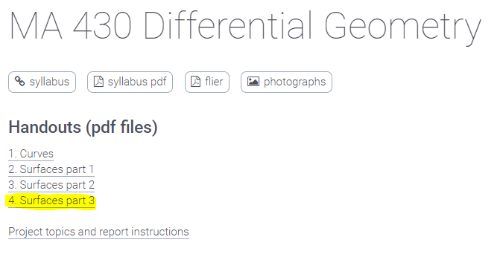
http://liavas.net/courses/math430/
Geodesics +
Christoffel Symbols

Slide 3
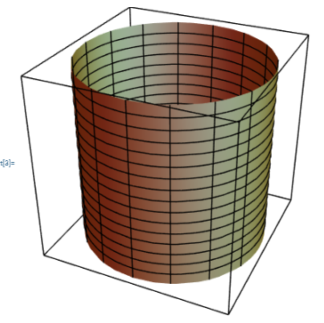
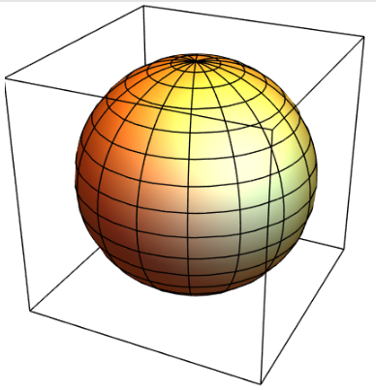
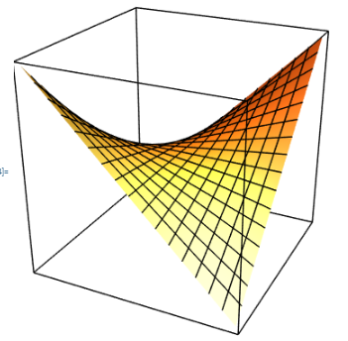

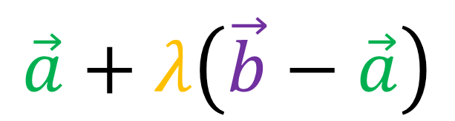
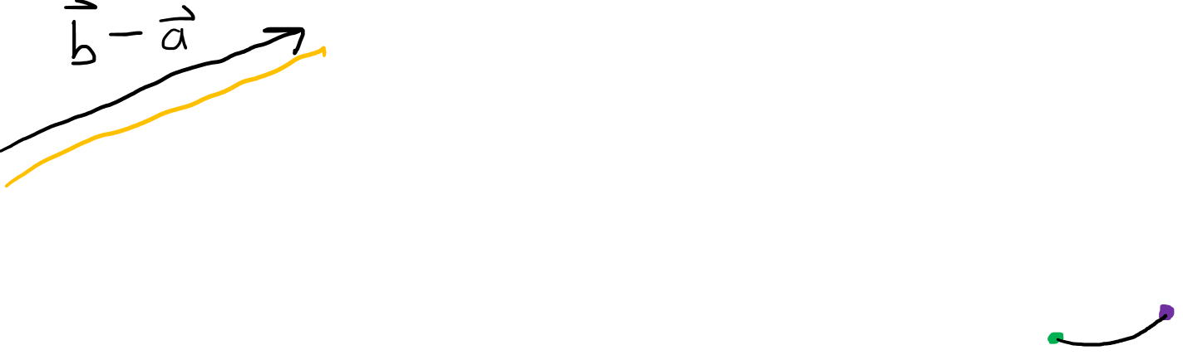

Shortest distance between two points?
Flat Space
Curved Spaces
$$b$$
$$a$$
$$\vec{a}+λ\left(\vec{b}−\vec{a}\right)$$

Slide 4
Shortest distance between two points?
Flat Space
Curved Spaces
Geodesic = straightest possible path in a curved surface/space.
$$b$$
$$a$$
$$\vec{a}+λ\left(\vec{b}−\vec{a}\right)$$

Slide 5
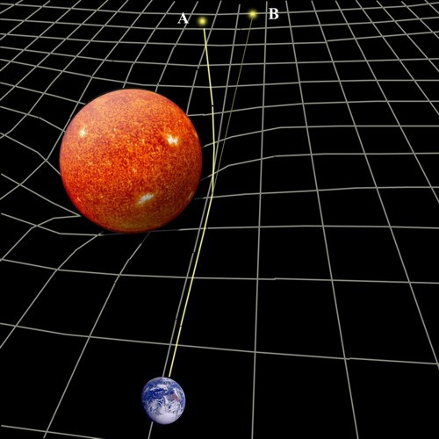
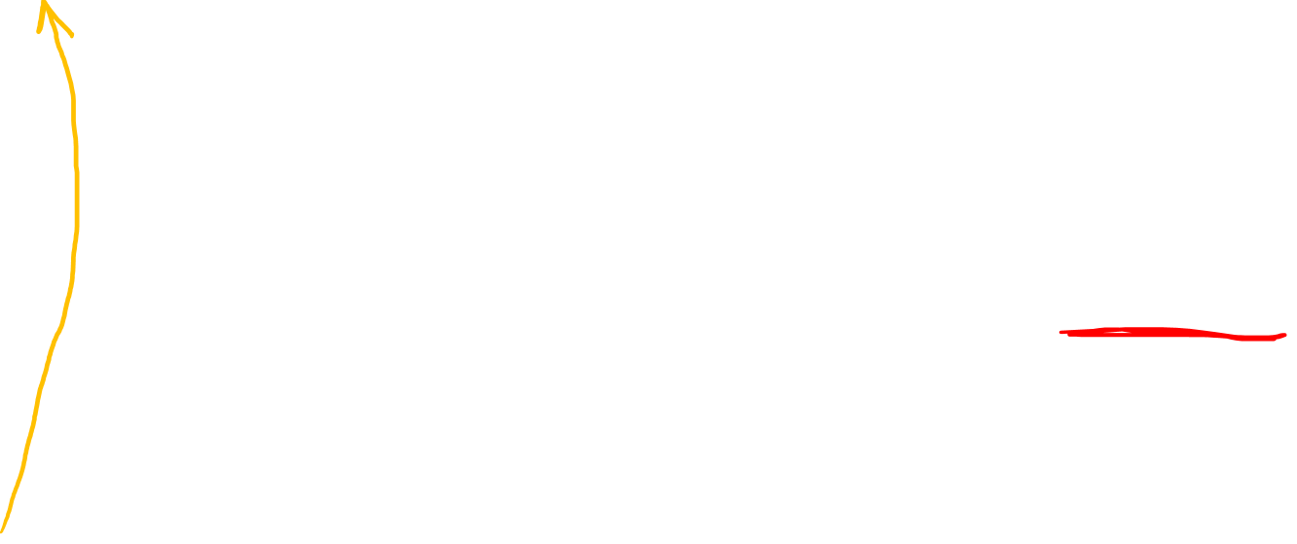
Who cares about Geodesics?
According to General Relativity…
Space-time is curved
Light doesn’t travel in a straight line
Light travels along Geodesic curves

Slide 6
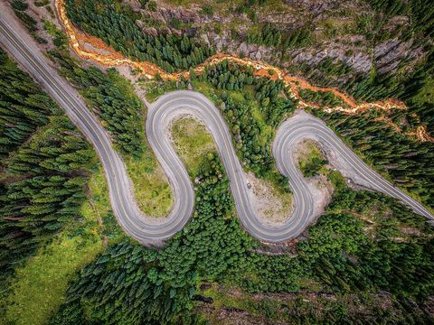
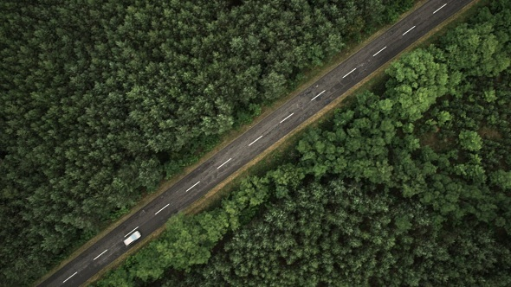
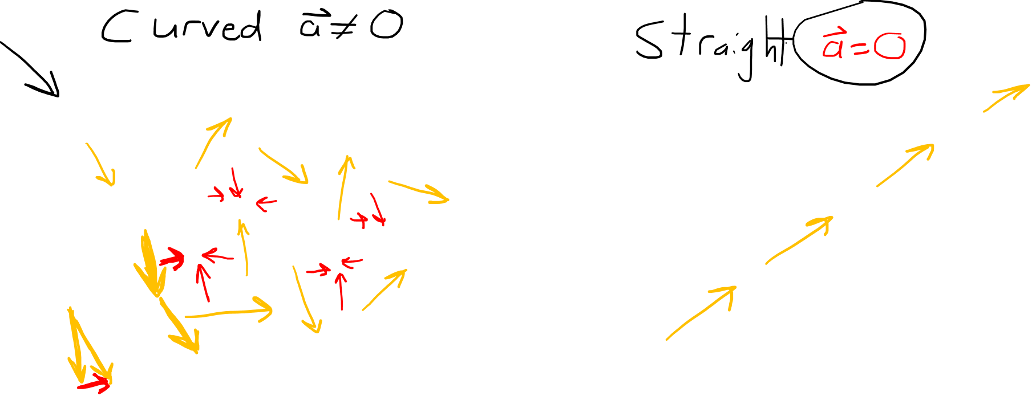
How do we know if a path is “straight” in flat space?
Velocity Vector (Yellow)
Acceleration Vector (Red)

Slide 7
How do we know if a path is “straight” in flat space?
Velocity Vector (Yellow)
Acceleration Vector (Red)

Slide 8
How do we know if a path is “straight” in flat space?
Velocity Vector (Yellow)
Acceleration Vector (Red)
In flat space, a straight path has zero acceleration when we travel along it at constant speed.

Slide 9
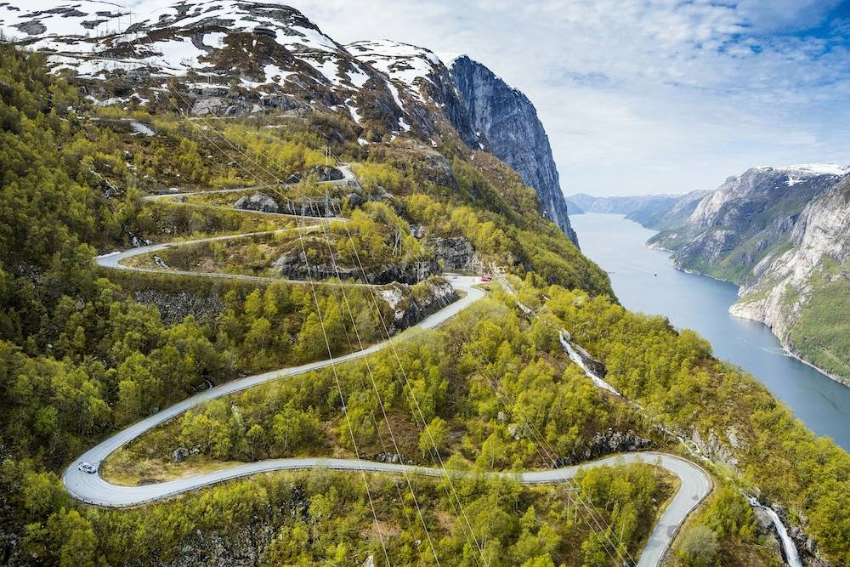
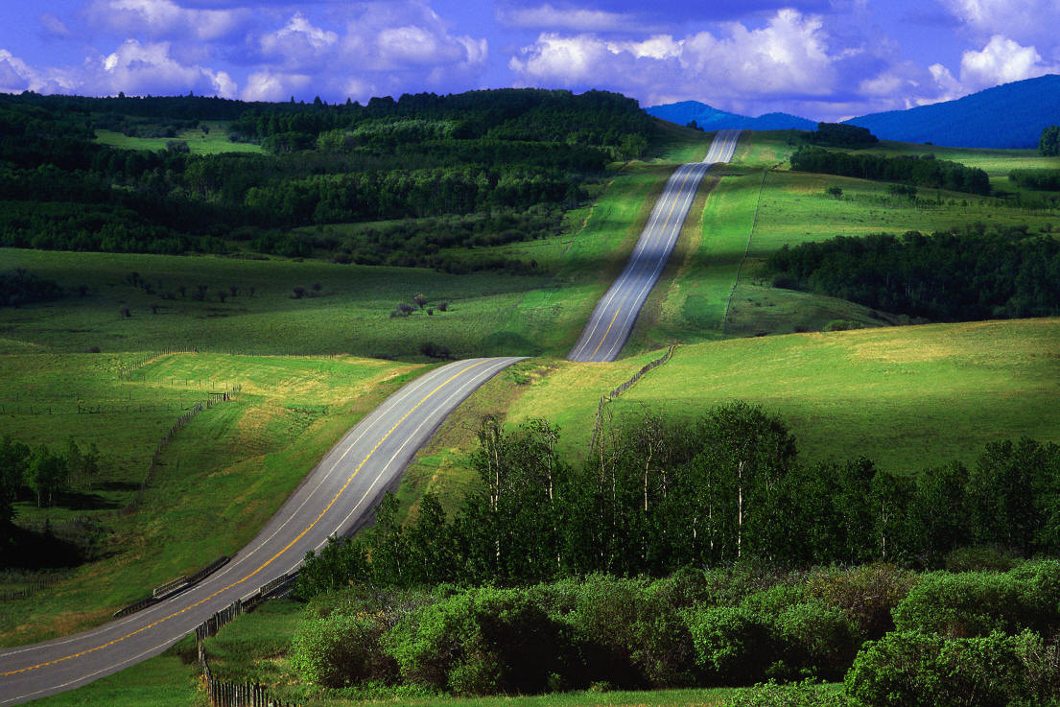
“Straight” paths (geodesics) in curved space…
Velocity Vector (Yellow)
Acceleration Vector (Red)

Slide 10
“Straight” paths (geodesics) in curved space…
Velocity Vector (Yellow)
Acceleration Vector (Red)

Slide 11
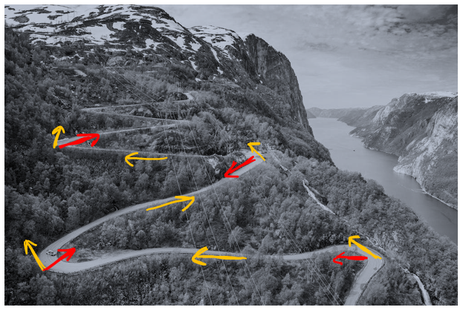
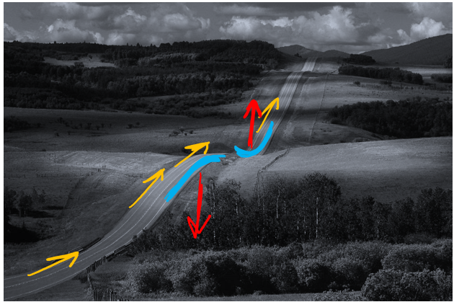
“Straight” paths (geodesics) in curved space…
Velocity Vector (Yellow)
Acceleration Vector (Red)

Slide 12
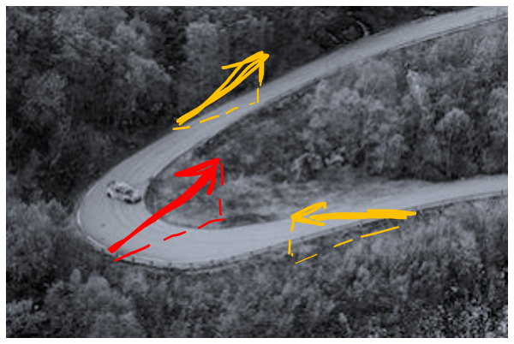
“Straight” paths (geodesics) in curved space…
Velocity Vector (Yellow)
Acceleration Vector (Red)

Slide 13
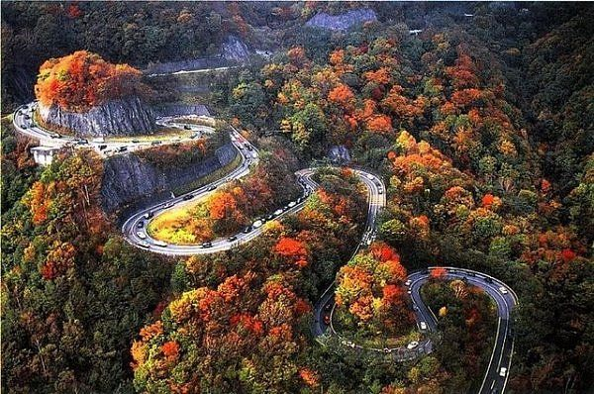
“Straight” paths (geodesics) in curved space…
Velocity Vector (Yellow)
Acceleration Vector (Red)
In curved space, a straight path has zero tangential acceleration when we travel along it at constant speed.

Slide 14
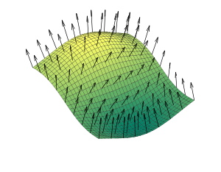
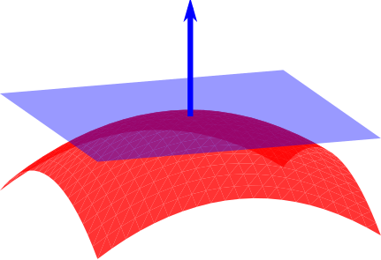
Normal Vectors
Image source: https://en.wikipedia.org/wiki/Normal_(geometry)

Slide 15
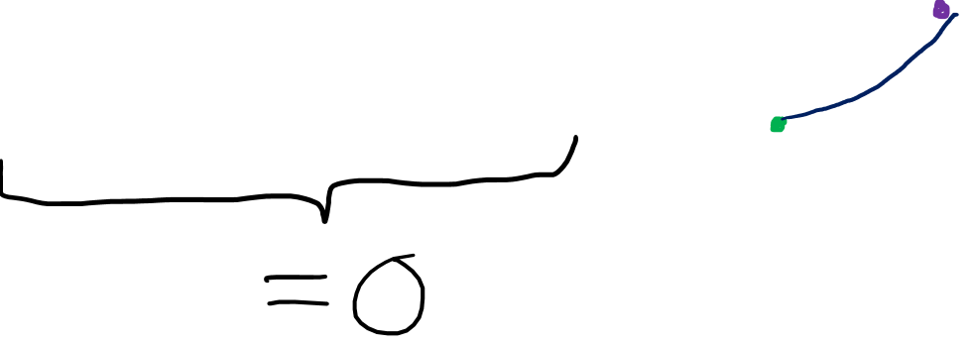
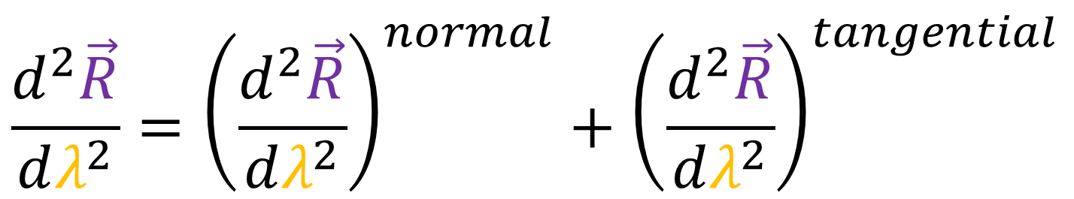
Plan to find geodesics…
To compute geodesic curves, we need to find curves where the acceleration vector is normal to the surface.
$$\frac{d^{2}\vec{R}}{dλ^{2}}={\left(\frac{d^{2}\vec{R}}{dλ^{2}}\right)}^{normal}+{\left(\frac{d^{2}\vec{R}}{dλ^{2}}\right)}^{tangential}$$

Slide 16
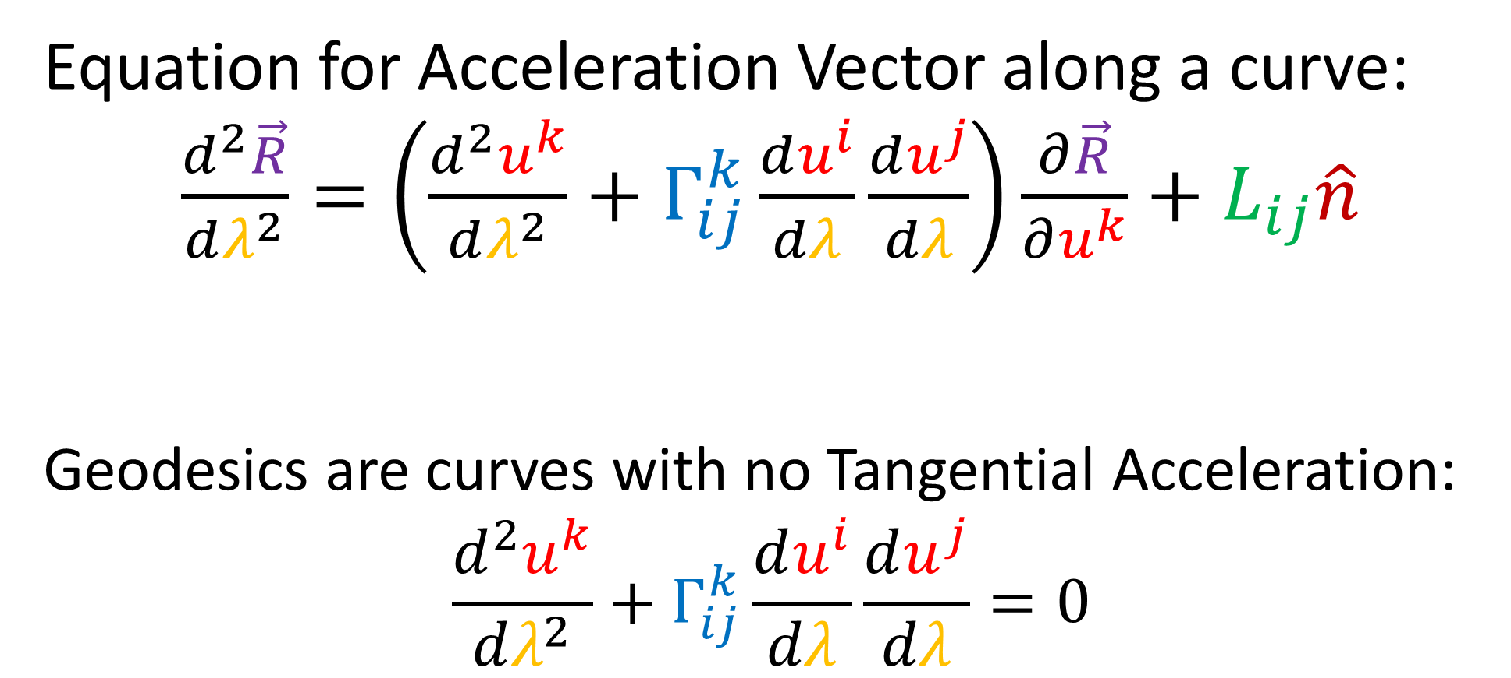
Sneak-Peek at main Results:
Equation for Acceleration Vector along a curve:
$\frac{d^{2}\vec{R}}{dλ^{2}}=\left(\frac{d^{2}u^{k}}{dλ^{2}}+Γ_{ij}^{k}\frac{du^{i}}{dλ}\frac{du^{j}}{dλ}\right)\frac{∂\vec{R}}{∂u^{k}}+L_{ij}\hat{n}$
Geodesics are curves with no Tangential Acceleration:
$$\frac{d^{2}u^{k}}{dλ^{2}}+Γ_{ij}^{k}\frac{du^{i}}{dλ}\frac{du^{j}}{dλ}=0$$

Slide 17

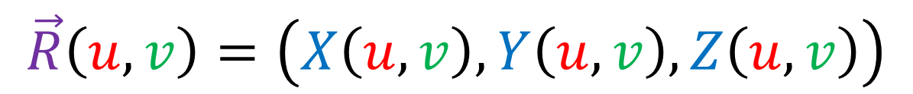


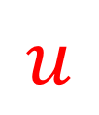
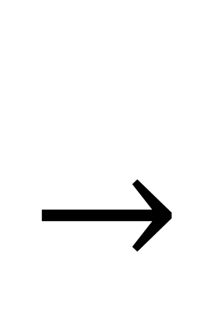

How do you make a 2D surface?
$$\vec{R}\left(u,v\right)=\left(X\left(u,v\right),Y\left(u,v\right),Z\left(u,v\right)\right)$$
$$u$$
$$Z$$
$$Y$$
$$X$$
$$v$$

Slide 18
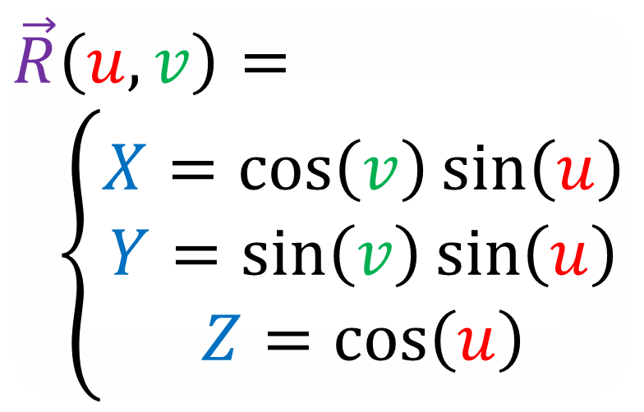
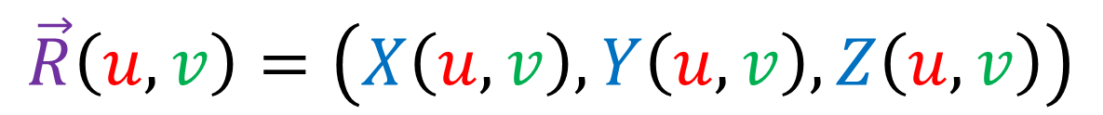
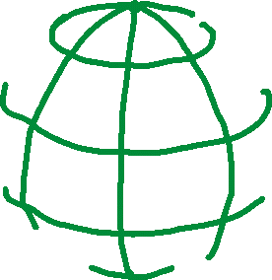
Parametric Equation for a Sphere
$$\vec{R}\left(u,v\right)=\left(X\left(u,v\right),Y\left(u,v\right),Z\left(u,v\right)\right)$$
$$u$$
$$\vec{R}\left(u,v\right)=$$
$\left\{\begin{aligned}X=\cos\left(v\right)\sin\left(u\right) \\ Y=\sin\left(v\right)\sin\left(u\right) \\ Z=\cos\left(u\right)\end{aligned}\right.$
$$v$$

Slide 19
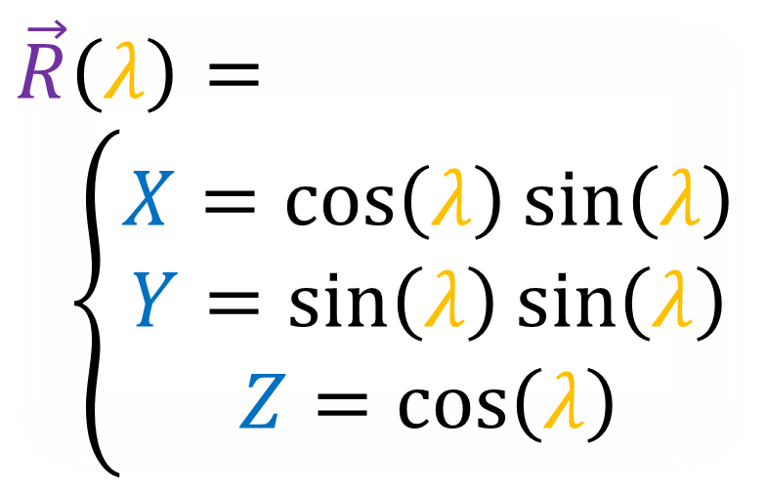
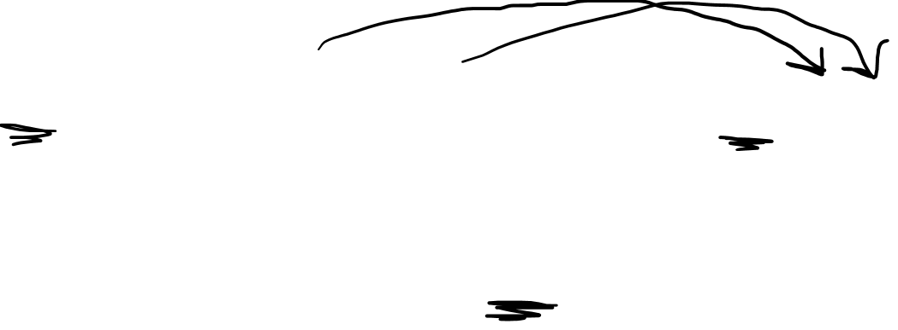
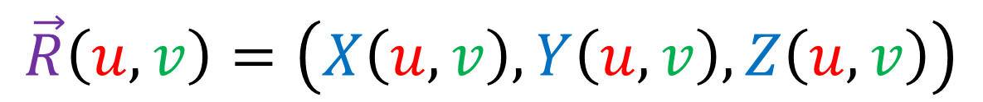


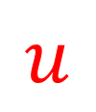
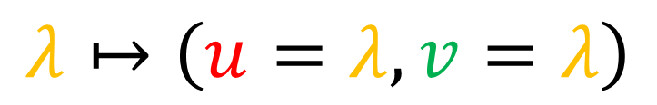
Parametric Equation for a Sphere
$$λ↦\left(u=λ,v=λ\right)$$
$$\vec{R}\left(u,v\right)=\left(X\left(u,v\right),Y\left(u,v\right),Z\left(u,v\right)\right)$$
$$u$$
$$\vec{R}\left(λ\right)=$$
$\left\{\begin{aligned}X=\cos\left(λ\right)\sin\left(λ\right) \\ Y=\sin\left(λ\right)\sin\left(λ\right) \\ Z=\cos\left(λ\right)\end{aligned}\right.$
$$\vec{R}$$
$$v$$

Slide 20


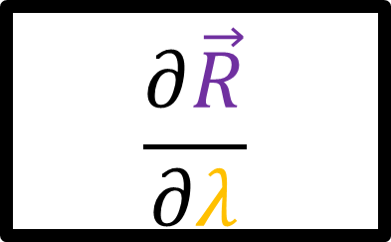
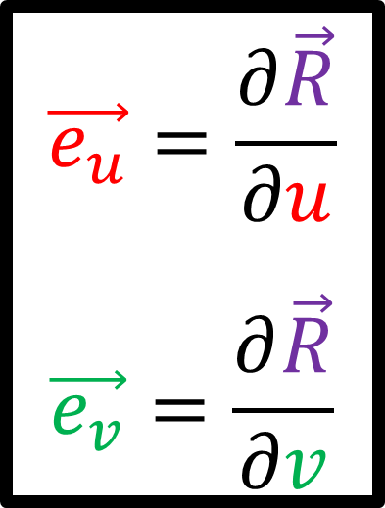


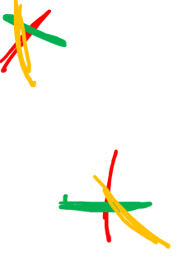
Tangent Planes on Surfaces
$$\vec{e_{u}}=\frac{∂\vec{R}}{∂u}$$
$$\vec{e_{v}}=\frac{∂\vec{R}}{∂v}$$
$$u$$
$$\vec{e_{v}}$$
$$\vec{e_{v}}$$
$$\vec{e_{u}}$$
$$\frac{∂\vec{R}}{∂λ}$$
$$\vec{e_{u}}$$
$$v$$

Slide 21

Acceleration Vector
$$\left(\frac{d^{2}\vec{R}}{dλ^{2}}\right)$$

Slide 22
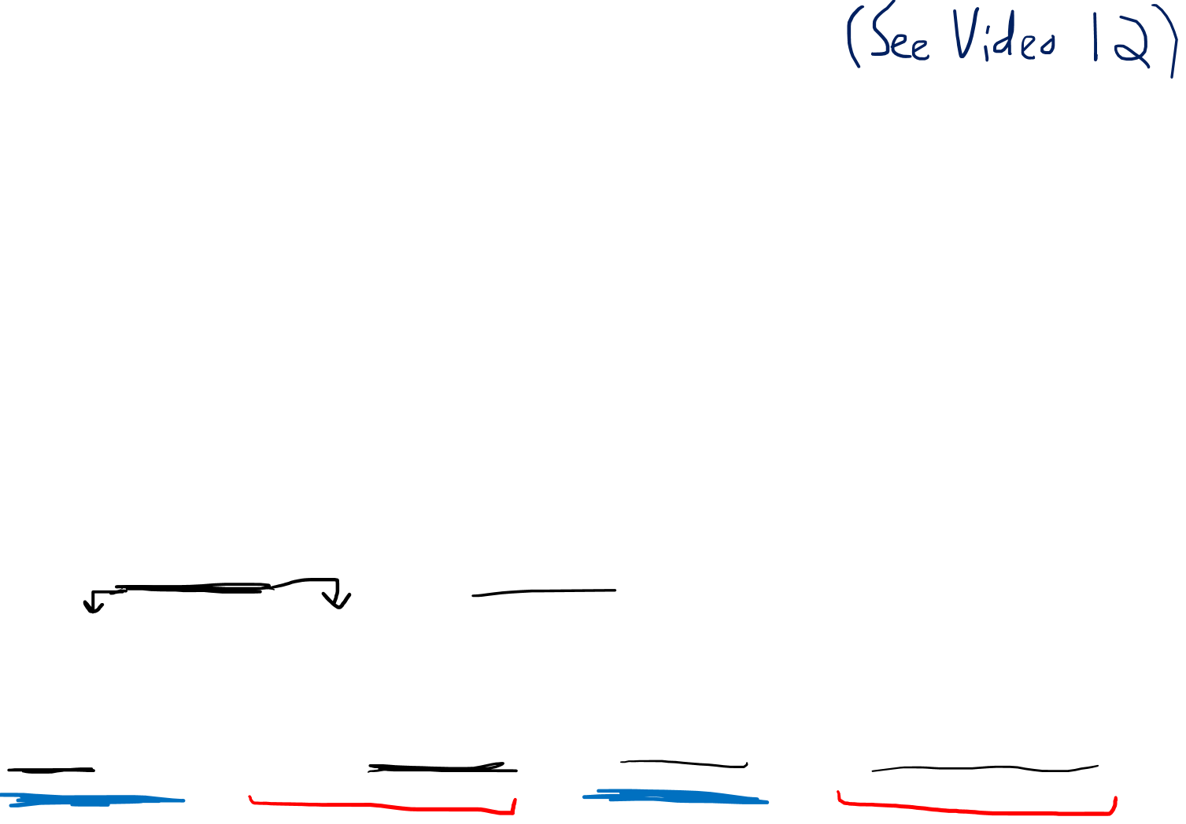
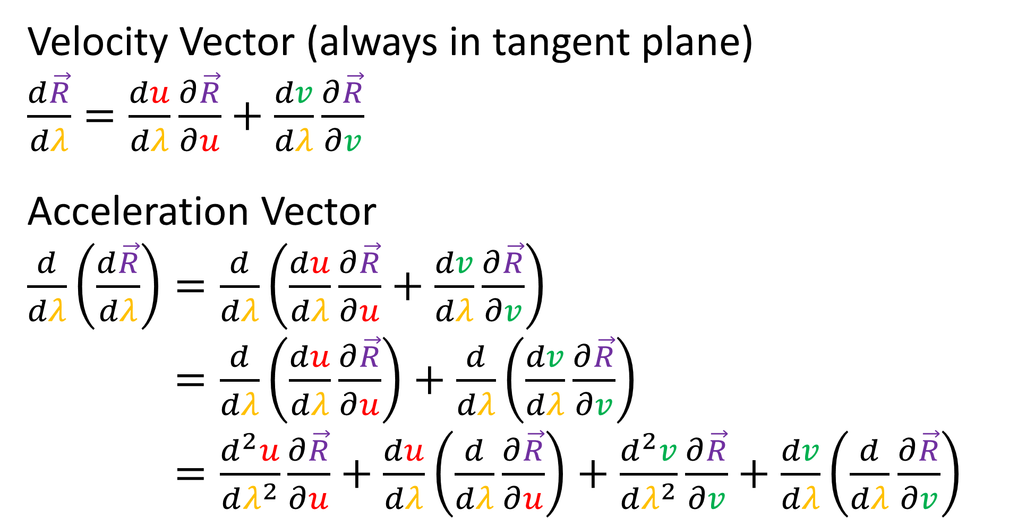
Velocity Vector (always in tangent plane)
$\frac{d\vec{R}}{dλ}=\frac{du}{dλ}\frac{∂\vec{R}}{∂u}+\frac{dv}{dλ}\frac{∂\vec{R}}{∂v}$
Acceleration Vector
$\frac{d}{dλ}\left(\frac{d\vec{R}}{dλ}\right)=\frac{d}{dλ}\left(\frac{du}{dλ}\frac{∂\vec{R}}{∂u}+\frac{dv}{dλ}\frac{∂\vec{R}}{∂v}\right)$
$\frac{d}{dλ}\left(\frac{d\vec{R}}{dλ}\right)=\frac{d}{dλ}\left(\frac{du}{dλ}\frac{∂\vec{R}}{∂u}\right)+\frac{d}{dλ}\left(\frac{dv}{dλ}\frac{∂\vec{R}}{∂v}\right)$
$\frac{d}{dλ}\left(\frac{d\vec{R}}{dλ}\right)=\frac{d^{2}u}{dλ^{2}}\frac{∂\vec{R}}{∂u}+\frac{du}{dλ}\left(\frac{d}{dλ}\frac{∂\vec{R}}{∂u}\right)+\frac{d^{2}v}{dλ^{2}}\frac{∂\vec{R}}{∂v}+\frac{dv}{dλ}\left(\frac{d}{dλ}\frac{∂\vec{R}}{∂v}\right)$

Slide 23
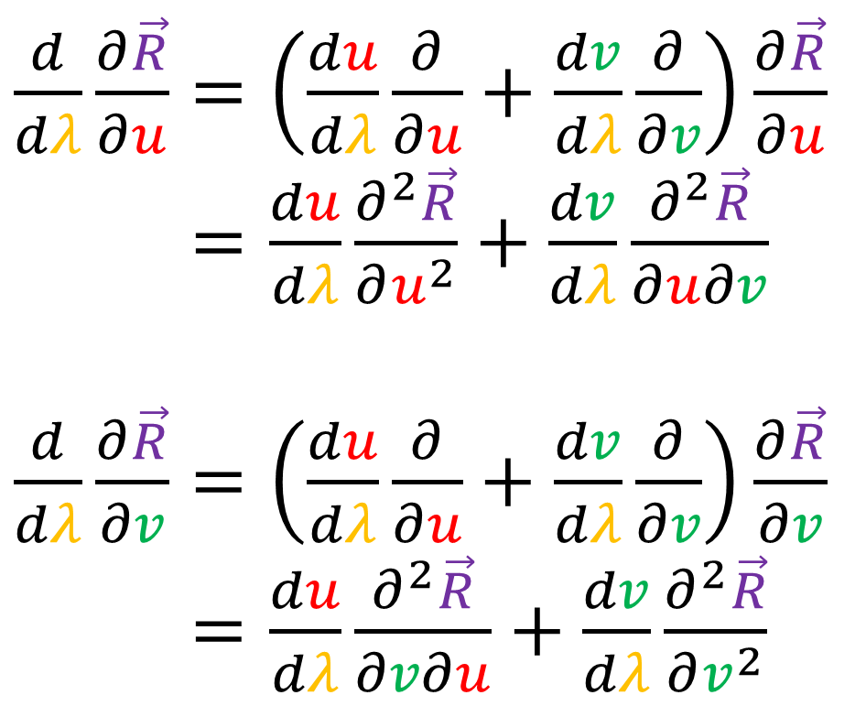
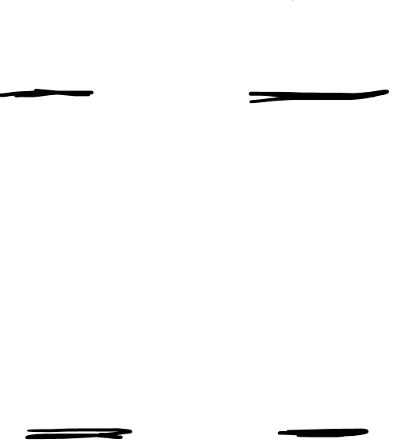
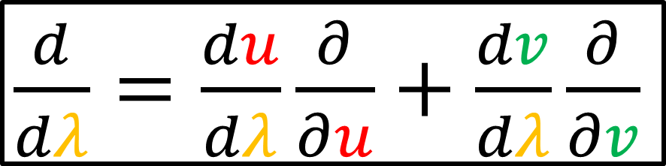
$\frac{d}{dλ}=\frac{du}{dλ}\frac{∂}{∂u}+\frac{dv}{dλ}\frac{∂}{∂v}$
$\frac{d}{dλ}\frac{∂\vec{R}}{∂u}=\left(\frac{du}{dλ}\frac{∂}{∂u}+\frac{dv}{dλ}\frac{∂}{∂v}\right)\frac{∂\vec{R}}{∂u}$
$\frac{d}{dλ}\frac{∂\vec{R}}{∂u}=\frac{du}{dλ}\frac{∂^{2}\vec{R}}{∂u^{2}}+\frac{dv}{dλ}\frac{∂^{2}\vec{R}}{∂u∂v}$
$\frac{d}{dλ}\frac{∂\vec{R}}{∂v}=\left(\frac{du}{dλ}\frac{∂}{∂u}+\frac{dv}{dλ}\frac{∂}{∂v}\right)\frac{∂\vec{R}}{∂v}$
$\frac{d}{dλ}\frac{∂\vec{R}}{∂v}=\frac{du}{dλ}\frac{∂^{2}\vec{R}}{∂v∂u}+\frac{dv}{dλ}\frac{∂^{2}\vec{R}}{∂v^{2}}$

Slide 24
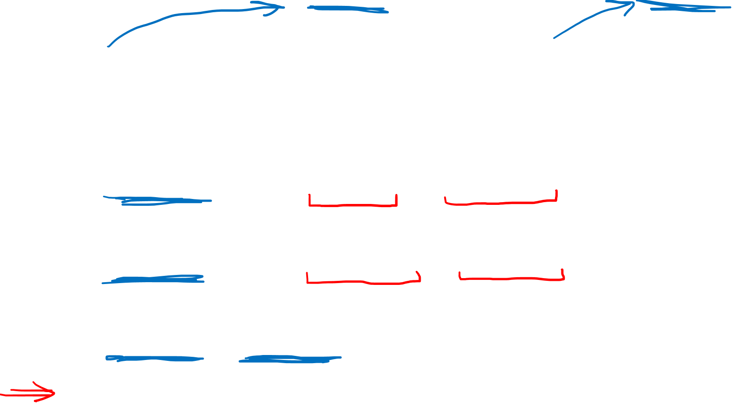
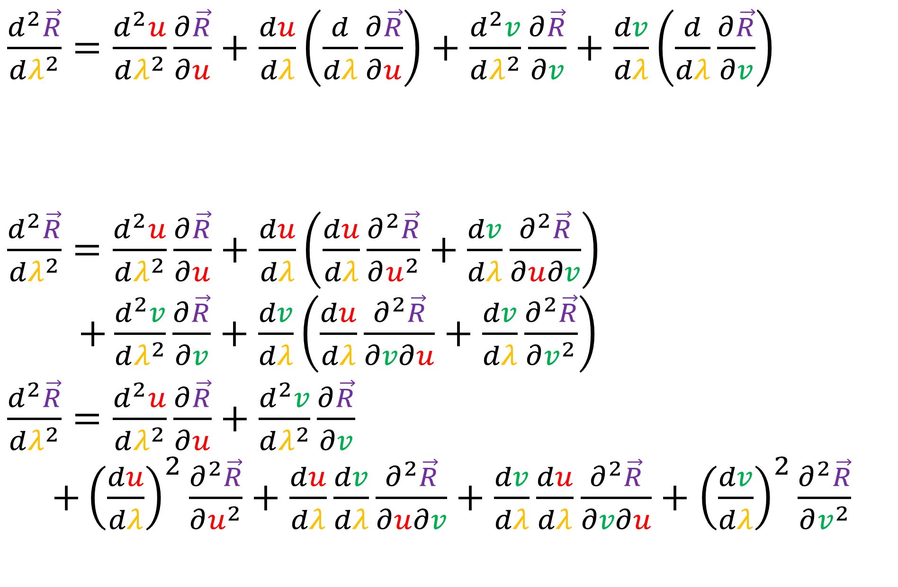
$\frac{d^{2}\vec{R}}{dλ^{2}}=\frac{d^{2}u}{dλ^{2}}\frac{∂\vec{R}}{∂u}+\frac{du}{dλ}\left(\frac{d}{dλ}\frac{∂\vec{R}}{∂u}\right)+\frac{d^{2}v}{dλ^{2}}\frac{∂\vec{R}}{∂v}+\frac{dv}{dλ}\left(\frac{d}{dλ}\frac{∂\vec{R}}{∂v}\right)$
$\frac{d^{2}\vec{R}}{dλ^{2}}=\frac{d^{2}u}{dλ^{2}}\frac{∂\vec{R}}{∂u}+\frac{du}{dλ}\left(\frac{du}{dλ}\frac{∂^{2}\vec{R}}{∂u^{2}}+\frac{dv}{dλ}\frac{∂^{2}\vec{R}}{∂u∂v}\right)$
$+\frac{d^{2}v}{dλ^{2}}\frac{∂\vec{R}}{∂v}+\frac{dv}{dλ}\left(\frac{du}{dλ}\frac{∂^{2}\vec{R}}{∂v∂u}+\frac{dv}{dλ}\frac{∂^{2}\vec{R}}{∂v^{2}}\right)$
$\frac{d^{2}\vec{R}}{dλ^{2}}=\frac{d^{2}u}{dλ^{2}}\frac{∂\vec{R}}{∂u}+\frac{d^{2}v}{dλ^{2}}\frac{∂\vec{R}}{∂v}$
$+{\left(\frac{du}{dλ}\right)}^{2}\frac{∂^{2}\vec{R}}{∂u^{2}}+\frac{du}{dλ}\frac{dv}{dλ}\frac{∂^{2}\vec{R}}{∂u∂v}+\frac{dv}{dλ}\frac{du}{dλ}\frac{∂^{2}\vec{R}}{∂v∂u}+{\left(\frac{dv}{dλ}\right)}^{2}\frac{∂^{2}\vec{R}}{∂v^{2}}$
$\frac{d}{dλ}\frac{∂\vec{R}}{∂u}=\frac{du}{dλ}\frac{∂^{2}\vec{R}}{∂u^{2}}+\frac{dv}{dλ}\frac{∂^{2}\vec{R}}{∂u∂v} \frac{d}{dλ}\frac{∂\vec{R}}{∂v}=\frac{du}{dλ}\frac{∂^{2}\vec{R}}{∂v∂u}+\frac{dv}{dλ}\frac{∂^{2}\vec{R}}{∂v^{2}}$

Slide 25

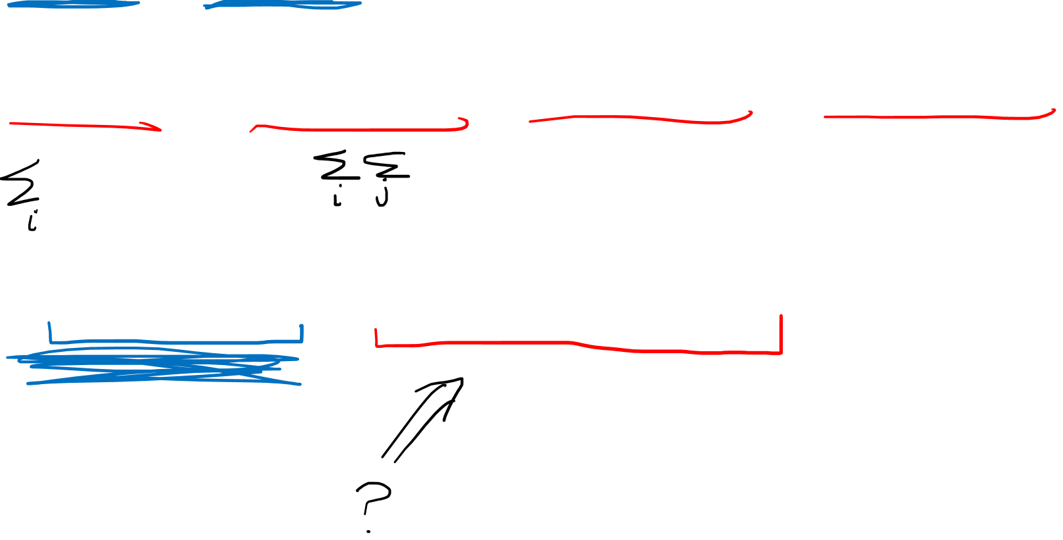
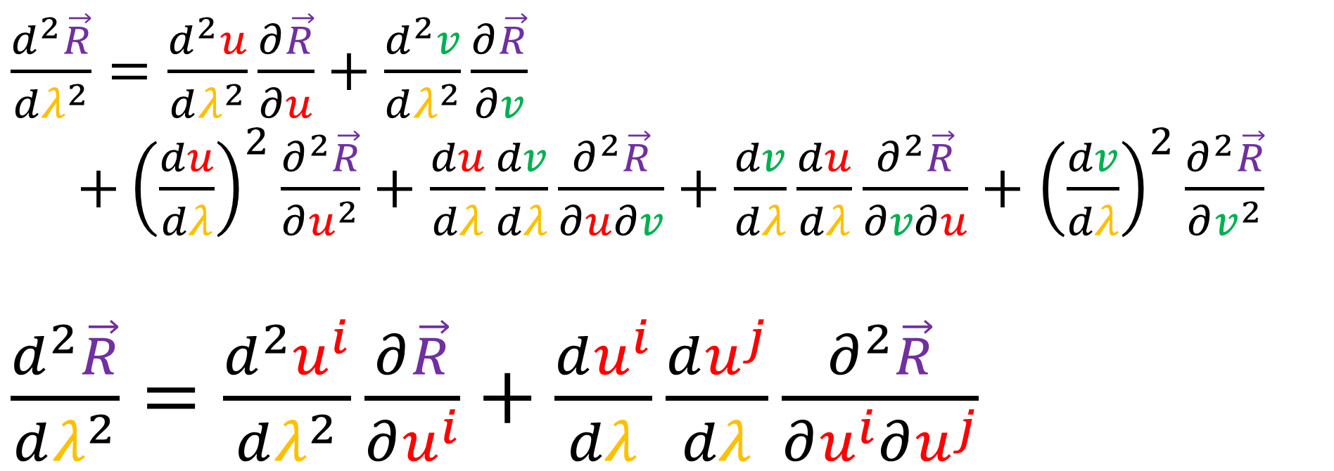
$\frac{d^{2}\vec{R}}{dλ^{2}}=\frac{d^{2}u}{dλ^{2}}\frac{∂\vec{R}}{∂u}+\frac{d^{2}v}{dλ^{2}}\frac{∂\vec{R}}{∂v}$
$+{\left(\frac{du}{dλ}\right)}^{2}\frac{∂^{2}\vec{R}}{∂u^{2}}+\frac{du}{dλ}\frac{dv}{dλ}\frac{∂^{2}\vec{R}}{∂u∂v}+\frac{dv}{dλ}\frac{du}{dλ}\frac{∂^{2}\vec{R}}{∂v∂u}+{\left(\frac{dv}{dλ}\right)}^{2}\frac{∂^{2}\vec{R}}{∂v^{2}}$
$\frac{d^{2}\vec{R}}{dλ^{2}}=\frac{d^{2}u^{i}}{dλ^{2}}\frac{∂\vec{R}}{∂u^{i}}+\frac{du^{i}}{dλ}\frac{du^{j}}{dλ}\frac{∂^{2}\vec{R}}{∂u^{i}∂u^{j}}$
$$u^{1}=u$$
$$u^{2}=v$$

Slide 26





$\frac{d^{2}\vec{R}}{dλ^{2}}=\frac{d^{2}u^{i}}{dλ^{2}}\frac{∂\vec{R}}{∂u^{i}}+\frac{du^{i}}{dλ}\frac{du^{j}}{dλ}\frac{∂^{2}\vec{R}}{∂u^{i}∂u^{j}}$
$\frac{∂^{2}\vec{R}}{∂u^{i}∂u^{j}}=Γ_{ij}^{1}\frac{∂\vec{R}}{∂u^{1}}+Γ_{ij}^{2}\frac{∂\vec{R}}{∂u^{2}}+L_{ij}\hat{n}$
$$\hat{n}$$
$\frac{∂\vec{R}}{∂u^{2}}$
$\frac{∂\vec{R}}{∂u^{1}}$

Slide 27

$\frac{d^{2}\vec{R}}{dλ^{2}}=\frac{d^{2}u^{i}}{dλ^{2}}\frac{∂\vec{R}}{∂u^{i}}+\frac{du^{i}}{dλ}\frac{du^{j}}{dλ}\frac{∂^{2}\vec{R}}{∂u^{i}∂u^{j}}$
$\frac{∂^{2}\vec{R}}{∂u^{i}∂u^{j}}=Γ_{ij}^{1}\frac{∂\vec{R}}{∂u^{1}}+Γ_{ij}^{2}\frac{∂\vec{R}}{∂u^{2}}+L_{ij}\hat{n}$
Second Fundamental Form $L_{ij}$ give us the normal components of $\frac{∂^{2}\vec{R}}{∂u^{i}∂u^{j}}$

Slide 28


$\frac{d^{2}\vec{R}}{dλ^{2}}=\frac{d^{2}u^{i}}{dλ^{2}}\frac{∂\vec{R}}{∂u^{i}}+\frac{du^{i}}{dλ}\frac{du^{j}}{dλ}\frac{∂^{2}\vec{R}}{∂u^{i}∂u^{j}}$
$\frac{∂^{2}\vec{R}}{∂u^{i}∂u^{j}}=Γ_{ij}^{1}\frac{∂\vec{R}}{∂u^{1}}+Γ_{ij}^{2}\frac{∂\vec{R}}{∂u^{2}}+L_{ij}\hat{n}$
Christoffel Symbols $Γ_{ij}^{k}$ give us the tangential components of $\frac{∂^{2}\vec{R}}{∂u^{i}∂u^{j}}$

Slide 29



$$\hat{n}$$
$\frac{∂\vec{R}}{∂u^{2}}$
$\frac{∂\vec{R}}{∂u^{1}}$

Slide 30





$\frac{∂^{2}\vec{R}}{∂u^{i}∂u^{j}}$
$$\hat{n}$$
$$L_{ij}$$
$\frac{∂\vec{R}}{∂u^{2}}$
$$Γ_{ij}^{1}$$
$\frac{∂\vec{R}}{∂u^{1}}$
$$Γ_{ij}^{2}$$

Slide 31

$\frac{d^{2}\vec{R}}{dλ^{2}}=\frac{d^{2}u^{i}}{dλ^{2}}\frac{∂\vec{R}}{∂u^{i}}+\frac{du^{i}}{dλ}\frac{du^{j}}{dλ}\frac{∂^{2}\vec{R}}{∂u^{i}∂u^{j}}$
$\frac{∂^{2}\vec{R}}{∂u^{i}∂u^{j}}=Γ_{ij}^{1}\frac{∂\vec{R}}{∂u^{1}}+Γ_{ij}^{2}\frac{∂\vec{R}}{∂u^{2}}+L_{ij}\hat{n}$

Slide 32





$\frac{d^{2}\vec{R}}{dλ^{2}}=\frac{d^{2}u^{i}}{dλ^{2}}\frac{∂\vec{R}}{∂u^{i}}+\frac{du^{i}}{dλ}\frac{du^{j}}{dλ}\frac{∂^{2}\vec{R}}{∂u^{i}∂u^{j}}$
$\frac{∂^{2}\vec{R}}{∂u^{i}∂u^{j}}=Γ_{ij}^{k}\frac{∂\vec{R}}{∂u^{k}}+L_{ij}\hat{n}$
$$\hat{n}$$
$\frac{∂\vec{R}}{∂u^{2}}$
$\frac{∂\vec{R}}{∂u^{1}}$

Slide 33



$\frac{d^{2}\vec{R}}{dλ^{2}}=\frac{d^{2}u^{i}}{dλ^{2}}\frac{∂\vec{R}}{∂u^{i}}+\frac{du^{i}}{dλ}\frac{du^{j}}{dλ}\frac{∂^{2}\vec{R}}{∂u^{i}∂u^{j}}$
$\frac{∂^{2}\vec{R}}{∂u^{i}∂u^{j}}=Γ_{ij}^{k}\frac{∂\vec{R}}{∂u^{k}}+L_{ij}\hat{n}$
$\frac{∂^{2}\vec{R}}{∂u^{i}∂u^{j}}⋅\frac{∂\vec{R}}{∂u^{l}}=\left(Γ_{ij}^{k}\frac{∂\vec{R}}{∂u^{k}}+L_{ij}\hat{n}\right)⋅\frac{∂\vec{R}}{∂u^{l}}$
$\frac{∂^{2}\vec{R}}{∂u^{i}∂u^{j}}⋅\frac{∂\vec{R}}{∂u^{l}}=Γ_{ij}^{k}\frac{∂\vec{R}}{∂u^{k}}⋅\frac{∂\vec{R}}{∂u^{l}}=Γ_{ij}^{k}g_{kl}$

Slide 34



$\frac{d^{2}\vec{R}}{dλ^{2}}=\frac{d^{2}u^{i}}{dλ^{2}}\frac{∂\vec{R}}{∂u^{i}}+\frac{du^{i}}{dλ}\frac{du^{j}}{dλ}\frac{∂^{2}\vec{R}}{∂u^{i}∂u^{j}}$
$\frac{∂^{2}\vec{R}}{∂u^{i}∂u^{j}}=Γ_{ij}^{k}\frac{∂\vec{R}}{∂u^{k}}+L_{ij}\hat{n}$
$\frac{∂^{2}\vec{R}}{∂u^{i}∂u^{j}}⋅\frac{∂\vec{R}}{∂u^{l}}𝔤^{lm}=Γ_{ij}^{k}g_{kl}$
$\frac{∂^{2}\vec{R}}{∂u^{i}∂u^{j}}⋅\frac{∂\vec{R}}{∂u^{l}}𝔤^{lm}=Γ_{ij}^{k}g_{kl}𝔤^{lm}$
$\frac{∂^{2}\vec{R}}{∂u^{i}∂u^{j}}⋅\frac{∂\vec{R}}{∂u^{l}}𝔤^{lm}=Γ_{ij}^{m}$
$g_{kl}𝔤^{lm}=δ_{k}^{m}$

Slide 35




$\frac{d^{2}\vec{R}}{dλ^{2}}=\frac{d^{2}u^{i}}{dλ^{2}}\frac{∂\vec{R}}{∂u^{i}}+\frac{du^{i}}{dλ}\frac{du^{j}}{dλ}\frac{∂^{2}\vec{R}}{∂u^{i}∂u^{j}}$
$\frac{∂^{2}\vec{R}}{∂u^{i}∂u^{j}}=Γ_{ij}^{k}\frac{∂\vec{R}}{∂u^{k}}+L_{ij}\hat{n}$
$Γ_{ij}^{m}=\frac{∂^{2}\vec{R}}{∂u^{i}∂u^{j}}⋅\frac{∂\vec{R}}{∂u^{l}}𝔤^{lm}$
$\frac{∂^{2}\vec{R}}{∂u^{i}∂u^{j}}⋅\hat{n}=\left(Γ_{ij}^{k}\frac{∂\vec{R}}{∂u^{k}}+L_{ij}\hat{n}\right)⋅\hat{n}$
$\frac{∂^{2}\vec{R}}{∂u^{i}∂u^{j}}⋅\hat{n}=L_{ij}\left(\hat{n}⋅\hat{n}\right)$
$\frac{∂^{2}\vec{R}}{∂u^{i}∂u^{j}}⋅\frac{\vec{e_{i}}×\vec{e_{j}}}{‖\vec{e_{i}}×\vec{e_{j}}‖}=L_{ij}$
$\vec{e_{i}}=\frac{∂\vec{R}}{∂u^{i}}$, $\vec{e_{j}}=\frac{∂\vec{R}}{∂u^{j}}$

Slide 36



$\frac{d^{2}\vec{R}}{dλ^{2}}=\frac{d^{2}u^{i}}{dλ^{2}}\frac{∂\vec{R}}{∂u^{i}}+\frac{du^{i}}{dλ}\frac{du^{j}}{dλ}\frac{∂^{2}\vec{R}}{∂u^{i}∂u^{j}}$
$\frac{∂^{2}\vec{R}}{∂u^{i}∂u^{j}}=Γ_{ij}^{k}\frac{∂\vec{R}}{∂u^{k}}+L_{ij}\hat{n}$
$Γ_{ij}^{k}=\frac{∂^{2}\vec{R}}{∂u^{i}∂u^{j}}⋅\frac{∂\vec{R}}{∂u^{l}}𝔤^{lk}$
$L_{ij}=\frac{∂^{2}\vec{R}}{∂u^{i}∂u^{j}}⋅\frac{\vec{e_{i}}×\vec{e_{j}}}{‖\vec{e_{i}}×\vec{e_{j}}‖}$

Slide 37


$\frac{d^{2}\vec{R}}{dλ^{2}}=\frac{d^{2}u^{i}}{dλ^{2}}\frac{∂\vec{R}}{∂u^{i}}+\frac{du^{i}}{dλ}\frac{du^{j}}{dλ}\frac{∂^{2}\vec{R}}{∂u^{i}∂u^{j}}$
$\frac{∂^{2}\vec{R}}{∂u^{i}∂u^{j}}=Γ_{ij}^{k}\frac{∂\vec{R}}{∂u^{k}}+L_{ij}\hat{n}$
$\frac{d^{2}\vec{R}}{dλ^{2}}=\frac{d^{2}u^{k}}{dλ^{2}}\frac{∂\vec{R}}{∂u^{k}}+\frac{du^{i}}{dλ}\frac{du^{j}}{dλ}\left(Γ_{ij}^{k}\frac{∂\vec{R}}{∂u^{k}}+L_{ij}\hat{n}\right)$
$\frac{d^{2}\vec{R}}{dλ^{2}}=\left(\frac{d^{2}u^{k}}{dλ^{2}}+Γ_{ij}^{k}\frac{du^{i}}{dλ}\frac{du^{j}}{dλ}\right)\frac{∂\vec{R}}{∂u^{k}}+$ $L_{ij}\frac{du^{i}}{dλ}\frac{du^{j}}{dλ}\hat{n}$

Slide 38



Plan to find geodesics…
To compute geodesic curves, we need to find curves where the acceleration vector is
normal to the surface.
$\frac{d^{2}\vec{R}}{dλ^{2}}={\left(\frac{d^{2}\vec{R}}{dλ^{2}}\right)}^{tangential} +{\left(\frac{d^{2}\vec{R}}{dλ^{2}}\right)}^{normal}$
$\frac{d^{2}\vec{R}}{dλ^{2}}=\left(\frac{d^{2}u^{k}}{dλ^{2}}+Γ_{ij}^{k}\frac{du^{i}}{dλ}\frac{du^{j}}{dλ}\right)\frac{∂\vec{R}}{∂u^{k}}+L_{ij}\frac{du^{i}}{dλ}\frac{du^{j}}{dλ}\hat{n}$

Slide 39


Plan to find geodesics…
To compute geodesic curves, we need to find curves where the acceleration vector is
normal to the surface.
$$\frac{d^{2}u^{k}}{dλ^{2}}+Γ_{ij}^{k}\frac{du^{i}}{dλ}\frac{du^{j}}{dλ}=0$$
Geodesic Equation

Slide 40




Summary
Geodesic = straightest possible path
in a curved surface/space.
A Geodesic curve has zero tangential acceleration when we travel along it at constant speed.
$\frac{d^{2}\vec{R}}{dλ^{2}}=\left(\frac{d^{2}u^{k}}{dλ^{2}}+Γ_{ij}^{k}\frac{du^{i}}{dλ}\frac{du^{j}}{dλ}\right)\frac{∂\vec{R}}{∂u^{k}}+L_{ij}\frac{du^{i}}{dλ}\frac{du^{j}}{dλ}\hat{n}$
$Γ_{ij}^{k}=\frac{∂^{2}\vec{R}}{∂u^{i}∂u^{j}}⋅\frac{∂\vec{R}}{∂u^{l}}𝔤^{lk}$
Geodesic Equations
$\frac{d^{2}u^{k}}{dλ^{2}}+Γ_{ij}^{k}\frac{du^{i}}{dλ}\frac{du^{j}}{dλ}=0$
$L_{ij}=\frac{∂^{2}\vec{R}}{∂u^{i}∂u^{j}}⋅\frac{\vec{e_{i}}×\vec{e_{j}}}{‖\vec{e_{i}}×\vec{e_{j}}‖}$

