Slide 1
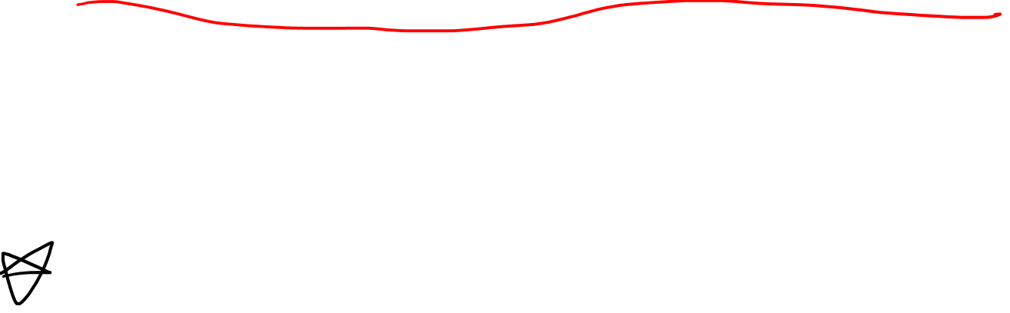
Covariant Derivative (Curved Surface Definition) And Parallel Transport
(See Video 17 on Flat Space Definition)
(Links in the description)

Slide 2
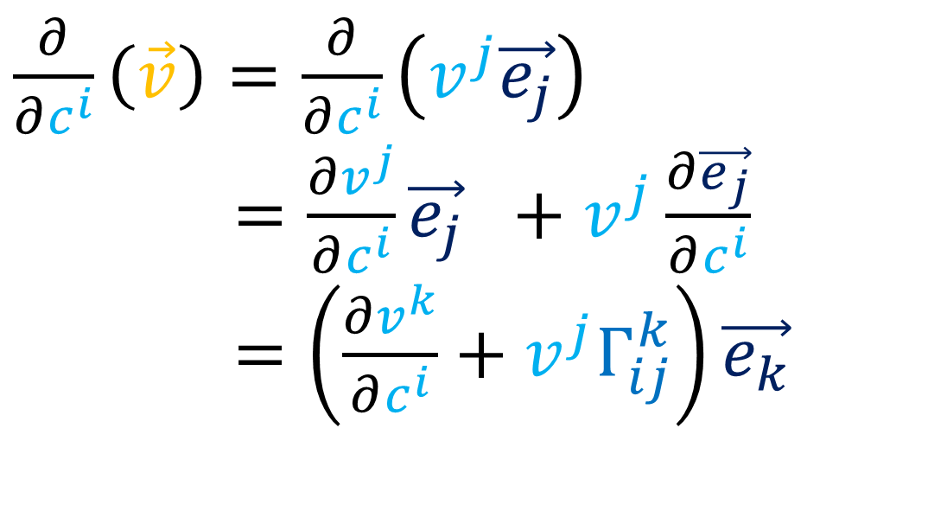
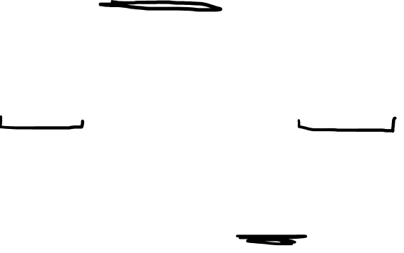
Covariant Derivative Summary
In flat space, the Covariant Derivative of a vector field…
is just the ordinary derivative
we make sure to differentiate both the vector components and the basis vectors.
$\frac{∂}{∂c^{i}}\left(\vec{v}\right)=\frac{∂}{∂c^{i}}\left(v^{j}\vec{e_{j}}\right)$
$\frac{∂}{∂u^{i}}\left(\vec{v}\right)=\frac{∂v^{j}}{∂c^{i}}\vec{e_{j}} +v^{j}\frac{∂\vec{e_{j}}}{∂c^{i}}$
$\frac{∂}{∂u^{i}}\left(\vec{v}\right)=\left(\frac{∂v^{k}}{∂c^{i}}+v^{j}Γ_{ij}^{k}\right)\vec{e_{k}}$

Slide 3

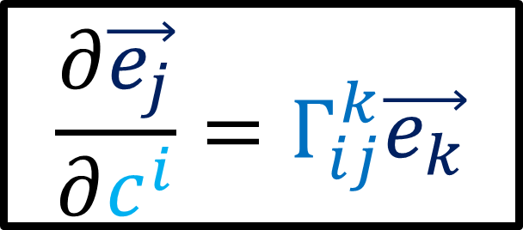
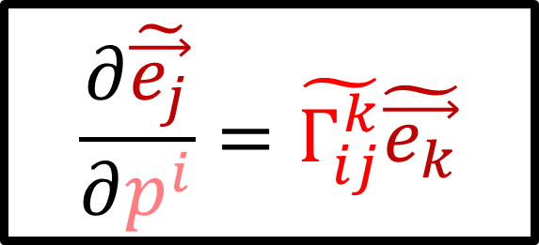
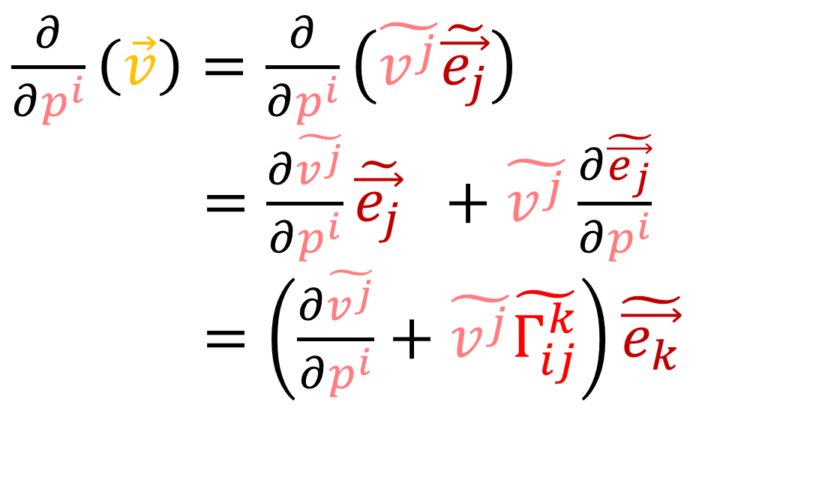
Covariant Derivative Summary
$$\frac{∂\vec{e_{j}}}{∂c^{i}}=Γ_{ij}^{k}\vec{e_{k}}$$
$$\frac{∂\tilde{\vec{e_{j}}}}{∂p^{i}}=\tilde{Γ_{ij}^{k}}\tilde{\vec{e_{k}}}$$
$\frac{∂}{∂c^{i}}\left(\vec{v}\right)=\frac{∂}{∂c^{i}}\left(v^{j}\vec{e_{j}}\right)$
$\frac{∂}{∂u^{i}}\left(\vec{v}\right)=\frac{∂v^{j}}{∂c^{i}}\vec{e_{j}} +v^{j}\frac{∂\vec{e_{j}}}{∂c^{i}}$
$\frac{∂}{∂u^{i}}\left(\vec{v}\right)=\left(\frac{∂v^{k}}{∂c^{i}}+v^{j}Γ_{ij}^{k}\right)\vec{e_{k}}$
$\frac{∂}{∂p^{i}}\left(\vec{v}\right)=\frac{∂}{∂p^{i}}\left(\tilde{v^{j}}\tilde{\vec{e_{j}}}\right)$
$\frac{∂}{∂u^{i}}\left(\vec{v}\right)=\frac{∂\tilde{v^{j}}}{∂p^{i}}\tilde{\vec{e_{j}}} +\tilde{v^{j}}\frac{∂\tilde{\vec{e_{j}}}}{∂p^{i}}$
$\frac{∂}{∂u^{i}}\left(\vec{v}\right)=\left(\frac{∂\tilde{v^{j}}}{∂p^{i}}+\tilde{v^{j}}\tilde{Γ_{ij}^{k}}\right)\tilde{\vec{e_{k}}}$

Slide 4
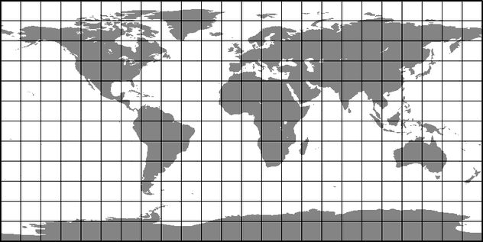
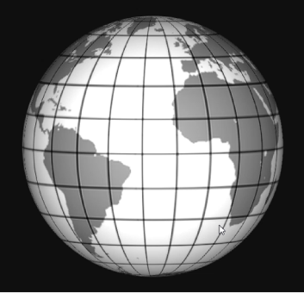



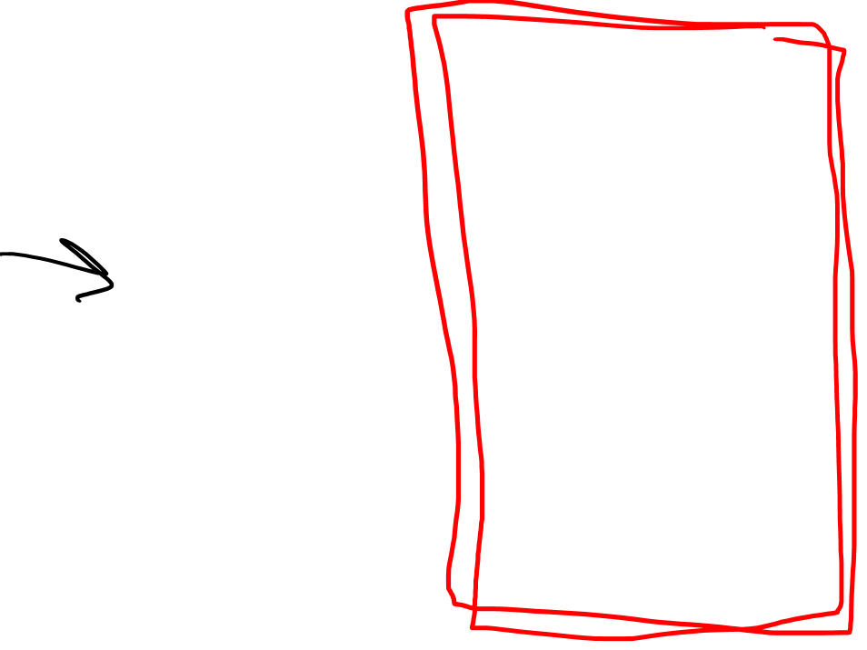
Definitions of Covariant Derivative
$$∇_{\vec{w}}\vec{v}$$
Abstract Definition
$$y$$
Curved-Space (Intrinsic) Definition
$$x$$
Curved-Space (Extrinsic)
Definition
Flat-Space Definition
Easiest
(Least Powerful)
Hardest
(Most Powerful)

Slide 5
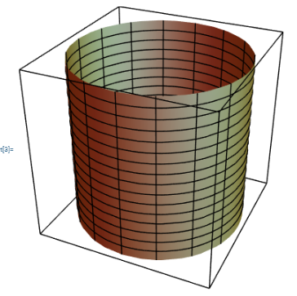
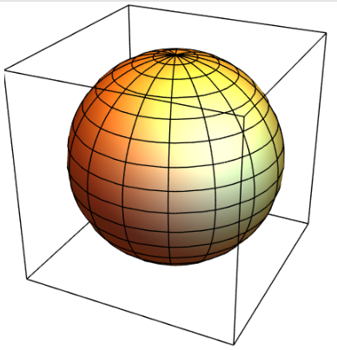
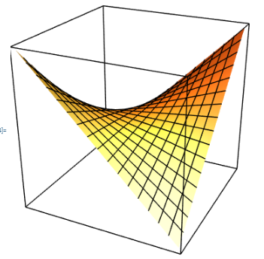
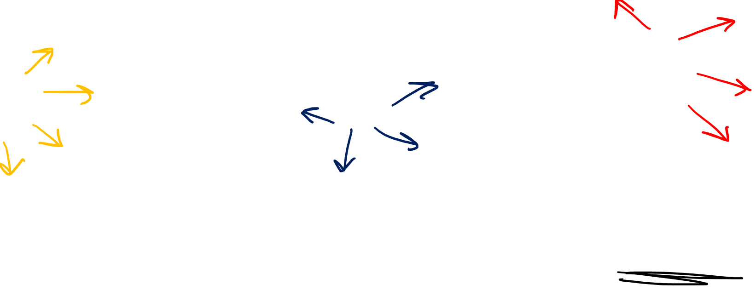
Examples of curved 2D surfaces…
Cylinder
Sphere
Hyperbolic Paraboloid
(“Saddle”)

Slide 6
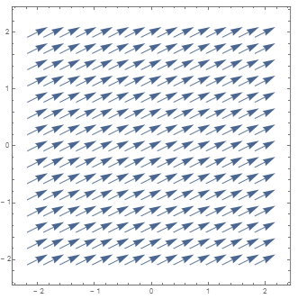
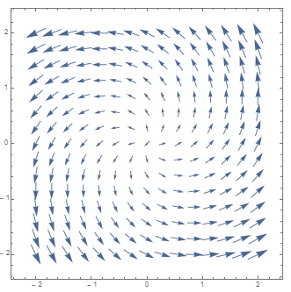
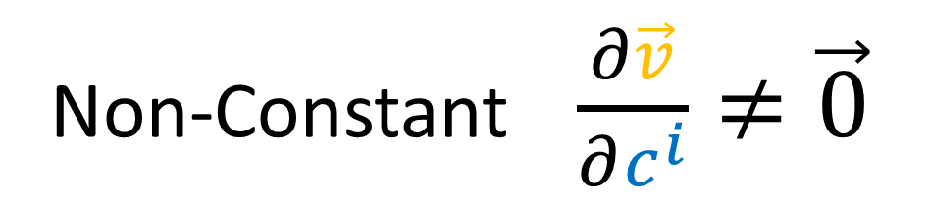
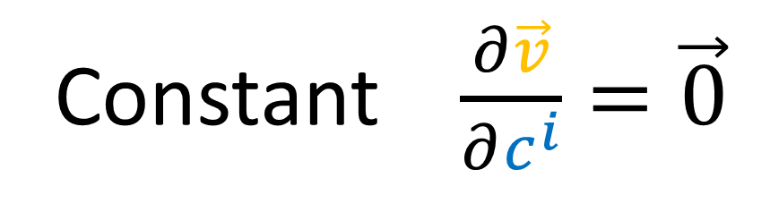
Constant $\frac{∂\vec{v}}{∂c^{i}}=\vec{0}$
Non-Constant $\frac{∂\vec{v}}{∂c^{i}}≠\vec{0}$

Slide 7
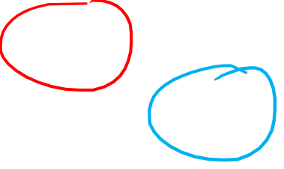

Slide 8


Slide 9
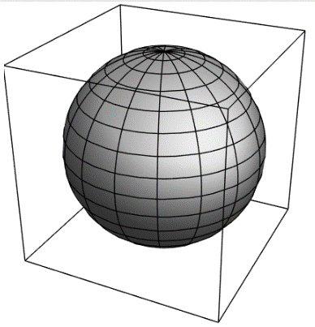
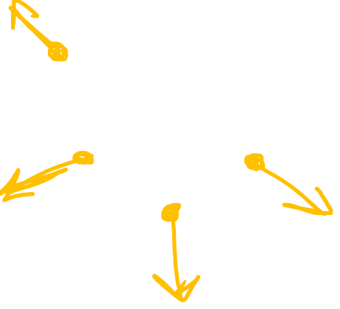

Slide 10
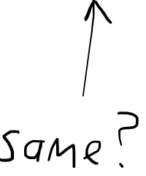

Slide 11
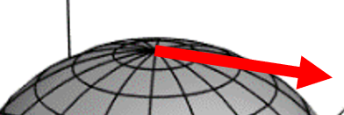
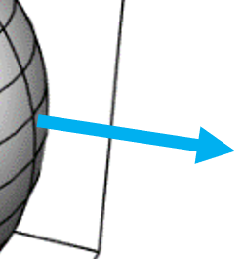
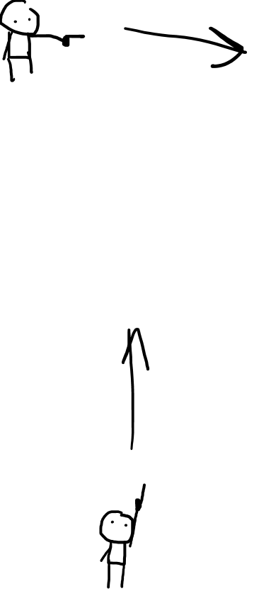

Slide 12

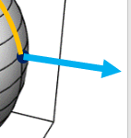

Slide 13
Parallel Transport:
a way of moving vectors around on a surface that “keeps them straight”.

Slide 14


Slide 17
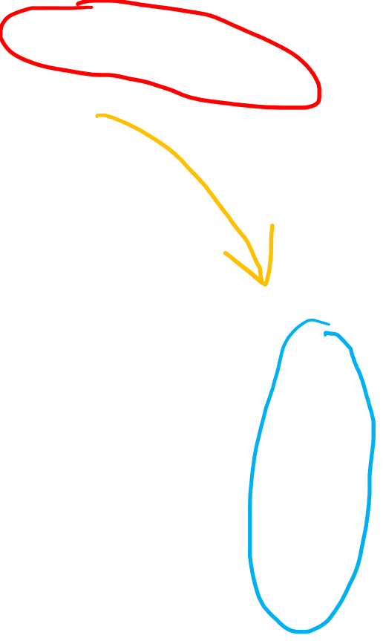
Parallel Transport:
a way of moving vectors around on a surface that “keeps them straight”.

Slide 18
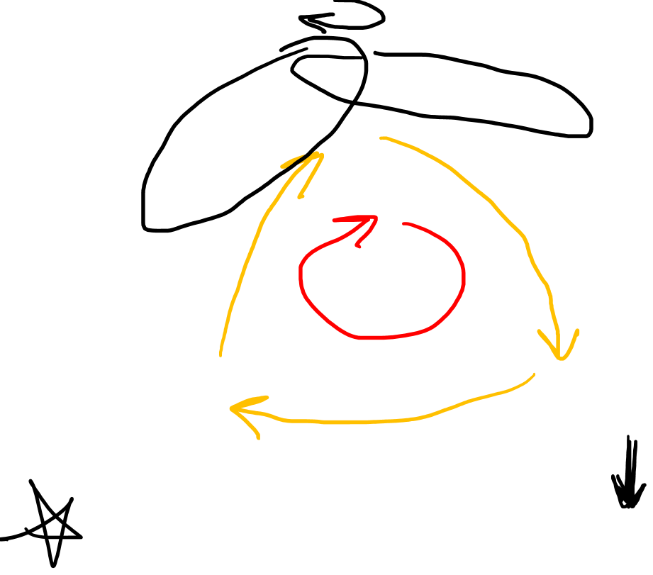
Parallel Transport doesn’t keep vectors “constant”.
It’s impossible to defined a “constant” vector field on a curved surface.
Parallel Transport keeps vectors “as constant as possible”, as we move step-by-step.

Slide 19
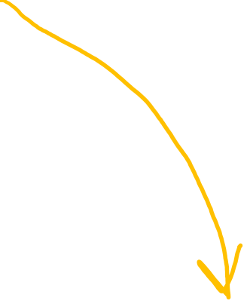

Slide 25


Slide 26
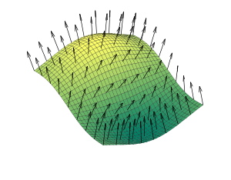
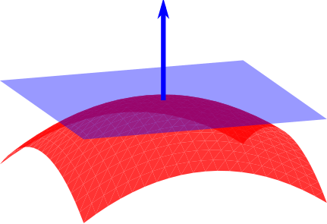
Normal Vectors
Image source: https://en.wikipedia.org/wiki/Normal_(geometry)

Slide 27
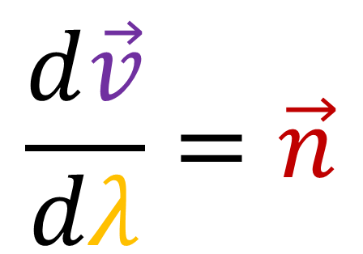

When parallel transporting a vector “forward”, the vector rate of change is completely normal to the surface.
Given a path, a “parallel transported” vector field will obey…
$$\frac{d\vec{v}}{dλ}=\vec{n}$$

Slide 28
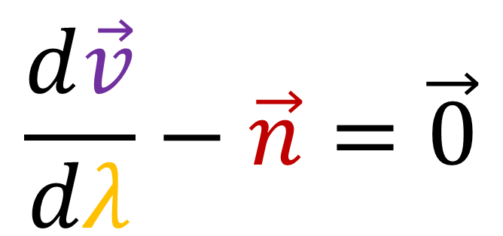
When parallel transporting a vector “forward”, the vector rate of change is completely normal to the surface.
Given a path, a “parallel transported” vector field will obey…
$$\frac{d\vec{v}}{dλ}−\vec{n}=\vec{0}$$

Slide 29
It’s impossible to defined a “constant” vector field on a curved surface.
Parallel Transport of a vector along a curve
=
Closest we can get to a “constant” vector field.
Covariant Derivative helps us find parallel transported vector fields!

Slide 30
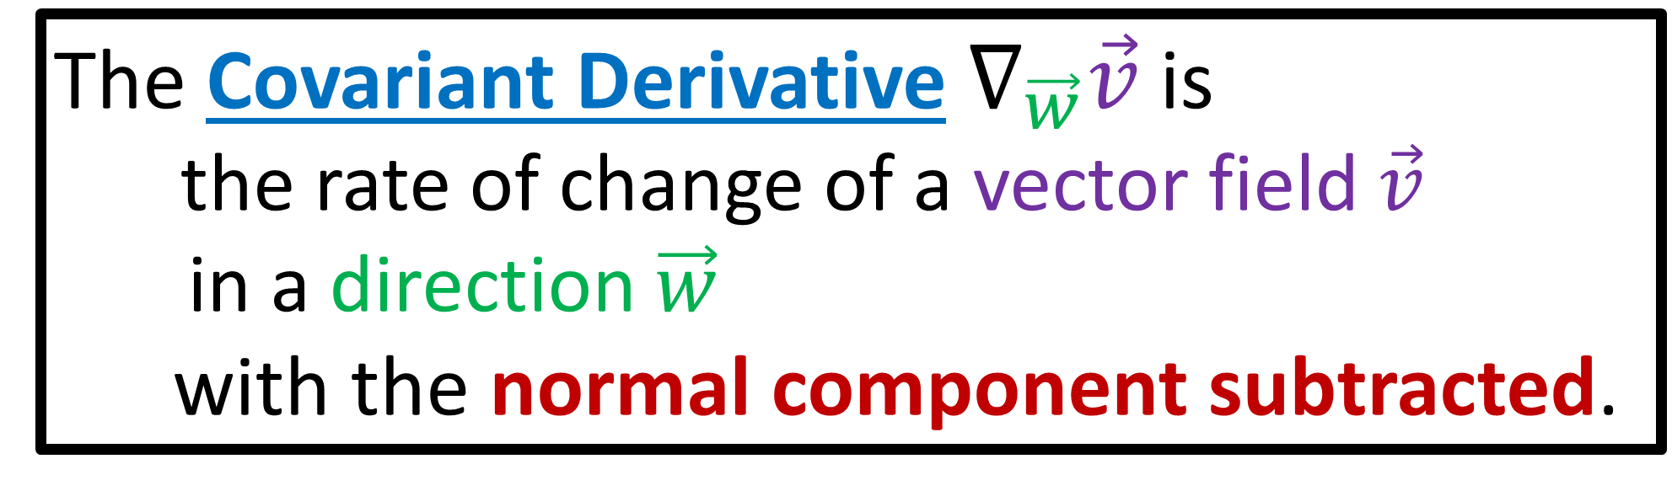

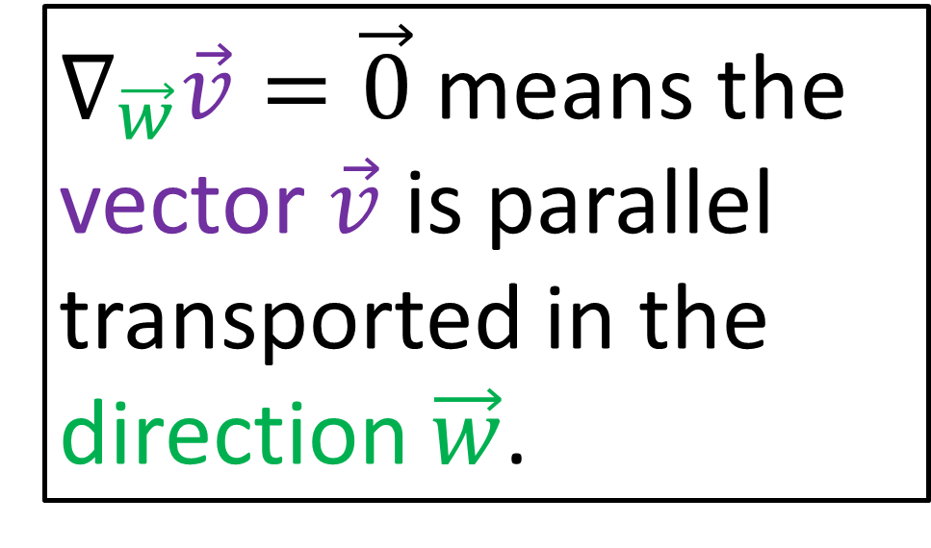
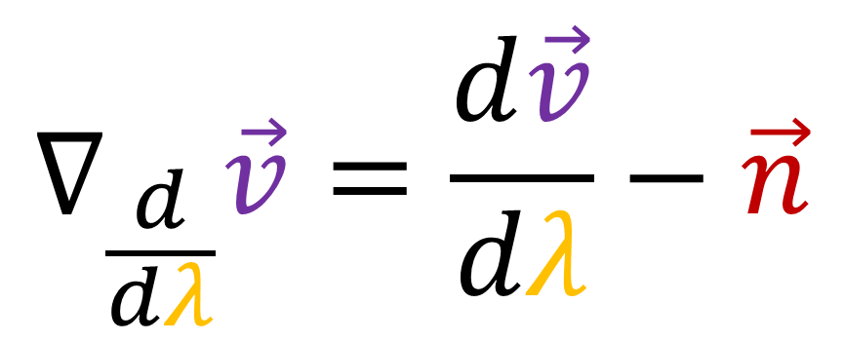
The Covariant Derivative $∇_{\vec{w}}\vec{v}$ is
the rate of change of a vector field $\vec{v}$
in a direction $\vec{w}$
with the normal component subtracted.
$∇_{\vec{w}}\vec{v}=\vec{0}$ means the vector $\vec{v}$ is parallel transported in the direction $\vec{w}$.
$$∇_{\frac{d}{dλ}}\vec{v}=\frac{d\vec{v}}{dλ}−\vec{n}$$

Slide 31
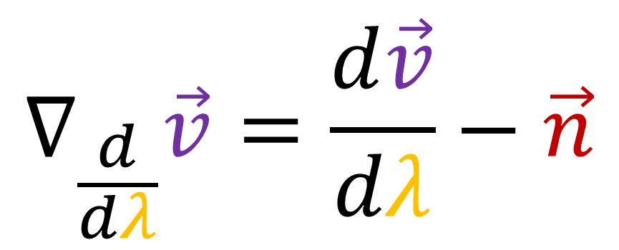
$$∇_{\frac{d}{dλ}}\vec{v}=\frac{d\vec{v}}{dλ}−\vec{n}$$

Slide 32
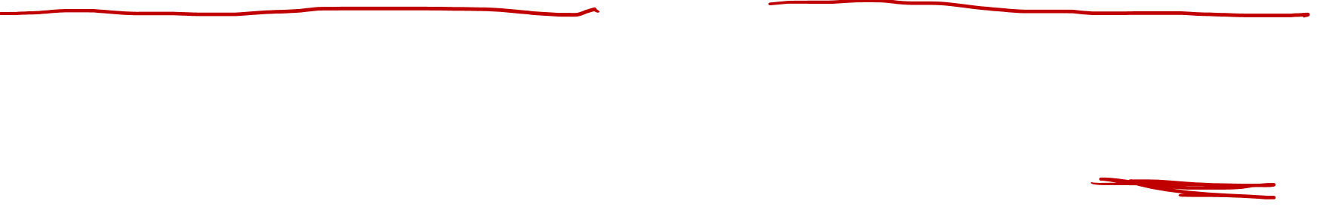
Example: (covariant derivative + parallel transport)
Sphere of radius=1

Slide 33

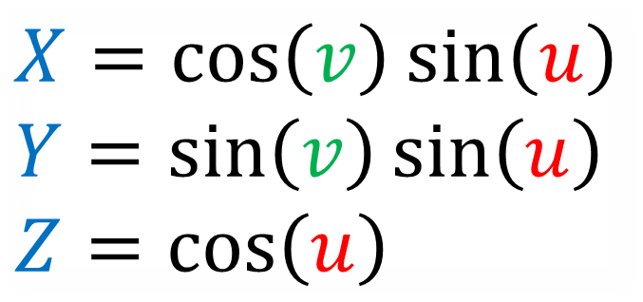
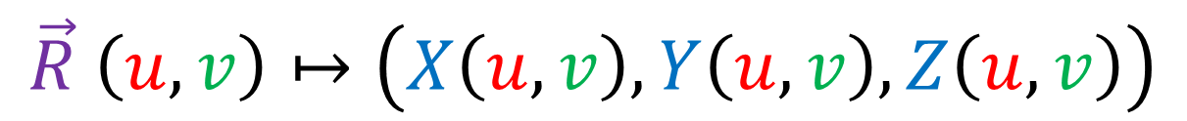



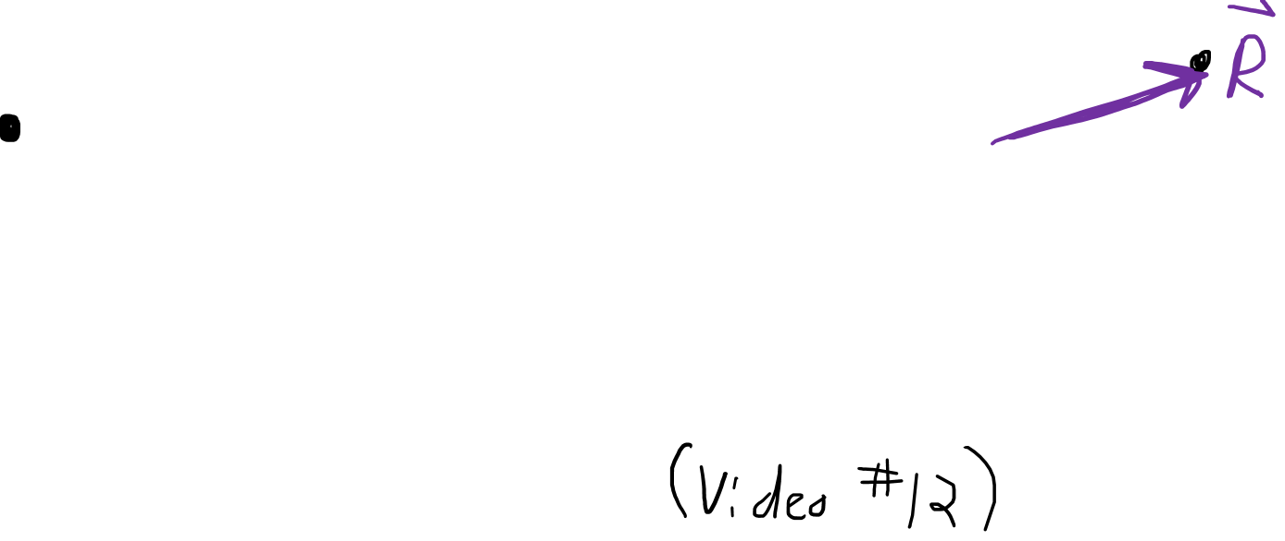
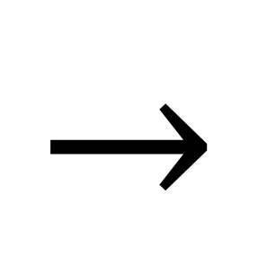

How do you make a 2D surface?
$$\vec{R} \left(u,v\right)↦\left(X\left(u,v\right),Y\left(u,v\right),Z\left(u,v\right)\right)$$
$$u$$
$$Z$$
$$Y$$
$$→$$
$$X$$
$$X=\cos\left(v\right)\sin\left(u\right)$$
$$Y=\sin\left(v\right)\sin\left(u\right)$$
$$Z=\cos\left(u\right)$$
$$v$$

Slide 34
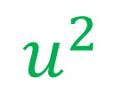
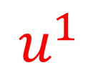
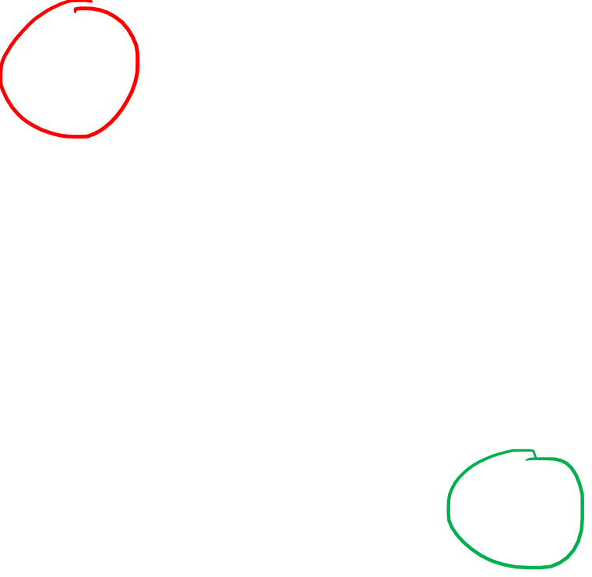
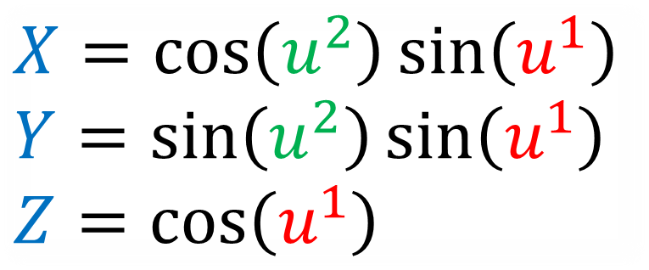
How do you make a 2D surface?
$$\vec{R}\left(u^{1},u^{2}\right)=\left(X\left(u^{1},u^{2}\right),Y\left(u^{1},u^{2}\right),Z\left(u^{1},u^{2}\right)\right)$$
$$u^{1}$$
$$Z$$
$$Y$$
$$→$$
$$X$$
$$X=\cos\left(u^{2}\right)\sin\left(u^{1}\right)$$
$$Y=\sin\left(u^{2}\right)\sin\left(u^{1}\right)$$
$$Z=\cos\left(u^{1}\right)$$
$$u^{2}$$

Slide 35

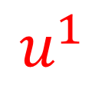

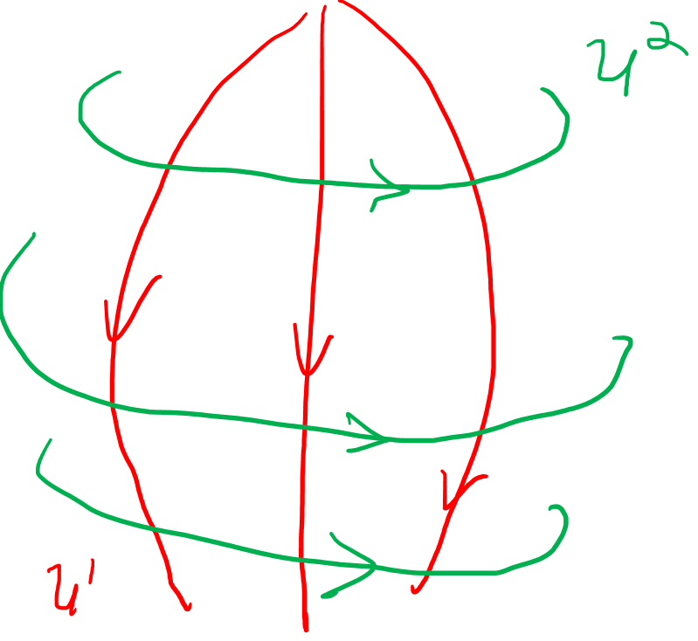
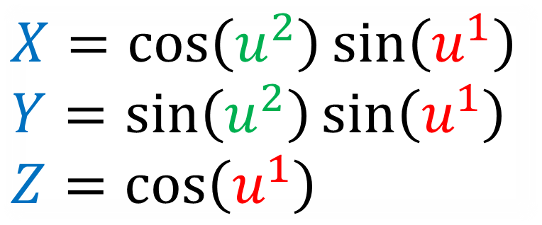

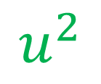
$$u^{1}$$
$$Z$$
$$Y$$
$$→$$
$$X$$
$$u^{2}$$
$$X=\cos\left(u^{2}\right)\sin\left(u^{1}\right)$$
$$Y=\sin\left(u^{2}\right)\sin\left(u^{1}\right)$$
$$Z=\cos\left(u^{1}\right)$$

Slide 36








Metric Tensor in $u,v$space
$$u$$
$$\vec{e_{v}}$$
$$\vec{e_{u}}=\frac{∂\vec{R}}{∂u}$$
$$\vec{e_{v}}=\frac{∂\vec{R}}{∂v}$$
$$\vec{e_{v}}$$
$$\vec{e_{u}}$$
$$\vec{e_{u}}$$
$$v$$

Slide 37









Metric Tensor in $u^{1},u^{2}$space
$$u^{1}$$
$$\vec{e_{2}}$$
$$\frac{∂\vec{R}}{∂u^{1}}=\vec{e_{1}}$$
$$\frac{∂\vec{R}}{∂u^{2}}=\vec{e_{2}}$$
$$\vec{e_{2}}$$
$$\vec{e_{1}}$$
$$\vec{e_{1}}$$
$$u^{2}$$

Slide 38



Covariant Derivative of a
tangent vector field $\vec{v}$
in the direction of the $u^{i}$ coordinate.
$$∇_{\frac{∂}{∂u^{i}}}\vec{v}$$

Slide 39






$$\vec{e_{2}}$$
$$\vec{e_{1}}$$
$∇_{\frac{∂}{∂u^{i}}}\vec{v}=\frac{∂\vec{v}}{∂u^{i}}−\vec{n}$
$=\frac{∂}{∂u^{i}}\left[v^{1}\vec{e_{1}}+v^{2}\vec{e_{2}} \right]−\vec{n}$
$=\frac{∂}{∂u^{i}}\left[v^{j}\vec{e_{j}}\right]−\vec{n}$
$=\left[\frac{∂v^{j}}{∂u^{i}}\vec{e_{j}}+v^{j}\frac{∂\vec{e_{j}}}{∂u^{i}}\right]−\vec{n}$
$$\vec{v}$$

Slide 40



$∇_{\frac{∂}{∂u^{i}}}\vec{v}=\frac{∂\vec{v}}{∂u^{i}}−\vec{n}$
$∇_{\frac{∂}{∂u^{k}}}\vec{v}=\left[\frac{∂v^{j}}{∂u^{i}}\vec{e_{j}}+v^{j}\frac{∂\vec{e_{j}}}{∂u^{i}}\right]−\vec{n}$
Second
Fundamental
Form
Christoffel Symbols
$\frac{∂\vec{e_{j}}}{∂u^{i}}=Γ_{ij}^{1}\vec{e_{1}}+Γ_{ij}^{2}\vec{e_{2}}+L_{ij}\hat{n}$

Slide 41








$\frac{∂\vec{e_{j}}}{∂u^{i}}$
$$\hat{n}$$
$$L_{ij}$$
$$Γ_{ij}^{1}$$
$$\vec{e_{2}}$$
$$Γ_{ij}^{2}$$
$$\vec{e_{1}}$$

Slide 42

$∇_{\frac{∂}{∂u^{i}}}\vec{v}=\frac{∂\vec{v}}{∂u^{i}}−\vec{n}$
$∇_{\frac{∂}{∂u^{k}}}\vec{v}=\left[\frac{∂v^{j}}{∂u^{i}}\vec{e_{j}}+v^{j}\frac{∂\vec{e_{j}}}{∂u^{i}}\right]−\vec{n}$
$\frac{∂\vec{e_{j}}}{∂u^{i}}=Γ_{ij}^{1}\vec{e_{1}}+Γ_{ij}^{2}\vec{e_{2}}+L_{ij}\hat{n}$

Slide 43


$∇_{\frac{∂}{∂u^{i}}}\vec{v}=\frac{∂\vec{v}}{∂u^{i}}−\vec{n}$
$∇_{\frac{∂}{∂u^{k}}}\vec{v}=\left[\frac{∂v^{j}}{∂u^{i}}\vec{e_{j}}+v^{j}\frac{∂\vec{e_{j}}}{∂u^{i}}\right]−\vec{n}$
$\frac{∂\vec{e_{j}}}{∂u^{i}}=Γ_{ij}^{k}\vec{e_{k}}+L_{ij}\hat{n}$

Slide 44


$∇_{\frac{∂}{∂u^{i}}}\vec{v}=\frac{∂\vec{v}}{∂u^{i}}−\vec{n}$
$∇_{\frac{∂}{∂u^{k}}}\vec{v}=\left[\frac{∂v^{j}}{∂u^{i}}\vec{e_{j}}+v^{j}\frac{∂\vec{e_{j}}}{∂u^{i}}\right]−\vec{n}$
$∇_{\frac{∂}{∂u^{k}}}\vec{v}=\left[\frac{∂v^{j}}{∂u^{i}}\vec{e_{j}}+v^{j}\left(Γ_{ij}^{k}\vec{e_{k}}+L_{ij}\hat{n}\right)\right]−\vec{n}$
$∇_{\frac{∂}{∂u^{k}}}\vec{v}=\left[\frac{∂v^{j}}{∂u^{i}}\vec{e_{j}}+v^{j}Γ_{ij}^{k}\vec{e_{k}}\right]+v^{j}L_{ij}\hat{n}−\vec{n}$

Slide 45


$∇_{\frac{∂}{∂u^{i}}}\vec{v}=$ $\left[\frac{∂v^{j}}{∂u^{i}}\vec{e_{j}}+v^{j}Γ_{ij}^{k}\vec{e_{k}}\right]+v^{j}L_{ij}\hat{n}−\vec{n}$
$∇_{\frac{∂}{∂u^{k}}}\vec{v}=$ $\left[\frac{∂v^{k}}{∂u^{i}}\vec{e_{k}}+v^{j}Γ_{ij}^{k}\vec{e_{k}}\right]+v^{j}L_{ij}\hat{n}−\vec{n}$
$∇_{\frac{∂}{∂u^{k}}}\vec{v}=$ $\left[\frac{∂v^{k}}{∂u^{i}}+v^{j}Γ_{ij}^{k}\right]\vec{e_{k}}+v^{j}L_{ij}\hat{n}−\vec{n}$
$∇_{\frac{∂}{∂u^{k}}}\vec{v}=\left[\frac{∂v^{k}}{∂u^{i}}+v^{j}Γ_{ij}^{k}\right]\vec{e_{k}}$

Slide 46



$∇_{\frac{∂}{∂u^{i}}}\vec{v}=\frac{∂\vec{v}}{∂u^{i}}−\vec{n}$
$∇_{\frac{∂}{∂u^{k}}}\vec{v}=\left[\frac{∂v^{k}}{∂u^{i}}+v^{j}Γ_{ij}^{k}\right]\vec{e_{k}}$
$\frac{∂\vec{e_{j}}}{∂u^{i}}=Γ_{ij}^{k}\vec{e_{k}}+L_{ij}\hat{n}$

Slide 47






$$\hat{n}$$
$\frac{∂\vec{e_{j}}}{∂u^{i}}=Γ_{ij}^{k}\vec{e_{k}}+L_{ij}\hat{n}$
$$\vec{e_{2}}$$
$\frac{∂\vec{e_{j}}}{∂u^{i}}⋅\vec{e_{l}}=\left(Γ_{ij}^{k}\vec{e_{k}}+L_{ij}\hat{n}\right)⋅\vec{e_{l}}$
$\frac{∂\vec{e_{j}}}{∂u^{i}}⋅\vec{e_{l}}=Γ_{ij}^{k}\vec{e_{k}}⋅\vec{e_{l}}$
$\frac{∂\vec{e_{j}}}{∂u^{i}}⋅\vec{e_{l}}=Γ_{ij}^{k}g_{kl}$
$$\vec{e_{1}}$$

Slide 48




$$\hat{n}$$
$\frac{∂\vec{e_{j}}}{∂u^{i}}=Γ_{ij}^{k}\vec{e_{k}}+L_{ij}\hat{n}$
$$\vec{e_{2}}$$
$\frac{∂\vec{e_{j}}}{∂u^{i}}⋅\vec{e_{l}}=Γ_{ij}^{k}g_{kl}$
$\frac{∂\vec{e_{j}}}{∂u^{i}}⋅\vec{e_{l}}𝔤^{lm}=Γ_{ij}^{k}g_{kl}𝔤^{lm}$
$\frac{∂\vec{e_{j}}}{∂u^{i}}⋅\vec{e_{l}}𝔤^{lm}=Γ_{ij}^{k}δ_{k}^{m}$
$$\vec{e_{1}}$$
$g_{kl}𝔤^{lm}=δ_{k}^{m}$
$δ_{k}^{m}$ $=\left\{\begin{aligned}1 if m=k \\ 0 if m≠k\end{aligned}\right.$

Slide 49



$$\hat{n}$$
$\frac{∂\vec{e_{j}}}{∂u^{i}}=Γ_{ij}^{k}\vec{e_{k}}+L_{ij}\hat{n}$
$$\vec{e_{2}}$$
$\frac{∂\vec{e_{j}}}{∂u^{i}}⋅\vec{e_{l}}=Γ_{ij}^{k}g_{kl}$
$\frac{∂\vec{e_{j}}}{∂u^{i}}⋅\vec{e_{l}}𝔤^{lm}=Γ_{ij}^{k}g_{kl}𝔤^{lm}$
$$\vec{e_{1}}$$
$g_{kl}𝔤^{lm}=δ_{k}^{m}$
$δ_{k}^{m}$ $=\left\{\begin{aligned}1 if m=k \\ 0 if m≠k\end{aligned}\right.$
$\left(\frac{∂\vec{e_{j}}}{∂u^{i}}⋅\vec{e_{l}}\right)𝔤^{lm}$ $=Γ_{ij}^{m}$

Slide 50


$∇_{\frac{∂}{∂u^{i}}}\vec{v}=\frac{∂\vec{v}}{∂u^{i}}−\vec{n}$
$∇_{\frac{∂}{∂u^{k}}}\vec{v}=\left[\frac{∂v^{k}}{∂u^{i}}+v^{j}Γ_{ij}^{k}\right]\vec{e_{k}}$
$Γ_{ij}^{k}=\left(\frac{∂\vec{e_{j}}}{∂u^{i}}⋅\vec{e_{l}}\right)𝔤^{lk}$

Slide 51



The Covariant Derivative $∇_{\vec{w}}\vec{v}$ is
the rate of change of a vector field $\vec{v}$
in a direction $\vec{w}$
with the normal component subtracted.
$$∇_{\frac{∂}{∂u^{i}}}\vec{v}=\frac{∂\vec{v}}{∂u^{i}}−\vec{n}=\left[\frac{∂v^{k}}{∂u^{i}}+v^{j}Γ_{ij}^{k}\right]\vec{e_{k}}$$

Slide 52


In flat space, the Covariant Derivative of a vector field…
is just the ordinary derivative
$∇_{\frac{∂}{∂u^{i}}}\vec{v}=\frac{∂\vec{v}}{∂u^{i}}$
On curved surfaces, the Covariant Derivative …
is the ordinary derivative with the normal component subtracted.
$∇_{\frac{∂}{∂u^{i}}}\vec{v}=\frac{∂\vec{v}}{∂u^{i}}−\vec{n}$

Slide 53


In flat space, the Covariant Derivative of a vector field…
is just the ordinary derivative
$∇_{\frac{∂}{∂u^{i}}}\vec{v}=\frac{∂\vec{v}}{∂u^{i}}$
$$∇_{\frac{∂}{∂u^{i}}}\vec{v}=\frac{∂\vec{v}}{∂u^{i}}−\vec{n}$$

Slide 54



The Covariant Derivative $∇_{\vec{w}}\vec{v}$ is
the rate of change of a vector field $\vec{v}$
in a direction $\vec{w}$
with the normal component subtracted.
$$∇_{\frac{∂}{∂u^{i}}}\vec{v}=\frac{∂\vec{v}}{∂u^{i}}−\vec{n}$$
$∇_{\frac{∂}{∂u^{k}}}\vec{v}=\left[\frac{∂v^{k}}{∂u^{i}}+v^{j}Γ_{ij}^{k}\right]\vec{e_{k}}$
$Γ_{ij}^{k}=\left(\frac{∂\vec{e_{j}}}{∂u^{i}}⋅\vec{e_{l}}\right)𝔤^{lk}$

Slide 55
The Covariant Derivative $∇_{\vec{w}}\vec{v}$ is
the rate of change of a vector field $\vec{v}$
in a direction $\vec{w}$
with the normal component subtracted.
$$∇_{\frac{∂}{∂u^{i}}}\vec{v}=\frac{∂\vec{v}}{∂u^{i}}−\vec{n}$$
$∇_{\frac{∂}{∂u^{k}}}\vec{v}=\left[\frac{∂v^{k}}{∂u^{i}}+v^{j}Γ_{ij}^{k}\right]\vec{e_{k}}$
$Γ_{ij}^{k}=\left(\frac{∂\vec{e_{j}}}{∂u^{i}}⋅\vec{e_{l}}\right)𝔤^{lk}$

Slide 56



From Tensor Calculus Video #16:
$$X=\cos\left(u^{2}\right)\sin\left(u^{1}\right)$$
$$Y=\sin\left(u^{2}\right)\sin\left(u^{1}\right)$$
$$Z=\cos\left(u^{1}\right)$$
$\frac{∂\vec{R}}{∂u^{1}}=\frac{∂X}{∂u^{1}}\frac{∂\vec{R}}{∂X}+\frac{∂Y}{∂u^{1}}\frac{∂\vec{R}}{∂Y}+\frac{∂Z}{∂u^{1}}\frac{∂\vec{R}}{∂Z}$
$\frac{∂\vec{R}}{∂u^{2}}=\frac{∂X}{∂u^{2}}\frac{∂\vec{R}}{∂X}+\frac{∂Y}{∂u^{2}}\frac{∂\vec{R}}{∂Y}+\frac{∂Z}{∂u^{2}}\frac{∂\vec{R}}{∂Z}$

Slide 57


From Tensor Calculus Video #16:
$$X=\cos\left(u^{2}\right)\sin\left(u^{1}\right)$$
$$Y=\sin\left(u^{2}\right)\sin\left(u^{1}\right)$$
$$Z=\cos\left(u^{1}\right)$$
$\frac{∂\vec{R}}{∂u^{1}}= \cos\left(u^{2}\right)\cos\left(u^{1}\right)\frac{∂\vec{R}}{∂X}+\sin\left(u^{2}\right)\cos\left(u^{1}\right)\frac{∂\vec{R}}{∂Y} −\sin\left(u^{1}\right)\frac{∂\vec{R}}{∂Z}$
$\frac{∂\vec{R}}{∂u^{2}}=−\sin\left(u^{2}\right)\sin\left(u^{1}\right)\frac{∂\vec{R}}{∂X}+\cos\left(u^{2}\right)\sin\left(u^{1}\right)\frac{∂\vec{R}}{∂Y}$
$g_{ij}→\left[\begin{matrix}\frac{∂\vec{R}}{∂u^{1}}⋅\frac{∂\vec{R}}{∂u^{1}} & \frac{∂\vec{R}}{∂u^{1}}⋅\frac{∂\vec{R}}{∂u^{2}} \\ \frac{∂\vec{R}}{∂u^{2}}⋅\frac{∂\vec{R}}{∂u^{1}} & \frac{∂\vec{R}}{∂u^{2}}⋅\frac{∂\vec{R}}{∂u^{2}}\end{matrix}\right]=\left[\begin{matrix}1 & 0 \\ 0 & {\left(\sin\left(u^{1}\right)\right)}^{2}\end{matrix}\right]$

Slide 58



$\frac{∂\vec{R}}{∂u^{1}}= \cos\left(u^{2}\right)\cos\left(u^{1}\right)\frac{∂\vec{R}}{∂X}+\sin\left(u^{2}\right)\cos\left(u^{1}\right)\frac{∂\vec{R}}{∂Y} −\sin\left(u^{1}\right)\frac{∂\vec{R}}{∂Z}$
$\frac{∂\vec{R}}{∂u^{2}}=−\sin\left(u^{2}\right)\sin\left(u^{1}\right)\frac{∂\vec{R}}{∂X}+\cos\left(u^{2}\right)\sin\left(u^{1}\right)\frac{∂\vec{R}}{∂Y}$
$\frac{∂}{∂u^{1}}\left(\frac{∂\vec{R}}{∂u^{1}}\right)=−\cos\left(u^{2}\right)\sin\left(u^{1}\right)\frac{∂\vec{R}}{∂X}−\sin\left(u^{2}\right)\sin\left(u^{1}\right)\frac{∂\vec{R}}{∂Y} −\cos\left(u^{1}\right)\frac{∂\vec{R}}{∂Z}$
$\frac{∂}{∂u^{2}}\left(\frac{∂\vec{R}}{∂u^{2}}\right)=−\cos\left(u^{2}\right)\sin\left(u^{1}\right)\frac{∂\vec{R}}{∂X}−\sin\left(u^{2}\right)\sin\left(u^{1}\right)\frac{∂\vec{R}}{∂Y}$
$\frac{∂}{∂u^{1}}\left(\frac{∂\vec{R}}{∂u^{2}}\right)=\frac{∂}{∂u^{2}}\left(\frac{∂\vec{R}}{∂u^{1}}\right)=−\sin\left(u^{2}\right)\cos\left(u^{1}\right)\frac{∂\vec{R}}{∂X}+\cos\left(u^{2}\right)\cos\left(u^{1}\right)\frac{∂\vec{R}}{∂Y}$

Slide 59



$\frac{∂\vec{R}}{∂u^{1}}= \cos\left(u^{2}\right)\cos\left(u^{1}\right)\frac{∂\vec{R}}{∂X}+\sin\left(u^{2}\right)\cos\left(u^{1}\right)\frac{∂\vec{R}}{∂Y} −\sin\left(u^{1}\right)\frac{∂\vec{R}}{∂Z}$
$\frac{∂\vec{R}}{∂u^{2}}=−\sin\left(u^{2}\right)\sin\left(u^{1}\right)\frac{∂\vec{R}}{∂X}+\cos\left(u^{2}\right)\sin\left(u^{1}\right)\frac{∂\vec{R}}{∂Y}$
$\frac{∂}{∂u^{1}}\left(\frac{∂\vec{R}}{∂u^{1}}\right)=−\cos\left(u^{2}\right)\sin\left(u^{1}\right)\frac{∂\vec{R}}{∂X}−\sin\left(u^{2}\right)\sin\left(u^{1}\right)\frac{∂\vec{R}}{∂Y} −\cos\left(u^{1}\right)\frac{∂\vec{R}}{∂Z}$
$\frac{∂}{∂u^{2}}\left(\frac{∂\vec{R}}{∂u^{2}}\right)=−\cos\left(u^{2}\right)\sin\left(u^{1}\right)\frac{∂\vec{R}}{∂X}−\sin\left(u^{2}\right)\sin\left(u^{1}\right)\frac{∂\vec{R}}{∂Y}$
$\frac{∂}{∂u^{1}}\left(\frac{∂\vec{R}}{∂u^{2}}\right)=\frac{∂}{∂u^{2}}\left(\frac{∂\vec{R}}{∂u^{1}}\right)=−\sin\left(u^{2}\right)\cos\left(u^{1}\right)\frac{∂\vec{R}}{∂X}+\cos\left(u^{2}\right)\cos\left(u^{1}\right)\frac{∂\vec{R}}{∂Y}$
$$g_{ij}→\left[\begin{matrix}1 & 0 \\ 0 & {\left(\sin\left(u^{1}\right)\right)}^{2}\end{matrix}\right]$$
$𝔤^{ij}→\left[\begin{matrix}1 & 0 \\ 0 & {1/\left(\sin\left(u^{1}\right)\right)}^{2}\end{matrix}\right]$

Slide 60


$$\frac{∂\vec{R}}{∂u^{i}}=\vec{e_{i}}$$

Slide 61
$\frac{∂\vec{R}}{∂u^{1}}= \cos\left(u^{2}\right)\cos\left(u^{1}\right)\frac{∂\vec{R}}{∂X}+\sin\left(u^{2}\right)\cos\left(u^{1}\right)\frac{∂\vec{R}}{∂Y} −\sin\left(u^{1}\right)\frac{∂\vec{R}}{∂Z}$
$\frac{∂\vec{R}}{∂u^{2}}=−\sin\left(u^{2}\right)\sin\left(u^{1}\right)\frac{∂\vec{R}}{∂X}+\cos\left(u^{2}\right)\sin\left(u^{1}\right)\frac{∂\vec{R}}{∂Y}$
$\frac{∂}{∂u^{1}}\left(\frac{∂\vec{R}}{∂u^{1}}\right)=−\cos\left(u^{2}\right)\sin\left(u^{1}\right)\frac{∂\vec{R}}{∂X}−\sin\left(u^{2}\right)\sin\left(u^{1}\right)\frac{∂\vec{R}}{∂Y} −\cos\left(u^{1}\right)\frac{∂\vec{R}}{∂Z}$
$\frac{∂}{∂u^{2}}\left(\frac{∂\vec{R}}{∂u^{2}}\right)=−\cos\left(u^{2}\right)\sin\left(u^{1}\right)\frac{∂\vec{R}}{∂X}−\sin\left(u^{2}\right)\sin\left(u^{1}\right)\frac{∂\vec{R}}{∂Y}$
$\frac{∂}{∂u^{1}}\left(\frac{∂\vec{R}}{∂u^{2}}\right)=\frac{∂}{∂u^{2}}\left(\frac{∂\vec{R}}{∂u^{1}}\right)=−\sin\left(u^{2}\right)\cos\left(u^{1}\right)\frac{∂\vec{R}}{∂X}+\cos\left(u^{2}\right)\cos\left(u^{1}\right)\frac{∂\vec{R}}{∂Y}$
$$g_{ij}→\left[\begin{matrix}1 & 0 \\ 0 & {\left(\sin\left(u^{1}\right)\right)}^{2}\end{matrix}\right]$$
$𝔤^{ij}→\left[\begin{matrix}1 & 0 \\ 0 & {1/\left(\sin\left(u^{1}\right)\right)}^{2}\end{matrix}\right]$

Slide 62




$$\vec{e_{1}}= \cos\left(u^{2}\right)\cos\left(u^{1}\right)\vec{e_{X}}+\sin\left(u^{2}\right)\cos\left(u^{1}\right)\vec{e_{Y}}−\sin\left(u^{1}\right)\vec{e_{Z}}$$
$\vec{e_{2}}=−\sin\left(u^{2}\right)\sin\left(u^{1}\right)\vec{e_{X}}+\cos\left(u^{2}\right)\sin\left(u^{1}\right)\vec{e_{Y}}$
$\frac{∂\vec{e_{1}}}{∂u^{1}}=−\cos\left(u^{2}\right)\sin\left(u^{1}\right)\vec{e_{X}}−\sin\left(u^{2}\right)\sin\left(u^{1}\right)\vec{e_{Y}}−\cos\left(u^{1}\right)\vec{e_{Z}}$
$\frac{∂\vec{e_{2}}}{∂u^{2}}=−\cos\left(u^{2}\right)\sin\left(u^{1}\right)\vec{e_{X}}−\sin\left(u^{2}\right)\sin\left(u^{1}\right)\vec{e_{Y}}$
$\frac{∂\vec{e_{2}}}{∂u^{1}}=\frac{∂\vec{e_{1}}}{∂u^{2}}=−\sin\left(u^{2}\right)\cos\left(u^{1}\right)\vec{e_{X}}+\cos\left(u^{2}\right)\cos\left(u^{1}\right)\vec{e_{Y}}$
$$g_{ij}→\left[\begin{matrix}1 & 0 \\ 0 & {\left(\sin\left(u^{1}\right)\right)}^{2}\end{matrix}\right]$$
$𝔤^{ij}→\left[\begin{matrix}1 & 0 \\ 0 & {1/\left(\sin\left(u^{1}\right)\right)}^{2}\end{matrix}\right]$

Slide 63


$Γ_{11}^{1}=\left(\frac{∂\vec{e_{1}}}{∂u^{1}}⋅\vec{e_{l}}\right)𝔤^{l1}$ | $Γ_{11}^{2}=\left(\frac{∂\vec{e_{1}}}{∂u^{1}}⋅\vec{e_{l}}\right)𝔤^{l2}$
$Γ_{12}^{1}=\left(\frac{∂\vec{e_{2}}}{∂u^{1}}⋅\vec{e_{l}}\right)𝔤^{l1}$ | $Γ_{12}^{2}=\left(\frac{∂\vec{e_{2}}}{∂u^{1}}⋅\vec{e_{l}}\right)𝔤^{l2}$
$Γ_{21}^{1}=\left(\frac{∂\vec{e_{1}}}{∂u^{2}}⋅\vec{e_{l}}\right)𝔤^{l1}$ | $Γ_{21}^{2}=\left(\frac{∂\vec{e_{1}}}{∂u^{2}}⋅\vec{e_{l}}\right)𝔤^{l2}$
$Γ_{22}^{1}=\left(\frac{∂\vec{e_{2}}}{∂u^{2}}⋅\vec{e_{l}}\right)𝔤^{l1}$ | $Γ_{22}^{2}=\left(\frac{∂\vec{e_{2}}}{∂u^{2}}⋅\vec{e_{l}}\right)𝔤^{l2}$

Slide 64

$Γ_{11}^{1}=0$ | $Γ_{11}^{2}=0$
$Γ_{12}^{1}=0$ | $Γ_{12}^{2}=\left(\frac{∂\vec{e_{2}}}{∂u^{1}}⋅\vec{e_{l}}\right)𝔤^{l2}$
$Γ_{21}^{1}=0$ | $Γ_{21}^{2}=\left(\frac{∂\vec{e_{1}}}{∂u^{2}}⋅\vec{e_{l}}\right)𝔤^{l2}$
$Γ_{22}^{1}=\left(\frac{∂\vec{e_{2}}}{∂u^{2}}⋅\vec{e_{l}}\right)𝔤^{l1}$ | $Γ_{22}^{2}=0$

Slide 65


$Γ_{11}^{1}=0$ | $$Γ_{11}^{2}=0$$
$Γ_{12}^{1}=0$ | $$Γ_{12}^{2}=\frac{\cos\left(u^{1}\right)\sin\left(u^{1}\right)}{{\left(\sin\left(u^{1}\right)\right)}^{2}}$$
$$Γ_{21}^{1}=0$$ | $$Γ_{21}^{2}=\frac{\cos\left(u^{1}\right)\sin\left(u^{1}\right)}{{\left(\sin\left(u^{1}\right)\right)}^{2}}$$
$$Γ_{22}^{1}=\left(−\cos\left(u^{1}\right)\sin\left(u^{1}\right)\right)\left(1\right)$$ | $Γ_{22}^{2}=0$

Slide 66


$Γ_{11}^{1}=0$ | $$Γ_{11}^{2}=0$$
$Γ_{12}^{1}=0$ | $$Γ_{12}^{2}=\frac{\cos\left(u^{1}\right)}{\sin\left(u^{1}\right)}$$
$$Γ_{21}^{1}=0$$ | $$Γ_{21}^{2}=\frac{\cos\left(u^{1}\right)}{\sin\left(u^{1}\right)}$$
$$Γ_{22}^{1}=−\cos\left(u^{1}\right)\sin\left(u^{1}\right)$$ | $Γ_{22}^{2}=0$

Slide 67


$Γ_{11}^{1}=0$ | $$Γ_{11}^{2}=0$$
$Γ_{12}^{1}=0$ | $$Γ_{12}^{2}=\frac{\cos\left(u^{1}\right)}{\sin\left(u^{1}\right)}$$
$$Γ_{21}^{1}=0$$ | $$Γ_{21}^{2}=\frac{\cos\left(u^{1}\right)}{\sin\left(u^{1}\right)}$$
$Γ_{22}^{1}=−\frac{1}{2}\sin\left(2u^{1}\right)$ | $Γ_{22}^{2}=0$

Slide 68

$Γ_{11}^{1}=0$ | $$Γ_{11}^{2}=0$$
$Γ_{12}^{1}=0$ | $$Γ_{12}^{2}=\cot\left(u^{1}\right)$$
$$Γ_{21}^{1}=0$$ | $$Γ_{21}^{2}=\cot\left(u^{1}\right)$$
$Γ_{22}^{1}=−\frac{1}{2}\sin\left(2u^{1}\right)$ | $Γ_{22}^{2}=0$

Slide 69


$∇_{\vec{e_{i}}}\vec{v}=\left[\frac{∂v^{k}}{∂u^{i}}+v^{j}Γ_{ij}^{k}\right]\vec{e_{k}}$
$$∇_{\frac{∂}{∂u^{k}}}\vec{v}$$

Slide 70


$∇_{\vec{e_{1}}}\vec{v}=\left[\frac{∂v^{k}}{∂u^{1}}+v^{j}Γ_{1j}^{k}\right]\vec{e_{k}}$
$∇_{\vec{e_{2}}}\vec{v}=\left[\frac{∂v^{k}}{∂u^{2}}+v^{j}Γ_{2j}^{k}\right]\vec{e_{k}}$
$$∇_{\frac{∂}{∂u^{k}}}\vec{v}$$

Slide 71

$∇_{\vec{e_{1}}}\vec{v}=\frac{∂v^{1}}{∂u^{1}}\vec{e_{1}}+\left[\frac{∂v^{2}}{∂u^{1}}+v^{2}Γ_{12}^{2}\right]\vec{e_{2}}$
$∇_{\vec{e_{2}}}\vec{v}=\left[\frac{∂v^{1}}{∂u^{2}}+v^{2}Γ_{22}^{1}\right]\vec{e_{1}}+\left[\frac{∂v^{2}}{∂u^{2}}+v^{1}Γ_{21}^{2}\right]\vec{e_{2}}$
$$∇_{\frac{∂}{∂u^{k}}}\vec{v}$$

Slide 72

$∇_{\vec{e_{1}}}\vec{v}=\frac{∂v^{1}}{∂u^{1}}\vec{e_{1}}+\left[\frac{∂v^{2}}{∂u^{1}}+v^{2}\cot\left(u^{1}\right)\right]\vec{e_{2}}$
$∇_{\vec{e_{2}}}\vec{v}=\left[\frac{∂v^{1}}{∂u^{2}}−v^{2}\frac{1}{2}\sin\left(2u^{1}\right)\right]\vec{e_{1}}+\left[\frac{∂v^{2}}{∂u^{2}}+v^{1}\cot\left(u^{1}\right)\right]\vec{e_{2}}$
$$∇_{\frac{∂}{∂u^{k}}}\vec{v}$$

Slide 73



$λ↦\left(u^{1}=\frac{π}{2},u^{2}=λ\right)$
$$\vec{v}=\cos\left(u^{2}\right)\vec{e_{1}}+\sin\left(u^{2}\right)\vec{e_{2}}$$

Slide 74


$λ↦\left(u^{1}=\frac{π}{2},u^{2}=λ\right)$
$$\vec{v}=\cos\left(u^{2}\right)\vec{e_{1}}+\sin\left(u^{2}\right)\vec{e_{2}}$$
$$∇_{\frac{d}{dλ}}\vec{v}=∇_{\frac{∂}{∂u^{2}}}\vec{v}$$
$= ∇_{\vec{e_{2}}}\vec{v}$

Slide 75



$λ↦\left(u^{1}=\frac{π}{2},u^{2}=λ\right)$
$$\vec{v}=\cos\left(u^{2}\right)\vec{e_{1}}+\sin\left(u^{2}\right)\vec{e_{2}}$$
$∇_{\vec{e_{2}}}\vec{v}=\left[\frac{∂v^{1}}{∂u^{2}}−v^{2}\frac{1}{2}\sin\left(2u^{1}\right)\right]\vec{e_{1}}+\left[\frac{∂v^{2}}{∂u^{2}}+v^{1}\cot\left(u^{1}\right)\right]\vec{e_{2}}$

Slide 76

$λ↦\left(u^{1}=\frac{π}{2},u^{2}=λ\right)$
$$\vec{v}=\cos\left(u^{2}\right)\vec{e_{1}}+\sin\left(u^{2}\right)\vec{e_{2}}$$
$$∇_{\vec{e_{2}}}\vec{v}=\left[\frac{∂v^{1}}{∂u^{2}}\right]\vec{e_{1}}+\left[\frac{∂v^{2}}{∂u^{2}}\right]\vec{e_{2}}$$

Slide 77

$λ↦\left(u^{1}=\frac{π}{2},u^{2}=λ\right)$
$$\vec{v}=\cos\left(u^{2}\right)\vec{e_{1}}+\sin\left(u^{2}\right)\vec{e_{2}}$$
$$∇_{\vec{e_{2}}}\vec{v}=\left[\frac{∂\left(\cos\left(u^{2}\right)\right)}{∂u^{2}}\right]\vec{e_{1}}+\left[\frac{∂\left(\sin\left(u^{2}\right)\right)}{∂u^{2}}\right]\vec{e_{2}}$$

Slide 78
$λ↦\left(u^{1}=\frac{π}{2},u^{2}=λ\right)$
$$\vec{v}=\cos\left(u^{2}\right)\vec{e_{1}}+\sin\left(u^{2}\right)\vec{e_{2}}$$
$$∇_{\vec{e_{2}}}\vec{v}=−\sin\left(u^{2}\right)\vec{e_{1}}+\cos\left(u^{2}\right)\vec{e_{2}}$$

Slide 79




$λ↦\left(u^{1}=\frac{π}{2},u^{2}=λ\right)$
$$\vec{v}=\cos\left(u^{2}\right)\vec{e_{1}}+\sin\left(u^{2}\right)\vec{e_{2}}$$
$$∇_{\vec{e_{2}}}\vec{v}=−\sin\left(u^{2}\right)\vec{e_{1}}+\cos\left(u^{2}\right)\vec{e_{2}}$$

Slide 80



$λ↦\left(u^{1}=\frac{π}{2},u^{2}=λ\right)$
$$\vec{v}=\vec{e_{2}}$$

Slide 81


$λ↦\left(u^{1}=\frac{π}{2},u^{2}=λ\right)$
$$\vec{v}=0\vec{e_{1}}+1\vec{e_{2}}$$
$∇_{\vec{e_{2}}}\vec{v}=\left[\frac{∂v^{1}}{∂u^{2}}−v^{2}\frac{1}{2}\sin\left(2u^{1}\right)\right]\vec{e_{1}}+\left[\frac{∂v^{2}}{∂u^{2}}+v^{1}\cot\left(u^{1}\right)\right]\vec{e_{2}}$

Slide 82

$λ↦\left(u^{1}=\frac{π}{2},u^{2}=λ\right)$
$$\vec{v}=0\vec{e_{1}}+1\vec{e_{2}}$$
$$∇_{\vec{e_{2}}}\vec{v}=\vec{0}$$

Slide 83




$λ↦\left(u^{1}=\frac{π}{2},u^{2}=λ\right)$
$$\vec{v}=0\vec{e_{1}}+1\vec{e_{2}}$$
$$∇_{\vec{e_{2}}}\vec{v}=\vec{0}$$

Slide 84


Vector Field on Curve
$→$ Check if Parallel Transport
(start with Initial Vector + Curve…)
Demand Parallel Transport
$→$ Get Resulting Vector Field

Slide 85




$λ↦\left(u^{1}=\frac{π}{2},u^{2}=λ\right)$
$$\vec{v_{0}}=\vec{e_{1}}$$
$$∇_{\vec{e_{2}}}\vec{v}=\vec{0}$$
$$\vec{v_{0}}$$

Slide 86







$λ↦\left(u^{1}=\frac{π}{2},u^{2}=λ\right)$
$$\vec{v_{0}}=1\vec{e_{1}}+0\vec{e_{2}}$$
$∇_{\vec{e_{2}}}\vec{v}=\left[\frac{∂v^{1}}{∂u^{2}}−v^{2}\frac{1}{2}\sin\left(2u^{1}\right)\right]\vec{e_{1}}+\left[\frac{∂v^{2}}{∂u^{2}}+v^{1}\cot\left(u^{1}\right)\right]\vec{e_{2}}$
$\vec{0} =\frac{∂v^{1}}{∂u^{2}}\vec{e_{1}}+\frac{∂v^{2}}{∂u^{2}}\vec{e_{2}}$
$\frac{∂v^{1}}{∂u^{2}}=0$
$\frac{∂v^{2}}{∂u^{2}}=0$
$$⇒$$
$$⇒$$
$$v^{1}=c_{1}$$
$$v^{2}=c_{2}$$

Slide 87







$λ↦\left(u^{1}=\frac{π}{2},u^{2}=λ\right)$
$$v^{1}\left(λ\right)=c_{1}$$
$$v^{2}\left(λ\right)=c_{2}$$
$$\vec{v_{0}}=1\vec{e_{1}}+0\vec{e_{2}}$$
$$v^{1}\left(λ=0\right)=c_{1}=1$$
$$v^{2}\left(λ=0\right)=c_{2}=0$$
$$c_{1}=1$$
$$c_{2}=0$$
$$v^{1}\left(λ\right)=1$$
$$v^{2}\left(λ\right)=0$$
$$⇒$$
$$\vec{v}\left(λ\right)=1\vec{e_{1}}+0\vec{e_{2}}$$

Slide 88

$λ↦\left(u^{1}=\frac{π}{2},u^{2}=λ\right)$
$$\vec{v_{0}}=\vec{e_{1}}$$
$$\vec{v}\left(λ\right)=1\vec{e_{1}}+0\vec{e_{2}}$$
$$\vec{v_{0}}$$

Slide 89



$λ↦\left(u^{1}=\frac{π}{4},u^{2}=λ\right)$
$$\vec{v_{0}}=\vec{e_{1}}$$
$$\vec{v_{0}}$$
$$∇_{\vec{e_{2}}}\vec{v}=\vec{0}$$

Slide 90




$λ↦\left(u^{1}=\frac{π}{4},u^{2}=λ\right)$
$$\vec{v_{0}}=1\vec{e_{1}}+0\vec{e_{2}}$$
$∇_{\vec{e_{2}}}\vec{v}=\left[\frac{∂v^{1}}{∂u^{2}}−v^{2}\frac{1}{2}\sin\left(2u^{1}\right)\right]\vec{e_{1}}+\left[\frac{∂v^{2}}{∂u^{2}}+v^{1}\cot\left(u^{1}\right)\right]\vec{e_{2}}$
$\vec{0} =\left[\frac{∂v^{1}}{∂u^{2}}−v^{2}\frac{1}{2}\sin\left(2\frac{π}{4}\right)\right]\vec{e_{1}}+\left[\frac{∂v^{2}}{∂u^{2}}+v^{1}\cot\left(\frac{π}{4}\right)\right]\vec{e_{2}}$
$\vec{0} =\left[\frac{∂v^{1}}{∂u^{2}}−\frac{v^{2}}{2}\right]\vec{e_{1}}+\left[\frac{∂v^{2}}{∂u^{2}}+v^{1}\right]\vec{e_{2}}$
$\frac{∂v^{1}}{∂u^{2}}−\frac{v^{2}}{2}=0$
$\frac{∂v^{2}}{∂u^{2}}+v^{1}=0$

Slide 91


$λ↦\left(u^{1}=\frac{π}{4},u^{2}=λ\right)$
$$\vec{v_{0}}=1\vec{e_{1}}+0\vec{e_{2}}$$
$∇_{\vec{e_{2}}}\vec{v}=\left[\frac{∂v^{1}}{∂u^{2}}−v^{2}\frac{1}{2}\sin\left(2u^{1}\right)\right]\vec{e_{1}}+\left[\frac{∂v^{2}}{∂u^{2}}+v^{1}\cot\left(u^{1}\right)\right]\vec{e_{2}}$
$\vec{0} =\left[\frac{∂v^{1}}{∂u^{2}}−v^{2}\frac{1}{2}\sin\left(2\frac{π}{4}\right)\right]\vec{e_{1}}+\left[\frac{∂v^{2}}{∂u^{2}}+v^{1}\cot\left(\frac{π}{4}\right)\right]\vec{e_{2}}$
$\vec{0} =\left[\frac{∂v^{1}}{∂u^{2}}−\frac{v^{2}}{2}\right]\vec{e_{1}}+\left[\frac{∂v^{2}}{∂u^{2}}+v^{1}\right]\vec{e_{2}}$
$\frac{dv^{1}}{dλ}−\frac{v^{2}}{2}=0$
$\frac{dv^{2}}{dλ}+v^{1}=0$

Slide 92







$λ↦\left(u^{1}=\frac{π}{4},u^{2}=λ\right)$
$\frac{dv^{1}}{dλ}−\frac{v^{2}}{2}=0$
$\frac{dv^{2}}{dλ}+v^{1}=0$
$$\vec{v_{0}}=1\vec{e_{1}}+0\vec{e_{2}}$$
$\frac{dv^{1}}{dλ}=\frac{1}{2}v^{2}$
$\frac{dv^{2}}{dλ}=−v^{1}$
$\frac{d}{dλ}$
$\frac{d}{dλ}$
$\frac{d^{2}v^{1}}{dλ^{2}}=\frac{1}{2}\frac{dv^{2}}{dλ}$
$\frac{d^{2}v^{2}}{dλ^{2}}=−\frac{dv^{1}}{dλ}$
$$⇒$$
$$⇒$$
$$⇒$$
$$⇒$$

Slide 93




$λ↦\left(u^{1}=\frac{π}{4},u^{2}=λ\right)$
$\frac{d^{2}v^{1}}{dλ^{2}}=\frac{1}{2}\frac{dv^{2}}{dλ}$
$\frac{d^{2}v^{2}}{dλ^{2}}=−\frac{dv^{1}}{dλ}$
$$\vec{v_{0}}=1\vec{e_{1}}+0\vec{e_{2}}$$
$\frac{dv^{1}}{dλ}=\frac{1}{2}v^{2}$
$\frac{dv^{2}}{dλ}=−v^{1}$
$\frac{d}{dλ}$
$\frac{d}{dλ}$
$2\frac{d^{2}v^{1}}{dλ^{2}}=\frac{dv^{2}}{dλ}$
$−\frac{d^{2}v^{2}}{dλ^{2}}=\frac{dv^{1}}{dλ}$
$$⇒$$
$$⇒$$
$$⇒$$
$$⇒$$
$−\frac{d^{2}v^{2}}{dλ^{2}}=\frac{1}{2}v^{2}$ $2\frac{d^{2}v^{1}}{dλ^{2}}=−v^{1}$

Slide 94




$λ↦\left(u^{1}=\frac{π}{4},u^{2}=λ\right)$
$\frac{d^{2}v^{1}}{dλ^{2}}=\frac{1}{2}\frac{dv^{2}}{dλ}$
$\frac{d^{2}v^{2}}{dλ^{2}}=−\frac{dv^{1}}{dλ}$
$$\vec{v_{0}}=1\vec{e_{1}}+0\vec{e_{2}}$$
$\frac{d^{2}v^{2}}{dλ^{2}}=−\frac{1}{2}v^{2}$
$\frac{d^{2}v^{1}}{dλ^{2}}=−\frac{1}{2}v^{1}$
$$⇒$$
$$⇒$$
$v^{2} \left(λ\right)=C\cos\left(\frac{λ}{\sqrt{2}}\right)+D\sin\left(\frac{λ}{\sqrt{2}}\right)$
$v^{1} \left(λ\right)=A\cos\left(\frac{λ}{\sqrt{2}}\right)+B\sin\left(\frac{λ}{\sqrt{2}}\right)$

Slide 95






$λ↦\left(u^{1}=\frac{π}{4},u^{2}=λ\right)$
$v^{1} \left(λ\right)=A\cos\left(\frac{λ}{\sqrt{2}}\right)+B\sin\left(\frac{λ}{\sqrt{2}}\right)$
$v^{2} \left(λ\right)=C\cos\left(\frac{λ}{\sqrt{2}}\right)+D\sin\left(\frac{λ}{\sqrt{2}}\right)$
$$\vec{v_{0}}=1\vec{e_{1}}+0\vec{e_{2}}$$
$v^{1}\left(λ=0\right)=A\cos\left(\frac{0}{\sqrt{2}}\right)+B\sin\left(\frac{0}{\sqrt{2}}\right)$
$v^{2}\left(λ=0\right)=C\cos\left(\frac{0}{\sqrt{2}}\right)+D\sin\left(\frac{0}{\sqrt{2}}\right)$
$$v^{1}\left(λ=0\right)=1=A$$
$$v^{2}\left(λ=0\right)=0=C$$

Slide 96






$λ↦\left(u^{1}=\frac{π}{4},u^{2}=λ\right)$
$v^{1} \left(λ\right)=\cos\left(\frac{λ}{\sqrt{2}}\right)+B\sin\left(\frac{λ}{\sqrt{2}}\right)$
$v^{2} \left(λ\right)=D\sin\left(\frac{λ}{\sqrt{2}}\right)$
$$\vec{v_{0}}=1\vec{e_{1}}+0\vec{e_{2}}$$
$\frac{∂v^{1}}{∂λ}=\frac{1}{2}v^{2}$
$−\frac{1}{\sqrt{2}}\sin\left(\frac{λ}{\sqrt{2}}\right)+\frac{B}{\sqrt{2}}\cos\left(\frac{λ}{\sqrt{2}}\right)=\frac{1}{2}D\sin\left(\frac{λ}{\sqrt{2}}\right)$
$\frac{B}{\sqrt{2}}=0$
$B=0$

Slide 97





$λ↦\left(u^{1}=\frac{π}{4},u^{2}=λ\right)$
$v^{1} \left(λ\right)=\cos\left(\frac{λ}{\sqrt{2}}\right)$
$v^{2} \left(λ\right)=D\sin\left(\frac{λ}{\sqrt{2}}\right)$
$$\vec{v_{0}}=1\vec{e_{1}}+0\vec{e_{2}}$$
$\frac{∂v^{2}}{∂λ}=−v^{1}$
$\frac{D}{\sqrt{2}}\cos\left(\frac{λ}{\sqrt{2}}\right)=−\cos\left(\frac{λ}{\sqrt{2}}\right)$
$D=−\sqrt{2}$

Slide 98


$λ↦\left(u^{1}=\frac{π}{4},u^{2}=λ\right)$
$v^{1} \left(λ\right)=\cos\left(\frac{λ}{\sqrt{2}}\right)$
$v^{2} \left(λ\right)=−\sqrt{2}\sin\left(\frac{λ}{\sqrt{2}}\right)$
$$\vec{v_{0}}=1\vec{e_{1}}+0\vec{e_{2}}$$
$\frac{∂v^{2}}{∂λ}=−v^{1}$
$\frac{D}{\sqrt{2}}\cos\left(\frac{λ}{\sqrt{2}}\right)=−\cos\left(\frac{λ}{\sqrt{2}}\right)$
$D=−\sqrt{2}$

Slide 99



$λ↦\left(u^{1}=\frac{π}{4},u^{2}=λ\right)$
$$\vec{v_{0}}=\vec{e_{1}}$$
$$\vec{v_{0}}$$
$\vec{v}=\cos\left(\frac{λ}{\sqrt{2}}\right)\vec{e_{1}}−\sqrt{2}\sin\left(\frac{λ}{\sqrt{2}}\right)\vec{e_{2}}$

Slide 100



Slide 101
$λ↦\left(u^{1}=\frac{π}{4},u^{2}=λ\right)$
$$\vec{v_{0}}=\vec{e_{1}}$$
$$\vec{v_{0}}$$
$\vec{v}=\cos\left(\frac{λ}{\sqrt{2}}\right)\vec{e_{1}}−\sqrt{2}\sin\left(\frac{λ}{\sqrt{2}}\right)\vec{e_{2}}$

Slide 102
$\vec{v}=\cos\left(\frac{λ}{\sqrt{2}}\right)\vec{e_{1}}+\sqrt{2}\sin\left(\frac{λ}{\sqrt{2}}\right)\vec{e_{2}}$
$$g_{ij}→\left[\begin{matrix}1 & 0 \\ 0 & {\left(\sin\left(u^{1}\right)\right)}^{2}\end{matrix}\right]$$
$$‖\vec{v}{\left.​\right\|}^{2}=\vec{v}⋅\vec{v}=v^{i}v^{j}g_{ij}=\left[\begin{matrix}v^{1} & v^{2}\end{matrix}\right]\left[\begin{matrix}g_{11} & g_{21} \\ g_{12} & g_{22}\end{matrix}\right]\left[\begin{aligned}v^{1} \\ v^{1}\end{aligned}\right]$$
$=\left[\begin{matrix}\cos\left(\frac{λ}{\sqrt{2}}\right) & \sqrt{2}\sin\left(\frac{λ}{\sqrt{2}}\right)\end{matrix}\right]$ $\left[\begin{matrix}1 & 0 \\ 0 & {\left(\sin\left(u^{1}\right)\right)}^{2}\end{matrix}\right]$ $\left[\begin{aligned}\cos\left(\frac{λ}{\sqrt{2}}\right) \\ \sqrt{2}\sin\left(\frac{λ}{\sqrt{2}}\right)\end{aligned}\right]$
$={\left[\cos\left(\frac{λ}{\sqrt{2}}\right)\right]}^{2}+{{\left(\frac{1}{\sqrt{2}}\right)}^{2}\left[\sqrt{2}\sin\left(\frac{λ}{\sqrt{2}}\right)\right]}^{2}$
$={\left[\cos\left(\frac{λ}{\sqrt{2}}\right)\right]}^{2}+{\left[\sin\left(\frac{λ}{\sqrt{2}}\right)\right]}^{2}$
$=1$

Slide 103
$\vec{v}=\cos\left(\frac{λ}{\sqrt{2}}\right)\vec{e_{1}}+\sqrt{2}\sin\left(\frac{λ}{\sqrt{2}}\right)\vec{e_{2}}$
$$g_{ij}→\left[\begin{matrix}1 & 0 \\ 0 & {\left(\sin\left(u^{1}\right)\right)}^{2}\end{matrix}\right]$$
$$‖\vec{v}{\left.​\right\|}^{2}=\vec{v}⋅\vec{v}=v^{i}v^{j}g_{ij}=\left[\begin{matrix}v^{1} & v^{2}\end{matrix}\right]\left[\begin{matrix}g_{11} & g_{21} \\ g_{12} & g_{22}\end{matrix}\right]\left[\begin{aligned}v^{1} \\ v^{1}\end{aligned}\right]$$
$=\left[\begin{matrix}\cos\left(\frac{λ}{\sqrt{2}}\right) & \sqrt{2}\sin\left(\frac{λ}{\sqrt{2}}\right)\end{matrix}\right]$ $\left[\begin{matrix}1 & 0 \\ 0 & {\left(\sin\left(u^{1}\right)\right)}^{2}\end{matrix}\right]$ $\left[\begin{aligned}\cos\left(\frac{λ}{\sqrt{2}}\right) \\ \sqrt{2}\sin\left(\frac{λ}{\sqrt{2}}\right)\end{aligned}\right]$
$={\left[\cos\left(\frac{λ}{\sqrt{2}}\right)\right]}^{2}+{{\left(\frac{1}{\sqrt{2}}\right)}^{2}\left[\sqrt{2}\sin\left(\frac{λ}{\sqrt{2}}\right)\right]}^{2}$
$={\left[\cos\left(\frac{λ}{\sqrt{2}}\right)\right]}^{2}+{\left[\sin\left(\frac{λ}{\sqrt{2}}\right)\right]}^{2}$
$=1$
Parallel transport keeps vector length constant!

Slide 104
It’s impossible to defined a “constant” vector field on a curved surface.
Parallel Transport of a vector along a curve
=
Closest we can get to a “constant” vector field.
Covariant Derivative helps us find parallel transported vector fields!

Slide 105



The Covariant Derivative $∇_{\vec{w}}\vec{v}$ is
the rate of change of a vector field $\vec{v}$
in a direction $\vec{w}$
with the normal component subtracted.
$$∇_{\frac{∂}{∂u^{i}}}\vec{v}=\frac{∂\vec{v}}{∂u^{i}}−\vec{n}$$
$∇_{\frac{∂}{∂u^{k}}}\vec{v}=\left[\frac{∂v^{k}}{∂u^{i}}+v^{j}Γ_{ij}^{k}\right]\vec{e_{k}}$
$Γ_{ij}^{k}=\left(\frac{∂\vec{e_{j}}}{∂u^{i}}⋅\vec{e_{l}}\right)𝔤^{lk}$
$∇_{\vec{w}}\vec{v}=\vec{0}$ means parallel transport!

