Slide 1

Covariant Derivative (Intrinsic Definition)
(See Videos 17,18 on Flat/Curved Space Definition)
(Links in the description)

Slide 2
…and Geodesics
(See Videos 15,16 on Geodesics)
(Links in the description)

Slide 3
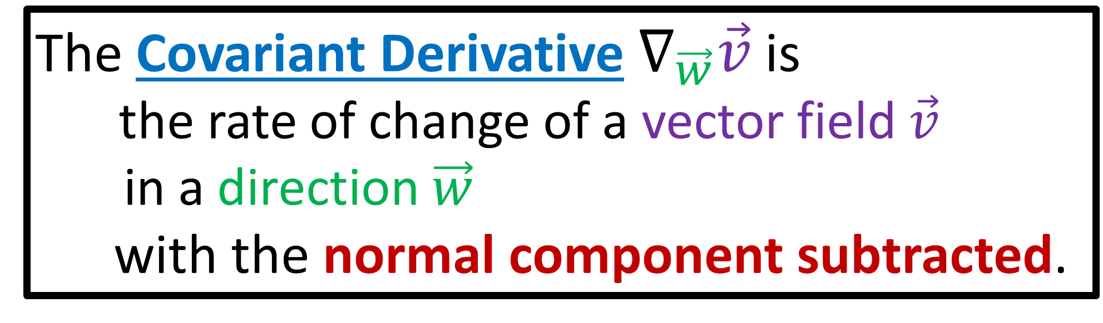

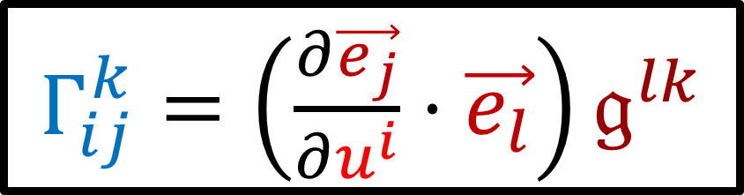
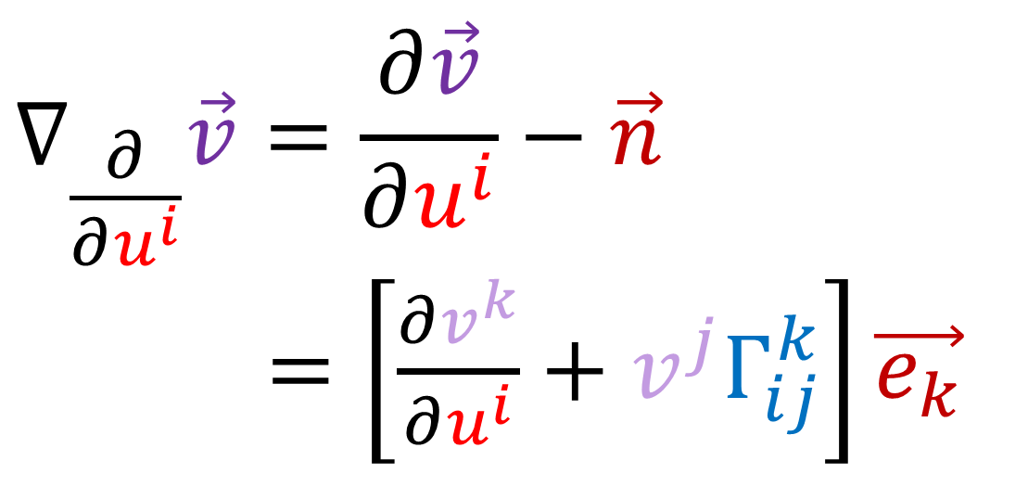
The Covariant Derivative $∇_{\vec{w}}\vec{v}$ is
the rate of change of a vector field $\vec{v}$
in a direction $\vec{w}$
with the normal component subtracted.
$$∇_{\frac{∂}{∂u^{i}}}\vec{v}=\frac{∂\vec{v}}{∂u^{i}}−\vec{n}$$
$∇_{\frac{∂}{∂u^{k}}}\vec{v}=\left[\frac{∂v^{k}}{∂u^{i}}+v^{j}Γ_{ij}^{k}\right]\vec{e_{k}}$
$Γ_{ij}^{k}=\left(\frac{∂\vec{e_{j}}}{∂u^{i}}⋅\vec{e_{l}}\right)𝔤^{lk}$
$∇_{\vec{w}}\vec{v}=\vec{0}$ means parallel transport!

Slide 5
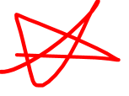
Parallel Transport
Source:
https://math.stackexchange.com/questions/2215084/parallel-transport-equations
(Link in descriptions)

Slide 6
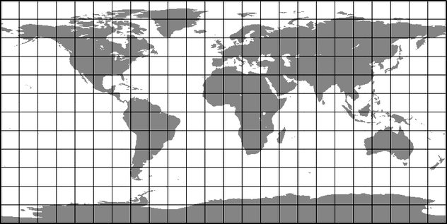





Definitions of Covariant Derivative
$$∇_{\vec{w}}\vec{v}$$
Abstract Definition
$$y$$
Curved-Space (Intrinsic) Definition
$$x$$
Curved-Space (Extrinsic)
Definition
Flat-Space Definition
Easiest
(Least Powerful)
Hardest
(Most Powerful)

Slide 7
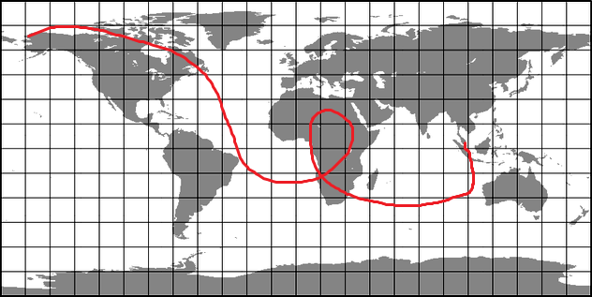
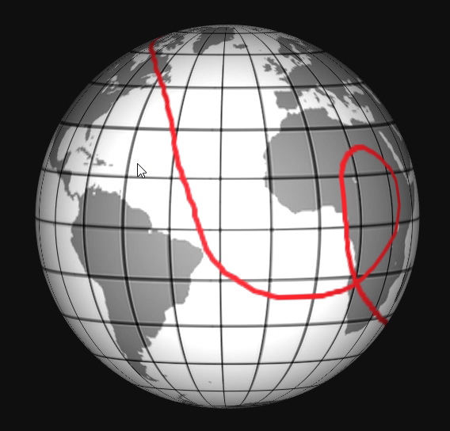

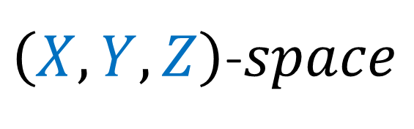


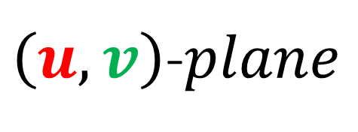


Two ways of looking at curved spaces
Intrinsic (“bug’s eye view”)
Extrinsic (“bird’s eye view”)
$$v$$
$$u$$
$$Z$$
$$Y$$
$\left(u,v\right)$-$plane$
$\left(X,Y,Z\right)$-$space$
$$X$$

Slide 8



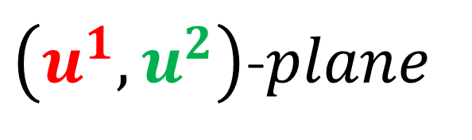
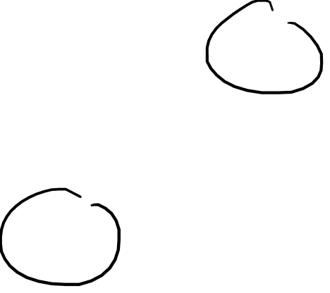


Two ways of looking at curved spaces
Intrinsic (“bug’s eye view”)
Extrinsic (“bird’s eye view”)
$$u^{2}$$
$$u^{1}$$
$$Z$$
$$Z$$
$$Y$$
$\left(u^{1},u^{2}\right)$-$plane$
$\left(X,Y,Z\right)$-$space$
$$X$$

Slide 9
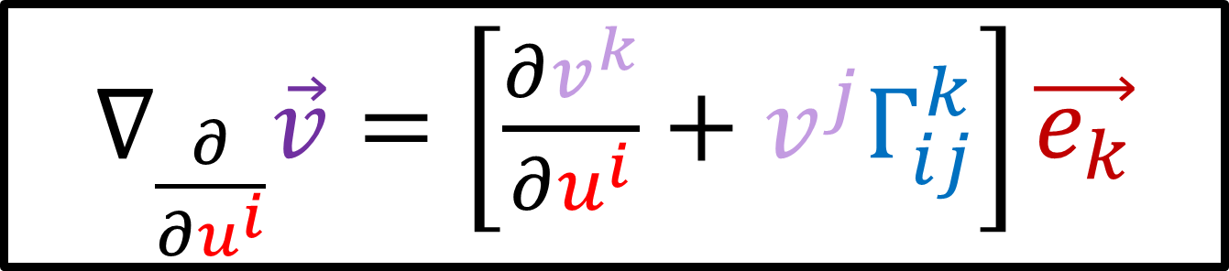


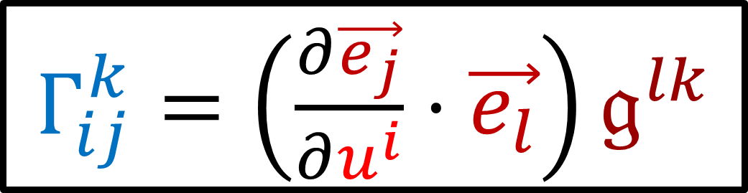
Moving to Intrinsic Geometry…
$∇_{\frac{∂}{∂u^{i}}}\vec{v}=\left[\frac{∂v^{k}}{∂u^{i}}+v^{j}Γ_{ij}^{k}\right]\vec{e_{k}}$
$∇_{\vec{w}}\vec{v}=\vec{0}→$ parallel transport!
$Γ_{ij}^{k}=\left(\frac{∂\vec{e_{j}}}{∂u^{i}}⋅\vec{e_{l}}\right)𝔤^{lk}$

Slide 10
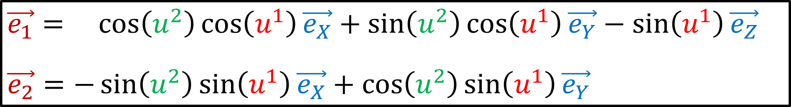
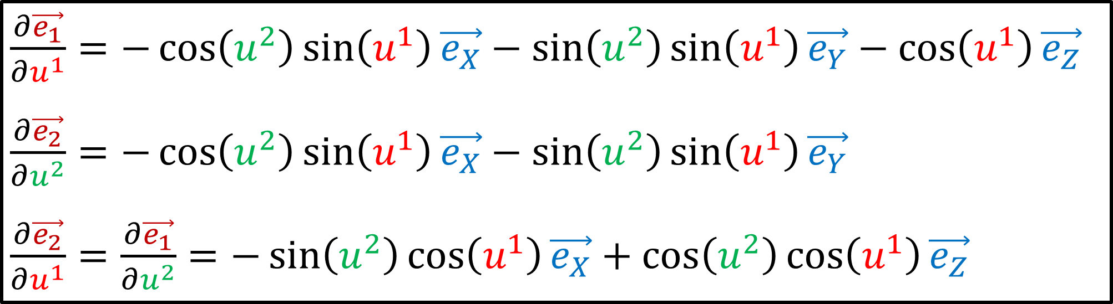
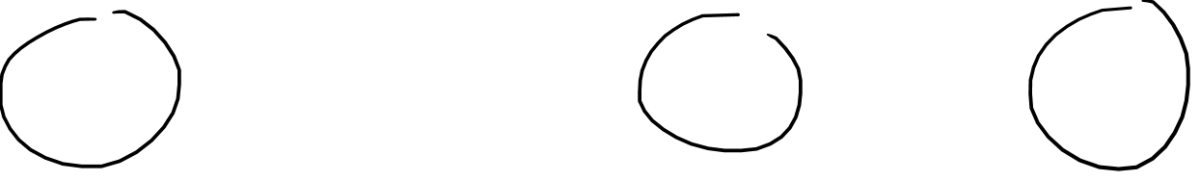
$$\vec{e_{1}}= \cos\left(u^{2}\right)\cos\left(u^{1}\right)\vec{e_{X}}+\sin\left(u^{2}\right)\cos\left(u^{1}\right)\vec{e_{Y}}−\sin\left(u^{1}\right)\vec{e_{Z}}$$
$\vec{e_{2}}=−\sin\left(u^{2}\right)\sin\left(u^{1}\right)\vec{e_{X}}+\cos\left(u^{2}\right)\sin\left(u^{1}\right)\vec{e_{Y}}$
$\frac{∂\vec{e_{1}}}{∂u^{1}}=−\cos\left(u^{2}\right)\sin\left(u^{1}\right)\vec{e_{X}}−\sin\left(u^{2}\right)\sin\left(u^{1}\right)\vec{e_{Y}}−\cos\left(u^{1}\right)\vec{e_{Z}}$
$\frac{∂\vec{e_{2}}}{∂u^{2}}=−\cos\left(u^{2}\right)\sin\left(u^{1}\right)\vec{e_{X}}−\sin\left(u^{2}\right)\sin\left(u^{1}\right)\vec{e_{Y}}$
$\frac{∂\vec{e_{2}}}{∂u^{1}}=\frac{∂\vec{e_{1}}}{∂u^{2}}=−\sin\left(u^{2}\right)\cos\left(u^{1}\right)\vec{e_{X}}+\cos\left(u^{2}\right)\cos\left(u^{1}\right)\vec{e_{Z}}$

Slide 11

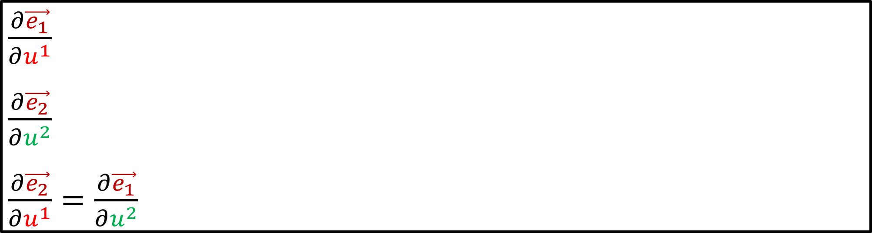



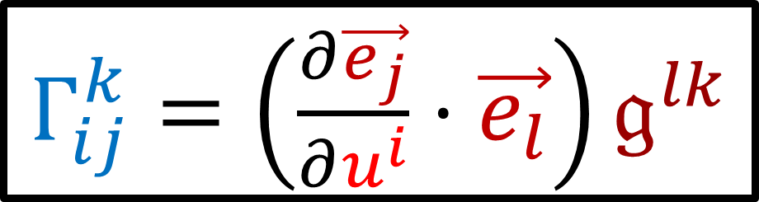

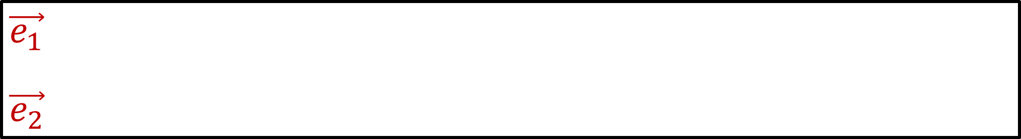

$$Z$$
$$\vec{e_{1}}$$
$\vec{e_{2}}$
No more
$$Y$$
$$X$$
$\frac{∂\vec{e_{1}}}{∂u^{1}}$
$\frac{∂\vec{e_{2}}}{∂u^{2}}$
$\frac{∂\vec{e_{2}}}{∂u^{1}}=\frac{∂\vec{e_{1}}}{∂u^{2}}$
$$Z$$
$$Y$$
No more
$$X$$
$Γ_{ij}^{k}=\left(\frac{∂\vec{e_{j}}}{∂u^{i}}⋅\vec{e_{l}}\right)𝔤^{lk}$

Slide 12
Why Intrinsic Geometry?

Slide 13
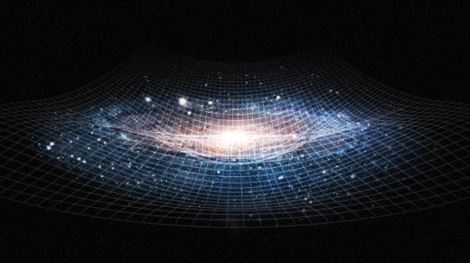
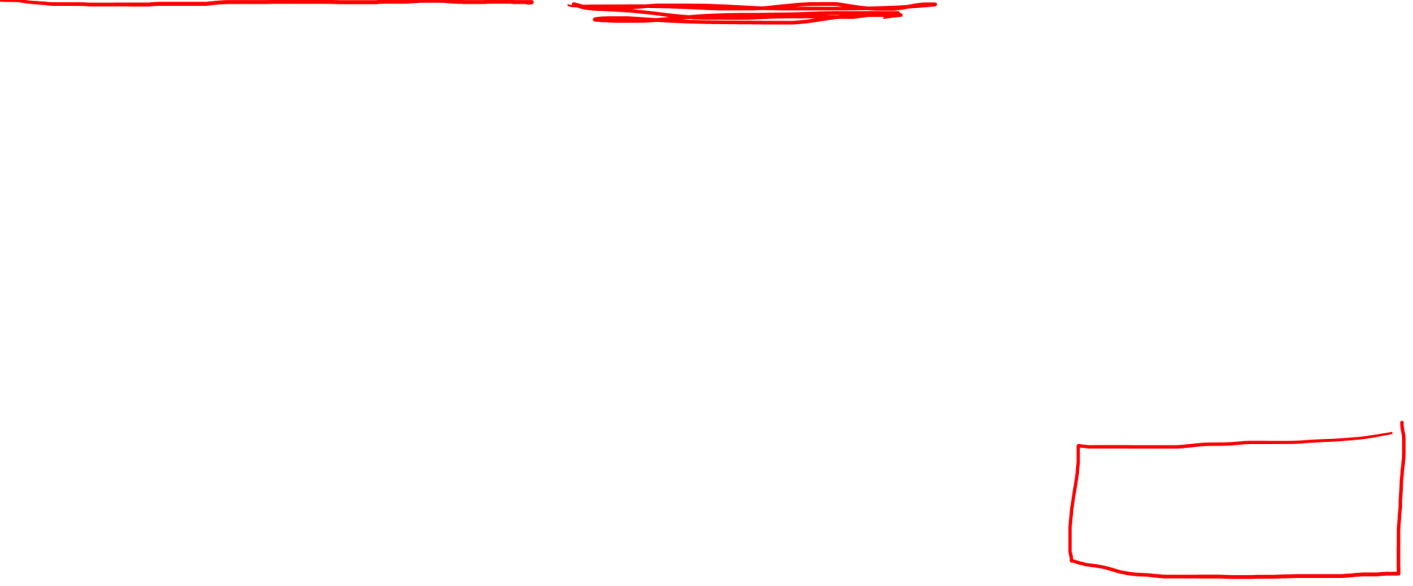
General Relativity (4D spacetime)
Origin outside
spacetime?
Spacetime
=
Intrinsically curved

Slide 14
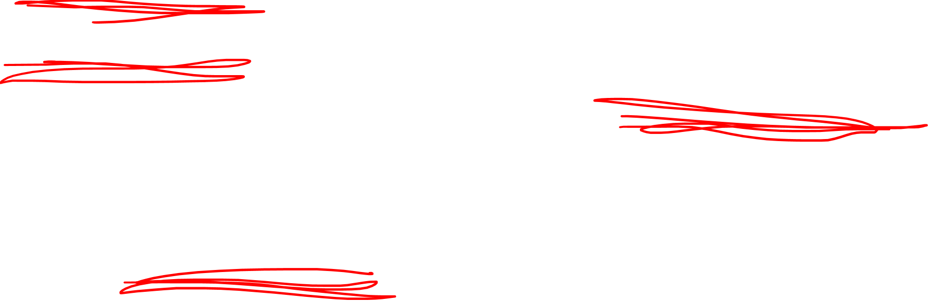




Intrinsic Geometry…
$$Z$$
$$\vec{R}$$
$$Y$$
Global XYZ
Coordinates
Position Vectors
Global Origin
$$X$$

Slide 15
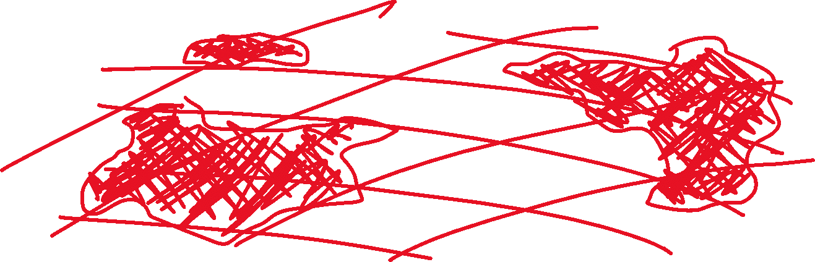

Slide 16


Slide 17
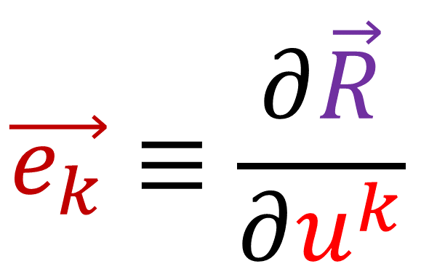
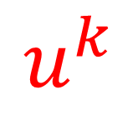

Two ways of looking at curved spaces
Extrinsic (“bird’s eye view”)
$$\vec{e_{k}}≡\frac{∂\vec{R}}{∂u^{k}}$$
$$u^{k}$$
$$\vec{R}$$

Slide 18
Two ways of looking at curved spaces
Extrinsic (“bird’s eye view”)
$$\vec{e_{k}}≡\frac{∂\vec{R}}{∂u^{k}}$$
$$u^{k}$$
$$\vec{R}$$

Slide 19
Two ways of looking at curved spaces
Extrinsic (“bird’s eye view”)
$$\vec{e_{k}}≡\frac{∂\vec{R}}{∂u^{k}}$$
$$u^{k}$$
$$\vec{R}$$

Slide 20
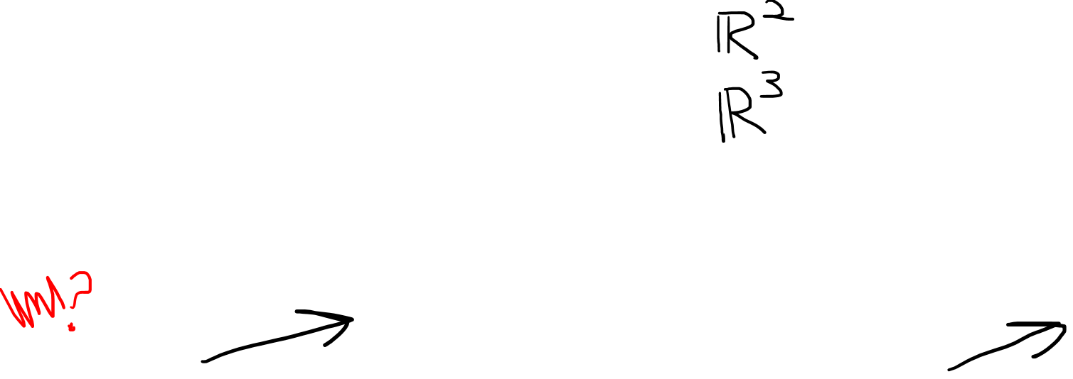


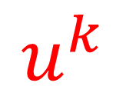
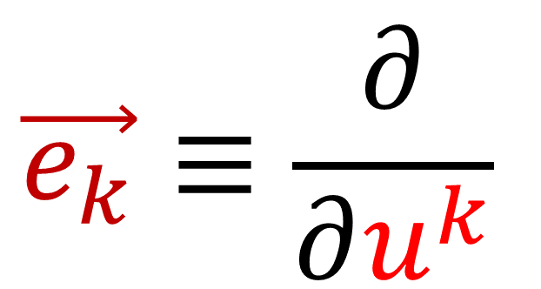
Two ways of looking at curved spaces
Intrinsic (“bug’s eye view”)
Extrinsic (“bird’s eye view”)
$$\vec{e_{k}}≡\frac{∂}{∂u^{k}}$$
$$\vec{e_{k}}≡\frac{∂\vec{R}}{∂u^{k}}$$
$\frac{∂}{∂u^{k}}$
$\frac{∂\vec{R}}{∂u^{k}}$
$$u^{k}$$
$$u^{k}$$
$$\vec{R}$$

Slide 21
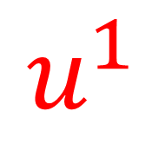
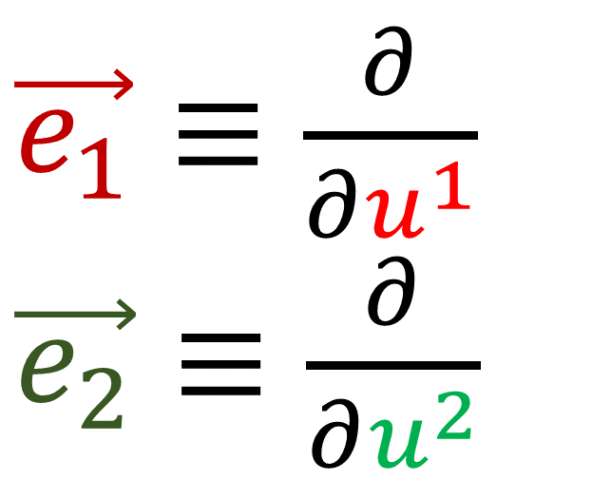
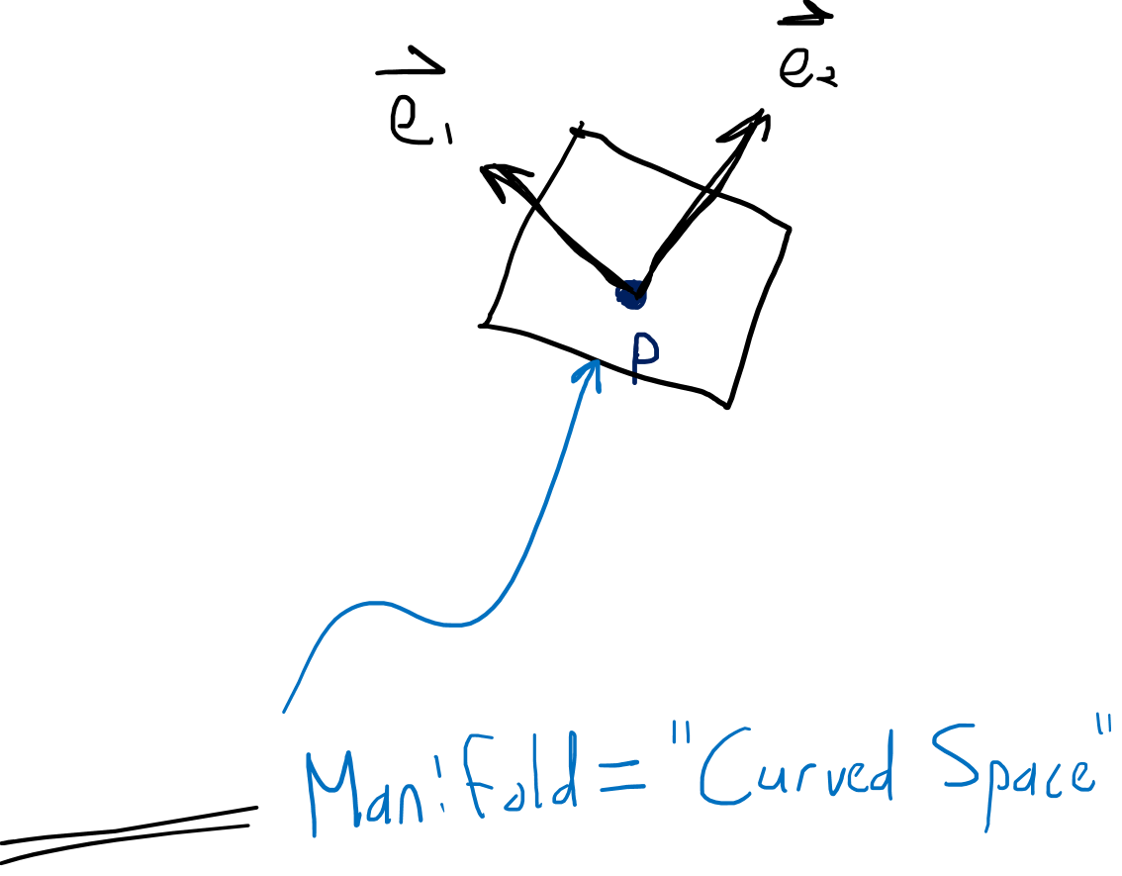

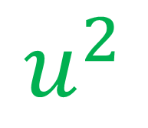
$\vec{e_{1}}≡\frac{∂}{∂u^{1}}$
$\vec{e_{2}}≡\frac{∂}{∂u^{2}}$
$$u^{2}$$
$$u^{1}$$
Vector Space $T_{p}M$

Slide 22
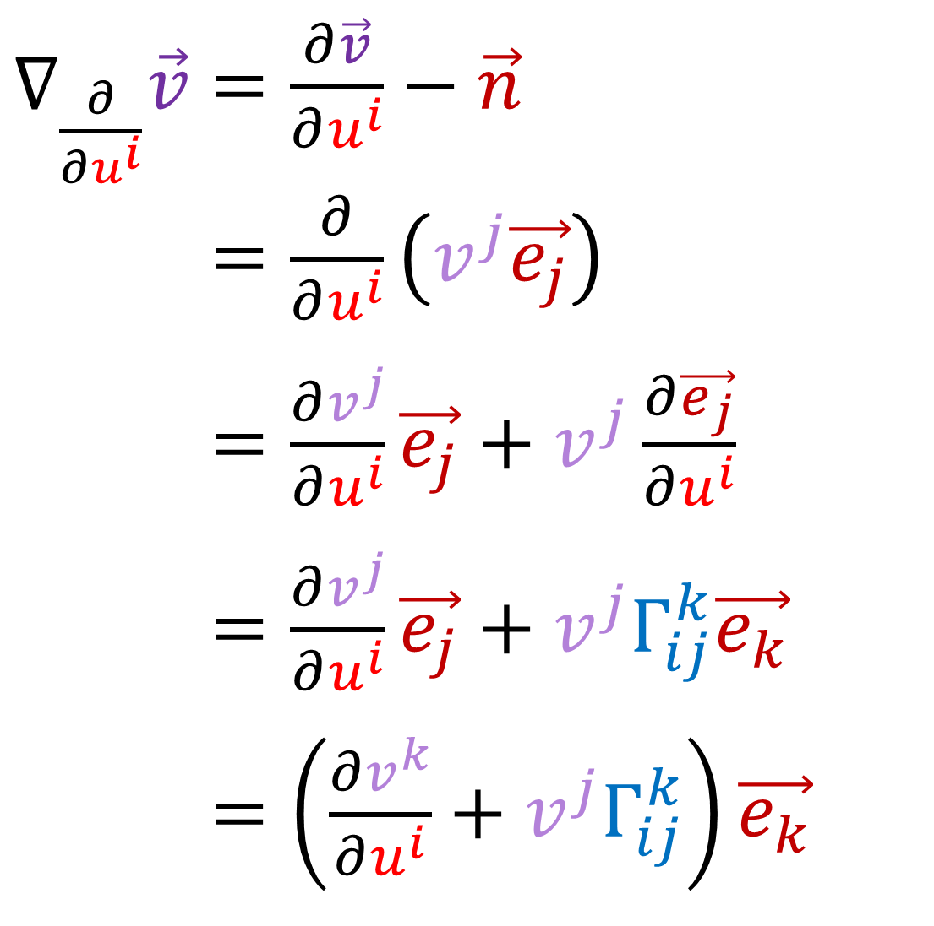
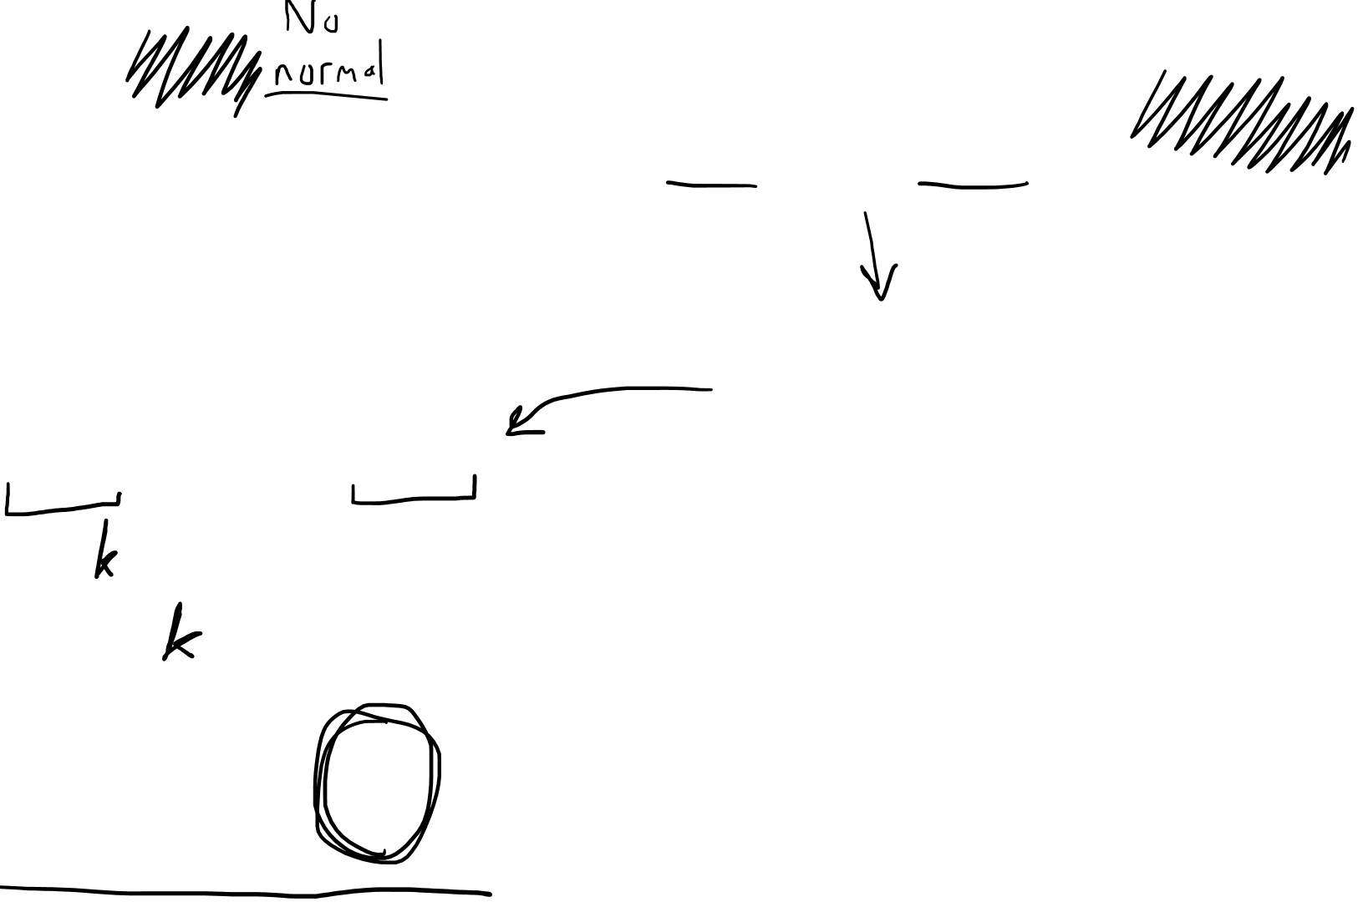
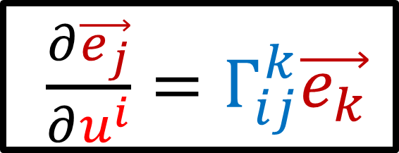
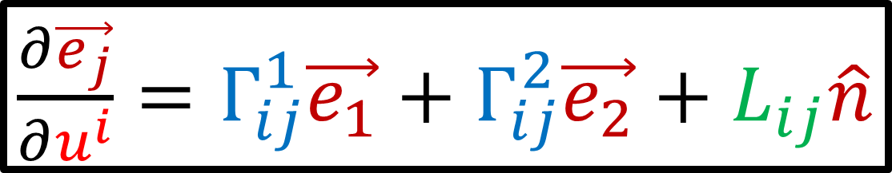
$∇_{\frac{∂}{∂u^{i}}}\vec{v}=\frac{∂\vec{v}}{∂u^{i}}−\vec{n}$
$∇_{\frac{∂}{∂u^{i}}}\vec{v}=\frac{∂}{∂u^{i}}\left(v^{j}\vec{e_{j}}\right)$
$∇_{\frac{∂}{∂u^{i}}}\vec{v}=\frac{∂v^{j}}{∂u^{i}}\vec{e_{j}}+v^{j}\frac{∂\vec{e_{j}}}{∂u^{i}}$
$∇_{\frac{∂}{∂u^{i}}}\vec{v}=\frac{∂v^{j}}{∂u^{i}}\vec{e_{j}}+v^{j}Γ_{ij}^{k}\vec{e_{k}}$
$∇_{\frac{∂}{∂u^{i}}}\vec{v}=\left(\frac{∂v^{k}}{∂u^{i}}+v^{j}Γ_{ij}^{k}\right)\vec{e_{k}}$
$\frac{∂\vec{e_{j}}}{∂u^{i}}=Γ_{ij}^{1}\vec{e_{1}}+Γ_{ij}^{2}\vec{e_{2}}+L_{ij}\hat{n}$
$\frac{∂\vec{e_{j}}}{∂u^{i}}=Γ_{ij}^{k}\vec{e_{k}}$

Slide 23
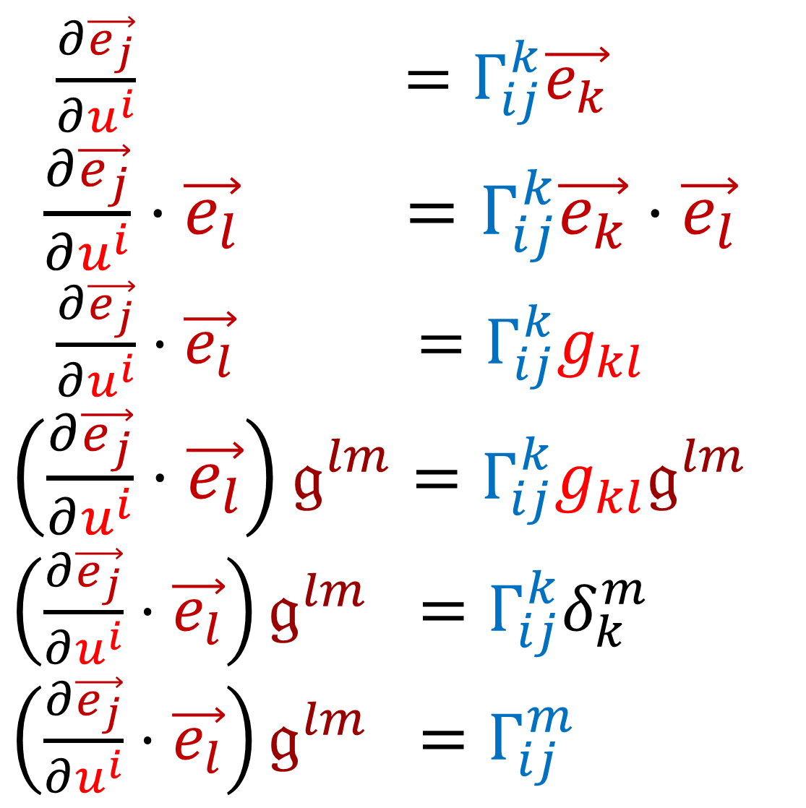
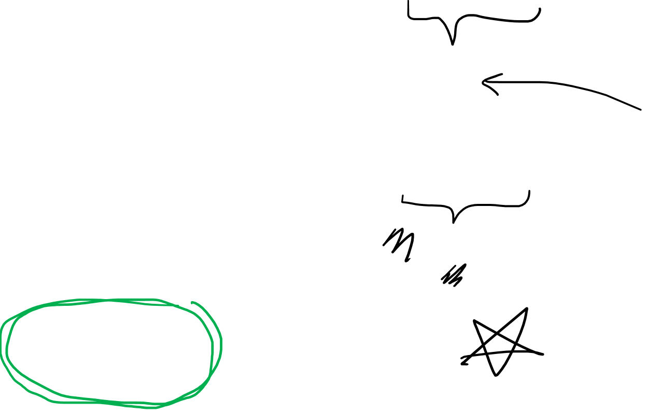
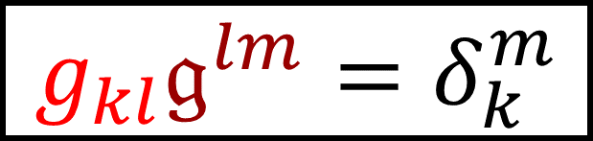
$\frac{∂\vec{e_{j}}}{∂u^{i}} =Γ_{ij}^{k}\vec{e_{k}}$
$\frac{∂\vec{e_{j}}}{∂u^{i}}⋅\vec{e_{l}} =Γ_{ij}^{k}\vec{e_{k}}⋅\vec{e_{l}}$
$\frac{∂\vec{e_{j}}}{∂u^{i}}⋅\vec{e_{l}} =Γ_{ij}^{k}g_{kl}$
$\left(\frac{∂\vec{e_{j}}}{∂u^{i}}⋅\vec{e_{l}}\right)𝔤^{lm}=Γ_{ij}^{k}g_{kl}𝔤^{lm}$
$\left(\frac{∂\vec{e_{j}}}{∂u^{i}}⋅\vec{e_{l}}\right)𝔤^{lm} =Γ_{ij}^{k}δ_{k}^{m}$
$\left(\frac{∂\vec{e_{j}}}{∂u^{i}}⋅\vec{e_{l}}\right)𝔤^{lm} =Γ_{ij}^{m}$
$g_{kl}𝔤^{lm}=δ_{k}^{m}$

Slide 24
$$\vec{e_{1}}= \cos\left(u^{2}\right)\cos\left(u^{1}\right)\vec{e_{X}}+\sin\left(u^{2}\right)\cos\left(u^{1}\right)\vec{e_{Y}}−\sin\left(u^{1}\right)\vec{e_{Z}}$$
$\vec{e_{2}}=−\sin\left(u^{2}\right)\sin\left(u^{1}\right)\vec{e_{X}}+\cos\left(u^{2}\right)\sin\left(u^{1}\right)\vec{e_{Y}}$
$\frac{∂\vec{e_{1}}}{∂u^{1}}=−\cos\left(u^{2}\right)\sin\left(u^{1}\right)\vec{e_{X}}−\sin\left(u^{2}\right)\sin\left(u^{1}\right)\vec{e_{Y}}−\cos\left(u^{1}\right)\vec{e_{Z}}$
$\frac{∂\vec{e_{2}}}{∂u^{2}}=−\cos\left(u^{2}\right)\sin\left(u^{1}\right)\vec{e_{X}}−\sin\left(u^{2}\right)\sin\left(u^{1}\right)\vec{e_{Y}}$
$\frac{∂\vec{e_{2}}}{∂u^{1}}=\frac{∂\vec{e_{1}}}{∂u^{2}}=−\sin\left(u^{2}\right)\cos\left(u^{1}\right)\vec{e_{X}}+\cos\left(u^{2}\right)\cos\left(u^{1}\right)\vec{e_{Z}}$

Slide 25

$$Z$$
$$\vec{e_{1}}$$
$\vec{e_{2}}$
No more
$$Y$$
$$X$$
$\frac{∂\vec{e_{1}}}{∂u^{1}}$
$\frac{∂\vec{e_{2}}}{∂u^{2}}$
$\frac{∂\vec{e_{2}}}{∂u^{1}}=\frac{∂\vec{e_{1}}}{∂u^{2}}$
$$Z$$
$$Y$$
No more
$$X$$
Need new strategy for getting
Christoffel Symbols $Γ_{ij}^{k}$

Slide 26

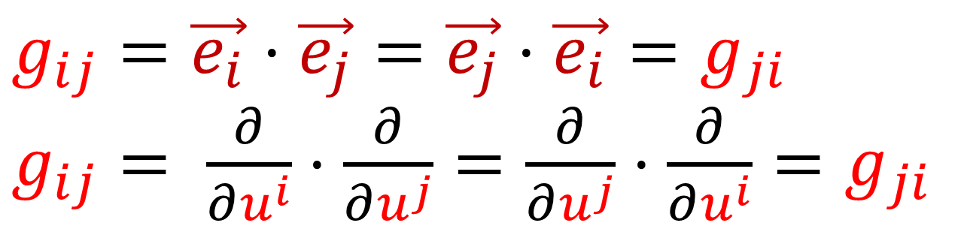

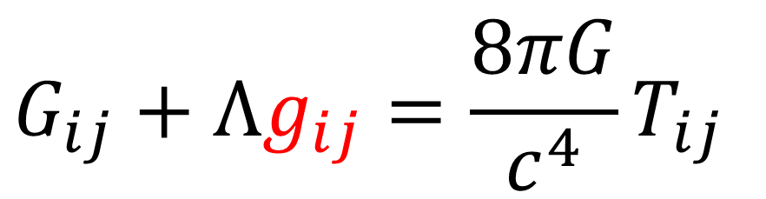
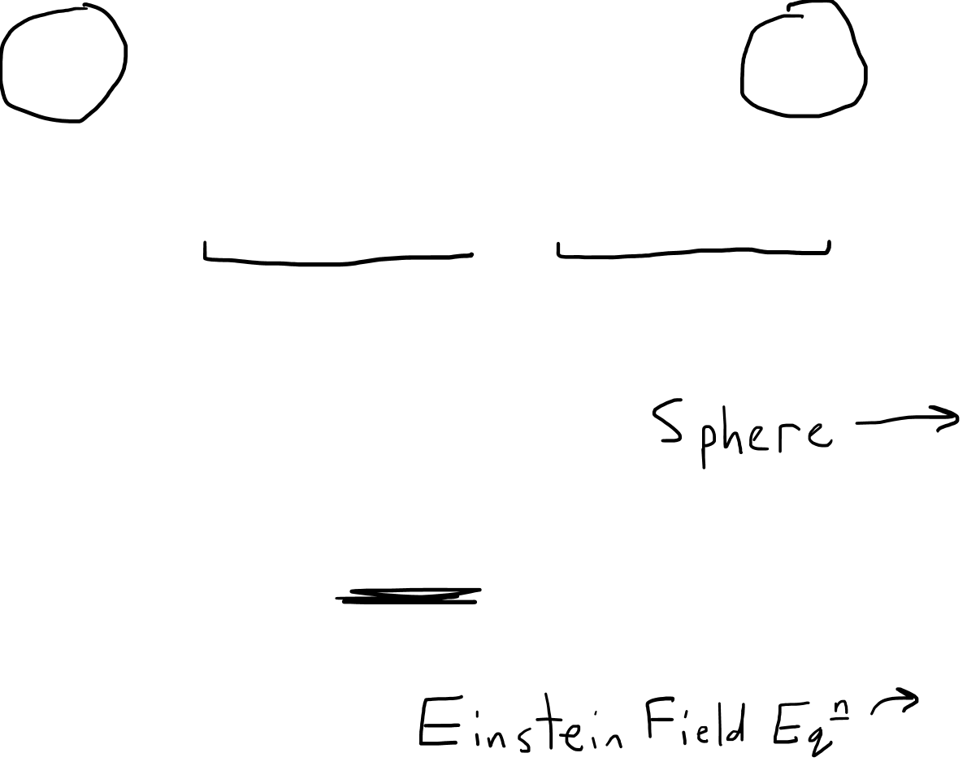
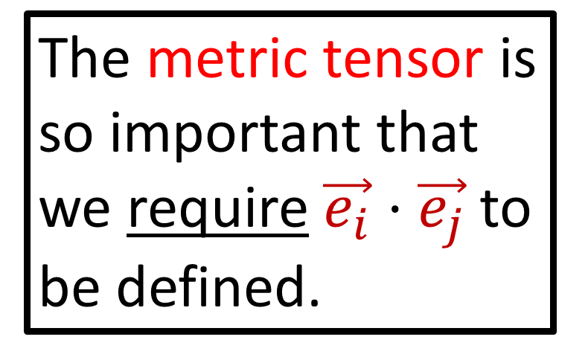

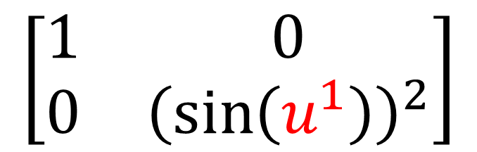
New formula for Christoffel Symbols (intrinsic)
$$g_{ij}=\vec{e_{i}}⋅\vec{e_{j}}=\vec{e_{j}}⋅\vec{e_{i}}=g_{ji}$$
$g_{ij}= \frac{∂}{∂u^{i}}⋅\frac{∂}{∂u^{j}}=\frac{∂}{∂u^{j}}⋅\frac{∂}{∂u^{i}}=g_{ji}$
$g_{ij}=g_{ji}$
Declare $g_{ij}$:
$$\left[\begin{matrix}1 & 0 \\ 0 & {\left(\sin\left(u^{1}\right)\right)}^{2}\end{matrix}\right]$$
The metric tensor is so important that we require $\vec{e_{i}}⋅\vec{e_{j}}$to be defined.
Solve for $g_{ij}$ from physics:
$$G_{ij}+Λg_{ij}=\frac{8πG}{c^{4}}T_{ij}$$

Slide 27
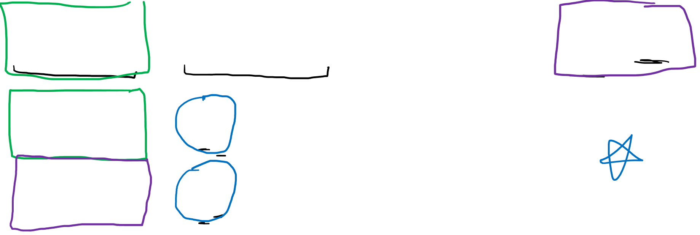



New formula for Christoffel Symbols (intrinsic)
$$g_{ij}=\vec{e_{i}}⋅\vec{e_{j}}=\vec{e_{j}}⋅\vec{e_{i}}=g_{ji}$$
$g_{ij}= \frac{∂}{∂u^{i}}⋅\frac{∂}{∂u^{j}}=\frac{∂}{∂u^{j}}⋅\frac{∂}{∂u^{i}}=g_{ji}$
$g_{ij}=g_{ji}$
$\frac{∂}{∂u^{i}}\left(\vec{e_{j}}\right)=\frac{∂}{∂u^{i}}\left(\frac{∂}{∂u^{j}}\right)=\frac{∂}{∂u^{j}}\left(\frac{∂}{∂u^{i}}\right)=\frac{∂}{∂u^{j}}\left(\vec{e_{i}}\right)$
$\frac{∂}{∂u^{i}}\left(\vec{e_{j}}\right)=Γ_{ij}^{k}\vec{e_{k}}$
$\frac{∂}{∂u^{j}}\left(\vec{e_{i}}\right)=Γ_{ji}^{k}\vec{e_{k}}$
$$Γ_{ij}^{k}=Γ_{ji}^{k}$$

Slide 28


$g_{ij}=g_{ji}$
$$Γ_{ij}^{k}=Γ_{ji}^{k}$$

Slide 29



New formula for Christoffel Symbols (intrinsic)
$\frac{∂}{∂u^{k}} g_{ij}=\frac{∂}{∂u^{k}}\left(\vec{e_{i}}⋅\vec{e_{j}}\right)$
$\frac{∂}{∂u^{k}} g_{ij}=\frac{∂\vec{e_{i}}}{∂u^{k}}⋅\vec{e_{j}}+\vec{e_{i}}⋅\frac{∂\vec{e_{j}}}{∂u^{k}}$
$\frac{∂}{∂u^{k}} g_{ij}=\left(Γ_{ik}^{l}\vec{e_{l}}\right)⋅\vec{e_{j}}+\vec{e_{i}}⋅\left(Γ_{jk}^{l}\vec{e_{l}}\right)$
$\frac{∂}{∂u^{k}} g_{ij}=Γ_{ik}^{l}\left(\vec{e_{l}}⋅\vec{e_{j}}\right)+Γ_{jk}^{l}\left(\vec{e_{i}}⋅\vec{e_{l}}\right)$
$\frac{∂}{∂u^{k}} g_{ij}=Γ_{ik}^{l}g_{lj}+Γ_{jk}^{l}g_{il}$
$\frac{∂\vec{e_{j}}}{∂u^{i}}=Γ_{ij}^{k}\vec{e_{k}}$
“metric compatibility”

Slide 30

New formula for Christoffel Symbols (intrinsic)
$\frac{∂}{∂u^{k}} g_{ij}=\frac{∂}{∂u^{k}}\left(\vec{e_{i}}⋅\vec{e_{j}}\right)$
$\frac{∂}{∂u^{k}} g_{ij}=\frac{∂\vec{e_{i}}}{∂u^{k}}⋅\vec{e_{j}}+\vec{e_{i}}⋅\frac{∂\vec{e_{j}}}{∂u^{k}}$
$\frac{∂}{∂u^{k}} g_{ij}=\left(Γ_{ik}^{l}\vec{e_{l}}\right)⋅\vec{e_{j}}+\vec{e_{i}}⋅\left(Γ_{jk}^{l}\vec{e_{l}}\right)$
$\frac{∂}{∂u^{k}} g_{ij}=Γ_{ik}^{l}\left(\vec{e_{l}}⋅\vec{e_{j}}\right)+Γ_{jk}^{l}\left(\vec{e_{i}}⋅\vec{e_{l}}\right)$
$\frac{∂}{∂u^{k}} g_{ij}=Γ_{ik}^{l}g_{jl}+Γ_{jk}^{l}g_{il}$
$\frac{∂\vec{e_{j}}}{∂u^{i}}=Γ_{ij}^{k}\vec{e_{k}}$
“metric compatibility”

Slide 31




New formula for Christoffel Symbols (intrinsic)
$$\frac{∂g_{ij}}{∂u^{k}}=Γ_{ik}^{l}g_{jl}+Γ_{jk}^{l}g_{il}$$
$$\frac{∂g_{ki}}{∂u^{j}}=Γ_{kj}^{l}g_{il}+Γ_{ij}^{l}g_{kl}$$
$$\frac{∂g_{jk}}{∂u^{i}}=Γ_{ji}^{l}g_{kl}+Γ_{ki}^{l}g_{jl}$$
$g_{ij}=g_{ji}$
$$Γ_{ij}^{k}=Γ_{ji}^{k}$$

Slide 32



New formula for Christoffel Symbols (intrinsic)
$$\frac{∂g_{ij}}{∂u^{k}}=Γ_{ik}^{l}g_{jl}+Γ_{jk}^{l}g_{il}$$
$$\frac{∂g_{ki}}{∂u^{j}}=Γ_{kj}^{l}g_{il}+Γ_{ij}^{l}g_{kl}$$
$$\frac{∂g_{jk}}{∂u^{i}}=Γ_{ji}^{l}g_{kl}+Γ_{ki}^{l}g_{jl}$$
$$\frac{∂g_{ij}}{∂u^{k}}+\frac{∂g_{ki}}{∂u^{j}}−\frac{∂g_{jk}}{∂u^{i}}$$
$$=Γ_{ik}^{l}g_{jl}+Γ_{jk}^{l}g_{il}$$
$$+Γ_{kj}^{l}g_{il}+Γ_{ij}^{l}g_{kl}$$
$$− Γ_{ji}^{l}g_{kl}−Γ_{ki}^{l}g_{jl}$$

Slide 33


New formula for Christoffel Symbols (intrinsic)
$Γ_{jk}^{l}g_{li}+Γ_{kj}^{l}g_{li}= \frac{∂g_{ij}}{∂u^{k}}+\frac{∂g_{ki}}{∂u^{j}}−\frac{∂g_{jk}}{∂u^{i}}$
$2Γ_{jk}^{l}g_{li}𝔤^{im}=𝔤^{im}\left(\frac{∂g_{ij}}{∂u^{k}}+\frac{∂g_{ki}}{∂u^{j}}−\frac{∂g_{jk}}{∂u^{i}}\right)$
$Γ_{jk}^{l}δ_{l}^{m} =\frac{1}{2}𝔤^{im}\left(\frac{∂g_{ij}}{∂u^{k}}+\frac{∂g_{ki}}{∂u^{j}}−\frac{∂g_{jk}}{∂u^{i}}\right)$
$Γ_{jk}^{m} =\frac{1}{2}𝔤^{im}\left(\frac{∂g_{ij}}{∂u^{k}}+\frac{∂g_{ki}}{∂u^{j}}−\frac{∂g_{jk}}{∂u^{i}}\right)$

Slide 34


Covariant Derivative of a Vector (Intrinsic)
$\frac{∂\vec{v}}{∂u^{i}}=\left(\frac{∂v^{j}}{∂u^{i}}+v^{j}Γ_{ij}^{k}\right)\vec{e_{k}}$
$Γ_{ij}^{k}=\frac{1}{2}𝔤^{kl}\left(\frac{∂g_{li}}{∂u^{j}}+\frac{∂g_{jl}}{∂u^{i}}−\frac{∂g_{ij}}{∂u^{l}}\right)$

Slide 35

Christoffel Symbols on the Sphere
$Γ_{11}^{1}=0$ | $$Γ_{11}^{2}=0$$
$Γ_{12}^{1}=0$ | $$Γ_{12}^{2}=\cot\left(u^{1}\right)$$
$$Γ_{21}^{1}=0$$ | $$Γ_{21}^{2}=\cot\left(u^{1}\right)$$
$Γ_{22}^{1}=−\frac{1}{2}\sin\left(2u^{1}\right)$ | $Γ_{22}^{2}=0$

Slide 36






$Γ_{jk}^{m}=\frac{1}{2}𝔤^{mi}\left(\frac{∂g_{ij}}{∂u^{k}}+\frac{∂g_{ki}}{∂u^{j}}−\frac{∂g_{jk}}{∂u^{i}}\right)$
$$g_{ij}→\left[\begin{matrix}1 & 0 \\ 0 & {\left(\sin\left(u^{1}\right)\right)}^{2}\end{matrix}\right]$$
$$𝔤^{ij}→\left[\begin{matrix}1 & 0 \\ 0 & 1/{\left(\sin\left(u^{1}\right)\right)}^{2}\end{matrix}\right]$$
$$\frac{∂g_{22}}{∂u^{1}}=2\sin\left(u^{1}\right)\cos\left(u^{1}\right)=\sin\left(2u^{1}\right)$$
$\frac{∂g_{ij}}{∂u^{k}}=0$ for all other $i,j,k$

Slide 37







$Γ_{jk}^{m}=\frac{1}{2}𝔤^{mi}\left(\frac{∂g_{ij}}{∂u^{k}}+\frac{∂g_{ki}}{∂u^{j}}−\frac{∂g_{jk}}{∂u^{i}}\right)$
$$\frac{∂g_{22}}{∂u^{1}}=$$
$$2\sin\left(u^{1}\right)\cos\left(u^{1}\right)$$
$$i=2, j=2, k=1$$
$Γ_{21}^{m}=\frac{1}{2}𝔤^{m2}\left(\frac{∂g_{22}}{∂u^{1}}+\frac{∂g_{12}}{∂u^{2}}−\frac{∂g_{21}}{∂u^{2}}\right)$
$Γ_{21}^{m}=\frac{1}{2}𝔤^{m2}\left(2\sin\left(u^{1}\right)\cos\left(u^{1}\right)\right)$
$Γ_{21}^{2}=\frac{1}{2}\frac{1}{{\left(\sin\left(u^{1}\right)\right)}^{2}}\left(2\sin\left(u^{1}\right)\cos\left(u^{1}\right)\right)$
$Γ_{21}^{m}=\frac{\cos\left(u^{1}\right)}{\sin\left(u^{1}\right)}=\cot\left(u^{1}\right)$
$$𝔤^{ij}→$$
$$\left[\begin{matrix}1 & 0 \\ 0 & 1/{\left(\sin\left(u^{1}\right)\right)}^{2}\end{matrix}\right]$$
$$=Γ_{12}^{2}$$

Slide 38




$Γ_{jk}^{m}=\frac{1}{2}𝔤^{mi}\left(\frac{∂g_{ij}}{∂u^{k}}+\frac{∂g_{ki}}{∂u^{j}}−\frac{∂g_{jk}}{∂u^{i}}\right)$
$$\frac{∂g_{22}}{∂u^{1}}=$$
$$2\sin\left(u^{1}\right)\cos\left(u^{1}\right)$$
$$i=1, j=2, k=2$$
$Γ_{22}^{m}=\frac{1}{2}𝔤^{m1}\left(\frac{∂g_{12}}{∂u^{2}}+\frac{∂g_{21}}{∂u^{2}}−\frac{∂g_{22}}{∂u^{1}}\right)$
$Γ_{21}^{m}=\frac{1}{2}𝔤^{m1}\left(−2\sin\left(u^{1}\right)\cos\left(u^{1}\right)\right)$
$Γ_{22}^{1}=−\frac{1}{2}\left(2\sin\left(u^{1}\right)\cos\left(u^{1}\right)\right)$
$Γ_{22}^{1}=−\frac{1}{2}\sin\left(2u^{1}\right)$
$$𝔤^{ij}→$$
$$\left[\begin{matrix}1 & 0 \\ 0 & 1/{\left(\sin\left(u^{1}\right)\right)}^{2}\end{matrix}\right]$$

Slide 39
Christoffel Symbols on the Sphere
$Γ_{11}^{1}=0$ | $$Γ_{11}^{2}=0$$
$Γ_{12}^{1}=0$ | $$Γ_{12}^{2}=\cot\left(u^{1}\right)$$
$$Γ_{21}^{1}=0$$ | $$Γ_{21}^{2}=\cot\left(u^{1}\right)$$
$Γ_{22}^{1}=−\frac{1}{2}\sin\left(2u^{1}\right)$ | $Γ_{22}^{2}=0$

Slide 40



Intrinsic Formula (works for extrinsic too)
$Γ_{jk}^{m}=\frac{1}{2}𝔤^{im}\left(\frac{∂g_{ij}}{∂u^{k}}+\frac{∂g_{ki}}{∂u^{j}}−\frac{∂g_{jk}}{∂u^{i}}\right)$
$Γ_{ij}^{k}=\left(\frac{∂\vec{e_{j}}}{∂u^{i}}⋅\vec{e_{l}}\right)𝔤^{lk}$
Extrinsic Formula

Slide 41




$$\frac{∂g_{ij}}{∂u^{k}} =\frac{∂\vec{e_{i}}}{∂u^{k}}⋅\vec{e_{j}}+\vec{e_{i}}⋅\frac{∂\vec{e_{j}}}{∂u^{k}}$$
$\frac{∂\vec{e_{j}}}{∂u^{i}}=\frac{∂\vec{e_{i}}}{∂u^{j}}$
$$\frac{∂g_{ij}}{∂u^{k}}+\frac{∂g_{ki}}{∂u^{j}}−\frac{∂g_{jk}}{∂u^{i}}$$
$=\frac{∂\vec{e_{i}}}{∂u^{k}}⋅\vec{e_{j}}+\vec{e_{i}}⋅\frac{∂\vec{e_{j}}}{∂u^{k}}$
$+\frac{∂\vec{e_{k}}}{∂u^{j}}⋅\vec{e_{i}}+\vec{e_{k}}⋅\frac{∂\vec{e_{j}}}{∂u^{i}}$
$−\frac{∂\vec{e_{j}}}{∂u^{i}}⋅\vec{e_{k}}−\vec{e_{j}}⋅\frac{∂\vec{e_{i}}}{∂u^{k}}$

Slide 42



$$\frac{∂g_{ij}}{∂u^{k}} =\frac{∂\vec{e_{i}}}{∂u^{k}}⋅\vec{e_{j}}+\vec{e_{i}}⋅\frac{∂\vec{e_{j}}}{∂u^{k}}$$
$\frac{∂\vec{e_{j}}}{∂u^{i}}=\frac{∂\vec{e_{i}}}{∂u^{j}}$
$$\frac{∂g_{ij}}{∂u^{k}}+\frac{∂g_{ki}}{∂u^{j}}−\frac{∂g_{jk}}{∂u^{i}}$$
$=\frac{∂\vec{e_{i}}}{∂u^{k}}⋅\vec{e_{j}}+\vec{e_{i}}⋅\frac{∂\vec{e_{j}}}{∂u^{k}}$
$+\frac{∂\vec{e_{k}}}{∂u^{j}}⋅\vec{e_{i}}+\vec{e_{k}}⋅\frac{∂\vec{e_{j}}}{∂u^{i}}$
$−\frac{∂\vec{e_{j}}}{∂u^{i}}⋅\vec{e_{k}}−\vec{e_{j}}⋅\frac{∂\vec{e_{i}}}{∂u^{k}}$
$=2\left(\vec{e_{i}}⋅\frac{∂\vec{e_{k}}}{∂u^{j}}\right)$

Slide 43




$Γ_{jk}^{m}=\frac{1}{2}𝔤^{mi}\left(\frac{∂g_{ij}}{∂u^{k}}+\frac{∂g_{ki}}{∂u^{j}}−\frac{∂g_{jk}}{∂u^{i}}\right)$
$Γ_{jk}^{m}=\frac{1}{2}𝔤^{mi}\left(2\left(\vec{e_{i}}⋅\frac{∂\vec{e_{k}}}{∂u^{j}}\right)\right)$
$Γ_{jk}^{m}=\left(\vec{e_{i}}⋅\frac{∂\vec{e_{k}}}{∂u^{j}}\right)𝔤^{mi}$

Slide 44


Covariant Derivative of a Vector (Intrinsic)
$∇_{\frac{∂}{∂u^{i}}}\vec{v}=\left(\frac{∂v^{k}}{∂u^{i}}+v^{j}Γ_{ij}^{k}\right)\vec{e_{k}}$
$Γ_{jk}^{m}=\frac{1}{2}𝔤^{mi}\left(\frac{∂g_{ij}}{∂u^{k}}+\frac{∂g_{ki}}{∂u^{j}}−\frac{∂g_{jk}}{∂u^{i}}\right)$

Slide 45




Summary (Intrinsic Geometry)
$$Z$$
$\vec{e_{i}}≡\frac{∂}{∂u^{i}}$
No more
$$Y$$
$$X$$
$$\vec{R}$$
$$u^{2}$$
$$u^{1}$$

Slide 46





Summary (Intrinsic Geometry)
$g_{ij}=g_{ji}$
“metric compatibility”
$$Γ_{ij}^{k}=Γ_{ji}^{k}$$
$\frac{∂}{∂u^{k}}\left(\vec{e_{i}}⋅\vec{e_{j}}\right)=\frac{∂\vec{e_{i}}}{∂u^{k}}⋅\vec{e_{j}}+\vec{e_{i}}⋅\frac{∂\vec{e_{j}}}{∂u^{k}}$
$Γ_{jk}^{m}=\frac{1}{2}𝔤^{mi}\left(\frac{∂g_{ij}}{∂u^{k}}+\frac{∂g_{ki}}{∂u^{j}}−\frac{∂g_{jk}}{∂u^{i}}\right)$

Slide 47


Slide 48

Summary (Intrinsic Geometry)
$∇_{\vec{w}}\vec{v}=\vec{0}→$ parallel transport!

Slide 49
Summary (Intrinsic Geometry)

Slide 50
Summary (Intrinsic Geometry)

Slide 51
Geodesics
(See Videos 15,16 on Geodesics)
(Links in the description)

Slide 52

Geodesic = straightest possible path
in a curved surface/space.

Slide 53


Geodesic = straightest possible path
in a curved surface/space.
Parallel Transport
$$∇_{\vec{w}}\vec{v}=\vec{0}$$

Slide 54


Geodesic = straightest possible path
in a curved surface/space.
Parallel Transport vector along itself
$$∇_{\vec{v}}\vec{v}=\vec{0}$$

Slide 55



$∇_{\frac{d}{dλ}}\frac{d}{dλ}=\frac{d}{dλ}\left(\frac{d}{dλ}\right)$
$\vec{0} =\frac{d}{dλ}\left(\frac{du^{j}}{dλ}\frac{∂}{∂u^{j}}\right)$
$___\vec{0}__=\frac{d}{dλ}\left(\frac{du^{j}}{dλ}\right)\frac{∂}{∂u^{j}}+\frac{du^{j}}{dλ}\frac{d}{dλ}\left(\frac{∂}{∂u^{j}}\right)$
$___\vec{0}__=\frac{d^{2}u^{j}}{dλ^{2}}\frac{∂}{∂u^{j}}+\frac{du^{j}}{dλ}\frac{d}{dλ}\left(\frac{∂}{∂u^{j}}\right)$
$___\vec{0}__=\frac{d^{2}u^{j}}{dλ^{2}}\frac{∂}{∂u^{j}}+\frac{du^{j}}{dλ}\left(\frac{du^{i}}{dλ}\frac{∂}{∂u^{i}}\right)\left(\frac{∂}{∂u^{j}}\right)$
$___\vec{0}__=\frac{d^{2}u^{j}}{dλ^{2}}\frac{∂}{∂u^{j}}+\frac{du^{i}}{dλ}\frac{du^{j}}{dλ}\left(\frac{∂^{2}}{∂u^{i}∂u^{j}}\right)$
Curve = some function of parameter $λ$
Tangent Vectors: $\frac{d}{dλ}$
Geodesic: $∇_{\frac{d}{dλ}}\frac{d}{dλ}=\vec{0}$

Slide 56



$\vec{0}=\frac{d^{2}u^{j}}{dλ^{2}}\frac{∂}{∂u^{j}}+\frac{du^{i}}{dλ}\frac{du^{j}}{dλ}\left(\frac{∂^{2}}{∂u^{i}∂u^{j}}\right)$
$\vec{0}=\frac{d^{2}u^{j}}{dλ^{2}}\vec{e_{j}}+\frac{du^{i}}{dλ}\frac{du^{j}}{dλ}\left(\frac{∂\vec{e_{j}}}{∂u^{i}}\right)$
$\vec{0}=\frac{d^{2}u^{j}}{dλ^{2}}\vec{e_{j}}+\frac{du^{i}}{dλ}\frac{du^{j}}{dλ}Γ_{ij}^{k}\vec{e_{k}}$
$\vec{0}=\left(\frac{d^{2}u^{k}}{dλ^{2}}+\frac{du^{i}}{dλ}\frac{du^{j}}{dλ}Γ_{ij}^{k}\right)\vec{e_{k}}$
Curve = some function of parameter $λ$
Tangent Vectors: $\frac{d}{dλ}$
Geodesic: $∇_{\frac{d}{dλ}}\frac{d}{dλ}=\vec{0}$
$\frac{∂\vec{e_{j}}}{∂u^{i}}=Γ_{ij}^{k}\vec{e_{k}}$

Slide 57


Geodesic Equations
$\frac{d^{2}u^{k}}{dλ^{2}}+Γ_{ij}^{k}\frac{du^{i}}{dλ}\frac{du^{j}}{dλ}=0$
Geodesic = curve resulting from parallel transporting
a vector along itself
Geodesic = straightest possible path in a curved space.
(See Videos 15+16 for more info)

