Slide 1
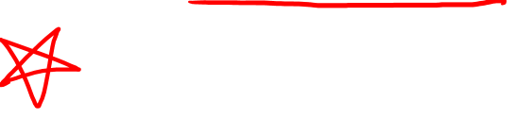
Covariant Derivative (Abstract Definition)
(See Videos 17,18,19 on other definitions)
(Links in the description)

Slide 2
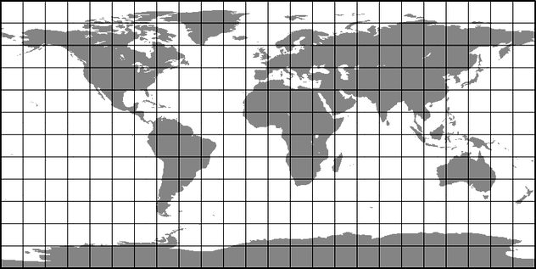




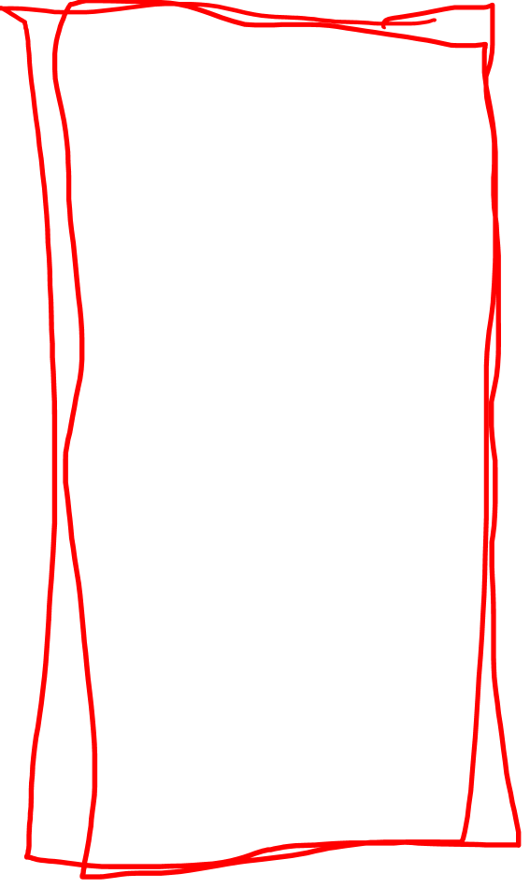
Definitions of Covariant Derivative
$$∇_{\vec{w}}\vec{v}$$
Abstract Definition
$$y$$
Curved-Space (Intrinsic) Definition
$$x$$
Curved-Space (Extrinsic)
Definition
Flat-Space Definition
Easiest
(Least Powerful)
Hardest
(Most Powerful)

Slide 3
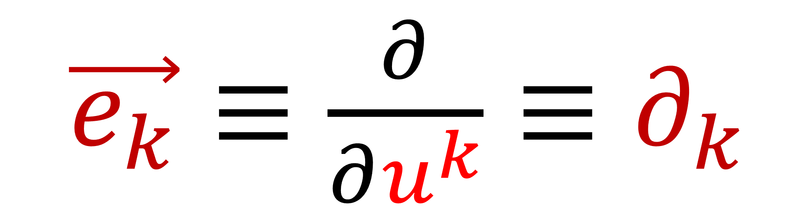
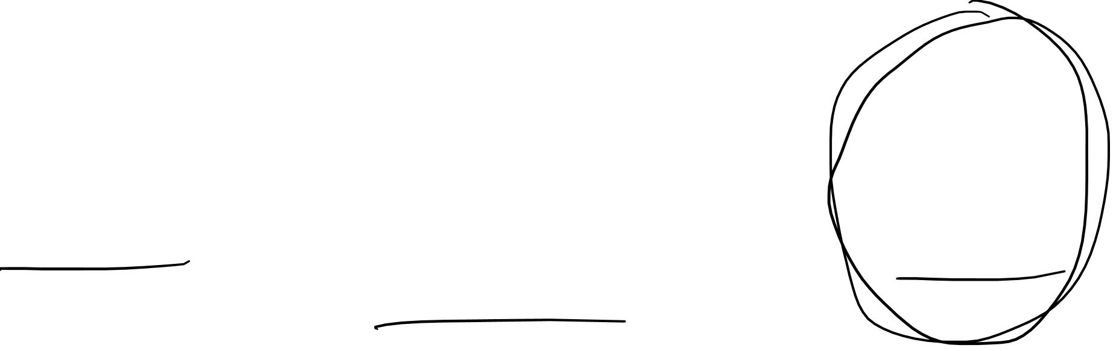
Basis vectors
$\vec{e_{k}}≡\frac{∂}{∂u^{k}}≡∂_{k}$

Slide 4
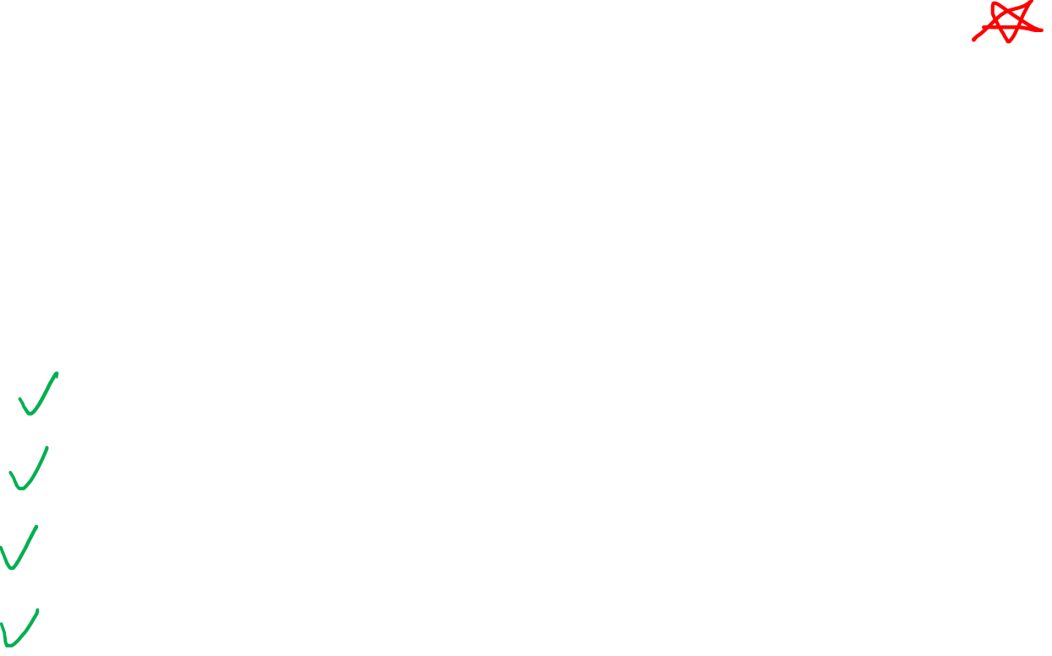
Abstract Definition of Covariant Derivative
We will find there are “several” covariant derivatives
The one we care about is called the Levi-Civita connection,
which comes from the Fundamental Theorem of Riemannian Geometry
2. Extend covariant derivatives to all tensor fields
Scalar Fields
Vector Fields
Covector Fields
Metric Tensor Fields

Slide 5
How did we invent Vector Spaces?

Slide 6
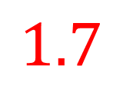

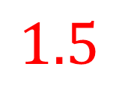


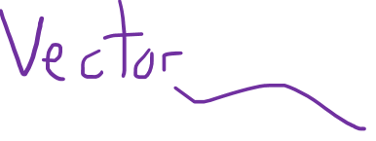

The Set $ℝ^{2}$
(pairs of real numbers)
$$y$$
$$1.7$$
$$x$$
$$\left[\begin{aligned}1.5 \\ 1.7\end{aligned}\right]$$
$$1.5$$

Slide 7

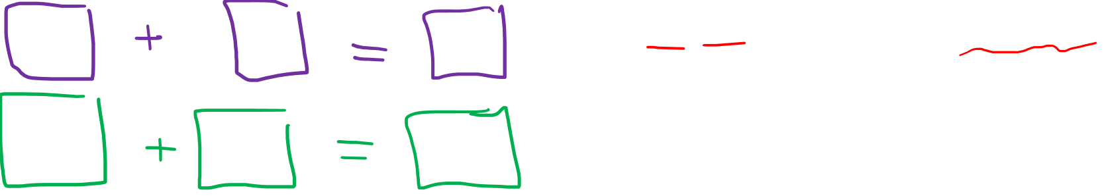
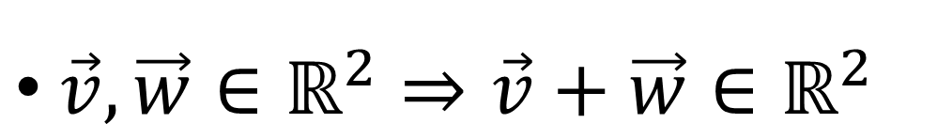
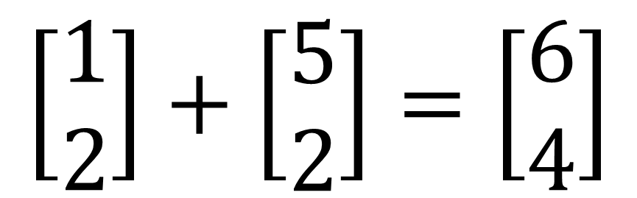
Members of $ℝ^{2}$
$\vec{v}, \vec{w}∈ℝ^{2}⇒\vec{v}+\vec{w}∈ℝ^{2}$
$$\left[\begin{aligned}1 \\ 2\end{aligned}\right]+\left[\begin{aligned}5 \\ 2\end{aligned}\right]=\left[\begin{aligned}6 \\ 4\end{aligned}\right]$$

Slide 8
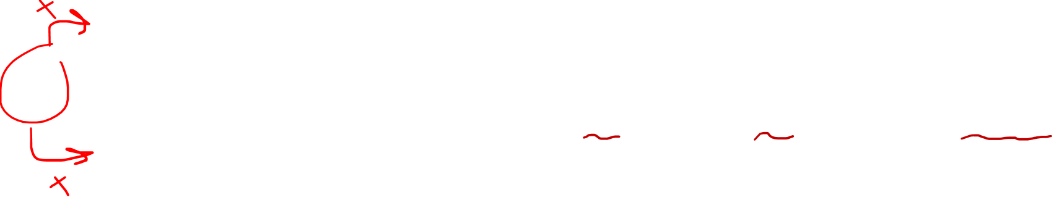
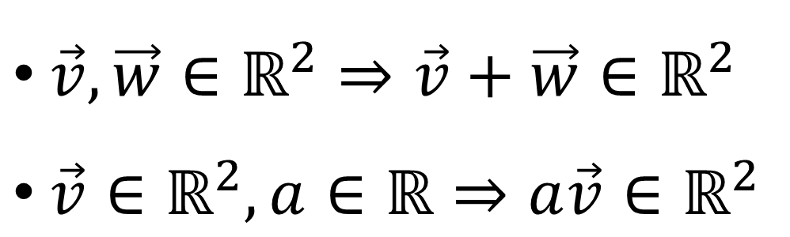
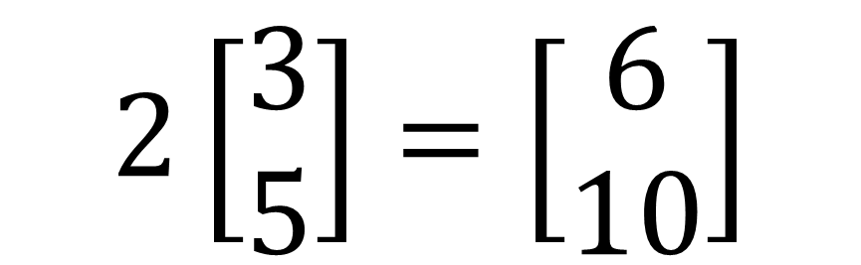
Members of $ℝ^{2}$
$\vec{v}, \vec{w}∈ℝ^{2}⇒\vec{v}+\vec{w}∈ℝ^{2}$
$\vec{v}∈ℝ^{2},a∈ℝ⇒a\vec{v}∈ℝ^{2}$
$$2\left[\begin{aligned}3 \\ 5\end{aligned}\right]=\left[\begin{aligned}6 \\ 10\end{aligned}\right]$$

Slide 9
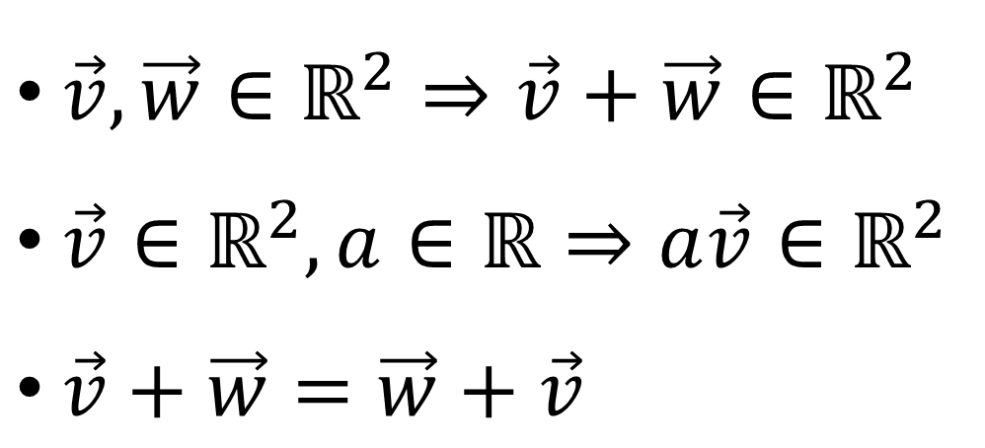
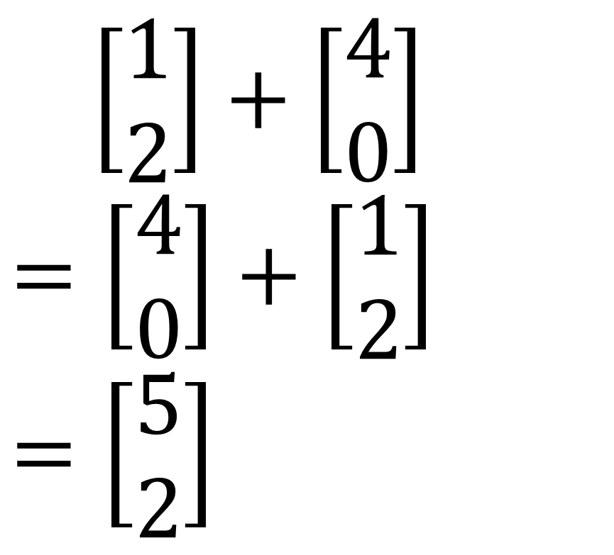
Members of $ℝ^{2}$
$\vec{v}, \vec{w}∈ℝ^{2}⇒\vec{v}+\vec{w}∈ℝ^{2}$
$\vec{v}∈ℝ^{2},a∈ℝ⇒a\vec{v}∈ℝ^{2}$
$\vec{v}+\vec{w}=\vec{w}+\vec{v}$
$\left[\begin{aligned}1 \\ 2\end{aligned}\right]+\left[\begin{aligned}4 \\ 0\end{aligned}\right]$
$$=\left[\begin{aligned}4 \\ 0\end{aligned}\right]+\left[\begin{aligned}1 \\ 2\end{aligned}\right]$$
$$=\left[\begin{aligned}5 \\ 2\end{aligned}\right]$$

Slide 10

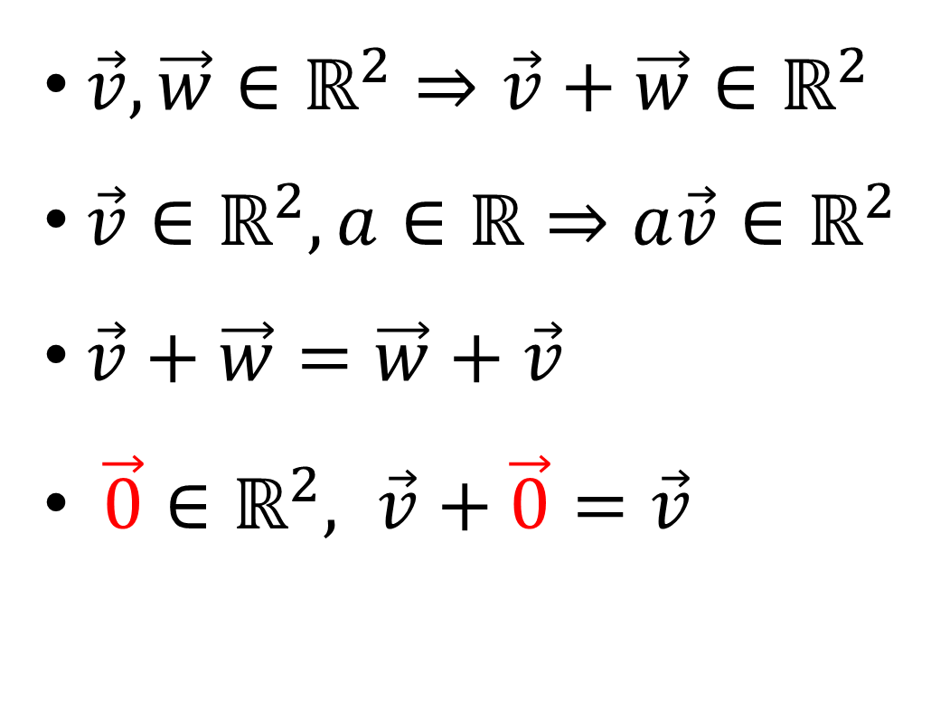
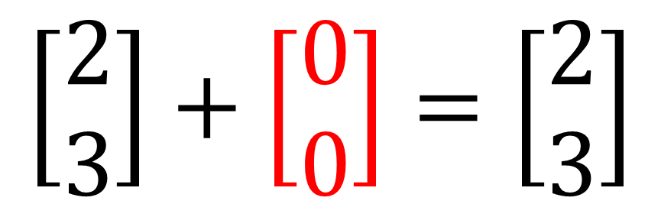
Members of $ℝ^{2}$
$\vec{v}, \vec{w}∈ℝ^{2}⇒\vec{v}+\vec{w}∈ℝ^{2}$
$\vec{v}∈ℝ^{2},a∈ℝ⇒a\vec{v}∈ℝ^{2}$
$\vec{v}+\vec{w}=\vec{w}+\vec{v}$
$\vec{0}∈ℝ^{2}, \vec{v}+\vec{0}=\vec{v}$
$$\left[\begin{aligned}2 \\ 3\end{aligned}\right]+\left[\begin{aligned}0 \\ 0\end{aligned}\right]=\left[\begin{aligned}2 \\ 3\end{aligned}\right]$$

Slide 11
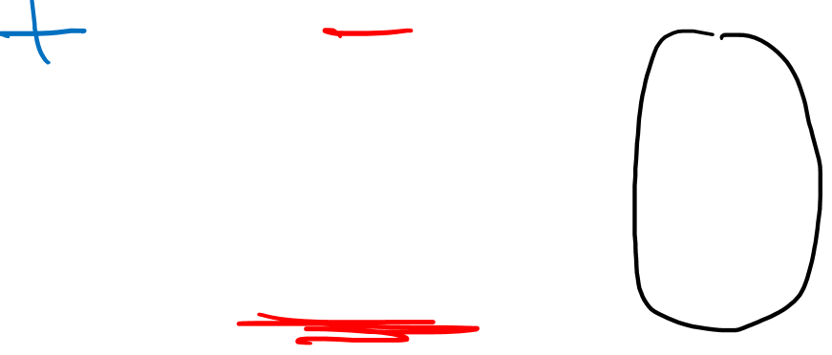
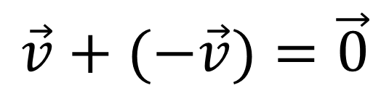
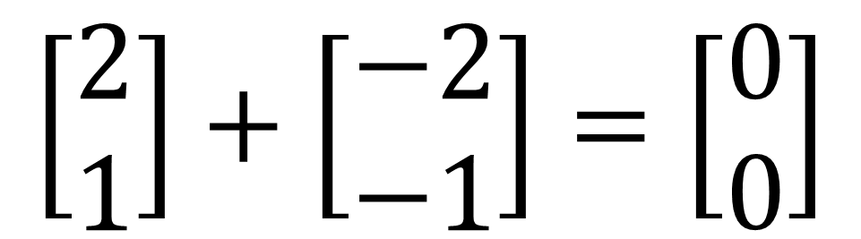
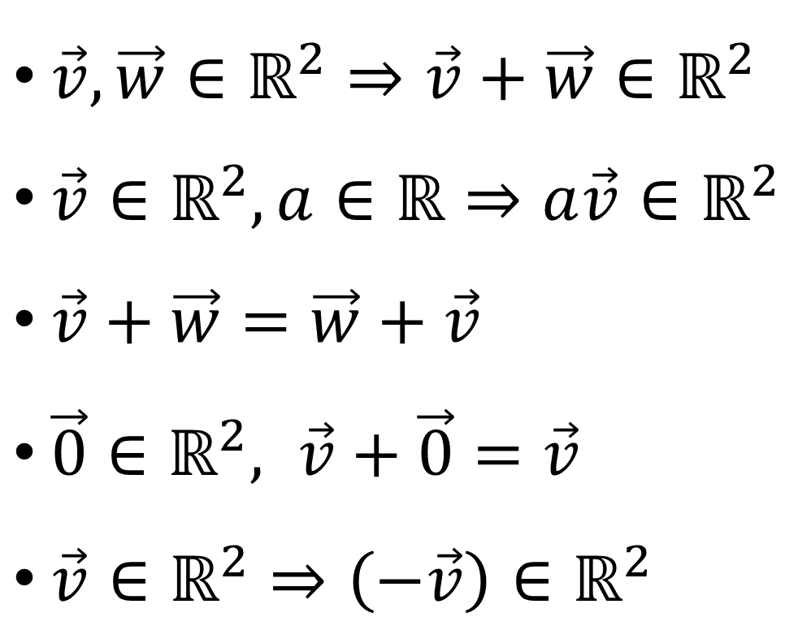
Members of $ℝ^{2}$
$\vec{v}, \vec{w}∈ℝ^{2}⇒\vec{v}+\vec{w}∈ℝ^{2}$
$\vec{v}∈ℝ^{2},a∈ℝ⇒a\vec{v}∈ℝ^{2}$
$\vec{v}+\vec{w}=\vec{w}+\vec{v}$
$\vec{0}∈ℝ^{2}, \vec{v}+\vec{0}=\vec{v}$
$\vec{v}∈ℝ^{2}⇒\left(−\vec{v}\right)∈ℝ^{2}$
$$\left[\begin{aligned}2 \\ 1\end{aligned}\right]+\left[\begin{aligned}−2 \\ −1\end{aligned}\right]=\left[\begin{aligned}0 \\ 0\end{aligned}\right]$$
$$\vec{v}+(−\vec{v})=\vec{0}$$

Slide 12

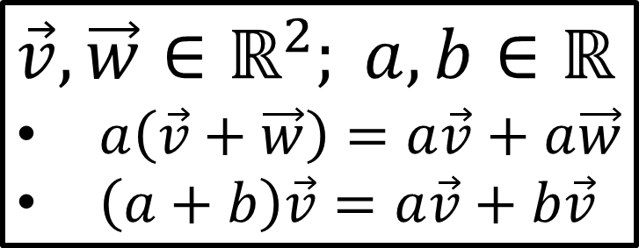
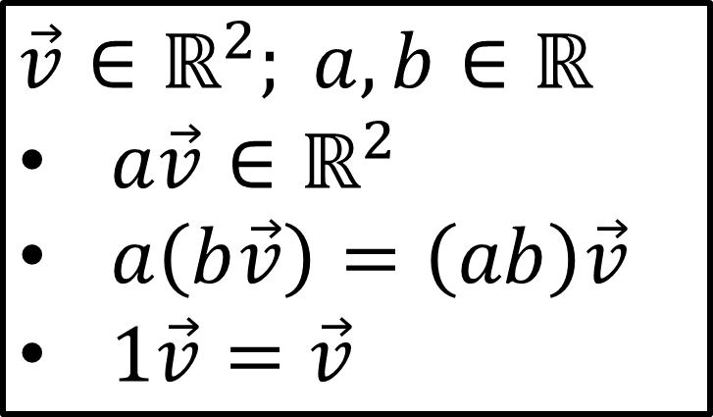
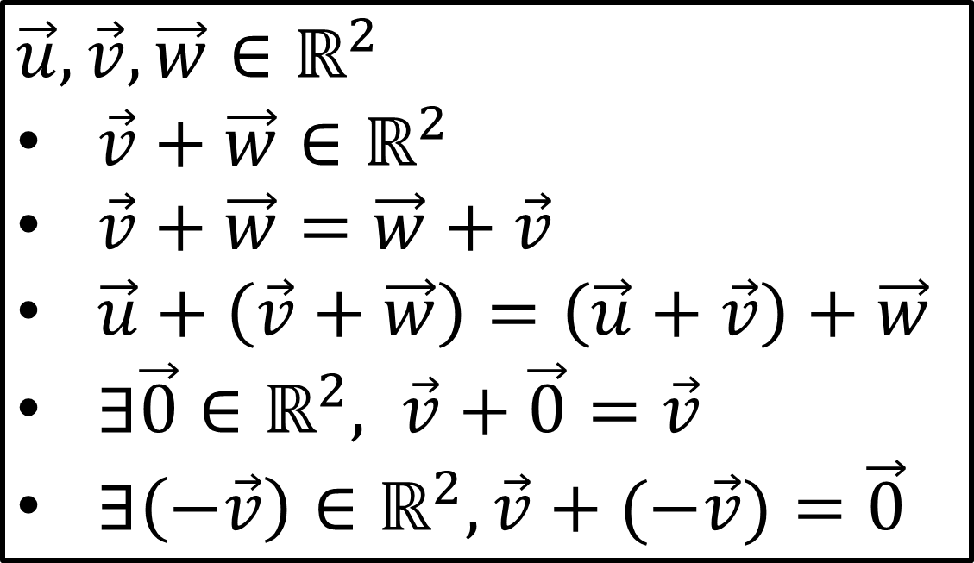
Members of $ℝ^{2}$
Addition Properties
Scaling Properties
$$\vec{u},\vec{v}, \vec{w}∈ℝ^{2}$$
$\vec{v}+\vec{w}∈ℝ^{2}$
$\vec{v}+\vec{w}=\vec{w}+\vec{v}$
$\vec{u}+\left(\vec{v}+\vec{w}\right)=\left(\vec{u}+\vec{v}\right)+\vec{w}$
$∃\vec{0}∈ℝ^{2}, \vec{v}+\vec{0}=\vec{v}$
$∃\left(−\vec{v}\right)∈ℝ^{2},\vec{v}+(−\vec{v})=\vec{0}$
$$\vec{v}∈ℝ^{2}; a,b∈ℝ$$
$a\vec{v}∈ℝ^{2}$
$a\left(b\vec{v}\right)=\left(ab\right)\vec{v}$
$1\vec{v}=\vec{v}$
Distribution Properties
$$\vec{v}, \vec{w}∈ℝ^{2}; a,b∈ℝ$$
$a\left(\vec{v}+\vec{w}\right)=a\vec{v}+a\vec{w}$
$\left(a+b\right)\vec{v}=a\vec{v}+b\vec{v}$

Slide 13
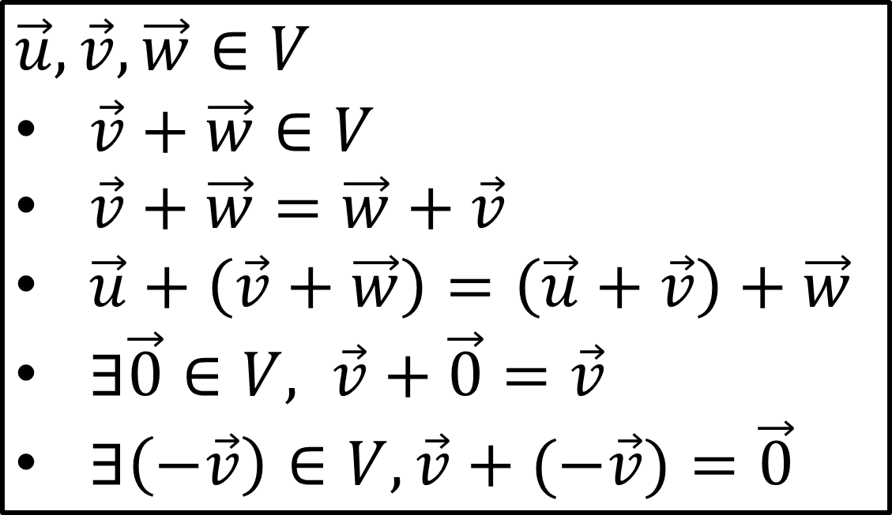
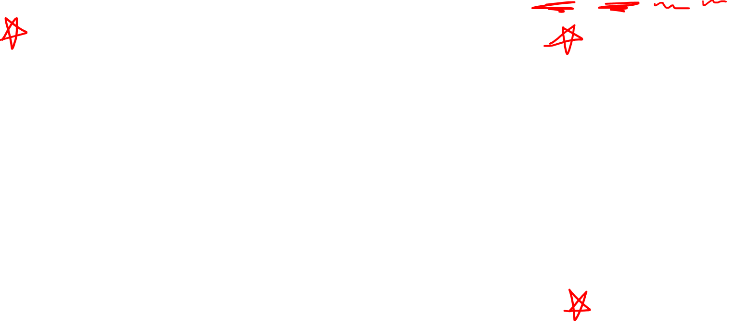

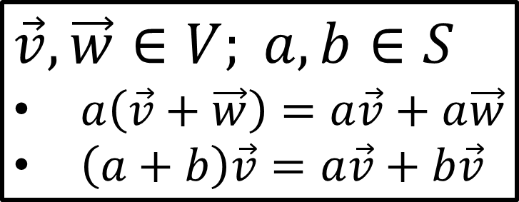
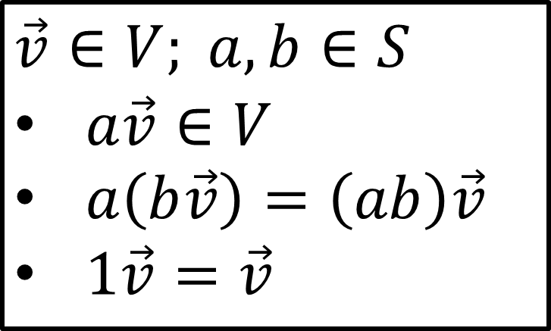
Vector Space Definition $(V,S,+,⋅)$
Addition Laws
Scaling Laws
$$\vec{u},\vec{v}, \vec{w}∈V$$
$\vec{v}+\vec{w}∈V$
$\vec{v}+\vec{w}=\vec{w}+\vec{v}$
$\vec{u}+\left(\vec{v}+\vec{w}\right)=\left(\vec{u}+\vec{v}\right)+\vec{w}$
$∃\vec{0}∈V, \vec{v}+\vec{0}=\vec{v}$
$∃\left(−\vec{v}\right)∈V,\vec{v}+(−\vec{v})=\vec{0}$
$$\vec{v}∈V; a,b∈S$$
$a\vec{v}∈V$
$a\left(b\vec{v}\right)=\left(ab\right)\vec{v}$
$1\vec{v}=\vec{v}$
Distribution Laws
$$\vec{v}, \vec{w}∈V; a,b∈S$$
$a\left(\vec{v}+\vec{w}\right)=a\vec{v}+a\vec{w}$
$\left(a+b\right)\vec{v}=a\vec{v}+b\vec{v}$

Slide 14
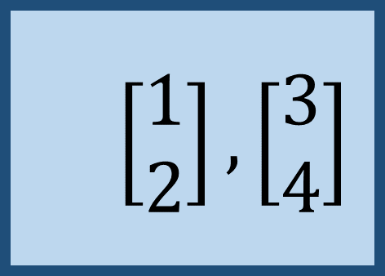


Vector Spaces
$$(V,S,+,⋅)$$
$$ℝ^{2}$$
$$\left[\begin{aligned}1 \\ 2\end{aligned}\right],\left[\begin{aligned}3 \\ 4\end{aligned}\right]$$

Slide 15
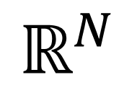
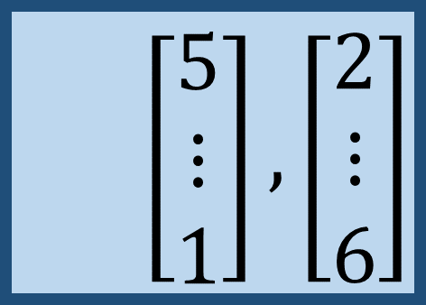
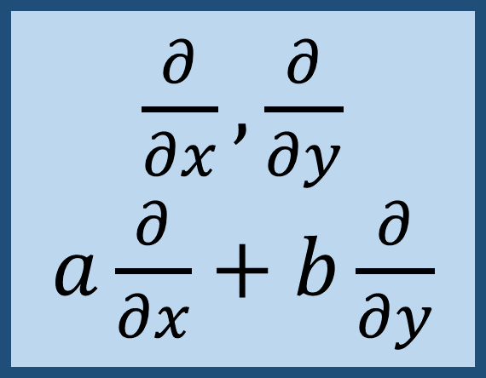

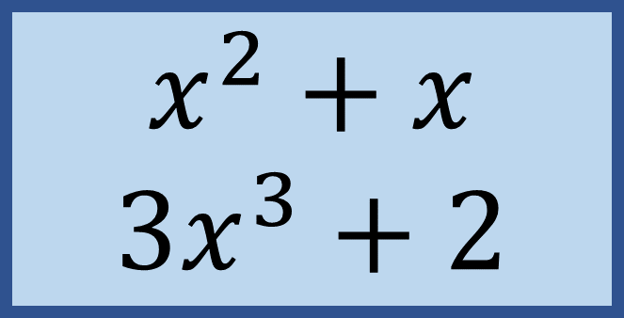

Vector Spaces
$$(V,S,+,⋅)$$
$$ℝ^{N}$$
$$\left[\begin{aligned}5 \\ ⋮ \\ 1\end{aligned}\right],\left[\begin{aligned}2 \\ ⋮ \\ 6\end{aligned}\right]$$
$$x^{2}+x$$
$$3x^{3}+2$$
$\frac{∂}{∂x},\frac{∂}{∂y}$ $a\frac{∂}{∂x}+b\frac{∂}{∂y}$
$N$-tuples of real numbers
Polynomials in $x$
Partial Derivatives

Slide 16
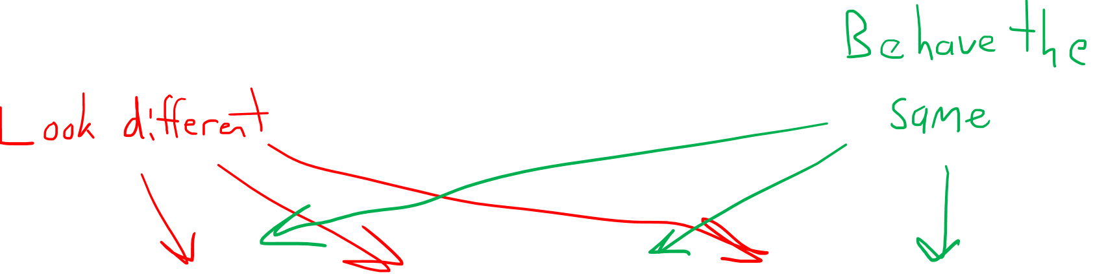
Vector Spaces
$$(V,S,+,⋅)$$
$$ℝ^{N}$$
$$\left[\begin{aligned}5 \\ ⋮ \\ 1\end{aligned}\right],\left[\begin{aligned}2 \\ ⋮ \\ 6\end{aligned}\right]$$
$$x^{2}+x$$
$$3x^{3}+2$$
$\frac{∂}{∂x},\frac{∂}{∂y}$ $a\frac{∂}{∂x}+b\frac{∂}{∂y}$
$N$-tuples of real numbers
Polynomials in $x$
Partial Derivatives

Slide 17
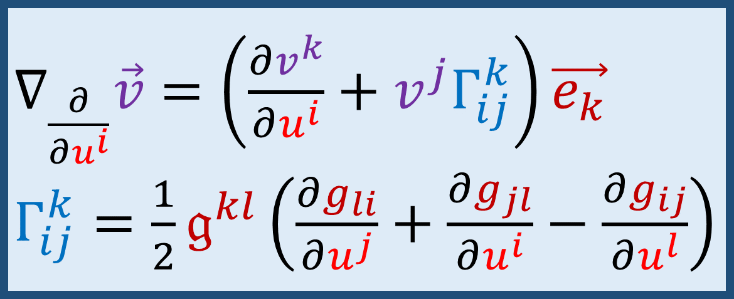
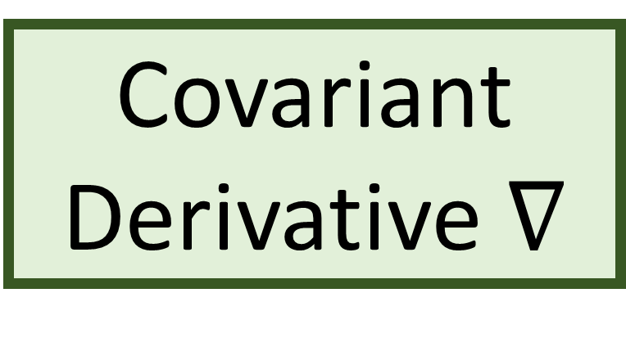
Covariant Derivative $∇$
$∇_{\frac{∂}{∂u^{i}}}\vec{v}=\left(\frac{∂v^{k}}{∂u^{i}}+v^{j}Γ_{ij}^{k}\right)\vec{e_{k}}$
$Γ_{ij}^{k}=\frac{1}{2}𝔤^{kl}\left(\frac{∂g_{li}}{∂u^{j}}+\frac{∂g_{jl}}{∂u^{i}}−\frac{∂g_{ij}}{∂u^{l}}\right)$

Slide 18


Covariant Derivative $∇$
Levi-Civita
Connection
$$…$$
$∇_{\frac{∂}{∂u^{i}}}\vec{v}=\left(\frac{∂v^{k}}{∂u^{i}}+v^{j}Γ_{ij}^{k}\right)\vec{e_{k}}$
$Γ_{ij}^{k}=\frac{1}{2}𝔤^{kl}\left(\frac{∂g_{li}}{∂u^{j}}+\frac{∂g_{jl}}{∂u^{i}}−\frac{∂g_{ij}}{∂u^{l}}\right)$
$$…$$

Slide 19
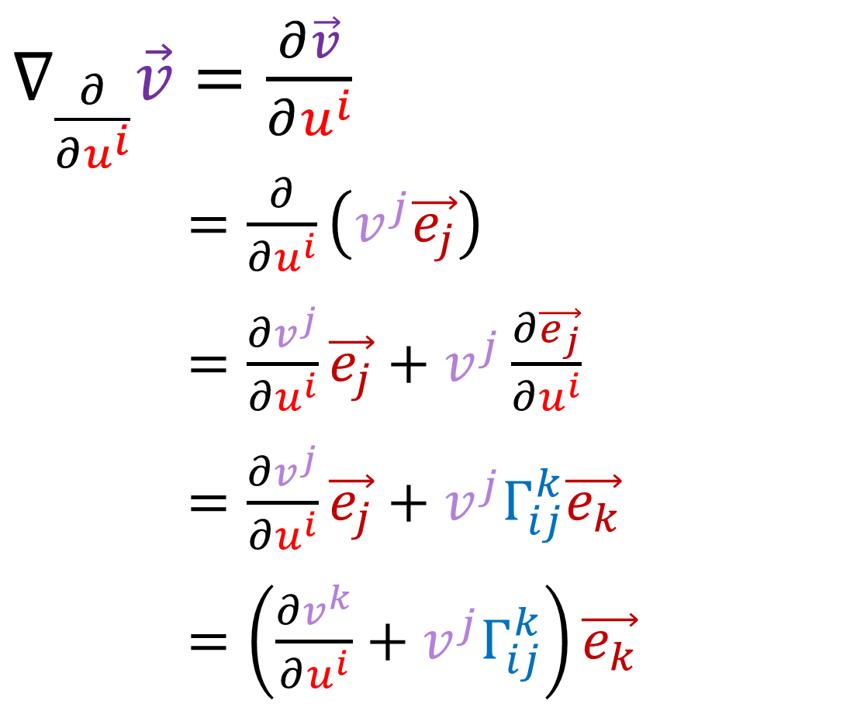
Previous Definition of Covariant Derivative
$∇_{\frac{∂}{∂u^{i}}}\vec{v}=\frac{∂\vec{v}}{∂u^{i}}$
$∇_{\frac{∂}{∂u^{i}}}\vec{v}=\frac{∂}{∂u^{i}}\left(v^{j}\vec{e_{j}}\right)$
$∇_{\frac{∂}{∂u^{i}}}\vec{v}=\frac{∂v^{j}}{∂u^{i}}\vec{e_{j}}+v^{j}\frac{∂\vec{e_{j}}}{∂u^{i}}$
$∇_{\frac{∂}{∂u^{i}}}\vec{v}=\frac{∂v^{j}}{∂u^{i}}\vec{e_{j}}+v^{j}Γ_{ij}^{k}\vec{e_{k}}$
$∇_{\frac{∂}{∂u^{i}}}\vec{v}=\left(\frac{∂v^{k}}{∂u^{i}}+v^{j}Γ_{ij}^{k}\right)\vec{e_{k}}$

Slide 20
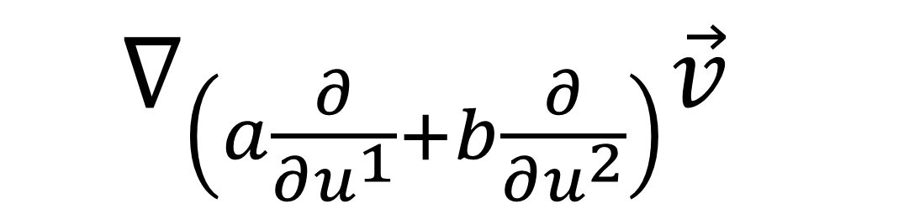
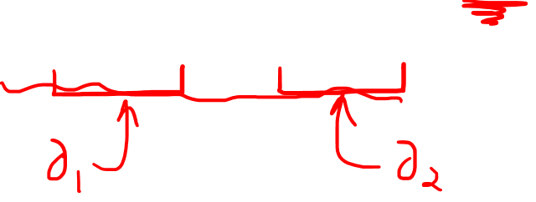
Covariant Derivative Properties
$=∇_{\left(a\frac{∂}{∂u^{1}}+b\frac{∂}{∂u^{2}}\right)}\vec{v}$

Slide 21
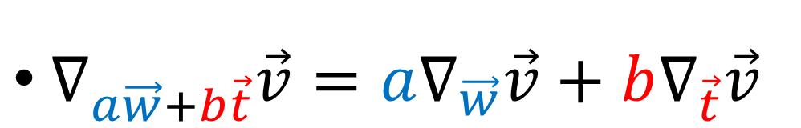
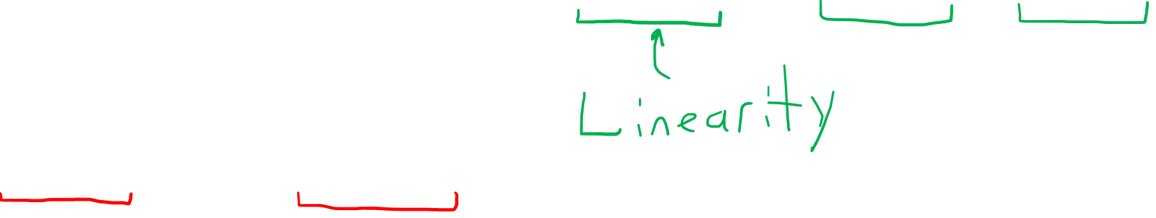
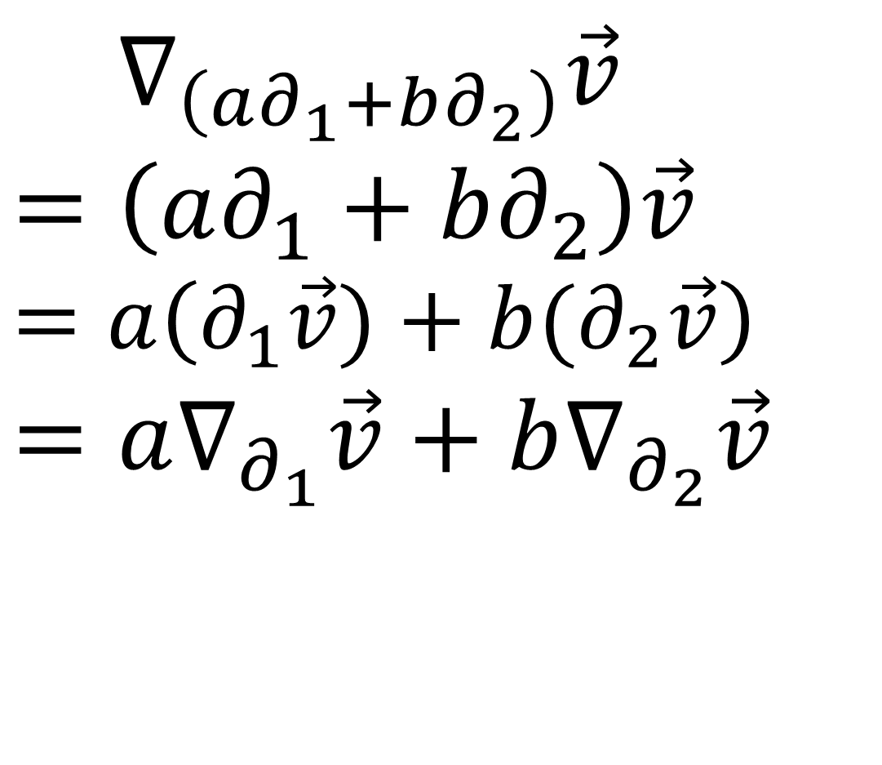
Covariant Derivative Properties
$=∇_{\left(a∂_{1}+b∂_{2}\right)}\vec{v}$
$=\left(a∂_{1}+b∂_{2}\right)\vec{v}$
$$=a\left(∂_{1}\vec{v})+b(∂_{2}\vec{v}\right)$$
$$=a∇_{∂_{1}}\vec{v}+b∇_{∂_{2}}\vec{v}$$
$∇_{a\vec{w}+b\vec{t}}\vec{v}=a∇_{\vec{w}}\vec{v}+b∇_{\vec{t}}\vec{v}$

Slide 22
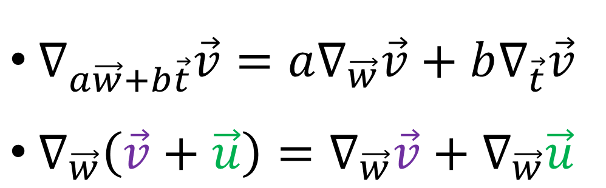
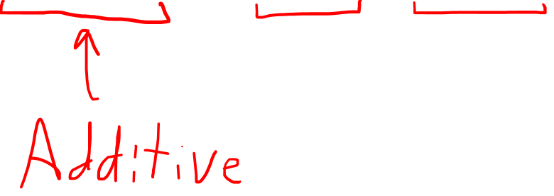
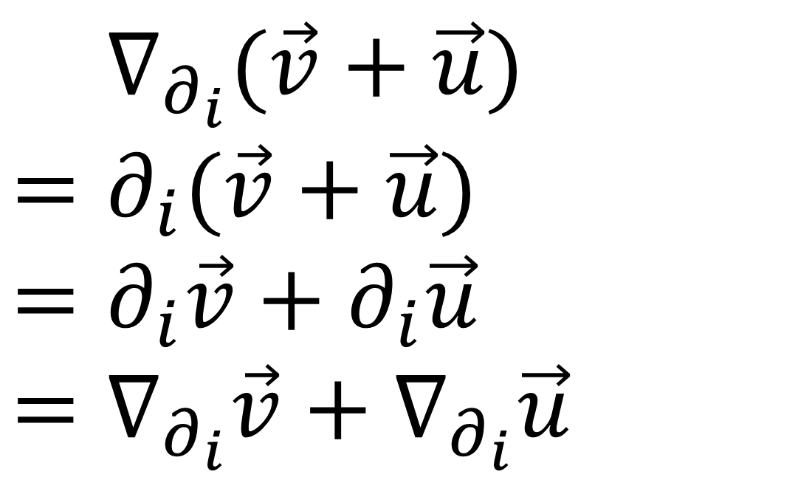
Covariant Derivative Properties
$$=∇_{∂_{i}}(\vec{v}+\vec{u})$$
$=∂_{i}(\vec{v}+\vec{u})$
$=∂_{i}\vec{v}+∂_{i}\vec{u}$
$$=∇_{∂_{i}}\vec{v}+∇_{∂_{i}}\vec{u}$$
$∇_{a\vec{w}+b\vec{t}}\vec{v}=a∇_{\vec{w}}\vec{v}+b∇_{\vec{t}}\vec{v}$
$∇_{\vec{w}}\left(\vec{v}+\vec{u}\right)=∇_{\vec{w}}\vec{v}+∇_{\vec{w}}\vec{u}$

Slide 23
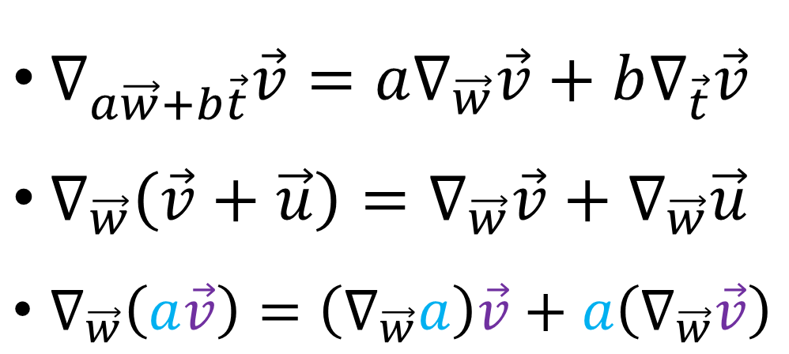
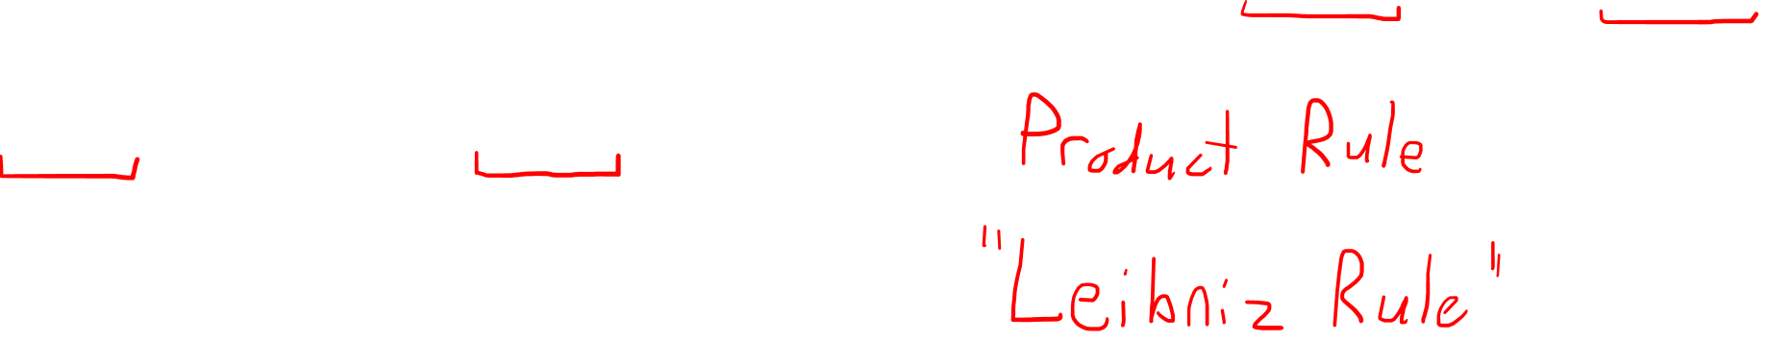

Covariant Derivative Properties
$$=∇_{∂_{i}}(a\vec{v})$$
$=\frac{∂}{∂u^{i}}(a\vec{v})$
$=\frac{∂a}{∂u^{i}}\vec{v}+a\frac{∂\vec{v}}{∂u^{i}}$
$=$ $\left(∇_{∂_{i}}a\right)\vec{v}+a(∇_{∂_{i}}\vec{v})$
$∇_{a\vec{w}+b\vec{t}}\vec{v}=a∇_{\vec{w}}\vec{v}+b∇_{\vec{t}}\vec{v}$
$∇_{\vec{w}}\left(\vec{v}+\vec{u}\right)=∇_{\vec{w}}\vec{v}+∇_{\vec{w}}\vec{u}$
$∇_{\vec{w}}\left(a\vec{v}\right)=\left(∇_{\vec{w}}a\right)\vec{v}+a\left(∇_{\vec{w}}\vec{v}\right)$

Slide 24




Covariant Derivative Properties
$$=∇_{∂_{i}}(a)$$
$=\frac{∂}{∂u^{i}}(a)$
$$=\frac{∂a}{∂u^{i}}$$
$∇_{a\vec{w}+b\vec{t}}\vec{v}=a∇_{\vec{w}}\vec{v}+b∇_{\vec{t}}\vec{v}$
$∇_{\vec{w}}\left(\vec{v}+\vec{u}\right)=∇_{\vec{w}}\vec{v}+∇_{\vec{w}}\vec{u}$
$∇_{\vec{w}}\left(a\vec{v}\right)=\left(∇_{\vec{w}}a\right)\vec{v}+a\left(∇_{\vec{w}}\vec{v}\right)$
$∇_{∂_{i}}\left(a\right)=\frac{∂a}{∂u^{i}}$
Partial Derivative for $u^{i}$
= Directional Derivative
in $u^{i}$ direction.

Slide 25





Covariant Derivative $∇$
$$∇_{□}□$$
Input
Field
$∇_{a\vec{w}+b\vec{t}}\vec{v}=a∇_{\vec{w}}\vec{v}+b∇_{\vec{t}}\vec{v}$
$∇_{\vec{w}}\left(\vec{v}+\vec{u}\right)=∇_{\vec{w}}\vec{v}+∇_{\vec{w}}\vec{u}$
$∇_{\vec{w}}\left(a\vec{v}\right)=\left(∇_{\vec{w}}a\right)\vec{v}+a\left(∇_{\vec{w}}\vec{v}\right)$
$∇_{∂_{i}}\left(a\right)=\frac{∂a}{∂u^{i}}$
Direction
$$∇_{\vec{w}}\vec{v}$$
Output
Field
“Connection”
(rate of change)

Slide 26











$$S$$
$$T_{p}S$$
$$p$$
$$q$$
$$T_{q}S$$
Parallel Transport provides a connection between tangent spaces in a curved space.
$∇_{\frac{d}{dλ}}\vec{v}=\vec{0}$

Slide 27

$$S$$
$$T_{p}S$$
$$p$$
$$q$$
$$T_{q}S$$
Covariant Derivative provides a connection between tangent spaces in a curved space.
$∇_{\frac{d}{dλ}}\vec{v}=\vec{0}$

Slide 28



Covariant Derivative $∇$
$∇_{a\vec{w}+b\vec{t}}\vec{v}=a∇_{\vec{w}}\vec{v}+b∇_{\vec{t}}\vec{v}$
$∇_{\vec{w}}\left(\vec{v}+\vec{u}\right)=∇_{\vec{w}}\vec{v}+∇_{\vec{w}}\vec{u}$
$∇_{\vec{w}}\left(a\vec{v}\right)=\left(∇_{\vec{w}}a\right)\vec{v}+a\left(∇_{\vec{w}}\vec{v}\right)$
$∇_{∂_{i}}\left(a\right)=\frac{∂a}{∂u^{i}}$
$\frac{∂}{∂u^{i}}$ $\vec{e_{j}}=Γ_{ij}^{k}\vec{e_{k}}$

Slide 29



Covariant Derivative $∇$
Christoffel Symbols /
Connection Coefficients
$∇_{a\vec{w}+b\vec{t}}\vec{v}=a∇_{\vec{w}}\vec{v}+b∇_{\vec{t}}\vec{v}$
$∇_{\vec{w}}\left(\vec{v}+\vec{u}\right)=∇_{\vec{w}}\vec{v}+∇_{\vec{w}}\vec{u}$
$∇_{\vec{w}}\left(a\vec{v}\right)=\left(∇_{\vec{w}}a\right)\vec{v}+a\left(∇_{\vec{w}}\vec{v}\right)$
$∇_{∂_{i}}\left(a\right)=\frac{∂a}{∂u^{i}}$
$$∇_{\vec{e_{i}}}\vec{e_{j}}=Γ_{ij}^{k}\vec{e_{k}}$$
Torsion-Free
$$∇_{w}\vec{v}=∇_{\vec{v}}\vec{w}$$
Metric Compatibility
$$∇_{\vec{w}}\left(\vec{v}⋅\vec{u}\right)=\left(∇_{\vec{w}}\vec{v}\right)⋅\vec{u}+\vec{v}⋅\left(∇_{\vec{w}}\vec{u}\right)$$

Slide 30






Torsion-Free
$$∇_{\vec{w}}\vec{v}=∇_{\vec{v}}\vec{w}$$
$$∇_{\vec{w}}\vec{v}−∇_{\vec{v}}\vec{w}=\left[\vec{v},\vec{w}\right]$$
$$∇_{\vec{w}}\vec{v}=∇_{\vec{v}}\vec{w}$$
Lie Bracket
$$\left[\vec{v},\vec{w}\right]=\vec{v}\vec{w}−\vec{w}\vec{v}$$
$\left[∂_{i},∂_{j}\right]=∂_{i}∂_{j}−∂_{j}∂_{i}=\frac{∂^{2}}{∂u^{i}∂u^{j}}−\frac{∂^{2}}{∂u^{j}∂u^{i}}=0$

Slide 31







Torsion-Free Property
$$∇_{\vec{e_{i}}}\vec{e_{j}}=Γ_{ij}^{k}\vec{e_{k}}$$
$$∇_{\vec{e_{j}}}\vec{e_{i}}=Γ_{ji}^{k}\vec{e_{k}}$$
$$∇_{\vec{e_{i}}}\vec{e_{j}}=∇_{\vec{e_{j}}}\vec{e_{i}}$$
$\frac{∂}{∂u^{i}}\left(\frac{∂}{∂u^{j}}\right)=\frac{∂}{∂u^{j}}\left(\frac{∂}{∂u^{i}}\right)$
$$Γ_{ij}^{k}\vec{e_{k}}=Γ_{ji}^{k}\vec{e_{k}}$$
$\frac{∂}{∂u^{i}}\left(\vec{e_{j}}\right)=\frac{∂}{∂u^{j}}\left(\vec{e_{i}}\right)$
$$Γ_{ij}^{k}=Γ_{ji}^{k}$$

Slide 32



Metric Compatibility
$$∇_{\vec{w}}\left(\vec{v}⋅\vec{u}\right)=\left(∇_{\vec{w}}\vec{v}\right)⋅\vec{u}+\vec{v}⋅\left(∇_{\vec{w}}\vec{u}\right)$$
“When we parallel transport two vectors, their dot product will stay the same.”
$$∇_{\vec{w}}\vec{v}=\vec{0}$$
$$∇_{\vec{w}}\vec{u}=\vec{0}$$
$$∇_{\vec{w}}\left(\vec{v}⋅\vec{u}\right)=\left(∇_{\vec{w}}\vec{v}\right)⋅\vec{u}+\vec{v}⋅\left(∇_{\vec{w}}\vec{u}\right)$$

Slide 33


Metric Compatibility
$$∇_{\vec{w}}\left(\vec{v}⋅\vec{u}\right)=\left(∇_{\vec{w}}\vec{v}\right)⋅\vec{u}+\vec{v}⋅\left(∇_{\vec{w}}\vec{u}\right)$$
“When we parallel transport two vectors, their dot product will stay the same.”
$$∇_{\vec{w}}\vec{v}=\vec{0}$$
$$∇_{\vec{w}}\vec{u}=\vec{0}$$
$$∇_{\vec{w}}\left(\vec{v}⋅\vec{u}\right)=\vec{0}$$

Slide 34



$$∇_{∂_{i}}\left(\vec{v}⋅\vec{u}\right)=\vec{0}$$
$$∂_{i}\left(\vec{v}⋅\vec{u}\right)=\vec{0}$$

Slide 35
Metric Compatibility
$$∇_{∂_{i}}\left(\vec{v}⋅\vec{u}\right)=\left(∇_{∂_{i}}\vec{v}\right)⋅\vec{u}+\vec{v}⋅\left(∇_{∂_{i}}\vec{u}\right)$$
$$∇_{∂_{i}}\vec{v}=\vec{0}$$
$=∇_{∂_{i}}\left({\left\|\vec{v}\right\|}^{2}\right)$
$$=∇_{∂_{i}}\left(\vec{v}⋅\vec{v}\right)$$
$$=\left(∇_{∂_{i}}\vec{v}\right)⋅\vec{v}+\vec{v}⋅\left(∇_{∂_{i}}\vec{v}\right)$$
$$=\vec{0}⋅\vec{v}+\vec{v}⋅\vec{0}$$
$$=\vec{0}$$
$$\vec{u}$$
$$\vec{v}$$
${\left\|\vec{v}\right\|}^{2}=$ $constant$

Slide 36




Metric Compatibility
$$∇_{\vec{e_{i}}}\vec{e_{j}}=Γ_{ij}^{k}\vec{e_{k}}$$
$$∇_{∂_{i}}\left(\vec{v}⋅\vec{u}\right)=\left(∇_{∂_{i}}\vec{v}\right)⋅\vec{u}+\vec{v}⋅\left(∇_{∂_{i}}\vec{u}\right)$$
$$∇_{\vec{e_{k}}}\left(\vec{e_{i}}⋅\vec{e_{j}}\right)=\left(∇_{\vec{e_{k}}}\vec{e_{i}}\right)⋅\vec{e_{j}}+\vec{e_{i}}⋅\left(∇_{\vec{e_{k}}}\vec{e_{j}}\right)$$
$$∂_{k}\left(\vec{e_{i}}⋅\vec{e_{j}}\right) =\left(Γ_{ik}^{l}\vec{e_{l}}\right)⋅\vec{e_{j}}+\vec{e_{i}}⋅\left(Γ_{jk}^{l}\vec{e_{l}}\right)$$
$$∂_{k}\left(\vec{e_{i}}⋅\vec{e_{j}}\right) =Γ_{ik}^{l}\left(\vec{e_{j}}⋅\vec{e_{l}}\right)+Γ_{jk}^{l}\left(\vec{e_{i}}⋅\vec{e_{l}}\right)$$
$$∂_{k}\left(g_{ij}\right) =Γ_{ik}^{l}g_{jl}+Γ_{kj}^{l}g_{il}$$

Slide 37



Torsion-Free + Metric Compatibility
$$∂_{k}g_{ij}=Γ_{ik}^{l}g_{jl}+Γ_{jk}^{l}g_{il}$$
$$∂_{j}g_{ki}=Γ_{kj}^{l}g_{il}+Γ_{ij}^{l}g_{kl}$$
$$∂_{i}g_{jk}=Γ_{ji}^{l}g_{kl}+Γ_{ki}^{l}g_{jl}$$
$$∂_{k}g_{ij}+∂_{j}g_{ki}−∂_{i}g_{jk}$$

Slide 38




Torsion-Free + Metric Compatibility
$$∂_{k}g_{ij}=Γ_{ik}^{l}g_{jl}+Γ_{jk}^{l}g_{il}$$
$$∂_{j}g_{ki}=Γ_{kj}^{l}g_{il}+Γ_{ij}^{l}g_{kl}$$
$$∂_{i}g_{jk}=Γ_{ji}^{l}g_{kl}+Γ_{ki}^{l}g_{jl}$$
$$∂_{k}g_{ij}+∂_{j}g_{ki}−∂_{i}g_{jk}$$
$$=2Γ_{jk}^{l}g_{il}$$
$\frac{1}{2}𝔤^{im}\left(∂_{k}g_{ij}+∂_{j}g_{ki}−∂_{i}g_{jk}\right)=Γ_{jk}^{m}$

Slide 39




Torsion-Free
Metric Compatibility
$$∇_{\vec{e_{i}}}\vec{e_{j}}=∇_{\vec{e_{j}}}\vec{e_{i}}$$
$$Γ_{ij}^{k}=Γ_{ji}^{k}$$
$$∇_{\vec{w}}\left(\vec{v}⋅\vec{u}\right)=\left(∇_{\vec{w}}\vec{v}\right)⋅\vec{u}+\vec{v}⋅\left(∇_{\vec{w}}\vec{u}\right)$$
$∂_{k}g_{ij}=Γ_{ik}^{l}g_{jl}+Γ_{jk}^{l}g_{il}$
Levi-Civita Connection
$$Γ_{jk}^{m}=\frac{1}{2}𝔤^{im}\left(∂_{k}g_{ij}+∂_{j}g_{ki}−∂_{i}g_{jk}\right)$$

Slide 40

Fundamental Theorem of Riemannian Geometry
(Riemannian Manifold = Curved Space with a metric)
There is a unique connection (covariant derivative) that is:
Torsion-Free
Has Metric Compatibility
This connection is called the Levi-Civita Connection.
Its Christoffel Symbols (connection coefficients) are:
$Γ_{jk}^{m}=\frac{1}{2}𝔤^{im}\left(∂_{k}g_{ij}+∂_{j}g_{ki}−∂_{i}g_{jk}\right)$

Slide 41


Covariant Derivative of a Covector Field
Tensors for Beginners 4: Covectors
$ε^{j}\left(\vec{e_{i}}\right)=δ_{i}^{j}$
Tensor Calculus 6: Differential Forms are Covectors
$du^{j}\left(\frac{∂}{∂u^{i}}\right)=\frac{∂u^{j}}{∂u^{i}}=δ_{i}^{j}$

Slide 42



Covariant Derivative of a Covector
$∇_{∂_{i}}\left(α\right)=∇_{∂_{i}}\left(α_{j}ε^{j}\right)$
$\frac{∂}{∂u^{i}}\left(\vec{v}\right)=\left(∇_{∂_{i}}α_{j}\right)ε^{j}+α_{j}\left(∇_{∂_{i}}ε^{j}\right)$
$\frac{∂}{∂u^{i}}\left(\vec{v}\right)=\frac{∂α_{j}}{∂u^{i}}ε^{j}+α_{j}\left(Λ_{ik}^{j}ε^{k}\right)$
$\frac{∂}{∂u^{i}}\left(\vec{v}\right)=\left(\frac{∂α_{k}}{∂u^{i}}+α_{j}Λ_{ik}^{j}\right)ε^{k}$
$∇_{∂_{i}}ε^{j}=Λ_{ik}^{j}ε^{k}$

Slide 43

Covariant Derivative of a Covector
$∇_{∂_{i}}\left(α\right)=∇_{∂_{i}}\left(α_{j}ε^{j}\right)$
$\frac{∂}{∂u^{i}}\left(\vec{v}\right)=\left(∇_{∂_{i}}α_{j}\right)ε^{j}+α_{j}\left(∇_{∂_{i}}ε^{j}\right)$
$\frac{∂}{∂u^{i}}\left(\vec{v}\right)=\frac{∂α_{j}}{∂u^{i}}ε^{j}+α_{j}\left(Λ_{ik}^{j}ε^{k}\right)$
$\frac{∂}{∂u^{i}}\left(\vec{v}\right)=\left(\frac{∂α_{k}}{∂u^{i}}+α_{j}Λ_{ik}^{j}\right)ε^{k}$
$∇_{∂_{i}}ε^{j}=Λ_{ik}^{j}ε^{k}$

Slide 44




Covariant Derivative of a Covector
$$α=\vec{a}⋅__$$
$$∇_{∂_{i}}\left(α\left(\vec{v}\right)\right)=∇_{∂_{i}}\left(\vec{a}⋅\vec{v}\right)$$
$$∇_{\vec{w}}\left(\vec{v}⋅\vec{u}\right)=\left(∇_{\vec{w}}\vec{v}\right)⋅\vec{u}+\vec{v}⋅\left(∇_{\vec{w}}\vec{u}\right)$$
Metric Compatibility
$$∇_{∂_{i}}\left(\vec{a}⋅\vec{v}\right)=\left(∇_{∂_{i}}\vec{a}\right)⋅\vec{v}+\vec{a}⋅\left(∇_{∂_{i}}\vec{v}\right)$$
$$∂_{i}\left(α\left(\vec{v}\right)\right)=\left(∇_{∂_{i}}α\right)\left(\vec{v}\right)+α\left(∇_{∂_{i}}\vec{v}\right)$$
$$∂_{i}\left(α_{k}ε^{k}\left(v^{r}\vec{e_{r}}\right)\right)=$$
$\left(\frac{∂α_{k}}{∂u^{i}}+α_{j}Λ_{ik}^{j}\right)ε^{k}\left(\vec{v}\right)+α\left(\left(\frac{∂v^{k}}{∂u^{i}}+v^{j}Γ_{ij}^{k}\right)\vec{e_{k}}\right)$

Slide 45



Covariant Derivative of a Covector
$$∂_{i}\left(α_{k}v^{r}ε^{k}\left(\vec{e_{r}}\right)\right)=$$
$\left(\frac{∂α_{k}}{∂u^{i}}+α_{j}Λ_{ik}^{j}\right)ε^{k}\left(\vec{v}\right)+\left(\frac{∂v^{k}}{∂u^{i}}+v^{j}Γ_{ij}^{k}\right)α\left(\vec{e_{k}}\right)$
$∂_{i}\left(α_{k}v^{k}\right)=\left(\frac{∂α_{k}}{∂u^{i}}+α_{j}Λ_{ik}^{j}\right)v^{k}+\left(\frac{∂v^{k}}{∂u^{i}}+v^{j}Γ_{ij}^{k}\right)α_{k}$
$\frac{∂}{∂u^{i}}\left(α_{k}v^{k}\right)=\frac{∂α_{k}}{∂u^{i}}v^{k}+α_{k}\frac{∂v^{k}}{∂u^{i}}+α_{j}v^{k}Λ_{ik}^{j}+α_{k}v^{j}Γ_{ij}^{k}$
$0=α_{j}v^{k}Λ_{ik}^{j}+α_{k}v^{j}Γ_{ij}^{k}$
$0=α_{k}v^{j}Λ_{ij}^{k}+α_{k}v^{j}Γ_{ij}^{k}$
$$Λ_{ij}^{k}=−Γ_{ij}^{k}$$

Slide 46


Mistake in the video
$0=α_{k}v^{j}Λ_{ij}^{k}+α_{k}v^{j}Γ_{ij}^{k}$
In the video, I imply that you can “cancel” $α_{k}v^{j}$ from both terms in the above equation
“Cancelling by division” is bad reasoning, because the above expression is actually a summation, so we can’t just “cancel” the terms
However, the equation must be true for ANY choice of $α_{k}$ and $v^{j}$ …
So we can pick convenient choices (mostly 0s and a 1) and prove that $Λ_{ij}^{k}=−Γ_{ij}^{k}$ component-by-component
In short, the result I got in the video is correct, but the reasoning was bad/unclear

Slide 47



Covariant Derivative of a Covector
$∇_{∂_{i}}\left(α\right)=\left(\frac{∂α_{k}}{∂u^{i}}+α_{j}Λ_{ik}^{j}\right)ε^{k}$
$∇_{∂_{i}}\left(α\right)=\left(\frac{∂α_{k}}{∂u^{i}}−α_{j}Γ_{ik}^{j}\right)ε^{k}$
$$Λ_{ij}^{k}=−Γ_{ij}^{k}$$

Slide 48



Covariant Derivative of a Tensor
$∇_{∂_{i}}\left(\vec{v}\right)=\left(\frac{∂v^{k}}{∂u^{i}}+v^{j}Γ_{ij}^{k}\right)\vec{e_{k}}$
$∇_{∂_{i}}\left(α\right)=\left(\frac{∂α_{k}}{∂u^{i}}−α_{j}Γ_{ik}^{j}\right)ε^{k}$
$$∇_{\vec{w}}\left(T⊗S\right)=\left(∇_{\vec{w}}T\right)⊗S+T⊗\left(∇_{\vec{w}}S\right)$$
$$∇_{∂_{i}}\left(g\right)=∇_{∂_{i}}\left(g_{rs}ε^{r}⊗ε^{s}\right)$$

Slide 49



$$∇_{\vec{w}}\left(T⊗S\right)=\left(∇_{\vec{w}}T\right)⊗S+T⊗\left(∇_{\vec{w}}S\right)$$
$$∇_{∂_{i}}\left(g\right)=∇_{∂_{i}}\left(g_{rs}ε^{r}⊗ε^{s}\right)$$
$=∇_{∂_{i}}\left(g_{rs}\right)\left(ε^{r}⊗ε^{s}\right)+$ $g_{rs}$ $∇_{∂_{i}}$ $\left(ε^{r}⊗ε^{s}\right)$
$=∂_{i}\left(g_{rs}\right)\left(ε^{r}⊗ε^{s}\right)$
$+$ $g_{rs}$ $\left(\left(∇_{∂_{i}}ε^{r}\right)⊗ε^{s}+ε^{r}⊗\left(∇_{∂_{i}}ε^{s}\right)\right)$
$$∇_{∂_{i}}\left(ε^{r}\right)=Λ_{ik}^{r}ε^{k}=−Γ_{ik}^{r}ε^{k}$$

Slide 50

$$∇_{\vec{w}}\left(T⊗S\right)=\left(∇_{\vec{w}}T\right)⊗S+T⊗\left(∇_{\vec{w}}S\right)$$
$$∇_{∂_{i}}\left(g\right)=∇_{∂_{i}}\left(g_{rs}ε^{r}⊗ε^{s}\right)$$
$=∇_{∂_{i}}\left(g_{rs}\right)\left(ε^{r}⊗ε^{s}\right)+$ $g_{rs}$ $∇_{∂_{i}}$ $\left(ε^{r}⊗ε^{s}\right)$
$=∂_{i}\left(g_{rs}\right)\left(ε^{r}⊗ε^{s}\right)$
$+$ $g_{rs}$ $\left(\left(∇_{∂_{i}}ε^{r}\right)⊗ε^{s}+ε^{r}⊗\left(∇_{∂_{i}}ε^{s}\right)\right)$
$=∂_{i}\left(g_{rs}\right)\left(ε^{r}⊗ε^{s}\right)$
$+$ $g_{rs}$ $\left(\left(−Γ_{ik}^{r}ε^{k}\right)⊗ε^{s}+ε^{r}⊗\left(−Γ_{ik}^{s}ε^{k}\right)\right)$

Slide 51


$$∇_{∂_{i}}\left(g\right)=∂_{i}\left(g_{rs}\right)\left(ε^{r}⊗ε^{s}\right)$$
$−$ $\left(g_{rs}Γ_{ik}^{r}\left(ε^{k}⊗ε^{s}\right)+g_{rs}Γ_{ik}^{s}\left(ε^{r}⊗ε^{k}\right)\right)$
$$∇_{∂_{i}}\left(g\right)=∂_{i}\left(g_{rs}\right)\left(ε^{r}⊗ε^{s}\right)$$
$−$ $\left(g_{ks}Γ_{ir}^{k}\left(ε^{r}⊗ε^{s}\right)+g_{rk}Γ_{is}^{k}\left(ε^{r}⊗ε^{s}\right)\right)$
$∇_{∂_{i}}\left(g\right)=\left[\frac{∂g_{rs}}{∂u^{i}}−g_{ks}Γ_{ir}^{k}−g_{rk}Γ_{is}^{k}\right]\left(ε^{r}⊗ε^{s}\right)$

Slide 52


Covariant Derivative of a Tensor
$∇_{∂_{i}}\left(\vec{v}\right)=\left(\frac{∂v^{k}}{∂u^{i}}+v^{j}Γ_{ij}^{k}\right)\vec{e_{k}}$
$∇_{∂_{i}}\left(α\right)=\left(\frac{∂α_{k}}{∂u^{i}}−α_{j}Γ_{ik}^{j}\right)ε^{k}$
$∇_{∂_{i}}\left(g\right)=\left[\frac{∂g_{rs}}{∂u^{i}}−g_{ks}Γ_{ir}^{k}−g_{rk}Γ_{is}^{k}\right]\left(ε^{r}⊗ε^{s}\right)$
$$∇_{\vec{w}}\left(T⊗S\right)=\left(∇_{\vec{w}}T\right)⊗S+T⊗\left(∇_{\vec{w}}S\right)$$

Slide 53



Another way to write Metric Compatibility…
$$∇_{\vec{w}}\left(\vec{v}⋅\vec{u}\right)=\left(∇_{\vec{w}}\vec{v}\right)⋅\vec{u}+\vec{v}⋅\left(∇_{\vec{w}}\vec{u}\right)$$
$\frac{∂g_{rs}}{∂u^{i}}=g_{ks}Γ_{ir}^{k}+g_{rk}Γ_{is}^{k}$
$∇_{∂_{i}}\left(g\right)=\left[\frac{∂g_{rs}}{∂u^{i}}−g_{ks}Γ_{ir}^{k}−g_{rk}Γ_{is}^{k}\right]\left(ε^{r}⊗ε^{s}\right)$
$∇_{∂_{i}}\left(g\right)=0\left(ε^{r}⊗ε^{s}\right)$
$$∇g=0$$

Slide 54



Christoffel Symbols on the Sphere
$Γ_{11}^{1}=0$ | $$Γ_{11}^{2}=0$$
$Γ_{12}^{1}=0$ | $$Γ_{12}^{2}=\cot\left(u^{1}\right)$$
$$Γ_{21}^{1}=0$$ | $$Γ_{21}^{2}=\cot\left(u^{1}\right)$$
$Γ_{22}^{1}=−\frac{1}{2}\sin\left(2u^{1}\right)$ | $Γ_{22}^{2}=0$
$$g_{ij}→$$
$$\left[\begin{matrix}1 & 0 \\ 0 & {\left(\sin\left(u^{1}\right)\right)}^{2}\end{matrix}\right]$$
$\frac{∂g_{rs}}{∂u^{i}}−g_{ks}Γ_{ir}^{k}−g_{rk}Γ_{is}^{k}$

Slide 55


$=\frac{∂g_{rs}}{∂u^{i}}−g_{ks}Γ_{ir}^{k}−g_{rk}Γ_{is}^{k}$
$=\frac{∂g_{22}}{∂u^{1}}−g_{22}Γ_{12}^{2}−g_{22}Γ_{12}^{2}$
$=\frac{∂g_{22}}{∂u^{1}}−2g_{22}Γ_{12}^{2}$
$=2\sin\left(u^{1}\right)\cos\left(u^{1}\right)−2{\left(\sin\left(u^{1}\right)\right)}^{2}\cot\left(u^{1}\right)$
$=2\sin\left(u^{1}\right)\cos\left(u^{1}\right)−2{\left(\sin\left(u^{1}\right)\right)}^{2}\frac{\cos\left(u^{1}\right)}{\sin\left(u^{1}\right)}$
$=0$

Slide 56





Covariant Derivative $∇$
Summary
$$∇_{\vec{e_{i}}}\vec{e_{j}}=Γ_{ij}^{k}\vec{e_{k}}$$
$∇_{a\vec{w}+b\vec{t}}\vec{v}=a∇_{\vec{w}}\vec{v}+b∇_{\vec{t}}\vec{v}$
$∇_{\vec{w}}\left(\vec{v}+\vec{u}\right)=∇_{\vec{w}}\vec{v}+∇_{\vec{w}}\vec{u}$
$∇_{\vec{w}}\left(a\vec{v}\right)=\left(∇_{\vec{w}}a\right)\vec{v}+a\left(∇_{\vec{w}}\vec{v}\right)$
$∇_{∂_{i}}\left(a\right)=\frac{∂a}{∂u^{i}}$
Covariant Derivative provides a connection between tangent spaces in a curved space.
Parallel Transport $∇_{∂_{i}}T=0$

Slide 57



Torsion-Free
Metric Compatibility
$$∇_{\vec{e_{i}}}\vec{e_{j}}=∇_{\vec{e_{j}}}\vec{e_{i}}$$
$$Γ_{ij}^{k}=Γ_{ji}^{k}$$
$$∇_{\vec{w}}\left(\vec{v}⋅\vec{u}\right)=\left(∇_{\vec{w}}\vec{v}\right)⋅\vec{u}+\vec{v}⋅\left(∇_{\vec{w}}\vec{u}\right)$$
$∂_{k}g_{ij}=Γ_{ik}^{l}g_{jl}+Γ_{kj}^{l}g_{il}$
$∇g=0$
Parallel transport keeps dot product of vectors constant.
if $∇_{\vec{w}}\vec{v}=\vec{0}=∇_{\vec{w}}\vec{u}$
then $∇_{\vec{w}}\left(\vec{v}⋅\vec{u}\right)=0$

Slide 58

Torsion-Free
Metric Compatibility
$$∇_{\vec{e_{i}}}\vec{e_{j}}=∇_{\vec{e_{j}}}\vec{e_{i}}$$
$$Γ_{ij}^{k}=Γ_{ji}^{k}$$
$$∇_{\vec{w}}\left(\vec{v}⋅\vec{u}\right)=\left(∇_{\vec{w}}\vec{v}\right)⋅\vec{u}+\vec{v}⋅\left(∇_{\vec{w}}\vec{u}\right)$$
$∂_{k}g_{ij}=Γ_{ik}^{l}g_{jl}+Γ_{kj}^{l}g_{il}$
$∇g=0$
Levi-Civita Connection
$$Γ_{jk}^{m}=\frac{1}{2}𝔤^{im}\left(∂_{k}g_{ij}+∂_{j}g_{ki}−∂_{i}g_{jk}\right)$$

Slide 59
Summary
Fundamental Theorem of Riemannian Geometry
The Levi-Civita Connection is the unique
torsion-free, metric compatible connection.
Levi-Civita Connection
$$Γ_{jk}^{m}=\frac{1}{2}𝔤^{im}\left(∂_{k}g_{ij}+∂_{j}g_{ki}−∂_{i}g_{jk}\right)$$

Slide 60


Summary
$∇_{∂_{i}}\left(a\right)=\frac{∂a}{∂u^{i}}$
$∇_{∂_{i}}\left(\vec{v}\right)=\left(\frac{∂v^{k}}{∂u^{i}}+v^{j}Γ_{ij}^{k}\right)\vec{e_{k}}$
$∇_{∂_{i}}\left(α\right)=\left(\frac{∂α_{k}}{∂u^{i}}−α_{j}Γ_{ik}^{j}\right)ε^{k}$
$∇_{∂_{i}}\left(g\right)=\left[\frac{∂g_{rs}}{∂u^{i}}−g_{ks}Γ_{ir}^{k}−g_{rk}Γ_{is}^{k}\right]\left(ε^{r}⊗ε^{s}\right)$
$$∇_{\vec{w}}\left(T⊗S\right)=\left(∇_{\vec{w}}T\right)⊗S+T⊗\left(∇_{\vec{w}}S\right)$$

Slide 61
Definitions of Covariant Derivative
$$∇_{\vec{w}}\vec{v}$$
Abstract Definition
$$y$$
Curved-Space (Intrinsic) Definition
$$x$$
Curved-Space (Extrinsic)
Definition
Flat-Space Definition
Easiest
(Least Powerful)
Hardest
(Most Powerful)

