Slide 1

Geometric Meaning of Ricci Curvature Tensor and Ricci Scalar
(First Watch Videos 22,23: Riemann Curvature Tensor)
(Link in the description)

Slide 2
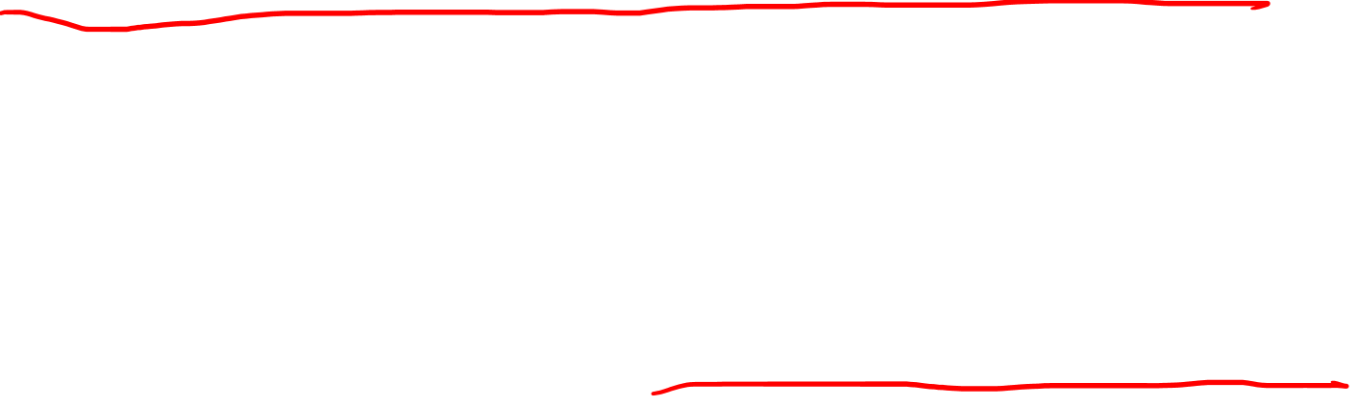
This video is about visual intuition for the Ricci Tensor/Scalar
Later video (Tensor Calculus #26)
will be on the algebraic properties
of the Ricci Tensor/Scalar

Slide 3
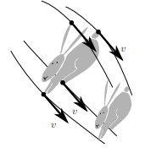
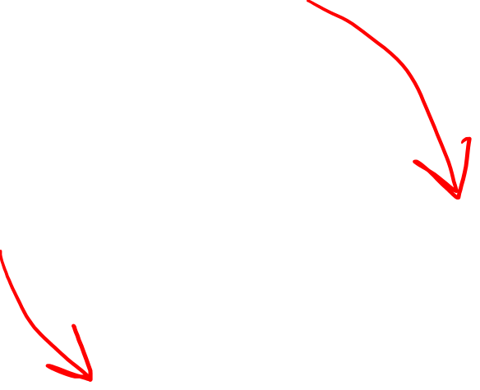
Ricci Tensor and Ricci Scalar
“Summarize” the Riemann Tensor
Ricci Tensor: Track “volume
change” along geodesics
Sectional Curvature
Volume element derivative
Ricci Scalar: Compare volume of a ball in curved space vs flat space
https://arxiv.org/pdf/gr-qc/0401099.pdf

Slide 4
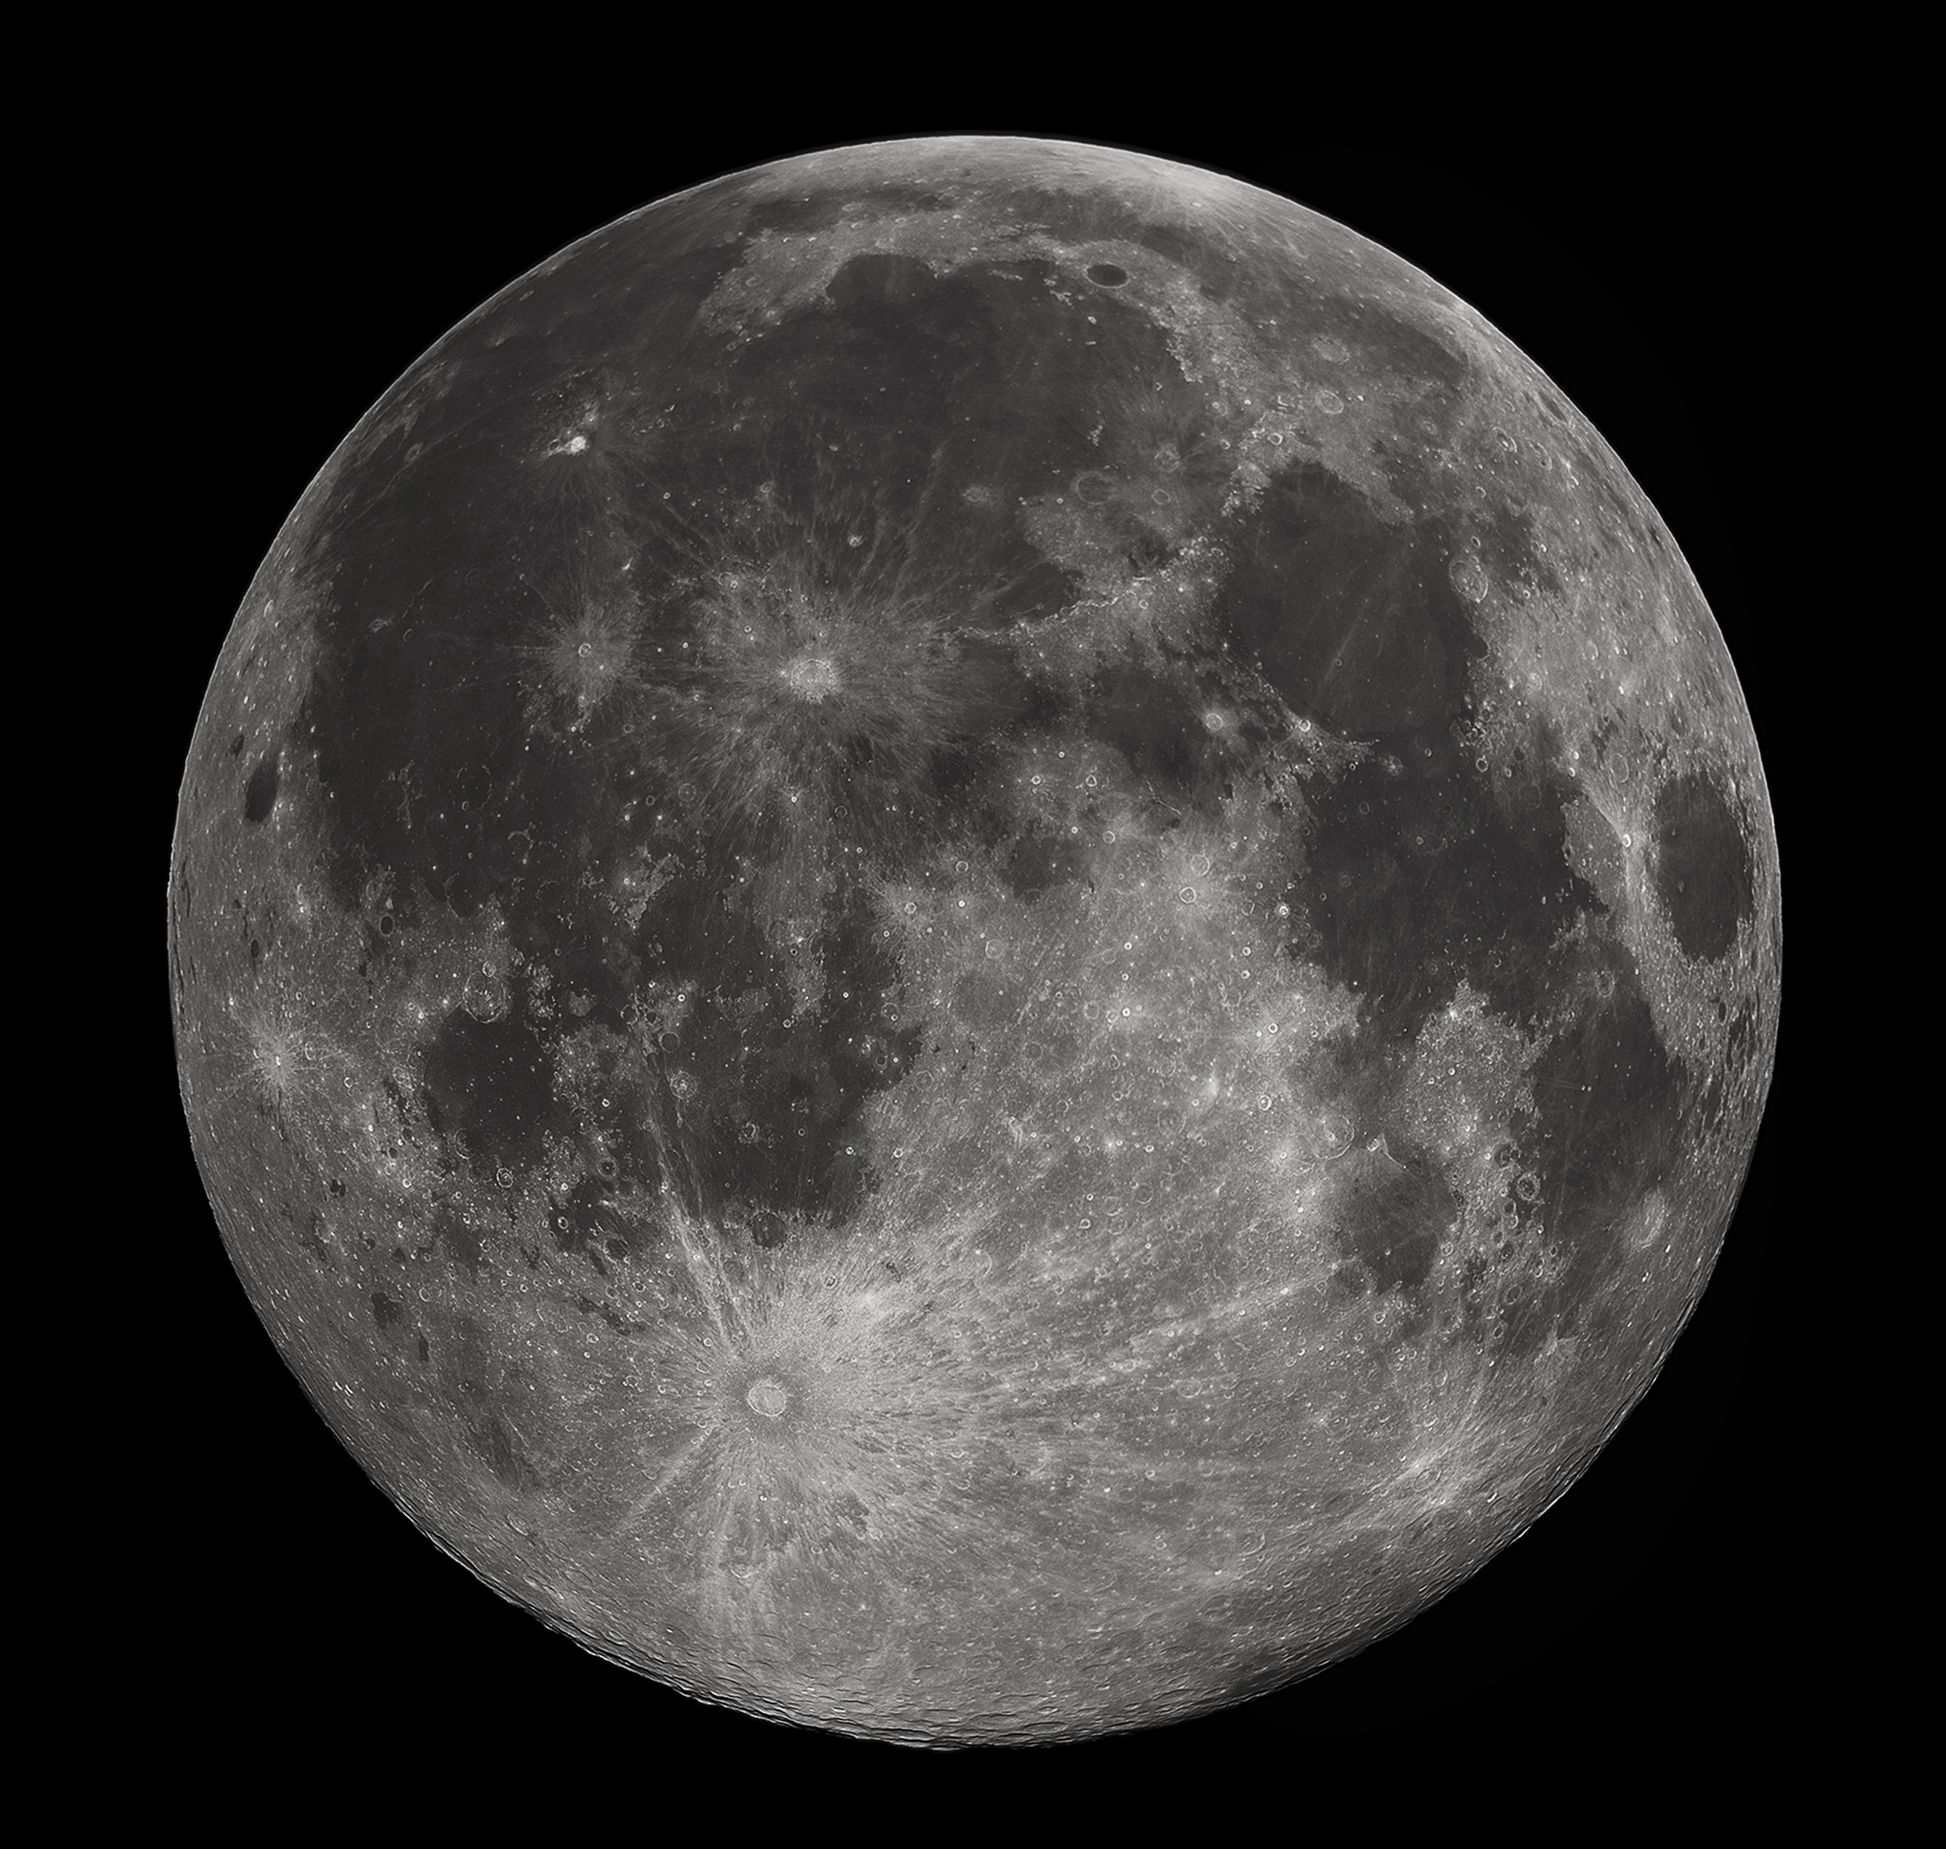
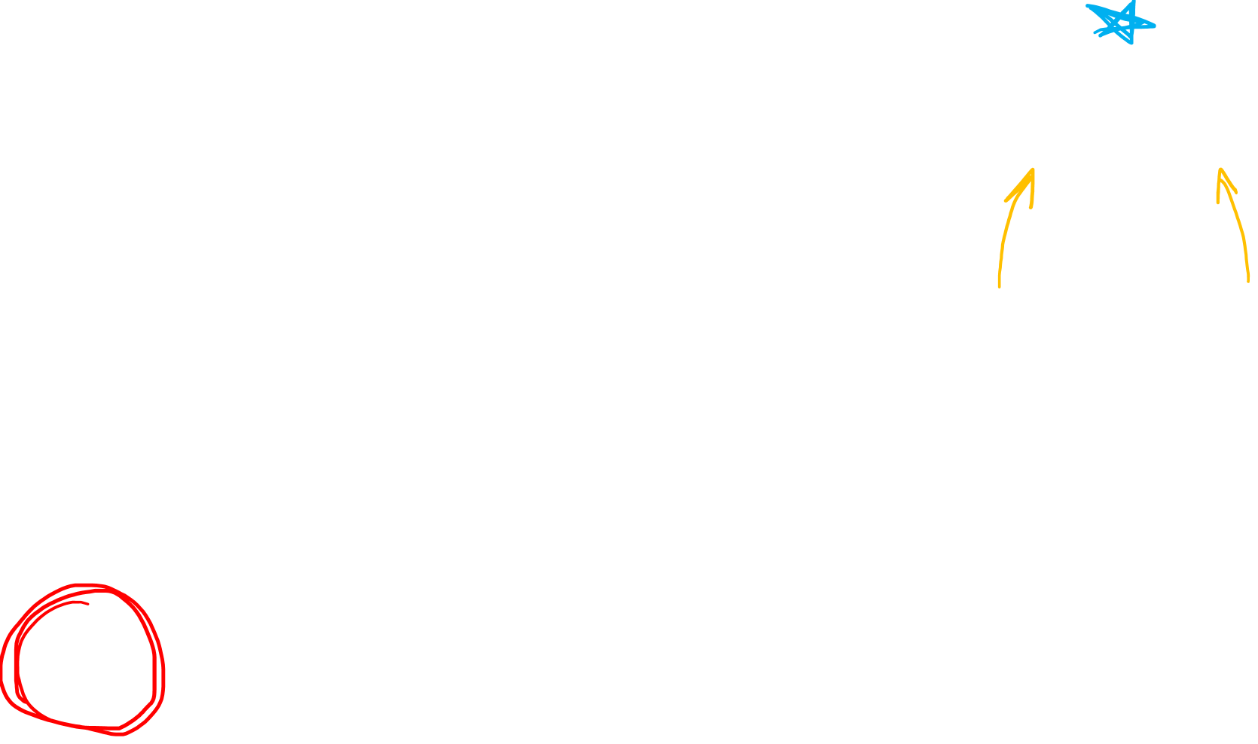
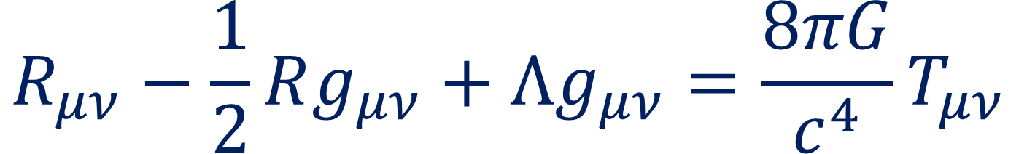
Ricci Tensor
Keeps track of
how “volumes” change along geodesics
Represents Gravity in G.R.
$$R_{μν}−\frac{1}{2}Rg_{μν}+Λg_{μν}=\frac{8πG}{c^{4}}T_{μν}$$

Slide 5
Ricci Scalar
Keeps track of how the size of a ball deviates from standard flat-space size.
Flat
Circle

Slide 6
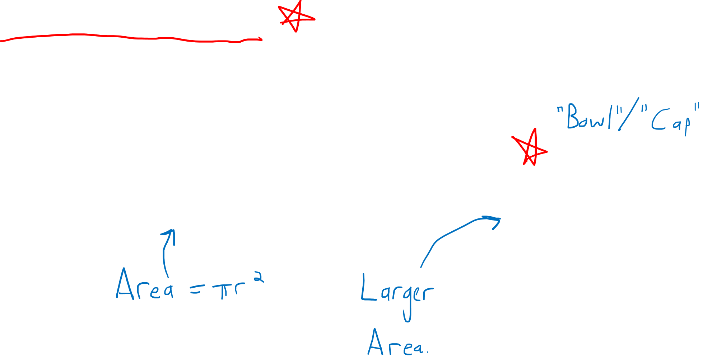
Ricci Scalar
Keeps track of how the size of a ball deviates from standard flat-space size.
Flat
Circle
“Curved” Circle

Slide 7
Curved space means…. We can fit a large area in a small boundary!

Slide 8
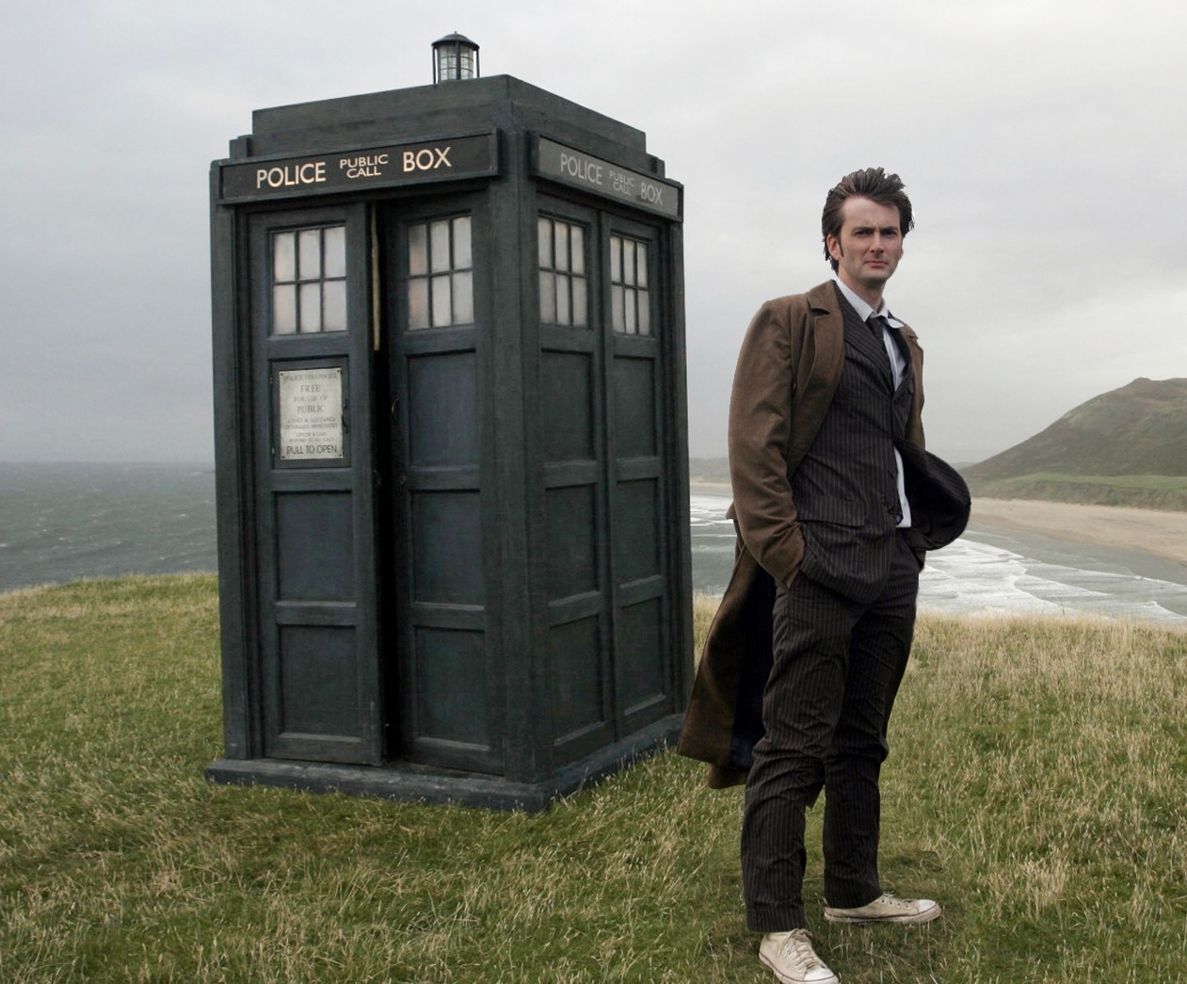
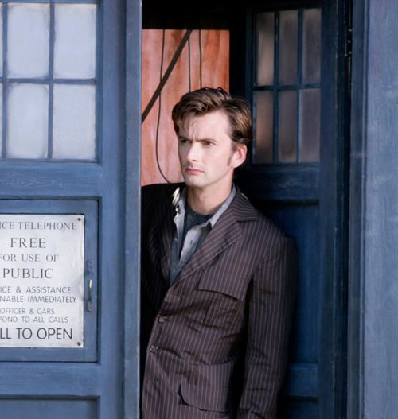
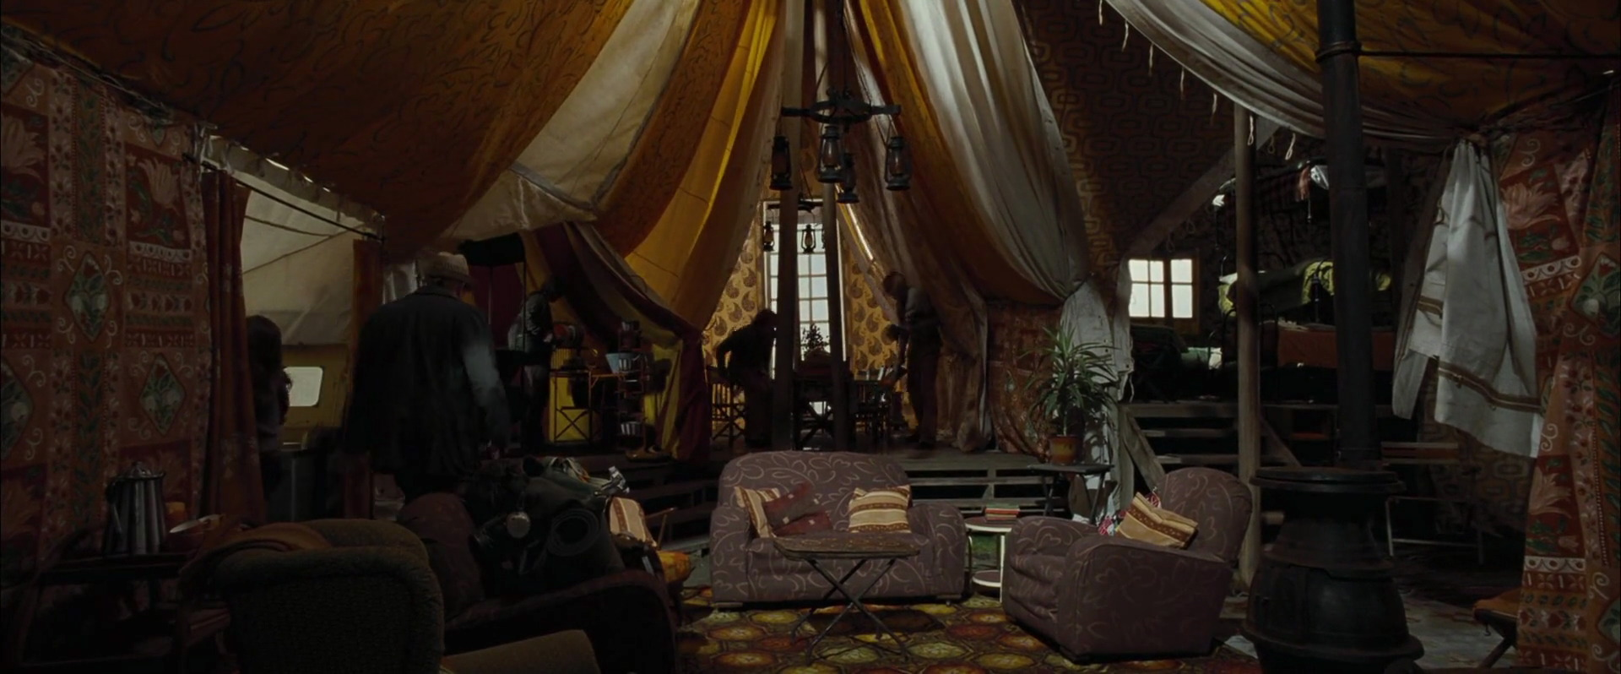

Slide 9
Experts in Differential Geometry!

Slide 10
Real math…

Slide 11
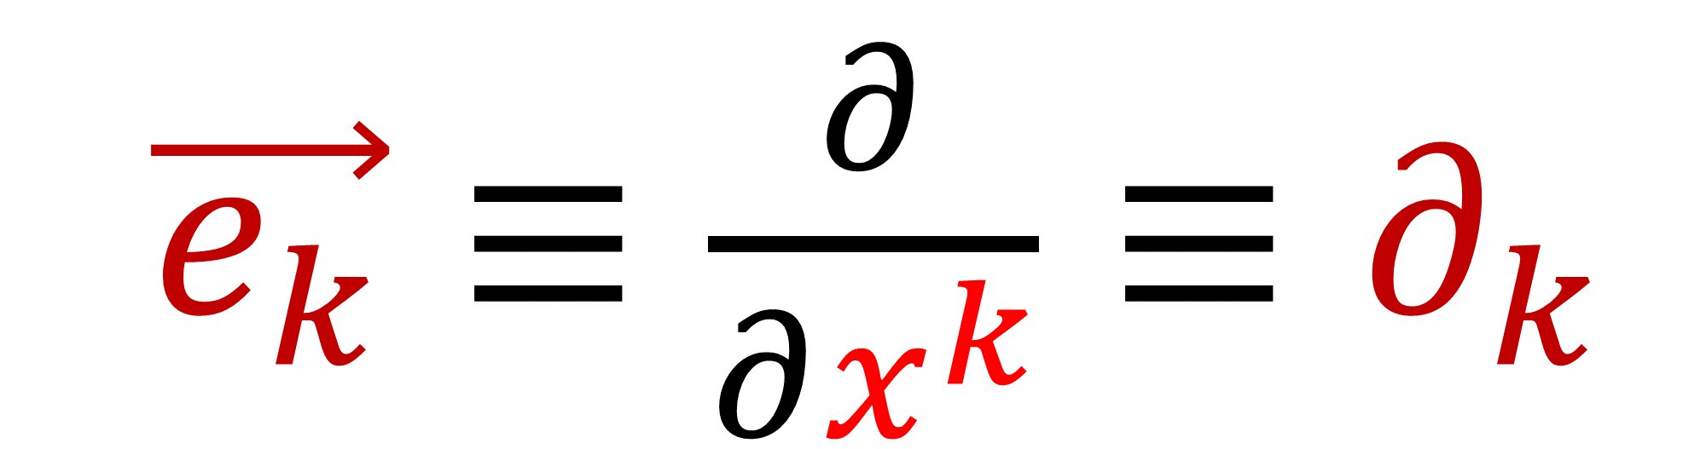
Basis vectors
$\vec{e_{k}}≡\frac{∂}{∂x^{k}}≡∂_{k}$

Slide 12
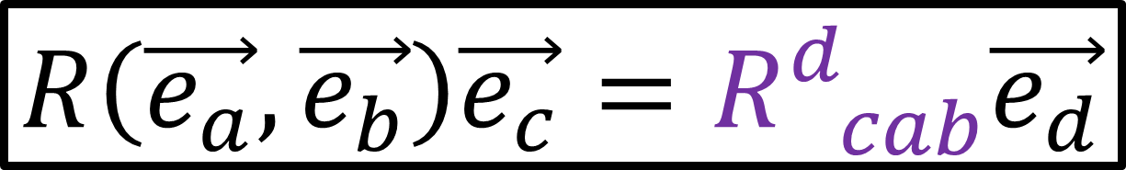
Riemann Curvature Tensor formulas:
$$R\left(\vec{u},\vec{v}\right)\vec{w}=∇_{\vec{u}}∇_{\vec{v}}\vec{w}−∇_{\vec{v}}∇_{\vec{u}}\vec{w}−∇_{\left[\vec{u},\vec{v}\right]}\vec{w}$$
$$R\left(\vec{e_{a}},\vec{e_{b}}\right)\vec{e_{c}}=R_{ cab}^{d}\vec{e_{d}}$$
$R_{ cab}^{d}=∂_{a}\left(Γ_{bc}^{d}\right)−∂_{b}\left(Γ_{ac}^{d}\right)+Γ_{bc}^{i}Γ_{ai}^{d}−Γ_{ac}^{j}Γ_{bj}^{d}$

Slide 13
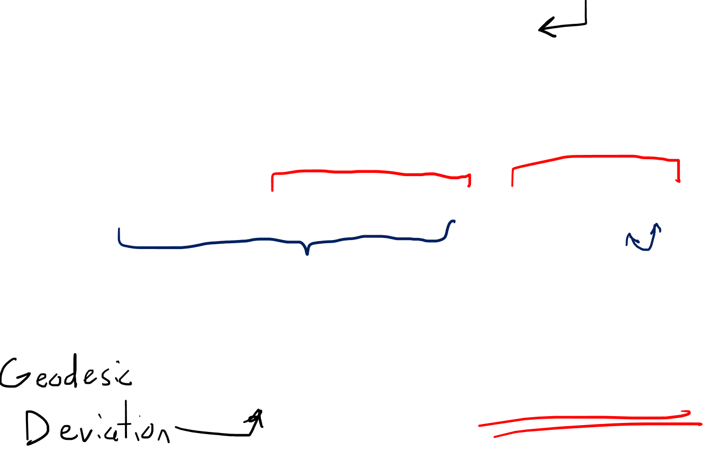




Geodesic Deviation
Geodesic
$$∇_{y}∇_{\vec{v}}\vec{v}=0$$
$$∇_{\vec{s}}∇_{\vec{v}}\vec{v}=0$$
$$\vec{s}$$
$$\vec{v}$$
$$∇_{\vec{s}}∇_{\vec{v}}\vec{v}−∇_{\vec{v}}∇_{\vec{s}}\vec{v}+∇_{\vec{v}}∇_{\vec{s}}\vec{v}=0$$
$R\left(\vec{s},\vec{v}\right)\vec{v} +∇_{\vec{v}}∇_{\vec{v}}\vec{s}=0$
$∇_{\vec{v}}∇_{\vec{v}}\vec{s}=−R\left(\vec{s},\vec{v}\right)\vec{v}$
Torsion- Free

Slide 14
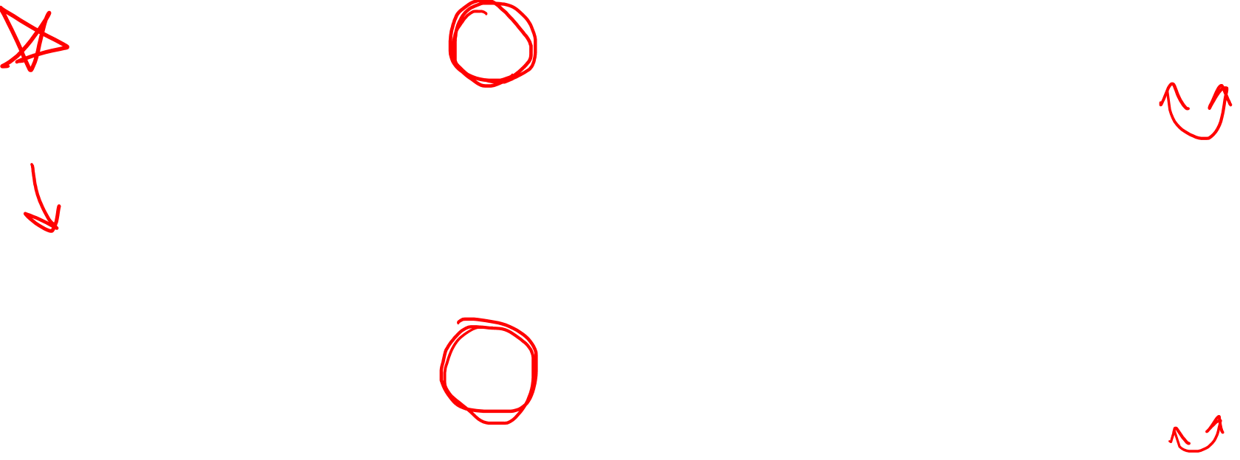
Warning about Sign Convention!
MY videos…
$∇_{\vec{v}}∇_{\vec{v}}\vec{s}=−R\left(\vec{s},\vec{v}\right)\vec{v}$ $=+R\left(\vec{v},\vec{s}\right)\vec{v}$
Other people might say…
$∇_{\vec{v}}∇_{\vec{v}}\vec{s}=+R\left(\vec{s},\vec{v}\right)\vec{v}$ $=−R\left(\vec{v},\vec{s}\right)\vec{v}$

Slide 15
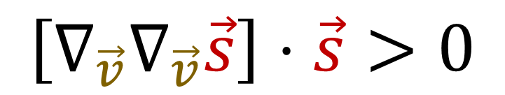

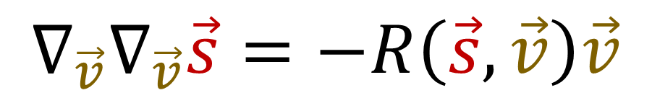
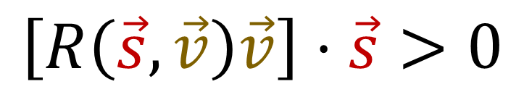





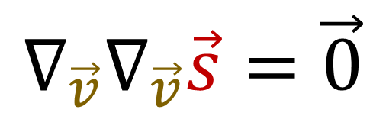

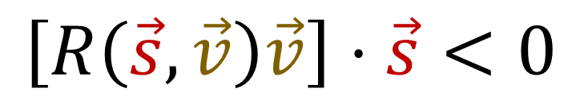

Geodesic Deviation
$$∇_{\vec{v}}∇_{\vec{v}}\vec{s}=−R\left(\vec{s},\vec{v}\right)\vec{v}$$
$$\vec{s}$$
$$\vec{s}$$
$$\vec{s}$$
$$∇_{\vec{v}}∇_{\vec{v}}\vec{s}$$
$$∇_{\vec{v}}∇_{\vec{v}}\vec{s}$$
$$∇_{\vec{v}}∇_{\vec{v}}\vec{s}=\vec{0}$$
$$\left[∇_{\vec{v}}∇_{\vec{v}}\vec{s}\right]⋅\vec{s}<0$$
$$\left[∇_{\vec{v}}∇_{\vec{v}}\vec{s}\right]⋅\vec{s}>0$$
$$\left[R\left(\vec{s},\vec{v}\right)\vec{v}\right]⋅\vec{s}>0$$
$$\left[R\left(\vec{s},\vec{v}\right)\vec{v}\right]⋅\vec{s}<0$$
$$\left[R\left(\vec{s},\vec{v}\right)\vec{v}\right]⋅\vec{s}=0$$

Slide 16
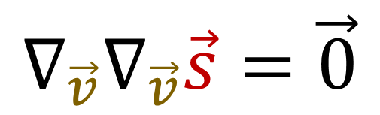






https://arxiv.org/pdf/gr-qc/0401099.pdf
Why use 2nd derivative? Why not 1st derivative?
$$∇_{\vec{v}}\vec{s}≠\vec{0}$$
$$\vec{s}$$
$$\vec{s}$$
$$∇_{\vec{v}}∇_{\vec{v}}\vec{s}=\vec{0}$$
$$\vec{v}$$
$$\vec{v}$$
Curved Space
Flat Space
$$∇_{\vec{v}}\vec{s}≠\vec{0}$$
$$∇_{\vec{v}}∇_{\vec{v}}\vec{s}≠\vec{0}$$
Geodesics (straight lines) can “spread”
with a non-zero first derivative.

Slide 17
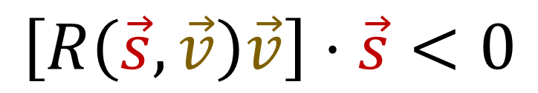
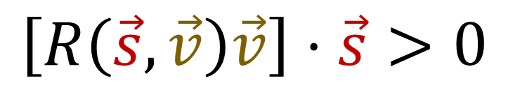

Geodesic Deviation
$$∇_{\vec{v}}∇_{\vec{v}}\vec{s}=−R\left(\vec{s},\vec{v}\right)\vec{v}$$
$$\vec{s}$$
$$\vec{s}$$
$$\vec{s}$$
$$∇_{\vec{v}}∇_{\vec{v}}\vec{s}$$
$$∇_{\vec{v}}∇_{\vec{v}}\vec{s}$$
$$\left[R\left(\vec{s},\vec{v}\right)\vec{v}\right]⋅\vec{s}=0$$
$$\left[R\left(\vec{s},\vec{v}\right)\vec{v}\right]⋅\vec{s}>0$$
$$\left[R\left(\vec{s},\vec{v}\right)\vec{v}\right]⋅\vec{s}<0$$
No Spreading
Converging
Diverging

Slide 18
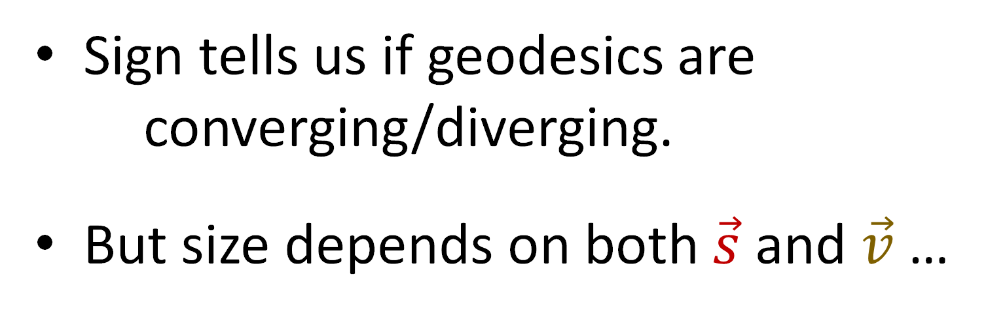
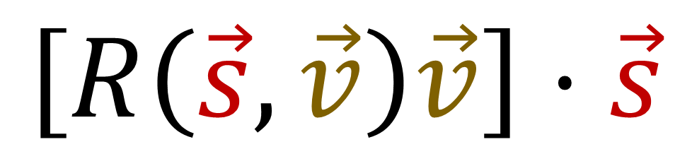
Geodesic Deviation
$$\left[R\left(\vec{s},\vec{v}\right)\vec{v}\right]⋅\vec{s}$$
$$\vec{s}$$
$$\vec{v}$$
Sign tells us if geodesics are
converging/diverging.
But size depends on both $\vec{s}$ and $\vec{v}$ …
Let’s try to “normalize” this result.

Slide 19
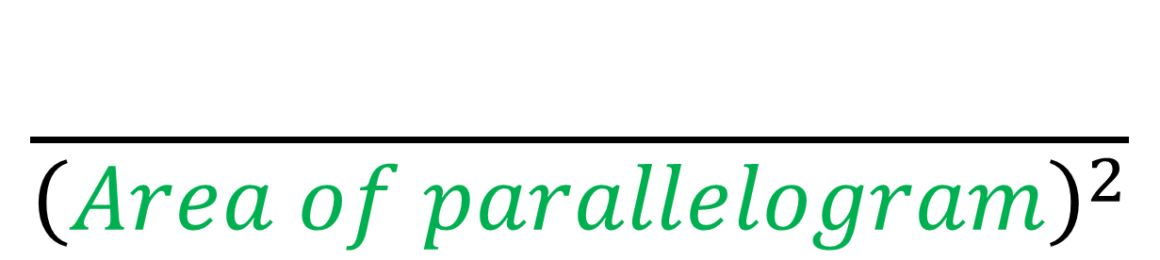
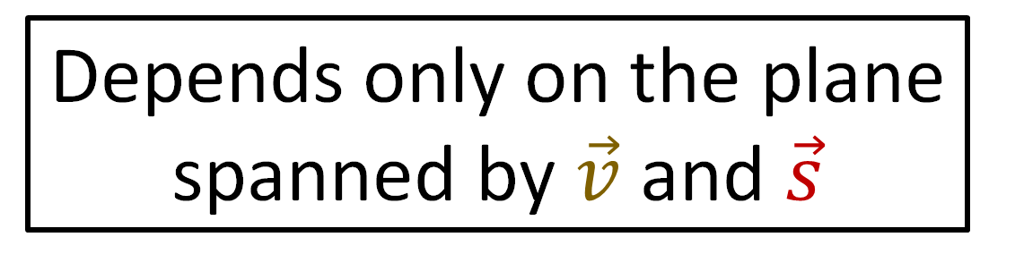
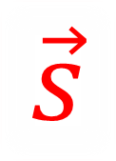

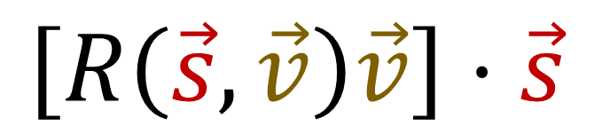

Let’s try to “normalize” this result...
$$\left[R\left(\vec{s},\vec{v}\right)\vec{v}\right]⋅\vec{s}$$
$$\frac{\left[R\left(\vec{s},\vec{v}\right)\vec{v}\right]⋅\vec{s}}{{\left(Area of parallelogram\right)}^{2}}$$
$$\vec{v}$$
Depends only on the plane spanned by $\vec{v}$ and $\vec{s}$
$$\vec{s}$$

Slide 20
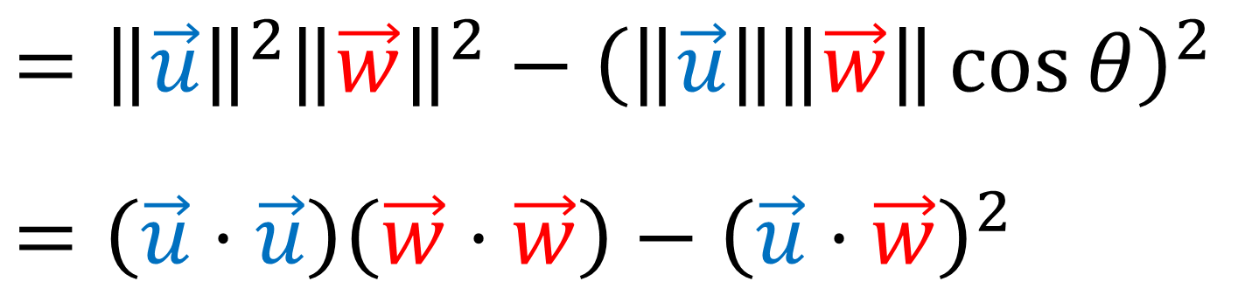
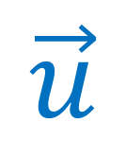
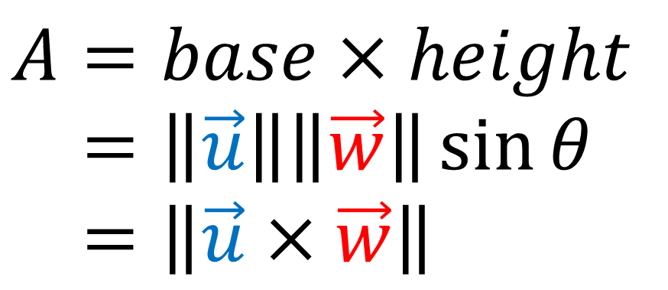
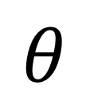
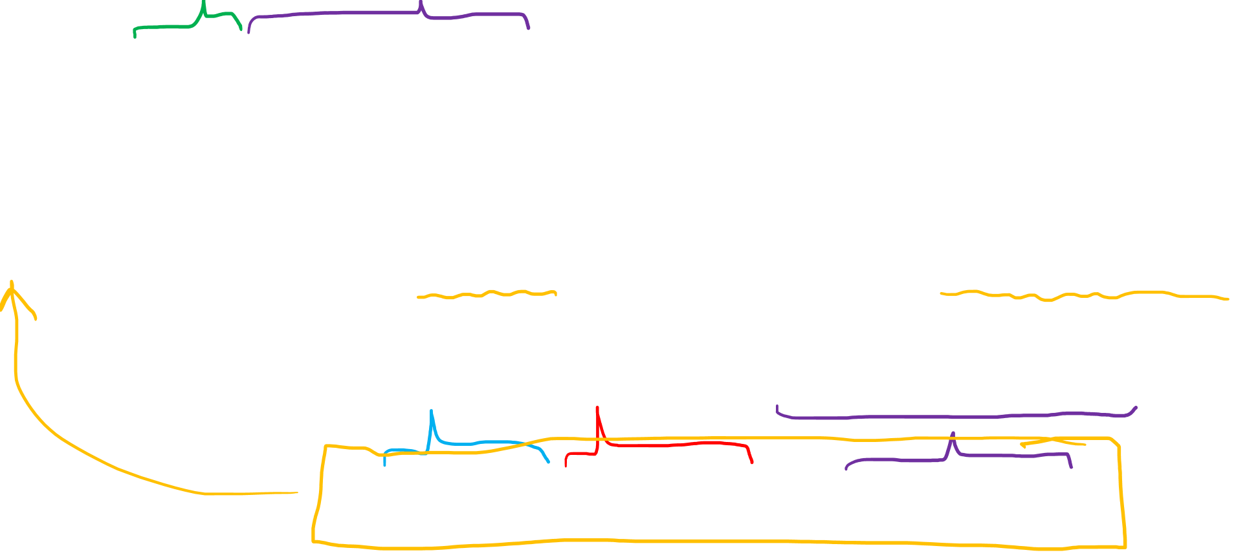

Area of Parallelogram
$$\vec{w}$$
$$A=base×height$$
$$A=\left\|\vec{u}\right\|\left\|\vec{w}\right\|\sin{θ}$$
$$A=\left\|\vec{u}×\vec{w}\right\|$$
$$θ$$
$$\vec{u}$$
$$A^{2}={\left\|\vec{u}\right\|}^{2}{\left\|\vec{w}\right\|}^{2}{\left(\sin{θ}\right)}^{2}={\left\|\vec{u}\right\|}^{2}{\left\|\vec{w}\right\|}^{2}\left(1−{\left(\cos{θ}\right)}^{2}\right)$$
$$={\left\|\vec{u}\right\|}^{2}{\left\|\vec{w}\right\|}^{2}−{\left(\left\|\vec{u}\right\|\left\|\vec{w}\right\|\cos{θ}\right)}^{2}$$
$$=\left(\vec{u}⋅\vec{u}\right)\left(\vec{w}⋅\vec{w}\right)−{\left(\vec{u}⋅\vec{w}\right)}^{2}$$

Slide 21
Let’s try to “normalize” this result...
$$\left[R\left(\vec{s},\vec{v}\right)\vec{v}\right]⋅\vec{s}$$
$$\frac{\left[R\left(\vec{s},\vec{v}\right)\vec{v}\right]⋅\vec{s}}{{\left(Area of parallelogram\right)}^{2}}$$
$$\vec{v}$$
Depends only on the plane spanned by $\vec{v}$ and $\vec{s}$
$$\vec{s}$$

Slide 22
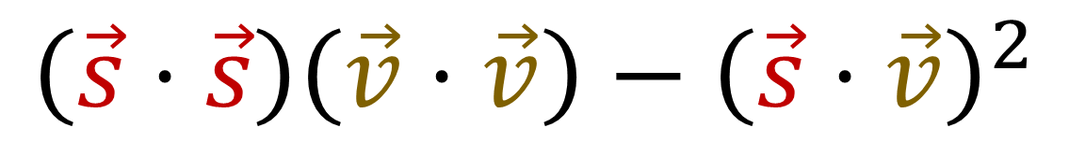
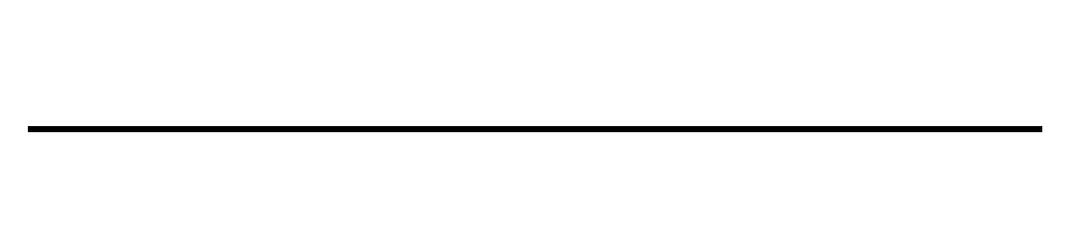
Let’s try to “normalize” this result...
$$\left[R\left(\vec{s},\vec{v}\right)\vec{v}\right]⋅\vec{s}$$
$$\frac{\left[R\left(\vec{s},\vec{v}\right)\vec{v}\right]⋅\vec{s}}{{\left(Area of parallelogram\right)}^{2}}$$
$$\left(\vec{s}⋅\vec{s}\right)\left(\vec{v}⋅\vec{v}\right)−{\left(\vec{s}⋅\vec{v}\right)}^{2}$$
$$\vec{v}$$
Depends only on the plane spanned by $\vec{v}$ and $\vec{s}$
$$\vec{s}$$

Slide 23
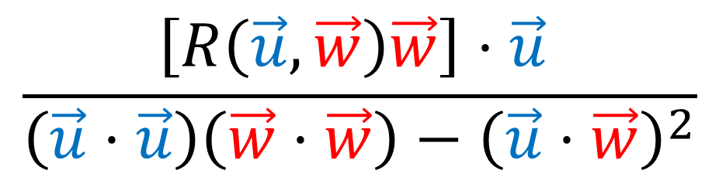
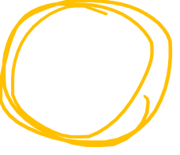

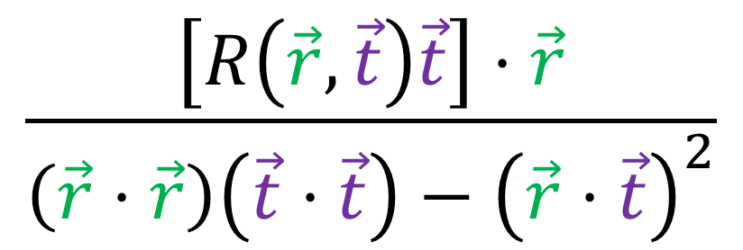
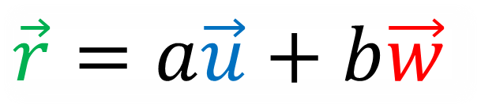
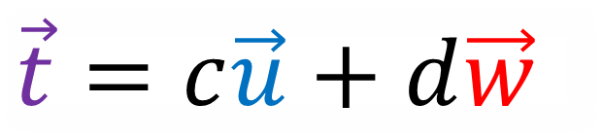


$$\frac{\left[R\left(\vec{u},\vec{w}\right)\vec{w}\right]⋅\vec{u} }{\left(\vec{u}⋅\vec{u}\right)\left(\vec{w}⋅\vec{w}\right)−{\left(\vec{u}⋅\vec{w}\right)}^{2}}$$
$$\frac{\left[R\left(\vec{r},\vec{t}\right)\vec{t}\right]⋅\vec{r}}{\left(\vec{r}⋅\vec{r}\right)\left(\vec{t}⋅\vec{t}\right)−{\left(\vec{r}⋅\vec{t}\right)}^{2}}$$
$$=$$
$$\vec{r}=a\vec{u}+b\vec{w}$$
$$\vec{u}$$
$$\vec{w}$$
$$\vec{t}=c\vec{u}+d\vec{w}$$

Slide 24





When we change vectors in the plane…
$$\vec{u}→a\vec{u}+b\vec{w}$$
$$\vec{w}→c\vec{u}+d\vec{w}$$
This formula stays constant
$$\frac{\left[R\left(\vec{u},\vec{w}\right)\vec{w}\right]⋅\vec{u} }{\left(\vec{u}⋅\vec{u}\right)\left(\vec{w}⋅\vec{w}\right)−{\left(\vec{u}⋅\vec{w}\right)}^{2}}$$
$$\frac{{\left(ad−bc\right)}^{2}}{{\left(ad−bc\right)}^{2}}⋅\frac{\left[R\left(\vec{u},\vec{w}\right)\vec{w}\right]⋅\vec{u} }{\left(\vec{u}⋅\vec{u}\right)\left(\vec{w}⋅\vec{w}\right)−{\left(\vec{u}⋅\vec{w}\right)}^{2}}$$

Slide 25


Recall: Tensors are Multilinear maps
$$T\left(a\vec{u},b\vec{w}\right)=abT\left(\vec{u}, \vec{w}\right)$$
$$T\left(\vec{u}+\vec{z}, \vec{w}\right)=T\left(\vec{u}, \vec{w}\right)+T\left(\vec{z}, \vec{w}\right)$$

Slide 26




Normalization…
$$\vec{u}→a\vec{u}+b\vec{w}$$ | $$\vec{w}→c\vec{u}+d\vec{w}$$
$R\left(\vec{u},\vec{w}\right)→$ $R\left(a\vec{u}+b\vec{w},c\vec{u}+d\vec{w}\right)$
$$=R\left(a\vec{u},c\vec{u}+d\vec{w}\right)+R\left(b\vec{w},c\vec{u}+d\vec{w}\right)$$
$$=R\left(a\vec{u},c\vec{u}\right)+R\left(a\vec{u}, d\vec{w}\right)+R\left(b\vec{w},c\vec{u}\right)+R\left(b\vec{w}, d\vec{w}\right)$$
$$=acR\left(\vec{u},\vec{u}\right)+adR\left(\vec{u}, \vec{w}\right)+bcR\left(\vec{w}, \vec{u}\right)+bdR\left(\vec{w}, \vec{w}\right)$$
$$=adR\left(\vec{u}, \vec{w}\right)+bcR\left(\vec{w}, \vec{u}\right)$$
$$=adR\left(\vec{u}, \vec{w}\right)−bcR\left(\vec{u}, \vec{w}\right)$$
$$=\left(ad−bc\right)R\left(\vec{u}, \vec{w}\right)$$
$$R\left(\vec{u},\vec{w}\right)=−R\left(\vec{w},\vec{u}\right)$$

Slide 27


$$\left[R\left(\vec{u},\vec{w}\right)\vec{w}\right]⋅\vec{u}$$

Slide 28



Normalization…
$$R\left(\vec{e_{1}},\vec{e_{2}}\right)\left(\vec{u}⋅\vec{w}\right)=\left(R\left(\vec{e_{1}},\vec{e_{2}}\right)\vec{u}\right)⋅\vec{w}+\vec{u}⋅\left(R\left(\vec{e_{1}},\vec{e_{2}}\right)\vec{w}\right)$$
$$0 =\left(R\left(\vec{e_{1}},\vec{e_{2}}\right)\vec{u}\right)⋅\vec{w}+\left(R\left(\vec{e_{1}},\vec{e_{2}}\right)\vec{w}\right)⋅\vec{u}$$
$$\left(R\left(\vec{e_{1}},\vec{e_{2}}\right)\vec{u}\right)⋅\vec{w}=−\left(R\left(\vec{e_{1}},\vec{e_{2}}\right)\vec{w}\right)⋅\vec{u}$$
$$R\left(\vec{e_{1}},\vec{e_{2}}\right)s=∇_{\vec{e_{1}}}∇_{\vec{e_{2}}}s−∇_{\vec{e_{2}}}∇_{\vec{e_{1}}}s−∇_{\left[\vec{e_{1}},\vec{e_{2}}\right]}s$$
$$R\left(\vec{e_{1}},\vec{e_{2}}\right)s=∂_{1}∂_{2}s−∂_{2}∂_{1}s−\left[∂_{1},∂_{2}\right]s$$
$$R\left(\vec{e_{1}},\vec{e_{2}}\right)s=\left[∂_{1},∂_{2}\right]s−\left[∂_{1},∂_{2}\right]s$$

Slide 29


Normalization…
$$\vec{u}→a\vec{u}+b\vec{w}$$ | $$\vec{w}→c\vec{u}+d\vec{w}$$
$$\left(R\left(\vec{e_{1}},\vec{e_{2}}\right)\vec{w}\right)⋅\vec{u}→R\left(\vec{e_{1}},\vec{e_{2}}\right)\left(c\vec{u}+d\vec{w}\right)⋅\left(a\vec{u}+b\vec{w}\right)$$
$$=R\left(\vec{e_{1}},\vec{e_{2}}\right)\left(c\vec{u}\right)⋅\left(a\vec{u}+b\vec{w}\right)+R\left(\vec{e_{1}},\vec{e_{2}}\right)\left(d\vec{w}\right)⋅\left(a\vec{u}+b\vec{w}\right)$$
$$=R\left(\vec{e_{1}},\vec{e_{2}}\right)\left(c\vec{u}\right)⋅\left(a\vec{u}\right)+R\left(\vec{e_{1}},\vec{e_{2}}\right)\left(c\vec{u}\right)⋅\left(b\vec{w}\right)$$
$+R\left(\vec{e_{1}},\vec{e_{2}}\right)\left(d\vec{w}\right)⋅\left(a\vec{u}\right)$ $+R\left(\vec{e_{1}},\vec{e_{2}}\right)\left(d\vec{w}\right)⋅\left(b\vec{w}\right)$
$$\left(R\left(\vec{e_{1}},\vec{e_{2}}\right)\vec{u}\right)⋅\vec{w}=−\left(R\left(\vec{e_{1}},\vec{e_{2}}\right)\vec{w}\right)⋅\vec{u}$$

Slide 30


Normalization…
$$\vec{u}→a\vec{u}+b\vec{w}$$ | $$\vec{w}→c\vec{u}+d\vec{w}$$
$$\left(R\left(\vec{e_{1}},\vec{e_{2}}\right)\vec{w}\right)⋅\vec{u}→R\left(\vec{e_{1}},\vec{e_{2}}\right)\left(c\vec{u}+d\vec{w}\right)⋅\left(a\vec{u}+b\vec{w}\right)$$
$$=R\left(\vec{e_{1}},\vec{e_{2}}\right)\left(c\vec{u}\right)⋅\left(a\vec{u}+b\vec{w}\right)+R\left(\vec{e_{1}},\vec{e_{2}}\right)\left(d\vec{w}\right)⋅\left(a\vec{u}+b\vec{w}\right)$$
$$=R\left(\vec{e_{1}},\vec{e_{2}}\right)\left(c\vec{u}\right)⋅\left(a\vec{u}\right)+R\left(\vec{e_{1}},\vec{e_{2}}\right)\left(c\vec{u}\right)⋅\left(b\vec{w}\right)$$
$+R\left(\vec{e_{1}},\vec{e_{2}}\right)\left(d\vec{w}\right)⋅\left(a\vec{u}\right)$ $+R\left(\vec{e_{1}},\vec{e_{2}}\right)\left(d\vec{w}\right)⋅\left(b\vec{w}\right)$
$$=cbR\left(\vec{e_{1}},\vec{e_{2}}\right)\vec{u}⋅\vec{w}+adR\left(\vec{e_{1}},\vec{e_{2}}\right)\vec{w}⋅\vec{u}$$
$$=(ad−bc)R\left(\vec{e_{1}},\vec{e_{2}}\right)\vec{w}⋅\vec{u}$$

Slide 31



Normalization…
$$\vec{u}→a\vec{u}+b\vec{w}$$
$$\vec{w}→c\vec{u}+d\vec{w}$$
$$R\left(\vec{u}, \vec{w}\right)\vec{w}⋅\vec{u} →$$
$$R\left(a\vec{u}+b\vec{w},c\vec{u}+d\vec{w}\right)\left(c\vec{u}+d\vec{w}\right)⋅\left(a\vec{u}+b\vec{w}\right)$$
$$={\left(ad−bc\right)}^{2}R\left(\vec{u}, \vec{w}\right)\vec{w}⋅\vec{u}$$

Slide 32


When we change basis in the plane…
$$\vec{u}→a\vec{u}+b\vec{w}$$
$$\vec{w}→c\vec{u}+d\vec{w}$$
This formula stays constant
$$\frac{\left[R\left(\vec{u},\vec{w}\right)\vec{w}\right]⋅\vec{u} }{\left(\vec{u}⋅\vec{u}\right)\left(\vec{w}⋅\vec{w}\right)−{\left(\vec{u}⋅\vec{w}\right)}^{2}}$$
$$\frac{{\left(ad−bc\right)}^{2}}{{\left(ad−bc\right)}^{2}}⋅\frac{\left[R\left(\vec{u},\vec{w}\right)\vec{w}\right]⋅\vec{u} }{\left(\vec{u}⋅\vec{u}\right)\left(\vec{w}⋅\vec{w}\right)−{\left(\vec{u}⋅\vec{w}\right)}^{2}}$$

Slide 33


When we change basis in the plane…
$$\vec{u}→a\vec{u}+b\vec{w}$$
$$\vec{w}→c\vec{u}+d\vec{w}$$
One option…
nope.
$$\left(\vec{u}⋅\vec{u}\right)\left(\vec{w}⋅\vec{w}\right)−{\left(\vec{u}⋅\vec{w}\right)}^{2}$$
$$\left[\left(a\vec{u}+b\vec{w})⋅(a\vec{u}+b\vec{w}\right)\right]\left[\left(c\vec{u}+d\vec{w})⋅(c\vec{u}+d\vec{w}\right)\right]−{\left[\left(a\vec{u}+b\vec{w})⋅(c\vec{u}+d\vec{w}\right)\right]}^{2}$$

Slide 34


When we change basis in the plane…
$$\vec{u}→a\vec{u}+b\vec{w}$$
$$\vec{w}→c\vec{u}+d\vec{w}$$
One option…
$$\left(\vec{u}⋅\vec{u}\right)\left(\vec{w}⋅\vec{w}\right)−{\left(\vec{u}⋅\vec{w}\right)}^{2}={\left\|\vec{u}×\vec{w}\right\|}^{2}$$
$$={\left\|\left(a\vec{u}+b\vec{w}\right)×\left(c\vec{u}+d\vec{w}\right)\right\|}^{2}$$
$$={\left\|ac\left(\vec{u}×\vec{u}\right)+ad\left(\vec{u}×\vec{w}\right)+bc\left(\vec{w}×\vec{u}\right)+bd\left(\vec{w}×\vec{w}\right)\right\|}^{2}$$
$$={\left\|ad\left(\vec{u}×\vec{w}\right)+bc\left(\vec{w}×\vec{u}\right)\right\|}^{2}$$
$$={\left\|ad\left(\vec{u}×\vec{w}\right)−bc\left(\vec{u}×\vec{w}\right)\right\|}^{2}$$
$$={\left\|\left(ad−bc\right)\left(\vec{u}×\vec{w}\right)\right\|}^{2} ={\left(ad−bc\right)}^{2}{\left\|\vec{u}×\vec{w}\right\|}^{2}$$

Slide 35

When we change basis in the plane…
$$\vec{u}→a\vec{u}+b\vec{w}$$
$$\vec{w}→c\vec{u}+d\vec{w}$$
This formula stays constant
$$\frac{\left[R\left(\vec{u},\vec{w}\right)\vec{w}\right]⋅\vec{u} }{\left(\vec{u}⋅\vec{u}\right)\left(\vec{w}⋅\vec{w}\right)−{\left(\vec{u}⋅\vec{w}\right)}^{2}}$$
$$\frac{{\left(ad−bc\right)}^{2}}{{\left(ad−bc\right)}^{2}}⋅\frac{\left[R\left(\vec{u},\vec{w}\right)\vec{w}\right]⋅\vec{u} }{\left(\vec{u}⋅\vec{u}\right)\left(\vec{w}⋅\vec{w}\right)−{\left(\vec{u}⋅\vec{w}\right)}^{2}}$$

Slide 36








Sectional Curvature
$$K\left(\vec{s},\vec{v}\right)=\frac{\left[R\left(\vec{s},\vec{v}\right)\vec{v}\right]⋅\vec{s}}{\left(\vec{s}⋅\vec{s}\right)\left(\vec{v}⋅\vec{v}\right)−{\left(\vec{s}⋅\vec{v}\right)}^{2}}$$
$$\vec{s}$$
$$\vec{s}$$
$$\vec{s}$$
$$K\left(\vec{s},\vec{v}\right)=0$$
$$K\left(\vec{s},\vec{v}\right)>0$$
$$K\left(\vec{s},\vec{v}\right)<0$$

Slide 37





Ricci Curvature
$$K\left(\vec{s},\vec{v}\right)=\frac{\left[R\left(\vec{s},\vec{v}\right)\vec{v}\right]⋅\vec{s}}{\left(\vec{s}⋅\vec{s}\right)\left(\vec{v}⋅\vec{v}\right)−{\left(\vec{s}⋅\vec{v}\right)}^{2}}$$
Take an orthonormal basis $\{\vec{e_{1}},\vec{e_{2}},…,\vec{e_{n}}\}$
and a direction vector $\vec{v}=\vec{e_{n}}$.
$$Ric\left(\vec{v},\vec{v}\right)=\sum_{i=1}^{D}{K\left(\vec{e_{i}},\vec{v}\right)}$$
$=\sum_{i}{\frac{\left[R\left(\vec{e_{i}},\vec{v}\right)\vec{v}\right]⋅\vec{e_{i}}}{\left(\vec{e_{i}}⋅\vec{e_{i}}\right)\left(\vec{v}⋅\vec{v}\right)−{\left(\vec{e_{i}}⋅\vec{v}\right)}^{2}}}$

Slide 38




$$K\left(\vec{s},\vec{v}\right)=0$$
$$Ric\left(\vec{v},\vec{v}\right)=\sum_{i=1}^{D}{K\left(\vec{e_{i}},\vec{v}\right)}=0$$
$$\vec{s}$$
$$\vec{v}$$

Slide 39

$$K\left(\vec{s},\vec{v}\right)=0$$
$$Ric\left(\vec{v},\vec{v}\right)=\sum_{i=1}^{D}{K\left(\vec{e_{i}},\vec{v}\right)}=0$$
$$\vec{s}$$
$$\vec{v}$$

Slide 40
$$K\left(\vec{s},\vec{v}\right)=0$$
$$Ric\left(\vec{v},\vec{v}\right)=\sum_{i=1}^{D}{K\left(\vec{e_{i}},\vec{v}\right)}=0$$
$$\vec{s}$$
$$\vec{v}$$

Slide 41



$$K\left(\vec{s},\vec{v}\right)=0$$
$$Ric\left(\vec{v},\vec{v}\right)=\sum_{i=1}^{D}{K\left(\vec{e_{i}},\vec{v}\right)}=0$$
$$\vec{s}$$
$$\vec{e_{1}}$$
$$\vec{v}$$
$$\vec{e_{2}}$$
$$\vec{v}$$

Slide 42




$$K\left(\vec{s},\vec{v}\right)=0$$
$$Ric\left(\vec{v},\vec{v}\right)=\sum_{i=1}^{D}{K\left(\vec{e_{i}},\vec{v}\right)}=0$$
$$\vec{s}$$
$$K\left(\vec{e_{1}},\vec{v}\right)=0$$
$$\vec{e_{1}}$$
$$\vec{e_{1}}$$
$$\vec{e_{1}}$$
$$\vec{e_{1}}$$
$$\vec{v}$$
$$\vec{e_{2}}$$
$$\vec{v}$$

Slide 43




$$K\left(\vec{s},\vec{v}\right)=0$$
$$Ric\left(\vec{v},\vec{v}\right)=\sum_{i=1}^{D}{K\left(\vec{e_{i}},\vec{v}\right)}=0$$
$$\vec{s}$$
$$K\left(\vec{e_{1}},\vec{v}\right)=0$$
$$K\left(\vec{e_{2}},\vec{v}\right)=0$$
$$\vec{e_{1}}$$
$$\vec{e_{2}}$$
$$\vec{e_{2}}$$
$$\vec{e_{2}}$$
$$\vec{v}$$
$$\vec{e_{2}}$$
$$\vec{v}$$

Slide 44

$$K\left(\vec{s},\vec{v}\right)=0$$
$$Ric\left(\vec{v},\vec{v}\right)=\sum_{i=1}^{D}{K\left(\vec{e_{i}},\vec{v}\right)}=0$$
$$\vec{s}$$
$$K\left(\vec{e_{1}},\vec{v}\right)=0$$
$$K\left(\vec{e_{2}},\vec{v}\right)=0$$
$$\vec{e_{1}}$$
$$\vec{v}$$
$$\vec{e_{2}}$$
$$\vec{v}$$

Slide 45


$$K\left(\vec{s},\vec{v}\right)>0$$
$$\vec{s}$$
$$\vec{e_{1}}$$
$$\vec{v}$$
$$\vec{e_{2}}$$
$$\vec{v}$$

Slide 46



$$K\left(\vec{s},\vec{v}\right)>0$$
$$\vec{s}$$
$$K\left(\vec{e_{1}},\vec{v}\right)>0$$
$$\vec{e_{1}}$$
$$\vec{e_{1}}$$
$$\vec{e_{1}}$$
$$\vec{e_{1}}$$
$$\vec{v}$$
$$\vec{e_{2}}$$
$$\vec{v}$$

Slide 47



$$K\left(\vec{s},\vec{v}\right)>0$$
$$\vec{s}$$
$$K\left(\vec{e_{1}},\vec{v}\right)>0$$
$$K\left(\vec{e_{2}},\vec{v}\right)>0$$
$$\vec{e_{1}}$$
$$\vec{e_{2}}$$
$$\vec{e_{2}}$$
$$\vec{e_{2}}$$
$$\vec{v}$$
$$\vec{e_{2}}$$
$$\vec{v}$$

Slide 48


$$K\left(\vec{s},\vec{v}\right)>0$$
$$Ric\left(\vec{v},\vec{v}\right)=∑ K\left(\vec{e_{i}},\vec{v}\right)>0$$
$$\vec{s}$$
$$K\left(\vec{e_{1}},\vec{v}\right)>0$$
$$K\left(\vec{e_{2}},\vec{v}\right)>0$$
$$\vec{e_{1}}$$
$$\vec{v}$$
$$\vec{e_{2}}$$
$$\vec{v}$$

Slide 49
$$K\left(\vec{s},\vec{v}\right)>0$$
$$Ric\left(\vec{v},\vec{v}\right)=∑ K\left(\vec{e_{i}},\vec{v}\right)>0$$
$$\vec{s}$$
$$K\left(\vec{e_{1}},\vec{v}\right)>0$$
$$K\left(\vec{e_{2}},\vec{v}\right)>0$$
$$\vec{e_{1}}$$
$$\vec{v}$$
$$\vec{e_{2}}$$
$$\vec{v}$$

Slide 50
$$K\left(\vec{s},\vec{v}\right)>0$$
$$Ric\left(\vec{v},\vec{v}\right)=∑ K\left(\vec{e_{i}},\vec{v}\right)>0$$
$$\vec{s}$$
$$K\left(\vec{e_{1}},\vec{v}\right)>0$$
$$K\left(\vec{e_{2}},\vec{v}\right)>0$$
$$\vec{e_{1}}$$
$$\vec{v}$$
$$\vec{e_{2}}$$
$$\vec{v}$$

Slide 51

$$K\left(\vec{s},\vec{v}\right)>0$$
$$Ric\left(\vec{v},\vec{v}\right)=∑ K\left(\vec{e_{i}},\vec{v}\right)>0$$
$$\vec{s}$$
$$K\left(\vec{e_{1}},\vec{v}\right)>0$$
$$K\left(\vec{e_{2}},\vec{v}\right)>0$$
$$\vec{e_{1}}$$
$$\vec{v}$$
$$\vec{e_{2}}$$
$$\vec{v}$$

Slide 52


$$K\left(\vec{s},\vec{v}\right)<0$$
$$\vec{s}$$
$$\vec{e_{1}}$$
$$\vec{v}$$
$$\vec{e_{2}}$$
$$\vec{v}$$

Slide 53




$$K\left(\vec{s},\vec{v}\right)<0$$
$$\vec{s}$$
$$K\left(\vec{e_{1}},\vec{v}\right)<0$$
$$\vec{e_{1}}$$
$$\vec{e_{1}}$$
$$\vec{e_{1}}$$
$$\vec{e_{1}}$$
$$\vec{v}$$
$$\vec{e_{2}}$$
$$\vec{v}$$

Slide 54



$$K\left(\vec{s},\vec{v}\right)<0$$
$$\vec{s}$$
$$K\left(\vec{e_{1}},\vec{v}\right)<0$$
$$K\left(\vec{e_{2}},\vec{v}\right)<0$$
$$\vec{e_{1}}$$
$$\vec{e_{2}}$$
$$\vec{e_{2}}$$
$$\vec{v}$$
$$\vec{e_{2}}$$
$$\vec{e_{2}}$$
$$\vec{v}$$

Slide 55


$$K\left(\vec{s},\vec{v}\right)<0$$
$$Ric\left(\vec{v},\vec{v}\right)=∑ K\left(\vec{e_{i}},\vec{v}\right)<0$$
$$\vec{s}$$
$$K\left(\vec{e_{1}},\vec{v}\right)<0$$
$$K\left(\vec{e_{2}},\vec{v}\right)<0$$
$$\vec{e_{1}}$$
$$\vec{v}$$
$$\vec{e_{2}}$$
$$\vec{v}$$

Slide 56
$$K\left(\vec{s},\vec{v}\right)<0$$
$$Ric\left(\vec{v},\vec{v}\right)=∑ K\left(\vec{e_{i}},\vec{v}\right)<0$$
$$\vec{s}$$
$$K\left(\vec{e_{1}},\vec{v}\right)<0$$
$$K\left(\vec{e_{2}},\vec{v}\right)<0$$
$$\vec{e_{1}}$$
$$\vec{v}$$
$$\vec{e_{2}}$$
$$\vec{v}$$

Slide 57
$$K\left(\vec{s},\vec{v}\right)<0$$
$$Ric\left(\vec{v},\vec{v}\right)=∑ K\left(\vec{e_{i}},\vec{v}\right)<0$$
$$\vec{s}$$
$$K\left(\vec{e_{1}},\vec{v}\right)<0$$
$$K\left(\vec{e_{2}},\vec{v}\right)<0$$
$$\vec{e_{1}}$$
$$\vec{v}$$
$$\vec{e_{2}}$$
$$\vec{v}$$

Slide 58
$$K\left(\vec{s},\vec{v}\right)<0$$
$$Ric\left(\vec{v},\vec{v}\right)=∑ K\left(\vec{e_{i}},\vec{v}\right)<0$$
$$\vec{s}$$
$$K\left(\vec{e_{1}},\vec{v}\right)<0$$
$$K\left(\vec{e_{2}},\vec{v}\right)<0$$
$$\vec{e_{1}}$$
$$\vec{v}$$
$$\vec{e_{2}}$$
$$\vec{v}$$

Slide 59

$$K\left(\vec{s},\vec{v}\right)<0$$
$$Ric\left(\vec{v},\vec{v}\right)=∑ K\left(\vec{e_{i}},\vec{v}\right)<0$$
$$\vec{s}$$
$$K\left(\vec{e_{1}},\vec{v}\right)<0$$
$$K\left(\vec{e_{2}},\vec{v}\right)<0$$
$$\vec{e_{1}}$$
$$\vec{v}$$
$$\vec{e_{2}}$$
$$\vec{v}$$

Slide 60



$$K\left(\vec{s},\vec{v}\right)<0$$
$$K\left(\vec{s},\vec{v}\right)>0$$
$$\vec{s}$$
$$\vec{s}$$
$$\vec{e_{1}}$$
$$\vec{v}$$
$$\vec{e_{2}}$$
$$\vec{v}$$

Slide 61



$$K\left(\vec{s},\vec{v}\right)<0$$
$$K\left(\vec{s},\vec{v}\right)>0$$
$$\vec{s}$$
$$\vec{s}$$
$$\vec{e_{1}}$$
$$K\left(\vec{e_{1}},\vec{v}\right)<0$$
$$\vec{e_{1}}$$
$$\vec{e_{1}}$$
$$\vec{e_{1}}$$
$$\vec{v}$$
$$\vec{e_{2}}$$
$$\vec{v}$$

Slide 62




$$K\left(\vec{s},\vec{v}\right)<0$$
$$K\left(\vec{s},\vec{v}\right)>0$$
$$\vec{s}$$
$$\vec{s}$$
$$\vec{e_{1}}$$
$$K\left(\vec{e_{1}},\vec{v}\right)<0$$
$$\vec{e_{2}}$$
$$\vec{e_{2}}$$
$$\vec{e_{2}}$$
$$\vec{v}$$
$$\vec{e_{2}}$$
$$K\left(\vec{e_{2}},\vec{v}\right)>0$$
$$\vec{v}$$

Slide 63





$$K\left(\vec{e_{1}},\vec{v}\right)<0$$
$$K\left(\vec{e_{2}},\vec{v}\right)>0$$
$$K\left(\vec{e_{1}},\vec{v}\right)=−K\left(\vec{e_{2}},\vec{v}\right)$$
$$Ric\left(\vec{v},\vec{v}\right)=∑ K\left(\vec{e_{i}},\vec{v}\right)=0$$
$$\vec{e_{1}}$$
$$\vec{v}$$
$$\vec{e_{2}}$$
$$\vec{v}$$

Slide 64
$$K\left(\vec{e_{1}},\vec{v}\right)<0$$
$$K\left(\vec{e_{2}},\vec{v}\right)>0$$
$$K\left(\vec{e_{1}},\vec{v}\right)=−K\left(\vec{e_{2}},\vec{v}\right)$$
$$Ric\left(\vec{v},\vec{v}\right)=∑ K\left(\vec{e_{i}},\vec{v}\right)=0$$
$$\vec{e_{1}}$$
$$\vec{v}$$
$$\vec{e_{2}}$$
$$\vec{v}$$

Slide 65

$$K\left(\vec{e_{1}},\vec{v}\right)<0$$
$$K\left(\vec{e_{2}},\vec{v}\right)>0$$
$$K\left(\vec{e_{1}},\vec{v}\right)=−K\left(\vec{e_{2}},\vec{v}\right)$$
$$Ric\left(\vec{v},\vec{v}\right)=∑ K\left(\vec{e_{i}},\vec{v}\right)=0$$
$$\vec{e_{1}}$$
$$\vec{v}$$
$$\vec{e_{2}}$$
$$\vec{v}$$

Slide 66

$$K\left(\vec{e_{1}},\vec{v}\right)<0$$
$$K\left(\vec{e_{2}},\vec{v}\right)>0$$
$$K\left(\vec{e_{1}},\vec{v}\right)=−K\left(\vec{e_{2}},\vec{v}\right)$$
$$Ric\left(\vec{v},\vec{v}\right)=∑ K\left(\vec{e_{i}},\vec{v}\right)=0$$
$$\vec{e_{1}}$$
$$\vec{v}$$
$$\vec{e_{2}}$$
$$\vec{v}$$

Slide 67
Ricci Curvature can tell us about SIZE… …but can’t tell us about SHAPE

Slide 68






http://www.math.ucsd.edu/~benchow/250-11-19.pdf
$$Ric\left(\vec{v},\vec{v}\right)=\sum_{i=1}^{D}{K\left(\vec{e_{i}},\vec{v}\right)}$$
$=\frac{\left[R\left(\vec{e_{i}},\vec{v}\right)\vec{v}\right]⋅\vec{e_{i}}}{\left(\vec{e_{i}}⋅\vec{e_{i}}\right)\left(\vec{v}⋅\vec{v}\right)−{\left(\vec{e_{i}}⋅\vec{v}\right)}^{2}}$
$= \frac{\left[R\left(\vec{e_{i}},\vec{v}\right)\vec{v}\right]⋅\vec{e_{i}}}{ \left(1\right) \left(1\right) − {\left(0\right)}^{2}}$
$$= \left[R\left(\vec{e_{i}},\vec{v}\right)\vec{v}\right]⋅\vec{e_{i}}$$
$= \left[R\left(\vec{e_{i}},v^{j}\vec{e_{j}}\right)v^{k}\vec{e_{k}}\right]⋅\vec{e_{i}}$
$$= v^{j}v^{k}\left[R\left(\vec{e_{i}}, \vec{e_{j}}\right)\vec{e_{k}}\right]⋅\vec{e_{i}}$$
$$= v^{j}v^{k}R_{ kij}^{i}$$
$$= v^{j}v^{k} R_{kj}$$
Ricci Tensor Components
$$R_{kj}=R_{ kij}^{i}$$

Slide 69







http://www.math.ucsd.edu/~benchow/250-11-19.pdf
$$Ric\left(\vec{v},\vec{v}\right)=v^{j}v^{k}R_{ kij}^{i}=v^{j}v^{k} R_{kj}$$
$$\vec{e_{i}}→\tilde{\vec{e_{x}}}=F_{x}^{i}\vec{e_{i}}$$
$$v^{j}→\tilde{v^{c}}=v^{j}B_{j}^{c}$$
$$F_{p}^{m}B_{n}^{p}=δ_{n}^{m}$$
$$R_{ kij}^{i}→\tilde{R_{ abc}^{b}}=F_{a}^{k}F_{b}^{i}F_{c}^{j}R_{ kij}^{i}B_{i}^{b}$$
$$Ric\left(\vec{v},\vec{v}\right)=\tilde{v^{a}}\tilde{v^{c}}\tilde{R_{ abc}^{b}}$$
$$Ric\left(\vec{v},\vec{v}\right)=(v^{x}B_{x}^{a})(v^{y}B_{y}^{c})(F_{a}^{k}F_{b}^{i}F_{c}^{j}R_{ kij}^{i}B_{i}^{b})$$
$$Ric\left(\vec{v},\vec{v}\right)=(v^{x}δ_{x}^{k})(v^{y}δ_{y}^{j})(R_{ kij}^{i}δ_{b}^{b})$$
$$Ric\left(\vec{v},\vec{v}\right)=v^{j}v^{k}R_{ kij}^{i}=v^{j}v^{k} R_{kj}$$

Slide 70










Ricci Tensor formula:
2-Sphere $(u^{1},u^{2})$
$$\left[\begin{matrix}1 & 0 \\ 0 & {\left(\sin\left(u^{1}\right)\right)}^{2}\end{matrix}\right]$$
$$R_{ab}=R_{ aib}^{i}$$
$R_{ 212}^{1}={\left(\sin\left(u^{1}\right)\right)}^{2}$
$$=1$$
$$R_{11}=R_{ 121}^{2}$$
$$R_{12}=0$$
$$R_{21}=0$$
$$R_{22}=R_{ 212}^{1}$$
$g_{ij}→$
$$\left[\begin{matrix}r^{2} & 0 \\ 0 & {r^{2}\left(\sin\left(u^{1}\right)\right)}^{2}\end{matrix}\right]$$
$$={\left(\sin\left(u^{1}\right)\right)}^{2}$$
$$R_{ 121}^{2}=𝔤^{22}R_{2121}=𝔤^{22}R_{1212}=𝔤^{22}g_{11}R_{ 212}^{1}$$

Slide 71




Ricci Curvature on Sphere:
$Ricci Tensor→$
$$\left[\begin{matrix}1 & 0 \\ 0 & {\left(\sin\left(u^{1}\right)\right)}^{2}\end{matrix}\right]$$
$$R\left(\vec{v}\right)=R_{ab}v^{a}v^{b}$$
$$\left[\begin{matrix}1 & 0 \\ 0 & {\left(\sin\left(u^{1}\right)\right)}^{2}\end{matrix}\right]$$
$$=R_{11}v^{1}v^{1}+R_{12}v^{1}v^{2}+R_{21}v^{2}v^{1}+R_{22}v^{2}v^{2}$$
$$=\left(1\right){\left(v^{1}\right)}^{2}+ 0 + 0 +{\left(\sin\left(u^{1}\right)\right)}^{2}{\left(v^{2}\right)}^{2}$$
$$={\left(v^{1}\right)}^{2}+{\left(\sin\left(u^{1}\right)\right)}^{2}{\left(v^{2}\right)}^{2}>0$$

Slide 72
Ricci Tensor: Track “volume change” along geodesics
Sectional Curvature
Volume element derivative
Orthonormal
Basis Only!
Any Basis!
…to be continued in next video!

