Slide 1

Dependency-Aware Code Smell Refactoring via Multi-Agent LLM System
Havriil Pietukhin, Ivan Polášek

Slide 2
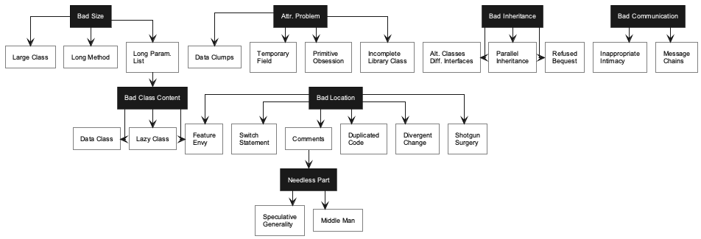

Research goal
Developers often fix code smells one at a time
In real projects, smells interact: fixing one can create another
Current AI tools don’t reliably handle these dependencies, so they can choose an order that introduces new smells or leaves the code only partially improved.
LLMs can edit code, but the order of edits still matters
Goal: optimize refactoring process by planning a safer order of edits
April 29, 2026
InnovAIte

Slide 3
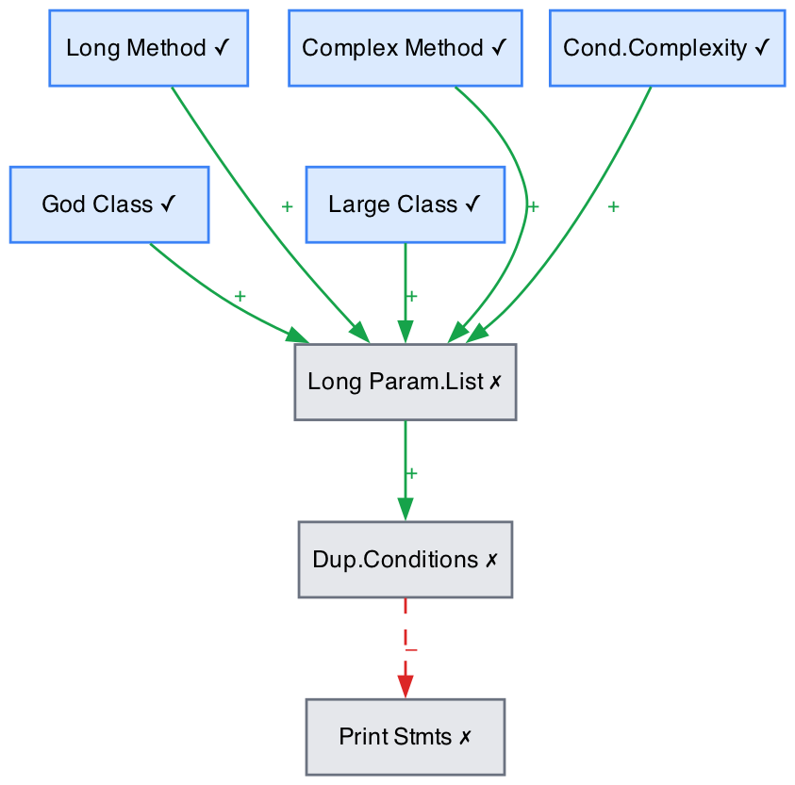
Dependency model
Each detected smell is a node in a graph.
Green edges show cases where one refactoring may remove another smell.
Red edges show cases where one refactoring may create another smell.
The planner uses this graph to choose a safer order of actions.
The graph can also store extra attributes, for example smell weight or project-specific priority.
April 29, 2026
InnovAIte

Slide 4
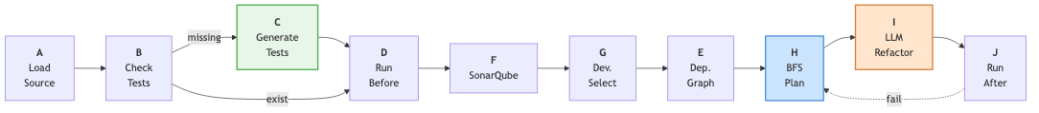
Code processing pipeline
1. Load the Java project and check the build/test setup.
2. Detect smells with SonarQube.
3. Let the developer choose target smells.
4. Build the smell dependency graph.
5. Plan the order of refactorings.
6. Apply changes with an LLM agent and validate them with tests and code quality metrics.
April 29, 2026
InnovAIte

Slide 5
Planning algorithms
Refactoring order matters: one fix can remove or create other smells.
The planner builds a dependency graph between detected smells
Green edges show smells that may disappear together.
Red edges show smells that may be introduced by a refactoring.
We propose two approaches:
Greedy planning selects the best-looking smell now, but may trigger new problems
Best-First Search looks ahead and chooses the next step that leads to a cleaner future state.

Slide 6
Future work
Evaluate planning quality across developer-committed refactoring sequences.
Validate dependency rules against empirical smell trajectories.
Extend the dependency model with additional smell types and refactoring operations.
Measure plan efficiency, negative dependency rate, and compile/test pass rate after each LLM patch.

Slide 7
Thank You for Your Attention

