Slide 1
Deep Learning: Satellite Imagery
Harrison Pincket
Dan Wang

Slide 2
Objective MOTIVATION
To predict the population density of a given region on the basis of satellite imagery of that region
The U.S. Census Bureau knows where people are and where people aren’t within the United States.
The same isn’t true of all countries.

Slide 3


Existing Models
UC Santa Barbara
1997
Linear regression
Arnhold Institute
2016
Deep learning
Other approaches use feature extraction. (Roads, Buildings, Terrain type) which could be used for population predictions.

Slide 4
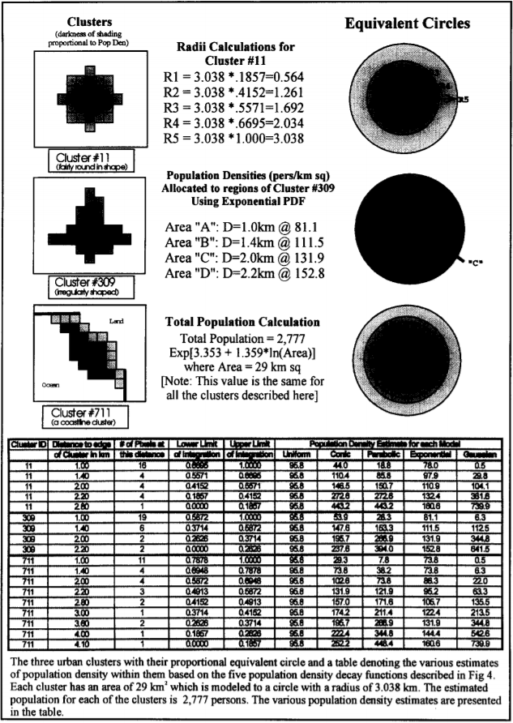
UC Santa Barbara Model
Night-time satellite imagery
Luminosity as proxy for human presence
Works well for developed regions with high access to electric lighting
Limited in extensibility to the rest of the world

Slide 5
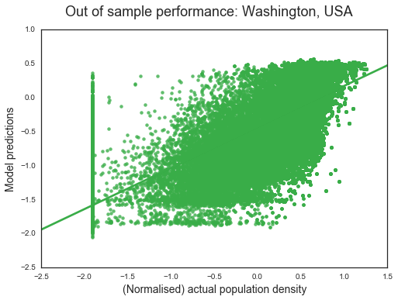
Arnhold INstitute
Applicable to daytime satellite imagery
High R² coefficient (here, a metric of explaining spatial variance in population)
Very weak at identifying regions of zero population

Slide 6
Data Integration
US Place Database
Federal Communications Commission (FCC) API
Find census block by latitude and longitude
"FIPS":"360775908001027"
Reduce to state + county + tract code by block name format
Find tract data in Census Gazetteer
Population
Longitudinal and latitudinal boundaries
Calculate population density and compare with NASA imagery
We pre-processed 55,000 image/pop records.
NASA Sat Imagery
FCC API
Census Pop by Tract
Model Record

Slide 7
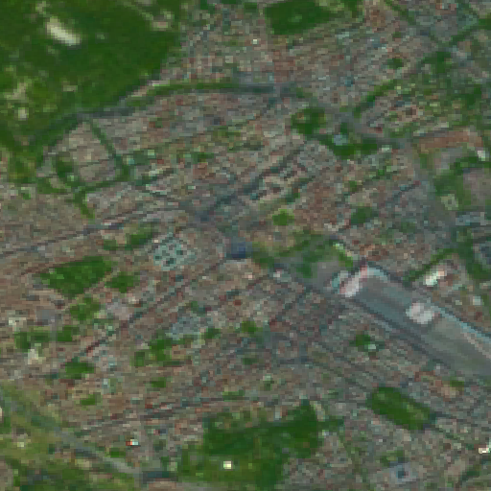
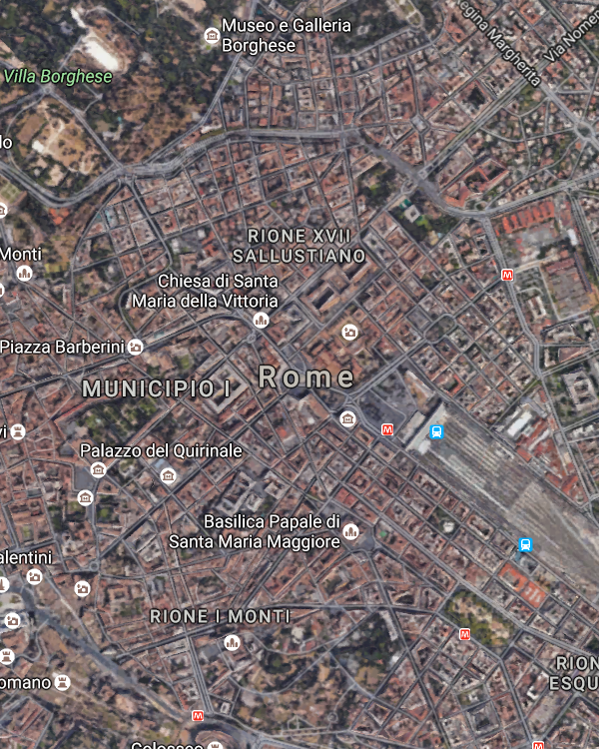
NASA LandSat 8 imagery

Slide 8
How images scale
Not too well
28 x 28 = 784 pixels = 784 bytes
512 x 512 = 262,144 pixels
With color: 262,144 pixels x (3 bytes / pixel) = 786,432 bytes

Slide 9
NASA LandSat 8 imagery

Slide 10
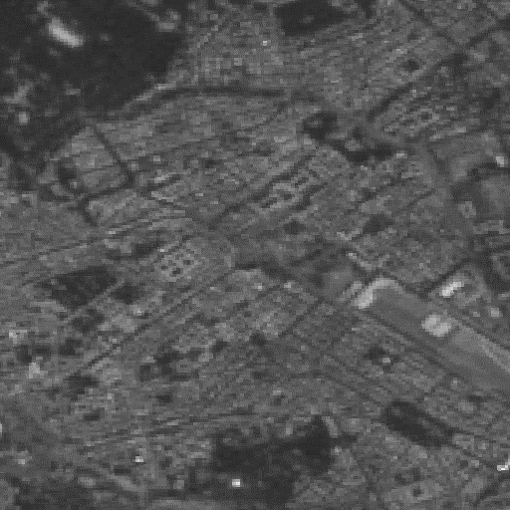
Grayscale
Typically not too bad
Information loss can be particularly severe in cases such as bodies of water
Wooded area…? (people could be living there) Or lake…? (they probably aren’t)
Slightly better than random at binary classification (~56%)

Slide 11
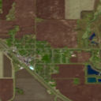
Our Model
Standard Convolutional Neural Net.
Convolutional Layers followed by Relu and max pooling.
F
C
128x 128 x
3
RE
LU
64
X
64
X
64
RE
LU
32
X
32
X
64
RE
LU
16
X
16
X
64
RE
LU
Max Pool
2x2
Max Pool
2x2
Max Pool
2x2
Max Pool
2x2

Slide 12
Various Attempts
Tried Variations in:
Greyscale
Pool Sizes
Convolution strides
Fully connected layer size
Error function
Num filters
Adding more layers didn’t help too much.

Slide 13
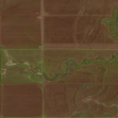
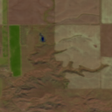
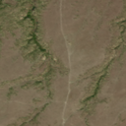
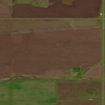
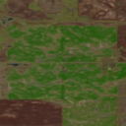
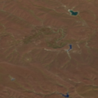
Issues
When dividing amongst all populations, 70% accuracy.
Census tracts don’t directly correspond to the images.

Slide 14
An Application: Identification of Unpopulated Areas
Does anybody live here?
“Null hypothesis”: This area is populated
Type I error: we predict unpopulated, but this area is actually populated
Type II error: we predict populated, but this area is actually unpopulated
It’s nice to minimize both, but Type I error should especially be avoided
Consider: firefighters need to know which areas to evacuate from a wildfire

Slide 15
Our Model at <1.0-Density Identification
Unpopulated defined as <1.0 person per square kilometer
Mediocre overall accuracy, but false positive rate of only <6%
Only 14 of 236 test images identified as unpopulated were actually populated
In other words:
Many unpopulated areas get labeled as populated (unfortunately)
But when our model says nobody lives in a place, that’s almost always true

Slide 16
Conclusions
Federal agencies put zero effort into making it easy
Large images are painful
It’s not great, but it’s not too bad either
Is the model trustworthy?

Slide 17
[The audience, both SHAKEN and STIRRED, reacts with THUNDEROUS AND PROLONGED APPLAUSE]

