Slide 1
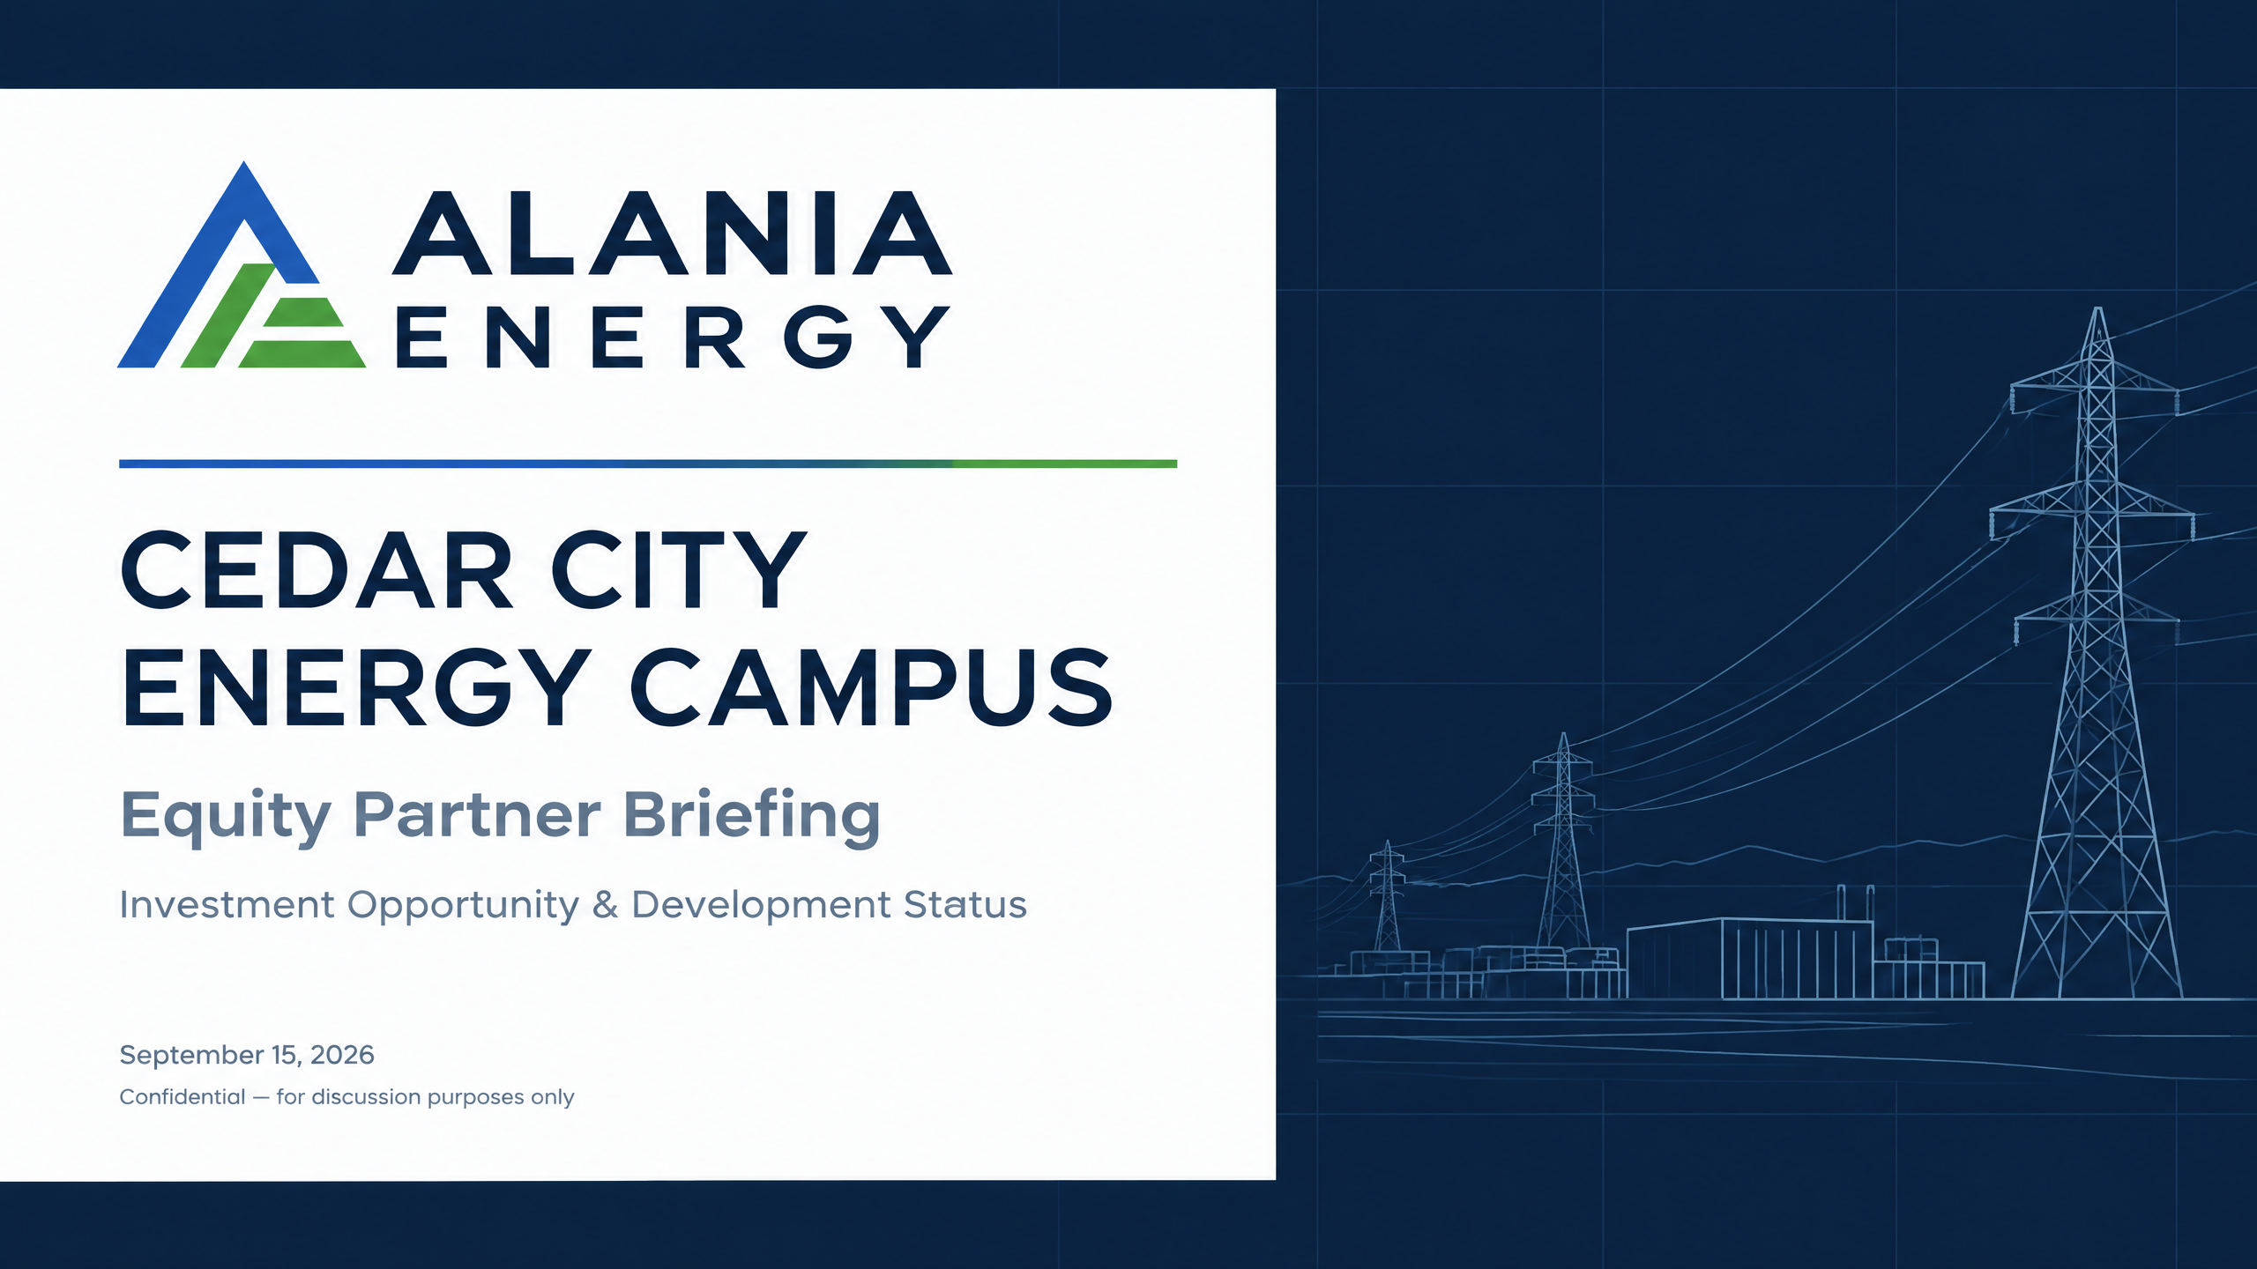
September 15, 2026
Confidential — for discussion purposes only
PRIVATE & CONFIDENTIAL

Slide 2



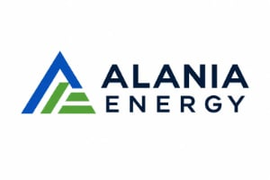

THE PROJECT HAS CROSSED THE HIGHEST-RISK DEVELOPMENT GATES
7,000 MW SCALE
COMMITTED OFFTAKE
Energy campus designed specifically to serve the massive power requirements of next-generation data-center loads in Cedar City, Utah.
3,000 MW of offtake committed across three credit-worthy local counterparties; PPA execution is the final pending step.
4,000 MW Expansion
EMBEDDED GROWTH POTENTIAL
Approved data-center load ready to contract behind the initial phase, utilizing the same site, utilities, and City framework.

Slide 3


EXECUTIVE SUMMARY
3,000 MW
4,000 MW
CONTRACTED REVENUE
EMBEDDED GROWTH
Committed long-term PPA capacity agreed to sign with three credit-worthy counterparties.
Approved data-center load ready to contract without repeating development risk.
$8.0B
100%
SENIOR CAPITAL
PRIVATE OWNERSHIP
Taxable conduit revenue bond issuance for the City; Stifel has agreed to lead the issuance.
ProjectCo retains title, depreciation, tax credits, and all merchant upside economics.

Slide 4



OWNERSHIP & CAPITAL STRUCTURE
PROJECTCO ECONOMICS
ProjectCo holds 100% title to all generation assets.
CAPITAL STACK ANCHORING
Senior debt proceeds from the $7.0B municipal bond issuance are loaned directly to ProjectCo on a non-recourse basis to the City.
Captures full depreciation, tax credits, and merchant upside.
Retains all project economics beyond PPA debt service.
Sponsor and partner equity completes the capital structure, funding the final development bridge to financial close and construction commencement.
CITY PARTNERSHIP
City acts as a conduit issuer and strategic partner.
No City equity ownership or moral obligation.
Fixed construction framework via executed agreement.

Slide 5

DEVELOPMENT MILESTONES ARE SUBSTANTIALLY COMPLETE
WORKSTREAM
STATUS
INVESTOR TAKEAWAY
Offtake
COMPLETE — EXECUTION PENDING
3,000 MW agreed to sign; 4,000 MW approved load remains
Senior Financing
COMMITTED
Stifel agreed to lead $8.0B municipal bond issuance
Site Control
COMPLETE
5,000 acres controlled; long-term ground leases completed
City Partnership
COMPLETE
Cedar City construction agreement executed
Utilities & Infrastructure
IN HAND
Water, gas, 350/550 kV lines, fiber and rail secured
Design & Procurement
UNDERWAY
Fluor engaged; long-lead equipment procurement in process

Slide 6







SITE INFRASTRUCTURE ADVANTAGE
A fully enabled 1,800-acre site reduces repeat development risk and accelerates speed-to-market.
5,000 ACRES CONTROLLED
HIGH-VOLTAGE POWER
WATER RIGHTS
Land under contract with long-term, financeable ground leases already completed.
Two high-voltage lines (350 kV and 550 kV) located directly on the property. Battery production non-lithium based.
1,000 acre feet water rights purchased and secured to support full-scale campus operations.
NATURAL GAS
FIBER CONNECTIVITY
RAIL ACCESS
Will Serve letter received- 9” adding 36” line-Large-volume natural-gas will-serve secured for primary generation supply.
High-capacity fiber infrastructure already on-site to serve data-center counterparties.
Direct rail access on the property to support construction logistics, ongoing manufacturing and heavy equipment.
CEDAR CITY ENERGY CAMPUS | CONFIDENTIAL

Slide 7

THE DELIVERY TEAM IS ASSEMBLED AROUND THE CRITICAL PATH
ALANIA ENERGY
FLUOR
SPONSOR & OPERATOR
EPC CONTRACTOR
Project sponsor contributing land and site value; retains operating control and sponsorship.
Engaged for engineering, procurement, and construction; schedule complete and long-lead procurement underway.
DIXIE POWER
STIFEL
O&M & LAST-MILE
SENIOR DEBT LEAD
Local utility identified to serve the last mile and operate the plant under performance standards.
Agreed to lead the $7.0 billion senior municipal bond issuance for the City of Cedar City.
CITY OF CEDAR CITY
EQUITY PARTNERS
CONDUIT & FRAMEWORK
PROJECTCO CAPITAL
Executed construction agreement fixing the build-out framework, approvals, and shared-facility interfaces.
Participating in ProjectCo LLC to complete the capital structure and capture long-term economics.

Slide 8

CAPITAL STACK OVERVIEW
LAYER
INSTRUMENT & DESCRIPTION
STATUS / SIZING
Senior Debt
Taxable conduit revenue bonds issued by the City of Cedar City; proceeds loaned to ProjectCo; non-recourse to the City.
$8.0B — Stifel agreed to lead
Construction Financing
Bank construction facility rolling into term debt at commercial operation.
To be arranged alongside senior issuance
Federal Support
DOE Section 303 support for qualifying equipment and infrastructure, separate from the bonds.
Scenario selection in process
Tax Attributes
Depreciation and available federal credits retained by ProjectCo as owner.
Eligibility confirmation in process
Sponsor & Partner Equity
Alania Energy as sponsor (land/site value contribution) plus equity partners in ProjectCo.
THIS RAISE

Slide 9

EQUITY INVESTMENT OPPORTUNITY
VEHICLE & OWNERSHIP
GOVERNANCE
ProjectCo LLC
Sponsor Control
100% privately owned entity; holds title to all generation assets and project economics.
Alania retains sponsorship and operating control; customary partner consents and reporting.
USE OF PROCEEDS
EXIT & LIQUIDITY
Development to Close
Multiple Paths
Funding for PPAs, FEED, design, EPC finalization, and construction working capital.
Refinancing at commercial operation, expansion tranches, or sale of ProjectCo interests.
Equity commitments are required ahead of financial close, with funding staged against key development milestones.

Slide 10

RISK MANAGEMENT FRAMEWORK
NEXT STEP
RESIDUAL RISK
PRINCIPAL ACTION
Execute PPAs
LOW
Sign agreed drafts with three counterparties including lender protections.
Interconnection & FEED
MODERATE
Confirm full-nameplate interconnection and complete FEED study.
Design & EPC
MODERATE
Finalize civil/geotech and fixed-price, date-certain EPC terms with Fluor.
O&M Agreement
LOW
Document Dixie Power O&M and last-mile agreements with ProjectCo.
Debt Sizing & Close
MARKET
Finalize sizing, coverage, and ratings; complete bond documentation with Stifel.
Final Approvals
LOW
Complete City/County sign-offs and related-party disclosures.

Slide 11

PATH TO FINANCIAL CLOSE
1
NDA & DATA-ROOM ACCESS
Immediate access to PPA forms, ground leases, City agreements, and utility documentation.
AVAILABLE FOR DILIGENCE
PPA Drafts & Counterparty Credit Info
•
Executed City Construction Agreement
•
2
MANAGEMENT & SITE VISIT
Fluor EPC Schedule & FEED Status
•
Stifel Engagement & Bond Sizing
Direct engagement with the Alania development platform and physical site validation in Cedar City.
•
Utility Will-Serve & Infrastructure Deeds
•
3
TERM SHEET & DILIGENCE
Execution of indicative term sheet followed by parallel diligence alongside bond documentation.
EQUITY AND SENIOR CAPITAL TARGETED TO CLOSE TOGETHER AS CONSTRUCTION COMMENCES

Slide 12

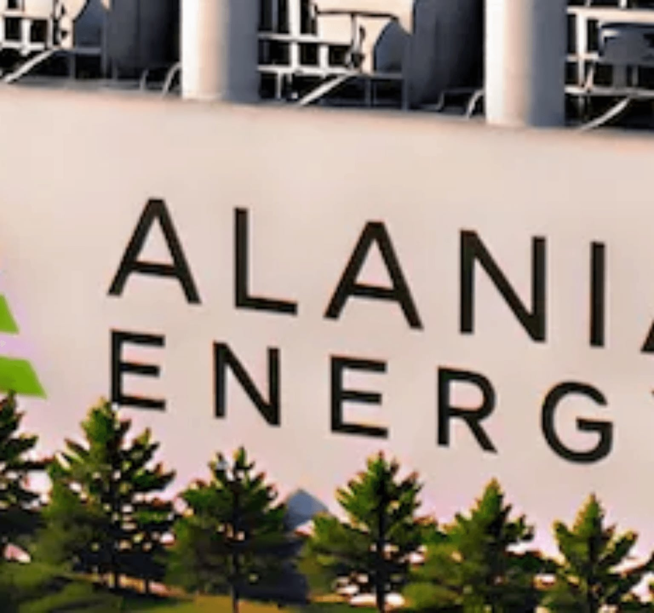

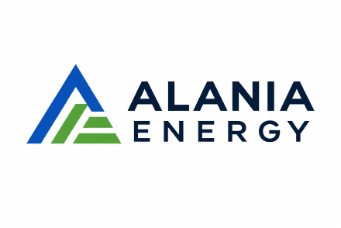
CEDAR CITY
ENERGY CAMPUS
Private ownership platform for scaled infrastructure and data-center growth.
Confidential — for discussion purposes only
© 2026 Alania Energy. All rights reserved.

