Slide 1
Bike Sharing Assignment
By Hanaa Parvez Khan

Slide 2
Business Goal
You are required to model the demand for shared bikes with the available independent variables. It will be used by the management to understand how exactly the demands vary with different features. They can accordingly manipulate the business strategy to meet the demand levels and meet the customer's expectations. Further, the model will be a good way for management to understand the demand dynamics of a new market.

Slide 3
Proposed Methodology
1
The initial check and cleaning of Data
2
Clean Data
Check and fix the Data Types
3
Encoding the Labels & Visualization
Remove unnecessary data & create the new factors
4
Visualizing the Relationship among variables
5
Deal With Categorical Variables- Create dummy variables
6
Splitting the Data into Training and Testing Sets
Building a linear model
Check the correlation
Performing EDA
Dropping the categorical variables as they are already dummy-encoded.
Residual Analysis of the train data
7
Making Predictions
Model Evaluation

Slide 4
About Data
Data Description
Our data-set has information from over 730 days with 16 features
Record index
Date
Season (1:spring, 2:summer, 3:fall, 4:winter)
Year (0: 2011, 1:2012)
Month (1 to 12)
Hour (0 to 23)
Holiday : whether that day is holiday or not
Weekday : day of the week
Working-day : if day is neither weekend nor holiday , value is 1. Otherwise 0
Weather situation : — 1: Clear, Few clouds, Partly cloudy, Partly cloudy — 2: Mist + Cloudy, Mist + Broken clouds, Mist + Few clouds, Mist — 3: Light Snow, Light Rain + Thunderstorm + Scattered clouds, Light Rain + Scattered clouds — 4: Heavy Rain + Ice Pallets + Thunderstorm + Mist, Snow + Fog
Normalized temperature in Celsius. Values are divided to 41 (max)
Normalized feeling temperature in Celsius. Values are divided to 50 (max)
Normalized humidity. The values are divided to 100 (max)
Normalized wind speed. The values are divided to 67 (max)
Count of casual users
Count of registered users
Count of total rental bikes including both casual and registered

Slide 5
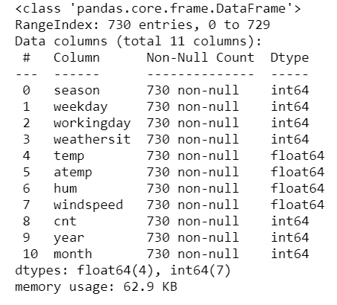
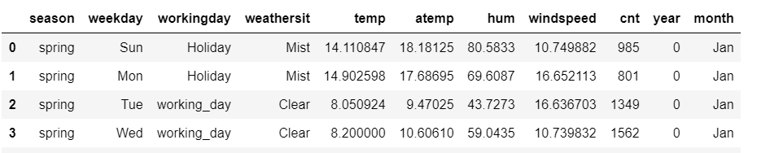
Encoding the Labels
From the data it can be see that: season, yr, mnth, holiday,weekday,workingday,weathersit all are categorical variables We will replace season, weekday and weathersit with appropriate values
Before Encoding
After Encoding

Slide 6
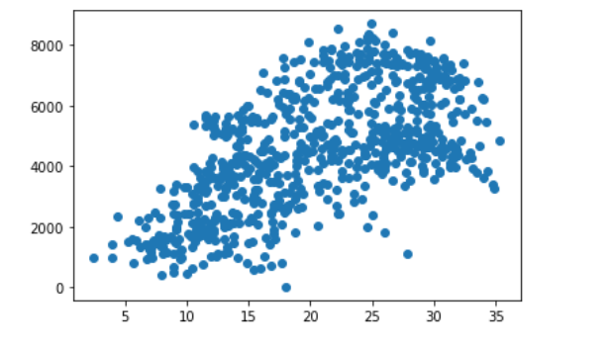
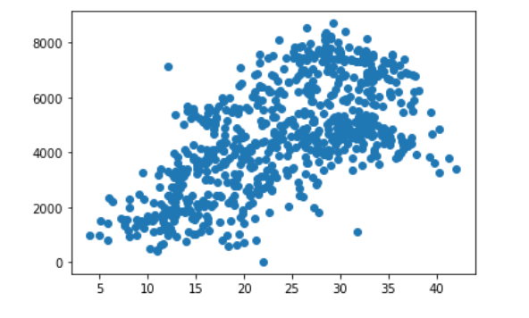
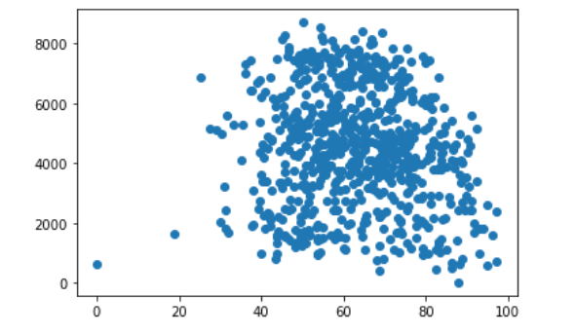
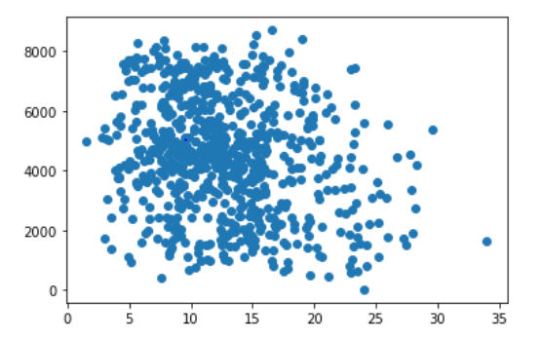
Numerical Variable Analysis
Bike Rentals are observed at higher temperatures
Bike Rentals are observed at higher "feel-like" temperatures.
Temperature being directly proportional to Humidity, Bike Rentals are making during high humidity
Wind speeds increase with a greater temperature difference. Wind speed near the surface is most highly correlated with the temperature.

Slide 7
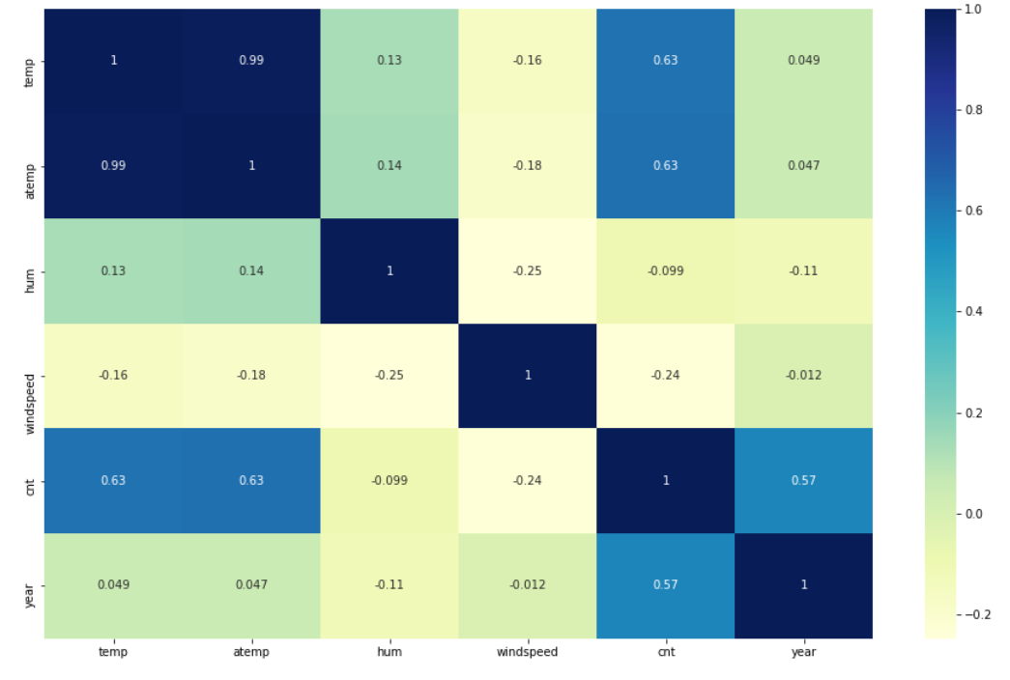
Visualizing the Relationship among variables(collinearity)

Slide 8
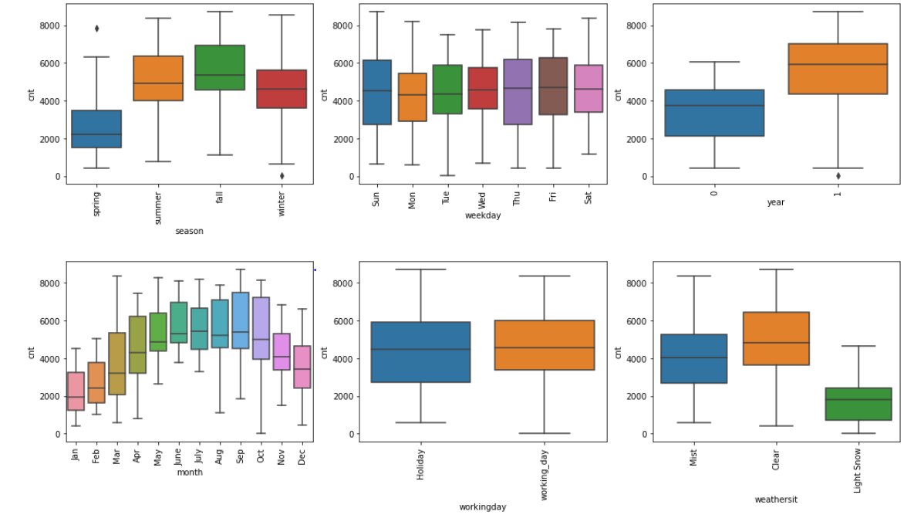
Categorical Variable Analysis
1)The demand of bike is less in the month of spring when compared with other seasons
2)The demand bike increased in the year 2019 when compared with year 2018.
3)Month Jun to Sep is the period when bike demand is high. The Month Jan is the lowest demand month.
4)The demand of bike is almost similar throughout the weekdays.
5)There is no significant change in bike demand with workign day and non working day.
6)The bike demand is high when weather is clear and Few clouds however demand is less in case of Lightsnow and light rainfall. 7)We do not have any dat for Heavy Rain + Ice Pallets + Thunderstorm + Mist, Snow + Fog , so we can not derive any conclusion. May be the company is not operating on those days or there is no demand of bike.

Slide 9
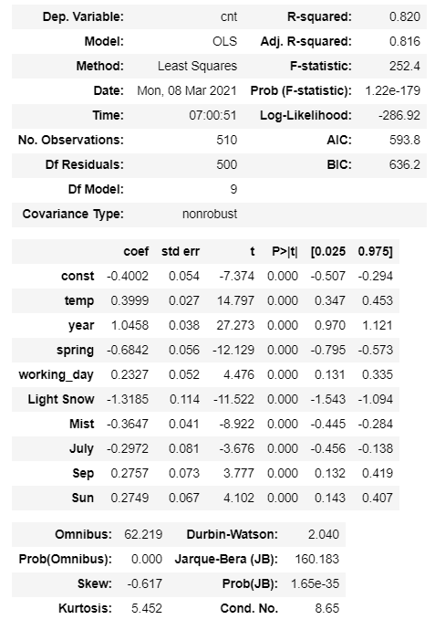
Building Liner Model
Use RFE Approach for FEATURE SELECTION. On the side you can see a summary of the model build along-with all the features selected

Slide 10
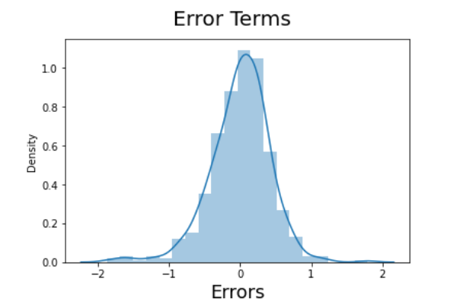
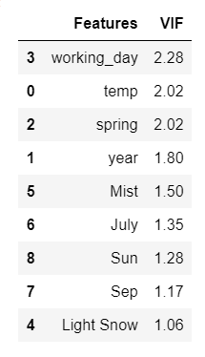
Variance Inflation Factor(VIF)
Residual Analysis of the train data
A rule of thumb for interpreting the variance inflation factor: 1 = not correlated. Between 1 and 5 = moderately correlated. Greater than 5 = highly correlated
In the below residual analysis we can the assumption is followed which is that the errors are independent and normally distributed

Slide 11
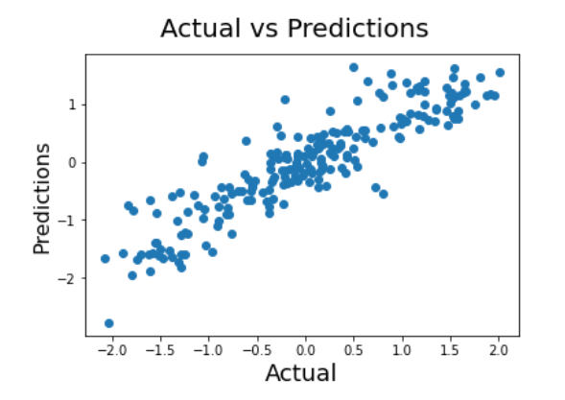
Model Evaluation
r-squared = 81% means: 81% less variance around the regression line than mean line. ... Actual data is 81% close to the regression line than mean line. 81% better prediction of actual values using regression line than mean line
“There is 81% less error between predicted values and actual values”
The R-squared score for the given model is .81

Slide 12
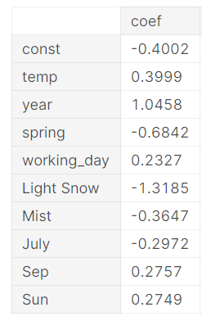
Conclusion
The top 5 variables that are seen effecting and benefitting the Bike Rental count are as follows:
Spring season : -0.6842
Temperature : 0.3999
Mist : -0.3647
Sun : 0.2749
working_day : 0.2327

Slide 13
Thank You

