Slide 1
Subjective Questions

Slide 2
Assignment-based Subjective Questions
Q-1) From your analysis of the categorical variables from the dataset, what could you infer about their effect on the dependent variable?
1)The demand of bike is less in the month of spring when compared with other seasons
2)The demand bike increased in the year 2019 when compared with year 2018.
3)Month Jun to Sep is the period when bike demand is high. The Month Jan is the lowest demand month.
4)The demand of bike is almost similar throughout the weekdays.
5)There is no significant change in bike demand with workign day and non working day.
6)The bike demand is high when weather is clear and Few clouds however demand is less in case of Lightsnow and light rainfall. 7)We do not have any dat for Heavy Rain + Ice Pallets + Thunderstorm + Mist, Snow + Fog , so we can not derive any conclusion. May be the company is not operating on those days or there is no demand of bike.

Slide 3
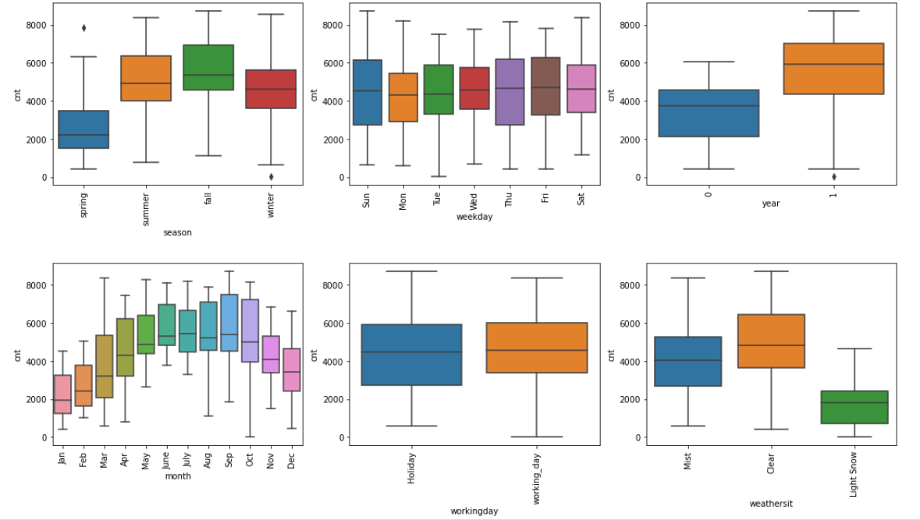

Slide 4
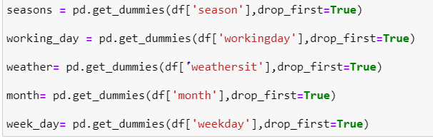
Q-2)Why is it important to use drop_first=True during dummy variable creation?
1) drop_first=True is important to use, as it helps in reducing the extra column
created during dummy variable creation. Hence it reduces the correlations
created among dummy variables.
2)Let’s say we have 3 types of values in Categorical column and we want to
create dummy variable for that column. If one variable is not furnished and
semi_furnished, then It is obvious unfurnished. So we do not need 3rd
variable to identify the unfurnished

Slide 5
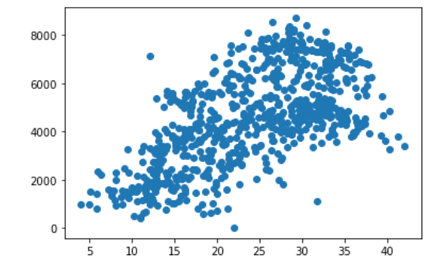
Q-3) Looking at the pair-plot among the numerical variables, which one has the highest correlation with the target variable?
Highest correlation exists between temp & cnt, where-
temp : temperature in Celsius
cnt: count of total rental bikes including both casual and registered

Slide 6
Q-4)How did you validate the assumptions of Linear Regression after building the model on the training set?
The most important assumption of a linear regression model is that the errors are independent and normally distributed.-
After we train a Linear Regression model on the given data set, if we run the training data through the same model, the model will generate predictions. Let’s call them y_test_pred. For each predicted value y_test_pred in the vector y_test_pred, there is a corresponding actual value y from the response variable vector y. In the above residual analysis we can the assumption is followed which is that the errors are independent and normally distributed.
Multicollinearity saps the statistical power of the analysis, can cause the coefficients to switch signs, and makes it more difficult to specify the correct model. Variance inflation factor (VIF) is a measure of the amount of multicollinearity in a set of multiple regression variables. More the VIF increases, the less reliable your regression results are going to be. VIF value should be below 5 to prove if there is no multicollinearity among indicators which is in the cse of our model.

Slide 7
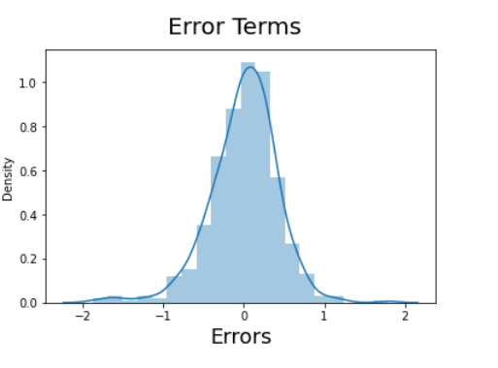
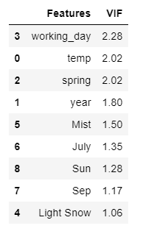
In the above residual analysis we can the assumption is followed which is that the errors are independent and normally distributed.
All the variables have VIF less than 5 and it's perfect!
Assumptions of Linear Regression:
The error terms are normally distributed.
The training and testing accuracy are nearly equal hence there is no Overfit/Underfit situation.
The predicted values have linear relationship with the actual values.

Slide 8
Q-5)Based on the final model, which are the top 3 features contributing significantly towards explaining the demand of the shared bikes?
The top 3 variables that are seen effecting and benefitting the Bike Rental count are as follows:
1.)Spring season : -0.6842
2.)Temperature : 0.3999
3.)Mist : -0.3647

Slide 9

General Subjective Questions
Q-1)Explain the linear regression algorithm in detail.
Linear regression is one of the very basic forms of machine learning where we train a model to predict the behavior of your data based on some variables. In the case of linear regression as you can see the name suggests linear that means the two variables which are on the x-axis and y-axis should be linearly correlated.
Linear regression is used to predict a quantitative response Y from the predictor variable X.
Mathematically, we can write a linear regression equation as:
Where a and b given by the formulas:

Slide 10
The Four Assumptions of Linear Regression
Linear relationship: There exists a linear relationship between the independent variable, x, and the dependent variable, y.
Independence: The residuals are independent. ...
Homoscedasticity: The residuals have constant variance at every level of x.
Normality: The residuals of the model are normally distributed.

Slide 11
Q-2)Explain the Anscombe’s quartet in detail.
Anscombe's Quartet can be defined as a group of four data sets which are nearly identical in simple descriptive statistics, but there are some peculiarities in the dataset that fools the regression model if built. They have very different distributions and appear differently when plotted on scatter plots.
Anscombe’s quartet comprises four datasets that have nearly identical simple statistical properties, yet appear very different when graphed.
The quartet is still often used to illustrate the importance of looking at a set of data graphically before starting to analyze according to a particular type of relationship, and the inadequacy of basic statistic properties for describing realistic datasets.

Slide 12
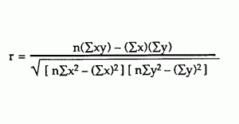
Q-3)What is Pearson’s R?
Correlation between sets of data is a measure of how well they
are related. The most common measure of correlation in stats is
the Pearson Correlation. The full name is the Pearson Product
Moment Correlation (PPMC). It shows the linear
relationship between two sets of data.
The potential problems with Pearson correlation is that it
is not able to tell the difference between dependent
variables and independent variables
The range of the correlation coefficient
is from -1 to 1.
Pearson correlation coefficient:-
Two other formulas are commonly used: the sample correlation coefficient and the
population correlation coefficient-
Sample correlation coefficient
Population correlation coefficient
The population correlation coefficient uses σ_{x} and σ_{y} as the population standard deviations, and σ_{xy} as the population covariance.
S_{x} and s_{y} are the sample standard deviations, and s_{xy} is the sample covariance.

Slide 13
Q-4)What is scaling? Why is scaling performed? What is the difference between normalized scaling and standardized scaling?
Feature scaling is a method used to normalize the range of
Independent
variables or features of data. In data processing, it is also known as
Data normalization and is generally performed during the data
preprocessing step.
In simple terms, "normalization" typically means that the range of values are
"normalized to be from 0.0 to 1.0". "Standardization" typically means
that the range of values are "standardized" to measure how many standard Deviations the value is from its mean.

Slide 14
Q-5)You might have observed that sometimes the value of VIF is infinite. Why does this happen?
An infinite VIF value indicates that the
corresponding variable may be expressed
exactly by a linear combination of other
variables (which show an infinite VIF as well)
In other words If there is perfect correlation,
then VIF = infinity. A large value of VIF indicates that there is a correlation between the variables. If the VIF is 4, this means
that the variance of the model coefficient is inflated by factor
of 4 due to the presence of multicollinearity.

Slide 15
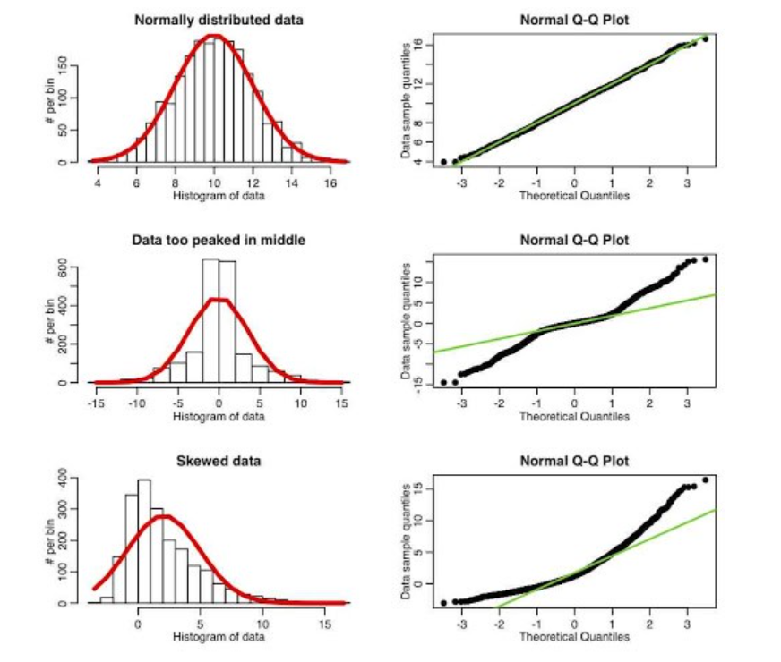
Q-6)What is a Q-Q plot? Explain the use and importance of a Q-Q plot in linear regression
Q-Q plots are used to find the type of distribution for a random variable whether it be a Gaussian
Distribution, Uniform Distribution, Exponential Distribution or even Pareto Distribution, etc. You can tell the type of distribution using the power of the Q-Q plot just by looking at the plot. In general, we are talking about Normal distributions. So we know how much of the data lies in the range of first standard deviation, second standard deviation and third standard
deviation from the mean. So knowing if a distribution is Normal opens up new doors for
us to experiment with the data easily
How does it work?
If the points at the ends of the curve formed from the points
are not falling on a straight line but indeed are
scattered significantly from the positions then we cannot
conclude a relationship between the x and y axes
which clearly signifies that our ordered values which we
wanted to calculate are not Normally distributed.

