Slide 1
ODESOLVERS
A Unified Python Interface to a Variety of Software for Solving Oridinary Differential Equations
Available at https://github.com/hplgit/odesolvers

Slide 2
Part 1
Background

Slide 3
Ordinary Differential Equation
We focus only on solving IVP for first order ODE systems.
u' = du/dt = f(u, t), scalar or vector.
Numerical methods:
explict vs implicit, one-step vs multi-step
Existing ODE software:
1. Traditional ODE solvers developed in Fortran or C:
Well-tested, stable, efficient, but cubersome to use.
2. ODE software developed in modern languages:
Clean syntax, user-friendly, but lack of generic interface.

Slide 4
Problem Area
Difficult to choose an appropriate ODE solver, especially for novice users who are new to ODE.
Diversity of numerical methods and software.
Accuracy, stability and efficiency.
User's understanding about solvers and the specific ODE problem.
Troublesome to switch among existing ODE software.

Slide 5
Switch-over Example u'' = 3 (1-u2) u' + u, u0 = (2.0, 1.0)
Dlsode in ODEPACK
program main
external f
integer i, iopt, iout, istate, itask, itol, iwork,
1 lrw, liw, mf, neq, nout
double precision atol, t, tout, rtol, rwork, u, urr
dimension u(2), rwork(52), iwork(20), urr(5,2)
neq = 2
mf = 10
itol = 1
rtol = 0.0d0
atol = 1.0d-6
lrw = 52
liw = 20
nout = 5
t = 0.0d0
tout = 0.2d0
u(1)= 2.0d0
u(2) = 0.0d0
itask = 1
istate = 1
do 100 iout = 1, nout
call dlsode(f,neq,u,t,tout,itol,rtol,atol,itask,
1 istate,iopt,rwork,lrw,iwork,liw,jac,mf)
urr(iout,1) = u(1)
urr(iout,2) = u(2)
100 tout = tout + 2d-1
end
subroutine f(neq, t, u, udot)
integer neq
double precision t, u, udot
dimension u(2), udot(2)
udot(1) = u(2)
udot(2) = 3.0d0*(1.0d0 - u(1)*u(1))*u(2) - u(1)
return
end
ode45 in Matlab
funsys.m:
function F = funsys(t, u)
F(1, 1) = u(2)
F(2, 1) = 3*(1 – u(1)*u(1))*u(2) – u(1)
In Matlab command window:
[t_s, u_s] = ode45('funsys', [0 1], [2;0])
ode in scipy
from scipy.integrate import ode
u0, t0 = [2.0, 0.0], 0.0
def f(t, u):
return [u[1],
3.*(1. - u[0]*u[0])*u[1] - u[0]]
r = ode(f).set_integrator(’dopri5’,
with_Jacobian=False)
r.set_initial_value(u0, t0)
while r.successful() and r.t <= 1.0:
r.integrate(r.t + 0.2)

Slide 6
The Preferred Solution:
A Unified Interface for ODE Solvers
Unified interface → Easy-to-switch
Clean syntax → Easy-to-study for users without much programming experience
User-friendly interface → Easy-to-use for novices

Slide 7
Part 2
Usage

Slide 8
Typical usage
Write the ODE problem in generic form u' = f(u, t)
Implement the right-hand side function f(u, t)
Create a method object with desired solver
method = SomeSolver(f, prm1=..., prm2=..., ...)
Set initial status, u(0) = u0
method.set_initial_condition(u0)
Solve the ODE problem within desired domain of time points
u, t = method.solve(time_points, terminate=...)

Slide 9
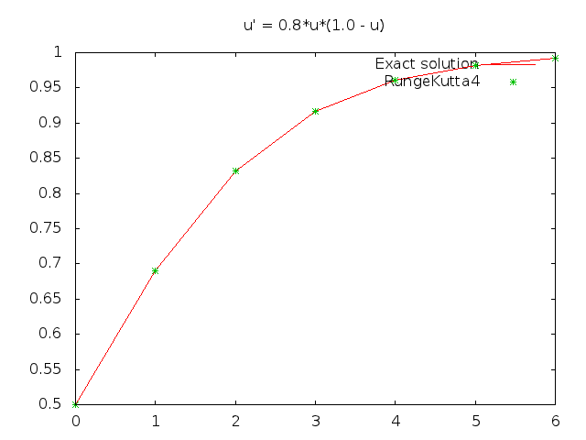
Example 1:
Logistic model with Population Growth Problem
u'(t) = a(u,t) (1 - u(t)) /C
where a = 0.8, C = 1.0
def f(u, t): # a = 0.8, C = 1.0
return 0.8*u*(1 – u)
method = odesolvers.RungeKutta4(f)
method.set_initial_condition(0.5) # u0 = 0.5
u, t = method.solve(numpy.arange(0.0, 7.0, 1.0))

Slide 10
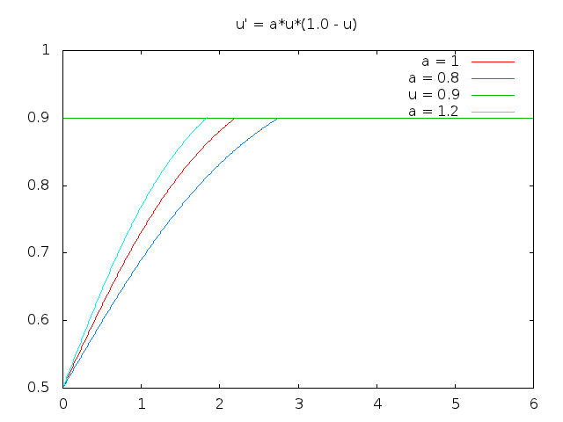
How Will the Population be Affected with Different Growth Rates?
When Will the Population Exceeds 0.9 Million?
def f(u, t, a): # f with extra parameter
return a*u*(1.0 - u)
time_points = numpy.arange(0.0, 7.0, 0.01)
u0 = 0.5
def _terminate(u, t, step_number):
# Stop when population exceeds 0.9 million
tol = 1e-6
return (u[step_number] - 0.9) < tol
u_solutions = {}
for a in [0.8, 1.0, 1.2]: # 3 different values of a
key = ’a = %g’ % a
method = odesolvers.RungeKutta4(f, f_args=(a,))
u_solutions[key], t = method.solve(time_points,
terminate=_terminate)
Extra argument for f: a
Loop with 3 different values for a
Stop events are defined

Slide 11
Example 2: Van der Pol Oscillator Problem
Try three solvers in a single loop.
y'' = 3(1 − y²)y + y
Introduce a new vector u = (y, y') = (u0, u1),
u' = (u1, 3.0*(1.0 - u0*u0)*u1 + u0)
def f(u,t): # Define ODE system with vector variables
u_0, u_1 = u
return [u_1, 3.0*(1.0 - u_0*u_0)*u_1 + u_0]
from odesolvers import *
solver_list = [Lsode, DormandPrince, Vode]
solutions = {}
for solver in solver_list:
method = solver(f)
method.set_initial_conditions([2.0, 1.0])
solutions[method.__name__], t = method.solve([0.0, 0.2, 0.4, 0.6, 0.8, 1.0])
Ode45 in Matlab
Scipy.integrate.ode
Dlsode in ODEPACK

Slide 12
Switch-over Example u'' = 3 (1-u2) u' + u, u0 = (2.0, 1.0)
Dlsode in ODEPACK
program main
external f
integer i, iopt, iout, istate, itask, itol, iwork,
1 lrw, liw, mf, neq, nout
double precision atol, t, tout, rtol, rwork, u, urr
dimension u(2), rwork(52), iwork(20), urr(5,2)
neq = 2
mf = 10
itol = 1
rtol = 0.0d0
atol = 1.0d-6
lrw = 52
liw = 20
nout = 5
t = 0.0d0
tout = 0.2d0
u(1)= 2.0d0
u(2) = 0.0d0
itask = 1
istate = 1
do 100 iout = 1, nout
call dlsode(f,neq,u,t,tout,itol,rtol,atol,itask,
1 istate,iopt,rwork,lrw,iwork,liw,jac,mf)
urr(iout,1) = u(1)
urr(iout,2) = u(2)
100 tout = tout + 2d-1
end
subroutine f(neq, t, u, udot)
integer neq
double precision t, u, udot
dimension u(2), udot(2)
udot(1) = u(2)
udot(2) = 3.0d0*(1.0d0 - u(1)*u(1))*u(2) - u(1)
return
end
ode45 in Matlab
funsys.m:
function F = funsys(t, u)
F(1, 1) = u(2)
F(2, 1) = 3*(1 – u(1)*u(1))*u(2) – u(1)
In Matlab command window:
[t_s, u_s] = ode45('funsys', [0 1], [2;0])
ode in scipy
from scipy.integrate import ode
u0, t0 = [2.0, 0.0], 0.0
def f(t, u):
return [u[1],
3.*(1. - u[0]*u[0])*u[1] - u[0]]
r = ode(f).set_integrator(’dopri5’,
with_Jacobian=False)
r.set_initial_value(u0, t0)
while r.successful() and r.t <= 1.0:
r.integrate(r.t + 0.2)

Slide 13
Further usage:
Supply f as a Fortran Subroutine
f_str = """
subroutine f_f77(neq, t, u, udot)
Cf2py intent(hide) neq
Cf2py intent(out) udot
integer neq
double precision t, u, udot,i,j,k
dimension u(neq), udot(neq)
udot(1) = u(2)
udot(2) = 3d0*(1d0 - u(1)**2)*u(2) - u(1)
return
end
"""
m = odesolvers.Lsode(None, f_f77=f_str)
m.set_initial_condition(u0)
u,t = m.solve(time_points)
f_f77 can either be supplied as multi-line string in Fortran, or as a F2py-compiled object.
from numpy import f2py
f2py.compile(f_str, modulename='callback',
verbose=False)
import callback
f_f77 = callback.f_f77
m = odesolvers.Lsode(None, f_f77=f_f77)
f_f77 is not a legal parameter for Fehlberg, which means that a Python function f is required as a mandatory parameter for class Fehlberg.
Then, if we want to try the same problem with Fehlberg method, must we re-implement f in Python? No!
# Switch to Fehlberg
m_new = m.switch_to('Fehlberg')
u_new, t = m_new.solve(time_points)
In Lsode:
self._parameters['f_f77'] = dict(name_wrapped='f', paralist_old='t,u', paralist_new='u,t')
self.f = lambda u,t: self.f_f77(t,u) → Automatically done in function func_wrapper()

Slide 14
Example 3:
A Simple DAE Problem: Chemical Kinetics
Linearly implicit systems of first order ODEs,
A(u,t) * u' = g(u,t) , where A is a square matrix.
Solvers: Lsodi, Lsoibt, Lsodis in Odepack
u(1)' = -0.04*u(1) + 1e4*u(2)*u(3)
u(2)' = 0.04*y(1) - 1e4*u(2)*u(3) + 3e7*u(2)**2
0 = u(1) + u(2) + u(3) - 1
Where A = 1 0 0
0 1 0
0 0 0
Supply a function res to compute the residual:
r = g(u,t) – A(u,t)*s
s is an internally generated approxiamation for u'.
Supply a function adda to add A to another matrix P.
Jacobian matrix dr/du is an optional input.
Provide initial value of u and u'.
Solve this DAE problem with the same steps as ODE problems.
def res(u, t, s, ires):
r = numpy.zeros(3,float)
r[0] = -.04*u[0] + 1e4*u[1]*u[2] - s[0]
r[1] = .04*u[0] - 1e4*u[1]*u[2] - 3e7*u[1]*u[1] - s[1]
r[2] = sum(u) - 1
return r,ires
def adda(u, t, p):
p[0][0] += 1.
p[1][1] += 1.
return p
u0 = [1.,0.,0.]
time_points = np.linspace(0., 4., 5)
ydoti = [-.04,.04,0.] # initial value of du/dt
m = odesolvers.Lsodi(res=res, ydoti=ydoti, adda_lsodi=adda)
m.set_initial_condition(u0)
u,t = m.solve(time_points)

Slide 15
Part 3
Design Issues

Slide 16
Class Hierarchy
43 subclasses
Each solver in this package is implemented as a class in a class hierarchy with a common super class Solver.
Common functionality and attributes is inherited from super classes.
Specific settings and fomula is implemented in the actual subclass.
Solver
ForwardEuler, MidpointIter,
Heun, Leapfrog, LeapfrogFiltered, AdamsBashforth2,
AdamsBashforth3,
AdamsBashforth4,
AdamsBashMoulton2,
AdamsBashMoulton3,
SymPy_odefun,
MidpointIter,
RK2, RK3, RK4,
MySolver.
SolverImplicit
Adaptive
RungeKutta
Ode_scipy
Odepack
BackwardEuler
Backward2Step
ThetaRule
Midpoint-Implicit
RKFehlberg
Adaptive-Residual
RKF45
RKC
RungeKutta1
RungeKutta2
RungeKutta3
RungeKutta4
Bogacki-Shampine
CashKarp
DormandPrince
Fehlberg,
MyRungeKutta
Vode
Dopri5
Dpri853
Lsode
Lsodes
Lsoda
Lsodar
Lsodi
Lsoibt
Lsodis

Slide 17
solvers._parameters & self._parameters
solvers._parameters:
_parameters = dict(
f = dict(
help = ’Right-hand side f(u,t) defining ODE’,
type = callable),
…
atol = dict(
help=’absolute tolerance for solution’,
type=(float,list,tuple,numpy.ndarray),
default=1e-8),
beta = dict(...),
…
)
>>> print len(solver._parameters.keys())
79
SomeMethod._required_parameters = ['f', ]
SomeMethod._optional_parameters = ['atol', ]
>>> m = SomeMethod(None)
>>> import pprint
>>> print pprint.pformat(m._parameters)
{’atol’: {’default’: 1e-08,
’help’: ’absolute tolerance for solution’,
’type’: (<type ’float’>,
<type ’list’>,
<type ’tuple’>,
<type ’numpy.ndarray’>)},
’f’: {’help’: ’right-hand side f(u,t) defining the ODE’,
’type’: <built-in function callable>}}
>>> print len(m._parameters.keys())
2
The property-information of legal parameters of a particular solver is loaded into self._parameters in the constructor function __init__().

Slide 18
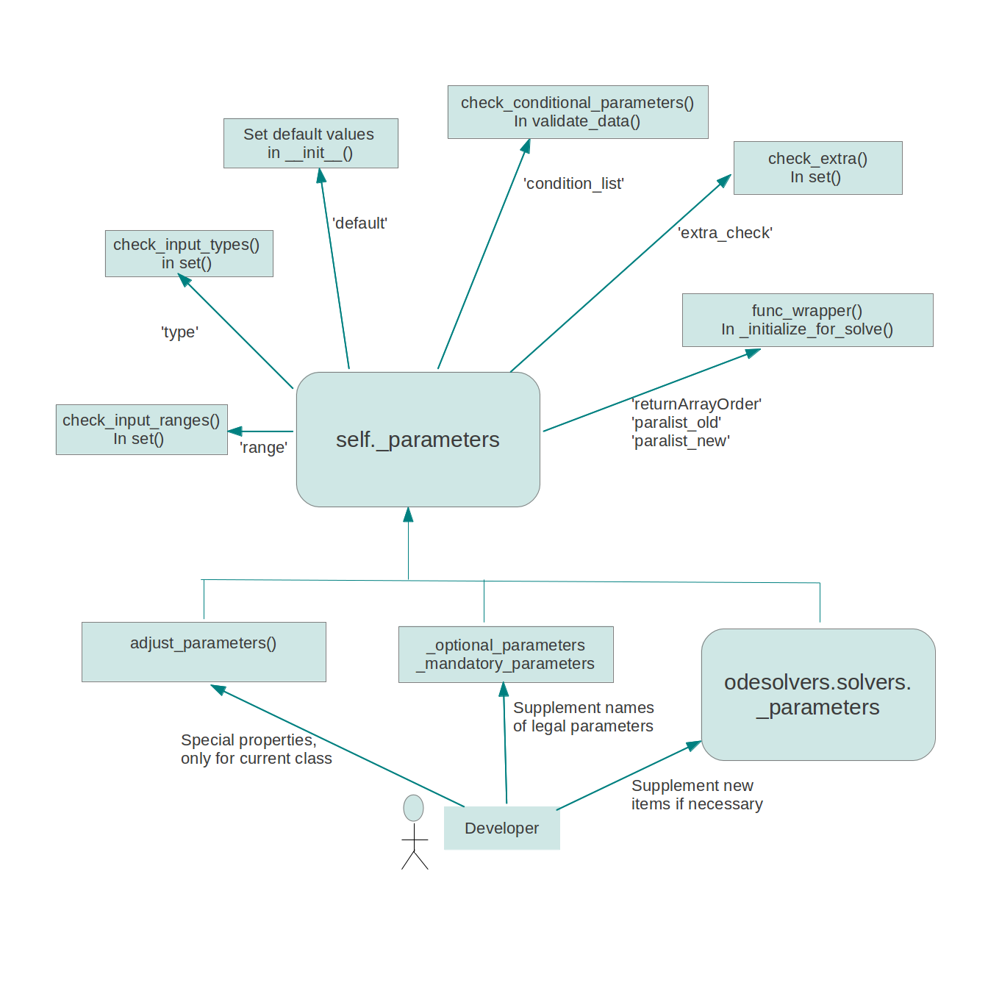
Automatic Check & Process of Parameters

Slide 19
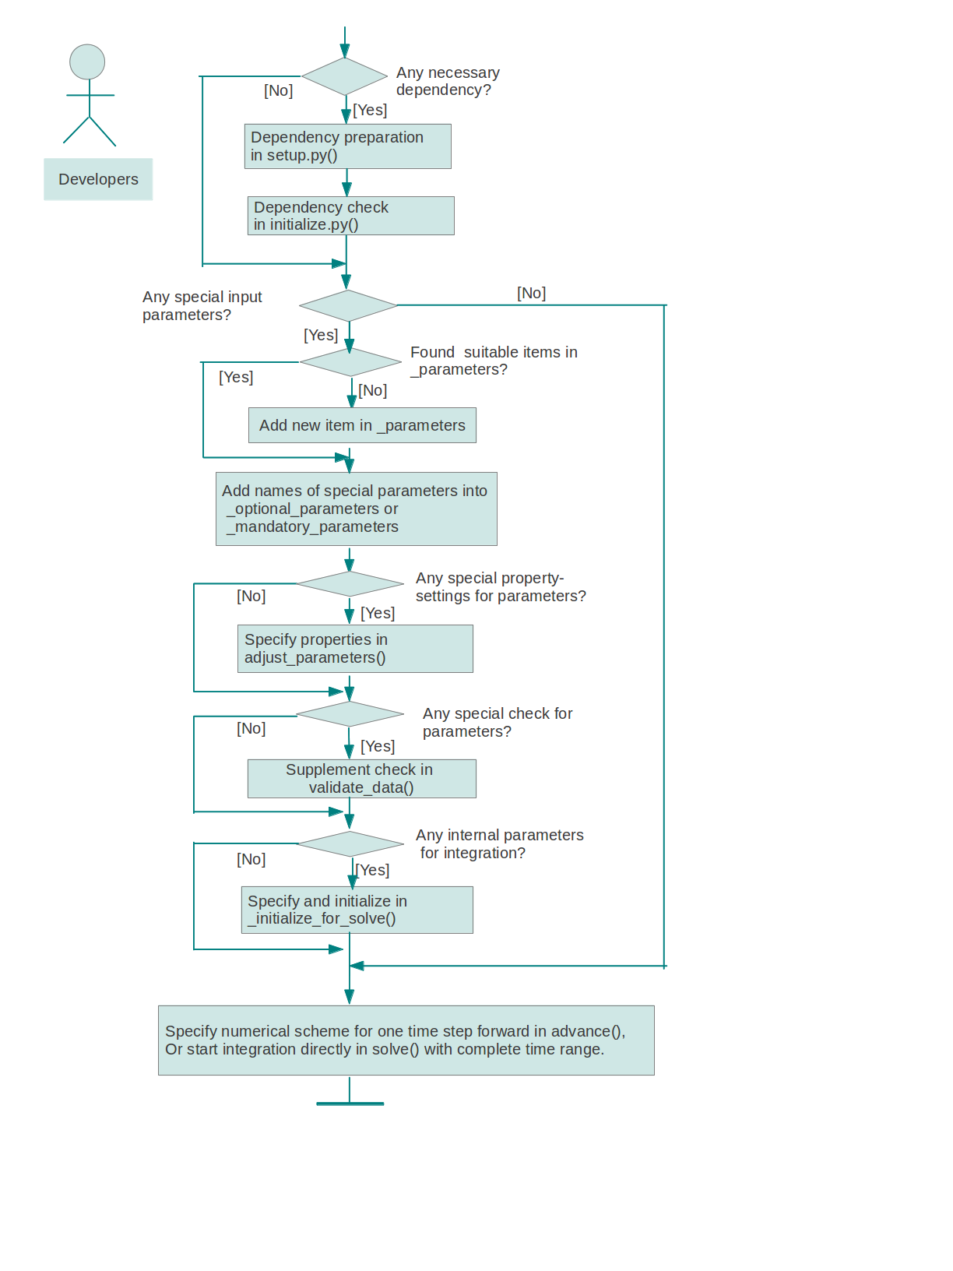
Routine to Integrate a New Solver
class RungeKutta3(Solver):
def advance(self):
u, f, n, t = self.u, self.f, self.n, self.t
dt = t[n+1] - t[n]
k1 = dt*f(u[n], t[n])
k2 = dt*f(u[n] + 0.5*k1, t[n] + dt/2.0)
k3 = dt*f(u[n] - k1 + 2*k2, t[n] + dt)
unew = u[n] + (1/6.0)*(k1 + 4*k2 + k3)
return unew

Slide 20
Part 4
Odepack

Slide 21
Comparison with Fortran Package ODEPACK
Fewer parameters:
dlsode in ODEPACK: 17 mandatory parameters + 10 optional ones
Lsode in odesolvers: 1 mandatory parameter + 15 optional ones
Shorter code: 346 lines in Fortran → 50 lines in Python.
Precise syntax of Python
simplified user interface of odesolvers
shortened parameter list
Better error-check, clearer messages:
Suppose a user forget to supply jacobian matrix when prameter iter_method is set to 1,
dlsode in ODEPACK → Segmentation fault.
Lsode in odesolvers → ValueError: Error! Insufficient input!
jac must be set when iter_method is 1!
Fewer interrupts with automatic error-handeling
For instance, when error-flag is returned as -1, → Excessive amount of work.
dlsode in ODEPACK → Interrupt.
Lsode in odesolvers → max_step = max_step + 200, and restart iteration.
(Increase the allowed step numbers without interrupt.)

Slide 22
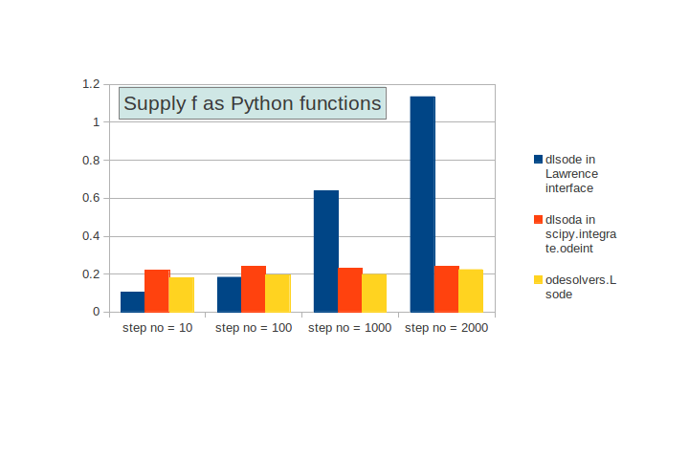
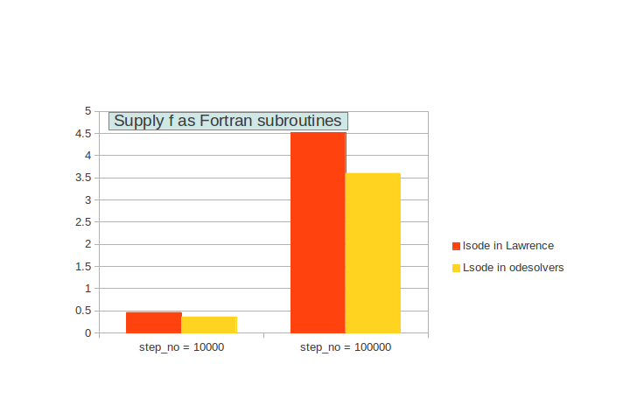
Comparison With Other Python Wrappers of ODEPACK
More efficient in comparison with the ODEPACK wrappers in scipy and Lawrence lab
1. In both figures, the running time of odesolvers.Lsode is much shorter than ode.lsode in Lawrence interface.
2. In the first example, odeint in scipy shows comparable efficiency as Odepack. However, in odeint, f can only be supplied as a Python function. This feature makes its efficiency in a limited level.

Slide 23
Part 5
PyDSTOOL

Slide 24
PyDSTool
xnames = ['x1', 'x2']
timeData = array([0, 11, 20])
x1data = array([10.2, -1.4, 4.1])
x2data = array([0.1, 0.01, 0.4])
xData = makeDataDict(xnames, [x1data, x2data])
DSargs = args(tdata=timeData, ics=xData, name='interp')
interptable = Generator.InterpolateTable(DSargs)
itabletraj = interptable.compute('interp')
wfn_str = '100 - (1 + a)*w*heav(0.2-sin(t+1))-2*itable - k*auxval1(t, w)*auxval2(y)'
yfn_str = '50 - (w/100)*y'
auxfndict = {'auxval1': (['t', 'x'],
'if(x>100,2*cos(10*t/pi), 0.5)'),
'auxval2': (['x'], 'x/2')}
DSargs = args(name='ODEtest')
DSargs.tdomain = [0,10]
DSargs.pars = {'k':1, 'a':2}
DSargs.inputs = {'itable' : itabletraj.variables['x1']}
DSargs.varspecs = {'w': wfn_str, 'y': yfn_str}
DSargs.fnspecs = auxfndict
DSargs.algparams = {'init_step' :0.02, 'strictopt':False}
DSargs.ics = {'w':30.0, 'y': 80}
PyDSTool is claimed to be 'a sophisticated & integrated simulation and analysis environment for dynamical systems models of physical systems (ODEs, DAEs, maps, and hybrid systems)'.
With this target, its structure and user interface is very sophisticated with a lot of options, related classes and very special syntax.
Core classes in PyDSTool: Point, Pointset, Variable, Trajectory, str, QuantSpec, Quantity, Var, Par, Fun, Input, Generator, Model, Event, PyCont, and Toolbox classes.
The above code is its 'a simple ODE' example in 'Get started' part from its webpage. Is it really simple?

Slide 25
My Attempt in PyDSTool.py
The first design principle of PyDSTool is described as index-free data structures. That is, the numerical data are stored mainly through Python dictionaries with string keys in PyDSTool.
For instance, regarding an ODE system with 5 equations (neq=5),
u → Var('u0'), Var('u1'), Var('u2'), Var('u3'), Var('u4')
t → Var('t')
f → Fun('u0'), Fun('u1'), Fun('u2'), Fun('u3'), Fun('u4')
My wrappers for u and t:
name_list = ['u%d' % i for i in range(neq)] # ['u0', 'u1', 'u2', 'u3', 'u4']
u, t = [PyDSTool.Var(name) for name in name_list], PyDSTool.Var('t')
Error occurs with the wrapping of function f.

Slide 26
Error with wrapping f to be:
Fun('udot0'), Fun('udot1'), Fun('udot2'), Fun('udot3'), Fun('udot4')
f is wrapped from f(u,t) to f_wrap(u0,u1,u2,u3,u4,t) first.
f_wrap = eval('lambda *args: f(args[:-1], args[-1])')
Then we should seperate f_wrap to be 5 separate function objects.
string2 = ','.join(['u[%d]' % i for i in range(neq)]) # 'u[0], u[1], u[2], u[3], u[4]'
udot = [eval('PyDSTool.Fun(f_wrap(%s,t)[%d],[%s],\"udot%d\")' \
% (string2, i,string2,i)) for i in range(neq)]
In other words,
udot[0] = PyDSTool.Fun(f_wrap(u[0],u[1],u[2],...,t)[0], [u[0],u[1],u[2],...], "udot0")
udot[1] = PyDSTool.Fun(f_wrap(u[0],u[1],u[2],...,t)[1], [u[0],u[1],u[2],...], "udot1")
…
This step is exactly where error happens.
IndexError: 0d-array cannot be indexed.
Reasonable because the return value of user-supplied f cannot be predicted in compiling process.

Slide 27
Part 6
Conclusion

Slide 28
Why odesolvers?
Completeness
43 solvers have been integrated.
Both classic numerical methods and complicated ODE solvers are available for different users.
Simple syntax & friendly user interface
Easy-to-learn, easy-to-switch, save programming time.
Free-of-charge and Easy-to-install
Great potential for future development
Planned to integrate the following solvers in the following month:
odelab, sundials, a couple of F77 routines codes by Hairer and Wanner.
Easy-to-join with other Python tools
A suitable facility for university courses

Slide 29
References
PyDSTool homepage, available at http://www2.gsu.edu/~matrhc/PyDSTool.htm
Test set for IVP solvers, available at http://www.dm.uniba.it/~testset/testivpsolvers
Netlib Repository, available at http://www.netlib.org
WikiPedia page for Ordinary Differential Equations, available at http://en.wikipedia.org/wiki/Ordinary\_differential\_equation
Hans Petter Langtangen, Python Scripting for Computational Science, Second edition, 2005
Clewley RH, Sherwood WE, LaMar MD, Guckenheimer JM (2007) PyDSTool, a software environment for dynamical systems modeling. Available at http://pydstool.sourceforge.net

Slide 30
The End

Slide 31
Ordinary Differential Equation
A relation that contains functions of only one independent variable, and one or more of their derivatives with respect to that variable.
Initial value problems (IVP).
High order ODE can be transformed to be a system of first order differential equations.
Hence, we focus only on solving IVP for first order ODE systems.
u' = du/dt = f(u, t), scalar or vector.

Slide 32
Numeric Methods for Solving ODEs
Explicit Vs Implicit:
u' = f(u,t) → (un+1 – un)/∆t.
un+1 = un + ∆t f(u, t)
Explicit (ForwardEuler) : un+1 = un + ∆t f(un, tn)
Only conditionaly stable, but simpler to implement.
Implicit (BackwardEuler): un+1 = un + ∆t f(un+1, tn+1 )
Often unconditionaly stable, but harder to solve.
Stiff ODEs often require an implicit solver, which is more expensive for each time step.
One-step & Multi-step

Slide 33
Existing ODE Software
Traditional ODE solvers developed in Fortran or C:
ODEPACK, rkc, rkf45, vode, epsode, etc..
Well-tested, stable, efficient,
but cubersome to use.
ODE software developed in modern languages:
Scipy, Sympy, Sundials, Matlab, etc..
Clean syntax, friendly user interface,
but still in lack of generic interface.

Slide 34
Why Python?
Popular in the field of scientific computing.
Clean and friendly syntax
Rich modularization
Great features for scientific computing, like slicing of numeric arrays, vectorization of functions.
Strong support with various powerful libraries, e.g.
GUI programming, CGI programming, etc..
Mixed-language programming style

Slide 35
User interface
__init__(self, f, **kwargs)
set_initial_condition(self, u0)
solve(self, time_points, terminate=None)
switch_to(self, solver_target, print_info=False, **kwargs)
set(self, strict=False, **kwargs)
get_parameter_info(self, print_info=False)
__repr__(self)
__str__(self) // parameters with non-default values
list_all_solvers()
list_available_solvers()

Slide 36
_parameters:
Global dictionary holding properties of all parameters.
'default'
'type'
'help_info'
'range'
'condition_list'
'paralist_old'
'paralist_new'
'returnArrayOrder'
'name_wrapped'
'extra_check'
(int, float)
1e-6
'Relative error tolerance'
(1, 2, 4, 5) or (0.0, 1.0)
{'1': ('jac',), '5':('ml','mu'), …}
'u, t'
't, u'
'C' or 'Fortran'
'f'
lambda float_seq: numpy.asarray(\
map(lambda x: isinstance(x, float), float_seq)).all()

Slide 37
func_wrapper()
Incompatible order in parameter lists
Incompatible array-index between Python arrays and Fortran arrays
Store return value of user-supplied functions in column-order
Compilation with -DF2PY_REPORT_ON_ARRAY_COPY = 1.
return Array Order | paralist_old | paralist_new | name_ wrapped
None | 'u,t,col_index-1' | 't,u,col_index' | 'jac_column_f77' | self.jac_column_f77 = lambda t,u,n: jac_column(u,t,n-1)
C | 'u,t' | 't,u' | 'jac_f77' | self.jac_f77 = lambda t,u: numpy.asarray(jac(u,t))
Fortran | 'u,t' | None | 'jac' | self.jac = lambda u,t: numpy.asarray(jac(u,t), order='Fortran')

