Slide 1
INF5631
Solving PDEs in parallel using petsc4py
Christoffer Stausland

Slide 2
Outline
Motivation
Quick «intro» to PETSc and petsc4py
Solvers, data structures and functions
Two example codes to show the adversity of PETSc
One implicit problem using Krylov or Direct solver (KSP)
One explicit problem using Distributed Arrays (DA)

Slide 3
Motivation
For quickly solving a linear system A*x=b arising from PDEs, we want a high-level parallel approach
PETSc in Python make this possible (supports also nonlinear problems)
Many solvers and datatypes exists
With few lines of code, we can solve huge systems running PETSc on potentially many nodes

Slide 4
PETSc
Suite of data structures and routines for parallel modelling of PDEs
Using MPI for parallelization (pthreads and CUDA also supported)
Well documented
Input argument based make general programs, and choose solver at runtime
Own input arguments is supported

Slide 5
petsc4py
Python wrapper for PETSc
Very similar syntax as PETSc, easily rewritten from C
Very little documentation or tutorials
Though documentation is lacking, the similarity to C lower the bar to used PETSc for people trying to avoid compiled code

Slide 6
PETSc solvers
Some of the Preconditioners supported:
Jacobi, ILU, ICC
Direct solvers:
LU, Cholesky
Krylov methods:
Chebyshev, Gonjugate Gradients, Richardson
Many more supported via external packages, dependent on the data structure
Complete list:
http://www.mcs.anl.gov/petsc/documentation/linearsolvertable.html

Slide 7
Data structures
Several data structures are supported:
AIJ: sparse matrix for serial and MPI
Dense
Block
Matfree
+++
Note that not all data structures are supported for all KSP methods

Slide 8
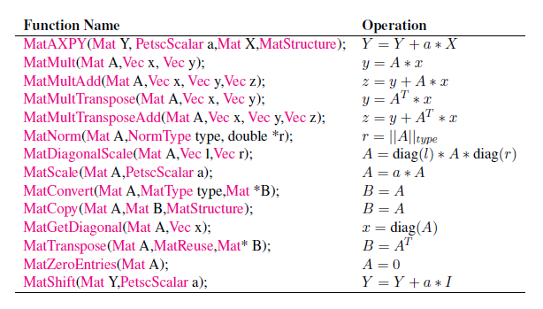
Some commonly used PETSc functions
All of these have a similar Python binding with same name excluding ‘Mat’

Slide 9
A typical solver function
Read input arguments
Allocate and set up matrix
Assemble matrix and get vectors
Run solver loop, solving Ax=b

Slide 10
A typical solver function 1/2 (setup)
def solver_BE_MAT_PETSc(I, a, L, Nx, C, T):
# I(x) is the init numpy array
# Create and allocate matrix of type AIJ (sparse). In parallel this
# will be a type MPIAIJ, and in serial it will be type SEQAIJ
A = PETSc.Mat().createAIJ([Nx+1, Nx+1],nnz=3)
# Get ownership range for this particular rank
[Istart, Iend] = A.getOwnershipRange()
# …Set values of the matrix in Backward Euler style…
# Get the left (current time step) and right (previous) hand side vectors
# with the same properties and type as matrix A. Set values from I(x)
u, u_1 = A.getVecs()
u_1.setValues(range(Istart,Iend),I[Istart:Iend])
# Assembles the matrix and vectors across the processes. Must be done
# in order to start solving the system
A.assemble(); u.assemble(); u_1.assemble()

Slide 11
A typical solver function 2/2 (solving)
# Need to make the solver ‘ksp’
ksp = PETSc.KSP()
ksp.create()
# As default we use Conjugent Gradient method
ksp.setType('cg')
ksp.getPC().setType('none')
# This should be overwritten by command line options, as we read here
ksp.setFromOptions()
# The solver are to use matrix A for solving the system
ksp.setOperators(A)
# Now we solve for each timestep:
for t in range(Nt):
ksp.solve(u_1,u)
# Swapping vectors
u, u_1 = u_1, u

Slide 12
Distributed Arrays (DA) 1/3
Structured grids often occur in PDE problems
DA are used for communication, laylout information and creating arrays, but not for storing
Very usefull when running in parallel, as it simplifies communication
Incorporate ghost cells at the local borders
The following example show the strength using DA (now a Forward Euler scheme)
The example do not use an explicit matrix, so we save time and memory

Slide 13
Distributed Arrays (DA) 2/3
# Boundary type: none, periodic, ghost, mirror
# Stencil type: box-type, star-type
# Creating the 1D grid (2D, 3D and nD is supported)
da = PETSc.DA().create(sizes=[Nx+1], boundary_type=2, stencil_type=0,
stencil_width=1)
da.setUniformCoordinates(0, L)
# Using matrix free now, so we are not using ‘getVecs’
u = da.createGlobalVector(); u_1 = da.createGlobalVector();
u.assemble(); u_1.assemble();
for n in range(0, Nt):
da.globalToLocal(u_1, local_vec)
local_vec_new = advance_function(local_vec, C, da)
da.localToGlobal(local_vec_new, u_1)
# Note the difference between global and local. No hardcopy,
# but communication for ghost cells

Slide 14
Distributed Arrays (DA) 3/3
# A function to solve each local vector (on each node) using numpy
def advance_function(u_1, C, da):
# No hardcopy
u = u_1.getArray()
# To local numpy solution vector
u_advance = np.zeros_like(u)
# Advance with matrix free type solver (note not using KSP in this case)
u_advance[1:-1] = C*u[:-2] + (1.-2*C)*u[1:-1] + C*u[2:]
# Back to PETSc vector, no hardcopy
u_return = PETSc.Vec().createWithArray(u_advance)
return u_return

Slide 15
My experience
When a good working method first was found (C tutorials to C function documentation to Python function listings), writing code was done in less than a week
Some time was used to solve implicit problems in two dimensions, until a example code was found doing this
Baseline: more time was spent finding solution to the problems than actually writing code and figuring out how PETSc worked

Slide 16
The end

Slide 17
A simple visualizer
Sometimes one want to do a quick visualization for validation while running:
def petsc_viz(U):
scatter, U0 = PETSc.Scatter.toZero(U)
scatter.scatter(U,U0,False,PETSc.Scatter.Mode.FORWARD)
solution = U.copy()
draw = PETSc.Viewer.DRAW()
draw(solution)

