Slide 1
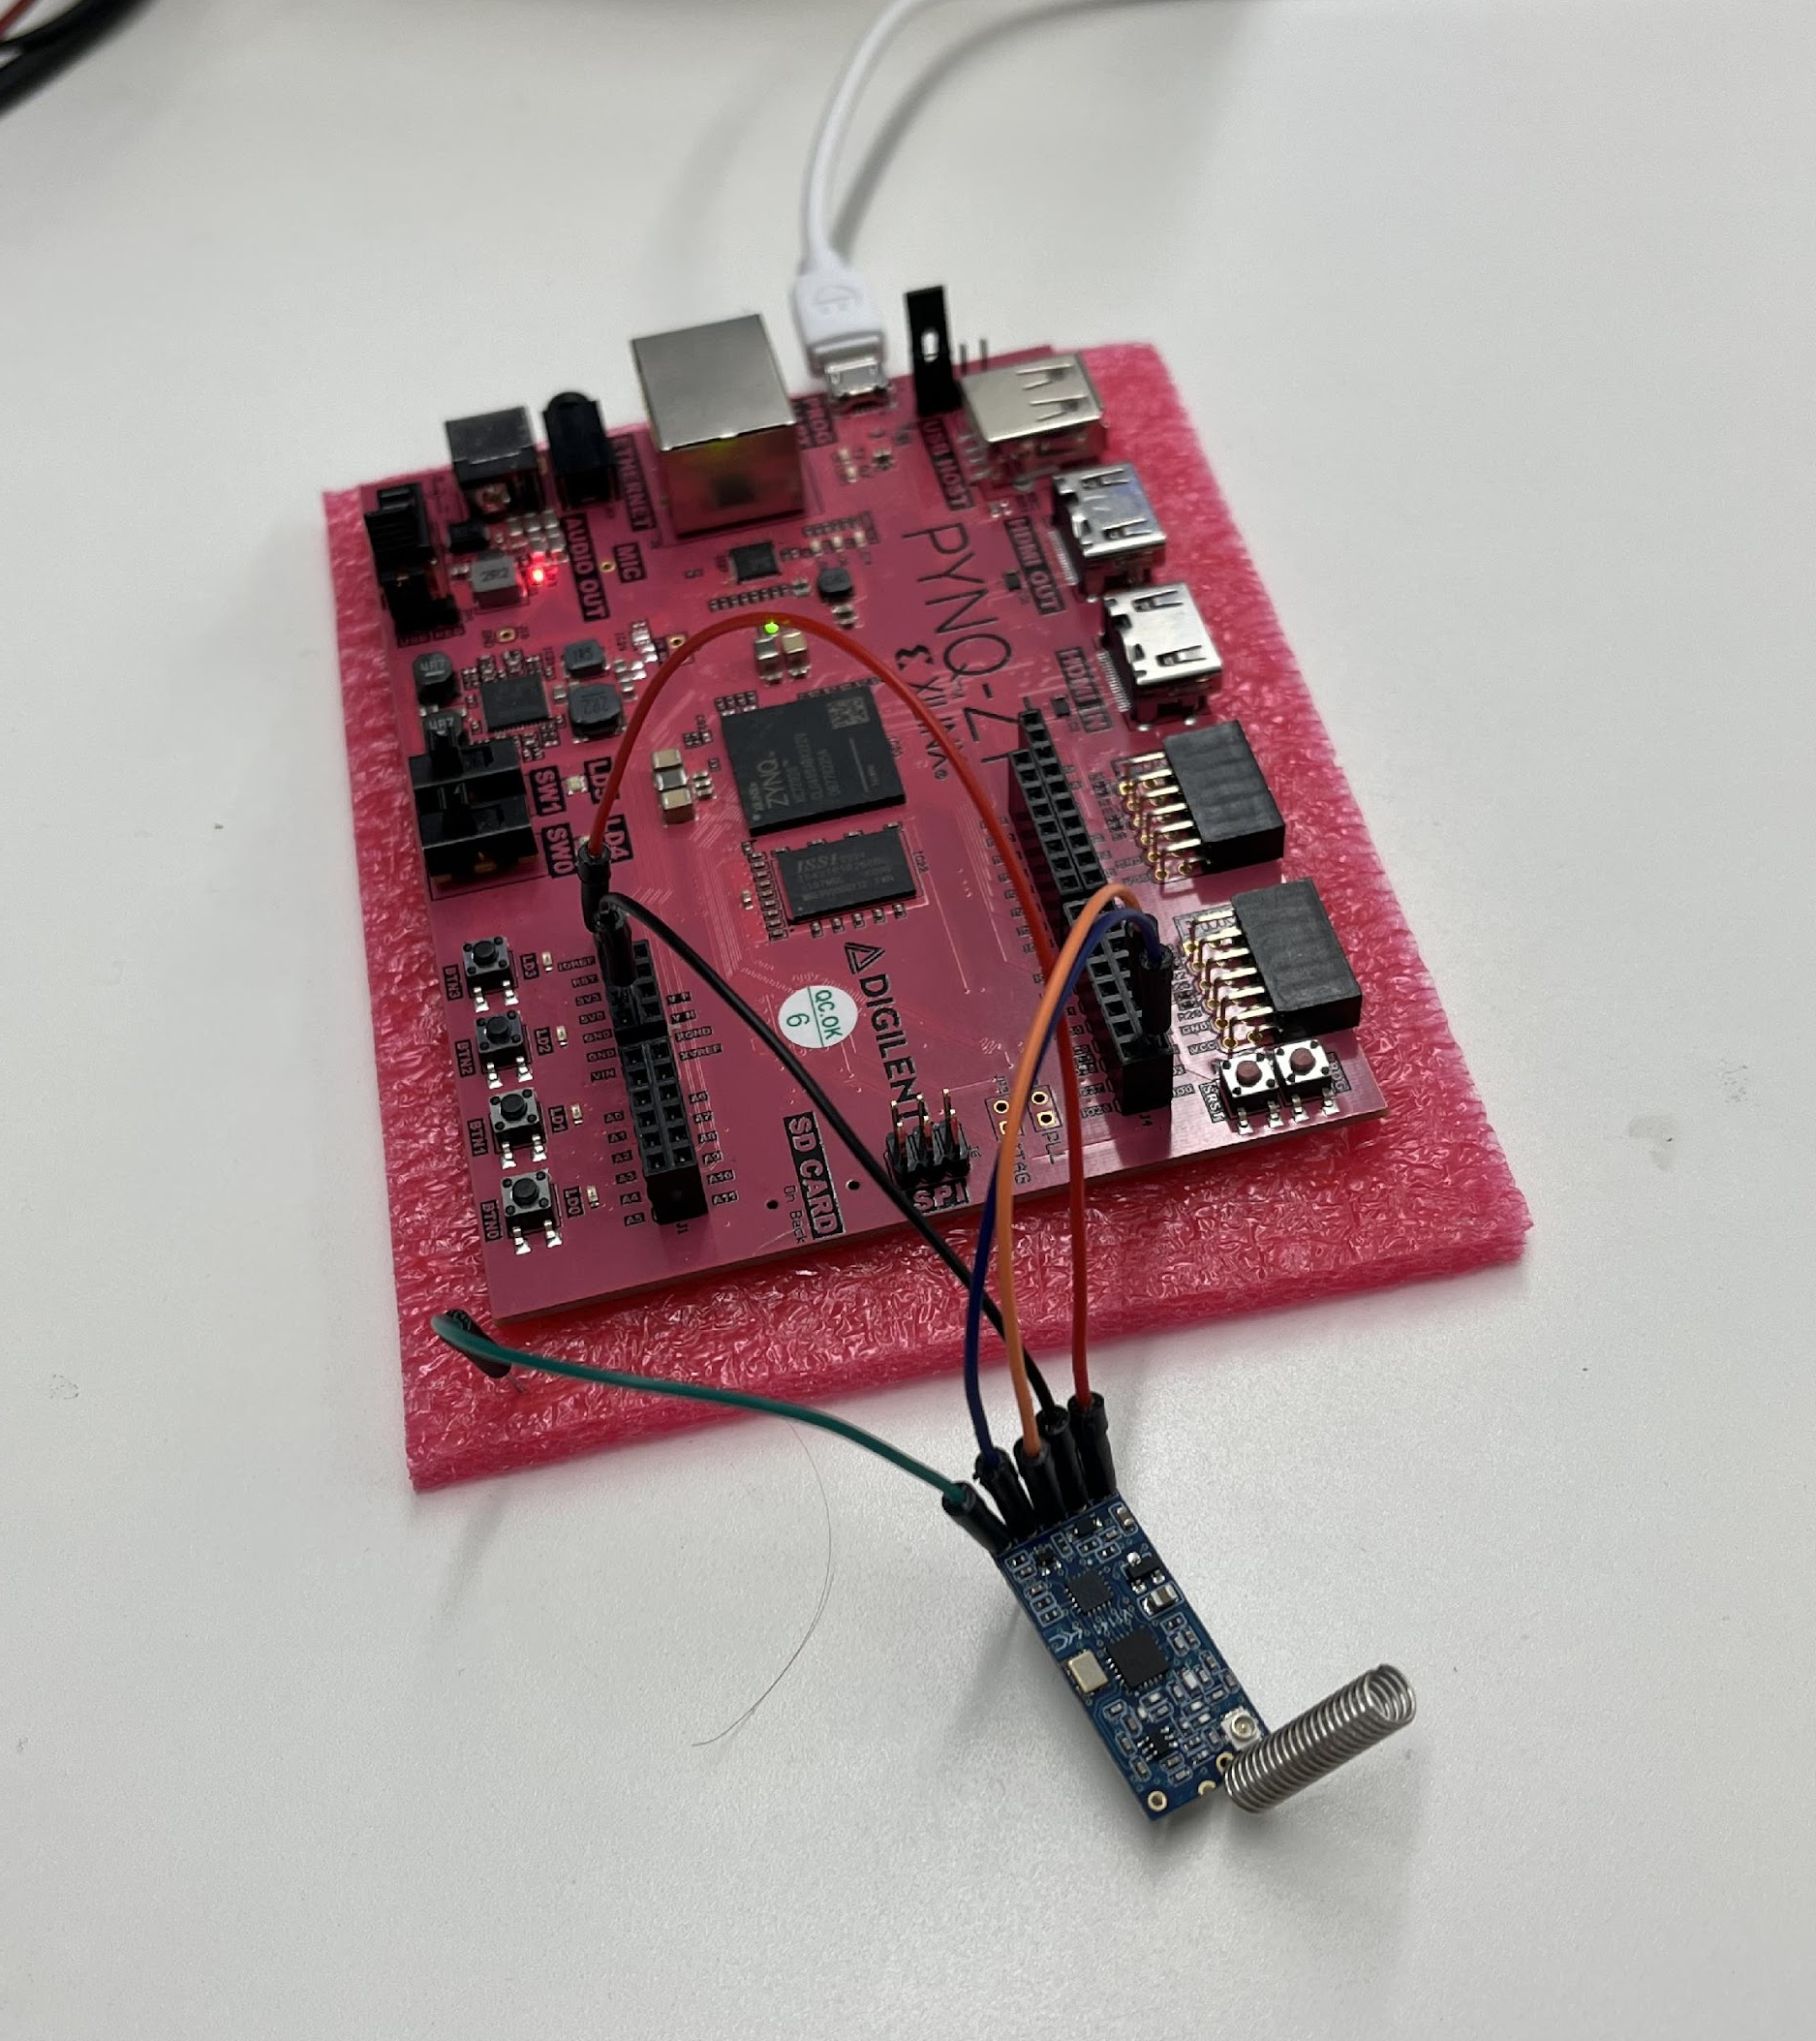
Encrypted Radio Communication Using FPGAs Github Repo Link: https://github.com/hplp/2025-fpga-design-projects-EncryptedRadio
Alex Clunan, Bobby Downey

Slide 2
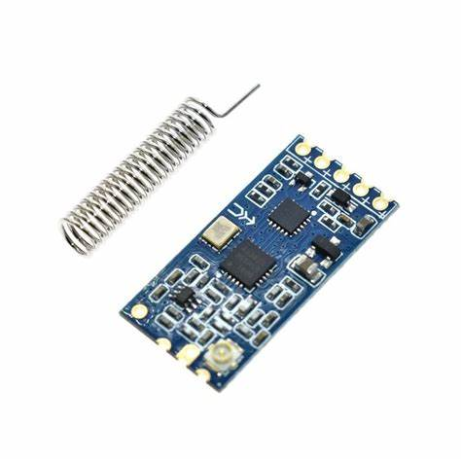
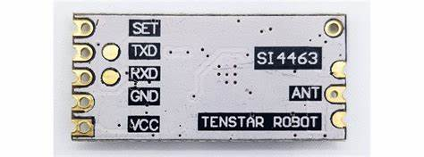
Project Overview
Used existing C code to generate an AES encryption/decryption IP block using Vitis HLS
Created a block design with the AES and UARTLite IP Blocks connected to the ZYNQ Processing System using AXI4-Lite
Interfaced HC-12 Transceivers with the PYNQ-Z1 board, using IO ports connected to the UARTLite interface
Hardware Platforms: PYNQ-Z1 FPGA Board, HC-12 Radio Module
Software Tools: Vitis HLS, Vivado, Vitis IDE

Slide 3
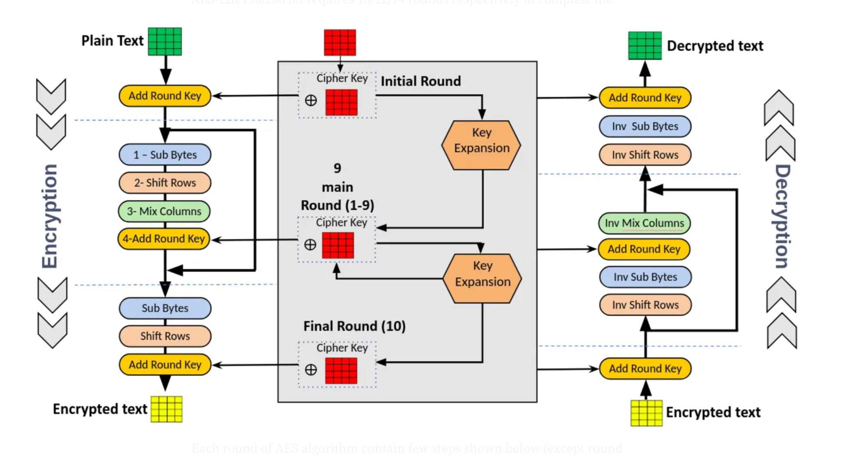
AES Encryption Overview
Function: AES_Encrypt(plaintext, expandedKey, Nr, ciphertext)
1. Copy input to state (16 bytes from plaintext)
2. Initial Round: AddRoundKey(state, expandedKey + 0)
3. Main Rounds (Nr iterations):
SubBytes(state)
ShiftRows(state)
MixColumns(state) (not in final round)
AddRoundKey(state, expandedKey + round_offset)
4. Final state written to ciphertext

Slide 4
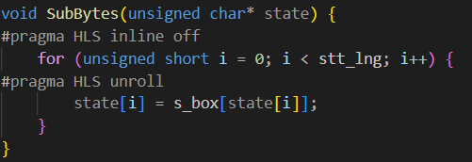
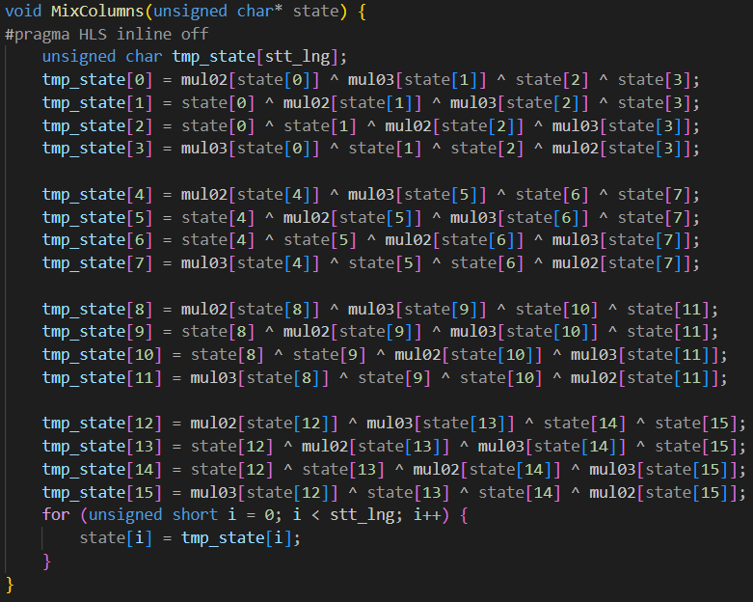
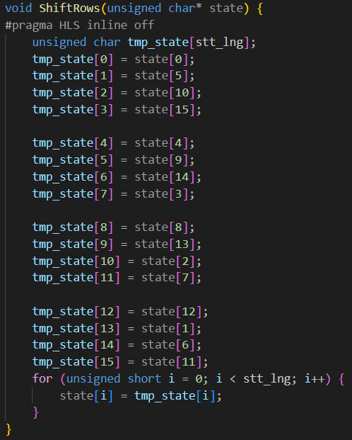
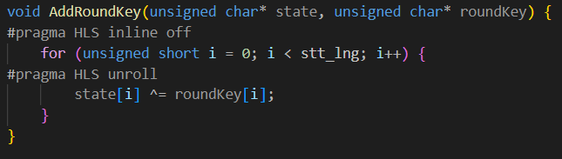
AES Encryption: Important Functions
SubBytes(state): Applies non-linear substitution using the S-box to protect against cryptanalysis
ShiftRows(state): Cyclically shifts rows of the state for diffusion
MixColumns(state): Applies matrix multiplication in GF(2^8) for diffusion
AddRoundKey(state, roundKey): XORs the state with the round key

Slide 5
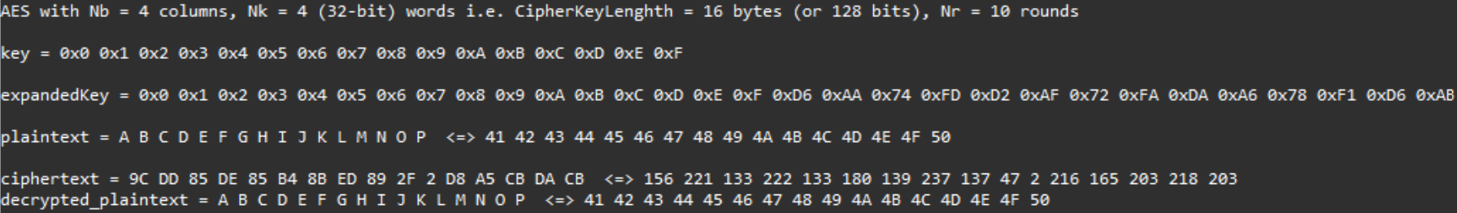

Design and Verification in Vitis HLS
Used Vitis HLS to verify AES Encryption module logic in C++
Simulated software behavior before hardware implementation
Exported design to IP Block

Slide 6
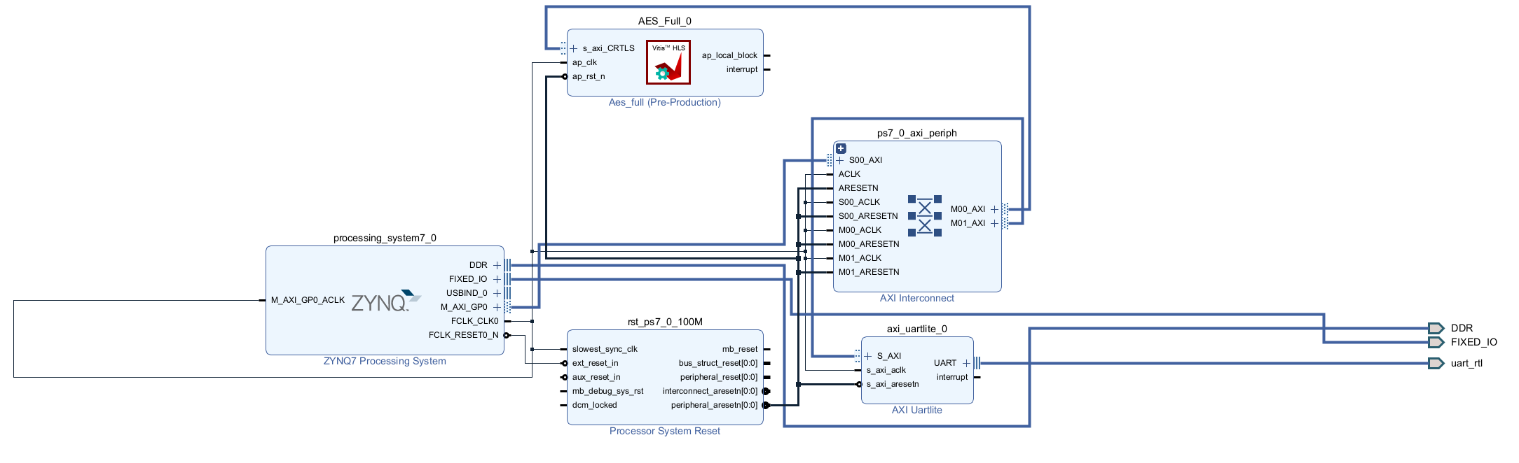
Vivado Block Design Integration
Imported HLS-generated IP into Vivado
Connected ARM PS, AES hardware, UARTLite, and AXI interconnects
Ensured proper memory mapping and IO interfacing

Slide 7
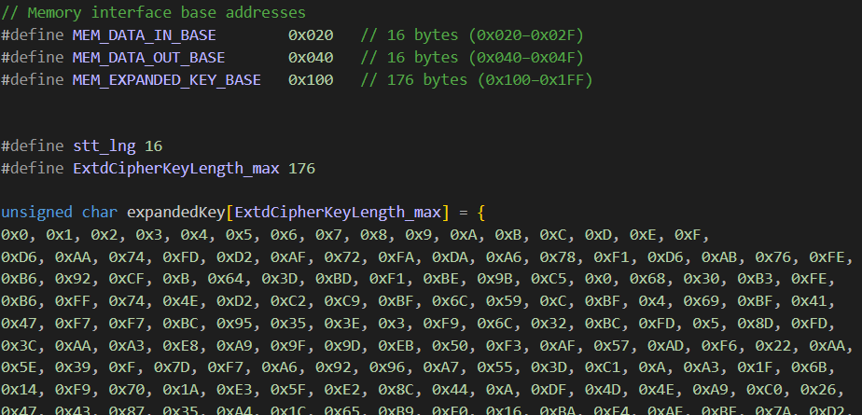
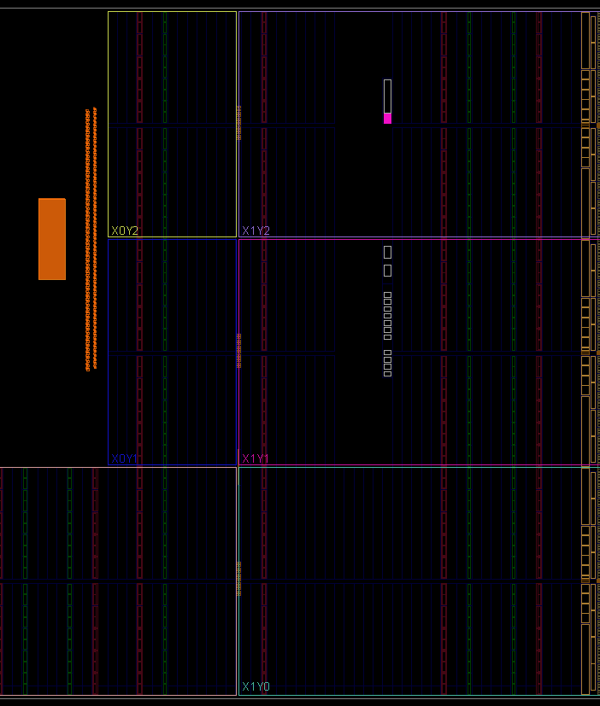
Hardware Verification in Vitis IDE
Exported .xsa (Xilinx Support Archive) file to Vitis IDE
Determined the base addresseses of AES hardware peripheral
Data In
Data Out
Expanded Key
AXI4-Lite
Hardcoded the expanded key from the Vitis HLS test

Slide 8
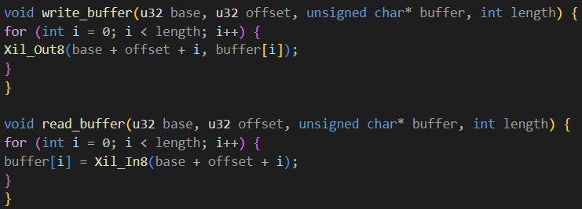
UART and AES Code Implementation
Included:
xil_io.h:
provides low-level memory-mapped I/O functions
Used for directly reading from or writing to peripherals registers via base addresses
xparameters.h:
Contains all hardware base addresses and configuration macros generated by the Vivado hardware design
Allows software to communicate with the hardware peripherals by referencing their configured memory-mapped addresses
xuartlite.h:
Provides functions to interface with the UARTLite peripheral
Useful for communication with external devices like radios or terminals
Configured UARTLite instance and AES address maps
Implemented read/write buffer functions for MMIO

Slide 9
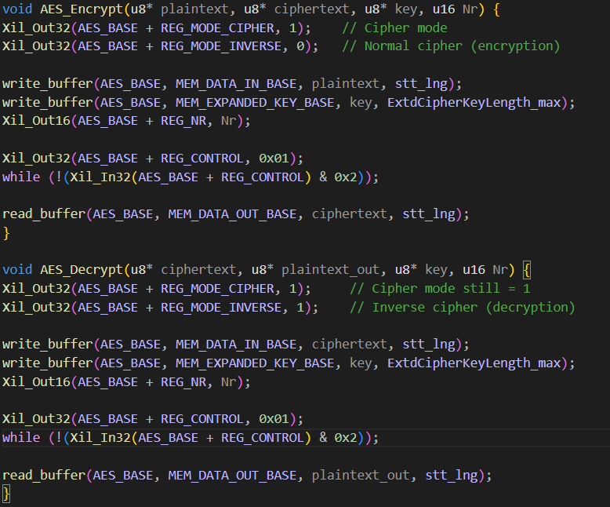
AES Encryption/Decryption Functions
AES_Encrypt
sets mode
inputs data
starts encryption
polls for completion
AES_Decrypt reverses the process with inverse mode
Used expanded key consistent with HLS to verify ciphertext

Slide 10
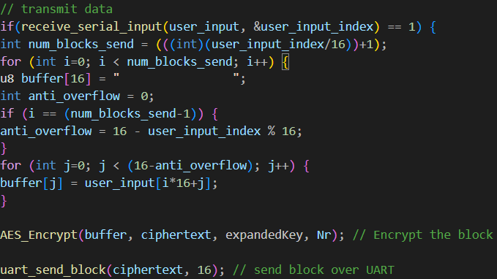
Serial Communication Pipeline: Send
Text is received from PC’s serial terminal
“\n” is the send character
Input data ⇒ 16-byte buffer
AES Encryption
Buffer is encrypted using AES-128 via the hardware peripheral
UART Transmission to HC-12 Radio
The encrypted 16-byte block is sent to the radio via UART
Steps 3-5 Repeat until all data is sent

Slide 11
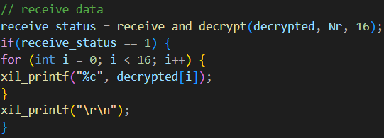
Serial Communication Pipeline: Receive
UART Reception
16 bytes are received from the radio over UART to decrypted buffer
AES Decryption
The encrypted block is decrypted back into plaintext
Display to Terminal
The decrypted message is printed to the serial terminal

Slide 12
Resources
Digilent PYNQ-Z1 Manual
https://digilent.com/reference/programmable-logic/pynq-z1/reference-manual
AMD Vitis HLS Documentation
https://docs.amd.com/r/2024.1-English/ug1399-vitis-hls/pragma-HLS-expression_balance
UVA Wiki for HLS & IP Labs
http://venividiwiki.ee.virginia.edu/mediawiki/index.php/ToolsXilinxLabsRTLHLSAES
http://venividiwiki.ee.virginia.edu/mediawiki/index.php/ToolsXilinxLabsRTLHLSIP
GitHub PYNQ Resources:
https://github.com/Xilinx/PYNQ/blob/master/boards/Pynq-Z1/base/vivado/constraints/base.xdc
AES Calculator for test verification
https://testprotect.com/appendix/AEScalc

