Slide 1
Performance Evaluation of CNN on Open-Source Platforms
Kavish, Hasantha, Melika

Slide 2
Goals
Software: PyTorch
Study the impact of post-training quantization on model accuracy
Models: LeNet on MNIST & AlexNet, EfficientNet on CIFAR-10
Post-Training Quantizations: INT8 and INT16
Hardware: Open Source Platforms: The NVDLA Simulator & Scale-Sim
Study the execution time of these models in the NVDLA Simulator
Study the utilization, mapping efficiency & cycles after deploying in Scale-Sim

Slide 3
Training Overview
Trained from Scratch with Full-Precision (FP32) on T4 GPU google collab:
Datasets:
LeNet: MNIST
AlexNet & EfficientNet: CIFAR-10
Data Preprocessing to get better accuracy:
LeNet:
Normalization: Normalized to mean 0.5 and standard deviation 0.5.
AlexNet:
Resizing: Input images resized to 227x227 to match AlexNet's input requirement.
Normalization: Normalized to mean (0.5, 0.5, 0.5) and standard deviation (0.5, 0.5, 0.5).
Data Augmentation: Random cropping and horizontal flipping for data augmentation.
EfficientNet:
Data Augmentation: Random cropping and horizontal flipping for data augmentation.
Normalization: Normalized to mean 0.5 and standard deviation 0.5.

Slide 4
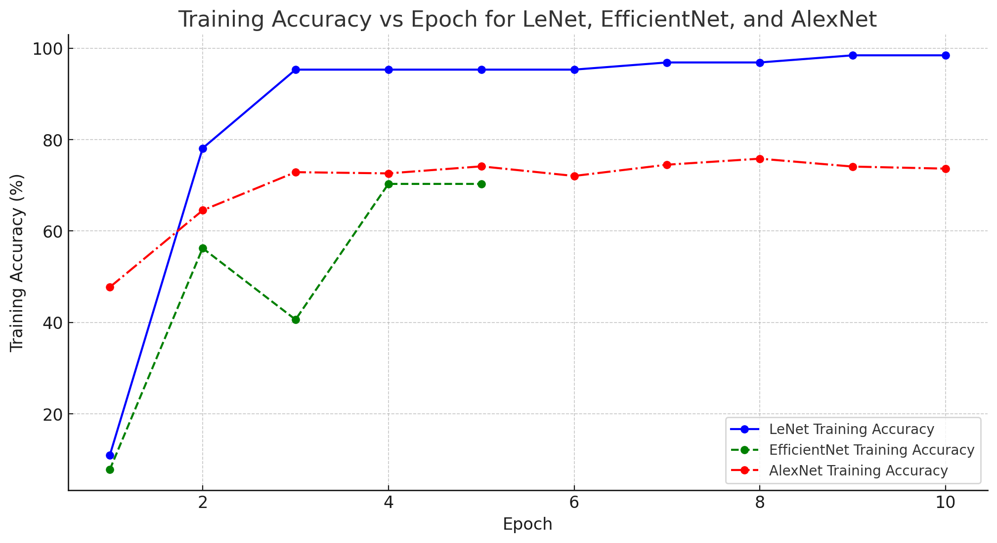
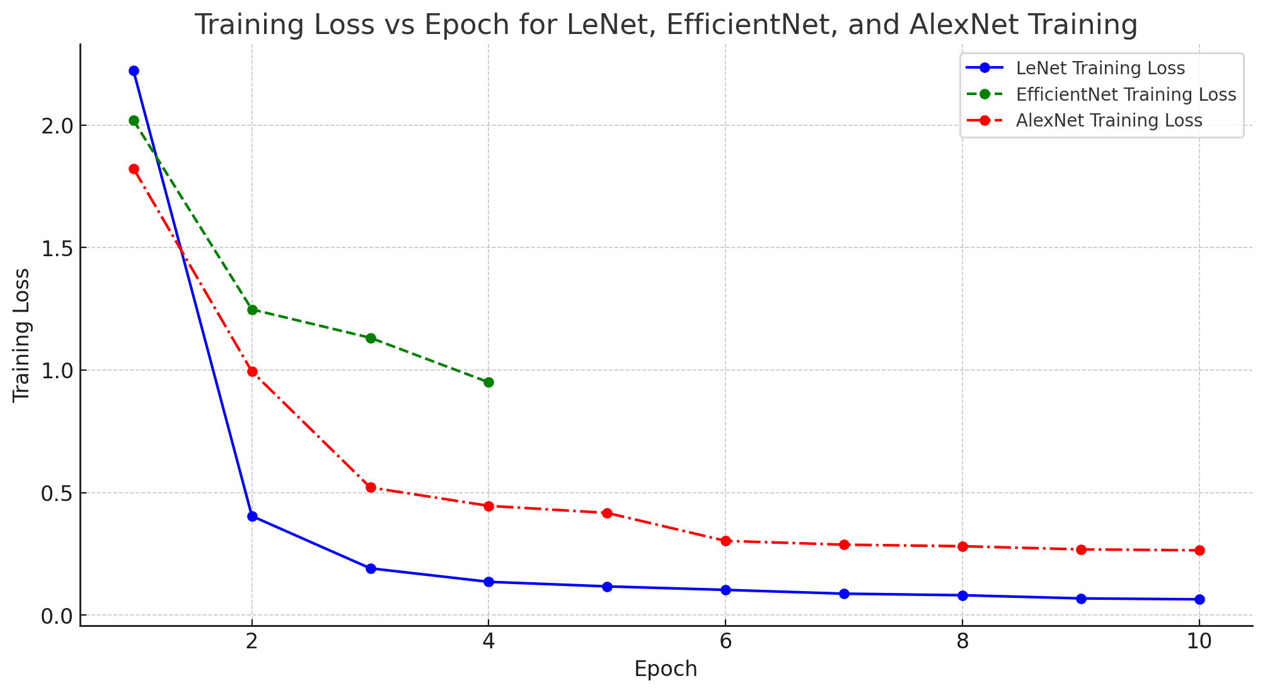
Accuracy VS Epoch Graph
Loss VS Epoch Graph

Slide 5
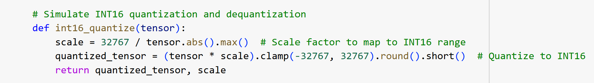
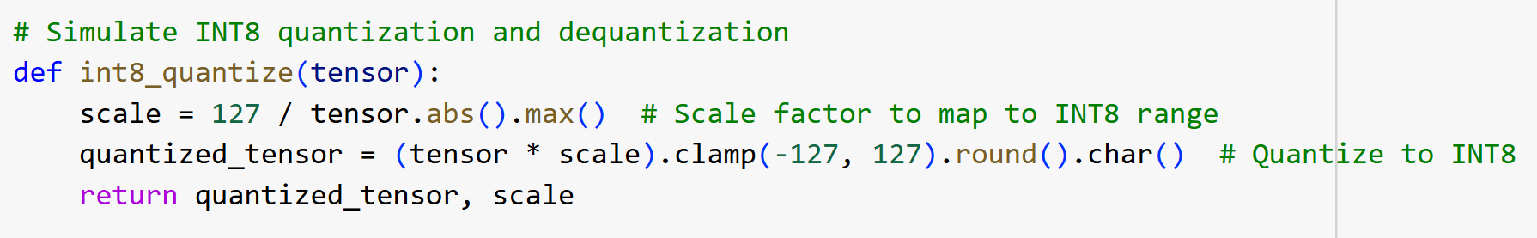
Quantization
Post-Training Quantization
Layer Wise Quantization
Inputs and Weights Quantized
Each Tensor has its own scaling factor

Slide 6
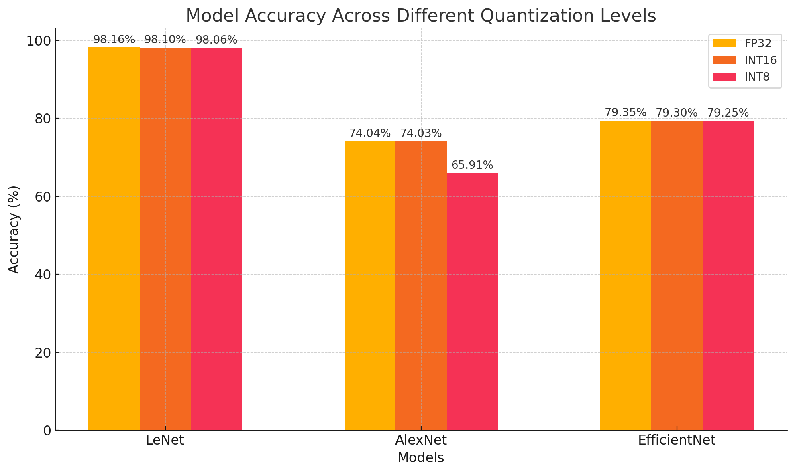
Quantization Results
Models | FP32 | INT16 | INT8
LeNet | 98.16% | 98.1% | 98.06%
AlexNet | 74.04 | 74.03 | 65.91%
EfficientNet | 79.35% | 79.3% | 79.25%

Slide 7
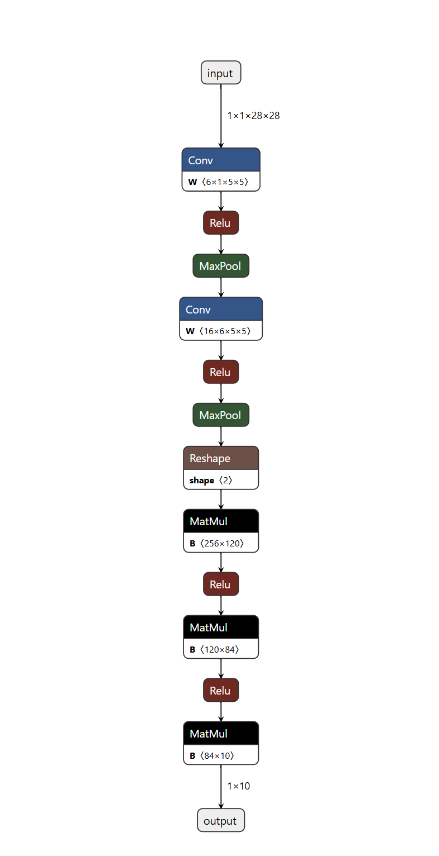
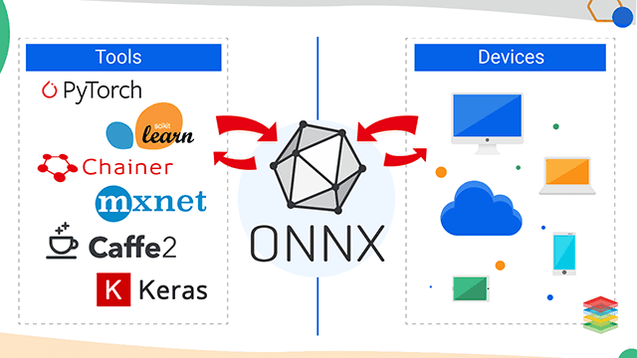
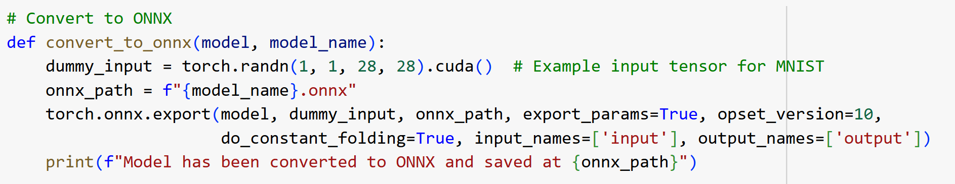
ONNX Conversion
Sources: https://onnx.ai/onnx/index.html, https://netron.app/

Slide 8
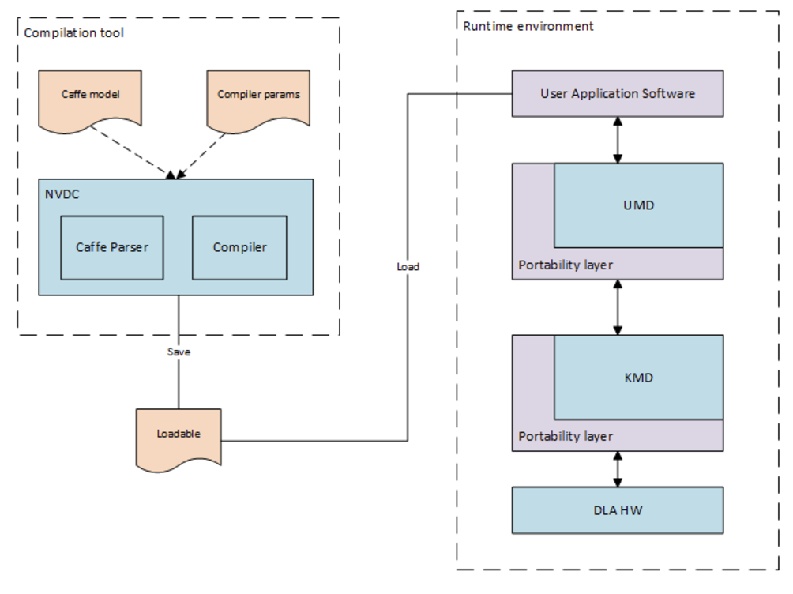
NVIDIA Deep Learning Accelerator (NVDLA)
Compiler
No ONNX support.
Caffe model gives .prototxt (architecture) and .caffemodel (weights).
Calibration file with the scaling values taken from TensorRT is used for quantization.
User-Mode Driver (UMD)
Loads the loadable and submits inference job to KMD.
Kernel-Mode Driver (KMD)
Configures functional blocks on NVDLA and schedules operations according to the inference jobs received.
Source : nvdla.org

Slide 9
Caffe Model
In the terminal:
python convertCaffe.py ./model/mmdet.onnx ./model/a.prototxt ./model/a.caffemodel
Source:http://gitlab.fanhantech.com/songfeixiang/face_embeding/-/tree/e367a4d5d22417bc37c4cbe49f2f1656eec7ae25/Insightface/tools/onnx2caffe

Slide 10
NVDLA - Implementation Options
GreenSocs QBox based Virtual Simulator
Synopsys VDK based Virtual Simulator
Verilator based Virtual Simulator
FireSim FPGA-accelerated Simulator (AWS FPGA)
Emulation on Amazon EC2 “F1” environment (AWS FPGA)
*Has stopped supporting all of these 5-6 years ago.

Slide 11
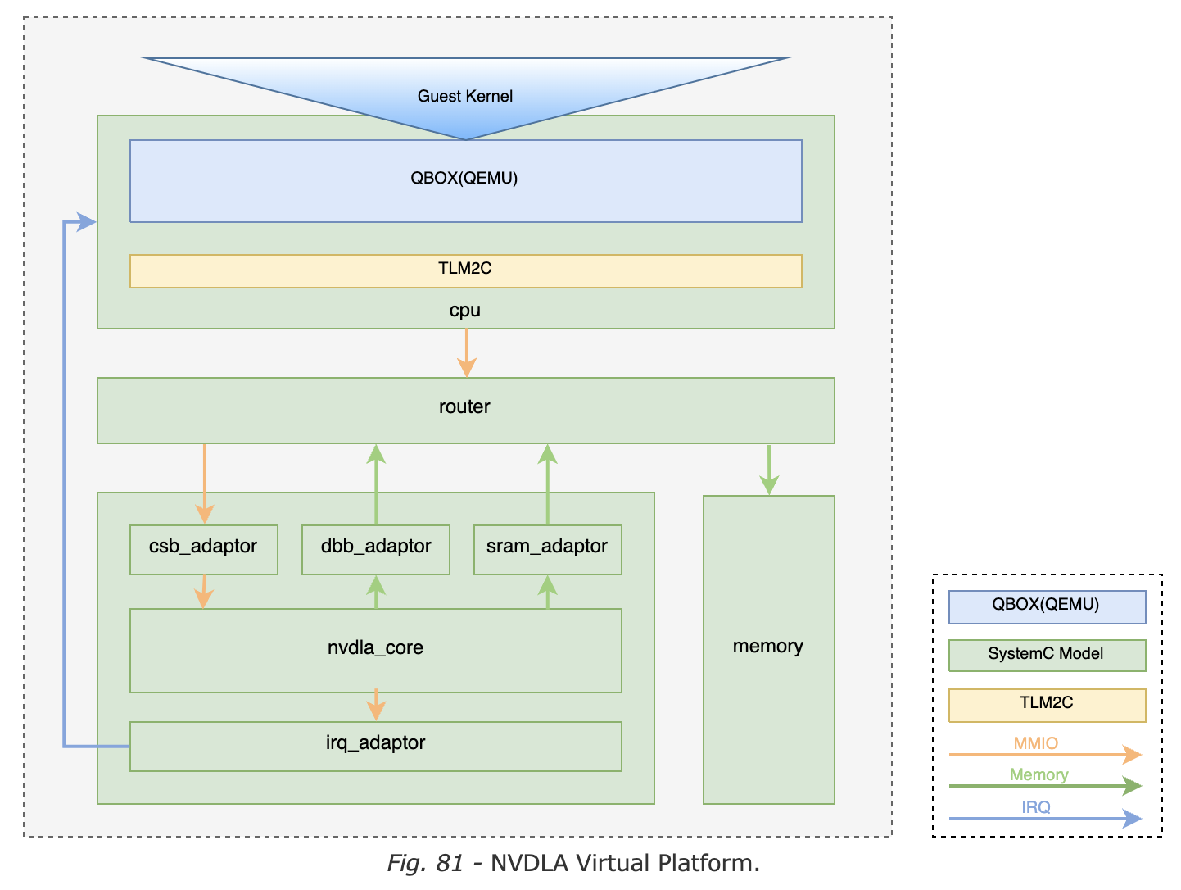
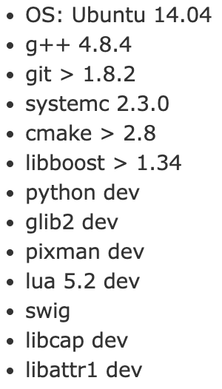
NVDLA - GreenSocs QBox based Virtual Simulator
Can run from a Docker.
QEMU CPU model (ARMv8) with NVDLA SystemC model.
SystemC models available for 3 configs,
nv_full (int8/fp16)
nv_large (int8/fp16)
nv_small (int8)
nv_full has 2048 8-bit MACs.
Source : nvdla.org

Slide 12
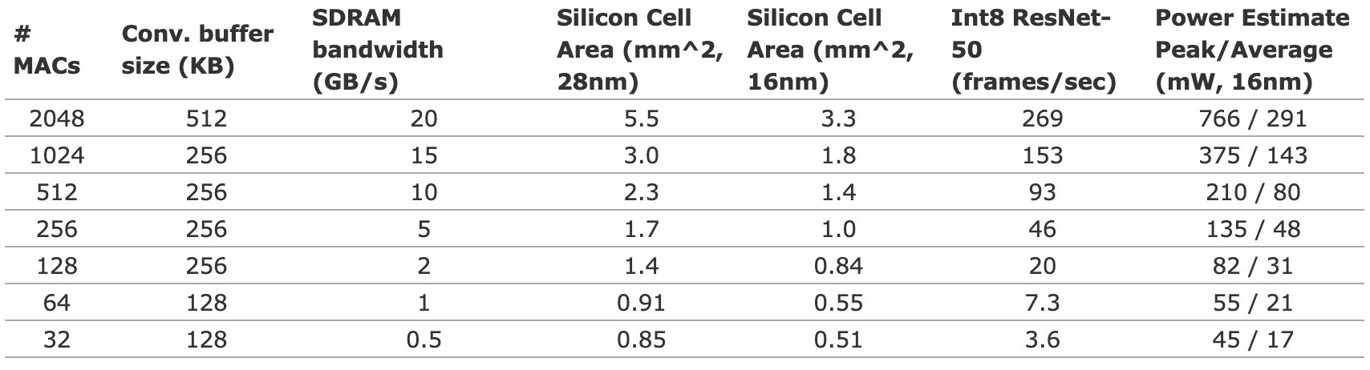
NVDLA - Results
The virtual simulator processes one image and gives the output for it along with the execution time.
An FPGA emulation can run regressions to get following results,
Model | FP16 | INT8
LeNet | 5,633 hrs | 10,401 hrs
ResNet-50 | 5,743,922 hrs | 4,834,791 hrs
Source : nvdla.org

Slide 13
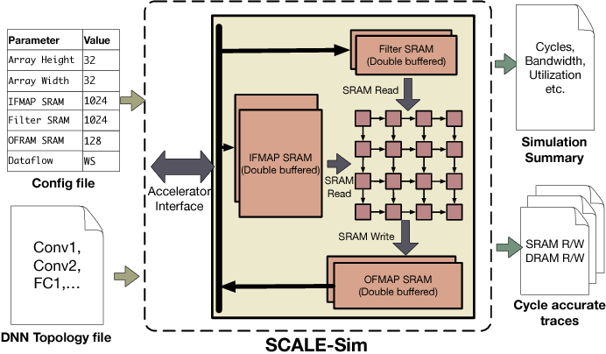
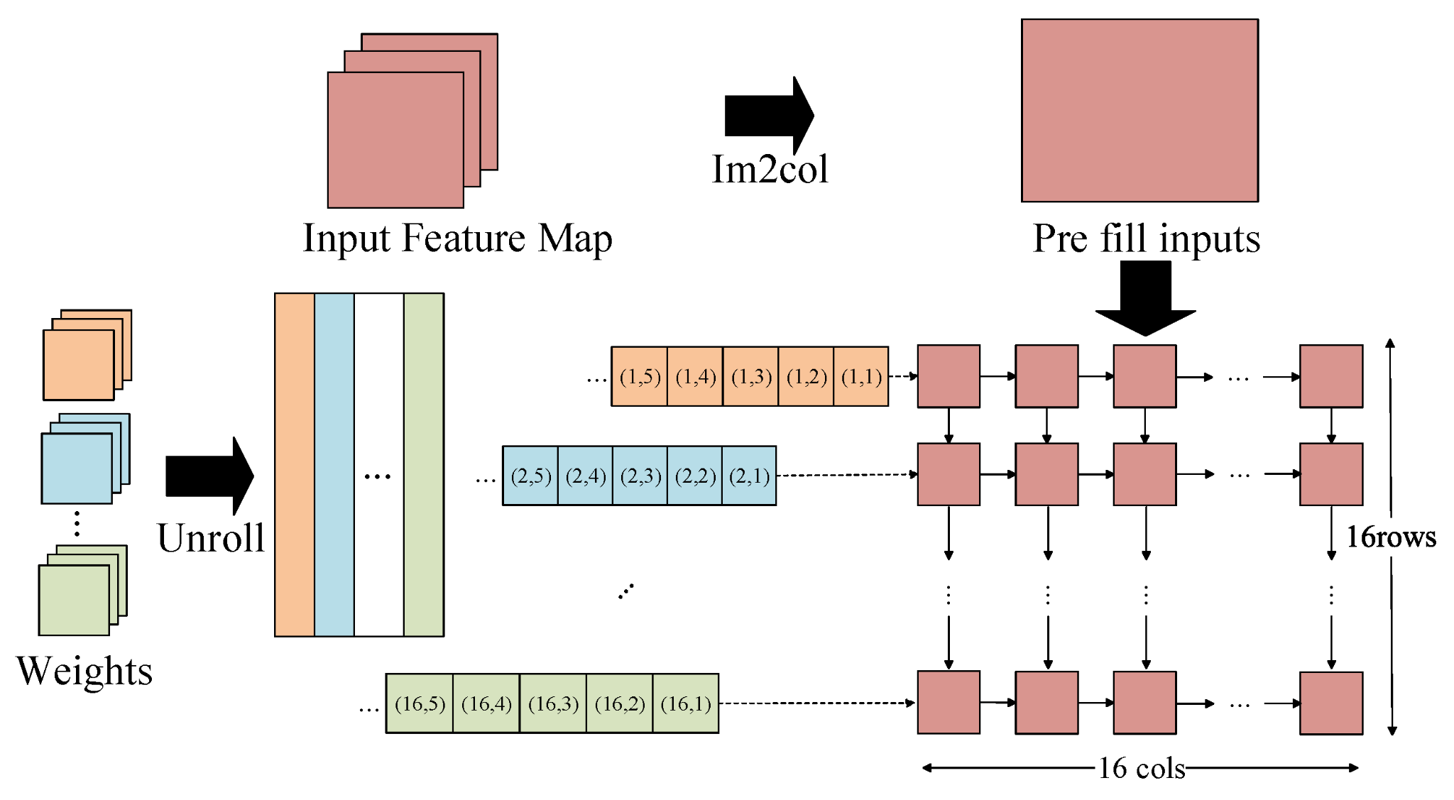
Scale-Sim (Systolic CNN Accelerator Simulator)
Source : A Fine-Grained Modeling Approach for Systolic Array-Based Accelerator - Y.Li et al
Source : SCALE-Sim: Systolic CNN Accelerator Simulator - A. Samajdar et al

Slide 14
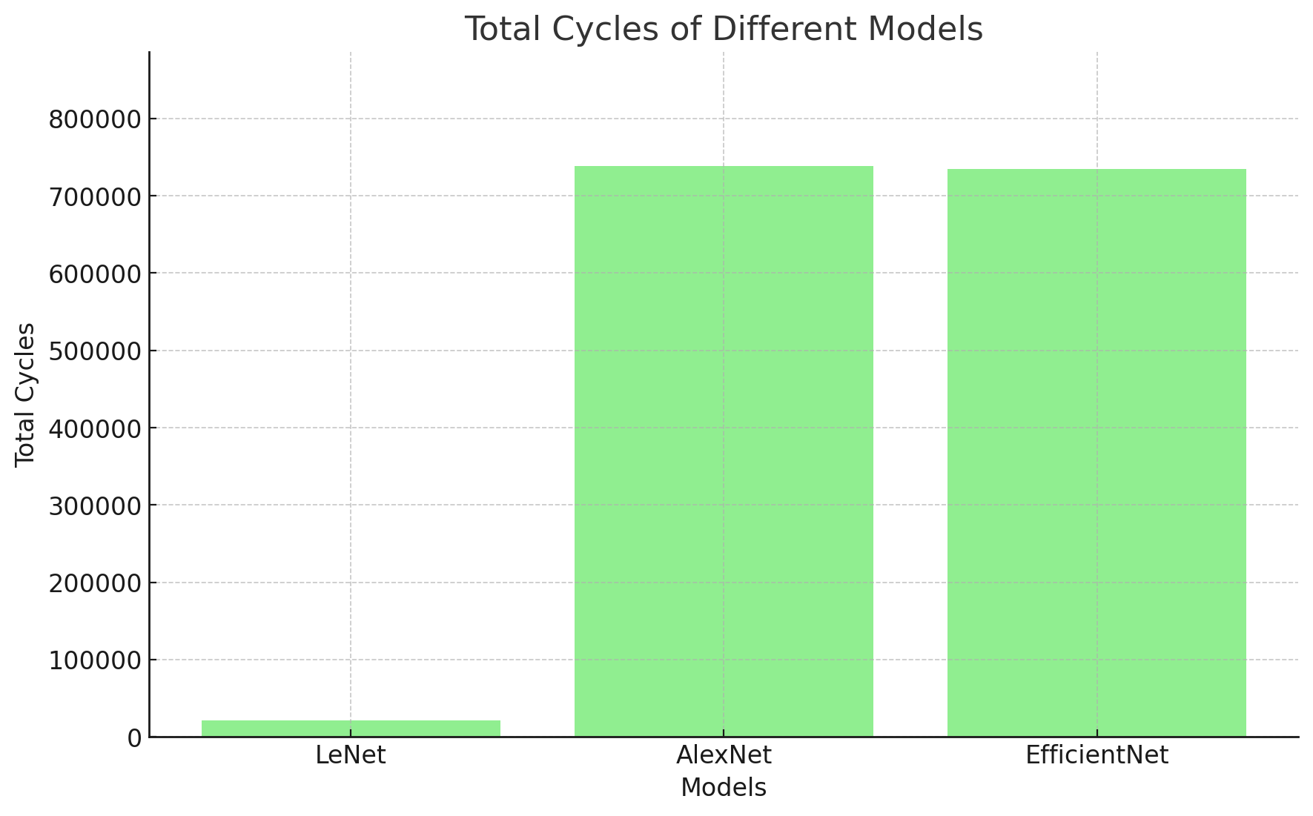
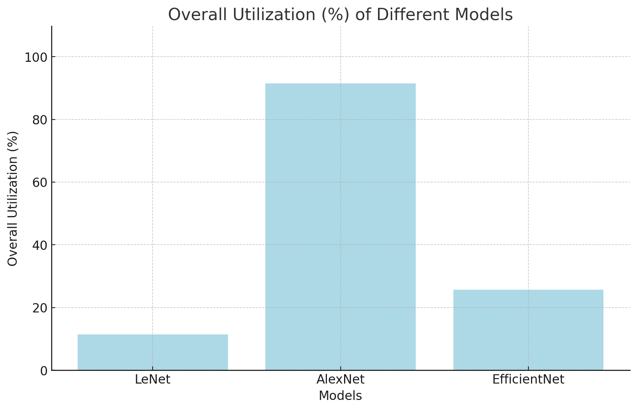
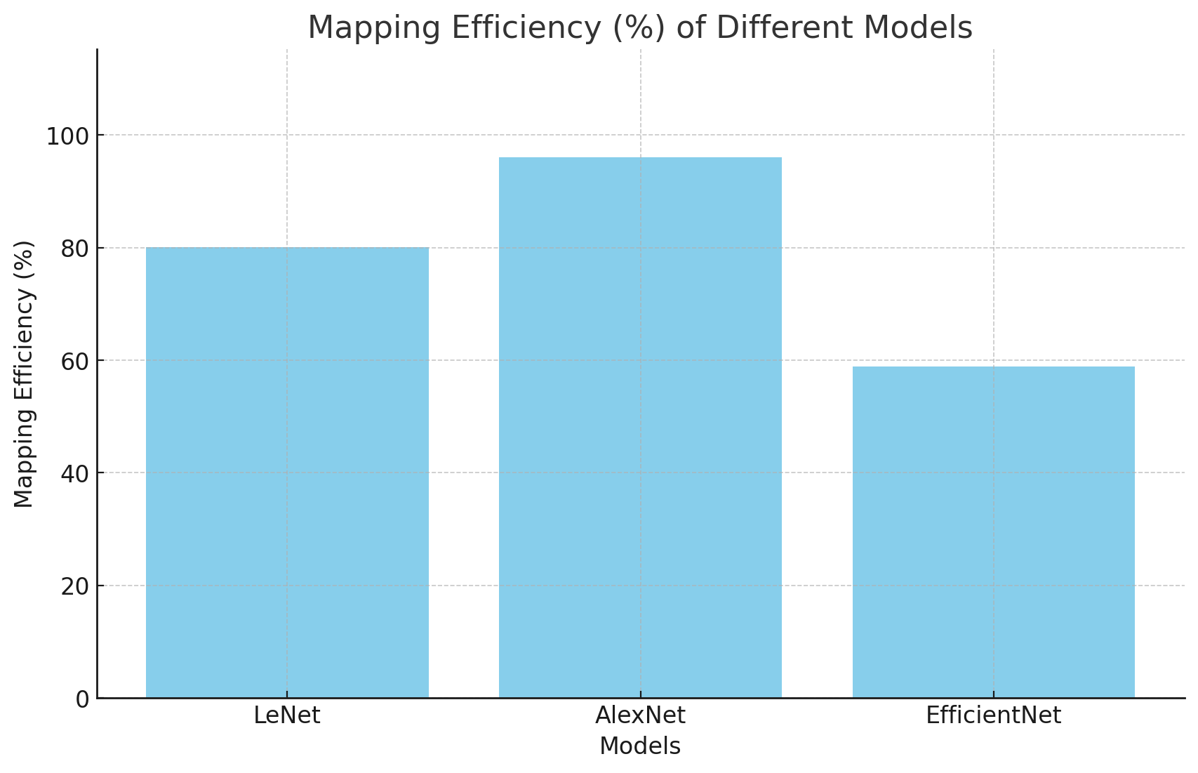
Results
Models | Cycles | Overall Utilization (%) | Mapping Efficiency (%)
LeNet | 20996 | 11.42 | 80.08
AlexNet | 738,385 | 91.45 | 96.05
EfficientNet | 735,114 | 25.66 | 58.85

Slide 15
Takeaway & Challenges
Takeaways:
Layer-wise Quantization: Allowed better control over scaling factors, maintaining accuracy.
Platform Utilization: The NVDLA gave detailed execution times; Scale-Sim helped assess utilization and mapping efficiency.
Data Preprocessing: Normalization and augmentation improved model robustness, especially for EfficientNet on CIFAR-10.
Challenges:
ONNX to Caffe Conversion: Lack of ONNX support in the NVDLA required converting to Caffe, which remains problematic.
Outdated Simulators: the NVDLA's outdated emulators forced us to use alternatives like Scale-Sim.
Complex Setup: Docker and QEMU setups for GreenSocs QBox required extensive troubleshooting.
Quantization Limitations: Scale-Sim lacked support for quantization.

Slide 16
Thank you

