Slide 1
Performance Evaluation of CNN and Attention layer on Open-Source Platform
Hasantha Ekanayake
Kavish Ranawella
Melika Morsali

Slide 2
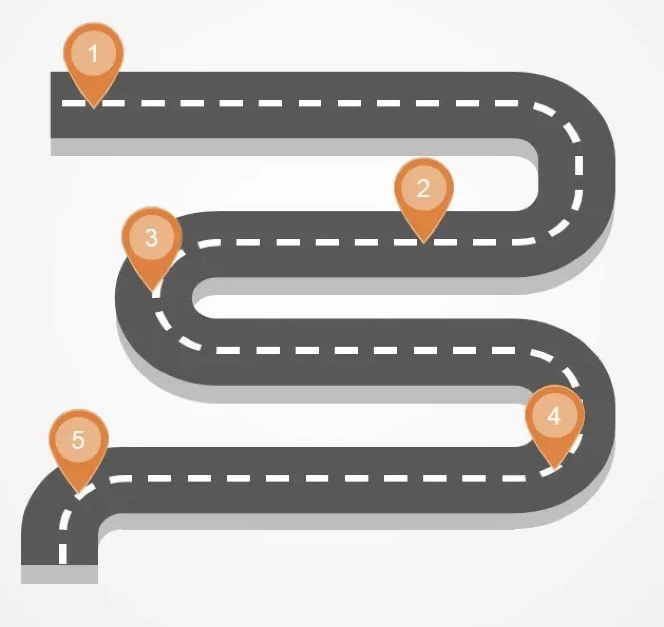
Roadmap
Phase 1: Model Training
Select CNN architecture (e.g., ResNet, MobileNet).
Train model on dataset (e.g., CIFAR-10, ImageNet).
Save trained model.
Phase 2: Post-Training Quantization
Apply INT8/INT4 quantization (PyTorch).
Validate model performance.
Export quantized model to ONNX.
Phase 3: NVDLA Deployment
Set up NVDLA environment (simulator).
Compile ONNX model using NVDLA Compiler.
Deploy and run inference.
Phase 4: Performance Benchmarking
Measure latency, energy, accuracy and resource utilization
Compare quantized vs. baseline performance.
Phase 5: Extend this Approach to the Transformer, Multi-Head Self-Attention Layer
Find a suitable open-Source accelerator

Slide 3
Applications
Optimize models for resource-constrained devices, improving latency and energy efficiency.
Deploy quantized CNNs for real-time image classification and object detection.
Transformer attention later for Natural Language Processing (NLP) application.

Slide 4
Thank you

