Slide 1

Proxy model
Why we need a proxy:
Motivation: SIM takes too much time,
Example: 500k design points cost 150+hours;
Why we choose MLP:
The task is a High-dimensional space function fitting task rather than a classification task;
MLP is a smooth model and a good fit for later searching;
MLP has a simple structure and we need a simple structure to prevent overfitting;
Parameters:
Width(systolic array)
Hight(systolic array)
Dataflow type(ws,os,is)
Buffersize
Software(mat mal)
M,N,K(matrix)
Output is a number representing cycles
5 FC Layers MLP Network
.
.
.
.
.
.
.
.
8 features input
output
Layer5
64x1
Layer1
8x128
Layer2
128x256
Layer3
256x128
Layer4
128x64

Slide 2
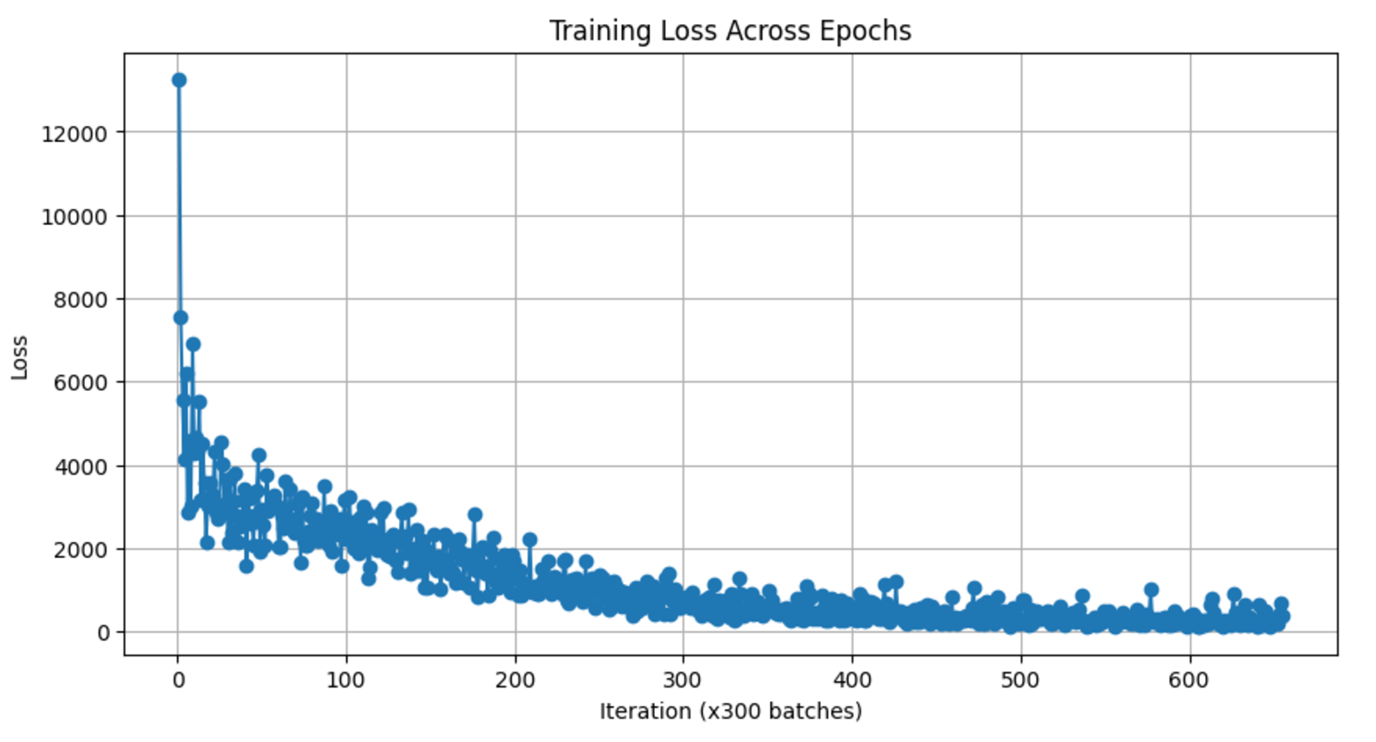
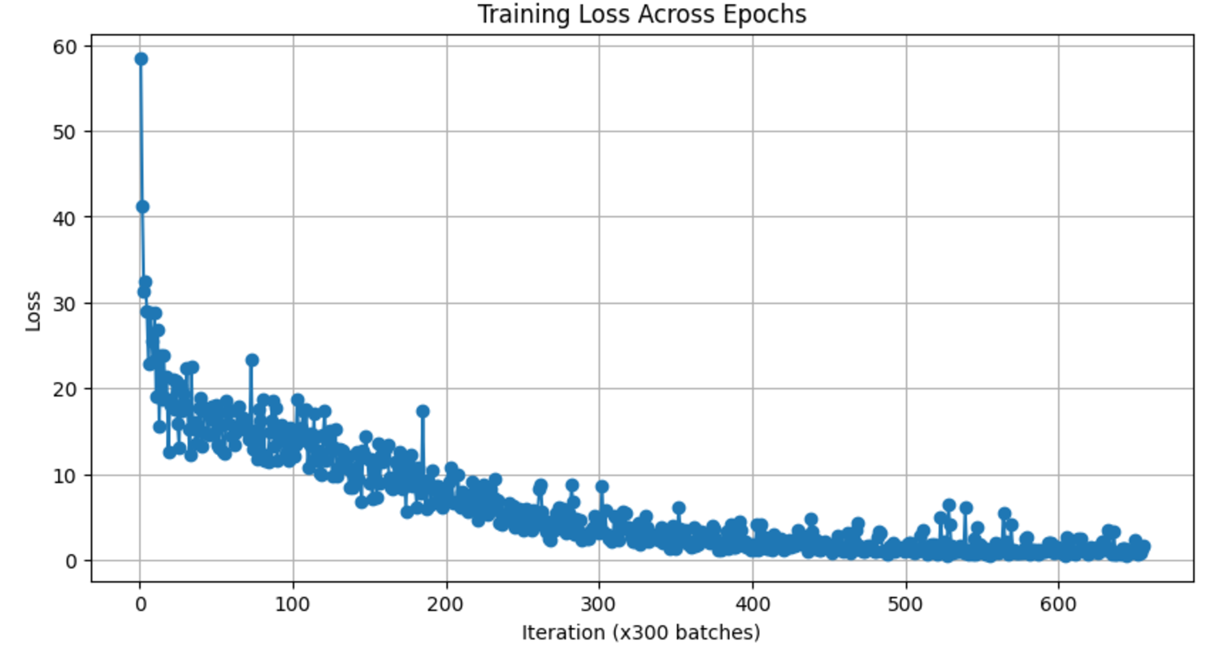
Proxy model result
Our results:
Make batch size 1;
Relative error within 1%
$$Prediction Loss={(Output−Target)}^{2}$$
$$Relative Loss={(Output−Target)}^{2}/Target$$
Figure: Prediction loss(MSE)
Figure: Relative prediction loss

