Slide 1
PositTune: Low-bitwidth Posit Quantization with Layer-wise Adaptive scaling
ECE 6501 Group8: Yimin Gao, Shan He, Zhenghong Chen

Slide 2
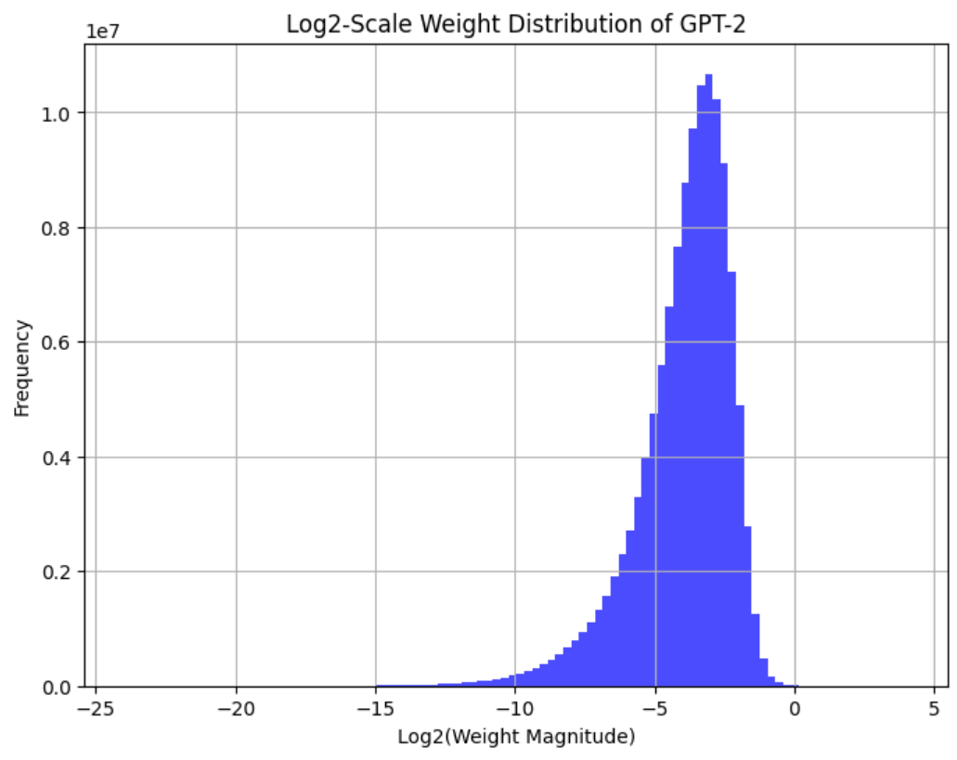
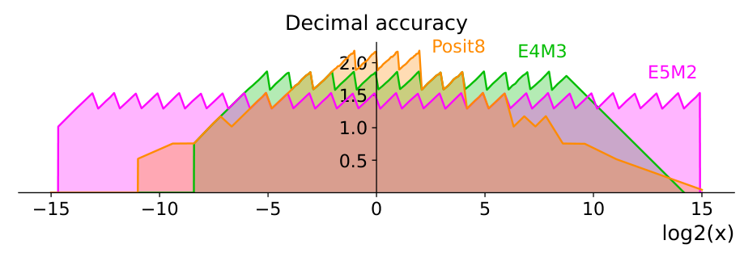
Motivation
Posit arithmetic: an alternative to floating-point representation
A wider dynamic range
Better accuracy around values close to 1
Why posit for training and inference at the edge, compared to fp?
More efficient design with less redundancy
More accurate at where we care the most
Posit Arithmetic, JL Gustafson - https://posithub.org/docs/Posits4.pdf
Notes:
Floating point numbers include a lot of redundancy for tasks such as ML where most of the weights are within a very small region

Slide 3
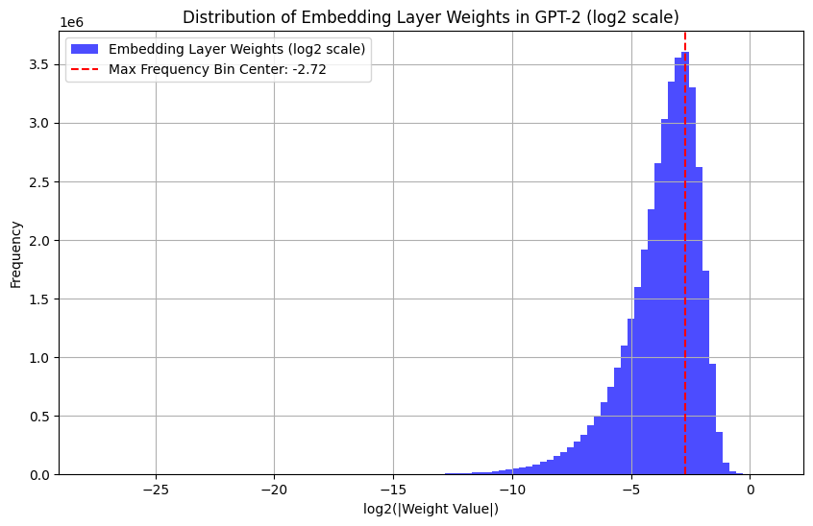
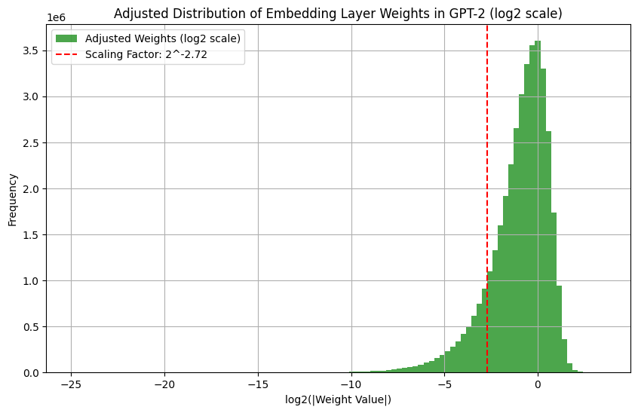
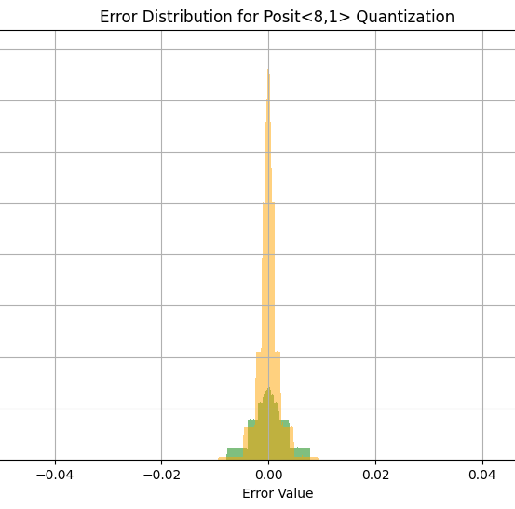
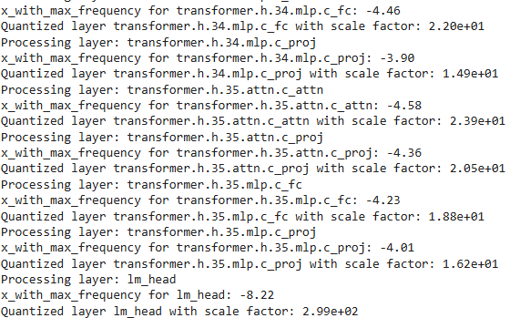
Posit is more accurate than fp around 1? We can shift the weight distribution!
1. Layer-wise weight analysis
2. Scale the weight distribution to the right where mean = 1
x 2^{2.72} =
3. Quantization error analysis => scaling helps!
4. Apply layer-wise adaptive scaling method to the entire ML model during quantization using Qtorch
Green: directly quantize to posit
Yellow: scale and quantize

Slide 4
Benchmark 1/3: GPT2
GPT2(Generative Pre-trained Transformer 2) is a large language model by OpenAI that generates coherent text by predicting the next word in a sequence. (774 million parameters)
Wiki text data is used for evaluating perplexity of the quantized model
prefix_texts: AI hardware is a field within computer engineering that
(Perplexity=19.41) Generated text: AI hardware is a field within computer engineering that studies the use of computers as tools, and a computer is an assembly of hardware and software, with no "unnatural" properties. That fact means that there is no natural "hardware" like a
Perplexity results | FP32 | FP8 | posit, nsize=8 es=0 | posit, nsize=8 es=1 | posit, nsize=6 es=0 | posit, nsize=6 es=1
No Scaling | 19.44 | 19.54 | 21.32 | 19.48 | 1.6+E07 | 21.83
Adaptive scaling | -- | -- | 19.41 | 19.479 | 24.03 | 20.12
Perplexity: the lower the better
Notes:
Perplexity is a metric that evaluates how well a language model predicts a sequence of words

Slide 5
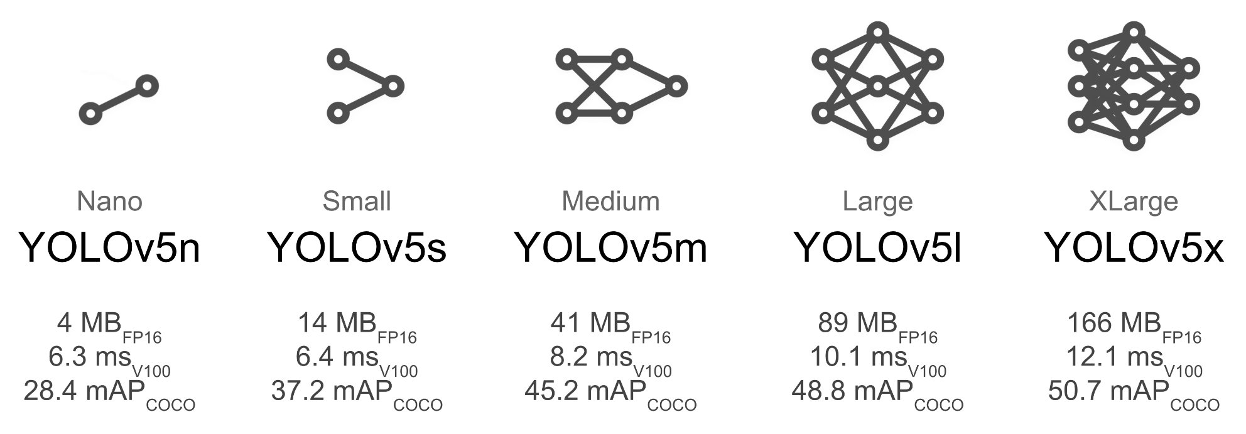

Benchmark 2/3: You Only Look Once (YOLO)
A deep learning model framework for object detection
 | FP16 | Posit, Nsize=8 es=1 Scale=8 | Posit, Nsize=8 es=1 Adaptive Scale | Posit, Nsize=6 es=1 Scale=1 | Posit, Nsize=6 es=1 Adaptive Scale
PERSON 1 | 0.86 | 0.85 | 0.88 | 0.60 | 0.56
PERSON 2 | 0.63 | 0.58 | 0.74 | 0.48 | 0.55
TIE | 0.61 | 0.54 | 0.63 | -- | --

Slide 6

Benchmark 3/3: ALBERT (A Little BERT)
BERT (Bidirectional Encoder Representations from Transformers) is a powerful language model that understands the context of words in a sentence.
ALBERT (A Lite BERT) is a smaller, faster version of BERT that reduces model size and improves efficiency by sharing parameters across layers and using optimized embedding techniques. [1]
Task: Answering an arbitrary question according to a given context.

Slide 7
Evaluation Results on SQuAD 2.0 dataset
Linear Layers Data types | fp32 | fp8 | Posit<6,1>*, No Scaling | Posit<6,1>*, Adaptive Scale
Overall
F1 Score | 86.19% | 85.36% | 83.62% | 85.85%
For Questions with Answers
F1 Score | 86.32% | 82.86% | 77.36% | 84.25%
*Linear Weight: nsize = 6, es =1; Other Weight: nsize = 8, es = 1; Linear Activation: nsize = 6, es = 1; Other Activation: nsize = 8, es = 1; F1 Score: Measures overlap between the predicted and ground-truth answers

Slide 8
Conclusion
Posit offers a promising alternative for edge inference, balancing efficiency and precision.
Layer-wise adaptive scaling in posit inference enables achieving the same accuracy with reduced bitwidth or higher accuracy at the same bitwidth.
A versatile posit arithmetic unit with configurable scaling at runtime is in demand to enhance efficiency in edge AI training and inference.

Slide 9
Thank you!

Slide 10
Backup Slides

Slide 11
Evaluation Results
 | Linear Weight Scale = 32 | Linear Weight Adaptive Scale | Linear Weight & Other Weight Adaptive Scale | Linear W&A and Other W&A Adaptive Scale | Linear Weight & Linear Activation Adaptive Scale
Exact Match | 83.4% | 83.4% | 82.9% | 83.4% | 84.1%
F1 Score | 86.41% | 86.39% | 85.85% | 86.39% | 86.93%
For Questions with Answers
Exact Match | 79.92% | 80.32% | 78.31% | 80.32% | 80.32%
F1 Score | 85.96% | 86.33% | 84.25% | 86.33% | 86.01%
For Questions without Answers
Exact Match | 86.85% | 86.45% | 87.45% | 86.45% | 87.84%
F1 Score | 86.85% | 86.45% | 87.45% | 86.45% | 87.84%
*Linear Weight: nsize = 6, es =1; Other Weight: nsize = 8, es = 1; Linear Activation: nsize = 6, es = 1; Other Activation: nsize = 8, es = 1;

Slide 12
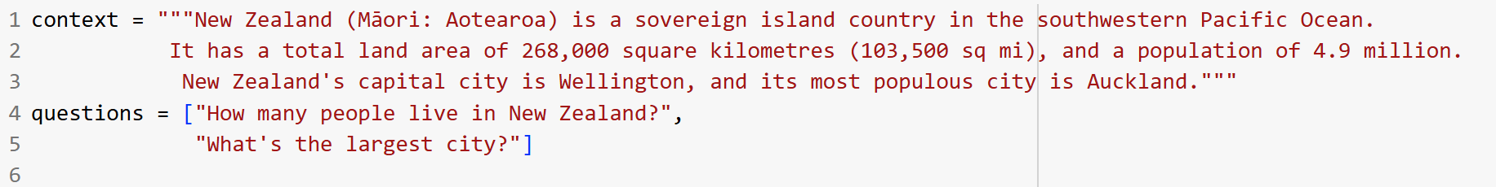
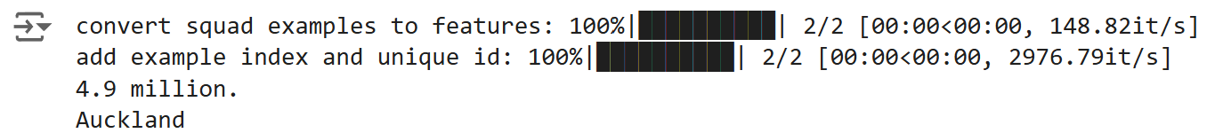
Demo: Question Answering
Answer an arbitrary question with a given context. (E.g.)
Context: New Zealand (Māori: Aotearoa) is a sovereign island country in the southwestern Pacific Ocean. It has a total land area of 268,000 square kilometres (103,500 sq mi), and a population of 4.9 million. New Zealand's capital city is Wellington, and its most populous city is Auckland.
Question: How many people live in New Zealand?
Answer: 4.9 million

