Slide 1

Chapter 4 Object Oriented Paradigm

Slide 2

Chapter 4 Objectives
Introduce concepts of OO software architecture
Describe a complete OO analysis and design process
Discuss general design principles in the context of OO design

Slide 3
Agenda
Introduction to OOP
  OOP Principles
  Classes & Their relationships
  Generic Principles
  Lessons learned
  Review Questions
An OOP practice in Study case
  OO Analysis
  OO Design

Slide 4
Introduction
What is OO?
  Object Oriented (programming, design, ...)
History dated back to 1960’s
  Shadowed by structured programming in 70’s
  Popular since 1980’s
Notes:
1.5 min

Slide 5
OO SE – A Broader Concept
OO Software Engineering
  OO Analysis
  OO Design
  OO Programming
We concentrate on OO Design in this class
Notes:
0.5 min

Slide 6
OO Principles
Three Principles
  Encapsulation
  Inheritance
  Polymorphism
Notes:
0.5 min

Slide 7
Encapsulation
Given a class, outside world
  See its interface (functional specification)
  But not implementation details
Examples?
  C++. Interface defined in header file.
Benefits?
  Allows flexibility.
  Allows team working.

Slide 8
Inheritance
A class can inherit from its base class
Example: design a car engine controller
  You’ve already got ignition timing, throttle position sensor, emission control – quite complex a system. Now your boss ask you to design a new model with “cruise control”. What shall you do?
  Design a new class and inherit from the old design!
  But why not directly do a copy and paste?

Slide 9
Polymorphism
Poly – multiple
Morph – form
Polymorphism – an object can have different appearance/behaviors under different circumstances
Example: graphical object system
  When you have a linked list of graphic objects
  How do you draw them out in C++, Java, and C#?
Notes:
2 min

Slide 10
Class
Class consists of
  Public interface
  Detailed implementation
Definition of class usually consists of
  “name” of the class
    Possibly included in a package or namespace
  List of attributes
  List of operations
    Special operations: constructor, destructor, etc.
Notes:
1 min

Slide 11
Accessibility Principle
When assigning accessibility of an attribute (operation):
  Expose as least information as possible!
Example:
  User needs to QuotePrice()
  QuotePrice() should be public
  However, the processingCost() should not be exposed because of commercial secret
Notes:
1 min

Slide 12
Relationship Among Classes
Very Complex!
A partial list of relationships:
  Composition
  Aggregation
  Association
  Inheritance
  ...
Notes:
0.5 min

Slide 13
Composition Relation
An object is composed of other object (Whole/Part relationship)
Example: a car consists of
  Chassis
  Window Shield
  Engine
  Transmission
Requirement: the life span of “components” and “owner” involved in a composition relationship must be same
Notes:
1.5 min

Slide 14
Aggregation
Similar to composition (but more relaxed)
Less restrictive on the “life span” of “owner” and “components”
Notes:
1 min

Slide 15
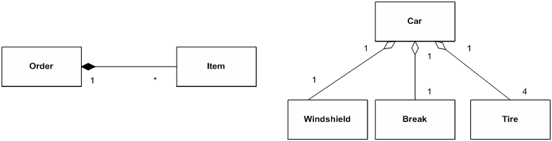
Compositon & Aggregation Example
Composition
Aggregation
Notes:
1 min

Slide 16
Association
Represents static logical relationship
An association link has
  Name of the association
  Multiplicity at each end
  Direction of association
Variation: Dependency
  Represented using dotted arrows
  X depends on Y if any changes of Y leads to changes in X
Notes:
1.5 min

Slide 17
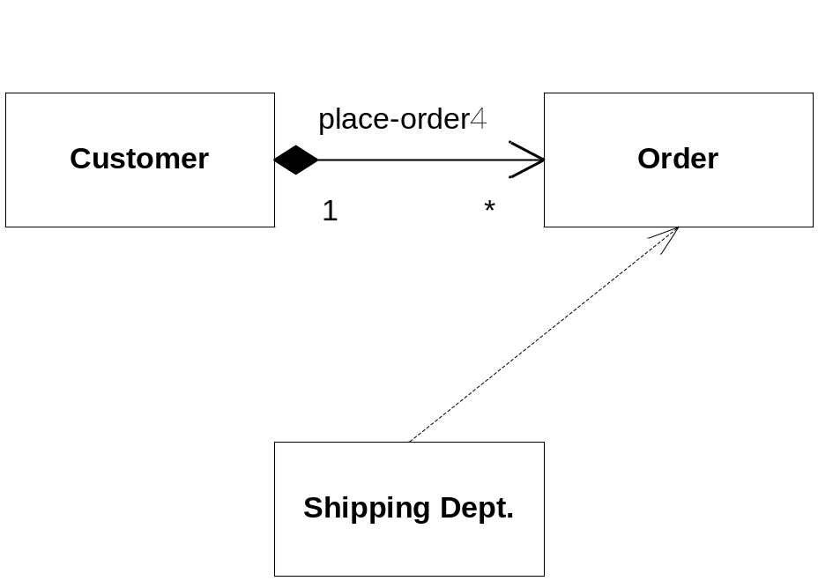
Association Example (- - ->)
Notes:
1 min

Slide 18
Inheritance
Sub-class inherits all protected and public attributes from base class
Notes:
1.5 min
Explain the business logic

Slide 19
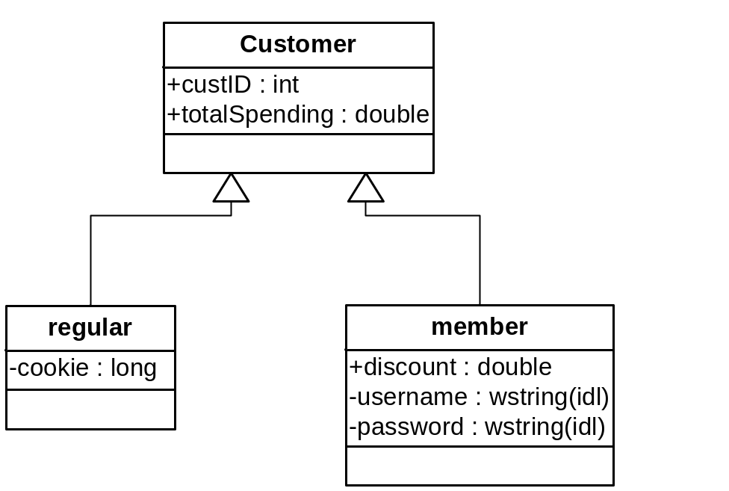
Inheritance Example
Notes:
1.5 min
Explain the business logic

Slide 20
Inheritance vs. Composition
OO provides two mechanisms for re-using
  Composition
  Inheritance
Which one to choose?
Example: Consider HouseOwner
  Derived class of Person and House
  Or, Derived class of Person who has an attribute House
Notes:
1 min

Slide 21
General Principle
Use inheritance only if derived class IS-A base class
  E.g., HouseOwner is a Person
Composition (Aggregation) is used to model HAS-A relationship
  E.g., HouseOwner has a House
Careful about inheritance, sometimes, weakens the encapsulation principle
Notes:
1.5 min

Slide 22
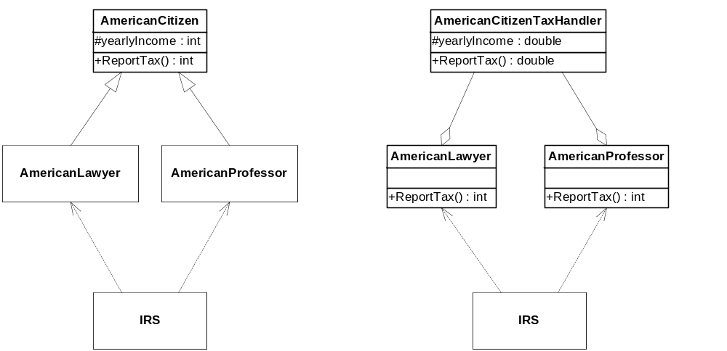
Inheritance against Encapsulation Example
What if ReportTax() now returns double? Leads to cascading changes in IRS
What’s the problem with this improved design?
Notes:
2.5 min
Lost the benefits of polymorphism

Slide 23
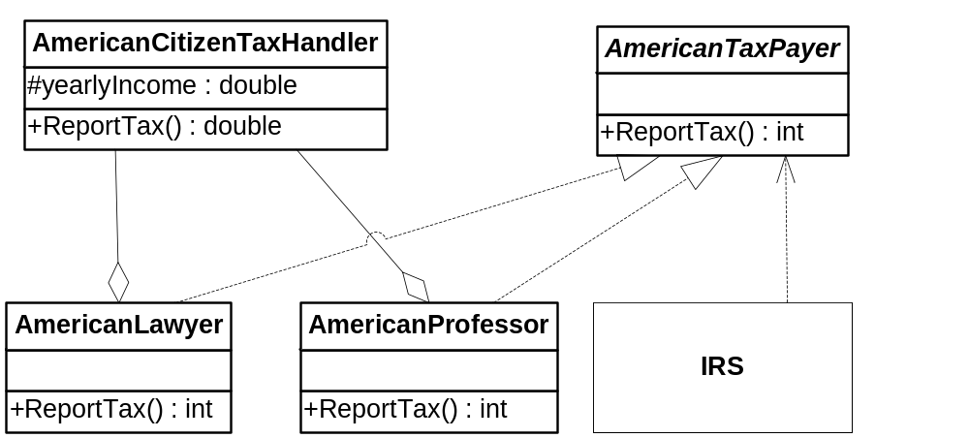
Yet another improved design
Notes:
1 min

Slide 24
Lessons Learned
If you have to form a dependency relationship, depends on?
  Interface! (base class, better abstract class)
Better to divide classes into two categories
  Interface class
  Implementation class
  -> Makes things much easier for large projects with many people involved!
Notes:
1 min
30 min now

Slide 25
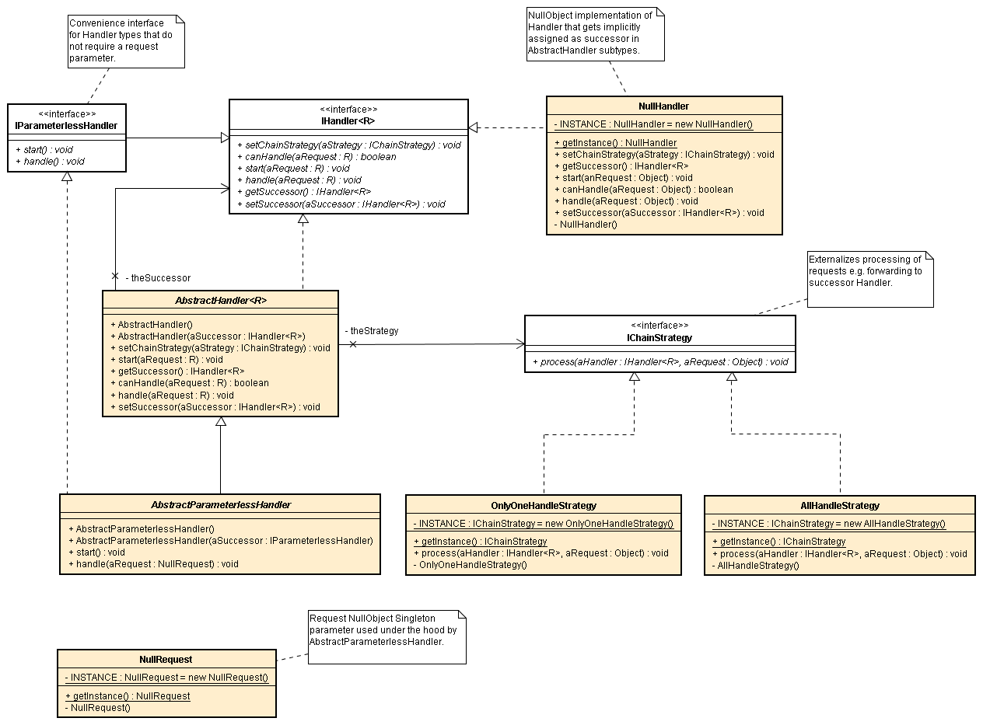
Lessons Learned
Notes:
1 min
30 min now

Slide 26
Case Study Example - OPS
OPS – Order Processing System
Part of an online store
  Online Catalog
  OPS
  Financial Department
  Shipping Department
Notes:
1.5 min

Slide 27
Requirements
(R1) Each customer has an online shopping cart, which allows addition and removal of items.
(R2) A customer is able to check out the shopping cart using credit card. The transaction is approved only when the financial department has verified the validity and the remaining credit line of the credit card.
(R3) Before the transaction is completed, a customer should be able to learn about the estimated arrival date, which is determined by the order processing time of the shipping department.
(R4) A customer can choose to cancel the transaction by clearing all items of the cart.
(R5) OPS must be available as a web accessible system. Customers can use popular Internet browsers to interact with OPS.
Notes:
2.5 min

Slide 28
Stage 1: OO Analysis
Outcome:
  Requirement specification
  Initial logic structure of the system
Two UML tools available
  Use case diagram
  Analysis class diagram
Notes:
1 min

Slide 29
Step 1: Design of Use Case Diagram
Use Case is a way that a user accesses the system
  User can be either real human user, or components of a bigger picture
Use Case Diagram depicts their relationship
Notes:
1 min

Slide 30
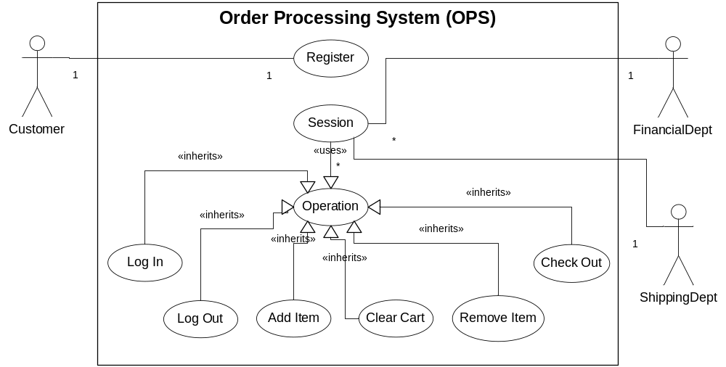
OPS Use Case Diagram
Notes:
1.5 min

Slide 31
Flow of Events
Use Case Diagram must be accompanied by the description of flow of events
Flow of Events: a sequence of operations for a use case ( Scenarios )
Notes:
0.5 min

Slide 32
Flow of Events
UC ID | 03
UC Name | Add Reservation
Summary | When a user wants to reserve a meeting room, she/he has to submit a Registration Form to Administration Department.
Dependency | 01
Actor | User
Precondition | Registered User
Description | When user wants to reserve a meeting room, he/she has to go Reserved Meeting Room List page (displayed as a Calendar) and click to New Reservation button or click on the Date that he/she want to reserve in order to create a new Registration Form. The Registration Form includes the following information: Room Number*, Media (Projector, TV Conference System), reserved duration*, and reserved date*. After fulfilling the form, If he/she clicks to Submit button, the request will be sent and the page will redirect to Reserved Meeting Room List page. In case, there is a conflict with another reservation, the reservation will be red for notification. *: required field
Alternative | When user clicks Submit button, the system will check if all required fields are fulfilled or not. If ok, the request will be sent. If not, the system will require user to complete.
Post-condition
Notes:
0.5 min

Slide 33
Example 1: Register
(1) user visits registration page
(2) user supplies desired user name and password and submit
(3) system checks if the user name is available
(4) if user name does not exist, insert it, and redirects to registration success page; otherwise redirects to failure page
Notes:
1.5 min

Slide 34
Example 2: Check Out
(1) user supplies credit card information and clicks check out
(2) system contacts financial department for charging the card
(3) if financial department approves the transaction, redirects to success page, at the same time, send the order to shipping dept; otherwise, redirects to failure page.
Notes:
1 min

Slide 35
Step 2: Analysis Class Diagram
Analysis Class Diagram
  also called “Concepts Class Diagram”
Describes
  Key classes of a system
  Their relationship
Abstraction of the system
  Not every class in analysis class diagram is implemented
  The diagram does not include all classes in the real implementation
Notes:
1 min

Slide 36
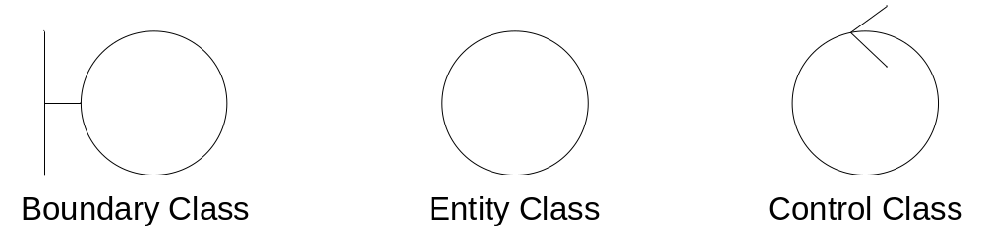
Noun Extraction
Three Diagrams
Notes:
1 min

Slide 37
Noun Extraction
Extracts all nouns in the flow of events description
Example:
Register. A customer visits the registration page, and specifies the desired user name and password. If there is already such a username/password pair, the system reports error; otherwise, it reports success. When the registration is completed, the user name, password, and the real name and the billing address are stored in a database system.
Notes:
1.5 min

Slide 38
Results of Analysis (Sample) I
customer:
  actors need not be represented.
registration page:
  modeled as a boundary class.
user name:
  should not be modeled as a class.
  can be modeled as an attribute of another class, e.g., CustomerIdentity.
Notes:
1 min

Slide 39
Results of Analysis (Sample) II
password:
  should be an attribute of CustomerIdentity.
username/password pair:
  should be modeled as CustomerIdentity.
system:
  “system reports error” in the initial description of the use case is not accurate enough.
  rephrase it as “errors are reported in a RegistrationErrorPage”. Thus a RegistrationErrorPage should be created as a boundary class.
Notes:
1.5 min

Slide 40
Results of Analysis (Sample) III
error:
  should not be modeled as a class.
success:
  RegistrationSuccessPage should be created as a boundary class.
registration:
  the word actually refers to the registration process. We have to create a controller class named RegistrationController for this use case.
Notes:
1 min

Slide 41
Results of Analysis (Sample) IV
real name:
  part of the CustomerInfomation class.
billing address:
  a part of CustomerInformation class. Look back at CustomerIdentity, it could be a part of the CustomerInformation.
database system:
  A wrapper class (i.e., boundary class) called CustomerInfoDB should be created to interact with the database.
Notes:
1 min

Slide 42
More Classes
RegistrationPage – a boundary class for registration.
RegistrationErrorPage – a boundary class for reporting registration error.
RegistrationSuccessPage – a boundary class for concluding the registration process.
CustomerIdentity – an entity class which records the user name and password of a customer.
Notes:
0 min

Slide 43
More Classes
CustomerInfomation – an entity class which records the information of a customer, e.g., his/her CustomerIdentity, real name, and billing address.
CustomerInfoDB – a boundary class which manipulates the customer information database.
SessionController – a controller class for coordinating a session. The class provides various operations for logging on, logging off, adding items, deleting items, clearing shopping cart, and checking out.
Notes:
0 min

Slide 44
More Classes
BrowserPage – a boundary class for browsing product catalog.
LoginPage – a boundary class for logging in.
LogoutPage – a boundary class for logging off.
CheckoutPage – a boundary class for accepting user credit card information and checking out shopping cart.
Notes:
0 min

Slide 45
More Classes
CheckoutSuccessPage – a boundary class for presenting success information and receipt.
CheckoutFailurePage – a boundary class for presenting failure information when financial information verification fails
ShoppingCartPage – a boundary class which displays the contents of a shopping cart and allows customer adding/removing items.
Notes:
0 min

Slide 46
More Classes
FinancialDeptWrapper – a boundary class for interacting with financial department.
ShippingDeptWrapper – a boundary class for interacting with shipping department.
InventoryDB – a boundary class for interacting with inventory database.
Notes:
0 min

Slide 47
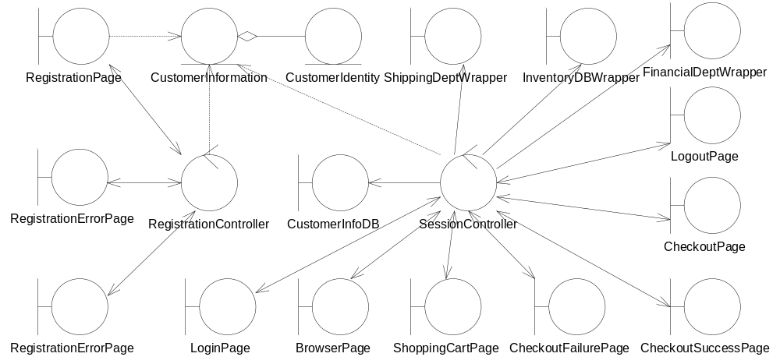
Resulting Diagram
Notes:
0.5 min
20 min now

Slide 48
OO Design
Goal: develop overall structure of system
Process:
  High level design process
  Detailed level design process
Tools used:
  CRC cards, class diagram, interaction diagram, state chart etc.
Notes:
1 min

Slide 49
Step 1: CRC Card Approach
Class-Responsibility-Collaborator
Identify classes to build a system
Team Work
  1 Facilitator
  1 Domain User
  4-6 System Analyzer and Designer
Notes:
1 min

Slide 50
Card
Class Name
Responsibility | Collaborators
Notes:
0.5 min

Slide 51
How To Play
Facilitator starts the process
The Team examine use case one by one
  Simulates the flow of events
  Player records responsibilities of classes
  If necessary, create new classes
When use case are solved, examine each responsibility of each class, repeat the same process
When to stop?
  When get to “private” details with no need of collaboration with other classes
Notes:
1.5 min

Slide 52
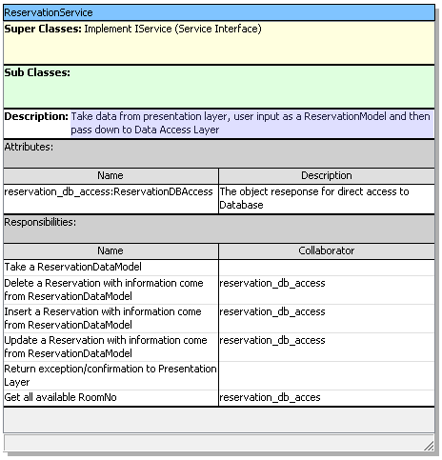
CRC in practices

Slide 53
Example: Use Case Register
Register. A customer visits the registration page, and specifies the desired user name and password. If there is already such a username/password pair, the system reports error; otherwise, it reports success. When the registration is completed, the user name, password, and the real name and the billing address are stored in a database system.
Notes:
1 min

Slide 54
CRC Card1: RegistrationPage
RegistrationPage
Responsibility | Collaborators
Knows user name
Knows password
Knows RegistrationController
Handles click-event of “Submit” button | RegistrationController
Notes:
1.5 min

Slide 55
Delve Into “Handle Submit Event”
RegistrationController
Responsibility | Collaborators
Handles the registration request (create an user account with the desired user name/password) | CustomerInfoDB, RegistrationSuccessPage, RegistrationFailurePage
Knows RegistrationPage
Knows (or Creates) RegistrationSuccessPage
Knows (or Creates) RegistrationFailurePage
Notes:
1 min

Slide 56
Jump to DBWrapper
CustomerInfoDB provides
  Verify if username/password exists
  Insert a pair of username/password
Any problems here?
  The two steps should be bundled into one single atomic step! ( dealing with concurrent system – when 2 customer request the same user name and password simultaneously)
Notes:
1 min

Slide 57
Step 2: Construct Interaction Diagram
Mostly used: sequence diagram
Process: reconstruct the flow of events using sequence diagram
Notes:
0.5 min

Slide 58
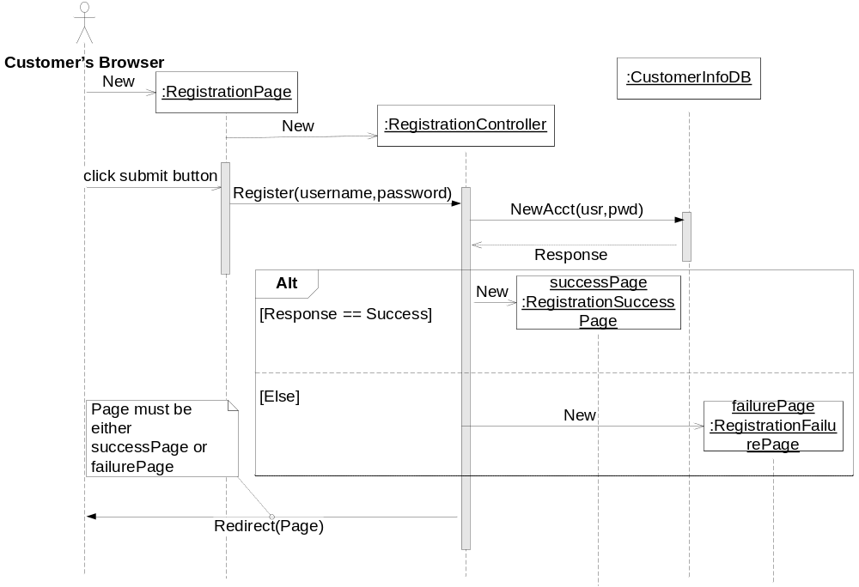
object. starts with “:”
Notes:
1.5 min

Slide 59
Step 3: Build State Chart
Describe the life-cycle of an object
Many times directly translated into implementation; sometimes not.
Conveys the spec between designer and programmer
Process:
  Study the “flow of events” of the use cases that a class is involved
Notes:
1.5 min

Slide 60
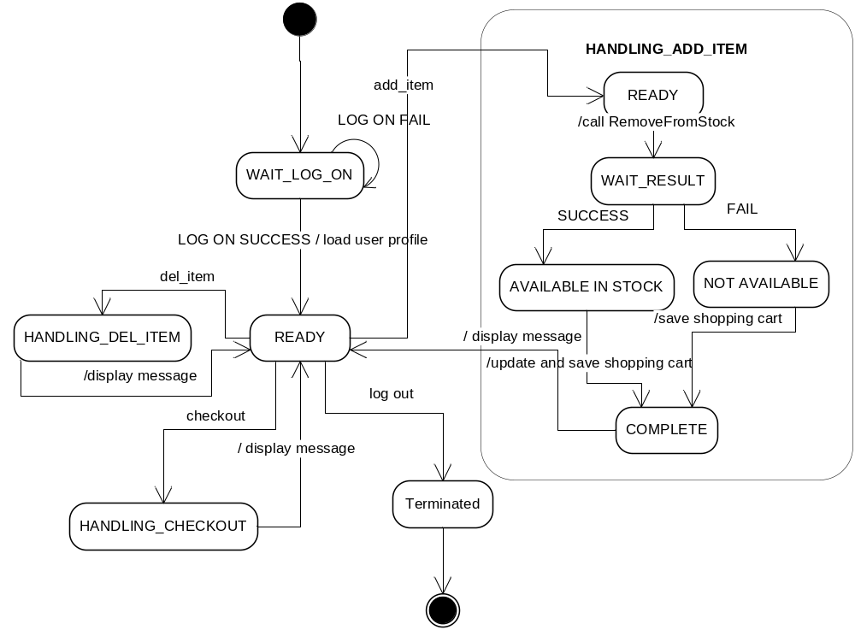
Example:
Notes:
1.5 min,
Ask students to explain the logic
33.5 min now

Slide 61
Step 4: Class Design
Purpose: Determine the set of
  attributes
  operations
Nail down the interface of each class
Outcome: class diagram
Notes:
1 min

Slide 62
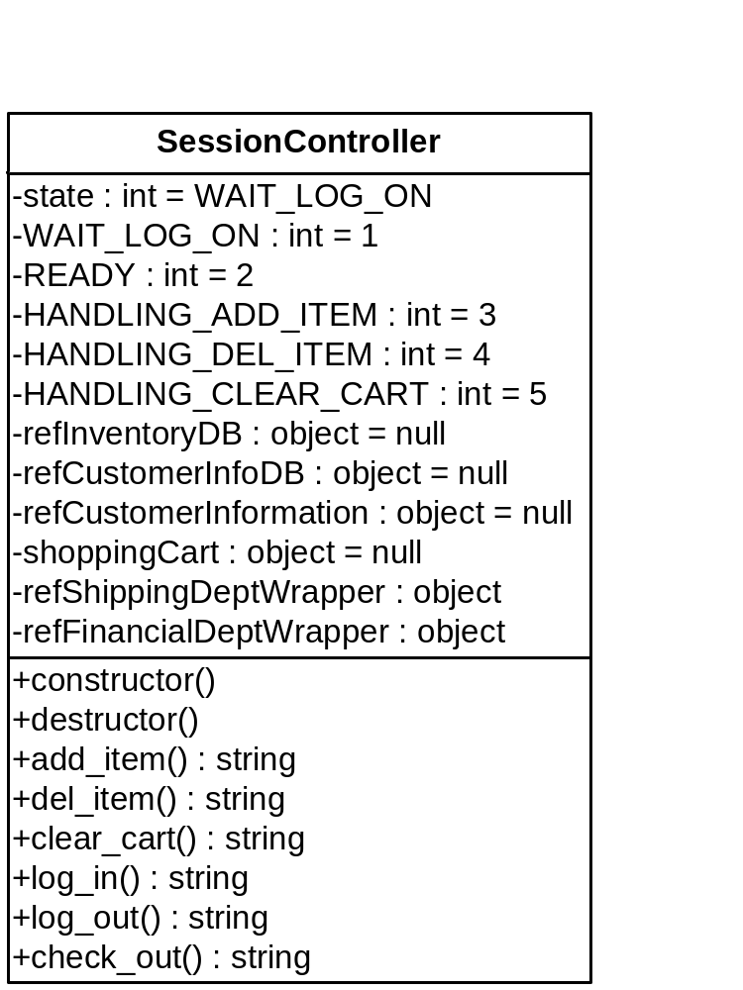
Example
Notes:
0 min

Slide 63
Class Design (Step 4 of OO Design)
Purpose: identify
  public interface
    interaction protocol between classes
    Should be nailed down first
  implementation details of classes
    private data members, algorithm of operations
Notes:
1 min

Slide 64
Identify Public Attributes & Ops
Start from CRC Cards
Examine each responsibility
  “Know ...” → attributes
  “Do ...” → operations
If necessary split class
  Principle: if a class is too big to be described using one sentence → split it
Notes:
1 min

Slide 65
Class Design Example
SessionController
Responsibility | Collaborators
Handles Login request | CustomerInfoDB,
Handles Logout request | CustomerInfoDB
Add an item into shopping cart | InventoryDB, ProductInfo
Delete an item into shopping cart | InventoryDB, ProductInfo
Clear shopping cart | InventoryDB, ProductInfo
Check out shopping cart | InventoryDB, ProductInfo, FinancialDeptWrapper, ShippingDeptWrapper
Knows the list of products in shopping cart
Knows the customer information (customer identity, real name, billing address etc.)
Knows LoginPage, LogoutPage, BrowserPage, ..., and CheckoutPage
Notes:
Do it on board

Slide 66
Operations
A class can provide 4 categories of ops
  Constructor
  Destructor
  Accessor
  Mutator
Design multiple constructors if necessary
Destructor: very important
  Release system resources
  Notice virtual destructors
Notes:
1.5 min

Slide 67
Handle Implementation Details
Start from each public operation
Think about how to implement it
  What attributes are needed?
  What private operations are needed?
    Pay special attention to the SHARED functionalities
      required by two or more operations
    DON’T WRITE VERY BIG OPERATIONS,
      hurt the maintainability of your program
Notes:
1 min

Slide 68
Example
Think about SaveShoppingCart() of CustomerInfoDB.
A Hash is generated for each item so that we can easily search items in the shopping cart
To compute hash needs 80 lines of code
In this case, better declare a separate operation computeHash()
Notes:
1 min

Slide 69
Identify private attributes
(1) Examine CRC Cards and Interaction Diagram, nail down the list of attributes needed
(2) Determine if they should be public or private
(3) Check state machine diagram, include more attributes if possible
Notes:
run it on board 3 min

Slide 70
Result
Notes:
1 min

Slide 71
Refine the Design of Operations
Consider the following
  What should be the return type
  What should be the parameters
Example: add_item of SessionController
  What should be parameters? 2 alternatives
    An Integer product ID
    A reference to ProductInfo object
    Given that SessionController already has the ability to translate productID to ProductInfo reference?
Notes:
1.5 min
2nd is better

Slide 72
Example (add-item) cont’d
Design Type
  Can it be void?
    No, we need to know whether the operation is successful or not
  Can it be bool?
    Yes, but how about the report of the failure reason?
      e.g., “# of item exceeds limit”, “item not available”, ...
  How about returning a string?
    null – no error
    not null – the string itself is the detailed failure info.
Notes:
1.5 min
13.5 min

Slide 73
Principle of Decoupling
Tight coupling is usually bad
Why?
  Hard to maintain
  Hard to extend
  Longer project compiling time
  ...
Notes:
0.5 min

Slide 74
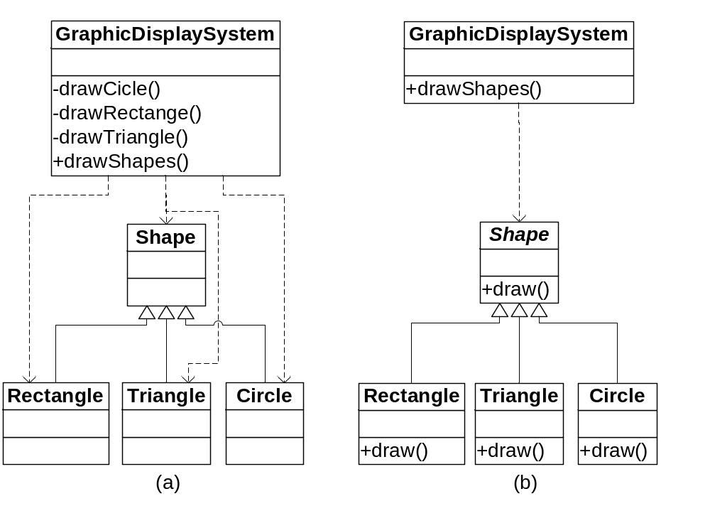
Example: which is better?
Less dependency
Easy expansion
Simplicity and elegancy in implementation
Notes:
2 min

Slide 75
Promote Cohesion
Cohesion: a class only performs closely related operations
Why high cohesion?
  Logically good! Easy to maintain→ don’t distribute logically related functions over multiple class!
Notes:
1 min

Slide 76
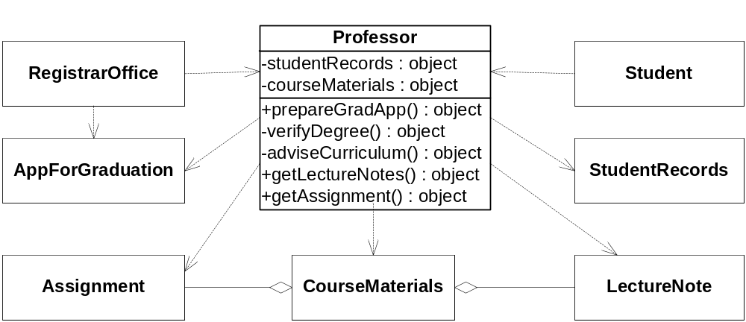
Example: An Initial Design of Professor Class
Notes:
2 min
Explain the logic

Slide 77
Business Logic Here
Professor provides service to students
  Teaching
  Preparation of Graduation Applications
Problem?
  The Professor class bears two functionalities
  Design is not co-hesive
Notes:
1.5 min

Slide 78
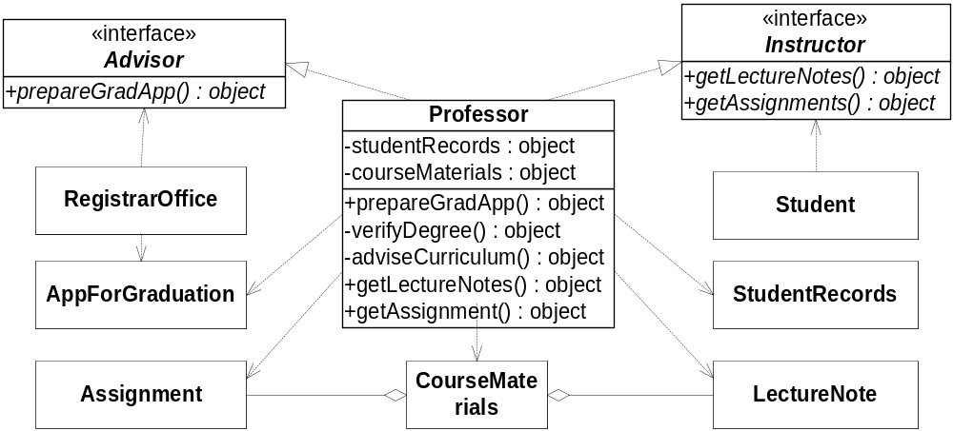
Improved Design
Notes:
1.5 min

Slide 79
Open-Closed Principle
Open to Extension
  The system can be extended to meet new requirements
Close to Modification
  The existing implementation should not be modified
How to do it?
  Inheritance and polymorphism
Notes:
1 min

Slide 80
Example
Notes:
0.5 min

Slide 81
Implications
Separate interface and implementation
  Better to have an abstract interface class and then a concrete class
  Depends on interface class only
Keep attributes private
  Don’t expose attributes if not necessary
Minimize the use of global variables
  Reduces coupling of modules
Notes:
1.5 min

