Slide 1

Performance Comparison of a Parallel Recommender Algorithm across three Hadoop-based Frameworks
HPML Conference, Lyon, Sept 2018
Christina P. A. Diedhiou
Supervisor: Dr. Bryan Carpenter
School of Computing

Slide 2
Objectives of the Session
Aim & Objectives of research
Overview Hadoop/ MPJ Express
Overview of Recommender Systems
Implementation of ALSWR
Evaluation and Comparison
Future works

Slide 3
Aims & objectives of research
Evaluate highly scalable parallel frameworks and algorithms for recommendation systems. Main interest on a Java Message Passing Interface: MPJ Express integrated with Hadoop.
Evaluate open source Java message passing library for parallel computing: MPJ Express
Use MPJ Express to implement collaborative filtering on datasets with an algorithm: ALSWR
Benchmark the performance and measure the parallel speedup
Compare our results with other frameworks: Mahout, Spark, Giraph

Slide 4
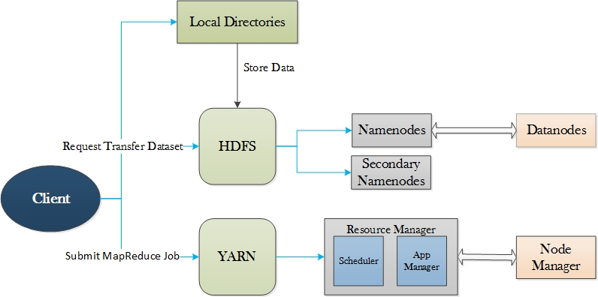
Hadoop
Hadoop:
A Framework that stores and processes voluminous amounts of data in a reliable and fault-tolerant manner
Hadoop 2 released in 2014
Yarn:
Resource Manager: Manage & allocate resources across cluster
Node Manager: Run on all nodes, report to RM
Application Master: Specific to each job, manage operation within containers, ensure there is enough containers

Slide 5
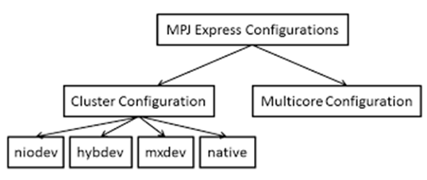
MPJ Express
Open source Java MPI-like library that allows application developers to write and execute parallel applications on multicore processors and compute clusters.
2015 MPJE provides Yarn base runtime

Slide 6
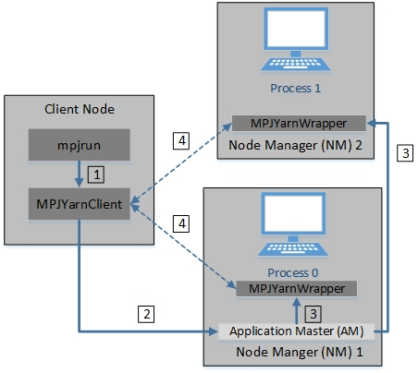
Integration of MPJE in Yarn
mpjrun.sh –yarn –np 2 –dev niodev MPJApp.jar
1)Submit YARN application
2)Request container allocation for Application Master (AM)
3)AM generates a Container Launch Context (CLC) and allocates container to each node
4)Each mpj-yarn-wrapper send outputs and error streams of the program to the MPJYarnClient

Slide 7

Recommender Systems
What is a Recommender System?
Software tools and techniques providing suggestions to users on items they might want/ like
Example of recommender systems: Netflix, Google news, YouTube, Amazon…
Content Based
Collaborative Filtering
Demographic
Recommender System

Slide 8
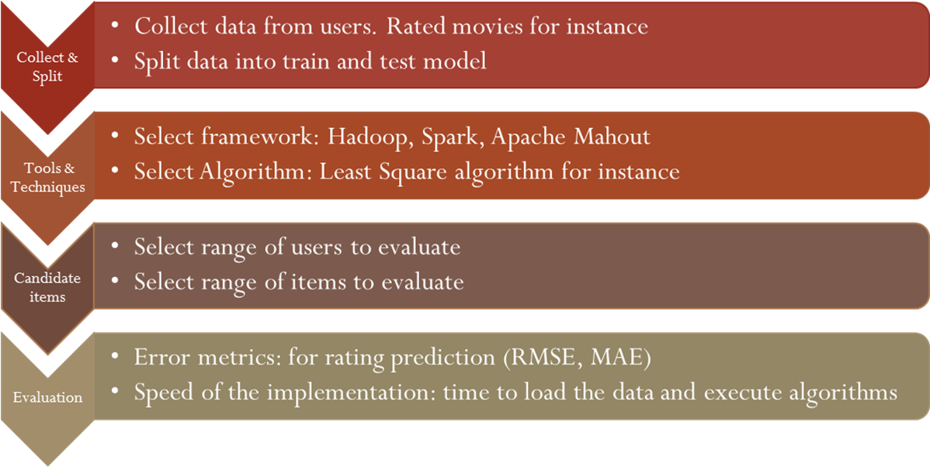
Collaborative Filtering
Based on users’ purchases or decisions histories
Rationality: 2 individuals sharing the same opinion on an item, will have similar taste on another item

Slide 9
Alternating Least Squares with Lambda Regularization (ALSWR)
ALSWR is an iterative algorithm. It shifts between fixing two different matrices until a convergence is reached.
Step 1: Initialize matrix M in a pseudorandom way
Step 2: Fix M, Solve U by minimizing the objective function (the sum of squared errors);
Step 3: Fix U, Solve M by minimizing the objective function similarly
Steps 2 and 3 are repeated until a stopping criterion is satisfied.

Slide 10
Implementation of ALSWR
Step 1 uses locally held matrix R decomposed by row and columns (users & items)
Step 2 update the items (movies), between (1) & (2) all locally computed elements of users are gathered and broadcast
Step 3 update the users. Between (2) & (3) all locally computed elements of items must be gathered together and broadcast to processing nodes.
Communication between nodes of cluster established by collective communication

Slide 11
Collective Communication
AllGather: enables elements to be send to all processes by gathering all these elements to all processes.
Allreduce: sum over all processes then distribute the results to all processes.
Barrier: Synchronisation. Prevents processes to go beyond a barrier unless they have all send a signal

Slide 12
Experiments
Data collected:
MovieLens users ratings 20+ millions ratings
Yahoo music users ratings 717 +millions ratings
Hardware: Linux cluster with 4 nodes 16+ cores
Software used: MPJ Express, Java, Hadoop 2
Algorithm: Least square methods: Alternating-Least-Squares with Weighted—Regularization (ALSWR)
Data storage: Hadoop distributed File System (HDFS)
Method:
Configuration of the nodes with Hadoop and YARN
Adding dataset in HDFS
Dataset partitioning with Map Reduce or MPJ Code
Run ALSWR java code
Experiments: Sequential (1 process) VS Parallel speedup (many processes)
Comparison with Spark, Mahout, Giraph

Slide 13
Results MovieLens data
Good parallel speedup for MPJ Express and Spark: time decreases when number of cores increases
No Variance for Mahout from 4 cores and above.
MPJ Express averagely 13.9 times faster than Mahout
MPJ Express averagely 1.4 times faster than Spark

Slide 14
Results MovieLens data
Closer Look on MPJE & Spark performance/ parallel speedup
Constant progress, but could be improved for better parallel computation

Slide 15
Results Yahoo music data
Time in minutes
Nbr Of Processes | MPJ Express | Spark
1 | 298 | 417
2 | 142 | 217
4 | 84.4 | 136
8 | 45.56 | 65
12 | 33.15 | 54
16 | 28.35 | 55
No computation for Mahout du to size of data
Better parallel speedup achieved for MPJE & Spark

Slide 16
Future works
More study on Spark Results
More experiments on Giraph
Assess and compare the accuracy RMSE
Generating synthetic datasets to reach “social media scale”

Slide 17
Further readings/ references
Zhou, Y., Wilkinson, D., Schreiber, R., & Pan, R. (2008). Large-scale parallel collaborative filtering for the Netflix prize. Lecture Notes in Computer Science (Including Subseries Lecture Notes in Artificial Intelligence and Lecture Notes in Bioinformatics), 5034 LNCS, 337–348. http://doi.org/10.1007/978-3-540-68880-8_32
Kabijo, M., & Llic, A. (2015). Recommending items to more than a billion people : Machine Learning. Retrieved from https://www.reddit.com/r/MachineLearning/comments/38d7xu/recommending_items_to_more_than_a_billion_people/?
Aamir Shafi, 2014, MPJ Express an implementation of message passing interface (MPI) in Java, http://www.powershow.com/view1/154baa-ZDc1Z/MPJ_Express_An_Implementation_of_Message_Passing_Interface_MPI_in_Java_powerpoint_ppt_presentation
http://mpj-express.org/
https://hadoop.apache.org/docs/r1.2.1/mapred_tutorial.html#Purpose

Slide 18
Contacts
Christina P. A. Diedhiou
christina.diedhiou@port.ac.uk
Dr. Bryan Carpenter
bryan.carpenter@port.ac.uk

