Slide 1
HPML Final Project · Spring 2026
SiMamba: Accelerating Mamba-3 State Space Model Inference in vLLM
Reproducible negative result: Simpson-style SISO dynamics train stably, but do not beat matched trapezoid or Mamba2; decode triton kernel is near parity while prefill needs fused-kernel work.
Team - 26
Soumil Baldota · ssb2234
Ansen Shia · as8008
David W Zhang · dwz2107
GitHub: https://github.com/orgs/hpmls26/repositories
Tracking: https://wandb.ai/ssb2234-columbia/simamba
Dr. Kaoutar El Maghraoui · Columbia University · Week of May 4, 2026
Notes:
We aim to accelerate inference for the Mamba-3 state space model within vLLM.

Slide 2
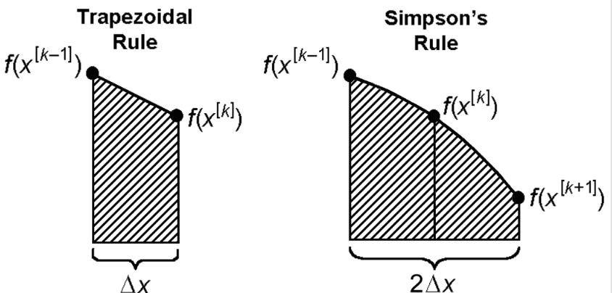
Motivation & Problem
Time budget: 1 minute.
Why this matters
Problem statement
Mamba3: state space language model designed to improve long context reasoning and inference efficiency compared to Transformers
Inference efficiency for Mamba-3 State Space Models on V100 GPUs
High memory traffic and prefill latency in SISO kernels
Standard trapezoidal discretization lacks the higher-order accuracy needed for state tracking
Simpson’s discretization: higher-order integration method that improves accuracy as it has an additional midpoint evaluation compared to trapezoidal discretization
Accelerate Mamba-3 SISO inference by replacing width-2 trapezoidal updates with width-3 Simpson-inspired discretization
Goal: Match or exceed trapezoidal baseline accuracy while minimizing decode-step overhead
HPML · Spring 2026
2 / 18
Notes:
That middle value helps capture curvature (how the function bends within the interval), so the integral/update is more accurate than assuming a straight-line change between endpoints.

Slide 3
Technical Approach — Model & Data
Time budget: ~1 min of the 3-min approach section.
Model
Dataset
Hardware
Architecture: SiMamba mixer (width-3 Simpson recurrence) with MambaLMHeadModel wrapper
Parameter count: 10M shape (d_model=160, n_layer=8, headdim=32)
Framework: PyTorch with custom Triton SISO kernels
Name: SlimPajama-627B-DC
Size: 500M training / 50M validation token subsets
Tokenizer: GPT-NeoX tokenizer, uint16 memmaps
License: Apache 2.0 (standard SlimPajama)
Splits: Fixed validation spans for deterministic evaluation
Sampling: No-replacement training block sampling
GPU: Single NVIDIA V100 (16GB)
Memory: fp32 master weights for SSM stability
Software stack: Python 3.10+, PyTorch, Triton, and EleutherAI tokenizer
HPML · Spring 2026
3 / 18

Slide 4
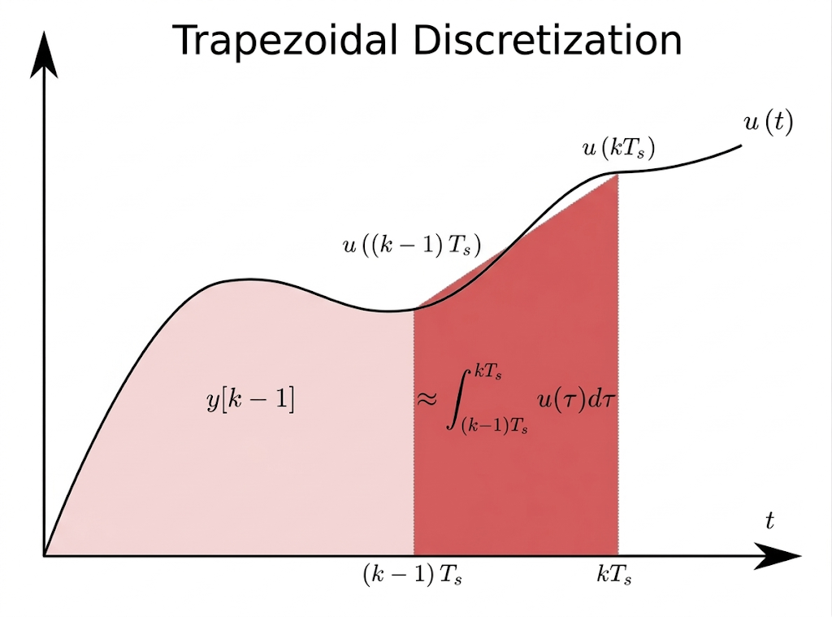
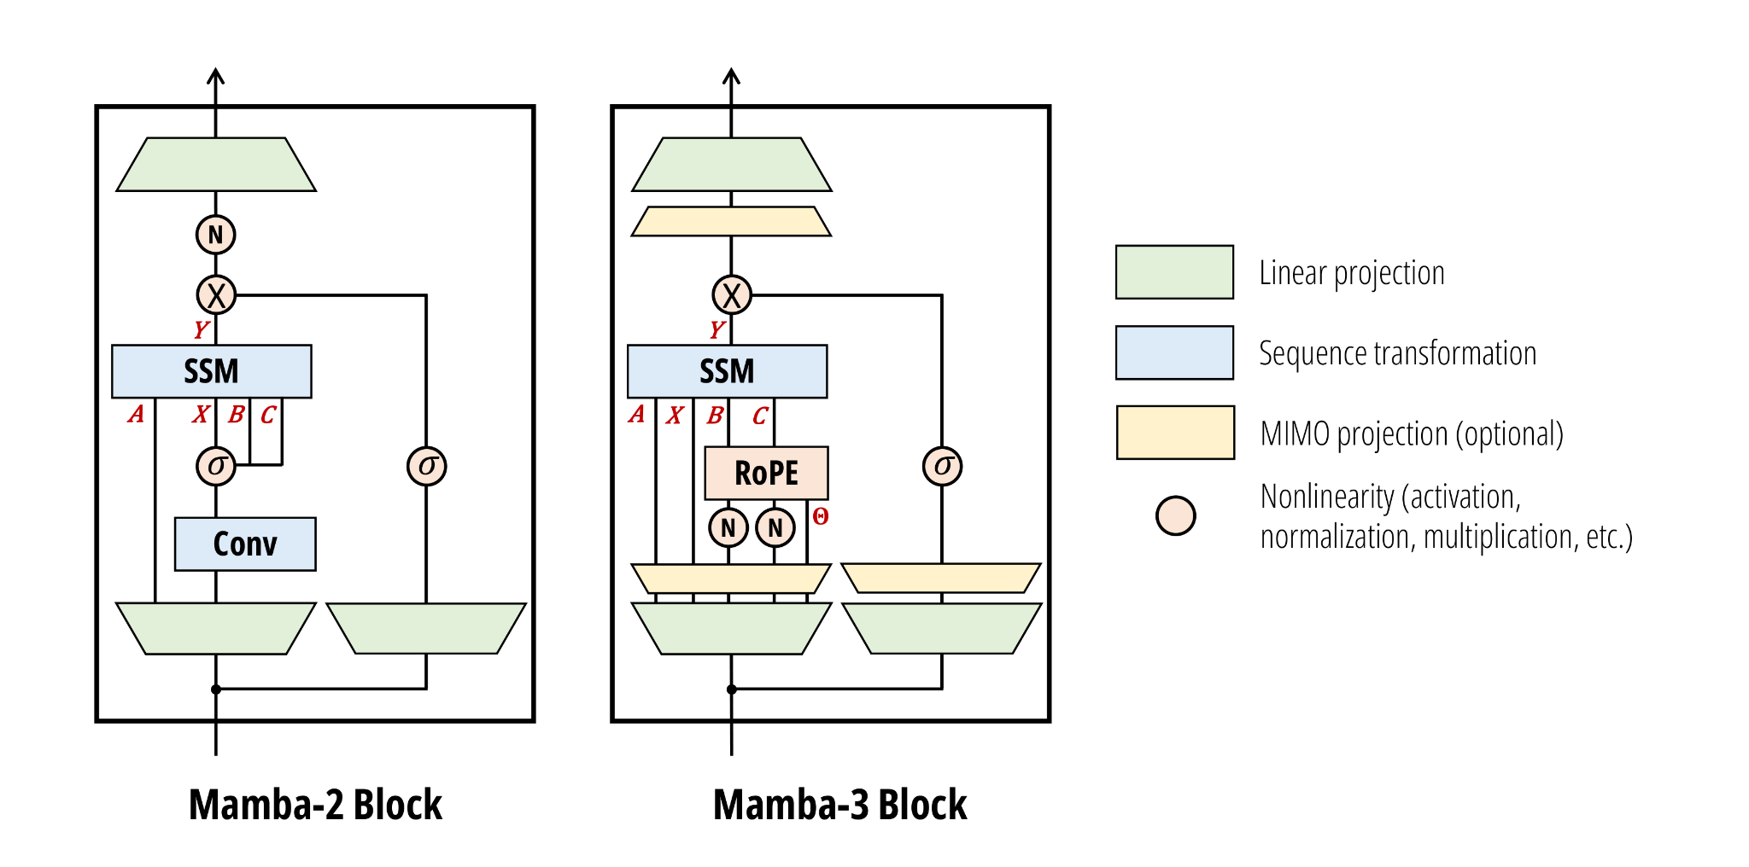
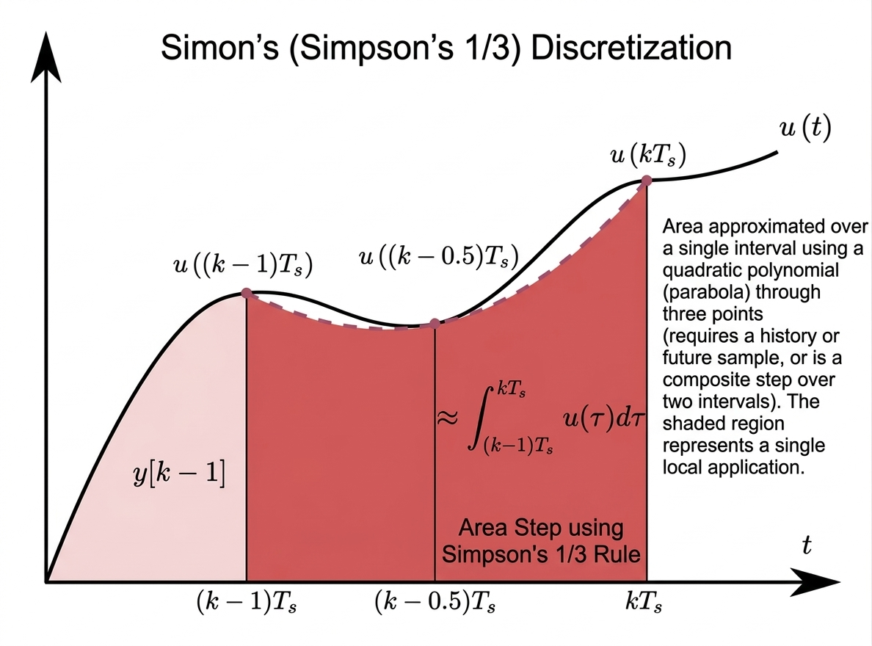
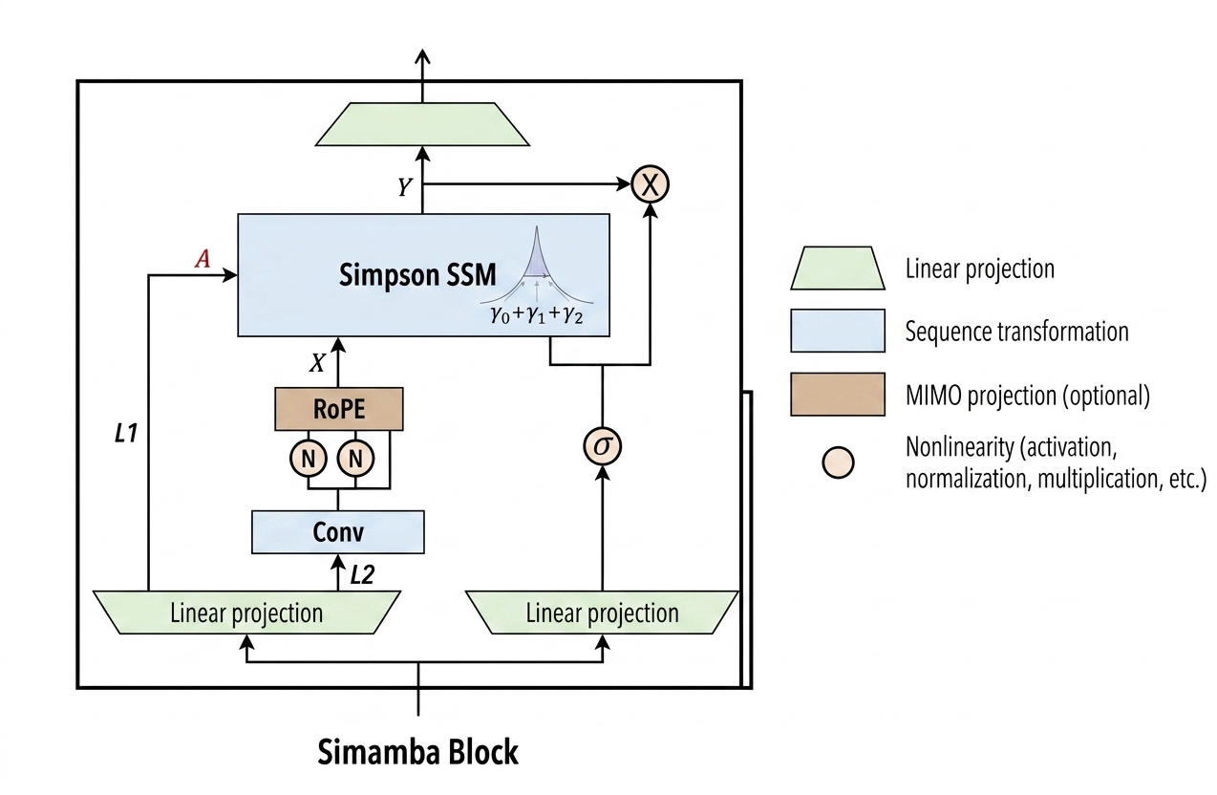
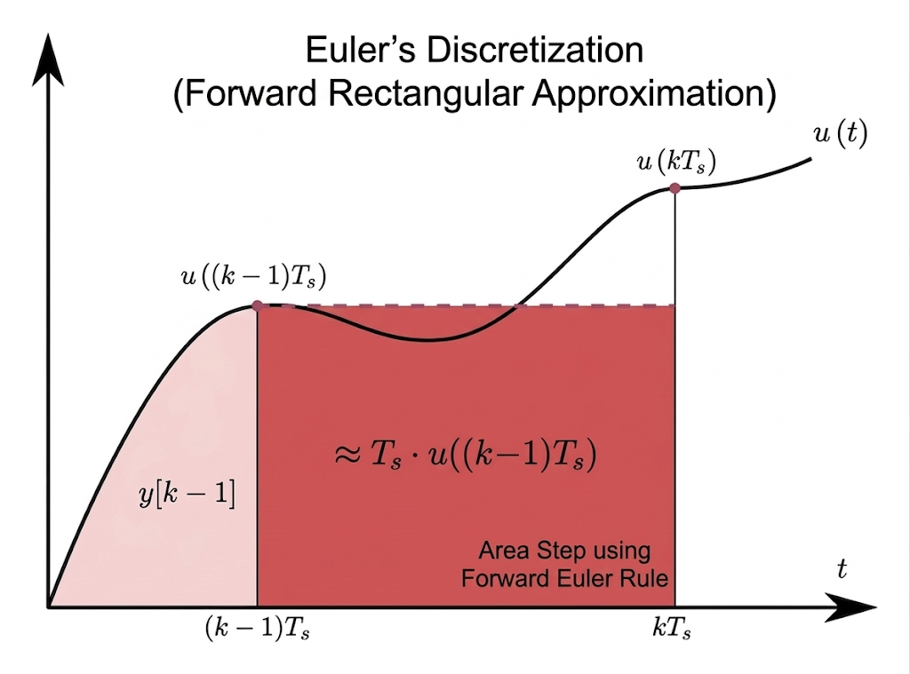
Technical Approach — Model & Data
HPML · Spring 2026
3 / 18

Slide 5
Technical Approach — Optimizations Applied
Time budget: ~2 min. Name each optimization, give a 1-line intuition for why it should help.
1.
Simpson-style SISO Dynamics
A width-3 recurrence update with a negative lag-2 term intended to provide higher-order accuracy over trapezoidal methods.
2.
Mamba2-style Causal Local Mixing
Adds a depthwise causal Conv1d over the x/B/C stream to account for local mixing confounds in model comparisons.
3.
FP32 Master Weight Training
Ensures numerical stability for State Space Model (SSM) updates on V100 hardware, preventing early gradient explosions.
HPML · Spring 2026
4 / 14

Slide 6
Profiling Methodology
Tools used, what was measured, and how we ensured measurements are stable.
Tools
Metrics captured
PyTorch Profiler
NVIDIA Nsight Systems
Weights & Biases for run-level tracking
Custom benchmarking scripts
Simamba kernel benchmark scripts
Validation loss
Training throughput in tokens/sec (median tail throughput)
Inference throughput in tokens/sec (prefill + decode)
Latency
Prefill latency (ms)
Decode step latency (ms)
End-to-end latency (ms)
Peak GPU Memory
HPML · Spring 2026
5 / 14

Slide 7
Results — Headline Numbers
Headline: the Simpson hypothesis was not validated, but the controls identify why and where the system bottleneck is.
1.08×
25.8%
4.9178
decode-step overhead
lower prefill peak memory
best Simamba val loss
Simamba vs Mamba-3: 0.0173 ms vs 0.0160 ms in B4/P1024/G256.
Simpson’s requires extra computation(a midpoint estimate) -> 1 extra intermediate computation during the state update
124.2 MB vs 167.4 MB in B4/P1024/G256
Latency still dominates because of extra tensors allocated by Mamba models
Mamba2 best: 4.8625; matched trapezoid: 4.9326
Measured on one Tesla V100 16GB. Prefill was slower than the Mamba-3 fused path, so fused-kernel work is required before production claims.
HPML · Spring 2026
6 / 14
Notes:
Decode step -> midpoint interpolation since we’re calculating one extra step so the decode is slightly slower
Prefill memory: our kernel isn’t as optimized
For validation loss this is what we got

Slide 8
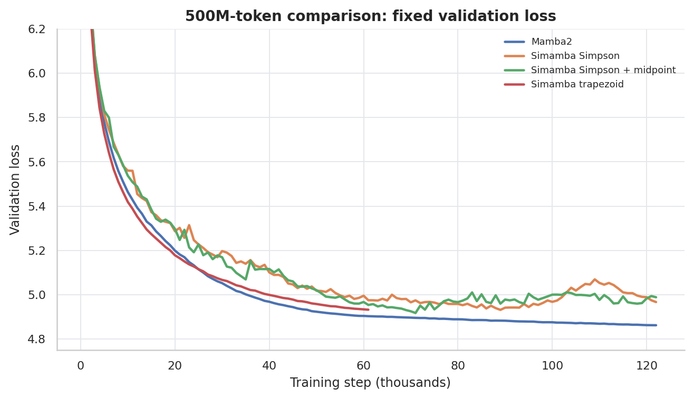
Results — Quality Curves
500M-token comparison from locally persisted W&B/training histories.
Takeaway
Mamba2 is the strongest overall baseline.
Simpson + midpoint reaches the best Simamba checkpoint, but validation degrades later.
Matched trapezoid(Mamba3) is competitive, so the Simpson correction is not yet a win.
Gradient curves point to harder optimization from the negative lag-2 term.
7 / 14

Slide 9
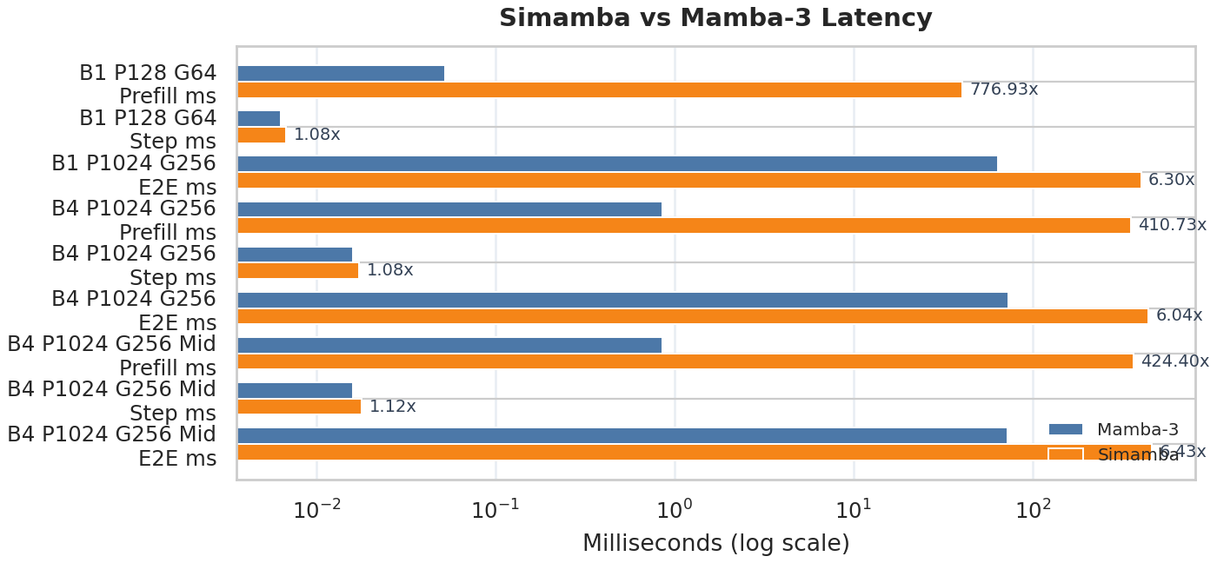
Profiler Evidence — Kernel Bottleneck
Repository SISO benchmark separates prefill from decode; this is where the implementation gap is clearest.
What to point at
Decode step is close: about 1.08x slower than Mamba-3
Prefill is not competitive: 410x - 777x slower in benchmark cases
Dominated by kernel launch and memory access overhead rather than the cost of Simpson’s discretization itself
Current path still has too much Python/memory traffic; needs a fused prefill kernel
Memory can be comparable or lower, but latency is the blocking metric.
HPML · Spring 2026
8 / 14
Notes:
The prefill path is currently not competitive because the implementation does not yet use a fully fused/optimized kernel pipeline. The slowdown is dominated by kernel-launch and memory-access overhead rather than the numerical cost of Simpson’s discretization itself.”

Slide 10
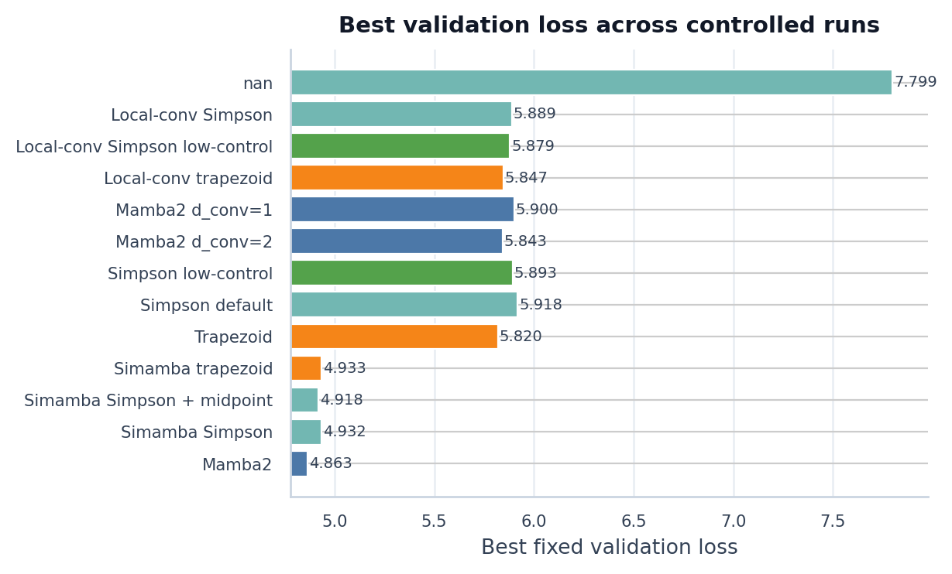
Demo / Visualization — Reproducible Artifacts
For a 1-minute demo, show the exported checkpoints and regenerate the paper figures from local run histories.
Exported models
soumil1/simamba-midpoint-10m-slimpajama-500m soumil1/mamba2-10m-slimpajama-500m
Serving path
vLLM Transformers backend --trust-remote-code --model-impl transformers
Rebuild figures
python scripts/generate_hpml_paper_assets.py
HPML · Spring 2026
9 / 14

Slide 11
Profiler Evidence — Prefill
NSYS profiler results
Metric | Simamba | Mamba-3 | Simamba / Mamba-3
Forward NVTX wall time | 242.418 ms | 8.134 ms | 29.8× slower
Total GPU kernel time | 19.342 ms | 6.848 ms | 2.8× higher
GPU kernel launches | 7,714 | 7 | 1102.0× more
CUDA API time, excluding sync | 53.423 ms | 0.104 ms | 513.1× higher
Kernel launch API time | 53.416 ms | 0.097 ms | 550.7× higher
Simpson is expected to be somewhat slower than trapezoid because it uses a wider recurrence and more coefficient computation
Simamba’s prefill path is dominated by kernel fragmentation and launch overhead, not by one slow fused kernel.
Mamba-3 uses a mostly fused forward path, while Simamba launches thousands of small CUDA kernels.
HPML · Spring 2026

Slide 12
Kernel group | Instances | GPU time | Share of Simamba GPU time
Elementwise multiply | 4,108 | 11.014 ms | 57.1%
Elementwise add | 1,798 | 3.775 ms | 19.6%
Copy / cast | 516 | 1.288 ms | 6.7%
Elementwise exp | 512 | 1.082 ms | 5.6%
cuBLAS batched GEMV | 256 | 1.048 ms | 5.4%
Clamp | 256 | 0.586 ms | 3.0%
PyTorch scan_outer_dim | 1 | 0.052 ms | 0.3%
About 76.7% of Simamba GPU time is spent in unfused add/multiply kernels. The next optimization should fuse Simpson coefficient computation and the recurrent update into a Mamba-3-style kernel.
HPML · Spring 2026

Slide 13
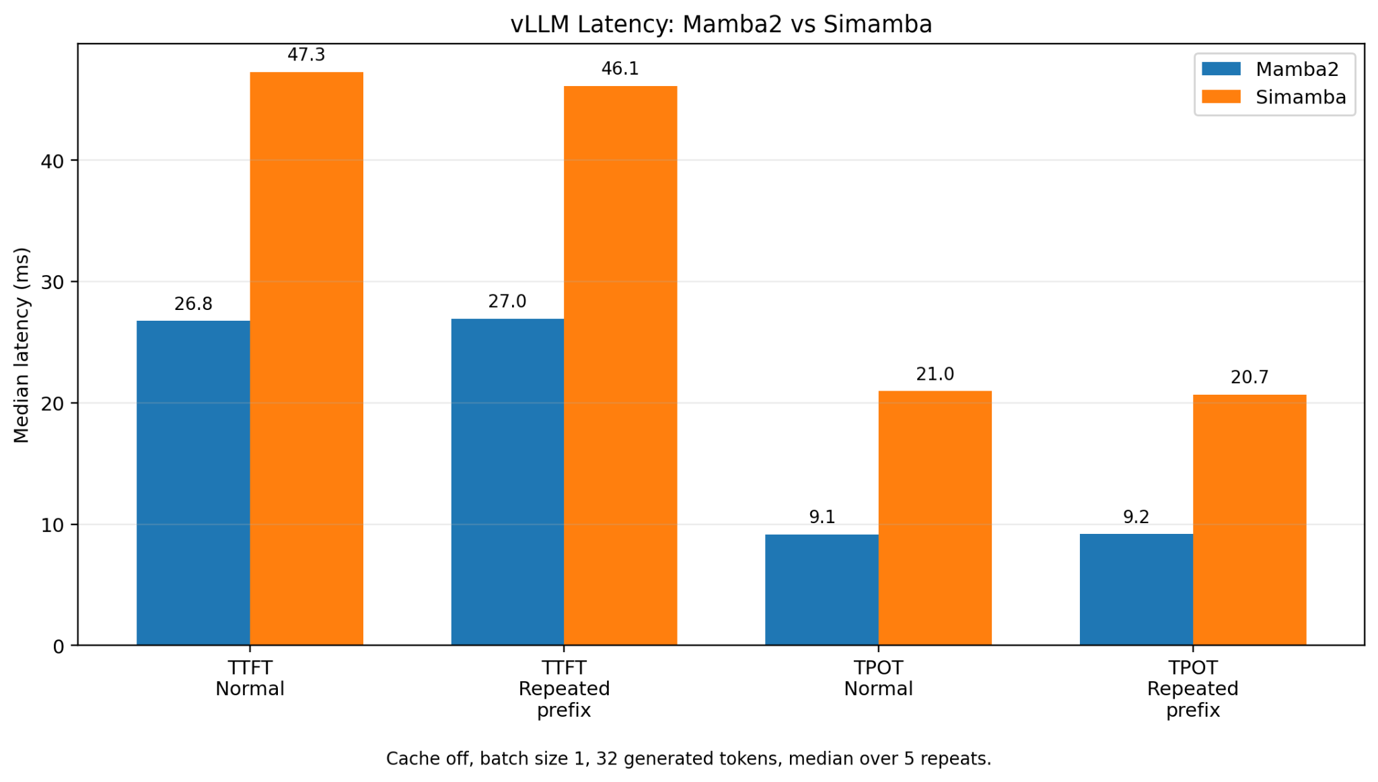
Profiler Evidence — VLLM Profiler
HPML · Spring 2026

Slide 14
Kernel Correctness
Check | Tensor | Max abs err | Mean abs err | Max rel err
Forward | output | 1.19e-6 | 8.37e-8 | 1.13e-3
Backward | Q | 0.00e0 | 0.00e0 | 0.00e0
Backward | K | 0.00e0 | 0.00e0 | 0.00e0
Backward | V | 0.00e0 | 0.00e0 | 0.00e0
Backward | ADT | 9.54e-7 | 1.21e-7 | 1.70e-6
Backward | DT | 0.00e0 | 0.00e0 | 0.00e0
Backward | Simpson coeff. | 8.94e-8 | 7.29e-9 | 7.34e-7
Backward | Midpoint coeff. | 7.45e-8 | 7.85e-9 | 8.16e-7
Simamba’s custom recurrence is numerically correct based off our comparisons with a reference PyTorch implementation (FP32)
HPML · Spring 2026
Notes:
Machine epsilon around 1.19e-7 for fp32

Slide 15
Lessons Learned
The most useful outcome is a controlled diagnosis, not a cherry-picked speedup claim.
What worked
What didn't work
fp32 parameters + cosine decay eliminated nonfinite skips in controlled runs
Fixed validation spans made small loss differences interpretable.
Matched trapezoid/local-conv controls separated discretization from architecture confounds
Decode path is close enough to justify more kernel work.
Unconstrained Simpson lag-2 correction produced noisier gradients and worse final validation
Prefill implementation is hundreds of times slower than the Mamba-3 fused path.
Larger-model attempts were dominated by V100 memory/runtime pressure.
Local mixing mattered more than the initial Mamba2 vs Simamba comparison suggested.
HPML · Spring 2026
10 / 14

Slide 16
Next Steps
Automatic prefix caching: explore how the state space formulation can yield more memory and compute efficient caching than Transformer KV caching
Reparameterize or anneal the Simpson correction so the negative lag-2 term cannot dominate early training.
Build a truly fused Simamba kernel plus the existing SISO path.
Run multiseed 50M-token comparisons after a single-seed Simpson variant beats the matched trapezoid baseline
Add a V100-compatible fallback benchmark mode that bypasses Mamba-3 kernels requiring tl.make_tensor_descriptor
Add finetuning-aware int4/pruning experiments instead of one-shot perturbations.
HPML · Spring 2026
11 / 14

Slide 17
Teamwork & Contributions
Required contribution summary for Team 26.
Member | Primary contributions | Tools / artifacts
Soumil Baldota ssb2234 | discretization experiments, fused triton kernels for forward and backward pass, training loop, throughput benchmarking. | mamba_ssm/modules/simamba.py mamba_ssm/ops/triton/simamba/**
Ansen Shia as8008 | vLLM integration, prefill caching, simamba mixer implementation, corresponding tests and diagnosis | vllm/model_executor/layers/mamba/simamba_mixer.py vllm/model_executor/layers/ops/simamba.py vllm/tests/models/test_simamba.py vllm/tests/models/conftest.py
David Zhang dwz2107 | Benchmark/profiling analysis with VLLM and Nsight System | profiling
All | Weekly coordination, result interpretation, experiment triage, negative-result review, final report and presentation | GitHub + W&B + shared docs
Collaboration: recurring working sessions around V100 runs, W&B dashboards, checkpoint handoffs, and paper/deck reviews. The final story was aligned around a reproducible negative result and the systems bottleneck it exposed.
HPML · Spring 2026
12 / 14

Slide 18
Thank you
Questions?
GitHub: github.com/hpmls26/simamba
Tracking: https://wandb.ai/ssb2234-columbia/simamba
HPML · Spring 2026
13 / 14

Slide 19
Backup — Experimental Setup
Configuration used for the controlled language-model comparisons.
Setting | Baseline/control | Simamba runs
Model family | Mamba2 or matched Simamba trapezoid | Simamba Simpson / Simpson+midpoint
Shape | 8 layers, d_model=160, d_state=64 | same; d_inner=320, 10 heads, headdim=32
Training data | SlimPajama 500M train / 50M val | same tokenized memmaps and fixed val spans
Batch / sequence | global batch 64, micro-batch 8, seq_len 128 | same
Optimizer | AdamW, weight decay 0.1, cosine decay | same; fp32 master params
Hardware | single Tesla V100-SXM2 16GB | same
Evaluation | best/final val loss, train throughput, grad norms | plus SISO benchmark and compression perturbations
HPML · Spring 2026
14 / 14

