Slide 1

Python Overview

Slide 2
Complete Python Bootcamp
In this lecture we will do a brief overview of what Python is, why choose Python for programming, and what you can do with Python.
This lecture in particular is geared towards people new to programming.

Slide 3
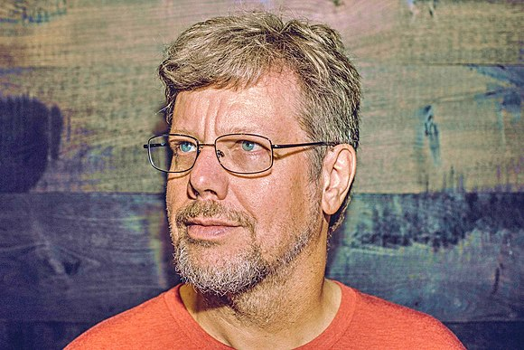
Complete Python Bootcamp
Brief History of Python
Created in 1990 by Guido van Rossum
Python 3 released in 2008

Slide 4
Complete Python Bootcamp
Brief History of Python
Specifically designed as an easy to use language
High focus on readability of code

Slide 5
Complete Python Bootcamp
Why Choose Python?
Designed for clear, logical code that is easy to read and learn.
Lots of existing libraries and frameworks written in Python allowing users to apply Python to a wide variety of tasks.

Slide 6
Complete Python Bootcamp
Why Choose Python?
Focuses on optimizing developer time, rather than a computer’s processing time.
Great documentation online:
docs.python.org/3

Slide 7
Complete Python Bootcamp
What can you do with Python?
This course first focuses on “base” Python, which consists of the core components of the language and writing scripts and small programs.
Later we begin to learn about outside libraries and frameworks that greatly expand Python’s capabilities.

Slide 8
Complete Python Bootcamp
What can you do with Python?
Automate simple tasks
Searching for files and editing them
Scraping information from a website
Reading and editing excel files
Work with PDFs
Automate emails and text messages
Fill out forms

Slide 9
Complete Python Bootcamp
What can you do with Python?
Data Science and Machine Learning
Analyze large data files
Create visualizations
Perform machine learning tasks
Create and run predictive algorithms

Slide 10
Complete Python Bootcamp
What can you do with Python?
Create websites
Use web frameworks such as Django and Flask to handle the backend of a website and user data
Create interactive dashboards for users

Slide 11
Complete Python Bootcamp
Once you understand base Python and begin working with a few libraries, you’ll quickly begin to see the vast potential Python has for your own projects!
Let’s get started with setting you up for the course!

