Slide 1
Implementing a Content-Based Document Search Engine with ML
Presenter: Hardik Polamarasetti

Slide 2

Overview
The primary objectives of developing this application were to:
Provide a user-friendly interface for uploading and storing HTML documents.
Implement a robust text processing pipeline to extract and vectorize text from HTML documents.
Develop a search mechanism using TF-IDF (Term Frequency-Inverse Document Frequency) and cosine similarity to rank documents

Slide 3


Platforms and Systems
Python on spyder
Chosen for its extensive libraries and frameworks that simplify data handling and machine learning.
Flask
Web application framework to handle uploads
Manage web requests, routing, and render HTML pages.
HTML
Front end web interface
CSS
Html formatting and styling

Slide 4
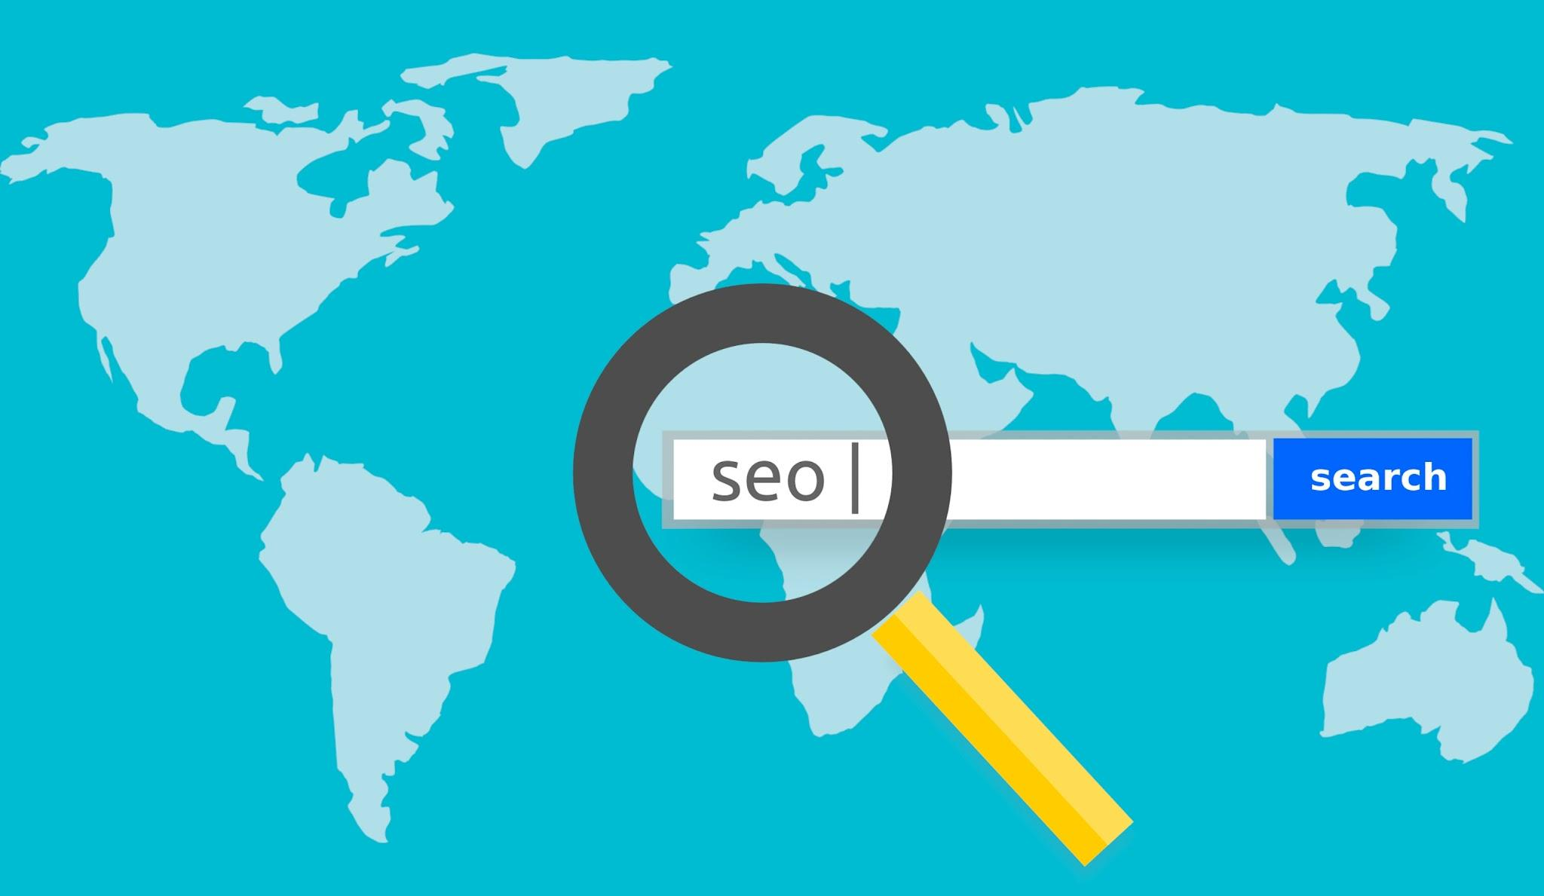
Tools
BeautifulSoup
Parsing HTML files
Extract text
preprocessing
Scikit-learn
Tdif vectorizer
Cosine similarity
Werkzeug
Security for managing uploaded files

Slide 5
Data Preprocessing and Vectorization:
Extracted text from HTML files using BeautifulSoup, which strips all HTML tags and retrieves clean text.
The text data is then vectorized using the TfidfVectorizer from scikit-learn, which transforms the text into a numerical format for similarity computations.
This vectorizer removes stop words to improve the focus on meaningful content.

Slide 6
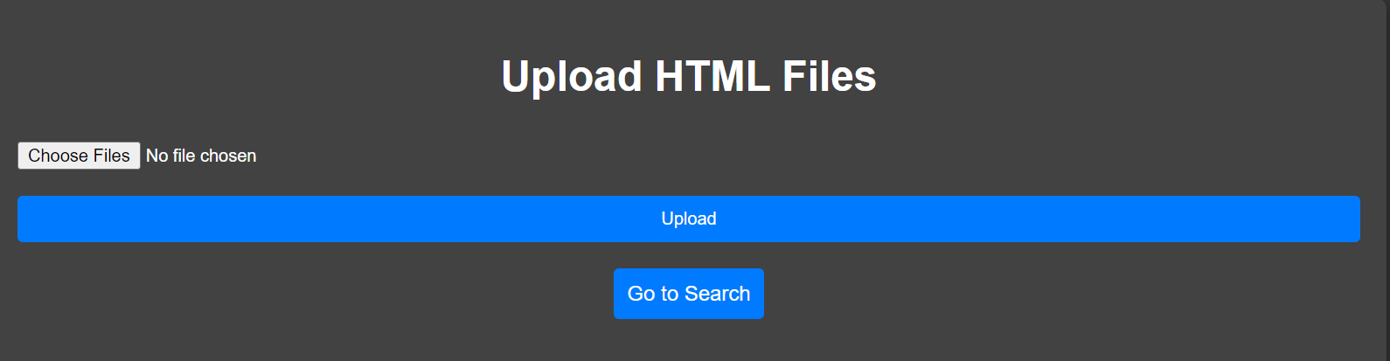
File Upload:
Users can upload one or multiple HTML files through the web interface.
Uploaded files are saved in a designated directory (user_uploads/), which is checked and created at startup if it does not exist.
File safety is ensured by checking files with Werkzeug's secure_filename() function.

Slide 7
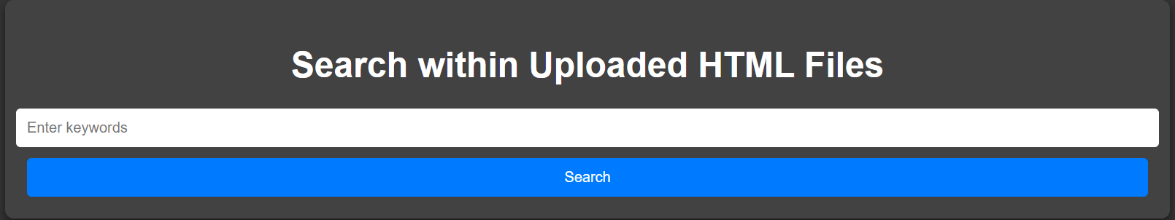
Search
A search query submitted via the web interface is transformed into its TF-IDF representation using the same vectorizer that was fit on the uploaded documents.
Cosine similarity scores are computed between the query vector and the document vectors in the TF-IDF matrix, providing a measure of relevance for each document relative to the query.

Slide 8
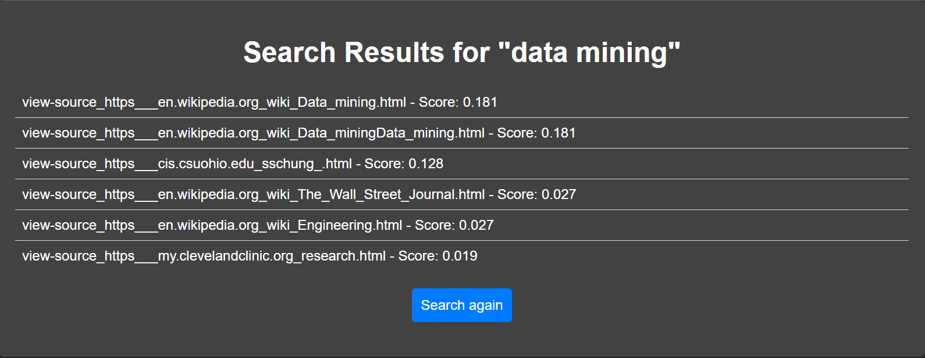
Results
Pairs file paths with their respective scores.
Results are sorted by their relevance scores in descending order, and the sorted results are displayed to the user.

Slide 9
Challenges
Using Flask
Efficiency:
The initial implementation processed documents on every search, leading to inefficiencies. This was optimized by storing vectorized representations and only re-vectorizing when new documents were uploaded.
Security
Implementation of Werkzeug

Slide 10



Future Considerations
Real time scraping of web results
More robust web framework
Django
More specialized search engine
Google scholar
Books, music, etc

Slide 11
References
https://beautiful-soup-4.readthedocs.io/en/latest/
https://flask.palletsprojects.com/en/3.0.x/
https://scikit-learn.org/stable/modules/generated/sklearn.feature_extraction.text.TfidfVectorizer.html
https://scikit-learn.org/stable/modules/generated/sklearn.metrics.pairwise.cosine_similarity.html
https://www.w3schools.com/css/
https://www.w3schools.com/html/

Slide 12
Demo

