Slide 1
Heart Disease Prediction Using Machine Learning
Presenter: Hardik Polamarasetti

Slide 2
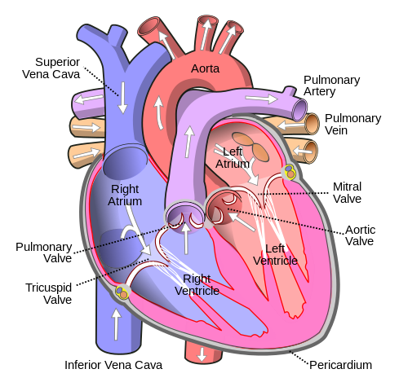
Goals of the Project
Objective: Develop a predictive model to identify individuals at risk of heart disease with high reliability.

Slide 3

Why does it matter?
Heart disease is the leading cause of death globally, claiming approximately 17.9 million lives each year, which accounts for 31% of all global deaths, according to the World Health Organization.
Early detection of heart conditions can significantly enhance outcomes by enabling timely intervention.

Slide 4

Project Overview
Data Source: heart.csv
Preprocessing
test/train sets
Models:
Decision Tree
Random Forest
KNN
Validation/Evaluation
Confusion Matrix
Classification Report
10 fold cross validation

Slide 5
Data Description and Collection
Features:
age: The age of the patient.
sex: sex of the patient
cp: Type of chest pain.
trestbps: Resting blood pressure.
chol: Serum cholesterol.
fbs: Fasting blood sugar > 120 mg/dl.
restecg: Resting electrocardiographic results.
thalach: Maximum heart rate achieved.
exang: Exercise induced angina.
oldpeak: ST depression induced by exercise relative to rest
Data Source: heart.csv
Data Size: 14 features, 4242 data points, 11kb
Data Collection Method: Collected from clinical studies.
Features Overview: Numerical and categorical data encompassing various aspects of cardiovascular health.

Slide 6

Systems and Tools Used
Pandas: Data manipulation and analysis.
NumPy: Numerical operations.
Matplotlib/Seaborn: Data visualization.
Scikit-learn: Model building, training, and evaluation.

Slide 7
Feature Selection and Data Preprocessing
Feature Selection: Based on their clinical relevance to heart disease.
Preprocessing Techniques:
Standardization of continuous variables.
'age', 'trestbps', 'chol', 'thalach', 'oldpeak'
One-hot encoding for categorical variables.
'sex', 'cp', 'fbs', 'restecg', 'exang', 'slope', 'ca', 'thal'

Slide 8
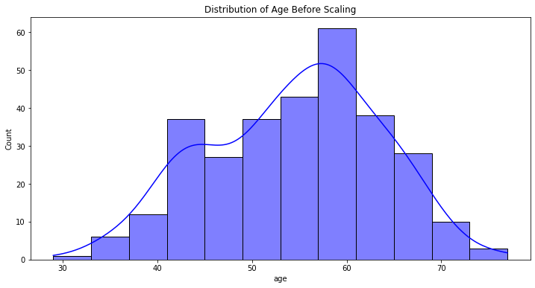
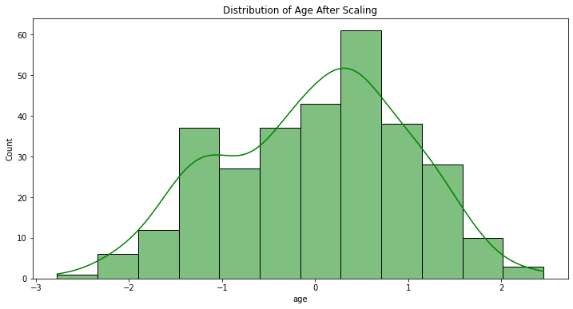
Visualization of the effect of preprocessing

Slide 9
Data Analytics Design
Training and Test Set Split: 80% training, 20% testing.
Binary classification to predict the presence of heart disease.

Slide 10
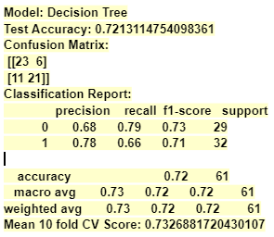
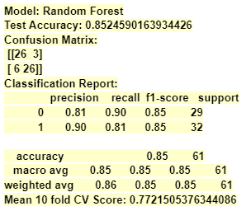
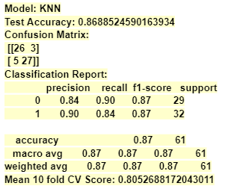
Model Evaluation Metrics and Results
Best Performing Model: KNN with an accuracy of 86.25%.

Slide 11
Conclusion and Future Work
Summary: The KNN model achieved the highest accuracy and performed well across multiple metrics.
Future Work: Explore more complex models like SVM and neural networks. Continue experimentation with hyper parameterization to enhance model accuracy.

Slide 12
References
https://www.who.int/health-topics/cardiovascular-diseases#tab=tab_1
https://www.kaggle.com/datasets/arezaei81/heartcsv/data
https://scikit-learn.org/

